Slide 1
GOES-16 Profiles, Rain Rate, TPW, DMW, DSI in AWIPS-2
Provisional PS-PVR
May 16, 2019

Slide 2
Overview of Products in AWIPS-2
GOES-16 Fielded in AWIPS-2 (GOES-17 not yet fielded)
  Style rules are modified to customize color maps, units, display ranges
NWS transmission of GOES-16 Cloud Products via the SBN :
  Total Precipitable Water (F,C,M), May 31, 2017
  DSI (F,C,M), May 31, 2017
  DMW (C,M), Jun 14, 2017
  Rainfall Rate (F), Jan 17, 2018
  Legacy Moisture/Temperature Profiles (C), Feb 28, 2018
  * ABI Sectors: F = Full Disk, C = CONUS and M = Meso
Examples of each are in the following slides

Slide 3
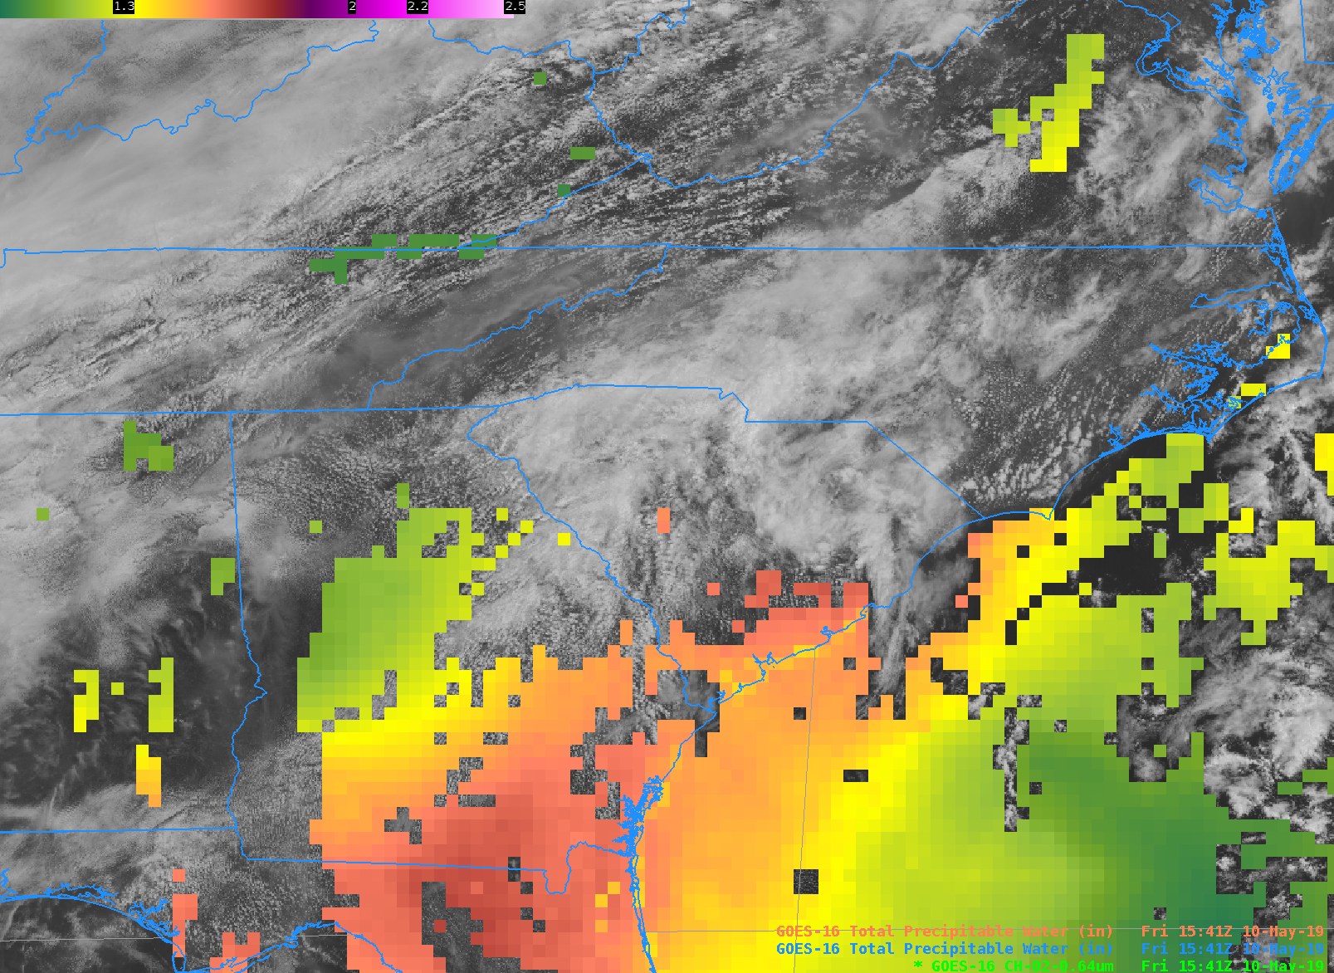
GOES-16 Total Precipitable Water
(Inches)
CONUS and Meso are displayed
14:22 Z 13 Feb 2018
Notes:
0 .7 1.3 2 2.2 2.5
Inches
0-2.5 is range

Slide 4
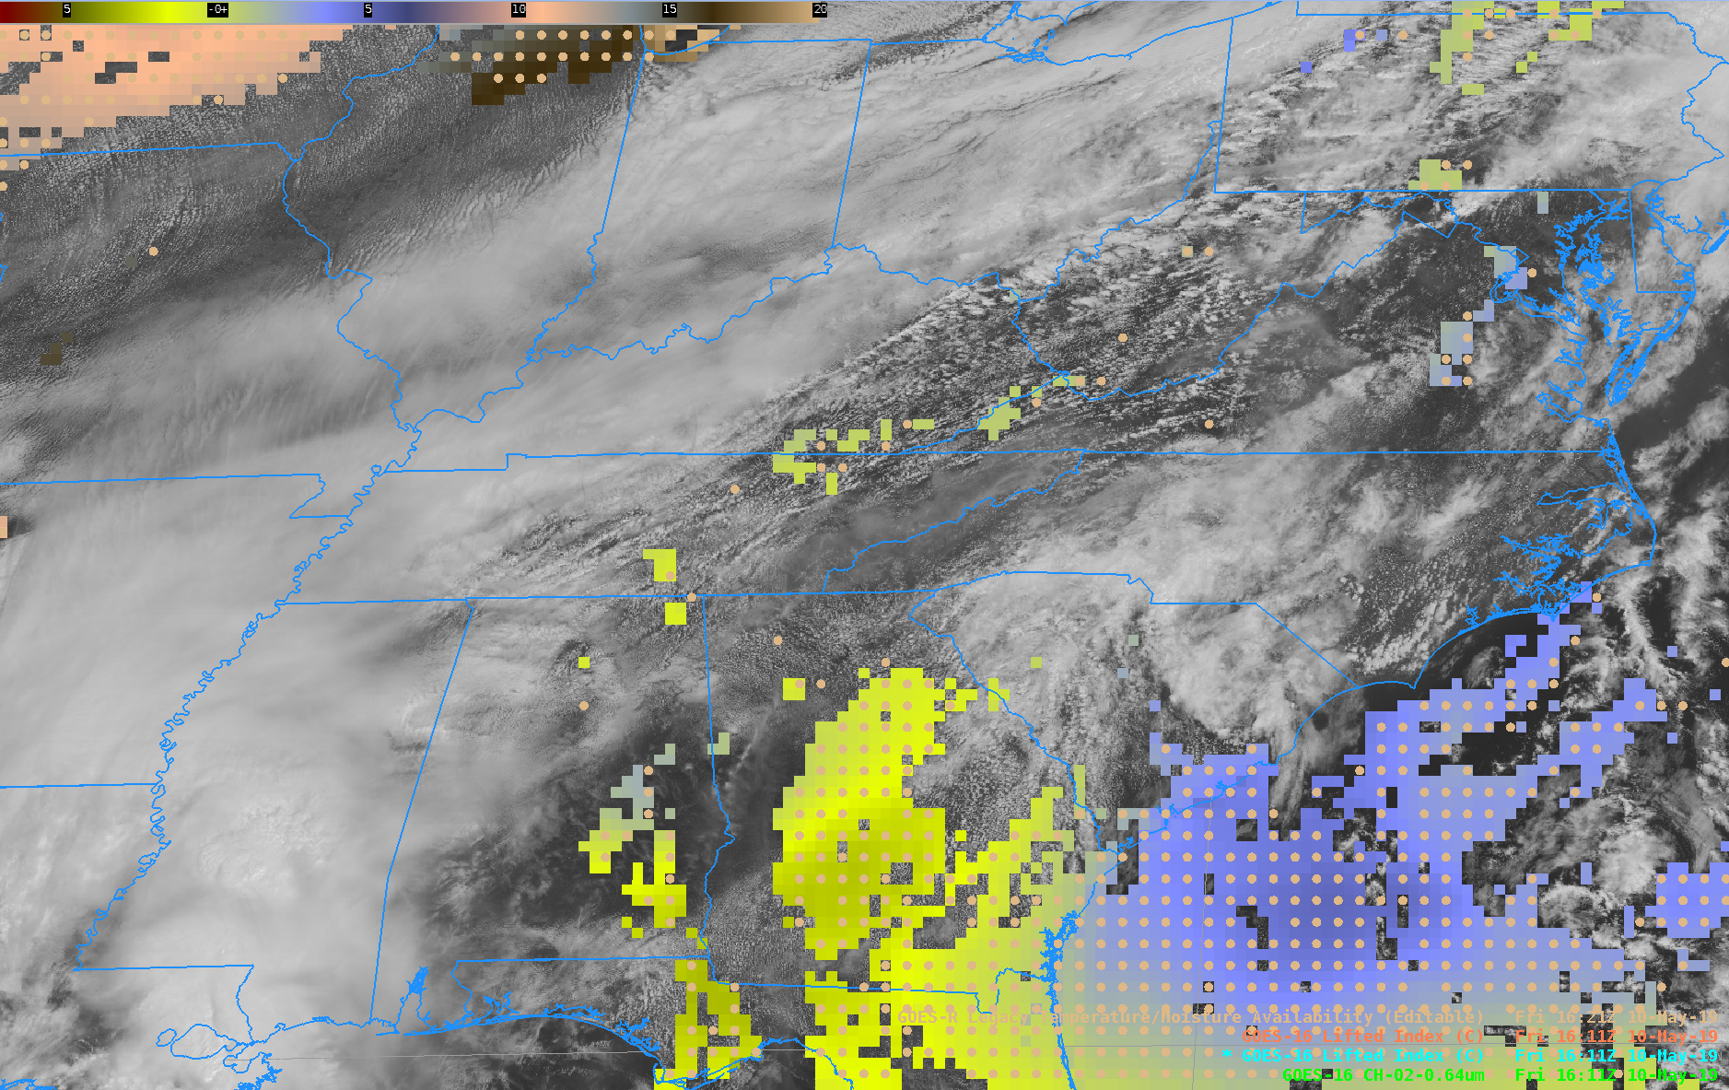
GOES-16 Lifted Index and Profile Availability (circles)

Slide 5
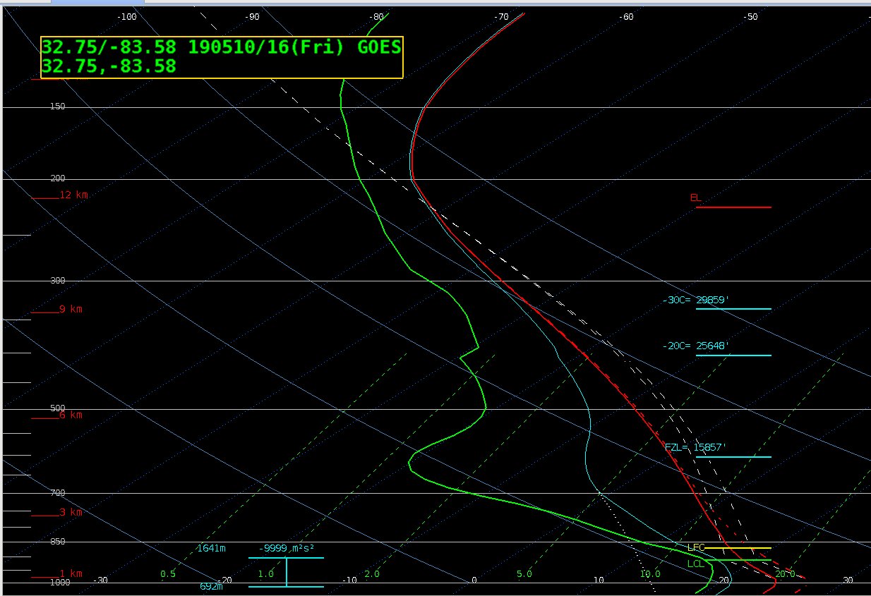
GOES-16 Vertical and Moisture Profile (Skew-T Central GA)
Temperature
Dew point Temperature
Wet Bulb Temperature

Slide 6
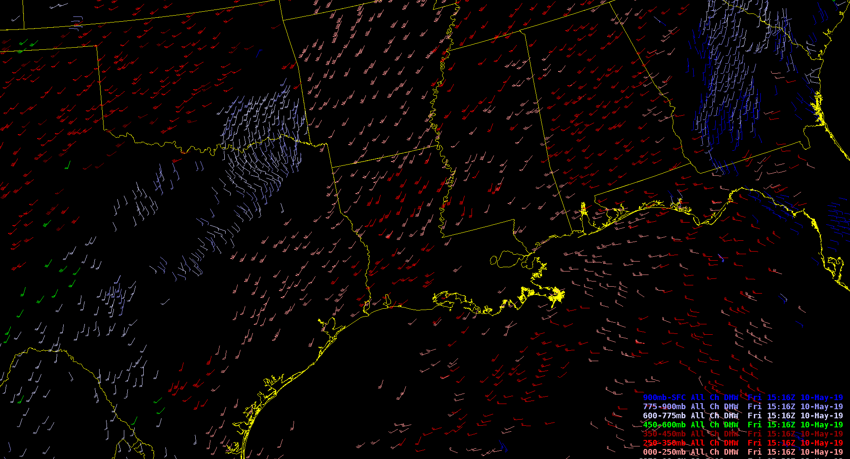
GOES-16 Derived Motion Winds (Pressure Range bins)

Slide 7
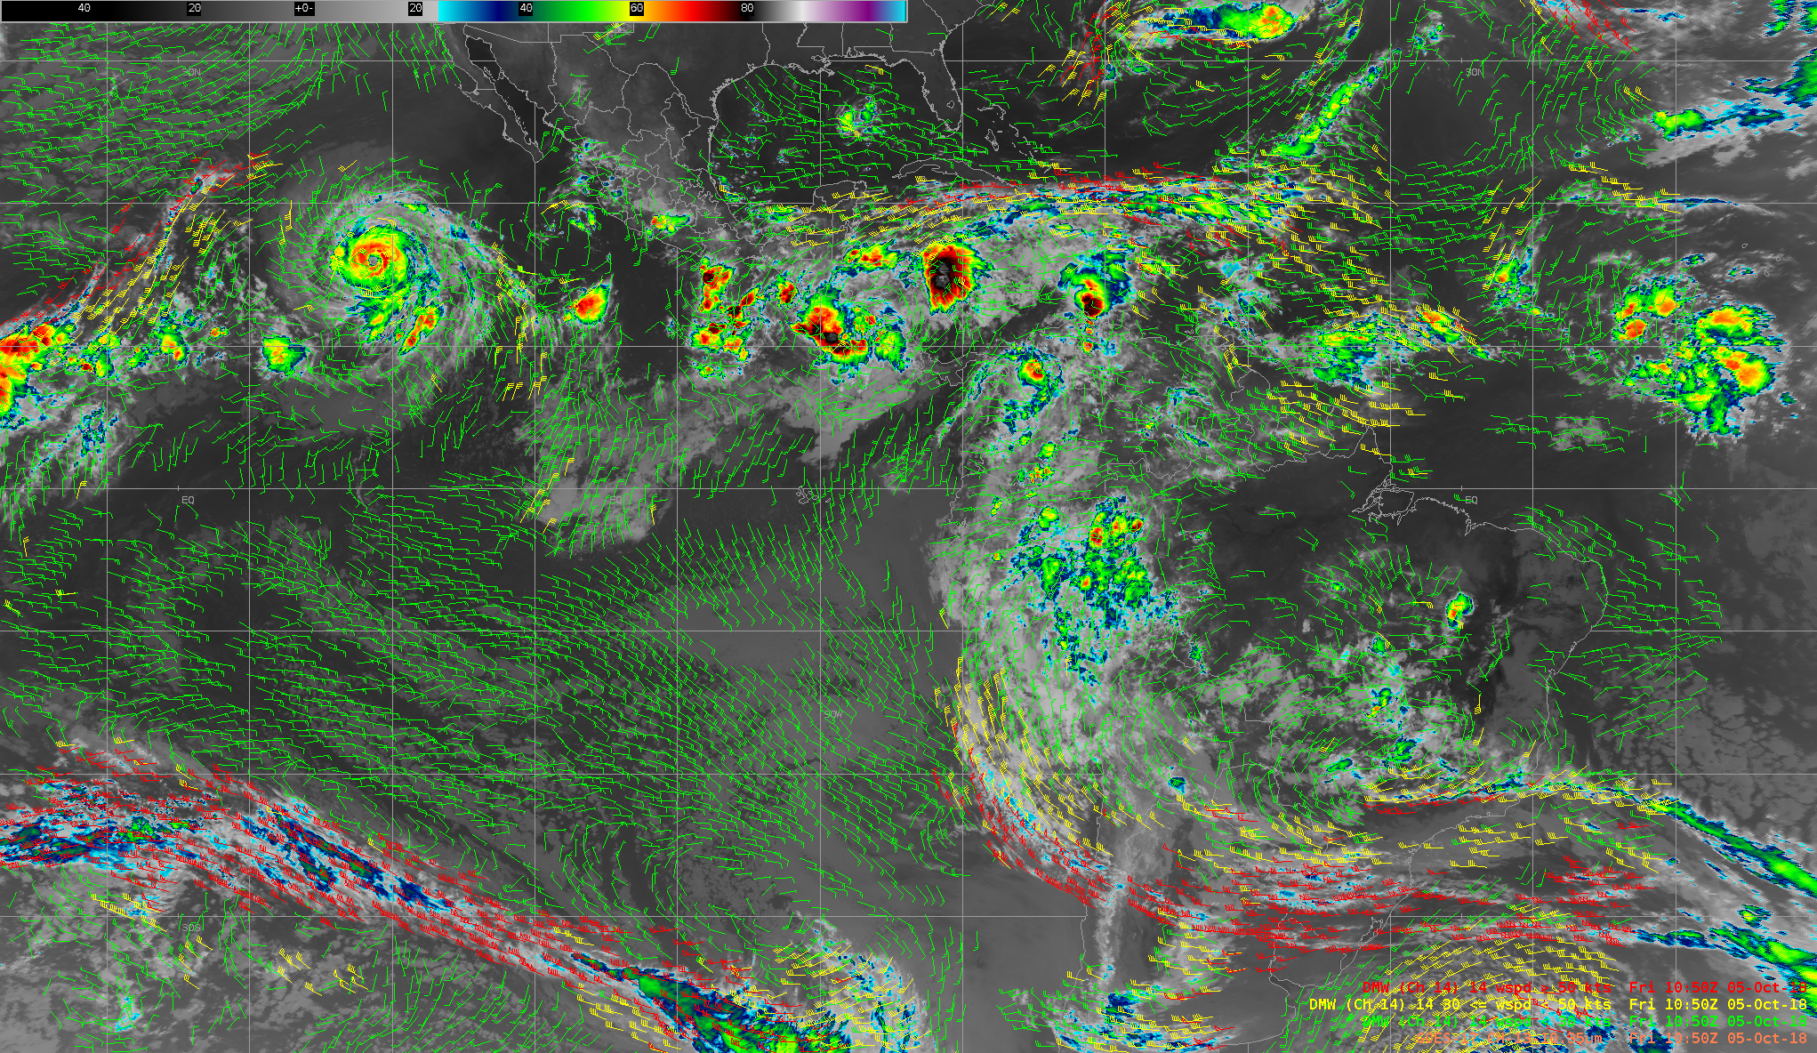
GOES-17 Derived Motion Winds (Oct ‘18 Mode 6 Test)
While the G17 AMVs are not used in the NWS NWP models today, NWS is planning an assessment of the impacts of LHP-degraded AMVs on the NWP model performance

Slide 8
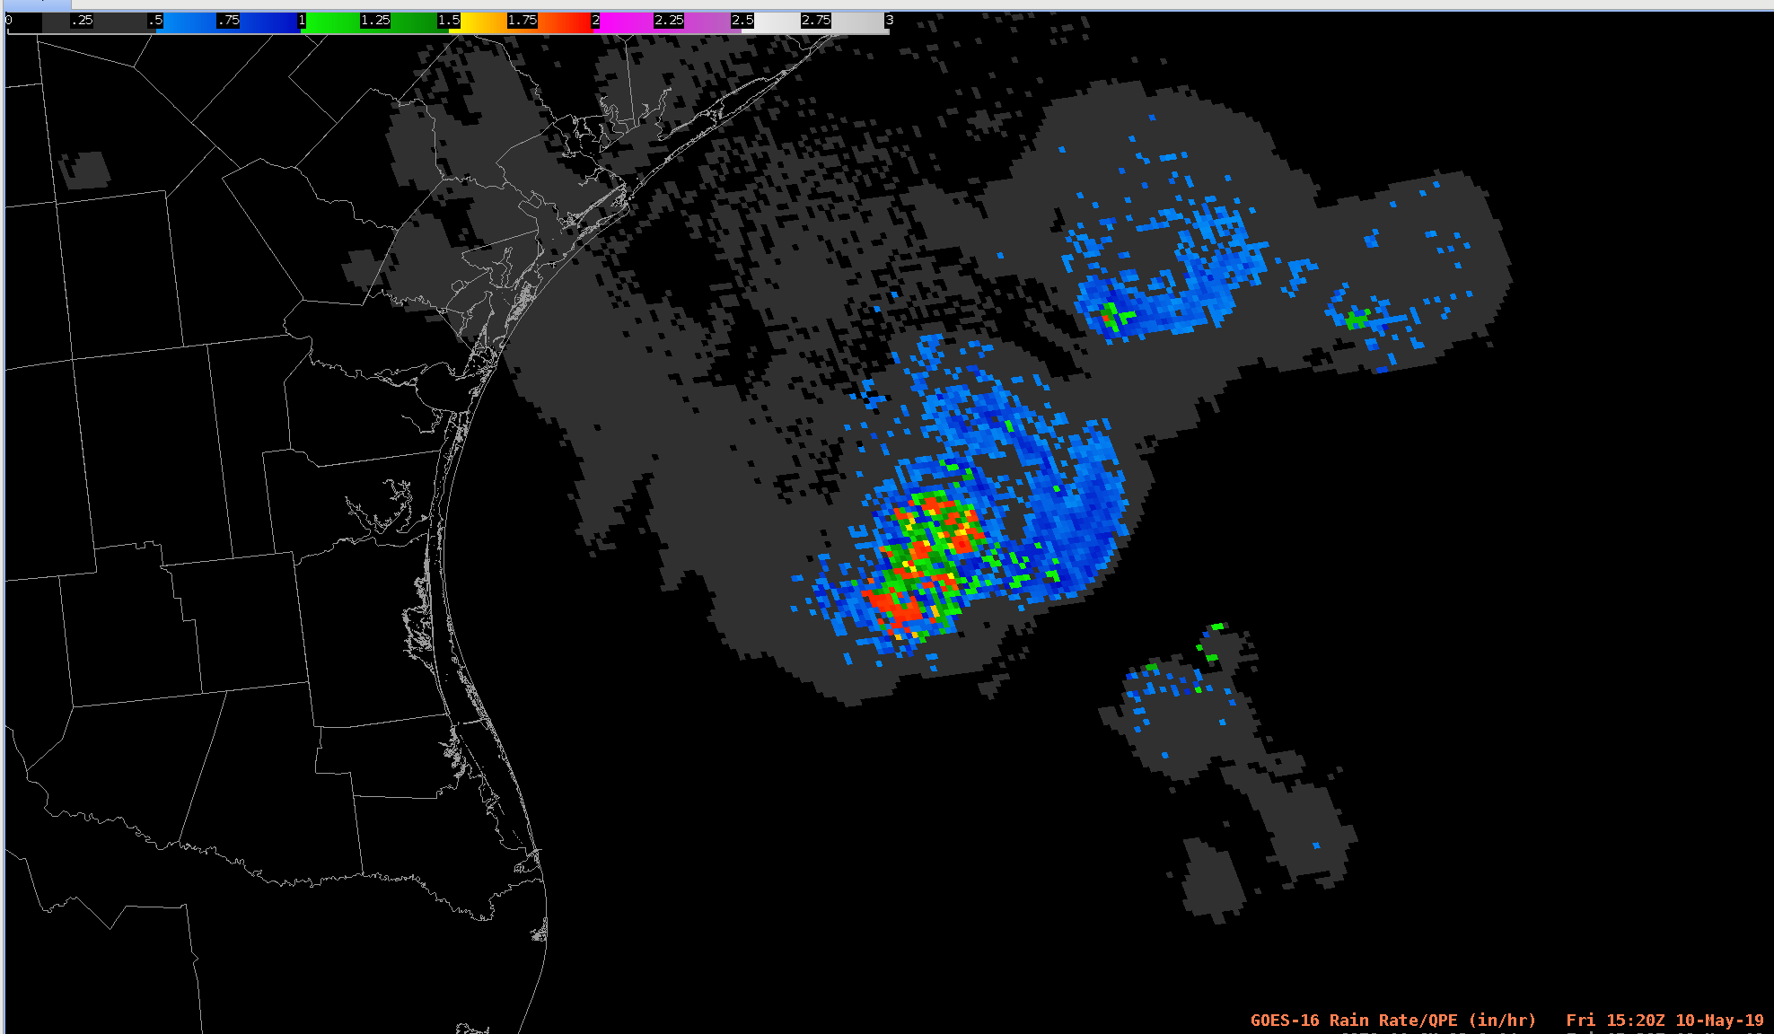
GOES-16 Rainfall Rate
Inches

