Slide 1
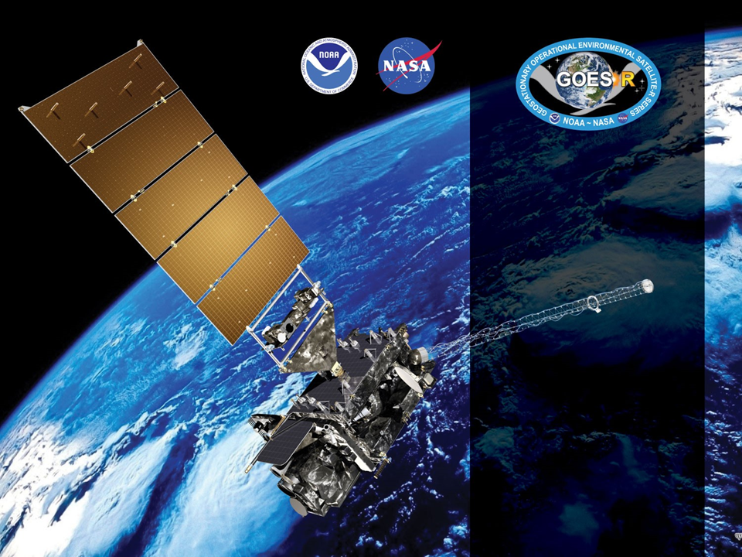
GOES-17 ABI L2+ SST
Provisional PS-PVR
July 25, 2019
GOES-R AWG
Alexander Ignatov*,
Matt Pennybacker, Irina Gladkova, Boris Petrenko, Olafur Jonasson, Yury Kihai, John Sapper
*NOAA NESDIS STAR
GST Inc., CCNY

Slide 2
Agenda
Product Overview
Specs/Requirements
G17 ABI Performance Issues
NOAA SST Monitoring System
Provisional Maturity Assessment
Transition to Enterprise
Path to Fully Validated/Operational
Summary and Recommendations

Slide 3
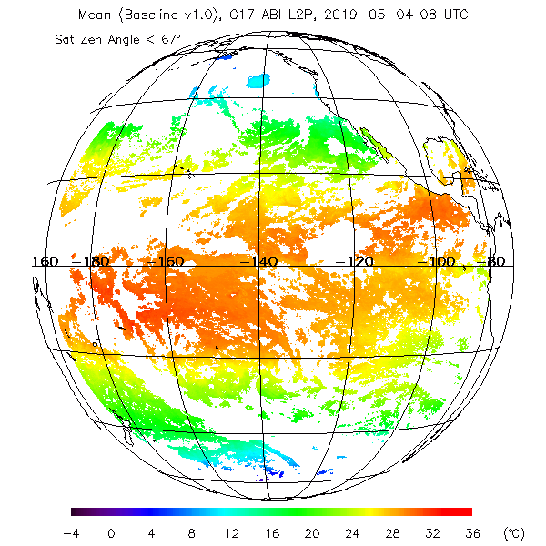
Product Overview
ABI Baseline SST Product:
  Uses Binary Cloud Mask “Conf. Clear” from Cloud Team as well as individual cloud tests
  Additionally Performs SST QC
  Regression trained against quality controlled in situ data
  Uses bands 11 (8.5µm),
  13 (10.3µm), 14 (11.2), 15 (12.3µm)
All 10min FD images are processed and aggregated into 1hr composites
Only L2 ABI fixed grid product is available (no equiangular gridded L3 product)
Open ocean only (no internal water)
No downstream products affected by SST
Example: 1hr Composite SST FD Image
from 2019-05-04 0800 UTC.

Slide 4
GOES-R SST specs
Vs. JPSS and Himawari-8 specs
Instrument | Measurement range | Accuracy⁽¹⁾ | Precision⁽²⁾
GOES-R (MRD) | 271 to 313 K | ±3.1 K* | 1.0 K*
JPSS | 271 to 313 K | ±0.2 K | 0.6 K
Himawari-8 | 271 to 313 K | ±0.2 K | 0.6 K
^{(*)} Ocean. Quantitative for LZA<=67º; Qualitative at LZA>67º
⁽¹⁾ Accuracy = Global Mean Bias of (SST - in situ SST)
⁽²⁾ Precision = Global Standard Deviation of (SST - in situ SST)
The MRD specs for ABI SST are much more liberal, and inconsistent with those for VIIRS and AHI. They do not meet users’ requirements, needs, or expectations
JPSS and H08 specs reflect users’ needs and expectations. All NOAA SST products meet these specs. This review evaluates SST product against the more stringent JPSS/H08 specs

Slide 5
Effects of G17 ABI
Performance Issues on SST
Primary effects of increased FPM temperature which impact SST retrievals from G17:
  Elevated Sensor Noise: The “nominal NEΔT” (for “coolest” periods) for G17 is up to 5x higher than for G16, in the thermal IR bands used for SST retrievals (8.4, 10.3, 11.2, and 12.3 μm)
  Increased Striping: Neighboring detectors have independent and time-varying biases, and as a result generate stripe artifacts in the SST imagery produced by G17 ABI
  Unstable and Inaccurate Calibration: In addition to systematic biases as a result of increased (over the nominal 82 K) FPM temperature, the ABI calibration algorithms cannot follow its fast variation throughout the day
  Saturation: In the most extreme heating conditions, some of the thermal infrared bands will saturate, yielding no useful data during this time. The 12.3 μm band is especially susceptible
  Gain Switching: In order to help reduce saturation, ABI is switched from gain mode 1 to a cruder gain mode 3 setting before heating is expected to occur. Each switch introduces discontinuities and extra noise in the brightness temperatures, rendering the SST unusable during gain mode 3 intervals
The current review focuses on best G17 performance periods with coolest FPM

Slide 6
NOAA SST Monitoring System

Slide 7
NOAA SST Monitoring
Visualization of validation and comparisons with global Level 4 (L4) fields, Canadian Meteorological Center (CMC) in the NOAA SST Quality Monitor (SQUAM; www.star.nesdis.noaa.gov/sod/sst/squam/; Dash et al., 2014)
Validation against QC’ed in situ SSTs from NOAA In situ SST Quality Monitor (iQuam; www.star.nesdis.noaa.gov/sod/sst/iquam/; Xu, Ignatov, 2014)
Visualization of regional imagery in the ACSPO Regional Monitor for SST (ARMS; www.star.nesdis.noaa.gov/sod/sst/arms/; Ding et al, 2016)
The three SST validation subsystems are fully established, documented & well utilized by the SST community (e.g., Group for High Resolution SST, GHRSST)
Consistent QC/Val/Evaluation methodologies are applied to various NOAA (JPSS, GOES-R, Himawari AHI, POES AVHRR, EOS MODIS) & partners’ products, to facilitate selection of best fit-for-purpose product to meet users’ needs

Slide 8
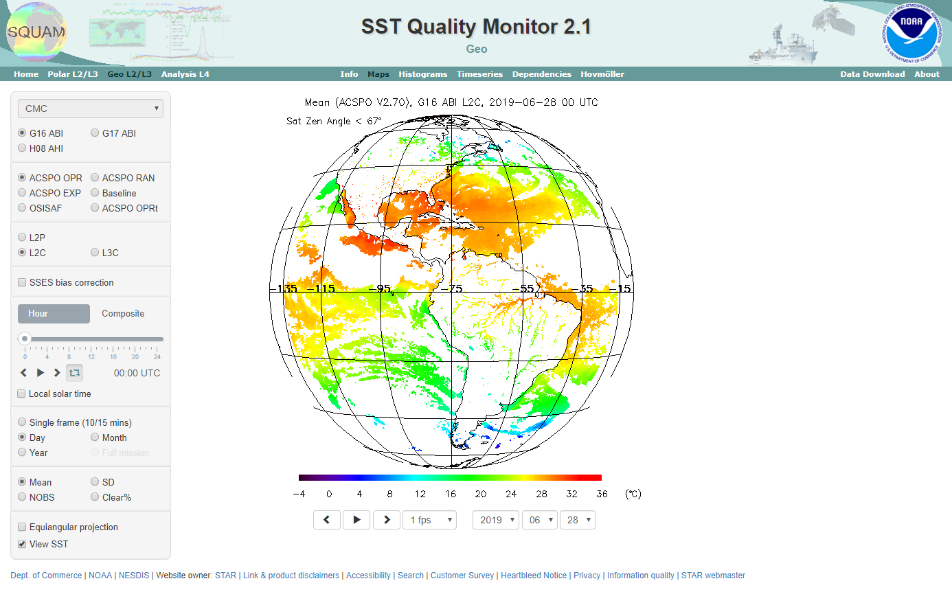
SST Quality Monitor
(SQUAM)
www.star.nesdis.noaa.gov/sod/sst/squam/
SQUAM monitors NOAA & partners SSTs globally, against in situ and L4 analyses

Slide 9
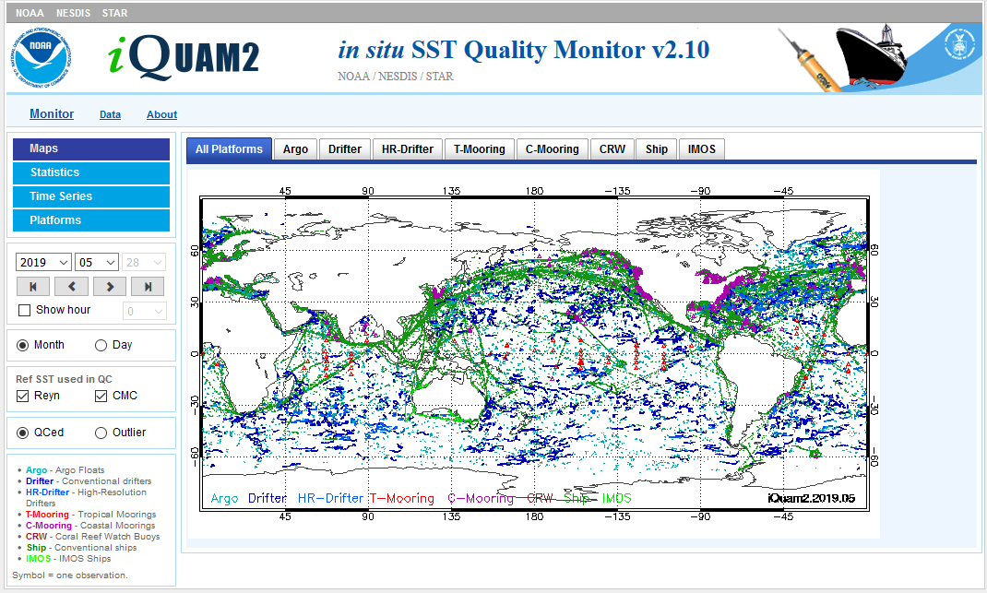
In situ SST Quality Monitor (iQuam)
www.star.nesdis.noaa.gov/sod/sst/iquam/
www.star.nesdis.noaa.gov/sod/sst/iquam/
iQuam applies uniform QC to in situ SSTs (drifters, moorings, Argo, ships) & serves to users

Slide 10
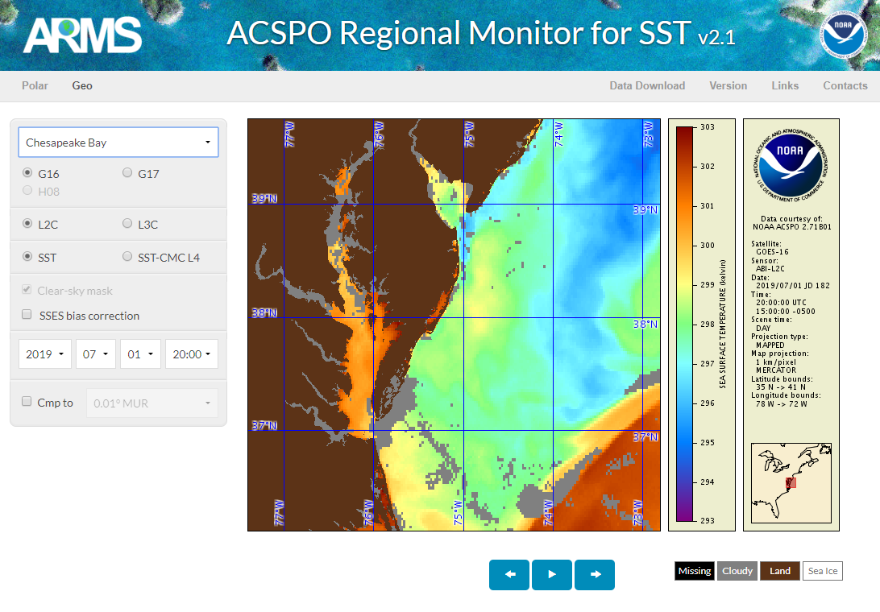
ACSPO Regional Monitor for SST (ARMS)
27 regions
www.star.nesdis.noaa.gov/sod/sst/arms/
ARMS monitors several L2-L3-L4 SST regionally and checks them for cross-consistency

Slide 11
Provisional
Maturity Assessment

Slide 12
Definition of
Provisional Validation
Definition and prior activities:
Validation activities are ongoing and the general research community is now encouraged to participate.
Severe algorithm anomalies are identified and under analysis. Solutions to anomalies are in development and testing.
Incremental product improvements may still be occurring.
Users are engaged in the Product Feedback Forums (PFF) and user feedback is assessed.
Status after Provisional Validation:
Product performance has been demonstrated through analysis of a small number of independent measurements obtained from select locations, periods, and associated ground truth or field campaign efforts.
Product analysis is sufficient to communicate product performance to users relative to expectations (Performance Baseline).
Documentation of product performance exists that includes recommended remediation strategies for all anomalies and weaknesses. Any algorithm changes associated with severe anomalies have been documented, implemented, tested, and shared with the user community.
Testing has been fully documented.
Product is ready for operational use and for use in comprehensive cal/val activities and product optimization.

Slide 13
Specific Objectives
of SST Provisional Review
Assess Accuracy & Precision of the SST product over a large/wide range of representative conditions, which may still be limited seasonally
SST meets its documented requirements (±0.2K mean bias, and 0.6K RMSD wrt. in situ data)* for view zenith angles ≤67º
Remediation strategies are in place for known issues
Product is ready for evaluation for potential operational use and for potential use in scientific publications
The scope of this review covers the performance of the GOES-17 SST during periods of the day (2000Z - 0800Z) when the ABI longwave focal plane module (FPM) temps. are stable at ~81K and gain mode 1 is set.
* Stringent JPSS/H8 specs are used, instead of liberal GOES-R MRD specs. Currently, SST product meets these stringent specs, most of the time

Slide 14
PLPT Events: Provisional Maturity
Provisional
PLPT ID | Descriptive Title | % Complete | Results | AWG POC
ABI-FD_SST04 (M3, M4) | Assess the accuracy & precision of ABI SST product. Verify if it (1) meets MRD specs for a limited (not seasonally representative) number of independent measurements; and (2) is ready for operational use. Or, identify fixes to the ABI sensor performance, clear-sky mask (CSM) or SST algorithm to make the SST product ready for operational use | 100 | Complete | Ignatov
14

Slide 15
Transition to the ACSPO Enterprise SST Algorithm scheduled in 2020

Slide 16
ACSPO Enterprise SST
The Advanced Clear-Sky Processor for Oceans (ACSPO) is the NOAA enterprise SST system, capable of processing all current polar and geostationary SST sensors (VIIRS, ABI, AHI, AVHRR, MODIS)
Work is in progress to integrate the ACSPO algorithms into the GOES-R ground system and replace Baseline SST in operations before full maturity
Near-real-time ACSPO v2.70 hourly SST products from G16 and H08 are currently being produced in STAR in a moderate assurance mode, distributed via PDA, and archived with PO.DAAC
Additional mitigations for G17 FPM performance issues are being developed and will be included in ACSPO v2.71

Slide 17
Baseline vs. Enterprise SST
Feature | Baseline | Enterprise
Algorithm | 2010 ACSPO⁽¹⁾ v1.20 (“SEVIRI”) | 2019 ACSPO⁽¹⁾ v2.70 (“AHI/ABI”)
Bands used for SST | Reconciled w/Enterprise-ACSPO | Day & Night: 8.6, 10.4, 11.2, 12.3 μm
Switch between day/night | Reconciled w/Enterprise-ACSPO | One algorithm ensures consistent diurnal cycle
Availability to users | PDA / CLASS | PDA / PO.DAAC
Clear-Sky Mask | Framework “one-size-fits-all” | Optimized for SST (consistent w/JPSS/H08)
Internal Waters | No | Yes
Gridded L3 Product | No | Yes (consistent w/VIIRS/AVHRR/AHI/MODIS)
Output File Format | Non-GDS2 | GDS2⁽²⁾ (Critical for International SST users)
SSES⁽³⁾ | No | Yes. Minimizes local SST biases & global SDs
1hr Compositing/Collation | Composite | Collated
Potential Improvements | Challenging | Ongoing
Science Maintenance/Val | Unique (Costly/Inefficient) | Unified (Enterprise Processes)
Reprocessing | No provision | Completed for G16; Ongoing for G17 & H08
Consistent w/NOAA SSTs | No | Yes (w/VIIRS/AVHRR/AHI/MODIS)
⁽¹⁾ ACSPO | Advanced Clear-Sky Processor for Oceans – NOAA Enterprise SST System
⁽²⁾ GDS2 | Group for Hi-Res SST (GHRSST) Data Spec v2.0 – SST community standard
⁽³⁾ SSES | Single Sensor Error Statistics – in-pixel estimates of SST bias and standard deviation (required by GDS2 format and by modelers, including NCEP)

Slide 18
G16/H08 SST Users
Baseline
  AWIPS/WFOs (G16/17; no H08)
ACSPO L2P/L3C: Requested/Looked at the Data (PDA pull)
  NOAA Geo-Polar Blended L4 SST (Eileen Maturi, Andy Harris, John Sapper)
  NOAA OPC (Bob Daniels, Fran Achorn)
  NOAA OAR GLERL (George Leshkevich – Great Lakes)
  PO.DAAC (Ed Armstrong, Wen-Hao Li, Tim McKnight)
  NOAA EMC HYCOM/NCODA (Ilya Rivin, Jim Cummings)
  NOAA EMC RTOFS (Avichal Mehra)
  NOAA Coast Watch – all nodes (Veronica Lance – Central, Ron Vogel – East Coast, Joaquin Trinanes – Caribbean, Dale Robinson – W. Coast, Melanie Abecassis – Pacific)
  Australian Bureau of Meteorology (Helen Beggs, Chris Griffin, Pallavi Govekar)
ACSPO L2P/L3C: Inquired/Expressed Interest (No routine pull yet)
  CSU/NHC (Galina Chirokova, Mark De Maria, Monica Bozeman)
  NOAA West Coast Ocean Forecast System (Alexander Kurapov)
  Canadian Met Centre (CMC) L4 (Dorina Surcel-Colan)
  NAVO (Bruce McKenzie)
  Danish Met Institute (Jacob Høyer)
  JMA (Toshiyuki Sakurai)

Slide 19
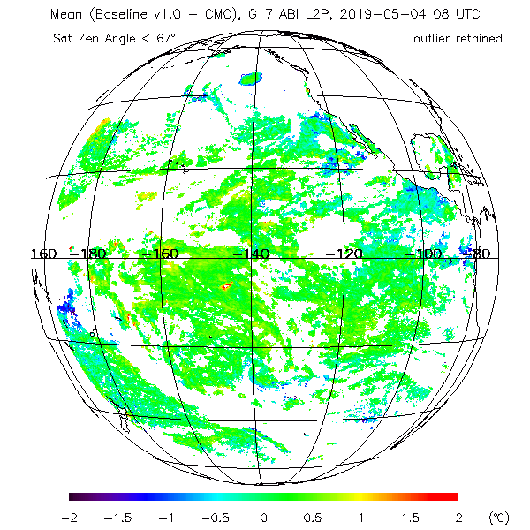
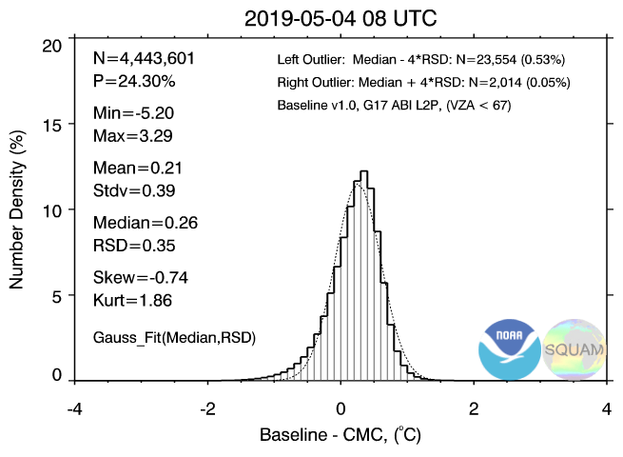
Compare with CMC L4 SST:
2019-05-04 0800 UTC
Baseline
Long cold tail in SST histograms
Cloud leakages (both cold and warm) most often occur around cloud edges, and along (some, not all) coastlines
Fixing those is an expensive effort, involving analyses of clear-sky mask in conjunction with SST QC

Slide 20
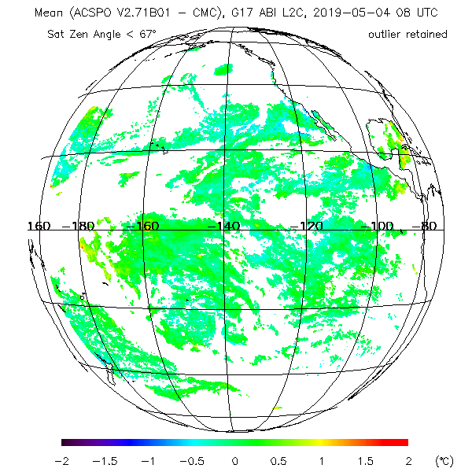
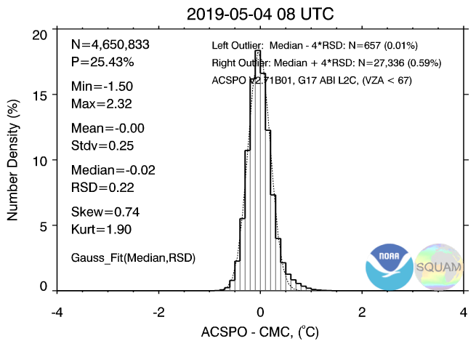
Compare with CMC L4 SST:
2019-05-04 0800 UTC
ACSPO
No long cold tail in SST histograms
Some residual cloud & SST depression around cloud edges also seen in ACSPO, but at much reduced scale
This comes at the expense of slightly reduced SST domain in questionable regions, but the areas screened out are indeed cloud

Slide 21
Current GOES-17 SST
Performance

Slide 22
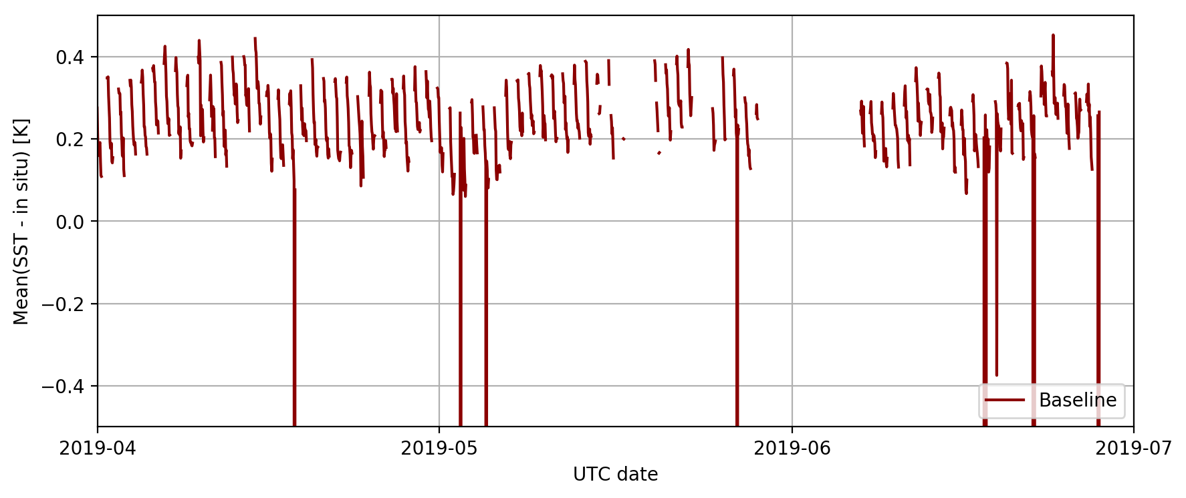
Mean Bias w.r.t. in situ SST
Focus period representative of current data
Each data point = 1hr FD statistic (1.5-3 thousand match-ups)
Mode 6
timeline
begins
Only gain mode 1 data are shown. Other gaps are primarily due to recent SQUAM instabilities. The G17 L1B algorithms have been relatively stable only since the mode 6 (10 minute) timeline was enabled. (Large dropouts are due to ADR269 opened for G16.)

Slide 23
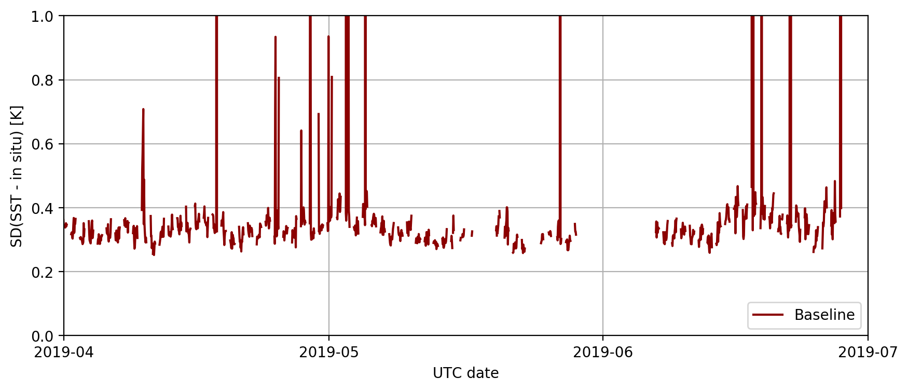
Std. Dev. w.r.t. in situ SST
Focus period representative of current data
Each data point = 1hr FD statistic (1.5-3 thousand match-ups)
Only gain mode 1 data are shown. Other gaps are primarily due to recent SQUAM instabilities. The G17 L1B algorithms have been relatively stable only since the mode 6 (10 minute) timeline was enabled. (Large spikes are due to ADR269 opened for G16.)

Slide 24
GOES-R SST specs
Vs. JPSS and Himawari-8 specs
Instrument | Measurement range | Accuracy | Precision
GOES-R (MRD) | 271 to 313 K | ±3.1 K | 1.0 K
JPSS | 271 to 313 K | ±0.2 K | 0.6 K
Himawari-8 | 271 to 313 K | ±0.2 K | 0.6 K
Typical values over the full satellite mission for NPP (JPSS) are ±0.07K accuracy, ~0.35K precision, and for G16 are ±0.2K accuracy, ~0.35K precision.
G17 SST Performance will be evaluated against JPSS/H08 specs which, hopefully, will be eventually reconciled
At present, Baseline SST for G17 only marginally meets the stringent accuracy spec, even during “cool” periods. The latter could have been easily adjusted by a simple “bias correction”, which however is deemed not needed in light of transition to enterprise in 2020

Slide 25
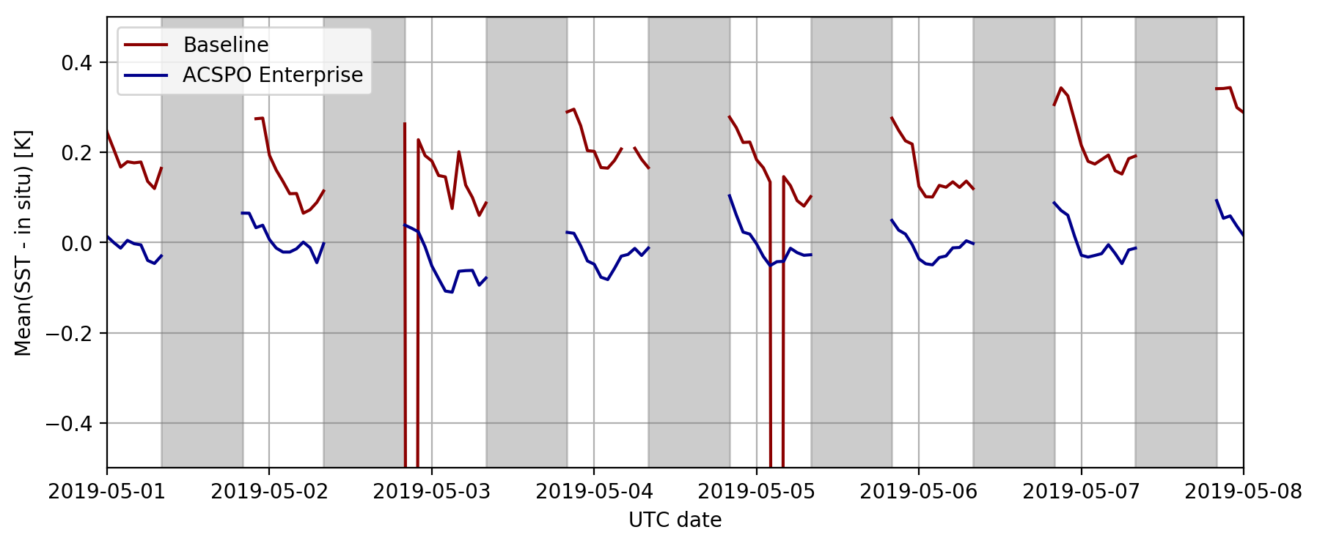
Mean Bias w.r.t. in situ SST
Specs:
±0.2K
Each data point = 1hr FD statistic (1.5-3 thousand match-ups)
Gain Mode 3 Intervals in Grey
Baseline SST is biased ~0.2K warm during gain mode 1 intervals. This is within the GOES-R specs, but outside the more stringent NOAA specs and the expectations of our users.

Slide 26
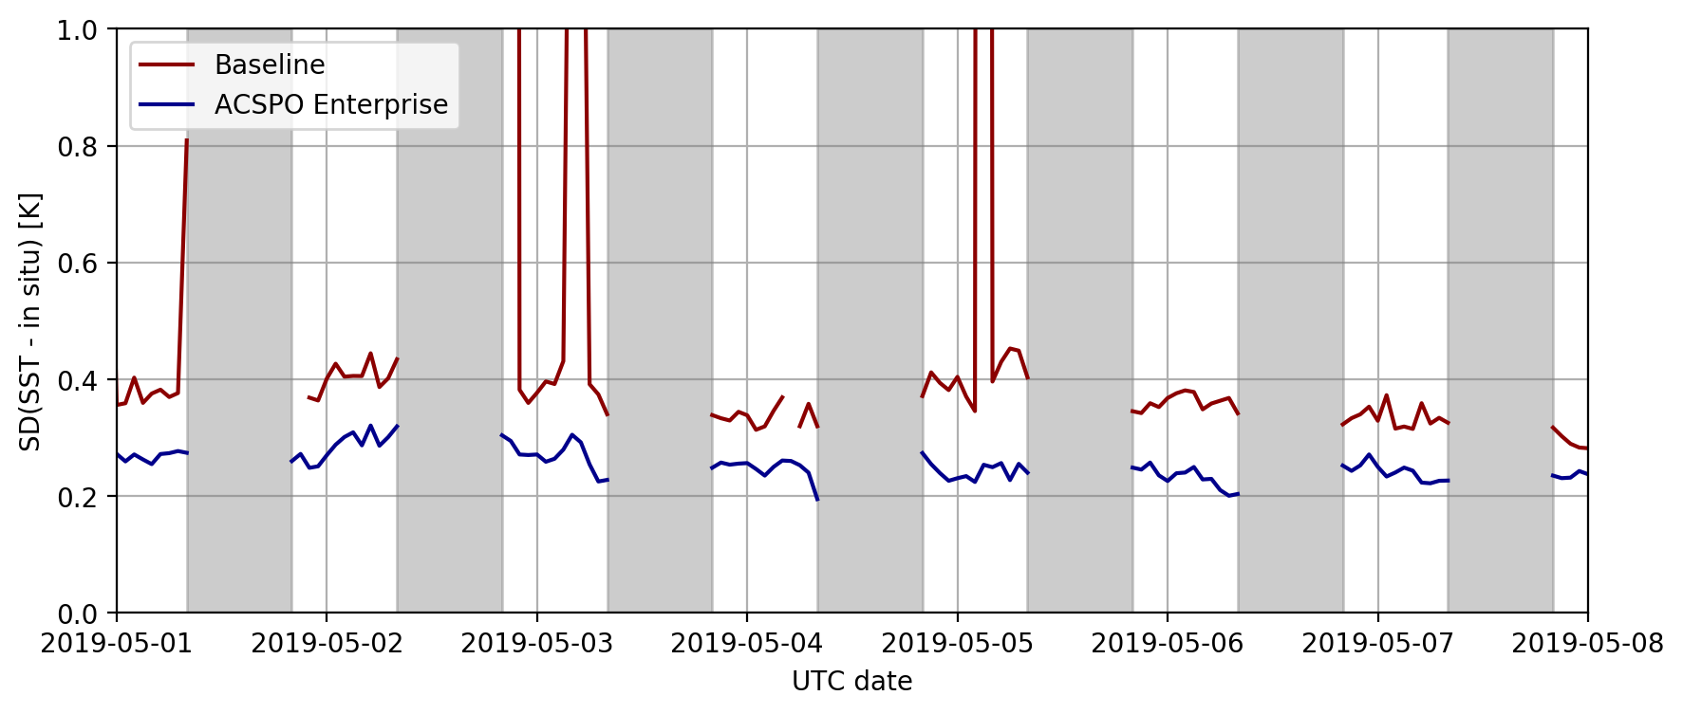
Std. Dev. w.r.t. in situ SST
Specs:
0.6K
Each data point = 1hr FD statistic (1.5-3 thousand match-ups)
Gain Mode 3 Intervals in Grey
Baseline SST precision is typically well within the NOAA specs during gain mode 1 intervals, except for outliers corresponding to clear-sky mask anomalies (ADR269).

Slide 27
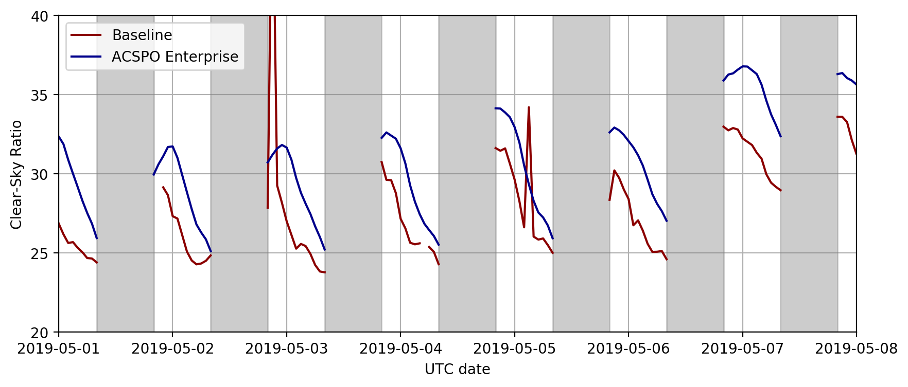
Clear-Sky Ratio
Clear-Sky Mask Anomalies
Gain Mode 3 Intervals in Grey
Baseline SST reported in fewer clear-sky pixels compared to enterprise.
Outliers correspond to clear-sky mask anomalies (ADR269).

Slide 28
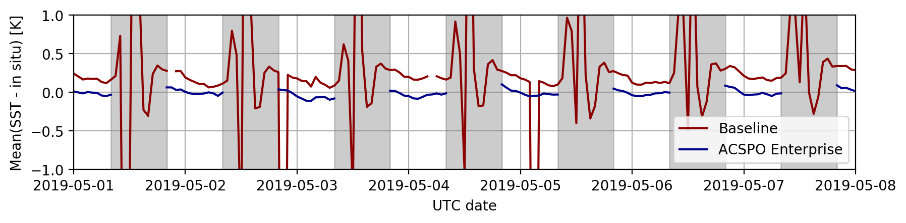
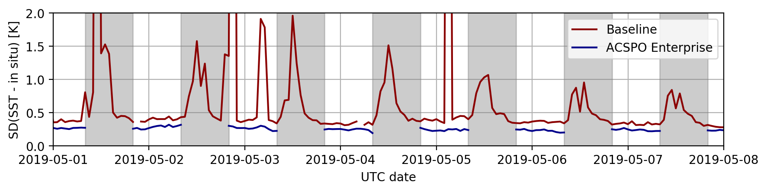
Assessment of
Warm Periods
Baseline SST is currently unusable during warm and gain mode 3 periods (in grey) due to significantly increased biases and std. devs.
Notes:
can add as many slides as needed. Large importance

Slide 29
Potential Improvements
to Warm Periods
SST data for warm periods will continue to be monitored in SQUAM for the effects of L1B improvements (e.g. predictive calibration)
When the gain mode selection flag is available in L1B, availability of usable SST into the gain mode 3 period will be explored
Will also explore the impact of predictive calibration on SST
The current TDQF is sensitive to cal biases that persist beyond the time that the FPM temperature has returned to nominal ~81 K. Alternative metrics will be explored to expand the usable time domain
The collation algorithm adopted in the ACSPO enterprise algorithm mitigates many data noise and striping issues
Despite all efforts to extend periods of available SST, during the warmest periods product will be unavailable for up to 6 hours each night, due to saturation of the 12.3 μm and strongly degraded performance of other bands

Slide 30
Remaining Unresolved ADRs

Slide 31
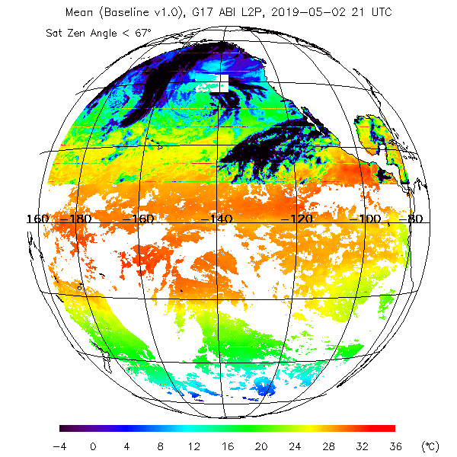
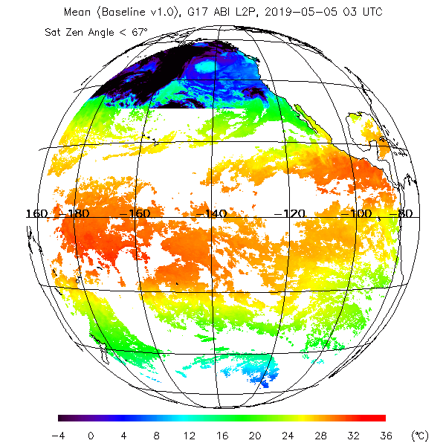
ADR 269: Clear-Sky Mask
Anomalies in Baseline SST
2019-05-02 2100 UTC
2019-05-05 0300 UTC
Entire Region Marked
“very good” QF

Slide 32
Other Unresolved ADRs
Two more ADRs related to filenames and metadata:
  ADR 509: Incorrect SST filenames
  ADR 608: Bad filenames and time_bounds variable for SST
ADRs 269, 509, and 608 were opened for GOES-16, prior to the launch of GOES-17, and continue to impact both platforms
All unresolved SST ADRs are either on hold or will be placed on hold pending integration of the ACSPO Enterprise SST algorithm in the GOES-R ground system
The resolution of ADRs affecting L1B products upstream of SST (e.g. ADRs 770/897/902 for striping in G17 ABI IR images and ADR 893 for predictive calibration) will likely require adjustments to the SST algorithm, which will be addressed in the Enterprise algorithm

Slide 33
Path to Full Maturity

Slide 34
Path to Full Maturity
Integrate the ACSPO Enterprise SST algorithm into the GOES-R ground system to provide users the best fit-for-purpose service & products, and to best satisfy their needs
Keep conducting PLPTs and improving the SST product
  Create match-ups with high-quality L4 analyses and in situ data, and display in SQUAM to guide product improvements
  Adjust algorithms, as needed (recalculate SST coefficients, tweak parameters in SST QC, etc.)
  Work with NOAA, national and international (GHRSST) users/partners, solicit feedback, and improve the product
  Work towards easy product access and archival
Explore additional mitigations for G17 ABI performance issues (cf. slide 29, and the following two slides)
Notes:
can add as many slides as needed. Large importance

Slide 35
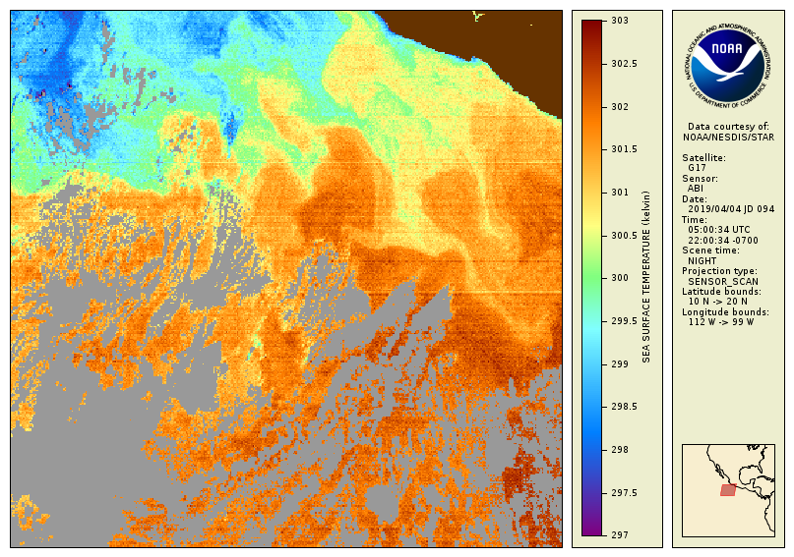
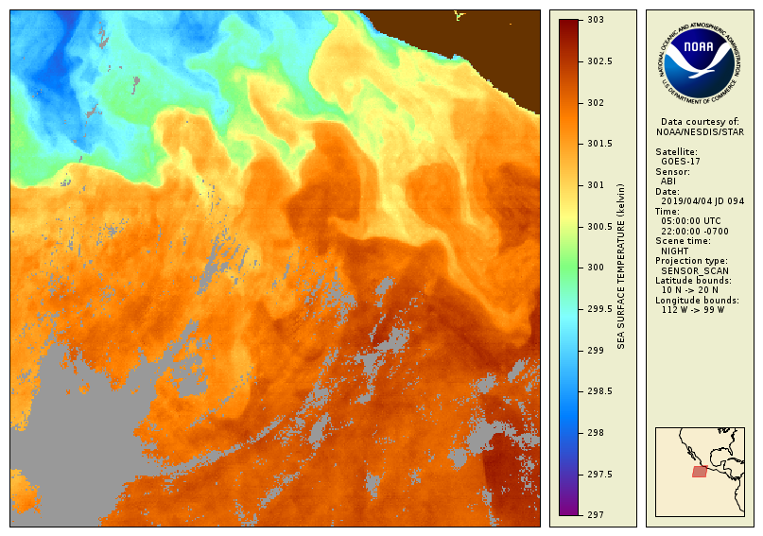
G17 ABI Mitigations in
ACSPO (1/2)
The ACSPO collation algorithm is effective at reducing both increased
noise and striping
Outside of gain mode 3 intervals, ACSPO collated G17 SST is now comparable to G16 in mean bias and overall image quality
Original Uncollated SST
ACSPO Collated SST

Slide 36
G17 ABI Mitigations in
ACSPO (2/2)
Of the bands used for SST retrievals, inaccurate and unstable calibration affects primarily the 11.2 μm band, which can be removed from the retrieval algorithm without impacting the global SST quality
Saturation and sensor noise primarily affect the 12.3 μm band, which is more difficult to remove
Predictive calibration may improve biases during “warm” periods, but initial assessments suggest that its positive effect on SST is limited
Due to the impact of the gain mode switches on SST retrievals, it will be necessary to work with the GOES-R AWG/CWG for:
  Data or metadata in the L1B products which indicate which gain mode is active
  An empirical correction to the L1B brightness temperatures to mitigate the jumps in bias that occur when the gain mode is switched

Slide 37
Conclusion

Slide 38
Recommendation
For SST Provisional Maturity
Product performance has been demonstrated through a large, but still seasonally limited, number of independent measurements.
Evaluation was performed for all FPM temperature regimes. Product looks better during favorable periods of sensor performance.
The analysis is sufficient for limited qualitative determinations of product fitness-for-purpose. The product may be tested in operational use, per users’ judgement
AWG SST Team believes that the G17 Baseline SST Product may be transitioned to Provisional status at this time
All tests appear to work
Major flaws can be attributed to known issues. Many of those will be mitigated after transitioning to the enterprise algorithm in 2020
Medium term (at least 3 months) validation was done successfully, in the full retrieval domain (Full Disk) during “cool” periods
PASSED

Slide 39
Summary
AWG believes that the G17 SST Product may be transitioned to Provisional status at this time
Remaining issues with the Baseline SST product will be irrelevant after integration of the ACSPO Enterprise SST algorithm into the GOES-R ground system
User Feedback will determine if any new issues will impact Full Validation Maturity
We will work with users interested in the NOAA enterprise product to facilitate data access and use

