Slide 1
Peer Stakeholder-Product Validation Review (PS-PVR)
GOES 16-17 EXIS EUVS:
User Perspective
Outline:
GOES R Observations
Ionosphere and Thermosphere
Models and Products
Status and Issues
19 May 2021
Presenter: Rodney Viereck
NOAA/NWS Space Weather Prediction Center and U. Colorado CIRES
Notes:
based on PLT reports from LASP

Slide 2
The EUV Spectrum and GOES R Observations
EUVS C
Thousands of spectral lines span orders of magnitude in brightness
Difficult to measure
Too much information for most operational models.
Spectral lines originate from different regions in the solar atmosphere:
Chromosphere
Transition Region
Corona
GOES EUVS measures a few key spectral lines in order to model the rest of the spectrum
EUVS A
EUVS B

Slide 3
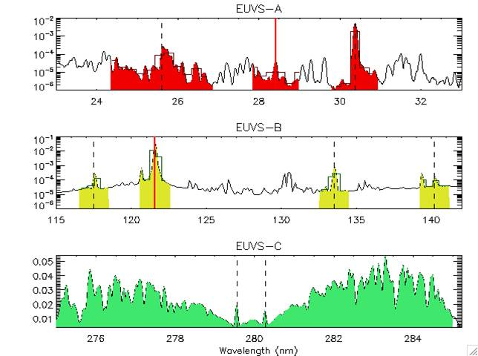
GOES 16 EXIS EUVS Measurements
Primary Measurements Used in Spectral Model:
Chromospheric:
MgII C/W (EUVS-C)
CIII 117.5 nm (EUVS-B)
CII 133.5 nm (EUVS-B)
Transition Region:
Ly-alpha 121.6 nm (EUVS-B)
SiIV/OIV 140.5 nm (EUVS-B),
HeII 30.4 nm (EUVS-A)
HeII 25.6 nm (EUVS-A)
Corona:
FeXV 28.4 nm (EUVS-A)
Hot Coronal:
0.1-0.8 nm (XRS)
0.05-0.4 nm (XRS)
From LASP (Eparvier)
Note: The stability of the EUVS-C observations will be applied to EUV-B and EUV-A to track performance and sensor degradation

Slide 4
GOES R EUV Product
Requirement: Low Resolution Solar Spectrum
5 nm spectral resolution
1 minute temporal resolution
Product combines
2 x-ray bands
8 EUV spectral lines
Spectral model
Note: Solar spectrum changes by factors of 2 to 10.
Atmospheric and Ionospheric densities change similarly

Slide 5
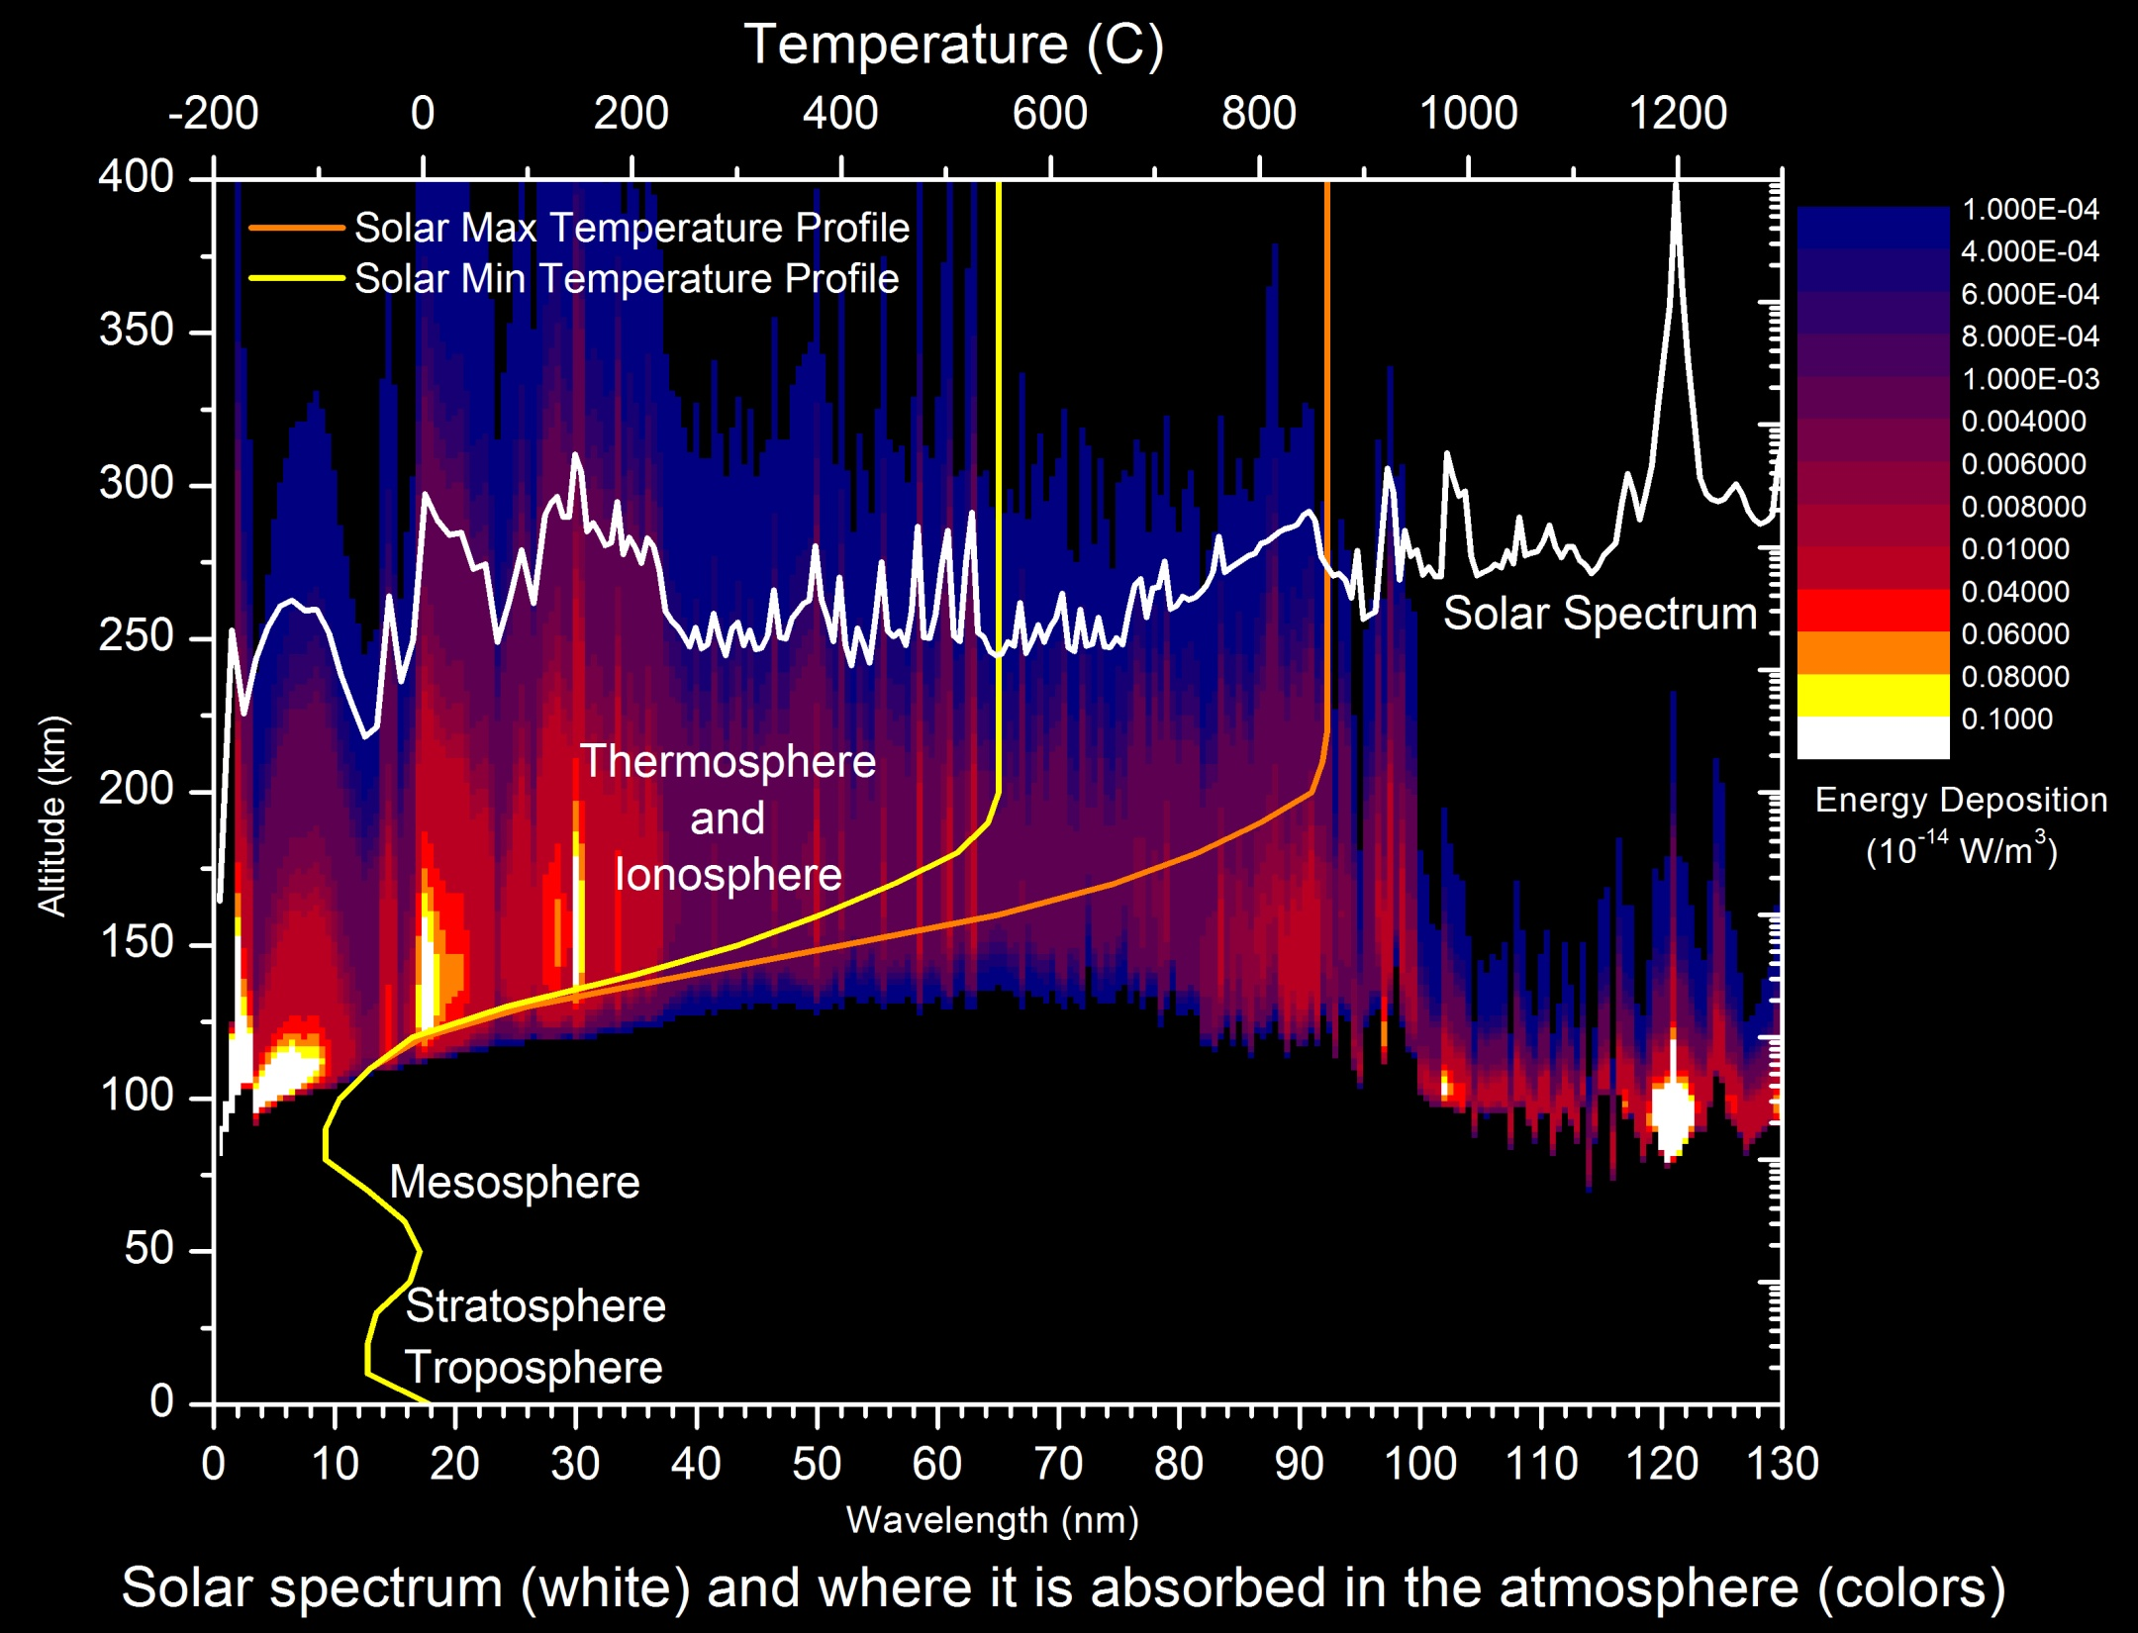
Solar EUV Energy Deposition into the Upper Atmosphere

Slide 6
Solar Variability and the Upper Atmosphere
Input: Solar EUV Irradiance Changes by Factors of 2-10
Result:
Neutral Temperature Changes by Factor of 2 (700K to 1300K)
Neutral Density Changes by Factor of 50
Electron Density Changes by Factor 10

Slide 7
Solar Variability and Satellite Drag
Neutral Density at 400 km calculated from 50 years of satellite tracking observations
Drag is proportional to density
Sources of variability in satellite drag
Solar EUV irradiance is the dominant

Slide 8
Application of the GOES EUVS data
Air Force High Accuracy Satellite Drag Model (HASDM)
Objective: Calculate and predict neutral density and satellite position for collision avoidance
Customers: DOD, NASA, NOAA, Every satellite operator in the US
Status: Operational (Use of GOES L1B data is not optimal)
NOAA Coupled Thermosphere Ionosphere Plasmasphere Model with Electrodynamics (CTIPe)
Objective: Calculate and predict ionosphere conditions for radio communication and satellite navigation
Customers: DHS/FEMA, FAA, ICAO, Construction, Agriculture, Mineral Exploration, etc…
Status: Operational (Use of GOES EUVS data not yet in operational version)
NOAA Whole Atmosphere Model – Ionosphere Plasmasphere with Electrodynamics (WAM-IPE based on the GFS weather model)
Objective: Calculate and predict neutral density and ionosphere conditions for radio satellite positioning, radio communication and satellite navigation
Customers: All of the above
Status: Transition to operations in 2021/22 (Use of EUVS data TBD)

Slide 9
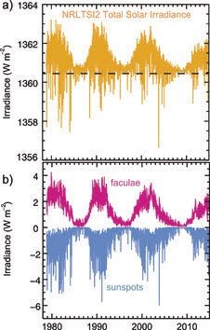
GOES EUVS Channel C: The MgII Core-to-Wing Ratio
Very stable measurement
UV (278 – 282 nm)
Ratio compensates for sensor degradation.
Tracking of sensor performance (translated to Channels A and B)
MgII Input to Models
HASDM (Air Force Space Command)
Total Solar Irradiance (Naval Research Lab).
Stratospheric Ozone Models
One of the longest measurements of solar variability (1978 NOAA-9 SBUV)
(Mg II)

Slide 10
Status
GOES 16 and 17 EUVS
L1B data require a number of ADR changes before it will be acceptable in operations.
Once the ADRs have been addressed, the L1B Spectral Model will need to be validated by SWPC.
Level 2 Products will require additional test and evaluation after that.
GOES 16 L1B data are being provided to the US Air Force for the Satellite Drag Model
This is not optimal. They will get operational data from SWPC once the ADRs have been addressed and the L2 data processing has been implemented at NWS.

Slide 11
Issues:
Implementation of the GOES R EUVS data and products has taken too long.
L1B data and products are still not ready for operations.

Slide 12
Summary
GOES EUVS L1b remain provisional but are expected to be ready once the ADRs are addressed.
GOES 16 EUVS L1b data are being provided to the USAF for the HASDM satellite drag model.
GOES EUVS Level 2 products will need to be validated by SWPC once the L1b data are corrected.
Note: GOES EUVS Data May Become Even More Important
A recently formed DOC Office of Space Commerce will eventually include civil Space Traffic Management and Space Situational Awareness. This office will likely manage satellite drag models which will require solar EUV input from GOES.

