Slide 1



Peer Stakeholder-Product Validation Review (PS-PVR)
GOES 16-17 EXIS EUVS
User Perspective
Ionosphere/thermosphere review
Mission and system impacts
History and improvements
Requirement specification issue
25 September, 2019
Presenter: Rodney Viereck
NOAA/NWS Space Weather Prediction Center and U. Colorado CIRES
Notes:
based on PLT reports from LASP

Slide 2
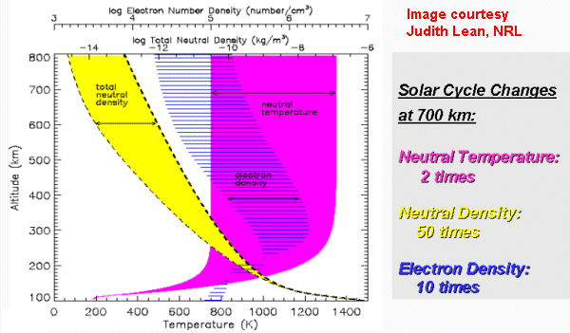
GOES Solar EUV Sensor (EUVS)
Monitor the disk-integrated solar Extreme UltraViolet (EUV) flux from 1 to 122 nm
  Primary source of heating and ionization of the upper atmosphere
Data Usage
  Models of the ionosphere (radio comm. and GPS nav.)
  Models of the thermosphere (orbit prediction collision avoidance)

Slide 3
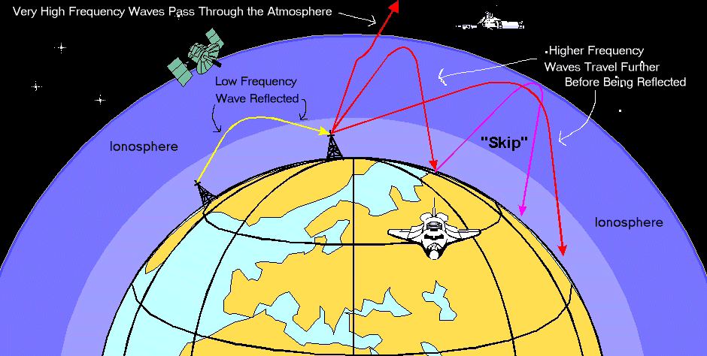
Ionosphere and Systems
Refracts, modifies, absorbs radio waves
  Refracting (bending) radio waves back to the ground Allowing communicate across long distances.
  Modifies the path of radio waves (and thus, the transit time) which affects GPS/GNSS location calculations
  Can absorb the radio waves we use for communication
Part of the magnetosphere current system
  Inducing currents in electric power lines and pipelines.
Magnetospheric Currents

Slide 4
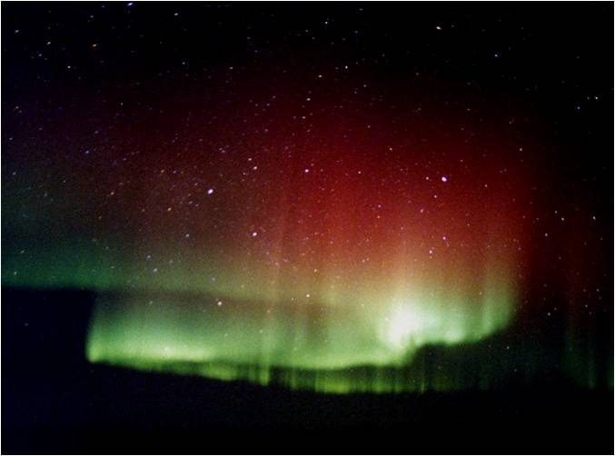
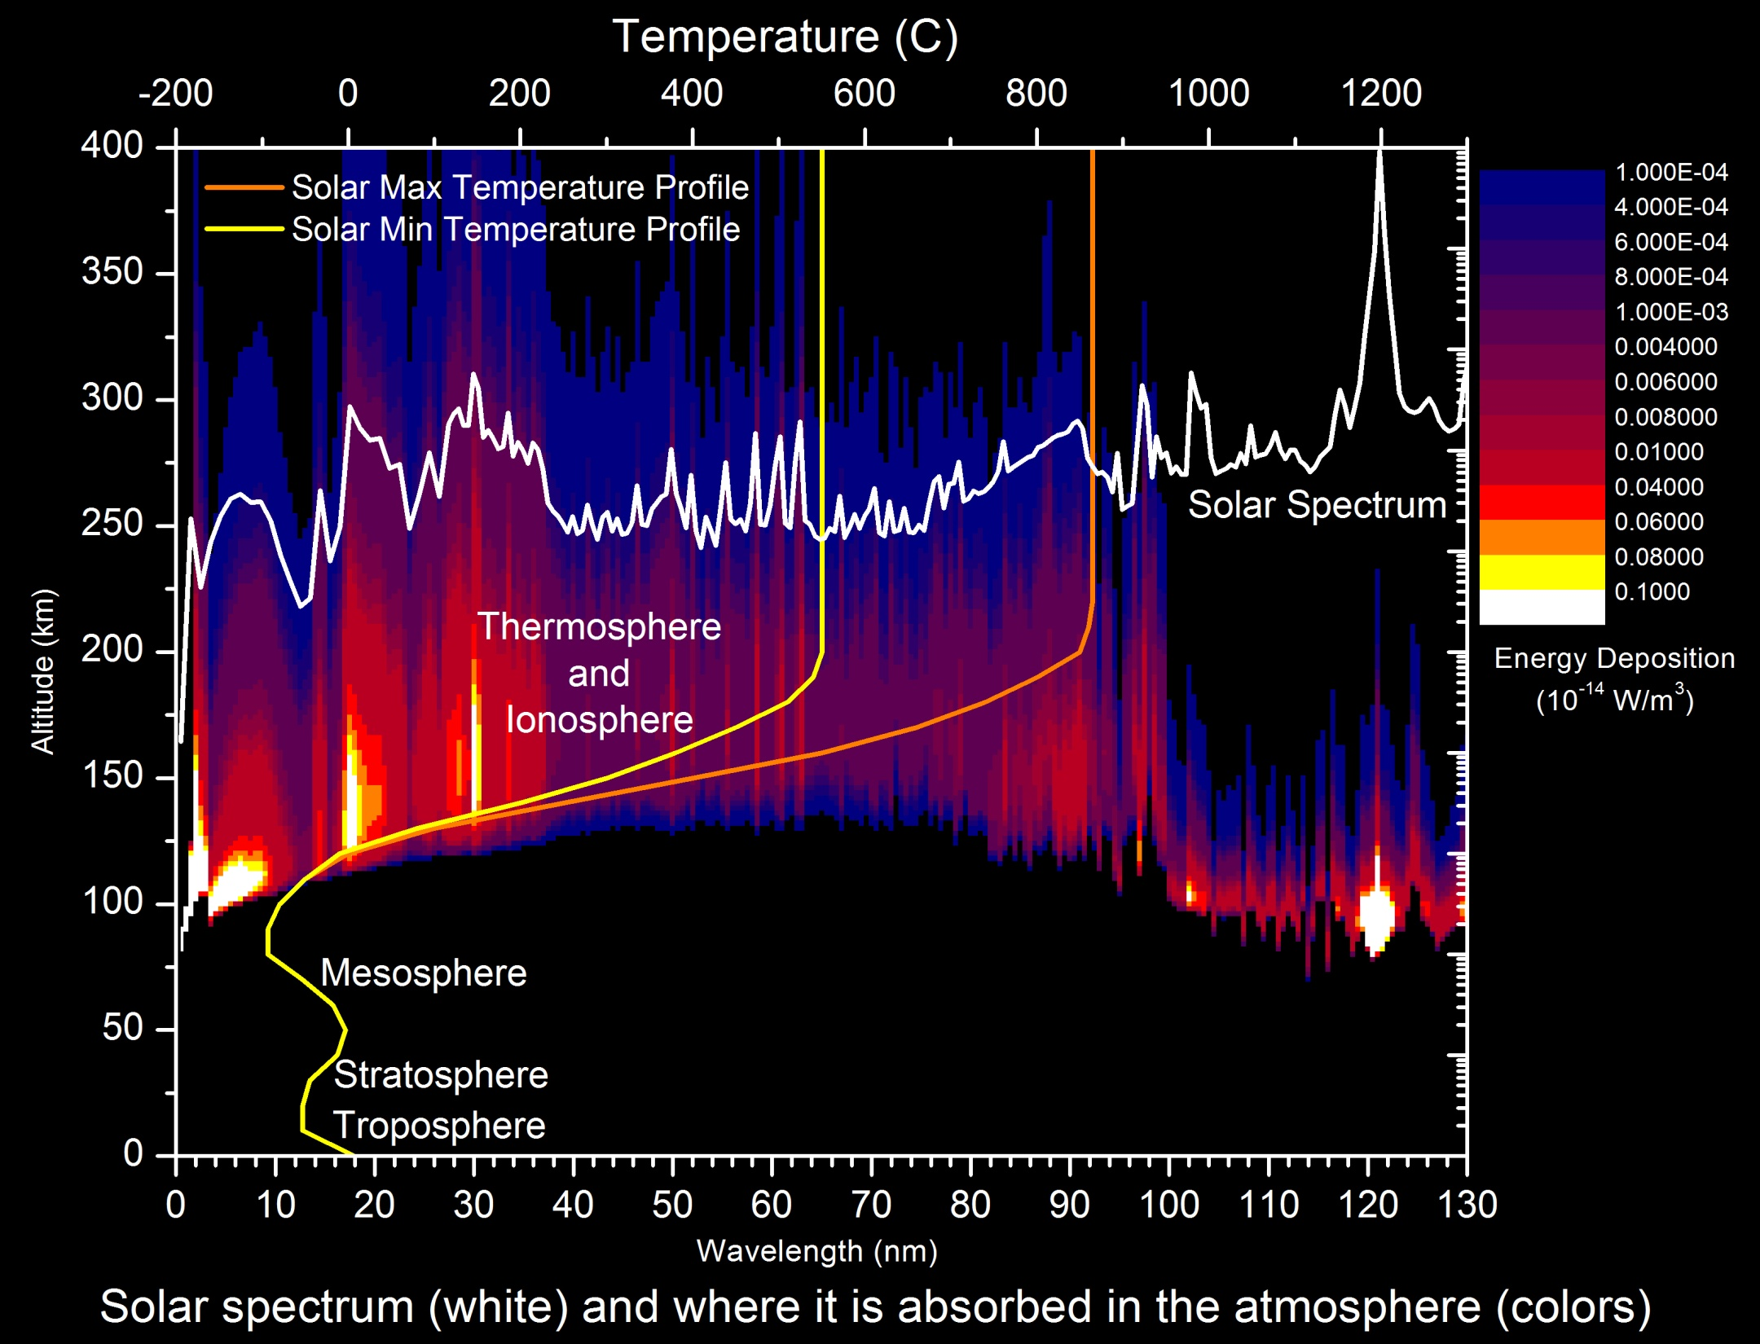
Solar EUV and the Ionosphere
The ionosphere
  Layer of electrons in the upper atmosphere
  Important to Radio communication, GPS/GNSS navigation
The ionosphere is highly variable
  Changes in solar EUV irradiance drives most of this variability
Satellites
Aurora
Meteors
Everest
Aircraft

Slide 5
Solar Variability in Thermosphere and Satellite Drag
Neutral Density at 400 km calculated from 50 years of satellite tracking observations
Drag is proportional to density
Sources of variability in satellite drag
Solar EUV irradiance is the dominant driver of satellite drag variability

Slide 6
History: GOES 13-15 EUV Bands
Original (planned) GOES NOP EUVS Bands
Original EUVS bands were separated and covered much of the EUV spectrum.
    This design depended upon stable thin-film metallic filters some of which proved to be unstable.
Final design relied upon diffraction grating angle to extend to longer wavelengths introducing multiple orders and overlapping bands.
Original Design
Actual (as built) GOES NOP EUVS Bands
Final Design

Slide 7
GOES 13-15 EUVS issues
Broad bands vs spectral lines limits the utility of the data
  Only three of the five broad bands provide unique and quantifiable information
  Overlapping optical orders creates too much uncertainty in identifying source of variability.
Heater Noise on some of the channels adds noise to the data (Channels A and B)
Filter degradation adds trends to data (Lyman Alpha)
GOES R Series will observe spectral lines and will track and correct the degradation and temperature dependence.

Slide 8
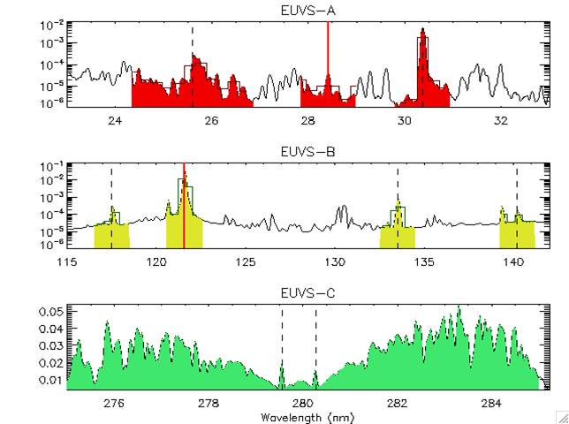
GOES 16 EXIS EUVS Measurements
Primary Measurements Used in Spectral Model:
  Chromospheric:
    MgII C/W (EUVS-C)
    CIII 117.5 nm (EUVS-B)
    CII 133.5 nm (EUVS-B)
  Transition Region:
    Ly-alpha 121.6 nm (EUVS-B)
    SiIV/OIV 140.5 nm (EUVS-B),
    HeII 30.4 nm (EUVS-A)
    HeII 25.6 nm (EUVS-A)
  Corona:
    FeXV 28.4 nm (EUVS-A)
  Hot Coronal:
    0.1-0.8 nm (XRS)
    0.05-0.4 nm (XRS)
From LASP (Eparvier)

Slide 9
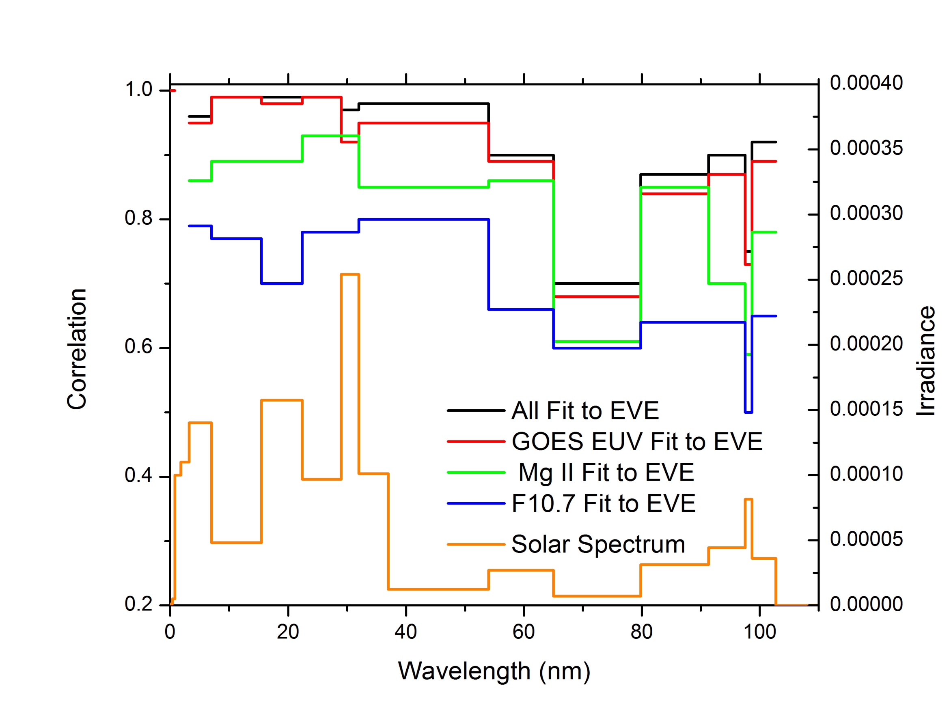
GOES 13-15 EUV Irradiance Proxy Model:
Stan_Bands = C₀ + C₁* MgII + C₂*MgII_smooth + C₃*F10.7 + C₄*XRS_Short + C₅*XRS_Long + C₆*EUVA + C₇*EUVB + C₈*EUVC + C₉*EUVD + C₁₀*EUVE
Creating a proxy model to reproduce daily SDO EVE observations
Proxy models have been developed (and sometimes used operationally) from research satellites that observe solar EUV
  Timed SEE, SOHO SEM, SORCE SOLSTICE, SDO EVE, etc…
These missions have limitations
  Spectral coverage, temporal resolution, lifetimes, etc
GOES EXIS EUVS will provide a comprehensive measure of solar irradiance

Slide 10
Models that Use GOES EUVS data
Air Force High Accuracy Satellite Drag Model (HASDM)
  Objective: Calculate and predict neutral density and satellite position for collision avoidance
  Customers: DOD, NASA, NOAA, Every satellite operator in the US (world?)
  Status: Operational
NOAA Coupled Thermosphere Ionosphere Plasmasphere Model with Electrodynamics (CTIPe)
  Objective: Calculate and predict ionosphere conditions for radio communication and satellite navigation
  Customers: DHS/FEMA, FAA, ICAO, Construction, Agriculture, Mineral Exploration, etc…
  Status: Test and evaluation: To be transitioned in FY2020
NOAA Whole Atmosphere Model – Ionosphere Plasmasphere with Electrodynamics (WAM-IPE based on the GFS weather model)
  Objective: Calculate and predict neutral density and ionosphere conditions for radio satellite positioning, radio communication and satellite navigation
  Customers: All of the above
  Status: Development, test, and evaluation: To be transitioned in FY2020 (or FY2021)

Slide 11
Issues and Concerns:
L1B Status and Schedule
Current EUVS L1b data does not meet requirements for operations
  Temperature corrections have not been correctly implemented
  Dark corrections have not been correctly implemented
Current schedule leaves a significant gap
  GOES 15 will be turned off in late 2019
  GOES 16 EUVS L1b data will not be ready until spring of 2020
  Schedule for implementation of the L2 data processing may add to the length of the data gap
Recommendation: ADR schedule and GOES 15 decommissioning timeline should be adjusted to try and have the GOES EUVS L1B data available before GOES 15 is turned off

Slide 12
Issues and Concerns:
EUVS Accuracy Requirements Definition
Current requirement only lists absolute accuracy of 20%
  Developers of ionosphere/thermosphere models can adjust for this
  Short term variations (non solar) of 5-10% meet accuracy requirements but renders the data useless
  E.g. Temperature-induce variations in the output can be larger than the daily and seasonal changes in solar irradiance
Recommendation: Requirements definition should include several components
  Absolute accuracy (transfer from NIST standard)
  Systematic changes (temperature, protons, electrons, etc…)
  Long-term trends (filter and detector degradation)
  Random error (noise)

Slide 13
Questions

