Slide 1
Final Peer Stakeholder-Product Validation Review (PS-PVR)
GOES 16-17 EXIS XRS: User Perspective
19 August, 2020
Rodney Viereck^{1,2}
Vic Pizzo¹
NOAA/NWS Space Weather Prediction Center
University of Colorado CIRES
Note: Vic Pizzo will be taking over as the NWS/SWPC POC for GOES EXIS
Outline:
Data
Applications
Status
Issues
Notes:
based on PLT reports from LASP

Slide 2
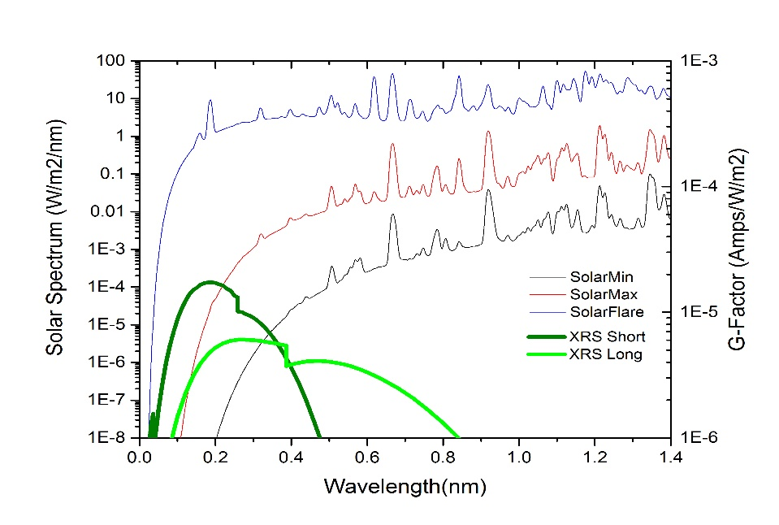
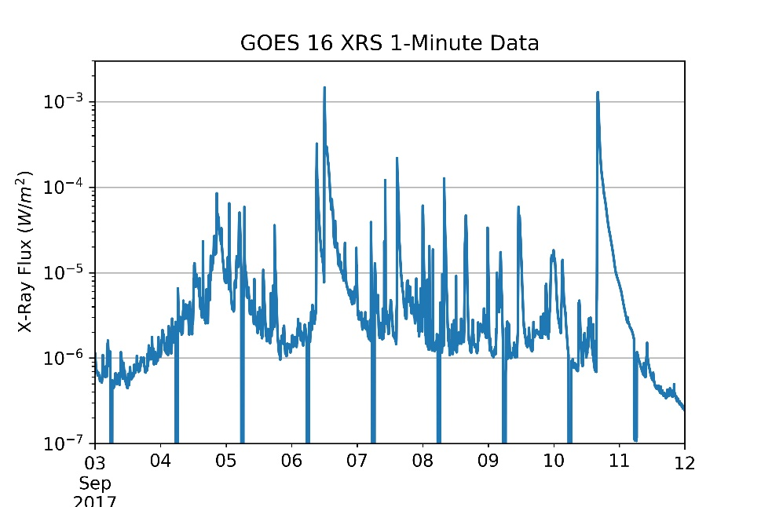
Solar X-Ray Sensor (XRS)
Monitor the disk-integrated solar flux in two x-ray wavelengths
XRSA 0.05 nm – 0.4 nm
XRSB 0.1 nm – 0.8 nm
Define the magnitude of solar x-ray flares
Solar X-Rays:
Change by several orders of magnitude in just a few minutes
Are the harbingers of impending space weather storms
Are absorbed in the lower ionosphere where the flare enhanced ionosphere blocks HF communication
Solar X-Ray Spectrum
Solar Flares
X
M
Flare Classification
C
Daily Eclipses
B
Day of September 2017

Slide 3
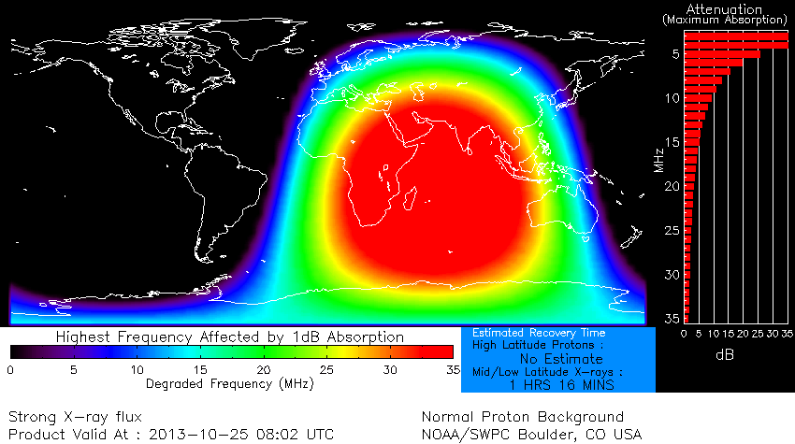
Primary Applications of the XRS
First notice of major space weather event
Most major space weather events start with a large solar flare
Establish first look at the size and
geo-effectiveness of an event
The magnitude of subsequent major
space weather (e.g. solar proton events
and geomagnetic storms) correlate with
the size and location of the flare.
GOES XRS is input to Space Weather Models
D-Region Absorption (HF Radio Blackouts)
Proton Prediction (Radiation Storms)
The XRS data drive one of the three NOAA Space Weather Scales
R-Scale or Radio Blackouts - driven GOES solar x-rays
S-Scale or Solar Radiation Storm – driven by GOES solar protons
G-Scale or Geomagnetic Storm – driven by USGS ground magnetometers
D-Region Absorption Model
Shows the location and intensity of radio blackouts

Slide 4
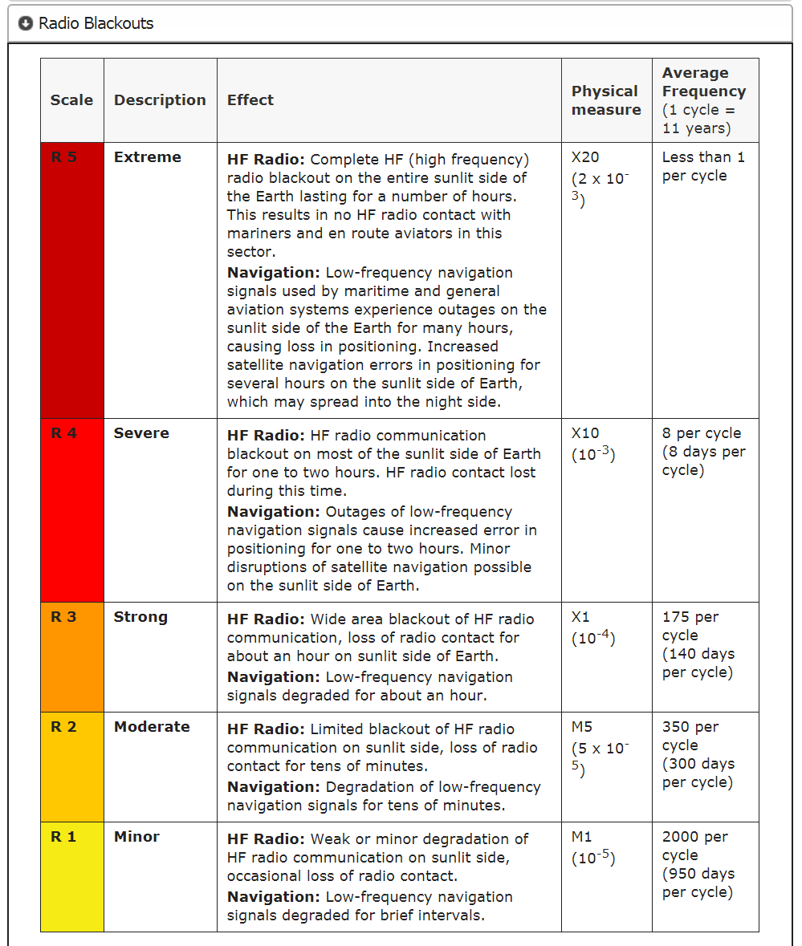
XRS Alert Levels
NOAA R-Scale
Alert Levels: M5, X1, X10, X20
Based on customer impacts
GOES XRS

Slide 5
GOES 16-17 XRS Status
GOES 16 XRS is now the primary XRS sensor for operations
NASA SDO EVE Sensor is providing secondary XRS-like proxy data
Currently working to bring GOES 17 XRS on line via development data stream before the fall eclipse period.
GOES 17 should be fully operational in spring of 2021.

Slide 6
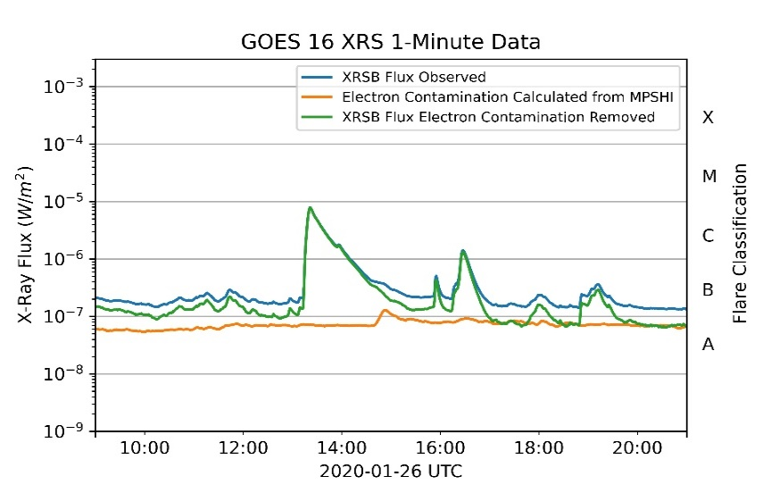
GOES 16-17 XRS Issues
Increased data latency
The high-resolution, 1 second data have latency of more than 30 sec due to data aggregation at the GRB terminal.
Impact: moderate
Electron contamination
The electron contamination is considerable during
periods of high electron flux but only affect lower
XRS flux values.
Impact: minor if corrected.
Proton contamination
The proton contamination is considerable during
periods of high proton flux which are relatively rare.
Impact: minor if corrected
Improved process to monitor and maintain sensor calibration and performance should result in better data quality however, the added complexity…
…has led to delays in getting the proper background levels set and the best electron contamination parameters into operations.
…requires long-term commitment for support throughout the mission.
Excessive time required to prepare the operational data stream.
GOES 16 L2 data was not operational until late 2019
Currently waiting on NWS to implement GOES 17
Electron Correction During Minor Flare
Note that electron contamination only impacts the lowest values

Slide 7
Delays in getting GOES 17 XRS data on line
GOES 17 L2 data were available for review in Late 2019
SWPC performed and completed a full validation of the GOES-17 data in January 2020.
Contracting issues within the NWS Office of Observations, along with extensive delays in the Integrated Dissemination Program (IDP) implementation schedule have delayed the availability of the realtime data stream.
SWPC will not have GOES-17 data operationally available to it until Spring 2021.
SWPC is working with the NWS Office of Observations to get a GOES -17 development data feed.
To support operations during the fall eclipse season
To provide redundancy if there is an outage of GOES-16 data feed and products.

Slide 8
Summary
GOES 16 and 17 XRS data meet the requirements for space weather operations.
GOES 16 XRS is the primary (and only) XRS in operations
GOES 17 XRS data may become available on a development stream before the upcoming eclipse period (early September)
GOES 17 XRS will become operational in the spring of 2021

