Slide 1


Peer Stakeholder-Product Validation Review (PS-PVR) for
GOES-17 EXIS XRS
L1b Provisional Maturity
presented: 24 April 2019
revised: 15 May 2019
Presenter: Janet Machol - NOAA NCEI and U. Colorado CIRES
Contributors:
U. of Colorado LASP: F. Eparvier, D. Woodraska, T. Eden, S. Mueller,
R. Meisner, M. Snow, A. Jones, T. Redick, T. Woods, ....
NCEI/CIRES: S. Codrescu, W. Rowland, M. Tilton, and C. Peck
Other: Rodney Viereck, Matt Garhart, ...

Slide 2
Outline
Quick Summary 4
Instrument and Products Overview 5
Review of Beta Maturity 8
L1b Product Quality 11
GPA Issues 12
Post-launch Product Tests (PLPTs) 13
Instrument Issues 29
Comparison to Performance Baseline 32
Summary of Remaining Issues 40
Provisional Maturity Assessment 44
Path to Full Validation 49
Backup - Details 52

Slide 3
Quick Summary
Initial testing using L0 data has provided most cal values.
GOES-17 behavior is similar to GOES-16.
  No surprises.
  Studies done with L1b, L2, and LASP-L0-processed data.
  Solar activity low since launch.
GPA: many ADRs submitted, many resolved, a few remain.
Instrument: new LUTs, some issues resolved, a few remain.
All PLPT tests:
Provisional Validation Product Maturity Assessment.
ADR = Algorithm Discrepancy Report
LUT = Look Up Table
PASSED
PASSED
Notes:
Define PASS

Slide 4
EXIS

Slide 5
EUV and X-Ray Irradiance Sensors (EXIS)
X-Ray Sensor (XRS)
  Monitor solar flares
    Impacts communications and navigation
    Warning for potential SEP events
Extreme Ultraviolet Sensor (EUVS)
  Measures ultraviolet irradiance which impacts upper atmosphere
Sun Pointing Sensor (SPS)
  Used for alignment (quad diode, 3.5° FOV)
EUVS
XRS
SPS
EXIS was designed, built and tested by the Laboratory for Atmospheric and Space Physics (LASP) at the University of Colorado.
Notes:
mention how long measured

Slide 6
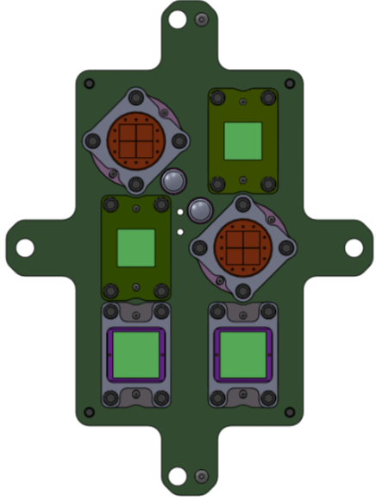
X-Ray Sensor (XRS)
2 soft X-ray wavelength bands
  A is 0.05-0.4 nm
  B is 0.1-0.8 nm; used for flare index
12 diodes total
  Silicon photodiodes with Be filters
  A1, B1 - low solar activity
  A2, B2 - solar max/flare
  2 dark diodes
Main products
  X-ray flux time series
    1 sec and averaged (L2)
  flare event detection (L2)
  flare location on solar disk (L2)
A2:
Solar max
/flare
A1:
Solar min
B1:
Solar min
B2:
Solar max
/flare
Dark
Dark
Notes:
scaled to match previous XRS bandpasses

Slide 7
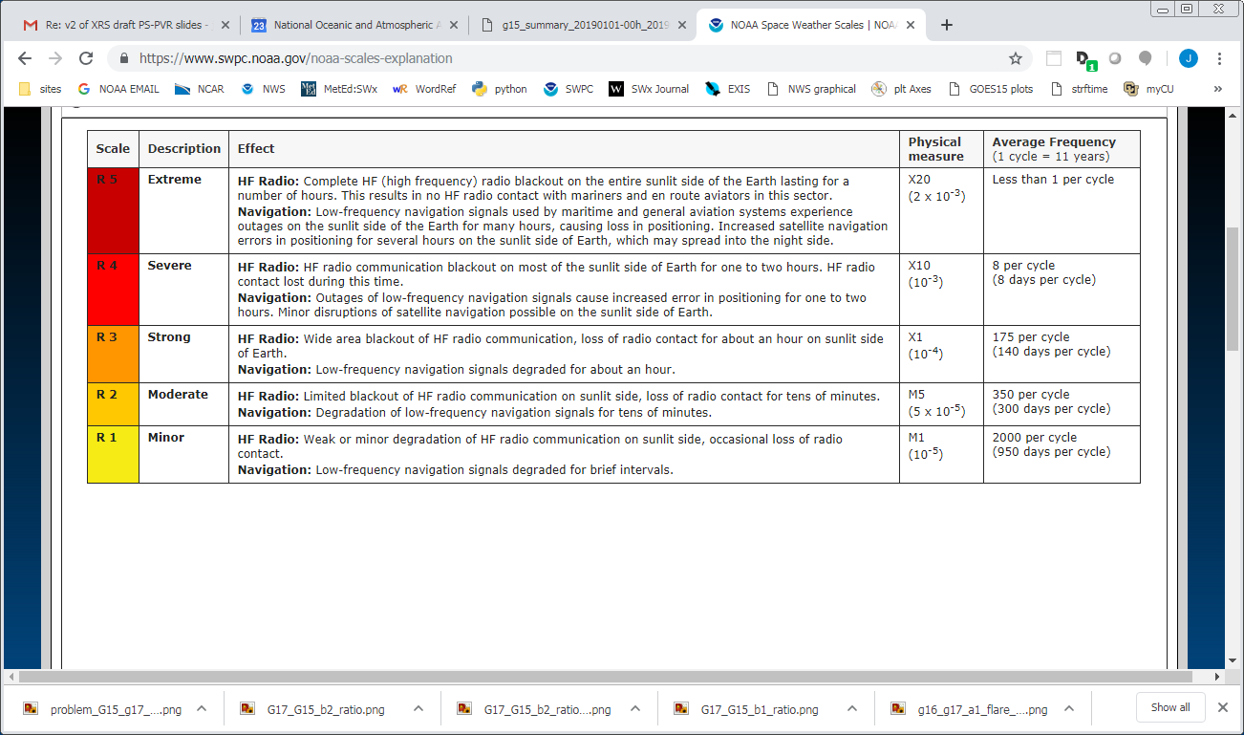
SWPC Radio Blackout Warnings
flare index from 1-minute averaged XRS-B1
Notes:
GOES-17 at/below R1, GOES-16 at R3

Slide 8
Review of Beta Maturity

Slide 9
XRS-related GPA Issues at Beta
12 ADRs to be resolved prior to XRS Provisional Status
ADR | Issue | * | Completed | Delivery date
590 | EXIS roll angle, time variable |  | yes | DO 07.00
228 | Wrong times in file names |  | yes | DO 07.01
267 | identify LUTS |  | yes | DO 07.00
536 | underuse of SPS angles |  | yes | DO 07.01
589 | EXIS Rev G LUTs |  | yes | DO 07.00
176 | XRS time stamps 'center' time |  | yes | DO 07.00
625 | roll angle time variable |  | yes | DO 07.00
397 | percent_uncorrectable_L0_errors < 0 |  | required for XRS full validation (Needs NCEI verification to close.) | DO 06.03
510 | SWx data slowdown (all instruments) |  | required after XRS full validation | DO 07.00/ in work
517 | Small but routine L1b gaps |  | yes | DO 06.03
612 | alg_container to 'not in use' |  | required for XRS full validation | DO 08.01
670 | XRS lunar transit flag not set |  | yes | MM 08.00
* Impact on Provisional status:
Minor Impact
Moderate Impact
Major Impact

Slide 10
Instrument Issues at Beta
to be resolved prior to Provisional Status
Title | Description | Status | Mitigation
Dark value for XRS-B1 | Quarterly offpoint measurements have not provided a dark value for B1 due to electron contamination. | CLOSED | Continue to use the pre-flight value. Continue to examine quarterly offpoints. New: Monitor low X-ray fluxes relative to electron contamination. (See Slide 29)
Spikes in data | Spikes in count data, likely due to particles. More frequent on some detectors than others. | CLOSED | Resolved for XRS with a L2 median filter algorithm. (Described in FM1 PS-PVR)
Electron contamination | At low X-Ray flux levels and high electron fluxes, the XRS A1 and B1 fluxes are artificially high due to electrons. | CLOSED | Correction algorithm implemented in L2 processing. (See Slide 30.)
Changes for future PLTs | A list of requested changes for PLTs for GOES-S and beyond has been created by LASP. | CLOSED | "Lessons Learned and Improvements" presented to MOST. Requests were implemented by Flight.

Slide 11
L1b Product quality assessment

Slide 12
GPA Issues for Provisional Validation
No current issues impacting Provisional Validation.
~38 XRS-related ADRs have been closed since 2016.

Slide 13
Post-Launch Product Tests
Test ID | Test Title | Operator | Status | Criteria
08 | XRS B1-B2 Crossover Threshold | LASP/NCEI | Pass | [1]
09 | XRS A1-A2 Crossover Threshold | LASP | Pass | [1]
10 | XRS Ratio – Threshold Assessment | LASP | Pass | [1]
11 | NOAA XRS Scaling Factors | LASP | Pass | [1]
12 | XRS L1b Uncertainties | LASP | Pass | [1]
13 | XRS Flare Location Comparison (L1b) | NCEI | Pass | [2]
14 | XRS/EUVS/Mg II Inter-Satellite Comparisons (L1b) | LASP/NCEI | Pass | [3]
Provisional Success Criteria:
[1] XRS L1b product data are available and analysis is complete.
[2] Solar flare responses are observed in all 4 elements of the quad-diodes.
[3] There is no pass/fail on the result itself of this cross-comparison.
Data analysis with L1b, L2, and locally processed L0 data.
Test plans and procedures are described in Appendix A.2 in the EXIS Readiness, Implementation, and Management Plan (RIMP v1.1; 416-R-RIMP-0316)

Slide 14
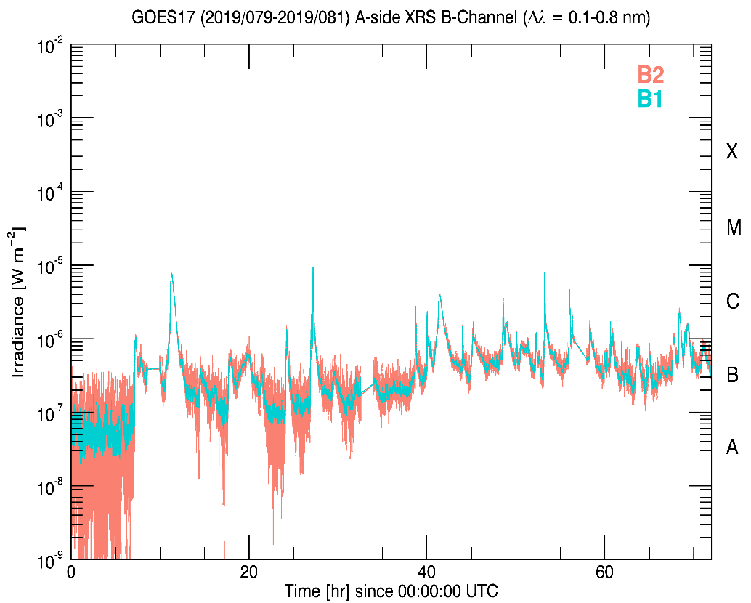
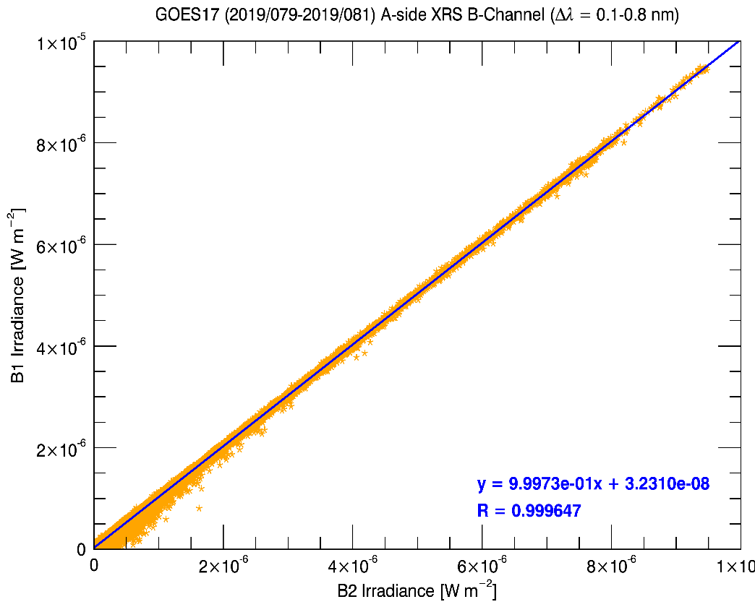
#8: XRS B1-B2 Crossover Threshold (1/3)
Choose flux level for primary channel to switch from B1 to B2.
GOES-16, 17 pre-flight: 10⁻⁶ W/m² (C1 class)
Provisional: 10⁻⁴ W/m² (X1 class)
B2 responsivity adjusted by 5% so that B1 and B2 fluxes match.
B1 saturates at 9x10⁻⁴ W m⁻²
fit >3x10⁻⁶ W m⁻²
crossover threshold = 10⁻⁴ W m⁻²
Notes:
B1 is considered truth because B2 is not centered properly at SURF.
B2 = 0.9475x B1 + 3e-8 before adjustment. Decreased the responsivity to make match.

Slide 15
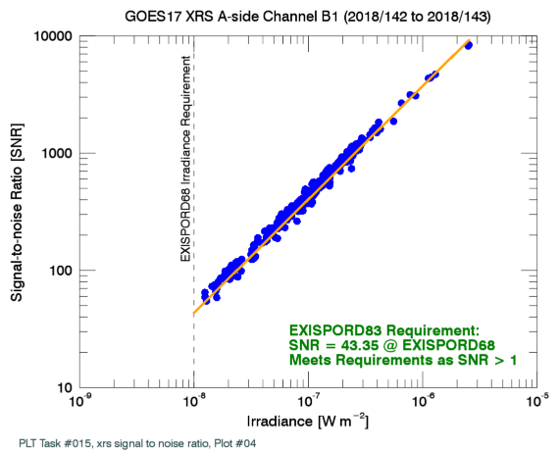
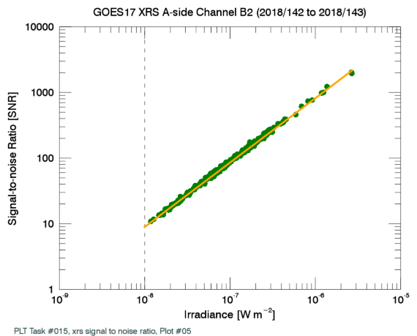
#8: XRS B1-B2 Crossover Threshold (2/3)
Signal-to-noise ratio is >>1 for chosen crossover threshold
10⁻⁴ W/m² crossover threshold
10⁻⁴ W/m² crossover threshold
Notes:
thrash!
Same considerations for channel A except saturation

Slide 16
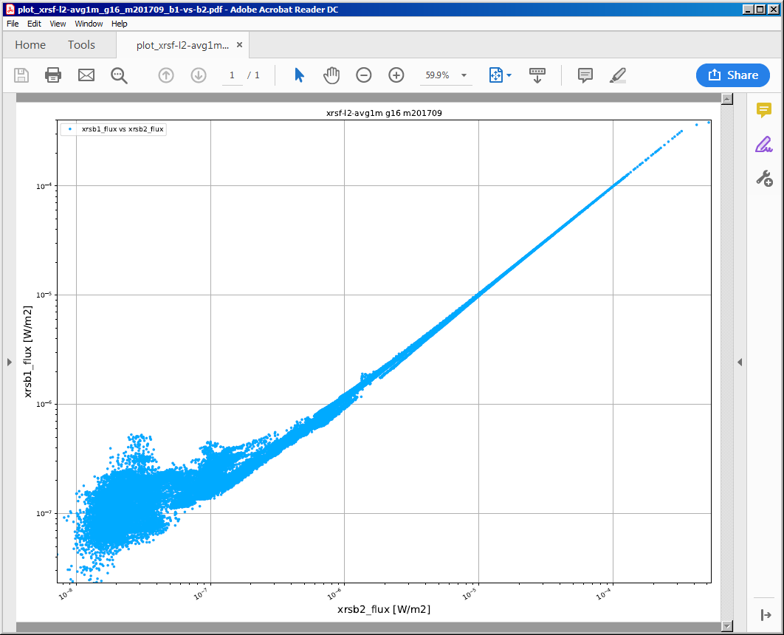
#8: XRS B1-B2 Crossover Threshold (3/3)
Analysis of event detection algorithm was done to clarify transition impacts.
During event if B1 < B2
  rise, fall: no issue
During event if B1 > B2
  rise: false peak if difference
  is large (recovery >4 mins)
  fall: no issue
Risks: calibration errors, SEP event
transition threshold = 10⁻⁴ W/m²
10⁻⁴
B2
10⁻⁴ W m⁻²
flare threshold = 5x10⁻⁵ W/m²
irradiance
B1
10⁻⁵
time
XRS-B1 flux [W m⁻²]
10⁻⁶
10⁻⁷
GOES-16 September 2017
1-minute averaged fluxes
10⁻⁷
10⁻⁶
10⁻⁵
10⁻⁴
XRS-B2 flux [W m⁻²]
Notes:
good agreement above 5 e -5
Same considerations for channel A except saturation

Slide 17
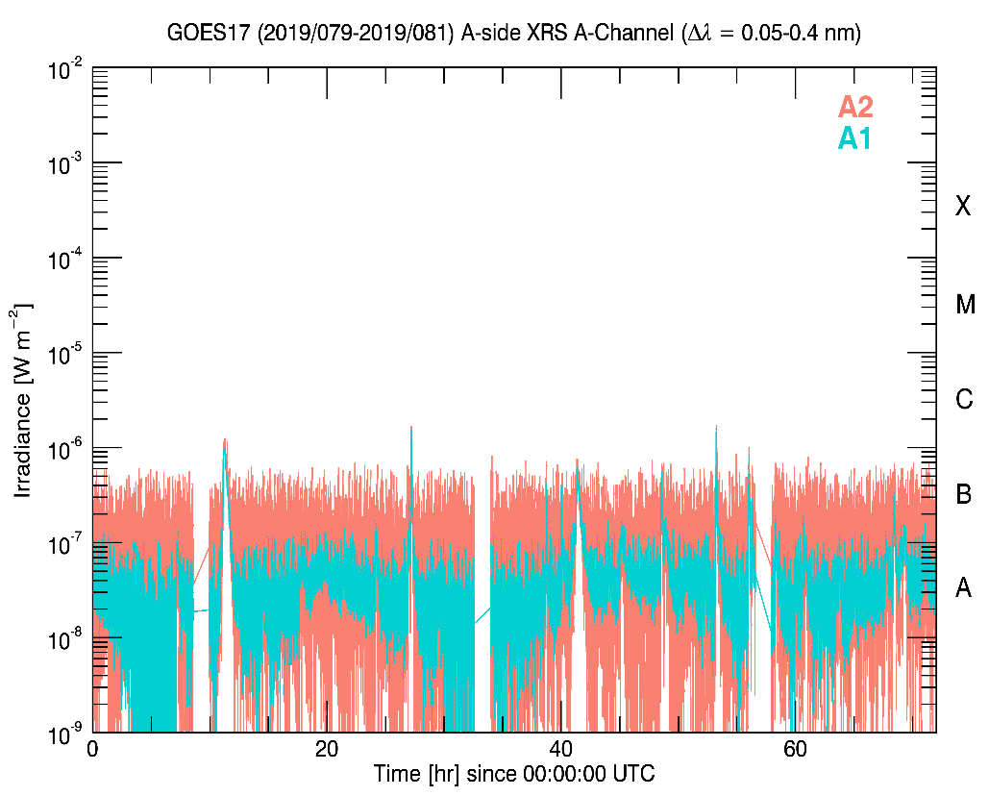
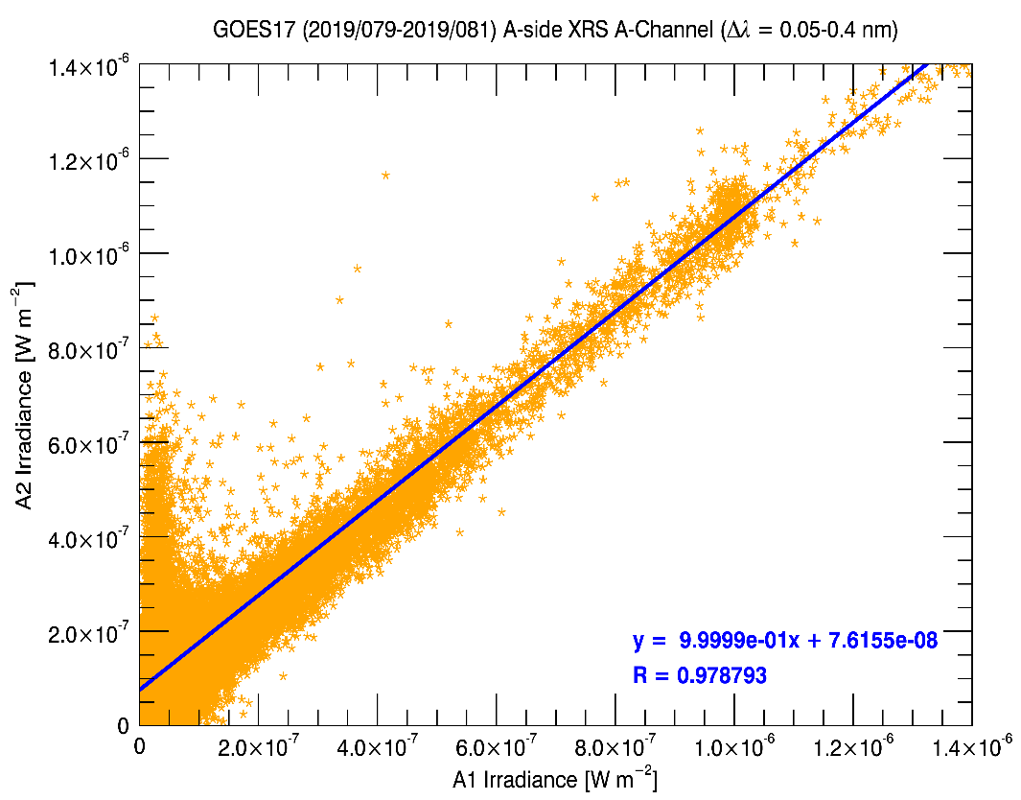
#9: XRS A1-A2 Crossover Threshold (1/2)
Choose flux level for primary channel to switch from A1 to A2.
GOES-16, 17 pre-flight: 10⁻⁶ W/m² (C1 class)
Provisional: 10⁻⁵ W/m² (M1 class)
A2 responsivity adjusted by 2% so A1 and A2 fluxes match.
A1 saturates at 7x10⁻⁴
crossover threshold = 10⁻⁵
fit >6x10⁻⁷ Wm⁻²
Notes:
A1 is considered truth because A2 is not centered properly at SURF.
A2 = 1.0209x A1 + 8e-8 before adjustment. So adjustment was a 2% increase in responsivity.

Slide 18
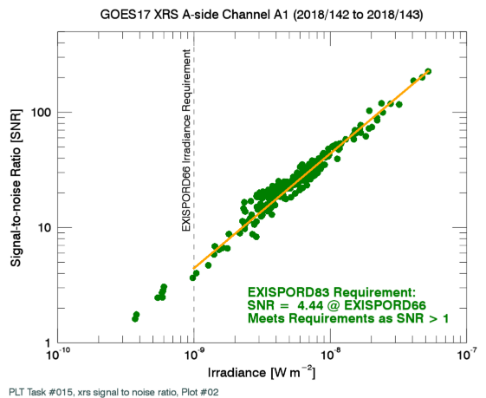
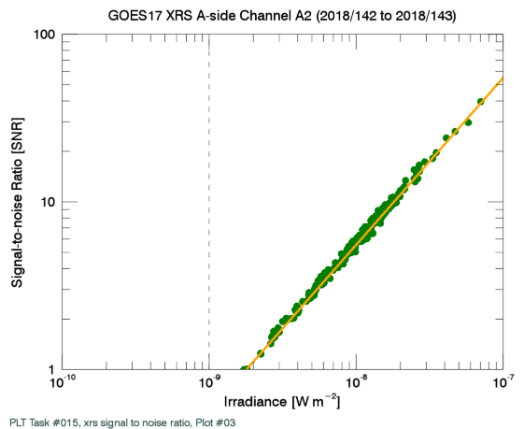
#9: XRS A1-A2 Crossover Threshold (1/2)
Signal-to-noise ratio is >1 for chosen crossover threshold
10⁻⁵ W/m² crossover threshold
10⁻⁵ W/m² crossover threshold
Notes:
For G17 saturation of XRS-A is around 9.2e-4 W/m^2. That’s probably close to the same number for all FMs.

Slide 19
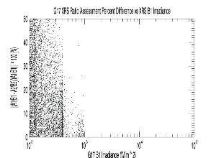
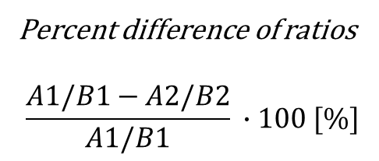
#10: XRS Ratio – Threshold Assessment
SWPC operations uses 1 minute X-ray fluxes for flares, especially M+ class.
  During a flare, 1-s ratio is used to monitor flare increases. (L2)
Objective: Find sensitivity of the XRS ratio to the XRS crossover thresholds.
Results: same as for GOES-16, but no big flares to look at yet.
  Fluxes remained lower than crossover thresholds of 10⁻⁵ for A and 10⁻⁴ for B
  <10% above M
50
40
30
20
10
0
Percent difference of ratios
$$\frac{A1/B1−A2/B2}{A1/B1} ∙100 [\%]$$
10⁻⁶ 10⁻⁵ (M class) 10⁻⁴ (X class) 10⁻³
GOES-17 B1 irradiance [W/m²]
Note: Backup slide #56 shows fluxes on this day.

Slide 20
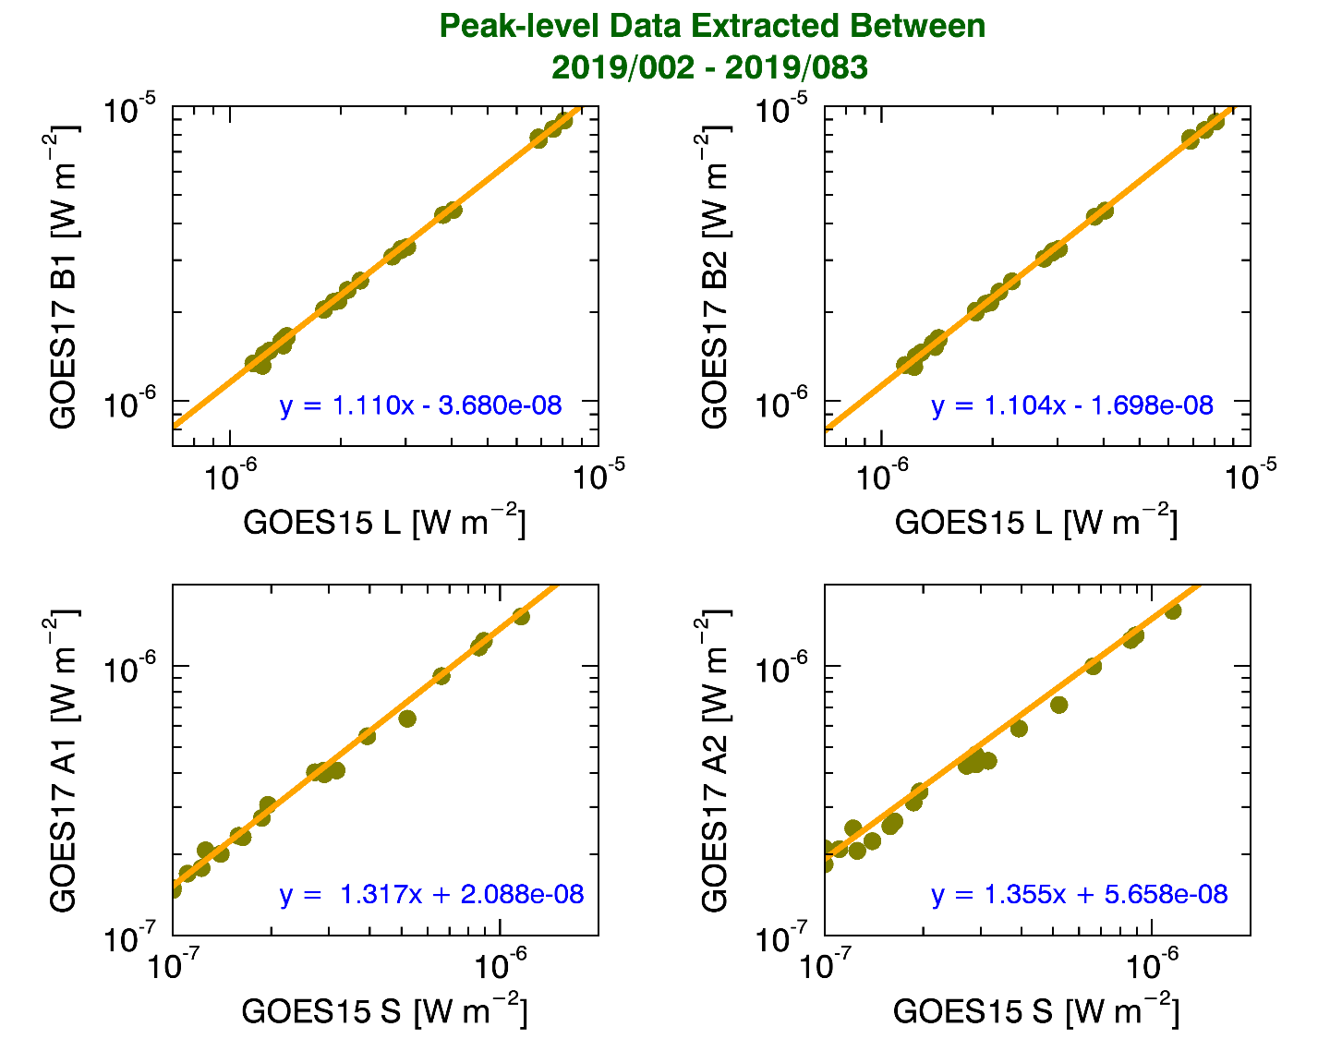
#11: NOAA XRS Scaling Factors
Objective: Determine the scaling needed to adjust EXIS XRS irradiances to the NOAA historical X-ray record.
Fit peaks
  use B1 > 10⁻⁶ W/ m².
  There has been little solar activity.
  GOES 15 corrected for scaling factor.
G17 to G15 factors
  B1: G17 / G15 = 1.110 (G16 / G15 = 1.07)
  A1: G17 / G15 = 1.317 (G16 / G15 = 1.37)
  Similar for B2 and A2 and for G16.
Notes:
There has not been much solar activity since GOES-17 launch.

Slide 21
#12: XRS L1b Uncertainties (1/3)
Objective: Determine the uncertainty in the XRS L1b fluxes.
Irradiances examined on 24 March 2019.
Results (σ_{E} /E @ flare-class threshold levels)
  There were no M or X class flares.
  A1: B 6.6%; C 2.5%
  B1: B 6.6%; C 2.6%; M (extrapolated): 2.5%

Slide 22








#12: XRS L1b Uncertainties (2/3)
$$g=$$
Diode gain (fC/DN)
Diode Current:
$$C= \frac{g\left(S−S_{0}\right)}{∆t}$$
$$S,S_{0}=$$
Diode, dark signal (DN)
$$∆t=$$
Integration time (sec)
$$σ_{C}=C{\left[{\left(\frac{σ_{g}}{g}\right)}^{2}+{\left(\frac{σ_{S}}{S−S_{0}}\right)}^{2}+{\left(\frac{σ_{S_{0}}}{S−S_{0}}\right)}^{2}+{\left(\frac{σ_{∆t}}{∆t}\right)}^{2}\right]}^{1/2}$$
Relative Uncertainty:
Flux:
$$F= \frac{C}{R}$$
Diode Responsivity (Amps m² W⁻¹)
$$R=$$
$$σ_{F}=F{\left[{\left(\frac{σ_{C}}{R}\right)}^{2}+{\left(\frac{{Cσ}_{R}}{R^{2}}\right)}^{2}\right]}^{1/2}$$
Relative Uncertainty:
Not included: SURF systematic issues, FOV, degradation, ...

Slide 23
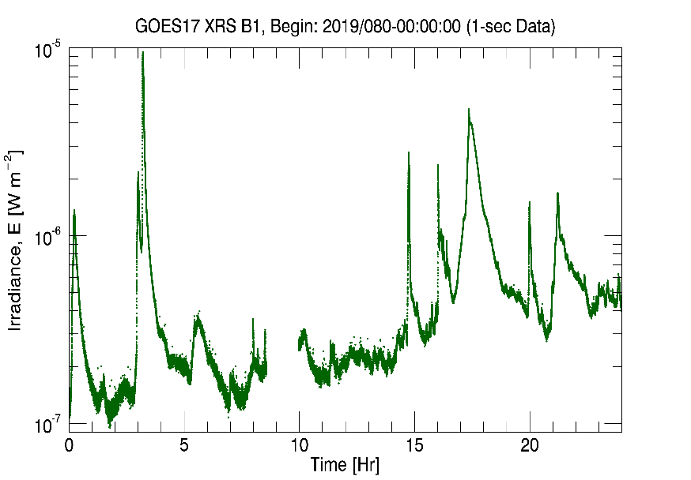
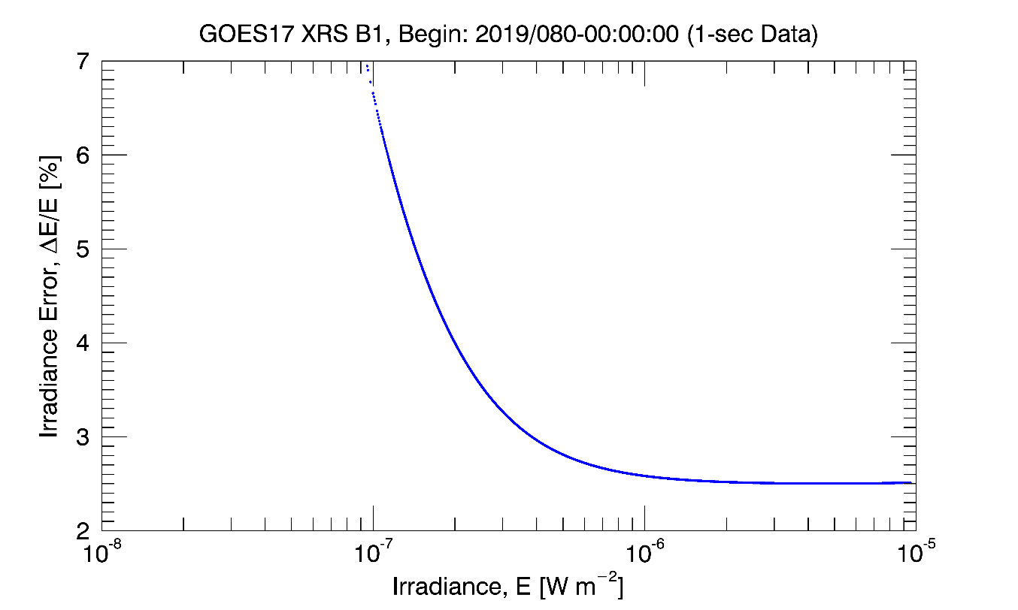
#12: XRS L1b Uncertainties (3/3)
Flux [W/m²]
Flux uncertainty as a function of flux.
time [hr]
M class
C class

Slide 24
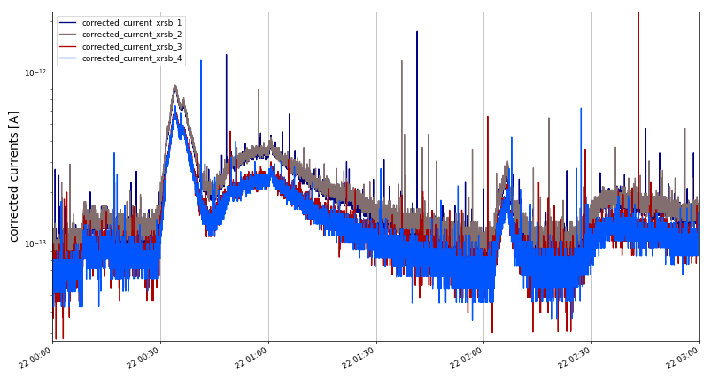
#13: XRS Flare Location Comparison
Objective: Solar flare responses are observed in all 4 elements of the quad-diodes.
GOES-17 quad diode currents on a 1-sec cadence for 22 March 2019 shows that each diode observes the flare.
Notes:
RHESSI: LEO, launched in 2002; X-ray imager;

Slide 25
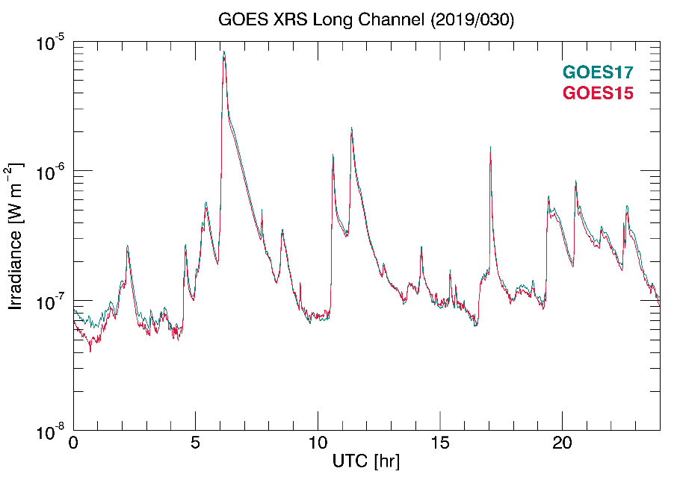
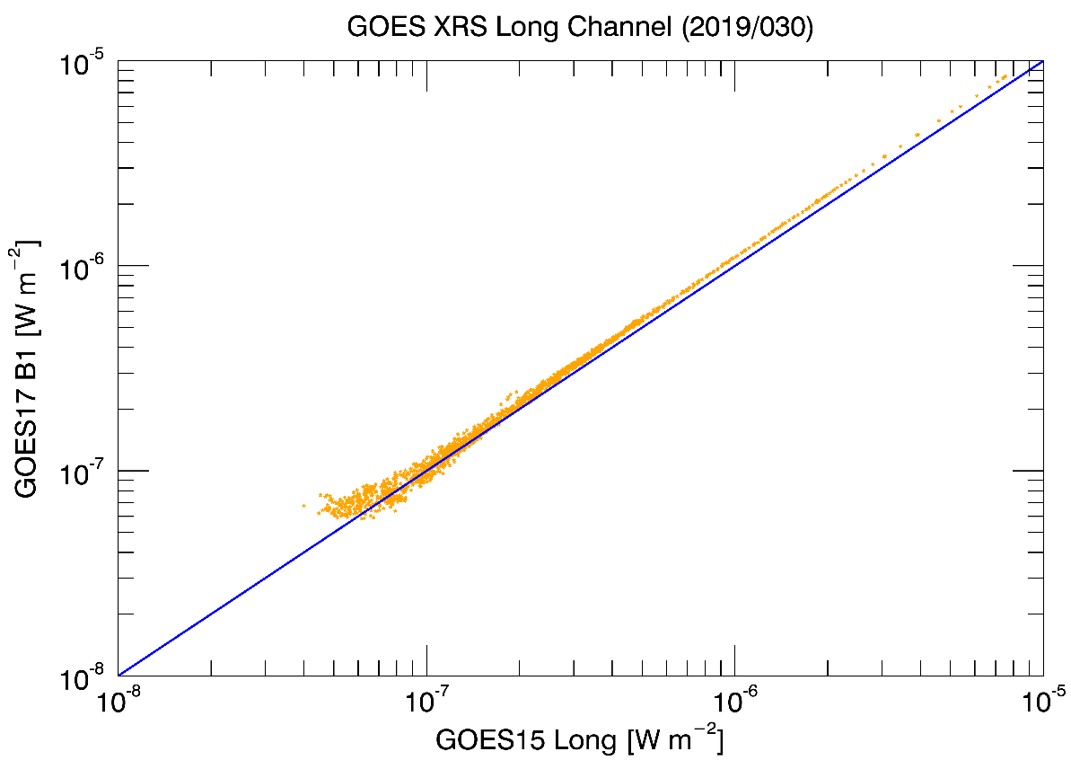
#14: Inter-Satellite Comparisons (1/4)
GOES-17 and GOES-15 XRS-B compared (30 January 2019).
  GOES-15 corrected for fudge factor.
Linear behavior at higher fluxes as expected.

Slide 26
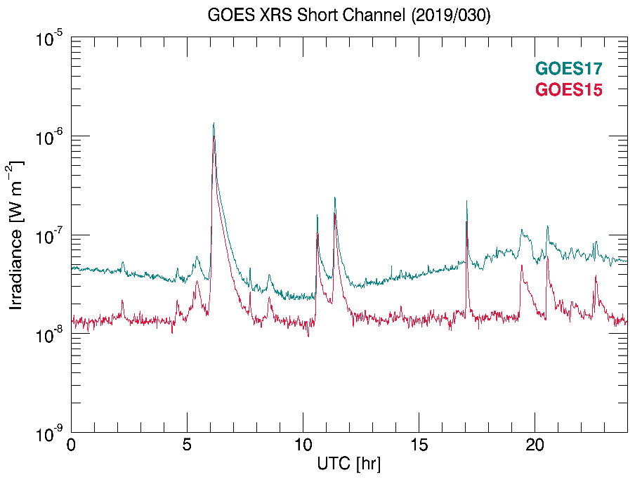
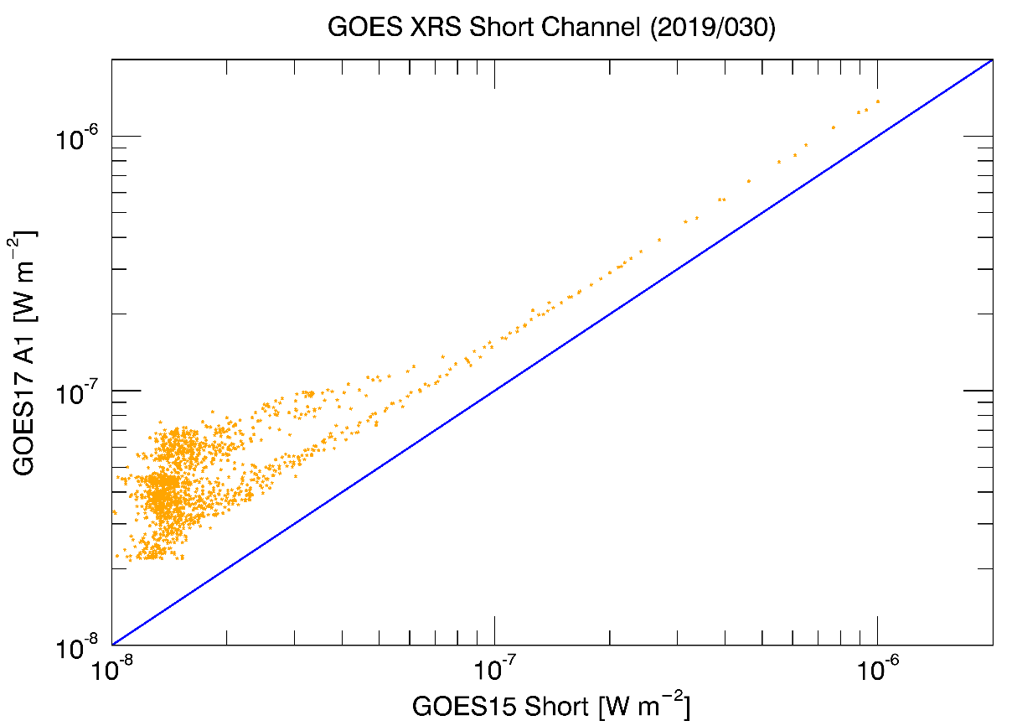
#14: Inter-Satellite Comparisons (2/4)
GOES-17 vs GOES-15 XRS-A
Shape difference is elevated electrons impacting GOES-17.
Notes:
doy 83 = March 24

Slide 27
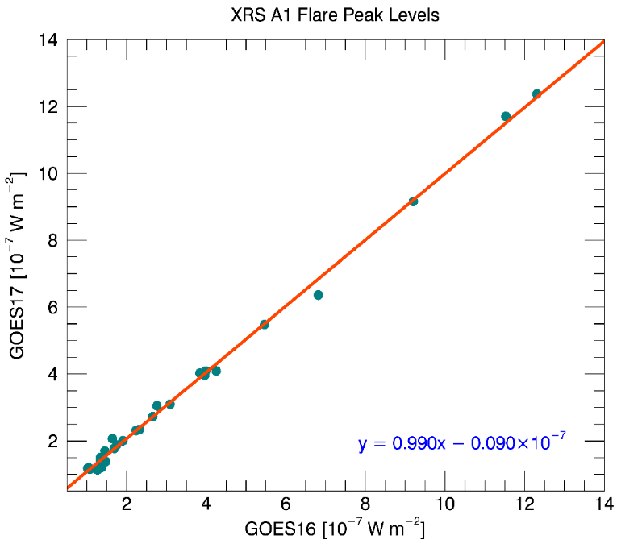
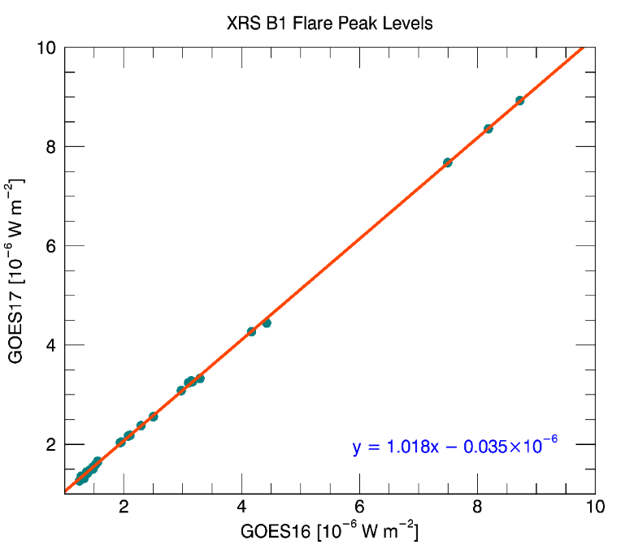
#14: Inter-Satellite Comparisons (3/4)
GOES 17 vs GOES 16 Peaks
  Slopes of ~1 demonstrate that XRS sensors respond similarly to these flares.
Approximate channel ratios
channel B G16/G15 =1.07
G17/G15 = 1.10
G17/G16 = 1.02
channel A G16/G15 = 1.37
G17/G15 = 1.32
G17/G16 = 0.99

Slide 28
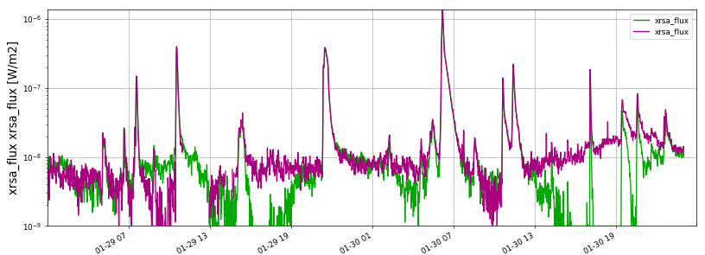
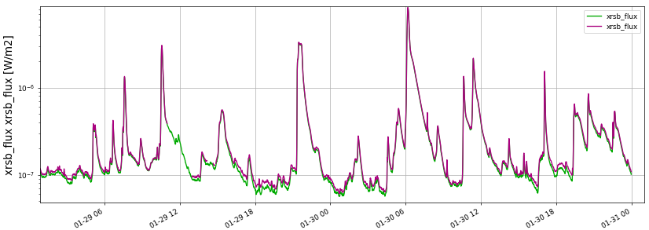
#14: Inter-Satellite Comparisons (4/4)
GOES 16 vs GOES 17 from 29-30 January 2019
  Plots: L2 1-min averages derived from L1b
10⁻⁶
GOES-16
GOES-17
10⁻⁷
XRS-A
10⁻⁸
Very low signals.
Backgrounds
still need
some adjustment.
10⁻⁹
GOES-16
GOES-17
XRS-B
10⁻⁶
10⁻⁷

Slide 29
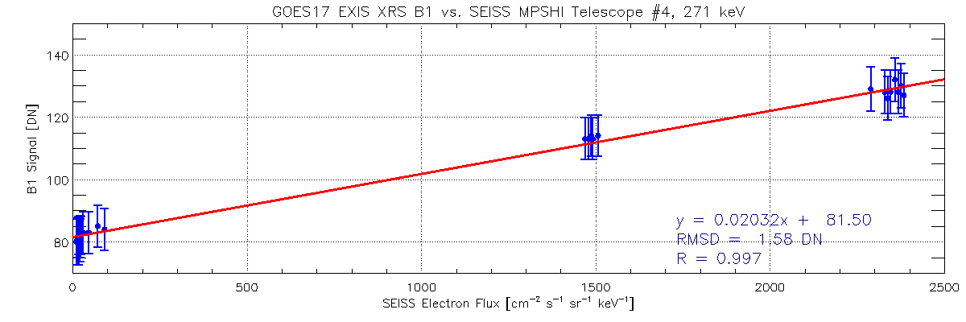
Instrument Issue: B1 Dark Counts
Objective: obtain B1 dark signal
B1 signal during offpoints as a function of SEISS electron flux.
Result is dark count value of 81.5 DN
  Statistically comparable to pre-launch value.

Slide 30
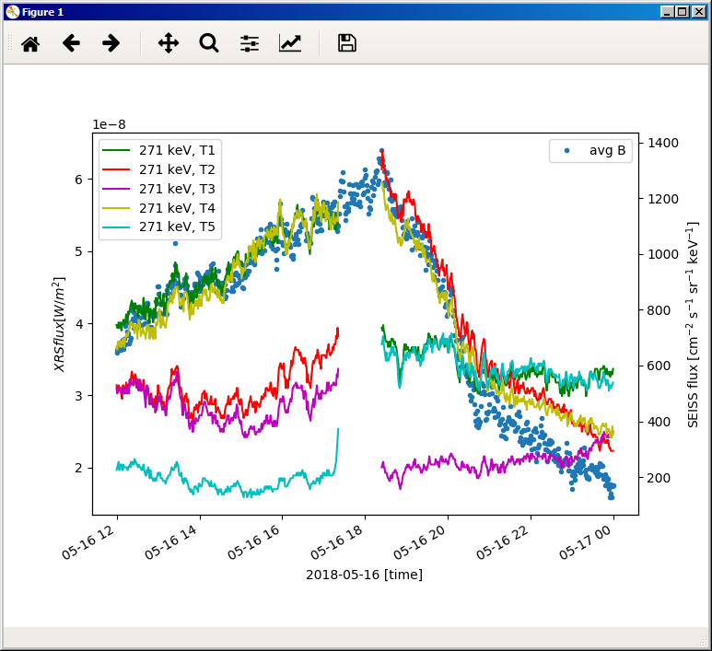
Instrument Issue: Electron Contamination (1/2)
Objective: Remove electron contamination from fluxes
  Impacts when X-ray fluxes are low, electron fluxes are high
XRS-B
After yaw flip:
T2, T4 primary
Before yaw flip:
T1, T4 primary
yaw flip

Slide 31
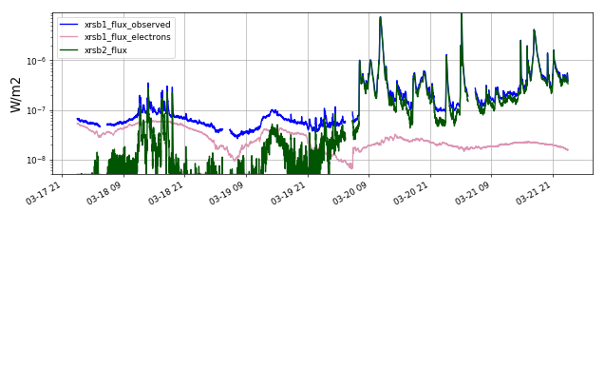
Instrument Issue: Electron Contamination (2/2)
Correction is in L2.
Based on fit to SEISS MPSHI telescopes and energy bands.
Fit parameters still under investigation.

Slide 32
Comparison to Performance BaseLINE

Slide 33
Performance Baseline
MRD ID | Quantity | MRD Requirement | MIT/LL Predicted Performance | NCEI Value at Provisional* | Related PLPTs | Status
2037 | Measurement Range XRS A | 5x10⁻⁹ to 5x10⁻⁴ W/m² | 5x10⁻¹⁰ to 5x10⁻² W/m² | 4.62x10⁻⁹ to 7.30x10⁻² W/m² | None | PASS
 | Measurement Range XRS B | 2x10⁻⁸ to 2x10⁻³ W/m² | 2x10⁻¹⁰ to 1x10⁻² W/m² | 6.13x10⁻⁹ to 4.40x10⁻² W/m²
2038 | Measurement Accuracy XRS A | < 20% at 20X min flux | A1: < 2.5% (BOL) A2: < 2.2% (BOL) | Not measured on orbit. | None | PASS
 | Measurement Accuracy XRS B | < 20% at 20X min flux | B1: < 2.4% (BOL) B2: < 2.3% (BOL) | Not measured on orbit.
2041 | Measurement Precision XRS A | 2% | 1.5% | 0.69% | None | PASS
 | Measurement Precision XRS B | 2% |  | 0.23%
2042 | Long-term Stability (over mission) | < ±5% or ability to track | Track changes. Estimated response change is <3% over life of mission | Current trend is flat. Ability to track. | -14** | PASS
* Calculations on next slides
** PLT-14 XRS/EUVS/Mg II Inter-Satellite Comparisons (L1b)

Slide 34
Performance Baseline
MRD ID | Description | Source of Values in Validation Table
2037 | XRS Product Measurement Range | Essentially no new values measured on orbit. Range minima are uncertainties due to noise for A1 and B1 (Slide 36) Range maxima are: flux equivalent of 989,000 DN (ASIC counter saturation) for A2 and B2 (See Slide 35)
2038 | XRS Product Measurement Accuracy | Not measured on orbit. Validated pre-launch.
2041 | XRS Product Measurement Precision | Essentially no new values measured on orbit. Percent precision = P/(20 x M)*100 (See Slides 35 and 36) P = Precision, M = MRD minimum measurable flux
2042 | XRS Long-term Stability | Relative to GOES-15, XRS is currently stable. (See Slide 37) Future monitoring: (1) GOES-16 vs. other GOES satellites, (2) ASIC gain calibrations, (3) FOV mappings, and (4) cruciform scans.

Slide 35
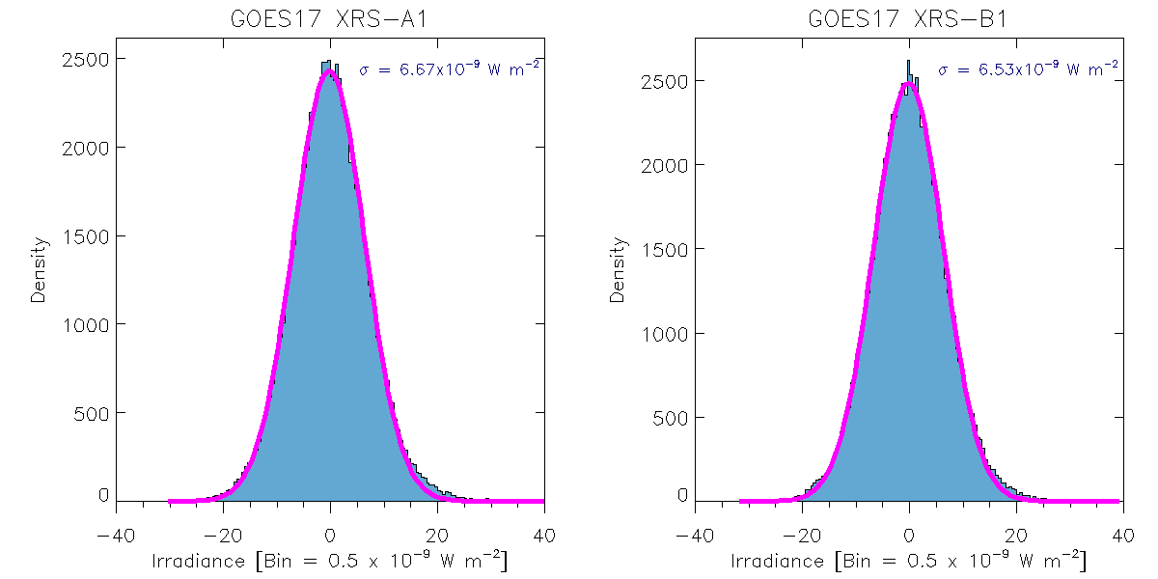
Uncertainty for XRS-A1 and -B1 (for MRD 2037, 2041)
Plots show noise distributions (with 1σ standard deviations) obtained by using high pass filter on measurements.
Equivalent irradiances for 1 DN (defines precision) at a typical temperature (13.95° C).
A1: 1 DN = 6.93e-10 W/m² B1: 1 DN = 9.39e-10 W/m²
A2: 1 DN = 7.378e-8 W/m² B2: 1 DN = 4.446e-8 W/m²
Convert σ[DN] to σ[W/m²] to get σ_{A1} and σ_{B1} (defines uncertainty)
A1: 1 DN = 6.93e-10 W/m² B1: 1 DN = 9.39e-10 W/m²
σ_{A1} at 1 DN = 6.67e-9 W/m² σ_{B1} at 1 DN = 6.53e-9 W/m²
Minimum ranges are the larger of the 1-DN equivalent irradiances and uncertainties (σ_{A1} or σ_{B1}) for A1 and B1.
A1 min: 6.67e-9 W/m² B1 min: 6.53e-9 W/m²
Maximum ranges are flux equivalent of 989,000 DN (ASIC counter saturation) for A2 and B2.
A1 max: 9.89e5 x 6.93e-10 W/m² = 6.85e-4 W/m² B1 max: 9.89e5 x 9.39e-10 W/m² = 9.29e-4 W/m²
A2 max: 9.89e5 x 7.378e-8 W/m² = 0.0730 W/m² B2 max: 9.89e5 x 4.446e-8 W/m² = 0.0440 W/m²
Notes:
Cut offs in points are: A1=2000, A2=1500, B1=2000, B2 =1000 with a Butterworth filter.
Simplistic math:
I think that answers by question -- the filter edge is at about 4000, 4500 or 5000 out of 86400,.
Considering a 2000 pt filters...
2000/86400 pts/day * 24 h/day * 60 mins/day = 33 mins
If max frequencies are twice this, then variability on a time scale of slower than 15 minutes is filtered out.

Slide 36
Percent precision for XRS-A1 and -B1
(for MRD 2041)
Percent precision = P/(20 x M)*100 (Factor of 20 from MRD 2038).
P = Precision = 1 DN equivalent irradiances
A: 6.93 x 10⁻¹⁰ W/m², B: 9.39 x 10⁻¹⁰ W/m² (from Slide 36)
M = MRD minimum measurable flux (from MRD2037)
A: 5.0 x 10⁻⁹ W/m², B: 2 x 10⁻⁸ W/m²
Percent precision = P/(20 x M)*100 (Factor of 20 from MRD 2038).
A: 6.93 x 10⁻¹⁰ W/m² / (20 x 5 x 10⁻⁹ W/m²) x 100 = 0.69%
B: 9.39 x 10⁻¹⁰ W/m² / (20 x 2 x 10⁻⁸ W/m²) x 100 = 0.23%

Slide 37
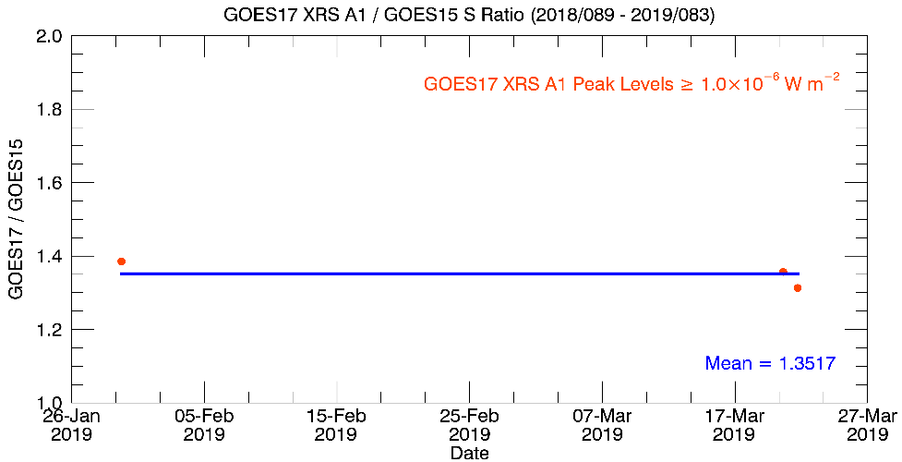
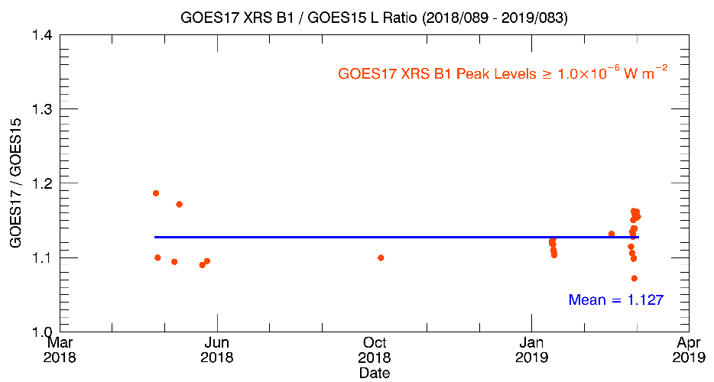
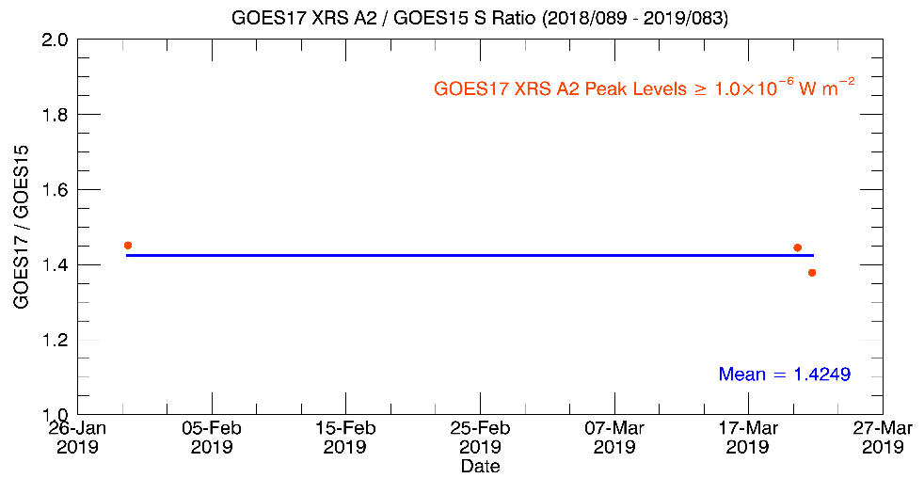
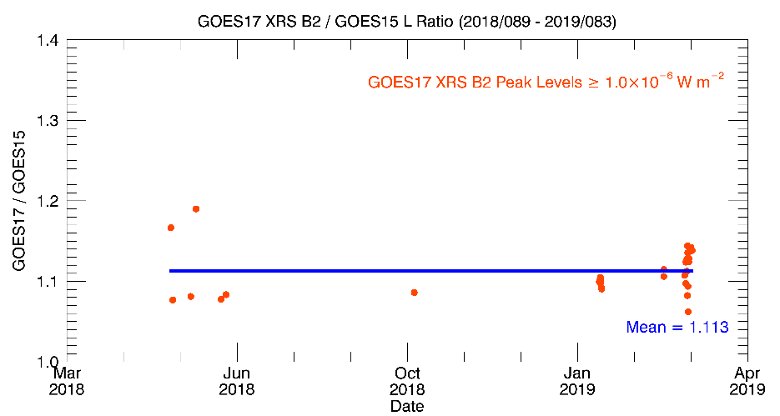
Stability of GOES-16 relative to GOES-15 (for MRD 2042)
GOES-17 is currently stable: ratios of XRS channels for GOES-17 / GOES-15 are flat.
There has been very little solar activity. Results are comparable to GOES-16.
Cause of noise is uncertain (GOES-15 data has 2 significant figures -> 5% noise).
A1
B1
A2
B2
Notes:
flares of 2018/148 seem to have a time shift between GOES-17 and GOES-15 and so were removed.

Slide 38
GOES-17 Waiver
XRS irradiances with e- contamination do not meet EXISPORD81 requirements*.
Change has been submitted for FM1 and FM2**. No CCR number yet.
Levels where XRS meets min performance w/o correction algorithm
Original for XRS-A & -B for GOES-16 Levels
 | E (MeV) | 0.3 | 0.45 | 1.05 | 1.9
 | J(>E) (p/cm2/sec) | 2.00E+07 | 7.00E+06 | 7.00E+05 | 1.50E+05
Levels XRS meets min performance w/o correction algorithm
XRS-A
G16 A→ | G16 A Scale Factor | 0.07 | 0.088 | 1 | 1
 | J(>E) (p/cm2/sec) | 1.4E+06 | 6.2E+5 | 7.00E+05 | 1.50E+05
G17 A→ | G17 A Scale Factor | 0.082 | 0.122 | 1 | 1
 | J(>E) (p/cm2/sec) | 1.6E+06 | 8.5E+5 | 7.00E+05 | 1.50E+05
XRS-B
G16 B→ | G16 Scale Factor | 0.17 | 0.19 | 1 | 1
 | J(>E) (p/cm2/sec) | 3.4E+06 | 1.3E+06 | 7.00E+05 | 1.50E+05
G17 B→ | G17 Scale Factor | 0.249 | 0.372 | 1 | 1
 | J(>E) (p/cm2/sec) | 5.0E+06 | 2.6E+06 | 7.00E+05 | 1.50E+05
* EXISPORD81 requirements are 20% accuracy for signal levels $≥$2.0 x 10⁻⁸ W m⁻² for A1 and $≥$2.0 x 10⁻⁷ W m⁻² for B1
**F. Eparvier, T. Eden, and T. Woods, EXIS_XRS_Waiver_13_Nov_2018.pptx
Notes:
RHESSI: LEO, launched in 2002; X-ray imager;

Slide 39
Roll Angle Error (Needed for L2 flare location)
σ_{roll_angle_SUVI} is the upper bound on the SUVI roll angle uncertainty. It is the upper the bound is the roll angle offset that gives the minimal measurable SUVI offset from AIA (0.15 pixel) at the limb. (Dan Seaton)
σ_{roll_angle_SUVI} = 0.02° (0.02° = 72 arcsecs)
σ_{roll_angle} is the EXIS mapping/pointing
uncertainty due to the roll angle. It has an upper
bound based on the impact at the limb.
σ_{roll_angle} = R_{Sun} x tan(0.01°)
= 0.0026 arcmin
= 0.16 arcsec
σ_{SPS} = SPS pointing uncertainty = 43 arcsecs
from SPS Performance and Characterization SN01 (LASP doc 133198), EXIS782
→ Upper bound on roll angle uncertainty is: sqrt(σ_{SPS}² + σ_{roll_angle}²) = 43 arcsecs
2σ_{roll_angle}
R_{Sun} = 15 arcmin
= 0.25°
σ_{roll_angle_SUVI} = 0.02°
limb of Sun

Slide 40
Summary of Remaining issues

Slide 41
Remaining XRS GPA Issues
7 ADRs for Full Validation
ADR | Issue | * | Description / Impacts | Delivery date
397 | percent_uncorrectable_L0_errors < 0 |  | awaiting NCEI verification that issue is completed | 06.03
523 | Eliminate SpWx L1b dependency on APID 384 |  |  | 08.00
612 | Set attribute for alg_container to 'not in use' |  |  | 09.00
795 | XRS packet_count - max range, long name |  |  | 08.01
872 | G17 solar array currents wrong |  |  | 09.00
892 | GOES-17 XRS Irregular File Start, End Times |  |  | ?
894 | Lunar transit flag not set properly |  |  | ?
445 | XRS and EUVS L1b outages during flares |  | Validate with X-class flare | closed in PR 06.07
* Impact on status:
Minor Impact
Moderate Impact
Major Impact

Slide 42
Remaining Instrument XRS Issues
# | Issue | Description | Comments to Users
1 | XRS-A is larger by 32% on GOES-17 than on GOES-15. | XRS-A: GOES-17/GOES-15 = 1.32 | The source of this discrepancy is unknown and is under investigation. The fluxes from GOES-8 through GOES-15 have all agreed. GOES-16 and -17 agree with each other.
2 | Dark radiation coefficients are set to 0 | The dark radiation coefficient is used to correct the signal for proton contamination during SEP events. It is currently not being applied. | Analysis to determine this term is in progress. Signals will be artificially high during SEP events, especially in the A2 and B2 channels.
3 | Dark counts | Improve dark counts with values from periods of lowest electron fluxes. Applies to all channels except B1. | Impact will be to slightly increase fluxes, but this will only be noticeable for the lowest XRS-A fluxes. (More of an issue for GOES-16).
4 | Electron contamination fit coefficients. | L2 electron contamination correction requires coefficients for SEISS MPSHI telescopes and energy bands. | The final coefficients are still being determined.

Slide 43
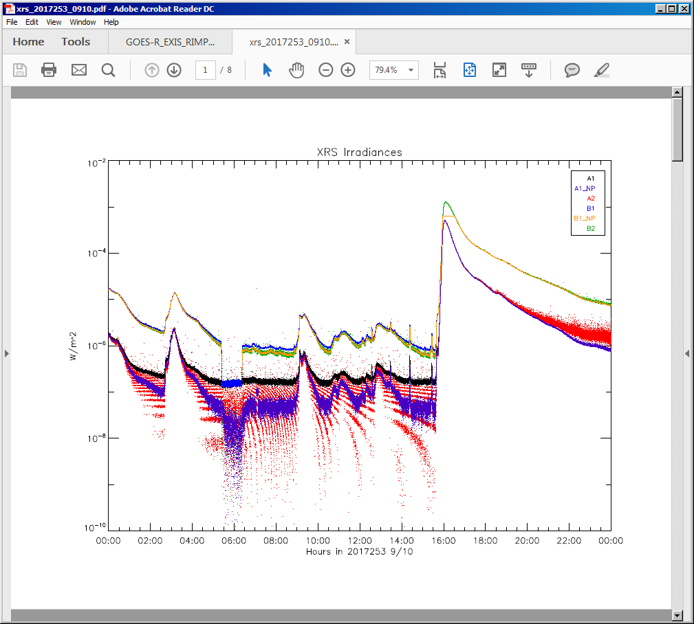
Instrument Issue: Dark Radiation Coefficients
Signal is higher in A2 than A1 in SEP event.
X
M
C
B
B2
B1
A2
Flux [W/m²] -- log scale
A1
CDRL 80 flux equation has a correction terms to account for SEPs; e.g.:
C_{rad, A1} = k_{A1} <C_{Dark, rad}>
Need to determine k_{i}
Time

Slide 44
Provisional maturity Assessment

Slide 45
Provisional Maturity Definition
Validation activities are ongoing and the general research community is now encouraged to participate.
Severe algorithm anomalies are identified and under analysis. Solutions to anomalies are in development and testing.
Incremental product improvements may still be occurring.
Product performance has been demonstrated through analysis of a small number of independent measurements obtained from GOES-15.
Product analysis is sufficient to establish product performance relative to expectations (Performance Baseline).
Documentation of product performance exists that includes recommended remediation strategies for all anomalies and weaknesses. Any algorithm changes associated with severe anomalies have been documented, implemented, and tested.
Testing has been fully documented.
Product is ready for operational use and for use in comprehensive cal/val activities and product optimization.

Slide 46
Provisional Validation (1/2)
Preparation Activities | Assessment
Validation activities are ongoing and the general research community is now encouraged to participate. | Validation activities are ongoing. Results have been discussed with SWPC. Release of data by NCEI will enable research community participation.
Severe algorithm anomalies are identified and under analysis. Solutions to anomalies are in development and testing. | There are no severe algorithm anomalies.
Incremental product improvements may still be occurring. | Product improvements will result from the resolution to issues given on the slides titled "Remaining XRS GPA Issues" and "Other Remaining XRS Issues"

Slide 47
Provisional Validation (2/2)
End State | Assessment
Product performance has been demonstrated through analysis of a small number of independent measurements obtained from select locations, periods, and associated ground truth or field campaign efforts. | XRS flux measurements have been compared with measurements from GOES-15 and -17. Instrument was calibrated at NIST.
Product analysis is sufficient to communicate product performance to users relative to expectations (Performance Baseline). | Yes, product performance will be communicated to users via the Readme.
Documentation of product performance exists that includes recommended remediation strategies for all anomalies and weaknesses. Any algorithm changes associated with severe anomalies have been documented, implemented, tested, and shared with the user community. | The PUG and CDRL80 require some updates. This presentation details major remaining issues and remediation strategies. The Readme will summarize remaining issues and strategies. Strategies have been discussed extensively with SWPC and agreed to by them.
Testing has been fully documented. | This presentation, PLT reports, and PLPT reports.
Product is ready for operational use and for use in comprehensive cal/val activities and product optimization. | Yes (for NCEI).

Slide 48
Summary and Recommendations
All sensors are performing very well.
Calibration LUTs have been updated. Further updates will occur.
Observed issues are similar to those for GOES-16.
Promising paths toward diagnoses and fixes of issues have been identified.
Some issues will prevent Full status unless resolved.
NCEI-CO recommends that FM2 XRS L1b data be transitioned to Provisional status at this time.

Slide 49
Path to FUll Validation

Slide 50
Path to Full Validation
Need X-Class flare and SEP events.
Data analysis with L1b, L2, and locally processed L0 data.
Identify and resolve instrument issues including those listed in the Summary of Remaining Issues slides.
Analyze daily, weekly and quarterly calibrations.
Provide updated calibration tables.
Continue analyzing PLPTs with more solar activity
  #12: XRS L1b Uncertainties - currently uncertainties are extrapolated
  for larger flare classes
  #13: XRS Flare Location Comparison - uncertainties are much lower
  for higher flare classes; will allow testing of algorithm.
  #14: Intersatellite Comparisons
Verify L1b revisions for ADRs on Remaining GPA Issues slides.
Complete waiver submission process.
Notes:
hope for some flares! SEP events.

Slide 51
Risks for Full Validation Status
Issue | * | Notes
New issues found during continued monitoring | Possible

Slide 52
backup slides

Slide 53
EXIS Calibrations
Nominal Weekly - 90 s comparison with secondary
  EUVS - A, -B Measure and trend darks and gain.
  EUVS-A Measure and trend primary filter changes.
  EUVS - A, -B, -C Measure and trend flatfield.
  EUVS -C Measure and trend primary channel offset.
Quarterly cruciform
  XRS, EUVS-A, -B, -C Measure and trend FOV map
  XRS, SPS Measure and trend internal gain, dark
Quarterly other
  XRS, EUVS-A, -B Measure radiation k factors
  SPS Check for radiation sensitivity
  EUVS-C Check radiation filtering, Mg II scaling.
  XRS Find cross-over thresholds for A1-A2 and B1-B2. Check impact on ratios.
  XRS Determine NOAA scaling, L1b uncertainties.
  EUVS L1b model baseline and uncertainties.
  EUVS Check for bootstrap relationships and degradations.
Longterm comparisons
  XRS compare flare locations from XRS and SUVI
  XRS, EUVS compare measurements with other satellites

Slide 54
XRS LUTs
As of 2019-03-15:
XRS_Cal_INR(FM2A_CDRL79RevD_PR_06_17_02)-593150600.0.h5
SPS_Cal_INR(FM2A_CDRL79RevD_PR_06_17_02)-593150600.0.h5
Yearly_1AU_Correction_Table(2019)-599572800.0.h5

Slide 55
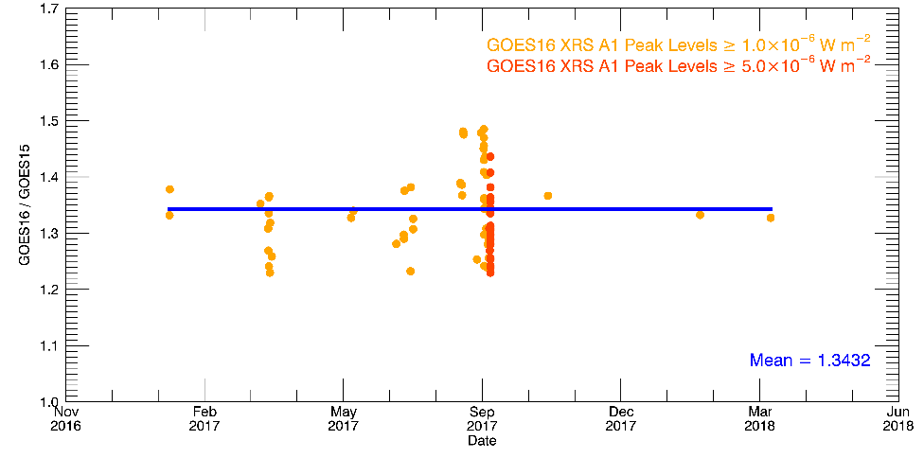
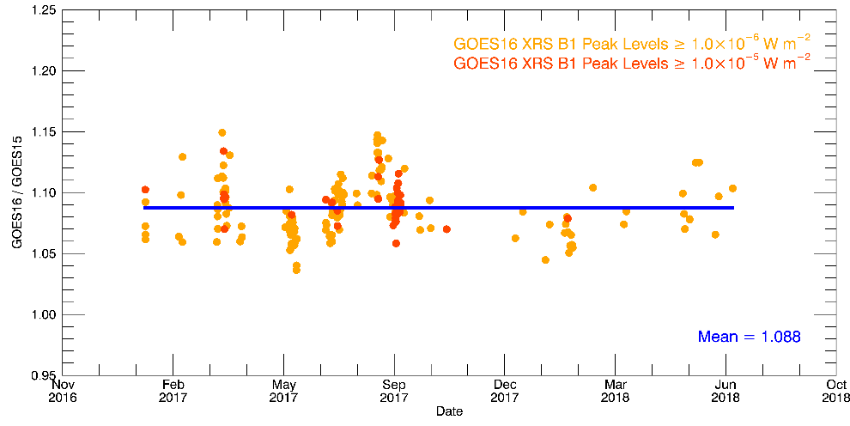
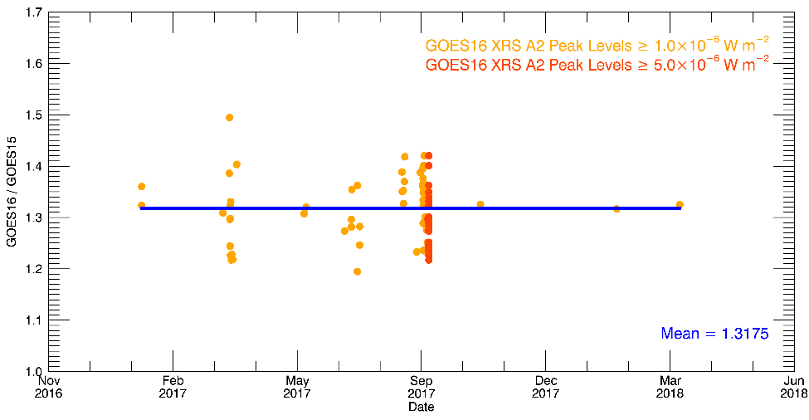
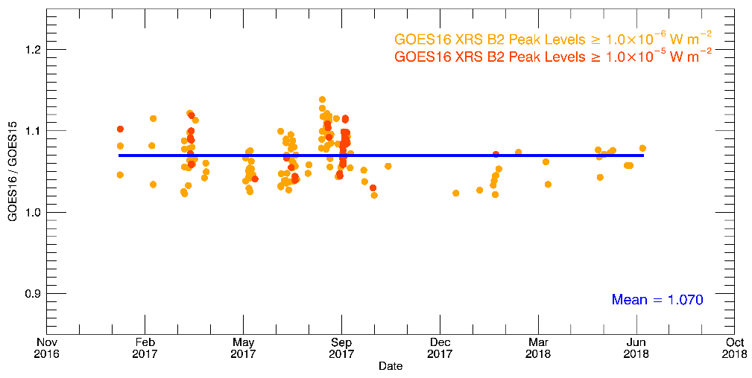
Stability of GOES-16 relative to GOES-15 (for MRD 2042)
GOES-16 is currently stable: ratios of XRS channels for GOES-16 / GOES-15 are flat.
Plots are GOES-16/GOES-15 for 2017/021 - 2018/221.
A1
B1
THIS IS GOES 16 DATA. PROVIDED FOR COMPARISON WITH GOES-17.
A2
B2

Slide 56
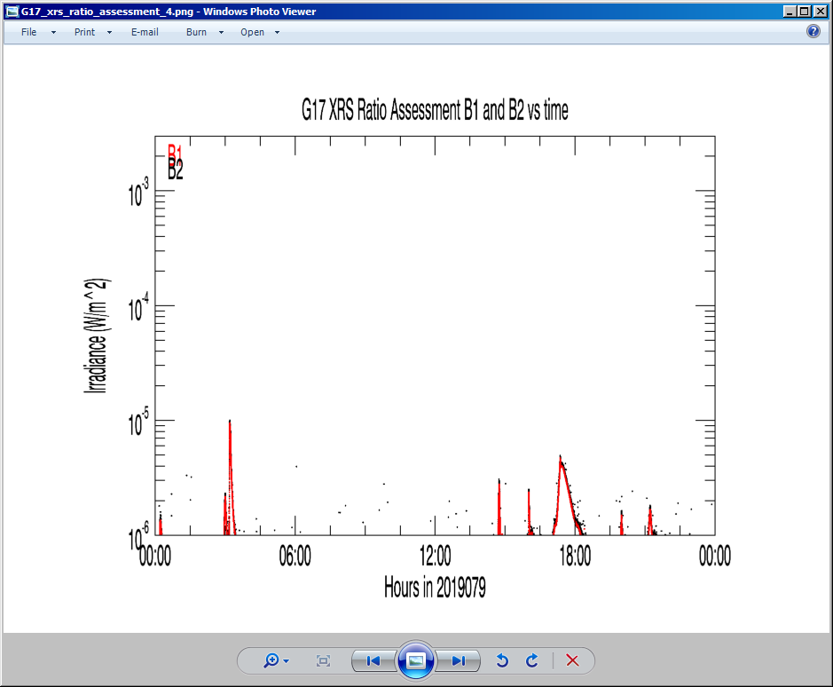
XRS-B fluxes used for
#10: XRS Ratio – Threshold Assessment

