Slide 1
GOES-17 Geostationary Lightning Mapper (GLM)
Full PS-PVR
February 24, 2021
William Koshak¹, Pete Armstrong²,
Doug Mach³, Monte Bateman³, Dennis Buechler⁴, Katrina Virts⁴
Scott Rudlosky⁵, Steve Goodman⁶
(with important inputs from many additional Cal/Val Team Members, & NASA Flight)
¹NASA/MSFC, ²MIT-LL, ³USRA, ⁴UAH, ⁵NOAA/NESDIS/STAR, ⁶TGA
GOES-R Calibration Working Group

Slide 2
Outline
Introduction
Performance Summary
PLPT Details
Progress Since Provisional Review
Assessment of Maturity
Summary and Recommendations

Slide 3
Outline
Introduction
Performance Summary
PLPT Details
Progress Since Provisional Review
Assessment of Maturity
Summary and Recommendations

Slide 4


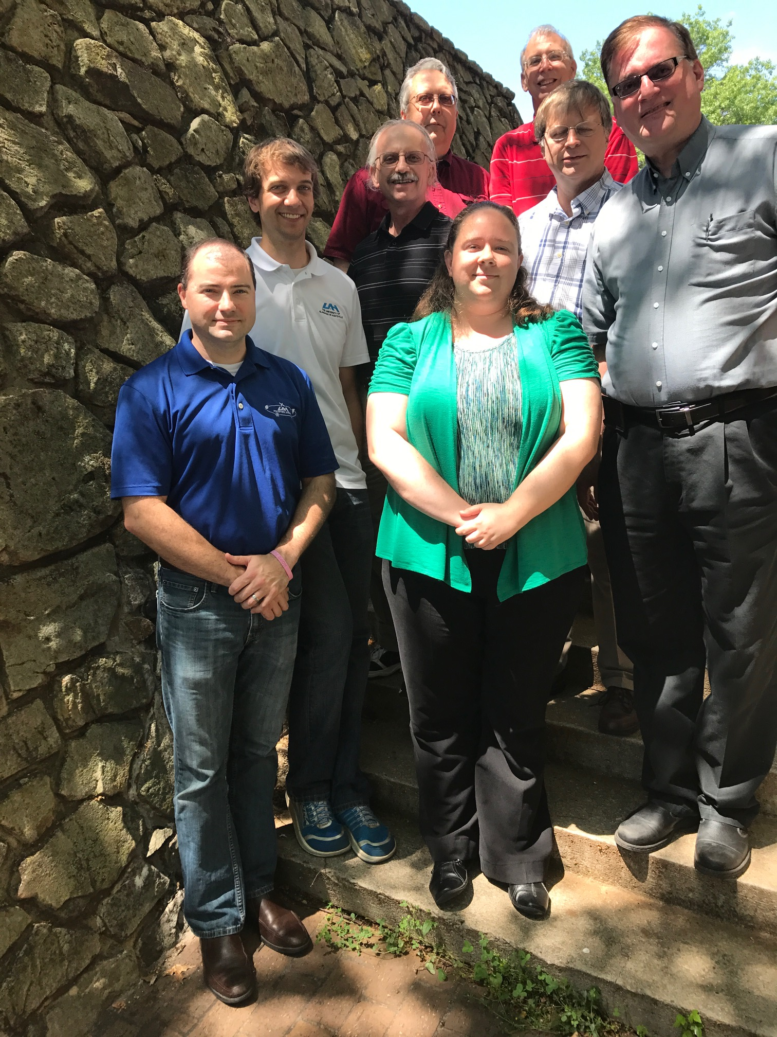
Cal/Val Team Members
NSSTC (Huntsville, AL)
NOAA/NESDIS/STAR
Various Remote
Ken Cummins (Univ Az)
Eric Bruning (TTU)
Steve Rutledge (CSU)
Adam Clayton (formerly CSU)
Max Marchand (CIRA)
Bob Holzworth (Univ. Wa)
Michael McCarthy (Univ. Wa)
Paul Krehbiel (NMT)
Ron Thomas (NMT)
Bill Rison (NMT)
Randy Longenbaugh (SNL)
Don MacGorman (NSSL)
Ken Pickering (UMD)
Michael Peterson (now @ Los Alamos)
Richard Sonnenfeld (NMT)
GOES-R Program Subj. Matter Expert: Steve Goodman (Thunderbolt Global Analytics)
Scott Rudlosky
(GOES-R Science; NWS
Activities Specialist)
MIT-Lincoln Lab
NASA Flight for INR
David Igli
Alan Reth
Bin Tan
Pete Armstrong
(Core Team Member)
Special Thanks to CVCT PRO
Liz Kline
Jon Fulbright
Core Team: William Koshak & Rich Blakeslee (MSFC), Doug Mach & Monte Bateman (USRA), Dennis Buechler (UAH), Katrina Virts (UAH)
Support Team (lower left): Phillip Bitzer & Jeff Burchfield (UAH)
Photos courtesy of William Koshak & Pete Armstrong, or publicly available

Slide 5
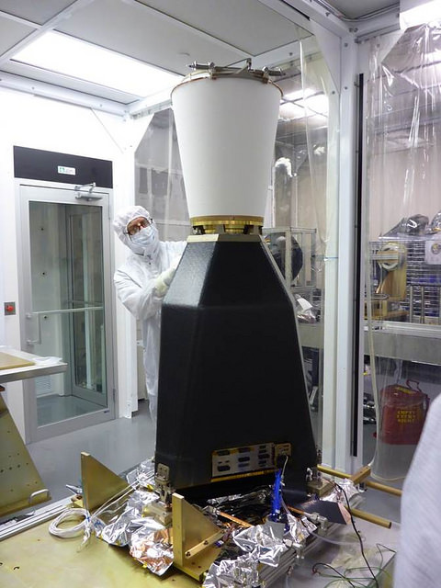
GLM Overview
  REQUIREMENTS:
  Provide continuous, full-disk lightning measurements for storm warning and nowcasting.
  Provide early warning of tornadic activity.
  Accumulate a long-term database to track decadal changes [of lightning].
INSTRUMENT DETAILS:
High-speed nadir-staring camera
CCD imager (1372x1300 pixels)
Near uniform spatial resolution
8 km nadir, 14 km edge of FOV
Coverage ~ ± 54 latitude
Single band 777.4 nm
2 ms frame rate
7.7 Mbps downlink data rate
  TRMM/LIS only 8 kbps
20 sec product latency
GLM is the first lightning mapper to be flown in geostationary orbit. Heritage LEO sensors include: Optical Transient Detector (1995-2000), and TRMM/LIS (1997-2015)

Slide 6
GLM Data Products Description
Events: pixel-level optical detection in one frame.
Groups: one or more (side/corner) adjacent pixel detections in one frame.
Flashes: one or more groups within 330 ms (i.e. ~ interstroke duration), & within 16.5km.

Slide 7
Important Validation Principles
(see RIMP for more details)
Targets of Opportunity (TOO): VAL of a Lightning Sensor differs from VAL of typical imager; i.e. since lightning transient, VAL is restricted to TOO.
Flash DE & FAR are Estimates: Because reference data normally doesn’t detect all lightning.
Source Physics: GLM detects in the optical (near-IR) and many of the reference datasets are in the RF. (e.g., LMAs see discharge breakdown in the VHF that might not show up in optical → apple/orange).
Source Scattering: Optical is cloud-scattered, but cloud is transparent to radio. So often see GLM detections near cloud edges where no radio sources.
ISS/LIS & FEGS are Critical: More of an apple/apple comparison w/GLM.

Slide 8
Performance Baseline Mapping
MRD | Parameter | MRD Value | Perf. Baseline (Model) |  | Related PLPTs
1259 | Production Mapping Accuracy [INR] | 5km ( = |𝛍|+3𝜎 < 140 μrad) | Nav error (7 d averaging) of 108 μrad for GOES-W |  | -011, (also -001, -002,-003, -004, -005, -006)
1260 | Product Measurement Range | (0-41900 evts/s, 0-8170 grps/s, 0-600 flsh/s) | Instr Vendor showed can handle peak 100Kevts/s (600flsh/s) |  | G16/17 Independent [see -009,-010 in G16 Full PS-PVR]
1261 | Product Measurement Accuracy | 70% total flash detection efficiency (DE) | Instr. Side | EOL* | -001, -002,-003, -004, -005, -006, -009,-010
 |  |  | Primary | 81%
 |  |  | Redundant | 83%
1264 | Product Measurement Precision | 5% | Open, with Flight reporting FAR ~ 1.1%, but open WRs on GS implementation loss |  | -001, -002,-003, -004, -005, -006, -009,-010
2112 | Product Time Tag | GOES-R system shall time tag product observations | n/a |  | -001, -002,-003, -004, -005, -006
*EOL = End of Life with reduction to flash DE by ~6% due to Coherency Filter removing single-group flashes

Slide 9
Time-Line Highlights
01 Mar 2018 GOES-S Launch
27 Mar 2018 GLM powered on @ 13:38:50 UTC
27 Mar 2018 Flow of real-time data began @ 13:43 UTC
30 Mar 2018 RTEP tuning began
12 Apr 2018 GLM Door Opened @ 5 UTC
28 Jun 2018 RTEP tuning ended
10 Jul 2018 GLM Beta Validation Began
02 Oct 2018 PS-PVR BETA Achieved
15 Oct 2018 DO.07.00.00 into OE @ 16:27 UTC
03 Dec 2018 Rev C LUT update into OE (RTEP sets, hot pixel mute, Parallax)
20 Dec 2018 PS-PVR PROVISIONAL Achieved
Progress 2019-present discussed later

Slide 10
Outline
Introduction
Performance Summary
PLPT Details
Progress Since Provisional Review
Assessment of Maturity
Summary and Recommendations

Slide 11
Performance Summary
MRD | Parameter | MRD Value | Performance Baseline (Model) | Performance Result
 |  |  |  | VaLiD | LATA | INR | Mach SIT
1259 | Production Mapping Accuracy | 5km ( = |𝛍|+3𝜎 < 140 μrad) | 108 μrad | n/a | 3.5km | 90 μrad | n/a
1260 | Product Measurement Range | (0-41900 evts/s, 0-8170 grps/s, 0-600 flsh/s) | 100Kevts/s (600flsh/s) | n/a | n/a | n/a | no cases where *LCFA unable to handle raw or filtered data rates
1261 | Product Measurement Accuracy | 70% total flash detection efficiency (DE) | 81% | 73% | n/a | n/a | n/a
1264 | Product Measurement Precision | 5% (flash FAR) [also MRD 639 which states same 5% value] | Flight reporting FAR ~ 1.1%, | 38% (2s) 10% (1200 s) 5% (inferred from CONUS obs & simulations) | n/a | n/a | n/a
2112 | Product Time Tag | GOES-R system shall time tag product observations | n/a | n/a | -0.8 ms | n/a | n/a
*LCFA = Lightning Cluster Filter Algorithm.

Slide 12
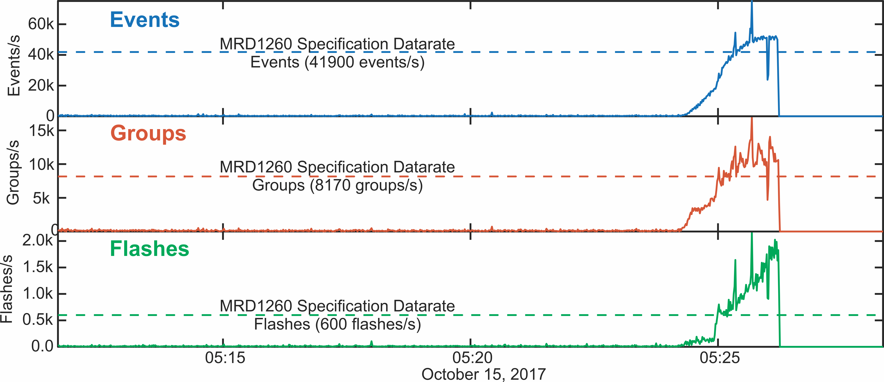
LCFA for GLM-16 handles above max Rate Spec
(when rate gets too high [∼51kevts/s, ∼14kgrps/s, ∼1.6kflsh/s] LCFA crashes)
LCFA
crash
LCFA
crash
LCFA
crash
Note: GLM-17 uses the same system and algorithm to process lightning data as GLM-16. There is no reason GLM-17 should not
be able to process the same amount of data. No cases were found where the algorithm crashed in the latest GLM-17 files.

Slide 13
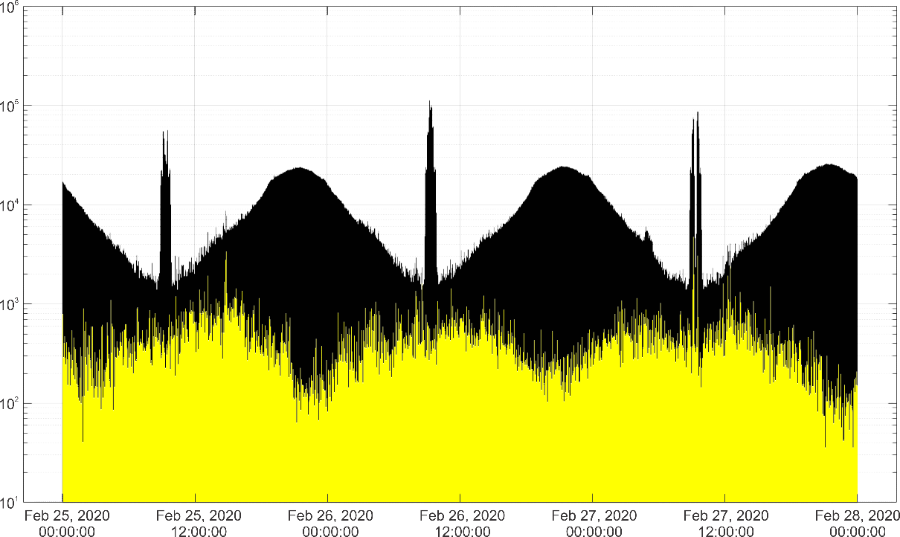
GLM-17 Blooming/Glint Filter
Substantially Reduces FAR
100kevts/sec
Example: February 25-27, 2020
  Black data: Very high event rates due to glint (overall high rates) and blooming (peaks around 12Z each day)
  Yellow data: Glint/Blooming data reduced 2-3 orders of magnitude
  (y-axis log scale)
The Blooming/Glint filter is significantly reducing the Blooming/Glint contributions
to the FAR

Slide 14
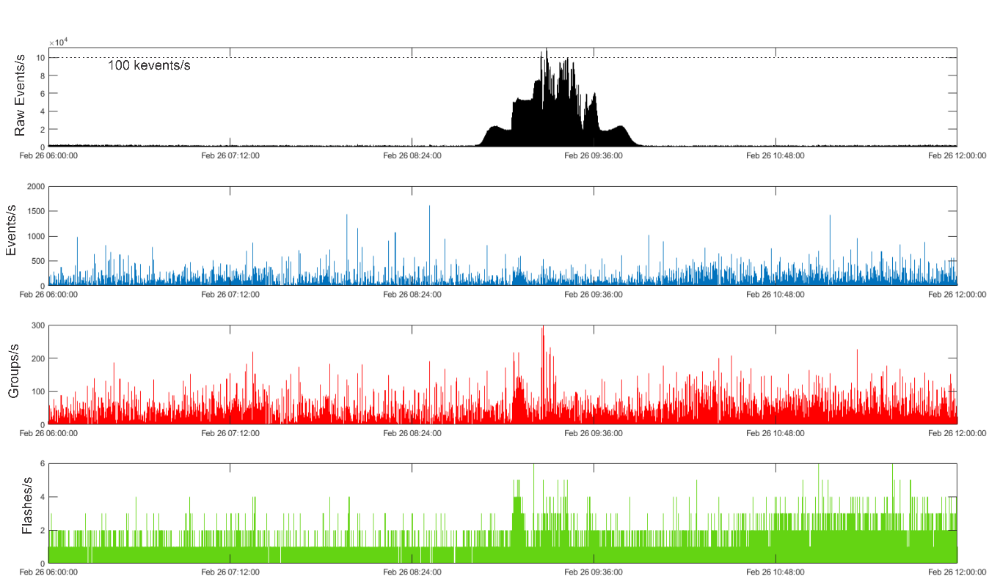
GLM-17 LCFA Peak Rate Spec
Algorithm did not crash when raw rates exceeded 100 kevents/sec)
Note that despite the high data rate, the LCFA continued to process the filtered events into groups and flashes
GLM-17 uses the same system and algorithm to process lightning data as GLM-16
  There is no reason GLM-17 should not be able to process the same amount of data
  No cases were found where the algorithm crashed in the latest GLM-17 files

Slide 15
Max Rates Low due to
Benefit of Blooming/Glint Filter
LCFA
crash
LCFA
crash
LCFA
crash

Slide 16
Flash DE Performance Summary
(GLM-17 vs Combined Ground Networks; 2 sec window; VaLiD tool)
Period (2020) | Flash DE | Flash DE (day) | Flash DE (night)
Jan | 0.76 | 0.75 | 0.76
Feb | 0.74 | 0.75 | 0.78
Mar | 0.74 | 0.72 | 0.76
Apr | 0.73 | 0.71 | 0.77
May | 0.73 | 0.68 | 0.76
Jun | 0.64 | 0.57 | 0.69
Jul | 0.67 | 0.61 | 0.72
Aug | 0.66 | 0.60 | 0.69
Sep | 0.66 | 0.60 | 0.68
Oct | 0.70 | 0.66 | 0.74
Nov | 0.74 | 0.69 | 0.75
Dec | 0.79 | 0.78 | 0.80
YEAR | 0.73 | 0.70 | 0.75

Slide 17
Flash FAR Performance Summary
(GLM-17 vs Combined Ground Networks; 2 sec & 1200 sec windows; VaLiD tool)
Period (2020) | 2 sec window |  |  | 1200 sec window
 | Flash FAR | Flash FAR (day) | Flash FAR (night) | Flash FAR | Flash FAR (day) | Flash FAR (night)
Jan | 0.41 | 0.38 | 0.31 | 0.10 | 0.08 | 0.06
Feb | 0.40 | 0.37 | 0.32 | 0.11 | 0.06 | 0.05
Mar | 0.38 | 0.35 | 0.29 | 0.09 | 0.06 | 0.04
Apr | 0.36 | 0.29 | 0.28 | 0.09 | 0.06 | 0.04
May | 0.40 | 0.31 | 0.29 | 0.08 | 0.05 | 0.04
Jun | 0.36 | 0.25 | 0.24 | 0.10 | 0.05 | 0.03
Jul | 0.39 | 0.27 | 0.26 | 0.11 | 0.05 | 0.04
Aug | 0.38 | 0.26 | 0.24 | 0.09 | 0.04 | 0.03
Sep | 0.35 | 0.25 | 0.21 | 0.10 | 0.05 | 0.03
Oct | 0.36 | 0.31 | 0.27 | 0.09 | 0.06 | 0.04
Nov | 0.38 | 0.38 | 0.32 | 0.09 | 0.07 | 0.05
Dec | 0.41 | 0.41 | 0.32 | 0.11 | 0.08 | 0.06
YEAR | 0.38 | 0.32 | 0.28 | 0.10 | 0.06 | 0.04
Poor Ref Network DE over ocean unfairly amplifies GLM FAR; note how FAR decreases when time window increases.

Slide 18
Performance Summary
(Additional Details on Group Location and Group Time Accuracy from LATA tool)
Period | Peak Location Accuracy (km) | Peak Timing Accuracy (ms)
Feb 2020 | 4 km | -1 ms
Mar 2020 | 3.5 km | -1 ms
Apr 2020 | 4 km | -0.8 ms
May 2020 | 3.5 km | -0.8 ms
Jun 2020 | 3.5 km | -0.8 ms
Jul 2020 | 3.5 km | -0.8 ms
Aug 2020 | 3.5 km | -0.8 ms
Sep 2020 | 4 km | -0.8 ms
Oct 2020 | 4.5 km | -0.8 ms
Nov 2020 | 4.5 km | -1 ms
Dec 2020 | 4.5 km | -1 ms
Jan 2021 | 4 km | -1 ms
Feb 2020-Jan 2021 | 3.5 km | -0.8 ms

Slide 19
Outline
Introduction
Performance Summary
PLPT Details
Progress Since Provisional Review
Assessment of Maturity
Summary and Recommendations

Slide 20
Defining Analysis Periods for Full Validation
20 Dec 2018 GLM-17 PS-PVR PROVISIONAL
27 Feb 2019 2nd Lev Thresh, Data Burst
30 Apr 2019 CDRL79 Rev D LUT
25 July 2019 Blooming Filter
01 Aug 2019 START TIME FOR SEASONAL ANALYSES
02 Oct 2019 Scale_factor & Add_offset fix for flash optical energy amplitude
27 Oct 2020 Various fixes (event longitude fix, single group filter, time error in metadata).
01 Nov 2020 START TIME FOR OPTIMAL ANALYSES
08 FEB 2021 END TIME (PS-PVR slide prep begins)
24 Feb 2021 GLM-17 PS-PVR FULL

Slide 21
Post-Launch Product Tests
Test ID | Abbreviated Test Titles for GLM
PLPT-GLM-001 | Validate DE/FAR & Location/Time using med/long-range networks (e.g., NLDN, EN, GLD360)
PLPT-GLM-002 | Validate DE/FAR & Location/Time using short-range networks (e.g., LMAs)
PLPT-GLM-003 | Validate Storm DE and Storm FAR using very long range systems (WWLLN, NEXRAD)
PLPT-GLM-004 N/A | Validate DE/FAR using very short-range optical systems (FEGS)
PLPT-GLM-005 | Validate DE/FAR & Location/Time using orbit-based optical systems (e.g., ISS/LIS)
PLPT-GLM-006 | Validate DE/FAR using ground-based E-field networks (e.g. HAMMA, LIP)
PLPT-GLM-009 | Validate L1b-L2 Cluster/Filter by comparing w/Spec (i.e. Mach) code
PLPT-GLM-010 | Validate L0-L1b Filter Algorithms by comparing w/Spec (i.e. Mach) code
PLPT-GLM-011 | Validate GLM INR w/comparisons to well-located ground points
PLPT-GLM-012 | Validate GLM BG DCC radiances with trending & comparisons
PLPT-GLM-013 | Validate GLM Flash Energies with trending & comparisons
Full test plans and procedures are given in the GLM Readiness, Implementation, and Management Plan (RIMP v2.0; 416-R-RIMP-0313)

Slide 22
Primary PLPT Tools
Item | Tool | Description | Code Language | Developer
1 | VaLiD | Validate Lightning Data tool performs shallow/deep dives of GLM data using wide range of ground-based datasets discussed in RIMP. | C | Bateman/USRA
2 | Cluster/Filter | In-house code for L0-L1b and L1b-L2 processing | Matlab | Mach/USRA
3 | HUDAT | Huntsville Area Marx Meter Array (HAMMA) User Data Analysis Technology with emphasis on lightning energy/physics. | IDL | Bitzer/UAH
4 | STROKE | STorm Retrievals frOm KSC E-Fields examines ground-based electric fields, lightning field changes, and the charges deposited by lightning in KSC, Florida. | IDL | Koshak/MSFC
5 | INR/Parallax | Validates GLM INR with comparisons to well-located ground points and employs GLM background images & lightning, ABI background images, and Laser beacon data | IDL | Buechler/UAH
6 | TT/DCC | Trending Tools for long-term trending of Deep Convective Clouds. | IDL | Buechler/UAH
7 | TT/Lightning | Trending Tools for long-term trending of lightning counts, flash duration, and lightning energy. | IDL, Matlab | Buechler/UAH Koshak/MSFC, Virts/UAH
8 | LMT | 24/7 Lightning Monitoring Tool (aka "Product Monitor") that alerts of problematic GLM performance | TBD | Product Area Lead
9 | CompareLLS | Compare Lightning Location System tool performs shallow/deep dives of GLM data using wide range of ground-based datasets discussed in RIMP. | Matlab | Cummins, UA
10 | XLMA | X Lightning Mapping Array tool for making standard 4-D plots of flashes. | IDL | Krehbiel & Rison of NMT
11 | lmatools | Analyzes LMA data [sort VHF source data into flashes; calculate flash areas, volumes, and channel lengths; produce gridded products; time series statistics of flash rate and size data; simulate LMA performance]. | Python | Bruning/TTU
12 | FEGST | Fly's Eye GLM Simulator Tool: Data acquisition, display, storage software, and s/w for analyzing FEGS data & inter-comparing it with other lightning optical datasets (e.g. GLM, ISS/LIS). | IDL | Quick/NPP
13 | ADTs | Ancillary Dataset Tools will be developed for processing datasets such as ABI, NEXRAD, SEVERI, WWLLN; some of these tools will be piggybacked to VaLiD. | Matlab & McIDas scripts | Mach/USRA Bateman/USRA
14 | SITs | Specialized Impromptu Tools written “on-the-fly” to handle any analyses that are needed, but that were unexpected. | C, IDL, Matlab, Mathematica | Cal/Val Team
15 | LATA | Location And Time Accuracy (LATA) Tool: Produces a variety of plots/histograms that characterize the overall location/time accuracy of GLM flashes/groups/events. | Matlab | Virts/NPP
Plus 2 New Tools: DE Threshold Method (Cummins/UA; Matlab), and DE/FAR Simulator (Virts/UAH; Matlab)

Slide 23
Flash Detection Efficiency (Bateman/USRA)
PASSED
PLPT-GLM-001
Period: 2020
2 sec window
# Ref Networks = 5
# GLM flshs = 83.4 M
# Ref flshs = 453.1 M
Ave DE = 73%
Notes:
Sample size: 6,725,357 matches

Slide 24
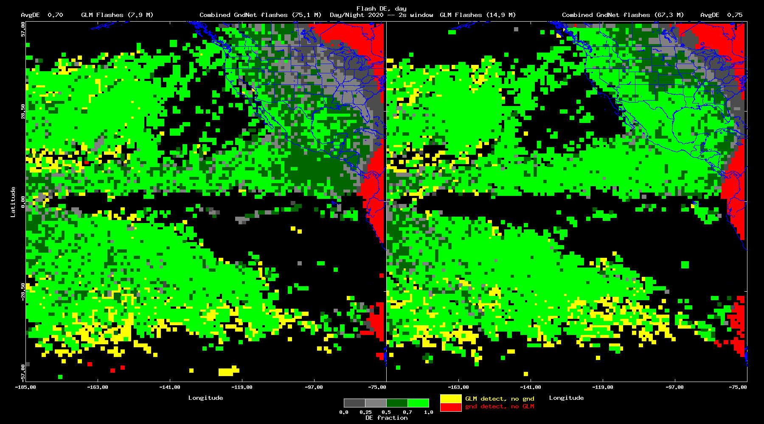
Flash Detection Efficiency (Bateman/USRA)
(DAY 70% DE, NIGHT 75% DE)
DAY
NIGHT
Notes:
Sample size: 6,725,357 matches

Slide 25
Flash Detection Efficiency Inference
(Cummins/UA)
PASSED
PLPT-GLM-001
PLPT-GLM-002
PLPT-GLM-005
Convolves:
ISS/LIS optical energies
KSCLMA
GLM thresholds
See Cummins AMS2021 details
DE Results:
73% (slide23 73%)
70% (slide24 70%) for day
75% (slide24 75%) for night
Notes:
Sample size: 133,055,347 matches (GLM-16) and 223,578 matches (ISS-LIS)

Slide 26
Flash False Alarm Rate (Bateman/USRA)
PASSED
PLPT-GLM-001
Period: 2020
2 sec window
# Ref Networks = 5
# GLM flshs = 83.4 M
# Ref flshs = 453.1 M
Ave FAR = 38%
  <5% CONUS
Small Ref Network DE over Ocean Unfairly Inflates FAR
No reason to believe GLM performance degrades from CONUS to Ocean, given instrument lab testing
0.0 0.05 0.3 0.6 1.0
FAR fraction
Notes:
Sample size: 6,725,357 matches

Slide 27
Flash False Alarm Rate (Bateman/USRA)
Period: 2020
120 sec window
# Ref Networks = 5
# GLM flshs = 83.4 M
# Ref flshs = 453.1 M
Ave FAR = 24%
  <5% CONUS + more
Small Ref Network DE over Ocean Unfairly Inflates FAR
No reason to believe GLM performance degrades from CONUS to Ocean, given instrument lab testing
0.0 0.05 0.3 0.6 1.0
FAR fraction
Notes:
Sample size: 6,725,357 matches

Slide 28
Flash False Alarm Rate (Bateman/USRA)
Period: 2020
1200 sec window
# Ref Networks = 5
# GLM flshs = 83.4 M
# Ref flshs = 453.1 M
Ave FAR = 10%
  <5% CONUS + even more
Small Ref Network DE over Ocean Unfairly Inflates FAR
No reason to believe GLM performance degrades from CONUS to Ocean, given instrument lab testing
0.0 0.05 0.3 0.6 1.0
FAR fraction
Notes:
Sample size: 6,725,357 matches

Slide 29
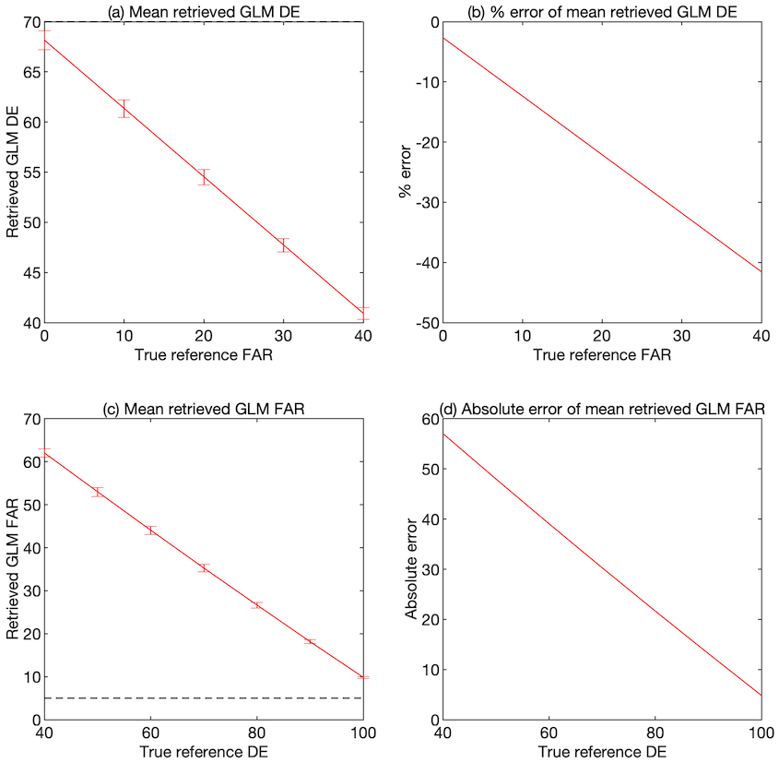
Simulations: Affect of Reference DE and FAR
(Virts/UAH)
Monte Carlo simulations:
  Define “true” lightning flashes
  Apply “true” GLM and reference DE and FAR
  Apply characteristic spatiotemporal errors
  Re-match simulated data ➝ retrieved GLM DE and FAR
This analysis: 60 days of simulations
  GLM DE = 0.7, FAR = 0.05
  Reference DE and FAR vary
Retrieved DE decreases as reference FAR increases
Retrieved FAR increases significantly as reference DE decreases: absolute errors range up to 50-60% as reference DE drops to 40%
See 38% FAR
in slide 26
~68% Ref Net DE very reasonable estimate !

Slide 30
IMPORTANT POINT
Simulation shows that a hypothetical spec-meeting GLM-17 (i.e. with DE =70%, FAR = 5%) would incorrectly appear to have an inflated FAR of 38% when the Ref Network(s) have a low DE of 68%.
Ref Network misses can incorrectly show up as GLM false alarms → GLM FAR unfairly amplified from 5% to 38%
Simulation is powerful since it allows one to
”look behind the curtain” to see what is REALLY
happening … in a quantitative way.
Simulation Theory report (Koshak, 2019)
Simulation Journal Paper (Virts & Koshak, 2021, in prog)
See 38% FAR
in slide 26
~68% Ref Net DE

Slide 31
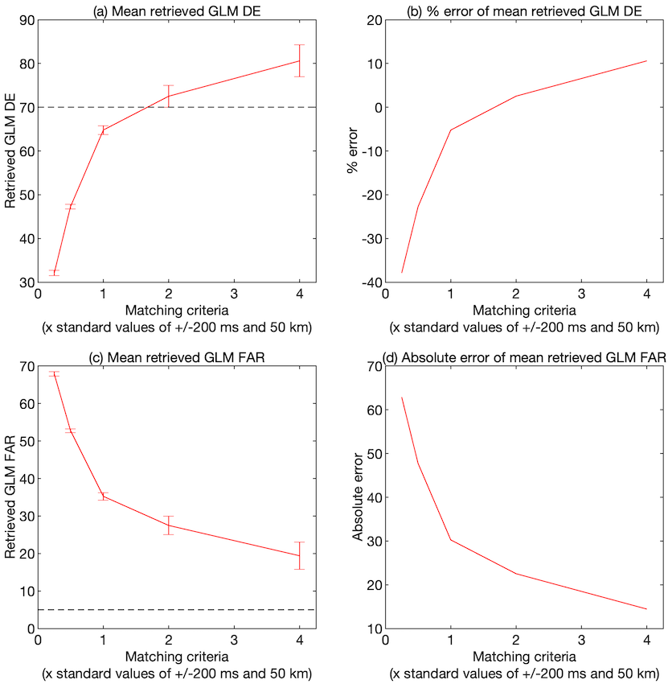
Simulations: Affect of Matching Criteria
(Virts/UAH)
This analysis:
  60 days of simulations
  GLM and reference DE = 0.7, FAR = 0.05
  Matching criteria = 0.25, 0.5, 1, 2, 4 × standard criteria of ±200 ms and 50 km
Strictest matching criteria underestimate true DE by 35% with 60% absolute error in retrieved FAR
Broadest matching criteria overestimate true DE by 10% with 15% absolute error in retrieved FAR
Larger error bars for the most broad matching criteria

Slide 32
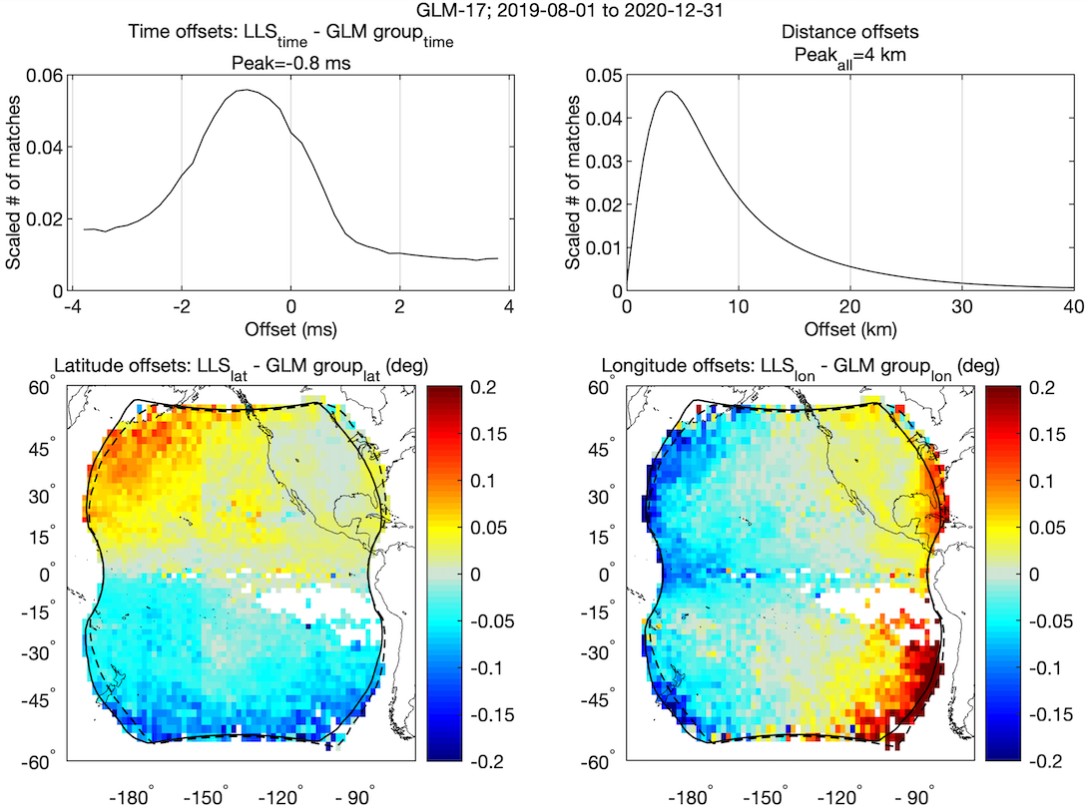
Location/Time Accuracy (Virts/UAH)
GLM-17 vs. ENGLN and GLD360
PASSED
PLPT-GLM-001
Offsets between GLM and “best” reference match
Sub-ms timing accuracy
Sub-pixel location accuracy over most of domain
Notes:
Sample size: 350,137,101 matches

Slide 33
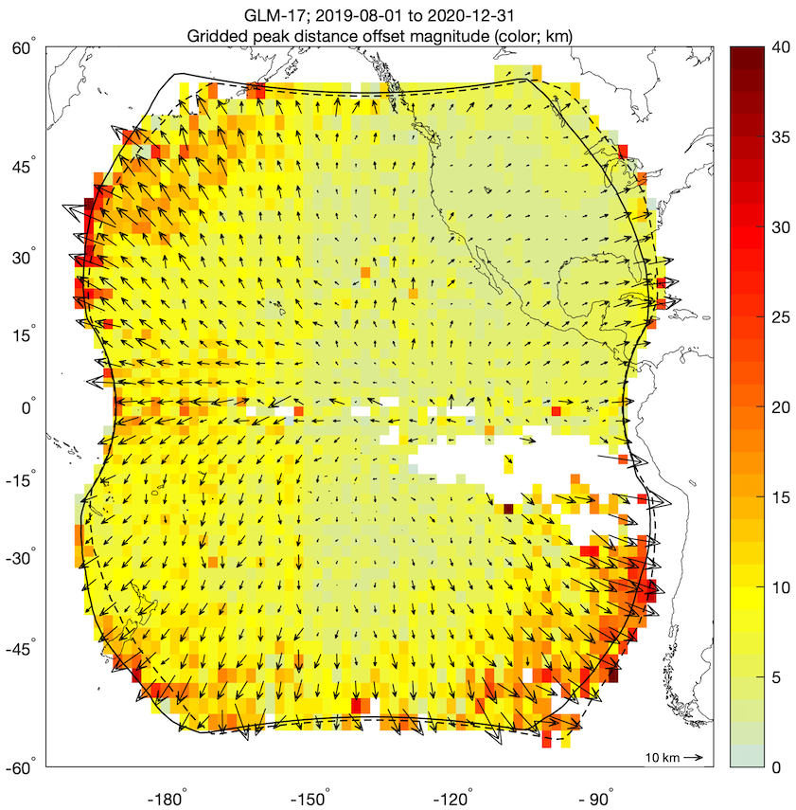
Location Accuracy (Virts/UAH)
GLM-17 vs. ENGLN and GLD360
Sub-pixel location accuracy over much of domain
Groups near limb must be shifted outward to match reference data
Notes:
Sample size: 350,137,101 matches

Slide 34
Also Note Event Location s/w Fix
(Mach/USRA)
Notes:
Sample size: 350,137,101 matches

Slide 35

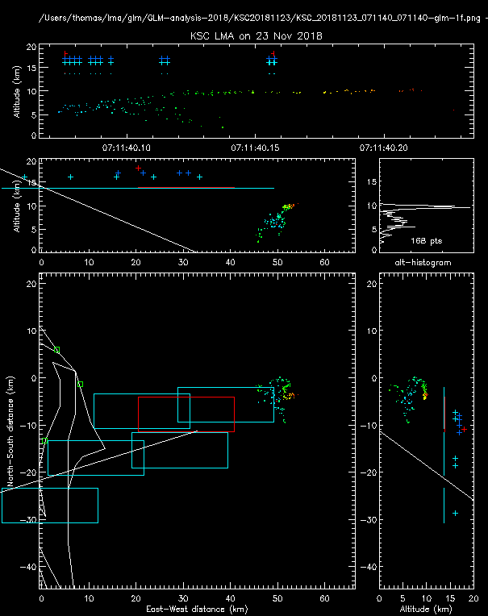
KSC Lightning Mapping Array (LMA)
(Thomas/NMT)
PASSED
PLPT-GLM-002
KSC LMA on 23 Nov 2018
Single flash well detected and timed
Location offset due to flash lower altitude; near FOV edge
35

Slide 36
DE Depends on Specifics
(Rutledge & Clayton / CSU)
36

Slide 37
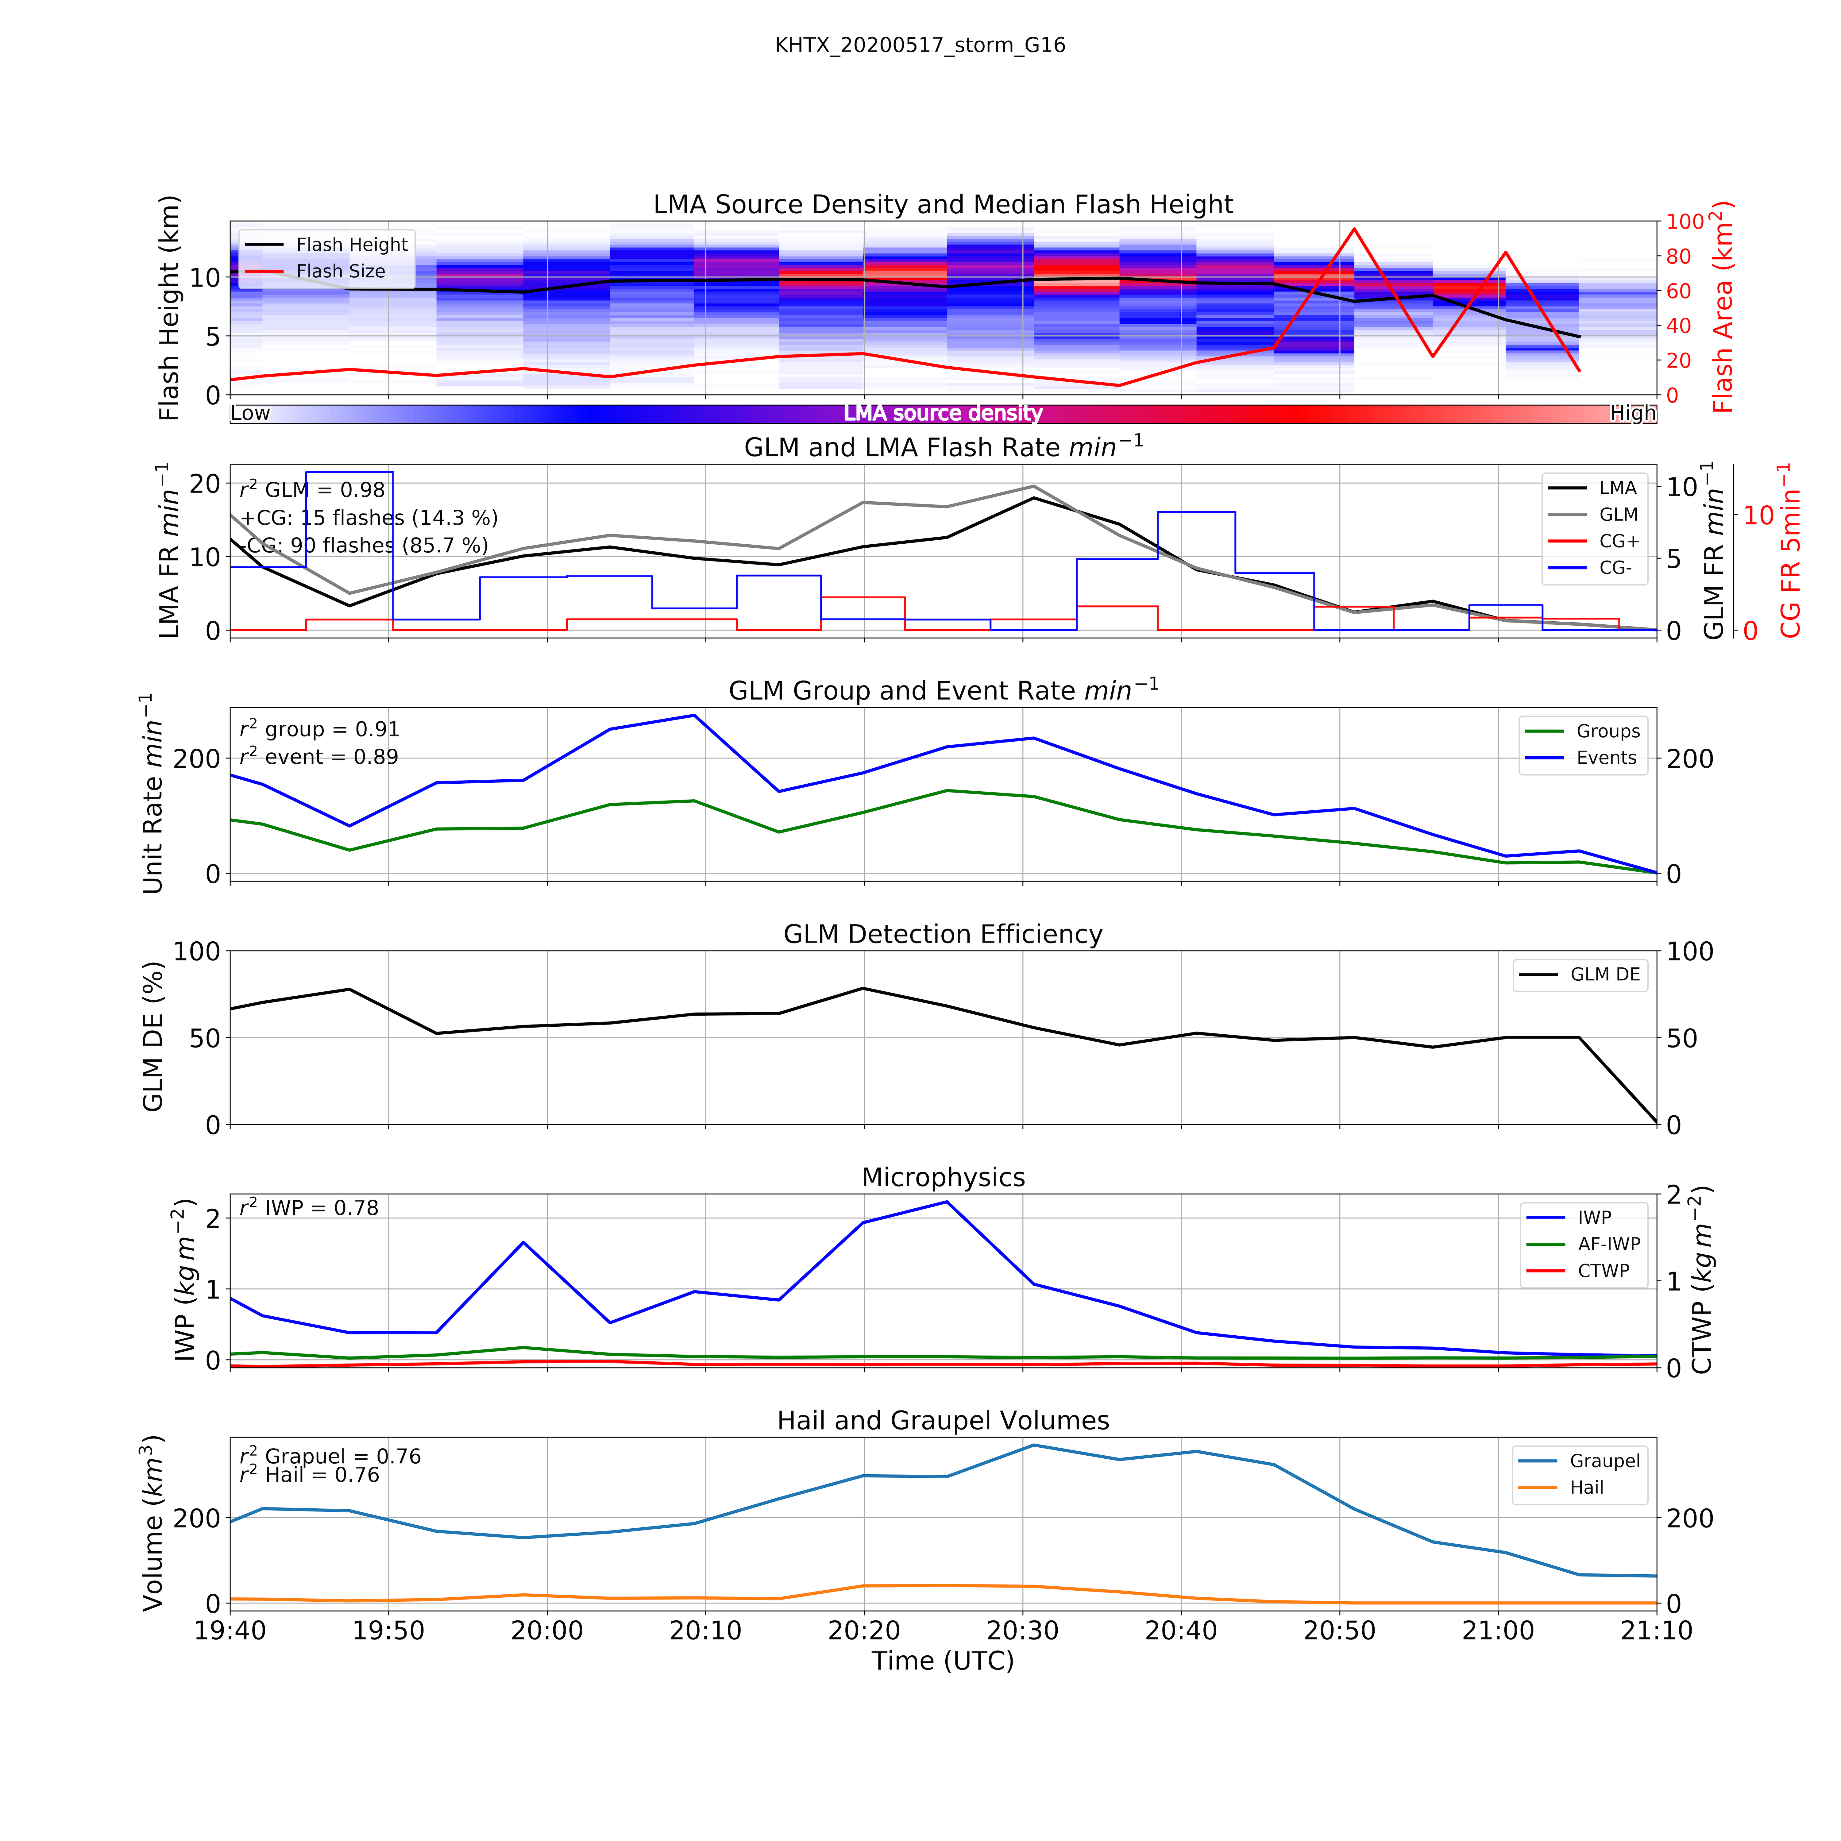
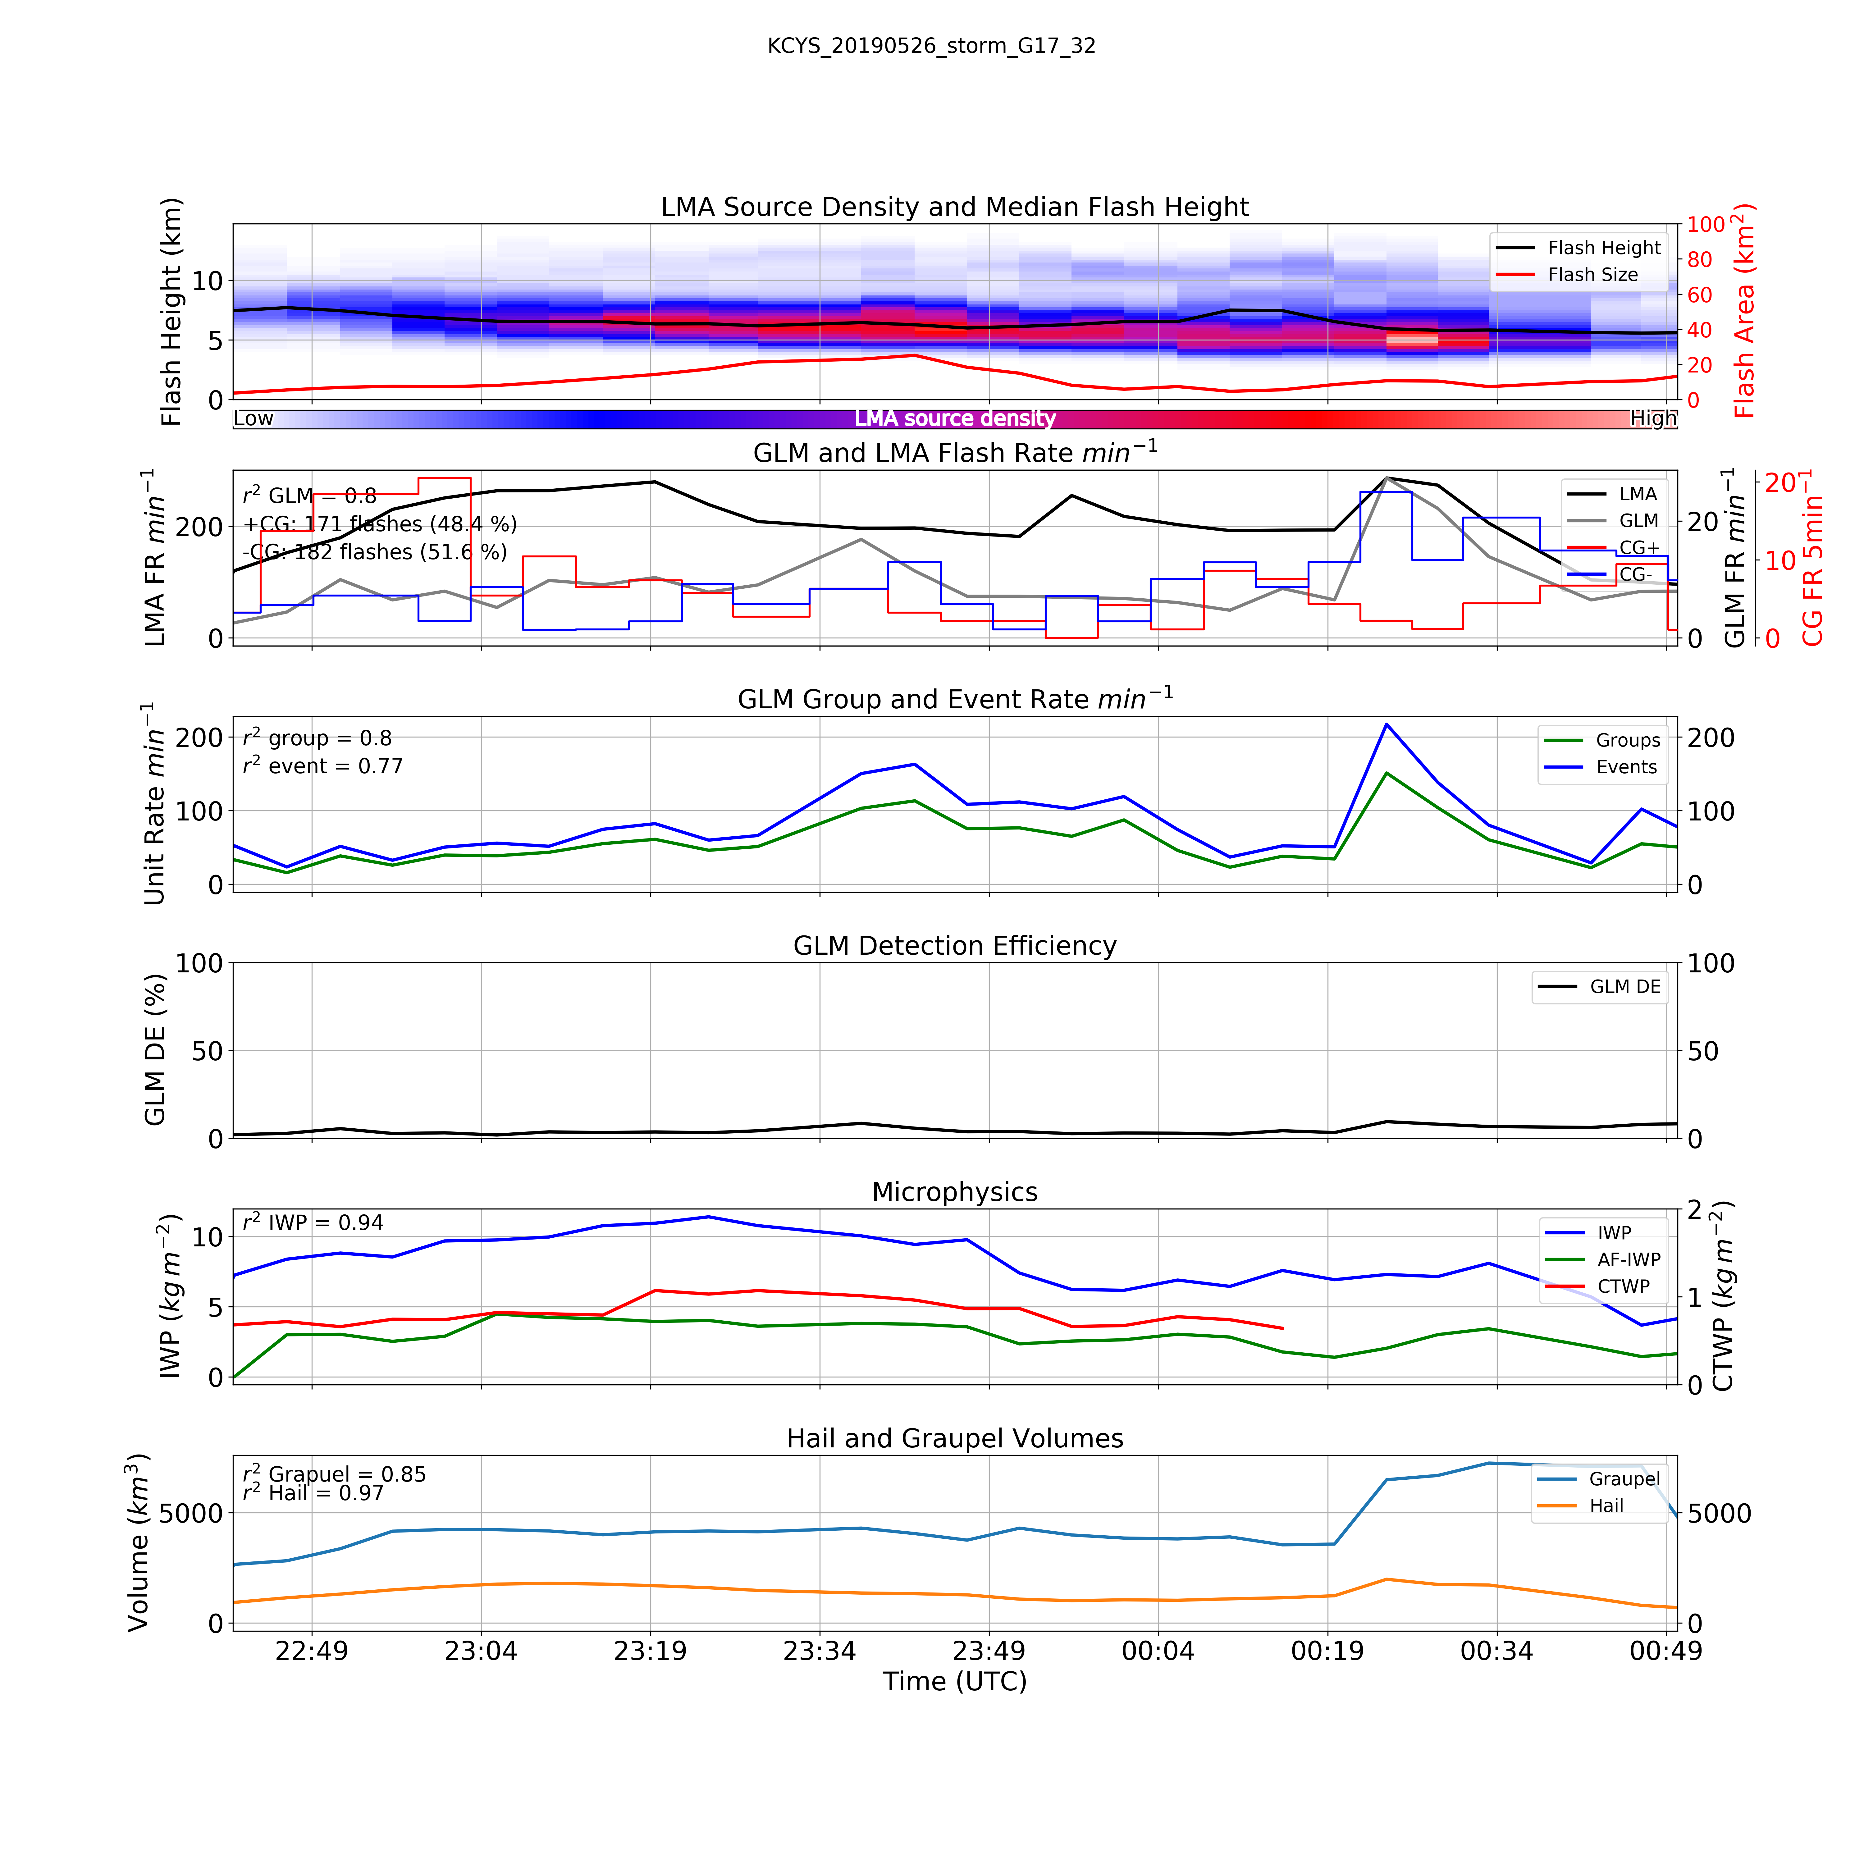
DE Depends on Specifics (EXAMPLE)
(Rutledge & Clayton / CSU)
2020-05-17 Alabama Case
2019-05-26 Inverted Polarity Colorado Storm
37

Slide 38
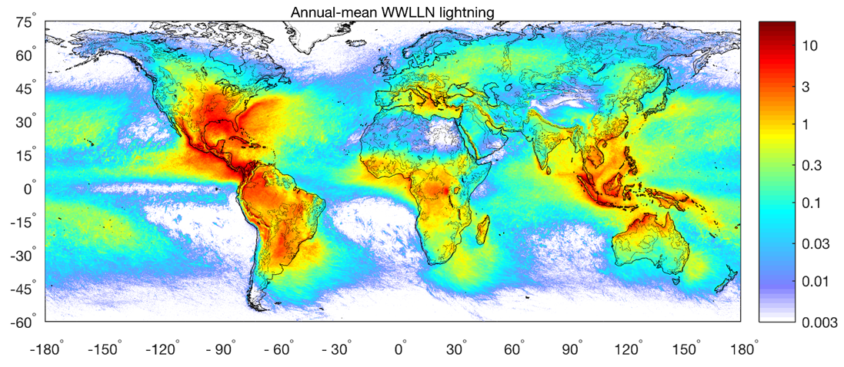
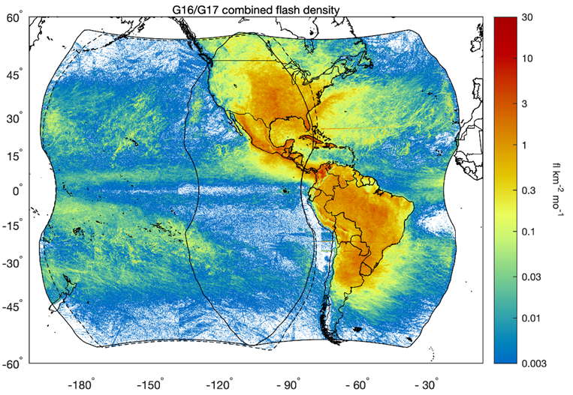
Comparisons with WWLLN
(Holzworth & McCarthy/Univ. Wash)
PASSED
PLPT-GLM-003
GLM-17 detects virtually all
storms; noise not an issue
for storm false detection
given knowledge of noise
locations/times (glint, hot
pixels, …). [see also PLPT-001]
Notes:
Sample size: 350,137,101 matches

Slide 39
Comparisons with WWLLN (cont.)
(Holzworth & McCarthy/Univ. Wash)
Verified GLM-17 performing similar to GLM-16 relative to WWLLN, given
natural
differences in
lightning
between
land/ocean.
More bright groups in GLM17 FOV … have larger WWLLN stroke energies.
Notes:
Sample size: 350,137,101 matches

Slide 40
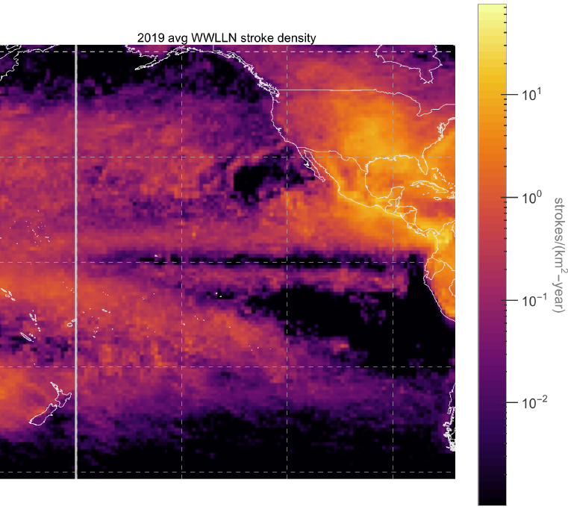
Comparisons with WWLLN (cont.)
(Holzworth & McCarthy/Univ. Wash)
WWLLN ave stroke density (2019)
GLM17 ave flash density (2019)
180 W
180 W
WWLLN relative detection efficiency does NOT change much in 1000 km, so sharp features are likely natural.
GLM-17 does a good job picking up the main features of WWLLN
GLM-17 has enhancements (e.g. off Ecuador, western edge Pacific 30N); also artifacts to the south that have since been mitigated.
Notes:
Sample size: 350,137,101 matches

Slide 41
Comparisons with WWLLN (cont.)
(Virts/UAH)
This extends the comparison to the next year (2020); again, they compare well.
Note yaw flip explains lower detection of GLM-17 in NE corner relative to WWLLN.
Notes:
Sample size: 350,137,101 matches

Slide 42
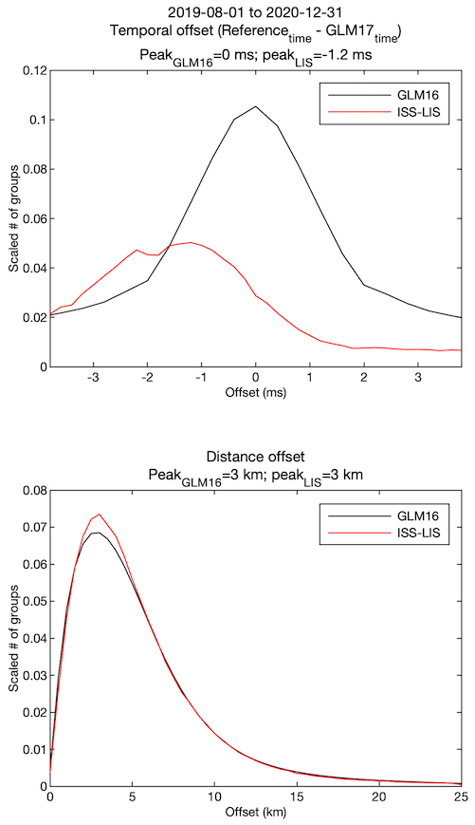
Location/Time Accuracy (Virts/UAH)
GLM-17 vs. GLM-16 and ISS-LIS
PASSED
PLPT-GLM-005
Comparison with group data from two other space-based optical sensors
Sub-ms timing accuracy with GLM-16
LIS has known timing shift of ~1 ms during analysis period
Peak distance errors of 3 km
Notes:
Sample size: 1,058,113,632 matches (GLM-16) and 867,589 matches (ISS-LIS)

Slide 43
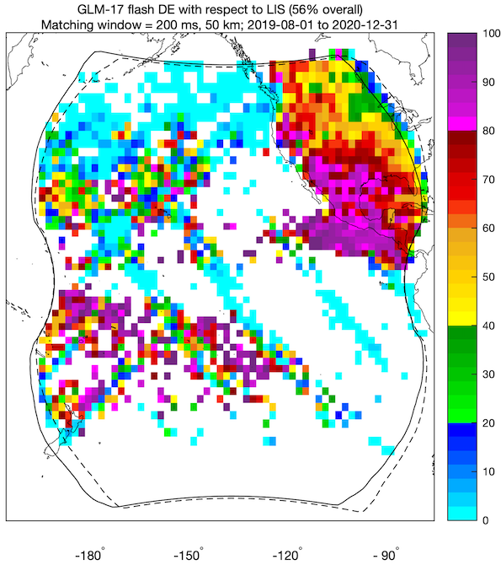
Flash Detection Efficiency (Virts/UAH)
GLM-17 vs. GLM-16 and ISS-LIS
Comparison of flash data with: GLM-16 (left), ISS/LIS (right)
Left Plot: GLM-17 flash DE estimated at 70.3% using Bitzer Bayesian methodology
Right Plot: Contamination from bad LIS orbits over Pacific
Notes:
Sample size: 133,055,347 matches (GLM-16) and 223,578 matches (ISS-LIS)

Slide 44
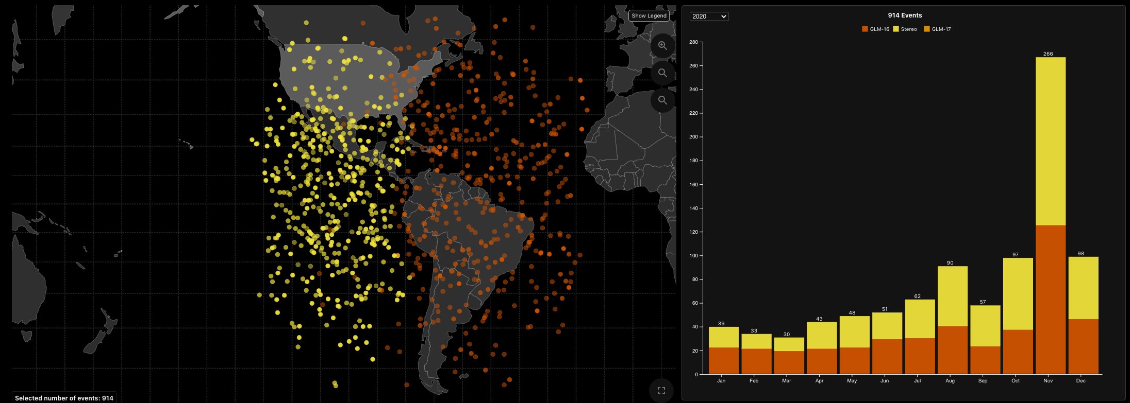
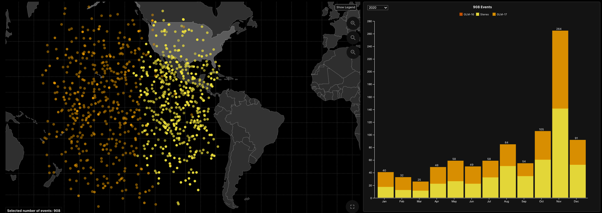
Bolide Locations & Counts (GLM-17 vs GLM-16)
(Longenbaugh/SNL; Goodman/TGA)
YELLOW: STEREO
DARK ORANGE: GLM-16
LIGHT ORANGE: GLM-17
Left-Hand Charts: show the bolide locations
  Locations approximately uniform across the FOV for both GLMs
Right-Hand Charts: show # of events & monthly variation of detections.
  Significant increase in the # of detections as GLM observed the Leonid meteor shower
  Stereo detections are included in the counts shown
GLM-16
914 events
GLM-17
908 events
Notes:
Sample size: 133,055,347 matches (GLM-16) and 223,578 matches (ISS-LIS)

Slide 45
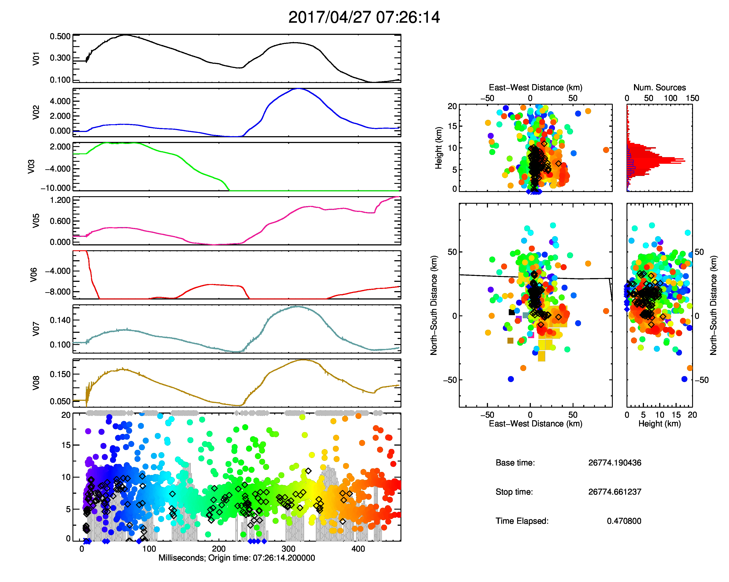
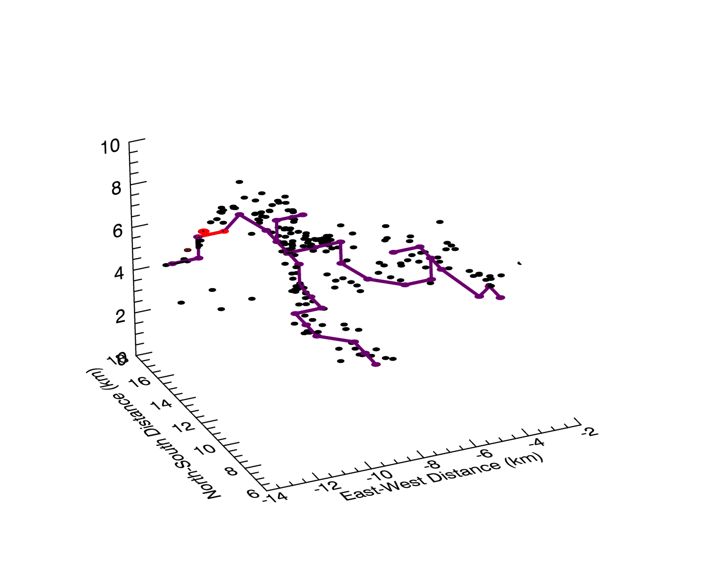
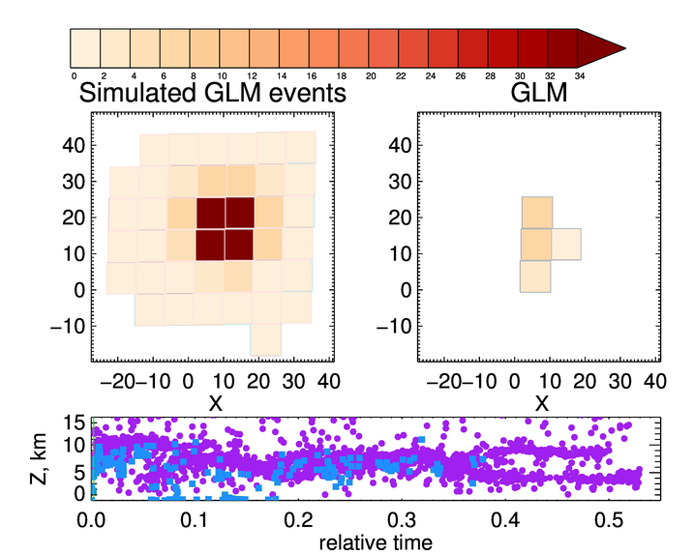
What Modulates Light Reaching GLM?
(Brunner & Bitzer, UAH)
PASSED
HAMMA
LMA
PLPT-GLM-006
HAMMA/LMA used to understand GLM DE:
  HAMMA E-field data used to estimate source photon strength on LMA channels
  Photons spread over frame-relevant channel segments
  Monte Carlo forward radiative transfer performed & recently improved (Brunner & Bitzer, 2020)
  Photons gridded at cloud-top to simulate GLM events
  Simulation compared to real GLM data
Microphysical Profiles
Simulation/Data Comparisons

Slide 46
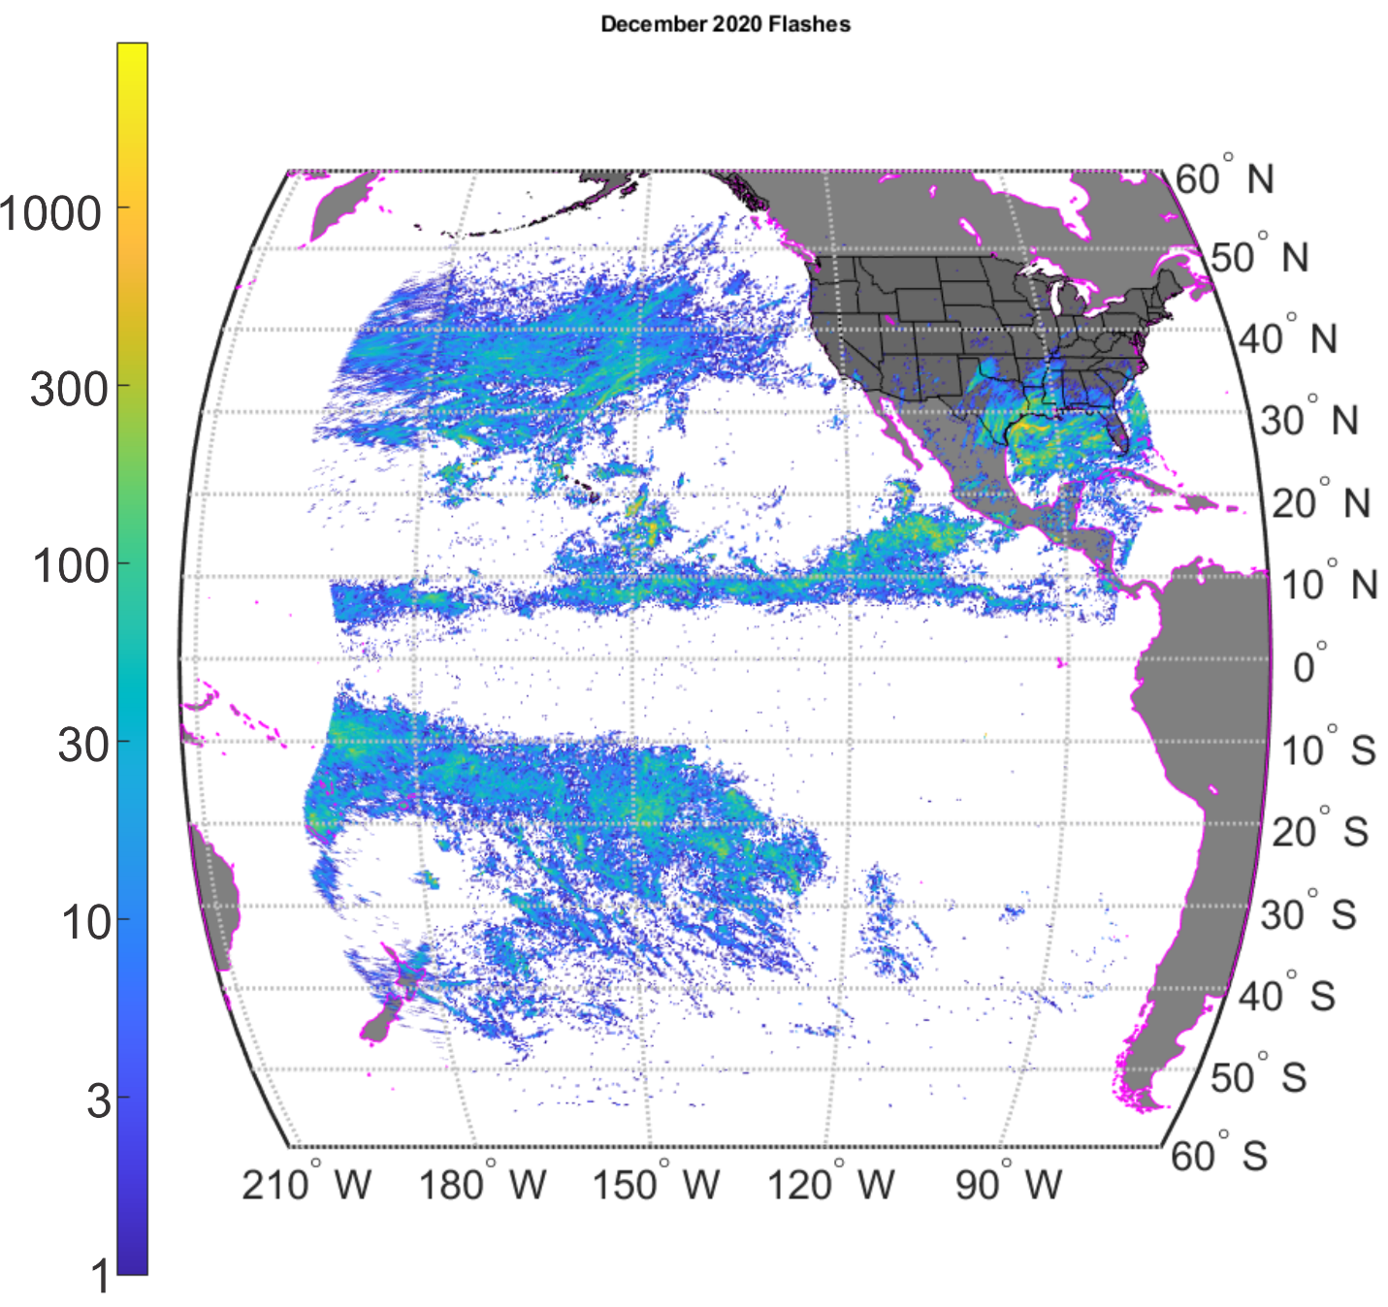
L1b-L2 LCFA Code (Mach/USRA)
PASSED
PLPT-GLM-009
Example LCFA Flashes for December 2020
No orphaned/parentless clustering errors
Clustering working well (other than artificial limits)
Flash single group filter can be improved
Notes:
Sample size: 133,055,347 matches (GLM-16) and 223,578 matches (ISS-LIS)

Slide 47
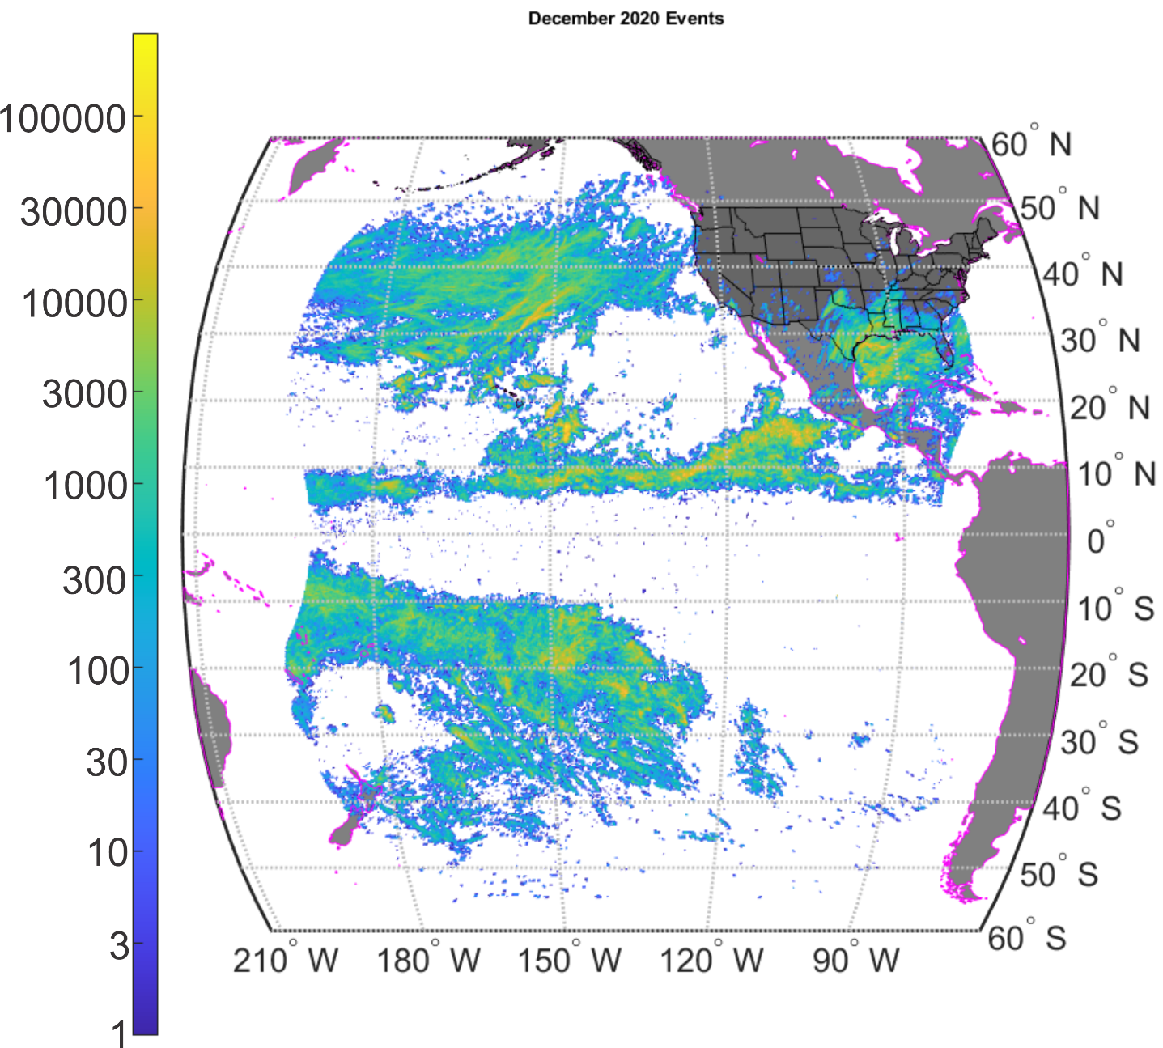
L0-L1b Code (Mach/USRA)
PASSED
PLPT-GLM-010
Example Filtered Events for December 2020
Most glint/blooming removed
Improvements beyond spec still possible
Notes:
Sample size: 133,055,347 matches (GLM-16) and 223,578 matches (ISS-LIS)

Slide 48
INR Analyses
(Armstrong/MIT LL; Tan, Igli, Reth /NASA Flight)
PASSED
PLPT-GLM-011
IPATS NS & EW angle shifts (µ ± 3σ values) plotted for late 2020/early 2021
IPATS shows good overall performance for days having over 1000 measurements (blue)
  Days with less than 1000 measurements (orange)
IPATS σ-value impacted by cloud motion & non-simultaneity of ABI/GLM backgrnd images
Larger EW-shifts near solstice, lower illumination over North America
±140 µrad MRD
2020
2021
Notes:
Sample size: 133,055,347 matches (GLM-16) and 223,578 matches (ISS-LIS)

Slide 49
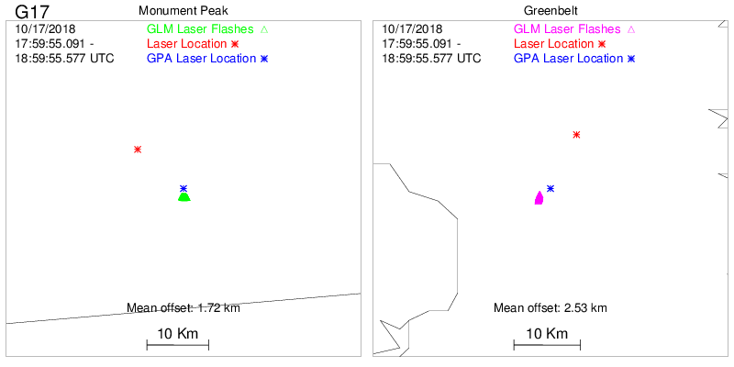
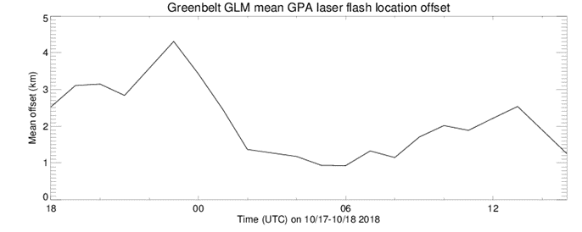


Laser Beacon Analyses
(Buechler/UAH)
PASSED
PLPT-GLM-011
Lower Plot Shows Laser Beacon Locations in GLM data (30-Nov-2017)
GLM GPA locations within 5 km of laser location during 24 hr (17-18 Oct 2018) period from Greenbelt site and for 1800 UTC from the Monument Peak site. (the Monument Peak laser was inoperable after the initial operation)
Monument Peak experienced problem after initial planned hourly operation
GLMGPA location offsets were within 5 km (MRD requirement)
Notes:
Sample size: 133,055,347 matches (GLM-16) and 223,578 matches (ISS-LIS)

Slide 50
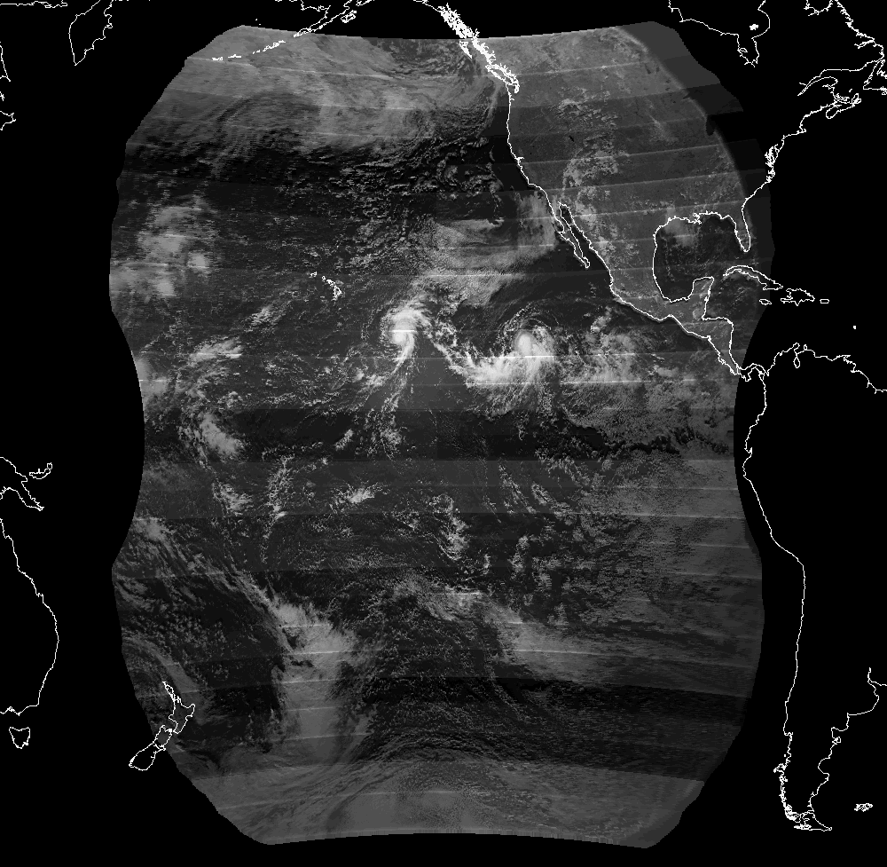
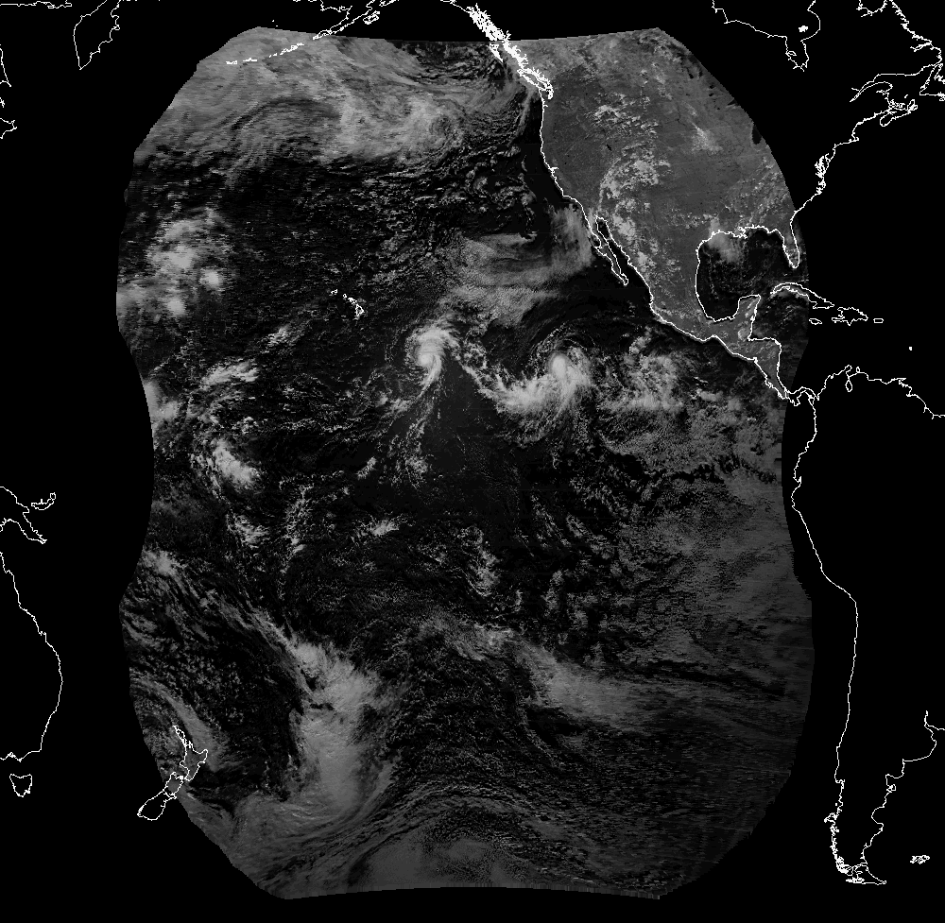
Deep Convective Cloud (DCC) Analyses
(Buechler/UAH)
PLPT-GLM-012
Uncalibrated GLM BG
Calibrated GLM BG
Notes:
Sample size: 133,055,347 matches (GLM-16) and 223,578 matches (ISS-LIS)

Slide 51
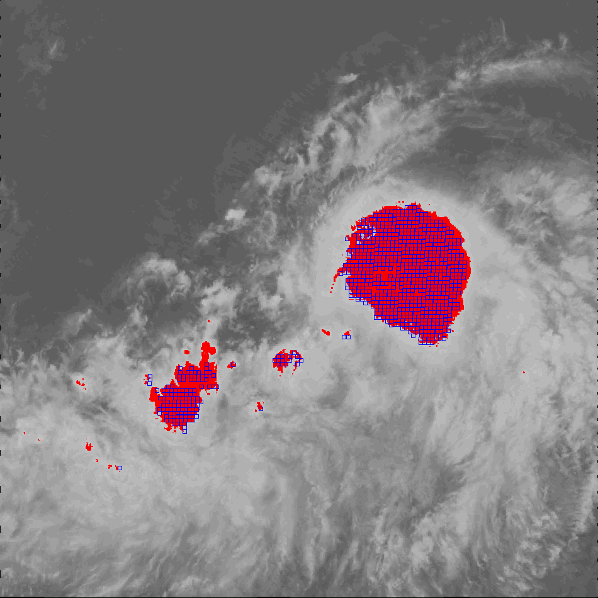
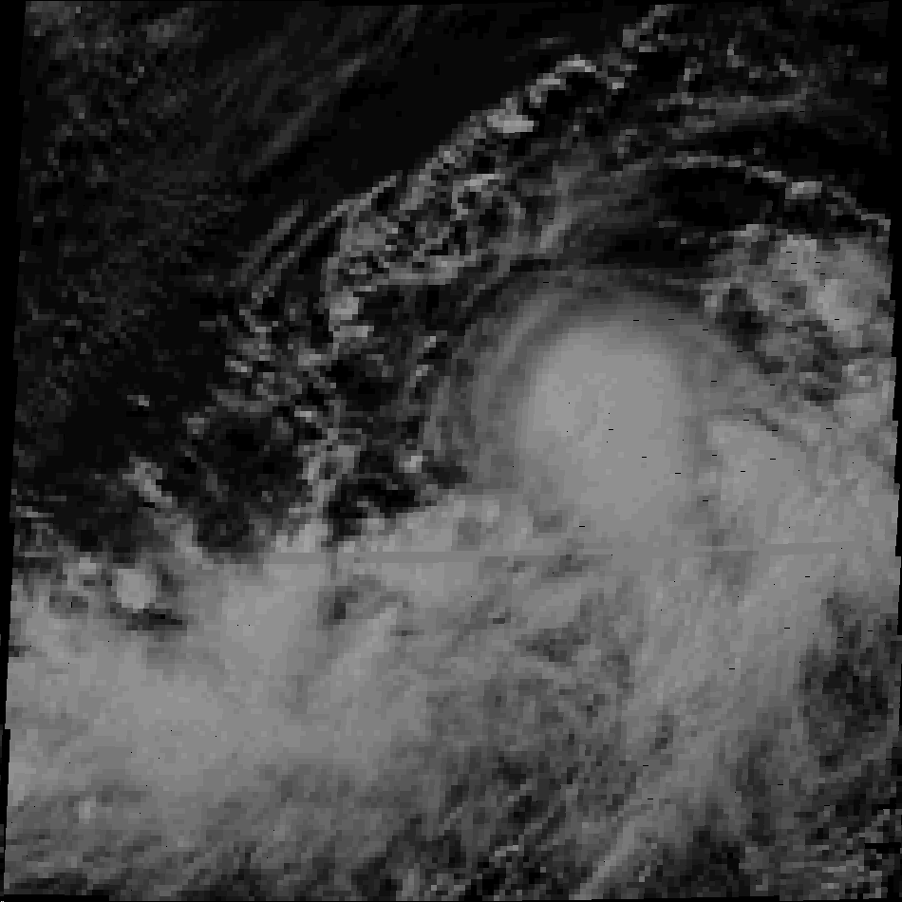
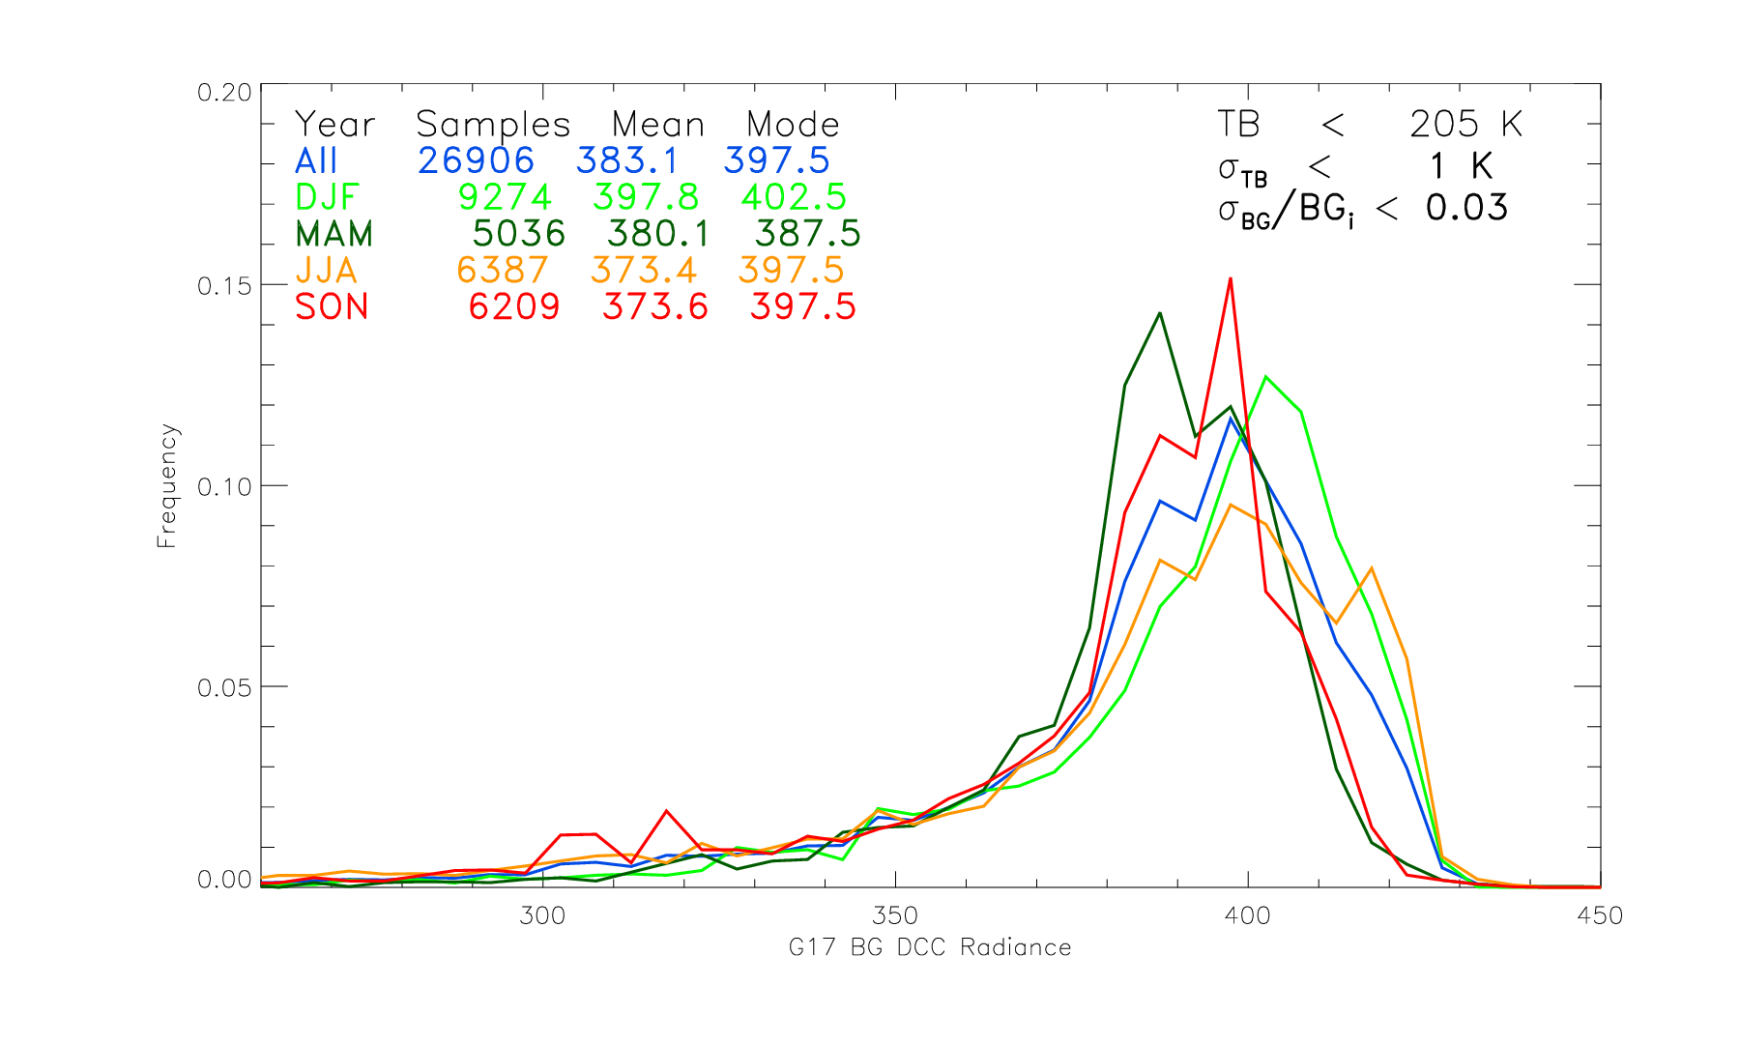
Deep Convective Cloud (DCC) Analyses
(Buechler/UAH)
ABI IR (ch14)
GLM BG
PASSED
PLPT-GLM-012
TB < 205 (red)
GLM BG (blue)
Seasonal DCC distributions
GLM background pixels co-located with ABI CH14 TB < 205K
SZA and SenZA < 40˚
Broad peak likely due to location of DCC within FOV and RTEPs.
Values consistent with TRMM LIS
Notes:
Sample size: 133,055,347 matches (GLM-16) and 223,578 matches (ISS-LIS)

Slide 52
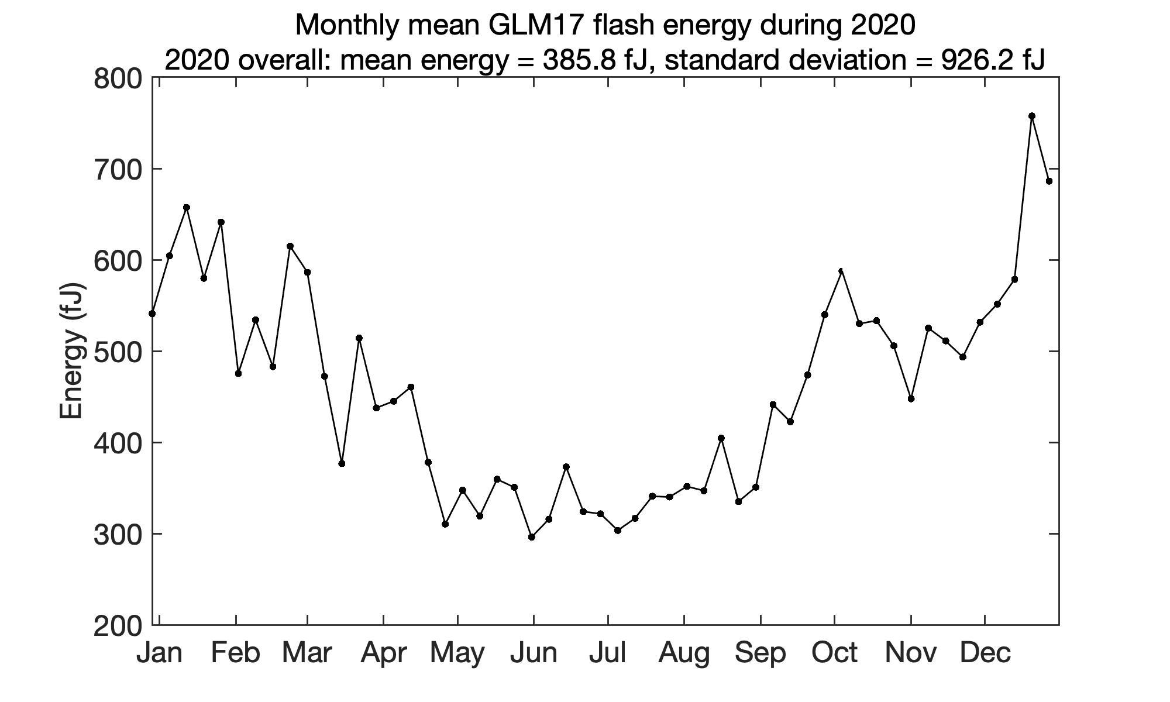
Flash Energy Trending
(Virts/UAH; Koshak/MSFC)
PASSED
PLPT-GLM-013
Period: 2020
Seasonal Effect (flash energies peak in Winter per LIS study in Koshak, 2017)
Mean of 385.8 f J (254.3 f J in G16 Full):
Boresight Effect*
(most G17 flashes at
large boresight)
Ocean Effect (many
G17 flashes over
ocean; are more
energetic there)
52
* Instrument Min detectable energy increases toward edge of FOV.

Slide 53
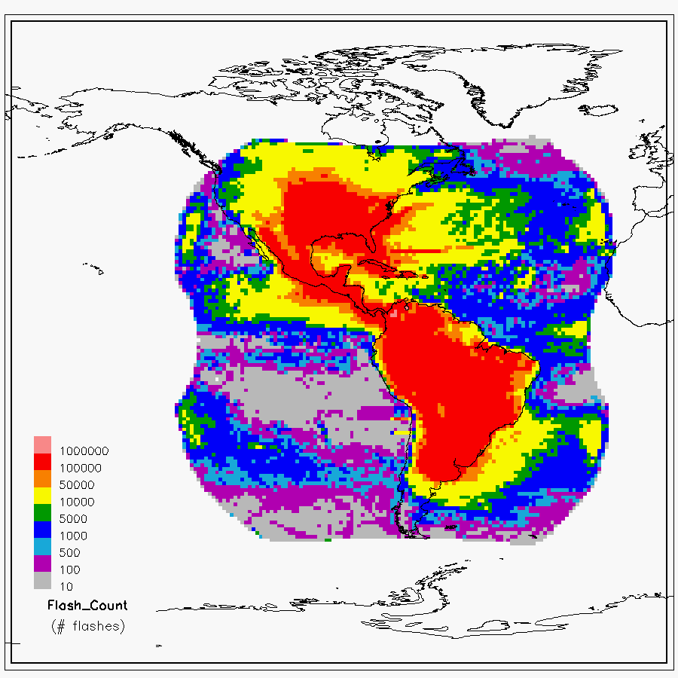
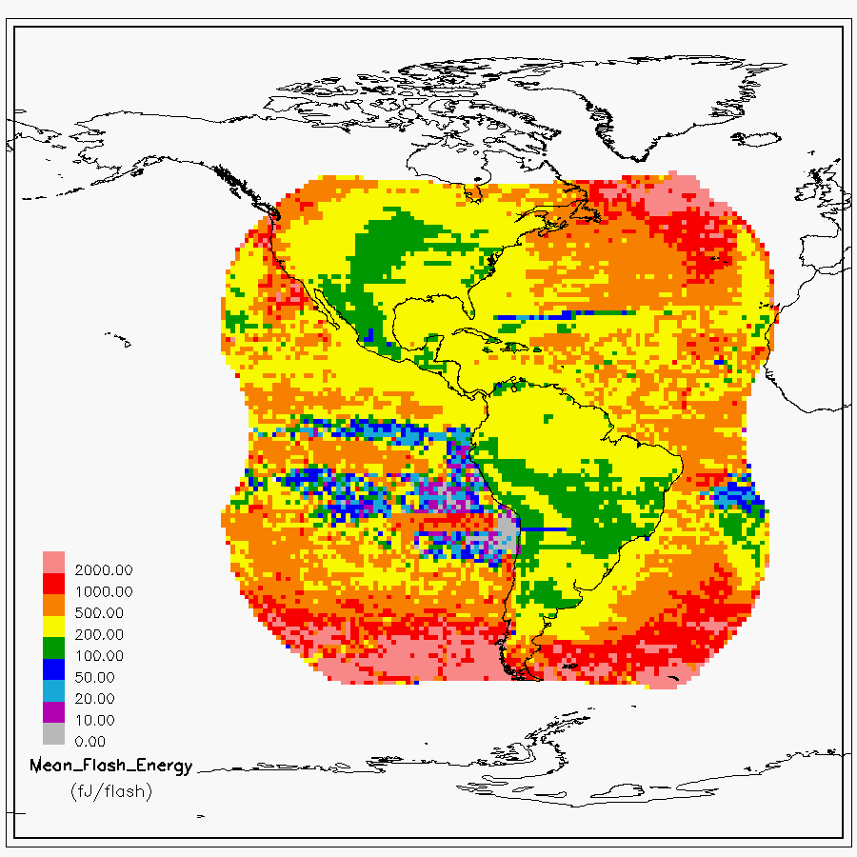
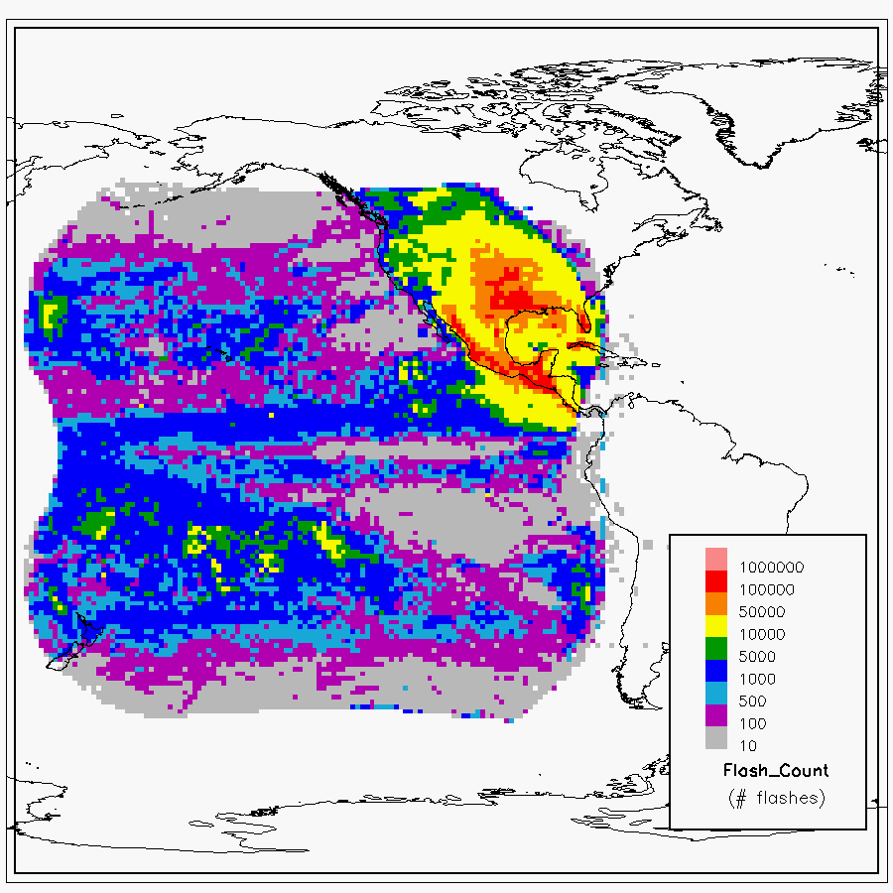
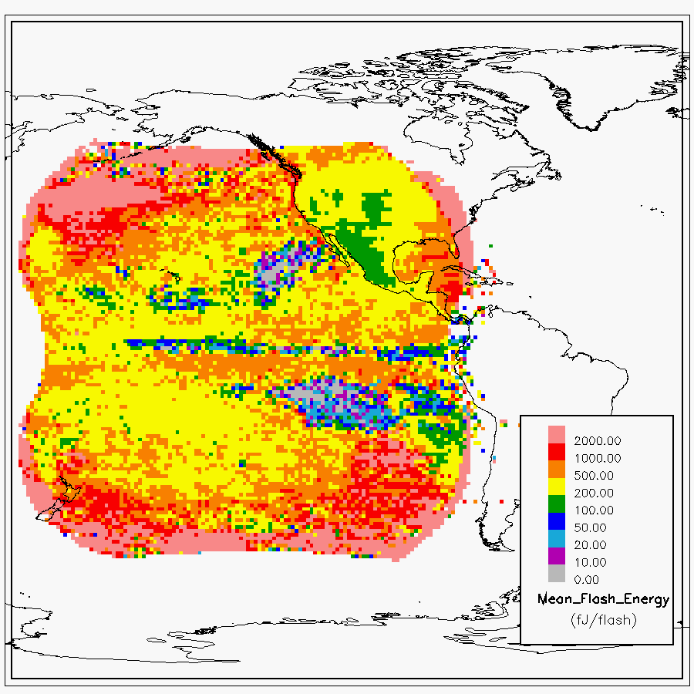
… more detail on Boresight & Oceanic Effects
(Koshak/MSFC)
GLM16 Count
GLM16 Energy
589 days (1 yr 7.4 mo)
(01Jan2018 – 12Aug2019)
GLM17 Count
GLM17 Energy
252 days (8.4 mo)
(04Dec2018 – 12Aug2019)
G16 had MUCH more flashes (@ small boresight & over land) where energy is small
G17 had MANY flashes (@ large boresight & over ocean) where energy is big
53

Slide 54
Outline
Introduction
Performance Summary
PLPT Details
Progress Since Provisional Review
Assessment of Maturity
Summary and Recommendations

Slide 55
Some “Ancient” History
(GLM-17 PROV PS-PVR 20 Dec 2018)
WR | ADR | Title | PR or DO | Date in OE | Impact
5996 | 628 | GLM - Add Parenthetical Information to CALINR LUTs | PR.07.00.01 | 15 Oct 2018 | other
3561 | 674 | Update GLM EFRC Algorithm to use updated CALINR format provided by GLM Flight | DO.07.00.00 | 15 Oct 2018 | other
4477 | -- | GLM L2 LCFA product has ‘n/a’ for production_data_source | DO.07.00.00 | 15 Oct 2018 | other
4507 | 338 | Use adjusted event times in Lightning L2+ product (TOF & associated) | DO.07.00.00 | 15 Oct 2018 | time
4696 | 382 | Group and flash areas GLM L2 (Discrepancy 20% between GS & LM) | DO.07.00.00 | 15 Oct 2018 | areas
5301 | 483 | GLM FM2 GPA LUTs for GOES-S | DO.07.00.00 | 15 Oct 2018 | DE/FAR
6466 | 740 | Duplicate Groups & Events Found in GLM L2 files | DO.07.00.00 | 15 Oct 2018 | energetics
6681 | 844 | GLM L2 Lightning needs _Unsigned on time offsets | PR.07.03.01 | 05 Nov 2018 | time
5930 | 615 | Burst of GLM events caused GLM L2+ outage (e.g., EXIS cruciform scans) | PR.07.02.00 | 05 Nov 2018 | FAR/DE
6073 | 638 | GLM glint box updated/fixed | PR.07.04.00 | Week of 3 Dec 2018 | FAR/DE
n/a | 855 | Update GOES-17 GLM Rev C LUT [for improved GS RTEP settings (i.e. replace 100 DN pre-launch settings), implement legacy 2nd Level Threshold settings to mute hot pixels, and implement Parallax Lite]. Rev C supersedes the LUT changes associated with WRs (6512, 6513, 6588) for (LUTI, Rev A, and Rev B, respectively). | PR.07.03.04 | 03 Dec 2018 | DE/FAR, location
Priority Key | 1 | 2 | 3

Slide 56
Status at Provisional Maturity
 | Past Status | Current Status | Future Outlook
DE | Performance has been stable without critical issues, but is notably reduced by ~ 10% from expectations (i.e. compared to G16) since RTEP thresholds were still @ ~100 DN pre-launch setting Want more assessments over other regions, seasons | More validation data accumulated with some regional gap filling Bulk (full FOV) spatially averaged performance value from VaLiD meeting spec DE value very sensitive to computation method and reference data filtering Low DE values near limb (large water/ice absorption on long slant path … see KSC storm LMA analysis) | After DO.08 2nd Lev Thresh deployed, thresholds will be lower resulting in better DE Want to further improve DE by adding L2 “put back algorithm” Keep 1st event in flash in DO.08 (does not increase DE, but increases detected details of a flash)
FAR | Bulk FAR value across GLM FOV needed to better quantify performance Blooming & Glint Filter design details and testing are mature; minor optimization expected Blooming and Glint filter should be in place for DO.08 (in April 2019) “Put Back” filter is still under development | GLM FAR (bulk FOV value) obtained but doesn’t meet spec since blooming filter & other noise reduction methods not yet implemented Blooming Filter design details and testing are mature; minor optimization expected Blooming and Glint filter should be in Dev. Env. for DO.08 in April 2019 | Implementation of Blooming Filter will mitigate solar glint/intrusion and improve FAR Bruning Gridded Product (incl. data quality) Meta-code to become ADR submission
INR/time | Critical issues have been resolved Recent performance is acceptable Major remaining issues: Time-of-Flight correction still needed in L2 (is implemented in L1b) Time order still an issue | Mode of location/timing error distributions meet spec Post-drift INR meeting spec Lightning ellipsoid parameters optimized to mitigate parallax Time-of-Flight correction now implemented in L2 Time order still an issue (considered low priority) | Monthly 3 degree grid cloud-top height maps desired to further reduce parallax Account for diurnal variation of INR in DO.08 Time order to be fixed in DO.08

Slide 57
Progress in 2019
WR | ADR | Title | PR or DO | Date in OE | Impact
6558 | 179 | Change GLM L2 Group and Flash Area units from km² to m² | PR.07.06.00 | 1/28/19 | areas
6097 | 647 | Implement GLM 2nd-level threshold filter code change (for optimal threshold adjustment) | PR.07.08.00 | 2/27/19 | DE/FAR
6098 | 649 | Implement GLM Data Burst filter code change (allows variable number of RTEPs within a Data Formatter to observe a data burst instead of the fixed value of 4) | PR.07.08.00 | 2/27/19 | FAR/DE
6460F | 645 | GLM Parallax (monthly topography approach) … closed 3/19/19 | N/A | N/A | location
7095 | 926 | GLM FM1 CDRL 79 Rev K LUT | PR.07.10.05 | 4/30/19 | DE/FAR
7095 | 928 | GLM FM2 CDRL 79 Rev D LUT [Note: WR5981F/ADR648 closed 5/13/19 because ADR 926/928 LUT updates sufficient] | PR.07.10.05 | 4/30/19 | DE/FAR
4758 | 373 | GLM Event Geolocation Does Not Match Vendor Results | DO.08.00.00 | 7/25/19 | location
4679, 5937 | 374 | GLM Blooming Filter | DO.08.00.00 | 7/25/19 | FAR
5016 | -- | GLM Coastline algorithm falls behind, BG images are missed | DO.08.00.00 | other | BG
6096 | 687 | LUT Filenames not Traceable to Metadata - ABI GLM | DO.08.00.00 | 7/25/19 | LUT used
6116 | 701 | GLM L2+ LCFA Product’s Yaw Flip Flag is fill (yaw flip state now given in L2) | DO.08.00.00 | 7/25/19 | yaw state
6465 7369 | 738 | GLM Optical Energy Distortions in PDA Stream (scale_factor, add_offset) | PR.08.03.04 | 10/02/19 | energy resolution
7369 | 739 | GLM Zero Energy Events and Groups (corrected using ADR 738) | PR.08.03.04 | 10/02/19 | energy values
Priority Key | 1 | 2 | 3

Slide 58
Progress in 2020
WR | ADR | Title | PR or DO | Date in OE | Impact
5983F | 650 | GLM GPA INR: Account for Diurnal Variation … closed 2/11/20 | N/A | N/A | location
5480 | 519 | GLM Lightning LCFA L2 Radiation Filter Threshold [remove all SGFs regardless of the number of events] | DO.09.02.00 | 10/27/20 | DE/FAR
6809 | 879 | GOES-17 GLM Event Longitude Values [correct event geolocation for events west of 180 deg] | DO.09.02.00 | 10/27/20 | location
6865 | 903 | GLM Geolocate Does Not Handle Empty EFRC Output Correctly [EFRC = Event Filter and Radiometric Caibration] | DO.09.02.00 | 10/27/20 | latency
7129 | 961 | Time Error in GLM Metadata [Metadata GLM-17 data product files sometimes has incorrect time info] | DO.09.02.00 | 10/27/20 | time
6690 | N/A | GLM L1b intermediate metadata inconsistent with product data | DO.09.05.00 | TBD | reporting
7990 | 1109 | GLM Flash Area equals Fill Value for Large Flashes | DO.09.05.00 | TBD | areas
Priority Key | 1 | 2 | 3

Slide 59
Status at Full Maturity
 | Past Status | Current Status | Future Outlook
DE | More validation data accumulated with some regional gap filling Bulk (full FOV) spatially averaged performance value from VaLiD meeting spec DE value very sensitive to computation method and reference data filtering Low DE values near limb (large water/ice absorption on long slant path … see KSC storm LMA analysis) | Performance has been good and stable without critical issues & meets spec In addition to ground-truth, DE has now been successfully assessed also by threshold method & detailed simulation method Progress in determining cause of low DE cases (e.g., Inverted Polarity and Severe Weather storms) Single Group Filter (SGF) implemented | Good instrument Improve performance with Triple Wide Setting Want to improve description of the flash (and potentially DE) by adding L2 “put back algorithm” (including keeping 1st group) Replace SGF with a Single Event Filter (SEF) since radiation “dots” usually create only 1 event flashes
FAR | GLM FAR (bulk FOV value) obtained but doesn’t meet spec since blooming filter & other noise reduction methods not yet implemented Blooming Filter design details and testing are mature; minor optimization expected Blooming and Glint filter should be in Dev. Env. for DO.08 in April 2019 | Blooming filter & other noise reduction methods verified to reduce GLM FAR [BF finalized/implemented] Reference networks determined to be inadequate outside of CONUS to give true GLM FAR (as verified by simulations) Increasing time window in VaLiD & Simulations both indicate GLM is homogeneous (so meets spec over its full FOV just as over CONUS) | Improve performance with Triple Wide Setting Bruning Gridded Product (including data quality) meta-code to become ADR submission
INR/time | Mode of location/timing error distributions meet spec Post-drift INR meeting spec Lightning ellipsoid parameters optimized to mitigate parallax Time-of-Flight correction now implemented in L2 Time order still an issue (considered low priority) | Performance has been good and stable without critical issues & meets spec Time order (ADR 375/1140) to be worked on (low priority) Metadata time order (ADR 961) fixed Event longitudes west of 180 W fixed Monthly topographic method for parallax mitigation not implemented Diurnal variation of INR closed | Desire to fix time order (ADR 375/1140) Desire to implement monthly topographic method for further mitigating parallax error Desire to have a 24-hr laser beacon session from Monument Peak to look at diurnal variation for G17 GLM in the west slot

Slide 60
Future Fixes
(WRs for beyond DO.09.05.00)
WR | ADR | Title | Build/State | Impacts
6412 | 549 | Eliminate GLM L1b dependency on APIDs 384 and 385 | TBD | data availability
7178 | 906 | GLM L1b – Ingest Directly Instrument Vendor CDRL079 Calibration Data Books | TBD | ingest data CDRL079
7538 | 1060 | Interim Solution to Facilitate GLM Gridded Data | TBD | gridded data
4705 (on hold) | 375 | Time Order, GLM L2 [originally planned for DO.09.00.00; see ADR1140] | Hold (4/19/21) | time
TBD | 1140 on hold | GLM Time Order Rule Change - ADR 375 follow-on | Hold (2/22/21) | time
4662F | 461 | GLM Data Quality Product | Hold (4/26/21) | quality
-- | 646 | GLM Gridded Product | Hold (4/26/21) | gridded data
7449 | -- | GLM Geographic Coverage Extents are incorrect [The lat_field_of_view_bounds and lon_field_of_view_bounds variables in the GLM L2 OMAS templates are incorrect.] | Hold (2/1/22) | FOV
Priority Key | 1 | 2 | 3

Slide 61
Outline
Introduction
Performance Summary
PLPT Details
Progress Since Provisional Review
Assessment of Maturity
Summary and Recommendations

Slide 62
Product Maturity Assessment
Preparation Activities | Assessment
Validation, Q&A, and anomaly resolution activities are ongoing | PLPTs have been completed. Validation in the form of near real time monitoring and periodic summary will continue. Anomaly resolution is ongoing.
Incremental product improvements may still be occurring | ADRs and WRs continue to be generated and resolved, as expected in normal operation.
Users are engaged and user feedback is assessed | Yes [ongoing]. GLM Value Assessment report completed.

Slide 63
Product Maturity Assessment (cont.)
End State | Assessment
Product performance for all products is defined and documented over a wide range of representative conditions via ongoing ground-truth and validation efforts | All aspects of performance for all GLM-17 L2 products have been defined in MRD and prelaunch baseline, evaluated with a series of PLPTs at Provisional and recently (for Full) over a wide range of representative conditions via ongoing validation efforts.
Products are operationally optimized, as necessary, considering mission parameters of cost, schedule, and technical competence as compared to user expectations | GLM-17 L2 products have been produced operational by the GS according to spec. [Val Ref data inadequate to fully evaluate FAR, but adjusts to VaLiD time window, and Simulations both point to GLM-17 meeting FAR spec, like it does over CONUS ]
All known product anomalies are documented and shared with the user community | ReadMe and the PS-PVR presentation are documented and shared with user community.
Product is operational | GLM-17 L2 products have been operational since 20 Dec 2018 (PROV PS-PVR).

Slide 64
Outline
Introduction
Performance Summary
PLPT Details
Progress Since Provisional Review
Assessment of Maturity
Summary and Recommendations

Slide 65
Summary
(all specs met: see slide 11 for summary of numerical details)
Flash DE meeting spec:
  Substantiated in detail by VaLiD tool using combined ground reference network data
  Further substantiated using Threshold Method (Cummins, AMS2021) … agrees VERY well w/VaLiD !!
  Further substantiated with Simulation Method (Koshak, 2019; Virts and Koshak, 2021)
Flash FAR inferred to meet spec:
  Blooming Filter design finalized & implemented 25 July 2019; other improvements (e.g. 2nd Level Threshold filter adjusted) also implemented
  Blooming Filter et al. have been verified to reduce GLM-17 FAR
  Determined ref networks inadequate to fully assess FAR over ocean where ref net DE is low: when ref net misses a flash it unfairly makes GLM look like it is false alarming when in fact it is not. (see Slide 30)
  Increasing VaLiD time-window, and simulations, both show GLM-17 FAR is actually better than low DE ref network suggests. GLM-17 is a homogeneous detector, so we believe best estimate of GLM-17 FAR are the (spec-meeting) values over CONUS.
Location and associated INR meeting spec:
  Parallax mitigated by implemention of improved lightning ellipsoid parameters
  Further improvements could be obtained if Monthly Topography Model is implemented
Timing accuracy meeting spec:
  But low-priority time-order issue (ADR 375/1140) to be fixed.
Future improvements:
  Replace Single Group Filter (SGF) with Single Event Filter (SEF)
  Implement a “put back filter”; includes keeping first group in flash
  New Products (Data Quality ADR 461, Gridded ADR 646) desired but need approval.

Slide 66
Recommendation for Full Maturity
Introduced CWG principles & approaches to GLM Val pursuant to the RIMP.
Provided Performance Baselines to be validated, and summarized overall compliance with requirements.
Summarized results from pertinent PLPTs that further detail compliance (including associated recent ongoing analyses).
Reviewed progress since PROV (including any fixes of issues identified at PROV PS-PVR), and assessed current status (including open ADRs/WRs).
Made Assessment of the Full Validation Maturity per GOES-R program.

Slide 67
Recommendation
CWG believes that the GOES-17 GLM L2
product (events, groups, flashes) has reached
Full Maturity as defined by the GOES-R Program, and therefore recommends that this product be transitioned to Full Validation Maturity status at this time.

