Slide 1
GLM Value Assessment Overview
Geostationary Lightning Mapper (GLM) value assessment (VA) aims to advise future satellite architecture decisions
Societal and forecast benefits are captured regardless of whether than can be quantified in dollars
Study evaluates GLM value by documenting benefits to the public via decisions made by end users
Identify well documented benefit pools where the GLM adds value, and suggest analysis required to accurately document which fraction of this potential value is being realized
Operational use cases help illustrate GLM value being realized through operational decisions by a wide variety of decision makers (i.e., both NWS and non-NWS)
Link: https://repository.library.noaa.gov/view/noaa/27429

Slide 2
Premise Statements
Application Area | Premise Statement
Improving Lightning Safety* | The GLM improves public safety across broad segments of society, and the socioeconomic benefit continues to grow as access is gained by users traditionally unable to afford lightning data (e.g., emergency managers, event organizers, local athletics officials, and the public).
Improving Severe Thunderstorm and Tornado Warnings* | Integrating GLM data into the severe weather warning process promotes earlier warning decisions, better assessment of the areal coverage of hazards, and fewer false alarms, especially during radar outages and in regions of poor radar coverage.
Improving Safety and Effectiveness of Wildfire Response* | The GLM benefits the firefighting community through unique identification of continuing current lightning strikes most likely to ignite fires, better pyrocumulonimbus characterization, and thunderstorm tracking in areas lacking robust radar coverage.
Improving Short-term Model Forecasts (Data Assimilation) | Lightning data assimilation (DA) is relatively new, especially GLM DA, but early results indicate many benefits, especially for short-range forecasts of radar reflectivity, accumulated precipitation, and lightning threat in convection-allowing models.
Improving Precipitation Estimation | The GLM observations improve satellite precipitation estimates, benefiting flash flood forecasting in significant portions of the western US, Hawaii, and US territorial islands without adequate radar coverage.
Improving Tropical Cyclone Diagnosis and Warning | The GLM identifies convective tendencies below cloud top in tropical cyclones (TCs) which helps better diagnosis TC structure and evolution and aids forecasts of TC intensity change including rapid intensification.
Improving Climate Applications | GLM data offer unique insights for monitoring climate-scale variability and response in a changing climate, a close link between lightning and convective cloud properties makes it an essential indicator of inter-annual to decadal change and a key variable for validating climate models.
Value of Filling Data Gaps* | The GLM’s broad spatial coverage and rapid temporal updates complement radar observations over CONUS to support severe weather warning decisions, and rapidly updating GLM observations over vast (often data sparse) regions outside CONUS provide decision makers with information they need to forecast, monitor, and react to thunderstorms, cyclones, and volcanic hazards at a faster cadence than ABI.
Value of Mitigating Aviation Hazards | The GLM observes the complete spatial footprint of total lightning flashes, which helps better characterize the lightning risk and increase confidence/certainty when suspending and resuming ramp operations, leading to enhanced safety, improved efficiency, and cost savings. The GLMs broad coverage and rapid updates provide tremendous cost savings to the aviation industry through improved diagnosis and avoidance of thunderstorm hazards, especially over oceans.
* Will discuss on subsequent slide

Slide 3
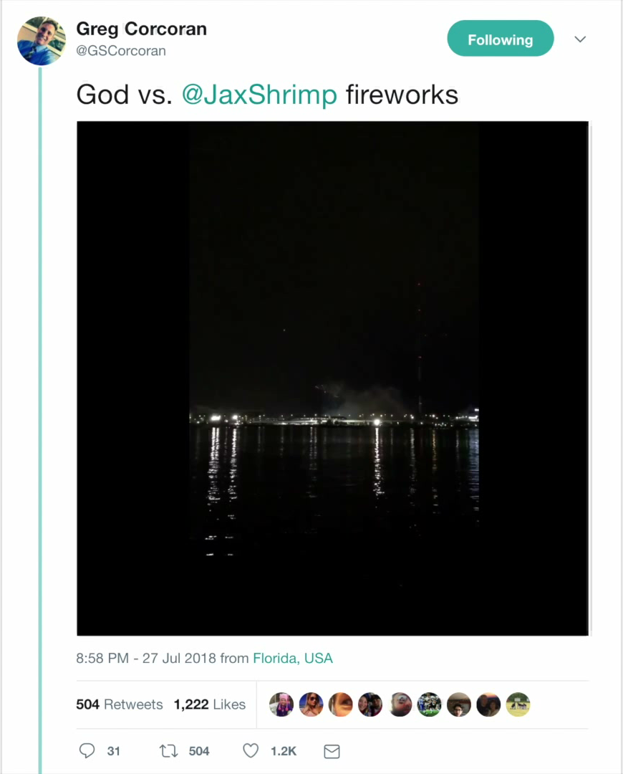
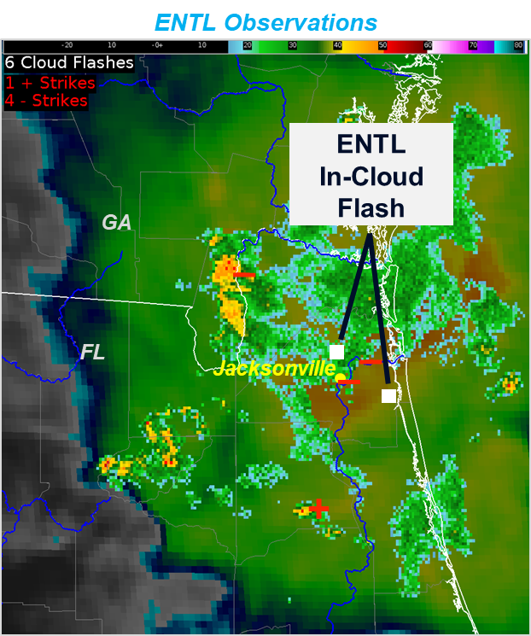
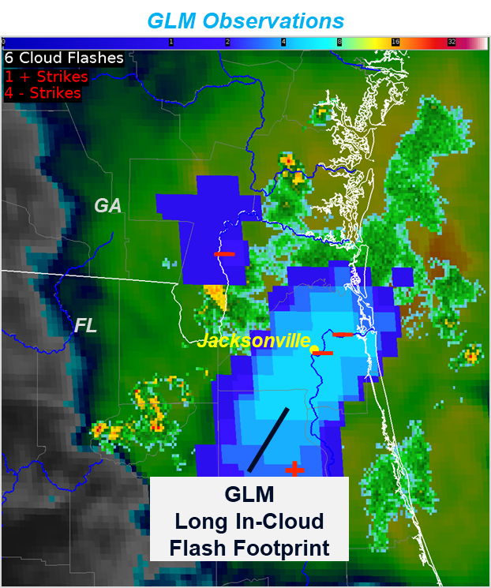
Improving Lightning Safety
The GLM improves public safety across broad segments of society, and the socioeconomic benefit continues to grow as access is gained by users traditionally unable to afford lightning data (e.g., emergency managers, event organizers, local athletics officials, and the public)
GLM depicts the entire flash footprint, revealing a connection between these distant storm cores not readily apparent with the ENTLN flash locations
Video shows long lightning channel striking ground several km apart

Slide 4
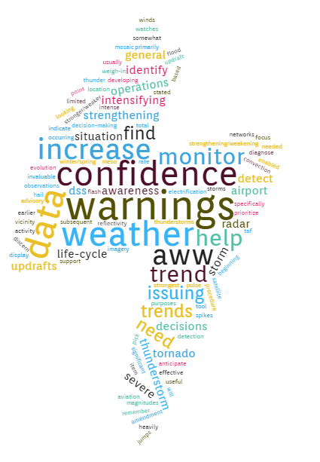
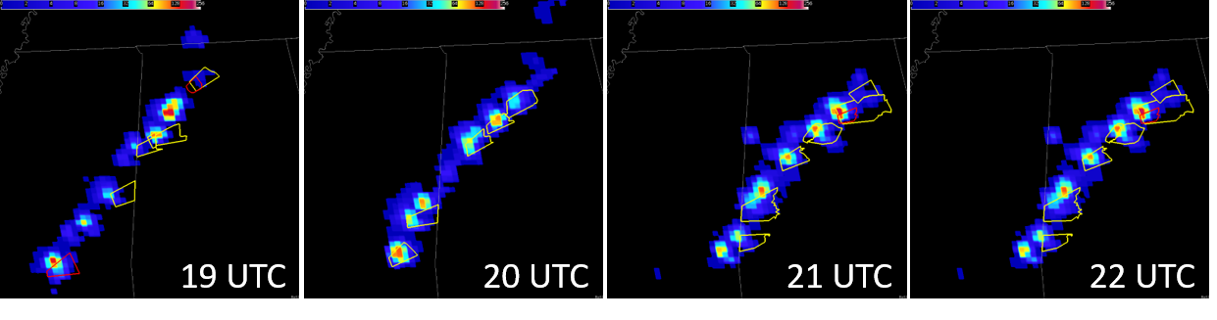
Improving Severe Thunderstorm and Tornado Warnings
Integrating GLM data into the severe weather warning process promotes earlier and easier warning decisions, better assessment of the areal coverage of hazards, and fewer false alarms, especially during radar outages and in regions of poor radar coverage.
NWS HUN GLM Survey
“In what ways do you use GLM during convective events, if any?”
Warmer colors in the Flash Extent Density indicate the most frequent GLM flashes, with maxima commonly collocated with severe thunderstorm (yellow) and tornado (red) warning polygons.

Slide 5
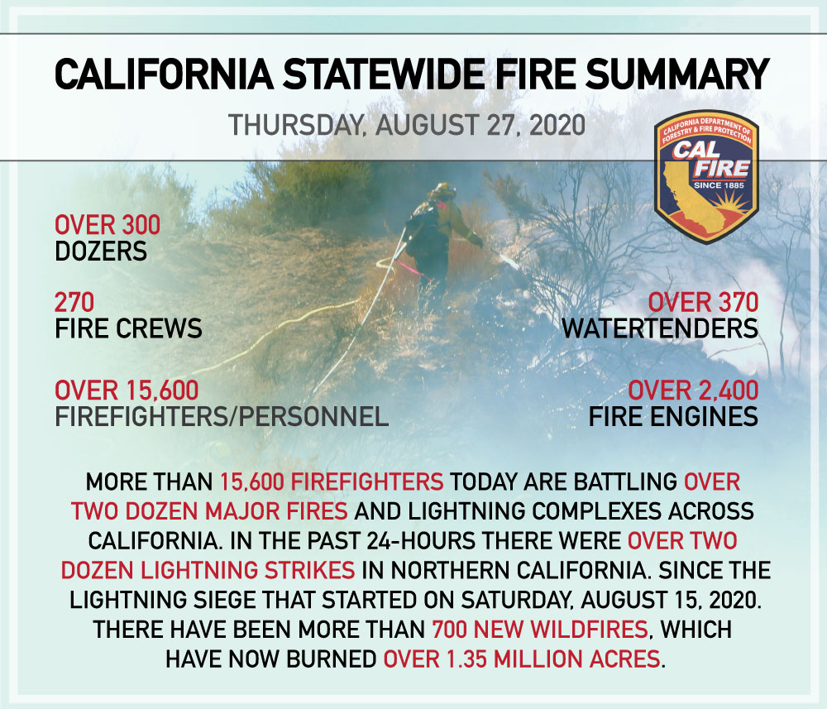
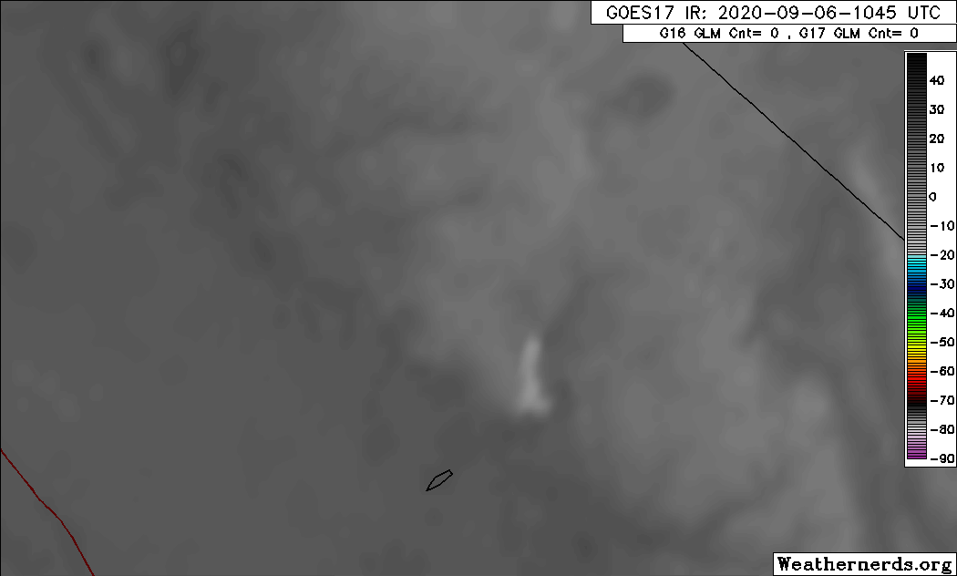
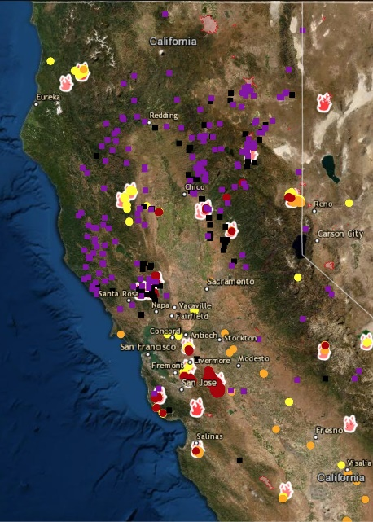
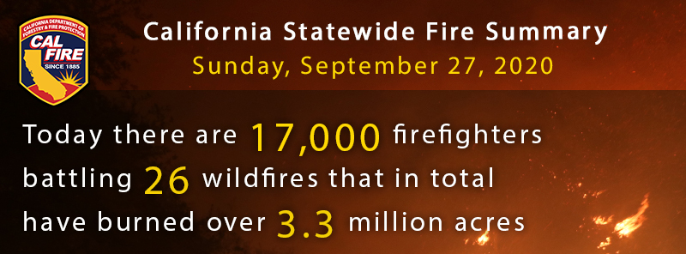
Improving Safety and Effectiveness of Wildfire Response
The GLM benefits the firefighting community through unique identification of continuing current lightning strikes most likely to ignite fires, better pyrocumulonimbus characterization, and thunderstorm tracking in areas lacking robust radar coverage.

Slide 6
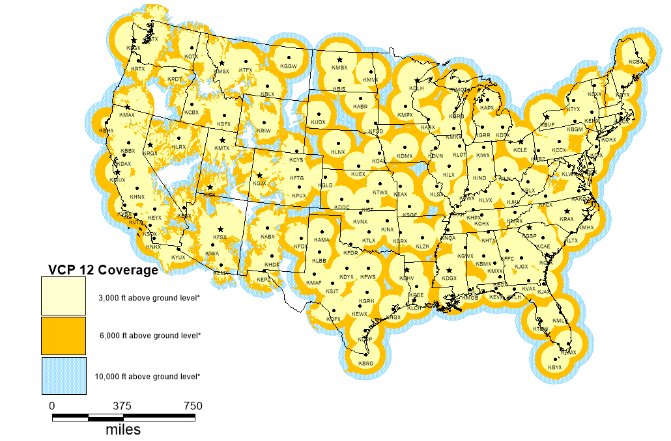
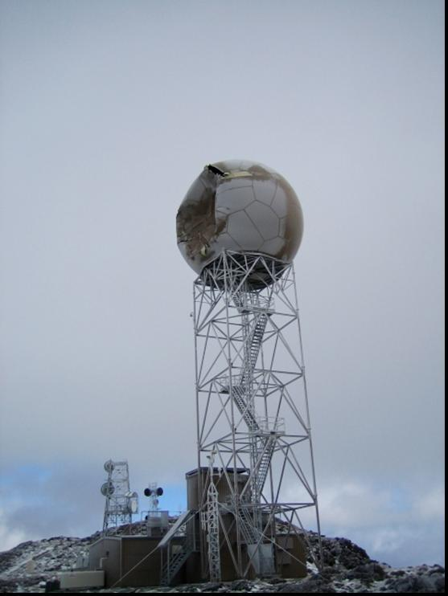
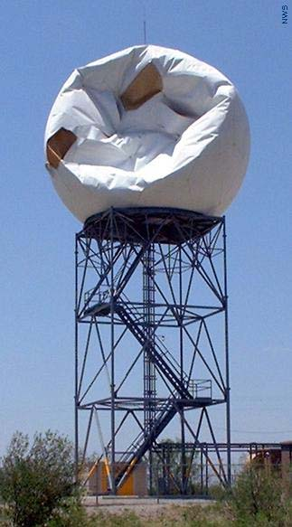
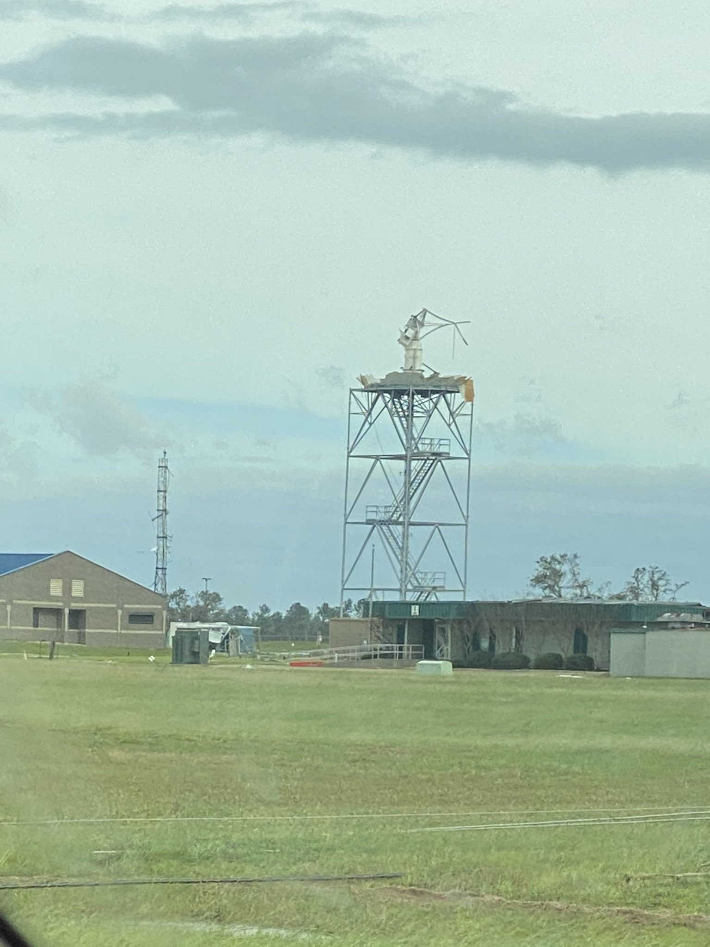
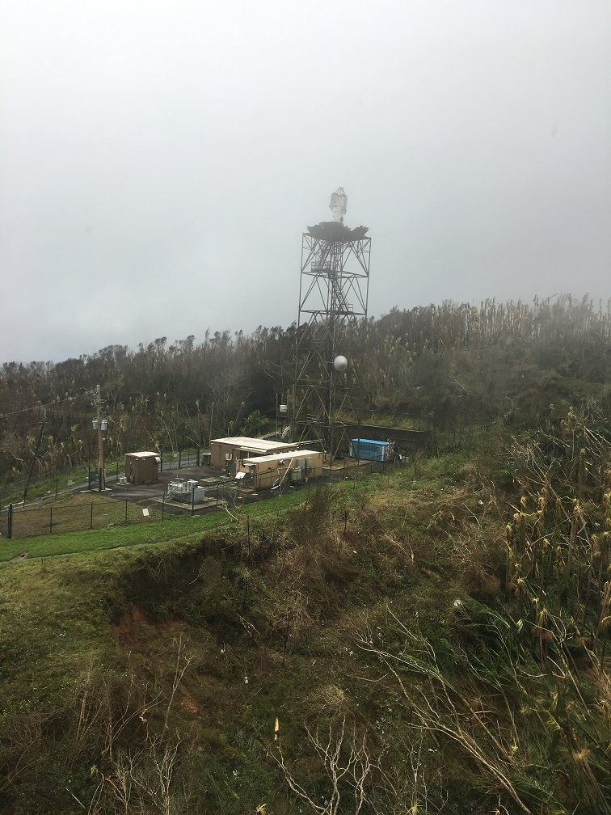
Value of Filling Data Gaps
The GLM’s broad spatial coverage and rapid temporal updates complement radar observations over CONUS to better support forecaster warning decisions, and rapidly updating GLM observations over vast (often data sparse) regions provide decision makers with information they need to forecast, monitor, and react to thunderstorm hazards.
Hurricane Maria required FEMA/NWS San Juan to use GLM as a radar replacement to help the restoration crews avoid lightning, and as a proxy for heavy rainfall while the radar was being restored (September – April).
Above: WSR-88D Radar Coverage
Far Left: Shipping traffic density
Left: Extreme weather-related radar damage

Slide 7
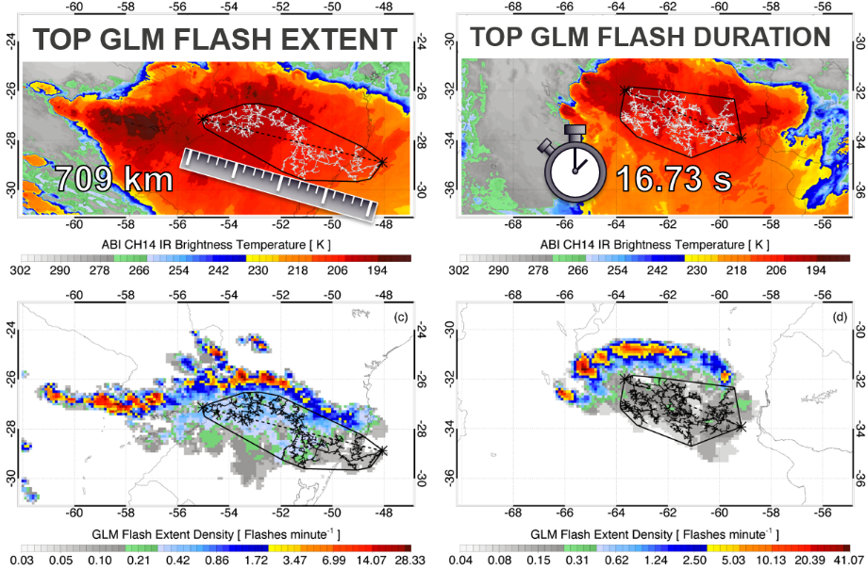
GLM Value Assessment Summary
Only four years since becoming reality, the GLM is shown to be establishing a legacy of applications likely to become ubiquitous across a wide variety of meteorological domains.
The GLM now provides a national and international baseline of freely available lightning data and establishes a baseline for widespread government and industry implementation.
The GLM moves from traditional point sources of lightning information to a rapidly-updating 2-D map that accurately portrays the full spatial extent of lightning activity.
Many operational users (e.g., NWS) have eagerly embraced this new source of lightning information and incorporated it into their workflow.
The GLM value will quickly multiply as the realized benefits spread.
Despite widespread use of lightning datasets, the GLM remains in its infancy and much of its value still waiting to be fully realized.
Document Link: https://repository.library.noaa.gov/view/noaa/27429
World Record Lightning Flashes
Megaflashes can individually produce up to 100 CGs
Larger megaflashes more likely to have more CGs
CGs can occur over 80% of the megaflash extent
Challenges the 30/30 rule!
*CG = cloud-to-ground ltg strike

