Slide 1
GOES-17 GLM in AWIPS
NWS/Obs Update to Full Validation PS-PVR
February 24, 2021

Slide 2
Outline
Fielding of Full Disk GLM
AWIPS Full Disk GLM Product Contents
Sample Gridded GLM Products in AWIPS2 (CAVE/D2D)
GLM into CSPP-Geo and Data assimilation in NCEP models
Next Steps for GLM Implementation in NWS
Notes:
High quality retrieval flag

Slide 3
Fielding of Full Disk GLM
Transmission of GOES-East and -West GLM Full disk punctured tiles began in early December of 2020
  Routed via Local Data Manager (LDM) from AWC thru Regions, then to sites
    (dev-ops data path)
Configurations for AWIPS ingest and display have been fielded to via TOWR-S Redhat Package Manager (RPM) version 20
  Available to all NWS Forecast offices, RFCs, Center Weather Service Units
Deactivated the CONUS/PACUS GLM products in early January 2021
  Full disk products have the same “look and feel” in AWIPS as the CONUS/PACUS products (same AWIPS plugin, colormaps, style rules)
NOAA VLab, TOWR-S Updates/Mailers, NWSchat for outreach, deployment coordination
  TOWR-S RPM Version 20 presentation link in VLab can be found here
  TOWR-S RPM Frequently asked Questions link in Vlab can be found here

Slide 4
AWIPS Full Disk GLM Product Contents
Full Disk tiles are derived from GLM L2 (from NWS GRB antenna downlink)
One- and five-minute grids, both updated/distributed every minute containing the most-recent one- or five-minute summation:
  1-min Flash Extent Density
  1-min Minimum Flash Area (replaces Average Flash Area)
  1-min Total Optical Energy
  5-min Flash Extent Density
  5-min Minimum Flash Area (replaces Average Flash Area)
  5-min Total Optical Energy
1-min and 5-min GLM fields are packaged in separate files
  Each of the 61 tiles which make up a scene are also in a distinct file
NWS is currently sending a tailored subset of available tiles
    See graphic next slide
Notes:
AICE - Ice Concentration product
AITA - Ice Age and Thickness
AIM - Ice Motion

Slide 5
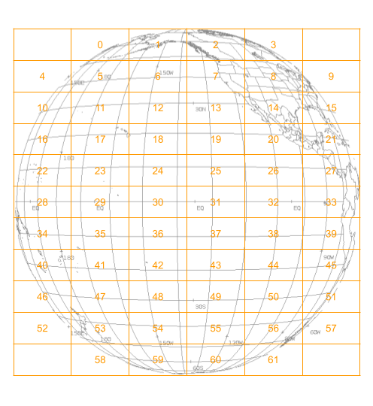
Schematic showing GOES-17 Tiles
For a given tile and scene time, a GLM product is produced if GLM detects lightning
NWS Central Region sends G-17 GLM tiles 0-43 to Regional LDMs
NWS Southern Region filters the data stream, sending only G-17 GLM Tiles 7, 8, 13 and 14 to SR offices
5
Notes:
G17: ^OR_GLM-L[23]-GLMF-M[3-6]_G17_T(07|08|13|14)_

Slide 6
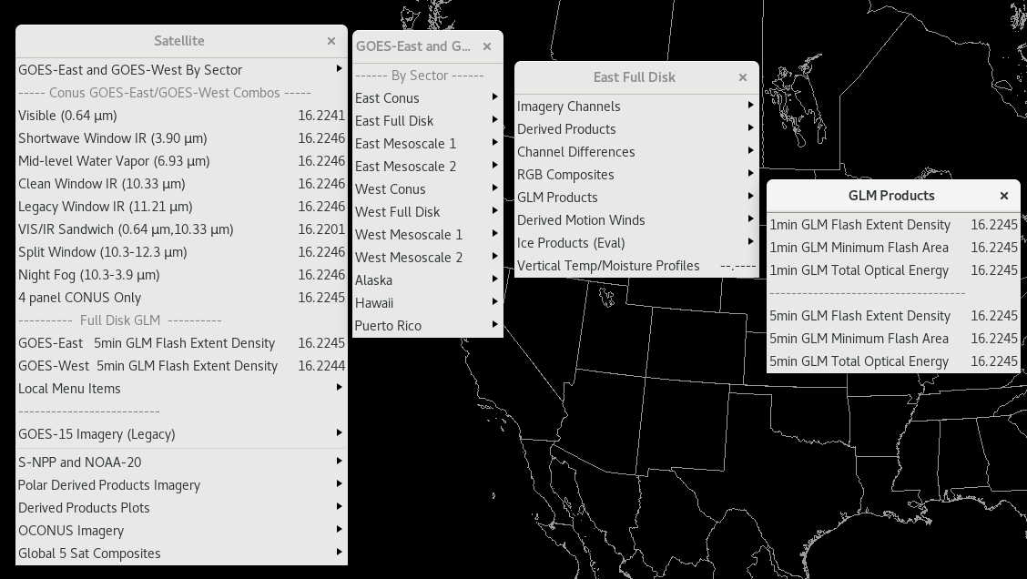
GLM Menu Items in AWIPS via TOWR-S RPM v20
1)
2)

Slide 7
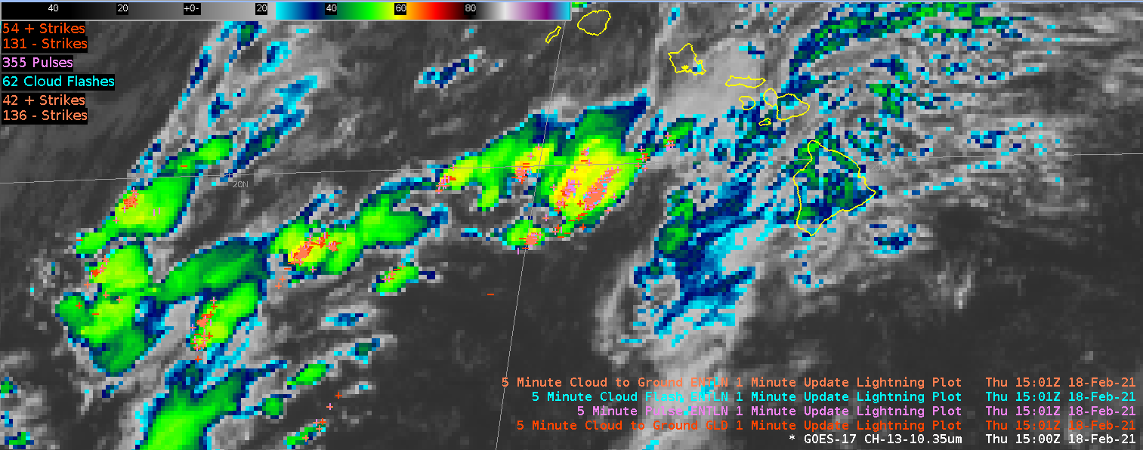
GOES-17 ABI 10.35um w/ ENTLN & GLD Lightning

Slide 8
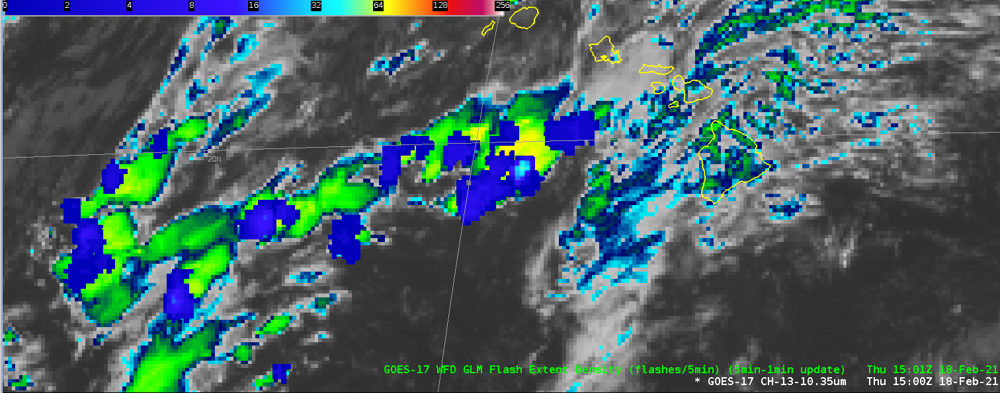
GOES-17 ABI 10.35um w/5-min GLM Flash Extent Density

Slide 9
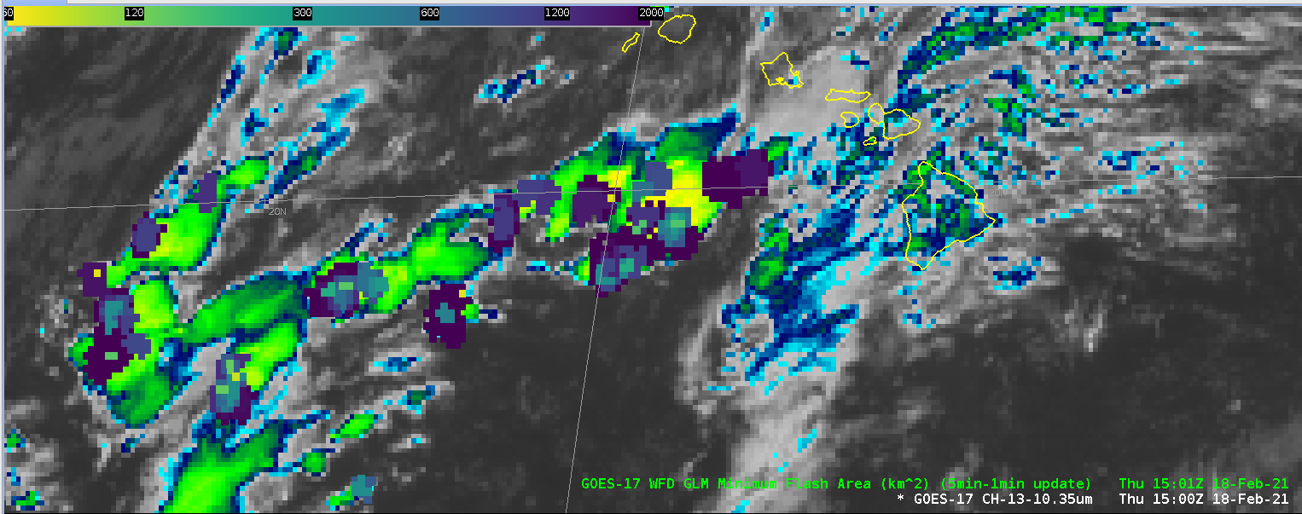
GOES-17 ABI 10.35um w/5-min GLM Minimum Flash Area

Slide 10
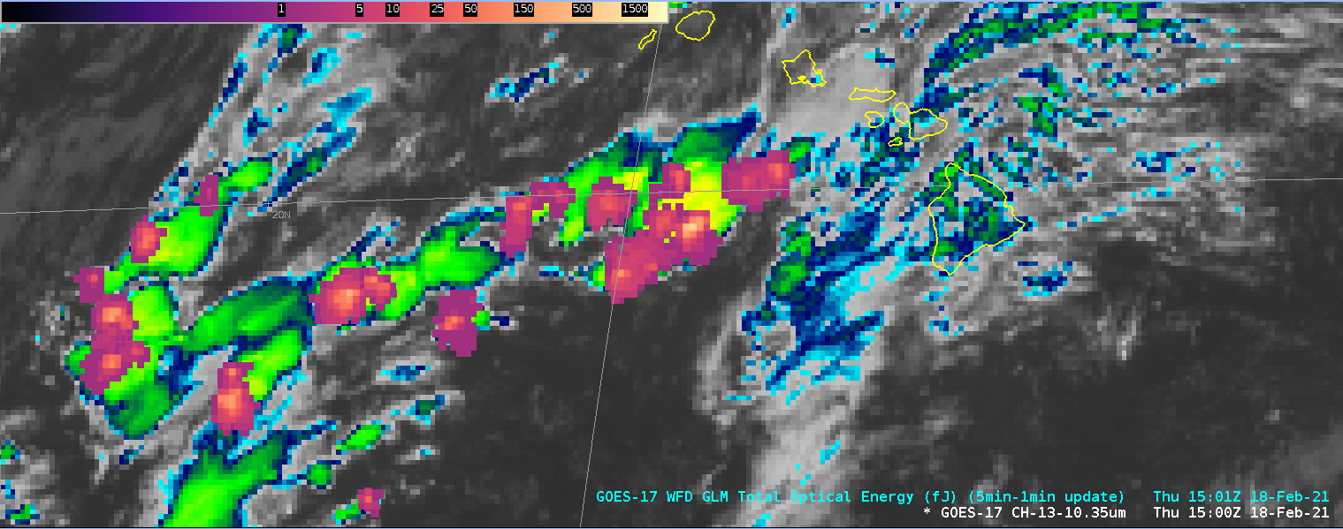
GOES-17 ABI 10.35um w/5-min Total Optical Energy

Slide 11
GLM into CSPP-Geo and Data assimilation in NCEP models
CSPP-Geo into NWS
  Plans to integrate GLM into NWS GRB ingest systems
  Establish direct flow of GLM from GRB ingest systems into AWIPS
Data assimilation into NCEP models
  Initial efforts are underway to pursue direct assimilation of flash extent density in collaboration with multiple partners
  Lightning obs are presently used as proxies for reflectivity and GLM is not yet used in operations. There are pending proposals under to advance this work via JTTI
Notes:
GLM has been integrated into ProbSevere v3, which will be demonstrated at the 2021 HWT. ProbSevere v2, which is operational at NCEP does not utilize GLM. Within the ProbSevere family of products, we also have an AI-based lightning nowcasting model that was trained using GLM

Slide 12
Next Steps
TOWR-S is working with GOES-R team on integration of punctured tile code to NESDIS production environment
NWS is coordinating with NESDIS for operational deployment schedule
TOWR-S is assisting UCAR staff on a COMET training module on GLM application during severe weather outbreaks over the CONUS June 3-4 / 6-7th 2020
NWS Office of Observations is carrying a milestone for transitioning GLM to operations (FY21 moving to FY22)
NWS expected to update its GRB antenna system ingest software with CSPP-Geo add-on for GLM punctured tiles
  NWS GRB antennas serve National Center and OCONUS offices
EMC efforts continue, evaluating assimilation of GLM into NWP systems
TOWR-S support and coordination for CY 2021 GLM field evaluations in AWIPS

Slide 13
Thank You
Questions/Comments?

Slide 14
Backup - Previous PS-PVR

Slide 15
GLM Gridded Products Description (1)
GLM Flash Extent Density (FED) grids are produced on the Aviation Weather Center ISatSS* for distribution via terrestrial LDM to NWS WFOs and some RFCs on the CONUS
ISatSS* uses the "glmtools" python package written by Eric Bruning at Texas Tech to compute one-minute FED
  Each Event in a one minute observation period is collected, mapped to its parent Flash, and assigned to a point on the GOES-16 ABI CONUS fixed grid array
  The FED is a count, for each pixel in the CONUS fixed grid, of the number of Flashes that had an Event located in that pixel
  If a Flash had multiple events take place in a single pixel, its FED contribution is still one
* ISatSS - Integrated Dissemination Program Satellite Support Subsystem (a software application)

Slide 16
GLM Gridded Products Description (2)
The ISatSS ‘Points into GLM Grids’ (PiGG) application executes the ‘glmtools’ code to:
  generate the minute-by-minute FED fields
  accumulate them into a sliding five minute array that updates once per minute
  packages the one- and five-minute arrays into an 8km resolution compressed netCDF4 file that is compatible with the AWIPS-II GOES-R imagery plugin
Prior to FED grid generation, another ISatSS application uses a “furthest from image center" technique to filter any given 20-second input L2+ file down to 25,000 Events. This is required to maintain latency performance in the face of glint blooming (spurious) Events

