Slide 1
GOES-17 Geostationary Lightning Mapper (GLM)
Provisional PS-PVR (CLOSURE)
December 20, 2018
William Koshak¹, Pete Armstrong²,
Doug Mach³, Dennis Buechler⁴, Monte Bateman³
(with important inputs from additional Cal/Val Team Members, & NASA Flight)
GOES-R Calibration Working Group
¹NASA/MSFC, ²MIT-LL, ³USRA, ⁴UAH

Slide 2
Outline
Introduction
Review of Beta Maturity
Product Quality Evaluation Overview
Provisional Maturity Assessment
PLPT Details
Path to Full Validation
Summary and Recommendations

Slide 3
Outline
Introduction
Review of Beta Maturity
Product Quality Evaluation Overview
Provisional Maturity Assessment
PLPT Details
Path to Full Validation
Summary and Recommendations

Slide 4
NOTE
The previous GLM-17 Provisional PS-PVR was held on 3 Dec 2018 under the assumption that ADR 855 (GLM-17 Rev C LUT, which includes: GS RTEP settings, 2nd Level Threshold for hot pixel muting, and Parallax Lite) was implemented. But 855 did not get implemented until 3:56PM ET on 3 Dec 2018. Therefore, this updated PS-PVR is conducted for the analysis period Dec 4-16, 2018 for closure.

Slide 5
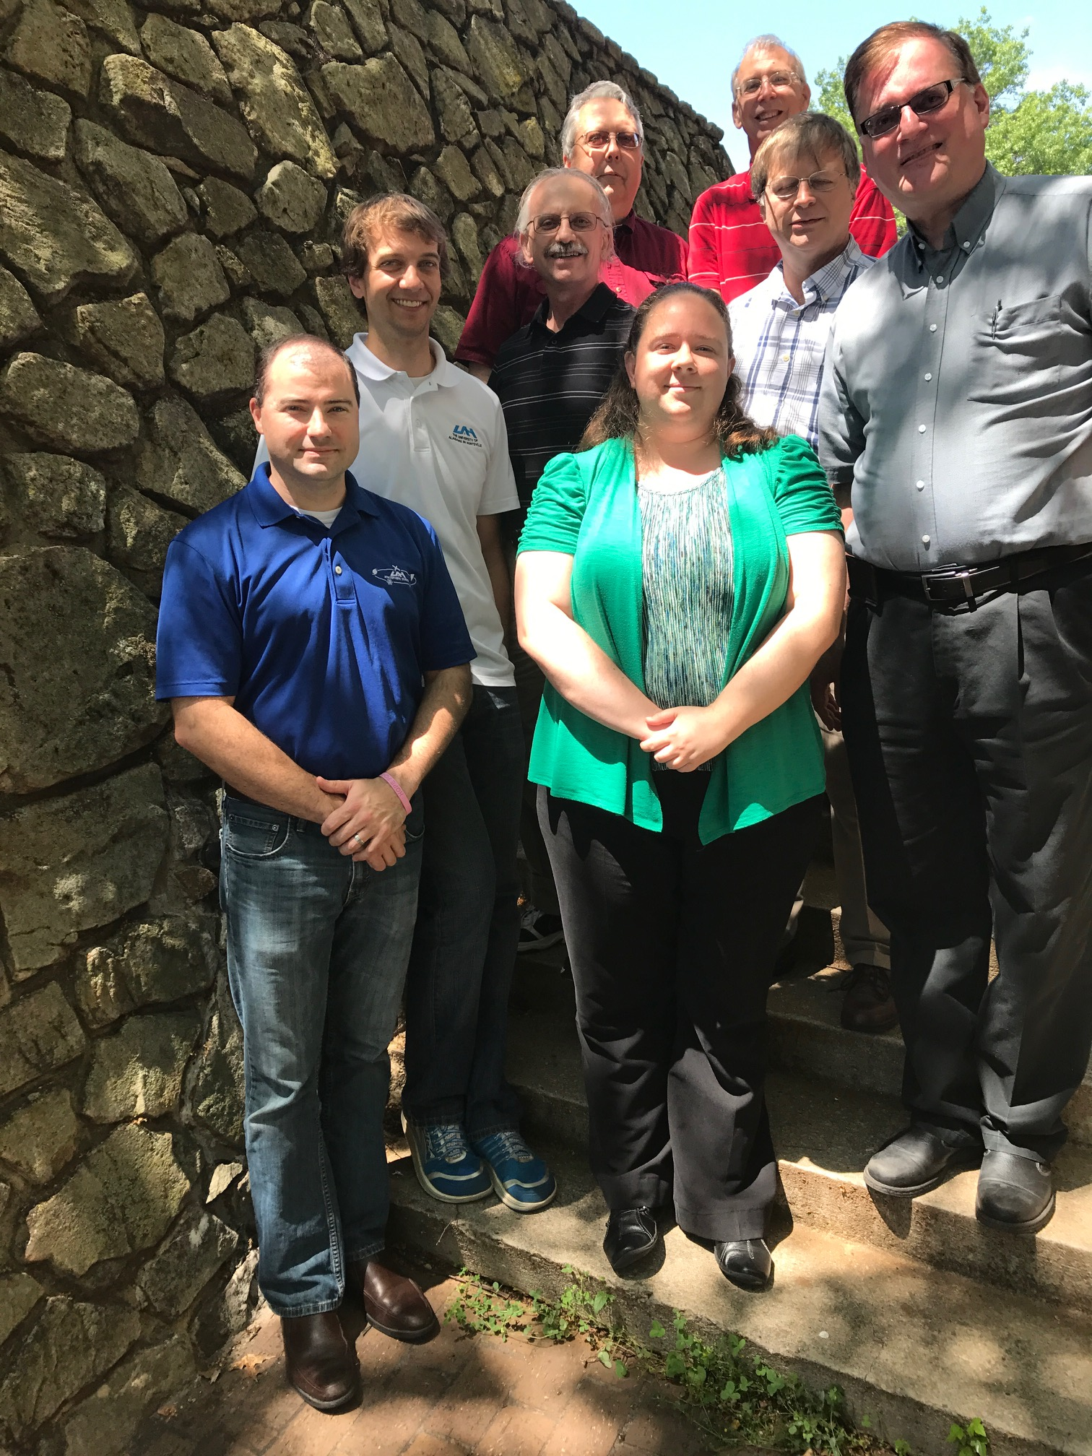
Cal/Val Team Members
NSSTC (Huntsville, AL)
MIT-Lincoln Lab
Various Remote
Ken Cummins (Univ Az)
Paul Krehbiel (NMT)
Ron Thomas (NMT)
Bill Rison (NMT)
Eric Bruning (TTU)
Don MacGorman (NSSL)
Steve Rutledge (CSU)
Max Marchand (CIRA)
Bob Holzworth (Univ. Wa)
Michael McCarthy (Univ. Wa)
Ken Pickering (UMD)
Michael Peterson (now @ Los Alamos)
Richard Sonnenfeld (NMT)
.
.
others
Pete Armstrong
(Core Team Member)
NASA Flight for INR
David Igle
Alan Reth
Core Team: William Koshak & Rich Blakeslee (MSFC), Doug Mach & Monte Bateman (USRA), Dennis Buechler (UAH)
Support Team (lower left): Phillip Bitzer & Jeff Burchfield (UAH); Katrina Virts (NPP)
Photo courtesy of William Koshak & Pete Armstrong

Slide 6
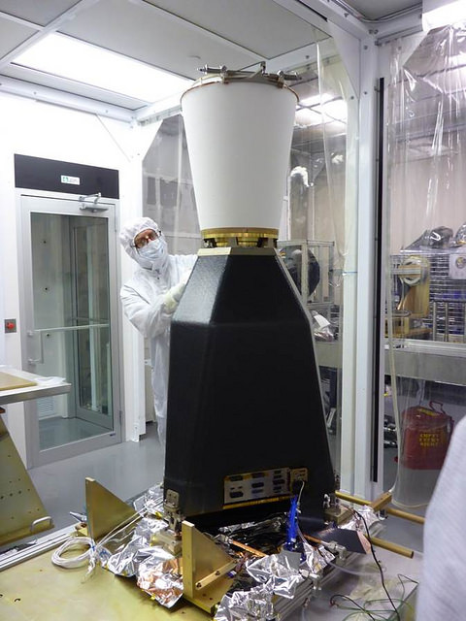
GLM Overview
  REQUIREMENTS:
  Provide continuous, full-disk lightning measurements for storm warning and nowcasting.
  Provide early warning of tornadic activity.
  Accumulate a long-term database to track decadal changes [of lightning].
INSTRUMENT DETAILS:
High-speed nadir-staring camera
CCD imager (1372x1300 pixels)
Near uniform spatial resolution
8 km nadir, 14 km edge of FOV
Coverage ~ ± 54 latitude
Single band 777.4 nm
2 ms frame rate
7.7 Mbps downlink data rate
  TRMM/LIS only 8 kbps
20 sec product latency
GLM is the first lightning mapper to be flown in geostationary orbit. Heritage LEO sensors include: Optical Transient Detector (1995-2000), and TRMM/LIS (1997-2015)

Slide 7
Important Validation Principles
(see RIMP for more details)
Targets of Opportunity (TOO): VAL of a Lightning Sensor differs from VAL of typical imager; i.e. since lightning transient, VAL is restricted to TOO.
Flash DE & FAR are Estimates: Because reference data normally doesn’t detect all lightning.
Source Physics: GLM detects in the optical (near-IR) and many of the reference datasets are in the RF. (e.g., LMAs see discharge breakdown in the VHF that might not show up in optical → apple/orange).
Source Scattering: Optical is cloud-scattered, but cloud is transparent to radio. So often see GLM detections near cloud edges where no radio sources.
ISS/LIS & FEGS are Critical: More of an apple/apple comparison w/GLM.

Slide 8
Outline
Introduction
Review of Beta Maturity
Product Quality Evaluation Overview
Provisional Maturity Assessment
PLPT Details
Path to Full Validation
Summary and Recommendations

Slide 9
Time-Line Highlights
01 Mar 2018 GOES-S Launch
27 Mar 2018 GLM powered on @ 13:38:50 UTC
27 Mar 2018 Flow of real-time data began @ 13:43 UTC
30 Mar 2018 RTEP tuning began
12 Apr 2018 GLM Door Opened @ 5 UTC
28 Jun 2018 RTEP tuning ended
10 Jul 2018 GLM Beta Validation Began
02 Oct 2018 PS-PVR Beta
15 Oct 2018 DO.07.00.00 into OE @ 16:27 UTC
03 Dec 2018 Rev C LUT update into OE

Slide 10
Risks to Reaching Provisional
(Summary Status at PS-PVR Beta)
There are no substantial risks or liens towards reaching Provisional on planned PS-PVR date of 3 Dec 2018
Most major s/w fixes will occur early-mid 2019, so primary emphasis for PROV will be larger sample size PLPT analyses, and more robust documentation of G17 performance.
Instrument h/w performance is very good and does not pose a substantial risk to achieving provisional
    However, G17 flash DE performance is slightly below G16, indicating further instrument tuning is warranted and encouraged.
    G17 Location/Timing on par with G16, but more hot pixel noise with G17

Slide 11
Outline
Introduction
Review of Beta Maturity
Product Quality Evaluation Overview
Provisional Maturity Assessment
PLPT Details
Path to Full Validation
Summary and Recommendations

Slide 12
Performance Baseline Mapping
MRD | Parameter | MRD Value | Perf. Baseline (Model) |  | Related PLPTs
1259 | Production Mapping Accuracy [INR] | 5km ( = |𝛍+3𝜎| < 140 μrad) | Nav error (7 d averaging) of 108 μrad for GOES-W |  | -011, (also -001, -002,-003, -004, -005, -006)
1260 | Product Measurement Range | (0-41900 evts/s, 0-8170 grps/s, 0-600 flsh/s) | Instr Vendor showed can handle peak 100Kevts/s (600flsh/s) |  | G16/17 Independent [see -009,-010 in G16 Full PS-PVR]
1261 | Product Measurement Accuracy | 70% total flash detection efficiency (DE) | Instr. Side | EOL* | -001, -002,-003, -004, -005, -006, -009,-010
 |  |  | Primary | 81%
 |  |  | Redundant | 83%
1264 | Product Measurement Precision | 5% | Open, with Flight reporting FAR ~ 1.1%, but open WRs on GS implementation loss |  | -001, -002,-003, -004, -005, -006, -009,-010
PORD | Parameter | PORD Value | Related PLPTs
094 | GLM Navigation Error | 4km ( = |𝛍+3𝜎| < 112 μrad) | -011
098 | Event Time Tag Accuracy | 1 ms | -001, -002,-003, -004, -005, -006
Reference: GLM PORD (Performance and Operational Requirements Document) V2.21, 9 Oct 2018.
MRD1259 & PORD 094: 28 μrad per km.
*EOL = End of Life with reduction to flash DE by ~6% due to Coherency Filter removing single-group flashes

Slide 13
Top Level Evaluation
 | Past Status | Current Status | Future Outlook
DE | Performance has been stable without critical issues, but is notably reduced by ~ 10% from expectations (i.e. compared to G16) since RTEP thresholds were still @ ~100 DN pre-launch setting. Want more assessments over other regions, seasons | More validation data accumulated with some regional gap filling. Bulk (full FOV) spatially averaged performance value from VaLiD meeting spec. DE value very sensitive to computation method and reference data filtering! Low DE values near limb (large water/ice absorption on long slant path … see KSC storm LMA analysis) | After DO.08 2nd Lev Thresh deployed, thresholds will be lower resulting in better DE. Want to further improve DE by adding L2 “put back algorithm”. Keep 1st event in flash in DO.08 (does not increase DE, but increases detected details of a flash)
FAR | Bulk FAR value across GLM FOV needed to better quantify performance. Blooming & Glint Filter design details and testing are mature; minor optimization expected. Blooming and Glint filter should be in place for DO.08 (in April 2019). “Put Back” filter is still under development. | GLM FAR (bulk FOV value) obtained but doesn’t meet spec since blooming filter & other noise reduction methods not yet implemented. Blooming Filter design details and testing are mature; minor optimization expected. Blooming and Glint filter should be in Dev. Env. for DO.08 in April 2019. | Implementation of Blooming Filter will mitigate solar glint/intrusion and improve FAR. Bruning Gridded Product (incl. data quality) Meta-code to become ADR submission.
INR/time | Critical issues have been resolved. Recent performance is acceptable. Major remaining issues: Time-of-Flight correction still needed in L2 (is implemented in L1b) Time order still an issue | Mode of location/timing error distributions meet spec. Post-drift INR meeting spec. Lightning ellipsoid parameters optimized to mitigate parallax. Time-of-Flight correction now implemented in L2. Time order still an issue (considered low priority) | Monthly 3 degree grid cloud-top height maps desired to further reduce parallax. Account for diurnal variation of INR in DO.08 Time order to be fixed in DO.08.

Slide 14
Outline
Introduction
Review of Beta Maturity
Product Quality Evaluation Overview
Provisional Maturity Assessment
PLPT Details
Path to Full Validation
Summary and Recommendations

Slide 15
Provisional Validation
Preparation Activities | Assessment
Validation activities are ongoing and the general research community is now encouraged to participate. | Validation activities are ongoing. The general research community has been participating and providing feedback.
Severe algorithm anomalies are identified and under analysis. Solutions to anomalies are in development and testing. | Operational and algorithm anomalies have been identified. Critical ones have been resolved; others in various stages of implementation. A few under investigation.
Incremental product improvements may still be occurring. | Incremental product improvements are expected.

Slide 16
Provisional Validation
End State | Assessment
Product performance has been demonstrated through analysis of a small number of independent measurements obtained from select locations, periods, and associated ground truth or field campaign efforts. | This has been demonstrated.
Product analysis is sufficient to communicate product performance to users relative to expectations (Performance Baseline). | This has been communicated in PS-PVR.
Documentation of product performance exists that includes recommended remediation strategies for all anomalies and weaknesses. Any algorithm changes associated with severe anomalies have been documented, implemented, tested, and shared with the user community. | Have been documented, for example this PS-PVR and the ReadMe file.
Testing has been fully documented. | Testing has been fully documented in this PS-PVR.
Product is ready for operational use and for use in comprehensive cal/val activities and product optimization. | We concur.

Slide 17
Recommendation
CWG believes that the GOES-17 GLM L2 product (events, groups, flashes) has reached the Provisional Maturity as defined by the GOES-R Program.

Slide 18
Outline
Introduction
Review of Beta Maturity
Product Quality Evaluation Overview
Provisional Maturity Assessment
PLPT Details
Path to Full Validation
Summary and Recommendations

Slide 19
Progress Since Beta (2 Oct 2018)
WR | ADR | Title | PR or DO | Date in OE | Impact
5996 | 628 | GLM - Add Parenthetical Information to CALINR LUTs | PR.07.00.01 | 15 Oct 2018 | other
3561 | 674 | Update GLM EFRC Algorithm to use updated CALINR format provided by GLM Flight | DO.07.00.00 | 15 Oct 2018 | other
4477 | -- | GLM L2 LCFA product has ‘n/a’ for production_data_source | DO.07.00.00 | 15 Oct 2018 | other
4507 | 338 | Use adjusted event times in Lightning L2+ product (TOF & associated) | DO.07.00.00 | 15 Oct 2018 | time
4696 | 382 | Group and flash areas GLM L2 (Discrepancy 20% between GS & LM) | DO.07.00.00 | 15 Oct 2018 | areas
5301 | 483 | GLM FM2 GPA LUTs for GOES-S | DO.07.00.00 | 15 Oct 2018 | DE/FAR
6466 | 740 | Duplicate Groups & Events Found in GLM L2 files | DO.07.00.00 | 15 Oct 2018 | energetics
6681 | 844 | GLM L2 Lightning needs _Unsigned on time offsets | PR.07.03.01 | 05 Nov 2018 | time
5930 | 615 | Burst of GLM events caused GLM L2+ outage (e.g., EXIS cruciform scans) | PR.07.02.00 | 05 Nov 2018 | FAR/DE
6073 | 638 | GLM glint box updated/fixed | PR.07.04.00 | Week of 3 Dec 2018 | FAR/DE
n/a | 855 | Update GOES-17 GLM Rev C LUT [for improved GS RTEP settings (i.e. replace 100 DN pre-launch settings), implement legacy 2nd Level Threshold settings to mute hot pixels, and implement Parallax Lite]. Rev C supersedes the LUT changes associated with WRs (6512, 6513, 6588) for (LUTI, Rev A, and Rev B, respectively). | PR.07.03.04 | 03 Dec 2018 | DE/FAR, location
Priority Key | 1 | 2 | 3 | 4 | 5 | 6 | 7

Slide 20
Provisional Analysis Periods
FIRST ATTEMPT (03 Dec 2018 PS-PVR):
Recent s/w Fixes: Implemented into OE 15 Oct 2018.
Period 1: OCT 15-24, 2018 (10 DAYS)
Drift: 24 Oct 2018 – 13 Nov 2018 (the GOES-17 satellite drifts to its final park at 137.2W during this period, and instruments placed in safe or diagnostic mode).
Cal Activities: A short period of ancillary cal activities and X-band com turn on.
INR averaging: A total of 7 days of INR averaging (Nov 13-19) required to assure optimal geolocating.
Additional s/w Fixes: Implemented into OE 15 Nov 2018.
Period 2: NOV 20-29, 2018 (10 DAYS)
THIS CLOSURE (20 Dec 2018 PS-PVR):
DEC 4-16, 2018 (13 DAYS)

Slide 21
Post-Launch Product Tests
Test ID | Abbreviated Test Titles for GLM
PLPT-GLM-001 | Validate DE/FER using med/long-range networks (e.g., NLDN, EN, GLD360)
PLPT-GLM-002 | Validate DE/FER using short-range networks (e.g., LMAs)
PLPT-GLM-003 | Validate Storm DE and Storm FAR using very long range systems (WWLLN, NEXRAD)
PLPT-GLM-004 | Validate DE/FER using very short range optical systems (FEGS)
PLPT-GLM-005 | Validate DE/FER using orbit-based optical systems (e.g., ISS/LIS)
PLPT-GLM-006 | Validate DE/FER using ground-based E-field networks (e.g. HAMMA, LIP)
PLPT-GLM-009 | Validate L1b-L2 Cluster/Filter by comparing w/Spec (i.e. Mach) code
PLPT-GLM-010 | Validate L0-L1b Filter Algorithms by comparing w/Spec (i.e. Mach) code
PLPT-GLM-011 | Validate GLM INR w/comparisons to well-located ground points
PLPT-GLM-012 | Validate GLM BG DCC radiances with trending & comparisons
PLPT-GLM-013 | Validate GLM Flash Energies with trending & comparisons
PLPTs emphasized across both provisional validation presentations (orange listed above).
Full test plans and procedures are given in the GLM Readiness, Implementation, and Management Plan (RIMP v1.2; 416-R-RIMP-0313)

Slide 22
Primary PLPT Tools
Item | Tool | Description | Code Language | Developer
1 | VaLiD | Validate Lightning Data tool performs shallow/deep dives of GLM data using wide range of ground-based datasets discussed in RIMP. | C | Bateman/USRA
2 | Cluster/Filter | In-house code for L0-L1b and L1b-L2 processing | Matlab | Mach/USRA
3 | HUDAT | Huntsville Area Marx Meter Array (HAMMA) User Data Analysis Technology with emphasis on lightning energy/physics. | IDL | Bitzer/UAH
4 | STROKE | STorm Retrievals frOm KSC E-Fields examines ground-based electric fields, lightning field changes, and the charges deposited by lightning in KSC, Florida. | IDL | Koshak/MSFC
5 | INR/Parallax | Validates GLM INR with comparisons to well-located ground points and employs GLM background images & lightning, ABI background images, and Laser beacon data | IDL | Buechler/UAH
6 | TT/DCC | Trending Tools for long-term trending of Deep Convective Clouds. | IDL | Buechler/UAH
7 | TT/Lightning | Trending Tools for long-term trending of lightning counts, flash duration, and lightning energy. | IDL | Buechler/UAH Koshak/MSFC
8 | LMT | 24/7 Lightning Monitoring Tool (aka "Product Monitor") that alerts of problematic GLM performance | TBD | Product Area Lead
9 | CompareLLS | Compare Lightning Location System tool performs shallow/deep dives of GLM data using wide range of ground-based datasets discussed in RIMP. | Matlab | Cummins, UA
10 | XLMA | X Lightning Mapping Array tool for making standard 4-D plots of flashes. | IDL | Krehbiel & Rison of NMT
11 | lmatools | Analyzes LMA data [sort VHF source data into flashes; calculate flash areas, volumes, and channel lengths; produce gridded products; time series statistics of flash rate and size data; simulate LMA performance]. | Python | Bruning/TTU
12 | FEGST | Fly's Eye GLM Simulator Tool: Data acquisition, display, storage software, and s/w for analyzing FEGS data & inter-comparing it with other lightning optical datasets (e.g. GLM, ISS/LIS). | IDL | Quick/NPP
13 | ADTs | Ancillary Dataset Tools will be developed for processing datasets such as ABI, NEXRAD, SEVERI, WWLLN; some of these tools will be piggybacked to VaLiD. | Matlab & McIDas scripts | Mach/USRA Bateman/USRA
14 | SITs | Specialized Impromptu Tools written “on-the-fly” to handle any analyses that are needed, but that were unexpected. | C, IDL, Matlab, Mathematica | Cal/Val Team
15 | LATA | Location And Time Accuracy (LATA) Tool: Produces a variety of plots/histograms that characterize the overall location/time accuracy of GLM flashes/groups/events. | Matlab | Virts/NPP

Slide 23
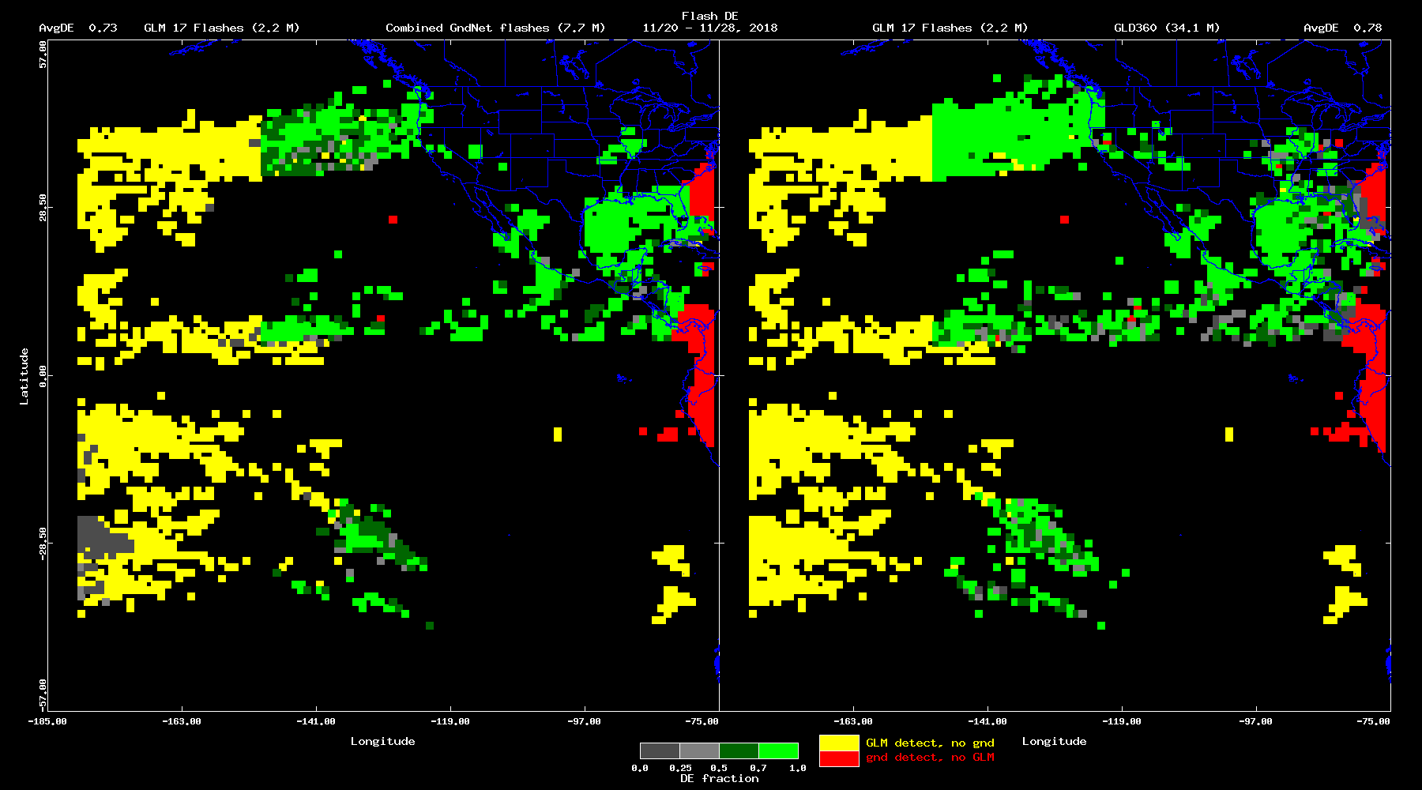
Flash Detection Efficiency (Bateman/USRA) in Period 2: GLM-17 vs. Combined and GLD360
PASSED
5 Combined Networks
GLD360
PLPT-GLM-001
in Period 2
(Nov 20-28, 2018)
Spatially
Averaged DE:
73%
78%
NOAA's GOES-17 satellite has not been declared operational and its data are preliminary and undergoing testing. Users receiving these data through any dissemination means (including, but not limited to, PDA and GRB) assume all risk related to their use of GOES-17 data and NOAA disclaims any and all warranties, whether express or implied, including (without limitation) any implied warranties of merchantability or fitness for a particular purpose.
Notes:
Sample size: 6,725,357 matches

Slide 24
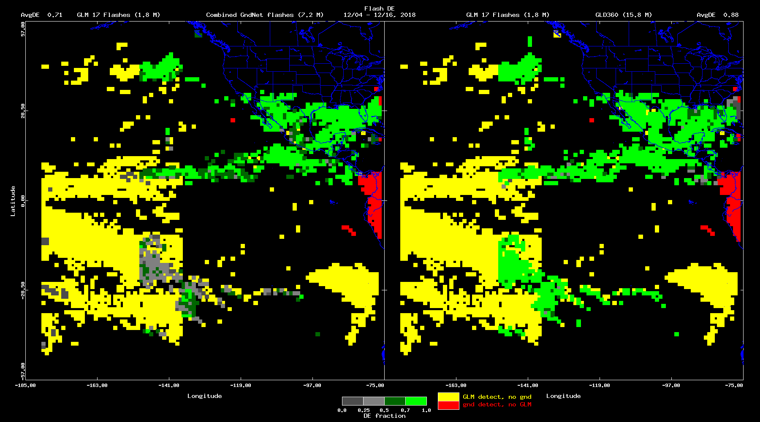
Flash Detection Efficiency (Bateman/USRA)
GLM-17 vs. Combined and GLD360
PASSED
4 Combined Networks
GLD360
PLPT-GLM-001
Dec 4-16, 2018
1.8 M GLM-17 Flashes
GLD360 does not see West of 150W.
NOTE: Official CWG flash DE results are from Bateman (VaLiD tool)
Spatially
Averaged DE:
71%
88%
NOAA's GOES-17 satellite has not been declared operational and its data are preliminary and undergoing testing. Users receiving these data through any dissemination means (including, but not limited to, PDA and GRB) assume all risk related to their use of GOES-17 data and NOAA disclaims any and all warranties, whether express or implied, including (without limitation) any implied warranties of merchantability or fitness for a particular purpose.
Notes:
Sample size: 6,725,357 matches

Slide 25
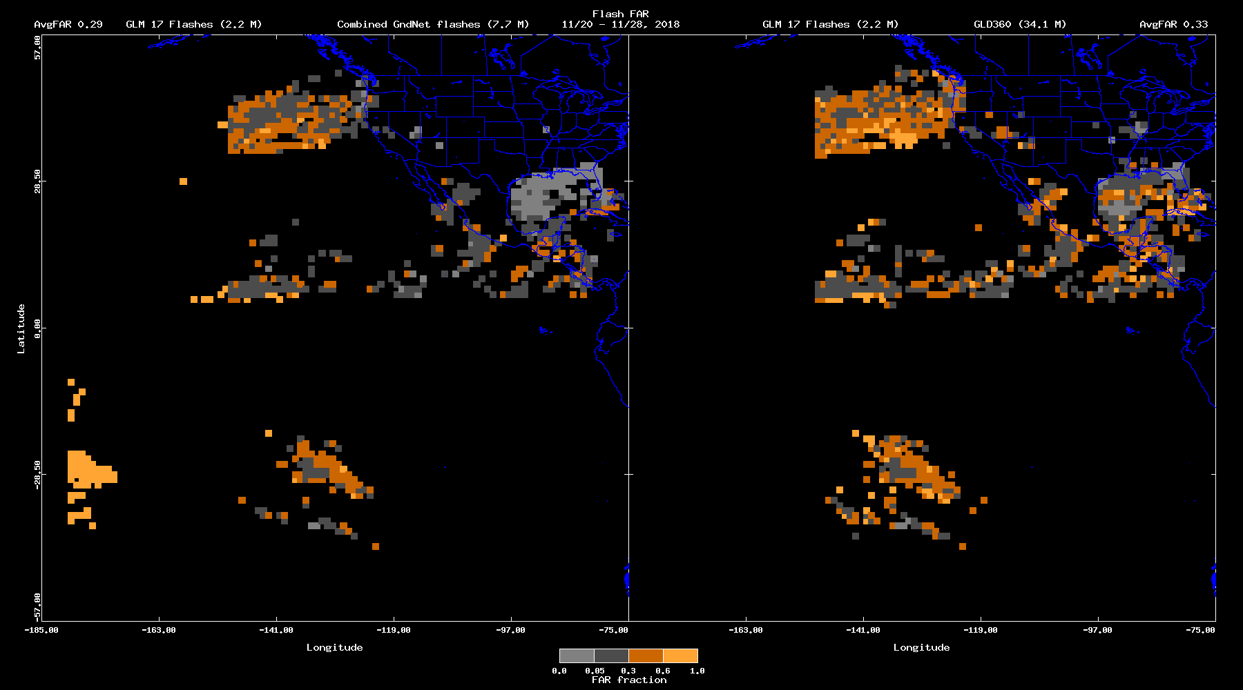
Flash False Alarm Rate (Bateman/USRA) in Period 2: GLM-17 vs. Combined and GLD360
Pending
5 Combined Networks
GLD360
PLPT-GLM-001
in Period 2
(Nov 20-28, 2018)
Spatially
Averaged FAR:
29%
33%
NOAA's GOES-17 satellite has not been declared operational and its data are preliminary and undergoing testing. Users receiving these data through any dissemination means (including, but not limited to, PDA and GRB) assume all risk related to their use of GOES-17 data and NOAA disclaims any and all warranties, whether express or implied, including (without limitation) any implied warranties of merchantability or fitness for a particular purpose.
Notes:
Sample size: 6,725,357 matches

Slide 26
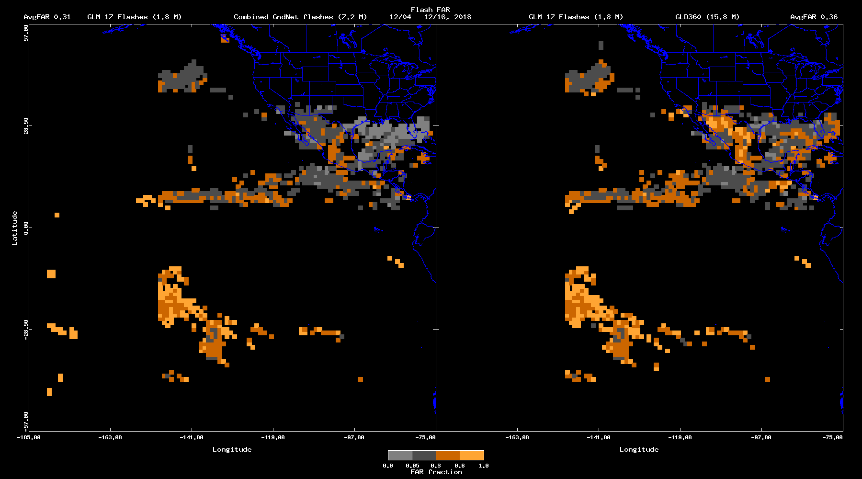
Flash False Alarm Rate (Bateman/USRA)
GLM-17 vs. Combined and GLD360
Pending
4 Combined Networks
GLD360
PLPT-GLM-001
Dec 4-16, 2018
Spatially
Averaged FAR:
31%
36%
NOAA's GOES-17 satellite has not been declared operational and its data are preliminary and undergoing testing. Users receiving these data through any dissemination means (including, but not limited to, PDA and GRB) assume all risk related to their use of GOES-17 data and NOAA disclaims any and all warranties, whether express or implied, including (without limitation) any implied warranties of merchantability or fitness for a particular purpose.
Notes:
Sample size: 6,725,357 matches

Slide 27
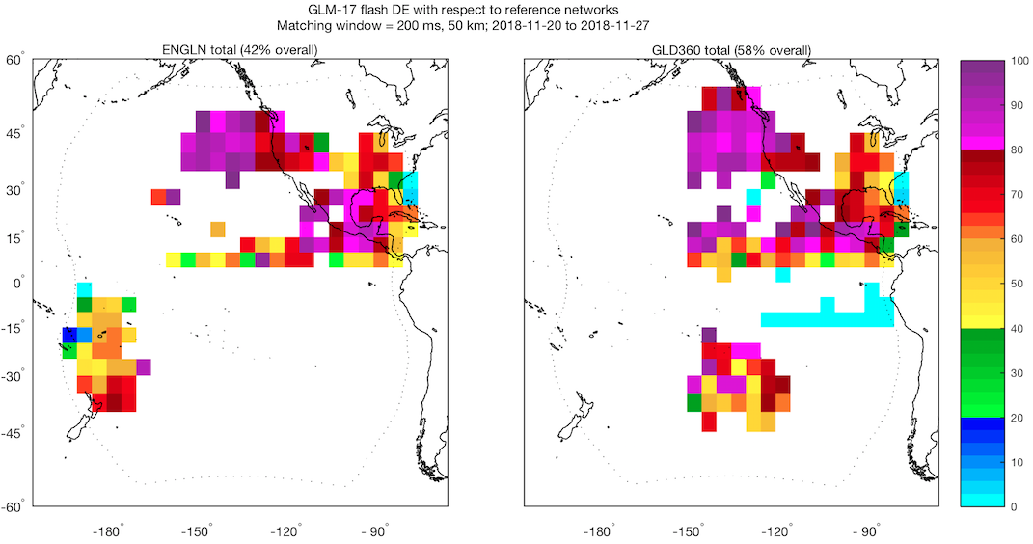
Flash Detection Efficiency (Virts/NASA)
Period 2: GLM-17 vs. ENGLN and GLD360
Low DE
PLPT-GLM-001
In Period 2
(Nov 20-27, 2018)
Highest DE over CONUS and northeastern Pacific
Most frequent lightning during this period was at the edge of GLM’s field of view (over southern Gulf Stream), producing lower overall DE
GHRC
Database
Does Not
Extend West
of 150W
ENGLN Throws
Out Flashes In
This Region
Spatially
Averaged DE:
66%
58%
Presumably low since
blue regions not filtered
NOAA's GOES-17 satellite has not been declared operational and its data are preliminary and undergoing testing. Users receiving these data through any dissemination means (including, but not limited to, PDA and GRB) assume all risk related to their use of GOES-17 data and NOAA disclaims any and all warranties, whether express or implied, including (without limitation) any implied warranties of merchantability or fitness for a particular purpose.
Notes:
Sample size = 635,630 matches (ENGLN) and 454,514 matches (GLD360). Note that GLD360 data is not provided west of 150W, and ENGLN appears to be missing data in the SE Pacific

Slide 28
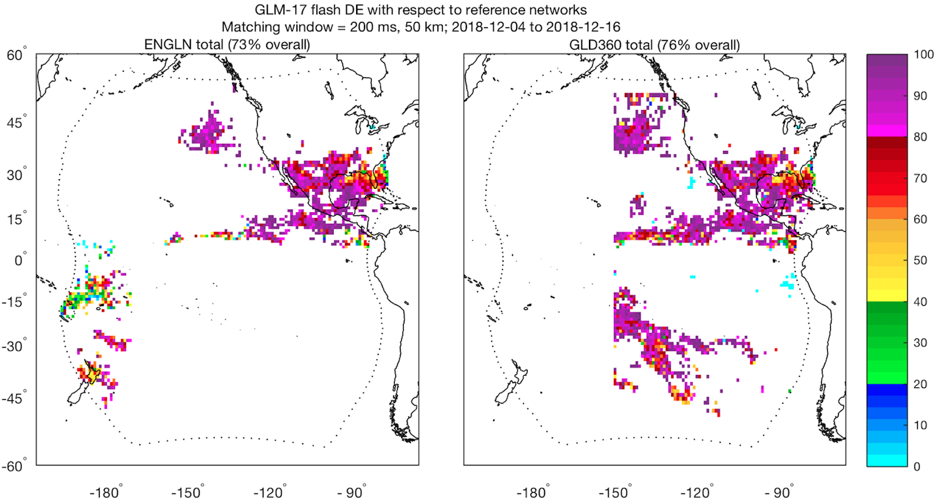
Flash Detection Efficiency (Virts/NASA)
GLM-17 vs. ENGLN and GLD360
PASSED
PLPT-GLM-001
Dec 4-16, 2018
Flash DE >80% over majority of domain;
SUBSTANTIALLY BETTER THAN PERIOD 2 !!
Lower DE over some near-limb areas
GLD360 not
available
west of 150W
Missing ENGLN
data
Spatially
Averaged DE:
76%
83%
NOAA's GOES-17 satellite has not been declared operational and its data are preliminary and undergoing testing. Users receiving these data through any dissemination means (including, but not limited to, PDA and GRB) assume all risk related to their use of GOES-17 data and NOAA disclaims any and all warranties, whether express or implied, including (without limitation) any implied warranties of merchantability or fitness for a particular purpose.
Notes:
Sample size: 2,065,999 matches (ENGLN) and 1,162,751 matches (GLD360). Note that GLD360 data is not provided west of 150W, and ENGLN appears to be missing data in the SE Pacific

Slide 29
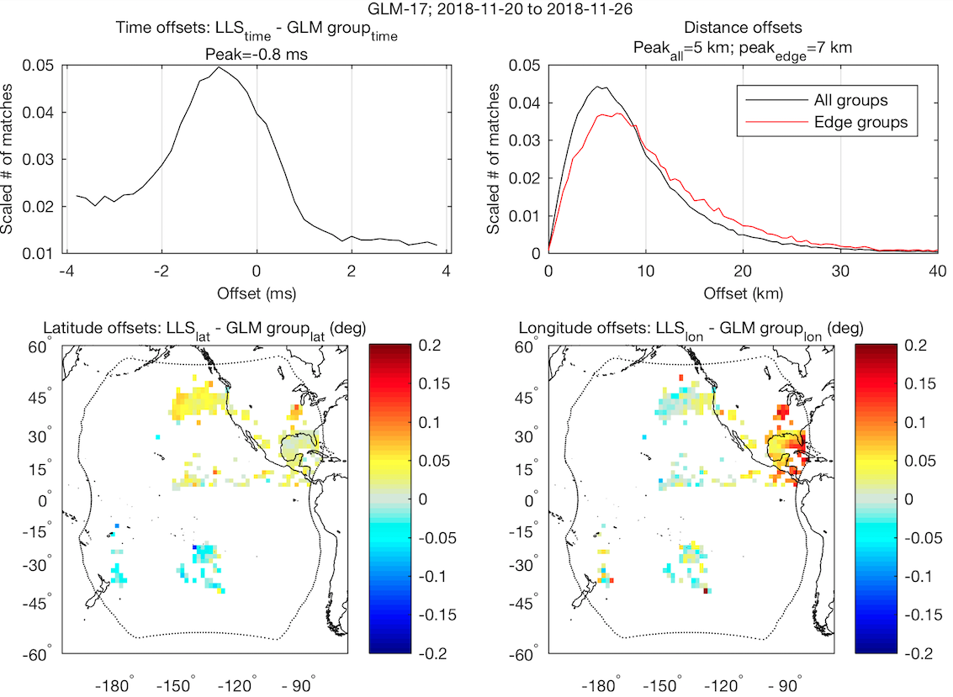
Time/Location Accuracy (Virts/NASA) in Period 2: GLM-17 vs. ENGLN and GLD360
PASSED
PLPT-GLM-001
In Period 2
(Nov 20-27, 2018)
Offsets between GLM and “best” reference match
Sub-ms timing accuracy
~Half-pixel location accuracy over most of domain, but larger error than Period 1 due to greater Parallax.
NOAA's GOES-17 satellite has not been declared operational and its data are preliminary and undergoing testing. Users receiving these data through any dissemination means (including, but not limited to, PDA and GRB) assume all risk related to their use of GOES-17 data and NOAA disclaims any and all warranties, whether express or implied, including (without limitation) any implied warranties of merchantability or fitness for a particular purpose.
Notes:
Sample size = 178,380 matches

Slide 30
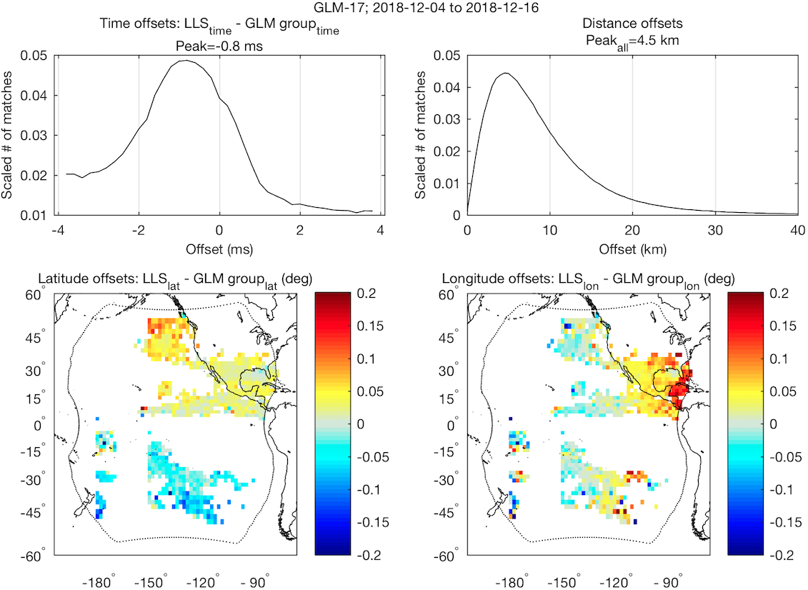
Time/Location Accuracy (Virts/NASA)
GLM-17 vs. ENGLN and GLD360
PASSED
PLPT-GLM-001
Dec 4-16, 2018
Offsets between GLM and “best” reference match
Sub-ms timing accuracy
Sub-pixel location accuracy over most of domain
NOAA's GOES-17 satellite has not been declared operational and its data are preliminary and undergoing testing. Users receiving these data through any dissemination means (including, but not limited to, PDA and GRB) assume all risk related to their use of GOES-17 data and NOAA disclaims any and all warranties, whether express or implied, including (without limitation) any implied warranties of merchantability or fitness for a particular purpose.
Notes:
Sample size = 2,896,228 matches

Slide 31
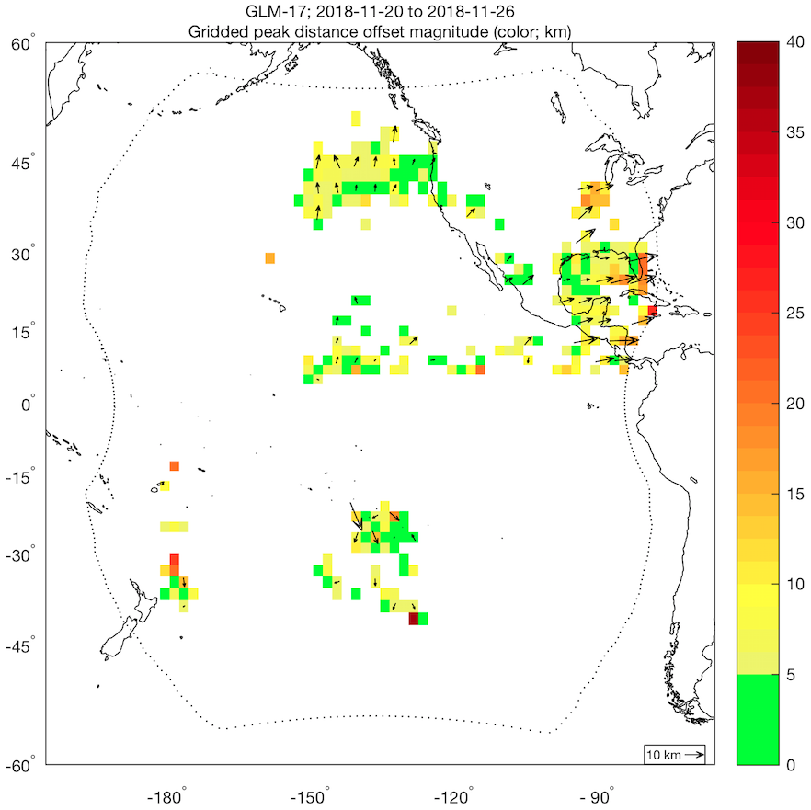
Location Accuracy (Virts/NASA) in Period 2: GLM-17 vs. ENGLN and GLD360
PASSED
PLPT-GLM-001
In Period 2
(Nov 20-27, 2018)
Groups near limb must be shifted outward to match reference data
NOAA's GOES-17 satellite has not been declared operational and its data are preliminary and undergoing testing. Users receiving these data through any dissemination means (including, but not limited to, PDA and GRB) assume all risk related to their use of GOES-17 data and NOAA disclaims any and all warranties, whether express or implied, including (without limitation) any implied warranties of merchantability or fitness for a particular purpose.
Notes:
Sample size = 178,380 matches

Slide 32
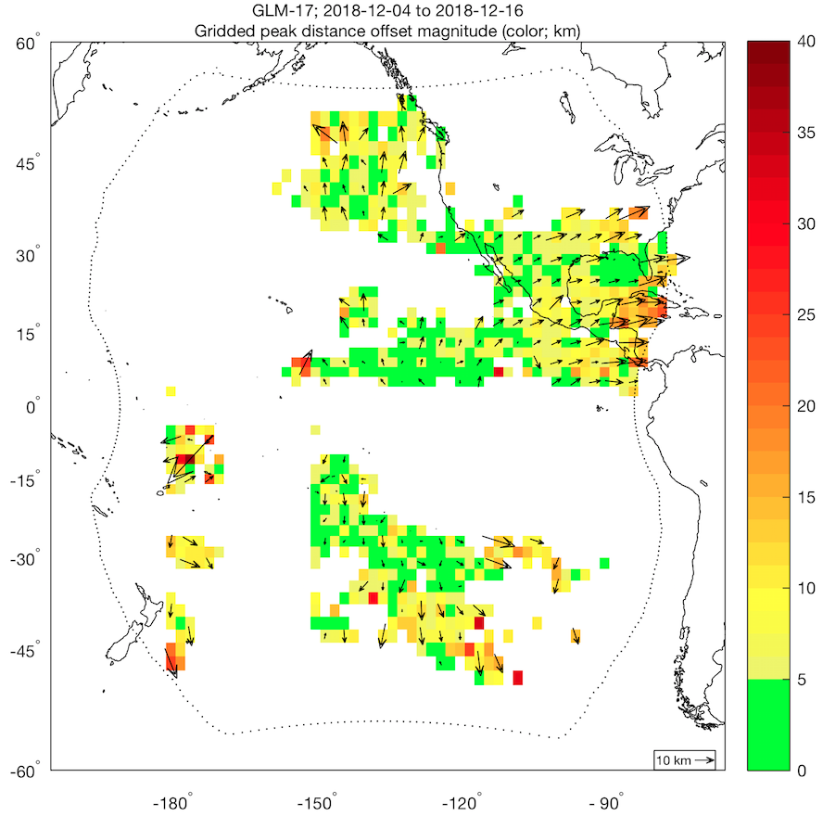
Time/Location Accuracy (Virts/NASA)
GLM-17 vs. ENGLN and GLD360
PASSED
PLPT-GLM-001
Dec 4-16, 2018
Sub-pixel location accuracy over much of domain
Groups near limb must be shifted outward to match reference data
NOAA's GOES-17 satellite has not been declared operational and its data are preliminary and undergoing testing. Users receiving these data through any dissemination means (including, but not limited to, PDA and GRB) assume all risk related to their use of GOES-17 data and NOAA disclaims any and all warranties, whether express or implied, including (without limitation) any implied warranties of merchantability or fitness for a particular purpose.
Notes:
Sample size: 2,896,228 matches

Slide 33
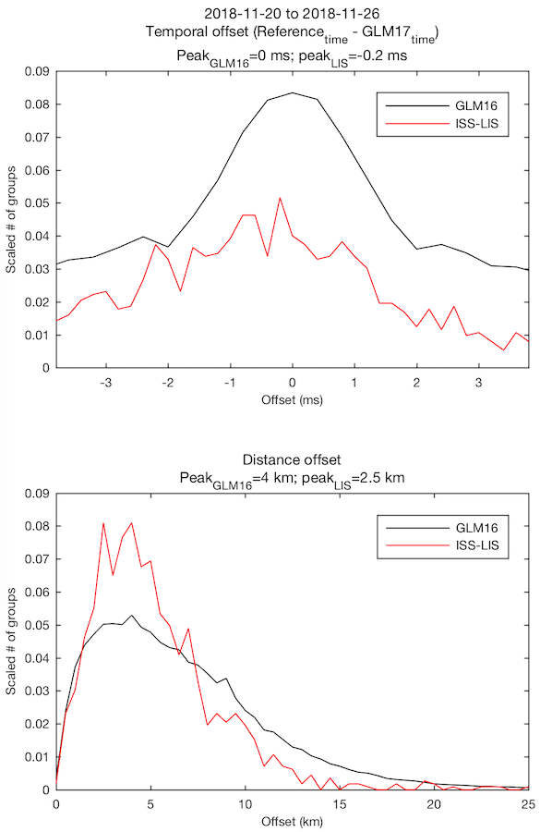
Time/Location Accuracy (Virts/NASA) in Period 2: GLM-17 vs. GLM-16 and ISS-LIS
PASSED
PLPT-GLM-005
In Period 2
(Nov 20-27, 2018)
Comparison with group data from two other space-based optical sensors
Sub-ms timing accuracy
Peak distance errors ~4 km compared with GLM-16
Small sample size with ISS-LIS
NOAA's GOES-17 satellite has not been declared operational and its data are preliminary and undergoing testing. Users receiving these data through any dissemination means (including, but not limited to, PDA and GRB) assume all risk related to their use of GOES-17 data and NOAA disclaims any and all warranties, whether express or implied, including (without limitation) any implied warranties of merchantability or fitness for a particular purpose.
Notes:
Sample size: 373,643 matches (GLM-16) and 1,124 matches (ISS-LIS)

Slide 34
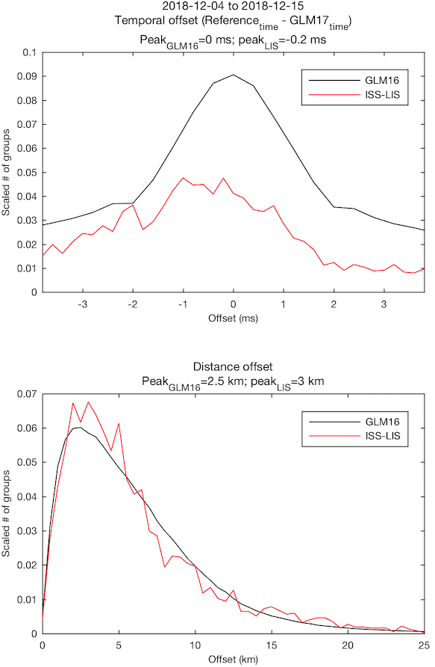
Time/Location Accuracy (Virts/NASA)
GLM-17 vs. GLM-16 and ISS-LIS
PASSED
PLPT-GLM-005
Dec 4-15, 2018
Comparison with group data from two other space-based optical sensors
Sub-ms timing accuracy
Peak distance errors < 3 km
NOAA's GOES-17 satellite has not been declared operational and its data are preliminary and undergoing testing. Users receiving these data through any dissemination means (including, but not limited to, PDA and GRB) assume all risk related to their use of GOES-17 data and NOAA disclaims any and all warranties, whether express or implied, including (without limitation) any implied warranties of merchantability or fitness for a particular purpose.
Notes:
Sample size: 5,981,337 matches (GLM-16) and 3,716 matches (ISS-LIS)

Slide 35
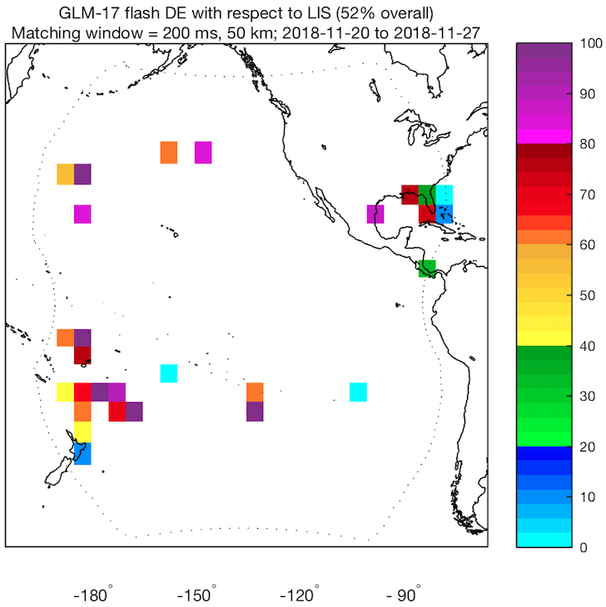
Flash Detection Efficiency (Virts/NASA) in Period 2: GLM-17 vs. ISS-LIS
PASSED
PLPT-GLM-005
In Period 2
(Nov 20-27, 2018)
Spatially
Averaged DE:
71%
NOAA's GOES-17 satellite has not been declared operational and its data are preliminary and undergoing testing. Users receiving these data through any dissemination means (including, but not limited to, PDA and GRB) assume all risk related to their use of GOES-17 data and NOAA disclaims any and all warranties, whether express or implied, including (without limitation) any implied warranties of merchantability or fitness for a particular purpose.
Notes:
Sample size: 102,532 matches (GLM-16) and 538 matches (ISS-LIS)

Slide 36
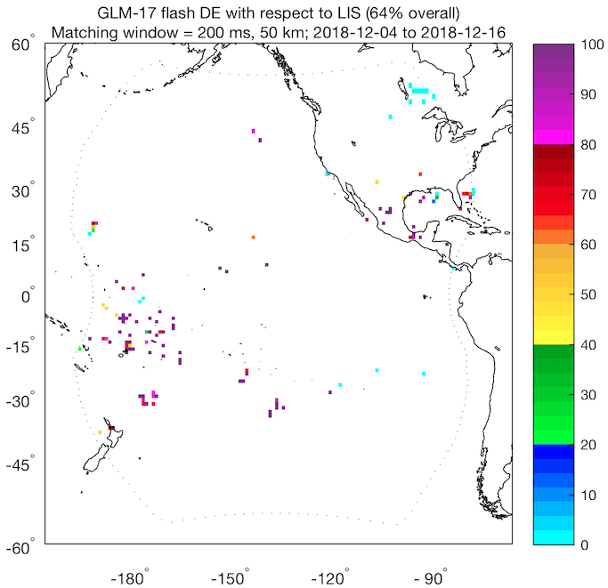
Flash Detection Efficiency (Virts/NASA)
GLM-17 vs. ISS-LIS
PASSED
PLPT-GLM-005
Dec 4-16, 2018
Small sample size when comparing with LIS
Substantial improvement in absolute DE
Spatially
Averaged DE:
71%
NOAA's GOES-17 satellite has not been declared operational and its data are preliminary and undergoing testing. Users receiving these data through any dissemination means (including, but not limited to, PDA and GRB) assume all risk related to their use of GOES-17 data and NOAA disclaims any and all warranties, whether express or implied, including (without limitation) any implied warranties of merchantability or fitness for a particular purpose.
Notes:
Sample size: 363,558 matches (GLM-16) and 551 matches (ISS-LIS)

Slide 37
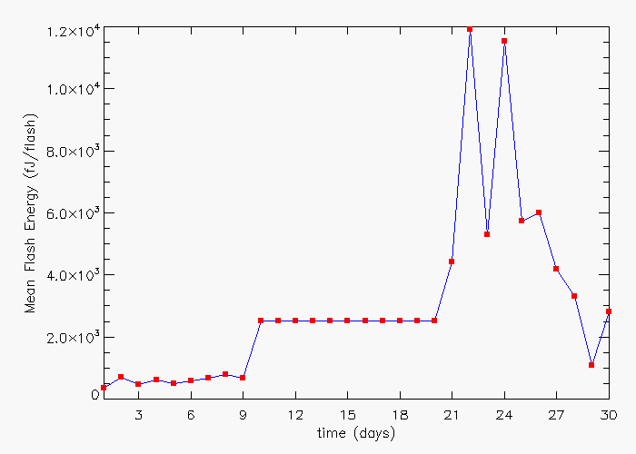
Flash Energy Trending (Koshak/MSFC)
Period 1
(Oct 15-24, 2018)
Ave = 620.5 fJ
Period 2
(Nov 20-29, 2018)
Ave = 5112.0 fJ
Drift
(+ cal + 7 d INR)
//
NOAA's GOES-17 satellite has not been declared operational and its data are preliminary and undergoing testing. Users receiving these data through any dissemination means (including, but not limited to, PDA and GRB) assume all risk related to their use of GOES-17 data and NOAA disclaims any and all warranties, whether express or implied, including (without limitation) any implied warranties of merchantability or fitness for a particular purpose.
37

Slide 38
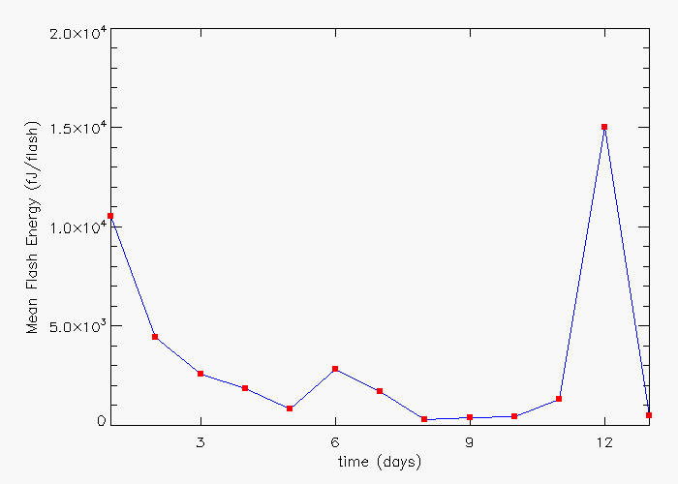
Flash Energy Trending (Koshak/MSFC)
Dec 4-16, 2018 (13 days)
Ave = 3088.4 fJ
NOAA's GOES-17 satellite has not been declared operational and its data are preliminary and undergoing testing. Users receiving these data through any dissemination means (including, but not limited to, PDA and GRB) assume all risk related to their use of GOES-17 data and NOAA disclaims any and all warranties, whether express or implied, including (without limitation) any implied warranties of merchantability or fitness for a particular purpose.
38

Slide 39
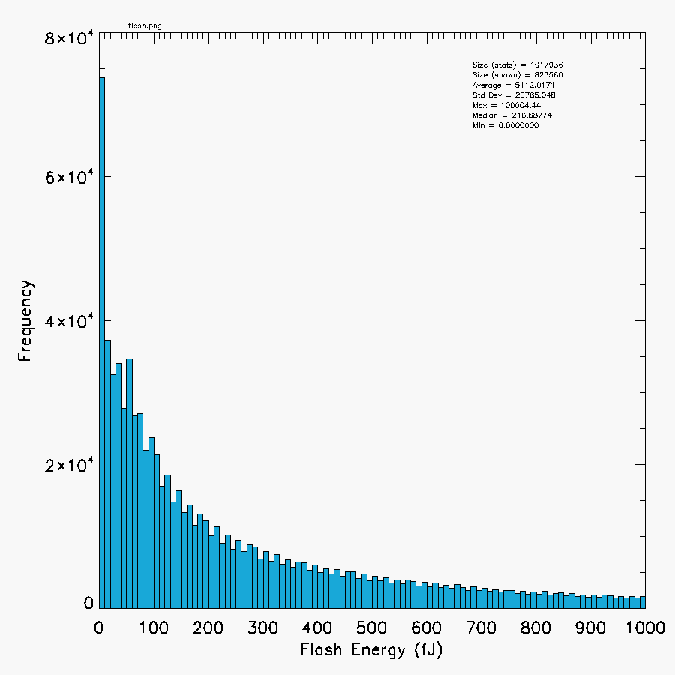
Flash Energy Trending (Koshak/MSFC)
Size = 1,017,936
Mean = 5112.0 fJ
Std. Dev. = 20,765.0 fJ
Max = 100,004.4 fJ
Median = 216.7 fJ
Min = 0.0 fJ
Period 2:
(Nov 20-29, 2018)
~ 1 M flashes
removed flashes with flash_quality_flag ⧧ 0 to help remove high-bias from blooming/glint
Mean of 5112.0 f J is far greater than 254.3 f J obtained from G16 Full.
Flash Energy
Freq. Dist.
NOAA's GOES-17 satellite has not been declared operational and its data are preliminary and undergoing testing. Users receiving these data through any dissemination means (including, but not limited to, PDA and GRB) assume all risk related to their use of GOES-17 data and NOAA disclaims any and all warranties, whether express or implied, including (without limitation) any implied warranties of merchantability or fitness for a particular purpose.
39

Slide 40
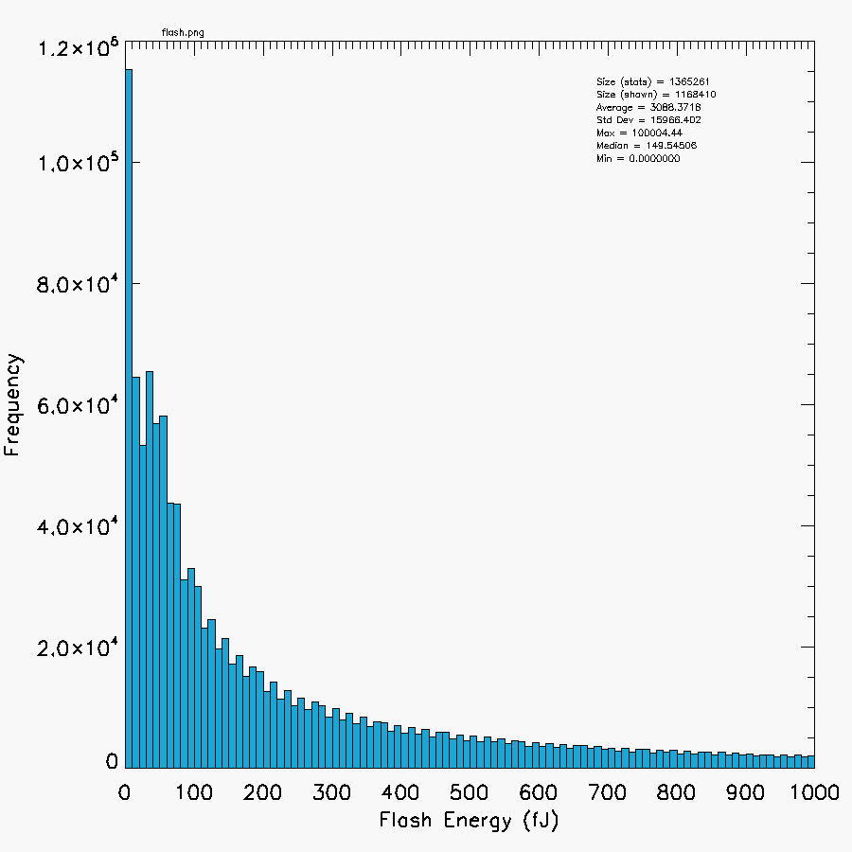
Flash Energy Trending (Koshak/MSFC)
Size = 1,365,261
Mean = 3088.4 fJ
Std. Dev. = 15,966.0 fJ
Max = 100,004.4 fJ
Median = 149.5 fJ
Min = 0.0 fJ
Dec 4-16, 2018
~ 1.4 M flashes
removed flashes with flash_quality_flag ⧧ 0 to help remove high-bias from blooming/glint
Mean of 3088.4 f J is far greater than 254.3 f J obtained from G16 Full.
Flash Energy
Freq. Dist.
NOAA's GOES-17 satellite has not been declared operational and its data are preliminary and undergoing testing. Users receiving these data through any dissemination means (including, but not limited to, PDA and GRB) assume all risk related to their use of GOES-17 data and NOAA disclaims any and all warranties, whether express or implied, including (without limitation) any implied warranties of merchantability or fitness for a particular purpose.
40

Slide 41
Flash Energy Trending (Koshak/MSFC)
PASSED
Recap:
G17 energies for Dec 4-16, 2018 not in family with G16 full PS-PVR energies … G17 energies are larger.
But, this makes sense because of:
  Boresight Effect (most G17 flashes at large boresight)
  Ocean Effect (most G17 flashes over ocean)
  Statistical Effect (G17 sample of natural lightning not as large relative to noise: glint, radiation dots)
  Seasonal Effect (flash energies peak in January per LIS study in Koshak, 2017)
Given the above qualifiers, this PLPT passes.
Hot pixel(s) spot (1ºx1º) over S. Pacific (West of S. America) now muted:
  Period 2: flash count = 224,073 (huge!), mean flash energy = 17,540.5 fJ (huge!)
  Dec 4-16: flash count = 2317 (nominal), mean flash energy = 108.7 fJ (nominal)
PLPT-GLM-013
41

Slide 42
Outline
Introduction
Review of Beta Maturity
Product Quality Evaluation Overview
Provisional Maturity Assessment
PLPT Details
Path to Full Validation
Summary and Recommendations

Slide 43
Future Fixes
(WRs for DO.08.00.00; DE: ~ April 2019, OE: ~Late June 2019)
WR | ADR | Title | PR Type 2 * | Impacts
5937/4697F | 374 | GLM Blooming Filter | No | FAR
6097 | 647 | Implement GLM 2nd-level threshold (for optimal threshold adjust) | Yes | DE/FAR
5981F | 648 | GLM GPA Coherency Filter LUT [depends on code implementation of ADR 647] | Yes | DE/FAR
6098 | 649 | Implement updated GLM Data Burst Filter | Yes | FAR/DE
4705 (on hold) | 375 | Time Order, GLM L2 (planned for DO.09.00.00) | No | time
4758 | 373 | GLM event geolocation does not match vendor results | No | location
5016 | -- | GLM Coastline algorithm falls behind, BG images are missed | No | other
5640 | -- | GLM EFRC failing to properly read in L1alpha BG object | No | other
6116 | 701 | GLM L2+ LCFA product’s yaw flip flag is fill | No | other
Priority Key | 1 | 2 | 3 | 4 | 5 | 6 | 7

Slide 44
Future Fixes (cont.)
(Possibly for DO.08.00.00, or else either earlier or later)
WR | ADR | Title | PR Type 2 * | Impacts
4662F | 461 | GLM Data Quality Product [ADDITIONAL PRODUCT REQUIRES SPSRB APPROVAL] | No | user interpretation
not created | 646 | GLM Gridded Product [ADDITIONAL PRODUCT REQUIRES SPSRB APPROVAL] | No | user interpretation
6460F | 645 | GLM Parallax | No | location
5983F | 650 | GLM GPA INR: Account for diurnal variation [in analysis by Flight, low priority] | TBD | location
5480 | 519 | GLM LCFA lightning radiation filter threshold (regarding SGF) [in analysis] | TBD | DE
5984F | 652 | GLM GPA keep first event in flash [in analysis by Flight, low priority] | TBD | data loss
6465 | 738 | Optical Energy Distortions in PDA Stream (from Michigan bolide analysis) [better energy range estimates being found] | Yes | energetics
not created | 739 | Dark Flashes (flashes with 0 energy, i.e. <1.5fJ) [likely to be merged w/738] | TBD | DE/FAR
Priority Key | 1 | 2 | 3 | 4 | 5 | 6 | 7

Slide 45
Outline
Introduction
Review of Beta Maturity
Product Quality Evaluation Overview
Provisional Maturity Assessment
PLPT Details
Path to Full Validation
Summary and Recommendations

Slide 46
Summary
Flash DE meeting spec overall:
  DE computation method VERY IMPORTANT in deciding final value ! … Equation, What filtered.
  Definite improvement in flash DE (given Rev C LUT update on 3 Dec 2018)
  Since NH Winter, not enough data to examine NW CONUS flash DE to see if depleted
Flash FAR not meeting spec, but to be improved:
  ADR 615 Fix for Bursts/Outages (e.g. from EXIS cruciform scans) now implemented
  ADR 638 GLM glint box update implemented week of 3 Dec 2018
  Blooming filter (ADR 374) still to be implemented to mitigate solar glint/intrusion
  False event “bars” at RTEP boundaries to be mitigated (ADR 647, 648)
  Bursts associated with Data Formatter to be mitigated (ADR 649)
Location and associated INR accuracy acceptable:
  Improvements due to Parallax Lite (improved lightning ellipsoid) implementation
  Further improvements expected with implementation of 3 deg grid model (ADR 645)
  Future improvements in INR expected by accounting for Diurnal Variation (ADR 650)
Timing accuracy acceptable:
  But low-priority time-order issue (ADR 375) to be fixed.
Misc future improvements:
  Improve SGF filter (ADR 519), “put back filter” (ADR TBD), Keep first event in flash (ADR 652)
  Granularity/Max Energy & Dark Flashes (ADR 738/739)
  New Products (Data Quality ADR 461, Gridded ADR 646) desired but need approval.

Slide 47
Recommendation
CWG believes that the GOES-17 GLM L2 product (events, groups, flashes) has reached the Provisional Maturity as defined by the GOES-R Program.

