Slide 1
Peer Stakeholder-Product Validation Review (PS-PVR)
For the Full Maturity of GOES-16 and GOES-17 MAG L1b Product
February 2021
GOES-R Calibration Working Group (CWG)
Presenter: Paul Loto’aniu¹
Contributors: Fadil Inceoglu¹, Michael Grotenhuis³, Fred Rich², and Sam Califf¹
¹NOAA-NCEI / CU-CIRES, ²MIT-LL, ³NASA-GSFC
This review incorporates results from NASA, PLTs, and MIT.

Slide 2
Outline
MAG Overview
Instrument Status Review
Product Quality Evaluation
  Summary of MAG Anomalies and Resolution Status
  PLPTs Supporting Assessment for Full Status
Full Maturity Assessment
Summary and Recommendations

Slide 3
MAG OVERVIEW
GOES-16 and GOES-17 MAG L1b Product Full PS-PVR

Slide 4
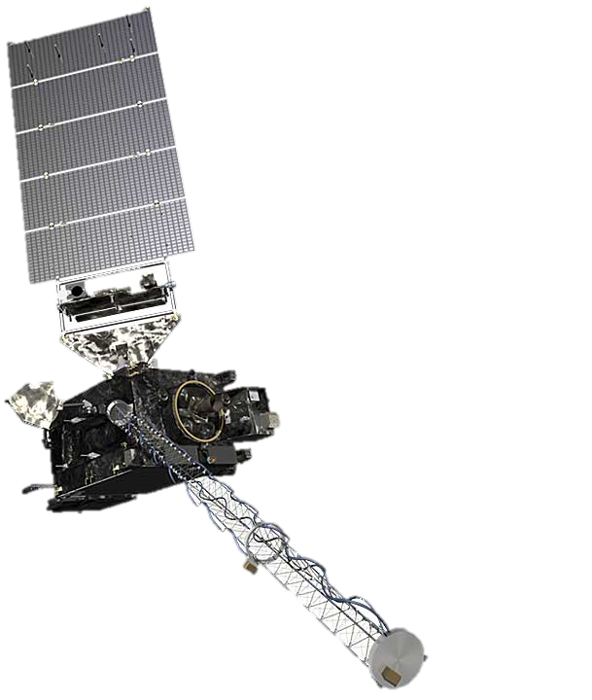
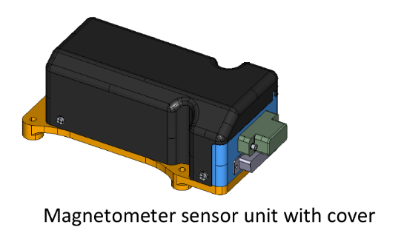
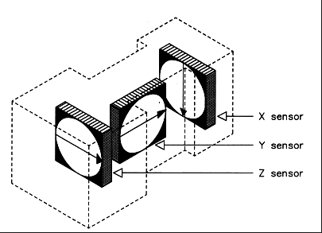
Instrument Description
Requirements similar to previous GOES series
Characteristics | GOES 8-12 | GOES 13-15 | GOES R-U
3-axis fluxgates | 2 | 2 | 2
Sampling Rate | 2 Hz | 2 Hz | 10 Hz
Low-Pass Filter Cutoff | 0.5 Hz | 0.5 Hz | ~2.5 Hz
Boom Length | 3 m | 8.5 m | 8.5 m
0.3 nT noise requirement.
1 nT accuracy requirement (but performance requirements for GOES-16/GOES-17 were loosened).
Two boom-mounted fluxgate magnetometers - Inboard MAG (IB) 6.3 m from boom base and Outboard MAG (OB) 8.5 m from the base.
Sensor units built by Macintyre Electronic Design Associates (MEDA) Inc, in Virginia, under contract from the instrument vendor Lockheed Martin.
Inboard MAG
Outboard MAG

Slide 5
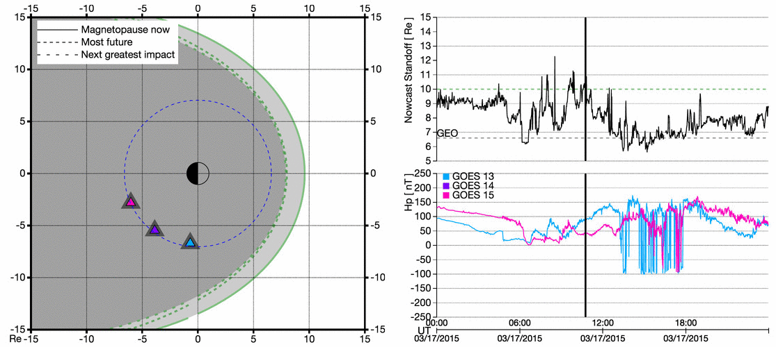
Example GOES-R Era Product
Magnetopause Crossing
Introduction
5

Slide 6
INSTRUMENT STATUS OVERVIEW
GOES-16 and -17 MAG L1b Product Full PS-PVR

Slide 7
Schedule of Previous Maturity Levels
GOES-16 MAG turned and boom deployment on 07 Dec 2016
GOES-17 MAG turned and boom deployment on 22 Mar 2018
Beta level (Vendor) PLTs and (NCEI) PLPTs completed
  G16 MAG Beta PS-PVR 25 May 2017, G17 MAG Beta PS-PVR 08 Aug 2019
Provisional level PLPTs completed
  G16 MAG Provisional PS-PVR, 28 Aug 2018, G17 MAG Provisional PS-PVR, 01 Nov 2019
Full validation level PLPTs NOT completed but satisfactory for Operations / Scientific use with limitations due to these ongoing work
Ongoing
    Machine learning algorithm to remove solar angle dependency/thermal issue
    Bias stability monitoring and adjustments as required
    Arcjet correction algorithm needs update for GOES-16
    Heater and other noise effects still being studied
  Investigations into the usability of the MAG data, given issues, in science research that would lead to new operational products.

Slide 8
PRODUCT QUALITY EVALUATION
GOES-16 and -17 MAG L1b Product Full PS-PVR

Slide 9
MAG Specific ADRs/WRs
Full Validation
ADR Number | WR Number | Short Description | Status | G16 | G17 | Expected Closure
610 | 6136 | Arcjet correction | closed | ✓ | ✓ | DO.08.00.00
890/1102 | 6880 | Update to arcjet correction | closed | ✓ | ✓ | DO.09.03.00/PR.09.06.01
1104 | N/A | Arcjet correction update for GOES-16 arcjet firing configuration changes | closed | ✓ | N/A
1050 | N/A | Update arcjet correction to use inverse matrices | closed | ✓ | ✓ | DO.09.03.00
449 | 5133 | Arcjet flag | closed | ✓ | ✓ | PR.06.17.04
450 | 5134 | IB shadow flag | closed | ✓ | ✓ | PR.06.17.04
430 | 4164 | Eclipse flag | closed | ✓ | ✓
204 | 5134/6235 | Reformat L1b variables with _unsigned attribute- | closed | ✓ | ✓ | DO.07.00.00/DO.08.00.00
267 | 5370 | LUT Filenames not Traceable to Metadata | closed | ✓ | ✓ | DO.07.00.00
565 | 5637 | MAG in EPN coords does not match LM algorithm | closed | ✓ | ✓ | DO.07.00.00

Slide 10
MAG Specific ADRs/WRs continued…
ADR Number | WR Number | Short Description | Status | G16 | G17 | Expected Closure
523 | 5512 | Eliminate SpWx L1b dependency on APID 384 | closed | ✓ | ✓ | DO.08.00.00
612 | 6065 | Revise algorithm_container attributes | closed | ✓ | ✓ | DO.08.00.00
750 | 6576 | G17 MAG - Frequent spikes in EPN | closed | ✓ | ✓ | DO.08.01.00
621 | 6099 | MAG - Disable 1.6Hz Filter - ADR 621 - PRO Type1 | closed | ✓ | ✓ | PR.06.12.00
989 | 7269 | New method to determine MAG maintenance/off flag | closed | ✓ | ✓ | DO.09.03.00
1045 | 7433 | Remove IB shadow flag from good quality flag mask | closed | ✓ | ✓ | DO.09.03.00
1137 |  | G17 MAG LUT update for yaw flip bias corrections | In_Deployment | N/A | ✓ | PR.09.06.08 Feb 2021
832 | 6686 | GOES-16 X-axis Bias Anomaly | Closed | ✓ | N/A | This will be looked at in future**
429 | 3643 | IB and OB do not meet success criteria of MAG-004 PLT | Closed | ✓ | ✓ | This work continues*
*This work continues as part of product improvement to account for thermal effects as will be shown in later slides
**Have not had time to study this in more detail

Slide 11
Summary of Major Anomalies
ADR Number | WR Number | Short Description | Specific Issues | Impacts
429 | 3643 | IB and OB do not meet success criteria of MAG-004 PLT | Inadequate thermal compensation (diurnal and seasonal variations due to solar angle and eclipses)* GOES-16 Analog/Digital conversion causes preferred counts and therefore enhanced noise Unexpected large DC magnetic contamination on GOES-16 - resolved through spacecraft maneuver to determine offsets and GOES-17 MAG redesign. | GOES-16/GOES-17 inboard MAGs not currently useable in operations. New sensors for GOES-T and –U, called GMAG. Limited science useability to develop new operational products
449, 610, 890, 1102, 1104, 1050 | 6136, 6880, 5133 | Arcjet firing contamination | Arcjet firings modify observed magnetic field (affects all GOES-R series satellites) – arcjet correction algorithm implemented for GOES-16, -17. GOES-16 arcjet firing configuration has changed making correction for GOES-16 invalid* GOES-16 arcjet firings becoming more frequent* How will arcjet firing design changes affect GOES-T and –U product* | Correction residual effects can create false forecasting. Limits MAG data useable in operations. GOES-16 increased periods of arcjet firing significantly limits data useability in operations.
*Work is continuing on these even though ADRs/WRs are closed

Slide 12
Summary of MAG anomalies
Analog to digital conversion – Part of WR 3643
Conversion from counts to science units shows preferred counts - ~0.3-0.5 nT noise contribution
~0.3 nT
~0.3 nT
Resolution:
This cannot be fixed through an ADR/WR.
On GOES-16 the issue remains but it affects quality of data for science community rather than operations.
For GOES-17 circuitry was redesigned which fixed the issue.
GOES-T/U new magnetometer system with new circuitry – problem should not occur.

Slide 13
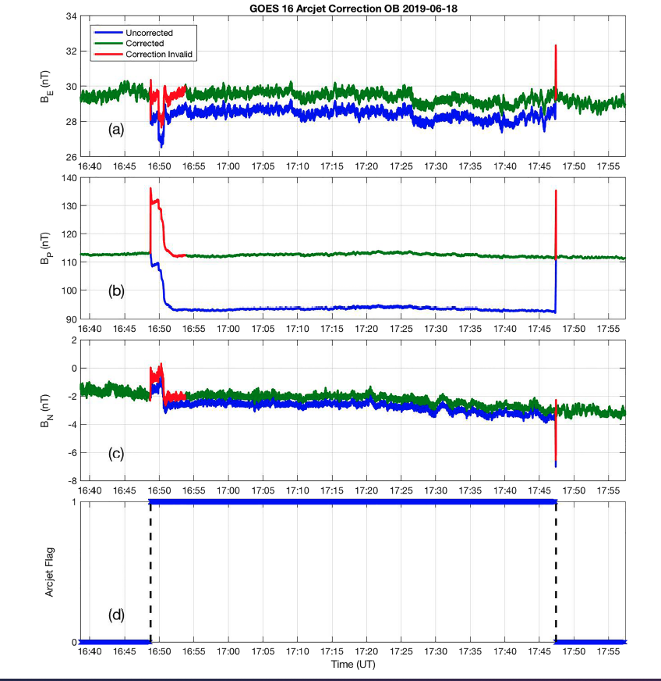
Summary of MAG anomalies
Arcjet Firings
Arcjet firings induce a magnetic field which modifies the observed ambient magnetic field.
Affects both GOES-16 and GOES-17.
~20 nT error in accuracy (arcjet periods not included in accuracy performance analysis)
Resolution Correction algorithm and arcjet flag - ADRs 449, 610, 890, 1102, 1104, 1050 all closed
GOES-16 MAG data
B_{E}-component
B_{p}-component
corrected
uncorrected
Continuing Issues
Residual artifacts from correction.
GOES-16 arcjet firing configuration changes.
B_{N}-component
ON
OFF
For description of algorithm: Califf, S., Early, D., Grotenhuis, M., Loto'aniu, T. M., & Kronenwetter, J. (2020). Correcting the arcjet thruster disturbance in GOES‐16 magnetometer data. Space Weather, 18, e2019SW002347. https://doi.org/10.1029/2019SW002347
Arcjet Flag

Slide 14
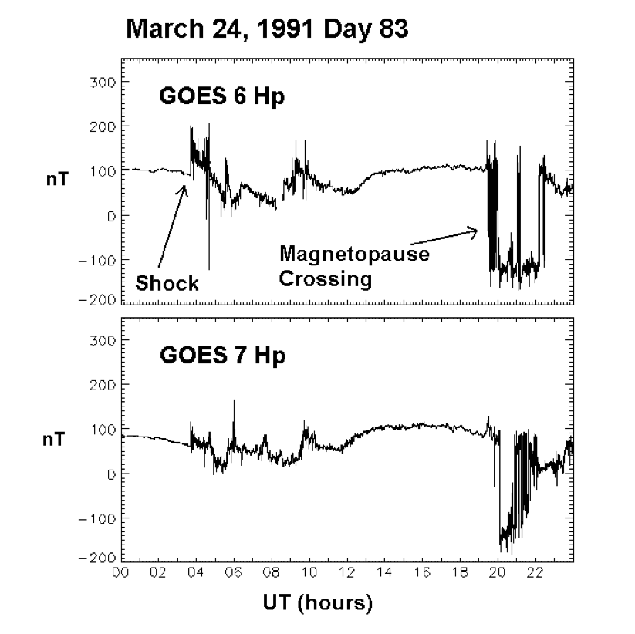
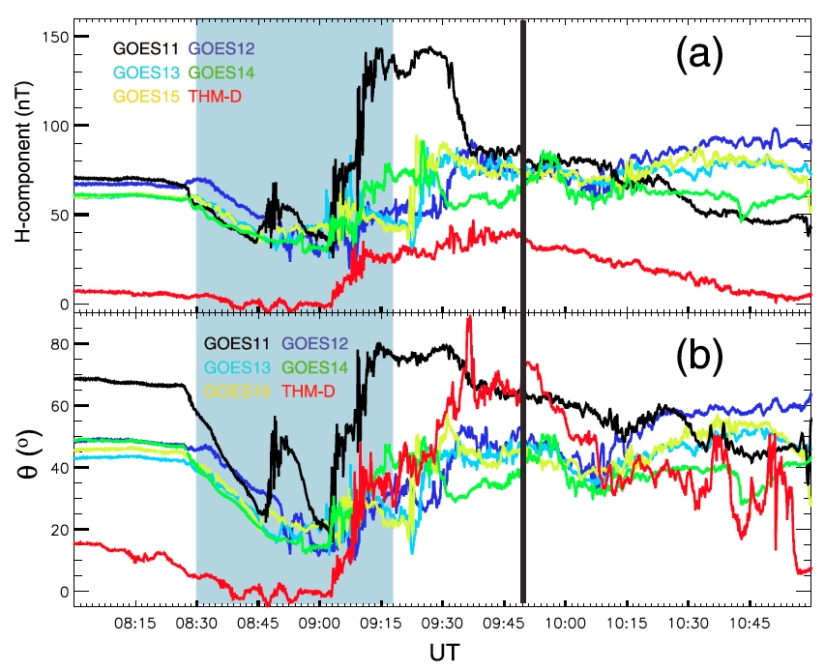
Summary of MAG anomalies
Arcjet Firings – Misinterpretation of data due to arcjet correction
Residual correction effects could be misinterpreted as shock or storm sudden commencement signal
Residual from correction
Bad correction could result in misinterpretation of spacecraft anomaly assessments.
corrected
uncorrected
Uncorrected
Howard Singer, Lorne Matheson, Richard Grubb, Ann Newman, David Bouwer, "Monitoring space weather with the GOES magnetometers," Proc. SPIE 2812, GOES-8 and Beyond, (18 October 1996);https://doi.org/10.1117/12.254077
Galaxy 15 anomaly
Loto'aniu, T. M., Singer, H. J., Rodriguez, J. V., Green, J., Denig, W., Biesecker, D., and Angelopoulos, V.(2015), Space weather conditions during the Galaxy 15 spacecraft anomaly, Space Weather, 13, 484– 502, doi:10.1002/2015SW001239.

Slide 15
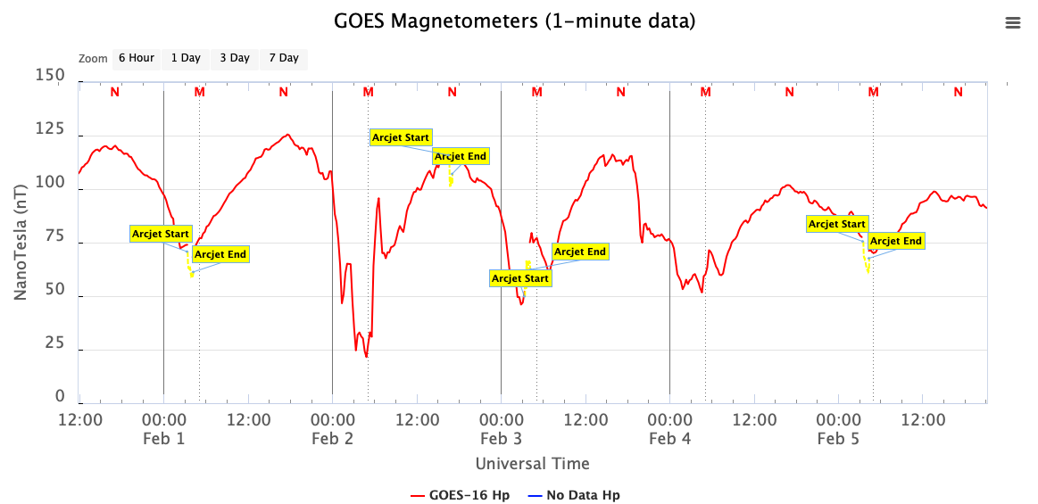
Summary of MAG anomalies
Arcjet Firings – Changes to arcjet firing configuration on GOES-16
1) More frequent firings on GOES16 – firings use to be about one every 4 days. Now up to twice in one day.
SWPC operation product
https://www.swpc.noaa.gov/products/goes-magnetometer

Slide 16
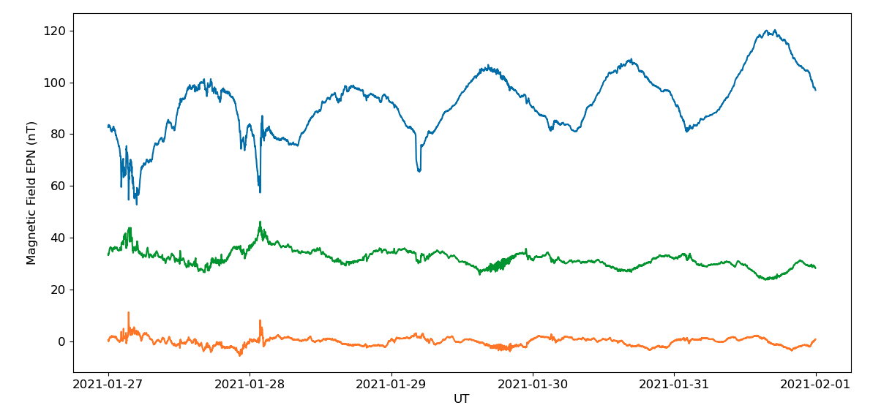
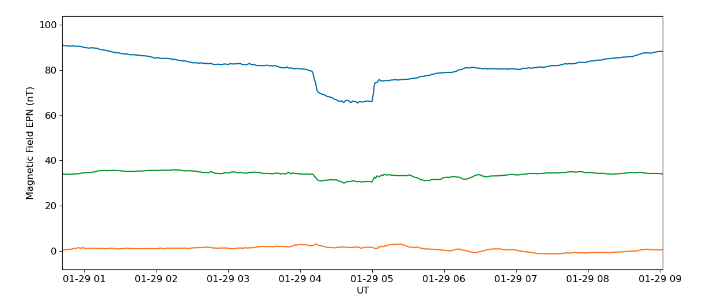
Summary of MAG anomalies
Arcjet Firings – Changes to arcjet firing configuration on GOES-16
2) Changing which thrusters are fired and arcjet voltage – wrong or no acrjet correction
SWPC operation product
Data to right looks all normal and corrected for arcjet firings
However, zoom in and we see an arcjet firing contamination that was not corrected or not corrected fully.
This is due to changes in which pairs of arcjets are fired. A partial correction would most definitely cause a misinterpretation of the data by the forecaster.

Slide 17
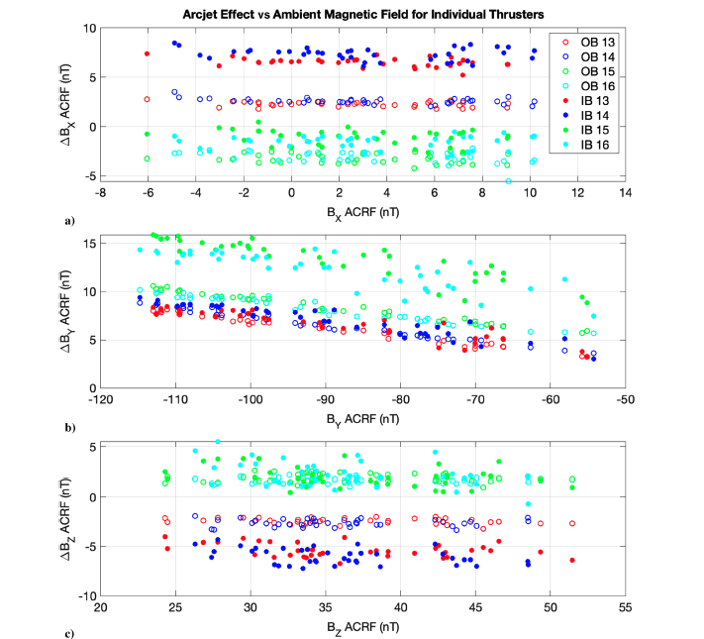
Summary of MAG anomalies
Arcjet Firings - Effect of changing which arcjet thruster fire
Thrusters 13/14 effect on IB sensor data
Thrusters 13/14 effect on OB sensor data
Thrusters 15/16 effect on OB and IB sensor data
The effect is different on each vector component of the magnetic field observation
Impact: Invalid operational data ~5-20% on any given day, while corrected data can be misinterpreted. Work ongoing…
S. Califf, T. M. Loto’aniu, D. Early, and M. Grotenhuis (2020), Arcjet Thruster Influence on Local Magnetic Field Measurements from a Geostationary Satellite, J. of Spacecraft and Rockets 57:1, 177-186.

Slide 18
Summary of MAG anomalies
Summary of Arcjet Firing Anomalies
Arcjet firings modify observed magnetic field (affects all GOES-R series satellites).
Arcjet correction algorithm implemented for GOES-16 and GOES-17. Need to develop models for GOES-T/U.
Algorithm correction residual effects result in data misinterpretation / wrong forecasting.
Correction not currently used in SWPC operations. Hence, limits on MAG data use in operations.
GOES-16 increased firing frequencies has significantly limited data useability in operations (~5-20% of unusable data over 1-2 days).
Will GOES-16 arcjet firing changes also happen on GOES-17? What about GOES-T and –U?
NCEI will work on better understanding the physics of the arcjet contamination, model it and develop better correction algorithm using machine learning techniques.

Slide 19
Summary of MAG anomalies
MAG Thermal Issues
Thermal Issues (Related to ADR 429)
The MEDA MAG sensors were found to be more sensitive to temperature changes and thermal gradients than expected and they affect the IB and OB differently:
          Solar angle dependent sensor response – NCEI still undertaking research to understand this issue and to compensate for it. We are working on machine learning algorithm. ~ 1year timeline for completion and implementation in operational product for GOES-16.
Bias stability and thermal anomalies – We observe other anomalies that we think maybe thermal related, and we have concerns about bias stabilities into the future. NCEI will continuously monitor and trend over multiple years to understand thermal issues/anomalies and look at developing correction algorithm.

Slide 20
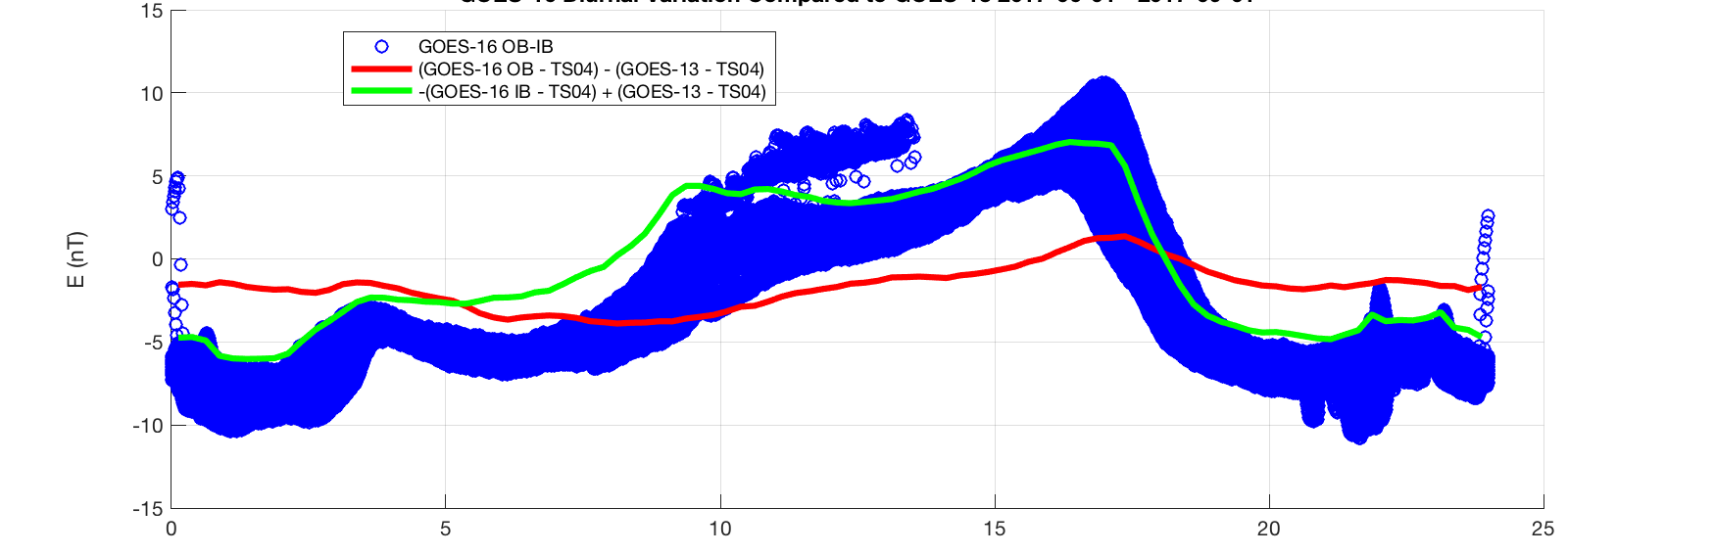
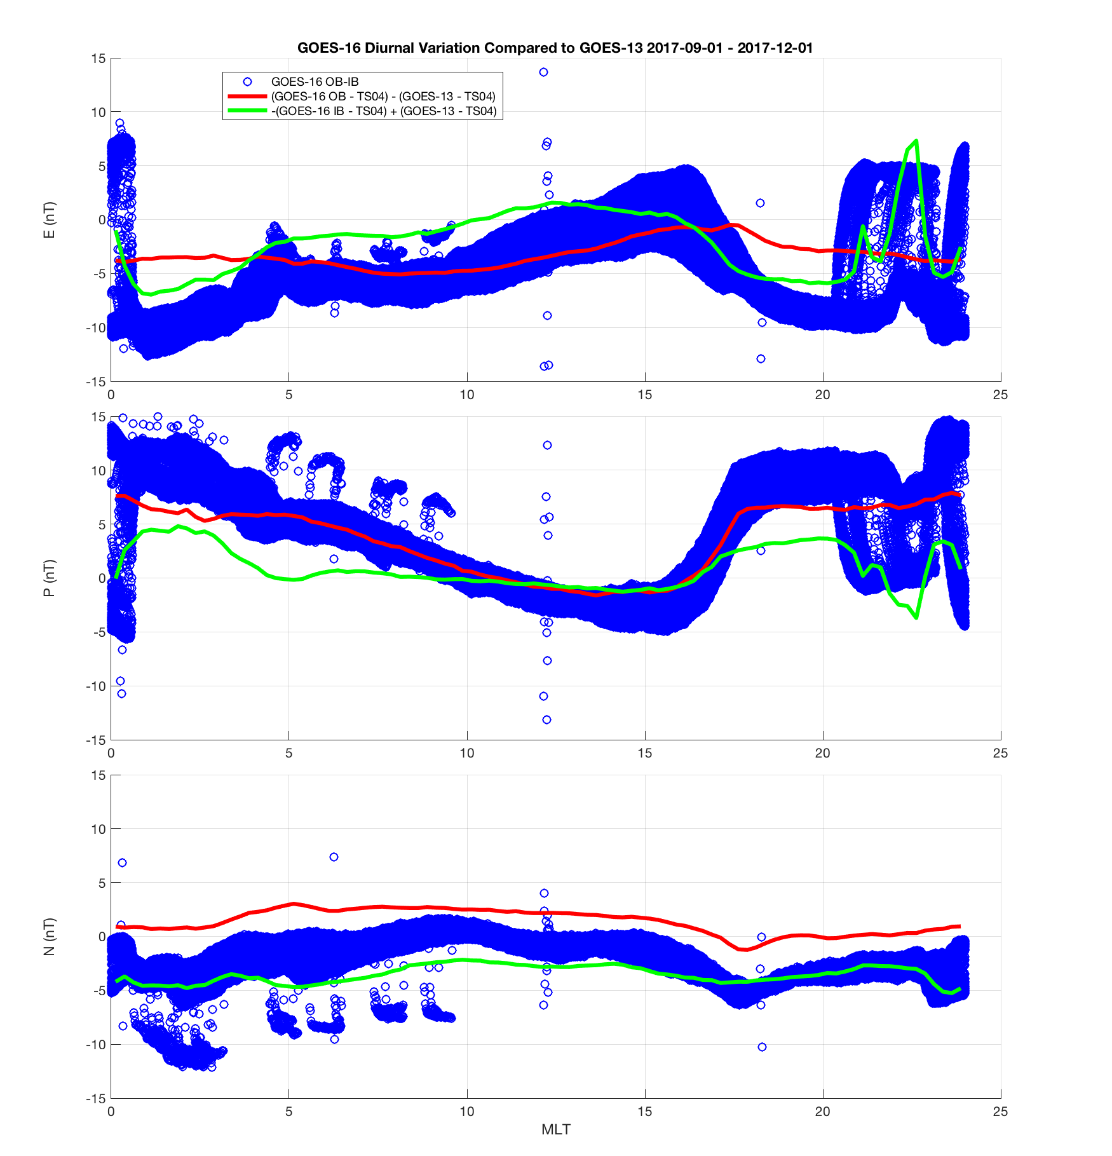
Summary of MAG anomalies
MAG Thermal Issues
Solar Angle Dependency
Note the blue dots which represent GOES-16 OB-IB over Jun-Aug 2017.
Variability in OB-IB is seen both seasonally and diurnally.
NCEI is working on machine learning algorithms to try to correct for these issues.
E-component being studied first because thermal issues are more obvious.
E-component
OB-IB should equal 0 nT
June-Aug 2017
P-component
Magnetic Local Time

Slide 21
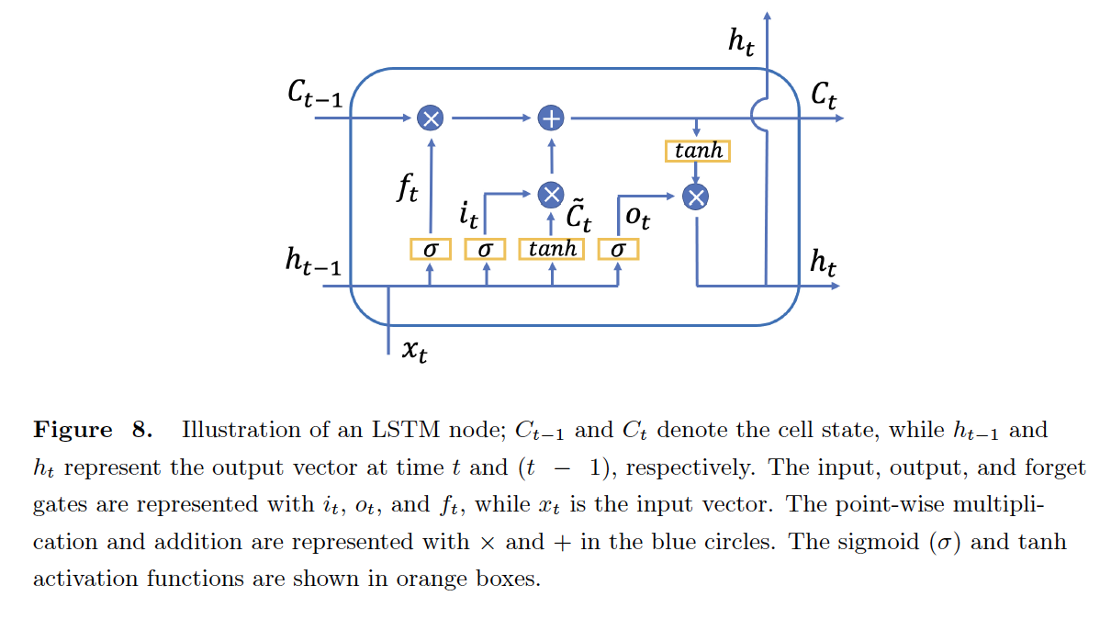
Summary of MAG anomalies
MAG Thermal Issues
Machine Learning for GOES-16 MAG Solar Angle Correction
Long short-term memory (LSTM) is an artificial recurrent neural network (RNN) architecture used in Deep Learning (DL).
The cell state, C_{t}, which is the core concept of the LSTMs, can learn which information to transfer forward or to forget using the gates.
For training of the LSTM networks, we employ an Adam optimizer (Kingma & Ba, 2014), and mean absolute error as our loss function as we are using our LSTM networks as regressors.
LSTM advantages:
Capable of processing the entire sequence of data including time series data and not just single data points such as images.
Usual RNN completely changes the existing data, whereas LSTM makes small modifications on the data and learns over time allowing greater finesse.
Inceoglu, F. and T.M. Loto’aniu (2021), Using unsupervised and supervised machine learning methods to correct offsets in magnetometer data from the GOES-16, In preparation.

Slide 22
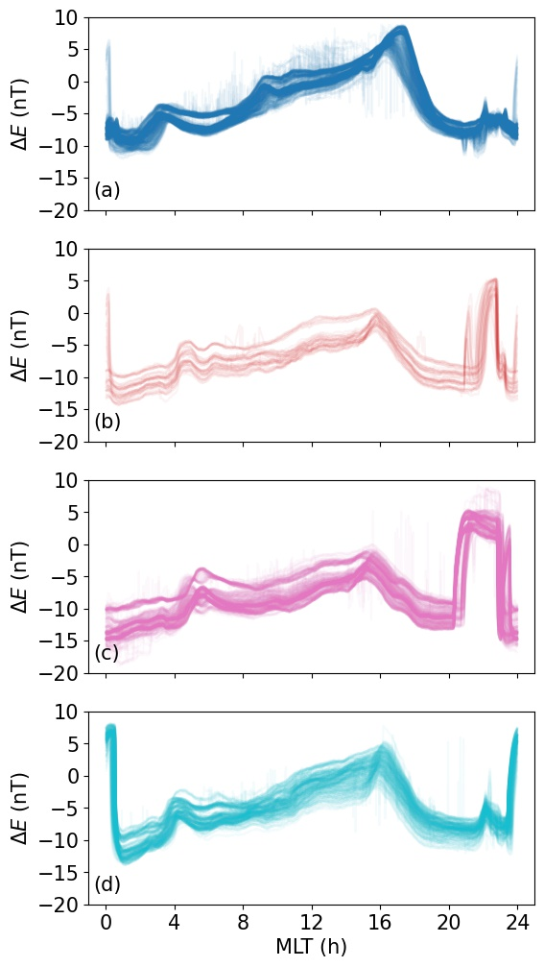
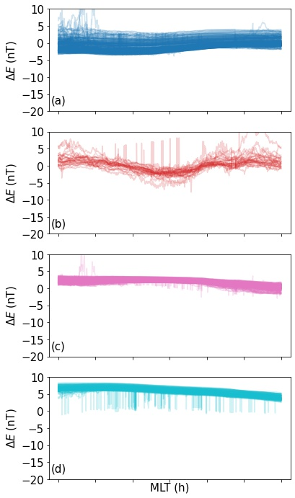
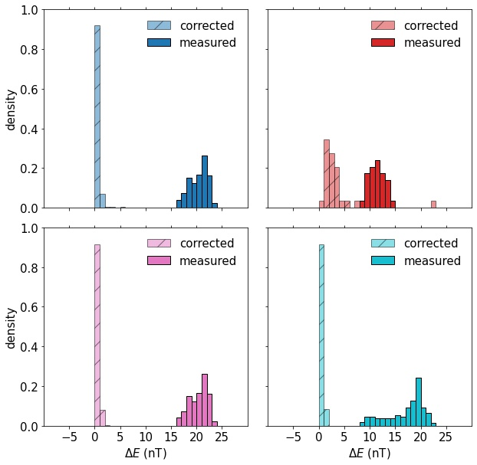
Summary of MAG anomalies
MAG Thermal Issues
Machine Learning for GOES-16 MAG IB Sensor Only
ADR 429 close but work is ongoing as research to improve Operations and Science knowledge and usability
4 clusters found separated by seasons
The corrected value differences st. dev. close to zero
Corrected clusters
GOES-16 E-comp. OB-IB differences
GOES-16 E-comp. OB-IB differences statistics
Inceoglu, F. and T.M. Loto’aniu (2021), Using unsupervised and supervised machine learning methods to correct offsets in magnetometer data from the GOES-16, In preparation.

Slide 23
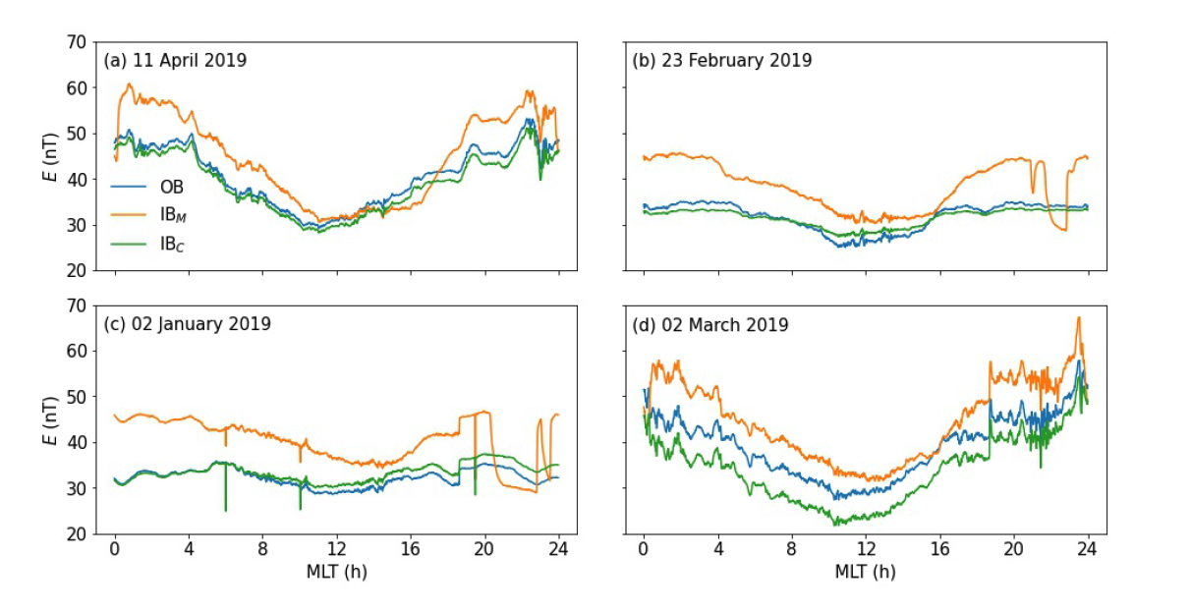
Summary of MAG anomalies
MAG Thermal Issues
Machine Learning for GOES-16 MAG IB Sensor Only
Example corrected GOES-16 IB sensor data. No GOES-16 data used in training set
Orange – uncorrected IB, Green corrected IB, Blue – OB
IB_{M} = Uncorrected IB
IB_{C} = Corrected IB

Slide 24
Summary of MAG anomalies
MAG Thermal Issues
Summary of Machine Learning Algorithm Development for GOES-16 MAG
Current work focuses on correcting GOES-16 IB data, which is the most affected by solar angle thermal issues.
Built one LSTM network for each cluster and utilize networks as regressors. Trained the network using GOES-17 MAG data, solar angle and spacecraft position (no GOES-16 data used in training).
Testing algorithm on GOES-16 IB E-component, and initial results are excellent.
Currently running machine learning methods for GOES-16 IB N- and P-components of the magnetic field vector.
Expecting completion of solar angle correction algorithm and implementing into data processing in about ~1 year.
Looking to apply algorithm to other MAG sensors/vector-components.
This work informs our plans to improve the arcjet correction methods using machine learning methods.

Slide 25
Summary of MAG anomalies
MAG Thermal Issues
Bias stability and Other Thermal Issues
GOES-17 MAG data

Slide 26
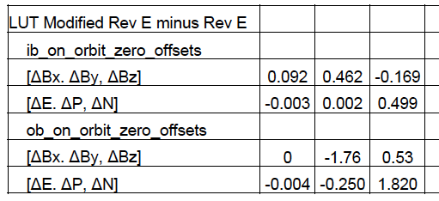
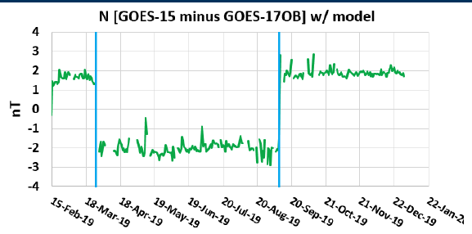
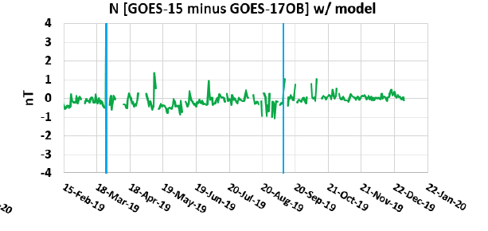
Summary of MAG anomalies
MAG Thermal Issues
Bias Stability - Yaw flip
Yaw flips shift the GOES-17 MAG data
By comparing the magnetic field before and after Yaw flips the bias in GOES-17 MAG can be adjusted. Results are shown in the Table above.
LUT for GOES-17 was updated.
ADR1137 to be implemented in January/February.

Slide 27
Summary of MAG thermal anomalies work
Although ADR 429 is closed, work is ongoing to study GOES-16 and GOES-17 thermal issues:
  Machine learning algorithm to remove solar angle dependency
  Bias stability monitoring and adjustments as required
  Studying anomalies/sudden jumps in data
  Heater effects on noise levels
  Studying new temperature compensation curve
  Lessons learned applied to GOES-T/U new instrument - GMAG

Slide 28
Full Validation - PLPTs
Title | Activity | Data Needed | Success Criteria
A.3.1 Cross-satellite intercalibration (full resolution data) [PLPT-MAG-002]** | Validate MAG L1b product by comparing it to other GOES in situ Magnetometer measurements. | Three months of data from GOES-16/17 (need not be contiguous). | Characterize data compared with other spacecraft observations.
A.3.2 Intercalibration per MLT [PLPT-MAG-003] | Validate MAG L1b product by comparing it to other GOES in situ Magnetometer measurements as a function of magnetic local time (MLT). | Three months of data from GOES-16/17 (need not be contiguous). | Characterize data compared with other spacecraft observations.
A.3.3 Diurnal/eclipse effects [PLPT-MAG-004] | Validate MAG L1b product by comparing inboard to outboard measurements taking into account diurnal/eclipse effects. | Three months of data from GOES-16/17 (need not be contiguous). | Characterize data compared with other spacecraft observations.
A.3.4 Comparison of gradiometer to other methods [PLPT-MAG-005] | Not started. Gradiometer method was not used in operations due to Inboard sensor issues.
RIMP v2 A.3.3 Noise Performance [PLPT-MAG-003]*** | Determine the noise level of the product and compare it to the MRD values of no more than 0.3 nT on each axis. | 7 days (need not be contiguous) | The success criteria is that the noise level of the product has been determined and compared to 0.3 nT requirement.
PLPT-MAG-006 | Temperature effect compensation* | These PLPTs are part of PLPTs A3.1/A.3.2/A.3.3 and continuing studies into thermal anomalies previously mentioned. Corrections will be implemented into GOES-16/17 L2+ processing at NCEI for MAG, while lessons learned can be applied to GMAG for GOES-T/U. | Temperature effect compensation*
PLPT-MAG-007 | Thermal electric effect compensation* | PLPT-MAG-007 | Thermal electric effect compensation*
PLPT-MAG-008 | Accuracy stability determination* | PLPT-MAG-008 | Accuracy stability determination*
*These PLPTs were not studied as separate PLPTs but instead results from other PLPTs and anomaly assessments informed us about these PLPTs.
**Full resolution data full validation has not been undertaken.
***There has been changes from RIMP v1.1 to v2

Slide 29
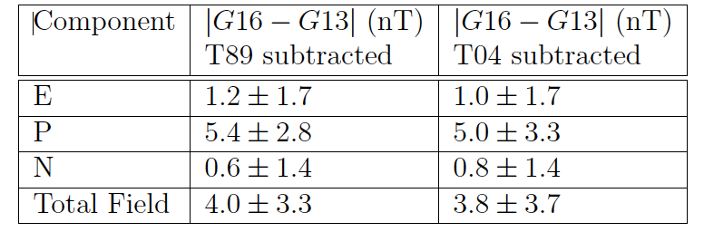


RIMP v1.1 PLPT-MAG-002
A.3.1/A.3.2 Cross-satellite intercalibration
Loto’aniu, T.M., et al. The GOES-16 Spacecraft Science Magnetometer. Space Sci Rev 215, 32 (2019). https://doi.org/10.1007/s11214-019-0600-
GOES-16 comparison to GOES-13 study suggest average per axis 2.3 nT $±$maximum 3$σ$ of 3.3 nT. This is consistent with waiver value of 2.3 nT $±$ 4 nT.
MIT collaboration, modified from Rich, F., et al. (2021) Inter-spacecraft Comparisons of GOES Magnetic Field Measurements, paper in preparation.
Result of GOES-16 comparison to nearby GOES-15 over long time period is similar to the waivered value. GOES-13/16 comparison was undertaken during period of spacecraft shadowing.
Result of GOES-17 to nearby GOES-15 over long time period is an improvement on bias or average, but worse for $σ$.
The current waivered values, for the most part, encompass these extended results
Pass
Waived values exclude arcjet firing effects

Slide 30
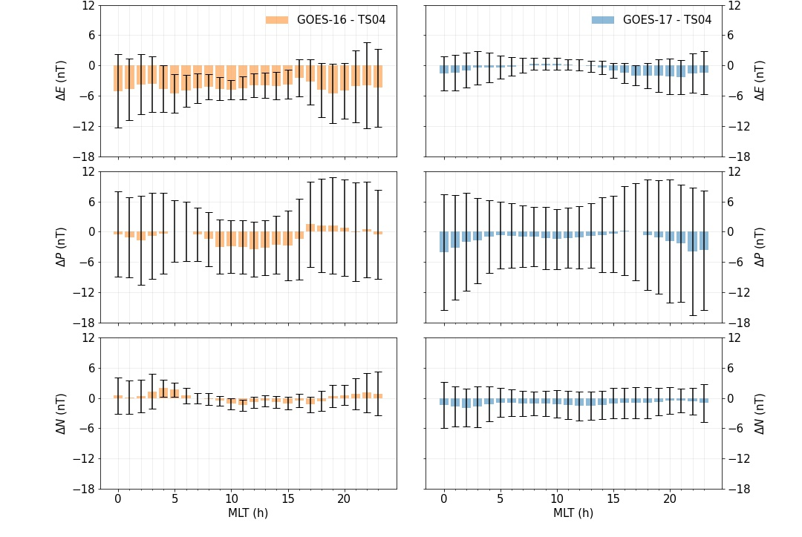
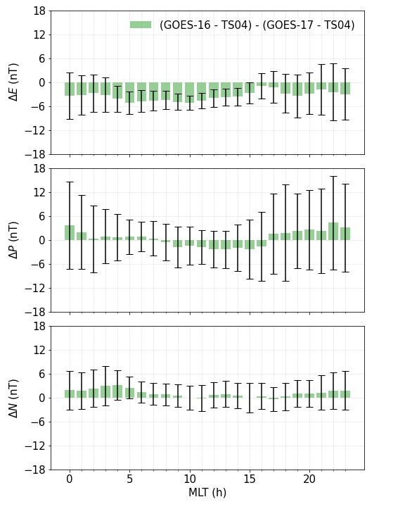
RIMP v1.1 PLPT-MAG-003
A.3.2 Intercalibration per Magnetic Local Time
Compare GOES-16 OB and GOES-17 OB to model ~6 months of 2020 data*
Compare GOES-16 OB to GOES-17 OB
*GOES-14/15 SWx data ceased operations early 2020. Therefore, we only compare G16 to G17.
These results are consistent with previous data. However, more work is needed to understand the variations with local time and to improve the product.
Partial pass

Slide 31
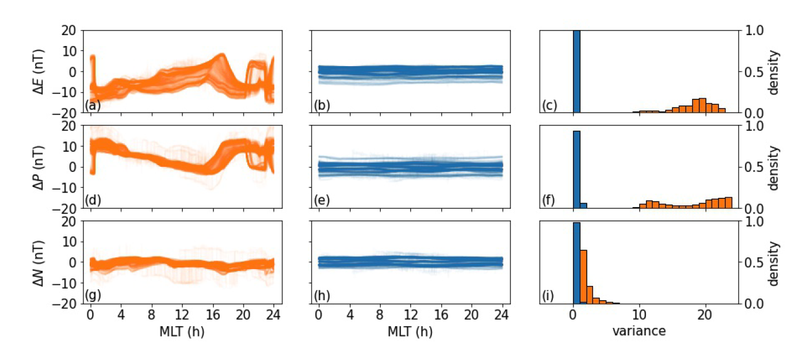
RIMP v1.1 PLPT-MAG-004
A.3.3 Diurnal/eclipse effects
GOES-16 IB-OB
GOES-17 IB-OB
GOES-16 and -17 IB-OB variance
The diurnal variance in the GOES-16 IB-OB data, especially for E and N-components of the magnetic field show far greater variance than for GOES-17.
Partial pass

Slide 32
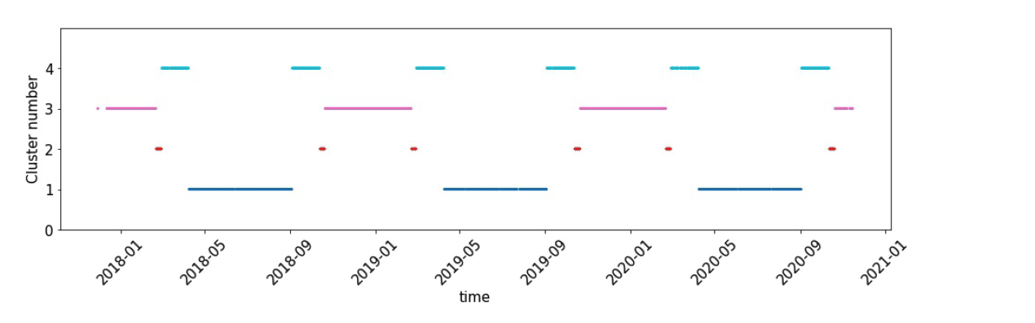
RIMP v1.1 PLPT-MAG-004
A.3.3 Diurnal/eclipse effects
E-component GOES-16 IB-OB analysis
1
2
3
From September to about mid-April each year the sensors can be completely or partially shadowed by the spacecraft bus from
the sun as it passes through the local midnight region.
Diurnal variation patterns change throughout the year. More work is needed to understand these variations with seasons and to improve the product.
4
GOES-16 MAG IB-OB Clusters
Partial pass

Slide 33
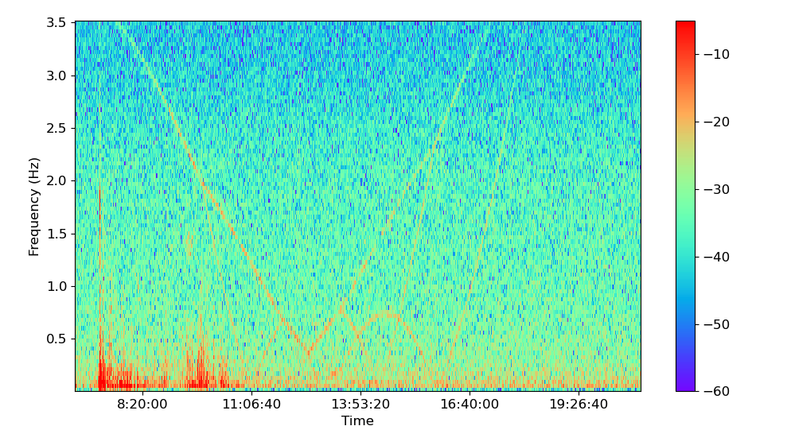
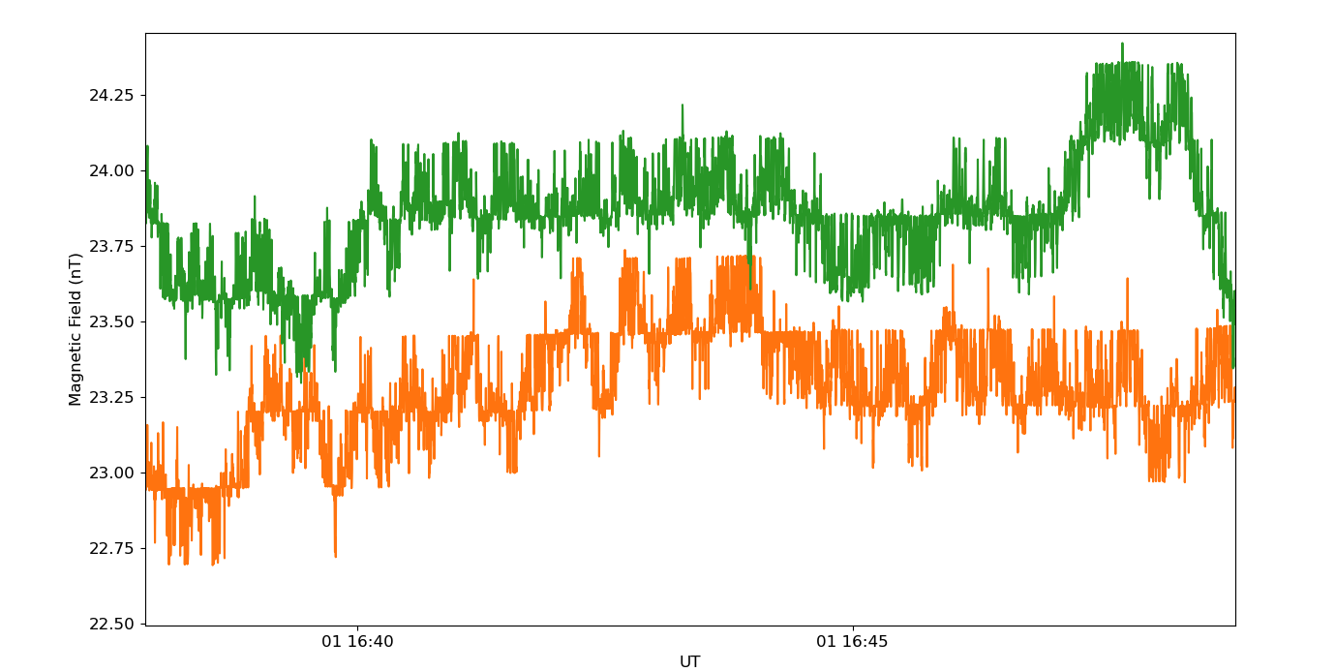
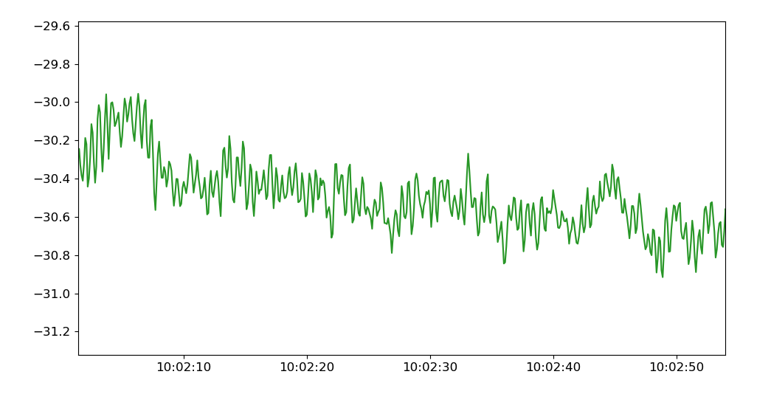
RIMP v2 PLPT-MAG-003
A3.3 Noise Performance
ADC and Reaction Wheel Noise
GOES-16 OB sensor
1 November 2020
GOES-17 OB sensor
Reaction Wheels
Reaction Wheels
Plasma wave?
GOES-16 OB 1 November 2020
ADC preferred counts
No preferred counts
Partial pass because we have not fully studied noise characteristics and contributions (e.g., new heater configuration on GOES-17).
Partial pass

Slide 34
RIMP v2 PLPT-MAG-003
A3.3 Noise Performance
reaction wheel
Ω_{H+}
plasma waves
Ω_{He+}
Event detection
Checking signal to noise for ability to detect plasma waves above reaction wheel noise suggests we can detect plasma wave events.
Using plasma waves in radiation belt models are part of future space weather product ideas.
Power
Frequency (Hz)
Partial pass

Slide 35
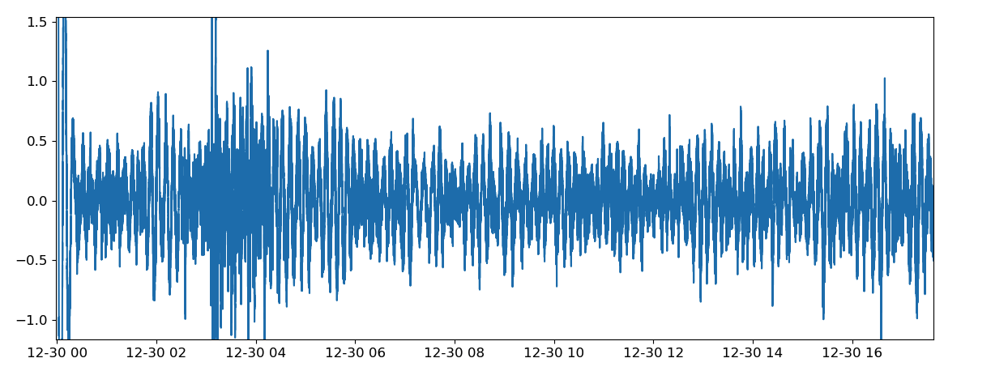
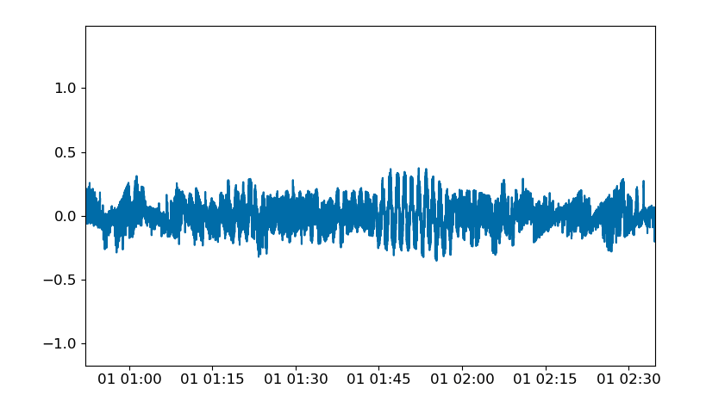
RIMP v2 PLPT-MAG-003
A3.3 Noise Performance
Heater Noise
GOES-16 OB sensor highpass filtered 30 Dec 2017
Same for GOES-17 but for 1 November 2020
Reaction Wheels
0.5 nT variations due to heater effects
0.5 nT variations due to heater effects
Same GOES-16 for 1 November 2020
After heater setpoint and duty cycle changes heater effects smaller
On GOES-16 changing setpoint (operating temp.) and heater duty cycle seems to helped decrease heater noise.
On GOES-17 study into heater noise not completed but the addition of extra heaters seems to make it more difficult to decrease heater noise.
Sharp edges due to ADC issue
No change from provisional
Partial pass

Slide 36
RIMP v2 PLPT-MAG-003
A3.3 Noise Performance
GOES-16
GOES-17
Noise contributions - unchanged from provisional:
Sensor: 0.1 nT
Reaction Wheels: 0.1 nT
ADC preferred counts: 0.3-0.5 nT
Heaters: Still in analysis (0-0.5 nT)
Noise contributions - unchanged from provisional:
Sensor: 0.1 nT
Reaction Wheels: 0.1 nT
No ADC noise
Heaters: Still in analysis (0-0.5 nT)
We believe MAG product noise is greater than 0.3 nT for both satellites, but we have not fully studied noise characteristics and contributions (e.g., new heater configuration on GOES-17).
Partial pass

Slide 37
FULL MATURITY ASSESSMENT
GOES-16 and -17 MAG L1b Product Full PS-PVR

Slide 38
GOES-16 MAG
Performance Baseline Status
Assessment at Full
MRD ID | Description | MRD Requirement | Predicted Performance Baseline | Assessment at Full | Related PLPTs | Status
2019 | Product Measurement Accuracy | 1 nT (per axis; original, waived) 2.3 ± 4.0 nT (per axis; for a 250 nT field; life of mission, excluding arcjet burning, assuming annual MAG cal maneuvers) | (3σ_{x},3σ_{y},3σ_{z})=(1.64,1.68,1.54) nT one year after initial cal maneuver (3σ_{x},3σ_{y},3σ_{z)}=(6.50,6.51,6.47) nT at EOL if no cal maneuvers after PLT | 2.3 ± 4.0 nT (per axis) | -02, -03, -04 | PASS (consistent with MRD waiver)
662 | Product Measurement Precision | Fluctuations < 0.3 nT | Fluctuations < 0.3 nT | ~ 0.5 -1.0 nT | -03 (RIMPv2) | PARTIAL PASS (consistent with provisional)

Slide 39
GOES-17 MAG
Performance Baseline Status
Assessment at Full
MRD ID | Description | MRD Requirement | Predicted Performance Baseline | Assessment at Full | Related PLPTs | Status
2019 | Product Measurement Accuracy | 1 nT (per axis; original, waived) 2.1 ± 0.8 nT (per axis; for a 250 nT field; life of mission, excluding arcjet burning, assuming annual MAG cal maneuvers) | (3σ_{x},3σ_{y},3σ_{z}) >2.3 nT per axis | ~3.0 nT (per axis) | -02, -03, -04 | PASS (consistent with MRD waiver)
662 | Product Measurement Precision | Fluctuations < 0.3 nT | Fluctuations < 0.3 nT | ~ 0-0.5 nT (per axis) | -03 (RIMPv2) | PARTIAL PASS (consistent with provisional)

Slide 40
Full Validation Assessment
Preparation Activities | Assessment
Validation, QA, and anomaly resolution activities are ongoing. | Validation activities are ongoing. Results have been discussed with SWPC. L1b data available at NCEI website enabling research community participation.
Incremental product improvements may still be occurring. | Work on science quality data will continue at NCEI for thermal, arcjet and noise related issues. However, some updates relating to this will be implemented at NCEI as post-L1b corrections in the L2 system.
Users are engaged and user feedback is assessed. | Product improvements will result from steps to mitigate known and yet to be discovered anomalies.

Slide 41
Full Validation Assessment
End State | Assessment
Product performance for all products is defined and documented over a wide range of representative conditions via ongoing ground truth and validation efforts. | Performance tests included in provisional PLPT results GOES-16 MAG L1b has been compared to GOES-13, 14 ,15 and 17. GOES-16 MAG L1b has been compared to Op77, T89 and Ts04 magnetic field models. The above were undertaken across different local times.
Products are operationally optimized, as necessary, considering mission parameters of cost and schedule, as compared to user expectations. | Yes, given resources and time.
All known product anomalies are documented, and shared with the user community. | PUG may need to be updated to reflect some changes. There are also documentation of recommended remediation in NASA, MIT-LL and NCEI presentations including this one.
Product is operational. | L1b going to PDA & GRB. Only GOES-16 data currently used by SWPC. For GOES-16, only OB sensor useable in operations.

Slide 42
SUMMARY & RECOMMENDATIONS
GOES-16 and -17 MAG L1b Products Full PS-PVR

Slide 43
Summary and Recommendations
Main issues identified:
  Arcjet firing contamination
  Thermal Issues
  Noise

Slide 44
Summary and Recommendations
Arcjet firing correction algorithm good start but continuing work recommended to improve the algorithm to address:
  Limits good quality MAG data available for operations
  Residual edge effects after correction create false interpretation of data
  Changes to arcjet firing configuration makes the correction invalid
  Increases in the number of firings increases period of invalid data for operations
  Arcjet contamination affects GOES-T/U also with new sensors (GMAG).
  We must better understand the physics of this problem likely that future NOAA-NASA GOES program procurements will utilizes similar arcjet systems and/or electric propulsion systems.
  Improvement required using more sophisticated methods such as machine learning

Slide 45
Summary and Recommendations
Recommendation that work continue to understand and correct for thermal and noise related issues that can improve the product. This work includes:
    IB sensors not useable in operations
    Impacts OB sensors but by how much is not clear
    Limit the science useability to develop new operational products
    Machine learning algorithm to remove solar angle dependency
    Bias stability monitoring and adjustments as required
    Studying anomalies/sudden jumps in data
    Heater and other effects on noise levels
    Studying new temperature compensation curve
    Lessons learned applied to GOES-T/U new instrument - GMAG
  Investigations into the usability of the MAG data, given thermal issues, in science research that would lead to new operational products.

Slide 46
Summary and Recommendations
Recommendation that work continue to develop tools for basic trending and to keep watch on bias stability and thermal issues

Slide 47
Summary and Recommendations
GMAG versus MAG
GOES-T and GOES-U have new magnetometer sensors called GMAG. We recommend that appropriate levels of expertise/staffing be maintained to account for the fact that GMAG is new, for unknown issues that may arise as a result of differences between MAG and GMAG instruments and to work on GMAG while continuing to improve MAG data.

