Slide 1
Peer Stakeholder-Product Validation Review (PS-PVR)
For the Provisional Maturity of GOES-17 MAG L1b Product
March 14, 2019
GOES-R Calibration Working Group (CWG)
Presenter: Sam Califf
Contributors: Paul Loto’aniu
NOAA NCEI / CIRES
This review incorporates results from NASA, PLTs, and MIT.

Slide 2
Outline
MAG Overview
  Instrument Description and Products
Review of Beta Maturity
Product Quality Evaluation
  Summary of MAG Anomalies
  PLPTs Supporting Assessment for Provisional Status
Provisional Maturity Assessment
Path to Full Validation Maturity
Summary and Recommendations
SWPC Statement

Slide 3
MAG OVERVIEW
GOES-17 MAG L1b Product Provisional PS-PVR

Slide 4
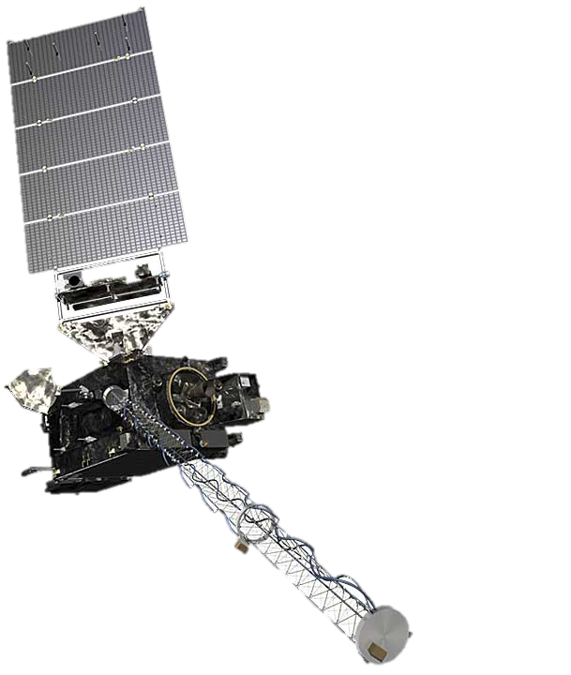
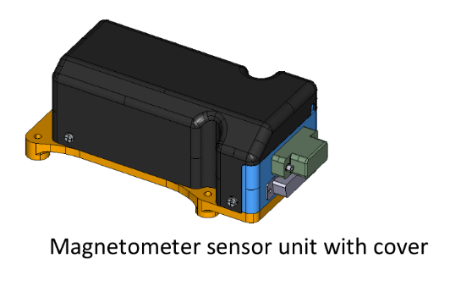
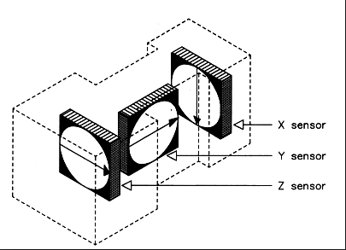
Instrument Description
Requirements similar to previous GOES series
Characteristics | GOES 8-12 | GOES 13-15 | GOES R-U
3-axis fluxgates | 2 | 2 | 2
Sampling Rate | 2 Hz | 2 Hz | 10 Hz
Low-Pass Filter Cutoff | 0.5 Hz | 0.5 Hz | ~2.5 Hz
Boom Length | 3 m | 8.5 m | 8.5 m
0.3 nT noise requirement.
0.016 nT digital resolution requirement.
1.0 nT accuracy performance requirement.
Two boom-mounted fluxgate magnetometers - Inboard MAG (IB) 6.3 m from boom base and Outboard MAG (OB) 8.5 m from the base.
Sensor units built by Macintyre Electronic Design Associates (MEDA) Inc, in Virginia, under contract from the instrument vendor Lockheed Martin.
Inboard MAG
Outboard MAG

Slide 5
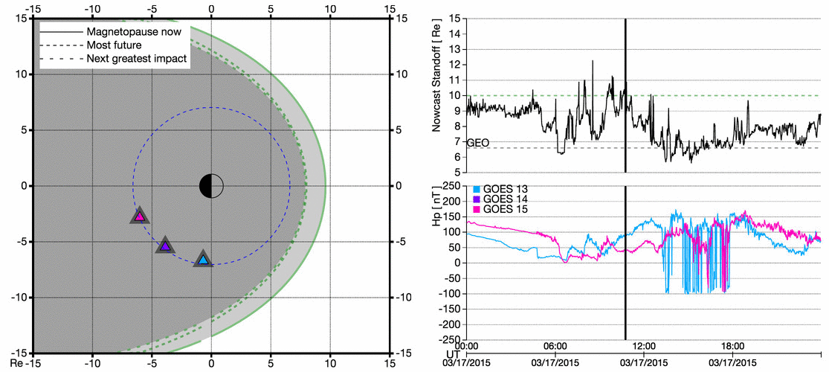
Example GOES-R Era Product
Magnetopause Crossing
Introduction
5

Slide 6
REVIEW OF BETA MATURITY
(MAG Beta PS-PVR, Aug. 2018)
GOES-17 MAG L1b Product Provisional PS-PVR

Slide 7
Post-Launch Test (PLT)
Timeline
Event | Description | Start | End
1 | (002) MAG Health Test - Part 1 [SLT 12PM] | 3/26/18 17:56 | 3/26/18 18:03
2 | (002) MAG Health Test - Part 2-ATS | 3/27/18 22:56 | 3/27/18 23:02
3 | (004) MAG Sensor Difference Comparison [Start] | 3/28/18 16:00 | 3/29/18 16:00
4 | (002) MAG Health Test - Part 3-ATS | 3/29/18 5:00 | 3/29/18 5:06
5 | (002) MAG Health Test - Part 4-ATS | 3/30/18 11:00 | 3/30/18 11:06
6 | (002) MAG Health Test - Part 5-ATS | 3/31/18 17:00 | 3/31/18 17:06
7 | (002) MAG Health Test - Part 6-ATS | 4/1/18 23:00 | 4/1/18 23:06
8 | (004) MAG Sensor Difference Comparison [End] | 4/26/18 16:00 | 4/27/18 16:00
9 | (003) MAG Sensitivity to Interference (End) | 5/11/18 14:00 | 5/11/18 15:00
10 | (001) MAG Initial Bias and Calibration Part 1 [SLT 11AM] | 7/12/18 15:33 | 7/12/18 20:15
11 | MAG Beta PS-PVR | 8/8/18 12:00 | 8/8/18 12:00
12 | RTS for MAG CCR6807 {No NSSK} | 8/8/18 14:57 | 8/8/18 14:58
13 | MAG Data in GRB | 8/9/18 15:00 | 8/9/18 15:00
14 | (001) MAG Initial Bias and Calibration Part 2 [SLT 11AM] | 8/20/18 15:35 | 8/20/18 19:36
15 | (001) MAG Update LUTs to Ground System | 9/19/18 13:00 | 9/19/18 14:00
16 | (001) MAG Ground System Implementation | 9/19/18 14:00 | 10/12/18 10:00
17 | (001) MAG LUTs Implemented in GPA | 10/12/18 10:00 | 10/12/18 11:00

Slide 8
Beta Summary
GOES-17 MAG shows improved performance relative to GOES-16 MAG
  No large initial biases on orbit
    Improved magnetic cleanliness
  No large (> 10 nT) transient magnetic contamination signals, reduced diurnal bias variation
    Improved thermal control
    Eliminated potential current loops
  No ADC sticking
    Fixed circuit design
GOES-17 MAG still has problems
  Thermal instability (e.g., temperature gradients, temperature compensation)
    Slowly drifting biases
    Uncertain thermal/heater influence
  Recent anomaly in diurnal bias trend (possibly only inboard MAG)
  Arcjet contamination

Slide 9
GOES 17 Risks to Provisional
ADR # | WR # | Title | WR Status | Delivery | Comments
449 | 5133 | Add MAG DQF for arcjet firing | Closed | Moderate priority. Alerts user to unusable data | Provisional
786 | 6321 | Update MAG PG Processing for APID202 update - PRO Type 2 | Closed | PR.07.00.00 | Provisional
 | 6269 | Bias of difference between G17 MAG IB and OB measurements changes from day-to-day | Closed | Flight/G17 | Provisional
 | 6271 (Flight) | Beginning 2018D187, G17 MAG IB/OB x and y-axis differences show excursions during part of the day | Submitted | Flight/G17 | Provisional
 | 6290 (Flight) | Trending of G17 MAG IB/OB differences has discontinuities after yaw flips | Submitted | Flight/G17 | Provisional

Slide 10
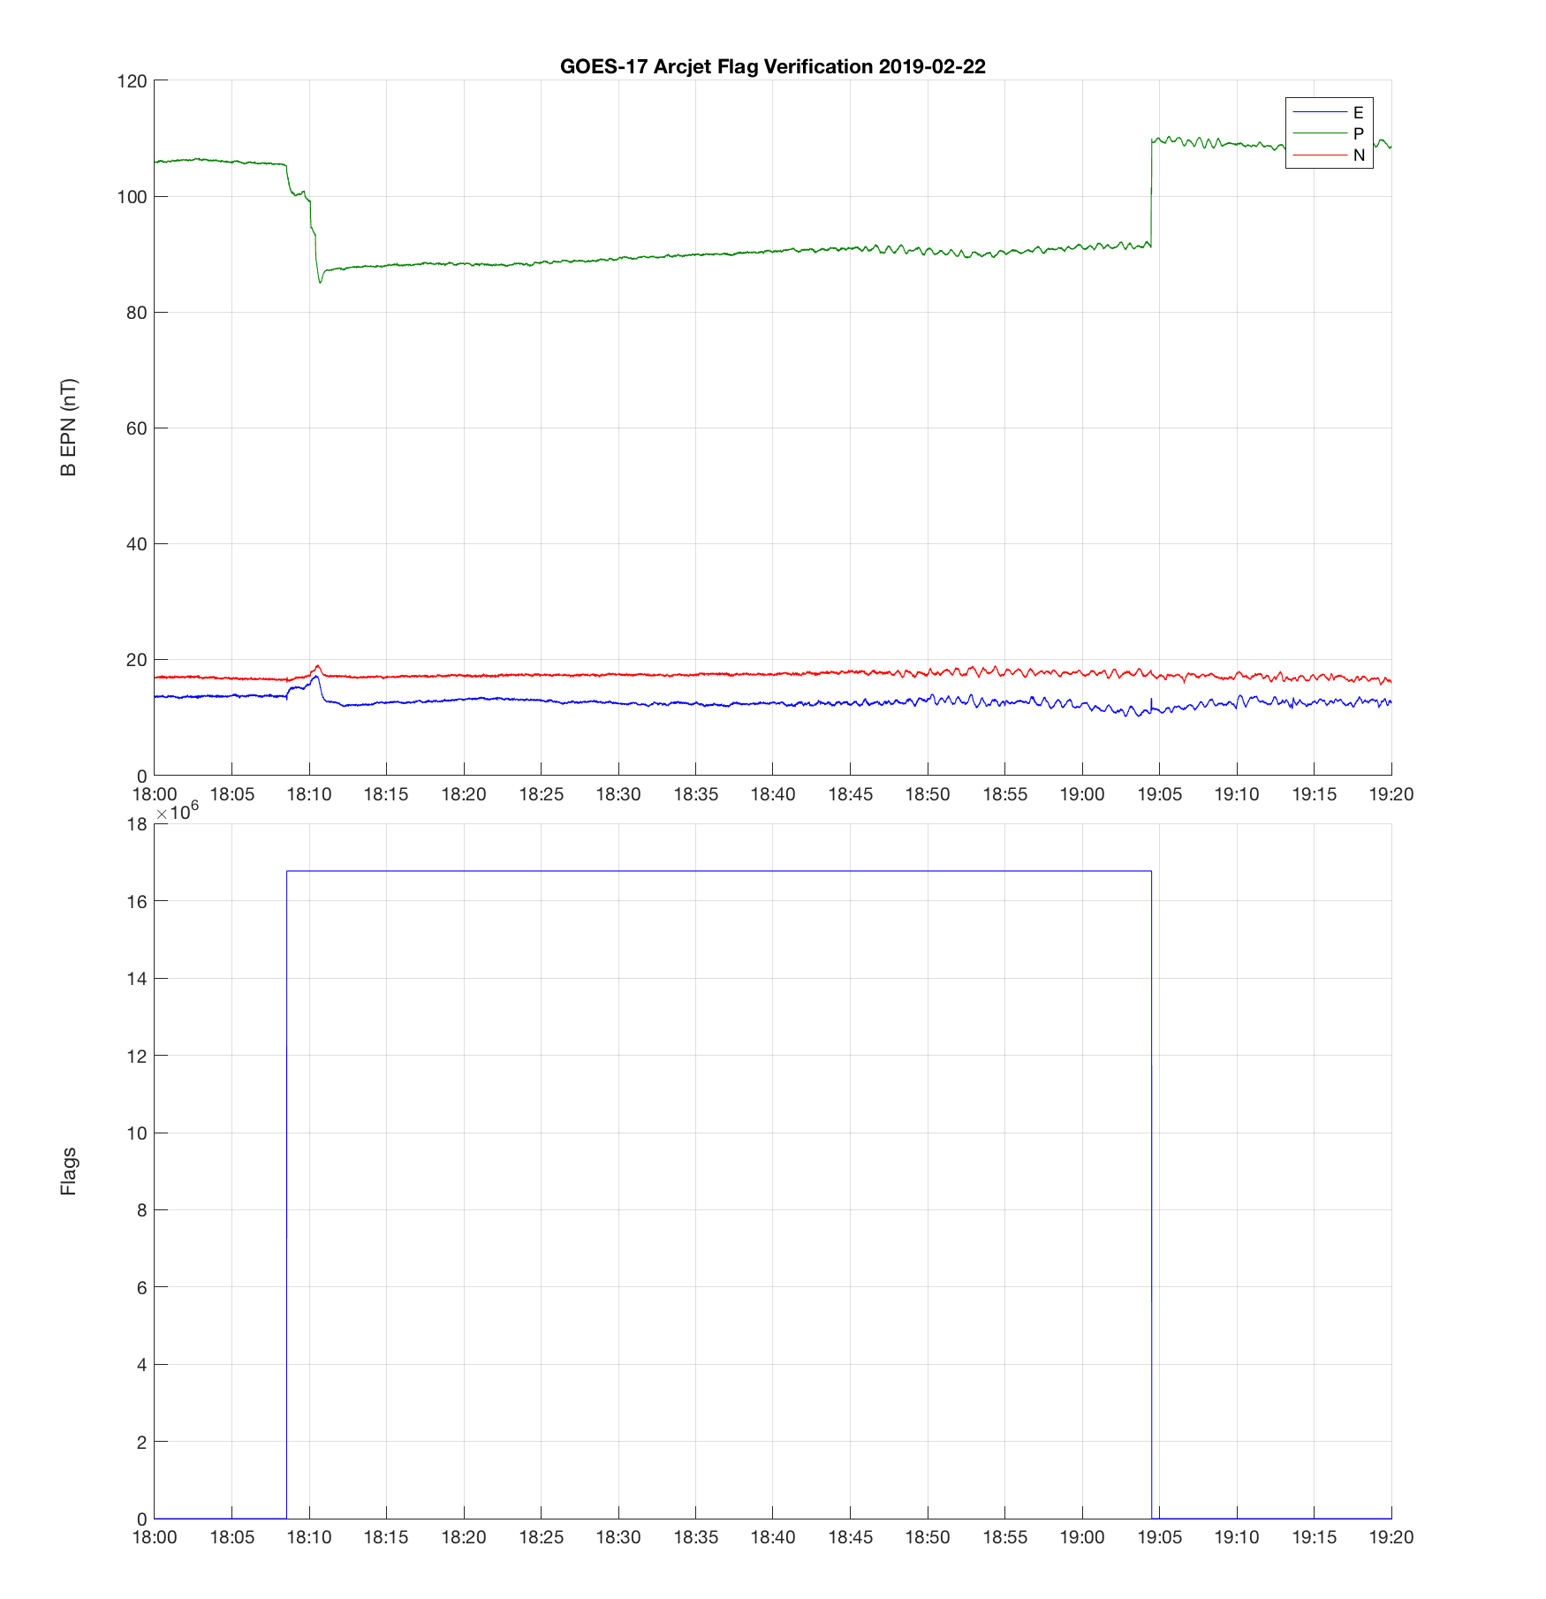
Verification of ADR 449
Arcjet firing flag in L1b (NCEI L2 Data)
Magnetic Field in EPN
Arcjets fired
Data Quality Flags

Slide 11
PRODUCT QUALITY EVALUATION
GOES-17 MAG L1b Product Provisional PS-PVR

Slide 12
Look Up Table
Current GOES-17 LUT
  MAG_CALINR_Parameters(FM2A_RevE_PR_07_07_02)-603441800.0.h5
There are two versions of the biases that correspond to the 10 deg C and 20 deg C Outboard MAG setpoints
  No SU temperature compensation is applied

Slide 13
Summary of MAG Performance
Flight Analysis from modified L1b

Slide 14
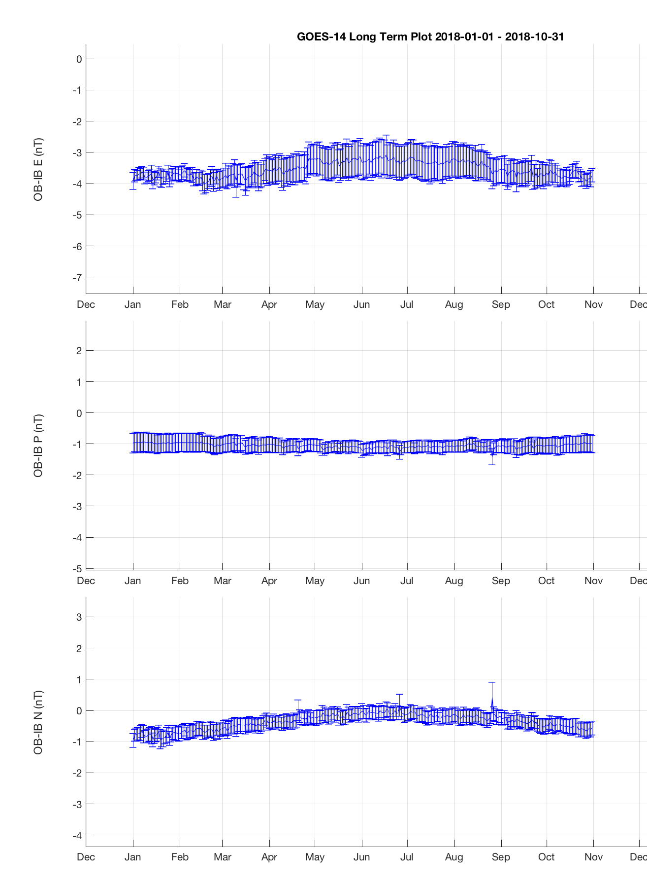
Summary of MAG Performance
GOES-17 (Correct LUTs from Flight)
GOES-14
Are the biases stable?
Will they repeat next year?

Slide 15
Summary of MAG Performance
Flight Analysis from modified L1b
Accuracy Requirement: 1 nT
Known bias offset + 3 sigma uncertainty

Slide 16
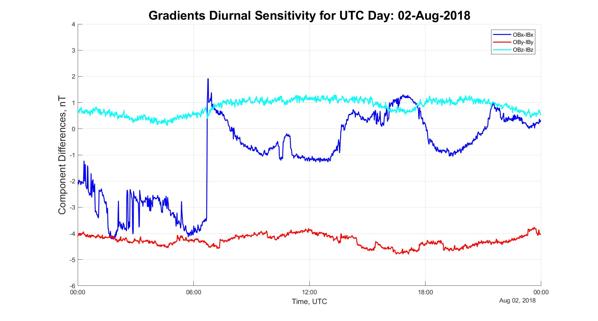
MAG Issues:
IB X Axis Bias Anomaly
Anomaly starting in July exceeds 1.0 nT accuracy requirement
Initial assessment indicates the issue is an inboard MAG problem
WR 6271
Flight Analysis from L0

Slide 17
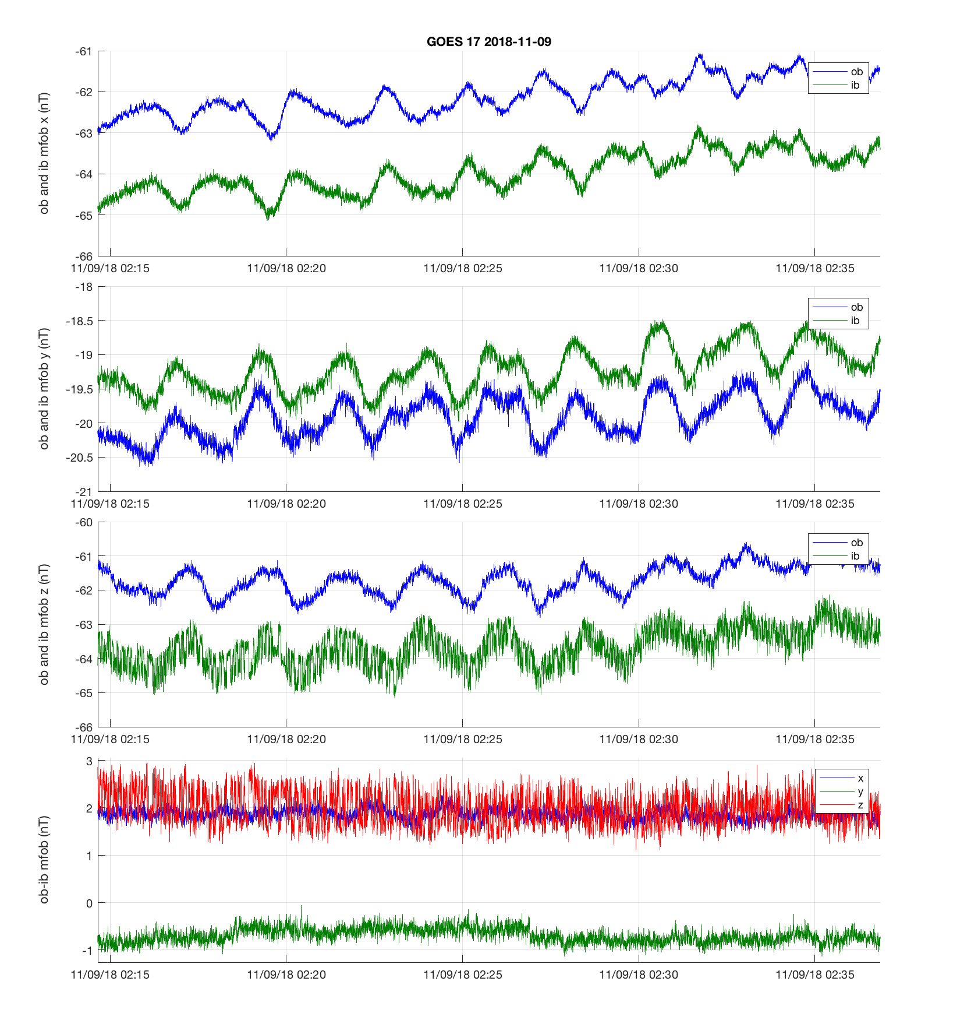
MAG Issues:
IB Z Axis Bias Anomaly
NCEI L0 Data
IB X Anomaly also present on Z axis
  Issue is discussed along with WR 6271
This example persists for hours during a ULF wave event
Important measurement for radiation belt dynamics
Rapid shifts in the Z axis bias

Slide 18
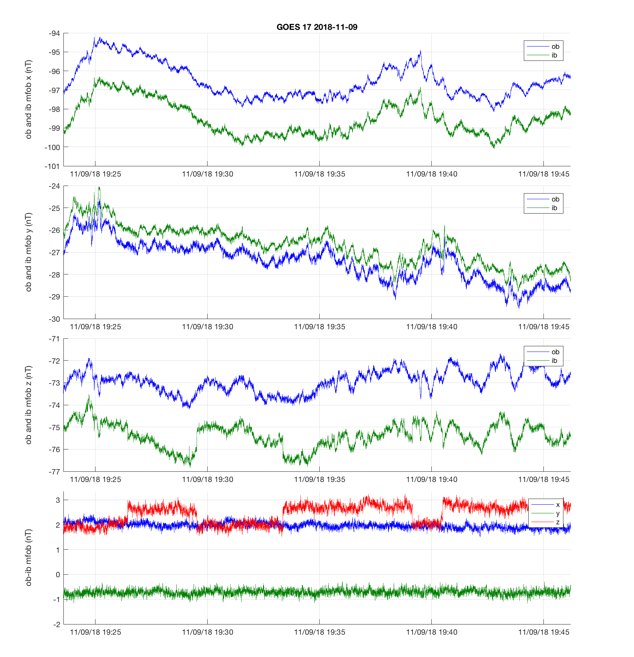
MAG Issues:
IB Z Axis Bias Anomaly
NCEI L0 Data
IB X Anomaly also present on Z axis
  Issue is discussed along with WR 6271
Bias shifts lasting for several minutes
Impacts radiation belt frequencies and future use for prediction and nowcast models

Slide 19
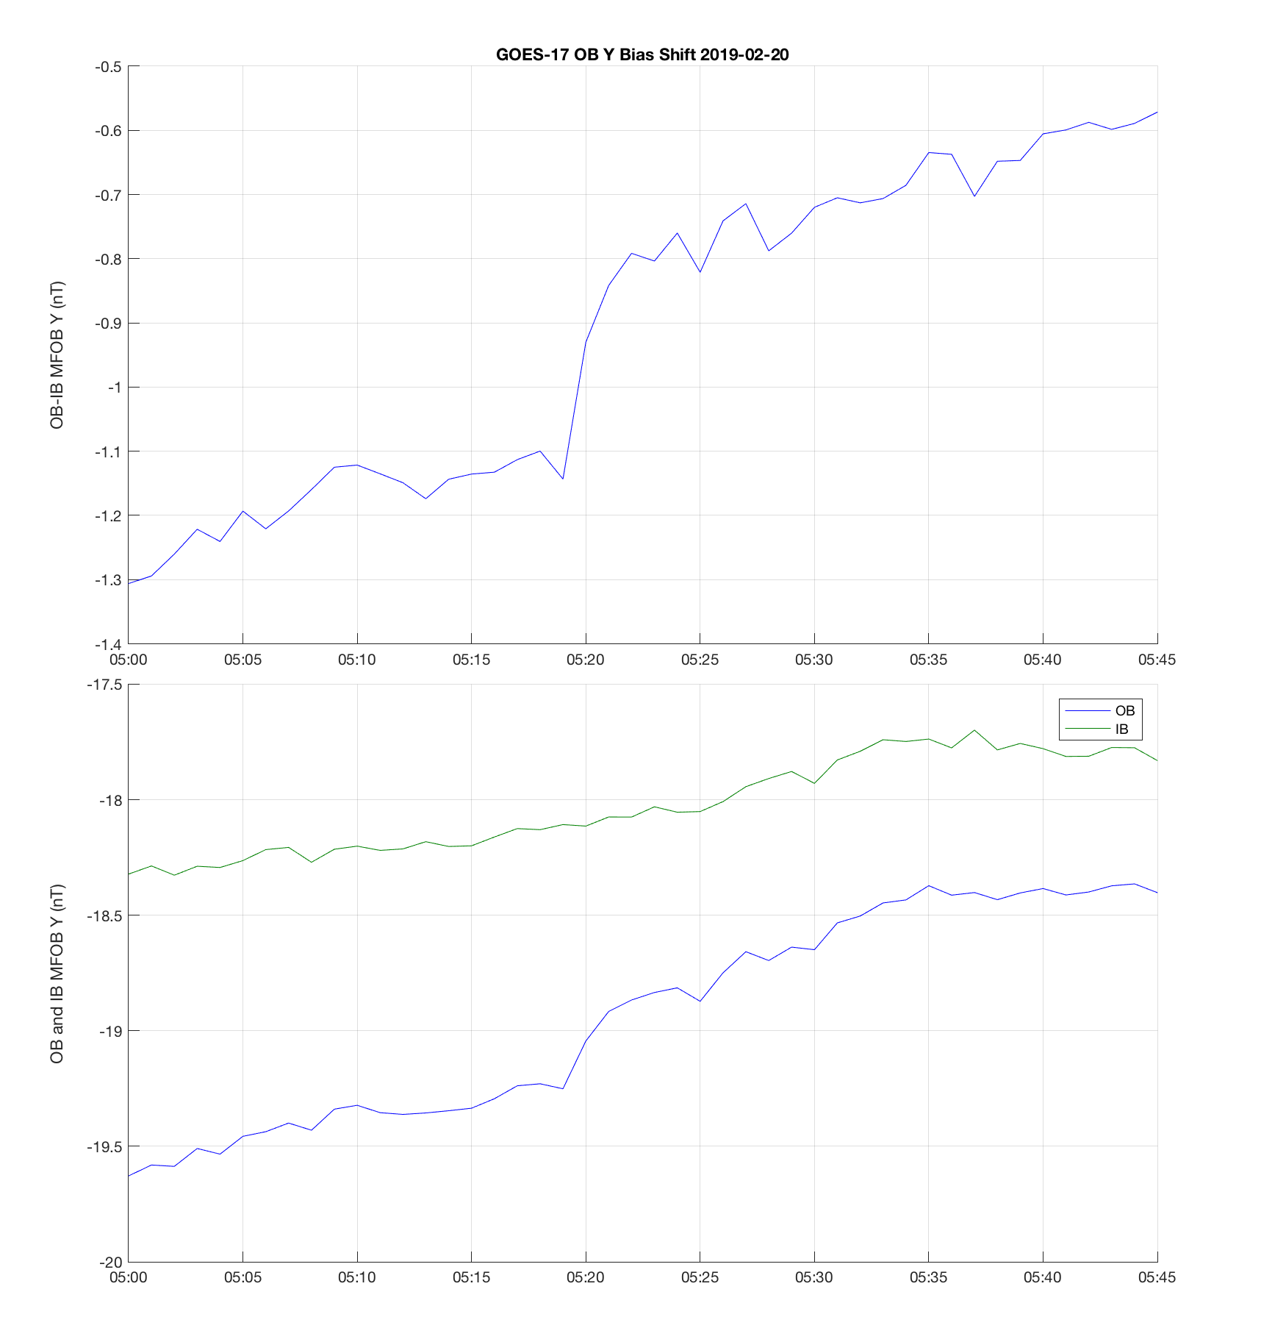
MAG Issues:
OB Y Axis Bias Shifts
NCEI L0 Data
OB Y bias shifts ~0.3 nT
Issue is discussed in anomaly meetings, but no WR
Thought to be related to temperature setpoint
  Heater induces temperature gradients
Still present after setpoint was changed back to 20 deg C
Outboard - Inboard
Inboard
Outboard

Slide 20
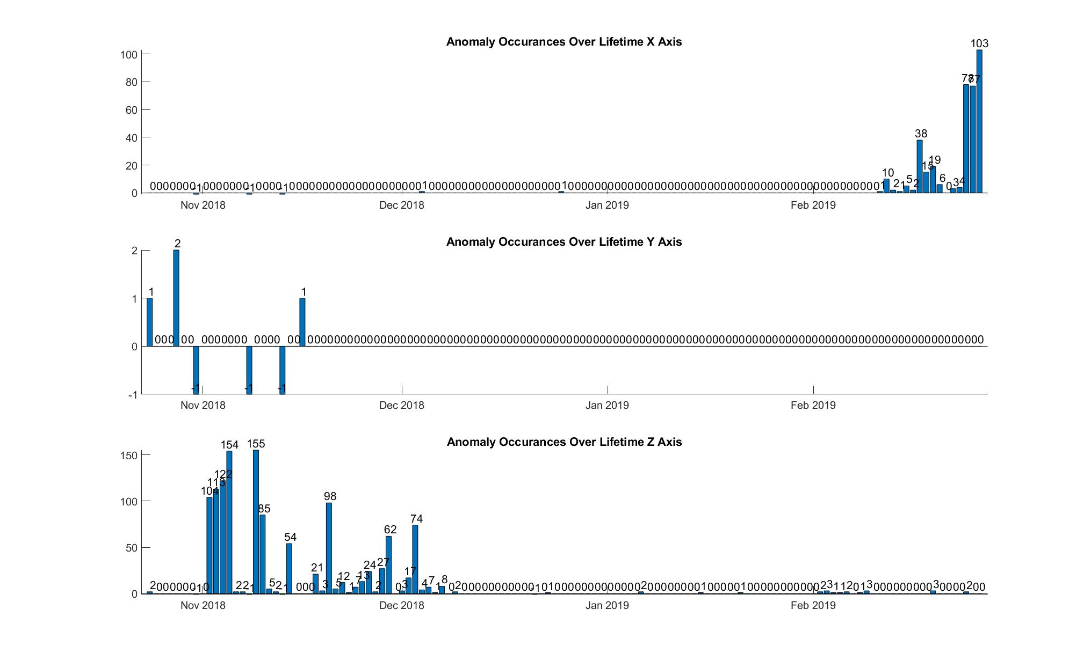
MAG Issues:
Bias Anomalies
Bias transients exist in all 3 axes
Seasonal dependence to transient occurrence

Slide 21
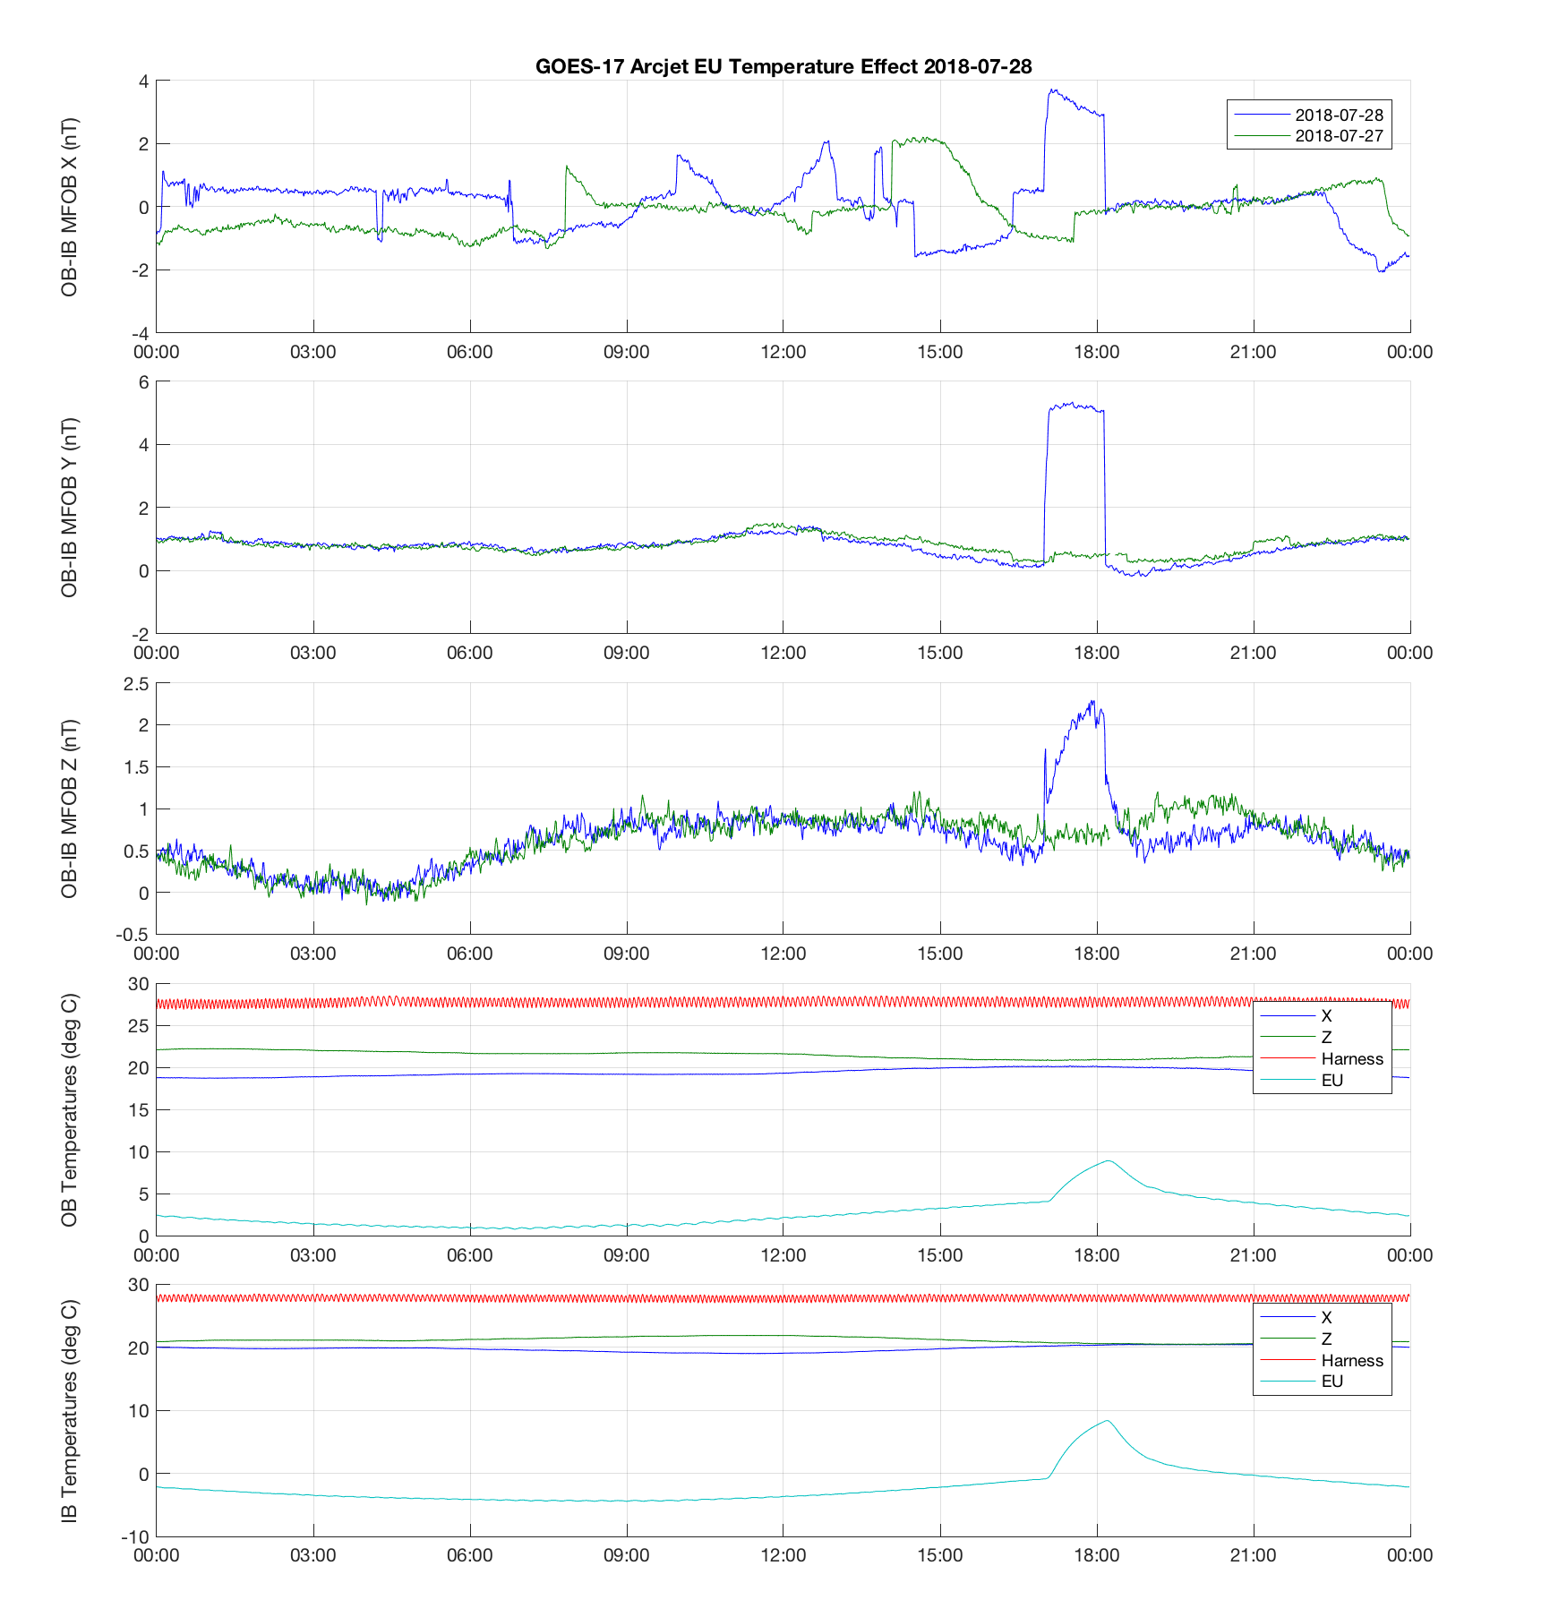
MAG Issues:
Arcjet and EU Temperature
NCEI L0 Data
Arcjet creates large contamination signal. Correction algorithm will be implemented.
  WR 6136 (DO.09), 6880 (TBD)
Biases affected after arcjet firing for 2-3 hrs
  WR 6290
EU temperature effect is variable, probably less than 1-2 nT
Thought to be related to EU heating, delay between temperature sensor and critical EU components
X Axis IB Anomaly
Arcjet signature
Y Axis OB “Popcorn Noise”
Post-Arcjet EU Temperature Effect
Arcjet Firing Heats EU

Slide 22
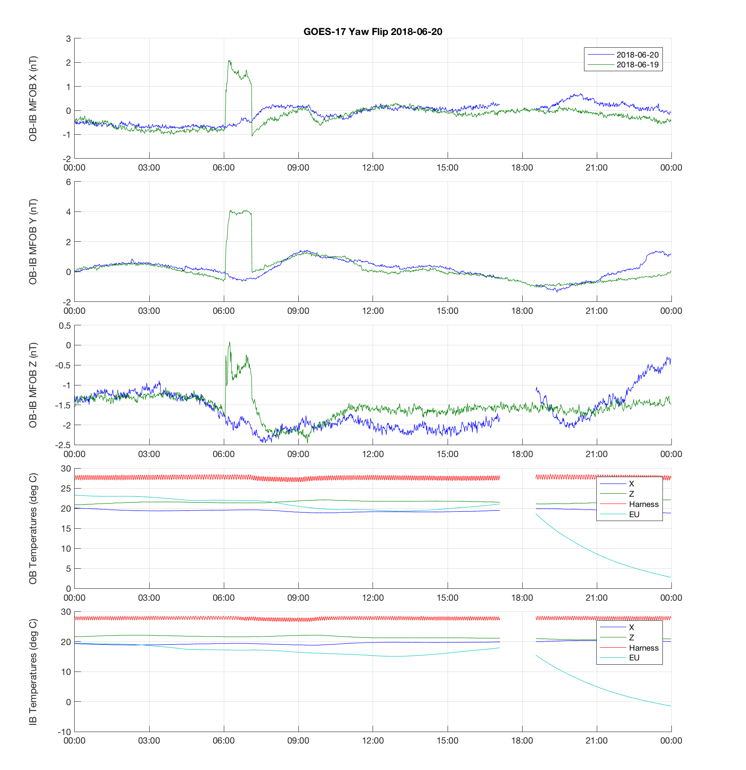
MAG Issues:
Yaw Flip Bias Discontinuity
NCEI L0 Data
Biases settle to new diurnal pattern after yaw flips
WR 6290
EU temperature changes by ~20 deg C
Possible EU temperature correction error
SU thermal gradients also change
Yaw Flip ~18:00
Biases Drift after Yaw Flip
EU Temperatures change after Yaw Flip

Slide 23
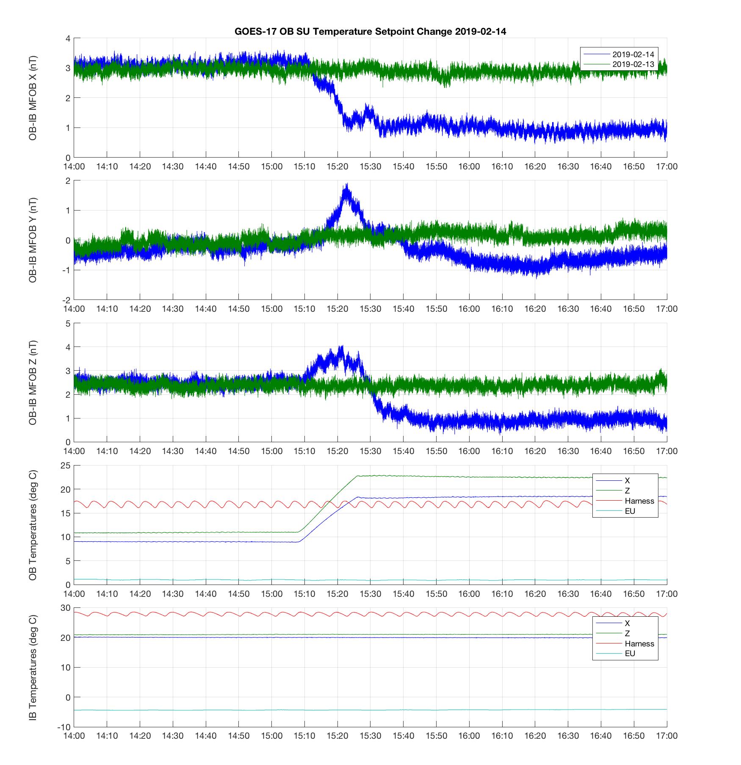
MAG Issues:
Heater Impact on Biases
NCEI L0 Data
Outboard SU setpoint change from 10 to 20 deg C
Bias transient ~2 nT related to temperature gradient induced by heater
New biases might be related to harness temperature
Heater Transient
New Biases
OB SU Heater is On During Temperature Ramp

Slide 24
MAG PLPTs Supporting Provisional Maturity
Name | Description
PLPT-MAG-001 | Comparison to quiet (and active) field models
PLPT-MAG-002 | Cross-satellite intercalibration
PLPT-MAG-003 | Intercalibration per Magnetic Local Time (MLT)
PLPT-MAG-004 | Diurnal/Eclipse effects
Partial Pass
These PLPTs are more often used together for data analysis
Name | Description
PLPT-MAG-009* | Noise performance*
Partial Pass
*Additional analysis we are undertaking because of instrument post launch performance issues

Slide 25
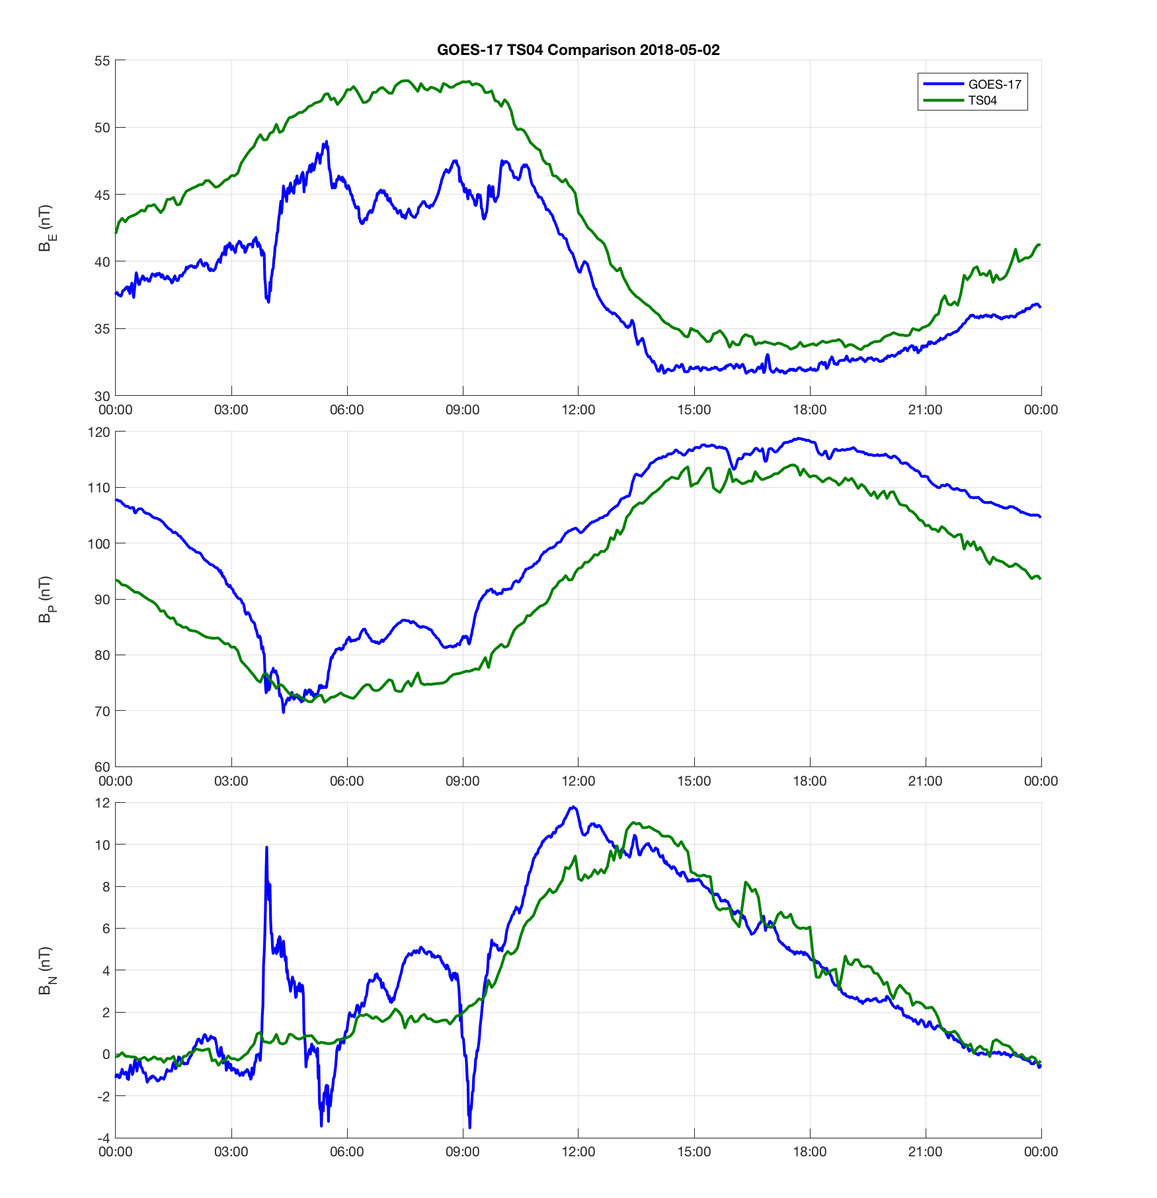
PLPT-MAG-001
Comparison to TS04 Model
Trend of GOES-17 follows TS04 for this day
There is uncertainty in the model
Do not yet have long-term comparison to model, instrument is still changing
Substorm effects not captured by model

Slide 26
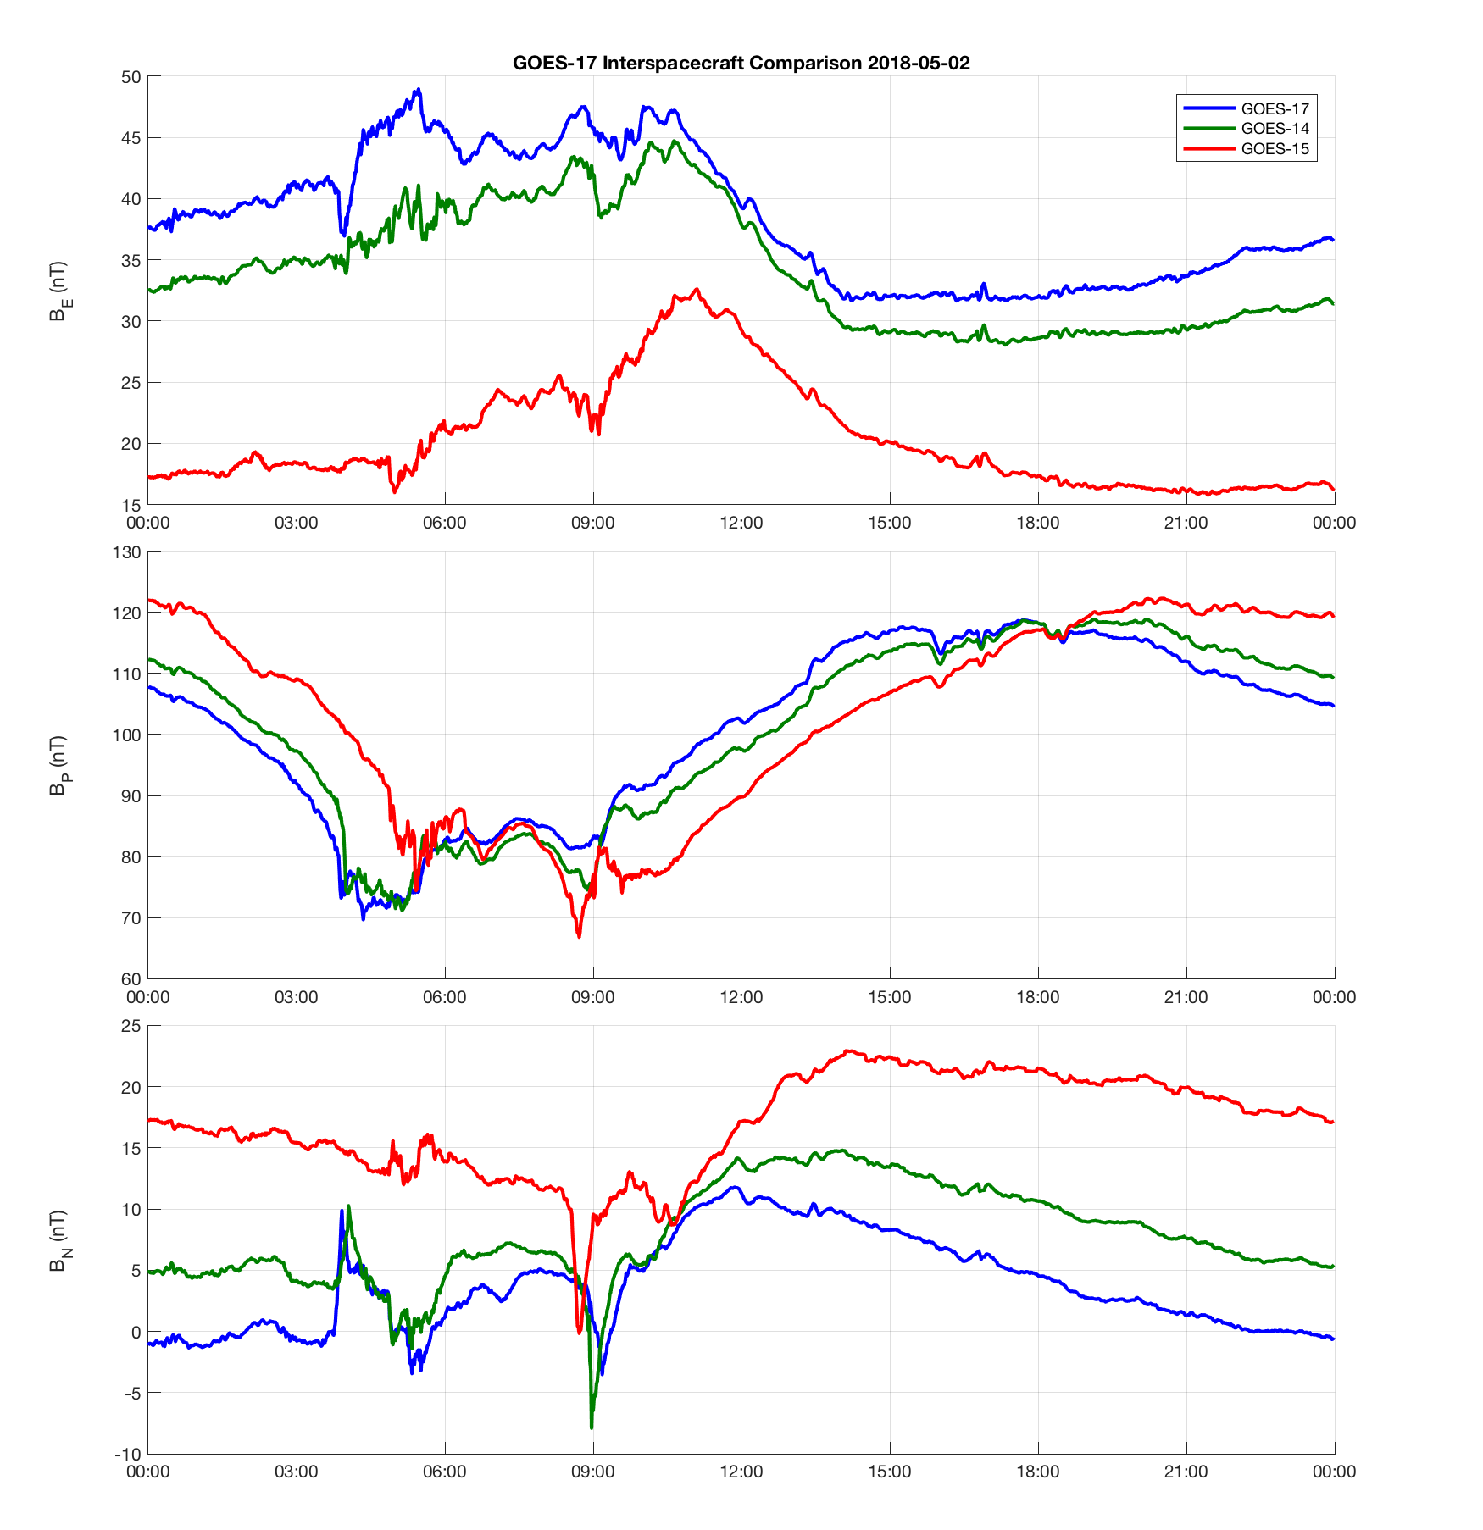
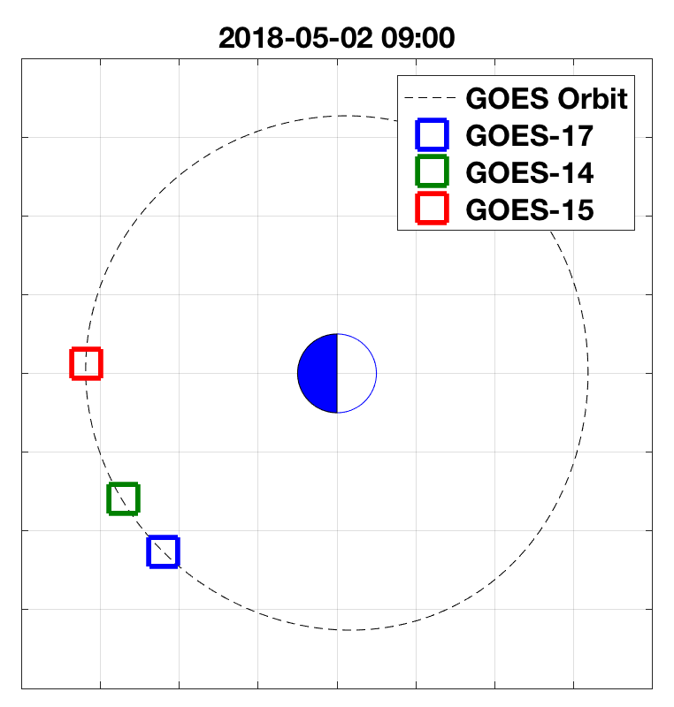
PLPT-MAG-002
Comparison to GOES-14 and GOES-15
GOES-17 observes similar variations to GOES-14 and GOES-15
Direct interspacecraft comparison is difficult because of spatial separation
GOES-15 is closer to geomagnetic equator, so B_{E} is smaller

Slide 27
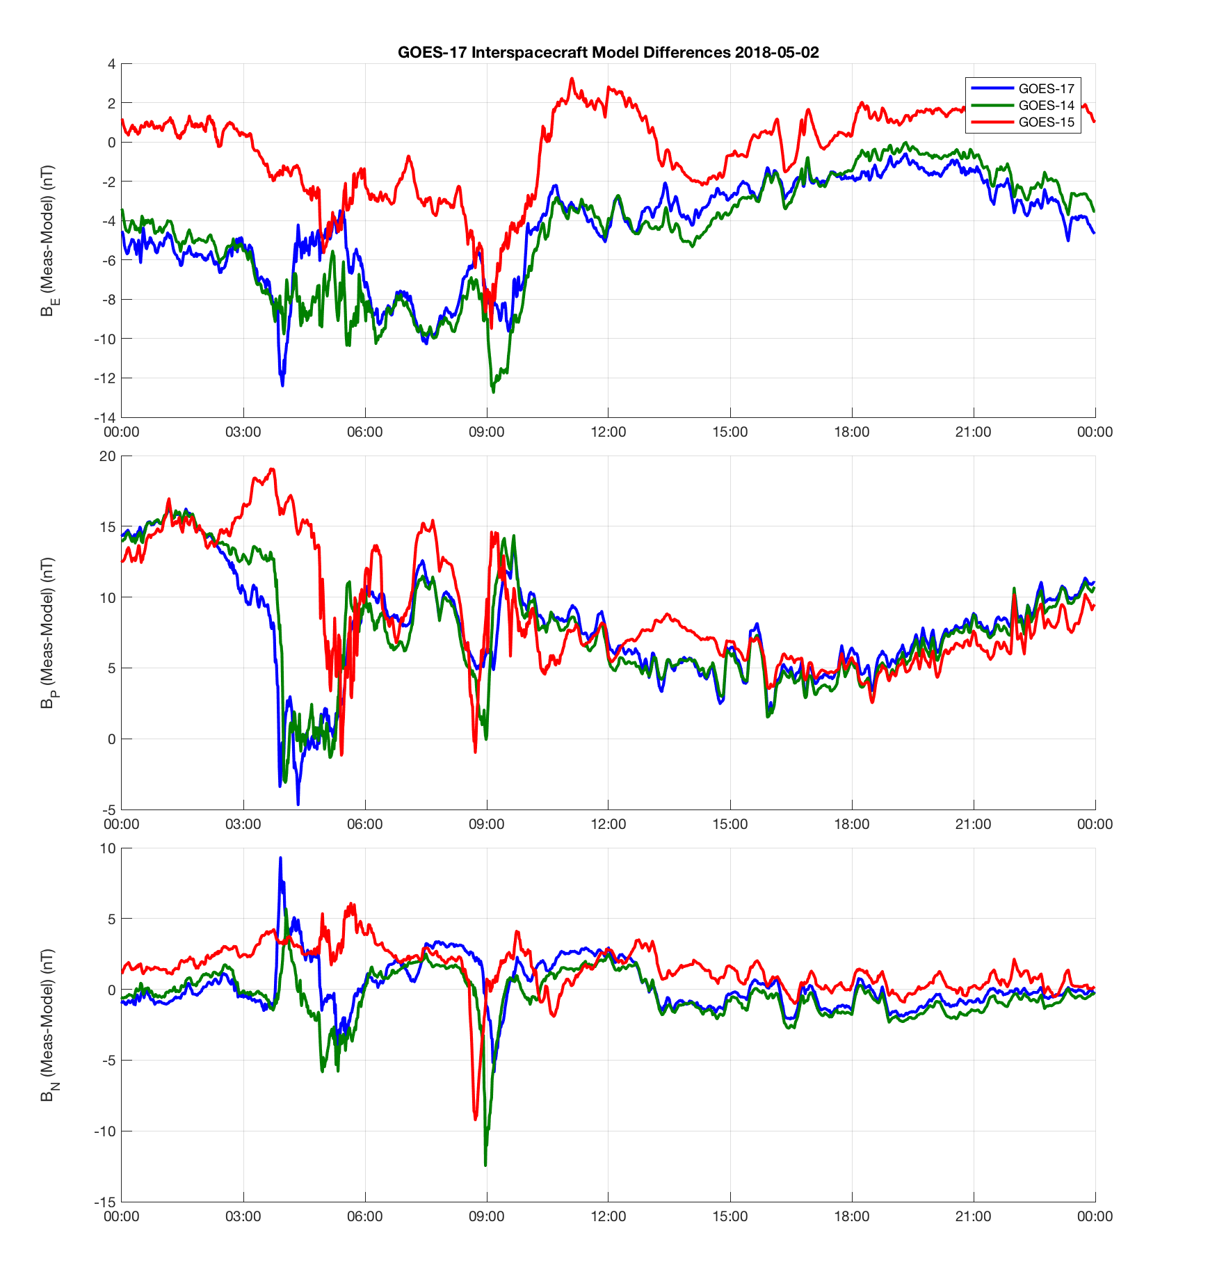
PLPT-MAG-002
Comparison to GOES NOP with Model Subtracted
Subtracting the model helps remove the mapping differences
The spacecraft observe similar differences relative to the model for the time period shown

Slide 28
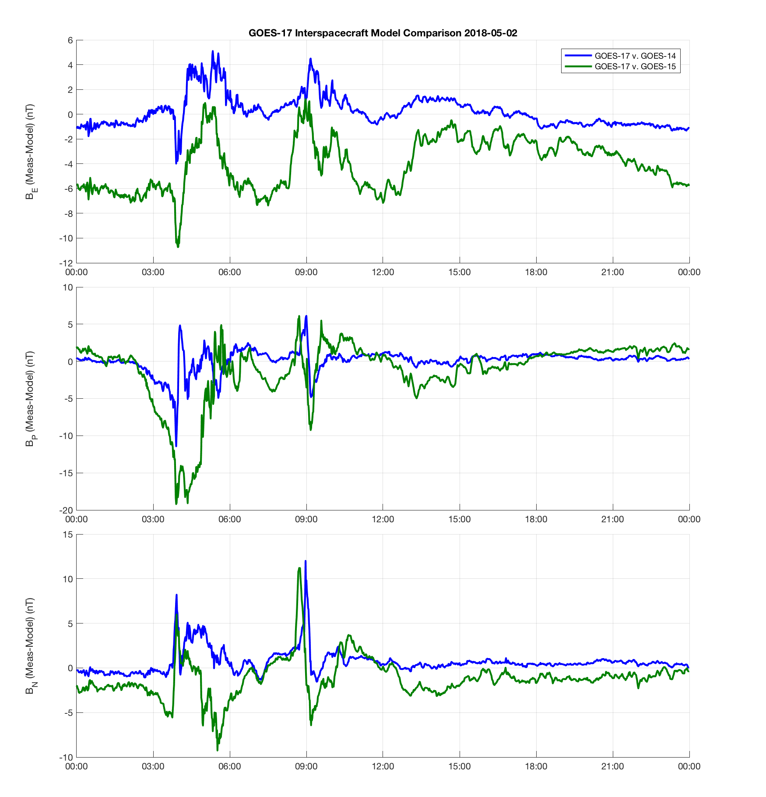
PLPT-MAG-002
Spacecraft differences with model subtracted
GOES-17 shows reasonable comparison with GOES-14 in this example
Accuracy estimate requires ongoing analysis, instrument configuration and biases are still changing

Slide 29
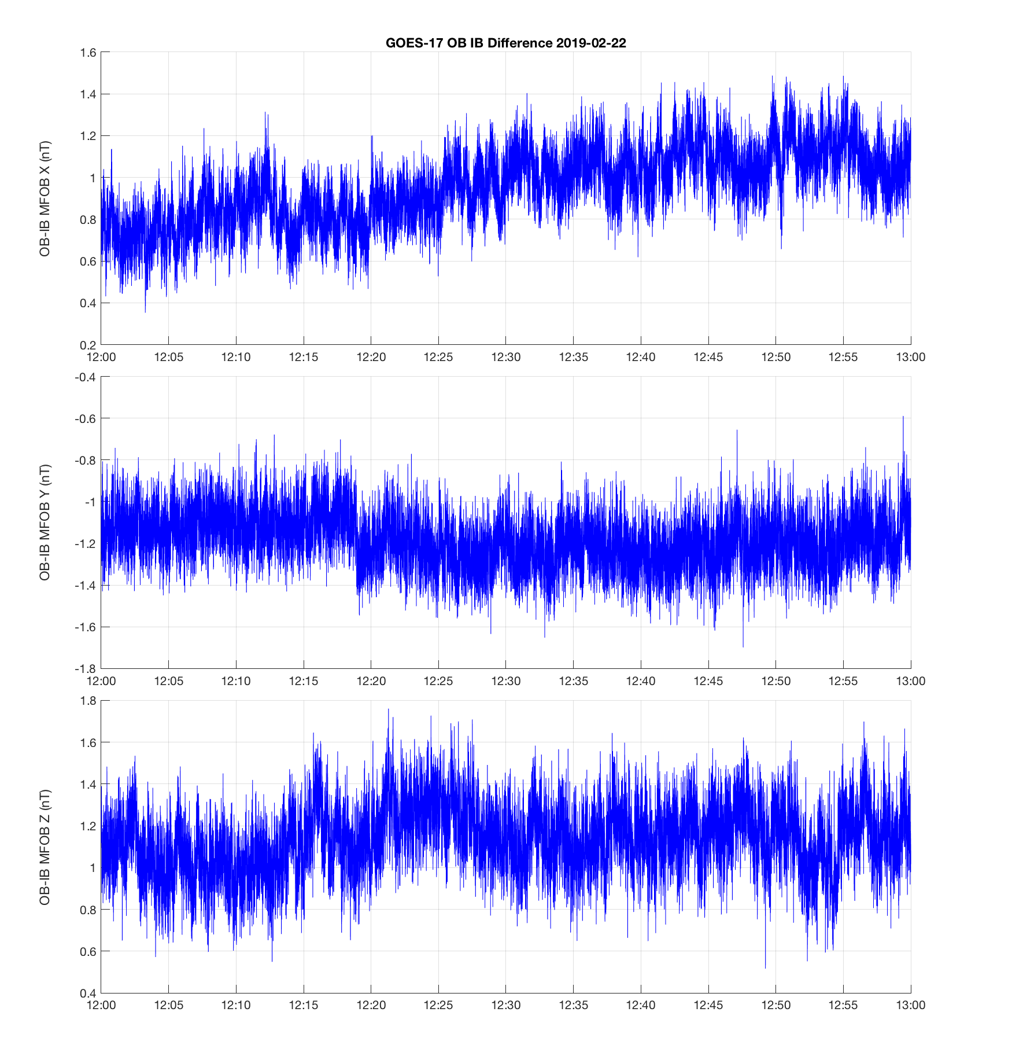
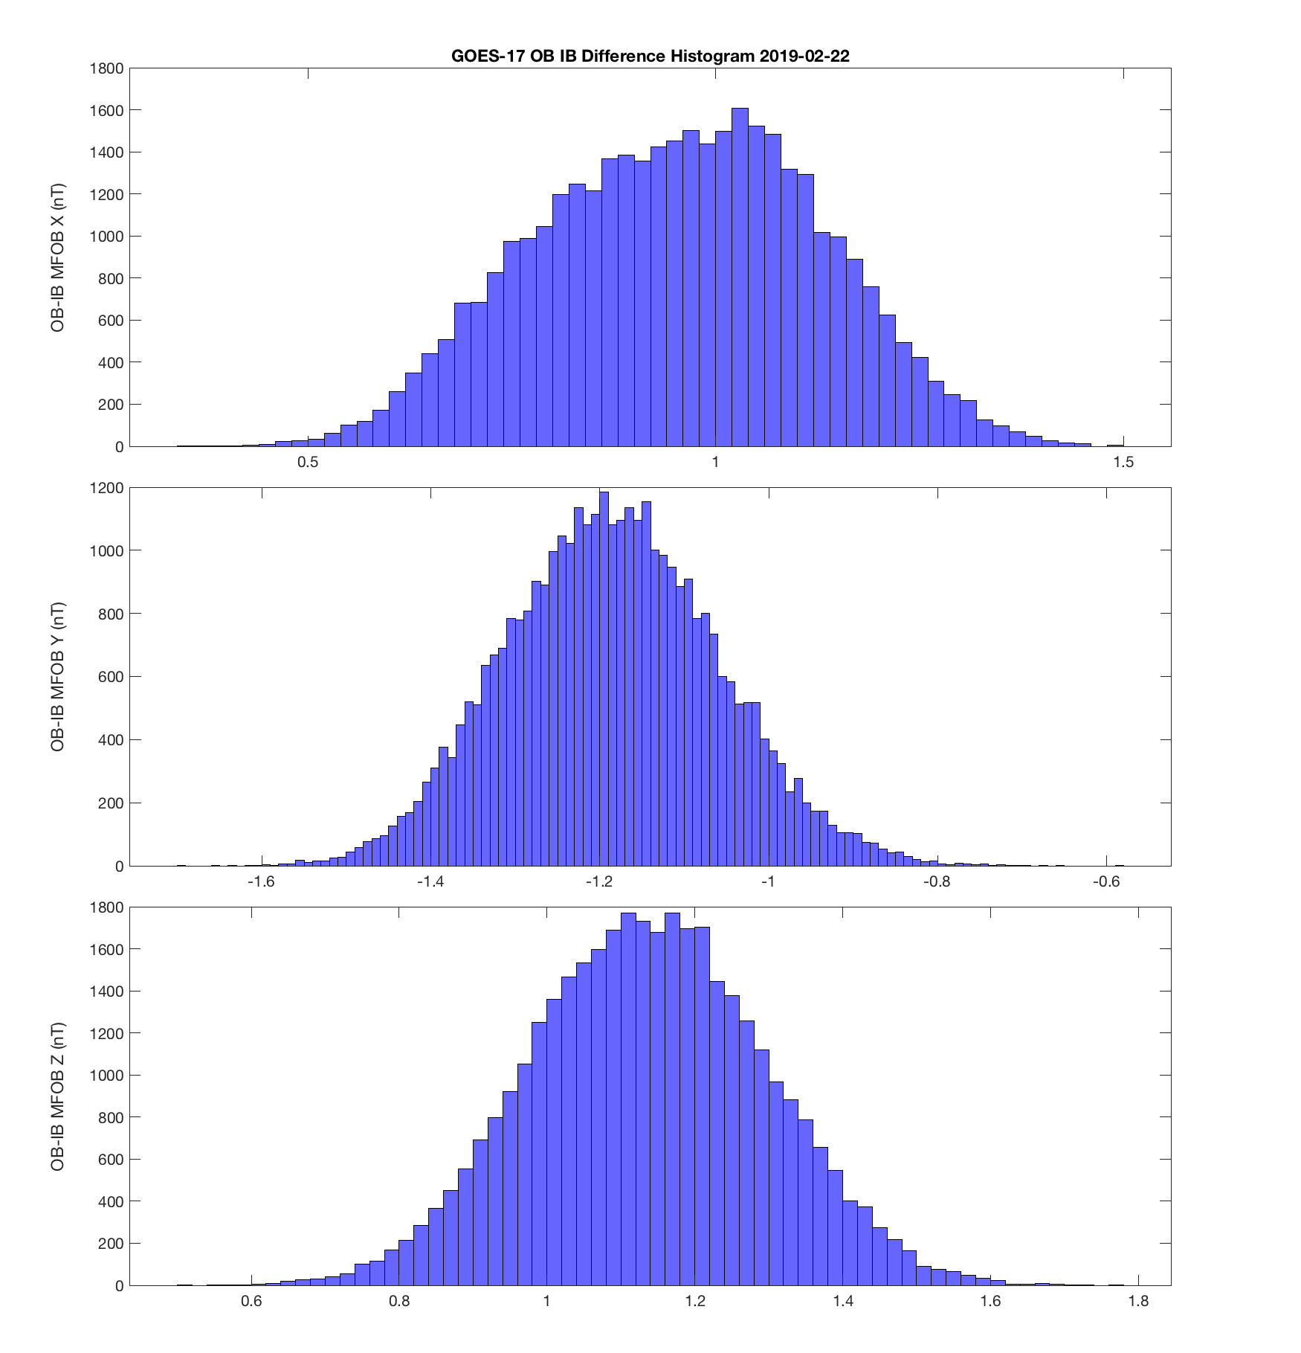
PLPT-MAG-009
Noise Performance
Noise contributions:
Sensor: 0.1 nT
Reaction Wheels: 0.1-0.2 nT
Heaters: Still in analysis, 0-0.5 nT
Reaction Wheels
Standard Deviation of OB-IB ~ 0.15 nT
3 Sigma ~ 0.3 nT per sensor
Courtesy of LM
ADC preferred counts

Slide 30
PROVISIONAL MATURITY ASSESSMENT
GOES-17 MAG L1b Product Provisional PS-PVR

Slide 31
GOES 17 Provisional Validation
Preparation Activities | Assessment
Validation activities are ongoing and the general research community is now encouraged to participate. | Validation activities are ongoing. Results have been discussed with SWPC. Release of data by NCEI will enable research community participation.
Severe algorithm anomalies are identified and under analysis. Solutions to anomalies are in development and testing. | Inboard MAG sensor will not be used in operations (same as GOES-16, not an optimal situation) Arcjet Flag implemented (ADR449) Arcjet correction algorithm currently being implemented (ADR610) Thermal instability, bias shifts, thermal compensation, noise still a concern, will require continued effort
Incremental product improvements may still be occurring. | Product improvements will result from steps to mitigate anomalies listed in “Path to Full Validation” charts below.
L2+ only: Users are engaged in the Product Feedback Forums (PFF) and user feedback is assessed. | NCEI continues to be engaged with SWPC for feedback on MAG L1b data quality.

Slide 32
GOES 17 Provisional Validation
End State | Assessment
Product performance has been demonstrated through analysis of independent measurements obtained from select locations, periods, and associated ground truth or field campaign efforts. | GOES-17 MAG L1b has been compared to GOES-13, 14, 15 and 16. GOES-17 MAG L1b has been compared to Op77, T89 and TS04 magnetic field models. The above were undertaken across different local times. Analysis ongoing.
Product analysis is sufficient to communicate product performance to users relative to expectations (Performance Baseline). | Yes, but instrument performance continues to evolve.
Documentation of product performance exists that includes recommended remediation strategies for all anomalies and weaknesses. Any algorithm changes associated with severe anomalies have been documented, implemented, tested, and shared with the user community. | PUG was updated to reflect changes (e.g., Arcjet flag details). There is also documentation of recommended remediation in NASA, MIT-LL and NCEI presentations including this one.
Testing has been fully documented. | In this presentation and supplemental materials.
Product is ready for operational use and for use in comprehensive cal/val activities and product optimization. | Yes

Slide 33
PATH TO FULL VALIDATION MATURITY
GOES-17 MAG L1b Product Provisional PS-PVR

Slide 34
Path to Full Validation
ADRs/WRs to be resolved prior to Full Validation
PLPTs to be conducted prior to Full Validation
Performance Baseline status
Risks to getting to Full, both from L1b product definition and user (SWPC) feedback

Slide 35
ADRs/WRs Impacting
Full Validation of MAG L1b
ADR # | WR # | Delivery Date | Title | ADR State | WR State
204 | 6235 | DO.08.00.00 | Reformat L1b variables with _Unsigned Attribute | In_Work | In_Work
397 | 4431 | DO.06.03.00 | SWx - Negative percent_uncorrectable_L0_errors | Analysis_Complete | Closed
523 | 5512 | DO.08.00.00 | Eliminate SpWx L1b dependency on APID 384 | In_Work | In_Test
596 | 5800 | DO.09.00.00 | Make Arc Jet Flag available for SEISS MPS-Lo | In_Work | In_Work
610 | 6136 | DO.09.00.00 | MAG Arc Jet Correction | In_Work | In_Work
612 | 6065 |  | Revise algorithm_container attributes | In_Development | In_Analysis
624 |  |  | Update Mag Matadata for LeapSeconds | In_Development
706 |  |  | GOES-S Mag LUT update for Arcjet Corr & Flag | Hold
750 | 6576 | DO.08.01.00 | G17 MAG - Frequent spikes in EPN | In_Analysis | In_Analysis
890 | 6880 |  | Updated MAG Arc Jet Correction | In_Analysis | In_Analysis
621 | 6099 | PR.06.12.00 | MAG - Disable 1.6Hz Filter - ADR 621 - PRO Type1 |  | In_Work
 | 6290 |  | Yaw Flip and Arcjet EU temperature compensation |  | Submitted
Note: Not all GOES-17 MAG L1b variables have been validated. E.g., most of the error flags have not been validated. Additional ADRs may come from more detailed analysis of L1b files.
Notes:
ADR 596 – not relevant to MAG data product

Slide 36
Path to Full Validation - PLPTs
Name | Description
PLPT-MAG-001 | Comparison to quiet (and active) field models
PLPT-MAG-002 | Cross-satellite intercalibration
PLPT-MAG-003 | Intercalibration per Magnetic Local Time (MLT)
PLPT-MAG-004 | Diurnal/Eclipse effects
PLPT-MAG-006 | Temperature effect compensation*
PLPT-MAG-007 | Thermal electric effect compensation*
PLPT-MAG-008 | Accuracy stability determination*
PLPT-MAG-009 | Noise performance*
*Post-Beta PLPTs
Need to update RIMP v1.1
Notes:
Updated to note these updates need to be made to the RIMP v1.1

Slide 37
MAG Performance Baseline Status
Assessment at Provisional
MRD ID | Description | Related PLPTs | Status
2019 | MAG Product Measurement Accuracy | -01, -02, -03, -04, -05 | PLPTs underway (currently does not meet requirements), GOES-17 has not been waivered.
662 | MAG Product Noise | -09 | PLPTs underway (currently does not meet requirements)

Slide 38
GOES-17 Performance Baseline Validation Status
MRD2019: Product Measurement Accuracy
Quantity | MRD Requirement | Performance Baseline | PLPT Measurement
Product Measurement Accuracy: | 1 nT per axis | (3σ_{x},3σ_{y},3σ_{z}) >2.3 nT per axis | ± 3 nT (per axis). Still in analysis
MRD2022: Product Measurement Precision
Quantity | MRD Requirement | Performance Baseline¹ | PLPT Measurement
Product Measurement Precision: | ≤ 0.016 nT (per axis) | One bit resolution = 0.016 nT/axis. Precision ≥ sensor noise level = 0.100 nT/axis | Not performed for G17
¹This requirement has flowed down to the magnetometer instrument to mean that the magnetic field shall have a resolution of 0.016 nT per axis. Based on the MRD definition of precision, the product with vary by at least the noise level of the sensor.
MRD662: Noise
Quantity | MRD Requirement | Performance Baseline | PLPT Measurement
Product Noise: | Fluctuations < 0.3 nT | Low pass filter removes all transients with frequencies ≥ 2.5 Hz | > 0.3 nT at < 2.5 Hz > 0.3 nT at ≥ 2.5 Hz
Notes:
Updated to show value from FM2 performance baseline

Slide 39
Path to Full Validation – Risks
Risk Name | Description | Impact | Mitigation and Schedule
Bias anomaly on inboard MAG | If the bias anomaly on the inboard MAG gets worse, our ability to quickly identify outboard problems thought OB-IB comparisons could be lost. | Could delay detection of problems with operational outboard MAG | NCEI will continuously monitor inboard MAG performance. (WR 6290)
If outboard sensor fails or performance significantly degraded | Since inboard sensor will not be used in operations, failure or significant performance degradation in outboard sensor will make operations with GOES-17 impossible. | Will degrade accuracy of instrument or result in non-operational instrument | NCEI will study the inboard sensor in order to understand whether it can be used in operations in the event that outboard sensor fails or degrades.
Arcjet flag and correction | Analysis of how well the arcjet flag and correction algorithm worked over next months could show flag and algorithm did not work so well. | Risk MAG L1b not getting through Full validation | NCEI will undertake detailed analysis of the arcjet flag and correction outputs after implementation in L1b product. If there is an issue, research another correction algorithm and implement it. (WR 6136)
Inadequate EU Temperature Compensation | Temperature calibration curves do not adequately calibrate data after arcjet firings, yaw flips, and long-term EU temperature fluctuations | Variations due to temperature in the data, impacts accuracy of L1b | Ground tests are being discussed to understand the EU thermal effects. (WR 6290)
MAG operating temperature / Heater affecting observations | Outboard Y sensor has bias shifts that appear to be related to the heater | Affects accuracy of L1b | Recently decided to return to 20 C. NCEI will be monitoring how temperature setpoint of the MAG sensors affect performance.

Slide 40
SUMMARY & RECOMMENDATIONS
GOES-17 MAG L1b Products Provisional PS-PVR

Slide 41
Summary and Recommendations
Main issues identified:
  Arcjet firing – flag implemented and correction algorithm being implemented
  Similar to GOES-16, continuing thermal issues are affecting accuracy
  IB X anomaly also present on IB Z axis
  OB Y axis has ~0.3 nT bias shifts
GOES-17 MAG shows some improvement over GOES-16 MAG, but it still does not meet requirements
  Issues will very likely to propagate to GOES-T and U
  Root cause of anomalous bias shifts is undetermined
Data will be usable for operations today to detect geomagnetic storms, but larger purpose of the measurement is significantly degraded
  Future geomagnetic field models, in situ wave measurements for radiation belt models, scientific research to enable better prediction of space weather
  Applications and user needs that will develop over the next 10-20 years
Inboard MAG should not be used in operations due to bias anomaly
  We now have two GOES-R series satellites with only one sensor that is suitable for operations
  There is concern that GOES-T and U will have the same problems
  Outboard MAG needs to be continuously monitored for similar issues

Slide 42
Summary and Recommendations
Recommend investigations into the usability of the MAG data in both operations and in science research that will lead to new operational products
Recommend annual calibration maneuvers to check stability of the biases
NCEI recommends GOES-17 MAG L1b for transition to Provisional status
  Need to continue to monitor bias anomalies and thermal stability
Recommend studies and tests be commissioned to comprehensively understand the issues on the GOES-R series MAGs and that corrective action be applied to the GOES-T and U MAGs.
  There is concern that MAGs on all four GOES-R satellites will have issues resulting in one or both MAGs not meeting operational usability criteria, and where all MAGs will not meet performance requirements.
  There is concern that the science utility (that can lead to operational products) of all MAGs on all four GOES-R satellites will be limited.

Slide 43
SWPC Statement
SWPC is highly appreciative of the work and contributions provided by NCEI, as well as the support provided by NASA, NOAA, LM and the entire GOES project.
SWPC concurs with NCEI’s recommendation for MAG to transition to provisional status, with the understanding that testing, tuning, and assessment are still required.
--Howard Singer, NOAA NWS SWPC Chief Scientist

Slide 44
Addendum
The following slides were added after the PS-PVR by the Program Office to provide clarification on the status of the G17 Magnetometer waivers.

Slide 45
Waivers
Magnetometer Accuracy & Magnetometer Noise
Waivers are in analysis and will be finalized after the yaw flip, which is scheduled for March 27, 2019.

Slide 46
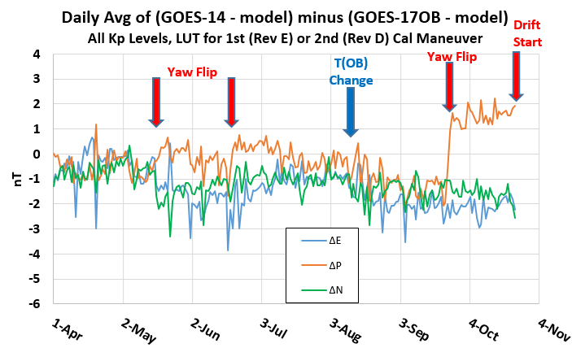
Best Magnetometer Reference for GOES-17 Outboard Mag is GOES-14 Outboard Mag:
(GOES14OB - model) minus (GOES17OB - model)
Awaiting yaw flip in late March 2019 to confirm calibration validity before waiver

