Slide 1
Peer Stakeholder-Product Validation Review (PS-PVR) For the Provisional Maturity of GOES-17 SEISS EHIS L1b Product
May 21, 2019
GOES-R Calibration Working Group (CWG)
Juan Rodriguez
NOAA NCEI / CIRES
We thank the University of New Hampshire for their guidance in the analysis of the pulse-height data.

Slide 2
Outline
Review of Beta Maturity
Product Quality Evaluation
General approach
Major Issues Remaining
Provisional Maturity Assessment
Path to Full Validation Maturity
Issues and status
PLPT
Risks
Summary and Recommendations

Slide 3
Energetic Heavy Ion Sensor (EHIS)
MRD 3.3.6.1.1 Energetic Heavy Ions
Primary purpose: measure fluxes of solar energetic particles (SEPs) and galactic cosmic rays (GCRs) responsible for Single Event Effects (SEE) in electronics
Single solid-state telescope using angle-detecting inclined sensor (ADIS) system to discriminate heavy ions by atomic number (Z)
L1b cadence is 5 minutes
Most recent FM2 (SN103) CDRL79 release: SEISS-D-EH079-3, Rev C (10 April 2018)
Contains constants used in L1b LUT and in flight tables
Most recent EHIS FM2 LUT: verified as at-launch version, "SeissEhisCalInrParameters(FM2A_CDRL79Rev-_DO_07_00_00)-582860861.0.h5"
inclined detectors
scintillator
Credit: SEISS-D-SY079_EHIS_CALTIM_Update-1-6-14

Slide 4
Galactic Cosmic Rays (GCRs)
Mewaldt et al.,
ApJLett, 723, 2010
Solar Energetic Particle (SEP) events are sporadic, duration ~ days
If large enough, trigger SWPC’s real-time solar radiation storm alerts (SGPS)
Heavy ion fluxes and event fluences used in upset calculations (EHIS)
None observed at Earth since launch of GOES-17
Galactic Cosmic Rays (GCRs) vary slowly (solar cycle ~ 11 yrs)
Very low flux levels but nonetheless pose a Single Event Effect (SEE) hazard
Measurements used to improve GCR flux models that are used in statistical predictions of upset rates (EHIS)

Slide 5
Review of Beta Maturity
GOES-17 EHIS L1b Product Provisional PS-PVR

Slide 6
Path to Provisional
Risks and associated ADRs needing resolution for Provisional
Changes to GOES-17 EHIS flight science tables (ATC/UNH)
PLPT overview

Slide 7
Path to Provisional:
Risks at G17 𝛃 PS-PVR (10 Aug 2018)
ADRs 342 and 582 were recommended for closure in July 2018 for G16 Provisional PS-PVR
No new G17 EHIS risks identified at G17 beta PS-PVR
Based on G16 experience, G17 EHIS launched with flight tables that reduced MeV electron contamination of lowest-energy hydrogen channel to insignificant levels
Existing G16 EHIS risks (Full) also apply to G17
ADR 727 (low HE1 fluxes) represents the greatest risk
One ADR (804) added since G17 Beta PS-PVR
See ‘Path to Full Validation’ section later

Slide 8
Check of ADR 582 for GOES-17
G16 Prime threshold: S = 16,000 cts/12s
G17 Prime threshold: S = 20,000 cts/12s
ADR 582 corrected the setting of the High Flux Rate (HFR) flag in L1b.
GOES-17 is responding to a higher threshold than GOES-16, as set by the flight sci_cnfg table.
Both seem to be triggering at slightly higher levels than the threshold set by sci_cnfg. Not a Ground issue.
These GOES-17 data are preliminary, non-operational data and are undergoing testing. Users bear all responsibility for inspecting the data prior to use and for the manner in which the data are utilized.

Slide 9
Changes to FM2 EHIS Tables Resulting from PLT
Date Uploaded | Rationale | Changed | L0 | L1b
18 Sept 2018 | Results of EHIS On-Orbit Calibration PLT (SEISS-TR-SY121-11) | Flight science tables (ele_engy, inst_cal, sci_cnfg) Ground LUT change not needed. | x | x
Notes for FM2:
1. FM2 launched with same logic as FM1 configured on 10 Mar 2017 -- removed electron contamination from the start. However, FM2 does not have a noisy D2A. Removal of D2A from logic complicates the H and He energy passbands. Consider reconfiguring FM2 logic to only address electron contamination.
2. Coordinate future GPA ground LUT changes to be simultaneous with incorporation of PLT results into flight tables, if needed. Improved configuration tracking of EHIS flight tables and ground LUTs is needed.

Slide 10
Path to Provisional - PLPTs
Title | Activity | Data Needed | Success Criteria
A.2.4 SEP Channel Cross-Comparison [PLPT-SEI-004] | On-orbit cross-calibration of EHIS with SGPS above 10 MeV, and with GOES 13-15 EPEAD. | One Solar Energetic Particle (SEP) event. | [Provisional] Differences quantified on data taken through Provisional phase.
A.2.6 Backgrounds Trending [PLPT-SEI-006] | Evaluate EHIS backgrounds in terms of expected galactic cosmic ray (GCR) fluxes. The analysis of EHIS heavy ion data will require long-term averages of L0 histograms. The analysis of EHIS proton and alpha particle rates as well as rates from the other two instruments could convert L1b fluxes back to counts, but it would be less ambiguous simply to average the L0 count rates. | Two months of continuous data. | [Provisional] Natural backgrounds preliminarily correlated with solar protons and GCRs.
EHIS PLPTs from RIMP v 1.0 (02 June 2016)
Data requirements for PLPT-SEI-004 at Provisional maturity have not been met
One SEP event required vs. zero SEP events since G17 launch
Data requirements for PLPT-SEI-006 at Provisional maturity have been exceeded
Two months of continuous data required vs. 135 days (5 solar rotations) used
Provisional success criteria require identification of calibration differences without necessarily resolving them
Success requires sufficient analysis to reveal the important issues that need to be pursued in Full Validation phase

Slide 11
Product quality assessment
GOES-17 EHIS L1b Product Provisional PS-PVR

Slide 12
Product Quality Assessment
PLPTs for Provisional
Top Level Evaluation
Provisional Performance Baseline Status

Slide 13
PLPTs for Provisional
PLPT-SEI-004: Solar Energetic Particle (SEP) Cross-Comparison
Cannot be performed until a large SEP event takes place
PLPT-SEI-006: Backgrounds
Presumably galactic cosmic ray (GCR) fluxes
Space climate rather than space weather – a retrospective application
Important indicator of instrument performance

Slide 14
Geometrical Factors for SEPs vs. GCRs
Relative contribution of different parts of spectral response curves to total counts depends on spectrum, affects effective energies and geometrical factors.
LUT factors calculated for these conditions
Accurate GCR analysis requires factors calculated for these conditions
The five colored curves represent the spectrum-weighted response functions for energy channels E1-E5.
UNH will provide spectral response curves by 2019-09-15. NCEI will use these to calculate geometrical factors for GCR fluxes.

Slide 15
PLPT-SEI-006
Evaluate EHIS backgrounds in terms of expected galactic cosmic ray (GCR) fluxes
Average months of data [during which flight tables did not change] to construct average spectrum (GCR fluxes are slowly-varying)
Hydrogen (proton) and helium (alpha) rates:
Average L0 rates or L1b fluxes over months
Baseline approach to analysis of EHIS heavy ion GCRs requires long-term averages of L0 histograms (ELF packets), followed by reprocessing using L1b algorithm
This approach did not work for GOES-16 Provisional PS-PVR due to elevated, Z-dependent backgrounds (Prime, NO S)
Alternative approach has been applied with some success: analysis of pulse-height (PHA) packets (Non-Prime) – reach-back to G16
Period used for GCR analyses: 2018-11-28 through 2019-04-11:
five 27-d Bartels solar rotations, no major data gaps, no SEP events

Slide 16
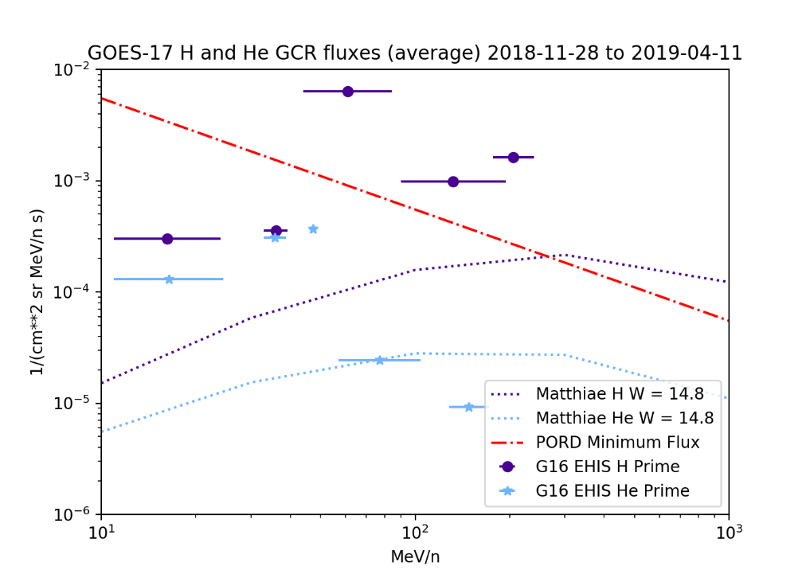
PLPT-SEI-006: H and He
GOES-16
GOES-17
Poisson error <= 1%: 135 days (5 solar rotations) of data used
Compared to Matthiä GCR model fluxes for the same period
Because LUT geometric factors (GFs) were derived for SEPs, not GCRs:
GCR fluxes are high with respect to model (as with SGPS) – high-energy tails in response curves
Differences between G16 and G17 are not conclusive
For Full validation, will reanalyze full bandpass functions (including high-energy tails) to determine GFs appropriate for GCRs (bandpasses to be provided by ATC/UNH)
These GOES-17 data are preliminary, non-operational data and are undergoing testing. Users bear all responsibility for inspecting the data prior to use and for the manner in which the data are utilized.

Slide 17
PLPT-SEI-006: Angle-Detecting Inclined Sensor (ADIS) Theory
Substantial science processing performed by EHIS flight software (FSW)
EHIS ADIS equations have more terms for more detectors than those at left
Using ADIS equations and others, FSW sorts heavy ions by Z (atomic number, nuclear charge) into a histogram
Uses uploadable flight science tables (‘ele_engy’, ‘inst_cal’, ’sci_cnfg’)
Produces a 600 x 5 (ZCAL*20 x energy) histogram reported in L0 every minute
ZCAL is the calculated estimate of Z
Histogram bin widths are 0.05e (Z = bin number / 20)
From Connell et al., NIMS A, v. 837, pp. 11-15, 2016

Slide 18
Pulse Height Analysis (PHA) Packets
Designed to support recalculation of flight software quantities on the ground as a check
Produced once per second
In place of first SCI-PHA packet each minute: SCI-PEC packet
Preempted by ENG-DMP (Memory Dump, e.g. IFC download) and ENG-MOP (Memory Operation) packets
Contain highest-priority particle detected during that second
Highest priority is Priority 1 (heavy ion) Non-Prime
Under GCR conditions, large fraction of PHA packets are zeros (empty)
Contents:
ADC digital numbers from detectors D1-D6
Trigger status of all thresholds on each detector
Various status flags including priorities 1-3, prime, non-prime
ADIS Dx and Dy, Zcal

Slide 19
Outline of FSW-based Algorithm Used for this PHA Analysis
Construct P1 (Non-Prime) histogram
For P1, convert ADC DNs to deposited energy in MeV using slopes and intercept from flight table ‘inst_cal’
Calculate departing energy Eo and total energy Etot from energies deposited in detectors
Construct E1, E2 and E3 histograms using threshold logic
Construct E4 and E5 histograms using threshold logic, Etot and flight table ‘ele_engy’
Calculate total P1 counts from histogram
Correct P1 counts for counts in R that are not included in E4 or E5
Dead-time correction is insignificant for GCRs
The rest of the algorithm follows CDRL80
Fits to P1 (Non-Prime) Histogram for E1-E5
Corrected P1 counts
Changed to duration of period in seconds

Slide 20
PLPT-SEI-006: ELF (operational) vs. PHA (reconstructed) histograms
Co-added ELF histograms (used for L1b):
Dominated by Prime conditions: elevated, Z-dependent backgrounds in E1-E3
Histogram constructed from PHA Non-Prime packets: backgrounds reduced by order-of-magnitude in E1-E3
Similar effect with GOES-16 data
These GOES-17 data are preliminary, non-operational data and are undergoing testing. Users bear all responsibility for inspecting the data prior to use and for the manner in which the data are utilized.

Slide 21
PLPT-SEI-006: GOES-17 Histogram Fit
2,564 valid P1 counts in 135 days
Ne
Mg
Si
S
Fe
C
N
O
These GOES-17 data are preliminary, non-operational data and are undergoing testing. Users bear all responsibility for inspecting the data prior to use and for the manner in which the data are utilized.

Slide 22
PLPT-SEI-006: GOES-16 and GOES-17 C, N, O, Fe GCR Fluxes
GOES-16
GOES-17
Fluxes retrieved either as zero or a statistical upper limit (as defined by CDRL80) are not plotted
These GOES-17 data are preliminary, non-operational data and are undergoing testing. Users bear all responsibility for inspecting the data prior to use and for the manner in which the data are utilized.

Slide 23
PLPT-SEI-006: GOES-16 and GOES-17 Ne, Mg, Si, S GCR Fluxes
GOES-16
GOES-17
Fluxes retrieved either as zero or a statistical upper limit (as defined by CDRL80) are not plotted
These GOES-17 data are preliminary, non-operational data and are undergoing testing. Users bear all responsibility for inspecting the data prior to use and for the manner in which the data are utilized.

Slide 24
PLPT-SEI-006: Assessment
H and He:
L1b results are high with respect to model, as before
Heavy ions (C-Fe):
G16 and G17 Non-Prime histograms have been constructed from L0 PHA data using analysis implementation of EHIS flight software algorithm
Resulting averaged fluxes agree reasonably well with GCR model
Discrepancies may be reduced with improved alpha-kappa (flight) tables
Updated flight tables exist for GOES-16, not yet uploaded
Comparisons of GOES-16 and GOES-17 data indicate reasonable consistency of performance
More definitive comparison requires reanalysis using full bandpasses
Planned for Full Validation
PASSED

Slide 25
Top Level Evaluation
 | Status at Beta PS-PVR (10 Aug 2018) | Current Status (21 May 2019) | Future Outlook
Hydrogen (proton) flux | H1 does not suffer from MeV electron contamination thanks to pre-launch flight table change | SEP event not yet observed To convert GCR observations accurately to fluxes, geometrical factors need to be reanalyzed | Upcoming solar minimum will provide good test of instrument First large SEP event of Solar Cycle 25?
Helium (alpha particle) flux | He fluxes only observed at GCR levels | SEP event not yet observed G17 assumed to have the same HE1 undercounting problem as G16; cannot be verified without SEP event To convert GCR observations accurately to fluxes, geometrical factors need to be reanalyzed | Root cause of HE1 undercounting problem not known despite extensive investigations Upcoming solar minimum will provide good test of instrument First large SEP event of Solar Cycle 25?
Heavy ions (C-Fe) | Heavy ion fluxes only observed at GCR levels, very sparse | SEP event not yet observed GCR fluxes demonstrated to be derivable from PHA data (below PORD Minimum flux req’t) To convert GCR observations accurately to fluxes, geometrical factors need to be reanalyzed | Upcoming solar minimum will provide good test of instrument First large SEP event of Solar Cycle 25?

Slide 26
GOES-17 EHIS
Performance Baseline Status
Assessment at Provisional
MRD ID | Description | MRD Requirement | Predicted Performance Baseline (CDRL 79 or RVRs) | NCEI Assessment at Provisional | Related PLPTs | Status
1978 | EHIS Orthogonality/Coverage | 1 direction | 1 direction | 1 direction | -04, -06 | PASS
1982 | EHIS Measurement Range | 10-200 MeV/n 5 mass groups: H, He, (C,N,O), Ne-S, & Fe | (MeV/n) H: 11.0-240 He: 11.0-173 C: 18.5-373 O: 22.0-465 Mg: 26.2-578 Fe: 37.5-977 | NCEI reviewed calibration analysis used to populate CDRL 79 | -04, -06 | PASS
1983 | EHIS Measurement Accuracy | 45% @min flux, 25% @10X min flux | 15.5-24.3% depending on species, energy band and Non-Prime/Prime status | Absolute accuracy cannot be verified on-orbit. | -04, -06 | GCR fluxes are below PORD Minimum flux level

Slide 27
Provisional Maturity Assessment
GOES-17 EHIS L1b Product Provisional PS-PVR

Slide 28
Provisional Validation
Preparation Activities | Assessment
Validation activities are ongoing and the general research community is now encouraged to participate. | Validation activities are ongoing. Results have been discussed with SWPC.
Severe algorithm anomalies are identified and under analysis. Solutions to anomalies are in development and testing. | Two open ADRs (727- low HE1 fluxes). Several ADRs (stemming from G16 data) have been closed.
Incremental product improvements may still be occurring. | UNH investigating large Z-dependent background under Prime conditions.

Slide 29
Provisional Validation
End State | Assessment
Product performance has been demonstrated through analysis of a small number of independent measurements obtained from select locations, periods, and associated ground truth or field campaign efforts. | G16 and G17 EHIS GCR fluxes compared to model
Product analysis is sufficient to communicate product performance to users relative to expectations (Performance Baseline). | Yes, to the limited extent that the Performance Baseline can be checked on-orbit.
Documentation of product performance exists that includes recommended remediation strategies for all anomalies and weaknesses. Any algorithm changes associated with severe anomalies have been documented, implemented, tested, and shared with the user community. | README will describe discrepancies and caveats at Provisional as well as peculiarities of the L1b product.
Testing has been fully documented. | This presentation.
Product is ready for operational use and for use in comprehensive cal/val activities and product optimization. | NCEI: By similarity with GOES-16 for heavy ion measurements

Slide 30
Recommendation
NCEI believes that the GOES-17 EHIS L1b product has reached Provisional Maturity as defined by the GOES-R Program
As with SGPS, by similarity with GOES-16 provisional results
Caveats:
No SEP event since GOES-17 launch – need at least two for Full validation
GCRs currently cannot be derived accurately from L0 ELF Prime-dominated histogram data – used L0 PHA instead
Continued refinement of on-orbit tables by UNH (periodic analysis of GCRs, or after large SEP events) is essential for proper performance of the instrument

Slide 31
Path to full Validation Maturity
GOES-17 EHIS L1b Product Provisional PS-PVR

Slide 32
Path to Full Validation
ADRs/WRs to be resolved prior to Full Validation.
PLPTs to be conducted prior to Full Validation.
Risks to getting to Full.
Special topic: ADR 727, EHIS unexpected low fluxes from lowest energy helium channel (HE1).

Slide 33
ADRs/WRs Affecting Full Validation of EHIS L1b
ADR# | WR # | Short Description | Status | G16 | G17 | Expected Closure
267 | 5370 | LUT Filenames not Traceable to Metadata | Closed | √ | √ | DO.07.00.00
414 | 4920 | Start and End Time Stamps for SEIS-L1b-EHIS | Closed | √ | √ | DO.07.00.00
510 | 5413,5483 | SWx L1b generation slowdown / stoppage | Closed | √ | √ | DO.07.00.00
517 | 4431, 3802 | Small but routine L1b gaps, mostly for SEISS (EHIS, MPS-LO, MPS-HI) | Closed | √ | √ | resolved by WR4431 in DO.06.03
703 | 6146 | Replace Be and B fluxes with fill values | Closed | √ | √ | PR.07.02.00
727 | 6113 | GOES-16 EHIS unexpected low fluxes from lowest energy helium channel (HE1) | Open |  |  | Flight WR
804 | 6661 | SEISS EHIS L1b ‘StatErrorsBounds’ variables issue [incorrect dimension name: ‘energy_bounds’ instead of ‘error_bounds’] | Open (conf. for G16 in DE) | Not in OE | Not in OE | PR.07.02.00 DO.08.00.00

Slide 34
Path to Full Validation - PLPTs
Title | Activity | Data Needed | Success Criteria
A.3.3 SEP Channel Cross-Comparison [PLPT-SEI-004] | On-orbit cross-calibration of EHIS with SGPS above 10 MeV, and with GOES 13-15 EPEAD. | Two Solar Energetic Particle (SEP) events. | [Full] Differences quantified on data taken through validation phase.
A.3.5 Backgrounds Trending [PLPT-SEI-006] | Evaluate EHIS backgrounds in terms of expected galactic cosmic ray (GCR) fluxes. The analysis of EHIS heavy ion data will require long-term averages of L0 histograms. The analysis of EHIS proton and alpha particle rates as well as rates from the other two instruments could convert L1b fluxes back to counts, but it would be less ambiguous simply to average the L0 count rates. | Four months of continuous data. | [Full] Perform analysis during validation phase.
EHIS PLPTs from RIMP v 1.0 (02 June 2016) – continuation of Provisional
Data requirements for Full validation:
A.3.3: 2 SEP events required
A.3.5: 4 months of data required
Full validation will emphasize more sophisticated calibration analysis:
Use of full, temperature-dependent bandpass functions
Calculation of GCR-appropriate geometrical factors
Use of pulse-height analysis (PHA) packet L0 data
Comparisons of GOES-16 and GOES-17
Set GOES-17 logic differently (keep D2A in logic) to compare performance?
Next solar minimum predicted for late 2019 or 2020

Slide 35
Path to Full Validation – Risks
Risk Name | Description | Impact | Mitigation (by Full)
GOES-16 EHIS unexpected low fluxes from lowest energy helium channels (HE1) | IF root cause of low helium fluxes not identified and fix implemented | THEN EHIS helium HE1 fluxes will be inaccurate during largest SEP events. | WR 6113 (Flight – root cause investigated) ADR 727 (alternative algorithmic approaches evaluated, NCEI recommendation made)
Low C-Fe Fluxes (SEP) | IF discrepancy between EHIS and SIS heavy ion fluxes is not understood | THEN EHIS data will not be trusted by the community | SEP issue – need another event Confirm with PHA analysis Discuss with SIS scientists
Low H fluxes (SEP) | IF discrepancy between EHIS and SGPS hydrogen fluxes is not understood | THEN EHIS data will not be trusted by the community | Off-line spectral analysis using temperature-dependent bandpasses
GCRs from histograms | IF GCRs cannot be retrieved from histograms | THEN GCR retrievals will have to rely on PHA analysis, which is not part of L1b baseline | UNH to reevaluate alpha-kappa coefficients using Sept 2017 SEP observations (revised tables still to be uploaded) NCEI to perform PHA analysis (complete – successful)
False Be and B fluxes | IF Be and B fluxes are not replaced with fill values | THEN someone will use them to draw false conclusions | ADR 703, WR 6146 (PRO Type 1) CLOSED

Slide 36
ADR 727: Evaluation of Alternatives
The lowest-energy GOES-16 EHIS helium channel (HE1) registered fluxes a factor of 6-7 low during the 10 Sept 2017 SEP event
There is evidence for this internal to the instrument (UNH) and by cross-comparison with other helium measurements (NCEI)
This violates 25% accuracy requirements in PORD (SEISSPORD160) and MRD (1983)
Despite extensive investigations by UNH, the root cause has not been identified
In September 2018, UNH recommended attractive algorithmic fixes that use helium PHA samples
This approach relies on the PHA packets during every 5-minute interval containing a significant number of helium samples (295 PHA packets per 5 minute interval)
Heavy ion counts take first priority in the PHA packets
During an extreme SEP event, will there be sufficient helium samples in the PHA packets in every 5-minute period?

Slide 37
ADR 727: Ratios of Helium Rate Counts to Helium PHA Counts
Ratio of He rate counts to He PHA counts increases during SEP event as heavies take priority in PHA packets
Ratios for E2-E5 are similar
Ratio for E1 is low – internal evidence of undercounting in E1
Undercounting affects P2 histograms as well as He rates
UNH idea: use ‘ratio of ratios’ to correct He E1 rates
From UNH report ‘EHIS FM1 HE1 Investigation’ (17 Sept 2018)

Slide 38
ADR 727: Analysis Approach
Use Solar Isotope Spectrometer (SIS) Level 2 1-hour average fluxes from ACE Science Center
Three highest-energy SIS channels overlap with two lowest-energy EHIS channels
Initial ‘back of the envelope’ analysis:
Use SIS fluxes of three most abundant species (C, N, O)
Interpolate to EHIS E1 energy
Convert interpolated E1 fluxes to counts/5 minutes
Compare sum of E1 C, N, O counts to 295 counts/5 min criterion
This is only a subset of the total heavy ion counts that would be measured
If predicted E1 CNO counts exceed 295 per 5 minutes for any length of time, then a PHA-based-approach cannot handle extreme SEP events

Slide 39
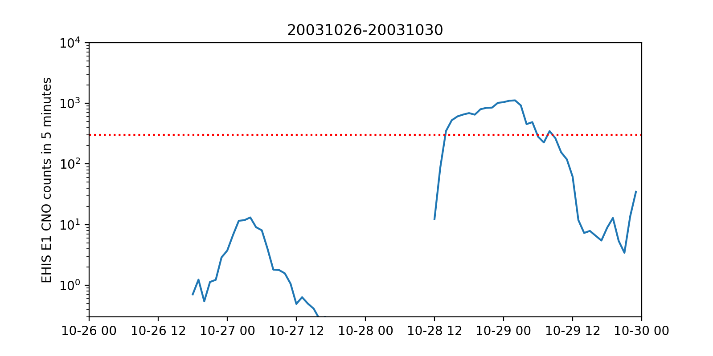
EHIS E1 CNO Counts/5 Minutes for Two of the Largest SC23 SEP Events
More than 295/5min heavy ion counts
Bastille Day 2000
More than 295/5min heavy ion counts
October 2003 ‘Halloween’

Slide 40
ADR 727: Conclusions
This simple analysis shows that the EHIS heavy ion (Priority 1) count rate would have exceeded 295 counts/5 min (number of PHA packets) for a large fraction of a day during historically extreme SEP events
PHA-based correction approaches recommended by UNH can be used retrospectively to correct the EHIS HE1 fluxes during moderate events like September 2017
PHA-based correction approaches are not suitable for real-time operational space weather use
Therefore, NCEI recommends that an SGPS-based Helium flux product be developed under ADR 727
NCEI has demonstrated (using the September 2017 events) that SGPS can produce helium fluxes that compare well with science-grade measurements

Slide 41
SEP Event Helium Fluences, September 2017
SEP Event, 5-9 Sept 2017
SEP Event, 10-14 Sept 2017
Low EHIS HE1 rates

Slide 42
ADR 727: Path Forward for an SGPS-based Helium Product
Flight:
Add demonstrated algorithm to CDRL 80
Calibrate SGPS alpha channels (geometric factors, proton contamination)
Ground:
Implement Flight algorithm to add helium variables to existing SGPS product
Additional data volume in GRB
NCEI:
Develop algorithm & software to calculate Level 2 5-minute averages of SGPS helium fluxes (adaptation/extension of existing averaging software)
Modify existing Level 2 LET algorithm & code to ingest SGPS helium fluxes and create LET spectrum from SGPS data
Deliver as part of Phase 3 to NWS/SWPC (work planned 2020-06-30 through 2020-12-31)
NWS/SWPC:
Transition NCEI-developed code to operations

Slide 43
Summary & Recommendations
GOES-16 ABI L1b Products Provisional PS-PVR

Slide 44
Summary
No Solar Energetic Particle (SEP) event since GOES-17 launch – this PS-PVR has relied on analysis of galactic cosmic ray (GCR) fluxes
Used analysis of Non-Prime data from Pulse Height Analysis (PHA) packets to estimate heavy ion (C-Fe) GCR fluxes – reach-back to G16 Provisional PS-PVR
G16 and G17 GCR fluxes agree reasonably well
Agreement of observations with GCR model fluxes:
H and He: poor, need to recalculate calibration factors for GCRs
Heavy ions: reasonable, will benefit from recalculation of calibration factors for GCRs
Risks to reaching Full Maturity have been identified

Slide 45
Recommendation
NCEI believes that the GOES-17 EHIS L1b product has reached Provisional Maturity as defined by the GOES-R Program
As with SGPS, by similarity with GOES-16 provisional results
Caveats:
No SEP event since GOES-17 launch – need at least two for Full validation
GCRs currently cannot be derived accurately from L0 ELF Prime-dominated histogram data – used L0 PHA instead
Continued refinement of on-orbit tables by UNH (periodic analysis of GCRs, or after large SEP events) is essential for proper performance of the instrument

