Slide 1
G16/17 MPS-Hi Full Validation PS-PVR SWPC Overview
MPS-Hi measures the energetic particles responsible for “deep” satellite charging, it is required for one of SWPC’s important customer alerts, and historical data are important for satellite design.
ADR 863 is important to ensure continuity of MPS-Hi measurements in the event of SGPS failure.
Mitigation of proton contamination in the MPS-Hi electron measurements appears to be excellent, but very large proton events have not yet occurred.
MPS-Hi – SGPS channel disagreement and possible degradation of MPS-Hi proton channels need to be further investigated.
SWPC is highly appreciative of the excellent work and diligence provided by NCEI, as well as the support from ATC and the entire GOES project.
SWPC concurs with NCEI’s recommendation for MPS-Hi to transition to Full Validation status, and we recommend continued effort to maintain and improve the data quality

Slide 2
Space Weather Economic Impacts
Abt Associates, 2017
MPS-Hi measures a component of the in-situ radiation environment responsible for spacecraft charging that can result in satellite-system anomalies and failure

Slide 3
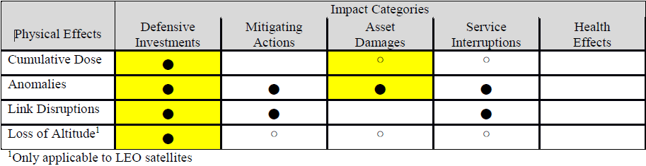
Space Weather Economic Impacts
Abt Associates, 2017
Satellite Impact Matrix
Defensive Investments: “… to protect the integrity of satellites from high cumulative radiation dosages and from anomalous satellite behaviors that can be caused by surface- and deep-dielectric charging.”
Mitigating Actions: “Assessment conducted after any anomalous satellite behavior”

Slide 4
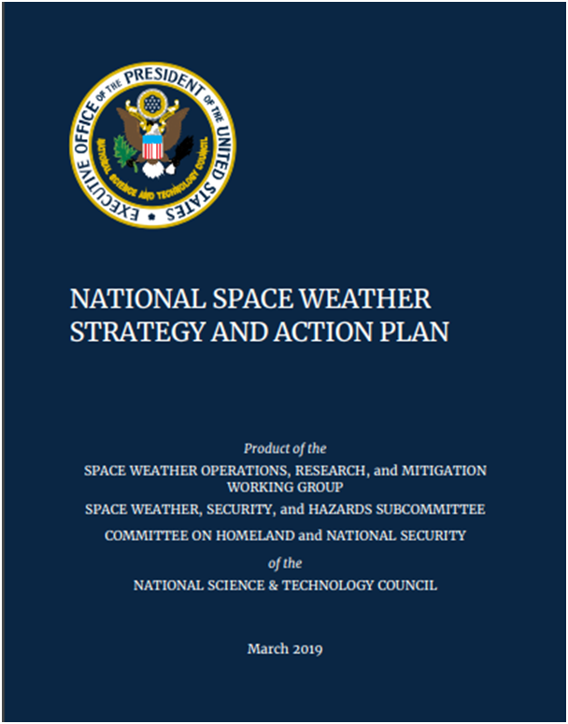
National Space Weather Action
Action 2.11.6: DOC, in coordination with NASA and DoD, develop a plan for a robust real-time assimilative environmental specification model such that it supports 1) Nowcasting of the space environment, and 2) Analysis and attribution of spacecraft anomalies due to routine and extreme space weather
MPS-HI will be an important data source for this data assimilative environmental model

Slide 5
G16/17 MPS-Hi Full Validation PS-PVR SWPC Overview
MPS-Hi measures the energetic particles responsible for “deep” satellite charging, it is required for one of SWPC’s important customer alerts, and historical data are important for satellite design.
ADR 863 is important to ensure continuity of MPS-Hi measurements in the event of SGPS failure.
Mitigation of proton contamination in the MPS-Hi electron measurements appears to be excellent, but very large proton events have not yet occurred.
MPS-Hi – SGPS channel disagreement and possible degradation of MPS-Hi proton channels need to be further investigated.
SWPC is highly appreciative of the excellent work and diligence provided by NCEI, as well as the support from ATC and the entire GOES project.
SWPC concurs with NCEI’s recommendation for MPS-Hi to transition to Full Validation status, and we recommend continued effort to maintain and improve the data quality

