Slide 1
Peer Stakeholder-Product Validation Review (PS-PVR) For the Provisional Maturity of GOES-17 SEISS MPS-HI L1b Product
December 18, 2018
GOES-R Calibration Working Group (CWG)
Presenter: Juan Rodriguez
Major Contributors: William Rowland, Athanasios Boudouridis
CIRES and NOAA NCEI

Slide 2
Outline
Review of Beta Maturity
Product Quality Evaluation
General approach
Major Issues Remaining
Provisional Maturity Assessment
Path to Full Validation Maturity
Issues and status
PLPT
Risks
Summary and Recommendations
Backup – Details of Individual PLPT

Slide 3
Magnetospheric Particle Sensor – High Energy (MPS-HI)
MRD 3.3.6.1.3 Magnetospheric Electrons and Protons: Medium and High Energy
Primary purpose: measure radiation belt particle fluxes in the energy range responsible for internal charging
5 electron telescopes and 5 proton telescopes
30 deg full-width conical FOVs, centers separated by 35 deg
Each electron telescope:
10 differential channels, 50 keV – 4 MeV
2 integral channels, >2 MeV and >4 MeV (latter not part of L1b)
Each proton telescope:
11 differential channels
7 channels, 80 keV – 1 MeV (trapped)
4 channels, 1-12 MeV (solar protons)
Two dosimeters (250 and 100 mil Al)
Distinguish particles depositing < 1 MeV and >1 MeV
Credit: SEISS-TR-MH074-2 Rev C, Figure 3-1

Slide 4
ALERT: Electron 2 MeV Integral Flux exceeded 1000pfu
SWPC alert at 1000 electrons/(cm² sr s) [pfu] was developed in consultation with the satellite industry
Based on GOES-East observations
Fluxes systematically lower than at GOES-West by factor of 2.5 [Meredith et al., 2015]
First alert issued 18 May 1995
In this otherwise quiet solar cycle, MeV electron fluxes have been very elevated starting in 2015
Primarily owing to the action of stream interaction regions (interface between solar wind of coronal hole and quiet sun origins) on the magnetosphere
Space Weather Message Code: ALTEF3 Serial Number: 2516 Issue Time: 2017 Jan 09 0501 UTC
CONTINUED ALERT: Electron 2MeV Integral Flux exceeded 1000pfu Continuation of Serial Number: 2515 Begin Time: 2017 Jan 05 1520 UTC Yesterday Maximum 2MeV Flux: 25537 pfu www.swpc.noaa.gov/noaa-scales-explanation Potential Impacts: Satellite systems may experience significant charging resulting in increased risk to satellite systems.

Slide 5
Review of Beta Maturity
GOES-17 MPS-HI L1b Products Provisional PS-PVR

Slide 6
Path to Provisional
Risks and associated ADRs needing resolution for Provisional
PLPT preview

Slide 7
Instrument/GPA Issues Identified and Resolution Status: MPS-HI
At Beta PS-PVR, NCEI-CO recommended that these issues be resolved prior to declaring the GOES-17 MPS-HI data of Provisional maturity.
Title | Description | Status | Mitigation
MPS-HI L1b overcorrection | Severe overcorrection of electron channels by L1b processing matrix inversion (G17) | ADR 762 closed | Replace full matrix inversion with bowtie inversion coefficients in CALINR file - COMPLETE
Inadequate removal of MPS-HI electron channel GCR backgrounds | Backgrounds in >2 MeV electron channels at SWPC alert levels. Violates PORD and MRD requirements. (G17) | ADR 762 closed | Perform analysis (NCEI) and modify coefficients in MPS-HI CALINR file - COMPLETE
ADR# | WR# | Short Description | Status | Closure DO
267 | 5370 | LUT Filenames not Traceable to Metadata | Closed | DO.07.00.00
762 | 6578 | G17 MPS-HI LUT update replacing matrix inversion with bowtie coefficients and modified E11 background removal coefficients | Closed | PR.07.00.04 on 10/15/2018 2100 UT

Slide 8
ADR 267: LUT Filenames not Traceable to Metadata
L2 algorithms need to know filename of LUT in real time
For example:
Calculation of errors for 1-min and 5-min averages requires knowledge of geometric factors used in L1b processing
L2 software opens LUTs for this information
Common need across all GOES-R SWx instruments
Impact of LUT version disconnect between L1b and L2 processing is inaccurate L2 data
Solution: added new global attribute ‘LUT_filenames’
MPS-HI check (October 17, 2018):
time_coverage_start = 2018-10-17T00:00:00.0Z time_coverage_end = 2018-10-17T00:00:29.0Z date_created = 2018-10-17T00:00:30.2Z LUT_Filenames = SeissMpsHiCalInrParameters(FM2A_CDRL79Rev-_PR_07_00_04_NCEI_modified_2018-09-10)-592902700.0.h5
Success - this is the version of the LUT modified by NCEI (ADR 762)

Slide 9
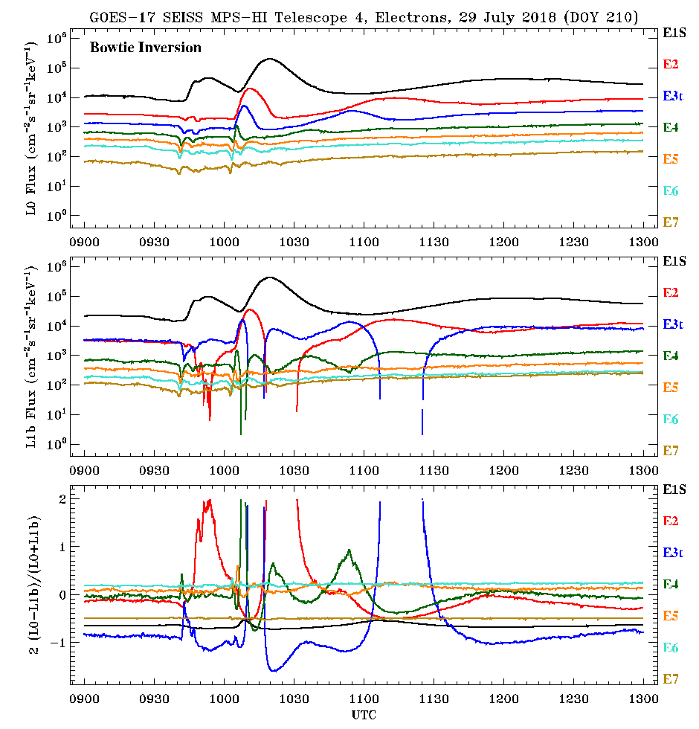
ADR 762, Modified LUT Motivation: Eliminate L1b Overcorrection of MPS-HI Electrons
As with GOES-16, L1b processing matrix inversion causes non-physical dropouts in GOES-17 MPS-HI fluxes.
Bowtie coefficients have been generated to replace full matrix inversion in L1b processing (ADR 762)
LUT modified by NCEI, as with GOES-16
LUT installed successively in DE and OE (since October 15, 2018)
Flux calculated from L0 using early version of new LUT
L1b Matrix Inversion
L1b results with old LUT
Non-physical dropouts
These GOES-17 data are preliminary, non-operational data and are undergoing testing. Users bear all responsibility for inspecting the data prior to use and for the manner in which the data are utilized.

Slide 10
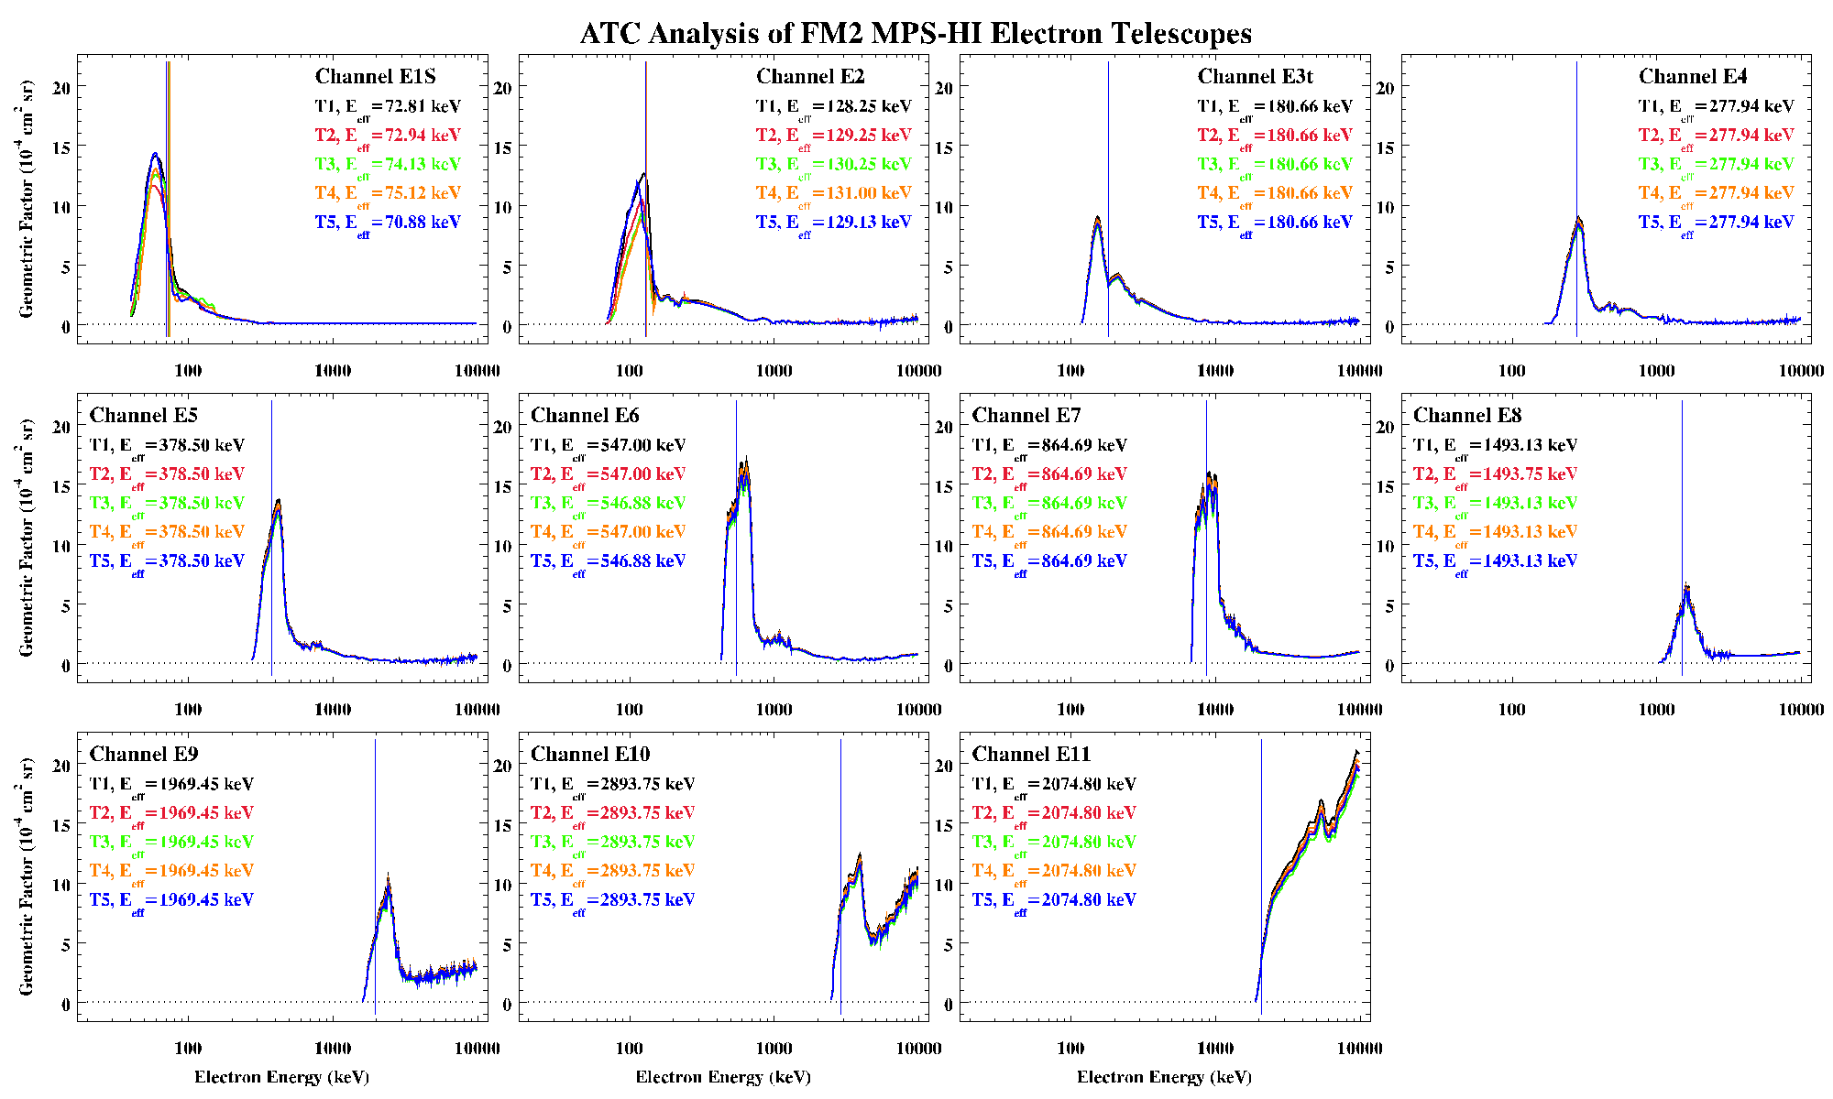
ADR 762, Modified LUT: Reanalyzed Channel Energy Responses
Data (analyzed beam measurements and Geant4 simulations) provided by ATC (CDRL 79). Synthesized by A. Boudouridis (NCEI) into tabulated functions used in bowtie analysis to calculate LUT parameters.
We thank Assurance Technology Corporation for their help with this.

Slide 11
ADR 762, Modified LUT Motivation: Background Correction
Background correction coefficients derived through a comparison of P11 and E9-E11 backgrounds over first several months of observations. See PLPT-SEI-006 for more information.
G17 E11 (>2 MeV), 24 April – 10 Sept 2018
T3
T1
SWPC alert level very close to uncorrected background level
T4
T2
T5
DOS
These GOES-17 data are preliminary, non-operational data and are undergoing testing. Users bear all responsibility for inspecting the data prior to use and for the manner in which the data are utilized.

Slide 12
ADR 762: Verification of successful installation of modified MPS-HI LUT in OE
Goal: verify that MPS-HI LUT modified & delivered by NCEI was successfully installed in OE
Data from 17 Oct 2018 (doy 290)
Compared to fluxes and flux errors calculated from L0 by NCEI
MPS-HI and SGPS L0 data aggregated into separate day files by A. Boudouridis
For each L1b file (30 samples per channel):
Calculate ratio of OE to NCEI products (flux and flux error, both in flux units)
Take mean and standard deviation of ratios
This gives a mean and a standard deviation for each L1b file
Ideally, mean = 1.0 and standard deviation = 0.0
Results are excellent: ratio mean = 1.0, stdev = 0.0 or ~1e-8 (latter observed when quantity involves special function such as square root)
Justify use of reprocessed data in Provisional PLPT

Slide 13
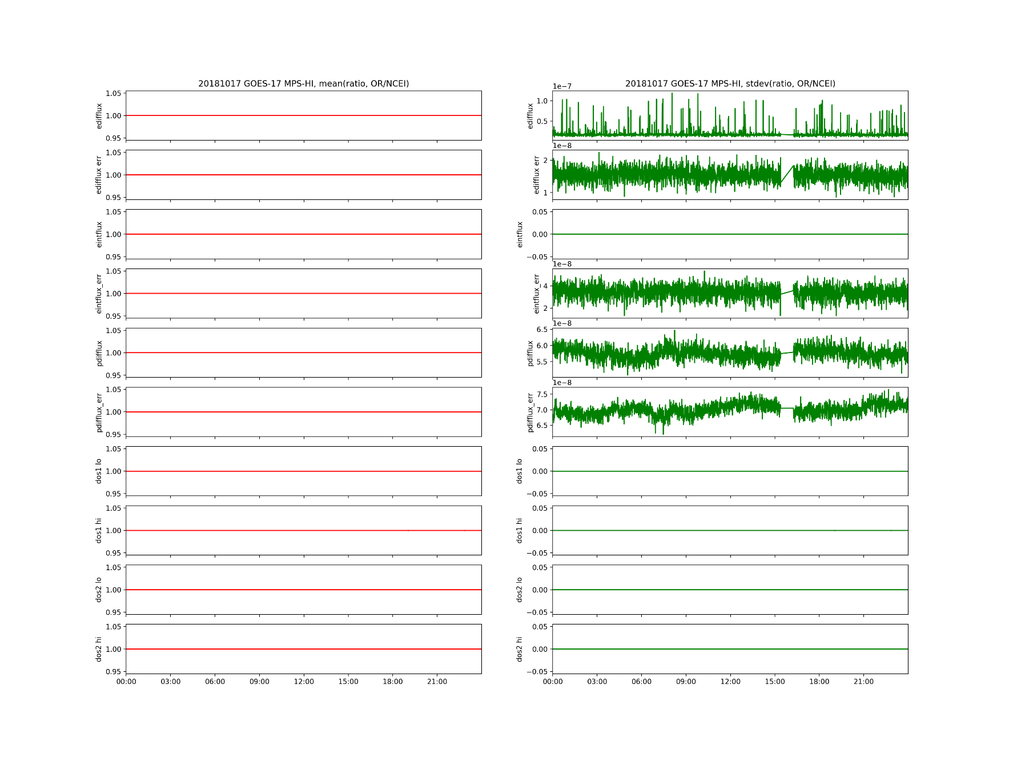
ADR 762: OE check using data from October 17, 2018: excellent agreement!
17 Oct 2018
In general:
Ratio mean = 1.0
Ratio stdev ~ 1e-8 or 0
Performance of modified LUT checked in DE on 01 Oct 18 prior to installation in OE
These GOES-17 data are preliminary, non-operational data and are undergoing testing. Users bear all responsibility for inspecting the data prior to use and for the manner in which the data are utilized.

Slide 14
Path to Provisional - PLPT
Title | Activity | Data Needed | Success Criteria
A.1.1 MPS-Hi Telescope Cross-Comparison [PLPT-SEI-002] | Inspect pitch-angle distributions (PADs) for geophysical realism. | One week of continuous data. (MAG and MPS-HI) | [Beta] PADs match science expectations as a function of local time and activity. [not performed by beta PS-PVR due to lack of adequate MAG data]
A.1.3, A.2.6 Backgrounds Trending [PLPT-SEI-006] | Model GCR spectra (e.g., NASA JSC Badhwar-O’Neill 2014) put through a forward model derived from MPS-HI instrument response functions to estimate MPS-HI channel fluxes for comparison with observations. | Two months of continuous data. (MPS-HI) | [Provisional] Natural backgrounds preliminarily correlated with solar protons and GCRs.
A.2.2 MPS-Hi Telescope Cross-Comparison [PLPT-SEI-002] | Determine the relative sensitivity/response among MPS-HI telescopes. | One month of continuous data. (MAG and MPS-HI) | [Provisional] Telescopes agree to within 25%.
A.2.4 SEP Channel Cross-Comparison [PLPT-SEI-004] | On-orbit cross-calibration of MPS-HI with SGPS 1-12 MeV protons, and with GOES 13-15 EPEAD. | One Solar Energetic Particle (SEP) event. | [Provisional] Differences quantified on data taken through Provisional phase.
A.2.5 Cross Satellite Comparison of Trapped Particles [PLPT-SEI-005] | Identify time periods when the two satellites should be measuring the same population, and compare results. To reach provisional maturity, comparisons involve plots of fluxes vs. energy in order to look for gross inconsistencies between sensors. | One month of continuous data. (MAG, MPS-HI) | [Provisional] Differences quantified on data taken through validation phase.
MPS-HI PLPTs from RIMP v 1.0 (02 June 2016)

Slide 15
Use of Reprocessed Data in PLPT
Due to date of changes to OE (ADR 762), not enough data for PLPT prior to PS-PVR
We have reprocessed L0 data using software that has been demonstrated to reproduce L1b results to ‘machine precision’ (see ADR 762 artifacts)
This demonstrated equivalence allows us to perform PLPT using reprocessed MPS-HI data
The reprocessed data used in PLPT are 1-minute averages of data from 20 June – 24 Sept 2018 (when GOES-17 was upright)

Slide 16
PLPTs for Provisional
PLPT-SEI-002: MPS-HI Telescope Cross-Comparison (Rowland)
PLPT-SEI-004: Solar Energetic Particle (SEP) Cross-Comparison – not possible due to lack of SEP events since G17 launch
PLPT-SEI-005: Cross-Satellite Comparison of Trapped Particles (Rodriguez)
PLPT-SEI-006: Backgrounds (Rodriguez)
PLPT-SEI-002 and -005 require new LUT
PLPT-SEI-006 produces inputs to new LUT

Slide 17
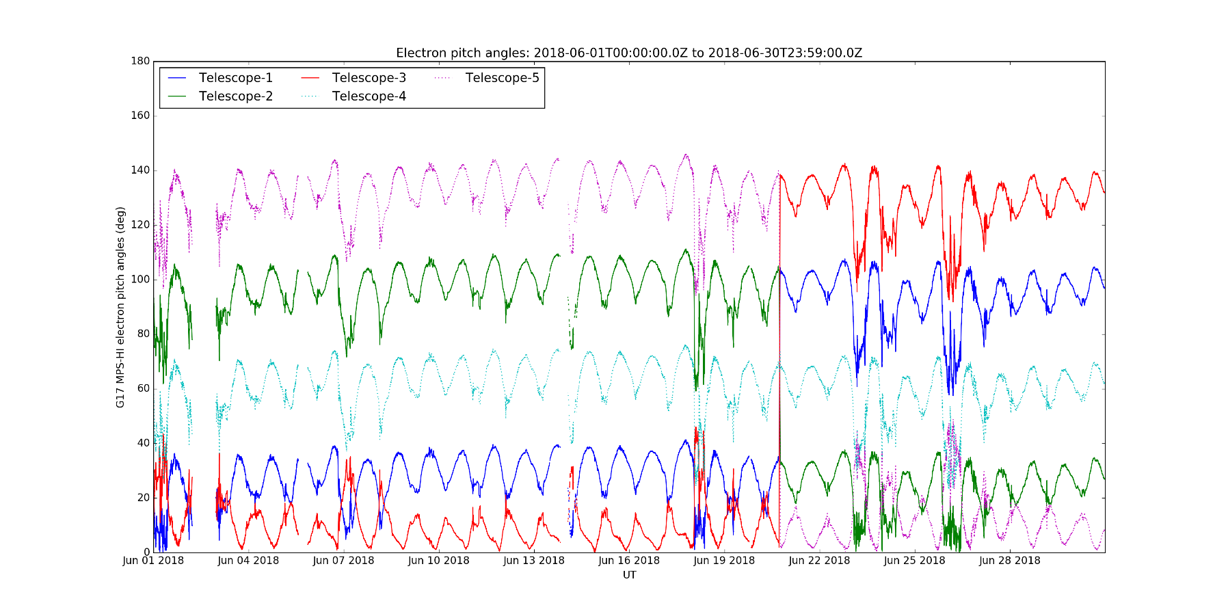
PLPT-SEI-002: MPS-HI Telescope Cross-Comparison: Method
These GOES-17 data are preliminary, non-operational data and are undergoing testing.
Users bear all responsibility for inspecting the data prior to use and for the manner in which the data are utilized.
yaw flip
Compares responses of MPS-HI telescopes when central pitch angle is the same
Under such conditions, telescopes should be measuring the same flux if effective energy is the same
Steps:
Input MPS-HI fluxes and pitch angles calculated from MAG L1b BRF
Identify whenever a pair of telescopes has pitch angles within 1 degree
Fold pitch angles > 90 degrees to get enough matches
Report measured fluxes for each pitch angle match
Estimate scaling factors optimally based on set of all matches (i.e. no reference telescope)
Ref: Rowland, W., and R. S. Weigel (2012), Intra-calibration of particle detectors on a three-axis stabilized geostationary platform, Space Weather, 10, S11002, doi:10.1029/2012SW000816.

Slide 18
PLPT-SEI-002: MPS-HI Telescope Cross-Comparison: Electrons
Scale factors for G17 MPS-HI Electron Telescopes
2018-May to 2018-July
 | Threshold | T1 | T2 | T3 | T4 “standard” | T5
E1 | 1000ct/min | 1.14 | 0.86 | 0.96 | 1.00 | 1.03
E2 | 1000ct/min | 1.13 | 0.90 | 0.98 | 1.00 | 1.12
E3 | 1000ct/min | 0.94 | 0.82 | 0.88 | 1.00 | 0.89
E4 | 100ct/min | 1.00 | 0.82 | 0.94 | 1.00 | 0.97
E5 | 100ct/min | 1.01 | 0.84 | 0.85 | 1.00 | 0.94
E6 | 100ct/min | 1.01 | 0.93 | 0.97 | 1.00 | 1.22
E7 | 100ct/min | 1.14 | 0.88 | 0.88 | 1.00 | 0.85
E8 | 100ct/min | 1.17 | 0.94 | 0.99 | 1.00 | 1.07
E9 | 100ct/min | 1.11 | 0.87 | 0.92 | 1.00 | 0.96
E10 | Too little signal | 1.09 | 0.98 | 0.97 | 1.00 | 1.02
E11 | 100ct/min | 1.12 | 0.94 | 0.94 | 1.00 | 0.98
Improvements over G16 analysis method:
3 months of data -> many more matches
Used complement for pitch angles >90⁰
Thresholding to eliminate low fluxes
Tested algorithm with proxy (“truth”) data to confirm performance
Residual Caveats
Variation in energies across telescopes not accounted for
Blue: <10%, Green: 10-20%, Red: >20%

Slide 19
PLPT-SEI-002: MPS-HI Telescope Cross-Comparison: Protons
Scale factors for G17 MPS-HI Proton Telescopes
2018-May to 2018-July
 | Threshold | T1 | T2 "Standard" | T3 | T4 | T5
P1 | 1000cts/min | 0.73 | 1.00 | 0.84 | 0.79 | 0.76
P2 | 1000cts/min | 1.14 | 1.00 | 1.59 | 1.06 | 0.98
P3 | 1000cts/min | 1.97 | 1.00 | 2.12 | 1.54 | 1.53
P4 | 1000cts/min | 1.97 | 1.00 | 1.94 | 1.32 | 1.15
P5 | 100cts/min | 2.26 | 1.00 | 2.56 | 1.42 | 1.37
P6 | 100cts/min | 0.91 | 1.00 | 2.09 | 1.54 | 1.68
P7 | 100cts/min marginal | 1.75 | 1.00 | 1.81 | 1.88 | 1.86
Improvements:
See prior slide.
Future/caveats:
Discrepancies appear to be symmetric about central telescope
Investigate whether species+energy differences (e.g. larger gyroradius for these protons) affect this analysis method as a calibration.
Blue: <10%, Green: 10-20%, Red: >20%
Technique not applied to solar proton channels P8-P11

Slide 20
PLPT-SEI-005: Cross-Satellite Comparison of Trapped Particles
Approach for differential fluxes:
Compare differential flux spectra from satellites separated by 1 hr in local time (G16: 75W, G17: 90W, G14: 105W)
For Kp < 2o (local time differences reduced)
Compare flux percentile spectra between telescopes of same orientation
0, ±35, ±70 deg from zenith (radially outward)
20 June – 24 Sept 2018 (GOES-17 upright)
MAGED (E, GdE) determined using same bowtie analysis / spectra as MPS-HI
Select comparisons briefed here; complete set in Backup Charts
>2 MeV integral electron fluxes analyzed separately
Telescope Order, North-to-South
MAGE/PD | MPS-HI E | MPS-HI P
7 | 3 | 1
8 | 1 | 4
1 | 4 | 2
6 | 2 | 5
9 | 5 | 3
Note: GOES-14 inverted during this period. GOES-16 and -17 are upright.

Slide 21
PLPT-SEI-005: Cross-Satellite Comparison of Trapped Particles
GOES-17 vs GOES-16 Protons
Telescope Order, North-to-South
MAGE/PD | MPS-HI E | MPS-HI P
7 | 3 | 1
8 | 1 | 4
1 | 4 | 2
6 | 2 | 5
9 | 5 | 3
The other G17 v G16 p+ comparisons are similar:
GOES-16 systematically low by 2-3x
P1 out-of-family, high
These GOES-17 data are preliminary, non-operational data and are undergoing testing. Users bear all responsibility for inspecting the data prior to use and for the manner in which the data are utilized.

Slide 22
PLPT-SEI-005: Cross-Satellite Comparison of Trapped Particles
GOES-17 vs GOES-14 Protons
Telescope Order, North-to-South
MAGE/PD | MPS-HI E | MPS-HI P
7 | 3 | 1
8 | 1 | 4
1 | 4 | 2
6 | 2 | 5
9 | 5 | 3
G17 v G14 p+ discrepancies show similar pattern:
G14 discrepancy greater in T1 & T8 (closer to 90 deg pitch angle)
All G14 spectra show kink between MP3 and MP4
These GOES-17 data are preliminary, non-operational data and are undergoing testing. Users bear all responsibility for inspecting the data prior to use and for the manner in which the data are utilized.

Slide 23
PLPT-SEI-005: Cross-Satellite Comparison of Trapped Particles
GOES-17 vs GOES-16 Electrons
Telescope Order, North-to-South
MAGE/PD | MPS-HI E | MPS-HI P
7 | 3 | 1
8 | 1 | 4
1 | 4 | 2
6 | 2 | 5
9 | 5 | 3
The other G17 v G16 e- comparisons agree similarly well except Etel4
These GOES-17 data are preliminary, non-operational data and are undergoing testing. Users bear all responsibility for inspecting the data prior to use and for the manner in which the data are utilized.

Slide 24
PLPT-SEI-005: Cross-Satellite Comparison of Trapped Particles
GOES-17 vs GOES-16 Electrons
Telescope Order, North-to-South
MAGE/PD | MPS-HI E | MPS-HI P
7 | 3 | 1
8 | 1 | 4
1 | 4 | 2
6 | 2 | 5
9 | 5 | 3
G16 e- Etel4 fluxes and spectral shape are out-of-family
These GOES-17 data are preliminary, non-operational data and are undergoing testing. Users bear all responsibility for inspecting the data prior to use and for the manner in which the data are utilized.

Slide 25
PLPT-SEI-005: Cross-Satellite Comparison of Trapped Particles
GOES-17 vs GOES-14 Electrons
Telescope Order, North-to-South
MAGE/PD | MPS-HI E | MPS-HI P
7 | 3 | 1
8 | 1 | 4
1 | 4 | 2
6 | 2 | 5
9 | 5 | 3
G14 e- spectra: low at lower energies, better agreement at higher energies
These GOES-17 data are preliminary, non-operational data and are undergoing testing. Users bear all responsibility for inspecting the data prior to use and for the manner in which the data are utilized.

Slide 26
PLPT-SEI-005: Improved method for comparing >2 MeV electron fluxes at different satellites
For G16 MPS-HI Provisional PS-PVR, regressed G16 to G13 >2 MeV flux by shifting one time series by one hour
For G17, have introduced a more rigorous method: ‘statistical asynchronous regression’ [O’Brien et al., JGR, 106, 2001]
Finds the time-invariant function that relates two time-varying but non-simultaneous quantities X, Y: Y = u(X)
Probability is conserved under a change of variables.
Uses cumulative distribution functions (CDFs): F(x), G(y)
To determine u(X) from data:
Map each x to y such that F(x) = G(y)
The resulting tabular relationship between mapped y and x defines u(X)
Plot complementary CDFs because electron flux distributions are biased toward low values: F>(x) = 1-F(x)

Slide 27
PLPT-SEI-005: GOES-16 and -17 T1 and T4 E11 (>2 MeV) fluxes agree well
G16 & G17 T1 & T4 E11 Complementary CDFs
Asynchronous regressions between G16 & G17 T1 & T4 E11

Slide 28
PLPT-SEI-005: GOES-17 and -14 >2 MeV fluxes agree over order-of-magnitude above alert level
G16 & G17 T4 and G14 >2 MeV Complementary CDFs
Asynchronous regression betw. G17 T4 & G14 >2 MeV fluxes

Slide 29
PLPT-SEI-005: asynchronous regression between GOES-16 and -13 >2 MeV fluxes (revisiting G16 PS-PVR)
G16 T1 & T4 and G13 >2 MeV Complementary CDFs
Asynchronous regression betw. G16 T4 & G13 >2 MeV fluxes

Slide 30
PLPT-SEI-005: Summary
Electrons:
Good agreement between G16 & G17 MPS-HI incl. >2 MeV channel
Exception: G16 Etel4 spectra are out-of-family – presented challenges in ground cal due to large differences in actual thresholds from modeled
Reasonable agreement between G17 MPS-HI and G14 MAGED
MAGED a little low at lower energies
Reasonable agreement between G17 T1 & T4 and G14 >2 MeV electrons currently used by SWPC for alerts
Expect differences between EPEAD and MPS-HI due to different FOVs
Difference between 2017 G16 vs. G13 comparisons and 2018 G17 vs. G14 comparisons is most likely due to the environment
Protons:
G16 MPS-HI and G14 MAGPD are a factor of 2-3 low compared to G17 MPS-HI
Path forward discussed in section on Path to Full Validation

Slide 31
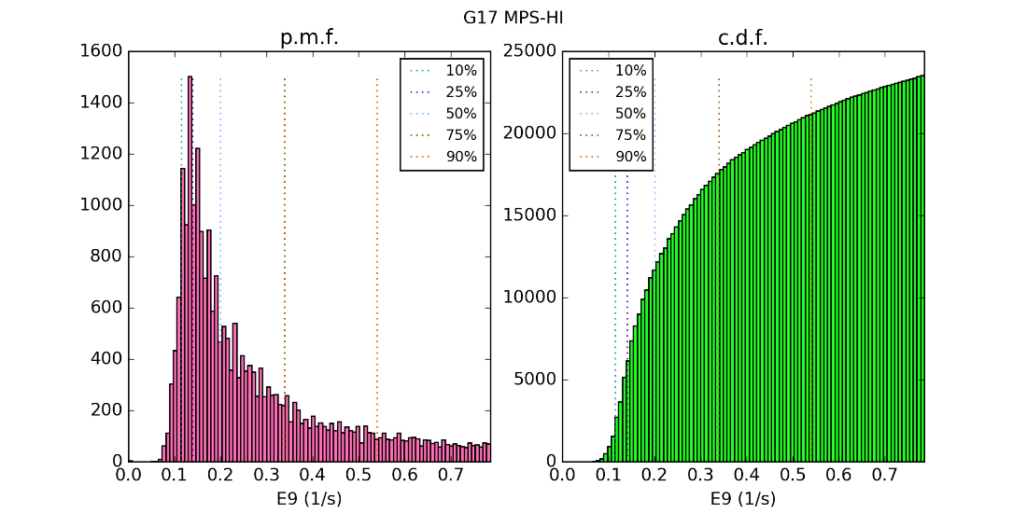
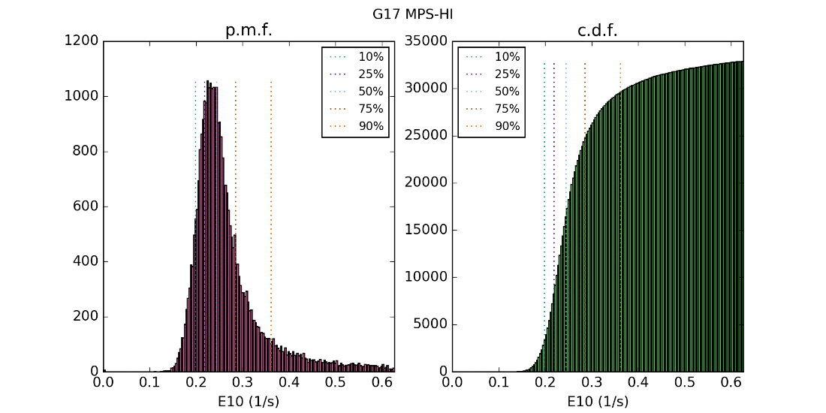
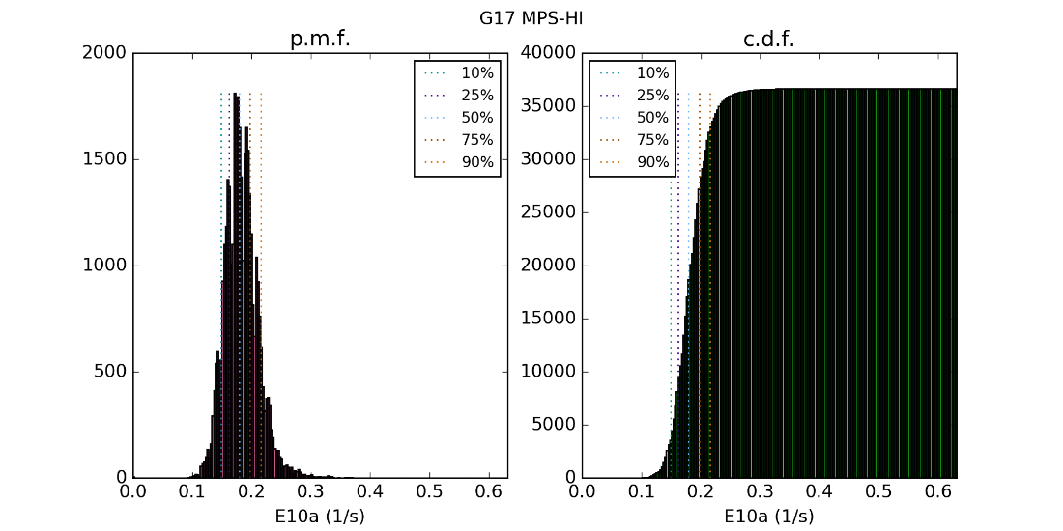
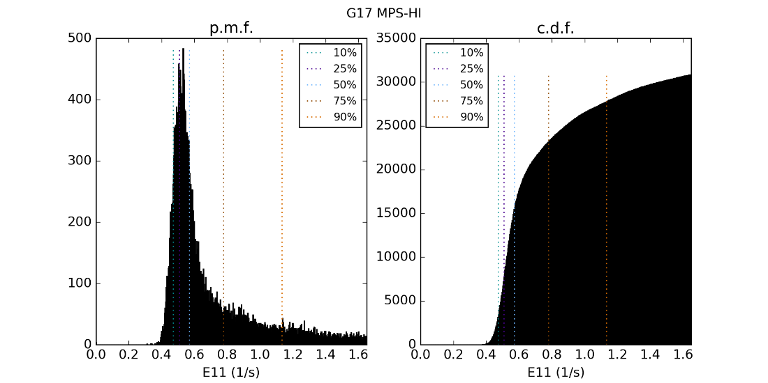
PLPT-SEI-006: Backgrounds
These GOES-17 data are preliminary, non-operational data and are undergoing testing. Users bear all responsibility for inspecting the data prior to use and for the manner in which the data are utilized.
Histograms of T4 E9-E11 counts, 5-min avgs., 24 Apr – 31 Aug 2018
Gaussians at low count end represent background due to galactic cosmic ray protons.

Slide 32
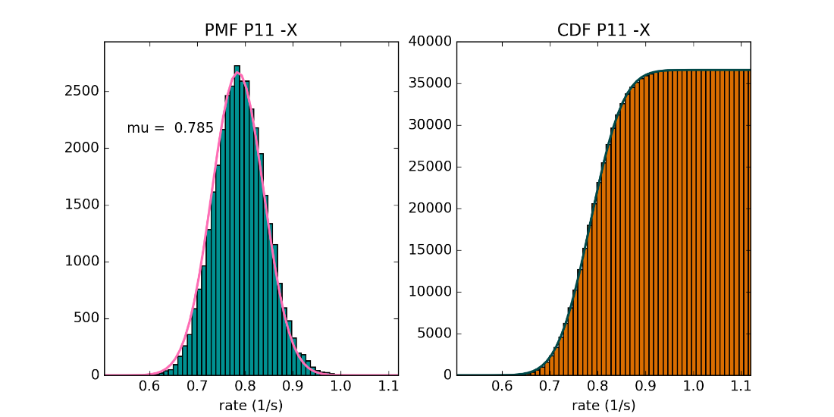
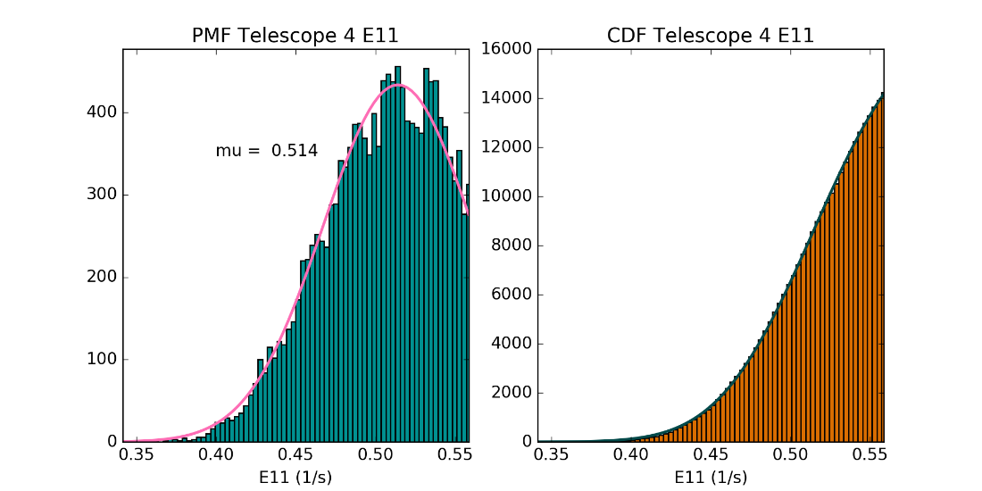
PLPT-SEI-006: Backgrounds
Fits to CDFs of P11 and E9-E11 determine mean rates.
$$f\left(x\right)=\frac{b}{σ\sqrt{2π}}\text{exp}\left[−\frac{{\left(x−μ\right)}^{2}}{2σ^{2}}\right]$$
$$F\left(x\right)=\frac{b}{2}\left[1+\text{erf}\left(\frac{x−μ}{σ\sqrt{2}}\right)\right]$$
These GOES-17 data are preliminary, non-operational data and are undergoing testing. Users bear all responsibility for inspecting the data prior to use and for the manner in which the data are utilized.

Slide 33
PLPT-SEI-006: Backgrounds
Gamma correction coefficient calculated for GOES-17 MPS-HI E9-E11 assuming P11 from SGPS –X is used and P11 G = 2.5 cm² sr. Table incorporated into revised MPS-HI LUT (ADR 762); will have to be recalculated if the geometrical factor for P11 changes.
(BNL calibration confirmed this GEANT-simulated value for P11 G.)
 | T1 | T2 | T3 | T4 | T5
E9 | 0.3641 | 0.3543 | 0.3724 | 0.4307 | 0.3776
E10 | 0.6369 | 0.6620 | 0.6693 | 0.7234 | 0.6686
E10a | 0.5829 | 0.5744 | 0.5707 | 0.5683 | 0.5084
E11 | 1.501 | 1.538 | 1.556 | 1.638 | 1.481
These GOES-17 data are preliminary, non-operational data and are undergoing testing. Users bear all responsibility for inspecting the data prior to use and for the manner in which the data are utilized.

Slide 34
Product quality assessment
GOES-17 MPS-HI L1b Products Provisional PS-PVR

Slide 35
G17: Top Level Evaluation
 | Status at Beta PS-PVR (10 Aug 2018) | Current Status | Future Outlook
Electron differential flux | Dropouts due to inversion matrix. Problem anticipated 4+ yrs ago Waiver (Feb 2015) led to NCEI being funded to develop new LUT with SWPC’s concurrence | Modified MPS-HI LUT installed and working properly in OE Comparison with G16 & G14 indicates reasonable agreement, with Etel4 needing further investigation (G16 reachback) | Intra-calibration results will be used to adjust cal coeffs in future LUT for Full validation
Backgrounds (E9-E11) | Backgrounds too high in E11 for SWPC to use this channel for >2 MeV alerts Existing contamination correction coefficients are too small | Modified MPS-HI LUT installed and working properly in OE Modified LUT provides adequate background correction | As GCRs peak during solar min (next few years), will determine whether modified correction continues to track E9-E11 backgrounds
Proton differential flux | No issues evident upon initial inspection of data | Comparison with G16 indicates that G16 may have degraded on-orbit due to radiation damage If so, expect G17 to degrade as well | Options include modifying geometrical factors in LUTs or determining different effective energies (metadata)
Solar proton channels (P9-P11) | Status not known due to lack of solar energetic particle (SEP) events | Status not known due to lack of solar energetic particle (SEP) events | Calibration of later FM MPS-HI and SGPS T1 at Brookhaven Van de Graaf authorized; results will reach back to earlier FMs via on-orbit cross-calibration

Slide 36
G16: Top Level Evaluation at Provisional (8 Dec 2017)
 | Status at Beta PS-PVR (10 Feb 2017) | Current Status | Future Outlook
Electron differential flux | Dropouts due to inversion matrix. Problem anticipated 3+ yrs ago Waiver (Feb 2015) led to NCEI being funded to develop new LUT with SWPC’s concurrence | Modified MPS-HI LUT installed and working properly in OE Comparison with G13 indicates reasonable agreement, with some areas of refinement needed | Cross-calibration results will be used to tweak cal coeffs in future LUT For FM2-FM4, NCEI will plan to prepare LUT earlier
Backgrounds (E9-E11) | Backgrounds too high in E11 for SWPC to use this channel for >2 MeV alerts Existing contamination correction coefficients are too small SGPS P11 fluxes used for correction are too low by 2x SGPS-X P9-P11 channels used in correction are too sensitive to temperature | Modified MPS-HI LUT installed and working properly in OE SGPS-X P11 temperature sensitivity has small effect on background removal Modified LUT provides adequate background correction P11 divide-by-two error (ADR427) fixed in DE but not in OE; OE introduction planned post-drift for PR.06.03 | Will verify OE after PR.06.03 installed As GCRs peak during solar min (next few years), will determine whether modified correction continues to track E9-E11 backgrounds SGPS-X P9-P10 temperature sensitivity will have to be fixed before they can be added to correction (LUT change); OR use P9-P11 from SGPS+X (code change)
Solar proton channels | Status not known due to lack of solar energetic particle (SEP) events | July and September SEP events reveal disagreement between SGPS and MPS-HI progressively increasing between 1 and 12 MeV No obvious reason for this discrepancy | Flight considering calibration of FM4 MPS-HI and SGPS together at Brookhaven Van de Graaf (MPS-HI protons not previously calibrated over 1-12 MeV)

Slide 37
Comparison of G16 and G17 MPS-HI at Provisional
Electrons:
G16 and G17 differential flux spectra agree well and with G14
>2 MeV integral electron fluxes agree well with each other; some differences with respect to G14
Protons:
G16 trapped protons are 2-3x low with respect to G17
G16 trapped protons are similar to G14 protons, which have degraded on-orbit probably due to radiation damage
Cannot compare G16 and G17 solar protons due to lack of SEP event since G17 launch
G16 solar protons disagreed with SGPS Telescope 1 protons

Slide 38
SWPC Overview
Terry Onsager (SWPC representative) will present SWPC’s overview at this point in the PS-PVR.

Slide 39
Provisional Maturity Assessment
GOES-17 MPS-HI L1b Products Provisional PS-PVR

Slide 40
Provisional Validation
Preparation Activities | Assessment
Validation activities are ongoing and the general research community is now encouraged to participate. | Validation activities are ongoing. Results have been discussed with SWPC. Release of data by NCEI will enable research community participation.
Severe algorithm anomalies are identified and under analysis. Solutions to anomalies are in development and testing. | Major anomalies fixed through LUT modification (ADR762). Correct performance of LUT verified in OE.
Incremental product improvements may still be occurring. | Incremental product improvements are expected, primarily through updated LUTs incorporating results of cross-cal.

Slide 41
Provisional Validation
End State | Assessment
Product performance has been demonstrated through analysis of a small number of independent measurements obtained from select locations, periods, and associated ground truth or field campaign efforts. | PLPTs performed on reprocessed MPS-HI fluxes from mid June – mid Sept 2018
Product analysis is sufficient to communicate product performance to users relative to expectations (Performance Baseline). | Yes, to the limited extent that the Performance Baseline can be checked on-orbit.
Documentation of product performance exists that includes recommended remediation strategies for all anomalies and weaknesses. Any algorithm changes associated with severe anomalies have been documented, implemented, tested, and shared with the user community. | Key issues affecting usability by SWPC have been fixed. Fixes have been discussed extensively with SWPC and agreed to by them.
Testing has been fully documented. | This presentation; memo on background correction.
Product is ready for operational use and for use in comprehensive cal/val activities and product optimization. | NCEI: yes.

Slide 42
Recommendation
NCEI believes that the GOES-17 MPS-HI L1b product has reached the Provisional Maturity as defined by the GOES-R Program

Slide 43
Path to full Validation Maturity
GOES-17 MPS-HI L1b Products Provisional PS-PVR

Slide 44
Path to Full Validation
ADRs/WRs to be resolved prior to Full Validation.
PLPTs to be conducted prior to Full Validation.
Performance Baseline status.
Risks to getting to Full, both from L1b product definition and user (SWPC) feedback

Slide 45
ADRs/WRs Impacting Full Validation of MPS-HI L1b
ADR# | WR# | Short Description | Status | Expected Closure
700 | 6115 | Yaw Flip Flag incorrect for SEISS MPS-HI products | In_Work | DO.07.01.00
780 | 6568 | G16 & G17 MPS-HI and MPS-LO IFC Leakage | ARB_Review | Not assigned
781 | 6477 | G17 & G17 MPS-HI and SGPS L1b data gaps near IFCs | In_Analysis | DO.09.00.00
863 | 6736 | Graceful degradation if SGPS data are not being generated | In_Analysis | TBD
845 | TBD | Update PUG with SEISS MPS-HI and MPS-LO Angular Zone Info | In_Analysis | TBD
872 | TBD | Solar array current not correct in G17 products | Submitted | TBD

Slide 46
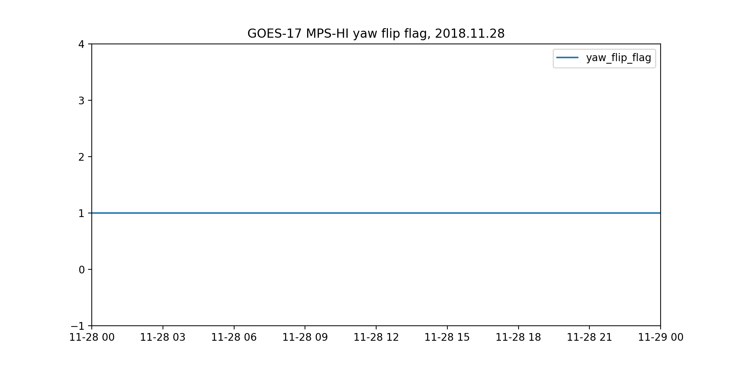
ADR 700: yaw_flip_flag incorrect for SEISS MPS-HI
GOES-17 has been inverted since 2018.09.24
yaw_flip_flag should be 2
On 2018.09.24, yaw_flip_flag changed from 0 to 1
In the same file, yaw_flip_flag attributes are correct:
valid_range = [0 2]
flag_values = [0 1 2]
flag_meanings = upright, neither, inverted

Slide 47
ADR780: G16 & G17 MPS-HI and MPS-LO L1b IFC leakage
MPS-HI problem description: IFC pulses are leaking into L1b proton fluxes
G17 channel P1 before June 11, and G16 P1 currently
On June 11, 2018, revised G17 (FM2) MPS-HI IFC table uploaded as part of PLT SEI-003 – moved problem from channel P1 to channels P6 & P7
Strongly evident in 1-minute averages
Occurs at end of periods when MODE flag set to 4
MODE = 4 used to mask IFCs, set L1b Instrument_Mode flag
IFC pulses last 1-2 seconds beyond MODE = 4
Not observed in other proton channels or in electron channels
Violates accuracy requirement
MPS-LO problem description: IFC pulses are leaking into L1b fluxes in over half the channels (electron and ion)
Occurs at end of periods when MODE flag set to 4
MODE = 4 used to mask IFCs, set L1b Instrument_Mode flag
Violates accuracy requirement

Slide 48
These GOES-17 data are preliminary, non-operational data and are undergoing testing. Users bear all responsibility for inspecting the data prior to use and for the manner in which the data are utilized.
25 June 2018, 1805-1825 UT, 1-second data: MODE = 4 pulse ends 2 seconds early, causing part of the second IFC pulse to be included in the L1b fluxes (indicated by solid arrows).
Gaps after IFC are addressed by ADR 781
Top to Bottom: the Mode flag, then alternating L0 counts and L1b fluxes in this channel from Telescopes 1 through 5

Slide 49
ADR 780: Information on IFC Tables and Recommended Path Forward
MPS-LO, MPS-HI and SGPS IFC mode status changes are out of sync with IFC pulser status:
Sensors report that they are in IFC mode 1-second before the IFC starts
Sensors report that they are back in Normal mode 1-second before IFC is completed
Evaluation by instrument:
MPS-HI: FM1 and FM2 IFC tables have different time durations but the same number of instructions (50)
All 50 instructions are required to optimally test MPS-HI
SGPS: all tables are ~10 seconds shorter than their allowed space, so there are no instructions (pulses) during the last second of the table
MPS-LO: IFC tables cannot be changed
Recommended path forward:
ATC recommends that, in the GPA software, the IFC mask should be extended for 2 seconds beyond the MODE = 4 (IFC mode) status.
This will prevent IFC leakage without compromising the functionality of the IFC tables.
Thanks to Elizabeth Dawson (ATC) for her contributions to this information, including tech memo dated 07 November 2018

Slide 50
ADR 781: MPS-HI and SGPS L1b data gaps near IFCs
Regular ~5-min gaps in MPS-HI and SGPS L1b near in-flight calibrations (IFCs)
These gaps are in addition to the L1b data gaps during IFCs, which are required and are based on instrument mode flag = 4
Gaps are simultaneous in MPS-HI and SGPS data
All channels and telescopes affected on both satellites
L0 data are available and valid during these gaps
No data (e.g., no fluxes, no quality flags) in affected granular L1b files except labels and global attributes
Diagnosis: when either SGPS is in IFC mode, downstream products (MPS-HI and the other SGPS) are not processed
Owing to use of SGPS channels for contamination correction of a small fraction of the total SGPS & MPS-HI channels
A preferable approach is graceful degradation of downstream data products:
The channels that require contamination correction will be somewhat degraded in the absence of the SGPS data undergoing IFC, but still usable
The channels that do not require contamination correction will not be degraded

Slide 51
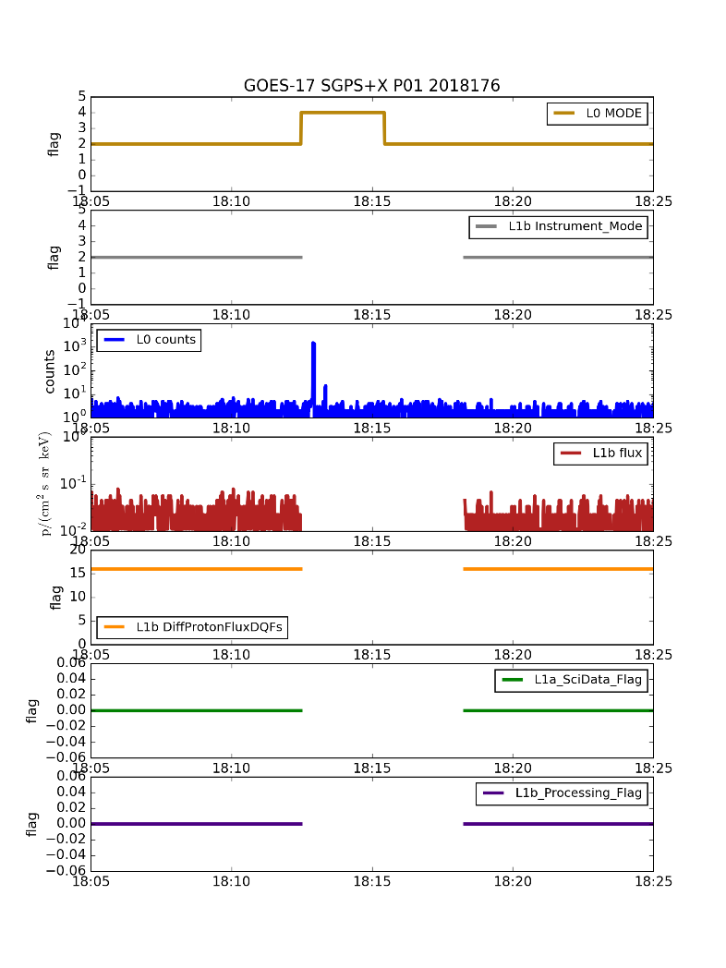
ADR 781: G17 MPS-HI Protons (T2 P7) and SGPS+X (P1) (example, 25 June 2018)
These GOES-17 data are preliminary, non-operational data and are undergoing testing. Users bear all responsibility for inspecting the data prior to use and for the manner in which the data are utilized.

Slide 52
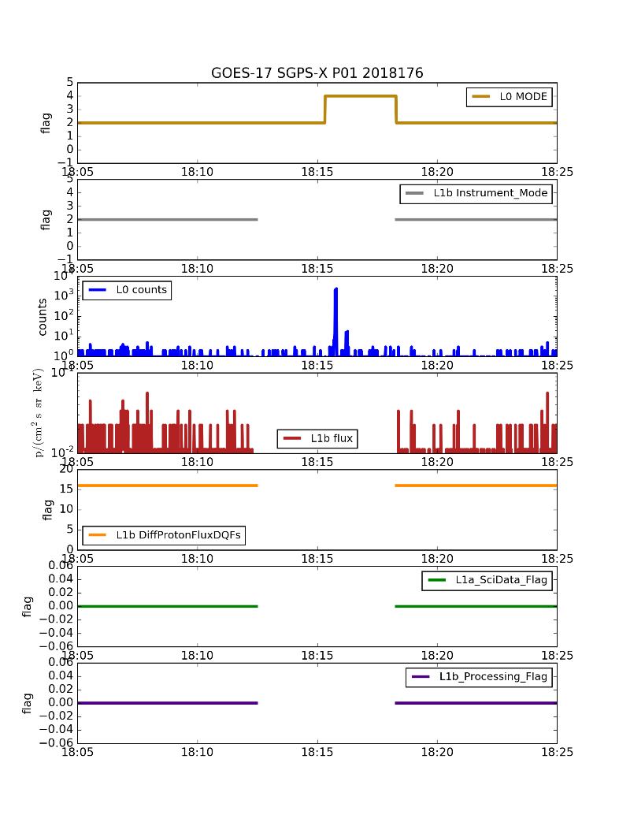
ADR 781: G17 MPS-HI Electrons (T2 E7) and SGPS-X (P1) (example, 25 June 2018)
These GOES-17 data are preliminary, non-operational data and are undergoing testing. Users bear all responsibility for inspecting the data prior to use and for the manner in which the data are utilized.

Slide 53
ADR 863: Graceful degradation if SGPS data are not being generated
Four electron channels from MPS-HI use SGPS-X data for a contamination correction. The SGPS P5 channel uses data from the opposite SGPS for a contamination correction. If for some reason (like a sensor failure) no data are being generated from one of the SGPS units, then the dependent products should still be produced with only graceful degradation. This is needed for Full validation of MPS-HI and SGPS. This is a generalization of ADR 781.
Case 1: SGPS-X data are not being generated
MPS-HI fluxes should be calculated as if SGPS-X fluxes were zero rather than missing -- graceful degradation of 4 electron channels.
SGPS L1b should still be produced with SGPS-X being all fill and SGPS+X containing valid fluxes (SGPS+X P5 being calculated as if SGPS-X fluxes were zero rather than missing -- graceful degradation of P5).
Case 2: SGPS+X data are not being generated.
MPS-HI fluxes should be produced, no dependence on SGPS+X, no degradation.
SGPS L1b should still be produced with SGPS+X being all fill and SGPS-X containing valid fluxes (SGPS-X P5 being calculated as if SGPS+X fluxes were zero rather than missing -- graceful degradation of P5).
Case 3: neither SGPS+X nor SGPS-X data being generated
MPS-HI fluxes should be calculated as if SGPS-X fluxes were zero rather than missing -- graceful degradation of 4 electron channels.

Slide 54
ADR 872: Solar array current not correct in G17 products
These GOES-17 data are preliminary, non-operational data and are undergoing testing. Users bear all responsibility for inspecting the data prior to use and for the manner in which the data are utilized.
GOES-16 MPS-HI 2018-10-01 0300-0700
GOES-17 MPS-HI 2018-10-01 0300-0700
Solar Array Current Eclipse Flag

Slide 55
Path to Full Validation - PLPT
Title | Activity | Data Needed | Success Criteria
A.3.1 MPS-Hi Telescope Cross-Comparison [PLPT-SEI-002] | Determine the relative sensitivity/response among MPS-HI telescopes. Account for differences in channel energy responses. | Three months of continuous data. (MAG and MPS-HI) | [Full] Telescopes agree to within 25%.
A.3.3 SEP Channel Cross-Comparison [PLPT-SEI-004] | On-orbit cross-calibration of MPS-HI with SGPS 1-12 MeV protons, and with GOES 13-15 EPEAD. | Two Solar Energetic Particle (SEP) events. | [Full] Differences quantified on data taken through validation phase.
A.3.4 Cross Satellite Comparison of Trapped Particles [PLPT-SEI-005] | Identify time periods when the two satellites should be measuring the same population, and compare results. Comparisons can be based on the satellites being within 15 degrees longitude (especially while G17 and G15 are separated by <10 deg at 126-135W), or using a very long time period. | Three months of continuous data. (MAG, MPS-HI) | [Full] Differences quantified on data taken through validation phase.
A.3.4 Backgrounds Trending [PLPT-SEI-006] | Model GCR spectra (e.g., NASA JSC Badhwar-O’Neill 2014) put through a forward model derived from MPS-HI instrument response functions to estimate MPS-HI channel fluxes for comparison with observations. Watch for deviation between P11-based correction and actual backgrounds. | Four months of continuous data. (MPS-HI, SGPS) | [Full] Perform analysis during validation phase.
MPS-HI Full Validation PLPTs from RIMP v 1.0 (02 June 2016) are a continuation of those completed for Provisional. Green annotations based on experience with MPS-HI.

Slide 56
Performance Baseline Status
Assessment at Provisional
MRD ID | Description | Related PLPTs | Status
1996 | MPS-HI Orthogonality/Coverage | -02, -04 | PLPTs underway
2000 | MPS-HI Measurement Range | -02, -04 | PLPTs underway
2001 | MPS-HI Measurement Accuracy | -02, -04, -05, -06 | PLPTs underway
MRD1996: Data in 5 directions
Currently being met for electrons and protons
MRD2000: Measurement Range
Requirements: Electrons 50 keV to 4 MeV plus >2 MeV; Protons 80 keV to 10 MeV
Currently, all channels are functional and exhibit characteristic variation in behavior w/ energy
Ground cal & cross-cal with G16 indicate that energy measurement range is covered
P8-P11 require SEP event for assessment
MRD2001: Measurement Accuracy
Requirements: @min flux <45%, @10X min flux < 25%
Absolute accuracy cannot be verified on-orbit
Provisional results of PLPT-05 indicate that G16 proton fluxes are systematically low by 2-3x relative to GOES-17
Provisional results of PLPT-02 indicate proton inter-telescope differences much greater than 25% -- technique may need to be refined (energy differences, finite gyroradius effect)

Slide 57
Possibility of MPS-HI Proton Radiation Damage
Damage in G14 MAGPD telescopes is likely
Data from all three MAGPDs (G13-15) show evidence of degradation on orbit while the MAGEDs appear not to be degraded
Similar POES MEPED proton telescopes have exhibited degradation after ~2 years on-orbit [Galand & Evans 2000; Sandanger+ 2015]
Attributed to radiation damage of surface-barrier detectors by <135 keV protons since MEPED electron detectors are shielded from them by 0.76 um Ni foil (similar to MAGED & MPS-HI Etels)
Creates dead layer in which p+ lose energy that does not contribute to pulse
Possibility of same mechanism causing problem in MPS-HI needs to be investigated for Full Validation
Different silicon detector technology used (ion-implanted)
Ion-implanted detectors have 0.1 um dead layer
Under 0.3 um Al for solar blindness on ohmic (exposed) side of 1st detector (30 um)
Calibration analysis will also be reviewed

Slide 58
Simulation of 130 keV Proton Penetration into MPS-HI Telescopes (SRIM-2012 Monte Carlo)
130 keV protons into MPS-HI Electron Telescope (with 0.75 um Ni foil)
135 keV protons into MPS-HI Proton Telescope (with 0.3 um Al coating)

Slide 59
Path to Full Validation – Risks
Risk Name | Description | Impact | Mitigation and Schedule
MPS-HI solar proton channel disagreement | IF MPS-HI P8-P11 and SGPS P1-P5 are not both calibrated at BNL VdG | THEN root cause of large disagreement will not be understood | Program has authorized ATC to add MPS-HI calibration to planned effort at BNL VdG (by Dec 2019) Wait for next SEP event to cross-cal G16 & G17
MPS-HI proton channel degradation | IF difference between G17 and G16 MPS-HI protons is due to on-orbit radiation damage | THEN all MPS-HI proton fluxes will be degraded starting 1-2 years after launch | By Full Validation, determine whether this is the root cause of discrepancy Update LUTs or develop new metadata on effective energies

Slide 60
Summary & Recommendations
GOES-17 ABI L1b Products Provisional PS-PVR

Slide 61
Summary
ADR 762: modified LUT installed & working in OE
Geometric factors from bowtie analysis
Increased background correction coefficients
Planned Provisional PLPTs completed
Except PLPT-SEI-004 Solar Energetic Particle (SEP) Cross-Comparison, which has not been possible due to lack of SEP events since G17 launch
All are provisional versions of PLPTs required for Full Maturity
Risks to reaching Full Maturity have been identified

Slide 62
Recommendation
NCEI believes that the GOES-17 MPS-HI L1b product has reached the Provisional Maturity as defined by the GOES-R Program

Slide 63
Backup slides
GOES-17 ABI L1b Products Provisional PS-PVR

Slide 64
PLPT-SEI-005 Spectral Comparisons

Slide 65
PLPT-SEI-005: Cross-Satellite Comparison of Trapped Particles
GOES-17 vs GOES-16 Protons
Telescope Order, North-to-South
MAGE/PD | MPS-HI E | MPS-HI P
7 | 3 | 1
8 | 1 | 4
1 | 4 | 2
6 | 2 | 5
9 | 5 | 3
These GOES-17 data are preliminary, non-operational data and are undergoing testing. Users bear all responsibility for inspecting the data prior to use and for the manner in which the data are utilized.

Slide 66
PLPT-SEI-005: Cross-Satellite Comparison of Trapped Particles
GOES-17 vs GOES-16 Protons
Telescope Order, North-to-South
MAGE/PD | MPS-HI E | MPS-HI P
7 | 3 | 1
8 | 1 | 4
1 | 4 | 2
6 | 2 | 5
9 | 5 | 3
These GOES-17 data are preliminary, non-operational data and are undergoing testing. Users bear all responsibility for inspecting the data prior to use and for the manner in which the data are utilized.

Slide 67
PLPT-SEI-005: Cross-Satellite Comparison of Trapped Particles
GOES-17 vs GOES-16 Protons
Telescope Order, North-to-South
MAGE/PD | MPS-HI E | MPS-HI P
7 | 3 | 1
8 | 1 | 4
1 | 4 | 2
6 | 2 | 5
9 | 5 | 3
These GOES-17 data are preliminary, non-operational data and are undergoing testing. Users bear all responsibility for inspecting the data prior to use and for the manner in which the data are utilized.

Slide 68
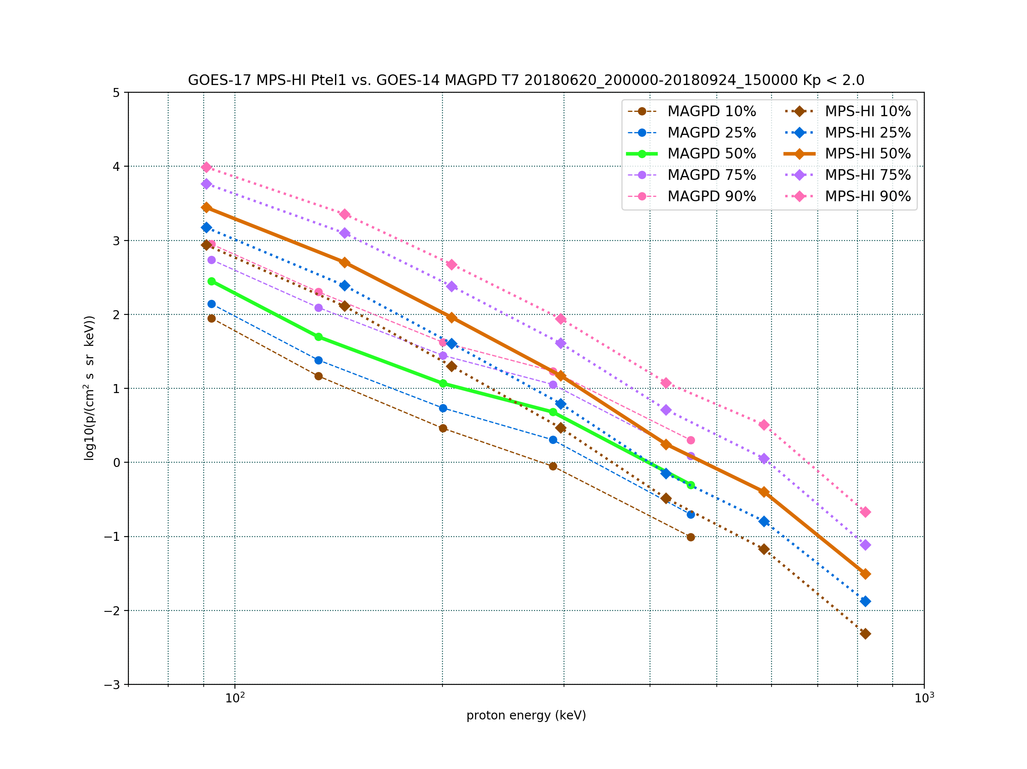
PLPT-SEI-005: Cross-Satellite Comparison of Trapped Particles
GOES-17 vs GOES-16 Protons
Telescope Order, North-to-South
MAGE/PD | MPS-HI E | MPS-HI P
7 | 3 | 1
8 | 1 | 4
1 | 4 | 2
6 | 2 | 5
9 | 5 | 3
These GOES-17 data are preliminary, non-operational data and are undergoing testing. Users bear all responsibility for inspecting the data prior to use and for the manner in which the data are utilized.

Slide 69
PLPT-SEI-005: Cross-Satellite Comparison of Trapped Particles
GOES-17 vs GOES-16 Protons
Telescope Order, North-to-South
MAGE/PD | MPS-HI E | MPS-HI P
7 | 3 | 1
8 | 1 | 4
1 | 4 | 2
6 | 2 | 5
9 | 5 | 3
These GOES-17 data are preliminary, non-operational data and are undergoing testing. Users bear all responsibility for inspecting the data prior to use and for the manner in which the data are utilized.

Slide 70
PLPT-SEI-005: Cross-Satellite Comparison of Trapped Particles
GOES-17 vs GOES-14 Protons
Telescope Order, North-to-South
MAGE/PD | MPS-HI E | MPS-HI P
7 | 3 | 1
8 | 1 | 4
1 | 4 | 2
6 | 2 | 5
9 | 5 | 3
These GOES-17 data are preliminary, non-operational data and are undergoing testing. Users bear all responsibility for inspecting the data prior to use and for the manner in which the data are utilized.

Slide 71
PLPT-SEI-005: Cross-Satellite Comparison of Trapped Particles
GOES-17 vs GOES-14 Protons
Telescope Order, North-to-South
MAGE/PD | MPS-HI E | MPS-HI P
7 | 3 | 1
8 | 1 | 4
1 | 4 | 2
6 | 2 | 5
9 | 5 | 3
These GOES-17 data are preliminary, non-operational data and are undergoing testing. Users bear all responsibility for inspecting the data prior to use and for the manner in which the data are utilized.

Slide 72
PLPT-SEI-005: Cross-Satellite Comparison of Trapped Particles
GOES-17 vs GOES-14 Protons
Telescope Order, North-to-South
MAGE/PD | MPS-HI E | MPS-HI P
7 | 3 | 1
8 | 1 | 4
1 | 4 | 2
6 | 2 | 5
9 | 5 | 3
These GOES-17 data are preliminary, non-operational data and are undergoing testing. Users bear all responsibility for inspecting the data prior to use and for the manner in which the data are utilized.

Slide 73
PLPT-SEI-005: Cross-Satellite Comparison of Trapped Particles
GOES-17 vs GOES-14 Protons
Telescope Order, North-to-South
MAGE/PD | MPS-HI E | MPS-HI P
7 | 3 | 1
8 | 1 | 4
1 | 4 | 2
6 | 2 | 5
9 | 5 | 3
These GOES-17 data are preliminary, non-operational data and are undergoing testing. Users bear all responsibility for inspecting the data prior to use and for the manner in which the data are utilized.

Slide 74
PLPT-SEI-005: Cross-Satellite Comparison of Trapped Particles
GOES-17 vs GOES-14 Protons
Telescope Order, North-to-South
MAGE/PD | MPS-HI E | MPS-HI P
7 | 3 | 1
8 | 1 | 4
1 | 4 | 2
6 | 2 | 5
9 | 5 | 3
These GOES-17 data are preliminary, non-operational data and are undergoing testing. Users bear all responsibility for inspecting the data prior to use and for the manner in which the data are utilized.

Slide 75
PLPT-SEI-005: Cross-Satellite Comparison of Trapped Particles
GOES-17 vs GOES-16 Electrons
Telescope Order, North-to-South
MAGE/PD | MPS-HI E | MPS-HI P
7 | 3 | 1
8 | 1 | 4
1 | 4 | 2
6 | 2 | 5
9 | 5 | 3
These GOES-17 data are preliminary, non-operational data and are undergoing testing. Users bear all responsibility for inspecting the data prior to use and for the manner in which the data are utilized.

Slide 76
PLPT-SEI-005: Cross-Satellite Comparison of Trapped Particles
GOES-17 vs GOES-16 Electrons
Telescope Order, North-to-South
MAGE/PD | MPS-HI E | MPS-HI P
7 | 3 | 1
8 | 1 | 4
1 | 4 | 2
6 | 2 | 5
9 | 5 | 3
These GOES-17 data are preliminary, non-operational data and are undergoing testing. Users bear all responsibility for inspecting the data prior to use and for the manner in which the data are utilized.

Slide 77
PLPT-SEI-005: Cross-Satellite Comparison of Trapped Particles
GOES-17 vs GOES-16 Electrons
Telescope Order, North-to-South
MAGE/PD | MPS-HI E | MPS-HI P
7 | 3 | 1
8 | 1 | 4
1 | 4 | 2
6 | 2 | 5
9 | 5 | 3
These GOES-17 data are preliminary, non-operational data and are undergoing testing. Users bear all responsibility for inspecting the data prior to use and for the manner in which the data are utilized.

Slide 78
PLPT-SEI-005: Cross-Satellite Comparison of Trapped Particles
GOES-17 vs GOES-16 Electrons
Telescope Order, North-to-South
MAGE/PD | MPS-HI E | MPS-HI P
7 | 3 | 1
8 | 1 | 4
1 | 4 | 2
6 | 2 | 5
9 | 5 | 3
These GOES-17 data are preliminary, non-operational data and are undergoing testing. Users bear all responsibility for inspecting the data prior to use and for the manner in which the data are utilized.

Slide 79
PLPT-SEI-005: Cross-Satellite Comparison of Trapped Particles
GOES-17 vs GOES-16 Electrons
Telescope Order, North-to-South
MAGE/PD | MPS-HI E | MPS-HI P
7 | 3 | 1
8 | 1 | 4
1 | 4 | 2
6 | 2 | 5
9 | 5 | 3
These GOES-17 data are preliminary, non-operational data and are undergoing testing. Users bear all responsibility for inspecting the data prior to use and for the manner in which the data are utilized.

Slide 80
PLPT-SEI-005: Cross-Satellite Comparison of Trapped Particles
GOES-17 vs GOES-14 Electrons
Telescope Order, North-to-South
MAGE/PD | MPS-HI E | MPS-HI P
7 | 3 | 1
8 | 1 | 4
1 | 4 | 2
6 | 2 | 5
9 | 5 | 3
These GOES-17 data are preliminary, non-operational data and are undergoing testing. Users bear all responsibility for inspecting the data prior to use and for the manner in which the data are utilized.

Slide 81
PLPT-SEI-005: Cross-Satellite Comparison of Trapped Particles
GOES-17 vs GOES-14 Electrons
Telescope Order, North-to-South
MAGE/PD | MPS-HI E | MPS-HI P
7 | 3 | 1
8 | 1 | 4
1 | 4 | 2
6 | 2 | 5
9 | 5 | 3
These GOES-17 data are preliminary, non-operational data and are undergoing testing. Users bear all responsibility for inspecting the data prior to use and for the manner in which the data are utilized.

Slide 82
PLPT-SEI-005: Cross-Satellite Comparison of Trapped Particles
GOES-17 vs GOES-14 Electrons
Telescope Order, North-to-South
MAGE/PD | MPS-HI E | MPS-HI P
7 | 3 | 1
8 | 1 | 4
1 | 4 | 2
6 | 2 | 5
9 | 5 | 3
These GOES-17 data are preliminary, non-operational data and are undergoing testing. Users bear all responsibility for inspecting the data prior to use and for the manner in which the data are utilized.

Slide 83
PLPT-SEI-005: Cross-Satellite Comparison of Trapped Particles
GOES-17 vs GOES-14 Electrons
Telescope Order, North-to-South
MAGE/PD | MPS-HI E | MPS-HI P
7 | 3 | 1
8 | 1 | 4
1 | 4 | 2
6 | 2 | 5
9 | 5 | 3
These GOES-17 data are preliminary, non-operational data and are undergoing testing. Users bear all responsibility for inspecting the data prior to use and for the manner in which the data are utilized.

Slide 84
PLPT-SEI-005: Cross-Satellite Comparison of Trapped Particles
GOES-17 vs GOES-14 Electrons
Telescope Order, North-to-South
MAGE/PD | MPS-HI E | MPS-HI P
7 | 3 | 1
8 | 1 | 4
1 | 4 | 2
6 | 2 | 5
9 | 5 | 3
These GOES-17 data are preliminary, non-operational data and are undergoing testing. Users bear all responsibility for inspecting the data prior to use and for the manner in which the data are utilized.

Slide 85
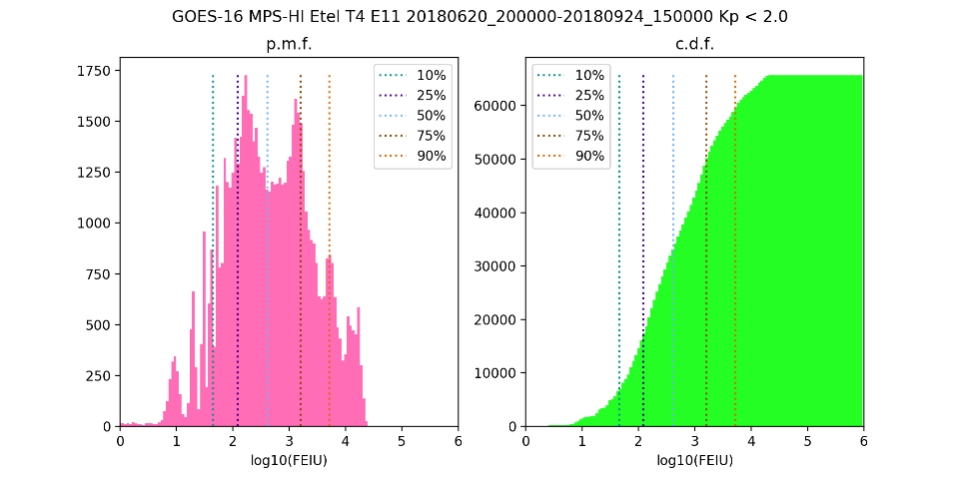
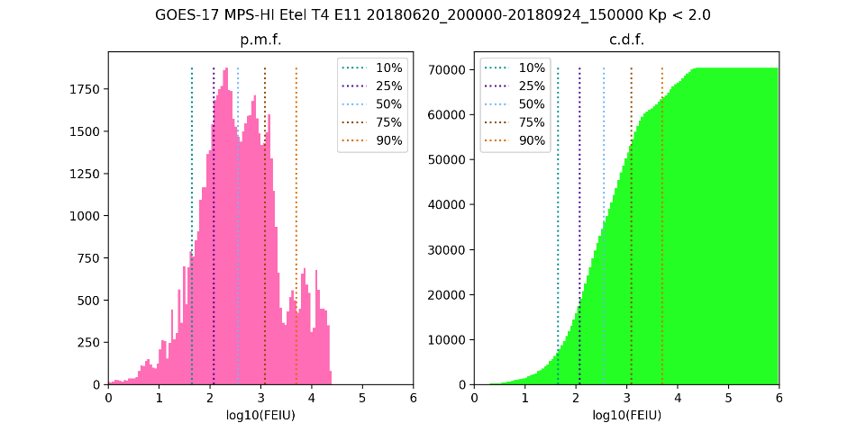
PLPT-SEI-005: Distributions of GOES-17 & -16 >2 MeV Electrons, 20 June – 24 Sept 2018
G16 T1 E11 | G16 T4 E11 | G17 T1 E11 | G17 T4 E11 | Medians
337. | 415. | 295. | 358. | e/(cm² s sr)
GOES-16 MPS-HI >2 MeV (E11), T1 and T4
GOES-17 MPS-HI >2 MeV (E11), T1 and T4

