Slide 1
Peer Stakeholder-Product Validation Review (PS-PVR) Full Maturity GOES-17 SEISS SGPS L1b Product PS-PVR
January 19, 2021
GOES-R Calibration Working Group (CWG)
Presenter: Brian Kress
Contributors: Athanasios Boudouridis, Juan Rodriguez
NOAA-NCEI / CIRES
This review incorporates results from Assurance Technology Corporation PLTs.

Slide 2
Outline
SGPS Overview
Review of Provisional Maturity Assessment
Product Quality Evaluation
PLPTs Supporting Assessment for Full Status
Full Maturity Assessment
Summary and Recommendations

Slide 3
SGPS OVERVIEW
GOES-17 SGPS L1b Full Validation PS-PVR

Slide 4
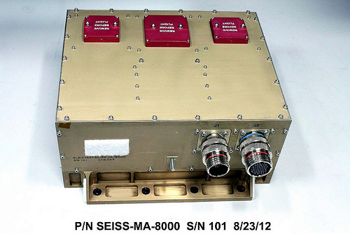
Space Environment In-Situ Suite (SEISS) Solar and Galactic Proton Sensor (SGPS)
2 Units, one looking East and one West
3 solid state telescopes on each unit
1-500 MeV protons in 13 differential channels, plus >500 MeV integral channel
4-500 MeV alphas in 12 energy bands
(now processed in L1b!)
GOES-17 SEISS sensors turned on 24 April 2018
SEISS SGPS designed, built, tested and calibrated by Assurance Technology Corporation (ATC)

Slide 5
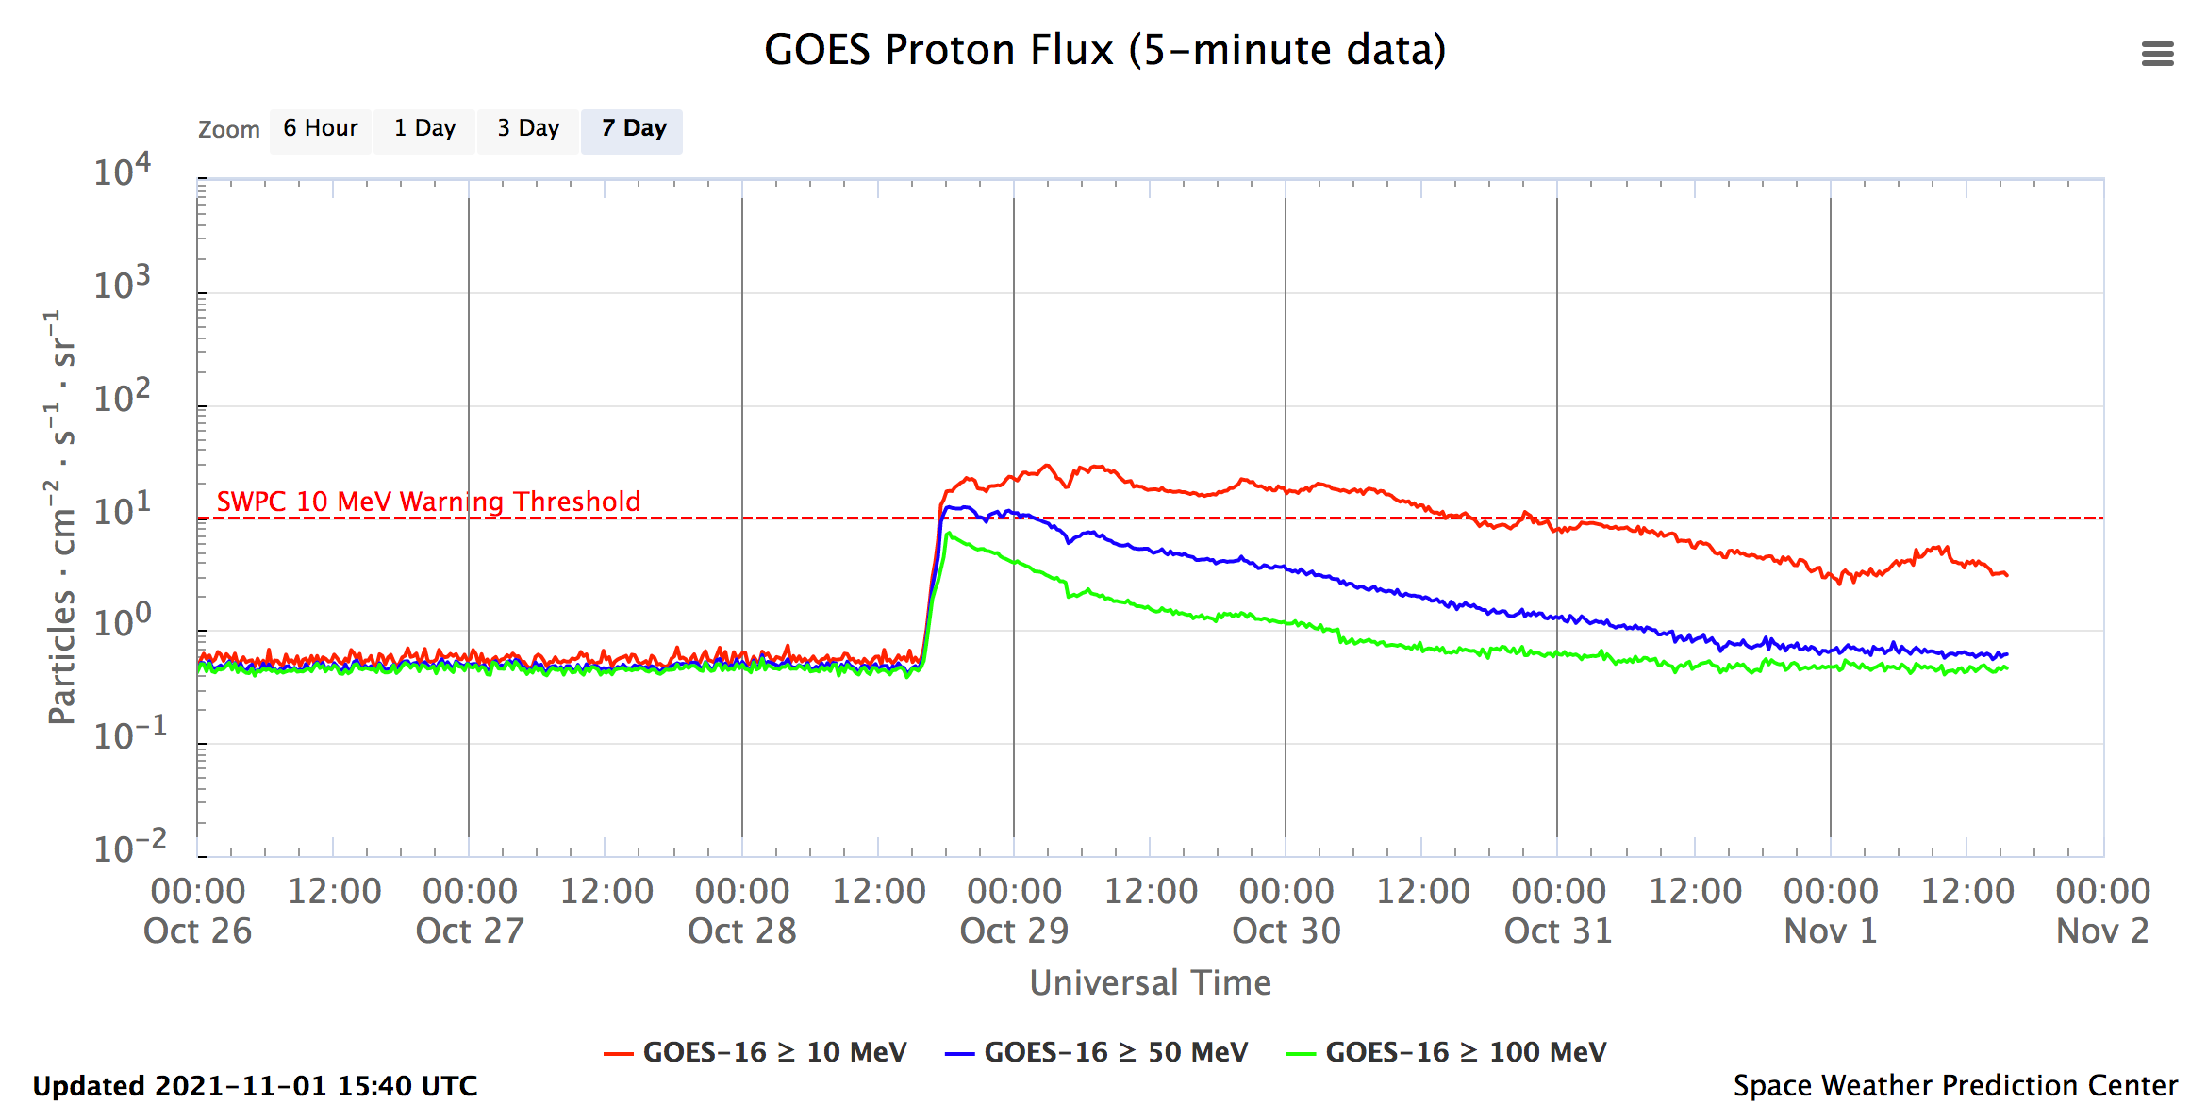
SGPS Operational Use: SWPC Solar Proton Event Alerts
NOAA SWPC solar proton flux: https://www.swpc.noaa.gov/products/goes-proton-flux
The EPS/EPEAD (Energetic Proton, Electron, and Alpha Detector) flown on GOES 1-15 (1975–present) monitored radiation hazard to spacecraft systems and humans in space from 10 to 100s of MeV protons produced during solar proton events (SPEs).
With the launch of NOAA's new GOES-R series, EPS/EPEAD has been replaced with SGPS.
Energy integrated fluxes shown above are computed from 13 ~1-500 MeV differential channel and >500 MeV integral channel fluxes from G16 SGPS-X (west viewing unit).

Slide 6
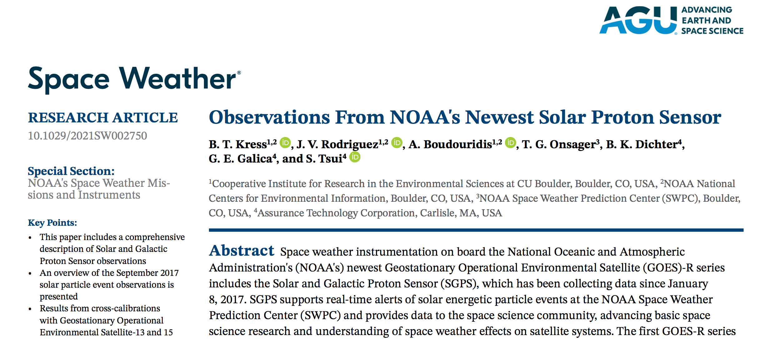
SGPS Paper in Space Weather
Contains culmination of work on PLPT-SEI-004, SEP Channel Cross-Comparison.
Paper link: https://doi.org/10.1029/2021SW002750
Highlighted in EOS: https://eos.org/editor-highlights/next-generation-solar-proton-monitors-for-space-weather
All data featured in paper and cross-calibration plots (supplemental materials) are available under the special events tab on NCEI’s GOES-R website: https://www.ngdc.noaa.gov/stp/satellite/goes-r.html
Includes Sept. 2017 cross-calibrations between GOES-16 SGPS and GOES-13 and -15 EPS/EPEAD
Comparisons with legacy GOES energetic particle measurements are critical for establishing consistent long-term data sets, understanding changes in long-term trends in SPE fluxes, and accounting for changes in space weather model results where legacy GOES energetic particle measurements have been used as model inputs.

Slide 7
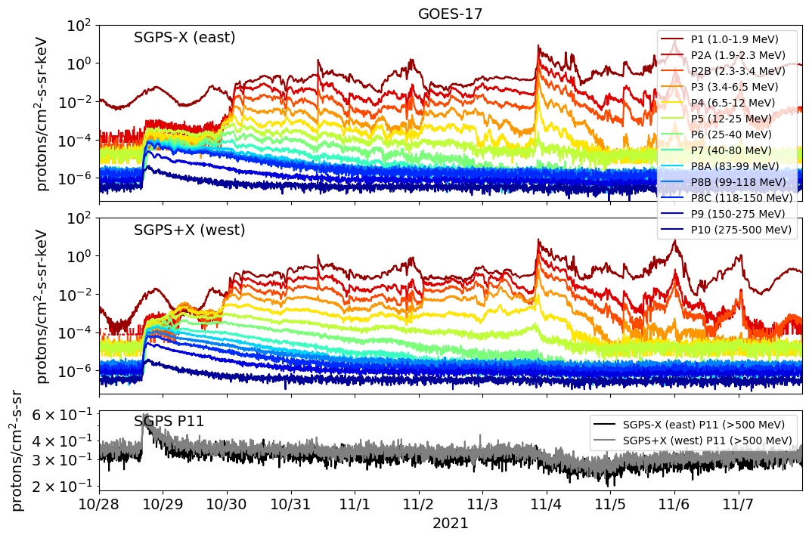
Oct-Nov. 2021 Solar Particle Event GOES-17 SGPS 5m Avg. L1b Fluxes
Interplanetary solar wind shock arrival at Earth
Ensuing geomagnetic storm on 4th Ideal period for SEP cross-
channel comparisons.
Unusual ~1-day period of very high energies only
(“hard spectrum”)
15:35 UT X1 solar flare
Sufficient >500 MeV SEPs for Ground Level Event (GLE) observed by ground-based neutron monitors
G17 SGPS Validation based on this event.
Forbush [1937] decrease in GCRs due to interplanetary solar wind shock propagating outward in heliosphere

Slide 8
REVIEW OF PROVISIONAL MATURITY (G17 SGPS PROVISIONAL PS-PVR, FEB. 27, 2019)
GOES-17 SGPS L1b Full Validation PS-PVR

Slide 9
Instrument/GPA Issues Identified and Resolution Status (Presented At 2/27/19 G17 SGPS Provisional PS-PVR)
No G17 SGPS specific instrument or GPA issues have been identified independent of general GOES-R series SGPS issues:
ADR 517, small but routine L1b gaps – Closed.
SGPS P5 overcorrection (L1b processing/LUT issue) – Addressed by ADR900, Closed.
Possible Electron contamination in SGPS+X P5 – Instrument issue, could be addressed with correction scheme using MPS-HI fluxes. No associated ADR yet. – No correction needed.
ADRs/WRs Impacting Validation of G17 SGPS L1b
ADR# | WR# | Short Description | Status | Expected Closure
267 | 5370 | LUT Filenames not Traceable to Metadata | Closed | DO.07.00.00
676 | 6100 | G17 ground LUT has SGPS–X dead time = 8e+07 s instead of 8e-07 s. | Closed | w/ LUT change
900 | TBA | G16 & G17 SGPS P5 correction coefficients LUT update | Submitted | w/ LUT change – Closed.
517 | 5484 | Small but routine L1b gaps, mostly for SEISS. | Closed | Closed in DO.06.02​ and ​DO.06.03
TBA | TBA | Electron contamination in SGPS-X P5 | TBD if ADR is needed | TBD – No correction needed.
Included in
beta review

Slide 10
Summary of G17 SGPS Status and NCEI Recommendations at 2/27/19 G17 SGPS Provisional PS-PVR
No known significant problems with G17 SGPS channels aside from general GOES-R series SGPS issues being worked
Overcorrection for out-of-band contamination in SGPS P5 resulting in negative values (e.g., as shown in slides 24 and 25 of G16 SGPS Full Validation PS-PVR).
Temperature dependence in some G16 SGPS-X channels (G17 SGPS temperature dependence shown to be small on slide 20 and in backup charts of G17 Provisional PS-PVR).
Electron contamination in G17 SGPS-X P5 (seen in slides 21 and 22 of G17 SGPS Provisional PS-PVR).
There were no solar particle events (SPEs) between G17 launch and the G17 SGPS Provisional PS-PVR on 2/27/19.
A SPE is needed to verify SGPS instrument performance.
NCEI recommended G17 SGPS L1b data be transitioned to provisional status with the caveat that G16 SGPS be relied on for SPE detection until G17 SGPS solar particle measurements could be validated.
G17 SGPS L1b was transitioned to Provisional quality status

Slide 11
PRODUCT QUALITY EVALUATION
GOES-17 SGPS L1b Full Validation PS-PVR

Slide 12
SGPS PLPTs Supporting Provisional Maturity
PLPT-SEI-001 SGPS D3-D1 Contamination Correction
PLPT-SEI-004 SEP Channel Cross-Comparison
PLPT-SEI-006 Backgrounds Trending

Slide 13
PLPT-SEI-001 SGPS D3-D1 Contamination Correction
Accumulated counts from G17 L0 data
Cumulative Summary:
G17 SGPS-X P7 w/ D3-D1 off rate = 2176. counts/day
G17 SGPS-X P7 w/ D3-D1 on rate = 1347. counts/day
On-off Ratio = 1347./2176. = 0.62
G17 SGPS+X P7 w/ D3-D1 off rate = 2242. counts/day
G17 SGPS+X P7 w/ D3-D1 on rate = 1463. counts/day
On-off Ratio = 1463./2242. = 0.65
G17 SGPS-X P8C w/ D3-D1 off rate = 4650. counts/day
G17 SGPS-X P8C w/ D3-D1 on rate = 2466. counts/day
On-off Ratio = 2466./4650.=0.53
G17 SGPS+X P8C w/ D3-D1 off rate = 4042. counts/day
G17 SGPS+X P8C w/ D3-D1 on rate = 2980. counts/day
On-off Ratio = 2980./4042.=0.74
In summary, P7 GCR rates drop by almost one-half when d3-d1 circuit is turned on, which is consistent with expected performance.
PASS

Slide 14
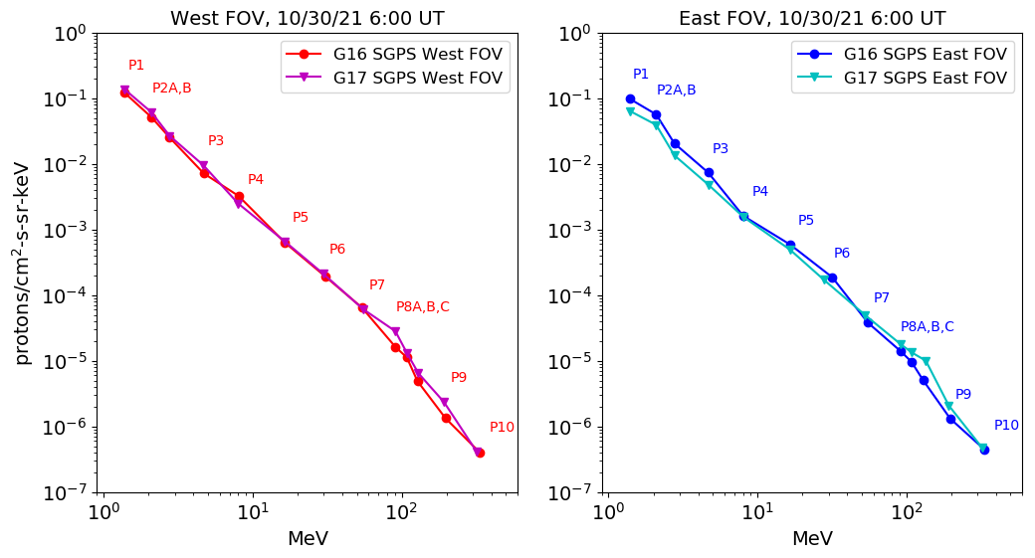
PLPT-SEI-004 SEP Channel Cross-Comparison, 10/30/21 6UT
5m avg. L1b
During non- geomagnetic storm period, T1 differences are due to different environment at
GOES-16 and -17.
T3 channel differences seen here are likely due to mischaracterization of G17 or G16 T3 energy channels.
In general, G17 SGPS fluxes compare well with G16 SGPS fluxes. Some evidence of mischaracterization of G17 or G16 T3 energy channels is seen in both +X and –X units. On 10/30/21 some differences in T1 channels due to geomagnetic effects are expected.

Slide 15
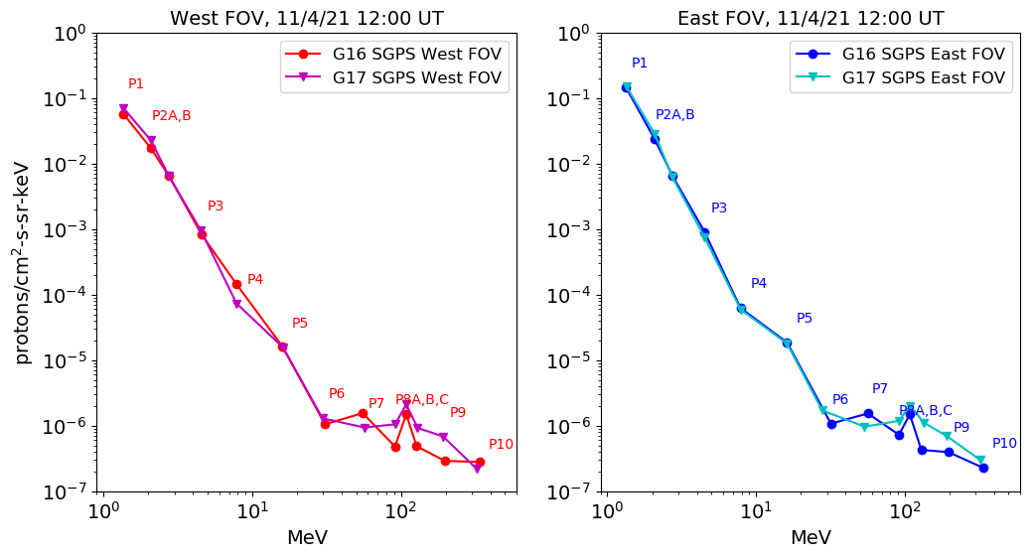
PLPT-SEI-004 SEP Channel Cross-Comparison, 11/4/21 12UT
5m avg. L1b
Good agreement at T1 energies during geomagnetic storm period
Known P4 channel calibration issue
Backgrounds

Slide 16
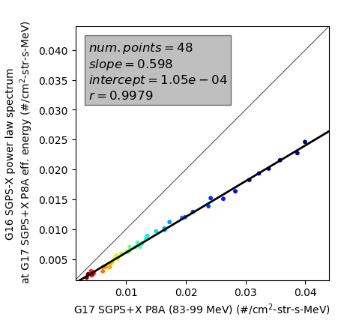
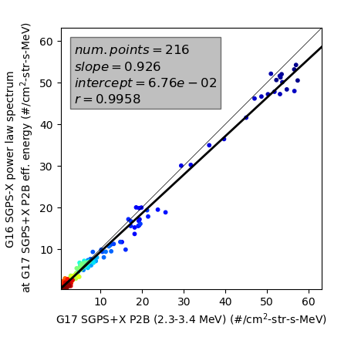
PLPT-SEI-004 SEP Channel Cross-Comparison Examples of Cross Calibration Results
5m avg. L1b samples
5m avg. L1b samples
Systematic difference between G16 and G17 P8A channels (west viewing units).
Good agreement between G16 and G17 P2B channels.

Slide 17
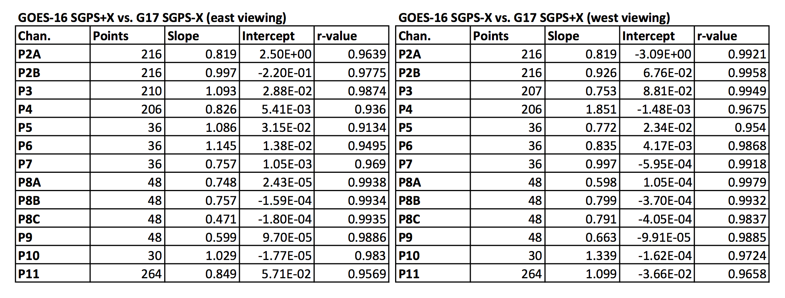
PLPT-SEI-004 SEP Channel Cross-Comparison Cross Calibration Results
Worst case is ~factor of 2 difference
Absolute accuracy cannot be verified on-orbit, however, results suggest that some channels are not meeting 25% accuracy requirement.
These differences are not unusual for comparisons between space-based particle detectors and are accepted by many as reasonable for space particle instruments, e.g., from Boyd et al. [2019], "there is excellent agreement with MagEIS, with more than 90% of points agreeing within a factor of 2" [Boyd, A. J., Reeves, G. D., Spence, H. E., Funsten, H. O., Larsen, B. A., Skoug, R. M., et al. (2019). RBSP-ECT combined spin-averaged electron flux data product. Journal of Geophysical Research: Space Physics, 124, 9142–9136. https://doi.org/10.1029/2019JA026733].
PASS

Slide 18
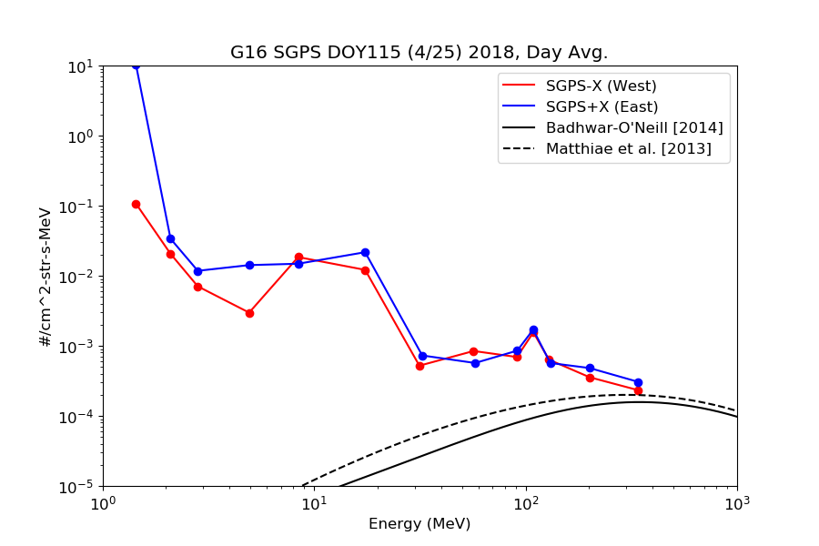
PLPT-SEI-006 Backgrounds Trending: Observed Backgrounds
One day averaged GCR backgrounds from GOES-16 and -17 L0 data.
GOES-17 GCR background count rates are similar to GOES-16, and in general there is better agreement between GOES-17 SGPS-X and SGPS+X units.
Background levels are significantly higher than GCR flux from accepted empirical models.

Slide 19
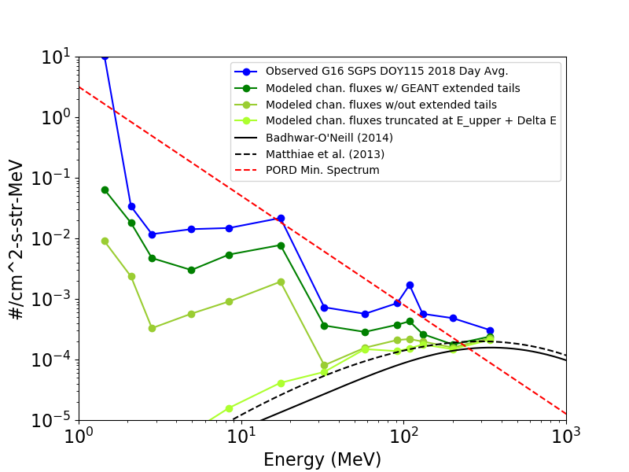
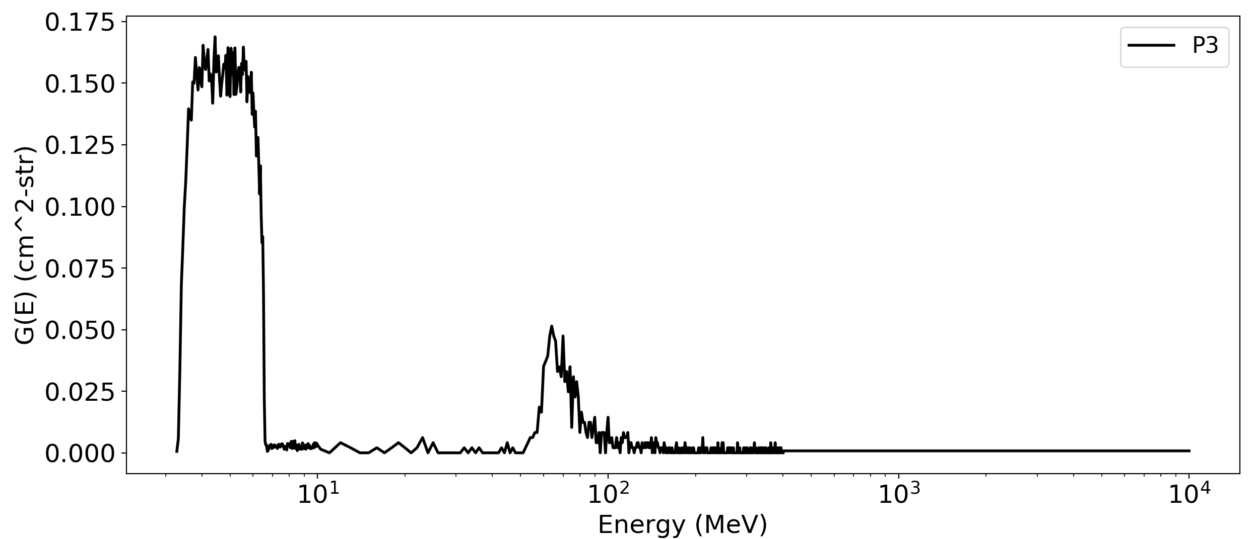
PLPT-SEI-006 Backgrounds Trending: Modeling Confirms Source of Backgrounds
Observed vs. Modeled GCR Backgrounds
(in 13 differential SGPS energy channels)
P3 GEANT Response Function
Truncated at chan.
E_upper + △E
PORD minimum
SEP spectrum
without extended tail
with extended
tail
High energy island
GCR models
Calibrated channel
PASS
Source of SGPS backgrounds is GCR counts.
Background levels are significantly higher than GCR fluxes from accepted empirical models.
Backgrounds are due to high energy tail portion of response function, not part of calibrated channel.
Differential channels calibrated for observing SEPs.
P11 (>500 MeV integral channel) measures GCRs.

Slide 20
FULL MATURITY ASSESSMENT
GOES-17 SGPS L1b Full Validation PS-PVR

Slide 21
Complete List of ADRs/WRs Impacting G17 SGPS to date
ADR# | WR# | Short Description | Status | Closure
267 | 5370 | LUT Filenames not Traceable to Metadata | Closed | DO 07.00.00
342 | 4502 | Inaccurate SWx Instrument_ID Fields | Closed | DO 06.03.00
405 | 4864 | Add temperatures to L1b data | Closed | DO 06.03.00
427 | 5010 & 5716 | Remove divide by 2 from P11 L1b processing | Closed | DO 06.03.00
491 | 5371 | SGPS T2 fluxes systematically ≈10% low (L1b processing error) | Closed | DO 06.03.00
517 | 5484 | Small but routine L1b gaps, mostly for SEISS. | Closed | Closed in DO.06.02​ and ​DO 06.03.00
676 | 6100 | G17 ground LUT has SGPS–X dead time = 8e+07 s instead of 8e-07 s. | Closed | PR.06.12.00 5/22/2018
* 900 | 7049 | G16 & G17 SGPS P5 correction coefficients LUT update | Closed | PR.07.10.02 4/10/2019
1025 | 7579 | Implement SGPS He processing in L1b | In operations Fix-fail in-work | DO.11.00.00 (Oct. 2022)
* ADRs up to 900 (all closed) identified as needed for Provisional and Full Maturity

Slide 22
Full Validation Assessment
Preparation Activities | Assessment
Validation, QA, and anomaly resolution activities are ongoing. | Validation activities are ongoing. Results have been discussed with SWPC. Research community participation is ongoing.
Incremental product improvements may still be occurring. | Continuing work on P5 out-of-band contamination removal and other channels.
Users are engaged and user feedback is assessed. | Yes (e.g., Frequent user questions/requests and NCEI responses).
GOES-R product maturity level preparation activities from RIMP v2.0. Responsible Organization: GOES-R GOES-R Program/Code 410

Slide 23
Full Validation Assessment
End State | Assessment
Product performance for all products is defined and documented over a wide range of representative conditions via ongoing ground truth and validation efforts. | G17 SGPS fluxes compared with observations from G16 SGPS. Both G17 SGPS units ground/beam calibrated.
Products are operationally optimized, as necessary, considering mission parameters of cost, schedule, and technical competence as compared to user expectations. | Yes, this is true of L1b. (There are continuing efforts to accommodate some L1b issues in L2 processing, e.g., modification of L2 event detection.)
All known product anomalies are documented, and shared with the user community. | Yes, in L1b README and through direct communications with user community.
Product is operational. | Yes.
GOES-R product maturity level preparation activities from RIMP v2.0. Responsible Organization: GOES-R GOES-R Program/Code 410

Slide 24
G17 SGPS Performance Baseline Status
MRD ID | Description | Related PLPTs | Status
MRD2005 | Product Orthogonality/Coverage | -04, -06 | Requirement met
MRD2009 | Product Measurement Range | -04, -06 | Requirement met
MRD2010 | Product Measurement Accuracy | -04, -06 | Ground calibrations meet 25/45% Accuracy requirement. On-orbit tests are ongoing.
MRD2005: Orthogonality/Coverage
Requirement: 2 directions
Currently being met
MRD2009: Measurement Range:
Requirement: Protons: 1 MeV - 500 MeV, > 500 MeV
SEP Channel Cross-comparisons with legacy instruments on GOES-13 and -15 indicate that energy range is being covered.
MRD2010: Measurement Accuracy
Requirements: 25% when flux level above background is greater than 10x minimum flux; 45% when flux level above background is between minimum flux and 10x minimum flux
Absolute accuracy cannot be verified on-orbit

Slide 25
Summary and Recommendations
Summary of GOES-17 SGPS instrument issues
P5 out-of-band contamination overcorrection resulted in negative reported fluxes – Negative fluxes resolved by ADR900 (set contamination removal coefficients to zero). Work is ongoing to determine sources of backgrounds and correct values for out-of-band removal coefficients.
Electron contamination in G17 SGPS-X P5 was shown to be a very small contribution to solar particle event fluxes (e.g, see slide 27 in G16 SGPS Full Validation PS-PVR).
Some channels may be poorly characterized (based on comparisons with G16 SGPS) – On-orbit calibration work is ongoing.
G17 SGPS does not exhibit significant temperature dependence (shown on slide 20 and in backup charts of G17 Provisional PS-PVR).
There are no known outstanding G17 SGPS measurement or L1b processing issues (aside from ADR1025 fix-fail, in-work). In general, GOES-17 SGPS is performing better than GOES-16 SGPS.
Systematic measurement differences between GOES-17 and -16 SGPS have been quantified, and GOES-16 has been cross calibrated with GOES-13 and -15.
NCEI recommends GOES-17 SGPS L1b for transition to Full Validation status.

Slide 26
BACKUP CHARTS
GOES-17 SGPS L1b Full Validation PS-PVR

Slide 27
P5 Out-Of-Band Correction (L1b processing correction)
P5 out-of-band
High energy islands
GEANT simulations indicate left island is due to rear entry particles and right is due to front-side entry.
In-band (desired)
P5 channel response
function
Goal is to remove contribution from P5 high energy islands:
Corrected P5 counts = total P5 counts – ($α_{P7}∗P7 flux+α_{P8A}∗P8A flux$)

Slide 28
Errata
This errata contains corrections made to the version presented on 1/19/21 (…_v1.pptx) that are now included in the archived version (…_v2.pptx).
1) First bullet on slide 4 “2 Units, one looking East (+X) and one West (-X)” modified to “2 Units, one looking East and one West” (since G17 periodically undergoes yaw flip).
2) In right column of third row in “Full Validation Assessment” chart on slide 22, modified from “Yes (e.g., Frequent Questions/Requests on slide 30 and NCEI responses).” to Yes (e.g., Frequent user questions/requests and NCEI responses). (The original version refers to slide 30 of the GOES-16 SGPS Full Validation PS-PVR.
3) In right column of first row in “Full Validation Assessment” chart on slide 23, modified the two bullets from:
SGPS fluxes compared with observations from MPS-HI, GOES-13, and -15.
Both units (SN101 and SN102) ground/beam calibrated
to:
G17 SGPS fluxes compared with observations from G16 SGPS
Both G17 SGPS units ground/beam calibrated
4) “(shown on slide 20 and in backup charts of G17 Provisional PS-PVR)” added to fourth sub bullet on slide 25.
5) Addition of this errata slide .

