Slide 1



GOES-17 Full Maturity PS-PVR
Solar UltraViolet Imager
17 September 2021
Jonathan Darnel, Daniel B. Seaton, Courtney Peck, Christian Bethge, Alison Jarvis
GOES-R Calibration Working Group, University of Colorado, CIRES, NOAA-NCEI
Notes:
New Background?

Slide 2
Outline
Overview of the GOES-17 SUVI
Review of the GOES-17 SUVI Provisional Assessment
Evaluation of the GOES-17 Level-1b Product Quality
  Anomalies and Resolution
  PLPTs -Trending and Degradation
Summary of Product Status
  Top priority items
  Conclusion

Slide 3
Acronym, Defined
AART: Algorithm Action Review Team
ADR: Algorithm Discrepancy Report
AIA: Atmospheric Imaging Assembly
CCD: Charge-Coupled Device
ECI: Extended Coronal Imaging
EUV: Extreme Ultraviolet
EUVS: Extreme UltraViolet Spectrometer
EXIS: EUV and X-ray Irradiance Sensor
FITS: Flexible Image Transport System
LUT: Look-Up Table
MIT-LL: MIT Lincoln Laboratory
OMAS: Operational Metadata Aggregation Service
PLPT: Post-Launch Product Test
SDO: Solar Dynamics Observatory
SUVI: Solar UltraViolet Imager
VSO: Virtual Solar Observatory
WR: Work Request

Slide 4
GOES-17 SUVI Full Maturity PS-PVR
Overview of SUVI

Slide 5
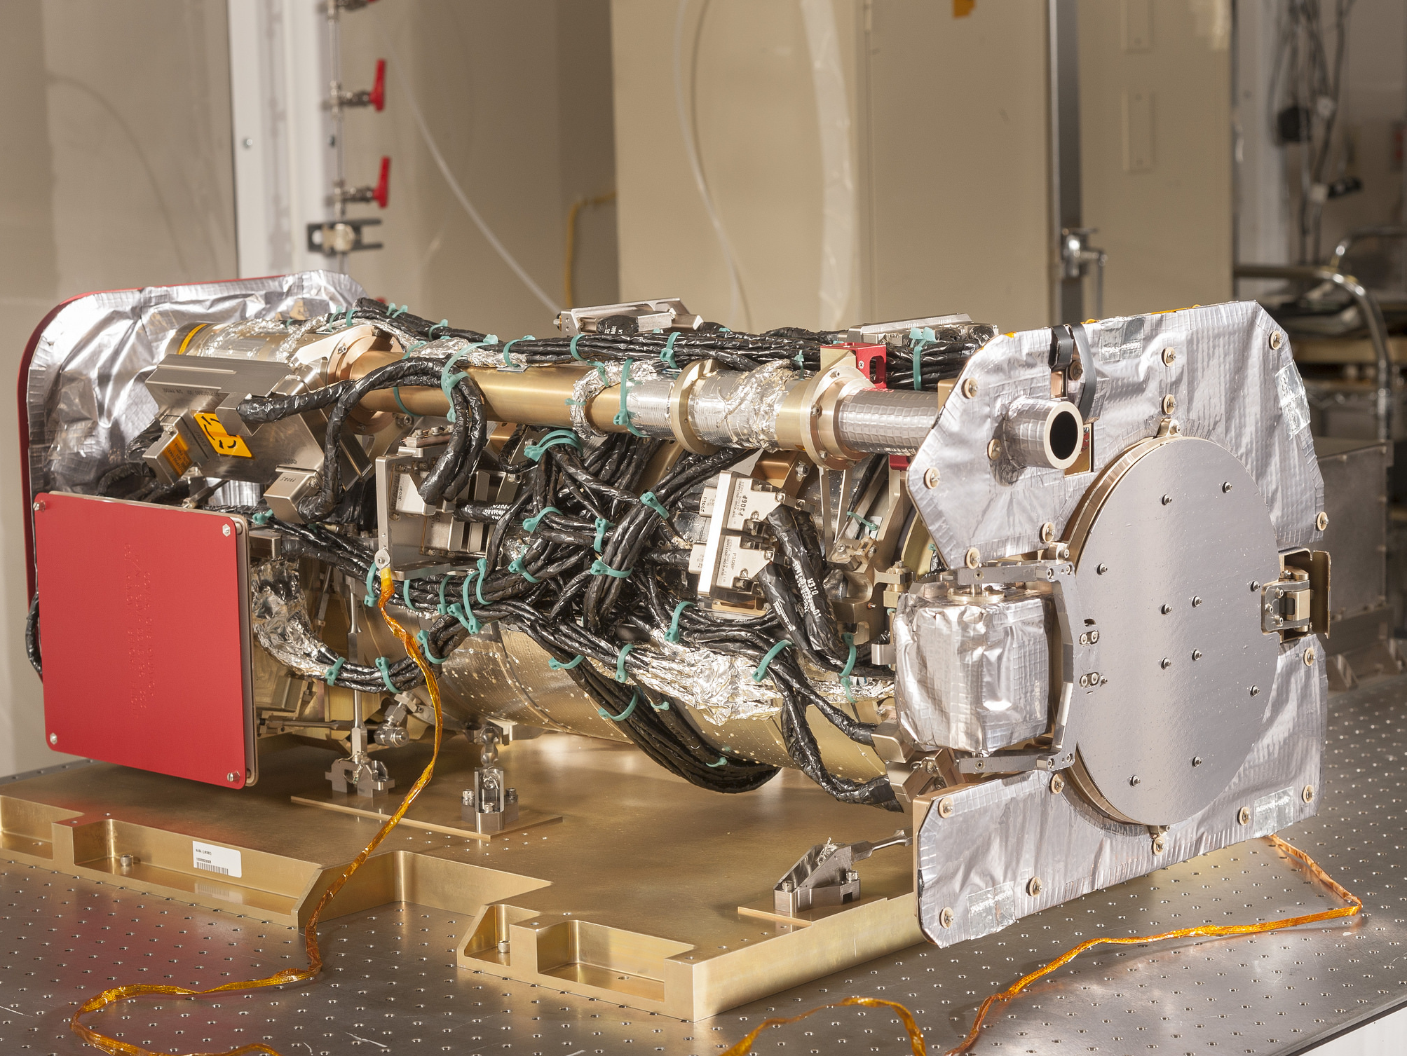
The SUVI Instrument

Slide 6
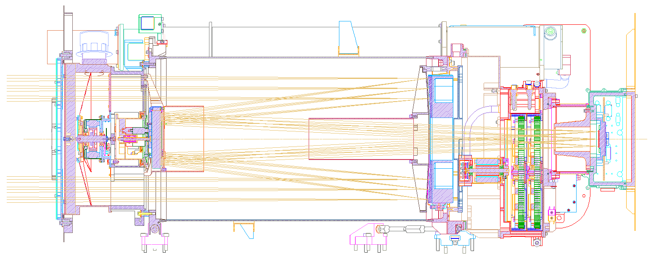
SUVI Overview
Entrance Filters
Focal Plane Filters
Aperture Selector
Secondary Mirror
Primary Mirror
CCD

Slide 7
Overview of SUVI
Key Instrument Performance Requirements
Pointing Accuracy: <3.0 arcmin
Pointing Knowledge: <2.5 arcsec
Field of view: >42×42 arcmin
Spatial resolution: <5 arcsec square pixels
Ensquared energy: >50% in 7×7 arcsec
(43% for 94 Å bandpass)
Six Channels: 94Å (FeXVIII), 131Å (FeVIII), 171Å (FeIX), 195Å (FeXII), 284Å (FeXV), 304Å (HeII)

Slide 8
Overview of SUVI
Key Instrument Operating Characteristics
1280×1280 pixel L1b Product Image
2.5 arcsec pixels, 53.3×53.3 arcmin FOV
14-bit CCD detector
Entrance aperture selector – 6 positions
2 Filter wheels:
  FW1: Open, Thin Al & Zr, Thick Al & Zr
  FW2: Glass, Open, Thin Al, Thin Zr, Thick Al
4-photodiode guide telescope for pointing

Slide 9
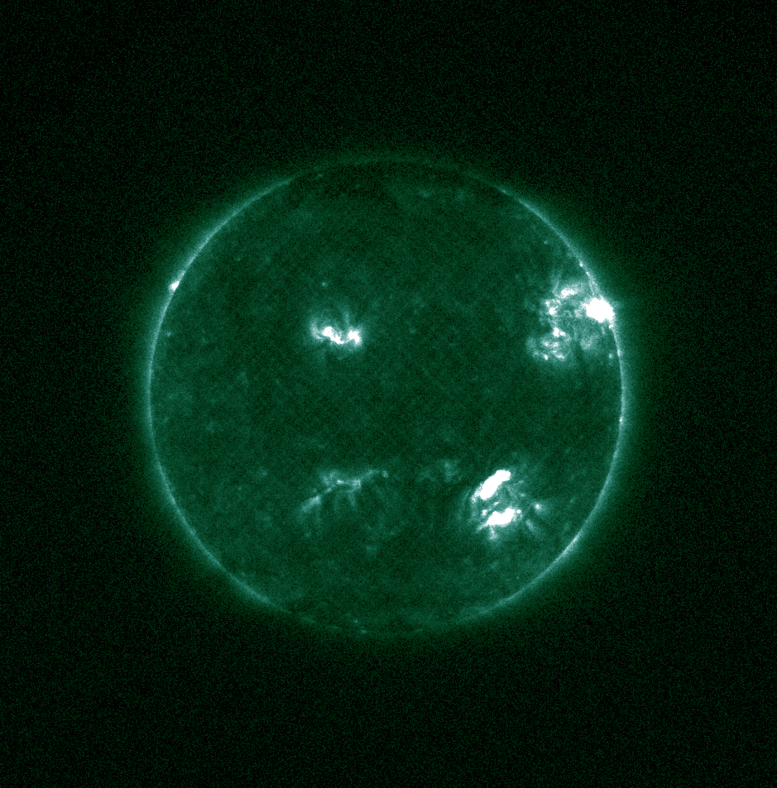
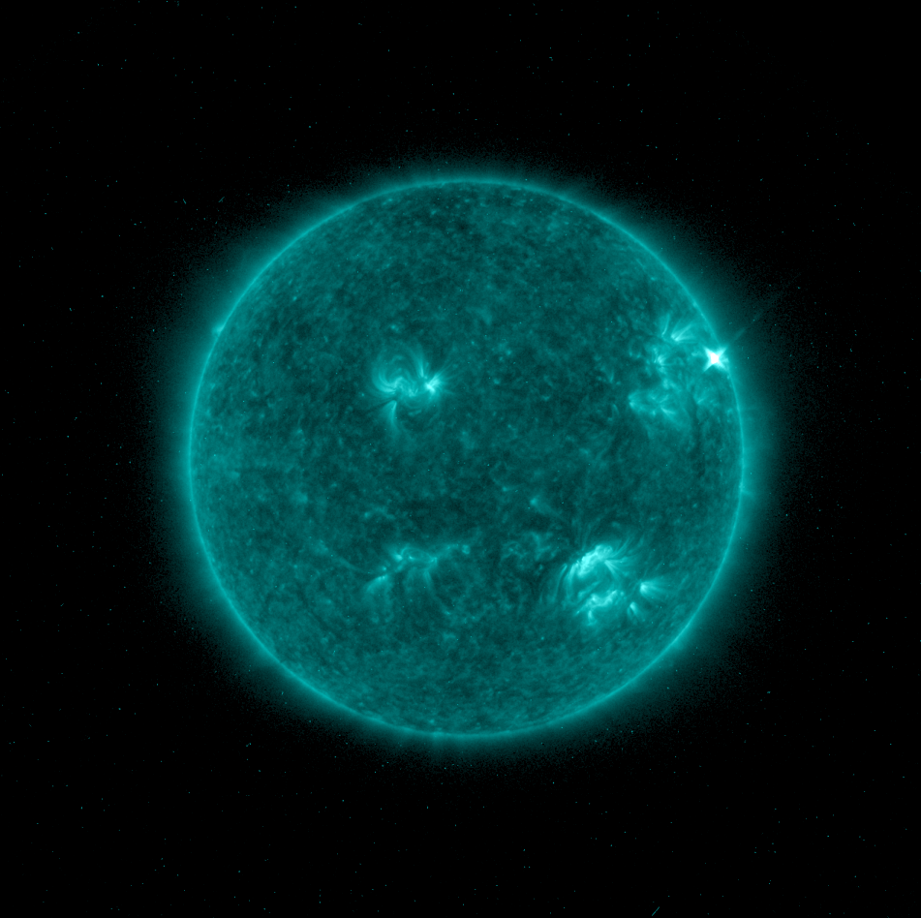
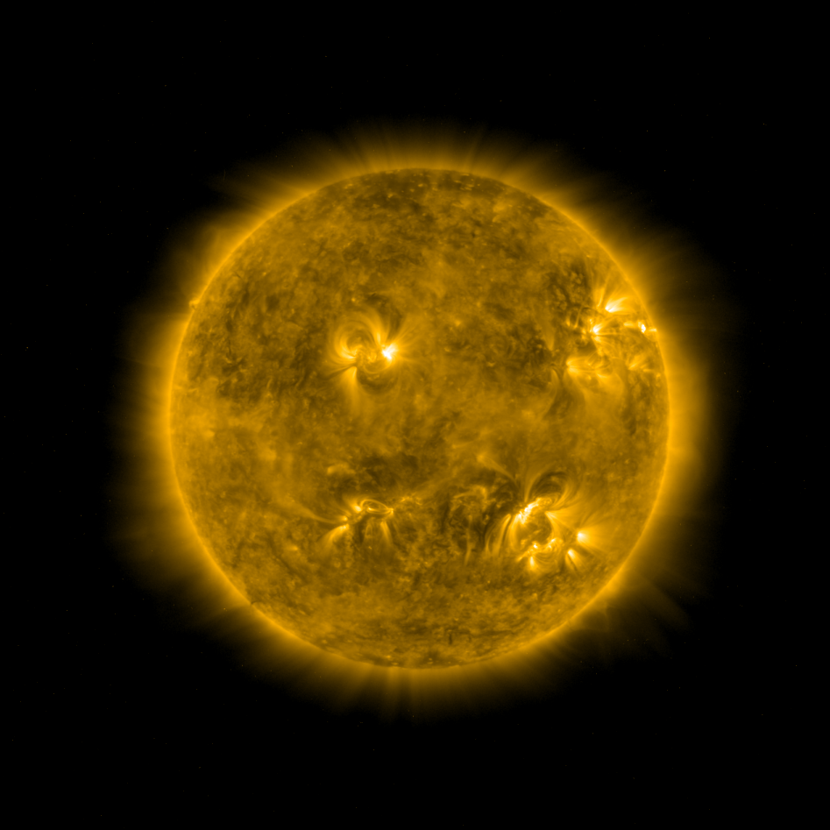
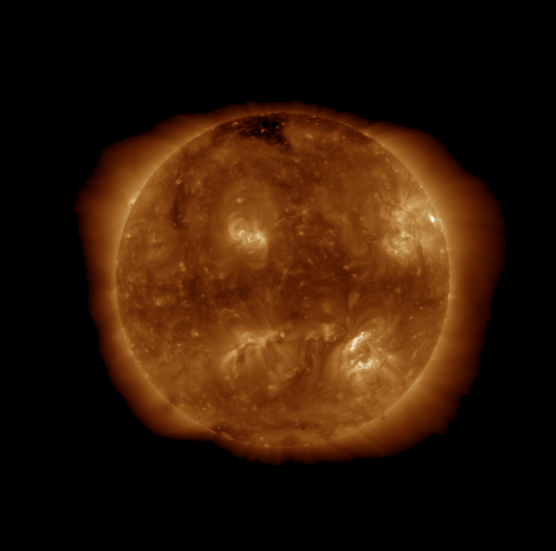
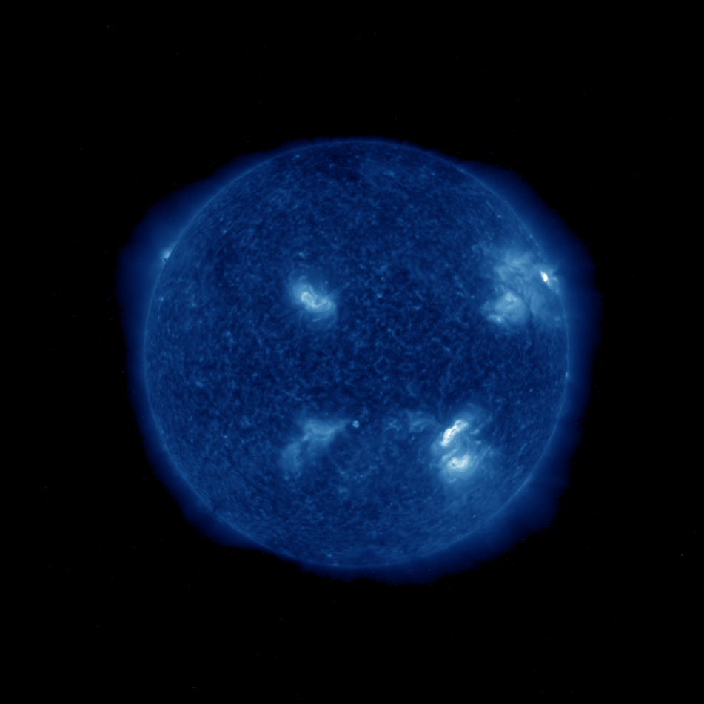
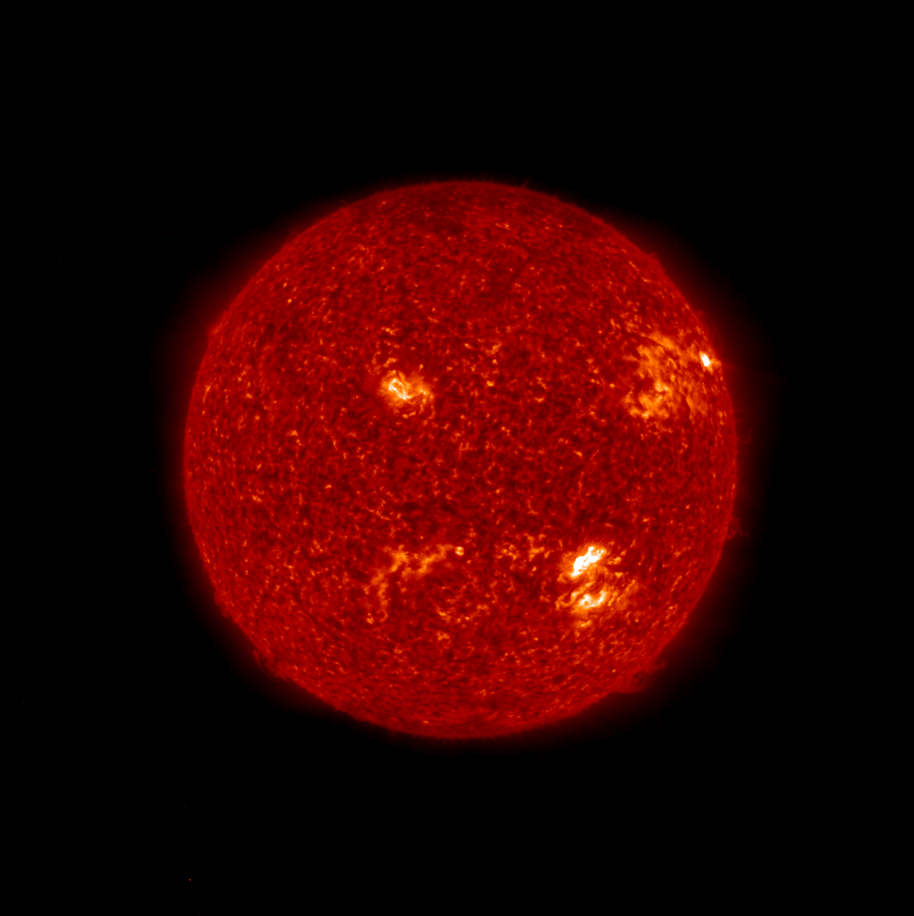
Overview of SUVI
Level-2 Composite Images
94Å
131Å
171Å
195Å
284Å
304Å
3 July 2021, 14:30

Slide 10
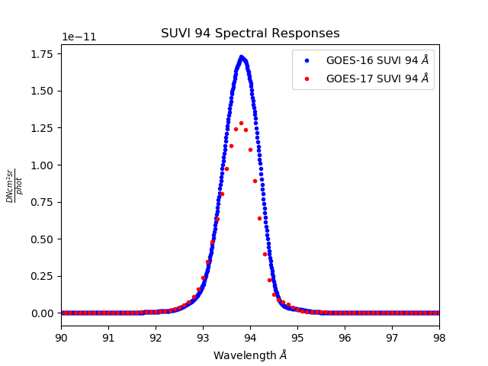
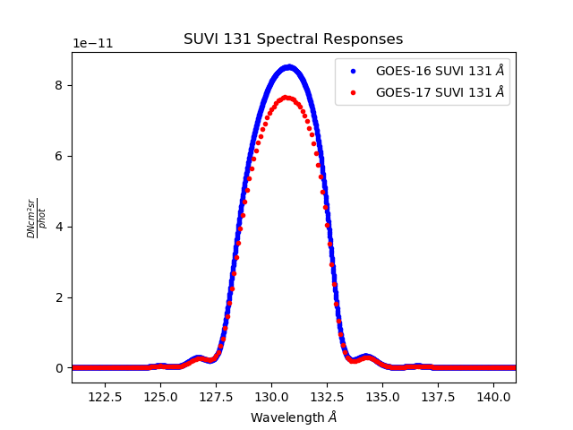
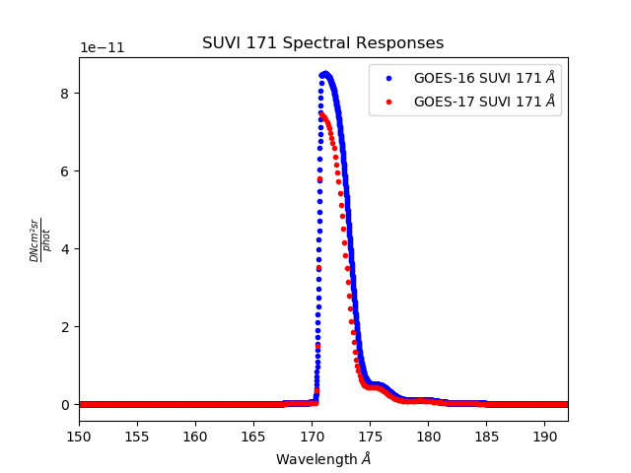
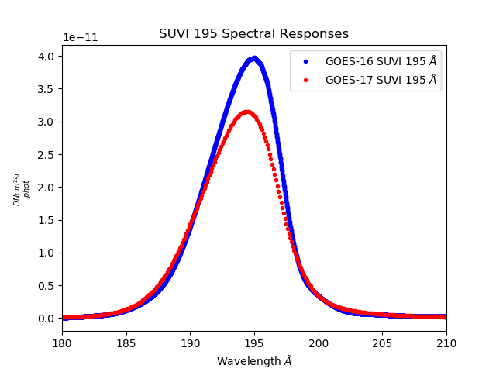
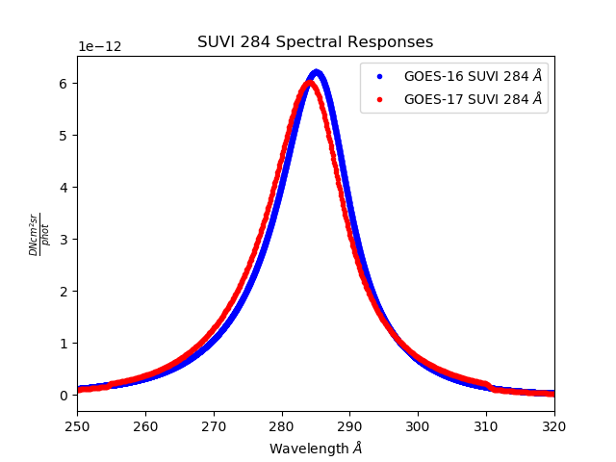
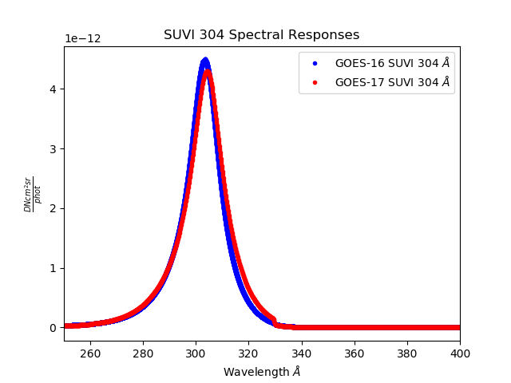
SUVI Spectral Response Functions

Slide 11
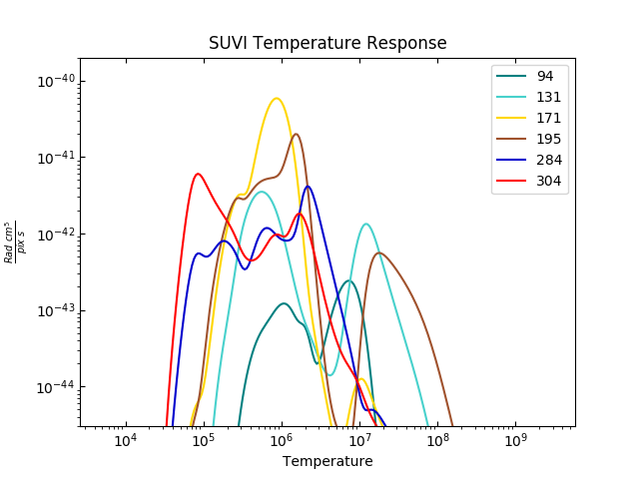

Slide 12
Issues from Provisional:
GOES-17 SUVI Light Leakage
(ADR 260/1059/1147)
Description and Mitigation

Slide 13
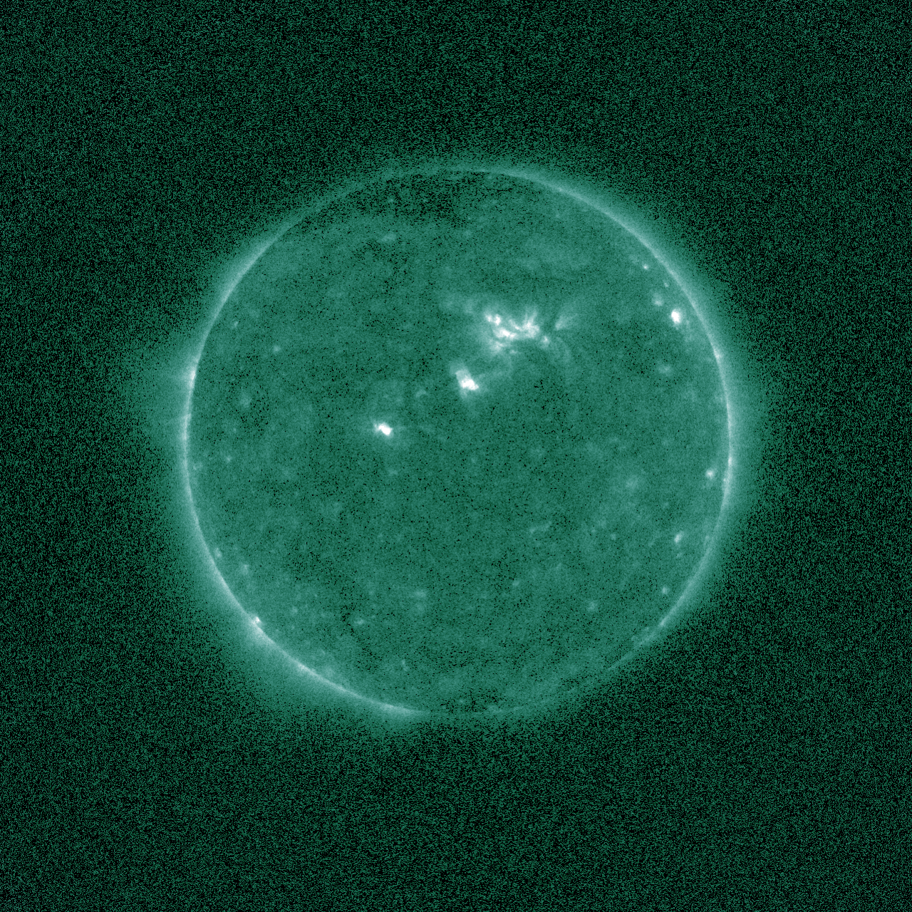
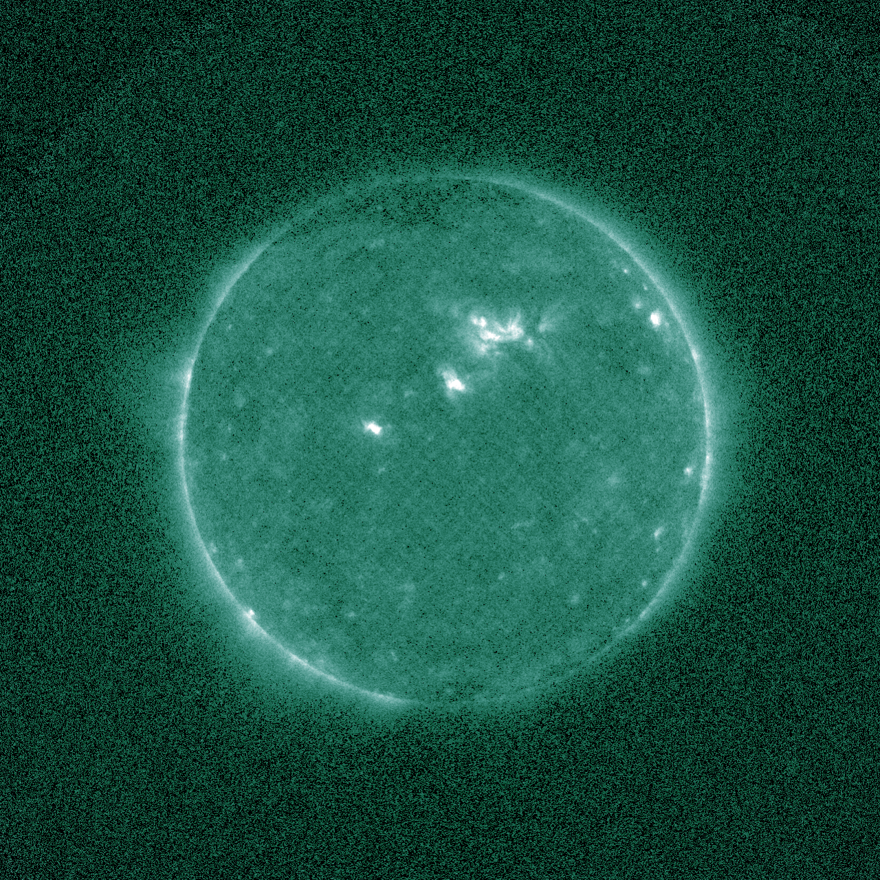
The issue: Light leak contaminates 94 Å images
(grid pattern from the mesh stabilizing the filters)
SUVI-16 94 Å image
SUVI-17 94 Å image (with light leak)

Slide 14
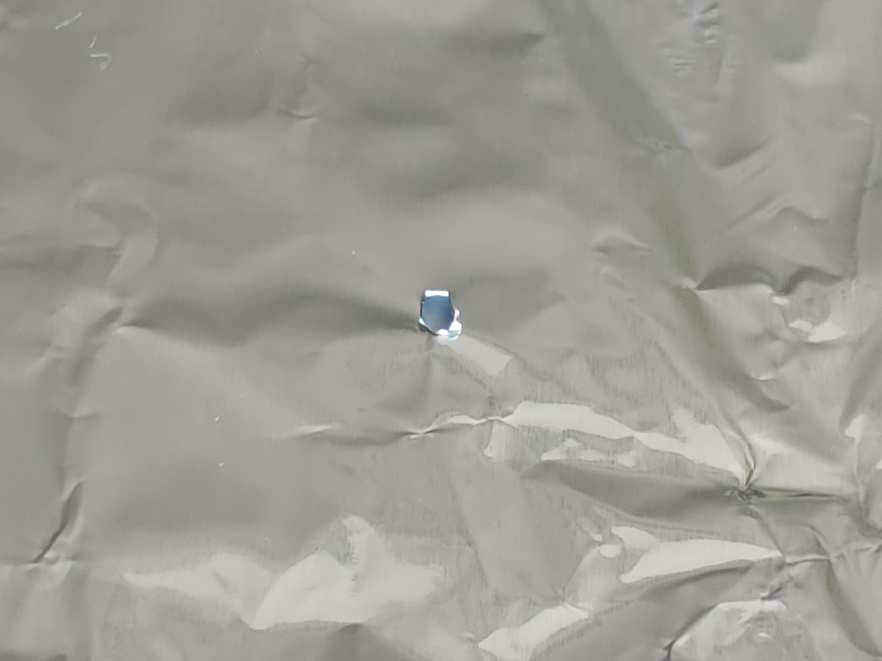
The issue: Light leak contaminates 94 Å images
(visual aid)
The most probable cause of the light leakage in the 94Å channel is a pinhole in the entrance filter.
The image here is of aluminium foil with a hole made with a toothpick.

Slide 15
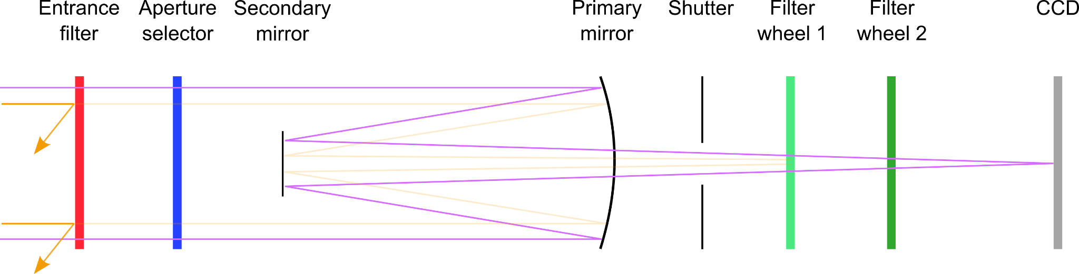

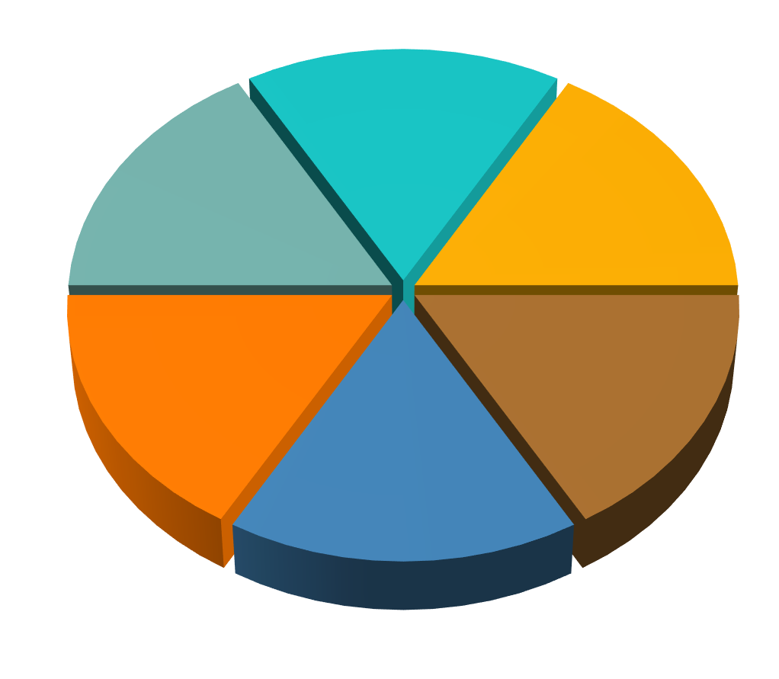
Regular scenario without light leak
Entrance filter rejects most
of the visible light, lets the
EUV wavelengths pass
Focal plane filters reduce visible light even more so that less than 1% of the detected light is out-of-band
simplified SUVI optical path
131 Å
94 Å
171 Å
304 Å
195 Å
284 Å

Slide 16
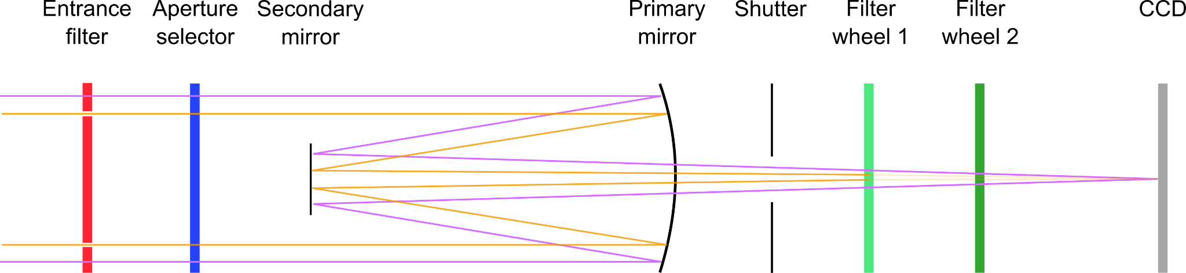
Light leak scenario
Pinhole in the entrance filter lets both visible light and EUV wavelengths pass (visible light at a much smaller aperture though!)
Focal plane filters still reduce visible light contribution, but because the Sun is more than 10 times brighter in visible wavelengths than in the EUV, it becomes detectable on the CCD
simplified SUVI optical path
131 Å
94 Å
171 Å
304 Å
195 Å
284 Å

Slide 17
Available filters in the filter wheels
Filter wheel 1:
Open
Thin Zirconium
Thick Zirconium
Thin Aluminum
Thick Aluminum
Filter wheel 2:
Fused Silica
Open
Thin Zirconium
Thin Aluminum
Thick Aluminum
(blue = relevant for 94 Å exposures)
Normal configuration for 94 Å exposures: Thin Zr / Open
Other possibilities: - Open / Thin Zr
- Thin Zr / Thin Zr (used for 5 ms flare exposures)
- Thick Zr / Open
- Thick Zr / Thin Zr
}
Mitigation strategy

Slide 18
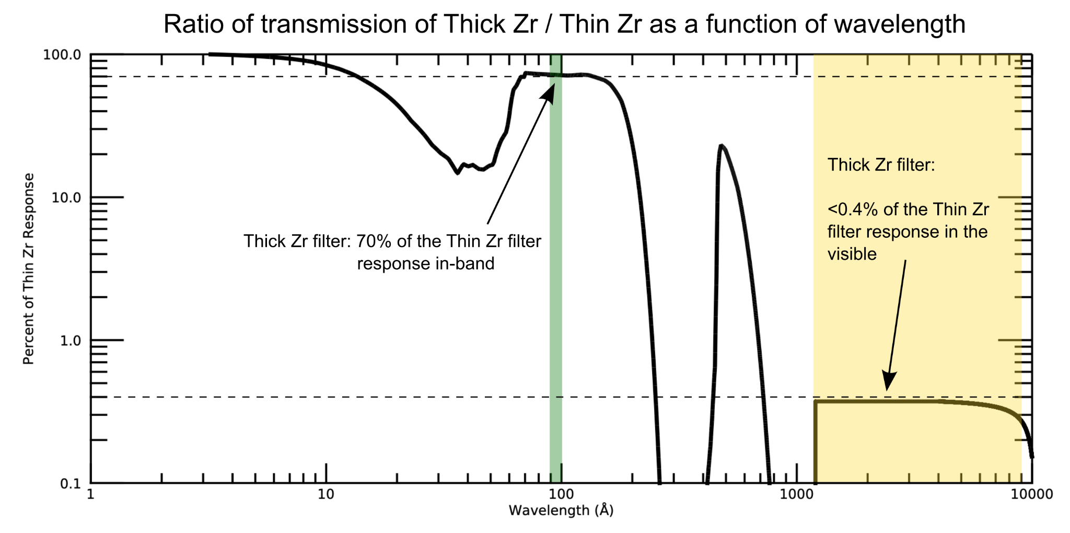
Why would we expect the thicker filter combinations to help?
(How to read this plot: How much light gets transmitted through the Thick Zr filter compared to the Thin Zr filter, as a function of wavelength.)
Thick Zr filter should only let <0.4% of the visible light pass compared to the Thin Zr filter, but still has 70% in-band response.
Notes:
Plot is the ratio of Thin Zr transmission and Thick Zr transmission.

Slide 19
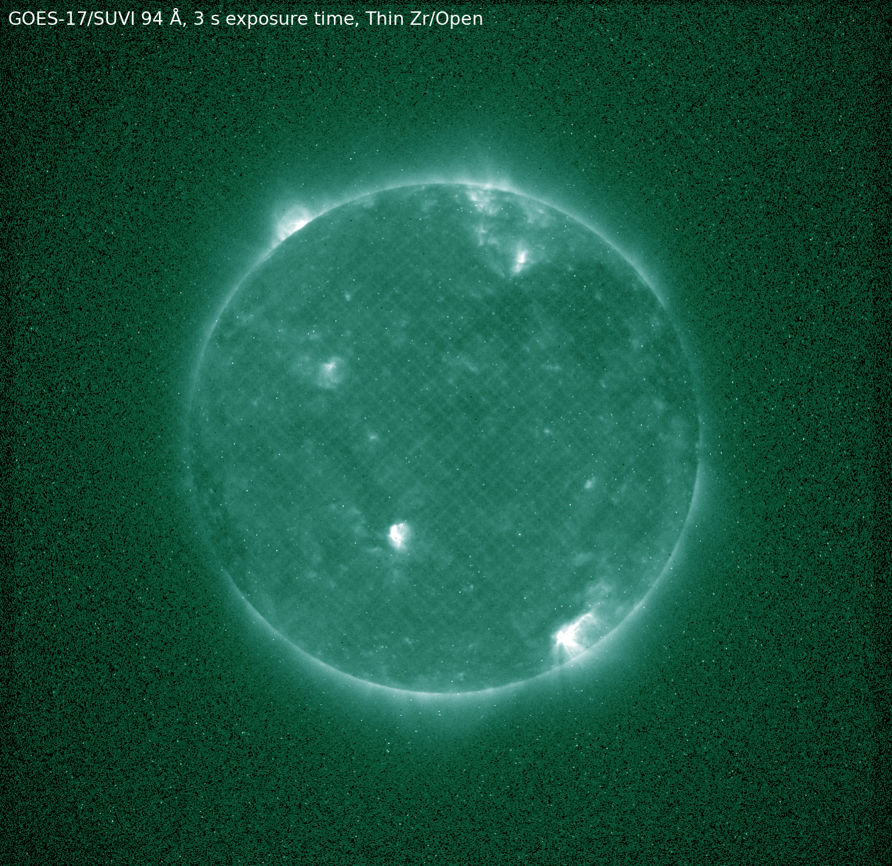
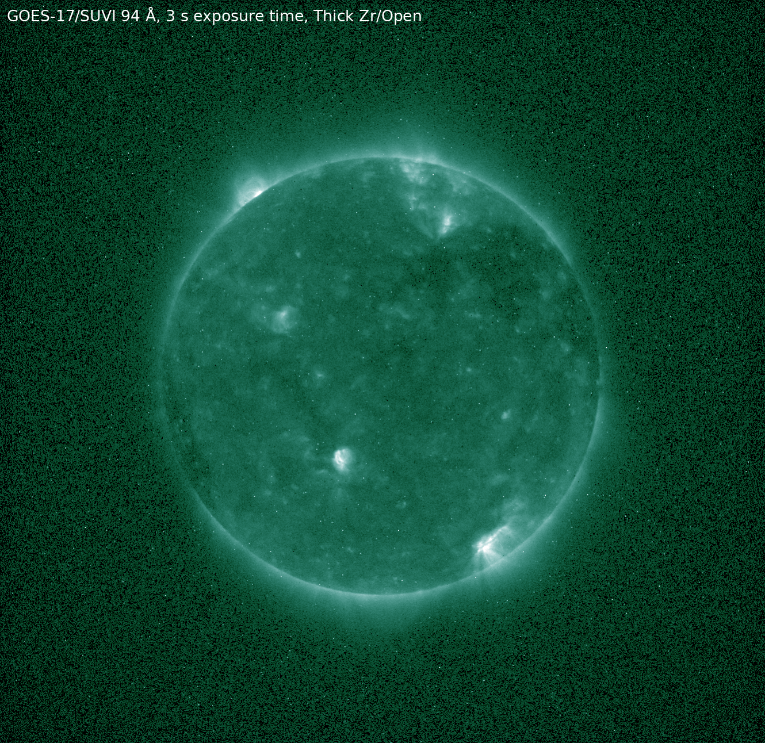
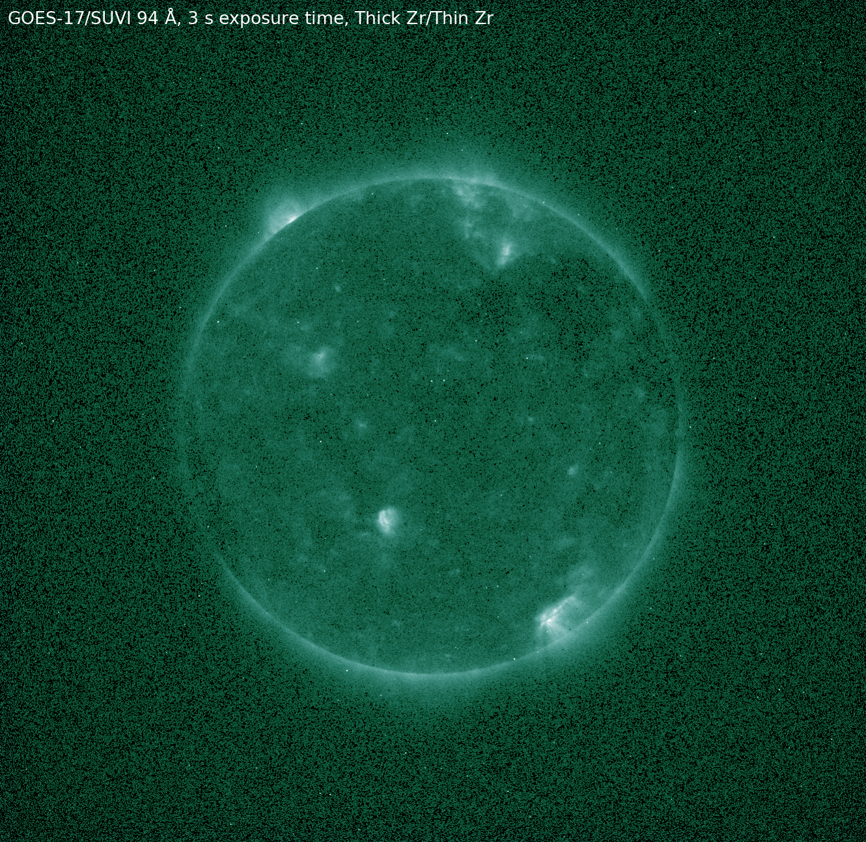
ADR 1145:
Observation test sequence with different filter combinations
to mitigate the light leak in the 94 Å channel
Test sequence image 1
Filter wheel 1: Thin Zr filter
Filter wheel 2: Open
3 sec exposure time
Test sequence image 2
Filter wheel 1: Thick Zr filter
Filter wheel 2: Open
3 sec exposure time
Test sequence image 3
Filter wheel 1: Thick Zr filter
Filter wheel 2: Thin Zr filter
3 sec exposure time

Slide 20
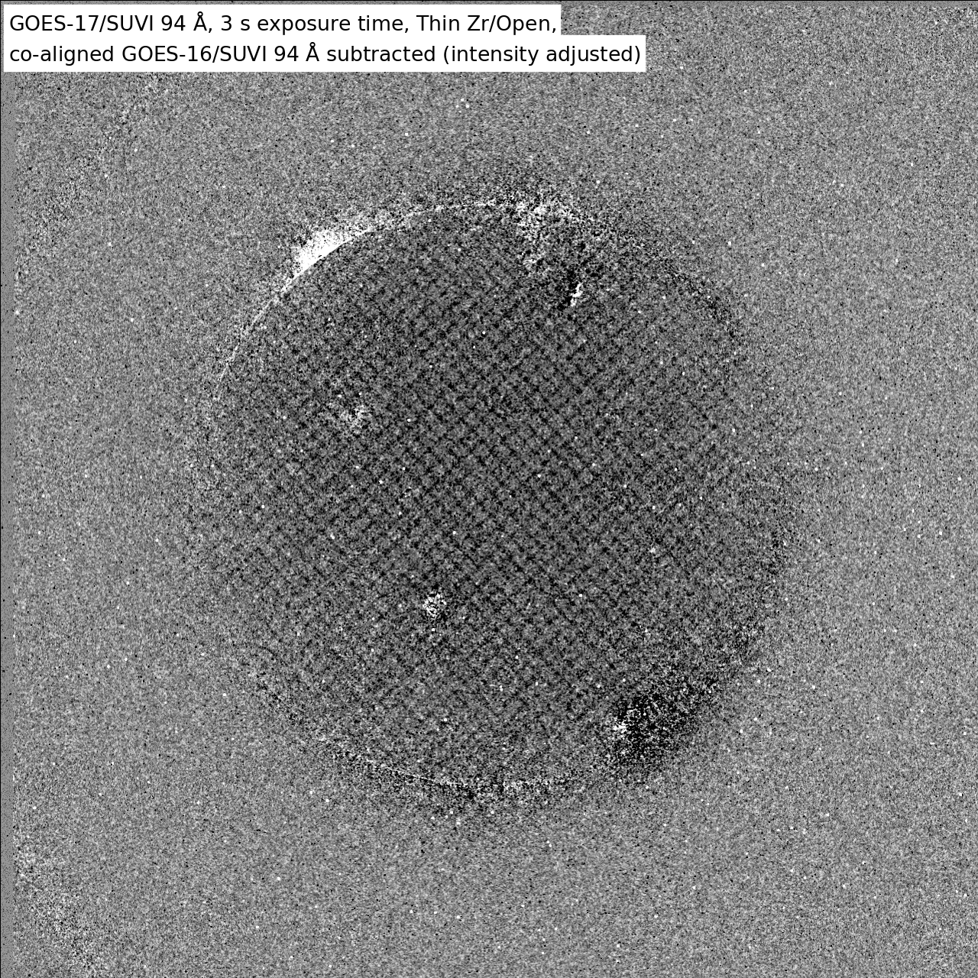
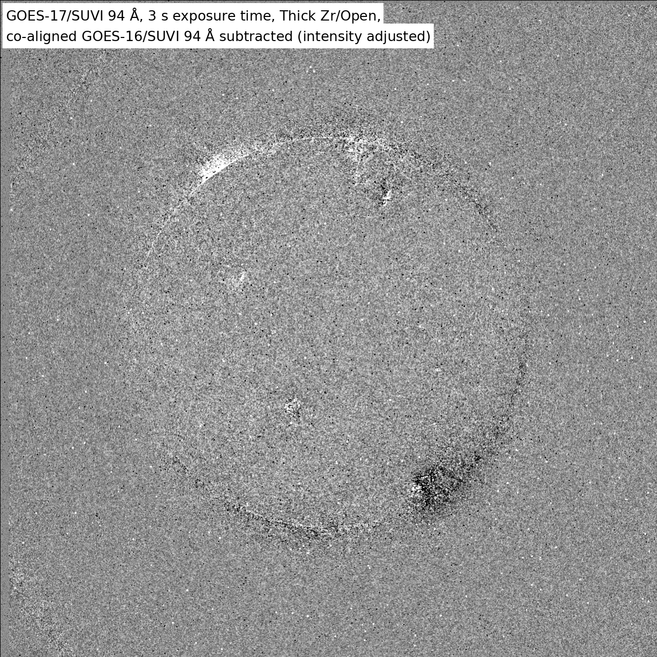
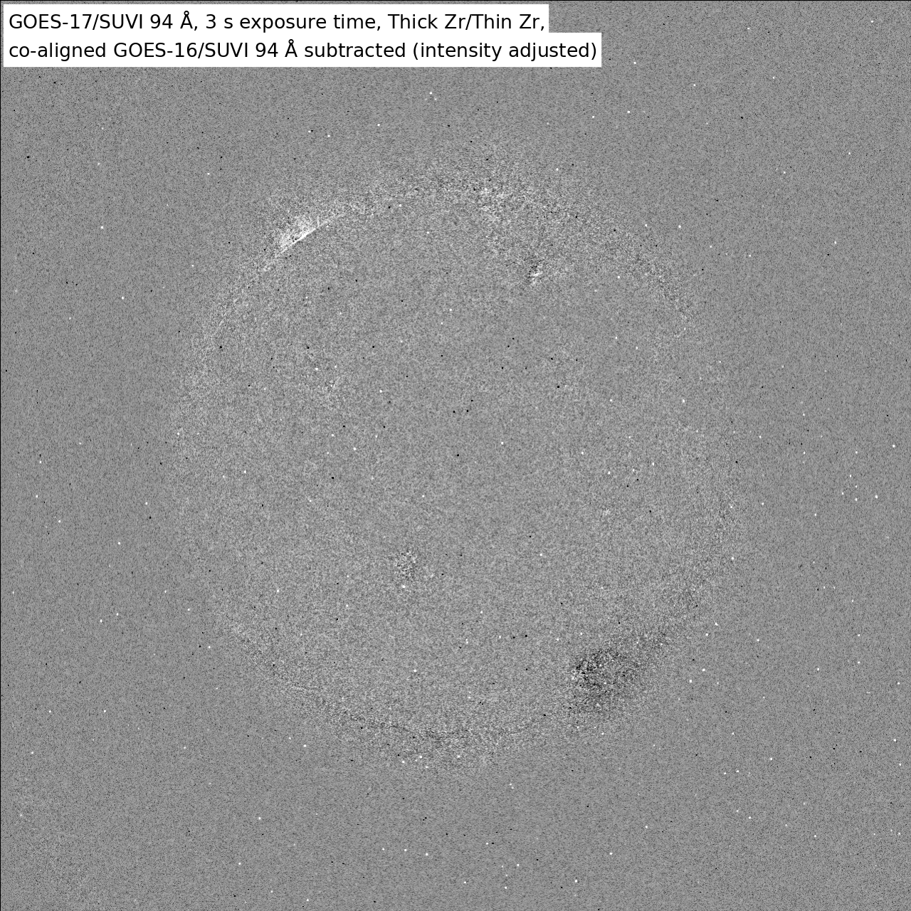
ADR 1145:
Observation test sequence with different filter combinations,
co-aligned GOES-16 94 Å image subtracted
Test sequence image 1
Filter wheel 1: Thin Zr filter
Filter wheel 2: Open
3 sec exposure time
Test sequence image 2
Filter wheel 1: Thick Zr filter
Filter wheel 2: Open
3 sec exposure time
Test sequence image 3
Filter wheel 1: Thick Zr filter
Filter wheel 2: Thin Zr filter
3 sec exposure time

Slide 21
ADR 1145:
Observation test sequence results in numbers
Image type | Filter wheel 1 | Filter wheel 2 | Exposure time [sec] | Mean signal in middle of image [DN] | Ratio: this image / regular image | Mean radiance in middle of image [W m⁻² sr⁻¹]
Regular 94 Å long exposure | Thin Zr | Open | 1 | 14.27 | 1. | 0.249
Test sequence image 1 | Thin Zr | Open | 3 | 41.88 | 2.935 | 0.244
Test sequence image 2 | Thick Zr | Open | 3 | 28.66 | 2.008 | 0.225
Test sequence image 3 | Thick Zr | Thin Zr | 3 | 10.04 | 0.704 | 0.228
Conclusion:
The “Test sequence image 2” instead of the regular 94 Å long exposure would mitigate the light leak issue for SUVI-17 and double the in-band 94 Å light.

Slide 22
Beyond GOES-17 SUVI
Updating the observing sequence is the preferred method for mitigating many issues:
  Light Leaks
  Long-term degradation, a.k.a. signal attenuation
It is expected that all SUVI instruments will require a sequence update at least once over the mission lifetime
Sequence updates require GPA modifications
The remedy for the GOES-17 SUVI Light Leak is needed generally for the SUVI GPA

Slide 23
Technical challenges to Updated SUVI Sequences
GPA needs updates
Further discussion in ADR section
Until the GPA is fixed, L2 thematic maps and downstream products will not be useful for forecast purposes.

Slide 24
Process to Update SUVI Imaging Sequences
NCEI designs the new sequence.
NCEI tests the sequence using the vendor-provided software tools.
NCEI submits the following to OSPO
  The design for the new sequence
  The updated LUTs for the SUVI GPA
  A technical memo describing the changes and the underlying need for the changes
OSPO creates new sequence using the NCEI-provided materials as references.
OSPO, NCEI, and the GOES-R Ground System coordinate for the simultaneous updating of the imaging sequence and SUVI GPA

Slide 25
Issues from Provisional:
GOES-16/GOES-17 Throughput Discrepancy
(ADR 1059)
Description and Mitigation

Slide 26
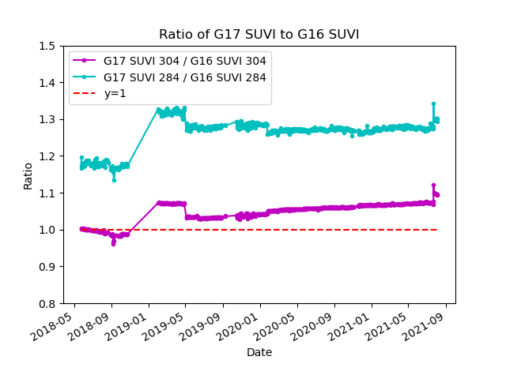
The G17/G16 SUVI Throughput Discrepancy
An updated to the calibration parameters on or about 11-2018 (post-drift) resulted in greater “throughput” for the G17 SUVI L1b product.
This “jump” in throughput is seen in every G17 SUVI channel - see backup slides.

Slide 27
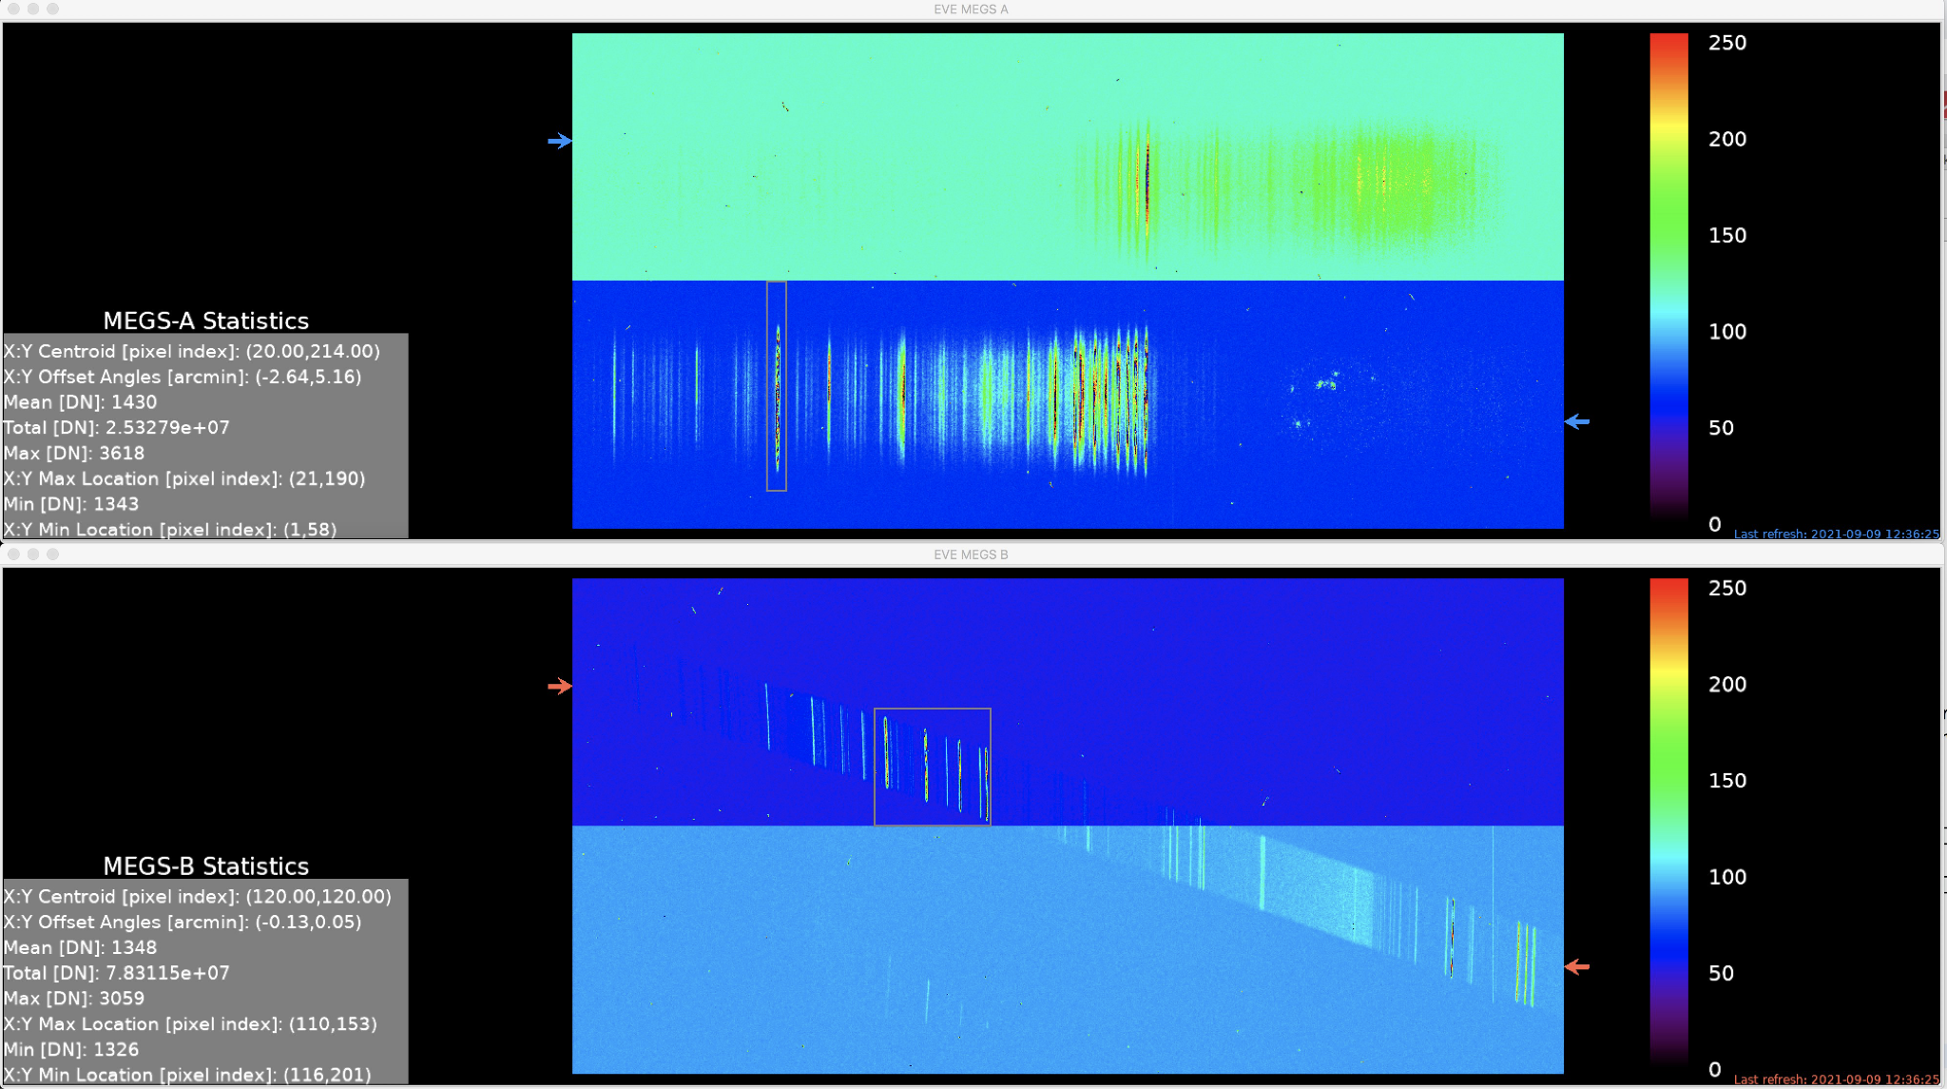
SDO Calibration Underflight - 9/9/2021
Success.
The release of calibrated data expected in ~ 6 months.
From Provisional Charts

Slide 28
Path Forward:
SDO-EVE calibration rocket underflight 9/9/2021
  Improved instrumentation from last underflight
  Will provide a definitive data point to resolve the discrepancy
NCEI will provide an updated LUT resolving the discrepancy (ADR 1059).
Notes:
Last underflight date during G17 PLT

Slide 29
GOES-17 SUVI Full Maturity PS-PVR
Overview of Status at Provisional Maturity
(10 May 2019)

Slide 30
ADRs from Provisional PS-PVR
ADR | WR | Delivery | Description | Disposition | Resolution
588 | 6347 | DO.08.01.00 | Image scale/offset should be dynamic | Improves product accuracy and compression | Closed
690 | 6643 | DO.08.01.00 | CDRL080 Update |  | Closed
932 | 7032 | DO.09.01.00 | SUVI background corr. is using wrong dark exposure. | Required for L1b accuracy | Closed
Notes:
Replace table with G17 ADRs

Slide 31
ADRs added after Provisional PS-PVR
ADR Number | WR Number | Delivery | Description | Priority | Disposition
1121 | 8149 | PR.09.03.03 | SUVI yaw flip navigation | Low
1145 | 8174 | Rejected | GOES-17 SUVI 94 Å Light Leak Mitigation | High | NCEI test sequence ran successfully. No further action needed.
1160 | - | In Work | Renaming SUVI-17 Navigation LUTs | Low
1021 | 7364 | DO.11.00 | SUVI L1b FITS files do not follow standards for CO | High | Risk to current software and future operations
1048 | 7558 | - | SUVI DATE_OBS,DATE_END need exp time subtracted | Moderate | Low impact to operations, but important for the permanent record
1059 | - | Hold | SUVI ADR 1020 follow on G17 LUT | High | Required for discrepancy resolution. Impacts 1147.
1181 | 8787 | - | SUVI J2000 time incorrect in netCDF files | Low | Only impacts CLASS users.
Notes:
1145 - No re-test required since data collected was sufficient.

Slide 32
ADR 1021
The SUVI GPA is incorrectly formatting the FITS “CONTINUE” header keyword
  A simple matter of whitespace
This causes some modern FITS software tools to break
NCEI and SPWC have frozen their software packages to avoid this issue, but other users will experience issues
  This is not a permanent solution
A path forward is defined, and NCEI is closely watching the progress and encourages a prompt deployment
Notes:
These are discussion slides for the different pertinent ADRs.

Slide 33
ADR 1048
The SUVI GPA does not take into account the exposure time at the instrument.
  “DATE-OBS” and “DATE-END” header keywords
This causes a ~1 sec error in the reported time of observation for the long exposure L1b products.
Critical for data stewardship.
Easy fix. Delivery TBD.

Slide 34
ADRs added after Provisional PS-PVR
ADR Number | WR Number | Delivery | Description | Priority | Disposition
260 | 6025 | None | SUVI Dark Exposure Scaling | ? | Closed/Reopened
1147 | 8433 | DO.11.00 | SUVI LUT needs to accommodate more flat fields | High | Part of Light Leak Mitigation
1159 | - | Hold | SUVI SAT_THR not calculated correctly | Moderate | Impacts L2 production

Slide 35
ADR 1159
SUVI L2 HDR Composite products require knowledge of the by-channel saturation level for each exposure
Currently reporting the maximum radiance in each image
Work-around at the level-2 processing is in place, but long-term operations needs a L1b fix

Slide 36
ADR 260/1059/1147
Covers a series of changes to implement the light leak mitigation sequence.
  Additional flatfields, flexible exposure times, updated LUTs with new flats and exposure times
Required to accommodate sequence updates for all SUVI instruments
Risk mitigation ADR

Slide 37
GOES-17 SUVI Full Maturity PS-PVR
Evaluation of Product
Quality

Slide 38
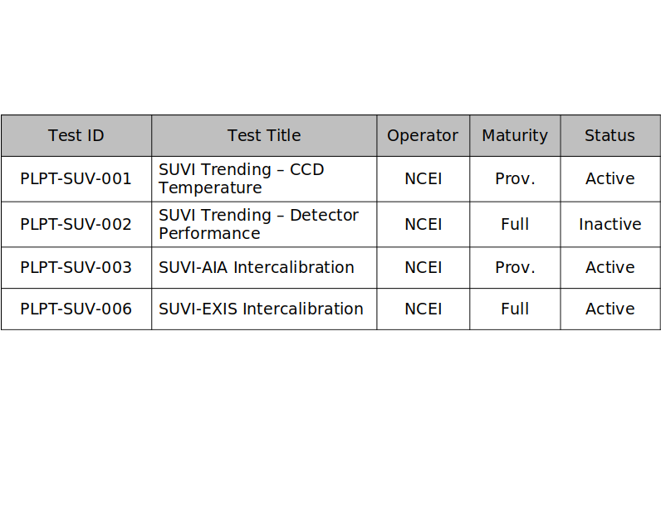
Ongoing
Ongoing
Ongoing
Ongoing
Trending activities use Ground System generated L1b products when possible.
PLPT-SUV-002 requires the use of L0 CCSDS data.
All PLPT activities have been successfully executed to date.

Slide 39
PLPT-SUV-001: CCD Temperature Trending
Demonstrated ability to extract and trend the SUVI detector temperatures

Slide 40
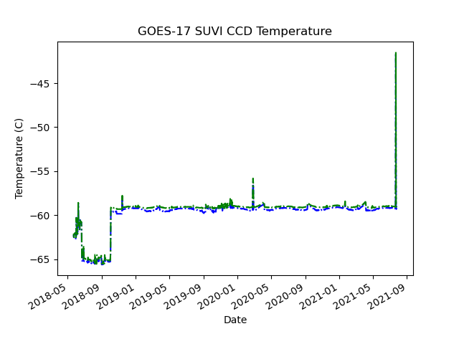
PLPT-SUV-001
SUVI CCD Temperature Trending
22 July 2021 - Bakeout
Notes:
Update graphic with G17 SUVI CCD temperatures

Slide 41
PLPT-SUV-002: Detector Performance
Extract key CCD characteristics and create trends to monitor the CCD performance
NCEI trends Dark Current, CCD Bias, and Read Noise.

Slide 42
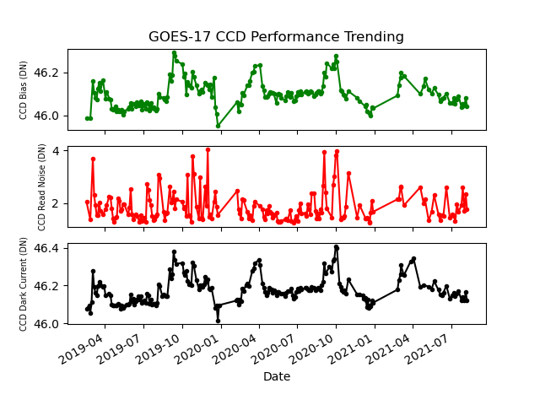
PLPT-SUV-002: Detector Performance
All detector performance quantities are very consistent over the time period shown.
Notes:
Update graphic.

Slide 43
PLPT SUVI-003: SUVI/AIA Intercomparison
Compares SUVI observations to the Atmospheric Imaging Assembly on NASA’s Solar Dynamics Observatory
Full image comparisons identify image defects/artifacts
Trend comparisons identify response degradation
Some differences in passbands between the two instruments introduce minor artifacts
Analysis is also supported by LM-ATC, LASP, Royal Observatory of Belgium, and others through international EUV solar instrument degradation working group
AIA has no 284 Å comparator channel
Notes:
PLPT SUVI-003: Dan and Alison to update analyses for G17 SUVI.

Slide 44
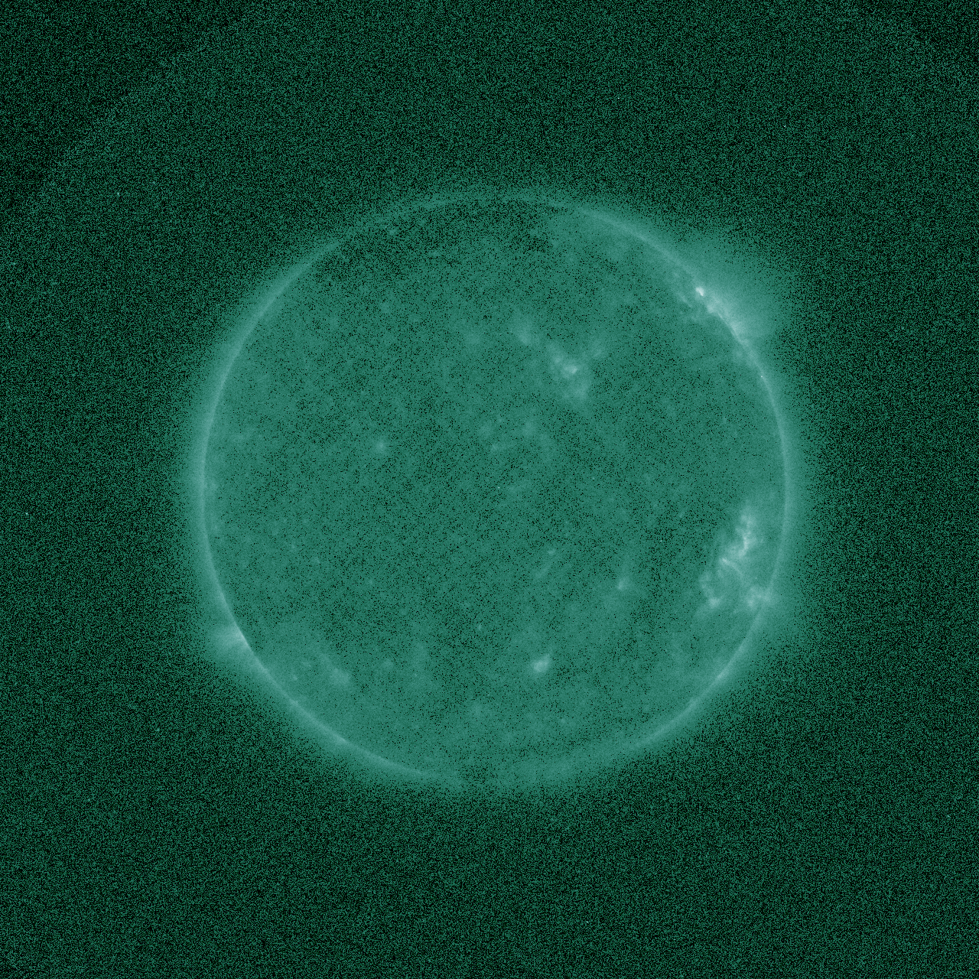
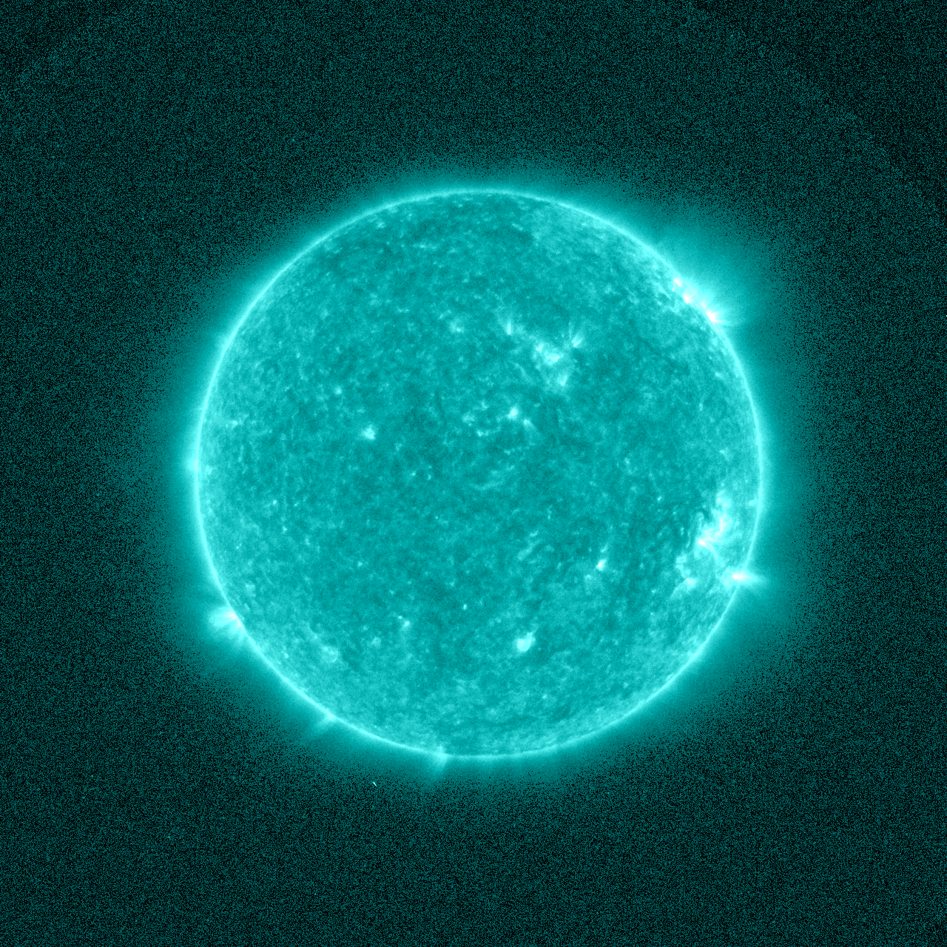
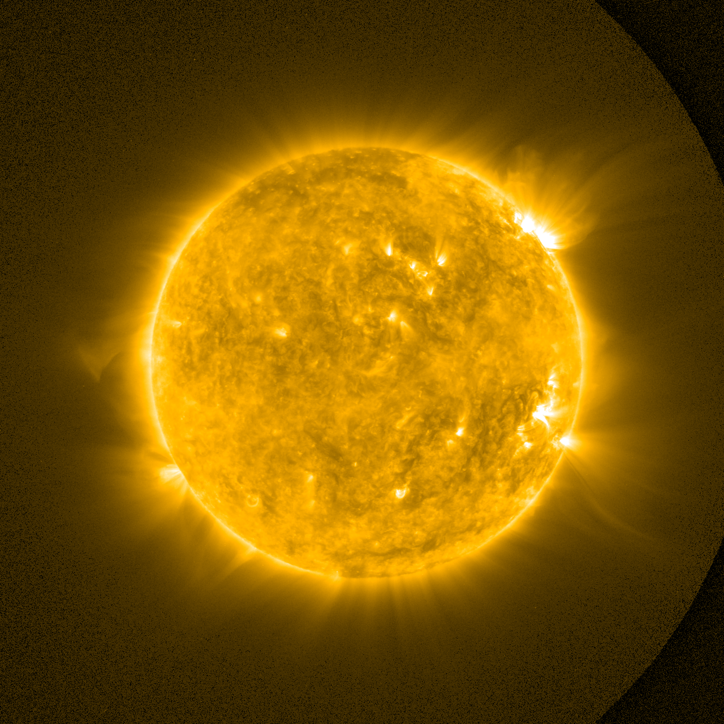
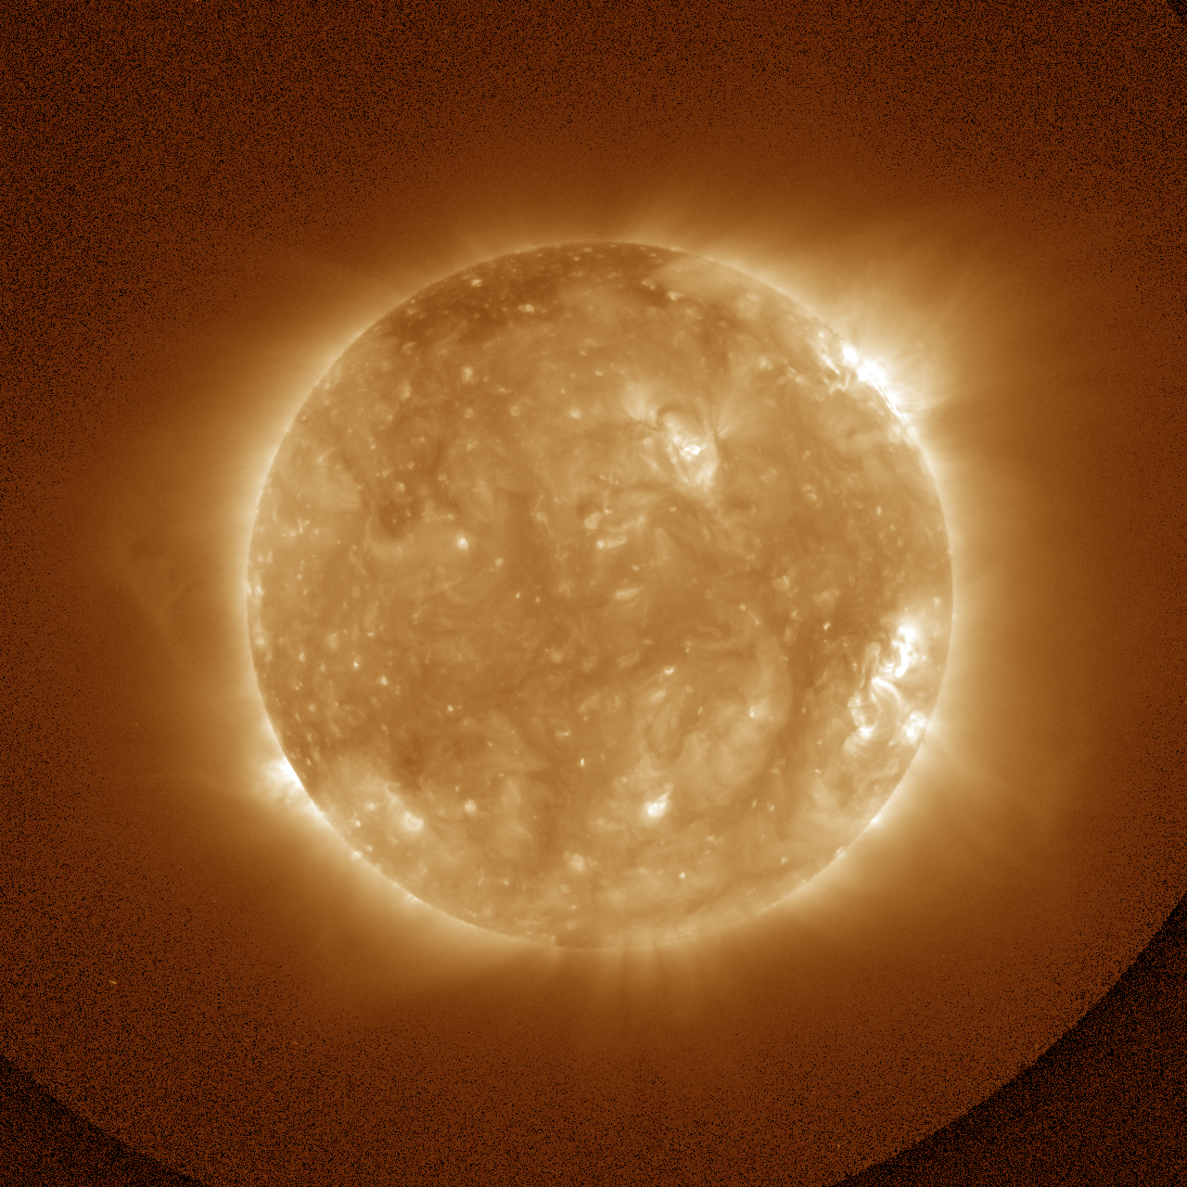
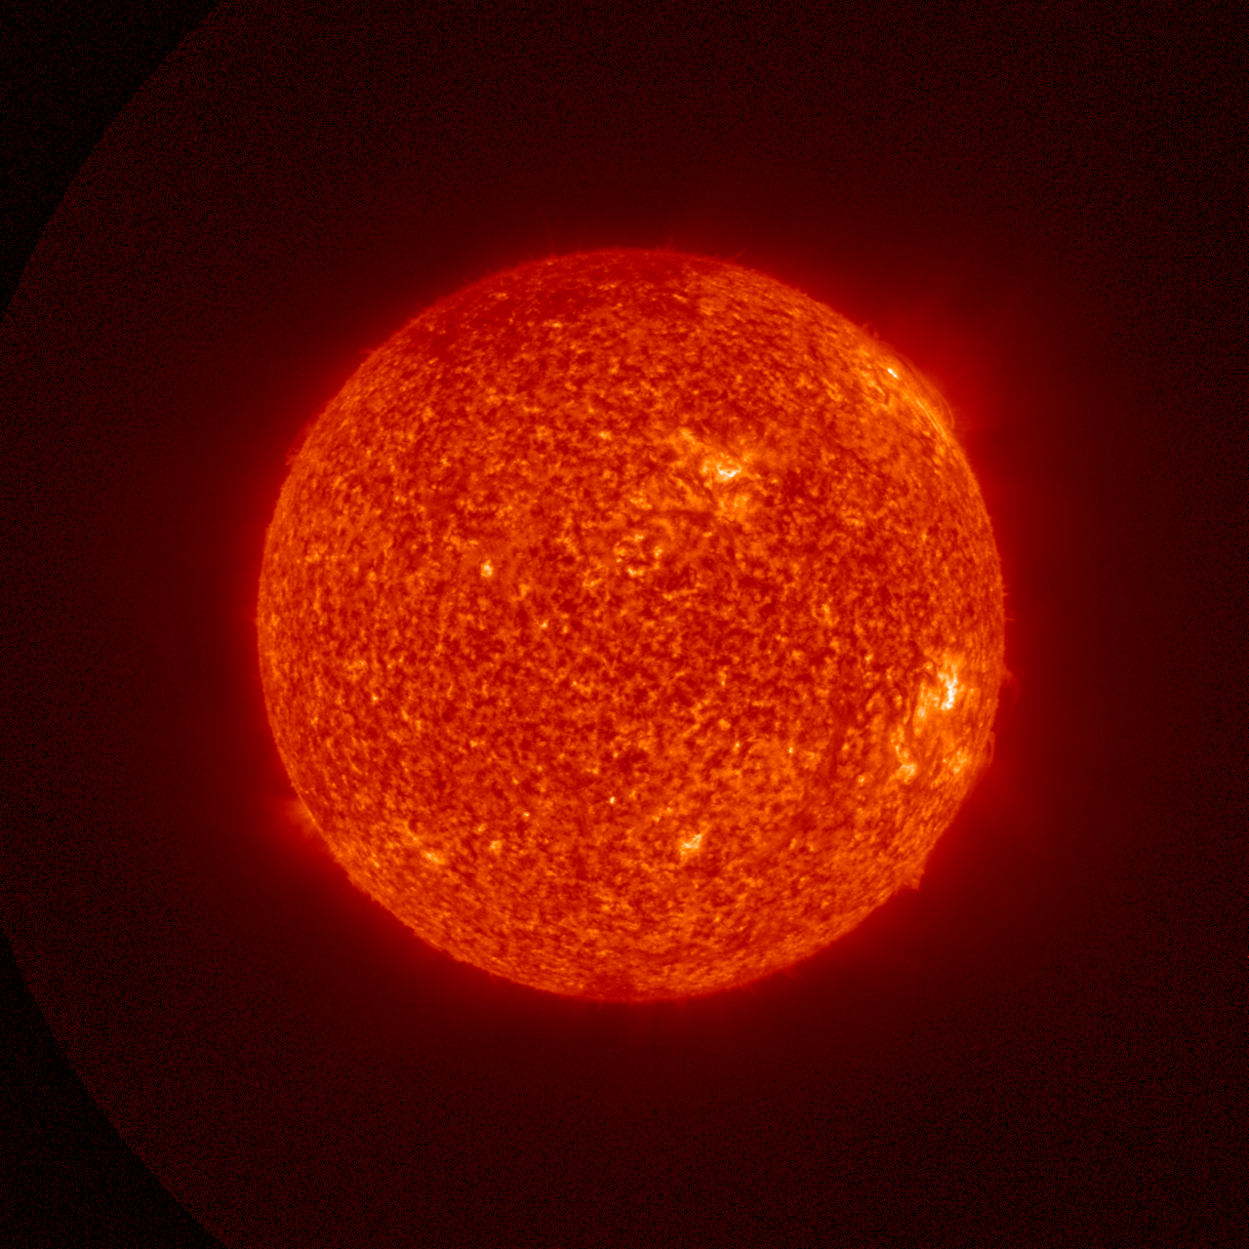
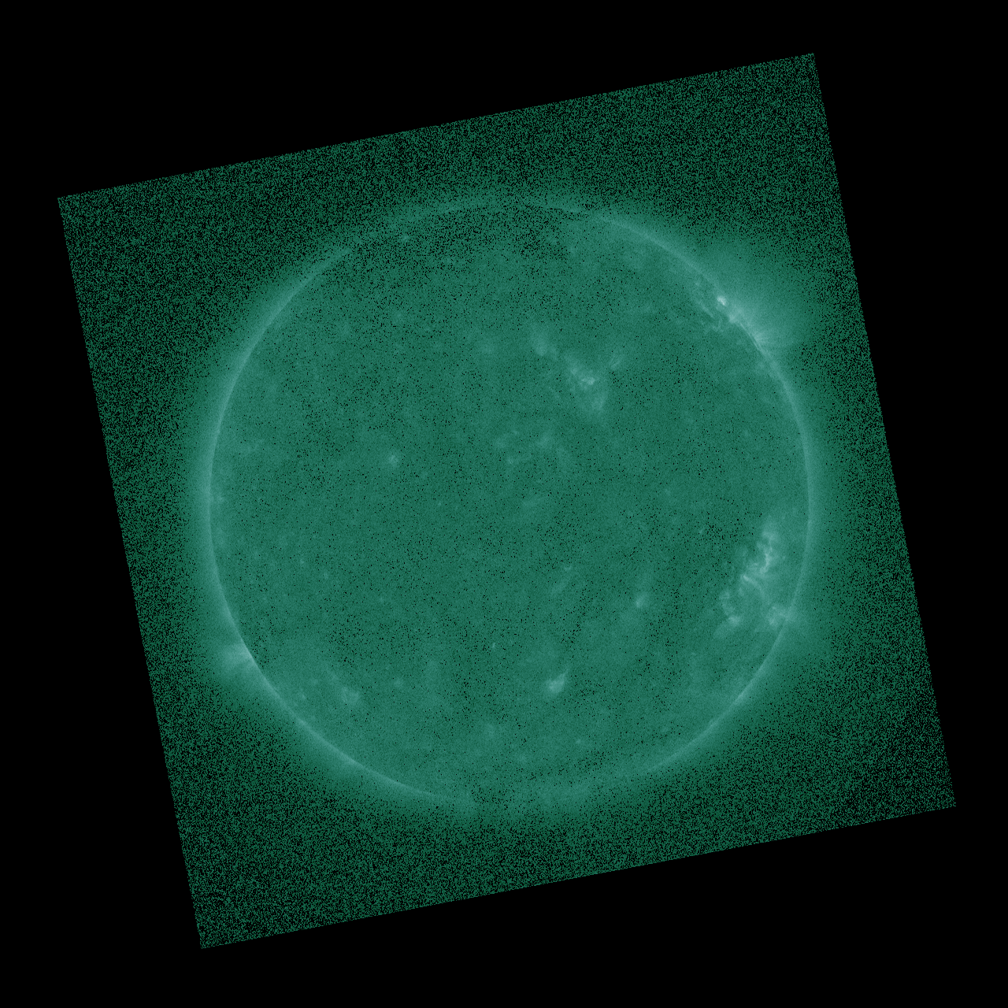
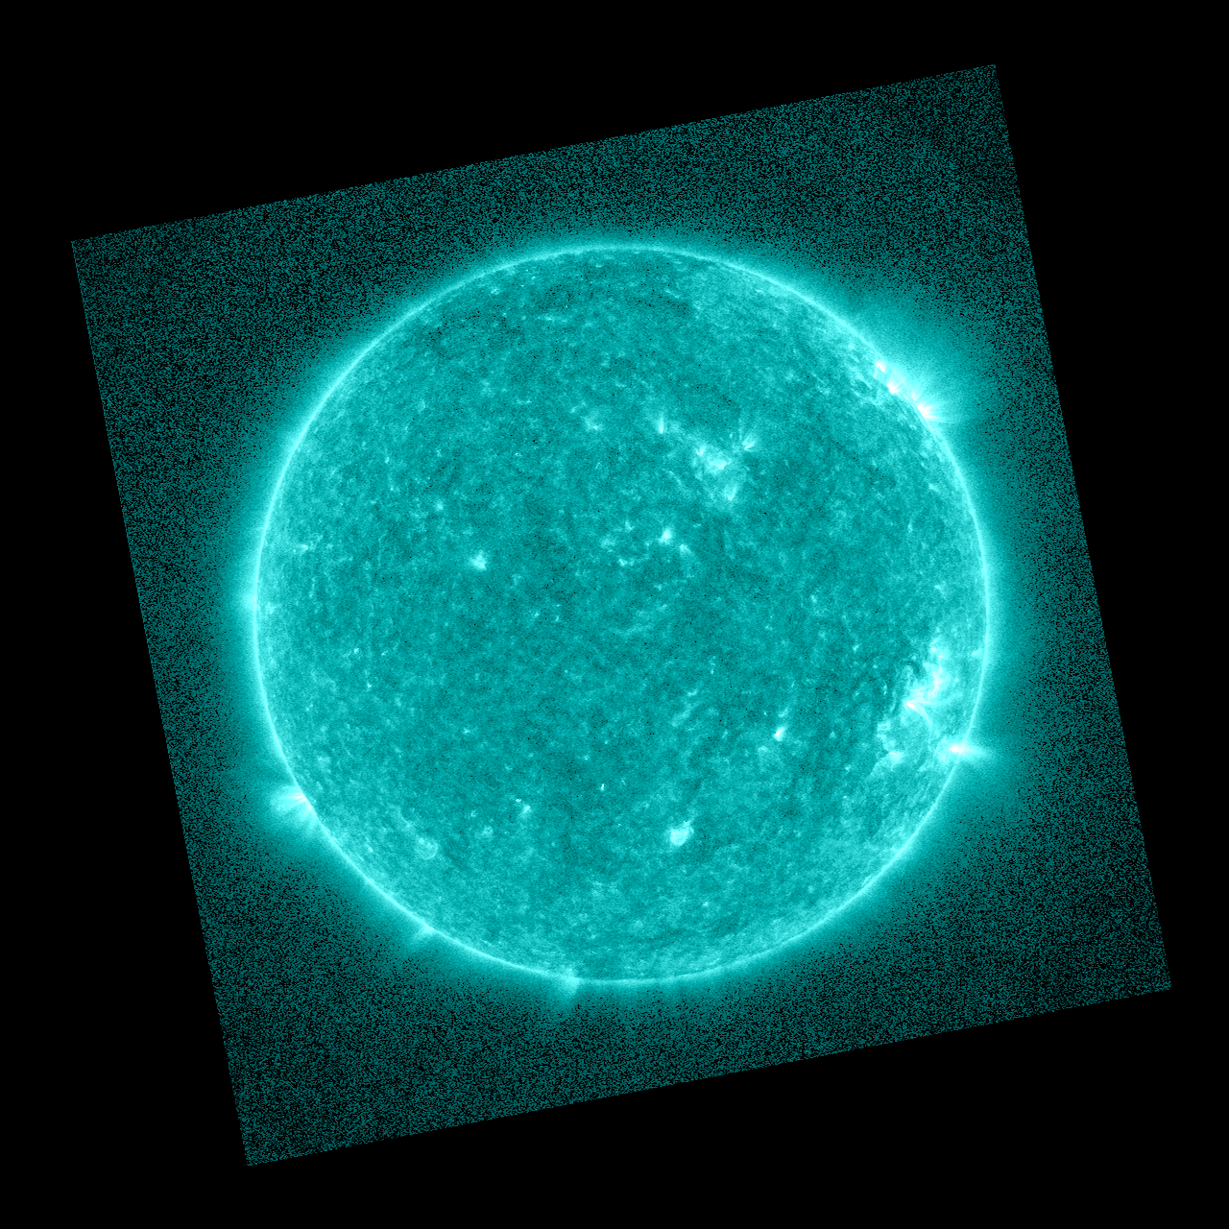
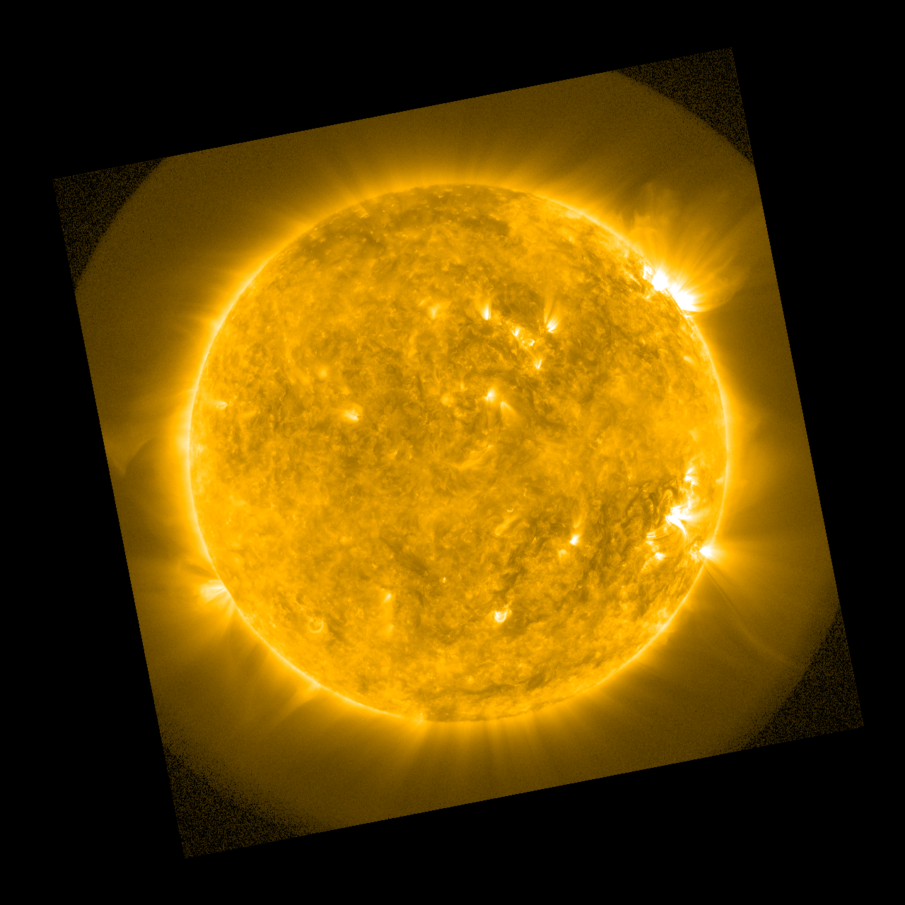
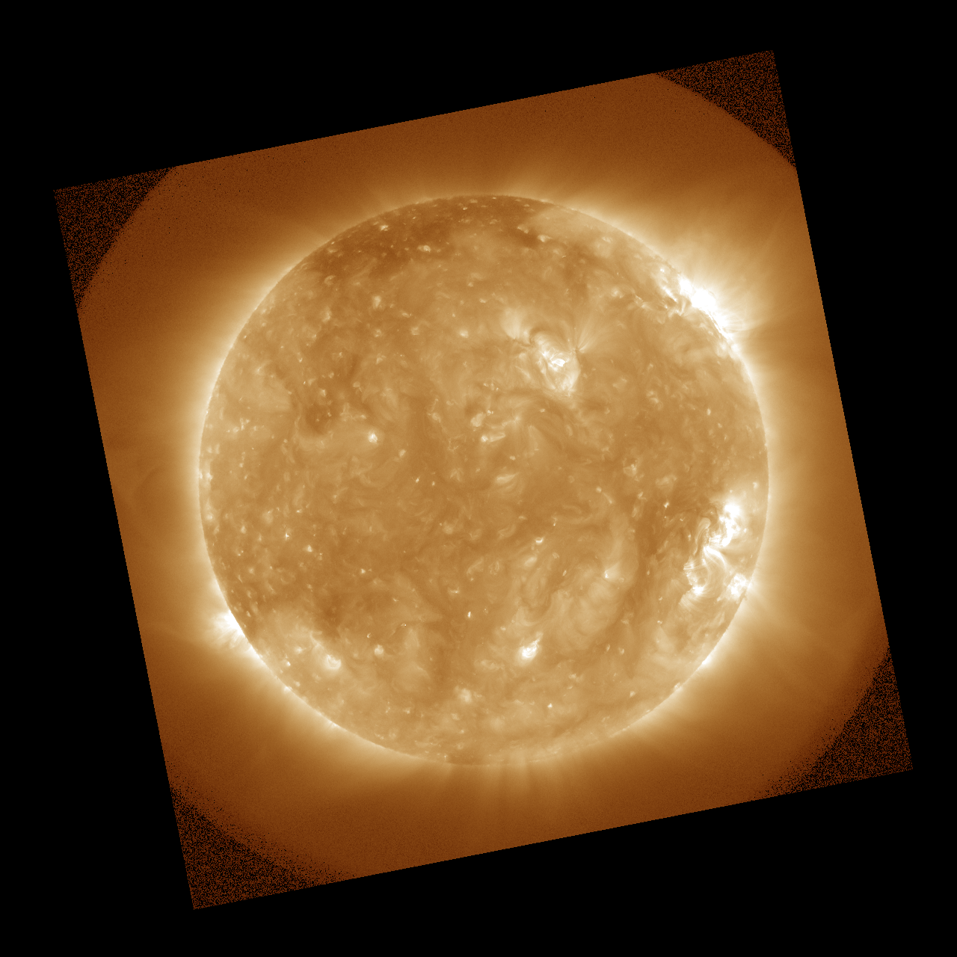
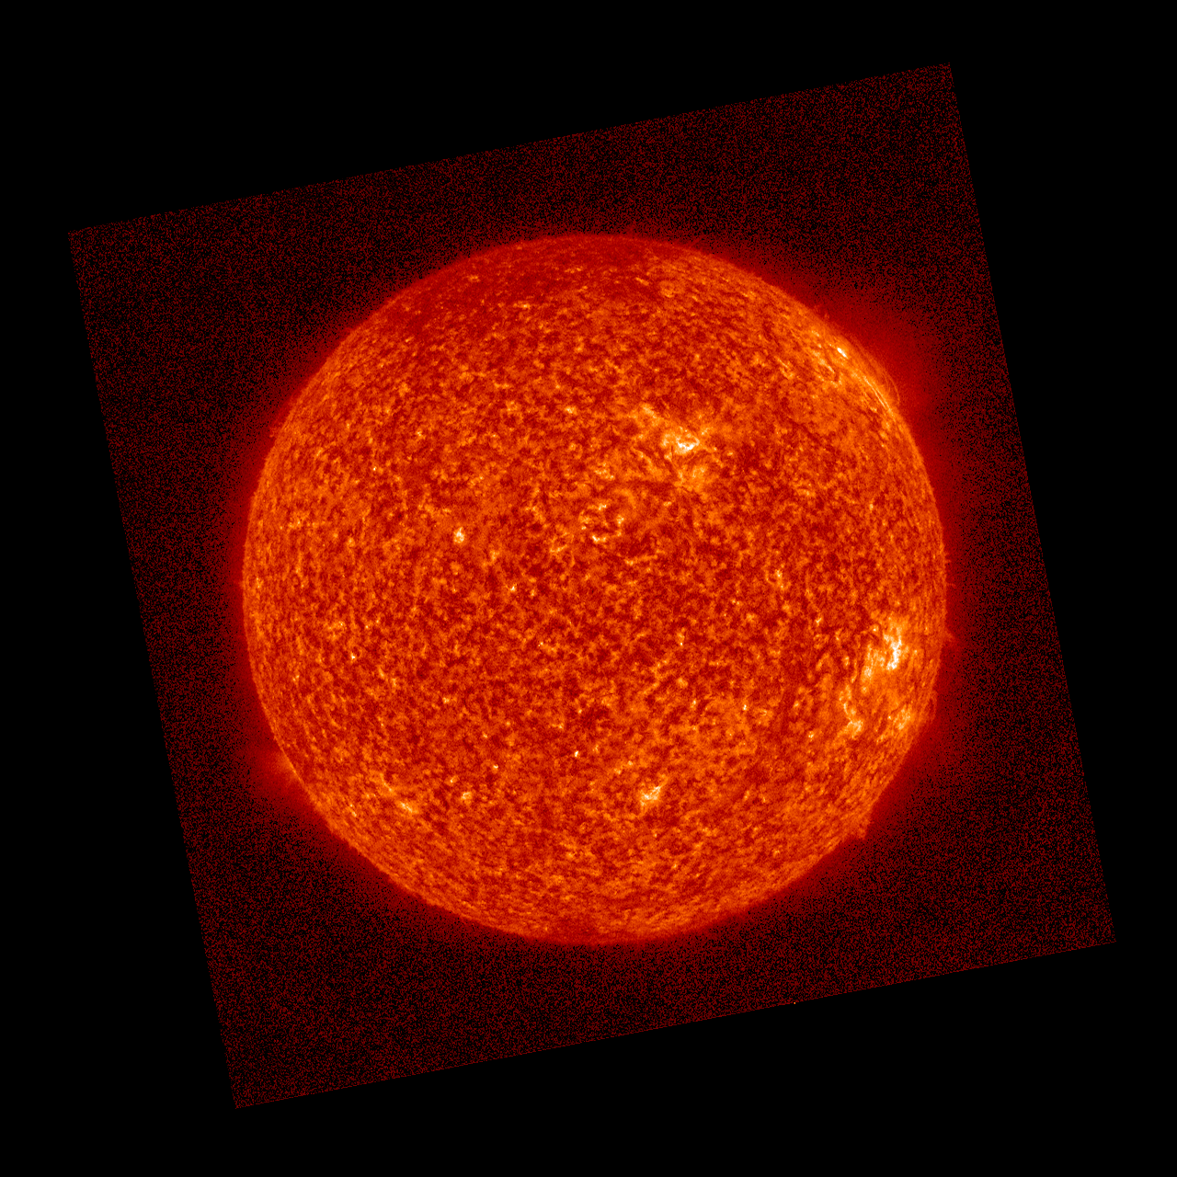
PLPT-SUVI-003: SUVI/AIA Intercalibration
Direct comparison of simultaneous images from SDO/AIA and GOES-16/SUVI can reveal image calibration issues as well is spatial defects.
SUVI
94 Å
131 Å
171 Å
195 Å
304 Å
AIA
2021 Aug 01 ~00:00 UT

Slide 45
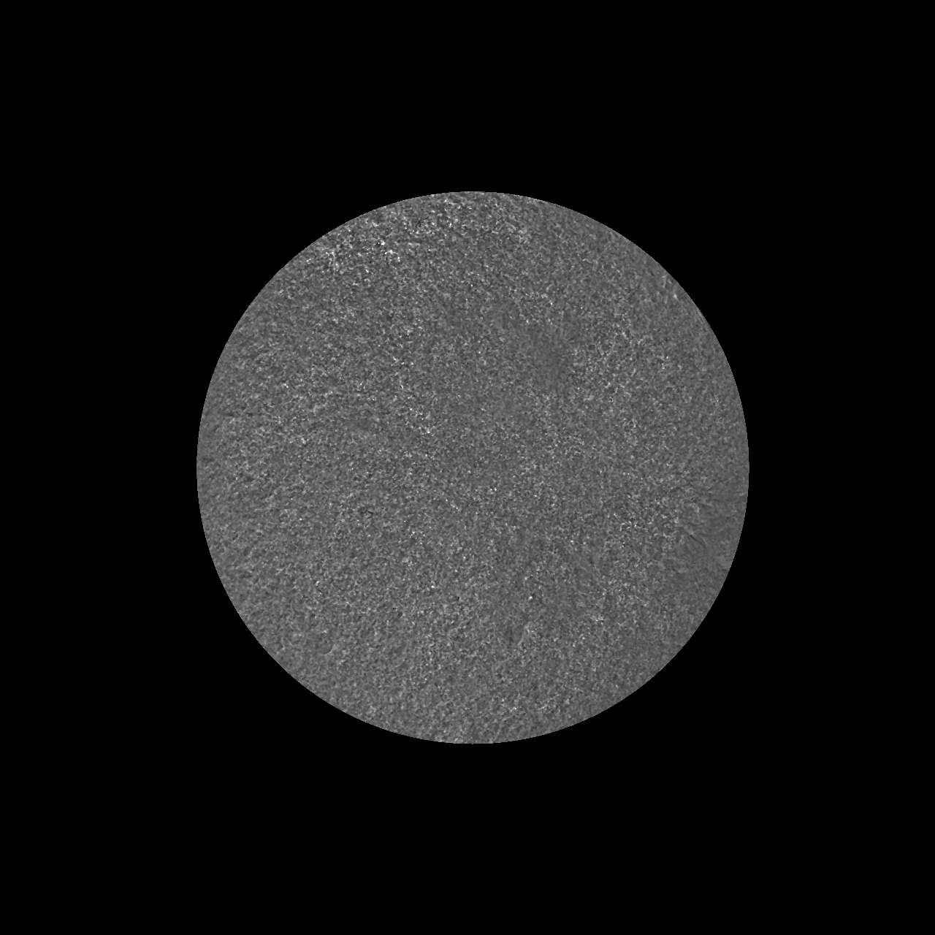
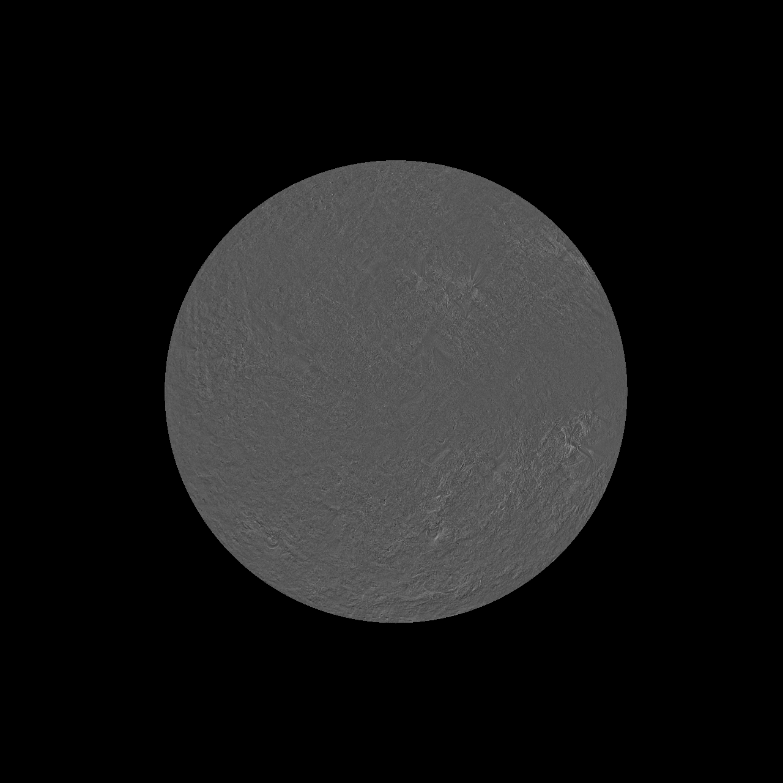
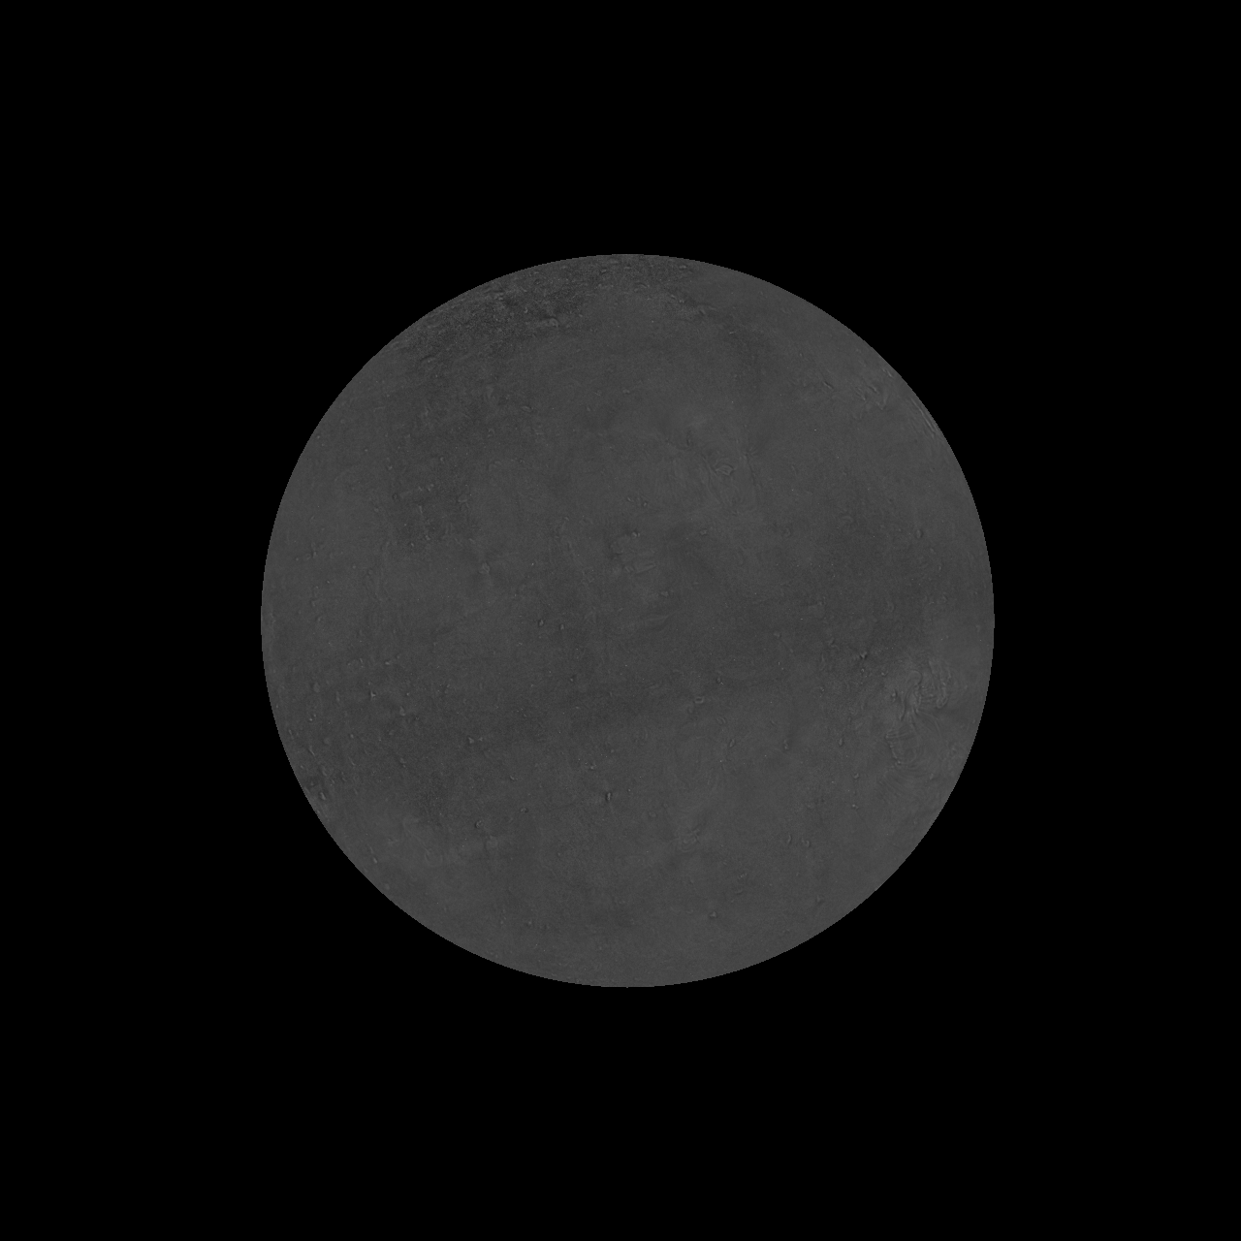
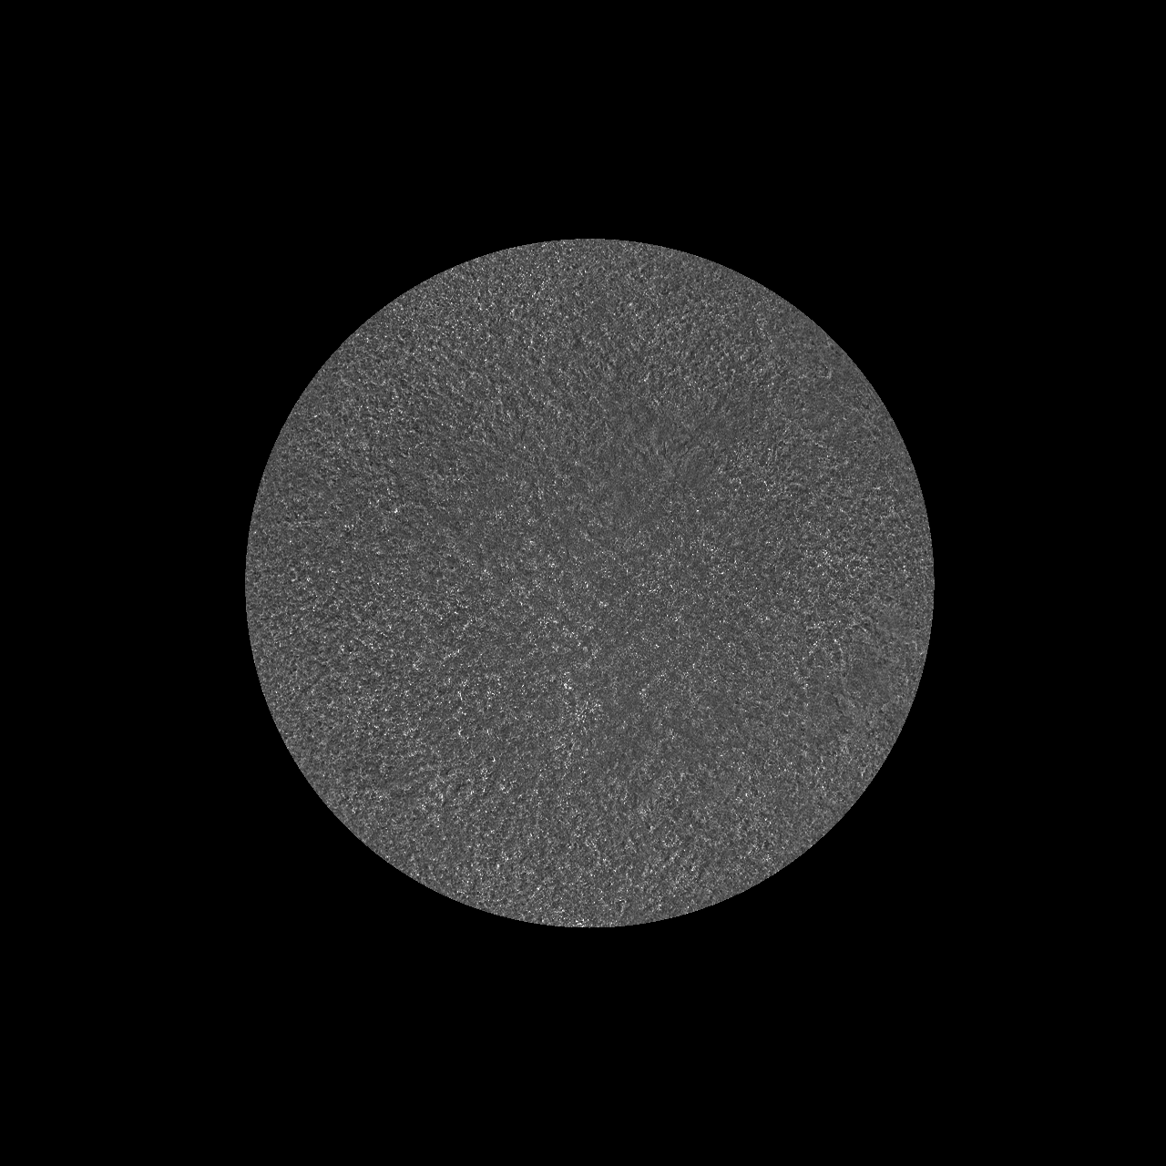
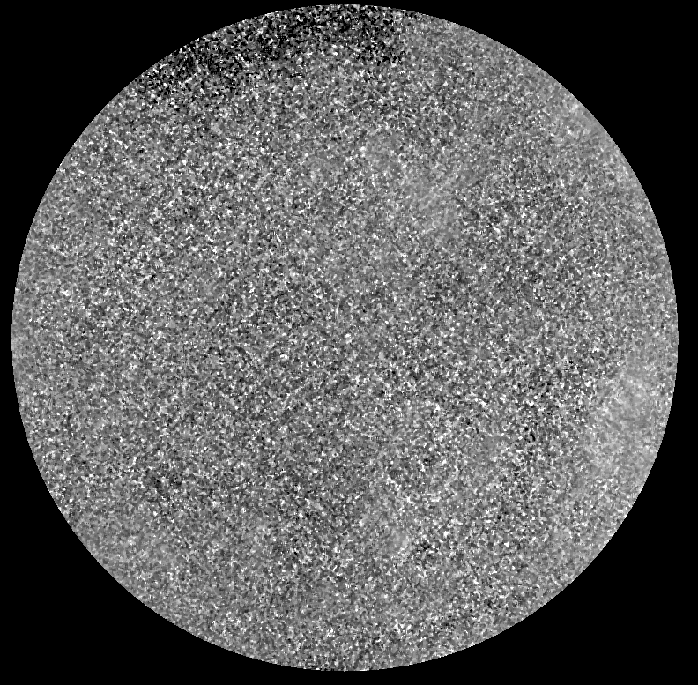
PLPT-SUVI-003: SUVI/AIA Intercalibration
Image ratios reveal flat response up to known passband differences and no large defects.
131 Å
171 Å
195/193 Å
304 Å
94 Å channel ratio shows a distinctive grid pattern. This is caused by uncorrected contributions from the 94 Å light leak and the shadow effect of the filter support grid.
Flat ratios indicate good SUVI/AIA agreement.

Slide 46
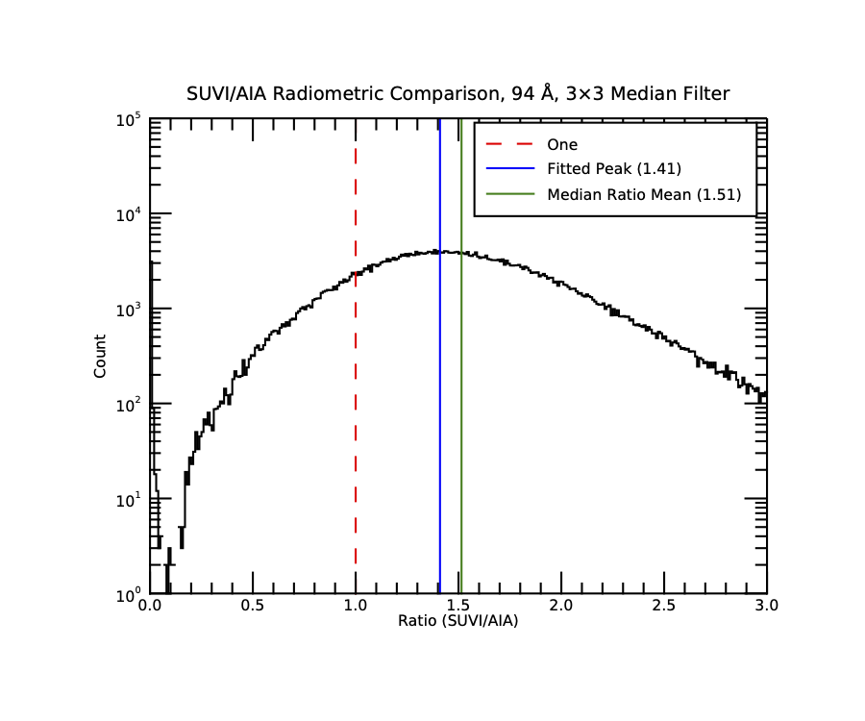
PLPT-SUVI-003: SUVI/AIA Intercalibration
Ratio histograms highlight any differences in response over range of radiances. Useful for identifying anomalies in pixel-to-pixel comparisons.
94 Å - Estimated theoretical ratio based on passband analysis: 1.07
Light leak artifacts prevent meaningful quantitative comparison of SUVI and AIA observations.

Slide 47
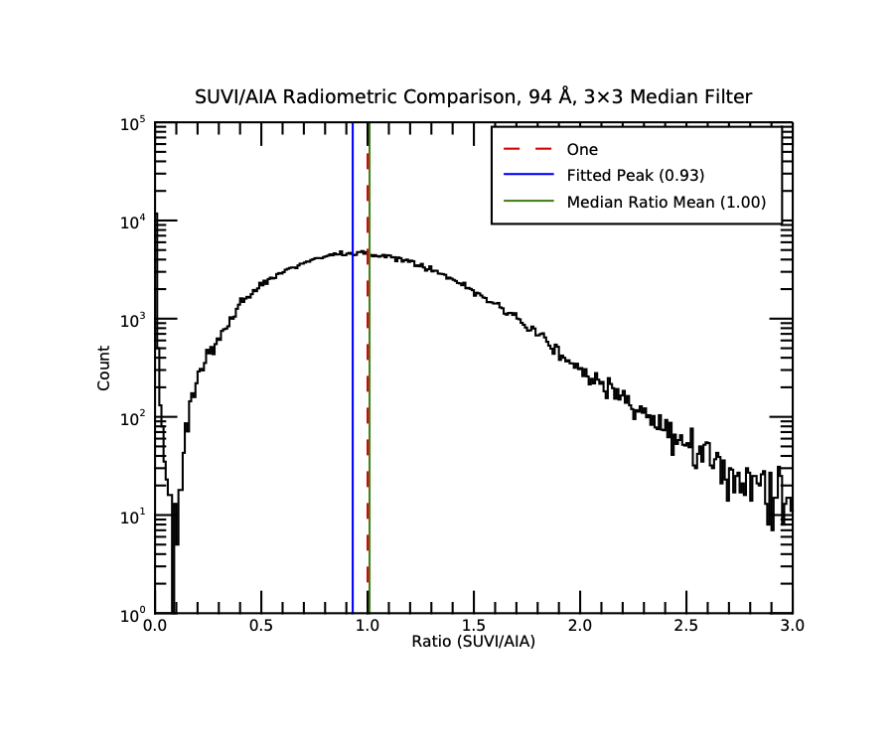
PLPT-SUVI-003: SUVI/AIA Intercalibration
Note: We can characterize the effects of the light leak with this technique. Compare 94 Å GOES-16 and GOES-17 histograms. 17 exceeds the expected theoretical ratio while 16 does not, and has an extended bright tail that is not present in 16.
GOES-17 SUVI 94 Å
GOES-16 SUVI 94 Å

Slide 48

PLPT-SUVI-003: SUVI/AIA Intercalibration
Ratio histograms highlight any differences in response over range of radiances. Useful for identifying anomalies in pixel-to-pixel comparisons.
131 Å - Estimated theoretical ratio based on passband analysis: 1.19
Overall good agreement, asymmetric tail probably results from high temperature response differences

Slide 49

PLPT-SUVI-003: SUVI/AIA Intercalibration
Ratio histograms highlight any differences in response over range of radiances. Useful for identifying anomalies in pixel-to-pixel comparisons.
171 Å - Estimated theoretical ratio based on passband analysis: 1.04
Very good agreement, passbands are very similar and imager performance is very uniform.

Slide 50

PLPT-SUVI-003: SUVI/AIA Intercalibration
Ratio histograms highlight any differences in response over range of radiances. Useful for identifying anomalies in pixel-to-pixel comparisons.
195 Å - Estimated theoretical ratio based on passband analysis: 0.87
Narrow distribution indicates imager performance is very uniform. Significant passband differences between the two instruments.

Slide 51

PLPT-SUVI-003: SUVI/AIA Intercalibration
Ratio histograms highlight any differences in response over range of radiances. Useful for identifying anomalies in pixel-to-pixel comparisons.
304 Å - Estimated theoretical ratio based on passband analysis: 0.98
Reasonable agreement, long tail results from off-peak high-temperature contributions in SUVI that are not present in AIA observations.
Summary: SUVI/AIA comparisons reveal no significant problems. Additional analysis using 2021 rocket data will refine the intercalibration of the two instruments.

Slide 52

PLPT-SUVI-003: SUVI/AIA Intercalibration
GOES-17 SUVI Integrated Responses
The intensity signals are dominated by solar activity. Solar Cycle 25 began in ~Dec 2019.
No observable objects can provide a standard candle to calculate absolute degradation for these EUV observations.
We calculate ratios of SUVI to AIA, to remove solar cycle variation.
Notes:
No external absolute reference!

Slide 53

PLPT-SUVI-003: SUVI/AIA Intercalibration
94 Å
Degradation not estimated due to the light leak

Slide 54

PLPT-SUVI-003: SUVI/AIA Intercalibration
131 Å
Total estimated degradation 13%
Estimated degradation per year ~4%

Slide 55

PLPT-SUVI-003: SUVI/AIA Intercalibration
171 Å
Total estimated degradation 2%
Estimated degradation per year <1%
ECI campaign

Slide 56

PLPT-SUVI-003: SUVI/AIA Intercalibration
195 Å
Total estimated degradation <2%
Estimated degradation per year <1%
ECI campaign

Slide 57

PLPT-SUVI-003: SUVI/AIA Intercalibration
304 Å
Total estimated degradation 16%
Estimated degradation per year 5%

Slide 58
Further Supporting Evidence in Back-Up Slides

Slide 59
PLPT-SUV-006
SUVI-EXIS Intercomparison
Straight ratio comparison of EXIS-EUVSA 284 and 304Å spectral irradiance measurements to SUVI 284 and 304Å channels.
GOES-16 EXIS-EUVSA products reached Provisional Maturity on 25 September 2019, with critical fixes applied to the Ground System on 10 December 2019.
  Subsequent GS-produced Level-1b and NCEI-reprocessed data can be used for SUVI trending.
SUVI and EXIS are very different instruments, and work is needed to achieve an apples-to-apples comparison.
Notes:
Jon to update this section

Slide 60

PLPT-SUV-006
SUVI-EXIS Intercomparison

Slide 61

PLPT-SUV-006
SUVI-EXIS Intercomparison

Slide 62

PLPT-SUV-006
SUVI-EXIS Intercomparison
SUVI/EXIS comparison of the 304 channel shows a slow degradation, not quite linear.
Circled area was the original data, which has been adjusted upwards to compensate for the shift in calibration post-drift.

Slide 63

PLPT-SUV-006
SUVI-EXIS Intercomparison
Assuming a linear trend, total degradation when compared against G16 EXIS-EUVSA is ~15%
~5% degradation per year.

Slide 64

PLPT-SUV-006
SUVI-EXIS Intercomparison
SUVI/EXIS comparison of the 284 channel hints at some degradation. The change in the calibration parameters LUT causes confusion, and so is omitted from the degradation trending.

Slide 65

PLPT-SUV-006
SUVI-EXIS Intercomparison
Assuming a linear trend from calendar year 2019, total degradation when compared against G16 EXIS-EUVSA is ~10%
~4% degradation per year.

Slide 66
GOES-17 SUVI Degradation vs. Comparator Instruments
Wavelength | Comparator Instrument | Estimated Degradation Rate per year compared with the listed instrument | Total Estimated Degradation compared with the listed instrument
94 | AIA/SUVI | N/A | N/A
131 | AIA/SUVI | 3.8% | 13%
171 | AIA/SUVI | <1% | 2%
195 | AIA/SUVI | <1% | <2%
284 | EUVS-A | 4% | 10%
304 | AIA/SUVI EUVS-A | 5% 4.7% | 16% 15%
Notes:
Rocket underflights for SDO delayed due to COVID-19! Rates are considered good for EUV solar instruments. (AIA 304 is > 99% degraded)

Slide 67
GOES-17 SUVI X-flare Linearity

Slide 68


2021 July 3 X1.5 Flare | 94 & 131 Å
94 & 131 Å are most important flare passbands | contour = where saturation occurs

Slide 69

2021 July 3 X1.5 Flare | 94 Å
Key Observations:
Some saturation in long exposure
Discrepancies between long & short exposures likely due to light leak
Given above, reasonable agreement across all 3 image types
Estimated saturation for a bright, compact flare: >X50 (flare exposure)

Slide 70

2021 July 3 X1.5 Flare | 131 Å
Key Observations:
Significant saturation in long exposure
Good agreement in unsaturated frames across all 3 image types
Max short exposure radiance <10% of saturation level
Estimated saturation for a bright, compact flare: >X20

Slide 71
GOES-17 SUVI Extended Coronal Imaging Campaign

Slide 72


Example: 2021 April Campaign
3
2
1
0 R☉
1
3
2
1
0 R☉
1
Campaign successfully gathered 3-panel mosaic images in 171 & 195 Å passbands.

Slide 73

2021 SUVI ECI CME Detections
Two notable coronal mass ejections (CMEs) in SUVI & LASCO
2021 Apr 29 16:30 UT
2021 April 30 12:34 UT
SUVI barely missed one CME that began just after April 30 15 UT campaign end.
Both SUVI CMEs were detected by LASCO CACTus¹ automated CME tool
1 http://sidc.oma.be/cactus/catalog/LASCO/2_5_0/qkl/2021/04/latestCMEs.html

Slide 74
Summary & Outlook
Three successful ECI campaigns on GOES-17 (2018, 2019, 2021)
ECI has not caused measurable impacts to SUVI instrument performance, but does disrupt operational data stream
First results in Nature Astronomy, DOI:10.1038/s41550-021-01427-8
ECI assessment and planning activities in development between OPPA (lead), NCEI, and SWPC. Future campaigns will:
  generate statistics (especially for halo CMEs) to assess ECI’s gap-filling capability
  enable further development of automated event detection tools
  inform development of next-generation EUV instrumentation

Slide 75
GOES-17 SUVI Full Maturity PS-PVR
Full Maturity Assessment

Slide 76
GOES-17 SUVI Performance Baseline Status
MRD ID | Description | Requirement | Results of NCEI Analysis | Status
2045 | Pointing Accuracy | 3’ | << 2.5” y, << 2.5” z | PASS
2046 | Product Pointing Knowledge | 2.5” | << 2.5” y, << 2.5” z | PASS
2052 | Long-term Stability (Product Measurement Precision in Radiance) | 30% | ≤ 22% | PASS*
Pointing requirements are well met.
NCEI has demonstrated with trending that the degradation of instrument response is slow, stable, and correctible.
* Cannot confirm for GOES-17 SUVI 94Å channel
76

Slide 77
GOES-R Full Maturity Criteria
Preparation Activity | Assessment
Validation, quality assessment, and anomaly resolution activities are ongoing. | NCEI continues to assess and diagnose issues with instrument performance and product quality. The anomaly resolution process is used as appropriate and involves NCEI’s participation in resolution and validation through the AART.
Incremental product improvements may still be occurring | Major product anomalies (ADR1059/1159) have been fully characterized and are unresolved. Some minor product issues, and some have the potential to impact operations. NCEI and MIT-LL are both working to further improve the SUVI L1b product.
Users are engaged and user feedback is assessed | NCEI engages with NWS/SWPC, and has ongoing efforts to engage scientific data disseminators such as VSO, SunPy, and Helioviewer.

Slide 78
GOES-R Full Maturity Criteria
End State | Assessment
Product performance for all products is defined and documented over a wide range of representative conditions via ongoing ground truth and validation efforts. | Long-term trending activities has allowed for the assessment of the GOES-17 SUVI across a variety of solar conditions. As allowed, the SUVI instrument are compared against other well-calibrated instruments including SDO calibration rocket underflights (Latest flight 9/9/2021).
Products are operationally optimized, as necessary, considering mission parameters of cost and schedule, as compared to user expectations. | Product optimization, such as LUT updates to calibration parameters, will occur as needed to maintain the SUVI L1b product.
All known product anomalies are documented, and shared with the user community. | All known product anomalies are documented within this presentation and within the L1b README documents.
Product is operational. | Yes, and is operationally leveraged through IDP and SPADES L2 product generation and at SWPC (9/1/2021).

Slide 79
GOES-17 SUVI Full Maturity PS-PVR
Summary of SUVI Product Status

Slide 80
Priorities for GOES-17 SUVI Level-1b
No impact to Operations or Full Validation Status:
  Update degradation correction coefficients
    Leverage SDO Rocket Underflight data as available (9/9/2021).
  Further improvements and bug fixes to SUVI Level-1b metadata (ADR 1021, 1121)
  Define a process for updating the SUVI observing sequence that addresses SWPC’s operational needs going forward.

Slide 81
Summary of GOES-17 SUVI Readiness for Full Maturity Status
The GOES-17 SUVI is providing data to NWS/SWPC in an operational capacity.
Trending activities demonstrate that the GOES-17 SUVI instrument performance is understood and corrections to the instrument degradation can be applied.
NCEI is actively engaging with NWS/SWPC and the wider scientific community.
NCEI affirms that all known Ground System and instrumental issues prohibitive to Full Validation Maturity for the GOES-17 SUVI have been resolved or have a clearly defined path forward.
NCEI affirms that all criteria for Full Validation Maturity have been met by the GOES-17 SUVI for channels 131, 171, 195, 284, and 304.

Slide 82
Summary of GOES-17 SUVI Readiness for Full Maturity Status
NCEI recommends the Review Panel withhold Full Validation Maturity Status from the GOES-17 SUVI 94Å channel.
  Upon confirmation that the changes to the GPA and Image sequence are successfully implemented, NCEI will draft a signed memo to recommend “Full” status
  The README will stress that the GOES-17 94Å data should not be used until the light leak is mitigated.
NCEI recommends to the Review Panel that Full Validation Maturity Status be considered for the GOES-17 SUVI channels 131, 171, 195, 284, and 304.

Slide 83
Reference and Back-up Slides

Slide 84
Throughput Discrepancy - Backup Slides

Slide 85


Slide 86


Slide 87


Slide 88


Slide 89
SUVI/AIA Intercomparison - Backup Slides

Slide 90

PLPT-SUVI-003: SUVI/AIA Intercalibration
GOES-16 SUVI 131Å Trending
Fe XXII Flare Line
SUVI and AIA agree the least in this channel with disagreements up to 10%. This is largely due to a flaring line seen more in SUVI channel than AIA

Slide 91

PLPT-SUVI-003: SUVI/AIA Intercalibration
GOES-16 SUVI 304Å Trending
The differences between the AIA and SUVI passbands result in differences, but differences remain with ~5%.

Slide 92

94 Å
Transparent dots show original data prior to correcting for inconsistent calibrations, such as LUT changes and discontinuities due to mini bakeouts after instrument resets
SUVI 17:
-2018/11/14 (effective area LUT change)
AIA:
-2021/2/19 (calibration change)

Slide 93

131 Å
Note: transparent dots overlap solid dots pre-2019
SUVI 17:
-2018/11/14 (effective area LUT change)
AIA:
-2018/6/8 (calibration change)
-2021/2/19 (calibration change)

Slide 94

171 Å
SUVI 16:
-2019/4/26 (reset/bakeout)
-2020/1/25 (reset/bakeout)
SUVI 17:
-2018/11/14 (effective area LUT change)
-2021/7/22 (reset/bakeout)
AIA:
-2020/7/24 (calibration change)

Slide 95

195 Å
SUVI 16:
-2019/4/26 (reset/bakeout)
-2020/1/25 (reset/bakeout)
SUVI 17:
-2018/11/14 (effective area LUT change)
-2021/7/22 (reset/bakeout)

Slide 96

304 Å
SUVI 16:
-2019/4/26 (reset/bakeout)
-2020/1/25 (reset/bakeout)
SUVI 17:
-2018/11/14 (effective area LUT change)
-2021/7/22 (reset/bakeout)
AIA:
-2018/6/8 (calibration change)
-2021/2/19 (calibration change)

Slide 97


PLPT-SUVI-003: SUVI/AIA Intercalibration
GOES-16 SUVI 94Å Trending
Trending shows close agreement for this channel.

Slide 98

PLPT-SUVI-003: SUVI/AIA Intercalibration
GOES-16 SUVI 171Å Trending
Trending shows close agreement for this channel.

Slide 99


PLPT-SUVI-003: SUVI/AIA Intercalibration
GOES-16 SUVI 195Å Trending
The passband differences (top-left plot) result in less agreement (within 5%) between AIA and SUVI.

Slide 100

304 Å
AIA 304 channel degradation around 75% in first 4 years

