Slide 1
GOES-17 SUVI PS-PVR
SWPC User Perspective
Steven Hill
NOAA/NWS Space Weather Prediction Center

Slide 2
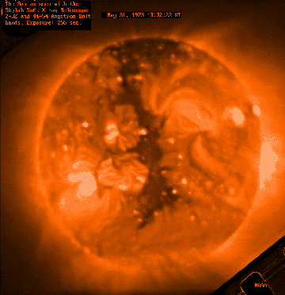
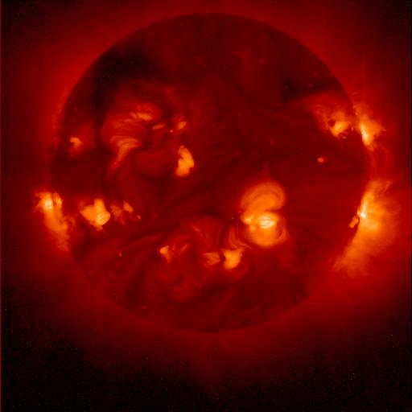
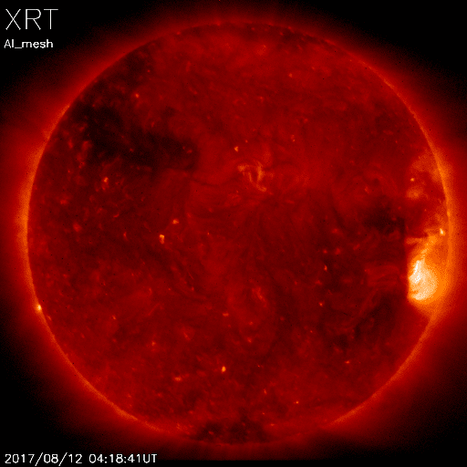
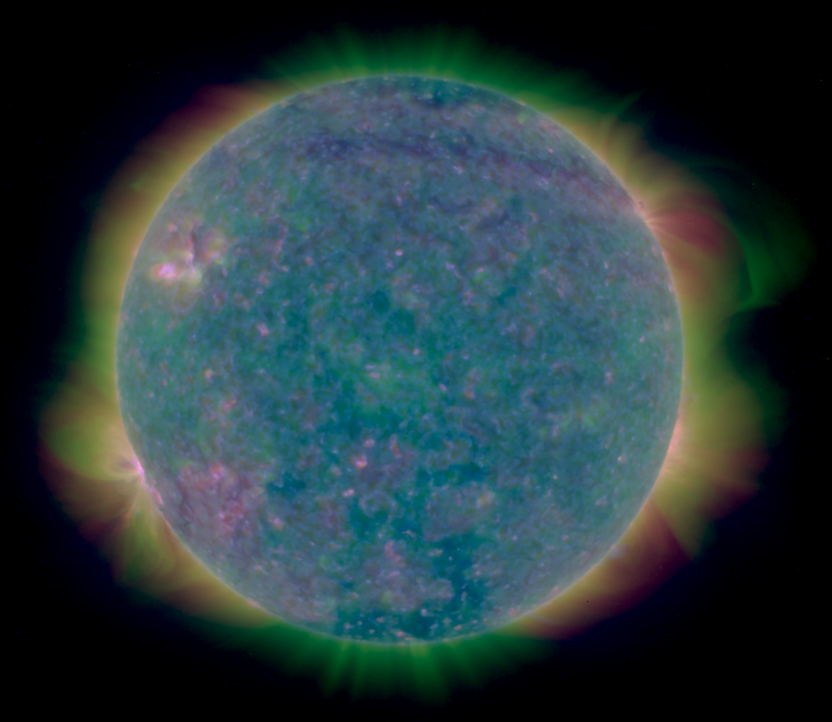
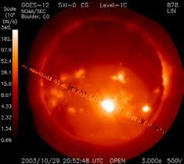
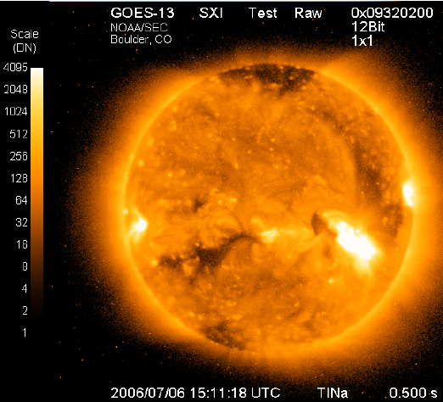
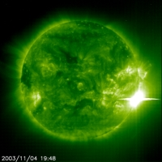
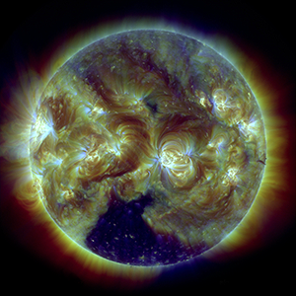
Heritage
Skylab
1973-74
Yokoh 1991-2001
Hinode
2006-
GOES 12
2001-2007
GOES 13-15
2006-2020
SUVI
SOHO EIT
1996-
SDO AIA
2010-
Notes:
First proposed GOES X-ray imager in 1970s
First formal study for what became GOES-12 SXI started in 1980s

Slide 3
Forecast Applications
Provide advance warning of solar activity
  “Over the horizon” look at active regions rotating onto the Earth-facing side of the sun
Provide warning of recurring geomagnetic storms
  Tracking coronal holes as they rotate across the solar disk
Provide warning of non-recurring geomagnetic storms
  Identify, locate, and characterize eruptions (flares, coronal mass ejections)
Provide warning of solar radiation storms
  Identify, locate, and characterize eruptions (flares, coronal mass ejections)
Assess solar flaring probability
  Intensity and complexity of solar active regions

Slide 4
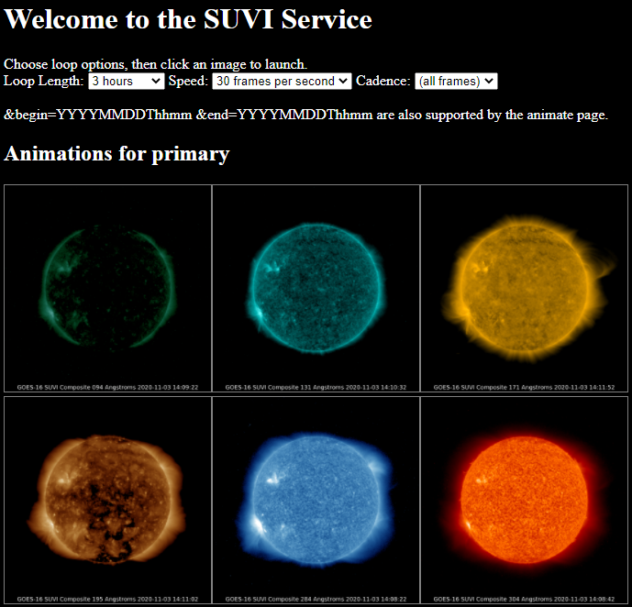
Data
Used primarily for situational awareness
Auto updating loops with selectable
  Duration: 3 hrs to 8 days
  Speed: 10 to 60 fps
  Cadence: 4 min to daily

Slide 5
Data Products
Product | Wavelength (nm) | Uses | Features and Temperature (K)
Composite Images | 9.4 | Flare location | Flares ~6x10⁶ K
 | 13.1 | Flare location | Flares ~6x10⁶ K and ‘hot’ flares ~15x10⁶ K
 | 17.1 | Active region characterization | Active regions ~6x10⁵ K
 | 19.5 | Active region characterization and flare location | Active regions ~1x10⁶ K and ‘hot’ flares ~20x10⁶ K
 | 28.4 | Coronal hole location and characterization | Coronal Holes (~2x10⁶ K)
 | 30.4 | Filament location and characterization | Filaments (~6x10⁴ K)
Thematic Map | All | Supervised pixel classifier | All
Notes:
SWPC doesn’t use the L1b products

Slide 6
GOES 16-17 SUVI Status
GOES 16 SUVI is the primary EUV imager for operations
GOES 17 SUVI was brought into operational service at SWPC and to the public on August 24, 2021
SWPC now has fully redundant solar EUV imaging
In addition, NASA’s SDO AIA imager provides backup, non-operational EUV imaging

Slide 7
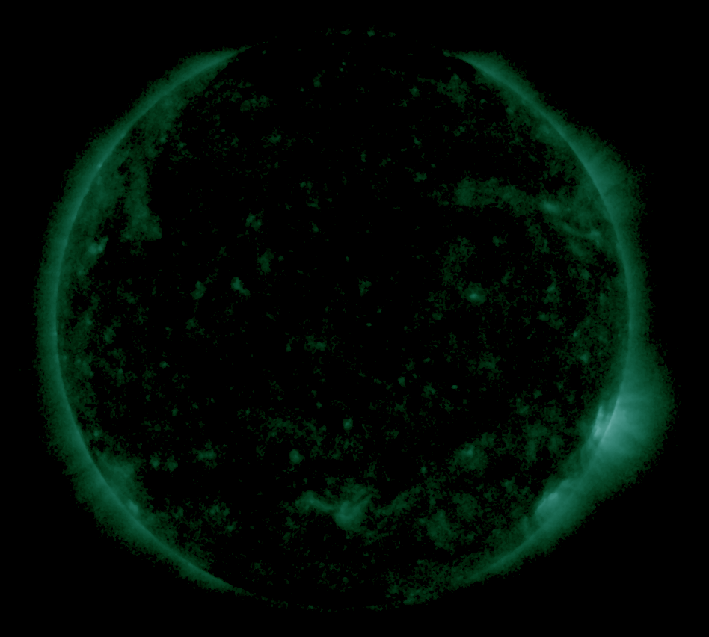
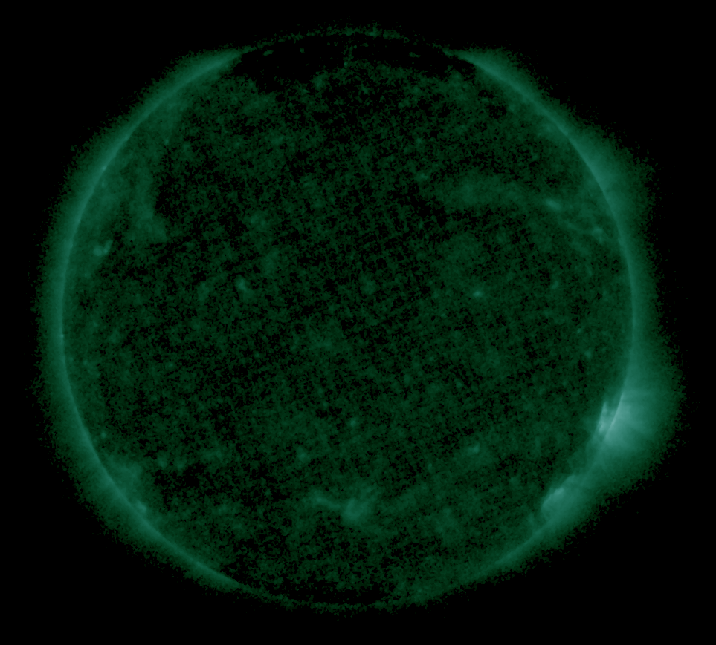
9.4 nm light leak
GOES-16
GOES-17

Slide 8
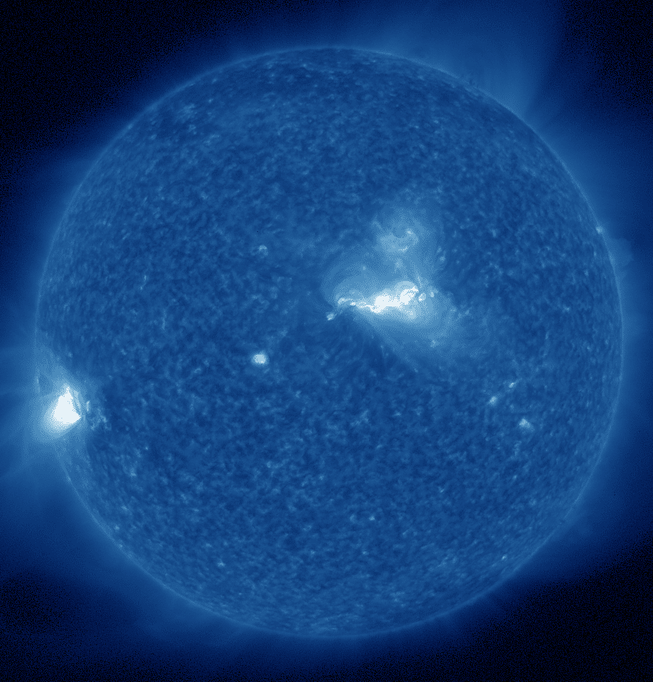
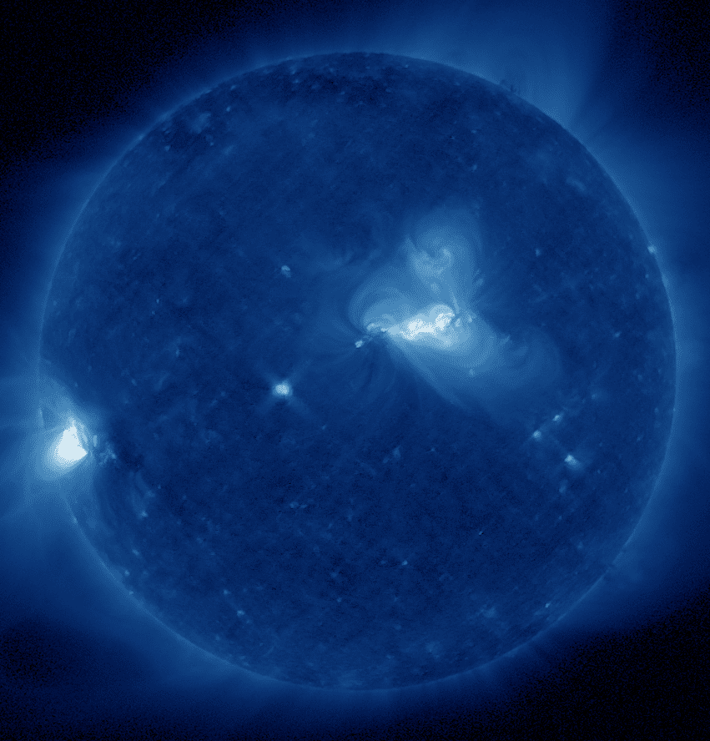
Channel Cross-Talk
30.4nm -> 28.4nm cross-talk

Slide 9
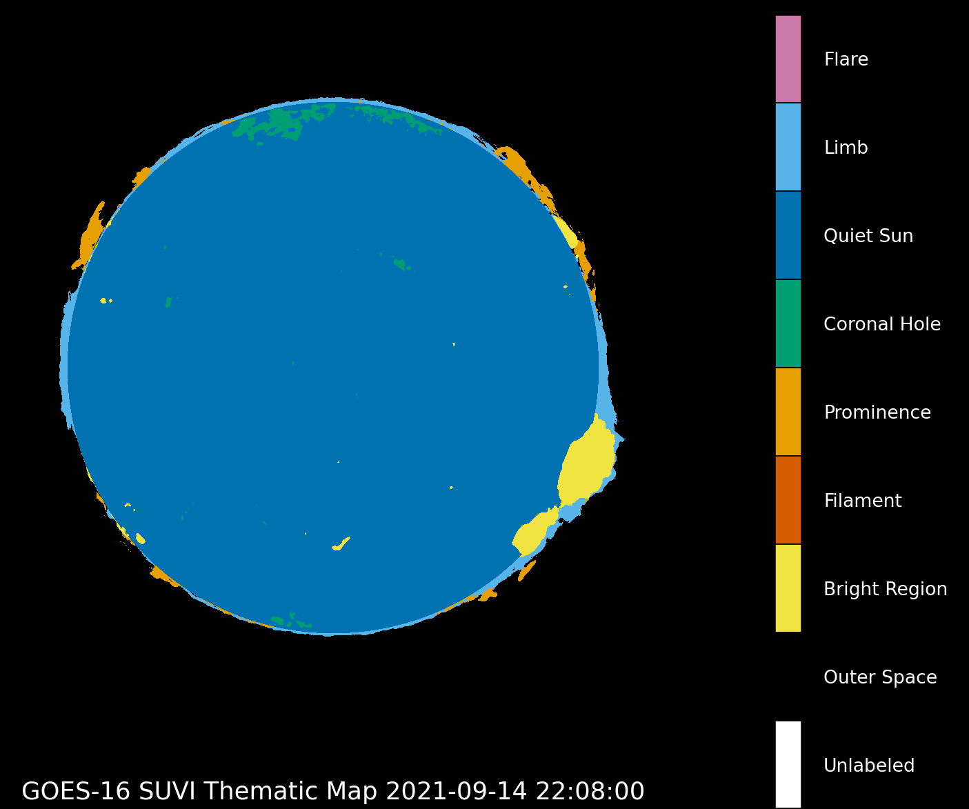
Thematic Map Improvements

Slide 10
Summary
GOES-17 SUVI is a success
  Minor product issues/features exist
  Meets the operational needs of SWPC
NCEI & Program persistence in overcoming issues and improving products

