Slide 1



GOES-17 Solar Ultraviolet Imager (SUVI)
Provisional PS-PVR
2019 May 14
Jonathan Darnel, Dan Seaton
GOES-R Calibration Working Group
CIRES, Univ. of Colorado & NOAA NCEI

Slide 2
AGENDA
SUVI Instrument Overview
Review of Beta Maturity
Product Quality Evaluation
  General approach
  Major Issues Remaining
Provisional Maturity Assessment
Path to Full Validation Maturity
  Issues and status
  PLPT
  Risks
Summary and Recommendations

Slide 3
Commonly-Used Acronyms (CUAs)
ADR : Algorithm Discrepancy Report
AIA : Atmospheric Imaging Assembly
CCD : Charged-Couple Device
EUV : Extreme UltraViolet
EXIS : EUV and X-ray Irradiance Sensor
FITS : Flexible Image Transport System
LUT : Look-Up Table
OMAS : Operational Metadata Aggregation Service
SDO : Solar Dynamics Observatory
SUVI : Solar UltraViolet Imager
WR : Work Request

Slide 4
SUVI Instrument & Products Overview

Slide 5
SUVI OVERVIEW

Slide 6
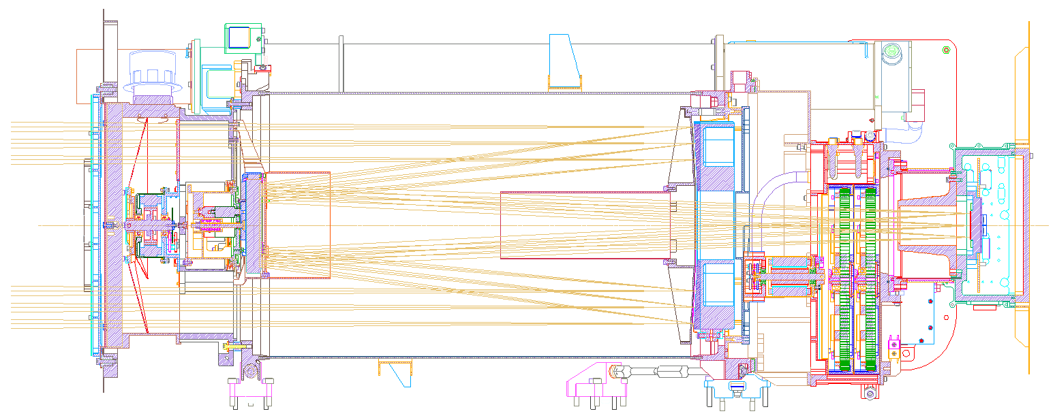
Entrance Filter
Primary Mirror
Secondary Mirror
Focal Plane Filters
CCD
Detector

Slide 7
Key SUVI Imager Requirements
Pointing knowledge: <2.5 arcsec
Pointing accuracy & stability: <0.5 arcsec
Field of view: >42×42 arcmin
Spatial resolution: <5 arcsec square pixels
Ensquared energy: >50% in 7×7 arcsec
  (43% for 94 Å bandpass)

Slide 8
Key SUVI Imager Characteristics
1280×1280 pixels
2.5 arcsec pixels, 53.5×53.3 arcmin FOV
14-bit CCD detector
Entrance aperture selector – 6 positions
2 Filter wheels:
  FW1: Open, Thin Al & Zr, Thick Al & Zr
  FW2: Glass, Open, Thin Al, Thin Zr, Thick Al
4-photodiode guide telescope for pointing

Slide 9
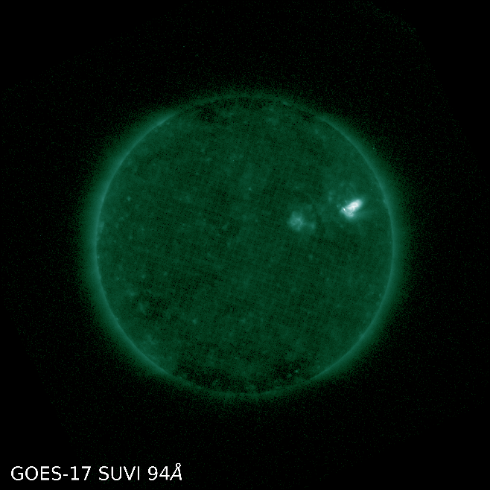
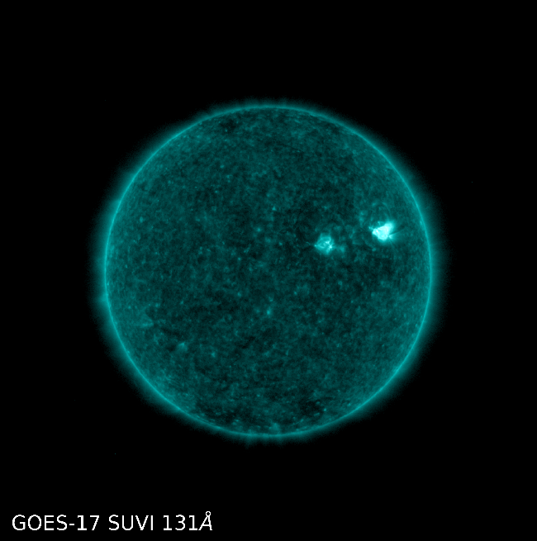
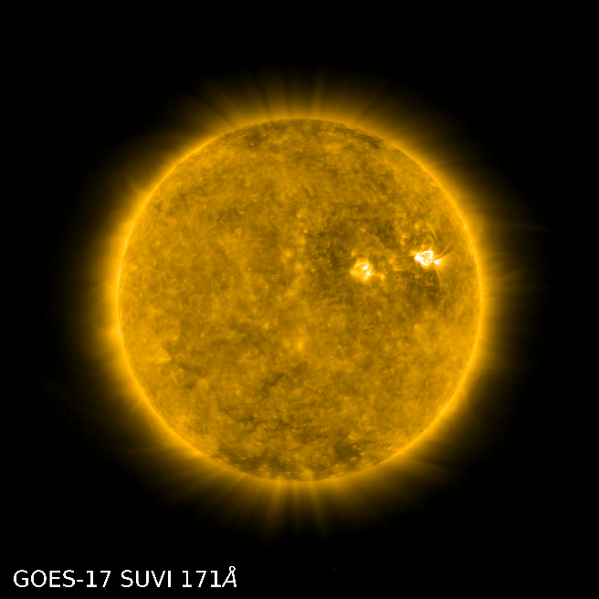
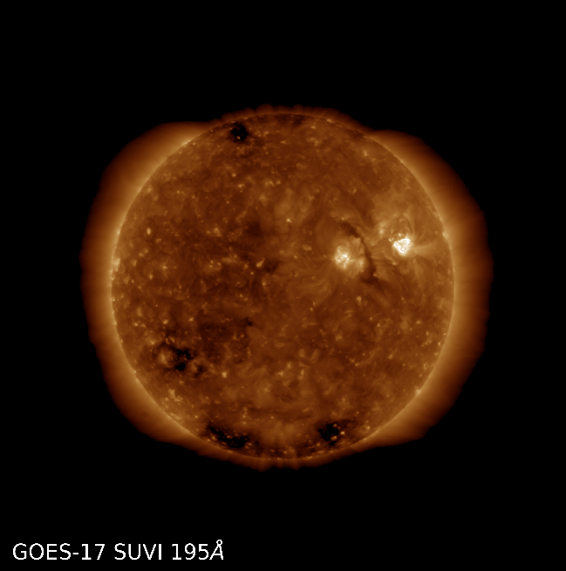
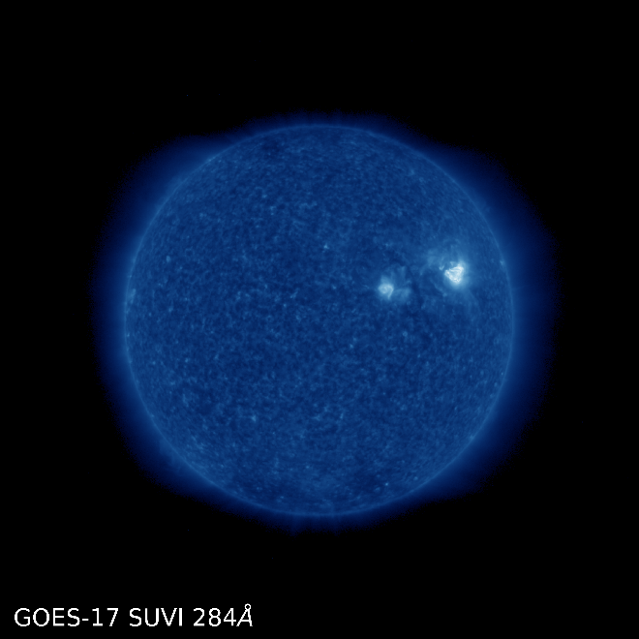
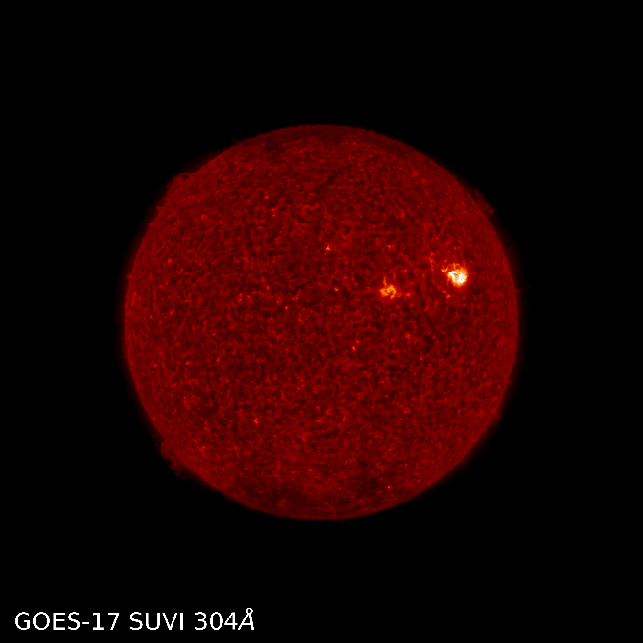
SUVI Channels
Data from March 21, 2019

Slide 10
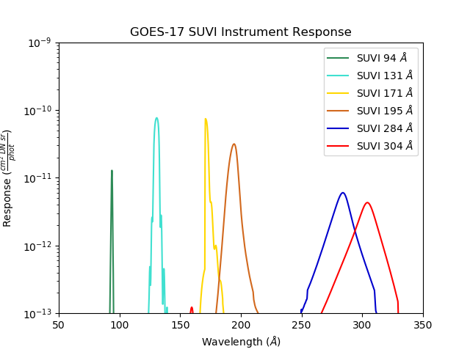
SUVI Spectral Response Functions
Computed using data from: SUVP-RP-11-2696_CDRL_079_FM2_FilterTransmissionFit.xlsx,
SUVP-RP-12-3699 -Rev B CDRL 074A Appendix – FM2_Throughput_Component_Data_V1.xlsx
Notes:
SUVI Response as a function of wavelength computed from several documents

Slide 11
File Formats:
netCDF vs. FITS
The SUVI L1b product is produced in both netCDF and FITS formats
The standard file format for the astrophysical community is FITS
NWS/SWPC and NCEI Level-2 algorithms expect FITS files
NCEI-CO considers the SUVI L1b FITS product as the standard, and these data are used for PLPT activities.

Slide 12
Current Look-up Table Filenames
Calibration:
SUVI_CalibrationParameters(FM2A_CDRL79Rev-_PR_07_00_04_NCEI_20181010)-594709000.0.h5
INR:
September 2018-March 2019:
SUVI_NavigationParameters(FM2A_CDRL79Rev-_PR.07.07.01)-602238100.0.xml
March 2019-present:
SUVI_NavigationParameters(FM2A_CDRL79Rev-_PR.07.07.01)-602236600.0.xml

Slide 13
Review of Beta Maturity

Slide 14
Path to Provisional Maturity
Resolve major GPA concerns.
Verify solutions to issues raised during PLT are resolved.
Fully validate L1b after major outstanding calibration issues (darks, flats) are resolved.
Upload revised calibration tables.
Six PLPTs to validate instrument calibration and performance, intercalibrate with other instruments.
Daily, weekly and quarterly calibrations underway.
Provisional maturity date currently set for May 14.
Notes:
Four items totally complete, two are semi-complete. We obviously missed the provisional deadlines described here.

Slide 15
Risks to Reaching Provisional at Beta PS-PVR
Risk | WR | Build | Impacts | Resolution in PLPT
Sun Center Pixel Values | 6456 | -- | Yaw flips will break INR. LUT updates | None
Missing columns and rows | -- | -- | None. To date, this has been observed only on GOES-16 SUVI. This is retained due to a lack of root cause and similar hardware/GPA between the instruments. | None.
SUVI FM2 LUT update | -- | -- | Incorrect radiometric values in L1b. Completed | None. Execute LUT update.
Images require despiking | 6709 | DO.08.01 | Unwanted noise in SUVI images | None (can apply a filter for L2+ products until L1b resolution)
Headers need additional instrument response metadata | 4551 4538 | DO 08.00 | Interferes with image analysis | ADR 311 Workaround: Can be reported via SUVI SolarSoft IDL and SunPy tools (still to be developed)
FITS headers do not provide units | 3012 | DO 08.00 | User confusion | ADR 311
15

Slide 16
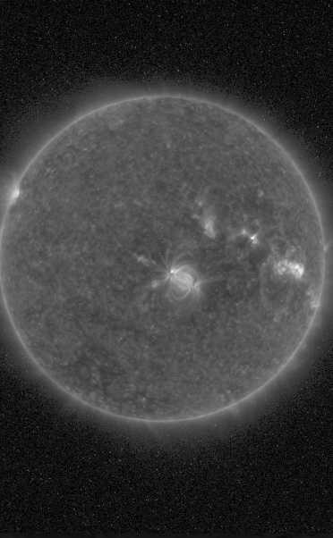
ADRs: 309
ADR 309: Images require despiking for radiometric accuracy. There exists a path forward (WR6709).

Slide 17
Risks to Provisional Discovered after Beta PS-PVR
ADR | WR | Delivery | Description | Disposition
588 | 6347 | DO 08.01 | SUVI Scale and Offset need to be dynamic | Path Forward Defined
690 | 6643 | DO 08.01 | Update to CDRL080 to address image navigation issues | TBD
932 | 7032 | TBD | SUVI background corr. is using wrong dark exposure | Assess as critical to Full Maturity Status
17

Slide 18
ADRs 588, 690, 932
588: Scaling for SUVI L1b products currently utilize static offset and scaling factors. This can lead to granularity in low-signal regimes.
690: CDRL080 update for handling to NAV issues.
932: SUVI GPA mixes exposure times in dark frame removal. The GPA needs to be selective with respect to different exposure times.

Slide 19
Product Quality Assessment

Slide 20
Assessment Overview
 | Status at β | Today | Required/Desired
INR | Pointing offsets incorrect Instrument Roll angle incorrect Yaw Flips invalidate prior pointing | Correct Pointing and Rolll offsets Applied Low-level systematic errors persist Yaw Flip requires LUT update | GPA fix to account for Yaw Flip status changes Complete INR LUT maintained
Radiometrics | Basically correct after LUT update Correct flatfields added to LUT | LUT updated for new calibration factors Degradation Trending activities started. Discrepancy identified between G16/G17 SUVI | GPA update to use LUT degradation factors Degradation trending activities producing consensus results Radiometric measurements of all SUVI instruments are understood and trended
Usability | Lack of certain metadata prohibit wide use by scientific community | Lack of certain metadata prohibit wide use by scientific community Impact to operations is minimal | All relevant radiometric metadata is included in L1b product Scaling of L1b products is dynamic and accurately reported Ease of use by wider scientific community

Slide 21
Post-Launch Product Tests Presented for Provisional
Test ID | Test Title | Operator | Maturity | Status
PLPT-SUV-001 | SUVI Trending – CCD Temperature | NCEI | Prov. | Active/PASS
PLPT-SUV-003 | SUVI-AIA Intercalibration | NCEI | Prov. | Active/PASS
PLPT-SUV-006 | SUVI-EXIS Intercalibration | NCEI | Full | Active
PLPT-SUV-007 | SUVI-EVE Rocket Intercalibration | NCEI | Full | Active
PLPT-SUV-00x | SUVI-SUVI Intercalibration | NCEI | Full | Active
All test plans and procedures are given in the SUVI Readiness, Implementation, and Management Plan (RIMP v1.1; 416-R-RIMP-0319)
Notes:
PLPTs do not provide resolution to GPA issues, are solely for long-term trending. Only 001 can be run before L1b calibration issues are stabilized.

Slide 22
Preliminary PLPT-SUVI-001: SUVI CCD Temperature Trending
Demonstrate the ability to extract and trending SUVI CCD Temperatures

Slide 23
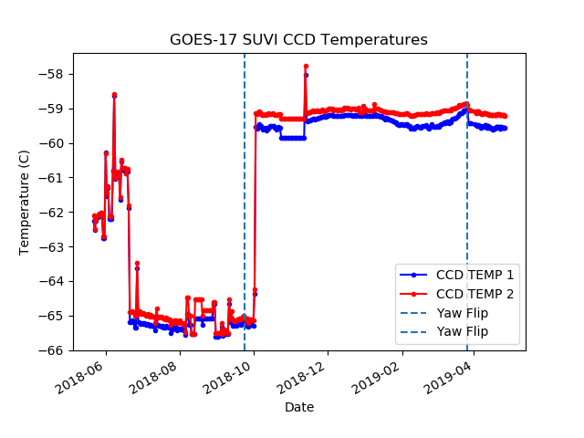
Preliminary PLPT-SUVI-001: SUVI CCD Temperature Trending
Notes:
The increase from ~-65C to ~59.5C was to have the two SUVI instruments have as few operational differences as possible.

Slide 24
Preliminary PLPT-SUVI-003: SUVI-AIA Intercalibration
Full field performance comparison via AIA-to-SUVI transformation and ratio (assesses flat field, focus and point-spread-function, bad pixels, and other image artifacts).
Radiometric inter-comparison via SUVI/AIA ratio versus theoretical expectations based on SUVI/AIA spectral response functions.
To ensure sufficient signal-to-noise only on-disk pixels used for radiometric analysis.

Slide 25
Preliminary PLPT-SUVI-003: SUVI-AIA Intercalibration
Summary: G17 SUVI appears to be slightly miscalibrated with respect to AIA. More study will be needed to fully interpret this result.
Passband | SUVI/AIA Ratio Mean | SUVI/AIA Ratio Median | Theoretical Ratio
94 Å | 1.46 | 1.65 | 1.0724
131 Å | 1.21 | 1.27 | 1.1871
171 Å | 1.27 | 1.29 | 1.0403
195 Å | 1.24 | 1.25 | 1.0456
284 Å | — | — | —
304 Å | 0.30 | 0.35 | 0.9757

Slide 26
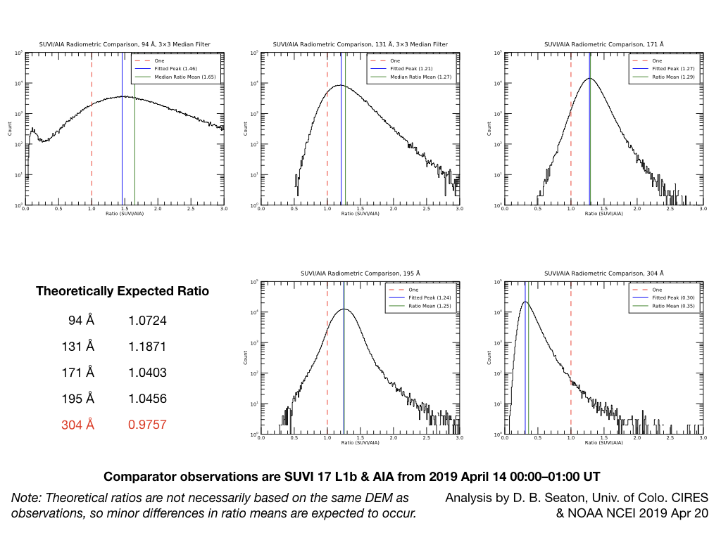
Preliminary PLPT-SUVI-003: SUVI-AIA Intercalibration

Slide 27
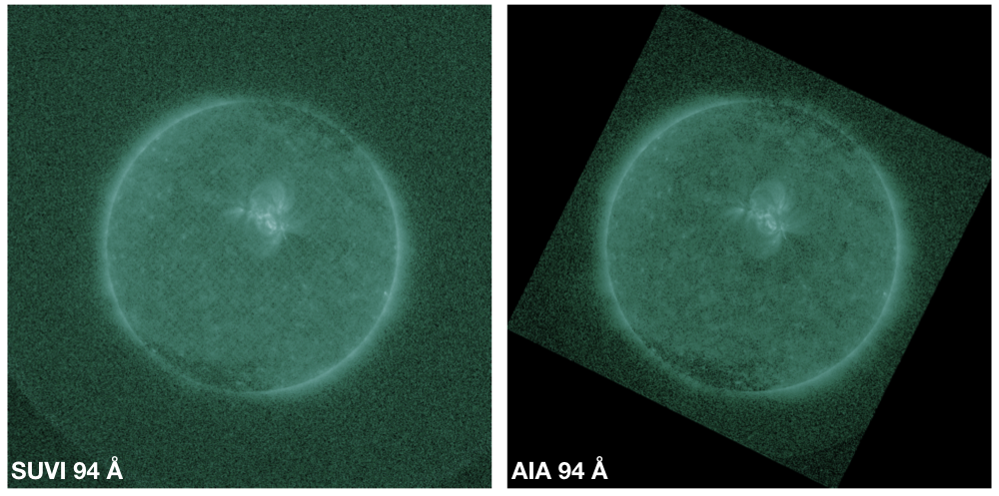
Preliminary PLPT-SUVI-003: SUVI-AIA Intercalibration

Slide 28
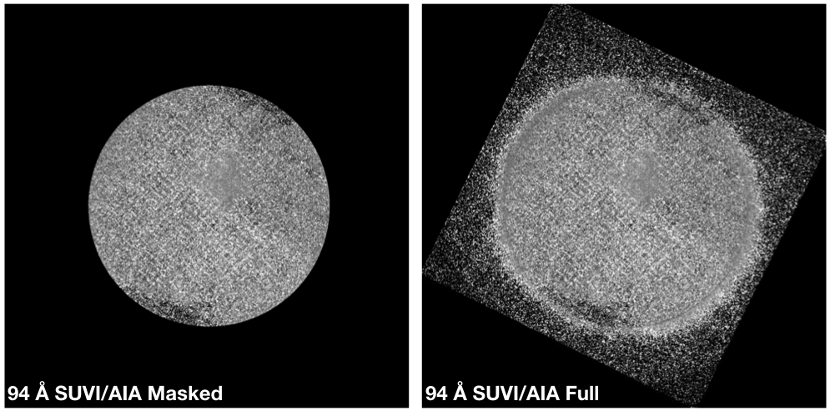
Preliminary PLPT-SUVI-003: SUVI-AIA Intercalibration

Slide 29
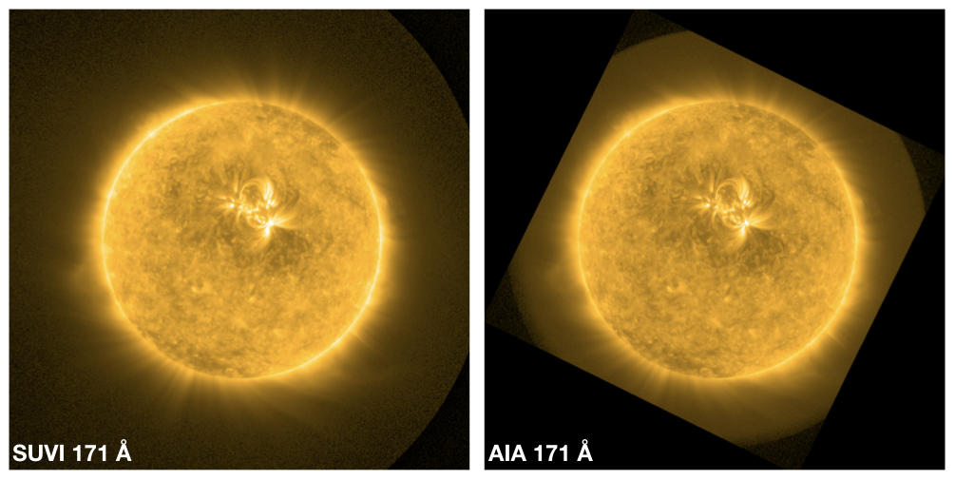
Preliminary PLPT-SUVI-003: SUVI-AIA Intercalibration

Slide 30
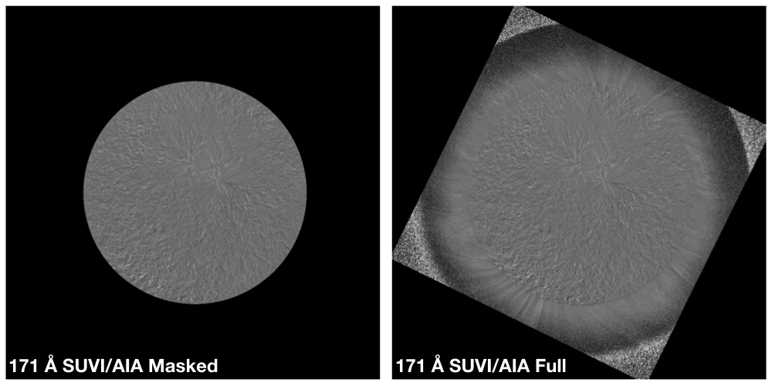
Preliminary PLPT-SUVI-003: SUVI-AIA Intercalibration

Slide 31
Preliminary PLPT-SUVI-003: SUVI-AIA Intercalibration
AIA 304 Å channel calibration appears to be incorrect and should not be used for this test until this can be resolved.
SUVI FM2 LUT update after drift appears to have led to a 10–20% increase in reported radiance compared to our expectations.
Impact on data usability at the moment is nonetheless negligible and product meets radiometry-related requirements.

Slide 32
Preliminary PLPT-SUVI-006:
SUVI-EXIS Intercalibration
Straight ratio comparison of EXIS-EUVSA 284 and 304Å spectral irradiance measurements to SUVI 284 and 304Å channels.
GOES-16 EXIS products have not yet reached provisional maturity, and as of yet may not be suitable for this comparison
Value for the GOES-16 EXIS-EUVSA shared by LASP are used here
SUVI and EXIS are very different instruments, and work is needed to achieve an apples-to-apples comparison.
The ratios between SUVI and EXIS measurements are an option in calculating the SUVI contamination correction.

Slide 33
Typical Solar Spectrum
He II
(Si XI)
Fe IX
Fe X
Fe XII
(Fe XXIV)
Fe XV
Fe X
(Fe XVIII)
Fe VIII
(Fe XXI)
Notes:
A typical spectrum with observed lines highlighted. Parentheses indicate lines that might be in the passband but are not present in this spectrum. Colors indicate approximate passband regions.

Slide 34
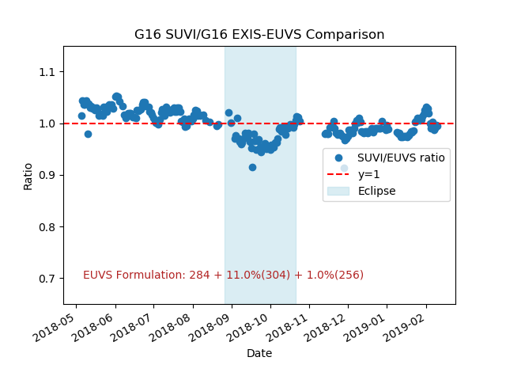
Preliminary PLPT-SUVI-006:
SUVI-EXIS Intercalibration
GOES-16 SUVI Retrospective
Notes:
This is an updated GOES-16 SUVI-EXIS EUVS 284 intercomparison.

Slide 35
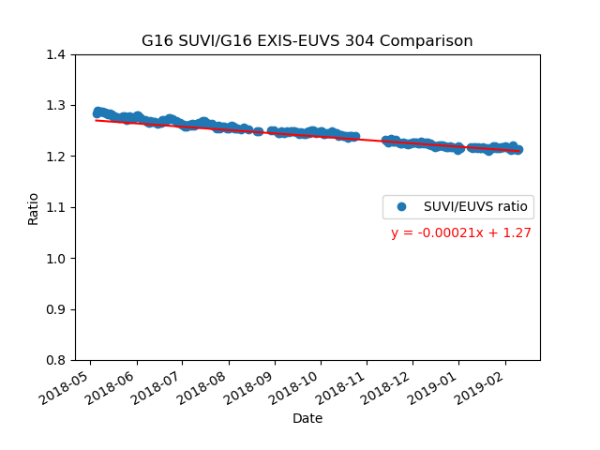
Preliminary PLPT-SUVI-006:
SUVI-EXIS Intercalibration
GOES-16 SUVI Retrospective
Notes:
This is an updated GOES-16 SUVI-EXIS EUVS 304 intercomparison.

Slide 36
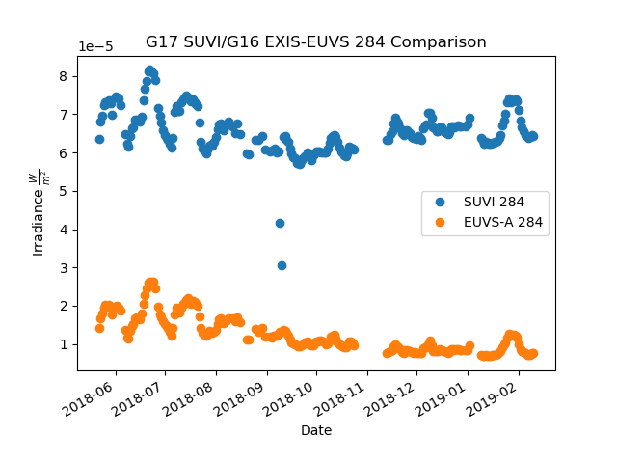
Preliminary PLPT-SUVI-006:
SUVI-EXIS Intercalibration
SUVI and EUVS measurements show similar trends.
Due to the broadband nature of the SUVI 284 and 304 channels, SUVI is measuring more than the discrete 284/304 lines.
Trend seems to shift upwards after 2018-11
Notes:
Straight-up 284measurements from GOES-17 SUVI and GOES-16 EXIS-EUVS.

Slide 37
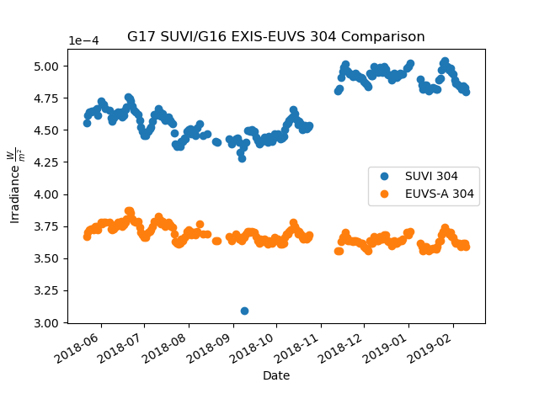
Preliminary PLPT-SUVI-006:
SUVI-EXIS Intercalibration
SUVI and EUVS measurements show similar trends.
Due to the broadband nature of the SUVI 284 and 304 channels, SUVI is measuring more than the discrete 284/304 lines.
Trend seems to shift upwards after 2018-11
Notes:
Straight-up 304 measurements from GOES-17 SUVI and GOES-16 EXIS-EUVS.

Slide 38
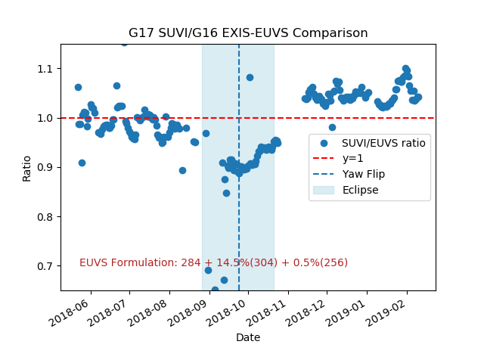
Preliminary PLPT-SUVI-006:
SUVI-EXIS Intercalibration
SUVI/EUVS 284 also uses GOES-16 EXIS-EUVSA 304 and 256 Å lines.
Notes:
Ratio shows a lot of variability. Early in eclipse season show some ECI measurements. LUT update is responsible for the jump after 2018-11.

Slide 39
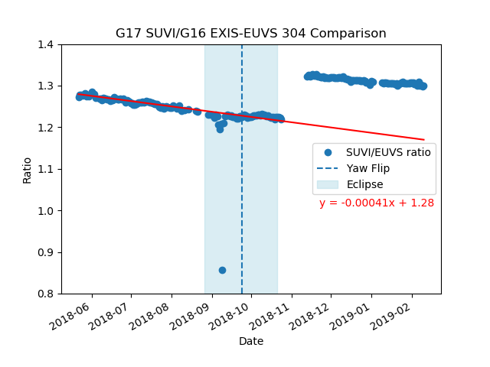
Preliminary PLPT-SUVI-006:
SUVI-EXIS Intercalibration
Both 284 and 304 Å demonstrate a discontinuity at or about 2018-11
Notes:
304 shows graceful degradation, some ECI signature. LUT update apparent after 2018-11.

Slide 40
Preliminary PLPT-SUVI-006:
SUVI-EXIS Intercalibration
GOES-16 SUVI trending activities continue.
  304 shows “graceful” degradation trend
  284 shows variability indicating that some aspects of this channel performance have not been captured.
  Signature of the eclipse season is apparent in the 284 data
GOES-17 SUVI trending against EXIS has begun
  October, 2018 LUT update is apparent in the data
  304 shows “graceful” degradation trend
  284 shows variability indicating that some aspects of this channel performance have not been captured.
  Signature of the eclipse season is apparent in the 284 data
  Signature if the ECI campaign is apparent in the data

Slide 41
Preliminary PLPT-SUVI-00x:
SUVI-SUVI Intercalibration
Straight ratio comparison of SUVI 94, 131, 171, 195, 284, 304 Å channels between GOES-16 and -17.
The spectral response functions are very similar between SUVI instruments.
Neither SUVI L1b products are corrected for degradation.

Slide 42
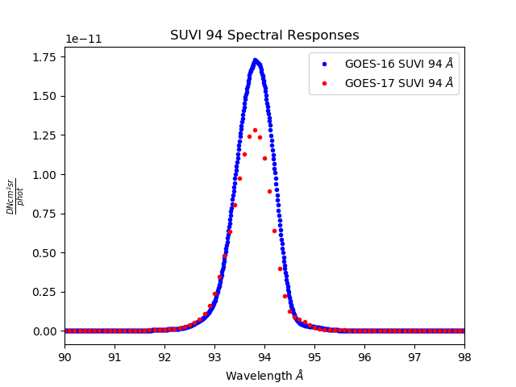
Preliminary PLPT-SUVI-00x:
SUVI-SUVI Intercalibration
Notes:
Show the respective responses of the GOES-16 and GOES-17 SUVI 94 channels.

Slide 43
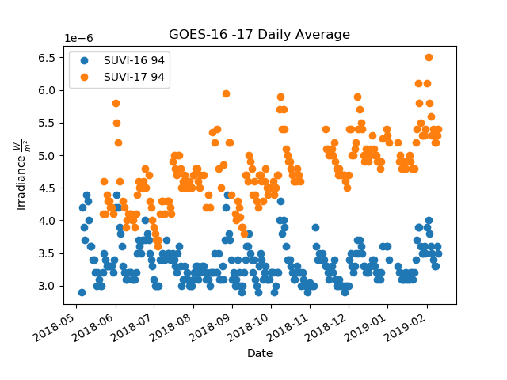
Preliminary PLPT-SUVI-00x:
SUVI-SUVI Intercalibration
Notes:
Straight-up measurements of the 94 channel GOES-16 and GOES-17 SUVI instruments.

Slide 44
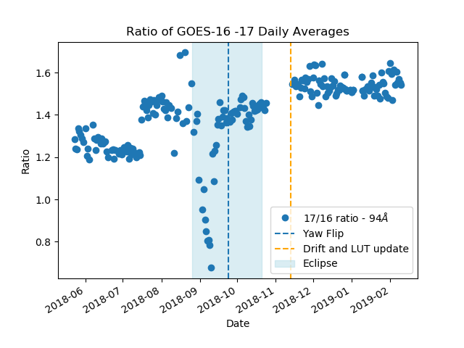
Preliminary PLPT-SUVI-00x:
SUVI-SUVI Intercalibration
Notes:
Pinhole(s) at 2018-07, ECI 2018-09, LUT update 2018-11

Slide 45
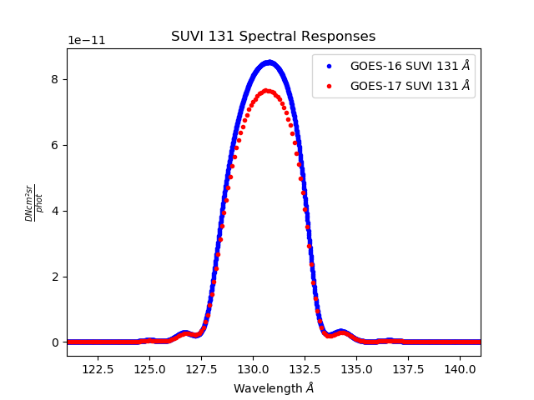
Preliminary PLPT-SUVI-00x:
SUVI-SUVI Intercalibration
Notes:
Respective responses for GOES-16 and GOES-17 SUVI 131 channels.

Slide 46
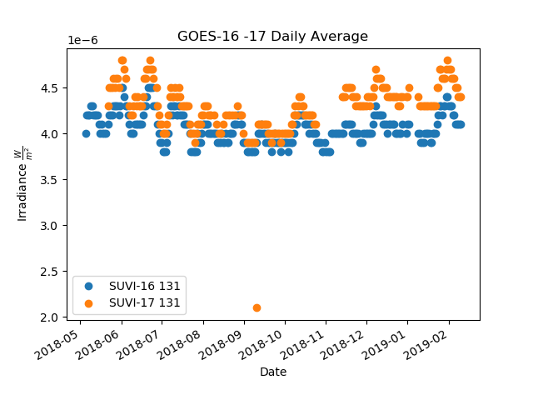
Preliminary PLPT-SUVI-00x:
SUVI-SUVI Intercalibration
Notes:
Straight-up measurements from GOES-16 and GOES-17 131 channel.

Slide 47
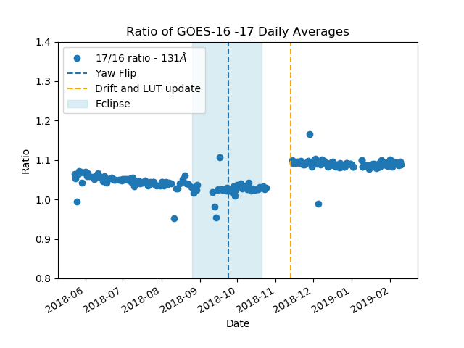
Preliminary PLPT-SUVI-00x:
SUVI-SUVI Intercalibration
Notes:
Ratio of 17/16 SUVI 131 channel. Little variability with some outliers. LUT update apparent at 2018-11.

Slide 48
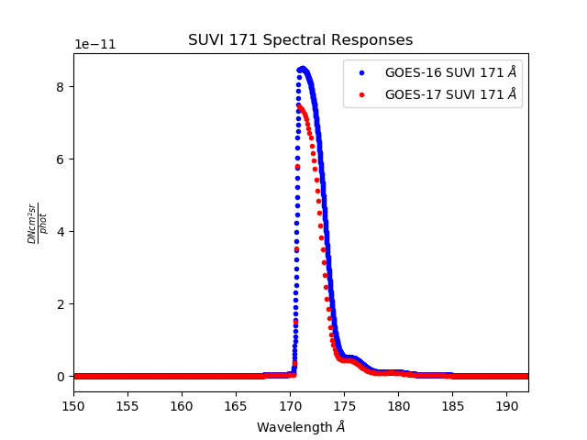
Preliminary PLPT-SUVI-00x:
SUVI-SUVI Intercalibration
Notes:
GOES-16 and GOES-17 SUVI response functions for the 171 channel.

Slide 49
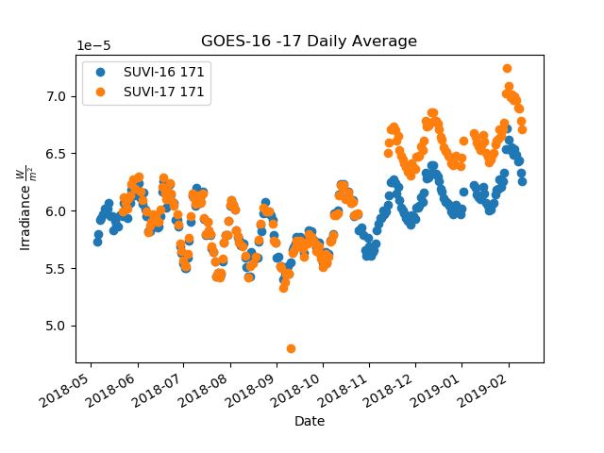
Preliminary PLPT-SUVI-00x:
SUVI-SUVI Intercalibration
Notes:
Straight-up measurements for the GOES-16 and GOES-17 171 channels.

Slide 50
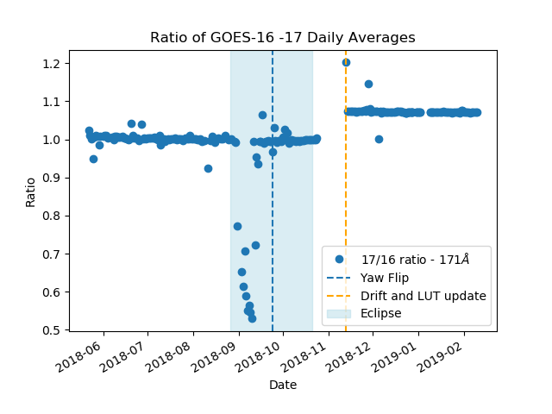
Preliminary PLPT-SUVI-00x:
SUVI-SUVI Intercalibration
Notes:
Ratio of 17/16 SUVI 171 channels. Little variability barring ECI and some outliers. LUT update effects apparent.

Slide 51
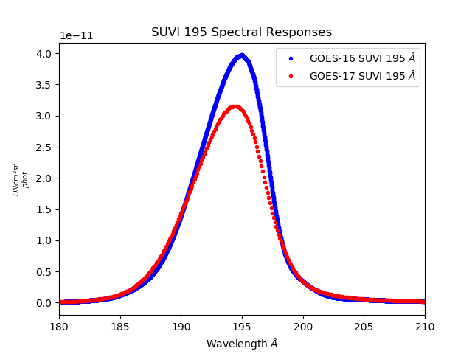
Preliminary PLPT-SUVI-00x:
SUVI-SUVI Intercalibration
Notes:
GOES-16 and GOES-17 SUVI response functions for the 195 channel.

Slide 52
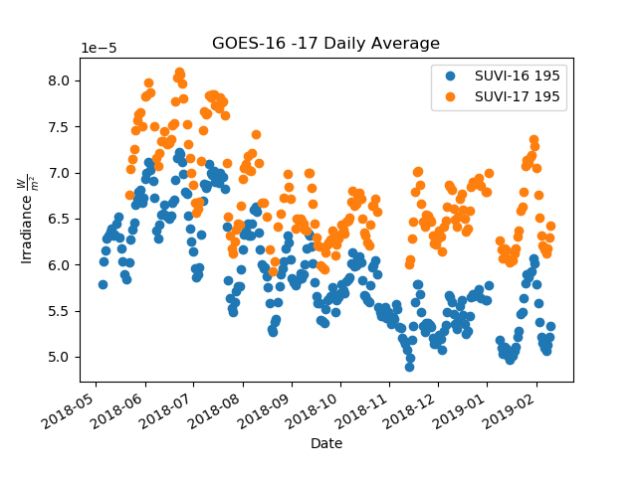
Preliminary PLPT-SUVI-00x:
SUVI-SUVI Intercalibration
Notes:
Straight-up measurements for the GOES-16 and GOES-17 195 channels.

Slide 53
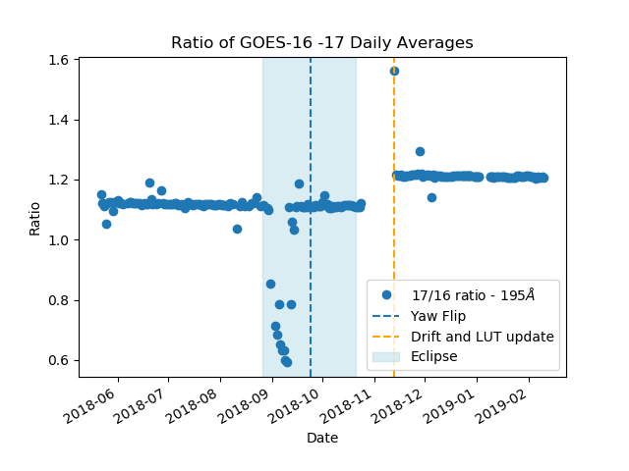
Preliminary PLPT-SUVI-00x:
SUVI-SUVI Intercalibration
Notes:
Ratio of 17/16 SUVI 195 channel. Little variability barring ECI and some outliers. LUT update effects apparent.

Slide 54
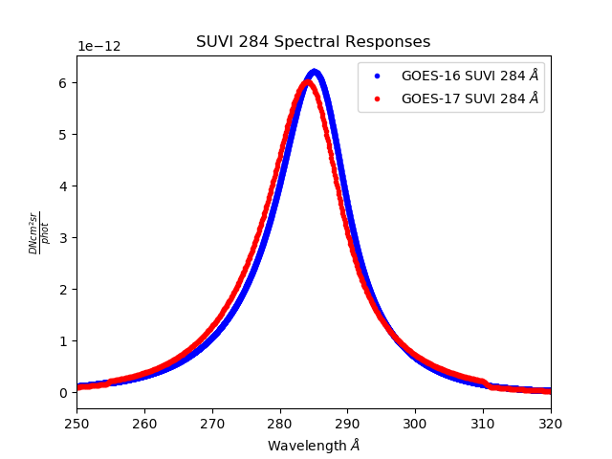
Preliminary PLPT-SUVI-00x:
SUVI-SUVI Intercalibration
Notes:
GOES-16 and GOES-17 SUVI response functions for the 284 channel.

Slide 55
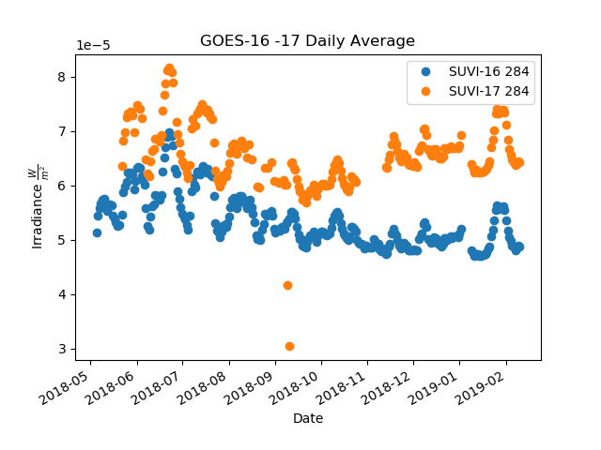
Preliminary PLPT-SUVI-00x:
SUVI-SUVI Intercalibration
Notes:
Straight-up measurements for the GOES-16 and GOES-17 284 channels.

Slide 56
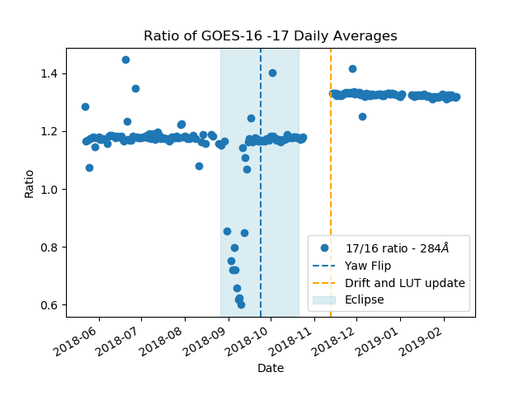
Preliminary PLPT-SUVI-00x:
SUVI-SUVI Intercalibration
Notes:
Ratio of 17/16 SUVI 284 channel. Little variability barring ECI and some outliers. LUT update effects apparent.

Slide 57
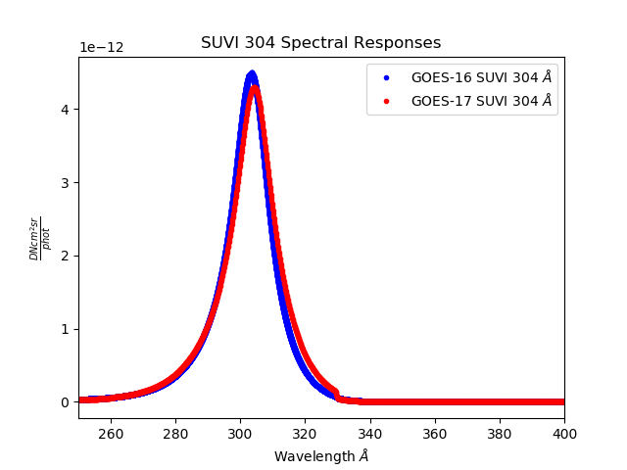
Preliminary PLPT-SUVI-00x:
SUVI-SUVI Intercalibration
Notes:
GOES-16 and GOES-17 SUVI response functions for the 304 channel.

Slide 58
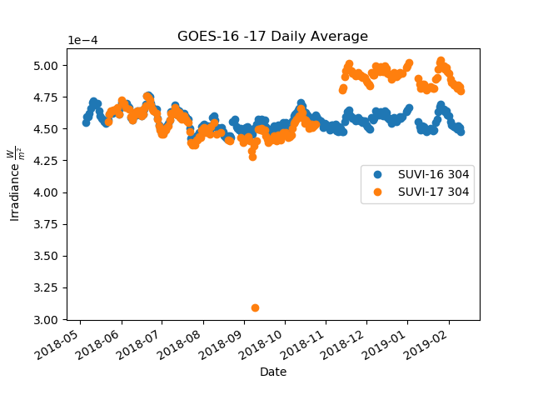
Preliminary PLPT-SUVI-00x:
SUVI-SUVI Intercalibration
Notes:
Straight-up measurements for the GOES-16 and GOES-17 304 channels.

Slide 59
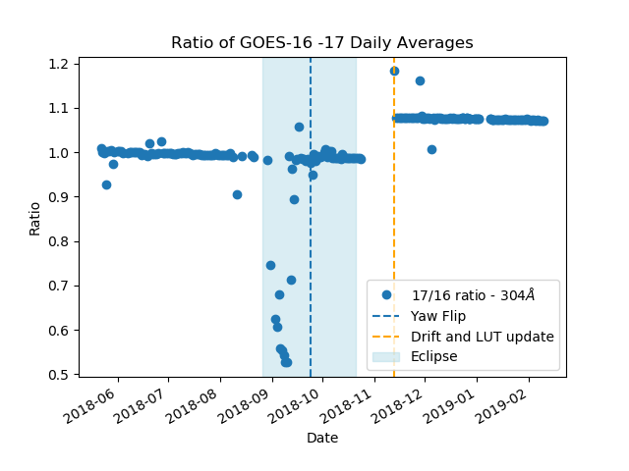
Preliminary PLPT-SUVI-00x:
SUVI-SUVI Intercalibration
Notes:
Ratio of 17/16 SUVI 304 channel. Little variability barring ECI and some outliers. LUT update effects apparent.

Slide 60
Preliminary PLPT-SUVI-00x:
SUVI-SUVI Intercalibration
The intercomparison of SUVI instruments as a trending activity has been started
The data show that the instruments are well matched
  The variability between EXIS and SUVI is not present in the SUVI-SUVI comparisons
  The instruments are measuring the same phenomena
GOES-17 SUVI is reporting values greater than the GOES-16 SUVI
  It is unclear which instrument is more “correct”
The LUT update to GOES-17 SUVI is apparent in the data.

Slide 61
Preliminary PLPT-SUVI-007:
SUVI-EVE Rocket Underflight Intercalibration
Convolve GOES-16 and GOES-17 SUVI Spectral Response Functions with EVE Rocket data for proxy SUVI irradiance
Compare to SUVI irradiance measurements
Neither SUVI L1b products are corrected for degradation.
Analysis under way.

Slide 62
SUVI Performance Baseline Status
Assessment at Provisional
MRD ID | Description | Related PLPTs | Status
2045 | Pointing Accuracy | PLPT-SUV-003 | Validated*
2046 | Product Pointing Knowledge | PLPT-SUV-003 | Validated*
2052 | Long-term Stability (Product Measurement Precision in Radiance) | PLPT-SUV-003, PLPT-SUV-006 | Preliminary results. Ongoing investigation
MRD2045: Pointing Accuracy
  Requirements: ±3.0 arcmin (3 sigma) (N-S,E-W) of Sun Center;
  Stability during 60 seconds: ±2.0 arcsec (1 sigma), ±6.0 arcsec (3 sigma) (N-S, E-W)
MRD2046: Product Pointing Knowledge/Mapping Accuracy
  Requirements: ±2.5 arcsec
MRD2052: Long-term Stability (Product Measurement Precision in Radiance)
  Requirements: ±30%
  Absolute accuracy cannot be verified on-orbit
* After corrections for Yaw Flip

Slide 63
SUVI Performance Baseline Status
Assessment at Provisional
MRD ID | Description | Requirement | MIT-LL Expected Performance | NCEI Analysis | Status
2045 | Pointing Accuracy | 3.0 Arcminutes | 2.5 Arcseconds | < 0.5 arcsec y, < 0.5 arcsec z | PASS
2046 | Product Pointing Knowledge | 2.5 Arcseconds | - | < 0.25arcsec y < 0.5 arcsec z | PASS
2052 | Long-term Stability | 30% | 19.5% | ~10% 284Å ~8% 304Å | PASS
Pointing requirements are well met.
Consistency between GOES-16 SUVI and GOES-17 SUVI is desired
  Performance “jump” from LUT update is concerning and being investigated
  Comprehension of the performance differences is an ongoing task and priority

Slide 64
Product Maturity Assessment
Preparation Activities | Assessment
Validation activities are ongoing and the general research community is now encouraged to participate. | Validation activities are ongoing. Results have been discussed with SWPC. Release of data by NCEI will enable research community participation.
Severe algorithm anomalies and deficiencies are identified and under analysis. Solutions to anomalies are in development and testing. | A combination of corrections to the algorithm and LUT updates have resolved most Cal/INR critical ADRs excluding ADR309 (despiking) (and 932)
Incremental product improvements may still be occurring. | Incremental product improvements are expected, primarily through updated LUTs incorporating results of cross-cal.

Slide 65
Product Maturity Assessment
End State | Assessment
Product performance has been demonstrated through analysis of a small number of independent measurements obtained from select locations, periods, and associated ground truth or field campaign efforts. | PLPTs discussed here demonstrate the product performance of the GOES-17 SUVI
Product analysis is sufficient to communicate product performance to users relative to expectations (Performance Baseline). | Yes.
Documentation of product performance exists that includes recommended remediation strategies for all anomalies and weaknesses. Any algorithm changes associated with severe anomalies have been documented, implemented, tested, and shared with the user community. | Key issues affecting usability by SWPC have been fixed. Fixes have been discussed extensively with SWPC and agreed to by them.
Testing has been fully documented. | This presentation, additional documentation to follow.
Product is ready for operational use and for use in comprehensive cal/val activities and product optimization. | NCEI: yes.

Slide 66
SUVI’s Path to Full Maturity
Critical ADRs, WRs, and risks to be resolved prior to Full Maturity.
PLPTs for Full Maturity
Comments on the status of the Performance Baseline

Slide 67
Risks and ADRs affecting Full
ADR | WR | Delivery | Description | Disposition
260 | 6025 | -- | SUVI Dark Exposure Scaling | Needed to mitigate instrument degradation and light leakage.
309 | 4353 | — | Images require despiking for radiometric accuracy | Under discussion.
588 | — | — | Image scale and offset need to be dynamic | No major impact to product quality, but would improve accuracy & compression.
664 | 5968 | DO 08.01 | SUVI Bad Pixel Table incorrectly orientated | Not critical for G17 SUVI at this time.
665 | 6617 | TBD | SUVI Bad Pixel Table needs to be updated | Placeholder for after 664 is resolved.
714 | 6345 | DO 08.01 | Remove automated degradation correction for SUVI | Degradation correction through LUT updates.
768 | 6397 | DO 08.00 | SUVI GPA INR causes ERROR and product does not distribute | Very difficult to track.
932 | 7032 | TBD | SUVI GPA incorrectly calculating dark frames
67

Slide 68
SUVI Light Leakage
In July of 2018, a suspected micrometeoroid struck the entrance filter of the GOES-17 SUVI
  This resulted in a pinhole in the entrance filter, allowing white light to enter the instrument
  This light leakage is most noticeable and impactful in the 94Å channel, a channel used for flaring conditions
  From looking at the 94Å background, it is estimated that the light leakage is contributing <0.7 W/(m^2 sr)
    Weak flaring regions are (10-100 W/(m^2 sr)) (<0.5%)
    Strong flaring regions are impacted less (<0.0025%)
  At this current level of light leakage, the GOES-17 SUVI is not operationally impacted

Slide 69
SUVI Light Leakage
Further micrometeoroid impacts and pinhole formation are anticipated for all SUVI instruments
  SUVI has mitigation capabilities
    Incorporated as part of the SUVI instrument design
    Use additional filters and change the instrument sequencing
  The Ground Segments Ground Processing Algorithm is not currently capable of accommodating this mitigation
  Successful resolution of ADR260/WR6025 will enable the implementation of light leakage mitigation
    Changes SUVI GPA to handle arbitrary exposure times
  ADR932 also has impact upon light leakage mitigation
    Corrects handling of frames for dark correction
NCEI will investigate further into light leakage effects and mitigation strategies.

Slide 70
ADR 932
Difficult to quantify impacts
  Over/under-correction of L1b products
Has implications for ADR 260
  Increasing exposure time to mitigate instrument degradation will lead to increased errors due to incorrect dark count subtraction.
Has implications for operational mitigation of Light Leakage issue
  Increasing exposure times to mitigate additional signal attenuation will lead to increased error due to incorrect dark count subtraction
Mean Error of QS ~3.2%, higher in short and flare exposures for 94Å
Errors will increase if the operational temperature is increased

Slide 71
Post-Launch Product Tests for Full
Test ID | Test Title | Operator
PLPT-SUV-001 | SUVI Trending – CCD Temperature | NCEI
PLPT-SUV-002 | SUVI Trending – Detector Performance | NCEI
PLPT-SUV-003 | SUVI-AIA Intercalibration | NCEI
PLPT-SUV-004 | SUVI-EVE Intercalibration | NCEI
PLPT-SUV-006 | SUVI-EXIS Intercalibration | NCEI
PLPT-SUV-007 | SUVI-EVE Underflight Intercalibration | NCEI
PLPT-SUV-00x | SUVI-SUVI Intercalibration | NCEI

Slide 72
Ongoing PLPTs from Provisional
PLPT-SUV-001 (SUVI Trending – CCD Temperatures)
PLPT-SUV-002 (SUVI Trending – Detector Performance)
  If LTC data available
PLPT-SUV-003 (SUVI-AIA Intercalibration)
PLPT-SUV-006 (SUVI-EXIS Intercalibration)
PLPT-SUV-00x (SUVI-SUVI Intercalibration)
  Update to SUVI RIMP needed.

Slide 73
NCEI’s Recommendation
NCEI believes that the GOES-17 SUVI L1b product has reached the Provisional Maturity as defined by the GOES-R Program

Slide 74
Disposition from NWS-SWPC
Comments and/or slides from Dr. Steven Hill of SWPC, speaking on behalf of the user community.

Slide 75
Summary and Conclusion
All ADRs/WRs critical to Provisional Maturity have been resolved, validated, or had a path of resolution defined.
We would like to thank the instrument vendor, ground system vendor, and the PRO-PASS team for all the help to reach this milestone.
NCEI-CO and SWPC recommend the GOES-17 SUVI L1b product for Provisional Maturity

Slide 76
Backup Slides

Slide 77
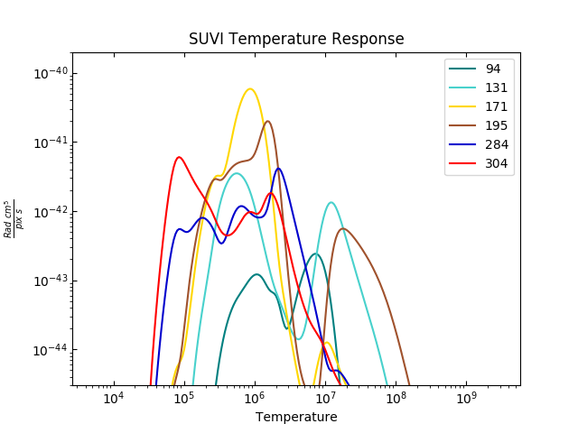
SUVI (Coronal) Temperature Response

Slide 78
Preliminary PLPT-SUVI-003: SUVI-AIA Intercalibration
AIA degradation tracked via direct and proxy measurements: EVE/MEGS-A, EVE Sounding Rocket, Flare Irradiance Spectral Model (FISM).

Slide 79
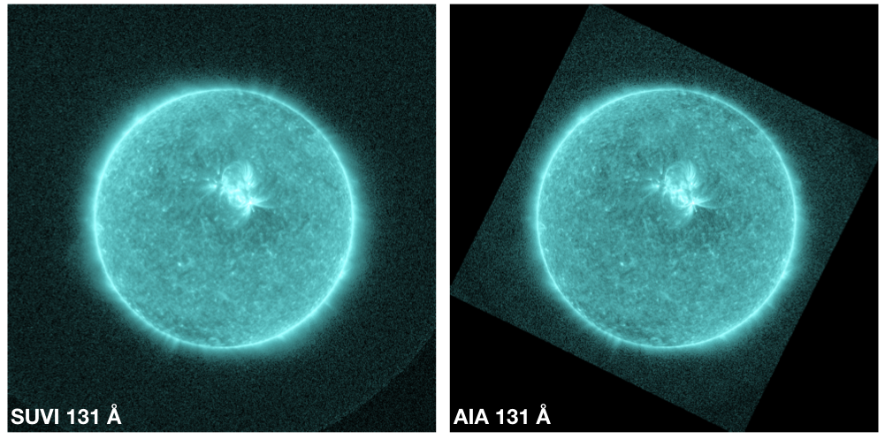
Preliminary PLPT-SUVI-003: SUVI-AIA Intercalibration

Slide 80
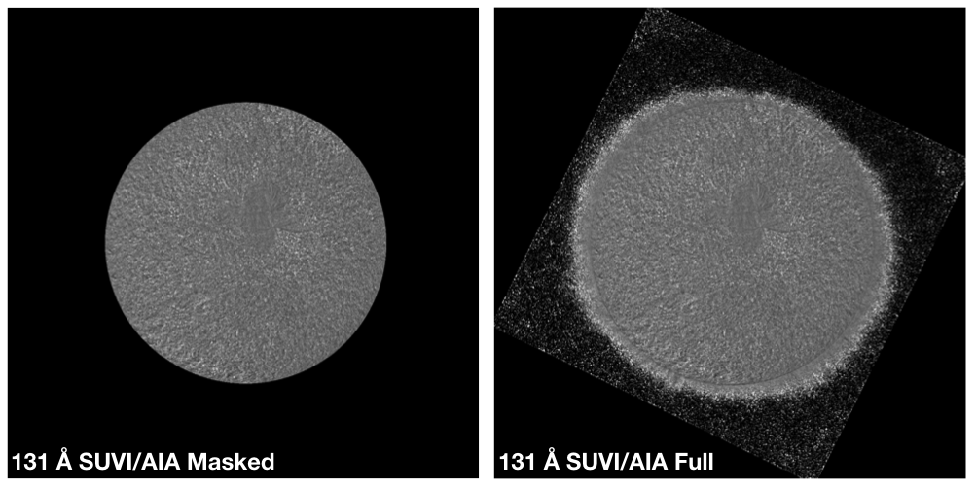
Preliminary PLPT-SUVI-003: SUVI-AIA Intercalibration

Slide 81
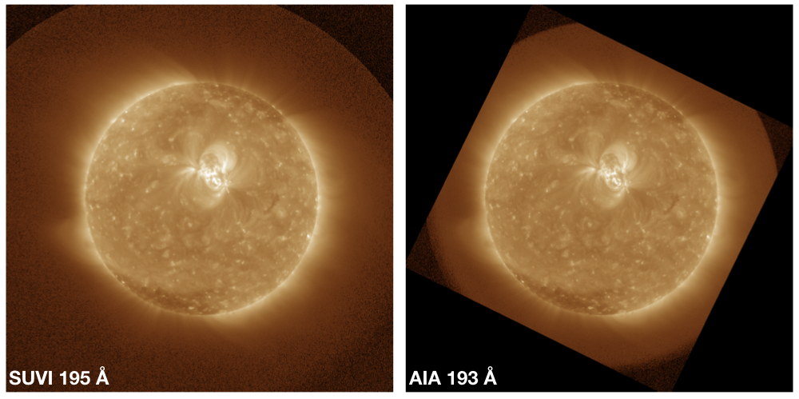
Preliminary PLPT-SUVI-003: SUVI-AIA Intercalibration

Slide 82
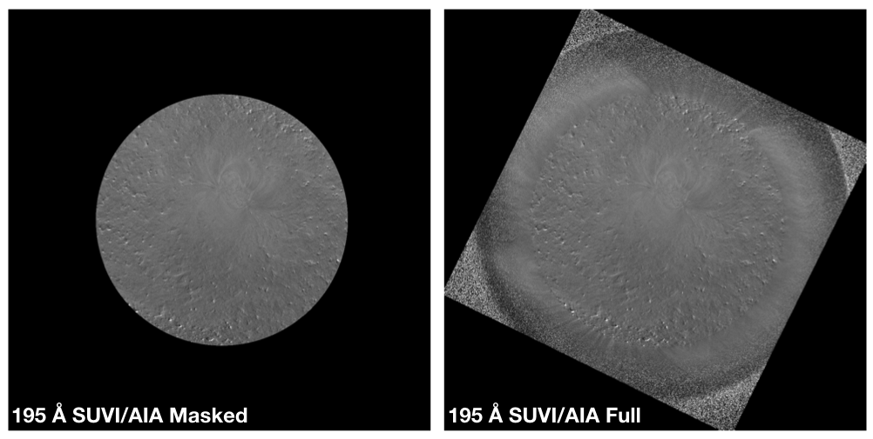
Preliminary PLPT-SUVI-003: SUVI-AIA Intercalibration

Slide 83
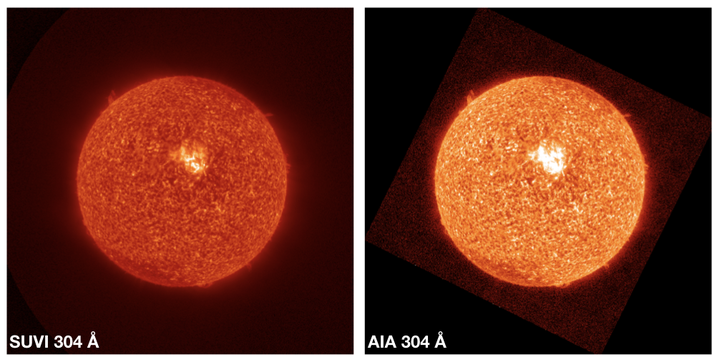
Preliminary PLPT-SUVI-003: SUVI-AIA Intercalibration

Slide 84
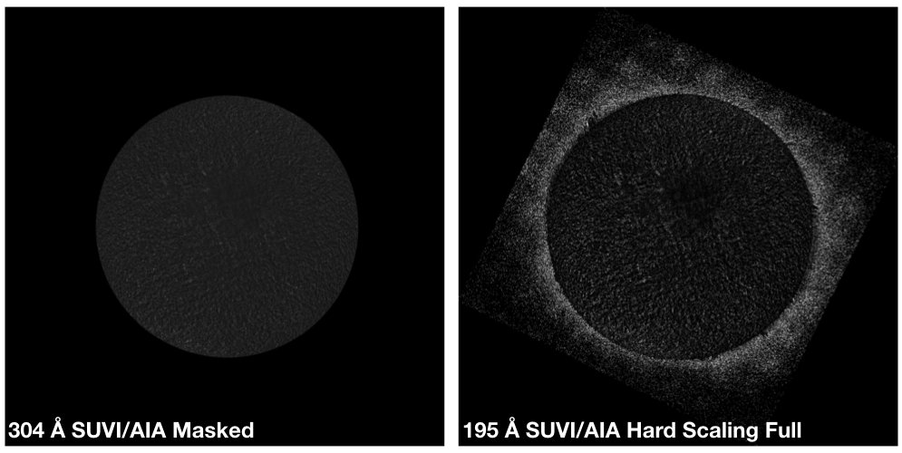
Preliminary PLPT-SUVI-003: SUVI-AIA Intercalibration

Slide 85
ADR 932
Feature | Mean Error | 47% of pixels have error | 2% of pixels have error
Disk | 3.2% | >6.67% | >13%
Active Region
Long | 0.10% | >0.2% | >0.4%
Short | 20% | >40% | >80%
Short Flare | 57% | >120% | >240%
Typical Flare
Short | 0.03% | >0.08% | >0.16%
Short Flare | 0.11% | >0.24% | >0.48%

