Slide 1
Disposition from NWS-SWPC
Comments and/or slides from Dr. Steven Hill of SWPC, speaking on behalf of the user community.

Slide 2
SWPC Data System Readiness
          SWPC has created a product-oriented system that fully integrated with GOES-NOP:
  Easy Primary/Secondary instrument selection
  Plots and displays modernized
  Data available via web data service
  Nine applications and models requiring transition to new GOES data system
  Critical (continuity) portions of SWPC system will be operational for GOES-16 in June 2019
Thanks to forecasters for extensive functional and usability feedback.

Slide 3
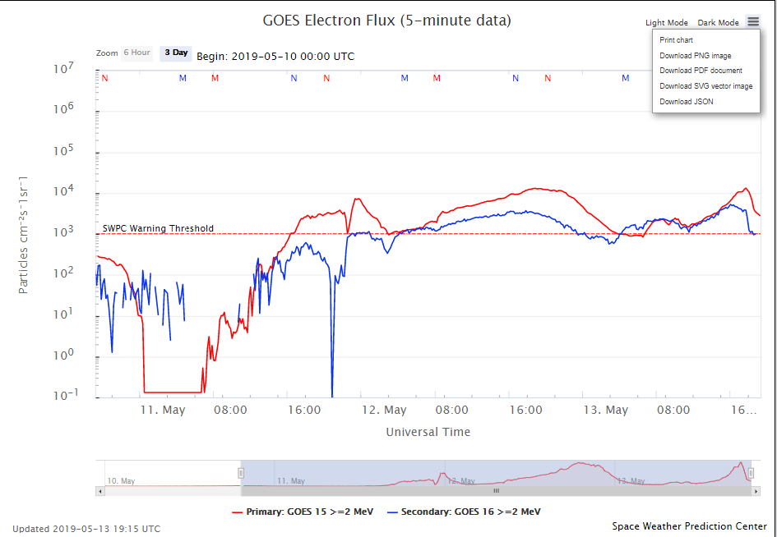
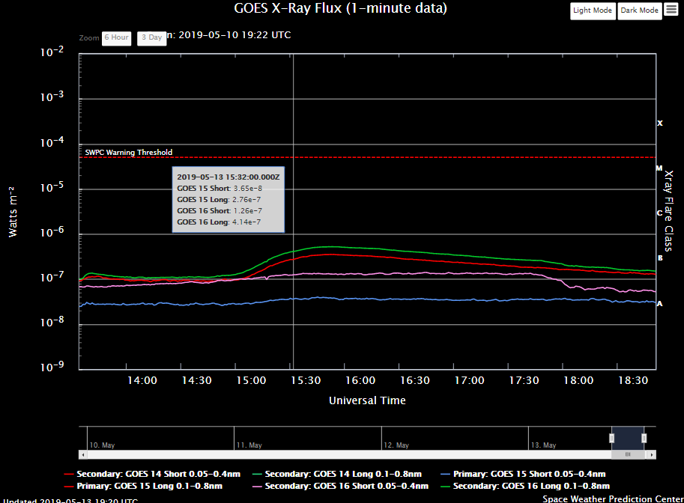
SWPC GOES-16 Time Series Displays
          Integrated with GOES-NOP
Export data and image files
Mouse-over for data values
Pre-selected or user-defined zoom
Light or dark background
Activate/deactivate plot lines
Upgrades to include:
  Longer data period
  Event display

Slide 4
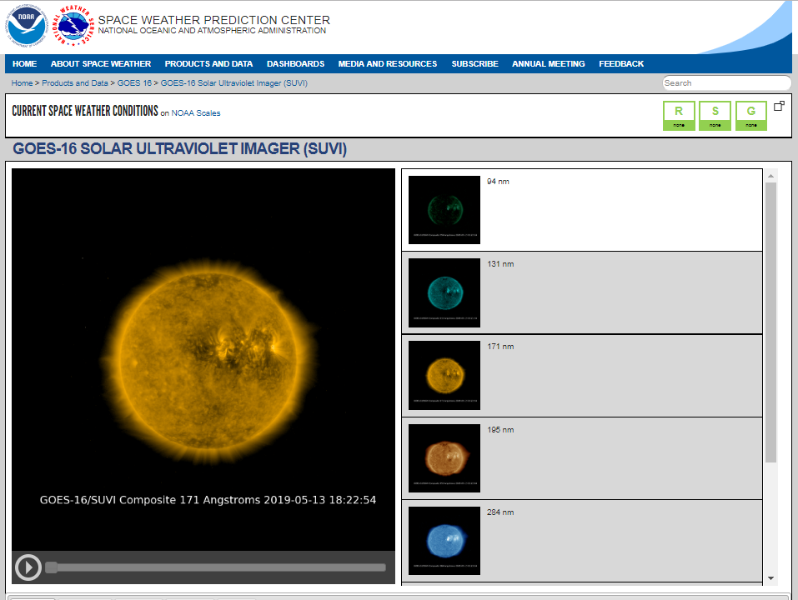
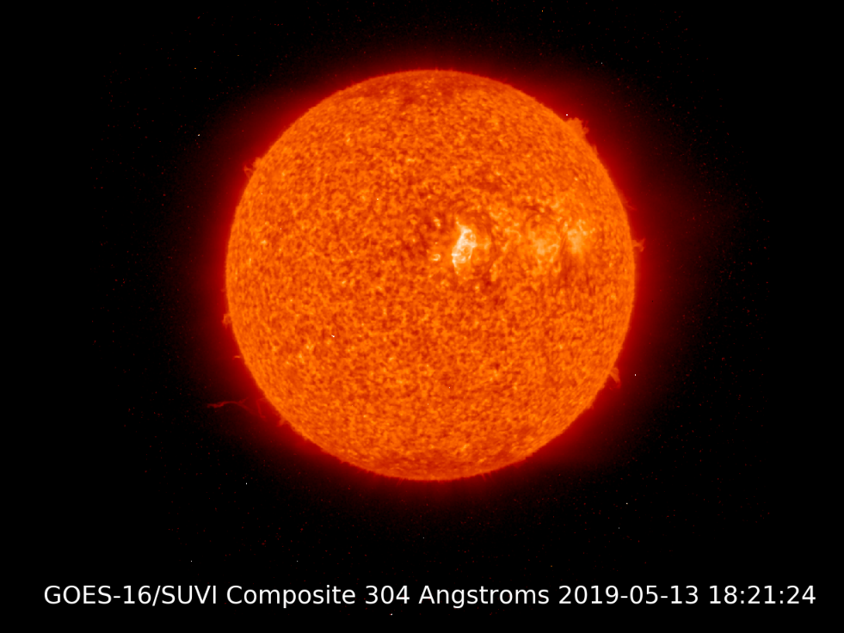
SWPC GOES-16 SUVI Displays
          Modeled on GOES NOP SXI
Primary/Secondary instrument selection
Images available via web data service
Custom median for ADR 309 (spikes)
Upgrades to include:
  Quantitative color bar
  Variable duration
  Variable sampling

Slide 5
SWPC GOES-17 Status/Concerns
SWPC recognized the thorough job done by NCEI in assessing and communicating status of GOES-17 SUVI analyses
Priority issues remaining for SWPC users:
  Need to correct spiking (ADR309)
  GOES-17 apparent calibration offset from GOES-16
  Appropriate dark frame selection

