Slide 1
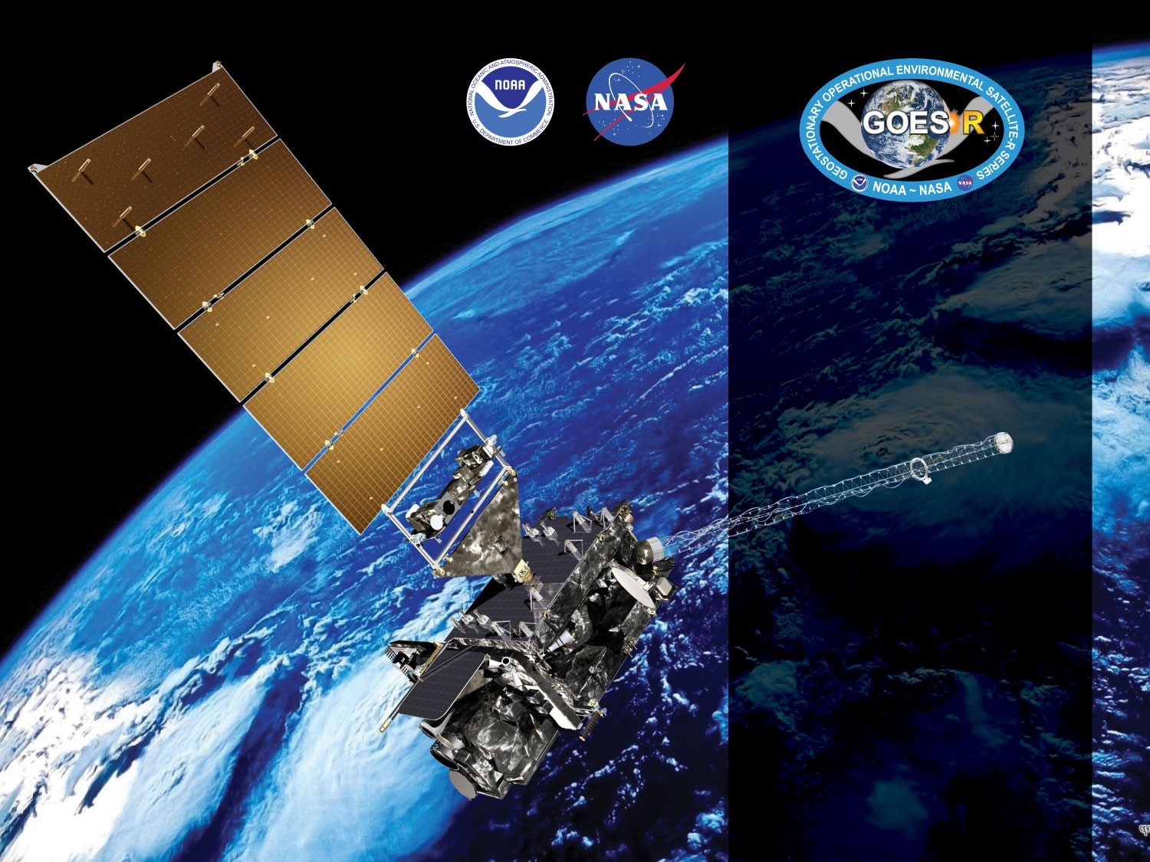
GOES-18 ABI L2+ Aerosol Optical Depth Provisional PS-PVR
November 9, 2022
GOES-R AWG
Istvan Laszlo¹, Mi Zhou², Hongqing Liu² and the
PRO Team
¹NOAA/NESDIS/STAR
²I.M. Systems Group, Inc.

Slide 2
Outline
Product Overview
Review of ADRs
Provisional Maturity Assessment
  Comparisons with AERONET, GOES-17, GOES-16, MODIS, VIIRS
Path to Full Validation Maturity
Summary and Recommendations
Supplement
  Various supporting material

Slide 3
Product Overview
  Aerosol optical depth (AOD):
    A measure of the columnar extinction (scattering + absorption) of radiation by aerosols. Proportional to the amount (number or mass concentration) of aerosol in an atmospheric column.
  Aerosol Particle Size (APS):
    A measure of the average size of aerosol particles in a unit volume of air. It is reported here (and traditionally) as the Ångström Exponent (AE) calculated from the AOD at two pairs of wavelengths. Small AE (<1) indicates large particle (diameter > 1 µm) and large AE (>2) indicates small particle (diameter < 1 µm).
  Products in file:
    550-nm AOD for Full Disk and CONUS in range -0.05 to +5
    AOD Quality flag (0=high; 1=medium, 2=low, 3=not produced)
    AE1 (0.47, 0.86 µm)and AE2 (0.86, 1.61 µm) over water for Full Disk and CONUS in range -1 to +3.
    AE Quality flag (0=high; 1=medium, 2=low, 3=not produced)
    Mean, max, min and standard deviation of 550-nm AOD (and in 10-degree latitude zones)

Slide 4
Product Overview - AOD
Product Definition and user’s guide (Pug) Volume 5: Level 2+ Products, REVISION 2.2, 17 DECEMBER 2019 - Table 5.10.1
 |  |  | AOD Measurement |  |  |  | Mapping
Product | Region | Surface Type | Range ^{[3]} | Accuracy | Precision | Performance Conditions ^{[1]} | Accuracy
AOD | Full Disk & CONUS | Over Land | -0.05 to 5 | (1) AOD < 0.04: 0.06 (2) 0.04 ≤ AOD ≤ 0.80: 0.04 (3) AOD > 0.80: 0.12 | (1) AOD < 0.04: 0.13 (2) 0.04 ≤ AOD ≤ 0.80: 0.25 (3) AOD > 0.80: 0.35 | LZA ≤ 60 degrees daytime ^{[2]} clear sky | 1 km
AOD | Full Disk & CONUS | Over Ocean | -0.05 to 5 | (1) AOD < 0.40: 0.02 (2) AOD > 0.40: 0.10 | (1) AOD < 0.40: 0.15 (2) AOD > 0.40: 0.23 | LZA ≤ 60 degrees daytime ^{[2]} clear sky | 1 km
[1] Conditions for data production prescribed by the algorithm also include snow/ice-free and, when over ocean, sunglint angle > 40 degrees.
[2] Conditions for high quality prescribed by the algorithm are for SZA ≤ 80 degrees.
[3] PUG lists -1 as the lower boundary of AOD range. To be consistent with JPSS and MODIS AOD range -0.05 is used since the G16 Provisional PS-PVR. (PUG should be updated.)
Horizontal resolution: 2 km
Temporal resolution: 5 min (CONUS), 15/10/5 min (M3/M6/M4 Full Disk) – mode dependent

Slide 5
Product Overview - APS
GOES-R Series Mission Requirements Document (MRD) January 6, 2021, 410-R-MRD-0070, Version: 3.31 - Section 3.3.3.1.4 Aerosol Particle Size
 |  |  | Measurement |  |  |  | Mapping
Product | Region | Surface Type | Range | Accuracy | Precision | Performance Conditions ^{[1]} | Accuracy
APS | Full Disk & CONUS | Over Ocean | -1 to 3 | 0.3 | 0.15^{[3]} | LZA ≤ 60 degrees daytime ^{[2]} clear sky | 1 km
[1] Conditions for data production prescribed by the algorithm also include sunglint angle > 40 degrees.
[2] Conditions for high quality prescribed by the algorithm are for SZA ≤ 80 degrees
[3] Should be relaxed from 0.15 to 0.6. (Consistent with JPSS APS, 0.6 is used in evaluation. Table should be added to the PUG with the relaxed precision value of 0.6)
Horizontal resolution: 2 km
Temporal resolution: 5 min (CONUS), 15/10/5 min (M3/M6/M4 Full Disk) – mode dependent

Slide 6
GOES-R AOD Product
Precedence Chain
4-level Cloud Mask
Cloud & Moisture Imagery
Snow Mask
ABI FSC product
IMS/SSMI snow ice mask
AOD
TPW
ABI product
GFS product
Climatology

Slide 7
Pre-Provisional Time-Line
01 Mar 2022 GOES-T Launch
14 Mar 2022 Renamed GOES-18 (at test position 89.5° W)
11 May 2022 GOES-18 AOD Beta Maturity
16 May – 6 Jun 2022 Spacecraft Drift to 136.8 ° W
5 Jul – 21 Jul 2022 Orbit Nudge to 137.0 ° W
25 Jul 2022 Band 2 (0.64 µm) calibration adjustment
27 Jul 2022 L1b data reached Provisional
28 Sept 2022 Clear-sky mask reached Provisional
9 November 2022 GOES-18 AOD PS-PVR Provisional

Slide 8
ADRs IN PROGRESS PRIOR TO GOES-18 AOD PROVISIONAL REVIEW
GOES-18 Aerosol Optical Depth L2 Product Provisional PS-PVR

Slide 9
ADRs Installed or in Progress
Title | Description | Impact | Mitigation | Status
ADR 920 | Incorrect latitude band percentage metadata | Leads to incorrect interpretation of zonal percentage metadata. | To be fixed when Enterprise Algorithm delivered | On hold
ADR 801 | Flag to indicate source of TPW is incorrectly set | Cannot identify source (ABI or model) of TPW used in AOD retrieval; hinders deep-dive analysis. | -”- | On hold
ADR 899 | Optimize TPW usage | Find a solution to allow AOD use current Sounding TPW, either through reducing the time delay for TPW or through a new executive allowing for a timeout of a 'critical' input before going to the backup input." | Needs L2 Infrastructure work | On hold
ADR 818 | Inconsistency in spatial coverage between M6 and M4 | Smaller spatial coverage from M6 than from M3. | Solution is known | In analysis
ADR 947 | Occasional missing data blocks | Decreased spatial coverage; may miss events. | -”- | In analysis
ADR1152 | incorrect/missing time variable in some L2 AOD files | Leads to incorrect date and time when processed | To be fixed | In analysis
Applies to G16, G17 and G18.
No “Big Impact” items.
None of these affects product quality in terms of accuracy and precision, except maybe ADR899.
Little Impact
Moderate Impact
Big Impact

Slide 10
Product quality evaluation
GOES-18 Aerosol Optical Depth L2 Product Provisional PS-PVR

Slide 11
Provisional PLPTs
Test ID | Short description | 16 | 17 | 18/19
ABI-FD_AOD01 | Verify that the Mode 6 FD product generated every 10 minutes is within required measurement range | B | P | P
ABI-CONUS_AOD02 | Verify that the Mode 6 CONUS product generated every 5 minutes is within required measurement range | B | P | P
ABI-FD_AOD03 | Verify that the Mode 4 FD product generated every 5 minutes is within required measurement range | B | P | P
ABI-CONUS_AOD04 | Verify that the Mode 4 CONUS product generated every 5 minutes is within required measurement range | B | P | P
ABI-FD_AOD05 | Assess precision and accuracy of Mode 6 FD product | B, P, F | P, F | P, F
ABI-CONUS_AOD06 | Assess precision and accuracy of Mode 6 CONUS product | B, P, F | P, F | P, F
B, P, F indicate test is required for Beta, Provisional, Full maturity.
Geostationary Operational Environmental Satellite (GOES) – R Series ABI L2+ Aerosol Optical Depth (AOD) Beta, Provisional and Full Validation Readiness, Implementation and Management Plan (RIMP) (v2.0; 410-R-RIMP-0326, Sep 29,2021).

Slide 12
Application of PLPT Qualitative & Quantitative Analysis Tests to each Domain
The analysis has 7 elements.
Each element is applied on the FD and CONUS domains.
Analysis Method |  | FD | CONUS
Visual | Visual Inspection of GOES 18 AOD
 | Visual Comparison with GOES 17&16 AOD
Quantitative | Comparison with ground measurements (AERONET)
 | Comparison with GOES 17 AOD product
 | Comparison with GOES 16 AOD product
 | Comparison with JPSS VIIRS AOD product
 | Comparison with EOS MODIS AOD product

Slide 13
GOES-18 Data Used in this Review
Time period: 07/26/2022 – 10/26/2022
  All daytime retrievals are used.
Matchups:
  G18 FD and CONUS AOD and AERONET AOD;
  G18 FD and CONUS AOD and GOES-17 AOD
  G18 FD and CONUS AOD and GOES-16 AOD
  G18 FD and CONUS AOD and MODIS AOD
  G18 FD and CONUS AOD and S-NPP and NOAA-20 VIIRS AOD.

Slide 14
Visual and Quantitative Comparisons:
Comparison with GOES-17
GOES-18 Aerosol Optical Depth L2 Product Provisional PS-PVR

Slide 15
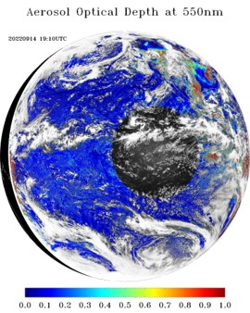

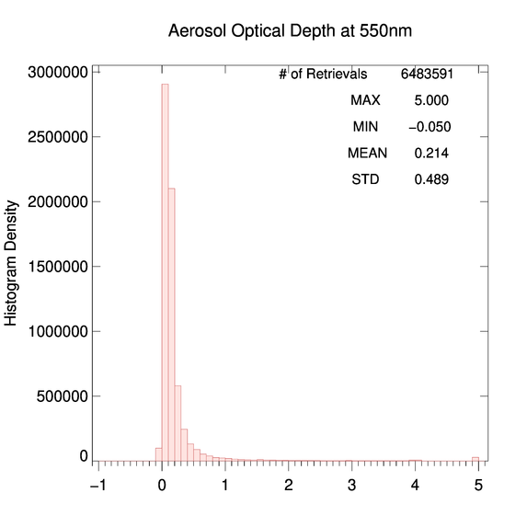
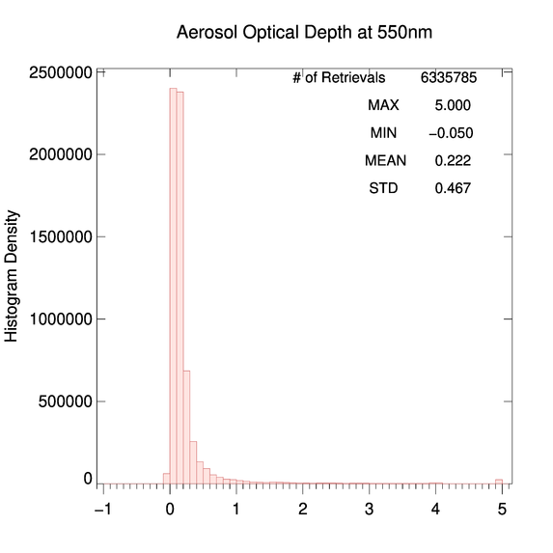
GOES-18 vs. GOES-17
Low+Medium+High QC AOD
09/14/2022 19:10 UTC
PLPT test ABI-FD_AOD01
G18 AOD field is as expected.
The spatial distribution of G18 AOD is visually similar to that of G17.
G18 and G17 histograms are similar with a slightly smaller G18 mean AOD compared to G17.
G18 AOD is within valid range. (Passed)
G18
G17

Slide 16
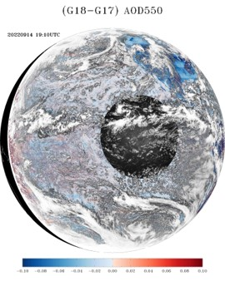
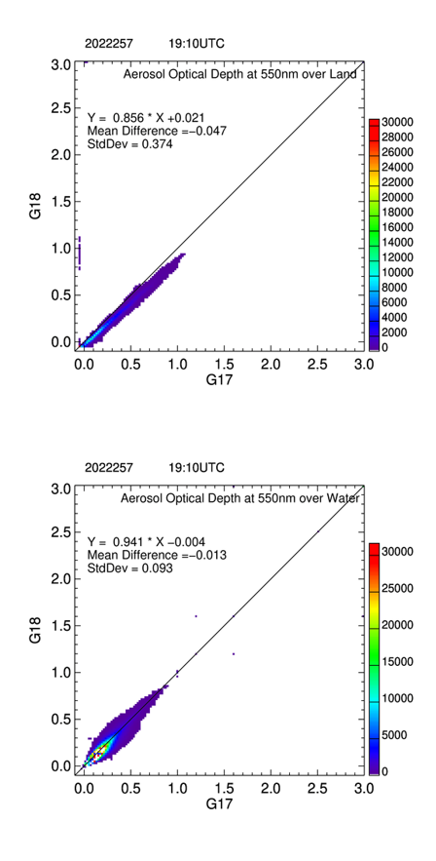
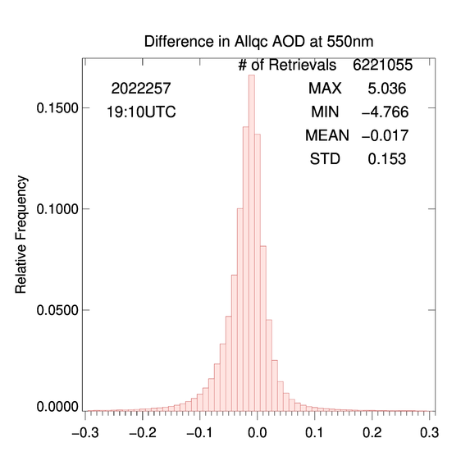
GOES-18 vs. GOES-17
Low+Medium+High QC AOD
09/14/2022 19:10 UTC
PLPT test ABI-FD_AOD01
The AOD differences are generally small except over land or at large view zenith angles.
The mean AOD difference is about -0.05 over land and is about -0.01 over water.
Spectral land-surface relationships must be updated for G18.
Land
Water

Slide 17
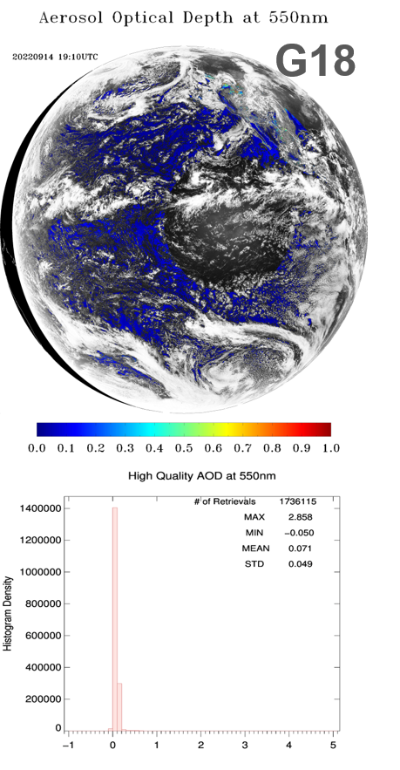
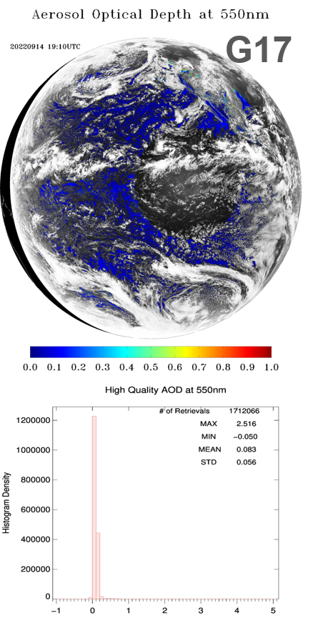
GOES-18 vs. GOES-17
High QC AOD
09/14/2022 19:10 UTC
PLPT test ABI-FD_AOD01
Results are similar to those for unfiltered AOD.
G18 AOD field is as expected.
The spatial distribution of G18 AOD is visually similar to that of G17.
G18 and G17 histograms are similar with a smaller G18 mean AOD compared to G17.
G18 AOD is within valid range. (Passed)

Slide 18
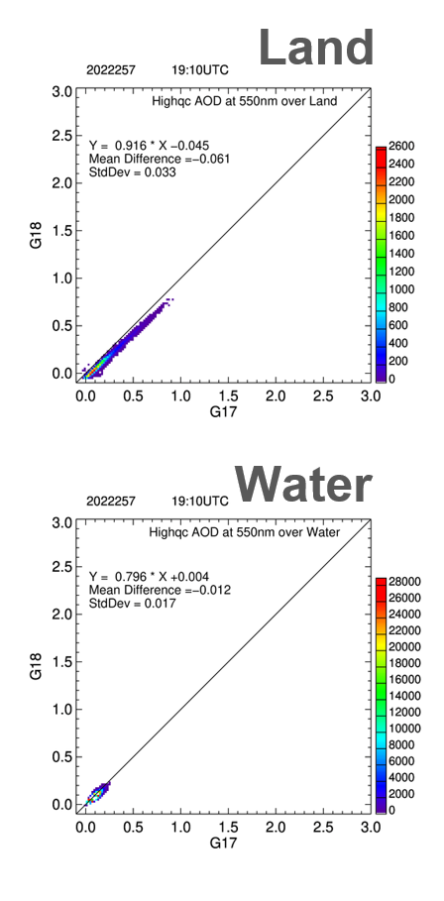
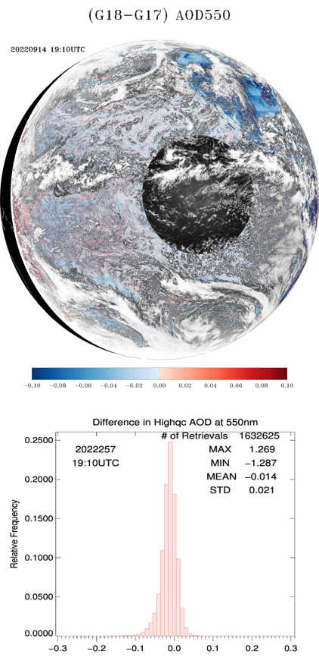
GOES-18 vs. GOES-17
High QC AOD
09/14/2022 19:10 UTC
PLPT test ABI-FD_AOD01
The AOD differences are generally small except over land or at large view zenith angles.
The mean AOD difference is about -0.06 over land and is about -0.01 over water.
Spectral land-surface relationships must be updated for G18.

Slide 19
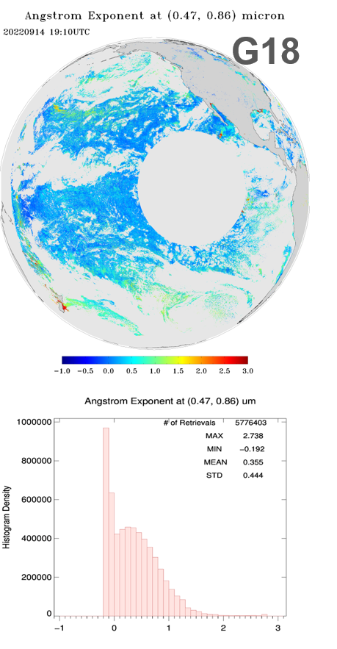
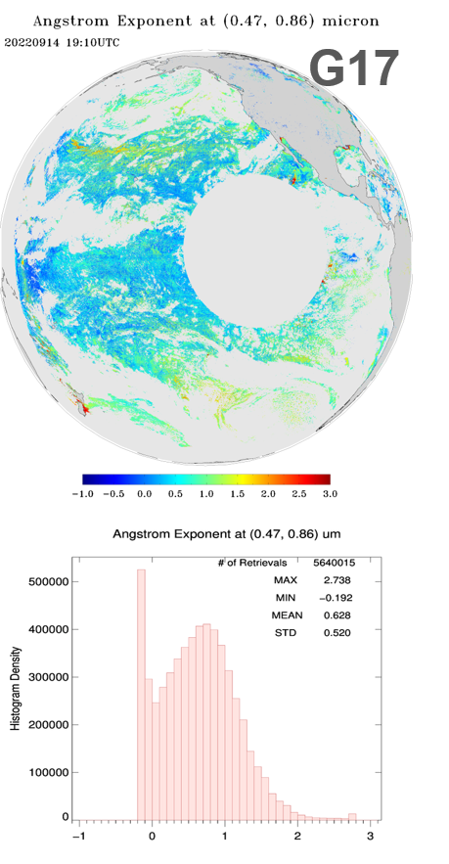
GOES-18 vs. GOES-17
Low+Medium+High QC AE1
09/14/2022 19:10 UTC
Low+medium+high QC Angstrom Exponent (AE) is used due to limited spatial coverage for medium and high QC retrievals.
The range of G18 AE1 in wavelength pair (0.47, 0.86) µm is as expected.
Relative to G17, G18 AE1 has larger number of smaller AE1 values, suggesting larger aerosol particles.

Slide 20
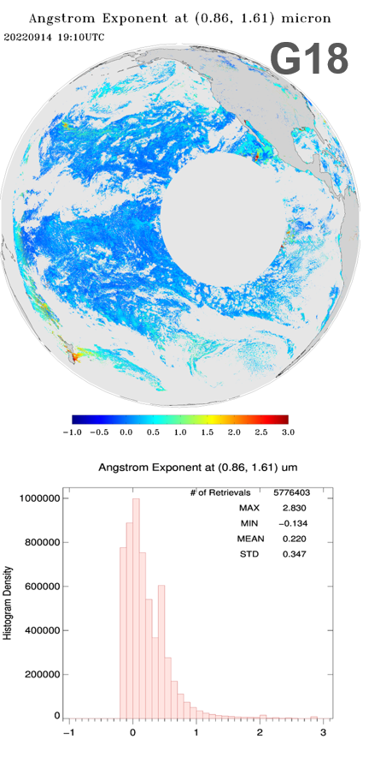
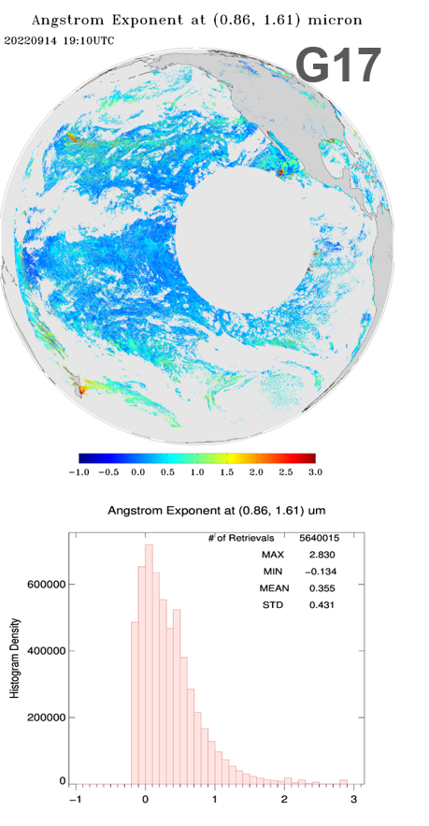
GOES-18 vs. GOES-17
Low+Medium+High QC AE2
09/14/2022 19:10 UTC
The range of G18 AE2 in wavelength pair (0.86, 1.61) µm is as expected.
Relative to G17, the G18 mean AE2 is smaller suggesting larger aerosol particles.
The difference between G18 and G17 AE2 is smaller than that for AE1.

Slide 21
GOES-18 vs. GOES-17
CONUS
Test ABI-CONUS_AOD02 (Supplement B):
  Results are similar to those for FD.
  CONUS G18 AOD (and APS) field is as expected.
  G18 AOD (and APS) is within valid range. (Passed)
  The spatial distribution of G18 AOD/APS is visually similar to that of G17.
  G18 and G17 histograms are similar with a slightly smaller G18 mean AOD compared to G17.
G18, G17 and G16 AOD over common area (Supplement E):
  Spatial pattern of G18 AOD is visually very similar to that of G17 and G18 AOD.
  Histograms show a relatively smaller mean G18 AOD value than that of G17 and G16.

Slide 22
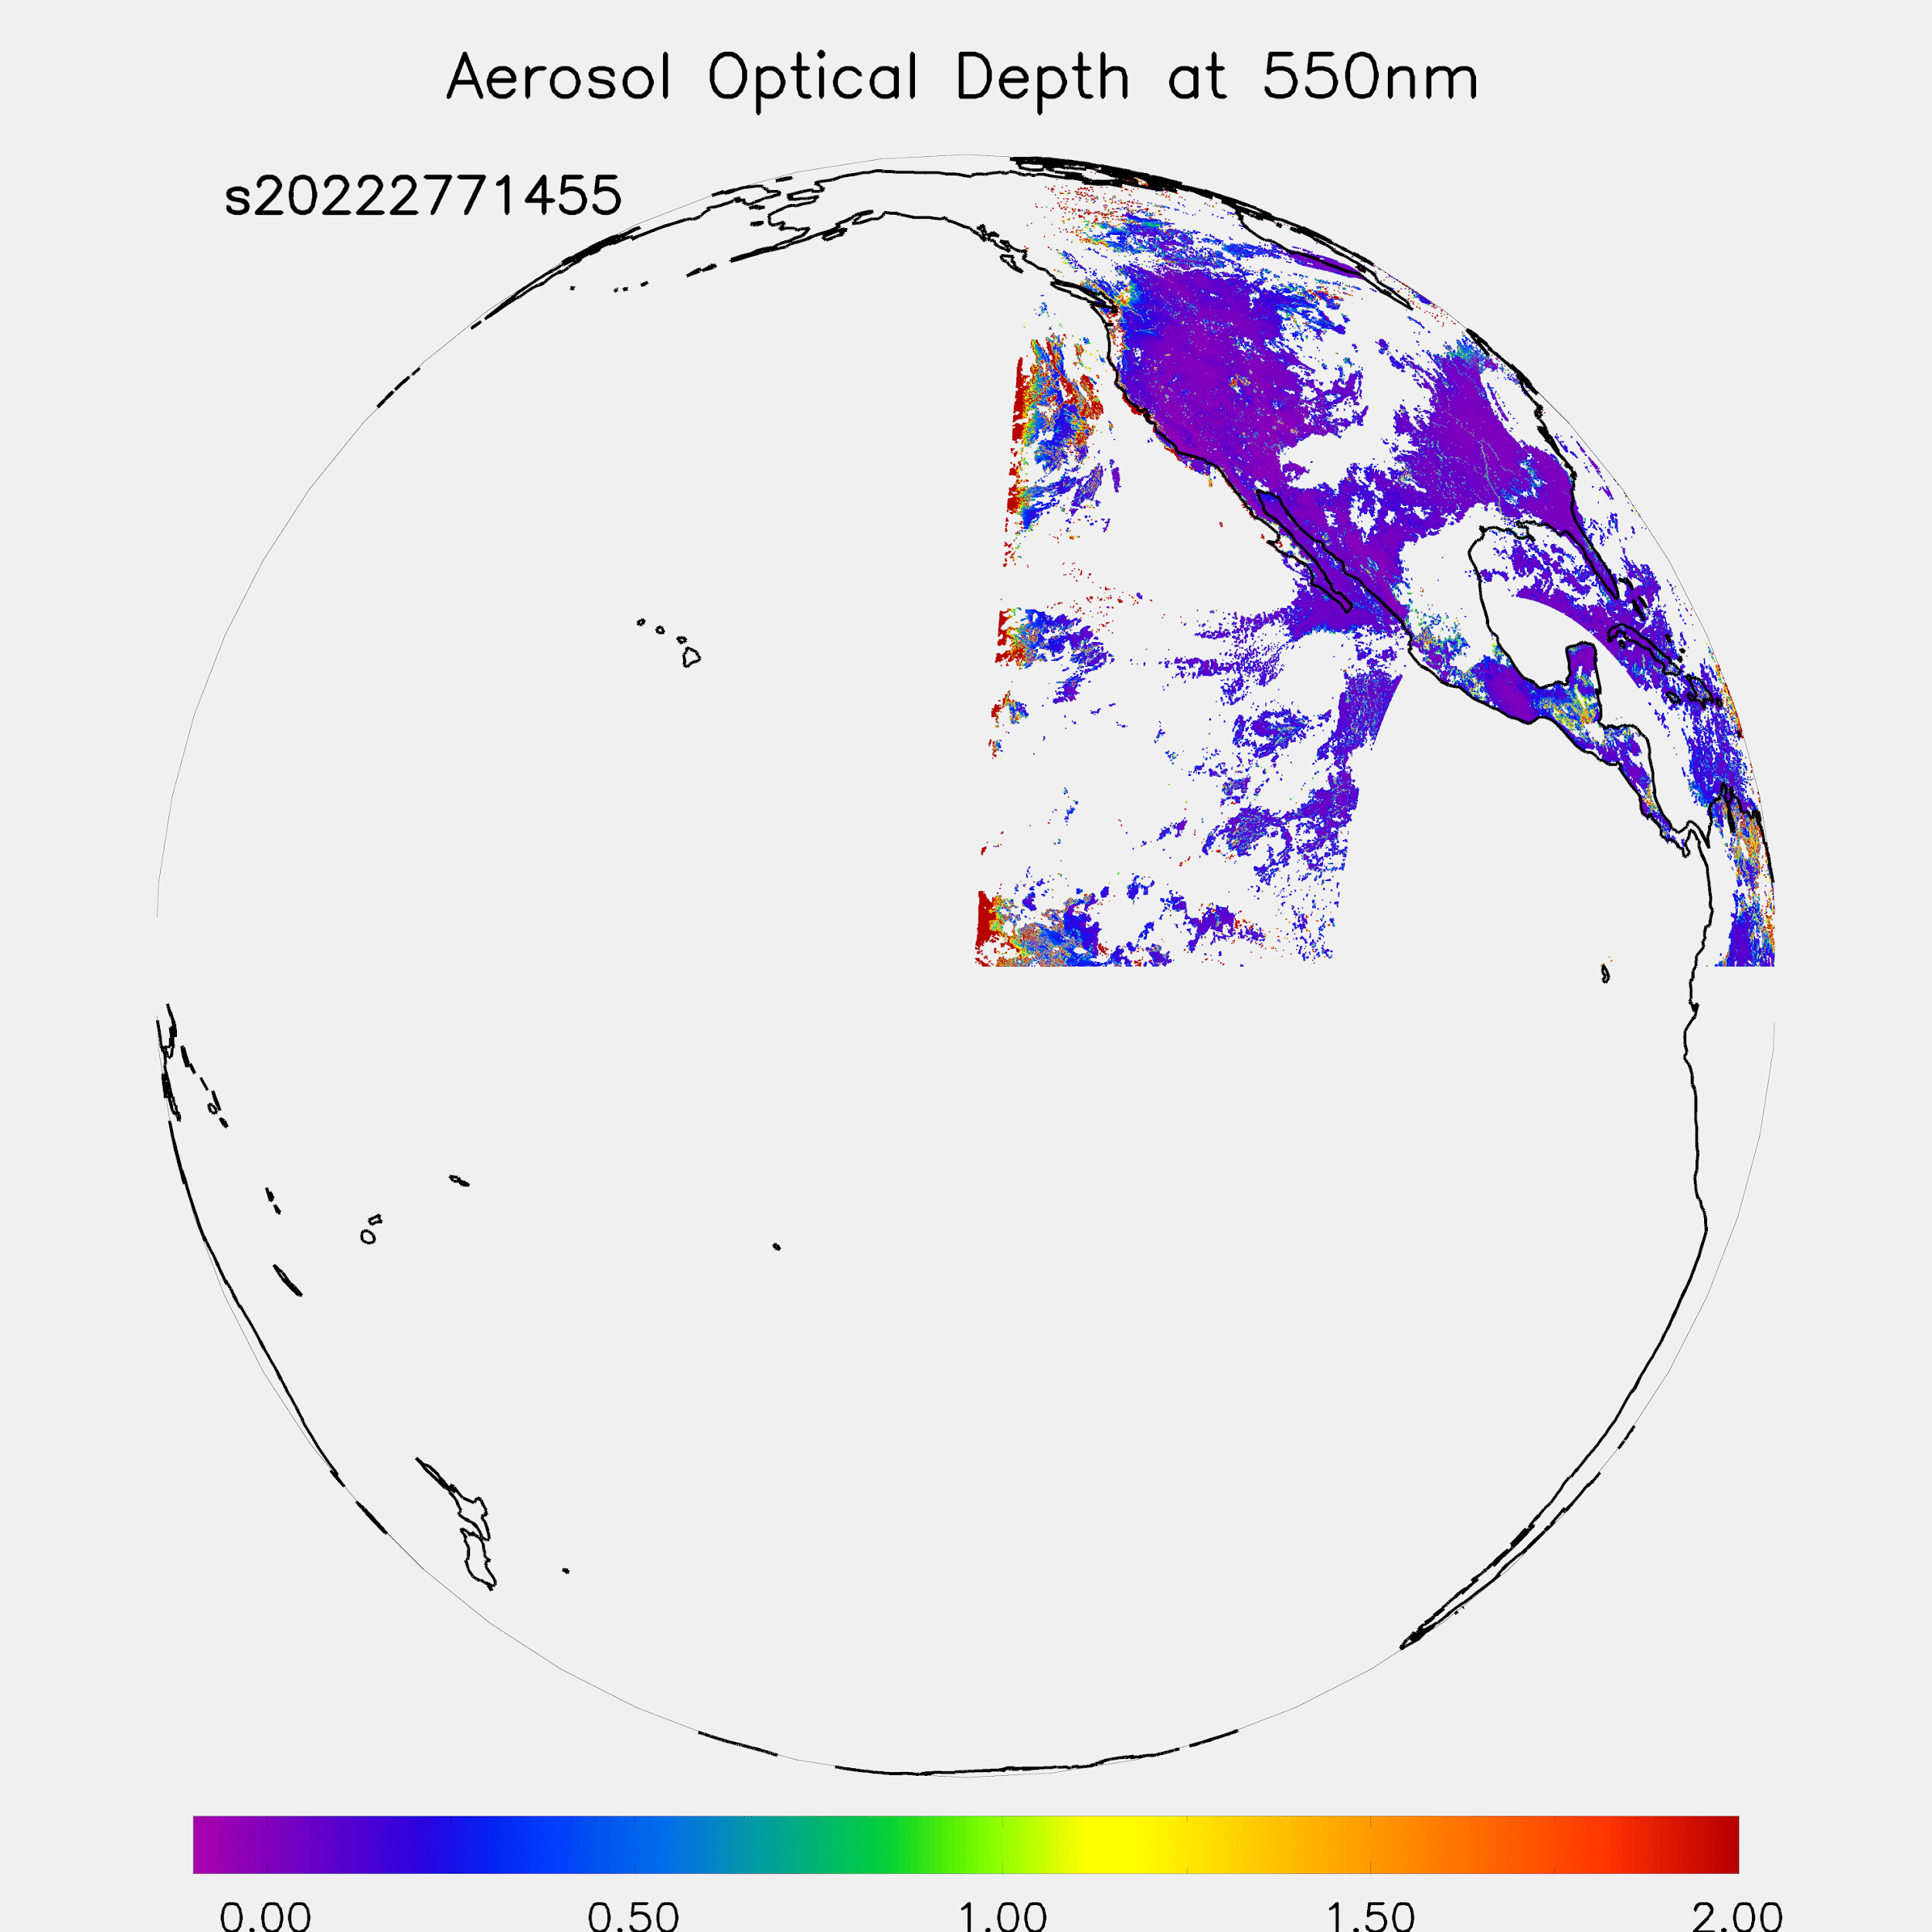
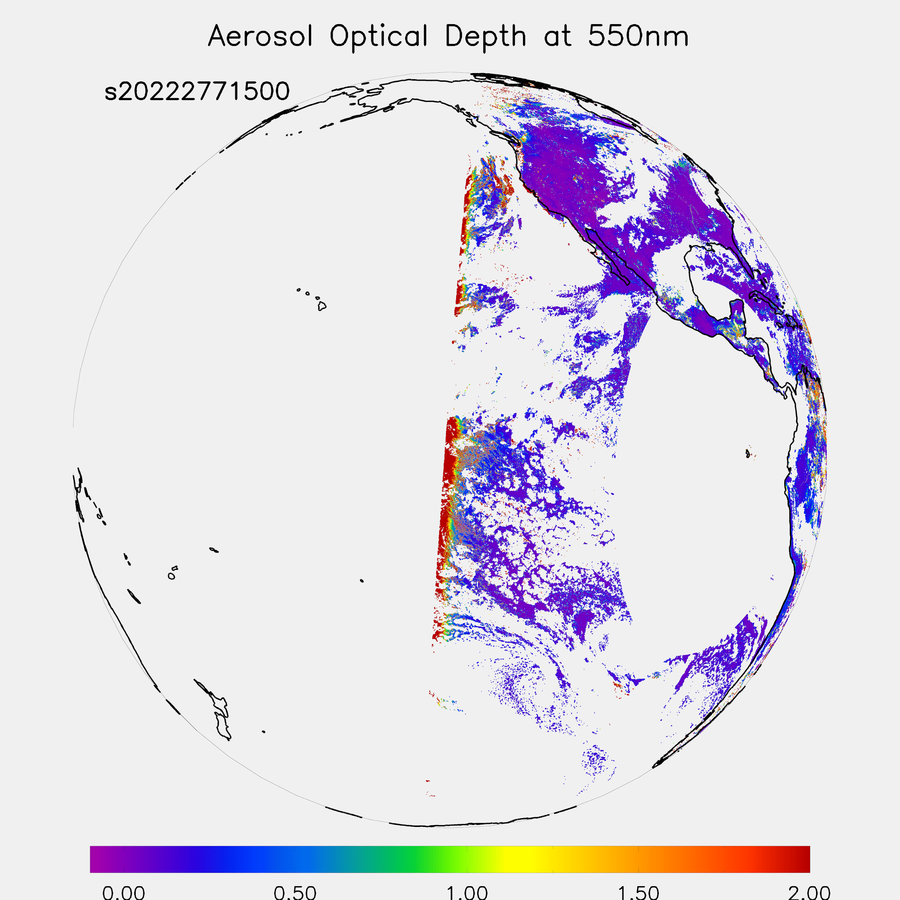
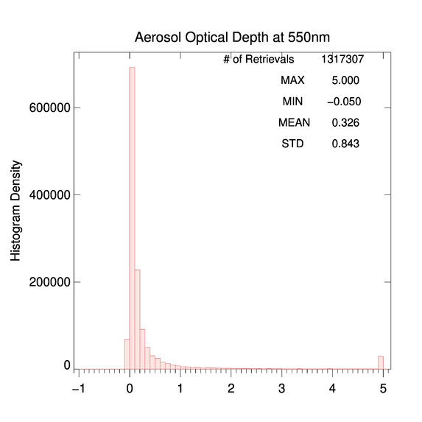
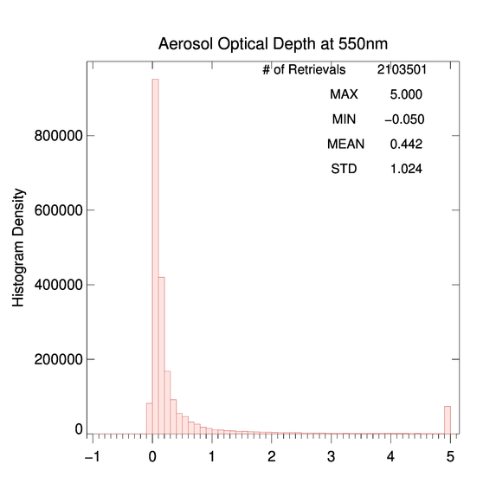
M4 AOD, Full Disk
Difference in M4 vs. M6 Spatial Coverage
October 4, 2022
PLPT test ABI-FD_AOD03
M4 full disk AOD is within valid range. (Passed)
Compared to M6, M4 has more missing data blocks of AOD. (Partial-Passed)
During M4 test 17:00 – 20:55 UTC on 9/25/2022, there were missing data blocks at 17:10 and 17:25 UTC, and no AOD retrievals were available after 17:25 UTC until switching back to M6 at 21 UTC.
M4
14:55 UTC
M6
15:00 UTC

Slide 23
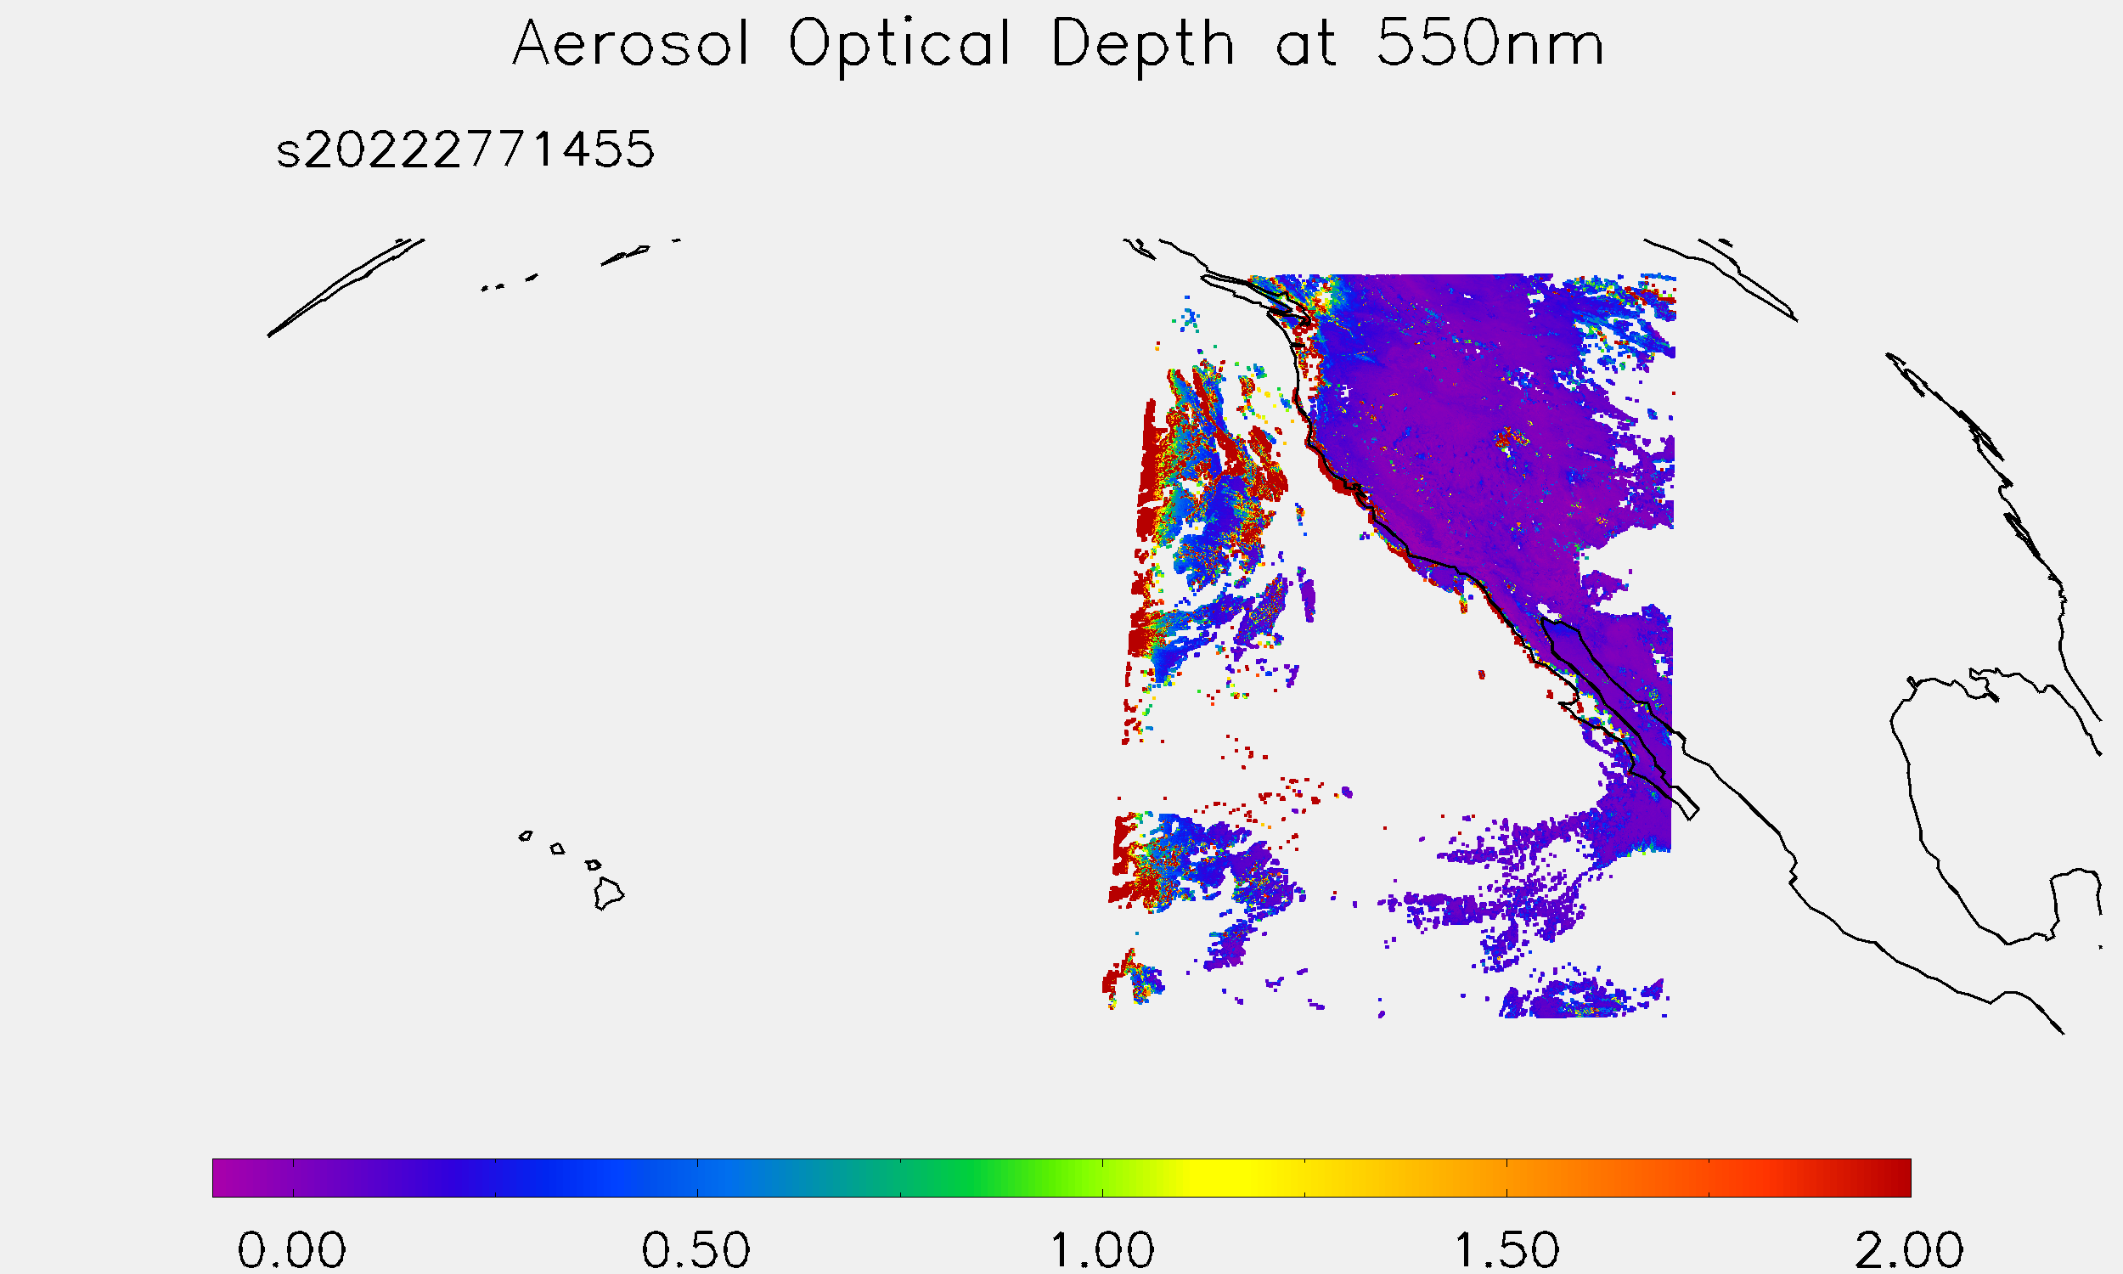
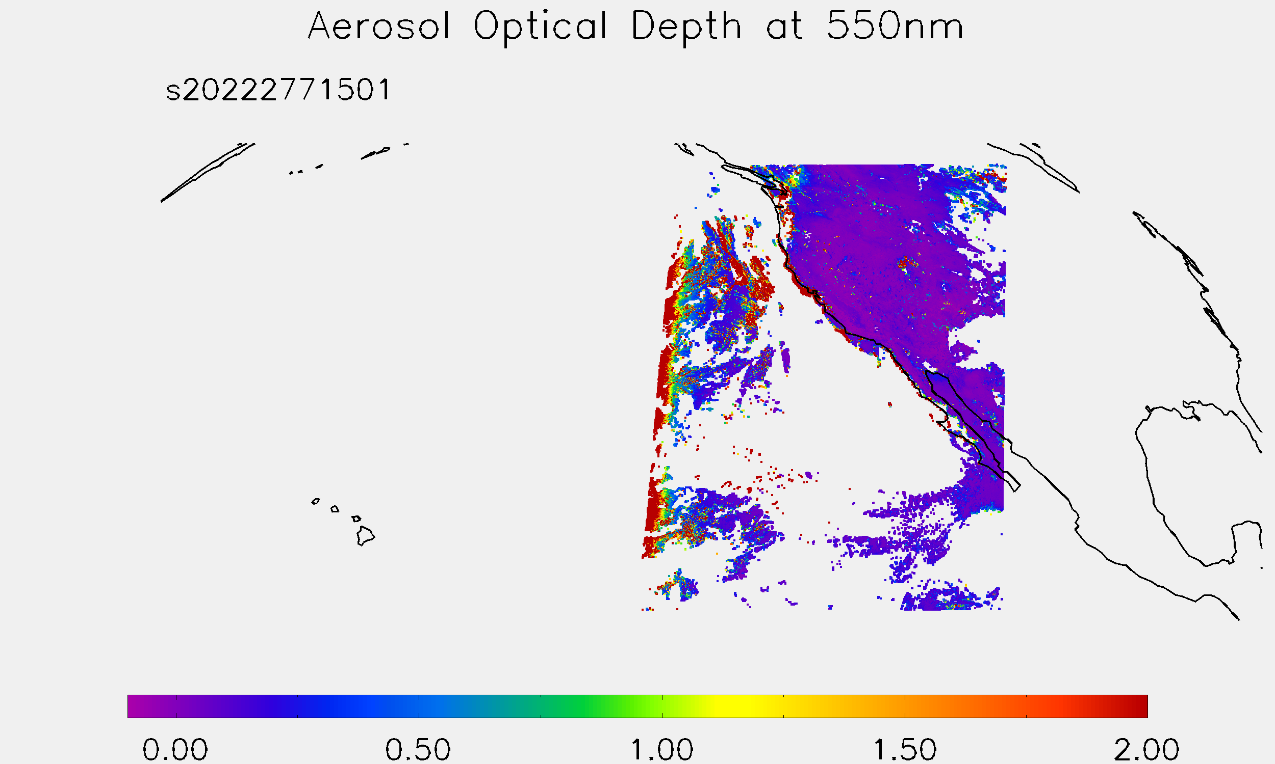
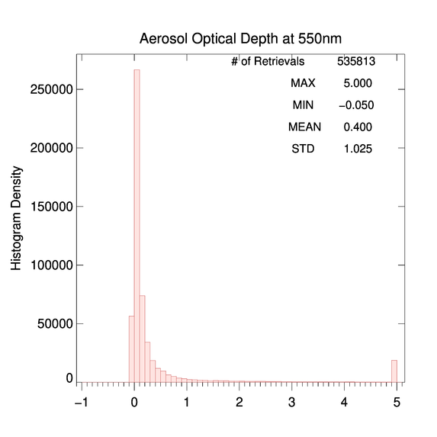
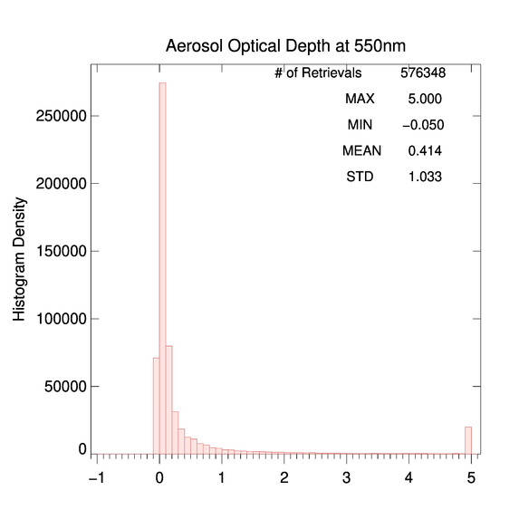
M4 AOD, CONUS
Difference in M4 vs. M6 Spatial Coverage
October 4, 2022
PLPT test ABI-CONUS_AOD04
M4 CONUS AOD is within valid range. (Passed)
M4 and M6 histograms are very similar.
Only a small difference between M4 and M6 mean AOD.
During M4 test 17:00 – 20:55 UTC on 9/25/2022, there were no AOD retrievals available after 17:25 UTC until switching back to M6 at 21:01 UTC. (Partial-Passed)
M4
14:55 UTC
M6
15:01 UTC

Slide 24
Quantitative Comparisons
PLPT Tasks ABI-FD_AOD05 and ABI-CONUS_AOD06
GOES-18 Aerosol Optical Depth L2 Product Provisional PS-PVR

Slide 25
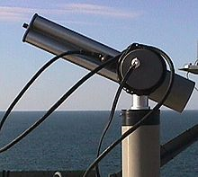
Reference Data
Reference data:
Version 3 L1.5 high-quality aerosol data from the ground-based Aerosol Robotic Network (AERONET) (Holben et al. 1998).
GOES-16 and -17 AOD.
MODIS and VIIRS AOD.
Time period:
07/26/2022 – 10/26/2022
AERONET

Slide 26
Definitions of Metrics for Quantitative Comparisons
Passed: Accuracy and Precision meet or slightly exceed requirements. Potential contributors for deviations are identified.
Partial-Passed: Accuracy/Precision deviates significantly from requirements, but potential contributors for deviations are identified.
Failed: Accuracy/Precision deviates significantly from requirements and source of poor performance is unknown, or source known and correction requires new algorithm.

Slide 27
Comparison with AERONET ground measurements
GS AOD product over FULL DISK
GOES-18 Aerosol Optical Depth L2 Product Provisional PS-PVR

Slide 28
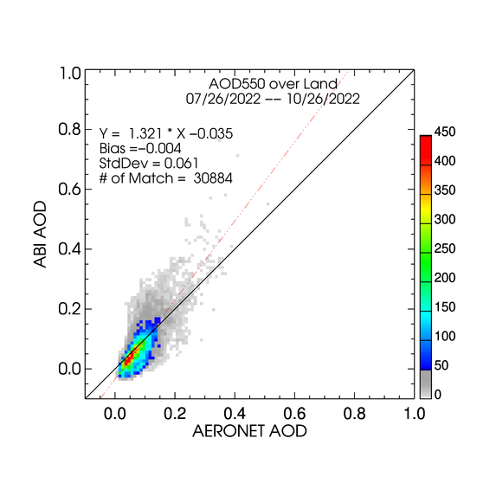
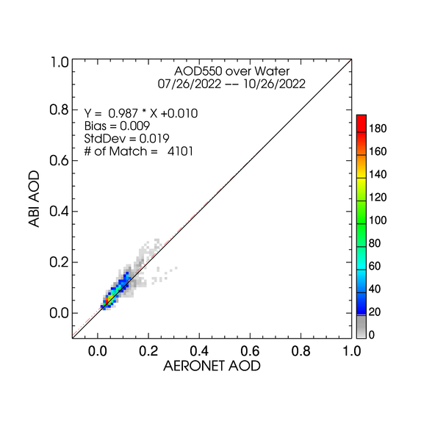
High QC GOES-18 AOD - FD
LAND
WATER
High quality AODs are plotted regardless of magnitude (range).
Majority of points are around 1:1 line.
Very small negative bias over land and positive bias over water.
STD over land is about three times as large as that over water.

Slide 29
G18 AOD Statistics - FD
High Quality 550-nm ABI AOD (07/26/2022 – 10/26/2022)
Range | Land |  |  |  | Water
 | AOD | Accuracy | Precision | # of points | AOD | Accuracy | Precision | # of points
Low | <0.04 | -0.02 (0.06) | 0.02 (0.13) | 4,054 | <0.4 | 0.01 (0.02) | 0.02 (0.15) | 4,101
Medium | 0.04 - 0.8 | 0.00 (0.04) | 0.06 (0.25) | 26,819
High | > 0.8 | 0.92 (0.12) | 0.11 (0.35) | 11 | >0.4 | -- | -- | 0
Accuracy and precision of G18 ABI 550-nm AOD in comparison with AERONET AOD over land and water using collocated ABI-AERONET dataset. F&PS requirements are in parenthesis.
(--) means data are not available and/or statistic is not calculated.
Accuracy and precision are evaluated using only high QC AOD in the required AOD ranges. Here “low”, “medium” and “high” refer to the magnitude of AOD not to its quality.
Requirements are met except for accuracy in high AOD range over land with very limited sample size. Data are not available in high AOD value range over water.

Slide 30
G17 AOD Statistics – FD
High Quality 550-nm ABI AOD (07/26/2022 – 10/26/2022)
Range | Land |  |  |  | Water
 | AOD | Accuracy | Precision | # of points | AOD | Accuracy | Precision | # of points
Low | <0.04 | -0.00 (0.06) | 0.03 (0.13) | 5,129 | <0.4 | 0.02 (0.02) | 0.02 (0.15) | 4,205
Medium | 0.04 - 0.8 | 0.03 (0.04) | 0.08 (0.25) | 29,544
High | > 0.8 | 0.25 (0.12) | 0.77 (0.35) | 21 | >0.4 | -- | -- | 0
Accuracy and precision of G17 ABI 550-nm AOD in comparison with AERONET AOD over land and water using collocated ABI-AERONET dataset. F&PS requirements are in parenthesis.
(--) means data are not available and/or statistic is not calculated.
Requirements are met except for those in high AOD range over land with very limited sample size. Data are not available in high AOD value range over water.
Comparing G17 stats to G18 stats indicates similar retrieval qualities.
  Only the time periods are same; slightly larger number of G17 retrievals is expected to result from input (reflectances, cloud mask etc.) difference.

Slide 31
G16 AOD Statistics – FD
High Quality 550-nm ABI AOD (07/26/2022 – 10/26/2022)
Range | Land |  |  |  | Water
 | AOD | Accuracy | Precision | # of points | AOD | Accuracy | Precision | # of points
Low | <0.04 | -0.02 (0.06) | 0.03 (0.13) | 10,842 | <0.4 | 0.02 (0.02) | 0.03 (0.15) | 6,795
Medium | 0.04 - 0.8 | 0.02 (0.04) | 0.07 (0.25) | 68,633
High | > 0.8 | 0.34 (0.12) | 0.33 (0.35) | 1,329 | >0.4 | -0.09 (0.10) | 0.11 (0.23) | 18
Accuracy and precision of G16 ABI 550-nm AOD in comparison with AERONET AOD over land and water using collocated ABI-AERONET dataset. F&PS requirements are in parenthesis.
(--) means data are not available and/or statistic is not calculated.
Requirements are met except for accuracy in high AOD range over land.
Comparing G16 stats to G18 stats indicates similar retrieval qualities except for the high AOD ranges.
  Only the time periods are same; significantly more stations, and thus matchups, are available for GOES-16.

Slide 32
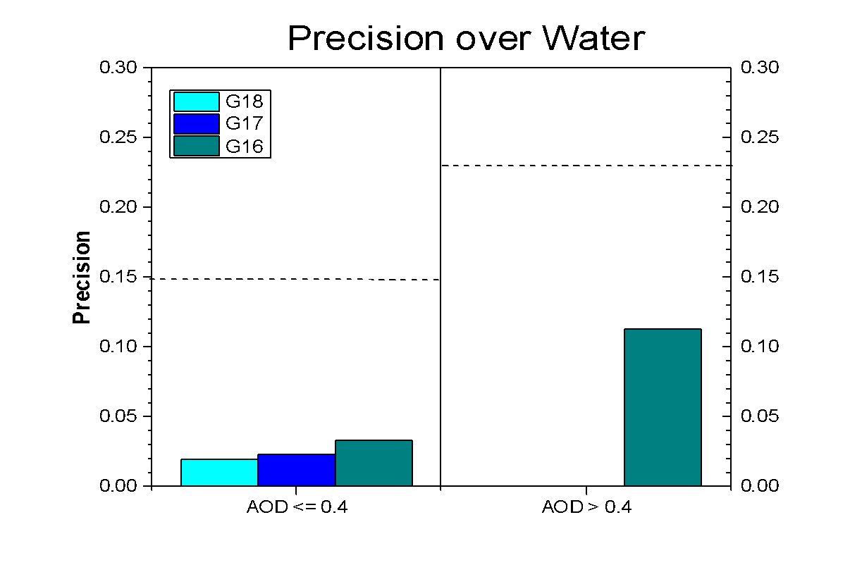
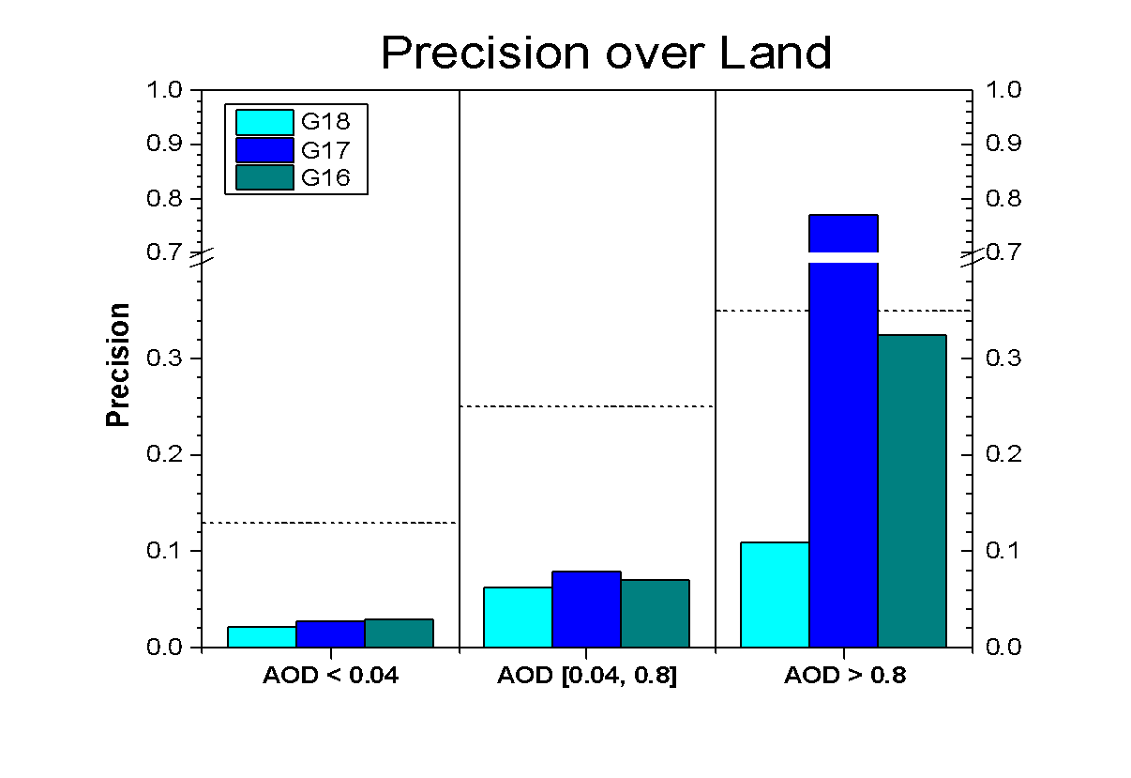
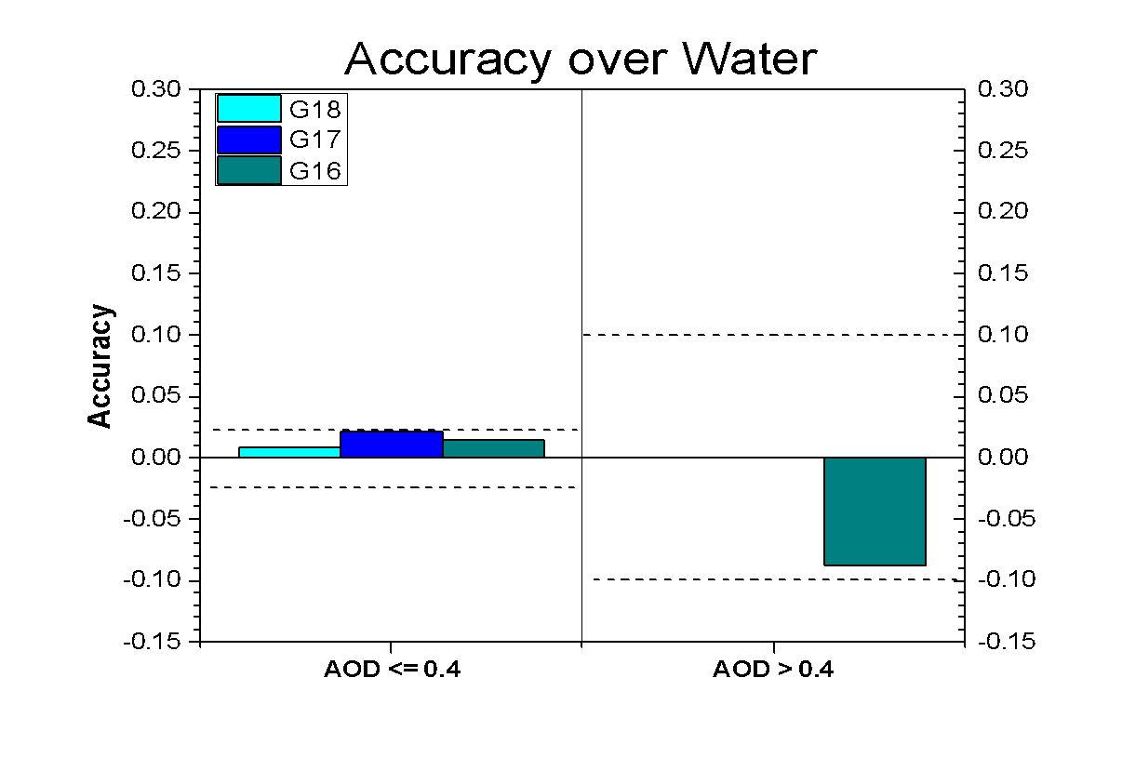
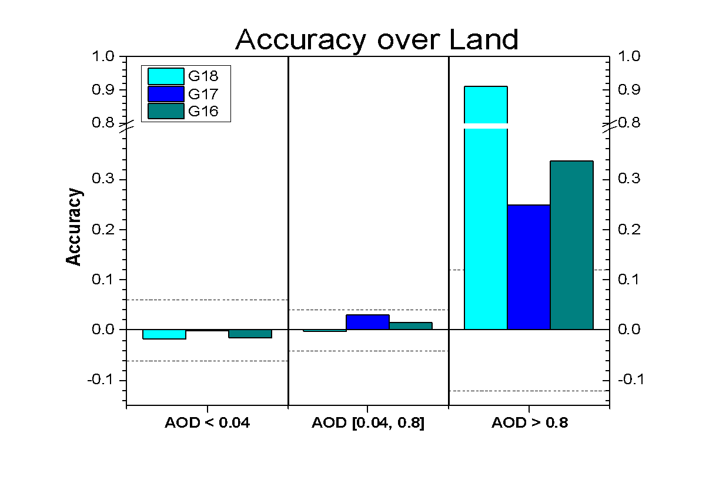
Graphical Summary of
G18, G17 and G16 A and P
Accuracy and precision values of G18 AOD are not very different from G16 and G17 in most AOD value ranges.

Slide 33
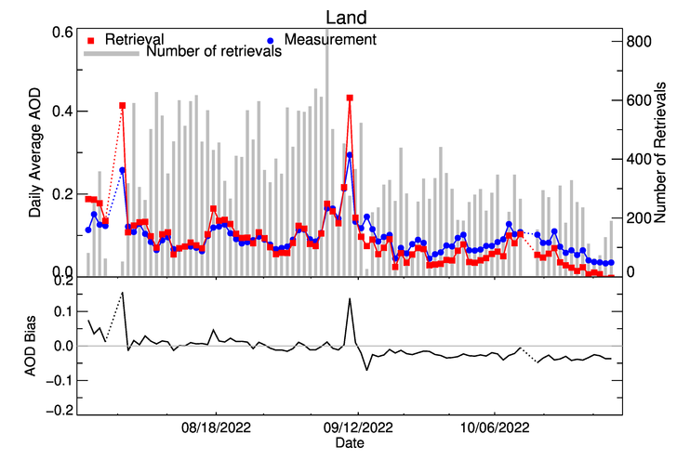
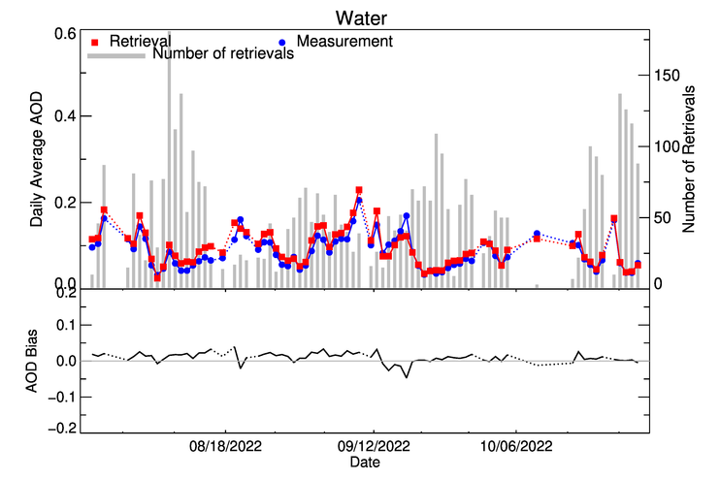
Time Series of G18 AOD - FD
07/26/2022 – 10/26/2022 High QC
Time series of daily average high-quality GOES-18 and AERONET AOD and of (GOES-18 – AERONET) (bias) for land (upper panel) and water (lower panel).
GOES-18 AOD tracks changes in AERONET AOD.
Day-to-day variability of bias is larger over land than over water.
Bias is mostly positive in summer and negative in fall over land.
No trend in bias over water.

Slide 34
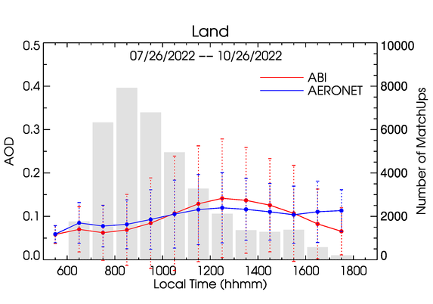
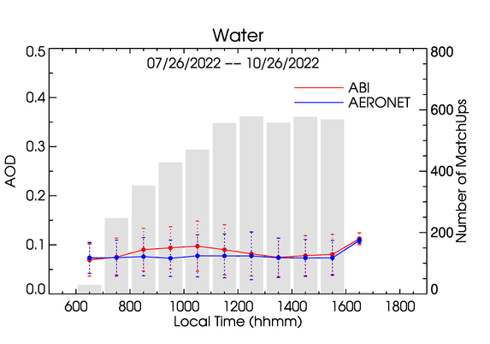
Diurnal Cycle - FD
07/26/2022 – 10/26/2022 High QC
AODs from all sites are averaged.
Diurnal variation of G18 AOD mostly follows that in AERONET AOD. (Not always true for individual sites!)
Over land, early afternoon G18 AODs are larger and otherwise smaller than AERONET AODs.
Over water, mid-morning (~10AM) G18 AOD is larger than AERONET AODs.

Slide 35
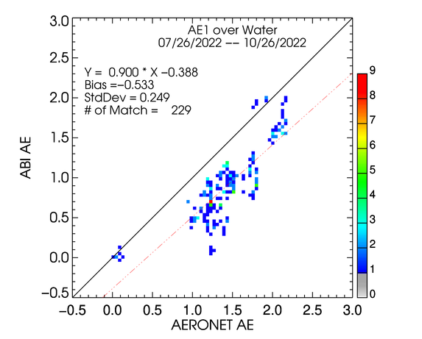
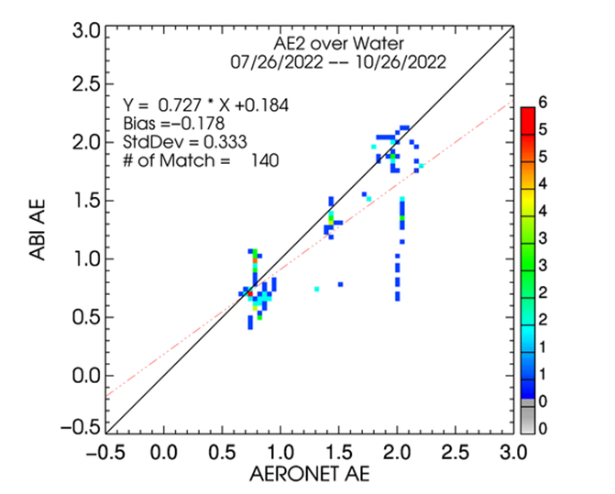
Top2 QC GOES-18 AE - FD
Top2 Quality results are based on (medium + high) qc ABI AE retrievals and AERONET AOD >= 0.15.
A relatively large negative AE1 bias of -0.5. A better agreement (bias of -0.1) before Band 2 calibration adjustment (Supplement C).
Agreement of G18 AE2 with AERONET AE2 is better .

Slide 36
Summary of GOES 18 vs. AERONET AOD Comparison
GOES-18 AOD retrievals were compared with AERONET version 3 level 1.5 data.
GOES-18 AOD meets the accuracy and precision requirements except for accuracy in high AOD range over land due to very limited sample size.
The performance of GOES-18 AOD in high AOD range over land is more or less similar to those of GOES-17 and GOES-16. Data are not available in high AOD value range over water.
Same is true for CONUS (Supplement B).
Overall metrics: Passed

Slide 37
Comparison with GOES-17, GOES-16, MODIS, VIIRS at AERONET Stations
FULL DISK
GOES-18 Aerosol Optical Depth L2 Product Provisional PS-PVR

Slide 38
Comparison with other satellite AOD
AOD over AERONET sites
Time period: 07/26/2022 – 10/26/2022.
Data:
  GOES-18: operational G18 GS AOD,
  GOES-16: operational G16 AOD.
  GOES-17: operational G17 AOD.
  VIIRS: S-NPP and NOAA-20 EPS AOD,
  MODIS: collection 6 Aqua and Terra AOD (Terra AOD only available through 10/10/2022),
A subset of matchups between the data above and AERONET is created:
  At each AERONET site, a matchup is considered when the ABI observation time in the AERONET-G18 matchup is within one-hour (10-min) window around the VIIRS/MODIS overpass (G16/G17) observation) time in the AERONET-VIIRS/MODIS (G16/G17) matchup.
Used high-quality M4 and M6 ABI AODs.

Slide 39
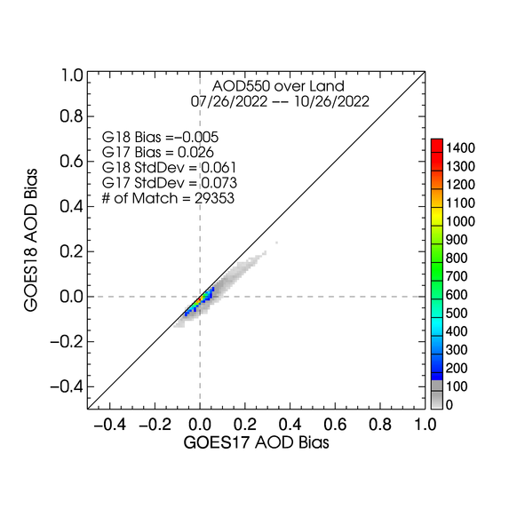
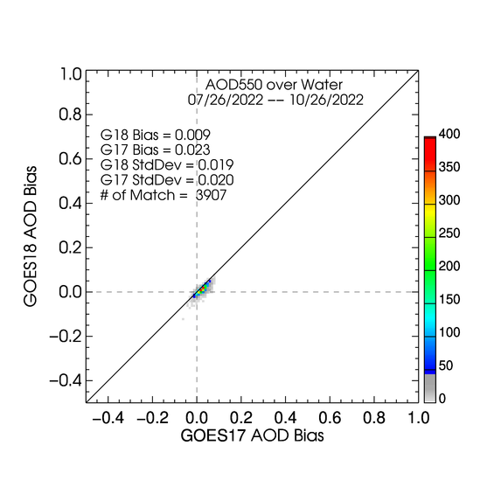
GOES-18 vs. GOES-17 bias
Over Land
Over Water
GOES-18 has smaller bias and slightly smaller standard deviation than GOES-17 over land and over water.

Slide 40
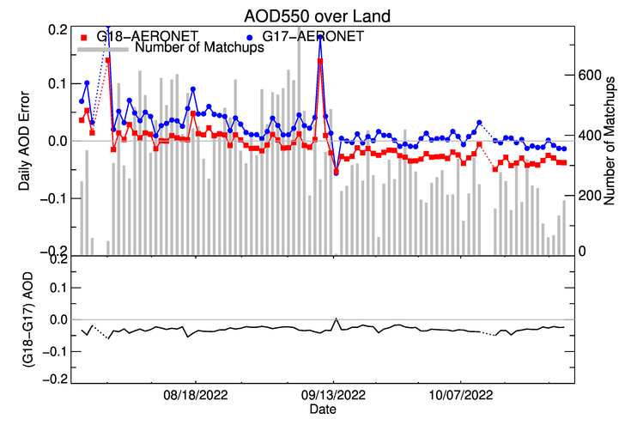
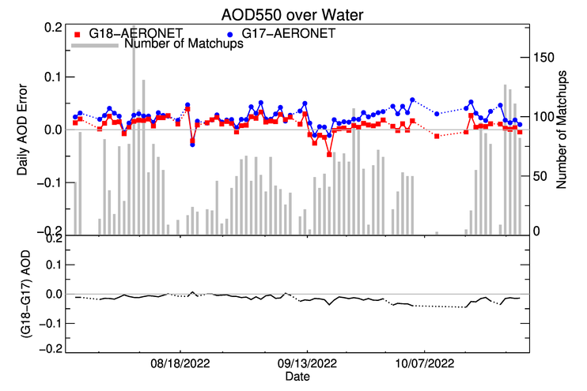
Time Series of Daily GOES-18 and GOES-17 Biases Relative to AERONET
GOES-18 daily AOD bias tracks that of GOES-17.
The GOES-18 daily AOD bias is smaller in summer but larger in fall over land.
The GOES-18 daily AOD bias is mostly smaller over water.

Slide 41
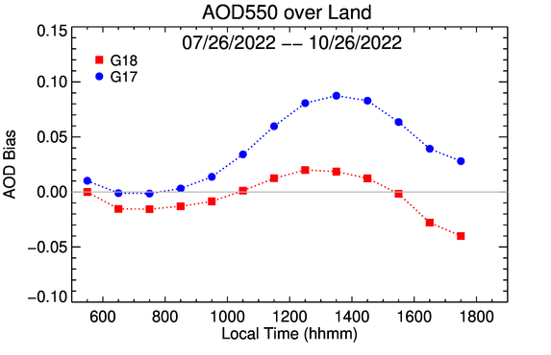
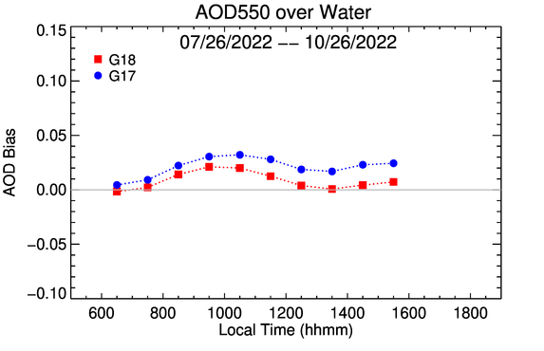
Diurnal Variation of Hourly GOES-18 and GOES-17 Biases Relative to AERONET
Diurnal cycle of (G18/ABI – AERONET) and (G17/ABI – AERONET) biases for land (left) and water (right).
GOES-18 and GOES-17 illustrate similar diurnal pattern over land and over water, respectively.
Over land, GOES-18 has a smaller bias during 10 – 15 local hours.
Over water, GOES-18 show a smaller hourly bias throughout.

Slide 42
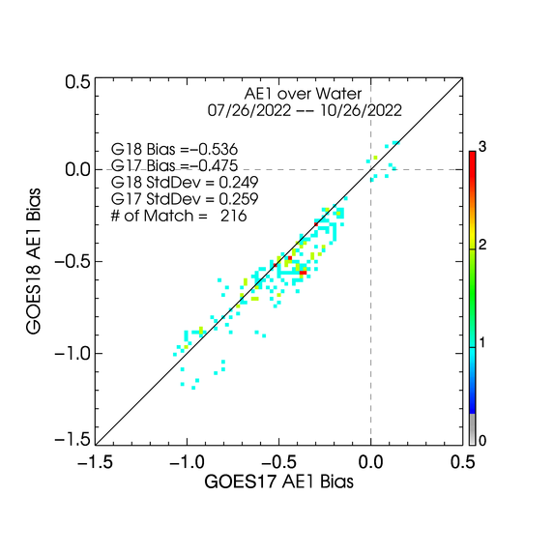
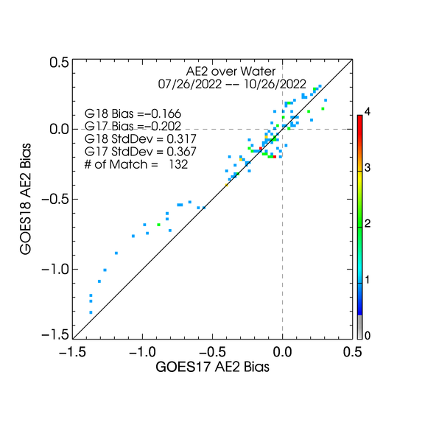
GOES-18 vs. GOES-17 AE Bias
AE1
AE2
The GOES-18 AE1 has a larger and AE2 has a smaller negative bias than GOES-17. The standard deviations are comparable.

Slide 43
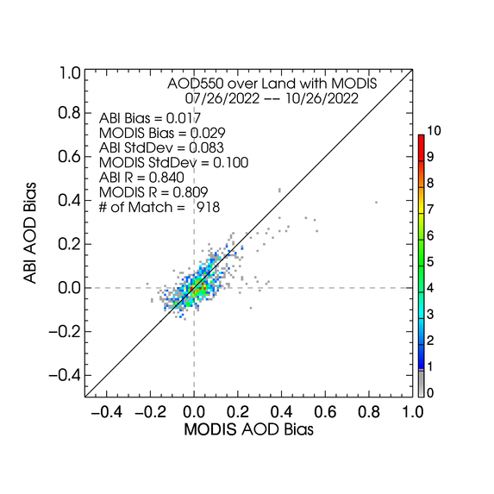
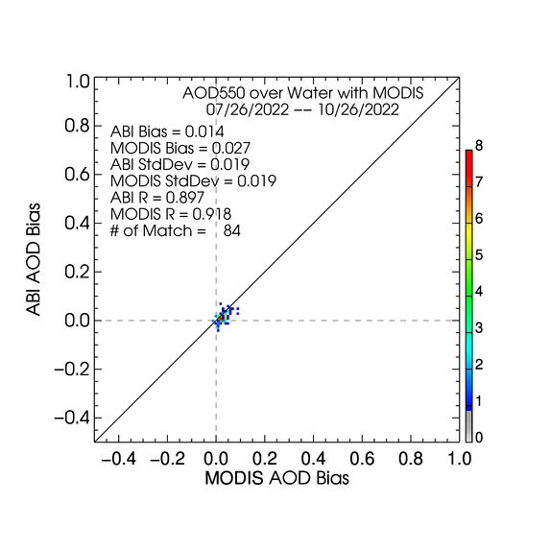
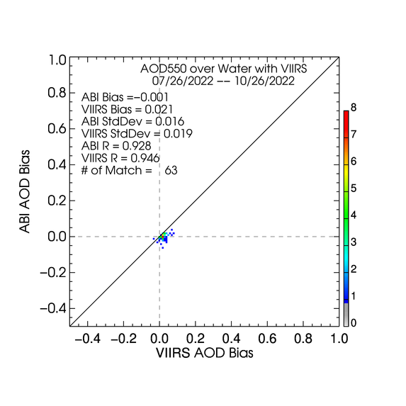
ABI bias vs. MODIS bias
Over Land
Over Water
Distributions of GOES-18/ABI and MODIS biases (wrt AERONET) are similar.

Slide 44
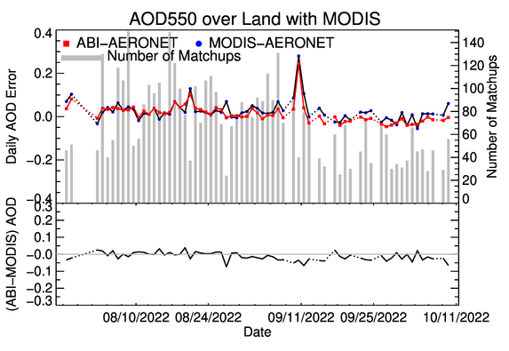
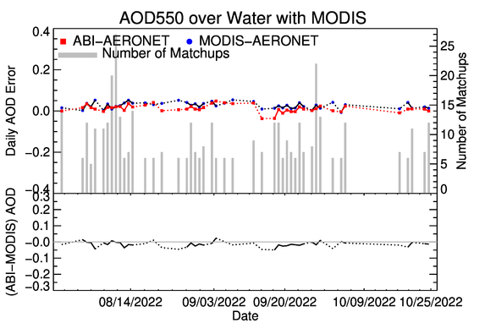
Time Series of Daily ABI and MODIS Biases Relative to AERONET
Magnitude of day-to-day variation of ABI and MODIS daily AOD biases are similar. Sometimes MODIS does “better”, at other times ABI bias is smaller.
Agreement between ABI and MODIS appears to be better than for VIIRS (Supplement D), likely because of similarity of algorithms, and because morning and afternoon MODIS observations lead to more observations, and thus to matchups.

Slide 45
Summary of Comparison with GOES-17, GOES-16, MODIS and VIIRS
GOES-18 AOD retrievals have been compared with VIIRS, MODIS, GOES-16 and GOES-17 AOD retrievals at AERONET sites. (Results for S-NPP and NOAA-20 VIIRS, and fo GOES-16 are in Supplement D.)
Over water, GOES-18 bias and standard deviation are similar to or smaller than VIIRS, MODIS, GOES-16 and GOES-17. (Passed)
Over land, GOES-18 bias and standard deviation are comparable or smaller than MODIS, GOES16 and GOES17; however, not as good as VIIRS, which likely benefits from more consistent geometry from afternoon only orbits to reduce the uncertainty in the land surface reflectance relationship parameterization . (Passed)

Slide 46
Provisional Maturity Assessment
GOES-18 Aerosol Optical Depth L2 Product Provisional PS-PVR

Slide 47
Provisional Validation
Preparation Activities | Assessment
Validation activities are ongoing and the general research community is now encouraged to participate. | Validation activities are ongoing. The general research community has been participating and providing feedback.
Risks to provisional are identified and the impacts are minor. Solutions to risks are in development. | Operational risks have been identified. Six AOD ADRs remain open (zonal percentages, TPW value/flag, occasional missing block, occasional incorrect time variable), but none of them impacts accuracy/precision, and expected to be taken care of in the Enterprise algorithm.
Incremental product improvements may still be occurring. | Incremental product improvements are expected.

Slide 48
Provisional Validation
End State | Assessment
Product performance has been demonstrated through analysis of a small number of independent measurements obtained from select locations, periods, and associated ground truth or field campaign efforts. | This has been demonstrated using AERONET as ground truth and independent statellite retrivals from VIIRS/MODIS and GOES16/17.
Product analysis is sufficient to communicate product performance to users relative to expectations (Performance Baseline). | This has been communicated in PS-PVR.
Documentation of product performance exists that includes recommended remediation strategies for all risks and weaknesses. Any algorithm changes associated with risks have been documented, implemented, tested, and shared with the user community. | These are documented in this PS-PVR presentation and will be documented in a separate ReadMe file.
Product is ready for operational use and for use in comprehensive cal/val activities and product optimization. | We concur.

Slide 49
Path to full Validation Maturity
GOES-18 Aerosol Optical Depth L2 Product Provisional PS-PVR

Slide 50
Issues and Status
ADRs Potentially Needing Resolution for Full VAL
ADR | Title | Status | Build
920 | Incorrect zonal percentage metadata | In analysis | --
801, 899 | Incorrect TPW Input and/or flag | In analysis | --
818, 947 | Occasional missing blocks over full disk AOD (CONUS) product | In analysis | --
1152 | Incorrect/missing time variable in some L2 AOD files | In analysis | --
None of these affects accuracy and precision, and so …
for achieving Full Validated Maturity they may not be critical.
However, fixing them is highly desirable; especially ADR 920 which may be used (by OSPO) in product monitoring.

Slide 51
Issues and Status
Other Actions Needed for Full VAL
Action | Title | Desired Implementation Date into OE
New ADR needed^{[1]} | L2 AOD algorithm - update the land-surface reflectance relationship derived from GOES-18 data at the operational position. | ≧6 month prior to PS-PVR FULL
New ADR Needed^{[2]} | L2 AOD algorithm – add a buffer to the processing block to improve the standard deviation test. | ≧6 month prior to PS-PVR FULL
New ADR needed^{[3]} | L2 AOD algorithm – Add and/or alter internal tests | ≧6 month prior to PS-PVR FULL
Issues “inherited” from G17 provisional PS-PVR.
[1] Currently the G17 land-surface reflectance relationships are applied for the G18 AOD retrievals. G18 matchups between L1b reflectances and AERONET AOD is being collected to derive/update the land-surface reflectance relationships. If needed, ADR will be submitted following the Provisional PS-PVR.
[2] Creation of ADR is TBD, depends on whether implementation of the enterprise algorithm takes care of the issue.
[3] If needed, ADR will be created when at least 6 months of G18 enterprise AOD is available for analysis.

Slide 52
Path to Full Validation - PLPTs
PLPT ID | Descriptive Title
ABI-FD_AOD05 | Assess precision and accuracy of Mode 6 FD product
ABI-CONUS_AOD06 | Assess precision and accuracy of Mode 6 CONUS product
AWG AOD Team will conduct these tests to further evaluate the L2 AOD product quality.
Full test plans and procedures are given in the AOD Readiness, Implementation, and Management Plan (RIMP v2.0; 410-R-RIMP-0326)

Slide 53
Path to Full Validation – Risks
Risk Name | Description | Impact |  | Mitigation and Schedule
Update land surface relationships | as discussed; Priority 1 | Moderate |  | New WR/ADR needed
Update AOD algorithm QC thresholds | as discussed; Priority 2 | Moderate |  | New WR/ADR needed
Add a buffer to processing block | as discussed; Priority 3 | Moderate | Little | New WR/ADR needed
Little Impact
Moderate Impact
Big Impact

Slide 54
Summary & Recommendations
GOES-18 Aerosol Optical Depth L2 Product Provisional PS-PVR

Slide 55
Summary
Overall, the G18 AOD product is ready for operational and scientific use
  In general, high quality retrievals are recommended for quantitative applications due to their better overall performance; however, the lower quality retrievals also have their merit for qualitative examination of local episodic events due to their greater spatial coverage.
Measured AOD performance against reference data
  Accuracy specs are met except for the limited sample size for high AOD range over land.
  Precision specs are met.
  Updates will be needed for land surface relationship and internal test thresholds to further improve performance.

Slide 56
Recommendation
AWG Aerosol Team believes that the GOES-18 L2 AOD product has reached Provisional Maturity as defined by the GOES-R Program.

Slide 57
supplementS
Supplement A: VISUAL AND QUANTITATIVE COMPARISONS WITH GOES-17 - CONUS
Supplement B: Comparison with AERONET ground measurements – CONUS
Supplement C: IMPACT OF Band 2 CALIBRATION ADJUSTMENT
Supplement D: Comparison with VIIRS/MODIS/GOES-16/GOES-17 at AERONET Stations
Supplement E: Comparison with G16 and G17 over common area
GOES-18 Aerosol Optical Depth L2 Product Provisional PS-PVR

Slide 58
Supplement A
VISUAL AND QUANTITATIVE COMPARISONS WITH GOES-17 - CONUS
GOES-18 Aerosol Optical Depth L2 Product Provisional PS-PVR

Slide 59
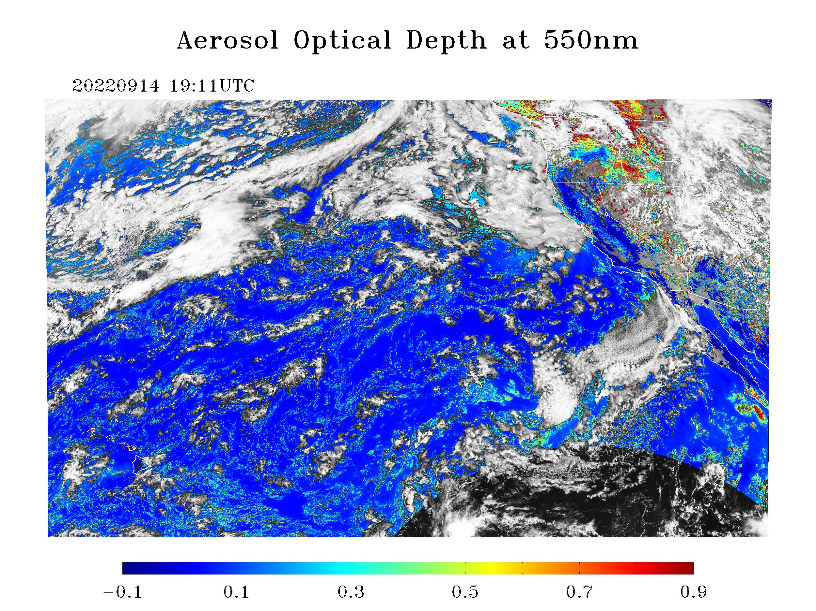



GOES-18 vs. GOES-17
Low+Medium+High QC AOD
09/14/2022 19:10 UTC
PLPT test ABI-CONUS_AOD02
Results are similar to those for FD.
G18 AOD field is as expected.
The spatial distribution of G18 AOD is visually similar to that of G17.
G18 and G17 histograms are similar with a slightly smaller G18 mean AOD compared to G17.
G18 AOD is within valid range.
G18
G17

Slide 60




GOES-18 vs. GOES-17
Low+Medium+High QC AOD
09/14/2022 19:10 UTC
PLPT test ABI-CONUS_AOD02
The AOD differences are generally small except over land.
The mean AOD difference is about -0.07 over land and is about -0.01 over water.
Spectral land-surface relationships must be updated for G18.
Land
Water

Slide 61




GOES-18 vs. GOES-17
High QC AOD
09/14/2022 19:10 UTC
PLPT test ABI-CONUS_AOD02
Results are similar to those for unfiltered AOD.
G18 AOD field is as expected.
The spatial distribution of G18 AOD is visually similar to that of G17.
G18 and G17 histograms are similar with a smaller G18 mean AOD compared to G17.
G18 AOD is within valid range.
G18
G17

Slide 62




GOES-18 vs. GOES-17
High QC AOD
09/14/2022 19:10 UTC
PLPT test ABI-CONUS_AOD02
The AOD differences are generally small.
The mean AOD difference is about -0.07 over land and is about -0.01 over water.
Spectral land-surface relationships must be updated for G18.
Land
Water

Slide 63




GOES-18 vs. GOES-17
Low+Medium+High QC AE1
09/14/2022 19:11 UTC
Low+medium+high QC Angstrom Exponent (AE) is used due to limited spatial coverage for medium and high QC retrievals.
The range of G18 AE1 in wavelength pair (0.47, 0.86) µm is as expected.
Relative to G17, G18 AE1 has larger number of smaller AE1 values, suggesting larger aerosol particles.
G18
G17

Slide 64




GOES-18 vs. GOES-17
Low+Medium+High QC AE2
09/14/2022 19:11 UTC
The range of G18 AE2 in wavelength pair (0.86, 1.61) µm is as expected.
Relative to G17, the G18 mean AE2 is smaller suggesting larger aerosol particles.
The difference between G18 and G17 AE2 is smaller than that for AE1.
G18
G17

Slide 65
Supplement B
Comparison with AERONET ground measurements - CONUS
GOES-18 Aerosol Optical Depth L2 Product Provisional PS-PVR

Slide 66


High QC - CONUS
LAND
WATER
High quality AODs are plotted regardless of magnitude (range).
Majority of points are around 1:1 line.
Small positive bias over land over water.
STD over land is about three times as large as that over water.

Slide 67
G18 AOD Statistics - CONUS
High Quality 550-nm ABI AOD (07/26/2022 – 10/26/2022)
Range | Land |  |  |  | Water
 | AOD | Accuracy | Precision | # of points | AOD | Accuracy | Precision | # of points
Low | <0.04 | -0.02 (0.06) | 0.02 (0.13) | 6,702 | <0.4 | 0.01 (0.02) | 0.02 (0.15) | 7,901
Medium | 0.04 - 0.8 | 0.00 (0.04) | 0.07 (0.25) | 39,421
High | > 0.8 | 0.90 (0.12) | 0.12 (0.35) | 22 | >0.4 | -- | -- | 0
Accuracy and precision of ABI 550-nm AOD in comparison with AERONET AOD over land and water using collocated ABI-AERONET dataset. F&PS requirements are in parenthesis.
(--) means data are not available and/or statistic is not calculated.
Accuracy and precision are evaluated using only high QC AOD in the required AOD ranges. Here “low”, “medium” and “high” refer to the magnitude of AOD not to its quality.
Requirements are met except for accuracy in high AOD range over land with very limited sample size. Data are not available in high AOD value range over water.

Slide 68
G17 AOD Statistics – CONUS
High Quality 550-nm ABI AOD (07/26/2022 – 10/26/2022)
Range | Land |  |  |  | Water
 | AOD | Accuracy | Precision | # of points | AOD | Accuracy | Precision | # of points
Low | <0.04 | 0.00 (0.06) | 0.03 (0.13) | 8,434 | <0.4 | 0.02 (0.02) | 0.02 (0.15) | 8,125
Medium | 0.04 - 0.8 | 0.04 (0.04) | 0.09 (0.25) | 44,407
High | > 0.8 | 0.44 (0.12) | 0.56 (0.35) | 40 | >0.4 | -- | -- | 0
Accuracy and precision of ABI 550-nm AOD in comparison with AERONET AOD over land and water using collocated ABI-AERONET dataset. F&PS requirements are in parenthesis.
(--) means data are not available and/or statistic is not calculated.
Requirements are met except for those in high AOD range over land with very limited sample size. Data are not available in high AOD value range over water.
Comparing G17 stats to G18 stats indicates similar retrieval qualities except for the high AOD ranges over land.
  Only the time periods are same; more number of G17 retrievals than G18 is expected to result from the input (reflectances, cloud mask etc.) difference.

Slide 69
G16 AOD Statistics – CONUS
High Quality 550-nm ABI AOD (07/26/2022 – 10/26/2022)
Range | Land |  |  |  | Water
 | AOD | Accuracy | Precision | # of points | AOD | Accuracy | Precision | # of points
Low | <0.04 | -0.02 (0.06) | 0.03 (0.13) | 21,438 | <0.4 | 0.02 (0.02) | 0.03 (0.15) | 12,193
Medium | 0.04 - 0.8 | 0.01 (0.04) | 0.05 (0.25) | 102,499
High | > 0.8 | -0.27 (0.12) | 0.25 (0.35) | 8 | >0.4 | -0.11 (0.10) | 0.09 (0.23) | 33
Accuracy and precision of ABI 550-nm AOD in comparison with AERONET AOD over land and water using collocated ABI-AERONET dataset. F&PS requirements are in parenthesis.
(--) means data are not available and/or statistic is not calculated.
Requirements are met except for accuracy in high AOD range over land.
Comparing G16 stats to G18 stats indicates similar retrieval qualities except for the high AOD ranges.
  Only the time periods are same; significantly more stations, and thus matchups, are available for GOES-16.

Slide 70




Graphical Summary of
G18, G17 and G16 A and P
Accuracy and precision values of G18 AOD are not very different from G16 and G17 in most AOD value ranges.

Slide 71


Time Series of G18 AOD - CONUS
07/26/2022 – 10/26/2022 High QC
Time series of daily average operational high-quality GOES-18 and AERONET AOD and of (GOES-18 – AERONET) (bias) for land (upper panel) and water (lower panel).
GOES-18 AOD tracks changes in AERONET AOD.
Day-to-day variability of bias is larger over land than over water.
Bias is mostly positive in summer and negative in fall over land.
No trend in bias over water.

Slide 72


Diurnal Cycle - CONUS
07/26/2022 – 10/26/2022 High QC
AODs from all sites are averaged.
Daily variation of G18 AOD mostly follows that in AERONET AOD. (Not always true for individual sites!)
Over land, morning/afternoon G17 AODs are smaller/larger than AERONET AODs.
Over water, morning G17 AOD is larger than AERONET AODs.

Slide 73


Top2 QC GOES-18 AE
AE1
AE2
Top2 Quality results are based on (medium + high) qc ABI AE retrievals and AERONET AOD >= 0.15.
A relatively large negative AE1 bias of -0.5.
Agreement of G18 AE2 with AERONET AE2 is better .

Slide 74
Supplement C
IMPACT OF BAND 2 CALIBRATION ADJUSTMENT ON GOES-18 AEROSOL PARTICLE SIZE
GOES-18 Aerosol Optical Depth L2 Product Provisional PS-PVR

Slide 75
EVALUATION STRATEGY
Band 2 calibration adjustment occurred on 7/25/2022
Evaluated G18 AEs at before and after the calibration adjustment
            Compared G18 AE to G17 AE
              Compared G18 AE to AERONET AE
Used full disk (medium + high) quality ABI AEs and AERONET AOD >= 0.15

Slide 76


GOES-18 vs. GOES-17 AE1
Before
After
G18 AE1 has a positive bias of 0.17 compared to G17 before calibration adjustment. Changes to -0.1 bias, suggesting larger aerosol particles, after calibration adjustment.

Slide 77


GOES-18 vs. GOES-17 AE2
Before
After
Impact of G18 ABI band 2 calibration adjustment on AE2 is smaller than on AE1; “before” and “after” G18-G17 mean AE2 differences are similar.

Slide 78


GOES-18 vs. AERONET AE1
Before
After
AE1 agrees reasonably well with AERONET before calibration adjustment.
AE1 bias increased significantly after adjustment.

Slide 79


GOES-18 vs. AERONET AE2
Before
After
AE2 agrees reasonably well with AERONET before calibration adjustment.
AE2 bias increased somewhat after adjustment.

Slide 80
Supplement D
Comparison with VIIRS/MODIS/GOES-16/GOES-17 at AERONET Stations
GOES-18 Aerosol Optical Depth L2 Product Provisional PS-PVR

Slide 81

ABI bias vs. S-NPP VIIRS bias - FD
Over Land
Over Water
Distributions of G18/ABI and S-NPP/VIIRS biases (wrt AERONET) around the (0,0) point are not very different.
G18/ABI over land (S-NPP/VIIRS over water) has a relatively larger bias and STD.

Slide 82


ABI bias vs. NOAA-20 VIIRS bias - FD
Over Land
Over Water
Distributions of G18/ABI and S-NPP/VIIRS biases (wrt AERONET) around the (0,0) point are not very different.
G18/ABI over land (S-NPP/VIIRS over water) has a relatively larger bias and STD.

Slide 83


Time Series of Daily ABI and S-NPP VIIRS Biases Relative to AERONET - FD
Upper panel: Time series of (G18/ABI – AERONET) and (S-NPP/VIIRS – AERONET) biases for land (left) and water (right).
Lower panel: Time series of (G18/ABI - S-NPP/VIIRS) for land (left) and water (right).
No trend in bias.

Slide 84


Time Series of Daily ABI and NOAA-20 VIIRS Biases Relative to AERONET - FD
Same as previous slide but for NOAA-20 VIIRS.
Day-to-day variability of differences is larger over land than over water.
No trend in bias.

Slide 85


GOES-18 vs. GOES-16 bias - FD
Over Land
Over Water
Over western US, GOES-18 has smaller bias and standard deviation than GOES-16 over land and over water.

Slide 86


Time Series of Daily GOES-18 and GOES-16 Biases Relative to AERONET - FD
GOES-18 daily AOD bias tracks changes of GOES-16 daily bias but with a smaller magnitude, especially over land.

Slide 87


Diurnal Variation of Hourly GOES-18 and GOES-16 Biases Relative to AERONET - FD
Diurnal cycle of (G18/ABI – AERONET) and (G16/ABI – AERONET) biases for land (left) and water (right).
Over land, GOES-18 shows a smaller bias in the local morning and a larger negative in the afternoon.
Over water, GOES-18 mostly show a similar or smaller diurnal bias.

Slide 88
Comparison with VIIRS/MODIS/GOES-16/GOES-17 at AERONET Stations
CONUS
GOES-18 Aerosol Optical Depth L2 Product Provisional PS-PVR

Slide 89


ABI bias vs. S-NPP VIIRS bias - CONUS
Over Land
Over Water

Slide 90


ABI bias vs. NOAA-20 VIIRS bias - CONUS
Over Land
Over Water

Slide 91


ABI bias vs. MODIS bias - CONUS
Over Land
Over Water

Slide 92


Time Series of Daily ABI and S-NPP VIIRS Biases Relative to AERONET
CONUS

Slide 93


Time Series of Daily ABI and NOAA-20 VIIRS Biases Relative to AERONET
CONUS

Slide 94


Time Series of Daily ABI and MODIS Biases Relative to AERONET
CONUS

Slide 95


GOES-18 vs. GOES16 bias - CONUS
Over Land
Over Water

Slide 96


GOES-18 vs. GOES17 bias - CONUS
Over Land
Over Water

Slide 97


Time Series of Daily GOES-18 and GOES-16 Biases Relative to AERONET - CONUS

Slide 98


Time Series of Daily GOES-18 and GOES-17 Biases Relative to AERONET - CONUS

Slide 99


Diurnal Variation of Hourly GOES-18 vs. GOES-16 Biases Relative to AERONET
- CONUS

Slide 100


Diurnal Variation of Hourly GOES-18 vs. GOES-17 Biases Relative to AERONET
- CONUS

Slide 101


GOES-18 vs. GOES-17 AE
AE1
AE2
Note there is no AE match-ups over CONUS between GOES-18 and GOES-16.

Slide 102


GOES-18 vs. GOES-17 AE Bias
AE1
AE2

Slide 103
Supplement E
Comparison with G16 and G17 over common area
GOES-18 Aerosol Optical Depth L2 Product Provisional PS-PVR

Slide 104






GOES-18 vs. GOES-17 vs. GOES-16
Low+Medium+High QC AOD
09/14/2022 19:10 UTC
A common area is selected to avoid the difference in spatial coverage.
The spatial pattern of G18 AOD is visually very similar to that of G17 and G18 AOD.
The histograms show a relatively smaller mean AOD value of G18 than that of G17 and G16.
G16 has more AOD retrievals than G18 and G17.
G18
G17
G16

Slide 105






GOES-18 vs. GOES-17 vs. GOES-16
Low+Medium+High QC AOD
09/14/2022 19:10 UTC
Analyzed AOD histograms separately over land and over water.
Over land, the mean value of G18 AOD is ~20% lower than those of G17 and G16.
Over water, the mean value of G18 AOD is close to G17 and ~10% smaller than G16.
G18
Land
Water
G17
G16

