Slide 1
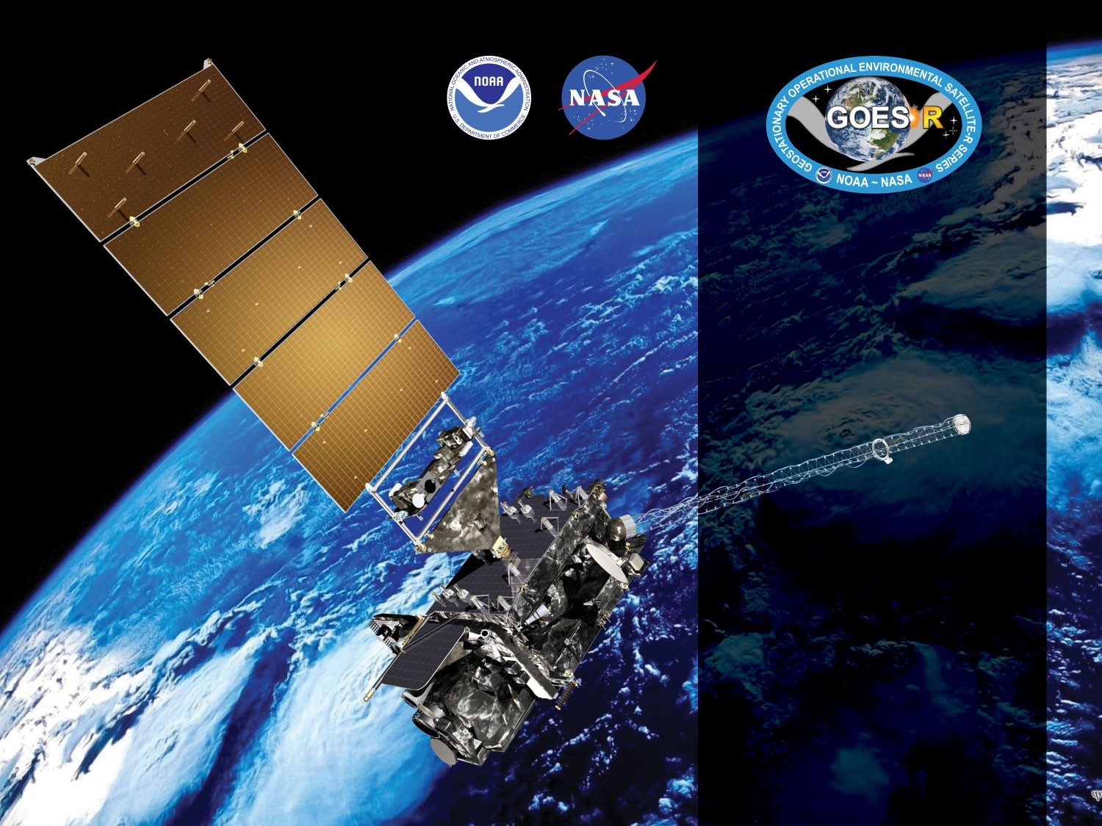
GOES-18 ABI L2+ Cloud Top Parameters Day Cloud Optical and Microphysical Properties
Provisional PS-PVR
November 21, 2022
Andi Walther,
Mark Kulie
GOES-R AWG

Slide 2
Requirements for Provisional COMP
Assess the accuracy and precision of all Cloud Optical Parameters over a wide range of representative conditions.
Document impacts from challenges with upstream dependencies.
Horizontal resolution, mapping accuracy and measurement range.
Product is ready for operational use and scientific publications .

Slide 3
Daytime Cloud Optical and Microphysical Properties

Slide 4
Product Overview
Baseline Products : Cloud Optical Thickness (COD) and Cloud Particle Size (CPS).
CPS is represented by Cloud Effective Radius which is a measure of cloud droplet distribution.
Liquid water path (LWP) and Ice Water Path (IWP) are future capabilities. They are calculated from COD and CPS and help to evaluate the provisional products above.
 | Requirements for Full Validation
Product | Range | Accuracy | Precision
COD | 0.5-50 | 2 or 20% (liquid) 3 or 30% (ice) | 2 or 20% (liquid) 3 or 30% (ice) | 65 degree solar zenith FD 4km resolution CONUS 2km
CPS | 0-50 μm | 4μm /10μm (liquid/ice) | 4μm /10μm | 65 degree solar zenith FD and CONUS 2km

Slide 5
Cloud Optical Parameters (COP) Readiness, Implementation, and Management Plan (RIMP) Activities
RIMP Activity 410-R-RIMP-0336 version 2, Table 1 | Short description
ABI-FD_COP01 | Verify that COP product generated at the required cadence for FD in ABI Mode 6
ABI-CONUS_COP02 | Verify that COP product generated at the required cadence for CONUS in ABI Mode 6
ABI-MESO_COP03 | Verify that COP product generated at the required cadence for mesoscale in ABI Mode 6
ABI-FD_COP04 | Verify that COP product generated at the required cadence for FD in ABI Mode 4
ABI-CONUS_COP05 | Verify that COP product generated at the required cadence for CONUS in ABI Mode 4
ABI-FD_COP06 | Assess the accuracy and precision of COP product generated for FD in ABI Mode 6
ABI-CONUS_COP07 | Assess the accuracy and precision of COP product generated for CONUS in ABI Mode 6
ABI-MESO_COP08 | Assess the accuracy and precision of COP product generated for mesoscale in ABI Mode 6

Slide 6
GOES-18 and Validation
Data Used in this Review
GOES-18 data:
  August 2022: 2 weeks for quantitative evaluation
  Several Days of GOES-18 were used for extended visual inspection.
  Comparisons to MODIS and GOES-18 were done for August 2022 MODIS-AQUA MYD06 collection 6.1 downloaded from ladsweb.modaps.eosdis.nasa.gov
  Comparisons with GOES-17
AMSR-2/GCOM JAXA downloaded from gcom-w1.jaxa.jp. $ days of analysis were done for August 2022.

Slide 7
Application of PLPT Quantitative
Analysis Tests
DCOMP has 3 Post Launch Product Tests (PLPTs) qualitative (visual) analyses (ABI-FD_COP01, ABI-CONUS_COP02, ABI-MESO_COP03) and 3 quantitative (accuracy and precision) analyses (ABI-FD_COP06, ABI-CONUS_COP07, ABI-MESO_COP08)
ABI-FD_COP01, ABI-CONUS_COP02) visual analyses and quantitative analyses (ABI-FD_COP06, ABI-CONUS_COP07) were performed. Full Disk for all 4 methods was used. CONUS domain visual and G17-G18 comparisons were also performed as well as a visual analysis of Meso products..
The applications of each method to each domain is summarized below.
Analysis Method | FD | CONUS | MESO
Visual Inspection
Comparison to MODIS MYD06 (all Products)
Comparison to G17
AMSR-E (REF and COD via LWP)
Notes:
SurfRad LST data is only over CONUS, we found no reason to repeat with FD
We used tight-time constraints for MODIS comparisons and no MESOS or CONUSs were found.
MESO images that are in-sync with CALIPSO are rare.
MESO domains over ocean where not found.
No reason to repeat CALIPSO FD analysis on CONUS.

Slide 8
Qualitative Success Definitions
PASSED
Specifications are met for product cadence and creation (No Visual artifacts).
PARTIAL-PASSED
Specifications are close to being met for product cadence and creation. Example: Products created with missing blocks or striping.
FAILED
Specifications are far from being met for product cadence and creation and cause of performance degradation is unknown

Slide 9
Quantitative Success Definitions
DCOMP
PASSED
Specifications are met for clouds with COD between 1 and 50. and where the phase matches that of the “truth” data and over non-snow or sea-ice surfaces
PARTIAL-PASSED
Specifications are close to being met for with COD between 1 and 50 and where the phase matches that of the “truth” data and over non-snow or sea-ice surfaces
FAILED
Specifications are far from being met for clouds with COD between 1 and 50 and where the phase matches that of the “truth” data and over non-snow or sea-ice surfaces

Slide 10
DCOMP Evaluation
Cloud Optical parameters are difficult to validate! Optical properties are radiative parameters. Thus, it is not possible to validate COD directly from in-situ observations without making assumptions about the scattering properties of cloud particles. ➔ Validation sources are rare!
Retrieval uncertainties of other parameters (e.g. Cloud mask, phase, height, snow mask) will heavily affect DCOMP retrieval uncertainties. As an example, COD can be wrong by 50% if cloud phase is falsely classified [Wolters et al. 2008].
Provisional evaluation strategy:
Visual inspection of mapped images, animations and joint histograms to detect obvious artifacts.
Direct comparison with ABI on GOES-17
MODIS Science team provides COD and CPS in collection 6.
For liquid clouds, passive microwave retrievals constrain the possible solutions for COD and CPS. Validation of LWP is, therefore, an indirect validation of COD and CPS.
MODIS-AQUA MYD06

Slide 11
Visual Inspection

Slide 12
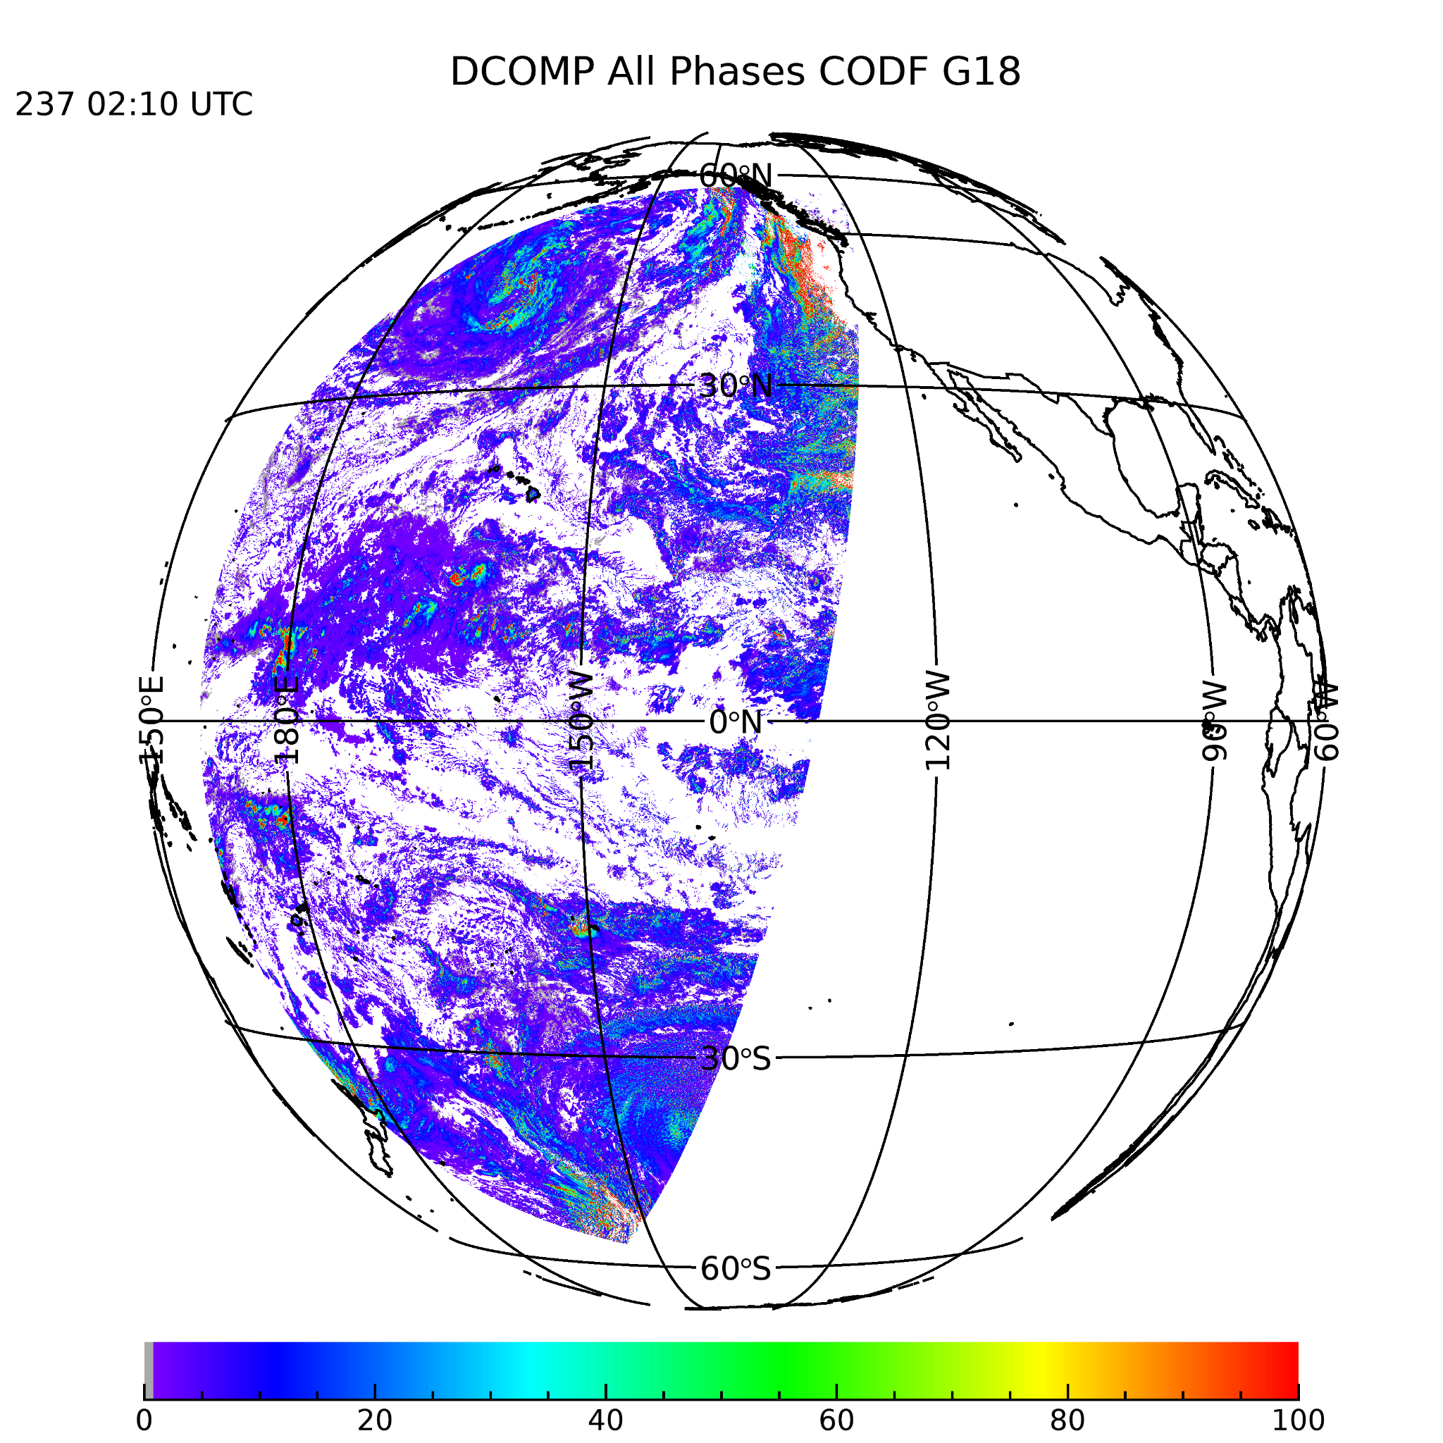
PLPT ABI-FD_COP01:
August 22 2022,
Cloud Optical Thickness
Using DQF bit-0*0
(day_algorithm_pixel_qf)
Visual inspection:
Reliable patterns and values.
Potential issues are some areas with high solar zenith together with high viewing zenith angles (to be expected).

Slide 13
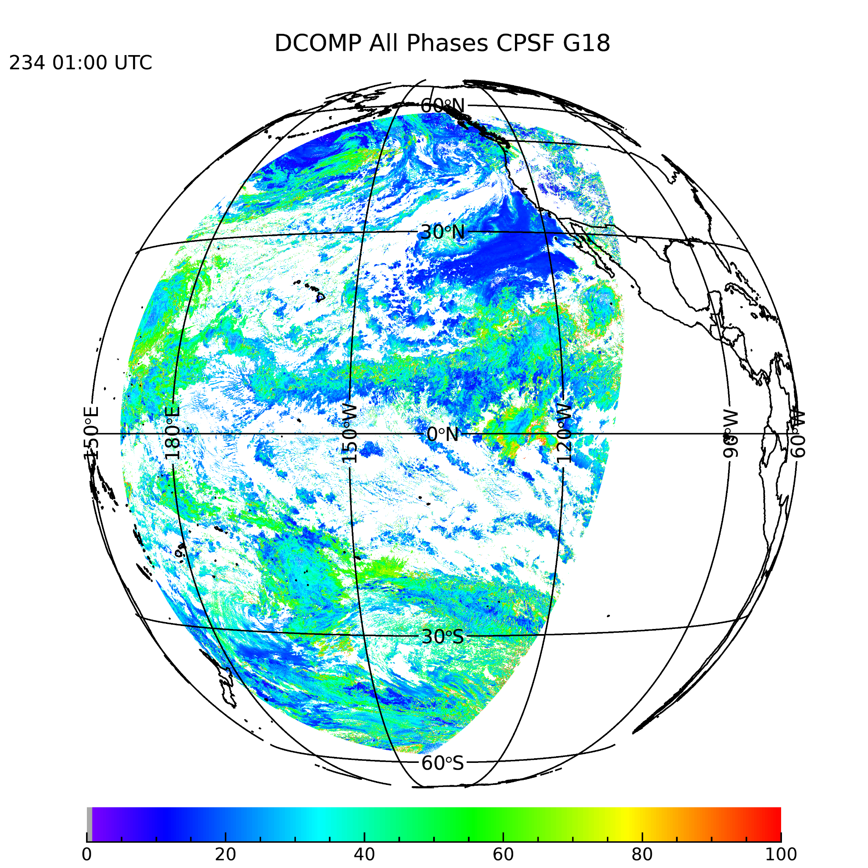
PLPT ABI-FD_COP01:
December 2 2018
Cloud Particle Size
Visual inspection:
Reliable patterns and values.

Slide 14
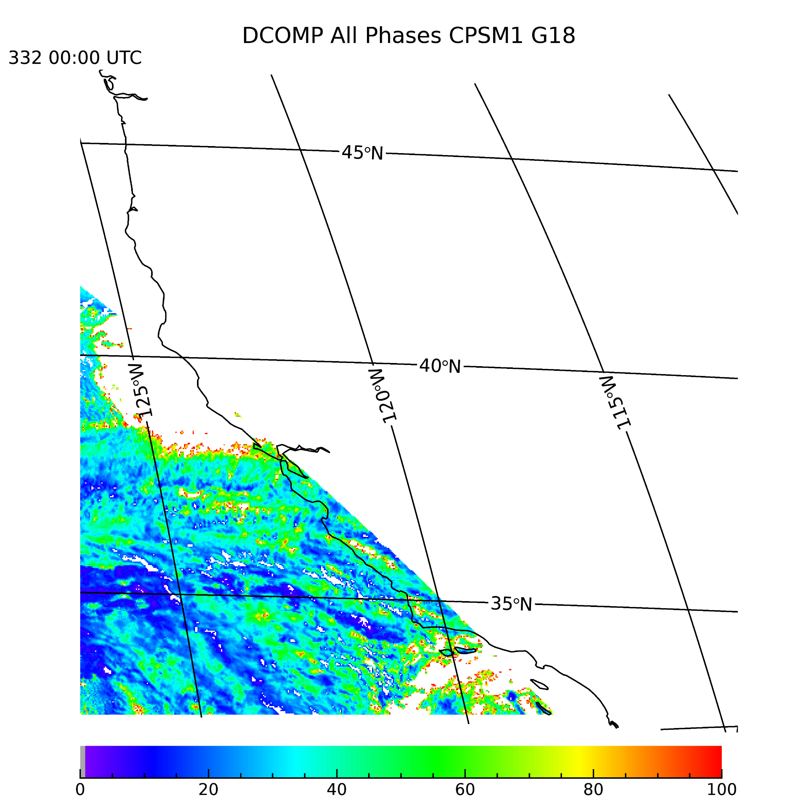
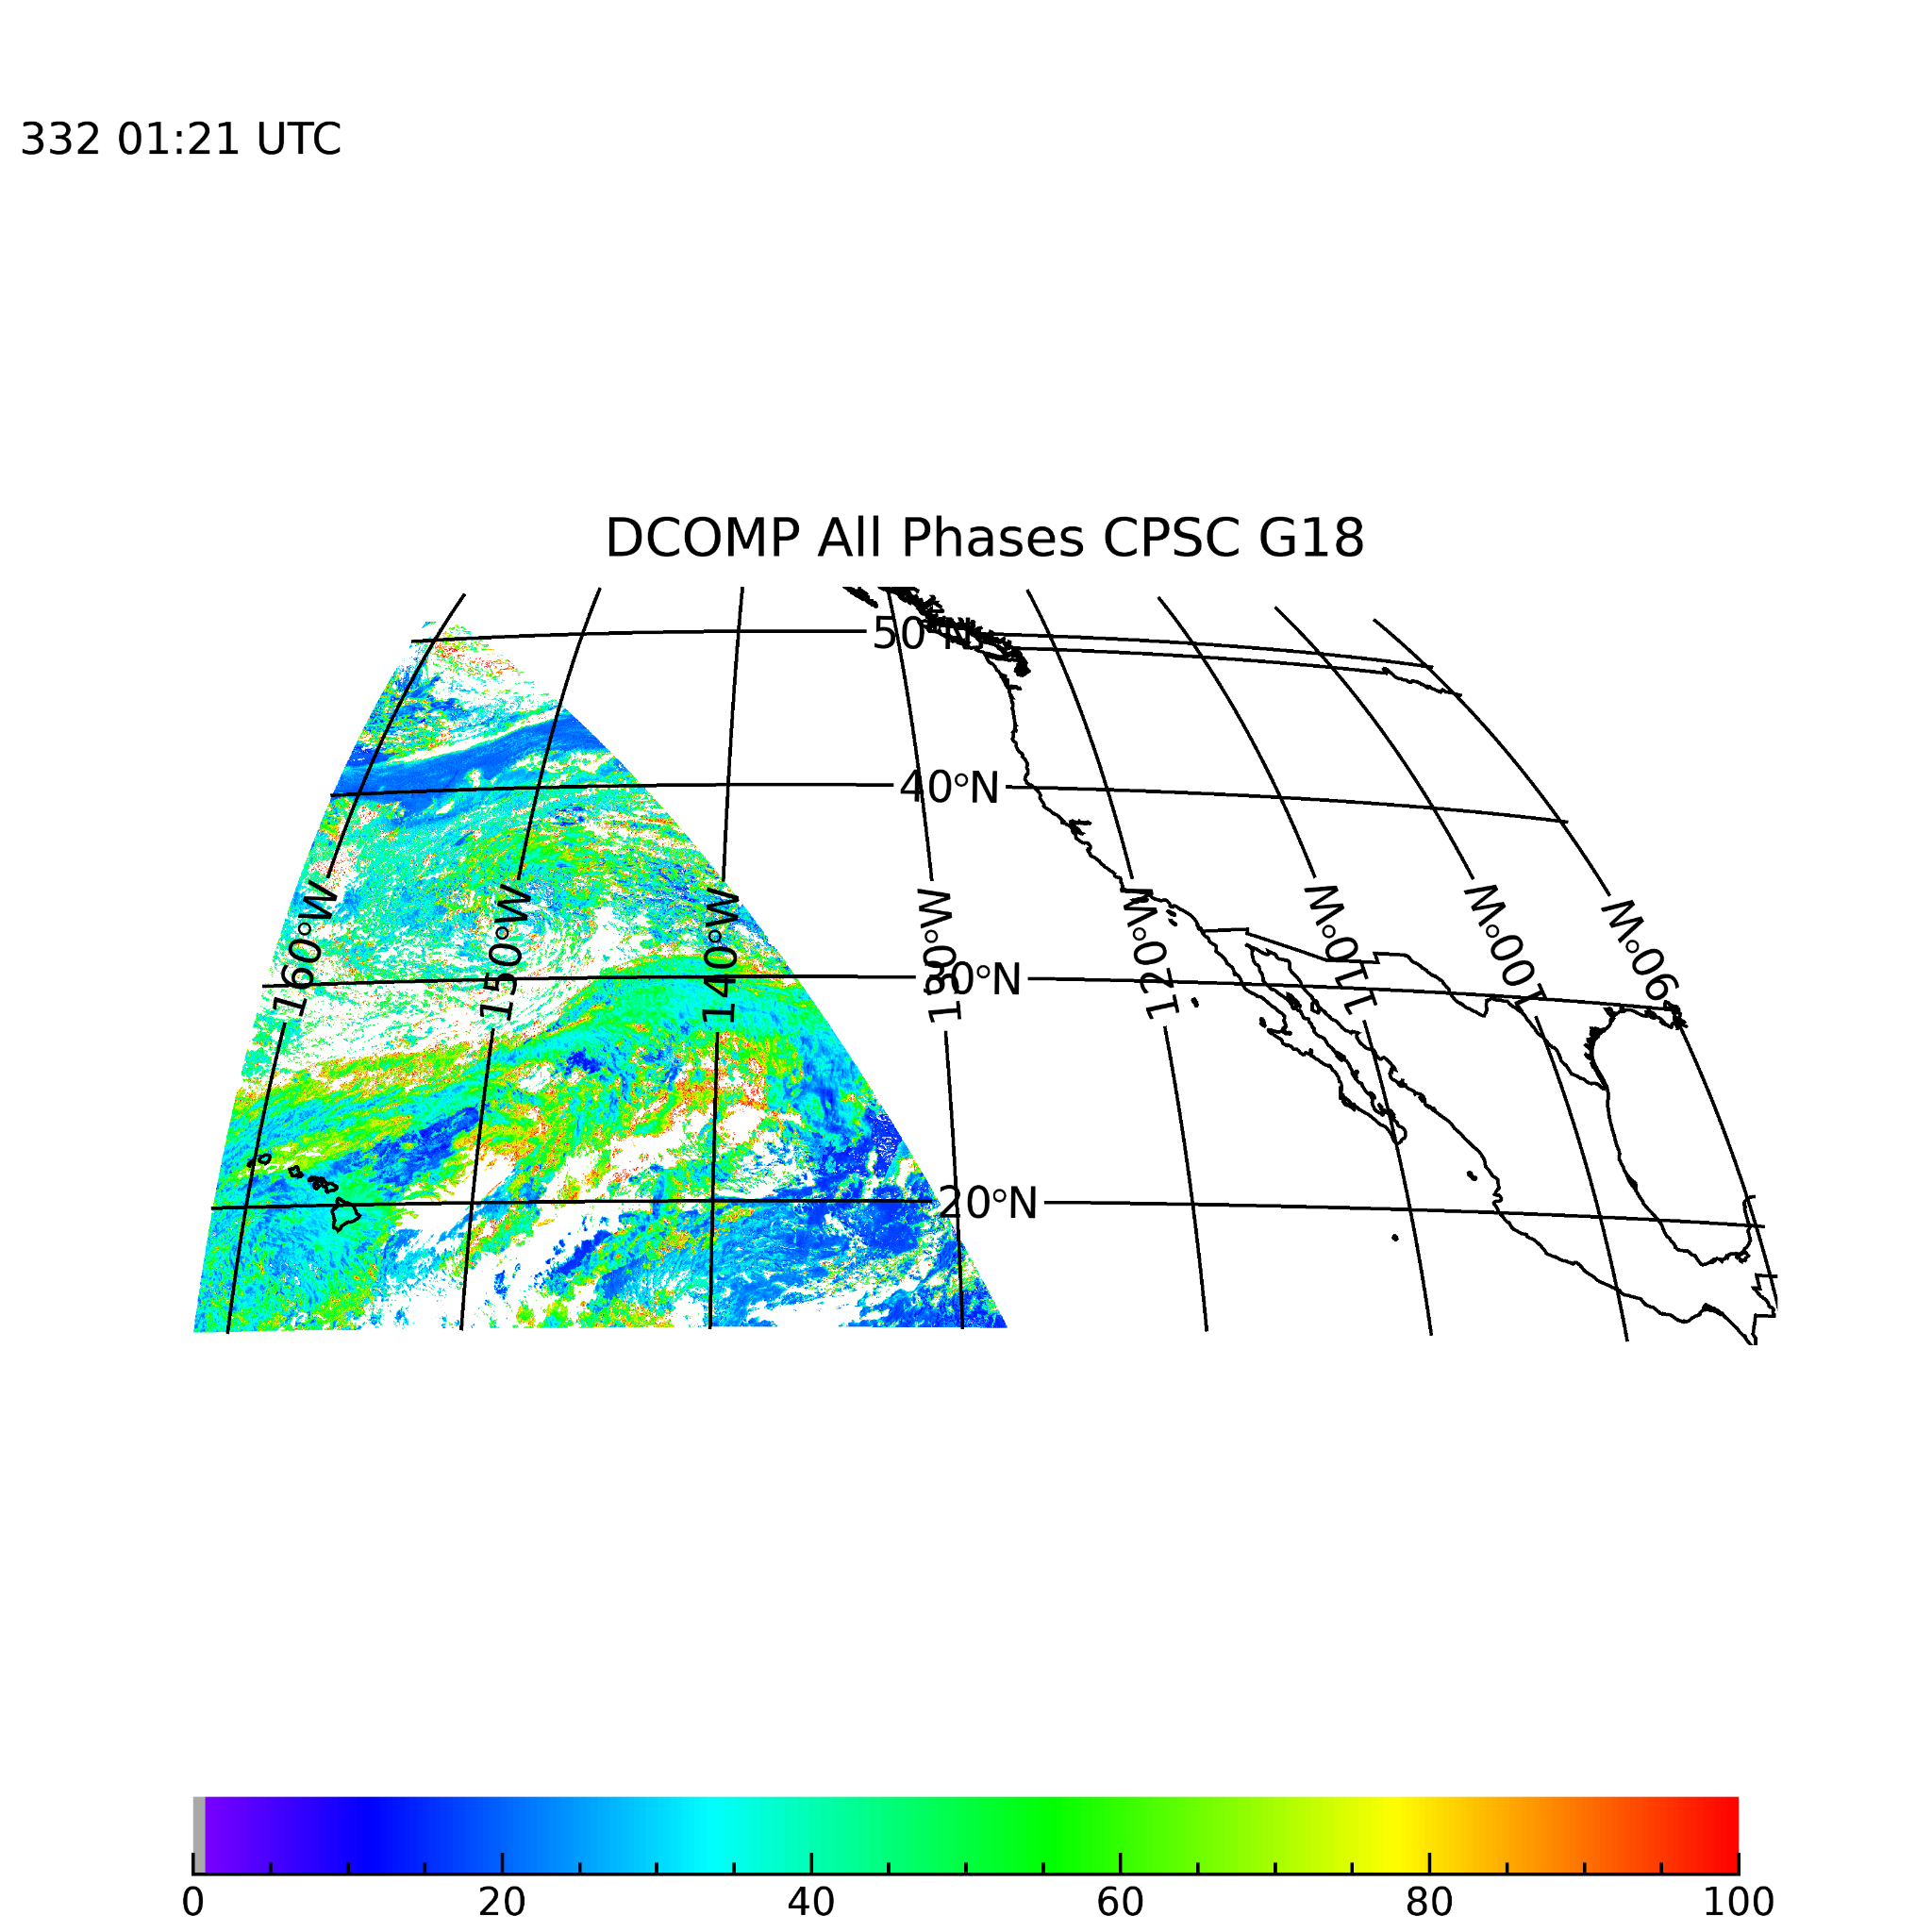
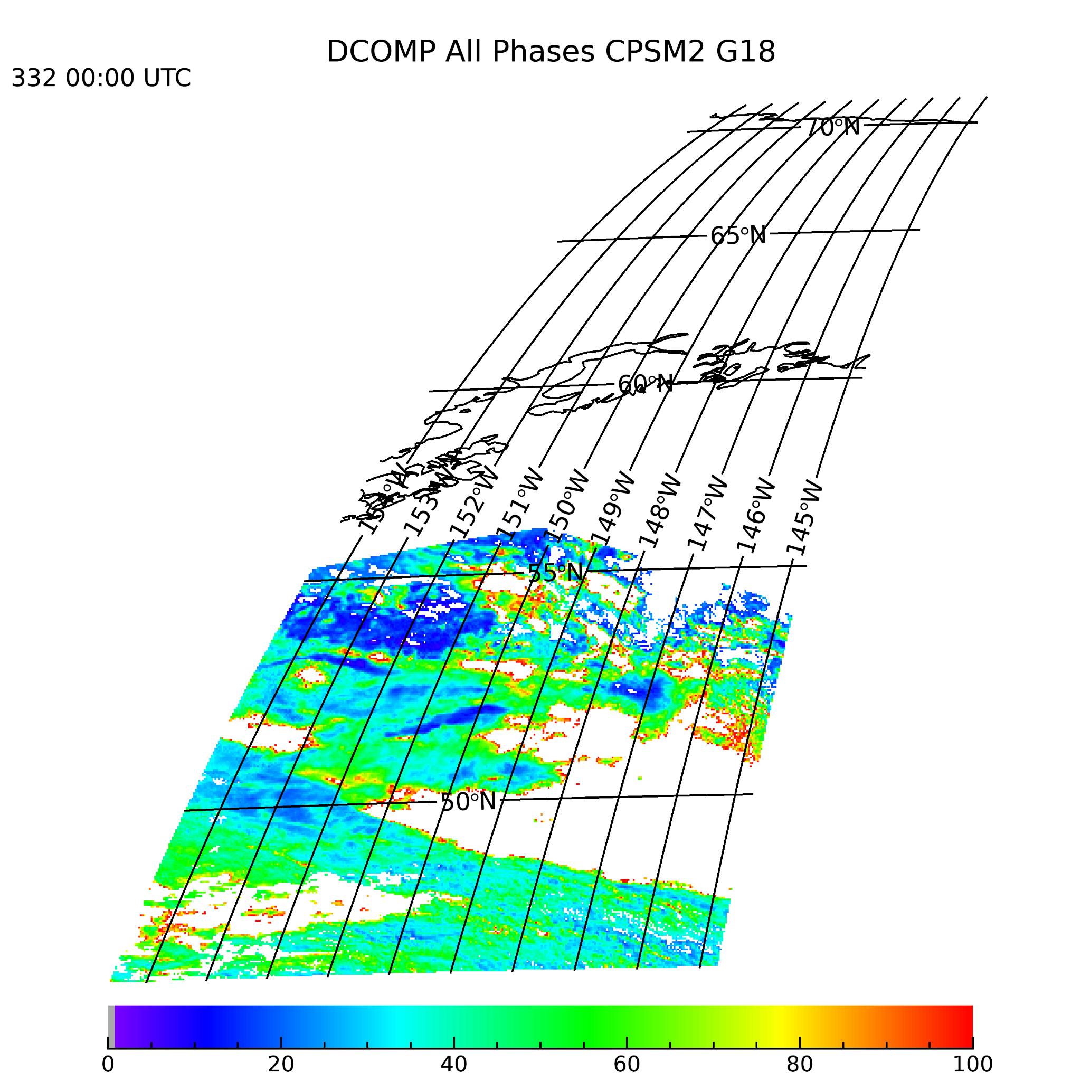
PLPTs ABI-CONUS_COP_02 &
ABI-MESO_COP03
CPS: CONUS and M1/M2
CPS and ACTP (Cloud Type) has all sub-region files in the last 30 days archive
The pattern and visualization check is satisfactory.

Slide 15
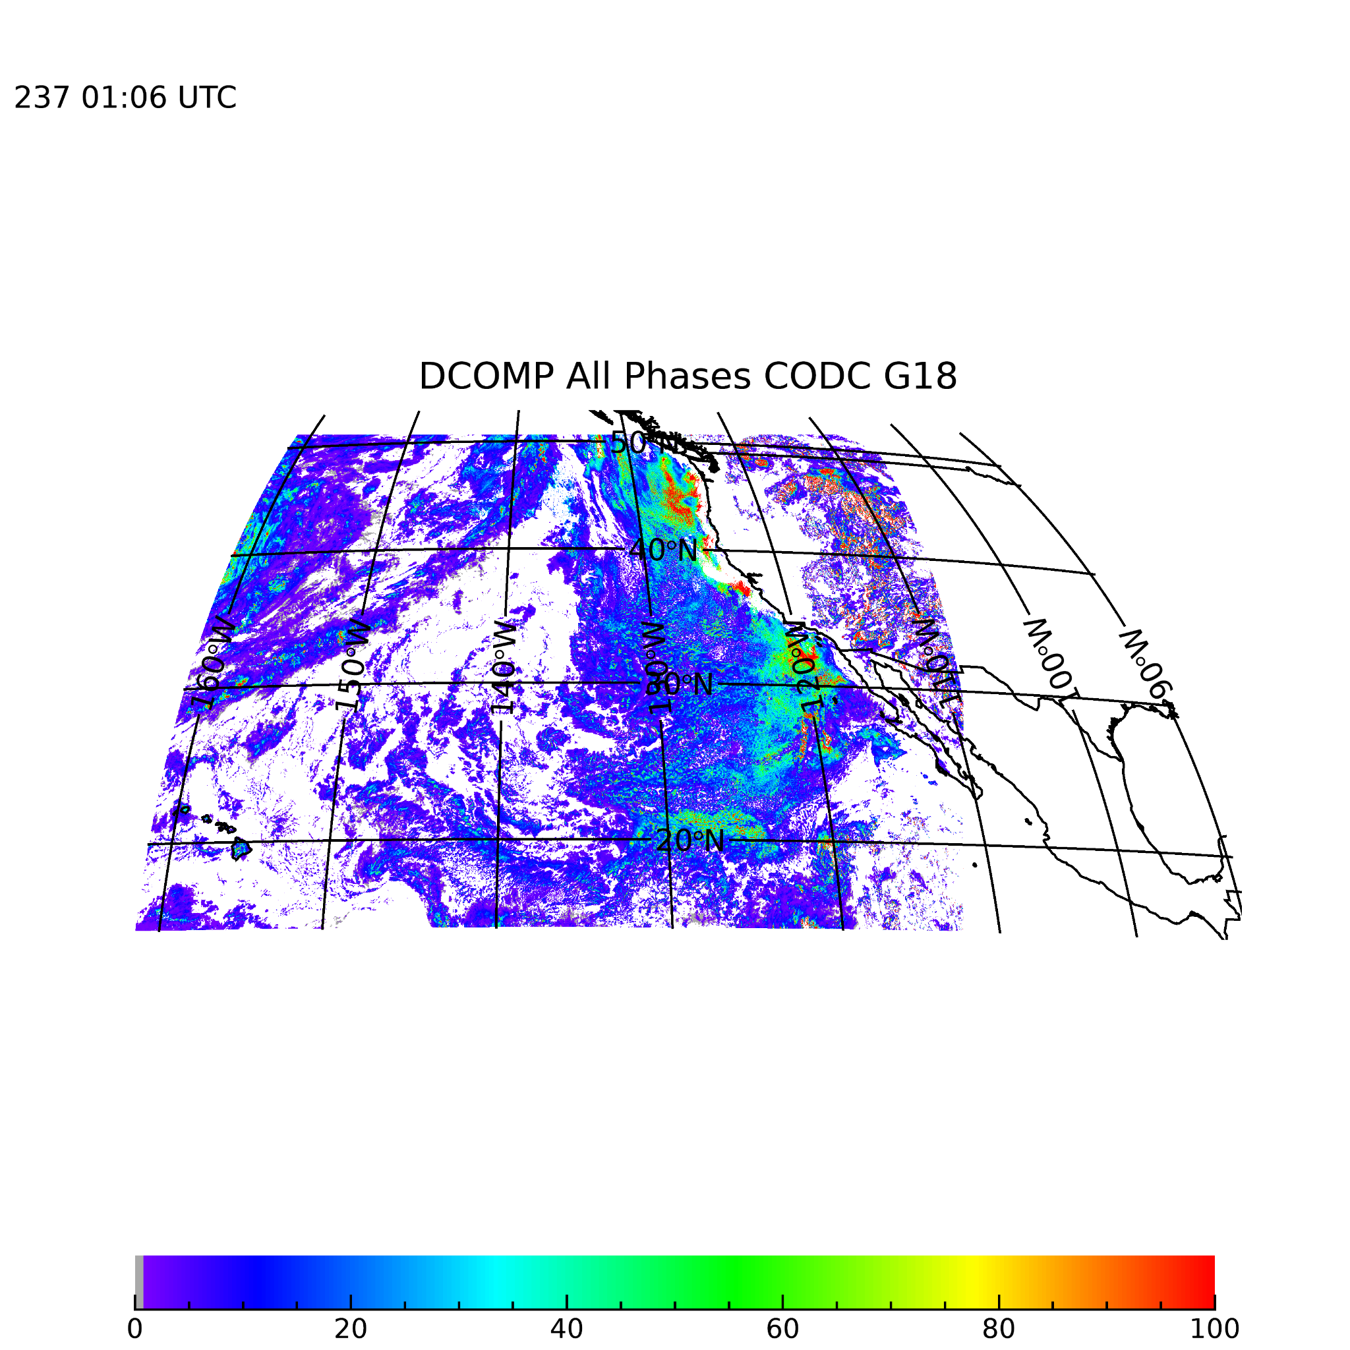
PLPTs ABI-CONUS_COP_02 &
ABI-MESO_COP03
COD: CONUS and M1/M2
COD has only CONUS and not the M1 and M2 sub-region files in the last 30 days archive.
The pattern and visualization check is satisfactory.

Slide 16
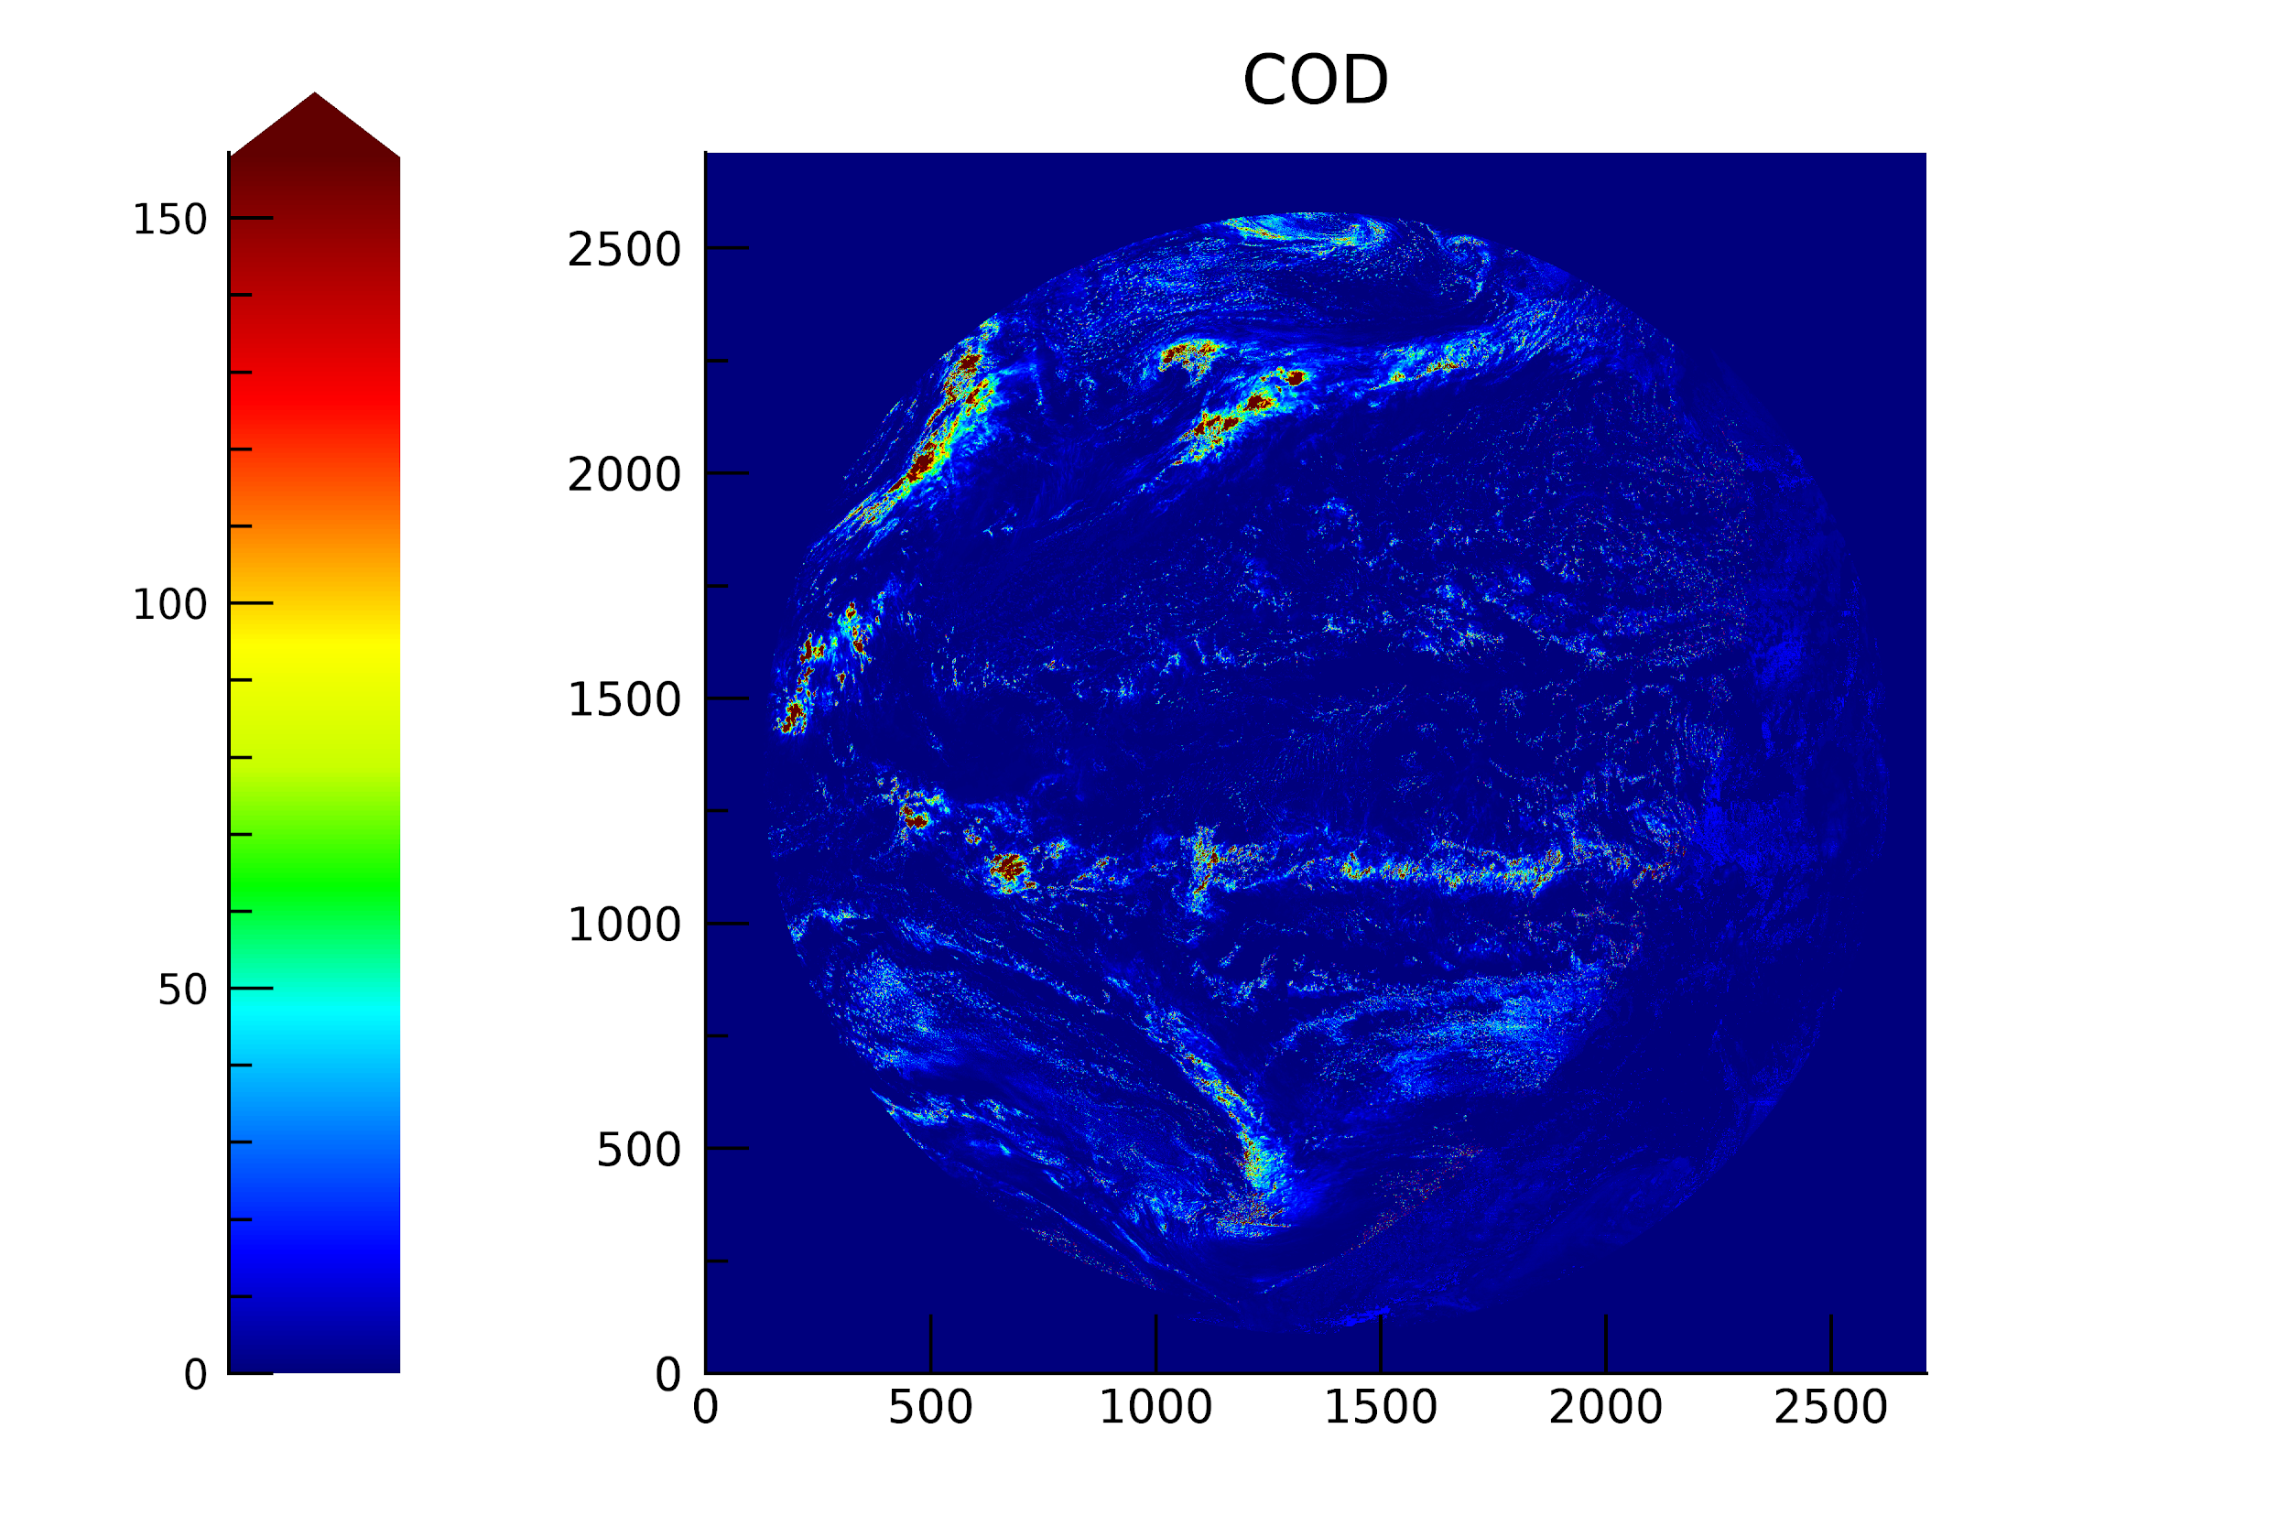
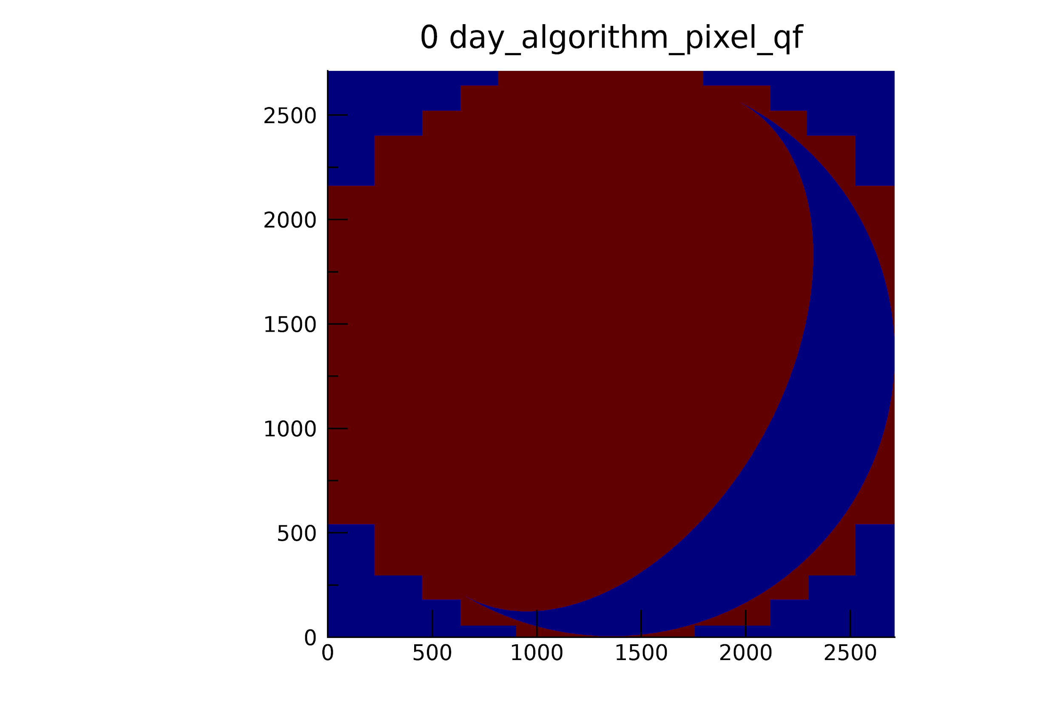
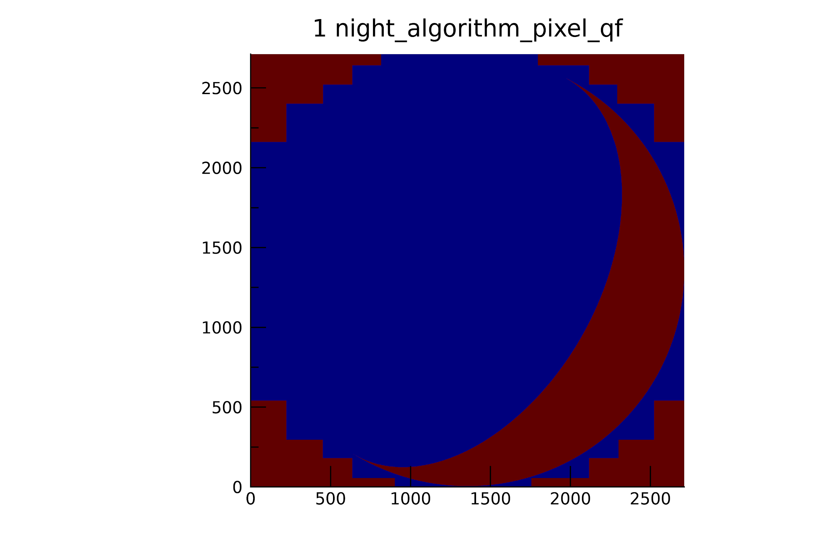
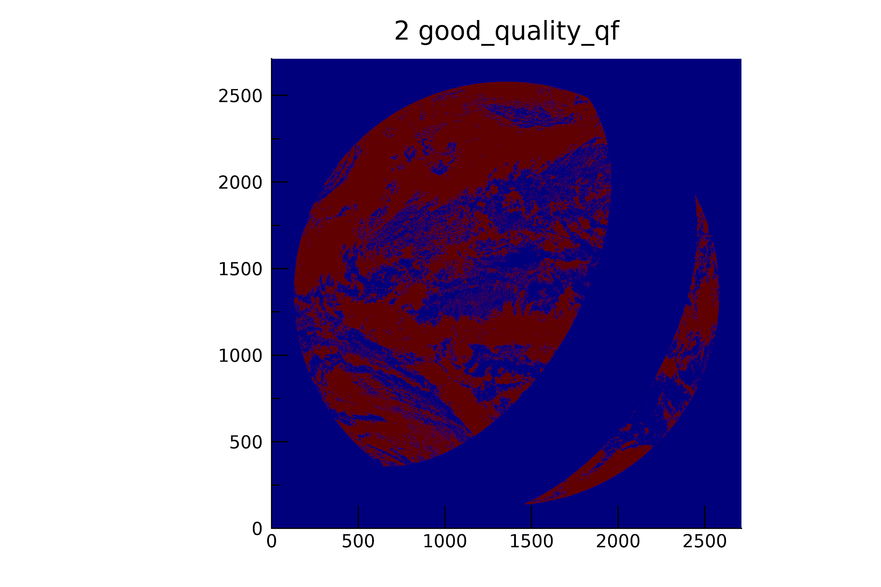
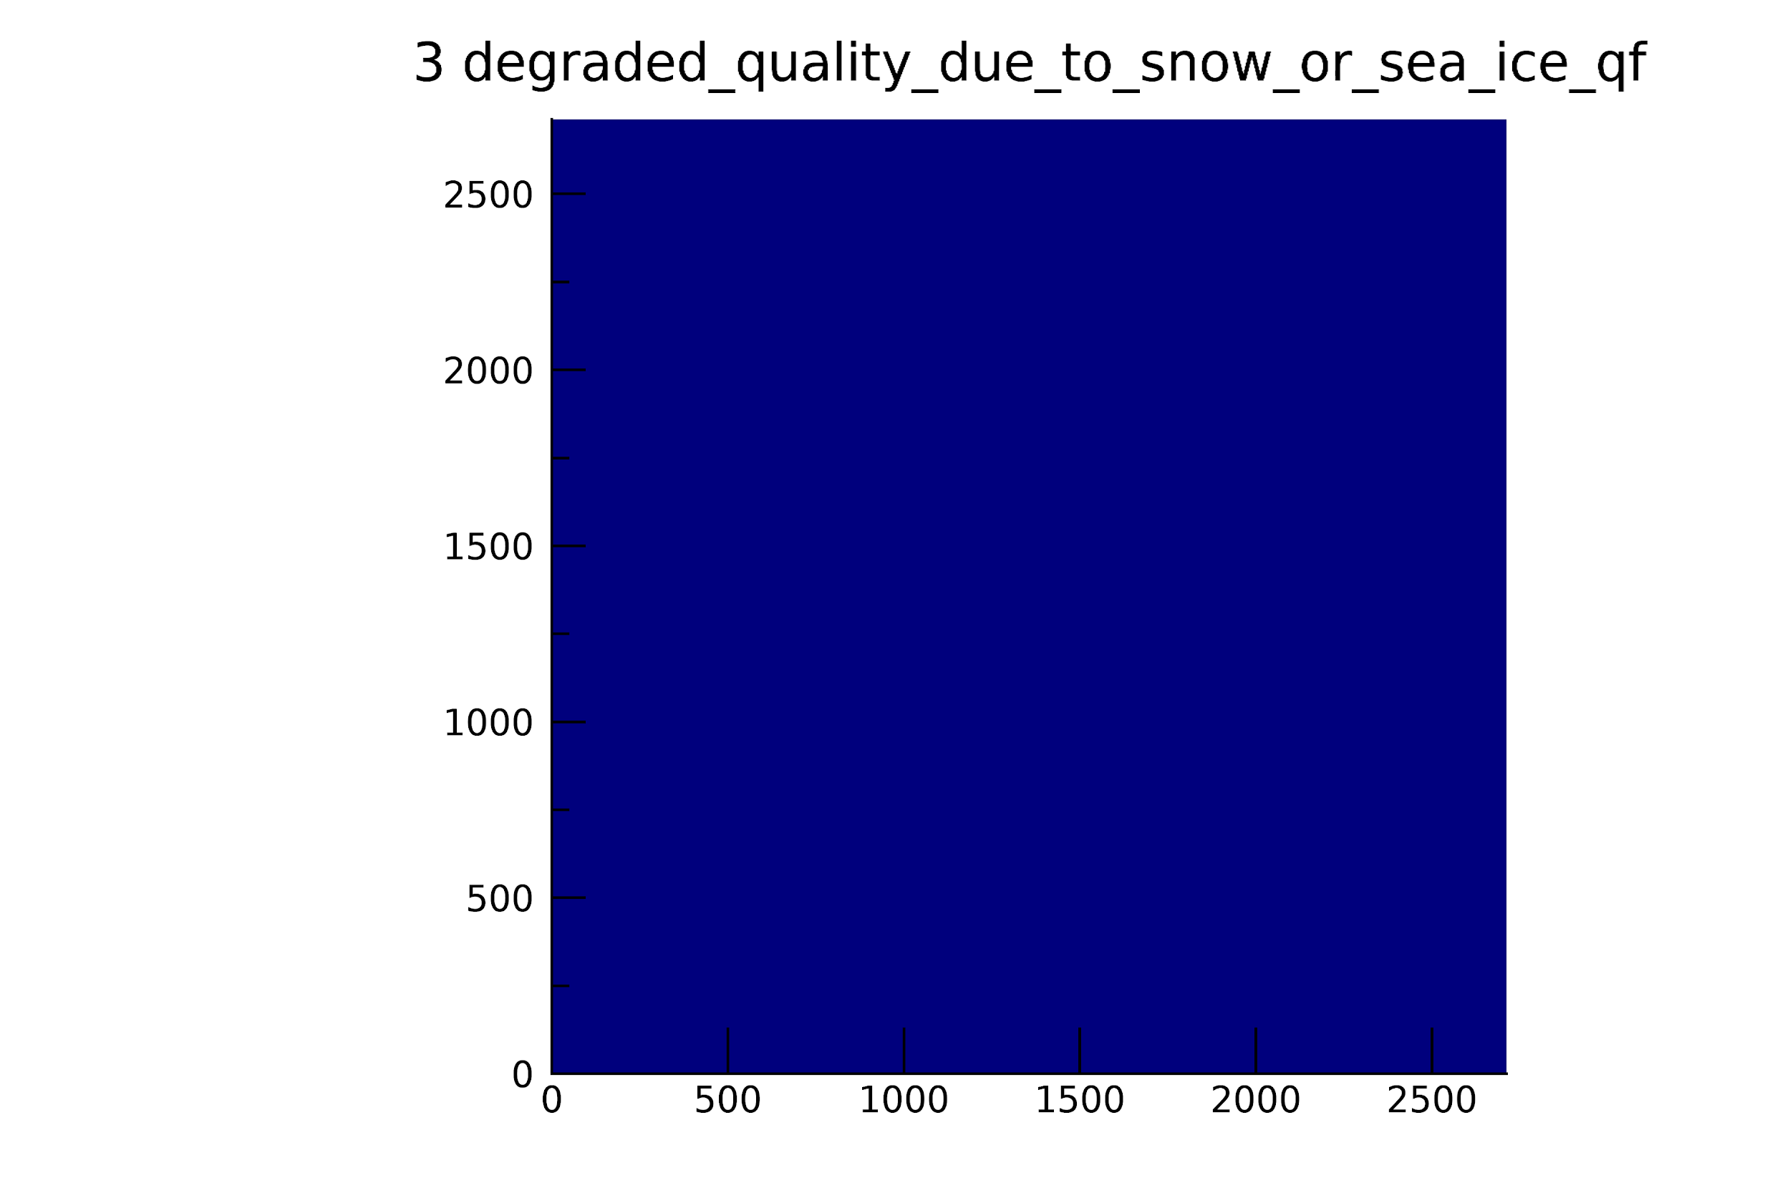
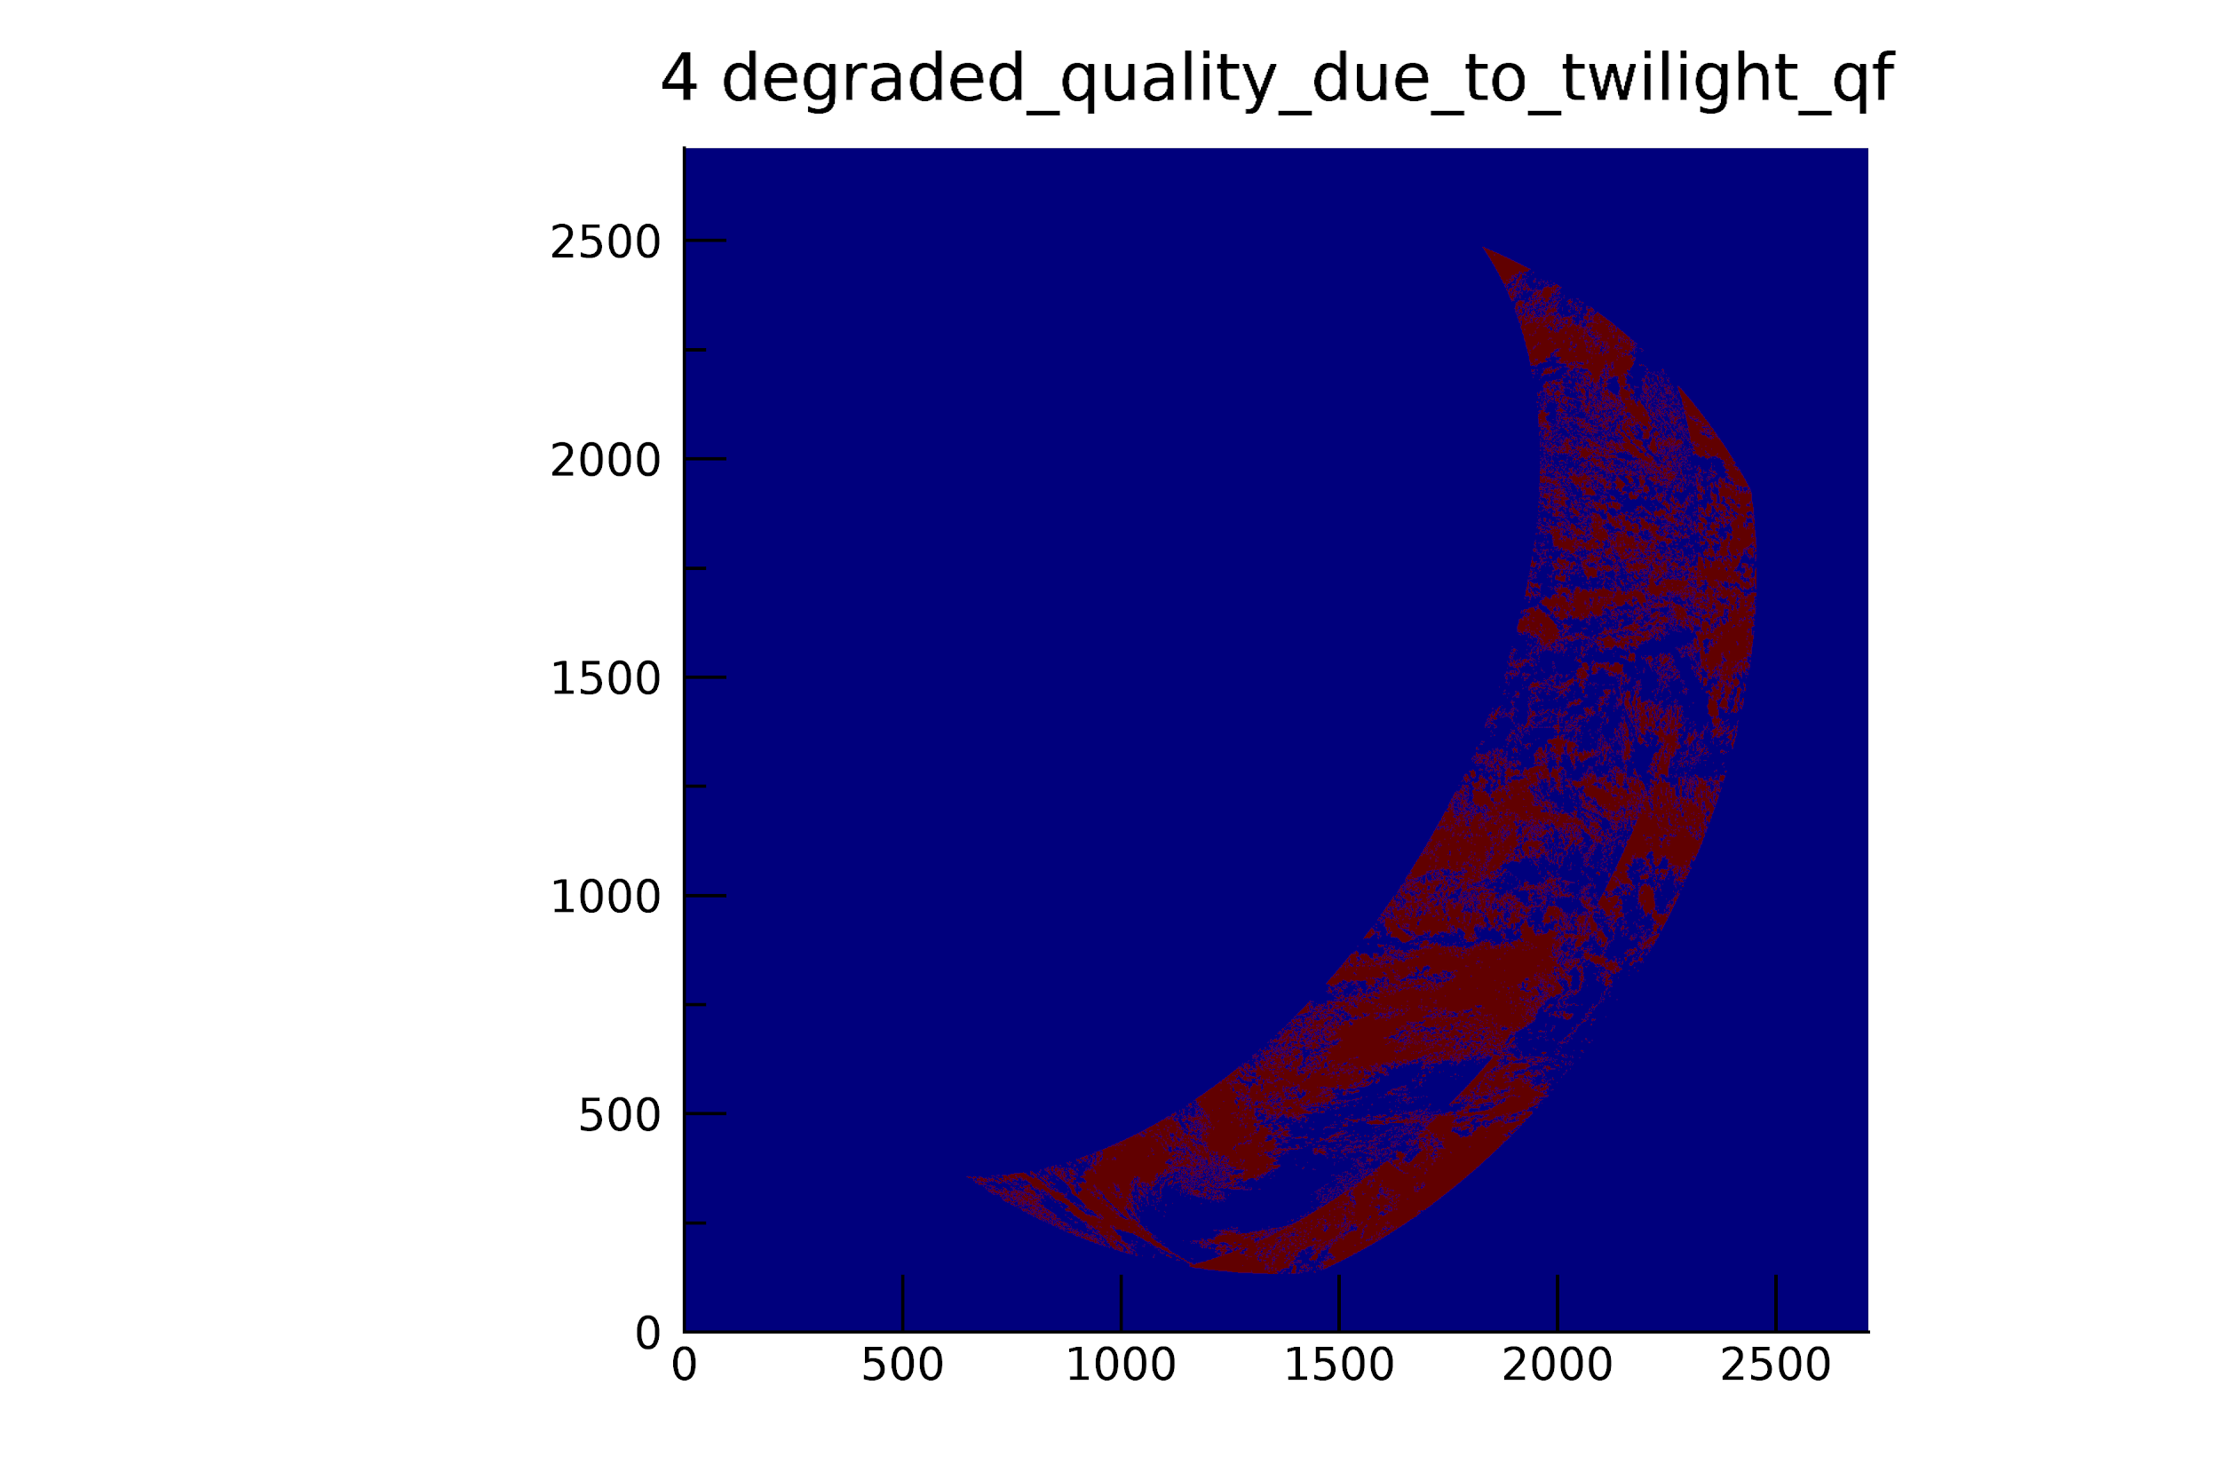
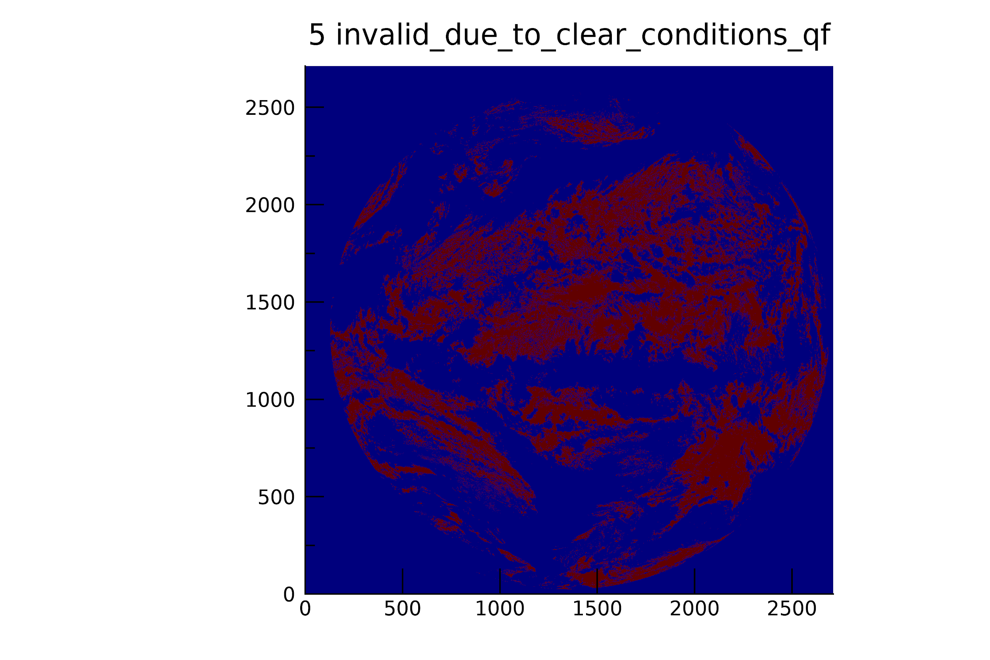
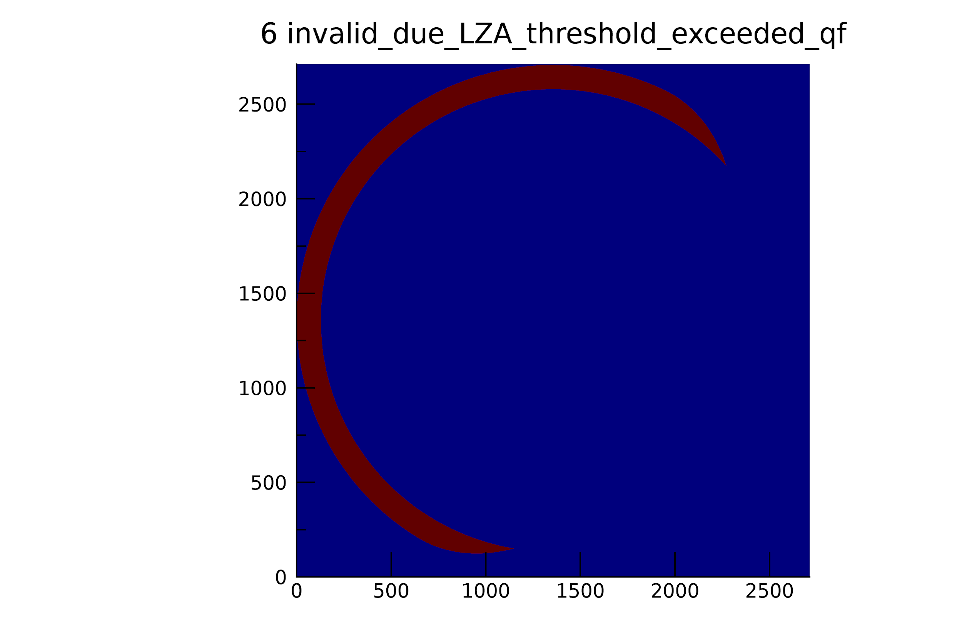
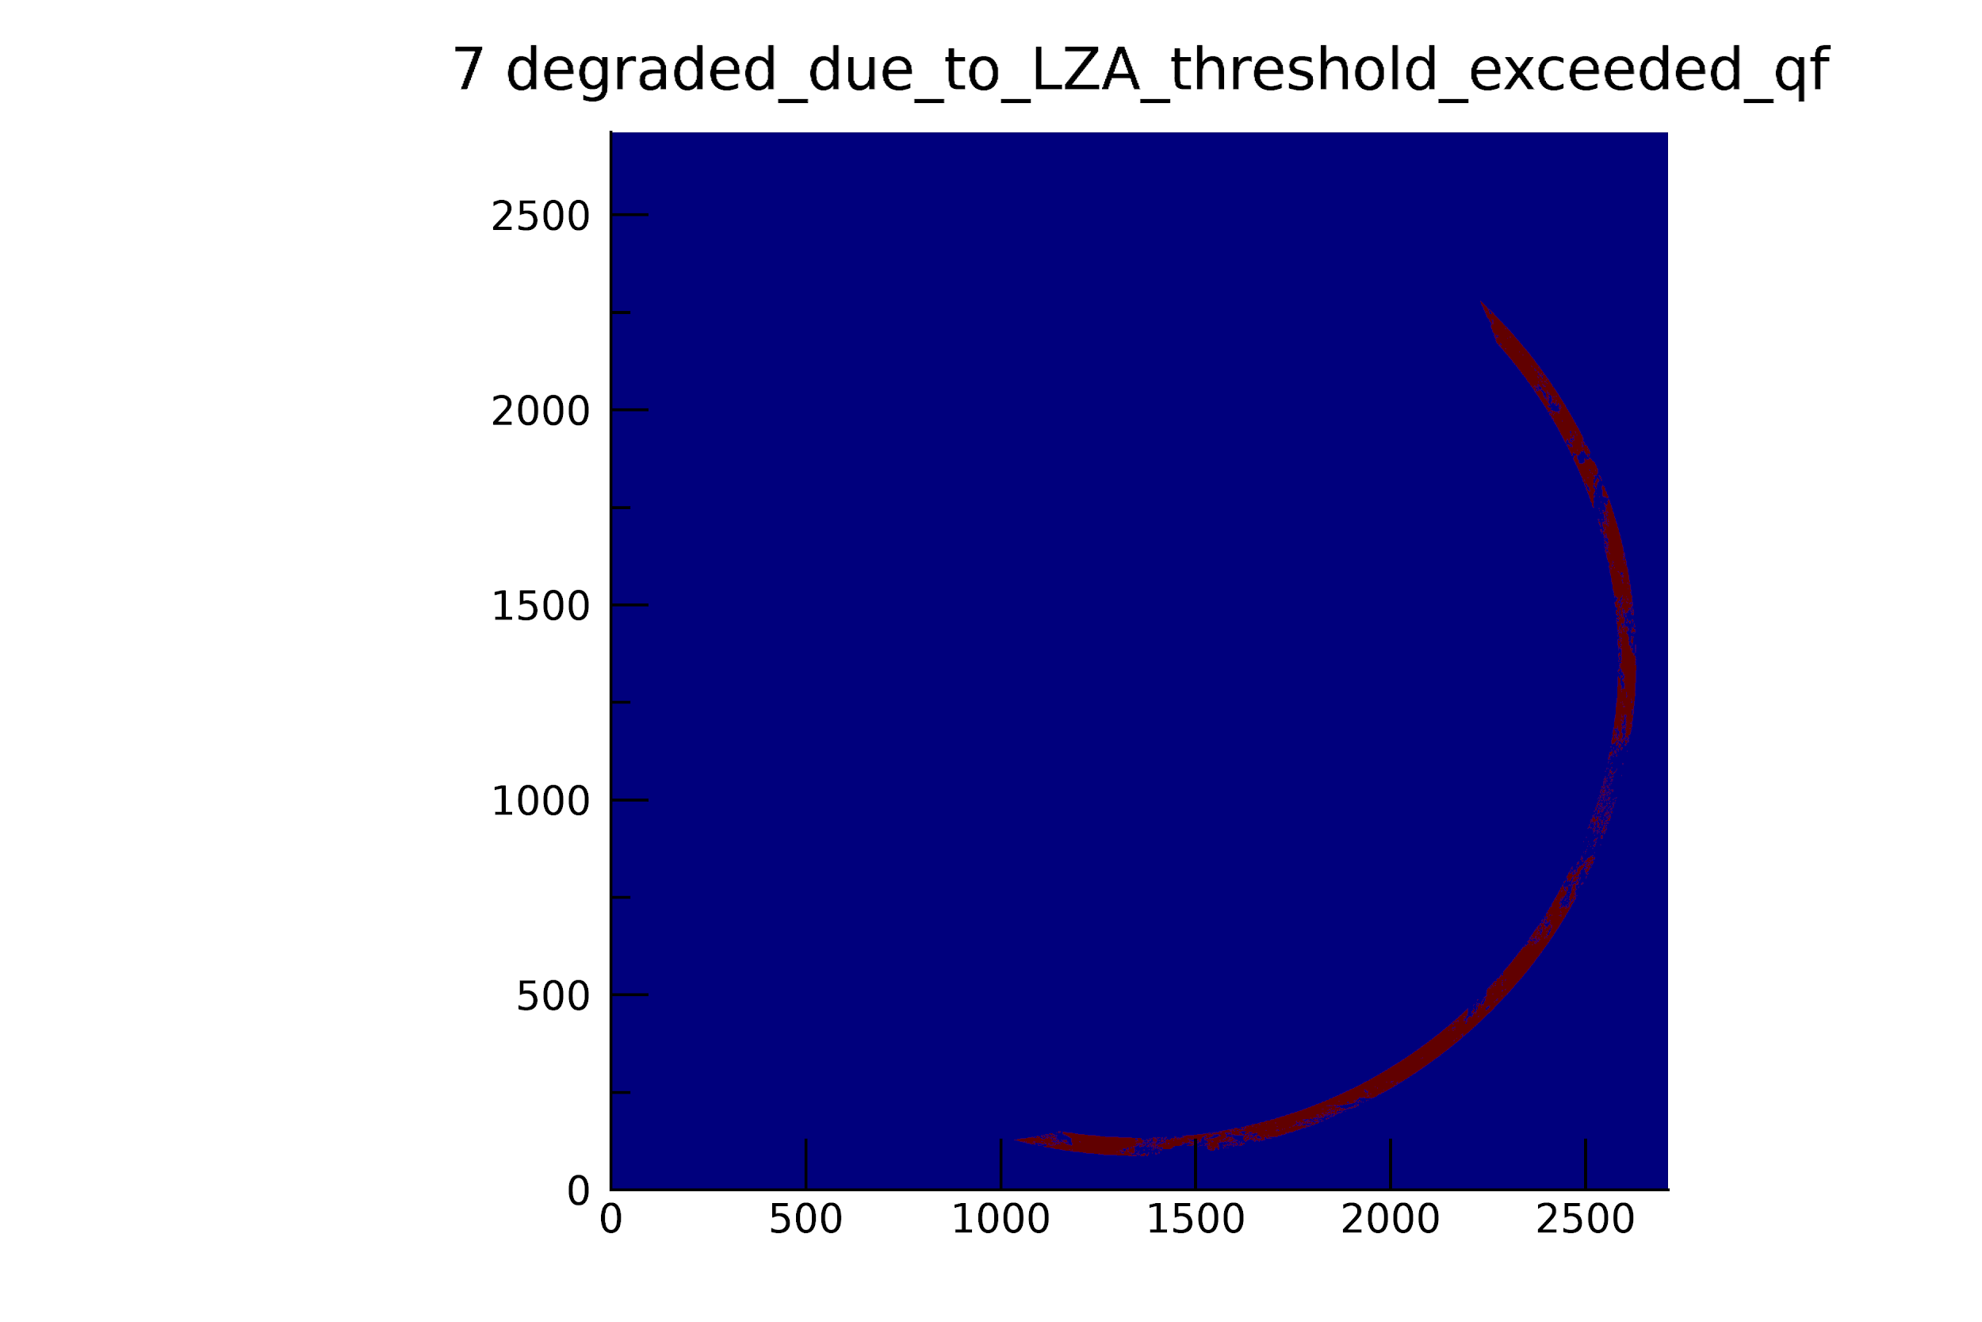
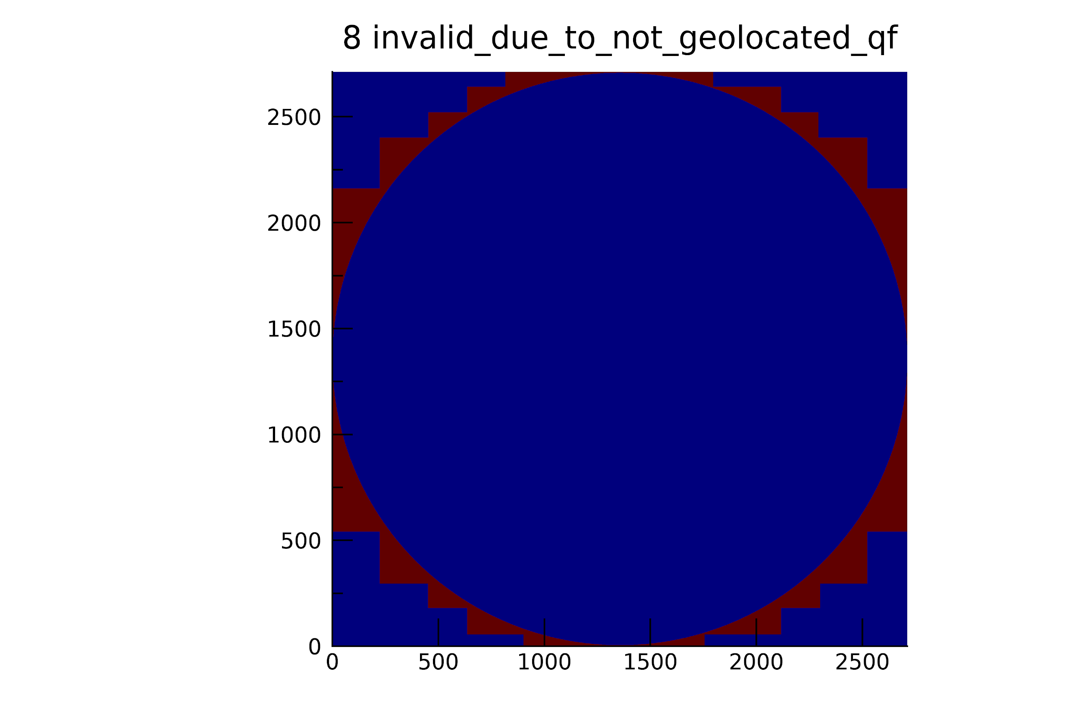
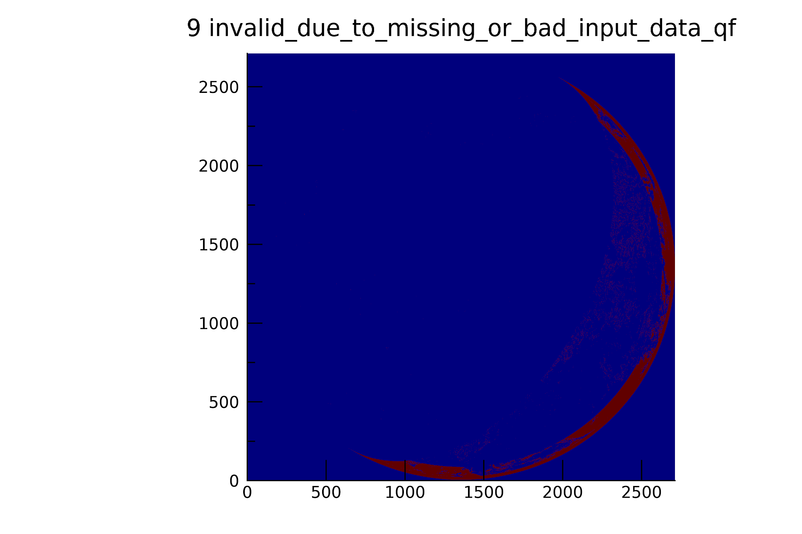
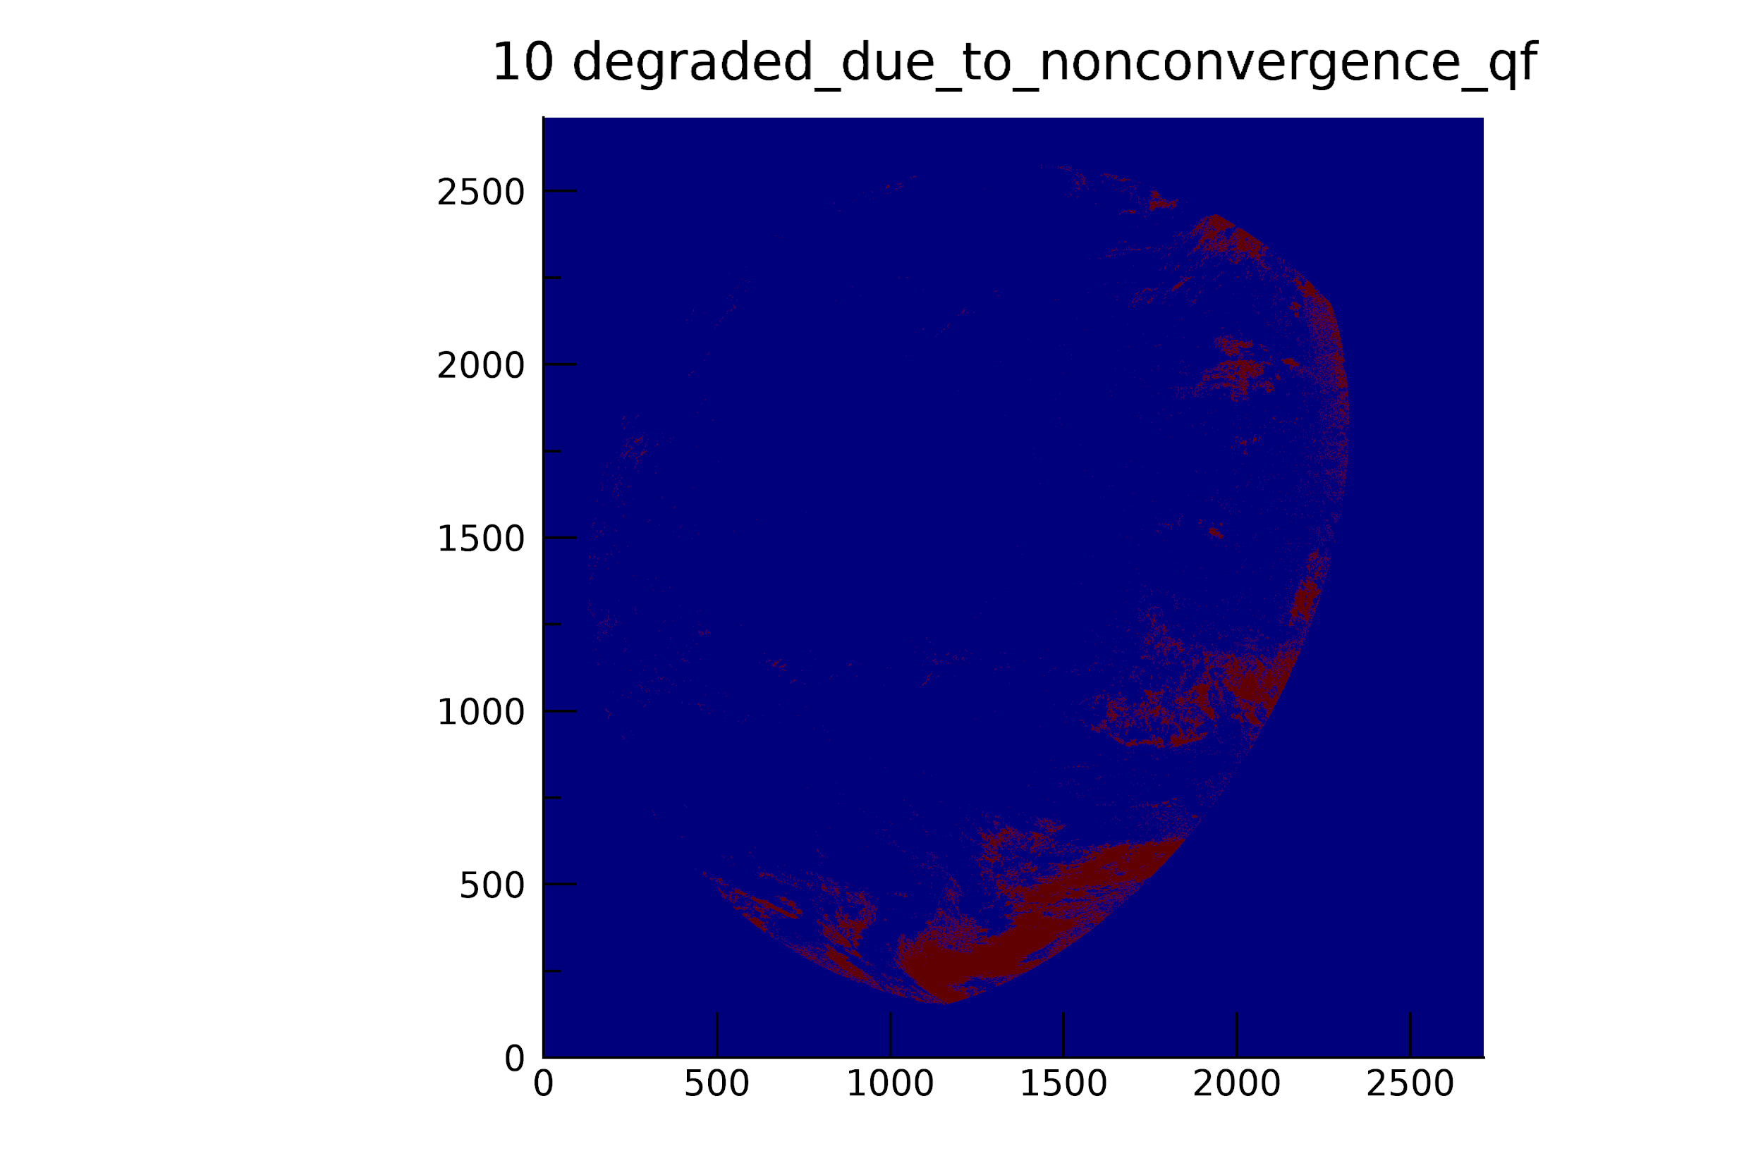
DQF Parameter COD (CPS is identical)
How can users filter the full-quality DCOMP values?

Slide 17
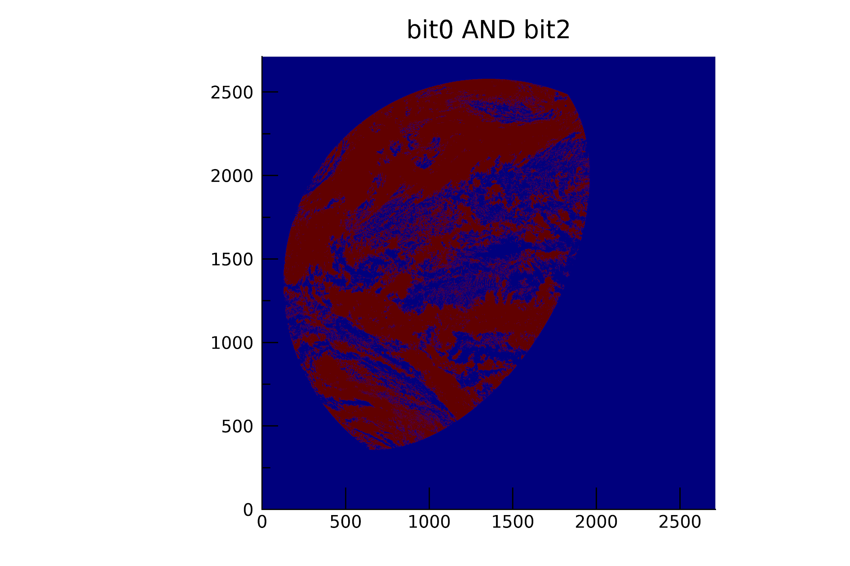
DQF COD
For current DQF definitions we need a combination of flags.
AND
=
Complicating DQF Factor: How to filter all pixels that DCOMP could have processed including solar/sensor zenith between 65 and 75?
Using DQF flags can be complicated for users.

Slide 18
Visual Inspection Summary
COD Products don’t show erroneous pattern.
CPS Products don’t show erroneous pattern.
Full Disk, CONUS, and MESO files produced at proper cadence.
PASSED
PASSED
PASSED

Slide 19
Comparison with the NASA MODIS Daytime Cloud Optical and Microphysical Products
GOES-18 Day Cloud Opt/Micro Products L2 Product Provisional PS-PVR

Slide 20
ABI/DCOMP Evaluation from MODIS
  Tasks and Challenges:
  Spatial and temporal co-location differences (spatial and temporal windows are 5km and 600 sec)
  MODIS approach is similar to DCOMP approach. The MODIS products are therefore not an independent validation source.
  Basic assumptions may be different (cloud phase, cloud height, surface conditions). These assumptions are beyond control of DCOMP and have to be tested/validated.
  Thus, a perfect match cannot be expected. The one-to-one comparisons shouldn’t be seen as validation/performance truth.
MODIS-AQUA MYD06

Slide 21
MODIS COD and CEPS Comparison Format
Collocated data between GOES-18 and AQUA/MODIS which had 10 minutes or less separation were used
The MODIS data was “warped” to GOES-18 by utilizing the CGMS (GOES-R fixed grid) equations to map the two datasets.
We don’t expect perfect agreement at the pixel scale (parallax) so these results are more qualitative.
All collocated MODIS granules were analyzed on August 18- August 28 2022

Slide 22
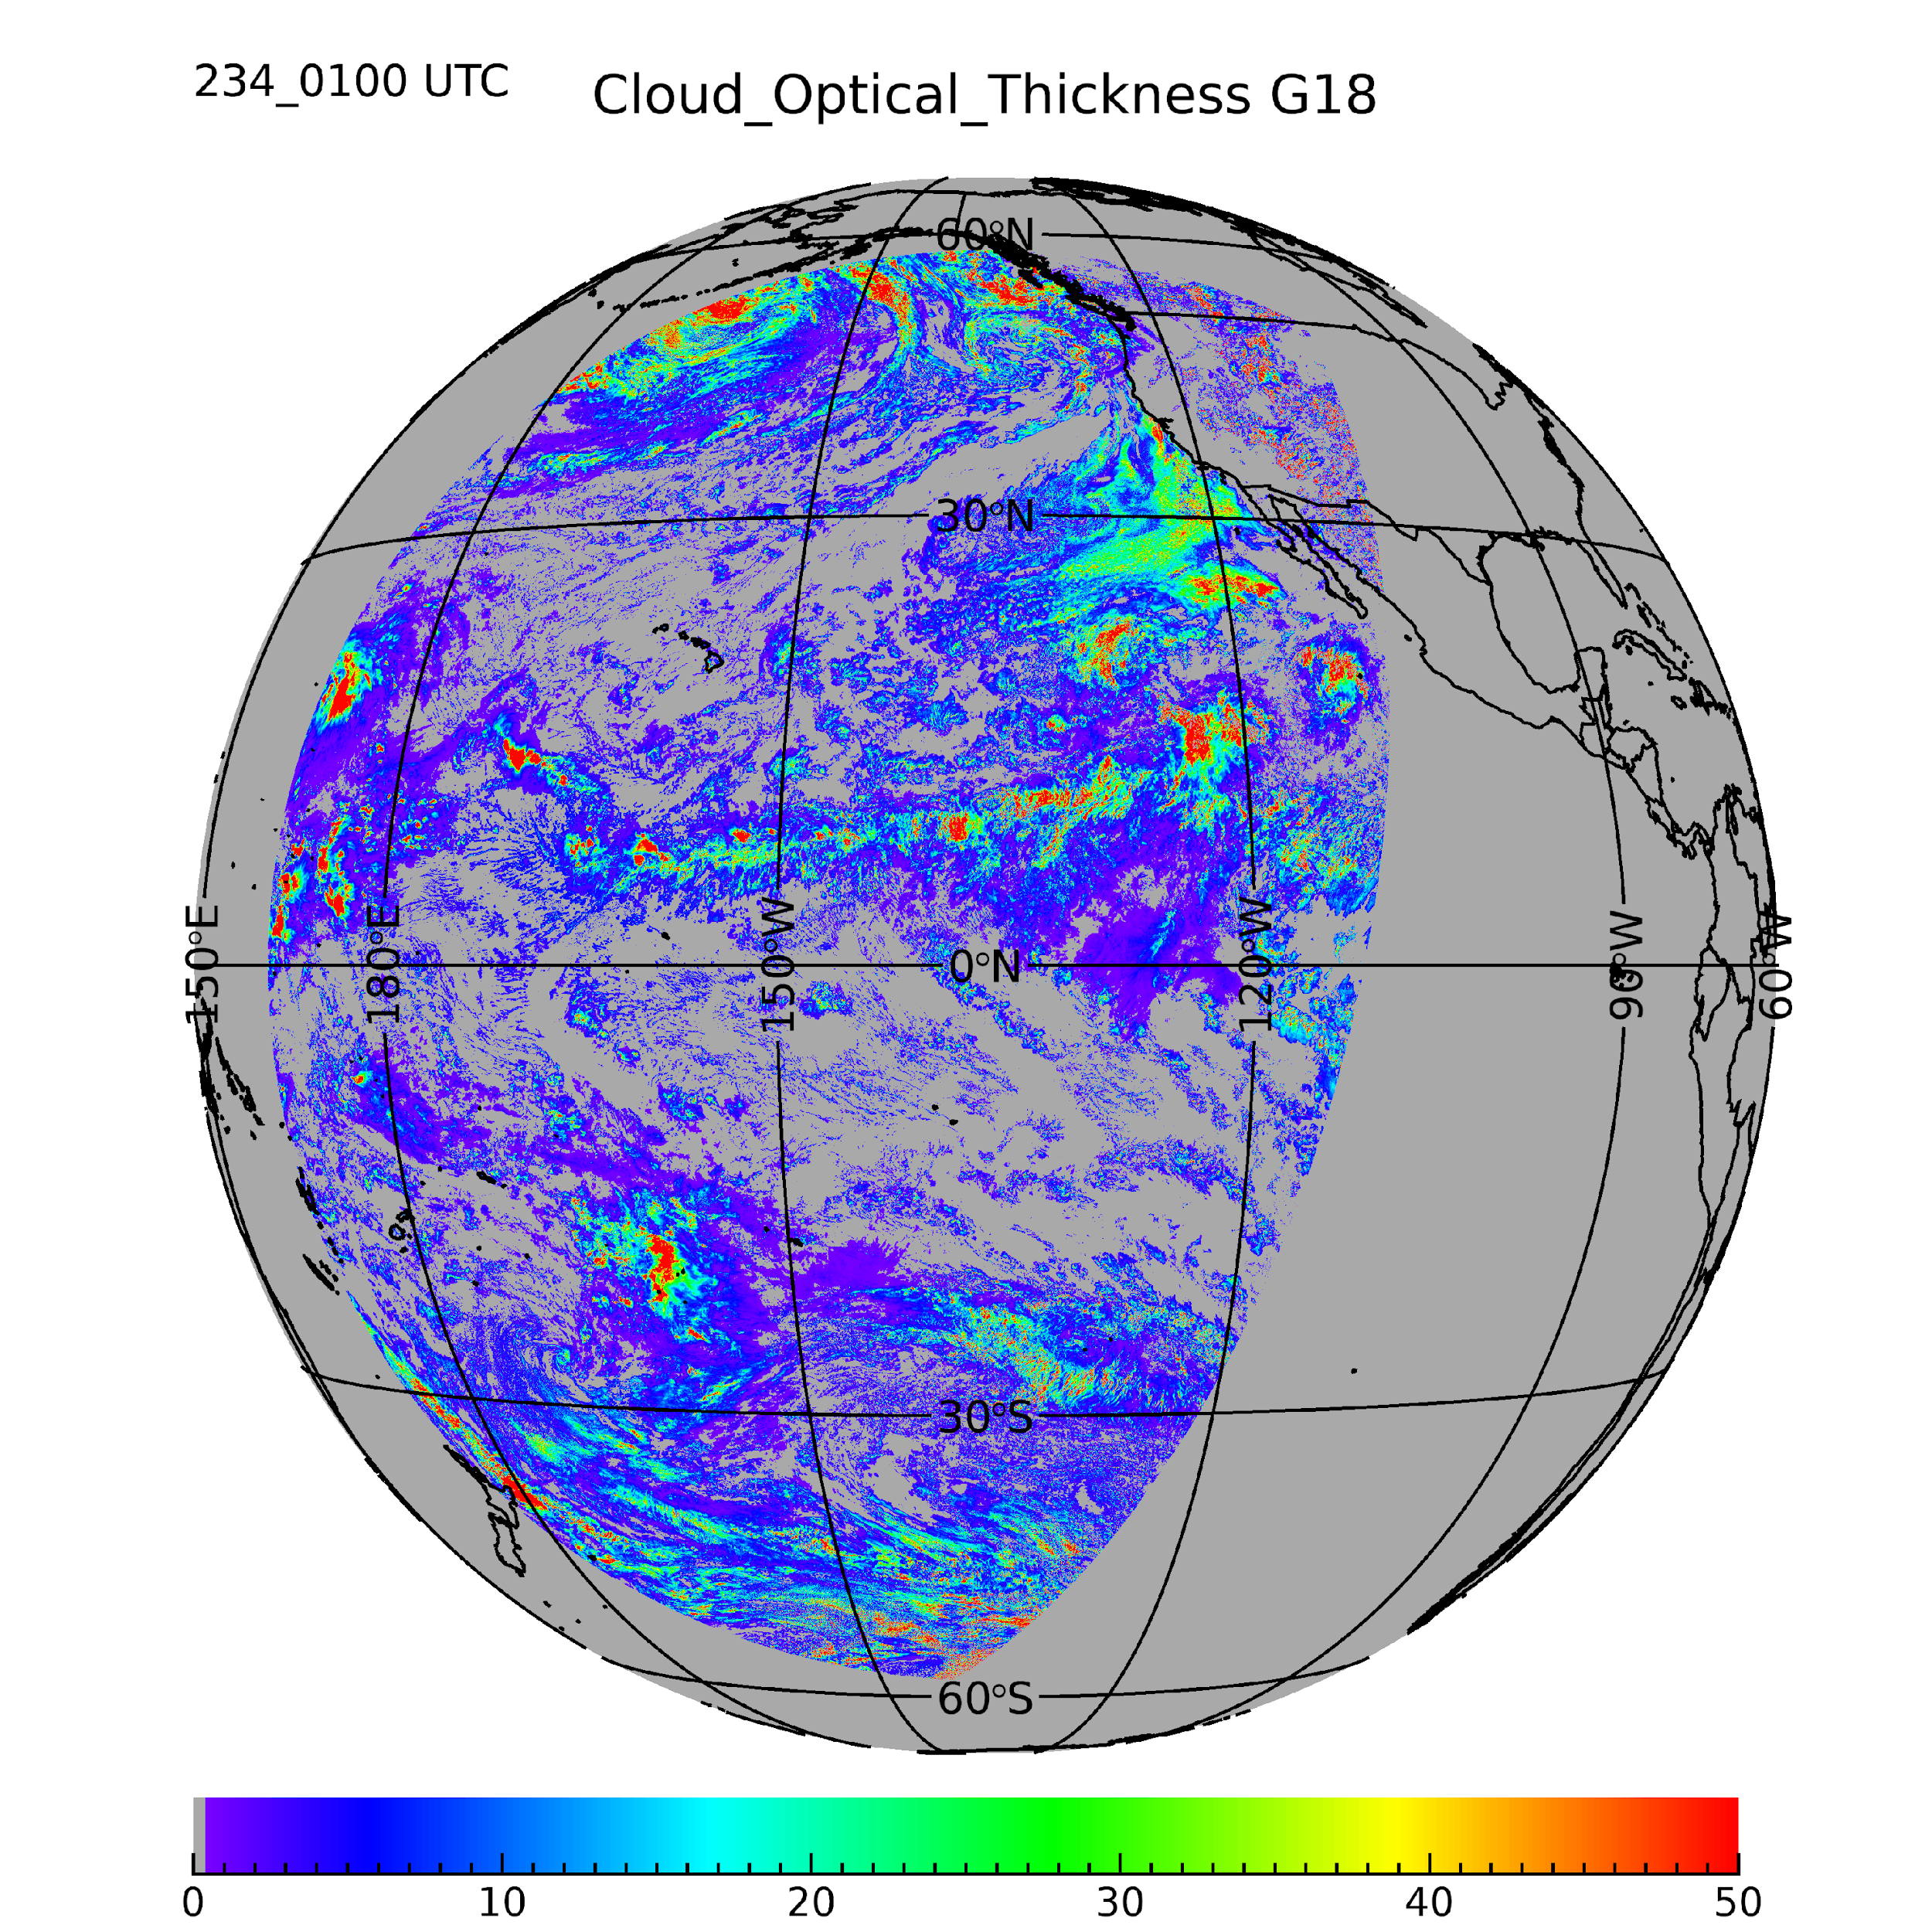
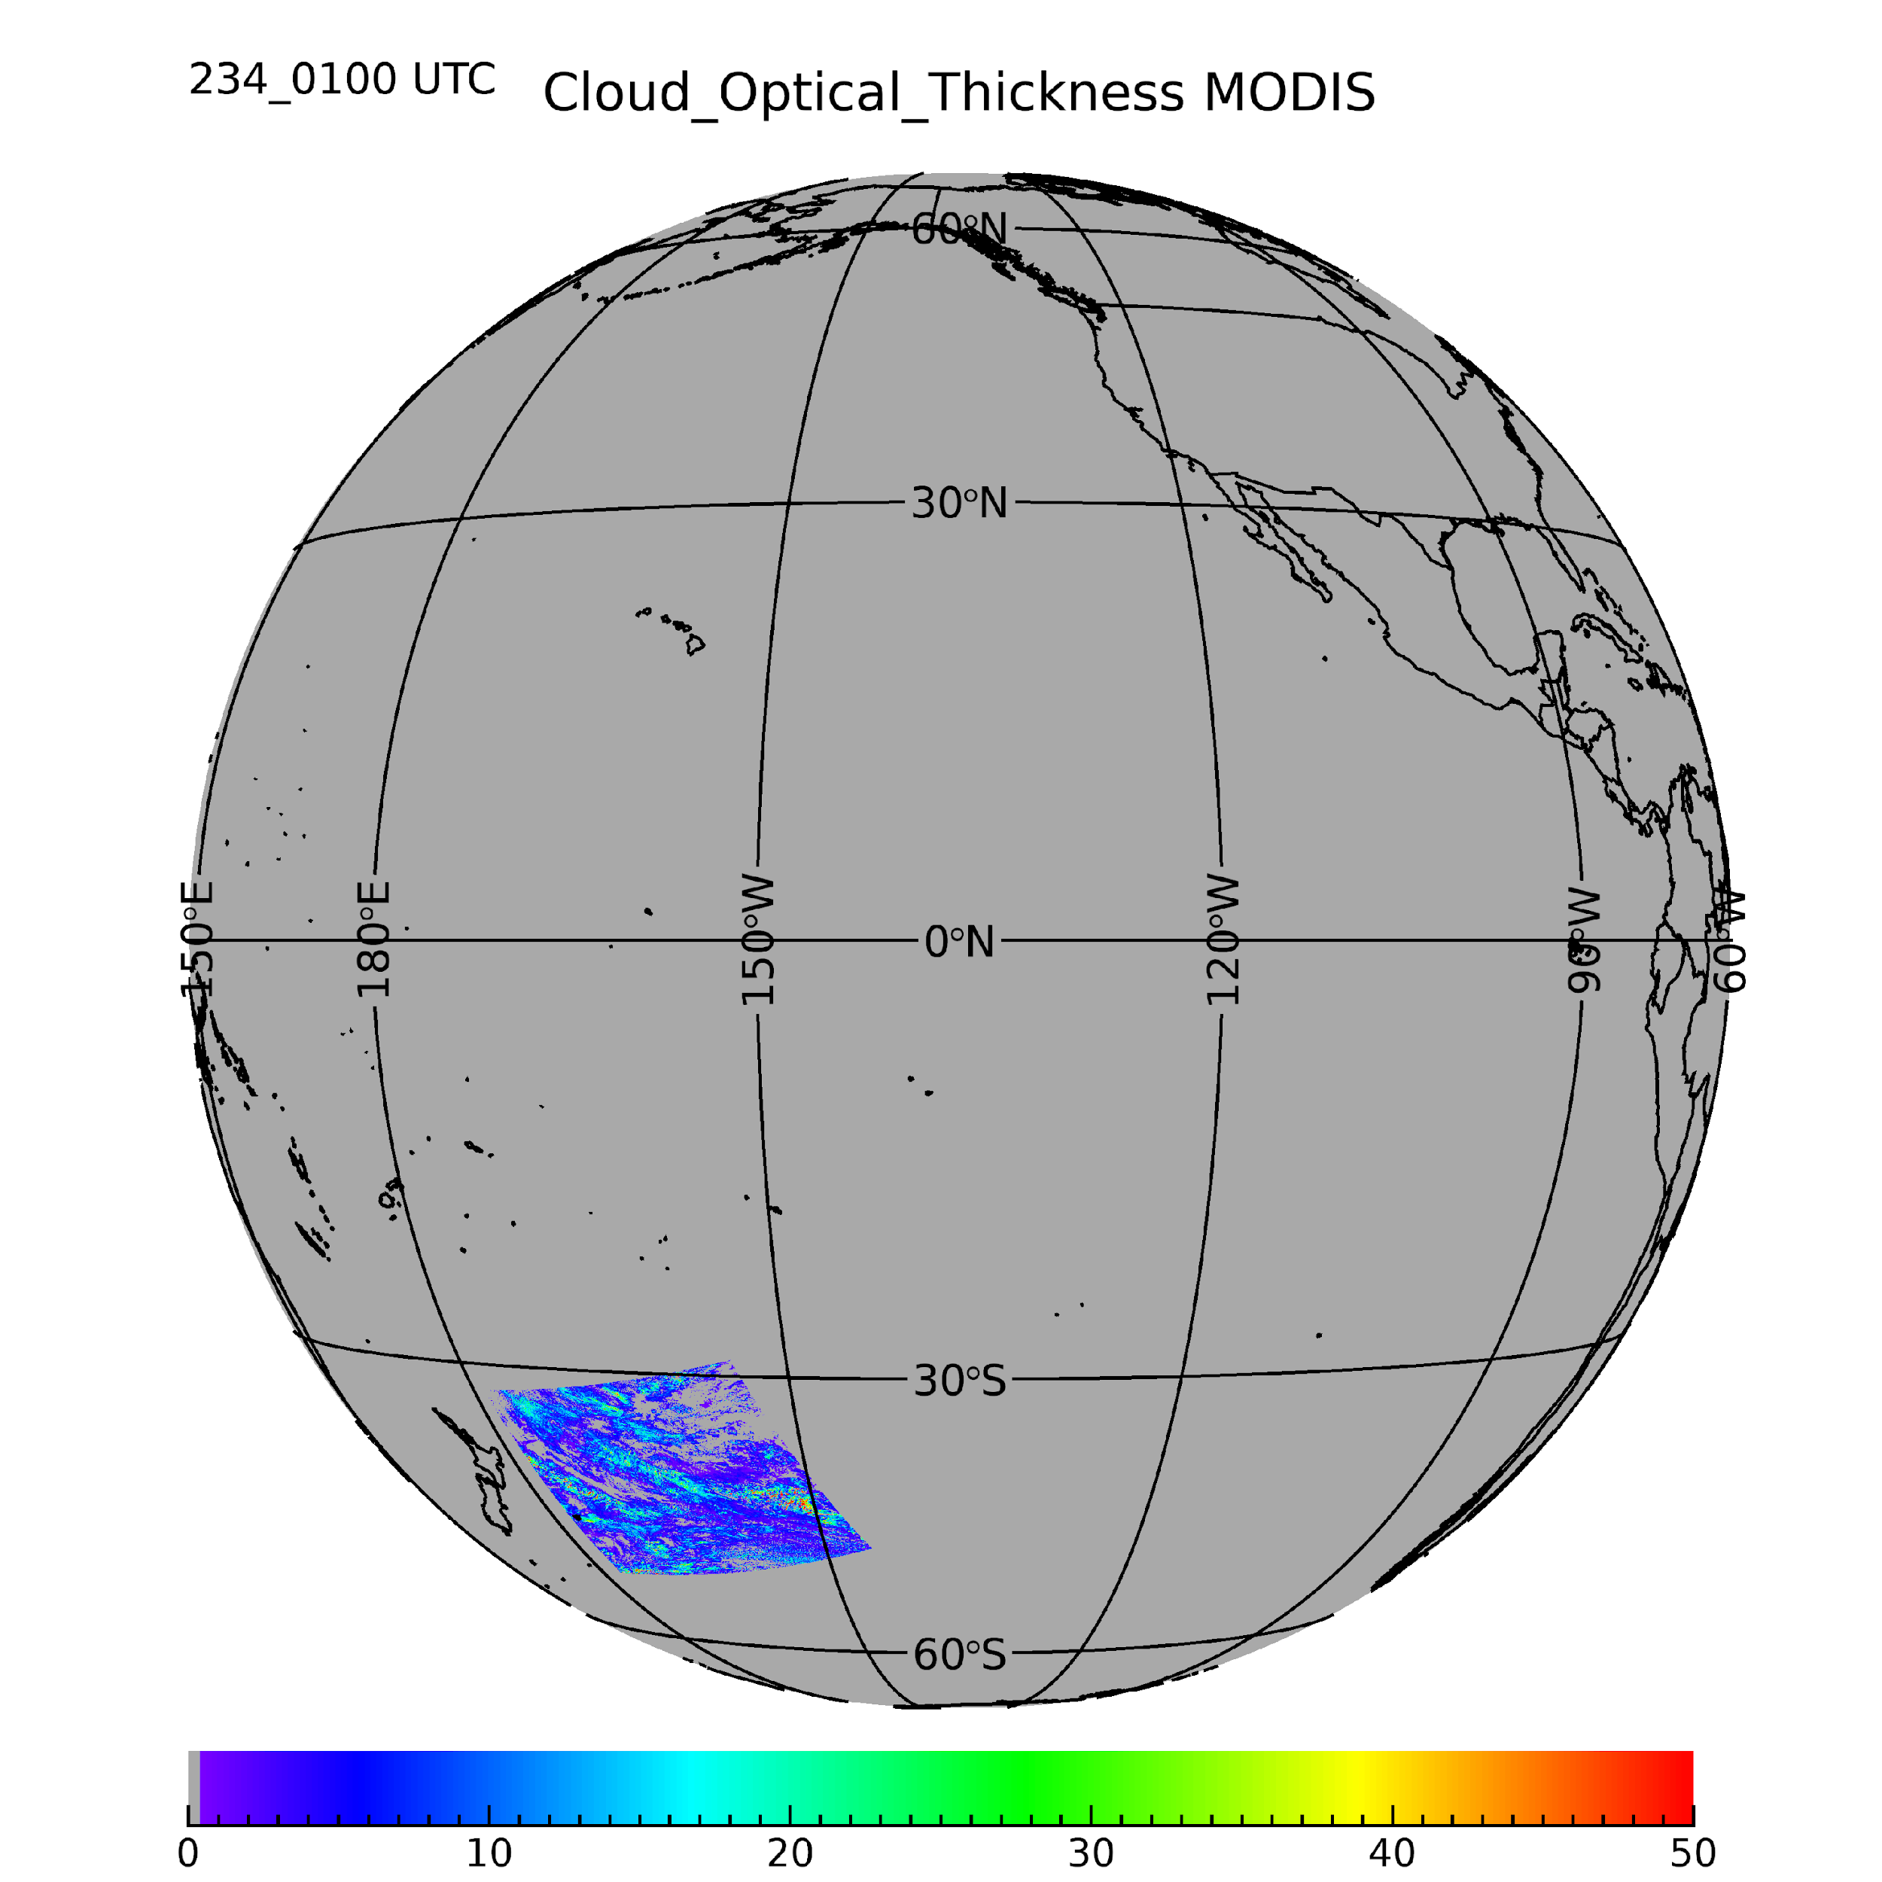
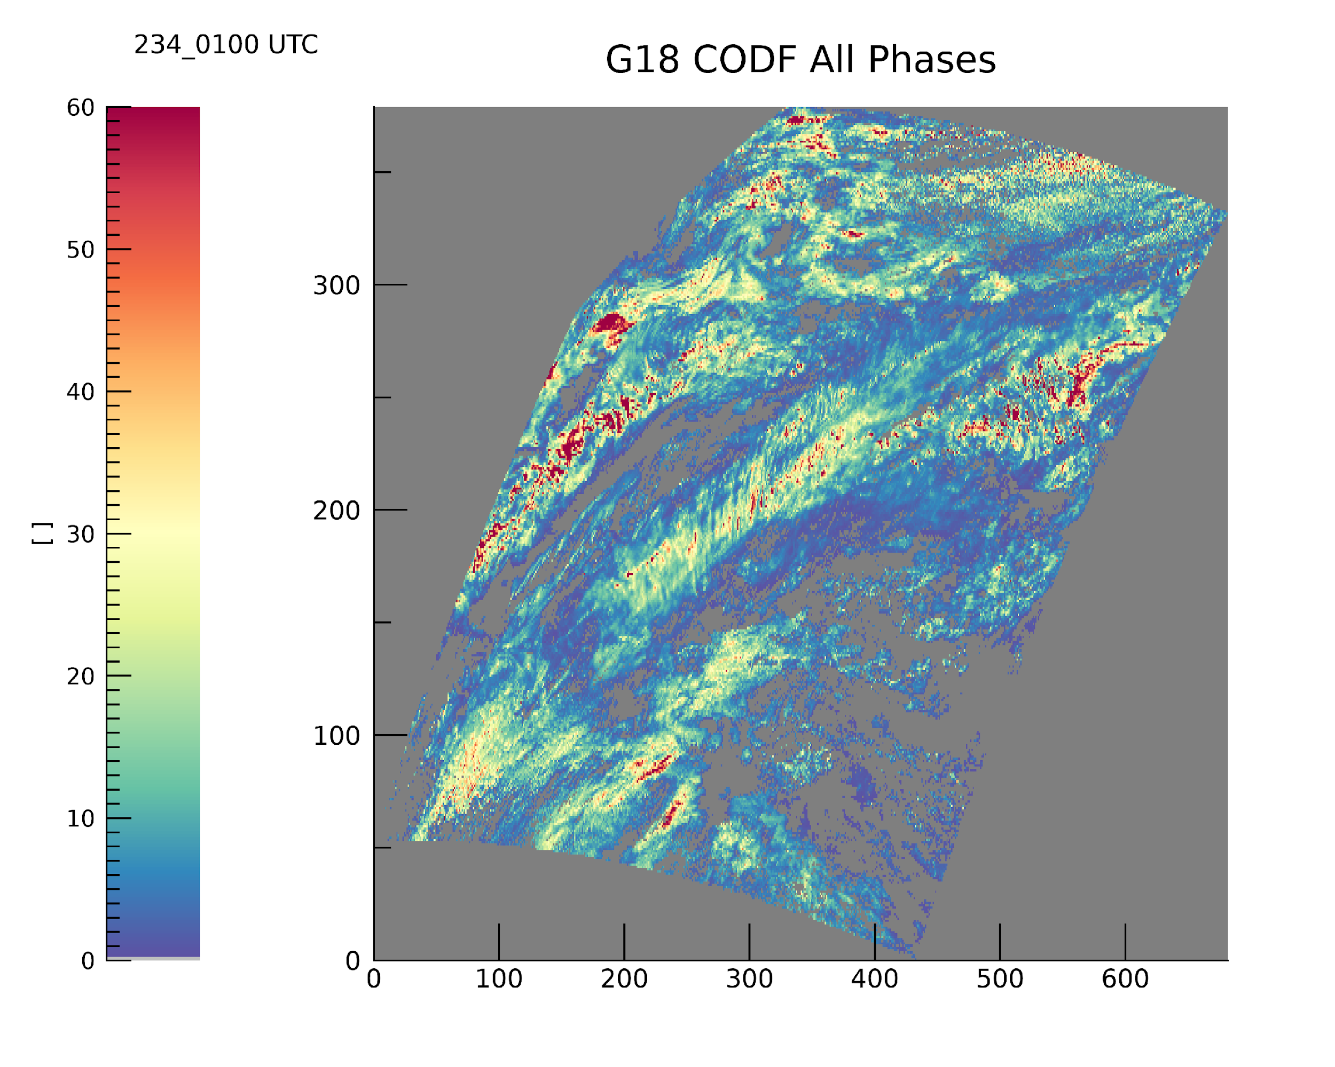
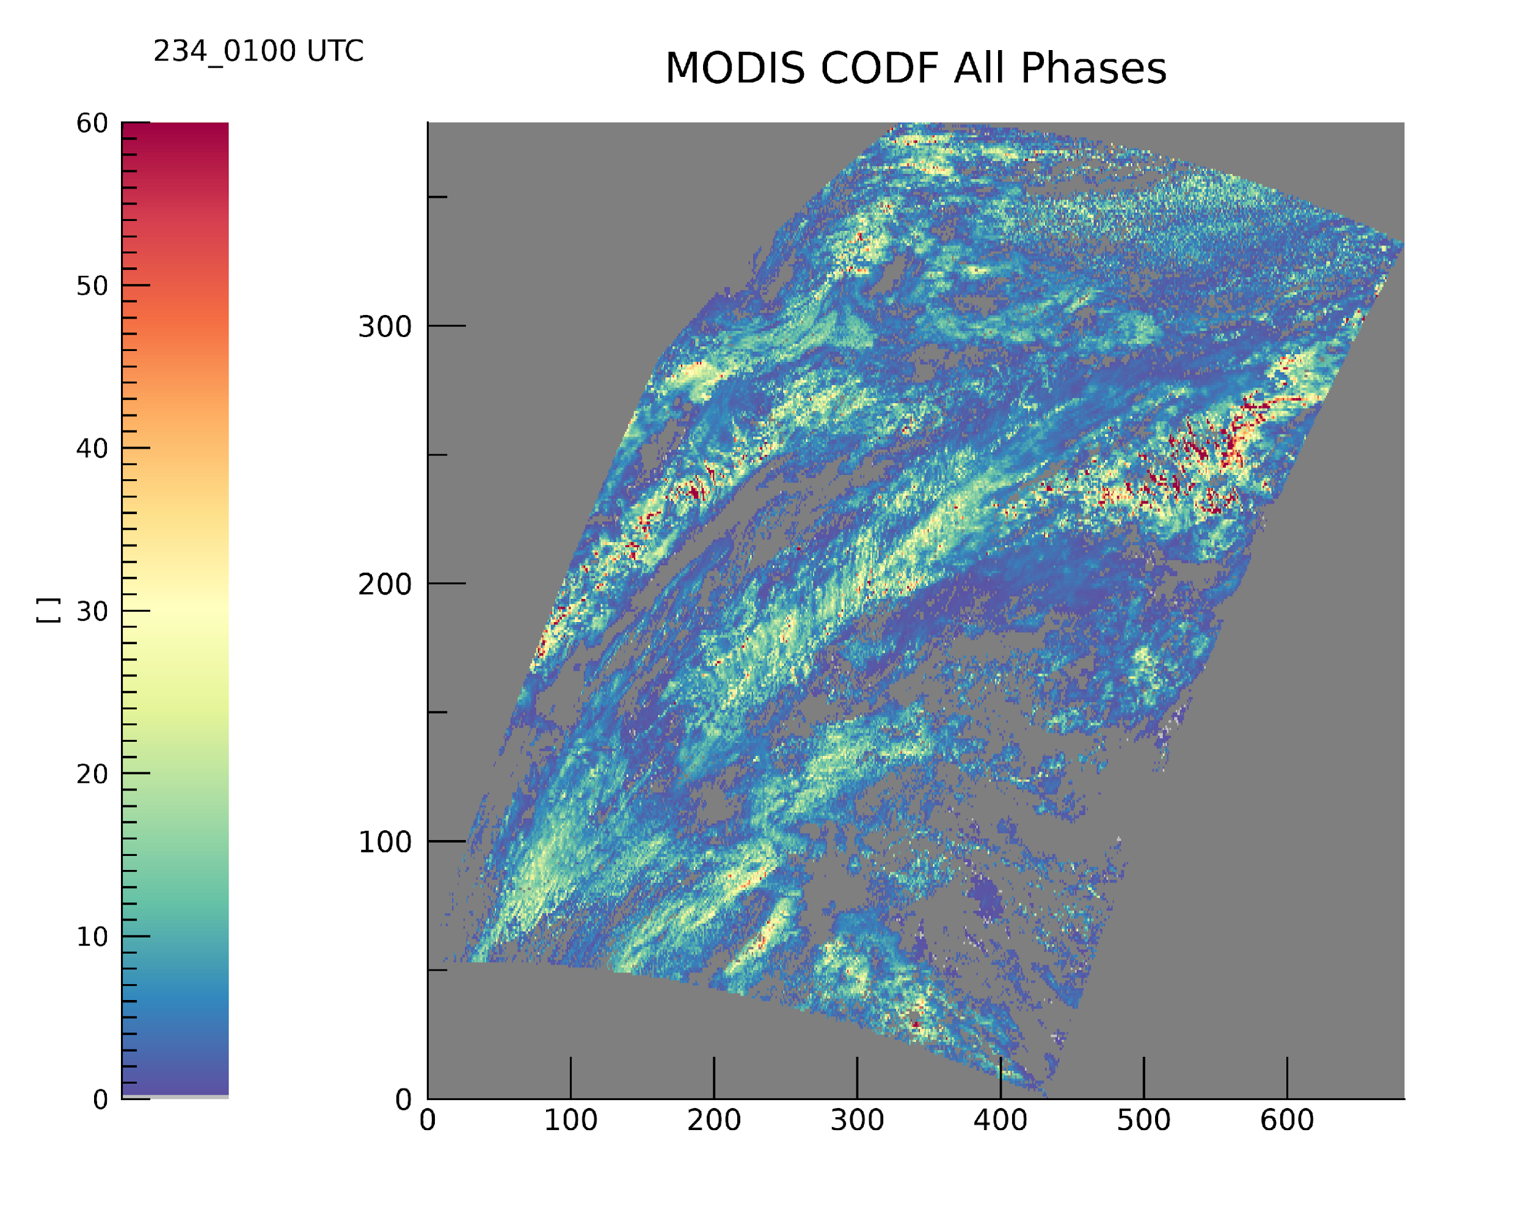
PLPT ABI-FD_COP06
Cloud Optical Depth
This shows an example case from 2022 day of year 234 01:00 UTC
The MODIS-AQUA values are gidded on the GOES-ABI grid. This makes direct 1:1 intercomparison possible.
The upper images show the GOES-18 disk with all DCOMP results (left) and the corresponding AQUA granule (right)
The possible time shift is about 10 minutes.
We made the same comparisons for all MODIS-AQUA granules of the 10 days validation period.

Slide 23
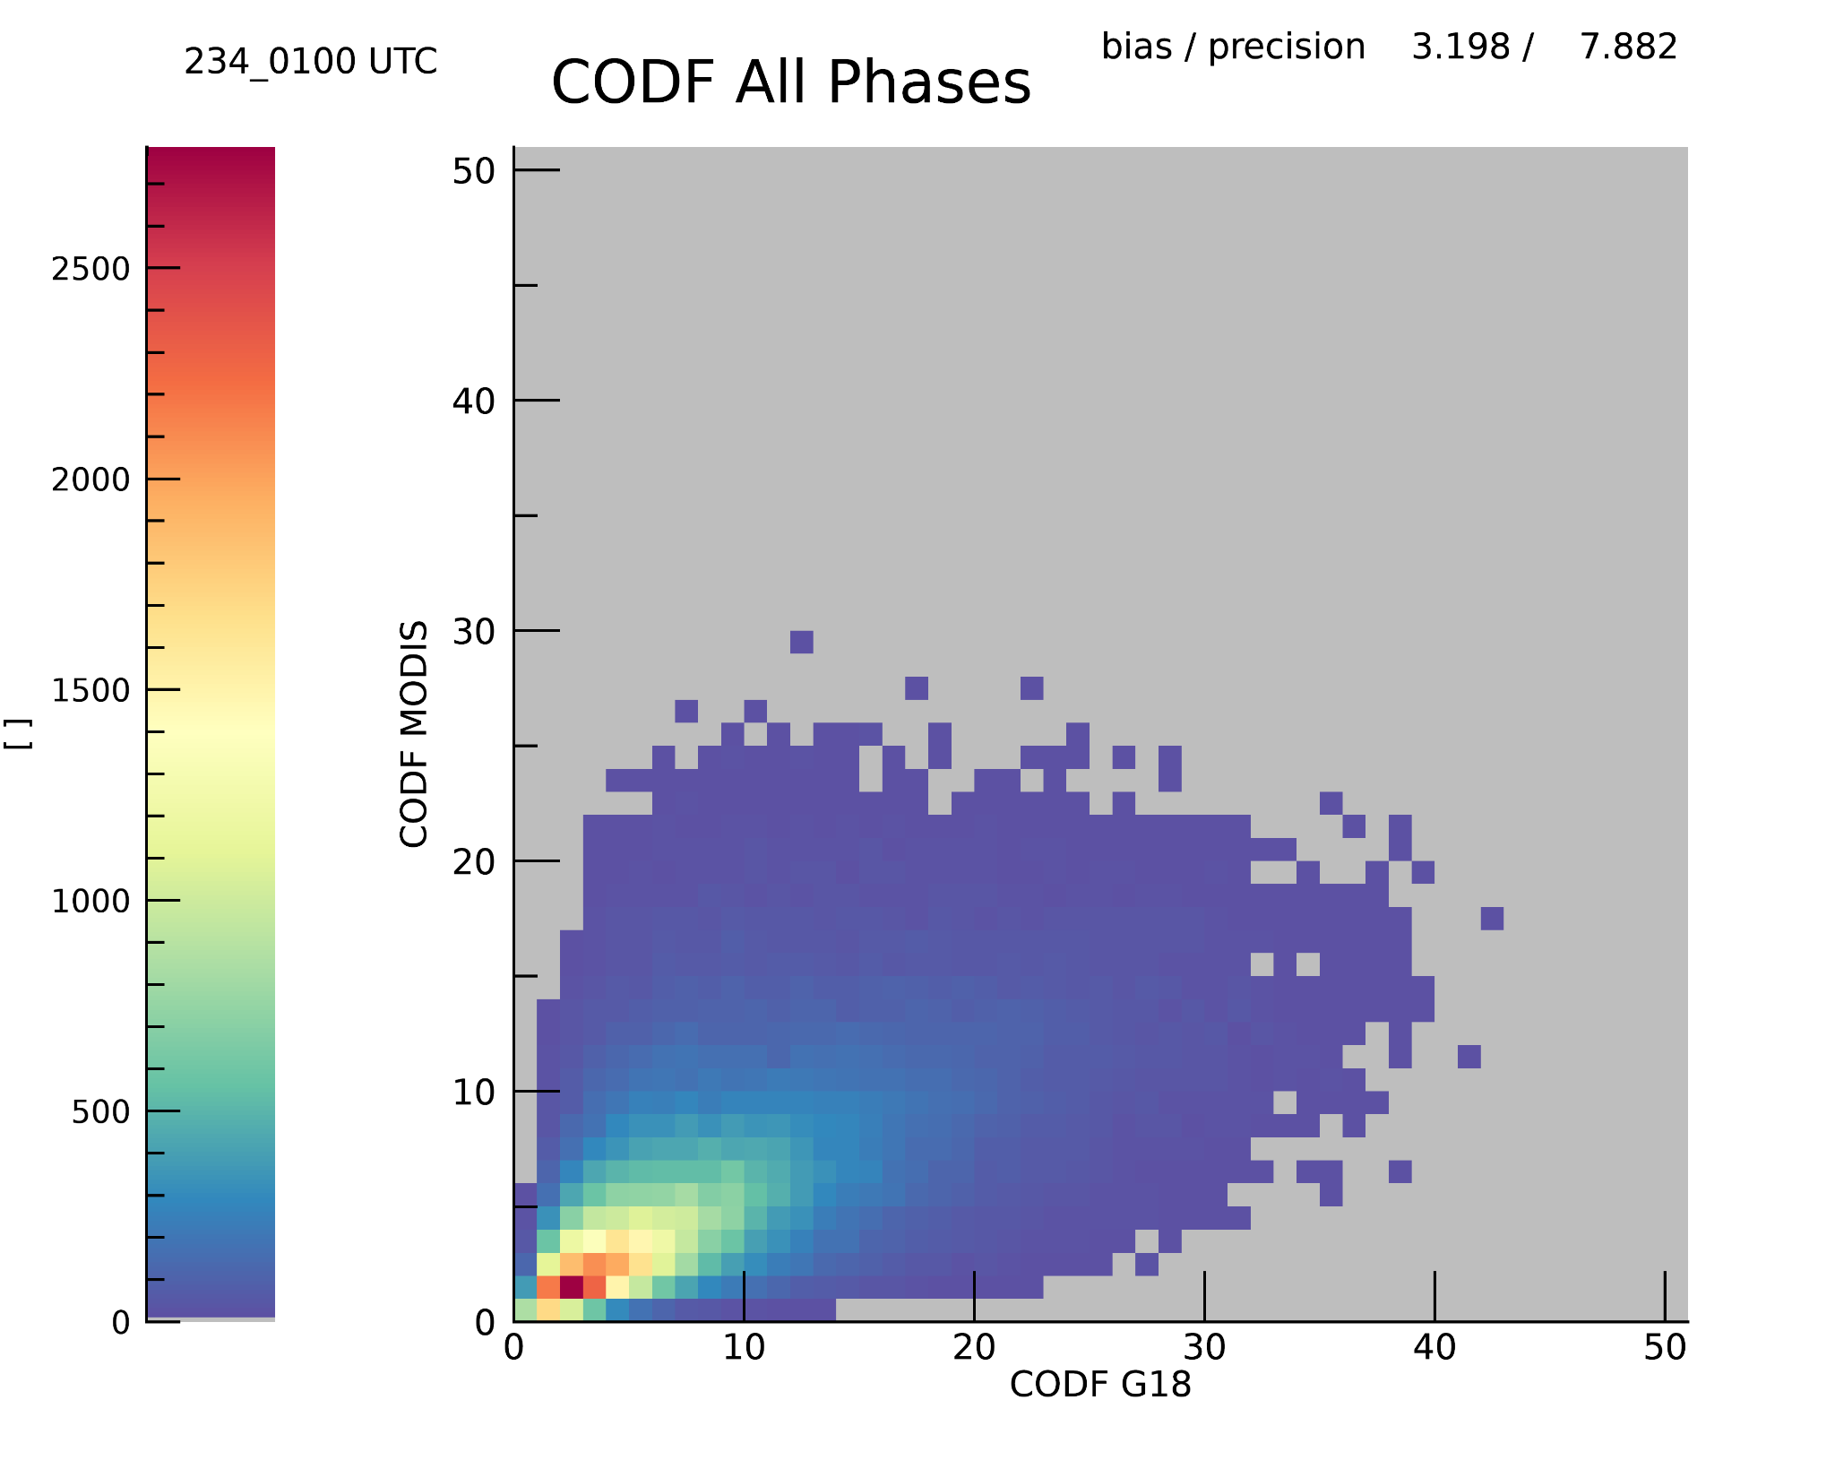
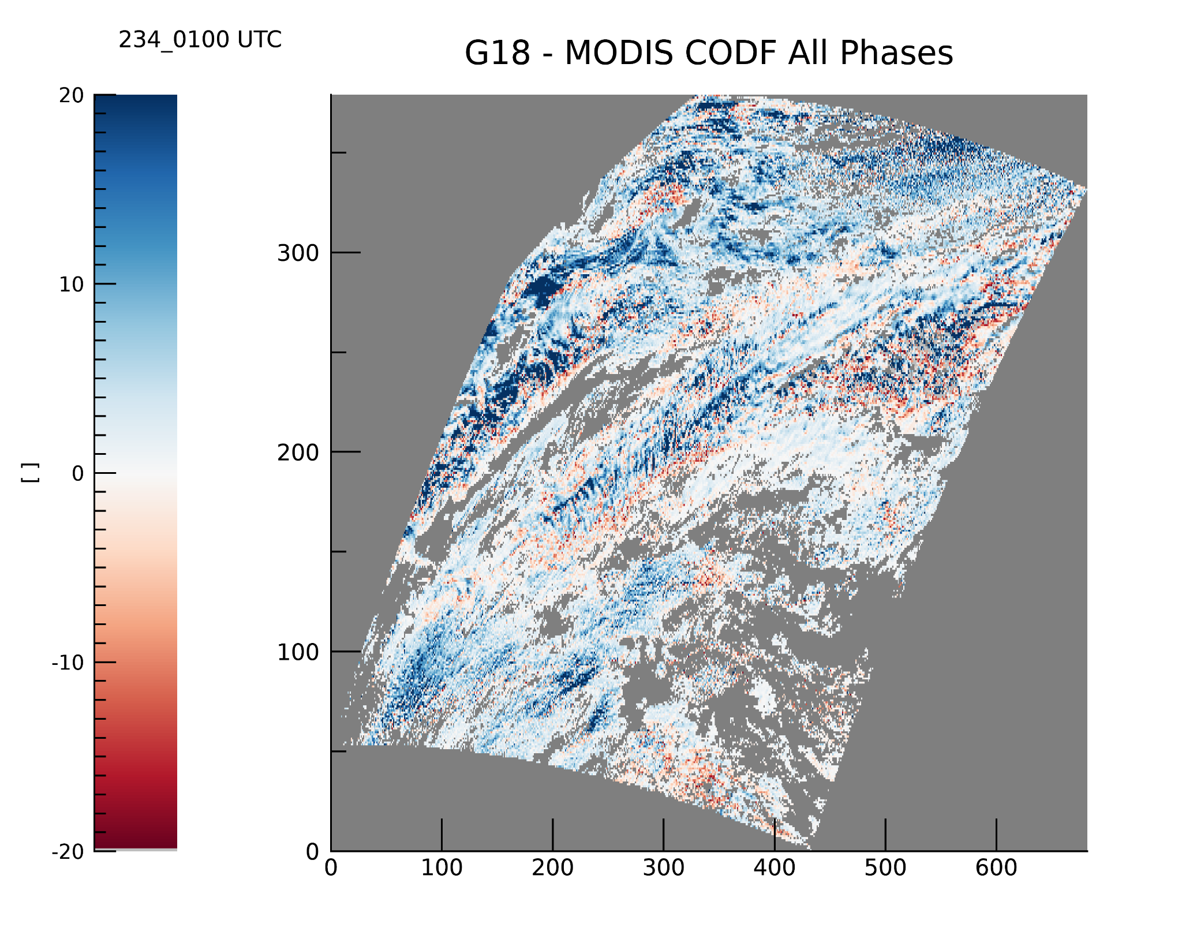
PLPT ABI-FD_COP06
Cloud Optical Depth
The differences are caused by small spatial shifts due to the selected spatial and temporal tolerance

Slide 24
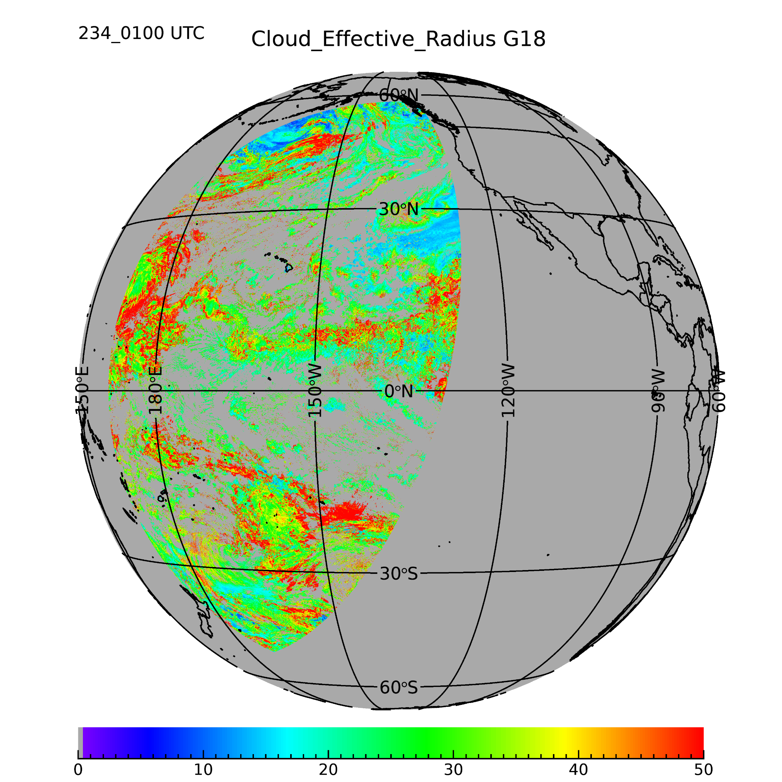
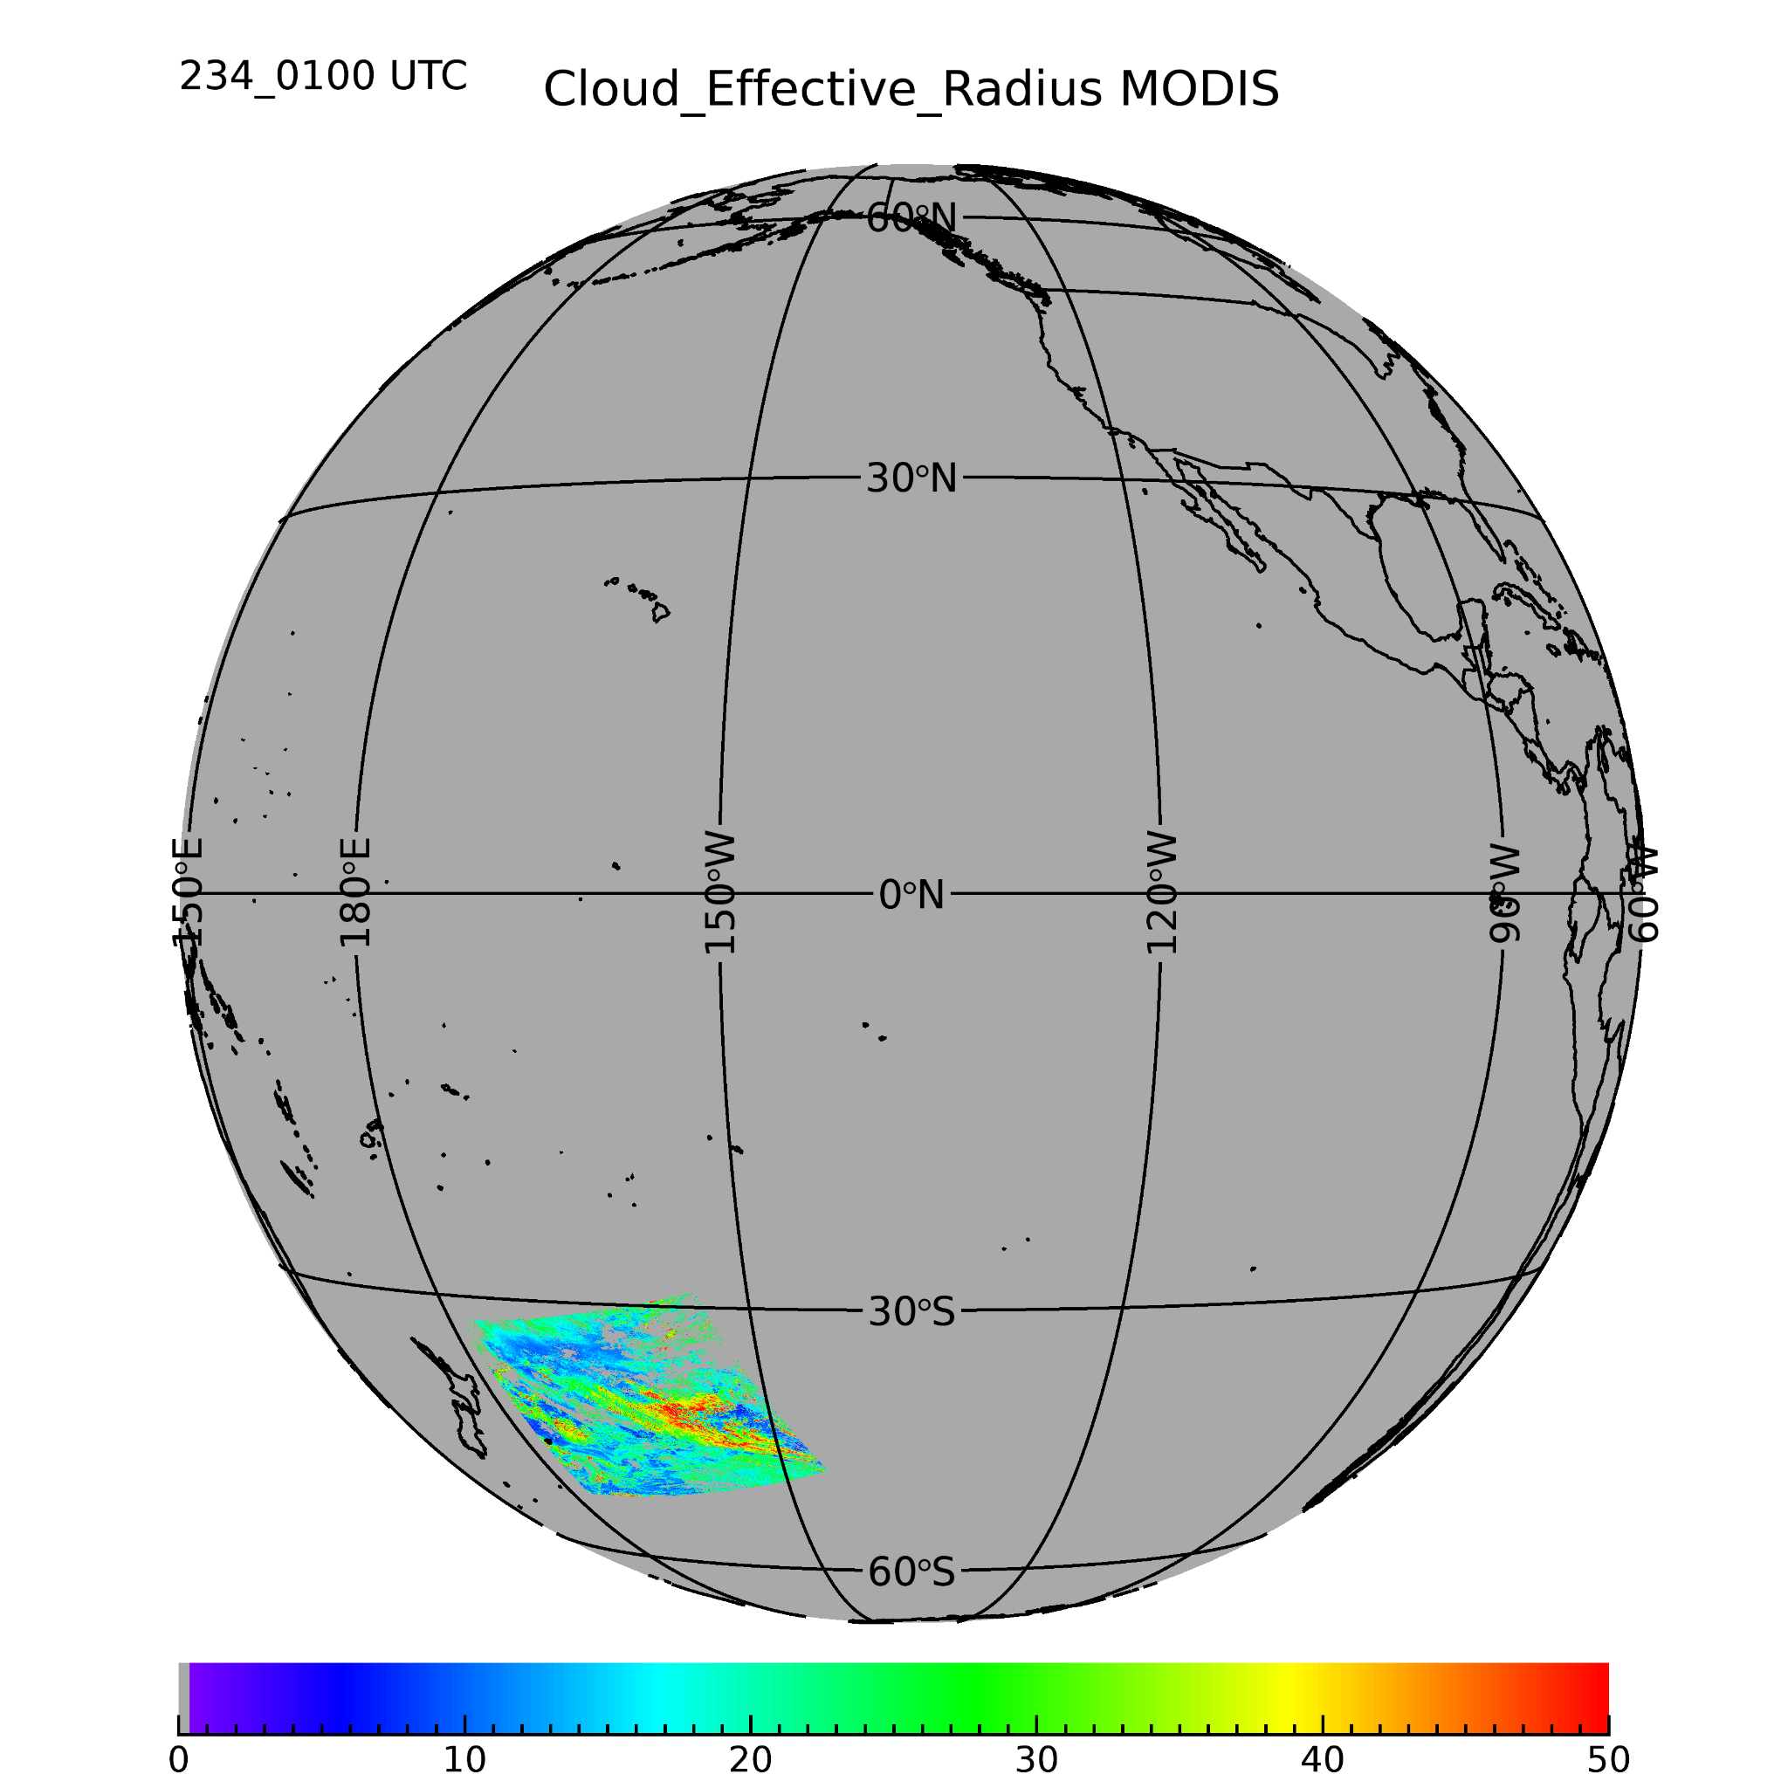
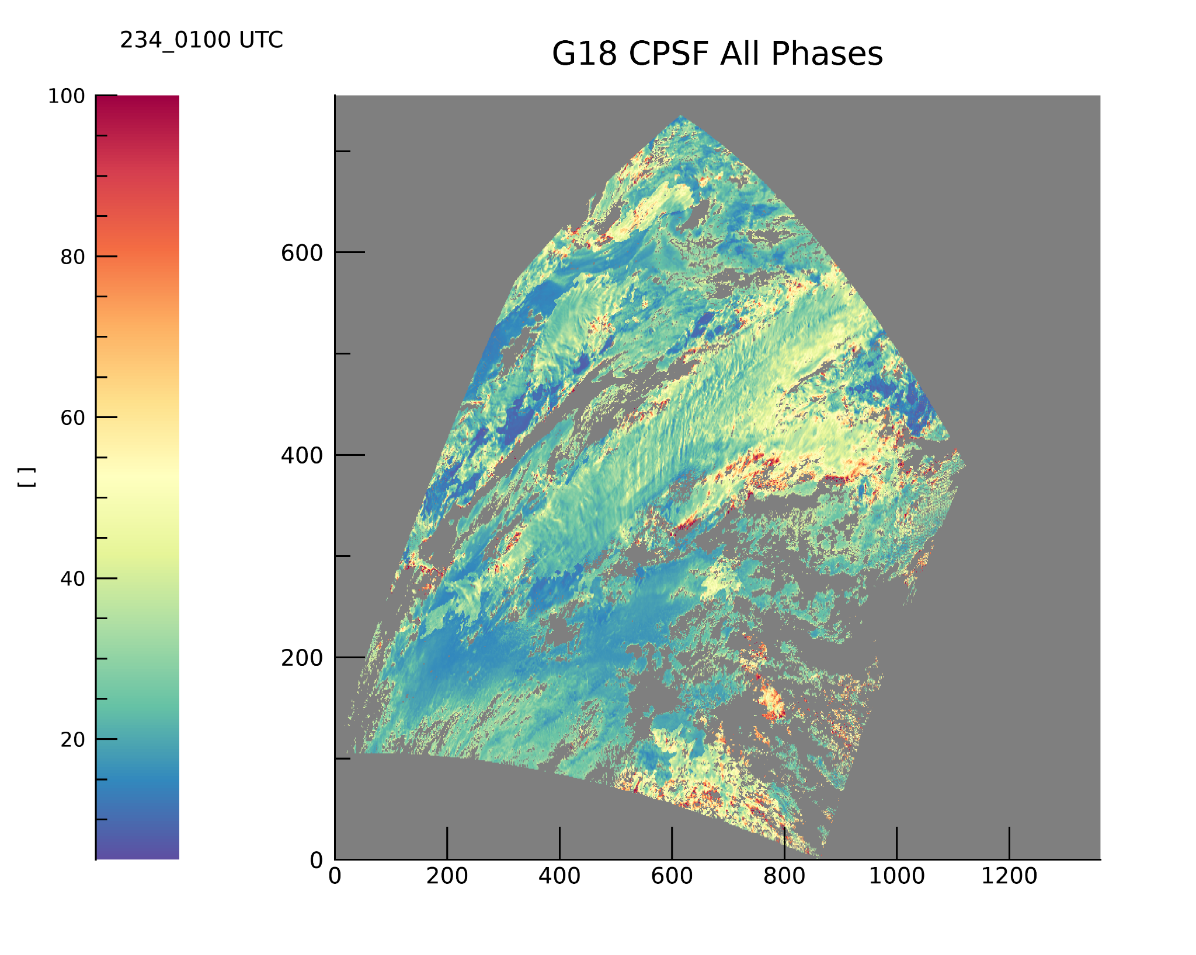
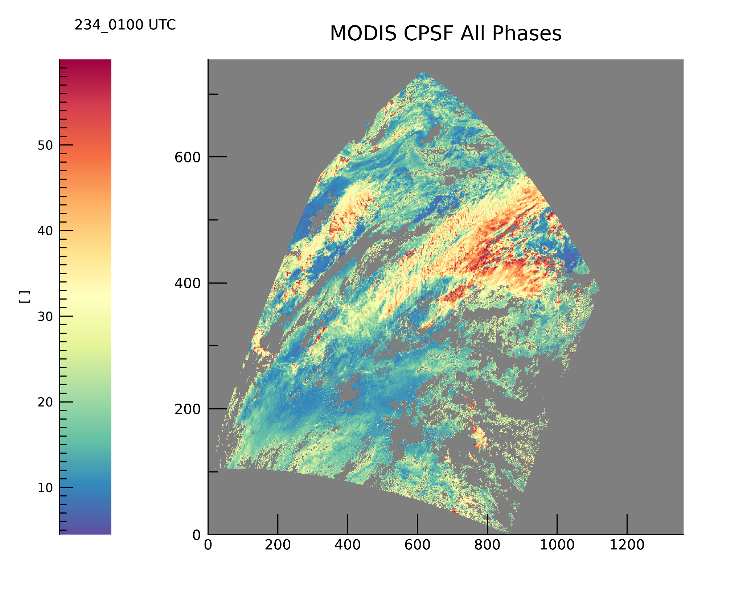
PLPT ABI-FD_COP06
Cloud Particle Size
This shows an example case for Cloud Particle Size from 2022 day of year 234 01:00 UTC
The MODIS -AQUA values are gidded on the GOES-ABI grid. This makes direct 1:1 intercomparison possible.
The possible time shift is about 10 minutes.
We made the same comparisons for all MODIS-AQUA granules of the 10 days validation period.

Slide 25
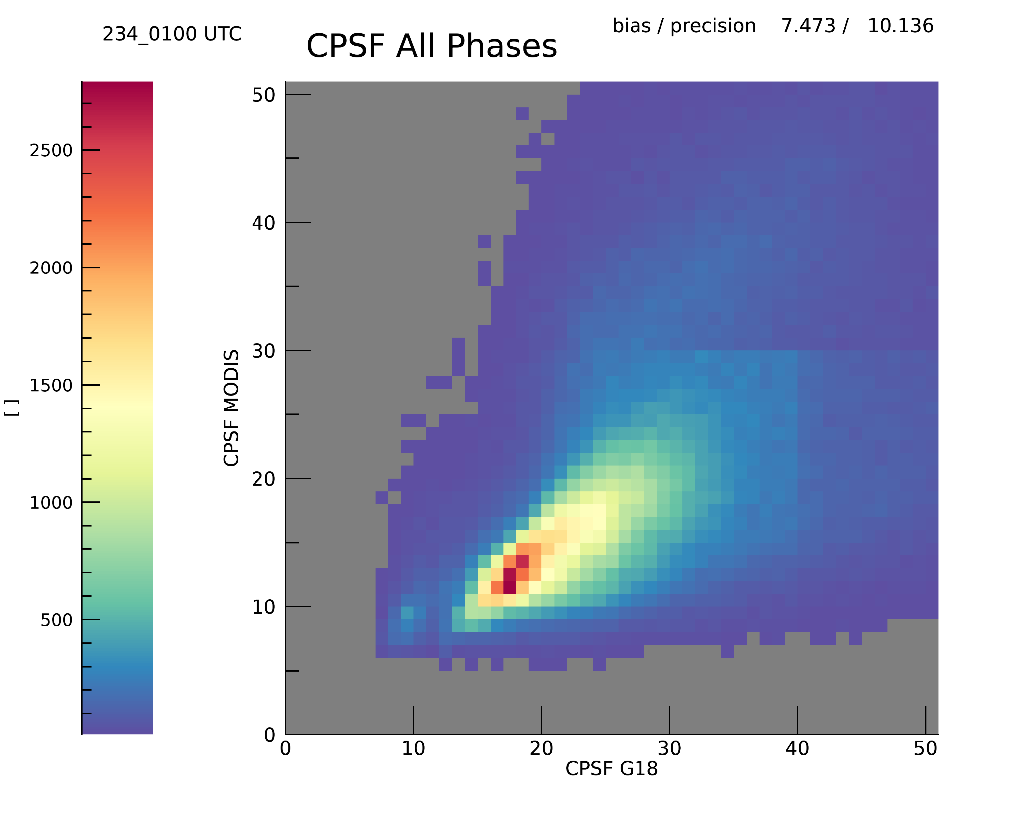
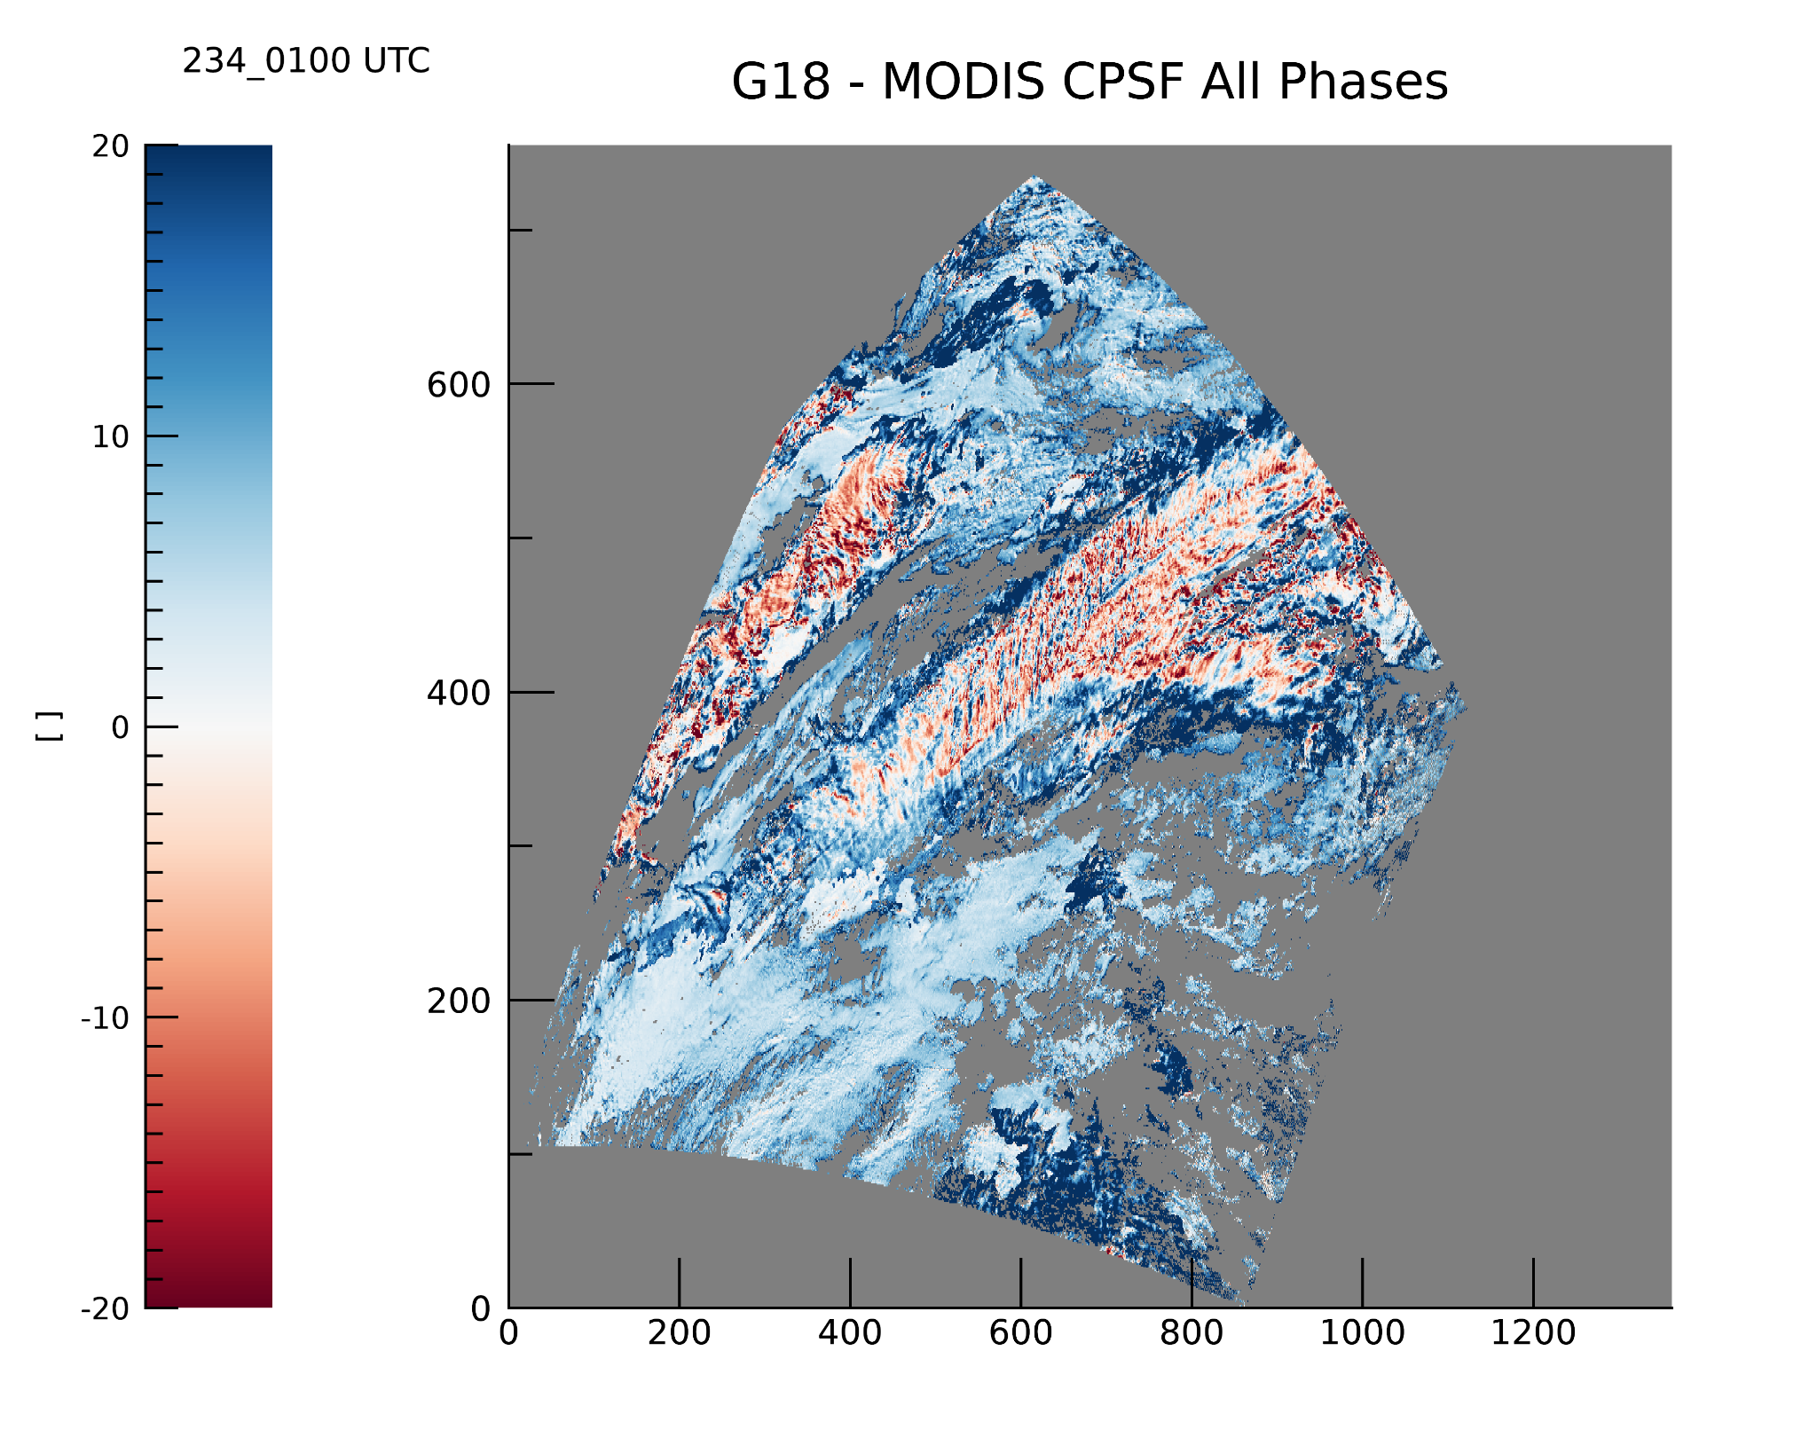
PLPT ABI-FD_COP06
Cloud Particle Size
CPS shows high correlation, but difference map shows distinctive pattern.

Slide 26
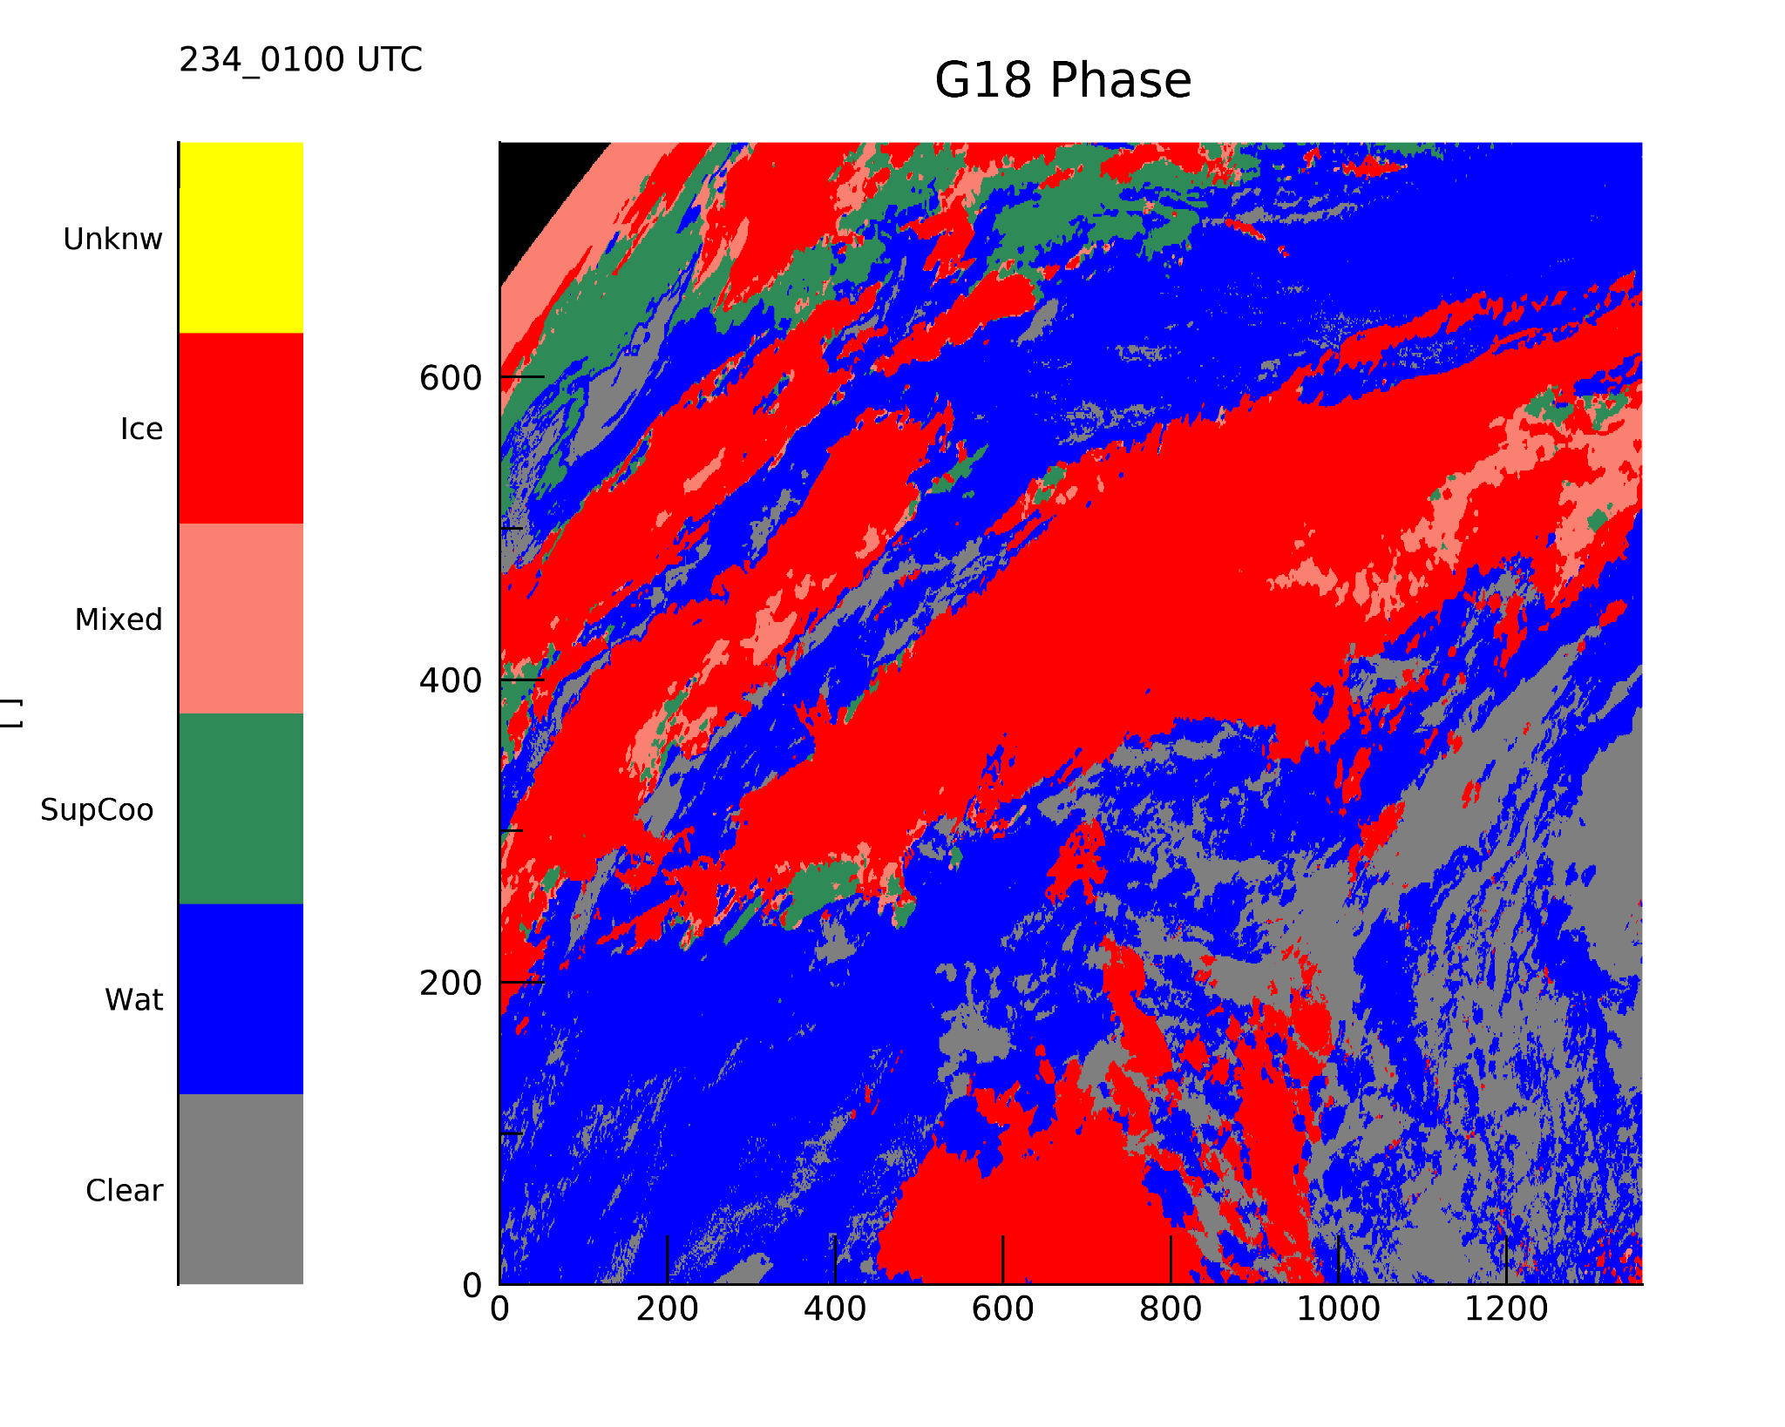
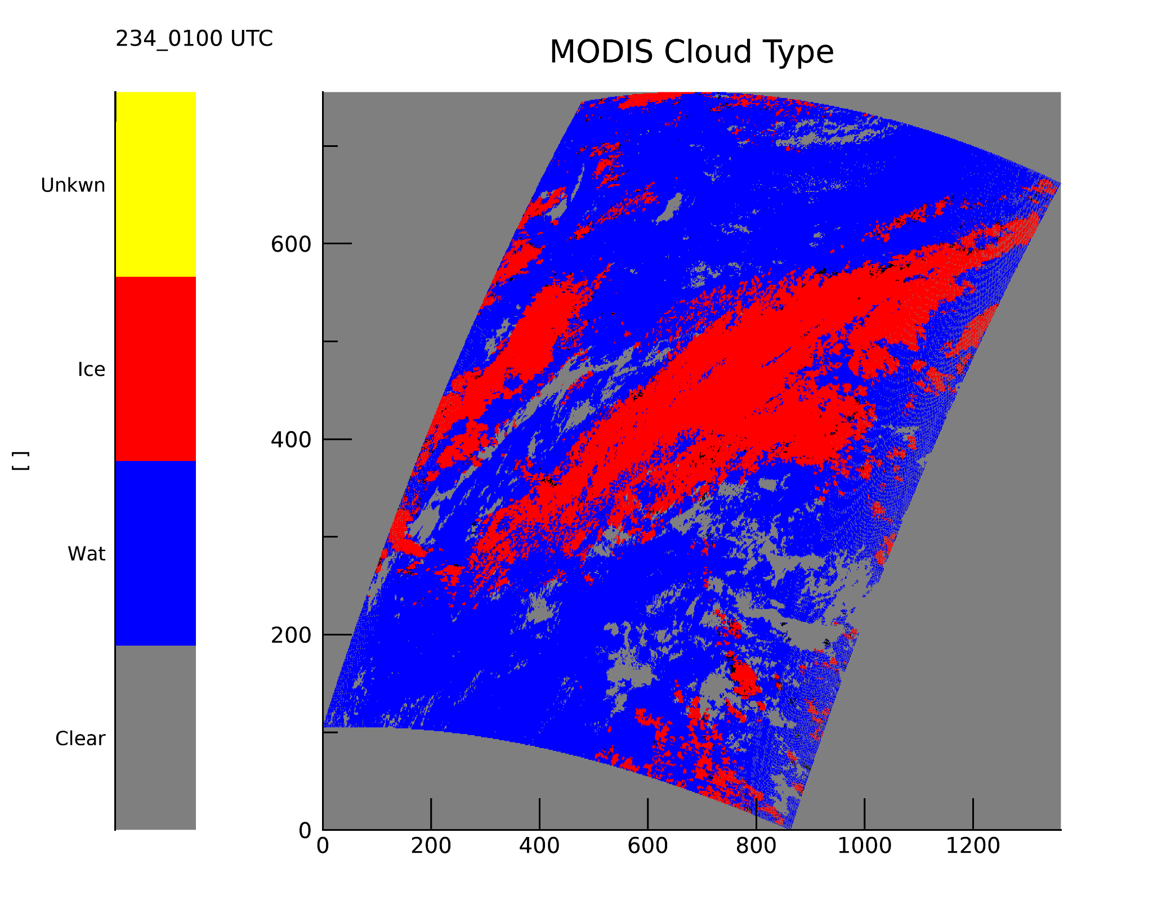
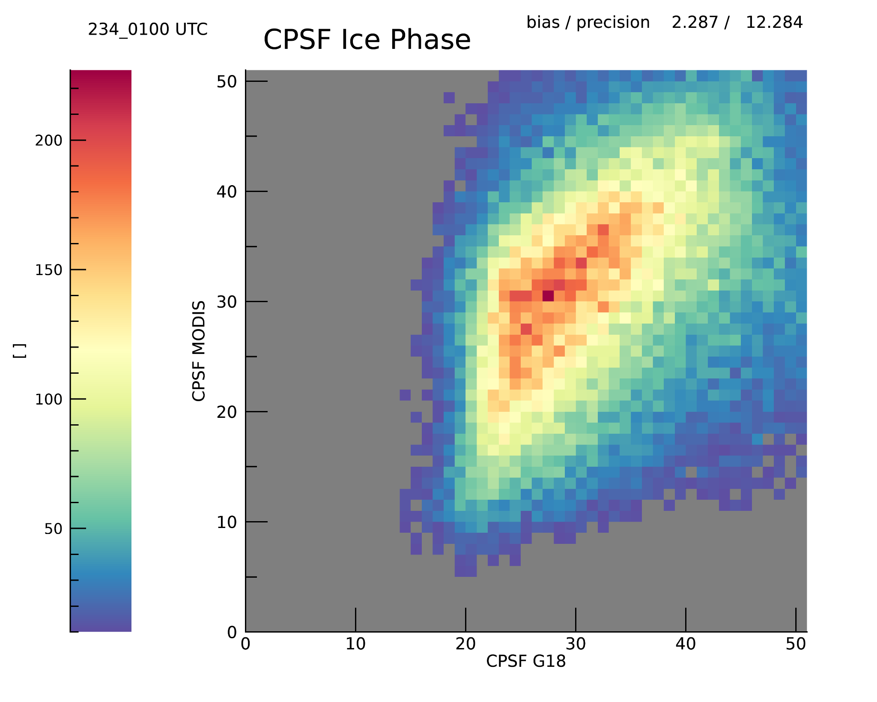
PLPT ABI-FD_COP06
Cloud Particle Size

Slide 27
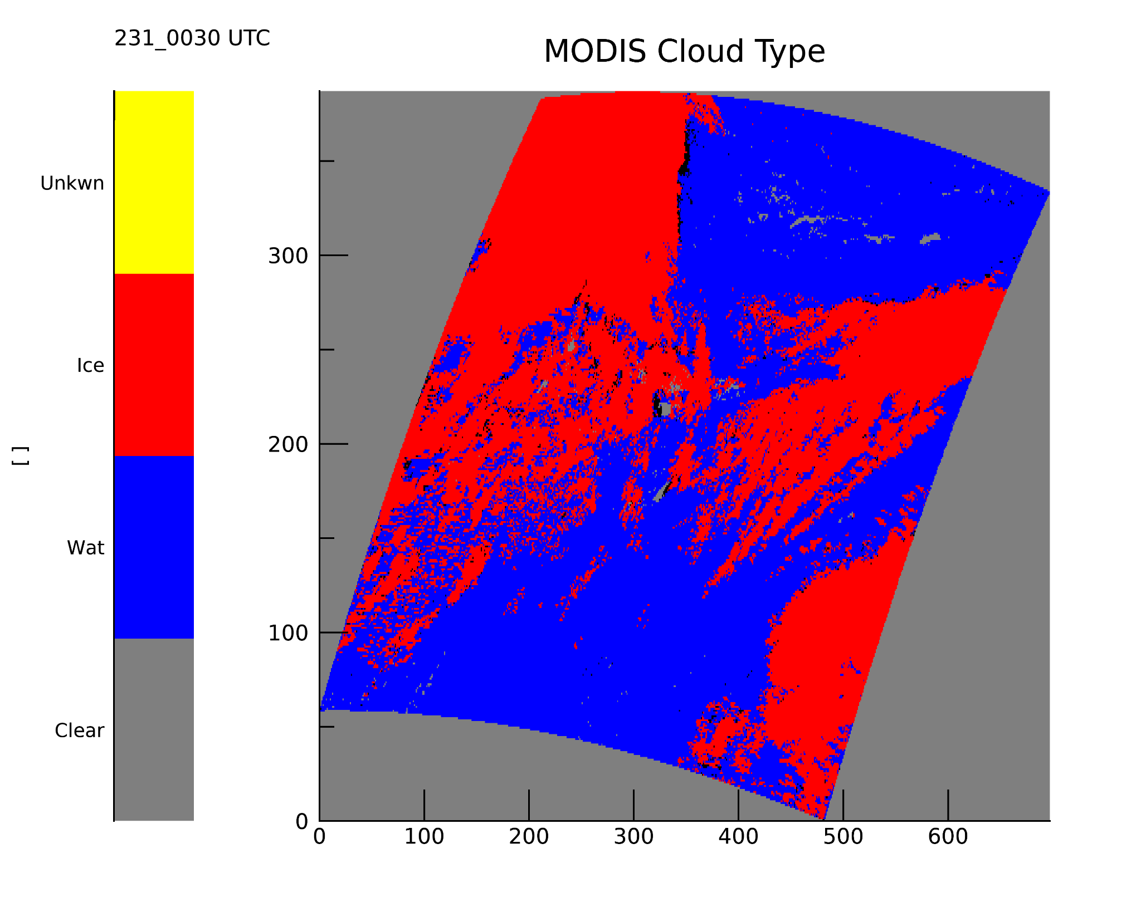
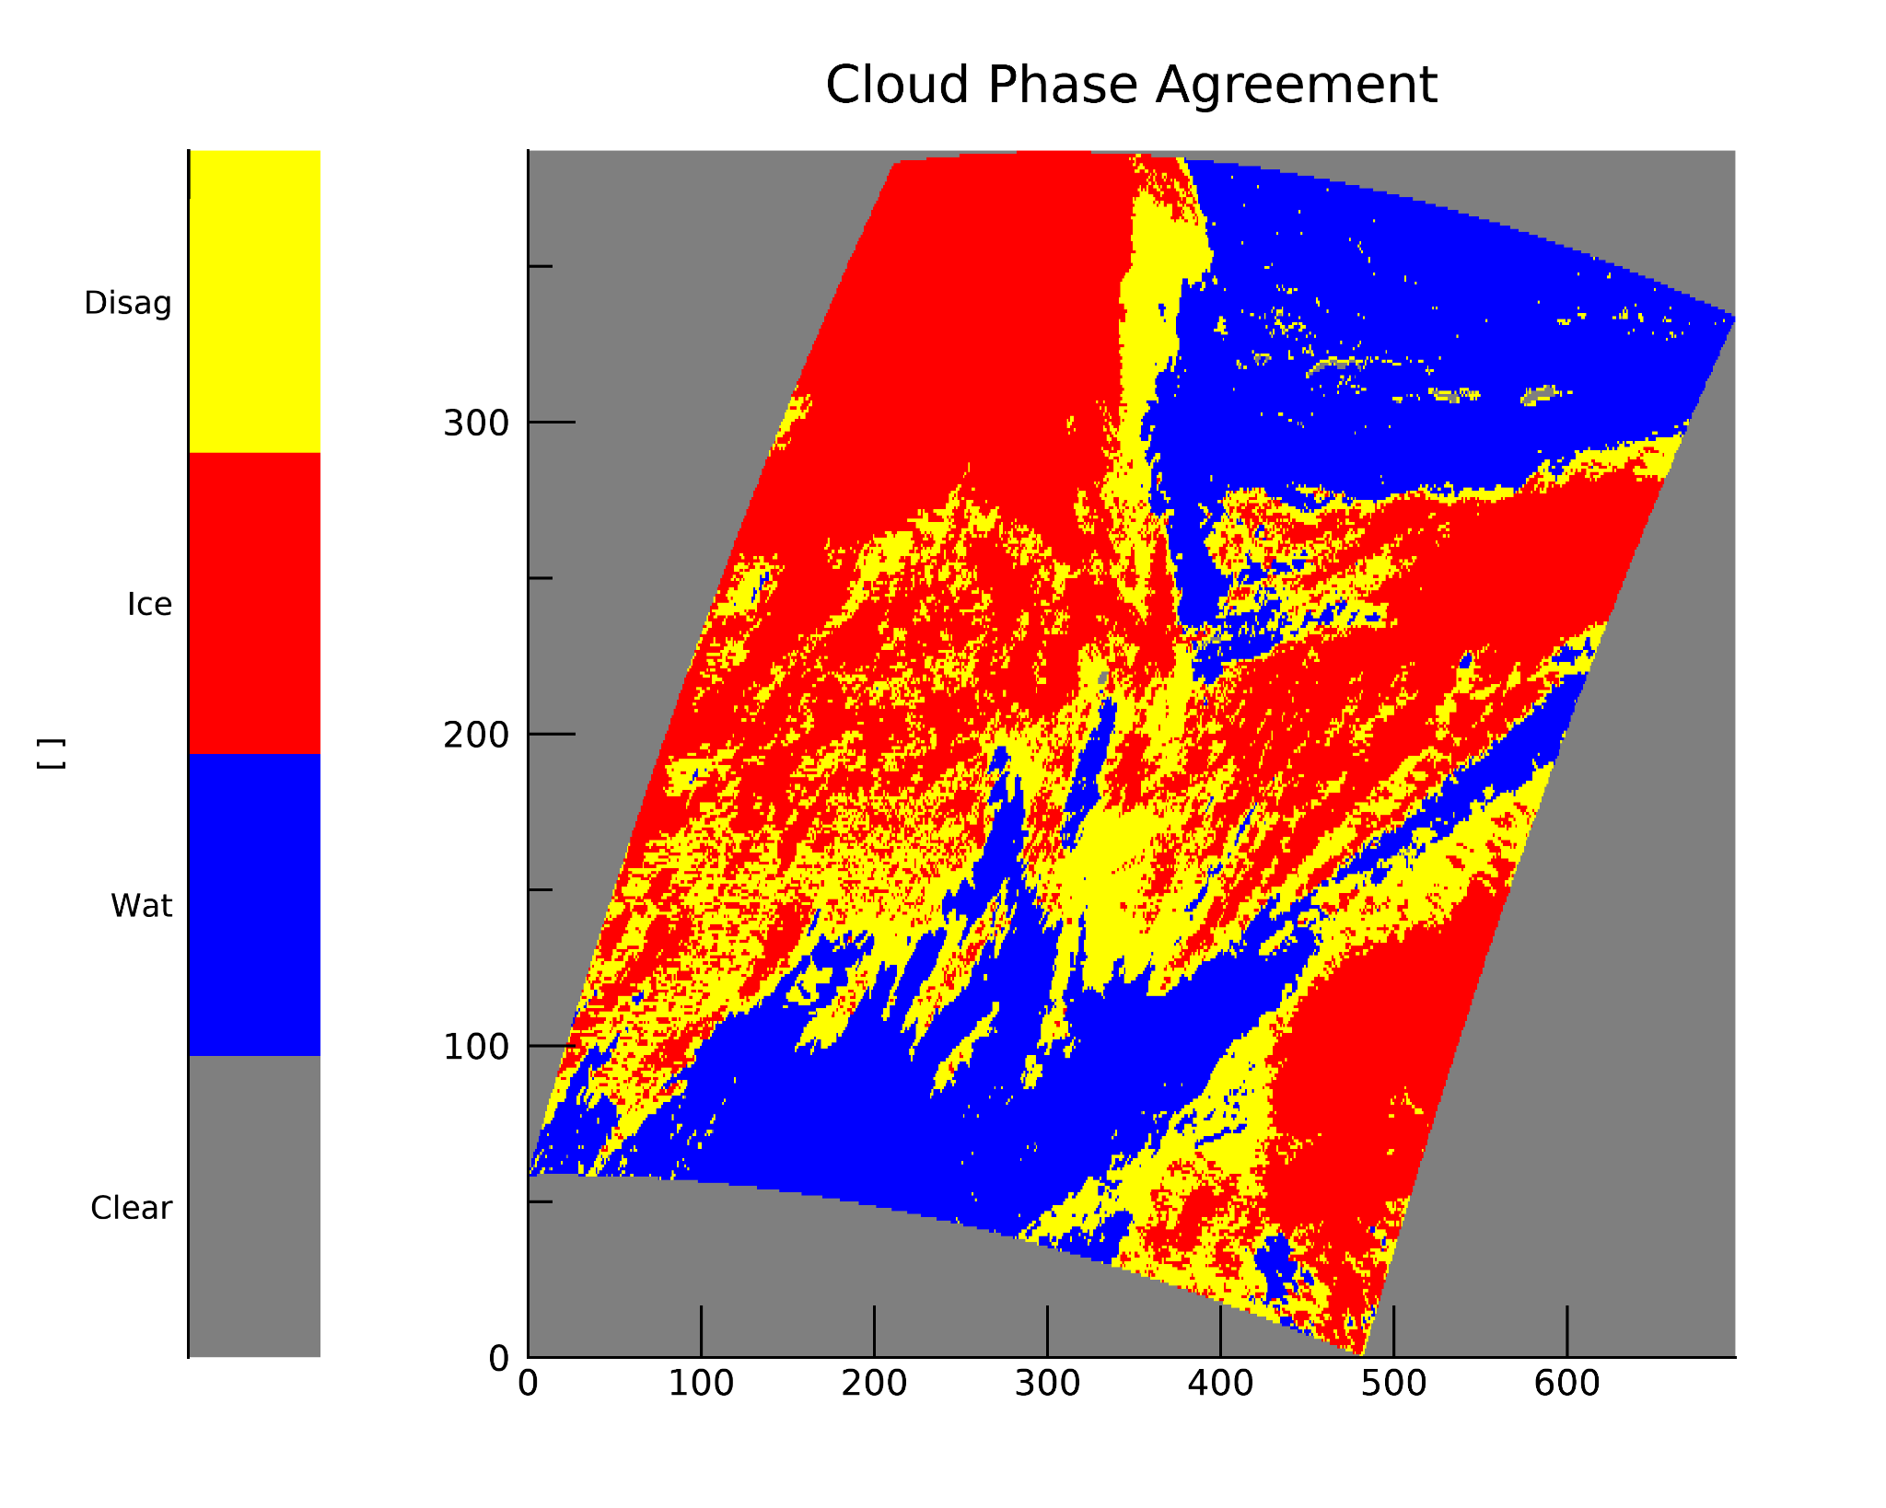
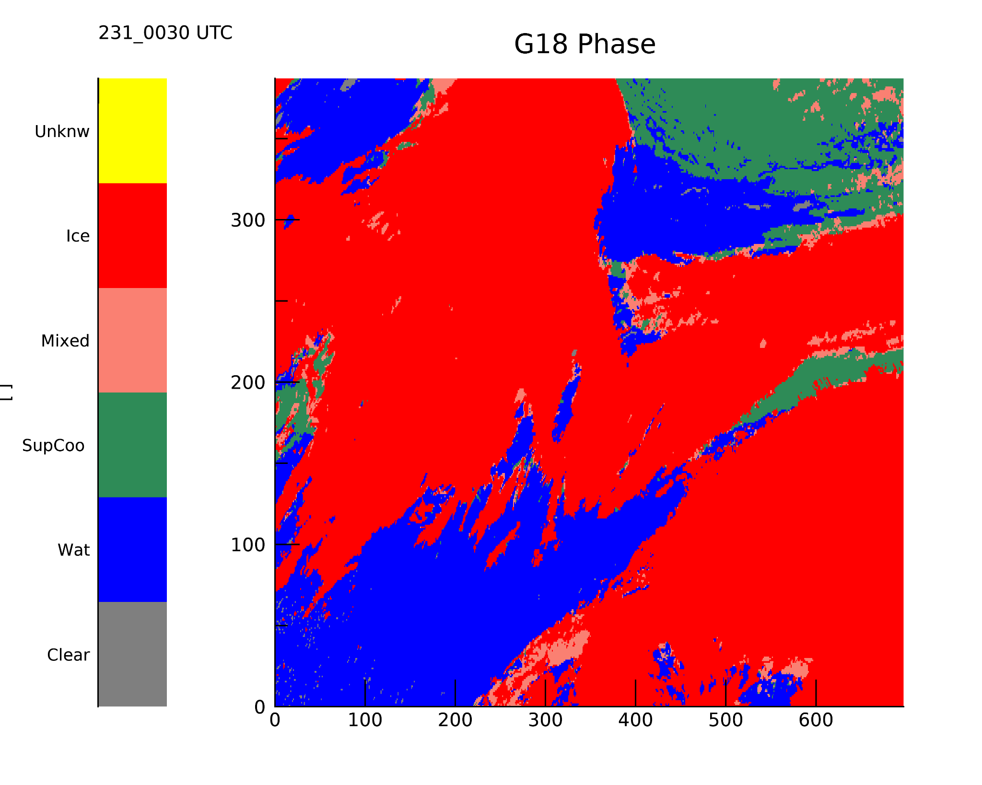
Cloud Phase Agreement
DCOMP strongly depends on cloud phase algorithm.
MODIS and G-18 often detect different cloud phase.
This makes inter-comparison complicated.

Slide 28
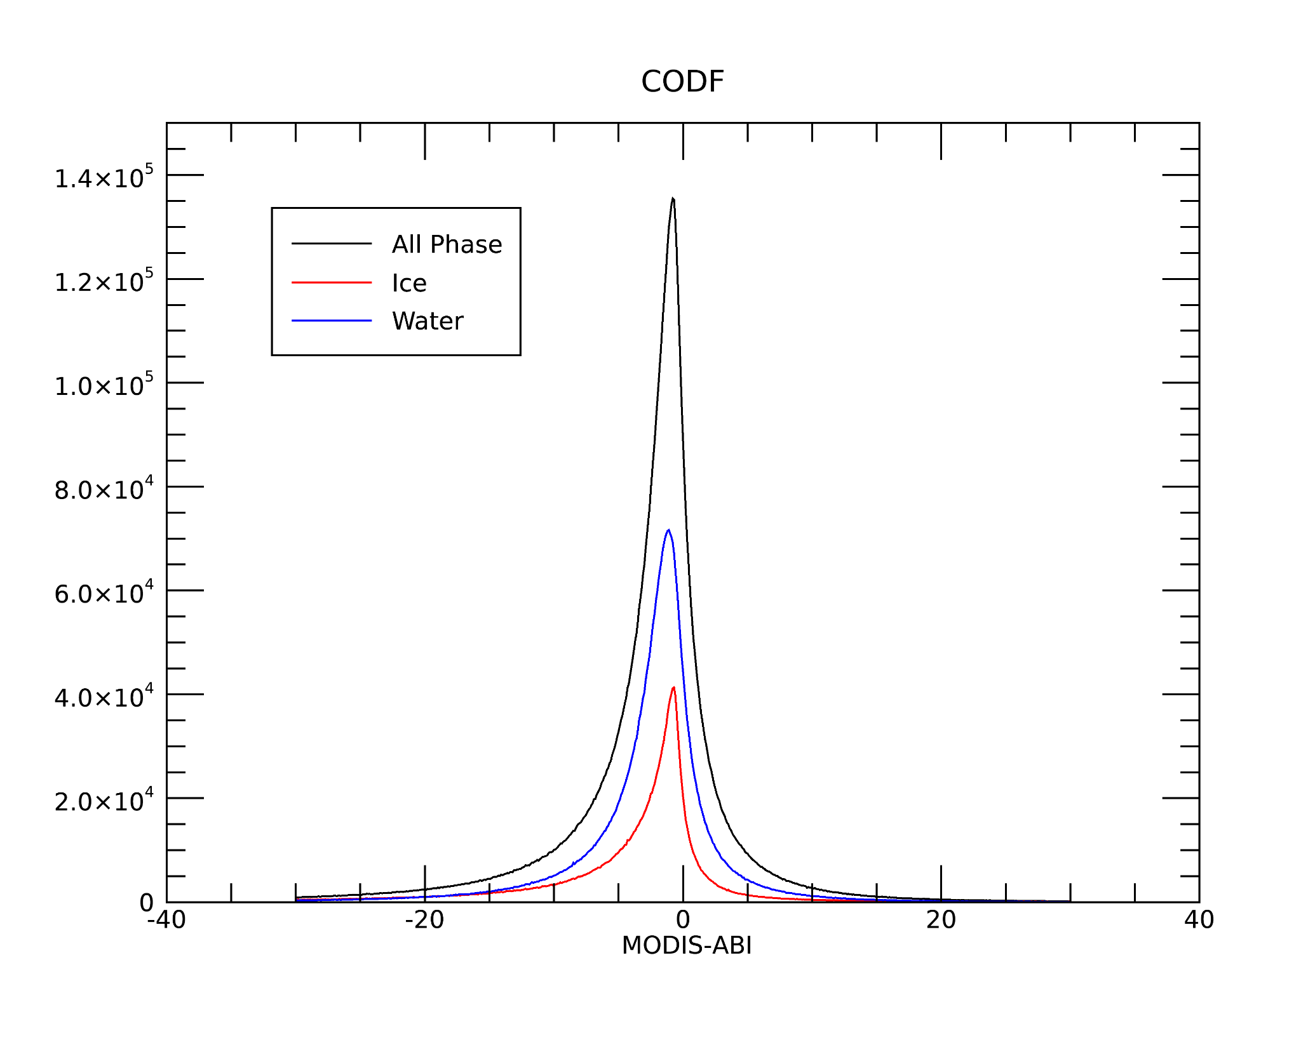
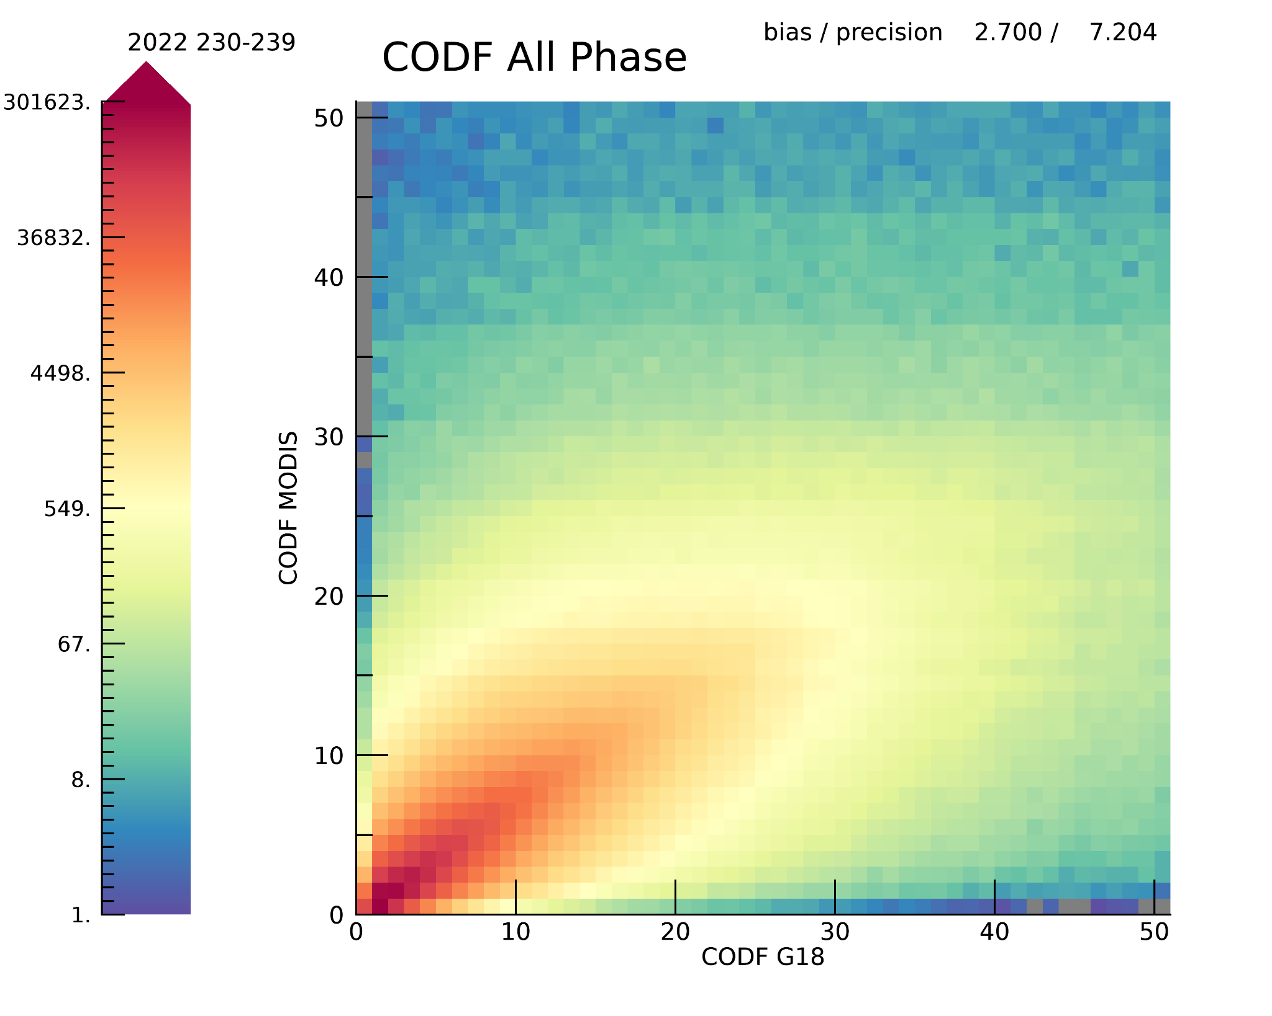
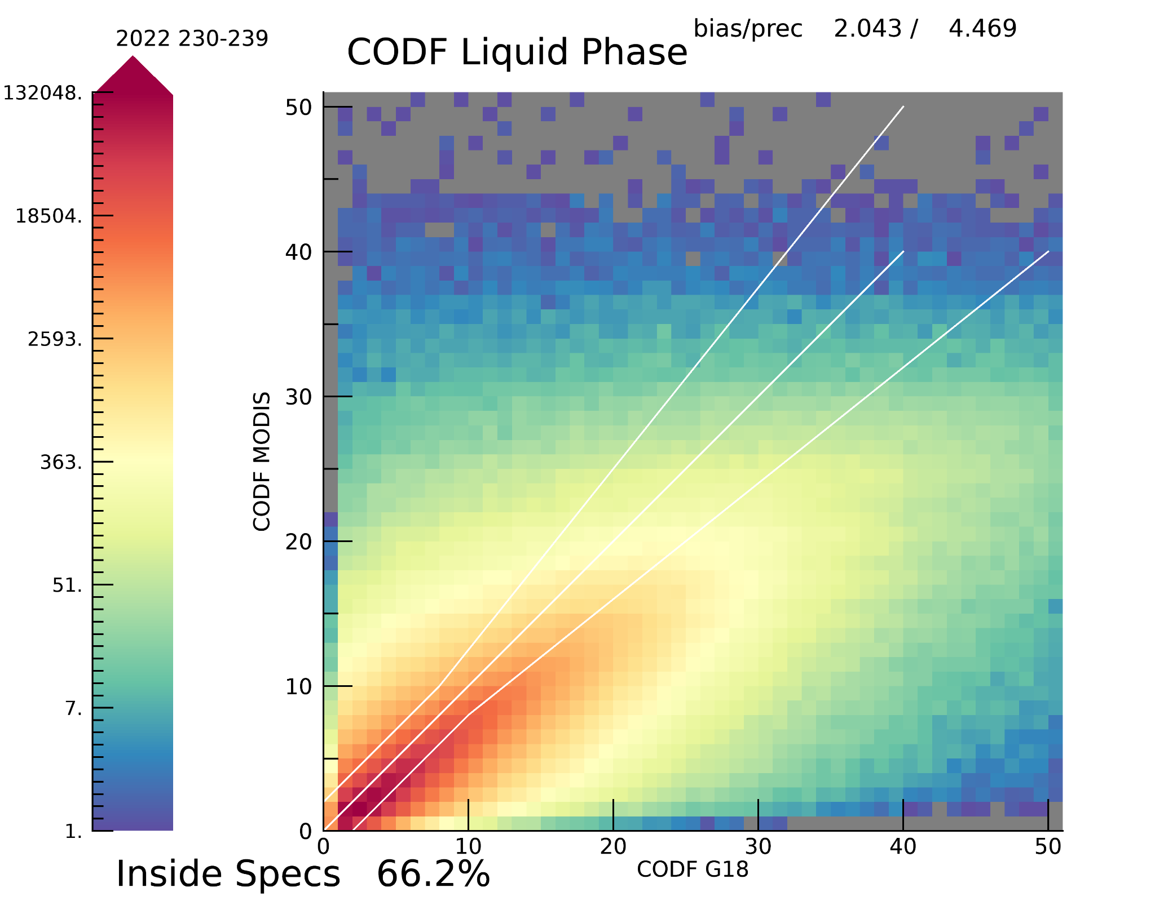
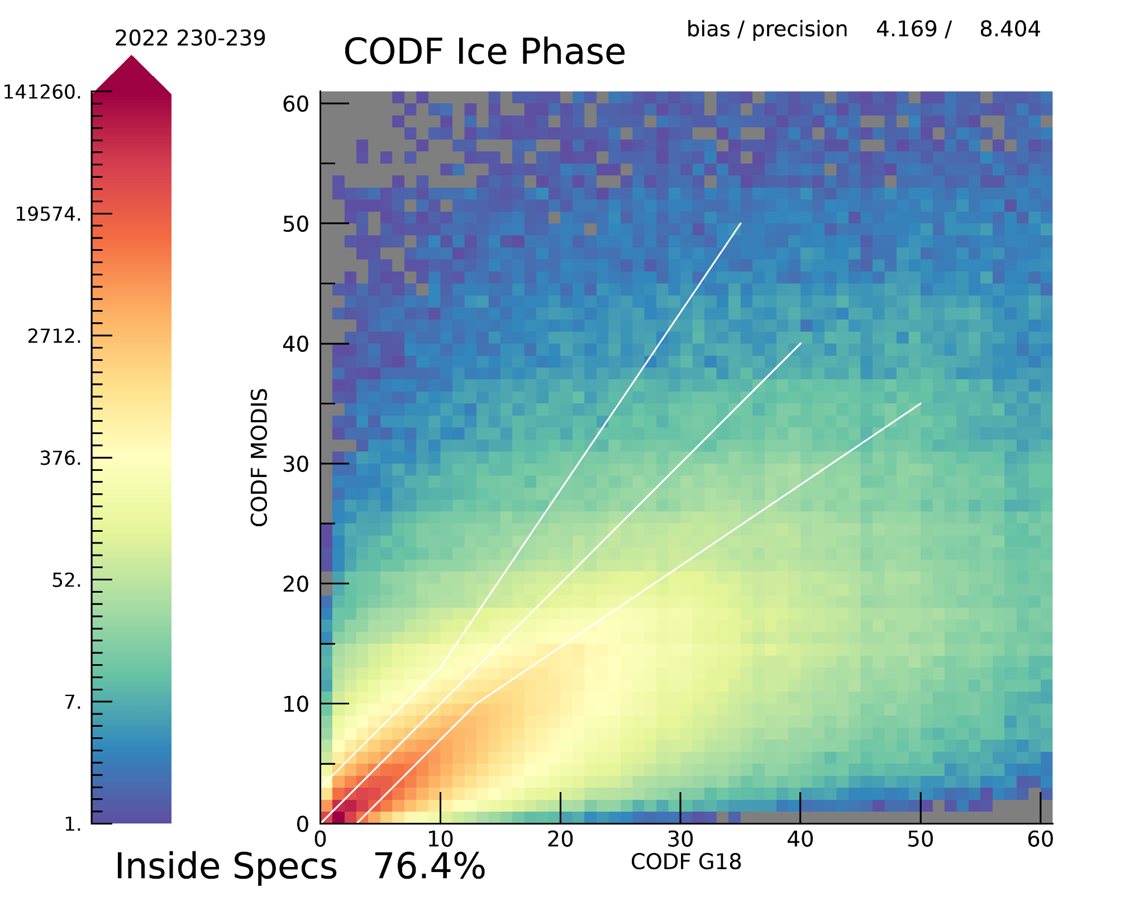
PLPT ABI-FD_COP06 (MODIS-ABI)
Cloud Optical Depth (DOY 230-239, 2022)

Slide 29
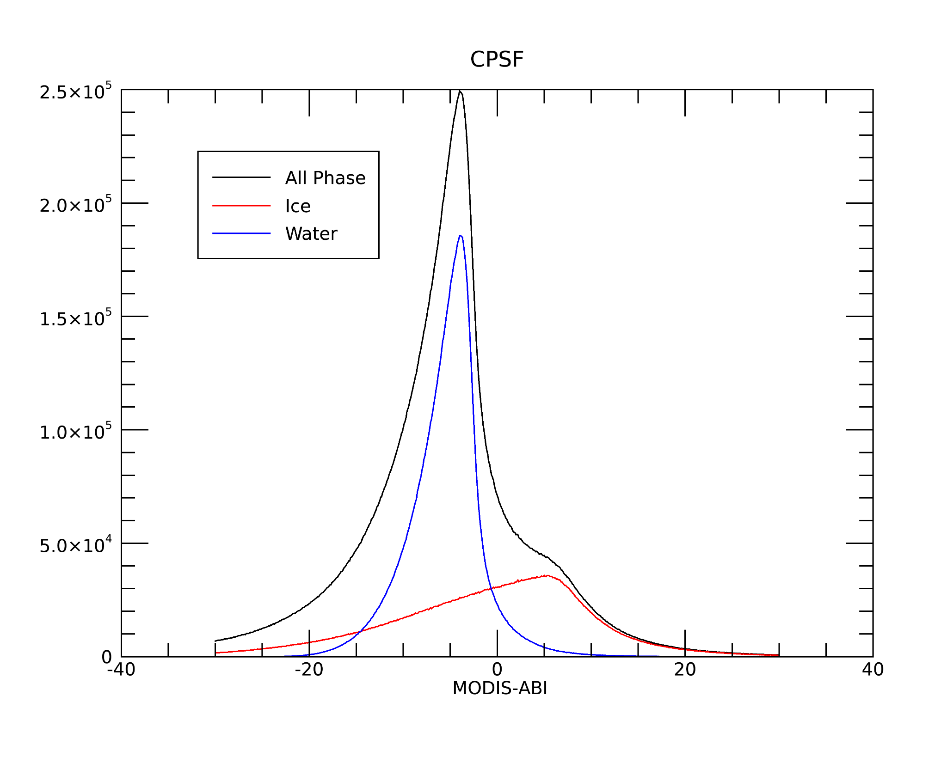
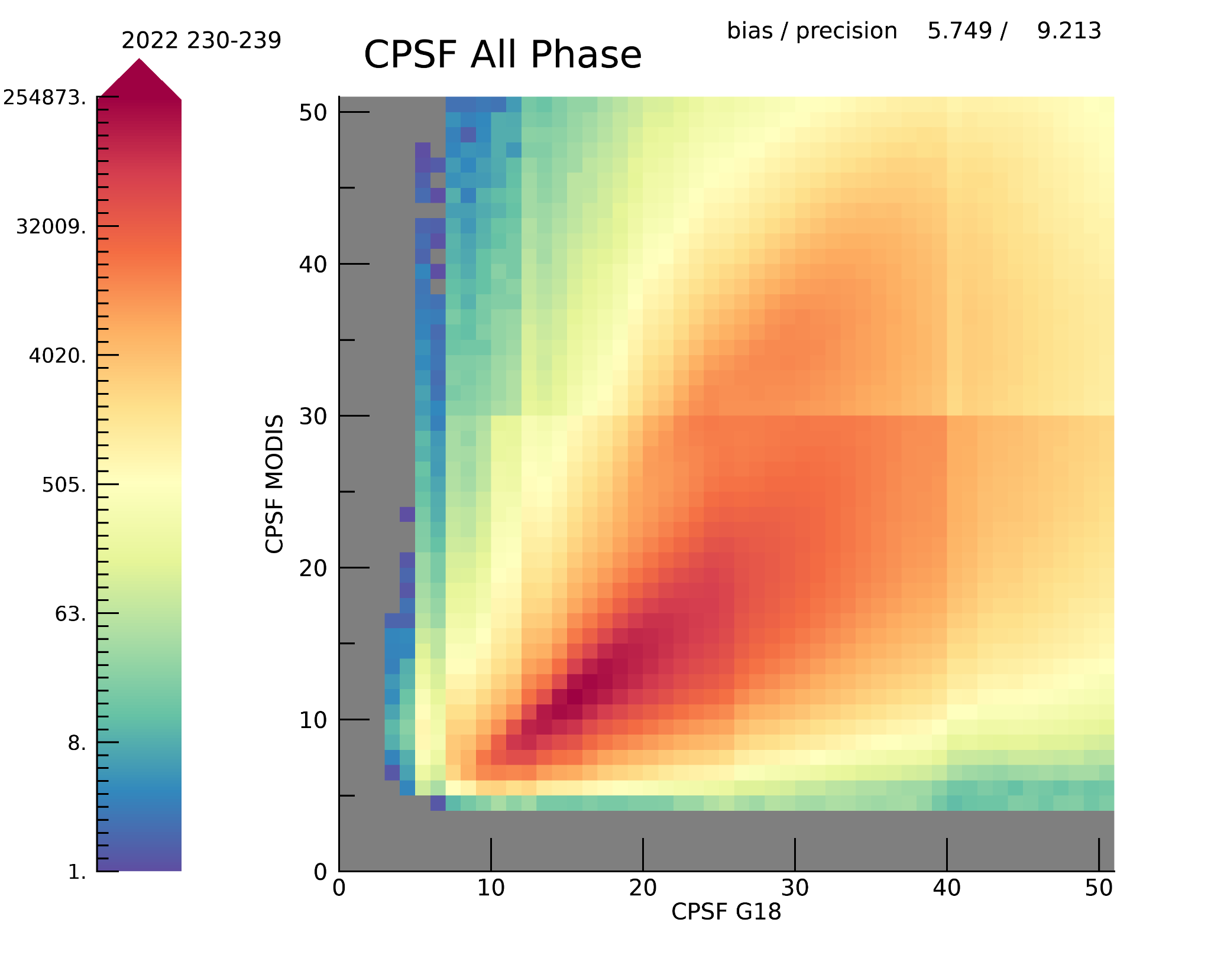
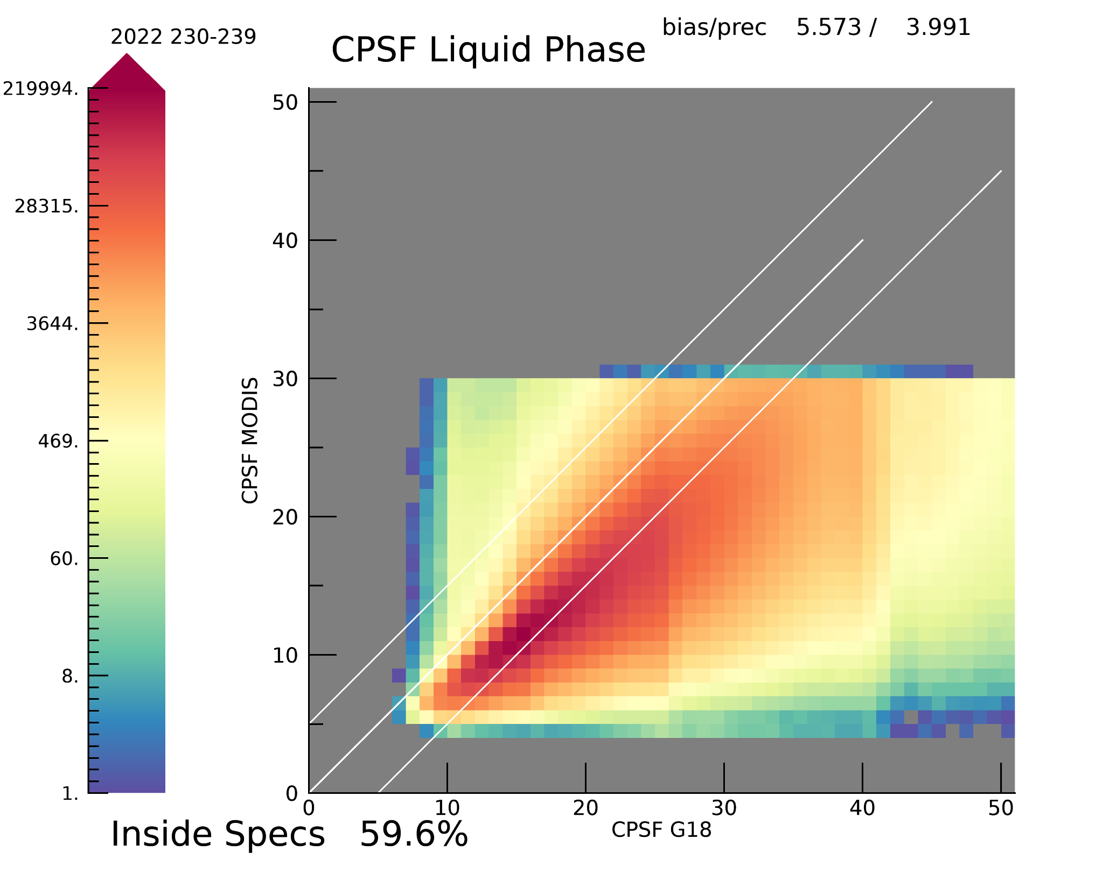
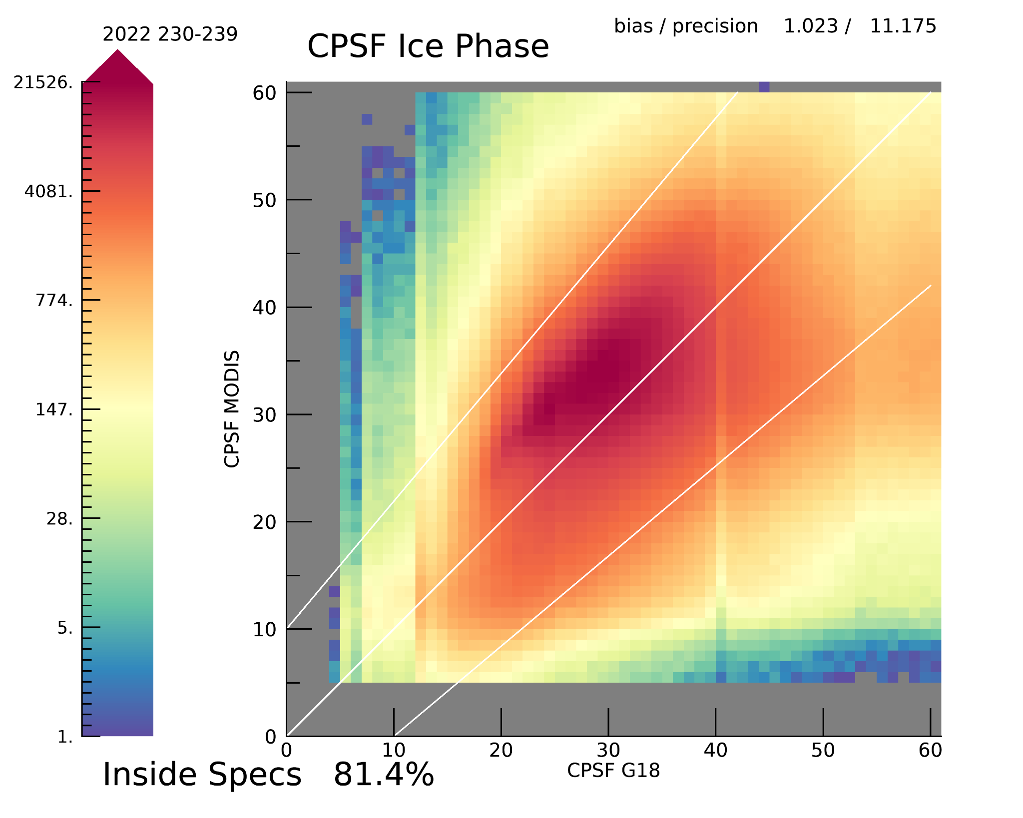
PLPT ABI-FD_COP06 (MODIS-ABI)
Cloud Particle Size (DOY 230-239, 2022)

Slide 30
Summary of Metrics: PLPT ABI-FD_COP06
Optical Depth
  mean accuracy = 100.0 * mean ( (G18-MODIS)/G18))
Cloud Particle Size
  mean accuracy = mean (G18-MODIS)
% in spec = percentage of pixels falling within spec lines (previous figures)
Parameter | Specified Measurement Accuracy (COD > 1) | Observed Accuracy | % in Spec
COD Water | 2 or 20% | 2.1 | 66%
COD Ice | 3 or 30% | 4.16 | 76%
CEPS Water | 4 micron | 5.7 micron | 59%
CEPS Ice | 10 micron | 1.02 micron | 81%
PASSED
PASSED
PART. PASS
PASSED
Notes:
If you can explain why DCOMP has so many high values of ICE REFF, not a failure.

Slide 31
Comparisons to MODIS
Summary
DCOMP/ABI on G18 to MODIS comparisons show close to the requirement specs results.
CODF shows high correlation for all pixels, and also for phase-separated results. The bias and the precision specs are met partly.
CPSF liquid phase clouds show high correlation for particle size up to 32 micron. DCOMP/ABI allows higher values in contrast to MODIS. CPSF ice clouds have more than 80% of clouds in the specs.
Justification that this is sufficient:
The time window of 10 minutes is too big to expect high precision and accuracy values for the often highly variable and inhomogenous cloud textures.
The different spatial resolution of the ABI cloud phase algorithm (2km) and cloud optical depth algorithm (4km) leads to complicated filtering and may falsify the result.
MODIS retrieval is very similar to DCOMP. The choice of the ice habits and the corresponding scattering phase function is arbitrary. No real statement can be made which product corresponds better to the truth.
Observation geometry can have a big impact. ( 3D effects etc..)
Notes:
If you can explain why DCOMP has so many high values of ICE REFF, not a failure.

Slide 32
Comparison Between GOES-18 and GOES-17 Daytime Cloud Optical and Microphysical Products
GOES-18 Day Cloud Opt/Micro Products L2 Product Provisional PS-PVR

Slide 33
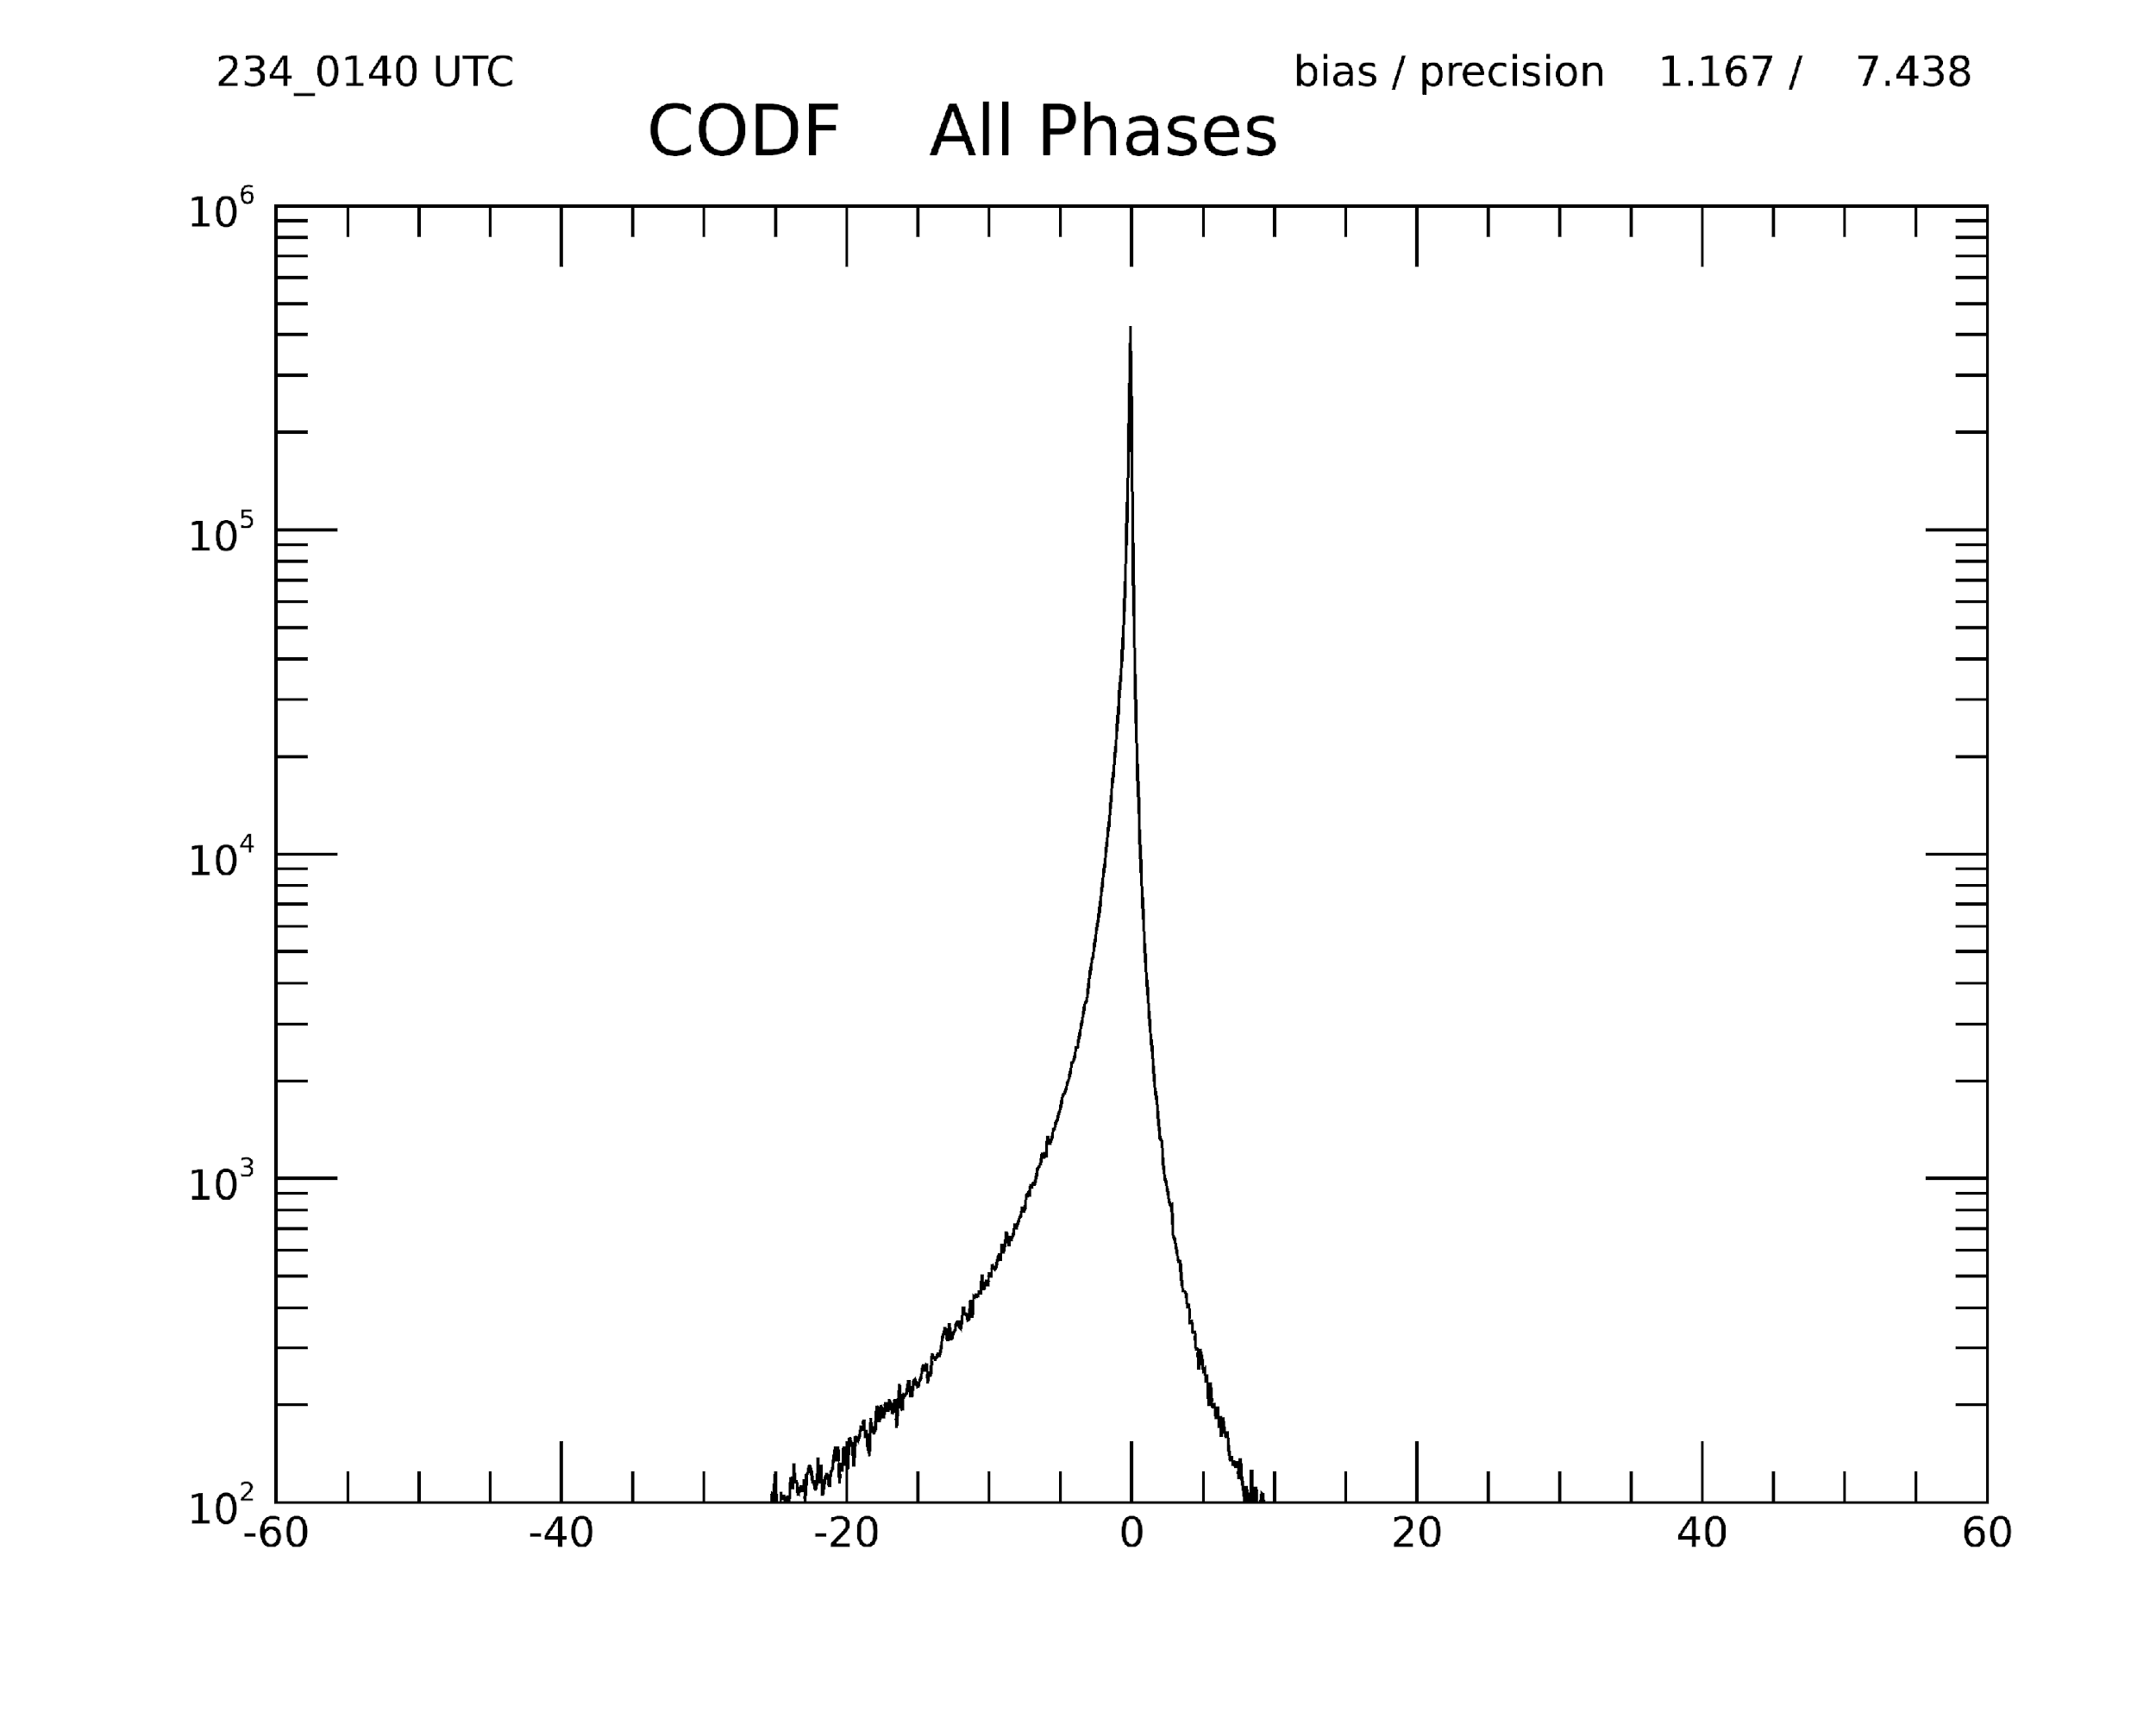
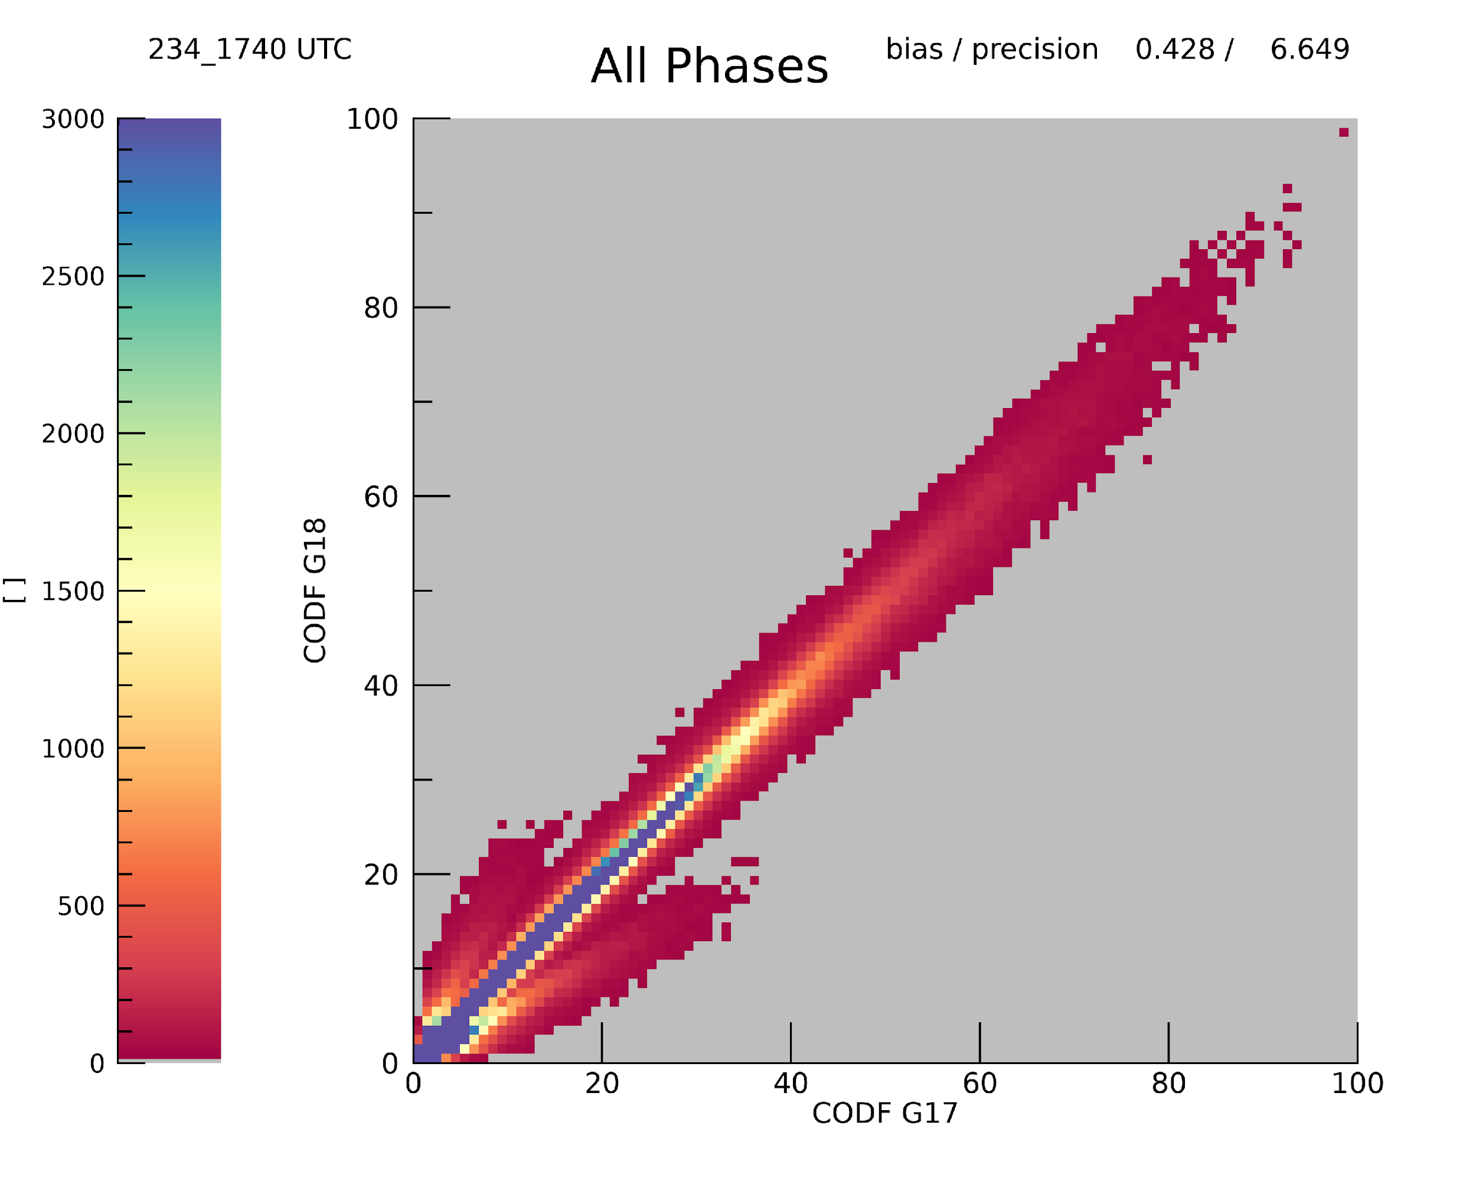
PLPT ABI-FD_COP06
G17/G18 Cloud Optical Depth Comparison
Bias plot (left) and scatterplot (right) of the G17 and G18 cloud optical depth (COD) comparisons. Data is from August 22, 2022 for Full Disk every 10 minutes from 14 to 21 UTC (Mode 6).
If GOES-17 were truth, GOES-18 meets spec

Slide 34
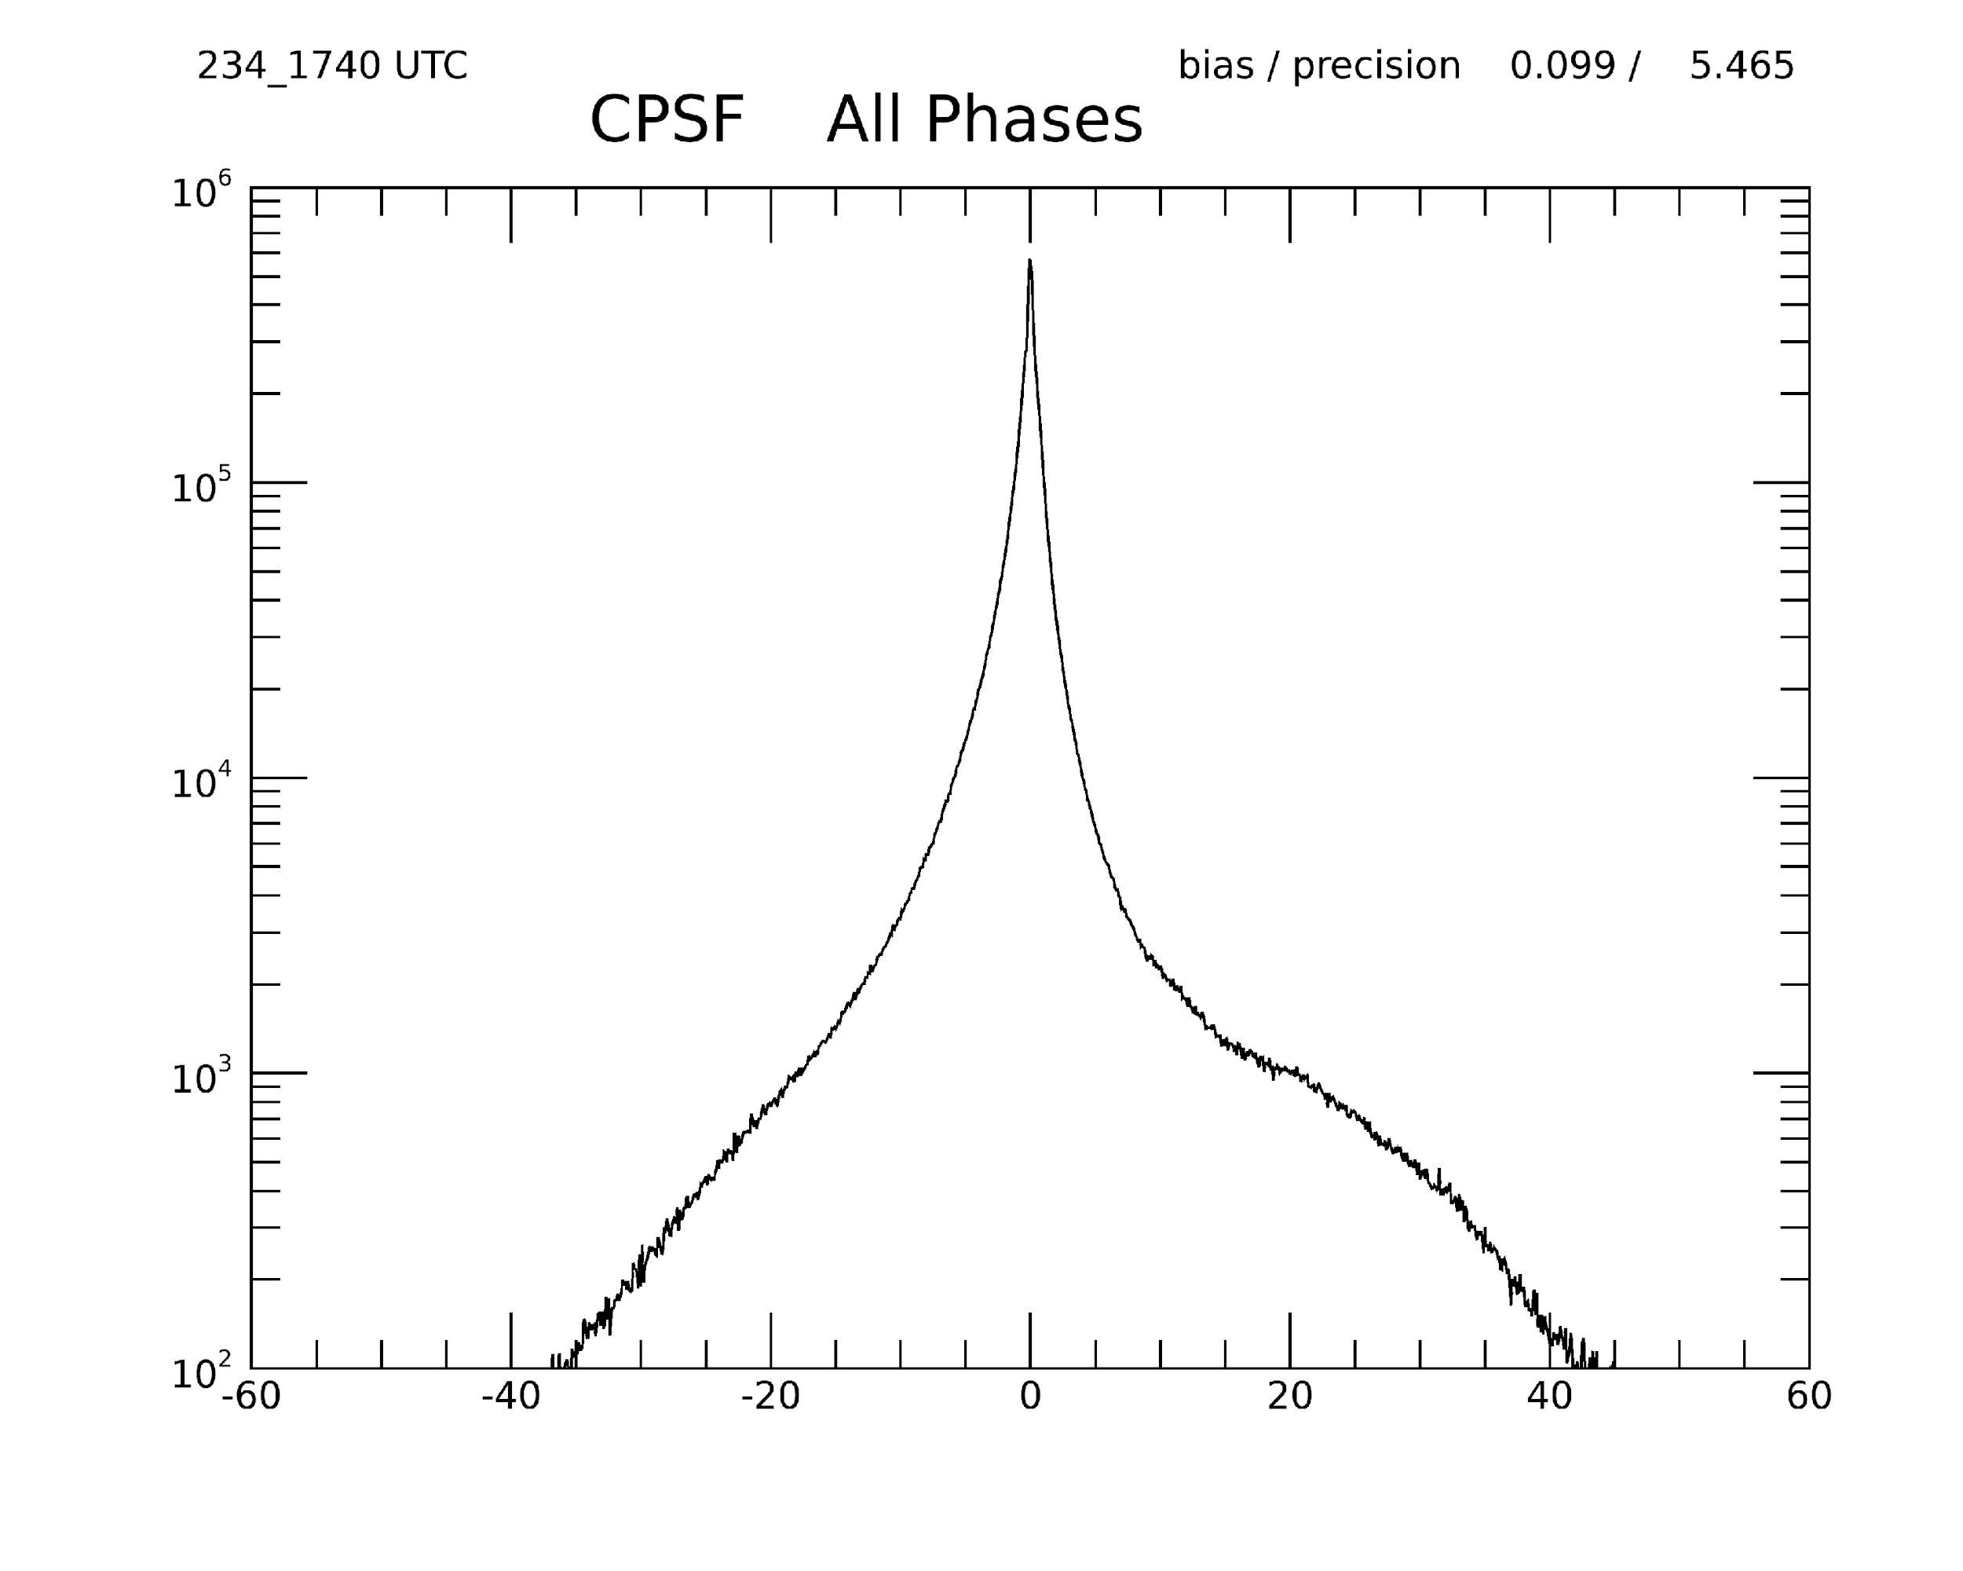
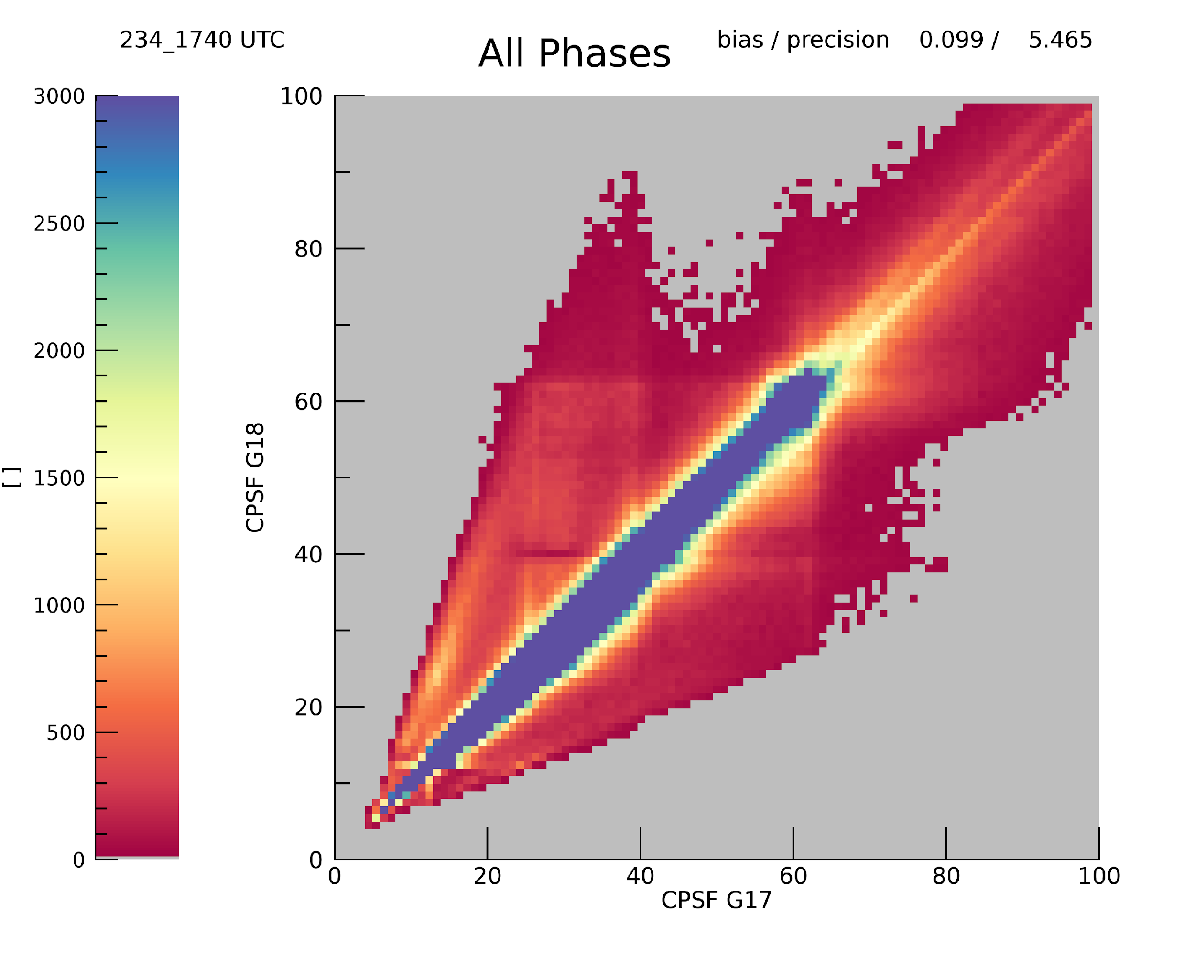
PLPT ABI-FD_COP06
G17/G18 Cloud Particle Size Comparison
Bias plot (left) and scatterplot (right) of the G17 and G18 cloud effective particle size (CEPS) comparisons. Data is from August 22, 2022 for Full Disk every 10 minutes from 14 to 21 UTC (Mode 6).
If GOES-17 were truth, GOES-18 meets spec

Slide 35


PLPT ABI-CONUS_COP02
G17/G18 Cloud Optical Depth Visual Comparison
COD CONUS (CODC) spatial resolution differs from COD FULL DISK (CODF) (2 vs 4km).

Slide 36




PLPT ABI-CONUS_COP07
G17/G18 Cloud Optical Depth Comparison
Main differences are caused by different cloud phase classification.
Liquid phase comparison shows a slight bias for thicker clouds

Slide 37


PLPT ABI-CONUS_COP02
G17/G18 Cloud Particle Size Comparison
CEPS CONUS (CPSC) spatial resolution is 2km.

Slide 38




PLPT ABI-CONUS_COP07
G17/G18 Cloud Particle Size Comparison
Main differences are caused by different cloud phase classification.

Slide 39
PLPT ABI-CONUS_COP07
Summary of Metrics G17/G18
Optical Depth
  mean accuracy = 100.0 * mean ( (g18-modis)/g18))
Cloud Particle Size
  mean accuracy = mean (g18-modis)
% in spec = percentage of pixels falling with spec lines (previous figures)
Parameter | Specified Measurement Accuracy (COD > 1) | Observed Accuracy | % in Spec
COD Water | 2 or 20% | 0.56 | 97%
COD Ice | 30% | 0.74 | 93%
CEPS Water | 4 micron | 0.51 micron | 87%
CEPS Ice | 10 micron | 0.38 micron | 85%
PASSED
PASSED
PASSED
PASSED
Notes:
If you can explain why DCOMP has so many high values of ICE REFF, not a failure.

Slide 40
Evaluation of LWP/ DCOMP

Slide 41
PLPT ABI-FD_COP06
AMSR-2 on GCOM-W1 /JAXA
Liquid Water Path (LWP) is a possible future ABI DCOMP product.
LWP calculated from COD and CPS (LWP = 5/9*COD*CPS for adiabatically layered clouds).
Microwave based sensors can retrieve LWP
Advantages if used as validation source:
  Different retrieval principles ➔ The only satellite-based independent validation source of DCOMP
  Link from radiative properties COD and (radiative) Effective Radius to macro-physical estimate of water mass in a cloud.
  Validation of LWP also validates COD and CPS.
Limitations:
  MW retrievals only see liquid particles.
  Coarser field of view (up to 40 ABI pixels in one GCOM pixel).
  Only over ocean.
  Several filtering and aggregation steps needed (cloud phase, etc.) homogeneity).
  Visualization is valuable tool, but exact quantitative validation is difficult.

Slide 42



PLPT ABI-FD_COP06
Liquid Water Path
Liquid Water Path FD is computed with adiabatic assumption on grid for Cloud Particle Size (Full disk: 27112 x 2712.)
Microwave based algorithms are sensitive to Liquid phase clouds only.
Liquid phase clouds only, but averaged over entire GCOM grid box.
ABI LWP for FD is computed from two different resolutions for COD and CPS. COD is averaged over valid pixels in 2x2 box of CPS grid.
Cut off of thick saturated clouds with COD greater than 50.
MW is insensitive to thin clouds, we exclude all clouds optically thinner than COD=5
We exclude all MW pixels with a rain flag.

Slide 43





PLPT ABI-FD_COP06
AMSR-2 on GCOM-W1 /JAXA
Different spatial resolution and limitations on liquid phase clouds, non-rain and clouds between COD bigger than 5 requires special filtering:
Left: AMSR-E on GCOM-W Liquid Water Path
Middle: ABI/G18 Water clouds only in spatial resolution of CODF (4km)
Right: ABI/G18 Water clouds spatially averaged to 20-km resolution
Comparisons on left is with smoothed ABI values.
Bias: 15.7mm Precision: 69mm for GW1AM2_202208172357

Slide 44
PLPT ABI-FD_COP06
AMSR-2 on GCOM-W1 /JAXA
Summary:
Visual comparison between AMSR-2/ GCOM LWP and ABI LWP shows good agreement in spatial pattern.
Challenges are the very different spatial resolutions and the limitation to only liquid clouds over ocean.
Despite the last point, the accuracy and precision show results within requirements or similar projects.
It is important to note that LWP is not an official product. However it is a derived product from COD/CPS. This allows comparison. It is an operational product on VIIRS from the Enterprise Algorithm.

Slide 45
DCOMP - Conclusions

Slide 46
Daytime PLPT Outcomes: Summary
All PLPT activities required to make PROVISIONAL have been completed.
Visual inspection, MODIS comparisons and AMSR-2 comparisons indicate the COD and CEPS are performing as expected.
Comparisons between GOES-17 and GOES-18 show good agreement
Visual inspection and MODIS comparisons indicate the ice phase COD is performing as expected.
We recommend PROVISIONAL Maturity for them

Slide 47
Provisional Maturity Assessment
GOES-18 Cloud Optical Parameters L2 Product Provisional PS-PVR

Slide 48
Provisional Validation
Preparation Activities | Assessment
Validation activities are ongoing and the general research community is now encouraged to participate. | Yes. Ongoing monitoring and Feedback provided by AWIPS Users
Severe algorithm anomalies are identified and under analysis. Solutions to anomalies are in development and testing. | None noted in summary
Incremental product improvements may still be occurring. | The transition to the enterprise algorithm is occurring.
L2+ only: Users are engaged in the Product Feedback Forums and user feedback is assessed. | Yes
End State | Assessment
Product performance has been demonstrated through analysis of a small number of independent measurements obtained from select locations, periods, and associated ground truth or field campaign efforts. | Both Day and nighttime optical properties are hampered by a lack of truth data. However, the team had provided an in depth assessment based on existing truth data
Product analysis is sufficient to communicate product performance to users relative to expectations (Performance Baseline). | Yes, analysis of DCOMP has shown that it meets specifications.
Documentation of product performance exists that includes recommended remediation strategies for all anomalies and weaknesses. Any algorithm changes associated with severe anomalies have been documented, implemented, tested, and shared with the user community. | Yes. See this GOES-18 review and the previous GOES-16 and GOES-17 Reviews
Testing has been fully documented. | Yes. See this GOES-18 review and the previous GOES-16 and GOES-17 Reviews
Product is ready for operational use and for use in comprehensive cal/val activities and product optimization. | Yes. See this GOES-18 review and the previous GOES-16 and GOES-17 Reviews

Slide 49
Path to Full Maturity
We expect to apply the same PLPTs to be conducted for Full Maturity (see slide 5 for RIMP activities)
  We are gathering an archive of golden days where we save L1,L2 and IPs.
  Goal: We will collect 30 days spread throughout all seasons (~1 week/season). This has been shown to be sufficient for seasonality assessments.
  We will engage the teams and obtain feedback from users to begin application-specific analysis.
  We will take advantage of opportunities for threshold adjustments.
Notes:
can add as many slides as needed. Large importance

Slide 50
Other Issues
(Potential changes after Enterprise integration)
Interlacing DQF for Day and Night products is still confusing. Separating the products and/or DQFs into separate files/variables should be revisited during Enterprise algorithm integration.
COD and CPS are often used together in many applications. COD (FD) is 4 km while CPS is 2 km. COD (CONUS) is 2 km. This makes it particularly difficult to interpret in the context of cloud phase. (Cloud Top Phase is 2km)
LWP and IWP, while intermediate products, are used more often than COD/CPS. We suggest that these be output as well.

Slide 51
Recommendation for Provisional Maturity
Provisional: product performance has been demonstrated through a large, but still (seasonally or otherwise) limited, number of independent measurements. The analysis is sufficient for limited qualitative determinations of product fitness-for-purpose, and the product is potentially ready for testing and operational use.
Cloud AWG Team, therefore, recommends that the Daytime Optical Properties data be transitioned to Provisional status.

