Slide 1
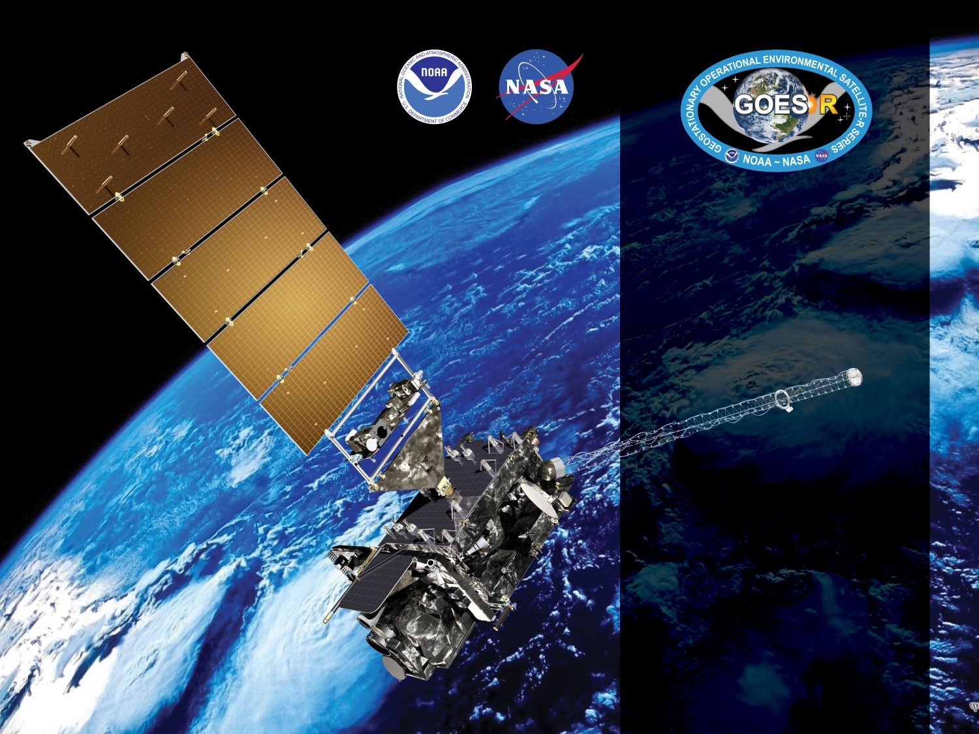
GOES-18 ABI L2+ Nighttime Cloud Optical and Microphysical properties
Provisional PS-PVR
Nov. 21, 2022
Pat Heck, Andi Walther, William Straka III
(CIMSS)
Team Lead: Mark Kulie (NOAA/NESDIS/STAR)
GOES-R AWG

Slide 2
NCOMP Requirements
Product | Range | Accuracy | Precision | Latency | Horizontal resolution
Cloud Optical Depth | 1 < COD < 8 | 20% (liquid) 30% (ice) | max of 0.8 or 35% | 5min | 2km
Cloud Particle Size | liquid: 2 < CPS < 32μm ice: 2 < CPS < 50μm | 4μm (liquid) 10μm (ice) | 100% (liquid) 45% (ice) | 5min | 2km
Liquid Water Path | 25 < LWP < 100 | max of 25 gm-2 or 15% | max of 25 gm-2 or 40% | 5min | 2km
NCOMP generated for Solar Zenith angles greater than 82º but accuracy and precision requirements only apply to SZA greater than 90º
Liquid water path (LWP) and Ice Water Path (IWP) are future capabilities. They are calculated from COD and CPS and LWP, in particular, can help to evaluate the products above.

Slide 3
RIMP Activities
RIMP Activity 410-R-RIMP-0336 version 2, Table 1 | Short description
ABI-FD_COP01 | Verify that COP product generated at the required cadence for FD in ABI Mode 6
ABI-CONUS_COP02 | Verify that COP product generated at the required cadence for CONUS in ABI Mode 6
ABI-MESO_COP03 | Verify that COP product generated at the required cadence for mesoscale in ABI Mode 6
ABI-FD_COP04 | Verify that COP product generated at the required cadence for FD in ABI Mode 4
ABI-CONUS_COP05 | Verify that COP product generated at the required cadence for CONUS in ABI Mode 4
ABI-FD_COP06 | Assess the accuracy and precision of COP product generated for FD in ABI Mode 6
ABI-CONUS_COP07 | Assess the accuracy and precision of COP product generated for CONUS in ABI Mode 6
ABI-MESO_COP08 | Assess the accuracy and precision of COP product generated for mesoscale in ABI Mode 6

Slide 4
Application of PLPT Quantitative Analysis Tests to each Domain
The analyses are comprised of 2 methods - Visual Inspection and Comparisons to other COP algorithms. Each of these were applied to the FD and CONUS domains during Mode 6 for validation.
3 PLPTs have qualitative (visual) analysis (ABI-FD_COP01, ABI-CONUS_COP02, ABI-MESO_COP03) and 2 deal with quantitative (accuracy and precision) analysis (ABI-FD_COP06 and ABI-CONUS_COP07)
ABI-FD_COP04 and ABI-CONUS_COP05 verified by GOES-R PRO that all products were being made during Mode 4
Quantitative comparisons of MESO ans CONUS domains were not conducted, but qualitative comparisons of Meso domains combined with qualitative results from the CONUS domain indicates there is no reason to expect any issues.
Analysis Method | FD | CONUS | MESO
Visual Inspection
Comparison to other COP algorithms (accuracy and precision
‹#›

Slide 5
Data Used in this Review
G-17 and G-18 NCOMP products
NASA Langley products
‹#›

Slide 6
Definitions of Metrics
Pass: No visual artifacts and/or COP meet F&PS.
Partial-Pass: COP meet F&PS with or without visual artifacts. Dominant issues are known.
Fail: COP do not meet F&PS. Cause of performance degradation is under investigation.

Slide 7
Examples of Visual Inspection of All Domains

Slide 8
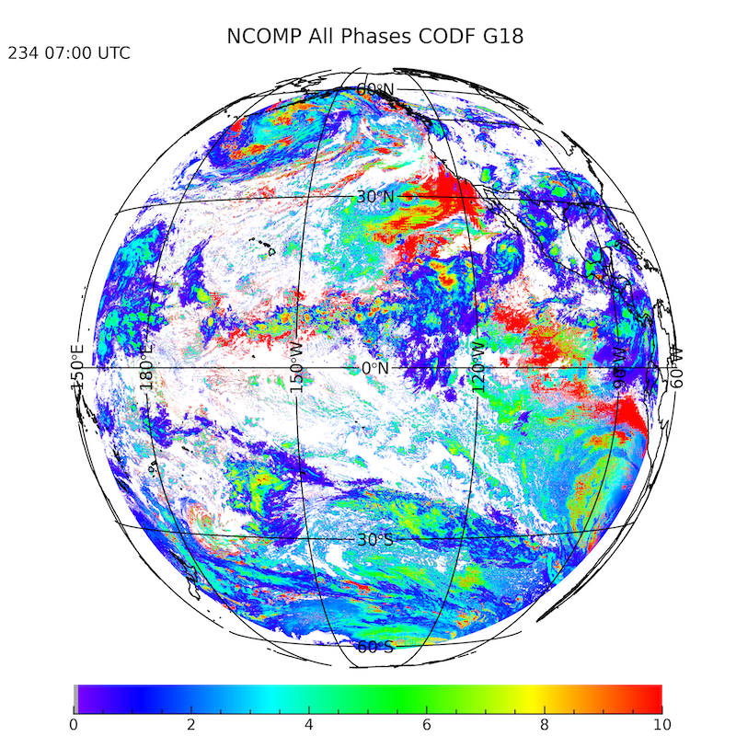
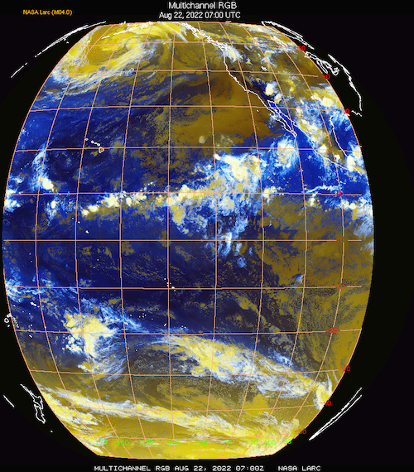
PLPT ABI-FD_COP01:
COD Full Disk Aug. 22, 2022 0700 TC
GOES-18 COD Full Disk
GOES-18 RGB
PASS

Slide 9
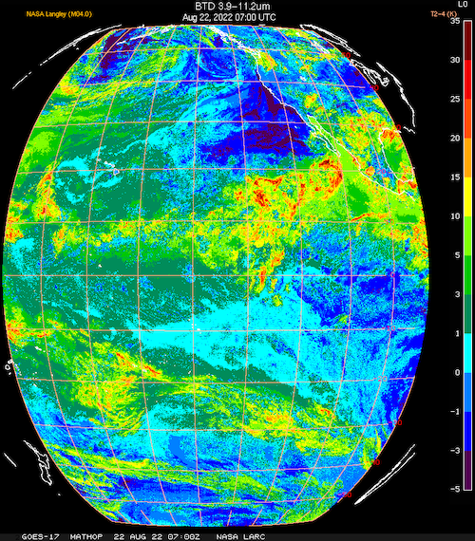
PLPT ABI-FD_COP01:
COD Full Disk Aug. 22, 2022 0700 UT
GOES-18 COD Full Disk
GOES-18 11.2 – 12.3µm
1
PASS

Slide 10
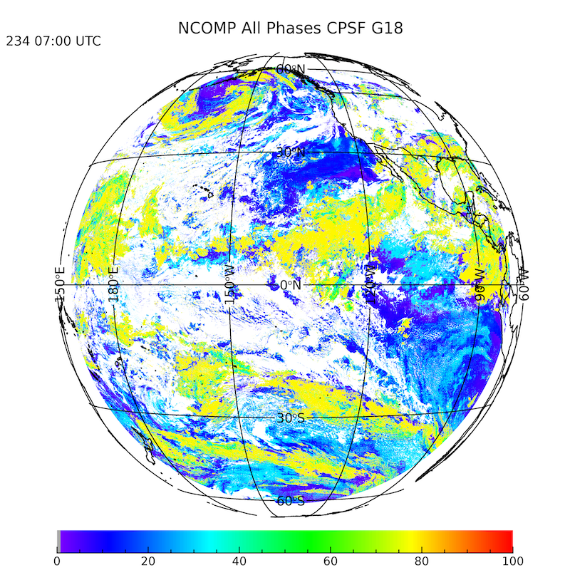
PLPT ABI-FD_COP01:
CPS Full Disk Aug. 22, 2022 0700 UTC
GOES-18 CPS Full Disk
GOES-18 RGB
PASS

Slide 11
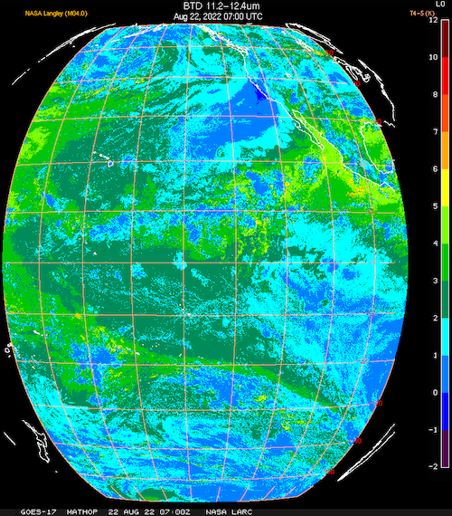
PLPT ABI-FD_COP01:
CPS Full Disk Aug. 22, 2022 0700 UTC
GOES-18 CPS Full Disk
GOES-18 3.9 – 11.2µm
1
PASS

Slide 12
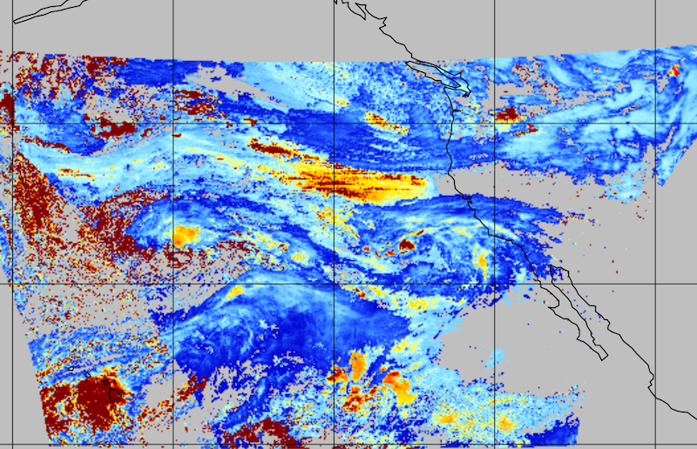
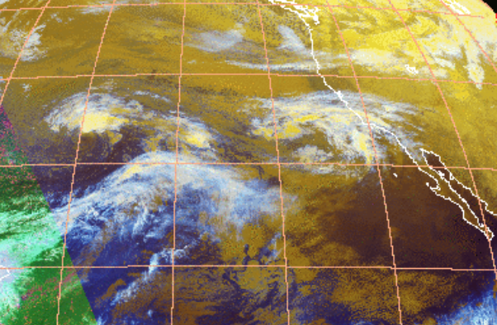
PLPT ABI-CONUS_COP02:
COD CONUS Nov. 28, 2022 0231 UTC
GOES-18 RGB
GOES-18 COD CONUS
PASS

Slide 13
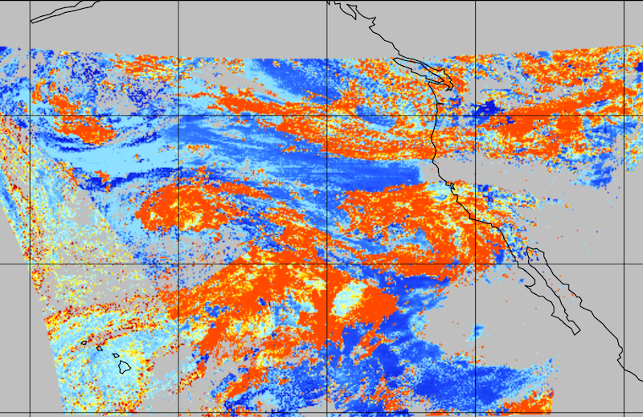
PLPT ABI-CONUS_COP02:
CPS CONUS Nov. 28, 2022 0231 UTC
GOES-18 RGB
GOES-18 CPS CONUS
PASS

Slide 14
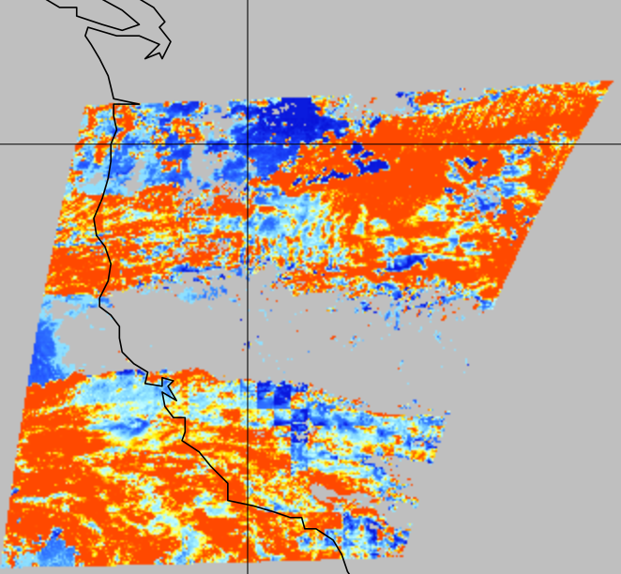
PLPT ABI-MESO_COP03:
CPS MESO1 Nov. 28, 2022 0231 UTC
GOES-18 RGB
GOES-18 CPS MESO1
PASS

Slide 15
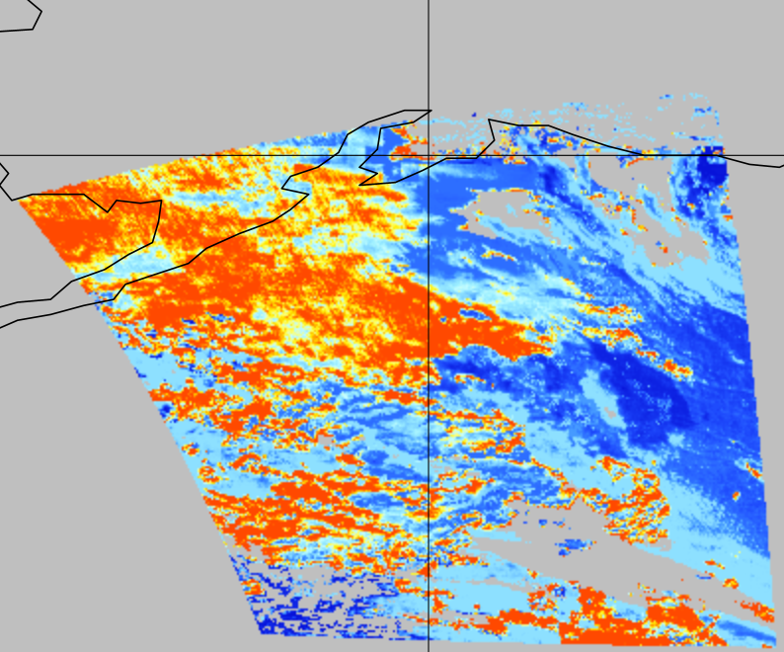

PLPT ABI-MESO_COP03:
CPS MESO2 Nov. 28, 2022 0231 UTC
GOES-18 RGB
GOES-18 CPS MESO2
PASS

Slide 16
Visual Inspection Summary
Full Disk COD and CPS inspections indicates both are reasonable and as expected.
CONUS COD and CPS inspections shows similar results.
MESO1 and MESO2 CPS inspections also show results.
The algorithm is performing as expected and satisfies ABI-FD_COP01, ABI-CONUS_COP02, and ABI-MESO_COP03
PASS
Notes:
Beta: the product is minimally validated and may still contain significant errors; based on product quick
looks using the initial calibration parameters.

Slide 17
Comparison of G-17 and G-18 NCOMP Results

Slide 18
COD and CPS Comparisons
Aug. 22, 2022 0800 UTC
Comparison hour of 0800 UTC chosen to avoid saturation of both channels 14 and 15 due to Heat Loop Pipe issue (peaks 1030 to 1630 UTC in August) for GOES-17
Compared COD and CPS for Full Disk
Showing combined phase retrievals followed by phase matched

Slide 19
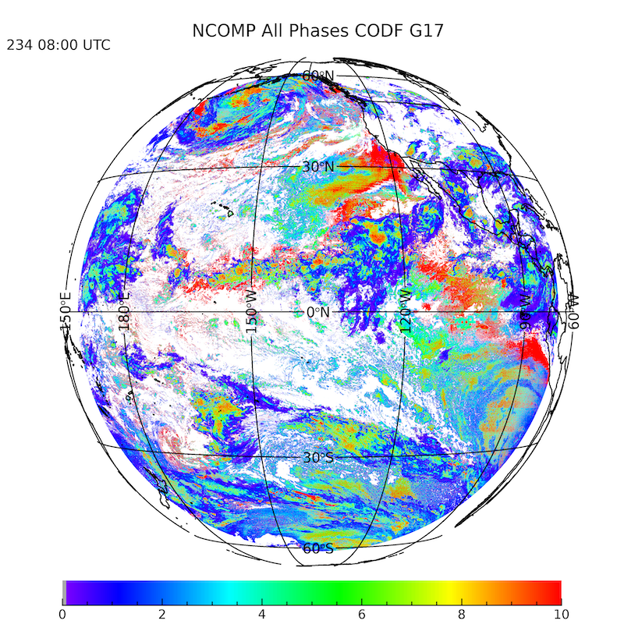
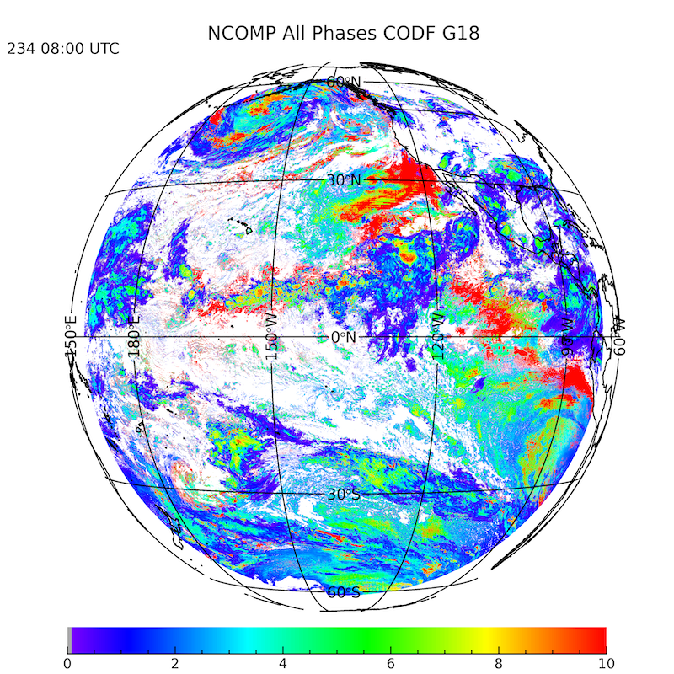
NCOMP COD Aug. 22, 2022 0800 UTC
GOES-17 COD Full Disk
GOES-18 COD Full Disk

Slide 20
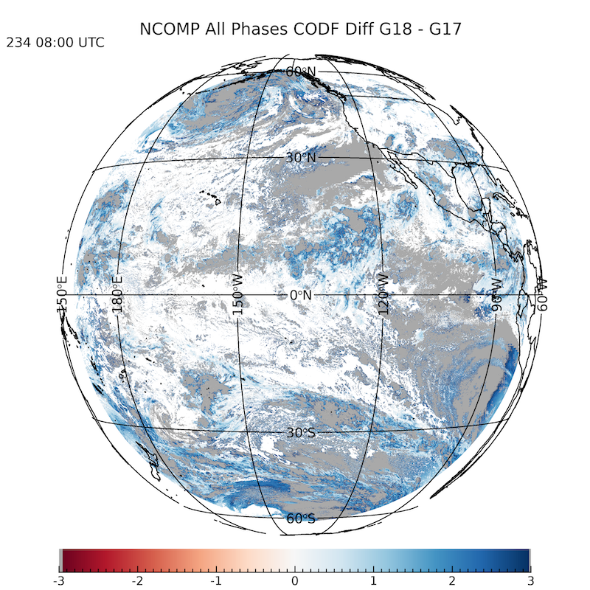
NCOMP COD Aug. 22, 2022 0800 UTC
GOES17 – GOES18 COD Full Disk
GOES-18 COD Full Disk

Slide 21
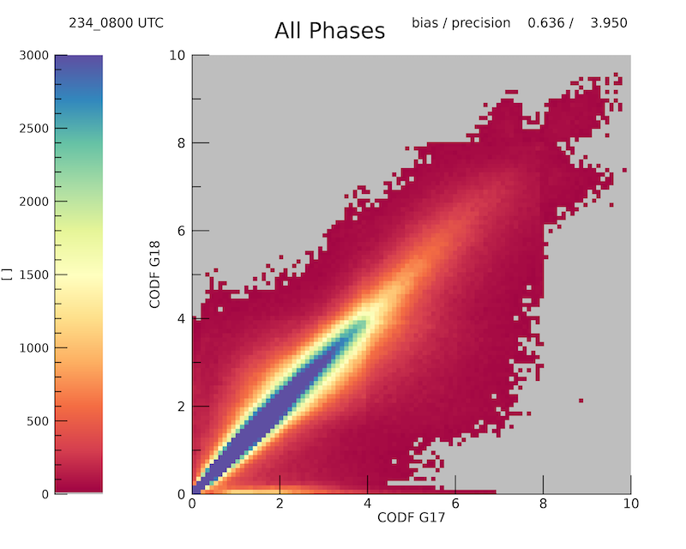
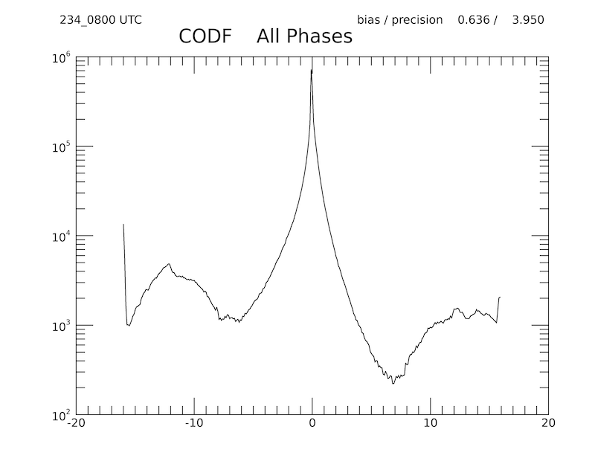
NCOMP COD Aug. 22, 2022 0800 UTC
GOES-17 vs GOES-18 COD Full Disk
GOES-17 vs GOES-18 COD Full Disk
bias = 0.636 precision = 3.950
bias = 0.636 precision = 3.950
Combined phase comparison is sufficient
Includes G-18 cloud edge pixels with improper ice phase, lower GOES-18 COD area.
Tails of distribution are mostly phase mismatches – not in scatter plot

Slide 22
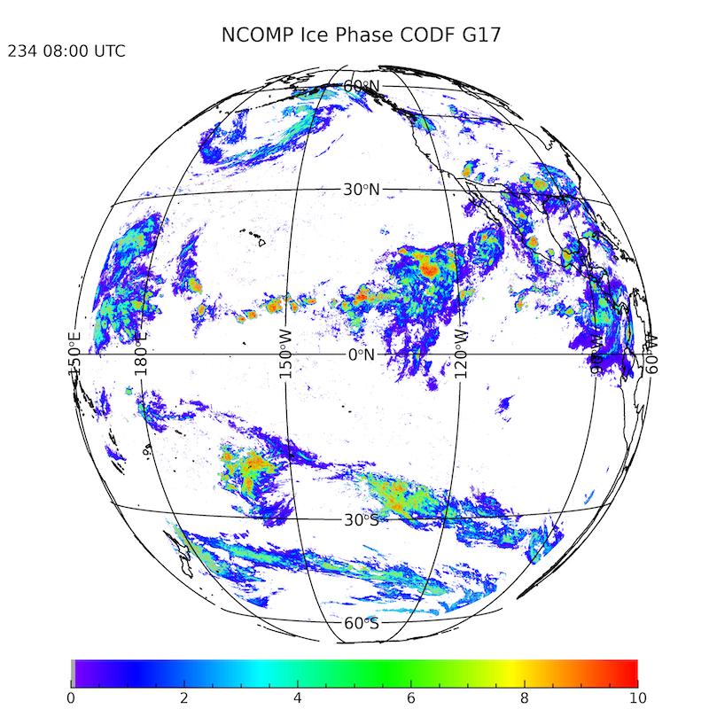

NCOMP COD Aug. 22, 2022 0800 UTC
Matched Cloud Phase: Ice
GOES-17 COD Full Disk
GOES-18 COD Full Disk

Slide 23
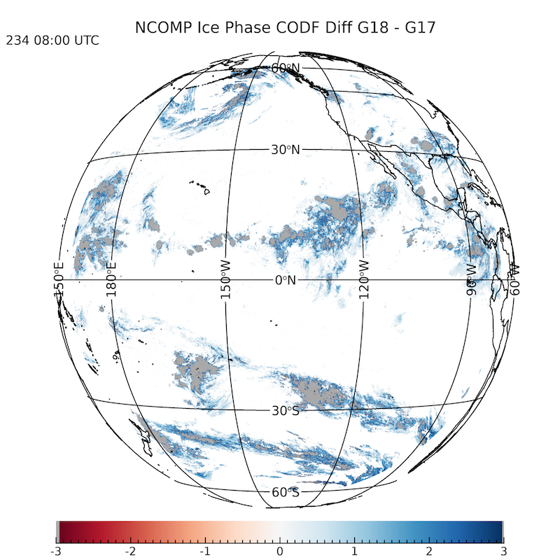
NCOMP COD Aug. 22, 2022 0800 UTC
Matched Cloud Phase: Ice
GOES17 – GOES18 COD Full Disk
GOES-18 COD Full Disk

Slide 24
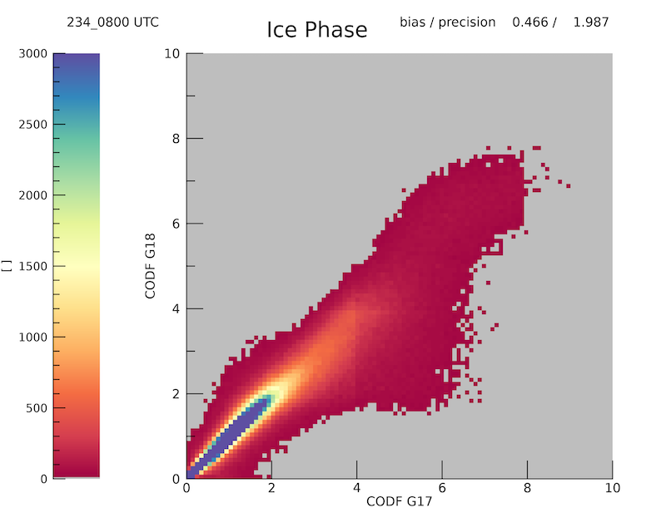
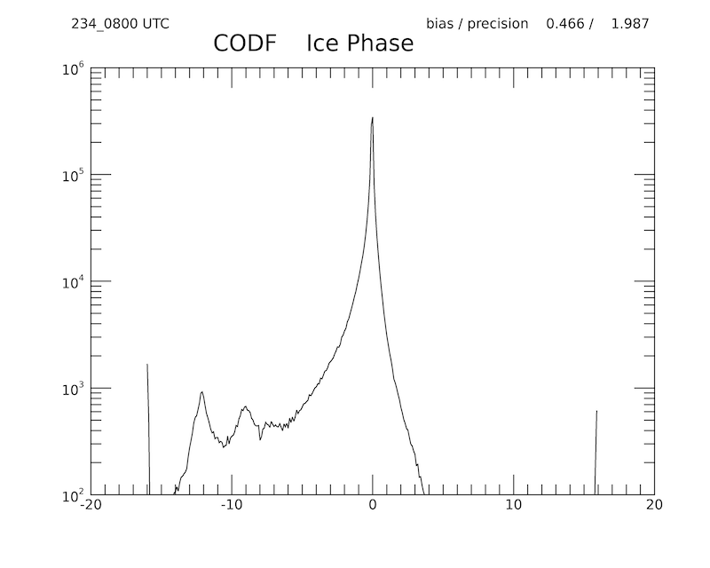
NCOMP COD Aug. 22, 2022 0800 UTC
Matched Cloud Phase: Ice
GOES-17 vs GOES-18 COD Full Disk
GOES-17 vs GOES-18 COD Full Disk
bias = 0.466 precision = 1.987
bias = 0.466 precision = 1.987
Ice cloud-only bias and precision improved compared to combined phase plots
Small numbers of pixels with lower GOES-18 COD, but overall bias acceptable
Note that the vast majority of these clouds are thin cirrus

Slide 25
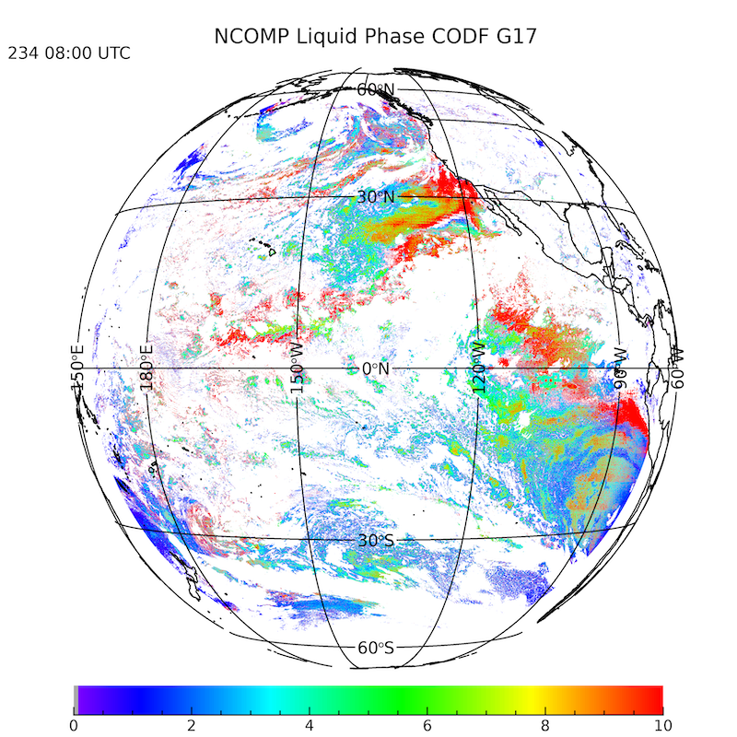
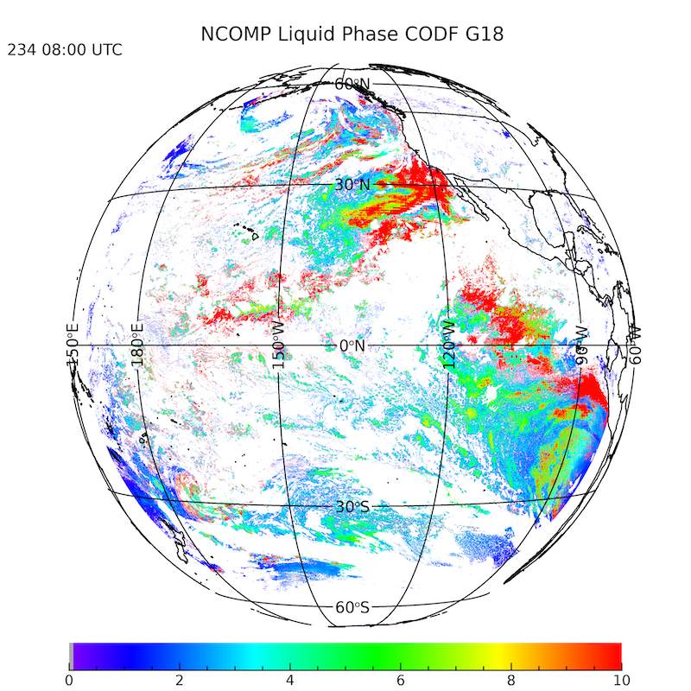
NCOMP COD Aug. 22, 2022 0800 UTC
Matched Cloud Phase: Liquid
GOES-17 COD Full Disk
GOES-18 COD Full Disk
GOES-18 COD Full Disk

Slide 26
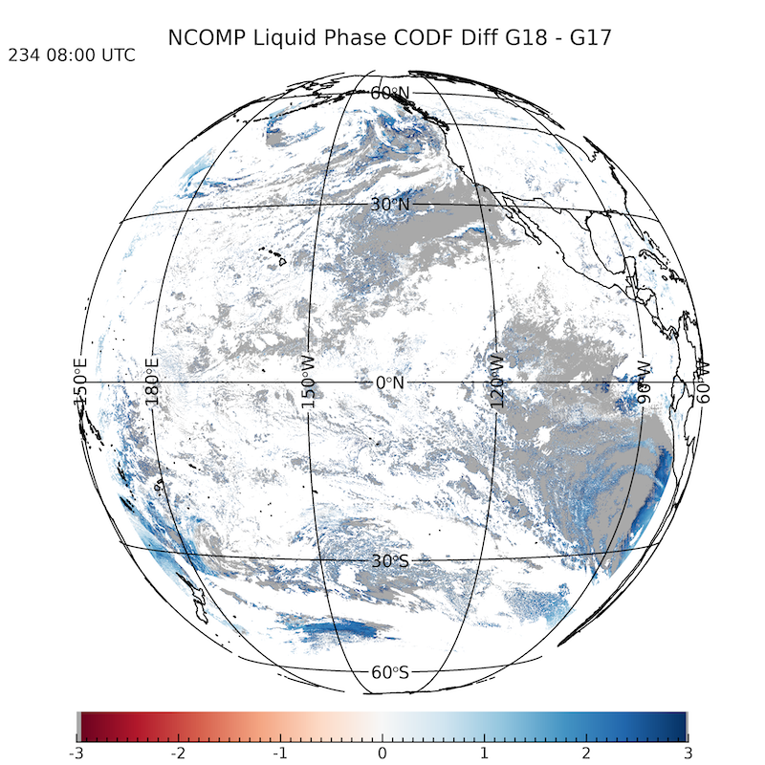
NCOMP COD Aug. 22, 2022 0800 UTC
Matched Cloud Phase: Liquid
GOES17 – GOES18 COD Full Disk
GOES-18 COD Full Disk

Slide 27
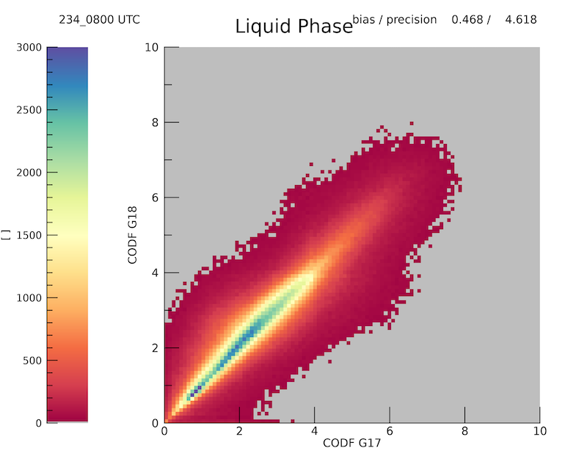
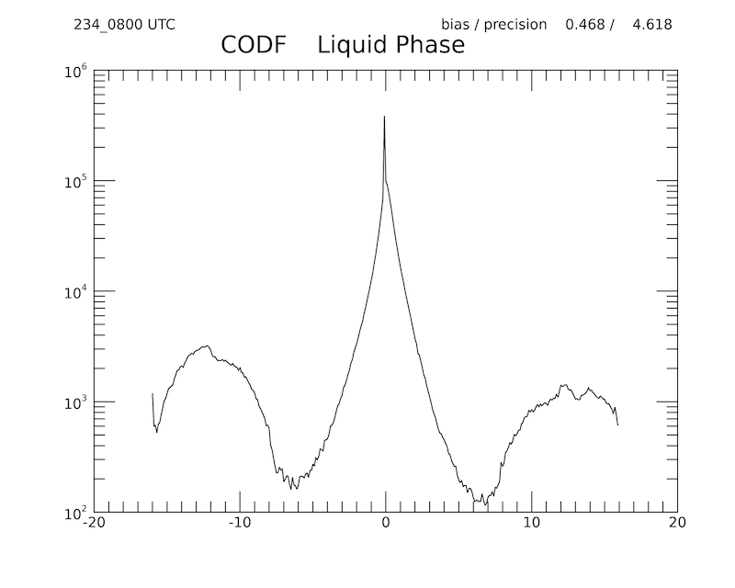
NCOMP COD Aug. 22, 2022 0800 UTC
Matched Cloud Phase: Liquid
GOES-17 vs GOES-18 COD Full Disk
GOES-17 vs GOES-18 COD Full Disk
bias = 0.468 precision = 4.618
bias = 0.468 precision = 4.618
Bias is acceptable, precision is highest for liquid clouds, but not unexpected.
thin water clouds, so can include highly variable optical depths in stratocumulus
Tales of distribution are not in scatter plot

Slide 28


NCOMP CPS Aug. 22, 2022 0800 UTC
GOES-17 CPS Full Disk
GOES-18 CPS Full Disk

Slide 29
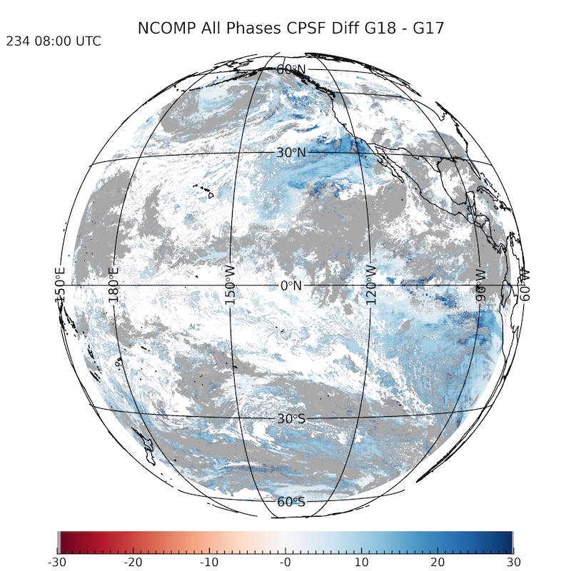
NCOMP CPS Aug. 22, 2022 0800 UTC
GOES17 – GOES18 CPS Full Disk
GOES-18 CPS Full Disk

Slide 30
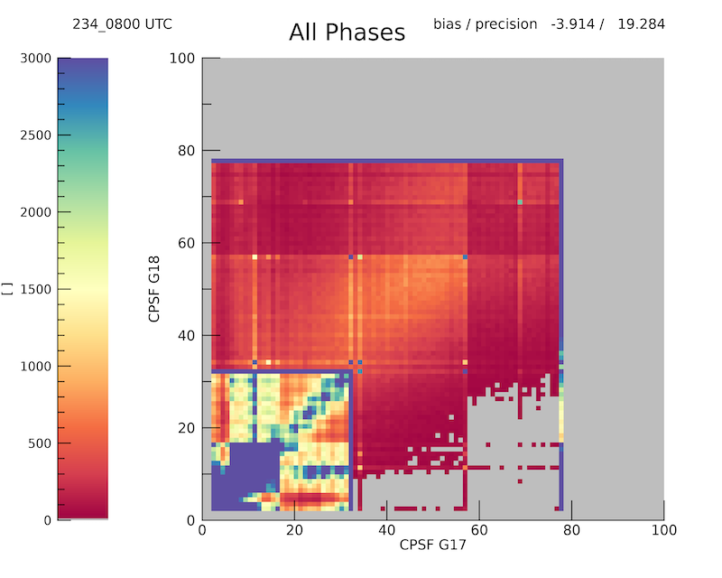
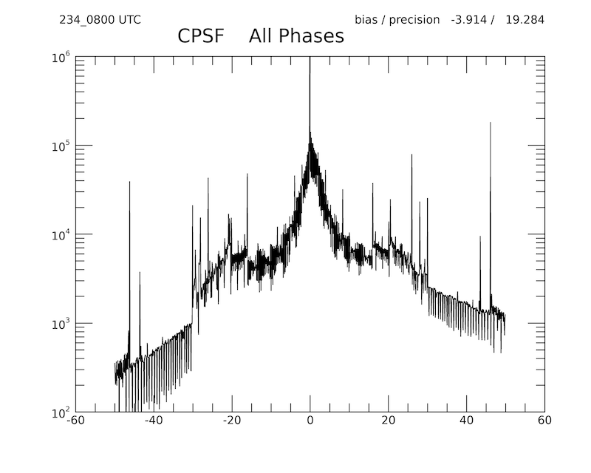
NCOMP CPS Aug. 22, 2022 0800 UTC
GOES-17 vs GOES-18 COD Full Disk
GOES-17 vs GOES-18 COD Full Disk
bias = -3.914 precision = 19.284
bias = -3.914 precision = 19.284
Large differences, particularly for water clouds (from imagery)
Water cloud and ice cloud need to be examined separately

Slide 31
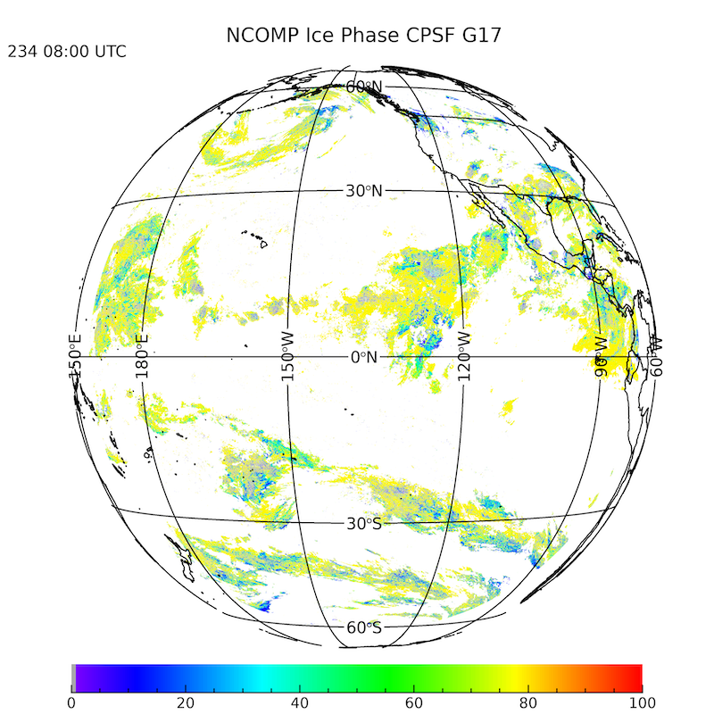

NCOMP CPS Aug. 22, 2022 0800 UTC
Matched Cloud Phase: Ice
GOES-17 CPS Full Disk
GOES-18 CPS Full Disk

Slide 32
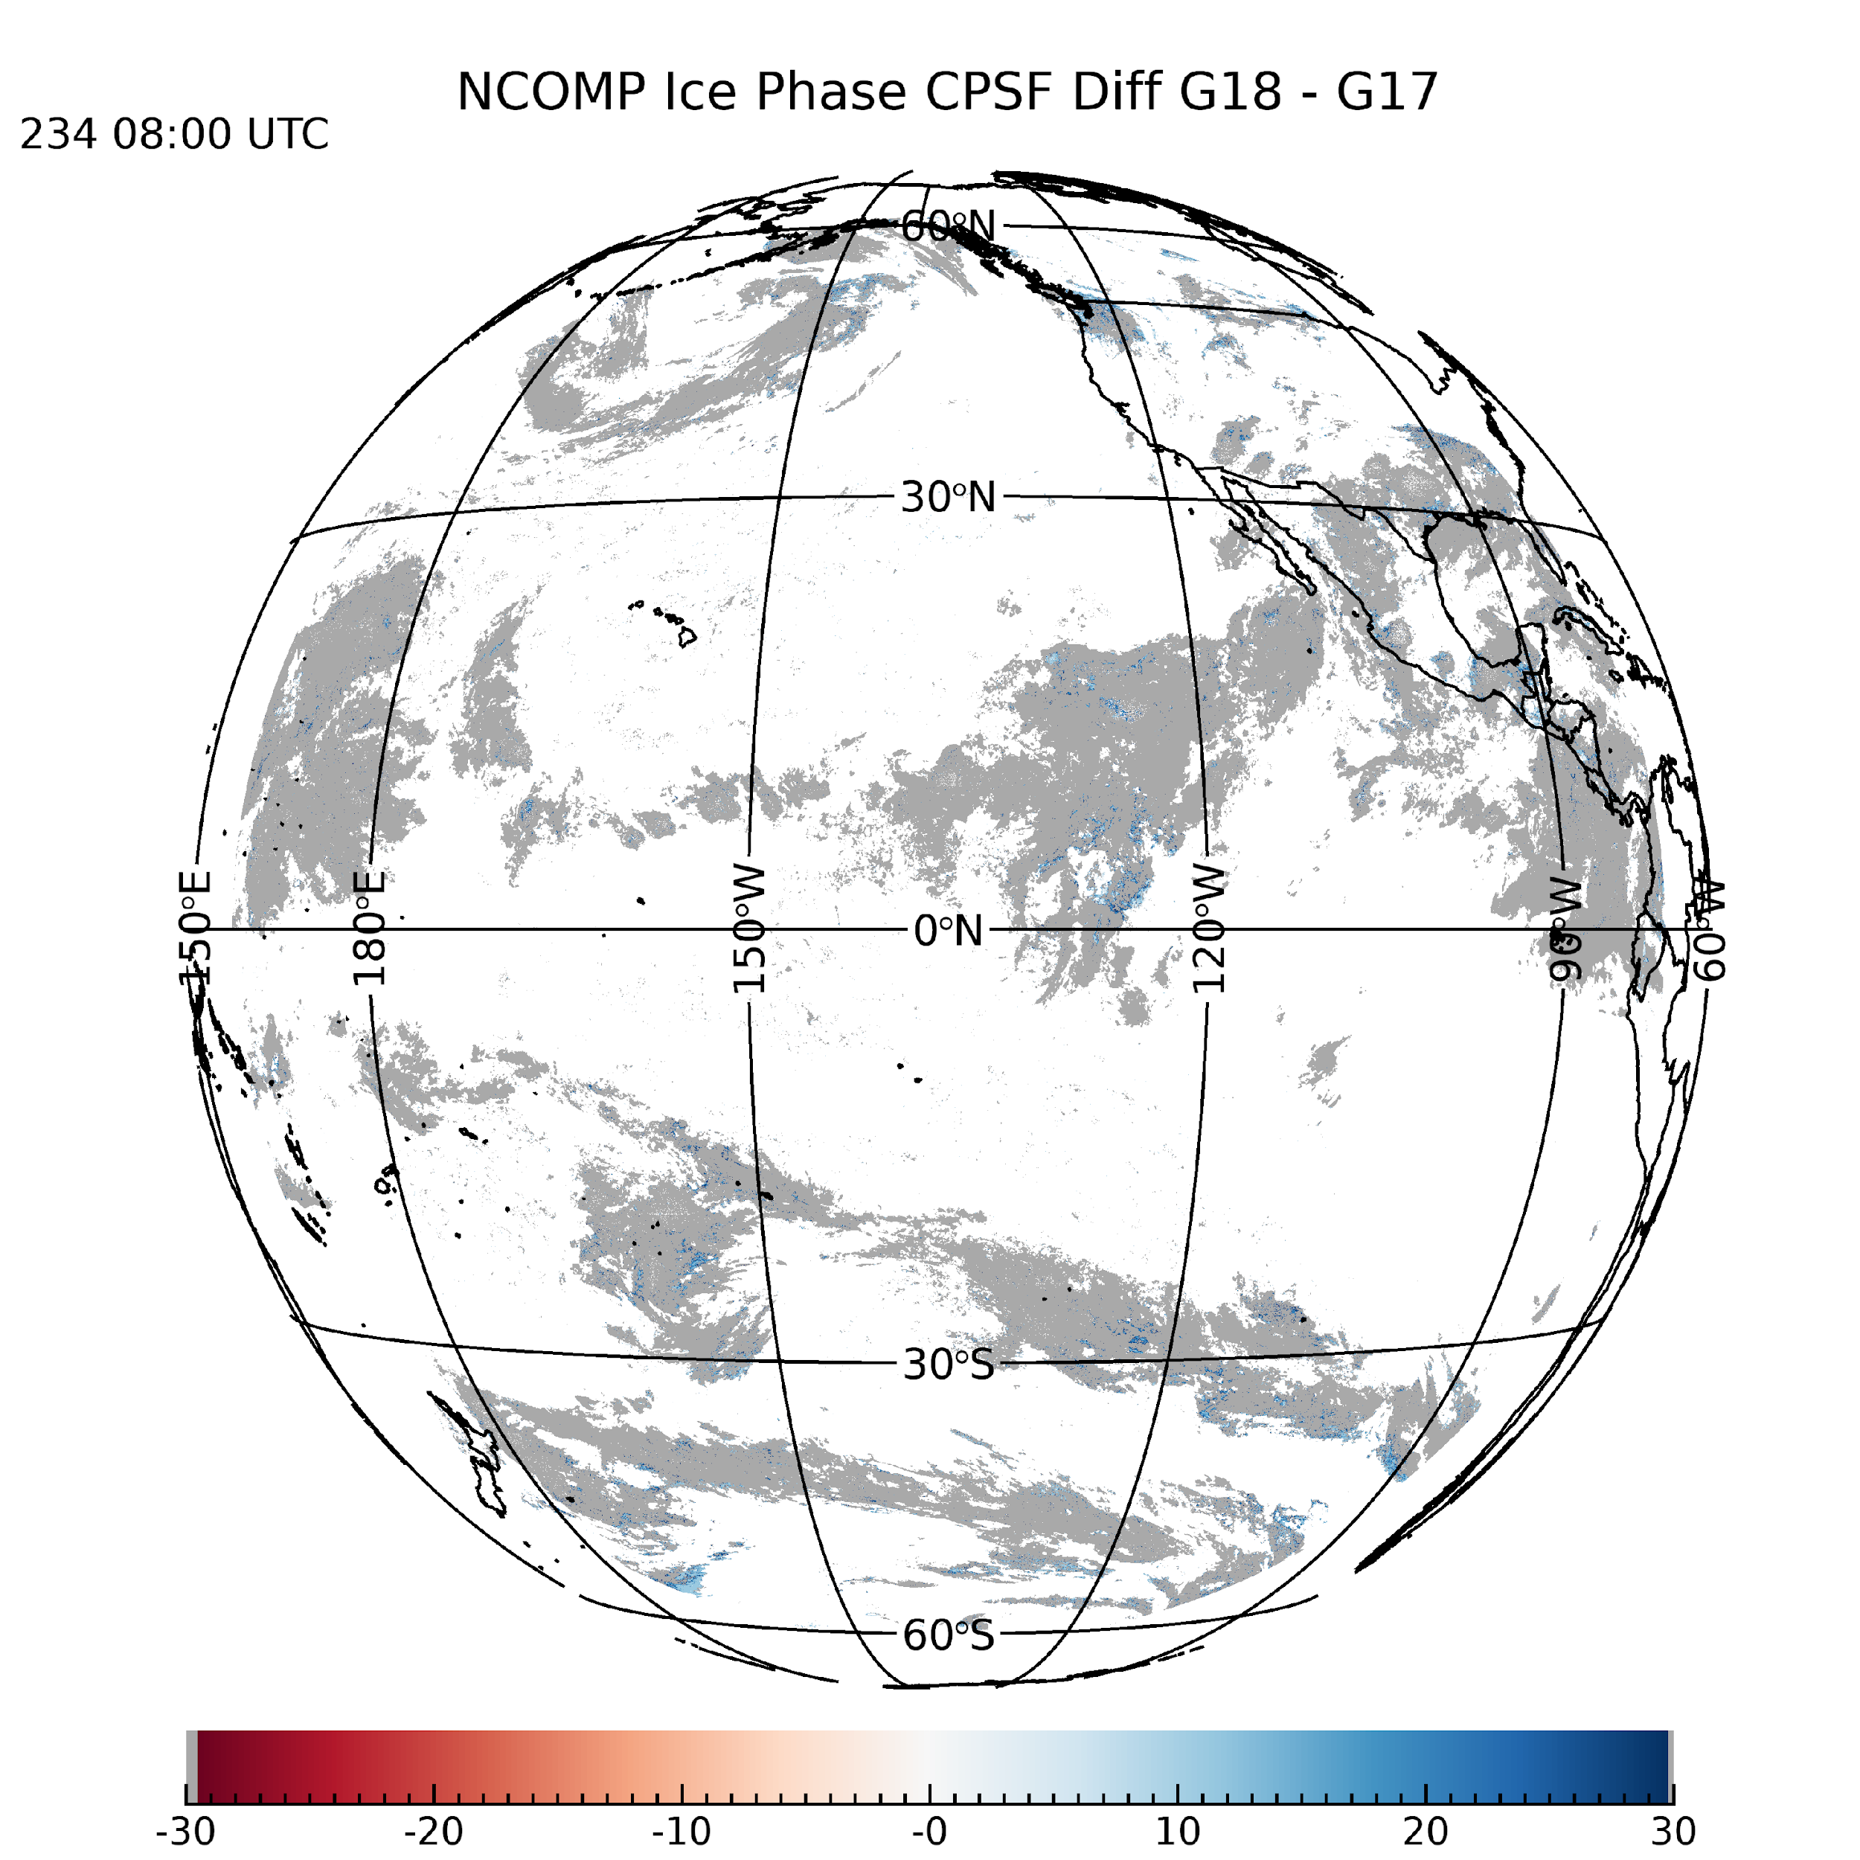
NCOMP CPS Aug. 22, 2022 0800 UTC
Matched Cloud Phase: Ice
GOES17 – GOES18 CPS Full Disk
GOES-18 CPS Full Disk

Slide 33
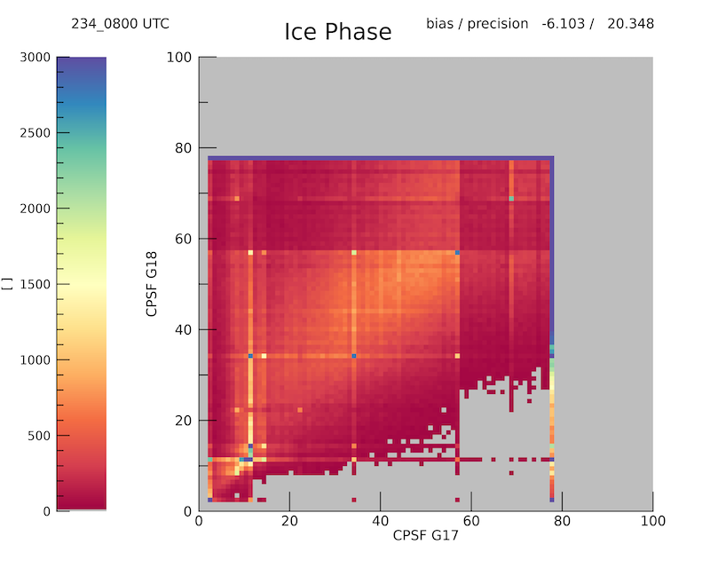
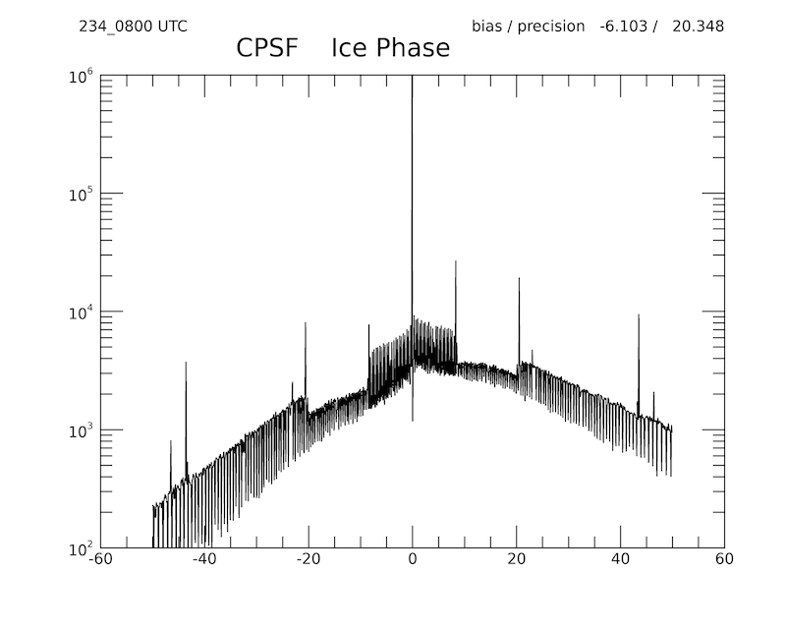
NCOMP CPS Aug. 22, 2022 0800 UTC
Matched Cloud Phase: Ice
GOES-17 vs GOES-18 CPS Full Disk
GOES-17 vs GOES-18 CPS Full Disk
bias = -6.103 precision = 20.348
bias = -6.103 precision = 20.348
Histogram shows that most results agree, but those are primarily ice clouds with diameters at the model nodes.
While this is not ideal, the retrievals from GOES-17 and GOES-18 do agree.
NCOMP particle size retrievals are very sensitive to small differences in RTM calculations

Slide 34
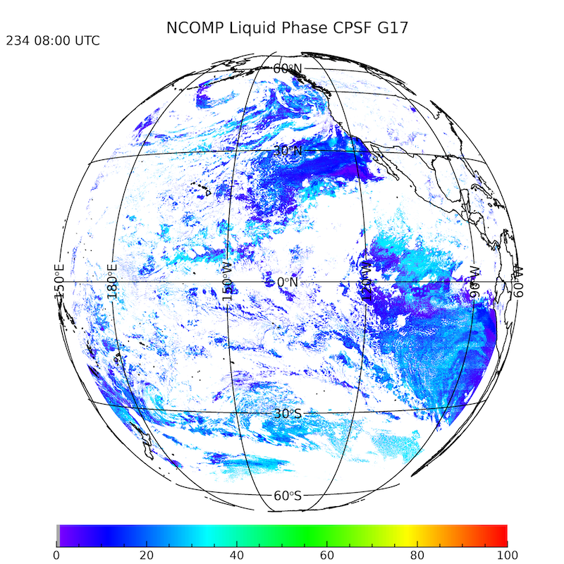
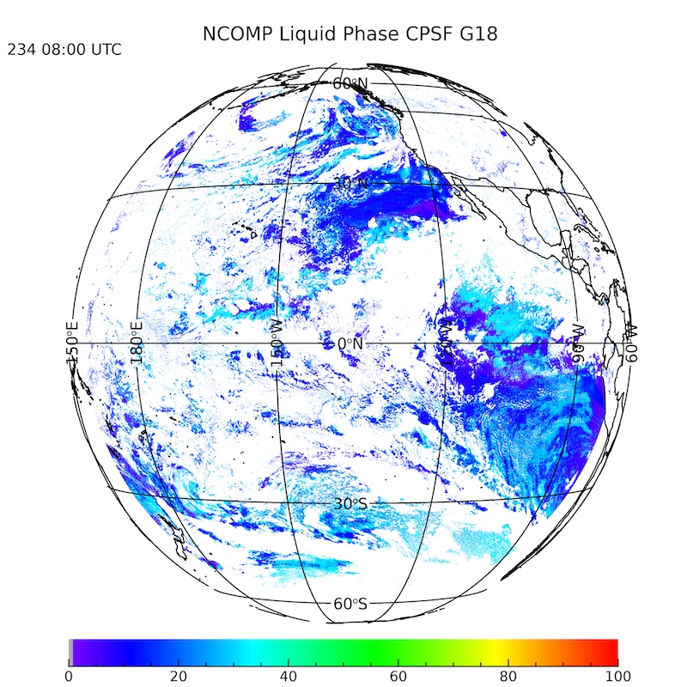
NCOMP CPS Aug. 22, 2022 0800 UTC
Matched Cloud Phase: Liquid
GOES-17 CPS Full Disk
GOES-18 CPS Full Disk
GOES-18 COD Full Disk

Slide 35
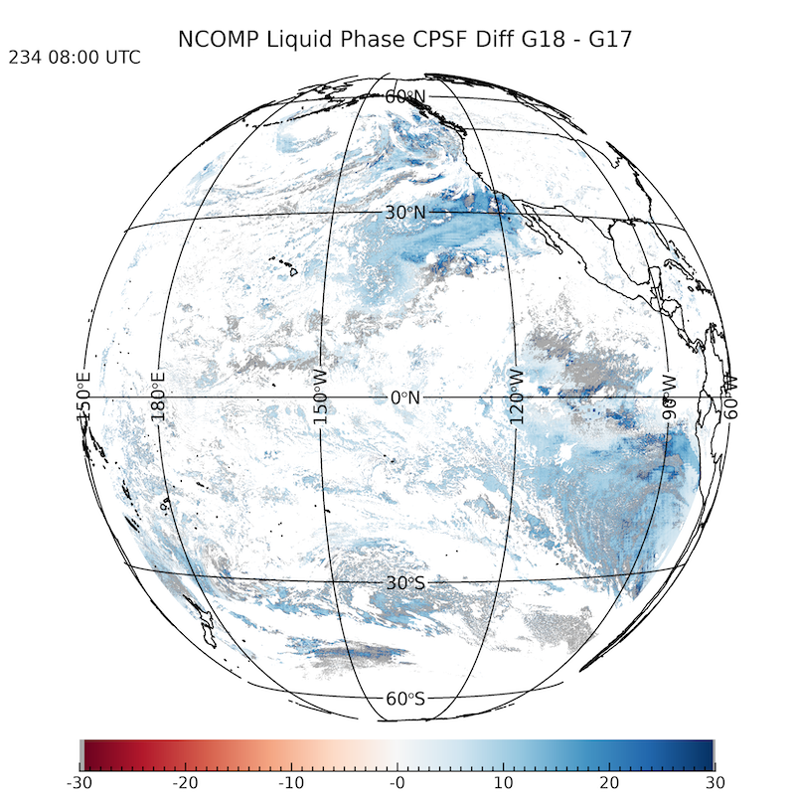
NCOMP CPS Aug. 22, 2022 0800 UTC
Matched Cloud Phase: Liquid
GOES17 – GOES18 CPS Full Disk
GOES-18 CPS Full Disk

Slide 36
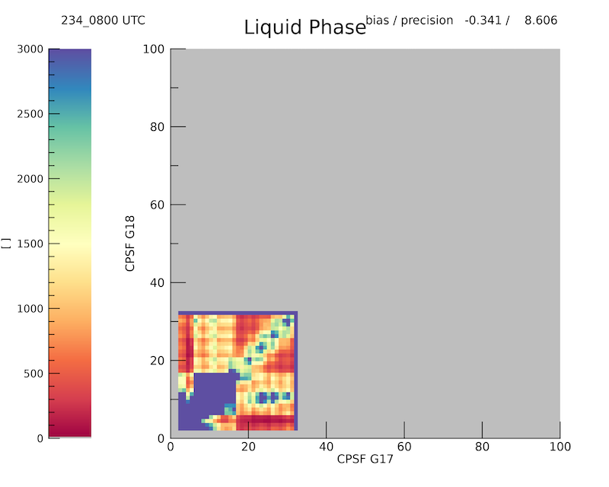
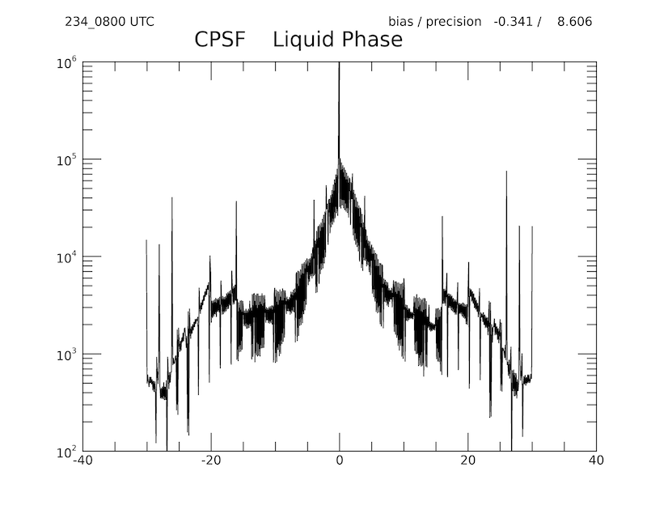
NCOMP CPS Aug. 22, 2022 0800 UTC
Matched Cloud Phase: Liquid
GOES-17 vs GOES-18 CPS Full Disk
GOES-17 vs GOES-18 CPS Full Disk
bias = -0.341 precision = 8.606
bias = -0.341 precision = 8.606
Histogram again shows that most results agree, but some model nodes appearing.
While this is not ideal, the retrievals from GOES-17 and GOES-18 do agree.
NCOMP particle size retrievals are very sensitive to small differences in RTM calculations

Slide 37
Summary of Comparison
of G-17 and G-18
COD from both satellites compare well.
CPS shows much, much greater variability, but generally agrees.
NCOMP particle size retrievals are very sensitive to small differences in RTM calculations and other inputs.
GOES-18 edge pixel phase mismatch is likely to accentuate both COD and CPS differences
COD
PASS
CPS
Partial PASS

Slide 38
Qualitative Comparison of G-18 NCOMP and Langley SatCORPS products

Slide 39
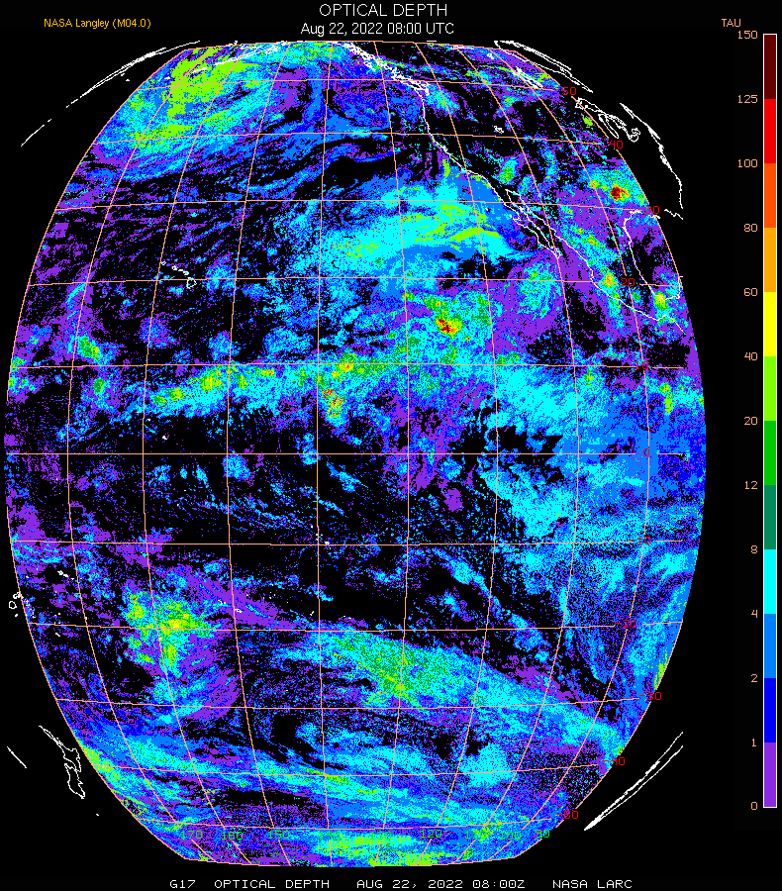
NCOMP and SatCORPS COD
Aug. 22, 2022 0800 UTC
NASA Langley SatCORPS
COD Full Disk
NCOMP GOES-18 COD Full Disk
1

Slide 40
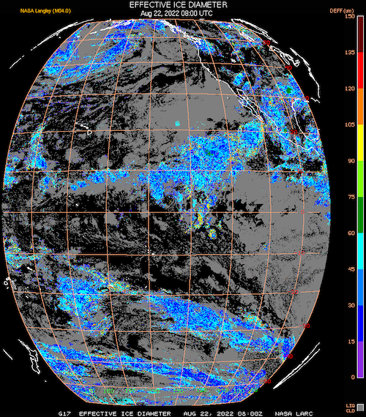
NCOMP and SatCORPS CPS
Ice Cloud Aug. 22, 2022 0800 UTC
NASA Langley SatCORPS
Ice CPS Full Disk
NCOMP GOES-18 Ice CPS Full Disk
1

Slide 41
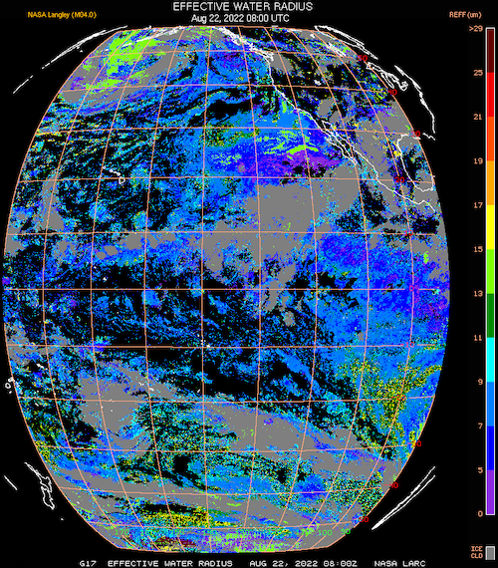
NCOMP and SatCORPS CPS
Liquid Cloud Aug. 22, 2022 0800 UTC
NASA Langley SatCORPS
Liquid CPS Full Disk
NCOMP GOES-18 Liquid CPS Full Disk
1

Slide 42
Summary of NCOMP and SatCORPS
Comparison
Some difficulties in visually comparing disparate, yet related, algorithms with different inputs, RTMs, phase and Cloud Height inputs/schemes.
Generally, COD compares well despite retrievals range differences.
CPS shows more variability, as expected, but generally agrees.
PASS

Slide 43
CPS and COD Validation Limitations
“Truth” datasets are difficult or impossible to find for CPS.
Field experiment data may provide some opportunities for CPS validation, but the inherent differences between FOVs, full column vs partial column or point-specific measurements are difficult to overcome.
For earlier GOES satellites comparisons to both CALIOP and CloudSat results have proven to difficult due to those products being not well understood, but for those earlier satellites, NCOMP did meet specifications.

Slide 44
Nighttime PLPT Outcomes: Summary
All FD PLPT activities required to make Provisional have been completed.
Primary validation using comparisons of GOES-17 and GOES-18 retrievals was successful for COD while CPS needs more study.
Quantitative PLPTs on CONUS and MESO domains were not performed but no reason to believe this impacts performance. Qualitative PLPTs indicate results are the same across domains.
Behavior revealed by PLPTs, under investigation:
  Discreet CPS bins in the NCOMP scheme that appear frequently. The iteration scheme will be examined.
  Sensitivities to RTM and other inputs needs to be quantified
  Some aspects of NCOMP ice cloud CPS retrieval could be updated to better match SatCORPS, but that algorithm has evolved in ways that are not repeatable for NCOMP’s application.
No issues that should prevent Provisional Maturity.
Subsequent modifications will be based on team feedback

Slide 45
Instrument/GPA Issues Identified
Post-launch and Resolution Status
Title | Description | Status | Mitigation
 | None
Notes:
PRO Fills In

Slide 46
Provisional Validation
Preparation Activities | Assessment
Validation activities are ongoing and the general research community is now encouraged to participate. | Yes. Ongoing monitoring and Feedback provided by AWIPS Users
Severe algorithm anomalies are identified and under analysis. Solutions to anomalies are in development and testing. | None noted in summary
Incremental product improvements may still be occurring. | The transition to the enterprise algorithm is occurring and other improvement are being evaluated, such as the replacement of NCOMP with COP from Enterprise ACHA
L2+ only: Users are engaged in the Product Feedback Forums and user feedback is assessed. | Yes
End State | Assessment
Product performance has been demonstrated through analysis of a small number of independent measurements obtained from select locations, periods, and associated ground truth or field campaign efforts. | Both Day and nighttime optical properties are hampered by a lack of truth data. However, the team had provided an in depth assessment based on existing truth data
Product analysis is sufficient to communicate product performance to users relative to expectations (Performance Baseline). | Yes, analysis of NCOMP has shown that it meets specifications.
Documentation of product performance exists that includes recommended remediation strategies for all anomalies and weaknesses. Any algorithm changes associated with severe anomalies have been documented, implemented, tested, and shared with the user community. | Yes. See this GOES-18 review and the previous GOES-16 and GOES-17 Reviews
Testing has been fully documented. | Yes. See this GOES-18 review and the previous GOES-16 and GOES-17 Reviews
Product is ready for operational use and for use in comprehensive cal/val activities and product optimization. | Yes. See this GOES-18 review and the previous GOES-16 and GOES-17 Reviews

Slide 47
Path to Full Maturity – Nighttime
We expect to apply the same PLPTs, as shown on slide 3, to be conducted for Full maturity
  We collect an archive of 30 days (1 week per season) of L1,L2 and IPs so that substantially more validation opportunities are obtained. This has been shown to be sufficient for seasonality assessments.
  Will coordinate with other teams to reduce duplicate collections.
  Will continue to investigate CPS sensitivities, particularly for ice clouds.
  Will continue to explore additional validation opportunities for COD and CPS.
Currently outstanding issues, unless fixed by handover, may prevent declaration of Full maturity.
  CPS issues for ice clouds
  Lower risk is CPS for water clouds
Notes:
can add as many slides as needed. Large importance

