Slide 1
GOES-18 L2 (Group 2) Provisional Validation
Peer/Stakeholder Product Validation Review (PS-PVR)
Oct. 12, 2022
NWS Perspective: AWIPS verification
John D. Evans, Derek van Pelt, and Lee Byerle
TOWR-S team, NWS Office of Observations

Slide 2
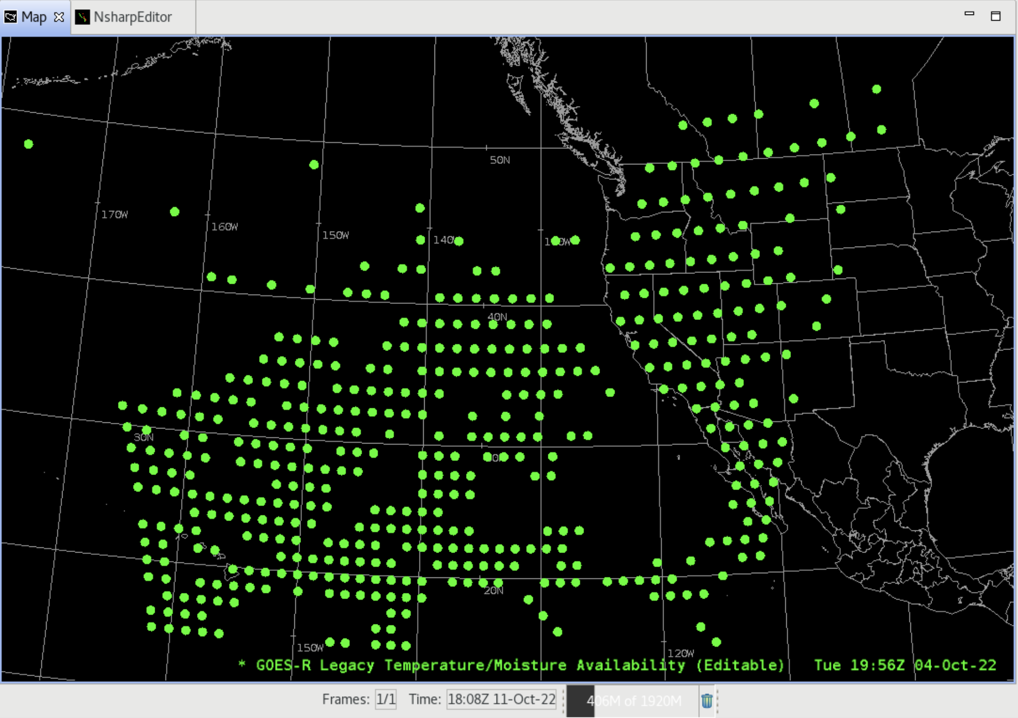
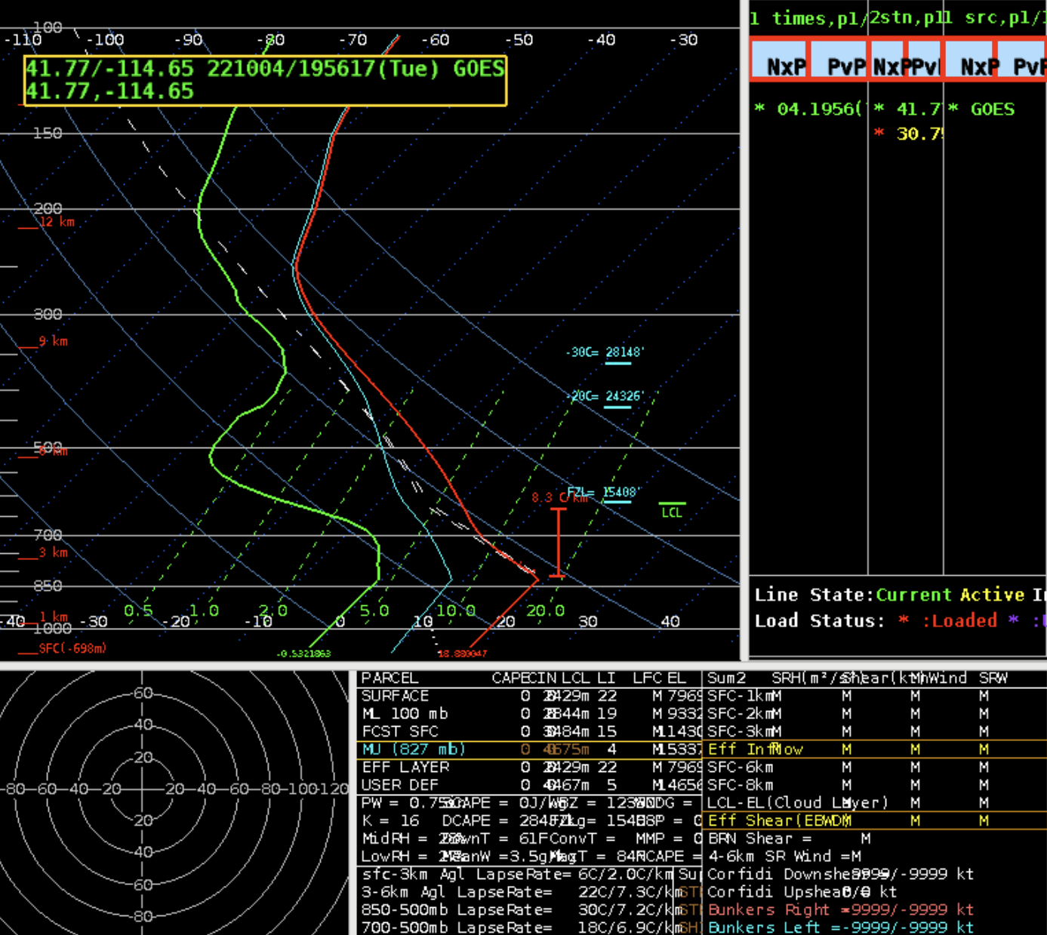
Legacy Atmospheric Profiles
Full (101-level) Legacy Vertical Profiles
GOES-18 Preliminary, Non-Operational Data

Slide 3
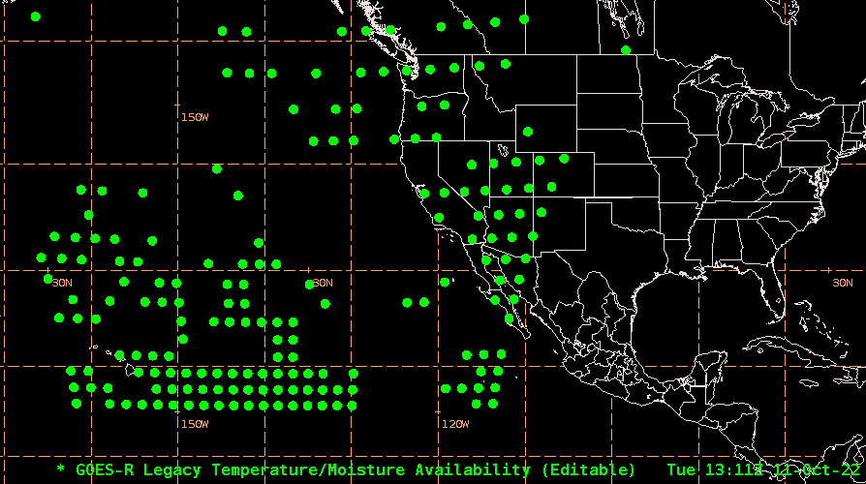
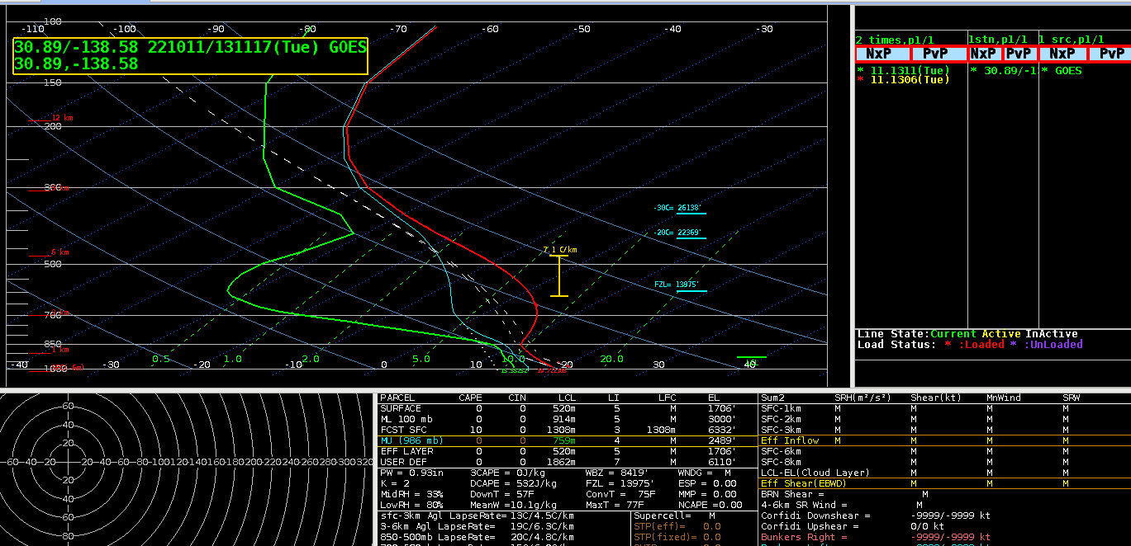
Legacy Atmospheric Profiles
Reduced (34-level) Legacy Vertical Profiles
GOES-18 Preliminary, Non-Operational Data

Slide 4
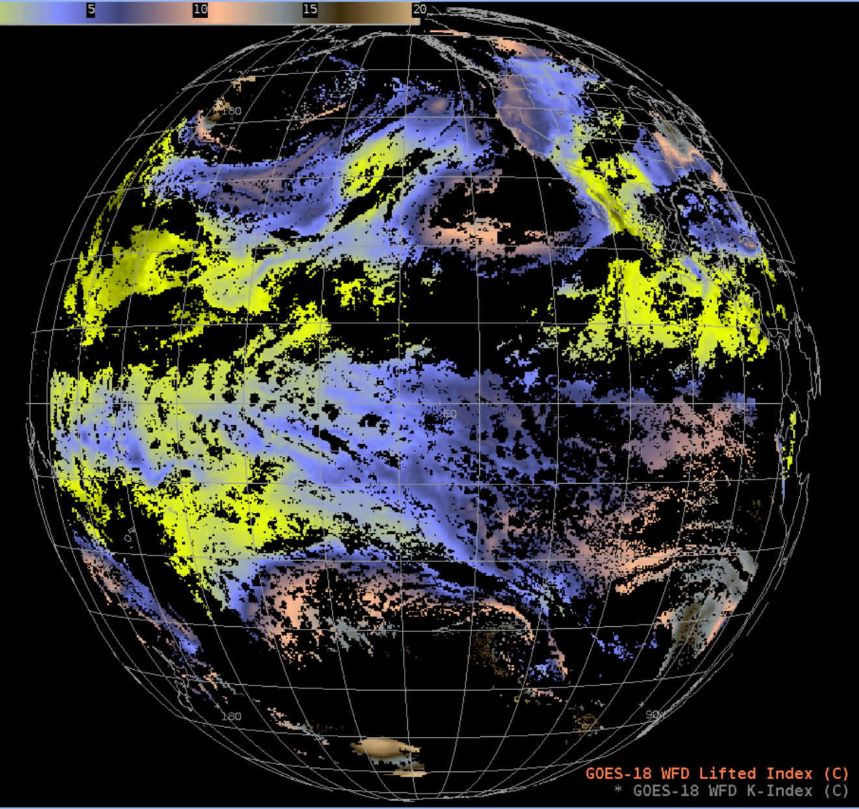
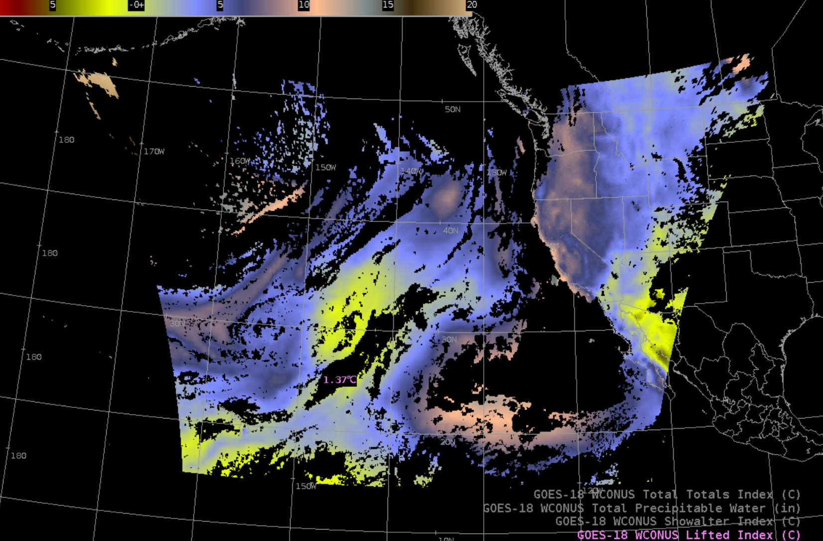
Derived Stability Indices: Lifted Index
GOES-18 Preliminary, Non-Operational Data

Slide 5
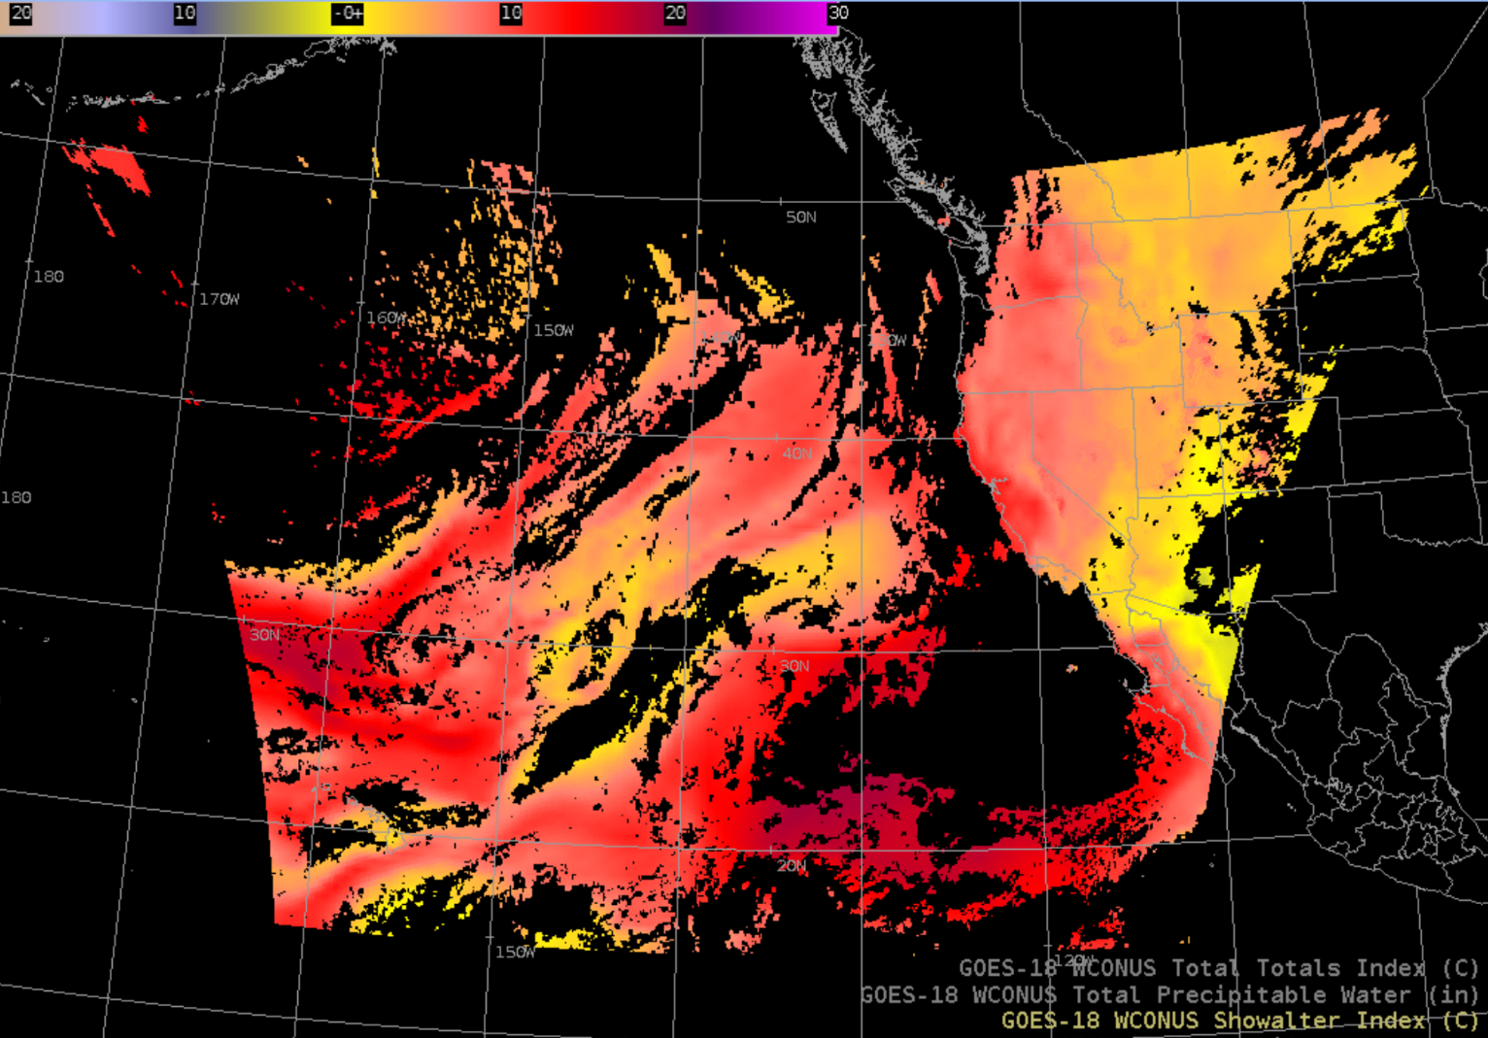
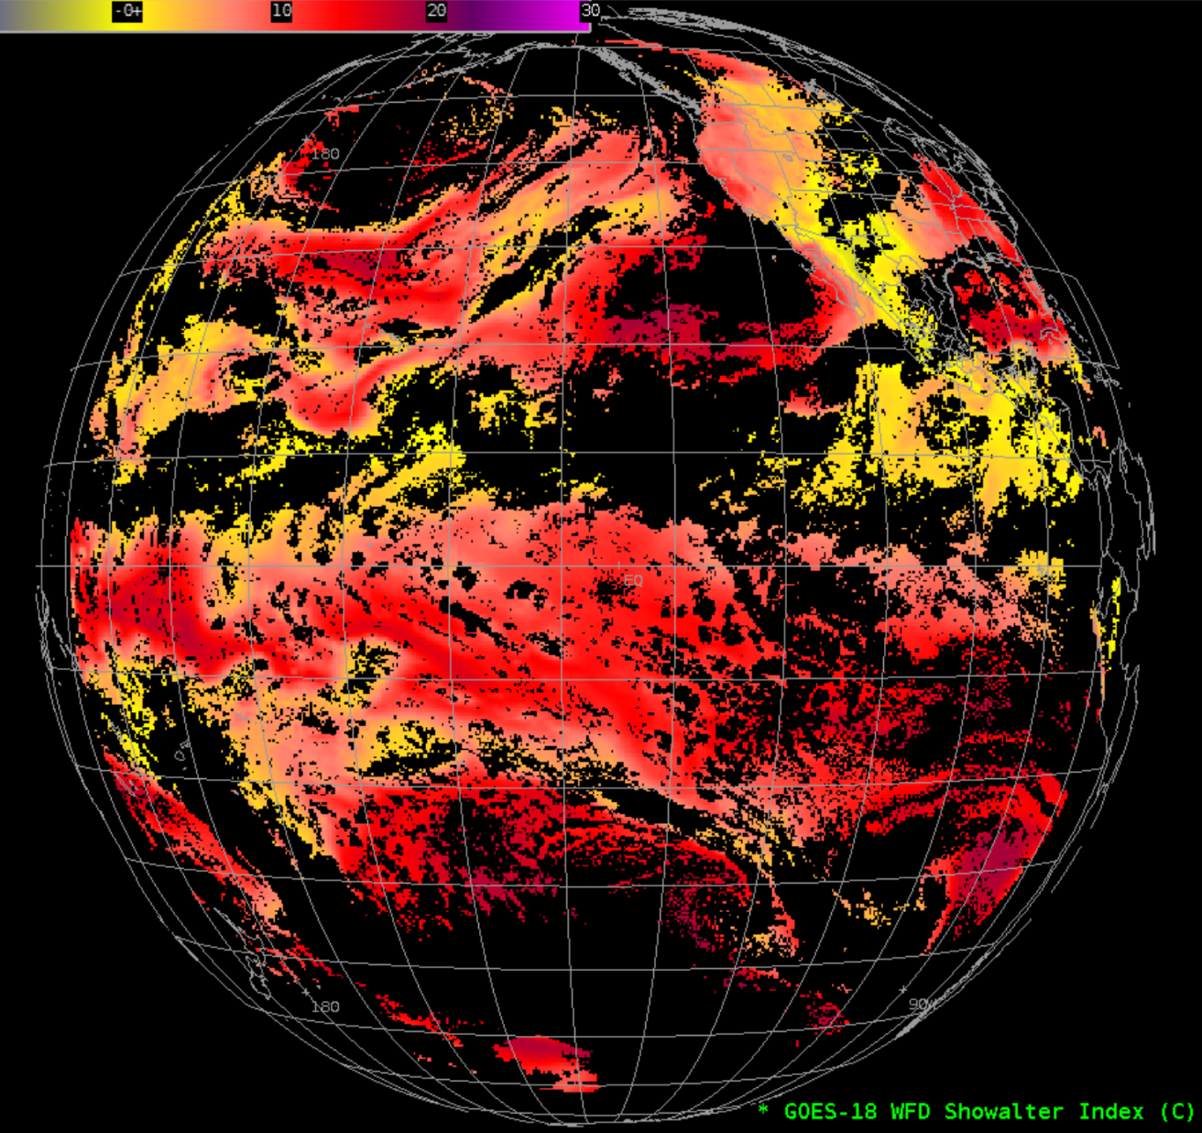
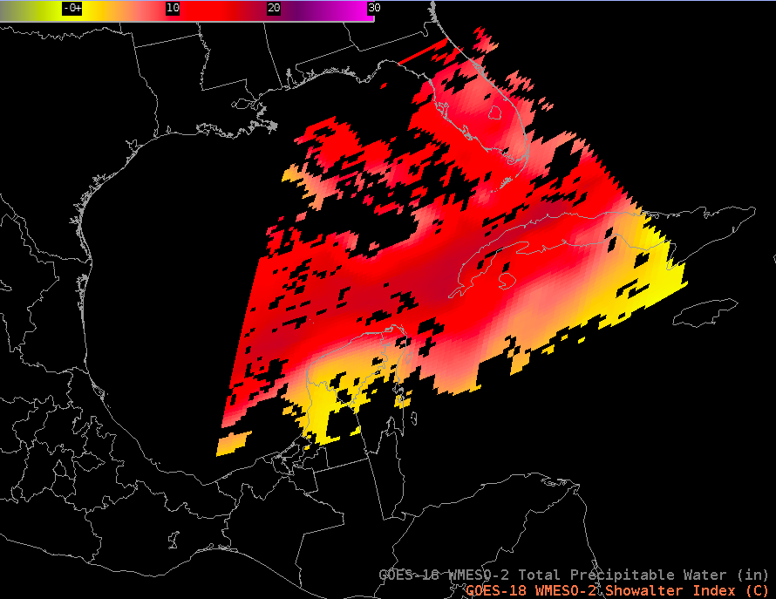
Derived Stability Indices:
Showalter Index
GOES-18 Preliminary, Non-Operational Data

Slide 6
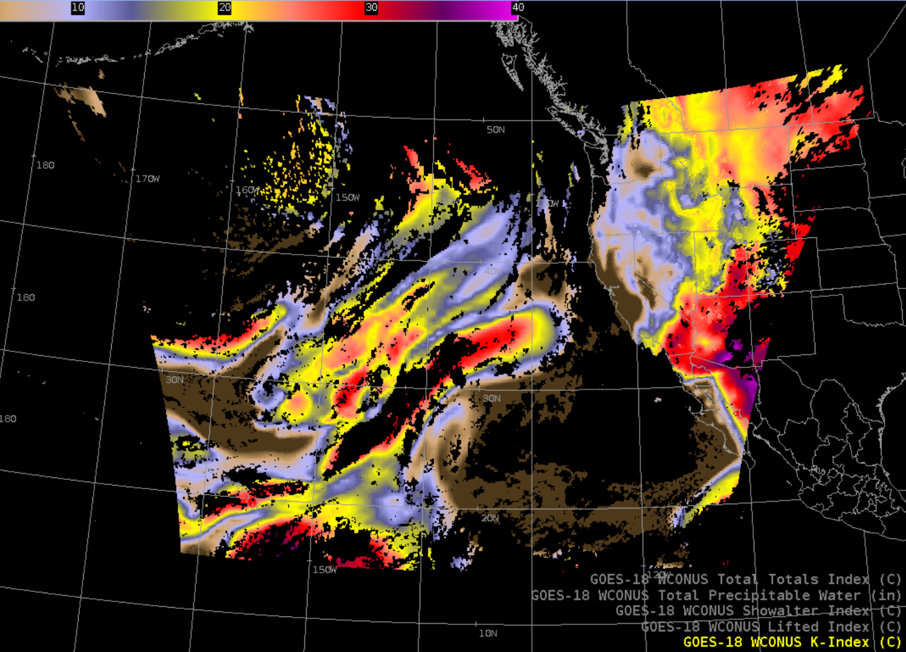
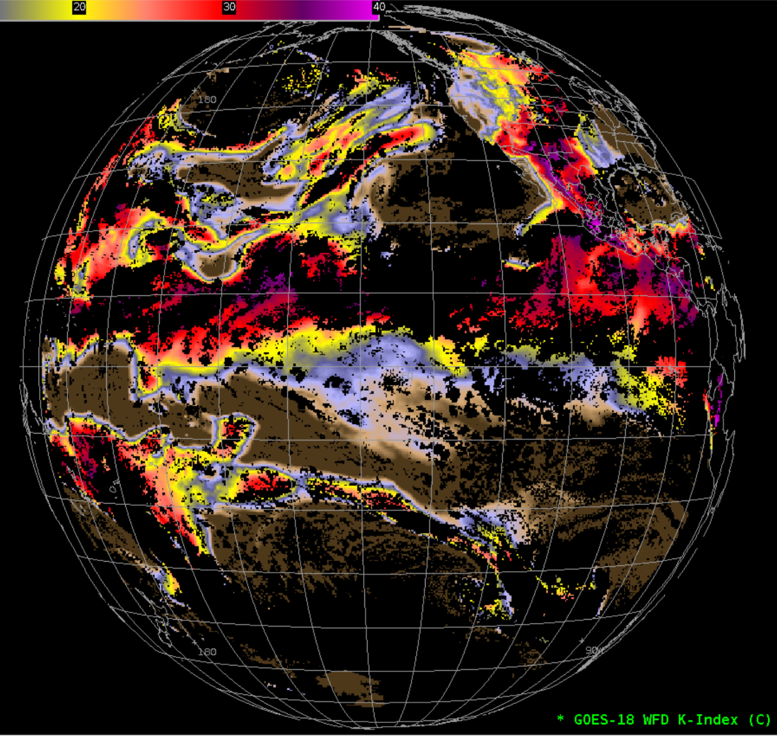
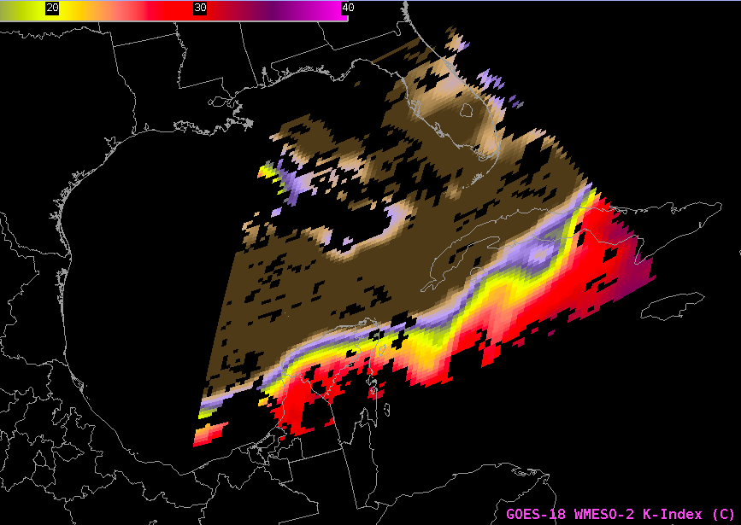
Derived Stability Indices: K-Index
GOES-18 Preliminary, Non-Operational Data

Slide 7
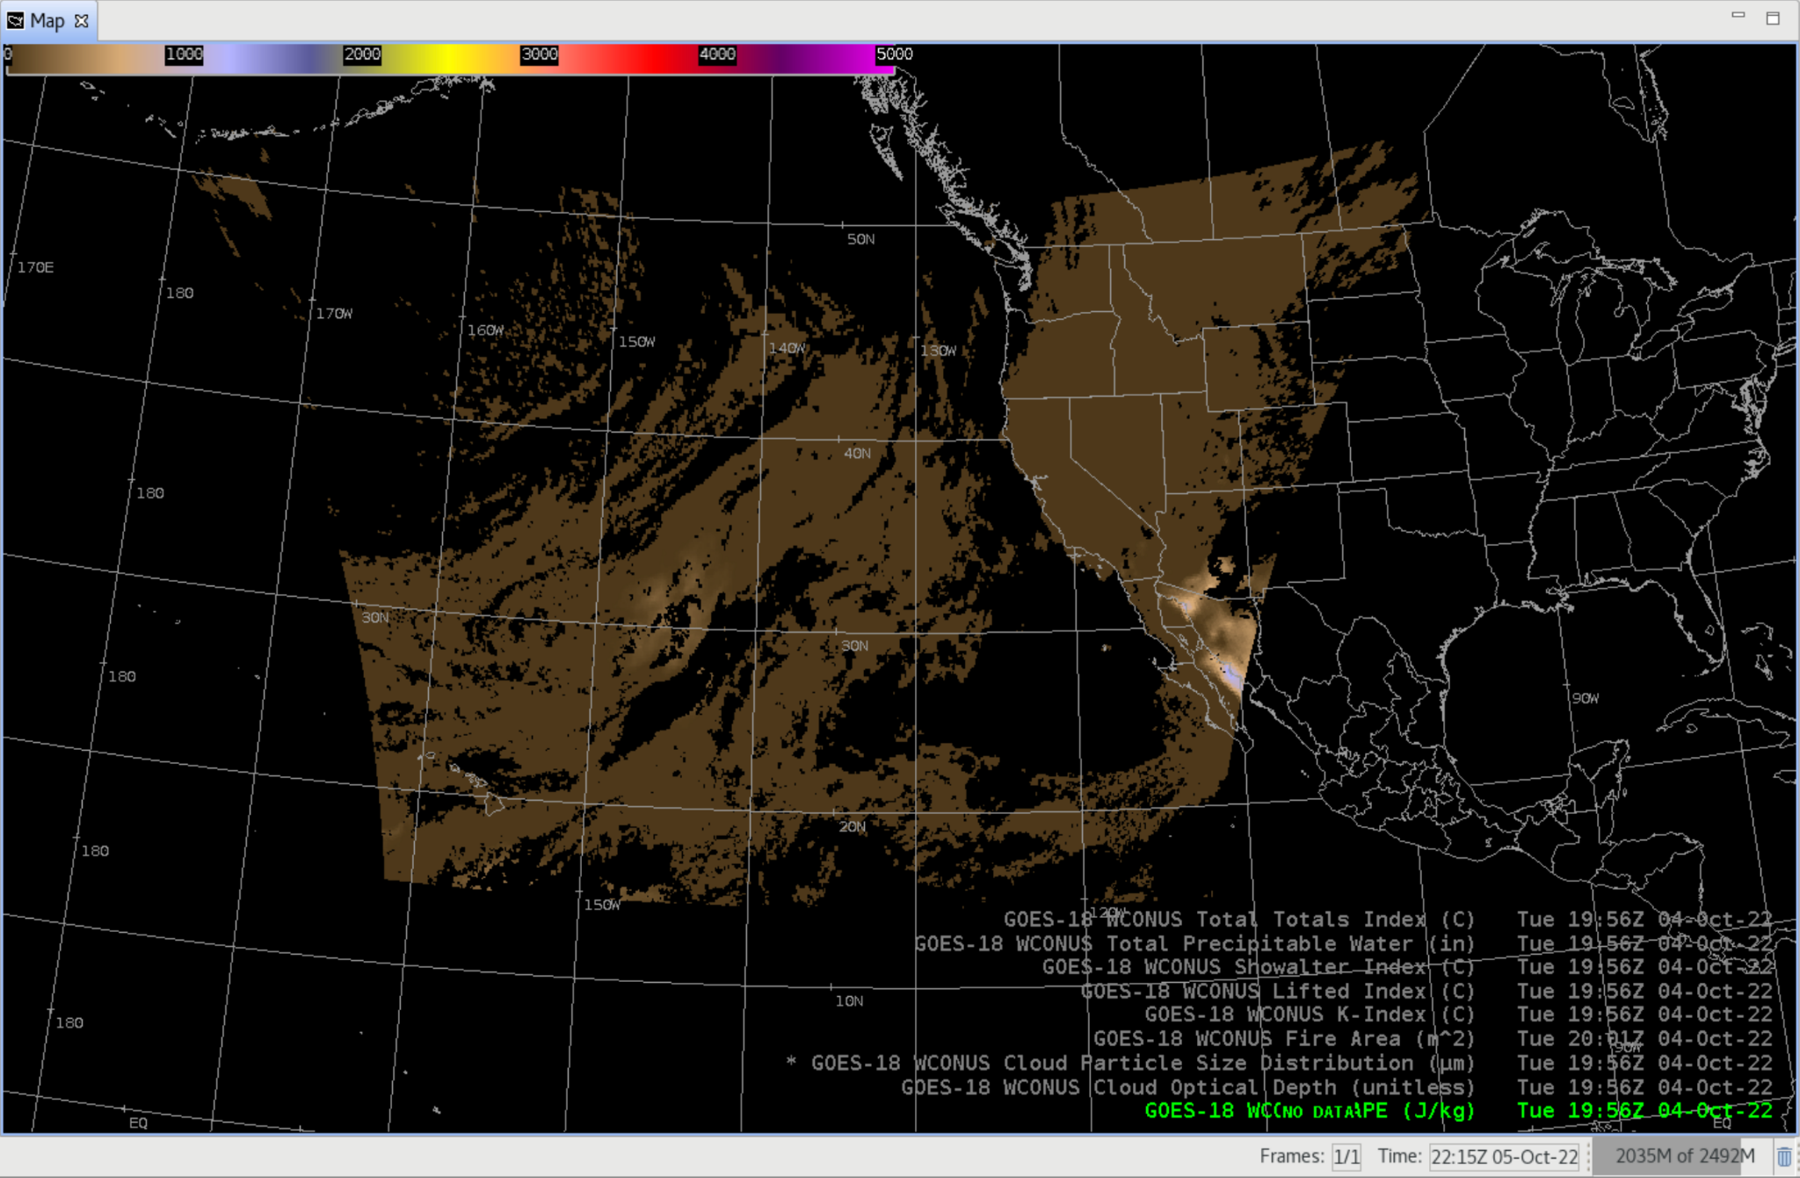
Derived Stability Indices:
Convective Available Potential Energy (CAPE)
GOES-18 Preliminary, Non-Operational Data

Slide 8
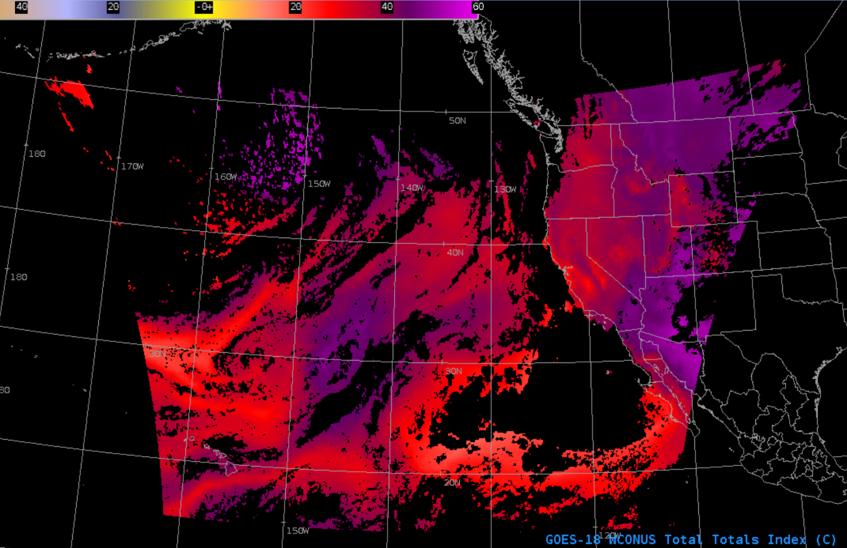
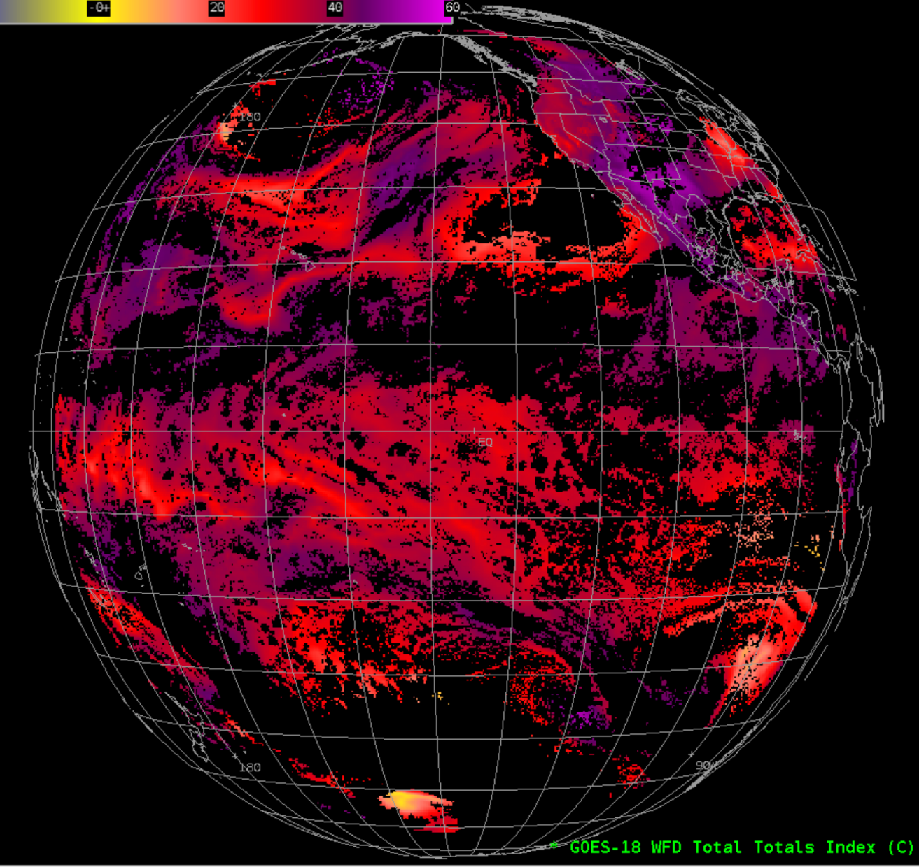
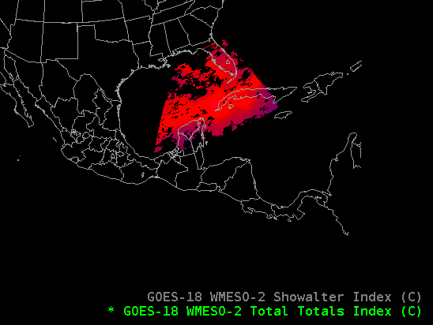
Derived Stability Indices: Total Totals Index
GOES-18 Preliminary, Non-Operational Data

Slide 9
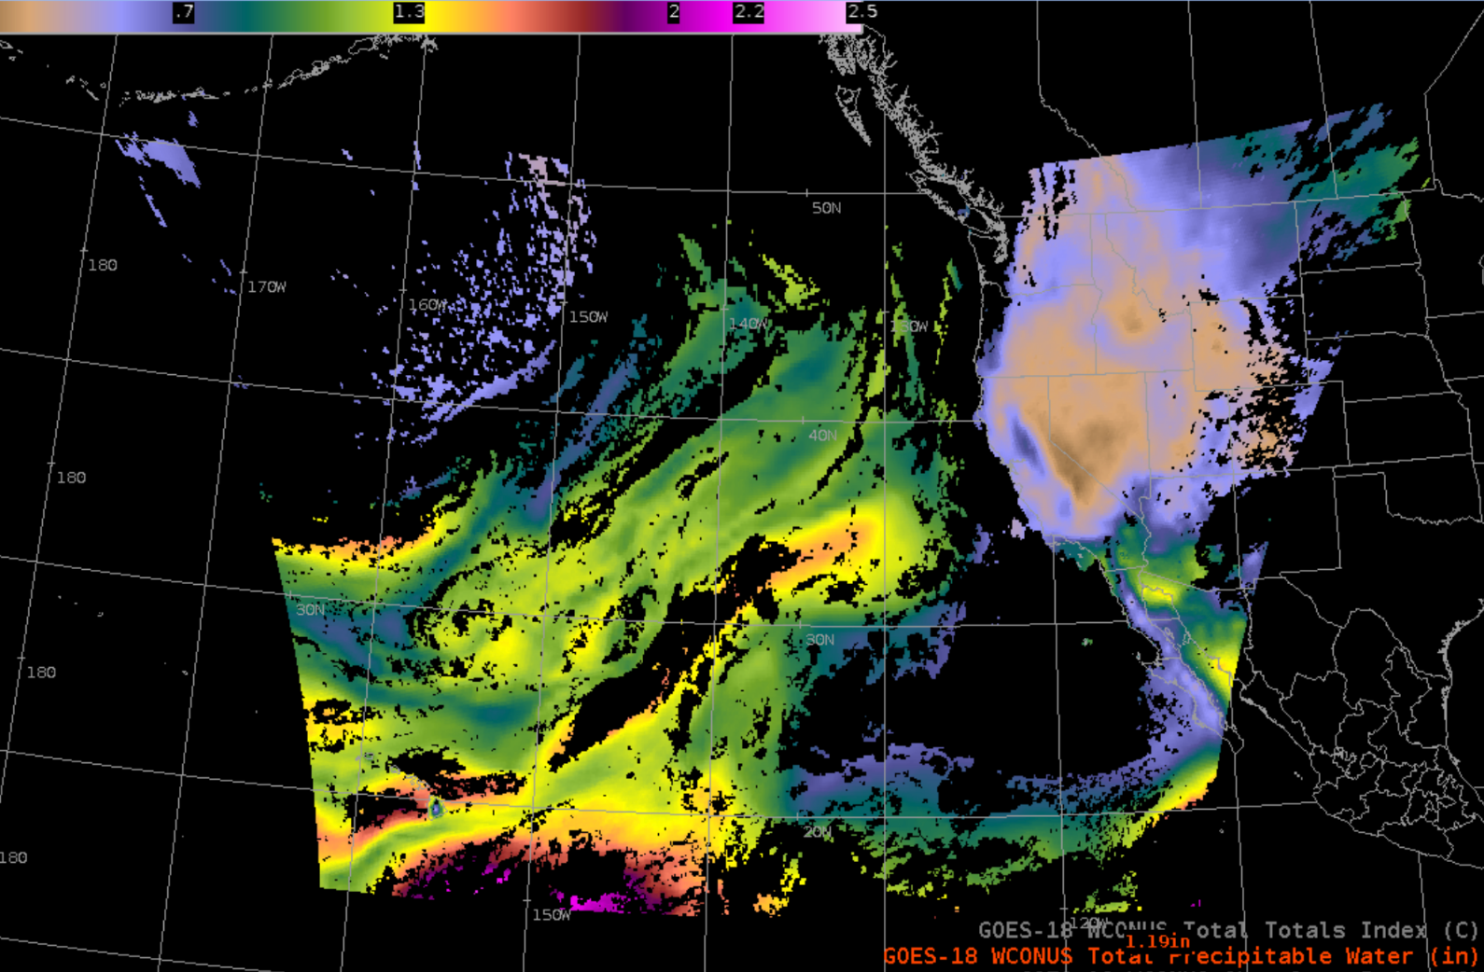
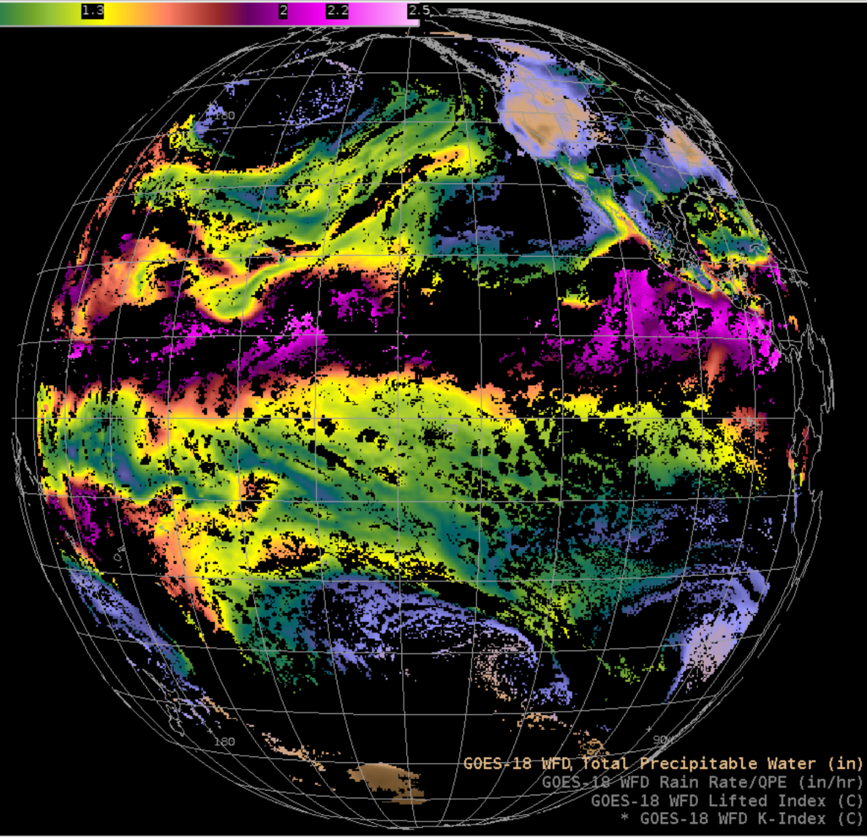
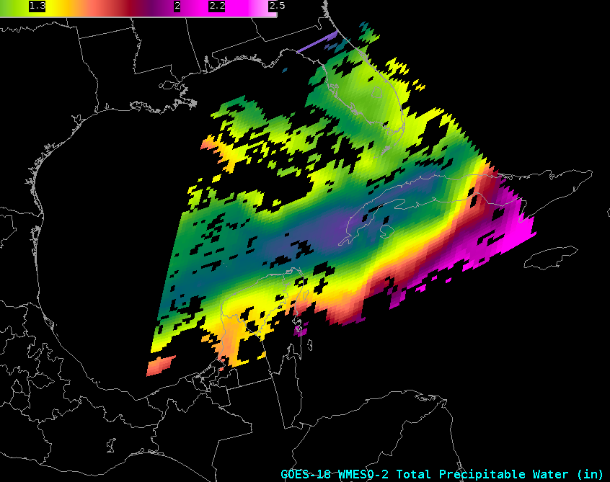
Total Precipitable Water
GOES-18 Preliminary, Non-Operational Data

Slide 10
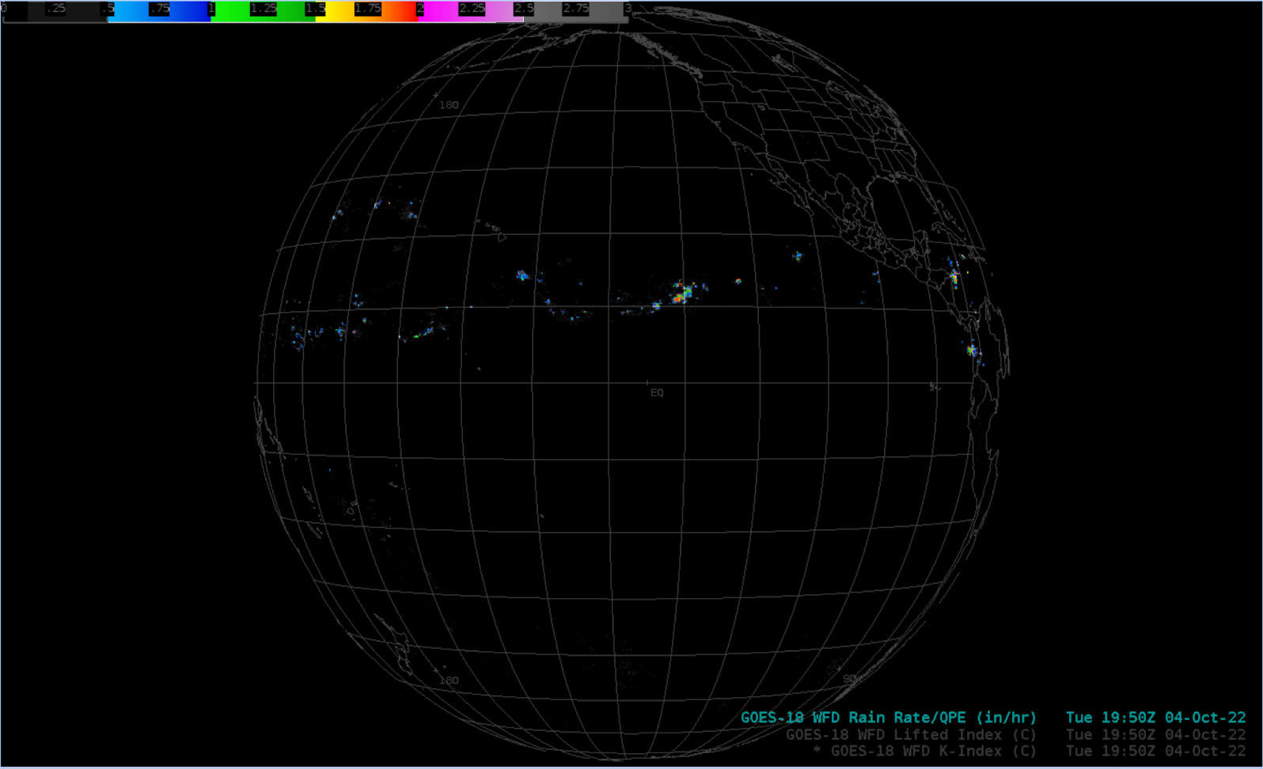
Rain Rate / Quantitative Precipitation Estimate
GOES-18 Preliminary, Non-Operational Data

Slide 11
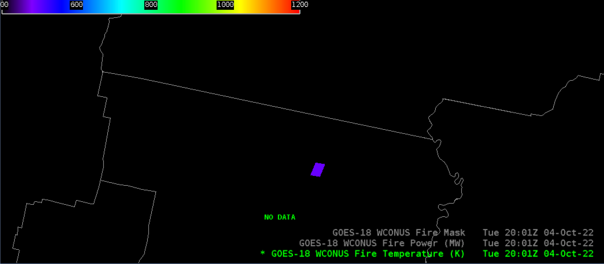
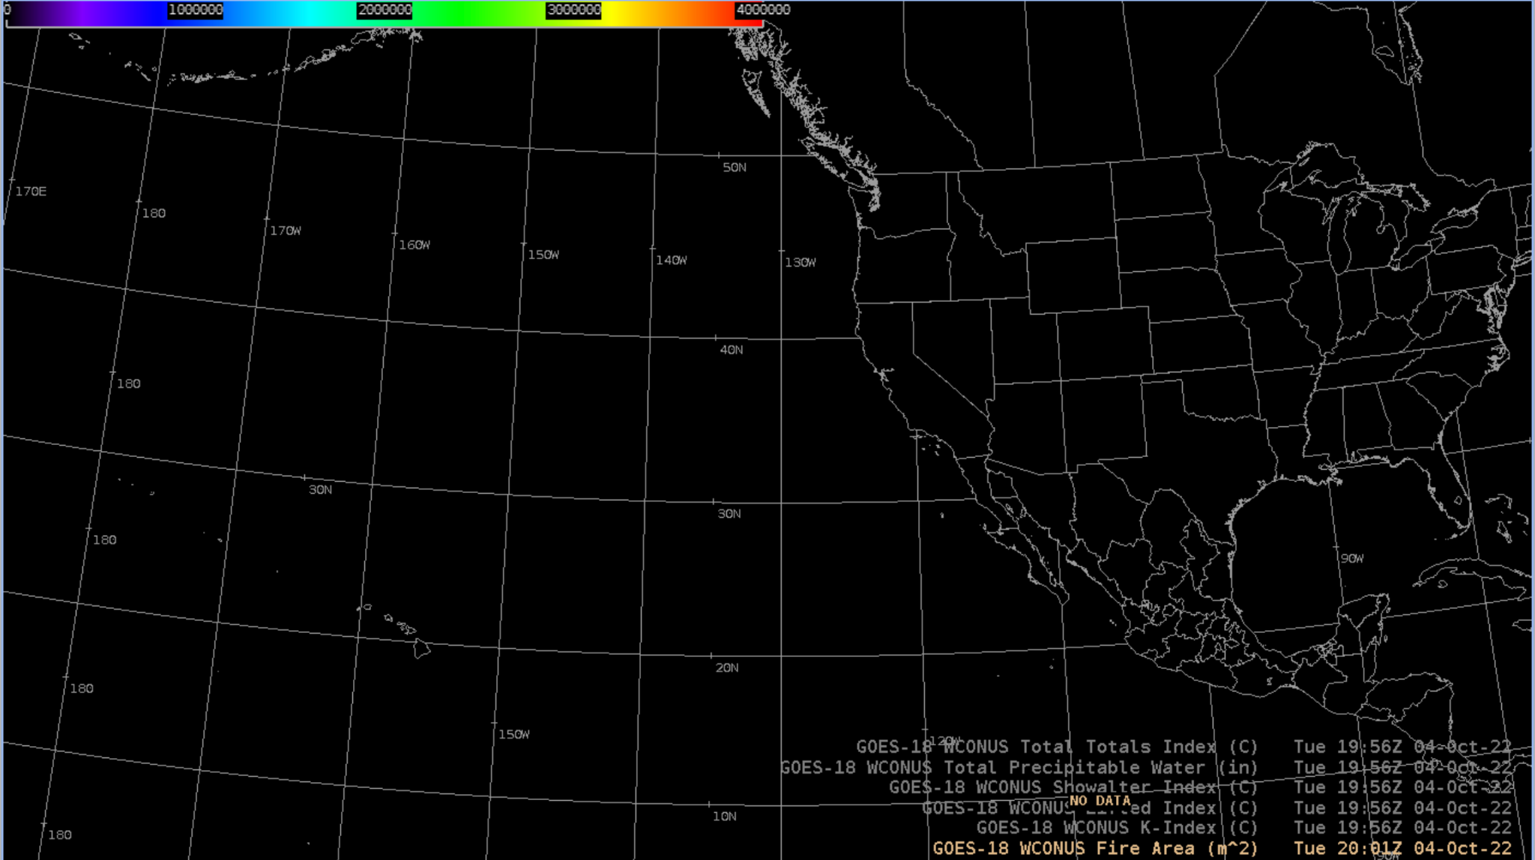
Fire Hotspots
GOES-18 Preliminary, Non-Operational Data
Available parameters:
Fire Power (MW)
Fire Temperature (K)
Fire Mask
Fire Area (m²)

Slide 12
Notes
AWIPS ingests and displays all these products using existing GOES-16/17 configurations.
    (Mostly in the AWIPS baseline;
    Reduced-levels LVMP/LVTP require TOWR-S RPM v22, deployed in Feb. 2022.)
  No fielding issues are expected
  G-18 products conform closely to G-16,17 conventions (GOES-R Product User Guide)
  AWIPS’ existing configurations for G16 and G17 are extensible for G18+

