Slide 1
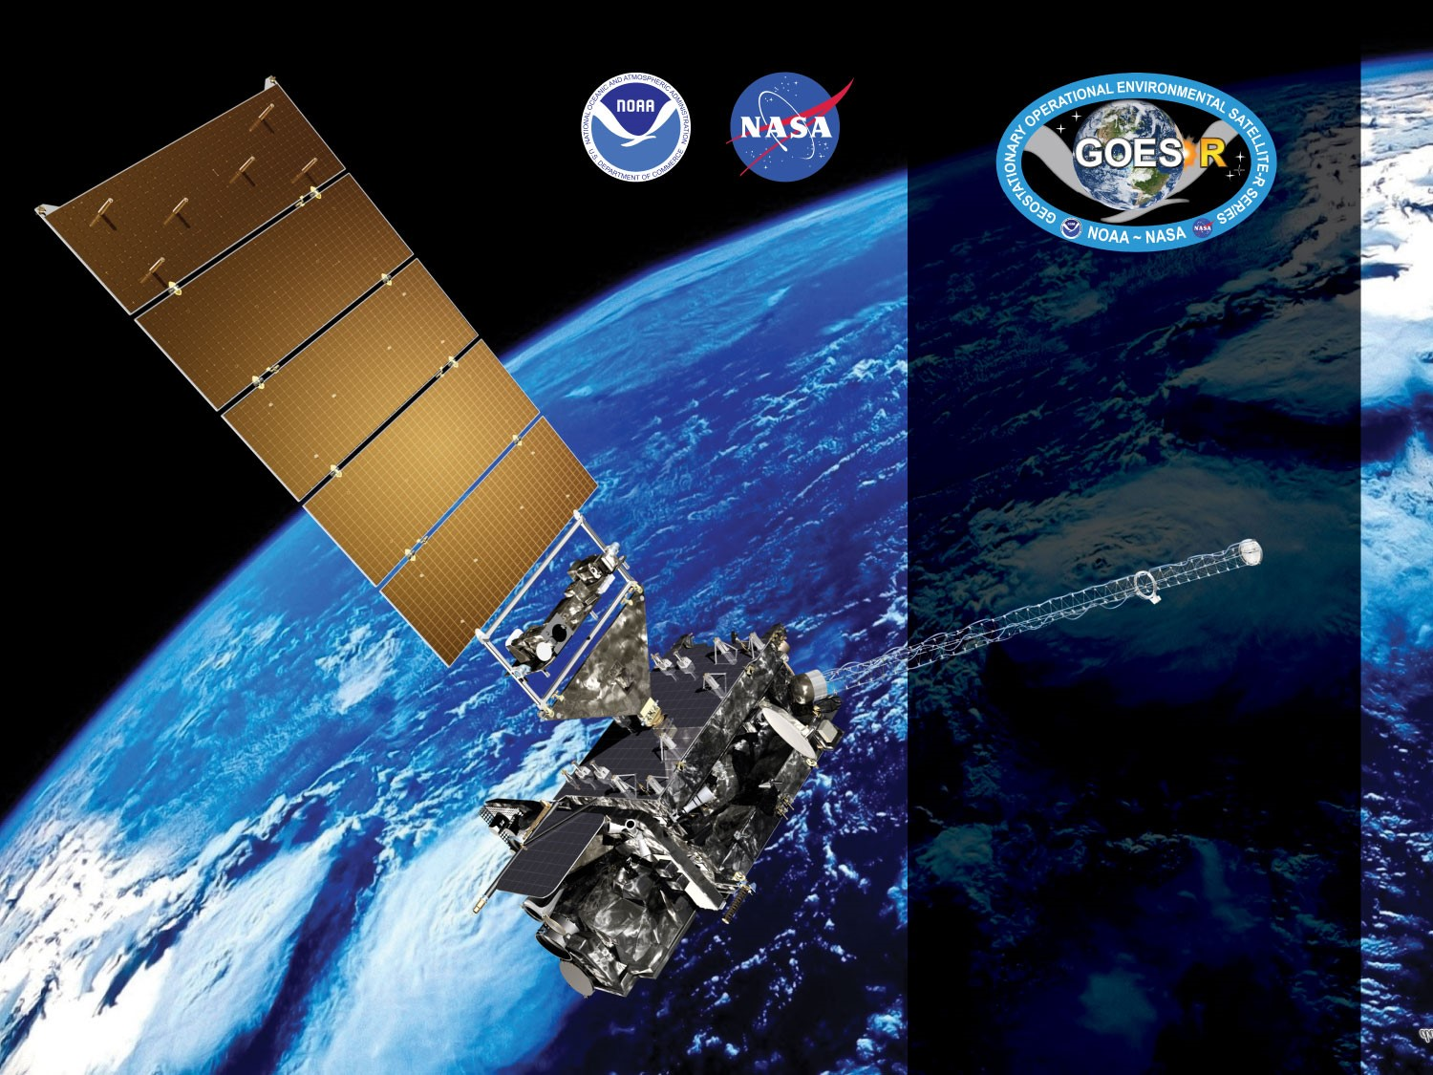
GOES-18 ABI L2+ Fire Detection and Characterization Provisional
PS-PVR
October 12, 2022
GOES-R AWG
Christopher Schmidt¹,
Ivan Csiszar², Shobha Kondragunta², Wei Guo³
¹CIMSS/UW-Madison
²NOAA/NESDIS/STAR
³IMSG at STAR

Slide 2
Outline
Provisional Validation Product Maturity Assessment
Product Overview
Status of FDC product related ADRs
Assessment results
Path to Full Maturity
Summary and Recommendations

Slide 3
Product Overview
The GOES-R ABI Fire Detection and Characterization Algorithm uses five ABI bands to identify and characterize fires using a contextual algorithm. It is the GOES-R series implementation of the Wildfire Automated Biomass Burning Algorithm (WFABBA). Four outputs are produced:
Mask: Contains fire classifications and metadata about non-fire pixels
Fire size*
Fire temperature*
Fire Radiative Power (FRP)
* Fire size and temperature should always be considered together. All of the characteristics represent a single fire that would produce the same radiance signal. ** Required when elevated focal plane temperature mitigation is active
Fire detection is sensitive to radiometric calibration, image navigation, band-to-band co-registration, and the remapping applied to the L0 data.
ABI Band | Central Wavelength (μm) | Required
2 | 0.64
7 | 3.9 | X
13 | 10.3 | X**
14 | 11.2 | X
15 | 12.3

Slide 4
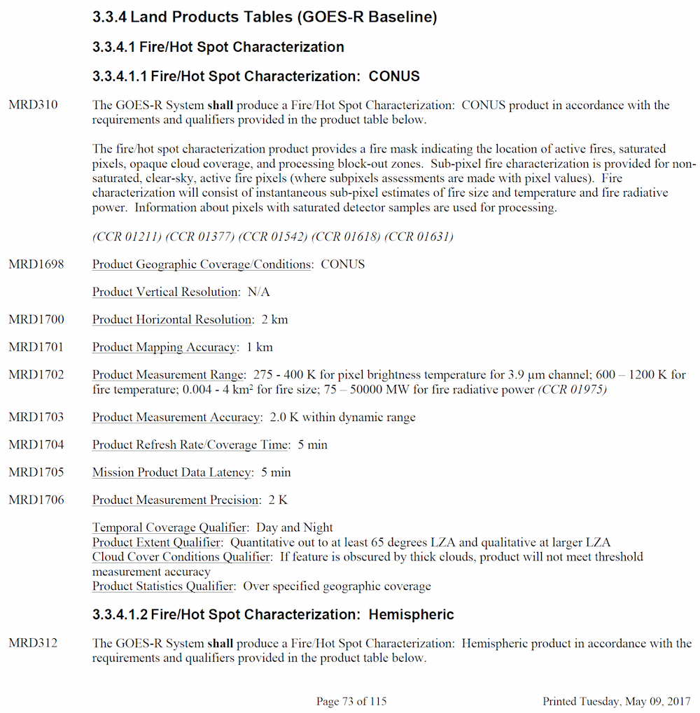
Product Overview: Specifications
Writing requirements for a satellite fire product is challenging given the lack of reliable truth data for fires. The requirement for the FDCA was crafted in terms of brightness temperature in band 7, which was interpreted to mean that fire characteristics combined with the background temperature estimate would recreate the band 7 brightness temperature within 2 K. The algorithm meets this requirement by design, characteristics are calculated by a recursion that recreates the input values to within <0.001 K.
In order to assure adequate product quality, user reviews in the Provisional and Validation Review stages are critical. Their acceptance of the product’s quality is the most important threshold. Since these requirements were written there has been advancement in terms of quantitative assessment of satellite fire products, techniques that are applied in the deep-dive analysis tool which will feature in later reviews.
CONUS, MESO, and FD (and Mode 3, 4, and 6) requirements are the same:

Slide 5
ADRs Resolved or still in progress since GOES-17 FDC Delta Provisional Maturity
ADR | Description | Impact | Mitigation | Status
ADR580 | Diagnostic data for FDCA | Every fire has several dozen associated parameters, many of which are useful for diagnosing why errors and false alarms have occurred and, even moreso, for determining the source of differences between the product produced within different systems. This will be very important for full validation. | Produce diagnostic data | Installation underway, should be available Oct 2022
ADR1281 | FDCA does not process Hawaii and some other islands. They are missing from two of the static ancillary landcover datasets. | RAVE algorithm is going operational for the Pacific and requires FDCA inputs over Hawaii. | Options include modifying the landcover databases, altering code logic, and replacing the databases | Options are under review
Little Impact
Moderate Impact
Big Impact

Slide 6
ADRs Resolved or still in progress since GOES-17 FDC Delta Provisional Maturity
ADR | Description | Impact | Mitigation | Status
ADR660 | Many false alarms following the resolution of ADR576 with install of PR 06.10. NESDIS (SAB) team noticed very many class 13 (high probability) and class 14 (medium possibility) false alarms in the FDCC and FDCF products. These false alarms were previously coded as class 15, low possibility fires, and had been left out of SAB analyses. The update did not introduce a new issue, it highlighted existing false alarm issues that were identified as an algorithm risk during the Provisional PS-PVR. | SAB changed procedures with FDCA product. (previously this stated that SAB ceased using the product, which was not the case, SAB limited which categories of fires go into HMS) | Jan 2019 update (installed 25 July 2019) improved situation, however false alarm rate remains high. Additional algorithm updates required to further reduce false positives unless Enterprise Fire Algorithm promoted first | Pending, related to ADRs 1049 and 847
ADR1049 | Episodes of fill data a few times a week. Reported 12 Nov 2019. Missing blocks primarily over South America. Caused by background calculation running to the maximum for many pixels, data expires from data fabric before algorithm completes. This is connected to some types (low possibility fires without FRP, primarily) of frequent false alarms | Some areas of images, usually Full Disk over South America, are not processed. | Algorithm update required unless Enterprise Fire Algorithm promoted first | Pending, related to ADRs 660 and 847
ADR847 | Same issue as ADR1049, but was reported a year earlier and framed differently. | Some areas of images, usually Full Disk over South America, are not processed. | Algorithm update required unless Enterprise Fire Algorithm promoted first | Pending, related to ADRs 660 and 1049
Little Impact
Moderate Impact
Big Impact

Slide 7
ADR notes
ADR 580 will greatly accelerate the delivery process.
The Enterprise Fire Algorithm (eFire) will include the updates for ADRs 660, 1049, and 847.
The issues reported in ADRs 660, 1049, and 847 derive from the same set of science issues that need to be resolved. The root causes are solar reflections off clouds and airmasses that elevate band 7 temperatures over band 14 temperatures. Both cause pixels to be dropped from background calculations and both can trigger false positives (primarily coded as low possibility fires)

Slide 8
PROVISIONAL VALIDATION MATURITY ASSESSMENT RESULTS
GOES-18 Fire Detection and Characterization Provisional PS-PVR

Slide 9
Top Level Evaluation
 | Current Status | Future Outlook
Visual Inspection: (Cadence, Availability) | Performance is in-line with experience with GOES-16, like GOES-17 it was expected to be worse due to relative distribution of land (most land is at higher viewing angles and mountainous, both of which tend to be more problematic) Known issues need resolution (ie noticeable false alarms due to ground features and recurring situations) | Expect false alarm rate reduction
Quantitative Performance: (Accuracy, Precision) | Performance of algorithm since the 2019 science update continues. GOES-18 FDCA product compares well to the GOES-16 FDCA product. GOES-18 FDCA matches GOES-17 FDCA within expectations outside of the heating periods. Application of terrain correction improves validation statistics. Water clouds produce a large number of false alarms. Solar farms are producing persistent false alarms. | Expect continued improvements in reducing false alarms

Slide 10
Qualitative Success Definitions
PASSED
Specifications are met for product performance.
PARTIAL-PASSED
Specifications are close to being met for product performance. Example: Not meeting false positive requirement, but being within reason.
FAILED
Specifications are far from being met for product performance.

Slide 11
Review of GOES-18 Provisional PLPTs
PLPT ID | Descriptive Title | Criteria | Pass
ABI-FD_FHS01 | Verify that fire activity detected in FD products generated every 10 min is in accordance with expected measurement range (Mode 6) | Products are generated when fires are present
ABI-CONUS_FHS02 | Verify that fire activity detected in CONUS products generated every 5 min is in accordance with expected measurement range (Mode 6) | Products are generated when fires are present
ABI-MESO_FHS03 | Verify that fire activity detected in MESO products generated every 30 seconds is in accordance with expected measurement range | Products are generated when fires are present
ABI-FD_FHS04 | Verify that fire-free pixels in FD products generated every 10 min are classified accordingly (Mode 6) * | No more than 25% of the detected fires cannot be seen in the Band 7 and/or reference data
ABI-CONUS_FHS05 | Verify that fire-free pixels in CONUS products generated every 5 min are classified accordingly (Mode 6) | No more than 25% of the detected fires cannot be seen in the Band 7 and/or reference data
ABI-MESO_FHS06 | Verify that fire-free pixels in MESO products generated every 30 seconds are classified accordingly (Mode 6) | No more than 25% of the detected fires cannot be seen in the Band 7 and/or reference data
ABI-FD_FHS07 | Verify that fire-free pixels in FD products generated every 15 min are classified accordingly (Mode 4) | No more than 25% of the detected fires cannot be seen in the Band 7 and/or reference data
ABI-CONUS_FHS08 | Verify that fire activity is detected in CONUS products generated every 5 min in accordance with expected measurement range (Mode 4) | No more than 25% of the detected fires cannot be seen in the Band 7 and/or reference data
ABI-FD_FHS09 | Verify that fire-free pixels in FD products generated every 5 min are classified accordingly (Mode 4) | Products are generated when fires are present
ABI-CONUS_FHS10 | Verify that fire-free pixels in CONUS products generated every 5 min are classified accordingly (Mode 4) | Products are generated when fires are present

Slide 12
Review of GOES-18 Provisional PLPTs
PLPT ID | Descriptive Title | Criteria | Pass
ABI-FD_FHS11 | Assess performance of FD product for an extended period that includes some but not all seasonal variability, to demonstrate operational readiness. | • Performance assessment documented in terms of the probability of fire detection, as a function of sub-pixel characteristics and omission and commission error rates for a large and wide range of representative conditions. Representative conditions include the full range of biomes and surface types and seasons present within the Full Disk, including but not limited to wildfires in boreal forest, rainforest, wooded mountains, grassy plains, and agricultural burning during the seasons present during the Provisional period. • Product deficiencies documented and remediation strategies in place for known issues. • Impacts from challenges with upstream dependencies documented. • Feedback from the primary users (NWS, NESDIS, NRL, etc.) is summarized and documented. • Product is ready for operational use and for use in scientific publications to document product performance.
ABI-CONUS_FHS12 | Assess performance of FD product for an extended period that includes some but not all seasonal variability, to demonstrate operational readiness. | Same as ABI-FD_FHS11 but for CONUS products
ABI-MESO_FHS13 | Assess performance of FD product for an extended period that includes some but not all seasonal variability, to demonstrate operational readiness. | Same as ABI-FD_FHS11 but for MESO products
Full test plans and procedures are given in the ABI L2+ Fire Hot Spot (FHS) Readiness, Implementation, and Management Plan (RIMP v2.0; 410-R-RIMP-0328)

Slide 13
Issues requiring resolution
Algorithm delays at night due apparently to warm, moist air: the brightness temperature difference between bands 7 and 14 remains elevated after the solar correction is no longer applied due to atmospheric conditions, causing large areas where all non-cloud pixels require more than 20 loops to find a background temperature. This leads to large delays and data drop-outs in the ground system. A similar issue during the day due to reflected solar radiation was resolved with threshold corrections. This requires a reworking of the background temperature calculation. (a more inclusive fix in any case) This also causes large areas of low possibility false alarms at times.
Reflections due to solar farms and water clouds
Isolated urban heat islands and bare soil that can look like hotspots (can cause code 10 “processed” false alarms, particularly vexing for HMS operators)
Hawaii and other islands are missing from some ancillary datasets that derived in whole or part from one particular USGS AVHRR landcover dataset

Slide 14
User Feedback (all ABIs)
There has been very little GOES-18-specific feedback given the relatively limited time it has been available, the co-location with GOES-17, the intermingling of the two during the interleave periods
Users have not reported noticeable differences during the interleave periods – this was expected
Some NWS WFOs do use the L2 FHS product, there are shortcomings with AWIPS displays
Production of the mesoscale FDCA was received very positively
Introduction of the metadata mask into AWIPS was received very well, some forecasters stated they preferred having access to it despite the visibility of false alarms
Smoke/aerosol work is underway
Very good results for known fires
FDCA is key to the Regional ABI and VIIRS Emissions (RAVE) product, validation paper “Hourly Biomass Burning Emission Product from Blended Geostationary and Polar-orbiting Satellites for Air Quality Forecasting Applications” has been published (https://doi.org/10.1016/j.rse.2022.113237)
Additional validation underway, initial results are very positive showing good correlation between emissions generated using the FDCA and ground sensors
Low detection rate at night: FIREX-AQ researchers noted that the detection rate at night seemed low; this was a side-effect of the sensitivity reductions made during previous updates
NESDIS/SAB/HMS – Hawaii is not being processed; updated validation for algorithm since July 2019 update shows a very strong improvement, updated validation paper in preparation
Notes:
IC: “is in press” changed to “has been published (https://doi.org/10.1016/j.rse.2022.113237)”

Slide 15
Provisional Validation Assessment
Success Criteria | Assessment
Performance assessment documented in terms of the probability of fire detection, as a function of sub-pixel characteristics and omission and commission error rates for a large and wide range of representative conditions. Representative conditions include the full range of biomes and surface types and seasons present within the Full Disk, including but not limited to wildfires in boreal forest, rainforest, wooded mountains, grassy plains, and agricultural burning during the seasons present during the Provisional period. | Commission rates are low to moderate depending on basis for comparison for highest confidence fire class. Omission rates appear to be as expected based on intensity of omitted fires. Commission rates are high for lowest possibility classes, most are caused by reflective clouds, solar farms, and surface features that mimic hotspots (urban areas, bare ground).
Product deficiencies documented and remediation strategies in place for known issues. | Pathway for algorithm updates identified (use of additional bands, refined background calculations)
Impacts from challenges with upstream dependencies documented. | No L2 upstream dependencies.
Feedback from the primary users (NWS, NESDIS, NRL, etc.) is summarized and documented. | Positive feedback from NWS for mesoscale product and fire metadata mask. NESDIS users reported improved false alarms. Air quality modelers report that for known fires performance is very good, dealing with the false alarms.
Product is ready for potential operational use (user decision based on the user's established criteria) and for use in scientific publications to document product performance. | NWS WFOs are using L2 product, smoke/aerosol modelers are using L2 product

Slide 16
Visual Inspection FHS Detection Mask

Slide 17
Purpose of Mask
The mask provides the disposition, per the algorithm, of every pixel in the image
Includes the 6 fire classes and their temporally filtered equivalents, codes for cloud tests and ecosystem and glint screens
DQFs are derived from the mask, so discussion here is about the mask
Codes 20-25 do not apply to ABI-class instruments at this time

Slide 18
Definition of Mask Codes
WF_ABBA final output fire mask codes v6.5.011g
Mask Codes | Definition
-99 | Non-processed region of input/output image (algorithm did not start)
0 | Non-processed region of input/output image (algorithm initialized pixel)
10 | Processed fire pixel
11 | Saturated fire pixel
12 | Cloud contaminated fire pixel
13 | High probability fire pixel
14 | Medium probability fire pixel
15 | Low probability fire pixel
20 | Processed fire pixel removed by sampling screen
21 | Saturated fire pixel removed by sampling screen
22 | Cloud contaminated fire pixel removed by sampling screen
23 | High probability fire pixel removed by sampling screen
24 | Medium probability fire pixel removed by sampling screen
25 | Low probability fire pixel removed by sampling screen
30 | Temporally Filtered Processed fire pixel
31 | Temporally Filtered Saturated fire pixel
32 | Temporally Filtered Cloud contaminated fire pixel
33 | Temporally Filtered High probability fire pixel
34 | Temporally Filtered Medium probability fire pixel
35 | Temporally Filtered Low probability fire pixel
40 | Space pixel
50 | Satellite zenith angle block-out zone, greater than threshold of 80°
60 | Reflectance (glint) angle or solar zenith angle block-out zone, within respective thresholds, 10° and 10° respectively
100 | Processed region of image
120 | Bad input data: missing data, 4 µm
121 | Bad input data: missing data, 11 µm
123 | Bad input data: saturation, 4 µm
124 | Bad input data: saturation, 11 µm
125 | Invalid reflectivity product input (value <0). Can be indicative of localized spikes in the reflectivity product/bad data

Slide 19
Definition of Mask Codes
126 | Unusable input data: 4 µm less than minimum threshold (200 K)
127 | Unusable input data: 11 µm less than minimum threshold (200 K)
130 | Reserved
150 | Invalid ecosystem type
151 | Sea water
152 | Coastline Fringe
153 | Inland Water and other Land/water mix
155 | Reserved
160 | Invalid emissivity value
170 | No background value could be computed
180 | Error in converting between temperature and radiance
182 | Error in converting adjusted temperatures to radiance
185 | Values used for bisection technique to hone in on solutions for Dozier technique are invalid.
186 | Invalid radiances computed for Newton’s method for solving Dozier equations
187 | Errors in Newton’s method processing
188 | Error in computing pixel area for Dozier technique
200 | 11 µm threshold cloud test
201 | Band 7 minus 14 difference below threshold and below freezing test
205 | 4 µm minus 11 µm negative difference threshold cloud test
210 | 4 µm minus 11 µm positive difference threshold cloud test
215 | Albedo threshold cloud test (daytime only)
220 | 12 µm threshold cloud test (only used when data available)
225 | 11 µm minus 12 µm negative difference threshold cloud test
230 | 11 µm minus 12 µm positive difference threshold cloud test
240 | Along scan reflectivity product test to identify and screen for cloud edge used in conjunction with 4 µm threshold
245 | Along scan reflectivity product test to identify and screen for cloud edge used in conjunction with albedo threshold

Slide 20
Visual Inspection
Visual inspection of the FDCA data provides a quick way to assess similarity between GOES-17 and GOES-18 outputs.
Differences are expected, due in part to the ~0.3° subpoint separation but more importantly due to the exact positions that are sampled in the raw data before the data is remapped. ABI has pretty sharp vision, the MTF of the raw band 7 data means that pointing differences on the orders of fractions of a sample (which is smaller than a pixel, roughly 44 μrad wide versus 56 μrad) produce noticeable differences, particularly near gradients such as fires, cloud edges, and even surface changes.
The masks match well, within expectations.

Slide 21
Visual Inspection
GOES-18 and GOES-17 CONUS loops from 20-24 UTC (13-17 PDT) for a fire that rapidly grew near the intersection of CA-140 and Cartens Rd. Winds were high and the fire grew out of a canyon rapidly, which is why it seems to explode out of nothing – it was probably screened by terrain initially.
First row of panels: 3.9 μm and 11.2 μm bands scaled from 295 K (white) to 330 K (black) and FDCA product mask (legend below)
Second row of panels: 3.9 μm - 11.2 μm brightness temperature difference, 3.9 μm - 11.2 μm radiance difference in 3.9 μm space, and the radiance difference minus the rolling average of the previous 5 frames (temporal radiance difference)
Both loops are remarkably similar, as they should be given the ~0.3° separation.

Slide 22
Visual Inspection

Slide 23
Visual Inspection
Masks show overall similar results between GOES-17 and GOES-18
Differences are attributable to differences in the L1b data, not algorithm behavior
L1b differences are largely due to the properties of the telescope and phasing of the remapper:
Band 7 unremapped data is very “sharp” so small differences in pointing due to position and satellite attitude result will pick up gradients a little differently
Band 14 unremapped data has a broader response than band 7
Some cloud differences are attributable to differences in band 2 reflectance
No obvious impact from the GOES-18 “barcode” artifact; magnitude of that signal is too small to have more than a very nominal impact on a very small number of pixel classifications; it does appear with cold cloud tops at times but the pixels alternate between cloud and cases where band 7 and band 14 brightness temperatures are cold and less than 2 K apart.

Slide 24
Using Landsat (8 and 9)/OLI reference data Using VIIRS fire products
Deep-Dive Validation

Slide 25
Methodology
Using near-coincident Landsat-(8 and 9)/OLI imagery to assess sub-pixel GOES-18/ABI fire activity
Temporal separation between paired Landsat-8/OLI and GOES-18/ABI data limited to < 5-minutes
Matches occur when Landsat pixels fall within estimated ABI pixel polygon
Landsat (8 & 9)/OLI 30-m fire masks provide quantitative measure of fire activity within ABI’s effective pixel footprint
Reference Landsat (8 & 9)/OLI fire data supporting commission/omission error assessment
Sub-pixel fire characterization (Fire Radiative Power) assessment was not performed for GOES-18 data
Northern hemisphere summer at high SZA at high northern latitudes is expected to cause GOES-West to underperform relative to GOES-East

Slide 26
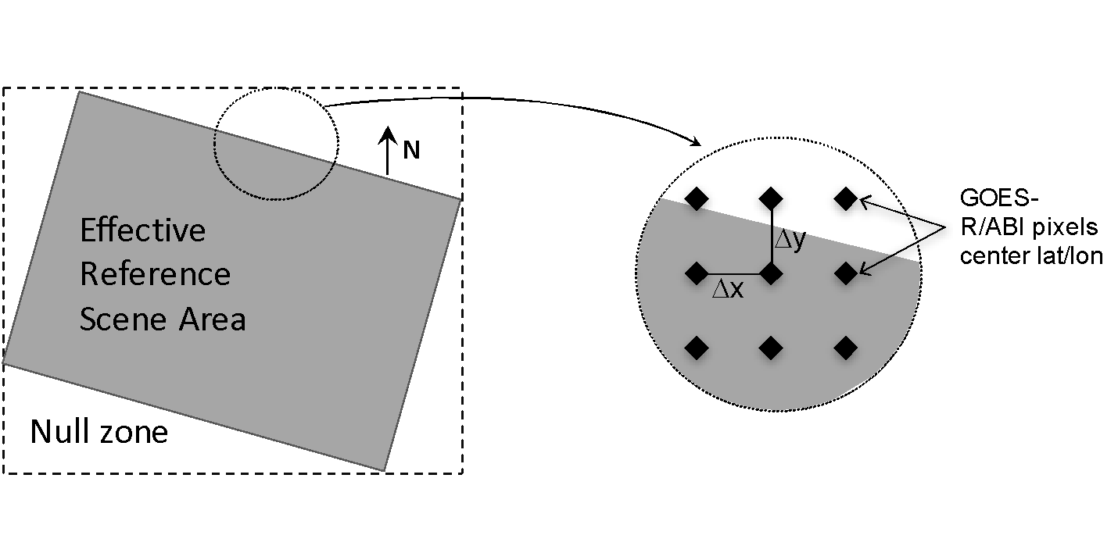
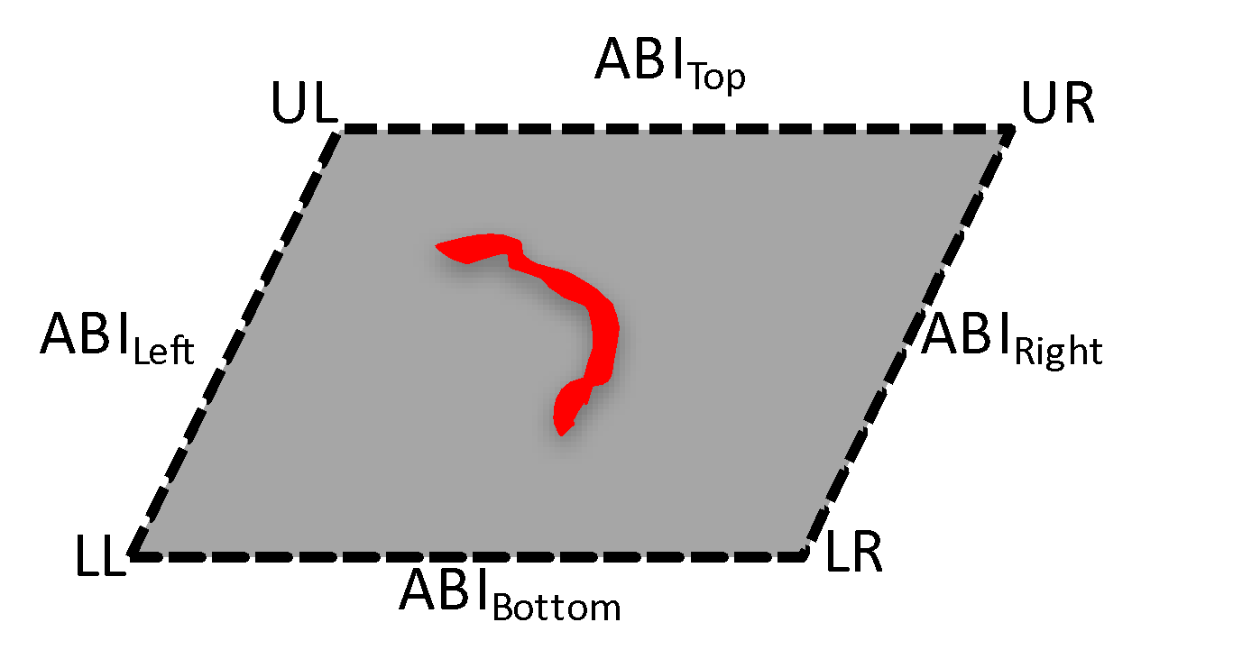
Methodology - Landsat-8/OLI Fire Detection Data Matching
C
o
-
l
o
c
a
t
e
I
n
d
i
v
i
d
u
a
l
D
e
r
i
v
e
A
B
I
P
e
r
-
P
i
x
e
I
l
n
p
u
t
G
O
E
S
A
B
I
M
a
t
c
h
A
c
q
u
i
s
i
t
i
o
n
V
e
r
i
f
y
D
a
t
a
O
v
e
r
l
a
p
A
B
I
P
i
x
e
l
s
W
i
t
h
S
u
m
m
a
r
y
F
i
r
A
e
c
t
i
v
e
F
i
r
e
D
a
t
a
(
S
p
a
t
i
a
l
M
a
t
c
h
i
n
g
T
≤
)
i
m
e
s
(
5
m
i
n
)
S
t
a
t
i
s
t
i
c
R
e
s
f
e
r
e
n
c
e
D
a
t
a
I
n
p
u
t
L
a
n
d
s
a
t
-
8
/
O
L
I
V
i
s
u
a
l
(
P
N
G
)
A
c
t
i
v
e
F
i
r
e
D
a
t
a
O
u
t
p
u
t
F
i
l
e
A
S
C
I
I
S
u
m
m
a
r
y
F
i
l
e
G
r
a
p
h
i
c
a
l
O
u
t
p
u
t
(
o
m
i
s
s
i
o
n
a
n
d
c
o
m
m
i
s
s
i
o
n
e
r
r
o
r
s
)
∑ (Fire Count_{Landsat8})
Data co-location
Sub-pixel active fire quantification

Slide 27
Algorithm performance with G16, G17, G18 in 2022
Validation was performed for G16, G17,G18 using data matched to reference Fire data (Landsat or VIIRS) from June 9 to August 27,2002 (DOY: 160-239)
One “reference fire pixel” is one 30x30m Landsat (L8 /L9) active fire pixel
The number of GOES-17 and GOES-18 matches are different, so validation rates are not identical
GOES-18 saturation temperature is ~410 K, the algorithm assumes it is ~412 K, so no pixels have been flagged as saturated, those fires are typically classified as “processed”
Deep dive validation was limited to fires within GOES 65° SZA
Notes:
IC: changed “1” to “One”

Slide 28
Algorithm performance with G16, G17, G18 in 2022
Pixel size of VIIRS-M fire product is about 750m
Pixel size of VIIRS-I fire product is about 375m
VIIRS-I and VIIRS-M fire products from Suomi NPP and NOAA-20
Enterprise Fire (eFire) implementation of FDCA also used in comparisons: eFire has some important differences related to known issues
Notes:
IC: added “Suomi” etc.

Slide 29
Validation Scores
Confirm rate indicates the percent of ABI fire pixels that can be verified by Landsat fire (at least 1 Landsat (or VIIRS) fire pixel falls into a given ABI fire pixel).
False alarm rate is percent of ABI fire pixels that cannot be verified by Landsat fire (at least 1 Landsat (or VIIRS) cloud free pixel fall into a given ABI fire pixel, but none of them was identified as Landsat fire).
Detection rate evaluates the capability of ABI fire product to catch big fire. Fire size was defined as the number of Landsat (or VIIRS) pixels in an ABI pixel.

Slide 30
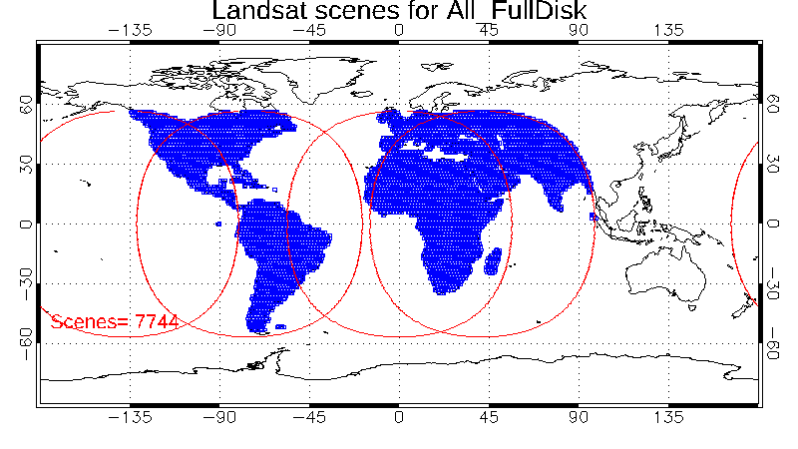
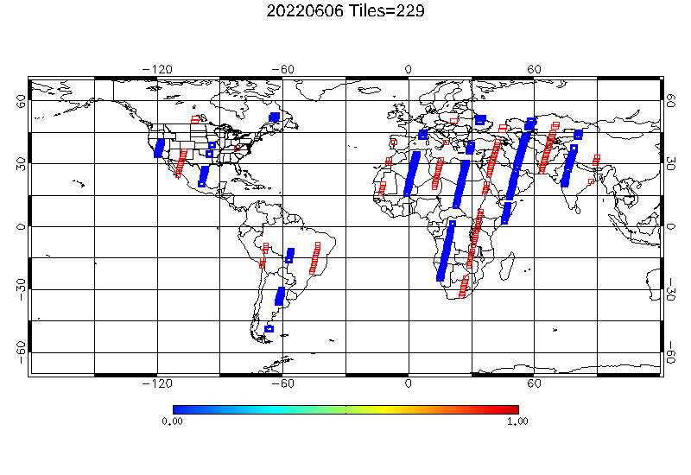
Landsat scenes collected
Both The Landsat-8 and Landsat-9 data falls in ABI or SEVIRI domains were collected.
About 200-250 scenes (200GB) were collected each day.
Notes:
Both The Landsat-8 and Landsat-9 data falls in ABI or SEVIRI domains were collected.
About 200-250 scenes were collected each day.

Slide 31
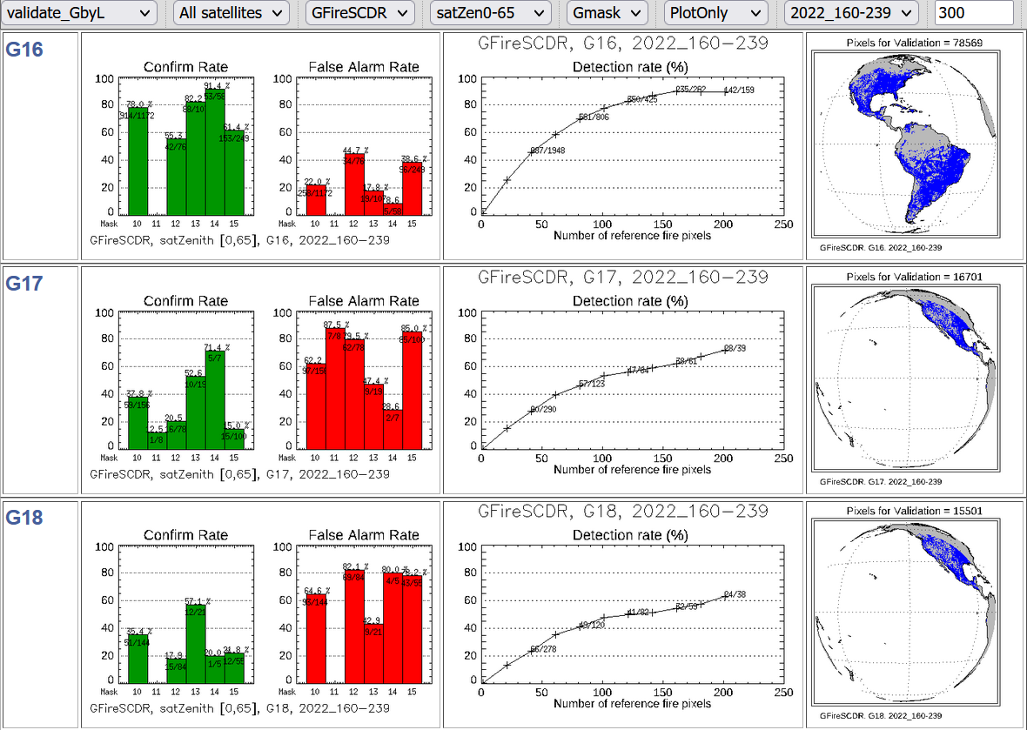
Validation by Landsat
Notes:
Confirm rate indicates the percent of ABI/SEVIRI fire pixels that can be verified by Landsat fire (at least 1 Landsat fire pixel falls into a given ABI/SEVIRI fire pixel).
False alarm rate is percent of ABI/SEVIRI fire pixels that cannot be verified by Landsat fire (at least 1 Landsat cloud free pixel fall into a given ABI/SEVIRI fire pixel, but none of them was identified as Landsat fire).
Detection rate evaluates the capability of ABI/SEVIRI fire product to catch big fire. Fire size was defined as the number of Landsat pixels in an ABI/SEVIRI pixel.
Validation scares of G16 and G18 is similar.
Confirm rate of G16 is much higher than G17 and G18. This is because the data samples for G17 and G18 validation if far from nadir.

Slide 32
Previous GOES-17 results
From GOES-17 deltaProvisional review
Rates are overall similar to those from 2022
Before Oct 23, 2020
After Oct 23, 2020

Slide 33
VIIRS Validation of G18 FDC and eFire
Validation with VIIRS uses the same overall procedures as the deep dive validation
The Enterprise Fire (eFire) implementation of the FDC is very similar but has some relevant differences that lead to better performance
eFire utilizes a more strict solar glint screen, which cuts out a large number of false positives
VIIRS results are somewhat better than deep dive results: larger datasets, different times of day, and match radius is more forgiving due to VIIRS pixel size
Notes:
IC: added “Suomi” etc.

Slide 34
VIIRS Validation of G18 FDC and eFire
Notes:
G18:
ABI fire on SCDR (Right):Pixels with fire Mask class15: very few were confirmed by VIIRS, especially for night granules
EFIRE (Left), false alarm was greatly reduced and shows high confirm rate for night.

Slide 35
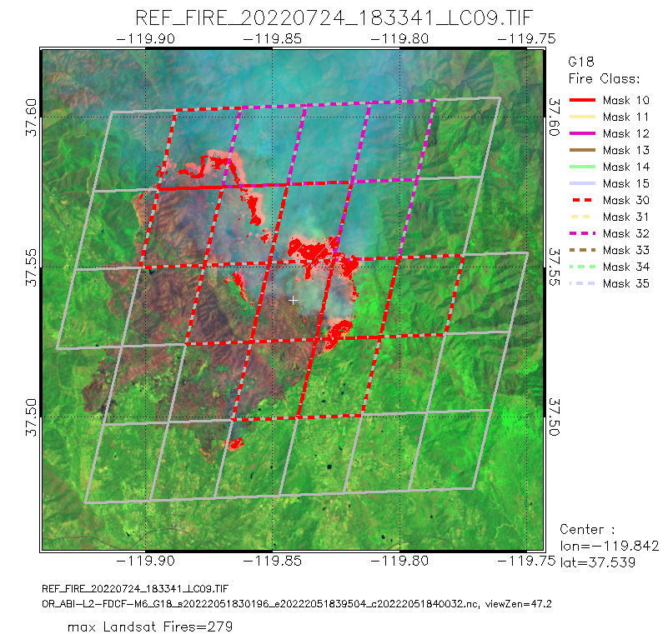
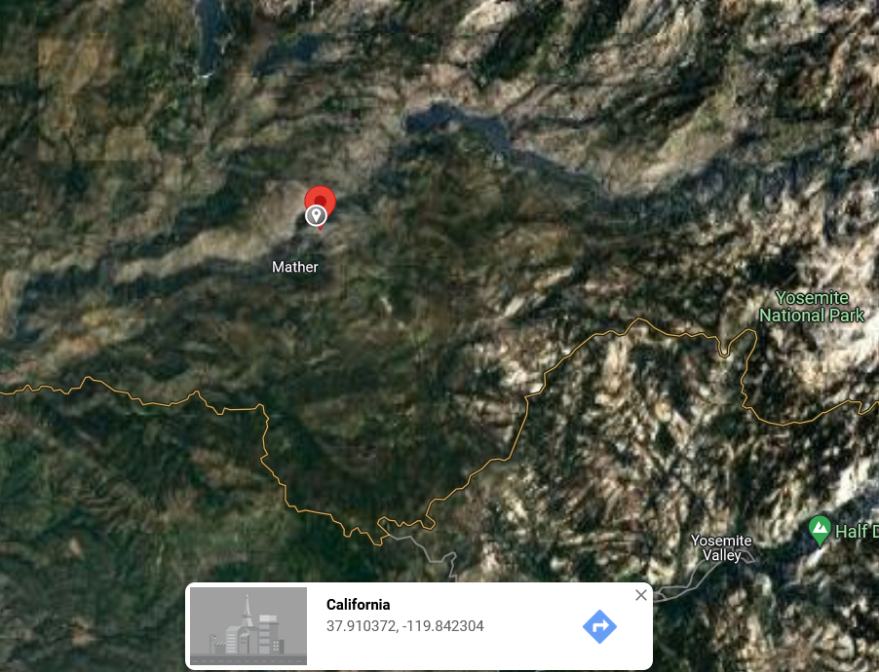
True Positives Oak Fire (2022)
Notes:
This case was reported:
https://www.reuters.com/business/environment/thousands-evacuated-californias-oak-fire-grows-quickly-2022-07-24/
July 24 (Reuters) - Firefighters deployed air tankers, bulldozers and hand crews to battle a fast-moving wildfire just west of Yosemite National Park on Sunday that suddenly and unpredictably grew into one of the largest fires of the year, forcing thousands of evacuations.
Fueled by extreme heat and tinder-dry forests and underbrush, the Oak Fire that began on Friday closed within half a mile (0.8 km) from the town of Mariposa Pines but was still more than 10 miles (16 km) from Yosemite, famed for its giant, ancient sequoia trees.

Slide 36
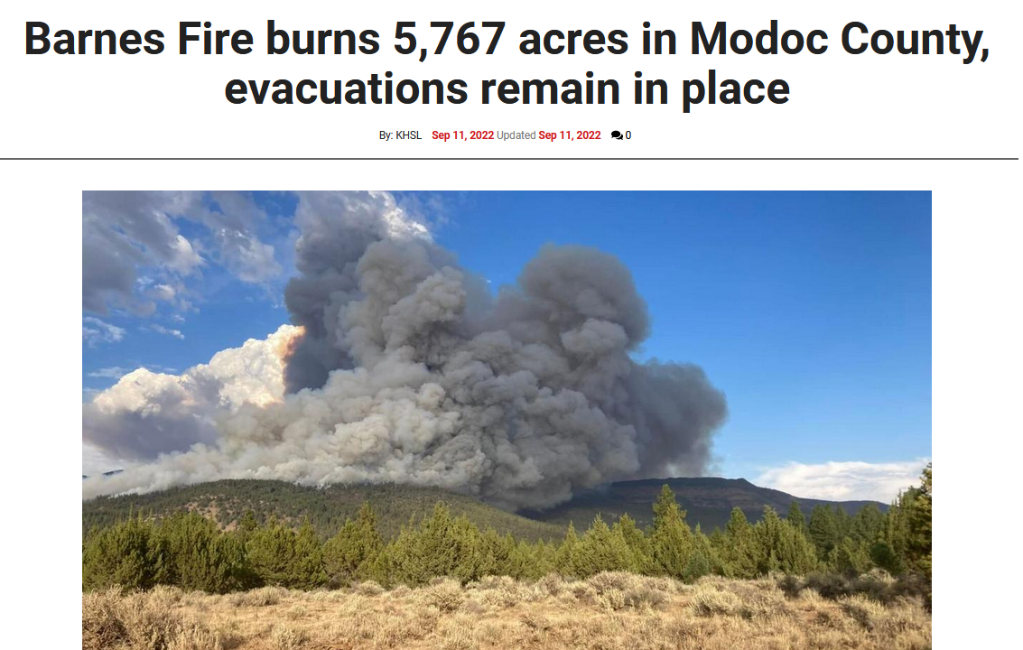
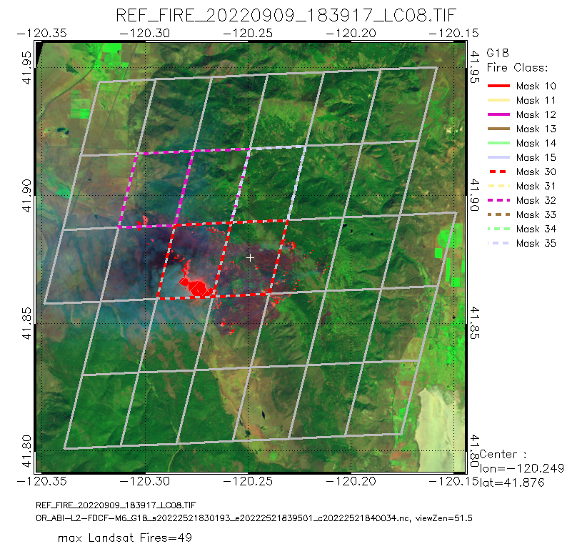
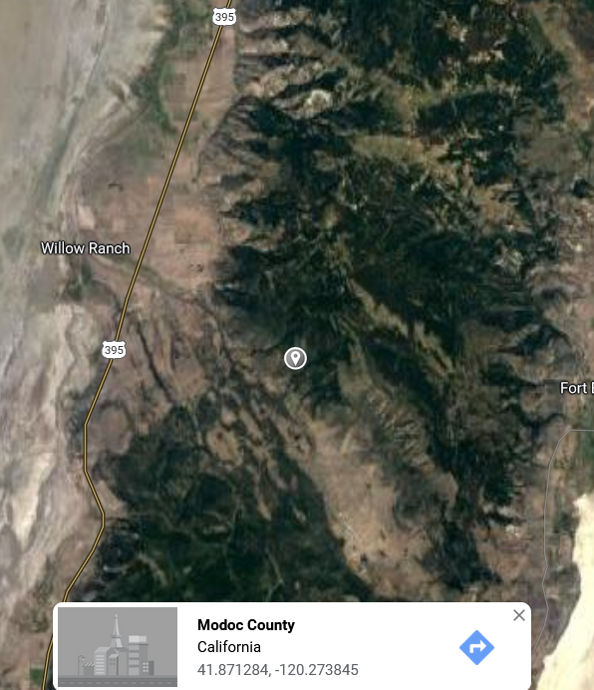
True Positives Recent big Fire near Willow Creek Ranch
https://www.actionnewsnow.com/news/fire-watch/barnes-fire-burns-5-500-acres-in-modoc-county-evacuations-remain/article_50ad32ce-30a0-11ed-9a1d-9fa7b54b545c.html
Notes:
Recent big fire 9/9/2022.
This case was reported by
https://www.actionnewsnow.com/news/fire-watch/barnes-fire-burns-5-500-acres-in-modoc-county-evacuations-remain/article_50ad32ce-30a0-11ed-9a1d-9fa7b54b545c.html
Barnes Fire burns 5,767 acres in Modoc County, evacuations remain in place
By: KHSL
Sep 11, 2022 Updated Sep 11, 2022
MODOC COUNTY, Calif. 9:44 A.M. SUNDAY UPDATE - The Barnes Fire in Modoc County has now burned 5,767 acres after it was driven by east winds, according to the Modoc National Forest. The fire remains at 0% contained.
One home was destroyed Saturday night. Officials say that they expect to have the fire contained in the Willow Creek Ranch area.
Crews said a spot fire across from County Road 9 was attacked by air tankers and ground crews on Friday.
Firefighters are taking direct attacks on the fire in the Fandango Peak area.

Slide 37
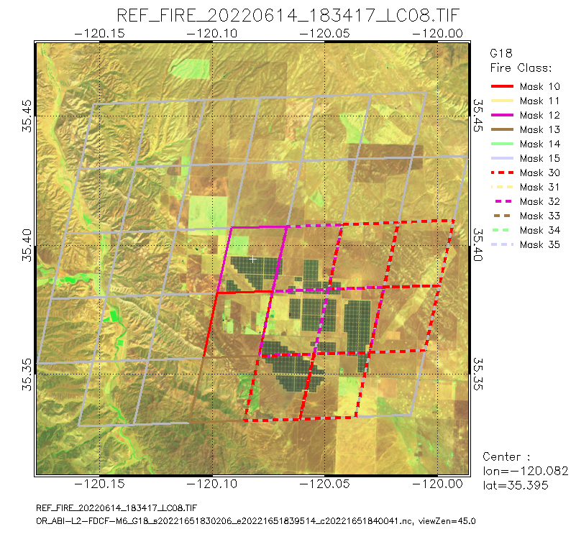
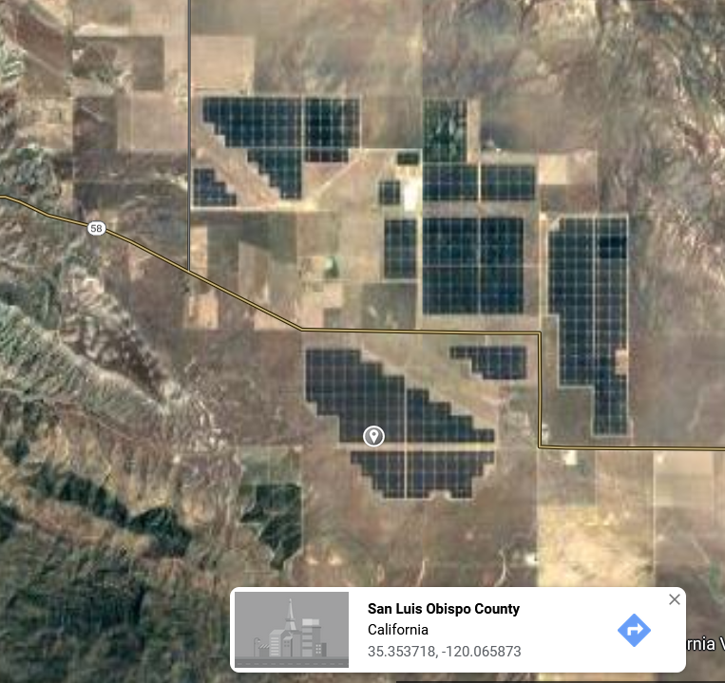
Known Issues: Reflections from solar panels
False Alarm :
Solar Panels in California
(Topaz)

Slide 38
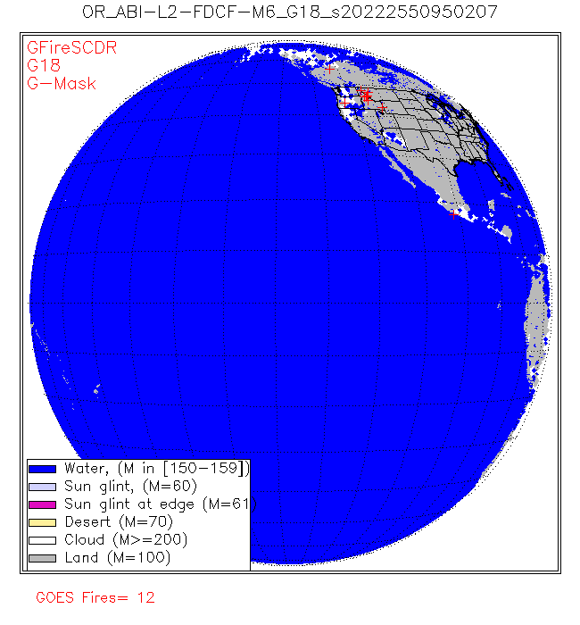
Known Issues:
Reflections from clouds, surface
Animation of the FDC Mask
(9:50Z – 14:40Z)
Large numbers of false positives are present in areas where forward scattering of sunlight off of clouds, water, and some surfaces is strongest

Slide 39
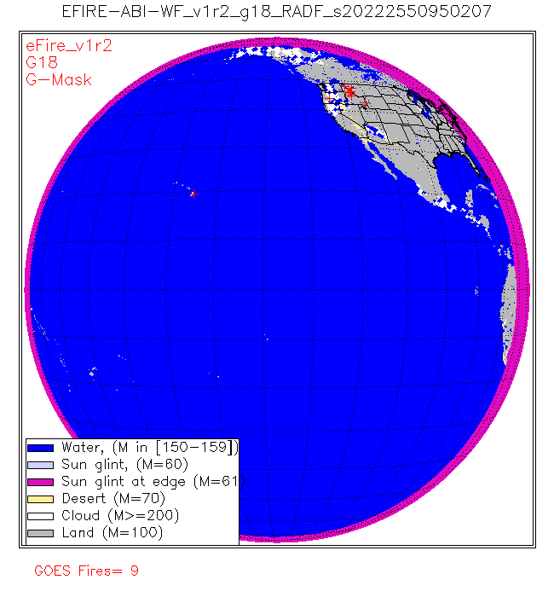
Known Issues:
Reflections from clouds, surface
Animation of the eFire Mask
(9:50Z – 14:40Z)
While virtually the same as the FDC in many respects, eFire employs a more strict glint screen, which slashes the number of false positives due to forward scattering.

Slide 40
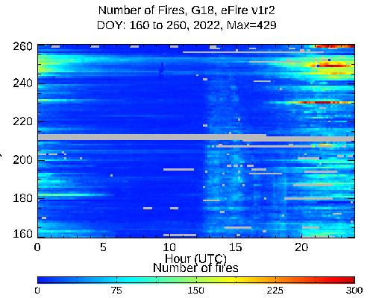
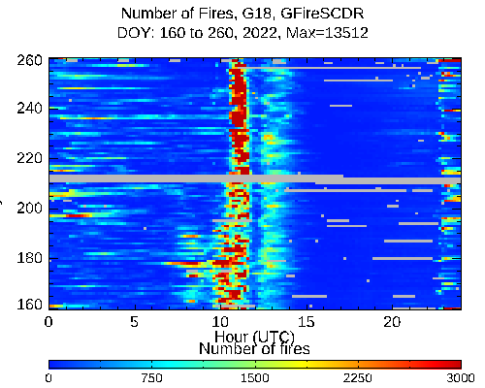
Known Issues:
Reflections from clouds, surface
A time-time graph of the fire counts in the FDC vs EFIRE. Note the different scales.

Slide 41
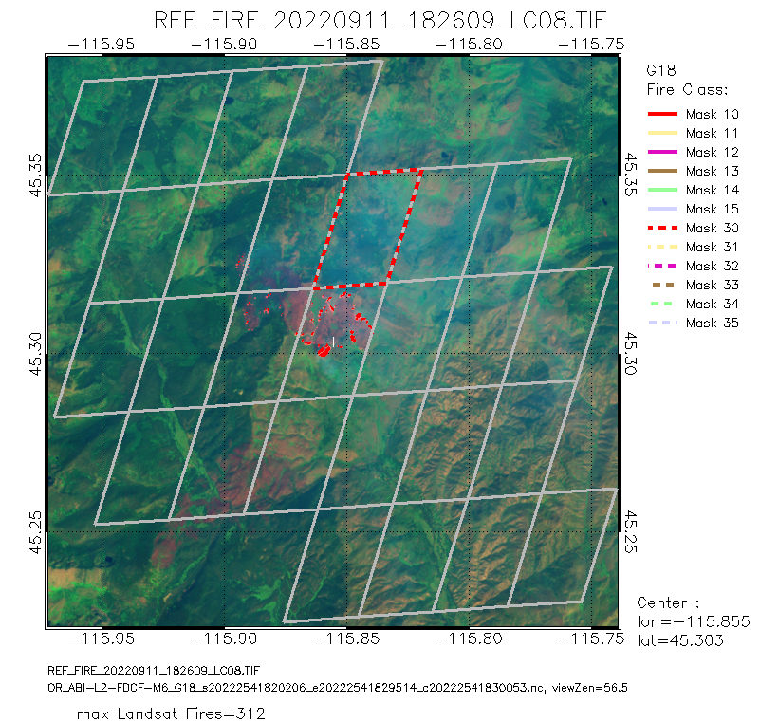
Known Issues:
Terrain Correction
Missed detection
The validation process flags this ABI fire (temporally filtered processed fire) as a miss, despite proximity to a large Landsat fire.

Slide 42
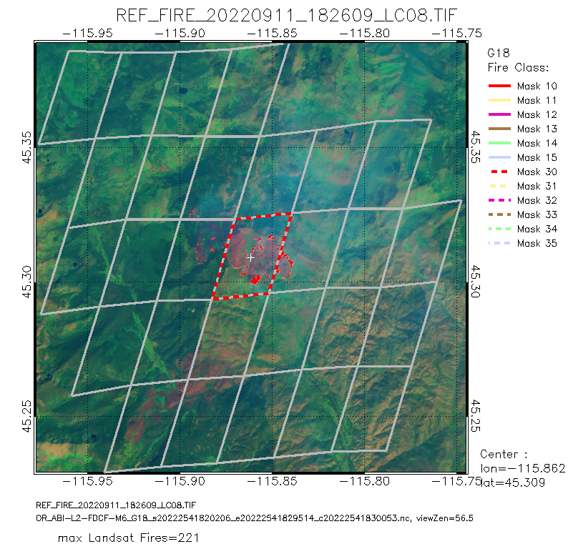
Known Issues:
Terrain Correction
Matched detection
With terrain correction applied to the FDC data, the ABI fire is now considered a true positive instead of a false alarm.

Slide 43
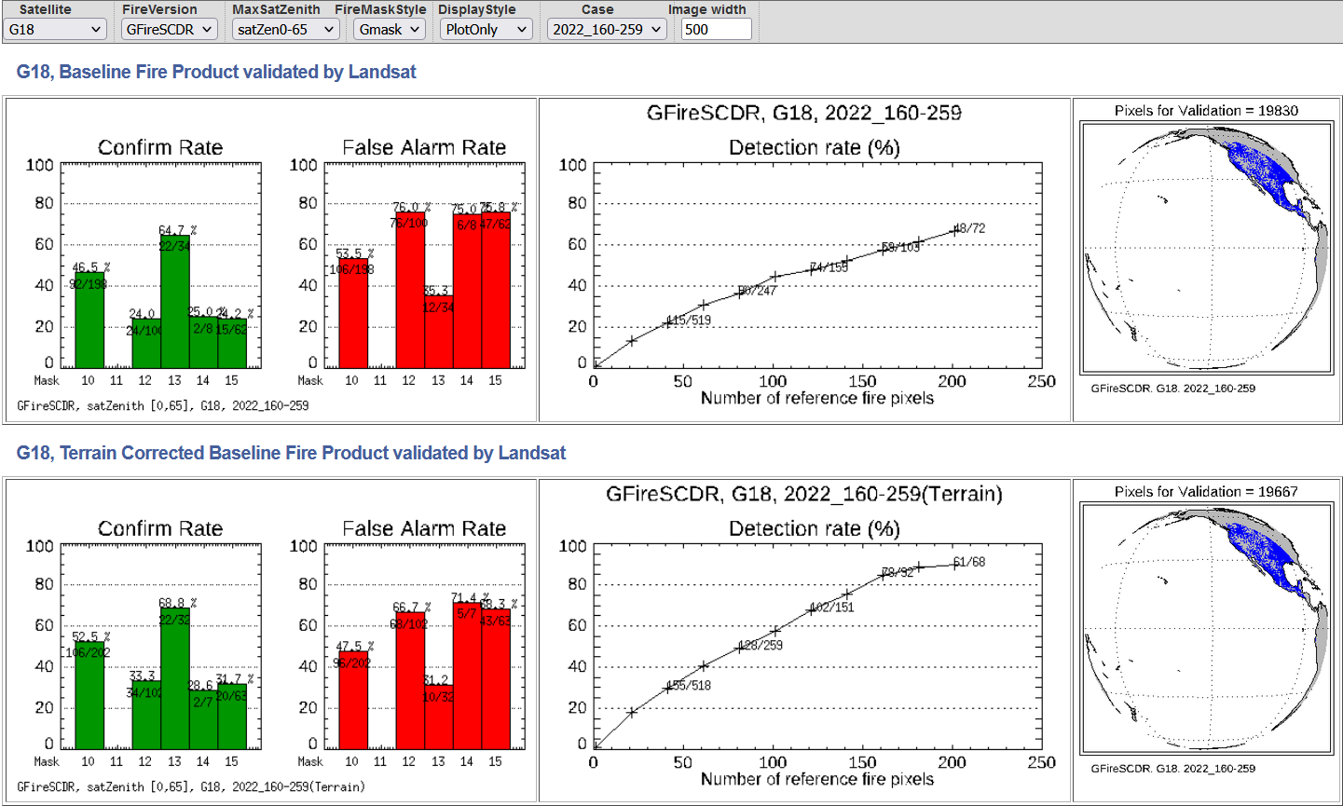
Validation of GOES-18 FDC by Landsat (using 100 days)
Terrain corrected geolocation improves the confirm rate and detection rate

Slide 44
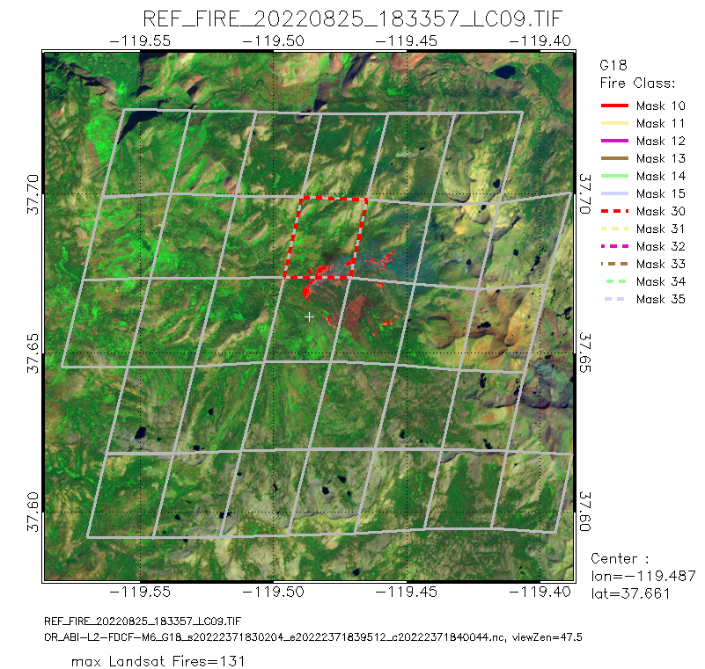
Known Issues:
Match distance
“Missed detection”
Even after terrain correction the lower part of this fire complex is labeled as a miss and counts against the FDCA. However, the reason for the “miss” may be connected to: remapping, small navigational offsets, terrain screening, errors in terrain correction, or some combination of those. Clustering the Landsat detections as an “event” and matching those to GOES “events” would be a more comprehensive way of assessing performance.

Slide 45
PATH TO FULL MATURITY
GOES-18 Fire Hot Spot Characterization Provisional PS-PVR

Slide 46
This is the Way
Full maturity follows the same PLPTs as Provisional
Test periods will be extended
Deep dive validation will be refined; New study by Hall et al (in preparation) shows better performance for GOES-17 than these deep dive analyses do, and there is a known issue with matching Landsat to GOES
The most important test is user acceptance of the fire detection rates (true positive, false positive, etc); the most common complaints are excess false positives and low sensitivity at night

Slide 47
Future Plans
There are ongoing discussions about the future direction of the FDC (and eFire for GOES-R) given the creation of a new NESDIS Wildfire Program and the pending testing of using a VOLCAT derivative for fire alerting and a new fire application system. Nevertheless, some items on this list are new and would benefit both systems.
Short-term improvements – Update surface ancillary data to enable processing of Hawaii (approach TBD), implement changes to glint angle screening similar to eFire approach, correct saturation threshold for GOES-18.
Medium-term improvements – Integration of persistent anomaly database, generate improved metadata for ecosystem/surface types (existing databases are at least 15 years old and remapping to ABI doesn’t account for terrain or the mix of types within the pixel), provide terrain-corrected fire locations and pixel outlines, improved handling of cloudy pixels, common file format for geostationary and polar fire products from NOAA, and creation of “fire events” that provide information about the fire pixel clusters like intensity and perimeter.
Ongoing semi-automated solar farm identification from satellite data – Affects all platforms, but there is not a unified strategy for identifying the farms in order to screen them out.
47
Notes:
IC: edited the first paragraph. I also added “improved handling of cloudy pixels” to the second one.

Slide 48
Provisional Validation
Preparation Activities | Assessment
Validation activities are ongoing and the general research community is now encouraged to participate. | Fires Team works with and receives feedback from users who apply data, such as NWS forecasters and smoke/aerosol modelers. Validation papers have been published.
Severe algorithm anomalies are identified and under analysis. Solutions to anomalies are in development and testing. | Development of fix for missed Hawaii processing is underway, ADRs cover other algorithm issues.
Incremental product improvements may still be occurring. | Work is underway to introduce terrain correction, modifications to background calculation, and increasing nighttime sensitivity.
L2+ only: Users are engaged in the Product Feedback Forums and user feedback is assessed. | User feedback has been received and assessed.
End State | Assessment
Product performance has been demonstrated through analysis of a small number of independent measurements obtained from select locations, periods, and associated ground truth or field campaign efforts. | Deep-dive validation is ongoing.
Product analysis is sufficient to communicate product performance to users relative to expectations (Performance Baseline). | Readme files and ATBD have been updated and numerous presentations given about the product, including at AMS meetings and the TOWR-S Satellite Book Club (where NWS forecasters are the primary audience).
Documentation of product performance exists that includes recommended remediation strategies for all anomalies and weaknesses. Any algorithm changes associated with severe anomalies have been documented, implemented, tested, and shared with the user community. | Studies have been published or soon will be which document algorithm performance and update history. ATBD and Readme discuss how to address anomalies and weaknesses.
Testing has been fully documented. | Testing methodology is documented in the ABI L2+ Fire Hot Spot (FHS) Readiness, Implementation, and Management Plan (RIMP v2.0; 410-R-RIMP-0328).
Product is ready for operational use and for use in comprehensive cal/val activities and product optimization. | Product is used in operational settings (such as NWS offices) and has been used in several studies validating smoke/aerosol models and algorithm performance.

Slide 49
SUMMARY & RECOMMENDATIONS
GOES-18 Fire Hot Spot Characterization Provisional PS-PVR

Slide 50
Summary & Recommendations
The AWG Fires Team asserts that the GOES-18 baseline Fire Detection and Characterization (FDC) product meets the success criteria and requirements for Provisional status
Sources of false alarms have been identified and include:
Reflections off water cloud and water
Surface features, including bare ground and solar farms
User feedback is sparse for GOES-18 data
GOES-17/-18 interleave highlighted similarities between products overall, and due to stability during GOES-17 heating periods due to the mitigation, end users were generally unaware of the difference between the two.
Prioritize addressing Hawaii, glint angle, and correcting GOES-18 saturation temperature
Regardless of what happens with the new program, these updates can be made ASAP and will produce immediate positive results

Slide 51
BACKUP
GOES-18 Fire Hot Spot Characterization Provisional PS-PVR

Slide 52
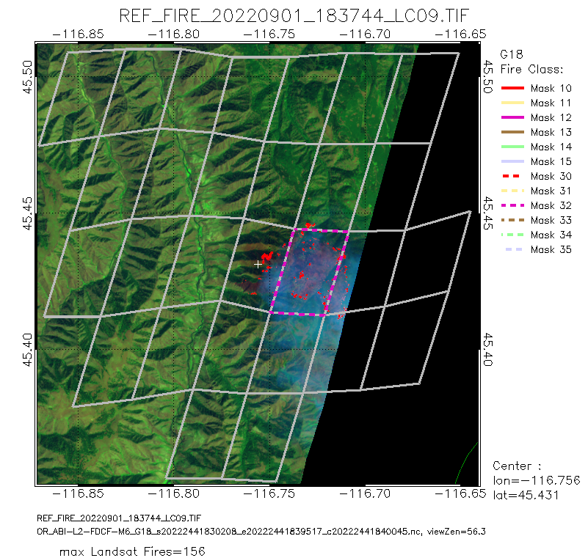
Known Issues:
Terrain screening
“Missed detection”
The thermal signature of this missed detection is screened by the terrain.

Slide 53
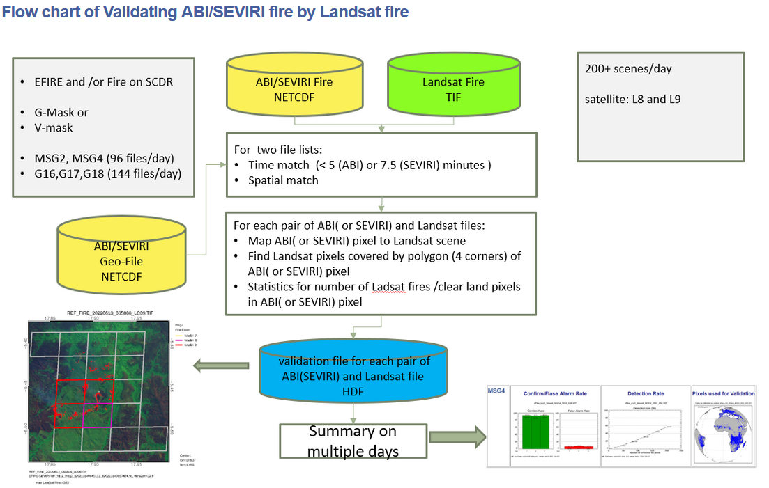
Validation by Landsat
Notes:
G-Mask: GOES style fire mark, with 12 entries for fire: 10:15, 30:35, When presenting the validation summary, they are merged to 6 classes.
V-Mask: VIIRS style fire mask with 3 entries for fire: 7:9, indicating low, medium, high confidence
EFIRE will detect fire pixels by using “improved WF_ABBA” algorithm, then calculate confidence and mask for fire pixels by using VIIRS fire confidence algorithm.

Slide 54
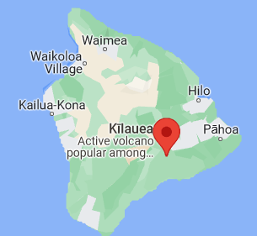
EFIRE : Hot spots in Hawaii
$ more 2022160/*.txt | grep Kilauea
During 10 days from DAY 160-189,2022,
337 Fires near Volcano Kilauea were detected

Slide 55
Solar Panel flag in eFire
During the 10 days (JDAY 160-169,2022), this pixel (with solar panel) was repeatedly detected as fire many times.
more 202216*/*.txt | grep Solar | grep "35.39" | grep "120.08"

Slide 56
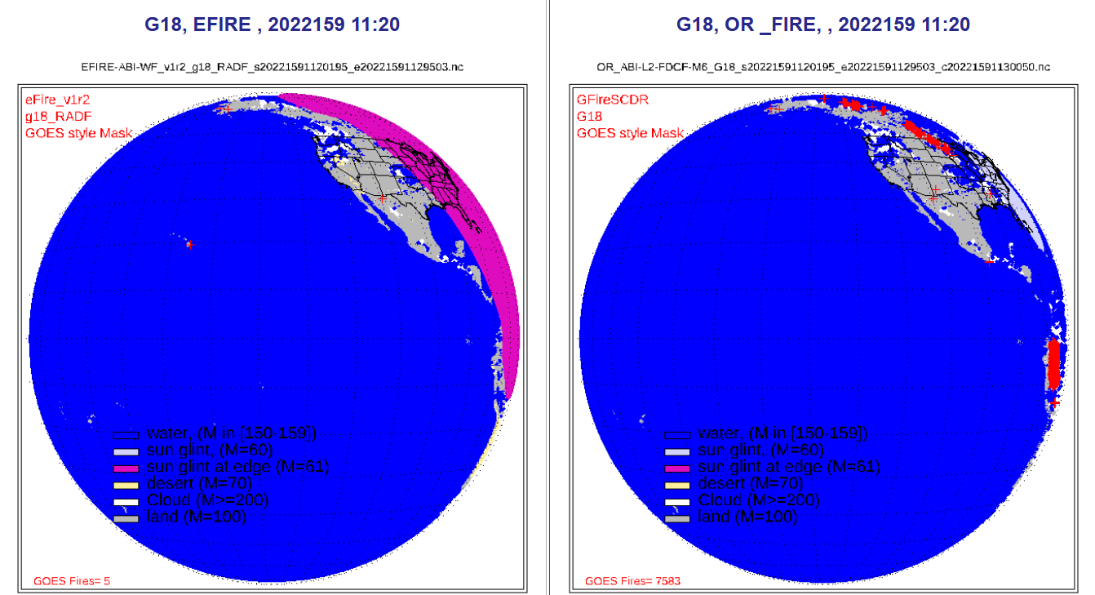
Known Issues:
Reflections from clouds, surface
Notes:
It was noticed that there a huge number of fires (sometime near 10000 pixels) were detected by G18 (WF_ABBA, right panel) between 10 to 14 UTC.
They were removed by EFIRE (left panel).

Slide 57
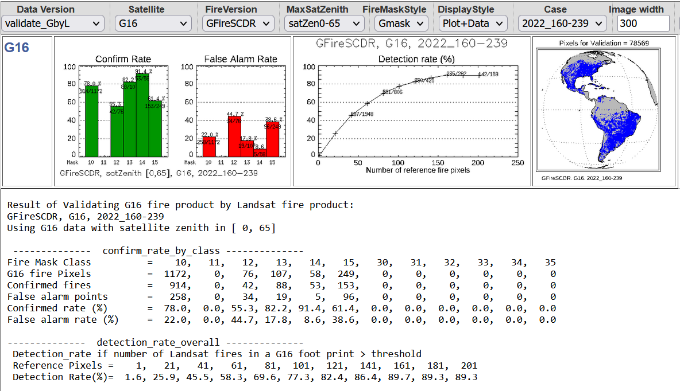
Validation by Landsat: G16
Notes:
This and next 2 slides shows the validation scores in detail.

Slide 58
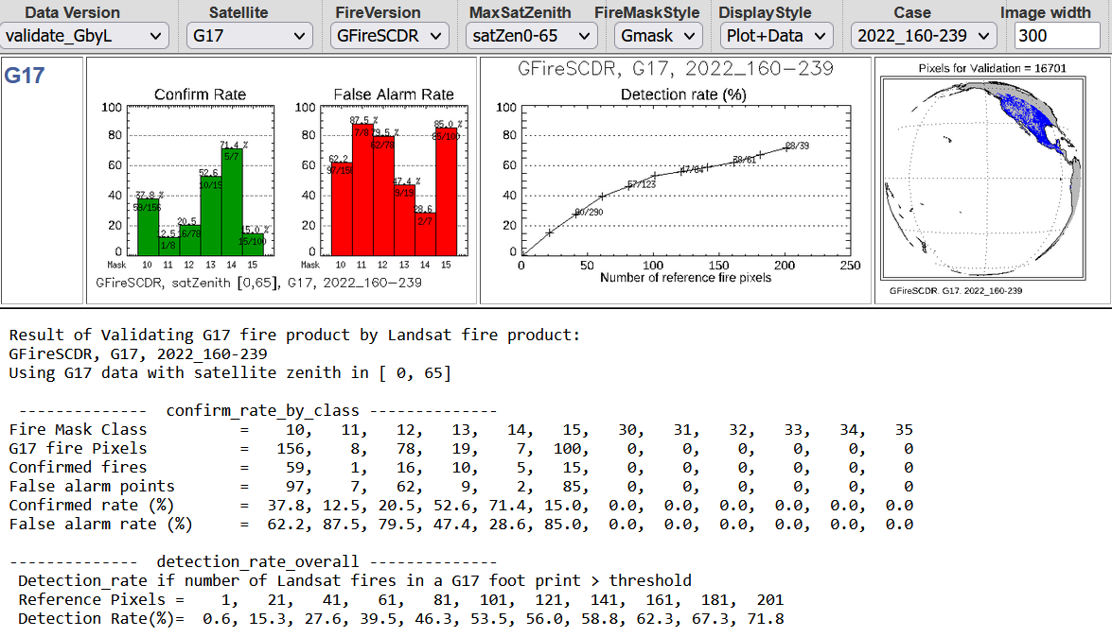
Validation by Landsat: G17

Slide 59
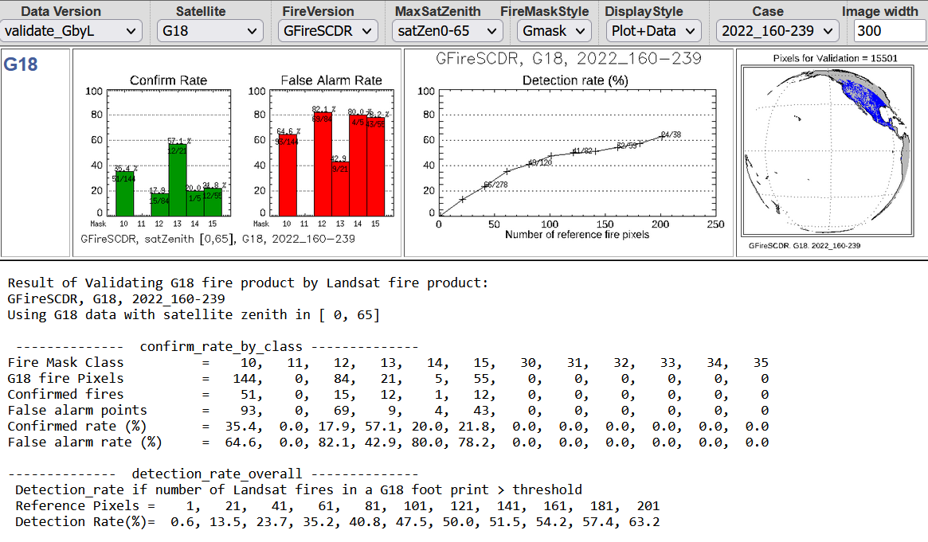
Validation by Landsat: G18

Slide 60
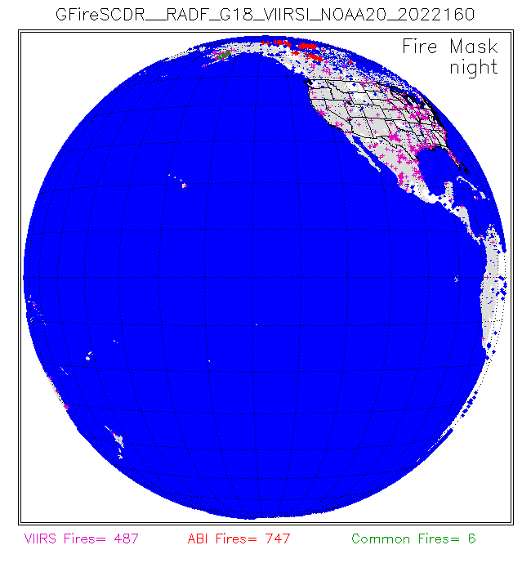
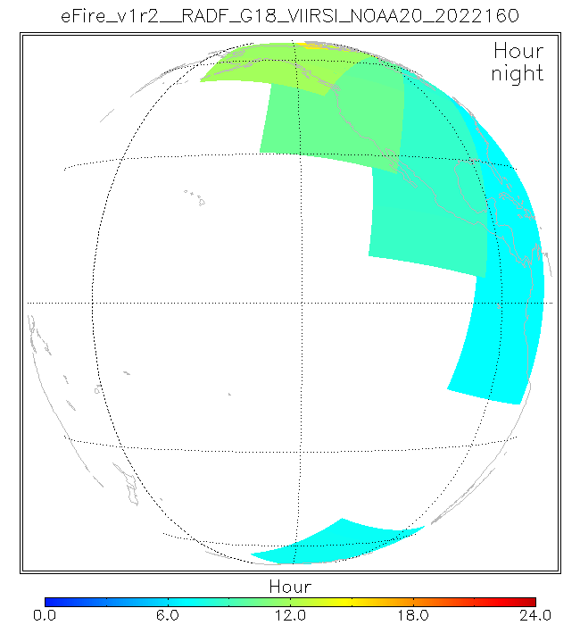
Daily composed Fire Mask and observation time of matched ABI-VIIRS pixels --Animation
Notes:
Daily composted “Fire mask” and “Observation (Hour in UTC) of matched AVI-VIIRS pixels.
Animation for night time was displayed, from DOY 160 to 250, 2022.
On the Fire mask image, the location of detected ABI fire and VIIRS fires were displayed. If both ABI and VIIRS appear in the same location (common fire), it was displayed as green.
It was noticed that there are many ABI fire pixels near over high latitude; they are false alarms due to sun glint. They will be removed if using EFIRE.
The style of images of observation time (right panel) changed with time. This because the module of validating Geostationary fire product by VIIRS fire product (“GbyV”) was upgraded 3 times in order to speed up processing:
Processing all matched pixels;
Process match pixels only if there is at least 1 land pixel in VIIRS granule.
Process match pixels over land only if there is at least 30 land pixel in VIIRS granule.

Slide 61
Validation G16 fire product by VIIRS
Notes:
G16:
ABI fire on SCDR (Right):Pixels with fire Mask class15: very few were confirmed by VIIRS, especially for night granules
EFIRE (Left), false alarm was greatly reduced and shows high confirm rate for night.

Slide 62
Validation G17 fire product by VIIRS
Notes:
G17:
ABI fire on SCDR (Right):Pixels with fire Mask class15: very few were confirmed by VIIRS, especially for night granules
EFIRE (Left), false alarm was greatly reduced and shows high confirm rate for night.

Slide 63
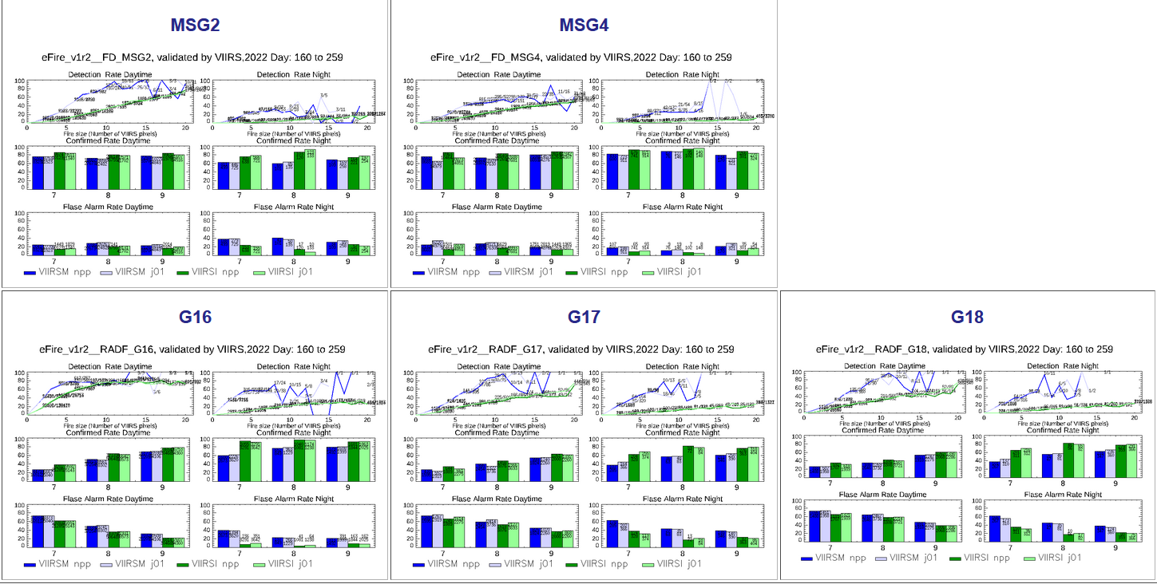
Validation on EFIRE product by VIIRS
using 100 days’ data
Notes:
G18
Validation on EFIRE product from ABI and SEVRI by VIIRS
using 100 days’ data
Fire confidence and class (3 level, 7:9) was calculated by “confidence method” in VIIRS-M algorithm.
Confirm rate for Fires with high confidence is also higher.

Slide 64
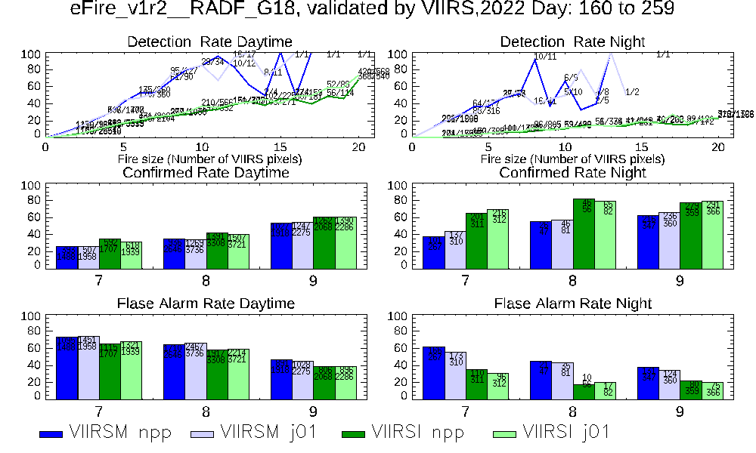
Validation G18 fire product by VIIRS using 100 days’ data
Notes:
Validation on EFIRE product from G18 by VIIRS
using 100 days’ data
Fire confidence and class (3 level, 7:9) was calculated by “confidence method” in VIIRS-M algorithm.
Confirm rate for Fires with high confidence is also higher.

Slide 65
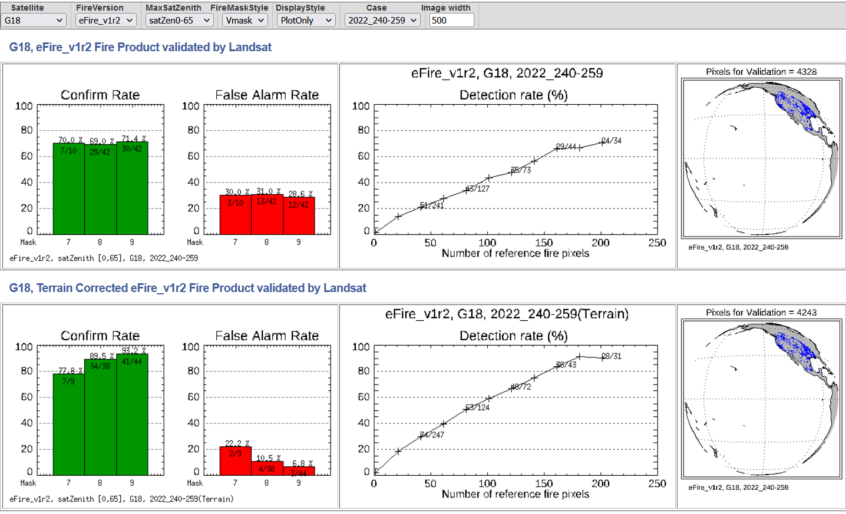
Validation G18 EFIRE by Landsat (20 days)
Terrain corrected geolocation improves the confirm rate and detection rate

