Slide 1
GOES-18 ABI Ice Concentration & Extent (AICE)
GOES-18 ABI Ice Thickness & Age (AITA)
L2 Provisional Validation
Peer/Stakeholder Product Validation Review (PS-PVR)
Dec. 29, 2022
AWIPS Verification / NWS Perspective
John D. Evans, Derek van Pelt, and Lee Byerle
TOWR-S team, NWS Office of Observations

Slide 2
Overview
ABI Ice Concentration & Extent (AICE):
Ice Concentration
Ice Surface Temperature
Ice Mask
ABI Ice Thickness & Age (AITA):
Ice Thickness
Ice Age (3 categories)
Ice Age (8 categories)
DQF semantics
Notes
Forecaster insights
AWIPS integration

Slide 3
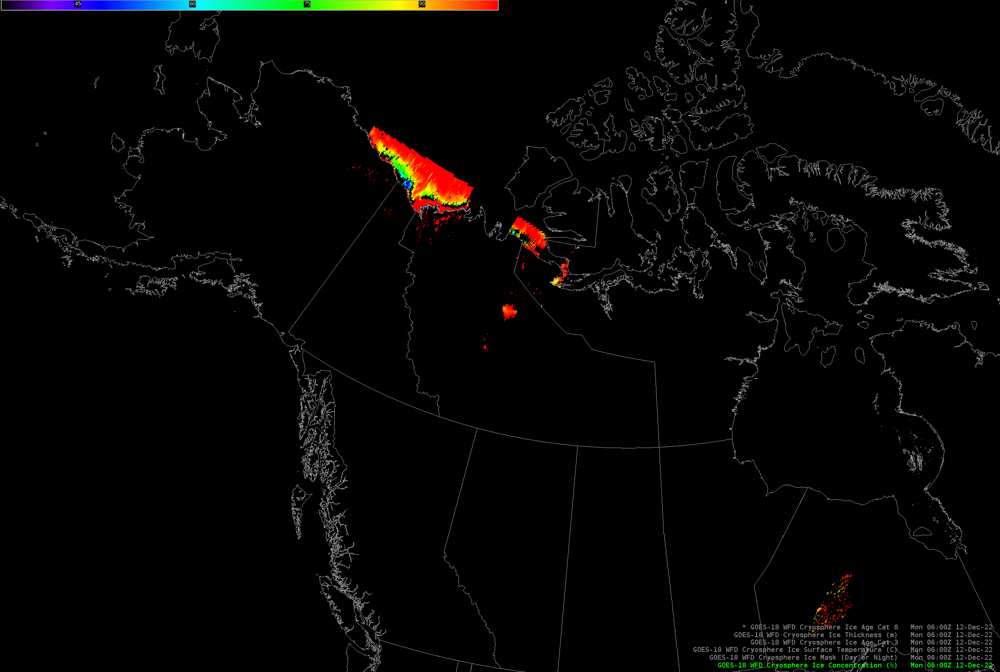
GOES-18 Ice Concentration (AICE)
(12/12 0600z - 12/15 0300z)

Slide 4
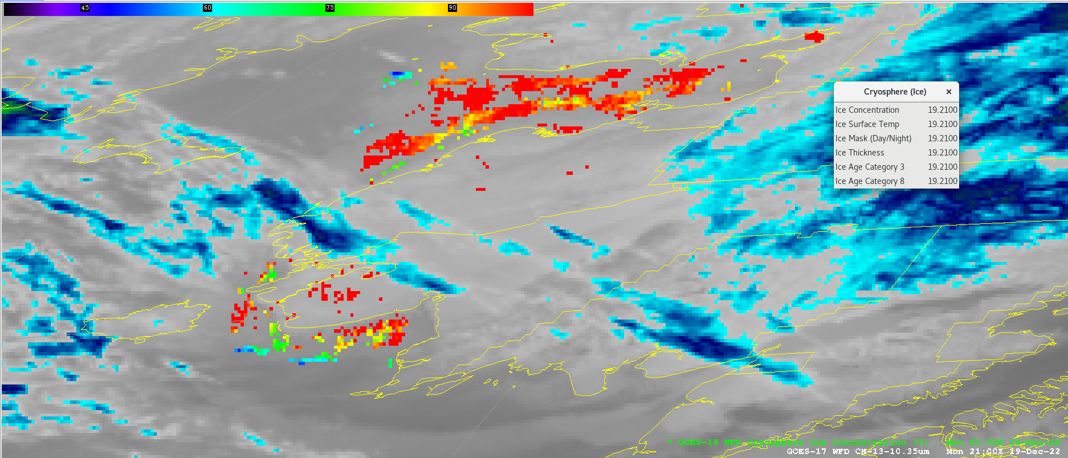
GOES-18 Ice Concentration (AICE)
(S.W. Alaska, 12/19 2100z)

Slide 5
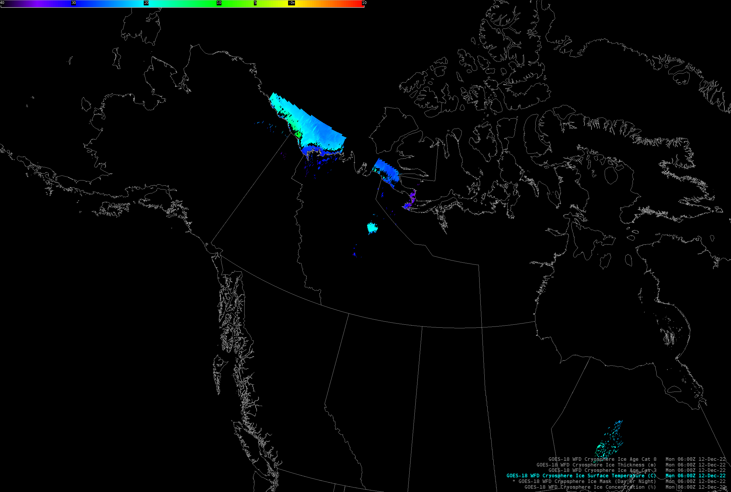
GOES-18 Ice Surface Temperature (AICE)
(12/12 0600z - 12/15 0300z)

Slide 6
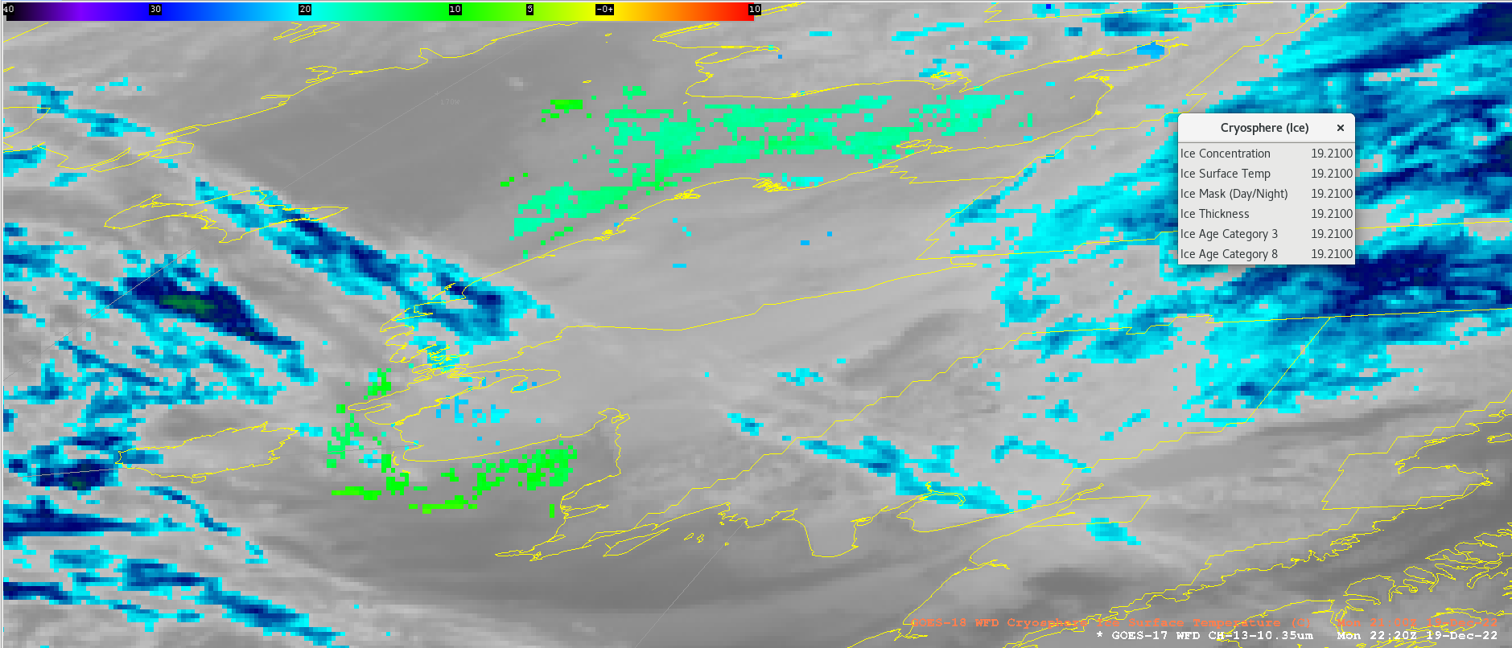
GOES-18 Ice Surface Temperature (AICE)
(S.W. Alaska, 12/19 2100z)

Slide 7
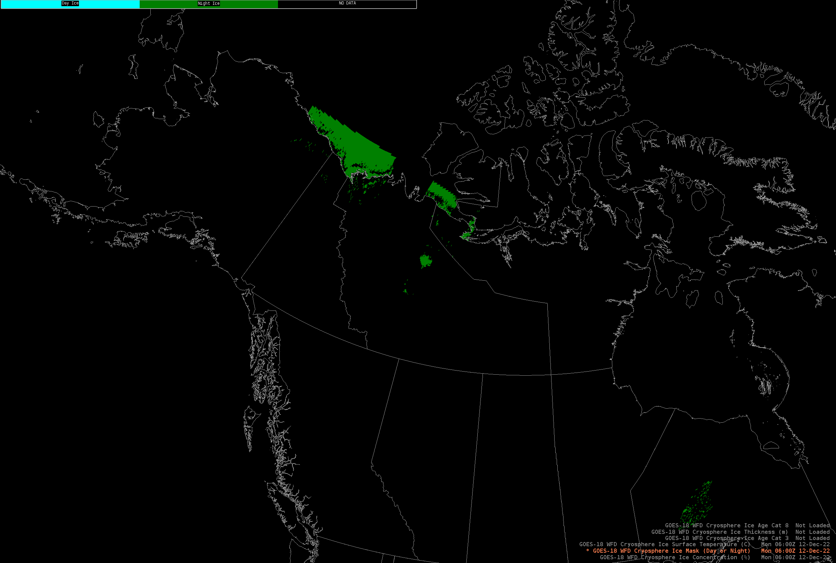
GOES-18 Ice Mask (AICE)
(12/12 0600z - 12/15 0300z)

Slide 8
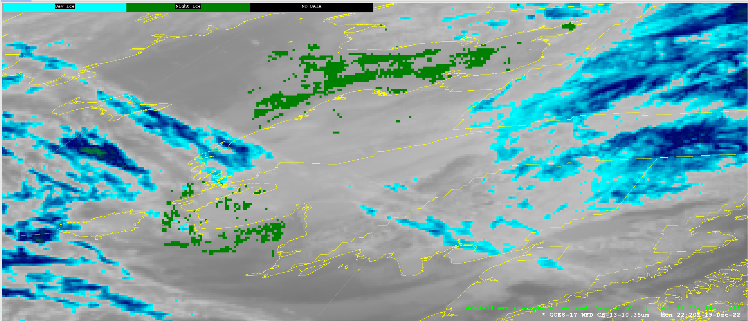
GOES-18 Ice Mask (AICE)
(S.W. Alaska, 12/19 2100z)

Slide 9
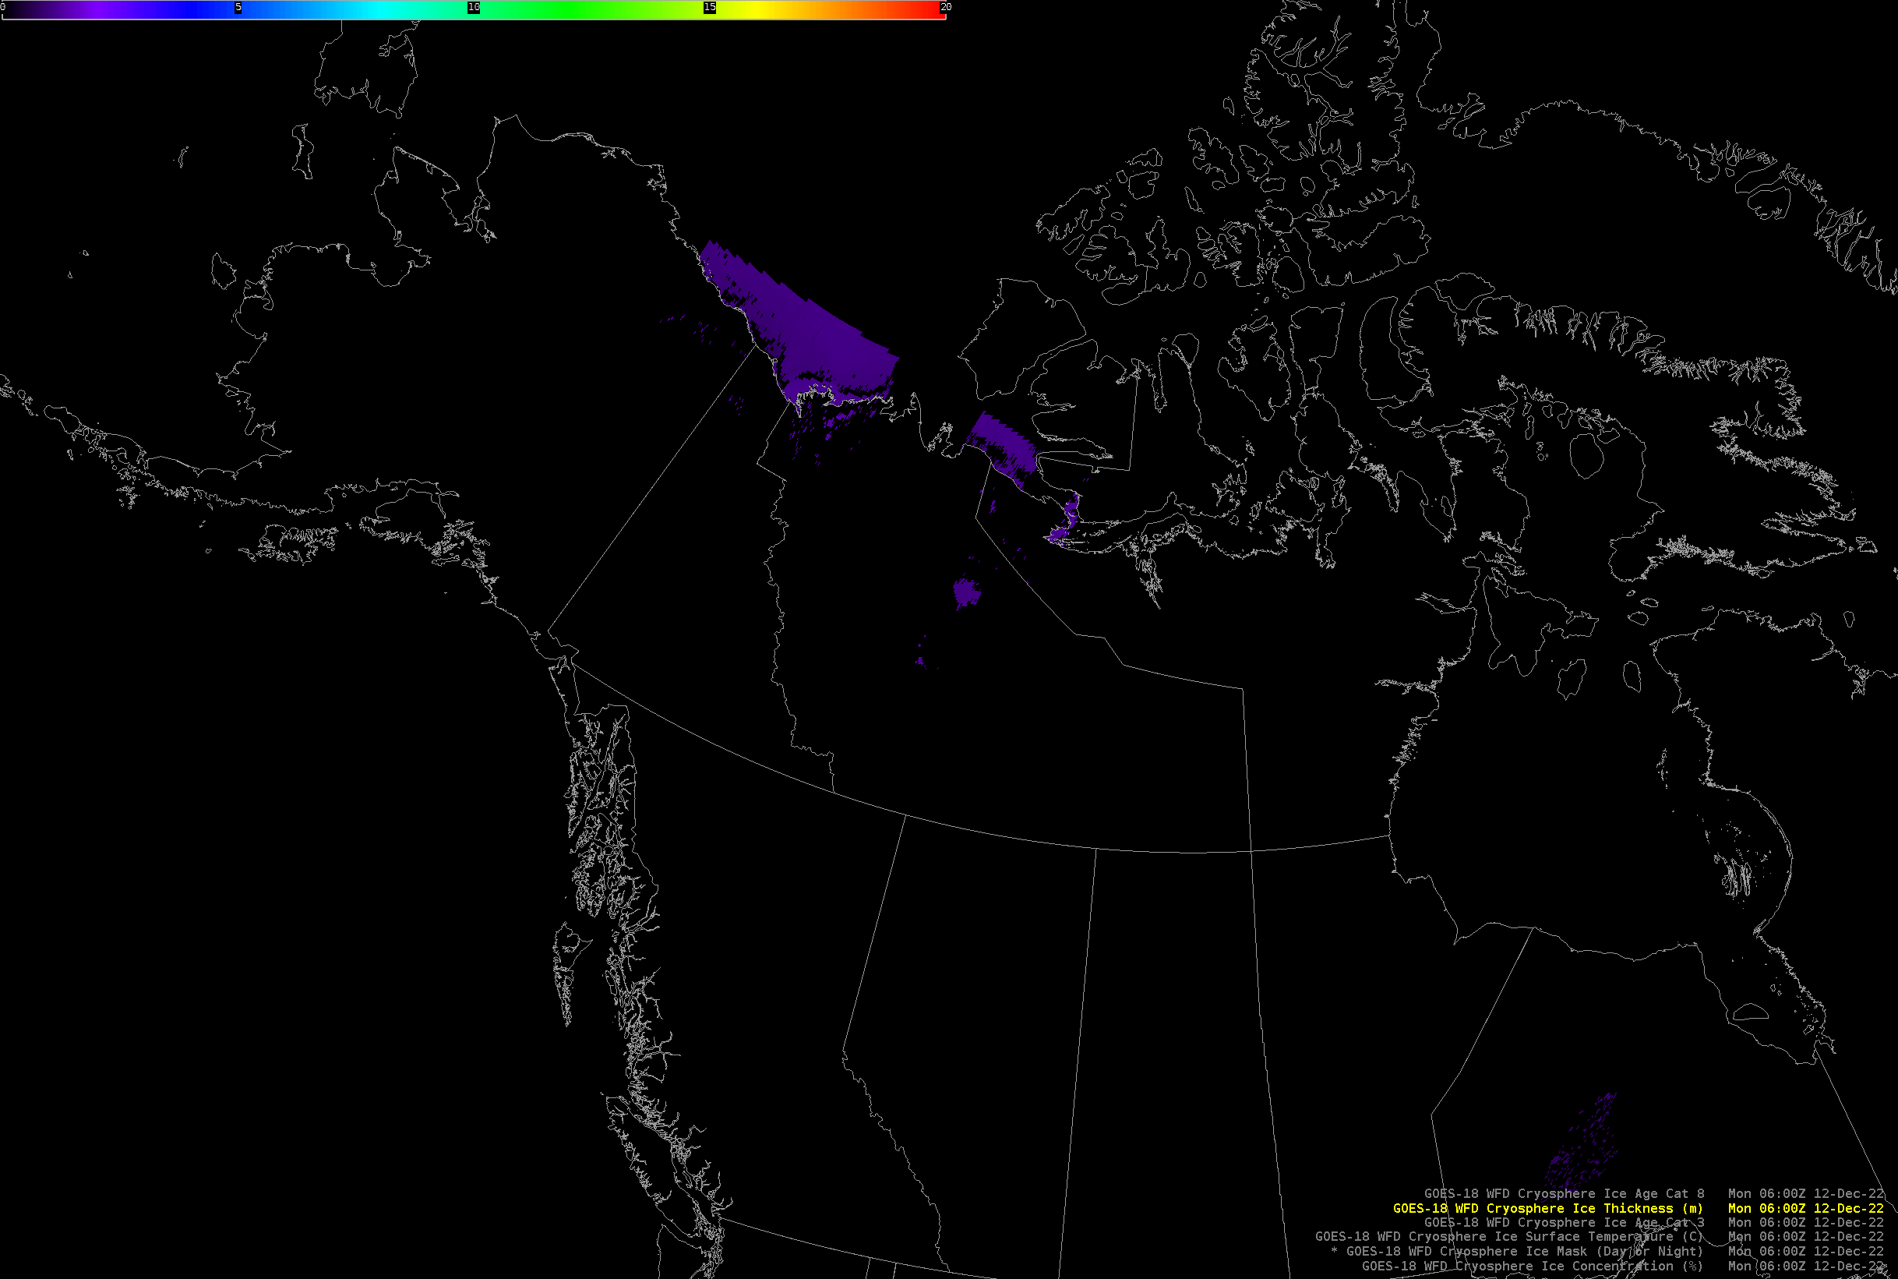
GOES-18 Ice Thickness (AITA)
(12/12 0600z - 12/15 0300z)

Slide 10
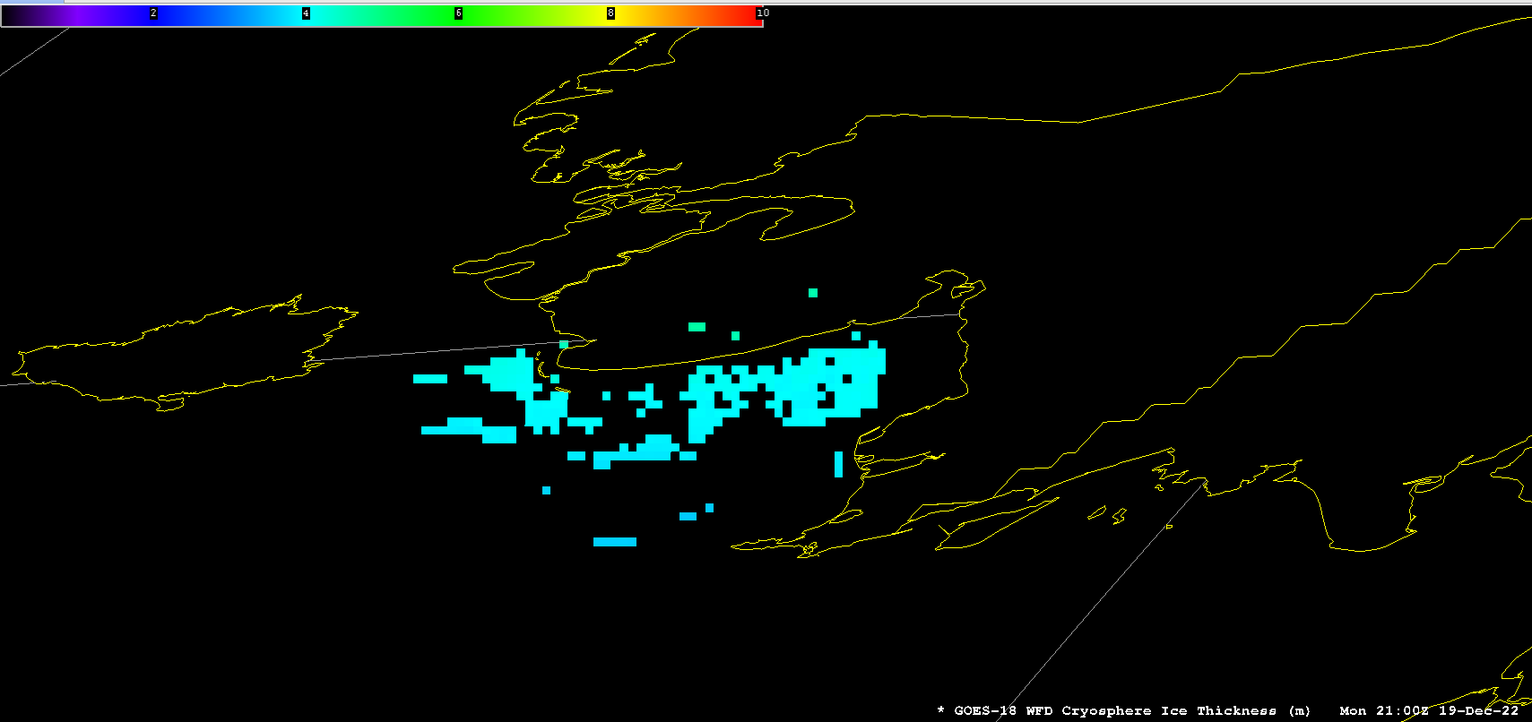
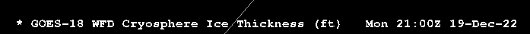
GOES-18 Ice Thickness (AITA)
(S.W. Alaska, 12/19 2100z)

Slide 11
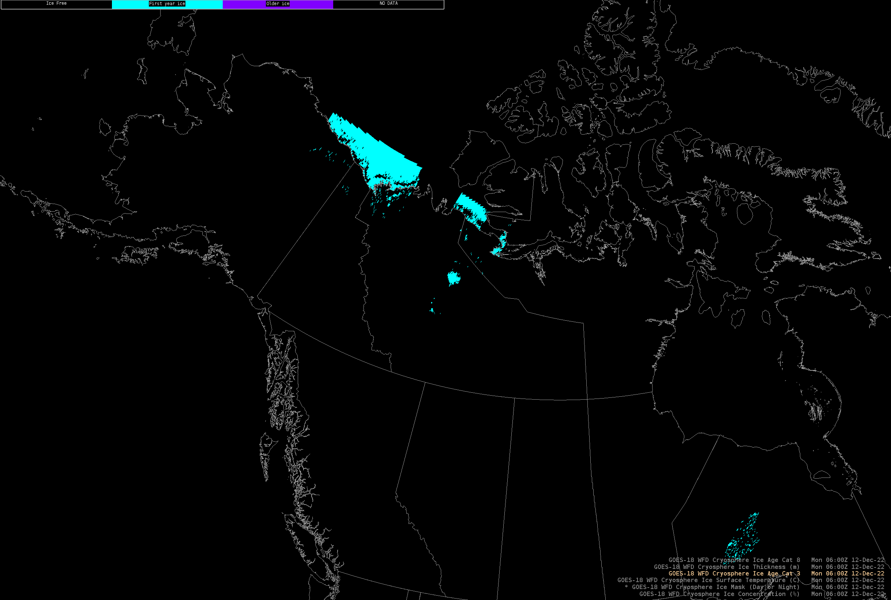
GOES-18 Ice Age: 3 categories (AITA)
(12/12 0600z - 12/15 0300z)

Slide 12
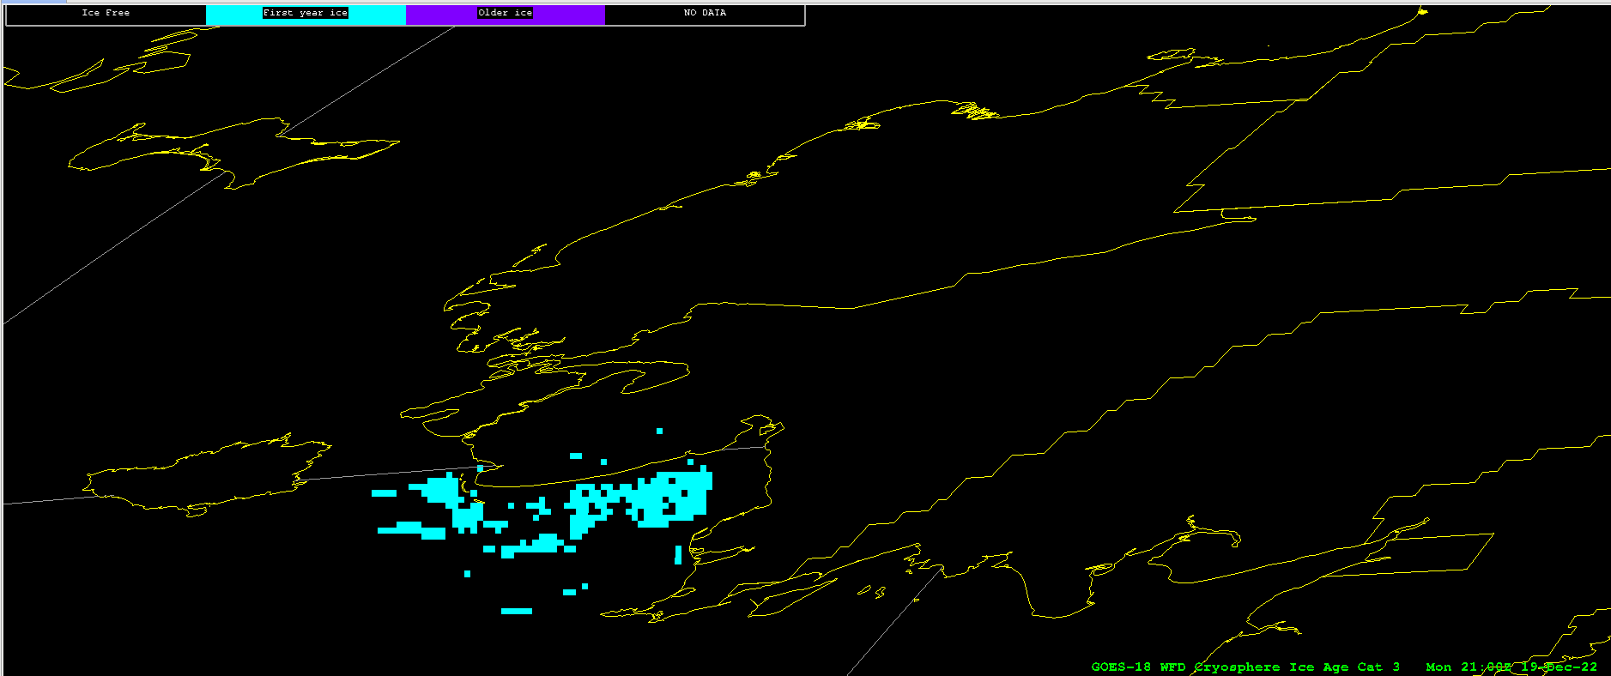
GOES-18 Ice Age: 3 categories (AITA)
(S.W. Alaska, 12/19 2100z)

Slide 13
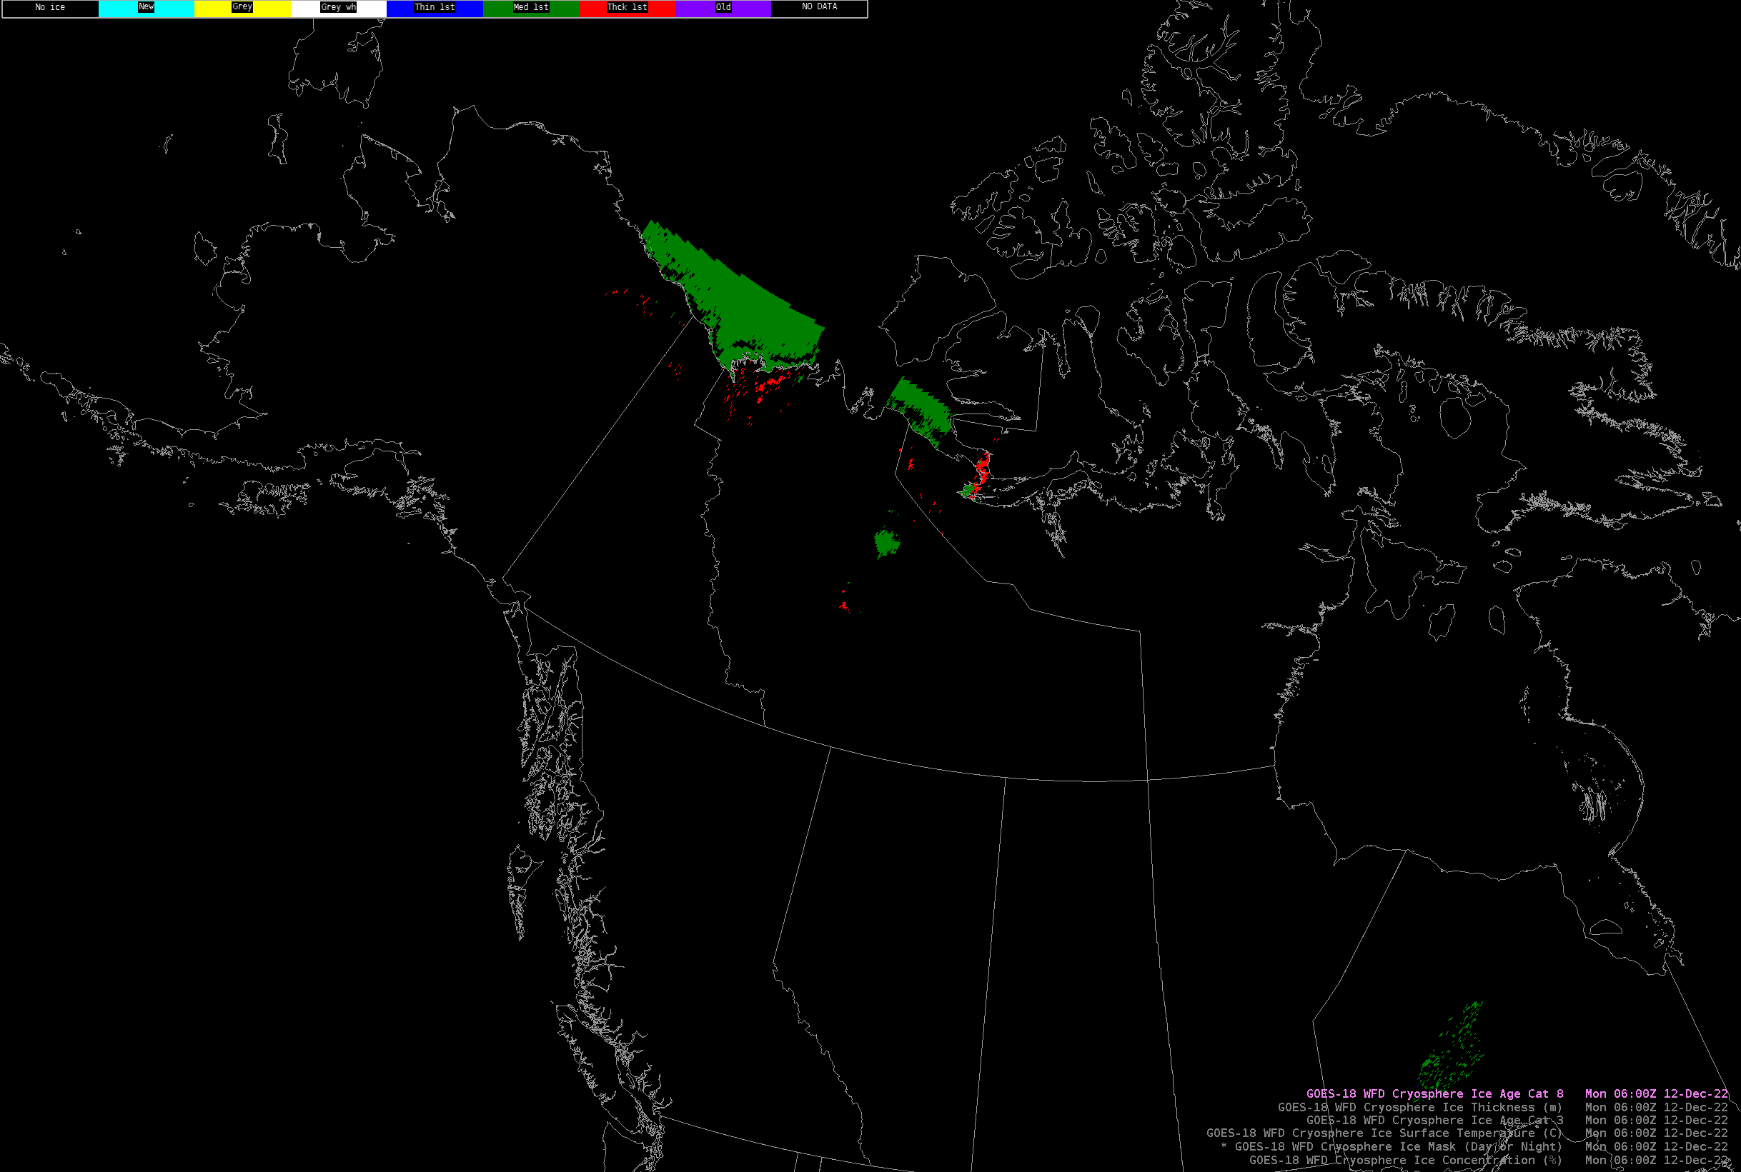
GOES-18 Ice Age: 8 categories (AITA)
(12/12 0600z - 12/15 0300z)

Slide 14
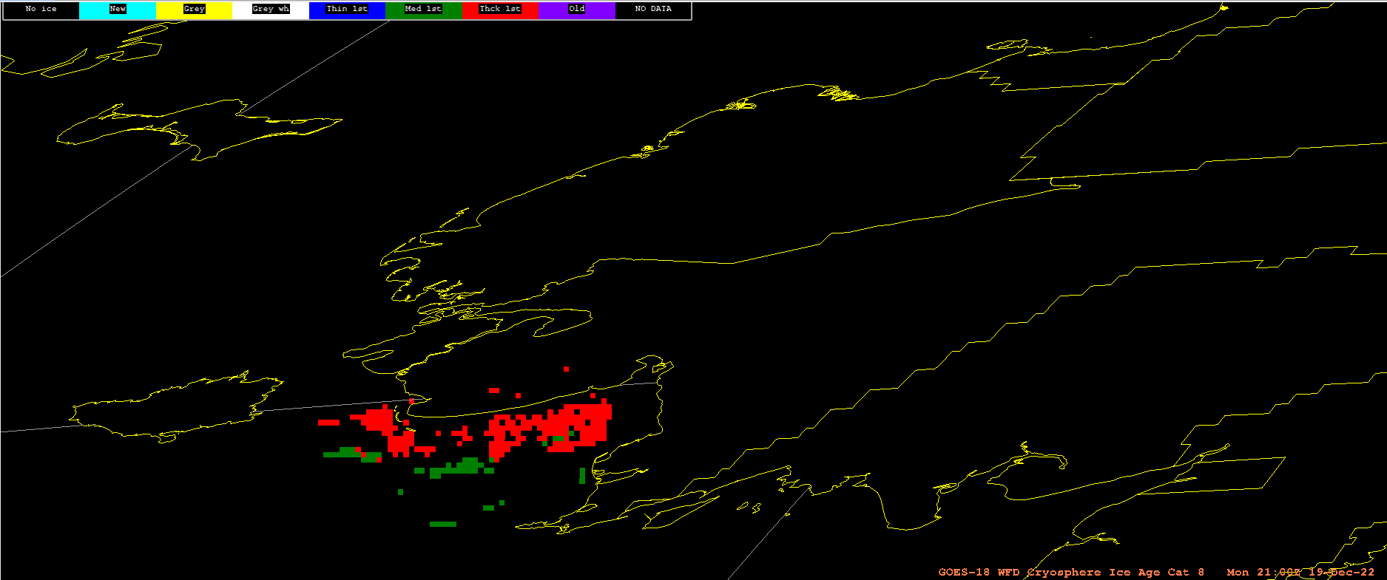
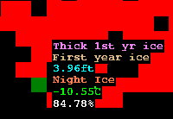
GOES-18 Ice Age: 8 categories (AITA)
(S.W. Alaska, 12/19 2100z)
(above). Example of cursor readout for 8-Cat, 3-Cat, Ice Thickness, Ice Mask, Ice Temp, Ice Conc, respectively.

Slide 15
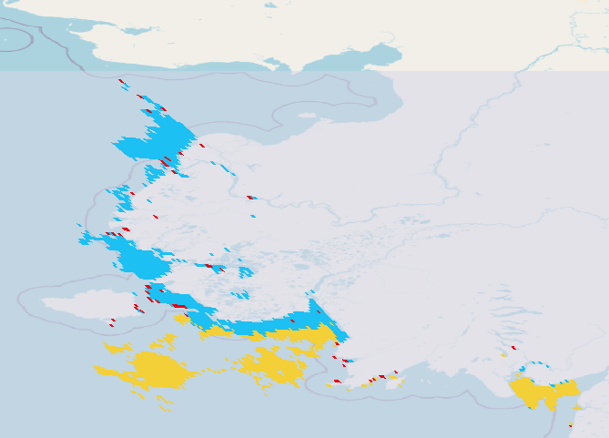

AITA: Data Quality Flags (DQFs)
Both AICE and AITA NetCDF files list the following DQF values and meanings:
This is different from Table 4 in the ATBD
These describe AICE DQFs; but AITA DQFs are 260, 261, 262, 263
Bitwise “and” of the AITA DQF values with flag_mask=3 (i.e., pick only the lowest 2 bits) produces correct values but surprising semantics:
260 -> 0 = normal
261 -> 1 = uncertain
262 -> 2 = nonretrievable
263 -> 3 = bad_data
IceThickness and IceAge{3,8} appear to have fill values wherever DQF is 261 or 263.
DQF:valid_range = | 0, 3
DQF:flag_masks = | 3, 3, 3, 3
DQF:flag_values = | 0, 1, 2, 3
DQF:flag_meanings = | normal, uncertain, nonretrievable, bad_data
From GOES-18, Dec. 12, 2022 (1200z - 1210z)
(OR_ABI-L2-AITAF-M6_G18_s20223461200212_e20223461209520_c20223461211348.nc)

Slide 16
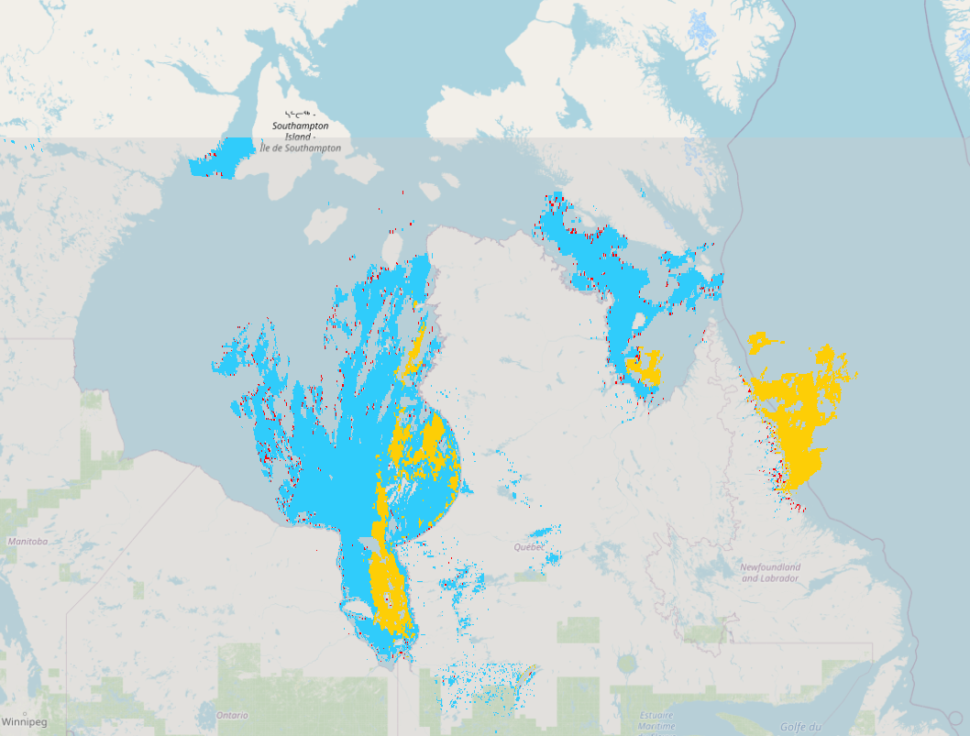
AITA: Data Quality Flags (DQFs)
Both AICE and AITA NetCDF files list the following DQF values and meanings:
These describe AICE DQFs; but AITA DQFs are 260, 261, 262, 263
Bitwise “and” with flag_mask=3
(i.e., pick only the lowest 2 bits) produces correct values but surprising semantics:
260 -> 0 = normal
261 -> 1 = uncertain
262 -> 2 = nonretrievable
263 -> 3 = bad_data
IceThickness and IceAge{3,8} appear to have fill values wherever DQF is 261 or 263.
DQF:valid_range = | 0, 3
DQF:flag_masks = | 3, 3, 3, 3
DQF:flag_values = | 0, 1, 2, 3
DQF:flag_meanings = | normal, uncertain, nonretrievable, bad_data
From GOES-16, Dec. 15, 2022 (0600z - 0610z)
(OR_ABI-L2-AITAF-M6_G16_s20223490600207_e20223490609515_c20223490611213.nc)

Slide 17
Notes
Forecaster insights:
  We tested data-flow, ingest, display, end-to-end using earlier versions of the products in a Winter 2020-2021 evaluation with several Great Lakes WFOs.
  Applications include
    Support for coastal fishing / shipping
    (ice concentration, thickness & age);
    Assessing lakeshore flooding potential
    (ice concentration, thickness & age);
    Public safety (ice thickness, ice motion).
  2km resolution isn’t suitable for bays, lakes, inlets, and other small-scale features
Ice Concentration and Age/Thickness products are compatible with AWIPS:
  Will need new AWIPS configurations; to be deployed in TOWR-S RPM v23, beginning Feb. 9, 2023
    Widespread adoption is expected by late March, 2023.
    No AWIPS code changes required.
  About those AITA DQFs:
    AITA’s DQF=260 seems to denote “normal” retrievals (inconsistent with NetCDF attributes). However:
    If IceThickness and IceAge{3,8} will always have fill values wherever DQF is 261 or 263, AWIPS can safely ignore the DQF. That’s tentatively how we’ll proceed.

