Slide 1
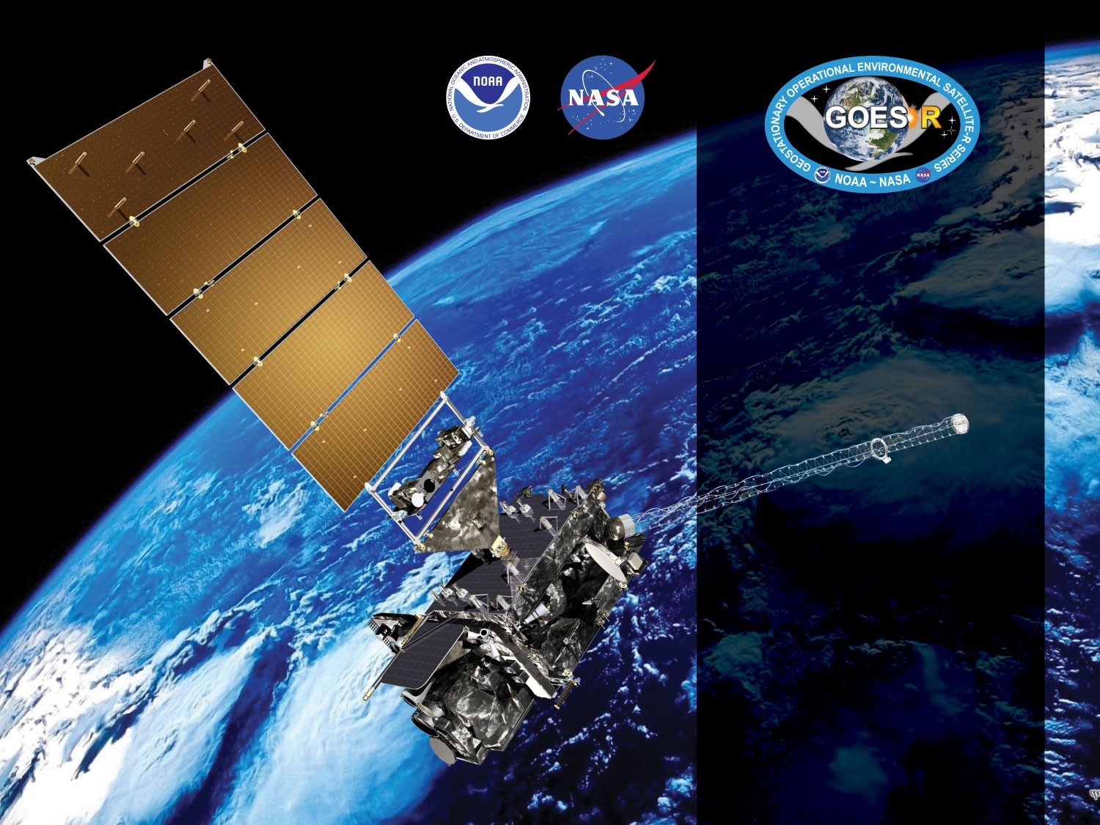


GOES-18 ABI L2+
Land Surface Temperature
Provisional PS-PVR
November 9, 2022
GOES-R AWG LST Team
Yunyue Yu*,
Peng Yu^{+,*}, Heshun Wang⁺
⁺CISESS/UMD
*NOAA/NESDIS/STAR
Presenter: Peng Yu

Slide 2
Outline
Product Overview
Provisional Validation Product Maturity Assessment:
  Visual inspection
  Product Validation
  Inter-sensor Comparison
Path to Full Maturity
Summary and Recommendations

Slide 3
PRODUCT OVERVIEW
GOES-18 Land Surface Temperature Provisional PS-PVR

Slide 4
LST Product Overview
Land Surface Temperature (LST) is how hot the “surface” of the Earth would feel to the touch
Emissivity-explicit split-window regression algorithm is used for GOES LST EDR generation
GOES-18 LST EDR consists of four products: Full Disk (2kmFD and FD), CONUS, and Meso-scale (MESO1 and MESO2)
Algorithm Transitioned from baseline to “enterprise” in August 2021: 2kmFD has been added during the transition
  Baseline: stratified by Total Precipitable Water (TPW) and Day/Night
  Enterprise: stratified by TPW, Sensor Zenith Angle, and Day/Night
  Enterprise LST package consists of the mitigation procedure to address the overheating issue for GOES-17 ABI
  Enterprise LST algorithm shares the same core as the LST algorithm in JPSS mission.

Slide 5
Mission Requirement
Products | LST (Skin): CONUS | LST (Skin): Full Disk | LST (Skin): Mesoscale
Geographic Coverage | CONUS | Full Disk | Mesoscale
Horizontal Resolution | 2km | 2/10km | 2km
Mapping Accuracy | 1km | 1/5km | 1km
Measurement Range (K) | 213 – 330 | 213 – 330 | 213 – 330
Measurement Accuracy¹ (K) | 2.5 | 2.5 | 2.5
Measurement Precision (K) | 2.3 | 2.3 | 2.3
Refresh Rate | 60 minutes | 60 minutes | 60 minutes
Vendor Allocated Ground latency | 3236 seconds | 806 seconds | 159 seconds
Extent Qualifier | Local Zenith Angle < 70 | Local Zenith Angle < 70 | Local Zenith Angle < 70
¹ The measurement accuracy 2.5 K is conditional with 1) known emissivity, 2) known atmospheric correction, and 3) 80% channel correction; 5K otherwise.

Slide 6
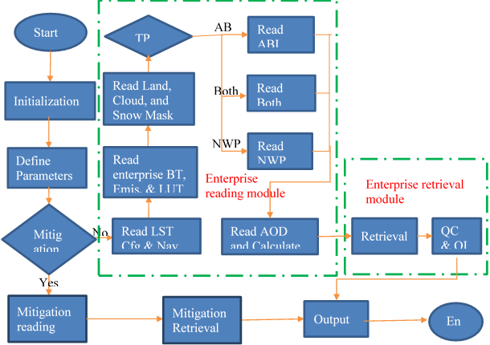
LST Processing Flow
LST is retrieved if
  good pixel availability
        input data not out of space
        input data not bad data
        input data not missing
  not over ocean
  Clear, probably clear, or probably cloudy

Slide 7
ADRs Resolved or still in progress since GOES-17 LST Provisional Maturity
Title | Description | Impact | Mitigation | Status
ADR 1040 (12/3/2019) | This ADR is created to have a tracking mechanism for the Enterprise Land Surface Temperature (ELST) algorithm which will be added to the Ground System | No impact. | PRO team tracking ELST progress | Ends with the implementation of the Enterprise LST.
ADR 1078 (2/27/2020) | When operating under cooling timeline, there is an outage of one of the two meso products. | No impact on GOES-18 LST | An update to the configuration to allow LST to be produced every hour at the top of the hour. | Closed.
ADR 1034 (3/5/2020) | Monthly emissivity files for Enterprise LST. | The current emissivity data in LST retrieval is based on monthly Seebor emissivity, which is static and may not reflect the near-real-time variation of the surface emission characteristics. | Seebor emissivity is being used. | Contingent on the evaluation results of the STAR emissivity product.
ADR 1136 (11/19/2020) | LST fails if requested L1bPixelMetadata is missing | Exception handling mechanism is missing when required FPT information from L1bPixelMetadata is missing. | The issue has been fixed and implemented. | Closed
ADR 1189 (1197) (8/24/2021) | The value of FPT_mitigation_flag is incorrectly set to 0 when mitigation algorithm is used. | No impact on GOES-18 LST. | Fixed and implemented. | Closed
ADR 1238 (5/16/2022) | Enterprise code needs access to mitigation parameters. | Minor impact. | Fixed and implemented. | Closed
Little Impact
Moderate Impact
Big Impact

Slide 8
PROVISIONAL VALIDATION PRODUCT MATURITY ASSESSMENT
GOES-18 Land Surface Temperature Provisional PS-PVR

Slide 9
Top Level Evaluation
 | Current Status | Future Outlook
Visual Inspection: (Range, Availability) | Performance has been good and stable without critical issues. | Expect continued good performance.
Quantitative Performance: (Accuracy, Precision) | Overall performance of Land Surface Temperature is good. LST product for Full Disk, CONUS, and MESOs, easily meet accuracy and precision specifications. GOES-18 LST product compares very well to the GOES-17 LST when the GOES-17 ABI FPM temperature is below 85K and G17 LST is retrieved with the enterprise algorithm. | Expect continued good performance

Slide 10
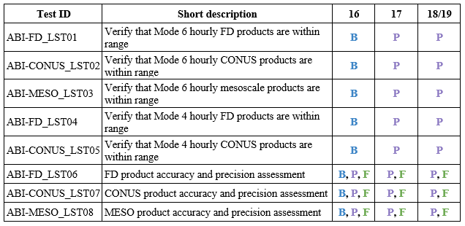
GOES-18 LST Provisional PLPTs
B – Beta maturity
P – Provisional maturity
F – Full maturity
Reference: Geostationary Operational Environmental Satellite (GOES) – R Series ABI L2+ Land Surface Temperature (LST) Beta, Provisional, and Full Validation Readiness, Implementation and Management Plan (RIMP) (v2.0; 410-R-RIMP-0331; September 28, 2021)

Slide 11
VISUAL INSPECTION
GOES-18 Land Surface Temperature Provisional PS-PVR

Slide 12
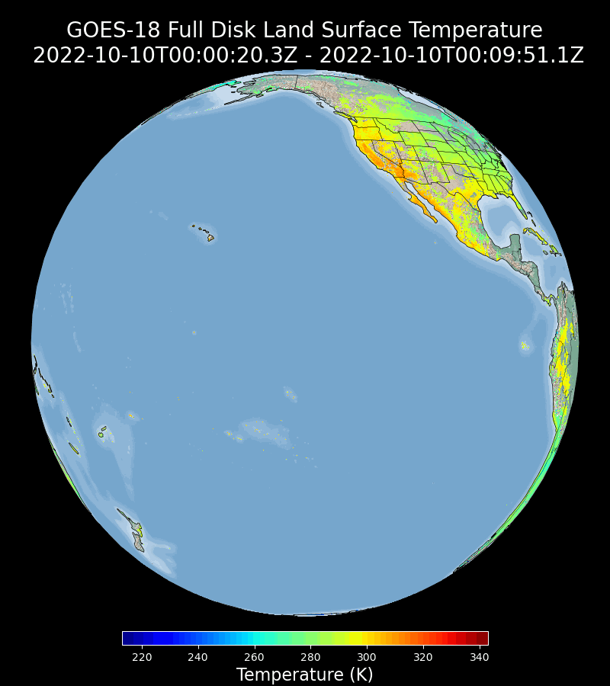
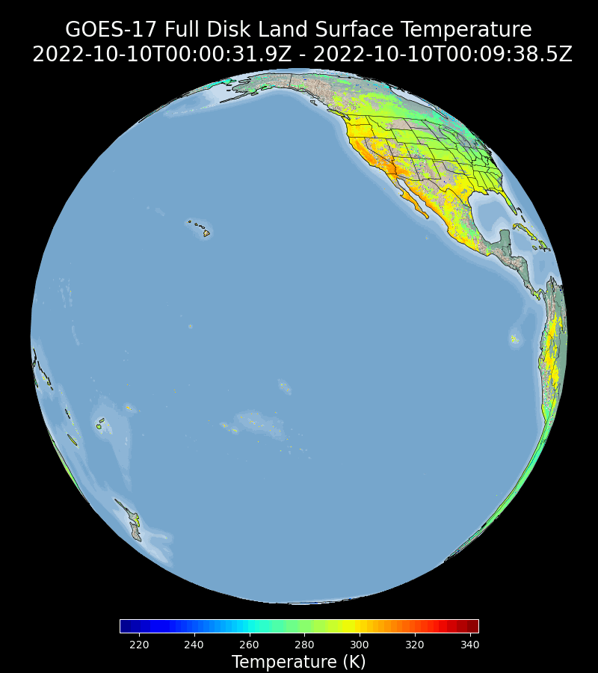
Visual Inspection: Full Disk LST (2KM)
GOES-18 2KMFD
GOES-17 2KMFD
GOES-18 FD LST is being visually inspected and compared to the GOES-17 LST on a daily basis. The product behaves normal with very good agreement to its GOES-17 counterpart when the FPM temperature of G17 ABI is not high
Notes:
The comparison presented here is qualitative, quantitative comparison results will presented later.

Slide 13
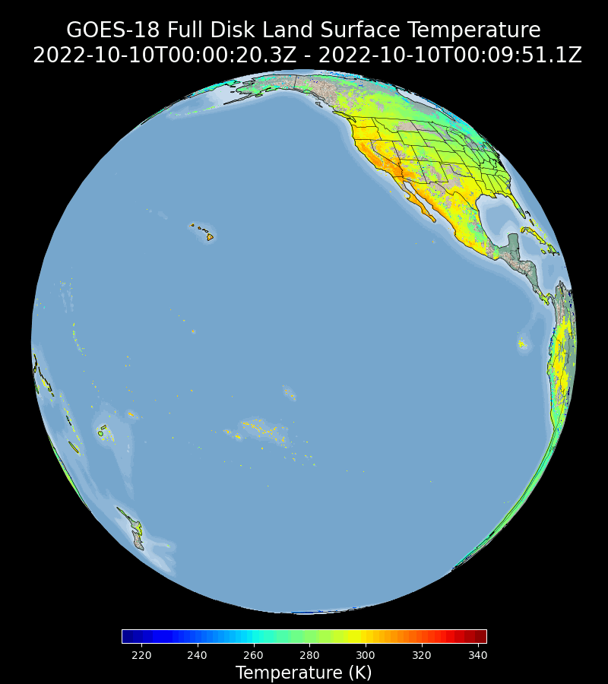

Visual Inspection: Full Disk LST (10KM)
GOES-18 FD
GOES-17 FD
GOES-18 FD LST is being visually inspected and compared to the GOES-17 LST on a daily basis. The product behaves normal with very good agreement to its GOES-17 counterpart when the FPM temperature of G17 ABI is not high
Notes:
2KM FD and 10KM FD LSTs currently coexist. The Former is expected to replaced the coarse resolution one.

Slide 14
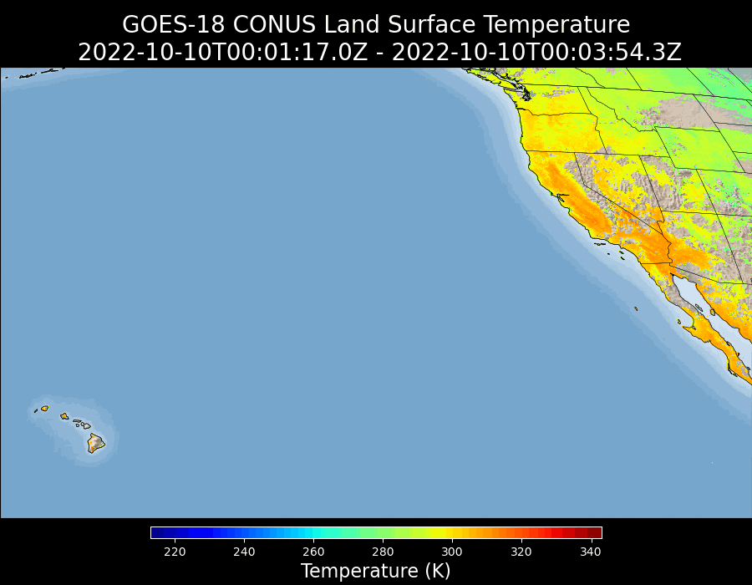
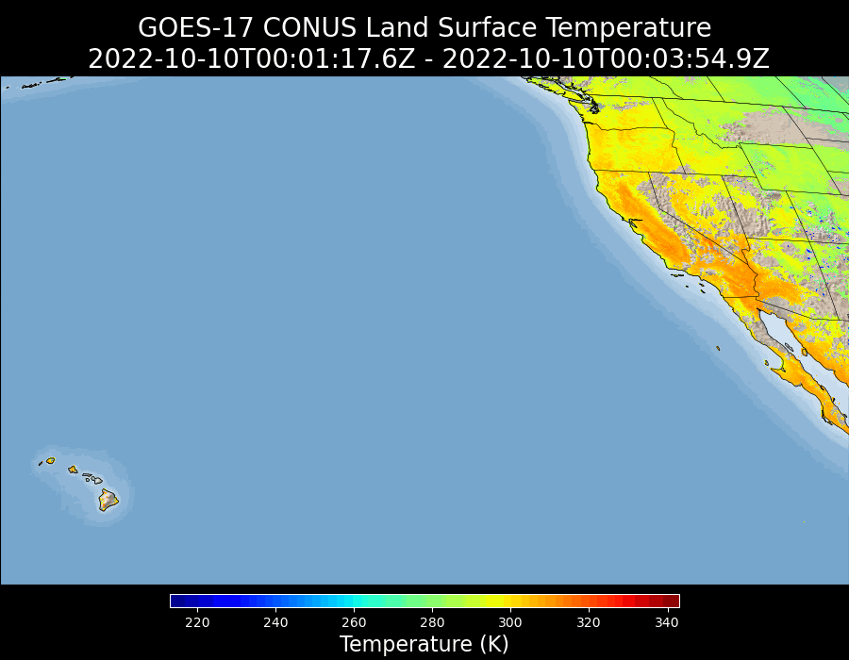
Visual Inspection: CONUS LST
GOES-18 CONUS
GOES-17 CONUS
GOES-18 CONUS LST is being visually inspected and compared to the GOES-17 LST on a daily basis. The product behaves normal with very good agreement to its GOES-17 counterpart when the FPM temperature of G17 ABI is not high

Slide 15
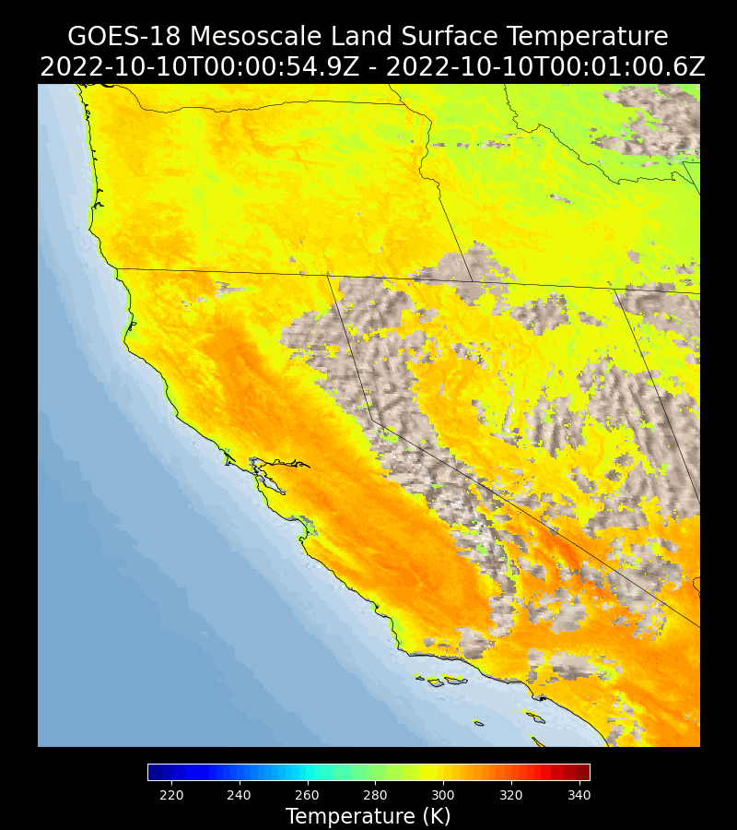
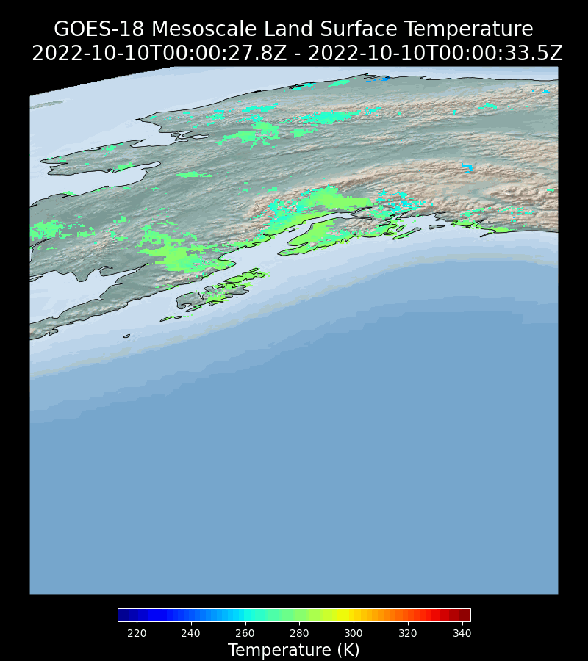
Visual Inspection: MESO LST
GOES-18 MESO1
GOES-18 MESO2
GOES-18 MESO LST is being visually inspected on a daily basis. The product behaves normal .

Slide 16
GOES-18 Land Surface Temperature Comparison to Reference LST Data
Validation with In-situ measurements:
  SURFRAD (Primary)
  ARM (Primary)
  NEON (Secondary)
Inter-satellite comparison with GOES-17 Land Surface Temperature
  2KMFD
  FD
  CONUS
Notes:
Mission requirements: 2.5 K bias and 2.3 K precision

Slide 17
PRODUCT VALIDATION
GOES-18 Land Surface Temperature Provisional PS-PVR

Slide 18
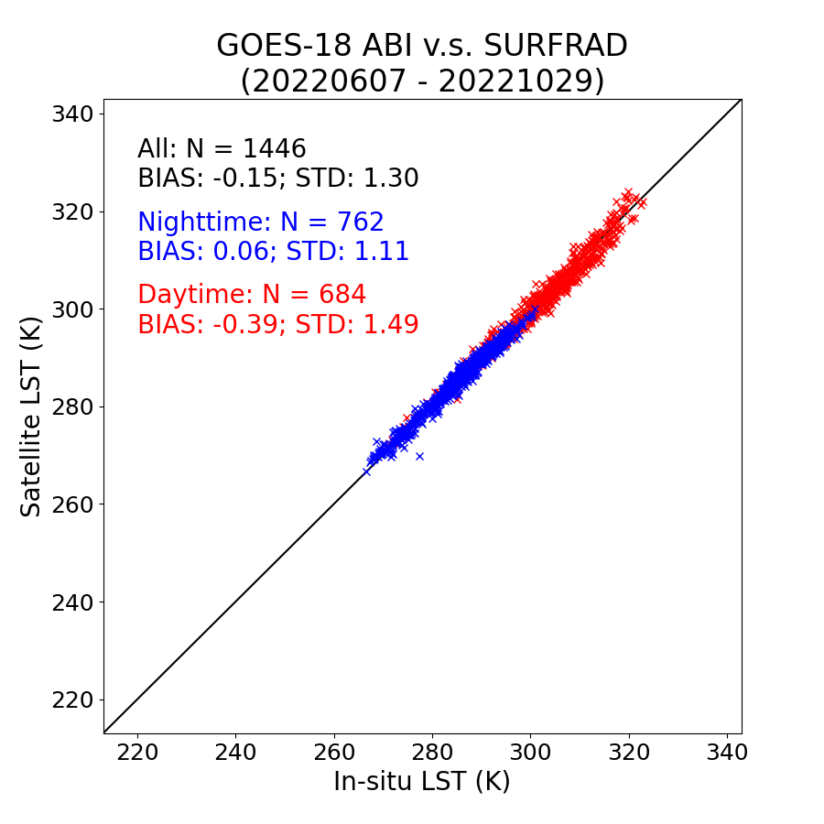
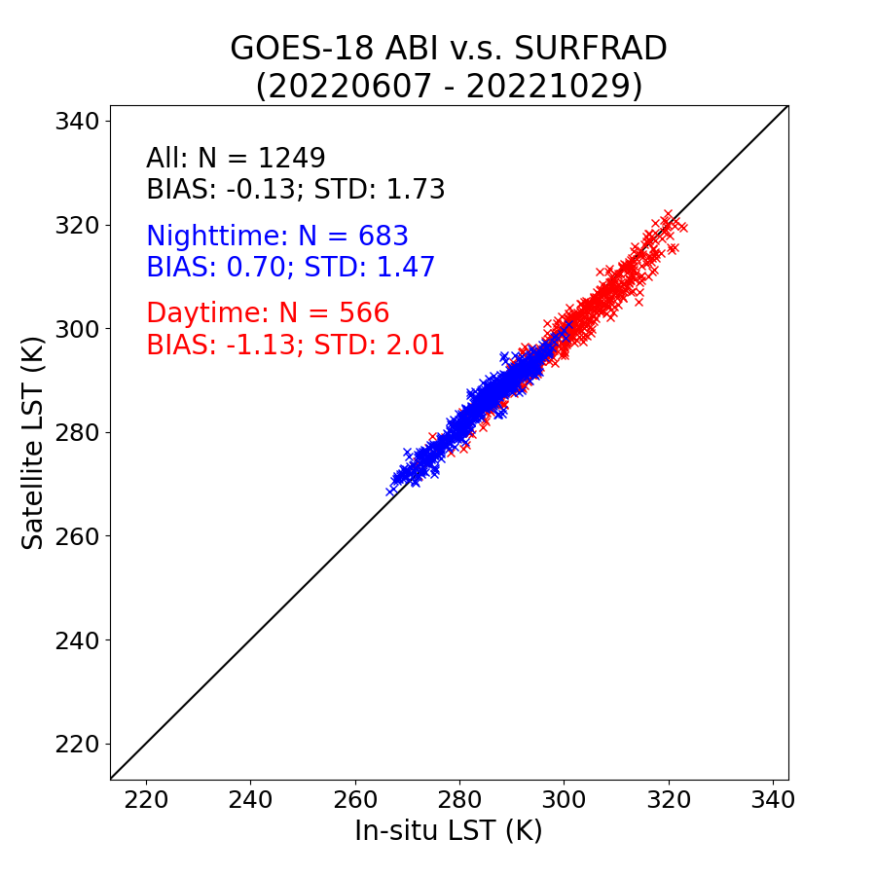
Validation Results: Full Disk with SURFRAD
GOES-18 2KMFD
GOES-18 FD (10 km)
Both GOES-18 Full Disk LSTs easily meet the required accuracy (2.5 K) and precision (2.3 K) at SURFRAD sites.
Notes:
In general, the 2km LST statistics is slightly better than the 10 km one. Better representativeness of the in-situ measurement when satellite pixel is smaller.

Slide 19
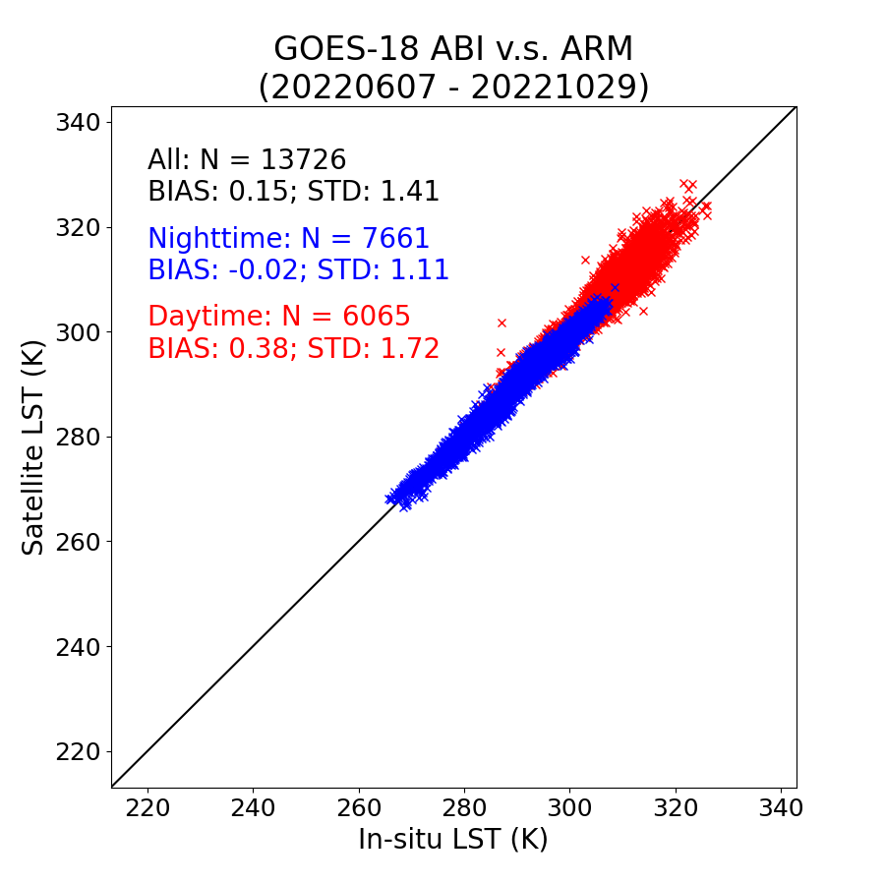
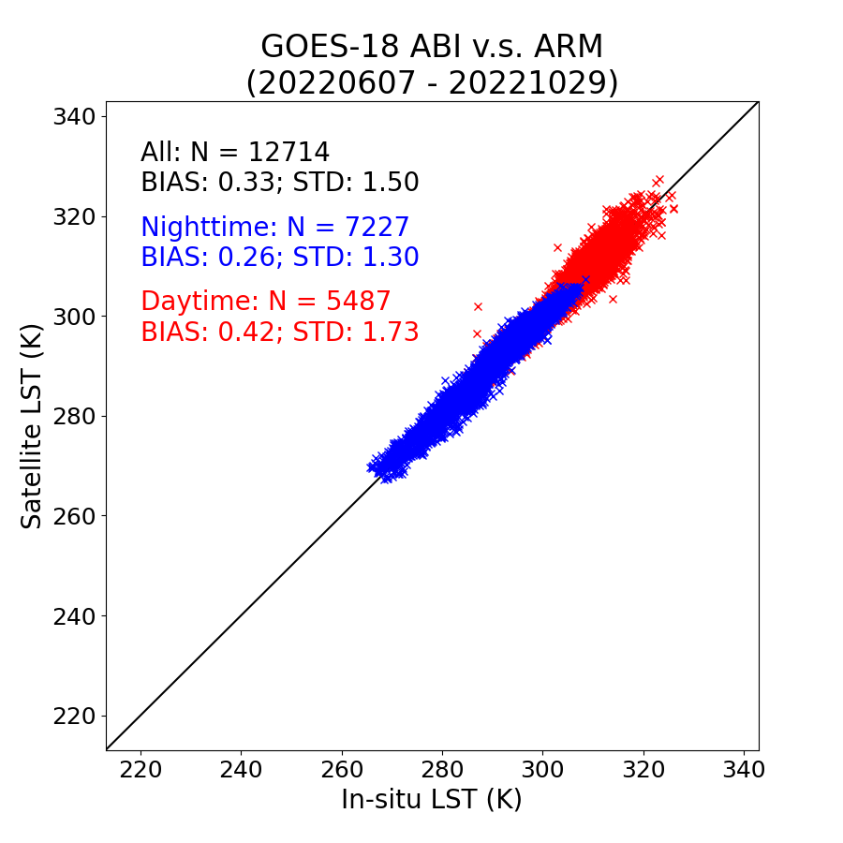
Validation Results: Full Disk with ARM
GOES-18 2KMFD
GOES-18 FD (10 km)
Both GOES-18 Full Disk LSTs easily meet the required accuracy (2.5 K) and precision (2.3 K) at ARM sites.

Slide 20
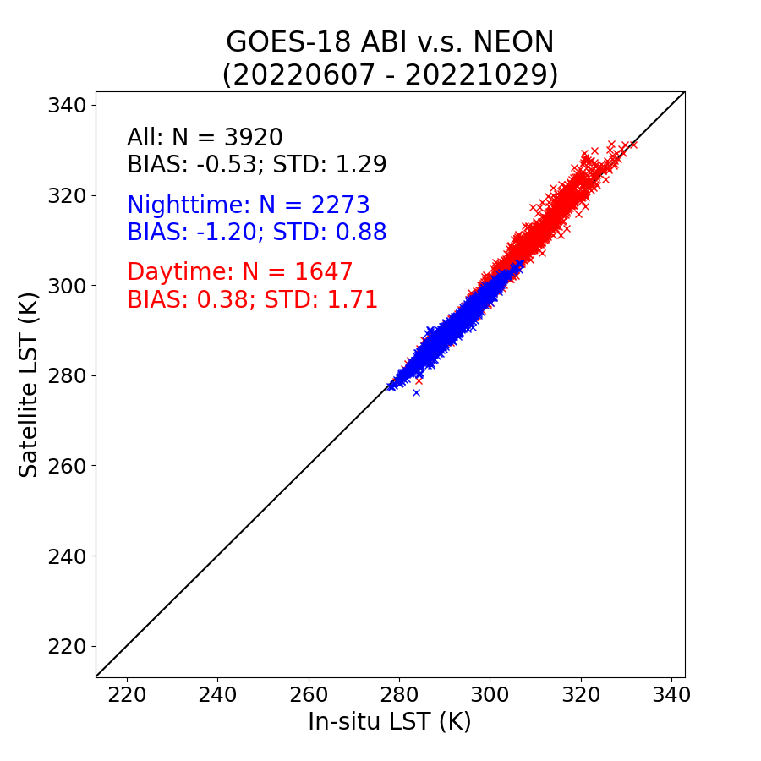
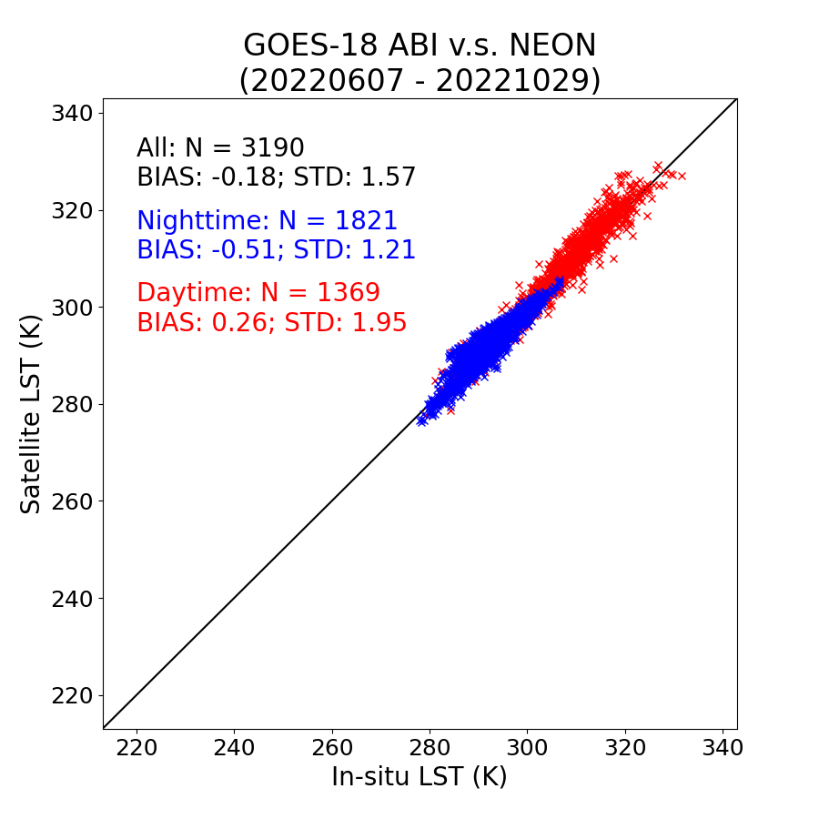
Validation Results: Full Disk at NEON
GOES-18 2KMFD
GOES-18 FD (10 km)
Both GOES-18 Full Disk LSTs easily meet the required accuracy (2.5 K) and precision (2.3 K) at NEON sites.
Notes:
NEON network was the newly added network in our routine practice of LST validation and monitoring activities. Lack of QC compared to the other two networks. Therefore it has been used as a secondary data source for validation purposes.

Slide 21
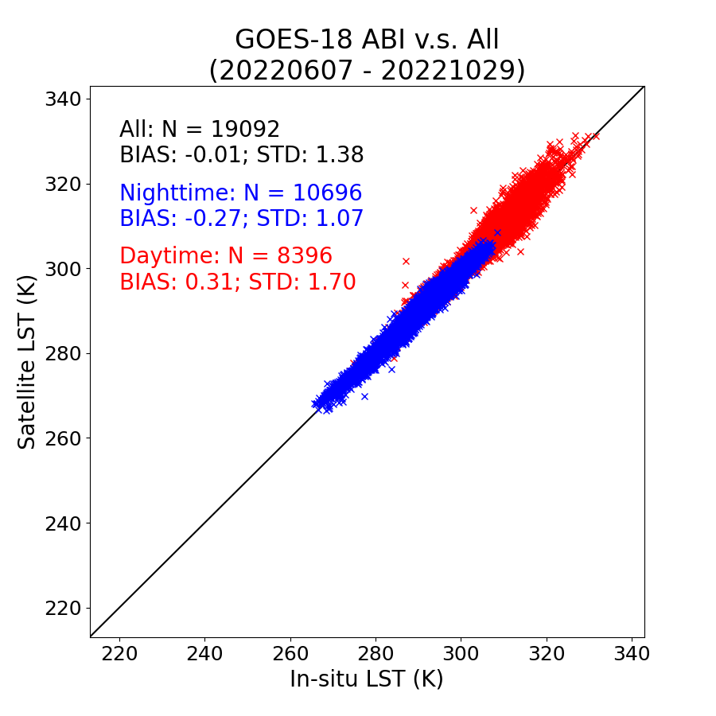
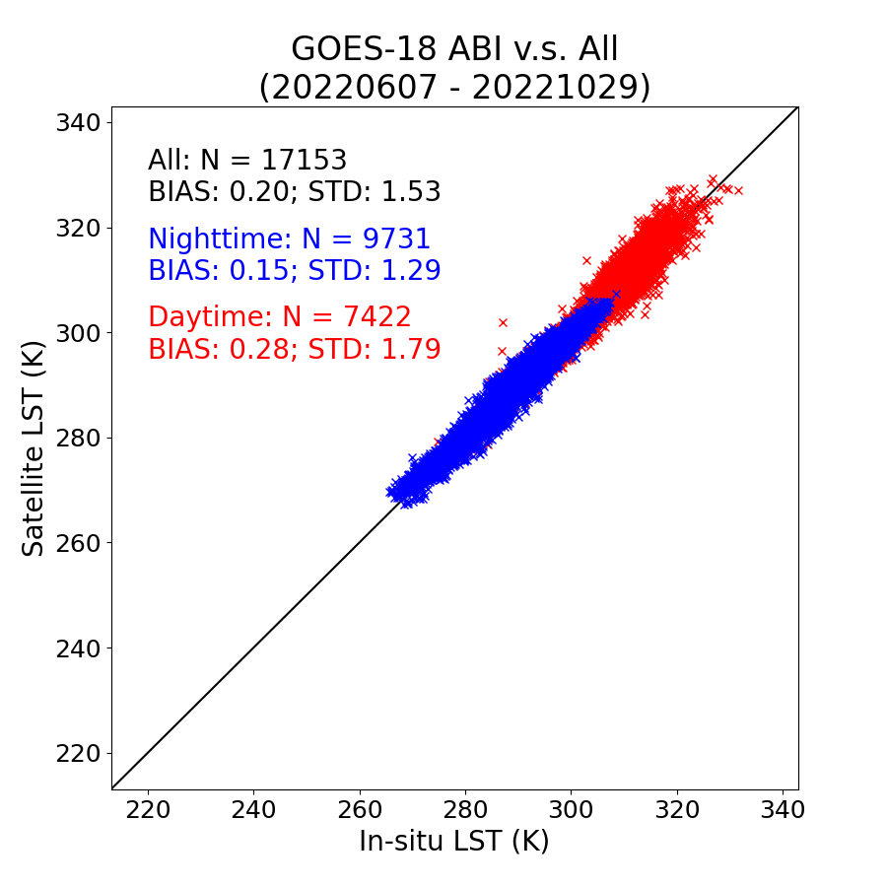
Validation Results: Full Disk summary
GOES-18 2KMFD
GOES-18 FD (10 km)
Both Full Disk LSTs easily met the mission requirement
Notes:
Few outliers exist.

Slide 22
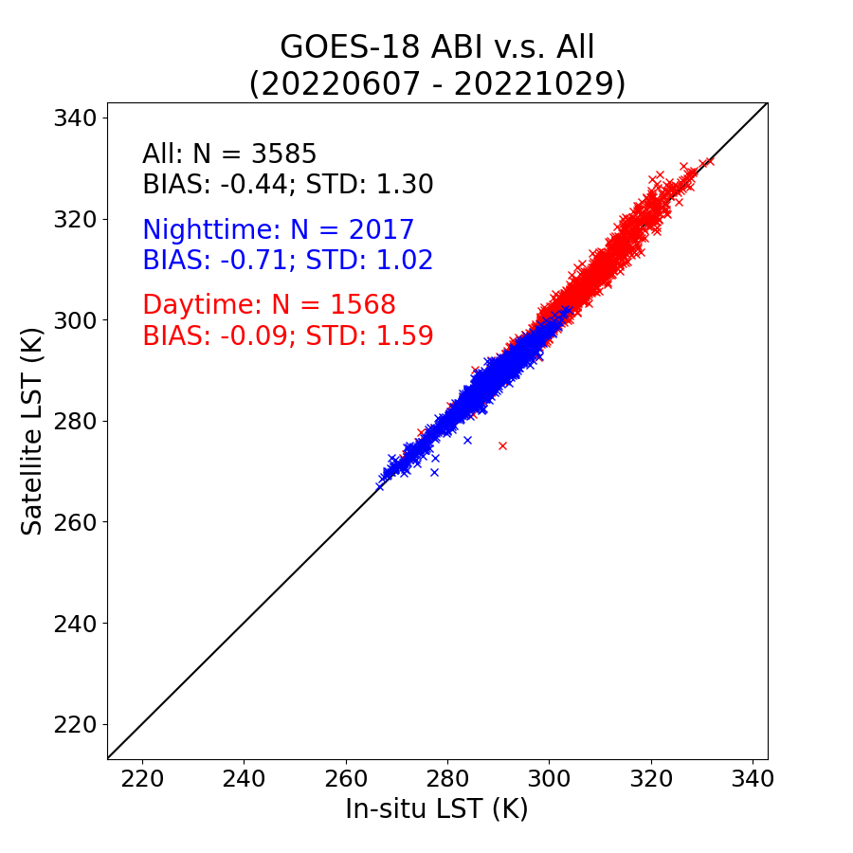
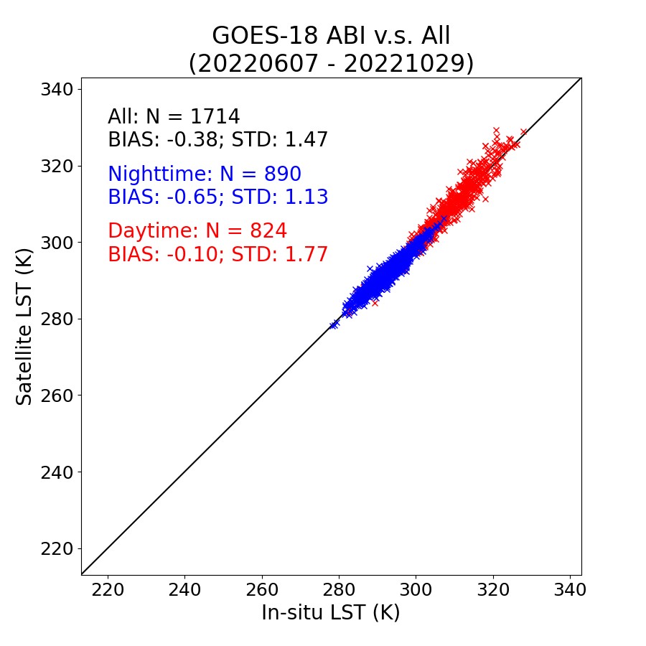
Validation Results: CONUS and MESO
GOES-18 CONUS
GOES-18 MESO
Both CONUS and MESO LSTs easily met the mission requirement

Slide 23
INTER-SENSOR COMPARISON
GOES-18 Land Surface Temperature Provisional PS-PVR

Slide 24
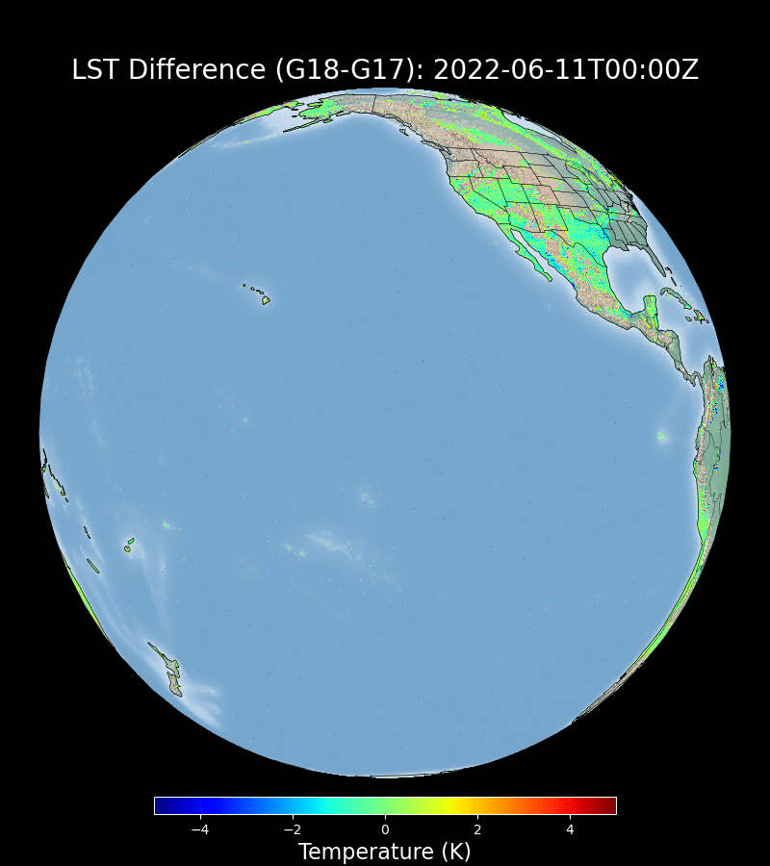
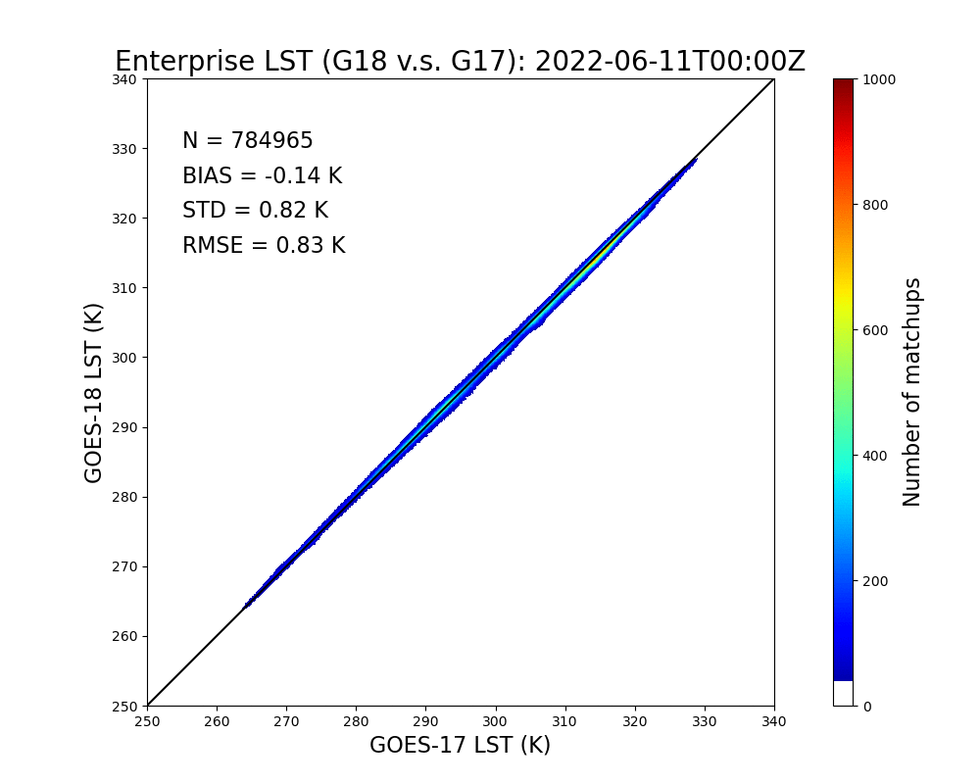
Inter-sensor LST comparison: G18 v.s. G17
GOES-18 Preliminary, Non-Operational Data
The two LSTs are in very good agreement in general.
Notes:
An example of the quantitative comparison between the G17 and G18 LSTs.
The comparison is done when G17 FPM is relatively low when its LST is retrieved with the enterprise algorithm.

Slide 25
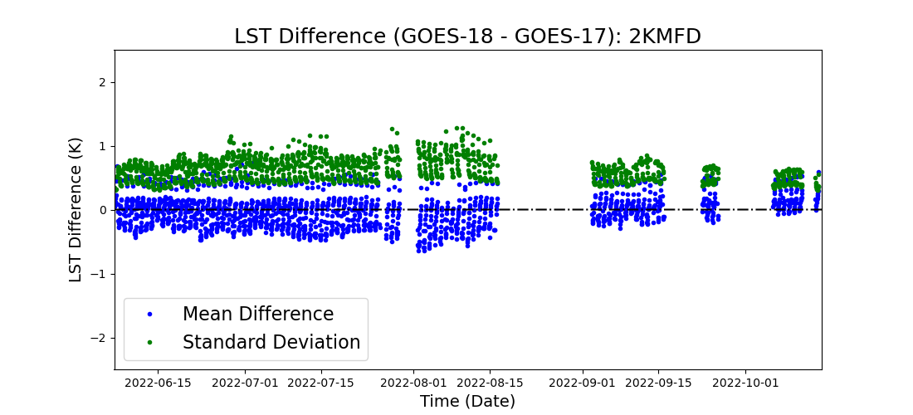
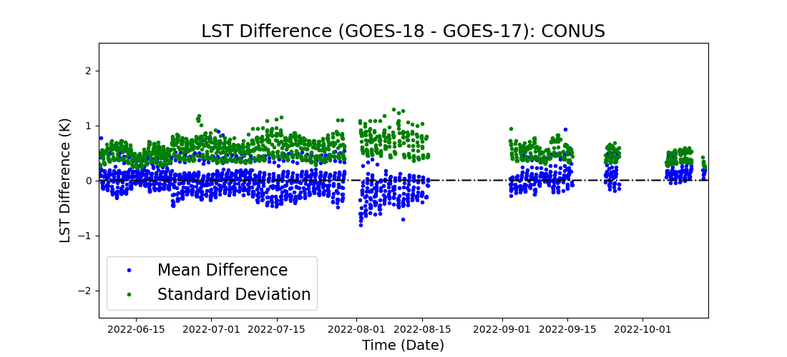
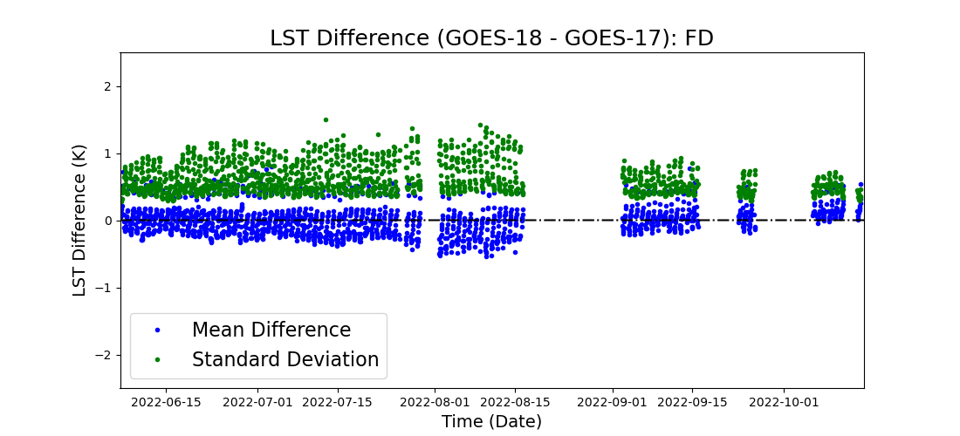
Inter-sensor LST comparison: G18 v.s. G17
The LST from G18 and G17 have been compared for FD, 2KMFD, and CONUS for all available scenes when the G17 ABI FPM temperature is not high;
Mean LST difference between the two satellites is close to zero;
Standard deviation of the difference is in general between 0.5 and 1 k;
Notes:
A summary of the inter-sensor LST comparison since G18 moves to ~137 W

Slide 26
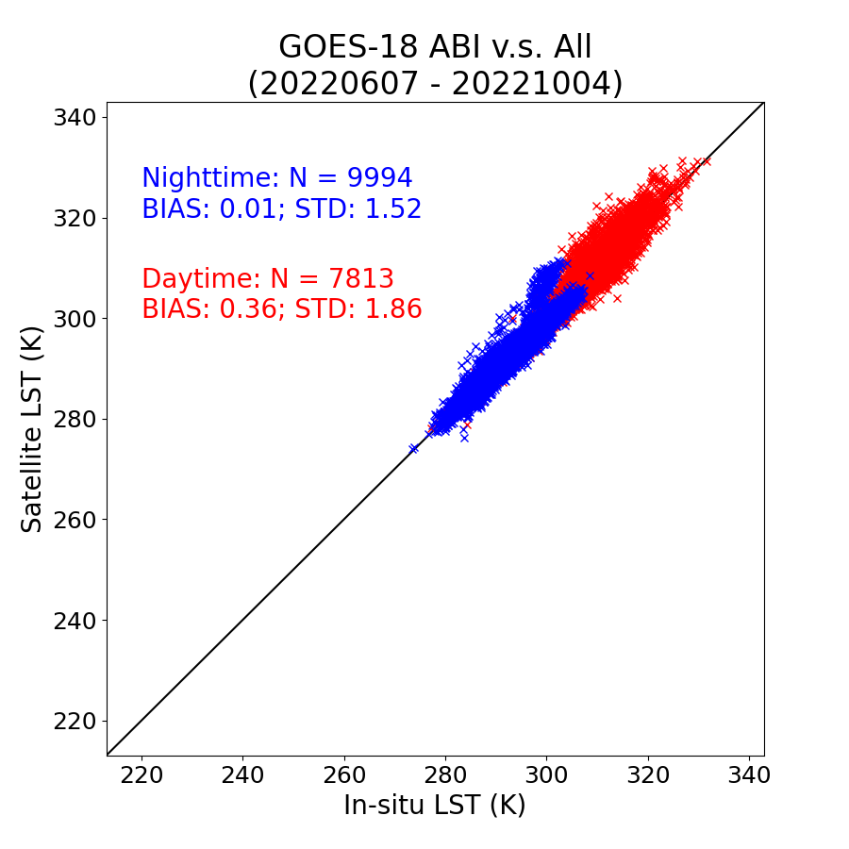
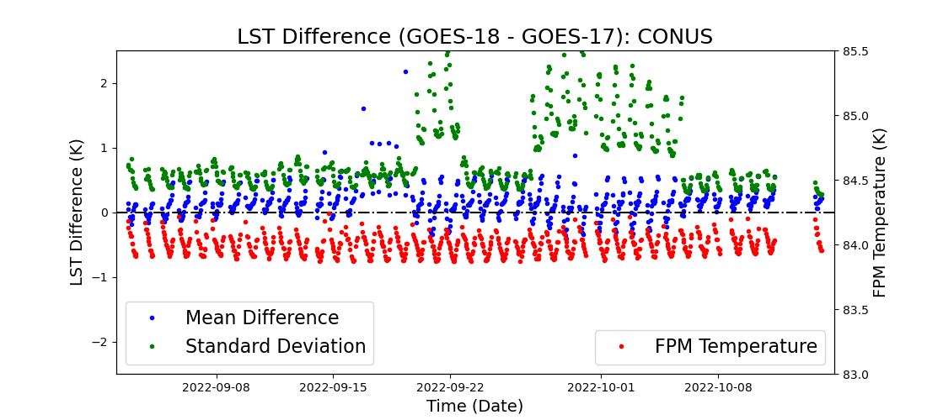
GOES-18 LST anomalies
1
2
3
Bias
STD
Period #1: 09/16 – 09/19 (G18 IR Anomaly);
Period #2: 09/20 – 09/22 (Elevated INR Errors);
Period #3: 09/26 – 10/05 (Image Navigation Anomaly).

Slide 27
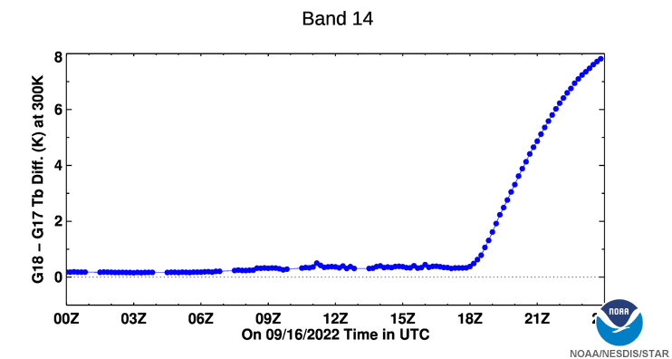
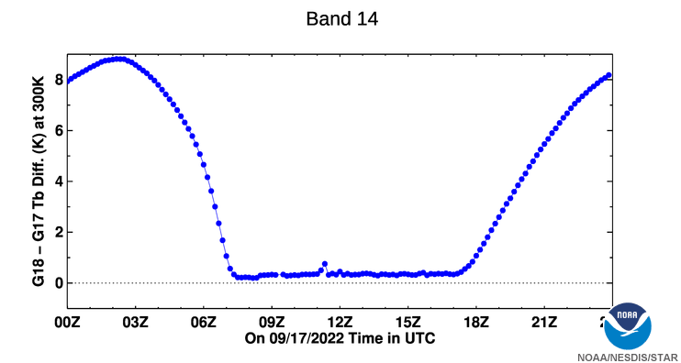
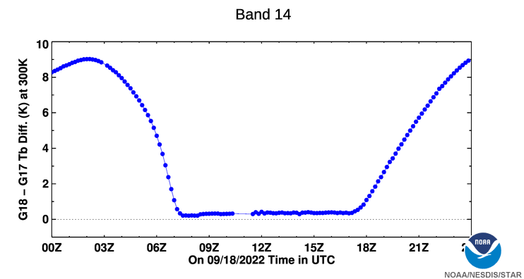
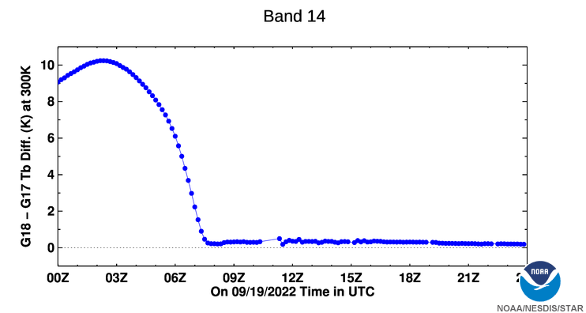
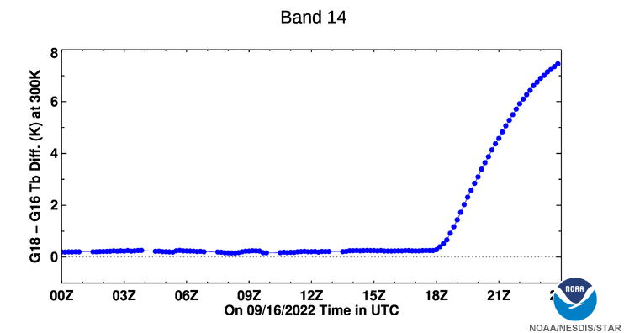
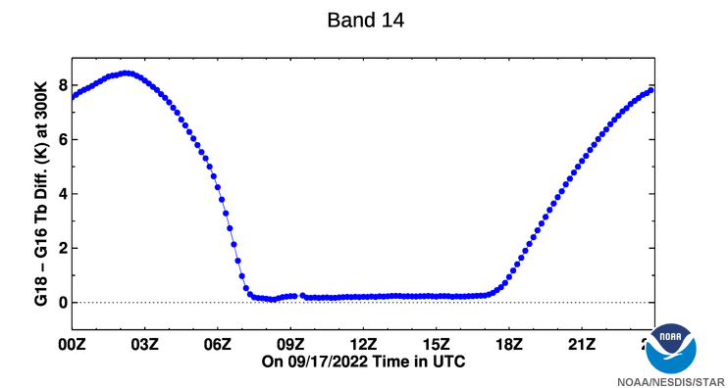
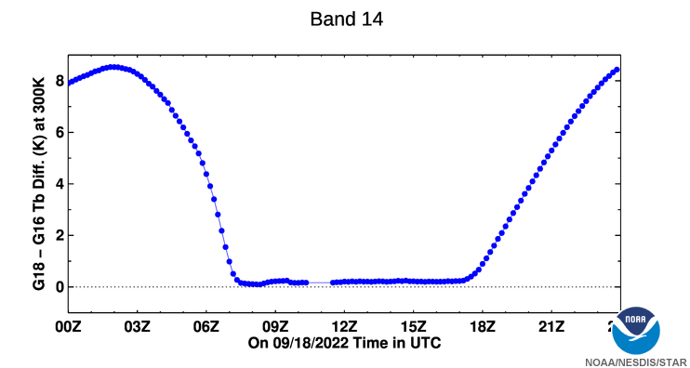
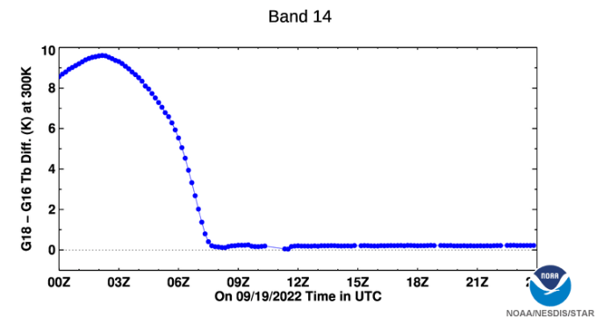
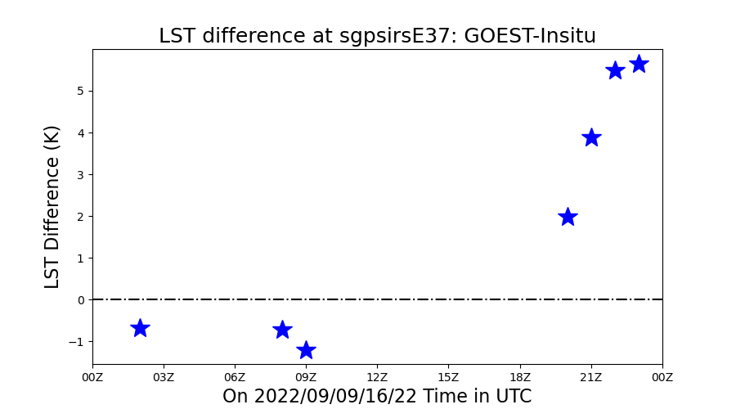
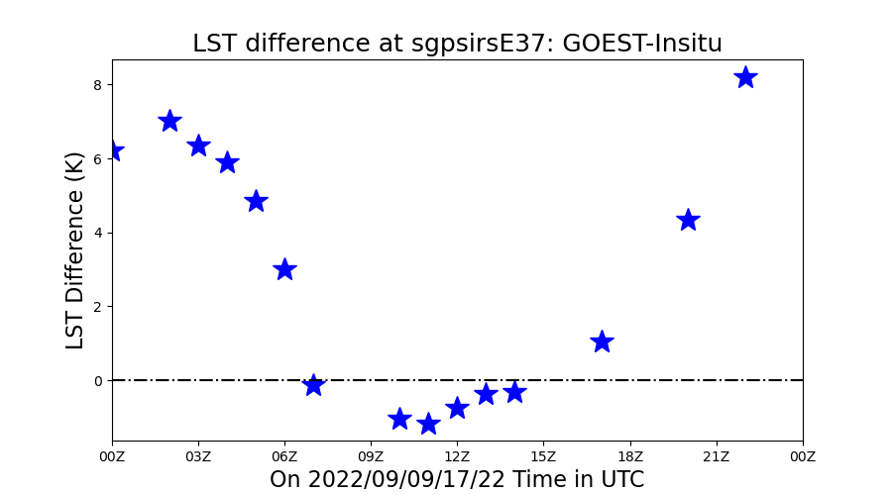
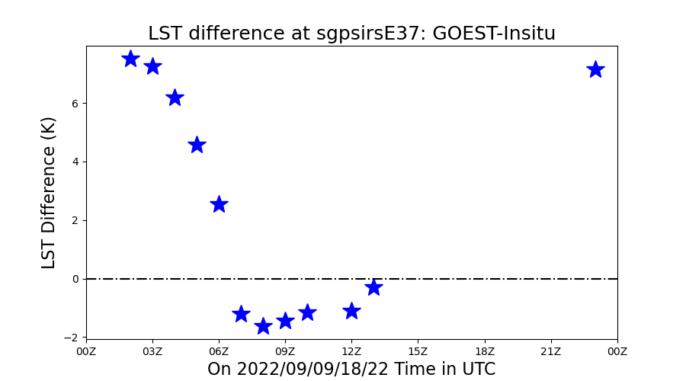
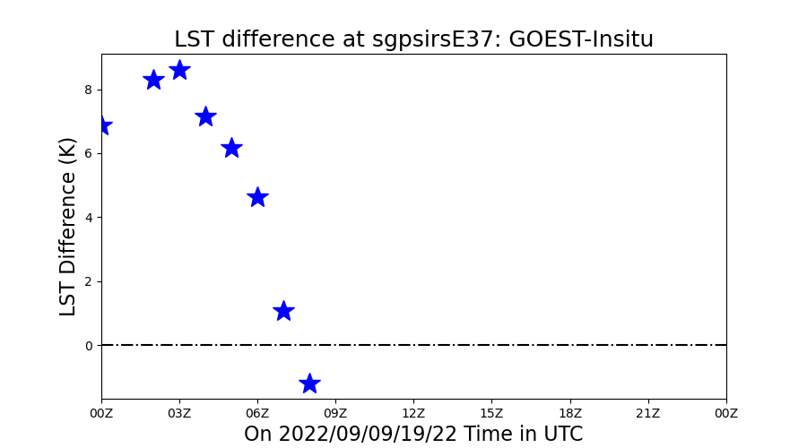
Tb (Band 14) comparison and LST validation
09/16
09/17
09/18
09/19
G18-G17
G18-G16
G18 LST-Insitu
The fluctuations (upper two rows) in band 14 radiances are consistent to G18 LST retrieval anomalies)

Slide 28
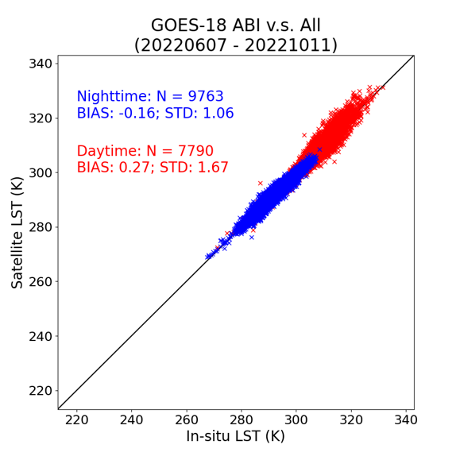
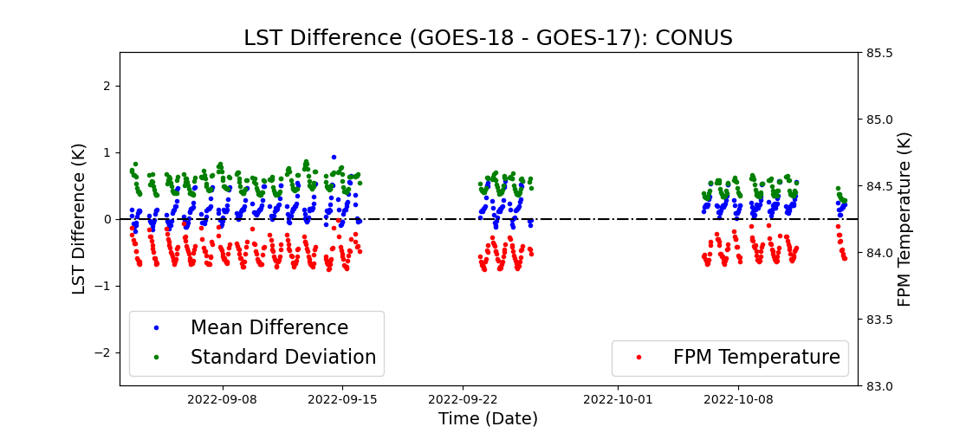
GOES-18 LST anomalies
1
2
3
Period #1: 09/16 – 09/19 (G18 IR Anomaly);
Period #2: 09/20 – 09/22 (Elevated INR Errors);
Period #3: 09/26 – 10/05 (Image Navigation Anomaly).

Slide 29
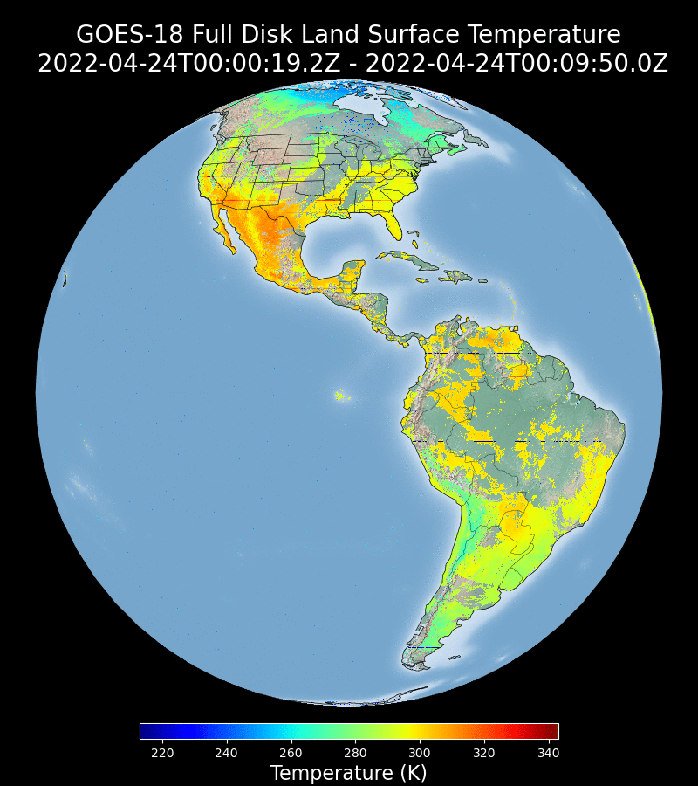
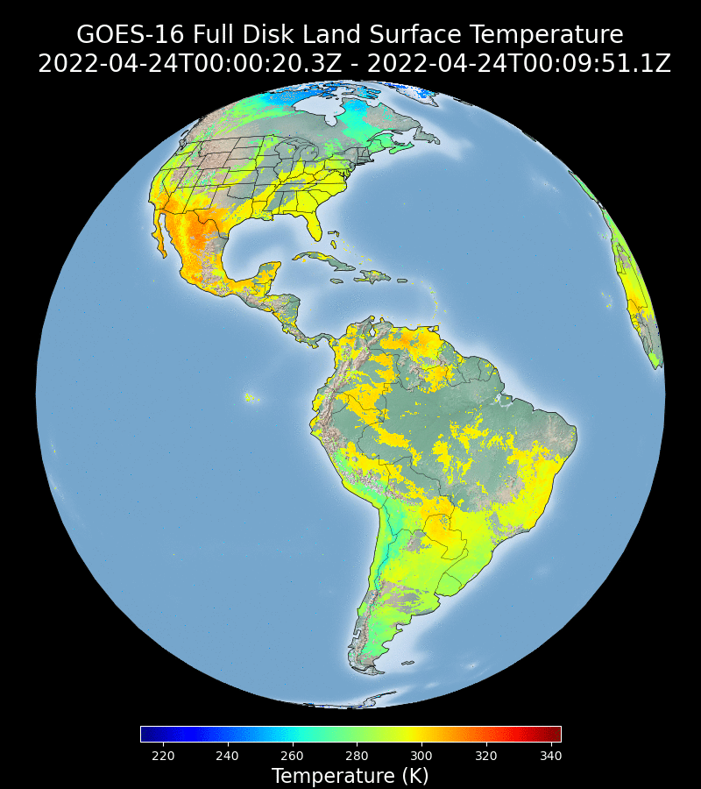
Other Minor Issues
Findings
Striping was found in the GOES-18 LST, because of the striping in the band 15 L1b data (bad/under-performing detectors): Fixed;
Missing data blocks/data files have been found: Still occur occasionally;
Empty data files were found (all fill values): hours 21 and 22 April 25: Have not been observed since GOES-18 moved to “WEST”.

Slide 30
Provisional Validation
Preparation Activities | Assessment
Validation activities are ongoing and the general research community is now encouraged to participate. | Agree
Severe algorithm anomalies are identified and under analysis. Solutions to anomalies are in development and testing. | No severe algorithm anomalies have been identified.
Incremental product improvements may still be occurring. | Incremental product improvements are expected.

Slide 31
Provisional Validation
End State | Assessment
Product performance has been demonstrated through analysis of a small number of independent measurements obtained from select locations, periods, and associated ground truth or field campaign efforts. | This has been demonstrated.
Product analysis is sufficient to communicate product performance to users relative to expectations (Performance Baseline). | This has been communicated in PS-PVR.
Documentation of product performance exists that includes recommended remediation strategies for all anomalies and weaknesses. Any algorithm changes associated with severe anomalies have been documented, implemented, tested, and shared with the user community. | These are documented in this slide and will be documented in a separate report.
Testing has been fully documented. | Testing will be documented in a PLPT Report.
Product is ready for operational use and for use in comprehensive cal/val activities and product optimization. | Agree

Slide 32
Recommendation
The Land Surface Temperature Science Team believes that the GOES-18 LST L2 product has met the Provisional Maturity criteria defined by the GOES-R Program and should be declared provisional.

Slide 33
PATH TO FULL VALIDATION MATURITY
GOES-18 Land Surface Temperature Provisional PS-PVR

Slide 34
Path to Full Validation Maturity
We expected to carry out the same activities for the full validation maturity
All major issues have been addressed
Minor issues:
  The daily/monthly emissivity data is considered to be used in LST retrieval for GOES satellites
  Some users prefer higher temporal resolution over an hourly product
No risks have been identified

Slide 35
SUMMARY AND RECOMMENDATIONS
GOES-18 Land Surface Temperature Provisional PS-PVR

Slide 36
Summary and Recommendations
The AWG Land Surface Temperature team recommends that the GOES-18 LST product be transitioned to Provisional status
Qualitative assessment of the GOES-18 LST
  No major issue
  Good agreement with GOES-17 LST
Quantitative assessment of GOES-17 LST
  Validation results with all in-situ networks easily met the mission requirement
  GOES-18 FD and CONUS LSTs are in good agreement with its GOES-17 counterpart

Slide 37
BACKUP
GOES-18 Land Surface Temperature Provisional PS-PVR

Slide 38

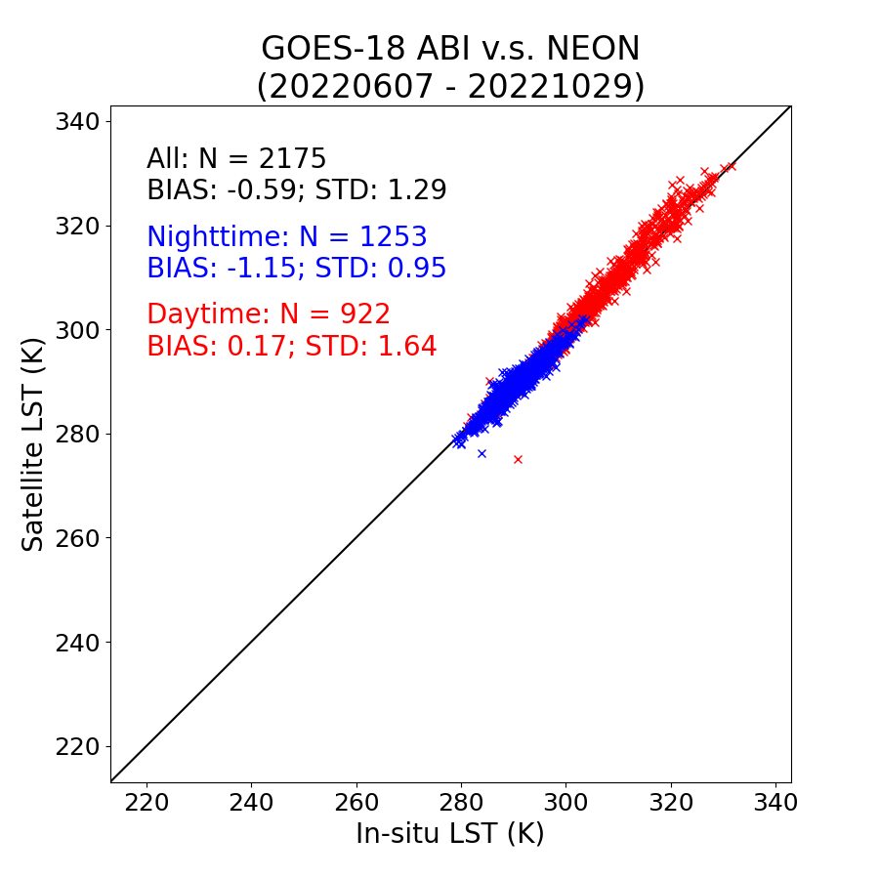
Detailed CONUS LST validation Results
SURFRAD
NEON
CONUS does not have coverage over ARM sites.

Slide 39
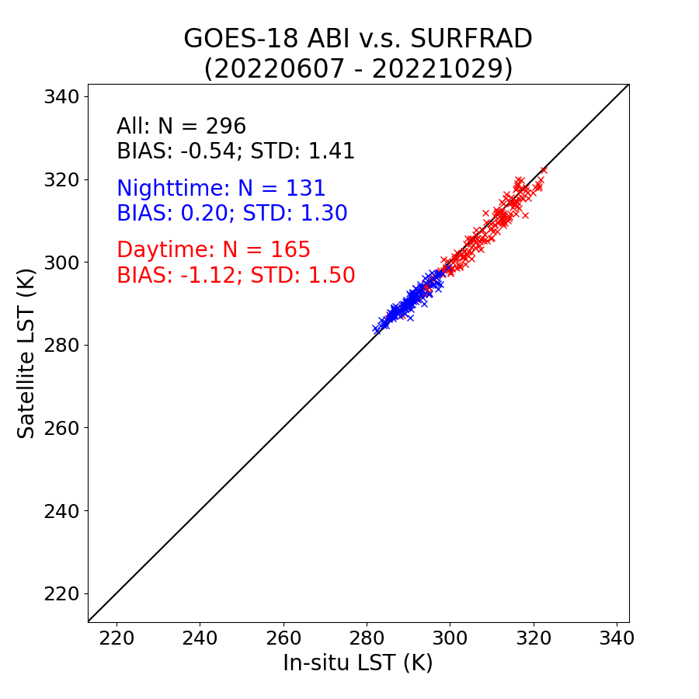
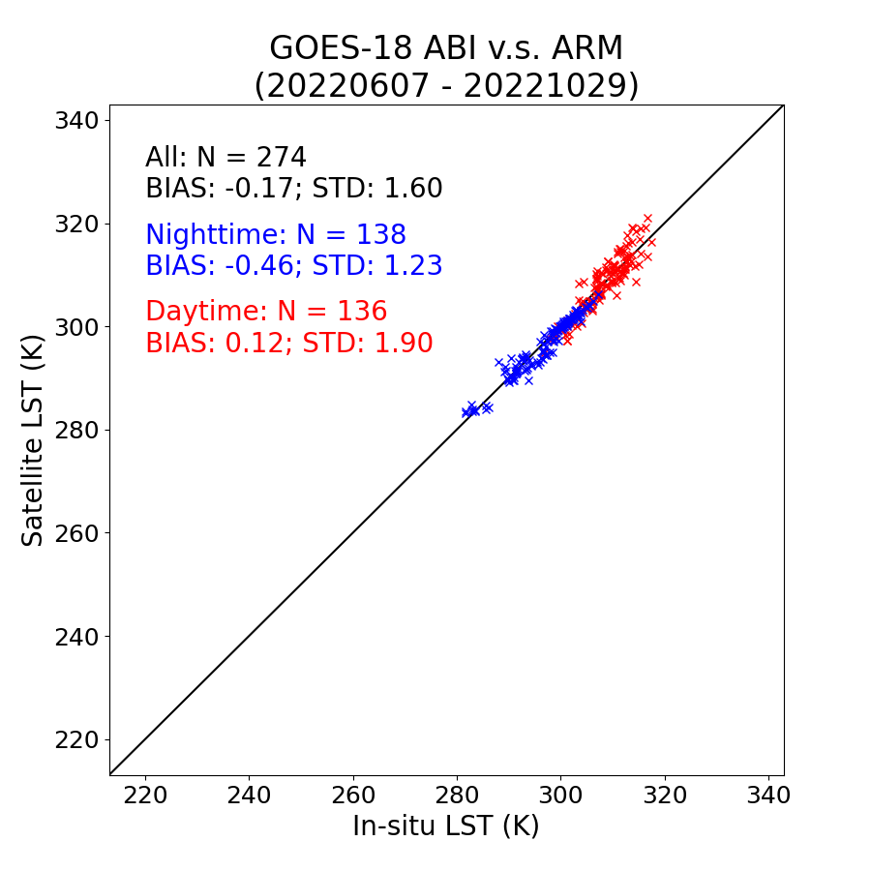
Detailed MESO LST validation Results
SURFRAD
ARM
NEON

