Slide 1
GOES-18 ABI L1b/CMI Full Validation PS-PVR NWS User Feedback
Friday, September 1, 2023
John Evans / GST, Inc. ... and the NWS OBS / TOWR-S team
john.d.evans@noaa.gov

Slide 2
NWS Integration of GOES-18 imagery
GOES-18 ABI imagery is used in AWIPS as either
Sectorized Cloud & Moisture Imagery (SCMI) tiles from GOES-R GS via the Satellite Broadcast Network (SBN)
Reduced-resolution "Full Northern Hemisphere" (6km nadir pixels) – all channels except Ch. 13 (native 2km nadir pixels)
Native-resolution West CONUS sector, Alaska regional sector, American Samoa regional sector
Mesoscale sectors or
L1b full-resolution files (FD, CONUS, Meso) via GOES Rebroadcast (GRB) antennas and CSPP-GEO software
GOES-18 ABI imagery works with existing baseline configurations (NCF, AWIPS, GRB)
Except American Samoa sector SCMI: new WMO header => new configs in NCF and Pacific Region sites
Shuffle-compressed SCMI: Seamless integration; Saving ~27 GB per day
No significant operational impact from "barcode artifact"
GOES-18 ABI imagery reaching all NWS operations since T2O on Jan 4, 2023

Slide 3
Recent tropical storms seen in GOES-18 ABI imagery
GOES-18 ABI Band 13 (10.3μm) imagery: 28-Aug-2023, 06-16z
Franklin
Idalia
Irwin

Slide 4
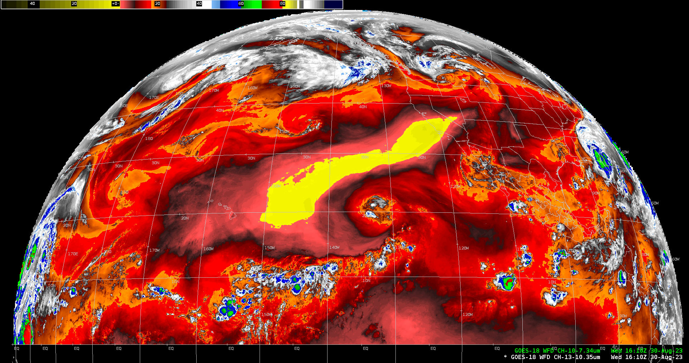
GOES-18 SCMI: Northern Hemisphere "Full Disk" disseminated via SBN
GOES-18 ABI Band 10 (7.3μm / water vapor) imagery: 30-Aug-2023, 16-20z

Slide 5
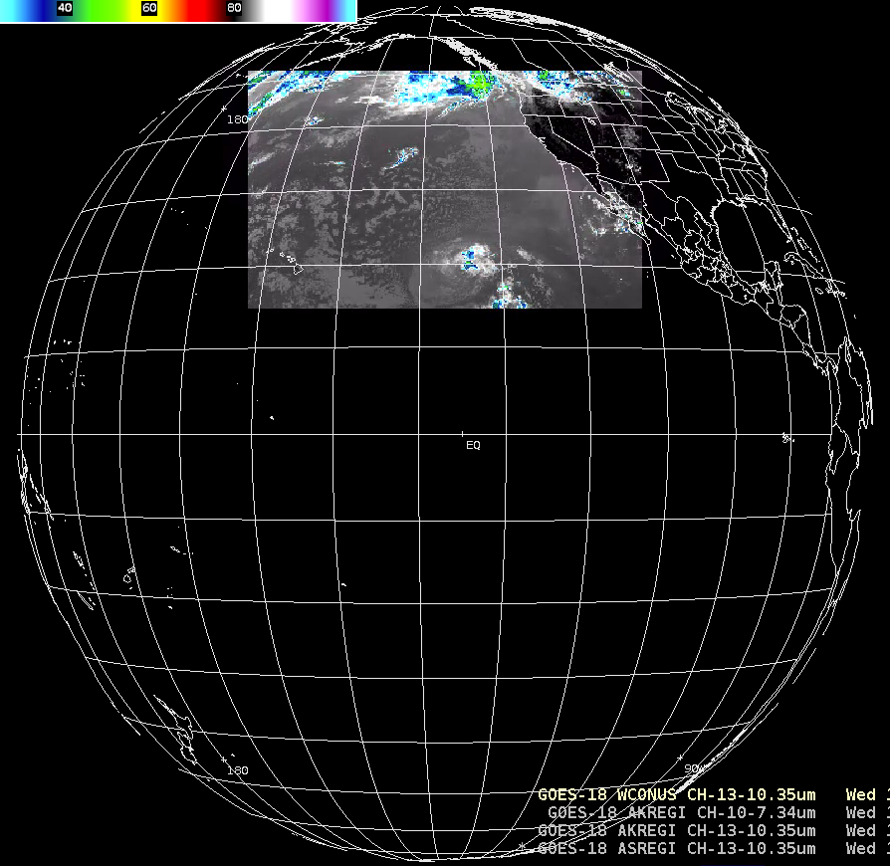
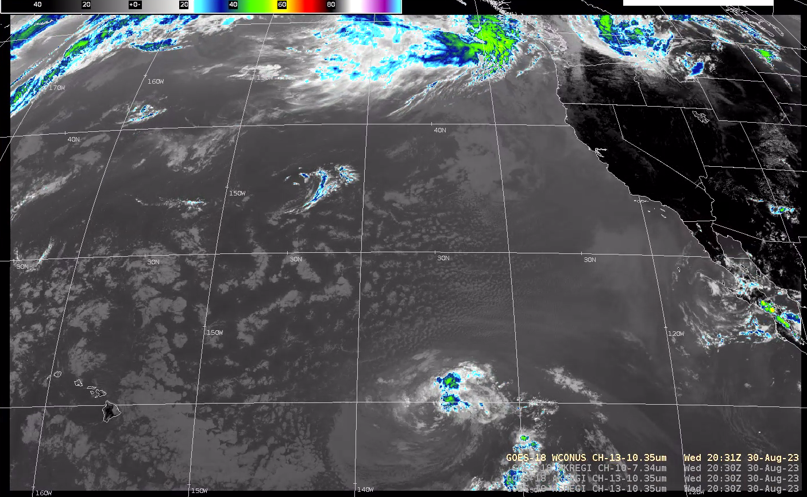
GOES-18 SCMI: West CONUS sector disseminated via SBN
GOES-18 ABI Band 13 (10.3μm) imagery: 30-Aug-2023, 20:31z

Slide 6
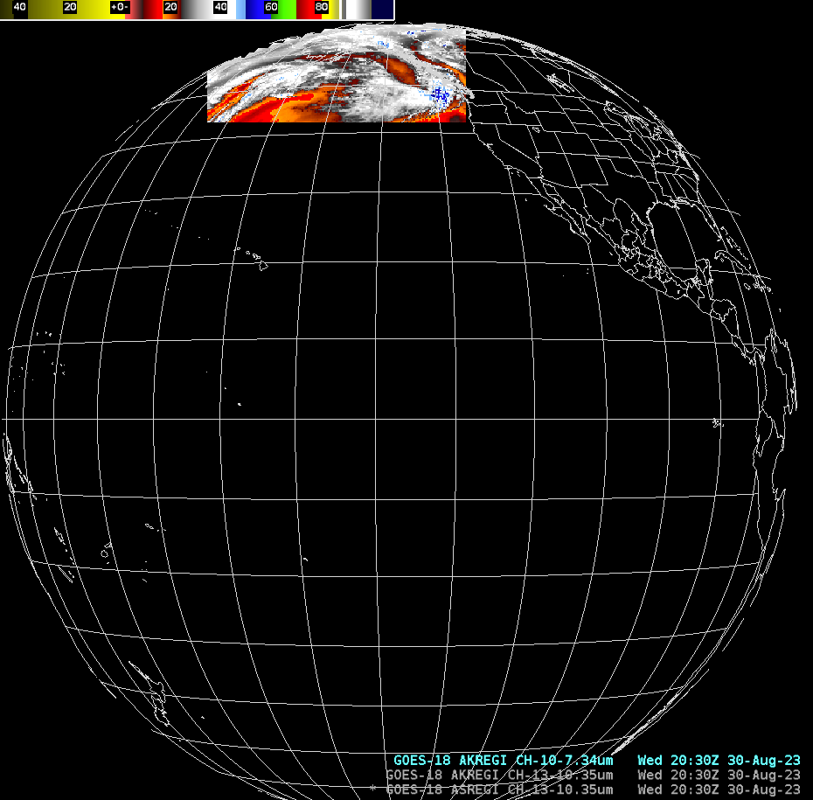
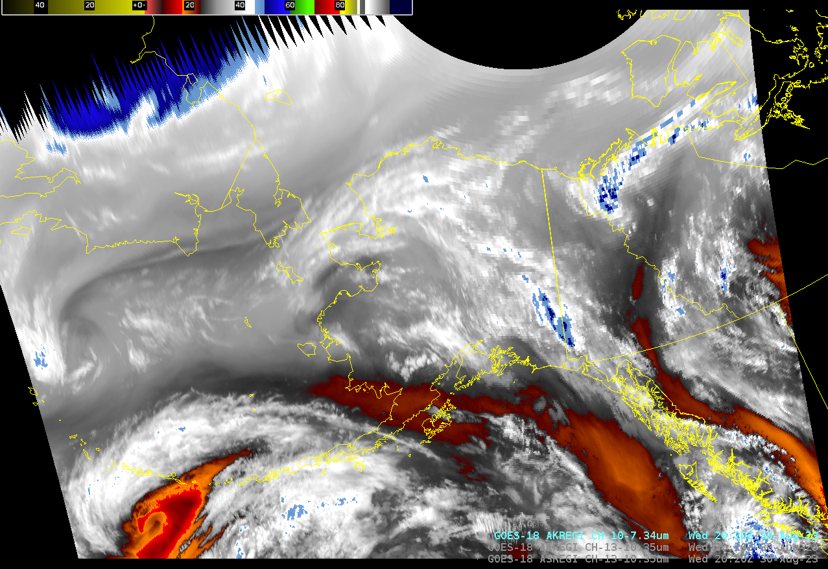
GOES-18 SCMI: Alaska regional sector disseminated via SBN
GOES-18 ABI Band 10 (Water vapor / 7.3μm) imagery: 30-Aug-2023, 20:31z

Slide 7
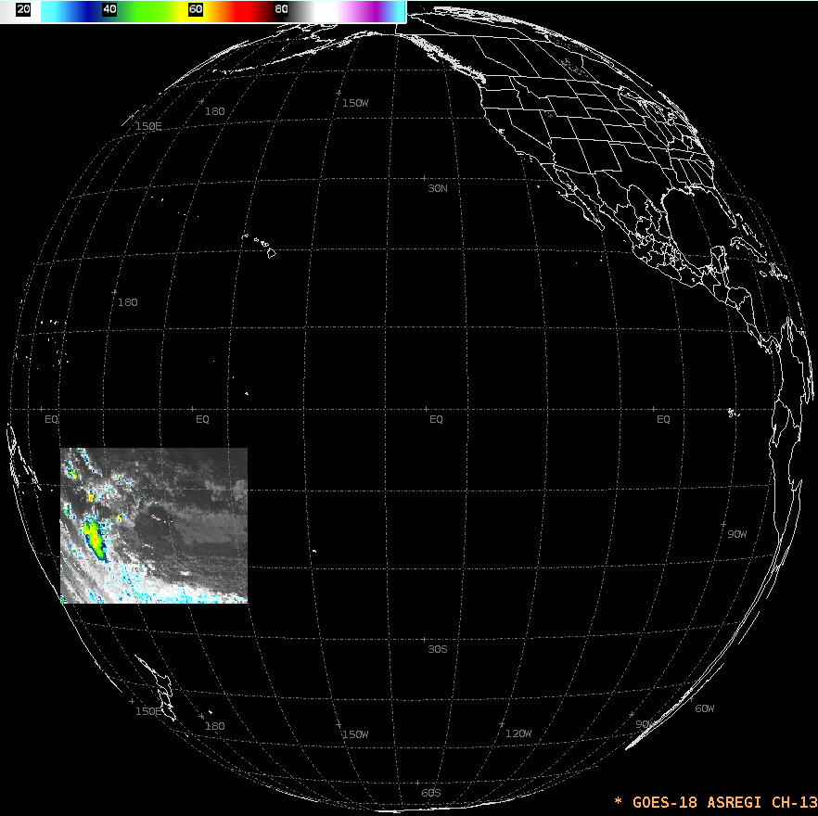
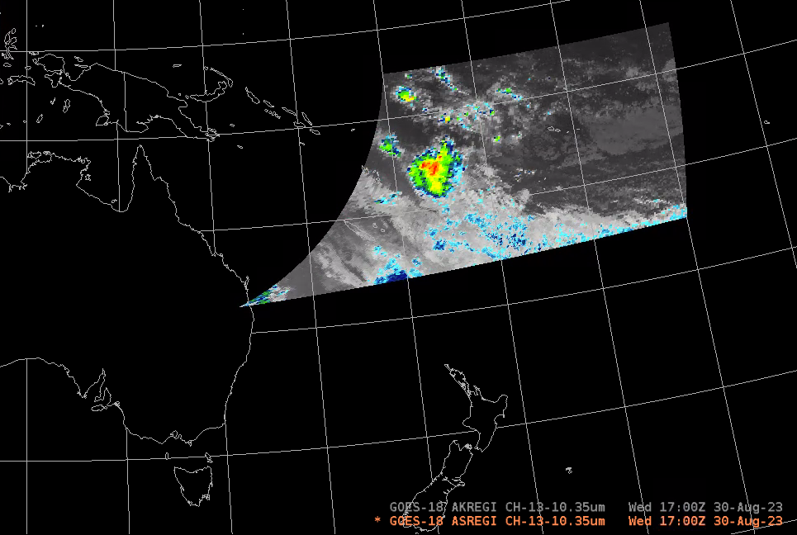
GOES-18 SCMI: American Samoa regional sector disseminated via SBN
GOES-18 ABI Band 13 (10.3μm) imagery: 30-Aug-2023, 17:00z

Slide 8
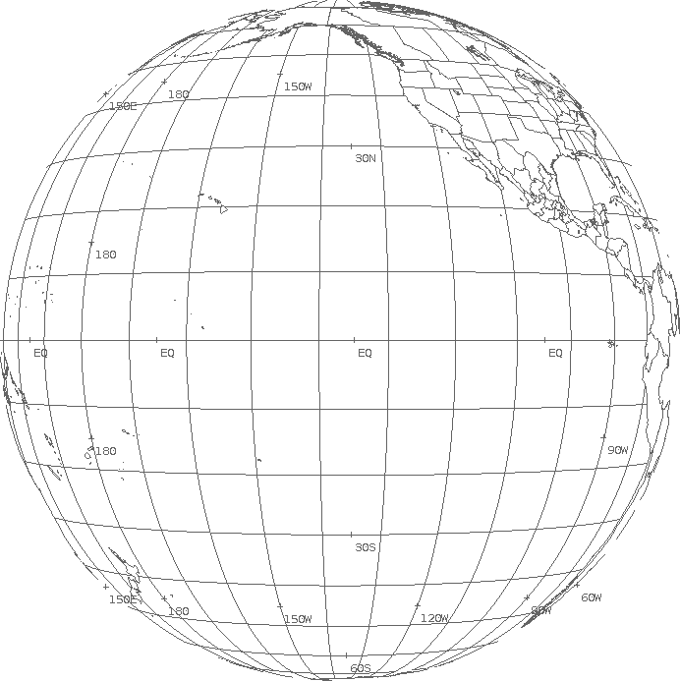
GOES-18 SCMI tiles disseminated via SBN
T001 (PAA) | T002 (PAB) | T003 (PAC)
T004 (PAD) | T005 (PAE) | T006 (PAF)
Full Disk (N. Hemisphere)
W. CONUS
Regional sectors
… from the forthcoming SBN / NOAAPort User Guide for GOES-R Imagery and Gridded Lightning data products
T001
(PAA)
T002
(PAB)
T003
(PAC)
T004 (PAD)
Alaska Regional Sector
T001 (PAA) | T002 (PAB) | T003 (PAC) | T004 (PAD)
T006 (PAF) | T007 (PAG) | T008 (PAH) | T009 (PAI)
T011 (PAK) | T012 (PAL) | T013 (PAM) | T014 (PAN)
T005 (PAE)
T010 (PAJ)
T015 (PAO)
T005 (PAE)
T006 (PAF)
T007 (PAG)
T008 (PAH)
1024/r
452
1356
W. CONUS (PACUS) Sector
1024/r
952/r
1024/r
1024/r
1024/r
1024/r
904/r
452
1356
604
1812
604
1812
600
1800
T001 (PAA)
T002 (PAB)
American Samoa Regional Sector
Full Disk Channels 1-12, 14-16: 6km pixels Full Disk Channel 13: 2km pixels
T003 (PAC)
T004 (PAD)
CONUS / W. CONUS tile sizes (columns / rows) are inversely proportional to each channel’s nadir resolution (r) in km:
Bands 1, 3, 5: r = 1
Band 2: r = 0.5
Bands 4, 6-16: r = 2

Slide 9
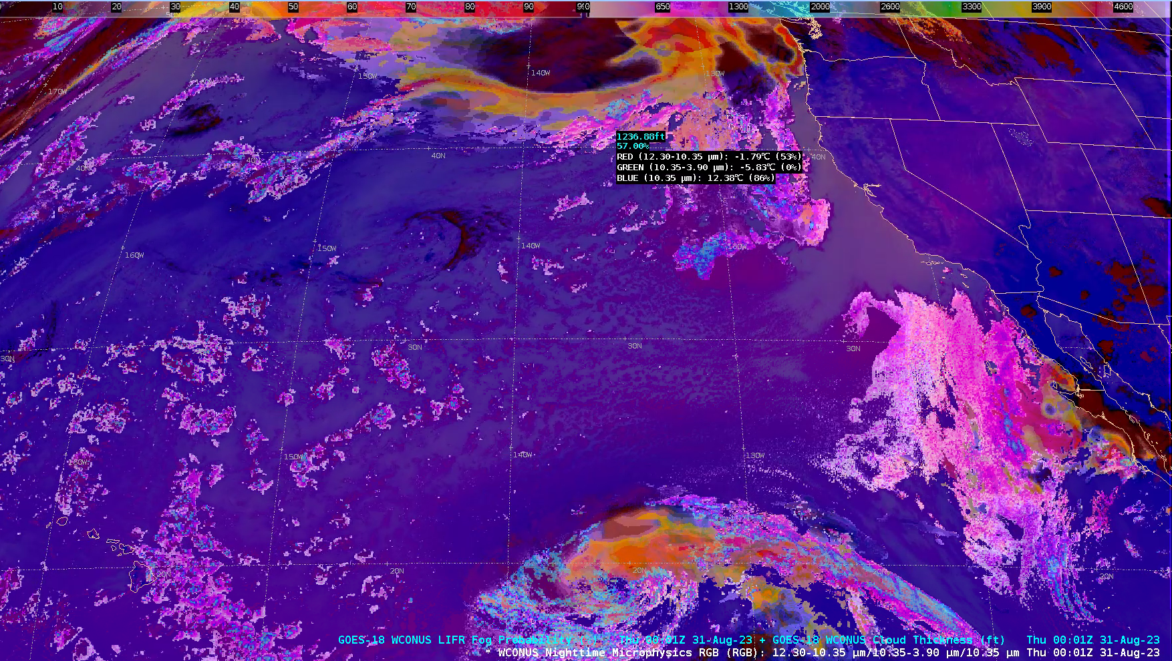
GOES-18 SCMI: RGB Composites w/ L2 sampling underlays
Nighttime microphysics RGB + Cloud thickness + LIFR fog probability

Slide 10
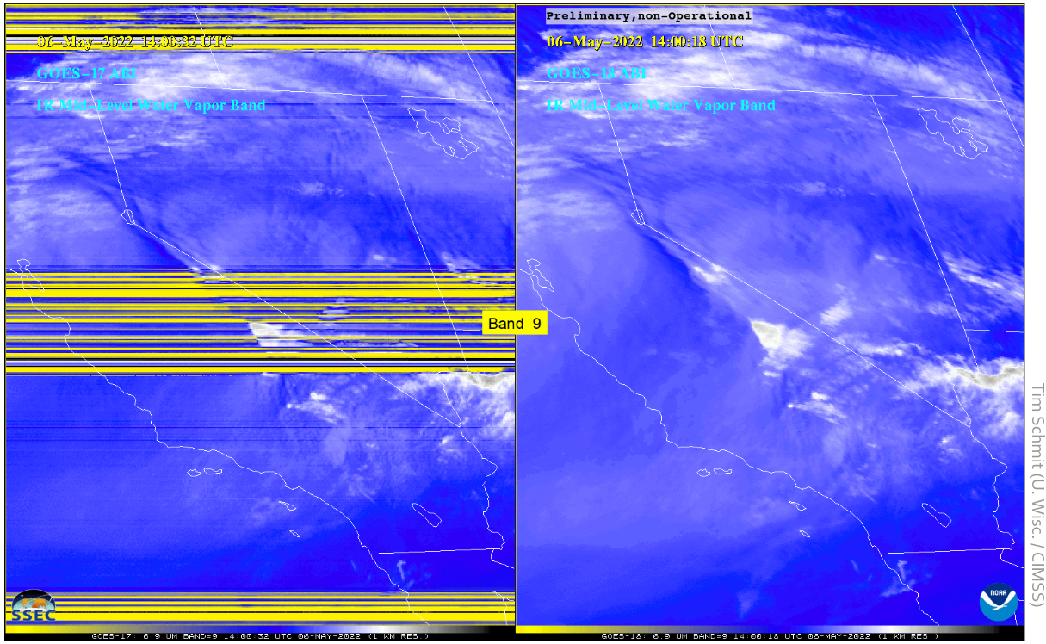
GOES-18 ABI imagery: No Loop Heat Pipe artifacts

