Slide 1
Peer and Stakeholder Product Validation Review (PS-PVR) for the
Provisional Maturity of GOES-18 ABI L1b Products
GOES-R Calibration Working Group
With assistance from many
28 July 2022

Slide 2
Presentation Outline
Introduction
  Background
  Scope and Organization
Key Performance
  Radiometric Calibration
  Image Navigation and Registration
  Notable issues
Maturity Assessment
  Entrance
  Exit
  Path to Full Validation
Summary and Recommendations

Slide 3
introduction

Slide 4
Background
GOES-18 (GOES-T before launch on 1 March 2022) is the 3rd in the GOES-R series.
  GOES-16 was launched on 19 Nov 2016 and has been serving as GOES-EAST since 18 Dec 2017.
  GOES-17 was launched on 1 March 2018 and has been serving as GOES-WEST since 12 Feb 2019.
GOES-17 ABI has a cooling system anomaly since launch.
  Particularly vulnerable during eclipse season such that GOES-15 must be called out for supplementary support.
  That drains valuable resources from NESDIS while degrading service to NWS.
  NOAA desires GOES-18 ABI service to start in August 2022.
The Provisional PS-PVR is a prerequisite for the Handover to NOAA.
  Complete in ~half of the time compared to GOES-16.

Slide 5
Scope and Organization
The Program defines three levels of maturity for the GOES-18 ABI L1b products:
  Beta: Achieved on 11 May 2022. Products meet the minimum requirements.
  Provisional: Being conducted now. Preliminary assessment of key performance under limited operation conditions for suitability of operation.
  Full Validation: One year later. Comprehensive assessment of all performance in all seasons.
The Program defines two types of post launch tests:
  Post-Launch Test (PLT): Engineering test from an instrument perspective (characterization, functionality).
  Post-Launch Product Tests (PLPT): Science test from a product perspective (performance requiring multiple functionalities).
We will review the preliminary results of the 11 PLPTs as planned per Readiness, Implementation, and Management Plan (RIMP).
  These PLPTs were selected to fulfil the goal of Provisional review.
  The review is organized around the selected key performances, instead of individual PLPTs.
    The PLPTs are summarized in the next two slides. Their reports are available separately.

Slide 6
PLPT for Provisional (1/2)
Test id & Name | Description | Results | Issue
PLPT-01 IR Validation | Assess ABI IR accuracy by comparing with hyperspectral sounders | The ABI radiances is very accurate, an order of magnitude better than the requirements. | None
PLPT-04 VNIR Validation | Assess ABI VNIR accuracy by comparing with VIIRS | The ABI radiances meet the requirements for all channels. | Minor B04: Striping. B05: Scene-dependent bias. All: Downward trend of gains.
PLPT-06 VNIR Validation - RVS | Assess ABI VNIR spatial uniformity using lunar images across the FOR | Data collection is ongoing. Preliminary results indicate no major issues. | Minor Three minor issues with the first data collection (see note page)
PLPT-09 Low Light SNR | Assess B02 SNR for dark scenes (5% albedo) | Collected part of the data. Will continue in Sept. Early results suggest compliance. | None
PLPT-10 Navigation | Evaluate NAV, FFR, and WIFR since 1st light. | The ABI INR meet all requirements. | Minor PLTs often interrupted 24 hour data collection, interfering with evaluation.
Notes:
Clipped moon at several images.
Vertical invalid lines at some images.
Several missing INST-CAL-LUN files.

Slide 7
PLPT for Provisional (2/2)
Test id & Name | Description | Results | Issue
PLPT-11 Co-registration | Evaluate CCR since 1st light. | All are better than MRD. 7/8 of the pairs are better than the Baseline. Comparable to GOES-16/17. | None
PLPT-12 Swath navigation | Evaluate SR and SSR since 1st light. | All are better than MRD. 8/10 are better than the Baseline. Comparable to GOES-16/17. | None
PLPT-17 Lunar NSS | Collect and analyze the lunar NSS data. | Preliminary result of the 6/8 and 7/6 data. | None
PLPT-19 Day 1 solar cal. | Evaluate the initial calibration of solar channels. | Delivered the updated B02 K-LUT | Minor Account for the suspected beta-dependence.
PLPT-40 Space Chasing | Evaluate the IR spatial uniformity in East-West direction | Confirm that the scan mirror emissivity update is successful. | None
PLPT-41 Space NSS | Evaluate the IR spatial uniformity in North-South direction | Preliminary results suggest reasonable scan mirror emissivity in the NS direction. | None

Slide 8
Key performance

Slide 9
Overview
Radiometric Calibration
  Solar (< 3 µm, Channels 1-6) and infrared (> 3 µm, Channels 7-16) channels.
  Accuracy, precision (noise), repeatability, and stability.
    Repeatability tests will be fully reported in full Validation review. Some results related to known issues such as PICA and barcode artifact will be reported.
    Will note the absence of instability, not a full report of the required stability.
Image Navigation and Registration
  Overall error; frame-to-frame; within frame.
  Channel-to-channel registration.
  Swath-to-swath registration.
Notable Issues
  Scan mirror emissivity (PICA).
  Channel 2 (0.64 µm) bias.
  Downward trend of solar channel gains
  Channel 7 (3.9 µm) noise.

Slide 10
Radiometric calibration
Key Performance

Slide 11
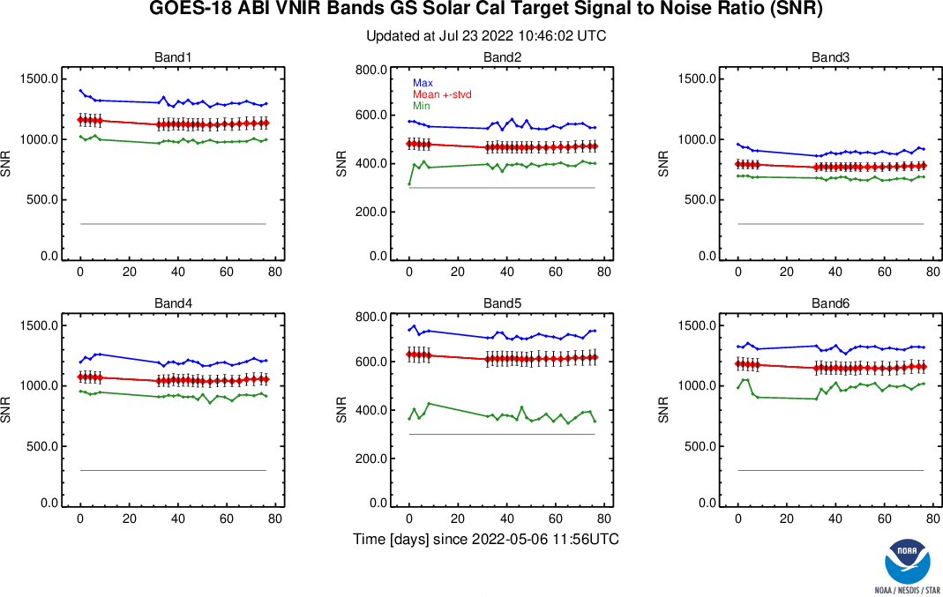
VNIR Noise (SNR) is better than MRD …
Maximum, Average ± stdv, minimum, and the MRD for the six ABI VNIR channels.
The higher, the better.
The min (green) must be higher than the requirement (gray).
GOES-18 ABI VNIR channels demonstrated the required Signal-to-Noise Ratio (SNR).
Channels 1, 4, and 6 are ~3 times better; Channels 3 and 5 are ~2 time better; and Channel 2 is ~1.5 times better.
The difference between pre- and post-drift is due in part to the update of E_{sun} and Q-LUT.

Slide 12
… and than GOES-16/17 (for 11 of 12 cases)
Low light SNR are enlarged by 10 times to fit the plot.
The methods of estimating low light SNR are different for GOES-16/17/18. The results may not be comparable.
The higher, the better.
G16 was waived to be higher than 300 for 99% of the detectors, and the rest 1% must be higher than 150. GOES-17/18 don’t need this waiver.
Waiver for G16. Unnecessary for G18.
GOES-18 ABI VNIR SNR is better than GOES-16/17 ABI (except in one case).

Slide 13
VNIR Radiances Are Accurate
The closer to zero, the better.
Requirement is marked by the green lines.
GOES-18 ABI VNIR accuracy is comparable to GOES-16/17 and meet the requirement of 5%.
B05 is not modified. It has large uncertainty and is only 2.1% brighter than SNPP VIIRS.
GOES-16/17 B02 were shown as corrected after Full Validation

Slide 14
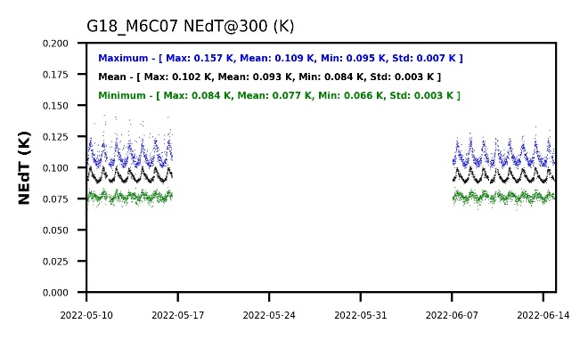
IR Noise (NEdT) is many times better than MRD …
The lower, the better.
… except for B07
(not many times better)
These are the NEdT of detector noise, not the NEdT of the resampled noise that would meet the requirement.

Slide 15
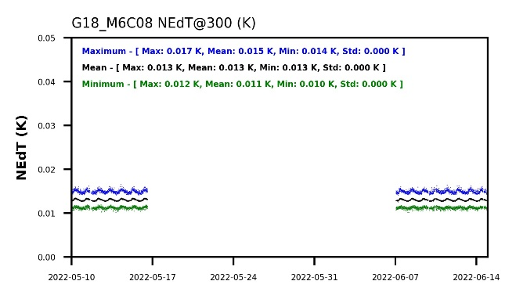
IR Noise (NEdT) is many times better than MRD …
The lower, the better.
~6 times better than requirement of 0.10 K
NEdT is also stable for all channels.

Slide 16
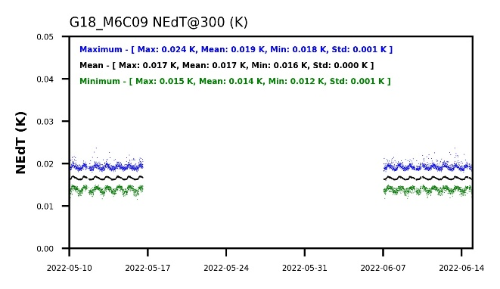
IR Noise (NEdT) is many times better than MRD …
The lower, the better.
~5 times better than requirement of 0.10 K
NEdT is also stable for all channels.

Slide 17
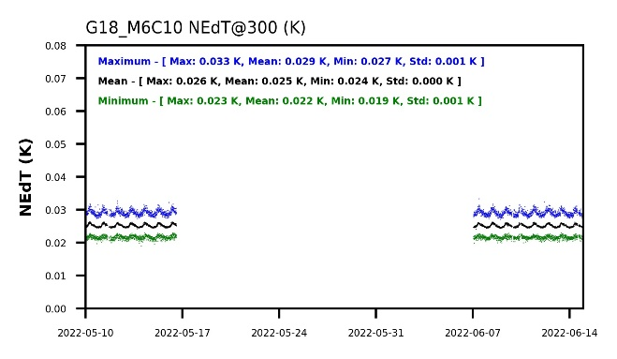
IR Noise (NEdT) is many times better than MRD …
The lower, the better.
~3 times better than requirement of 0.10 K
NEdT is also stable for all channels.

Slide 18
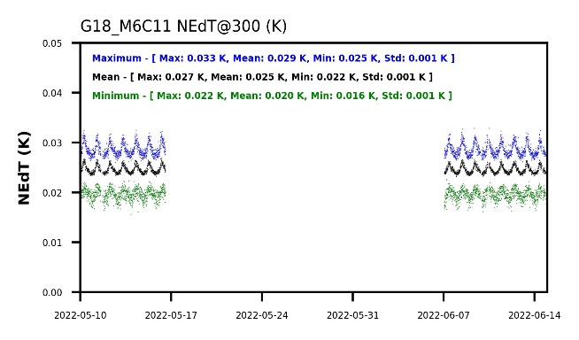
IR Noise (NEdT) is many times better than MRD …
The lower, the better.
~3 times better than requirement of 0.10 K
NEdT is also stable for all channels.

Slide 19
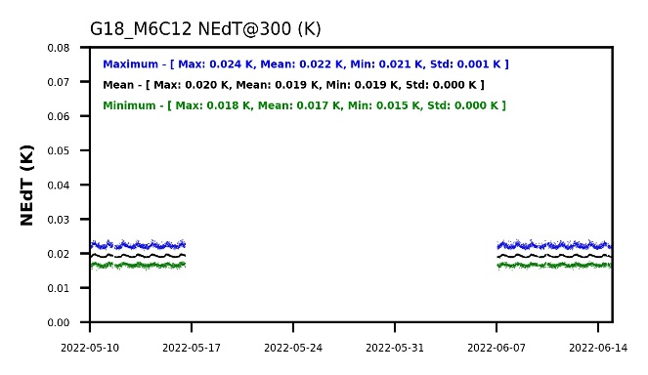
IR Noise (NEdT) is many times better than MRD …
The lower, the better.
~4 times better than requirement of 0.10 K
NEdT is also stable for all channels.

Slide 20
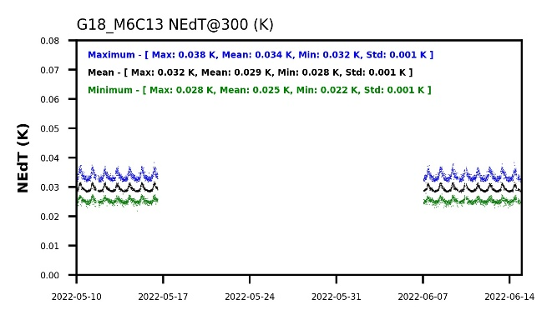
IR Noise (NEdT) is many times better than MRD …
The lower, the better.
~3 times better than requirement of 0.10 K
NEdT is also stable for all channels.

Slide 21

IR Noise (NEdT) is many times better than MRD …
The lower, the better.
~4 times better than requirement of 0.10 K
NEdT is also stable for all channels.

Slide 22
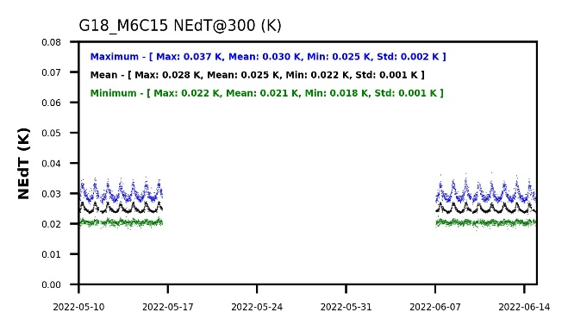
IR Noise (NEdT) is many times better than MRD …
The lower, the better.
~3 times better than requirement of 0.10 K
NEdT is also stable for all channels.

Slide 23
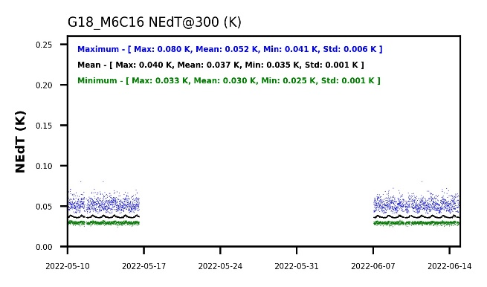
IR Noise (NEdT) is many times better than MRD …
The lower, the better.
~2 times better than requirement of 0.10 K
NEdT is also stable for all channels.

Slide 24
… and is comparable to GOES-16
The lower, the better.
Not compared with GOES-17 because of the LHP anomaly.
Comparable to Baseline and GOES-16, better than MRD.
B07 will be addressed separately later.

Slide 25
IR Radiances Are Accurate …
The closer to zero, the better.
Requirement is marked by the green lines.
Comparable to or slightly better than GOES-16/17.
An order of magnitude better than MRD.

Slide 26
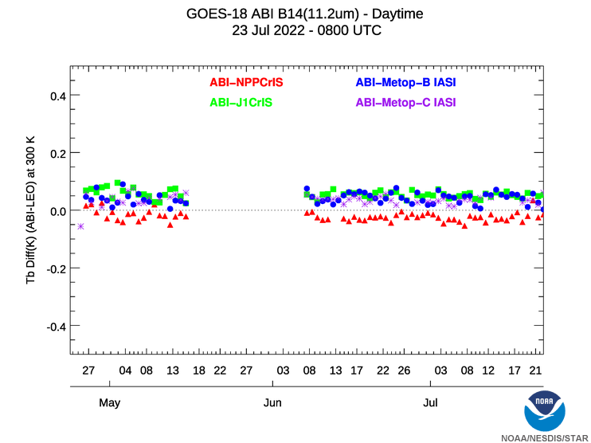
… and Stable
The closer to zero, the better.
Other channels are similar.
Nighttime is often better.
ABI accuracy is comparable to hyperspectral sounders.

Slide 27
Image navigation and registration
Key Performance

Slide 28
Navigation (NAV) is accurate …
The lower, the better.
GOES-18 at Provisional is comparable to or better than GOES-16/17 at Full Validation.
All are better than the requirements and baseline with ample margin.
No data to evaluate performance during eclipse or for Mode 4.

Slide 29
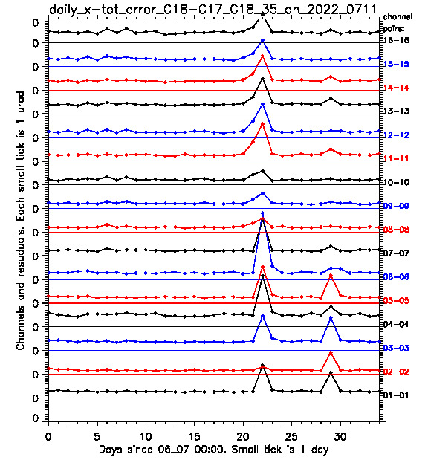
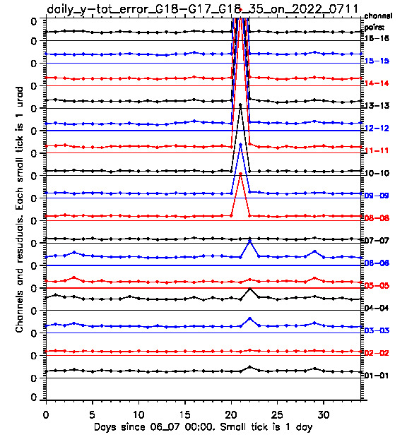
… and stable
Comparison with GOES-17, a new capability to evaluate sounding channels as well.
Comparison with Ground Control Point (GCP or “chips) are similar.
Performance is stable except for the known anomalies.
  Partial failure of scan mirror emissivity LUT update on 6/28.
  GMAC Calibration Maneuver 1 (6/29) and 2 (7/6).
Legend: ABI/G18 images are navigated with fragments of ABI/G17 images. The difference metrics (|bias|+3*STD in daily average) is plotted on the level equal to the channel number. Color varies to distinguish the neighboring plots. Zero level is plotted in the same color. EW direction (x) is on the left, NS direction (y) is on the right. Each step in the ladder plot is equal to 10 µrad.
Observations: All ABI/G18 channels show small and stable navigation error except for the days of known ABI/G18 INR anomalies.
Notes:
6/28 3:00 - 9:00 UTC. Co-registration correction outage for IR channels has led to the EW navigation errors up to 15 µrad and NS navigation error up to 68 µrad. The reason for this major INR anomaly are wrong emissivity LUT, which prevented IR star observations from 6/27 21:00 to 6/29 9:00 UTC.
6/29 18:30 - 20:30 UTC. GMAG Magnetometer calibration maneuver was conducted between 18:30 and 23:30 UTC. The ABI was parked at 18:30 UTC the timeline 19 was started at 22:17 UTC. The first FD image after is 22:20 UTC with elevated residuals for all bands. The FD images starting from 22:30 UTC fell back to normal ranges. The results were presented at the 07/08/2022 CWG meeting.
GMAG Magnetometer calibration maneuver was conducted between 18:30 and 23:30 UTC. The ABI was parked at 18:30 UTC the timeline 19 was started at 22:12 UTC. The first FD image after is 22:20 UTC with elevated residuals for all bands. The FD images starting from 22:30 UTC fell back to normal ranges. The results were presented at the 7/15/22 CWG meeting.
All three events are described in CWG CEL on the web.

Slide 30
Frame-Frame Registration (FFR) is accurate …
The lower, the better.
Comparable to GOES-16/17. Much better than MRD.

Slide 31
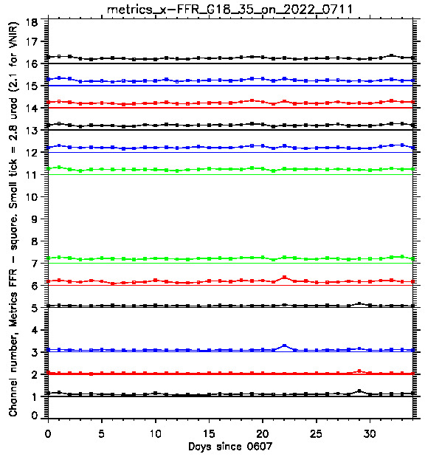
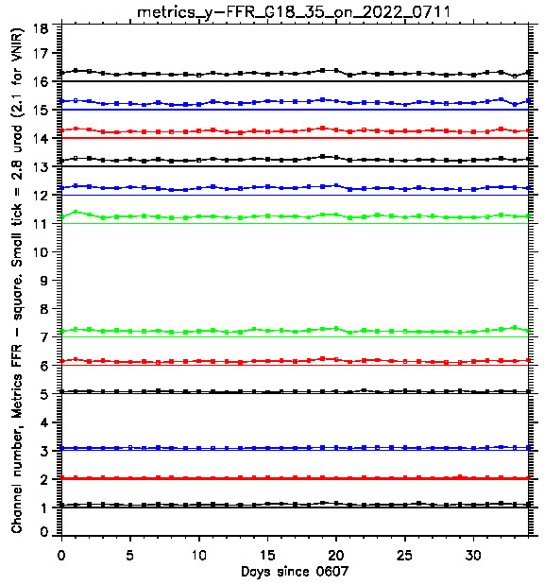
… and stable
Legend: Channel MRD FFR metrics (|bias|+3*STD in daily average) is plotted on the level equal to the channel number. Color varies to distinguish the neighboring plots. Zero level is plotted in the same color. EW direction (x) is on the left, NS direction (y) is on the right. Each step in the ladder plot is equal to MRD requirement.
Observations: All window channels satisfy MRD with margin all days of evaluation.

Slide 32
Within Frame Registration (WIFR)
The lower, the better.
Comparable to GOES-16/17 at their Full Validation and better than Baseline and MRD.
Improvement is ongoing.

Slide 33
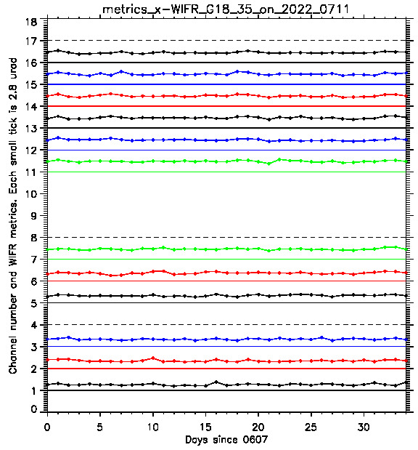
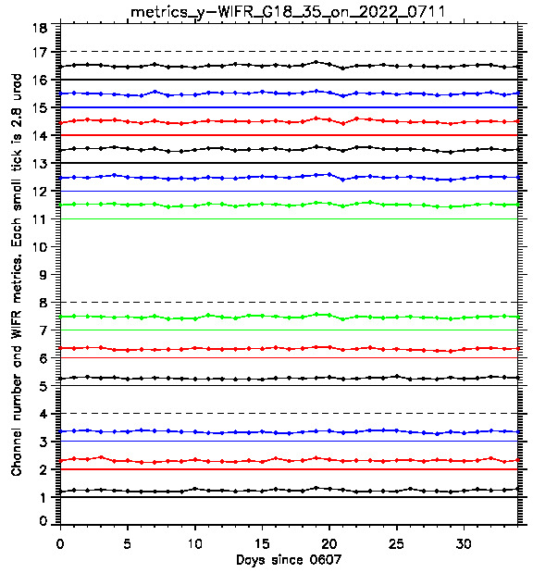
… and stable
Legend: Channel MRD WIFR metrics (|bias|+3*STD in daily average) is plotted on the level equal to the channel number. Color varies to distinguish the neighboring plots. Zero level is plotted in the same color. EW direction (x) is on the left, NS direction (y) is on the right. Each step in the ladder plot is equal to MRD requirement.
Observations: All window channels satisfy MRD all days of evaluation.

Slide 34
Channel-Channel Registration (CCR) is accurate …
The lower, the better.
All meet the MRD. One exceeds Baseline. Several are worse than GOES-16 or GOES-17 or have low margin.
Improvement is ongoing.

Slide 35
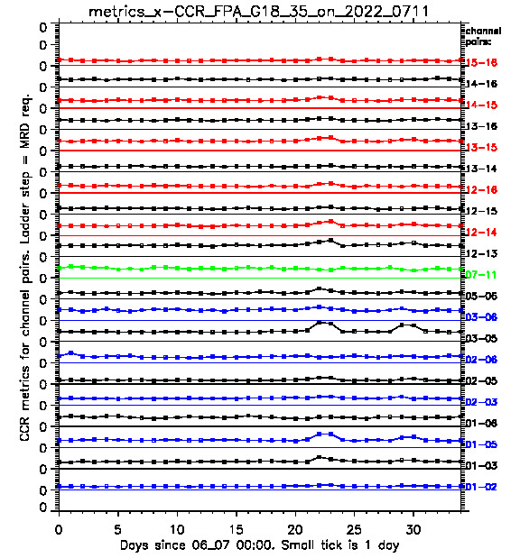
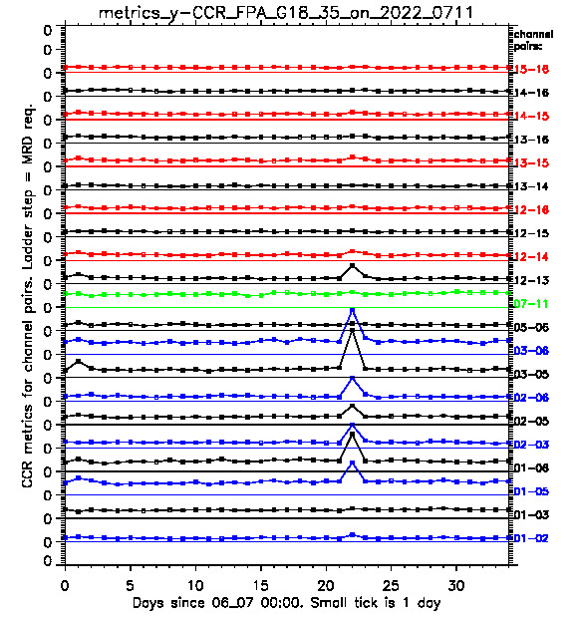
… and stable – within FPA
Legend: Channel MRD CCR metrics (|bias|+3*STD in daily average) is plotted on the level equal to the channel number. Color varies to distinguish the neighboring plots. Zero level is plotted in the same color. EW direction (x) is on the left, NS direction (y) is on the right. Each step in the ladder plot is equal to MRD requirement.
Observations: Within-focal plane channel pair CCR satisfy MRD all days of evaluation except for the days of known INR anomalies.

Slide 36
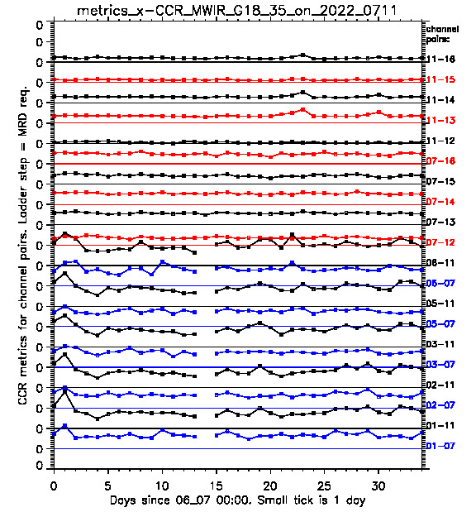
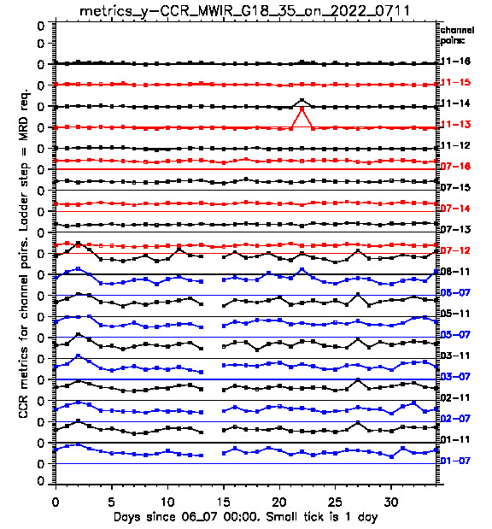
… and stable – MWIR
Legend: Channel MRD CCR metrics (|bias|+3*STD in daily average) is plotted on the level equal to the channel number. Color varies to distinguish the neighboring plots. Zero level is plotted in the same color. EW direction (x) is on the left, NS direction (y) is on the right. Each step in the ladder plot is equal to MRD requirement.
Observations: MWIR-LWIR channel pair CCR satisfy MRD all days of evaluation except for the days of known INR anomalies. MWIR-VNIR pairs show the values close or exceeding MRD requirements some days.

Slide 37
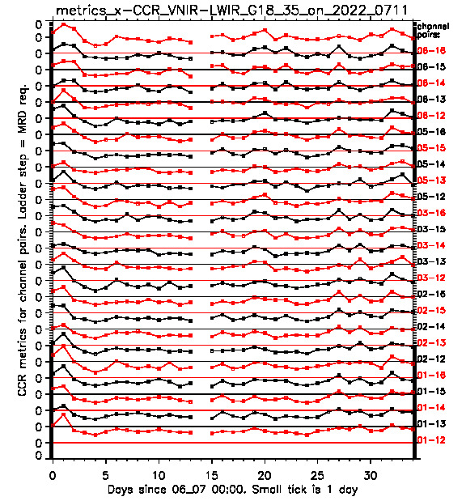
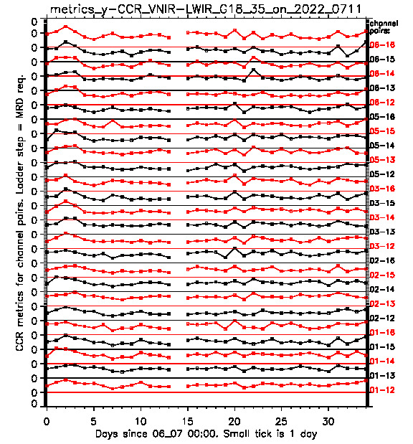
… and stable – VNIR & LWIR
Legend: Channel MRD CCR metrics (|bias|+3*STD in daily average) is plotted on the level equal to the channel number. Color varies to distinguish the neighboring plots. Zero level is plotted in the same color. EW direction (x) is on the left, NS direction (y) is on the right. Each step in the ladder plot is equal to MRD requirement.
Observations: VNIR-LWIR channel pair CCR tends to satisfy MRD all days of evaluation in y (NS) direction. For x (EW) direction, VNIR-LWIR pairs show the values close or exceeding MRD requirements.

Slide 38
Swath-Swath Registration (SSR) is accurate …
The lower, the better.
All meet the MRD. Two exceed Baseline. Several are worse than GOES-16 or GOES-17 or have low margin.
Improvement is ongoing.

Slide 39
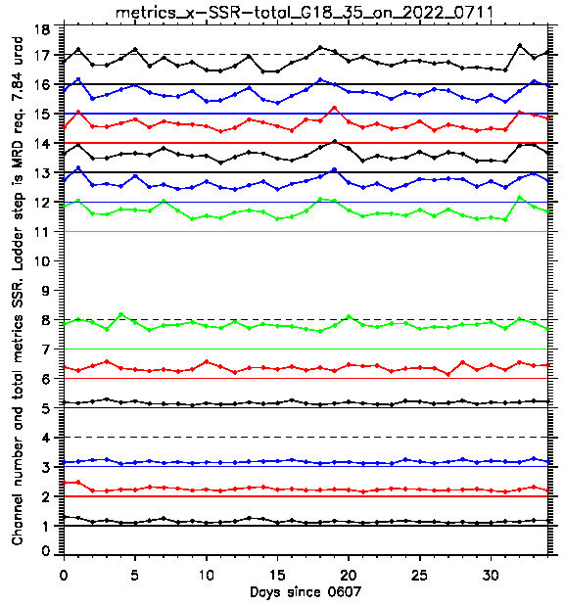
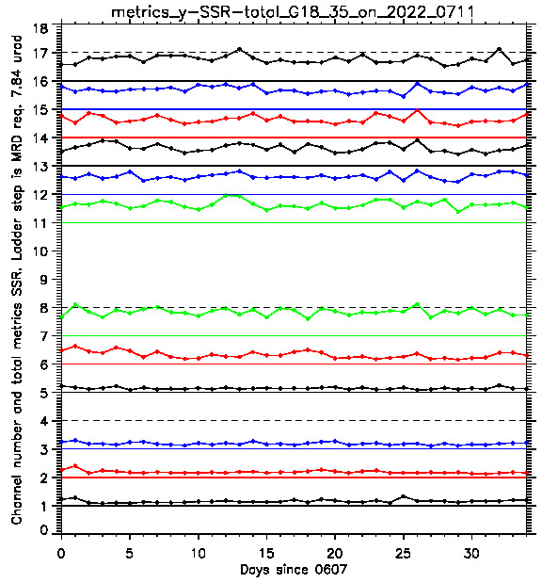
… and stable
Legend: Channel MRD SSR metrics (|bias|+3*STD in daily average) is plotted on the level equal to the channel number. Color varies to distinguish the neighboring plots. Zero level is plotted in the same color. EW direction (x) is on the left, NS direction (y) is on the right. Each step in the ladder plot is equal to MRD requirement.
Observations: All VNIR channels satisfy MRD with margin all days of evaluation. IR channels have small margin and can exceed MRD some days.

Slide 40
Notable issues
Key Performance

Slide 41
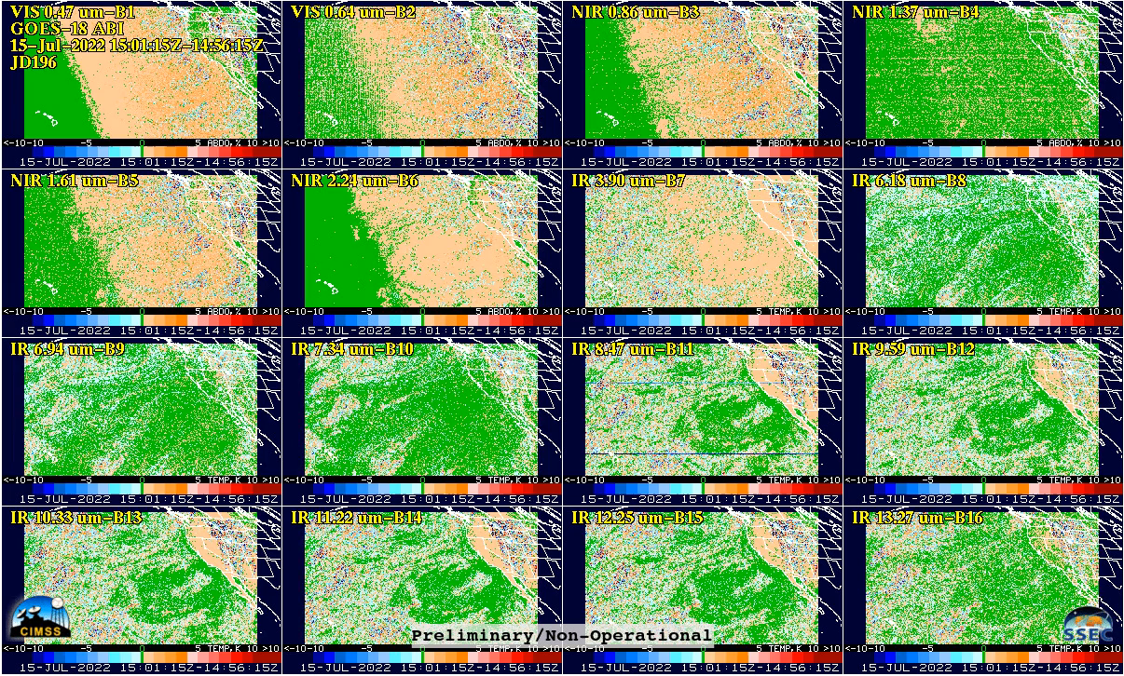
Periodic Infrared Calibration Anomaly (PICA)
PICA disappeared ~2000 UTC on 7/15
M. Gunshor and T. Schmit
Notes:
https://cimss.ssec.wisc.edu/satellite-blog/images/2022/07/loop_16paneltimediff_2022196_GOES18R_CONUS_M6_B12345678910111213141516_0016PANELS_timediff.mp4

Slide 42
PICA and Scan Mirror Emissivity
PICA was discovered in March 2017 from GOES-16 data, and was corrected in October 2017.
Post-launch tests have since been revised for future ABI.
It was corrected for GOES-17 ABI before the data became widely available to users.
GOES-18 adopted a more open data policy. PICA was reported by users.
Scan mirror emissivity was updated as planned.
  The update had a minor issue. It has since been corrected and deployed.
The issue has been resolved.

Slide 43
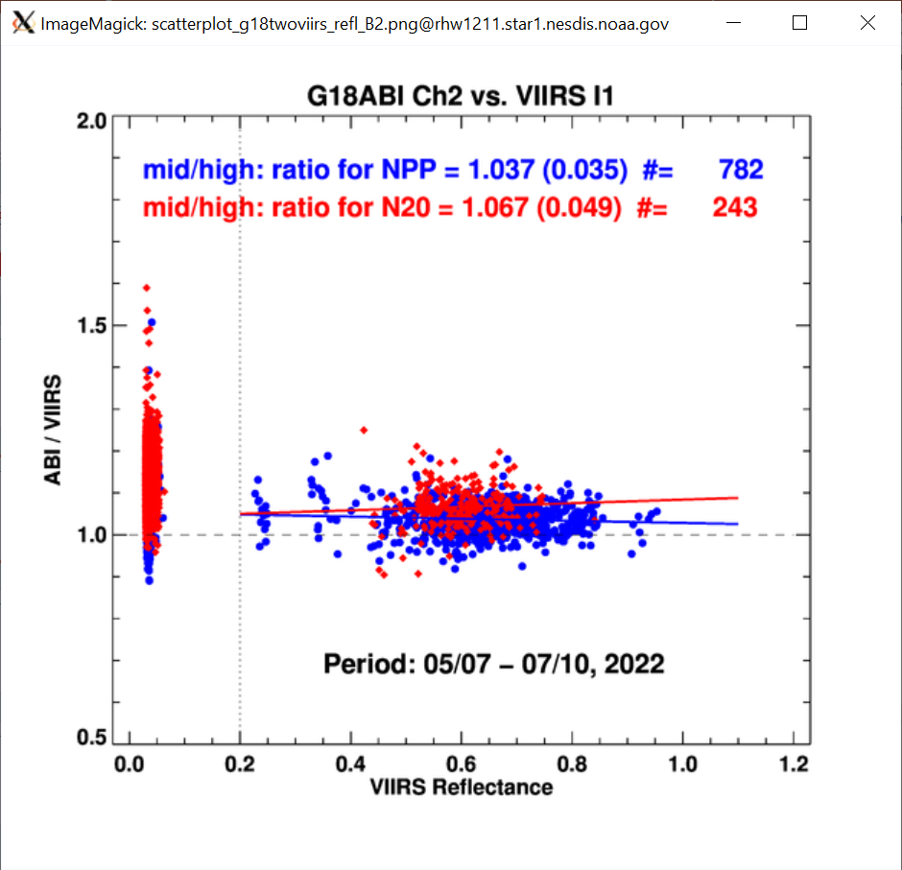
Channel 2 Bias and K-LUT
GOES-18 ABI is 3.7% brighter than the SNPP VIIRS, and 6.7% brighter than the VIIRS on NOAA-20.
The correction, based on prelaunch data, reduced the GOES-18 ABI B02 reflectance by 3.5%.

Slide 44
Channel 2 Bias and K-LUT
The 0.64 µm channel of GOES-16 ABI was found to be brighter than the commonly accepted values in March 2017.
  It also happened to GOES-17, as well as similar instruments AHI & AMI.
The bias was corrected for GOES-16/17 ABI in April 2019 by modifying the directional reflectance of ABI’s Solar Diffuser, aka the K-LUT.
For GOES-18 (and GOES-19), it is decided to update the K-LUT before the Provisional Review to avoid a future change in operational data.
The directional reflectance for ABI B02 (K-LUT) was updated as planned.
  The deployment had a minor issue, but it has since been corrected.
The issue has been resolved.

Slide 45
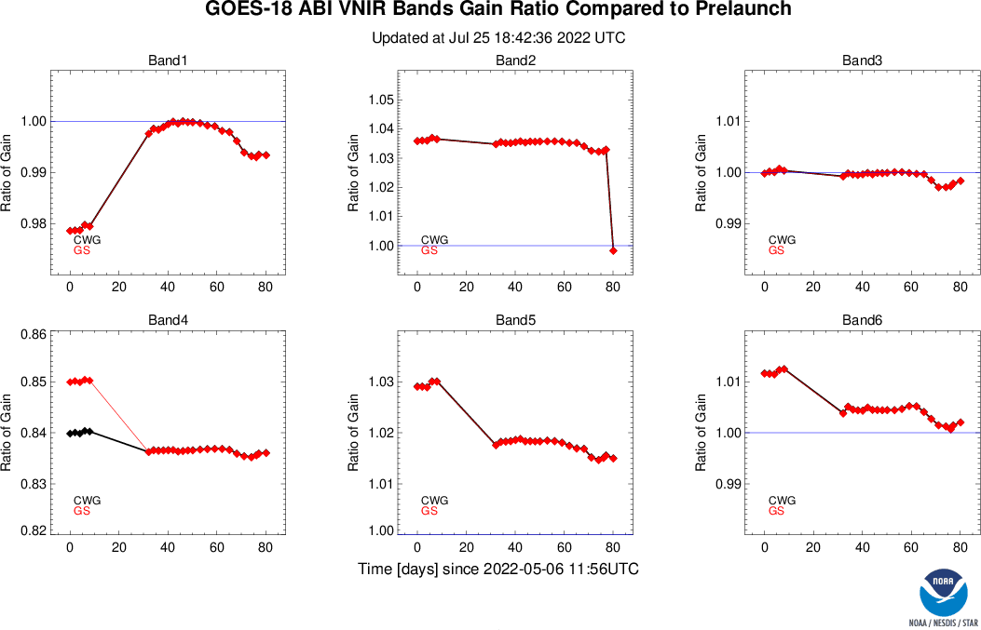
Downward Trend of Solar Channel Gains
The gain of GOES-18 ABI solar channels (1-6) was found in early July to decrease.
  For all channels, but worst for B01.
  Up to 0.7% in two weeks.
  Slowed down, and may be reverted.
    The change between pre- and post-drift, on the other hand, is due to change in E_{sun} and the Q-LUT update.
Similar trend was found for GOES-16.
  The pre-launch characterization of GOES-16 SD is suspected to have error.
  Similar error is expected for GOES-17/18 SD.
  Investigation of all SD K-LUT are ongoing.
This issue is expected to be closed soon.

Slide 46
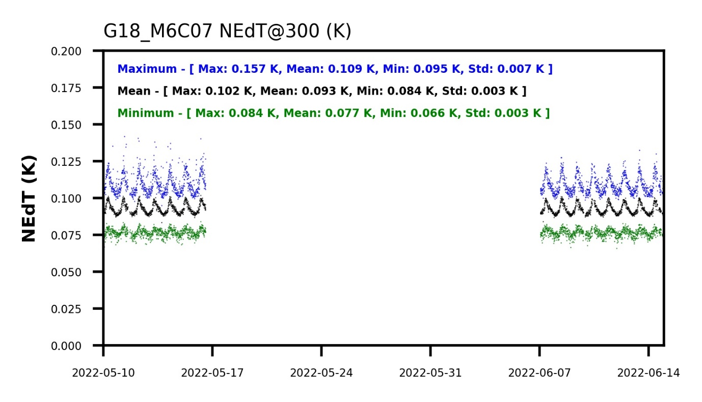
High NEdT for GOES-18 ABI Channel 7
GOES-18 ABI B07 NEdT is higher than GOES-16, higher than GOES-17 with Gain Set I and III, at all levels of maturity and for both mean and max.

Slide 47
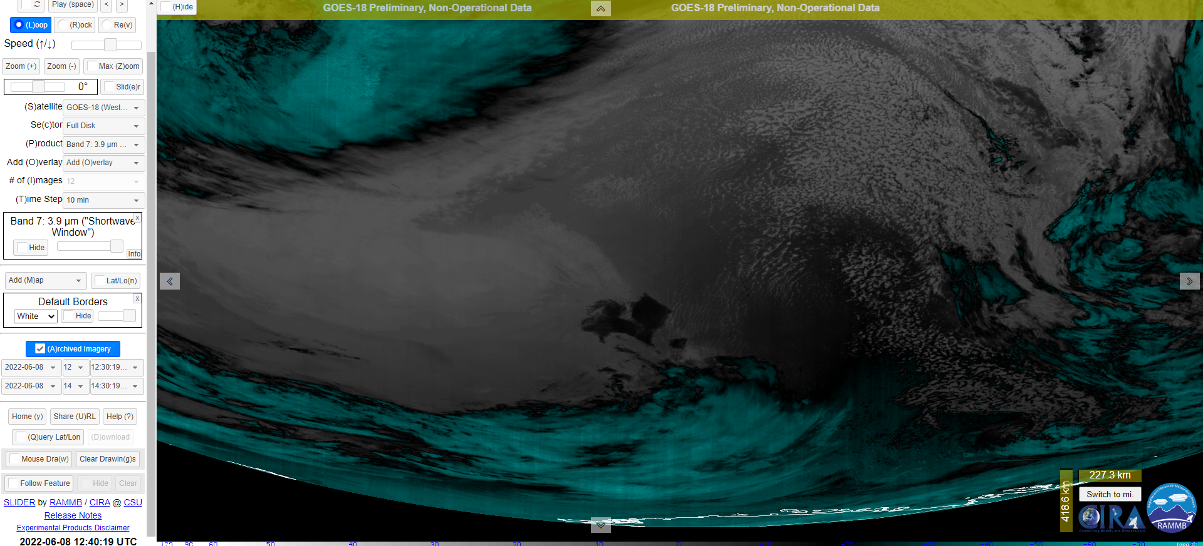
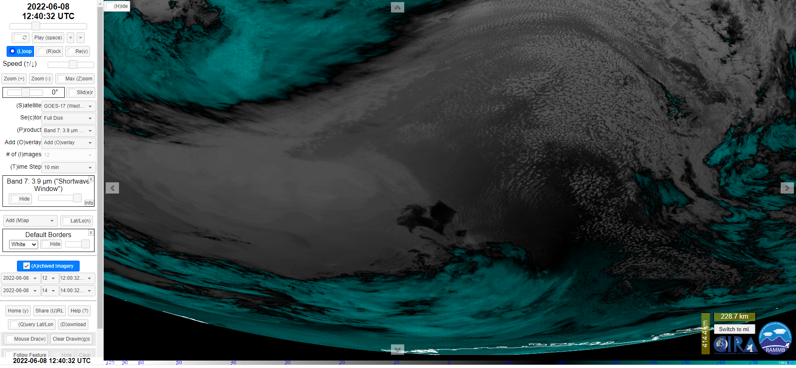
Also Found Vertical Striping
GOES-18
D. Lindsey
GOES-17

Slide 48
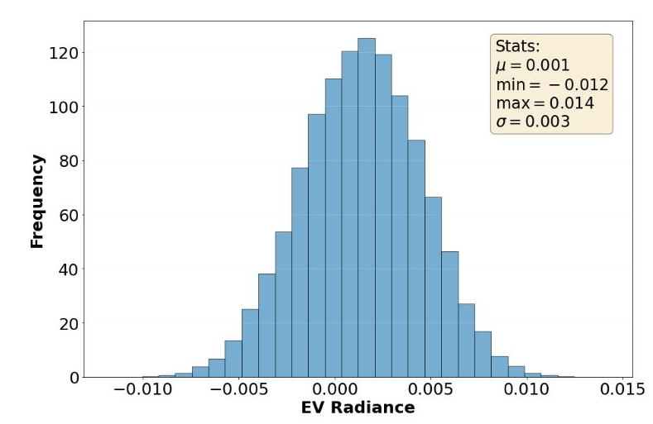
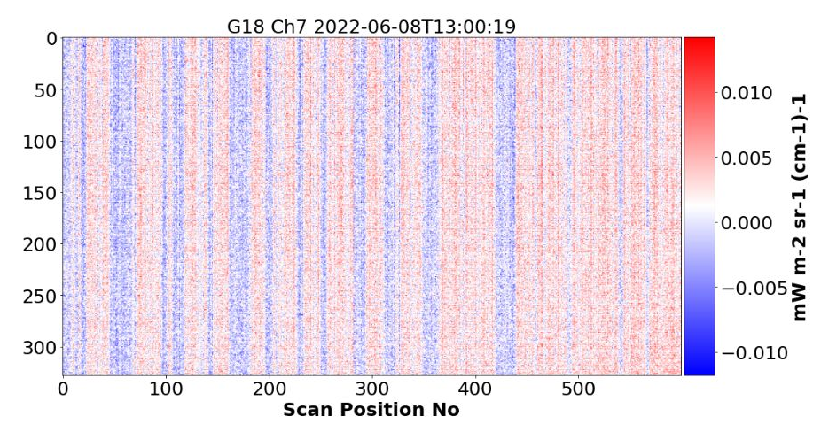
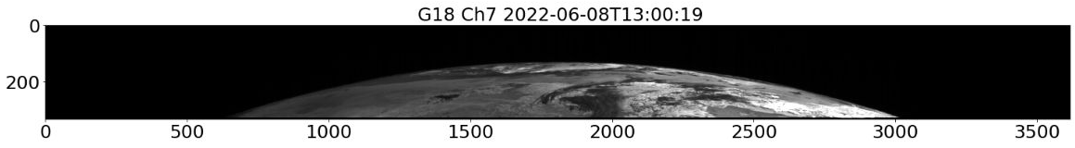
Within SPEC Noise Can Be Non-Random
Histogram: Noise is normally distributed and within spec.
Image: Part of the noise is not random in space.

Slide 49
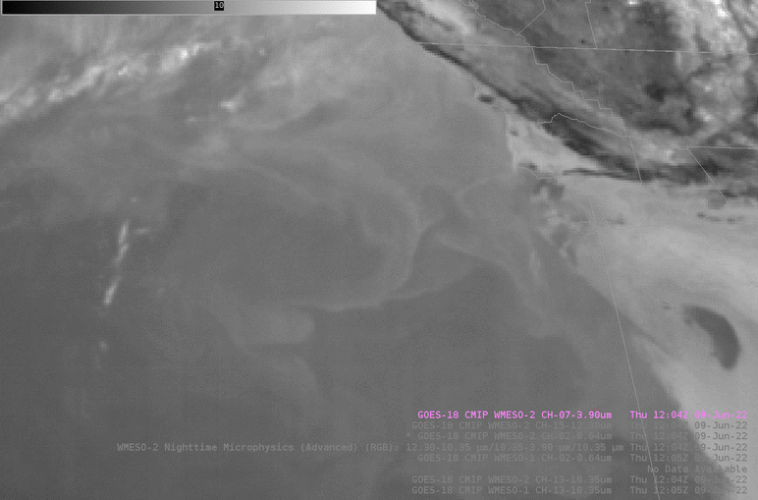
The non-random noise may contribute to the barcode artifact …
B. Line

Slide 50
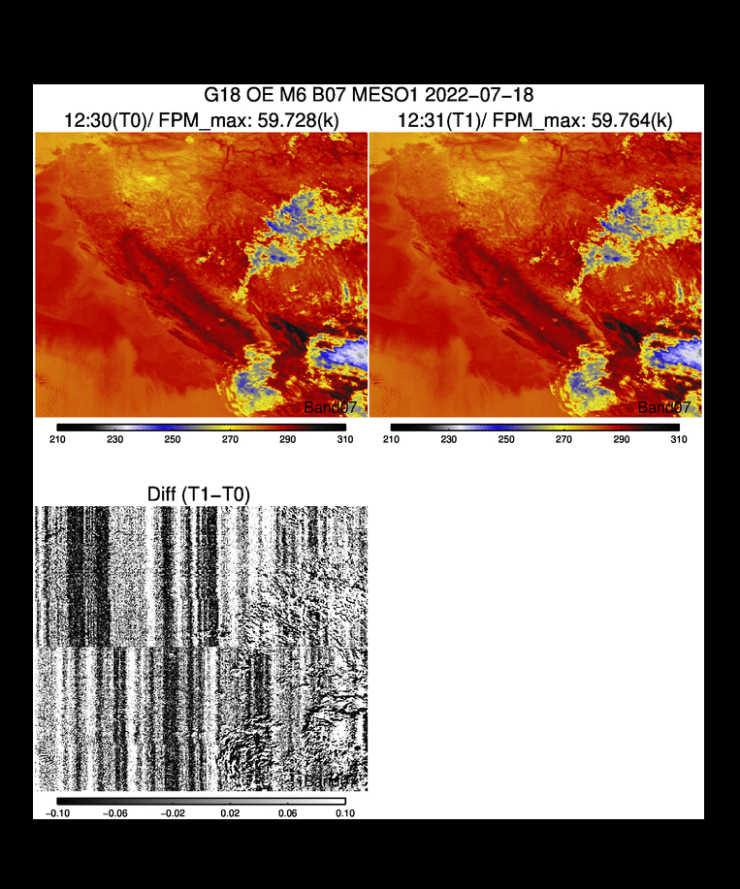
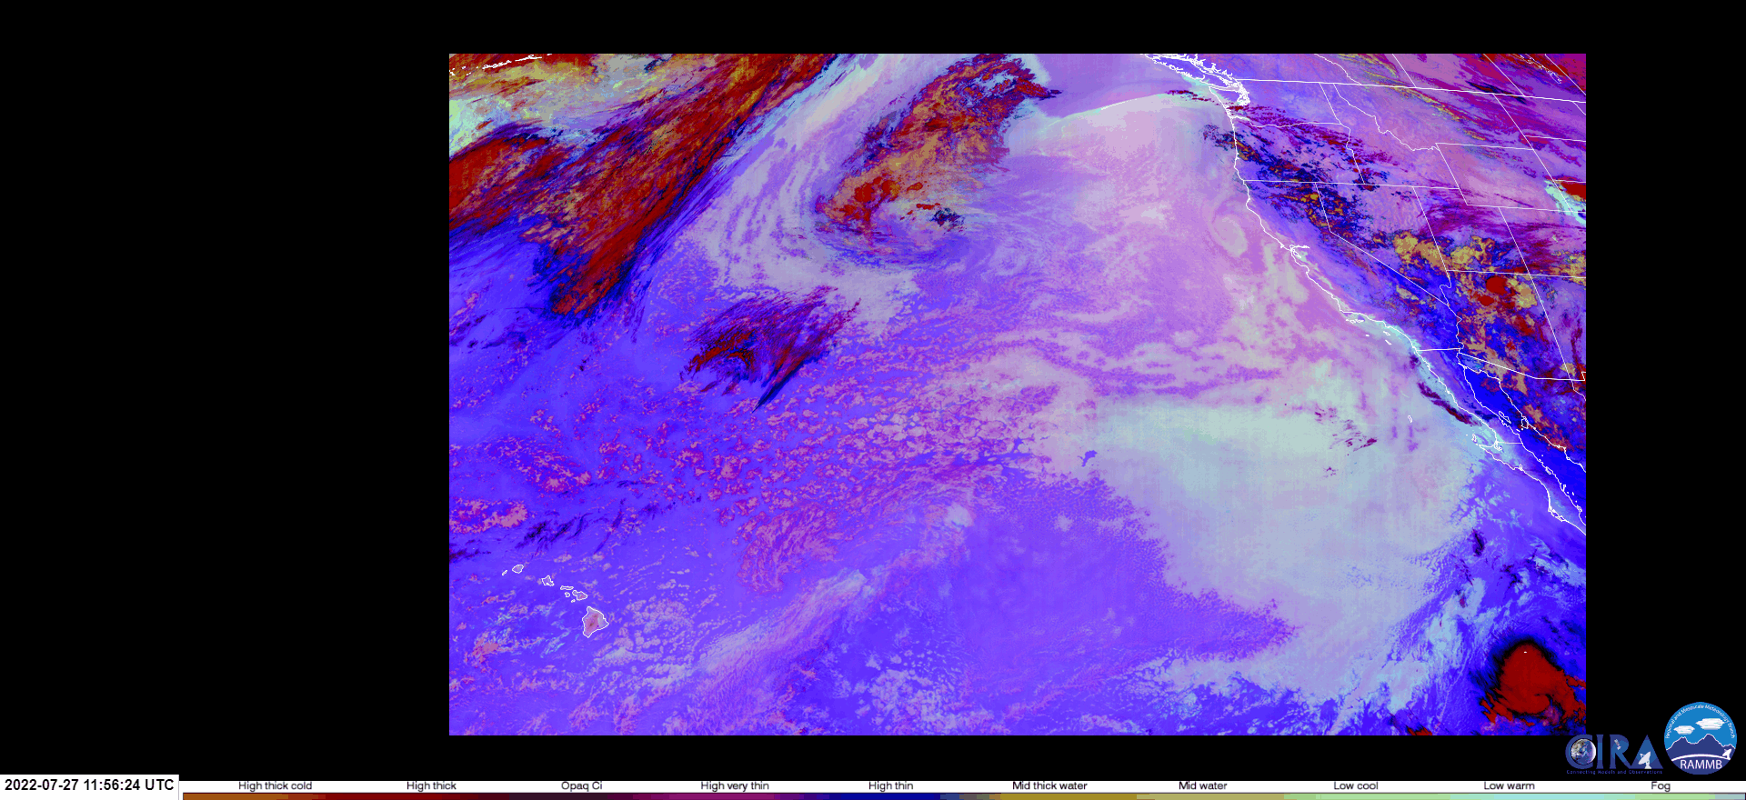
… esp. Those of Time or Channel Differences
Barcode artifact is more visible in time-difference image …
… and channel difference image.

Slide 51
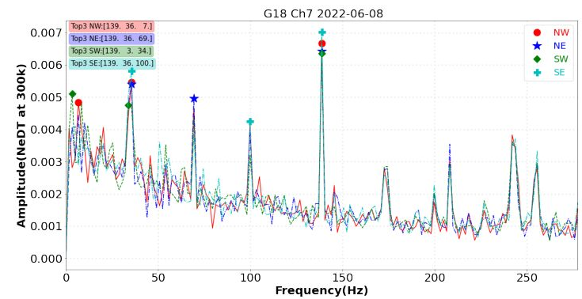
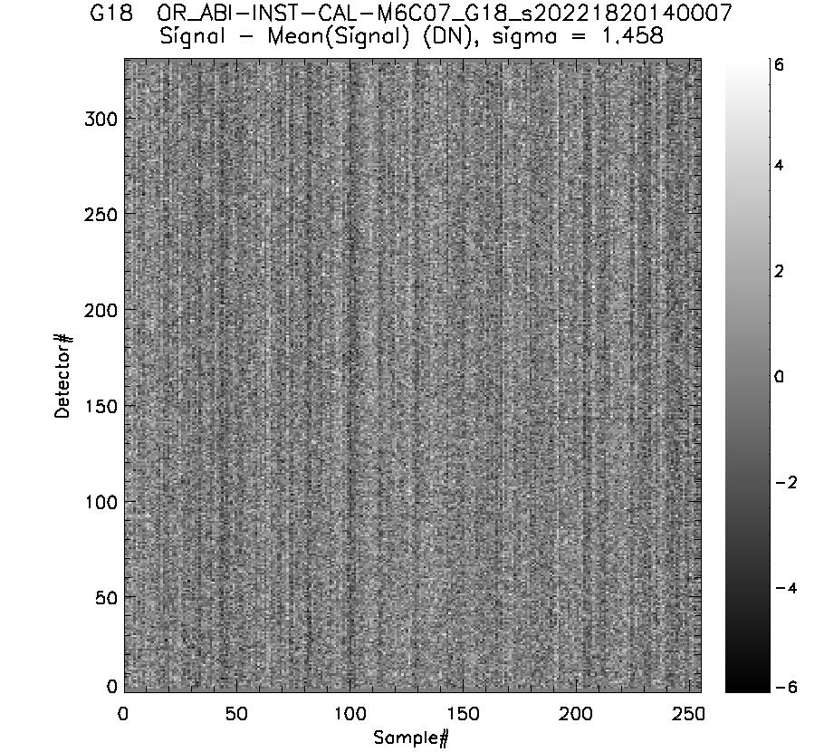


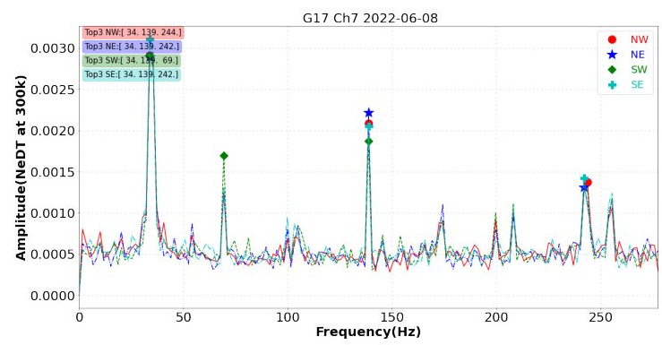
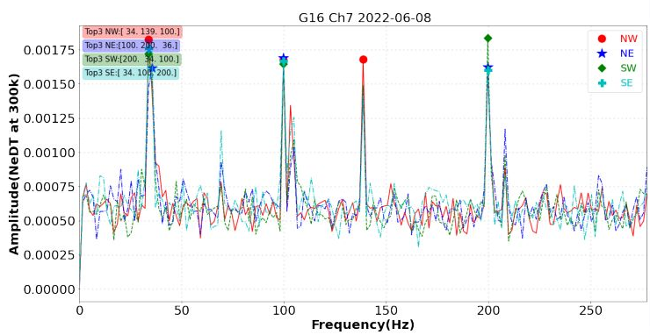
Characteristics
G18
G17
G16
B. Efremova
Found in GOES-16/17/18, but stronger for GOES-18.
Confirmed with Fourier analysis
Similar in all four corners
  Perhaps everywhere in the FOR
FFT: G18 ≅ 2 x G17; G17 ≅ 2 x G16
Common characteristic frequencies for three or two ABIs

Slide 52
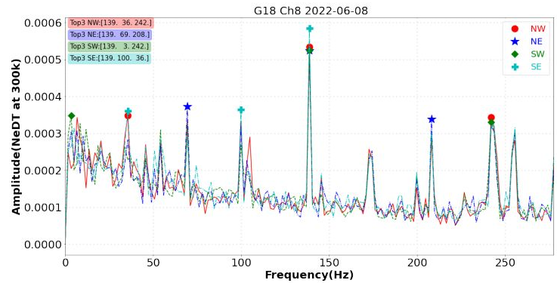
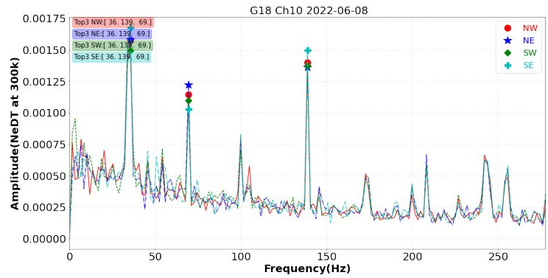
Characteristics
Found in Channels 7–16, but stronger for Channel 7.
  No channel-unique characteristic frequency.
Did not find significant change with time of day and day to day.
  Magnitude may be larger at night.
Also found in AHI-8.
  May or may not be related.

Slide 53
Summary of Channel 7 Noise
GOES-18 ABI Channel 7 noise is higher than the other two ABIs in all aspects.
Part of the noise is not random, which may contribute to the “Barcode Artifact” in some images.
  Especially in images of low radiance and time or channel differences.
Non-random noise exists in all IR channels of all ABIs, sharing common characteristic frequencies, but the magnitude is larger for GOES-18 ABI B07.
The characteristic frequencies are not known to change within FOR, time of day, and day to day, but the amplitude may be larger at night.
It is not yet known
  Whether the non-random noise in GOES-18 ABI B07 can be reduced in operation?
  How much will that improve L2+ products and user experience?
This issue is open.

Slide 54
Maturity Assessment

Slide 55
Provisional Maturity Criteria
Preparation Activities | Assessment
Validation activities are ongoing and the general research community is now encouraged to participate. | Product quality has been bench marked. Comprehensive validation activities are ongoing. The general research community has been actively participating and providing feedback.
Severe algorithm anomalies are identified and under analysis. Solutions to anomalies are in development and testing. | Two moderate anomalies have been resolved. One moderate anomaly is being investigated.
Incremental product improvements may still be occurring. | Incremental product improvements are expected.

Slide 56
Provisional Maturity Criteria
End State | Assessment
Product performance has been demonstrated through analysis of a small number of independent measurements obtained from select locations, periods, and associated ground truth or field campaign efforts. | This has been demonstrated.
Product analysis is sufficient to communicate product performance to users relative to expectations (Performance Baseline). | This has been communicated.
Documentation of product performance exists that includes recommended remediation strategies for all anomalies and weaknesses. Any algorithm changes associated with severe anomalies have been documented, implemented, tested, and shared with the user community. | Product performance has been documented in test reports and elsewhere. A summary for general users has been submitted for Beta Maturity and will be updated for Provisional Maturity.
Testing has been fully documented. | Testing has been fully documented in PLPT Report.
Product is ready for operational use and for use in comprehensive cal/val activities and product optimization. | We concur.

Slide 57
Past and Current Status, and Future Outlook
 | Past Performance | Current Status | Future Outlook
IR Calibration | Accurate and stable. Slightly higher noise than GOES-16. Except that B07 noise is much higher than GOES-16/17. Had PICA. | Corrected for PICA. Replaced the detector for B11 R086. Found the Barcode Artifact for B07 images. Ongoing characterization. Path to solution is not yet clear. | Transition into routine operation support, including interleave. Mitigate the B07 noise.
VNIR Calibration | Accurate and stable. B02 had the anticipated bias. | B02 bias has been corrected. Downward trend of gains for most channels. Likely due to “beta-dependence”. B04 has minor striping. B05 bias may weakly depend on scene radiance. | Resolve the downward trend of gains. Investigate the B04 striping. Investigate the B05 scene-dependent bias.
INR | Strong performance After the static and dynamic LOS correction, 300 µrad in total After correction of 100 µrad LWIR shift with respect to MWIR Updated RDP and scan encoder scale. The INR team (Flight, MOST, vendor, CWG) are more skillful and confident in operating the ABI navigation algorithms. | INR is MRD-compliant. Some margins are low; RDP LUT are under verification and further refinement; Kalman filter may need no further tuning. | Implement incremental improvements to make MRD compliance stable in time and with better margins. Will reach Performance Baseline.

Slide 58
Path to Full Validation
Complete PLPTs.
Resolve current issues.
Monitor for new anomalies.
Prepare comprehensive assessment of instrument performance and L1b product quality for maturity promotion.
Identify and manage risks.

Slide 59
Summary and Recommendations
Introduced the context in which this review is conducted.
  Compressed time in order to provide GOES-18 ABI L1b and CMI products to users before the eclipse starts in August.
Reviewed the Post-Launch Product Tests (PLPT) activities.
Highlighted key performances of ABI L1b product.
  INR; VNIR; IR.
  Excellent accuracy and precision (except for B07), as compared to MRD, Baseline, and GOES-16/17 performance.
  Assessed some aspects of repeatability, for example in connection with PICA.
  Found no evidence of unstable performances.
  Described and summarized the current understanding of the elevated B07 noise.
Assessed the Provisional Maturity per GOES-R Program
Outlined the path to Full Validation maturity.
Recommendation: The GOES-18 ABI L1b products be promoted to the Provisional Maturity per GOES-R Program.

