Slide 1
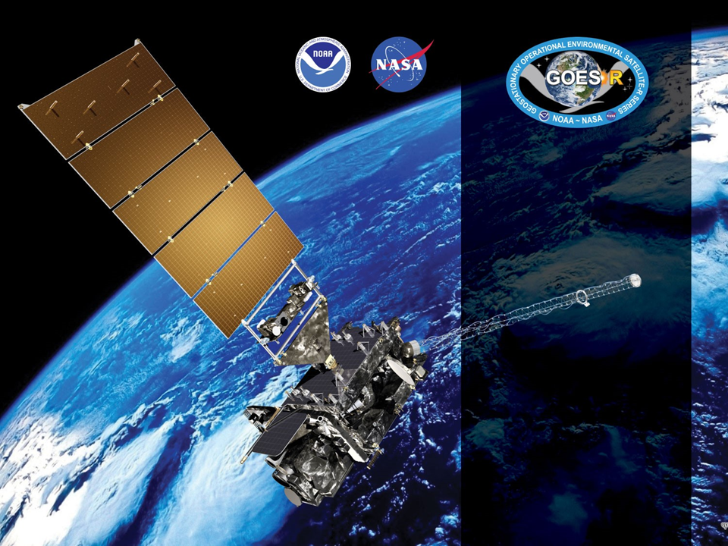
GOES-18 ABI L2+ SST
Provisional PS-PVR
November 21, 2022
GOES-R AWG SST Team
Alexander Ignatov*,
Yury Kihai, Victor Pryamitsyn, Irina Gladkova, Alex Semenov, Boris Petrenko, Olafur Jonasson, Frank Johnson
*NOAA NESDIS STAR,
GST Inc & CCNY

Slide 2
Agenda
Product Overview
Specs/Requirements
NOAA SST Monitoring System
Beta-Review & Path to Provisional
Provisional Maturity Assessment
Conclusion & Path to Fully Validated/Operational
Summary and Recommendations

Slide 3
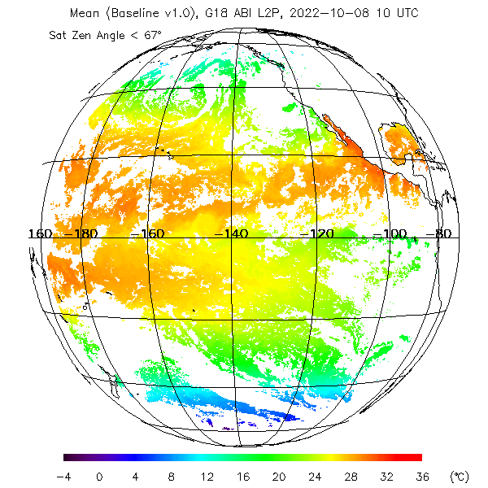
Baseline Product Overview
Baseline SST Product:
  Uses Binary Cloud Mask “Confidently Clear” from Cloud Team as well as individual cloud tests
  Additionally Performs SST QC
  Employs regression trained against quality controlled in situ data
  Uses 11(8.5µm), 13(10.3µm), 14(11.2), &15(12.3µm) bands
Processes all 10min FD data and aggregates them into 1hr composites
Only L2 baseline product is available (no gridded L3 produced)
Open ocean only (no internal water)
No downstream products affected by SST
Example 1hr composite SST FD Image
on 08 October 2022 @10UTC

Slide 4
GOES-R SST Specs
Mission / Instrument | Range | Accuracy⁽¹⁾ | Precision⁽²⁾
GOES-R ABI (F&PS/MRD) | 271 to 313 K | ±3.1 K* | 1.0 K*
JPSS VIIRS | 271 to 313 K | ±0.2 K | 0.6 K
POES/Metop-FG AVHRR | 271 to 313 K | ±0.2 K | 0.6 K
Metop-SG METimage | 271 to 313 K | ±0.2 K | 0.6 K
EOS MODIS | 271 to 313 K | ±0.2 K | 0.6 K
Himawari-8/9 AHI | 271 to 313 K | ±0.2 K | 0.6 K
MTG FCI | 271 to 313 K | ±0.2 K | 0.6 K
^{(*)} Ocean. Quantitative for LZA<=67º; Qualitative at LZA>67º
⁽¹⁾ Accuracy = ‘Global’ (Full Disk) Bias of (Sat - in situ SST)
⁽²⁾ Precision = ‘Global’ (FD) Standard Deviation of (Sat - in situ SST)
The F&PS/MRD specs for ABI SST are more liberal & inconsistent with LEO AVHRR/MODIS/VIIRS and GEO AHI/FCI. They may not meet requirements, needs, and expectations of many users
This review evaluates baseline G18 SST vs GOES-R F&PS specs

Slide 5
Compliance with requirements is assessed using the
NOAA SST Monitoring System

Slide 6
NOAA SST Monitoring
Visualization of validation against QC’ed in situ data from iQuam and comparisons with global Level 4 (L4) fields, such as Canadian Meteorological Center (CMC) and UKMO OSTIA in the NOAA SST Quality Monitor (SQUAM; www.star.nesdis.noaa.gov/sod/sst/squam/; Dash et al., 2010)
QC’ed in situ SSTs come from NOAA in situ SST Quality Monitor (iQuam; www.star.nesdis.noaa.gov/sod/sst/iquam/; Xu, Ignatov, 2014)
Monitoring of Brightness Temperatures input in ACSPO SST Retrievals (MICROS; www.star.nesdis.noaa.gov/sod/sst/micros/; Liang et al, 2016)
Visualization of regional imagery in the ACSPO Regional Monitor for SST (ARMS; www.star.nesdis.noaa.gov/sod/sst/arms/; Ding et al, 2017)
The four SST validation subsystems are fully established, documented & well utilized by the SST community (e.g., Group for High Resolution SST, GHRSST)
Consistent QC/Val methodologies applied to various in situ & satellite SSTs, produced by NOAA (from JPSS, POES, Metop-FG/SG, H08/09, GOES-R) & partners, to facilitate selection of best fit-for-purpose product to meet users’ needs

Slide 7
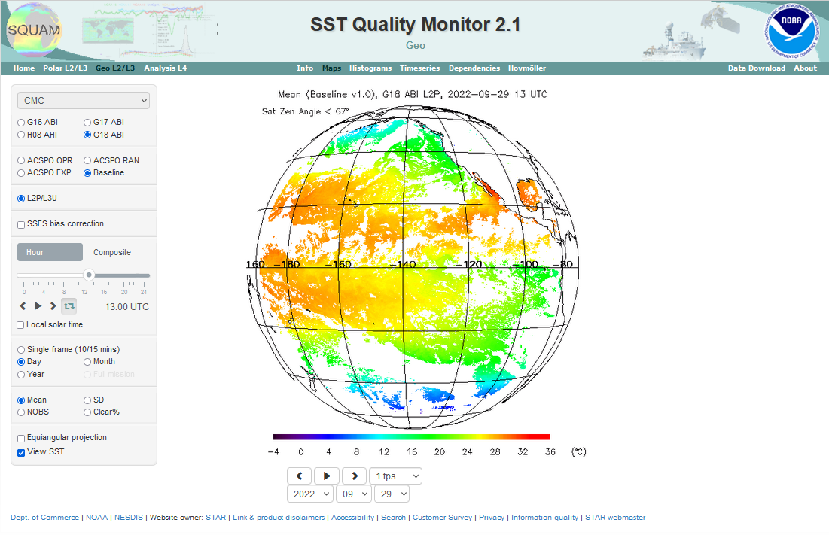
SST Quality Monitor
(SQUAM)
SQUAM monitors NOAA & partners SSTs in full retrieval domains (global for LEO, FD for GEO), vs in situ and L4 analyses
Monitoring of Baseline SST product was excluded from SQUAM, due to planned transition to enterprise ACSPO products
Analyses presented in this review were made for baseline SST produced by GOES-R GS my manual ingest in SQUAM
www.star.nesdis.noaa.gov/sod/sst/squam/

Slide 8
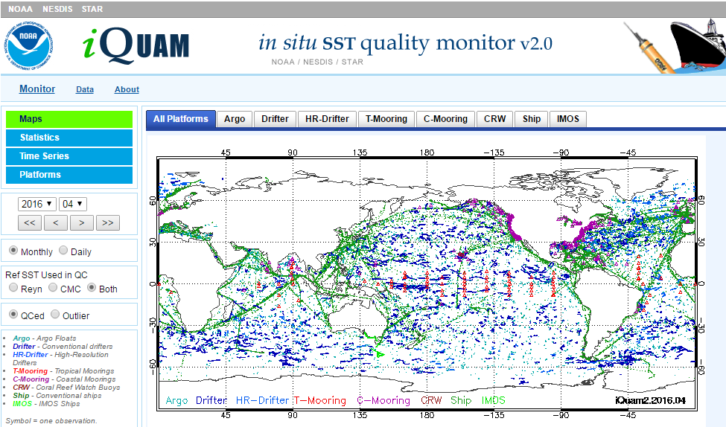
In situ SST Quality Monitor (iQuam)
www.star.nesdis.noaa.gov/sod/sst/iquam/
iQuam applies uniform QC to in situ SSTs (drifters, moorings, Argo, ships) & serves to users

Slide 9
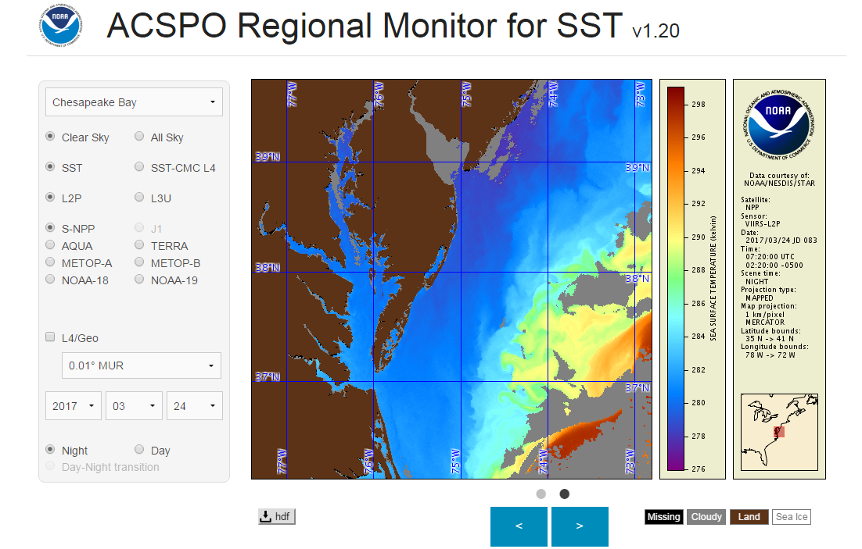
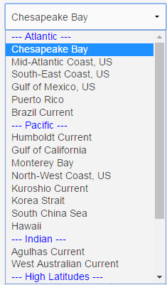
ACSPO Regional Monitor for SST (ARMS)
www.star.nesdis.noaa.gov/sod/sst/arms/
27 regions
ARMS monitors imagery & mask for several L2/3/4 enterprise SST & checks them for cross-consistency. (ARMS does not monitor baseline SST and not used in this review.)

Slide 10
Summary of Beta Status
in May 2022 & Path to Provisional

Slide 11
Beta Status (May 2022)
End State (Fully achieved at the time of β-review)
  Product made available to users to gain familiarity with data formats & parameters
  Product may still contain significant errors
  Product is not optimized for operational use
Summary of β-findings & Path to Provisional
The product may contain significant errors and may not meet GOES-R specs
Out of 5 major issues (identified at the time of G16 beta review in May’2017), 2 remain fixed only partially
Next slide summarizes the issues and their status

Slide 12
No G18-specific WRs/ADRs were required and/or issued
WRs/ADRs submitted for G16 (still valid for G18)
Title | Description | Status | Planned Mitigation | Current Status
WR3207 | SST DQF appears to be incorrect | In_Work | DO.06 | Partially resolved
ADR269 (WR4214) | Anomalies in SST Product | In_Work | DO.06 | Partially resolved
Notes:
PRO Fills this In

Slide 13
G18 Provisional
Maturity Assessment

Slide 14
Definition of Provisional
From SST RIMP
Activities
                VAL and QA ongoing. General research community encouraged to participate
                Severe algorithm anomalies identified & under analyses. Solution to anomalies are in development/testing
                Incremental product improvements may still be occurring
                Users engaged in the customer forums. Users’ feedback is assessed
End State
  Product performance demonstrated through analysis of a large, but still (seasonally, regionally, etc.) limited, number of independent measurements
  Analyses are sufficient for limited qualitative determination of product fitness-for-purpose
  Documentation of product performance exists & includes remediation strategies for all anomalies & weaknesses
  Analyses are sufficient to communicate product performance to users relative to expectations
  Product is ready for test operational use / comprehensive Cal/Val / optimization

Slide 15
Specific Objectives
of SST Provisional Review
Assess Accuracy & Precision of the SST product over a large/wide range of representative conditions, which may still be limited seasonally
SST meets its documented requirements (±3.1K mean bias, and 1K RMS wrt. in situ data) for view zenith angles ≤67º
Remediation strategies are in place for known issues
Product is ready for evaluation for potential operational use and for potential use in scientific publications

Slide 16
PLPT Events: Provisional Maturity
SST RIMP Version 2.0, 410-R-RIMP-0342, 9/28/21
Provisional
PLPT ID | Descriptive Title | % Complete | Results | AWG POC
ABI-FD_SST01 | Verify that SST product is generated at the required cadence for FD | 100% | Complete | Ignatov
ABI-FD_SST02 | Assess the accuracy and precision of the SST product | 100% | Complete | Ignatov
16

Slide 17
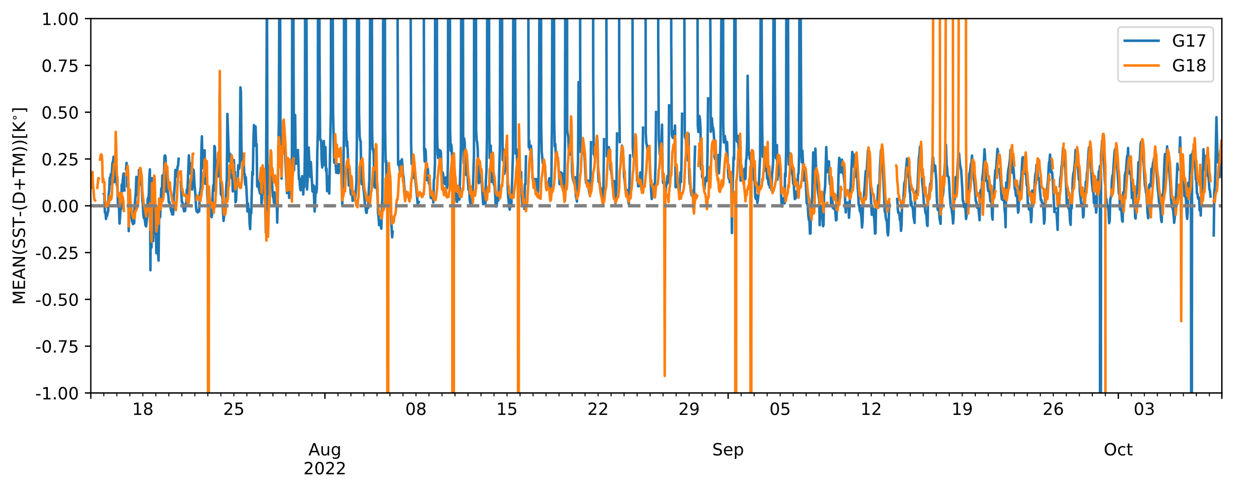
Accuracy
(Mean Bias wrt. in situ SSTs)
G17 subject to LHP issues
G18 product is more stable
Each data point = 1hr FD statistic (1.5-3 thousand match-ups)
G17 is subject to LHP issues, during some ‘bad’ periods
G18 is more stable in time (as expected)
Overall, both are within the ±3.1K MRD/F&MPS accuracy spec
Occasionally, both G17 and G18 products show ‘outliers’ (discussed later)

Slide 18
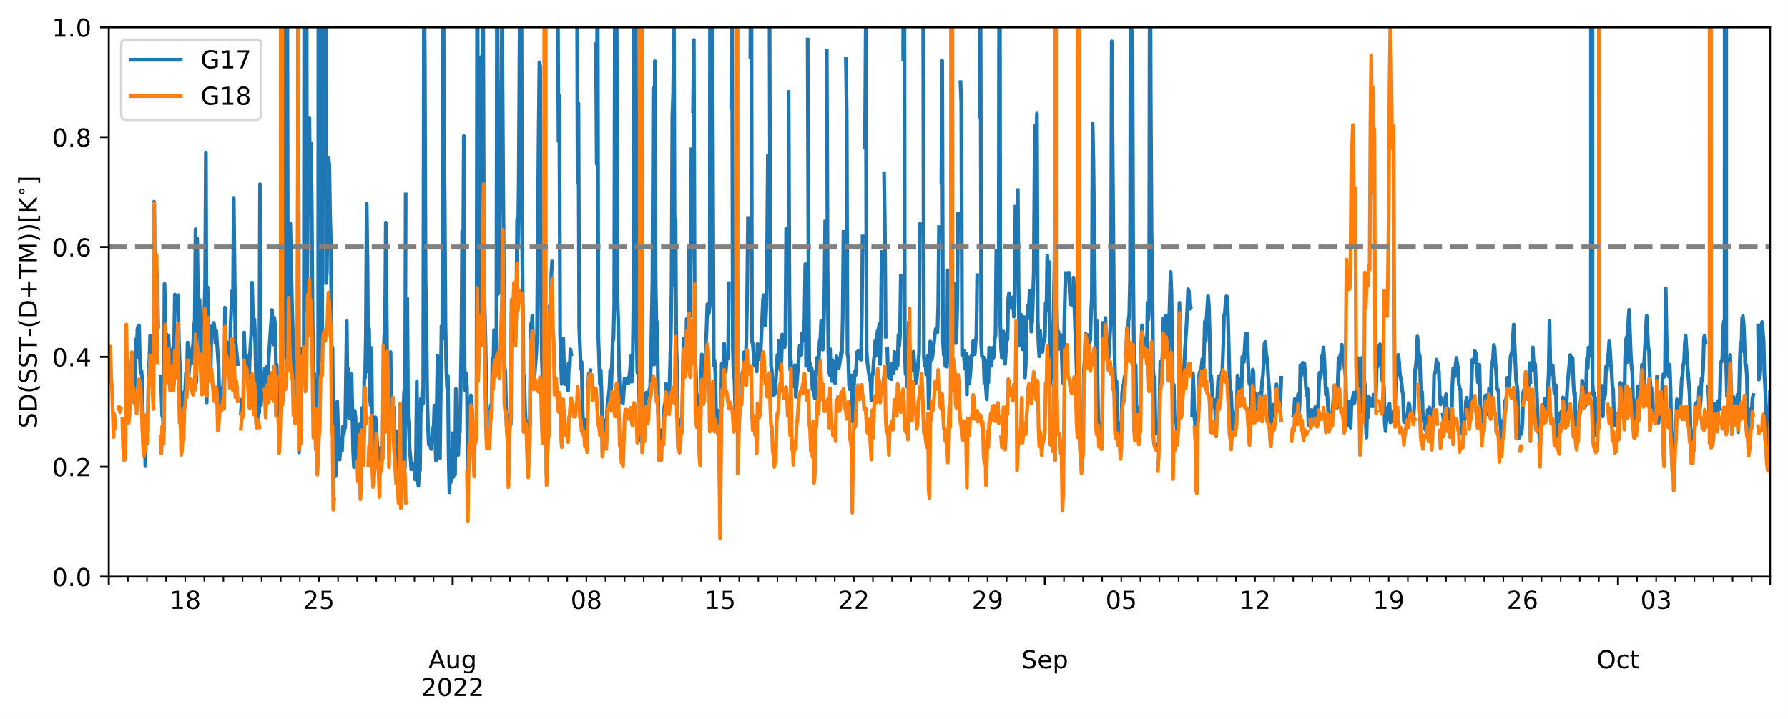
Precision
(RMSD wrt. in situ SSTs)
G17 subject to LHP issues
G18 product is more precise & stable in time
G17 is subject to LHP issues, during its ‘bad’ periods (expected)
G18 is generally more precise (smaller SD) & more stable in time (expected)
Overall, both are within the 1K MRD/F&MPS precision spec
Occasionally, both G17 and G18 products show ‘outliers’ (discussed later)

Slide 19
Typical (Good) Example:
G18 vs G17 FD Imagery
(01 Oct 2022 @15UTC)

Slide 20
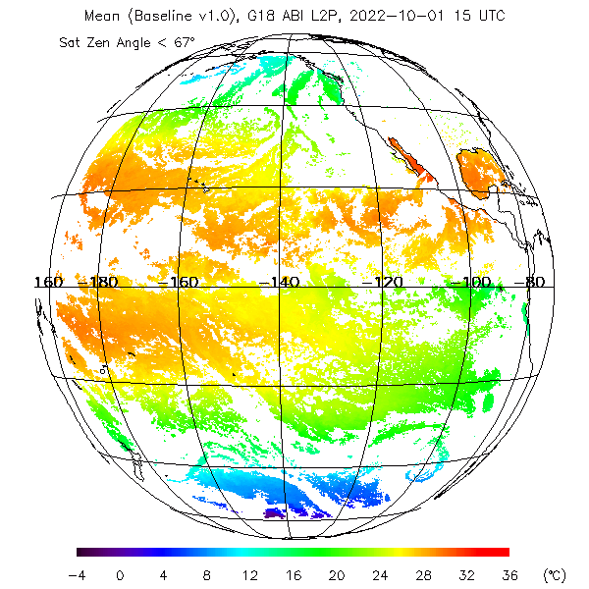
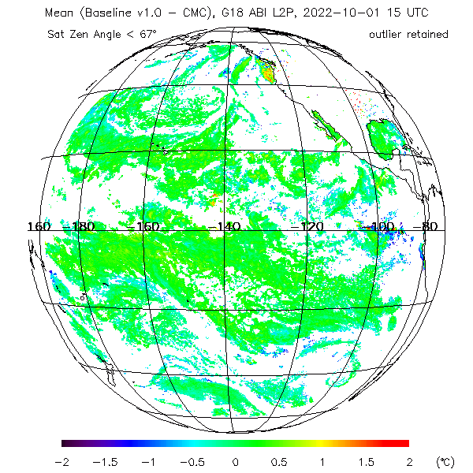
Typical G18 Baseline SST Product
G18 SST on 1 Oct 2022 @15UTC
G18 – CMC L4 SST on 1 Oct 2022 @15UTC
G18 SST shows typical SST distribution in the FD retrieval domain
Deviation from first-guess Level 4 CMC SST (Canadian Met Centre, one of the best gap-free analyses) is ~0K. Comparison w/L4 gives at-glance performance (e.g., shows cloud leakages)

Slide 21
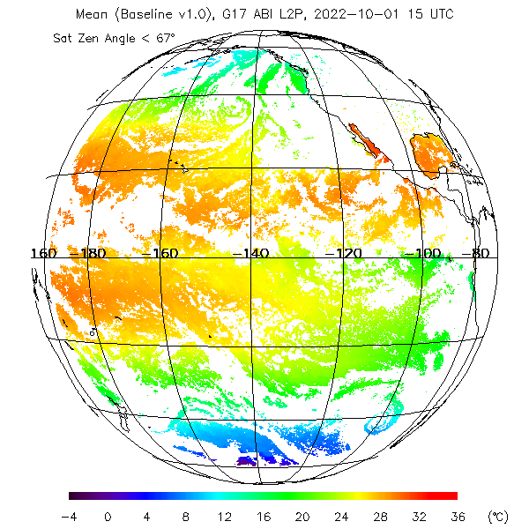
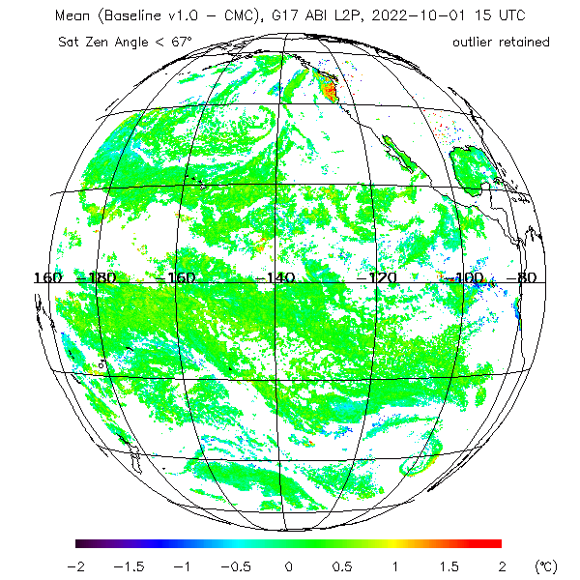
Corresponding G17 SST Product
G17 SST on 1 Oct 2022 @15UTC
G17-L4 SST on 1 Oct 2022 @15UTC
G17 SST is consistent with G18
Deviations from first-guess L4 SST are also very comparable between G17/18

Slide 22
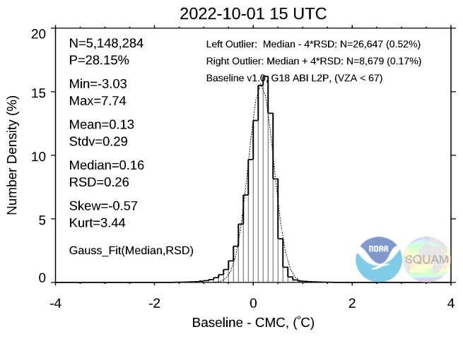
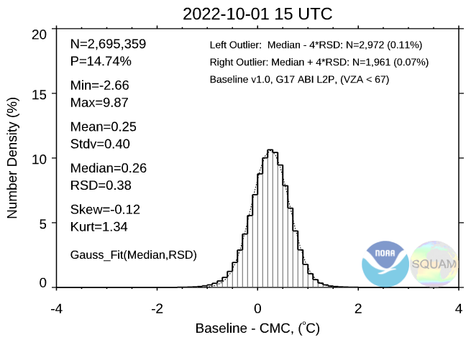
G17/18 Histograms of SST-L4 CMC
G18-L4 SST on 1 Oct 2022 @15UTC
G17-L4 SST on 1 Oct 2022 @15UTC
Coverage for G18 SST is often improved over G17 (expected, due to LHP issue)
Mean bias & SD for G18 are smaller than for G17 (expected; due to LHP issue)

Slide 23
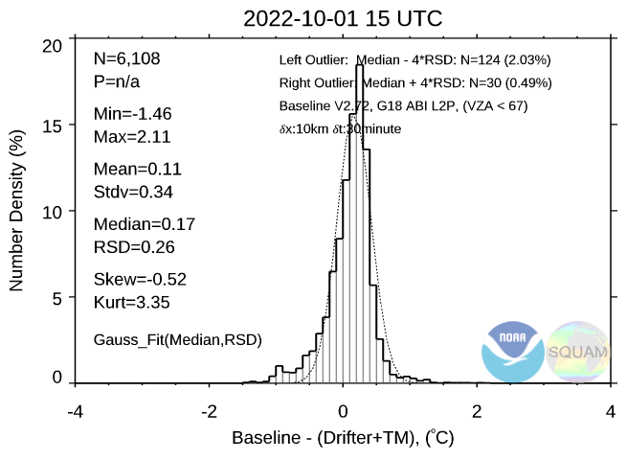
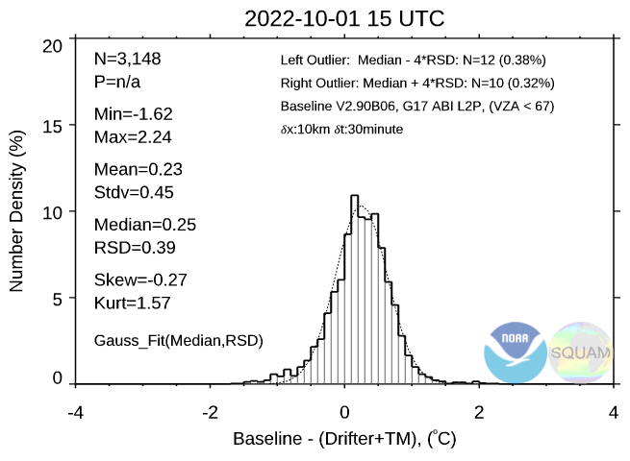
G17/18 Histograms of SST - in situ
G18-L4 SST on 1 Oct 2022 @15UTC
G17-L4 SST on 1 Oct 2022 @15UTC
Number of matchups for G18 SST is ×2 compared to G17 (consistent w/L4)
Mean bias & SD for G18 are improved over G17 (again, consistent w/L4)

Slide 24
Atypical (Bad) Example:
G18 vs G17 FD Imagery
(30 Sep 2022 @01UTC)

Slide 25
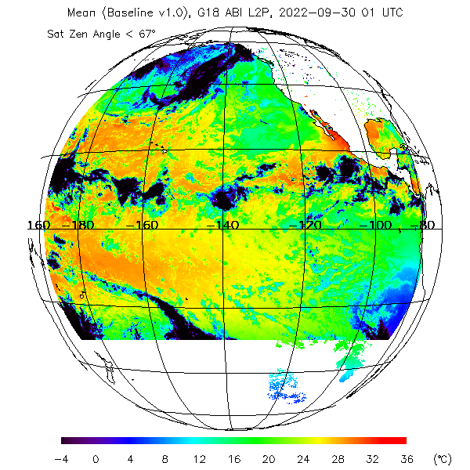
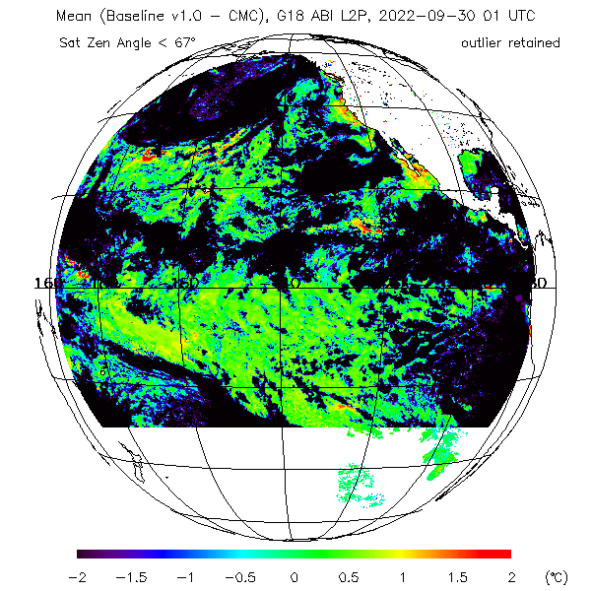
Atypical G18 Baseline SST Product
G18 SST on 30 Sep 2022 @01UTC
G18-L4 SST on 30 Sep 2022 @01UTC
G18 SST shows large anomalies with negative SST. Lower part of FD truncated
Deviation from first-guess L4 SST confirms these anomalies seen in SST

Slide 26
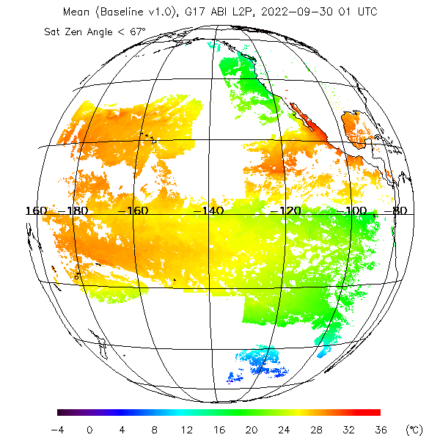
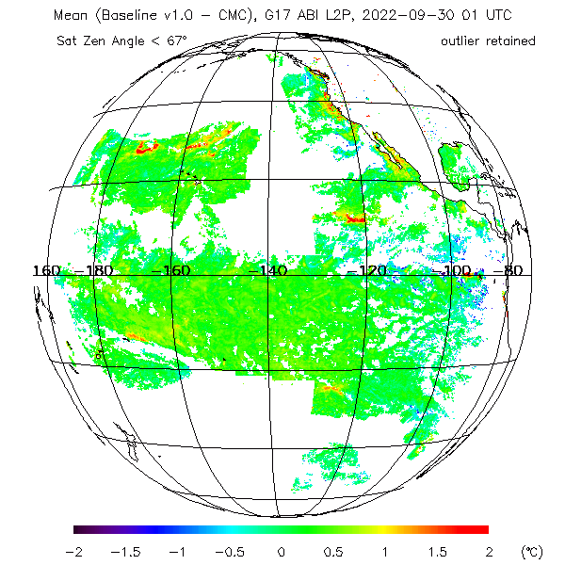
Corresponding G17 SST Product
G17 SST on 30 Sep 2022 @01UTC
G17-L4 SST on 30 Sep 2022 @01UTC
G17 SST also shows blocky/incomplete structure (similar to G18)
SST in this incomplete domain appears reasonable (no negative anomalies)

Slide 27
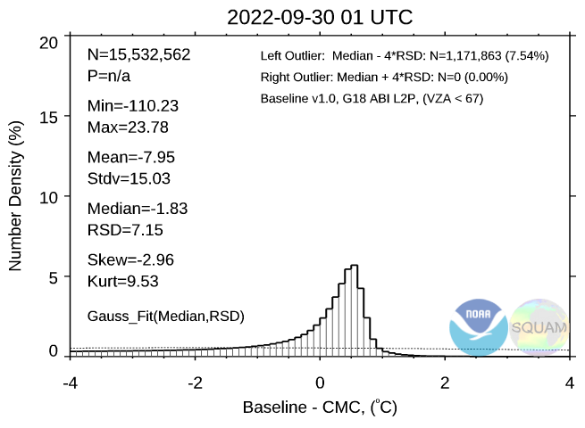
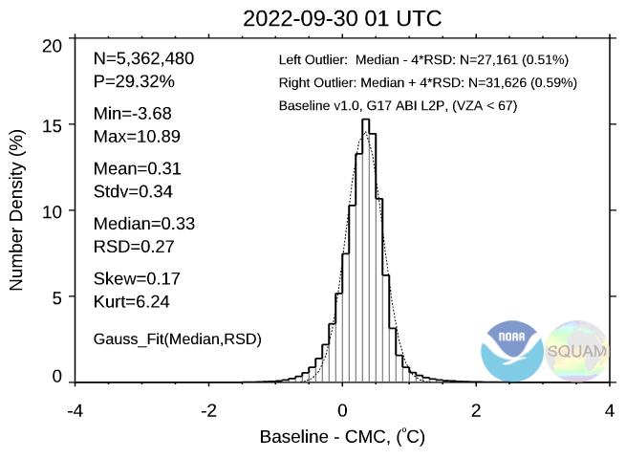
G17/18 Histograms of SST-L4 CMC
G18-L4 SST on 30 Sep 2022 @01UTC
G17-L4 SST on 30 Sep 2022 @01UTC
G18 performance statistics are strongly degraded (explains outliers in time series)
For G17, performance statistics in this particular case are reasonable & within specs

Slide 28
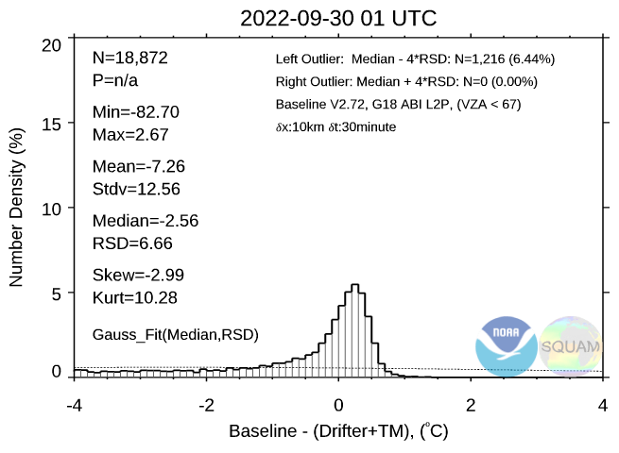
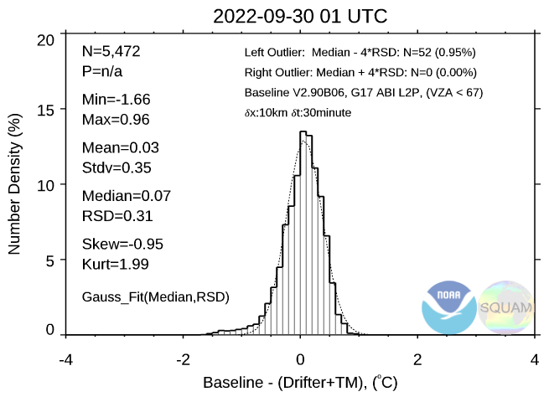
G17/18 Histograms of SST-in situ
G18-L4 SST on 30 Sep 2022 @01UTC
G17-L4 SST on 30 Sep 2022 @01UTC
G18 in situ VAL statistics are strongly degraded, explaining outliers in time series
For G17, performance statistics, in this particular case, are reasonable & within specs

Slide 29
G16 Beta (May’2017) and Provisional (Mar’2018) Reviews have shown similar anomalies due to coding implementation issues. Those were documented in WR3207 ‘Incorrect DQFs’ and ADR269/WR4214 ‘Anomalies in SST product’.
PRO Team was aware of both technical issues and worked on fixes in 2017-2018.

Slide 30
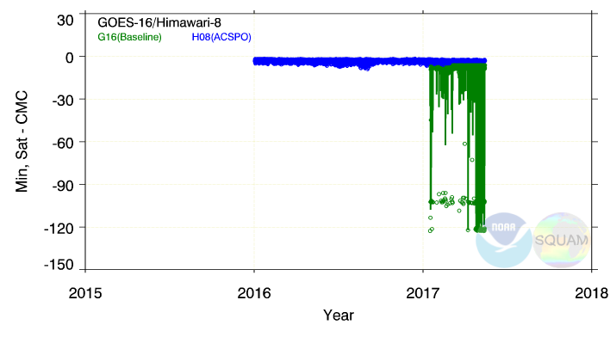
From G16 Beta Review (May’2017)
min (G16 L2 – CMC L4) SST
Only SST pixels with QF = “Very Good” are monitored in SQUAM
Image on 2017-02-11T20:51 corresponding to these minima is shown on the next slide
Some pixels (marked as “very good”) report SST ~100K colder than CMC L4 or in situ SST. ADR269/WR4214 ‘Anomalies in SST product’.

Slide 31
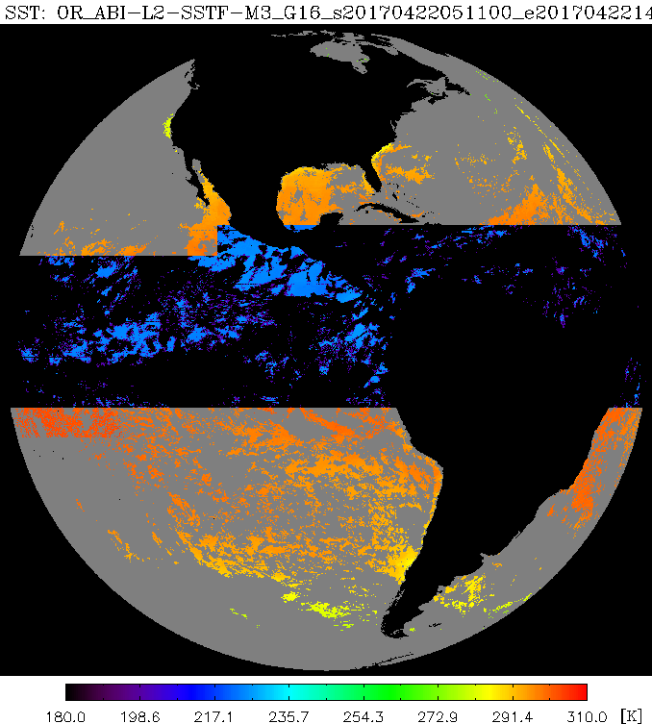
From G16 Beta Review (May’2017)
Very cold SST marked as “best quality”
11 February 2017, 20:51 UTC
SST s with “Very Good” QF may be
colder than background SST by 100 K
The source of such anomalies is unknown to STAR. Tickets submitted to PRO: WR3207 ‘Incorrect DQFs’ and ADR269/ WR4214 ‘Anomalies in SST product’

Slide 32
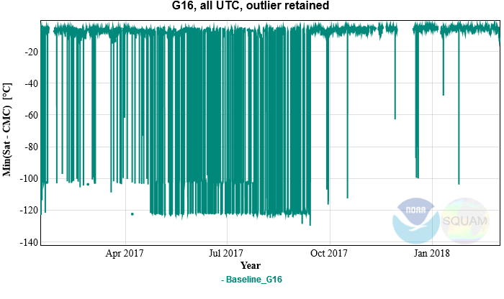
From G16 Provisional Review (Mar’2018)
min (G16 L2 – CMC L4) SST
Only SST pixels with QF = “Very Good” are monitored in SQUAM
The problem was first reported with G16 in Mar’2017 under ADR269
“Black-outs” occurred almost every single day up until Sep’2017
The outages have reduced in Sep’2017, but still occur occasionally

Slide 33
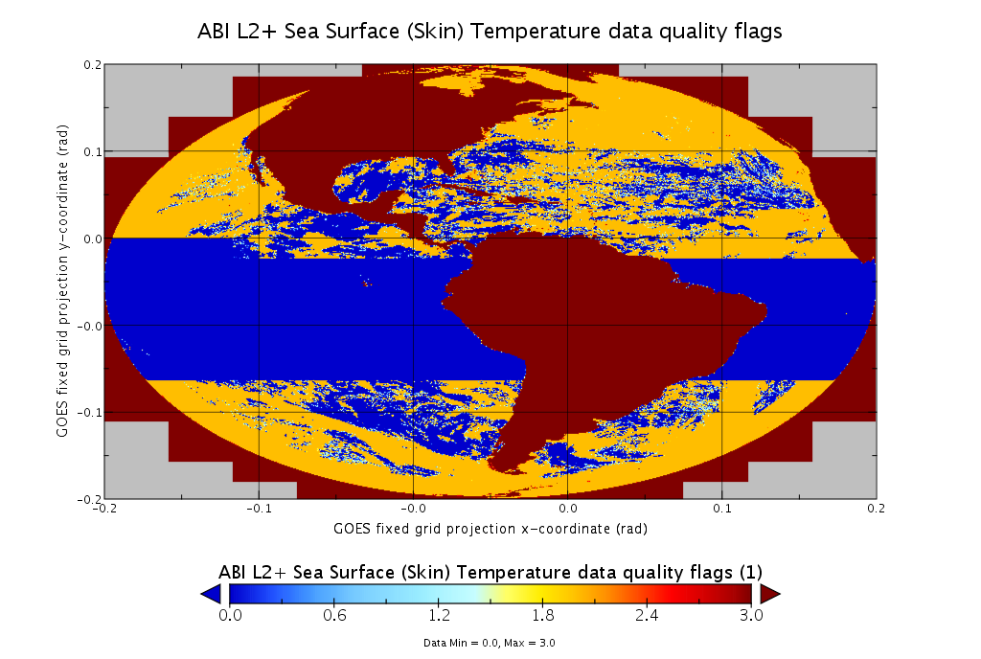
From G16 Provisional Review (Mar’2018)
Most recent occurrence on 23 Feb 2018
OR_ABI-L2-SSTF-M3_G16_s20180541700396_e20180541756160_c20180541800261.nc
Latest WR3207 ‘Incorrect DQFs’ and ADR269/ WR4214 ‘Anomalies in SST product’.
Also, incorrect time_bounds = 9.969209968386869E36 (ADR 509)

Slide 34
Path to G18 Full Maturity

Slide 35
Path to Full Maturity
Implement NOAA Enterprise Algorithm – Advanced Clear-Sky Processor for Ocean (ACSPO). This will provide users with artifact-free, best fit-for-purpose products, and satisfy their needs & expectations
Keep conducting the same PLPTs & improving product
  Create match-ups w/high-quality L4 analyses and in situ data & display in SQUAM, to guide products improvements
  Adjust algorithms, as needed (recalculate SST coefficients, tweak parameters in SST QC, etc)
  Work with NOAA, National and International (GHRSST) users & partners, solicit feedback, and improve product
  Work towards product easy access and archival
Notes:
can add as many slides as needed. Large importance

Slide 36
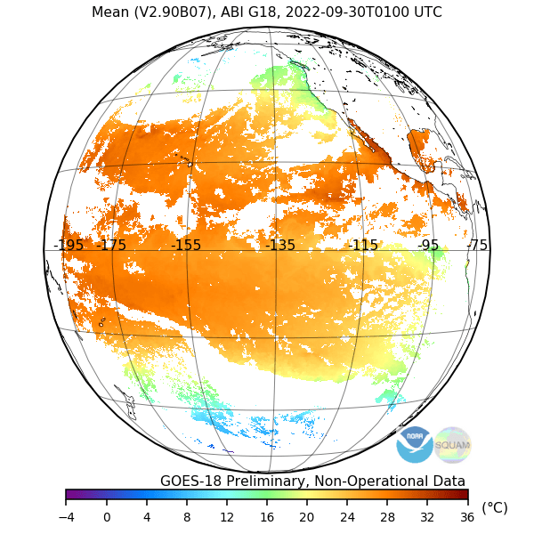
ACSPO is not subject to the anomalies present in G18 baseline product
G18 ACSPO SST on 30 Sep 2022 @01UTC
G18 Baseline SST on 30 Sep 2022 @01UTC
ACSPO G18 & G17 SSTs are accurate, complete, and consistent
No massive cold SST blocks w/DQF=5 / no outliers in time series

Slide 37
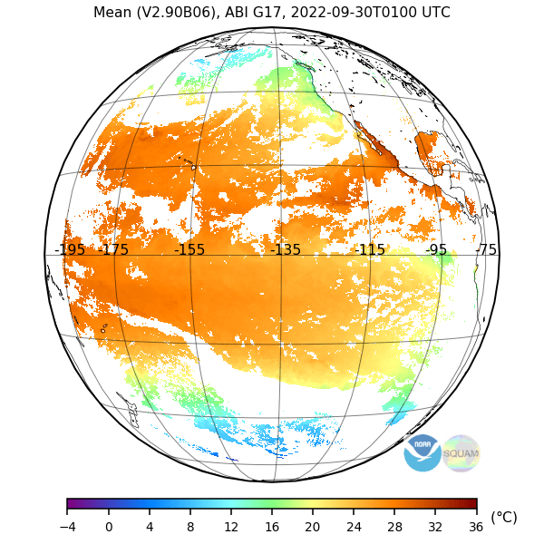
ACSPO is not subject to the anomalies present in G17 baseline product
G17 ACSPO SST on 30 Sep 2022 @01UTC
G17 Baseline SST on 30 Sep 2022 @01UTC
ACSPO G18 & G17 SSTs are accurate, complete, and consistent
No ‘blocky’ structure in imagery / no drop-outs/pop-ups in time series

Slide 38
Baseline vs. Enterprise SST
Feature | Baseline | Enterprise
Algorithm | 2010 ACSPO⁽¹⁾ v1.20 (“SEVIRI”) | 2022 ACSPO⁽¹⁾ v2.70/2.80 (“AHI/ABI”)
Bands used for SST | Reconciled w/ACSPOv2.41 | Day & Night: 8.6, 10.4, 11.2, 12.3 μm
Switch between day/night | Reconciled w/Enterprise | One algorithm ensures consistent diurnal cycle
Availability to users | PDA | PDA (To be archived in PO.DAAC)
Clear-Sky Mask | Framework “One-size-fits-all” | Optimized for SST, consistent for LEO/GEO
Internal Waters | No | Yes
Gridded L3U Product | No | Yes (consistent w/VIIRS/AVHRR/AHI/MODIS)
Output File Format | Non-GDS2 | GDS2⁽²⁾ – Critical for International SST users
SSES⁽³⁾ | No | Yes. Minimizes local SST biases & global SDs
1hr Compositing/Collation | Composite (propagates cloud) | Collated (minimizes cloud leakages)
Fixes/Improvements | Challenging | Ongoing (e.g. adding fronts in ACSPO 2.60)
Science Maintenance/Val | Unique (Costly/Less Efficient) | Unified (Enterprise Processes)
Reprocessing | No provision | Ongoing (for G16/17//ABI & H8/AHI)
Consistent w/NOAA SSTs | No | Yes (w/VIIRS/AVHRR/AHI/MODIS)
⁽¹⁾ ACSPO | Advanced Clear-Sky Processor for Oceans – NOAA Enterprise SST System
⁽²⁾ GDS2 | Group for Hi-Res SST (GHRSST) Data Spec v2.0 – SST community standard
⁽³⁾ SSES | Single Sensor Error Statistics – in-pixel estimates of SST bias and standard deviation (required by GDS2 format and by modelers, including NCEP)

Slide 39
Conclusion

Slide 40
Provisional Validation
Preparation Activities | Assessment
Validation activities are ongoing and the general research community is now encouraged to participate. | Ongoing validation activities. Feedback provided by AWIPS users.
Severe algorithm anomalies are identified and under analysis. Solutions to anomalies are in development and testing. | Science of the SST algorithm is solid. The implementation code has 2 issues: (1) occasional wrong DQFs; and (2) blocky data exclusions. Both are adrressed in the enterprise ACSPO code
Incremental product improvements may still be occurring. | Transition to enterprise ACSPO implementation is recommended.
L2+ only: Users are engaged in the Product Feedback Forums and user feedback is assessed. | Yes.
End State | Assessment
Product performance has been demonstrated through analysis of a small number of independent measurements obtained from select locations, periods, and associated ground truth or field campaign efforts. | Yes and more. Analyses have been performed for all FD data for a representative 3-month period and we are confident that these analyses are sufficient to determine the product performance.
Product analysis is sufficient to communicate product performance to users relative to expectations (Performance Baseline). | Yes. Analyses show SST is generally within specifications.
Documentation of product performance exists that includes recommended remediation strategies for all anomalies and weaknesses. Any algorithm changes associated with severe anomalies have been documented, implemented, tested, and shared with the user community. | Yes. See this G18 provisional review, and prior G16 beta and provisional reviews (in May 2017 and Mar 2018, respectively)
Testing has been fully documented. | Yes. See this G18 provisional review, and prior G16 beta and provisional reviews (in May 2017 and Mar 2018, respectively)
Product is ready for operational use and for use in comprehensive cal/val activities and product optimization. | Yes. See this G18 provisional review, and prior G16 beta and provisional reviews (in May 2017 and Mar 2018, respectively)

Slide 41
Recommendation
For SST Provisional Maturity
Product performance has been demonstrated through a large, but still seasonally limited, number of independent measurements. The analysis is sufficient for limited qualitative determinations of product fitness-for-purpose, and the product is potentially ready for testing in operational use
AWG SST Team therefore recommends that the G18 Baseline SST Product be transitioned to Provisional status at this time
All tests appear to work
Remaining deficiencies are attributed to known technical issues beyond science team competencies
3-months validation was done successfully, in the FD retrieval domain
So far, L1B issues are not impacting SST performance significantly
PASSED

Slide 42
Summary
AWG recommends that the G18 SST Product be transitioned to Provisional status at this time
Remaining technical issues in baseline product are fully addressed in the enterprise ACSPO algorithm. No fixes are recommended in baseline
We are working with users interested in NOAA enterprise (ACSPO) product to facilitate data access & use

