Slide 1
GOES-18 L2 (Group 3) Provisional Validation
Peer/Stakeholder Product Validation Review (PS-PVR)
Nov. 9, 2022
NWS Perspective / AWIPS Verification
John D. Evans and Derek van Pelt
TOWR-S team, NWS Office of Observations

Slide 2
Overview
Land Surface Temperature
Aerosol Optical Depth
Aerosol Detection Product: Dust, Smoke
Rain Rate/Quantitative Precipitation Estimate

Slide 3
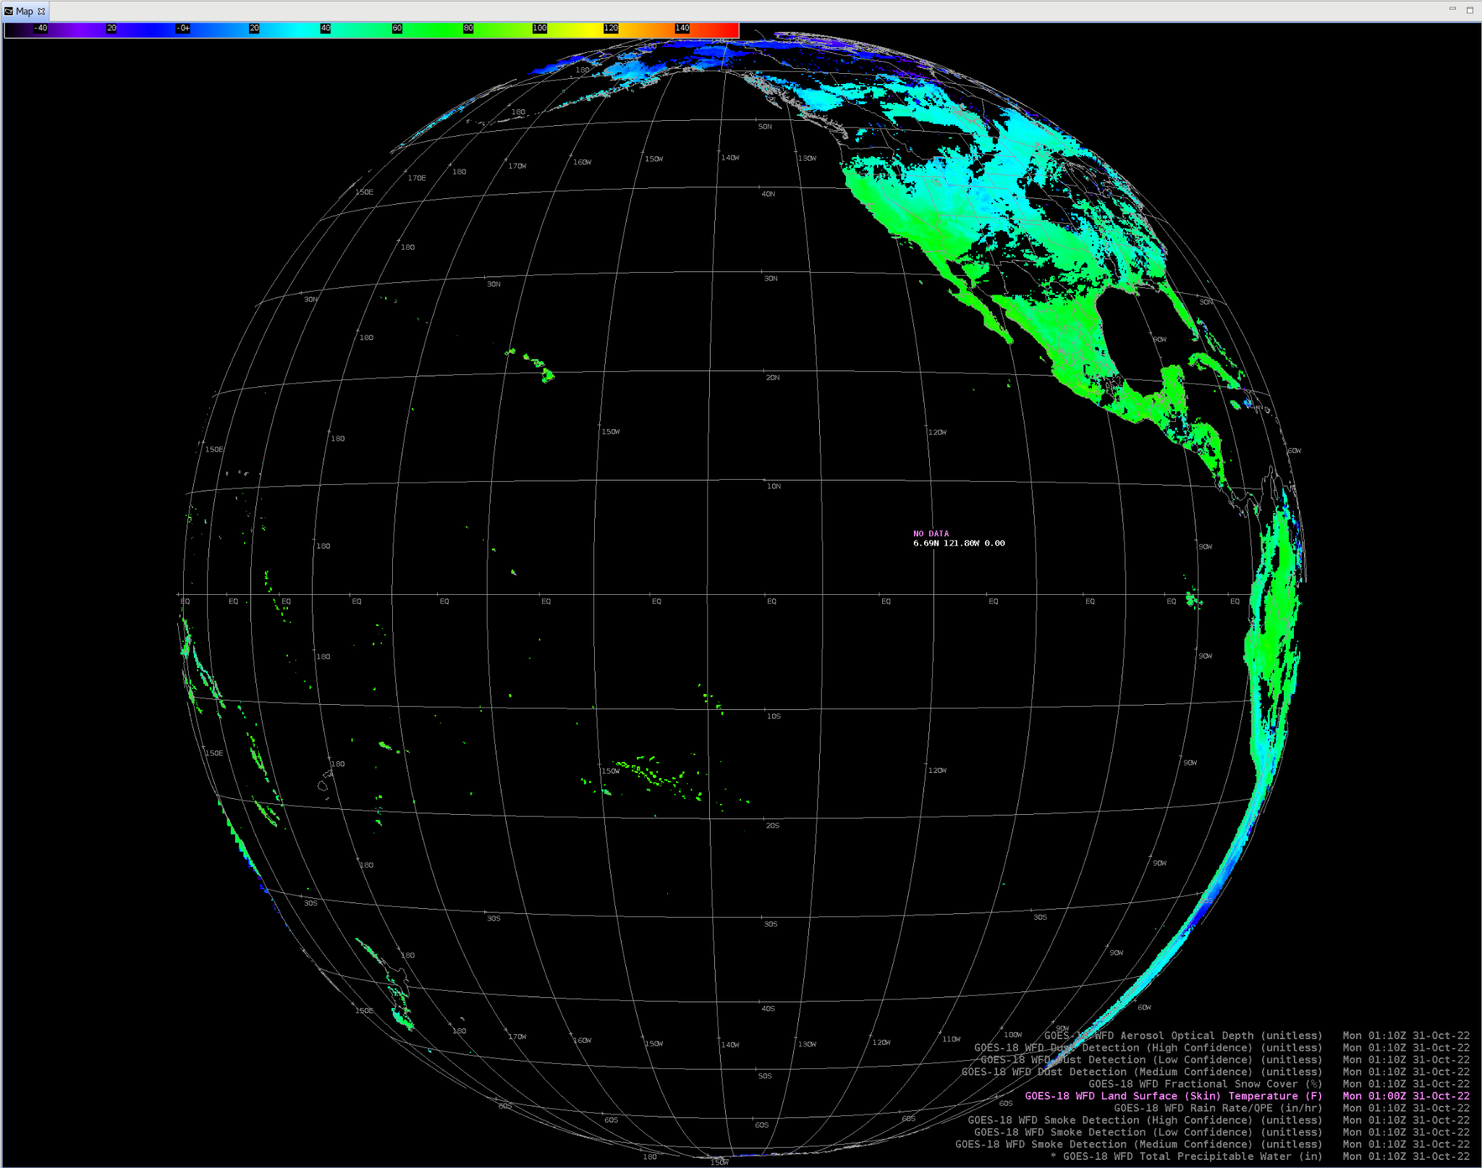
Land Surface Temperature
GOES-18 Preliminary, Non-Operational Data
Satellite Book Club (July 9, 2020) discussed wintertime use cases of LST in a Weather Forecast Office: flash freezes, fishing and boating in inland waters, ice estimates

Slide 4
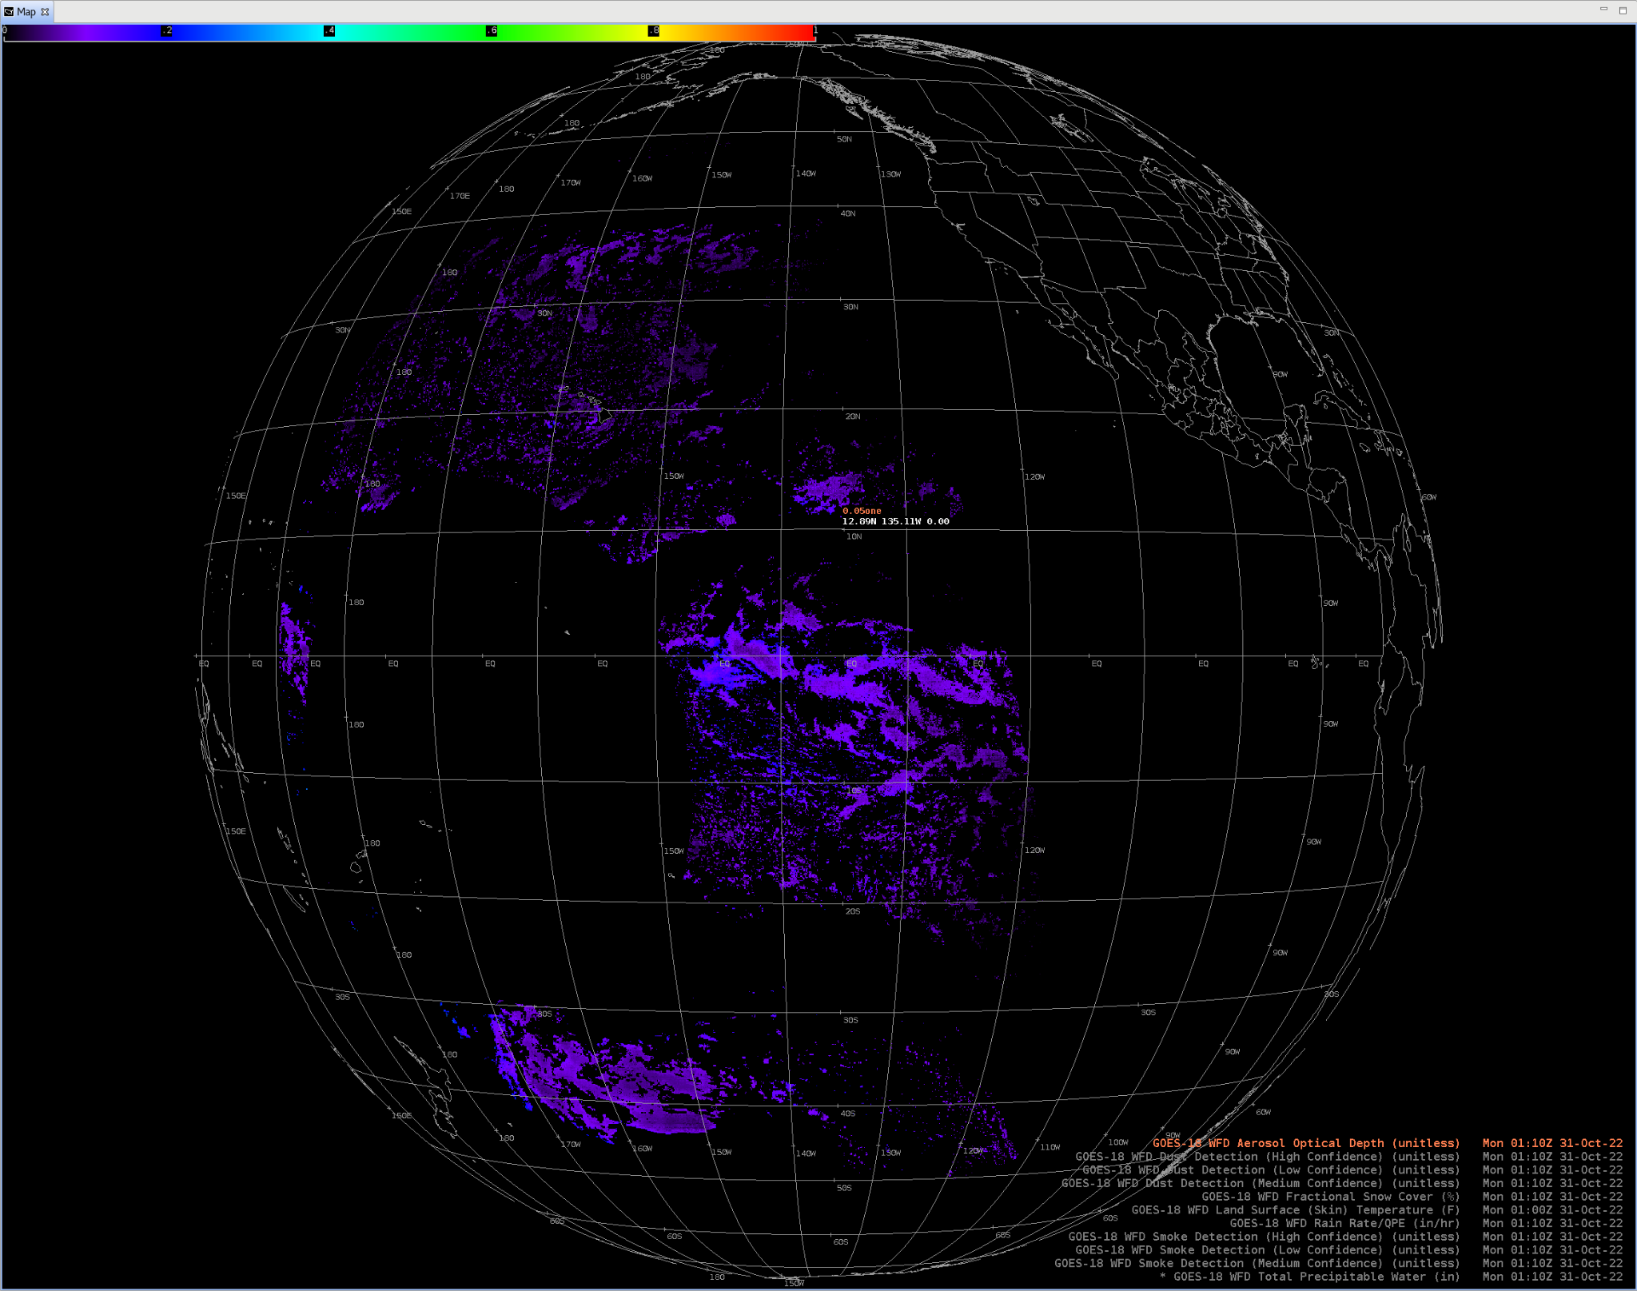
Aerosol Optical Depth
GOES-18 Preliminary, Non-Operational Data

Slide 5
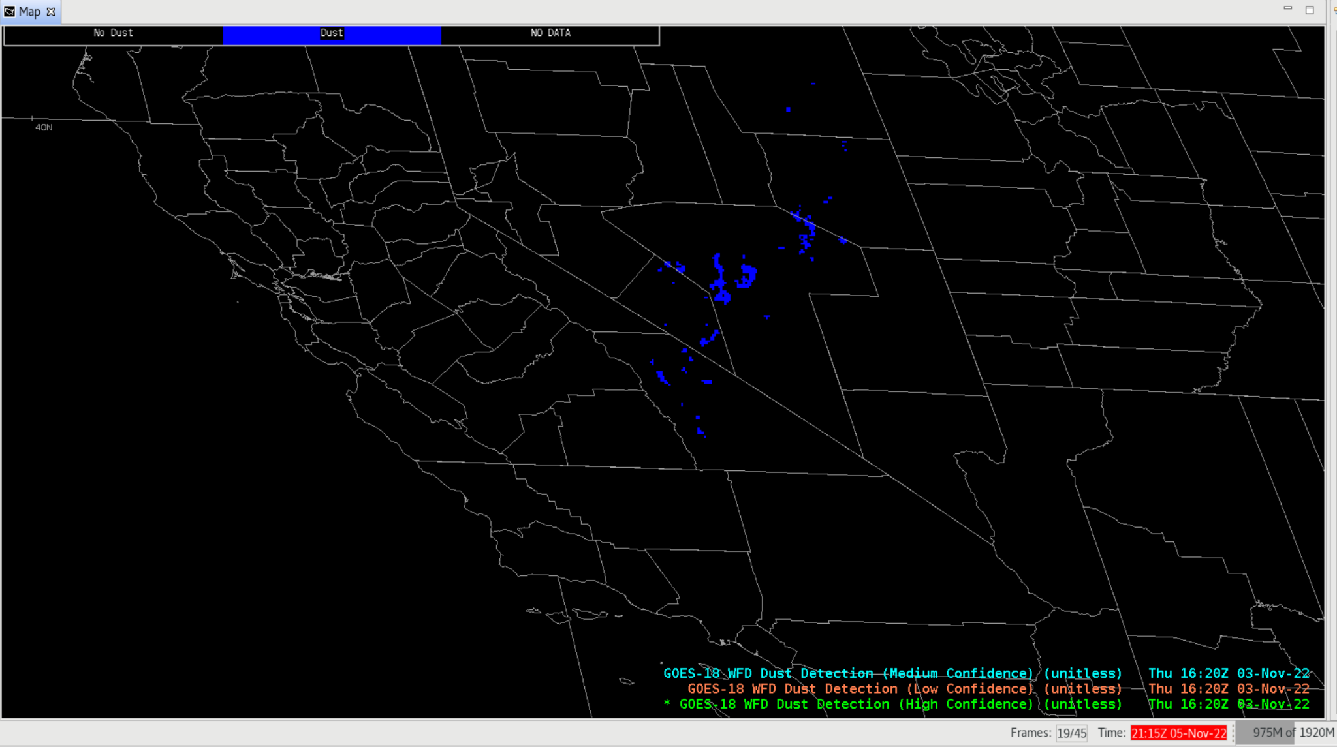
Aerosol Detection Product: Dust
GOES-18 Preliminary, Non-Operational Data

Slide 6
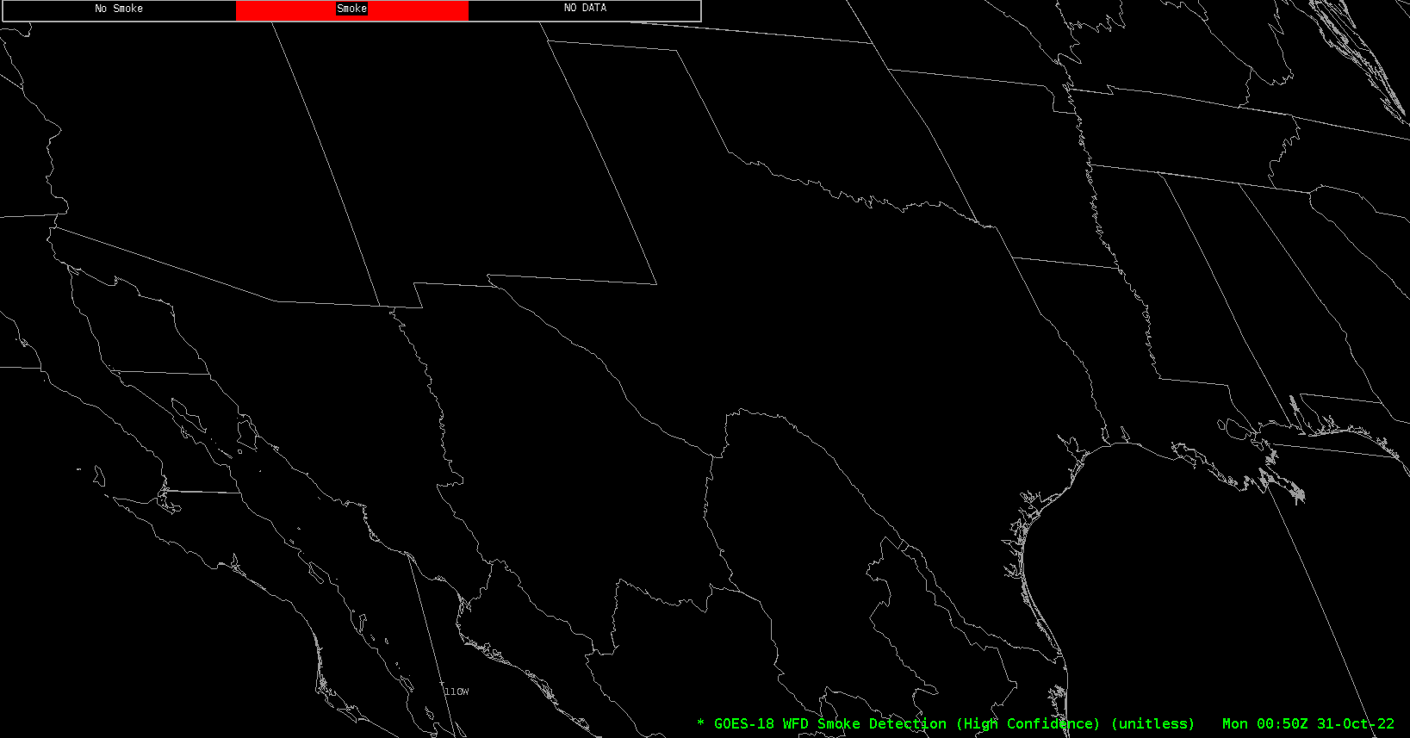
Aerosol Detection Product: Smoke
GOES-18 Preliminary, Non-Operational Data

Slide 7
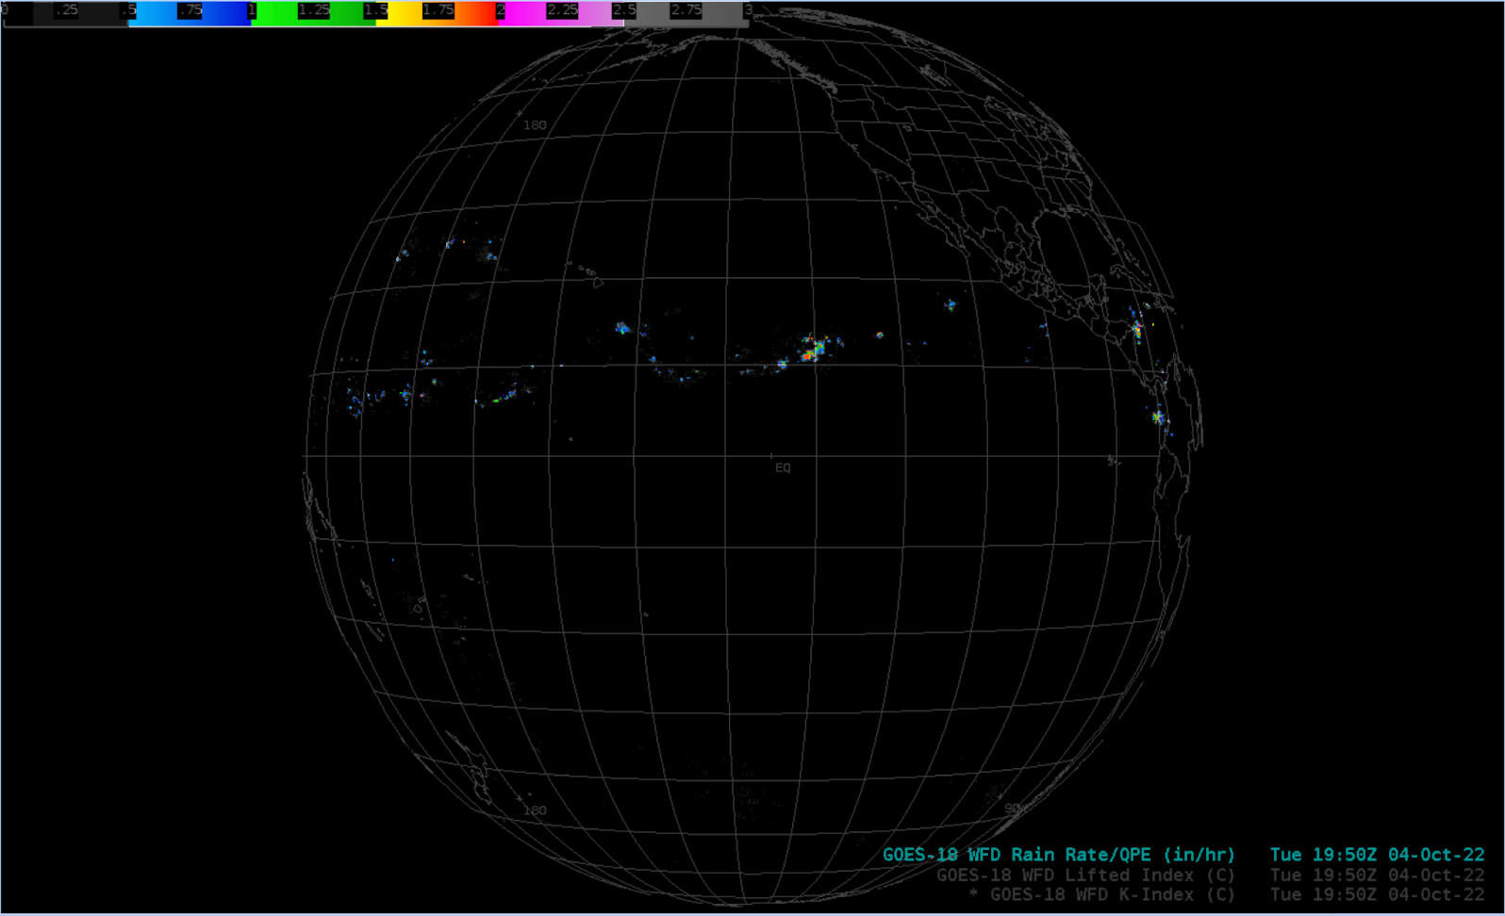
Rain Rate / Quantitative Precipitation Estimate
GOES-18 Preliminary, Non-Operational Data

Slide 8
Notes
AWIPS ingests and displays all these products using baseline GOES-16/17 configurations.
  No fielding issues are expected
  G-18 products conform closely to G-16,17 conventions (GOES-R Product User Guide)
  AWIPS’ existing configurations for G16 and G17 are extensible for G18+

