Slide 1
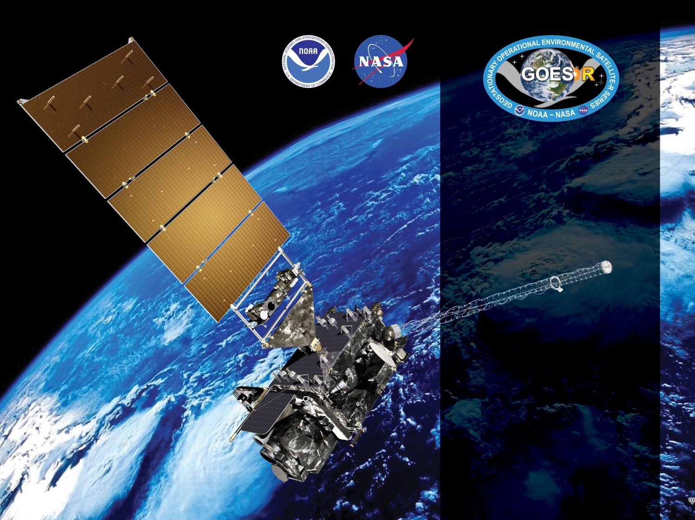


GOES-16 & -18 ABI L2+
Fractional Snow Cover (FSC)
Provisional PS-PVR
December 9, 2022
GOES-R AWG
Peter Romanov¹, Yinghui Liu², Jeff Key²
¹CREST/CUNY
²NOAA/NESDIS/STAR
Notes:
PS-PVR - Peer-Stakeholder Product Validation Review

Slide 2
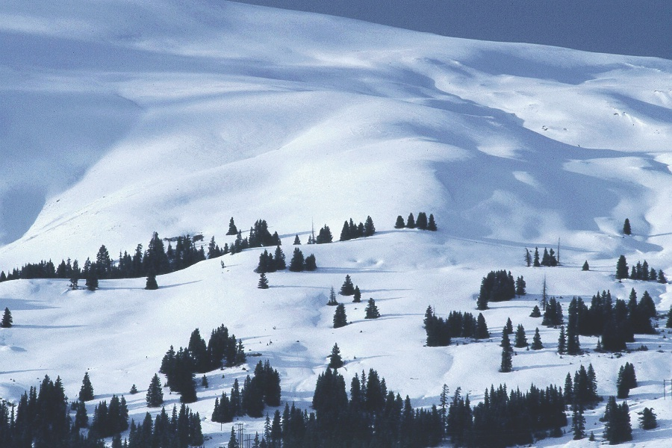
Outline
Fractional Snow Cover (FSC) product definition, requirements, history, and overview
Enterprise FSC Algorithm Introduction and Validation
Provisional Maturity Assessment
Path to Full Validation
Users
Summary and Recommendations

Slide 3
PRODUCT OVERVIEW

Slide 4
Fractional Snow Cover Definition
Fractional Snow Cover (FSC)* is the fractional area covered by snow in each satellite pixel as seen from space. It is often referred to as the “viewable snow fraction”. The viewable FSC is determined by the actual snow cover fraction on the ground within the pixel and by the snow cover masking by vegetation canopy.
FSC retrievals are expressed as the fraction of the ABI pixel covered by snow, continuously from 0.0 = no snow cover to 1.0 = total snow cover.
*Fractional snow cover and FSC are terms typically used with ABI, whereas snow fraction or snow cover fraction are the more common terms used with VIIRS. Here we use the three interchangeably.

Slide 5
A Brief History
The baseline ABI fractional snow cover algorithm was developed by NOHRSC & JPL. It used a MODIS multi-endmember multispectral linear inversion snow fraction algorithm (MODSCAG).
By 2018 it was determined that taking full ownership of the baseline algorithm would be problematic and that the algorithm would not be sustainable in NESDIS.
In 2021 a decision was made not to put the ABI baseline algorithm into operations and to it with a snow fraction algorithm/product analogous to the one of VIIRS (Enterprise algorithm)
Compared to MODSCAG, the VIIRS Enterprise algorithm is simpler, more robust and easier to implement and modify. However, modifications associated with the different observation geometry were needed to adapt the VIIRS algorithm to ABI.
In the last two years modifications have been introduced to the VIIRS Enterprise algorithm to adapt it to ABI. The new ABI FSC algorithm and software was delivered to the STAR ASSISTT team in summer 2021. Integration in the GOES-R Development Environment (DE) was completed in October-November 2022.
NOHRSC: National Operational Hydrological Remote Sensing Center
JPL: Jet Propulsion Laboratory
MODSCG: MODIS Snow Covered Area and Grain Size

Slide 6
ABI Enterprise FSC Algorithm Overview
Enterprise Snow algorithm follows a traditional approach to snow cover and snow fraction characterization used in VIIRS, MODIS and AVHRR data processing systems
The algorithm includes two steps, snow identification and snow fraction estimation
Two products are derived, the Binary Snow Cover (or FSC IP) and the Fractional snow Cover (FSC) Product
Snow retrievals are performed over land and require daytime clear sky conditions.
The algorithm relies on the satellite observed radiance in the visible, near infrared, shortwave infrared and infrared bands. Algorithm requires a number of auxiliary datasets
The ABI Enterprise snow algorithm is a version of an earlier developed snow algorithm for VIIRS which was adapted to ABI observations

Slide 7
Product Requirements
GOES-R ABI Fractional Snow Cover Requirements
Satellite Source | GOES-R ABI
Measurement Range | 0.0 – 1.0 fractional cover
Accuracy | 0.30
Precision | 0.25
Latency | 60 min
Refresh | 60 min
Coverage | Full Disk, CONUS, Meso
Horizontal Resolution | 2 km
Mapping Accuracy | 1 km
Cloud Cover Conditions Qualifier | Clear conditions associated with threshold accuracy
Temporal Coverage Qualifier | Sun at < 67 deg. daytime solar zenith angle
Product Extent Qualifier | Quantitative out to at least 55° LZA and qualitative at larger LZA
- No requirement for the accuracy of snow/no-snow discrimination or binary snow cover map (VIIRS: 90%)
Notes:
OSCAR - WMO’s Observing Systems Capability Analysis and Review Tool
There was a presentation given to the GOES-R Algorithm Development Executive Board (ADEB) members in 2010 that clearly notes that incorrect (and current) accuracy and precision specs for the fractional snow cover product and what they should be (accuracy: 15%; precision: 30%). Why they were never corrected is unclear to us.

Slide 8
ABI SNOW ALGORITHMS AND PRODUCTS

Slide 9
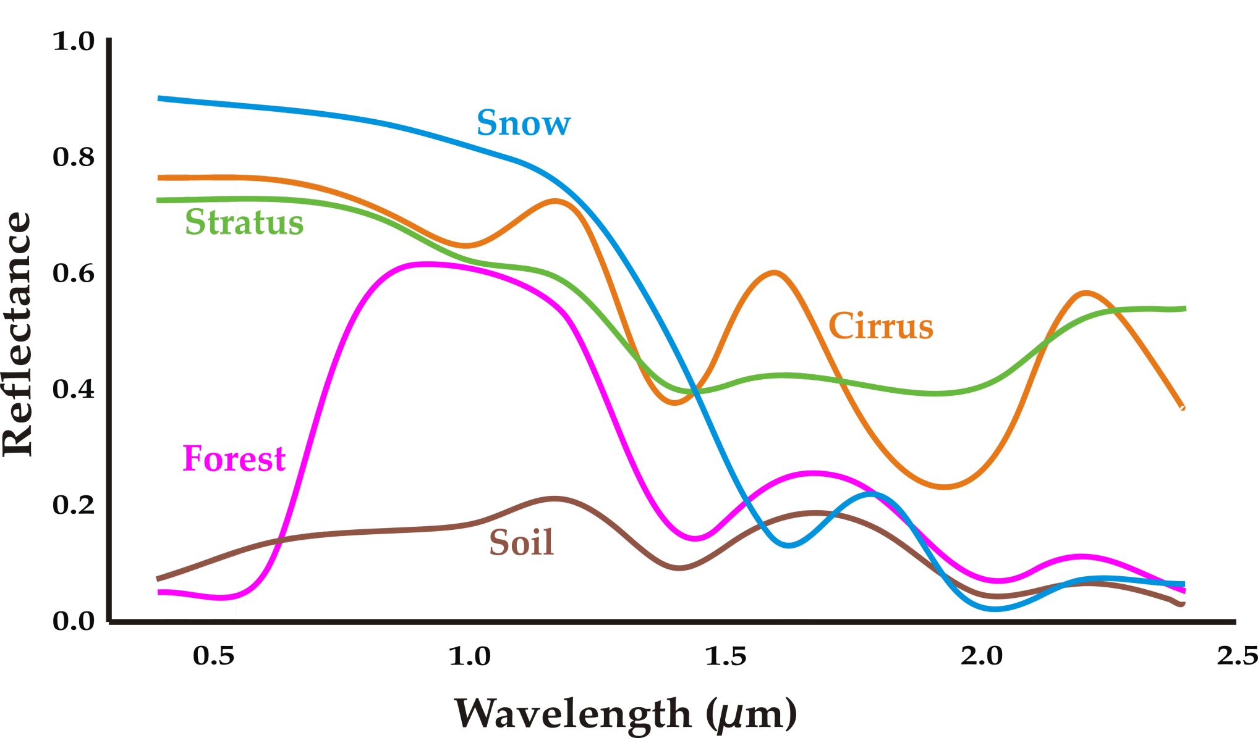
Snow Identification: Physical Basis
Snow can be identified in satellite imagery primarily due to a large drop in its reflectance from the visible (~0.6µm) to the shortwave infrared (~1.6µ m) spectral band. This spectral feature distinguishes snow from most other natural land surface types and clouds.
The snow spectral reflectance drop is often quantified using a normalized difference between the observed TOA reflectance in the visible and shortwave infrared bands. It is also known as the Normalized Difference Snow Index:
NDSI = (R_{vis} – R_{svir}) / (R_{vis +} R_{svir})
Besides NDSI other spectral features used in snow identification include IR Brightness Temperature, NDVI, R_{vis} , R_{svir}

Slide 10
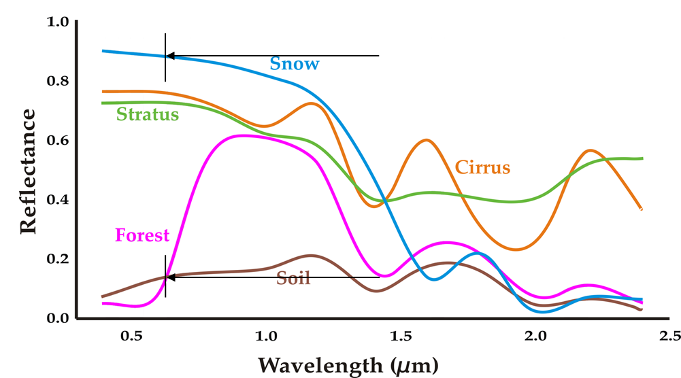
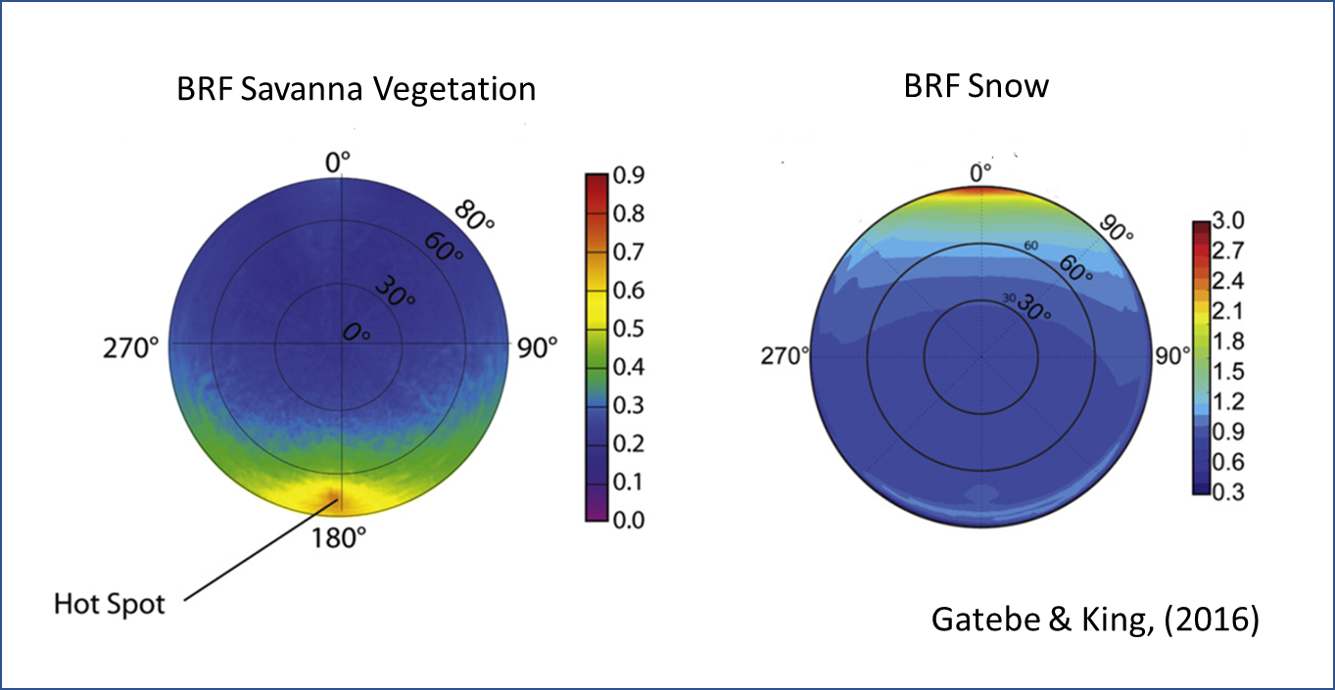
Snow Fraction: Physical Basis
Sub-pixel snow fraction can be determined owing to a strong reflectance difference between snow and other land surface types
The reflectance difference is the largest in the visible spectral band
If the reflectance of snow (R_{Snow}) and of the snow-free land (R_{Land}) is known, the Snow Fraction can be estimated using a linear mixture approach
SnowFraction = (R - R_{Land})/(R_{Snow} – R_{Land} )
The snow and snow-free land reflectance change substantially with the viewing and illumination geometry. Accurate characterization of the angular anisotropy of snow and snow-free land reflectance is critical for accurate snow fraction retrieval
BRF: Bidirectional Reflectance Function

Slide 11
Enterprise Snow Algorithm
Two steps: Snow identification and snow fraction retrieval
Both algorithms are applied during daytime (SolZA < 80⁰) to clear sky pixels over land
Derived products: Binary Snow Map and Snow Fraction
Auxiliary Data Set 1
Auxiliary Data Set 2
Spectral Threshold Values
Land-water mask
Tabulated snow TOA BRF
Tabulated snow-free land
TOA BRF
Snow Cover Climatology
LST Climatology
Surface Elevation
Enterprise Snow Retrieval Algorithm
Satellite Data
- Reflectance
- Brightness Temperature
- Observation Angles
- Cloud mask
Snow Identification
“Snow”
pixels
Snow Fraction Retrieval
Binary Snow Map
Snow Fraction Map

Slide 12
Enterprise Algorithm: Snow Identification
  Two-steps:
  (1) Initial Snow Identification
    - Spectral threshold-based decision tree algorithm (Modified MODIS SnowMap algorithm)
    - Uses NDSI/NDVI, reflectance (band 2,3,5) , IR brightness temperature (band 13)
  (2) Consistency Testing: Verifies plausibility of identified snow against
    - Snow cover climatology
    - Land surface temperature climatology
Spectral Threshold Values
Land-water mask
Snow Cover Climatology
LST Climatology
Surface Elevation
Snow Identification
Satellite Data
- Reflectance (ABI bands 2,3,5)
- Brightness Temperature (band 13)
- Observation Angles
- Cloud mask
Initial Snow Identification
“Snow”
pixels
Consistency Testing
Binary Snow Map

Slide 13
Snow Fraction Retrieval Algorithm
  Snow fraction is derived for cloud-clear pixels identified as “snow-covered”
  ABI-observed visible reflectance (band 2) is used
  Linear unmixing technique with two end-members is applied
    SnowFraction = (R - R_{Land})/(R_{Snow} – R_{Land} )
  R - Observed TOA reflectance in the visible band (band 2)
  R_{Land} - Predicted TOA reflectance of snow-free land surface
  R_{Snow} - Predicted TOA reflectance of snow-covered land
  R_{Land} and R_{Snow}
    Dependent on the observation geometry (Ɵ_{sol} , Ɵ_{sat} , ɸ_{azm})
    Precalculated using physical radiative transfer model (SBDART)
    Tabulated at 5⁰ interval for Ɵ_{sol} and Ɵ_{sat} and at 10⁰ interval for ɸ_{azm}

Slide 14
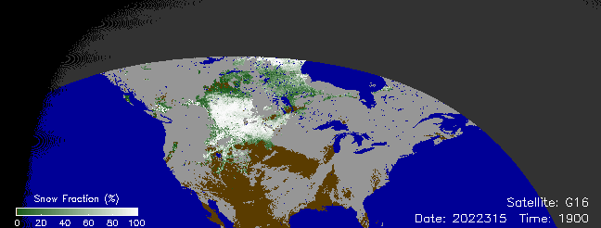
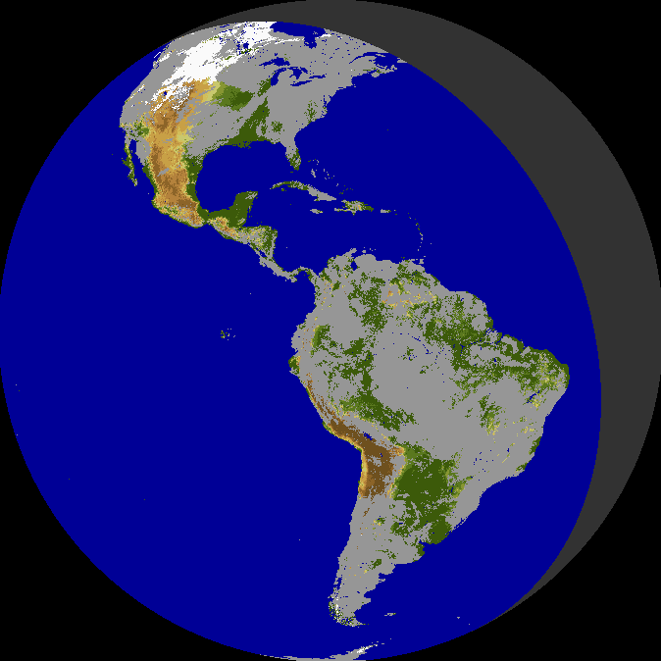
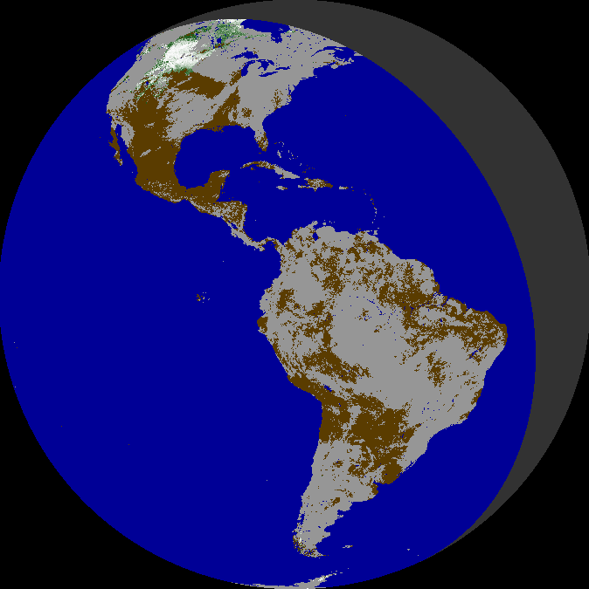

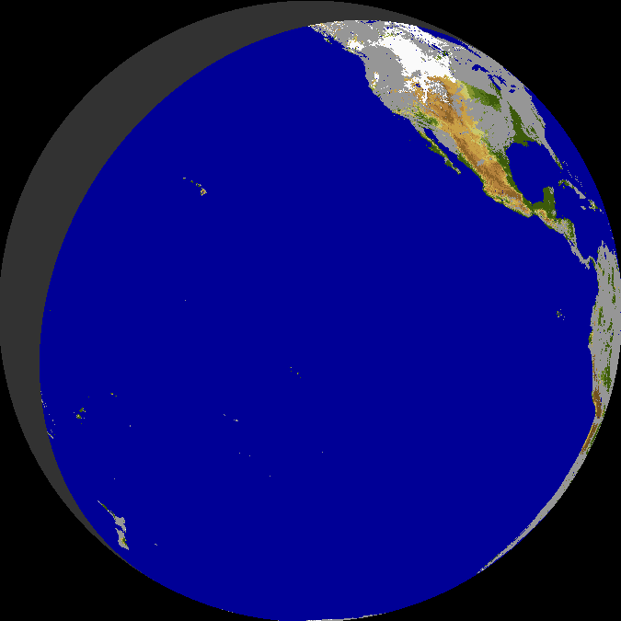
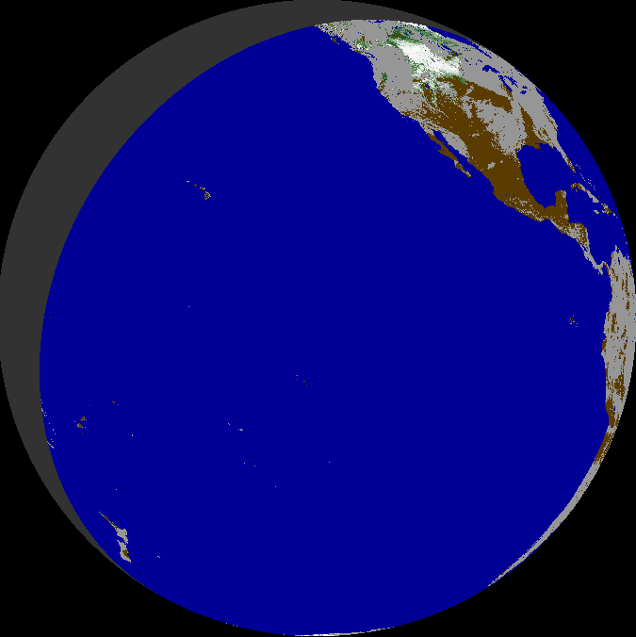

Binary and Fractional Snow: Offline Generation
  Full disk hourly snow products from both ABI sensors (GOES-16 and GOES-17/18) have been routinely generated offline since the end of 2021
  Enterprise snow algorithms were used with the Baseline cloud mask
  Both Binary Snow and Snow Fraction have been produced
Binary Snow
GOES-16 ABI
11/11/2022
1900 UTC
Snow Fraction
GOES-16 ABI
11/11/2022
1900 UTC
Land
Water
Cloud
No retrieval
Binary Snow
GOES-18 ABI
11/11/2022
1900 UTC
Snow Fraction
GOES-18 ABI
11/11/2022
1900 UTC
No coverage

Slide 15
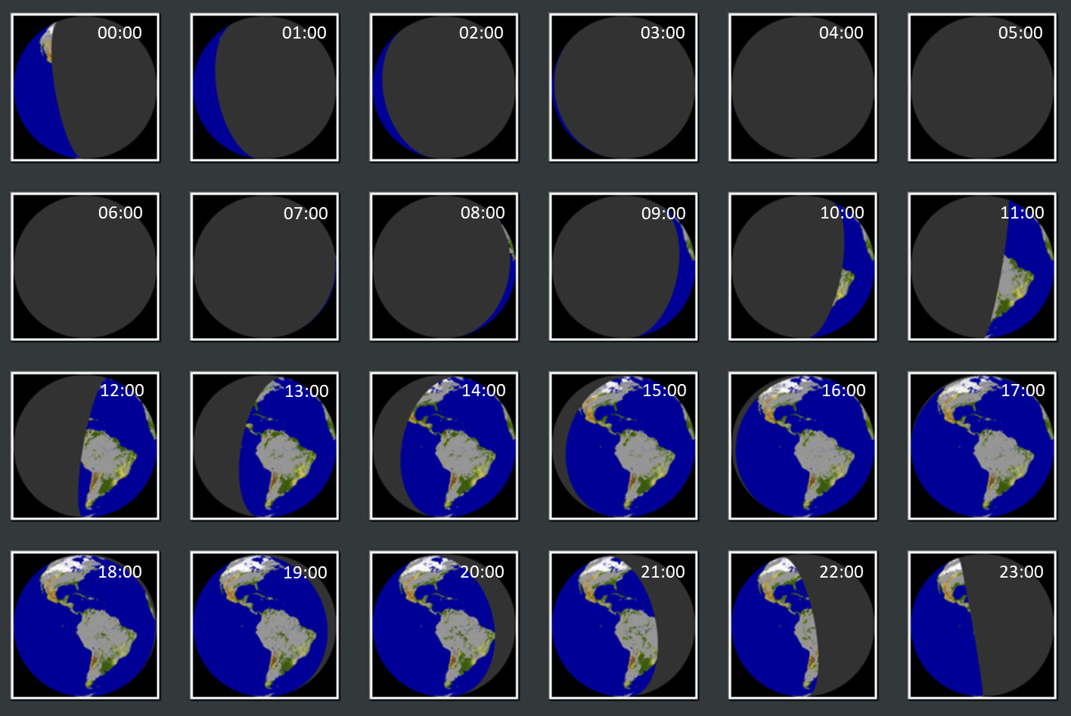
GOES-R ABI: Daytime Coverage
  ABI daytime observations providing meaningful coverage of the land area are available
  - Over North America from 1400 to 2300 UTC (to 0000 UTC with GOES-West)
  - Over South America from 1200 UTC to 2100 UTC (GOES-East only)
ABI GOES-16 Snow Maps
February 23, 2022
0000 – 2300 UTC
Hourly images
Snow
Cloud
No retrieval

Slide 16
ABI SNOW PRODUCT EVALUATION

Slide 17
Top Level Summary of
Product Quality
Our analysis involved GOES ABI snow products covering a limited period of time (10/20/2022-12/5/2022 for GOES-16 and 11/29/2022-12/5/2022 for GOES-18). ABI snow products were generated using Enterprise algorithms within the GOES-R DE system.
Examined FSC snow products from both G16 and G18 FSC were found to meet the mission accuracy and precision requirements.
Anomaly has been identified in the performance of the FSC algorithm in DE. It reduces the accuracy of the product but not beyond the requirements. The particular reason for this anomaly has yet to be determined.
Non-critical inconsistencies have been identified in quality flags in the Fractional Snow Cover Product. Corrective actions have been taken implementation team
Conclusion: The enterprise FSC product is ready for operational implementation. The quality of the product will improve once the problem causing the performance anomaly is identified and fixed. Further quality monitoring of the product is critical to verify that its quality remains acceptable in other seasons of the year.
Notes:
NDSI - Normalized Difference Snow Index

Slide 18
PLPTs Under Review: Provisional
FSC PLPT test IDs, short descriptions, and execution status for each satellite (GOES-16, -17, and -18/-19), with a "P" indicating the test is required (or was done) for Provisional maturity, and an "F" indicating the test is required for Full maturity. These are from the July 2021 RIMP.
Test ID | Short description | 16 | 17 | 18/19
ABI-FD_FSC01 | Verify Mode 6 FD product is generated every hour where snow exists and falls within expected measurement range | P | P | P
ABI-CONUS_FSC02 | Verify Mode 6 CONUS product is generated every hour where snow exists and falls within expected measurement range | P | P | P
ABI-MESO_FSC03 | Verify Mode 6 mesoscale product is generated every hour where snow exists and falls within expected measurement range | P | P | P
ABI-FD_FSC04 | Verify Mode 4 FD product is generated every hour where snow exists and falls within expected measurement range | P | P | P
ABI-CONUS_FSC05 | Verify Mode 4 CONUS product is generated every hour where snow exists and falls within expected measurement range | P | P | P
ABI-FD_FSC06 | Assess accuracy and precision of the FD snow product | P, F | P, F | P, F
ABI-CONUS_FSC07 | Assess accuracy and precision of the CONUS snow product | P, F | P, F | P, F
ABI-MESO_FSC08 | Assess accuracy and precision of the mesoscale snow product | P, F | P, F | P, F
18
Notes:
RIMP - Readiness, Implementation, and Management Plan

Slide 19
GOES-16 and GOES-18 Data
Used in this Review
For this review we examined ABI Snow products
Generated with the Enterprise snow algorithm within GOES-R DE system
Enterprise cloud mask was used, not the Baseline as in the Offline system
FSC and FSC IP products (DR_ABI-L2-FSC, DR_I_ABI-L2-FSC)
Time period :
GOES-16: from October 10, 2022 to December 5, 2022
GOES-18: from November 29, 2022 to December 5, 2022
Time range: 1400 to 2300 UTC (day-time coverage of the Northern Hemisphere land area)
Full Disk and CONUS coverage
Full Disk products: Performance/accuracy was examined
CONUS products: Verified output structure and content.

Slide 20
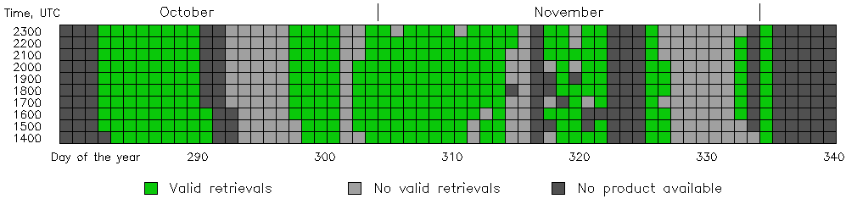
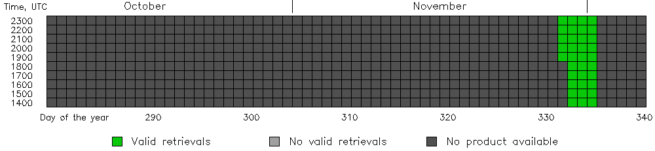
GOES-16 and GOES-18 FSC Products
Available/Suitable for Analysis
ABI FSC products were not always generated in the GOES-R DE. Some generated products did not contain valid data. There was too little snow within the GOES domain in the month of October. Near-complete sets of ABI daily data were available for 20 days for G16 and for 3 days for G18.
  GOES-16
  GOES-18

Slide 21
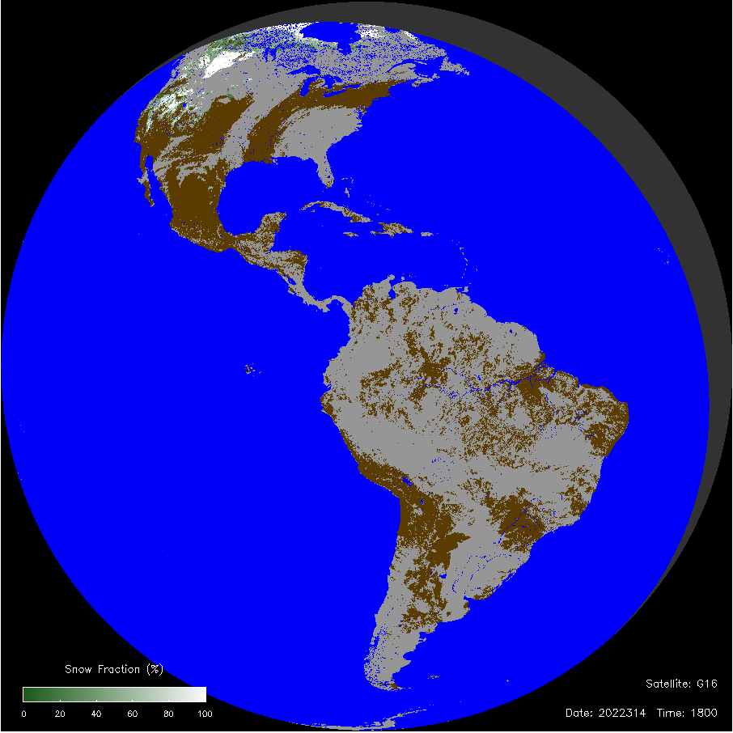
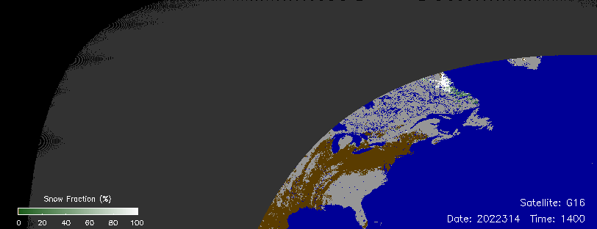
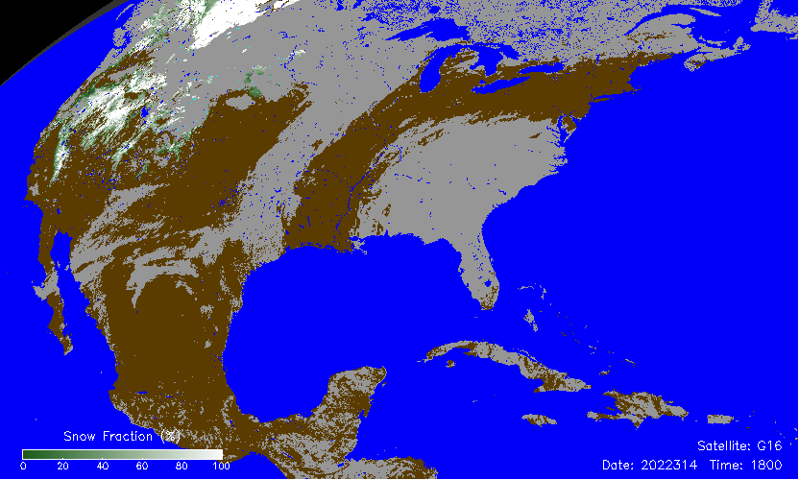
Visual Inspection - GOES-16 Snow
Snow Fraction
GOES-16
GOES-16 snow products generated in GOES-R DE with the Enterprise algorithm provide realistic characterization of the snow extent and of the snow cover fraction over daytime scenes (clouds are shown in light gray)
CONUS products are consistent with the Full Disk products
Land
Water
Cloud
No data
No coverage
Snow maps converted to a latitude-longitude grid

Slide 22
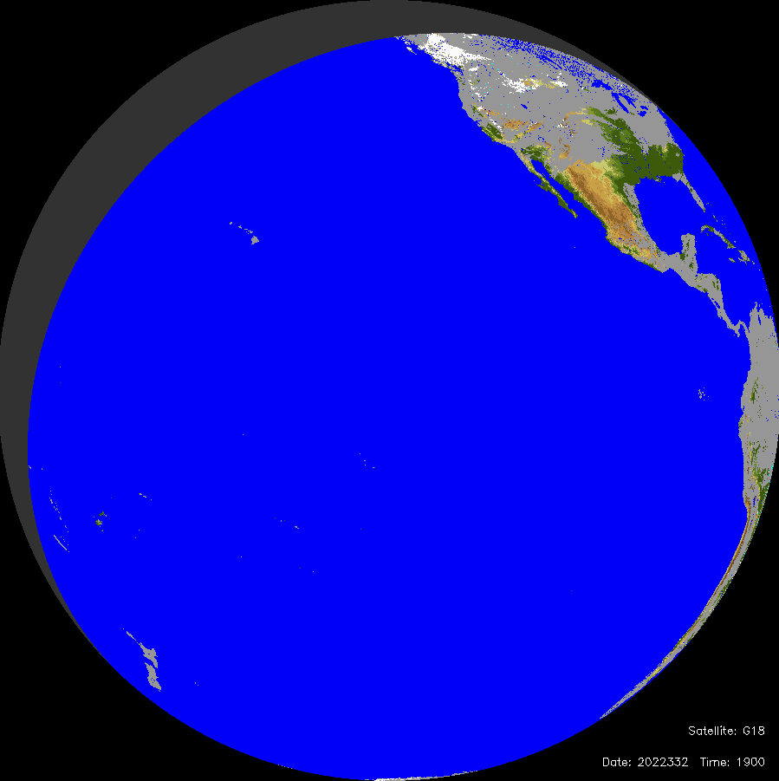
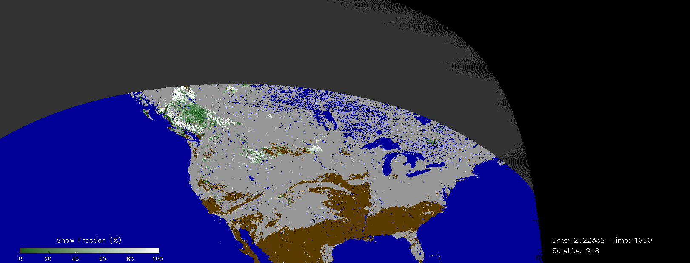
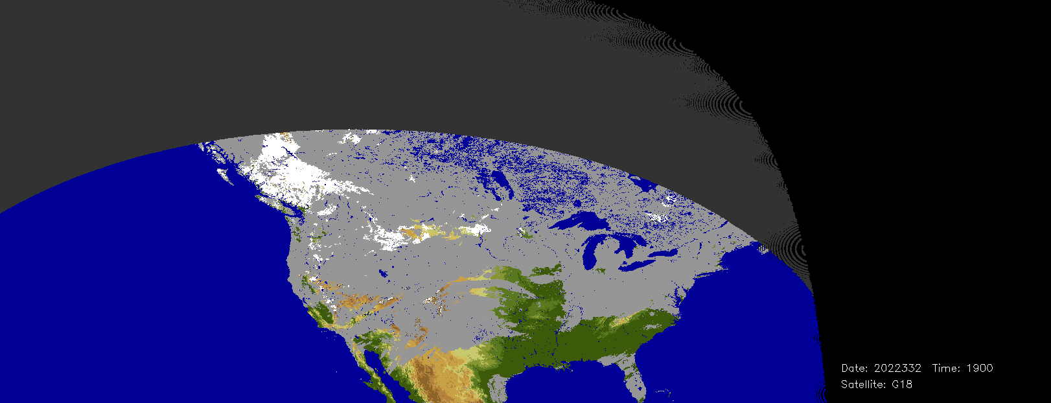
Visual Inspection - GOES-18 Snow
GOES-18 snow products generated in GOES-R DE with the Enterprise algorithm provide realistic characterization of the snow extent and of the snow cover fraction over daytime scenes
Snow maps converted to a latitude-longitude grid
Binary Snow Map
GOES-18
Snow Fraction
GOES-18
Land
Water
Cloud
No retrieval
No coverage
Binary Snow Map
GOES-18

Slide 23
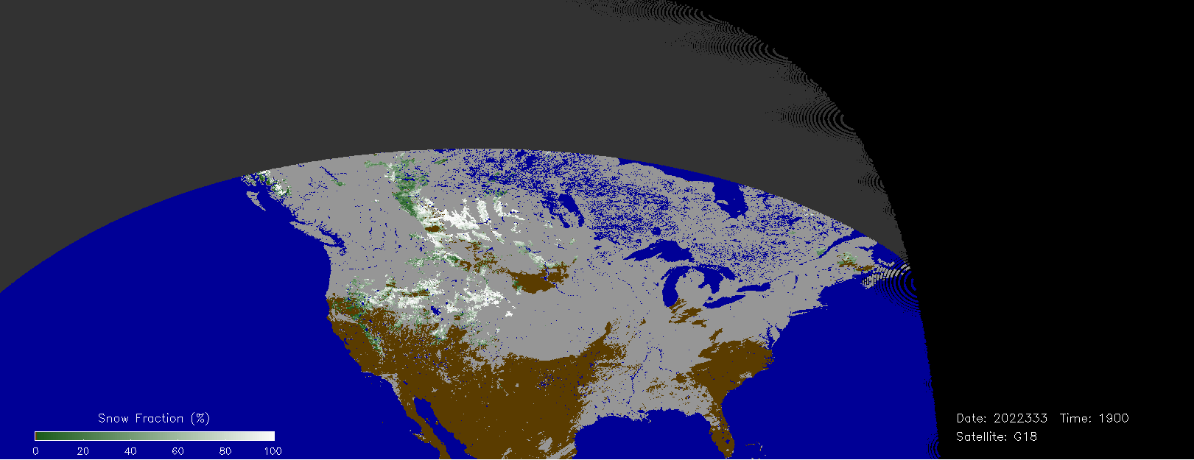
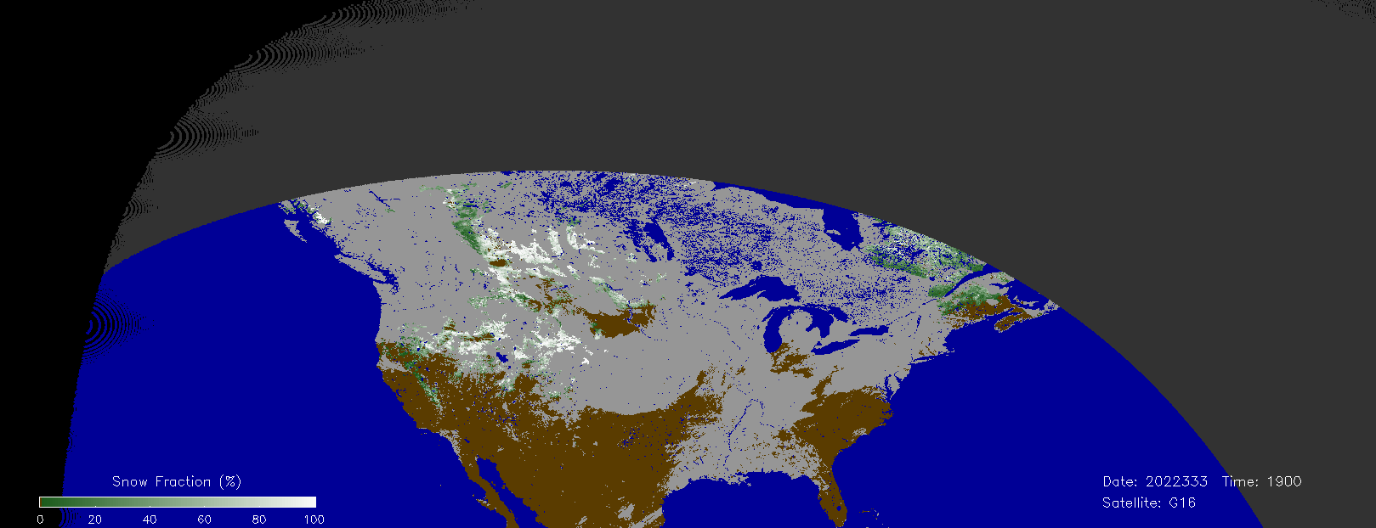
Visual Inspection: GOES-16 vs GOES-18
Snow products produced in GOES-R DE with ABI GOES-16 and -18 data were qualitatively similar over North America both with respect to the snow cover properties (snow extent, snow fraction) and to the cloud mask.
Snow Fraction
GOES-18
Snow Fraction
GOES-16

Slide 24
Product Content Inspection
Product Value | Meaning
0 | Snow-free land
1-100 or 1 | Snow fraction (%) or Snow Flag
125 | Fill value (No data)
128 | No snow retrieval
Product Field
Snow product code values and quality flag values have been checked. Two minor inconsistencies have been identified between quality flags in the FSC and in the FSC IP product
Inconsistency has been reported to the implementation team. The problem has been fixed.
QF Value | Meaning
0 | Valid retrieval (clear sky)
105 | Water
110 | Cloud
111 | Rejected snow (1)
112 | Rejected snow (2)
113 | Rejected snow (3)
114 | Rejected snow (4)
115 | Rejected snow (5)
120 | Unclassified
121 | Insufficient daylight
122 | Undetermined
124 | Bad data
125 | Fill Value (No data)
Quality Flag
24

Slide 25
PRODUCT VALIDATION
- Binary Snow Map (FSC IP)
- Fractional Snow Cover (FSC)

Slide 26
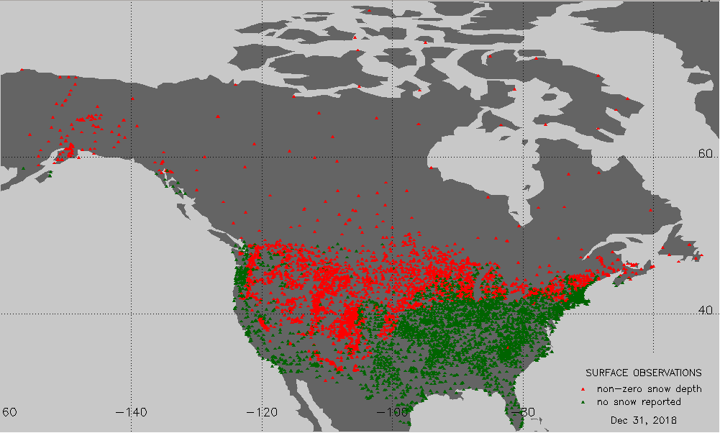
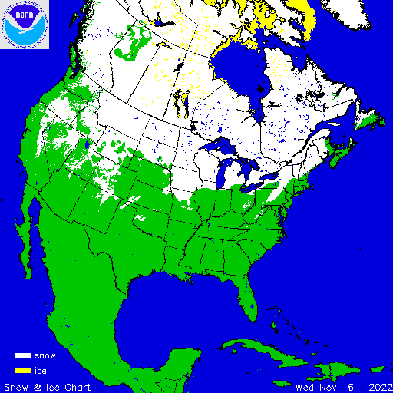
Binary Snow Product: Validation Approach
- Direct comparison with in situ snow observations
- Comparison with IMS (NOAA Interactive) snow product at 4 km resolution
- Only valid ABI binary snow retrievals were involved (daytime, cloud-clear)
In the peak of the winter seasons snow depth are available from over 5,000 stations in North America (WMO, Coop, CoCoRAHS, Snotel). Most stations are located below 55⁰N latitude.
IMS daily charts are routinely produced at NOAA National Ice Center and are available from NSIDC. Charts cover only the Northern Hemisphere.

Slide 27
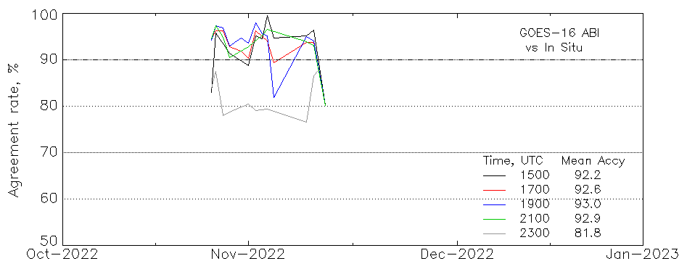
Binary Snow: G16 ABI vs In Situ
About 1000 matched observations daily
92-93% mean agreement at 1500 to 2100 UTC
Accuracy drops at 2300 UTC due to large, above 70⁰ , solar and satellite zenith angles of observations
At these angles the product is not supposed to satisfy accuracy requirements
Disagreement may be partially due to errors in station reports (~1-2%) and due to the difference in the time of observation
Estimated daily rate of agreement of ABI snow vs in situ data
Notes:
Warm period: peaks in late February, low in early March, peaking again by late March, 16:00-21:00 local time.

Slide 28
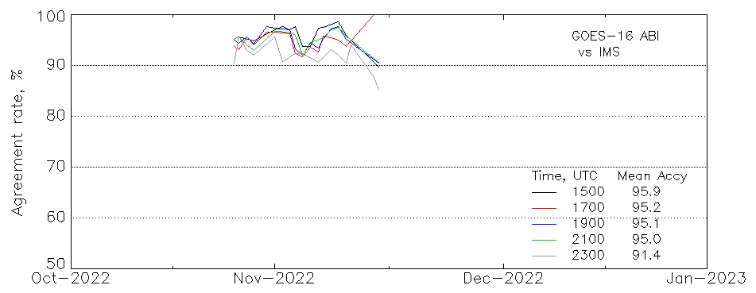
Binary Snow Map: G16 ABI vs IMS
Comparison performed over all North America within GOES-16 domain
95-96% agreement between the products
Reduced accuracy at l2300 UTC due to large (above 70⁰) solar and satellite zenith angles of observation
Estimated daily rate of agreement of ABI snow vs IMS
North America
Notes:
Warm period: peaks in late February, low in early March, peaking again by late March, 16:00-21:00 local time.

Slide 29
Binary Snow: G18 vs IMS and in Situ
ABI G18 binary snow map agreement to IMS and in situ data, 11/29/2022 – 12/1/2022
Time, UTC | Agreement to IMS, range % | Agreement to in situ, range %
1400 | 81 … 94 | 78 … 90
1500 | 95 … 98 | 89 … 94
1600 | 95 … 96 | 91 … 94
1700 | 94 … 95 | 91 … 96
1800 | 94 … 96 | 92 … 93
1900 | 93 … 96 | 92 … 93
2000 | 92 … 96 | 91 … 93
2100 | 89 … 96 | 87 … 92
2200 | 89 … 94 | 84 … 89
2300 | 93 … 96 | 78 … 84
Validation performed for three days 11/29/2022 to 12/1/2022
Product performance was similar to GOES-16
Better ABI agreement to IMS data than in situ
91-96% snow mapping accuracy (1600 to 2000 UTC)
Over 90% accuracy from 1500 to 2100 UTC
Accuracy decreases at earlier and later times due to prevailing observations at high solar zenith angle

Slide 30
Binary Snow: Validation Statistics
No specific requirements for ABI Binary Snow accuracy. We use VIIRS requirement instead
ABI Enterprise Binary Snow products from both G16 and G18 satisfy VIIRS accuracy requirements
Product Requirement | Satellite | Requirement (VIIRS) | Test Value (range) | Pass/Fail
Probability of Correct Snow/No-Snow Discrimination | GOES-16 | 90% | 92-97%* | Pass
 | GOES-18 | 90% | 91-96%* | Pass
*For ABI observations over North America in the end of November – beginning of December at 1600 to 2000 UTC.

Slide 31
Fractional Snow Cover Evaluation Approach
“Viewable snow fraction” is a remotely sensed parameter, it is not observed in situ and therefore its retrieval accuracy can not be directly evaluated. Therefore the performance of the snow fraction product was assessed using consistency tests.
Consistency of ABI Snow Fraction Product has been examined
- By comparing matching retrievals from GOES-East and GOES-West
- By comparing ABI snow fraction with similar products derived from other satellite sensors (e.g., VIIRS, AVHRR)
Theoretical estimates of snow fraction retrieval accuracy have been performed
- This at least partially compensates for the lack of validation with independent data
- May support or question uncertainty estimates based on consistency tests

Slide 32
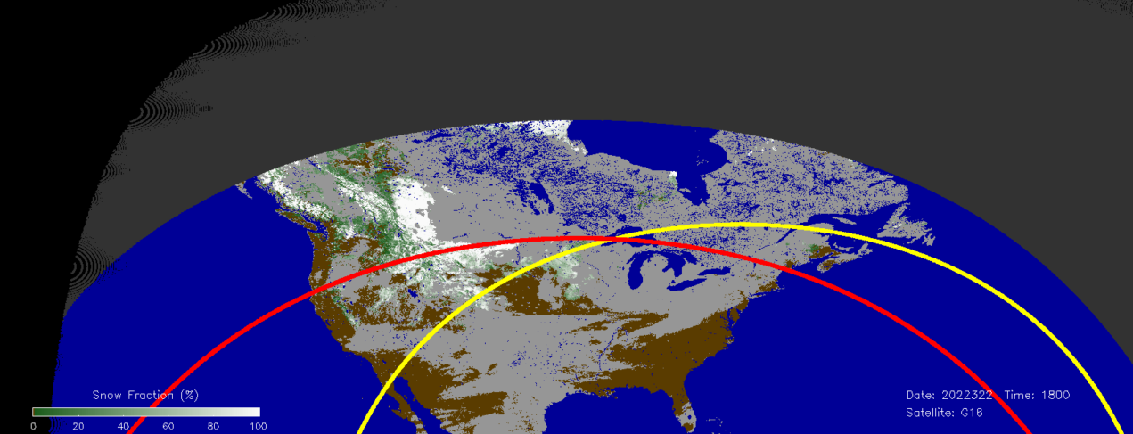
Snow Fraction: Exclusions
Exclusions for quantitative accuracy assessment: Ɵ_{sat} < 55⁰ , Ɵ_{sol} < 67⁰
At larger angles the product is supposed to be qualitatively realistic
Existing exclusions exclude most of North America seasonal snow cover from the quantitative analysis and product evaluation
GOES-16 ABI
Nov 18, 2022 1800 UTC
GOES-East ABI Snow fraction map with an overlaid line of 55⁰ satellite zenith angle (yellow) and 67⁰ solar zenith angle (red)
SolZA=67⁰
SatZA=55⁰

Slide 33
Fractional Snow Cover: Theoretical Accuracy Estimate
Error propagation: Method to predict the function’s uncertainty using known (or assumed) uncertainty of its variables
For the Snow Fraction (SF) this is another way to estimate the expected retrieval error
Source of uncertainty | Affected Variable | Assumed uncertainty
Visible reflectance measurement noise and calibration error | Observed Reflectance (R) | 0.005
Variable atmospheric composition | Observed Reflectance (R) | 0.1
Variable reflective properties of the snow-free land surface | Snow-free land visible reflectance (R_{land}) | 0.1
Variable reflective properties of snow | Snow visible reflectance (R_{snow}) | 0.1
Residual uncertainty of snow reflectance due to angular anisotropy | Snow visible reflectance (R_{snow}) | 0.03
Residual uncertainty of snow-free land reflectance due to angular anisotropy | Snow-free land visible reflectance (R_{land}) | 0.03
    SF = (R - R_{Land})/(R_{Snow} – R_{Land} )
    σ²_{SF} = Σ_{i=1,3} (∂SF/∂x_{i})² σ_{xi} ²
    x_{i=1,3} : R, R_{land} , R_{Snow}
Estimated Snow Fraction uncertainty (σ_{SF} ) with all variables’ uncertainties combined : 0.14 … 0.23

Slide 34
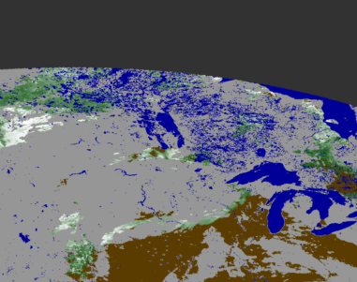
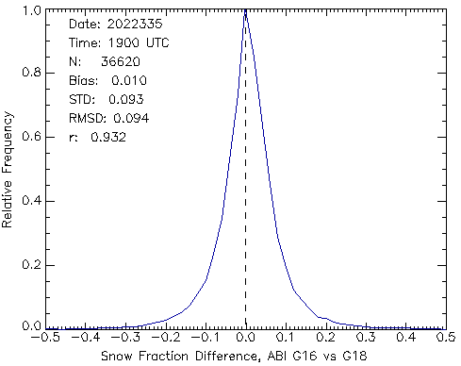
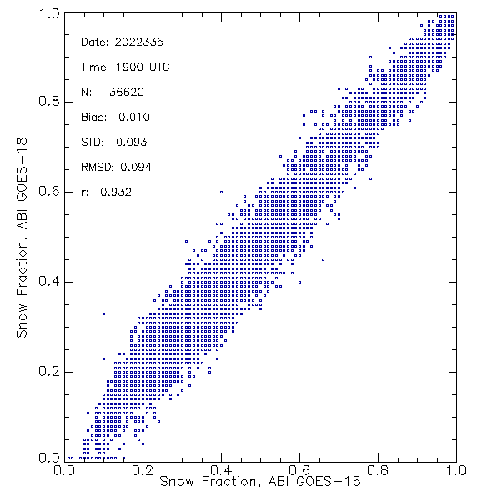
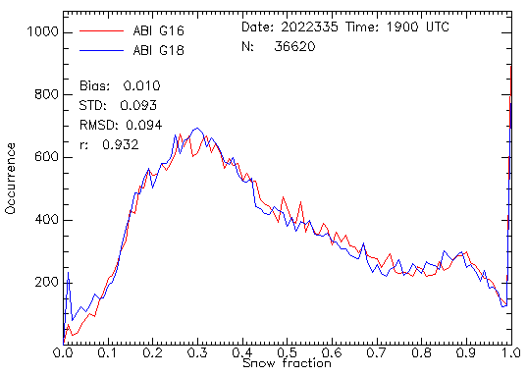
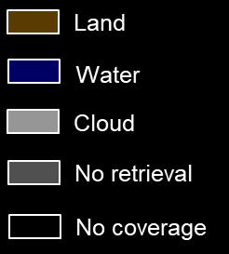
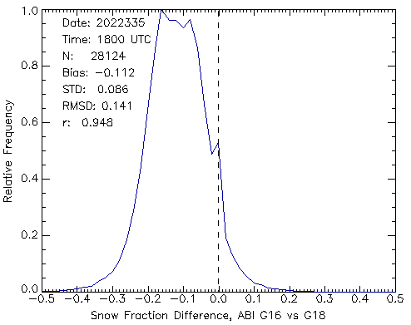
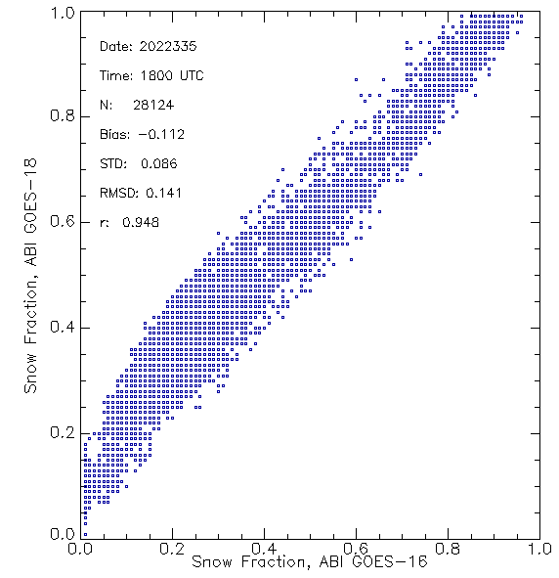
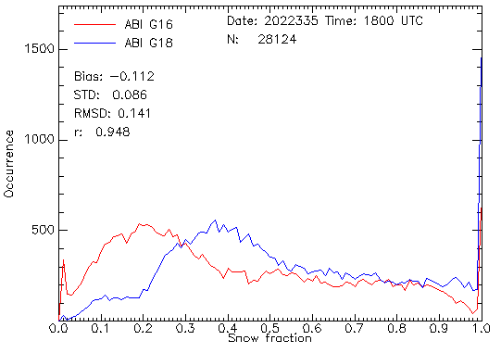
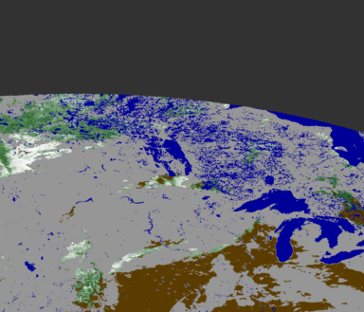
Snow Fraction: ABI G16 vs ABI G18
ABI GOES-16
Dec 1, 2022, 1900 UTC
1900 UTC
ABI GOES-18
Dec 1, 2022, 1900 UTC
1800 UTC
Snow Fraction retrievals from G16 and G18 are close when the solar-satellite relative azimuth angle for both sensors is similar (at 1900 UTC). The bias increases when relative azimuth angles are different. Still accuracy and precision remain within the requirements.
Error Statistics for 12/1/2022 (1600 to 2100 UTC) : Accuracy (Bias) : < 0.22
Precision (STD): 0.10 … 0.18

Slide 35
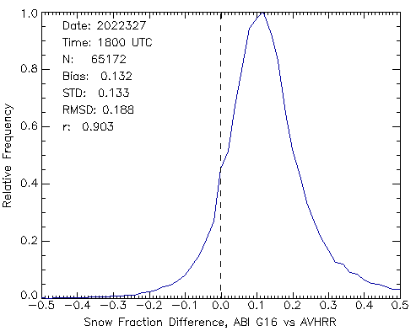
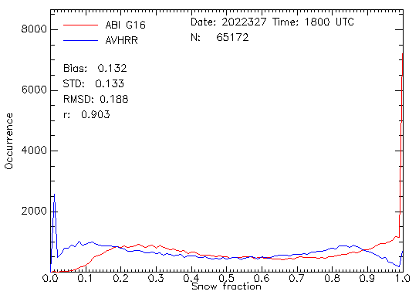
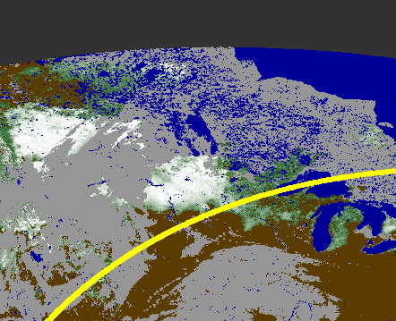
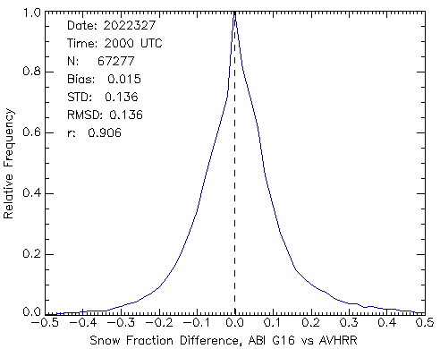
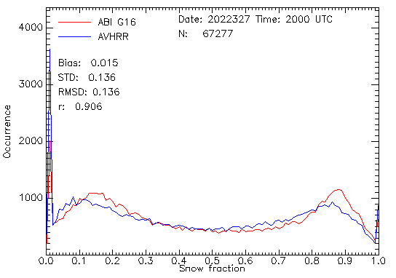
Snow Fraction: ABI G16 vs AVHRR
1800 UTC
2000 UTC
ABI GOES-16
Nov 23, 2022, 1800 UTC
Ɵ_{sat}=55⁰
ABI G16 vs AVHRR Snow Fraction Match-up Statistics, 11/3/2022 1500-2200UTC
Accuracy (Bias) : < 0.22
Precision (STD): 0.12 … 0.18
Part of mismatch (mostly STD) may be due to gridding-related uncertainty
Snow cover located mostly beyond the ABI geometry angles exclusion range
Comparison is performed mostly at ABI satellite zenith angles above 55⁰.

Slide 36
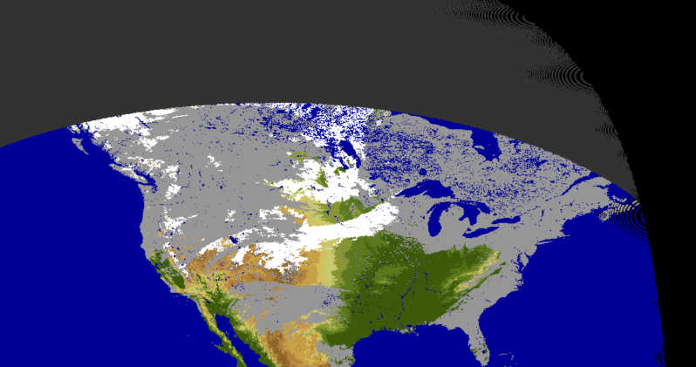
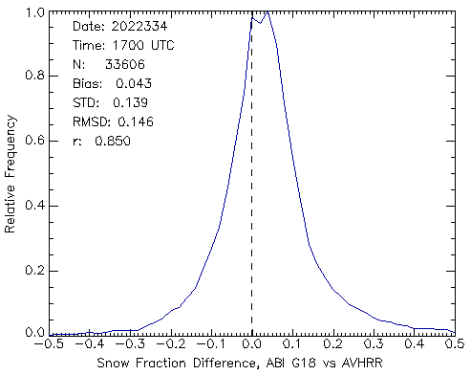
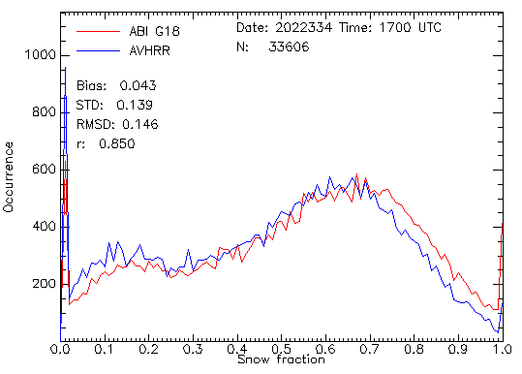
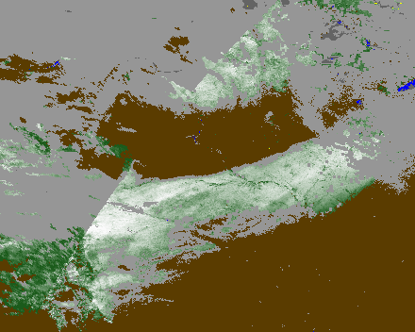
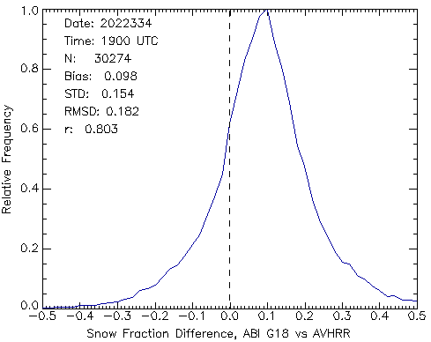
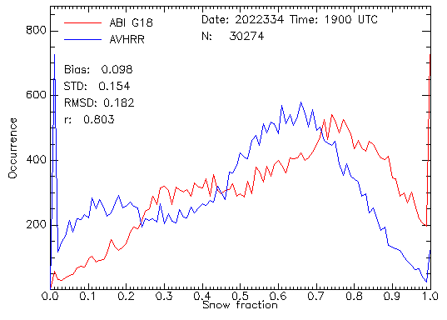
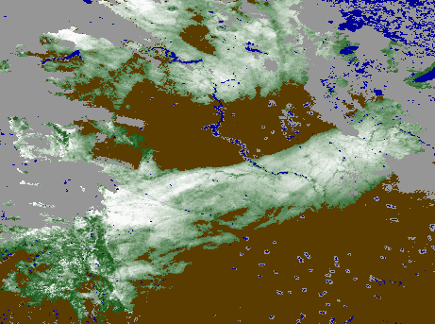
Snow Fraction: ABI G18 vs AVHRR
1700 UTC
AVHRR METOP-B Nov 30, 2022
1900 UTC
ABI G18 vs AVHRR Match-up Statistics, 11/29/2022 – 12/1/2022, 1500 - 2200 UTC
Accuracy (Bias) : < 0.21
Precision (STD): 0.11 … 0.18
ABI GOES-18
Nov 30, 2022, 1700 UTC

Slide 37
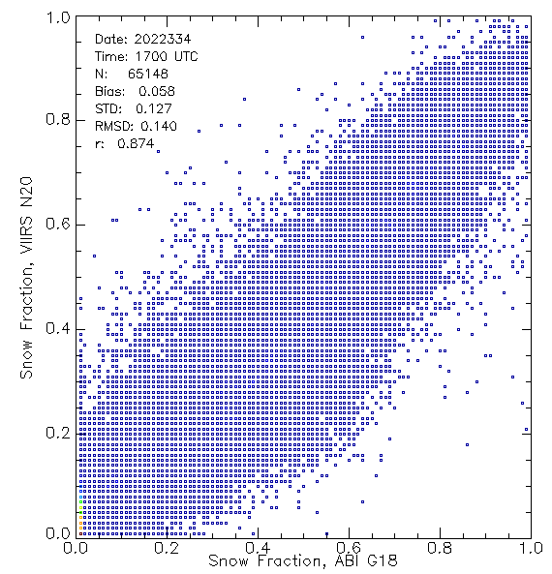
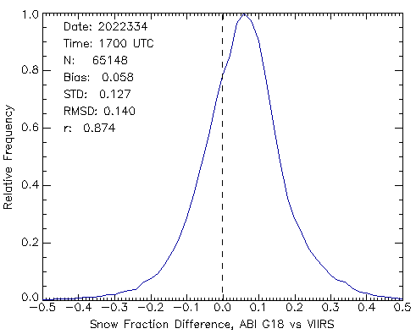
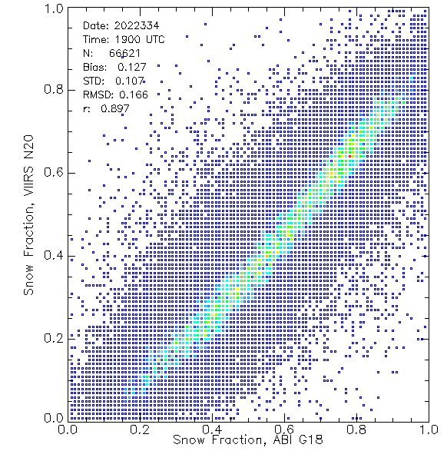

Snow Fraction: ABI G18 vs VIIRS
1700 UTC
1900 UTC
ABI GOES-18
Nov 30, 2022, 1700 UTC
ABI G18 vs VIIRS Match-up Statistics, 11/30/2022, 1500 – 2200 UTC
Accuracy (Bias) : < 0.20
Precision (STD): 0.10 … 0.18

Slide 38


Snow Fraction: Performance Anomaly
Larger variability of the derived snow fraction with time of the day (and, hence with the observation geometry) was found in the GOES-R DE snow fraction as compared to the Offline product. This translates into in a larger, time-dependent, bias (and, hence, reduced accuracy) of the DE product. Product precision is not affected.
This anomaly does not reduce the DE product accuracy beyond the requirement, but fixing the issue will improve the product performance. We believe that the problem may be caused by inconsistency in calculation, application and/or convention used with respect to the solar-satellite relative azimuth angle in the DE and in the Offline system. The operational code has been requested and is being examined to identify the reason for the difference.
ABI G18 vs G16 Snow Fraction comparison statistics for the Development and Offline output. Individual estimates are averaged over 3 days, 11/29/2022 to 12/1/2022.
Accuracy Requirement
Precision Requirement

Slide 39
Snow Fraction: Validation Statistics
Product Requirement | Satellite | Requirement | Test Value | Pass/Fail
Measurement Accuracy | G16 | 0.30 | < 0.21 | Pass
 | G18 | 0.30 | < 0.22 | Pass
Measurement Precision | G16 | 0.25 | 0.12 … 0.18 | Pass
 | G18 | 0.25 | 0.11 … 0.18 | Pass
Validation results are for ABI observations performed mostly at large solar and satellite zenith angles, beyond the geometry exclusion boundaries (Ɵ_{sat} < 55⁰ , Ɵ_{sol} < 67⁰) set in the requirements.

Slide 40
Validation Summary
GOES-16 and 18 ABI binary (IP) fractional snow cover FD products from DE over the period October 15 – December 5, 2022, 1400 to 2300 UTC have been evaluated.
ABI Binary snow product was evaluated by comparing with in situ data and IMS.
The ABI fractional snow cover products were evaluated by comparing with similar and finer resolution satellite data. Theoretical accuracy estimates have been performed.
Binary snow validation results
- 91-97% accuracy of snow/no-snow discrimination at 1600 to 2000 UTC
- Over 90% accuracy 1500 to 2100 UTC
- Retrieval accuracy satisfies requirements set for VIIRS
Snow Fraction validation results
  - Similar performance of GOES-16 and -18 ABI snow fraction products
  - Measurement accuracy is better than 0.22, the precision range is 0.11 to 0.18
  - Theoretical uncertainty estimates generally support validation results
  - Product meets the requirements for both accuracy and precision

Slide 41
PROVISIONAL MATURITY ASSESSMENT

Slide 42
Provisional Validation
Preparation Activities | Assessment
Validation activities are ongoing and the general research community is now encouraged to participate. | True
Severe algorithm anomalies are identified and under analysis. Solutions to anomalies are in development and testing. | Algorithm anomaly has been identified and it is under analysis. The product accuracy is reduced but does not go beyond the requirements.
Incremental product improvements may still be occurring. | Yes
L2+ only: Users are engaged in the Product Feedback Forums and user feedback is assessed. | Potential users have not yet been engaged. Product is not yet available to the users.
End State | Assessment
Product performance has been demonstrated through analysis of a small number of independent measurements obtained from select locations, periods, and associated ground truth or field campaign efforts. | True
Product analysis is sufficient to communicate product performance to users relative to expectations (Performance Baseline). | True
Documentation of product performance exists that includes recommended remediation strategies for all anomalies and weaknesses. Any algorithm changes associated with severe anomalies have been documented, implemented, tested, and shared with the user community. | True.
Testing has been fully documented. | True
Product is ready for operational use and for use in comprehensive cal/val activities and product optimization. | Partially True. The product is ready for use in comprehensive cal/val activities and product optimization. The product can not yet be offered for operational use.

Slide 43
PATH TO FULL VALIDATION

Slide 44
Full Validation PLPTs
FSC PLPT test IDs, short descriptions, and execution status for each satellite (GOES-16, -18/-19), with a "P" indicating the test is required (or was done) for Provisional maturity, and an "F" indicating the test is required for Full maturity.
Test ID | Short description | 16 | 18/19
ABI-FD_FSC06 | Assess accuracy and precision of the FD snow product | P, F | P, F
ABI-CONUS_FSC07 | Assess accuracy and precision of the CONUS snow product | P, F | P, F
ABI-MESO_FSC08 | Assess accuracy and precision of the mesoscale snow product | P, F | P, F

Slide 45
Path to Full Validation – Risks
Risk Name | Description | Impact | Mitigation and Schedule
N/A

Slide 46
Users and Applications
At present there are no operational users for the ABI fractional snow cover.
- NOAA land models rely on IMS data for snow extent
- Snow fraction is internally generated within models
General problems hampering operational/climatological application of ABI snow products
  - Coverage gaps due to clouds
  - Coarse (2km) spatial resolution (1 km is required, as per M. Barlage)
- Frequent changes in the cloud mask. This makes snow products inconsistent in time.
ABI snow products appear most appropriate for two types of application:
- Interactive analysis where ABI products may support the decision making (e.g., IMS)
- Blended snow products where ABI snow retrievals is combined with microwave sensor data to provide gap-free coverage (e.g., GMASI)

Slide 47
SUMMARY & RECOMMENDATIONS

Slide 48
Summary
The performance of the new ABI Enterprise FSC algorithm has been evaluated using a (very) limited set of snow products generated from GOES-16 and -18 within the GOES-R Development Environment (DE) .
The examined Binary Snow and Snow Fraction products satisfy the existing mission precision and accuracy requirements.
Anomaly has been identified in the performance of the FSC product. The product accuracy is reduced but not beyond the mission requirements. A possible reason for the anomaly has been identified. The problem may be fixed after the product becomes operational. FSC IP product (Binary Snow) and the FSC precision is not affected.
There are currently no operational users, primarily because users are comfortable with a binary interactive product (IMS). We expect that to change as the ABI product becomes operational and people start working with the ABI product.

Slide 49
Recommendation
Promote the new ABI Enterprise FSC algorithm to operations
Fix the anomaly in the FSC algorithm. The product performance will improve.
Continue monitoring of the product performance to obtain more reliable/justified/comprehensive accuracy estimates.
Continue working to improve the product properties and usability
    - Improve the spatial resolution to 0.5 km
    - Develop and implement daily composited products

Slide 50



