Slide 1



Peer Stakeholder-Product Validation Review (PS-PVR)
GOES 18 EXIS XRS and EUVS: User Perspective
27 November, 2022
Rodney Viereck
University of Colorado, CIRES
NOAA/NWS Space Weather Prediction Center
Outline:
Sensors
Applications
Issues
Status
Notes:
based on PLT reports from LASP

Slide 2
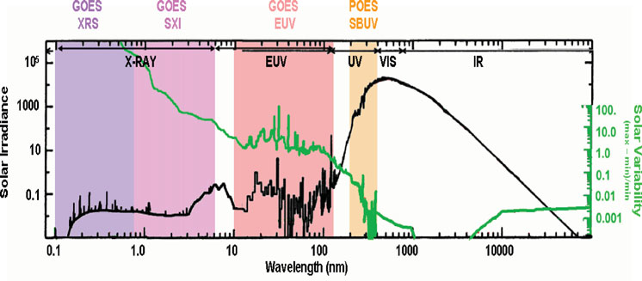
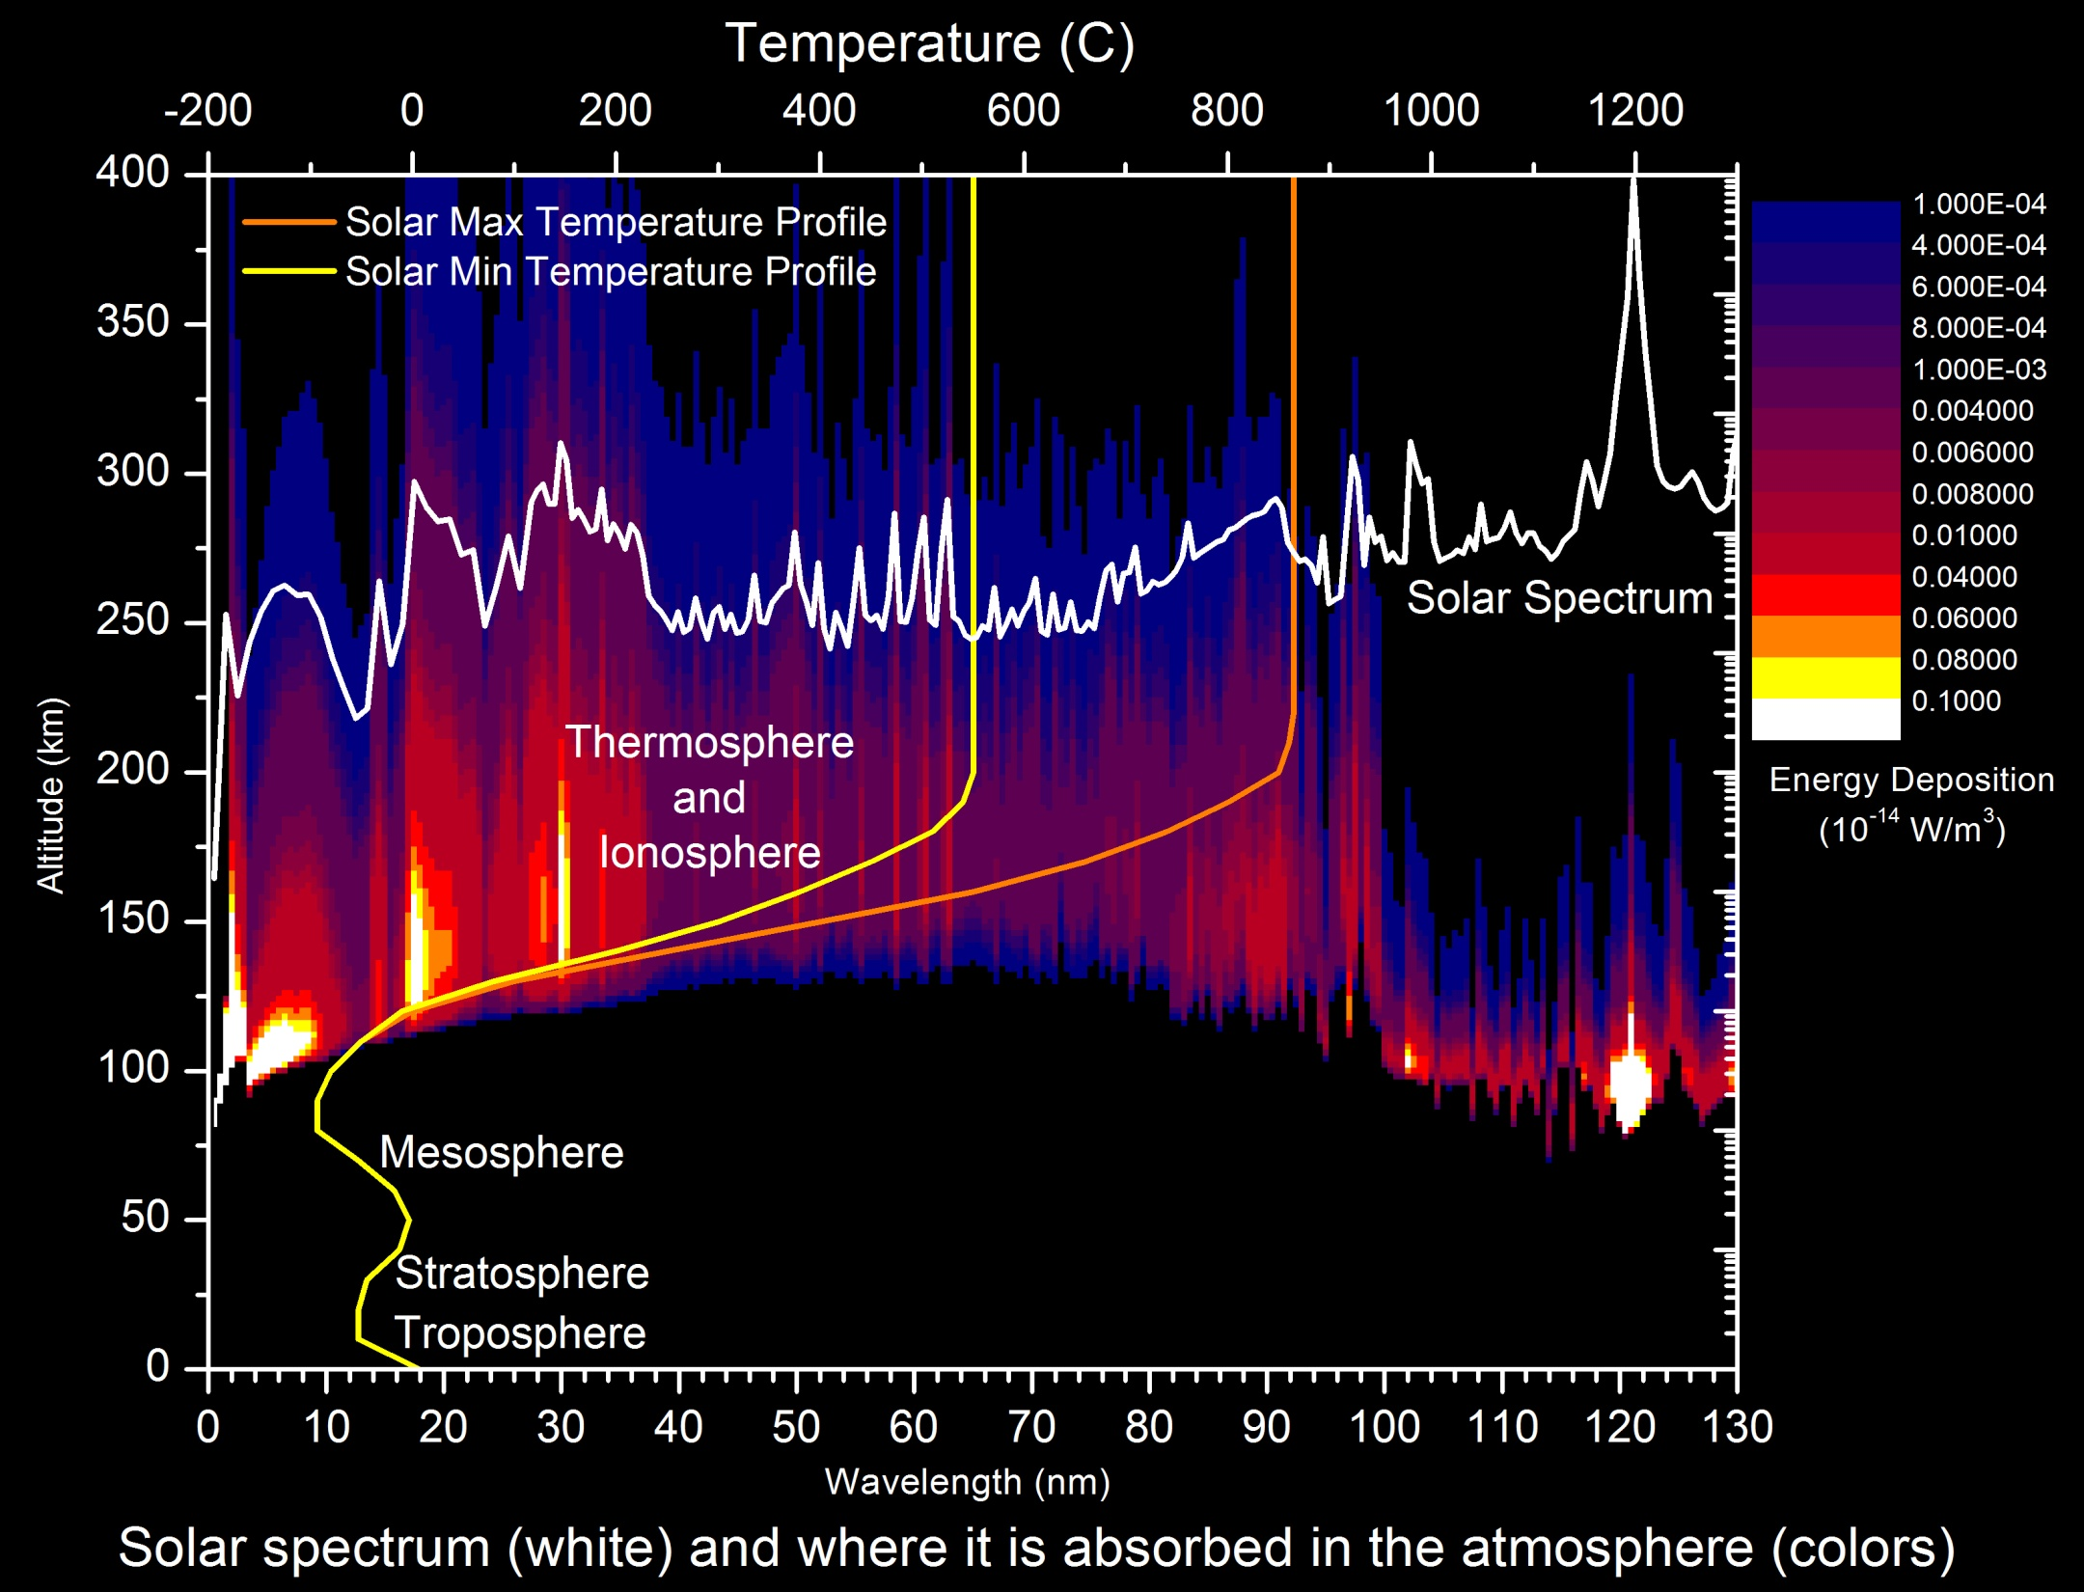
Solar X-Ray and EUV Irradiance
Highly Variable
  X-Ray Variations of order 10⁵
  EUV Variations of order 2 to 50
Absorbed in the Upper Atmosphere
  Between 80 and 1000 km.
Results in very large changes in the thermosphere (neutral density) and ionosphere (electron density)
  Direct Impacts:
    Radio communication
    Satellite orbits and drag
  Indirect Impacts
    Satellite navigation (GPS)
    Other space weather (geomagnetic storms and solar radiation storms)

Slide 3
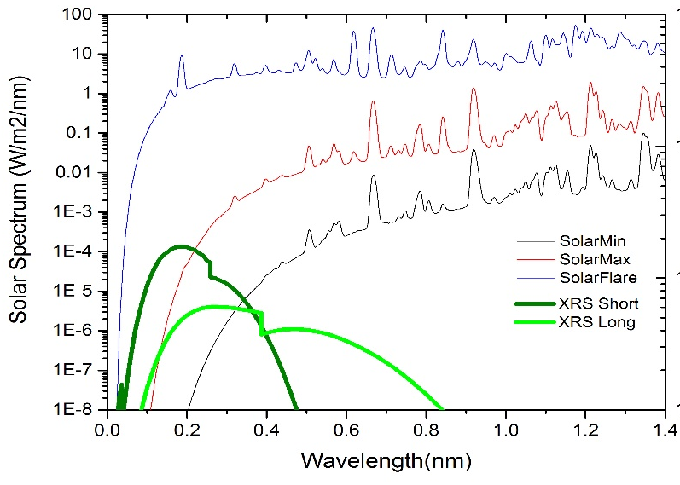
GOES Solar X-Ray Sensor
(XRS)
Provide measurement of the magnitude and location* of solar flares.
Requirements: Monitor the disk-integrated solar flux in two x-ray wavelengths.
  XRSA 0.05 nm – 0.4 nm
  XRSB 0.1 nm – 0.8 nm
  Three second cadence
  10 second latency (actual latency is 30 sec.)
Solar X-Rays:
  Change by several orders of
  magnitude in just a few minutes.
  Are absorbed in the lower ionosphere
  where the flare enhanced electron
  density blocks HF communication.
  * Note: Flare location is new to the GOES R series XRS.

Slide 4
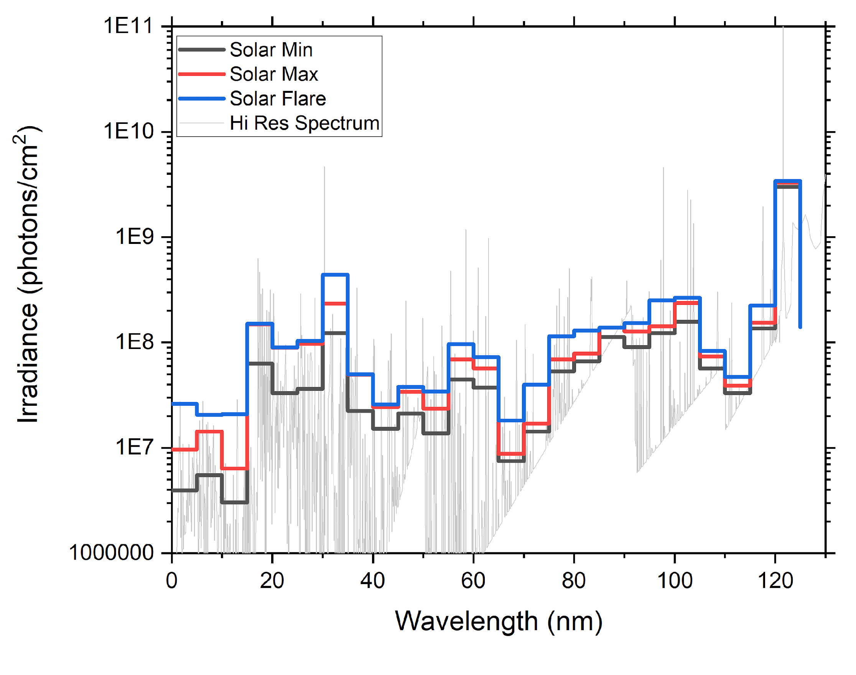
GOES Solar Extreme UltraViolet Sensor (EUVS)
The EUVS measures the solar energy input to the ionosphere and thermosphere.
GOES EUV Requirement:
Solar spectra from 5 to 120 nm
5 nm spectral resolution.
1 minute temporal resolution.
Solar EUV irradiances change by factors of 2 to 50 on times scales of minutes to years.
The thermosphere (neutral density) and ionosphere (electron density) change by similar amounts across all time scales.
Unfortunately, the complexity of a sensor that could measure all wavelengths with the reliability to last the entire GOES mission and maintain calibration throughout would be cost prohibitive.

Slide 5
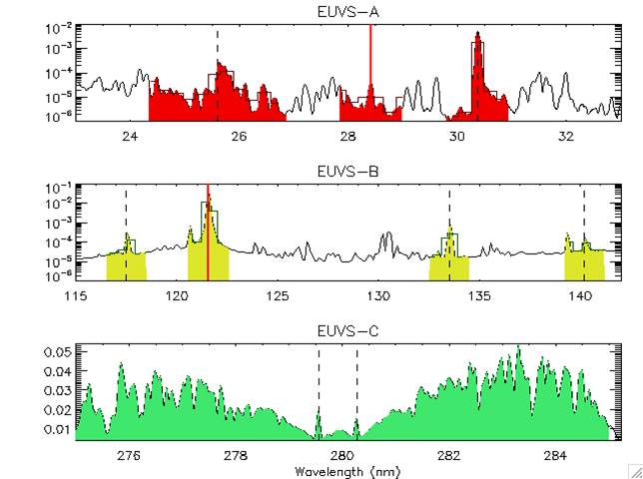
GOES 16 EXIS EUVS Measurements
Primary Measurements Used in Spectral Model:
  Chromospheric:
    MgII C/W (EUVS-C)
    CIII 117.5 nm (EUVS-B)
    CII 133.5 nm (EUVS-B)
  Transition Region:
    Ly-alpha 121.6 nm (EUVS-B)
    SiIV/OIV 140.5 nm (EUVS-B),
    HeII 30.4 nm (EUVS-A)
    HeII 25.6 nm (EUVS-A)
  Corona:
    FeXV 28.4 nm (EUVS-A)
  Hot Coronal:
    0.1-0.8 nm (XRS)
    0.05-0.4 nm (XRS)
From LASP (Eparvier)
Note: The stability of the EUVS-C observations is applied to EUV-B to track performance and sensor degradation.

Slide 6
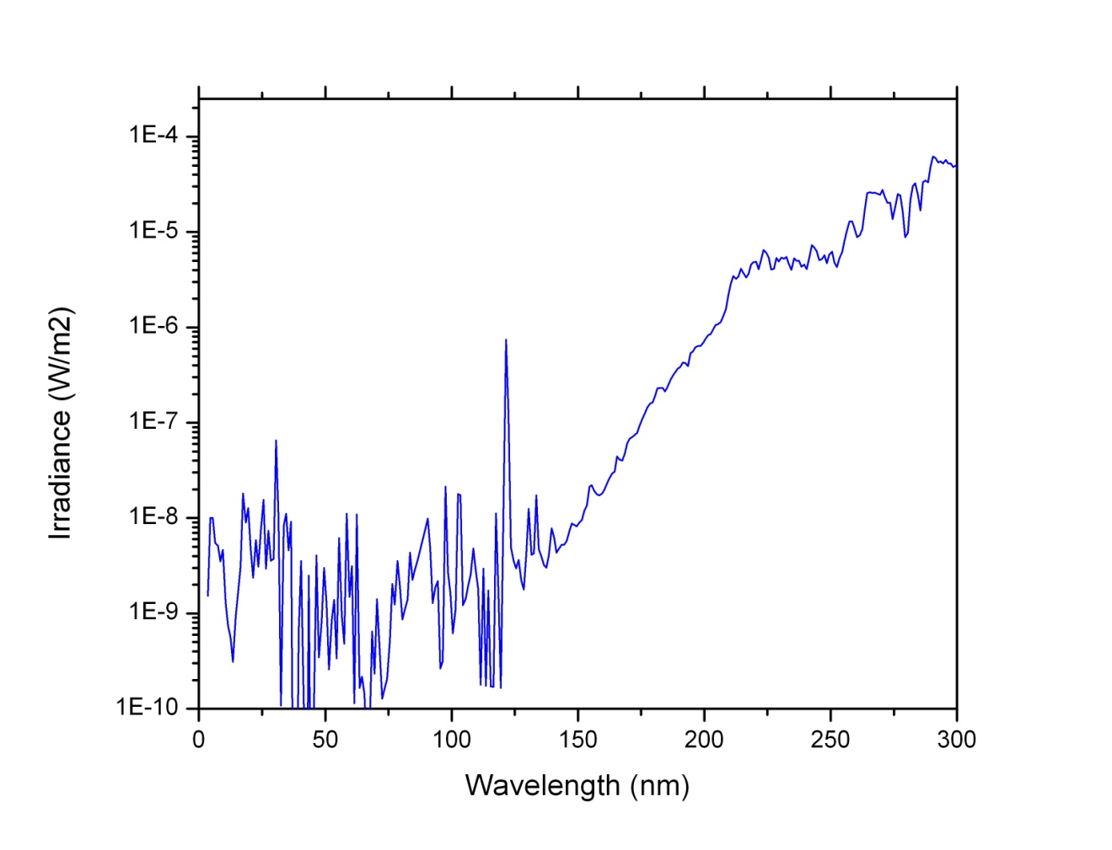
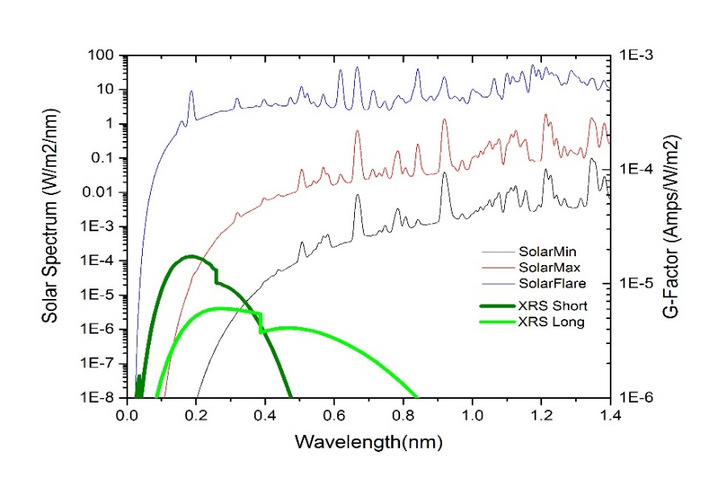
GOES X-Ray Sensor (XRS) and Extreme Ultra Violet Sensor (EUVS)
X-Ray EUV FUV UV
Solar Spectrum
GOES XRS Bands
GOES EUVS Bands

Slide 7
Applications of the XRS .
Nearly 50-years of continuous measurement of solar x-ray irradiance.
Definitive measurement of the magnitude of solar flares.
  Critical for operations.
  Fundamental for solar research.
Early warning for other space weather.
  Most major space weather events start with a large solar flare.
Flare location and magnitude provide an estimate of the geo-effectiveness of an event.
  The size of a flare is strongly correlated with the magnitude of the resulting major space weather… e.g. solar proton events and geomagnetic storms.
The XRS data drive one of the three NOAA Space Weather Scales.
  R-Scale or Radio Blackouts - driven GOES solar x-rays
  S-Scale or Solar Radiation Storm – driven by GOES solar protons
  G-Scale or Geomagnetic Storm – Driven by USGS ground magnetometers
Input to Space Weather Models
  D-Region Absorption Model (Specification of HF Radio Blackouts)
  Proton Prediction Model (Prediction of Radiation Storms).
  Ionosphere/Thermosphere models (to be added soon)

Slide 8
Application of the GOES EUVS data
Air Force High Accuracy Satellite Drag Model (HASDM)
  Calculates and predicts neutral density and satellite position for collision avoidance
  Users: DOD, NASA, NOAA, Every satellite operator in the US
NOAA Whole Atmosphere Model – Ionosphere Plasmasphere with Electrodynamics (WAM-IPE based on the GFS weather model)
  Specify and predict ionosphere conditions for radio communication and satellite navigation.
  Specify and predict neutral density for satellite orbit predictions and collision avoidance.
  Customers: DOD, DHS/FEMA, FAA, ICAO, Satellites, Construction, Agriculture, Mineral Exploration, etc…
  Status: Currently developing the appropriate interface between the GOES EUVS data and the operational WAM-IPE model
GOES EUVS Data Will Become Even More Important: The recently formed DOC Office of Space Commerce will eventually include civil Space Traffic Management and Space Situational Awareness. This office will likely manage satellite drag models which will require solar EUV input from GOES to improve model performance.

Slide 9
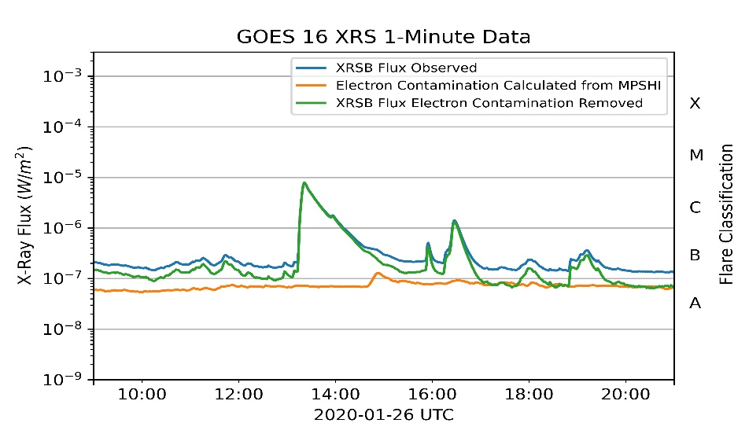
XRS/EUVS Issues:
Data latency
  GOES XRS 1-second data have latency of more than 30 seconds (due to unexpected data aggregation in the GRB).
  Impact: major (modifications to correct this are under consideration)
Electron contamination
  GOES XRS data have significant electron contamination.
  Impact: minor (when corrected)
Proton contamination
  GOES XRS data have significant
  proton contamination.
  Impact: minor (when corrected)
Not enough uninterrupted
GOES 18 data to provide
accurate trending and
electron/proton corrections.
Electron Correction During Minor Flare
Note that electron contamination only impacts the lowest values

Slide 10
GOES XRS and EUVS Status
GOES 16 is currently the primary for XRS/EUVS sensors for operations.
GOES 17 XRS is the secondary for XRS/EUVS sensors
  Backup for GOES 16
  Coverage during periodic GOES 16 EUVS and XRS calibrations
  Coverage during fall and spring eclipse periods
GOES 18 XRS/EUVS data are nearly ready for operations
  Sensor performance is good.
  Level 1 data are good
  Software to generate Level 2+ products has been installed and tested on the NWS operational IDP system.
  Still awaiting the implementation of updated LUTs for L1 data.
  Parameters for more accurate electron and proton contamination still need to be implemented in the L2 software.

Slide 11
Questions?

