Slide 1
GOES-18 Geostationary Lightning Mapper (GLM)
Provisional PS-PVR
October 31, 2022
William Koshak¹, Pete Armstrong²,
Doug Mach³, Monte Bateman⁴, Dennis Buechler⁴, Katrina Virts⁴
Scott Rudlosky⁵, Steve Goodman⁶
(with important inputs from many additional Cal/Val Team Members, & NASA Flight)
¹NASA/MSFC, ²MIT-LL, ³USRA, ⁴UAH, ⁵NOAA/NESDIS/STAR, ⁶TGA

Slide 2
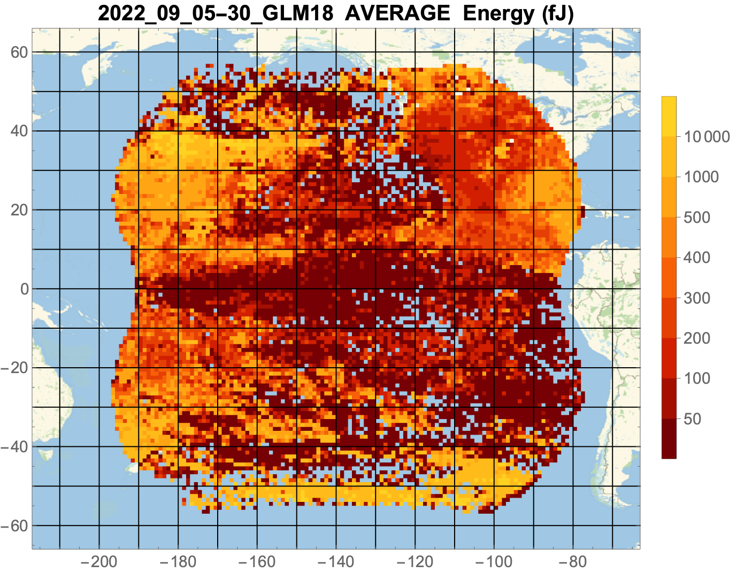
HAPPY GLM-18 HALLOWEEN !
Flash Energy Data Pumpkin
NOAA's GOES-18 satellite has not been declared operational and its data are preliminary and undergoing testing. Users receiving these data through any dissemination means (including, but not limited to, PDA and GRB) assume all risk related to their use of GOES-18 data and NOAA disclaims any and all warranties, whether express or implied, including (without limitation) any implied warranties of merchantability or fitness for a particular purpose.
Notes:
Sample size: 6,725,357 matches

Slide 3
Outline
Introduction
Review of Beta Certification
Product Quality Evaluation Overview
Provisional Maturity Assessment
PLPT Details
Path to Full Validation
Summary and Recommendations

Slide 4
Outline
Introduction
Review of Beta Certification
Product Quality Evaluation Overview
Provisional Maturity Assessment
PLPT Details
Path to Full Validation
Summary and Recommendations

Slide 5


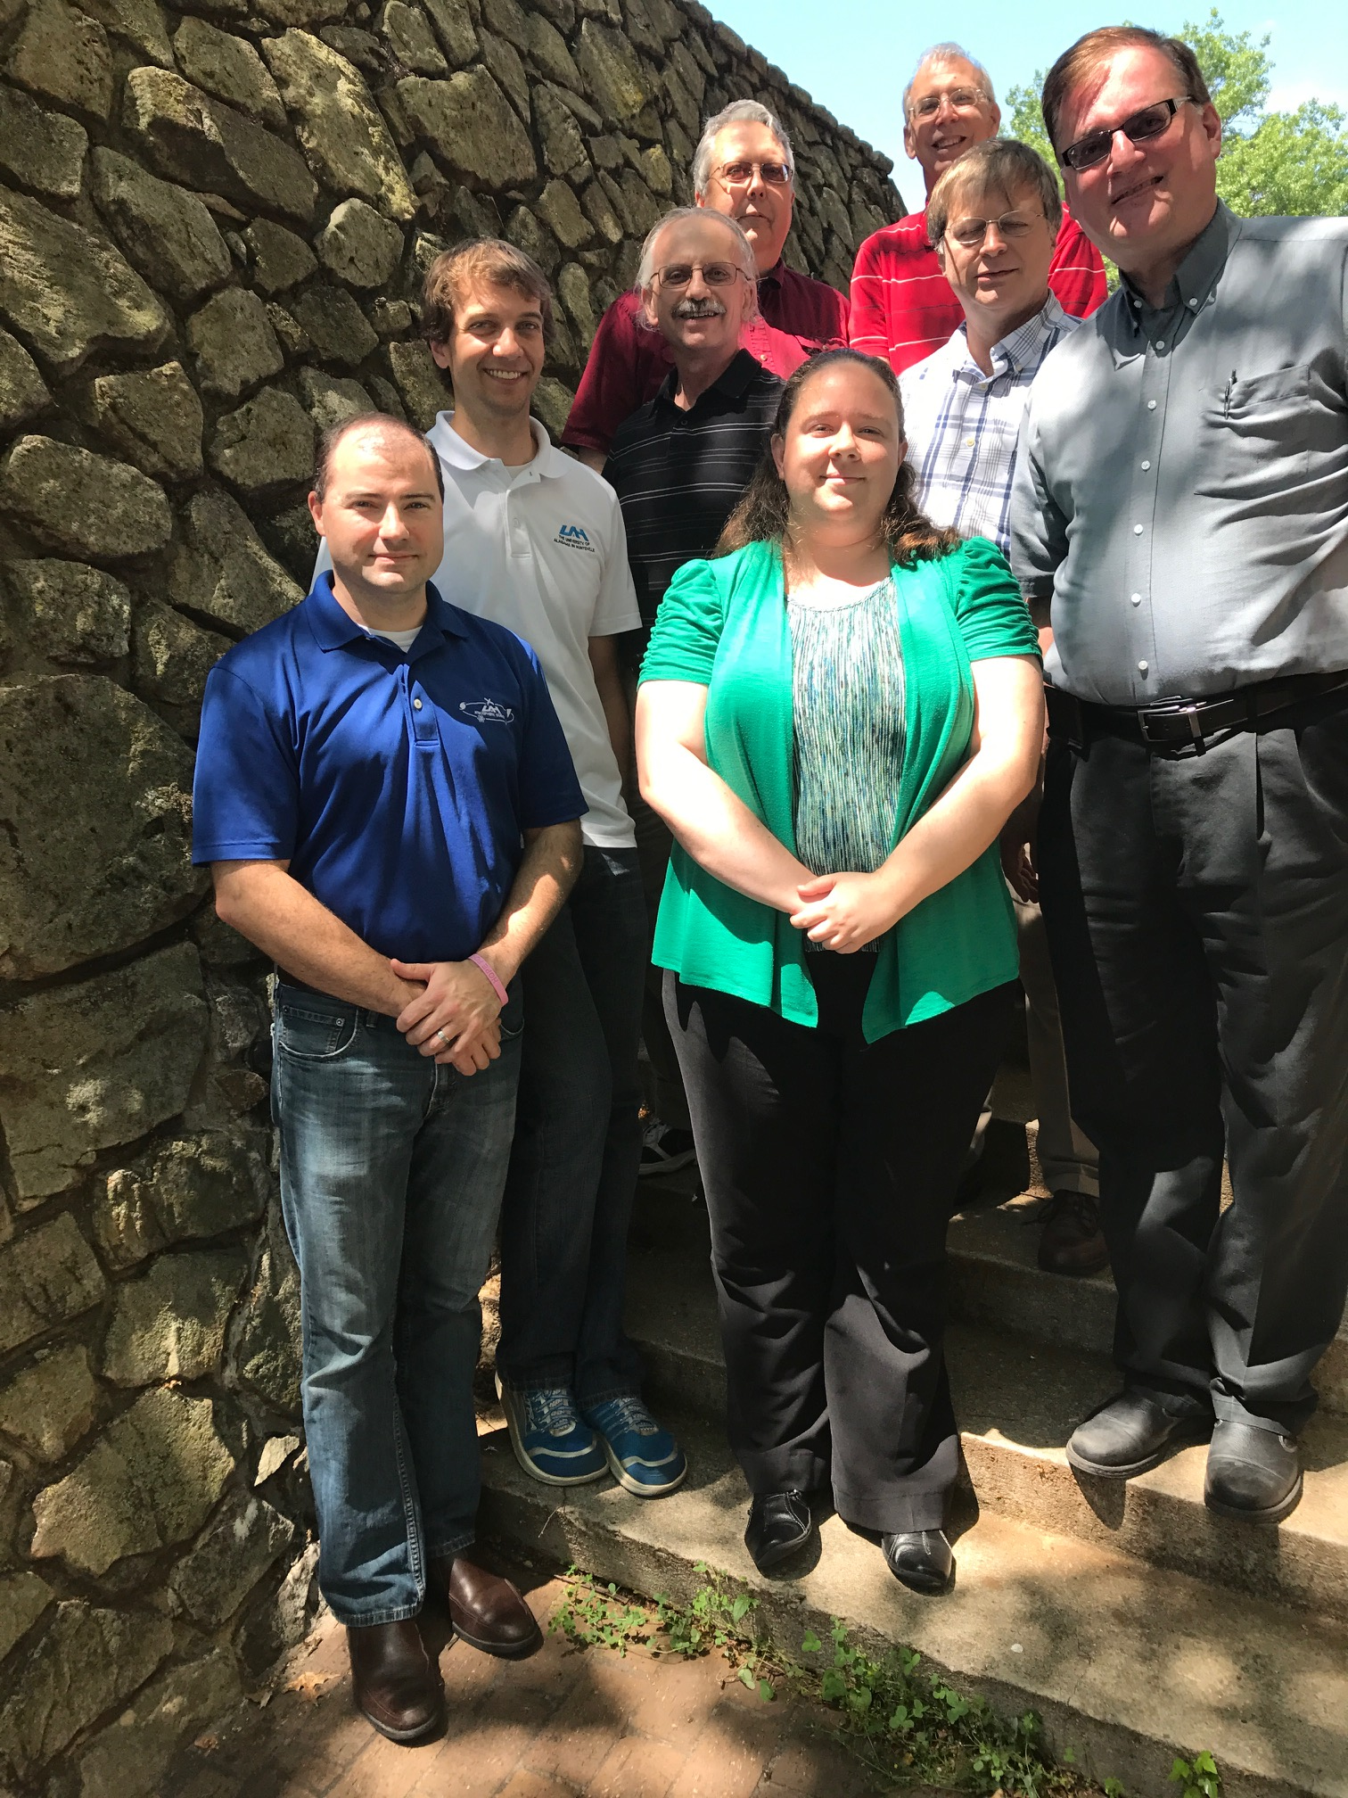
Cal/Val Team Members
NSSTC (Huntsville, AL)
NOAA/NESDIS/STAR
Various Remote
Eric Bruning (TTU)
Jacquelyn Ringhausen (CIWRO)
Jeff Lapiere (AEM)
Ken Cummins (UA)
Steve Rutledge (CSU)
Adam Clayton (formerly CSU)
Max Marchand (CIRA)
Bob Holzworth (Univ. Wa)
Michael McCarthy (Univ. Wa)
Randy Longenbaugh (SNL)
Michael Peterson (LANL)
GOES-R Program Subj. Matter Expert: Steve Goodman (Thunderbolt Global Analytics)
Scott Rudlosky
(GOES-R Science; NWS
Activities Specialist)
MIT-Lincoln Lab
NASA Flight for INR
David Igli
Alan Reth
Bin Tan
Special Thanks to CVCT PRO
Liz Kline
Jon Fulbright
Core Team: William Koshak (MSFC), Doug Mach (USRA), Monte Bateman, Dennis Buechler & Katrina Virts (UAH), Rich Blakeslee (MSFC)
Support Team (lower left): Phillip Bitzer & Jeff Burchfield (UAH)
Pete Armstrong
(Core Team Member)
Photos courtesy of William Koshak & Pete Armstrong, or publicly available

Slide 6
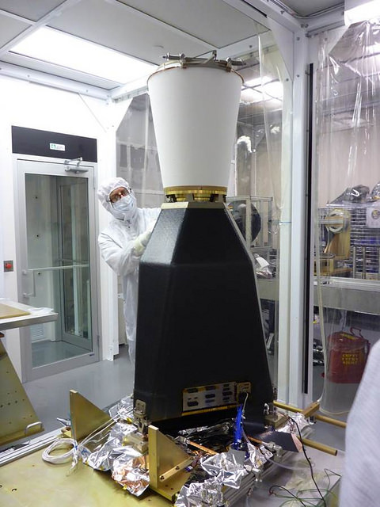
GLM Overview
  REQUIREMENTS:
  Provide continuous, full-disk lightning measurements for storm warning and nowcasting.
  Provide early warning of tornadic activity.
  Accumulate a long-term database to track decadal changes [of lightning].
INSTRUMENT DETAILS:
High-speed nadir-staring camera
CCD imager (1372x1300 pixels)
Near uniform spatial resolution
8 km nadir, 14 km edge of FOV
Coverage ~ ± 54 latitude
Single band 777.4 nm
2 ms frame rate
7.7 Mbps downlink data rate
  TRMM/LIS only 8 kbps
20 sec product latency
GLM is the first lightning mapper to be flown in geostationary orbit. Heritage LEO sensors include: Optical Transient Detector (1995-2000), and TRMM/LIS (1997-2015)

Slide 7
GLM Data Products Description
Events: pixel-level optical detection in one frame.
Groups: one or more (side/corner) adjacent pixel detections in one frame.
Flashes: one or more groups within 330 ms (i.e. ~ interstroke duration), & within 16.5km.

Slide 8
Important Validation Principles
(see RIMP for more details)
Targets of Opportunity (TOO): VAL of a Lightning Sensor differs from VAL of typical imager; i.e. since lightning transient, VAL is restricted to TOO.
Flash DE & FAR are Estimates: Because reference data normally doesn’t detect all lightning.
Source Physics: GLM detects in the optical (near-IR) and many of the reference datasets are in the RF. (e.g., LMAs see discharge breakdown in the VHF that might not show up in optical → apple/orange).
Source Scattering: Optical is cloud-scattered, but cloud is transparent to radio. So often see GLM detections near cloud edges where no radio sources.
ISS/LIS & FEGS are Critical: More of an apple/apple comparison w/GLM.

Slide 9
Outline
Introduction
Review of Beta Certification
Product Quality Evaluation Overview
Provisional Maturity Assessment
PLPT Details
Path to Full Validation
Summary and Recommendations

Slide 10
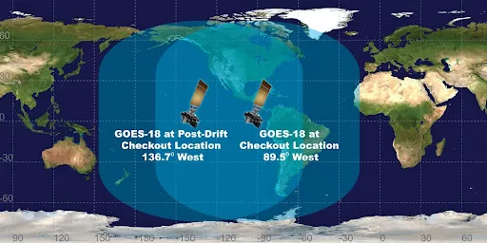
Time-Line Highlights
GOES-18
Drift: 89.5W to 136.8W
May 16 - June 6, 2022
Nudge: 136.8 to 137.0
July 5-21, 2022
… and GOES-17 137.2 to 137.3
same period.
8
01 Mar 2022 GOES-T Launch (4 yrs to the day of GOES-S Launch)
14 Mar 2022 Attained Geo. Orbit (now GOES-18)
29 Mar 2022 GLM Powered On
14 Apr 2022 GLM Door Opened & 1st Light
12-14 May 2022 Pre-Drift GLM-18 Quicklooks (Huntsville/Koshak/Virts)
02 Jun 2022 Public Release (video of GLM-18 lightning)
07-13 Jun 2022 Post-Drift GLM-18 Quicklooks (Huntsville/Virts)
01 Sep 2022 CDRL079 LUT Update went live @ 18:58 UT
05-16 Sep 2022 Beta Certification Quicklooks (Huntsville/Koshak/Virts)
16 Sep 2022 Beta Certification

Slide 11
Risks to Reaching Provisional
(Summary Status at Beta Certification)
There are no substantial risks or liens towards reaching Provisional on planned PS-PVR date of 31 Oct 2022
Primary emphasis for PROV will be larger sample size PLPT analyses, and more robust documentation of GLM-18 performance.
Instrument h/w performance is very good and does not pose a substantial risk to achieving provisional
    However, quick-looks indicated anomalous noise in GLM-18 not seen in GLM-16 or GLM-17 for same region.

Slide 12
Outline
Introduction
Review of Beta Certification
Product Quality Evaluation Overview
Provisional Maturity Assessment
PLPT Details
Path to Full Validation
Summary and Recommendations

Slide 13
Performance Baseline Mapping
MRD | Parameter | MRD Value | Perf. Baseline (Model) |  | Related PLPTs
1259 | Production Mapping Accuracy [INR] | 5km ( = |𝛍|+3𝜎 < 140 μrad) | Nav error (7 d averaging) of 103 μrad for GOES-W |  | -011, (also -001, -002,-003, -004, -005, -006)
1260 | Product Measurement Range | (0-41900 evts/s, 0-8170 grps/s, 0-600 flsh/s) | Instr Vendor showed can handle peak 100Kevts/s (600flsh/s) |  | G16/17 Independent [see -009,-010 in G16 Full PS-PVR]
1261 | Product Measurement Accuracy | 70% total flash detection efficiency (DE) | Instr. Side | EOL* | -001, -002,-003, -004, -005, -006, -009,-010
 |  |  | Primary | 90.3%
 |  |  | Redundant | 90.5%
1264 | Product Measurement Precision | 5% | Open, with Flight reporting FAR ~ 2.6% |  | -001, -002,-003, -004, -005, -006, -009,-010
2112 | Product Time Tag | GOES-R system shall time tag product observations | n/a |  | -001, -002,-003, -004, -005, -006
*EOL = End of Life with reduction to flash DE by ~6% due to Coherency Filter removing single-group flashes

Slide 14
Top Level Evaluation
 | Past Status | Current Status | Future Outlook
DE | NO BETA VALIDATION DONE, ONLY QUICKLOOKS (Sep 5-16, 2022) FOR BETA CERTIFICATION: 75% (wrt ENGLN) 79% (wrt GLD360) | More validation data accumulated with some regional gap filling. +/- 1 sec time window used is optimal based on detailed simulations Low DE values near limb (large water/ice absorption on long slant path) Bulk (full FOV) spatially averaged performance value meeting 70% spec. | Add Put Back Algorithm to further improve DE. Keep 1st event in flashes not retained by the Coherency Algorithm in DO.08 (not only increases DE but increases detected details of a flash) Modify Single Group Flash (SGF) filter to save those SGFs that are likely due to lightning.
FAR | NO BETA VALIDATION DONE, AND NO SPECIFIC COMPUTATION OF FAR PERFORMED AS PART OF QUICKLOOKS: But quicklooks showed that GLM-18 had substantial improvement in flash count over CONUS after 9/1/2022 LUT update installed. | More validation data accumulated with some regional gap filling. +/- 10 min time window used is optimal based on detailed simulations Bulk (full FOV) spatially averaged performance value of 12% still above 5% spec, but in-family with GLM-17. | Tuning of Blooming Filter in LUT update on 11/1/2022 (est.) expected to further reduce FAR. FAR could be reduced by raising thresholds and/or tuning filters. HSV group prefers the latter (but is not our decision).
INR/time | NO BETA VALIDATION DONE, ONLY QUICKLOOKS (Sep 5-16, 2022) FOR BETA CERTIFICATION; mode of the error distributions were: 3.5 km location error 0.8 ms timing error | Mode of the error distributions are: 3.5 km location error 0.8 ms timing error So mode of location/timing error distributions meet spec INR NS/EW angles occasionally violate spec. | Monthly 3º grid cloud-top height maps preferred to reduce parallax, but hard sell to Program given spec already met Maintain 7-day ave RPY values across processing string discontinuities. [If GS processing strings don’t have these values, then GS shall use the initial angles provided in the most current version of CDRL079 Cal Data Books for that flight unit.]

Slide 15
Performance Summary
MRD | Parameter | MRD Value | Performance Result
 |  |  | VaLiD | LATA | INR | Mach SIT
1259 | Production Mapping Accuracy | 5km ( = |𝛍|+3𝜎 < 140 μrad) | n/a | 3.5km | 119 μrad | n/a
1260 | Product Measurement Range | (0-41900 evts/s, 0-8170 grps/s, 0-600 flsh/s) | n/a | n/a | n/a | no cases where LCFA* unable to handle raw or filtered data rates
1261 | Product Measurement Accuracy | 70% total flash detection efficiency (DE) | 74% | n/a | n/a | n/a
1264 | Product Measurement Precision | 5% (flash FAR) [also MRD 639 which states same 5% value] | 12% | n/a | n/a | n/a
2112 | Product Time Tag | GOES-R system shall time tag product observations | n/a | -0.8 ms | n/a | n/a
*LCFA = Lightning Cluster Filter Algorithm.

Slide 16
Outline
Introduction
Review of Beta Certification
Product Quality Evaluation Overview
Provisional Maturity Assessment
PLPT Details
Path to Full Validation
Summary and Recommendations

Slide 17
Provisional Validation
Preparation Activities | Assessment
Validation activities are ongoing and the general research community is now encouraged to participate. | Validation activities are ongoing. The general research community has been participating and providing feedback.
Severe algorithm anomalies are identified and under analysis. Solutions to anomalies are in development and testing. | Operational and algorithm anomalies have been identified. Critical ones have been resolved; others in various stages of implementation. A few under investigation.
Incremental product improvements may still be occurring. | Incremental product improvements are expected.

Slide 18
Provisional Validation
End State | Assessment
Product performance has been demonstrated through analysis of a small number of independent measurements obtained from select locations, periods, and associated ground truth or field campaign efforts. | This has been demonstrated.
Product analysis is sufficient to communicate product performance to users relative to expectations (Performance Baseline). | This has been communicated in PS-PVR.
Documentation of product performance exists that includes recommended remediation strategies for all anomalies and weaknesses. Any algorithm changes associated with severe anomalies have been documented, implemented, tested, and shared with the user community. | Have been documented, for example this PS-PVR and the ReadMe file.
Testing has been fully documented. | Testing has been fully documented in this PS-PVR.
Product is ready for operational use and for use in comprehensive cal/val activities and product optimization. | We concur.

Slide 19
Recommendation
CWG believes that the GLM-18 L2 product (events, groups, flashes) has reached the Provisional Maturity as defined by the GOES-R Program.

Slide 20
Outline
Introduction
Review of Beta Certification
Product Quality Evaluation Overview
Provisional Maturity Assessment
PLPT Details
Path to Full Validation
Summary and Recommendations

Slide 21
Progress Since GLM-17 Full
(since 24 Feb 2021)
WR | ADR | Title | PR or DO | Date in OE | Impact to this VAL
375 | 375 | Time order GLM L2 | CLOSED | N/A | N/A
-- | 1140 | GLM Time Order Rule Change - ADR 375 follow-on | CLOSED | N/A | N/A
-- | 1196 | Inability to read/edit GLM Semi-static parameters | CLOSED | N/A | Documentation obtained
8694 | 1177 | G16/G17 L0 GLM unknown data formatter | CLOSED | N/A | N/A
7990 | 1109 | GLM Flash Area equals Fill Value for Large Flashes | DO.09.05.00 | 6/30/21 | low
 | 1211 | G18 GLM LUTs for Test Slot (CDRL79 Rev C) | PR.09.08.19 | 4/1/22 | high
 | 1241 | G18 GLM LUTs for West Slot (CDRL79 Rev C) | PR.09.08.27 | 6/1/22 | high
 | 1264 | G18 GLM CDRL79 Rev D | PR.09.08.32 | 7/29/22 | high
 | 1268 | G18 GLM CDRL79 Rev E | PR.09.08.34 | 9/1/22 | high

Slide 22
Provisional Analysis Period
01 Sep 2022: CDRL079 LUT Update (PRO Release PR.09.08.34) went live
18:58 UT
02 Sep 2022 – 12 Oct 2022: Recommended Provisional Analysis Period *
13 Oct 2022 – 16 Nov 2022: Operational Interleave of GOES-17/18 started at
16:01 UTC
01 Nov 2022 into OE (est.): GLM LUT Update (primarily tuning of Blooming Filter); some quick-looks of the effects of this LUT update provided as ancillary information, time permitting.
*Solar UltraViolet Imager Extended Coronal Imaging (SUVI ECI) conducted from mid-Aug to
Sep 8 (15:30 UTC), 2022 that could provide noise during first 7 days (Sep 2-8)

Slide 23
Post-Launch Product Tests
Test ID | Abbreviated Test Titles for GLM
PLPT-GLM-001 | Validate DE/FER using med/long-range networks (e.g., NLDN, EN, GLD360)
PLPT-GLM-002 | Validate DE/FER using short-range networks (e.g., LMAs)
PLPT-GLM-003 | Validate Storm DE and Storm FAR using very long range systems (WWLLN, NEXRAD)
PLPT-GLM-004 | Validate DE/FER using very short range optical systems (FEGS)
PLPT-GLM-005 | Validate DE/FER using orbit-based optical systems (e.g., ISS/LIS)
PLPT-GLM-006 | Validate DE/FER using ground-based E-field networks (e.g. HAMMA, LIP)
PLPT-GLM-009 | Validate L1b-L2 Cluster/Filter by comparing w/Spec (i.e. Mach) code
PLPT-GLM-010 | Validate L0-L1b Filter Algorithms by comparing w/Spec (i.e. Mach) code
PLPT-GLM-011 | Validate GLM INR w/comparisons to well-located ground points
PLPT-GLM-012 | Validate GLM BG DCC radiances with trending & comparisons
PLPT-GLM-013 | Validate GLM Flash Energies with trending & comparisons
PLPTs not required for GLM-18 Provisional
Full test plans and procedures are given in the GLM Readiness, Implementation, and Management Plan (RIMP v2.0; 410-R-RIMP-0313)

Slide 24
Primary PLPT Tools
Item | Tool | Description | Code Language | Developer
1 | VaLiD | Validate Lightning Data tool performs shallow/deep dives of GLM data using wide range of ground-based datasets discussed in RIMP. | C | Bateman/USRA
2 | Cluster/Filter | In-house code for L0-L1b and L1b-L2 processing | Matlab | Mach/USRA
3 | HUDAT | Huntsville Area Marx Meter Array (HAMMA) User Data Analysis Technology with emphasis on lightning energy/physics. | IDL | Bitzer/UAH
4 | STROKE | STorm Retrievals frOm KSC E-Fields examines ground-based electric fields, lightning field changes, and the charges deposited by lightning in KSC, Florida. | IDL | Koshak/MSFC
5 | INR/Parallax | Validates GLM INR with comparisons to well-located ground points and employs GLM background images & lightning, ABI background images, and Laser beacon data | IDL | Buechler/UAH
6 | TT/DCC | Trending Tools for long-term trending of Deep Convective Clouds. | IDL | Buechler/UAH
7 | TT/Lightning | Trending Tools for long-term trending of lightning counts, flash duration, and lightning energy. | IDL, WL | Buechler/UAH Koshak/MSFC
8 | LMT | 24/7 Lightning Monitoring Tool (aka "Product Monitor") that alerts of problematic GLM performance | TBD | Product Area Lead
9 | CompareLLS | Compare Lightning Location System tool performs shallow/deep dives of GLM data using wide range of ground-based datasets discussed in RIMP. | Matlab | Cummins, UA
10 | XLMA | X Lightning Mapping Array tool for making standard 4-D plots of flashes. | IDL | Krehbiel & Rison of NMT
11 | lmatools | Analyzes LMA data [sort VHF source data into flashes; calculate flash areas, volumes, and channel lengths; produce gridded products; time series statistics of flash rate and size data; simulate LMA performance]. | Python | Bruning/TTU
12 | FEGST | Fly's Eye GLM Simulator Tool: Data acquisition, display, storage software, and s/w for analyzing FEGS data & inter-comparing it with other lightning optical datasets (e.g. GLM, ISS/LIS). | IDL | Quick/NPP
13 | ADTs | Ancillary Dataset Tools will be developed for processing datasets such as ABI, NEXRAD, SEVERI, WWLLN; some of these tools will be piggybacked to VaLiD. | Matlab & McIDas scripts | Mach/USRA Bateman/USRA
14 | SITs | Specialized Impromptu Tools written “on-the-fly” to handle any analyses that are needed, but that were unexpected. | C, IDL, Matlab, Mathematica | Cal/Val Team
15 | LATA | Location And Time Accuracy (LATA) Tool: Produces a variety of plots/histograms that characterize the overall location/time accuracy of GLM flashes/groups/events. | Matlab | Virts/NPP

Slide 25
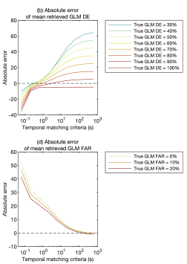
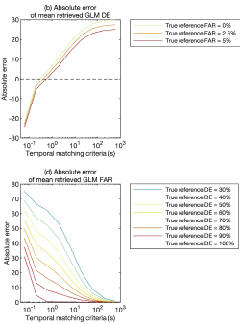
Optimal Time Windows for DE/FAR
(Virts and Koshak, 2022 Simulations, Fig. 8 & 9)
Reasonable Ref Network
(DE 70%, FAR 5%)
Variable Ref Network
(as shown)
GLM DE error
GLM DE error
1 sec
1 sec
GLM FAR error
GLM FAR error
600 sec
(10 min)
600 sec
(10 min)

Slide 26
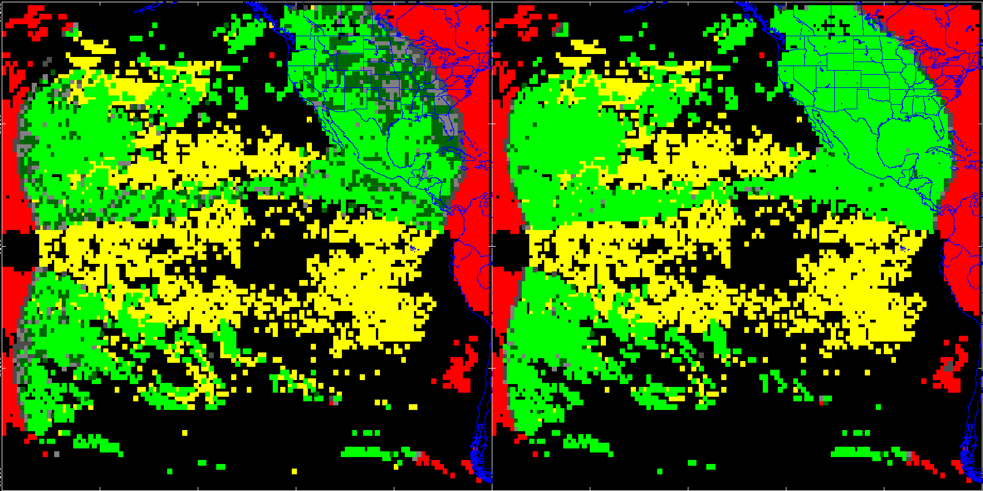

GLM-18 DE (Bateman/UAH)
Sep 2022 (Entire Month)
PASSED
± 1 s (Official Result)
± 10 min (for comparison only)
PLPT-GLM-001
GLM-18 compared to clustered ground networks
0.74 DE value
For optimal
±1 sec time window
DE values shown in white are bulk values across FOV
0.74
0.94
0.0
NOAA's GOES-18 satellite has not been declared operational and its data are preliminary and undergoing testing. Users receiving these data through any dissemination means (including, but not limited to, PDA and GRB) assume all risk related to their use of GOES-18 data and NOAA disclaims any and all warranties, whether express or implied, including (without limitation) any implied warranties of merchantability or fitness for a particular purpose.
Notes:
Sample size: 6,725,357 matches

Slide 27
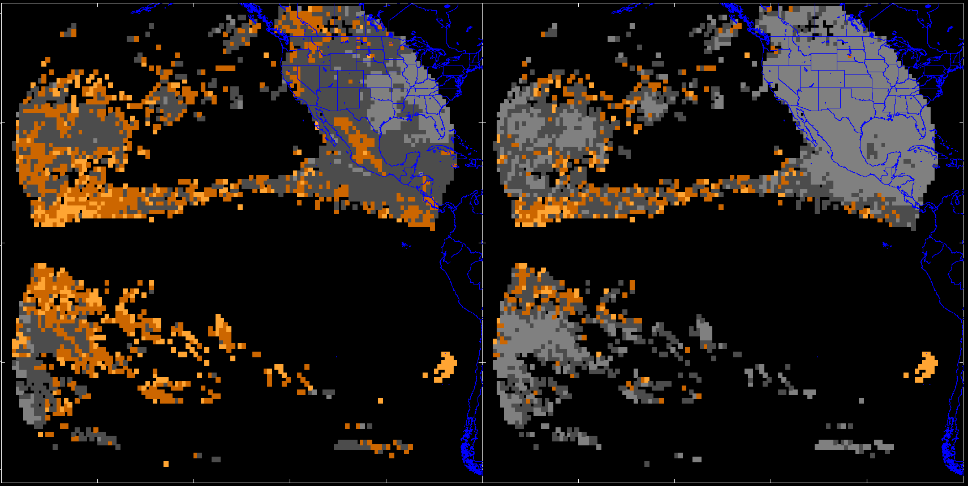

GLM-18 FAR (Bateman/UAH)
Sep 2022 (Entire Month)
PENDING
± 1 s (for comparison only)
± 10 min (Official Result)
PLPT-GLM-001
GLM-18 compared to clustered ground networks
0.12 FAR value
For optimal
±10 min time window
FAR values shown in white are bulk values across FOV
0.29
0.12
NOAA's GOES-18 satellite has not been declared operational and its data are preliminary and undergoing testing. Users receiving these data through any dissemination means (including, but not limited to, PDA and GRB) assume all risk related to their use of GOES-18 data and NOAA disclaims any and all warranties, whether express or implied, including (without limitation) any implied warranties of merchantability or fitness for a particular purpose.
Notes:
Sample size: 6,725,357 matches

Slide 28
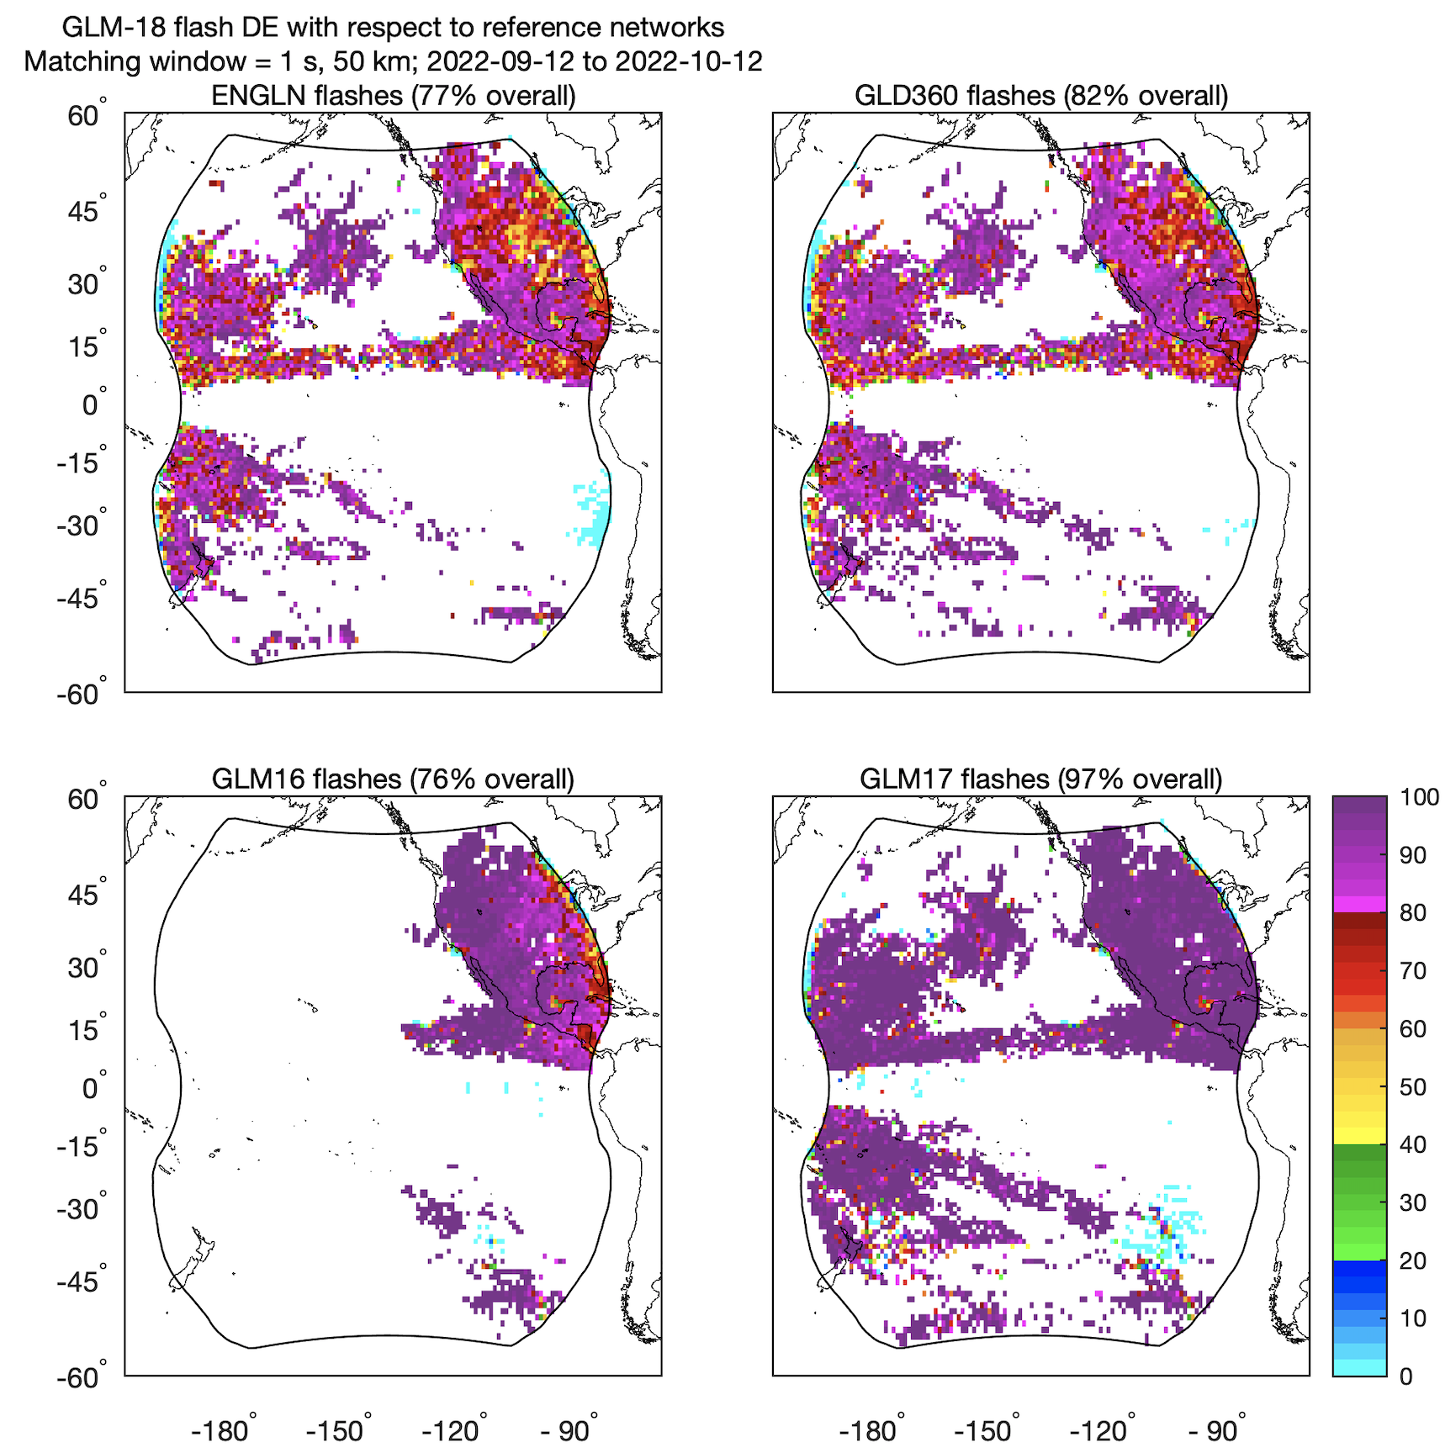
Flash Detection Efficiency (Virts/UAH)
GLM-18 vs. ENGLN, GLD360, GLM-16, and GLM-17
PASSED
PLPT-GLM_001
Simulations indicate temporal matching windows of ~±1 s (used here) most accurately estimate the true aggregate GLM DE
DE vs. GLM-17 with a similar FOV is 97%
DE vs. GLM-16 is 76% (lower near the limb)
DE vs. ground networks is 77-82% (lower near the limb)
NOAA's GOES-18 satellite has not been declared operational and its data are preliminary and undergoing testing. Users receiving these data through any dissemination means (including, but not limited to, PDA and GRB) assume all risk related to their use of GOES-18 data and NOAA disclaims any and all warranties, whether express or implied, including (without limitation) any implied warranties of merchantability or fitness for a particular purpose.
Notes:
Sample size: 5-10 million matches

Slide 29
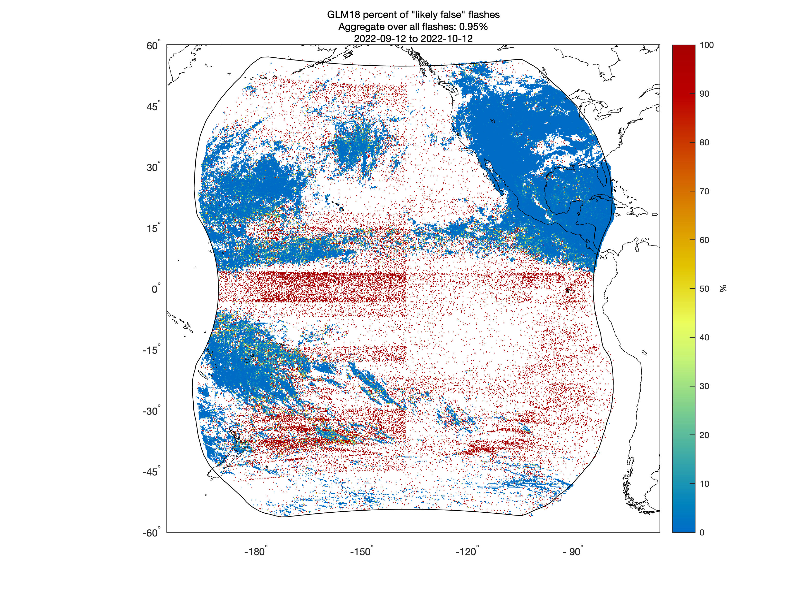
Flash False Alarm Rate (Virts/UAH)
GLM-18 vs. ENGLN, GLD360, and WWLLN
PENDING
PLPT-GLM_001
Simulations indicate temporal matching windows of ~minutes most accurately estimate the true aggregate GLM FAR. Here we use a ±10 min window.
Only 0.95% of GLM-18 flashes cannot be matched with any reference flash
FAR value is enhanced in a grid cell when no lightning occurs in the grid cell
NOAA's GOES-18 satellite has not been declared operational and its data are preliminary and undergoing testing. Users receiving these data through any dissemination means (including, but not limited to, PDA and GRB) assume all risk related to their use of GOES-18 data and NOAA disclaims any and all warranties, whether express or implied, including (without limitation) any implied warranties of merchantability or fitness for a particular purpose.
Notes:
Sample size: 7 million matched flashes; 69,000 unmatched flashes

Slide 30
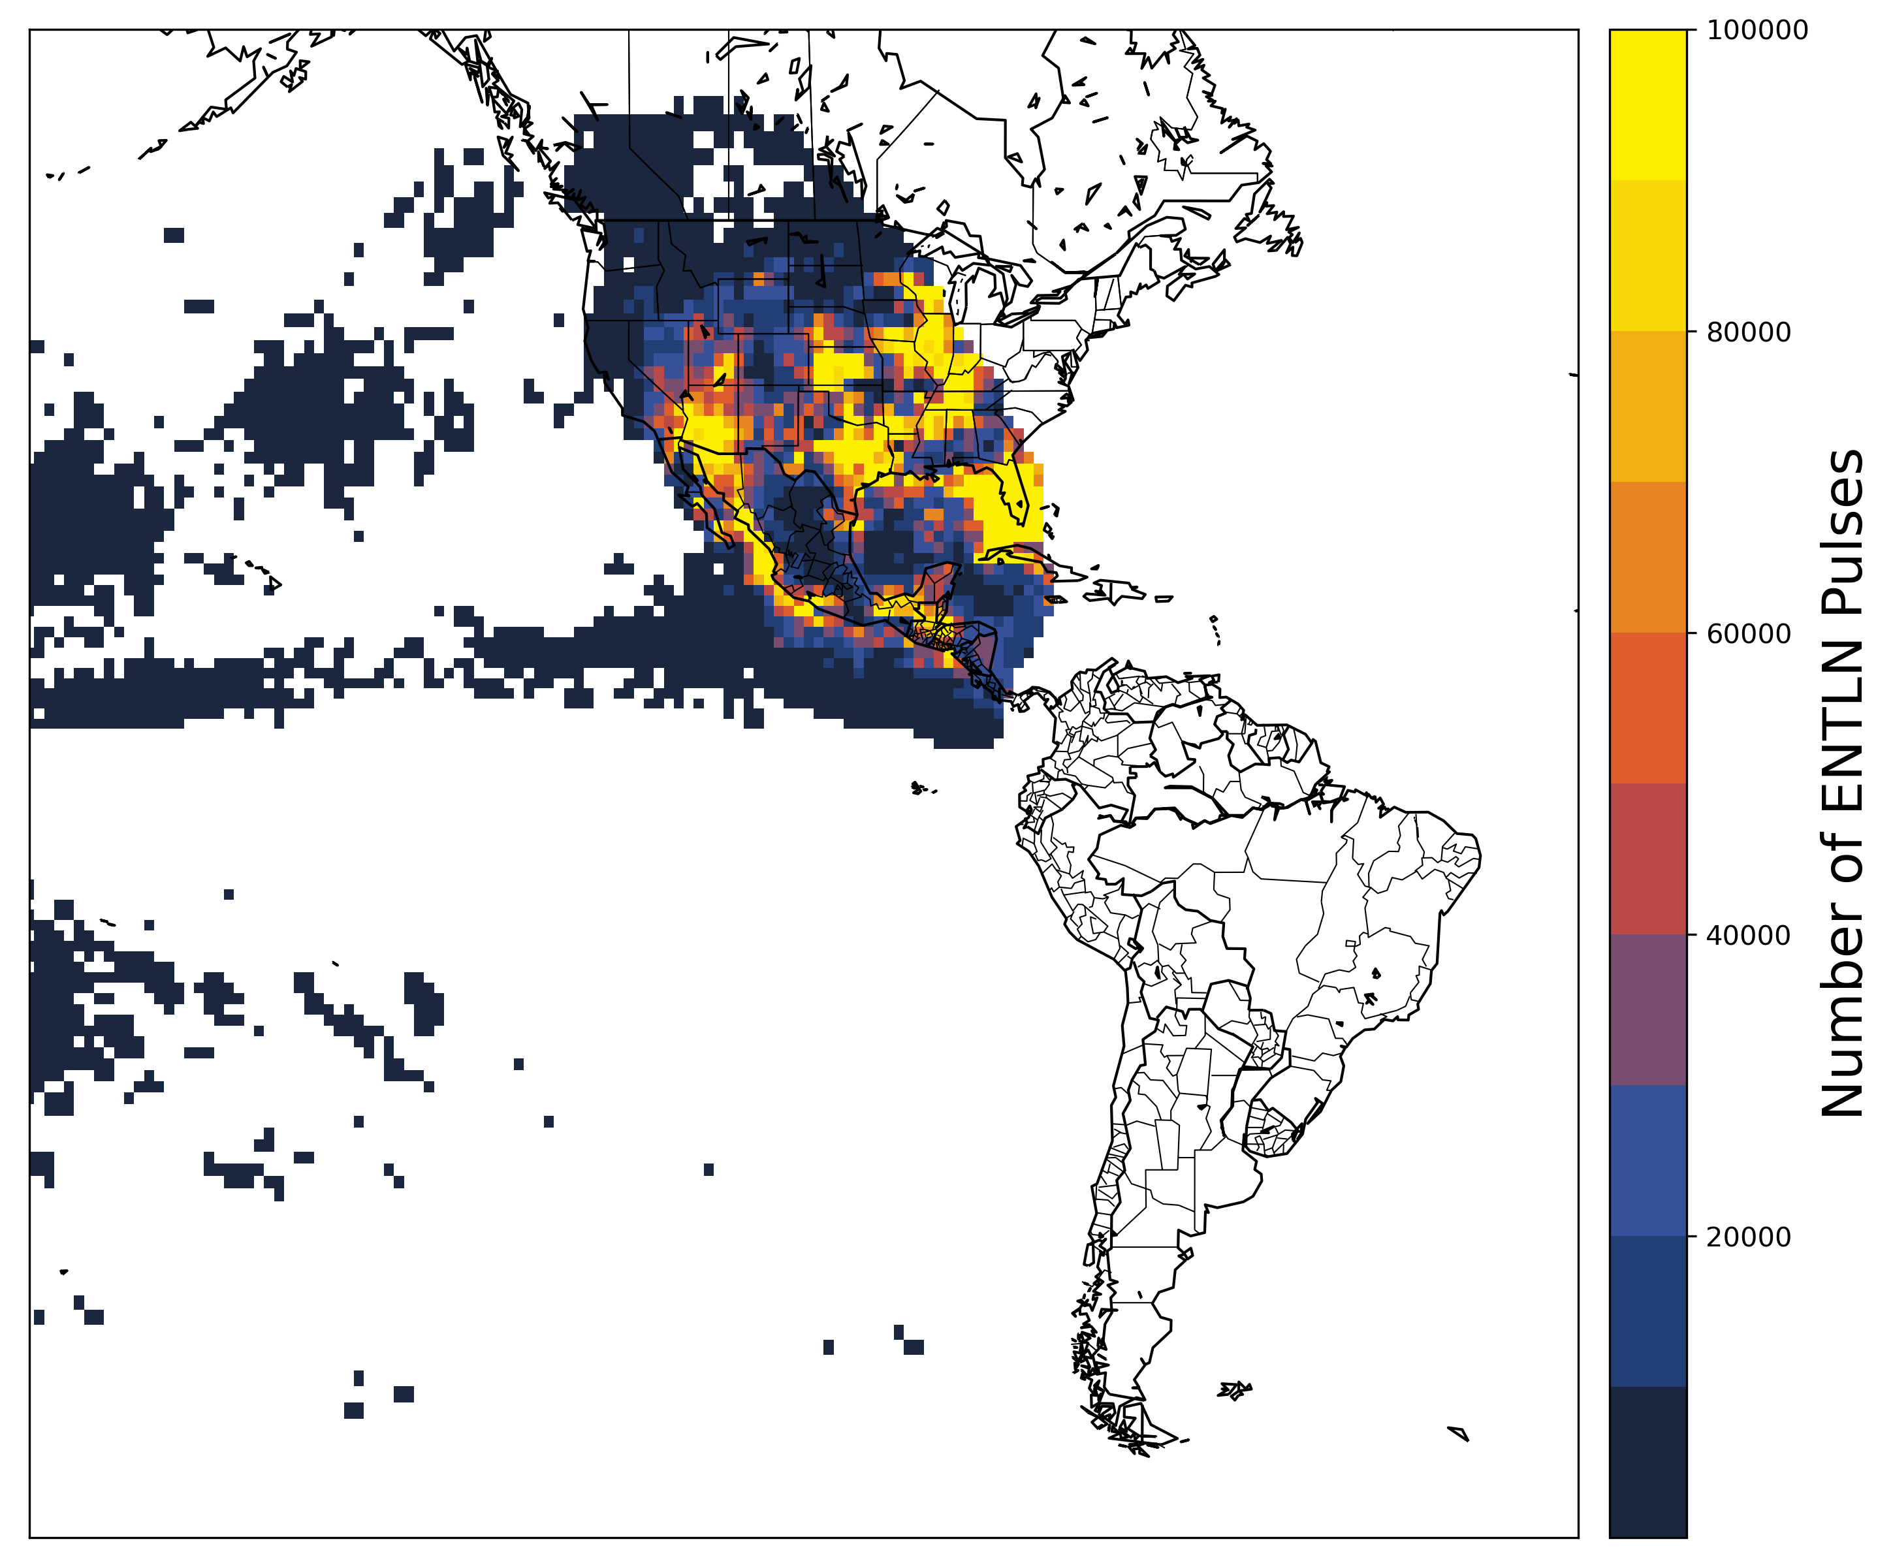
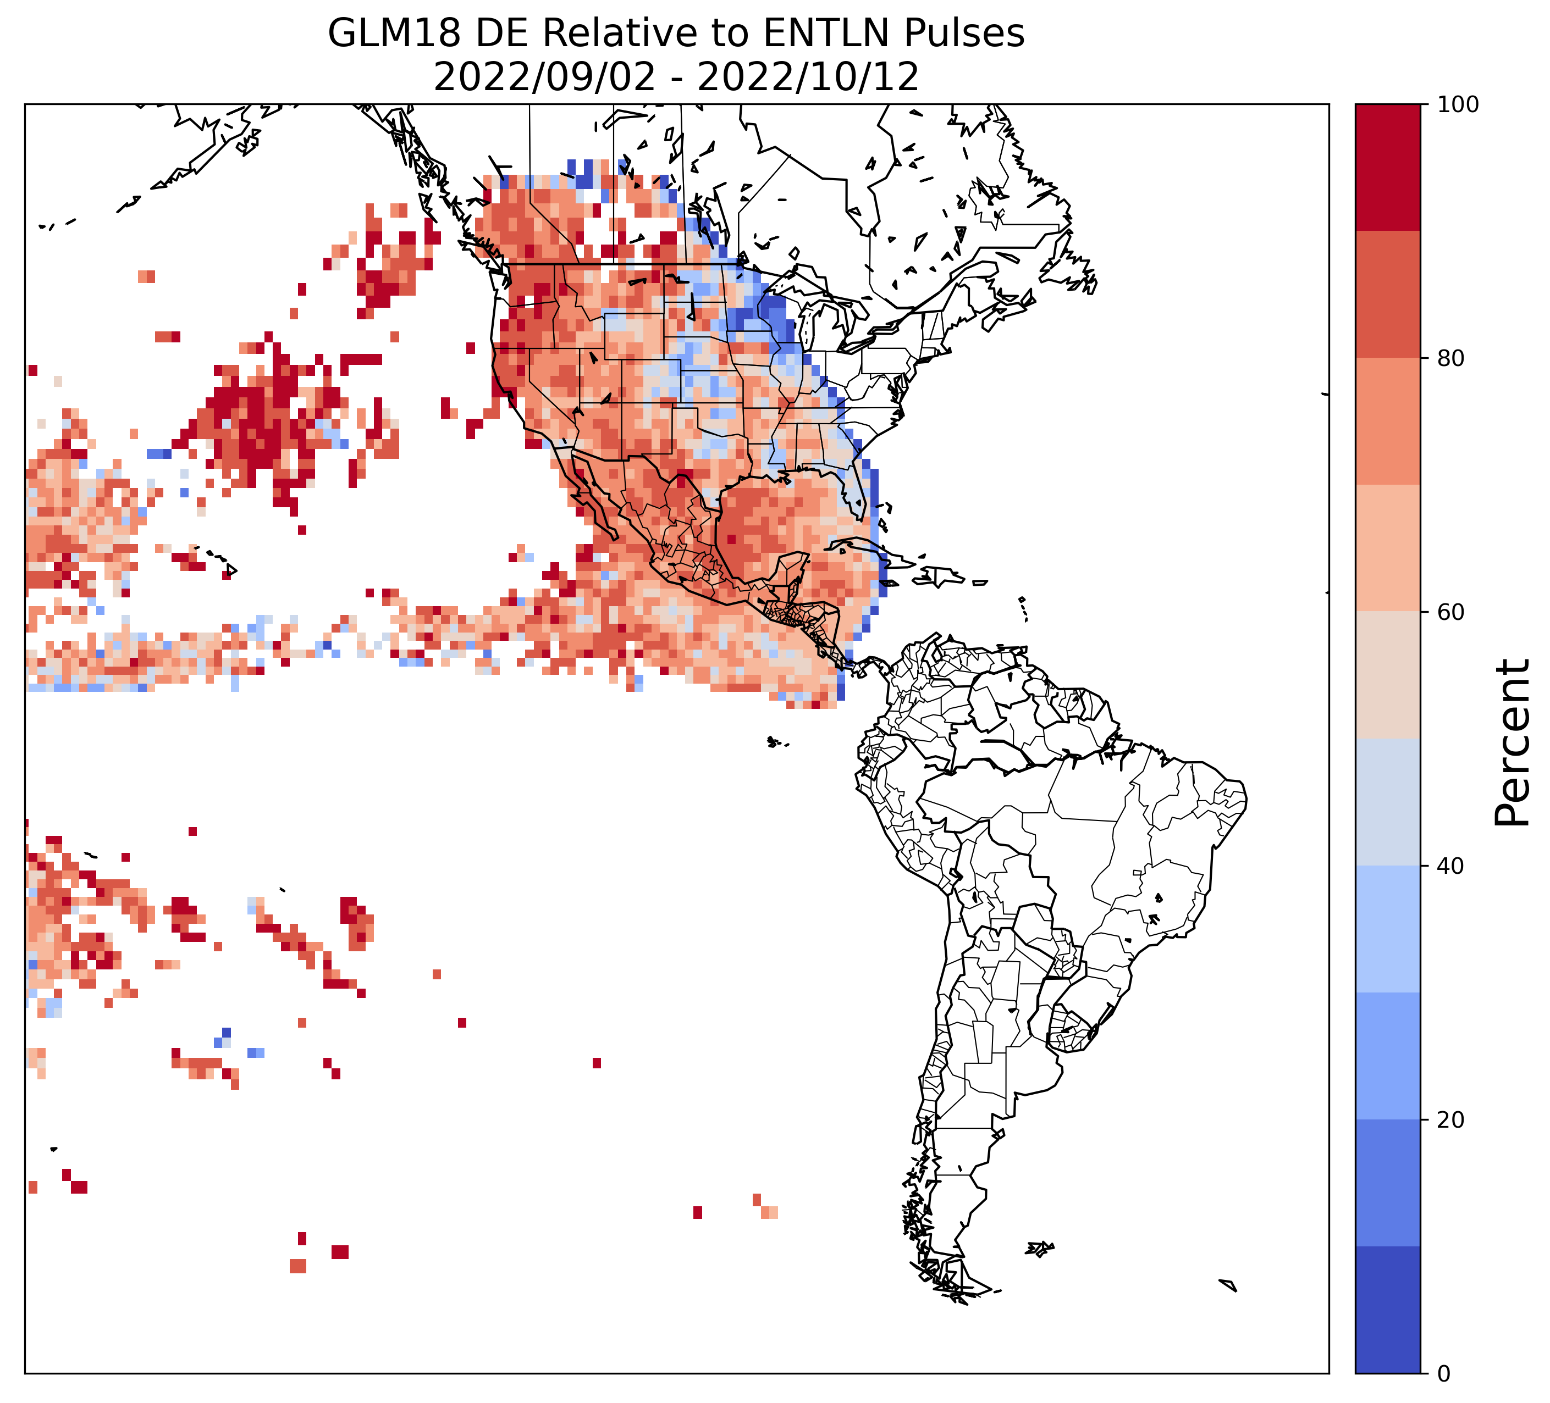
Pulse Detection Efficiency (Lapierre/AEM)
GLM-18 vs. ENTLN Pulses
PASSED
PLPT-GLM_001
Sep 2 – Oct 12, 2022
For each ENTLN pulse, compared all GLM-18 events within 330 ms & 15 km
GLM-18 DE was 70% relative to the ENTLN pulses, and would be >70% had ENTLN flashes been used
NOAA's GOES-18 satellite has not been declared operational and its data are preliminary and undergoing testing. Users receiving these data through any dissemination means (including, but not limited to, PDA and GRB) assume all risk related to their use of GOES-18 data and NOAA disclaims any and all warranties, whether express or implied, including (without limitation) any implied warranties of merchantability or fitness for a particular purpose.
Notes:
Sample size: 5-10 million matches

Slide 31
GOES-18 GLM DE (Bitzer/UAH)
Detection Efficiency Relative to Lightning Mapping Array
PASSED
As a reference lightning data set, use the North Alabama Lightning Mapping Array (NALMA).
Sort NALMA VHF sources into flashes, and find GLM-18 data that occurs during a flash and within the spatial footprint.
Analysis is from one storm on Sept 25, 2022, spanning most of the day.
PLPT-GLM-002
GLM-18 detects >70% of flashes that are at least half a pixel in area.
GLM-18 outperforms GLM-17 (because of viewing angle), but currently lags behind GLM-16
Area (km2) from LMA | Num Flashes from LMA | DE GLM-18 | DE GLM-17 | DE GLM-16
All | 12621 | 0.504 | 0.372 | 0.657
> 8 | 11283 | 0.550 | 0.410 | 0.704
> 16 | 9416 | 0.622 | 0.471 | 0.770
> 32 | 7015 | 0.730 | 0.571 | 0.861
> 64 | 4798 | 0.834 | 0.686 | 0.940
> 100 | 3563 | 0.882 | 0.762 | 0.970
NOAA's GOES-18 satellite has not been declared operational and its data are preliminary and undergoing testing. Users receiving these data through any dissemination means (including, but not limited to, PDA and GRB) assume all risk related to their use of GOES-18 data and NOAA disclaims any and all warranties, whether express or implied, including (without limitation) any implied warranties of merchantability or fitness for a particular purpose.
Notes:
Sample size: 6,725,357 matches

Slide 32
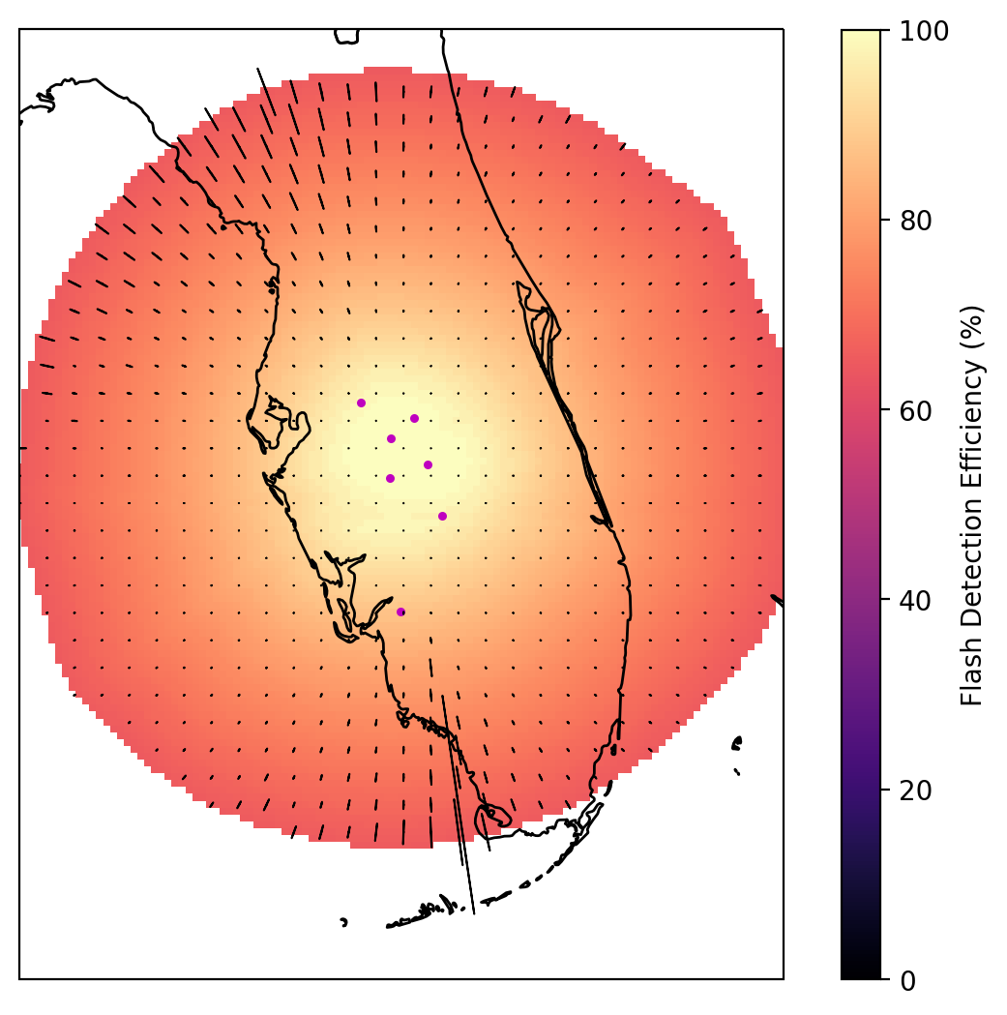
LMA & GLM 16/17/18: Hurricane Ian
(Ringhausen/CIWRO)
PASSED
PLPT-GLM-002
7 LMA sensors
7th LMA sensor attached to vehicle (mobile)
Mobile sensor moved 3 times
Mobile sensor only included
in a VHF source
solution retrieval
when stationary
Mobile Sensor
NOAA's GOES-18 satellite has not been declared operational and its data are preliminary and undergoing testing. Users receiving these data through any dissemination means (including, but not limited to, PDA and GRB) assume all risk related to their use of GOES-18 data and NOAA disclaims any and all warranties, whether express or implied, including (without limitation) any implied warranties of merchantability or fitness for a particular purpose.
Notes:
Sample size: 6,725,357 matches

Slide 33
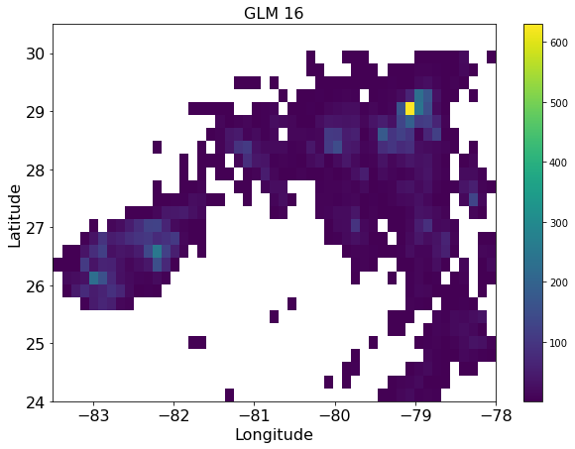
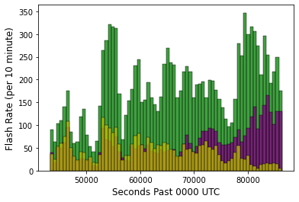
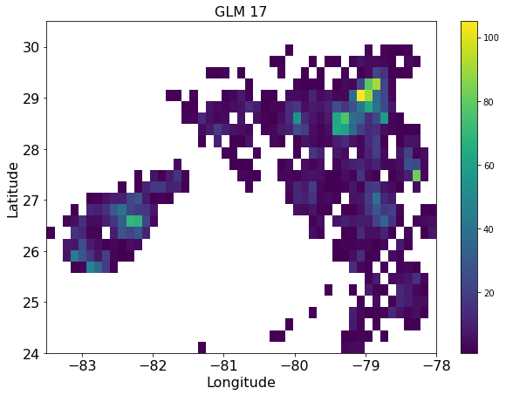
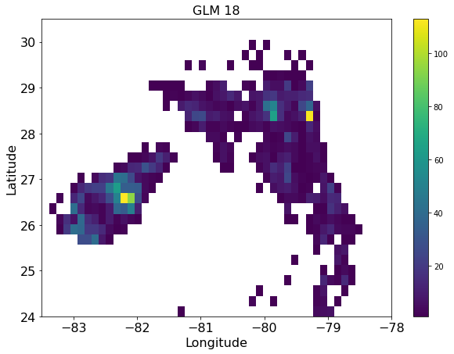
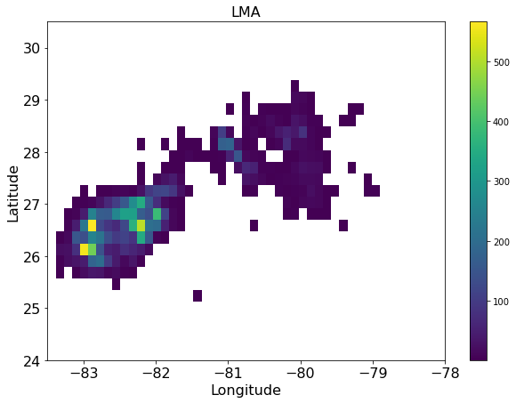
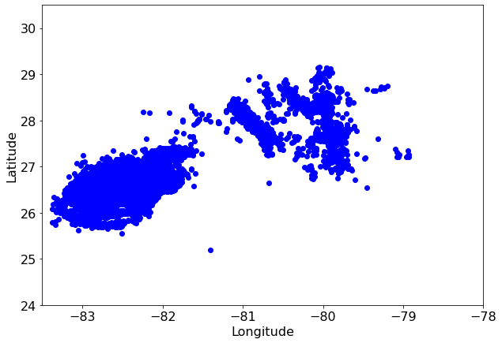
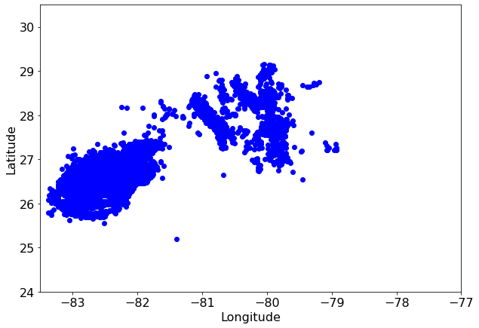
LMA & GLM 16/17/18: Hurricane Ian
(Ringhausen/CIWRO)
GLM-16
PASSED
GLM 16
9/28/2022: 12:00-23:59 UTC
PLPT-GLM-002
GLM 16
GLM-16 detected
3x as many flashes
  --Makes sense since Hurricane Ian at edge of GLM-17/18 FOV
GLM-18 detected slightly more flashes earlier in period than GLM-17
  --GLM-17 detected more later in the period
LMA showed difference in location of maximum flash density compared to GLMs
GLM 17
GLM 18
GLM-17
GLM 17
GLM-18
GLM 18
LMA
GLM 16 | 13181
GLM 17 | 4555
GLM 18 | 3168
LMA | 12719
NOAA's GOES-18 satellite has not been declared operational and its data are preliminary and undergoing testing. Users receiving these data through any dissemination means (including, but not limited to, PDA and GRB) assume all risk related to their use of GOES-18 data and NOAA disclaims any and all warranties, whether express or implied, including (without limitation) any implied warranties of merchantability or fitness for a particular purpose.
Notes:
Sample size: 6,725,357 matches

Slide 34
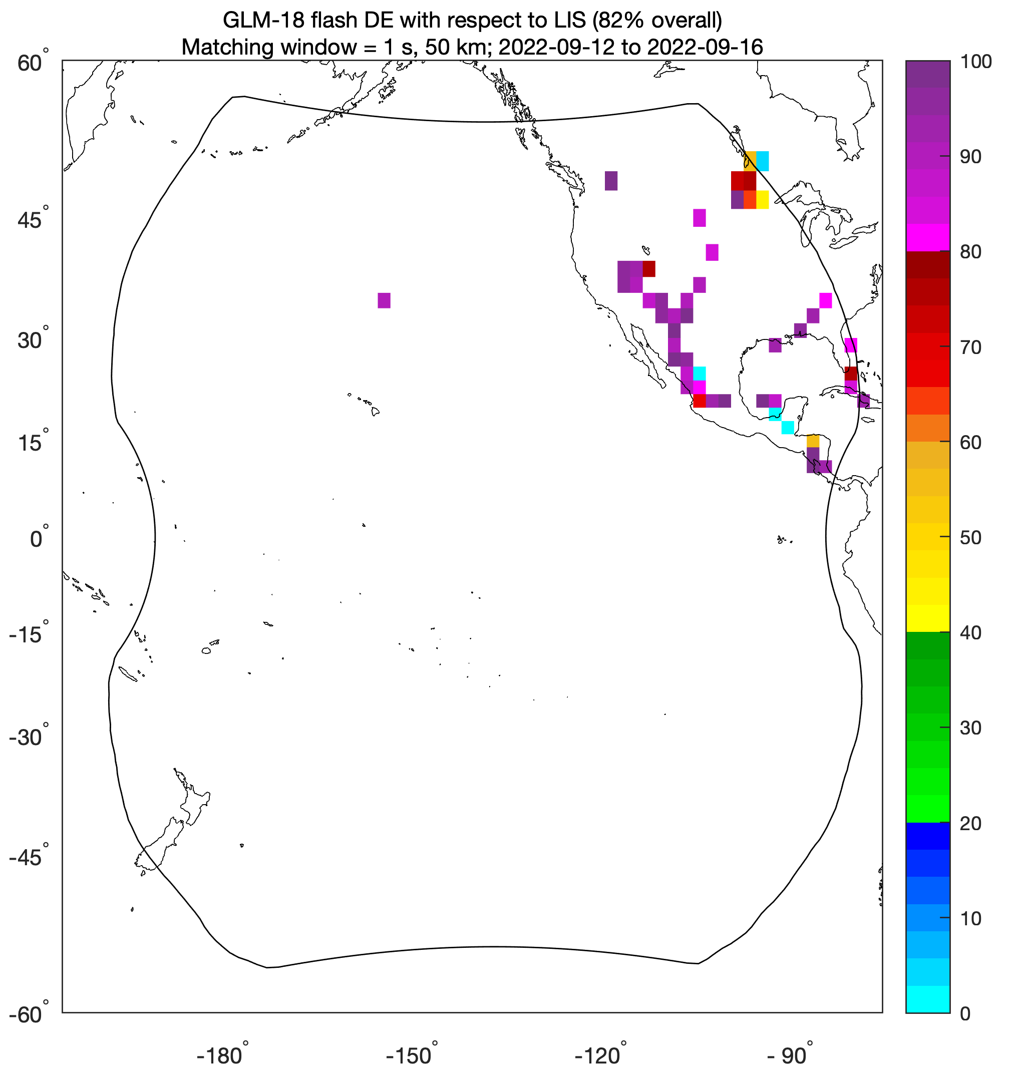
Flash Detection Efficiency (Virts/UAH)
GLM-18 vs. ISS-LIS
PASSED
PLPT-GLM_005
LIS moved to a new location on ISS in early July and has had intermittent outages, including one from 9/17-9/21
GLM-18’s DE with respect to LIS was 82% prior to this outage, and 49% afterward when LIS had multiple orbits with obvious artifacts (not shown)
NOAA's GOES-18 satellite has not been declared operational and its data are preliminary and undergoing testing. Users receiving these data through any dissemination means (including, but not limited to, PDA and GRB) assume all risk related to their use of GOES-18 data and NOAA disclaims any and all warranties, whether express or implied, including (without limitation) any implied warranties of merchantability or fitness for a particular purpose.
Notes:
Sample size: ~2000 matches

Slide 35
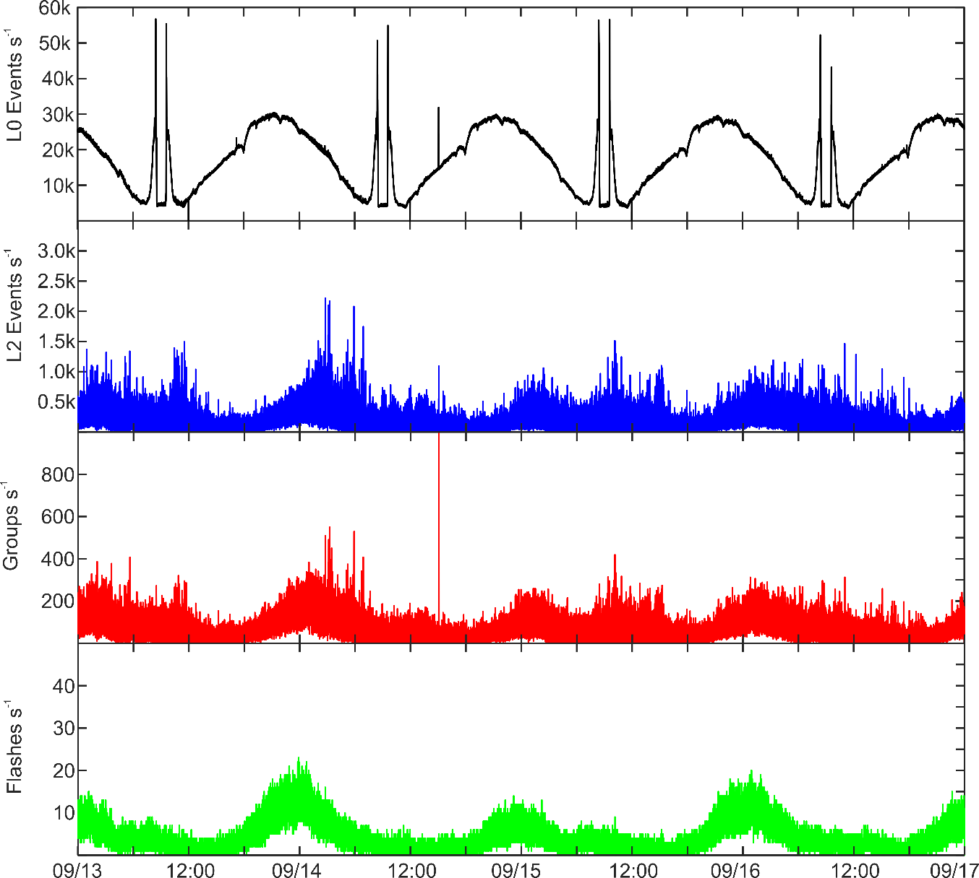
GLM-18 LCFA Peak Rate Spec (Mach/USRA)
Algorithm did not crash during test period ~60k events/sec
The LCFA continued to process the filtered events into groups and flashes
No cases were found where the algorithm crashed in the latest GLM-18 files
NOAA's GOES-18 satellite has not been declared operational and its data are preliminary and undergoing testing. Users receiving these data through any dissemination means (including, but not limited to, PDA and GRB) assume all risk related to their use of GOES-18 data and NOAA disclaims any and all warranties, whether express or implied, including (without limitation) any implied warranties of merchantability or fitness for a particular purpose.
Notes:
Sample size: 6,725,357 matches

Slide 36
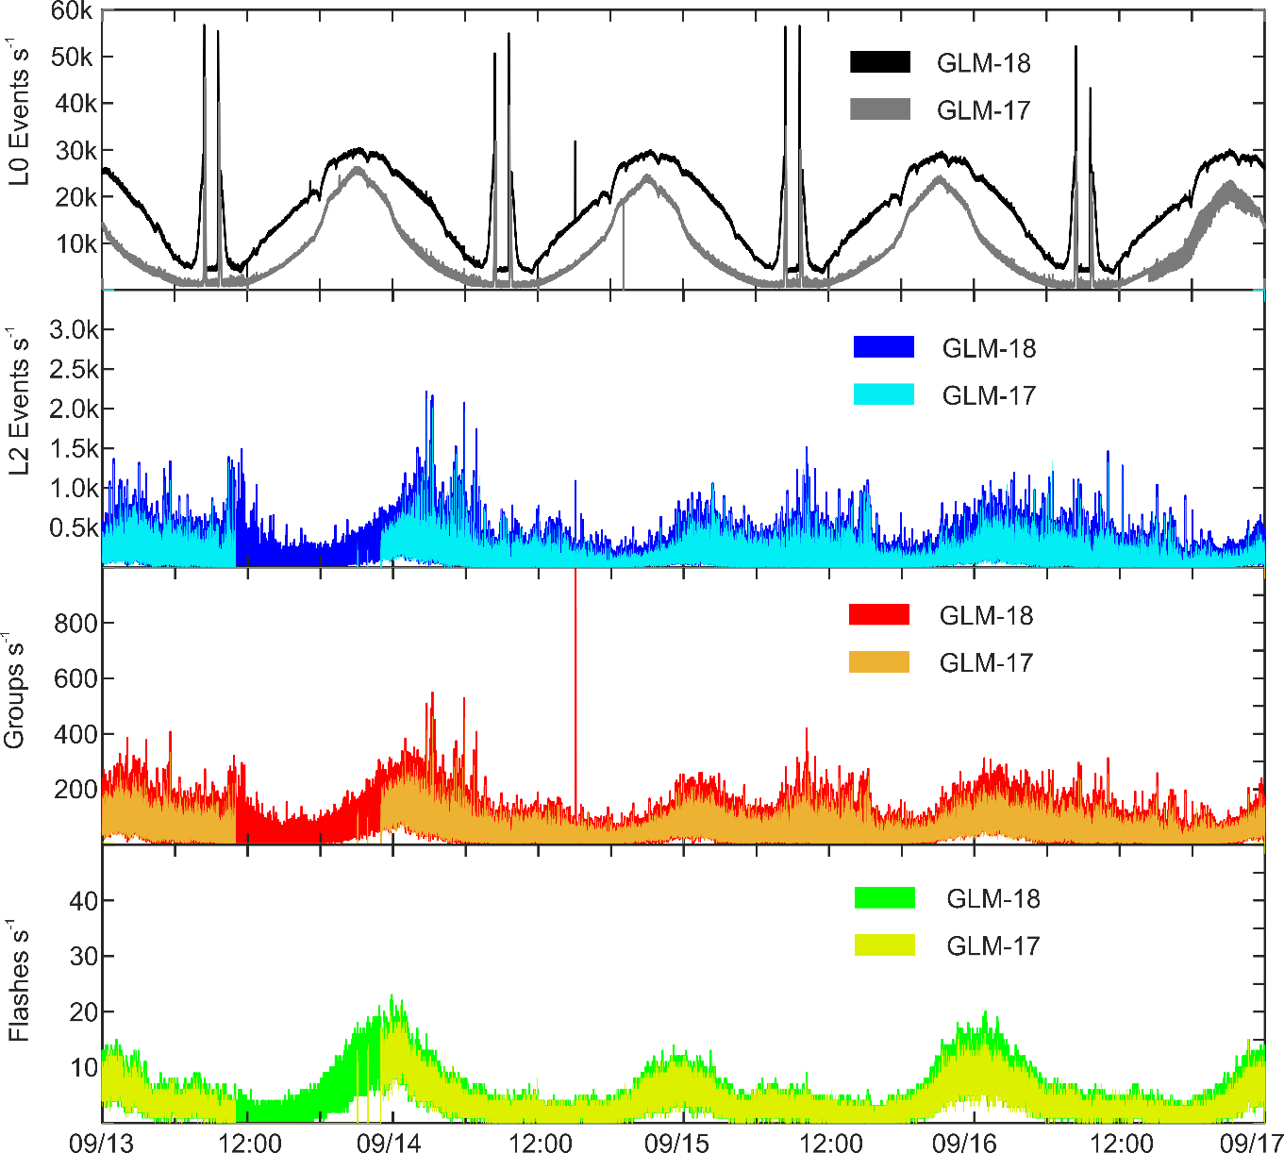
GLM-18 & GLM-17 Comparison Rate
Comparison (Mach/USRA)
GLM-18 L0 event rates higher than GLM-17 L0 event rates
GLM-18 L2 event/group/flash rates slightly higher than GLM-17 L2 event/group/flash rates
Some of the extra data is likely noise (see later slides)
NOAA's GOES-18 satellite has not been declared operational and its data are preliminary and undergoing testing. Users receiving these data through any dissemination means (including, but not limited to, PDA and GRB) assume all risk related to their use of GOES-18 data and NOAA disclaims any and all warranties, whether express or implied, including (without limitation) any implied warranties of merchantability or fitness for a particular purpose.
Notes:
Sample size: 6,725,357 matches

Slide 37
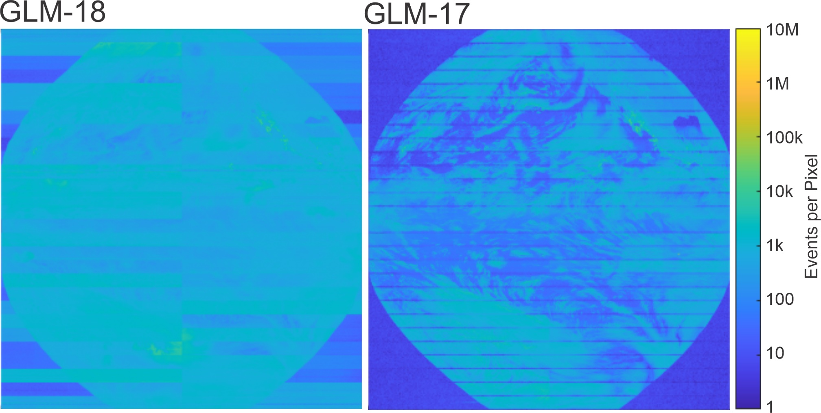
GLM-18 Raw (L0) Events Compared to
GLM-17 Raw (L0) Events (Mach/USRA)
24 hour L0 Events 28-Sept-2022
GLM-18 24 Hour Event Count: 1.48e9
GLM-17 24 Hour Event Count: 0.94e9
GLM-18 Overall Higher Event Rate
GLM-18 Less Uniform Event Detection
NOAA's GOES-18 satellite has not been declared operational and its data are preliminary and undergoing testing. Users receiving these data through any dissemination means (including, but not limited to, PDA and GRB) assume all risk related to their use of GOES-18 data and NOAA disclaims any and all warranties, whether express or implied, including (without limitation) any implied warranties of merchantability or fitness for a particular purpose.
Notes:
Sample size: 6,725,357 matches

Slide 38
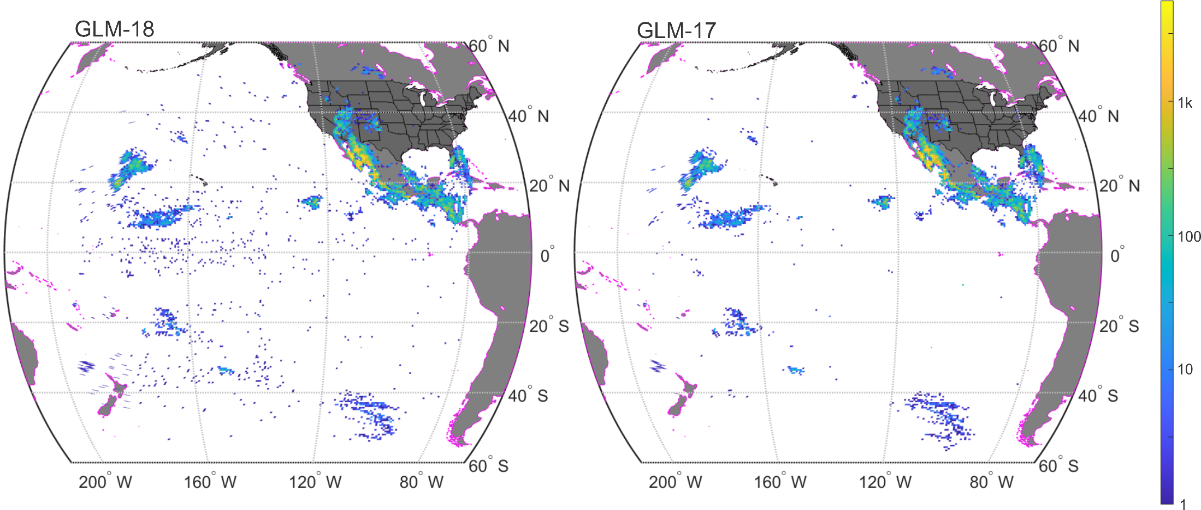
GLM-18 L2 LCFA Results Compared to
GLM-17 L2 LCFA Results (Mach/USRA)
Flashes
Dots are “flashes”
w/2 or more groups
24 hour LCFA Results 28-Sept-2022
GLM-18 24 Hour Flash Count: 3.25e5
GLM-17 24 Hour Flash Count: 2.98e5
GLM-18 Slightly Higher Flash Count
GLM-18 More “Scattered” Flashes (noise?)
NOAA's GOES-18 satellite has not been declared operational and its data are preliminary and undergoing testing. Users receiving these data through any dissemination means (including, but not limited to, PDA and GRB) assume all risk related to their use of GOES-18 data and NOAA disclaims any and all warranties, whether express or implied, including (without limitation) any implied warranties of merchantability or fitness for a particular purpose.
Notes:
Sample size: 6,725,357 matches

Slide 39
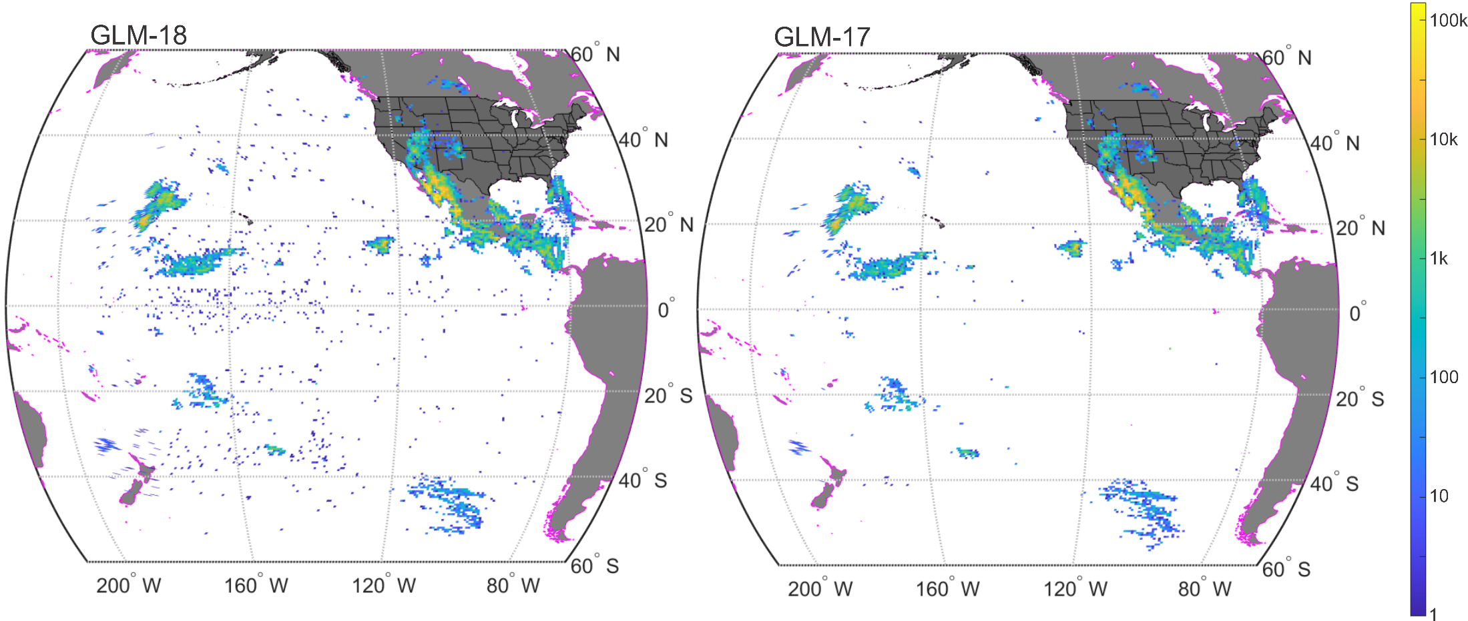
GLM-18 L2 LCFA Results Compared to
GLM-17 L2 LCFA Results (Mach/USRA)
Groups
Dots are “flashes”
w/2 or more groups
24 hour LCFA Results 28-Sept-2022
GLM-18 24 Hour Group Count: 6.23e6
GLM-17 24 Hour Group Count: 4.85e6
GLM-18 Slightly Higher Group Count
GLM-18 More “Scattered” Groups (noise?)
NOAA's GOES-18 satellite has not been declared operational and its data are preliminary and undergoing testing. Users receiving these data through any dissemination means (including, but not limited to, PDA and GRB) assume all risk related to their use of GOES-18 data and NOAA disclaims any and all warranties, whether express or implied, including (without limitation) any implied warranties of merchantability or fitness for a particular purpose.
Notes:
Sample size: 6,725,357 matches

Slide 40
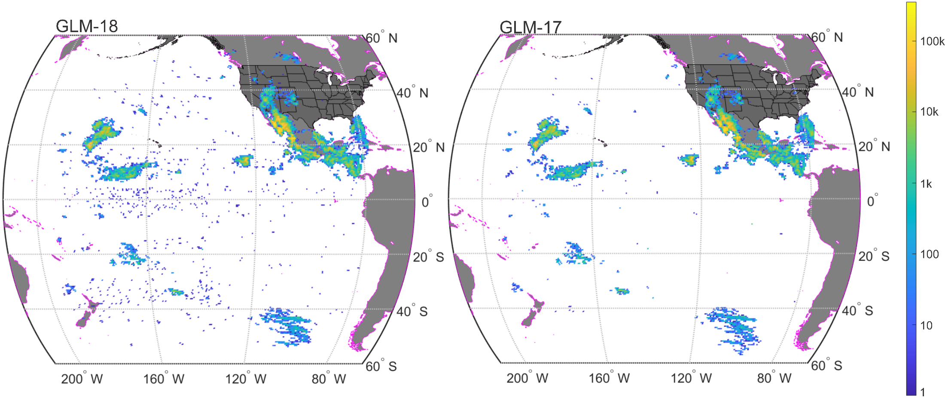
GLM-18 L2 LCFA Results Compared to
GLM-17 L2 LCFA Results (Mach/USRA)
Events
Dots are “flashes”
w/2 or more groups
24 hour L2 LCFA Results28-Sept-2022
GLM-18 24 Hour L2 Event Count: 1.63e7
GLM-17 24 Hour L2 Event Count: 1.27e7
GLM-18 Slightly Higher Event Count
GLM-18 More “Scattered” Events (noise?)
NOAA's GOES-18 satellite has not been declared operational and its data are preliminary and undergoing testing. Users receiving these data through any dissemination means (including, but not limited to, PDA and GRB) assume all risk related to their use of GOES-18 data and NOAA disclaims any and all warranties, whether express or implied, including (without limitation) any implied warranties of merchantability or fitness for a particular purpose.
Notes:
Sample size: 6,725,357 matches

Slide 41
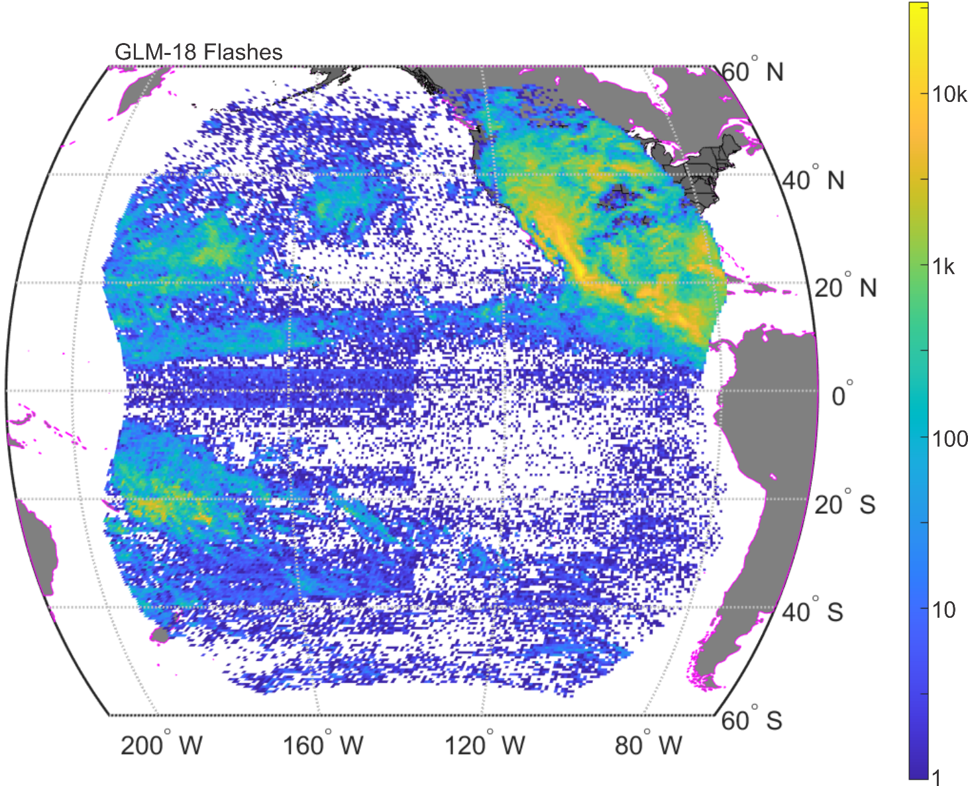
L1b-L2 LCFA Code (Mach/USRA)
PASSED
PLPT-GLM-009
Example LCFA Flashes for 10-Sept-2022 to 10-Oct-2022
A Few orphaned/parentless clustering errors
  Maybe Mach code error
Clustering working well (other than artificial limits)
Filtering can be improved
NOAA's GOES-18 satellite has not been declared operational and its data are preliminary and undergoing testing. Users receiving these data through any dissemination means (including, but not limited to, PDA and GRB) assume all risk related to their use of GOES-18 data and NOAA disclaims any and all warranties, whether express or implied, including (without limitation) any implied warranties of merchantability or fitness for a particular purpose.
Notes:
Sample size: 6,725,357 matches

Slide 42
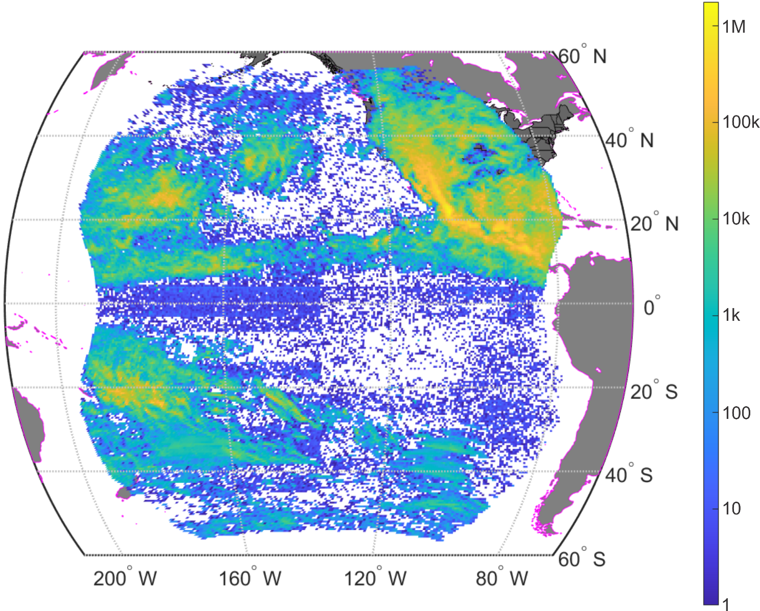
L0-L1b Code (Mach/USRA)
PASSED
PLPT-GLM-010
Example Filtered Events for 10-Sep-2022 to 10-Oct-2022
Nearly all glint/blooming artifacts removed
Improvements to noise removal needed
NOAA's GOES-18 satellite has not been declared operational and its data are preliminary and undergoing testing. Users receiving these data through any dissemination means (including, but not limited to, PDA and GRB) assume all risk related to their use of GOES-18 data and NOAA disclaims any and all warranties, whether express or implied, including (without limitation) any implied warranties of merchantability or fitness for a particular purpose.
Notes:
Sample size: 6,725,357 matches

Slide 43
GLM INR (Flight IPATS)
PENDING-INR
PLPT-GLM-011
IPATS analysis of GLMINR-003 datasets
  IPATS: INR Performance Assessment Tool Set
Sept 23 – 29 dataset indicates navigation violation in both NS and EW angles
MRD requirement (|µ|+3σ < 140 µrad)
Must review remaining datasets collected since installation of updated navigation parameters Sep 1
Although 119 µrad < 140 µrad
implies meeting the spec,
analysis period relatively short,
and deserves further
examination (as part of future
FULL val)
NOAA's GOES-18 satellite has not been declared operational and its data are preliminary and undergoing testing. Users receiving these data through any dissemination means (including, but not limited to, PDA and GRB) assume all risk related to their use of GOES-18 data and NOAA disclaims any and all warranties, whether express or implied, including (without limitation) any implied warranties of merchantability or fitness for a particular purpose.
Notes:
Sample size: 6,725,357 matches

Slide 44
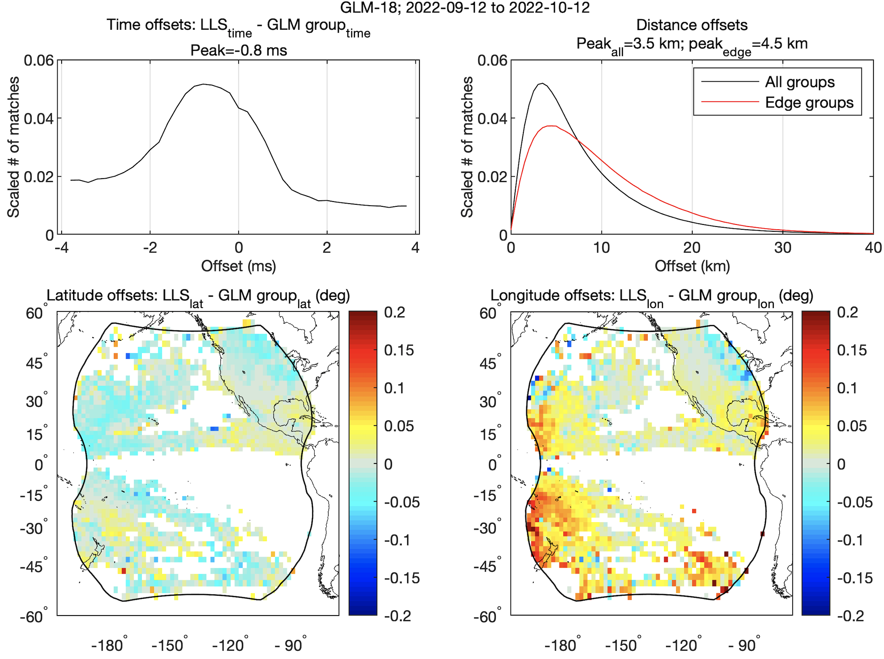
Timing/Location Accuracy (Virts/UAH)
GLM-18 vs. ENGLN and GLD360
PASSED
PLPT-GLM_011
Offsets between GLM-18 group and “best” reference match
(±4 ms and 50 km)
Sub-millisecond timing accuracy
~Half-pixel location accuracy over most of the domain
Better location accuracy than GLM-17 when it was declared provisional, and similar to GLM-17 now
NOAA's GOES-18 satellite has not been declared operational and its data are preliminary and undergoing testing. Users receiving these data through any dissemination means (including, but not limited to, PDA and GRB) assume all risk related to their use of GOES-18 data and NOAA disclaims any and all warranties, whether express or implied, including (without limitation) any implied warranties of merchantability or fitness for a particular purpose.
Notes:
Sample size: 27 million matches

Slide 45
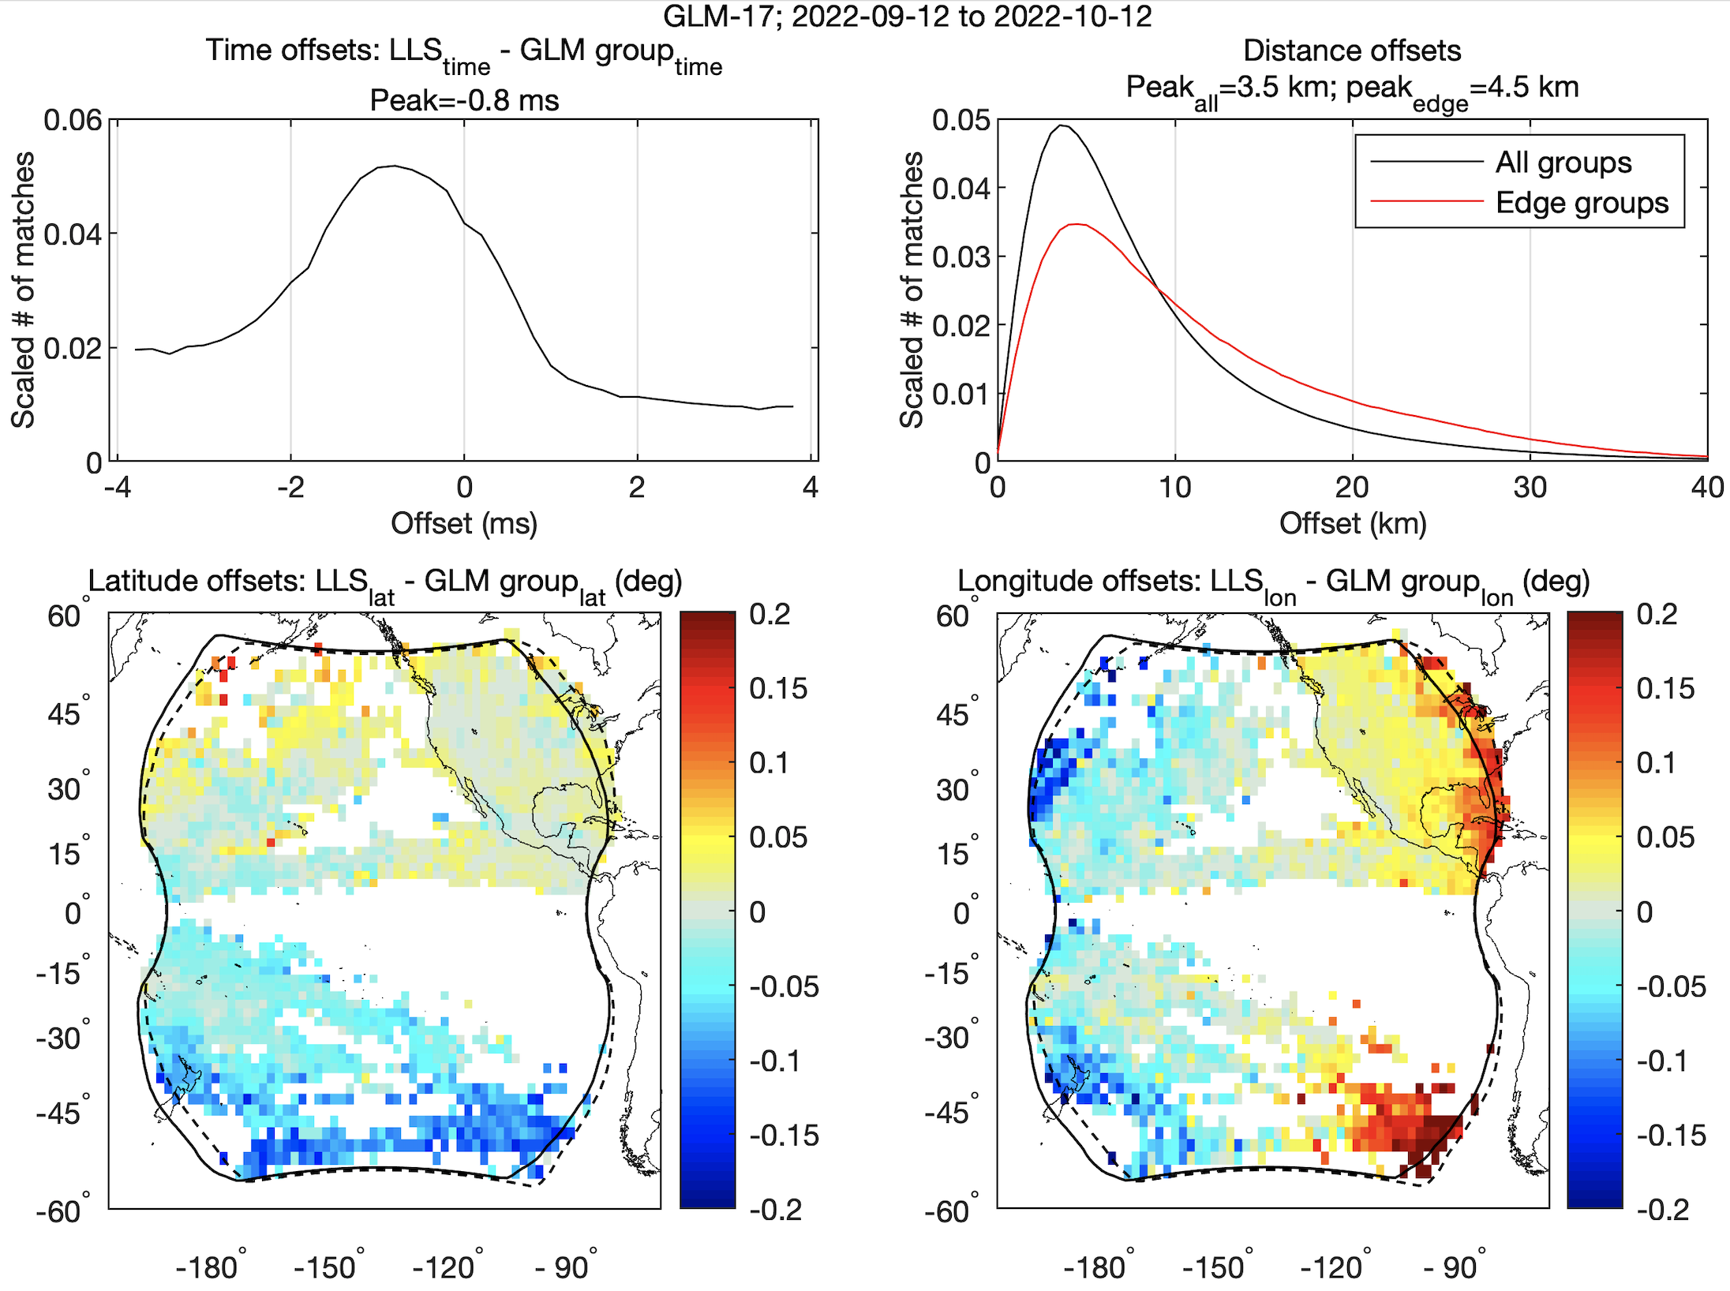
Timing/Location Accuracy (Virts/UAH)
GLM-17 vs. ENGLN and GLD360
NOAA's GOES-18 satellite has not been declared operational and its data are preliminary and undergoing testing. Users receiving these data through any dissemination means (including, but not limited to, PDA and GRB) assume all risk related to their use of GOES-18 data and NOAA disclaims any and all warranties, whether express or implied, including (without limitation) any implied warranties of merchantability or fitness for a particular purpose.

Slide 46
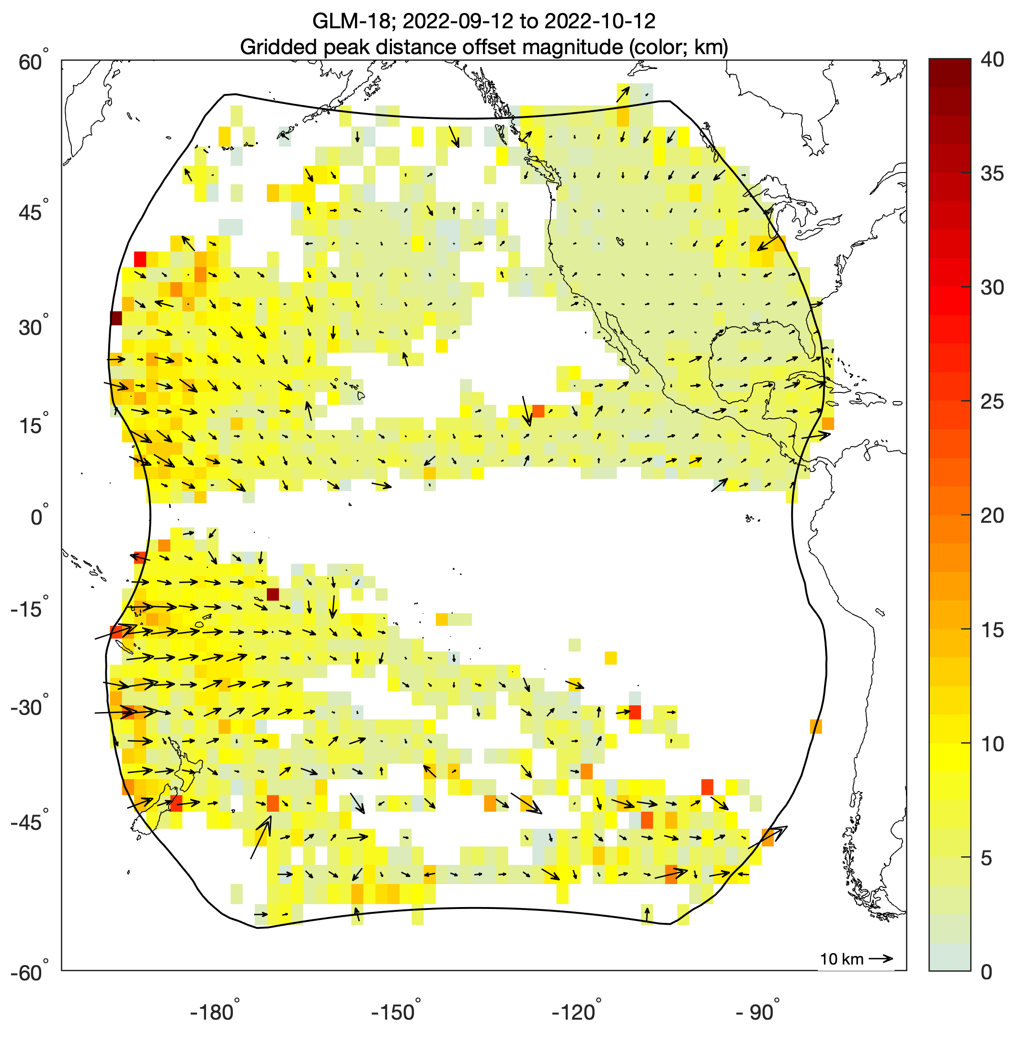
Location Accuracy (Virts/UAH)
GLM-18 vs. ENGLN and GLD360
PASSED
PLPT-GLM_011
Vectors indicate how GLM-18 groups would need to be shifted to best match the reference networks
Iterative tuning with Lockheed Martin has reduced parallax errors
NOAA's GOES-18 satellite has not been declared operational and its data are preliminary and undergoing testing. Users receiving these data through any dissemination means (including, but not limited to, PDA and GRB) assume all risk related to their use of GOES-18 data and NOAA disclaims any and all warranties, whether express or implied, including (without limitation) any implied warranties of merchantability or fitness for a particular purpose.
Notes:
Sample size: 27 million matches

Slide 47
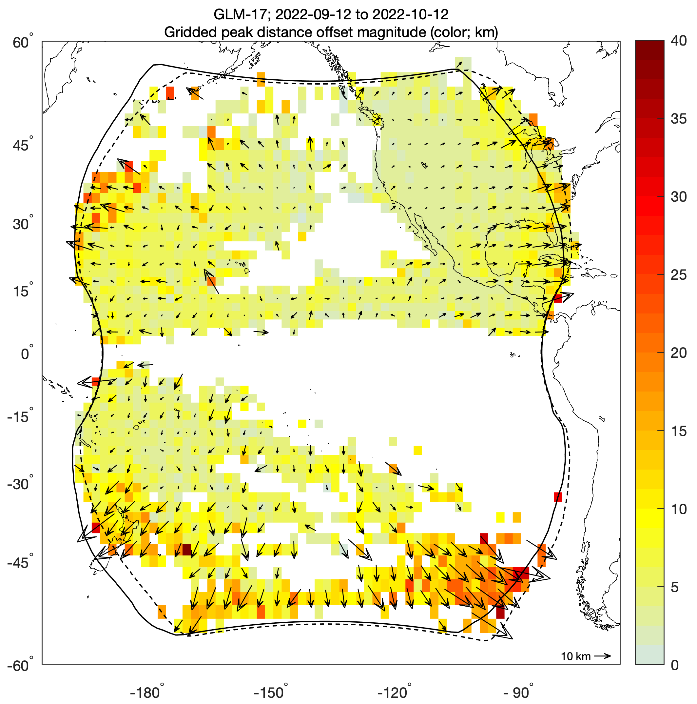
Location Accuracy (Virts/UAH)
GLM-17 vs. ENGLN and GLD360
PASSED
PLPT-GLM_011
NOAA's GOES-18 satellite has not been declared operational and its data are preliminary and undergoing testing. Users receiving these data through any dissemination means (including, but not limited to, PDA and GRB) assume all risk related to their use of GOES-18 data and NOAA disclaims any and all warranties, whether express or implied, including (without limitation) any implied warranties of merchantability or fitness for a particular purpose.

Slide 48
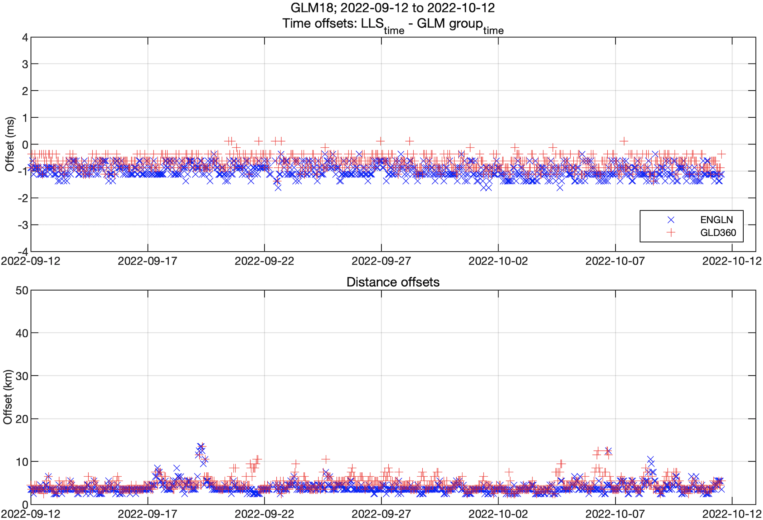
Timing/Location Accuracy (Virts/UAH)
GLM-18 vs. ENGLN and GLD360
PASSED
PLPT-GLM_011
Hourly time series of peak time and distance offsets from the reference networks
Consistent temporal and spatial accuracy over the ~1 month analysis period
NOAA's GOES-18 satellite has not been declared operational and its data are preliminary and undergoing testing. Users receiving these data through any dissemination means (including, but not limited to, PDA and GRB) assume all risk related to their use of GOES-18 data and NOAA disclaims any and all warranties, whether express or implied, including (without limitation) any implied warranties of merchantability or fitness for a particular purpose.
Notes:
Sample size: 16-20 million matches

Slide 49
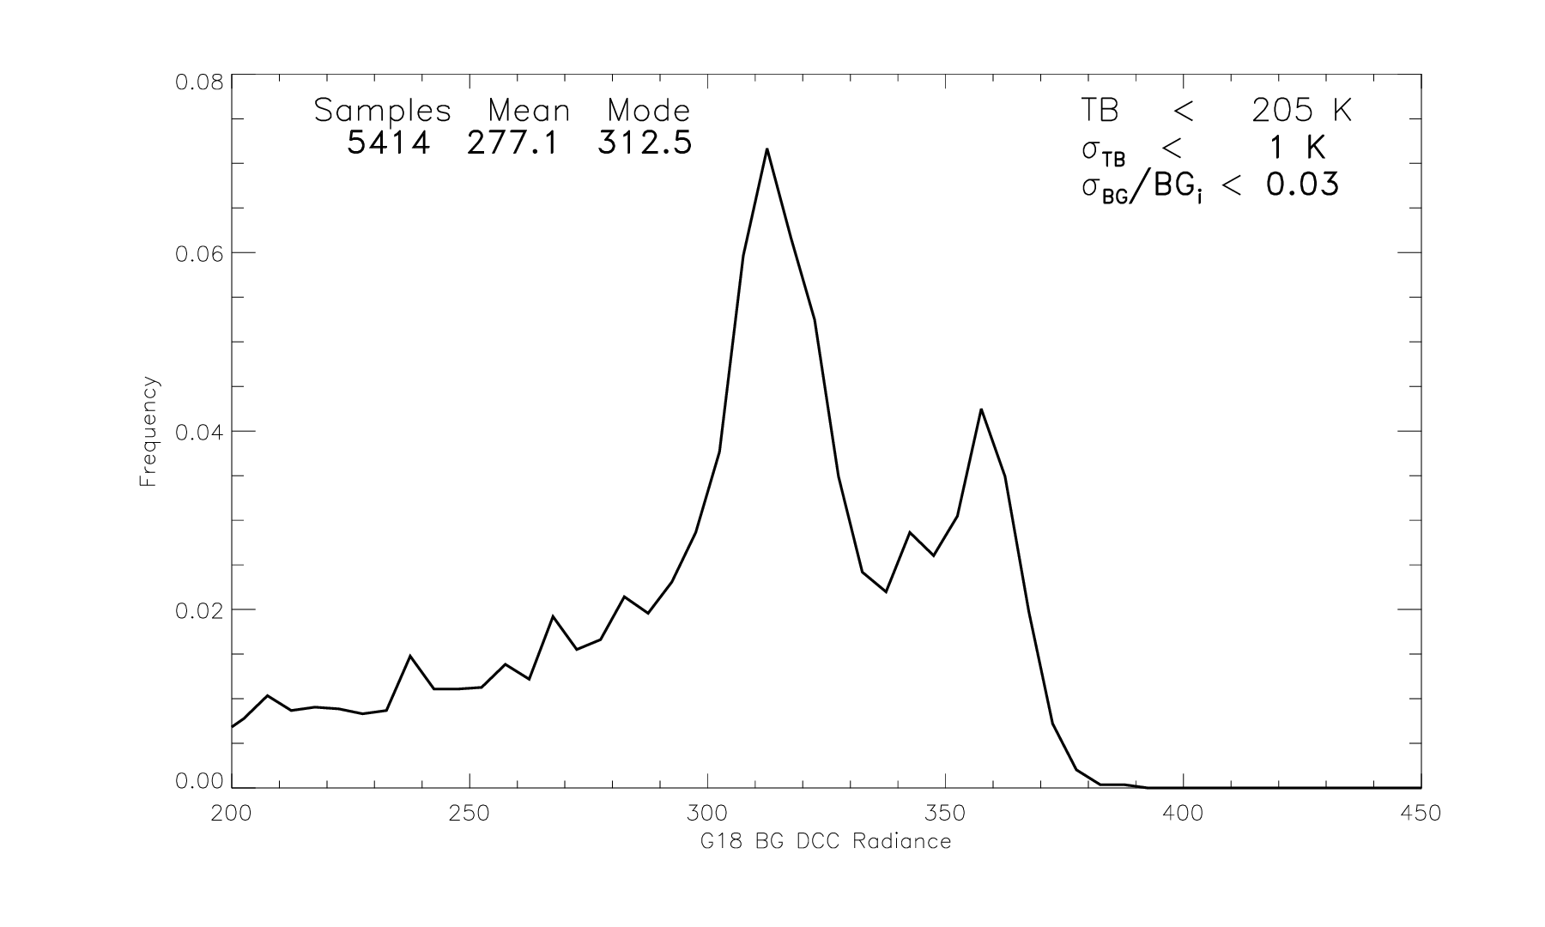
GLM-18 Background DCC (Buechler/UAH) over 7 days in Sep/Oct 2022
PASSED
PLPT-GLM-012
GLM18 Deep Convective Cloud (DCC) characterization
Mean DCC radiance comparable to previous GOES GLM sensors
NOAA's GOES-18 satellite has not been declared operational and its data are preliminary and undergoing testing. Users receiving these data through any dissemination means (including, but not limited to, PDA and GRB) assume all risk related to their use of GOES-18 data and NOAA disclaims any and all warranties, whether express or implied, including (without limitation) any implied warranties of merchantability or fitness for a particular purpose.
Notes:
Sample size: 6,725,357 matches

Slide 50
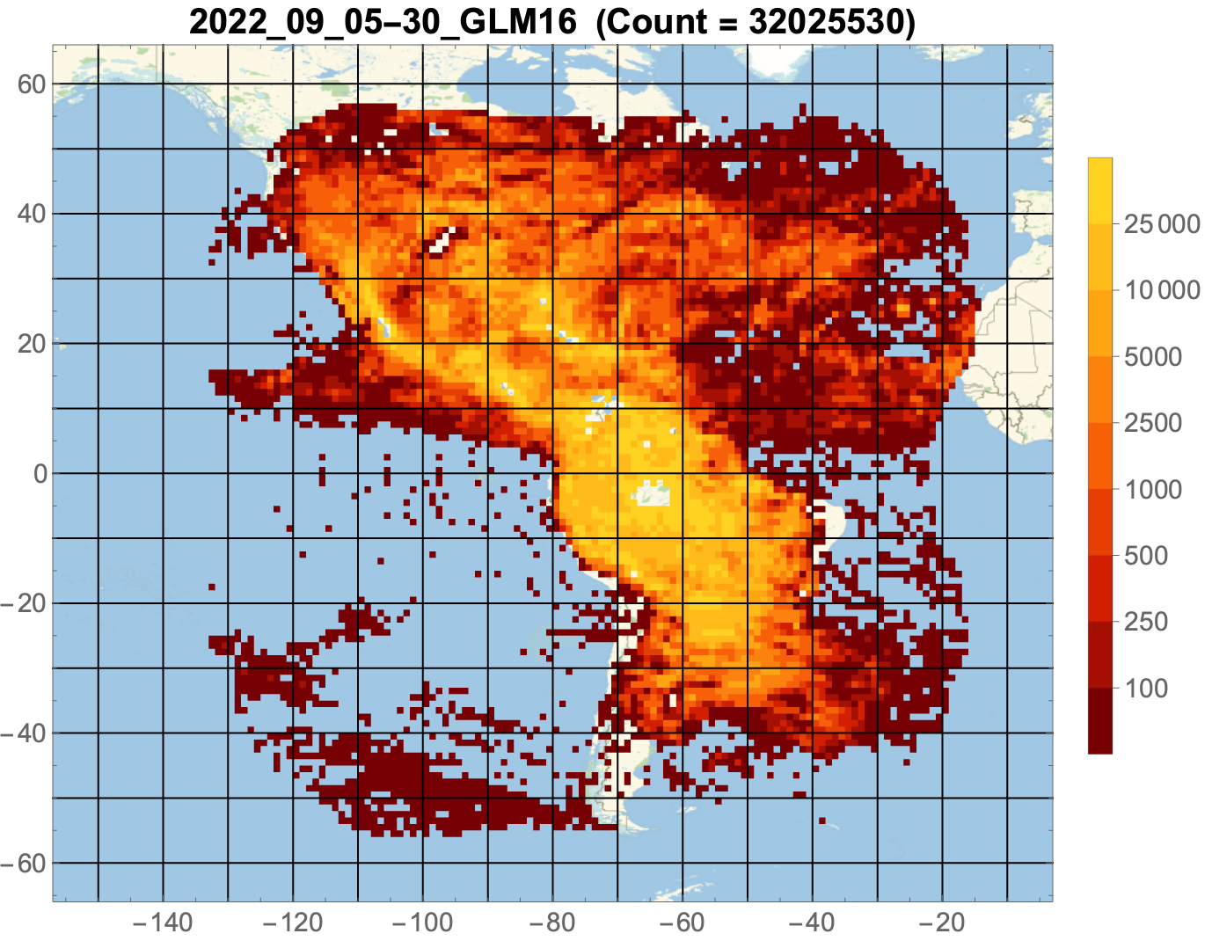
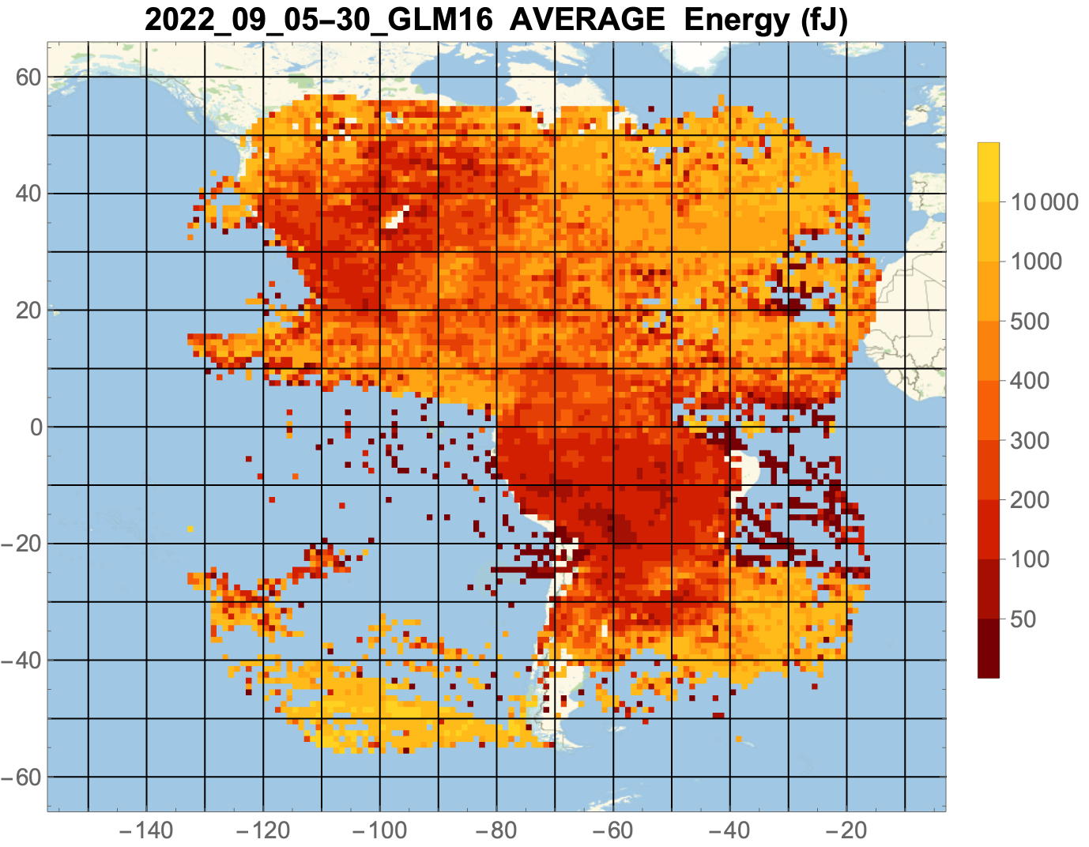
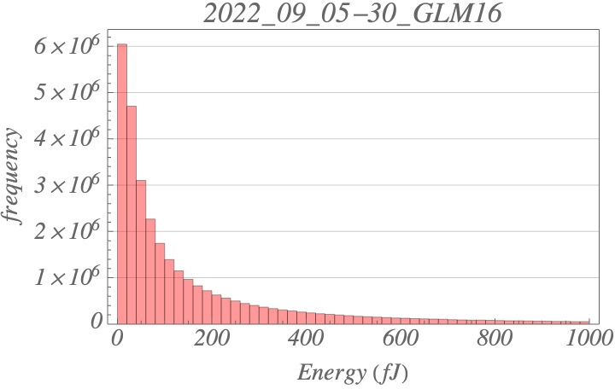
Optical Energy (Koshak/MSFC)
Bench-marking for long-term degradation checks
PASSED
PLPT-GLM-RAD-013
GLM-16
Sep 5-30, 2022
32.0 M flashes
237.1 fJ ave
NOAA's GOES-18 satellite has not been declared operational and its data are preliminary and undergoing testing. Users receiving these data through any dissemination means (including, but not limited to, PDA and GRB) assume all risk related to their use of GOES-18 data and NOAA disclaims any and all warranties, whether express or implied, including (without limitation) any implied warranties of merchantability or fitness for a particular purpose.
Notes:
Sample size: 6,725,357 matches

Slide 51
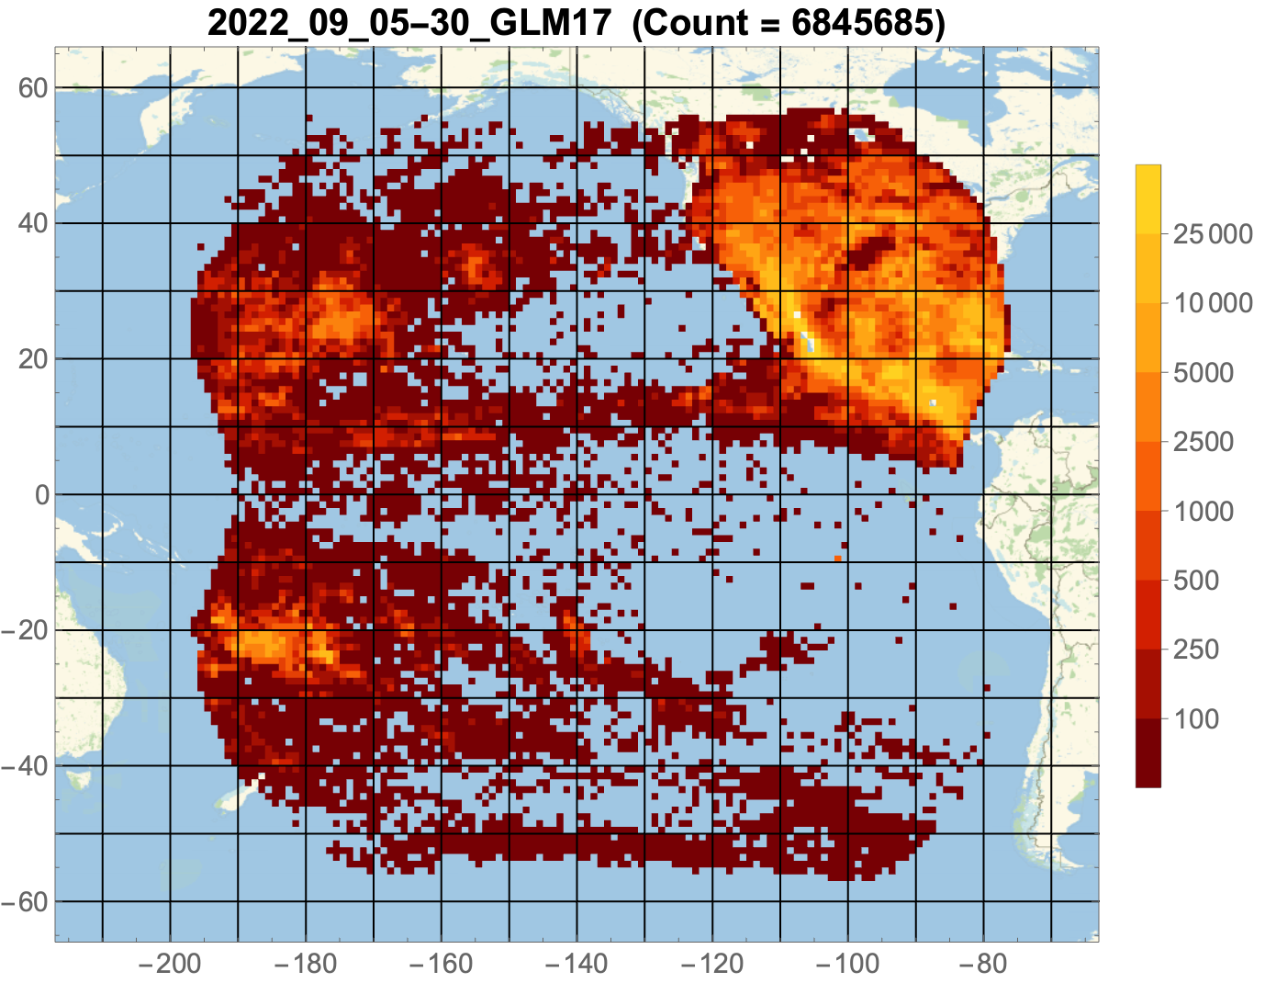
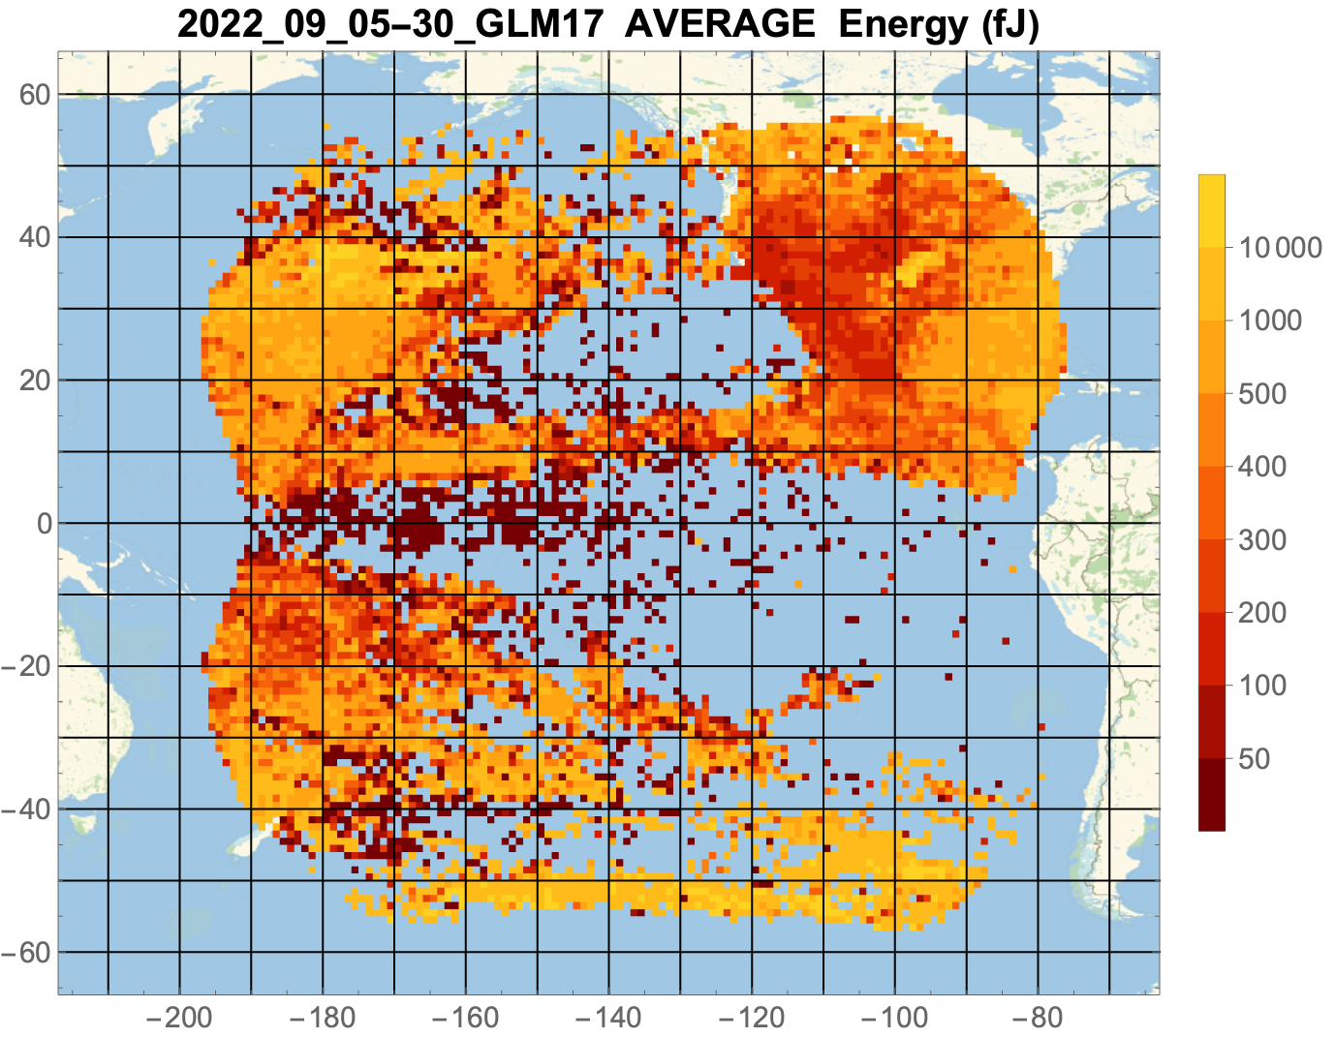
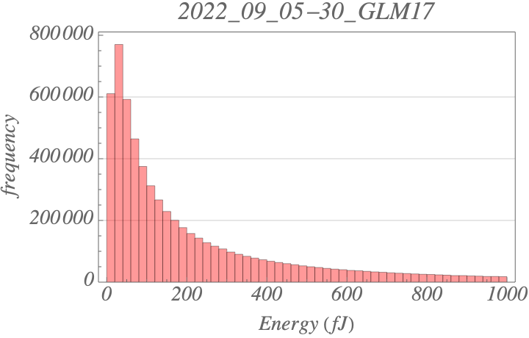
Optical Energy (Koshak/MSFC)
Bench-marking for long-term degradation checks
PASSED
PLPT-GLM-RAD-013
GLM-17
Sep 5-30, 2022
6.8 M flashes
443.8 fJ ave
NOAA's GOES-18 satellite has not been declared operational and its data are preliminary and undergoing testing. Users receiving these data through any dissemination means (including, but not limited to, PDA and GRB) assume all risk related to their use of GOES-18 data and NOAA disclaims any and all warranties, whether express or implied, including (without limitation) any implied warranties of merchantability or fitness for a particular purpose.
Notes:
Sample size: 6,725,357 matches

Slide 52
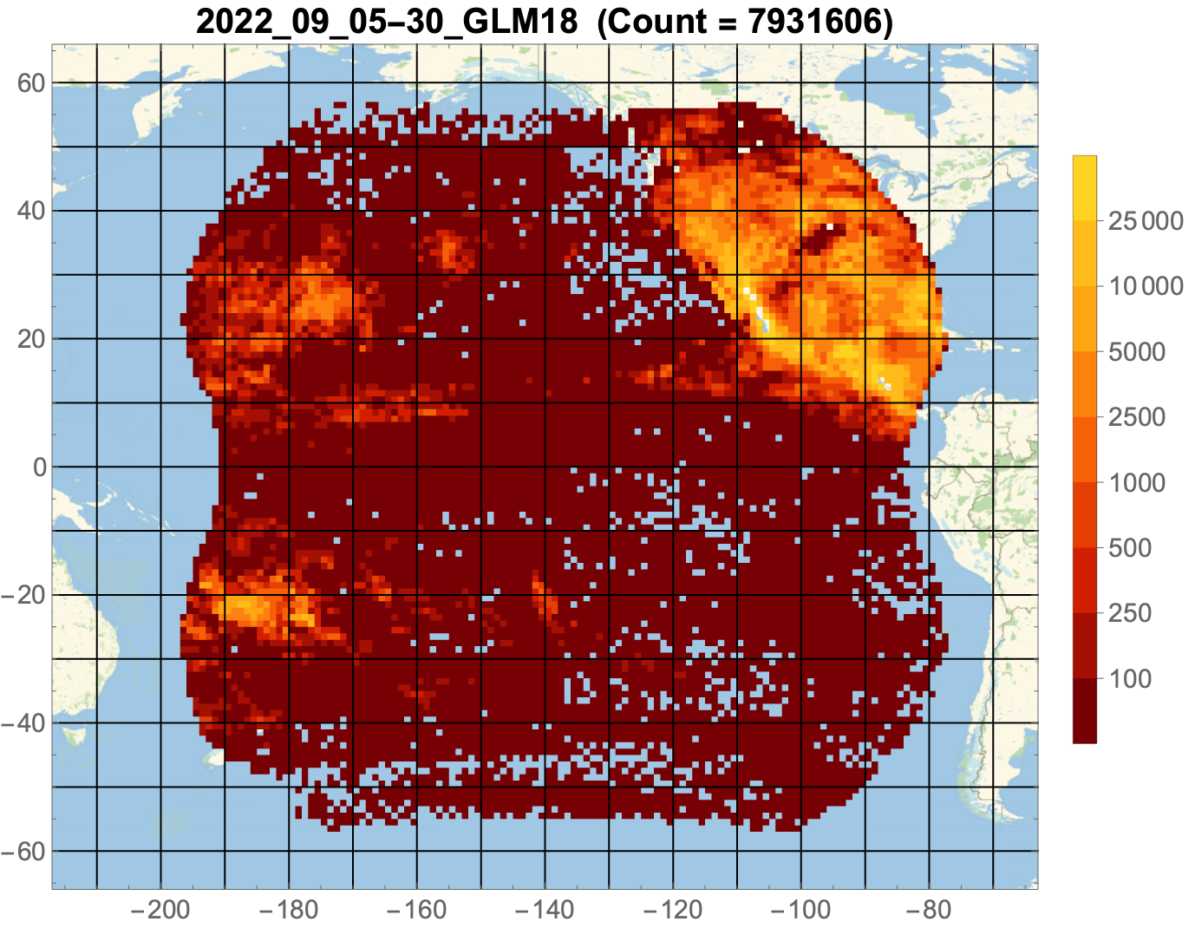
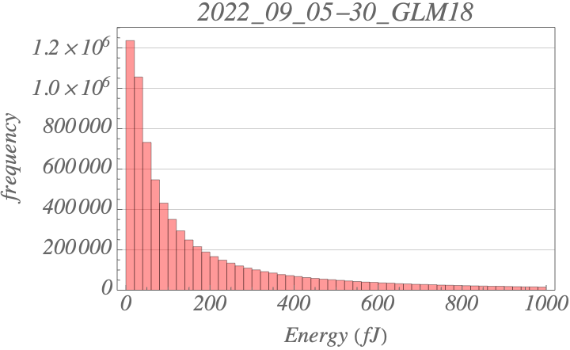
Optical Energy (Koshak/MSFC)
Bench-marking for long-term degradation checks
PASSED
PLPT-GLM-RAD-013
GLM-18
Sep 5-30, 2022
7.9 M flashes
314.6 fJ ave
More (low energy) flashes seen by GLM-18 than GLM-17 due to:
  SUVI ECI mid Aug to Sep 8
  Lower GLM-18 thresholds
NOAA's GOES-18 satellite has not been declared operational and its data are preliminary and undergoing testing. Users receiving these data through any dissemination means (including, but not limited to, PDA and GRB) assume all risk related to their use of GOES-18 data and NOAA disclaims any and all warranties, whether express or implied, including (without limitation) any implied warranties of merchantability or fitness for a particular purpose.
Notes:
Sample size: 6,725,357 matches

Slide 53
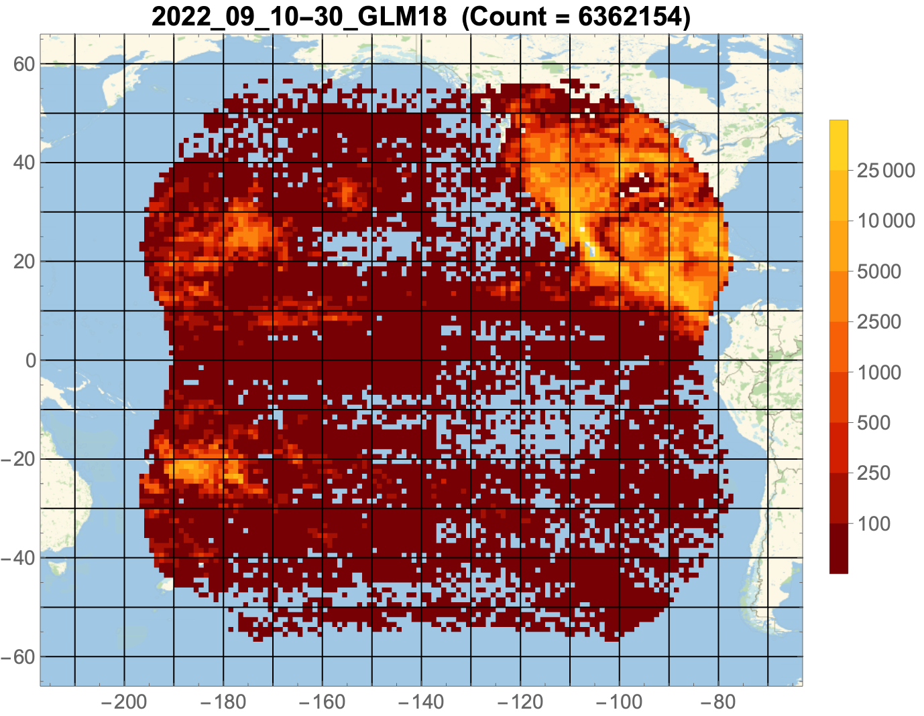
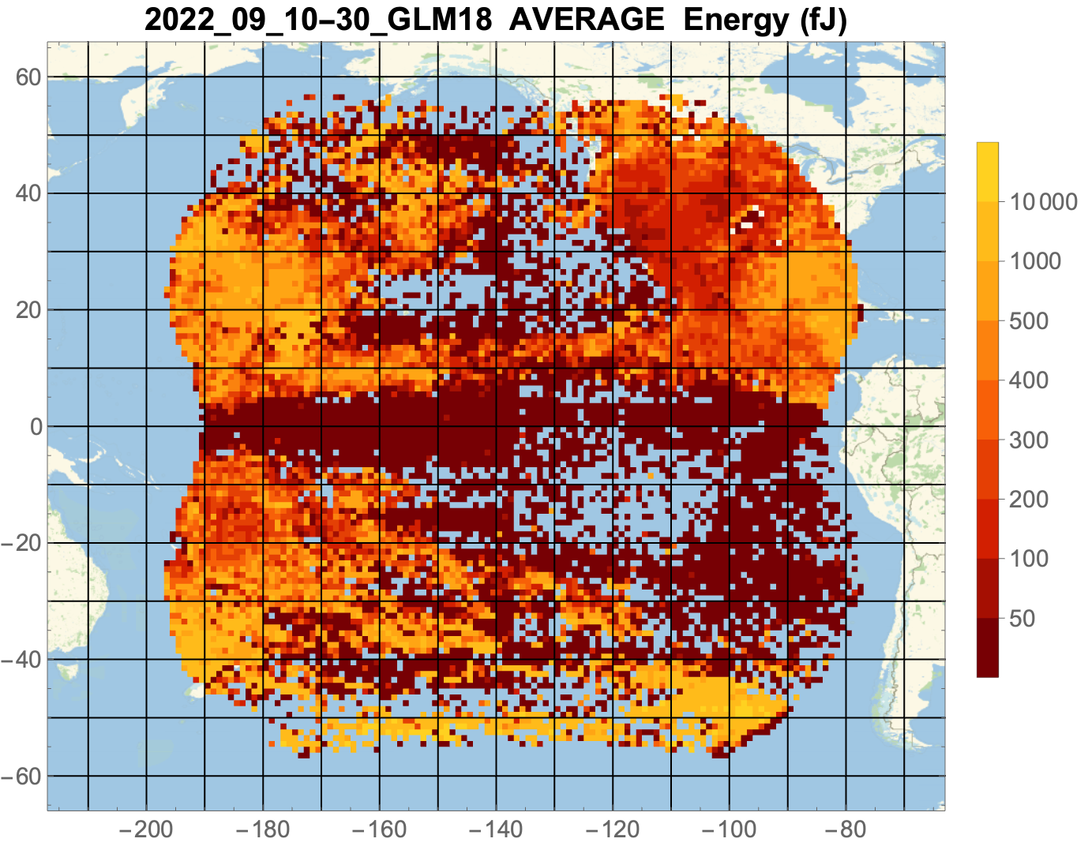
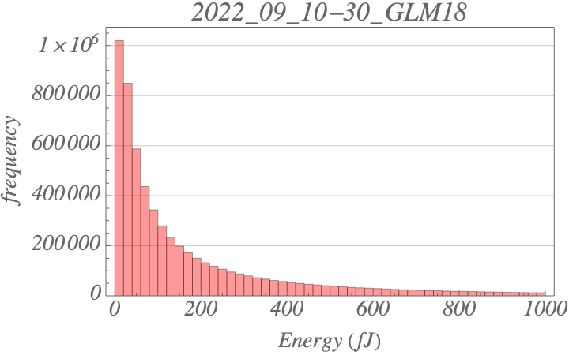
Optical Energy (Koshak/MSFC)
Bench-marking for long-term degradation checks
PASSED
PLPT-GLM-RAD-013
GLM-18
Sep 10-30, 2022
6.4 M flashes
304.2 fJ ave
SUVI ECI not accounting for the many low energy flashes … so presumably lower GLM-18 thresholds is the cause
NOAA's GOES-18 satellite has not been declared operational and its data are preliminary and undergoing testing. Users receiving these data through any dissemination means (including, but not limited to, PDA and GRB) assume all risk related to their use of GOES-18 data and NOAA disclaims any and all warranties, whether express or implied, including (without limitation) any implied warranties of merchantability or fitness for a particular purpose.
Notes:
Sample size: 6,725,357 matches

Slide 54
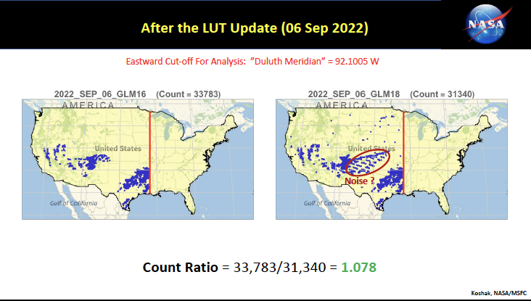
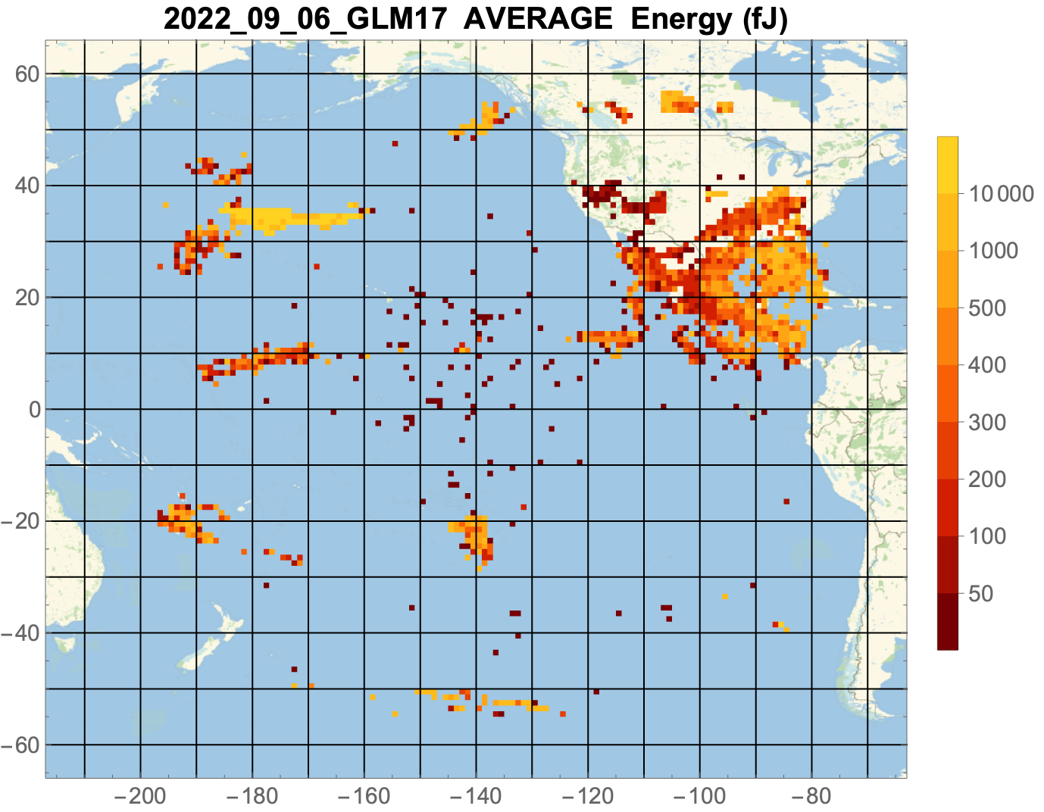
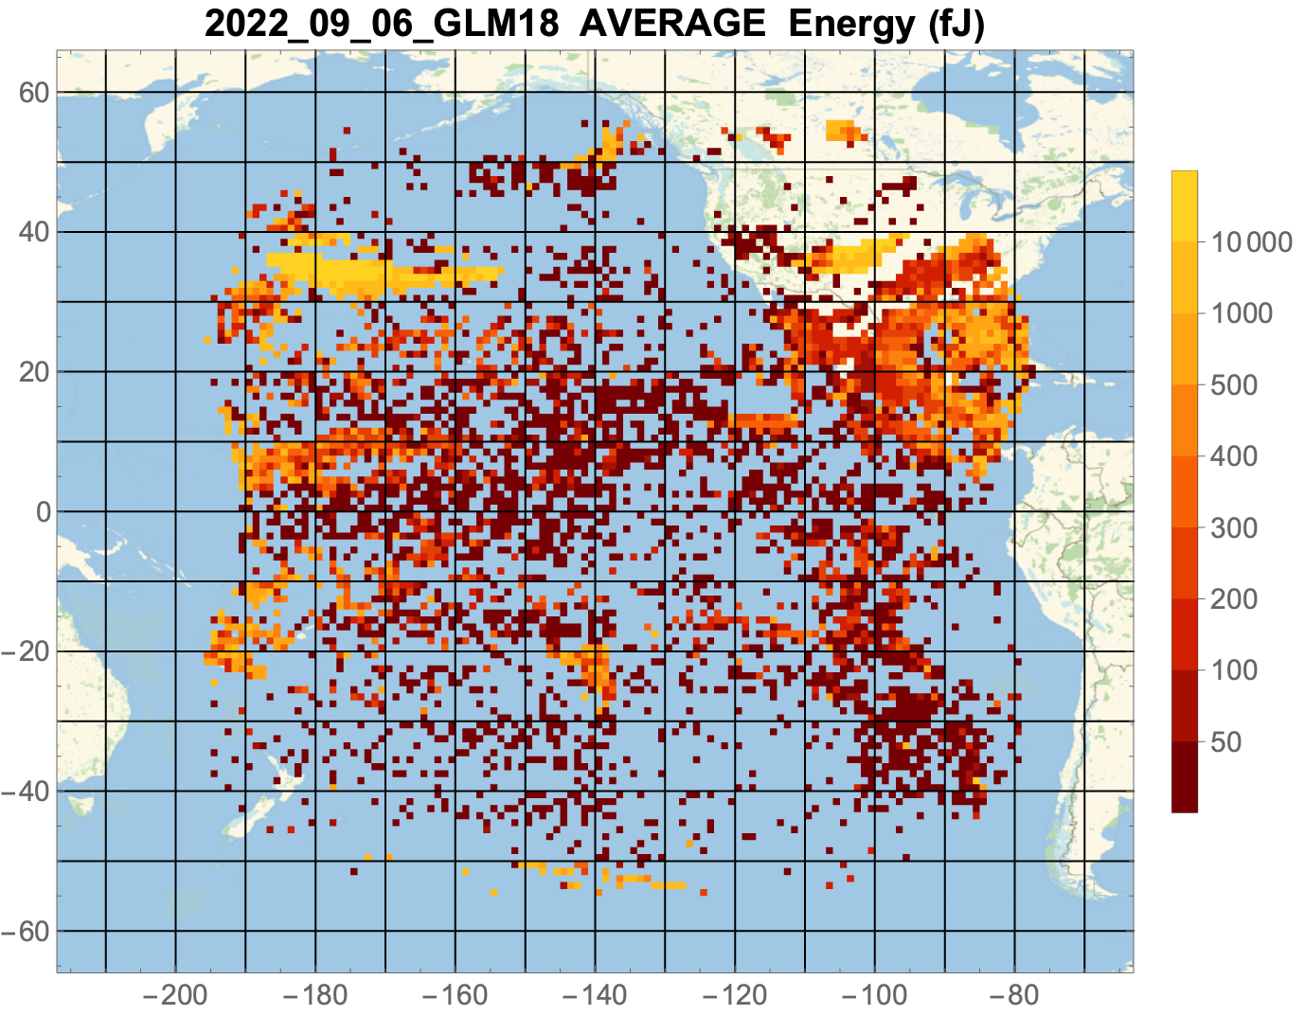
Optical Energy (Koshak/MSFC)
Identification of GLM-18 noise over CONUS
PASSED
PLPT-GLM-RAD-013
GLM-16/17/18
Sep 6, 2022
GLM-18 sees extreme energies over CONUS not seen by
GLM-16 & 17
GLM-16
GLM-18
GLM-17
GLM-18
NOAA's GOES-18 satellite has not been declared operational and its data are preliminary and undergoing testing. Users receiving these data through any dissemination means (including, but not limited to, PDA and GRB) assume all risk related to their use of GOES-18 data and NOAA disclaims any and all warranties, whether express or implied, including (without limitation) any implied warranties of merchantability or fitness for a particular purpose.
Notes:
Sample size: 6,725,357 matches

Slide 55
Outline
Introduction
Review of Beta Certification
Product Quality Evaluation Overview
Provisional Maturity Assessment
PLPT Details
Path to Full Validation
Summary and Recommendations

Slide 56
LUT Updates & Future Fixes
WR | ADR | Title | PR or DO | Date in OE | Impact to this VAL
 | 1291 | G18 GLM CDRL79 Rev F | PR.09.08.38 | 11/1/22 est | high
6412* | 549 | Eliminate GLM L1b dependency on APIDs 384 and 385 | DO.11.00.00 | Dec 2022 | medium
8478& | N/A | Add GLM Flash Extent Density product | DO.11.00.00 | Dec 2022 | medium
7178 | 906 | GLM CDRL79-to-GS LUT translation tool (a tool for LUT creation) | DO.11.00.00 | N/A | medium
7449 | N/A | GLM Geographic Coverage Extents are incorrect | DO.12.00.00 | Spring 2023 | low
 | 1234 | GLM Storage Slot LUTs | TBD | TBD | low
N/A | 1278 | GLM RTEP errors and warnings | TBD | TBD | medium
7538 | 1060 | Interim Solution to Facilitate GLM Gridded Product | HOLD | TBD | low
8479& | N/A | Add 5-minute accumulation to GLM Flash Extent Density | TBD | TBD | low
8964& | N/A | Store GLM Flash Extent Density product to LZSS | TBD | TBD | low
* WR6412 was reassigned to PRO PASS, as the only practical way to check it out is a code inspection.
& FED won't go out over AWIPS until we turn the spigot on (March 2023 at the earliest, but TNCF tests maybe before then). FED to LZSSc is a problem right now on the receive side … it's not set up for tar balls, so it may have to go to eGRESc instead. TOWR-S is fine either way

Slide 57
Outline
Introduction
Review of Beta Certification
Product Quality Evaluation Overview
Provisional Maturity Assessment
PLPT Details
Path to Full Validation
Summary and Recommendations

Slide 58
Summary
Flash DE meeting 70% spec:
  Virts and Koshak (2022) simulations confirm ±1 sec time window best for DE retrieval
  DE = 74%. (near the 73% DE of GLM-17 FULL PS-PVR)
  Mach (LCFA) and Koshak (energy) analyses show GLM-18 more sensitive than GLM-17
  Effect of most recent LUT update (affecting Blooming Filter) to be determined
Flash FAR above 5% spec, but in-family with GLM-17:
  Virts and Koshak (2022) simulations confirm ±10 min time window best for FAR retrieval
  FAR = 12% (near the 10% FAR of GLM-17 FULL PS-PVR)
  Mach (LCFA) and Koshak (energy) analyses show GLM-18 more sensitive than GLM-17
  Effect of most recent LUT update (affecting Blooming Filter) to be determined
  FAR could be lowered by raising thresholds and/or adjusting filters.
Location/timing meeting spec:
  3.5 km and -0.8 ms (same values for GLM 17 FULL PS-PVR)
  INR angles occasionally violate 140 microradian spec
Max Data Rates meeting spec:
  Can handle max Event, Group, and Flash data rates

Slide 59
Comment on 12% FAR Result
  Virts and Koshak (2022) simulations confirm that increasing matching time window to ±10 min does produce more accurate FAR results. This is because, as stated in Bateman et al. (2021), you are allowing Ref Net to detect some more flashes from the storm which can then get matched to the GLM flash.
  But this improvement can only be so much (i.e. is limited) if the Ref Net is so BAD that it detects very few or no flashes in the storm. (like over Pacific)
  So this means that GLM FAR is likely lower than the 12% value.
  Indeed: “800 lb Gorilla” is the very low FAR over CONUS where Ref Net DE is GOOD.
  So we believe GLM-18 FAR is still likely lower than 12%, but it is difficult to estimate exactly how much lower, and we know there is still real noise:
    Mach (LCFA) and Koshak (energy) analyses show GLM-18 noisier than GLM-17, due to GLM-18’s lower threshold settings
    There is still legitimate glint/solar-intrusion blooming in certain regions of GLM-18 FOV.

Slide 60
Recommendation
CWG believes that the GLM-18 L2 product (events, groups, flashes) has reached the Provisional Maturity as defined by the GOES-R Program.

