Slide 1
GOES-18 GMAG Provisional Certification PSPVR
09/16/2022
CU/CIRES – NOAA/NCEI
Aspen Davis, Alison Jarvis,
Paul Loto’aniu, Michael Grotenhuis, Frederick Rich,
Alessandra Pacini, Fadil Inceoglu
Thanks also to the rest of the NCEI Space Weather Group
GOES-R Calibration Working Group Organization
Acknowledgements:
NSOF, GOES-R Flight/NASA, Lockheed Martin, GSFC, Harris/GOES-R Ground
SWPC and Howard Singer

Slide 2
Agenda
GMAG overview
Instrument status review
Review of Beta level PLT outcomes
Product quality assessment
Path to Full Validation Maturity
Summary and Recommendation

Slide 3
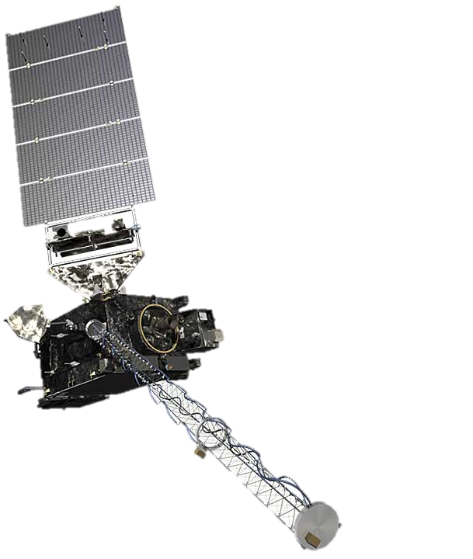
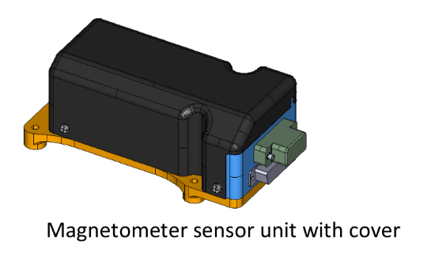
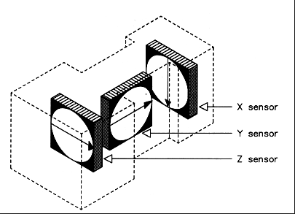
GMAG Overview
Characteristics | GOES 8-12 | GOES 13-15 | GOES R-U
3-axis fluxgates | 2 | 2 | 2
Sampling Rate | 2 Hz | 2 Hz | 10 Hz
Low-Pass Filter Cutoff | 0.5 Hz | 0.5 Hz | ~2.5 Hz
Boom Length | 3 m | 8.5 m | 8.5 m
Inboard (IB) GMAG
0.3 nT noise requirement.
1 nT accuracy requirement (but performance requirements for GOES-16/GOES-17 were loosened).
Two boom-mounted fluxgate magnetometers - Inboard GMAG (IB) 6.3 m from boom base and Outboard GMAG (OB) 8.5 m from the base.
GOES-16 and GOES-17 sensor units built by Macintyre Electronic Design Associates (MEDA) Inc, in Virginia, under contract from the instrument vendor Lockheed Martin.
GOES-18 sensor units, called GMAG, built by NASA-GSFC Planetary Magnetospheres Lab in Maryland, under a contract separate from the spacecraft.
Outboard (OB) GMAG

Slide 4
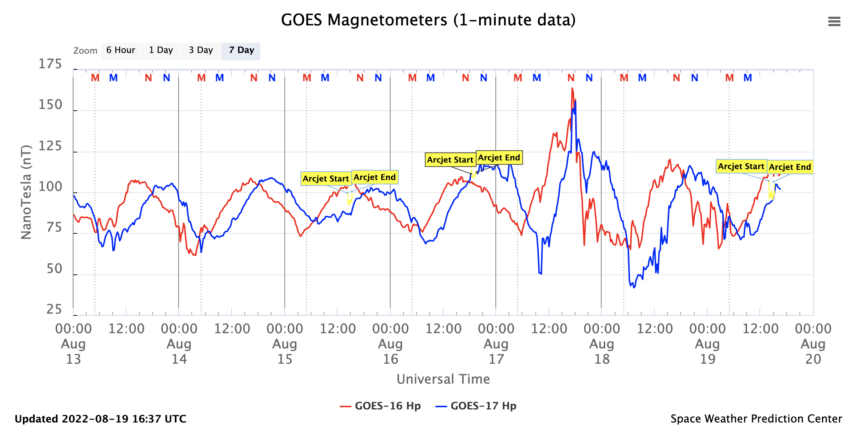
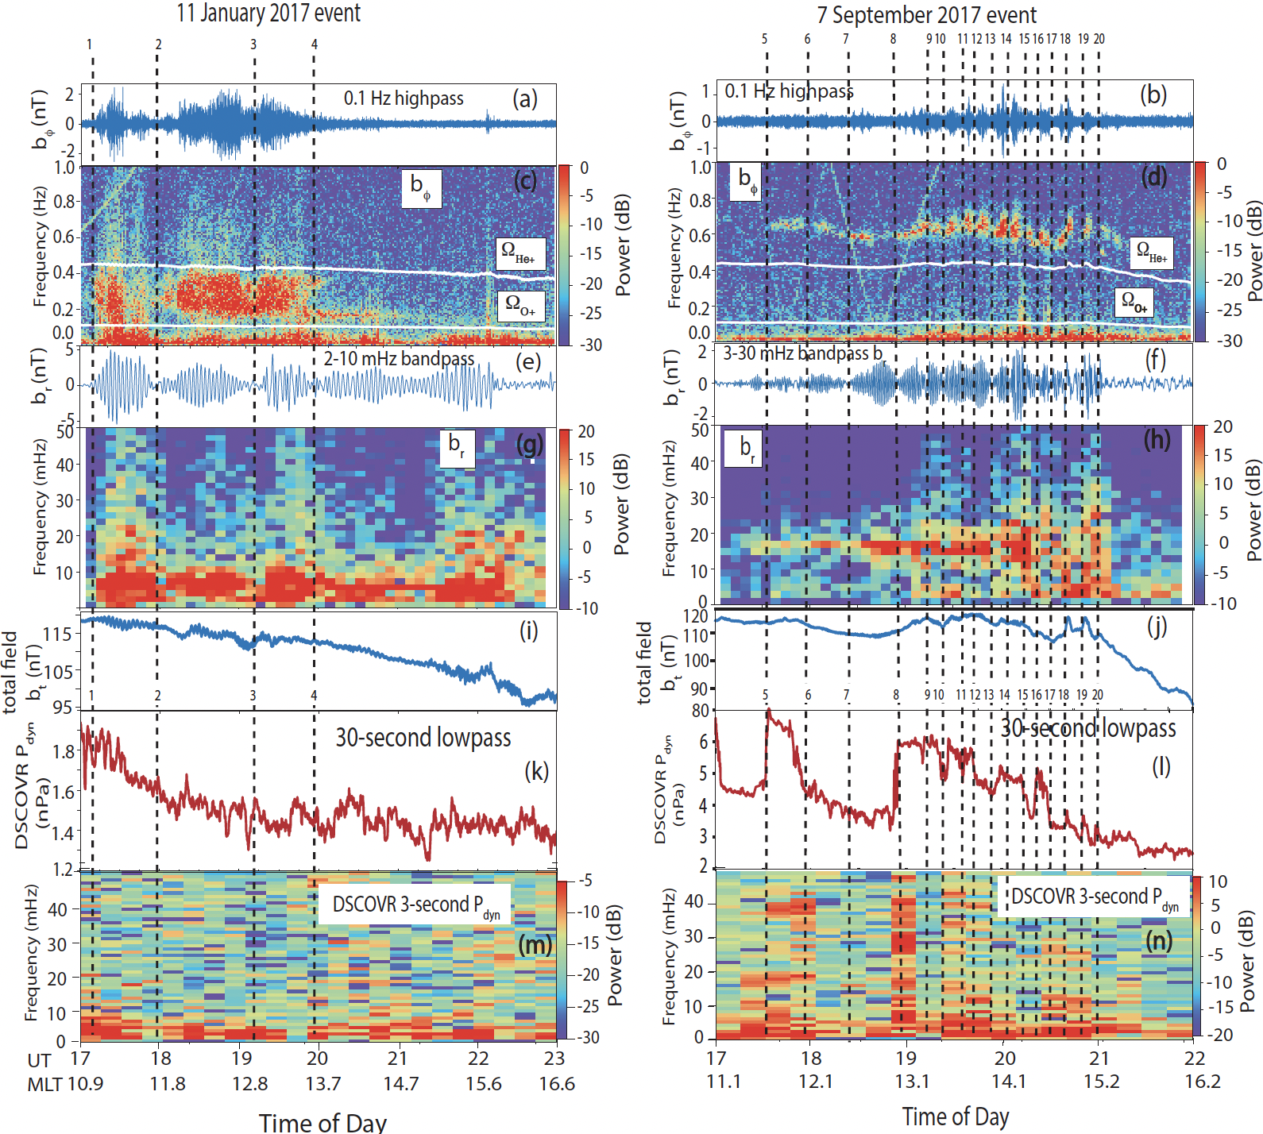
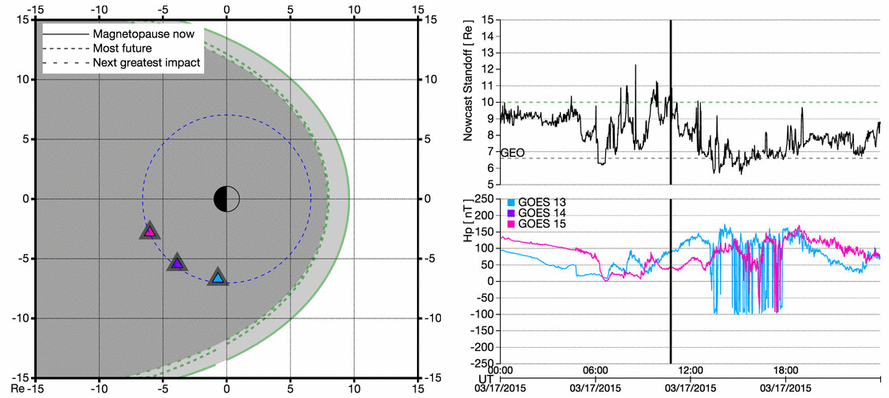
Data Usage
Operationally used by forecasters at SWPC
Real-time magnetometer dashboard on SWPC website
https://www.swpc.noaa.gov/products/goes-magnetometer
Scientific usage for research
Event identification
Figure 1, Loto’aniu et al. 2020, https://doi.org/10.1002/essoar.10503339.1
Continuing towards operational implementation of products such as magnetopause crossing identification

Slide 5
Instrument Status Review

Slide 6
Schedule of Previous Maturity Levels
GOES-18 GMAG turned on and boom deployed on 23 Mar, 2022
Beta level (Vendor) PLTs completed and Beta declared on 11 July, 2022
PLPTs (NCEI) supporting Provisional have been continuing
Ongoing
Machine learning algorithm to improve arcjet correction
Bias stability and accuracy monitoring as required
Continuing study into scientific usability of magnetometer data
Operationally implementing products such as magnetopause crossing and quiet field model for use by SWPC
Researching and generating new products

Slide 7
Review Of Beta Level PLT Outcomes

Slide 8
Post Launch Test (PLT) and Milestones Timeline
Event | Description | Start | End
1 | GMAG Boom is deployed | 3/23/22 10:40 | 3/23/22 13:43
2 | GMAG Data Flow | 3/23/22 13:43 | n/a
3 | (003) GMAG Sensitivity to Interference (Start) | 3/23/22 13:43 | 6/28/22 1:05
4 | (004) GMAG Sensor Difference Comparison [Start Daily Series] | 3/23/22 13:43 | 7/12/22 13:00
5 | (002) GMAG Calibration Step Test | 3/28/22 16:15 | 3/28/22 16:22
6 | (005) GMAG Inboard Temperature Set Point | 4/15/22 16:00 | 4/24/22 15:50
7 | (005) GMAG Outboard Temperature Set Point | 5/2/22 16:00 | 5/8/22 15:47
8 | 1st Possible GMAG Public Outreach | 5/4/22 13:00 | n/a
9 | (001) GMAG Initial Bias and Calibration 3 Rev 1 | 6/29/22 18:30 | 6/29/22 22:30
10 | (001) GMAG Initial Bias and Calibration 1 Rev | 7/6/22 18:21 | 7/6/22 18:21
11 | (Opportunity) GMAG Entrance Criteria met - Beta | 7/11/22 14:21 | n/a
12 | (001) GMAG Update LUTs to Ground System | 8/3/22 23:30 | 8/4/22 0:30
13 | (001) GMAG LUTs Implemented in GPA | 8/8/22 14:00 | 8/8/22 15:00

Slide 9
PLT’s Under Review
PLT ID | Descriptive Title | % Complete | Results | Delivered Vendor Report | CWG POC
G18-C-PLT-MAG-001 | Calibration Maneuver | 100 | Pass | Final report submitted Aug 19, 2022 | Mike Grotenhuis
G18-C-PLT-MAG-002 | Health Test | 100 | Pass | Final report submitted Mar 29, revised Aug 23, 202 | Mike Grotenhuis
G18-C-PLT-MAG-003 | Sensitivity to Interference | 100 | Pass | Final report submitted Aug 23, 2022 | Jacob Gruesbeck
G18-C-PLT-MAG-004 | Sensor difference/ratio | 100 | Pass | Final report submitted Aug 23, 2022, continuous updates | Mike Grotenhuis
G18-C-PLT-MAG-005 | Temperature Setpoint Test | 100 | Pass | Final report submitted May 19, 2022, revised Aug 23, 2022 | Mike Grotenhuis
Required for Beta Maturity : PLT-002,-003,-004,-005

Slide 10
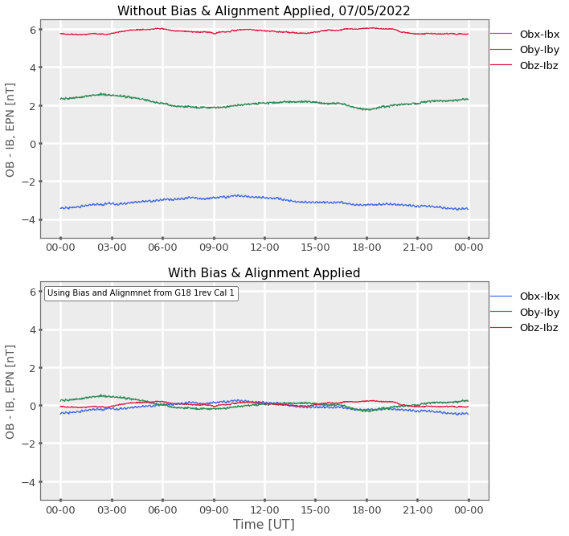
PLT G18-C-MAG-001: Calibration Maneuver
PASSED
One 3rev maneuver and one 1rev maneuver performed to determine the sensor zero-level bias and alignment offset
Improvements made to the calibration determination algorithm
Values determined from 3rev were uploaded to the LUT and implemented on 8/8/2022
Applying bias and alignment to field data improves the OB-IB offset significantly
 | OBx | OBy | OBz |  | IBx | IBy | IBz
Bias – 3rev [nT] | 4.28 | -1.52 | -2.25 |  | 3.13 | -2.54 | 7.66
Bias - 1rev [nT] | 4.19 | -1.57 | -2.47 |  | 3.14 | -2.48 | 7.83
Alignment – 3rev [rad] | 0.0019 | -0.0024 | -0.0107 |  | 0.0031 | 0.0016 | 0.0130
Alignment – 1Rev [rad] | 0.0011 | -0.0031 | -0.0118 |  | 0.0021 | 0.0022 | 0.0141

Slide 11
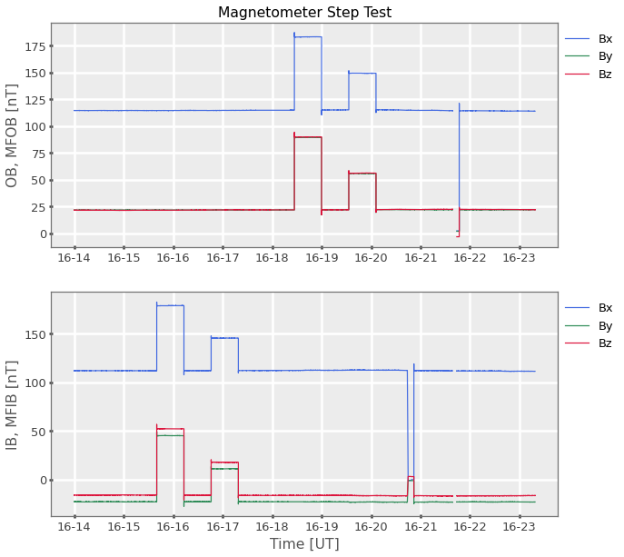
PLT G18-E-MAG-002: Health Test
PASSED
The Goddard Magnetometer provides the functionality to place a known incremental step on all axes of a specified sensor
Testing that the GMAG measures the full range of values that might be observed in space
GMAG successfully registered all pulses proportionally to the input signal as expected

Slide 12
PLT-G18-E-MAG-003 Sensitivity to Interference
PASSED
Test subsystems to demonstrate that no stray fields are greater than magnetometer noise requirement
Noise requirement : 0.3 nT
Outside of the Arc Jet disturbances, none of the spacecraft generated fields cause the magnetometer measurement to exceed the required noise levels.
Arcjet signature was expected and there is ongoing work to generate a correction (more details on correction in following sections)
Events involving spacecraft slewing do cause changes in magnetic field, but these are expected
IMU to ST Calibration Large Slews, IMU to ST Calibration Small Slews, and SEGA Resolver Calibration
Sensitivity to interference monitoring continues through full validation
Subsystem | B Field Change
Momentum Adjustments | Within requirement
Aux Comm Power On | Within requirement
LTR Thruster Calibrations | Within requirement
GLM Initial Power On | Within requirement
SUVI Initial Power On | Within requirement
EXIS Power On | Within requirement
East West Station Keeping | Within requirement
IMU to Star Tracker Calibration (small and large slews) | Within requirement
SUVI-GT/FSS Alignment Calibration | Within requirement
SEGA Resolver Calibration | Within requirement
SEISS DPU On | Within requirement
SEISS Sensor Suite Power On | Within requirement
ABI Full Up Operational Config | Within requirement
GLM to Normal Mode | Within requirement
ABI Solar Calibration | Within requirement
Zero Crossings of Reaction wheels | Within requirement
SUVI Boustrophedon Test | Within requirement
Umbra Entrance and Penumbra Exit | Within requirement
Arcjet Effect – North South Station Keeping | above requirement - expected
From GMAG vendor team

Slide 13
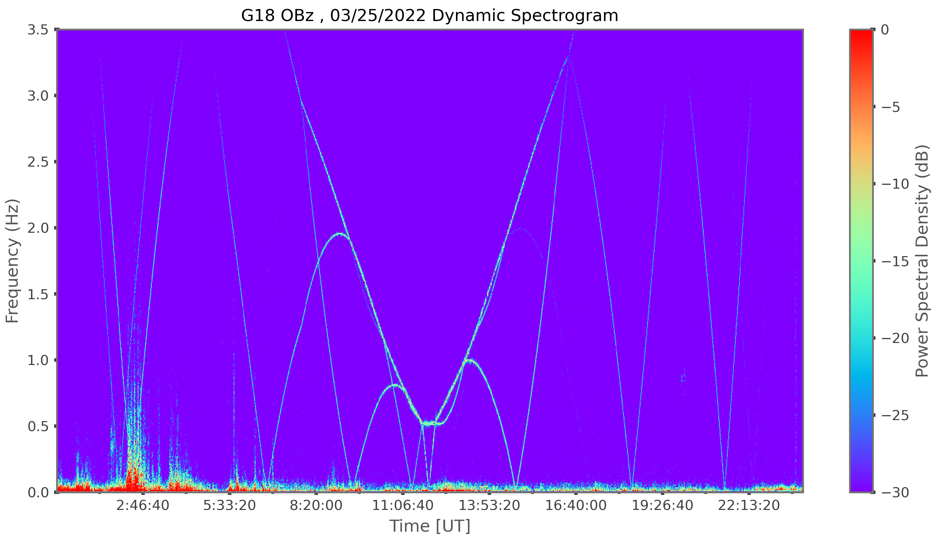
PLT-G18-E-MAG-003 : Reaction Wheel Zero Crossing
PASSED
FFT during RW zero crossing
G18 OBz dynamic spectrogram
OB
Noise requirement
Reaction wheel
Zero crossing
IB
FFT of reaction wheels shows that noise level is below requirement
Reaction wheel signatures clearly visible in dynamic spectrogram as expected
From GMAG vendor team

Slide 14
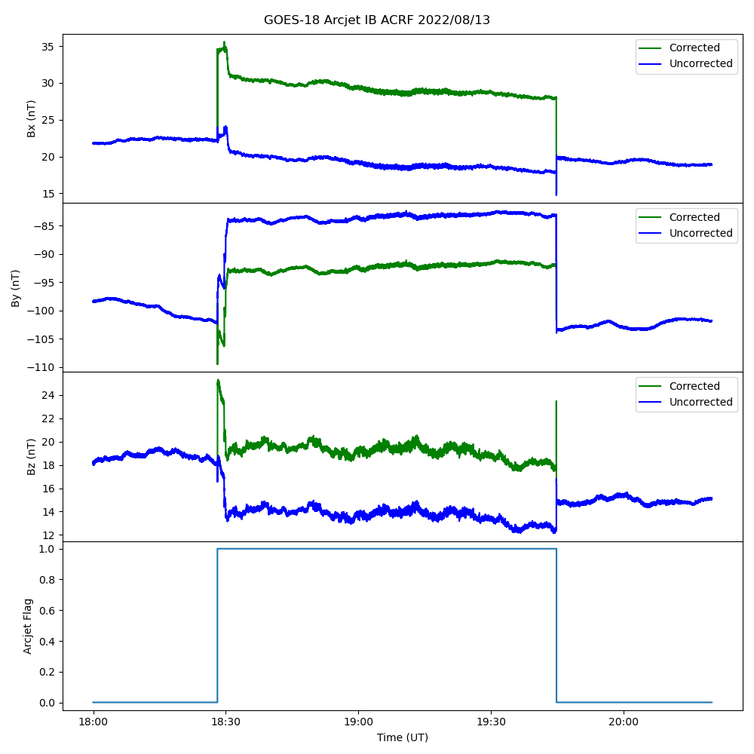
PLT-G18-E-MAG-003 Arcjet Effect
Arcjet firings have interference effects on magnetometer data, similar to GOES-16 and 17
GOES – 18 firings generally occur for up to 90 minutes once every 4 days
Firings are flagged, however, the current correction is not valid
Modified firing schedule on GOES-16 due to low power has led to more frequent, short bursts with different configuration
GOES-18 correction matrices have not yet been determined due to different configuration pairings and needing further analysis

Slide 15
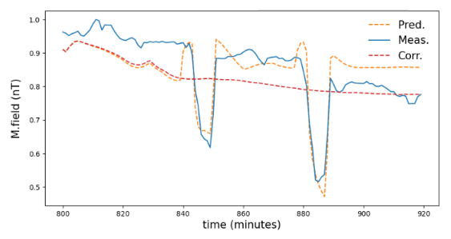
PLT-G18-E-MAG-003 New Arcjet Correction
The arcjet correction that is currently used does not work for all GOES-R satellites or arcjet configurations
NCEI is developing a new correction algorithm to remove the arcjet signal using machine learning
The correction is being developed for GOES-16 currently, and a preliminary results is shown to the right
Arcjet Correction Preliminary Result- GOES 16
Arcjet effect

Slide 16
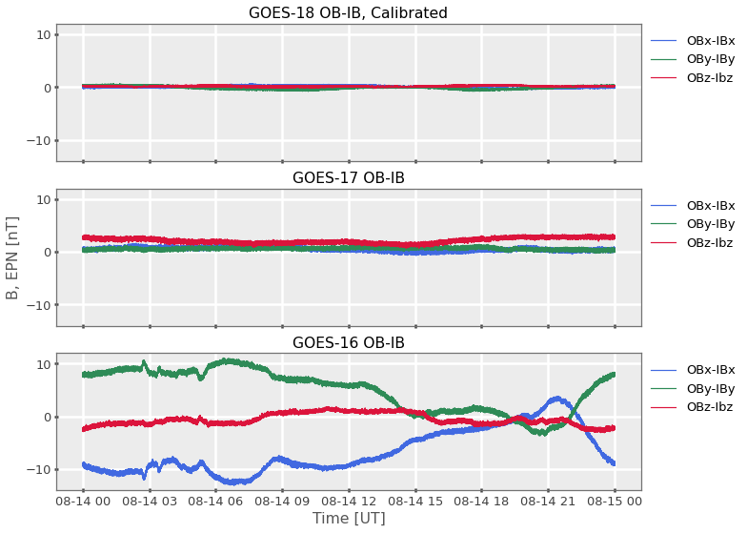
PLT-G18-E-MAG-004 Sensor Difference Comparison
PASSED
OB (outboard) – IB (inboard) differences for GOES-16, 17 and 18 (calibrated)
Ideal, calibrated sensors would have 0nT OB-IB difference and be flat throughout the day
Significant improvement from GOES-16 to GOES-18, note consistent y-axis range
Calibrations bring GOES-18 differences close to 0
Does not vary more than 1nT per 24 hours
Sensor differences
GOES-18 Calibrated [nT] | Obx-Ibx | Oby-IBy | Obz-IBz | Total Field | |OB|/|IB|
Standard deviation 4 hours MLT noon | 0.08 | 0.18 | 0.06 | 0.19 | 1

Slide 17
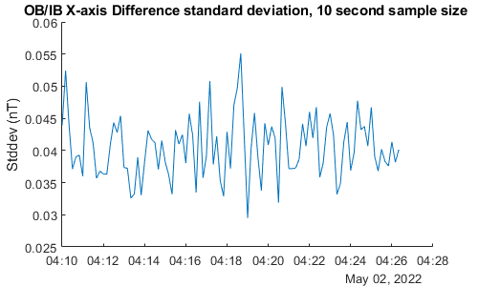
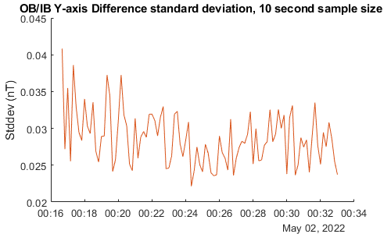
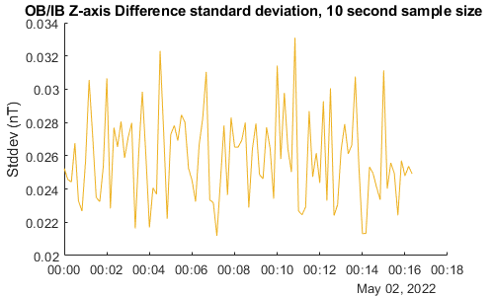
PLT-G18-E-MAG-005 Magnetometer Thermal Sensitivity
PASSED
GOES magnetometers have multiple heaters to control thermal environment of the sensors
PLT 005 Determines optimal heater setpoint for GMAG
Throughout the day, there is not a large change between the IB and OB sensors, even with heater duty cycle changes due to orbital thermal environment changes
No compelling reason to modify temperature from recommended setpoint of 23 C
Continued investigations as part of full validation
OB-IB Standard Deviation, X
Y
Heater Duty Cycle over ~24 hours
Max duty cycle 60.0 %
1 sigma average (nT)
X: 0.0406
Y: 0.0287
Z: 0.0259
Z

Slide 18
Product Quality Assessment
For Provisional Level

Slide 19
Provisional Validation PLPT’s NCEI
Descriptive Title | Activity | Data needed | Success criteria | Results
PLPT-MAG-001-Comparison to quiet field models | Validate GMAG L1b product for geomagnetically quiet conditions (Kp <2) by comparing to accepted models of Earths internal plus external magnetospheric field. | 7 days (need not be contiguous) | Data demonstrate that GMAG measurements are close to magnetic field model values. | pass
PLPT-MAG-002- Cross-satellite intercalibration (1 min data) | Validate GMAG l1b product by comparing it to operational GOES-R Series in situ magnetometer instruments. | 7 days (need not be contiguous) | Data demonstrate that GMAG observations are consistent with other spacecraft observations. | pass
PLPT-MAG-003- Noise Performance | Determine the noise level of the product and compare it to the MRD values of no more than 0.3 nT on each axis. | 7 days (need not be contiguous) | Noise level of the product has been determined and compared to 0.3 nT requirement. | pass
From MAG RIMP v2.0, July 2021

Slide 20
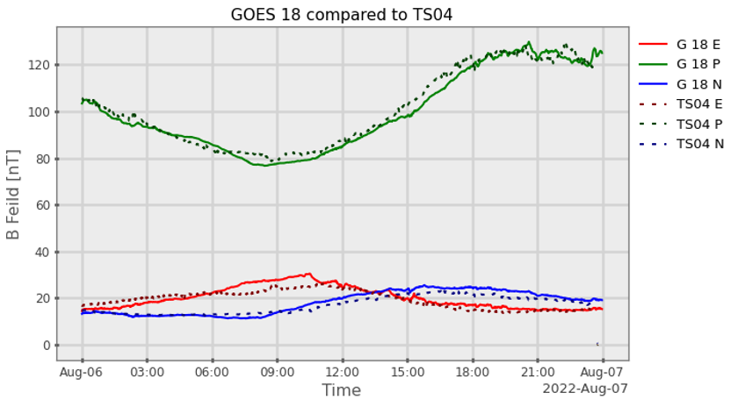
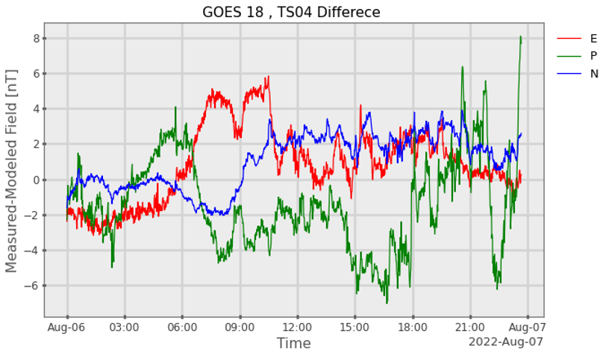
PLPT-MAG-001 Comparison to Models
PASSED
GOES-18 1 minute average data was compared to the Tsyganenko 2004 model (TS04) for quiet time conditions
Our implementation of TS04 model successfully incorporates solar wind parameters that are propagated from DSCOVR (L1) to the Earths bow-shock
previous method required waiting 6-8 weeks for solar wind data
Example of quiet day 08/06/2022, with updated RevB LUT applied to GOES-18 data
Model profile matches GOES-18 within -6, +8 nT

Slide 21
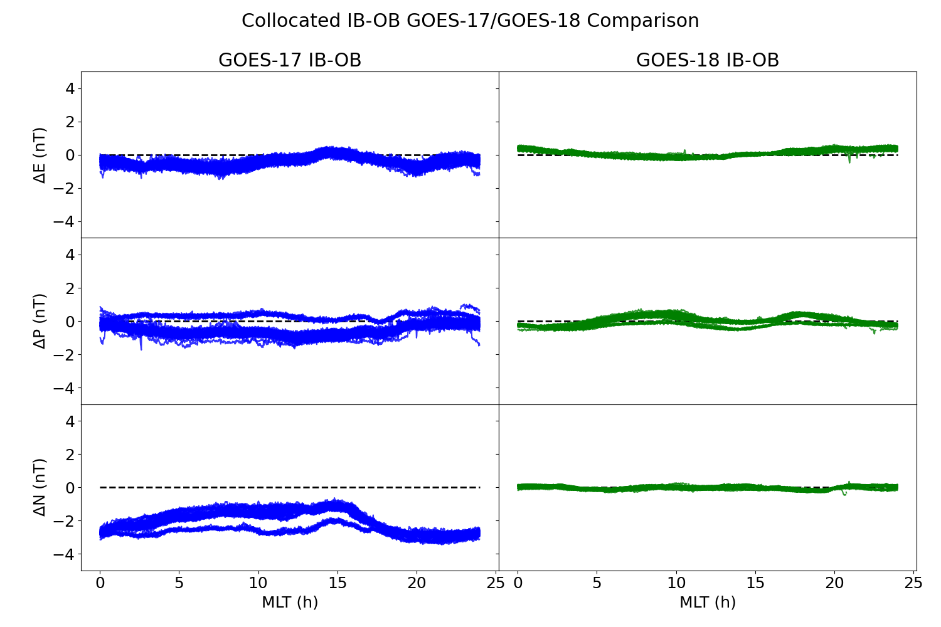
PLPT-MAG-002 Cross-Satellite Intercalibration: IB-OB differences
PASSED
Collocation comparison of GOES-17 and GOES-18 is subject to inaccuracies in both satellites, not just GOES-18. Comparisons can only be as accurate as GOES-17.
Plot at right demonstrates IB-OB minute averages of EPN data, which is overlaid for each day of the collocation period (6/1 – 8/15) - discounting GOES-17 thermal tests and arcjet firings.
The table below shows the average and standard deviation for this data.
1.5 months of data
Mean +/- σ | EPN E (nT) | EPN P (nT) | EPN N (nT)
GOES-17 | -0.428 +/- 0.30 | -0.473 +/- 0.44 | -2.100 +/- 0.62
GOES-18 | 0.091 +/- 0.21 | -0.004 +/- 0.26 | -0.008 +/- 0.11

Slide 22
PLPT-MAG-002 Cross-Satellite Intercalibration
PASSED
GOES 18 – GOES 17 Statistical Difference | EPN E (Mean + 3σ nT) | EPN P (Mean + 3σ nT) | EPN N (Mean + 3σ nT) | EPN Total Field (Mean + 3σ nT)
Outboard | 1.149 | 0.621 | 1.856 | 0.581
Inboard | 1.588 | 1.337 | 1.058 | 1.690
Data from 7 quiet days (Kp < 2) with no arcjet firings were used for the following analysis.
The table above shows statistical values for the difference between GOES-17 and GOES-18 for inboard and outboard data, both component wise and for the total field.
The plot to the right is a representative example of GOES-17 data compared to GOES-18 on a quiet day. Note the better inter-comparison at noon UT, and the constant offset in N.
Difference @ noon UT: 0.3 nT
Δ over day: 1.5 nT
Difference @ noon UT: 0.1 nT
Δ over day: 0.5 nT
Difference @ noon UT: 1.3 nT
Δ over day: 0.4 nT

Slide 23
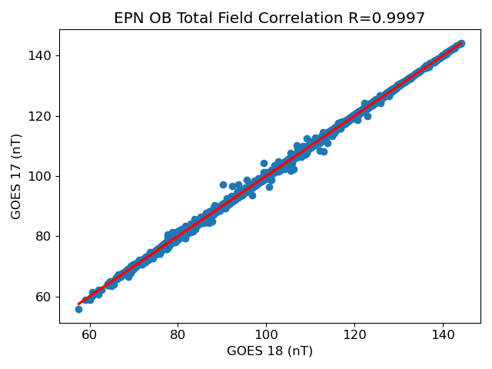
PLPT-MAG-002 Cross-Satellite Intercalibration
PASSED
The plot at left shows the correlation between outboard EPN GOES-18 and GOES-17 data for 7 quiet days.
The table below shows statistics from this correlation for the outboard and inboard sensor, for each component and total field. All had linear correlations with $R^{2}$ > 0.99.
Non- zero Y-intercept indicates bias differences
Qualitatively, we consider GOES-18 magnetometers meet the 1nT requirement outside of arcjet firing times. Quantitative accuracy is part of ongoing work towards full validation
2
Slope / Intercept | EPN E | EPN P | EPN N | EPN Total Field
OB | 0.998 / -1.086 | 1.037 / -0.048 | 0.999 / 1.757 | 0.998 / 0.178
IB | 1.037 / -1.743 | 1.010 / -1.783 | 0.975 / -0.237 | 1.006 / -1.748

Slide 24
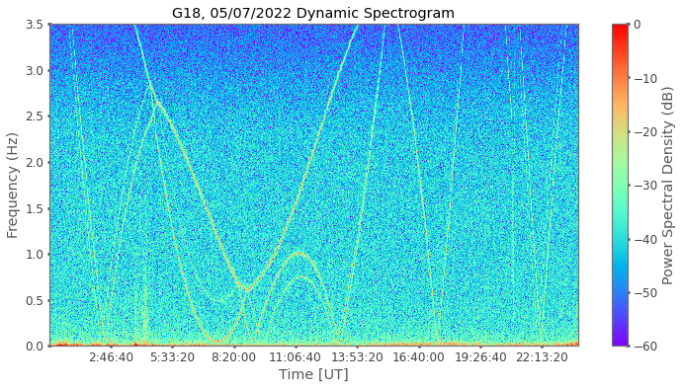
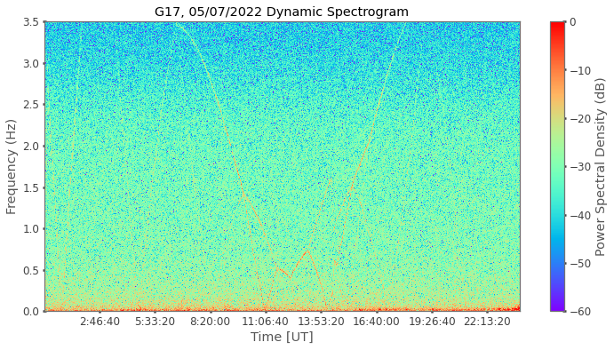
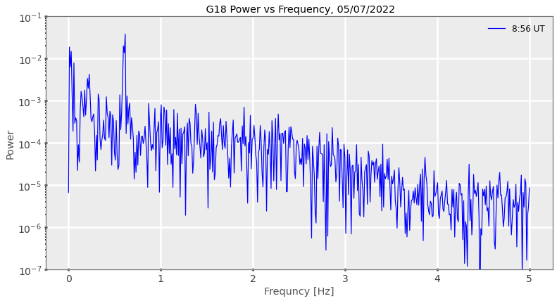
PLPT-MAG-003 Noise Performance
PASSED
GOES-18
GOES-17
Reaction wheels
2.5Hz Butterworth Filter
Significant reduction in background noise power with GOES-18
Amplitude of reaction wheel noise is < 0.2nT, background is ~0.1nT
Reaction wheel effect is the same on G18 as G17
Noise is below 0.3nT requirement (not during arcjet firing periods)

Slide 25
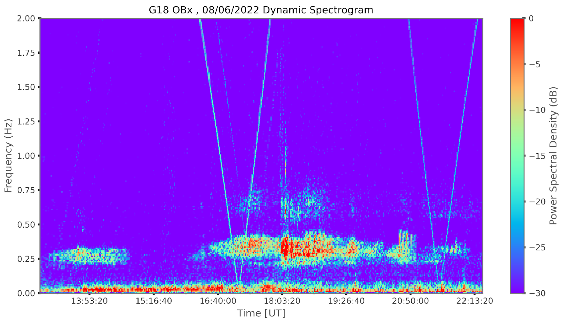
PLPT-MAG-003 Noise Performance
PASSED
Event detection in dynamic spectrograms
Reaction wheel
Lower-power plasma wave
Higher-power plasma wave
Background noise levels are low enough to identify events such as plasma waves
Possible to identify the power signature of some plasma wave during times with reaction wheel signatures, although not as clear
-lower power waves may be missed
ULF and plasma wave event detection are part of future space weather product ideas
-Important for the enhancement and scattering of dangerous energetic particles in the magnetosphere

Slide 26
PLPT-MAG-003 Noise Performance
Noise Contributions
Sensor : < 0.1nT
Reaction Wheels : 0.1nT to 0.2nT
No significant ADC noise
Heaters : ongoing analysis for full validation, less than 0.02nT
We conclude GMAG product noise is within the 0.3nT requirement.

Slide 27
GOES 18 Provisional Validation
Preparation Activities | Assessment
Validation activities are ongoing and the general research community is now encouraged to participate. | Validation activities are ongoing. Results have been discussed with SWPC. Release of data by NCEI will enable research community participation.
Severe algorithm anomalies are identified and under analysis. Solutions to anomalies are in development and testing. | Irregular timestamps Ground fix (ADR 1232) is in work, and NCEI has the capability for a workaround Arcjet correction algorithm being optimized for GOES-18
Incremental product improvements may still be occurring. | Product improvements will result from steps to mitigate anomalies listed in “Path to Full Validation” charts.
L2+ only: Users are engaged in the Product Feedback Forums (PFF) and user feedback is assessed. | NCEI continues to be engaged with SWPC for feedback on MAG L1b data quality.

Slide 28
GOES 18 Provisional Validation
End State | Assessment
Product performance has been demonstrated through analysis of independent measurements obtained from select locations, periods, and associated ground truth or field campaign efforts. | GOES-18 MAG L1b has been compared to GOES-17 and GOES-16. GOES-18 MAG L1b has been compared to TS04 and OP77 magnetic field model. The above were undertaken across different local times. Analysis ongoing.
Product analysis is sufficient to communicate product performance to users relative to expectations (Performance Baseline). | Yes, and instrument performance continues to be studied.
Documentation of product performance exists that includes recommended remediation strategies for all anomalies and weaknesses. Any algorithm changes associated with severe anomalies have been documented, implemented, tested, and shared with the user community. | Provisional level ReadMe will include a note about the effect of and fix to irregular timestamps. PUG will be updated to include the fix as well. There is also documentation of analysis in NASA, MIT-LL and NCEI presentations including this one.
Testing has been fully documented. | In this presentation and supplemental materials.
Product is ready for operational use and for use in comprehensive cal/val activities and product optimization. | Yes, with implementation of solution to ADR 1232 via Ground fix.

Slide 29
Path to Full Validation Maturity

Slide 30
Path to Full Validation
ADRs/WRs to be resolved prior to Full Validation
PLPTs to be conducted prior to Full Validation
Performance Baseline status
Risks to getting to Full, both from L1b product definition and user (SWPC) feedback

Slide 31
GMAG Specific ADR’s and WR’s
ADR | WR | Short Description | Status | Expected Closure
1266 |  | G18 GMAG RevB LUT | completed | PR.09.08.33
1232 | 9135 | GMAG irregular timestamps | In_Work | DO.11.00.00
1213 |  | G18 GMAG LUT for PLT | completed | PR.09.08.13
1203 |  | Mag L1b solar array current index label incorrect | In_Work | DO.12.00.00
1171 | 9326 | EXIS/MAG/SEISS ECEF_Z range | WR In_Analysis | HOLD
1056 |  | DO GS updates for GMAG on GOES-T/U | Closed | DO.09.03.00/DO.10.01.01
1046 |  | Erroneous MAG L1b quality flag set periods | Closed | WR Closed
1045 |  | Remove IB shadow flag from good quality flag mask | Closed | DO.09.03.00/DO.10.01.01
1010 |  | MAG LUTs for DO 08.01.00 | Closed | PR.08.03.03
1002 |  | Move leap second comments for MAG EXIS and SEISS | Closed | DO.09.03.00/DO.10.01.01
890 |  | Updated MAG Arc Jet Correction | Closed | DO.09.03.00/DO.10.01.01

Slide 32
GMAG Specific ADR’s and WR’s
ADR | WR | Short Description | Status | Expected Closure
 | 7346 | Ground MM updates required for GMAG on GOES-T/U | closed | MM.10.03.00
 | 7011 | DO needs a better way to configure MAG L0 data to receive on the L band in support of yaw flips | in work | TBD
 | 8520 | GMAG documentation incorrect in some cases | closed | MM.10.03.00
 | 8349 | update t4_status perofm files to support GMAG for G18/19 | hold | HOLD

Slide 33
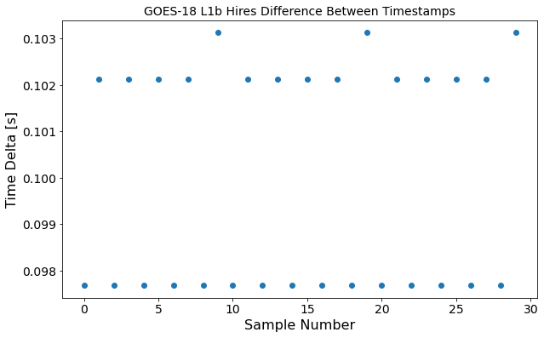
ADR 1232 Irregular Timestamps
Difference between timestamps (delta)
• There is an irregular difference between GMAG timestamps (delta), i.e. they do not repeat every 0.1 sec
•Due to a problem with the measurement cadence; delta is within requirements, just not at regular intervals
-regular timestamps : 0.1, 0.2, 0.3, 0.4, 0.5
-irregular timestamps : 0.102, 0.2, 0.303, 0.401, 0.503
•This creates issues for L1b -> L2 NCEI and SWPC operational processing:
- L2 algorithms assume regular timestamps at exactly 0.1 sec intervals
•Shown is an example of high-resolution L1b file that has irregular timestamp deltas
Regular timestamps would all have 0.1s delta
Irregular delta

Slide 34
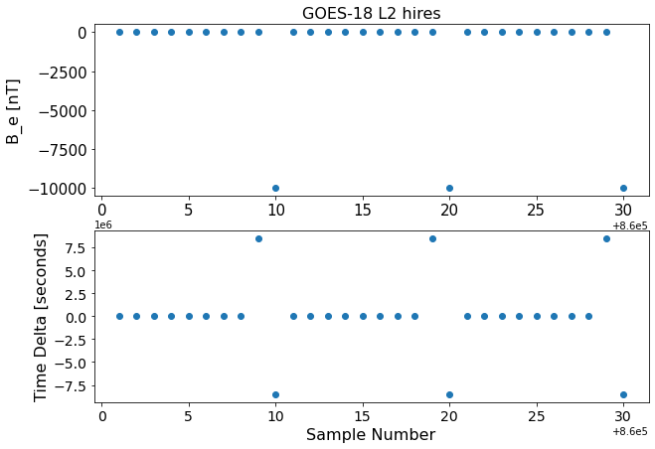
ADR 1232 Irregular Timestamps
•SWPC operationally uses L2 1 minute averaged data
•There is a clear outlier repeating once every 10 samples, thus 10% of the data is affected
• The resulting Hires fill value is not included in 1 minute average data, however, 10% of the information is missing from each average
•Resolution : round timestamps
-ADR status is “in work”
•Ground has recently developed a fix and NCEI will verify once delivered
-can be included in an upcoming PRO release
Effect on Hires L2 data
B_epn fill value
Largely offset timestamps

Slide 35
Path to Full Validation - PLPTs
Descriptive Title | Activity | Data needed | Success criteria
PLPT-MAG-001-Comparison to quiet field models | Validate GMAG L1b product for geomagnetically quiet conditions (Kp <2) by comparing to accepted models of Earths internal plus external magnetospheric field. | 90 days (kp < 2, need not be contiguous) | Data demonstrate that GMAG measurements are close to magnetic field model values.
PLPT-MAG-002- Cross-satellite intercalibration (full resolution data) | Validate GMAG l1b product by comparing it to operational GOES-R Series in situ magnetometer instruments. | 90 days (|Dst| ≤ 30 nT, need not be contiguous) | Data demonstrate that GMAG observations are consistent with other spacecraft observations.
PLPT-MAG-003- Noise Performance | Determine the noise level of the product and compare it to the MRD values of no more than 0.3 nT on each axis. | 90 days (kp < 2, need not be contiguous) | Noise level of the product has been determined and compared to 0.3 nT requirement.
From MAG RIMP v2.0, July 2021

Slide 36
MAG Performance Baseline Status
Assessment at Provisional
MRD ID | Description | Related PLPTs | Status
2019 | MAG Product Measurement Accuracy | -002 | PLPTs ongoing for full validation
662 | MAG Product Noise | -003 | PLPTs ongoing for full validation

Slide 37
GOES-18 Performance Baseline Validation Status
MRD2019: Product Measurement Accuracy
Quantity | MRD Requirement | Performance Baseline | PLPT Measurement
Product Measurement Accuracy: | 1 nT per axis | (3σ_{x},3σ_{y},3σ_{z}) 1 nT per axis | ± 1 nT (per axis). (not including arcjet periods) Still in analysis
MRD2022: Product Measurement Precision
Quantity | MRD Requirement | Performance Baseline¹ | PLPT Measurement
Product Measurement Precision: | ≤ 0.016 nT (per axis) | One bit resolution = 0.016 nT/axis. Precision ≥ sensor noise level = 0.100 nT/axis | 0.1 nT (not including arcjet periods) still in analysis
¹This requirement has flowed down to the magnetometer instrument to mean that the magnetic field shall have a resolution of 0.016 nT per axis. Based on the MRD definition of precision, the product with vary by at least the noise level of the sensor.
MRD662: Noise
Quantity | MRD Requirement | Performance Baseline | PLPT Measurement
Product Noise: | Fluctuations < 0.3 nT | Low pass filter removes all transients with frequencies ≥ 2.5 Hz | 0.3nT at < 2.5 Hz (not including arcjet periods) still in analysis
Notes:
Updated to show value from FM2 performance baseline

Slide 38
Path to Full Validation – Risks
Risk Name | Description | Impact | Mitigation and Schedule
Arcjet flag and correction | Current Arcjet correction needs to be optimized for GOES-18. Analysis of how well the arcjet flag and correction algorithm work over the next months could show flag and algorithm do not work well. Additionally, changes to arcjet firing configurations could make correction not work. | Risk GMAG L1b corrected variables being worse than uncorrected variables. | NCEI will undertake detailed analysis of the arcjet flag and correction outputs after implementation in L1b product. NCEI will also continue work towards an improved arcjet correction using machine learning.
Irregular timestamps affect on L2 processing | If fix is not included, L2 1 minute averages will lack 10% of the samples in each average. L2 Hires datasets will require additional processing for science purposes. Additionally, products that are working towards operational implementation and depend on L2 Hires inputs (magnetopause crossing and quiet field model) will not be correctly generated. | Risks operational L2 1 minute average products missing samples in the average. Also risks L2 Hires datasets requiring additional processing for science purposes and being used with caution as input to other future operational products. | NCEI is working with SWPC to develop a workaround. Ground is implementing a fix to make time stamps regular in L1b. Expected closure is D0.11 or PRO release.
Bias stability | Bias stability should be monitored for any changes in zero level offsets. | LUT values for zero level bias and misalignment offset will not be accurate. | NCEI will perform continuing monitoring and analysis of bias stability.

Slide 39
Summary and Recommendations

Slide 40
Summary and Recommendations
Main issues identified:
Irregular timestamps in L2 processing
Arcjet firing contamination
Noise : e.g., reaction wheels

Slide 41
Recommendations: Irregular timestamps
We recommend that ADR 1232 be implemented in the ground system before L2 data is operationally used by SWPC.
Ground fix has been developed, and NCEI has the capability to implement a work around if necessary
We also recommend that until there is a fix in the ground system, the provisional level readme should include a statement warning users to be careful when using L2 Hires datasets, due to irregular timestamping.
High resolution data is scientifically useful for identifying certain waves, such as those that can contribute to enhancement and scattering of dangerously energetic particles
The irregular timestamp issue makes L2 Hires data require inconvenient processing by users to remove data fill values and irregular timestamps
Provisional level readme should include a brief description of the potential difficulties using L2 Hires datasets and that upcoming data releases will include a fix

Slide 42
Recommendations: Arcjets
The current arcjet correction algorithm should be optimized for GOES-18
Correction matrices need to be updated in the LUT which will require further study through full validation
We recommend continued work to improve the arcjet correction using machine learning
This will help improve the correction for times of low power levels, different arcjet configurations and edge effects
This is computationally intensive and additional computing power may be needed
We also recommend further study of the effects of arcjets on the science quality of data

Slide 43
Recommendations: Other
We recommend continued work to improve the utility of data products for operations and science quality
Recommendation for ongoing bias stability monitoring
Recommend ongoing comparisons of the utility of MEDA mag and GMAG data for operational and scientific use
Recommendation that data stewardship continue work towards improving the quality of data and reprocess archived data when necessary

Slide 44
Contact : aspen.davis@noaa.gov
paul.lotoaniu@noaa.gov
Questions?

