Slide 1
Peer Stakeholder-Product Validation Review (PS-PVR)
For the Full Maturity of GOES-18 SEISS
EHIS L1b Product
November 12, 2024
(revised November 19, 2024)
Juan V. Rodriguez
University of Colorado CIRES and NOAA NCEI
Contributions: B. Kress, A. Boudouridis, UNH, ATC
The support for ATC’s SEA-48 is gratefully acknowledged.
This Full Validation PS-PVR was made possible by the 08 June 2024 SEP event.

Slide 2
Outline
EHIS Overview
Path to Full Validation Maturity
Product Quality Evaluation (PLPTs)
Full Maturity Assessment
Summary and Recommendations

Slide 3
EHIS OVERVIEW
GOES-18 EHIS L1b Product Full Validation PS-PVR

Slide 4
Energetic Heavy Ion Sensor (EHIS)
inclined detectors (D2 & D3)
Credit: SEISS-D-SY079_EHIS_CALTIM_Update-1-6-14
Primary purpose: measure fluxes of solar energetic particles (SEPs) and galactic cosmic rays (GCRs) responsible for Single Event Effects (SEE) in electronics
Single solid-state telescope using angle-detecting inclined sensor (ADIS) system to discriminate heavy ions by atomic number (Z)
L1b cadence is 5 minutes
Most recent FM3 (SN104) CDRL79 release: SEISS-D-EH079-4, Rev A (13 August 2019)
D6
D5
D4
D1
R
Scintillator (S)
Detector | Function | Beam Calibrated
D1, D2, D3 | ADIS | p+: yes, α++: no, heavies: yes
D4 (A, B, C ganged) | Channel E1 stopping | p+: yes, α++: no, heavies: yes
D5 (A, B, C ganged) | Channel E2 stopping | p+: yes, α++: no, heavies: yes
D6 (A, B, C ganged) | Channel E3 stopping | p+: yes, α++: no, heavies: no
R (ranging) | E4 & E5 (penetrating) | p+: yes, α++: no, heavies: no
S (scintillator) | active anticoincidence | no

Slide 5
Nomenclature and Flux Units
A proton is the nucleus of a hydrogen atom
  Atomic number Z = 1
  One nucleon: proton
An alpha particle is the nucleus of a helium-4 atom
  Atomic number Z = 2
  Four nucleons: two protons and two neutrons
SGPS L1b proton and alpha particle fluxes are provided in units of particles/(cm² sr s keV)
EHIS L1b hydrogen and helium nucleus fluxes are provided in units of particles/(cm² sr s MeV/nuc)
To convert SGPS units to EHIS units:
  Multiply by 1000
  Multiply by the number of nucleons (1 or 4)

Slide 6
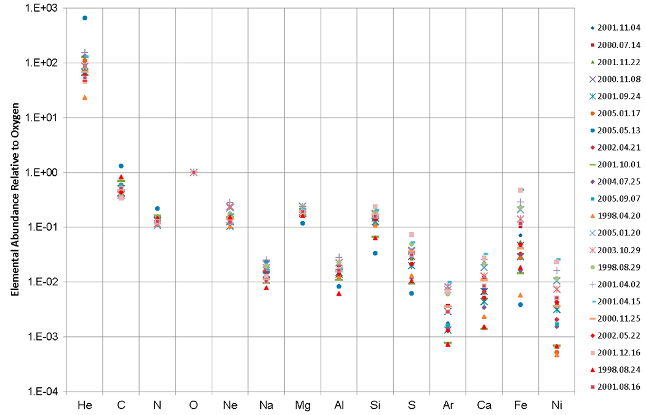
Solar Heavy Ions Are Much Less Abundant than He and H
Solar protons (hydrogen nuclei) are an order-of-magnitude more abundant than solar alpha particles (helium-4 nuclei)
Relative Abundances of Heavy Ions (12-60 MeV/n) in 22 SEP Events from Solar Cycle 23 (ACE SIS data) [Bharath et al., 2013, https://ams.confex.com/ams/93Annual/webprogram/Paper216161.html]

Slide 7
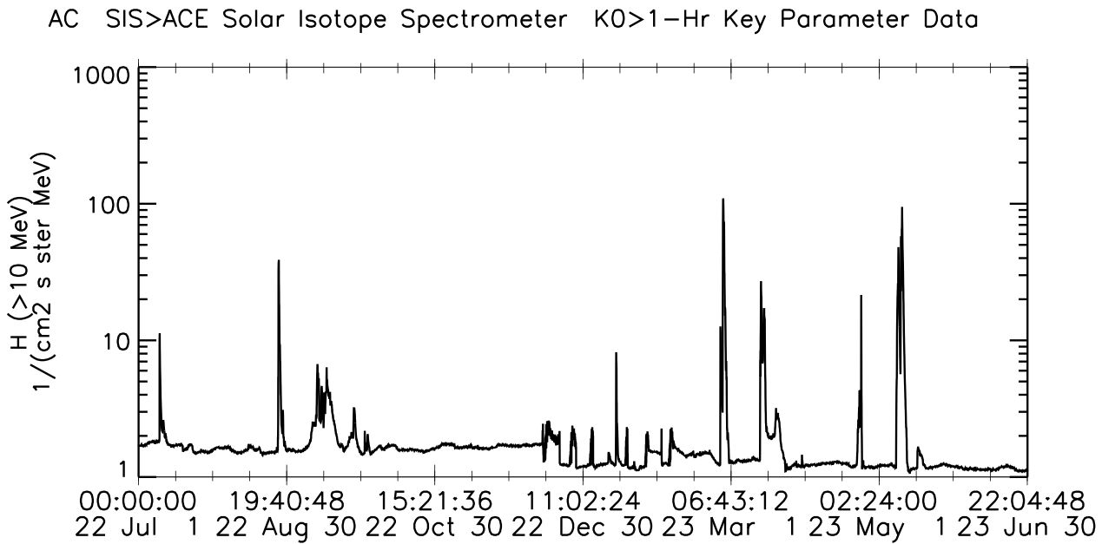
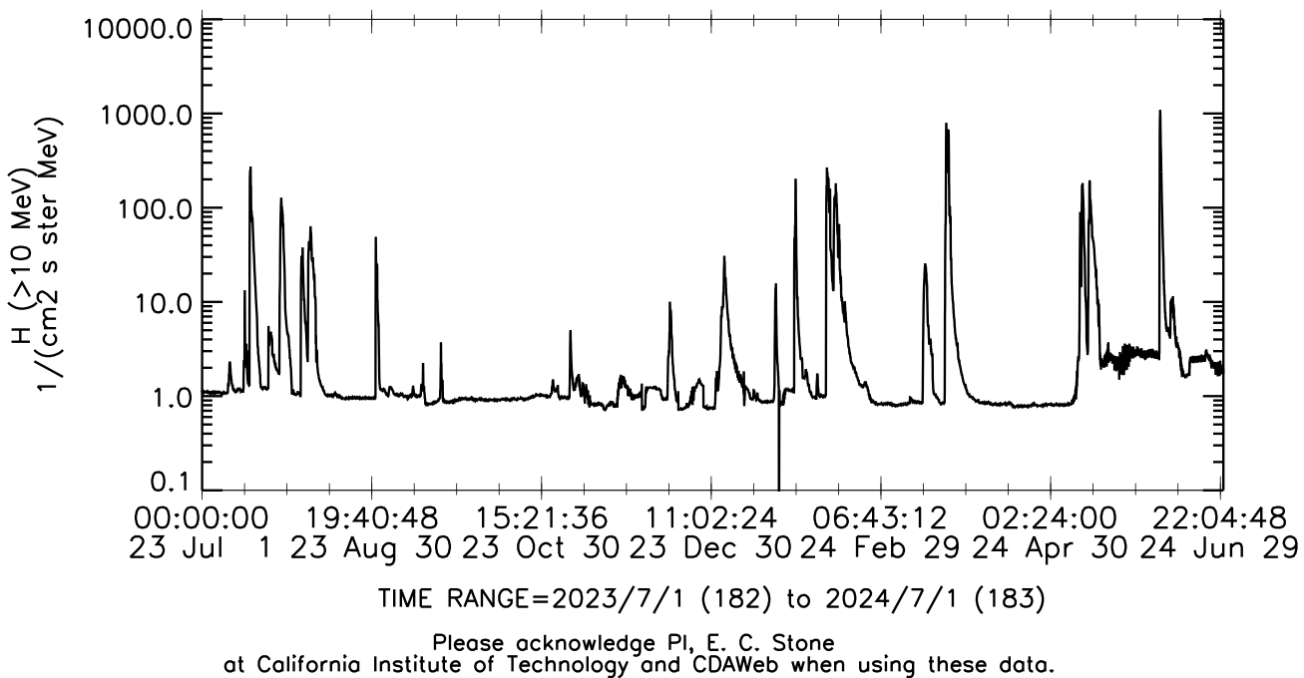
Solar Energetic Particle (SEP) Events since 01 July 2022
Event analyzed for SGPS Provisional
Event analyzed for SGPS Full
Event analyzed for EHIS Provisional
Event analyzed for EHIS Full
Events analyzed for EHIS Full
Event analyzed for SGPS Full

Slide 8
Galactic Cosmic Rays (GCRs)
Mewaldt et al.,
ApJLett, 723, 2010
Solar Cycle 23 Cosmic Ray Flux Variation
Solar Energetic Particle (SEP) events are sporadic, with durations of several days
  If large enough, trigger SWPC’s real-time solar radiation storm alerts (SGPS)
  Protons and alphas used in FAA-SWPC aviation dose model (SGPS)
  Heavy ion fluxes and event fluences used in upset calculations (EHIS)
  Some weak events observed at Earth since GOES-18 launched
Galactic Cosmic Rays (GCRs) vary slowly (solar cycle ~ 11 yrs)
  Very low flux levels but nonetheless pose a Single Event Effect (SEE) hazard
  Measurements could be used to improve GCR flux models that are used in statistical predictions of upset rates (EHIS)

Slide 9
EHIS Data Description
L1b He and H (Priorities 2 and 3) fluxes are calculated from coincidence rates contained in SCI-HCR packets
  1-s cadence, complete set of rates in 3 s – averaged to 5 minutes
  Corrected for dead time using 3-s Priority counts contained in SCI-HCR packets
L1b heavy ion (Priority 1) fluxes [Z = 6 (C) to 29 (Cu)] calculated from histograms contained in SCI-ELF packets and summed Priority 1 counts from SCI-HCR packets
  1-m cadence, 5 histograms summed prior to nonlinear maximum likelihood fit
  Corrected for dead time using time-averages of 3-s Priority counts contained in SCI-HCR packets
Corrected for upward fluxes using Priority counts in SCI-PEC packets (1-m cadence)
Scintillator (S) used in anti-coincidence (.NOT.S) to exclude side-penetrating particles when S is less than ‘High Flux Level’ value in ‘sci_cnfg’ flight table
  .NOT.S = Non-Prime
  NO S = Prime
  SCI-HCR packets contain both NonPrime and Prime rates
  Each minute, SCI-ELF (histograms) and SCI-PEC packets are either NonPrime or Prime, based on Scintillator state
  Reported L1b fluxes (H, He, heavies) are NonPrime or Prime based on Scintillator state
1-Hz SCI-PHA packets contain highest-priority particle event every second
  Designed as a valuable diagnostic; not used in real-time (L1b processing)
  NonPrime is higher priority than Prime, Priority 1 is higher priority than Priority 2, etc.
SEPs analyzed using L1b H and He fluxes from EHIS and SGPS
Heavy ion GCRs analyzed using P1 histograms accumulated from PHA packets
In GEO, EHIS L1b data are almost always in Prime state due to high levels of radiation belt electron fluxes incident on the anti-coincidence Scintillator.

Slide 10
Path to full Validation Maturity
GOES-18 EHIS L1b Product Full PS-PVR

Slide 11
Path to Full Validation
Summary of issues remaining after Provisional Validation
Table status
ADR status
PLPTs to be conducted prior to Full Validation

Slide 12
Summary of Issues Remaining after Provisional Validation
PLPT-SEI-004: Only weak, spectrally soft SEP events had been observed by GOES-18. Only H1, H2 and HE1 could be cross-calibrated.
PLPT-SEI-006: Energy response (bandpass) functions had not yet been delivered. Backgrounds could not be evaluated for accurate comparison with GCR flux models without full response functions.
The main risk standing in the way of Full validation was the lack of a SEP event with sufficiently great carbon-iron fluxes to validate the lowest-energy channel (like the 10-11 Sept 2017 event used to validate GOES-16 EHIS).

Slide 13

G18 EHIS Flight and Ground Table History
Date Changed | Rationale | Changed | L0 | L1b
14 June 2022 | Update slopes and intercepts in inst_cal table | Flight science tables (ele_engy, inst_cal, sci_cnfg) | x | x
23 June 2022 | Revert to launch config | Flight science tables | x | x
21 July 2022 | Update slopes and intercepts in inst_cal table | Flight science tables | x | x
10 November 2022 1610 UT (flight) / 1825 UT (LUT) | Results of EHIS On-Orbit Calibration PLT SEI-002 (SEISS-TR-SY121-11) | COORDINATED: Flight science tables (delivered 10/11) Ground LUT (delivered 11/1) (ADR 1292) | x | x
23 May 2023 | ADR1064 | Ground LUT |  | x
EHIS FM3 LUT names:
Version at launch: FM3_EHIS_CALINR_Parameters-V1.0.h5 = “SeissEhisCalInrParameters(FM3A_CDRL79RevA_PR_09_08_14)”
Version after ADR1292, 10-16 Nov 2022: “SeissEhisCalInrParameters(FM3A_CDRL79RevB_PR_09_08_39)” [could not be found for checking]
Version at Provisional status (starting 16 Nov 2022): FM3_EHIS_CALINR_Parameters_V1.1.h5 = “SeissEhisCalInrParameters(FM3A_CDRL88RevB_PR_09_08_39)”
Version after ADR1327 = “SeissEhisCalInrParameters(FM3A_CDRL88RevB_PR_12_02_01_and_ADR1327)”
Version after 2023-11-28 = “SeissEhisCalInrParameters(FM3A_CDRL88RevB_DO_13_00_00)” [no change]

Slide 14
EHIS ADRs
ADR# | WR# | Short Description | Current Status | Expected Closure
1064 |  | SEISS EHIS He conversion from SGPS | Closed | PR.12.02.01
1171 | 9326 | EXIS/MAG/SEISS ECEF_Z range | Closed | DO.12.00.00
1278 | n/a | G18 SEISS EHIS LUT Update | Cancelled
1292 |  | G18 SEISS EHIS CDRL88 Rev B | Closed | PR.09.08.39 (11/18/22)
1327 |  | Make EHIS LUT Compatible with DO.12.01.00 baseline | Closed | With ADR 1064
1383 | 9955 | SEISS EHIS HE1 and HE2 energy bounds set erroneously to zero (‘0.0 MeV’ in plot legends) | In work | Type 2 before DO.15.00.00
1385 |  | Install updated G16 EHIS LUT based on ATC’s extended on-orbit analysis | Closed | PR.13.02.00 (02/07/24)
1411 | 9956 | G17 EHIS HE1 and HE2 not produced from 105W | In work | DO.15.00.00 (should be in test by time of G17 reactivation in early 2025)
ADRs 1383 and 1411 are intended to fix errors introduced with implementation of ADR 1064
As shown later, ADR 1064 was predicated on a narrow view of relative accuracy that ignored important scientific aspects of the data. L1b README advises users not to use He data contained in EHIS L1b files

Slide 15
Path to Full Validation - PLPTs
EHIS Full PLPTs from RIMP v 2.0 (09 July 2021) – continuation of Provisional
Title | Activity | Data Needed | Success Criteria
A.3.4 SEP Channel Cross-Comparison [PLPT-SEI-004] | On-orbit cross-calibration of EHIS with SGPS above 10 MeV | Two Solar Energetic Particle (SEP) events. | [Full] Differences quantified on data taken through validation phase.
A.3.6 Backgrounds Trending [PLPT-SEI-006] | Evaluate EHIS backgrounds in terms of expected galactic cosmic ray (GCR) fluxes. | Four months of continuous data. | [Full] Perform analysis during validation phase.
Data requirements for Full validation:
  A.3.3: 2 SEP events required - met for H and He, only one event for heavy ions
  A.3.5: 4 months of data required – met for H and He, exceeded for heavy ions
Full validation is not possible without at least one large SEP event with heavy ion fluxes (Carbon to Iron) above backgrounds - the 08 June 2024 event satisfied this criterion (barely)
Full validation will emphasize more sophisticated calibration analysis:
  Calculation of GCR-appropriate geometry-energy factors from response/bandpass functions delivered by ATC
  Use of pulse-height analysis (PHA) packet L0 data for both SEP and GCR heavy ion flux calculation

Slide 16
Product quality assessment
GOES-18 EHIS L1b Product Full PS-PVR

Slide 17
Product Quality Assessment
PLPTs for Provisional
Top Level Evaluation
Full Validation Performance Baseline Status

Slide 18
PLPTs for Full Validation
PLPT-SEI-004: Solar Energetic Particle (SEP) Cross-Comparison
  No single event permits a complete characterization of the product
  18 July 2023: highly anisotropic onset permits evaluation of ADR 1064
  10-12 May 2024: large solar wind dynamic pressure permits cross-comparison of G16 and G18 and the three look directions (SGPS -X, EHIS, SGPS +X)
    Spectral hardness (GLE74) permits cross-comparison of EHIS H1-5 and HE1-2 channels despite low >10 MeV proton fluxes
  08 June 2024: largest event since Sept 2017 permits comparison of heavy ions in lowest energy channel with observations at L1
PLPT-SEI-006: Backgrounds
  Important indicator of instrument performance
  Are they consistent with predictions of galactic cosmic ray (GCR) fluxes?
    GCRs = space climate rather than space weather
    Heavy ion GCRs are significant cause of Single Event Effects
  New: GCR-appropriate geometry-energy factors derived from instrument response functions that were delivered by ATC in June 2024 under SEA-48
    Geometric factors derived for SEPs (decreasing power laws) are not generally valid for GCRs, whose spectra increase with energy in the EHIS energy range

Slide 19
PLPT-SEI-004: SEP Cross-Comparison
Event | >10 MeV p+ Peak Flux | Feature | H | He | Heavy Ions
18 July 2023 | 620 p/cm²-s-sr (pfu) | Highly anisotropic onset for evaluation of ADR 1064 | G16 & G18 / EHIS & SGPS, SOHO/ERNE & EPHIN | G16 & G18 /EHIS & SGPS, SOHO/ERNE & EPHIN, ACE/SIS | n/a
10-12 May 2024 | 208 pfu (10 May) 116 pfu (11 May) | Long period of solar wind Pdyn >10 nPa for G16-G18 and three-direction comparison | G18/SGPS, G16 & G18 /EHIS | G18/SGPS, G16 & G18/EHIS, ACE/SIS | n/a
08 June 2024 | 1030 pfu | Just large enough for heavy ion comparison; low Pdyn (1-2 nPa) gives poor conditions for SGPS-EHIS xcal | Not cross-calibrated | Not cross-calibrated | G16 & G18/EHIS, ACE/SIS

Slide 20
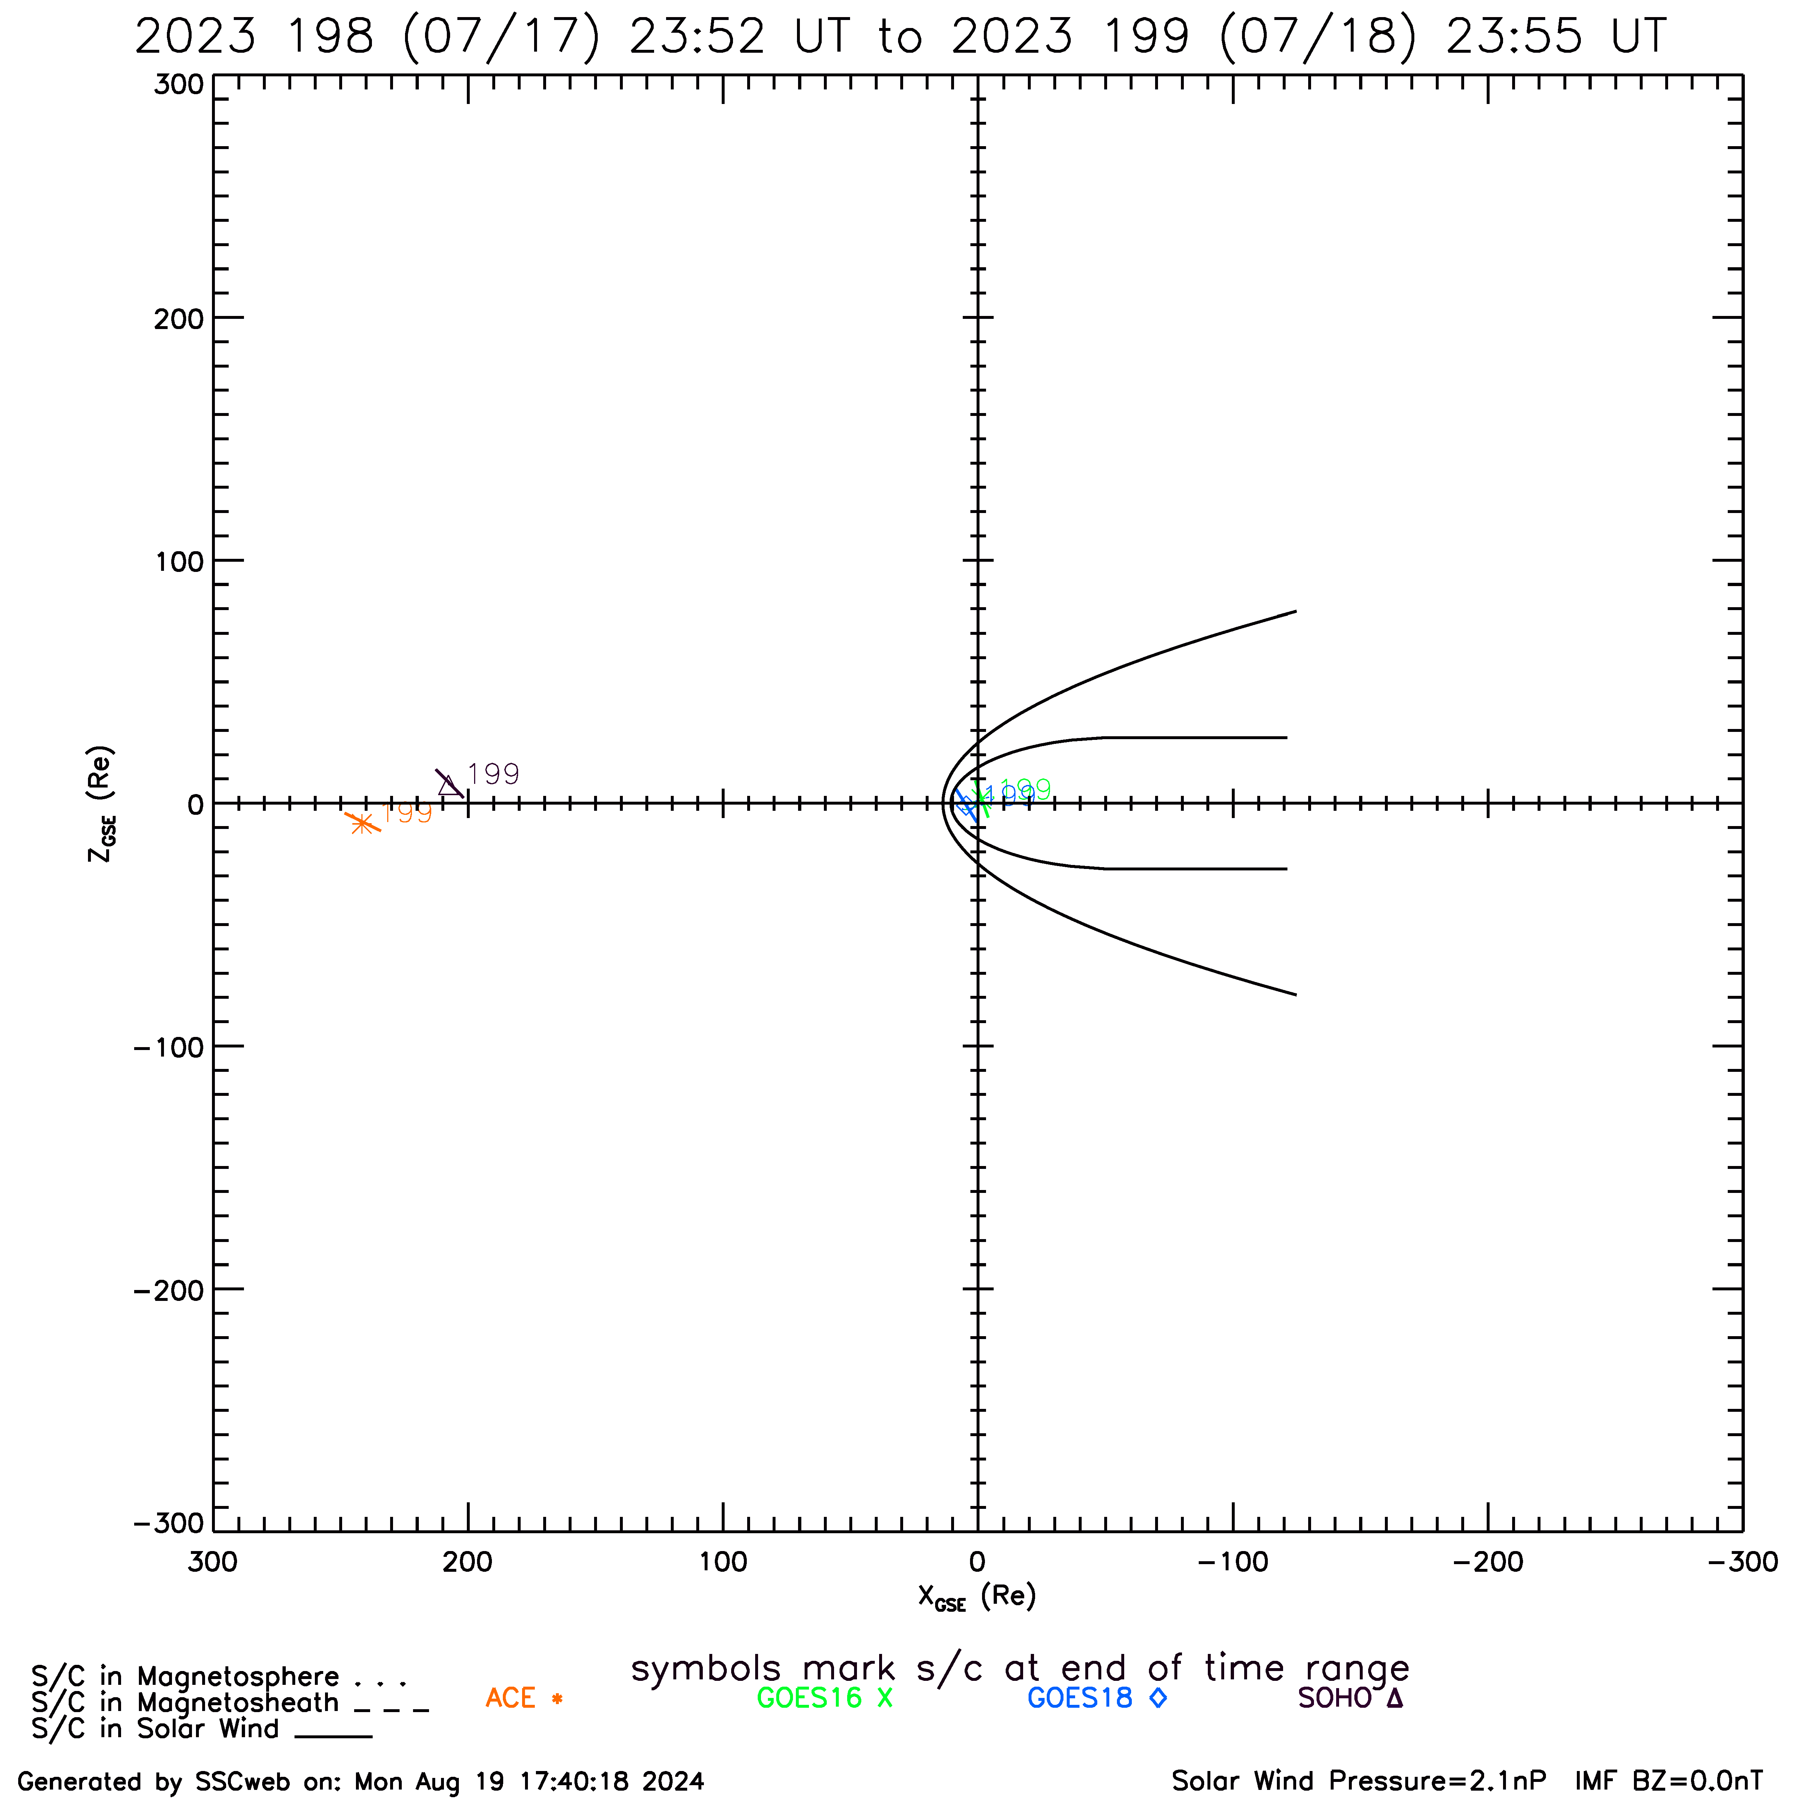
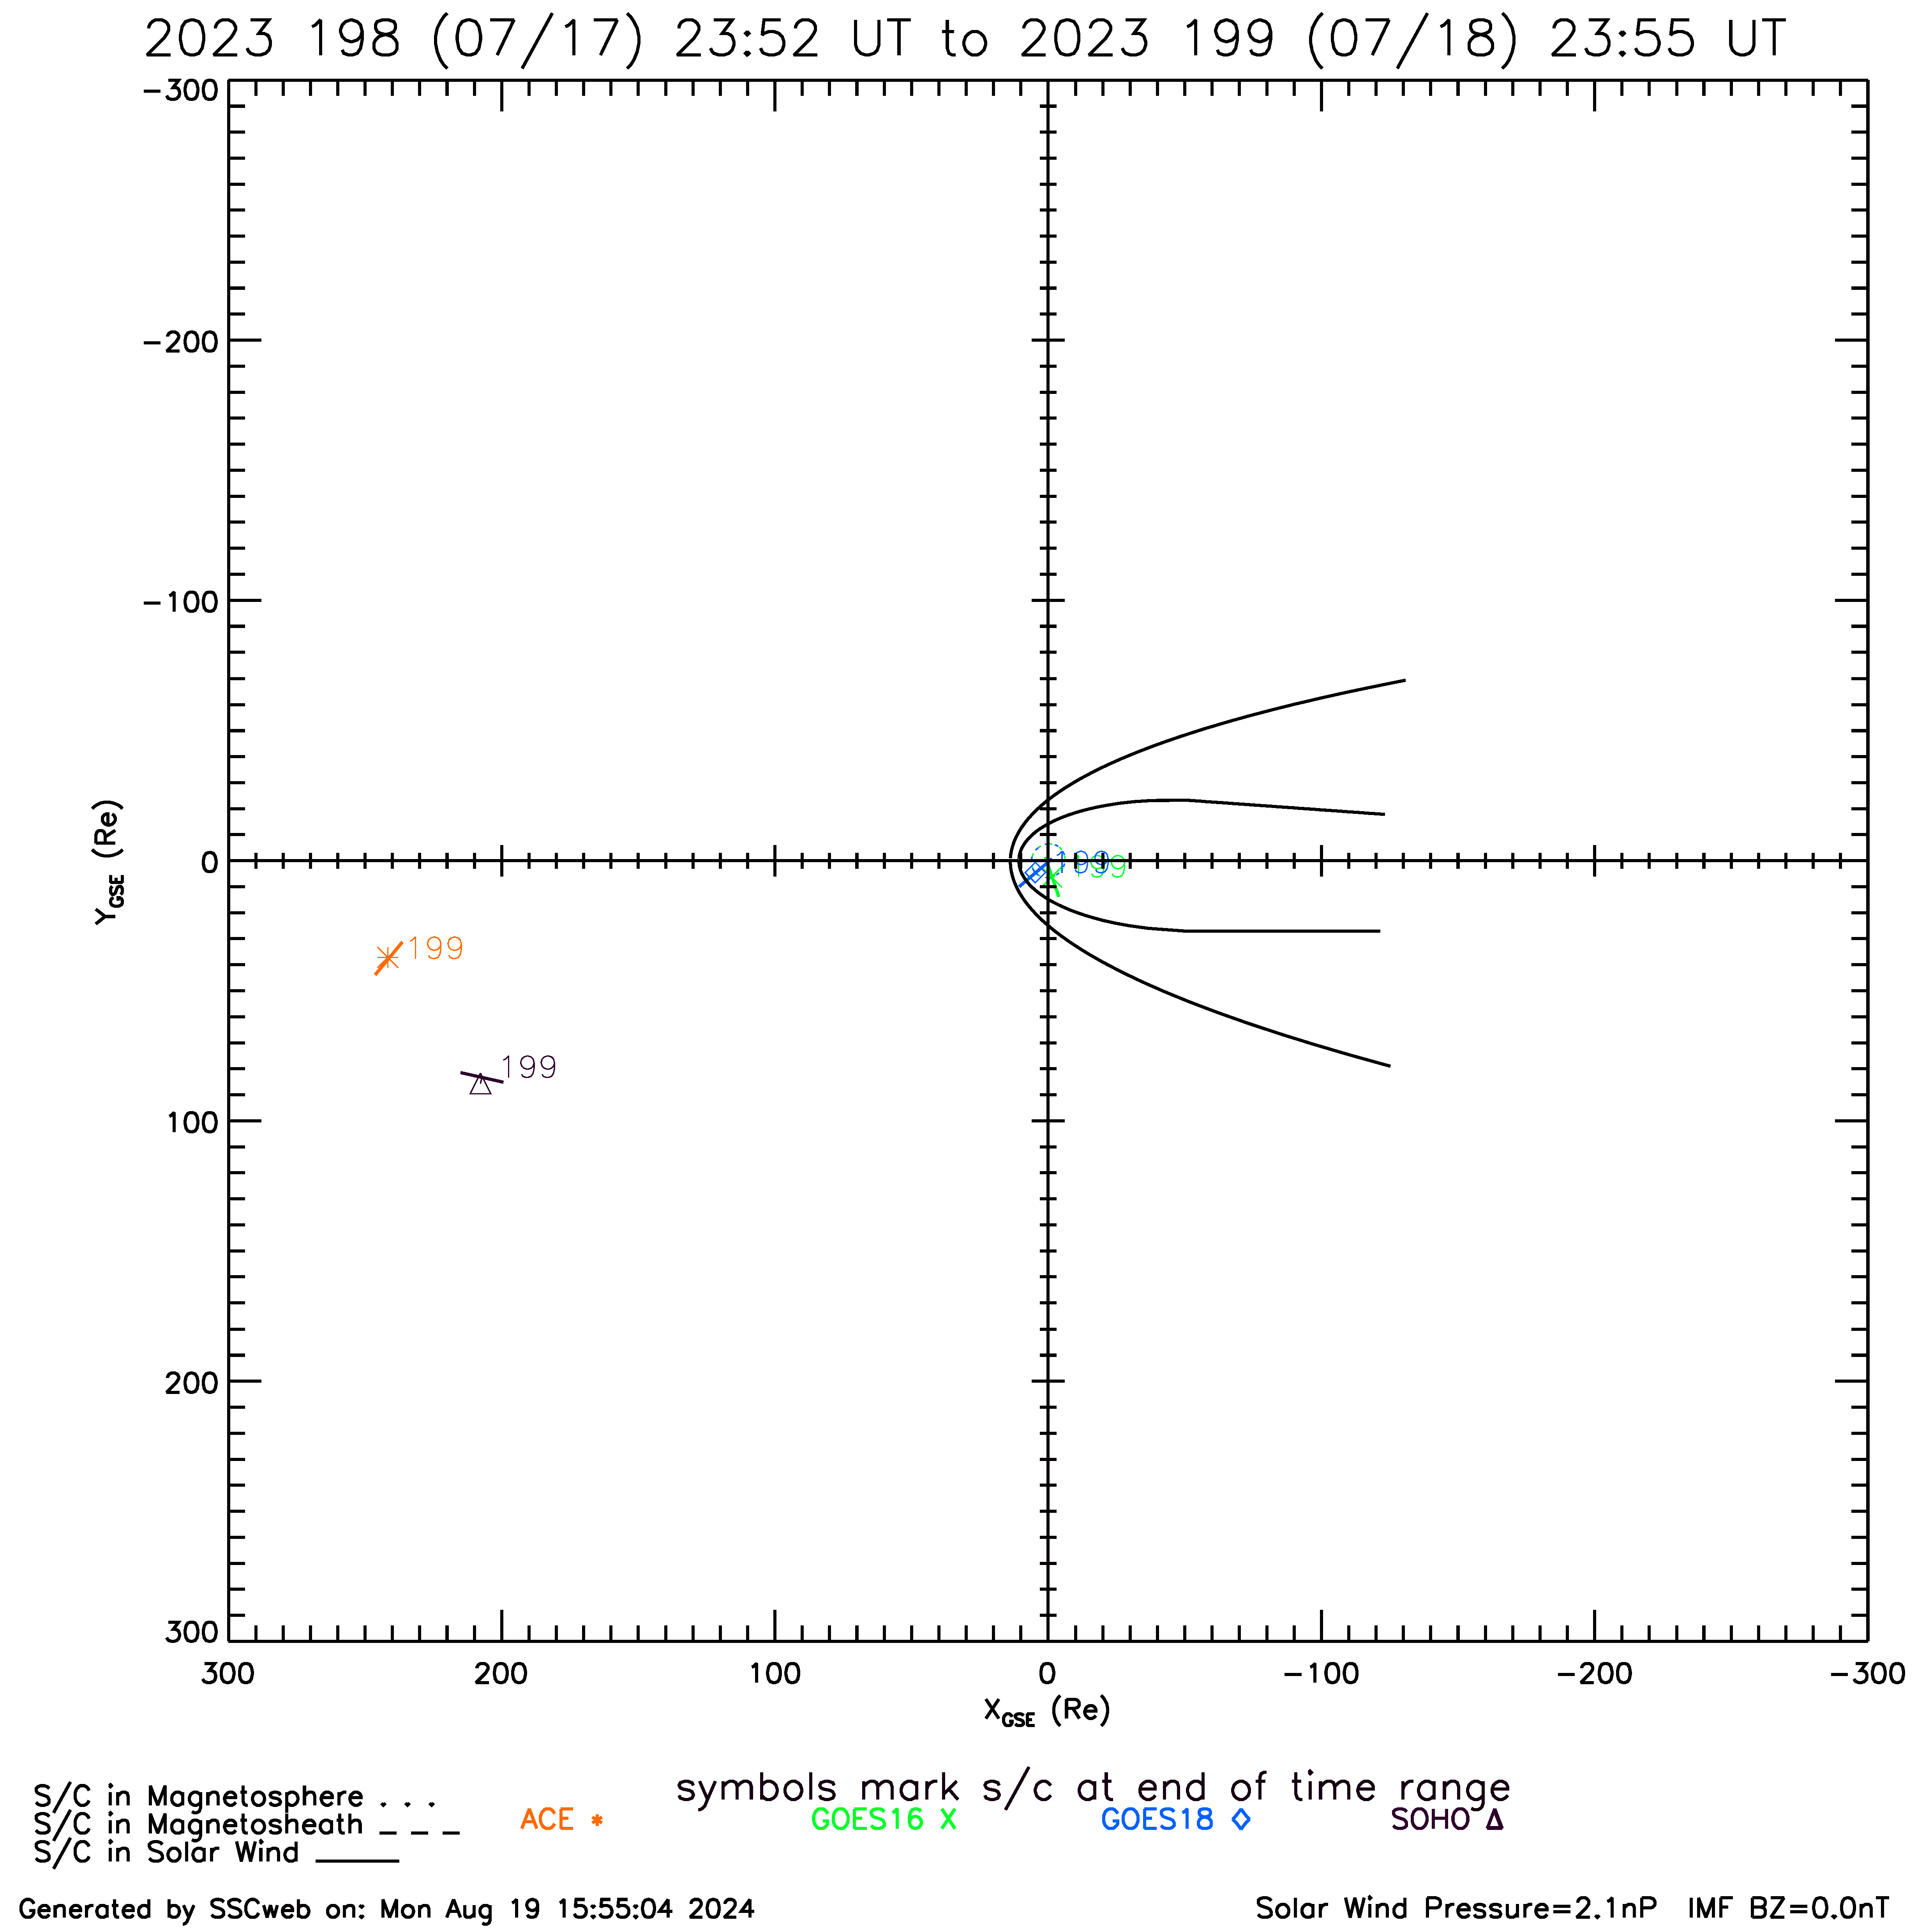
Comparison of GOES and L1 Fluxes Reveals Source Anisotropy during Event Onset
X-Z plane: all satellites close to the ecliptic
Y-Z plane: SOHO far off Sun-Earth line
SOHO
GOES
ACE
GOES
ACE
SOHO

Slide 21
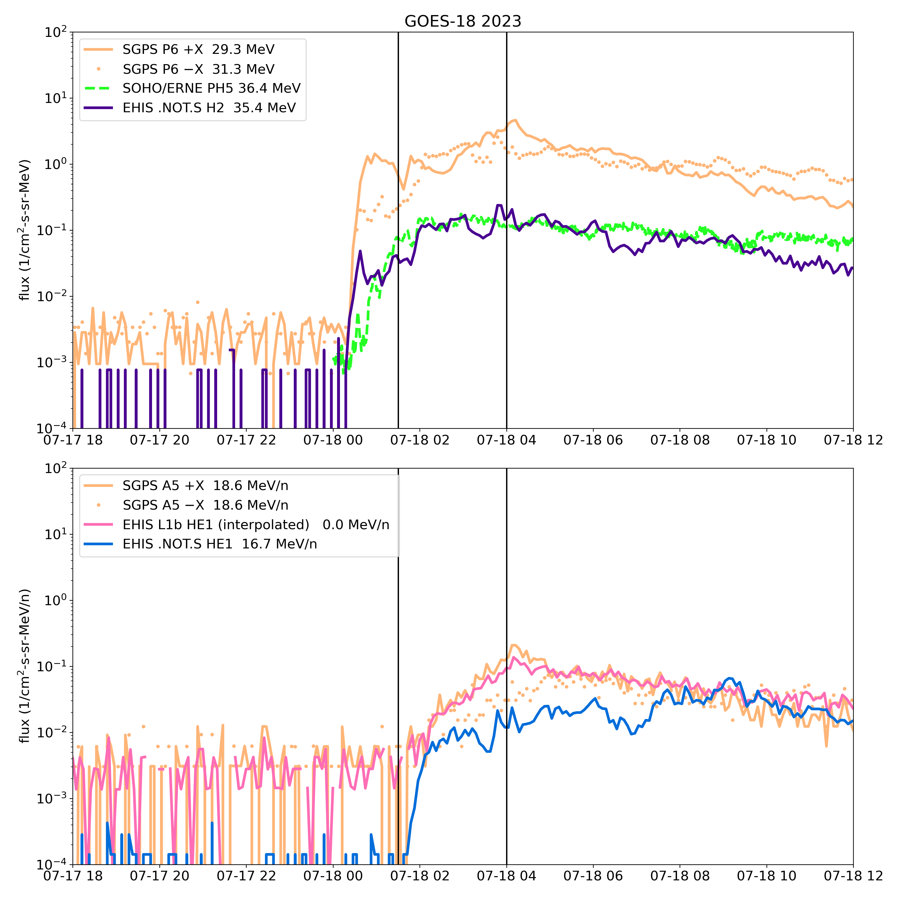
Comparison of GOES-18 and L1 Fluxes Reveals Source Anisotropy during Event Onset
Non-uniform features of event onset
  Alpha onset ~1.5 h later than proton onset - based on velocity considerations alone would be ~0.25 h
  Westward-looking (-X) GOES proton fluxes initially less than eastward-looking (+X) fluxes - reverse of normal
  At GOES, radial (EHIS) and westward (SGPS-X) alpha flux observations less than eastward (SGPS+X) fluxes
  May be caused by the interplanetary (source) anisotropy overcoming attenuation by geomagnetic cutoffs
The EHIS HE1 .NOT.S zenith-looking fluxes provide important information for understanding the event
ADR-1064 EHIS L1b HE1 looks like SGPS A5 eastward-looking fluxes in this event
ADR 1064 replacement of HE1 and HE2 with interpolated SGPS fluxes distorts the scientific picture, eliminating unique information provided by EHIS observations

Slide 22
ADR 1064 Evaluation
The EHIS HE1 and HE2 fluxes provide unique information on the access of helium SEPs to geostationary orbit, including the effects of interplanetary anisotropy and geomagnetic cutoffs
To address the low magnitude of the EHIS fluxes compared to SGPS, ADR 1064 should have added an interpolated SGPS helium flux or a scale factor for the EHIS fluxes (COSPAR guidelines) rather than replacing the EHIS fluxes
In the L1b README updated for Full Validation, NCEI recommends use of SGPS avg5m alpha fluxes rather than EHIS L1b HE1 and HE2
NCEI will have to reprocess the EHIS data to make the missing EHIS helium fluxes available to the public.

Slide 23
09-12 May 2024 SEP event during Gannon storm: Pdyn > 10 nPa
Separated by 4 hours in local time, differences at GOES-East and -West due to geomagnetic cutoffs commonly prevent accurate cross-calibration
Large solar wind Pdyn (>10 nPa) suppresses geomagnetic cutoffs globally, permitting cross-calibration (xcal) of SEP fluxes at GOES-East and -West in all look directions (eastward, zenith, westward) (Rodriguez+2014)
The longest period (~20 hrs) of Pdyn > 10 nPa during a SEP event since GOES-16 launch was observed during the extreme Gannon geomagnetic storm in May 2024 (SYM-H, min = -518 nT)
Two distinct SEP events during this period:
  2024-05-10: Onset 1335 UT, peak >10 MeV flux = 208 pfu @ 1745 UT
    Weak at higher energies,
    Not a good xcal opportunity
  2024-05-11: Onset 0210 UT, peak >10 MeV flux = 116 pfu @ 0910 UT
    Sufficiently energetic to be observed at ground level (GLE 74)
    Good opportunity for xcal of all EHIS proton channels and EHIS HE1 channel
    Prior to this event, xcal of G16 and G18 EHIS H2-H5 and HE1 was not possible
Cross-calibration period selected: 2024-05-11, 06-15 UT

Slide 24
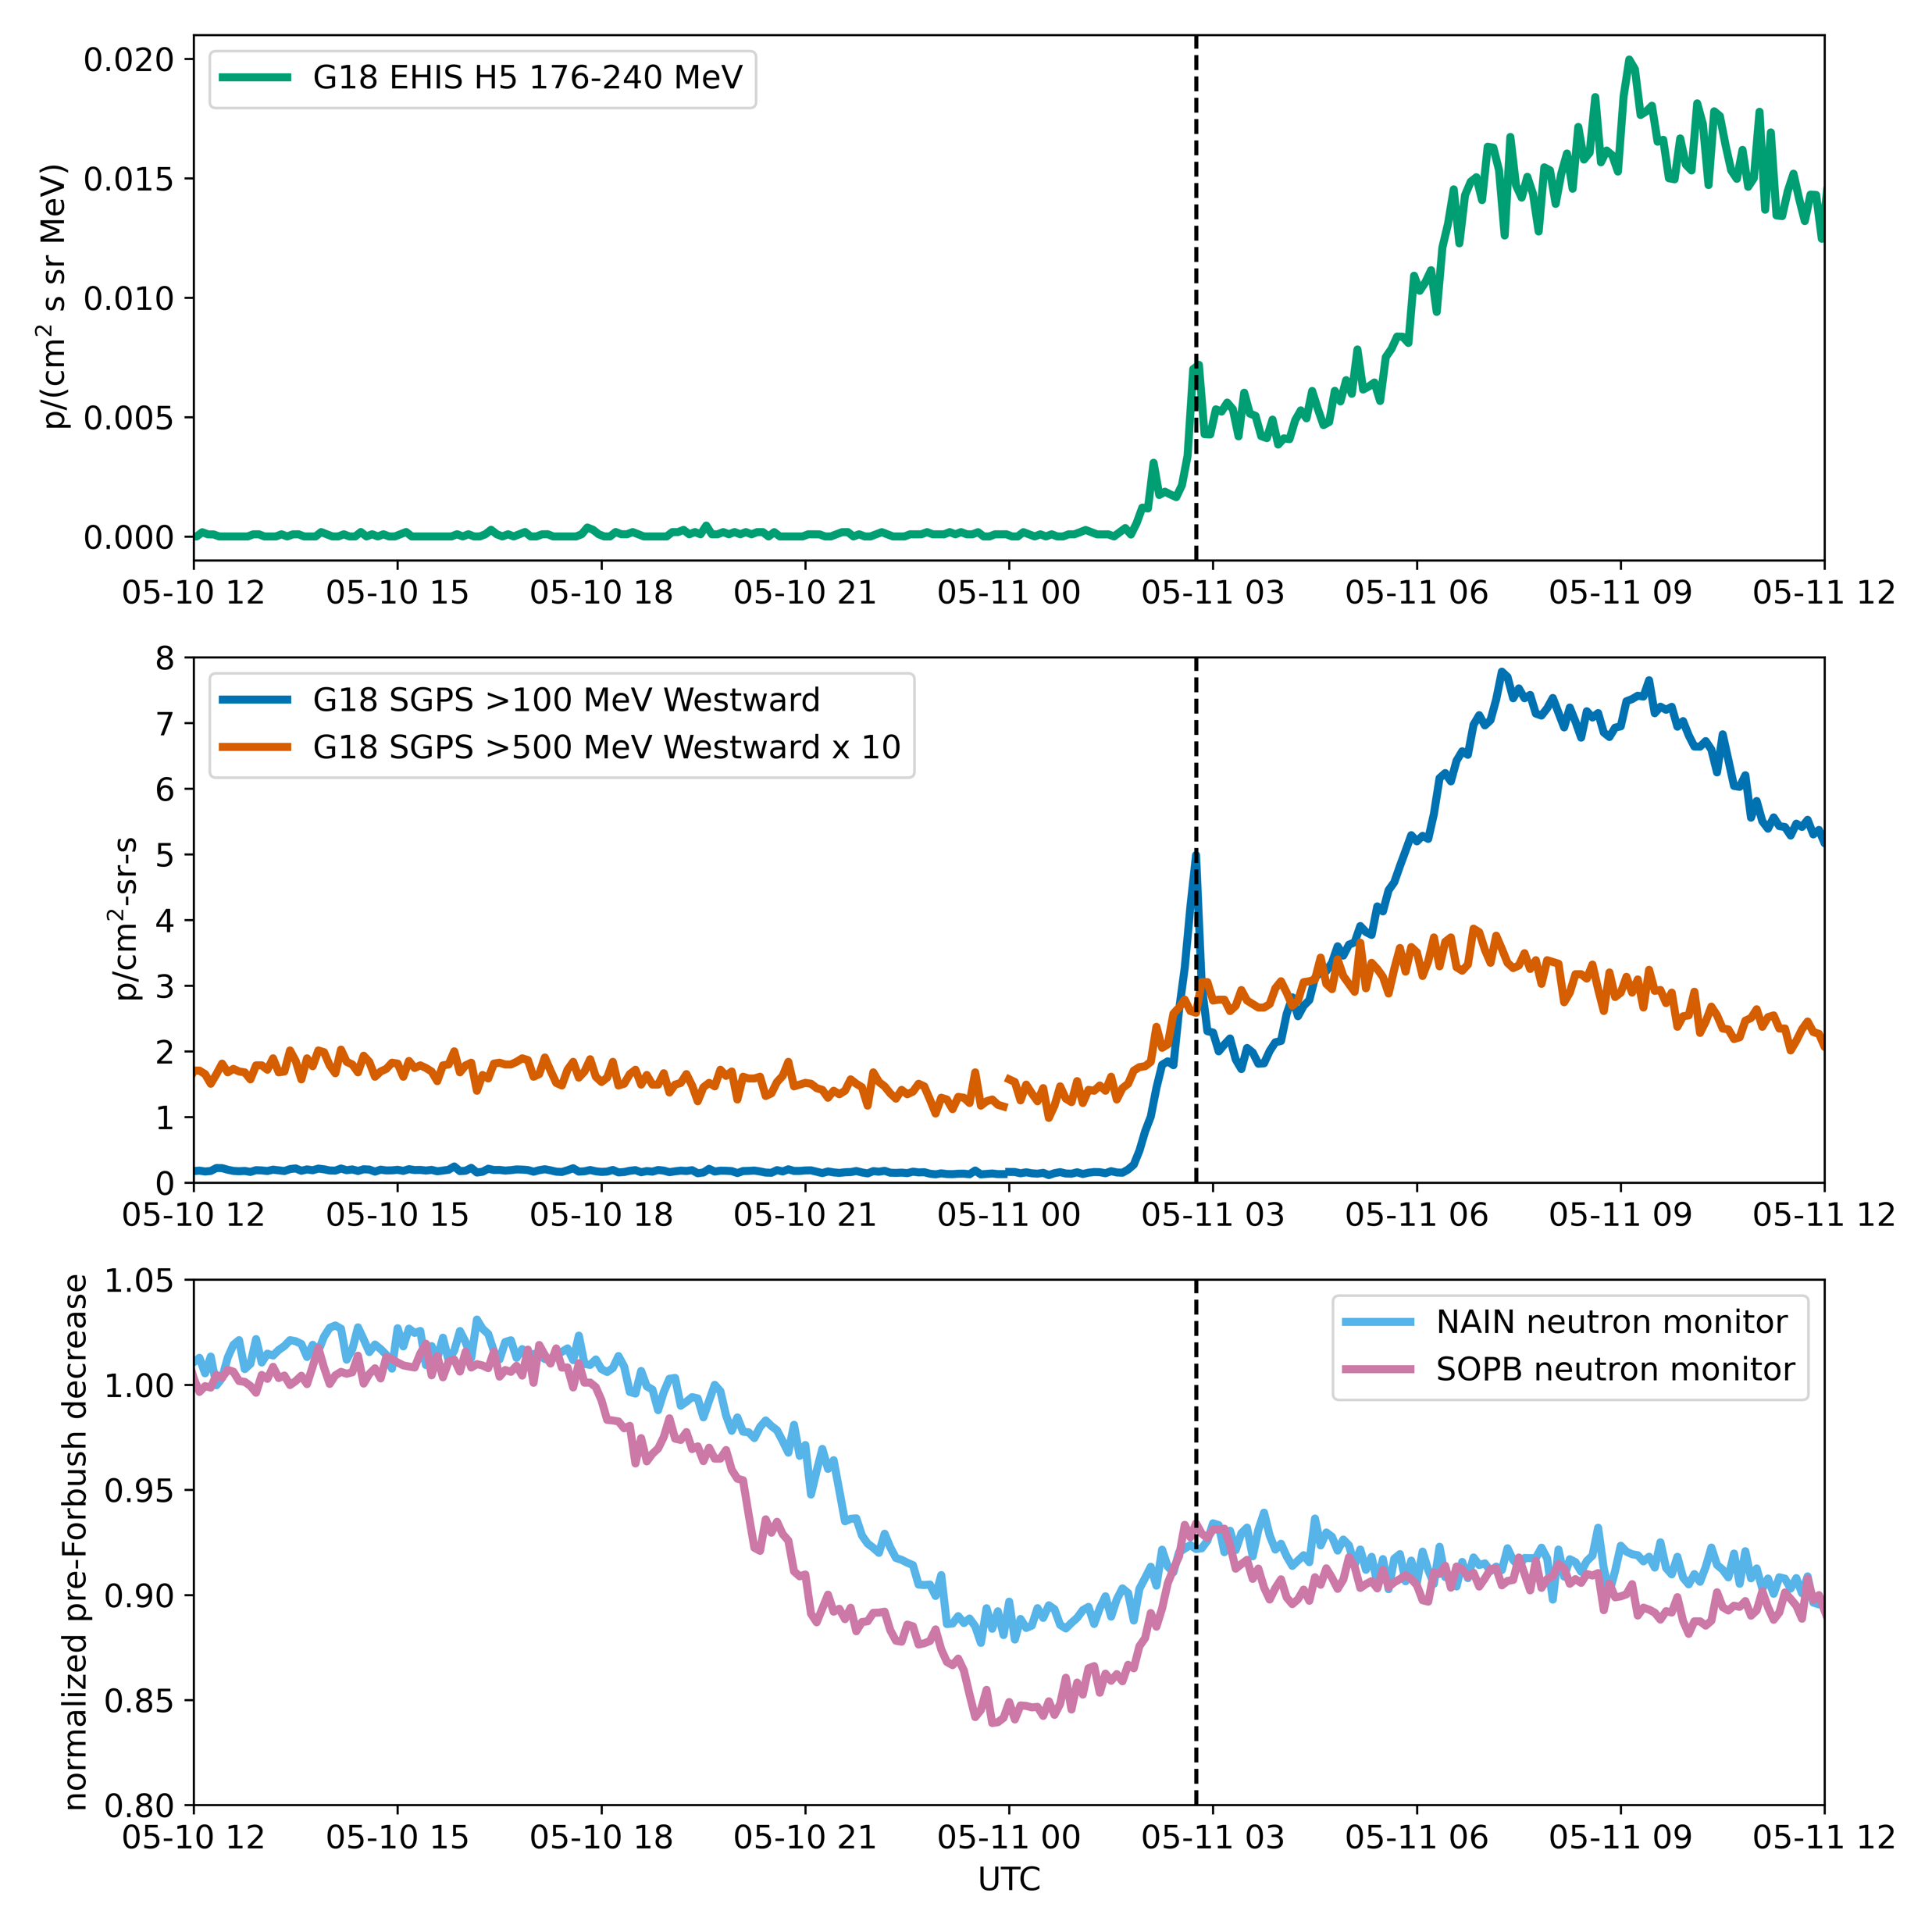
Though weak, 11 May 2024 event was sufficiently energetic to be observed by EHIS H5 and on the ground
GLE 74 is the first ground-level enhancement (GLE) in cosmic-ray count rates since October 2021
Superposed on a Forbush decrease in GCR fluxes
Initial peak observed by EHIS H5 corresponds to peak in GLE flux observed at South Pole (SOPB)
Nain is the northernmost town in Labrador
We acknowledge the NMDB database (www.nmdb.eu) founded under the European Union's FP7 programme (contract no. 213007), and the PIs of individual neutron monitors at: Nain (University of Delaware Department of Physics and Astronomy and the Bartol Research Institute, USA), and South Pole Bare (University of Wisconsin, River Falls, USA).

Slide 25
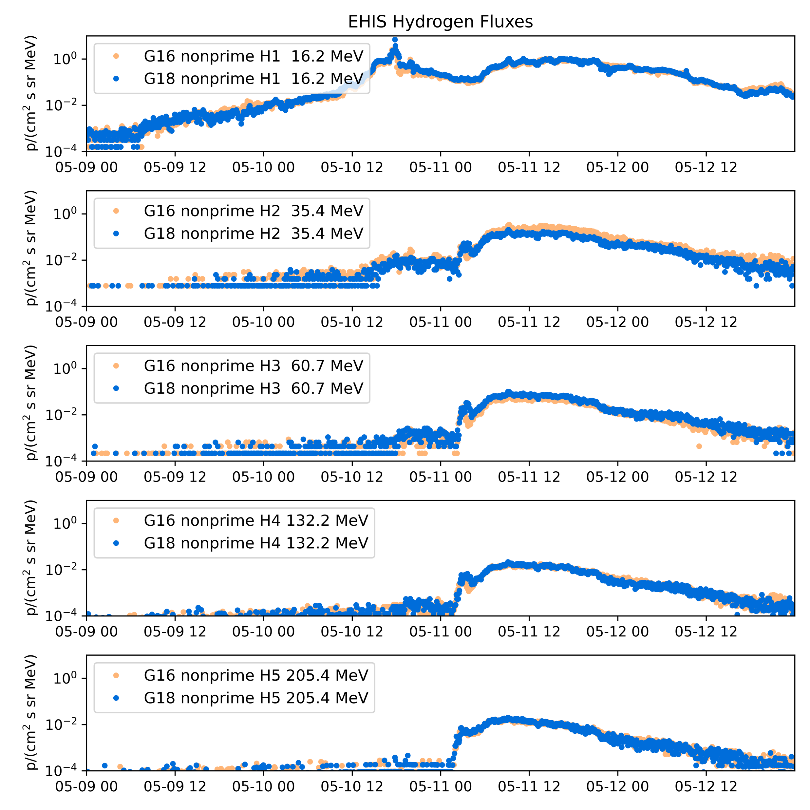
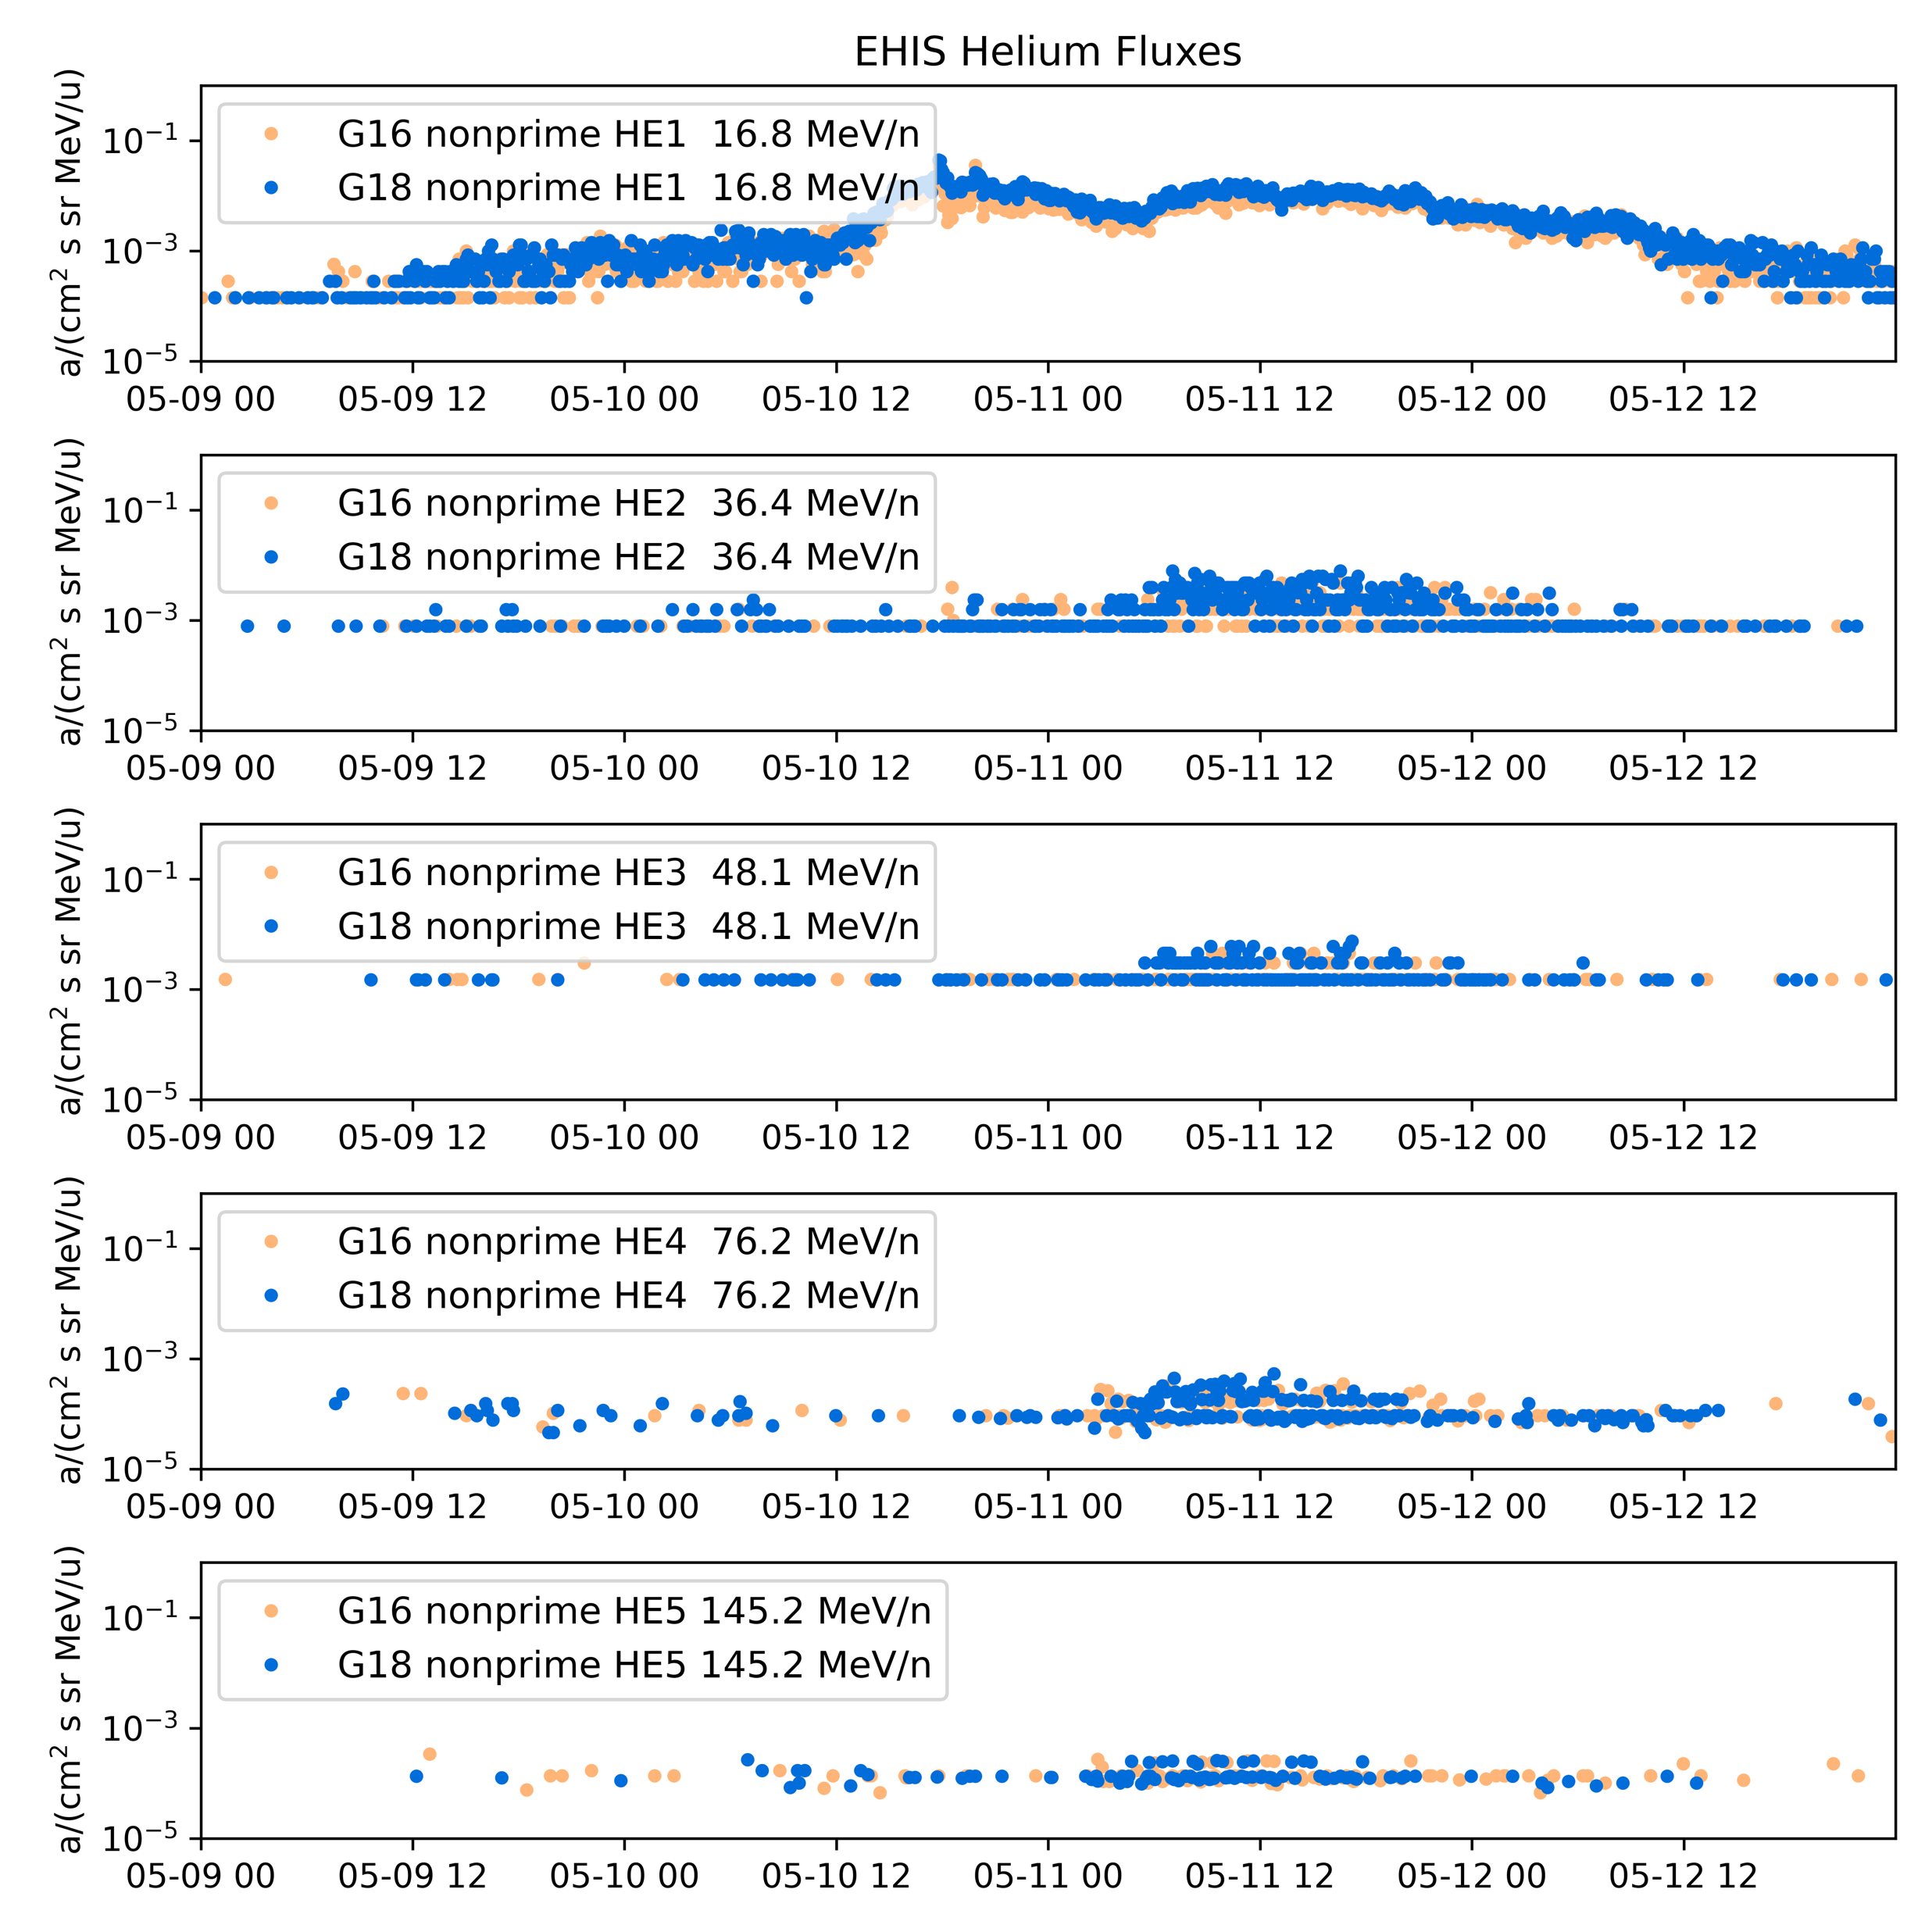
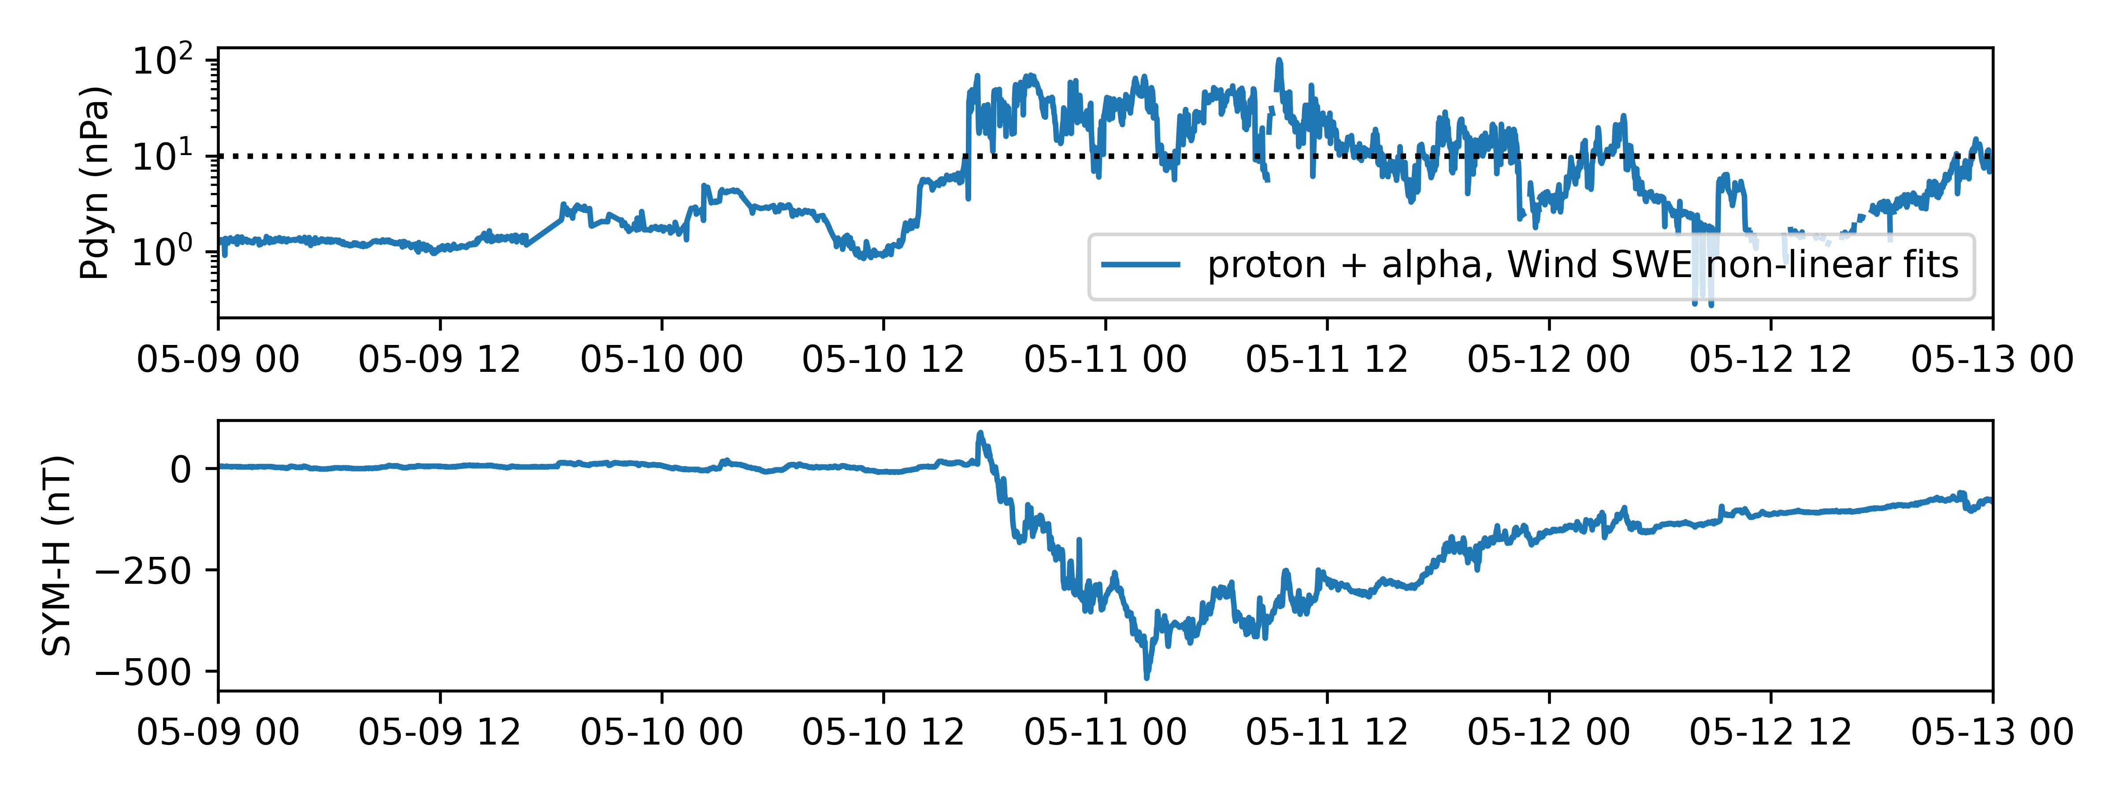
09-12 May 2024 SEP event during Gannon storm: Pdyn > 10 nPa
xcal
xcal

Slide 26
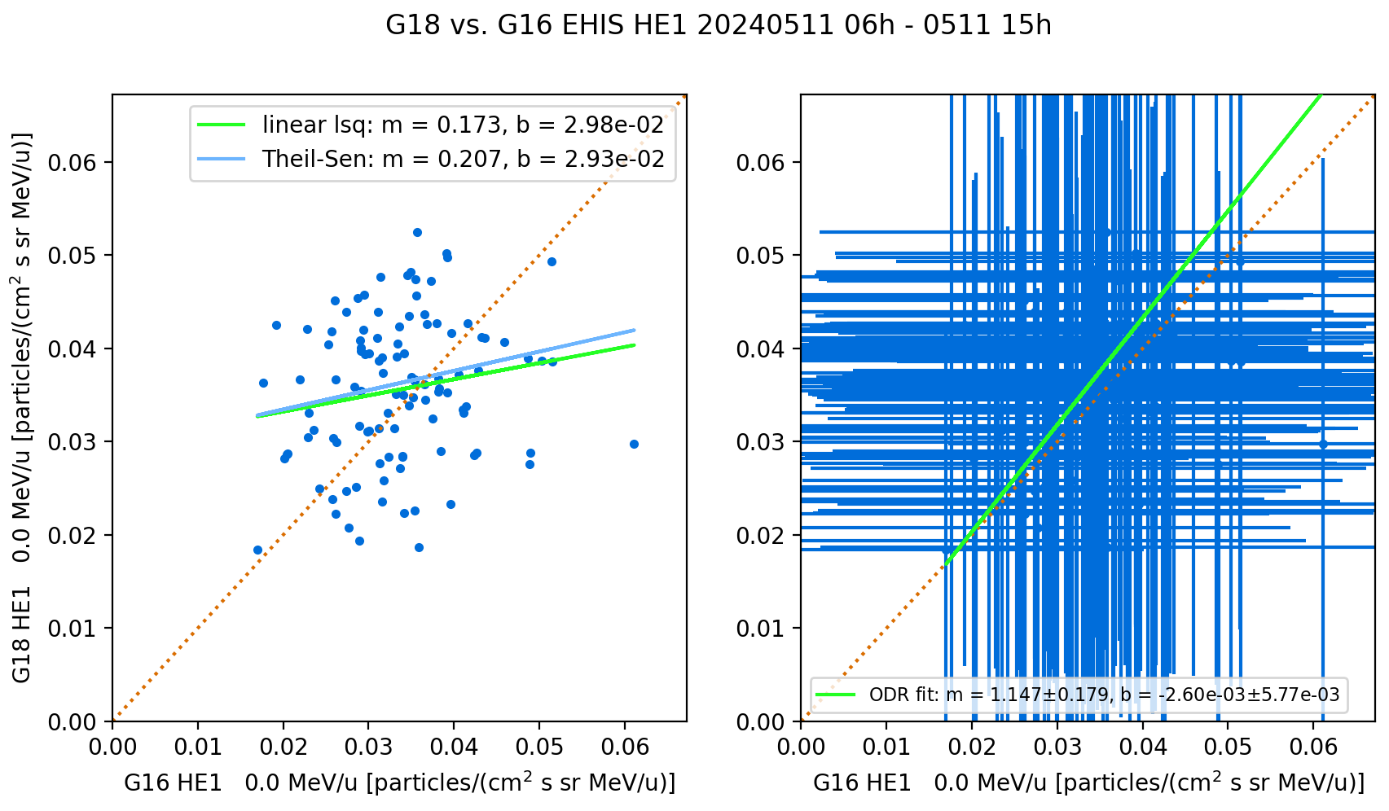
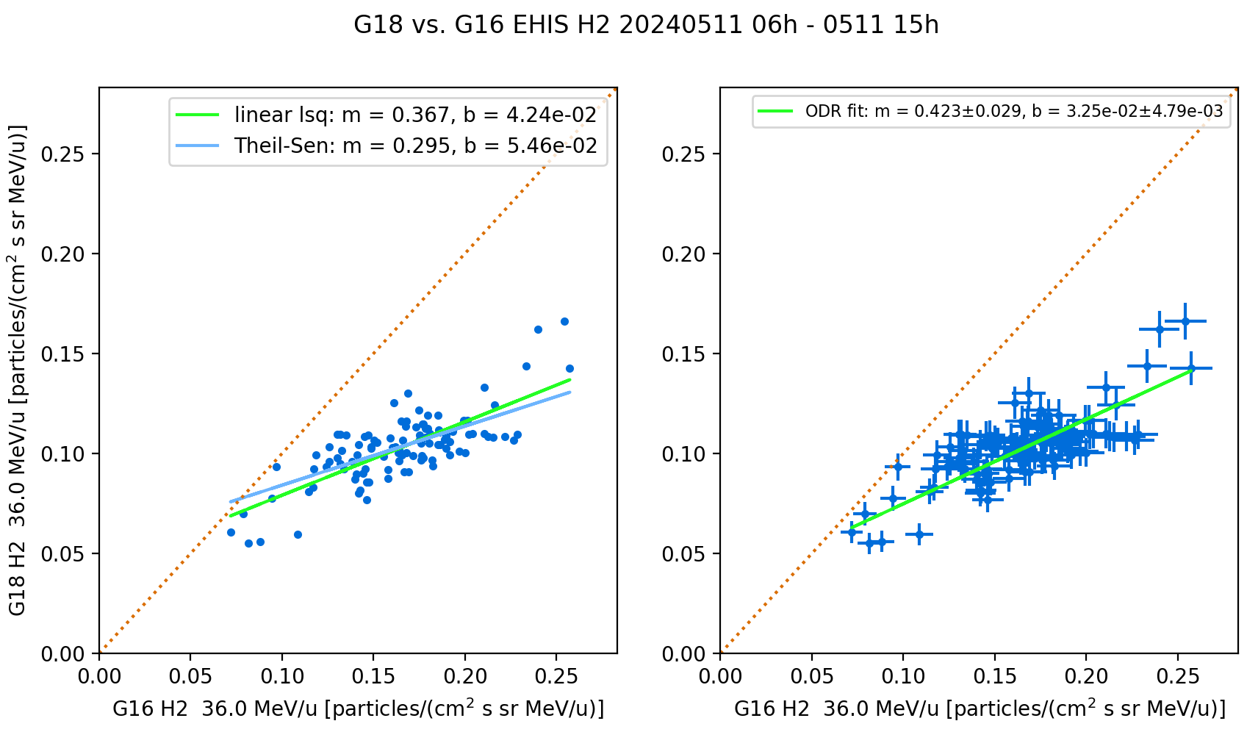
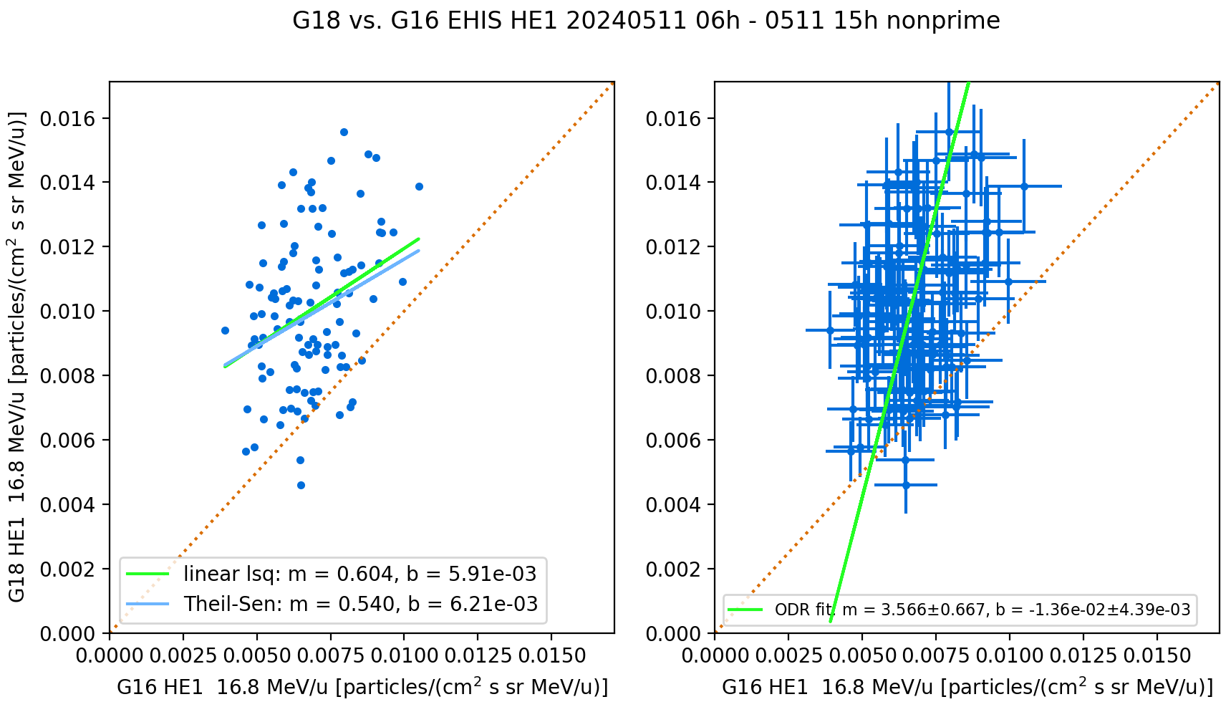
G18 vs G16 EHIS Comparisons,
2024.05.11 06-15 UT
Used Orthogonal Distance Regression (ODR) to account for uncertainty in both variables.
Channel | L1b (Prime) | NonPrime
H1 | 1.076±0.030 | 1.025±0.038
H2 | 0.423±0.029 | 0.396±0.032
H3 | 1.315±0.048 | 1.595±0.121
H4 | 1.351±0.059 | 1.235±0.084
H5 | 1.256±0.043 | 1.429±0.129
HE1 | 1.147±0.179 | 3.566±0.667
Statistical errors in HE1 (ADR 1064) ↑ are much larger than in EHIS-measured fluxes ↓.

Slide 27
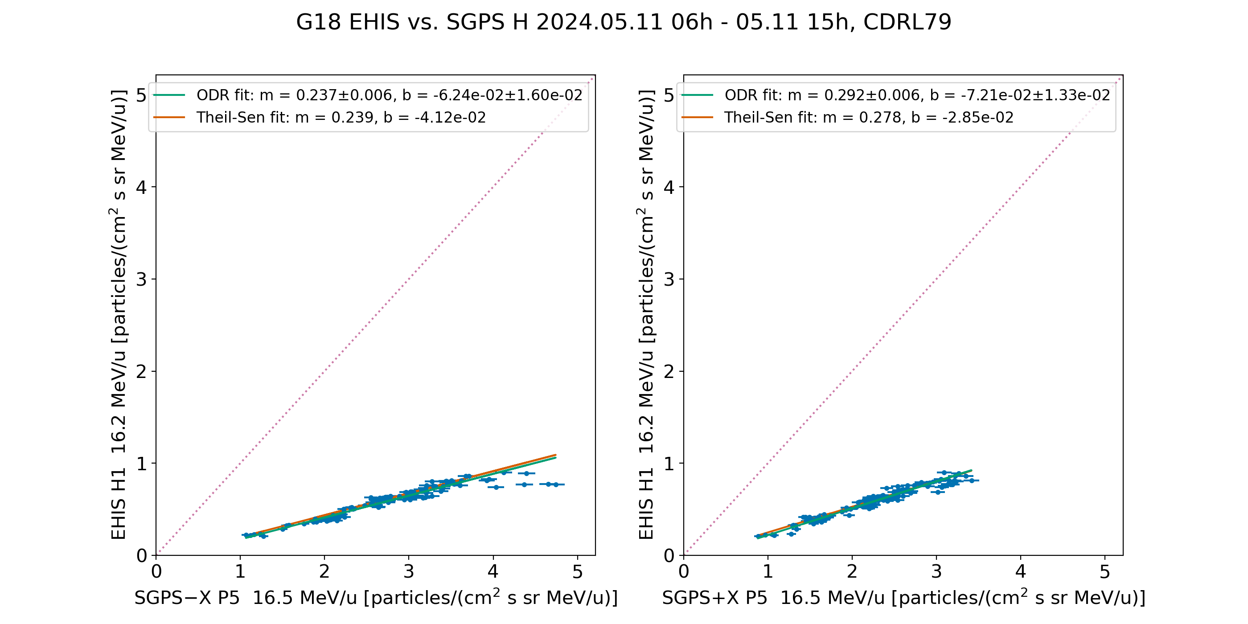
PLPT-SEI-004: Compare G18 EHIS H1 and SGPS P5 Proton Fluxes
G18 EHIS H1 response is 24% that of SGPS -X P5 (Westward), 29% that of SGPS +X P5 (Eastward)

Slide 28
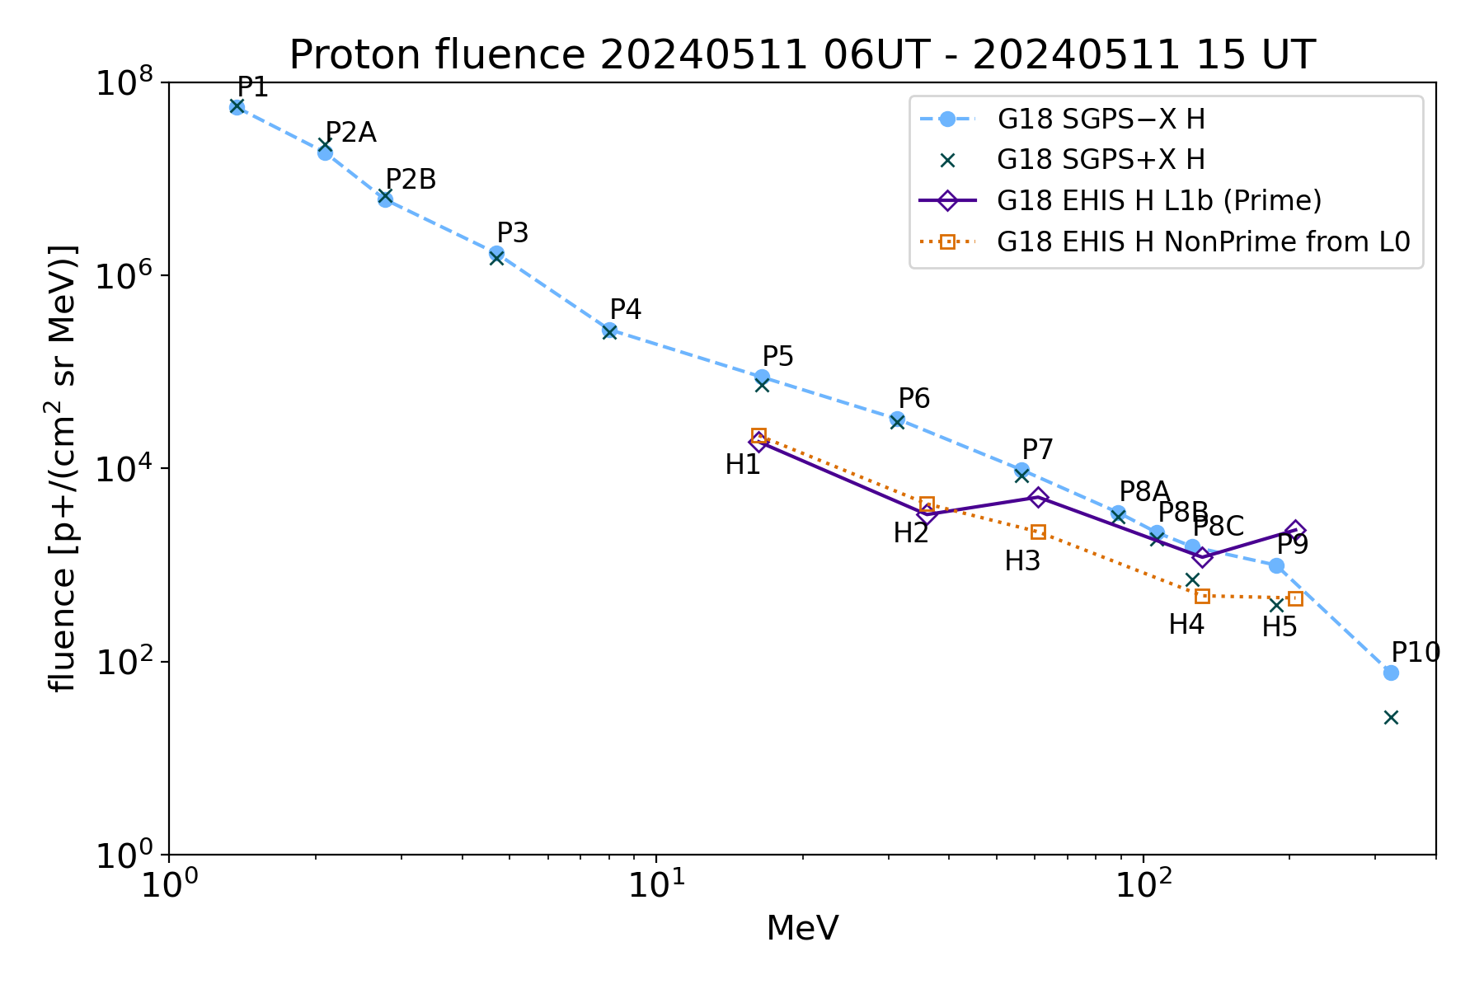
PLPT-SEI-004:
G18 H Fluence Spectra
Fluence period same as scatter plot
EHIS.NOT.S/SGPS-X @
H1: 0.243
H2: 0.177
H3: 0.272
H4: 0.327
H5: 0.706
NonPrime (.NOT.S) p+ fluxes have OOM lower backgrounds than Prime
Backgrounds not removed

Slide 29
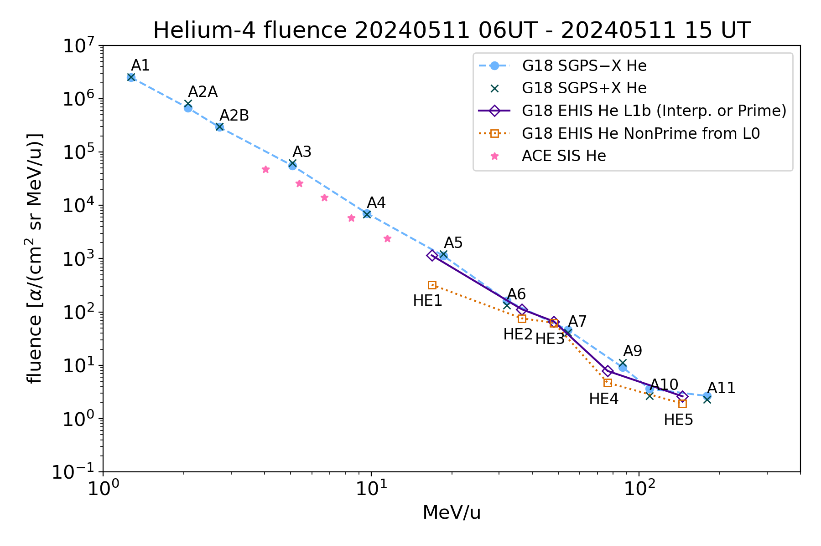
PLPT-SEI-004:
G18 He Fluence Spectra
Fluence period same as scatter plot
Unreliable as measure of solar alpha particle fluence – dominated by backgrounds
EHIS/SGPS-X
@ HE1, L1b (ADR 1064): 0.771
@HE1, .NOT.S: 0.217
@ HE2, L1b (ADR 1064): 0.939
@HE2, .NOT.S: 0.635
Backgrounds not removed

Slide 30
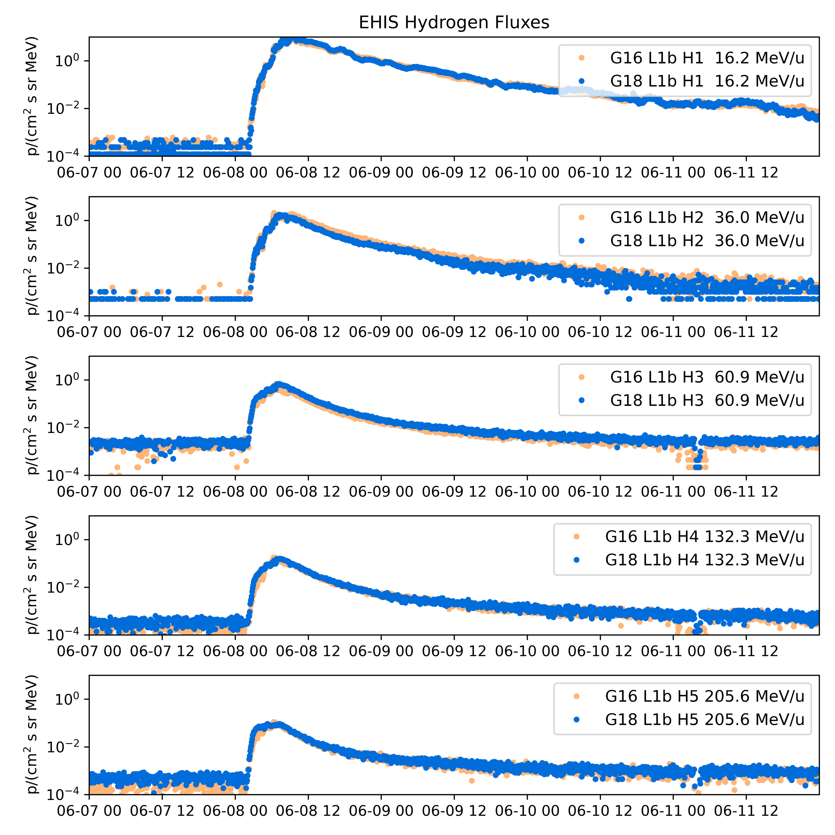
PLPT-SEI-004: 08 June 2024 event was largest to date in Solar Cycle 25
2024-06-08 event was much larger (>10 MeV proton peak flux = 1030 pfu) than May event
Pdyn was low (1-2 nPa), making for poor cross-calibration conditions within the magnetosphere (EHIS to SGPS, G16 to G18)
Instead, use this event to compare G18 and G16 EHIS to ACE/SIS (heavy ions)
  Luckily, this was an iron-rich event (iron fluxes comparable to oxygen)
  There is an ambiguity in the quantitative comparisons due to the attenuating effect of geomagnetic cutoffs on EHIS fluxes
Comparison period selected: 2024-06-08, 0000-2355 UT (fluence)
xcal

Slide 31
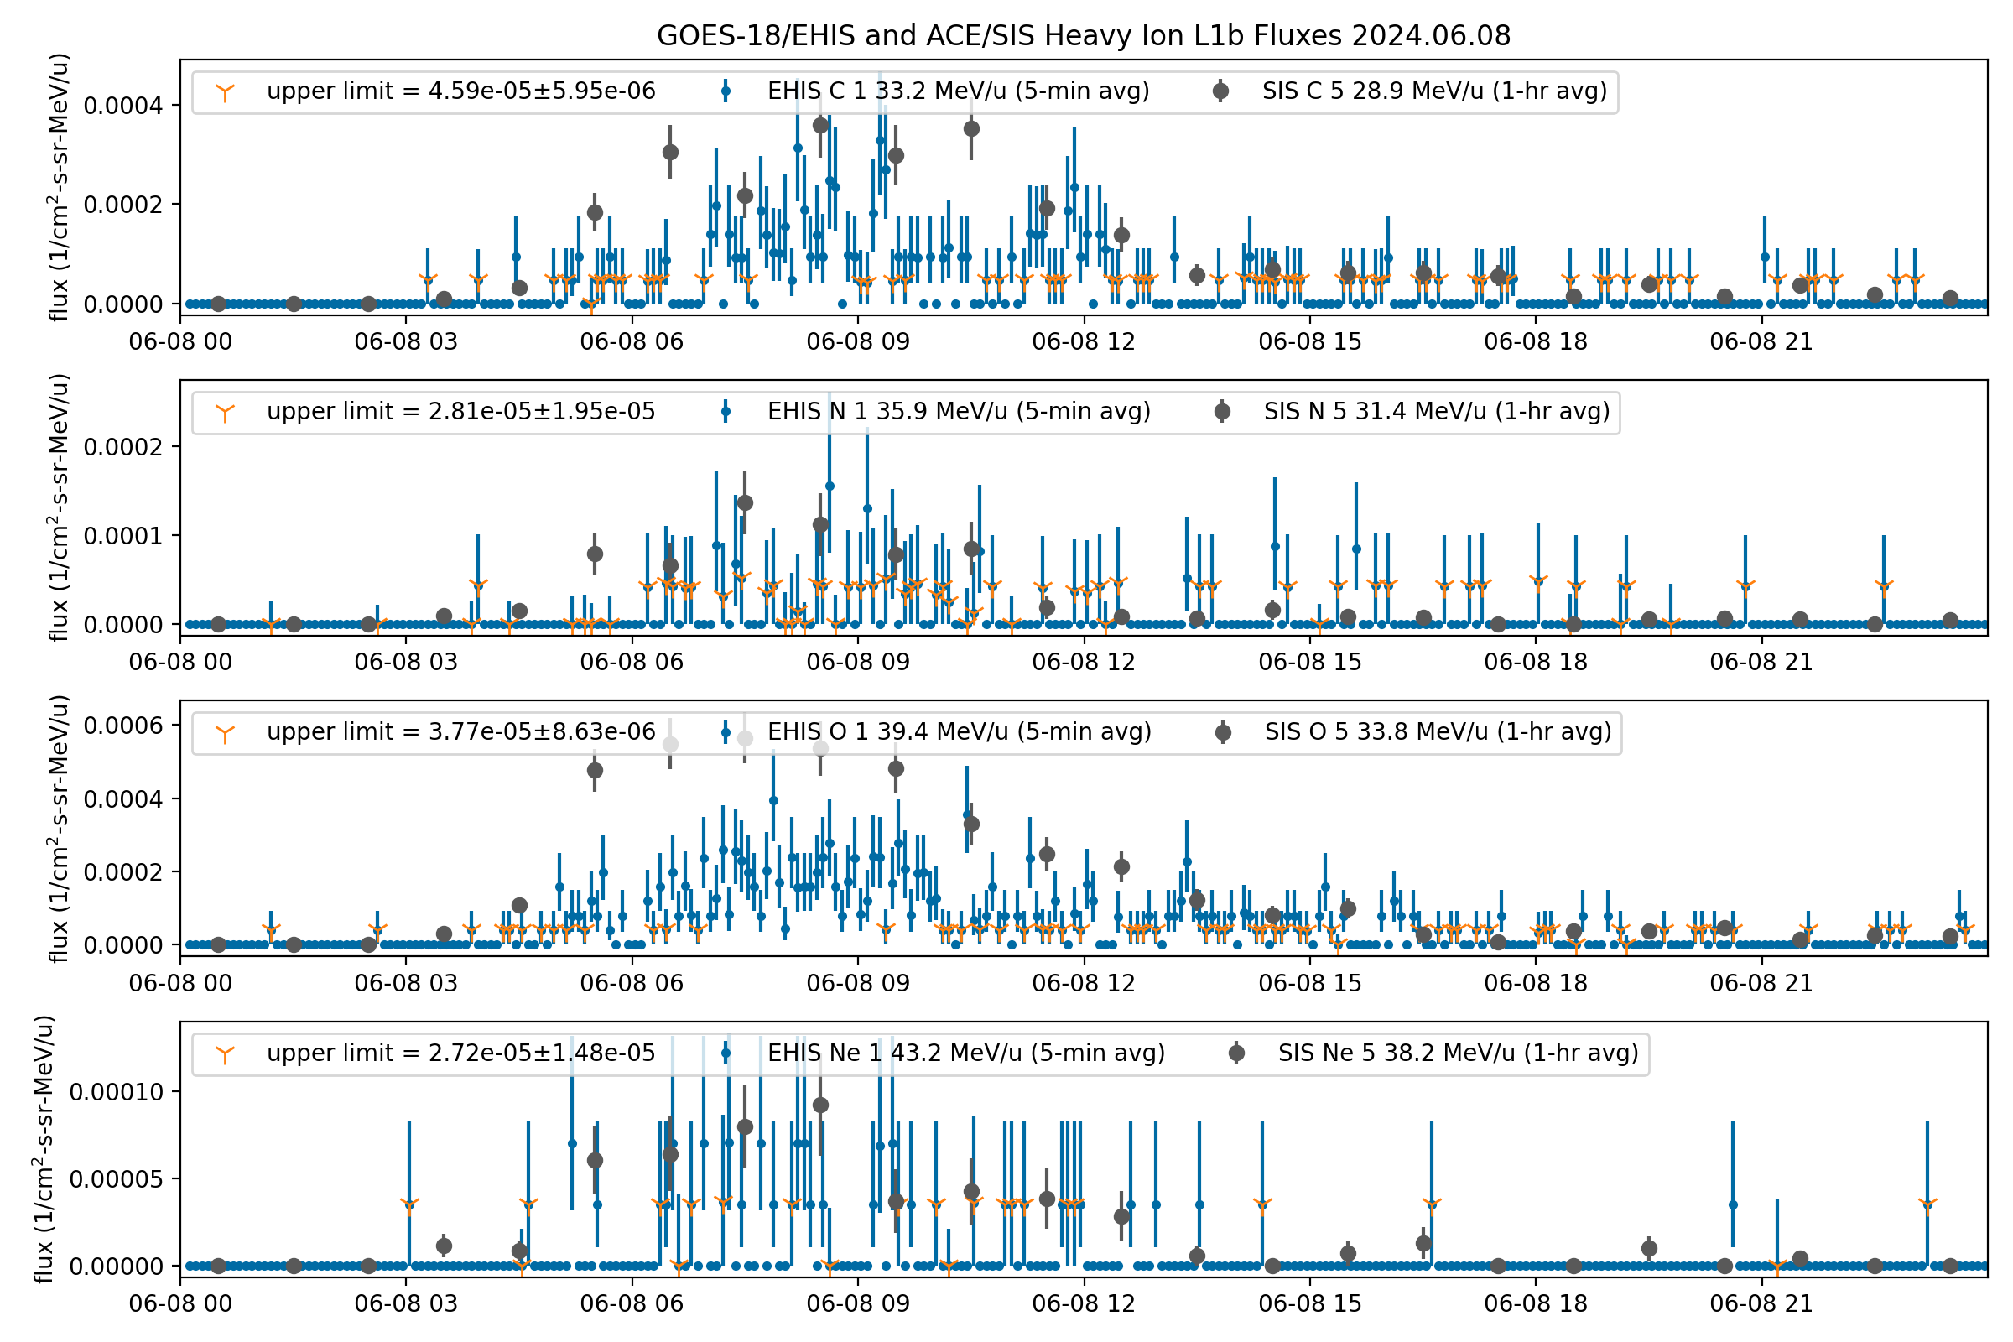
PLPT-SEI-004: G18 EHIS L1b and ACE SIS C, N, O and Ne time series
Qualitative comparison - EHIS energies do not match SIS energies

Slide 32
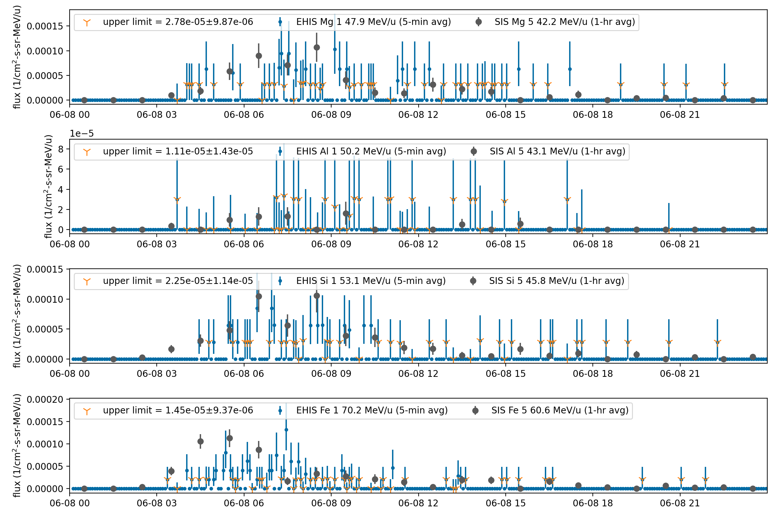
PLPT-SEI-004: G18 EHIS L1b and ACE SIS Mg, Al, Si and Fe time series
No Al fluxes above upper limits.
A qualitative comparison - EHIS energies do not match SIS energies

Slide 33
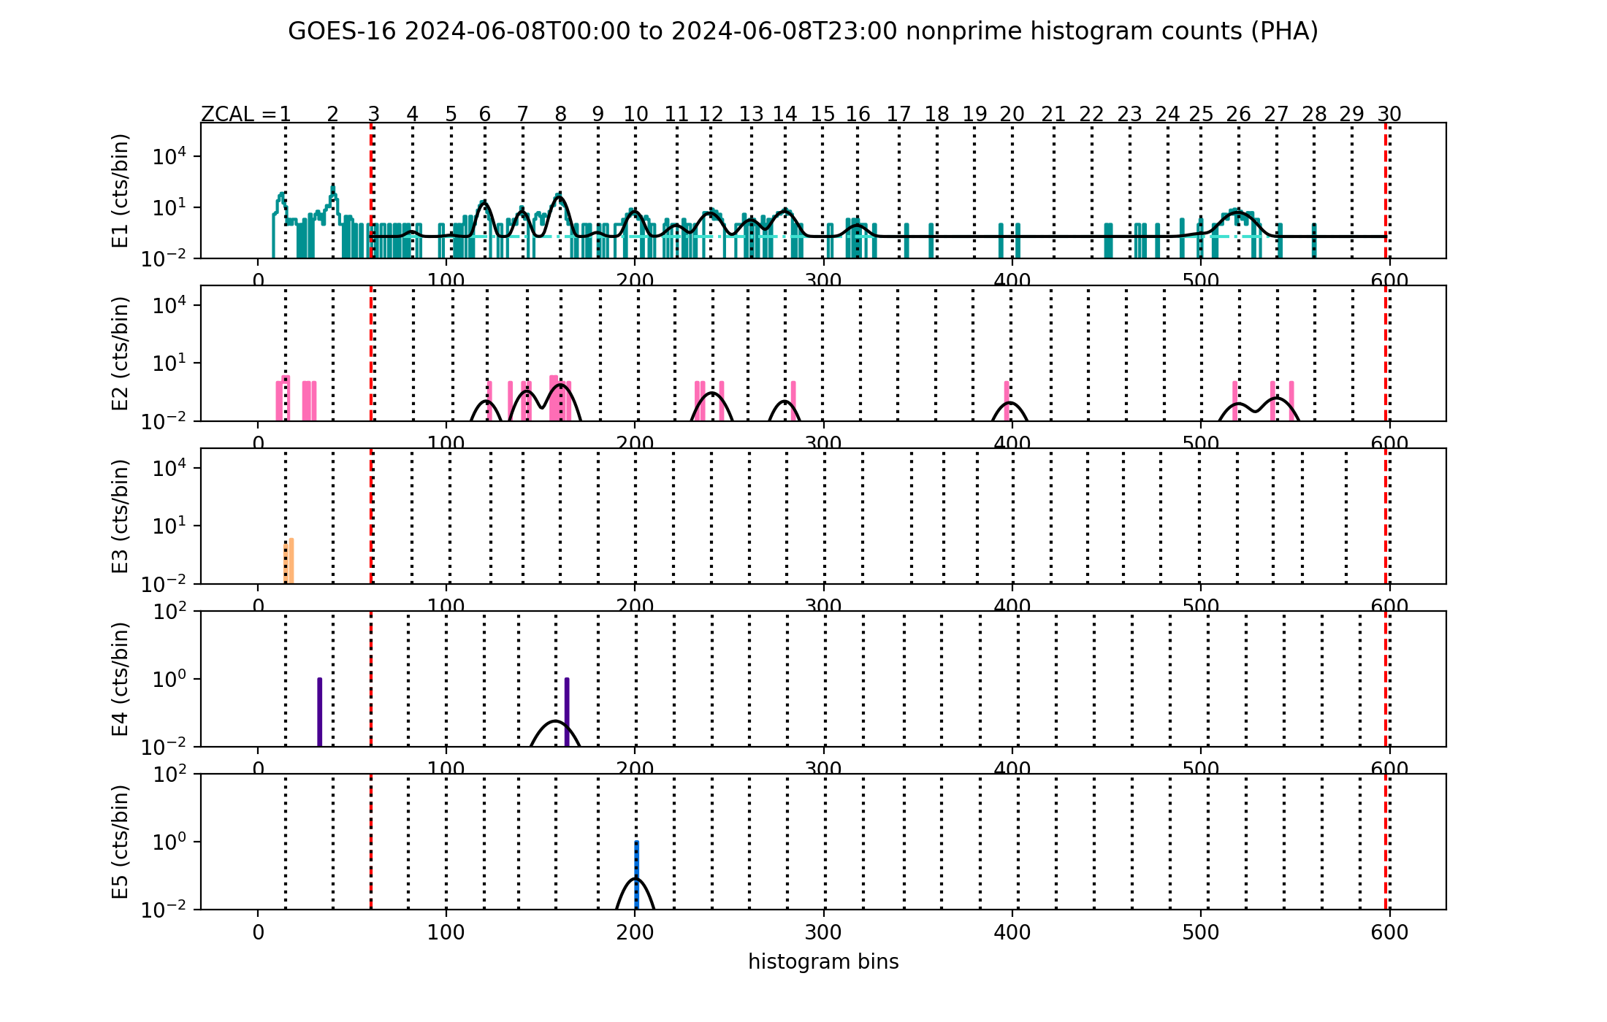
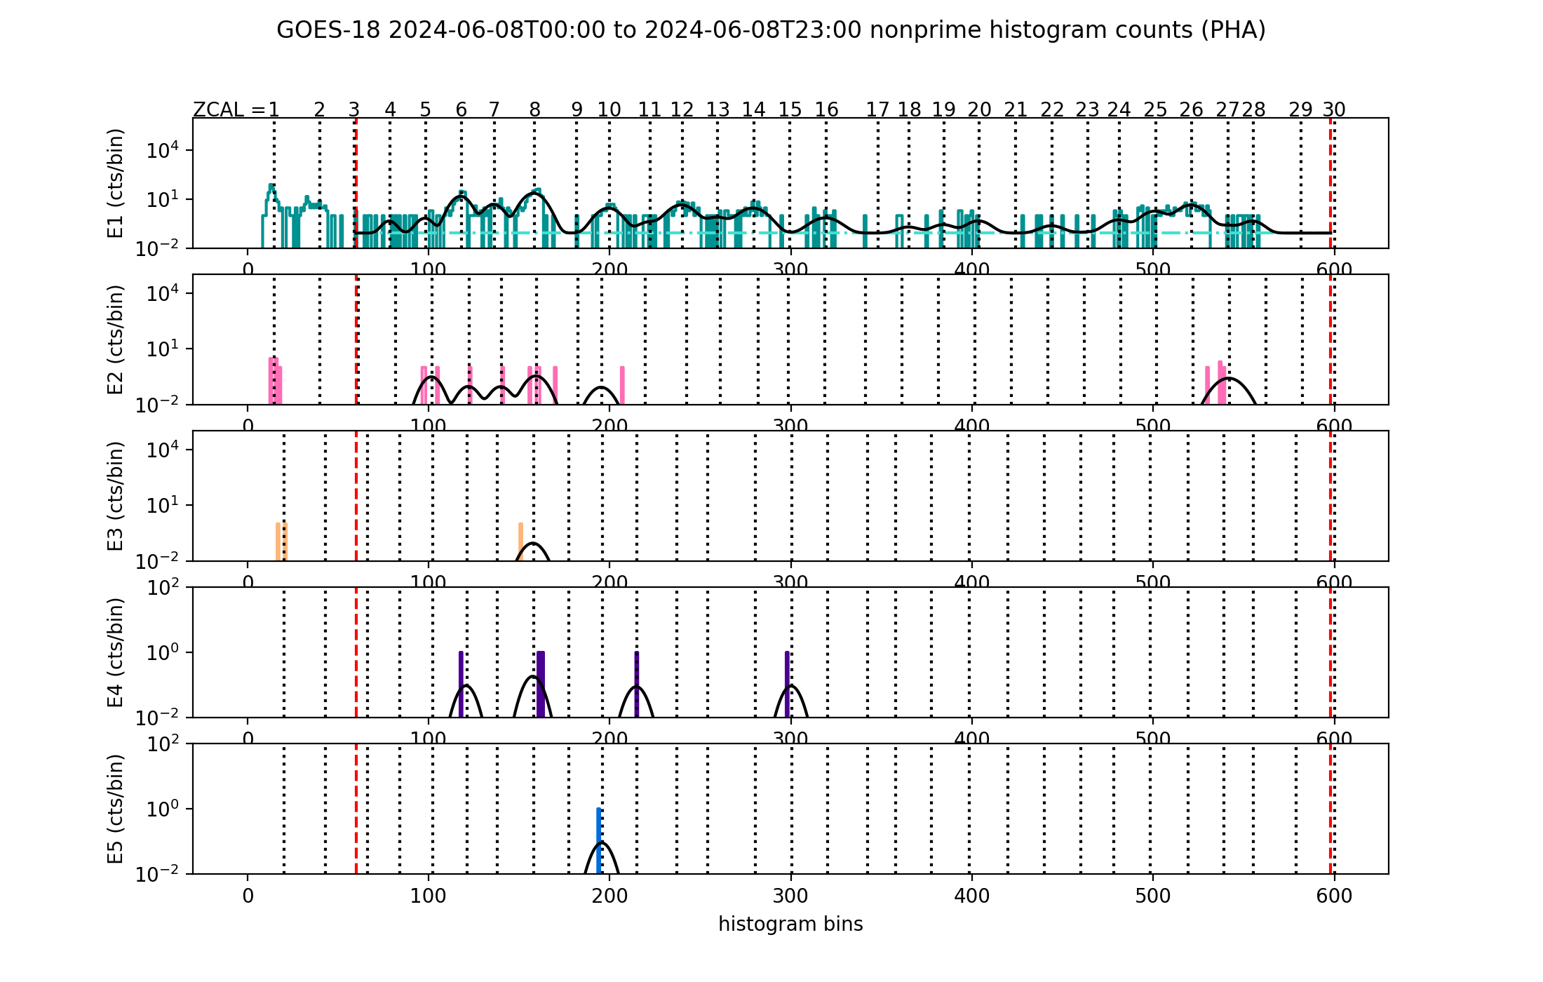
PLPT-SEI-004: 08 June 2024, SCI-PHA histogram curve fits, one day of data
Except for the E1 channel, histogram heavy-ion counts are very sparse during this event
GOES-16 SCI-PHA Histogram
GOES-18 SCI-PHA Histogram
N
Si
S
Fe
C
O
Ne
Mg
N
Si
S
Fe
C
O
Ne
Mg

Slide 34
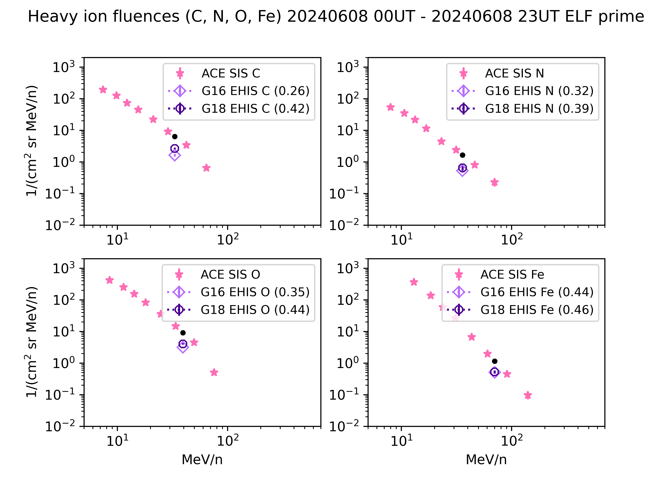
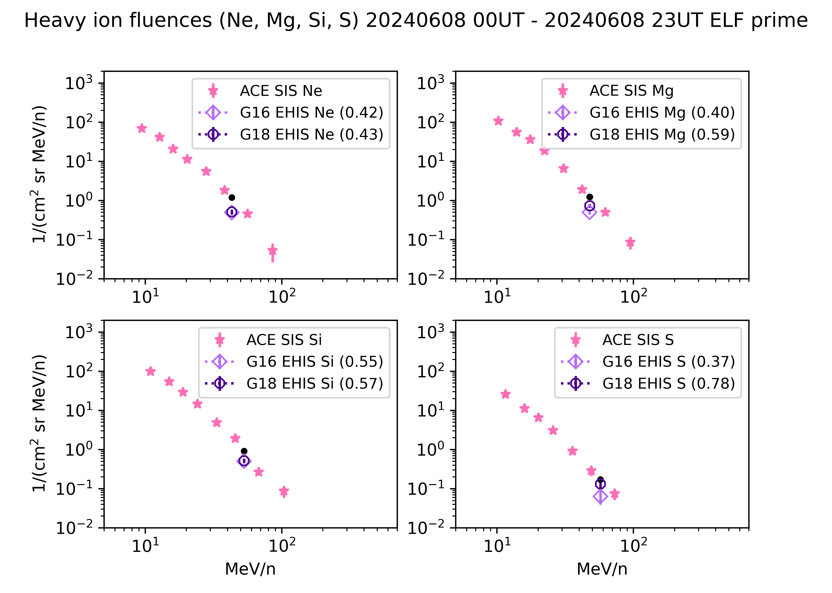
PLPT-SEI-004: G18 and G16 EHIS and ACE SIS fluences (1) - ELF
Calculated from summed L0 SCI-ELF histograms using NCEI implementation of L1b algorithm.
EHIS in Prime state (scintillator out of circuit)
Ratios of EHIS to interpolated SIS fluxes are 0.26-0.62 for GOES-16 and 0.39-0.78 for GOES-18.
There may be some geomagnetic cutoff effects on C, N, and O (see backup charts); otherwise, differences are due to calibration.

Slide 35
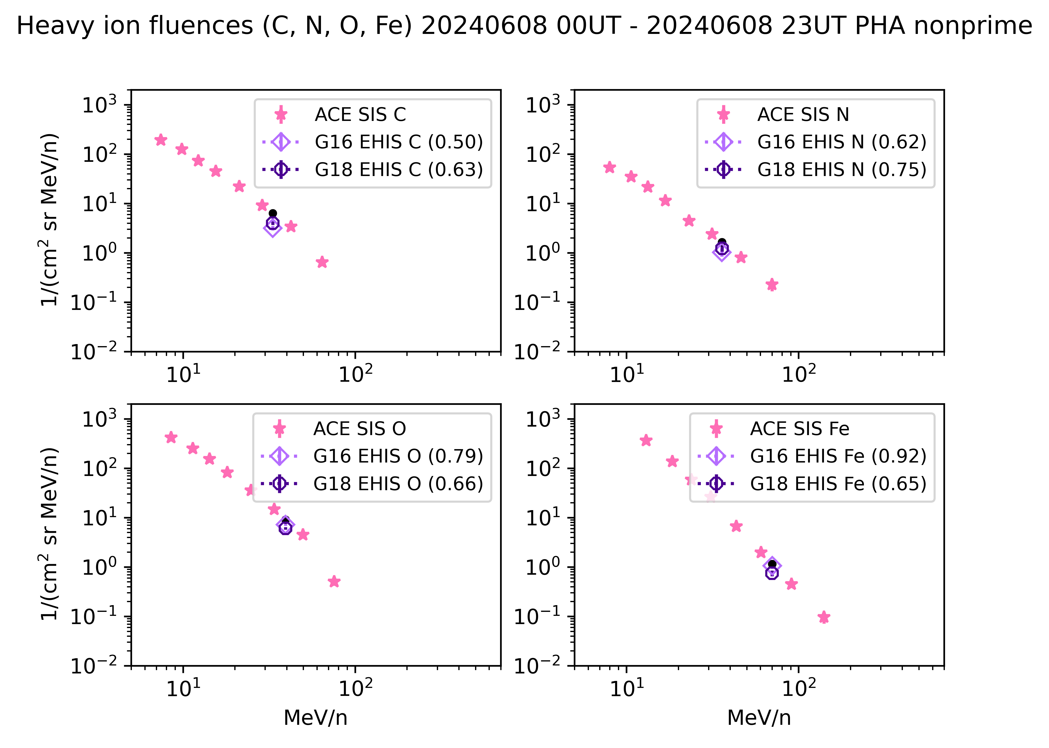
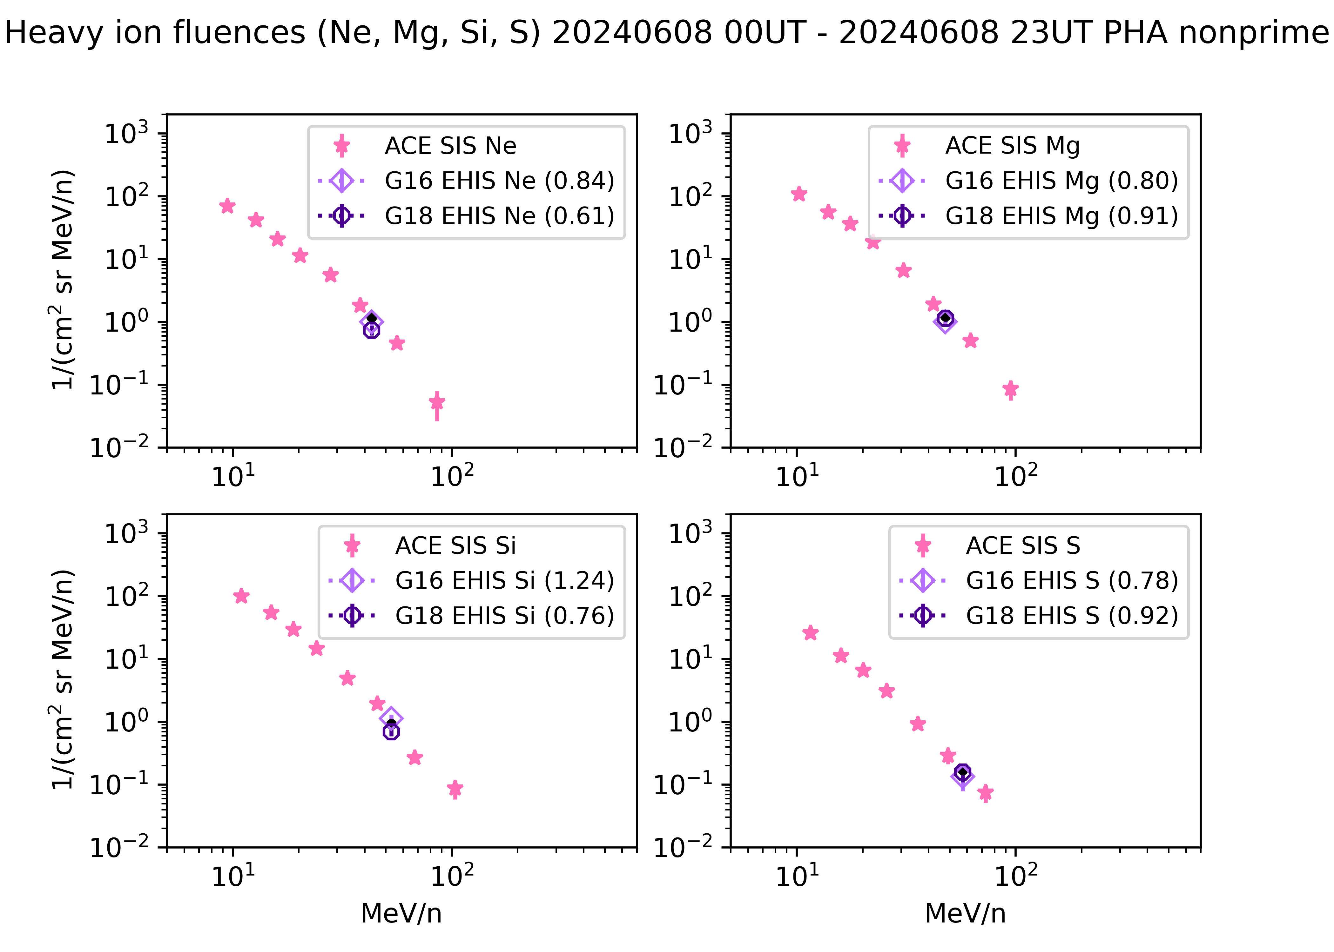
PLPT-SEI-004: G18 and G16 EHIS and ACE SIS fluences (2) - PHA
Calculated from histogram created from L0 SCI-PHA packets using NCEI implementation of flight software and L1b algorithm. Non-prime data (scintillator in circuit)
Ratios of EHIS to interpolated SIS fluxes are 0.50-1.24 for GOES-16 and 0.61-0.92 for GOES-18. There may be some geomagnetic cutoff effects on C, N, and O (see backup charts); otherwise, differences are due to calibration.

Slide 36
PLPT-SEI-004 Conclusions
Three SEP events studied for GOES-18 full validation
18 July 2023
  Highly anisotropic onset used to evaluate ADR 1064
  Modification seems to be working as designed
  Result is not an accurate representation of solar helium fluxes (HE1 and HE2) looking toward zenith
10-12 May 2024
  Long period of solar wind dynamic pressure > 10 nPa allowed valid GOES-East to -West and EHIS/SGPS comparison
  Second of two SEP events was energetic (GLE74), permitted cross-comparison of EHIS H1-5 and HE1-2 despite low fluxes
  G18 and G16 EHIS H1 agree well, G18 H2 is low (0.4x) wrt G16, G18 H3-H5 are high (1.24-1.60x) wrt G16
  G18 EHIS HE1 is 3.6x greater than G16 (based on EHIS L0)
  G18 EHIS hydrogen fluxes are 0.24-0.71x G18 SGPS-X hydrogen based on fluence comparison
  G18 EHIS HE1-2 L1b (ADR 1064) are 0.78-0.94x G18 SGPS-X based on fluence comparison
08 June 2024
  Iron-rich nature of event permitted heavy ion cross-comparison with ACE/SIS from carbon to iron
  Compared GOES-16 and -18 C, N, O, Ne, Mg, Si and Fe fluxes in lowest-energy channel to ACE/SIS
  Fluences from SCI-ELF packets (same as L1b): ratio of EHIS to SIS (interpolated)
    G16: 0.26-0.62
    G18: 0.39-0.78
  Fluences from SCI-PHA packets (non-prime): ratio of EHIS to SIS (interpolated)
    G16: 0.50-1.24
    G18: 0.61-0.92
RIMP success criteria: On-orbit cross-calibration of EHIS with SGPS above 10 MeV, Two Solar Energetic Particle (SEP) events, Differences quantified on data taken through validation phase.
RIMP success criteria met for SEP cross-comparison.

Slide 37
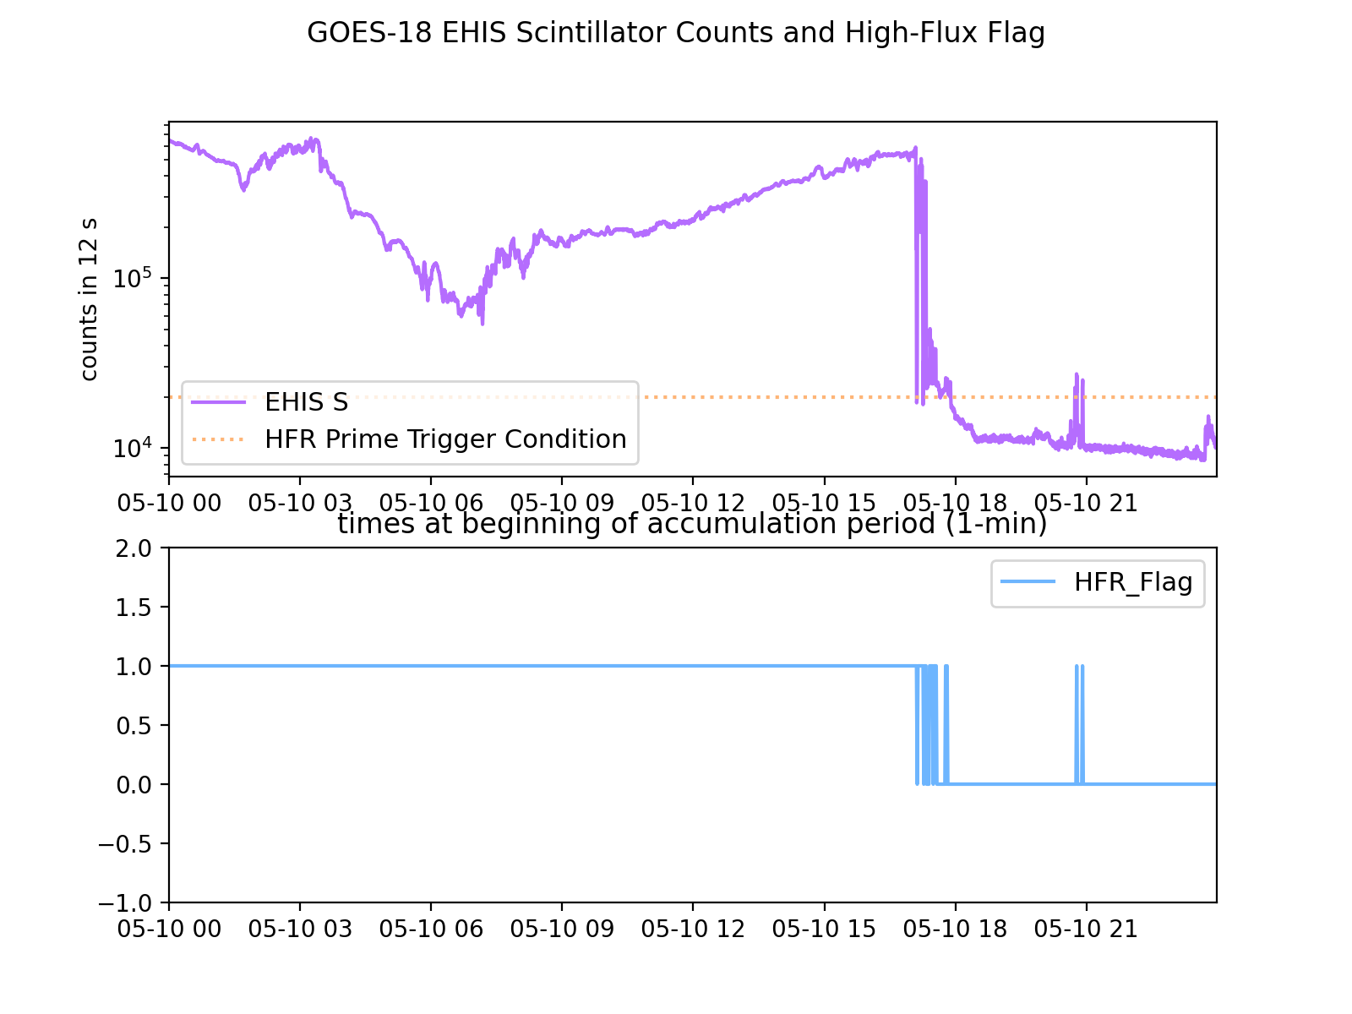
Revisit High Flux Rate (HFR) Flag Setting
A higher scintillator ‘high flux rate’ criterion should be set on one of the EHIS’s (GOES-18 or 19) in order to get NonPrime data in real time
  The NonPrime data (with the scintillator in the circuit) is better quality than the Prime data - more accurate, lower backgrounds
  Radiation belt electrons impinging on the scintillator keep the instrument in Prime mode most of the time
  The new criterion would be set above the level of counts from radiation belt electrons
  The downside is increased dead-time correction - within the validity range of the existing algorithm and, to date, small
If the program is open to this, NCEI will perform the analysis and recommend a revised HFR setting
Radiation belt dropout at the commencement of Gannon Storm on 10 May 2024 causes OOM drop in G18 EHIS scintillator counts

Slide 38
Geometrical Factors for SEPs vs. GCRs
Relative contribution of different parts of spectral response curves to total counts depends on spectrum, affects effective energies and geometrical factors.
Body of function dominates response to SEPs
Tail of function dominates response to GCRs
LUT geometrical factors are calculated for these conditions (PLPT-SEI-004)
Accurate GCR analysis (PLPT-SEI-006) requires geometrical factors calculated for these conditions
The five colored curves represent the spectrum-weighted relative response functions for energy channels E1-E5.

Slide 39
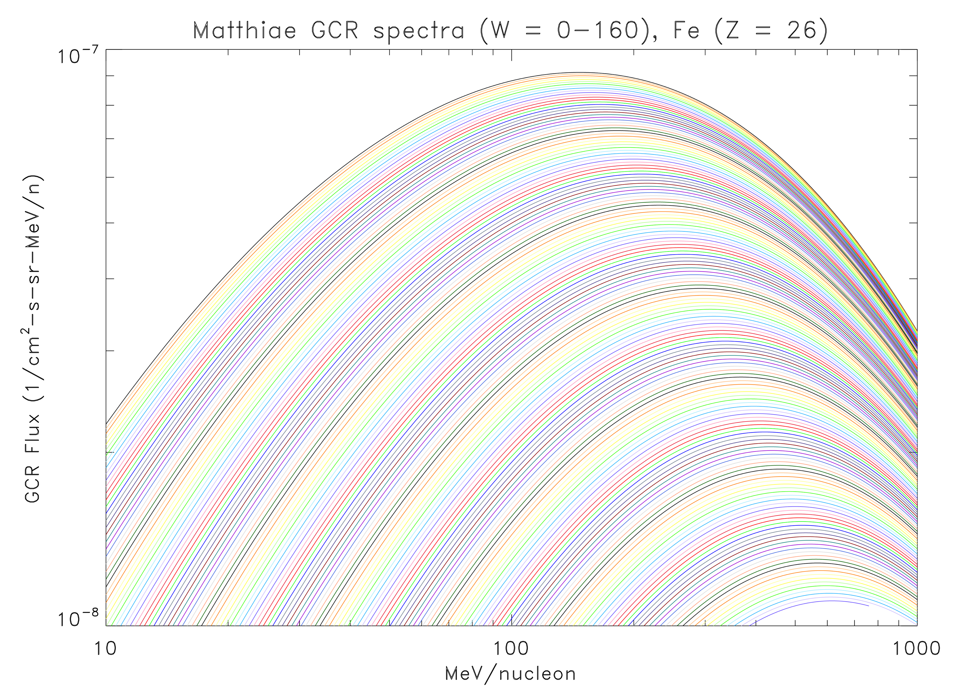
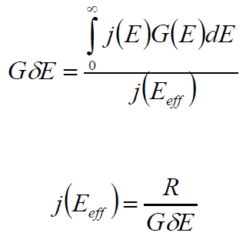
Bowtie analysis of EHIS energy response functions
Under SEA-48, ATC simulated EHIS spectral (energy) response functions
  For GOES-16 and GOES-18 EHIS
  Units of response functions vs. energy are cm² sr
NCEI’s first application of these response functions is to calculate the geometry-energy factors (GdE) for GCR spectra using the ‘bowtie’ method
  NCEI has applied this method to the calculation of GdE for GOES 16-19 MPS-HI
  For GCRs, the family of spectra used is from the Matthiä+ 2013 GCR model
Bowtie analysis determines the effective energy (Eeff) at which the spread in GdE is minimum for the set of spectra used in the analysis
Bowtie analysis, differential: cm² sr MeV/n

Slide 40
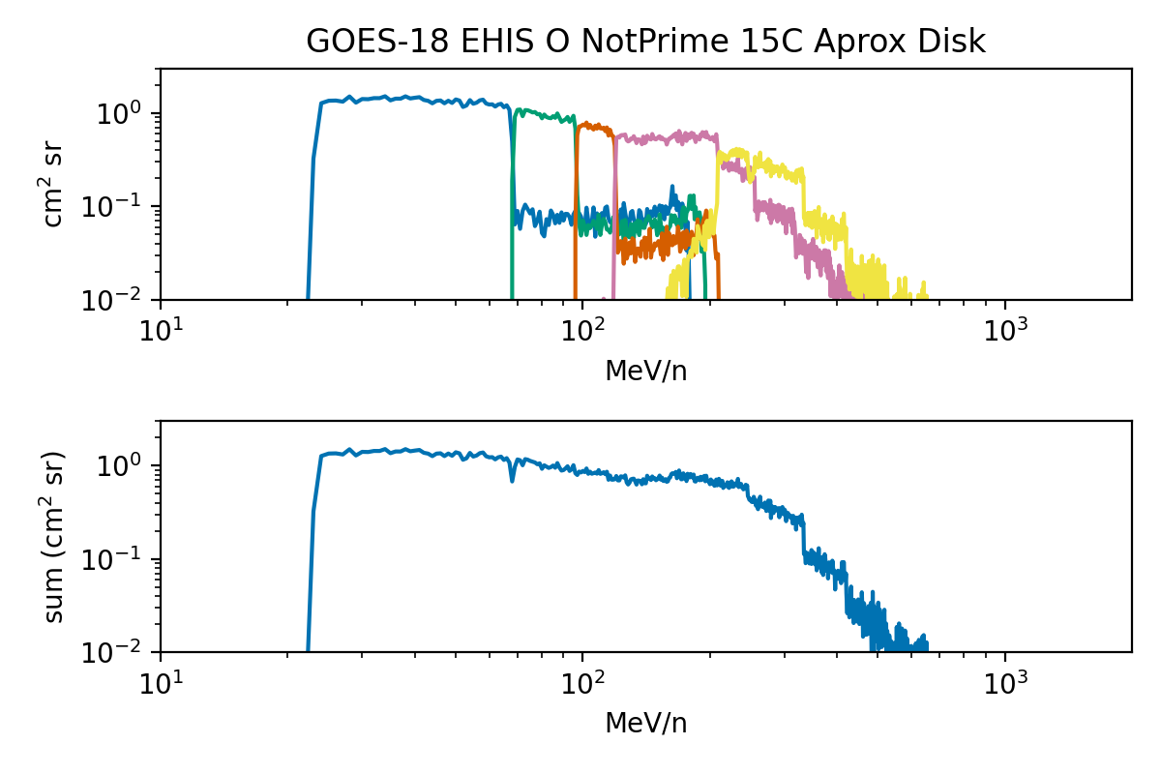
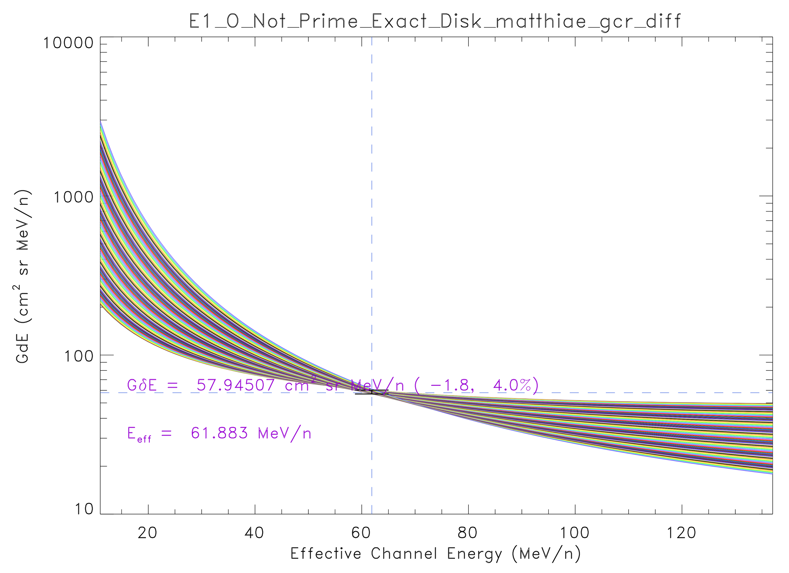
Bowtie example: Oxygen
Oxygen Response Functions
Bowtie Result for Oxygen Channel E1 (Not Prime)
Bowtie Results for Oxygen (Not Prime)
Channel | Egm from LUT (MeV/n) | Eeff, bowtie (MeV/n) | Eeff/Egm | GdE, 5%ile (cm^2 sr MeV/n) | GdE, 50%ile (cm^2 sr MeV/n) | GdE, 95%ile (cm^2 sr MeV/n) | GdE,bowtie/GdE,LUT
E1 | 38.82 | 61.88 | 1.59 | 56.88 | 57.95 | 60.24 | 0.96
E2 | 80.62 | 96.48 | 1.20 | 31.42 | 31.59 | 31.95 | 1.21
E3 | 107.61 | 120.60 | 1.12 | 19.25 | 19.30 | 19.41 | 1.52
E4 | 164.27 | 192.73 | 1.17 | 67.48 | 67.76 | 68.33 | 1.40
E5 | 340.43 | 281.02 | 0.83 | 43.82 | 43.92 | 44.13 | 0.45
Effective energies increase for E1-E4 relative to geometric mean of LUT band edges since spectrum is increasing or flat over their energy ranges.

Slide 41
PLPT-SEI-006: Backgrounds
Compare EHIS backgrounds to predicted galactic cosmic ray (GCR) fluxes
  Matthiä+ 2013 GCR model fluxes for the same period
Average 4 months of data to construct average H and He spectrum
  For Matthiä model, derived W = 88.2 from Oulu corrected neutron monitor counts averaged during four Bartels rotations 2593-2596 (18 September 2023 – 3 January 2024)
  GCR fluxes vary little over this period
  Flight tables did not change during this period
Masked SEP fluxes using ACE/SIS 1-hr ‘solar_activity_flag’
Hydrogen (proton) and helium (alpha) fluxes:
  Calculated averages of NonPrime (.NOT.S) rates, converted to fluxes using CDRL 79 geometric factors (GFs) and energy band edges, and newly-calculated ’bowtie’ GFs and energies
Heavy ion fluxes:
  Analysis of ZCAL histogram aggregated from highest-priority events (P1 Non-Prime, .NOT.S) from pulse-height analysis (PHA) packets
  Use longer period due to sparseness of data (17 November 2022 - 8 June 2024 ~ 18 months)
  For Matthiä model, derived W = 45.1 (BR 2581, start of period) and W = 88.1 (BR 2602, end of period) for calculation of bracketing model spectra
Results compared using LUT and ‘bowtie’ characterizations (for the first time)
Period used for L0 rates (H, He) analyses: 15 Sept 2023 - 15 Jan 2024
Period used for PHA (heavy ion) analyses: 17 Nov 2022 - 08 Jun 2024

Slide 42
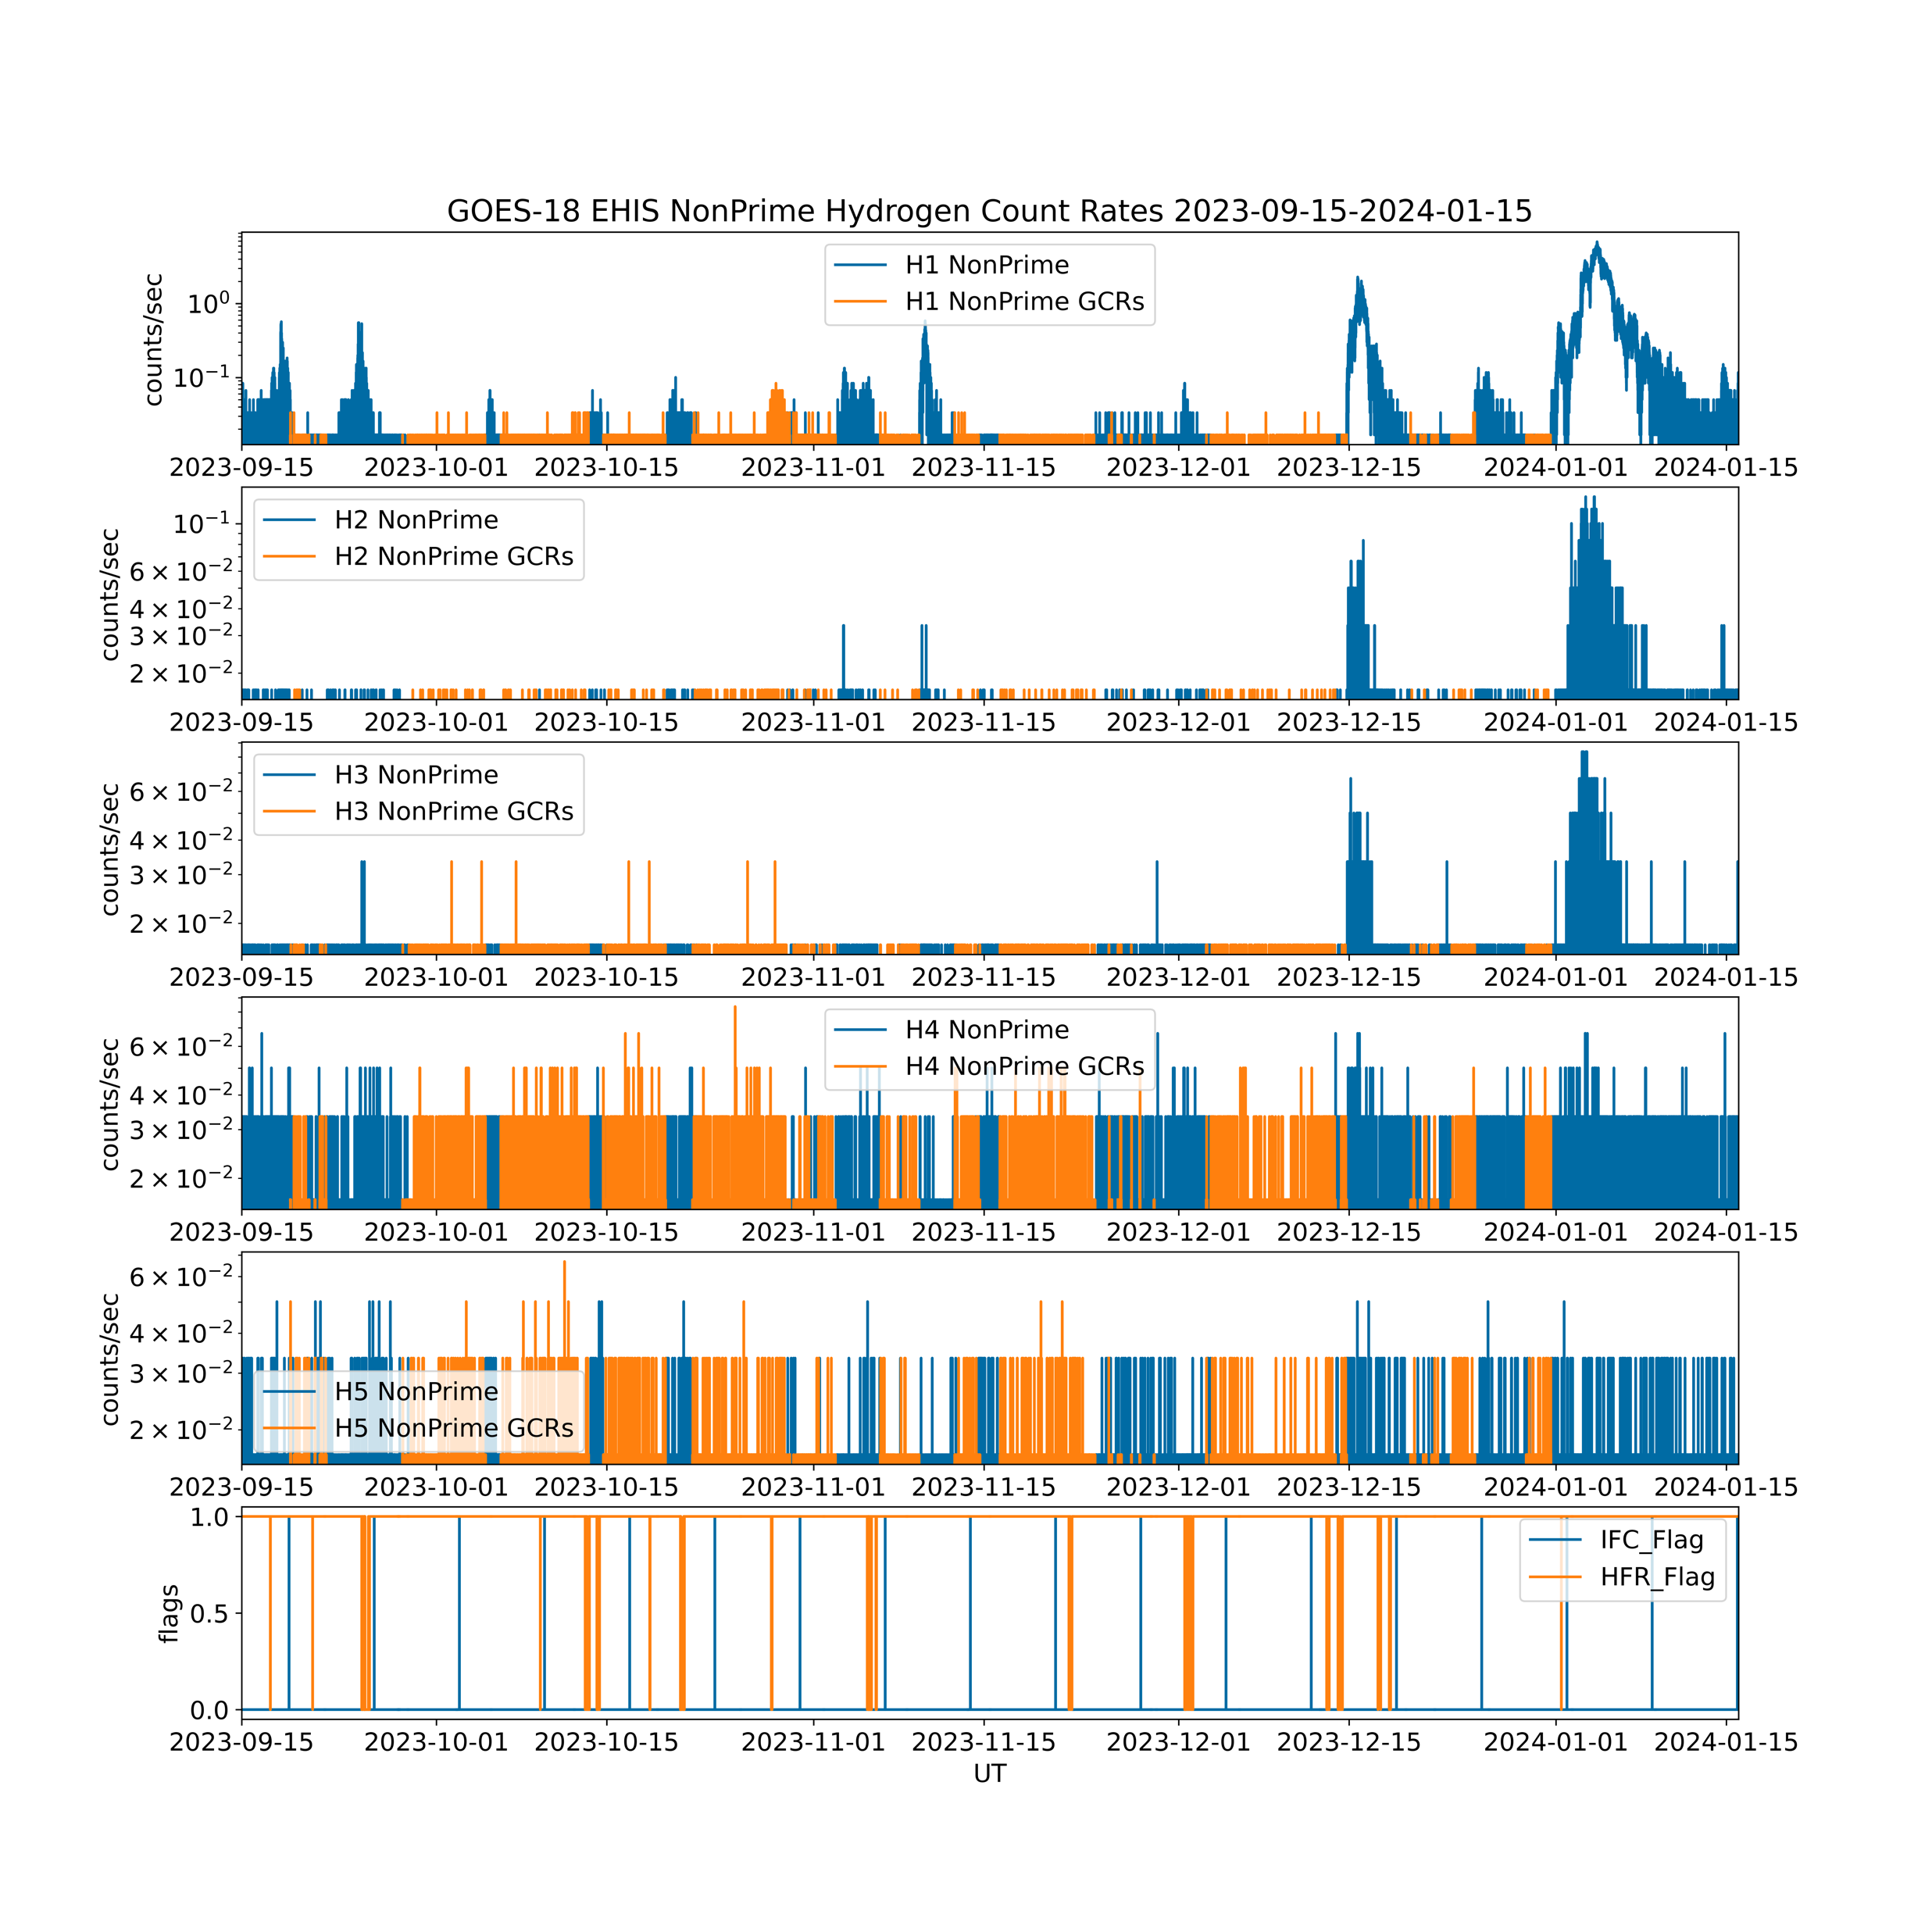
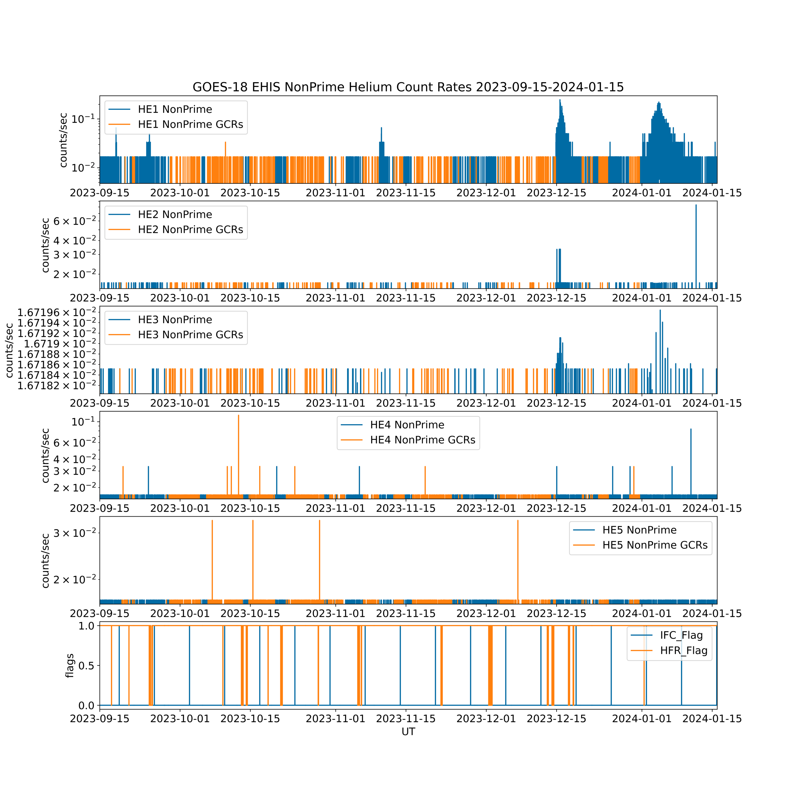
PLPT-SEI-006: Time Series Masked to Remove SEPs
Use ACE SIS ‘solar_activity_flag’ to mask SEPs (in blue below)
G18 EHIS NonPrime H
15 Sept 2023 - 15 Jan 2024
G18 EHIS NonPrime He

Slide 43
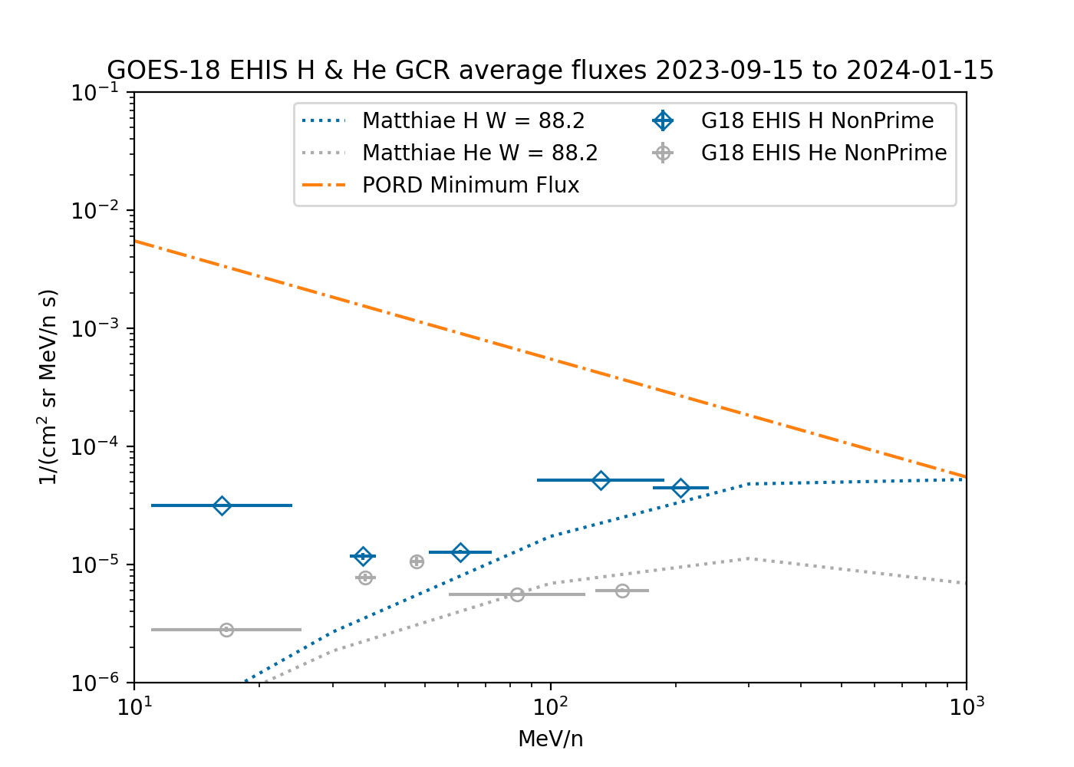
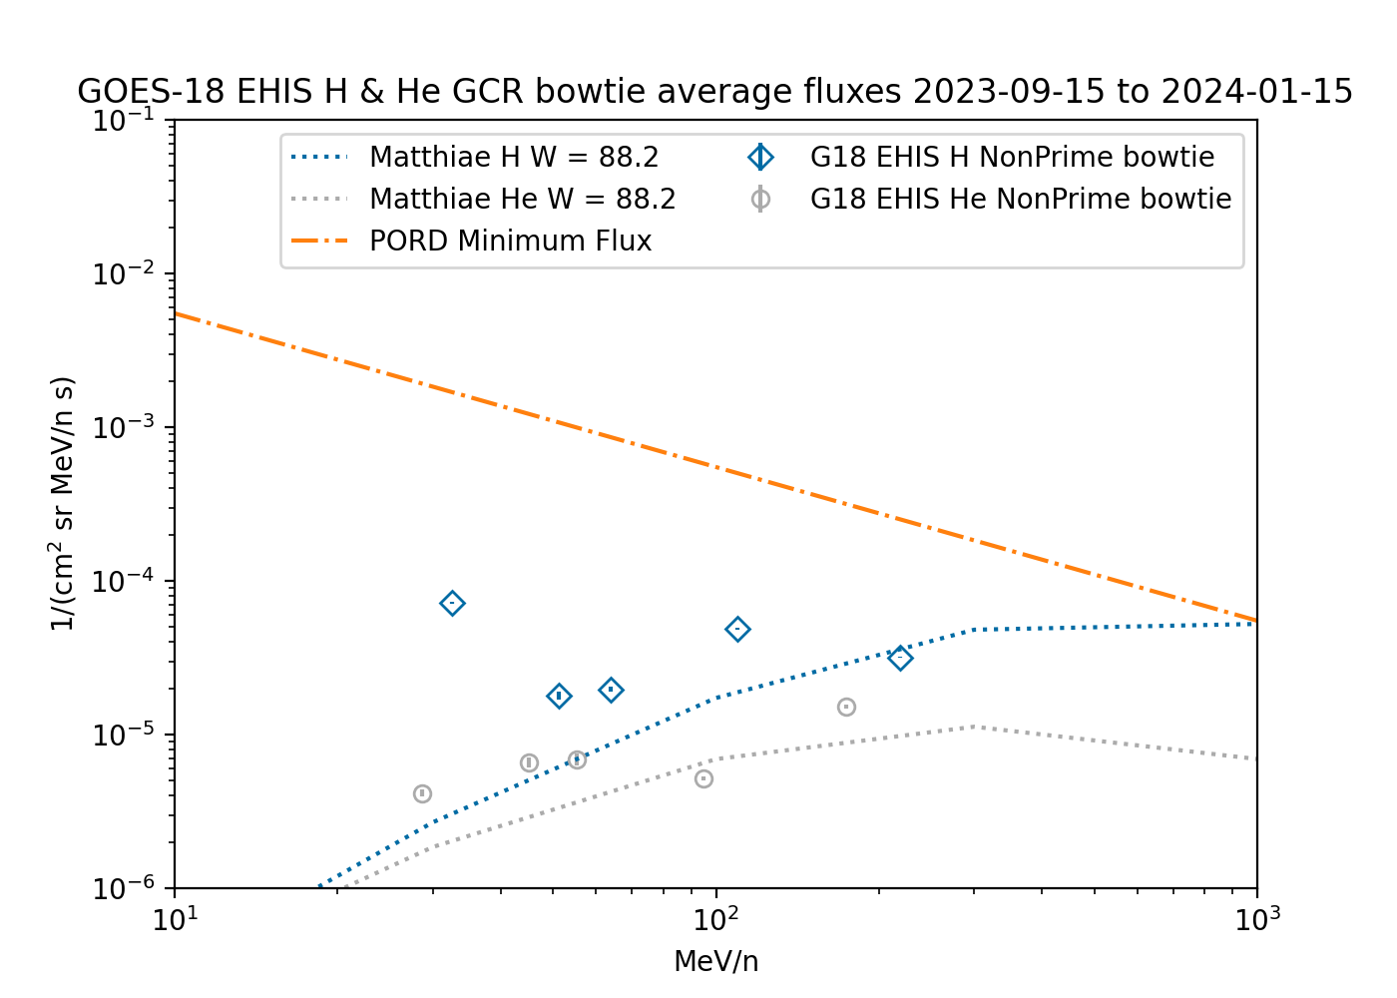
PLPT-SEI-006: GOES-18 H and He
.NOT.S (NonPrime) Only
Using LUT GFs and energies
Using ‘bowtie’ GFs and energies
Bowtie energies are greater for lowest energy channels
Resulting fluxes are greater than GCR model though same OOM
  He fluxes ~2-3x high except at He4, which agrees well
  H1 fluxes are still an outlier (~2 OOM high with respect to model)
  H1 GCR fluxes should be less than, not greater than, H2 GCR fluxes

Slide 44
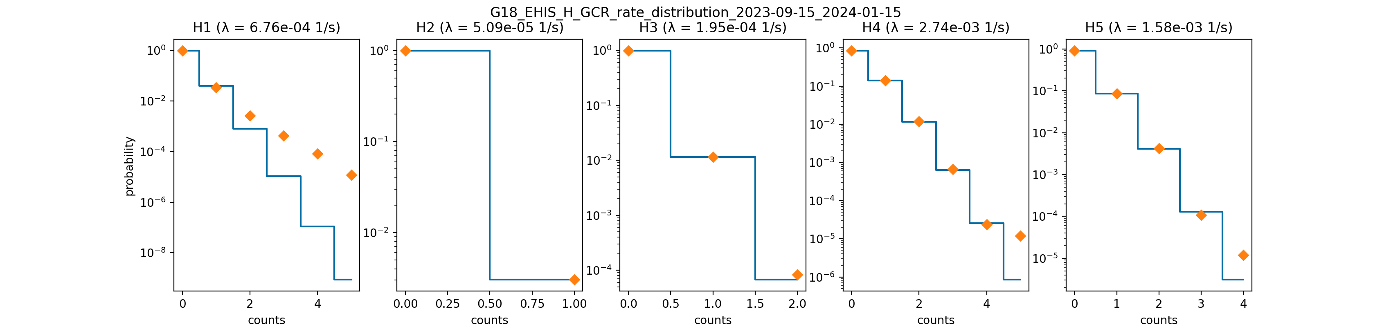
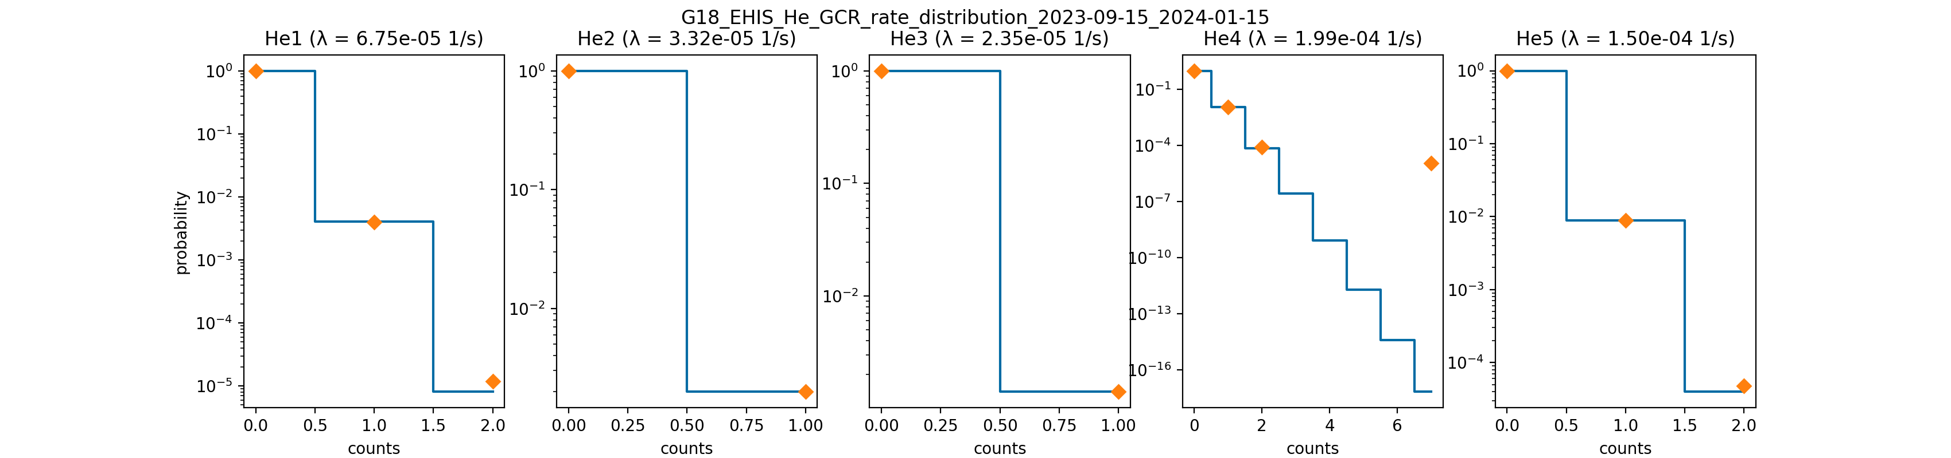
Observed and Calculated Counts Distributions Indicate EHIS Rates Channels are Free of Significant Instrumental Noise
If the backgrounds are composed of a single population, they should match a Poisson distribution calculated using the observed average count rate.
H1 has the most pronounced departure from a single Poisson distribution.
Upon closer examination, this high-rate tail is due to weak unmasked SEP events.
However, the tail is not large enough to completely explain the excessive H1 background fluxes.

Slide 45
PLPT-SEI-006: Assessment,
H and He Backgrounds
Four months of data analyzed (15 Sept 2023 - 15 January 2024)
Analyzing backgrounds requires careful masking of SEP fluxes
  Period of analysis approaching solar maximum makes this more challenging
  ACE/SIS ‘solar_activity_flag’ is excellent for this purpose
  Some weak SEP events still slip through and contribute to H1 ‘backgrounds’
Response functions simulated by ATC have been analyzed by NCEI using validated ‘bowtie’ method used for MPS-HI electrons
Application of ‘bowtie’ (E_{eff}, GdE) to background rates results in more physically correct comparison with Matthiä GCR model
  EHIS H and He .NOT.S. (aka NonPrime) observations are of the same OOM as model (apart from H1)
  Fluxes are still too high in general
  He fluxes agree better than H fluxes
Analysis of EHIS rates backgrounds statistics indicates that they are dominated by a single population matching the expected Poisson distribution
These results show that the EHIS rates (H and He) backgrounds are dominated by GCRs, but the channel characterization is not yet at the stage where accurate GCR fluxes can be calculated from EHIS observations
  Note: GCR fluxes are too low to lie within the required EHIS measurement range
RIMP success criteria: Evaluate EHIS backgrounds in terms of expected galactic cosmic ray (GCR) fluxes using four months of continuous data. Perform analysis during validation phase.
RIMP success criteria met for H and He backgrounds.

Slide 46
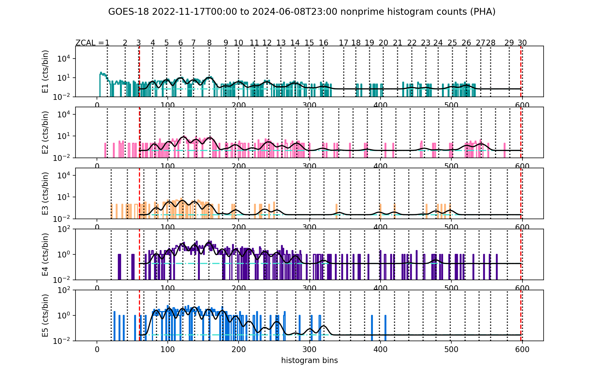
PLPT-SEI-006: Heavy Ion Backgrounds
GOES-18 NonPrime Histogram Fit
2276 valid P1 counts, 237 days equiv.
C
N
O
Ne
Mg
Si
S
Fe
Elements do not seem to be resolved well in E4 and E5
GCR fluxes calculated from P1 histogram constructed from SCI-PHA packets. Processed with post-PLT flight table version 20221005 and ground LUT version FM3A_CDRL88RevB_DO_13_00_00

Slide 47
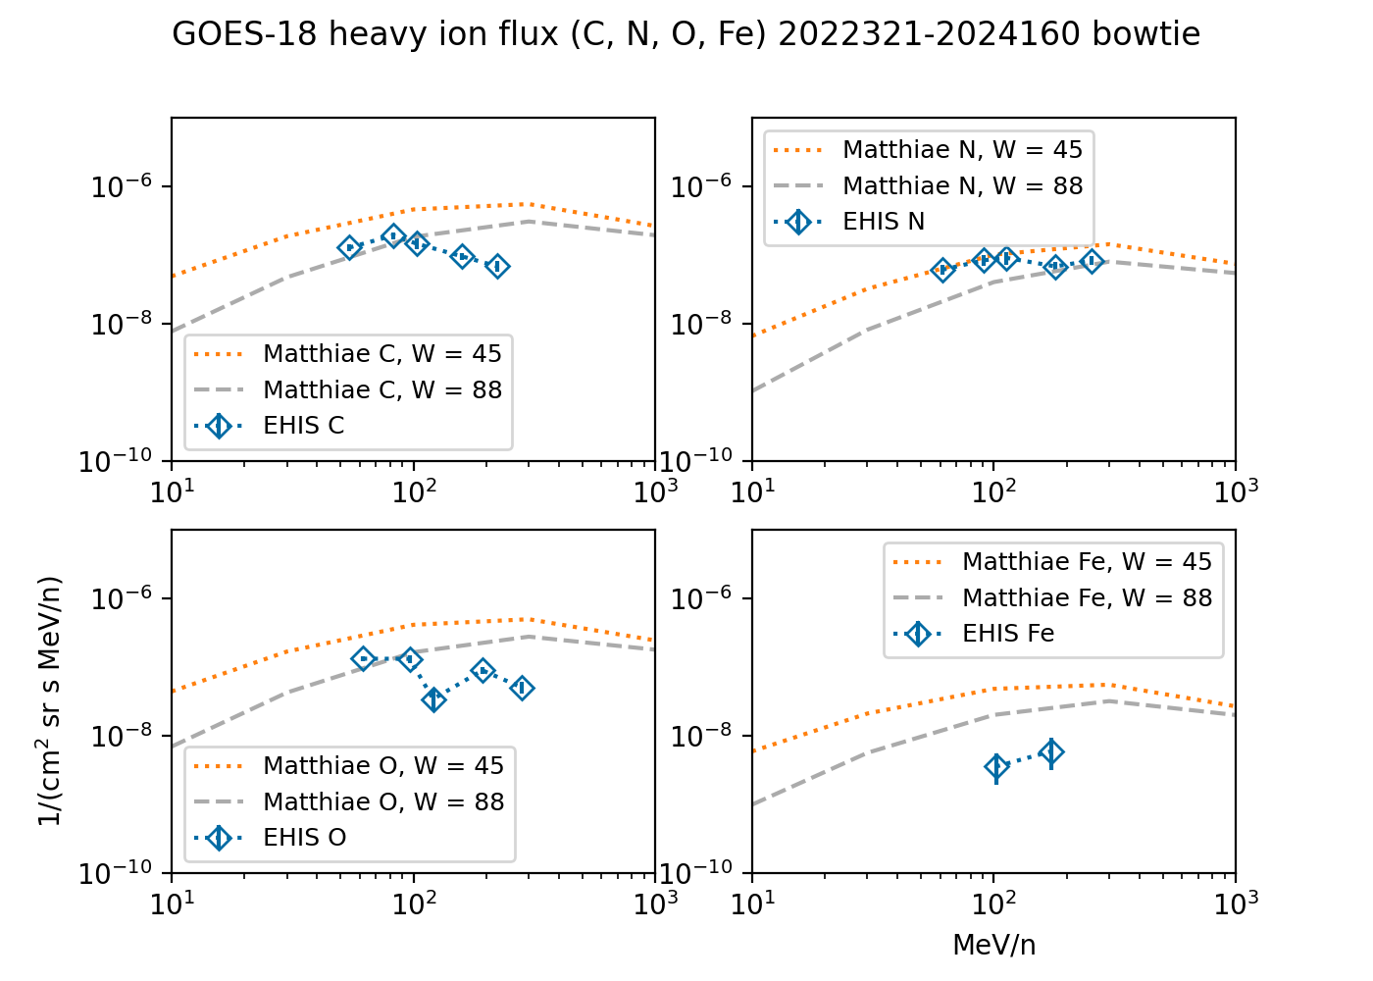
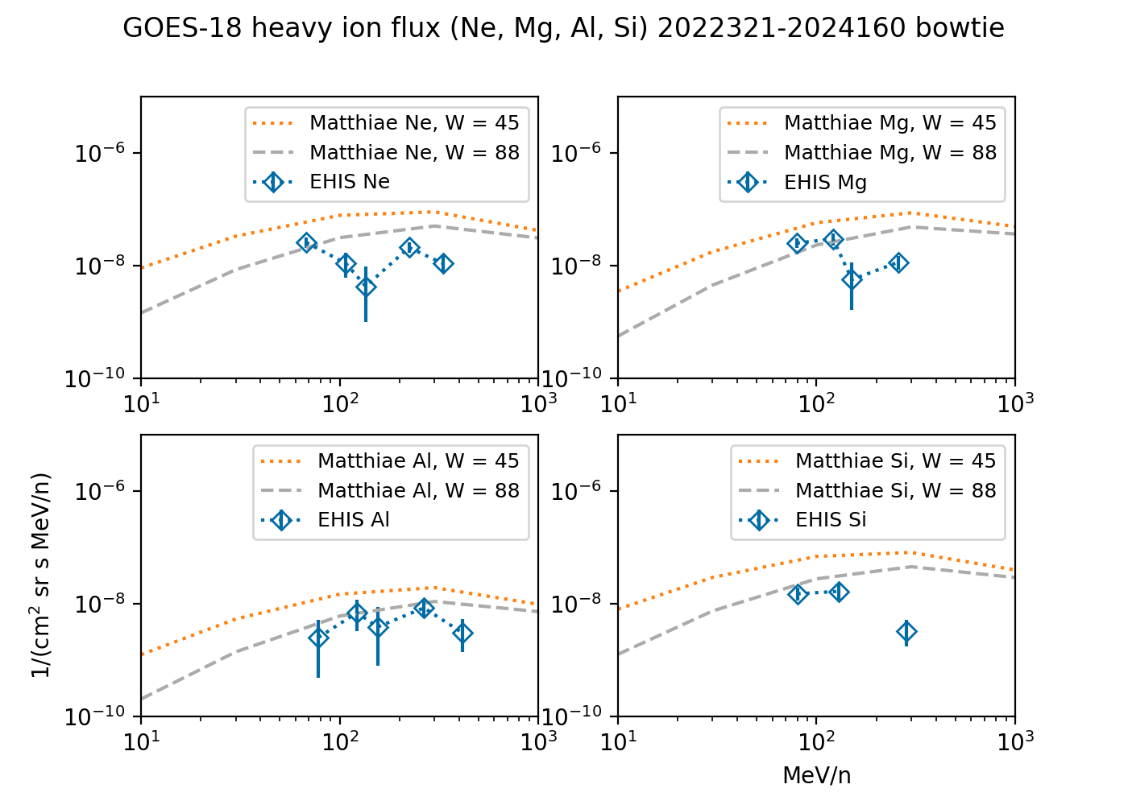
PLPT-SEI-006: GOES-18
GCR Heavy Ion fluxes
C, N, O, Fe
Ne, Mg, Si, S
Used G18 flight table version 20221005 and ground LUT version FM3A_CDRL88RevB_DO_13_00_00

Slide 48
PLPT-SEI-006: Assessment,
Heavy Ion Backgrounds
Analyzing backgrounds requires careful masking of SEP fluxes
  Period of analysis approaching solar maximum makes this more challenging
  ACE/SIS ‘solar_activity_flag’ is excellent for this purpose
Response functions simulated by ATC have been analyzed by NCEI using validated ‘bowtie’ method used for MPS-HI electrons
Application of ‘bowtie’ (E_{eff}, GdE) to background rates results in more physically correct comparison with Matthiä GCR model
Lowest 1-2 energy channels are generally bracketed by the GCR model, Fe being the notable exception (quite low with respect to model)
Higher-energy channels are generally lower than the GCR model
These results show that the EHIS heavy ion backgrounds are dominated by GCRs, but the channel characterization is not yet at the stage where accurate GCR fluxes can be calculated from EHIS observations, except perhaps some of the lower energy channels
  Note: GCR fluxes are too low to lie within the required EHIS measurement range
RIMP success criteria: Evaluate EHIS backgrounds in terms of expected galactic cosmic ray (GCR) fluxes using four months of continuous data. Perform analysis during validation phase.
RIMP success criteria met for heavy ion backgrounds.

Slide 49
Top Level Evaluation
 | Status at Beta (01 Aug 2022) | Status at Provisional (15 Nov 2022) | Status at Full (12 Nov 2024)
Hydrogen (proton) flux | Weak SEP event (H only) on 11-14 May 2022 Prime to Non-Prime switch at low S levels, as designed | G18 H1 agrees well with G17 & G16 H1 G18 H1 is ~3x lower than SGPS To convert backgrounds accurately to fluxes, spectral response functions G(E) need to be reanalyzed for GCR spectra Need G(E, T) to evaluate possible temperature sensitivity | G18 and G16 EHIS H1 agree well, G18 H2 is low (0.4x) wrt G18, G18 H3-H5 are high (1.24-1.60x) wrt G16 G18 EHIS H fluxes are 0.24-0.71x G18 SGPS-X H G18 EHIS H backgrounds analyzed using G(E)
Helium (alpha particle) flux | He fluxes only observed at background levels | G18 HE1 agrees well with G17 HE1 G18 HE1 is ~4x lower than SGPS To convert backgrounds accurately to fluxes, G(E) need to be reanalyzed for GCR spectra | G18 EHIS HE1 is 3.6x greater than G16 (based on EHIS L0) G18 EHIS HE1-2 L1b (ADR 1064) are 0.78-0.94x G18 SGPS-X He G18 EHIS He backgrounds analyzed using G(E)
Heavy ions (C-Cu) | Heavy ion fluxes only observed at background levels | Significant SEP fluxes not yet observed GCR fluxes derived from NonPrime PHA data, agree with model To convert backgrounds accurately to fluxes, G(E) need to be reanalyzed for GCR spectra | 08 June 2024 SEP event was iron-rich, significant heavy ion (C, N, O, Mg, Si, Fe) L1b (5-min) fluxes in lowest energy channel G16 and G18 cross-calibrated with ACE/SIS during this event G18 EHIS heavy ion backgrounds analyzed using G(E)

Slide 50
GOES-18 EHIS
Performance Baseline Status
Assessment at Full
MRD ID | Description | MRD Requirement | Predicted Performance Baseline (CDRL 79 or RVRs) | NCEI Assessment at Full | Related PLPTs | Status
1978 | EHIS Orthogonality/Coverage | 1 direction | 1 direction | 1 direction | -04, -06 | PASS
1982 | EHIS Measurement Range | 10-200 MeV/n 5 mass groups: H, He, (C,N,O), Ne-S, & Fe | (MeV/n) H: 11.0-240 He: 11.0-173 C: 18.5-373 O: 22.0-465 Mg: 26.2-578 Fe: 37.5-977 | Lowest energies validated using SEP and GCR fluxes | -04, -06 | Similar to GOES-16, which is at Full Maturity
1983 | EHIS Measurement Accuracy | 45% @min flux, 25% @10X min flux | 15.5-24.3% depending on species, energy band and Non-Prime/Prime status | Absolute accuracy cannot be verified on-orbit. | -04, -06 | Similar to GOES-16, which is at Full Maturity

Slide 51
FULL Maturity Assessment
GOES-18 EHIS L1b Product Full PS-PVR

Slide 52
Full Validation
Preparation Activities | Assessment
Validation, quality assurance, and anomaly resolution activities are ongoing. | Validation activities are ongoing. Path forward for the main issues has been identified.
Incremental product improvements may still be occurring. | Incremental product improvements are expected, primarily through updated flight tables LUTs incorporating results of continuing analysis
Users are engaged and user feedback is assessed. | Operational users are still unfamiliar with the data due to dearth of large SEP events. SWPC and NCEI are working to improve user familiarity and to make EHIS L1b and L2 data available in real time to the public through the SWPC testbed.
From 410-R-RIMP-0318 Version 2.0 07/09/2021,
Responsible Organization: GOES-R Program/Code 410

Slide 53
Full Validation
End State | Assessment
Product performance for all products is defined and documented over a wide range of representative conditions via ongoing ground-truth and validation efforts. | Three SEP events used for Full validation. Solar heavy ions (C-Fe) could only be evaluated in one S3 SEP event, in only the lowest energy channel.
Products are operationally optimized, as necessary, considering mission parameters of cost, schedule, and technical competence as compared to user expectations. | Yes, with continuing work on on-orbit calibrations, L1b and L2 processing.
All known product anomalies are documented and shared with the user community. | This presentation and the L1b README
Product is operational. | NCEI: yes.
From 410-R-RIMP-0318 Version 2.0 07/09/2021,
Responsible Organization: GOES-R Program/Code 410

Slide 54
Risks at Full Validation
Risk Name | Description | Impact | Mitigation Status as of 01 July 2024
Channels E4 and E5 are not accurately characterized | IF the characterization of E4 and E5 (D6 penetrating) is not improved | THEN the large SEP events of Solar Cycle 25 will be inaccurately observed | GCR analysis shows that elemental resolution is poor in E4 and E5 Extended-period on-orbit calibration of G18 should be performed (as was done for G16)
Low EHIS fluxes from helium channels | IF root cause of low helium fluxes not identified and fix implemented | THEN EHIS helium fluxes will be inaccurate during largest SEP events. | Root hardware cause of G16 low fluxes was not resolved under WR 6113 ADR 1025 added SGPS alpha fluxes to SGPS L1b product ADR 1064 has replaced EHIS He fluxes with interpolated SGPS fluxes, an approach with which NCEI has disagreed NCEI science reprocessing will be based on EHIS non-prime data and will provide scaling factors to match SGPS (following COSPAR PRBEM recommendation)
No C-Fe SEP Fluxes | IF a large SEP event does not take place | THEN G18 cannot reach Full Maturity | CLOSED: June 8, 2024 SEP event was sufficiently iron-rich to allow for Full Maturity validation, although it was weaker than 10-11 Sept 2017 event in >10 MeV protons
Diurnal Variation of H SEP fluxes | IF amount of diurnal variation due to temperature cannot be quantified | THEN EHIS H data will be unreliable in determining effects of magnetospheric shielding on SEP H fluxes | Off-line spectral analysis using recently-delivered temperature-dependent bandpasses from ATC remains to be performed

Slide 55
Summary & Recommendations
GOES-18 EHIS L1b Products Full PS-PVR

Slide 56
Summary
GOES-18 EHIS L1b heavy ion SEP fluxes have been validated to the same level as GOES-16 EHIS L1b, which reached Full Maturity.
Solar Energetic Particle (SEP) event in June 2024 (at the time, largest since September 2017) permitted evaluation of EHIS heavy ion SEP fluxes in the lowest energy channel - carbon to iron.
  Analysis used both ELF and PHA packets
  Agreement with ACE/SIS is fair to good – better for PHA (NonPrime)
Non-Prime samples from Pulse Height Analysis (PHA) packets were analyzed to estimate heavy ion GCR fluxes – as in G18 Provisional PS-PVR.
  At lowest energies, results agree with GCR model fluxes (except iron)
  At higher energies, results depart from model, histograms do not seem to have good elemental resolution – further on-orbit calibration needed
  Heavy ion GCR flux levels are below the measurement requirement
NCEI concludes that the GOES-18 EHIS L1b product has reached Full Maturity as defined by the GOES-R Program.

Slide 57
Recommendations
NCEI recommends that GOES-18 EHIS L1b data be transitioned to Full Validation status
NCEI recommends continuing on-orbit calibrations of GOES-18 EHIS to improve the histogram quality at all energies
  This could be performed by ATC under a future SEA.
NCEI recommends that work continue on open EHIS L1b ADRs
NCEI recommends setting a higher scintillator high-flux criterion on one of the EHIS’s (GOES-18 or 19) in order to get higher-quality NonPrime data in real time

Slide 58
Backup charts
Comparison of EHIS and SGPS energy and angular coverage
Rigidities of GOES-18 heavy ion channels (E1)
Detailed GOES-16 and -18 plots from 18 July 2023 event onset
GOES-16 cross-calibrations from 11 May 2024 event
ACE/SIS heavy ion spectra from 08 June 2024 event
GOES-16 and -18 SCI-ELF histograms from 08 June 2024 event
GOES-18 H and He rates during a short GCR-only period

Slide 59
EHIS vs. SGPS
Characteristic | EHIS | SGPS
Look Directions | 1, radially outward | 2, westward and eastward
Field-of-view, full angle | 60º | T1 & T2: 60º, T3: 90º
Energy range, hydrogen (H) | 11 – 239 MeV | 1.0 – 500 MeV, >500 MeV
Number of channels, H | 5 differential | 13 differential, 1 integral
Geometric factors, H (prime) | 2.13, 1.05, 0.84, 0.56, 0.56 cm² sr | T1: 0.10-0.12, T2: 0.38-0.50, T3: 0.43-2.5 cm² sr
Energy range, helium (He) | 11 – 165 MeV/u | 1.0 – 224 MeV/u
Number of channels, He | 5 differential | 11 differential
Geometric factors, He (prime) | 2.15, 1.05, 0.72, 0.56, 0.56 cm² sr | T1: 0.05-0.11, T2: 0.29-0.31, T3: 0.72-2.5 cm² sr
EHIS H1 (11.0-24.0 MeV) and SGPS P5 (11.64-23.27 MeV) have nearly the same energy range, can be compared directly
  GF (H1) = 2.13 cm² sr, GF (P5) = 0.12 cm² sr: H1 is 18x more sensitive than P5
EHIS HE1 (11-25.2 MeV/u) is bracketed by SGPS A4 (7.5-12.3 MeV/u) and A5 (14.0-24.9 MeV/u)
  GF (HE1) = 2.15 cm² sr, GF (A4, A5) = 0.10 cm² sr: HE1 is >20x more sensitive than A4 and A5

Slide 60
Rigidities of GOES-18 EHIS Heavy Ion Channels (E1)
E1 | C | N | O | Ne | Mg | Al | Si | Fe
R_lo (MV) | 288 | 253 | 401 | 454 | 482 | 517 | 579 | 947
R_eff (MV) | 389 | 468 | 535 | 608 | 645 | 694 | 777 | 1291
R_hi (MV) | 527 | 624 | 716 | 816 | 866 | 935 | 1048 | 1770
The rigidity of a solar- or galactic-origin particle determines whether it can access a location inside the magnetosphere
Solar ions are in general not fully stripped of their electrons - ‘q’ here is taken from Leske+1995 (SEP energies approximately in same range as EHIS E1)
Empirically, up to 40-80 MeV proton fluxes observed eastward in GEO are suppressed by geomagnetic cutoffs (Rodriguez+2010, Kress+2021)
  Depends on geomagnetic activity during the SEP event
  Rigidities in red are equivalent to proton energies in the 40-80 MeV range
This overstates the effect on EHIS fluxes because the fluxes arriving from zenith are affected less by geomagnetic cutoffs than those arriving eastward

Slide 61
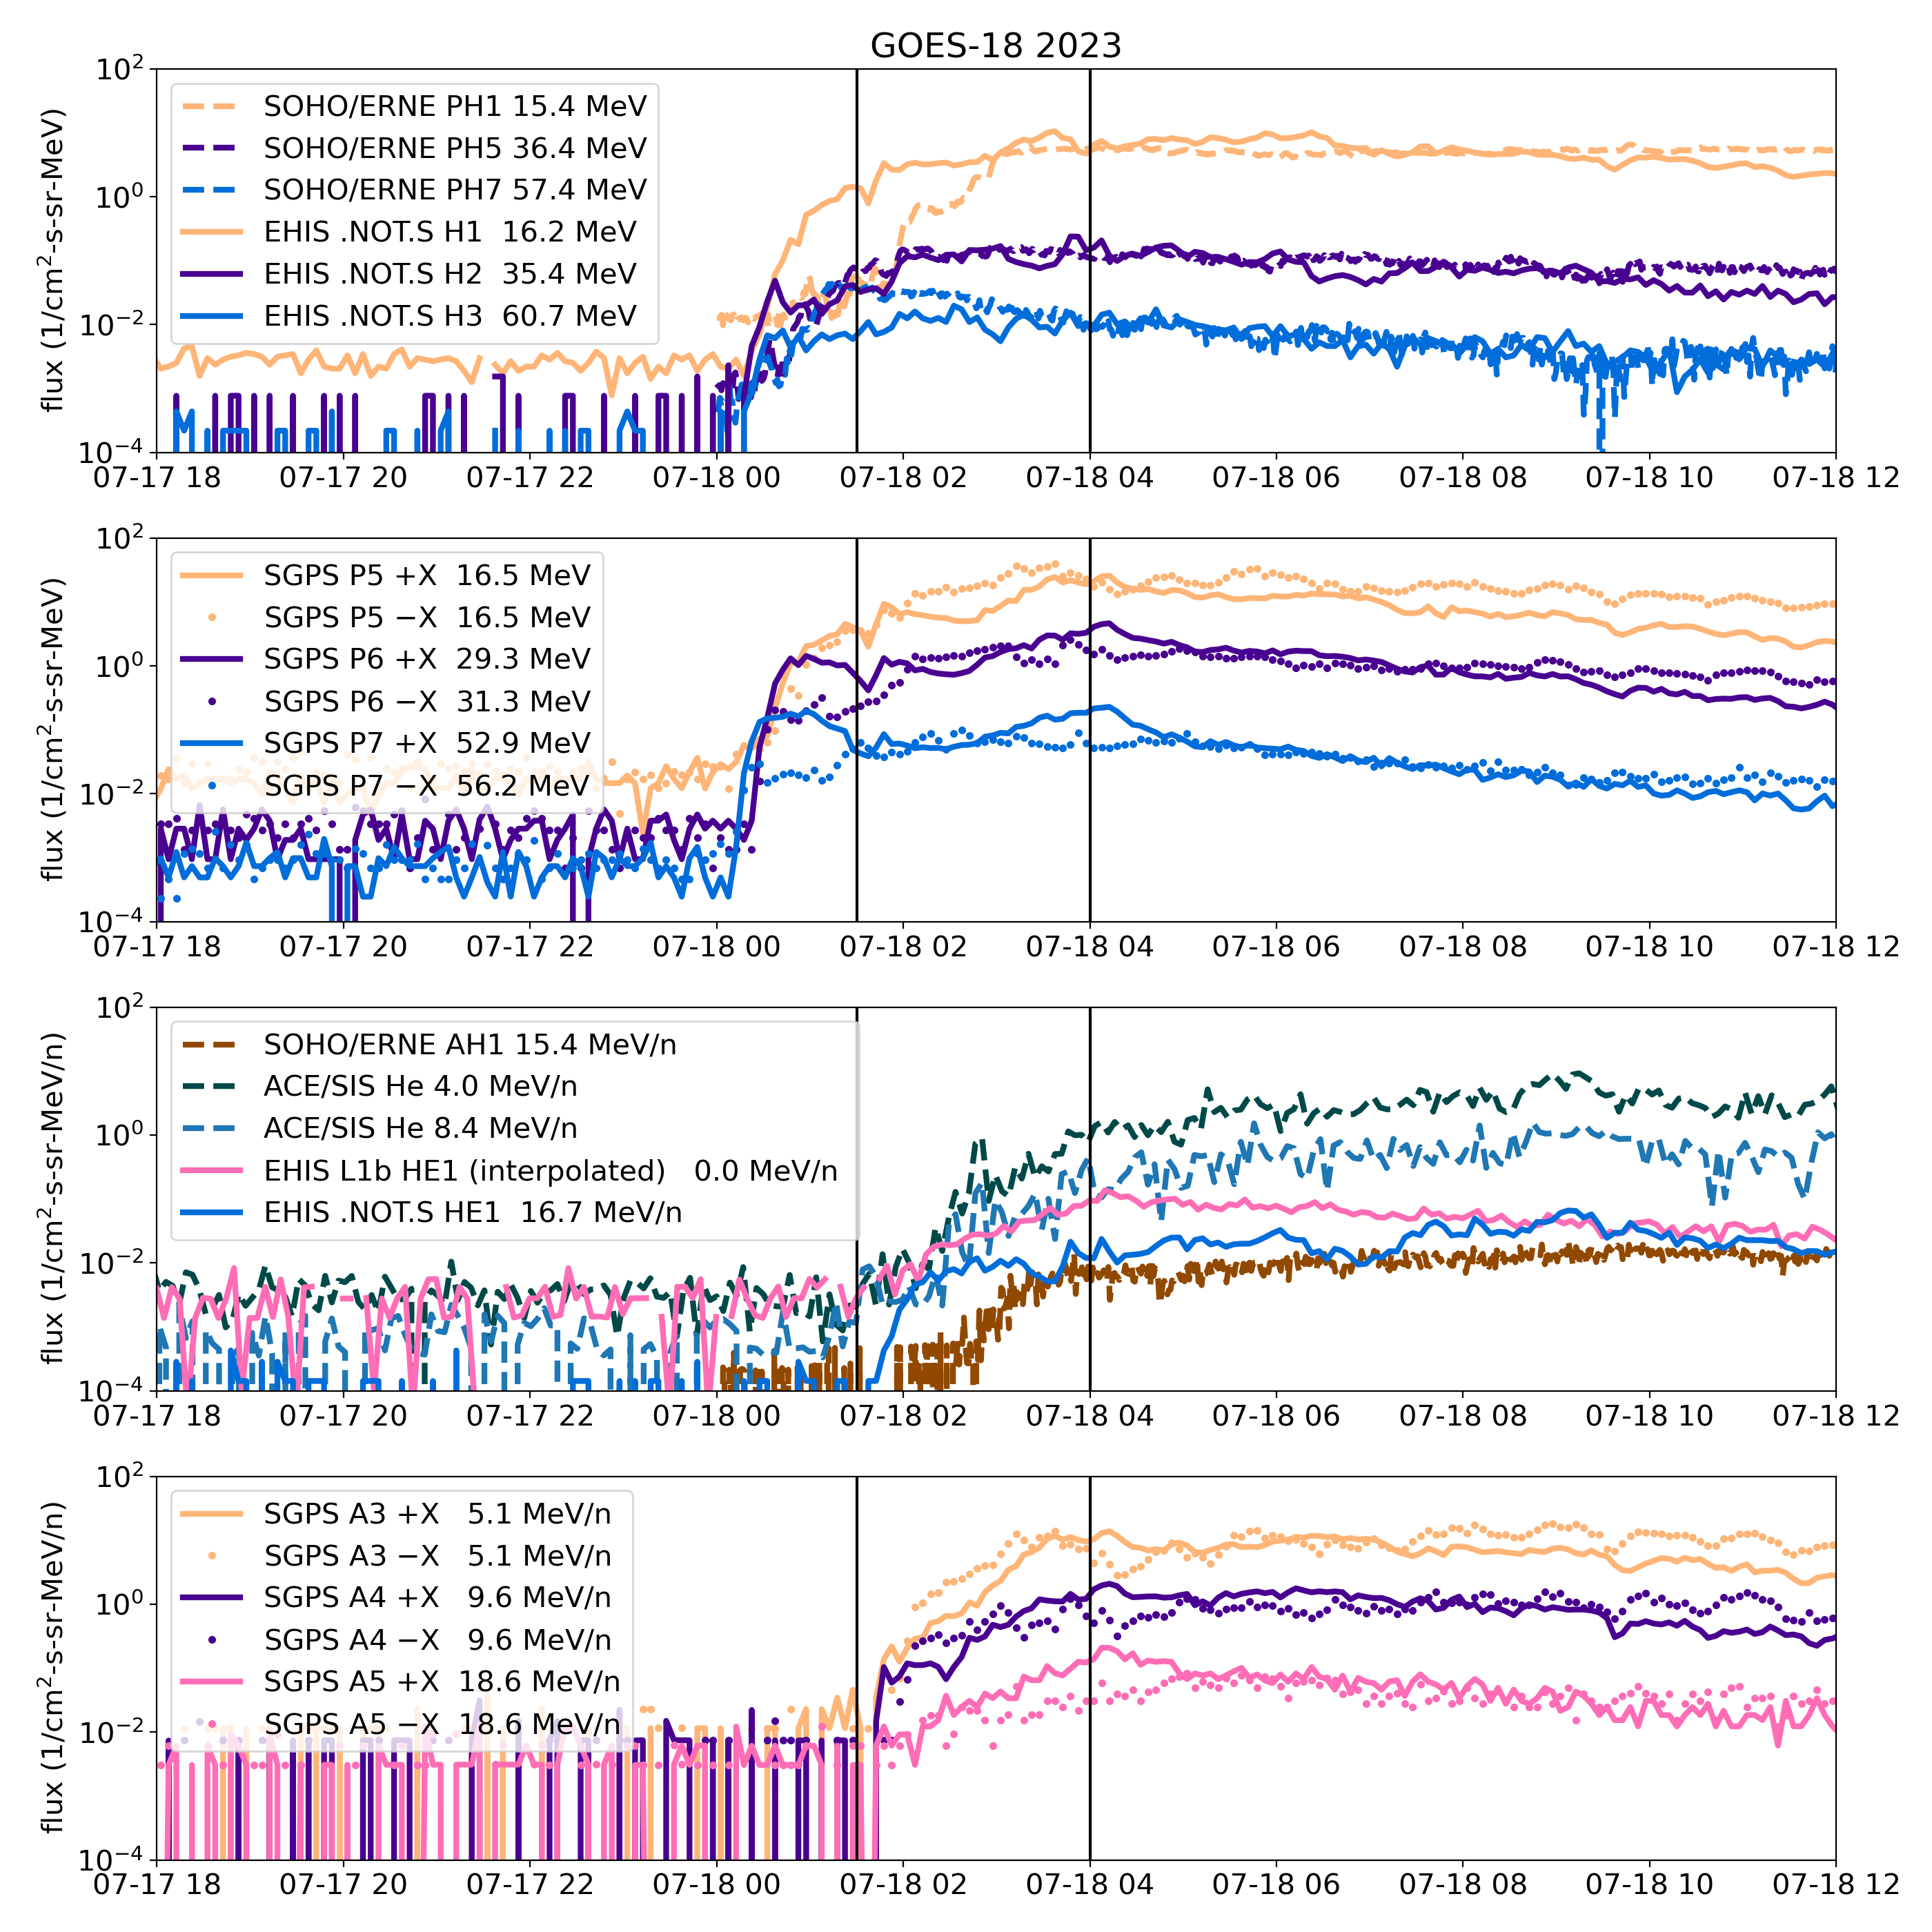
Comparison of GOES-18, ACE and SOHO Fluxes Reveals Anisotropy during Event Onsets
Non-uniform features of event onset
  Proton onset reaches full value 1 hr later at SOHO than at GOES
  Alpha onset ~1.5 h later than proton onset at GOES and ACE, and later by ~1 more hour at SOHO - based on velocity considerations alone would be ~0.25 h
  Westward-looking (+X) GOES proton fluxes initially less than eastward-looking fluxes
  At ~16 MeV/n at GOES, radial (EHIS) and westward (SGPS-X) alpha flux observations less than eastward fluxes
  This may be caused by the interplanetary (source) anisotropy overcoming the attenuating effect of geomagnetic cutoffs
The EHIS HE1 .NOT.S fluxes provide important information for understanding the event onset
ADR 1064 replacement of HE1 and HE2 with interpolated SGPS fluxes distorts the scientific picture, eliminating unique information provided by EHIS observations

Slide 62
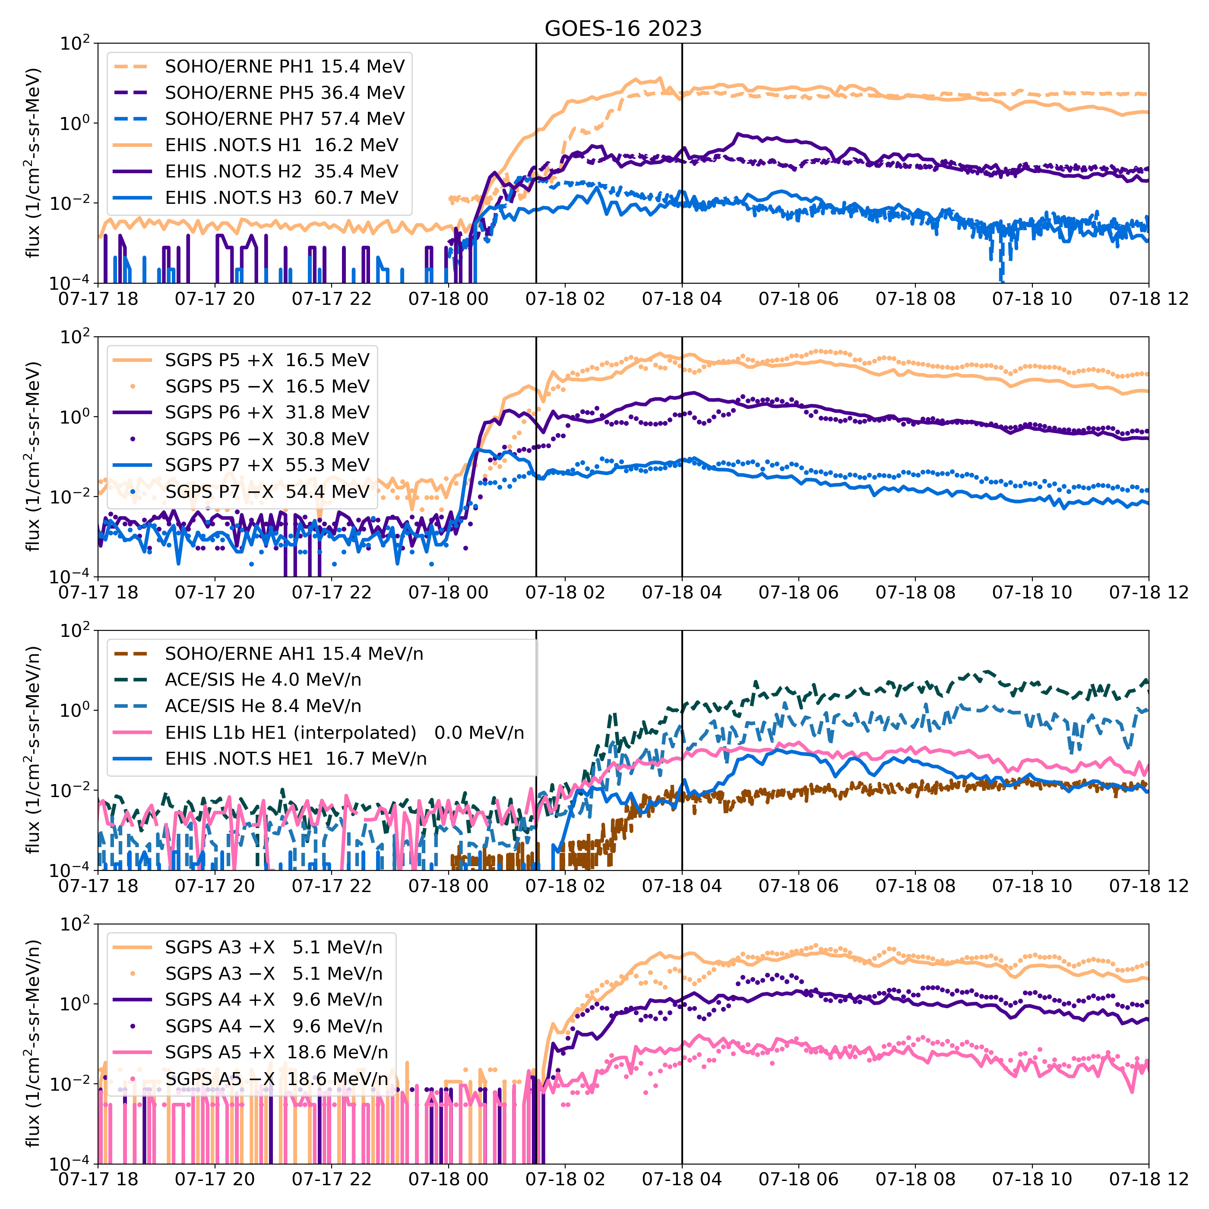
Comparison of GOES-16, ACE and SOHO Fluxes Reveals Anisotropy during Event Onsets
Non-uniform features of event onset
  Proton onset reaches full value 1 hr later at SOHO than at GOES
  Alpha onset ~1.5 h later than proton onset at GOES and ACE, and later by ~1 more hour at SOHO - based on velocity considerations alone would be ~0.25 h
  Westward-looking (+X) GOES proton fluxes initially less than eastward-looking fluxes - interplanetary (source) anisotropy overcoming the attenuating effect of geomagnetic cutoffs?
  EHIS (radial) HE1 variation similar to SGPS -X (westward) A4 and A5 variations, distinct from eastward (and the interpolated L1b HE1 fluxes)
The EHIS HE1 .NOT.S fluxes provide important information for understanding the event onset
ADR 1064 replacement of HE1 and HE2 with interpolated SGPS fluxes distorts the scientific picture, eliminating unique information provided by EHIS observations

Slide 63
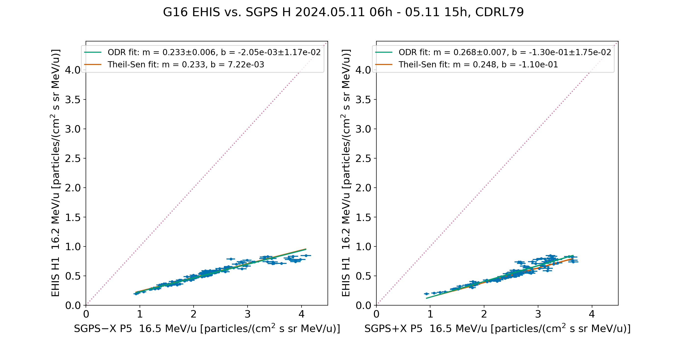
PLPT-SEI-004: Compare G16 EHIS H1 and SGPS P5 Proton Fluxes
G16 EHIS H1 response is 23% that of SGPS -X P5 (Westward), 27% that of SGPS +X P5 (Eastward)

Slide 64
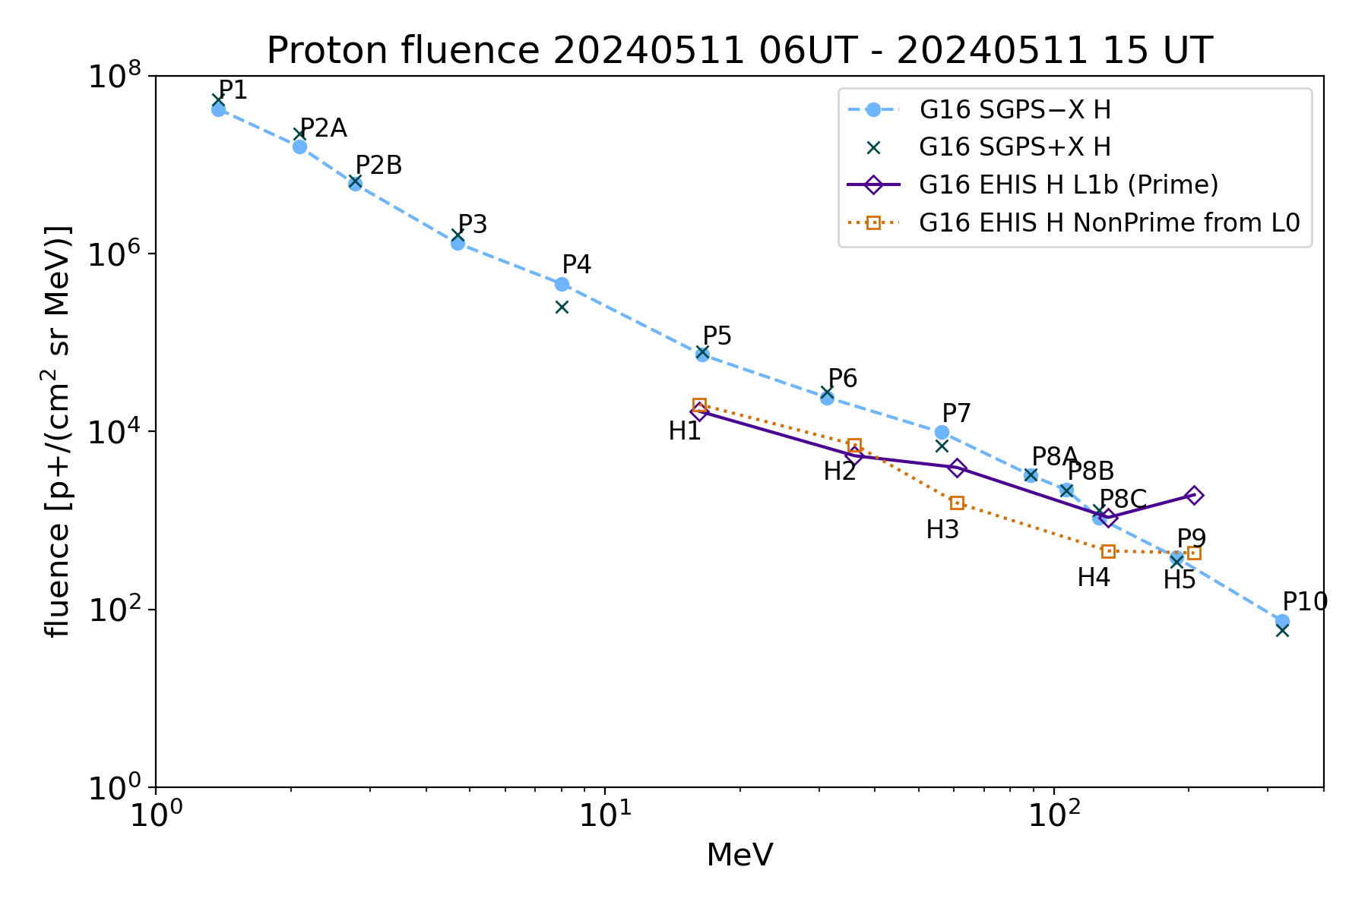
PLPT-SEI-004: G16 H Fluence Spectra
Fluence period same as scatter plot
EHIS.NOT.S/SGPS-X @
H1: 0.268
H2: 0.367
H3: 0.295
H4: 0.484
H5: 1.49
NonPrime (.NOT.S) p+ fluxes have OOM lower backgrounds than Prime
Backgrounds not removed

Slide 65
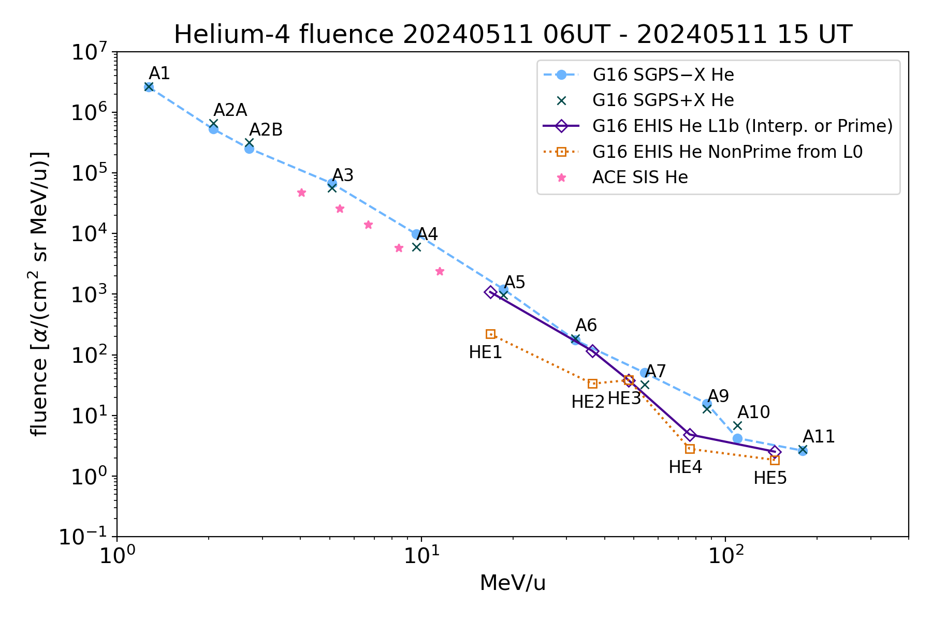
PLPT-SEI-004: G16 He Fluence Spectra
Fluence period same as scatter plot
Unreliable as measure of solar alpha particle fluence – dominated by backgrounds
EHIS/SGPS-X
@ HE1, L1b (ADR 1064): 0.653
@HE1, .NOT.S: 0.132
@ HE2, L1b (ADR 1064): 0.902
@HE2, .NOT.S: 0.259
Backgrounds not removed

Slide 66
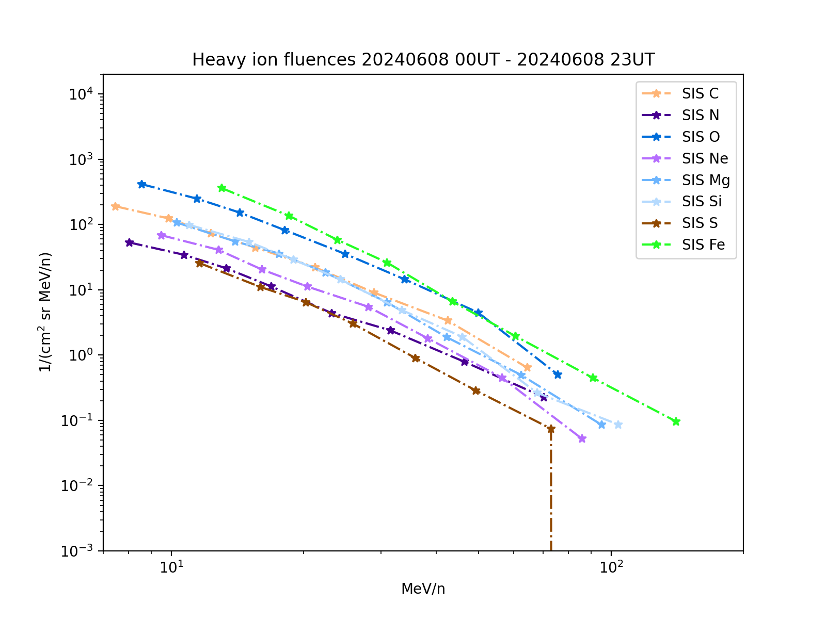
PLPT-SEI-004: ACE SIS Fluences, 2024-06-08
Oxygen and iron fluxes are comparable - this is an iron-rich event

Slide 67
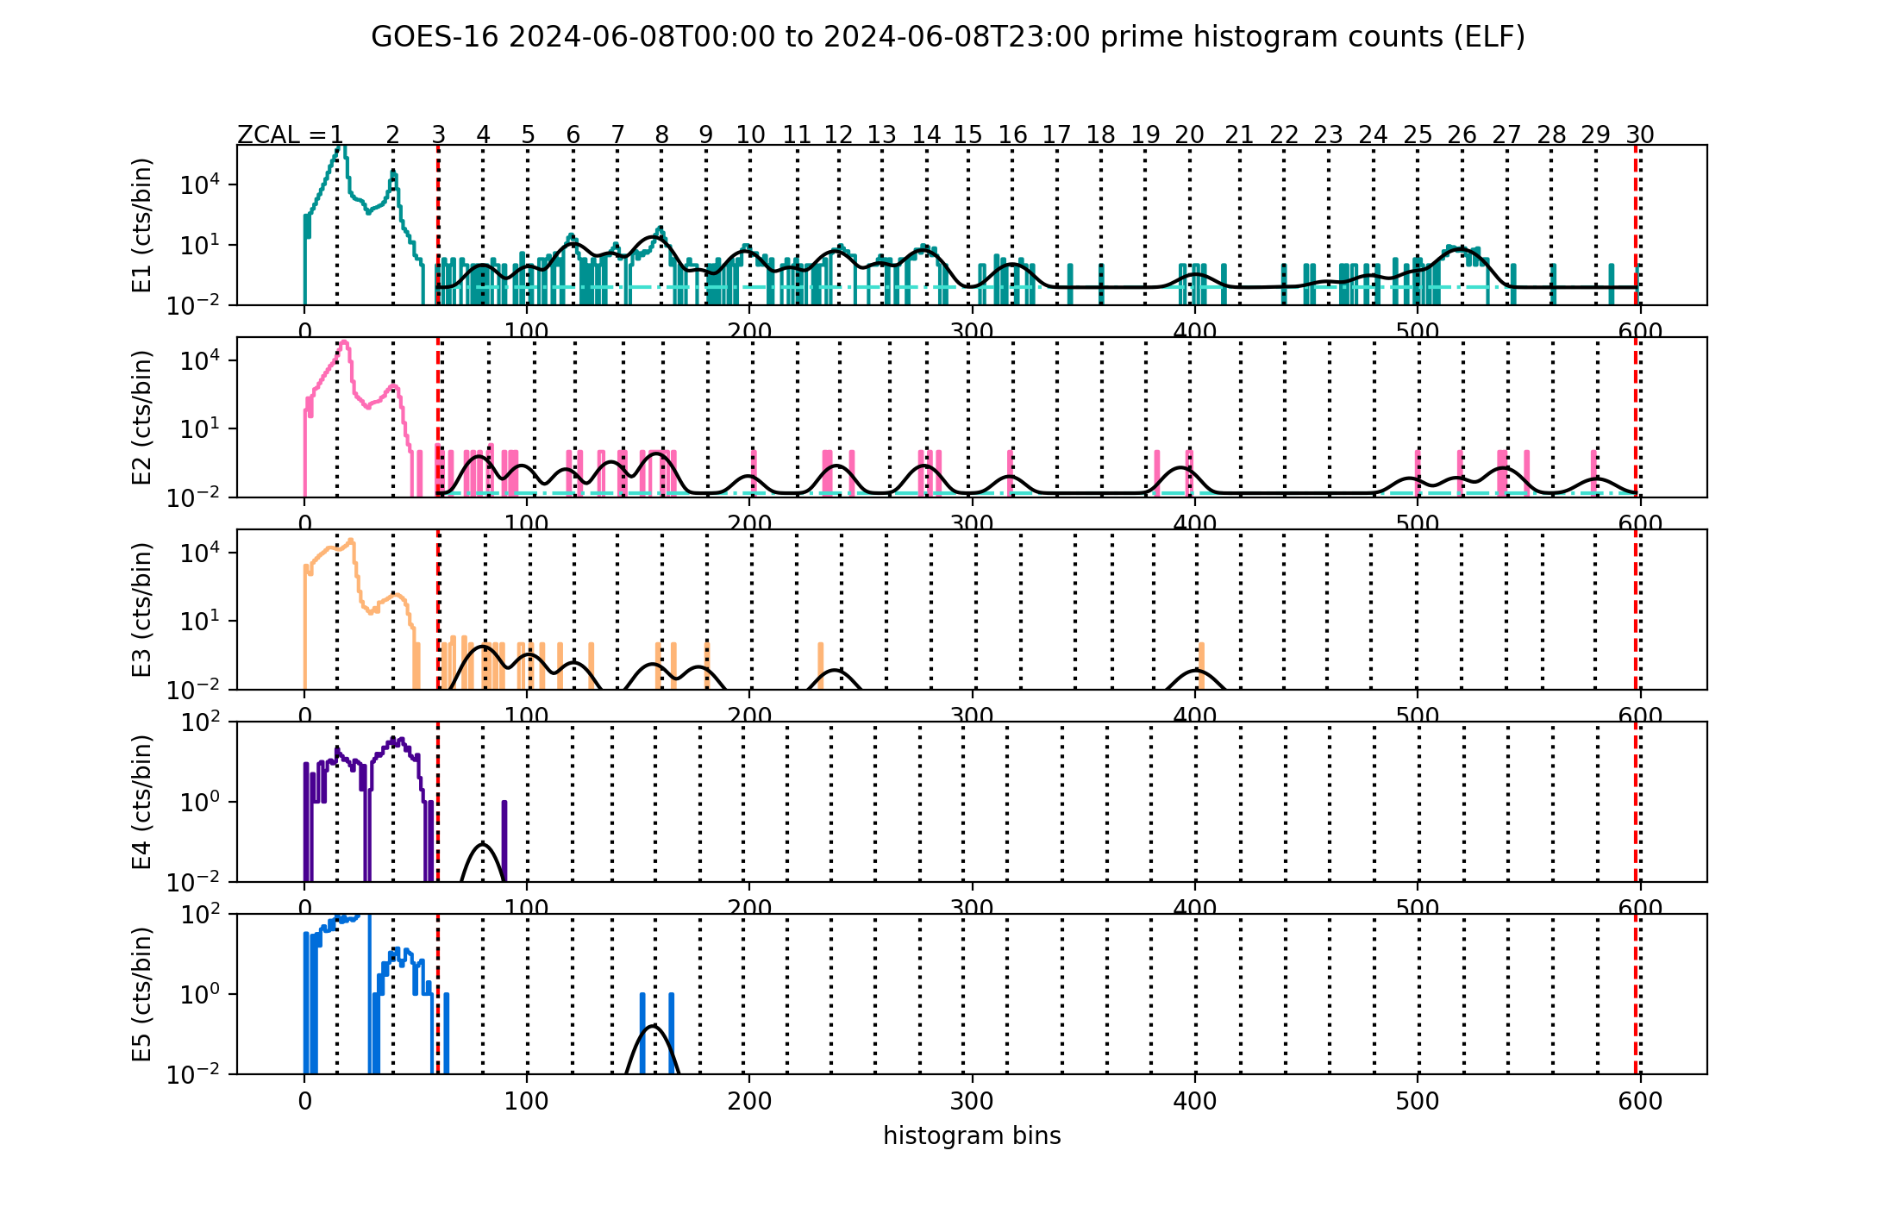
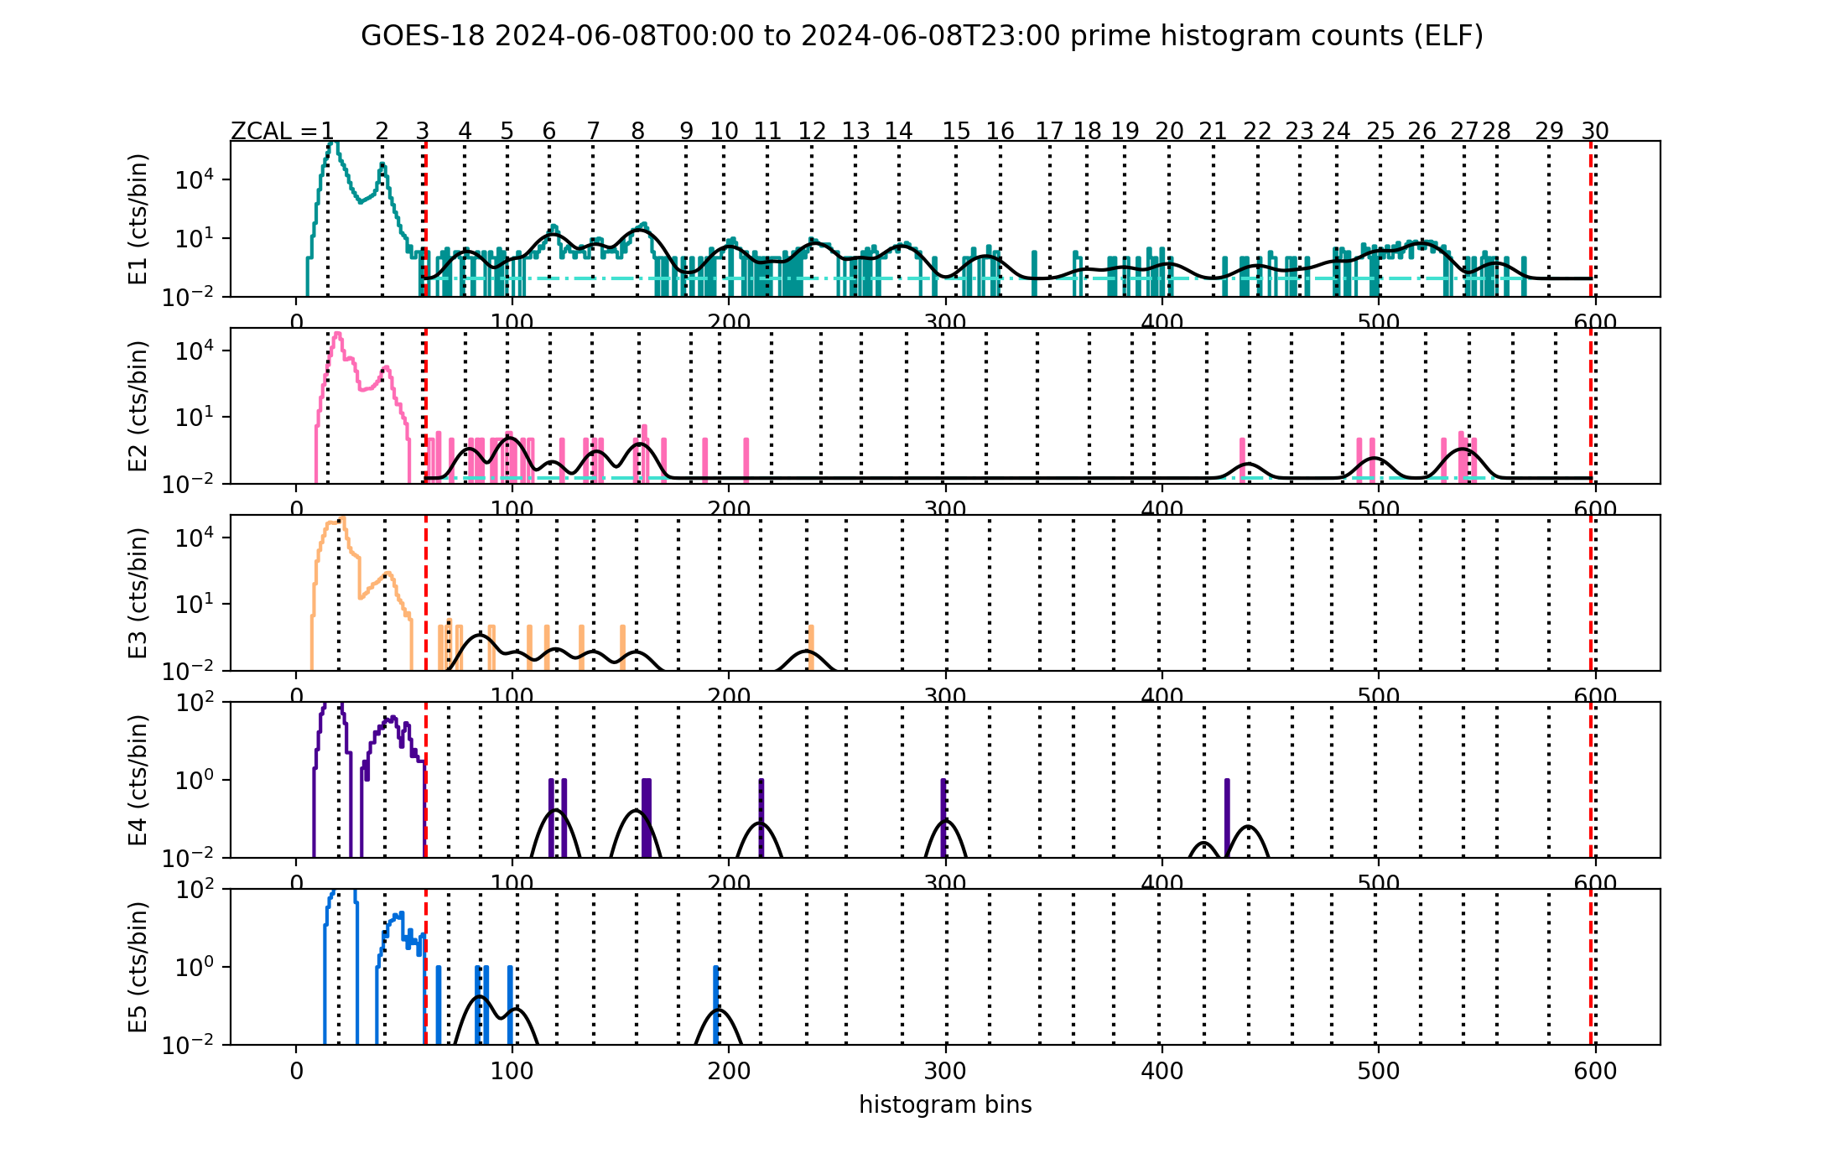
PLPT-SEI-004: 08 June 2024, SCI-ELF histogram curve fits, one day of data
Except for the E1 channel, histogram heavy-ion counts are very sparse during this event
GOES-16 SCI-ELF Histogram
GOES-18 SCI-ELF Histogram
N
O
Si
S
Fe
N
C
Ne
O
Si
S
Fe
Mg
C
Ne
Mg

Slide 68
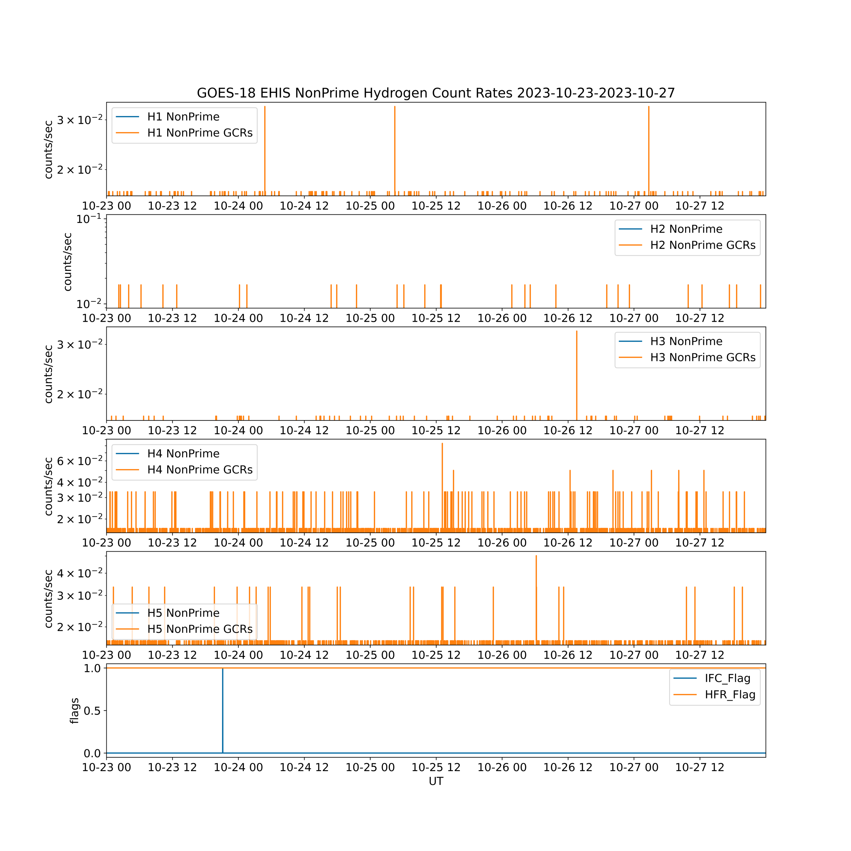
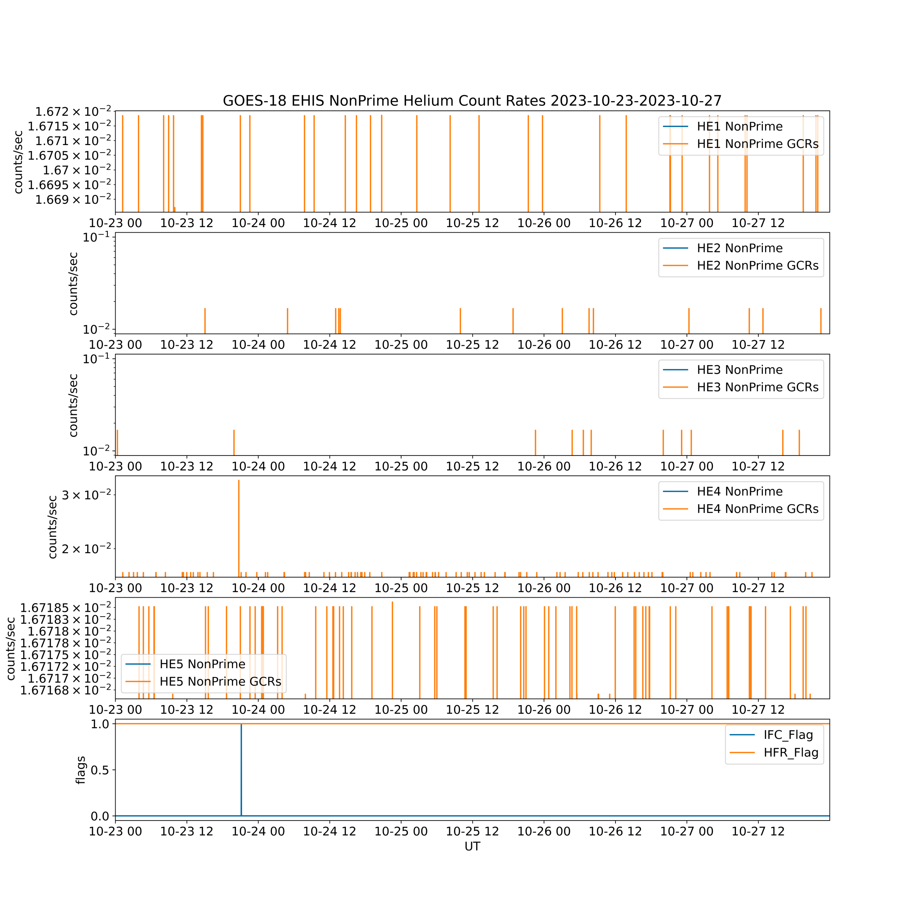
PLPT-SEI-006:
Short GCR-only Period
G18 EHIS NonPrime H
23-27 October 2023
G18 EHIS NonPrime He

Slide 69
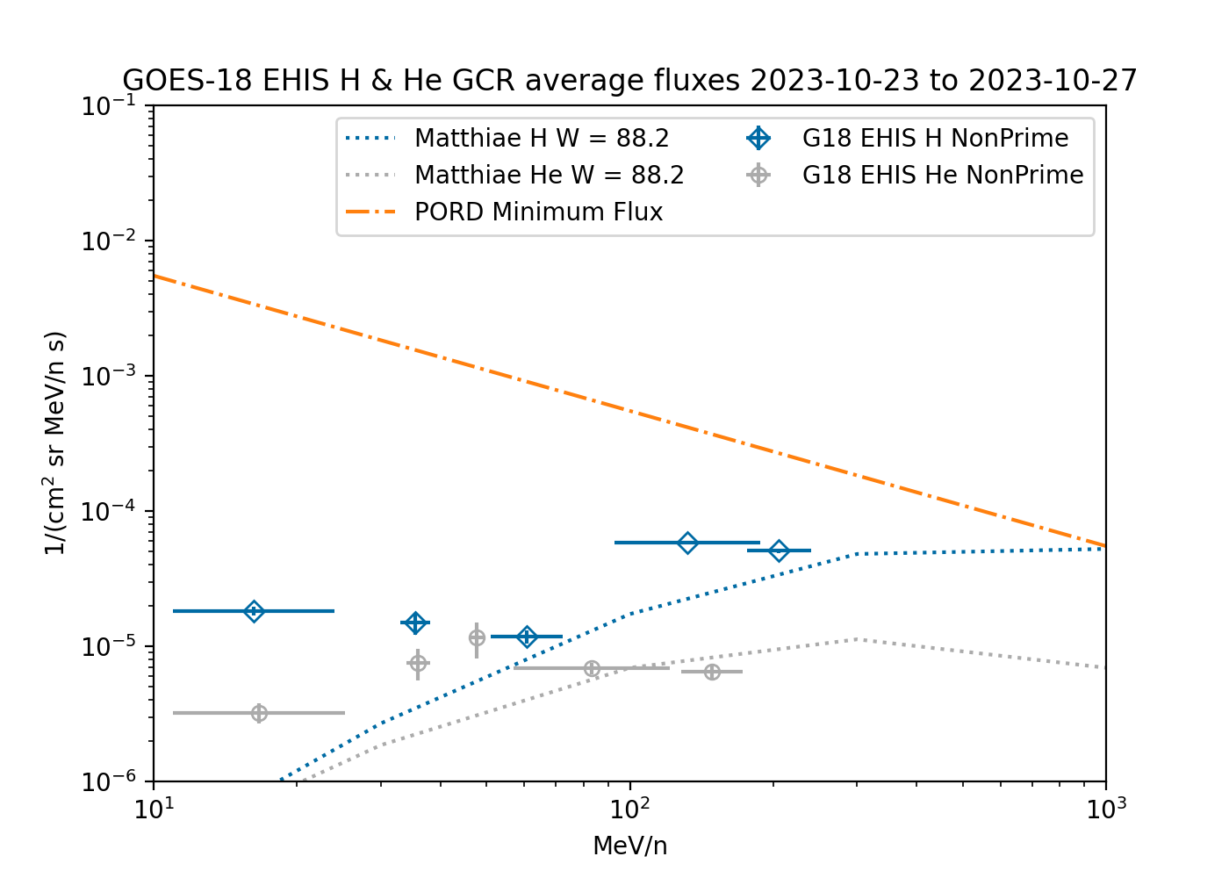

PLPT-SEI-006: GOES-18 H and He
.NOT.S (NonPrime) Only
Short GCR-only Period
Using LUT GFs and energies
Using ‘bowtie’ GFs and energies
Bowtie energies are greater esp. for lowest energy channels
Resulting fluxes are greater than model though same OOM
  He fluxes ~2-3x high except at He4, which agrees well
  H1 fluxes are still an outlier (~1 OOM high)
  H1 GCR fluxes should be less than H2 GCR fluxes

Slide 70


Observed and Calculated Counts Distributions Indicate EHIS Rates Channels are Free of Significant Instrumental Noise
If the backgrounds are composed of a single population, they should match a Poisson distribution calculated using the observed average count rate.
Here, during a short GCR-only period, H1 does not depart from a single Poisson distribution.
There is no evidence for SEP fluxes during this short period. However, the H1 fluxes are still high compared to the model (and the H2 fluxes, which should be greater).

