Slide 1
Peer Stakeholder-Product Validation Review (PS-PVR) For the Full Maturity of GOES-18 SEISS MPS-HI L1b Product
November 16, 2023
GOES-R Calibration Working Group (CWG)
Presenter: Athanasios Boudouridis (CIRES and NOAA NCEI)
Contributors: Juan Rodriguez, Brian Kress, Kevin Hallock, Robert Allsopp (CIRES and NOAA NCEI)
William Rowland (NOAA NCEI)
The NCEI team wish to thank the MPS-HI vendor Assurance Technology Corporation, the MIT Lincoln Labs, the Space Weather Prediction Center, and the GOES-R Program

Slide 2
Outline
Introduction
Review of Provisional Maturity
Status at Provisional
ADR/WR status
Product Quality Evaluation
PLPTs for Full Maturity
Discussion of additional investigations
Status at Full Validation Review
Full Maturity Assessment
Status
Performance
Risks
Summary and Recommendations
Backup Slides

Slide 3
GOES-R Program
Satellites launched to date:
GOES-16 (R): launched 19 November 2016
GOES-East (75.2ºW) since 18 December 2017
GOES-17 (S): launched 01 March 2018
In storage (104.7ºW) since 14 March 2023
Was GOES-West (137.2ºW) from 12 February 2019
to 3 January 2023
GOES-18 (T): launched 01 March 2022
GOES-West (136.8ºW) since 3 January 2023
Each GOES-R-series observatory carries a Space Environment In-Situ Suite (SEISS)
GOES-18 SEISS turned on 25 April 2022

Slide 4
Magnetospheric Particle Sensor – High Energy (MPS-HI)
MRD 3.3.6.1.3 Magnetospheric Electrons and Protons: Medium and High Energy
Primary purpose: measure radiation belt particle fluxes in the energy range responsible for internal charging
5 electron telescopes and 5 proton telescopes
30 deg full-width conical FOVs, centers separated by 35 deg
Each electron telescope:
10 differential channels, 50 keV – 4 MeV
2 integral channels, >2 MeV and >4 MeV (latter not part of L1b)
Each proton telescope:
11 differential channels
7 channels, 80 keV – 1 MeV (trapped)
4 channels, 1-12 MeV (solar protons)
Two dosimeters (250 and 100 mil Al)
Distinguish particles depositing < 1 MeV and >1 MeV
Credit: SEISS-TR-MH074-2 Rev C, Figure 3-1

Slide 5
ALERT: Electron 2 MeV Integral Flux Exceeded 1000 pfu
Space Weather Message Code: ALTEF3
Serial Number: 3381
Issue Time: 2023 Nov 07 1624 UTC
ALERT: Electron 2MeV Integral Flux exceeded 1000pfu
Threshold Reached: 2023 Nov 07 1600 UTC
Station: GOES16
Potential Impacts: Satellite systems may experience significant charging resulting in increased risk to satellite systems.
Space Weather Message Code: ALTEF3
Serial Number: 3386
Issue Time: 2023 Nov 12 0500 UTC
CONTINUED ALERT: Electron 2MeV Integral Flux exceeded 1000pfu
Continuation of Serial Number: 3385
Begin Time: 2023 Nov 07 1600 UTC
Yesterday Maximum 2MeV Flux: 4373 pfu
Space Weather Prediction Center (SWPC) alert at 1000 electrons/(cm² sr s) [pfu] was developed in consultation with the satellite industry
Based always on GOES-East observations
Fluxes systematically lower than at GOES-West by factor of 2.5 [Meredith et al., 2015]
First alert was issued on 18 May 1995
MeV electron fluxes have been very elevated starting in 2015
Primarily owing to the action of stream interaction regions (interface between solar wind of coronal hole and quiet sun origins) on the magnetosphere

Slide 6
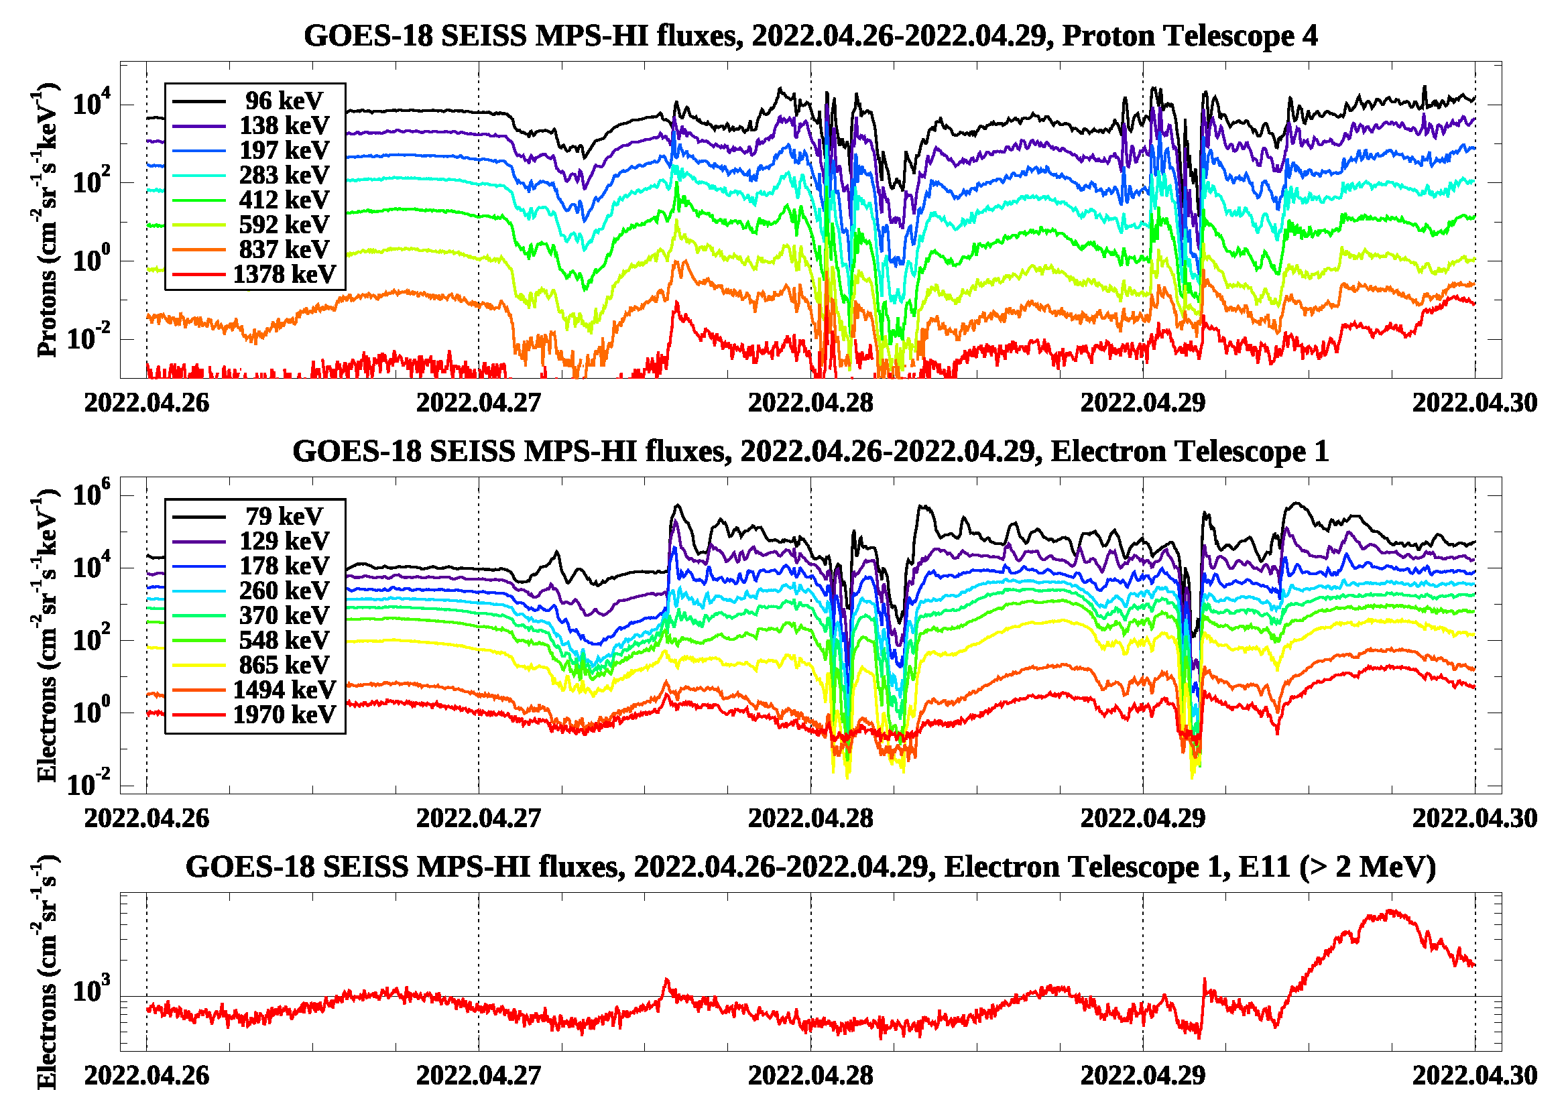
GOES-18 SEISS
First Public Image (MPS-HI)

Slide 7
Review of Provisional Maturity G18 SEISS MPS-HI Provisional, Oct. 11, 2022
GOES-18 MPS-HI L1b Products Full PS-PVR

Slide 8
GOES-18: Status at Provisional
Summary of remaining issues
Solar Proton Channels
Comparison of MPS-HI channels P8-P11 with SGPS P1-P4 for a suitable Solar Energetic Particle (SEP) event
Disagreement of MPS-HI P8-P10 fluxes with those of SGPS P1-P3
Similar flux levels in MPS-HI channel P11 and SGPS channel P4
Comparison of GOES-18 MPS-HI with other operational GOES-R series satellites
Good agreement between GOES-17 and GOES-18 for most cases
Much higher GOES-18 P11 channel fluxes compared to GOES-16
Requires a more suitable SEP event
Requires beam calibration of MPS-HI and SGPS (has been approved by the program, planned by the instrument vendor)
Background Removal
Modification of the background removal coefficients is successful in yielding appropriate background levels, consistent with Galactic Cosmic Ray (GCR) fluxes
Complication: the space environment is changing
Requires continued monitoring
Possible revision of the background removal coefficients in the future

Slide 9
Instrument/GPA Issues Identified and Progress Status: MPS-HI
Following is a list of ADRs that directly or indirectly affect the GOES-18 MPS-HI.
ADR# | WR# | Short Description | Current Status | Expected Closure
780 | 6845 | G16 & G17 MPS-HI and MPS-LO L1b IFC Leakage | Closed | DO.12.00.00
781 | 6477 8404 | G16 & G17 MPS-HI and SGPS L1b data gaps near IFCs | Fixed | DO.09.02.00 DO.13.00.00
863 | 6736 | Graceful degradation when SGPS data not generated | In Analysis | DO.14.00.00
1209 | N/A | G18 SEISS LUTs | Closed | PR.09.08.14
1253 | N/A | Update to G18 MPS-HI LUT | Closed | PR.09.08.34

Slide 10
ADR 863: Graceful degradation when SGPS data not generated
Applies to all GOES-R spacecraft
Four electron channels from MPS-HI use SGPS-X data for a contamination correction. The SGPS P5 channel uses data from the opposite SGPS for a contamination correction. If for some reason (like a sensor failure) no data are being generated from one of the SGPS units, then the dependent products should still be produced with only graceful degradation. This is a generalization of ADR 781.
With respect to MPS-HI:
Case 1: SGPS-X data are not being generated
MPS-HI fluxes should be calculated as if SGPS-X fluxes were zero rather than missing -- graceful degradation of 4 electron channels.
Case 2: SGPS+X data are not being generated.
MPS-HI fluxes should be produced, no dependence on SGPS+X, no degradation.
Case 3: neither SGPS+X nor SGPS-X data being generated
MPS-HI fluxes should be calculated as if SGPS-X fluxes were zero rather than missing -- graceful degradation of 4 electron channels.
CAUTION: ADR 863 can become critical in case of catastrophic failure of SGPS. MPS-HI E11 channel will be lost even though it is still functioning.

Slide 11
ADR 1253: Modification of the GOES-18 MPS-HI LUT
L1b overcorrection of MPS-HI electrons, resulting in artificial dropouts and unphysical fluxes
Affects all electron channels, differential and integral
Result of the inverse matrix technique to determine fluxes
Solution: diagonal matrix derived using the Bowtie technique
L1b insufficient background correction for MPS-HI electrons, resulting in higher background levels
Affects electron channels E9-E11
Especially important for integral channel E11, as it affects the Space Weather Prediction Center alerts
Result of small background removal coefficients
Solution: calculate new background removal coefficients (PLPT-SEI-006)

Slide 12
Product quality EVALUATION
GOES-18 MPS-HI L1b Products Full PS-PVR

Slide 13
Path to Full Validation - PLPTs
Title | Activity | Data Needed | Success Criteria
A.3.2 MPS-Hi Telescope Cross-Comparison [PLPT-SEI-002] | Determine the relative sensitivity/response among MPS-HI telescopes. | Three months of continuous data. (MAG, MPS-HI) | [Full] Telescopes agree to within 25%.
A.3.4 SEP Channel Cross-Comparison [PLPT-SEI-004] | On-orbit cross-calibration of MPS-HI with SGPS 1-12 MeV protons, and all operational GOES-R Series SEISS sensors. | Two Solar Energetic Particle (SEP) events. | [Full] Differences quantified on data taken through validation phase.
A.3.5 Cross Satellite Comparison of Trapped Particles [PLPT-SEI-005] | To inter-calibrate MPS-HI with the same measurements on other operational GOES-R Series satellites. The MPS-HI inter-calibration part of the test is critical for establishing the consistency of the NOAA real-time >2 MeV electron flux alerts between operational GOES-R Series satellites. | Three months of continuous data. (MAG, MPS-HI) | [Full] Differences quantified on data taken through validation phase.
A.3.6 Backgrounds Trending [PLPT-SEI-006] | To evaluate MPS-HI backgrounds in terms of expected galactic cosmic ray (GCR) fluxes. | Four months of continuous data. (MPS-HI, SGPS) | [Full] Perform analysis during validation phase.
MPS-HI Full Validation PLPTs from RIMP v 2.0 (09 July 2021).

Slide 14
Use of Reprocessed Data prior to ADR 1253 implementation
ADR 1253 went live in the OE on September 1, 2022
Operational electron data prior to that cannot be used for any analysis
NCEI reprocessed L0 data using software that has been demonstrated to reproduce L1b results to ‘machine precision’ (ADR 1253 verification)
This demonstrated equivalence allowed NCEI to perform Provisional PLPTs using reprocessed MPS-HI data
Any Full validation analysis that requires data prior to ADR 1253 implementation will use these reprocessed data

Slide 15
PLPTs for Full Validation
PLPT-SEI-002: MPS-HI Telescope Cross-Comparison (Hallock, Allsopp, Rowland)
PLPT-SEI-004: Solar Energetic Particle (SEP) Cross-Comparison (Kress)
PLPT-SEI-005: Cross-Satellite Comparison of Trapped Particles (Boudouridis, Rodriguez)
PLPT-SEI-006: Backgrounds Trending (Boudouridis, Rodriguez)

Slide 16
PLPT-SEI-002: MPS-HI Telescope Cross-Comparison: Introduction
Pass
Pitch Angle definition and telescope orientations
Pitch angle (PA) is angle between the particle velocity and the magnetic field (B-field).
G18 Upright
Etel.3
Expected
approx. PAs:
Etel.3: 150○
Etel.1: 115○
Etel.4: 80○
Etel.2: 45○
Etel.5: 10○
B-field
Etel.1
$≈$100○
Etel.4 particle velocity
$≈$80○
Etel.4
+z
Etel.4 look direction
Supplementary angle (SPA) = 180-PA
Particles return to the equator after bouncing near the poles with SPA
-x
Etel.2
+y
Etel.5
Body Reference Frame (BRF) coordinate system: +X East, +Y South, +Z Earthward

Slide 17
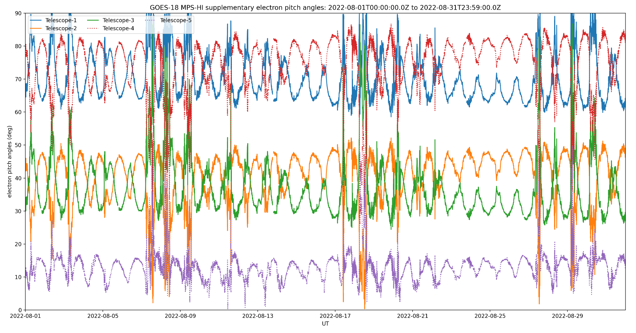
PLPT-SEI-002: MPS-HI Telescope Cross-Comparison: Method
Pass
Compares responses of MPS-HI telescopes when central pitch angle is the same
Under such conditions, telescopes should be measuring the same flux for the same effective energy
The technique has been validated twice: 1) G17 MPS-LO zone intracal, and 2) G13/G15 MAGED/PD cross-telescope comparisons (Rodriguez et al., [2020], JSWSC)
GOES-18
Electrons
Procedure steps:
Input MPS-HI fluxes and pitch angles calculated from MAG L1b BRF
Identify whenever a pair of telescopes has pitch angles within 1 degree
Fold pitch angles > 90 degrees to get enough matches
Report measured fluxes for each pitch angle match
Estimate scaling factors with respect to a reference telescope
Ref: Rowland, W., and R. S. Weigel (2012), Intra-calibration of particle detectors on a three-axis stabilized geostationary platform, Space Weather, 10, S11002, doi:10.1029/2012SW000816.

Slide 18
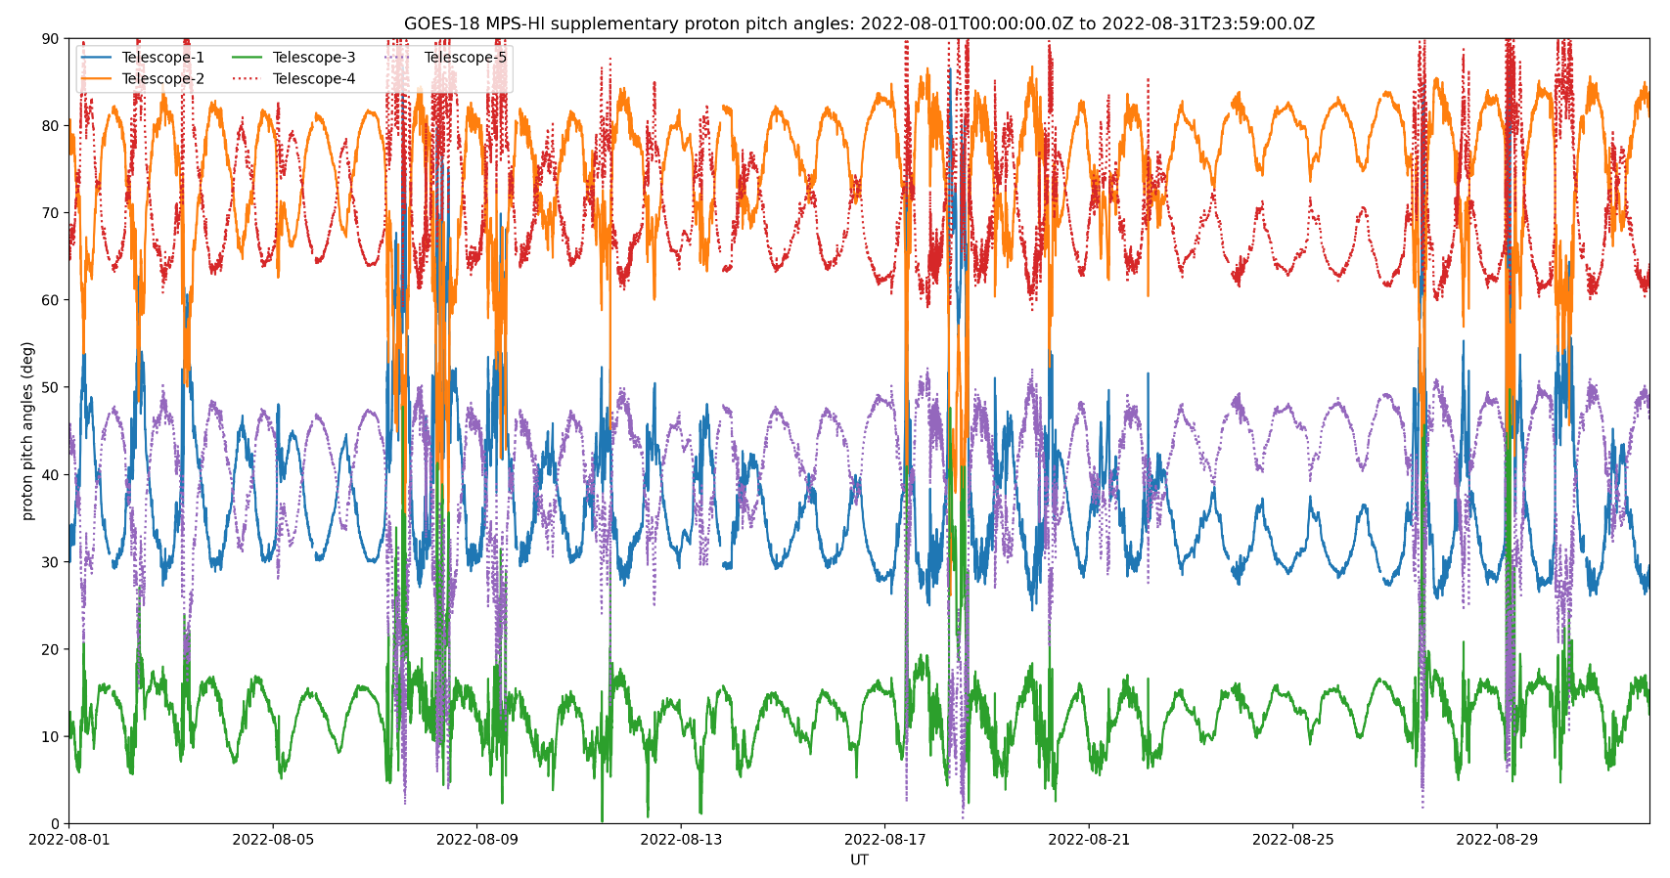
PLPT-SEI-002: MPS-HI Telescope Cross-Comparison: Method
Pass
Improvements over the years
Larger data sample (3 months in this case)
Use of supplementary angles
Thresholding to eliminate low fluxes
GOES-18
Protons
Remaining Caveats
Account for variation in channel energies across telescopes
GOES-18 GMAG: Missing 1 sample every 10 data points (ADR 1232, GMAG irregular timestamps)
MPS-HI uses 1-min averages, therefore 540 points instead of 600
Does not significantly affect the results of PLPT-002
Issue was fixed on December 7, 2022

Slide 19
PLPT-SEI-002: MPS-HI Telescope Cross-Comparison: Results
Pass
Electron Scale Factors
September 7-December 6, 2022
Proton Scale Factors
September 7-December 6, 2022
Energy band | Count threshold | T1 | T2 | T3 | T4 | T5
E1 | 1000/min | 1.036 | 0.926 | 0.964 | 1.000 | 1.000
E2 | 1000/min | 0.958 | 1.233 | 1.104 | 1.000 | 1.165
E3 | 1000/min | 0.919 | 0.785 | 0.811 | 1.000 | 1.061
E4 | 1000/min | 1.009 | 0.960 | 0.983 | 1.000 | 1.081
E5 | 1000/min | 0.973 | 1.020 | 0.947 | 1.000 | 1.048
E6 | 1000/min | 0.996 | 1.102 | 0.996 | 1.000 | 1.038
E7 | 1000/min | 1.006 | 0.985 | 1.106 | 1.000 | 1.175
E8 | 100/min | 0.985 | 0.865 | 0.826 | 1.000 | 1.009
E9 | 100/min | 0.630 | 0.682 | 0.706 | 1.000 | 0.690
E10 | 100/min | 0.757 | 0.813 | 0.956 | 1.000 | 0.937
E11 | 100/min | 0.718 | 0.812 | 0.943 | 1.000 | 0.747
Energy band | Count threshold | T1 | T2 | T3 | T4 | T5
P1 | 1000/min | 0.723 | 1.000 | 0.760 | 0.977 | 1.273
P2 | 1000/min | 0.942 | 1.000 | 0.922 | 1.064 | 1.025
P3 | 1000/min | 0.877 | 1.000 | 0.921 | 1.084 | 1.083
P4 | 1000/min | 0.932 | 1.000 | 1.031 | 1.088 | 0.963
P5 | 100/min | 0.802 | 1.000 | 0.900 | 1.026 | 0.942
P6 | 100/min | 0.926 | 1.000 | 1.103 | 1.116 | 1.287
P7 | 100/min | 0.915 | 1.000 | 1.002 | 1.077 | 1.197
Technique not applicable to solar proton channels P8-P11
Electron scale factors are mostly within the 25% requirement.
Proton scale factors are mostly within the 25% requirement.
Lower scale factors occur mostly for higher energy channels with less count rates.
Blue: <10%, Green: 10-25%, Red: >25%
Pink: <100 PA matches
Orange: <1000 PA matches

Slide 20
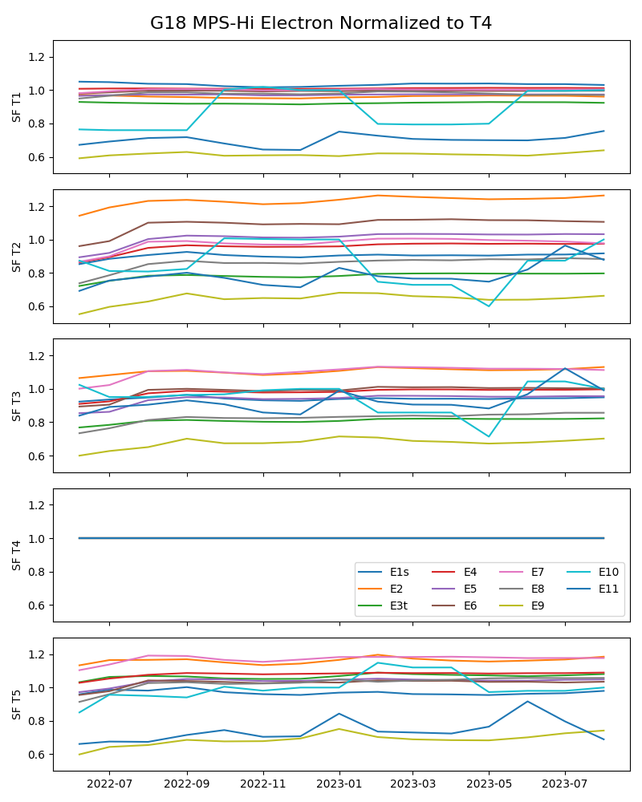
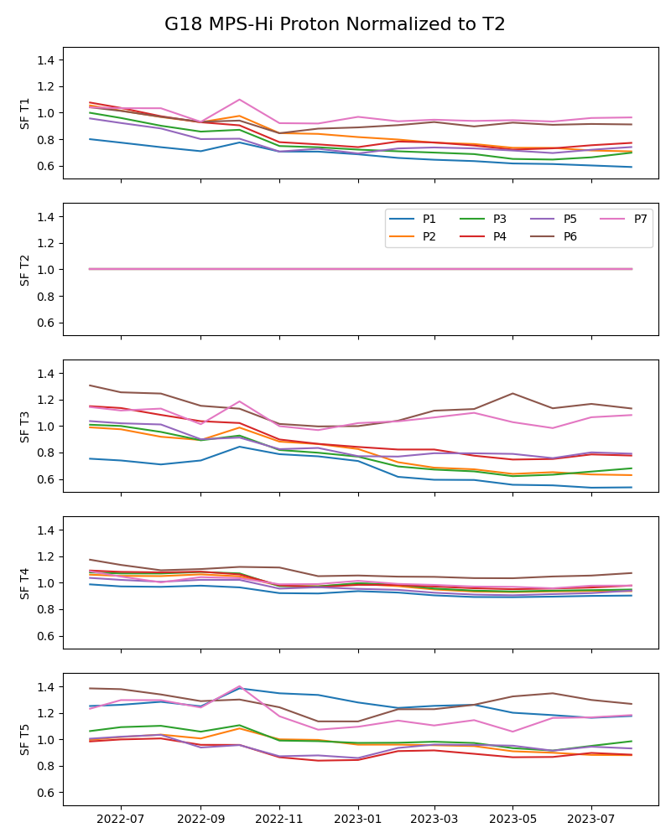
PLPT-SEI-002: MPS-HI Telescope Cross-Comparison: Long term
Pass
Electron Summary, 06/2022-10/2023
Proton Summary, 06/2022-10/2023
Mostly steady (except for low matches channels)
Calculation every month for the next 3 months

Slide 21
PLPT-SEI-002: MPS-HI Telescope Cross-Comparison: Summary
Found telescope pitch angle matches
Used the technique of Rowland and Weigel (2012) to calculate scale factors for all energies and telescopes
The electron scale factors are mostly < 25%, the telescopes agree within 25% accuracy
GOES-18 electron telescopes performed better than GOES-16
GOES-18 electron telescopes performed similarly to GOES-17
The proton scale factors are mostly < 25%, the telescopes agree within 25% accuracy
GOES-18 proton telescopes performed better than GOES-16
GOES-18 proton telescopes performed better than GOES-17
PLPT-SEI-002 for GOES-18 is a solid
Pass

Slide 22
PLPT-SEI-004: SEP Channel
Cross-Comparison: Provisional Event
27-30 August 2022 SEP Event
During a period of somewhat elevated solar wind dynamic pressure, all MPS-HI units P8-P10 fluxes are significantly lower than SGPS P1-P3 fluxes from all SGPS units.
MPS-HI P11 fluxes are similar to SGPS P4 fluxes.
All MPS-HI units report similar fluxes in the P8-P10 channel range.
The GOES-18 MPS-HI P11 fluxes are higher than the P11 fluxes on the GOES-16 MPS-HI unit.
During periods of high solar wind dynamic pressure and/or increased geomagnetic activity, the geosynchronous orbit is immersed in the SEP fluxes, becoming homogeneous and isotropic with respect to SEPs
All 3 MPS-HI units and 6 SGPS units onboard the GOES 16-18 spacecraft should observe the same SEP fluxes in channels of similar energy range

Slide 23
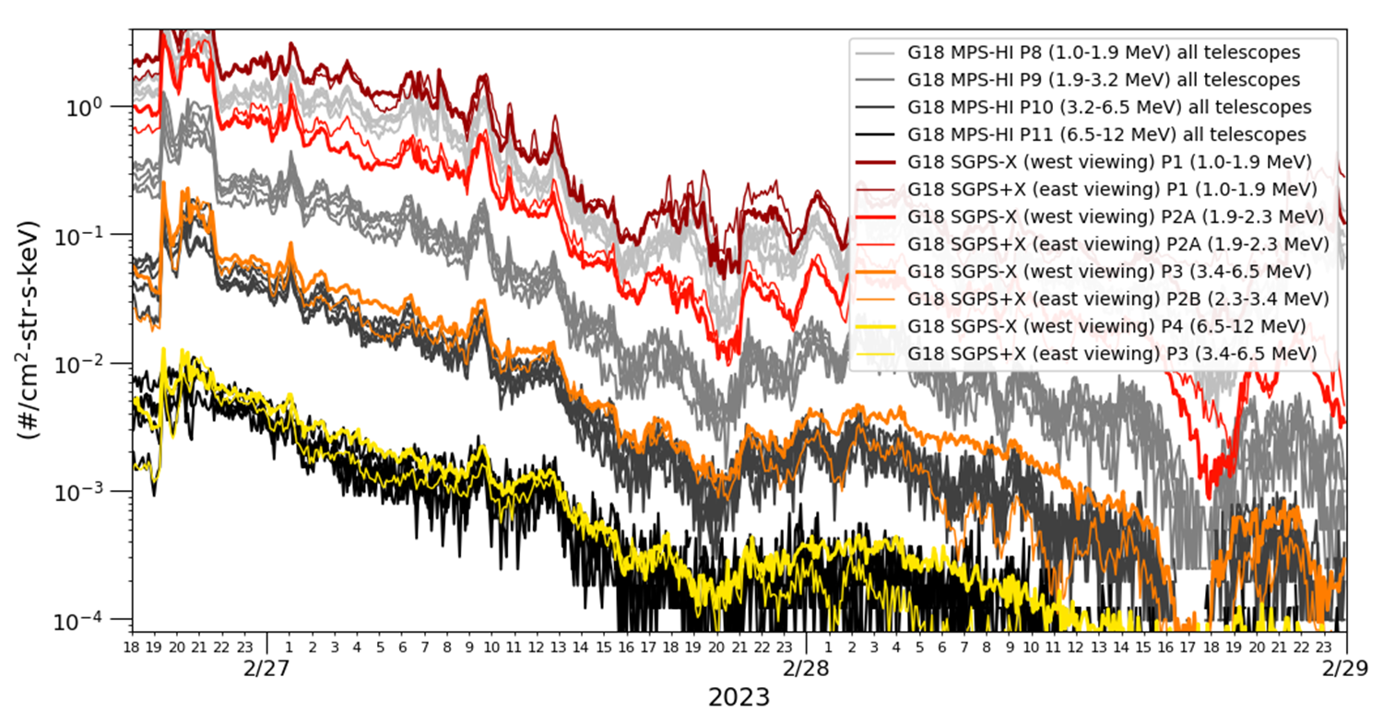
PLPT-SEI-004: SEP Channels Cross-Comparison: New Event
Pass
5-minute averaged L1b fluxes
Suppression of geomagnetic shielding of SEPs by the 26-28 Feb. 2023 geomagnetic storm should bring the MPS-HI P8-P11 fluxes into agreement with SGPS P1-P4 fluxes.
Differences seen here are thought to be due to mischaracterization of the MPS-HI SEP channels, which did not undergo calibration at a beam facility during ground calibrations.

Slide 24
PLPT-SEI-004 SEP Channels
Cross-Comparison: SEP Spectra
Pass
26-28 February 2023 SEP event
In general, MPS-HI SEP channels are reporting significantly lower fluxes than similar SGPS channels, except for G17 and G18 MPS-HI P11 fluxes, which span the range of SGPS P4 fluxes
G16 MPS-HI P10 and P11 channels are reporting lower than G17 and G18 P10 and P11 channels in all telescopes
Overall adjustment of the MPS-HI SEP channel LUT parameters is needed for all MPS-HI units, in order to bring them into agreement with the SGPS units.
MPS-HI SN104 (Serial Number 104, spare unit) is scheduled for calibration at the Brookhaven National Laboratory (BNL) in December 2023.

Slide 25
PLPT-SEI-004: SEP Channel
Cross-Comparison: Summary
In general, GOES-16, GOES-17, and GOES-18 MPS-HI P8 and P9 like telescope-channel pairs agree well, within <20% difference in most cases. GOES-16 MPS-HI P10 and P11 channels are reporting significantly lower than GOES-17/GOES-18 P10 and P11 channels in all telescopes (the GOES-16/-18 MPS-HI SEP channel cross-comparison is included in the backup slides).
GOES-R series MPS-HI SEP channels are in general reporting significantly low with respect to SGPS units, even during an SEP event accompanied by high solar wind dynamic pressure and a geomagnetic storm.
Work to resolve the above discrepancies is ongoing
Upcoming ground/beam calibrations of MPS-HI and SGPS spare units (MPS-HI SEP channels have never been beam calibrated). The current schedule is:
MPS-HI SN104 at the Brookhaven National Laboratory (BNL): December 2023
SGPS SN110 at the Brookhaven National Laboratory (BNL): December 2023
PLPT-SEI-004 for GOES-18 is a
Pass

Slide 26
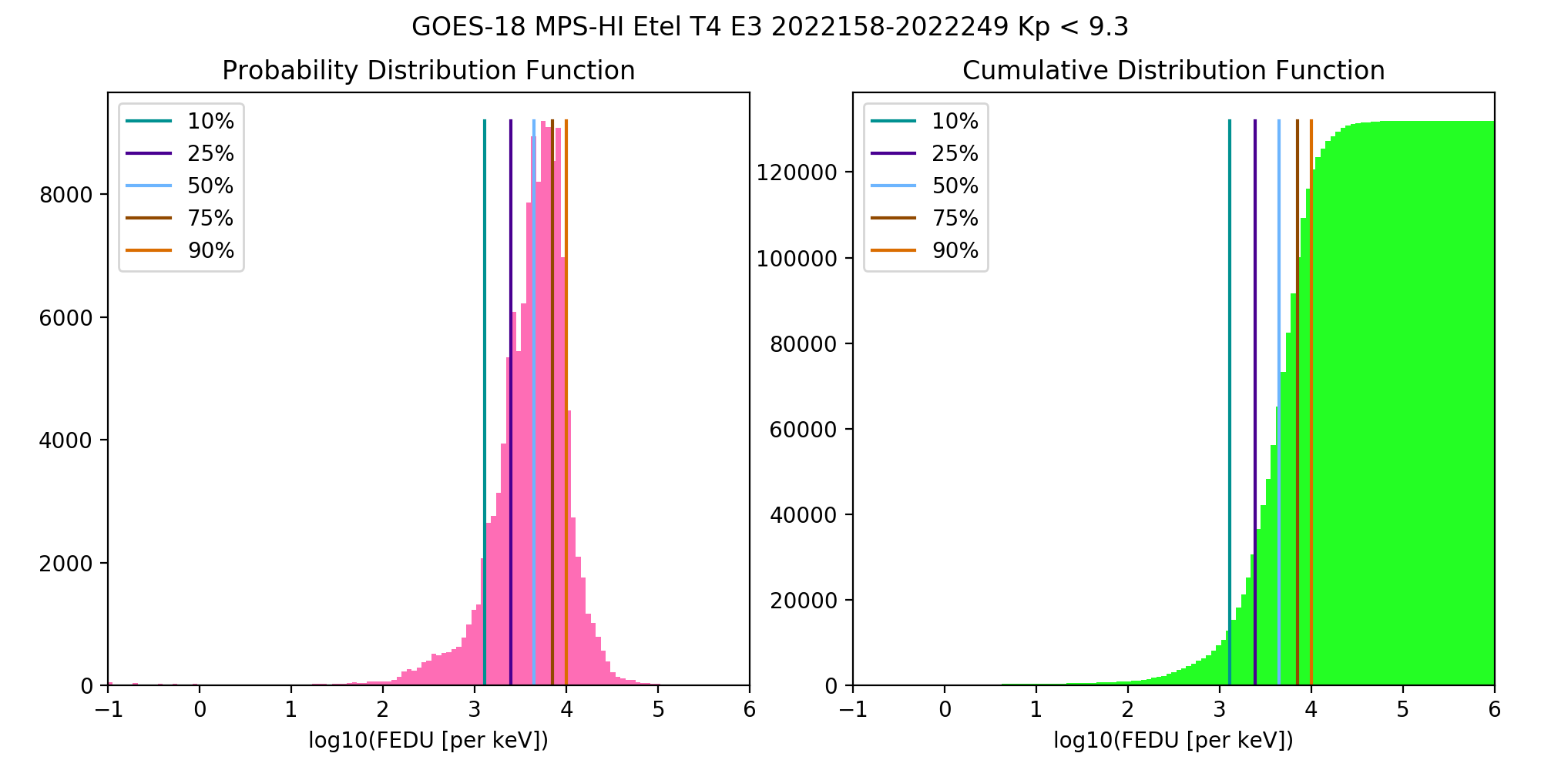
PLPT-SEI-005: Cross-Satellite Comparison of Trapped Particles: Technique
Pass
Compare statistical differential flux spectra from GOES-17 and GOES-18, separated by only 0.4 degrees longitude:
GOES-17 (137.2W) to GOES-18 (136.8W), 09/07/2022-12/06/2022 (3 months)
Calculate the particle distributions for all channels and telescopes
Compare flux percentile spectra for telescopes of the same orientation
0, ±35, ±70 deg from zenith (radially outward)
Note: GOES-17 MPS-HI was inverted during this period
PDF: Number of fluxes in each flux bin
CDF: Number of fluxes up to a flux bin
Percentile fluxes: Flux at which number of fluxes < percentile
50% is the median of the distribution

Slide 27
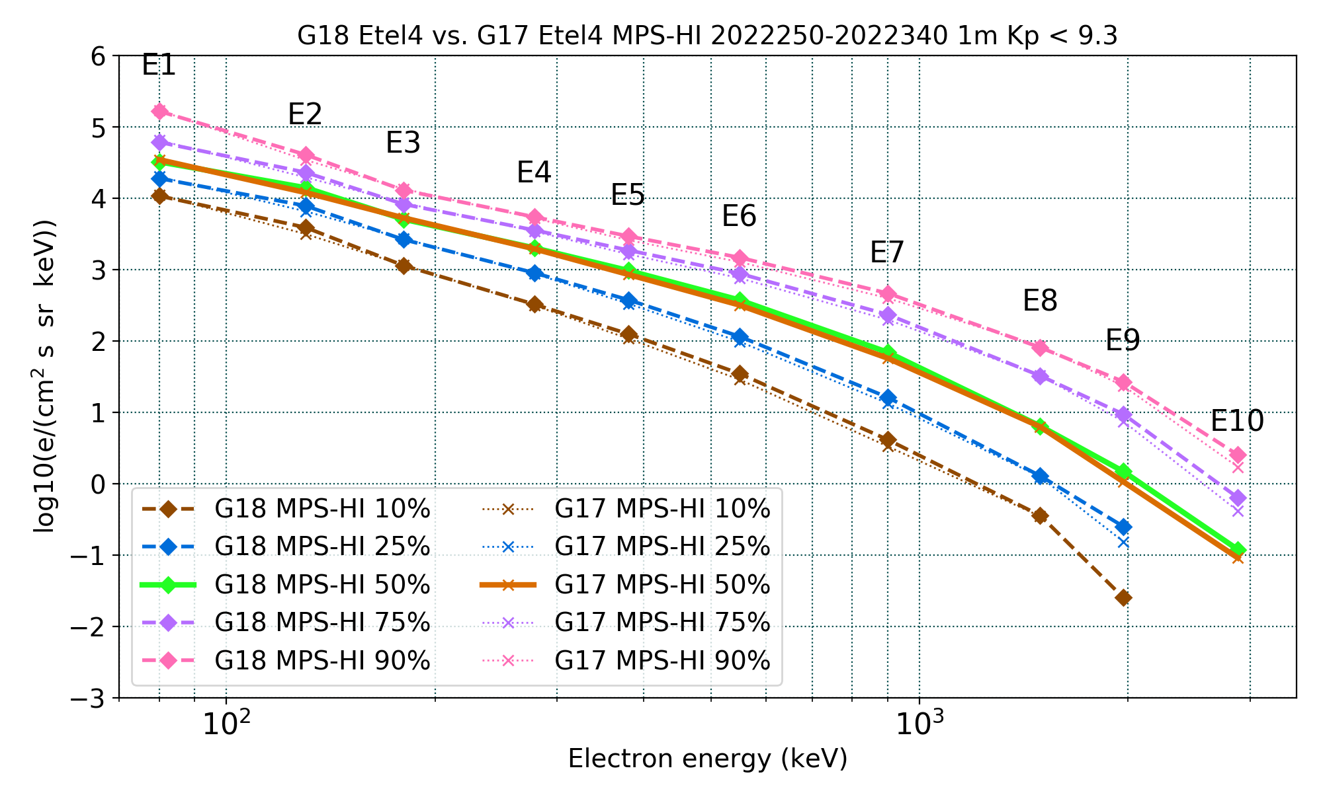
PLPT-SEI-005: Cross-Satellite Comparison of Trapped Particles: Results
Pass
GOES-18 vs GOES-17 Electrons , 09/07/2022–12/06/2022
GOES-17 fluxes are slightly less than GOES-18: GOES-17 has been in orbit for over 5 years
Excellent agreement!
Missing or significantly lower fluxes are at residual background levels
Boudouridis, A., Rodriguez, J. V., Kress, B. T., Dichter, B. K., & Onsager, T. G. (2020). Development of a bowtie inversion technique for real‐time processing of the GOES‐16/‐17 SEISS MPS‐HI electron channels. Space Weather, 18, e2019SW002403. https://doi.org/10.1029/2019SW002403

Slide 28
PLPT-SEI-005: Cross-Satellite Comparison of Trapped Particles: Results
Pass
GOES-17 over GOES-18 Electrons, 09/07/2022–12/06/2022
 |  | G17 ET5 | : | G18 ET3 |  |  | G17 ET2 | : | G18 ET1 |  |  | G17 ET4 | : | G18 ET4 |  |  | G17 ET1 | : | G18 ET2 |  |  | G17 ET3 | : | G18 ET5
 |  |  | Q |  |  |  |  | Q |  |  |  |  | Q |  |  |  |  | Q |  |  |  |  | Q
Energy (keV) | 10 | 25 | 50 | 75 | 90 | 10 | 25 | 50 | 75 | 90 | 10 | 25 | 50 | 75 | 90 | 10 | 25 | 50 | 75 | 90 | 10 | 25 | 50 | 75 | 90
80 | 0.79 | 0.82 | 0.82 | 0.81 | 0.78 | 1.03 | 1.06 | 1.08 | 1.04 | 0.95 | 1.03 | 1.06 | 1.07 | 1.06 | 1.03 | 0.81 | 0.83 | 0.83 | 0.84 | 0.83 | 1.05 | 1.07 | 1.07 | 1.06 | 1.06
130 | 0.80 | 0.82 | 0.82 | 0.82 | 0.83 | 0.82 | 0.85 | 0.87 | 0.86 | 0.84 | 0.81 | 0.84 | 0.86 | 0.85 | 0.84 | 0.83 | 0.84 | 0.85 | 0.85 | 0.84 | 0.94 | 0.95 | 0.95 | 0.95 | 0.93
180 | 0.95 | 0.99 | 0.99 | 0.99 | 0.99 | 1.10 | 1.14 | 1.15 | 1.15 | 1.15 | 1.01 | 1.03 | 1.04 | 1.05 | 1.04 | 0.82 | 0.84 | 0.86 | 0.86 | 0.86 | 1.24 | 1.27 | 1.27 | 1.26 | 1.27
278 | 0.89 | 0.90 | 0.92 | 0.92 | 0.92 | 1.13 | 1.15 | 1.14 | 1.11 | 1.11 | 0.97 | 0.97 | 0.97 | 0.96 | 0.96 | 0.86 | 0.87 | 0.88 | 0.87 | 0.86 | 1.18 | 1.16 | 1.14 | 1.11 | 1.10
380 | 0.79 | 0.82 | 0.85 | 0.86 | 0.86 | 0.96 | 0.98 | 0.97 | 0.97 | 0.97 | 0.86 | 0.88 | 0.88 | 0.88 | 0.88 | 0.86 | 0.86 | 0.87 | 0.87 | 0.87 | 1.19 | 1.18 | 1.15 | 1.13 | 1.11
550 | 0.77 | 0.78 | 0.77 | 0.77 | 0.76 | 0.85 | 0.87 | 0.87 | 0.88 | 0.88 | 0.83 | 0.85 | 0.85 | 0.86 | 0.87 | 0.95 | 0.96 | 0.97 | 0.98 | 0.98 | 1.07 | 1.09 | 1.04 | 1.02 | 1.00
900 | 1.27 | 1.26 | 1.20 | 1.18 | 1.15 | 0.89 | 0.92 | 0.91 | 0.91 | 0.90 | 0.81 | 0.83 | 0.83 | 0.85 | 0.85 | 0.70 | 0.71 | 0.74 | 0.76 | 0.77 | 1.28 | 1.25 | 1.23 | 1.20 | 1.19
1493 | 0.81 | 0.90 | 0.90 | 0.90 | 0.90 | 0.95 | 1.04 | 1.06 | 1.05 | 1.08 | 0.97 | 0.97 | 0.98 | 1.00 | 1.03 | 0.80 | 0.85 | 0.80 | 0.83 | 0.85 |  | 1.07 | 1.16 | 1.15 | 1.14
1969 |  | 0.97 | 0.99 | 0.98 | 0.97 | 0.52 | 0.93 | 0.95 | 0.96 | 0.98 |  | 0.61 | 0.72 | 0.79 | 0.87 | 0.27 | 0.66 | 0.69 | 0.74 | 0.76 |  | 0.81 | 0.93 | 0.93 | 0.94
2880 |  |  | 1.02 | 0.88 | 0.87 |  |  | 1.01 | 0.81 | 0.83 |  |  | 0.76 | 0.65 | 0.68 |  |  | 0.63 | 0.56 | 0.59 |  |  | 1.47 | 1.22 | 1.16
GOES-17 greater than GOES-18: <10% 10-25% >25%
The comparisons are made by taking the ratio of the GOES‐17 to the GOES‐18 percentile fluxes, following interpolation to 10 common energies (80, 130, 180, 278, 380, 550, 900, 1,493, 1,969, and 2,880 keV) assuming a piecewise power‐law distribution.
Boudouridis, A., Rodriguez, J. V., Kress, B. T., Dichter, B. K., & Onsager, T. G. (2020). Development of a bowtie inversion technique for real‐time processing of the GOES‐16/‐17 SEISS MPS‐HI electron channels. Space Weather, 18, e2019SW002403. https://doi.org/10.1029/2019SW002403

Slide 29
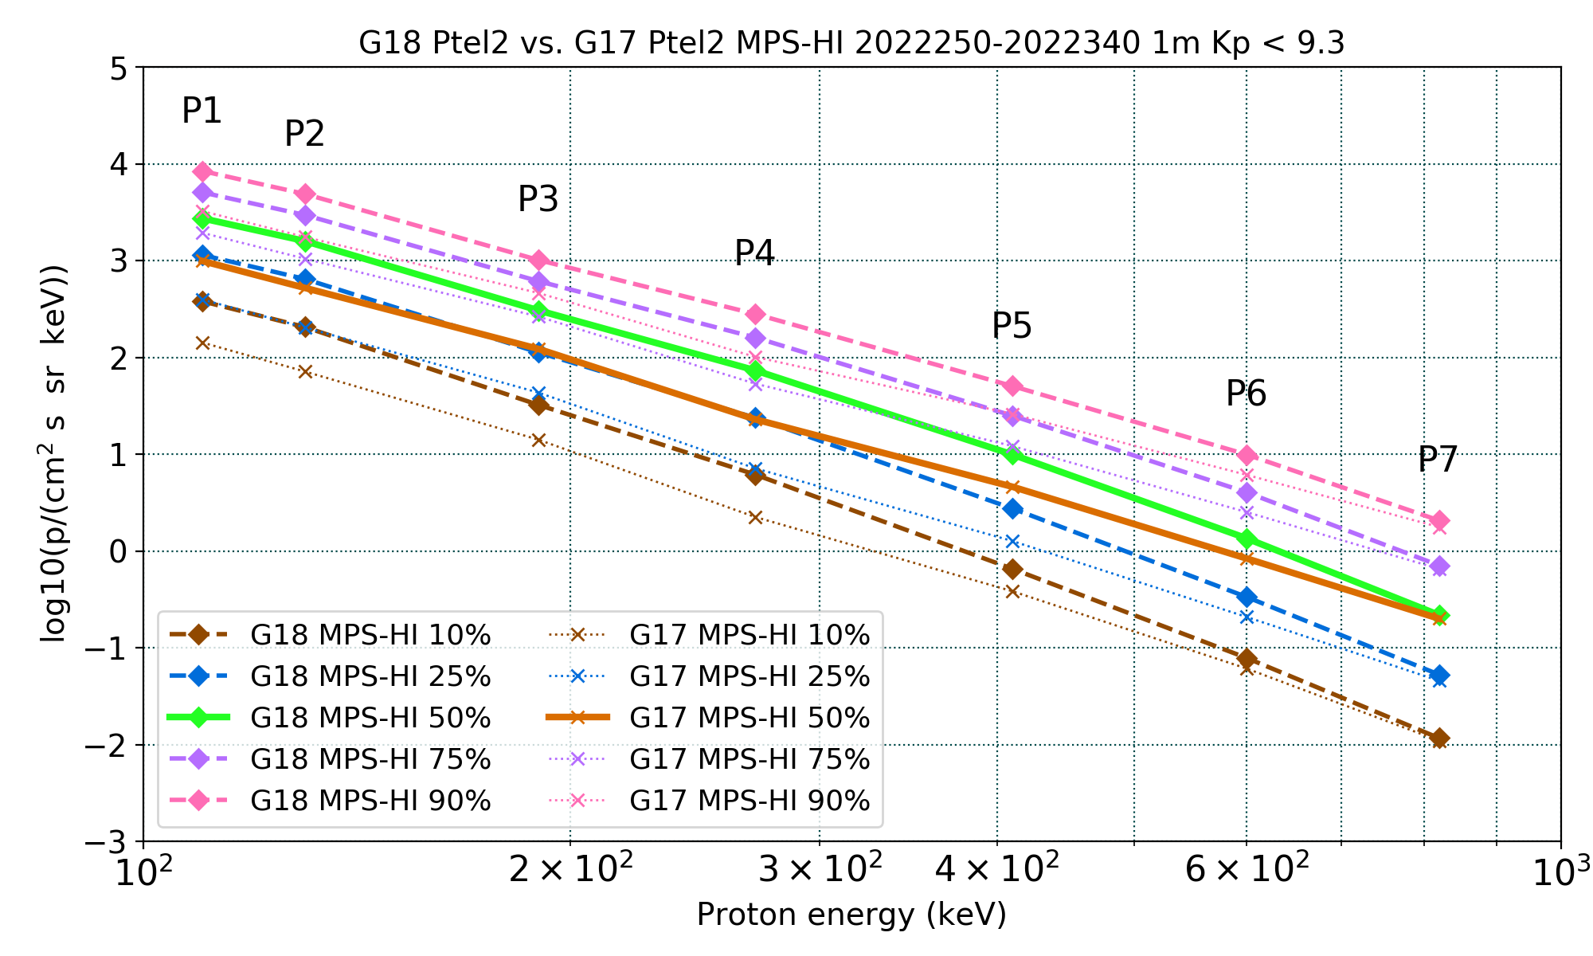
PLPT-SEI-005: Cross-Satellite Comparison of Trapped Particles: Results
Pass
GOES-18 vs GOES-17 Protons , 09/07/2022–12/06/2022
GOES-17 fluxes are significantly less than GOES-18 in channels P1-P5 and all telescopes
GOES-17 fluxes are moderately less than GOES-18 in channels P6-P7 (except for PTel1)
This observation has been documented extensively (G16/G17 Full PS-PVR, G18 PLT SEI-011, and multiple NCEI and MIT studies)
Also observed with G16
A degradation of the proton detectors is actively being investigated
Apply only to P1-P7
Boudouridis, A., Rodriguez, J. V., Kress, B. T., Dichter, B. K., & Onsager, T. G. (2020). Development of a bowtie inversion technique for real‐time processing of the GOES‐16/‐17 SEISS MPS‐HI electron channels. Space Weather, 18, e2019SW002403. https://doi.org/10.1029/2019SW002403

Slide 30
PLPT-SEI-005: Cross-Satellite Comparison of Trapped Particles: Results
Pass
GOES-17 over GOES-18 Protons, 09/07/2022–12/07/2022
 |  | G17 PT3 | : | G18 PT1 |  |  | G17 PT5 | : | G18 PT4 |  |  | G17 PT2 | : | G18 PT2 |  |  | G17 PT4 | : | G18 PT5 |  |  | G17 PT1 | : | G18 PT3
 |  |  | Q |  |  |  |  | Q |  |  |  |  | Q |  |  |  |  | Q |  |  |  |  | Q
Energy (keV) | 10 | 25 | 50 | 75 | 90 | 10 | 25 | 50 | 75 | 90 | 10 | 25 | 50 | 75 | 90 | 10 | 25 | 50 | 75 | 90 | 10 | 25 | 50 | 75 | 90
110 | 0.49 | 0.42 | 0.45 | 0.48 | 0.53 | 0.58 | 0.61 | 0.61 | 0.64 | 0.67 | 0.37 | 0.35 | 0.36 | 0.38 | 0.38 | 0.55 | 0.51 | 0.56 | 0.61 | 0.68 | 0.91 | 0.80 | 0.85 | 0.80 | 0.88
130 | 0.37 | 0.31 | 0.33 | 0.36 | 0.40 | 0.49 | 0.51 | 0.50 | 0.54 | 0.56 | 0.35 | 0.32 | 0.33 | 0.35 | 0.36 | 0.39 | 0.36 | 0.39 | 0.43 | 0.48 | 0.88 | 0.77 | 0.81 | 0.75 | 0.84
190 | 0.31 | 0.27 | 0.27 | 0.29 | 0.33 | 0.42 | 0.42 | 0.42 | 0.44 | 0.44 | 0.44 | 0.39 | 0.40 | 0.43 | 0.46 | 0.33 | 0.31 | 0.33 | 0.34 | 0.39 | 0.75 | 0.66 | 0.65 | 0.61 | 0.67
270 | 0.30 | 0.26 | 0.24 | 0.26 | 0.28 | 0.46 | 0.46 | 0.43 | 0.47 | 0.47 | 0.36 | 0.30 | 0.31 | 0.33 | 0.36 | 0.32 | 0.28 | 0.28 | 0.30 | 0.34 | 0.77 | 0.67 | 0.62 | 0.59 | 0.63
410 | 0.33 | 0.29 | 0.26 | 0.27 | 0.29 | 0.59 | 0.58 | 0.54 | 0.57 | 0.59 | 0.59 | 0.46 | 0.46 | 0.49 | 0.51 | 0.51 | 0.42 | 0.41 | 0.43 | 0.47 | 0.77 | 0.70 | 0.65 | 0.59 | 0.64
600 |  | 0.54 | 0.51 | 0.51 | 0.53 | 0.77 | 0.74 | 0.72 | 0.75 | 0.73 | 0.78 | 0.62 | 0.62 | 0.63 | 0.62 |  | 0.76 | 0.75 | 0.77 | 0.82 |  | 1.65 | 1.54 | 1.47 | 1.53
820 |  | 1.05 | 0.65 | 0.72 | 0.69 | 0.99 | 0.82 | 0.88 | 0.92 | 0.90 | 0.94 | 0.86 | 0.92 | 0.92 | 0.85 |  | 0.97 | 0.93 | 0.96 | 0.98 |  | 0.93 | 0.99 | 1.06 | 1.10
GOES-17 less than GOES-18: <10% 10-25% 25-50% 50-75% >75%
The comparisons are made by taking the ratio of the GOES‐17 to the GOES‐18 percentile fluxes, following interpolation to 7 common energies (110, 130, 190, 270, 410, 600, and 820 keV) assuming a piecewise power‐law distribution.
Boudouridis, A., Rodriguez, J. V., Kress, B. T., Dichter, B. K., & Onsager, T. G. (2020). Development of a bowtie inversion technique for real‐time processing of the GOES‐16/‐17 SEISS MPS‐HI electron channels. Space Weather, 18, e2019SW002403. https://doi.org/10.1029/2019SW002403

Slide 31
PLPT-SEI-005: Cross-Satellite Comparison of Trapped Particles: Results
Pass
T3
GOES-18 channel E11 $(>2$ MeV)
T1
1000 electrons per (cm² sr s)
T4
T2
T5
DOS

Slide 32
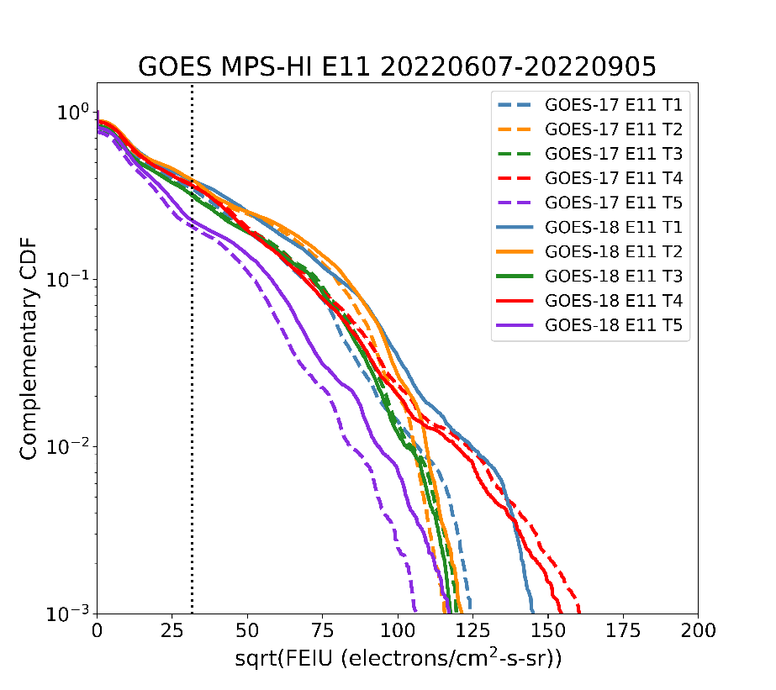
PLPT-SEI-005: Cross-Satellite Comparison of Trapped Particles: Results
Pass
Comparison of >2 MeV electron fluxes for 06/07/2022-09/05/2022: Use a rigorous method to compare two time series at different satellites: ‘Statistical Asynchronous Regression’ [O’Brien et al., JGR, 106, 2001].
Finds the time-invariant function that relates two time-varying but non-simultaneous quantities X, Y: Y = u(X)
Uses cumulative distribution functions (CDFs): F(x), G(y)
To determine u(X) from data:
Map each x to y such that F(x) = G(y)
The resulting tabular relationship between mapped y and x defines u(X)
Plot complementary CDFs because electron flux distributions are biased toward low values: F>(x) = 1-F(x)
O’Brien, T. P., Sornette, D., & McPherron, R. L. (2001) Statistical asynchronous regression: Determining the relationship between two quantities that are not measured simultaneously, Journal of Geophys. Res., Space Phys. 106, 13,247‒13,259. https://doi.org/10.1029/2000JA900193.

Slide 33
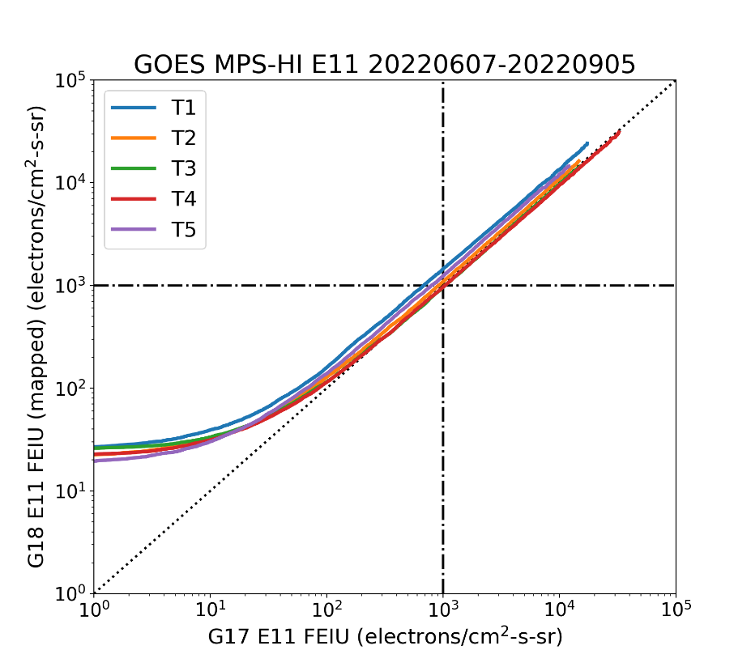
PLPT-SEI-005: Cross-Satellite Comparison of Trapped Particles: Results
Pass
Comparison of >2 MeV electron fluxes for 06/07/2022-09/05/2022: Use a rigorous method to compare two time series at different satellites: ‘Statistical Asynchronous Regression’ [O’Brien et al., JGR, 106, 2001].
Calculate the percentile ratios of the G17/G18 E11 integral flux (note different E11 energies)
Good agreement for the central telescope T4 that is used by SWPC for its alerts
Not so good agreement for T1 and T5, G17 lower
G17/G18 MPS-HI Integral Flux Ratio
Percentile | T1 | T2 | T3 | T4 | T5
50 | 0.65 | 0.88 | 0.95 | 0.99 | 0.73
75 | 0.71 | 0.93 | 1.04 | 1.05 | 0.79
90 | 0.73 | 0.92 | 1.03 | 1.06 | 0.81
O’Brien, T. P., Sornette, D., & McPherron, R. L. (2001) Statistical asynchronous regression: Determining the relationship between two quantities that are not measured simultaneously, Journal of Geophys. Res., Space Phys. 106, 13,247‒13,259. https://doi.org/10.1029/2000JA900193.

Slide 34
PLPT-SEI-005: Cross-Satellite Comparison of Trapped Particles: Summary
Differential fluxes (3 months)
Compared GOES-18 to GOES-17 when the two are only 0.4 degrees longitude apart (09/07/2022-12/06/2022)
Calculated particle distributions and flux percentile spectra
The electron spectra are mostly identical
Some lower G17 fluxes as expected by the age of the GOES-17 detector
GOES-18 ETel5 has somewhat lower fluxes in some energy channels
The proton spectra show much lower GOES-17 fluxes in channels P1-P5, and somewhat lower fluxes in P6-P7
Known issue with GOES-17 (and GOES-16) that is being actively investigated
Integral flux, channel E11 (3 months)
Used Statistical Asynchronous Regression to compare G17 and G18
Central telescope T4 in good agreement, G17 lower at T1 and T5
PLPT-SEI-005 for GOES-18 is a
Pass

Slide 35
PLPT-SEI-006: Backgrounds Trending: Introduction
Pass
MPS-HI E9-E11 Background Removal
The four highest-energy electron channels from MPS-HI (E9, E10, E10A, and E11) are susceptible to contamination by 100’s of MeV protons. The baseline correction algorithm (CDRL80) uses fluxes from SGPS –X P9, P10 and P11 to estimate and remove the spurious rates due to proton contamination.
$$M_{ELE}\left(i,E11\right)=N_{ELE}^{true}\left(i,E11\right)−C_{ELE}^{obc}\left(i,E11\right)$$
$$C_{ELE}^{obc}\left(i,E11\right)=α\left(i,E11\right)F_{{SGPS−X}_{P9}}+β\left(i,E11\right)F_{{SGPS−X}_{P10}}+γ\left(i,E11\right)F_{{SGPS−X}_{P11}}$$
At launch CDRL80 sets $α=0$, $β≠0$, $γ≠0$.
Together with the values for E9, E10, and E10A, they comprise the dataset "theOutOfBandWeightingFactors" in the MPS-HI LUT.
The baseline correction derives $β$ and $γ$ for solar proton spectra from GEANT4 simulations of the proton responses of the electron channels.
The baseline algorithm is inadequate to correct for the observed slowly-varying background due presumably to Galactic Cosmic Ray (GCR) protons.

Slide 36
PLPT-SEI-006: Backgrounds Trending: Methodology
Pass
G18 MPS-HI E9-E11 Revised Background Removal (ADR1253)
The background removal coefficients were corrected so as to better account for the GCR proton contamination (J. Rodriguez/A. Boudouridis). This involves a number of observations and assumptions (demonstrated for MPS-HI E11):
The first assumption is that the MPS-HI backgrounds are due to the GCRs.
SGPS P11 is the best single measure of GCR fluxes, and therefore is used exclusively for the background correction, $α=0$, $β=0$, $C_{ELE}^{obc}\left(i,E11\right)=γ\left(i,E11\right)F_{{SGPS−X}_{P11}}$.
The remaining coefficient $γ$ is calculated separately for each telescope.
Since SGPS-X P11 can track the GCR background well, we can average the SGPS-X P11 fluxes and the background fluxes in E11 due to the GCRs, yielding
$$γ\left(i,E11\right)={\overline{C_{ELE}^{obc}(i,E11)}}/{\overline{F_{{SGPS−X}_{P11}}}}=G_{P11}{\overline{C_{ELE}^{obc}(i,E11)}}/{\overline{C_{P11}}}$$

Slide 37
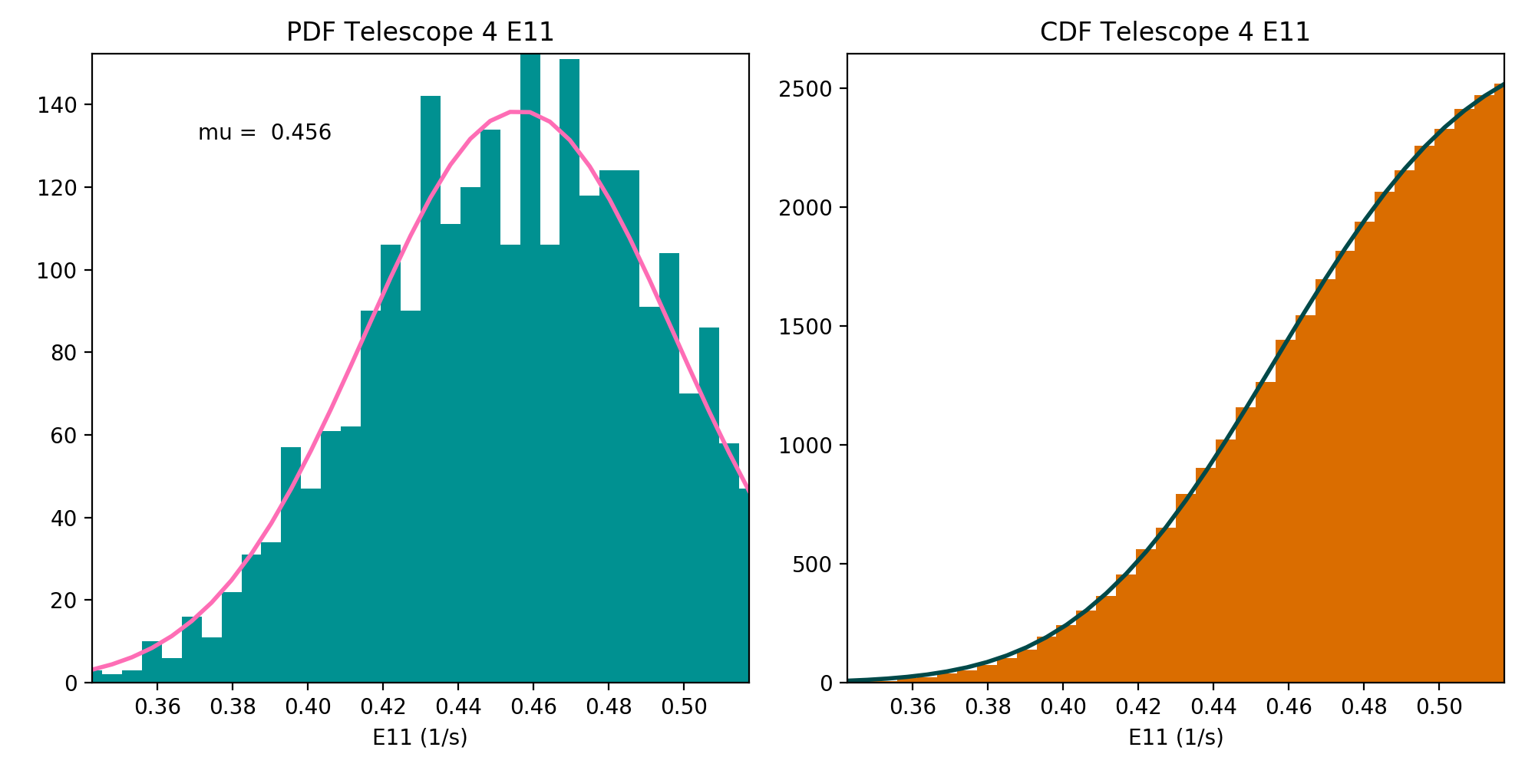
PLPT-SEI-006: Backgrounds Trending: Methodology
Pass
Modeling the GCR background
Assume that the peak and the part of the PDF below the peak are dominated by the rates due to GCRs, model as Gaussians.
Gaussian PDF: $f\left(x\right)=a exp\left[−\frac{{(x−μ)}^{2}}{2σ^{2}}\right]$
Gaussian CDF: $F\left(x\right)=aσ\sqrt{\frac{π}{2}}\left[1+erf\left(\frac{x−μ}{σ\sqrt{2}}\right)\right]$
Conduct the analysis using 5-min averages during a 4-month period, 09/01/2022-12/31/2022.
Fit the CDF that is varying smoothly, instead of PDF.
$\overline{C_{ELE}^{obc}(i,E11)}=μ_{E11}$ (fitted E11 mean).
Do the same for SGPS-X P11 counts, $\overline{C_{P11}}=μ_{P11}$
Repeat for E9, E10, E10A.
Estimate gammas.

Slide 38
PLPT-SEI-006: Backgrounds Trending: Results
Pass
Full Validation Results
Gamma correction coefficients calculated for GOES-18 MPS-HI E9-E11, from 4 months of data, September-December 2022
 | E9 | E10 | E10A | E11
T1 | 0.3663 | 0.6165 | 0.6060 | 1.4834
T2 | 0.3914 | 0.6183 | 0.5683 | 1.4698
T3 | 0.4001 | 0.6502 | 0.4970 | 1.4620
T4 | 0.4467 | 0.6691 | 0.5466 | 1.5488
T5 | 0.3967 | 0.6018 | 0.5267 | 1.4145

Slide 39
PLPT-SEI-006: Backgrounds Trending: Results
Pass
T3
GOES-18 channel E11 $(>2$ MeV)
T1
1000 electrons per (cm² sr s)
T4
SWPC alert level very close to uncorrected backgrounds
T2
T5
Corrected backgrounds more representative of the GCR spectrum
DOS

Slide 40
PLPT-SEI-006: Backgrounds Trending: Comparisons with Past Estimations
Pass
 | E9 | E10 | E10A | E11
T1 | 0.2963 | 0.6096 | 0.6194 | 1.4499
T2 | 0.3139 | 0.6045 | 0.5876 | 1.4328
T3 | 0.3477 | 0.6456 | 0.5249 | 1.4346
T4 | 0.3869 | 0.6686 | 0.5662 | 1.5167
T5 | 0.3440 | 0.6092 | 0.5519 | 1.4253
Pre-drift gammas (ADR 1253), 04/25/2022-05/17/2022
 | E9 | E10 | E10A | E11
T1 | 0.3663 | 0.6165 | 0.6060 | 1.4834
T2 | 0.3914 | 0.6183 | 0.5683 | 1.4698
T3 | 0.4001 | 0.6502 | 0.4970 | 1.4620
T4 | 0.4467 | 0.6691 | 0.5466 | 1.5488
T5 | 0.3967 | 0.6018 | 0.5267 | 1.4145
Post-drift gammas (Full), 09/01/2022-12/31/2022
Full Validation gammas are, in general, higher than the ADR 1253 gammas, but lower than the Provisional Validation gammas
 | E9 | E10 | E10A | E11
T1 | 0.3763 | 0.6447 | 0.6313 | 1.5764
T2 | 0.4218 | 0.6462 | 0.5971 | 1.6014
T3 | 0.4226 | 0.6789 | 0.5204 | 1.5521
T4 | 0.4876 | 0.7018 | 0.5695 | 1.6545
T5 | 0.4182 | 0.6232 | 0.5497 | 1.5384
Post-drift gammas (Provisional), 07/01/2022-08/31/2022

Slide 41
PLPT-SEI-006: Backgrounds Trending: Summary
The baseline algorithm underestimates the backgrounds
It is inadequate to correct for the observed slowly-varying GCRs
After the correction, the background level is still too close to the SWPC E11 (> 2 MeV) alert level
Revision of the algorithm performed by Juan Rodriguez for G16/G17 can be applied to GOES-18
The revised algorithm is successful in reducing the backgrounds to appropriate levels
Caveat: the space environment is varying
The SGPS-X P11 fluxes, that the correction is based on, are decreasing
Gamma correction factors are nonetheless stable
The E11 fluxes above the SWPC >2 MeV alert level are not significantly affected
NCEI will revise "theOutOfBandWeightingFactors" in the MPS-HI LUT
PLPT-SEI-006 is considered a
Pass

Slide 42
PLPT-SEI-006: Backgrounds Trending: Additional Investigation
During the GOES-18 Provisional PS-PVR, the difference between the two estimates of the background removal coefficients (gammas) raised questions on the association of the E9-E11 backgrounds to the SGPS –X P11 (>500 MeV) fluxes
A third estimate during the Full PS-PVR (this presentation), also different from the other two, prompted NCEI to investigate this association further
With one more year of GOES-18 data available, and nearly 7 years of GOES-16 data to date, we present our findings here
The results suggest a good relation between E9-E11 backgrounds and SGPS –X P11 fluxes, at least for some telescopes
A path forward is envisioned where new gammas are calculated for GOES-18 from a longer time period, compared with the current estimates, and included in the MPS-HI LUT through a new ADR
A reprocessing of the past data is added to the NCEI ongoing reprocessing effort list
Similar considerations for GOES-16/-17 will be pursued in the future

Slide 43
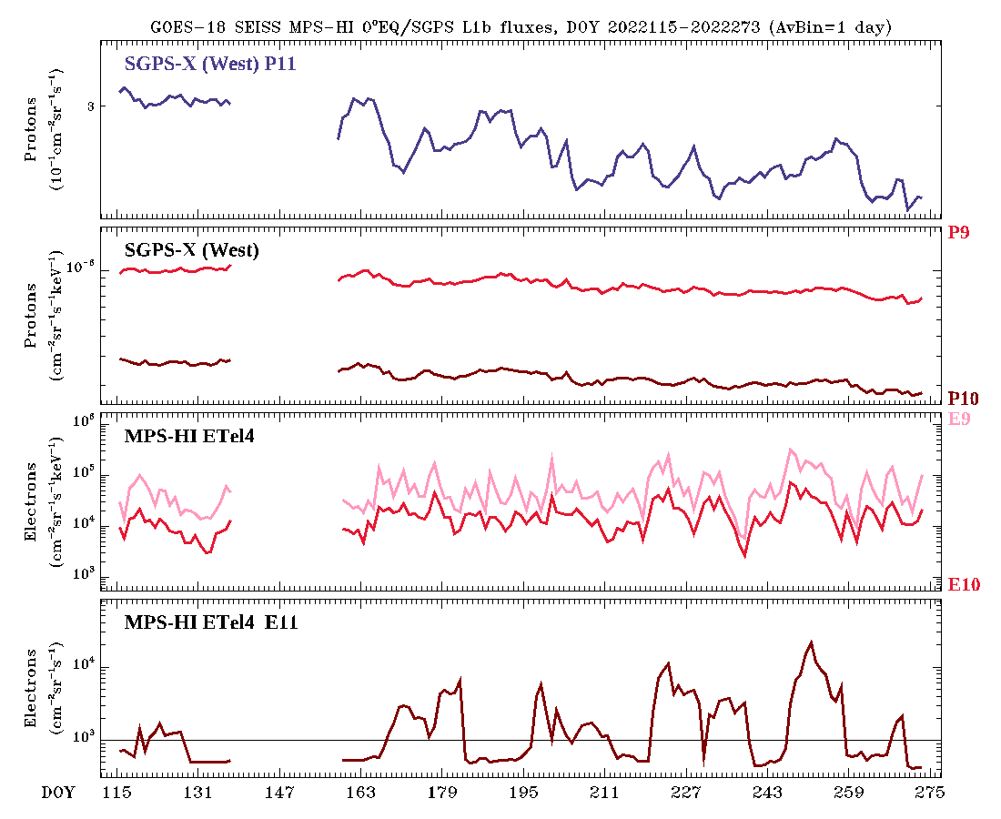
PLPT-SEI-006: Backgrounds Trending: Additional Investigation
Entire mission plot 04/25/2022-09/30/2022 (at Provisional)
$γ\left(i,E11\right)=\frac{\overline{C_{ELE}^{obc}(i,E11)}}{\overline{F_{{SGPS−X}_{P11}}}}$
SGPS-X P11 flux is decreasing over time
Post-drift gammas are greater than pre-drift gammas
Inclusion of SGPS P9 and/or P10 will not improve the situation, as they are both decreasing at a faster rate
Not an issue with G18 SGPS, shows in G16/G17
The space environment is changing
PROVISIONAL
ADR 1253
ADR 1253
PROVISIONAL
Results at Provisional Validation, 10/11/2022

Slide 44
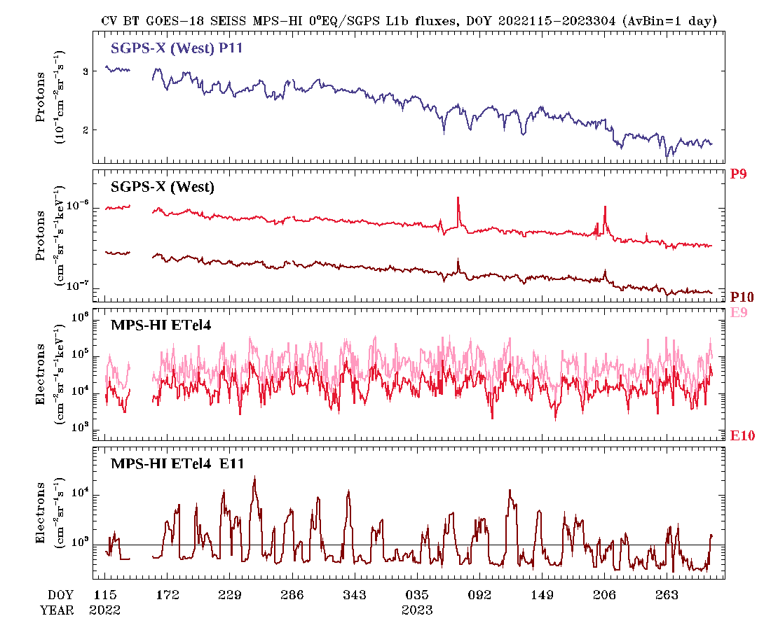
PLPT-SEI-006: Backgrounds Trending: Additional Investigation
GOES-18 entire mission plot 04/25/2022-10/31/2023
$γ\left(i,E11\right)=\frac{\overline{C_{ELE}^{obc}(i,E11)}}{\overline{F_{{SGPS−X}_{P11}}}}$
SGPS-X P11 flux is decreasing over time
E11 backgrounds seem to be decreasing as well

Slide 45
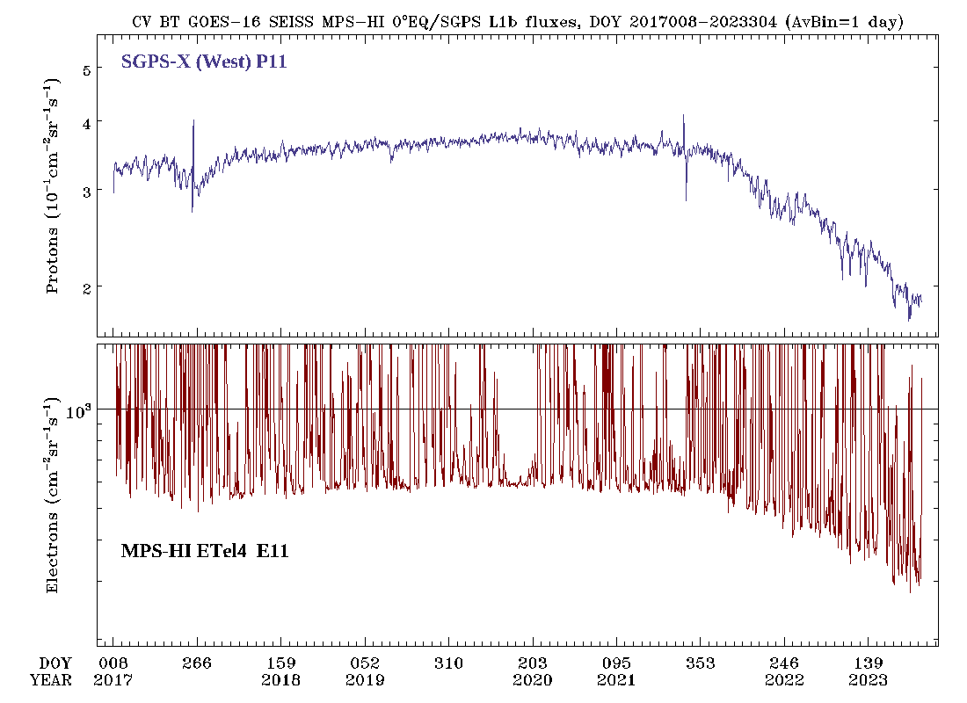
PLPT-SEI-006: Backgrounds Trending: Additional Investigation
GOES-16 entire mission plot 01/08/2017-10/31/2023
Bowtie analysis for MPS-HI E11 is included but the backgrounds are not removed
SGPS-X P11 flux is decreasing over time
MPS-HI E11 backgrounds are also decreasing

Slide 46
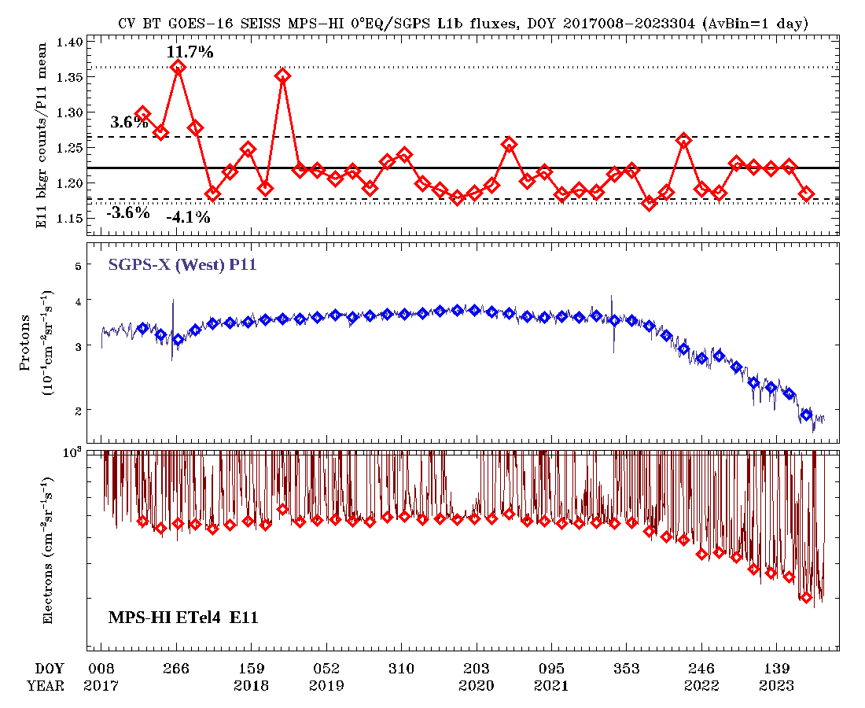
PLPT-SEI-006: Backgrounds Trending: Additional Investigation
GOES-16 MPS-HI E11 T4 entire mission plot 01/08/2017-10/31/2023
Take the ratio of E11 background counts over P11 mean flux (gamma-like)
Ratio of E11 backgrounds to SGPS-X P11 fluxes stays constant
Caveat: Off equatorial telescopes show a decline of gammas, higher the further away from the equator

Slide 47
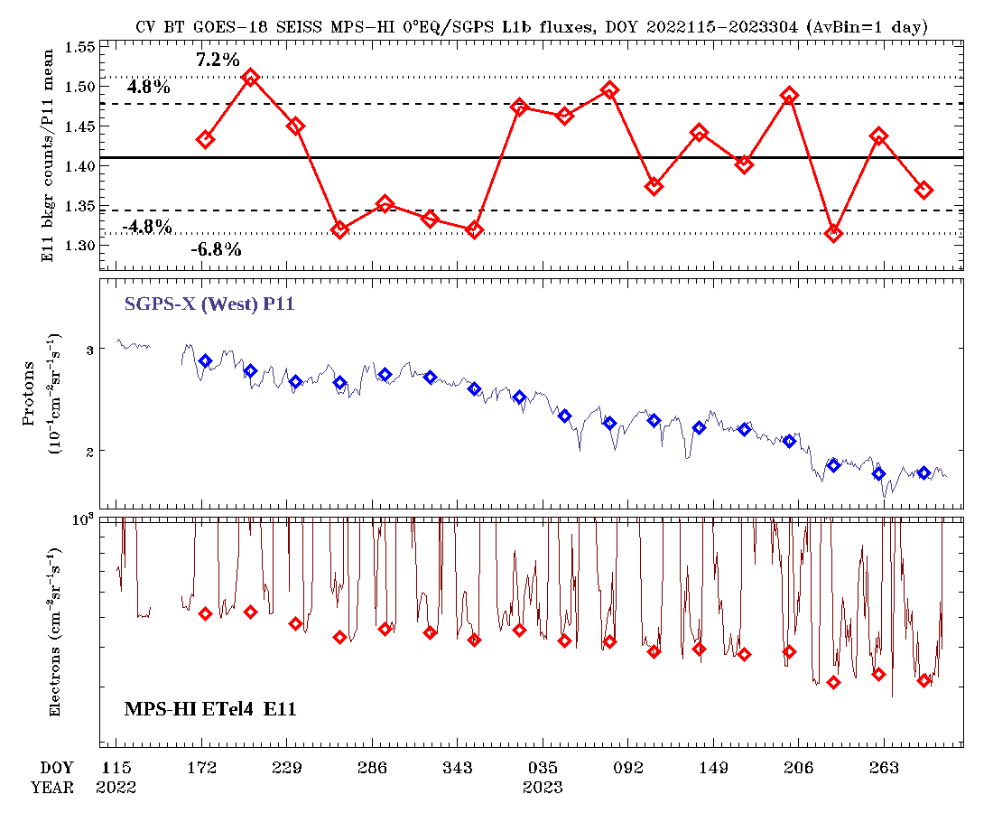
PLPT-SEI-006: Backgrounds Trending: Additional Investigation
GOES-18 MPS-HI E11 T4 entire mission plot 04/25/2022-10/31/2023
Take the ratio of E11 background counts over P11 mean flux (gamma-like)
Ratio of E11 backgrounds to SGPS-X P11 fluxes stays constant
Caveat: Off equatorial telescopes show a decline of gammas, higher the further away from the equator

Slide 48
PLPT-SEI-006: Backgrounds Trending: Path Forward
Perform the rigorous E11 backgrounds and P11 mean calculation, Gaussian fits of the respective histograms, every month of GOES-18 data, estimate Gammas
Compare with current estimates: ADR 1253, Provisional/Full Validations
If in good agreement, estimate Gammas for a longer time period
Repeat the whole process for channels E9, E10, E10A
Submit an ADR to replace the current Gamma values of ADR 1253
Add a reprocessing item in the NCEI ongoing reprocessing effort list to correct past data
Investigate possible changes for GOES-16, reprocessing of past GOES-16/-17 data
Keep monitoring of Gamma variations with SGPS P11 fluxes as we collect more data
Conduct further revisions of the Gamma values in the LUT if needed

Slide 49
GOES-18 Full PLPTs: Summary
PLPT-SEI-002: MPS-HI Telescope Cross-Comparison
Calculated scale factors for all energy and telescope pairs, during pitch angle matches with significant flux levels [Rowland and Weigel, 2012]
Most electron and proton energy/telescope pairs are within 25% accuracy
PLPT-SEI-004: Solar Energetic Particle (SEP) Cross-Comparison
Compared G17 and G18 MPS-HI units, and G18 SGPS and MPS-HI units during a high dynamic pressure event (isotropy of fluxes has been achieved)
MPS-HI units agree within ~20% (with some exceptions)
G18 MPS-HI P8-P10 not in agreement with SGPS P1-P3, but P11 agrees with SGPS P4
PLPT-SEI-005: Cross-Satellite Comparison of Trapped Particles
Compared GOES-18 to GOES-17 when they are only 0.4 degrees longitude apart, by calculating particle distributions and flux percentile spectra
Electron spectra agree well, G17 proton spectra are much lower in P1-P5, lower in P6-P7
PLPT-SEI-006: Backgrounds Trending
Calculated gamma correction factors by fitting lower part of MPS-HI E9-E11 distributions to Gaussians, and doing the same with SGPS-X P11 (considered the only source of backgrounds)
Correction leads to appropriate background levels, but the space environment is varying
Might require revision of the gamma correction factors in the MPS-HI LUT
Pass
Pass
Pass
Pass

Slide 50
GOES-18: Status at Full Review
 | Observed Issue | Current Status | Future Outlook
Backgrounds (E9-E11) | Backgrounds too high in E11 for SWPC to use this channel for >2 MeV alerts Existing contamination correction coefficients are too small | Modified MPS-HI LUT installed on 09/01/2022 is working properly in OE Modified LUT provides adequate background correction | Varying space environment warrants update of the background removal coefficients in the LUT NCEI will keep monitoring
Proton differential flux (P1-P7) | No issues evident upon initial inspection of data | Comparisons with G16/G17 indicates that G16/G17 may have degraded on-orbit due to radiation damage Expect G18 to degrade as well? | Options include modifying geometrical factors in LUTs or determining different effective energies (metadata) NCEI will keep monitoring
Solar proton channels (P8-P11) | MPS-HI channels P8-P10 lower than SGPS P1-P3 GOES-18 MPS-HI P10-P11 higher than GOES-16/-17 | Possible root cause: Inaccurate geometric factors or energies Under investigation | Calibration of later MPS-HI and SGPS T1 units at BNL Planned for December 2023

Slide 51
GOES-18: Remaining Issues
Summary
Solar Proton Channels
Comparison of MPS-HI channels P8-P11 with SGPS P1-P4
Disagreement of MPS-HI P8-P10 fluxes with those of SGPS P1-P3
Similar flux levels in MPS-HI channel P11 and SGPS channel P4
Comparison of GOES-18 MPS-HI with other operational GOES-R series satellites
Good agreement between GOES-17 and GOES-18 for most cases
Much higher GOES-18 P11 channel fluxes compared to GOES-16
Requires beam calibration of MPS-HI and SGPS (has been approved by the program, planned by the instrument vendor for December 2023)
Background Removal
Modification of the background removal coefficients is successful in yielding appropriate background levels, consistent with Galactic Cosmic Ray (GCR) fluxes
Complication: the space environment is varying
Might require revision of the background removal coefficients in the MPS-HI LUT

Slide 52
Full Maturity Assessment
GOES-18 MPS-HI L1b Products Full PS-PVR

Slide 53
Full Validation
Preparation Activities | Assessment
Validation, quality assurance, and anomaly resolution activities are ongoing. | Validation activities are ongoing. Path forward for the main issues has been identified.
Incremental product improvements may still be occurring. | Incremental product improvements are expected, primarily through updated LUTs incorporating results of cross-cal.
Users are engaged and user feedback is assessed. | Engagement with the operational and scientific community is on an ongoing basis. User concerns and questions are routinely addressed.
From 410-R-RIMP-0318 Version 2.0 07/09/2021,
Responsible Organization: GOES-R Program/Code 410

Slide 54
Full Validation
End State | Assessment
Product performance for all products is defined and documented over a wide range of representative conditions via ongoing ground-truth and validation efforts. | PLPTs performed on reprocessed and/or L1b MPS-HI fluxes during various periods throughout the mission.
Products are operationally optimized, as necessary, considering mission parameters of cost, schedule, and technical competence as compared to user expectations. | Yes, to the limited extent of available resources and time, prioritized based on customer needs.
All known product anomalies are documented and shared with the user community. | This presentation, the L1b Readme files, the memos on background correction, and article by Boudouridis et al. [2020] in Space Weather.
Product is operational. | NCEI: yes.
From 410-R-RIMP-0318 Version 2.0 07/09/2021,
Responsible Organization: GOES-R Program/Code 410

Slide 55
Performance Baseline Status
Assessment at Full Validation
MRD ID | Description | Related PLPTs | Status
1996 | MPS-HI Orthogonality/Coverage | -02, -04 | PLPTs underway
2000 | MPS-HI Measurement Range | -02, -04 | PLPTs underway
2001 | MPS-HI Measurement Accuracy | -02, -04, -05, -06 | PLPTs underway
MRD1996: Data in 5 directions
Currently being met for electrons and protons
MRD2000: Measurement Range
Requirements: Electrons 50 keV to 4 MeV plus >2 MeV; Protons 80 keV to 10 MeV
Currently, all channels are functional and exhibit characteristic variation in behavior w/ energy
Ground cal & cross-cal activities indicate that energy measurement range is covered
MRD2001: Measurement Accuracy
Requirements: @min flux <45%, @10X min flux < 25%
Absolute accuracy cannot be verified on-orbit
Results of PLPT-002 indicate that the inter-telescope differences are rarely greater than 25%
Results of PLPT-004 show that GOES-18 MPS-HI P8-P10 reported fluxes are systematically low compared to SGPS channels P1-P3, and GOES-18 P10-P11 are higher than GOES-16/-17 P10-P11
Results of PLPT-005 indicate that GOES-18 proton fluxes are systematically higher than GOES-16/-17 fluxes
Results of PLPT-006 show that the space environment is varying, backgrounds need to be monitored

Slide 56
Remaining Risks
Risk Name | Description | Impact | Mitigation and Schedule
MPS-HI E9-E11 Background removal variation | IF the variation of the space environment is not adequately assessed | THEN proper tracking of the backgrounds will be insufficient | NCEI will monitor the changes in the space environment Will revisit background removal and modify the LUT accordingly
MPS-HI solar proton channel disagreement | IF MPS-HI P8-P10 and SGPS P1-P3 are not both calibrated | THEN root cause of large disagreement will not be understood | Program has authorized MPS-HI and SGPS units calibrations, and vendor has planned for them

Slide 57
Summary & Recommendations
GOES-18 MPS-HI L1b Products Full PS-PVR

Slide 58
Summary
ADR/WR status: all ADRs identified for GOES-18 or indirectly affect it have been closed or have clear path forward
ADR 863: back in analysis, a possible solution has been identified
Can become critical in case of catastrophic SGPS failure, as SWPC alert channel E11 will be lost
Planned Full PLPTs have been completed
Remaining risks that have been identified
MPS-HI and SGPS SEP channel disagreement: Beam Calibration is scheduled for MPS-HI P8-P11 and SGPS P1-P4 channels
Space environment is varying: E9-E11 background removal might need a revision
863 | 6736 9318 | Graceful degradation when SGPS data not generated | In Analysis | DO.14.00.00

Slide 59
Recommendations
NCEI believes that the GOES-18 MPS-HI L1b product has reached the Full Maturity as defined by the GOES-R Program

Slide 60
Backup slides
GOES-18 MPS-HI L1b Products Full PS-PVR

Slide 61
Topics covered
ADR 1253: Demonstration and Verification
GOES-18 PLPT Comparisons of Full and Provisional Validations
PLPT-SEI-004: SEP Channel Cross-Comparison: GOES-16 vs GOES-18 MPS-HI
PLPT-SEI-005: Cross-Satellite Comparison of Trapped Particles: GOES-17/GOES-18 remaining telescope percentile spectra
GOES-16/GOES-17 proton sensor comparison to GOES-18

Slide 62
ADR 1253 Demonstration and Verification

Slide 63
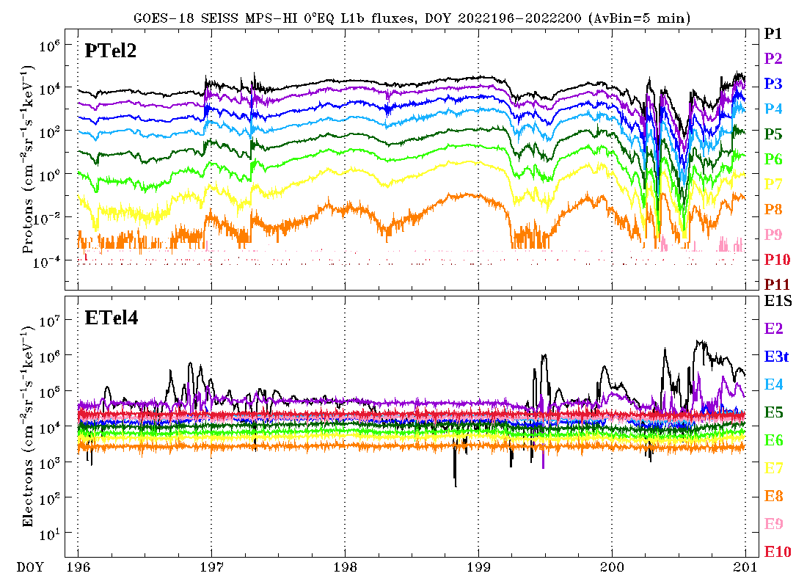
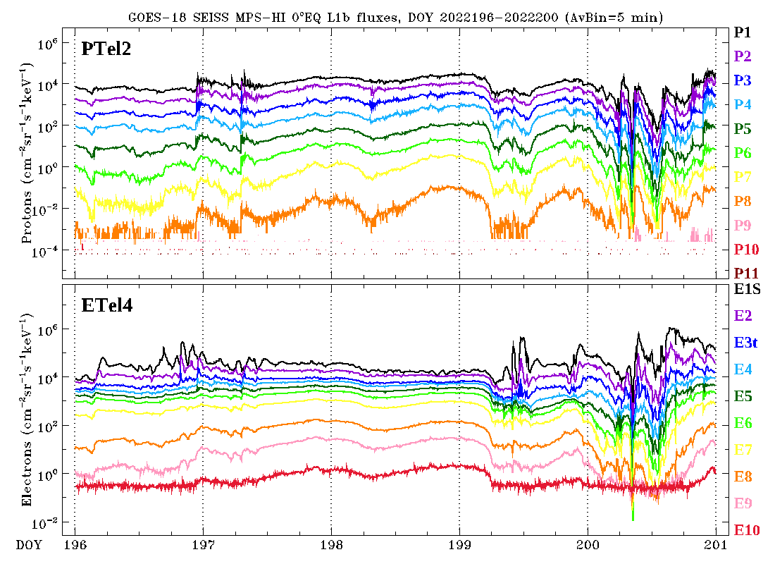
ADR 1253: Modification of the GOES-18 MPS-HI LUT
OPS L1b, July 15-19, 2022
Bowtie technique, July 15-19, 2022
Application of the bowtie analysis to produce L1b electron fluxes from L0 counts
Uses a diagonal matrix with Geometric Factors (GF) and channel Effective Energies derived from the minimalization of the variation of the GF for a variety of spectra, using a proxy dataset (CRRES)
The bowtie technique is successful in producing good quality L1b electron data from L0 counts
Boudouridis, A., Rodriguez, J. V., Kress, B. T., Dichter, B. K., & Onsager, T. G. (2020). Development of a bowtie inversion technique for real‐time processing of the GOES‐16/‐17 SEISS MPS‐HI electron channels. Space Weather, 18, e2019SW002403. https://doi.org/10.1029/2019SW002403

Slide 64
ADR 1253: Modification of the GOES-18 MPS-HI LUT
T3
GOES-18 channel E11 $(>2$ MeV)
T1
1000 electrons per (cm² sr s)
T4
SWPC alert level very close to uncorrected backgrounds
T2
T5
Corrected backgrounds more representative of the GCR spectrum
DOS

Slide 65
Demonstration of equivalence of reprocessed NCEI data and OE L1b (ADR 1253)
Goal: verify that ADR 1253 (GOES-18) was successfully implemented in the OE
Compared to fluxes and flux errors calculated from L0 by NCEI
MPS-HI and SGPS L0 data aggregated into separate day files
L0 day files processed into L1b day files based on CDRL79/CDRL80
MPS-HI electron fluxes were derived using the bowtie diagonal matrix
For each L1b file (30 samples per channel):
Calculate ratio of OE to NCEI products (flux and flux error, both in flux units)
Take mean and standard deviation of ratios
This gives a mean and a standard deviation for each L1b file
Ideally, mean = 1.0 and standard deviation = 0.0
Results are good: ratio mean = 1.0, ratio standard deviation = 0.0 or ≲10⁻⁷ (latter observed when quantity involves special function such as square root)

Slide 66
2 September 2022
Demonstration of equivalence of reprocessed NCEI data and OE L1b (ADR 1253, GOES-18)
In general:
Mean = 1.0
StDev ≲ 10⁻⁷

Slide 67
GOES-18 PLPT Comparisons of Full and Provisional Validations

Slide 68
PLPT-SEI-002: MPS-HI Telescope Cross-Comparison: Comparison with Provisional results
Pass
Provisional Validation
Full Validation
Electrons , 06/07/2022–09/06/2022
Electrons , 09/07/2022–12/06/2022
Energy band | Count threshold | T1 | T2 | T3 | T4 | T5
E1 | 1000/min | 1.050 | 0.857 | 0.925 | 1.000 | 0.962
E2 | 1000/min | 0.971 | 1.151 | 1.070 | 1.000 | 1.138
E3 | 1000/min | 0.928 | 0.727 | 0.773 | 1.000 | 1.037
E4 | 1000/min | 1.009 | 0.871 | 0.915 | 1.000 | 1.033
E5 | 1000/min | 0.966 | 0.903 | 0.861 | 1.000 | 0.980
E6 | 1000/min | 0.980 | 0.971 | 0.901 | 1.000 | 0.963
E7 | 1000/min | 0.983 | 0.874 | 1.008 | 1.000 | 1.104
E8 | 100/min | 0.953 | 0.748 | 0.742 | 1.000 | 0.926
E9 | 100/min | 0.593 | 0.556 | 0.602 | 1.000 | 0.608
E10 | 100/min | 0.777 | 0.861 | 1.004 | 1.000 | 0.763
E11 | 100/min | 0.677 | 0.704 | 0.849 | 1.000 | 0.673
Energy band | Count threshold | T1 | T2 | T3 | T4 | T5
E1 | 1000/min | 1.036 | 0.926 | 0.964 | 1.000 | 1.000
E2 | 1000/min | 0.958 | 1.233 | 1.104 | 1.000 | 1.165
E3 | 1000/min | 0.919 | 0.785 | 0.811 | 1.000 | 1.061
E4 | 1000/min | 1.009 | 0.960 | 0.983 | 1.000 | 1.081
E5 | 1000/min | 0.973 | 1.020 | 0.947 | 1.000 | 1.048
E6 | 1000/min | 0.996 | 1.102 | 0.996 | 1.000 | 1.038
E7 | 1000/min | 1.006 | 0.985 | 1.106 | 1.000 | 1.175
E8 | 100/min | 0.985 | 0.865 | 0.826 | 1.000 | 1.009
E9 | 100/min | 0.630 | 0.682 | 0.706 | 1.000 | 0.690
E10 | 100/min | 0.757 | 0.813 | 0.956 | 1.000 | 0.937
E11 | 100/min | 0.718 | 0.812 | 0.943 | 1.000 | 0.747
Blue: <10%, Green: 10-25%, Red: >25%
Pink: <100 PA matches
Orange: <1000 PA matches

Slide 69
PLPT-SEI-002: MPS-HI Telescope Cross-Comparison: Comparison with Provisional results
Pass
Provisional Validation
Full Validation
Protons , 06/07/2022–09/06/2022
Protons , 09/07/2022–12/06/2022
Energy band | Count threshold | T1 | T2 | T3 | T4 | T5
P1 | 1000/min | 0.798 | 1.000 | 0.752 | 0.986 | 1.253
P2 | 1000/min | 1.052 | 1.000 | 0.986 | 1.060 | 0.998
P3 | 1000/min | 0.994 | 1.000 | 1.007 | 1.077 | 1.063
P4 | 1000/min | 1.071 | 1.000 | 1.142 | 1.090 | 0.987
P5 | 100/min | 0.950 | 1.000 | 1.030 | 1.034 | 1.005
P6 | 100/min | 1.037 | 1.000 | 1.310 | 1.167 | 1.383
P7 | 100/min | 1.035 | 1.000 | 1.154 | 1.069 | 1.269
Energy band | Count threshold | T1 | T2 | T3 | T4 | T5
P1 | 1000/min | 0.723 | 1.000 | 0.760 | 0.977 | 1.273
P2 | 1000/min | 0.942 | 1.000 | 0.922 | 1.064 | 1.025
P3 | 1000/min | 0.877 | 1.000 | 0.921 | 1.084 | 1.083
P4 | 1000/min | 0.932 | 1.000 | 1.031 | 1.088 | 0.963
P5 | 100/min | 0.802 | 1.000 | 0.900 | 1.026 | 0.942
P6 | 100/min | 0.926 | 1.000 | 1.103 | 1.116 | 1.287
P7 | 100/min | 0.915 | 1.000 | 1.002 | 1.077 | 1.197
Blue: <10%, Green: 10-25%, Red: >25%
Pink: <100 PA matches
Orange: <1000 PA matches

Slide 70
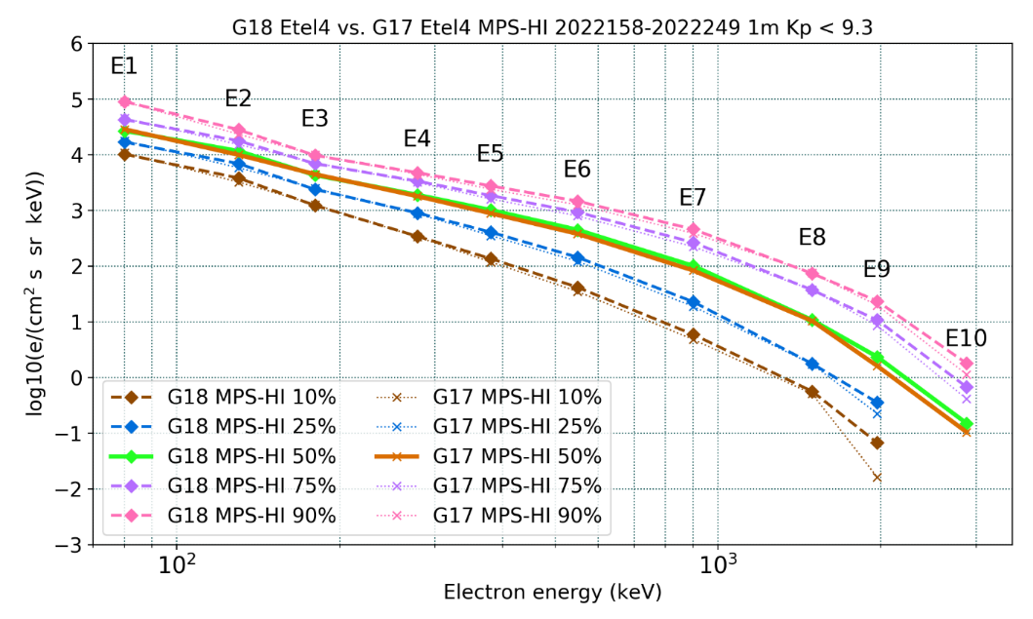
PLPT-SEI-005: Cross-Satellite Comparison of Trapped Particles:
Comparison with Provisional Results
Provisional Validation
Full Validation
GOES-18 vs GOES-17 Electrons , 06/07/2022–09/05/2022
GOES-18 vs GOES-17 Electrons , 09/07/2022–12/06/2022
The electron spectra from the two 3-months periods agree very well
Electron telescope 4 is not affected by the GOES-17 yaw flip
GOES-18 electron telescope 4 is consistent with GOES-17 electron telescope 4

Slide 71
PLPT-SEI-005: Cross-Satellite Comparison of Trapped Particles:
Comparison with Provisional Results
GOES-17 over GOES-18 Electrons, 06/07/2022–09/05/2022
Provisional Validation
 |  | G17 ET3 | : | G18 ET3 |  |  | G17 ET1 | : | G18 ET1 |  |  | G17 ET4 | : | G18 ET4 |  |  | G17 ET2 | : | G18 ET2 |  |  | G17 ET5 | : | G18 ET5
 |  |  | Q |  |  |  |  | Q |  |  |  |  | Q |  |  |  |  | Q |  |  |  |  | Q
Energy (keV) | 10 | 25 | 50 | 75 | 90 | 10 | 25 | 50 | 75 | 90 | 10 | 25 | 50 | 75 | 90 | 10 | 25 | 50 | 75 | 90 | 10 | 25 | 50 | 75 | 90
80 | 0.94 | 0.95 | 0.95 | 0.93 | 0.91 | 0.81 | 0.84 | 0.86 | 0.83 | 0.77 | 1.05 | 1.06 | 1.07 | 1.05 | 1.00 | 1.05 | 1.04 | 1.04 | 1.03 | 1.03 | 0.92 | 0.91 | 0.90 | 0.89 | 0.89
130 | 0.92 | 0.92 | 0.92 | 0.91 | 0.91 | 0.69 | 0.71 | 0.72 | 0.72 | 0.70 | 0.85 | 0.84 | 0.85 | 0.86 | 0.83 | 1.02 | 1.01 | 1.01 | 1.00 | 0.99 | 0.85 | 0.84 | 0.84 | 0.83 | 0.84
180 | 0.93 | 0.93 | 0.93 | 0.93 | 0.93 | 1.05 | 1.06 | 1.07 | 1.07 | 1.05 | 1.03 | 1.04 | 1.04 | 1.04 | 1.03 | 0.92 | 0.93 | 0.91 | 0.91 | 0.91 | 1.36 | 1.34 | 1.32 | 1.32 | 1.33
278 | 0.88 | 0.87 | 0.87 | 0.86 | 0.87 | 1.03 | 1.02 | 0.99 | 0.98 | 0.97 | 0.98 | 0.96 | 0.95 | 0.95 | 0.94 | 0.99 | 0.98 | 0.96 | 0.96 | 0.96 | 1.25 | 1.21 | 1.15 | 1.13 | 1.14
380 | 0.86 | 0.88 | 0.88 | 0.88 | 0.88 | 0.87 | 0.88 | 0.88 | 0.87 | 0.87 | 0.87 | 0.87 | 0.87 | 0.87 | 0.87 | 0.96 | 0.96 | 0.95 | 0.96 | 0.96 | 1.12 | 1.12 | 1.11 | 1.08 | 1.09
550 | 0.93 | 0.91 | 0.90 | 0.89 | 0.88 | 0.87 | 0.88 | 0.87 | 0.88 | 0.87 | 0.84 | 0.84 | 0.85 | 0.86 | 0.86 | 0.96 | 0.96 | 0.96 | 0.97 | 0.97 | 0.92 | 0.91 | 0.88 | 0.86 | 0.86
900 | 1.22 | 1.19 | 1.13 | 1.11 | 1.10 | 0.75 | 0.76 | 0.76 | 0.77 | 0.76 | 0.81 | 0.83 | 0.83 | 0.84 | 0.85 | 0.88 | 0.88 | 0.88 | 0.88 | 0.88 | 1.37 | 1.34 | 1.26 | 1.24 | 1.22
1493 | 0.93 | 0.88 | 0.88 | 0.88 | 0.91 | 0.95 | 0.94 | 0.90 | 0.95 | 0.95 | 0.90 | 0.98 | 0.97 | 1.00 | 1.02 | 0.93 | 0.96 | 0.94 | 0.93 | 0.94 |  | 1.25 | 1.18 | 1.18 | 1.19
1969 | 0.20 | 0.89 | 0.91 | 0.93 | 0.95 | 0.34 | 0.74 | 0.74 | 0.79 | 0.80 | 0.24 | 0.63 | 0.69 | 0.80 | 0.84 | 0.74 | 0.82 | 0.83 | 0.86 | 0.91 |  | 0.90 | 0.93 | 0.95 | 0.98
2880 |  |  | 1.00 | 0.92 | 0.91 |  |  | 0.86 | 0.70 | 0.72 |  |  | 0.70 | 0.61 | 0.64 |  |  | 0.64 | 0.56 | 0.62 |  |  | 1.45 | 1.12 | 0.98
GOES-17 over GOES-18 Electrons, 09/07/2022–12/06/2022
Full Validation
 |  | G17 ET5 | : | G18 ET3 |  |  | G17 ET2 | : | G18 ET1 |  |  | G17 ET4 | : | G18 ET4 |  |  | G17 ET1 | : | G18 ET2 |  |  | G17 ET3 | : | G18 ET5
 |  |  | Q |  |  |  |  | Q |  |  |  |  | Q |  |  |  |  | Q |  |  |  |  | Q
Energy (keV) | 10 | 25 | 50 | 75 | 90 | 10 | 25 | 50 | 75 | 90 | 10 | 25 | 50 | 75 | 90 | 10 | 25 | 50 | 75 | 90 | 10 | 25 | 50 | 75 | 90
80 | 0.79 | 0.82 | 0.82 | 0.81 | 0.78 | 1.03 | 1.06 | 1.08 | 1.04 | 0.95 | 1.03 | 1.06 | 1.07 | 1.06 | 1.03 | 0.81 | 0.83 | 0.83 | 0.84 | 0.83 | 1.05 | 1.07 | 1.07 | 1.06 | 1.06
130 | 0.80 | 0.82 | 0.82 | 0.82 | 0.83 | 0.82 | 0.85 | 0.87 | 0.86 | 0.84 | 0.81 | 0.84 | 0.86 | 0.85 | 0.84 | 0.83 | 0.84 | 0.85 | 0.85 | 0.84 | 0.94 | 0.95 | 0.95 | 0.95 | 0.93
180 | 0.95 | 0.99 | 0.99 | 0.99 | 0.99 | 1.10 | 1.14 | 1.15 | 1.15 | 1.15 | 1.01 | 1.03 | 1.04 | 1.05 | 1.04 | 0.82 | 0.84 | 0.86 | 0.86 | 0.86 | 1.24 | 1.27 | 1.27 | 1.26 | 1.27
278 | 0.89 | 0.90 | 0.92 | 0.92 | 0.92 | 1.13 | 1.15 | 1.14 | 1.11 | 1.11 | 0.97 | 0.97 | 0.97 | 0.96 | 0.96 | 0.86 | 0.87 | 0.88 | 0.87 | 0.86 | 1.18 | 1.16 | 1.14 | 1.11 | 1.10
380 | 0.79 | 0.82 | 0.85 | 0.86 | 0.86 | 0.96 | 0.98 | 0.97 | 0.97 | 0.97 | 0.86 | 0.88 | 0.88 | 0.88 | 0.88 | 0.86 | 0.86 | 0.87 | 0.87 | 0.87 | 1.19 | 1.18 | 1.15 | 1.13 | 1.11
550 | 0.77 | 0.78 | 0.77 | 0.77 | 0.76 | 0.85 | 0.87 | 0.87 | 0.88 | 0.88 | 0.83 | 0.85 | 0.85 | 0.86 | 0.87 | 0.95 | 0.96 | 0.97 | 0.98 | 0.98 | 1.07 | 1.09 | 1.04 | 1.02 | 1.00
900 | 1.27 | 1.26 | 1.20 | 1.18 | 1.15 | 0.89 | 0.92 | 0.91 | 0.91 | 0.90 | 0.81 | 0.83 | 0.83 | 0.85 | 0.85 | 0.70 | 0.71 | 0.74 | 0.76 | 0.77 | 1.28 | 1.25 | 1.23 | 1.20 | 1.19
1493 | 0.81 | 0.90 | 0.90 | 0.90 | 0.90 | 0.95 | 1.04 | 1.06 | 1.05 | 1.08 | 0.97 | 0.97 | 0.98 | 1.00 | 1.03 | 0.80 | 0.85 | 0.80 | 0.83 | 0.85 |  | 1.07 | 1.16 | 1.15 | 1.14
1969 |  | 0.97 | 0.99 | 0.98 | 0.97 | 0.52 | 0.93 | 0.95 | 0.96 | 0.98 |  | 0.61 | 0.72 | 0.79 | 0.87 | 0.27 | 0.66 | 0.69 | 0.74 | 0.76 |  | 0.81 | 0.93 | 0.93 | 0.94
2880 |  |  | 1.02 | 0.88 | 0.87 |  |  | 1.01 | 0.81 | 0.83 |  |  | 0.76 | 0.65 | 0.68 |  |  | 0.63 | 0.56 | 0.59 |  |  | 1.47 | 1.22 | 1.16
GOES-17 higher than GOES-18: <10% 10-25% >25%

Slide 72
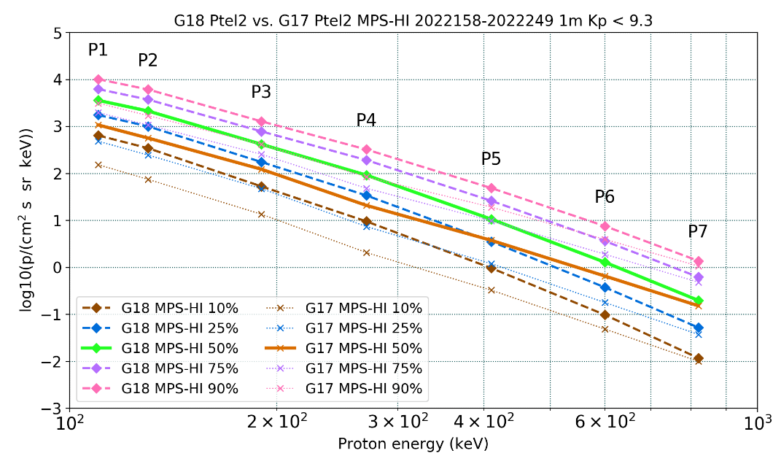
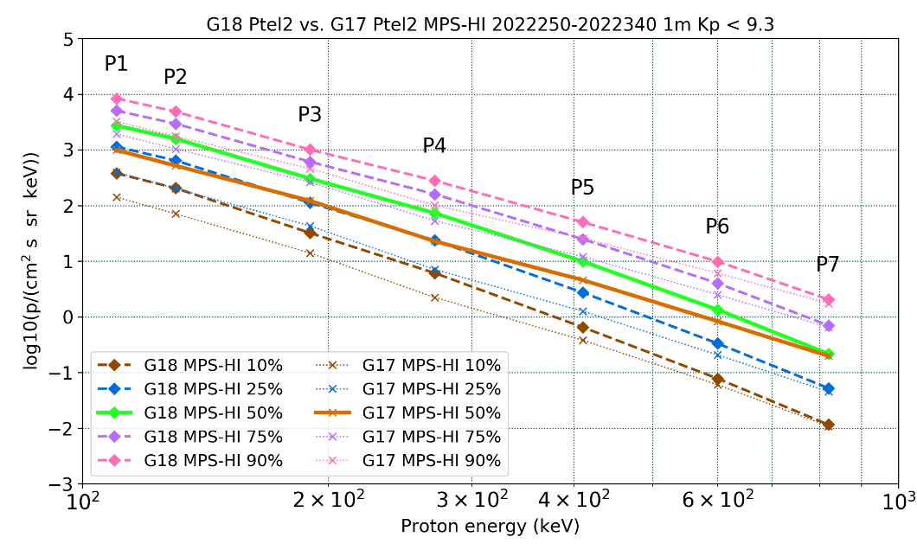
PLPT-SEI-005: Cross-Satellite Comparison of Trapped Particles:
Comparison with Provisional Results
Provisional Validation
Full Validation
GOES-18 vs GOES-17 Protons , 06/07/2022–09/05/2022
GOES-18 vs GOES-17 Protons , 09/07/2022–12/06/2022
GOES-18 vs GOES-17 Electrons , 06/07/2022– 09/05/2022
The proton spectra from the two 3-months periods agree very well
Proton telescope 2 is not affected by the GOES-17 yaw flip
GOES-18 proton telescope 2 is higher than GOES-17 proton telescope 2
Well known issue with GOES-17 proton data (also with GOES-16)

Slide 73
PLPT-SEI-005: Cross-Satellite Comparison of Trapped Particles:
Comparison with Provisional Results
GOES-17 over GOES-18 Protons, 06/07/2022–09/05/2022
Provisional Validation
 |  | G17 PT1 | : | G18 PT1 |  |  | G17 PT4 | : | G18 PT4 |  |  | G17 PT2 | : | G18 PT2 |  |  | G17 PT5 | : | G18 PT5 |  |  | G17 PT3 | : | G18 PT3
 |  |  | Q |  |  |  |  | Q |  |  |  |  | Q |  |  |  |  | Q |  |  |  |  | Q
Energy (keV) | 10 | 25 | 50 | 75 | 90 | 10 | 25 | 50 | 75 | 90 | 10 | 25 | 50 | 75 | 90 | 10 | 25 | 50 | 75 | 90 | 10 | 25 | 50 | 75 | 90
110 | 0.41 | 0.45 | 0.48 | 0.55 | 0.61 | 0.41 | 0.44 | 0.49 | 0.50 | 0.55 | 0.24 | 0.28 | 0.30 | 0.32 | 0.31 | 0.44 | 0.48 | 0.51 | 0.55 | 0.68 | 0.42 | 0.46 | 0.48 | 0.55 | 0.54
130 | 0.37 | 0.40 | 0.43 | 0.47 | 0.54 | 0.35 | 0.37 | 0.40 | 0.41 | 0.46 | 0.22 | 0.25 | 0.27 | 0.29 | 0.28 | 0.31 | 0.34 | 0.35 | 0.38 | 0.48 | 0.35 | 0.38 | 0.39 | 0.44 | 0.44
190 | 0.29 | 0.30 | 0.29 | 0.32 | 0.37 | 0.31 | 0.32 | 0.34 | 0.33 | 0.37 | 0.26 | 0.27 | 0.29 | 0.33 | 0.32 | 0.25 | 0.26 | 0.25 | 0.27 | 0.32 | 0.38 | 0.38 | 0.37 | 0.40 | 0.41
270 | 0.28 | 0.28 | 0.26 | 0.28 | 0.31 | 0.32 | 0.31 | 0.32 | 0.32 | 0.35 | 0.22 | 0.22 | 0.23 | 0.25 | 0.26 | 0.27 | 0.26 | 0.25 | 0.26 | 0.28 | 0.39 | 0.38 | 0.37 | 0.39 | 0.40
410 | 0.31 | 0.32 | 0.31 | 0.32 | 0.33 | 0.44 | 0.42 | 0.41 | 0.42 | 0.44 | 0.34 | 0.34 | 0.35 | 0.38 | 0.39 | 0.37 | 0.37 | 0.36 | 0.37 | 0.37 | 0.35 | 0.37 | 0.39 | 0.40 | 0.40
600 |  | 0.95 | 0.96 | 1.00 | 1.01 | 0.59 | 0.59 | 0.59 | 0.60 | 0.61 | 0.50 | 0.48 | 0.51 | 0.52 | 0.52 |  | 0.66 | 0.64 | 0.65 | 0.67 |  | 0.63 | 0.60 | 0.63 | 0.64
820 |  | 0.53 | 0.85 | 0.97 | 0.89 | 0.51 | 0.66 | 0.68 | 0.67 | 0.69 | 0.85 | 0.71 | 0.77 | 0.78 | 0.77 |  | 0.57 | 0.80 | 0.83 | 0.90 |  | 0.93 | 0.72 | 0.67 | 0.67
GOES-17 over GOES-18 Protons, 09/07/2022–12/06/2022
Full Validation
 |  | G17 PT3 | : | G18 PT1 |  |  | G17 PT5 | : | G18 PT4 |  |  | G17 PT2 | : | G18 PT2 |  |  | G17 PT4 | : | G18 PT5 |  |  | G17 PT1 | : | G18 PT3
 |  |  | Q |  |  |  |  | Q |  |  |  |  | Q |  |  |  |  | Q |  |  |  |  | Q
Energy (keV) | 10 | 25 | 50 | 75 | 90 | 10 | 25 | 50 | 75 | 90 | 10 | 25 | 50 | 75 | 90 | 10 | 25 | 50 | 75 | 90 | 10 | 25 | 50 | 75 | 90
110 | 0.49 | 0.42 | 0.45 | 0.48 | 0.53 | 0.58 | 0.61 | 0.61 | 0.64 | 0.67 | 0.37 | 0.35 | 0.36 | 0.38 | 0.38 | 0.55 | 0.51 | 0.56 | 0.61 | 0.68 | 0.91 | 0.80 | 0.85 | 0.80 | 0.88
130 | 0.37 | 0.31 | 0.33 | 0.36 | 0.40 | 0.49 | 0.51 | 0.50 | 0.54 | 0.56 | 0.35 | 0.32 | 0.33 | 0.35 | 0.36 | 0.39 | 0.36 | 0.39 | 0.43 | 0.48 | 0.88 | 0.77 | 0.81 | 0.75 | 0.84
190 | 0.31 | 0.27 | 0.27 | 0.29 | 0.33 | 0.42 | 0.42 | 0.42 | 0.44 | 0.44 | 0.44 | 0.39 | 0.40 | 0.43 | 0.46 | 0.33 | 0.31 | 0.33 | 0.34 | 0.39 | 0.75 | 0.66 | 0.65 | 0.61 | 0.67
270 | 0.30 | 0.26 | 0.24 | 0.26 | 0.28 | 0.46 | 0.46 | 0.43 | 0.47 | 0.47 | 0.36 | 0.30 | 0.31 | 0.33 | 0.36 | 0.32 | 0.28 | 0.28 | 0.30 | 0.34 | 0.77 | 0.67 | 0.62 | 0.59 | 0.63
410 | 0.33 | 0.29 | 0.26 | 0.27 | 0.29 | 0.59 | 0.58 | 0.54 | 0.57 | 0.59 | 0.59 | 0.46 | 0.46 | 0.49 | 0.51 | 0.51 | 0.42 | 0.41 | 0.43 | 0.47 | 0.77 | 0.70 | 0.65 | 0.59 | 0.64
600 |  | 0.54 | 0.51 | 0.51 | 0.53 | 0.77 | 0.74 | 0.72 | 0.75 | 0.73 | 0.78 | 0.62 | 0.62 | 0.63 | 0.62 |  | 0.76 | 0.75 | 0.77 | 0.82 |  | 1.65 | 1.54 | 1.47 | 1.53
820 |  | 1.05 | 0.65 | 0.72 | 0.69 | 0.99 | 0.82 | 0.88 | 0.92 | 0.90 | 0.94 | 0.86 | 0.92 | 0.92 | 0.85 |  | 0.97 | 0.93 | 0.96 | 0.98 |  | 0.93 | 0.99 | 1.06 | 1.10
GOES-17 lower than GOES-18: <10% 10-25% 25-50% 50-75% >75%

Slide 74
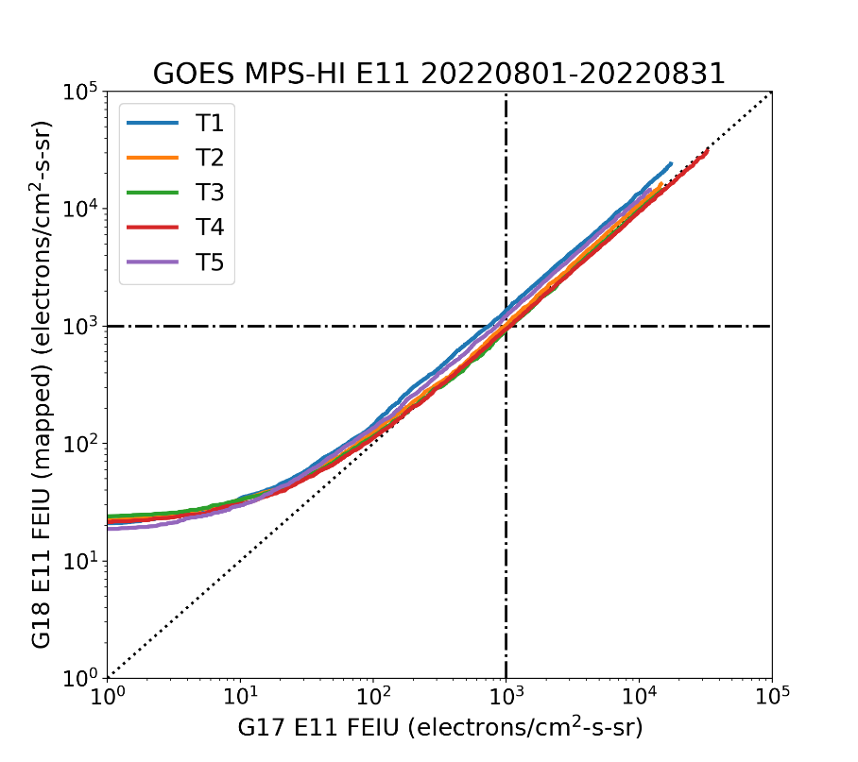
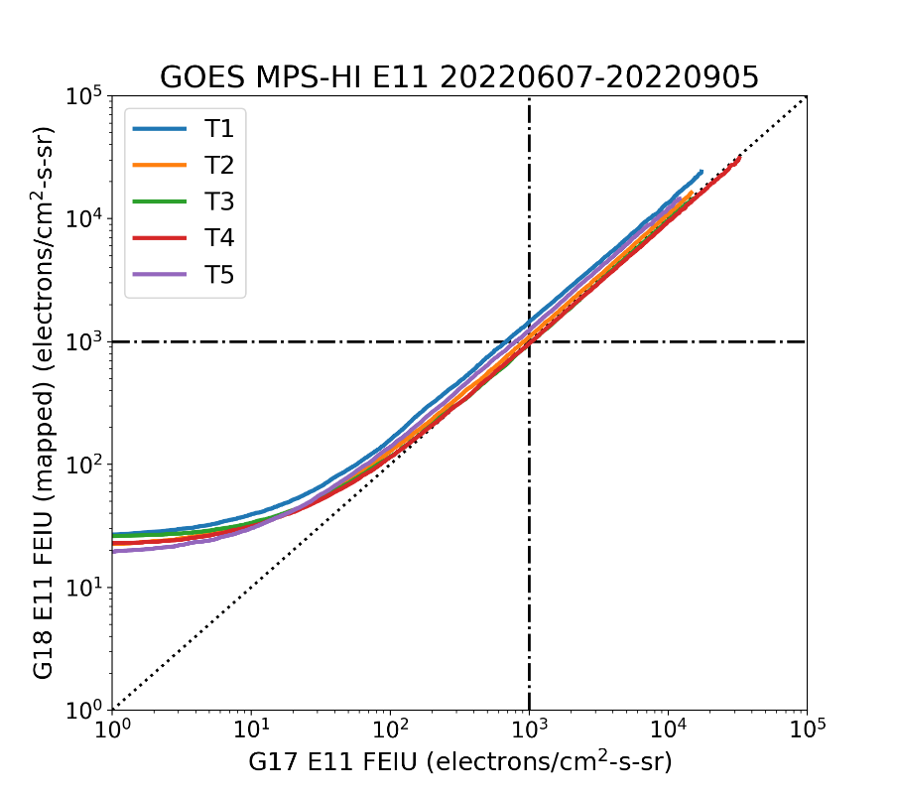
PLPT-SEI-005: Cross-Satellite Comparison of Trapped Particles:
Comparison with Provisional
Provisional Validation
Full Validation
G17/G18 MPS-HI E11 Integral Flux Ratio
Percentile | T1 | T2 | T3 | T4 | T5
50 | 0.74 | 0.98 | 1.08 | 1.05 | 0.81
75 | 0.73 | 0.92 | 1.03 | 1.06 | 0.81
90 | 0.74 | 0.92 | 1.04 | 1.08 | 0.81
G17/G18 MPS-HI Integral Flux Ratio
Percentile | T1 | T2 | T3 | T4 | T5
50 | 0.65 | 0.88 | 0.95 | 0.99 | 0.73
75 | 0.71 | 0.93 | 1.04 | 1.05 | 0.79
90 | 0.73 | 0.92 | 1.03 | 1.06 | 0.81

Slide 75
PLPT-SEI-004: SEP Channel Cross-Comparison: GOES-16 vs GOES-18 MPS-HI

Slide 76
PLPT-SEI-004 SEP Channels
Cross-Comparison: Summary and Considerations
August 2022 SEP event comparisons between G18 and G17 MPS-HI SEP channel fluxes were presented at the G18 MPS-HI provisional PS-PVR. The worst case discrepancy between G18 and G17 MPS-HI channels was approximately a factor of 2.
Since G18 and G17 were in close proximity during this period (~0.4 degrees longitude apart), we expected nearly identical flux measurements from like MPS-HI channels with same telescope look directions.
However, MPS-HI channels are reporting low with respect to SGPS, which has undergone ground/beam calibrations and has been validated against the older G13 and G15 EPS and ACE-EPAM measurements. This is thought to be due to mischaracterization of the MPS-HI SEP channel geometric factors and/or energy bounds, since the MPS-HI SEP channels did not undergo calibration at a beam facility during ground calibrations.
Upcoming ground calibrations of MPS-HI SN104 (spare unit) SEP channels at Brookhaven National Laboratory (BNL) (early December 2023) may inform adjustments of geometric factors or energy bounds in the on-orbit MPS-HI units, to bring the MPS-HI SEP channels into better agreement with SGPS and other space based measurements.
Scaling factors characterizing differences between G18 and G16 MPS-HI SEP channel reported fluxes are included in the backup slides, however, overall adjustment of MPS-HI SEP channel LUT parameters is needed for all MPS-HI units, to bring them into agreement with the other validated space-based measurements.

Slide 77
PLPT-SEI-004: SEP Channel
Cross-Comparison: G16 vs G18 MPS-HI
Scatter plot of 5 min averaged GOES-16 and GOES-18 MPS-HI L1b PTel3 P8 fluxes, on linear scales in left panel and log scales in right panel (same data and fit is shown in both plots). The full G16-G18 MPS-HI P8-P11, PTels 1-5 comparison results are shown on the following slide.

Slide 78
PLPT-SEI-004: SEP Channel
Cross-Comparison: G16 vs G18 MPS-HI
In general, GOES-16 and GOES-18 MPS-HI P8 and P9 like telescope-channel pairs agree well, within <20% difference in most cases.
G16 MPS-HI P10 and P11 channels are reporting significantly lower than G18 P10 and P11 channels in all telescopes.

Slide 79
PLPT-SEI-005: Cross-Satellite Comparison of Trapped Particles: GOES-17/GOES-18 remaining telescope percentile spectra

Slide 80
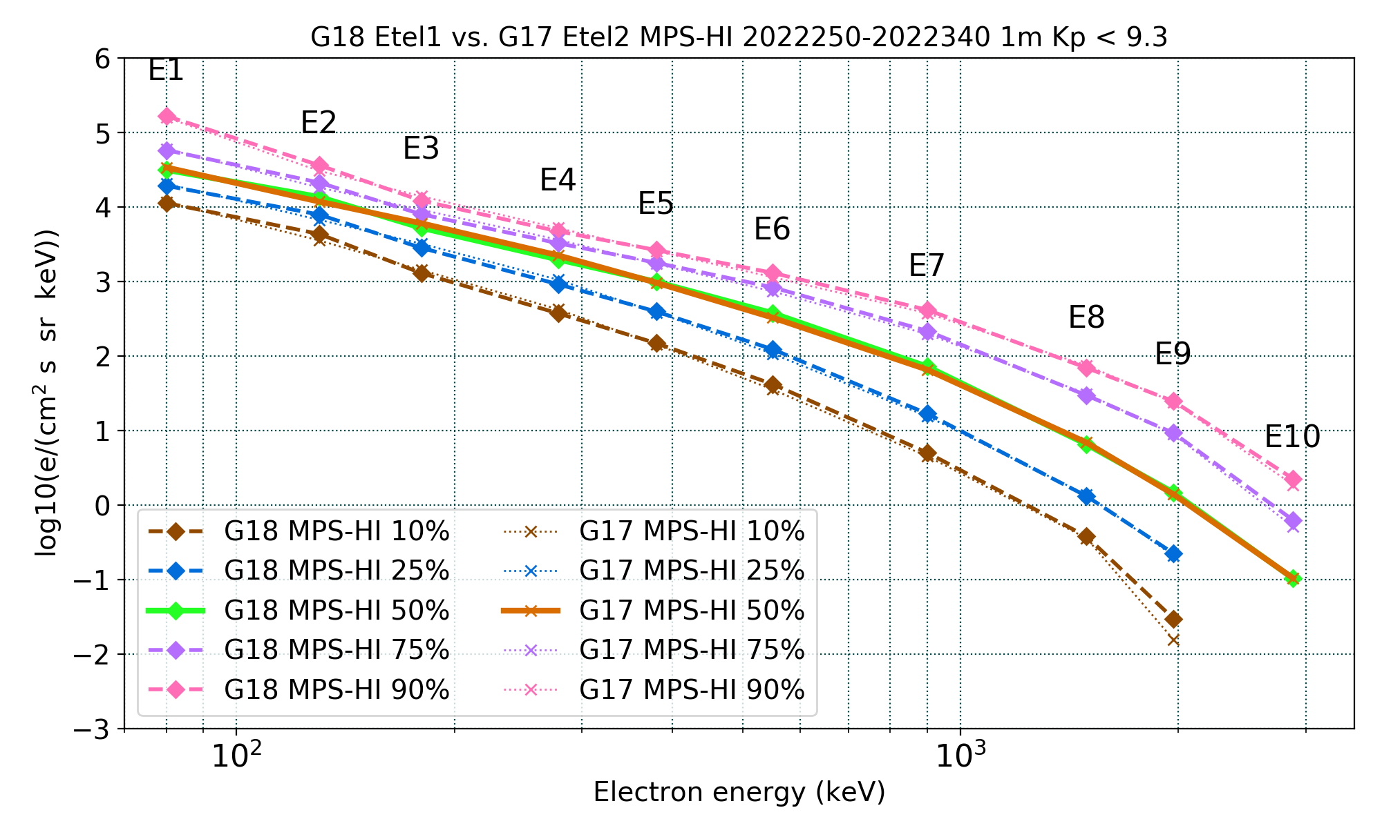
PLPT-SEI-005: Cross-Satellite Comparison of Trapped Particles: Results
GOES-18 vs GOES-17 Electrons , 09/07/2022–12/06/2022
Excellent agreement!
Missing or significantly lower fluxes are at residual background levels
Boudouridis, A., Rodriguez, J. V., Kress, B. T., Dichter, B. K., & Onsager, T. G. (2020). Development of a bowtie inversion technique for real‐time processing of the GOES‐16/‐17 SEISS MPS‐HI electron channels. Space Weather, 18, e2019SW002403. https://doi.org/10.1029/2019SW002403

Slide 81
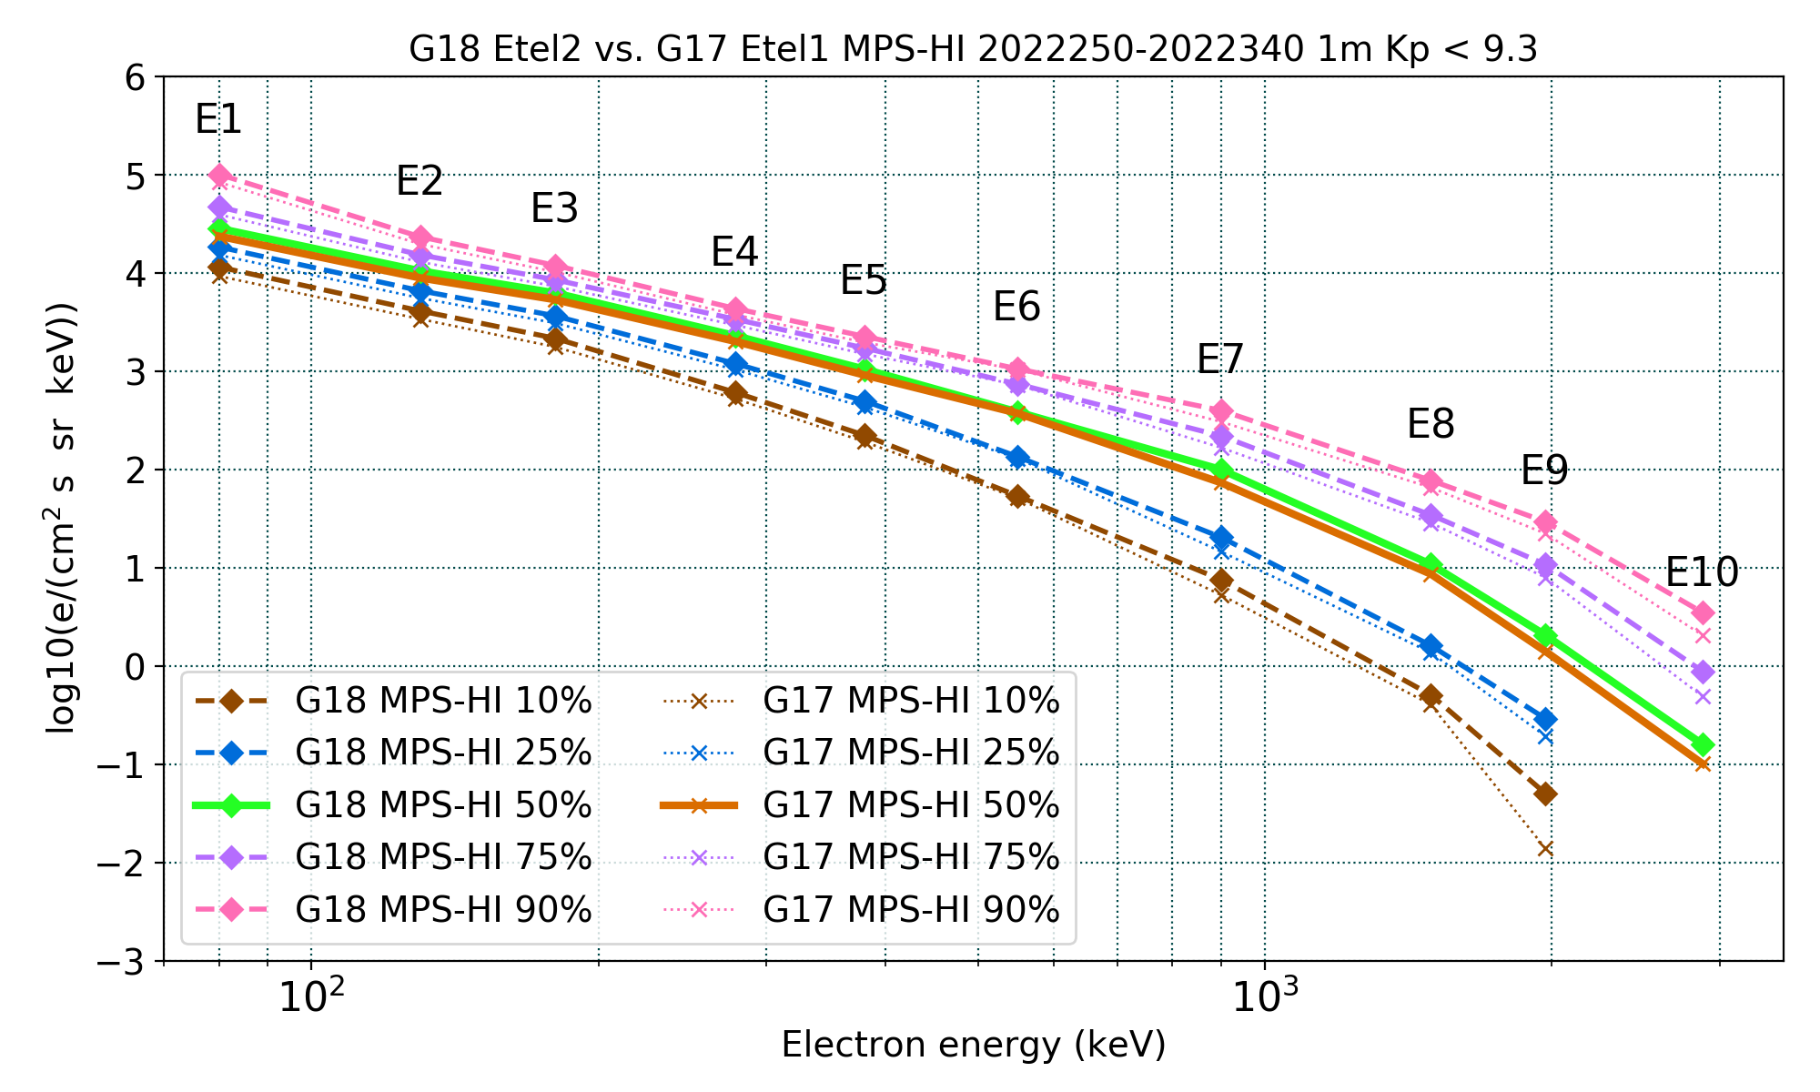
PLPT-SEI-005: Cross-Satellite Comparison of Trapped Particles: Results
GOES-18 vs GOES-17 Electrons , 09/07/2022–12/06/2022
Excellent agreement!
Missing or significantly lower fluxes are at residual background levels
Boudouridis, A., Rodriguez, J. V., Kress, B. T., Dichter, B. K., & Onsager, T. G. (2020). Development of a bowtie inversion technique for real‐time processing of the GOES‐16/‐17 SEISS MPS‐HI electron channels. Space Weather, 18, e2019SW002403. https://doi.org/10.1029/2019SW002403

Slide 82
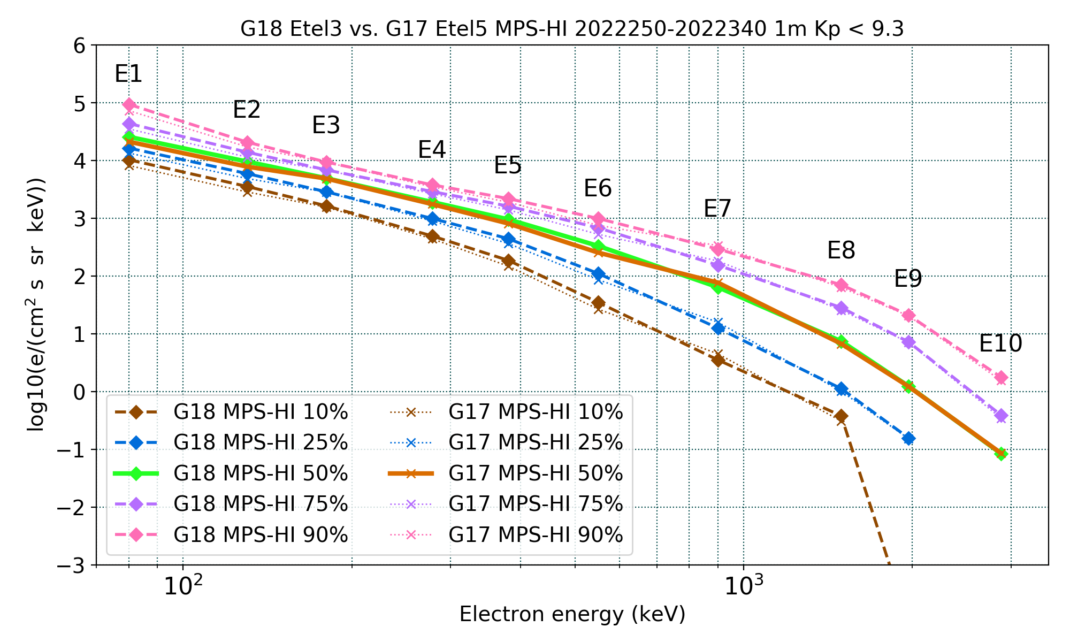
PLPT-SEI-005: Cross-Satellite Comparison of Trapped Particles: Results
GOES-18 vs GOES-17 Electrons , 09/07/2022–12/06/2022
Excellent agreement!
Missing or significantly lower fluxes are at residual background levels
Boudouridis, A., Rodriguez, J. V., Kress, B. T., Dichter, B. K., & Onsager, T. G. (2020). Development of a bowtie inversion technique for real‐time processing of the GOES‐16/‐17 SEISS MPS‐HI electron channels. Space Weather, 18, e2019SW002403. https://doi.org/10.1029/2019SW002403

Slide 83
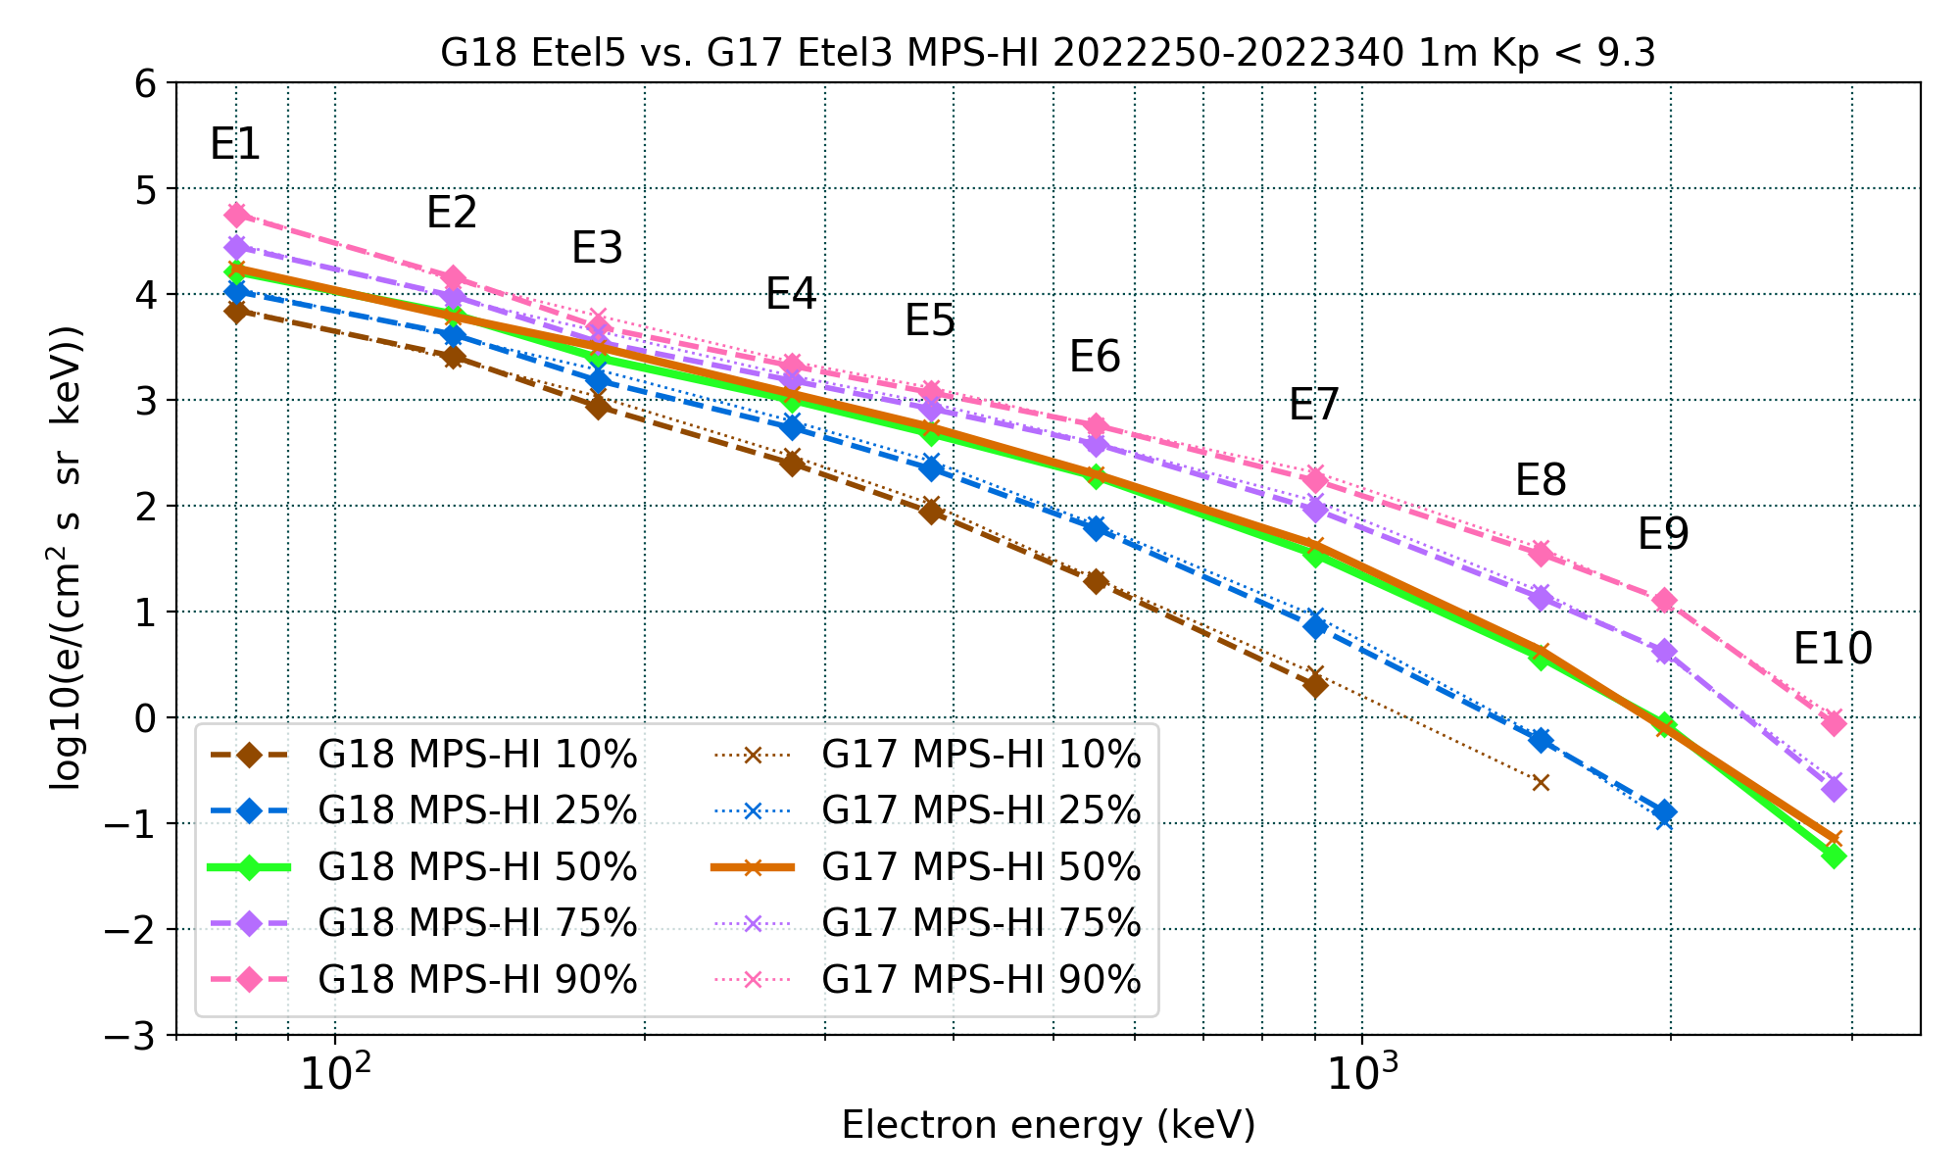
PLPT-SEI-005: Cross-Satellite Comparison of Trapped Particles: Results
GOES-18 vs GOES-17 Electrons , 09/07/2022–12/06/2022
Excellent agreement!
Missing or significantly lower fluxes are at residual background levels
Boudouridis, A., Rodriguez, J. V., Kress, B. T., Dichter, B. K., & Onsager, T. G. (2020). Development of a bowtie inversion technique for real‐time processing of the GOES‐16/‐17 SEISS MPS‐HI electron channels. Space Weather, 18, e2019SW002403. https://doi.org/10.1029/2019SW002403

Slide 84
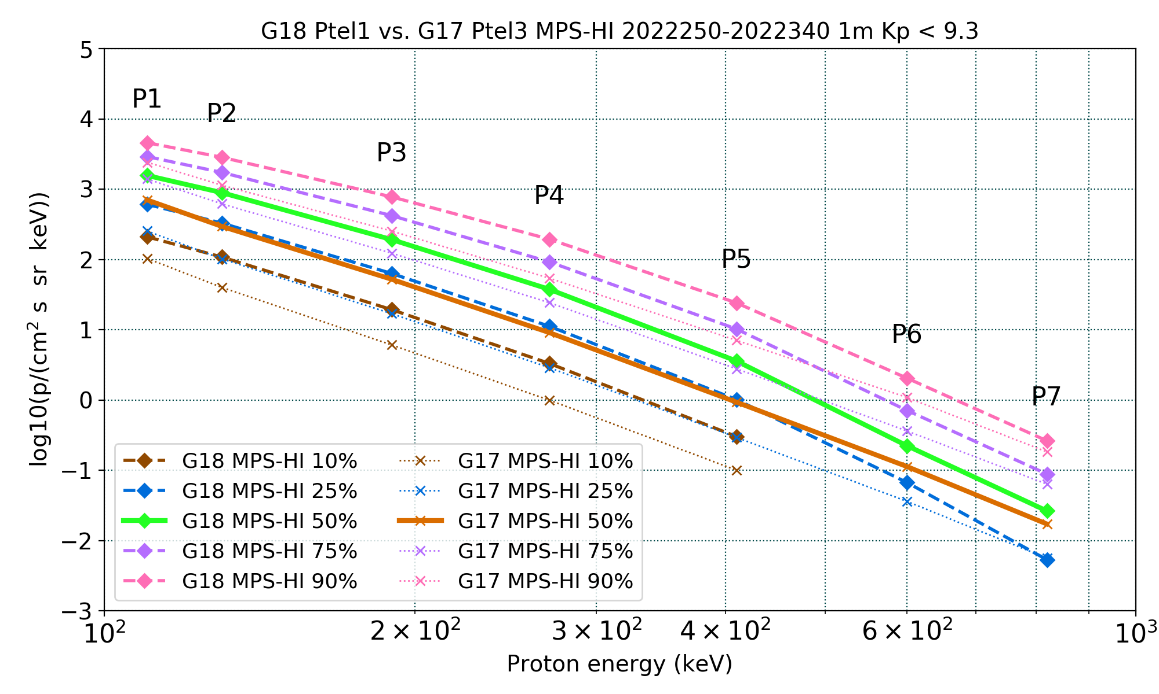
PLPT-SEI-005: Cross-Satellite Comparison of Trapped Particles: Results
GOES-18 vs GOES-17 Protons , 09/07/2022–12/06/2022
Apply only to P1-P7
Boudouridis, A., Rodriguez, J. V., Kress, B. T., Dichter, B. K., & Onsager, T. G. (2020). Development of a bowtie inversion technique for real‐time processing of the GOES‐16/‐17 SEISS MPS‐HI electron channels. Space Weather, 18, e2019SW002403. https://doi.org/10.1029/2019SW002403

Slide 85
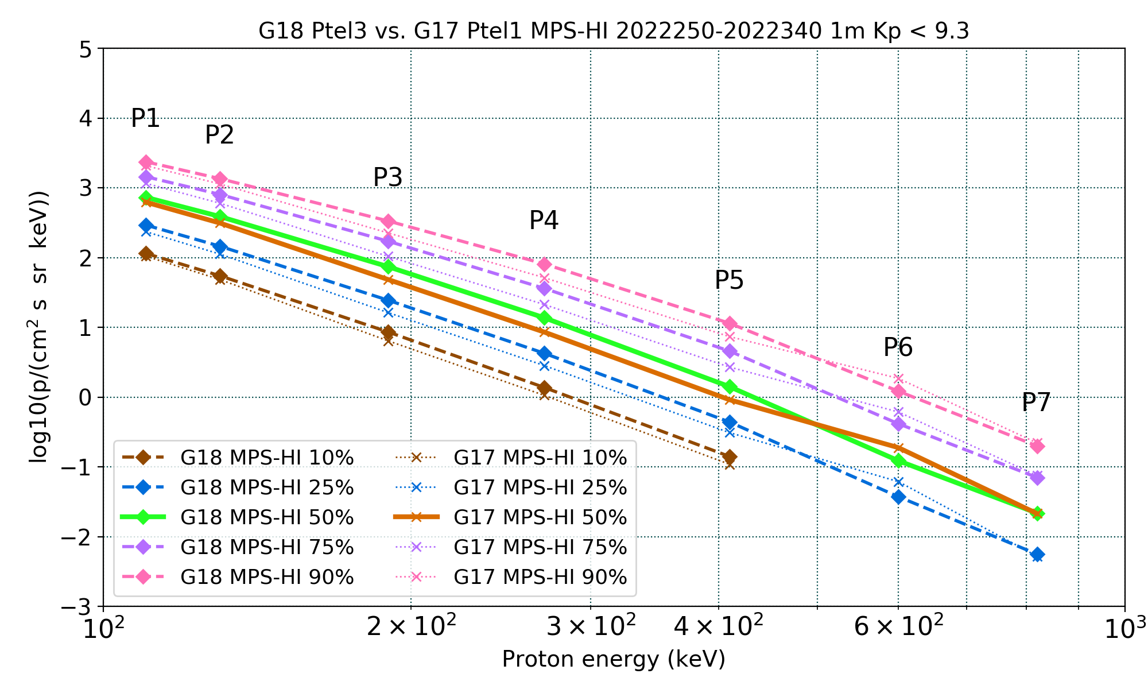
PLPT-SEI-005: Cross-Satellite Comparison of Trapped Particles: Results
GOES-18 vs GOES-17 Protons , 09/07/2022–12/06/2022
Apply only to P1-P7
Boudouridis, A., Rodriguez, J. V., Kress, B. T., Dichter, B. K., & Onsager, T. G. (2020). Development of a bowtie inversion technique for real‐time processing of the GOES‐16/‐17 SEISS MPS‐HI electron channels. Space Weather, 18, e2019SW002403. https://doi.org/10.1029/2019SW002403

Slide 86
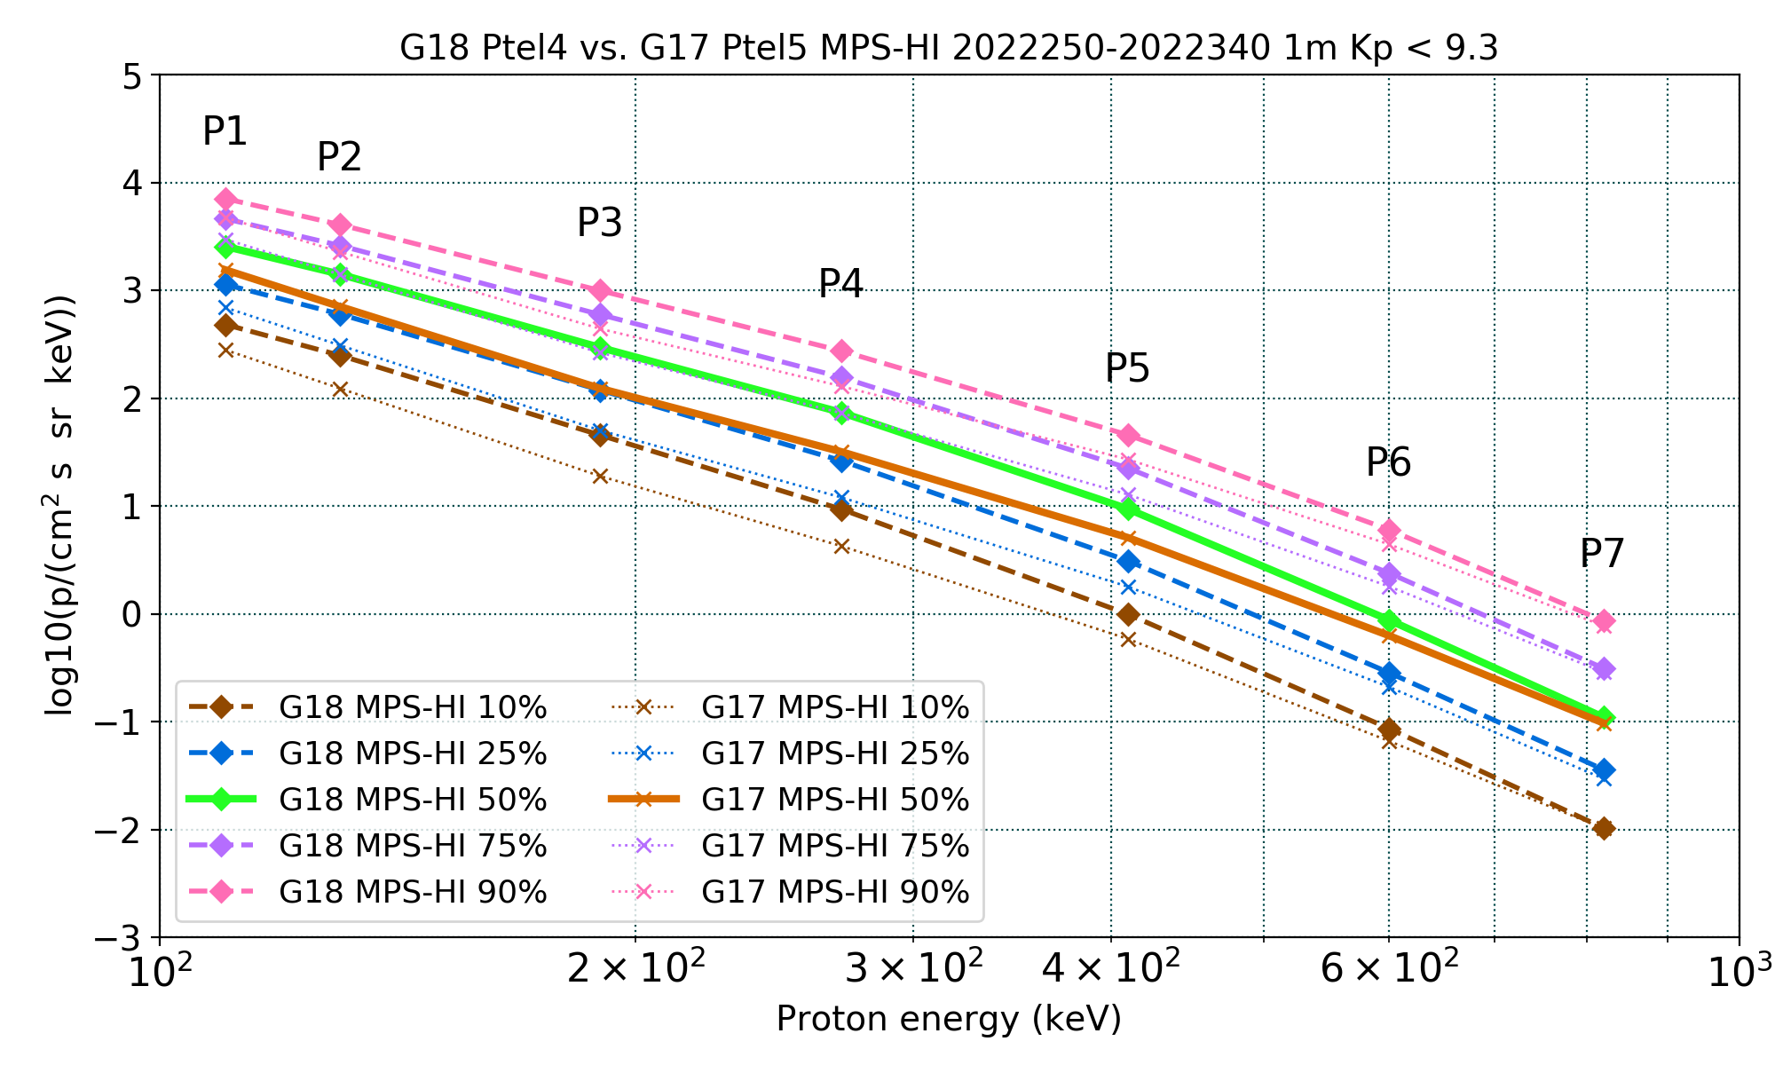
PLPT-SEI-005: Cross-Satellite Comparison of Trapped Particles: Results
GOES-18 vs GOES-17 Protons , 09/07/2022–12/06/2022
Apply only to P1-P7
Boudouridis, A., Rodriguez, J. V., Kress, B. T., Dichter, B. K., & Onsager, T. G. (2020). Development of a bowtie inversion technique for real‐time processing of the GOES‐16/‐17 SEISS MPS‐HI electron channels. Space Weather, 18, e2019SW002403. https://doi.org/10.1029/2019SW002403

Slide 87
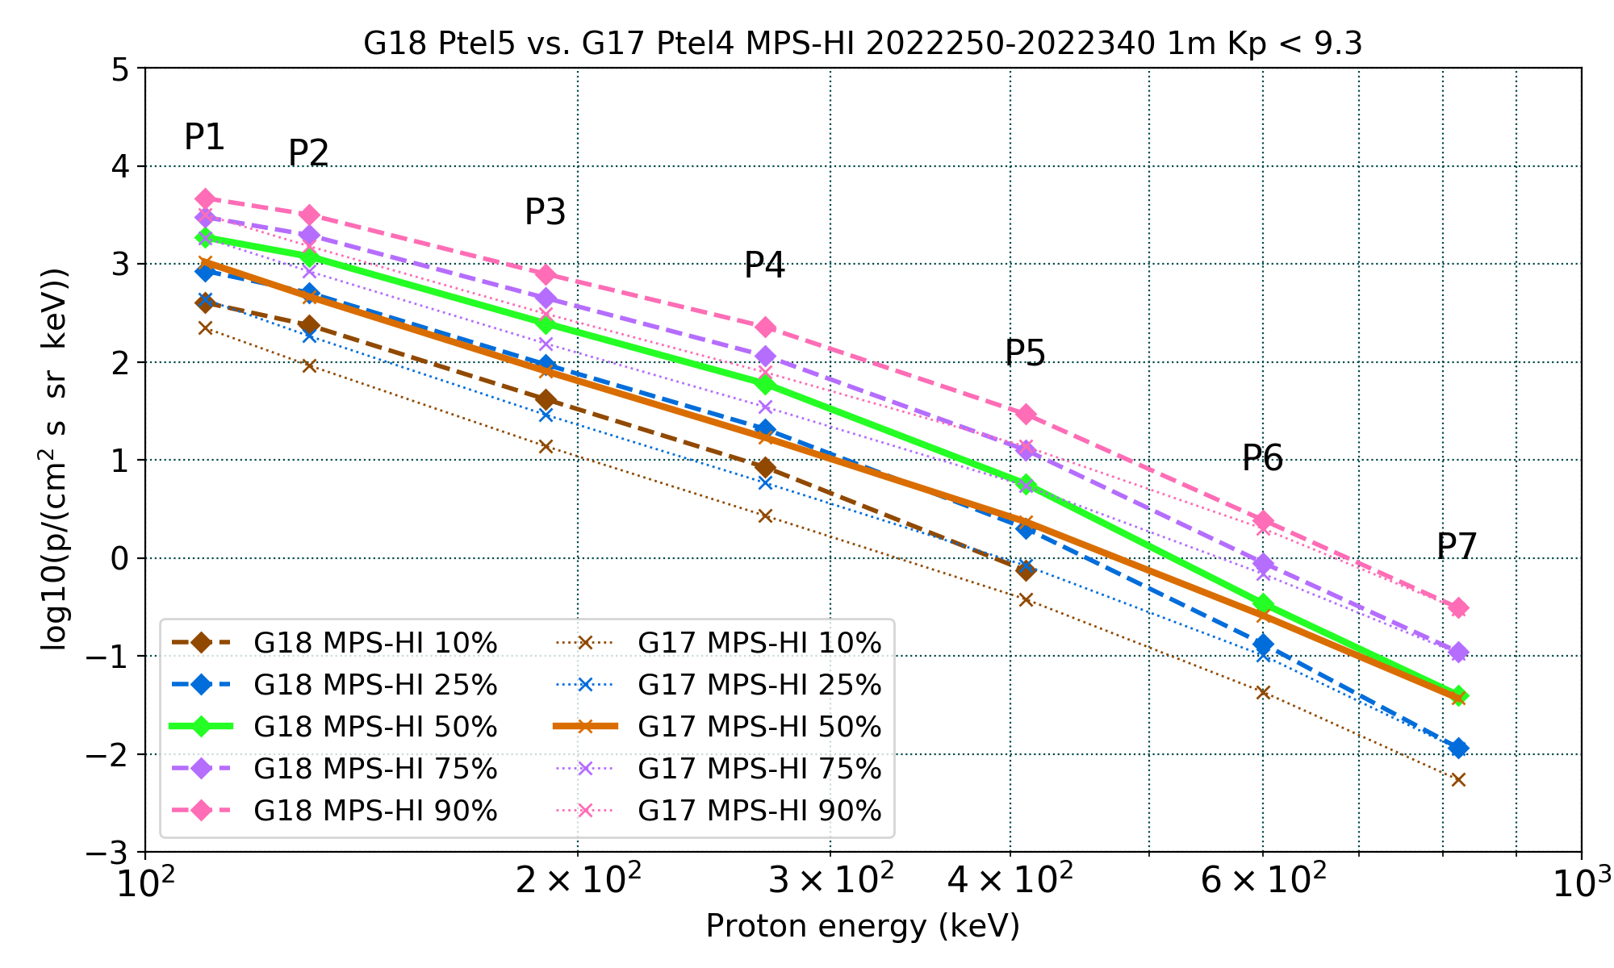
PLPT-SEI-005: Cross-Satellite Comparison of Trapped Particles: Results
GOES-18 vs GOES-17 Protons , 09/07/2022–12/06/2022
Apply only to P1-P7
Boudouridis, A., Rodriguez, J. V., Kress, B. T., Dichter, B. K., & Onsager, T. G. (2020). Development of a bowtie inversion technique for real‐time processing of the GOES‐16/‐17 SEISS MPS‐HI electron channels. Space Weather, 18, e2019SW002403. https://doi.org/10.1029/2019SW002403

Slide 88
GOES-16/GOES-17 proton sensor comparison to GOES-18
Satellite proximities permitting comparisons:
Until 16 May 2022: GOES-18 at 89.5ºW
14.3º (~1 hour LT) from GOES-16
Common separation distance for past comparisons between GOES satellites
GOES-18 drifted to near GOES-West
After 06 June 2022: GOES-18 at 136.8ºW
0.4º from GOES-17
Comparison periods: 3 weeks before drift and 3 weeks after drift

Slide 89
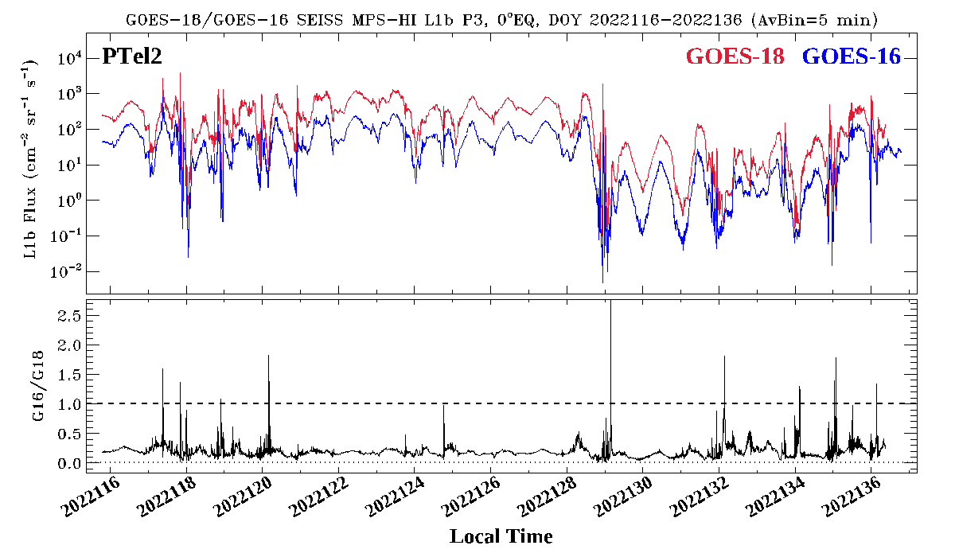
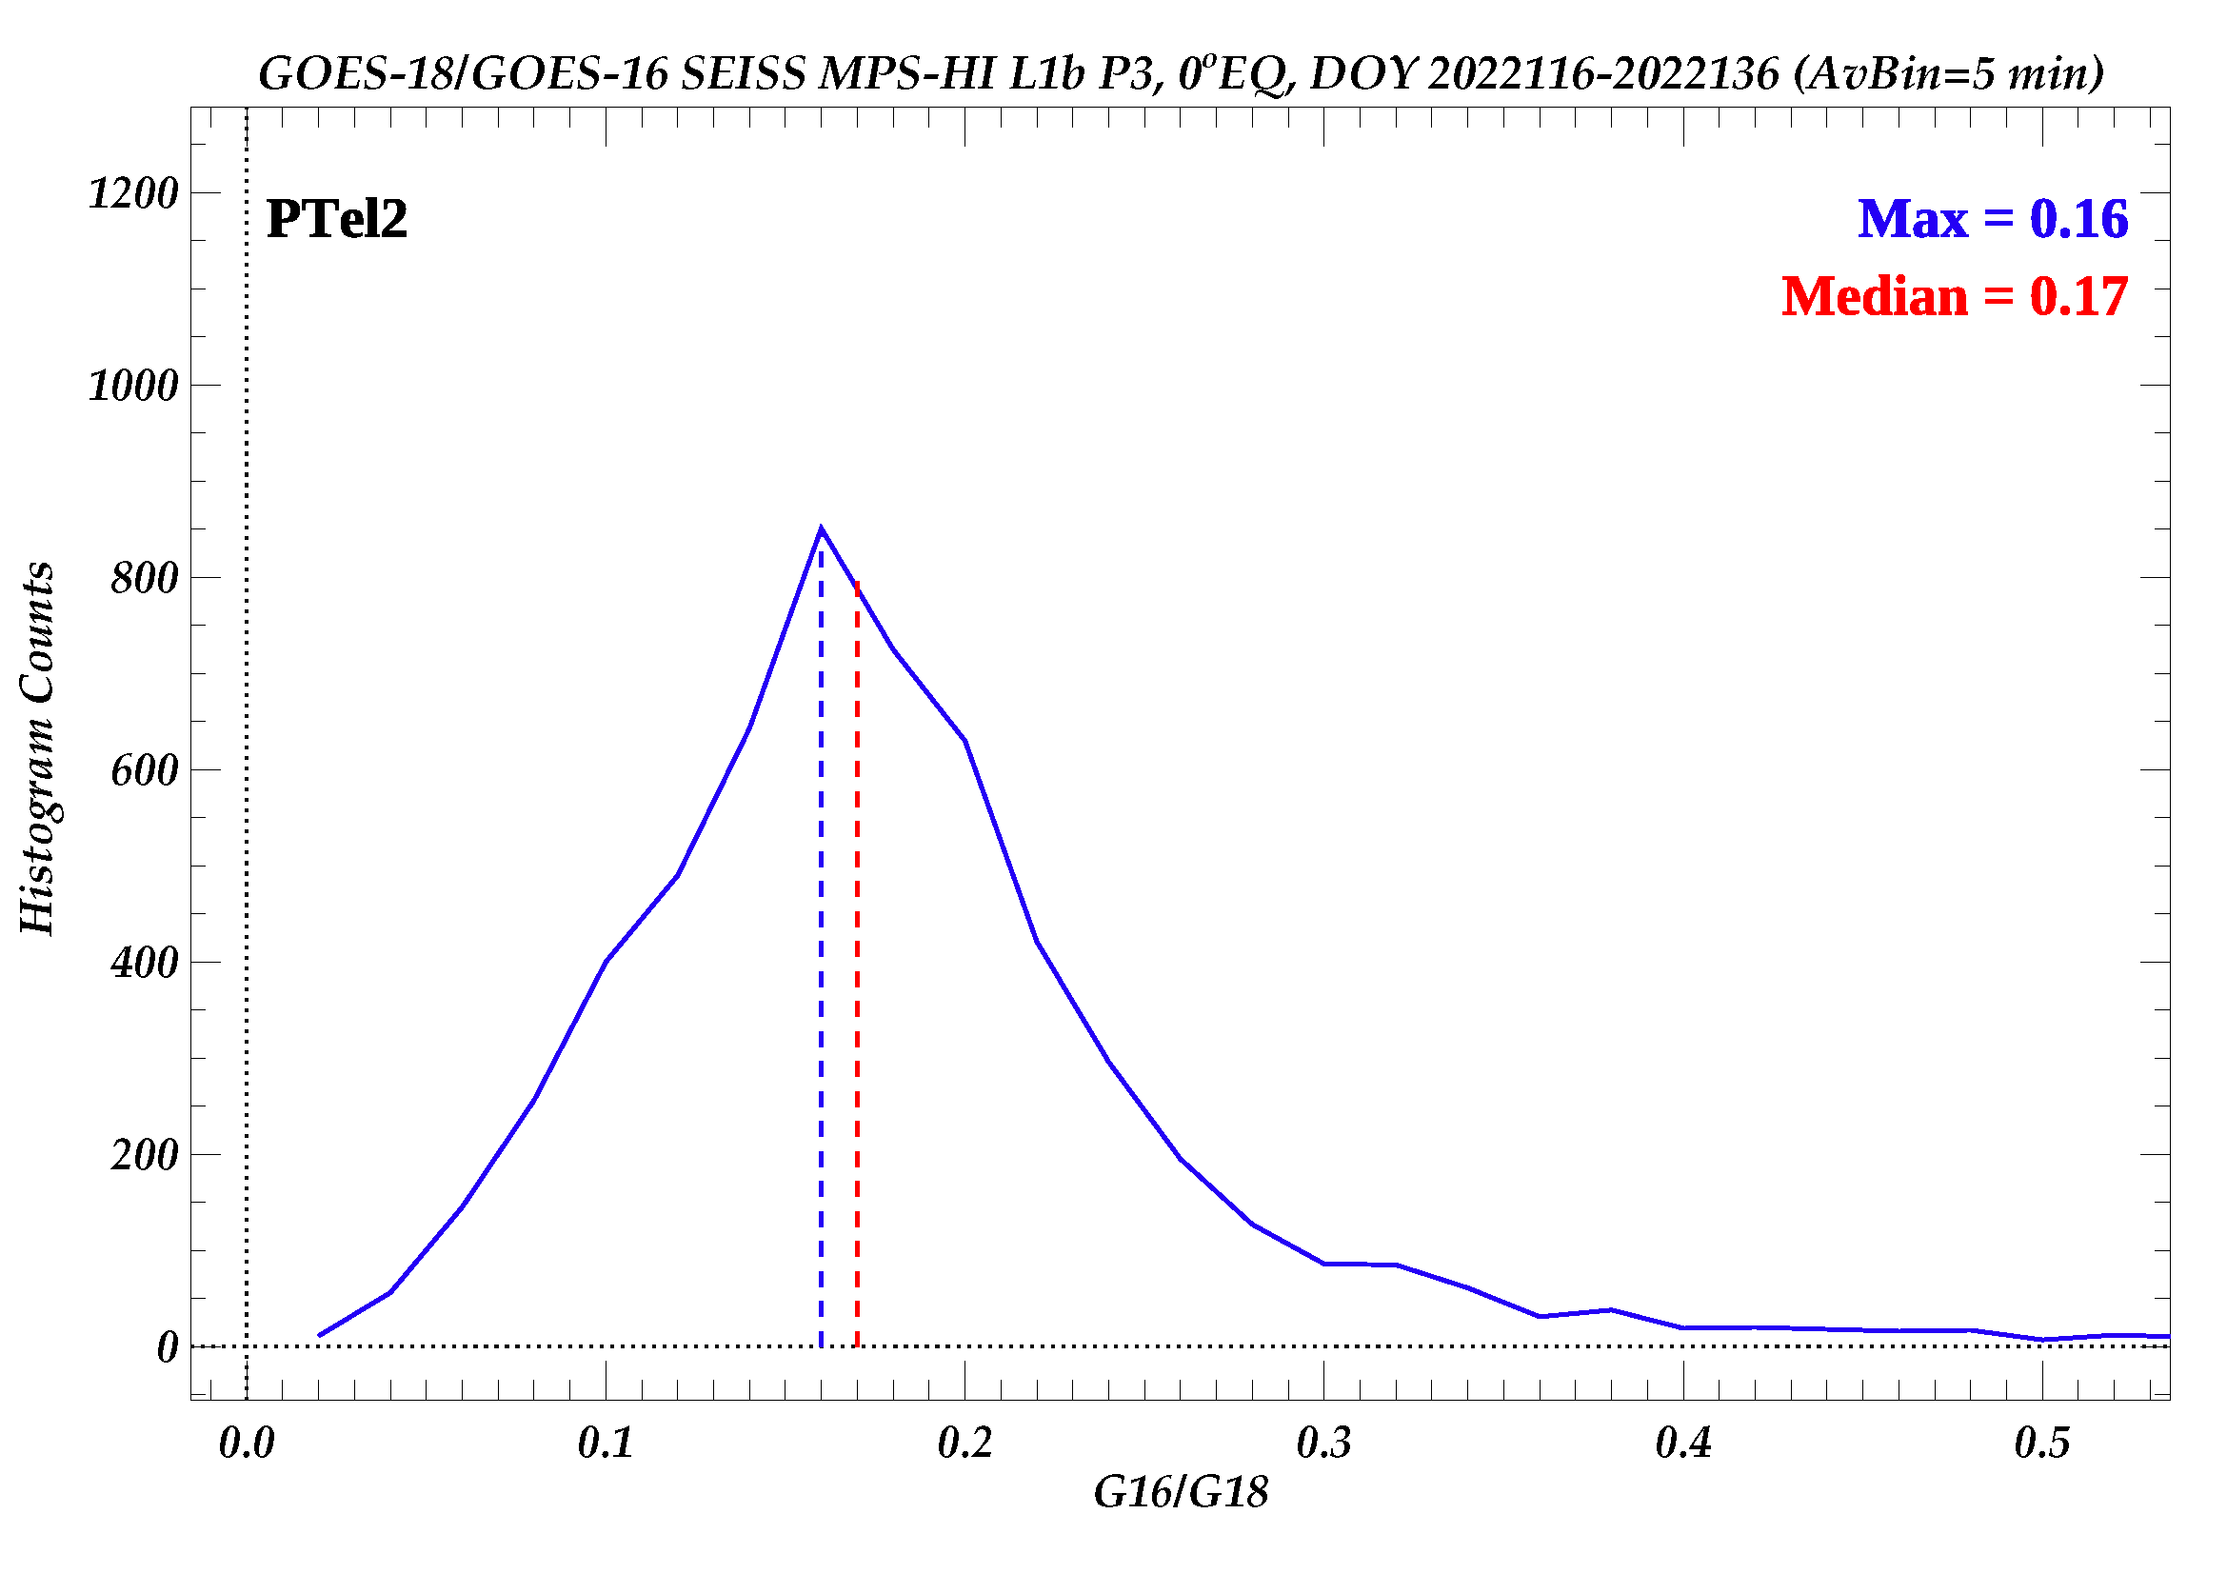
GOES-16/-18 flux comparison
Plot GOES-18 and GOES-16 MPS-HI channel P3 Proton Telescope 2 (PTel2 ) 5-min averaged fluxes for 3 weeks while the two spacecraft were in proximity, GOES-16 at 75.2W longitude and GOES-18 at 89.5W longitude, April 26 to May 16, 2022.
PTel2 is the central Proton telescope looking along the equator.
Take the ratio GOES-16/GOES-18 of P3 PTel2 5-min averaged fluxes.
Make the histogram of GOES-16/-18 MPS-HI P3 PTel2 5-min averaged fluxes for this period.
The median of the GOES-16 to GOES-18 PTel2 P3 flux ratio distribution is 0.17 (factor of 6).
The G16/G18 flux ratios are around 0.2.

Slide 90
GOES-16/-18 flux comparison
Ratio medians
Protons
<10% 10-25% >25%
Channel | PTel1 | PTel4 | PTel2 | PTel5 | PTel3
P1 | 0.41 | 0.41 | 0.45 | 0.97 | 0.50
P2 | 0.28 | 0.20 | 0.21 | 0.39 | 0.33
P3 | 0.22 | 0.16 | 0.17 | 0.38 | 0.26
P4 | 0.24 | 0.15 | 0.17 | 0.36 | 0.27
P5 | 0.24 | 0.14 | 0.22 | 0.42 | 0.21
P6 | 0.33 | 0.32 | 0.26 | 0.97 | 0.54
P7 | 0.54 | 0.42 | 0.38 | 1.11 | 0.72
P8 | 0.88 | 0.69 | 0.78 | 1.22 | 0.95
P9 | 0.83 | 1.18 | 0.86 | 0.95 | 1.03
P10 | 0.84 | 0.69 | 0.69 | 0.61 | 0.78
P11 | 0.21 | 0.37 | 0.29 | 0.33 | 0.31
The GOES-16/GOES-18 proton flux ratio median is in general small, but especially small for the P1-P5 channels.

Slide 91
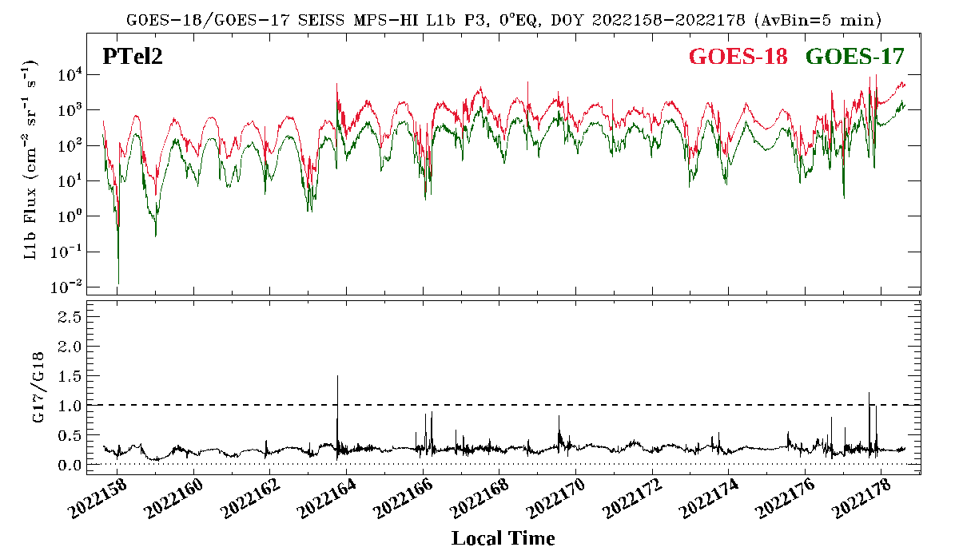
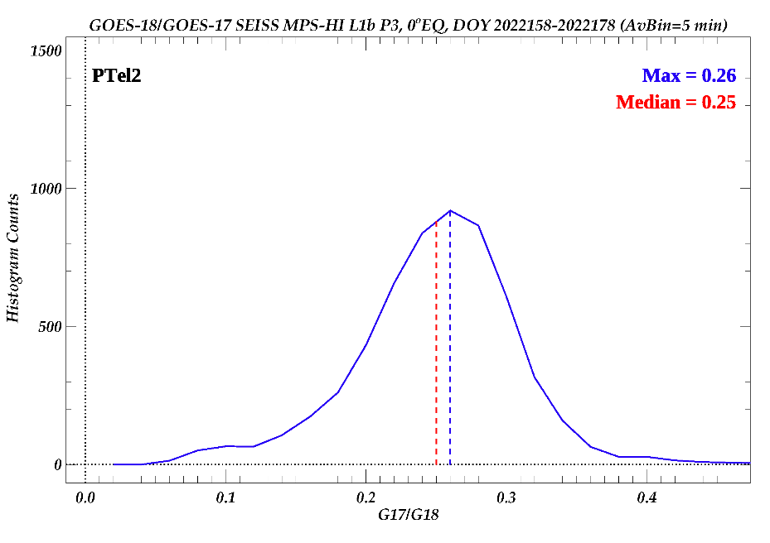
GOES-17/-18 flux comparison
Plot GOES-18 and GOES-17 MPS-HI channel P3 Proton Telescope 2 (PTel2 ) 5-min averaged fluxes for 3 weeks while the two spacecraft were in proximity, GOES-17 at 137.2W longitude and GOES-18 at 136.8W longitude, June 7 to June 27, 2022.
PTel2 is the central Proton telescope looking along the equator.
Take the ratio GOES-17/GOES-18 of P3 PTel2 5-min averaged fluxes.
Make the histogram of GOES-17/-18 MPS-HI P3 PTel2 5-min averaged fluxes for this period.
The median of the GOES-17 to GOES-18 PTel2 P3 flux ratio distribution is 0.25 (factor of 4).
The G17/G18 flux ratios are around 0.3.

Slide 92
GOES-17/-18 flux comparison
Ratio medians
Protons
<10% 10-25% >25%
Channel | PTel1 | PTel4 | PTel2 | PTel5 | PTel3
P1 | 0.50 | 0.49 | 0.27 | 0.61 | 0.57
P2 | 0.37 | 0.33 | 0.21 | 0.28 | 0.35
P3 | 0.26 | 0.29 | 0.25 | 0.23 | 0.37
P4 | 0.26 | 0.29 | 0.20 | 0.23 | 0.37
P5 | 0.31 | 0.39 | 0.31 | 0.34 | 0.38
P6 | 0.99 | 0.57 | 0.46 | 0.63 | 0.62
P7 | 0.86 | 0.69 | 0.80 | 0.84 | 0.71
P8 | 1.00 | 0.83 | 1.25 | 0.76 | 0.73
P9 | 1.18 | 1.00 | 0.52 | 1.07 | 1.17
P10 | 1.16 | 1.00 | 0.86 | 1.00 | 1.00
P11 | 1.00 | 1.00 | 1.00 | 1.00 | 1.00
The GOES-17/GOES-18 proton flux ratio median is very small for the P1-P5 channels.

