Slide 1
Peer Stakeholder-Product Validation Review (PS-PVR)
For the Full Maturity of GOES-18 SEISS MPS-LO L1b Product
December 6, 2023
GOES-R Calibration Working Group (CWG)
Trevor Leonard
CIRES CU Boulder / NOAA NCEI
Contributors: Athanasios Boudouridis, Brian Kress, Juan Rodriguez
CIRES CU Boulder / NOAA NCEI

Slide 2
Outline
MPS-LO Overview
Review of Provisional Maturity Assessment
Product Quality Evaluation
  Instrument and GPA Anomalies and Resolution
  Analysis and PLPTs Supporting Assessment for Full Status
Full Maturity Assessment
Summary and Recommendations

Slide 3
MPS-LO OVERVIEW
GOES-18 MPS-LO L1b Product Full PS-PVR

Slide 4
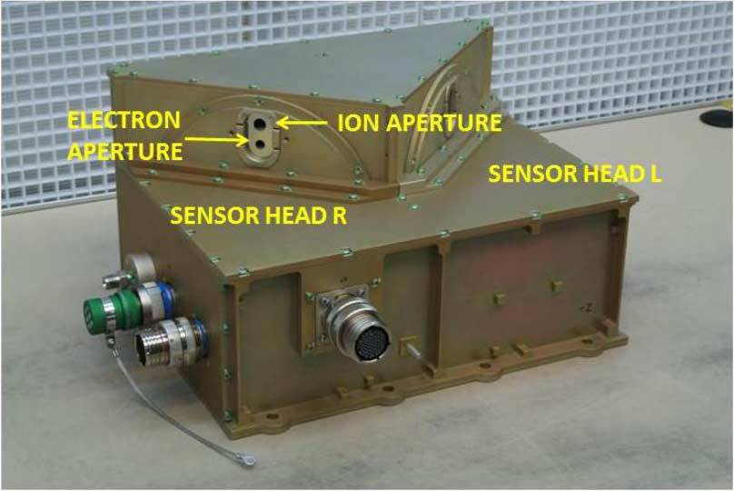
Space Environment In-Situ Suite (SEISS)
Magnetospheric Particle Sensor - Low Energy (MPS-LO)
Primary purpose: measure GOES frame charging and spacecraft charging environment
Electrostatic analyzers (2 ESAs per species) with Microchannel plates (MCPs) as the detection elements
Measures electrons and ions within 30 eV – 30 keV over 15 logarithmically-spaced energy channels
14 angular zones (12 unique) in the north-south plane and 2 background zones
  15 deg FOV angular zones with combined total 180 deg FOV
  30 deg overlap in FOV across 4 angular zones should yield similar fluxes
L1b product: low energy magnetospheric electron and proton fluxes (counts/cm²-s-str-keV)
  2 x 14 x 15 = 420 flux time-series in MPS-LO L1b data
SEISS MPS-LO designed, built, tested and calibrated by Assurance Technology Corporation (ATC)

Slide 5
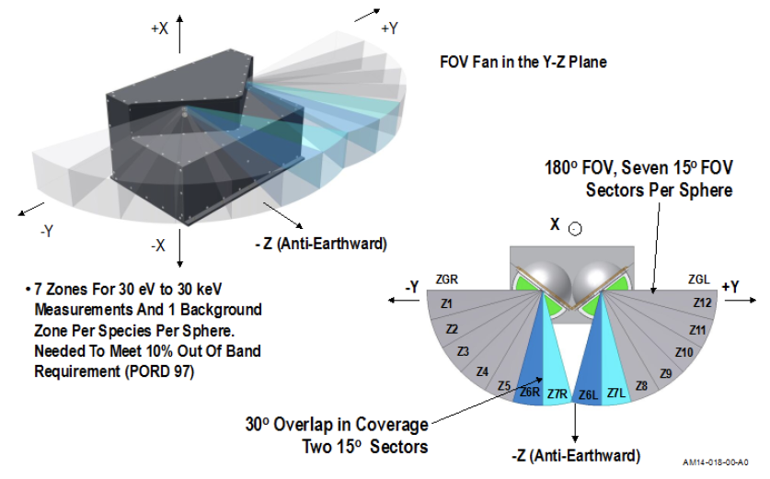
SEISS MPS-LO FOV

Slide 6
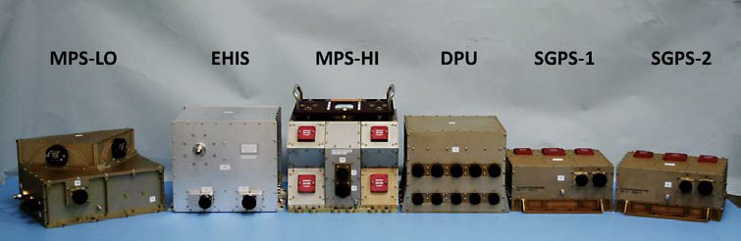
SEISS MPS-LO
An individual energy step observation interval is slightly less than 1/16 of a second and all 15 energy steps are observed during a 1 second cycle
A dead time correction is applied to each observation interval in accordance to the electronics event processing time
Ground processing uses the background zone observations to remove penetrating radiation from the particle observations
Magnetic field vector observations from the GOES magnetometer is essential for calculating pitch angle for each telescope / angular zone

Slide 7
A Few Comments About MPS-LO
NOAA’s first plasma instrument on GOES!
Measures thermal population (~1keV at geosynchronous)
Measuring the low energy component of a plasma is notoriously difficult – Plasma instruments are known to require special care.
Surface charging on spacecraft is associated with <50 keV electrons [NASA, “Mitigating in-space charging effects – a guideline,” NASA Technical Handbook NASA- HDBK-4002A, March 3, 2011].
Electrostatic discharge (ESD) due to spacecraft charging causes most of the environmentally related anomalies on spacecraft, and surface charging has caused the most serious anomalies, i.e., those that have resulted in the loss of the mission [Koons et al., 1999].
In addition to its operational use at SWPC, we are looking forward to making this data available to the science community.

Slide 8
MPS-LO Primary Operational Use
Data stream for NOAA-NWS SWPC
MPS-LO Density and Temperature Moments and Level of Spacecraft Charging
MAG L1b 1m averages
Level 1b
Level 2
SEISS MPS-LO L2 1m averages and the Density and Temperature Moments and Level of Spacecraft Charging algorithm are phase 2 algorithms. MPS-LO 5m averages is phase 3.
L2 densities and temperatures are also used in the L2 Magnetometer Magnetopause Crossing Detection algorithm as an indicator of magnetopause crossings at geosynchronous.
The L2 Moments algorithm identifies ion line signatures of SC charging and uses the ion line to determine the spacecraft potential:
When an ion line is not present, the L2 Moments routine uses an empirical relation between densities, temperatures, and level of charging to monitor SC charging.
1 sec.
Ion line
Backgrounds from heightened radiation belt fluxes
GOES-16 MPS-LO spectrogram of count rates, with ion line signatures of spacecraft charging. The first ion line enhancement appears near 1 keV at ~5:30-6:30 UT during an eclipse period.
UT Hours
On 22 March 2017

Slide 9
Review of Provisional Maturity
(Declared Provisional Validation on 2022/11/29)
GOES-18 MPS-LO L1b Product Full PS-PVR

Slide 10
Instrument/GPA Issues
Identified and Resolution Status
(Presented at G18 SEISS MPS-LO Provisional PS-PVR on 2022/11/29)
High Backgrounds / Negative Fluxes
  Addressed by ADR 326 MPS-LO GPA Changes, ADR 1277 and ADR 1316 G18 MPS-LO LUT Updates, and empirical derivation of background removal coefficients by NCEI.
  Background removal coefficients will need additional updates.
Interzonal crosstalk observed in energy-dependent background count rates on-orbit.
  Monitor the effect of on-orbit HV changes, when required after MPS-LO HV optimization.
Evidence for significant error in absolute values of reported fluxes (e.g., PLPT-SEI-003: MPS-LO Zone Cross-Comparison and PLPT-SEI-005 Cross satellite Comparison of Trapped Particles).
  Scale geometric factors using results from [Full] PLPT-SEI-003 MPS-LO Zone Cross-Comparison to bring MPS-LO zones into agreement. The Zone Cross-Comparison procedure should be repeated periodically to check for agreement among MPS-LO zones and scale geometric factors as needed.
  Densities and temperatures from L2 processing will be affected by error in absolute values of reported fluxes, but the empirical relation used to determine level of charging from density and temperature (yet to be determined for MPS-LO) will compensate for these errors.

Slide 11
MPS-LO Specific ADRs/WRs
ADR | WR | Short Description | Status | Closure
228 | 3961/7067 | SEISS record time mismatches with filenames | Closed | DO.07.01.00/DO.10.01.01 (2021/12/09)
326 | 5424/5860 | MPS-LO GPA Changes | Closed | DO.07.01.00
449/ 596 | 5133/5800 | Make Arc Jet Flag available for SEISS MPS-LO | Closed | DO.07.00.00/DO.10.01.00
780 | 6585/6845 | GPA update for SEISS MPS-HI and MPS-LO L1b IFC leakage | Closed | DO.12.00.00 (2023 May)
1003 | 7506 | Flight delivery of SEISS FM3 LUTs | Closed | PR.09.05.01 (2021/08/20)
1171 | 9326 | EXIS/MAG/SEISS ECEF_Z range | Closed | DO.12.00.00 (2023/05/23)
1198/1199 | N/A | G16/G17 MPS-LO LUT updates | Closed | PR.09.08.08 (2022/10/02)
1209 | N/A | NCEI G18 SEISS LUT Actions (the real prelaunch LUTs) | Closed | PR.09.08.14 (2022/04/14)
1277 | N/A | G18 SEISS MPS-LO LUT Update | Closed | PR.08.08.38 (2022/11/01)
1316 | N/A | G16 and G18 SEISS MPS-LO LUT Update | Closed | PR.11.04.04 (2023/05/04)

Slide 12
PRODUCT QUALITY EVALUATION
GOES-18 MPS-LO L1b Product Full PS-PVR

Slide 13
Summary of MPS-LO Anomalies
(Common to all MPS-LO flight models to date)
High Backgrounds / Negative Fluxes
  Previous strategy with ADR 326 for G16 and G17 is also applied to G18
  Continued work on the empirical derivation of background removal coefficients
  Source of backgrounds is not fully understood
Interzonal Crosstalk
  G16/FM1 crosstalk seen in on-orbit data. Analysis to estimate correction coefficients not developed
  G17/FM2 crosstalk measured with ground/beam calibrations and is apparent in on-orbit data.
  G18/FM3 crosstalk observed on-orbit (slide 24)
Evidence for significant error in absolute values of reported fluxes (e.g., PLPT-SEI-003 and PLPT-SEI-005), which was also studied on G16 and G17 with no resolution. Possible sources of error in reported fluxes:
  Gradual decrease in in-band and background zone response with time (seen on slide 34)
  No crosstalk correction scaling of geometric factors
  May be insufficient or too much background removal
  To reduce crosstalk and noise, instrument not operated in full saturation
Degraded performance of lower energy ion channels due to persistent high backgrounds
  Previously studied on G16 and G17 with no resolution
Effect of arc jet firing
  Previously resolved on G16 and G17 with ADR 596 and resolution is true for G18

Slide 14
  High Backgrounds / Negative Fluxes –
  ADR 326 and Empirical Derivation of Background Removal Coefficients at NCEI
GOES-18 MPS-LO L1b Product Full PS-PVR

Slide 15
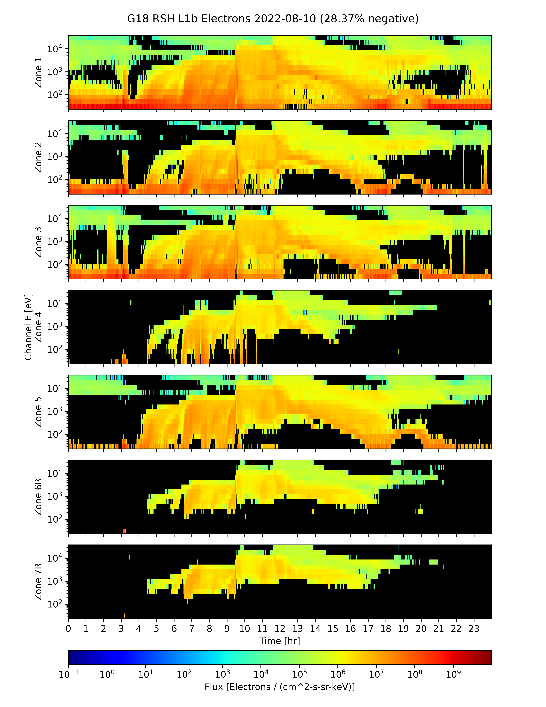
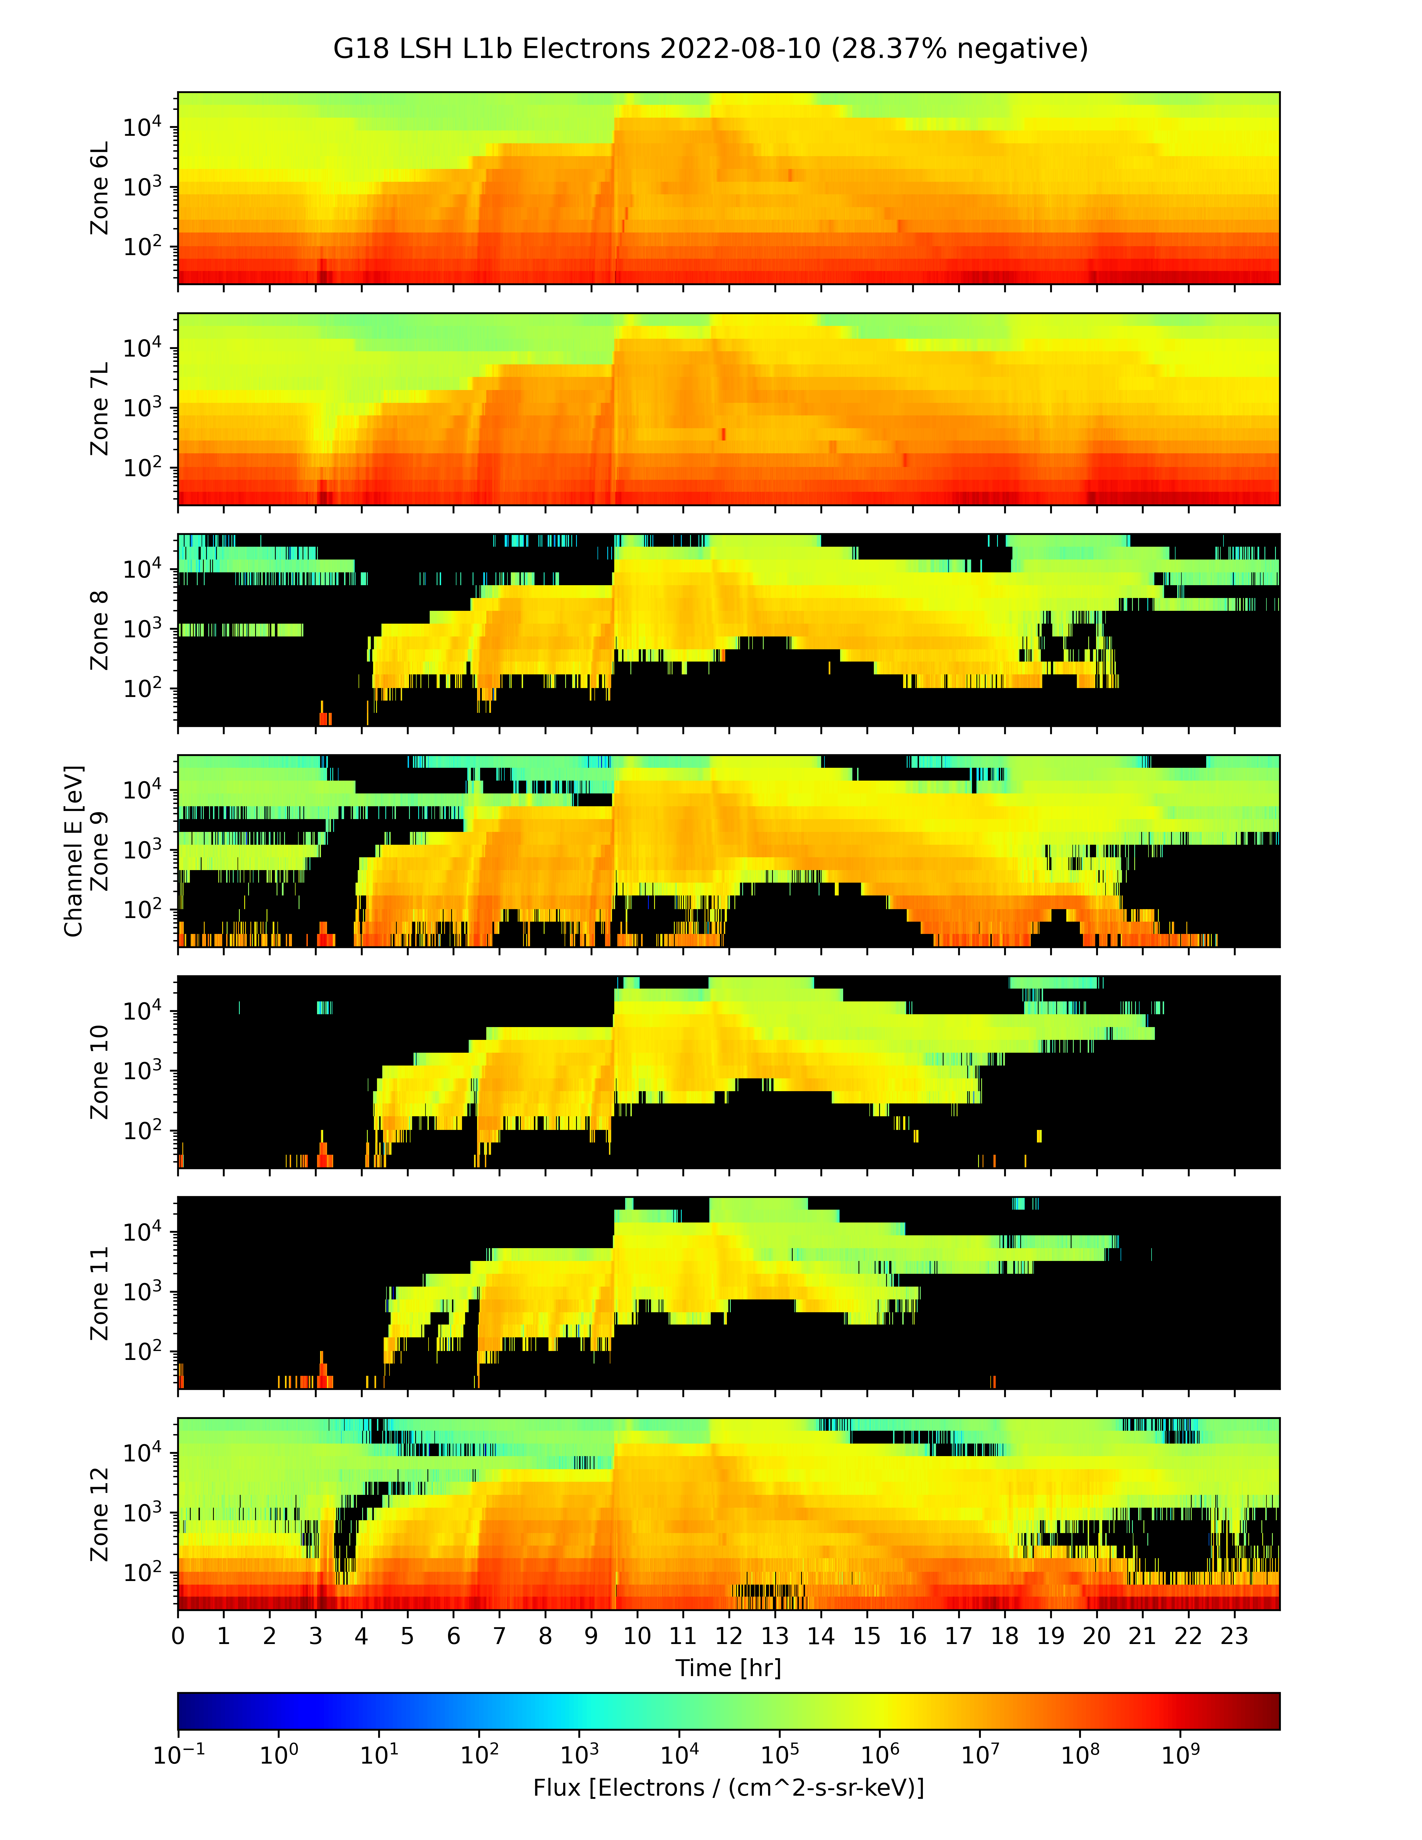
G18 MPS-LO L1b Fluxes 2022/08/12
(Prior to implementation of ADR 1277 MPS-LO LUT Update)
Right Sensor Head Ions
Left Sensor Head Ions
Black pixels indicate negative flux (non-physical), due to excessive background subtraction.
Negative flux (black pixels) due to high backgrounds: Corrected counts = total counts – background counts
Addressed by ADR326/WR5860 MPS-Lo GPA Changes, in build DO.07.01.00, and LUT updates (ADR1277 and ADR1316).

Slide 16
MPS-LO Background Removal
In-band
(electrons or ions)
Penetrating radiation / Backgrounds
~
Sweep voltage
(selects 15 energies)
BG
In-band
Illuminated zone accumulates
both in-band and BG counts
Unilluminated
Background
Zone
14 zones
(viewing directions)
Simplified background (BG) removal expression :
Corrected Counts = Total counts – BG Removal Coefficient x BG Counts
Pre- ADR326 CDRL80 expression has 4 BG removal coefficients, one for each species and sensor head, all were set to one in the launch version of the MPS-LO LUT. Analysis shows need for energy and zone dependent BG removal coefficients with values <1 for most energy-zone pairs. Need to characterize in-band vs. BG response for 14 zones x 15 energies for electrons and ions.

Slide 17

Three Actions Addressing MPS-LO
High Backgrounds / Negative Fluxes
ADR326: Implement energy dependent background subtraction, previously energy-sweep averaged (Also involves non-trivial modification to error term – Complete description in ADR_326_Addendum_Revised_10-2-18.pdf.)
  $Currently: M_{m,k,i,j}=N_{m,k,i,j}^{tot.}−C_{m,k}{Avg_N}_{m,k}^{BG}$
  $Modify to: M_{m,k,i,j}=N_{m,k,i,j}^{tot.}−C_{m,k}N_{m,k,j}^{BG}$
ADR326: Generalization of background (BG) removal coefficient to include zone and energy dependence
  $C_{m,k}$ (2✕2) → $C_{m,k,i,j}$ (2✕2✕7✕15)
NCEI: Empirical derivation of BG removal coefficients (by demanding positive fluxes, averaged over some interval, using many months of data).
m = 1,2 for electrons and ions respectively.
k = 1,2 for right and left sensor heads.
r = 1-4 is species & sensor head group index,
for ions-R, ions-L, electrons-R, electrons-L.
i = 1-7 is zone index for 7 zones in each SH.
j = 1-15 is energy channel index.

Slide 18
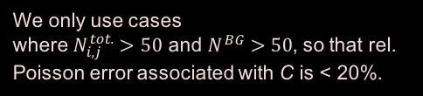

Empirical Determination of Background Removal Coefficients
The corrected counts M in a given zone and energy channel are the total counts N^{tot.} minus the counts from penetrating radiation
$M_{i,j}=N_{i,j}^{tot.}−C_{i,j}N^{BG}$,
where i and j are the is the zone and energy indices, respectively, and the counts in zone i due to penetrating radiation is assumed to be proportional to the counts in the associated (same species and sensor head) background zone N^{BG}.
If we demand that the flux averaged over some time-interval is non-negative, this places an upper bound on the background removal coefficient.
$${\overline{M}}_{i,j}={\overline{N}}_{i,j}^{tot.}−C_{i,j}{\overline{N}}^{BG}≥0 → C_{i,j}≤\frac{{\overline{N}}_{i,j}^{tot.}}{{\overline{N}}^{BG}}$$
where the overbar denotes an average over some time interval (e.g., 5 min. averages from 1s data). An upper bound for $C_{i,j}$ can be determined empirically by taking the minimum value of ${\overline{N}}_{i,j}^{tot.}/{\overline{N}}^{BG}$ attained over months of data
Set $C_{i,j}=Min\left[{\left(\frac{{\overline{N}}_{i,j}^{tot.}}{{\overline{N}}^{BG}}\right)}_{k}\right]$,
where k is index for the averaging interval, and we take minimum from many such intervals. An upper bound of 1 is also placed on the C coefficients.
We only use cases
where $N_{i,j}^{tot.}>50$ and $N^{BG}>50$, so that rel. Poisson error associated with C is < 20%.

Slide 19
Empirical Background
Removal Coefficients
ADR 1277 G18 SEISS MPS-LO LUT Update implemented the following BRC tables (2022/11/01).
Electron Background Removal Coefficients
Ion Background Removal Coefficients

Slide 20
Empirical Background
Removal Coefficients
ADR 1316 G18 SEISS MPS-LO LUT Update implemented the following BRC tables (2023/05/04).
Electron Background Removal Coefficients
Ion Background Removal Coefficients

Slide 21
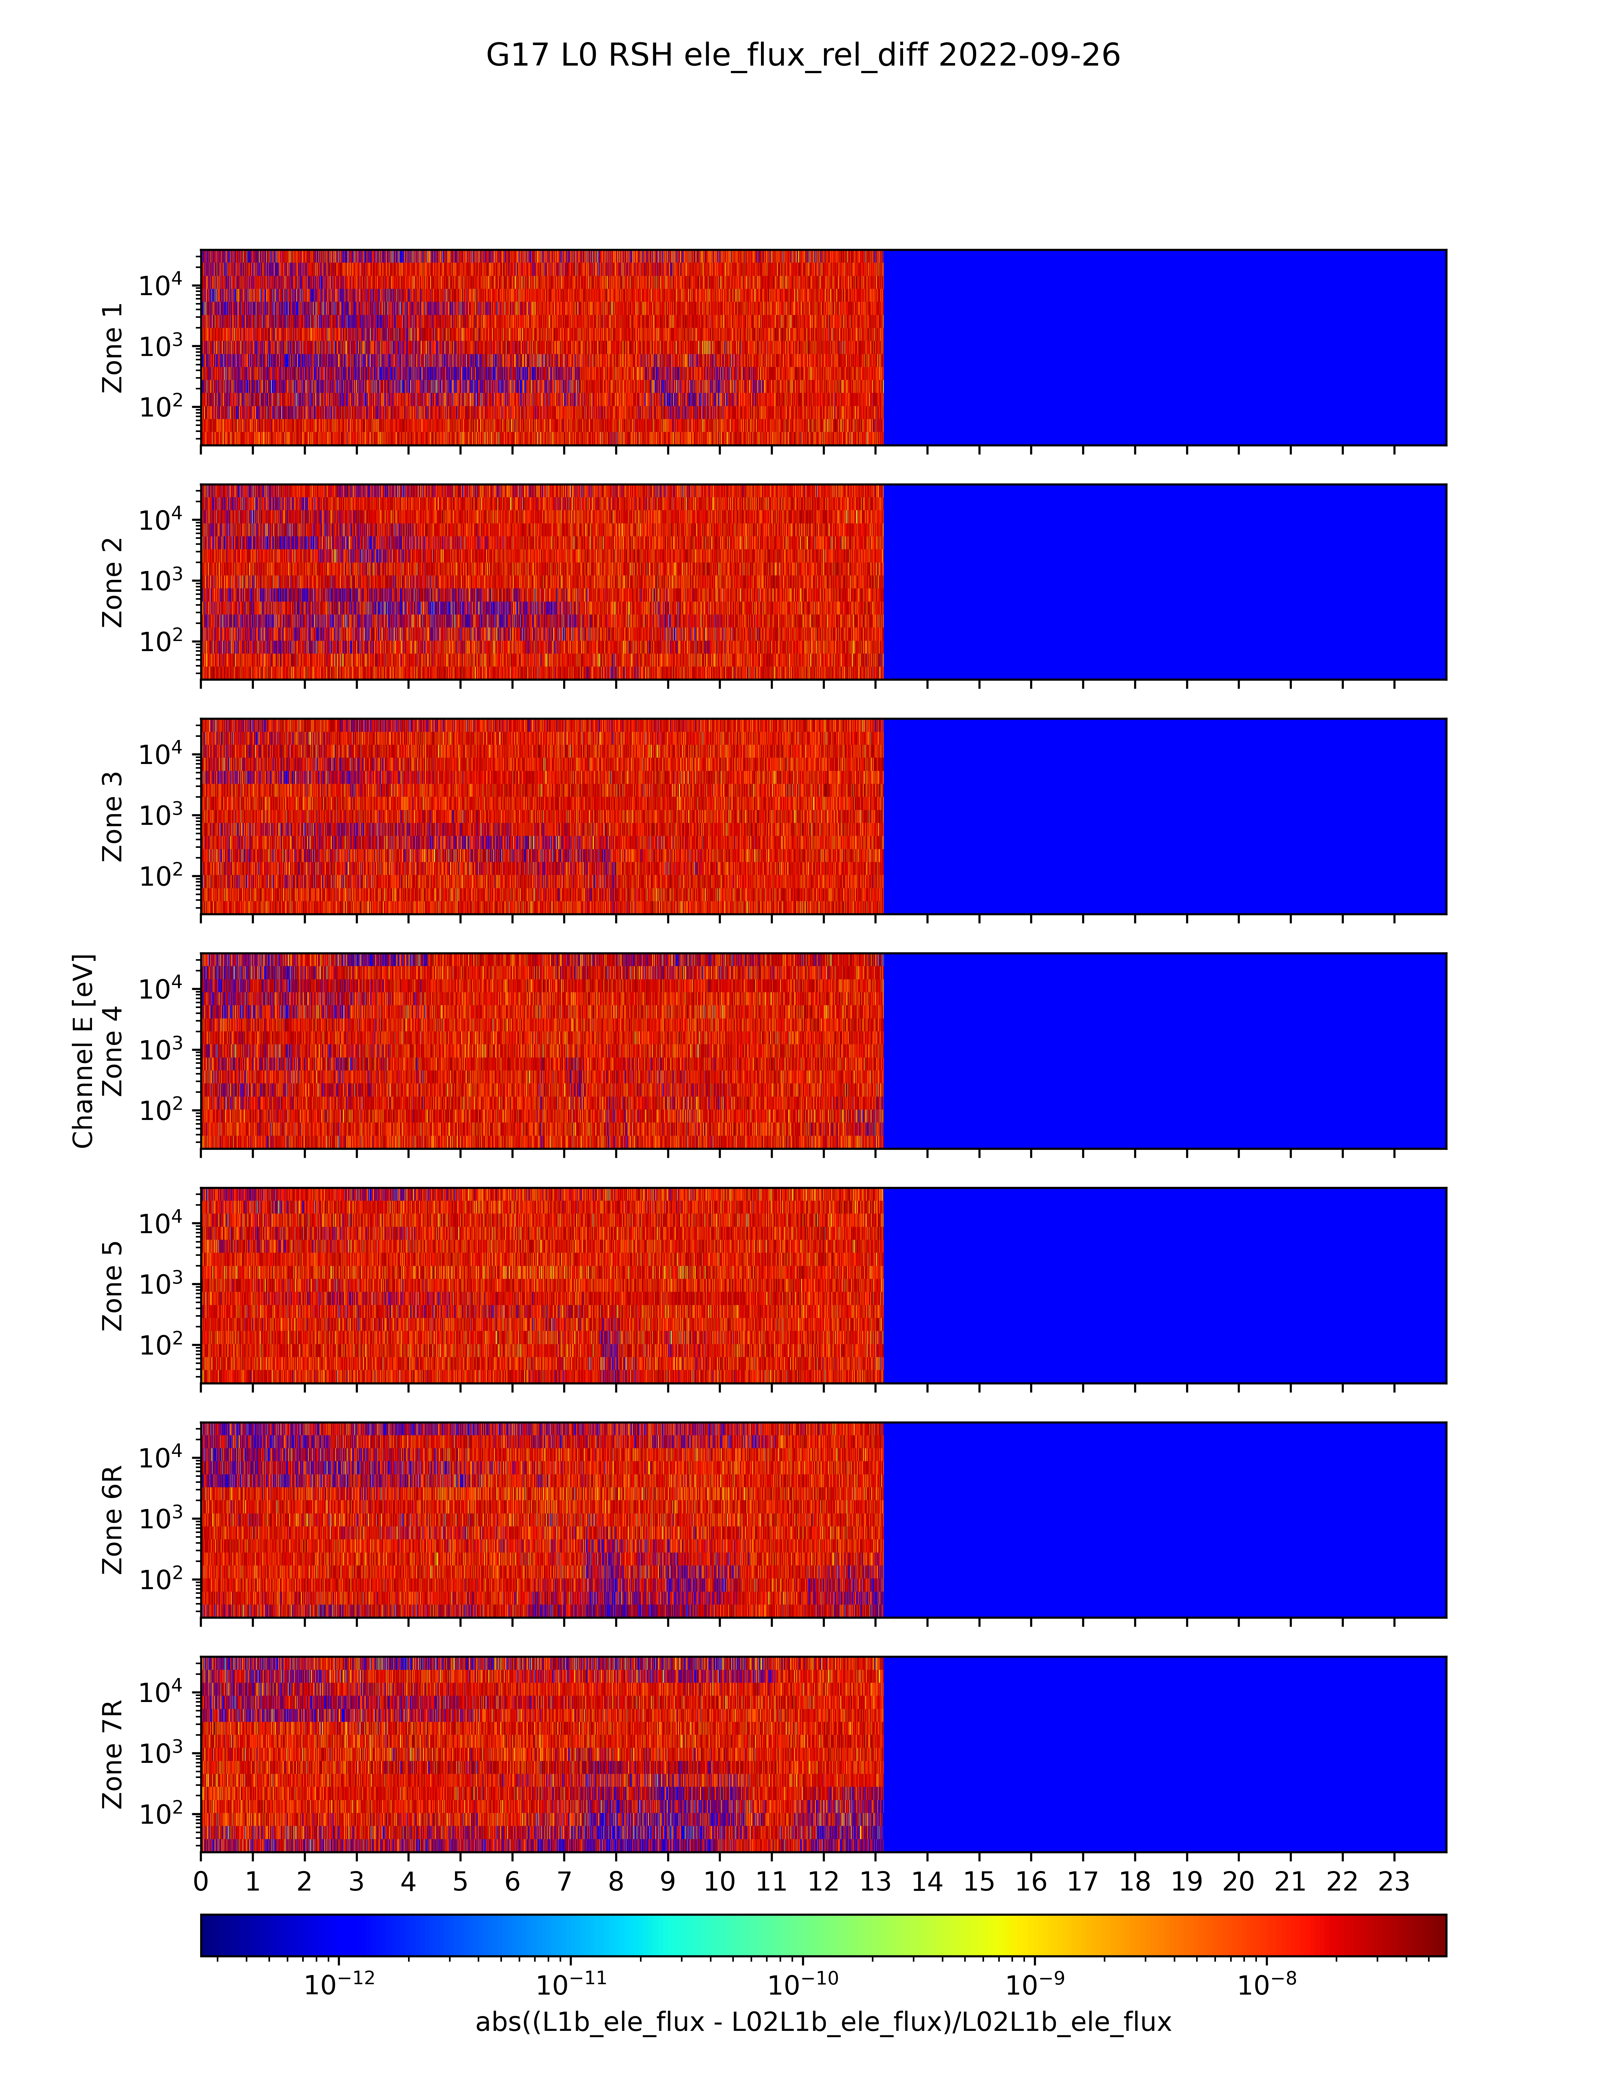
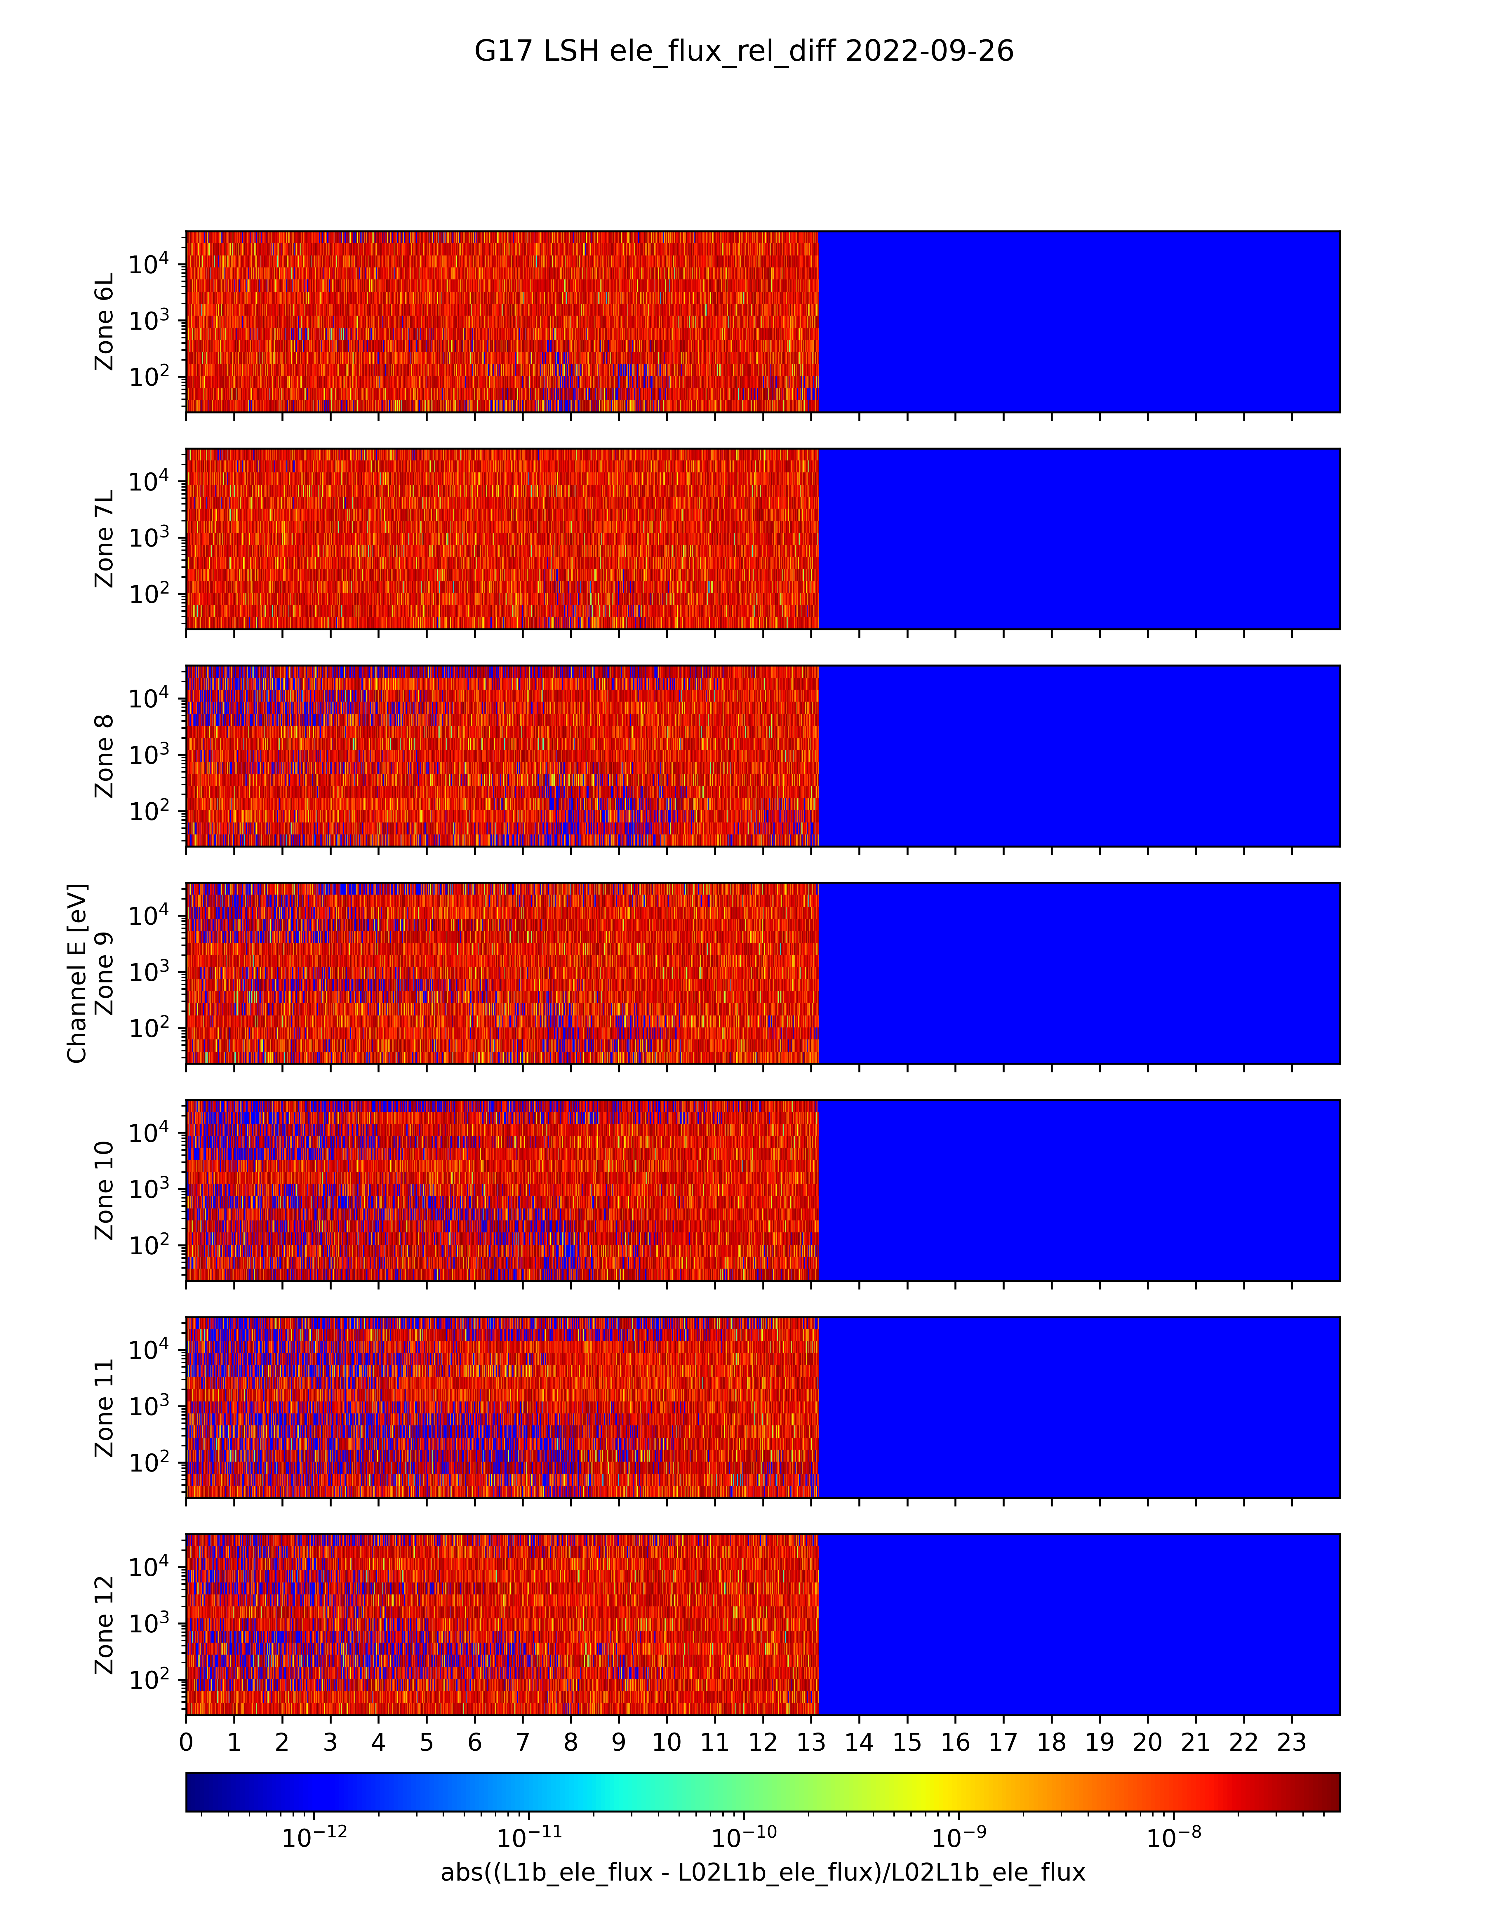
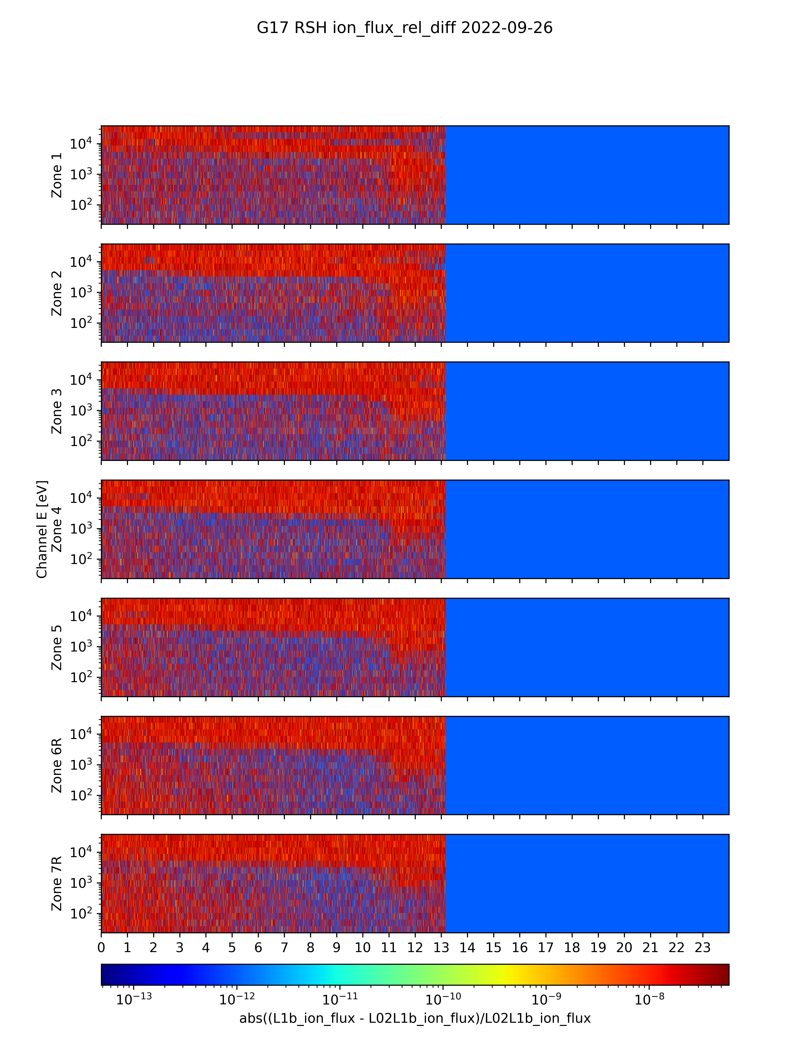
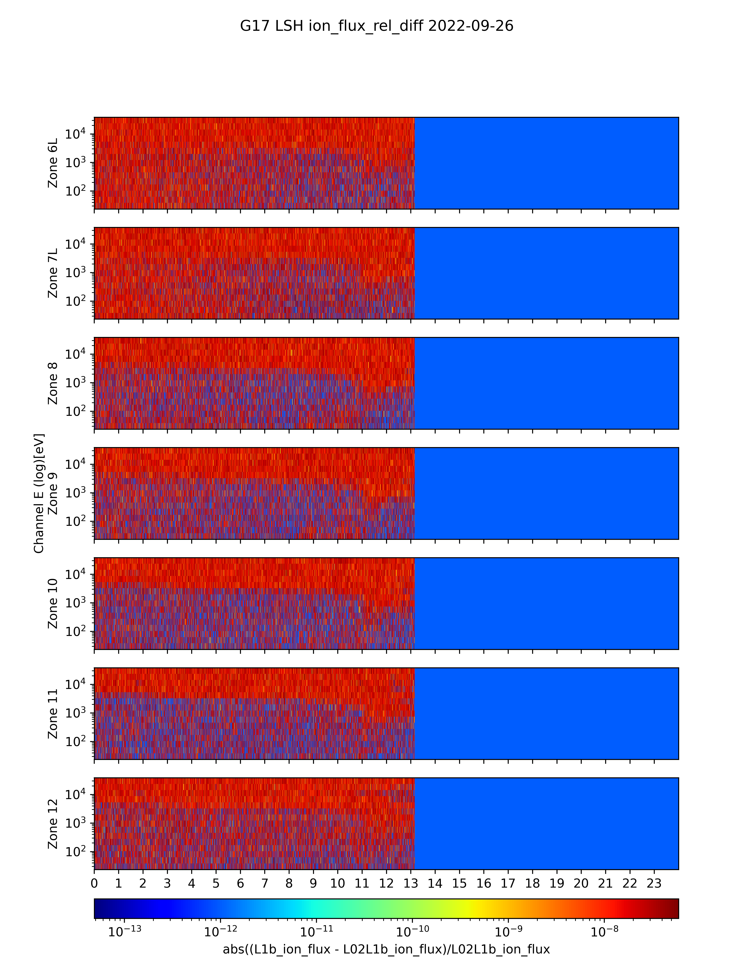
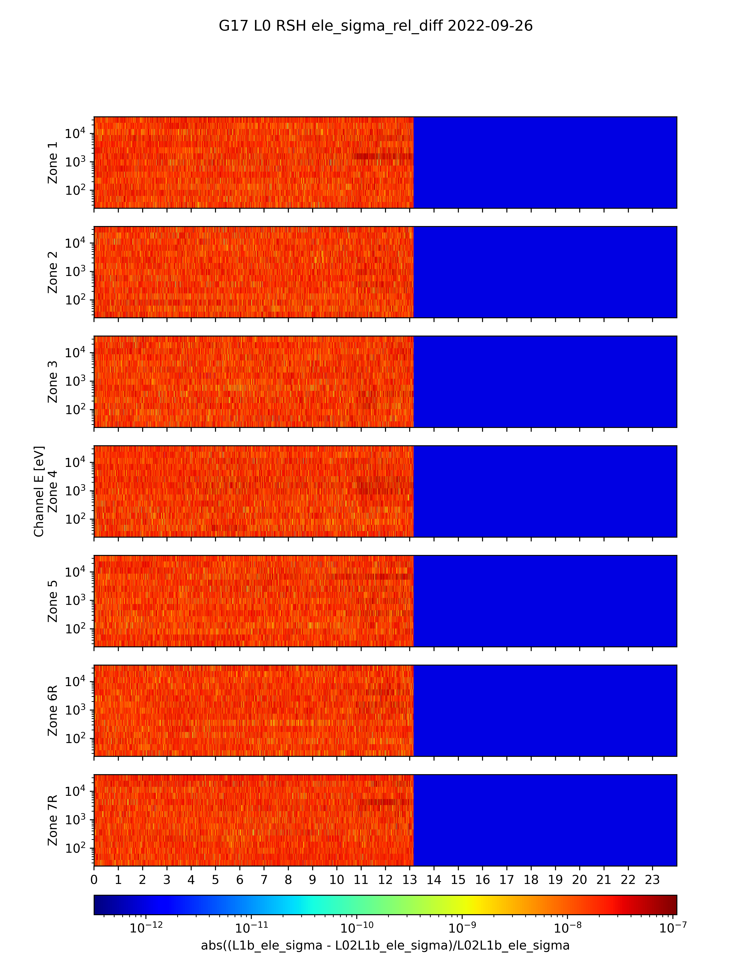
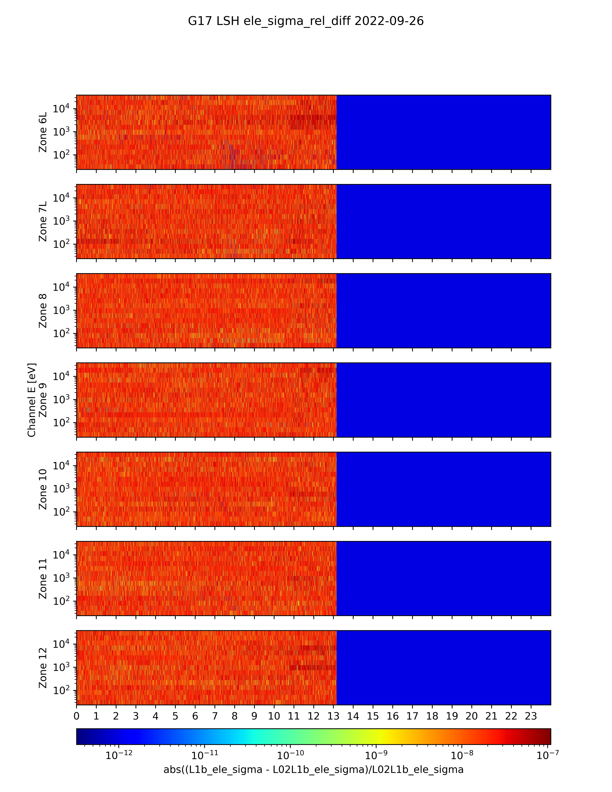
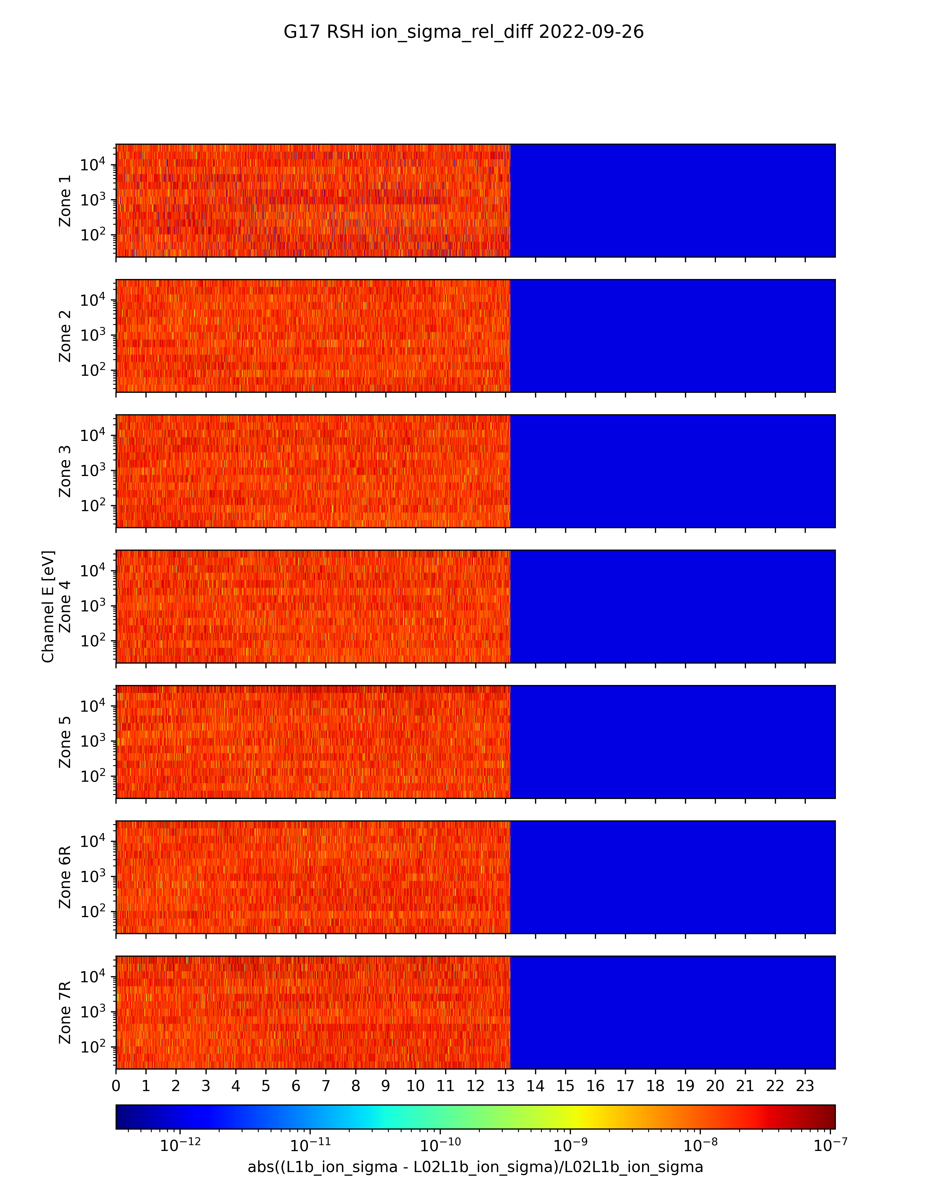
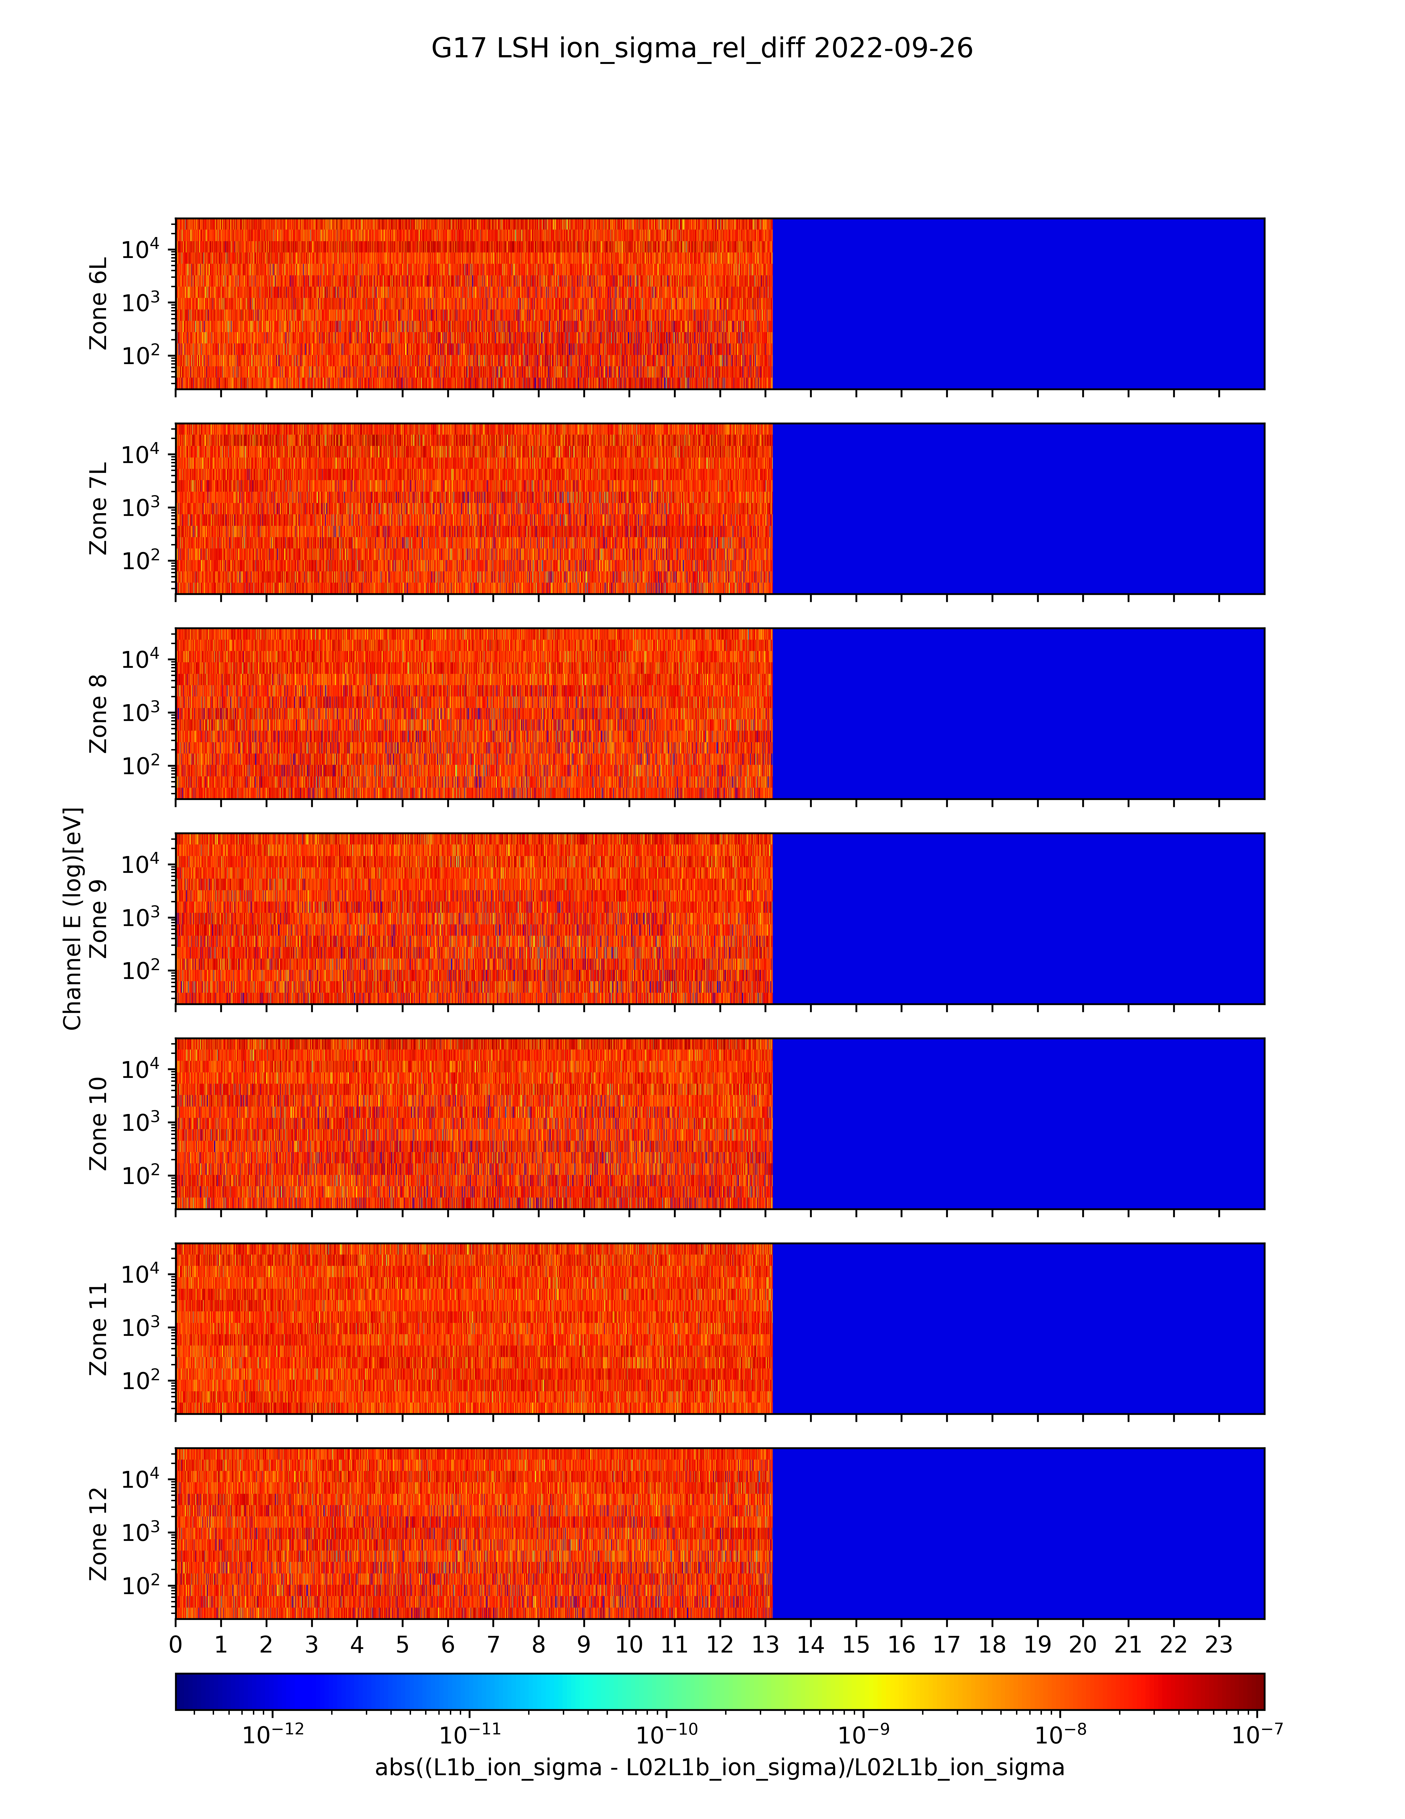
Verification of ADRs 1277/1316
(L1b – NCEI_in-house_L0_to_L1b) / NCEI_in-house_L0_to_L1b
Left sensor head electrons
Right sensor head ions
Left sensor head ions
Right sensor head electrons
Verification of fluxes for ~13hrs of test data
Flux error term for R & L SH electrons and ions
Verification of flux error term
Rel. difference < 1.E-7 in all cases.
Verification of ADR 1277: G18 L1b flux and error in agreement with NCEI’s in-house L0 to L1b result to within 1.E-7 (using single precision floats).

Slide 22
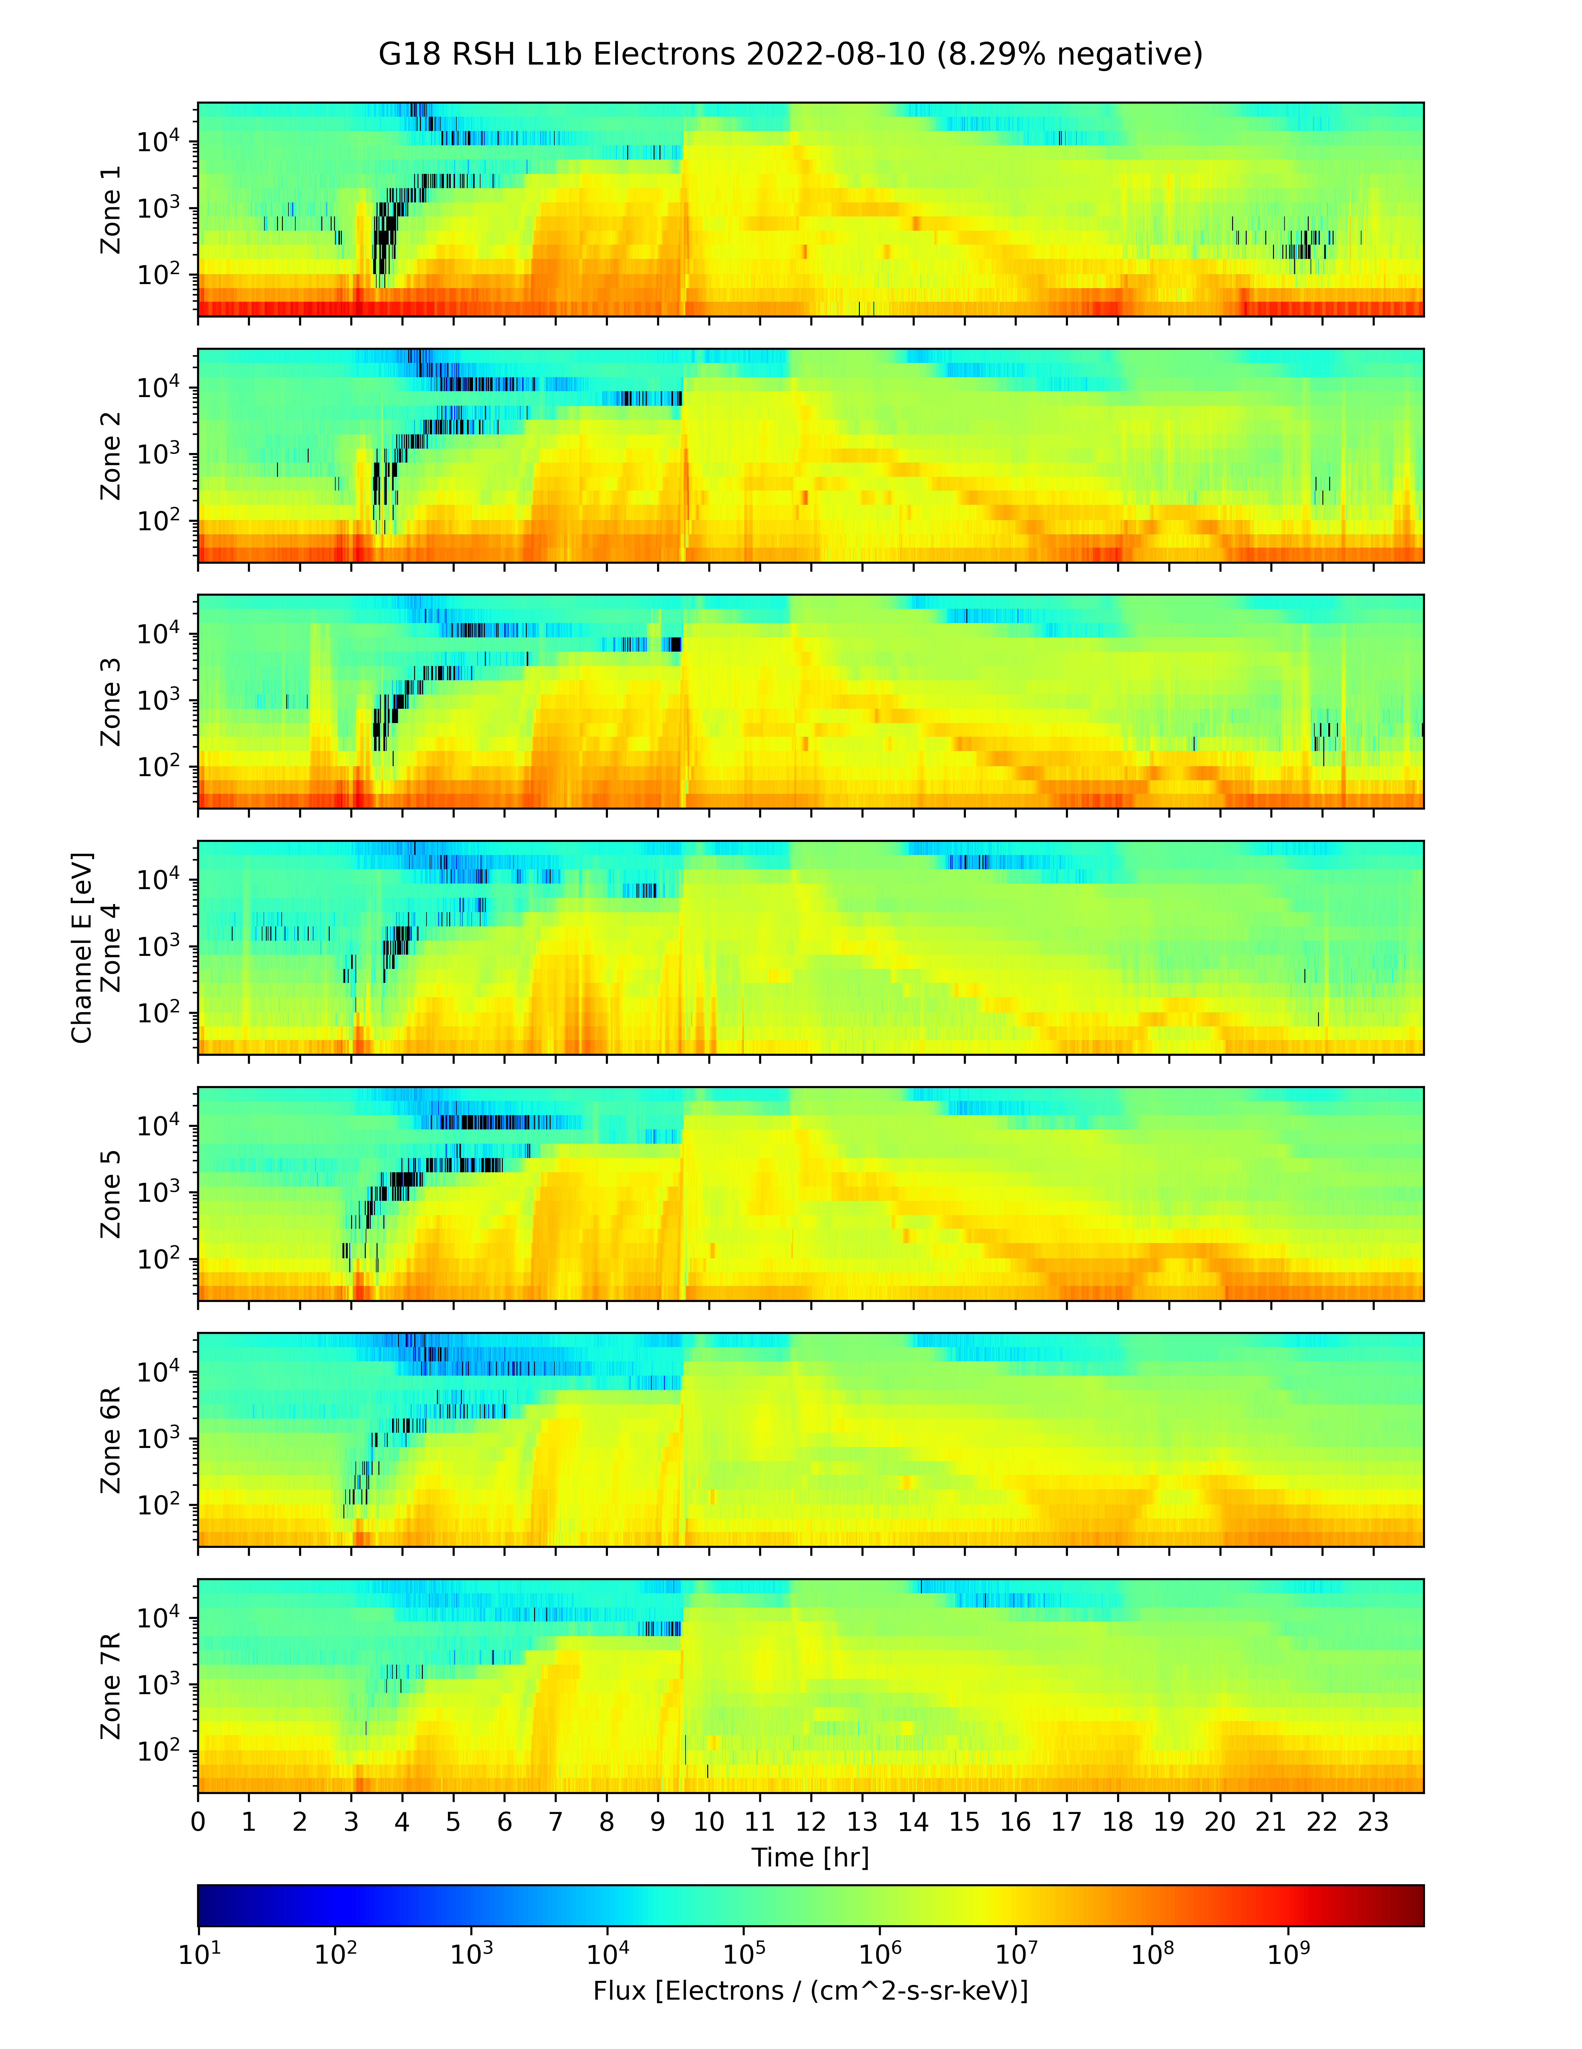
Background Removal Example 2022/08/10
No Empirical Background Removal Coefficients
New Empirical Background Removal Coefficients
Black pixels indicate negative flux (non-physical), due to excessive background subtraction.
Negative flux (black pixels) due to high backgrounds: Corrected counts = total counts – background counts
Addressed by ADR326/WR5860 MPS-Lo GPA Changes and ADR1277 (LUT update).

Slide 23
Additional MPS-LO Anomalies
Interzonal Crosstalk
  Partial resolution on slide 27 of G16/G17 Full Validation PS-PVR
Effect of High Backgrounds on Low Energy Ions Measurement
  Low signal to noise instrument/environment issue – No L1b resolution.
Effect of Arc Jet Firing
  Resolved with ADR596

Slide 24
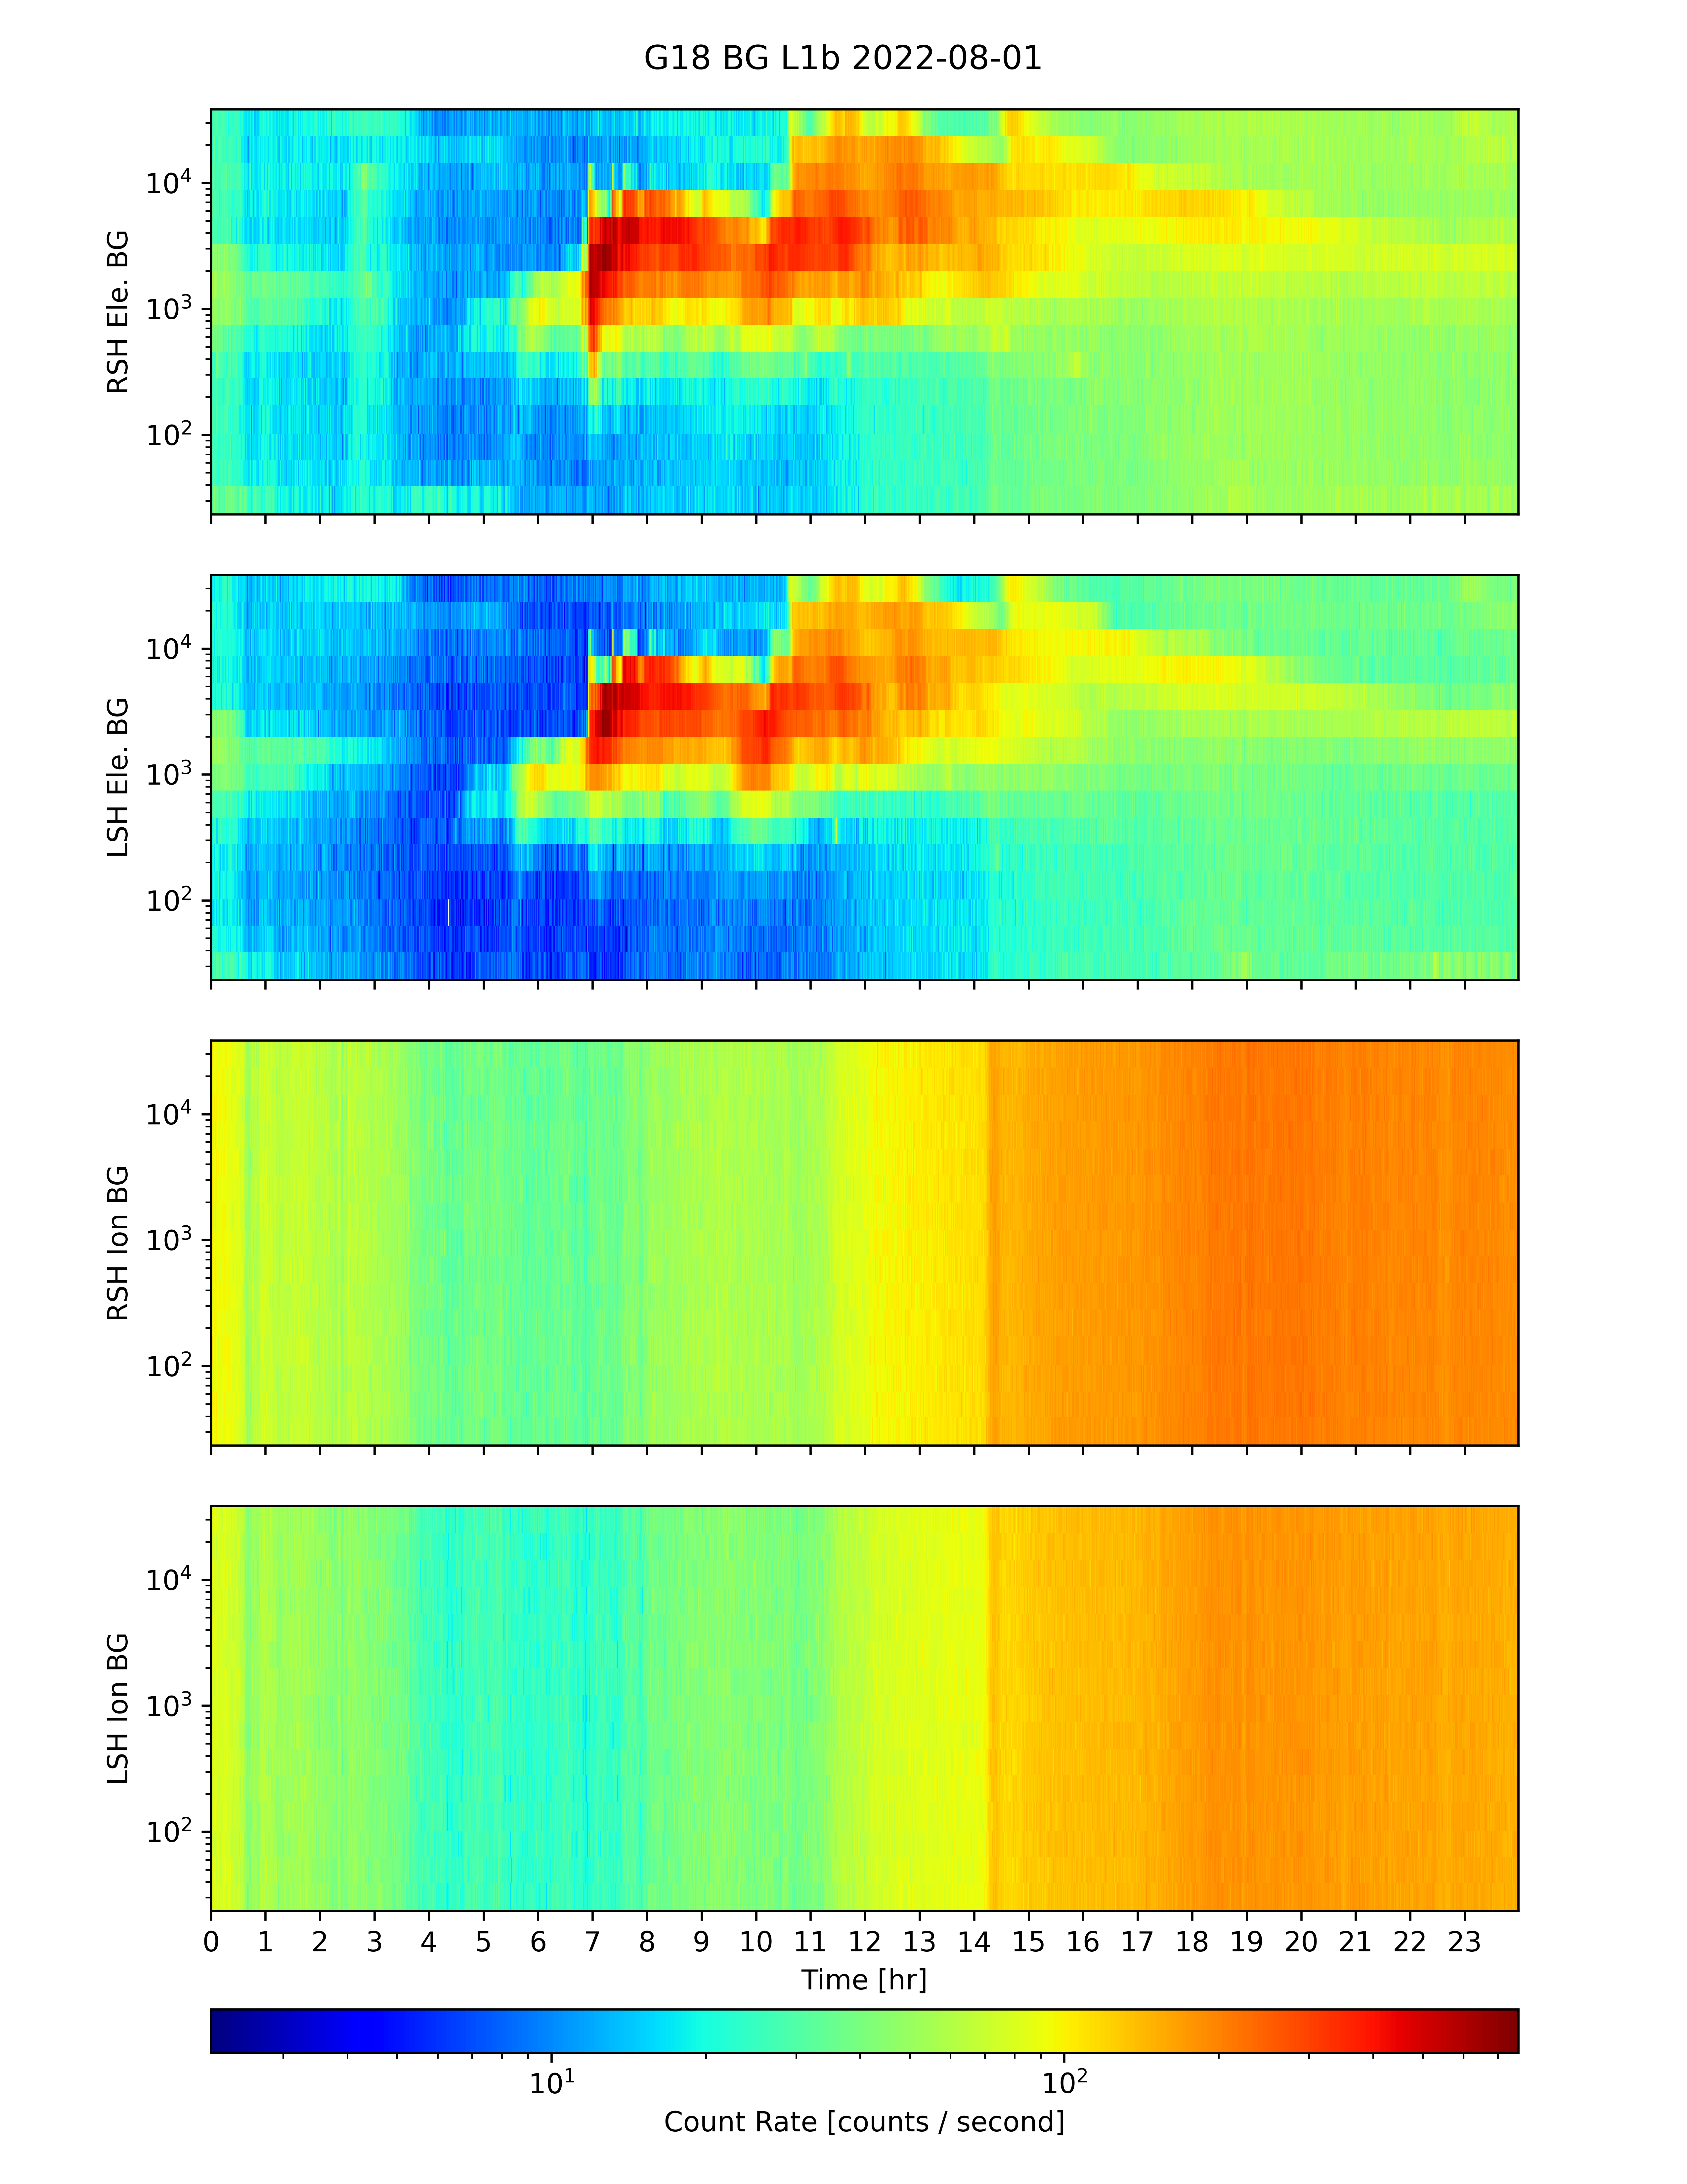
Crosstalk Between Zones Seen in G18 MPS-LO Background Zones
G18 MPS-LO Backgrounds 2022/08/01
Crosstalk is apparent in energy-sweep dependent count rates in electron background zones in on-orbit data. (Counts from penetrating radiation/particles should be independent of energy-sweep.)
Right sensor head
electron background zone
Energy-sweep dependent crosstalk from illuminated zones
Left sensor head
electron background zone
Right sensor head
ion background zone
Energy-sweep independent backgrounds from penetrating radiation
Left sensor head
ion background zone

Slide 25
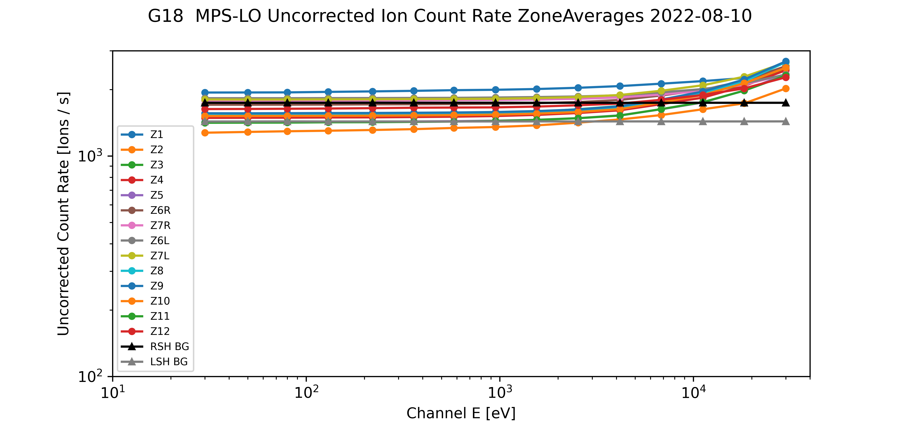
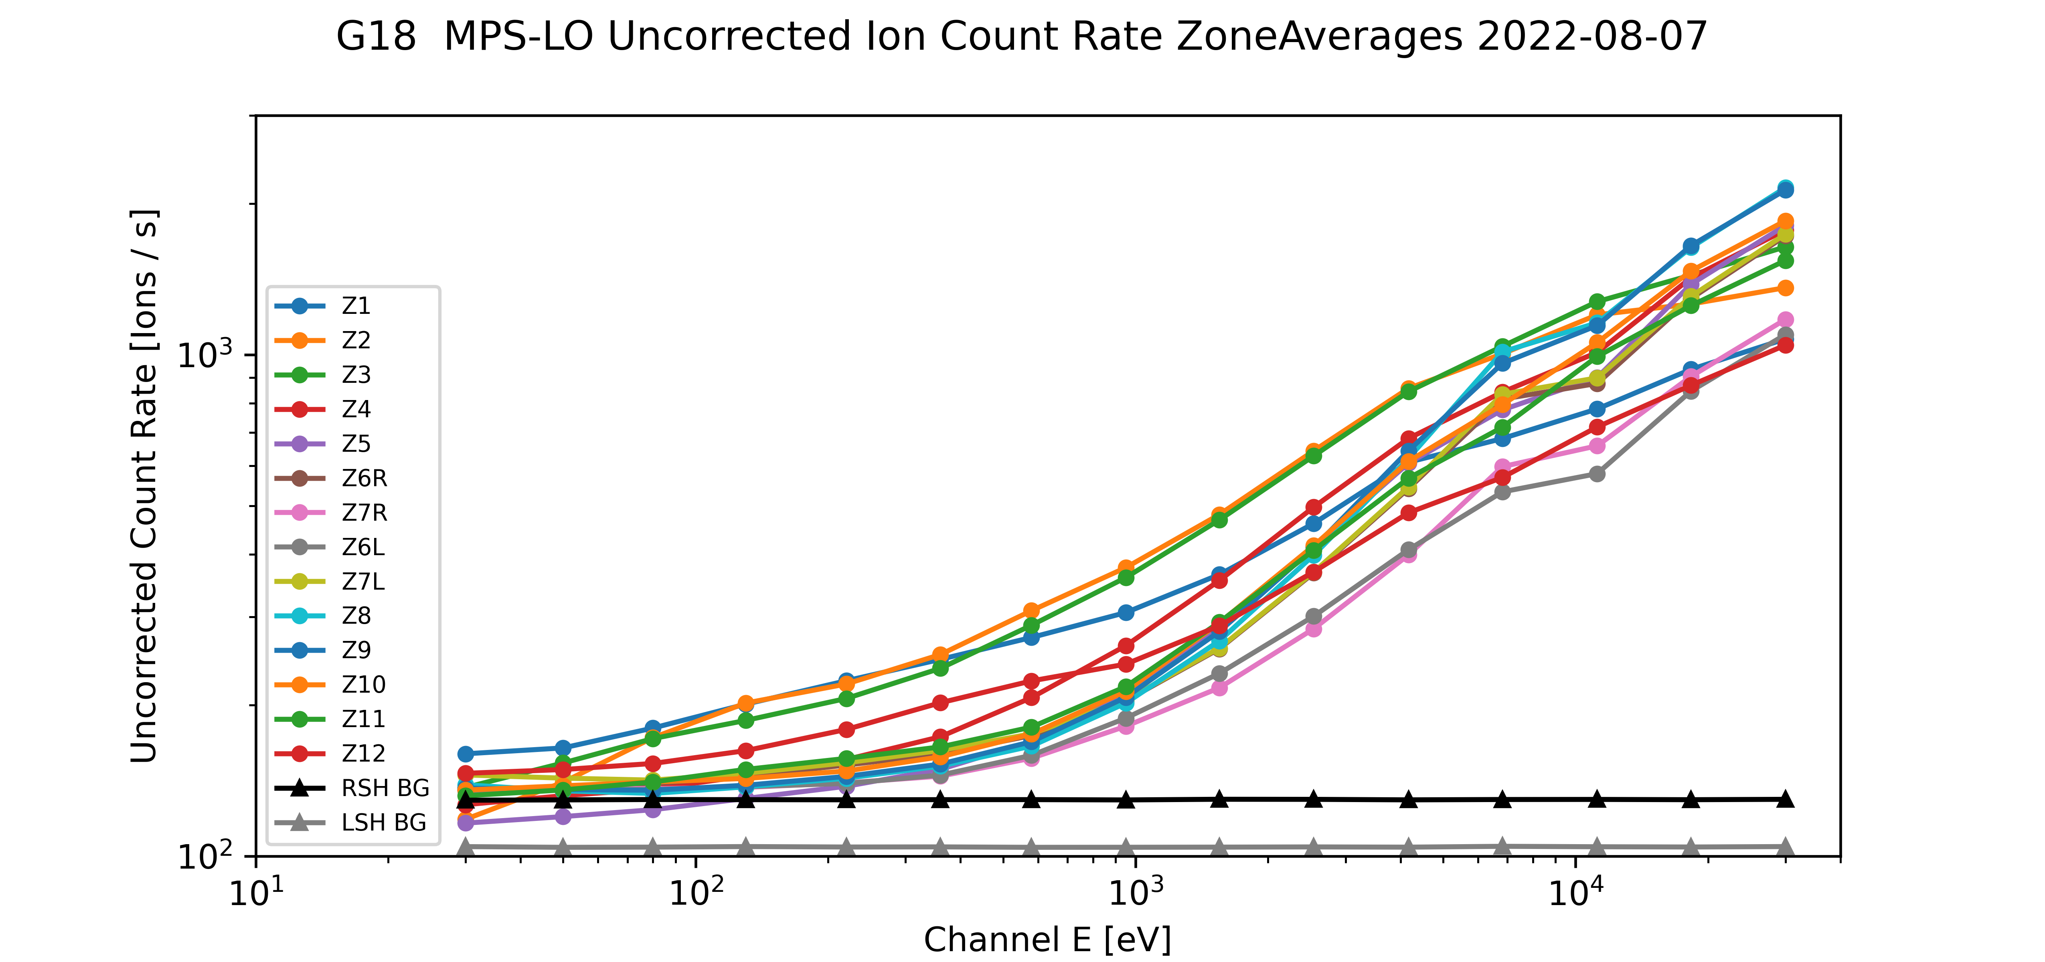
Effect of High Backgrounds on Low Energy Ions Measurement
Energy independent count rate at lower energies dominated by background counts.
Signal to background ratio low on days when backgrounds are high.
Similar result for G16 and G17 MPS-LO
This is an instrument issue due to unexpectedly high background rates. There is no known resolution.
High radiation belts
(high backgrounds)
Moderate geomagnetic storm day
(elevated ions)

Slide 26
  MPS-LO Full Post Launch Product Tests (PLPTs)
GOES-18 MPS-LO L1b Product Full PS-PVR

Slide 27
Path to Full Maturity - PLPTs
Title | Activity | Data Needed | Success Criteria
A.3.3 MPS-LO Zone Cross-Comparison [PLPT-SEI-003] | Evaluate PADs, determine relative sensitivity/response among MPS-LO zones, and calculate inter-calibration factors for Z6L/Z6R and Z7L/Z7R for all 15 energies and for both electrons and ions. | Three months of continuous data. | Zones agree to within 25% absent spacecraft charging similar to or greater than channel energy.
A.3.5 Cross Satellite Comparison of Trapped Particles [PLPT-SEI-005] | Inter-calibrate MPS-LO with the same measurements on other operational GOES-R Series satellites. | Three months of continuous data. | Differences quantified on data taken through validation phase.
A.3.6 Backgrounds Trending [PLPT-SEI-006] | Trend daily/weekly minima from MPS-LO ion and electron background zones | Four months of continuous data. | Perform analysis during validation phase.
MPS-LO Full PLPTs from RIMP v 2.0 (09 July 2021)

Slide 28
MPS-LO PLPTs Supporting
Full Maturity
PLPT-SEI-003 MPS-Lo Zone Cross-Comparison
PLPT-SEI-005 Cross satellite Comparison of Trapped Particles
PLPT-SEI-006 Backgrounds Trending
* Results from these full validation PLPTs will need to be applied to bring G18 MPS-LO into compliance with requirements.
PARTIAL PASS
PASS
PASS

Slide 29
PLPT-SEI-003: MPS-LO Zone Cross-Comparison – Method (1/4)
Compares fluxes measured by pairs of MPS-LO angular zones when central pitch angles (α) are the same or supplementary.
Under such conditions, zones should observe the same flux at the same energy
Steps:
  Input 1-min MPS-LO fluxes and pitch angles calculated from MAG BRF
  Identify whenever a pair of zones has pitch angles within 1 degree and pitch angles varying more slowly than 30 deg/minute
  Use supplementary angles of pitch angles > 90 degrees to have sufficient matches (assumes up- and down-going trapped fluxes are the same on a 1-minute timescale)
  Report observed fluxes for each pitch angle match
  Estimate scaling factors optimally based on set of all matches
B (magnetic field dir.)
Zone A look dir.
α
B
α
α
OR
α+90º
Zone A look dir.
Zone B look dir.
Zone B look dir.
Ref: Rowland, W., and R. S. Weigel (2012), Intra-calibration of particle detectors on a three-axis stabilized geostationary platform, Space Weather, 10, S11002, doi:10.1029/2012SW000816.

Slide 30
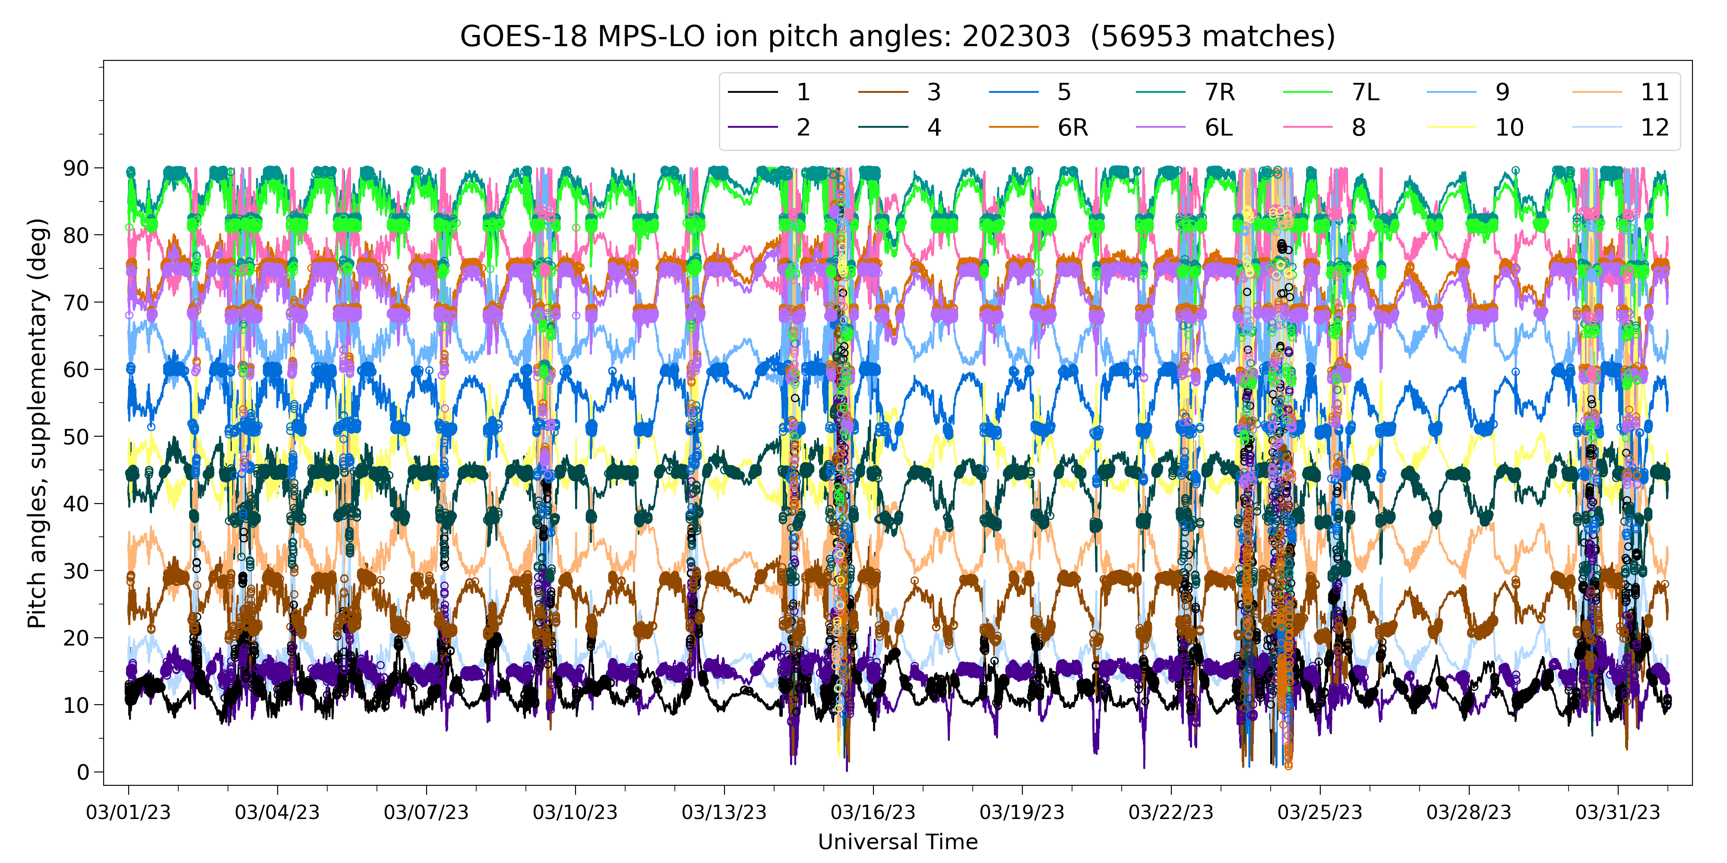
PLPT-SEI-003 – Method (2/4)
Example: Ion Pitch Angles, March 2023 (supplementary angles of p.a. > 90 deg)
90°
Zone
60°
30°
0°
Dots indicate pitch angle matches
1,000-10,000 matches per month per energy-zone pair

Slide 31

PLPT-SEI-003 – Method (3/4)
Use Nelder-Mead method to minimize the following objective function: sum of squares of the following difference term (~30k terms [matches] in the sum per energy)
To reduce effect of statistical noise, use only matches where both fluxes correspond to at least 1000 counts/minute
A non-linear problem: need a good initial guess for the scale factors in order for the solution to converge
  1000-6000 iterations needed, depending on the energy and species
  2.5 (4.3) hours needed for three months, 14 zones, 15 energies of ions (electrons) on macOS 2.4 GHz 8-Core Intel Core i9
Because they are only valid in a relative sense, scale factors must be normalized – here, normalized to those of Zone 8 (arbitrary choice)
$$R\left(m\right)=\frac{{SF}_{i}\left(m\right)J_{i}\left(m\right)−{SF}_{j}\left(m\right)J_{j}\left(m\right)}{{SF}_{i}\left(m\right)J_{i}\left(m\right)+{SF}_{j}\left(m\right)J_{j}\left(m\right)}$$
Ref: Rowland, W., and R. S. Weigel (2012), Intra-calibration of particle detectors on a three-axis stabilized geostationary platform, Space Weather, 10, S11002, doi:10.1029/2012SW000816.

Slide 32
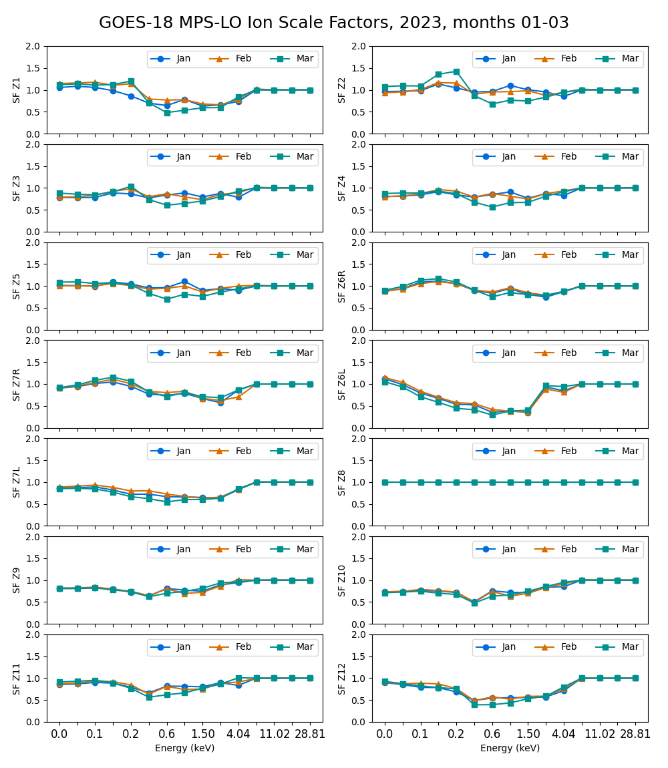
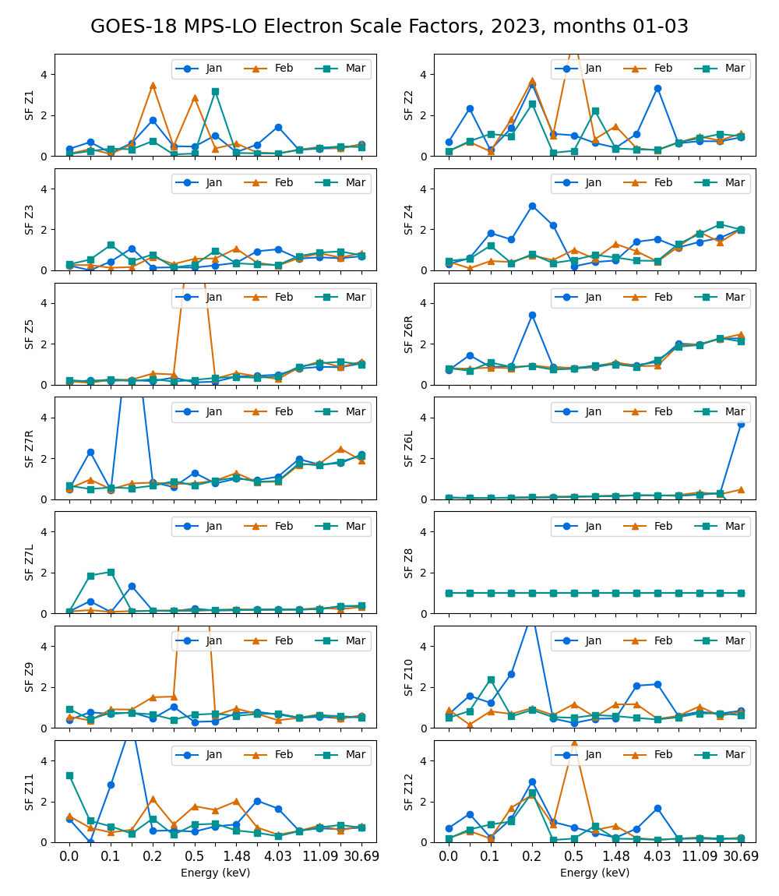
PLPT-SEI-003 – Scale Factor Results (4/4)
Multiplicative scale factors plotted vs. energy channel for each zone
Marginal consistency month-to-month indicates need to do this on a monthly basis
Large monthly deviations of the electron scale factors continues to be monitored

Slide 33
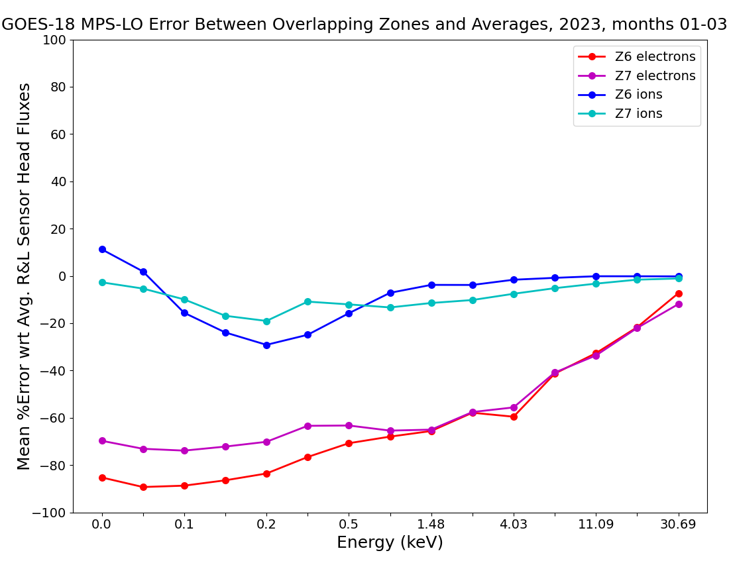
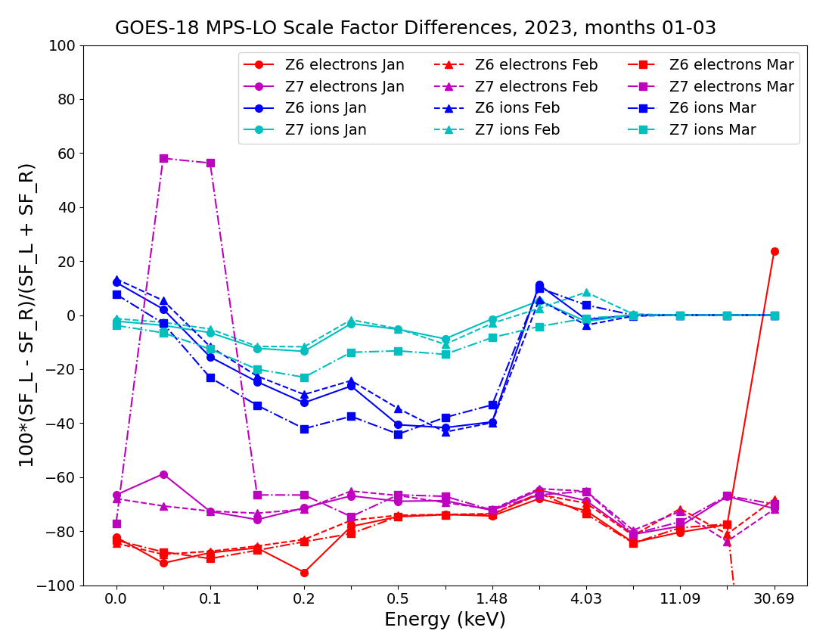
PLPT-SEI-003 – Overlapping Zones Comparison (Z6R/Z6L and Z7R/Z7L)
3-month mean of error of each overlapping zone with respect to average of overlapping pair
Error computed from Z6 and Z7 scale factors
determined with method described on previous slides
Using 3 months of 1 min. averaged fluxes, the percent error with respect to the avg. of the overlapping pair is calculated for each 1 min. Then, the mean value of errors is calculated.
The error computed by comparing fluxes from overlapping zones (left) is mostly in agreement with scale factor error described on previous slides (right), showing verification of results by an independent method.
Success Criteria (RIMP): Zones agree to within 25% absent spacecraft charging similar to or greater than channel energy.
PARTIAL PASS

Slide 34
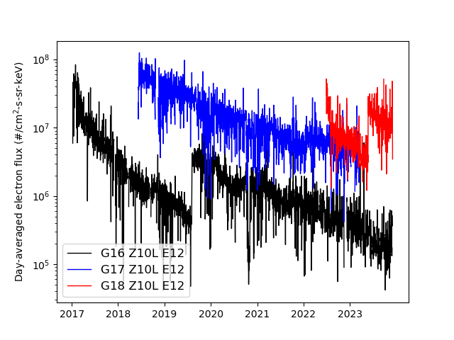
PLPT-SEI-005: Cross Satellite Comparison of Trapped Particles
Comparison of G16, G17 & G18 MPS-LO Z10 E12 fluxes
G16 drift 89.5º to 75.2ºW GOES West
G17 drift 89.5ºW to 137.2ºW GOES East
G18 drift 89.5º to GOES west location
Long term trending of day-averaged MPS-LO fluxes show steady non-geophysical decline.
Similar orders-of-magnitude decline is seen in all electron zone-energy channels.
Ion zone-energy channels show significantly less decline (420 analogous ion and electron flux plots created, available on request).
Steady decline in MPS-LO response since launch makes cross-comparison analysis ineffective.
G16 EMCP changed from step 25 to 26 on 2019-08-06 13:56:00 UT.
G18 EMCP changed from step 24 to 25 on 2023-05-25 14:27:00 UT.

Slide 35
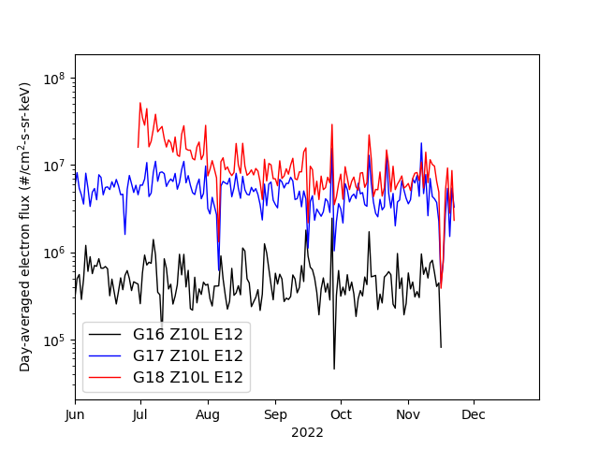
PLPT-SEI-005: Cross Satellite Comparison of Trapped Particles
Comparison of G16, G17 & G18 MPS-LO Z10 E12 fluxes
Similar timing of flux variations
Note similar variations in G17 and G18 MPS-LO Z10 E12 fluxes, but initially rapid decline in G18 reported fluxes

Slide 36
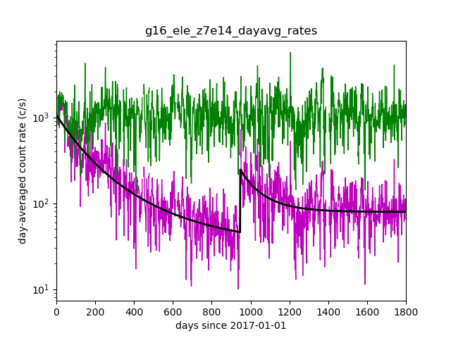

In Development Correction of
MPS-LO MCP Gain Decline (1/2)
Analysis to determine corrections for each zone-energy channel:
  Nonlinear fit (black trace) to: $\log_{10}({rate)=Ae^{−DOY/τ}+c}$ (3 parameters)
  Dead-time corrected day-averaged count rate scaled up to fit at first light, i.e., Correction factor = fit(t=0) / fit(t)
G16 MPS-LO Electron Zone 7R, E15
    Assumes relatively steady long-term rates over several year period. (Figure on following slide shows this is a reasonable assumption at higher MPS-LO energies.
    Does not account for different MCP HV settings on-orbit and during ground/beam cal.
  Must recompute BG removal coefficients after applying corrections.
Corrected
Uncorrected
Two fits performed then forced to agree on 2019-08-06.

Slide 37
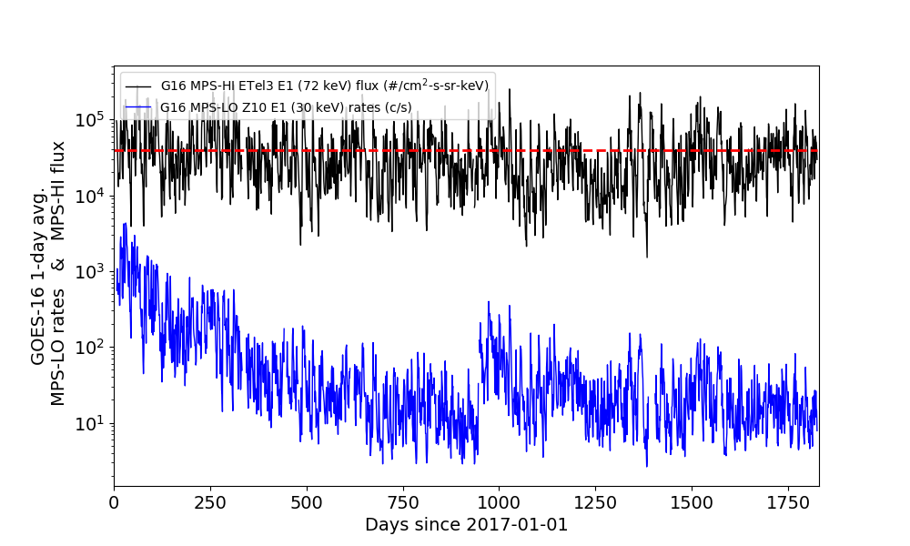
Compare G16 MPS-LO 30 keV and G16 MPS-HI 72 keV
Mean value
(Last day in plot is 2021-12-31)

Slide 38
In Development Correction of
MPS-LO MCP Gain Decline (2/2)
Some possible ways to constrain/modify fits include:
  Demand agreement between G16, G17 and G18 MPS-LO long-term flux variations
  Demand similar G16, G17 and G18 MPS-LO fits in like zone-energy channels
  Choose fits that force G17 and G18 fluxes to agree, while both are operating at GOES west location
  Reproduce long-term MPS-HI flux variations at highest MPS-LO energies
Requirements for implementation in L2 processing (used by SWPC)
  Set L1b background removal coefficients to zero to avoid convoluting background zone decline with in-band zone decline
  Include background zone count rates in L1b products to allow for post-ops background removal [current L1b: (2 species x 14 zones x 15 energies) to suggested L1b: (2x16x15)]
  Deploy NCEI MPS-LO MCP gain correction code and background removal to SWPC L2 product processing

Slide 39
PLPT-SEI-005: Cross Satellite Comparison of Trapped Particles: Summary
Previously: G16 & G17 MPS-LO Statistical Comparisons with Denton et al. [2015; 2016] model, based on 1990-2007 observations from the Magnetospheric Plasma Analyzer (MPA) instruments on-board seven Los Alamos National Laboratory (LANL) satellites at GEO (e.g., shown in G16/G17 Full Validation PS-PVR, slides 45 & 46).
Geophysically different eV-keV ion and electron flux levels at GOES East and West locations make direct comparisons between G16 and G18 MPS-LO units ineffective for determining relative responses.
Proximity of G17 and G18 warrant direct comparisons; however, decline in MCP gain in all MPS-LO units since launch (seen on previous slide) make G17 and G18 MPS-LO absolute cross-comparison analysis ineffective.
Corrections for decline in MCP gain are under development at NCEI.
Success criteria (RIMP): Differences quantified on data taken through validation phase.
PASS

Slide 40
PLPT-SEI-006:
Backgrounds Trending
Extensive analysis of G18 MPS-LO backgrounds were performed for empirical determination of BG removal coefficients (slides 15-22).
Ratio of G18 MPS-LO in-band to background response characterized with determination of background removal coefficients.
As shown in previous MPS-LO PS-PVR, the source of backgrounds is not fully understood (mainly radiation belt electrons, but at lower energies than expected).
  Simulations show that penetration of MPS-LO box by electrons should be limited >=MeV.
  Good correlation between MPS-LO backgrounds and 100s of keV electrons (400-800 keV).
The ion observations can be severely impacted during high background time periods due to low signal to noise ratio (slide 25).
In general, in-band and background zone responses have been gradually decreasing since launch (slide 34).
Success criteria (RIMP): Perform analysis during validation phase.
PASS

Slide 41
FULL MATURITY ASSESSMENT
GOES-18 MPS-LO L1b Product Full PS-PVR

Slide 42
Summary of G18 MPS-LO Instrument/GPA
Issues Identified and Resolution Status
High Backgrounds / Negative Fluxes
    Resolution: ADR 326 MPS-LO GPA Changes, ADRs 1277/1316 G18 MPS-LO LUT update, and empirical derivation of background removal coefficients by NCEI.
    BG removal coefficients will need additional updates and the source of backgrounds not fully understood.
Interzonal crosstalk
    Observed on-orbit with G16, G17, and now G18 MPS-LO.
    MPS-LO HV optimized to reduce crosstalk but a complete solution is not currently available.
Evidence for significant error in absolute values of reported fluxes (e.g., PLPT-SEI-003: MPS-LO Zone Cross-Comparison and PLPT-SEI-005: Cross Satellite Comparison of Trapped Particles)
    MCP decline has a significant impact on absolute values of reported fluxes.
    Gradual decrease in in-band and background zone response with time (seen on slide 34)
Degraded performance of lower energy ion channels due to persistent high backgrounds
  Previously studied on G16 and G17 with no resolution

Slide 43
GOES-18 MPS-LO
Performance Baseline Status
Assessment at Full PS-PVR
MRD ID | Description | MRD Requirement | MIT/LL Predicted Performance Baseline | NCEI Assessment at Full Maturity | Related PLPTs | Status
1987 | MPS-LO Orthogonality/ Coverage | 5 directions | 14 directions (zones) | 14 directions (zones) | -03 | PASS
1991 | MPS-LO Measurement Range | 30 eV – 30 keV (protons and electrons) | 30 eV – 30 keV | 0.025-30.8 keV (electrons) 0.030-30.0 keV/q (ions) [values from CDRL79] | -05 | PASS
1992 | MPS-LO Measurement Accuracy | 45% @min flux, 25% @10X min flux | 420 separate accuracies (2 species x 14 angles x 15 energies); Worst case for 10x min flux: Electrons: 23%; Ions: 20% Worst case for min flux: Electrons: 40%; Ions: 38% | Absolute accuracy cannot be verified on-orbit. Results of PLPT-03 and factor of ~5 decline in MCP response (in some zones) indicate that 25% relative accuracy not currently achieved on-orbit. | -03, -05, -06 | Results of PLPT-03, 05 and 06 will need to be applied

Slide 44
Full Validation Assessment
Preparation Activities | Assessment
Validation, QA, and anomaly resolution activities are ongoing. | Validation activities are ongoing and any results will be discussed with SWPC. Research community participation is ongoing.
Incremental product improvements may still be occurring. | Continued analysis and updates of the NCEI empirical background removal coefficients.
Users are engaged and user feedback is assessed. | Yes, product improvements will result from steps to mitigate known and yet to be discovered anomalies.
GOES-R product maturity level preparation activities from RIMP v2.0. Responsible Organization: GOES-R GOES-R Program/Code 410

Slide 45
Full Validation Assessment
End State | Assessment
Product performance for all products is defined and documented over a wide range of representative conditions via ongoing ground-truth and validation efforts. | G18/FM3/SN104 MPS-LO ground/beam calibrated. Performance tests included in full maturity PLPT results
Products are operationally optimized, as necessary, considering mission parameters of cost, schedule, and technical competence as compared to user expectations. | Yes, to the limited extent that absolute accuracy can verified on-orbit.
All known product anomalies are documented, and shared with the user community. | A complete description of known anomalies will be included in readme file with release of data to public.
Product is operational. | Yes
GOES-R product maturity level preparation activities from RIMP v2.0. Responsible Organization: GOES-R GOES-R Program/Code 410

Slide 46
SUMMARY & RECOMMENDATIONS
GOES-18 MPS-LO L1b Products Full PS-PVR

Slide 47
Summary
The G18/FM3 MPS-LO anomalies identified that negatively impact performance:
  High Backgrounds / Negative Fluxes – Addressed by ADR 326 MPS-LO GPA Changes, ADR 1277 and ADR 1316 G18 MPS-LO LUT Update, and empirical derivation of background removal coefficients by NCEI. Background removal coefficients will need additional updates.
  Interzonal Crosstalk – Observed in energy-dependent background count rates on-orbit.
  Evidence for significant error in absolute values of reported fluxes (e.g., PLPT-SEI-003: MPS-LO Zone Cross-Comparison and PLPT-SEI-005 Cross satellite Comparison of Trapped Particles) – Geometric factors will need periodic adjustment.
MPS-LO uses the ion-line to identify SC charging and quantify the level of charging. If an ion line is not present, MPS-LO L2 processing uses an empirical relation between densities, temperatures, and level of charging to monitor SC charging.
Densities and temperatures from L2 processing will be affected by error in absolute values of reported fluxes, but the empirical relation used to determine level of charging from density and temperature (yet to be determined for MPS-LO) will compensate for errors in absolute value of reported fluxes.
G18/FM3 MPS-LO is currently performing as needed to fulfill an intended operational use, i.e., identifying SC charging and level of charging.
A path to achieving accurate fluxes and moments has been identified (on following slide).

Slide 48
Recommendations
NCEI recommends G18 MPS-LO L1b data for transition to Full Validation status.
    Continue performing MPS-LO HV optimization procedure every 6 months. (Initial ATC recommendation to perform HV optimization every 6 months – May modify to once per year as MCPs stabilize.)
Monitor effect of changes in HV setting on observed count rates.
Background removal coefficients will need to be updated regularly. We recommend performing empirical determination of background removal coefficients and MPS-LO LUT update following each HV optimization.
In-development NCEI MCP gain decline correction can be applied to SWPC L2 products if L1b products include background zone count rates as described on slide 38.

Slide 49
Recommendations Cont.
Scale geometric factors using results from [Full] PLPT-SEI-003 MPS-LO Zone Cross-Comparison to bring MPS-LO zones into agreement. The Zone Cross-Comparison procedure should be repeated periodically to check for agreement among MPS-LO zones and scale geometric factors as needed.
Perform careful comparisons with current data from other missions (e.g., LANL MPA), to insure quality of data for science community and support space weather modeling and prediction at SWPC. This activity is included in [Full] PLPT-SEI-005. This will provide scaling of geometric factors needed to correct error in absolute values of reported fluxes.
Empirically determined parameters used in the SEISS Level 2 Density and Temperature Moments and Level of Spacecraft Charging algorithm need to be tailored to MPS-LO.
MPS-LO is NOAA’s first plasma instrument on GOES –
We need to take special care!

