Slide 1
Peer Stakeholder-Product Validation Review (PS-PVR) For the Full Maturity of GOES-18 SEISS SGPS L1b Product
September 13, 2023
GOES-R Calibration Working Group (CWG)
Presenter: Brian Kress
Contributors: Athanasios Boudouridis, Trevor Leonard, Juan Rodriguez, Kevin Hallock, Katherine Pitts, Jon Fulbright
NOAA NCEI / CIRES

Slide 2
Outline
SGPS Overview
Review of Provisional Maturity Assessment
Product Quality Evaluation
SGPS PLPTs Supporting Assessment for Full Status
Full Maturity Assessment
Summary and Recommendations

Slide 3
SGPS OVERVIEW
GOES-18 SGPS L1b Product Full Validation PS-PVR

Slide 4
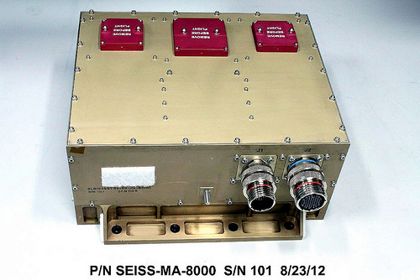
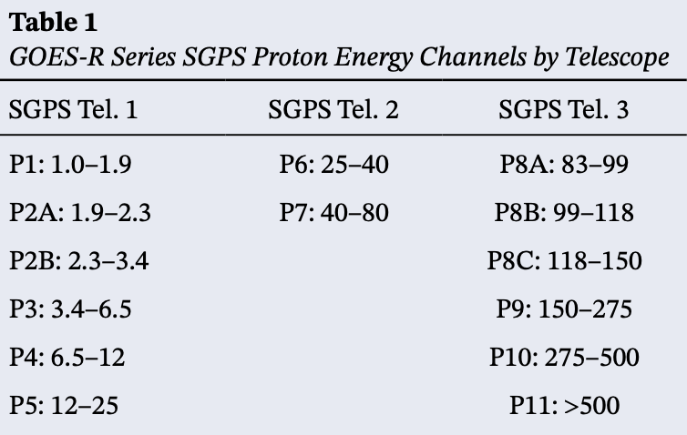
Space Environment In-Situ Suite (SEISS) Solar and Galactic Proton Sensor (SGPS)
2 Units, one looking East (+X) and one West (-X)
3 solid state telescopes on each unit
1-500 MeV protons in 13 differential channels, plus >500 MeV integral channel
4-500 MeV alphas in 12 energy channels
T1
T3
T2
Channel energies in MeV
GOES-18 SEISS sensors turned on 25 April 2022
SEISS SGPS designed, built, tested and calibrated by Assurance Technology Corporation (ATC)

Slide 5
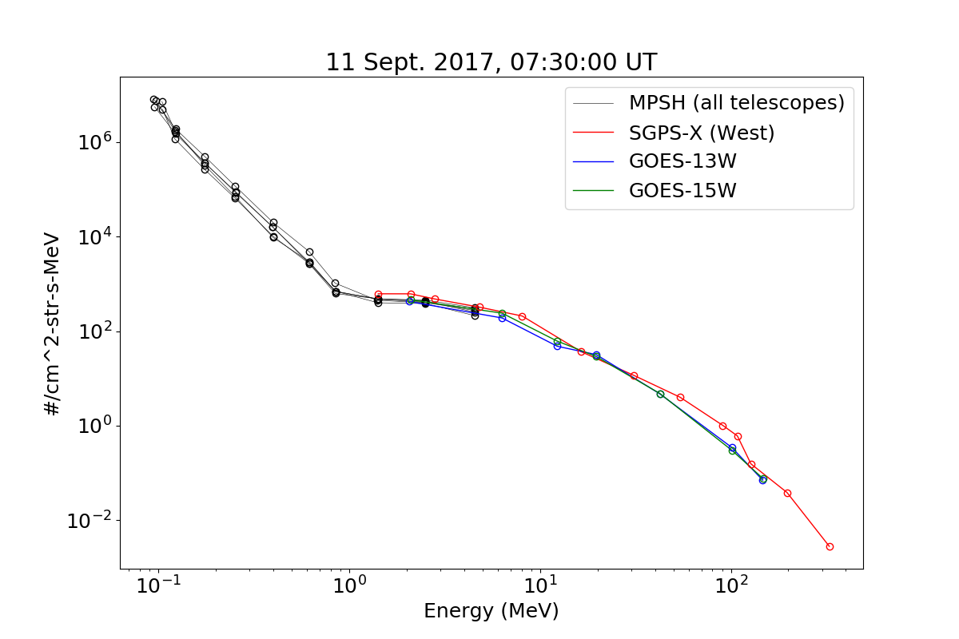
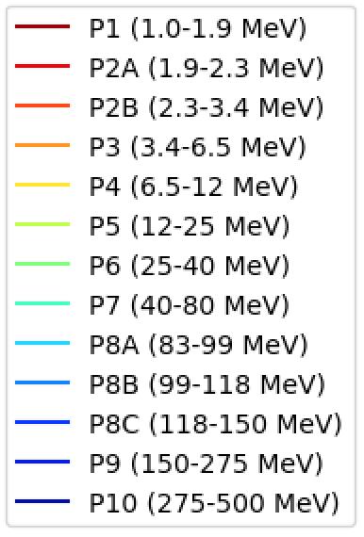
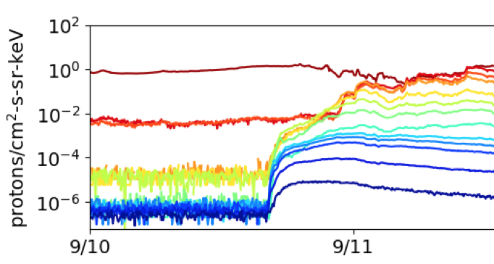
Introductory Material: Space Particle Data Units and Plotting
Two types of units typically used for SEP fluxes
Differential flux: particles / (cm²-s-steradian-MeV)
Integral flux is integrated in energy, above some threshold energy:
j _{>10 MeV}$[particles / (cm2−s−sr)] = \int_{10 MeV}^{∞}{ j_{differential}}dE$
SEP event fluences are also sometimes reported: particles / (cm²-sr-MeV)
Common presentation formats
Energy spectrum (flux vs. energy)
(at some time snapshot)
Timeseries data
5m averaged spectra from GOES-13 and -15 EPS and
GOES-16 SGPS and MPS-HI during Sept. 2017 GLE.

Slide 6
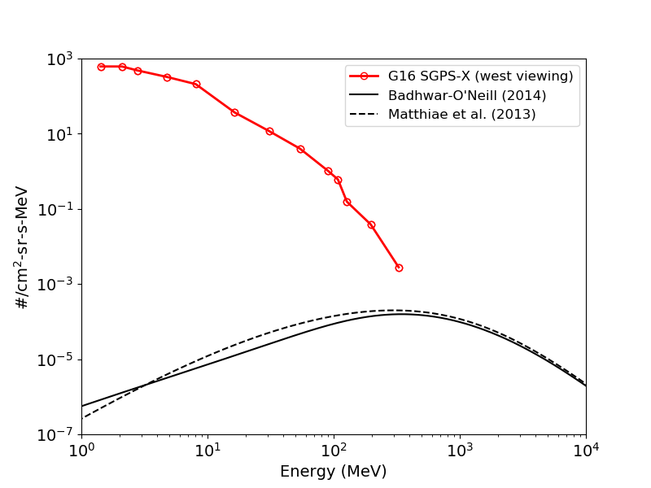
Introductory Material: Energetic Ions In Space
Solar Energetic Particles (SEPs)
Produced during Solar Particle Events (SPEs) lasting one to several days.
Cause heightened levels of harmful radiation in space
Approximately 50 - 100 SPEs per 11 yr. solar cycle
Mostly < 500 MeV protons
P1
P2A,B
P3
P4
P5
P6
P7
10-14 Sept. 2017 Solar Particle Event
(at 7:30 UT on 9/11)
P8A,B,C
P9
Galactic Cosmic Rays (GCRs)
Thought to originate from supernovae and galactic nuclei.
Always present in space
Energies up to and > 10¹¹ GeV
Flux peak ~400 MeV
≈ 99.5% H & He
P10
GCR models

Slide 7
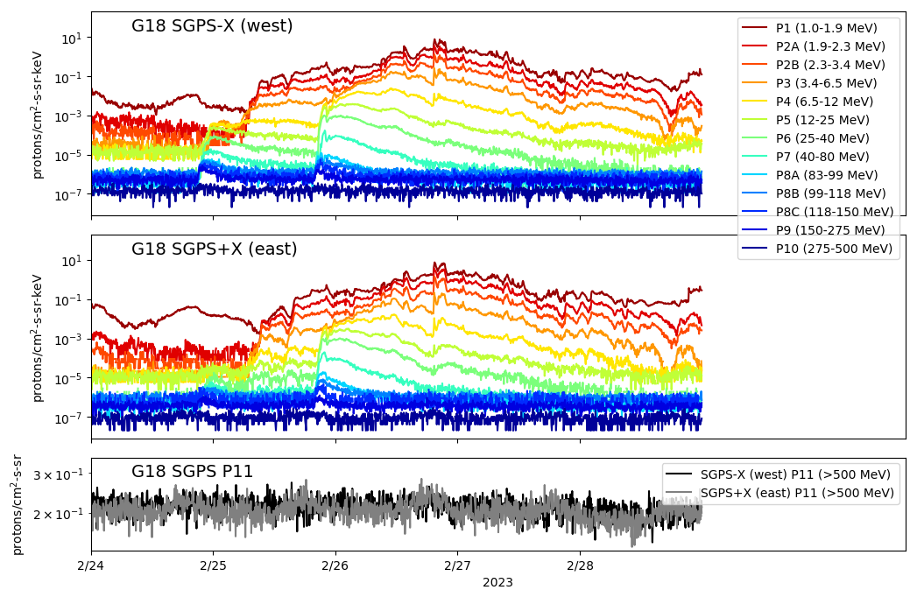
SGPS 5m Averaged L1b Proton Fluxes From 24-28 Feb. 2023 Solar Particle Event
Little to no enhancement in SGPS P10 during this event
Diurnal Temperature dependent fluctuations in some SGPS+X T3 channels
M3.7 flare
at 20 UT
M6 flare
at 21 UT
SGPS-X and +X differential proton channel fluxes (26 channels) shown in upper 2 panels.
SGPS-X and +X integral proton channels (>500 MeV) fluxes shown in lowest panel.

Slide 8
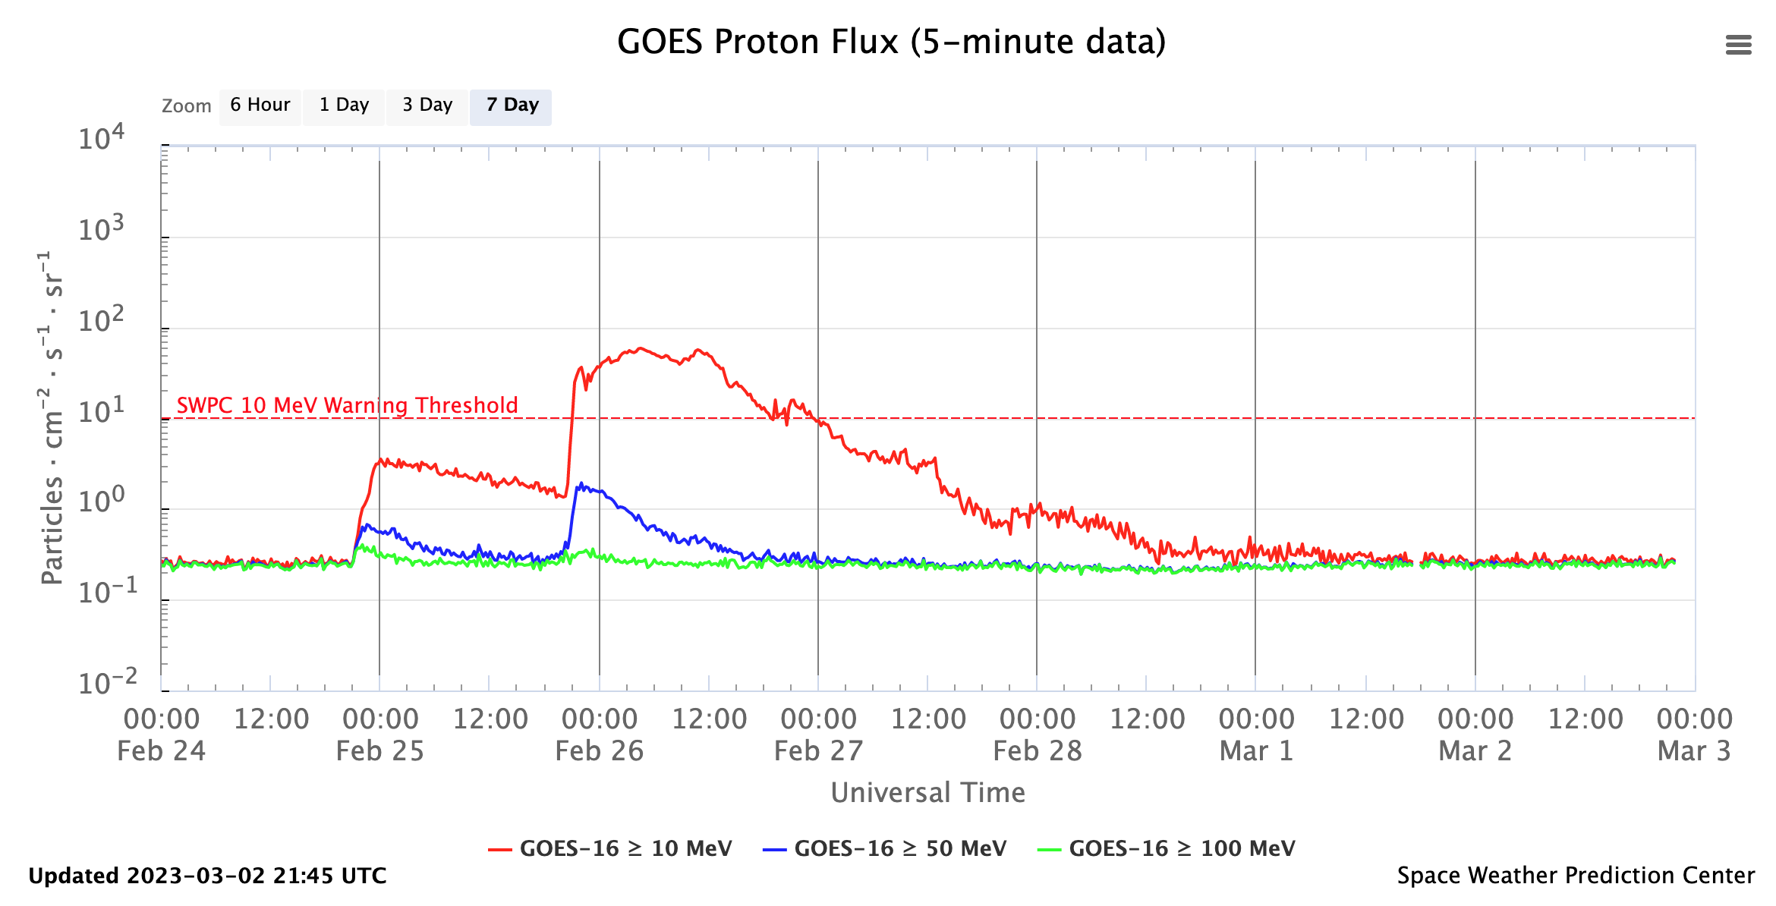
SGPS Primary Operational Use
Real-time integral solar proton fluxes from the NWS Space Weather Prediction Center’s (SWPC’s) public web page (https://www.swpc.noaa.gov/products/goes-proton-flux).
The original GOES 1-15 Energetic Particle Sensor (EPS) (1975-2020) was primarily intended to monitor the radiation hazard to spacecraft systems and humans in space from 10 to 100s of MeV protons produced during solar proton events (SPEs).

Slide 9
SGPS Primary Operational Use
Data stream for NOAA-NWS SWPC Solar Proton Event Detection and Radiation Storm Alerts
Level 1b
Level 2
1 sec.
The NOAA Space Weather Scales communicate to the general public current and future space weather conditions and possible effects on people and systems.
Numbered levels, analogous to hurricanes, tornadoes, and earthquakes that convey severity.

Slide 10
REVIEW OF PROVISIONAL MATURITY G18 SEISS Provisional PS-PVR, September 13, 2022
GOES-18 SGPS L1b Product Full Validation PS-PVR

Slide 11
Instrument/GPA Issues Identified and Resolution Status (Presented at 9/13/22 G18 SGPS Provisional PS-PVR – Current status updated in yellow and red text)
No G18 SGPS specific instrument or GPA issues have been identified that are independent of general GOES-R series SGPS issues:
ADR 517, small but routine L1b gaps – Closed.
SGPS P5 overcorrection (L1b processing/LUT issue) – Addressed by ADR900, Closed.
Electron contamination in G18 SGPS-X and +X P5 – Instrument issue, contamination found to be very small with respect to a moderate SEP event – No correction needed.
Temperature dependent fluctuations in G18 SGPS+X T3 channels – Correction implemented in L2 processing. Analysis to generate table of coefficients needed for G18 SGPS+X.
Open ADRs/WRs (as presented at 9/13/22 G18 SGPS Provisional PS-PVR)
ADR | WR | Short Description | Status | Expected Closure | 9/13/23 status
781 | 8404 | SEISS MPS-HI and SGPS L1b data gaps near IFCs part 2 | Work completed – To be implemented in DO.12.00.00 | DO.12.00.00 | Expect closure of fix-fail in DO.13.00.00
863 | 6736 | Graceful degradation when SGPS data from opposite looking unit not generated | In Analysis | Flight Analysis High Priority; Correction may be later | In Analysis
1025 | 7579 | Implement SGPS He processing in L1b | In operations Fix-fail in-work | DO.11.00.00 (Oct. 2022) | Closed

Slide 12
Excerpts from 9/13/22 G18 SGPS Provisional PS-PVR Summary and Recommendations
G18 T1 and T2 channel measurements in general compare well with G16 and G17 T1 and T2 channel measurements.
There has not been a solar particle event since G18 launch [up to 9/13/22] with sufficient enhancement at energies >80 MeV to verify that SGPS T3 channels are performing well.
G18 SGPS T3 background count rates are nominal.
In general, PLT and PLPT results indicate that G18 SGPS is performing similarly to the G16 and G17 SGPS units.
NCEI recommends G18 SGPS L1b data for transition to provisional status with the caveat that G16 SGPS be relied on for Solar Particle Event (SPE) Detection until analysis of G18 SGPS T3 is performed.
G18 SGPS L1b was transitioned to Provisional quality status on 9/13/22

Slide 13
PRODUCT QUALITY EVALUATION
GOES-18 SGPS L1b Product Full Validation PS-PVR

Slide 14
SGPS PLPTs Supporting Full Maturity
PLPT-SEI-001 D3-D1 Contamination Correction
PLPT-SEI-006 Backgrounds Trending
PLPT-SEI-004 SEP Channel Cross-Comparison

Slide 15
PLPT-SEI-001 SGPS D3-D1 Contamination Correction
D3-D1 circuit designed to reject rear-entry protons
GCR counts accumulated over ~45 day intervals with D3-D1 circuit on/off
SGPS+X P7 on counts/day = 823.49
SGPS+X P7 off counts/day = 1471.9
on/off ratio = 0.56
SGPS-X P7 on counts/day = 1164.9
SGPS-X P7 off counts/day = 1966.7
on/off ratio = 0.59
SGPS+X P8C on counts/day = 725.68
SGPS+X P8C off counts/day = 1088.9
on/off ratio = 0.67
SGPS-X P8C on counts/day = 1980.8
SGPS-X P8C off counts/day = 4306.1
on/off ratio = 0.46
In summary, P7 GCR rates drop by $≈$0.6 when d3-d1 circuit is turned on, which is consistent with expected performance.
PASS

Slide 16
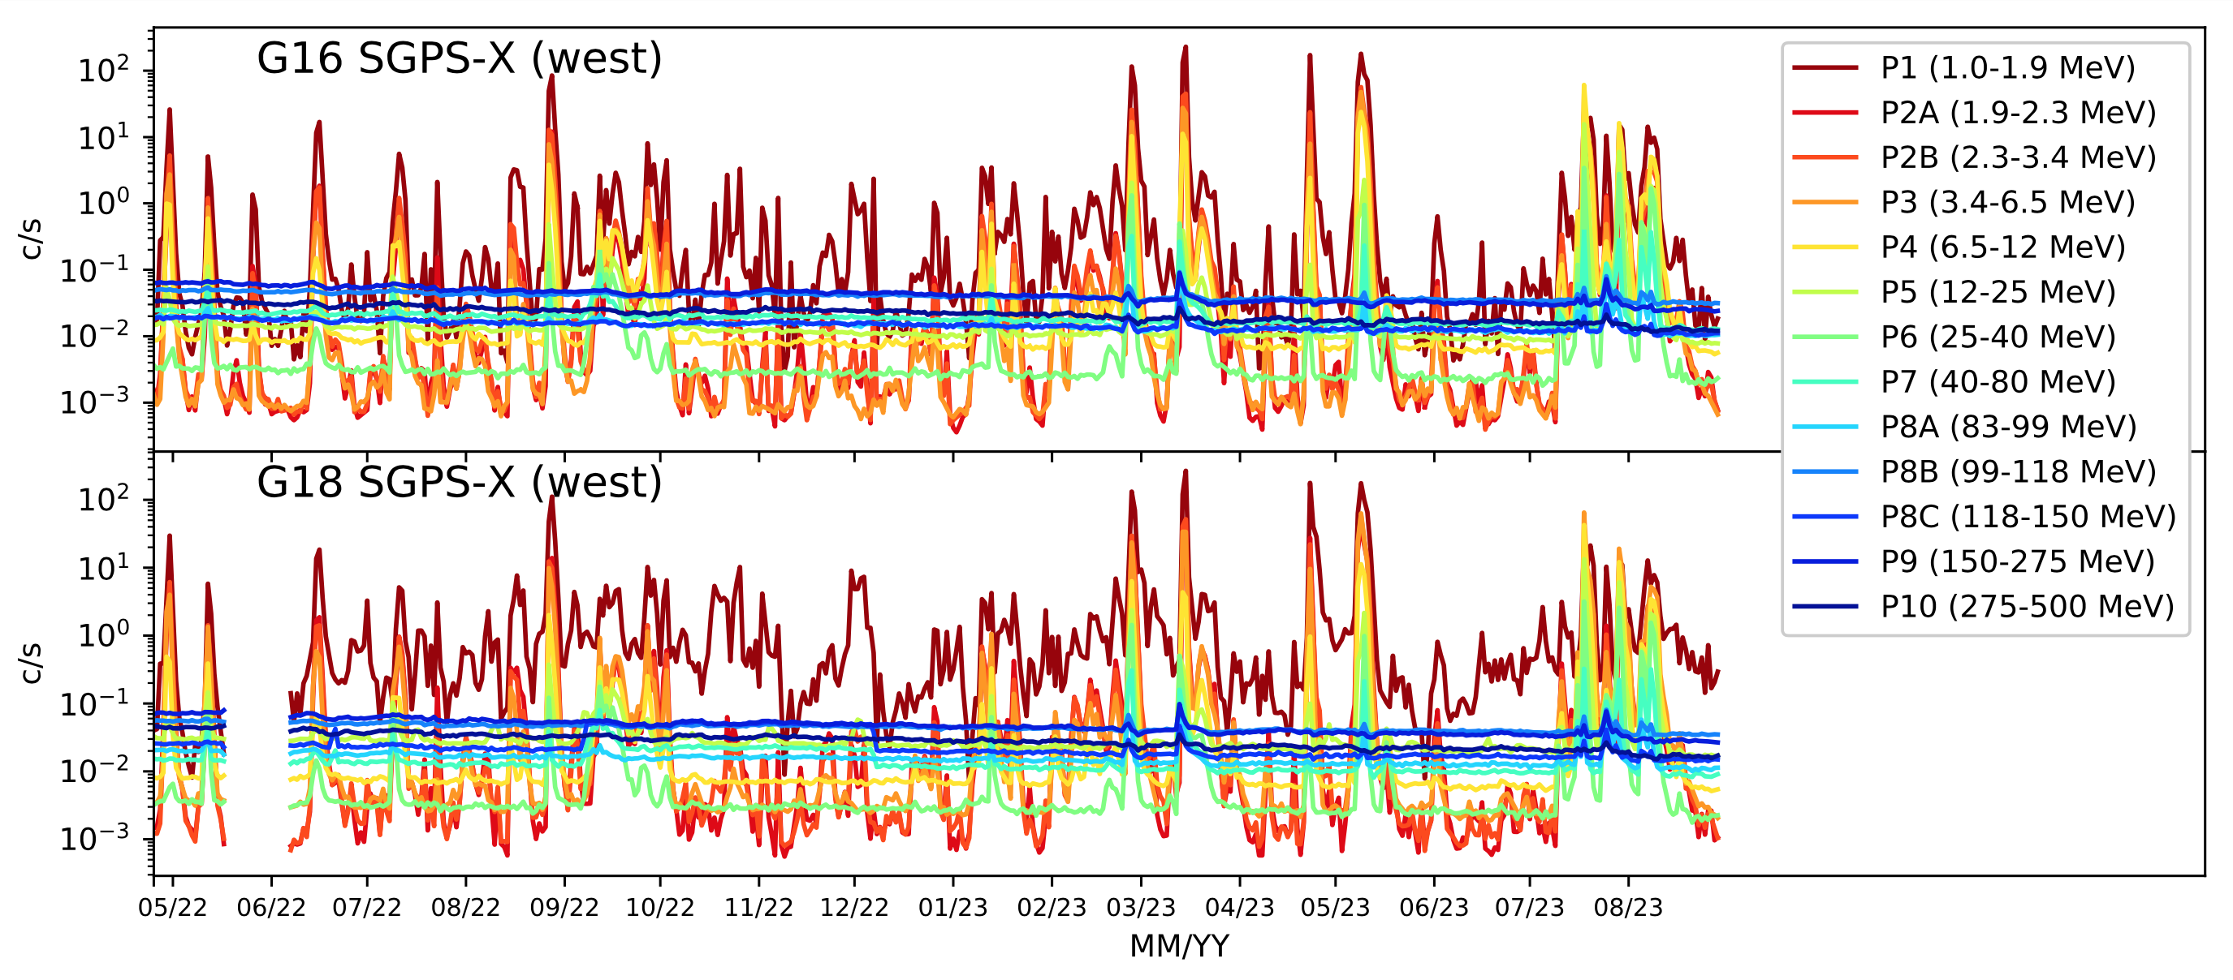
PLPT-SEI-006 Backgrounds Trending: G16 and G18 SGPS Background Rates
May 2022 – Aug. 2023 SGPS 1-day averaged L0 count rates
Drift to 137.2º W
T2 and T3 energy channels usually at background levels
G18 SGPS sensor activation on 4/25/2022
P1-P2B above background levels since G18 SGPS sensor activation.
T3 channels (dark blue traces) generally at background levels, w/ some enhancements in 2023.
Backgrounds trending PLPT yields results in family with G16.
PASS

Slide 17
PLPT-SEI-004 SEP Channel Cross-Comparisons (Next 6 slides)
GOES-18 SGPS L1b Product Full Validation PS-PVR

Slide 18
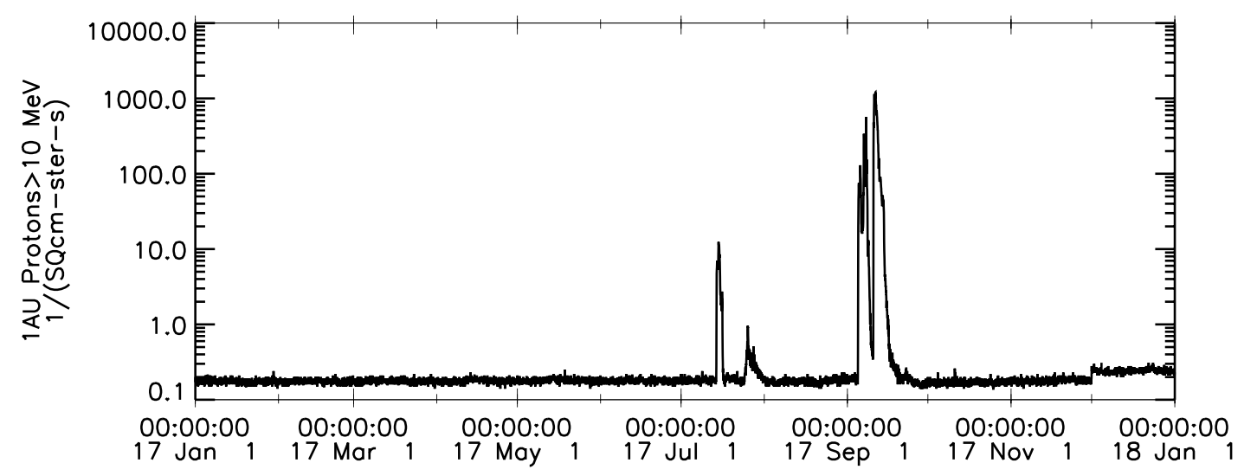
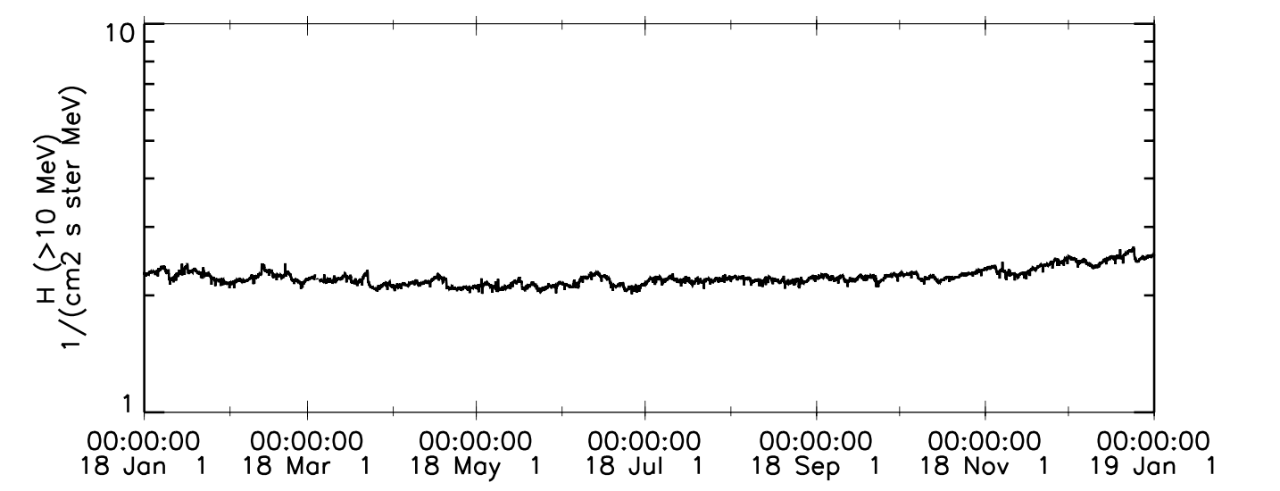
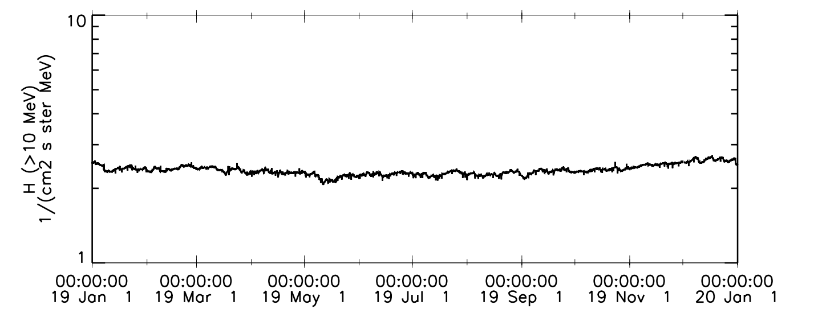
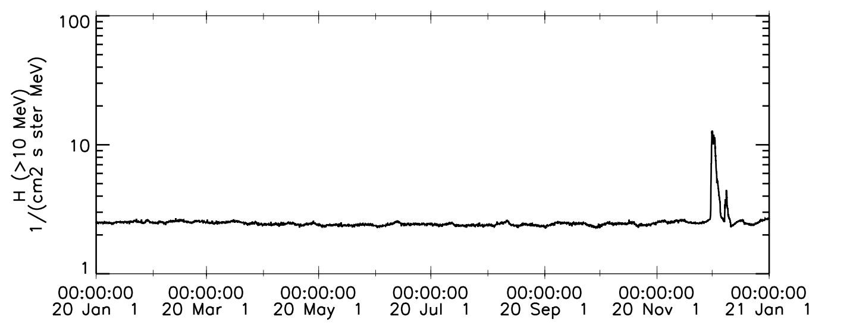
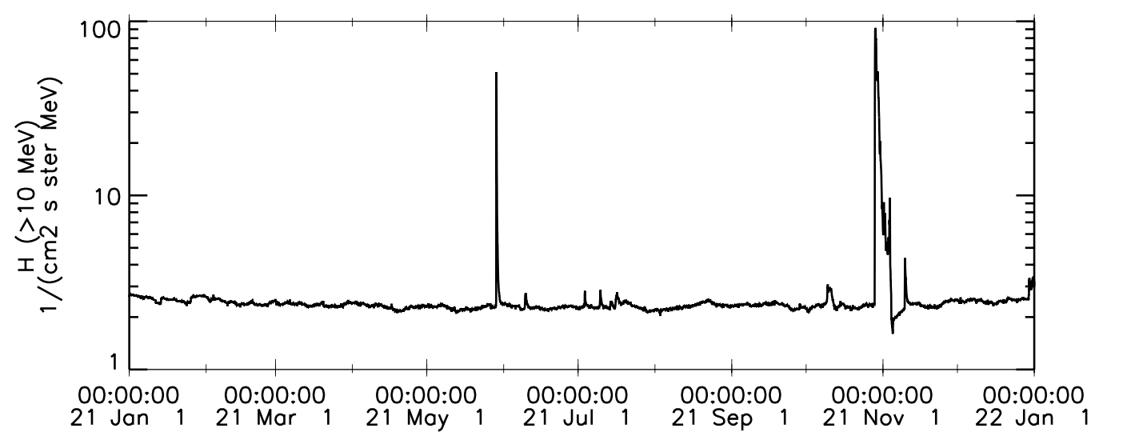
2017-2021 SEP Events
Advanced Composition Explorer (ACE) Solar Isotope Spectrometer (SIS) >10 MeV Protons
2017
Sept. 2017 SEP
Event (GLE 72)
2018
ACE SIS data from PI E. C. Stone
(CA inst. of technology) via CDAWeb.
July 2017 SEP
Event (Soft)
No >10 MeV events in 2018
2019
2020
No >10 MeV events in 2019
Nov-Dec 2020
SEP Event (Soft)
2021
Oct-Nov 2021
SEP event
(GLE 73)
May 2021
SEP Event (Soft)
Incorrect units on CDAWeb’s vertical axis in 2018-2023 plots, should be 1/(cm2 s ster)

Slide 19
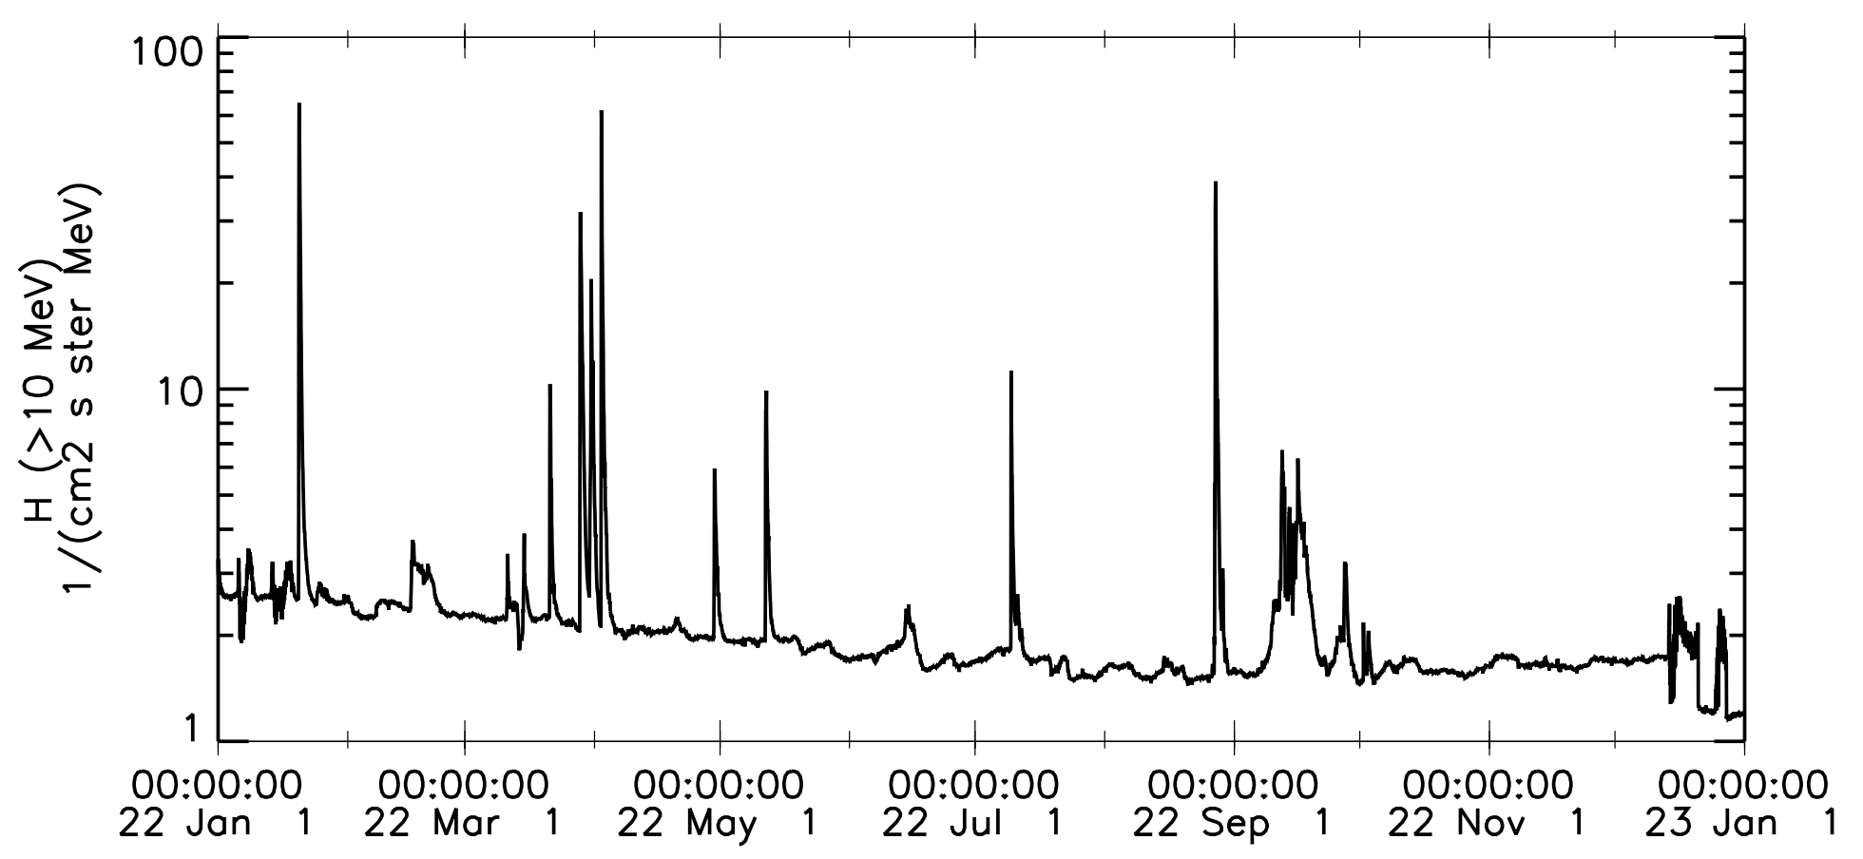
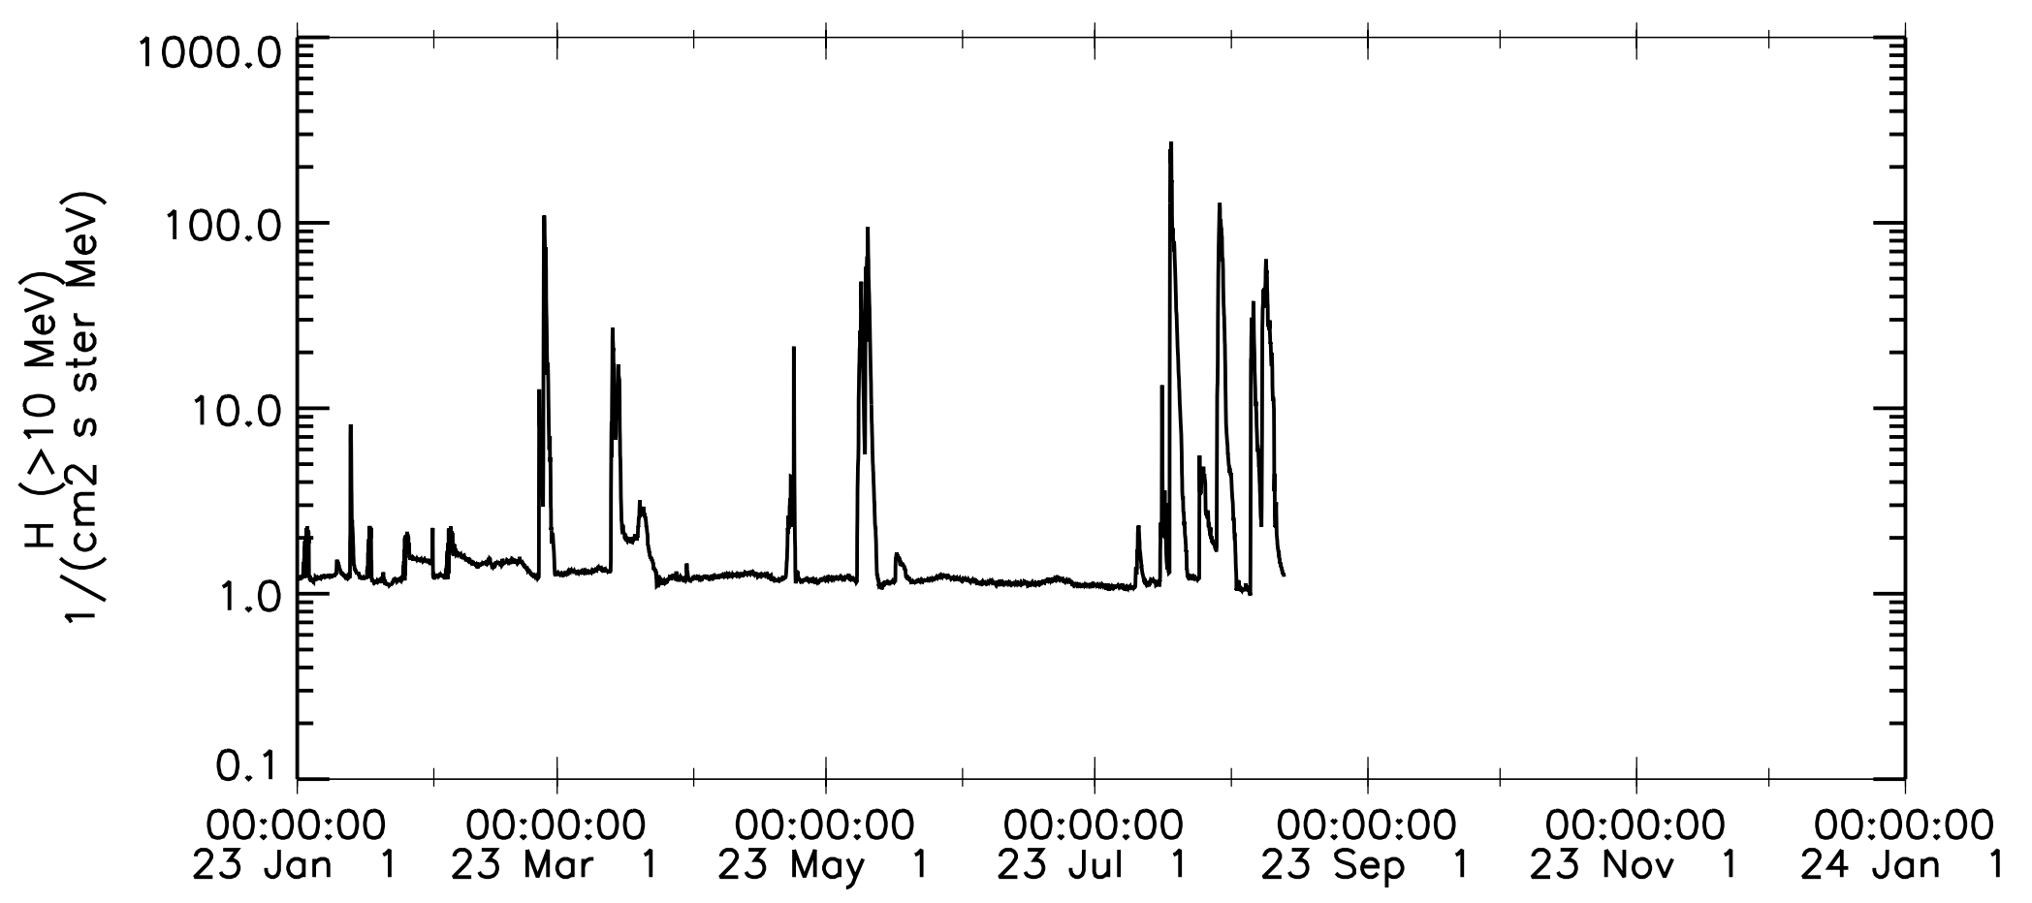
2022 & 2023 SEP Events
2022
G18 SEISS sensors turned on 25 April 2022
July event used for G18 SGPS Provisional PLPT-SEI-004 SEP Channel Cross-Comparison
(T1 & T2 only)
27-29 Aug.
Aug. event used for G18 MPS-HI and EHIS Provisional PLPT-SEI-004 SEP Channel Cross-Comparisons
All “soft” events in 2022, with elevated fluxes only in channels <= P7
(40-80 MeV)
11-13 May
9-11 July
29-31 April
13-20 Sept.
14-16 June
2023
8-12 May; T3 chans.
15-22 July, T3 chans.
24-28 Feb.
T3 chans.
24 July – 2 Aug., T3 chans.
5-12 Aug., T3 chans.
22-24 Apr.
T1 & T2 only
13-21 Mar.
T3 chans.
13-16 March and 25-27 July used for G18 SGPS Full Val. PLPT-SEI-004 SEP Channel Cross-Comparison of T3 channels

Slide 20
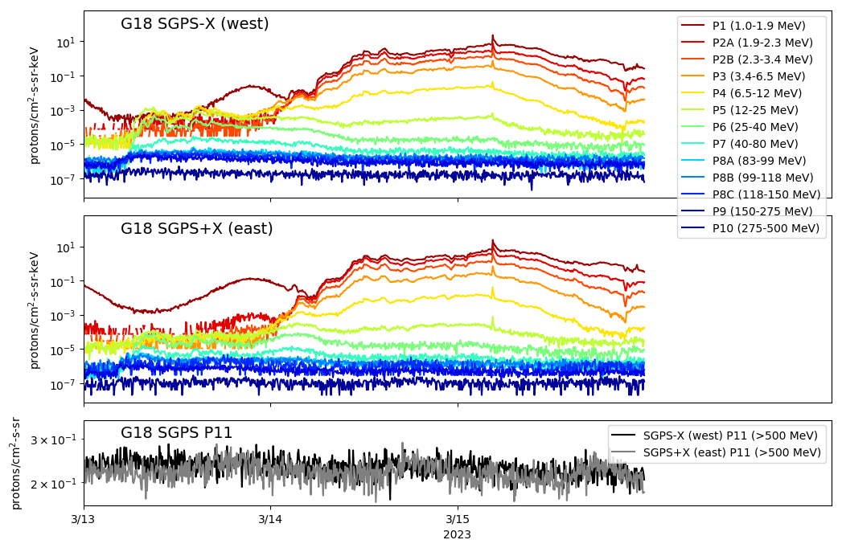
PLPT-SEI-004 SEP Channel Cross Comparison: 13-15 March 2023 Solar Particle Event
G18 SGPS 5m averaged L1b fluxes from 13-15 March 2023
T3 differential energy channels (P8-P10) are barely elevated above backgrounds and noisy during this event, but it is the best option for the G18-G16 cross-comparisons, shown in following slides.

Slide 21
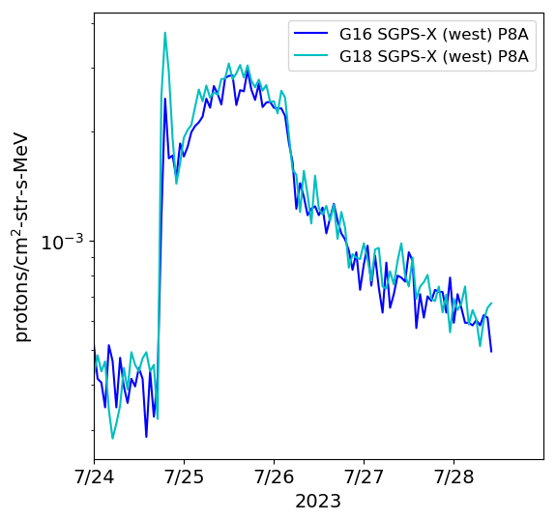
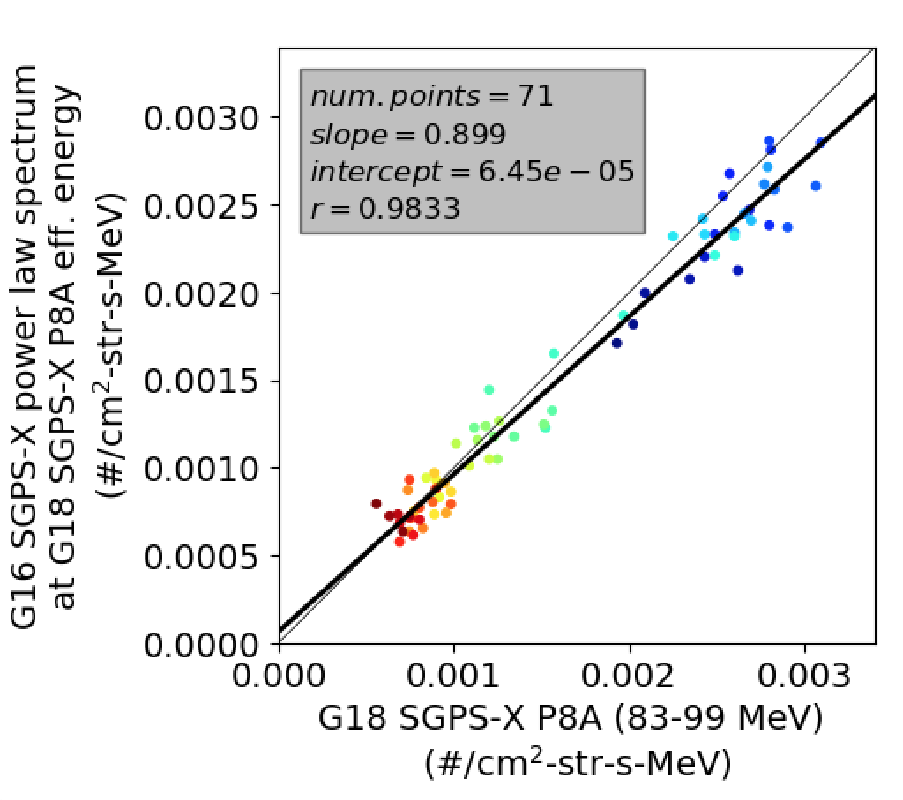
PLPT-SEI-004 SEP Channel Cross Comparison: Time Series and Cross-comparison Scatter Plot Example
G16 vs. G18 SGPS-X P8A 24-30 July 2023 SEP event cross comparison
G18 and G16 SGPS Cross comparison of 5m averaged L1b fluxes during 24-30 July 2023.
Results indicate ~10% systematic difference between G18 and G16 SGPS-X P8A measurements.
We do not know which measurement is more accurate.

Slide 22
PLPT-SEI-004 SEP Channel Cross Comparison: Results
Worst cases
Results generated using comparisons from both March and July 2023 SEP events.
Measurements from like channels and look-directions agree to within 10% in most cases.
Worst cases are SGPS-X P8A and P9 (scatter plots shown in backup slides).
Not able to determine G16-G18 scaling for SGPS+X P8C and P10 due to low response and noisy data (Note low r–values and scatter plots shown in Backup slide 34).
SGPX+X P7 agreement is poor because G16 SGPS+X P7 D3-D1 circuit is not working properly and is disabled. Result is high “background” in G16 SGPS+X P7 from rear entry particles.
Alpha count rates too low to perform similar comparisons for alpha channels.

Slide 23
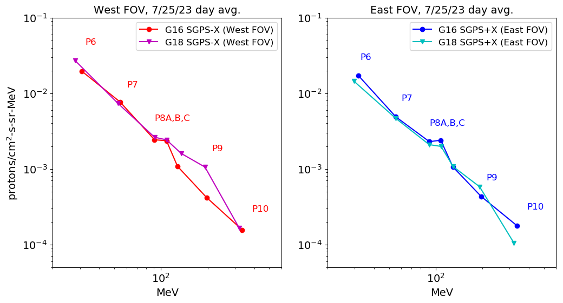
PLPT-SEI-004 SEP Channel Cross Comparison: Summary
G18 SGPS-X P8C and P9 appear to be reporting too high.
Apparent agreement in P8C day averaged flux is misleading. See SGPS+X P8C results on previous slide and P8C scatter plot on Backup slide 34.
Somewhat higher P6 & P7 day avg. fluxes are expected in west viewing SGPS units (than in east viewing shown in right panel) due to geomagnetic effects.
+X/-X agreement expected between higher energy P8-P10 channels.
Anonymously low response in G18 SGPS+X P10. Other P10 channels agree well.
G18 and G16 SGPS day averaged L1b spectra (flux vs. energy) from 7/25/23 provide a good example of overall T3 cross calibration results.
Anomalous G18 channels are G18 SGPS-X P8C, P9 and SGPS+X P8C, P10.
P8B reports a little high in all SGPS units at low flux levels when there is significant contribution from GCRs, but follows a power law spectrum well during large SEP events w/ steeply falling energy spectrum.
Pass

Slide 24
FULL MATURITY ASSESSMENT
GOES-18 SGPS L1b Product Full Validation PS-PVR

Slide 25
Full Validation Assessment
Preparation Activities | Assessment
Validation, QA, and anomaly resolution activities are ongoing. | Validation activities are ongoing. Results have been discussed with SWPC. Research community participation is ongoing.
Incremental product improvements may still be occurring. | Continuing work on SGPS P5 out-of-band contamination removal, G18 SGPS+X T3 temperature dependence, and possible mischaracterization of some T3 channels. G18 SGPS+X P10 low response is a watch item. Continuing work on ADRs 781 and 863.
Users are engaged and user feedback is assessed. | Yes (e.g., Frequent user questions/requests and NCEI responses).
GOES-R product maturity level preparation activities from RIMP v2.0. Responsible Organization: GOES-R GOES-R Program/Code 410

Slide 26
Full Validation Assessment
End State | Assessment
Product performance for all products is defined and documented over a wide range of representative conditions via ongoing ground truth and validation efforts. | G18 SGPS+X and -X units ground/beam calibrated. Backgrounds trending PLPT yields results in family with G16 & G17 FMs T1 and T2 validation using data from 9-11 July 2022 Solar Particle Event T2 and T3 validation using data from 13-15 March 2023 Solar Particle Event
Products are operationally optimized, as necessary, considering mission parameters of cost, schedule, and technical competence as compared to user expectations. | Yes, with continuing work on calibration coefficients, L1b and L2 processing.
All known product anomalies are documented, and shared with the user community. | In PS-PVR presentations, L1b READMEs, Kress et al. [2021], and communication with user community.
Product is operational. | Yes
GOES-R product maturity level preparation activities from RIMP v2.0. Responsible Organization: GOES-R GOES-R Program/Code 410
Kress, B. T., Rodriguez, J. V., Boudouridis, A., Onsager, T. G., Dichter, B. K., Galica, G. E., and Tsui, S. (2021). Observations from NOAA's newest solar proton sensor. Space Weather, 19, e2021SW002750. https://doi.org/10.1029/2021SW002750

Slide 27
Open ADRs/WRs Impacting G18 SGPS L1b
ADR# | WR# | Short Description | Status | Expected Closure
781 | 8404 | SEISS MPS-HI and SGPS L1b data gaps near IFCs | In Work | DO.13.00.00
863 | 6736 | Graceful degradation when SGPS data not generated | In Analysis | Flight Analysis High Priority; Correction may be later
(These ADRs both apply to all SGPS FMs, not exclusively GOES-18.)

Slide 28
G18 SGPS Performance Baseline Status
MRD ID | Description | Related PLPTs | Status
MRD2005 | Product Orthogonality/Coverage | -04, -06 | Requirement met
MRD2009 | Product Measurement Range | -04, -06 | Requirement met
MRD2010 | Product Measurement Accuracy | -04, -06 | Ground calibrations meet 25/45% Accuracy requirement. On-orbit tests are ongoing.
MRD2005: Orthogonality/Coverage Requirement: 2 directions
Currently being met by east and west viewing SGPS units.
MRD2009: Measurement Range Requirement: Protons 1 MeV - 500 MeV, > 500 MeV
Ground calibrations and G16-18 PLPT-SEI-004 SEP Channel Cross-Comparisons demonstrate that energy range is being covered.
MRD2010: Measurement Accuracy Requirements: 25% when flux level above background is greater than 10x minimum flux; 45% when flux level above background is between minimum flux and 10x minimum flux
Absolute accuracy cannot be verified on-orbit.
28

Slide 29
SUMMARY & RECOMMENDATIONS
GOES-18 SGPS L1b Products Provisional PS-PVR

Slide 30
Summary
G18 SGPS proton measurements in general compare well with G16 measurements. Exceptions are G18 SGPS-X P8C & P9, which appear to be reporting too high, and SGPS+X P10 which shows little to no response during 2022-2023 SEP events. T1 channels agree exceptionally well (results presented during G18 Provisional PS-PVR, shown in Backup slide 36).
G18 SGPS instrument, calibration and L1b processing anomalies:
Additional analysis of anomalous channels and adjustment of L1b LUT coefficients is needed.
G18 SGPS+X T3 channels exhibit temperature dependent fluctuations (Seen in slide 24 of G18 SGPS Provisional PS-PVR). A temperature dependence correction has been implemented in the operational L2 processing code. Analysis to generate tables of coefficients for this correction is needed for G18.
Analysis to determine SGPS P5 out-of-band correction coefficients (currently set to zero, illustrated in slides 24 & 25 of G16 full validation PS-PVR, applies to all FMs)
Continuing work on ADRs 781 and 863.
In general, PLT and PLPT results indicate that G18 SGPS is performing similarly to the G16 and G17 SGPS units.

Slide 31
Recommendations
NCEI recommends G18 SGPS L1b data is transitioned to Full Validation status.
NCEI recommends continuing work on SGPS instrument and calibration anomalies (summary on previous slide).
NCEI recommends continuing work on SGPS L1b and L2 processing (e.g., open L1b ADRs).

Slide 32
BACKUP SLIDES
GOES-18 SGPS L1b Product Full Validation PS-PVR

Slide 33
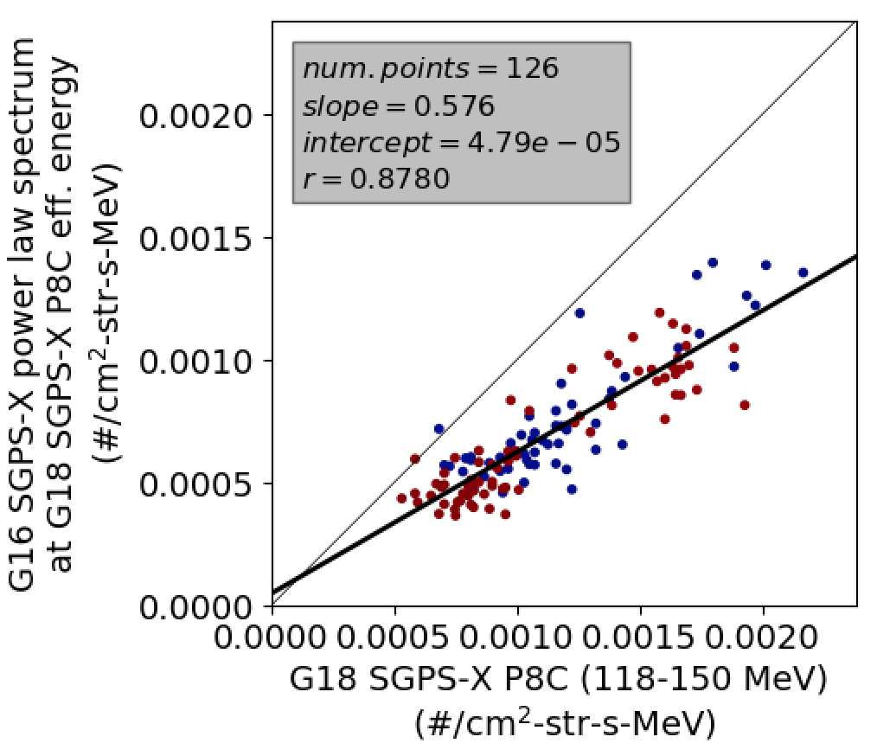
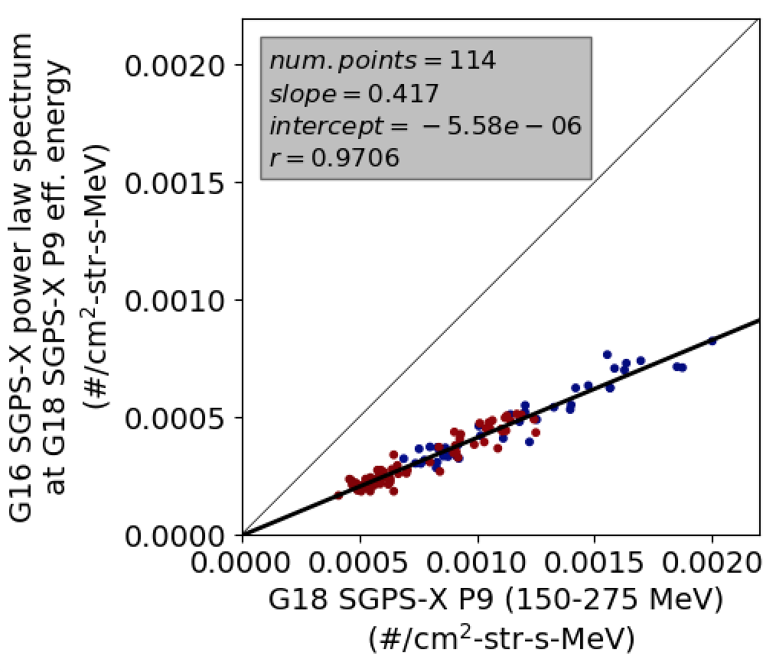
PLPT-SEI-004 SEP Channel Cross Comparison Selected Scatter Plots: SGPS-X P9 & P8C
Significant systematic errors in G16 and/or G18 SGPS-X P8C & P9 channels

Slide 34
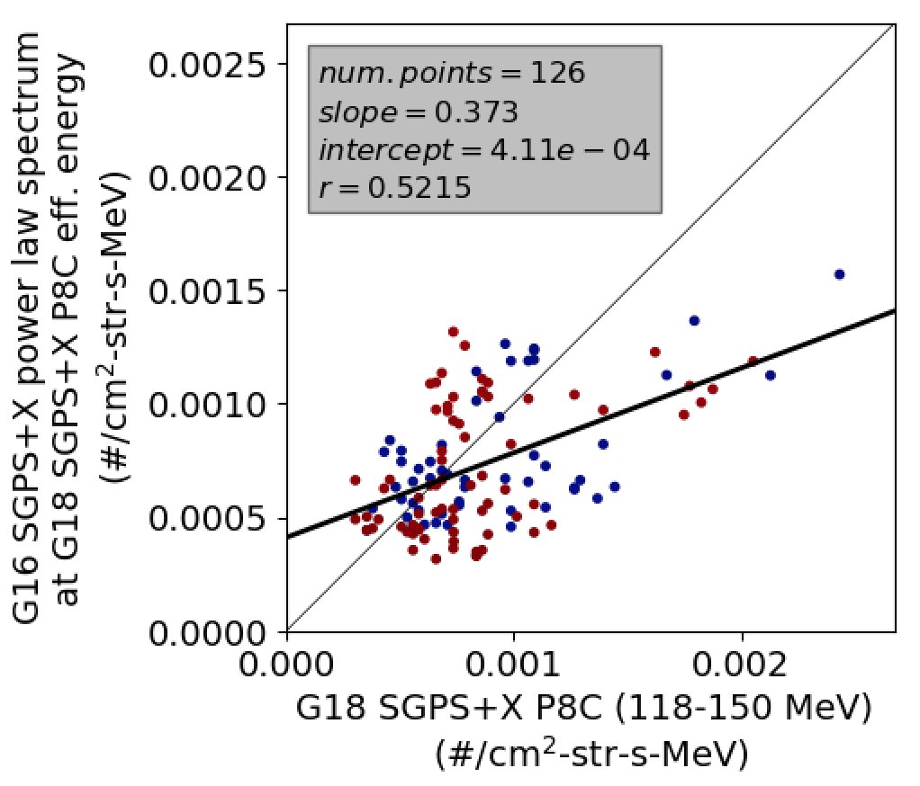
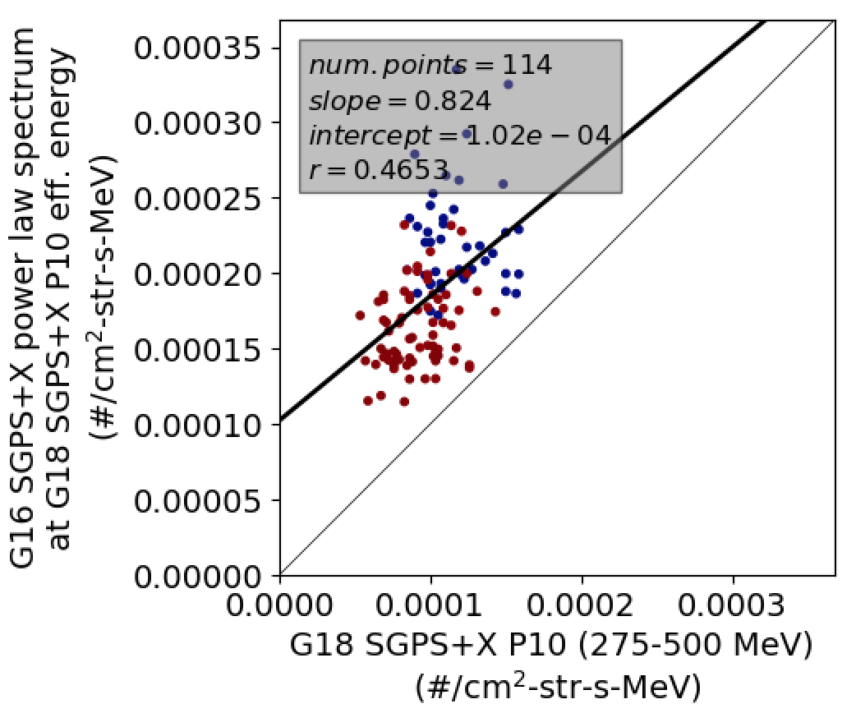
PLPT-SEI-004 SEP Channel Cross Comparison Selected Scatter Plots: SGPS+X P8C & P10
Not able to determine G16-G18 SGPS+X P8C and P10 scaling coefficients due to low response, high noise, and temperature dependence in SGPS+X P8C and P10 during March and July 2023 SPEs.

Slide 35
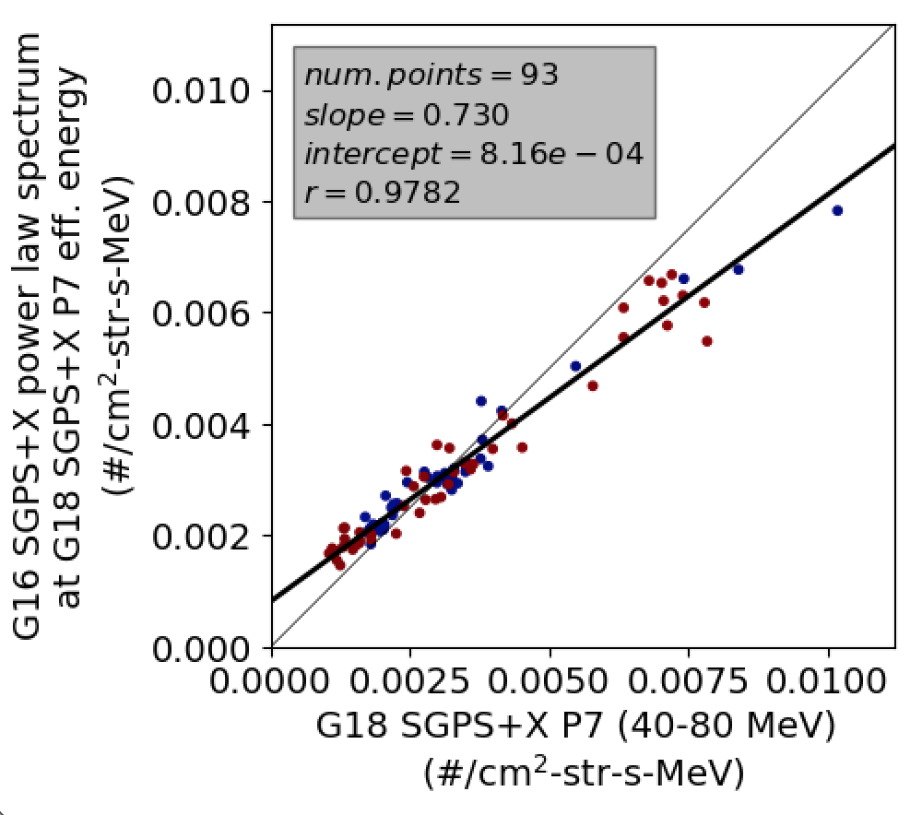
PLPT-SEI-004 SEP Channel Cross Comparison Selected Scatter Plots: SGPS+X P7
Linear fit to G16 vs. G18 SGPS+X P7 skewed due to combination of high “backgrounds” in G16 flux and higher reported flux from G18 at higher fluxes, when there is a steep spectral falloff.
G16 SGPS+X D3-D1 (rear entry contamination removal) disabled due to anonymously low reported fluxes when enabled (i.e., overcorrection). Analysis to determine new effective energy bounds and geometric factor for this channel
needs to be performed.

Slide 36
PLPT-SEI-004 SEP Channel Cross Comparison G18-G17 SGPS T1 channel comparisons from July 2022 SEP event, presented during G18 SGPS Provisional PS-PVR
Worst case is ~26% difference.
Measurements from like channels and look-directions generally agree to within 10%.
Worst case is ~26% difference between G18 and G17 SGPS-X P2A.
Worst P6 & P7 case (noisy data) is ~30% difference between G18 and G17 SGPS-X P6.
SGPS T3 proton count rates too low to perform similar comparisons for T3 channels.
Alpha count rates too low to perform similar comparisons for alpha channels.

Slide 37
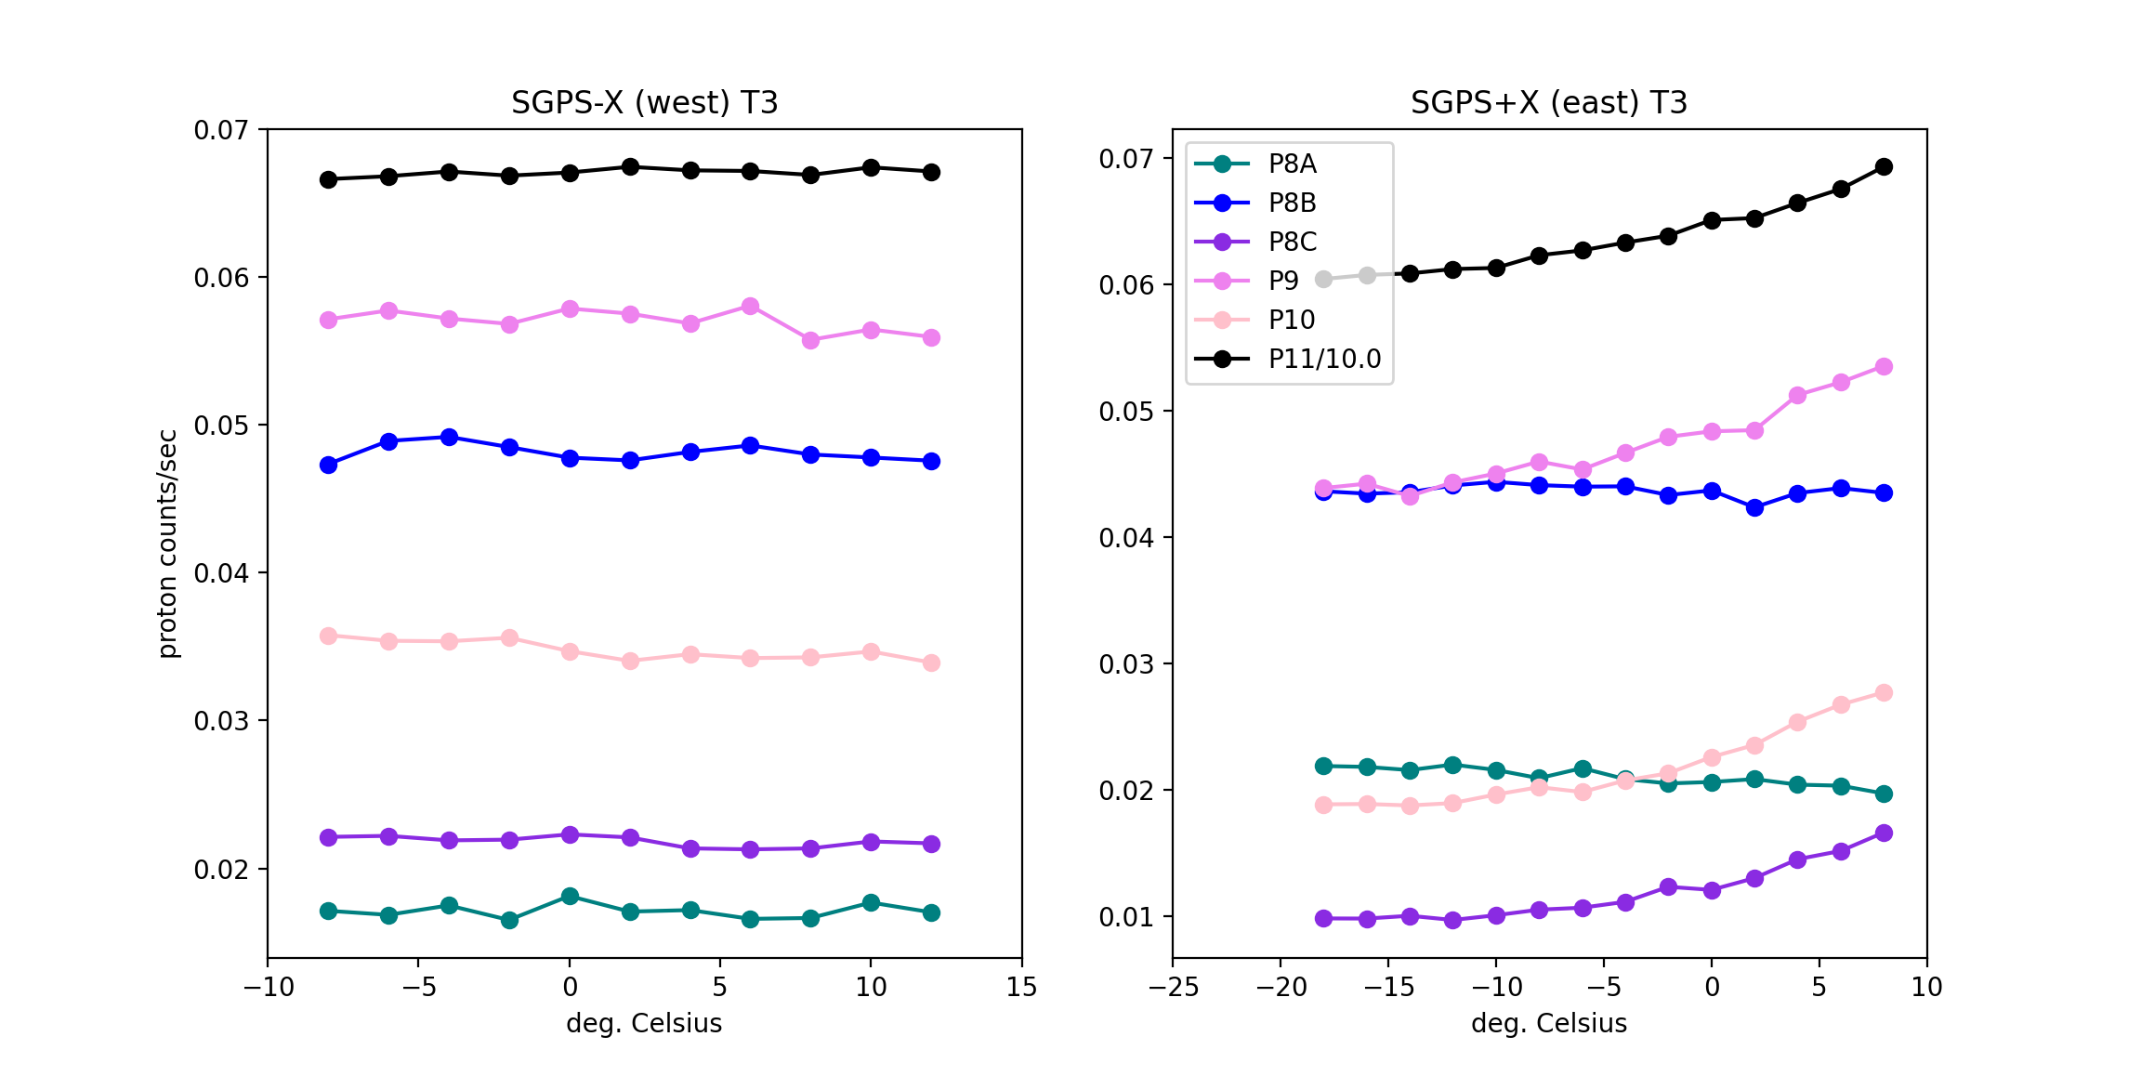
G18 SGPS T3 Temperature Dependence
GOES-18
Quiet conditions (steady) GCR counts from L0 data binned in 2 deg. temp. bins 2022 DOYs 196-227.
G18 SGPS+X T3 temperature dependent fluctuations in backgrounds count rates of 15-50% (P11-P8C) means we will see similar (but not necessarily the same) fluctuations in SPE reported fluxes.
T3 fluctuations will have a very small impact on SWPC’s computed >10 MeV integral flux, mainly used for alerts, but will have a significant impact on the computed >100 MeV flux, also used for alerts, and important during very large events.
SGPS-X (currently west viewing) is currently used by SWPC for SPE alerts. If SC is yaw flipped, SGPS+X will be needed.
Temperature correction implemented in operational L2 code. Analysis to generate table of coefficients will be performed.
G16 and G17 temperature dependence is shown in the G17 provisional PS-PVR presentation, slide 20 & backup slides.

Slide 38
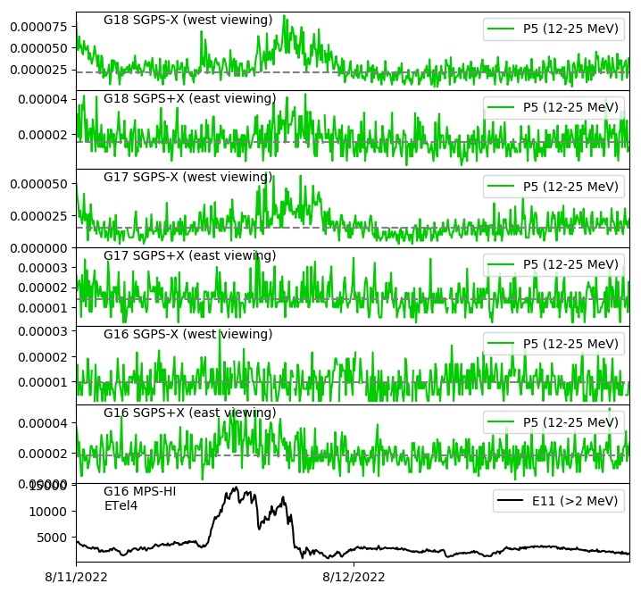
SGPS P5 Electron Contamination
5m averaged L1b flux
Electron contamination in SGPS P5 due to chance double coincidence triggered by two electrons in two adjacent T1 detectors.
Electron contamination in G18 SGPS-X P5
Electron contamination in G18 SGPS+X P5
Electron contamination in G17 SGPS-X P5
#/cm²-s-sr-keV
Little or no electron contamination in G17 SGPS+X P5
No discernable electron contamination in G16 SGPS-X P5
Electron contamination in G16 SGPS+X P5
It’s not known why some SGPS units are susceptible to this contamination and others are not.
The effect of this contamination on SEP measurements is small, shown on slide 27 of G16 Full Validation PS-PVR.
#/cm²-s-sr
Radiation belt electrons

