Slide 1
Peer Stakeholder-Product Validation Review (PS-PVR) For the Provisional Maturity of GOES-18 SEISS SGPS L1b Product
September 13, 2022
GOES-R Calibration Working Group (CWG)
Presenter: Brian Kress
Contributors: Athanasios Boudouridis, Juan Rodriguez, Kevin Hallock
NOAA NCEI / CIRES
These GOES-18 data are preliminary, non-operational data and are undergoing testing. Users bear all responsibility for inspecting the data prior to use and for the manner in which the data are utilized.

Slide 2
Outline
SGPS Overview
Review of Beta/PLT Maturity
Product Quality Evaluation
SGPS PLPTs Supporting Provisional Maturity
Additional Instrument Health Tests
Provisional Maturity Assessment
Path to Full Validation Maturity
Summary and Recommendations
These GOES-18 data are preliminary, non-operational data and are undergoing testing. Users bear all responsibility for inspecting the data prior to use and for the manner in which the data are utilized.

Slide 3
SGPS OVERVIEW
GOES-18 SGPS L1b Product Provisional PS-PVR
These GOES-18 data are preliminary, non-operational data and are undergoing testing. Users bear all responsibility for inspecting the data prior to use and for the manner in which the data are utilized.

Slide 4
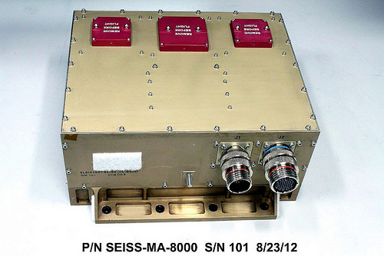
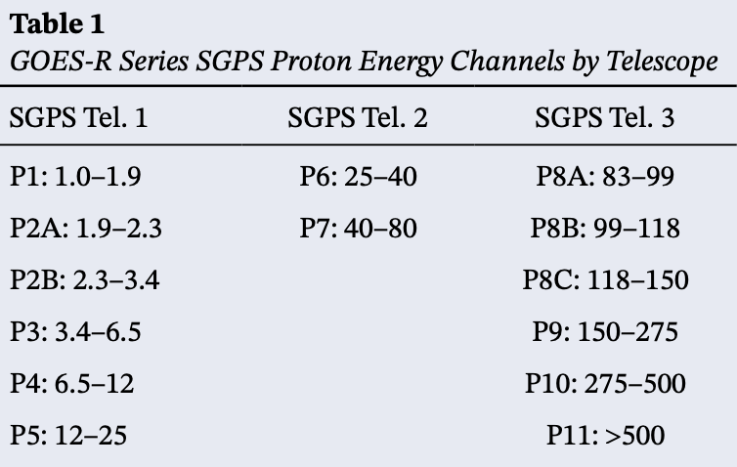
Space Environment In-Situ Suite (SEISS) Solar and Galactic Proton Sensor (SGPS)
2 Units, one looking East (+X) and one West (-X)
3 solid state telescopes on each unit
T1
T3
T2
1-500 MeV protons in 13 differential channels, plus >500 MeV integral channel
4-500 MeV alphas in 12 energy channels
Channel energies in MeV
GOES-18 SEISS sensors turned on 25 April 2022
SEISS SGPS designed, built, tested and calibrated by Assurance Technology Corporation (ATC)
These GOES-18 data are preliminary, non-operational data and are undergoing testing. Users bear all responsibility for inspecting the data prior to use and for the manner in which the data are utilized.

Slide 5
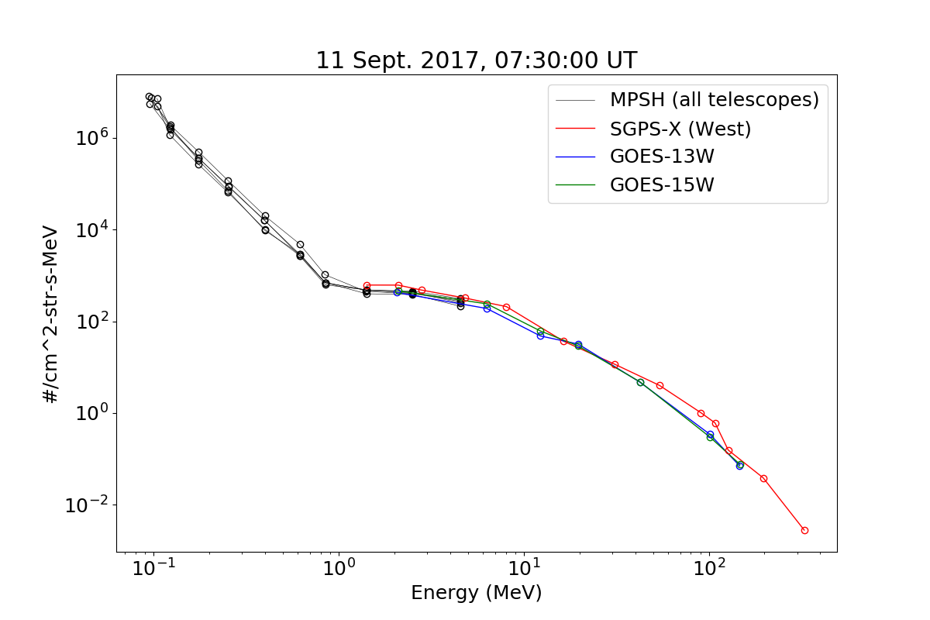
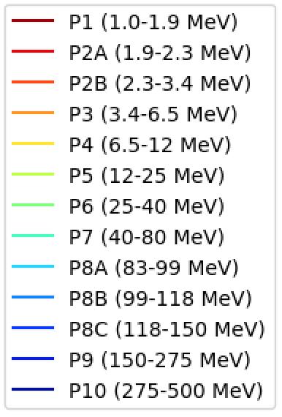
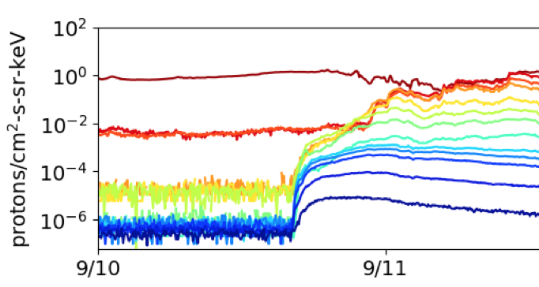
Introductory Material: Space Particle Data Units and Plotting
Two types of units typically used for SEP fluxes
Differential flux: particles / (cm²-s-steradian-MeV)
Integral flux is integrated in energy, above some threshold energy:
j _{>10 MeV}$[particles / (cm2−s−sr)] = \int_{10 MeV}^{∞}{ j_{differential}}dE$
SEP event fluences are also sometimes reported: particles / (cm²-sr-MeV)
Common presentation formats
Energy spectrum (flux vs. energy)
(at some time snapshot)
Timeseries data
5m averaged spectra from GOES-13 and -15 EPS and
GOES-16 SGPS and MPS-HI during Sept. 2017 GLE.
These GOES-18 data are preliminary, non-operational data and are undergoing testing. Users bear all responsibility for inspecting the data prior to use and for the manner in which the data are utilized.

Slide 6
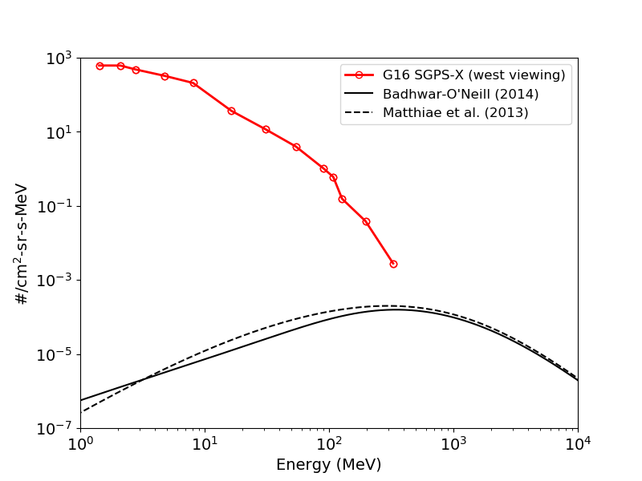
Introductory Material: Energetic Ions In Space
Solar Energetic Particles (SEPs)
Produced during Solar Particle Events (SPEs) lasting one to several days.
Cause heightened levels of harmful radiation in space
Approximately 50 - 100 SPEs per 11 yr. solar cycle
Mostly < 500 MeV protons
P1
P2A,B
P3
P4
P5
P6
10-14 Sept. 2017 Solar Particle Event
(at 7:30 UT on 9/11)
P7
P8A,B,C
Galactic Cosmic Rays (GCRs)
Thought thought to originate from supernovae and galactic nuclei.
Always present in space
Energies up to and > 10¹¹ GeV
Flux peak ~400 MeV
≈ 99.5% H & He
P9
P10
GCR models
These GOES-18 data are preliminary, non-operational data and are undergoing testing. Users bear all responsibility for inspecting the data prior to use and for the manner in which the data are utilized.

Slide 7
SGPS Primary Operational Use
Data stream for NOAA-NWS SWPC Solar Proton Event Detection and Radiation Storm Alerts
Level 1b
Level 2
1 sec.
The NOAA Space Weather Scales communicate to the general public current and future space weather conditions and possible effects on people and systems.
Numbered levels, analogous to hurricanes, tornadoes, and earthquakes that convey severity.
These GOES-18 data are preliminary, non-operational data and are undergoing testing. Users bear all responsibility for inspecting the data prior to use and for the manner in which the data are utilized.

Slide 8
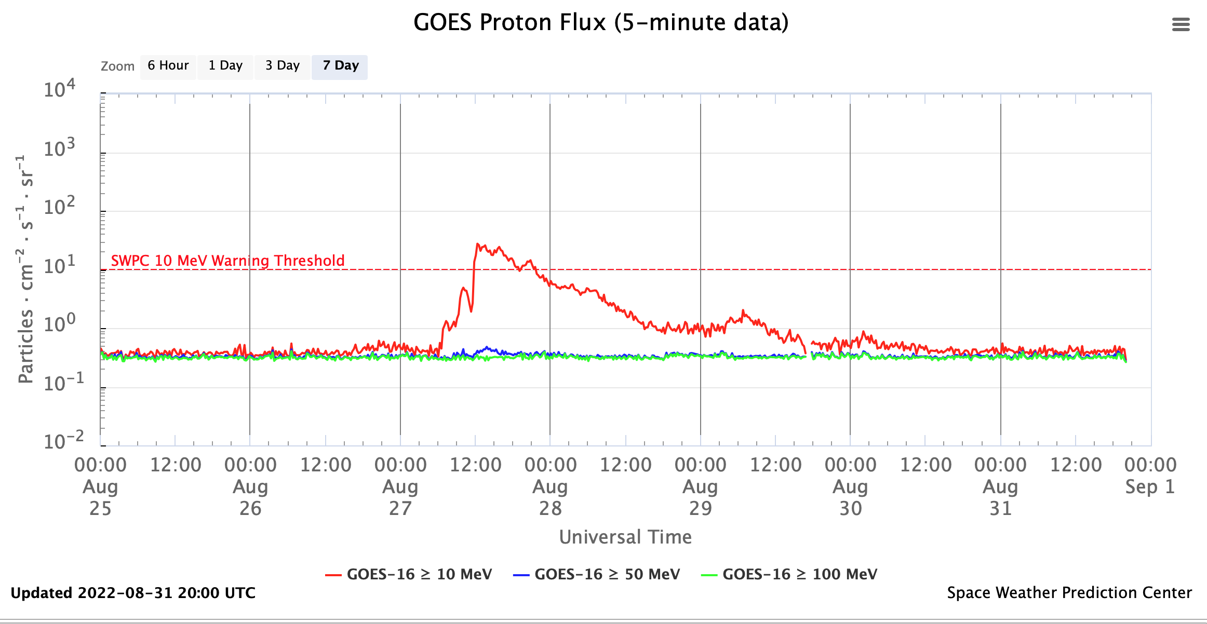
SGPS Primary Operational Use
Real-time integral solar proton fluxes from the NWS Space Weather Prediction Center’s (SWPC’s) public web page (https://www.swpc.noaa.gov/products/goes-proton-flux).
The original GOES 1-15 Energetic Particle Sensor (EPS) (1975-2020) was primarily intended to monitor the radiation hazard to spacecraft systems and humans in space from 10 to 100s of MeV protons produced during solar proton events (SPEs).
These GOES-18 data are preliminary, non-operational data and are undergoing testing. Users bear all responsibility for inspecting the data prior to use and for the manner in which the data are utilized.

Slide 9
REVIEW OF BETA MATURITY G18 SEISS Beta, Aug. 1, 2022
GOES-18 SGPS L1b Product Provisional PS-PVR
These GOES-18 data are preliminary, non-operational data and are undergoing testing. Users bear all responsibility for inspecting the data prior to use and for the manner in which the data are utilized.

Slide 10
G18 SGPS Vendor PLTs / Beta Overview
PLT | CDRL | PLT Name | Start Date | End Date | Prelim Report Due (+2 Weeks) | Final Report Due (+2 Months)
 | SEISS-TR-Y121-3-2 | Sensor Activation | 4/25/2022 | 4/25/2022 | 5/9/2022 | 6/24/2022
SEI-006 | SEISS-TR-Y121-3-6 | SGPS+X Initial IFCs | 4/26/2022 | 4/27/2022 | 5/11/2022 | 6/27/2022
SEI-008 | SEISS-TR-Y121-3-8 | SGPS D3-D1 | 6/20/2022 | 6/21/2022 | 7/5/2022 | 8/19/2022
SEI-007 | SEISS-TR-Y121-3-10 | SGPS Cross Calibration | 6/7/2022 | 6/17/2022 | 7/1/2022 | 9/19/2022
PLT 006
Required for Beta
IFC – In-flight Calibration
Will discuss SGPS Cross Calibration in following slides.
No SEISS PLPTs supporting Beta maturity.
NCEI verified G18 SGPS science measurements in L1b data.
These GOES-18 data are preliminary, non-operational data and are undergoing testing. Users bear all responsibility for inspecting the data prior to use and for the manner in which the data are utilized.

Slide 11
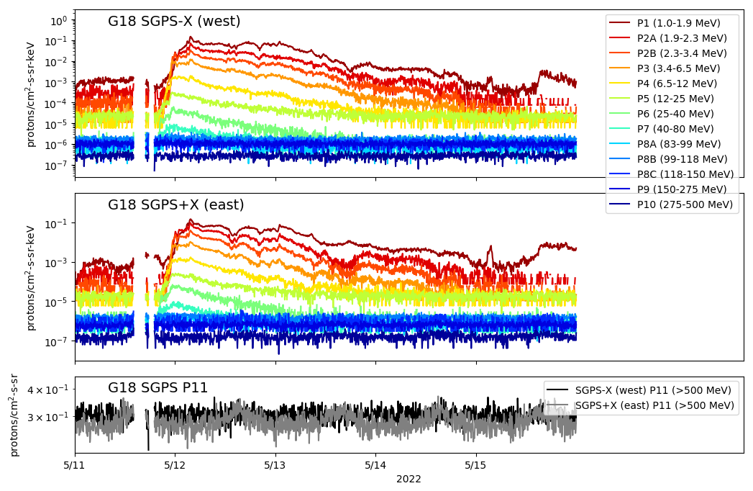
Beta Validation Artifact: GOES-18 SGPS 11-May-2022 Solar Particle Event
G18 SGPS 5m averaged L1b data
Note temperature dependence in G18 SGPS+X T3 channels (seen in diurnal variations).
T3 differential energy channels (P8-P10) not elevated above backgrounds during this event.
Data gaps
These GOES-18 data are preliminary, non-operational data and are undergoing testing. Users bear all responsibility for inspecting the data prior to use and for the manner in which the data are utilized.

Slide 12
PRODUCT QUALITY EVALUATION
GOES-18 SGPS L1b Product Provisional PS-PVR
These GOES-18 data are preliminary, non-operational data and are undergoing testing. Users bear all responsibility for inspecting the data prior to use and for the manner in which the data are utilized.

Slide 13
SGPS PLPTs Supporting Provisional Maturity
PLPT-SEI-004 SEP Channel Cross-Comparison
PLPT-SEI-006 Backgrounds Trending
These GOES-18 data are preliminary, non-operational data and are undergoing testing. Users bear all responsibility for inspecting the data prior to use and for the manner in which the data are utilized.

Slide 14
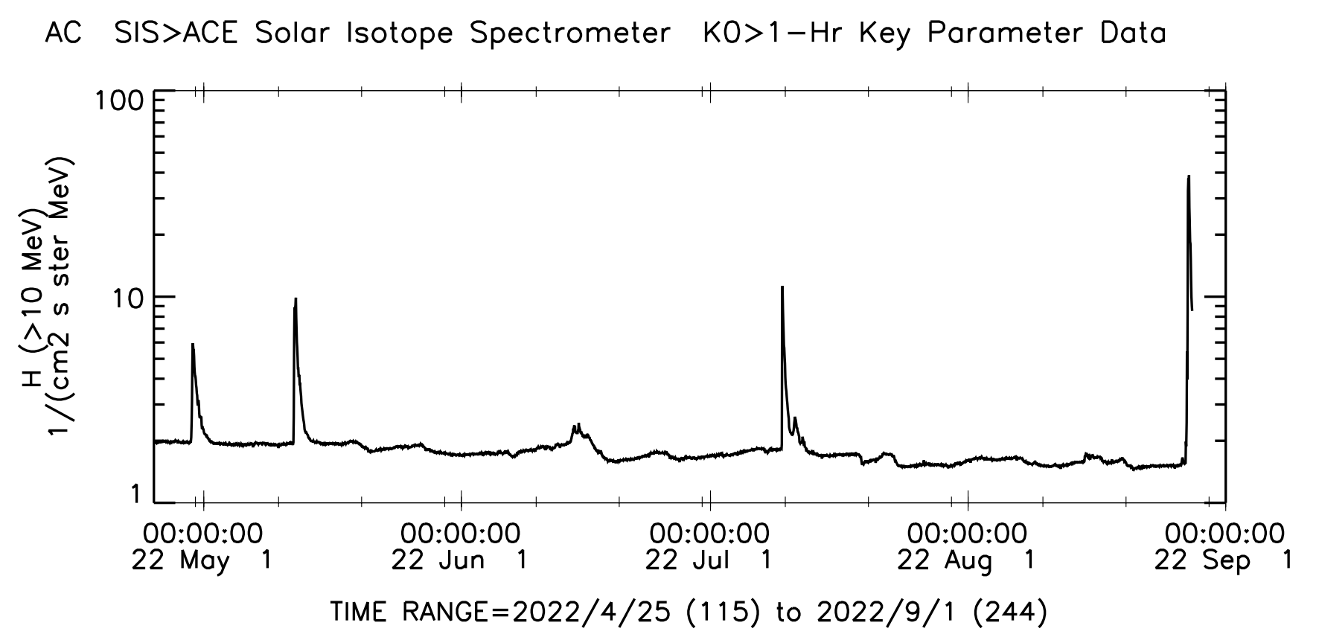
Solar Particle Events Since G18 SGPS Sensor Activation on 4/25/2022
27-29 Aug.
11-13 May
9-11 July
29-31 April
This event used for PLPT-SEI-004 SEP Channel Cross-Comparison
14-16 June
ACE SIS Data provider:
PI, E. C. Stone at CA Inst.
of Tech., via CDAWeb
Five “soft” Solar Particle Events (< 80 MeV energies only) since G18 sensor activation.
No solar particle events with T3 energies (~80 to >500 MeV) elevated above backgrounds since G18 launch.
Need to analyze SEP event data with sufficient enhancement at energies >100 MeV to reach Full Validation.
These GOES-18 data are preliminary, non-operational data and are undergoing testing. Users bear all responsibility for inspecting the data prior to use and for the manner in which the data are utilized.

Slide 15
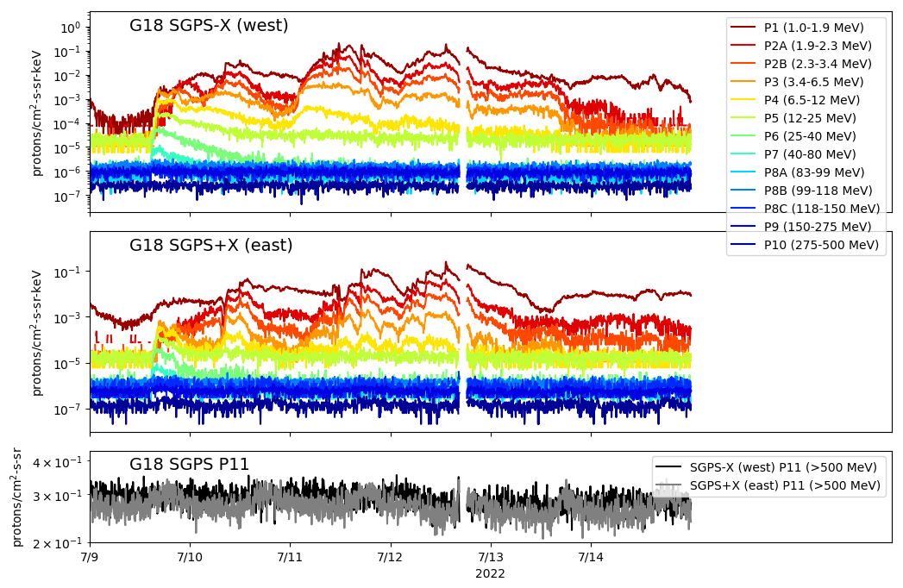
PLPT-SEI-004 SEP Channel Cross Comparison: 9-11 July 2022 Solar Particle Event
G18 SGPS 5m averaged L1b fluxes from 9-14 July 2022
T3 differential energy channels (P8-P10) not elevated above backgrounds during this event.
This event used for G18-G17 cross comparisons shown in following slides.
These GOES-18 data are preliminary, non-operational data and are undergoing testing. Users bear all responsibility for inspecting the data prior to use and for the manner in which the data are utilized.

Slide 16
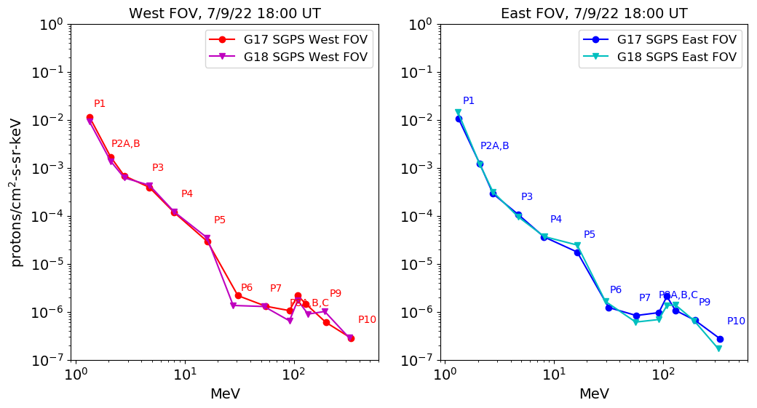
PLPT-SEI-004 SEP Channel Cross Comparison: Cross Sensor Comparison Overview
Very nice agreement
Noisy data and backgrounds – valid comparison not possible.
G18 and G17 SGPS 5m averaged L1b spectra (flux vs. energy) from 18 UT on 9 July 2022
A 10 MeV Proton gyro radius at geosynchronous is much greater than the G17 and G18 spacecraft separation (1000s of km vs. ~300 km) – We expect identical flux measurements from like channels with same telescope look directions.
These GOES-18 data are preliminary, non-operational data and are undergoing testing. Users bear all responsibility for inspecting the data prior to use and for the manner in which the data are utilized.

Slide 17
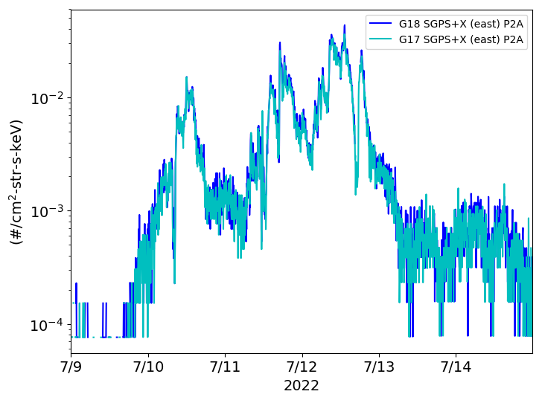
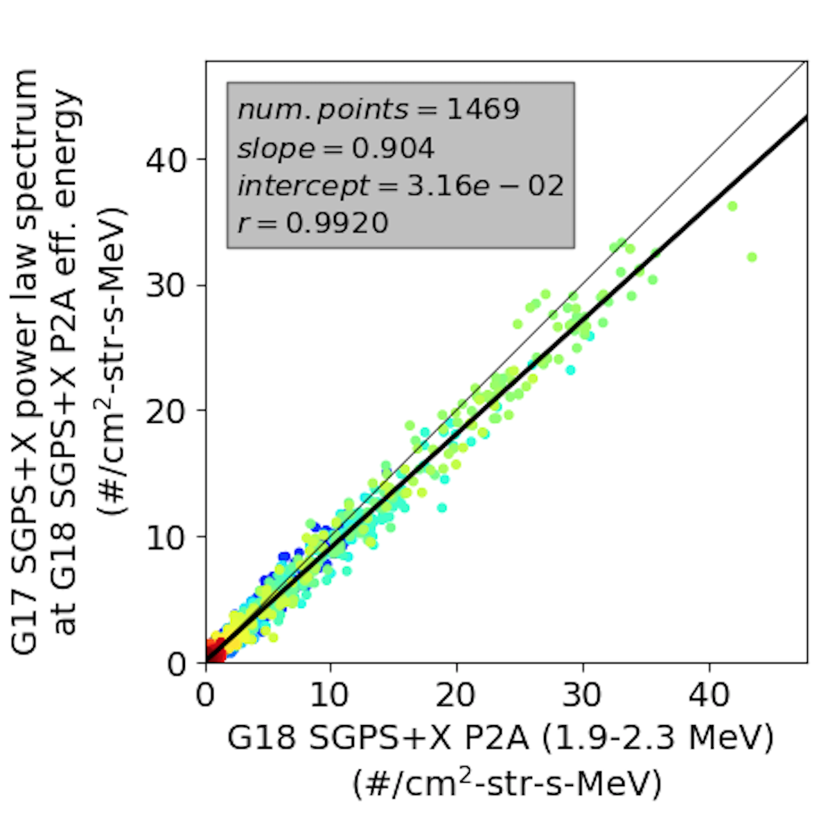
PLPT-SEI-004 SEP Channel Cross Comparison: Time Series and Cross-comparison Scatter Plot Example
G17 vs. G18 SGPS+X P2A cross comparison
G18 and G17 SGPS Cross comparison of 5m averaged L1b fluxes during 9-14 July 2022.
Results indicate ~10% systematic difference between G18 and G17 SGPS+X P2A measurements.
These GOES-18 data are preliminary, non-operational data and are undergoing testing. Users bear all responsibility for inspecting the data prior to use and for the manner in which the data are utilized.

Slide 18
PLPT-SEI-004 SEP Channel Cross Comparison Results
Worst case is ~26% difference.
Measurements from like channels and look-directions generally agree to within 10%.
Worst case is ~26% difference between G18 and G17 SGPS-X P2A.
Worst P6 & P7 case (noisy data) is ~30% difference between G18 and G17 SGPS-X P6.
SGPS T3 proton count rates too low to perform similar comparisons for T3 channels.
Alpha count rates too low to perform similar comparisons for alpha channels.
These GOES-18 data are preliminary, non-operational data and are undergoing testing. Users bear all responsibility for inspecting the data prior to use and for the manner in which the data are utilized.

Slide 19
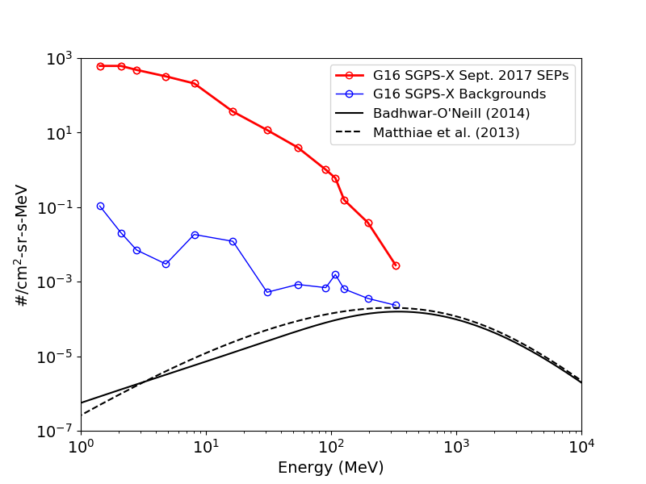
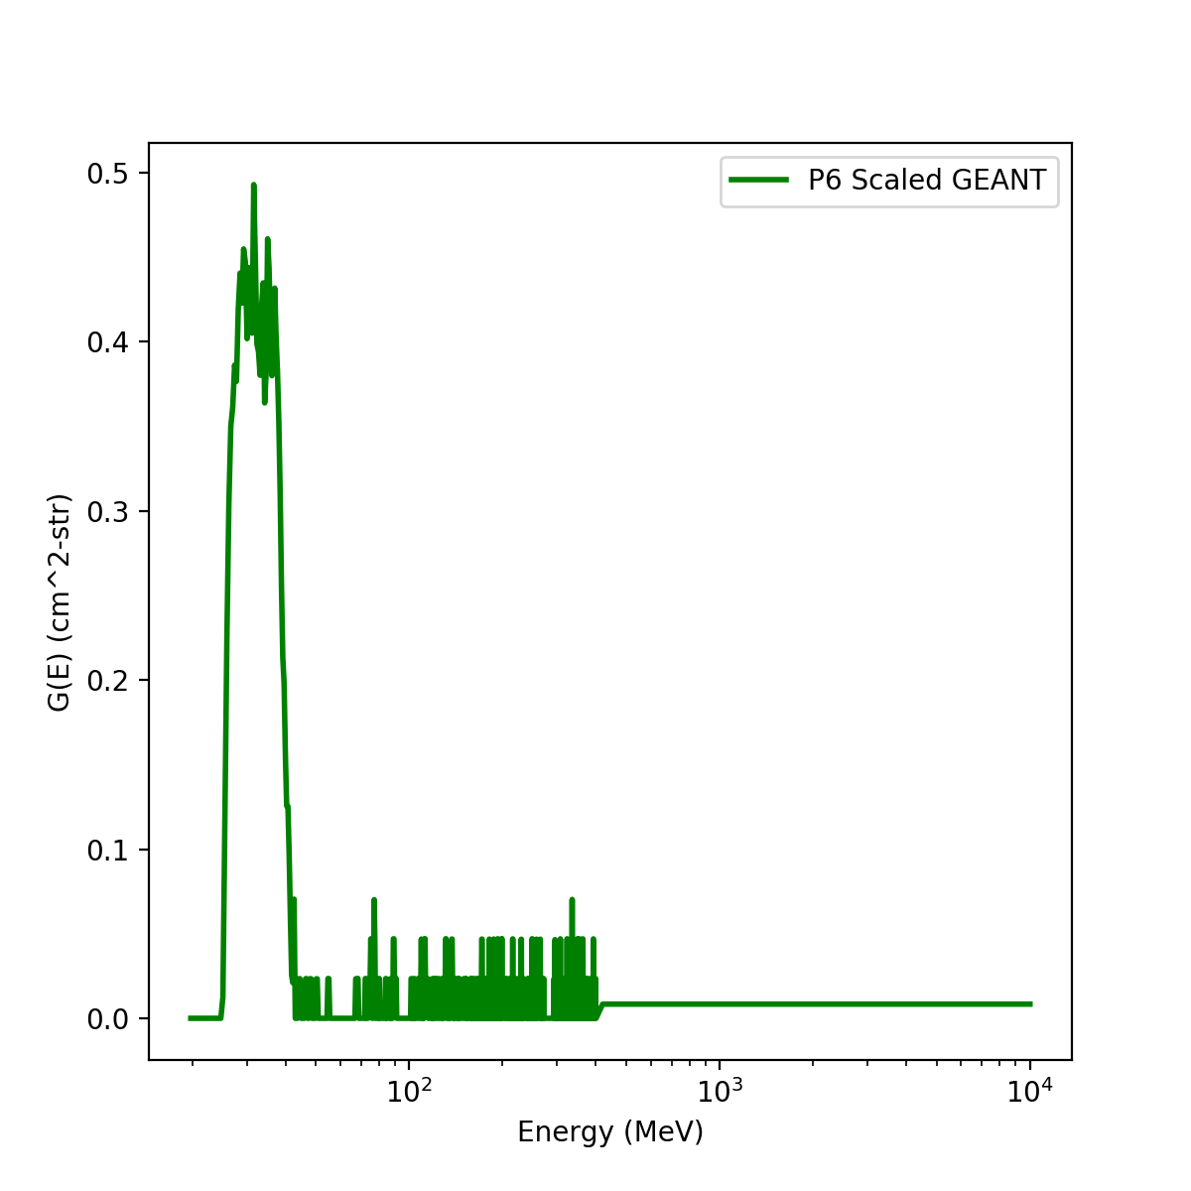
PLPT-SEI-006 Backgrounds Trending: SGPS Backgrounds
GEANT (simulated) Response Function
P1
SGPS channels are calibrated with 4-8 beam energies spanning the in-band portion of each channel.
SGPS P1-P10 Backgrounds
(1-day averaged)
7:30 UT on 11 Sept. 2017 (SEP event)
P10
Backgrounds are mainly from GCR counts picked up by response function high energy tail and islands (not calibrated).
GCR spectrum
SGPS channels are calibrated with 4-8 beam energies spanning the in-band portion of channel response functions (shown in right panel).
Background counts are from GCRs detected in high energy tail portion of response function
(Analysis showing this is in the G16 Full validation PS-PVR, slide 34).
Results from full analysis showing that we can not detect a problem with the in-band portion of the response functions from background rates are included in the G17 Provisional PS-PVR, slides 11-14.
These GOES-18 data are preliminary, non-operational data and are undergoing testing. Users bear all responsibility for inspecting the data prior to use and for the manner in which the data are utilized.

Slide 20
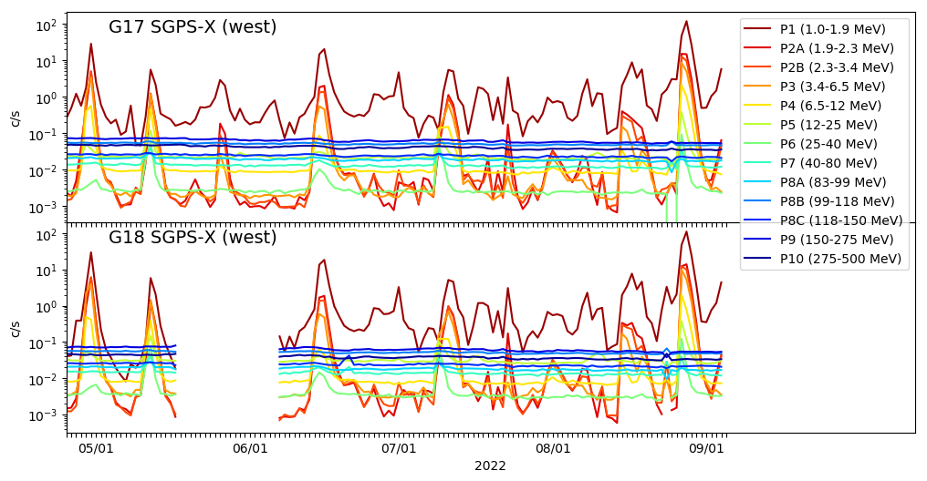
PLPT-SEI-006 Backgrounds Trending: G17 and G18 SGPS Background Rates
1-day averaged L0 count rates
G18 drift to GOES West location
T3 energy channels at backgrounds since G18 SGPS turn-on
G18 SGPS sensor activation on 4/25/2022
May – Sept. 2022 SGPS T1 differential channels (P1-P5) measure magnetospheric protons and SEP events.
May – Sept. 2022 SGPS T3 differential channels (P8-P10) are at background levels during this period.
These GOES-18 data are preliminary, non-operational data and are undergoing testing. Users bear all responsibility for inspecting the data prior to use and for the manner in which the data are utilized.

Slide 21
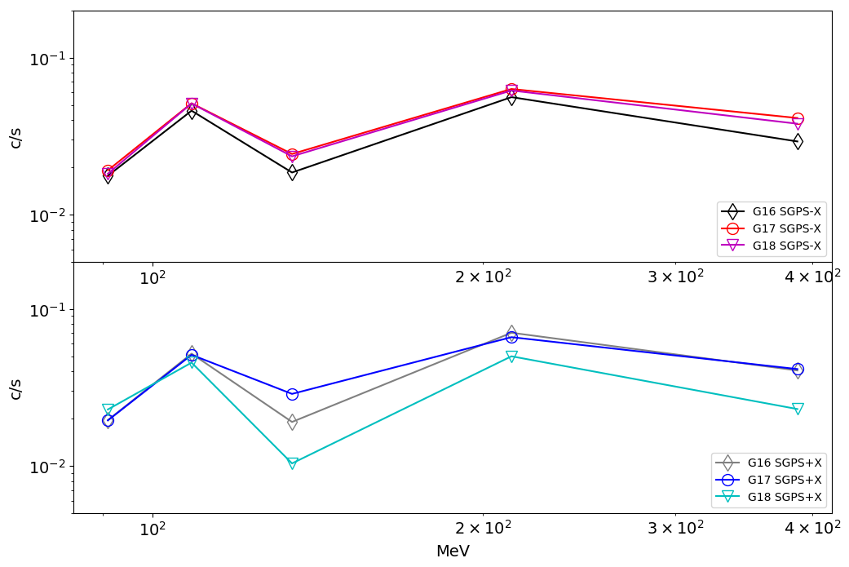
PLPT-SEI-006 Backgrounds Trending: G17 and G18 SGPS Background Rates
4-month average of SGPS T3 background count rates from L0
G18 SGPS+X P8C, P9, P10
count rates up to factor of two lower.
In general, comparison of G16, G17 and G18 T3 background count rates indicate there is not a serious problem with G18 SGPS T3 channels.
However, G18 SGPS+X P8C, P9, and P10 background count rates are up to factor of two lower. This does not necessarily mean there is a problem with characterization of the in-band part of the corresponding response functions. This is a watch item for Full Validation.
These GOES-18 data are preliminary, non-operational data and are undergoing testing. Users bear all responsibility for inspecting the data prior to use and for the manner in which the data are utilized.

Slide 22
PLPT Summary
PLPT-SEI-004 SEP Channel Cross-Comparison
The SEISS PLPTs are not in general pass-fail tests, however a summary statement is that G17 and G18 SGPS like-channels compare well, with <10% difference in most cases.
The greatest difference is ≈26% between G17 and G18 SGPS-X P2A
PLPT-SEI-006 Backgrounds Trending
The primary goal of the Backgrounds Trending PLPT, for the purposes of this review, is to verify that there are no significant problems with the G18 SGPS+X and -X T3 channels.
Comparisons between G17 and G18 SGPS background rates do not indicate any serious issues with the G18 SGPS channels.
Pass
Pass
These GOES-18 data are preliminary, non-operational data and are undergoing testing. Users bear all responsibility for inspecting the data prior to use and for the manner in which the data are utilized.

Slide 23
Additional Instrument Health Tests (Not covered by PLPTs)
Tests for G18 SGPS temperature dependence
SGPS P5 electron contamination
These GOES-18 data are preliminary, non-operational data and are undergoing testing. Users bear all responsibility for inspecting the data prior to use and for the manner in which the data are utilized.

Slide 24
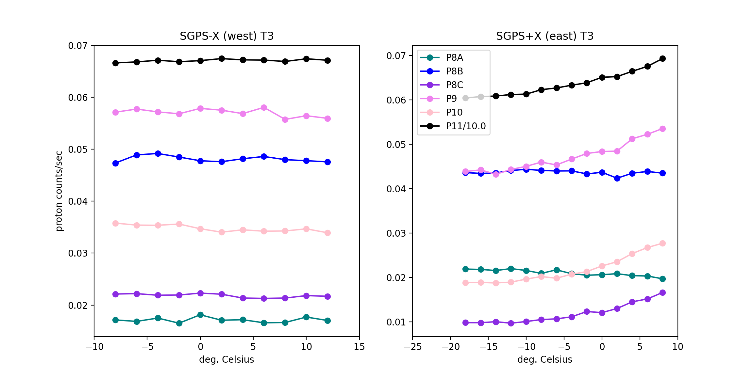
G18 SGPS T3 Temperature Dependence
GOES-18
Quiet conditions (steady) GCR counts from L0 data binned in 2 deg. temp. bins 2022 DOYs 196-227.
G18 SGPS+X T3 temperature dependent fluctuations in backgrounds count rates of 15-50% (P11-P8C) means we will see similar (but not necessarily the same) fluctuations in SPE reported fluxes.
T3 fluctuations will have a very small impact on SWPC’s computed >10 MeV integral flux, mainly used for alerts, but will have a significant impact on the computed >100 MeV flux, also used for alerts, and important during very large events.
SGPS-X (currently west viewing) is currently used by SWPC for SPE alerts. If SC is yaw flipped, SGPS+X will be needed.
Temperature correction implemented in operational L2 code. Analysis to generate table of coefficients will be performed.
G16 and G17 temperature dependence is shown in the G17 provisional PS-PVR presentation, slide 20 & backup slides.
These GOES-18 data are preliminary, non-operational data and are undergoing testing. Users bear all responsibility for inspecting the data prior to use and for the manner in which the data are utilized.

Slide 25
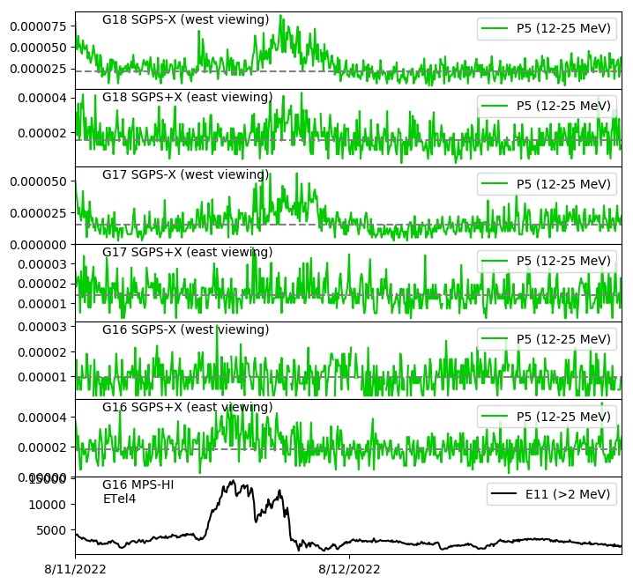
SGPS P5 Electron Contamination
5m averaged L1b flux
Electron contamination in SGPS P5 due to chance double coincidence triggered by two electrons in two adjacent T1 detectors.
Electron contamination in G18 SGPS-X P5
Electron contamination in G18 SGPS+X P5
Electron contamination in G17 SGPS-X P5
#/cm²-s-sr-keV
Little or no electron contamination in G17 SGPS+X P5
No discernable electron contamination in G16 SGPS-X P5
Electron contamination in G16 SGPS+X P5
It’s not known why some SGPS units are susceptible to this contamination and others are not.
The effect of this contamination on SEP measurements is small, shown on slide 27 of G16 Full Validation PS-PVR.
#/cm²-s-sr
Radiation belt electrons
These GOES-18 data are preliminary, non-operational data and are undergoing testing. Users bear all responsibility for inspecting the data prior to use and for the manner in which the data are utilized.

Slide 26
PROVISIONAL MATURITY ASSESSMENT
GOES-18 SGPS L1b Product Provisional PS-PVR
These GOES-18 data are preliminary, non-operational data and are undergoing testing. Users bear all responsibility for inspecting the data prior to use and for the manner in which the data are utilized.

Slide 27
Provisional Validation -1
Preparation Activities | Assessment
Validation activities are ongoing and the general research community is now encouraged to participate. | Validation activities are ongoing. Results have been discussed with SWPC. Release of data by NCEI will enable research community participation.
Severe algorithm anomalies are identified and under analysis. Solutions to anomalies are in development and testing. | ADRs 781, 863 and 1025 are in-analysis and in-work with expected closures in DO.11.00.00 and DO.12.00.00
Incremental product improvements may still be occurring. | Product improvements will result from steps to mitigate known and yet to be discovered anomalies.
These GOES-18 data are preliminary, non-operational data and are undergoing testing. Users bear all responsibility for inspecting the data prior to use and for the manner in which the data are utilized.

Slide 28
Provisional Validation -2
End State | Assessment
Product performance has been demonstrated through analysis of independent measurements obtained from select locations, periods, and associated ground truth or field campaign efforts. | G18 SGPS+X and -X units ground/beam calibrated. Partial validation using data from 9-11 July 2022 Solar Particle Event
Product analysis is sufficient to communicate product performance to users relative to expectations (Performance Baseline). | Yes, at SGPS T1 and T2 energies. May still find T3 instrument and/or calibration anomalies.
Documentation of product performance exists that includes recommended remediation strategies for all anomalies and weaknesses. Any algorithm changes associated with severe anomalies have been documented, implemented, tested, and shared with the user community. | In this and previous PS-PVR presentations (e.g., temperature dependence correction) and in supplemental materials. A complete description of known anomalies will be included in readme file with release of public data.
Testing has been fully documented. | In this presentation and supplemental materials.
Product is ready for operational use and for use in comprehensive cal/val activities and product optimization. | Yes, please refer to Summary and Recommendations (slides 35-37).
These GOES-18 data are preliminary, non-operational data and are undergoing testing. Users bear all responsibility for inspecting the data prior to use and for the manner in which the data are utilized.

Slide 29
PATH TO FULL VALIDATION MATURITY
GOES-18 SGPS L1b Product Provisional PS-PVR
These GOES-18 data are preliminary, non-operational data and are undergoing testing. Users bear all responsibility for inspecting the data prior to use and for the manner in which the data are utilized.

Slide 30
Path to Full Validation
ADRs/WRs to be resolved prior to Full Validation.
PLPTs to be conducted prior to Full Validation.
Performance Baseline status.
These GOES-18 data are preliminary, non-operational data and are undergoing testing. Users bear all responsibility for inspecting the data prior to use and for the manner in which the data are utilized.

Slide 31
ADRs/WRs Impacting Full Validation of G18 SGPS L1b
ADR# | WR# | Short Description | Status | Expected Closure
781 | 8404 | SEISS MPS-HI and SGPS L1b data gaps near IFCs part 2 | Work completed – To be implemented in DO.12.00.00 | DO.12.00.00
863 | 6736 | Graceful degradation when SGPS data not generated | In Analysis | Flight Analysis High Priority; Correction may be later
1025 | 7579 | Implement SGPS He processing in L1b | In operations Fix-fail in-work | DO.11.00.00 (Oct. 2022)
Will need to analyze SEP event data with sufficient enhancement at energies >100 MeV to reach full validation – May find instrument and/or calibration anomalies.
These GOES-18 data are preliminary, non-operational data and are undergoing testing. Users bear all responsibility for inspecting the data prior to use and for the manner in which the data are utilized.

Slide 32
Path to Full Validation - PLPTs
Title | Activity | Data Needed | Success Criteria
A.2.3 SEP Channel Cross-Comparison [PLPT-SEI-004] * This is a Provisional PLPT | On-orbit cross-calibration of SEP channels. | One SPE with sufficient enhancement at energies >100 MeV for cross-calibration of SGPS T3. | Quantify differences in reported fluxes.
A.3.1 SGPS D3-D1 Contamination Correction [PLPT-SEI-001] | Complete analysis of P7 response functions based on D3-D1 test results. | Full G18 D3-D1 test results (to be completed 1/20/2023) | Full characterization of SGPS P7 response functions
A.3.4 SEP Channel Cross-Comparison [PLPT-SEI-004] | On-orbit cross-calibration of SGPS with EHIS above 10 MeV and MPS-HI and SGPS 1-12 MeV protons, and cross calibrations of SGPS+X and -X units. | Two Solar Energetic Particle (SEP) events. | [Full] Differences quantified on data taken through validation phase.
A.3.6 Backgrounds Trending [PLPT-SEI-006] | Evaluate SGPS backgrounds in terms of expected galactic cosmic ray (GCR) fluxes. | Four months of continuous data. | [Full] Perform analysis during validation phase.
From RIMP v2.0, July 2021
Full PLPTs are ongoing continuations of Provisional PLPTs.
Need to analyze SEP event with sufficient enhancement at energies >100 MeV to reach full validation.
These GOES-18 data are preliminary, non-operational data and are undergoing testing. Users bear all responsibility for inspecting the data prior to use and for the manner in which the data are utilized.
32

Slide 33
G18 SGPS Performance Baseline Status
MRD ID | Description | Related PLPTs | Status
MRD2005 | Product Orthogonality/Coverage | -04, -06 | Requirement met
MRD2009 | Product Measurement Range | -04, -06 | Requirement met
MRD2010 | Product Measurement Accuracy | -04, -06 | Ground calibrations meet 25/45% Accuracy requirement. On-orbit tests are ongoing.
MRD2005: Orthogonality/Coverage
Requirement: 2 directions
Currently being met
MRD2009: Measurement Range:
Requirement: Protons: 1 MeV - 500 MeV, > 500 MeV
Ground calibrations and G16-18 PLPT-SEI-004 SEP Channel Cross-Comparisons demonstrate that energy range is being covered.
MRD2010: Measurement Accuracy
Requirements: 25% when flux level above background is greater than 10x minimum flux; 45% when flux level above background is between minimum flux and 10x minimum flux
Absolute accuracy cannot be verified on-orbit
These GOES-18 data are preliminary, non-operational data and are undergoing testing. Users bear all responsibility for inspecting the data prior to use and for the manner in which the data are utilized.
33

Slide 34
SUMMARY & RECOMMENDATIONS
GOES-18 SGPS L1b Products Provisional PS-PVR
These GOES-18 data are preliminary, non-operational data and are undergoing testing. Users bear all responsibility for inspecting the data prior to use and for the manner in which the data are utilized.

Slide 35
Summary
G18 T1 and T2 channel measurements in general compare well with G16 and G17 T1 and T2 channel measurements.
There has not been a solar particle event since G18 launch with sufficient enhancement at energies >80 MeV to verify that SGPS T3 channels are performing well.
G18 SGPS T3 background count rates are nominal.
G18 SGPS+X T3 channels exhibit temperature dependent fluctuations. A temperature dependence correction has been implemented in the operational L2 code. Analysis to generate tables of coefficients for this correction will be performed.
G18 SGPS-X exhibits electron contamination when radiation belts are enhanced. The impact of electron contamination on SEP measurements is very small.
In general, PLT and PLPT results indicate that G18 SGPS is performing similarly to the G16 and G17 SGPS units.
These GOES-18 data are preliminary, non-operational data and are undergoing testing. Users bear all responsibility for inspecting the data prior to use and for the manner in which the data are utilized.

Slide 36
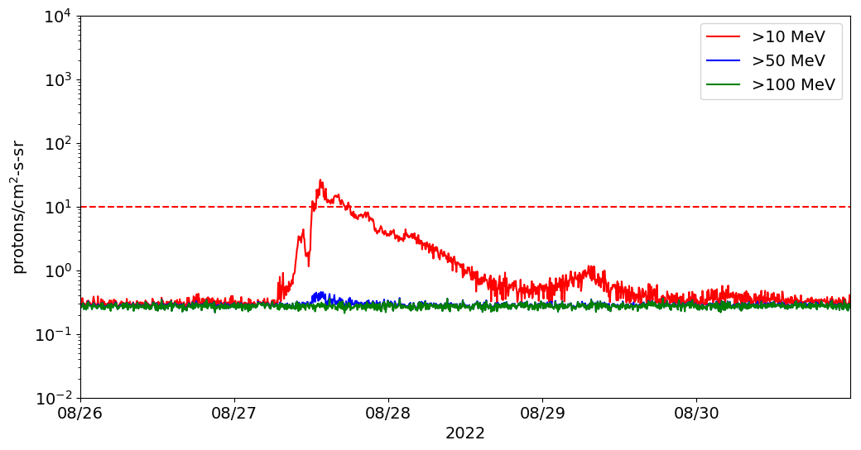
Additional Comments on SGPS L1b Transition to Provisional Status
G16 SGPS transition to provisional status was based on the July and Sept. 2017 SPEs. Issues were found that would not have been discovered with no SEP measurements (e.g., SGPS+X P7 approx. a factor of 7 low), but there were no show stoppers.
G17 SGPS was transitioned to provisional status with no measurements during SPEs. G17 SGPS has since been shown to be performing better than G16 SGPS, in general.
The decision to transition G17 SGPS L1b to provisional status was based on G16 SGPS performance and G17 SGPS background rates, which were similar to G16’s.
Current G16 SGPS operational integral fluxes (from SWPC public facing web page) and G18 SPADES L2 integral fluxes are shown below.
GOES-16 Operational
GOES-18 SPADES L2
Integral fluxes from 5m avg. L1b
(Not necessarily identical to G16 integral fluxes due to geophysical differences between GOES east and west longitudes.)
These GOES-18 data are preliminary, non-operational data and are undergoing testing. Users bear all responsibility for inspecting the data prior to use and for the manner in which the data are utilized.

Slide 37
Recommendations
NCEI recommends G18 SGPS L1b data for transition to provisional status with the caveat that G16 SGPS be relied on for Solar Particle Event (SPE) Detection until analysis of G18 SGPS T3 is performed.
The SWPC SPE Detection code uses integral flux computed by fitting a power law to SGPS’s 13 differential channels plus the >500 MeV integral channel flux. Three recommended steps to mitigate the effect of anomalous channels are
Temperature correction downstream of L1b processing (✅ done).
Implement an option to remove any particular channel from the integral flux calculation and event detection in L2 processing.
Implement an option to use any combination of SGPS+X and SGPS-X channels in a single integral flux calculation and event detection.
(In current L2 processing, event detection is done separately for each unit.)
These GOES-18 data are preliminary, non-operational data and are undergoing testing. Users bear all responsibility for inspecting the data prior to use and for the manner in which the data are utilized.

Slide 38
BACKUP SLIDES
GOES-18 SGPS L1b Product Provisional PS-PVR
These GOES-18 data are preliminary, non-operational data and are undergoing testing. Users bear all responsibility for inspecting the data prior to use and for the manner in which the data are utilized.

Slide 39
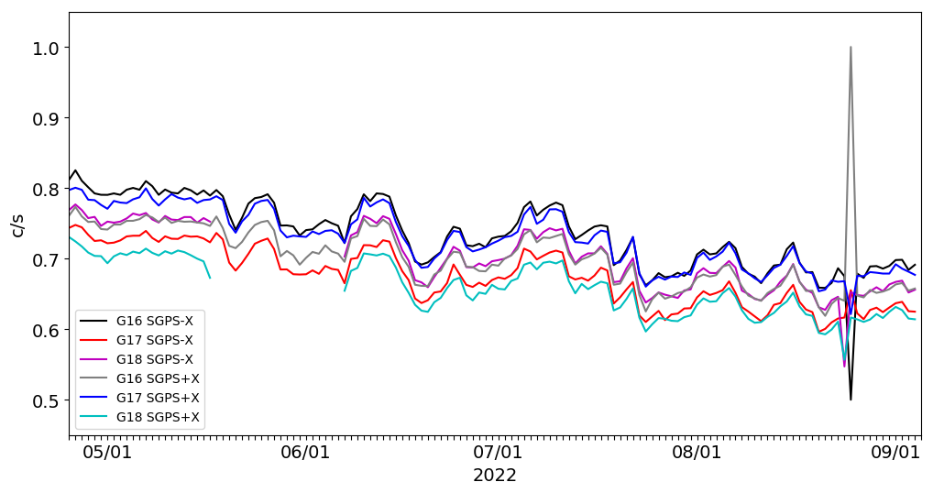
May-Sept. P11 (>500 MeV) Count Rates
SGPS P11 (>500 MeV)
These GOES-18 data are preliminary, non-operational data and are undergoing testing. Users bear all responsibility for inspecting the data prior to use and for the manner in which the data are utilized.

