Slide 1
GOES-18 Full Maturity PS-PVR
Solar UltraViolet Imager
30 November 2023
Jonathan Darnel, Christian Bethge, Alison Jarvis, Donald Schmit
GOES-R Calibration Working Group, University of Colorado, CIRES, NOAA-NCEI
Notes:
New Background?

Slide 2
Outline
Overview of the GOES-18 SUVI
Review of the GOES-18 SUVI Full Maturity Assessment
Evaluation of the GOES-18 Level-1b Product Quality
Anomalies and Resolution
PLPTs -Trending and Degradation
Summary of Product Status
Top priority items
Conclusion

Slide 3
Acronyms, Defined
AART: Algorithm Action Review Team
ADR: Algorithm Discrepancy Report
AIA: Atmospheric Imaging Assembly
ALS: Advanced Light Source
CCD: Charge-Coupled Device
ECI: Extended Coronal Imaging
EUV: Extreme Ultraviolet
EUVS: Extreme UltraViolet Spectrometer
EXIS: EUV and X-ray Irradiance Sensor
FITS: Flexible Image Transport System
LBNL: Lawrence Berkeley National Laboratory
LUT: Look-Up Table
MIT-LL: MIT Lincoln Laboratory
NB: “Nota Bene” - translates to “note well” or “pay attention”
OMAS: Operational Metadata Aggregation Service
PLPT: Post-Launch Product Test
SDO: Solar Dynamics Observatory
SUVI: Solar UltraViolet Imager
VSO: Virtual Solar Observatory
WR: Work Request

Slide 4
GOES-18 SUVI Full Maturity PS-PVR
Overview of SUVI

Slide 5
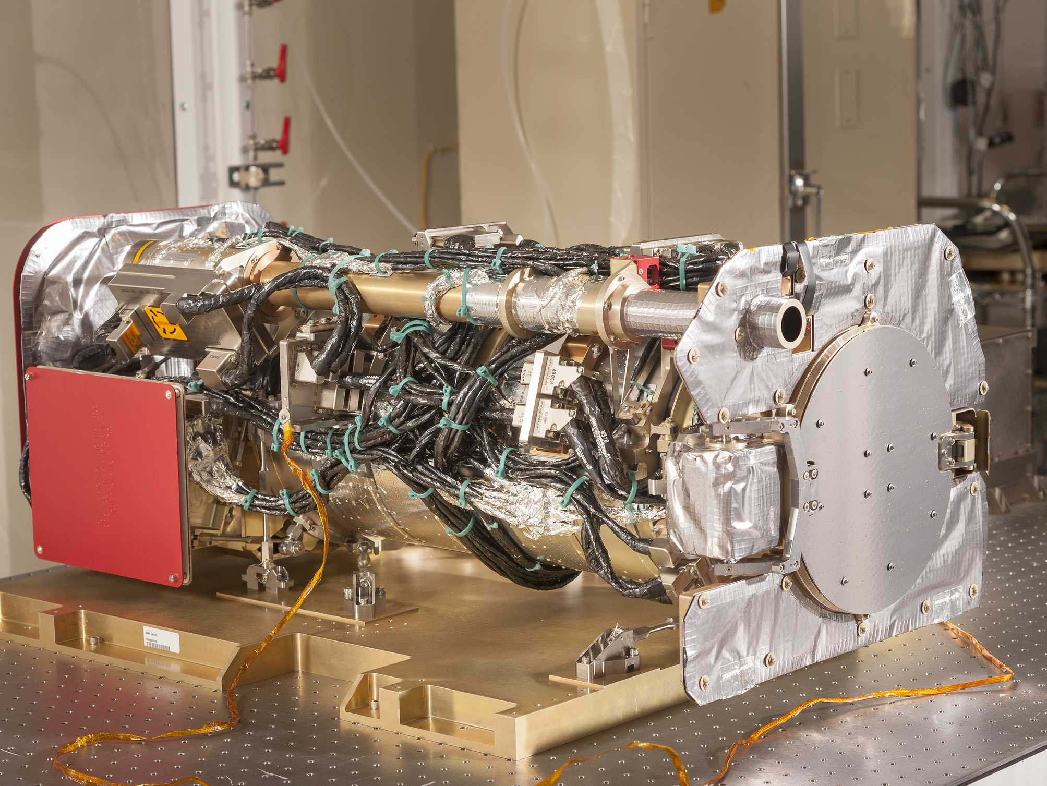
The SUVI Instrument

Slide 6
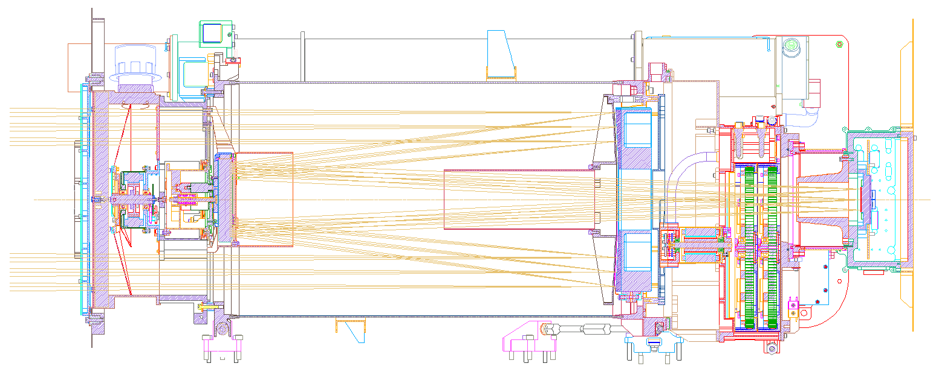
SUVI Optical Layout
Entrance Filters
Focal Plane Filters
Aperture Selector
Secondary Mirror
Primary Mirror
CCD

Slide 7
Overview of SUVI
Key Instrument Performance Requirements
Pointing Accuracy: <3.0 arcmin
Pointing Knowledge: <2.5 arcsec
Field of view: >42×42 arcmin
Spatial resolution: <5 arcsec square pixels
Ensquared energy: >50% in 7×7 arcsec
(43% for 94 Å bandpass)
Six Channels: 94Å (FeXVIII), 131Å (FeVIII), 171Å (FeIX), 195Å (FeXII), 284Å (FeXV), 304Å (HeII)

Slide 8
Overview of SUVI
Key Instrument Operating Characteristics
1280×1280 pixel L1b Product Image
2.5 arcsec pixels, 53.3×53.3 arcmin FOV
14-bit CCD detector
Entrance aperture selector – 6 positions
2 Filter wheels:
FW1: Open, Thin Al & Zr, Thick Al & Zr
FW2: Glass, Open, Thin Al, Thin Zr, Thick Al
4-photodiode guide telescope for pointing

Slide 9
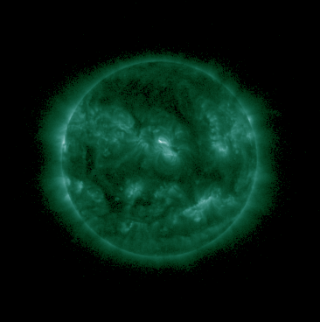
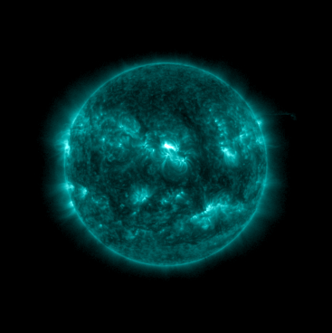
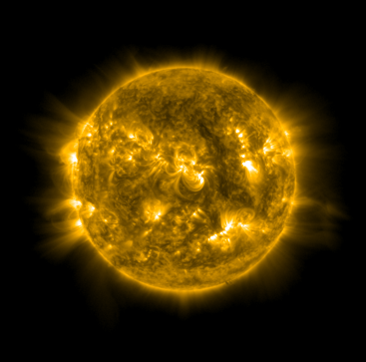
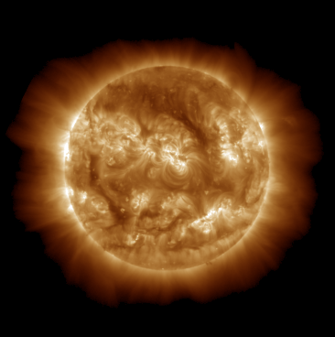
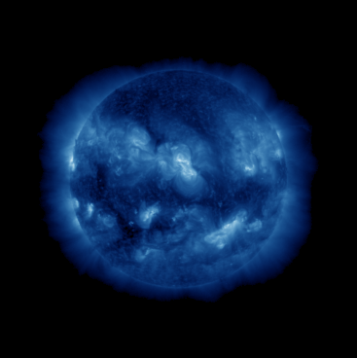
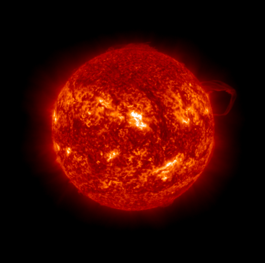
Overview of SUVI
Level-2 Composite Images
5 October 2023, 19:10
94Å
131Å
171Å
195Å
284Å
304Å

Slide 10
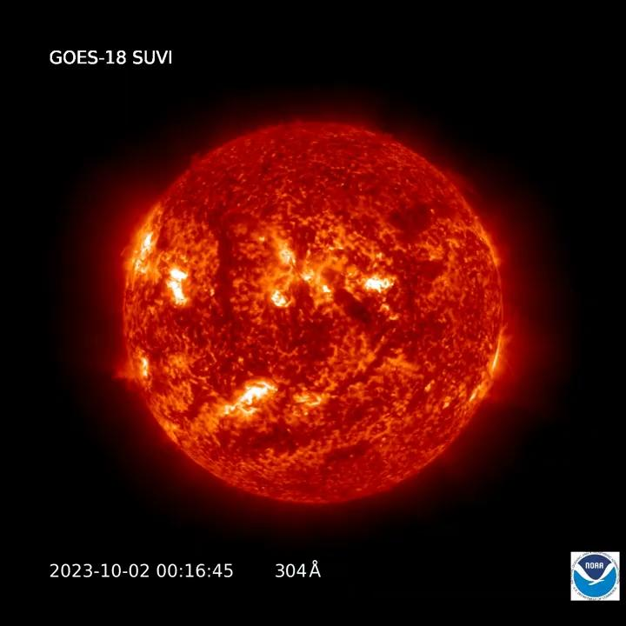
Overview of SUVI

Slide 11
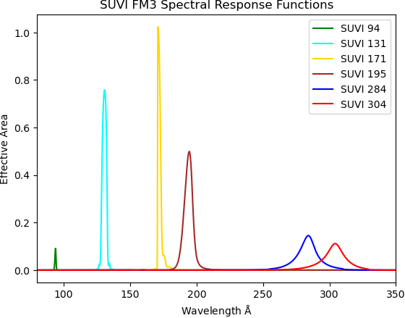
SUVI Spectral Response Functions
FM3 (GOES-18) SRFs plotted alongside FM1 (GOES-16) SRFs:
94Å SRF
131Å SRF
171Å SRF
195Å SRF
284Å SRF
304Å SRF

Slide 12
File Formats:
netCDF vs. FITS
The SUVI L1b product is produced in both netCDF and FITS formats
The standard file format for the astrophysical community is FITS
NWS/SWPC and NCEI Level-2 algorithms expect FITS files
NCEI-CO considers the SUVI L1b FITS product as the standard, and these data are used for PLPT activities.

Slide 13
Current Look-up Table Filenames
Calibration LUT:
SUVI_CalibrationParameters(FM3A_CDRL79RevBv2_PR_12_02_01)-737188400.0.h5
INR LUT:
SUVI_NavigationParameters(FM3A_ADR1290_NCEI_PR_12_02_01)-737188400.0.xml

Slide 14
Review at Full Maturity

Slide 15
Current ADR List
Risk | ADR | WR | Build | Impacts | Comments
Ground System Handling of Dark Frames | 260 | 6025 |  | Changes to the SUVI imaging sequences will not be properly handled | Resolved.
SUVI L1b FITS non-compliance | 1021 | 7364 | DO.11.00.00 | Breaks current and future software | Resolved.
SUVI DATE-OBS needs exposure time correction | 1048 | 7558 | DO.12.01.00 | Observation time metadata does not match observations. | Resolved.
SUVI GPA cannot handle additional flatfields | 1147 | 8433 |  | Mitigation for degradation/light leaks cannot be done. | Resolved.
Saturation Thresholds calculated incorrectly | 1159 | 8932 | DO.12.00.00 | All downstream L2+ products | Resolved.
Frequent fill values in SUVI L1b space location fields. | 1263 | 9321 | DO.12.00.00 | User confusion, possible impact to 1276 resolution. | Pending Review
Uncorrected Roll Angle Error | 1276 | 9406 | n/a | Causes INR errors due to uncorrected roll. Common to all SUVI instruments | Rejected.
Installation of G18 SUVI INR LUT | 1290 |  |  | INR incorrect in G18 SUVI L1b | Resolved 1 Nov. 2022

Slide 16
ADR 1159
ADR 1159 - SUVI Saturation Thresholds Incorrectly Calculated in the Level-1b.
The saturation threshold of the SUVI instrument is needed for L2+ processing
(2¹⁴ - 1 DN)*(conversion to radiance)
The SUVI Composite Image product, a basal L2 product, relies on accurate saturation threshold estimates
The current ground system solution matches NCEI calculations to within 0.2%
NCEI considers this to be acceptable.

Slide 17
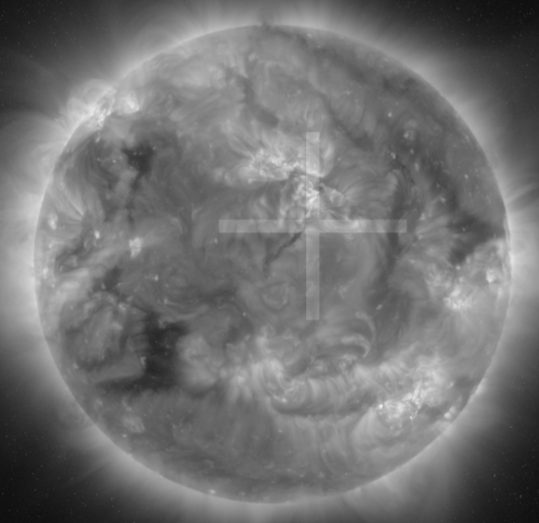
ADRs 260 and 1147
ADRs 260 and 1147 were meant to be closed with GOES-18 SUVI active PLPT GOES18-O-SUVPLPT-001.
A LUT mis-match resulted in no Level-1b data being produced. 260/1147 could not be confirmed as “resolved”.
ADR 260 was tested during a special imaging sequence on 22 March 2023. ADR 260 is now resolved.
ADR 1147 was tested in the development environment of the GOES-R Ground System on 1 May 2023. ADR 1147 is now resolved.
SUVI Image from the ADR1147 test.

Slide 18
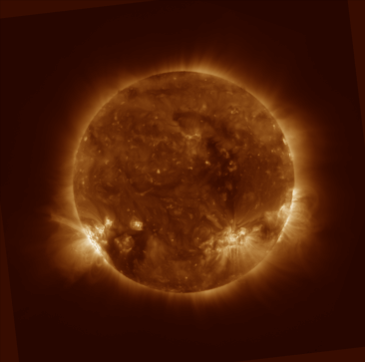
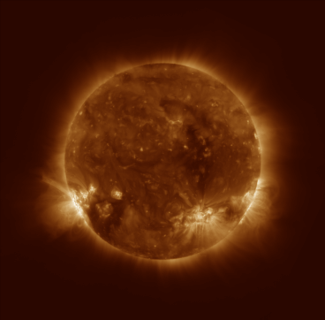
Uncorrected Rotation Update (ADR 1276)
Context: Key to INR is knowledge of the orientation of the SUVI instrument with respect to the Sun. The relative rotation of the SUVI instrument to solar north is captured in the CROTA and PC_{ij} keywords of the SUVI Level-1b product. Users have communicated to NCEI that there is an unknown contribution to the relative rotation that is not captured in CROTA and PC_{ij}.
NB: Every SUVI instrument is impacted by this issue.
Level-1b
CROTA corrected
Unresolved INR errors

Slide 19
Uncorrected Rotation Update (ADR 1276)
A user contacted NCEI about “alignment issues” with the GOES-R SUVI data
Investigation by NCEI revealed persistent uncorrected errors in the SUVI L1b roll angle (CROTA) up to 0.25° for the GOES-18 SUVI. NCEI also confirmed other SUVI instruments were impacted in a similar manner.
There are two plausible contributing factors: orbital effects or gimbal setting/reading uncertainty.
GOES-R PSE determined that MRD2045/2046 only applied to pointing (i.e. Sun Center) and that all pointing requirements were being met.
Outcome: No action will be taken to mitigate for this persistent uncorrected error in the SUVI roll angle. Once NCEI is providing reprocessed SUVI L1b data to the public, NCEI will inform users that the NCEI reprocessed data should be the preferred dataset.

Slide 20
GOES-18 SUVI Full Maturity PS-PVR
Evaluation of Product
Quality

Slide 21
Assessment Overview
 | Today | Required/Desired
INR | Correct Pointing and Roll offsets Applied Low-level systematic errors persist Uncorrected roll causes small INR errors | Complete INR LUT maintained All known contributors to INR characterized and accounted for.
Radiometrics | LUT updated for new calibration factors Degradation Trending activities are ongoing. Working to understand radiometric differences between G16/17/18 | Established method to disseminate degradation correction factors Degradation trending activities producing consensus results Radiometric measurements of all SUVI instruments are understood and trended Consistency between all SUVI radiometrics.
Usability | All relevant radiometric metadata is included in L1b product Scaling of L1b products is dynamic and accurately reported SUVI data is shared through Helioviewer and the VSO! SUVI tools are in SunPy! | Ease of use by wider scientific community

Slide 22
GOES-18 SUVI Post-Launch Products Test
Presented for Full Maturity
Test ID | Test Title | Operator | Status
PLPT-SUV-001 | SUVI Trending - CCD Temperature | NCEI | Ongoing
PLPT-SUV-002 | SUVI Trending - Detector Performance | NCEI | Ongoing
PLPT-SUV-003 | SUVI Trending - AIA Intercalibration | NCEI | Ongoing
PLPT-SUV-006 | SUVI Trending - EXIS Intercalibration | NCEI | Ongoing
PLPT-SUV-007 | SUVI Trending - SUVI Intercalibration | NCEI | Ongoing
Trending activities use Ground System generated L1b products when possible.
PLPT-SUV-002 requires the use of L0 CCSDS data.
All PLPT activities have been successfully executed to date.
All test plans and procedures are given in the SUVI Readiness Implementation and Management Plan
(SUVI RIMP v2.0; 410-R-RIMP-0319)

Slide 23
PLPT-SUV-001: CCD Temperature Trending
Demonstrated ability to extract and trend the SUVI detector temperatures
Scientific CCDs are cooled to reduce thermal noise

Slide 24
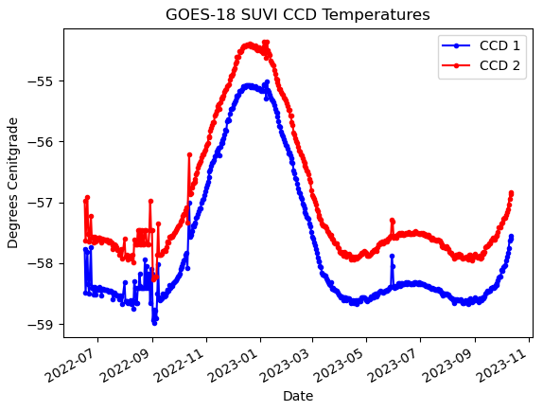
PLPT-SUV-001
SUVI CCD Temperature Trending
The GOES-18 SUVI CCD temperatures are steady and within the expected range.
Notes:
Update graphic with G17 SUVI CCD temperatures

Slide 25
PLPT-SUV-002: Detector Performance
Extract key CCD characteristics and create trends to monitor the CCD performance
NCEI trends Dark Current, CCD Bias, and Read Noise.

Slide 26
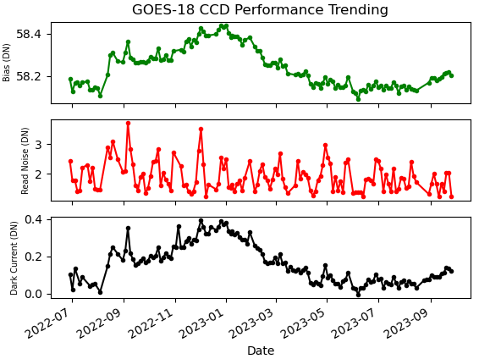
PLPT-SUV-002: Detector Performance
All GOES-18 SUVI detector performance quantities are very consistent over the time period shown.
Notes:
Update graphic.

Slide 27
Interlude - SUVI Ground Calibration
The SUVI instruments were calibrated on an individual component basis.
Instrument-level testing was limited to alignment checks (white light, without filters) or “sanity-check” tests (low-level in-band irradiance)
The SUVI mirror pairs went through extensive in-band testing
Testing occurred over 10 years ago
The impact of aging on mirror performance has not been tested
The CCD quantum efficiency was measured at a limited number of wavelengths
A quantum efficiency model was constrained using these measurements.
Fresh (untested) filters are installed onto the SUVI instrument pre-flight.
Reference filters manufactured to the same specifications were tested at LBNL ALS facility.
Measurements from witness samples are used to constrain the filter transmission model.
There are many contributions to the uncertainty of the overall SUVI response
These uncertainties most likely contribute to the measured differences between GOES-16/17/18 SUVI instruments and SUVI/AIA

Slide 28
PLPT SUVI-003: SUVI/AIA Intercomparison
Compares SUVI observations to the Atmospheric Imaging Assembly (AIA) on NASA’s Solar Dynamics Observatory
Full image comparisons identify image defects/artifacts
Trend comparisons identify response degradation
Some differences in passbands between the two instruments introduce minor artifacts
Analysis is also supported by LM-ATC, LASP, Royal Observatory of Belgium, and others through international EUV solar instrument degradation working group
AIA has no 284 Å comparator channel

Slide 29
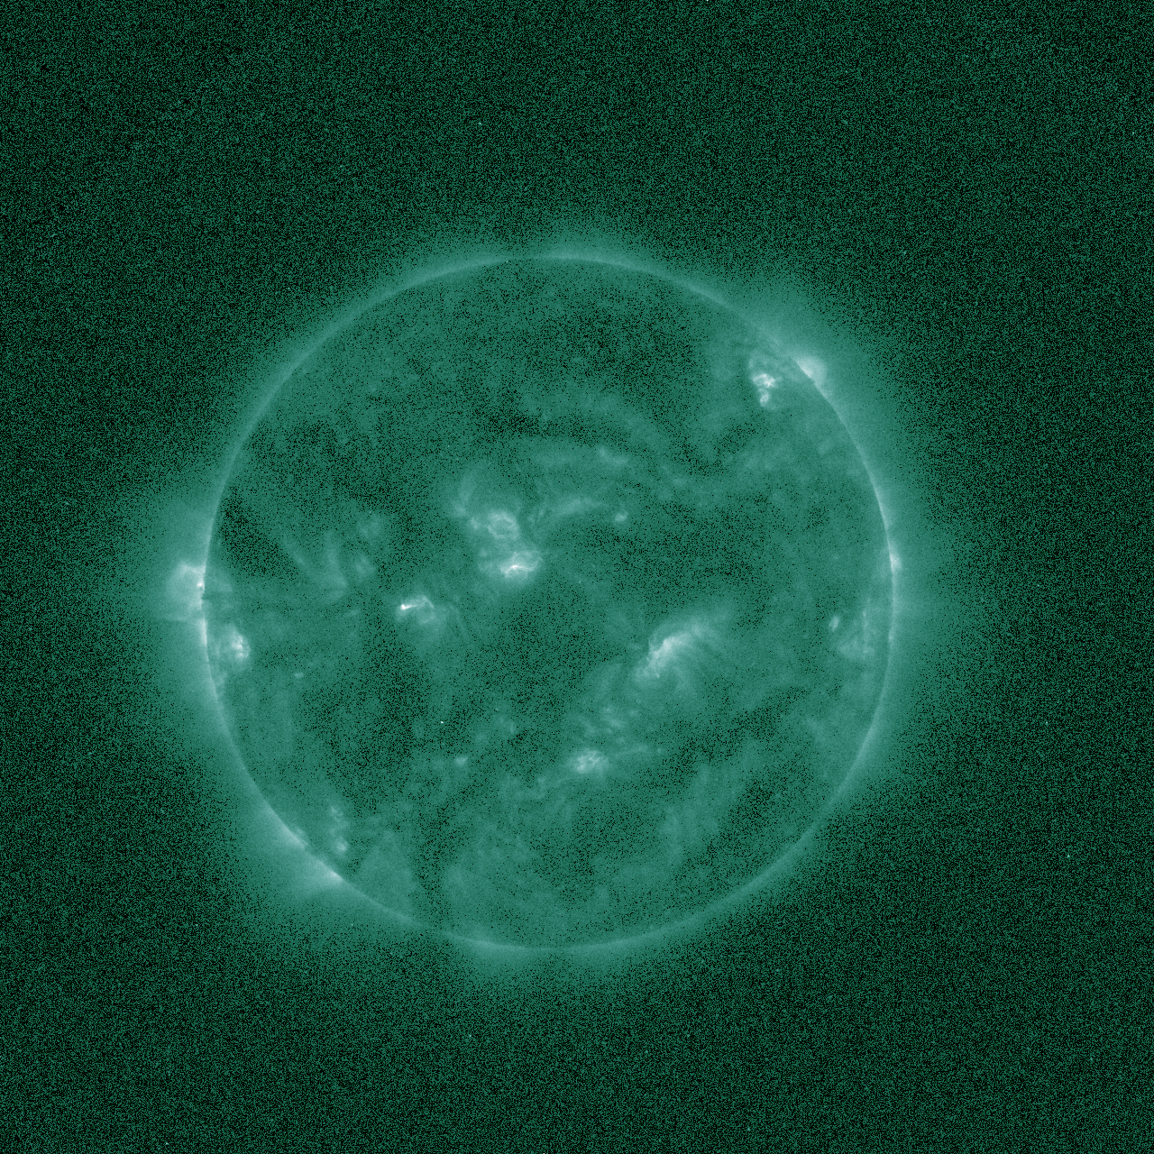
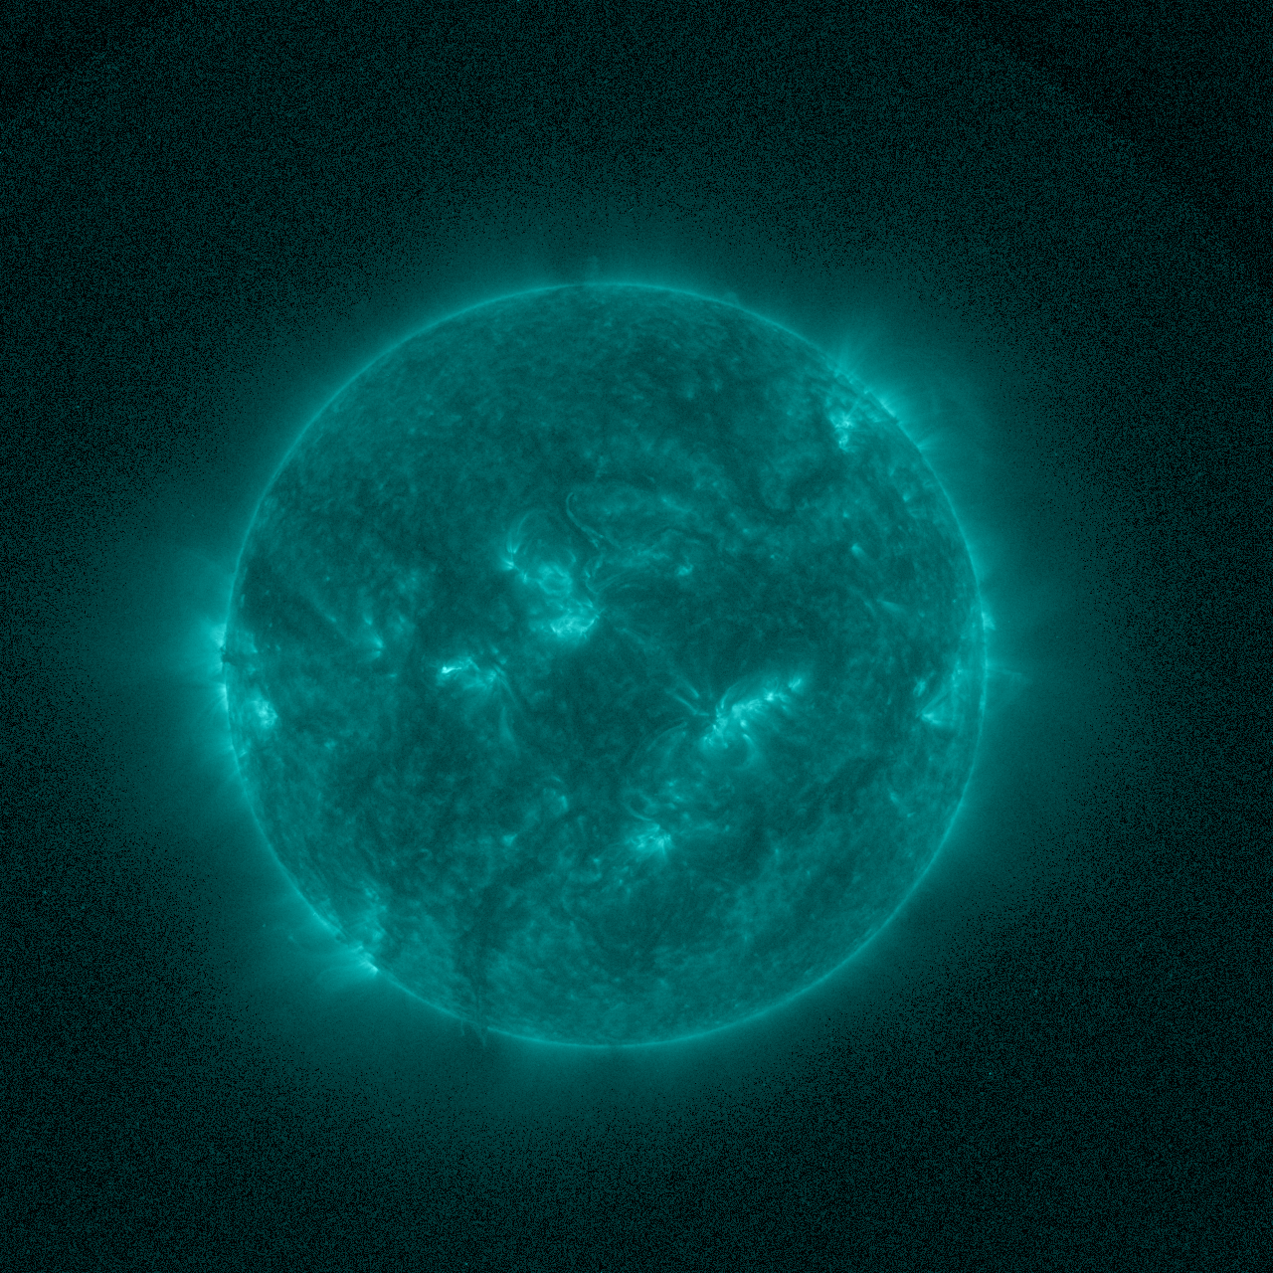
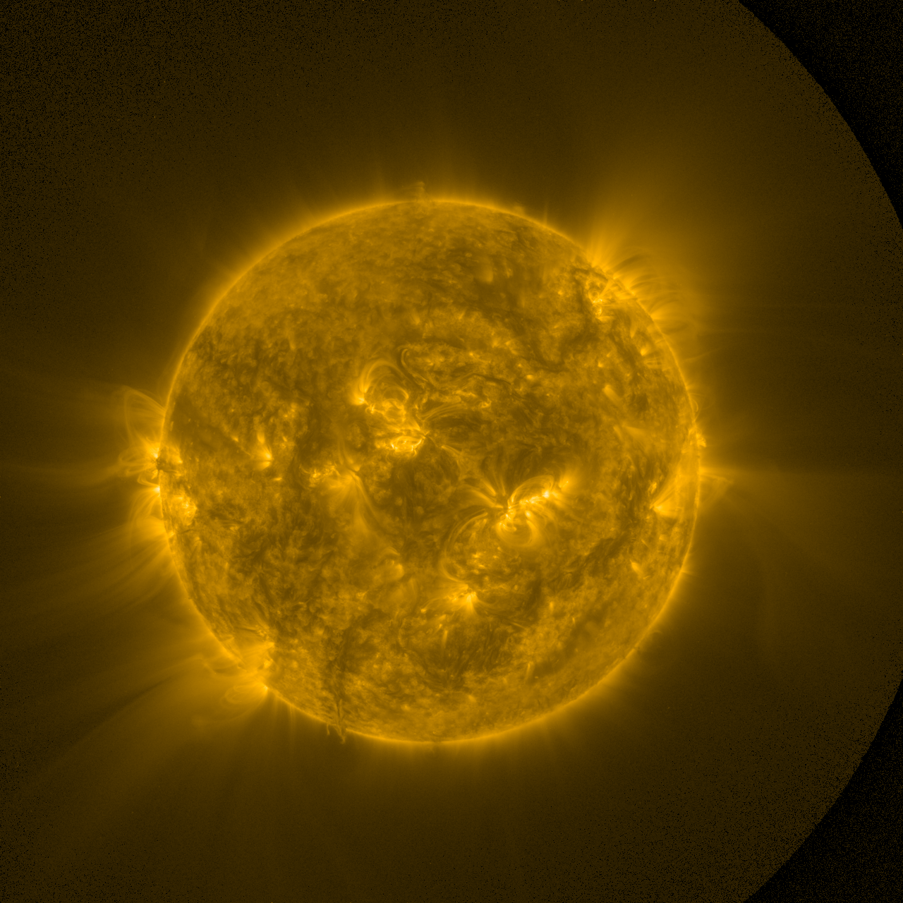
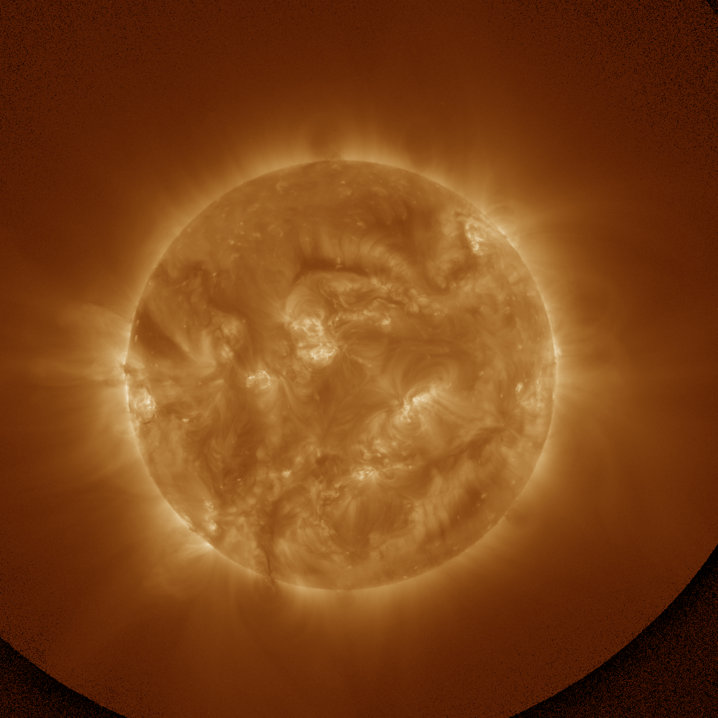
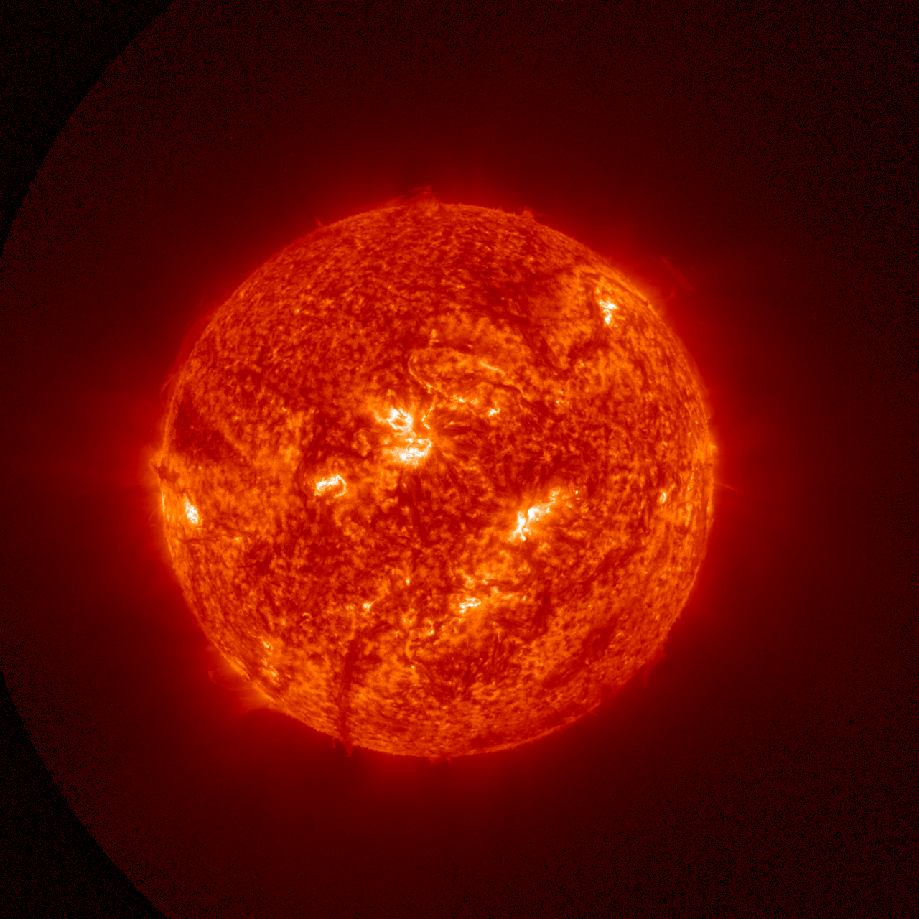
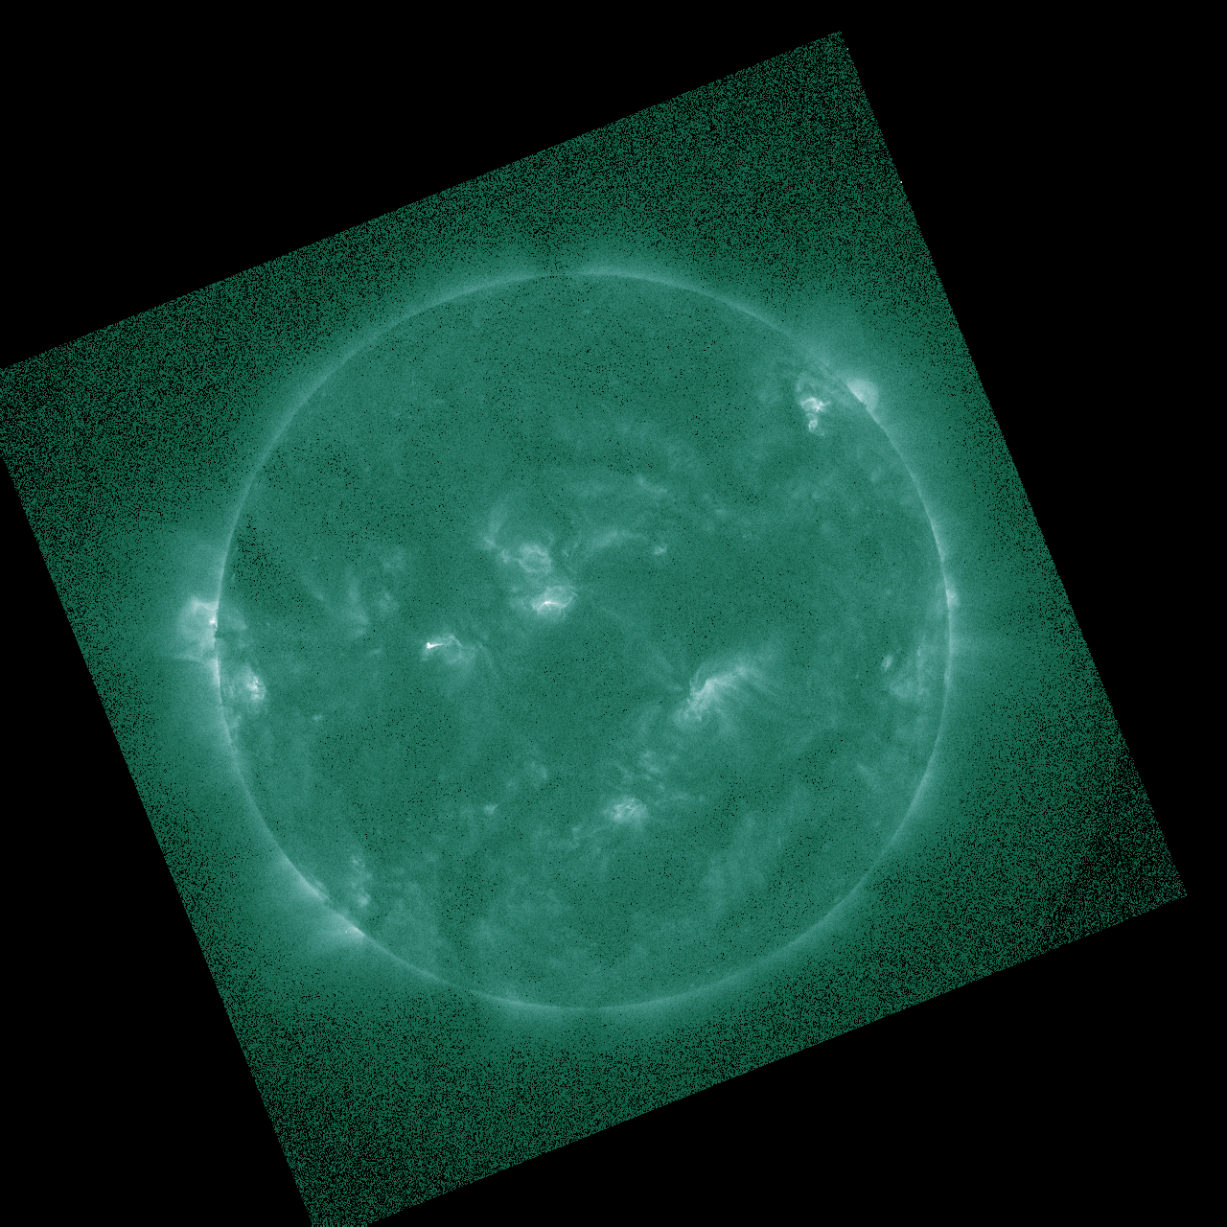
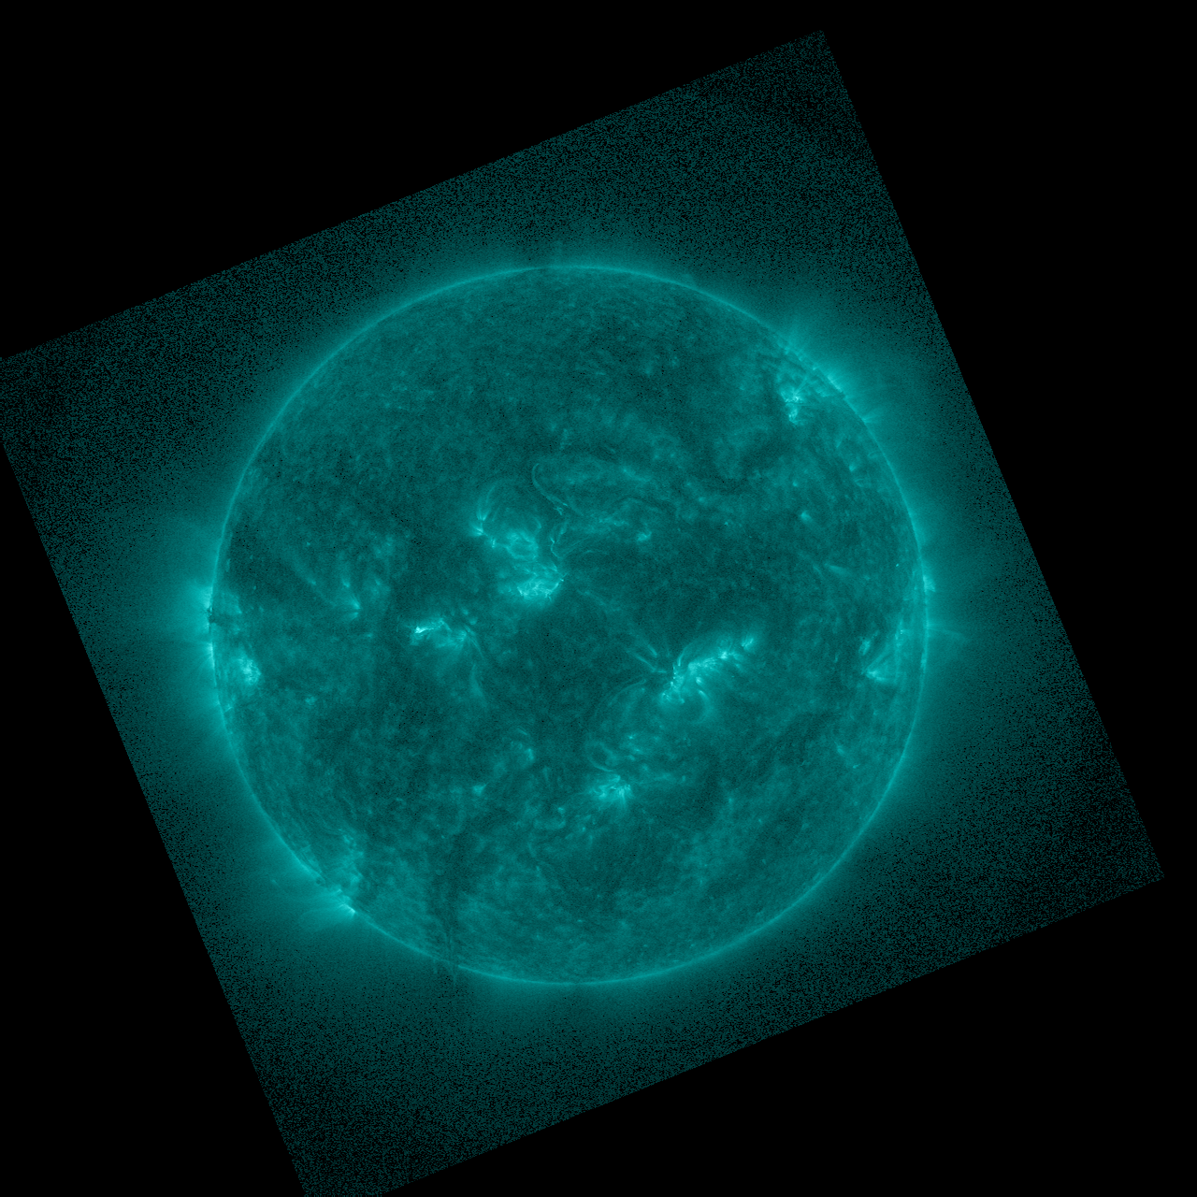
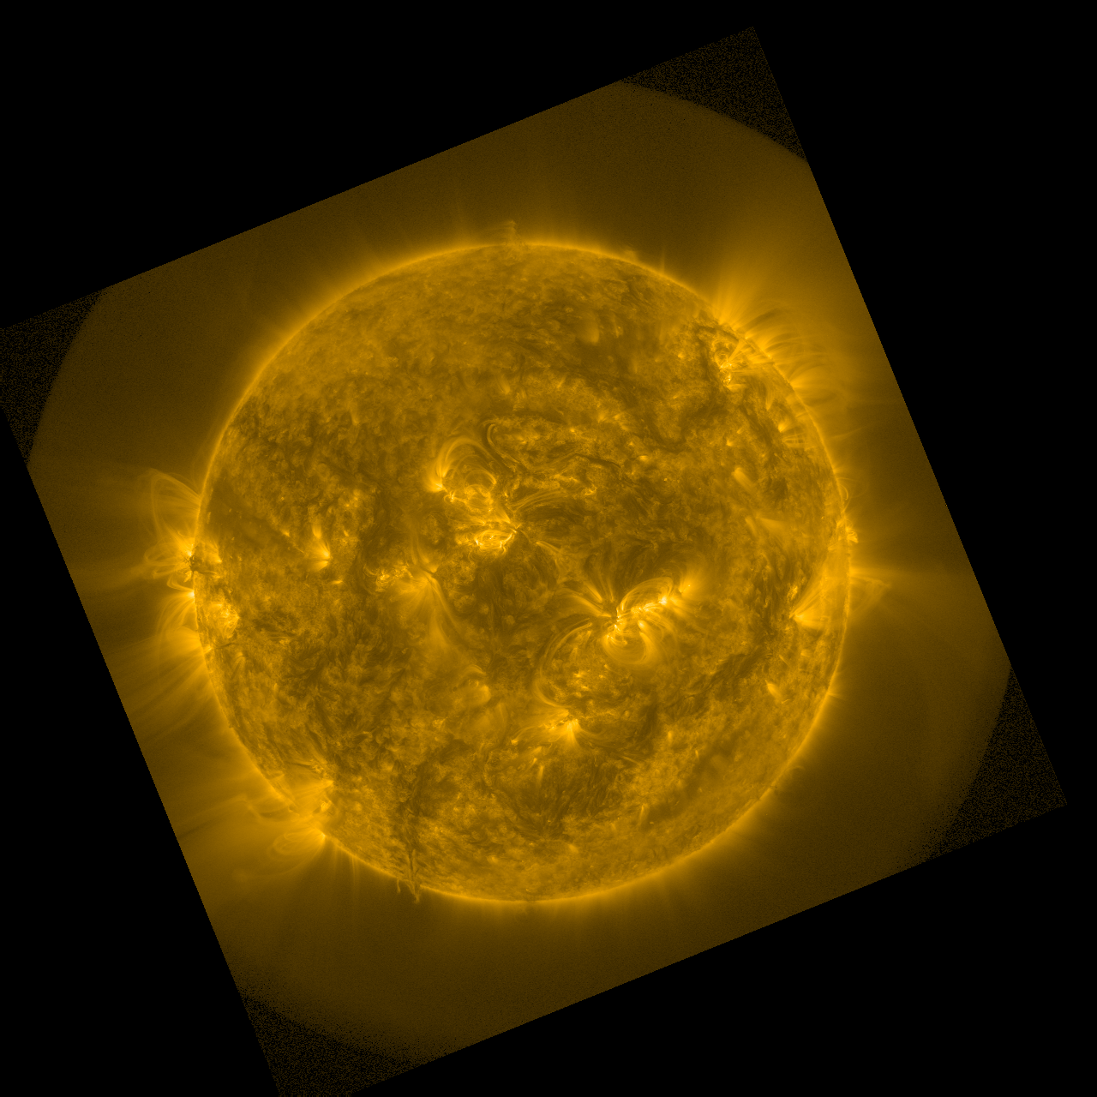
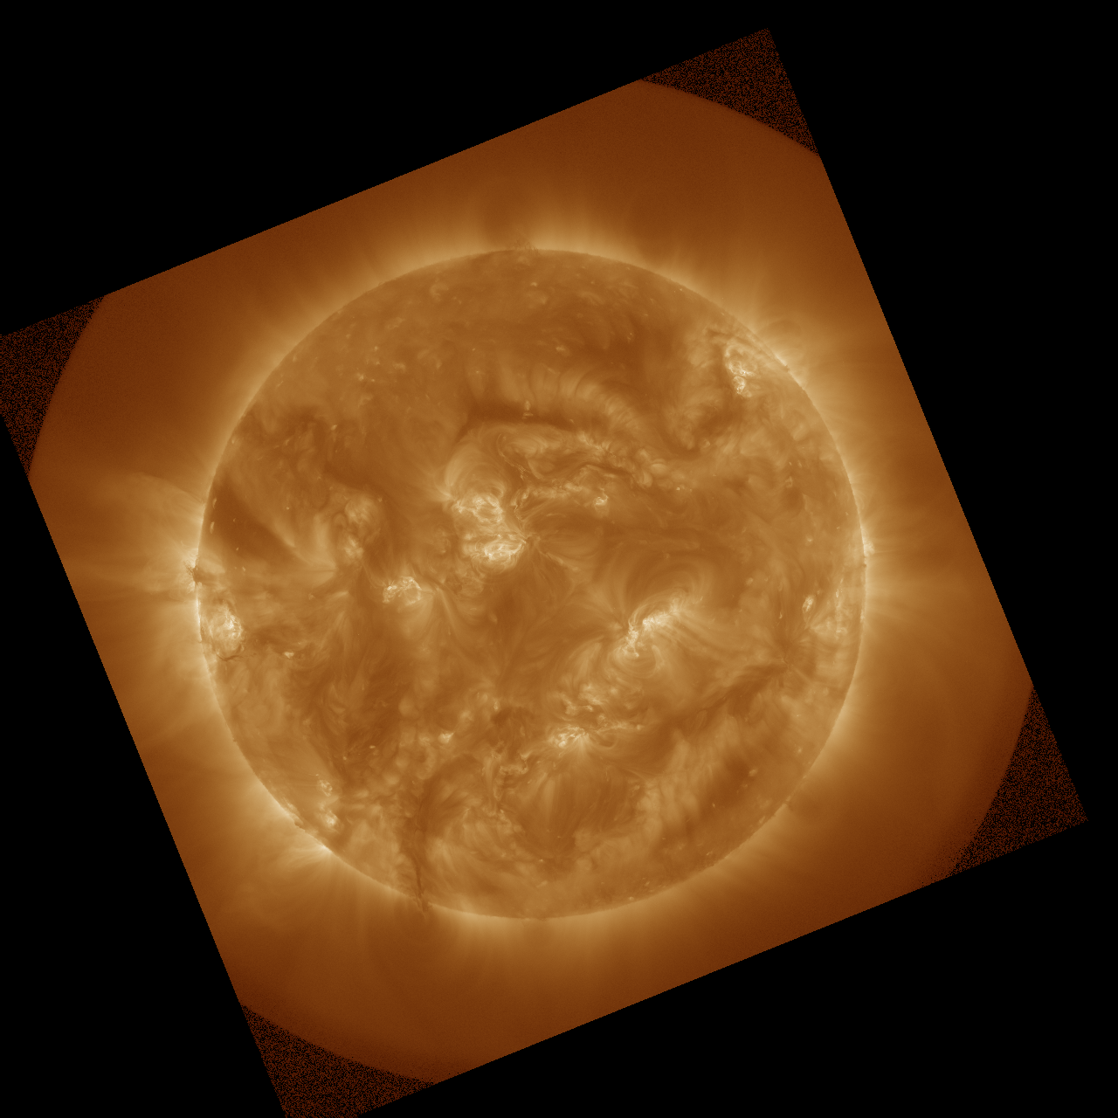
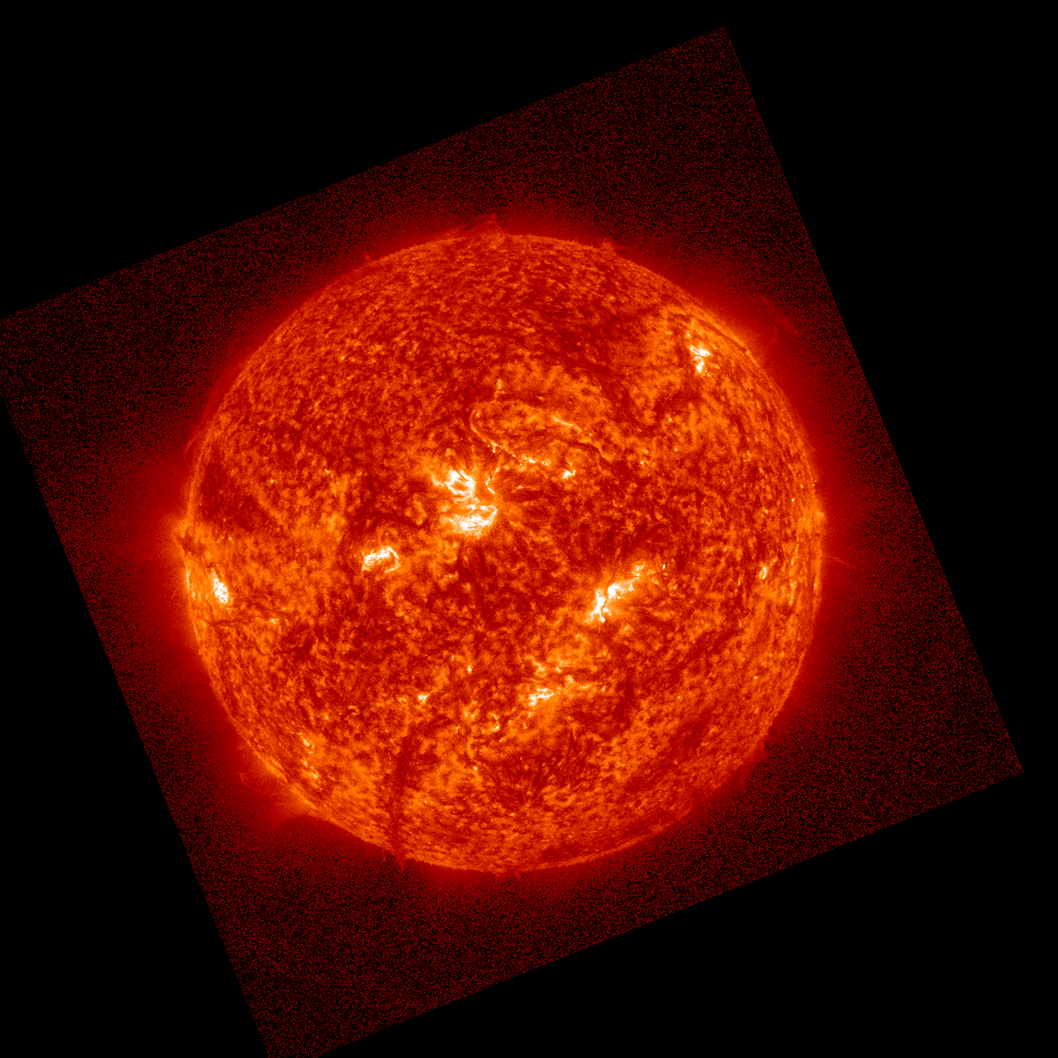
PLPT-SUVI-003: SUVI/AIA Intercalibration
Direct comparison of simultaneous images from SDO/AIA and GOES-18/SUVI can reveal image calibration issues as well as spatial defects.
SUVI
94 Å
131 Å
171 Å
195 / 193 Å
304 Å
5 Sept 2023 ~00:05 UT
AIA

Slide 30
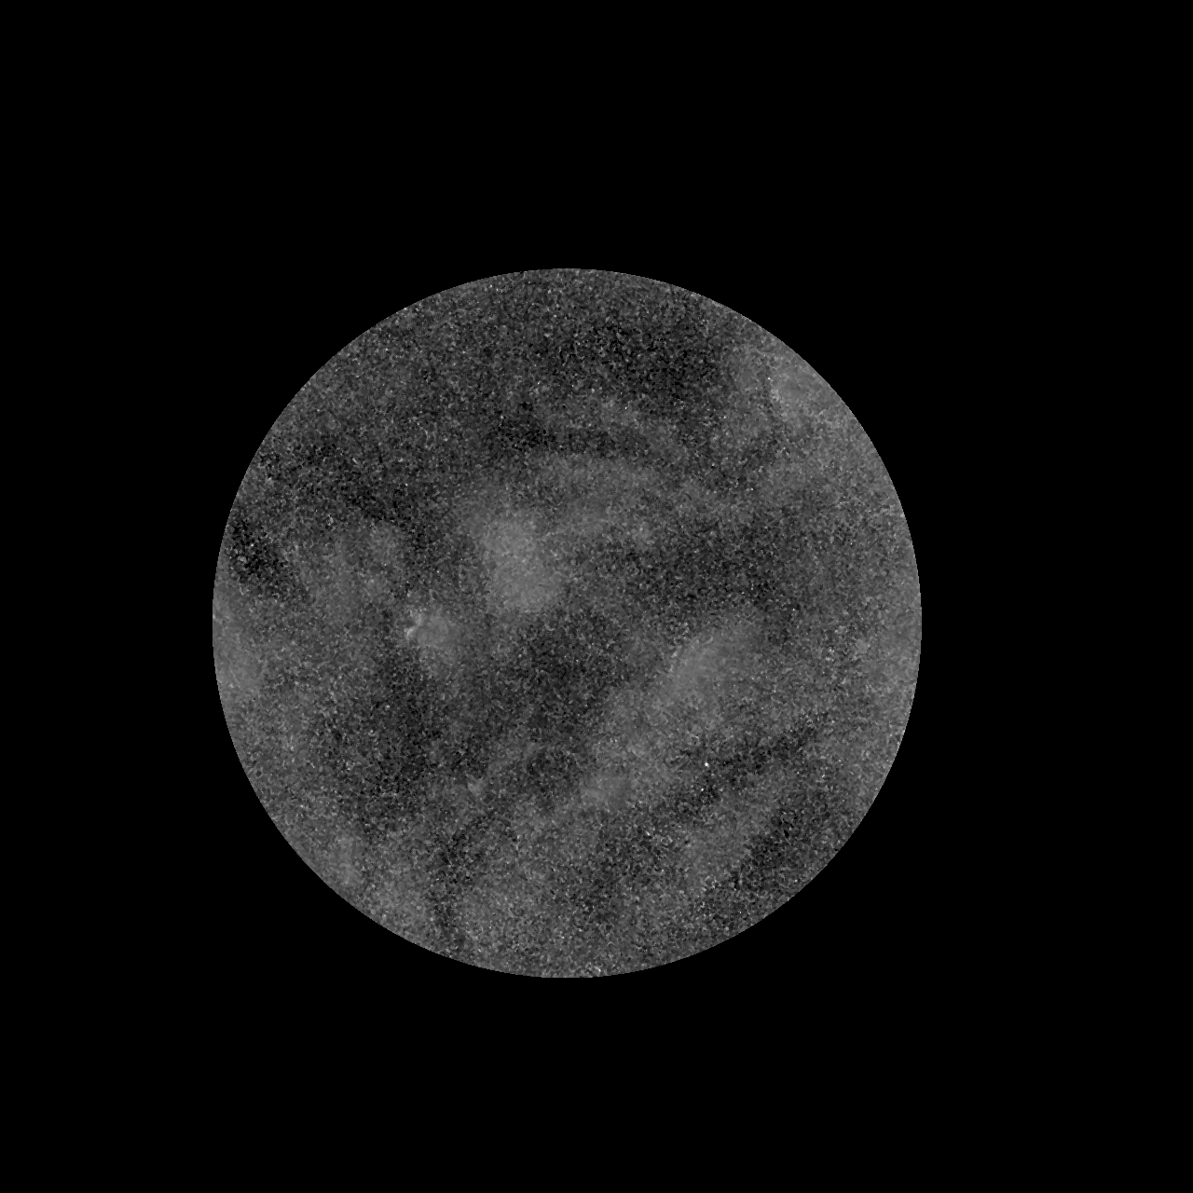
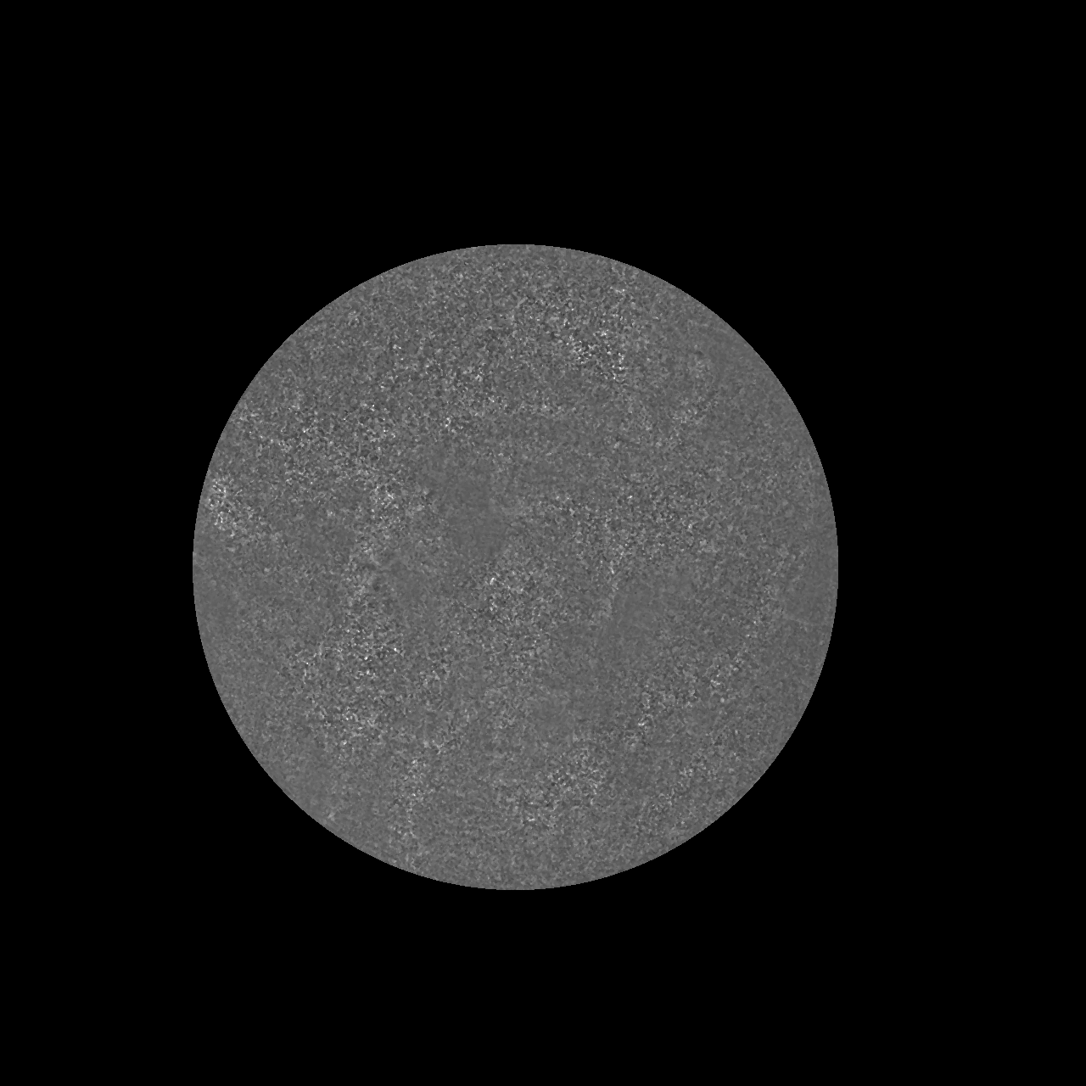
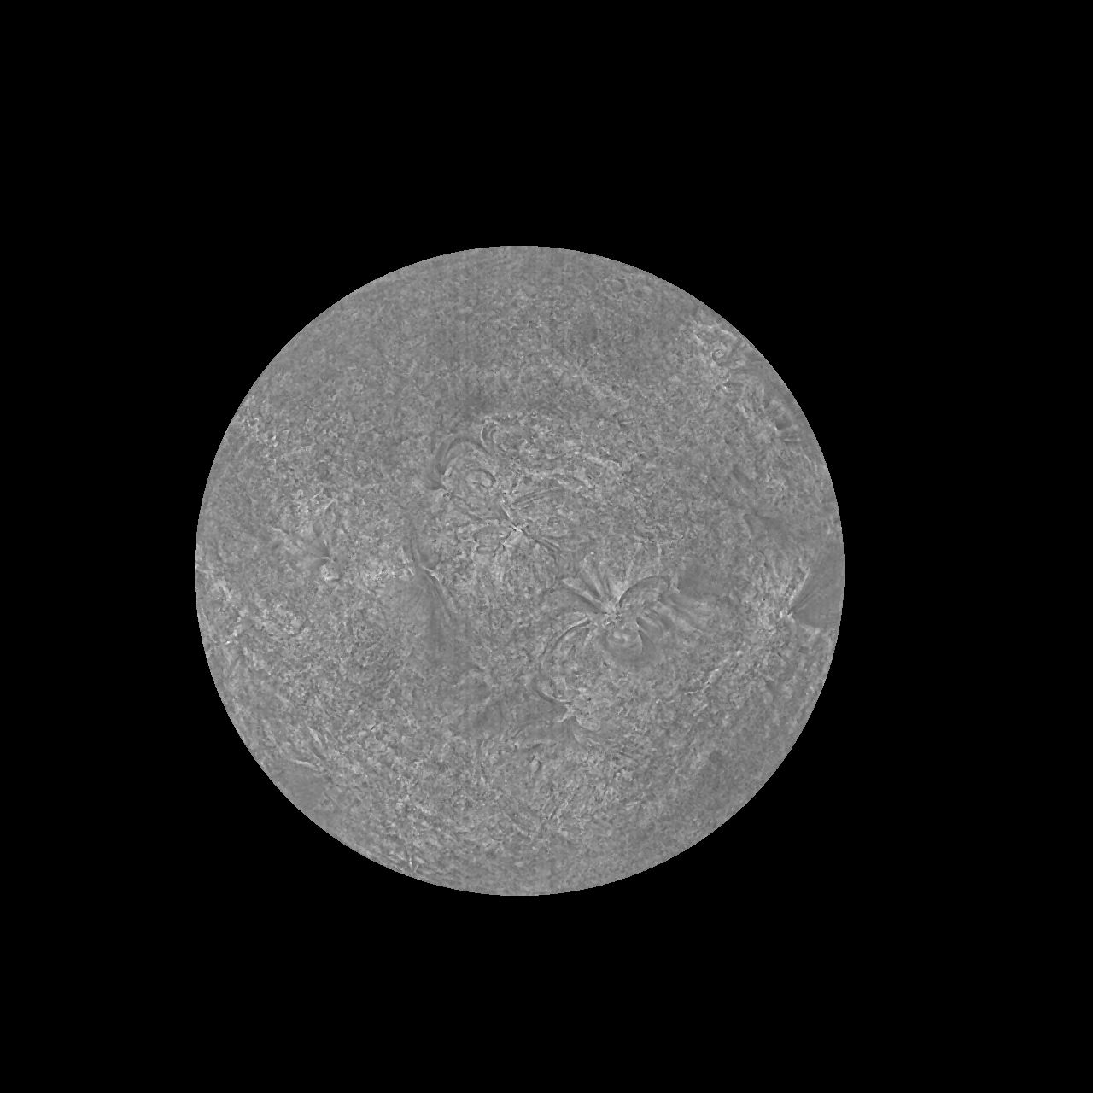
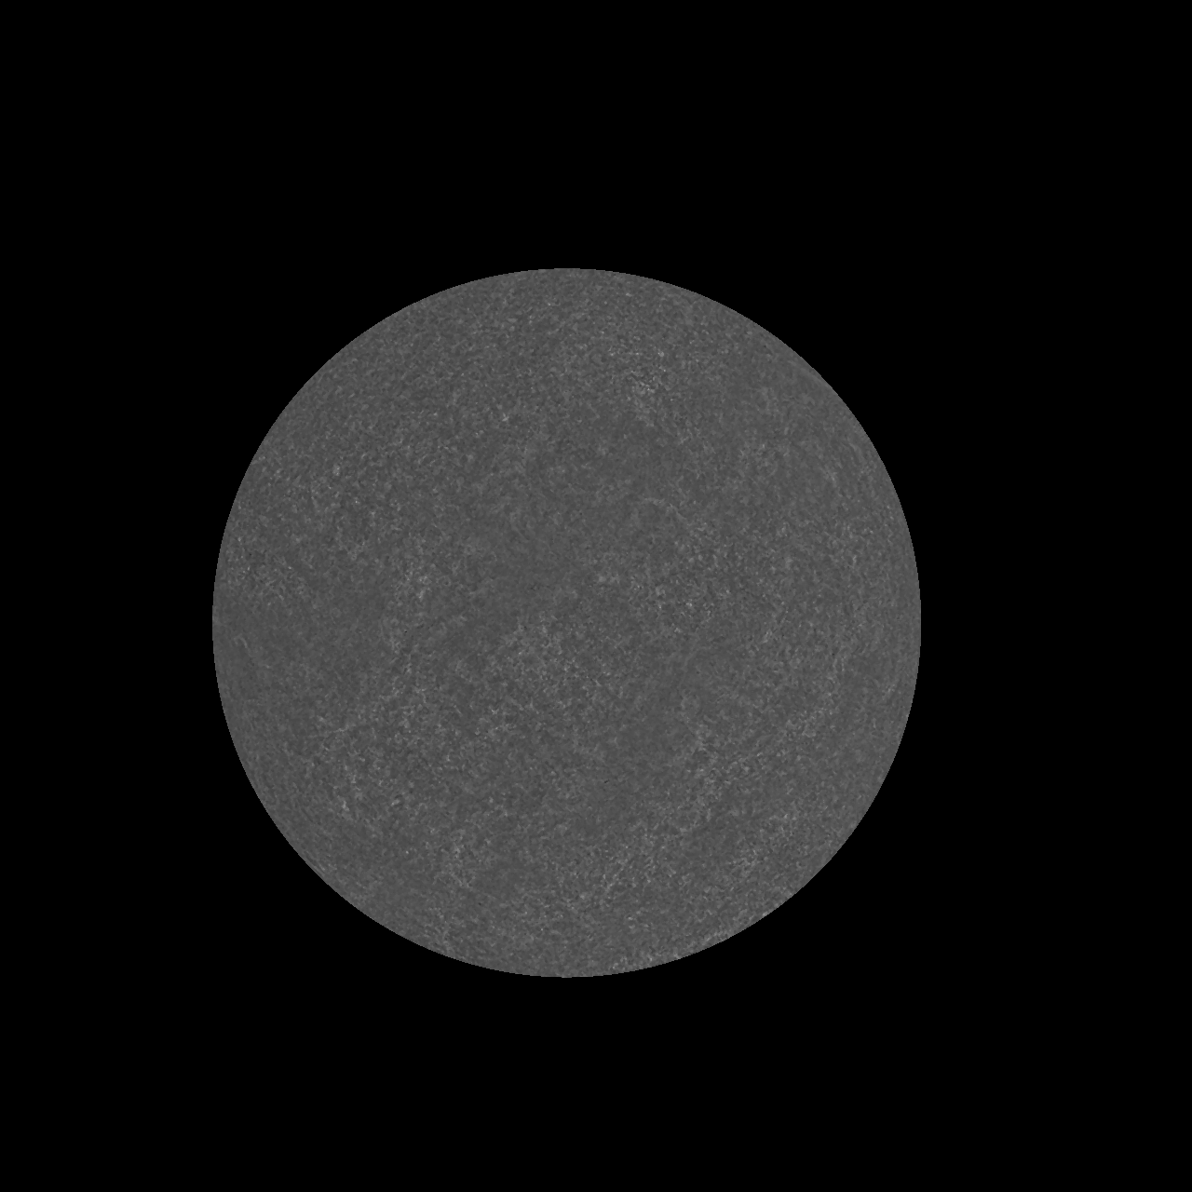
PLPT-SUVI-003: SUVI/AIA Intercalibration
Image ratios reveal flat response up to known passband differences and no large defects.
94 Å
131 Å
171 Å
195/193 Å
304 Å

Slide 31
PLPT SUVI-003: SUVI/AIA Intercomparison
Ratio histograms for SUVI/AIA:
Convolve EVE spectra at a similar solar activity level (2014) with the SUVI and AIA passbands expected ratio
Divide co-aligned and co-temporal SUVI and AIA images
measured ratio
Notes:
PLPT SUVI-003: Dan and Alison to update analyses for G17 SUVI.

Slide 32
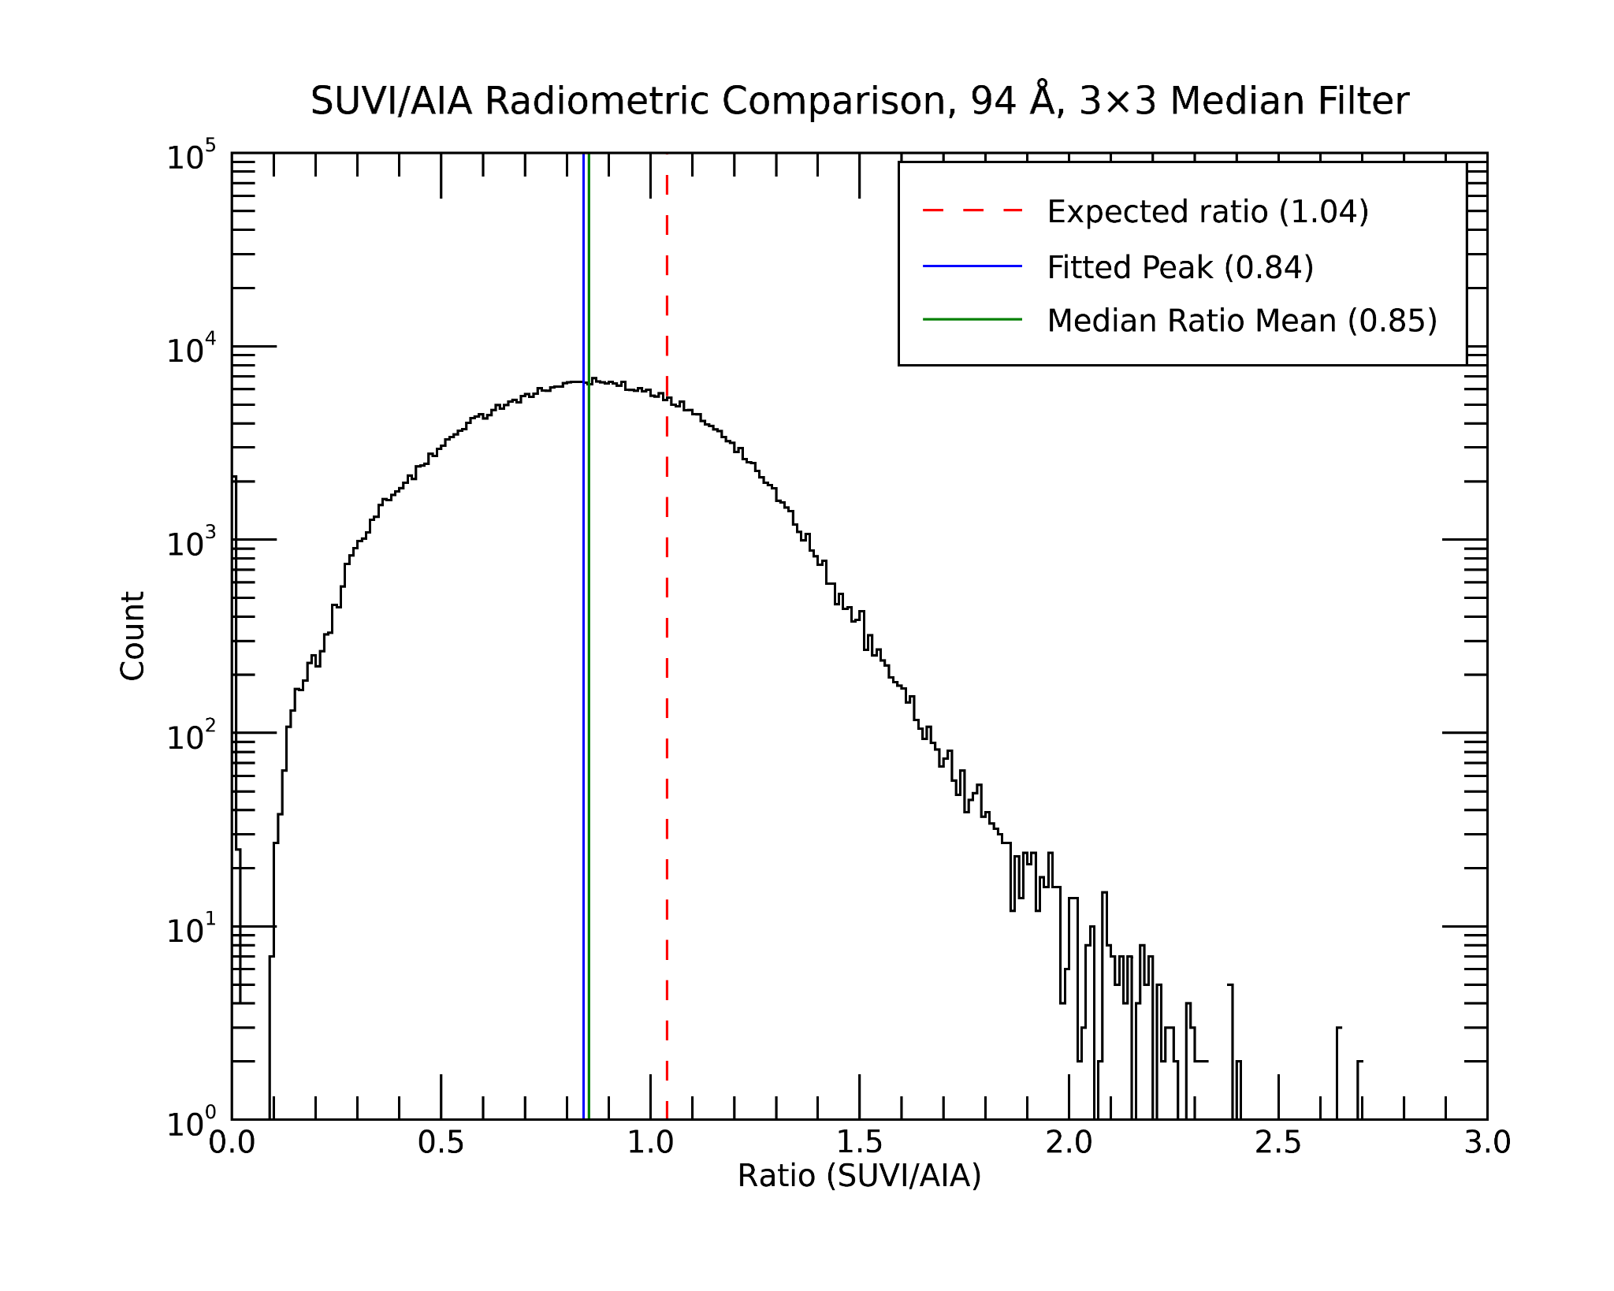
PLPT-SUVI-003: SUVI/AIA Intercalibration
Ratio histograms highlight any differences in response over range of radiances. Useful for identifying anomalies in pixel-to-pixel comparisons.
94 Å Estimated theoretical ratio based on passband analysis: 1.04
Fitted ratio: 0.84 / 0.85
Overall good agreement. Noisiest of the channels, so the distribution is rather broad.

Slide 33
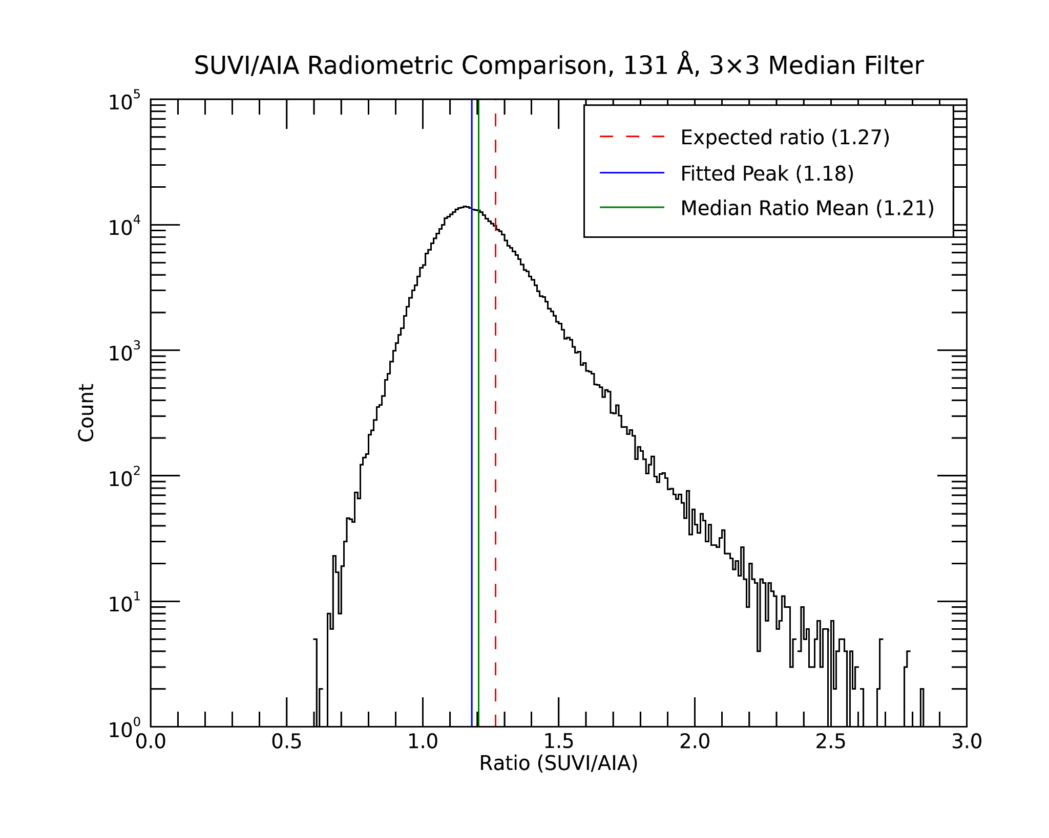
PLPT-SUVI-003: SUVI/AIA Intercalibration
Ratio histograms highlight any differences in response over range of radiances. Useful for identifying anomalies in pixel-to-pixel comparisons.
131 Å Estimated theoretical ratio based on passband analysis: 1.27
Fitted ratio: 1.18 / 1.21
Overall good agreement. Asymmetric tail probably results from residual misalignment and high temperature response differences.

Slide 34
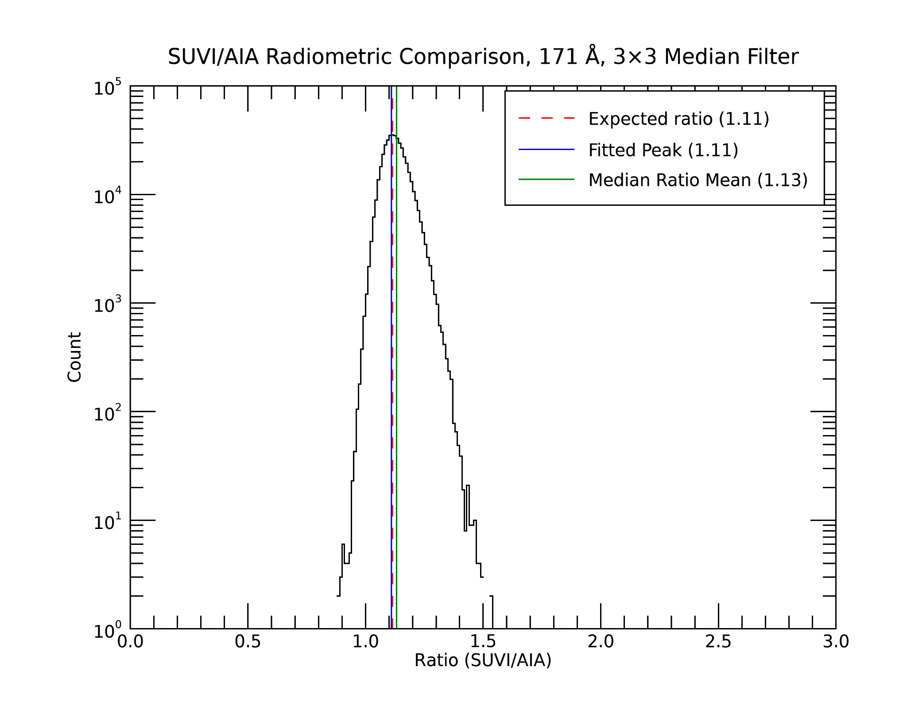
PLPT-SUVI-003: SUVI/AIA Intercalibration
Ratio histograms highlight any differences in response over range of radiances. Useful for identifying anomalies in pixel-to-pixel comparisons.
171 Å Estimated theoretical ratio based on passband analysis: 1.11
Fitted ratio: 1.11 / 1.13
Very good agreement.
Passbands are very similar and imager performance is very uniform.

Slide 35
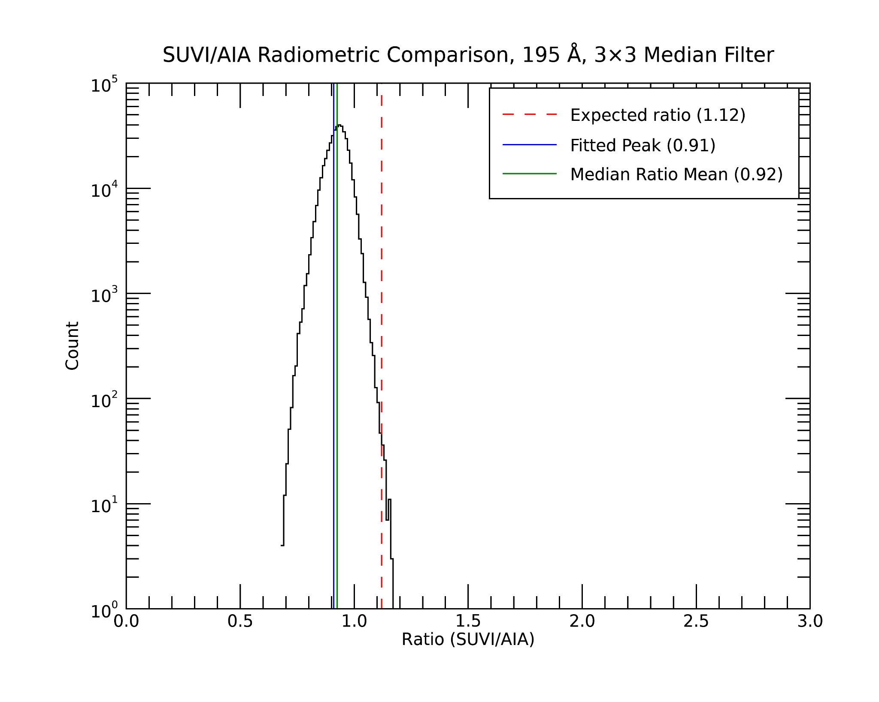
PLPT-SUVI-003: SUVI/AIA Intercalibration
Ratio histograms highlight any differences in response over range of radiances. Useful for identifying anomalies in pixel-to-pixel comparisons.
195 / 193 Å Estimated theoretical ratio based on passband analysis: 1.12
Fitted ratio: 0.91 / 0.92
Reasonable agreement. Narrow distribution indicates imager performance is very uniform. Differences are probably caused by the significant passband differences between the two instruments.

Slide 36
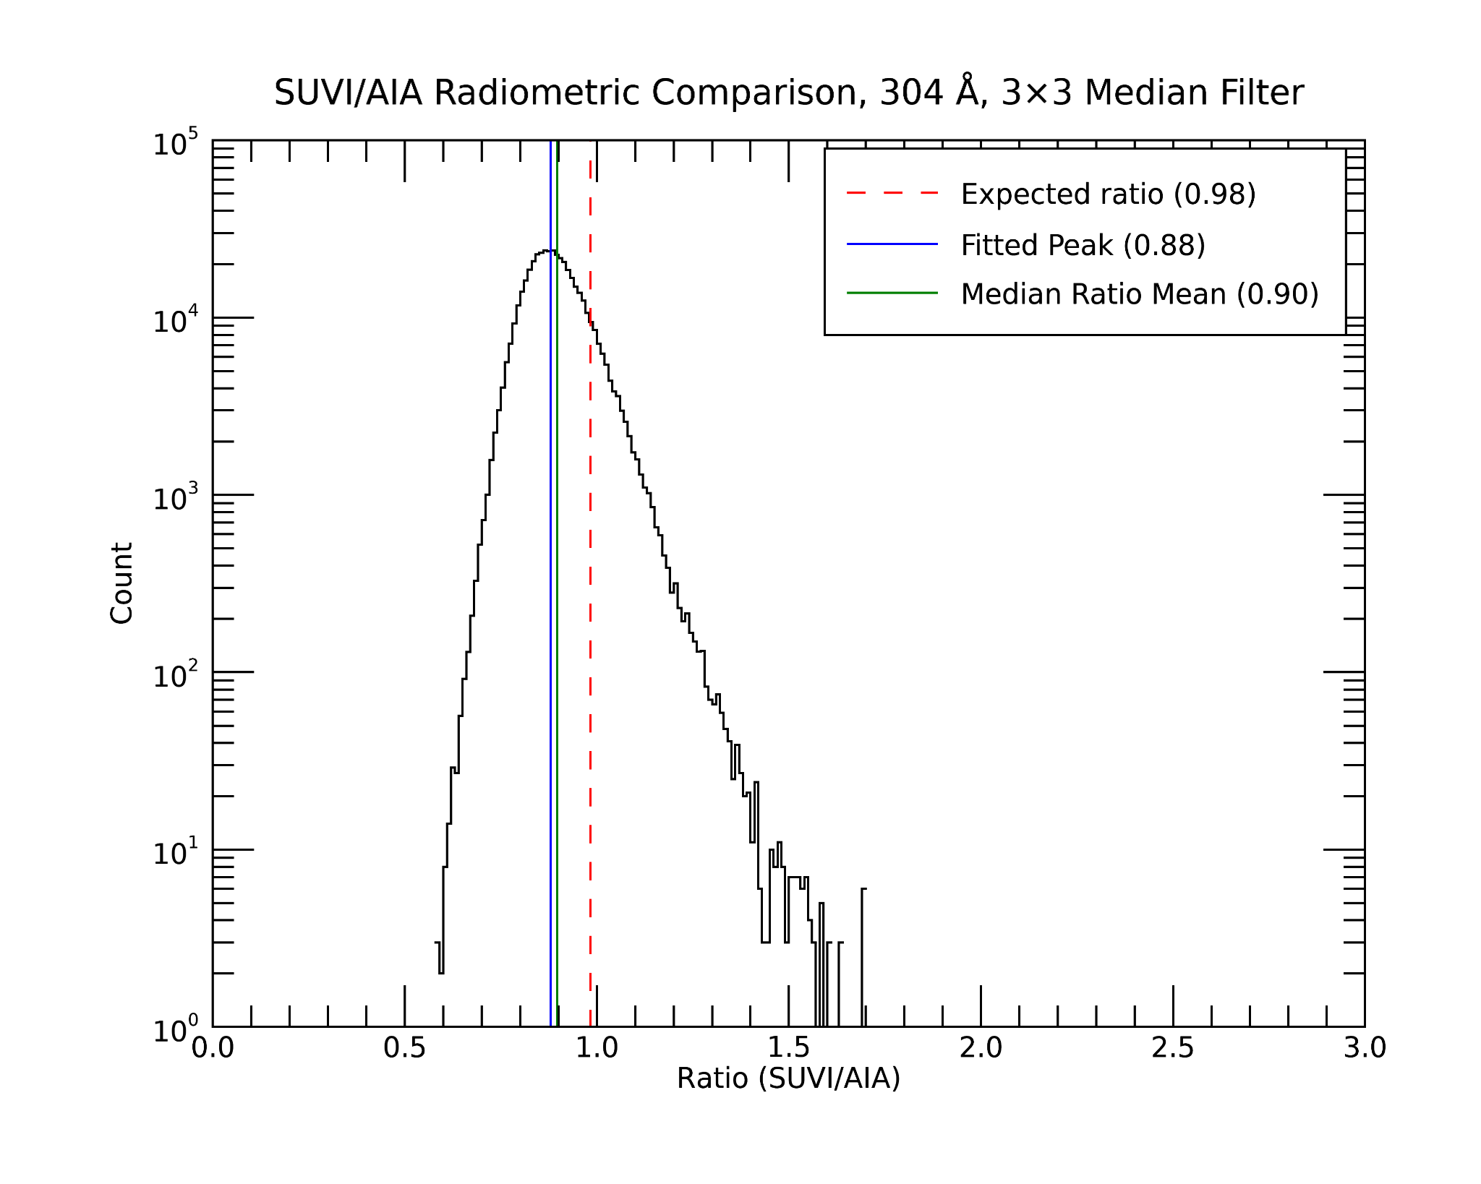
PLPT-SUVI-003: SUVI/AIA Intercalibration
Ratio histograms highlight any differences in response over range of radiances. Useful for identifying anomalies in pixel-to-pixel comparisons.
304 Å Estimated theoretical ratio based on passband analysis: 0.98
Fitted ratio: 0.88 / 0.90
Overall good agreement.
Differences are probably caused by residual misalignment, high temperature response differences, and 284 Å contamination for SUVI.

Slide 37
PLPT-SUVI-003: SUVI/AIA Intercalibration
Summary:
GOES-18/SUVI and AIA radiometric comparison shows results within expected ranges for all comparable wavelength channels.
The largest deviations are found in 94 Å and 195 Å, which are due to noise (94 Å) and passband differences (193/195 Å).

Slide 38
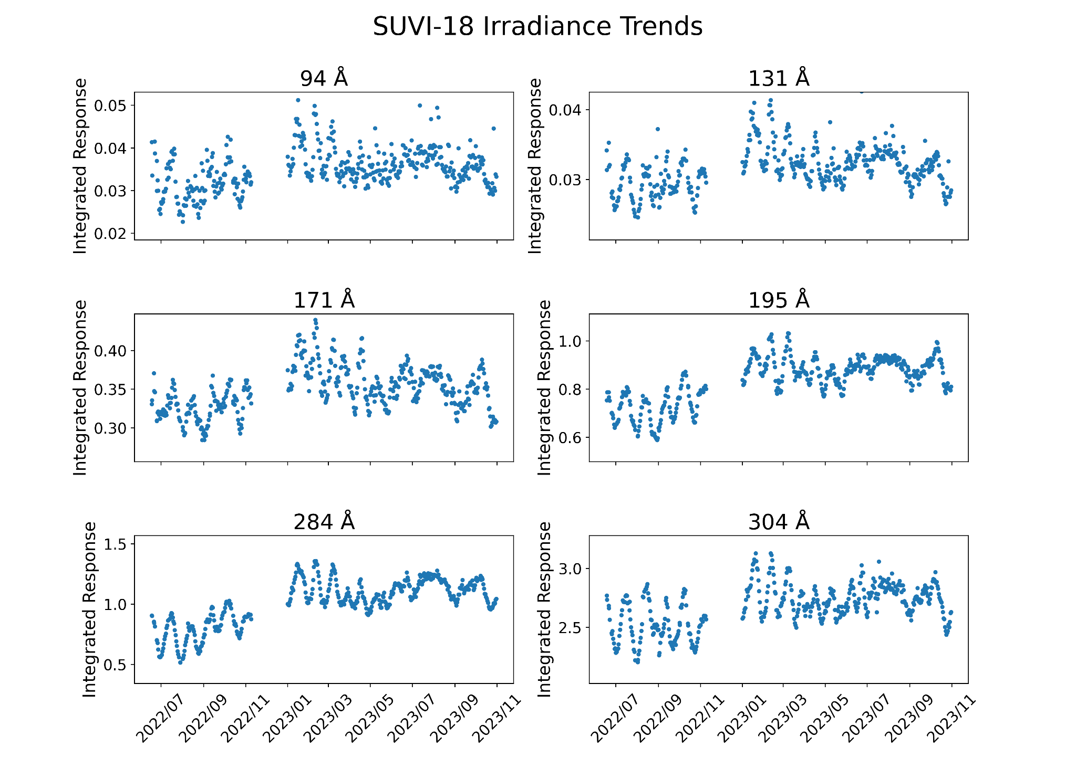
PLPT-SUVI-003: SUVI/AIA Intercalibration
GOES-18 SUVI Integrated Responses
Individual intensity signals are dominated by solar activity, particularly as we approach solar maximum.
No observable objects can provide a standard candle to calculate absolute degradation for these EUV observations.
We calculate ratios of SUVI to other SUVI instruments and AIA, to remove solar cycle variation.

Slide 39
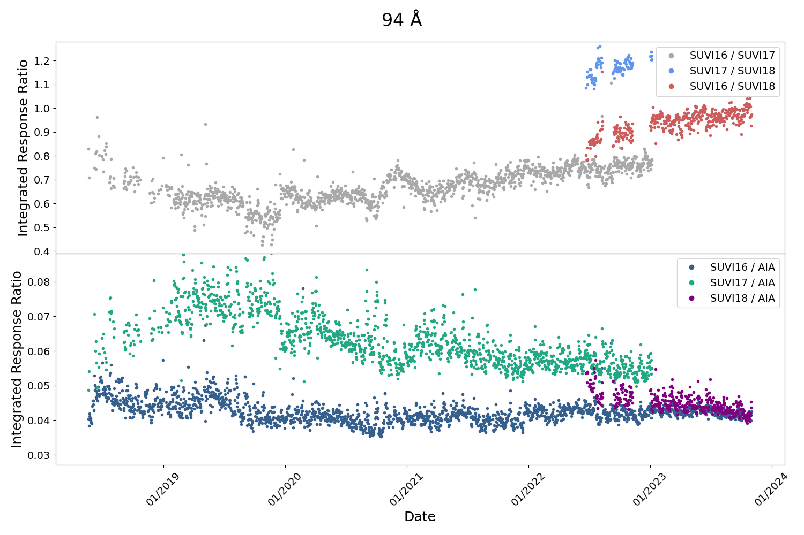
PLPT-SUVI-003: SUVI/AIA Intercalibration
GOES-18 SUVI Integrated Responses
94 Å: SUVI-16, 17, 18 and AIA bakeout / jump corrected long term trends (May 2018 - October 2023)
Note that due to general high variability in 94 Å data as well as the light leaks in SUVI-17 and recently SUVI-16 94 Å, trends for this wavelength are harder to quantify

Slide 40
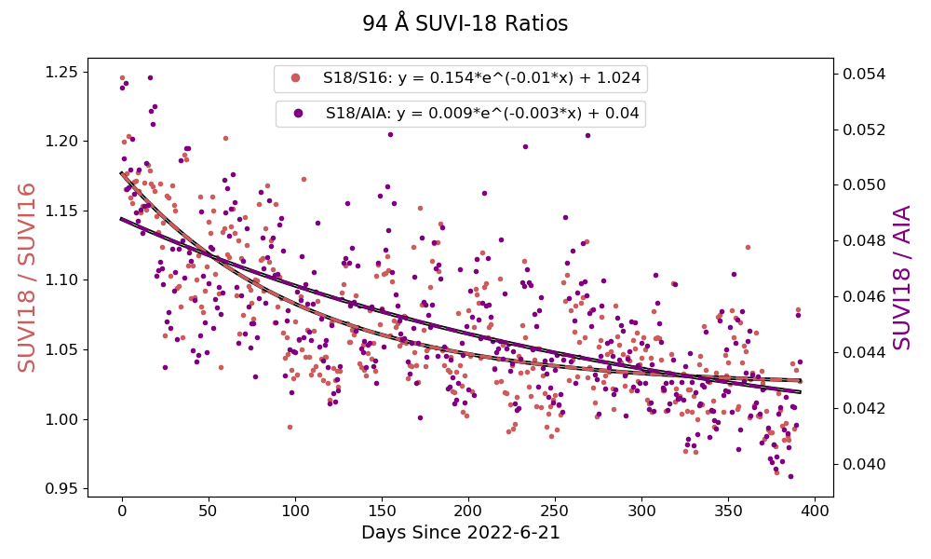
PLPT-SUVI-003: SUVI/AIA Intercalibration
GOES-18 SUVI Integrated Responses
Estimated 94 Å SUVI-18 Mission* Degradation Relative to:
SUVI 16: 12.6%
AIA: 12.7%
*Note: here we define mission degradation of SUVI-18 over the period from 6/21/2022 (calibrations first applied) to 10/31/2023

Slide 41
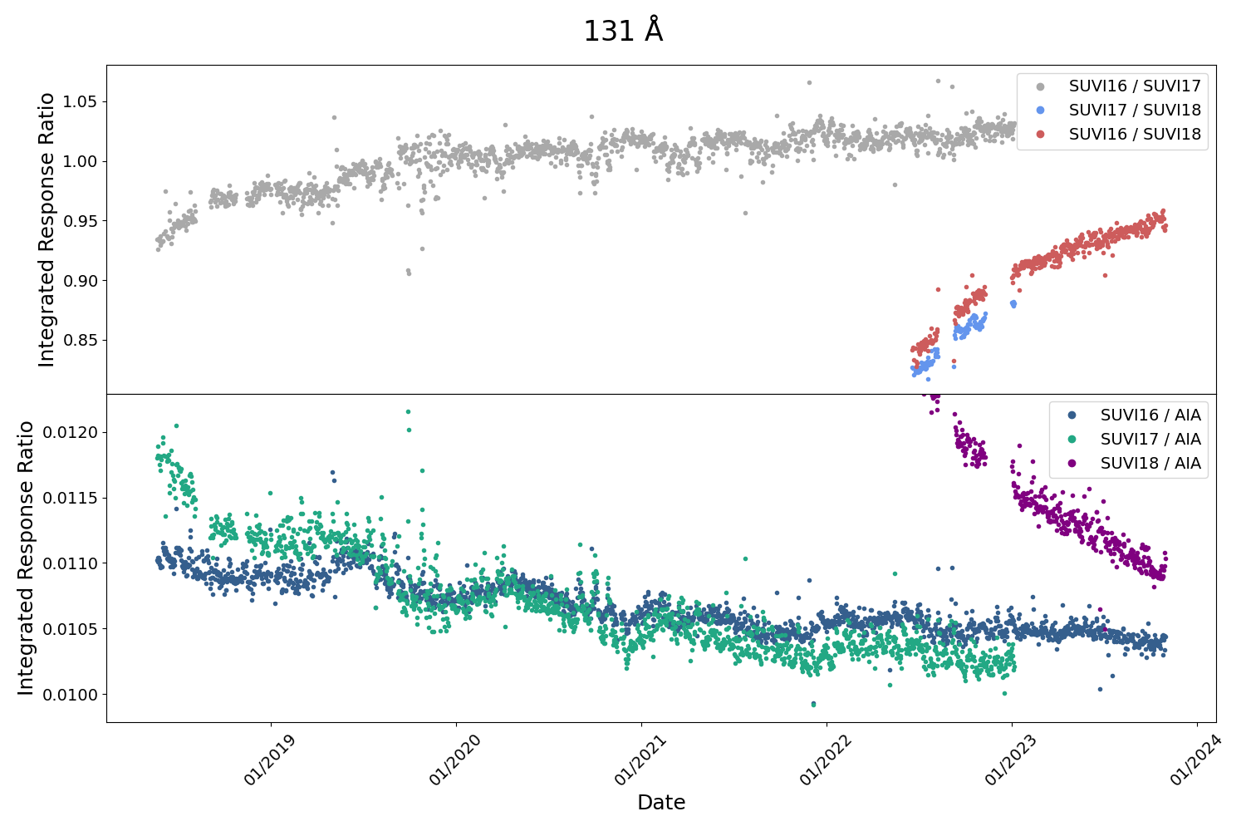
PLPT-SUVI-003: SUVI/AIA Intercalibration
GOES-18 SUVI Integrated Responses
131 Å: SUVI-16, 17, 18 and AIA bakeout / jump corrected long term trends (May 2018 - October 2023)
Yearly variation present in the long term trending, with steady net degradation
Significant, sustained, early exponential decay of GOES-18

Slide 42
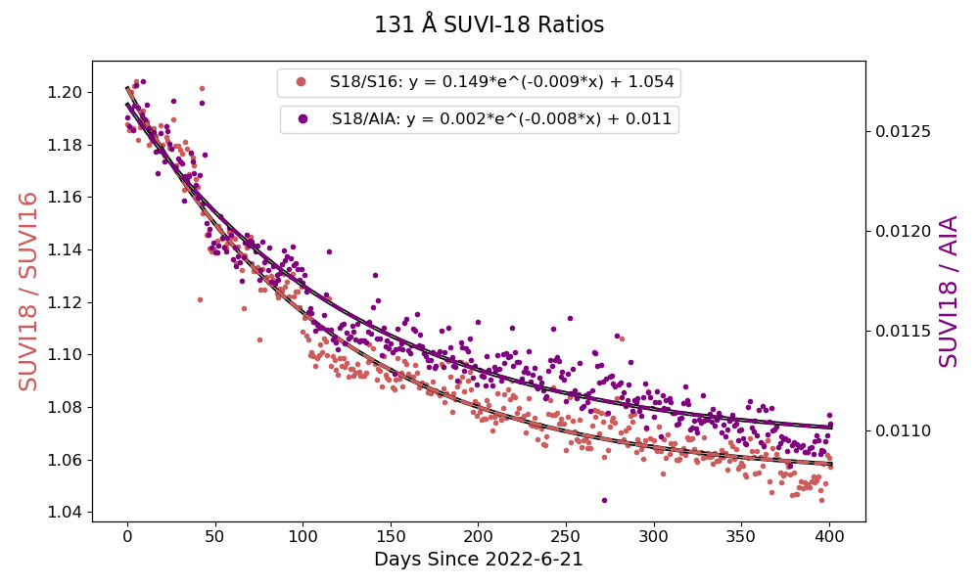
PLPT-SUVI-003: SUVI/AIA Intercalibration
GOES-18 SUVI Integrated Responses
Estimated 131 Å SUVI-18 Mission Degradation Relative to:
SUVI 16: 11.9%
AIA: 12.8%

Slide 43
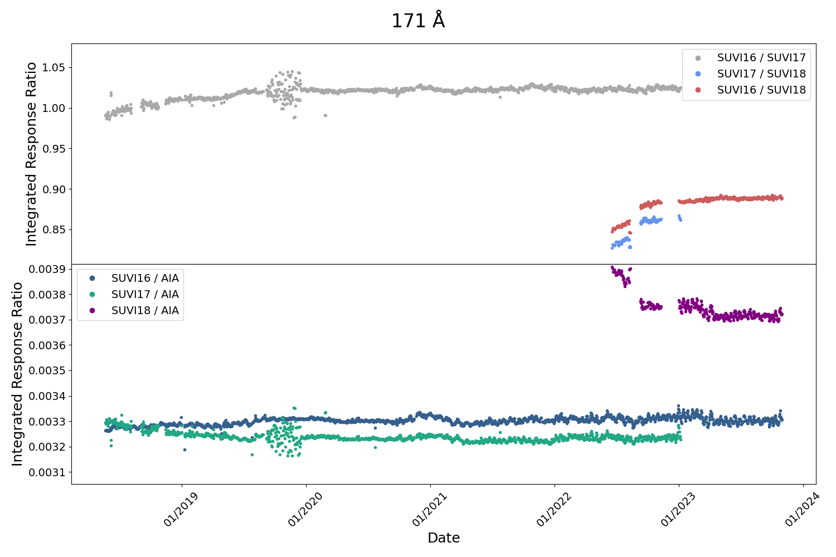
PLPT-SUVI-003: SUVI/AIA Intercalibration
GOES-18 SUVI Integrated Responses
171 Å: SUVI-16, 17, 18 and AIA bakeout / jump corrected long term trends (May 2018 - October 2023)
Relatively level long term trending of SUVI-16 and SUVI-17 relative to each other and AIA
Early exponential decay of GOES-18 that levels off
G17 ECI
Notes:
Note interesting feature of the AIA data at the beginning of 2023, not yet explained

Slide 44
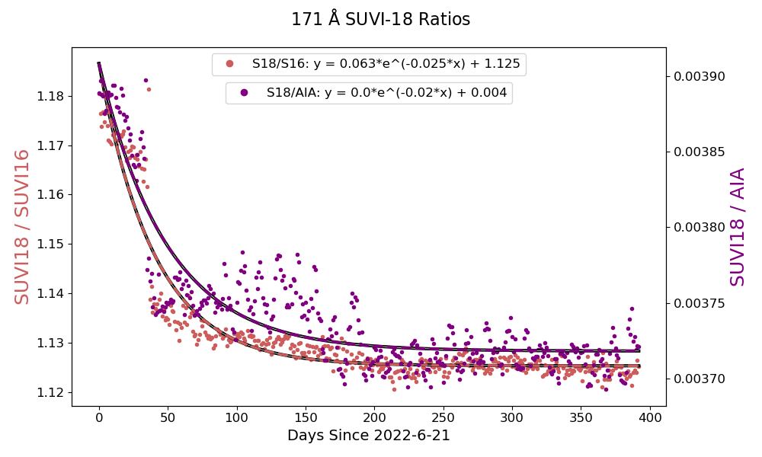
PLPT-SUVI-003: SUVI/AIA Intercalibration
GOES-18 SUVI Integrated Responses
Estimated 171 Å SUVI-18 Mission Degradation Relative to:
SUVI 16: 5.2%
AIA: 4.9%

Slide 45
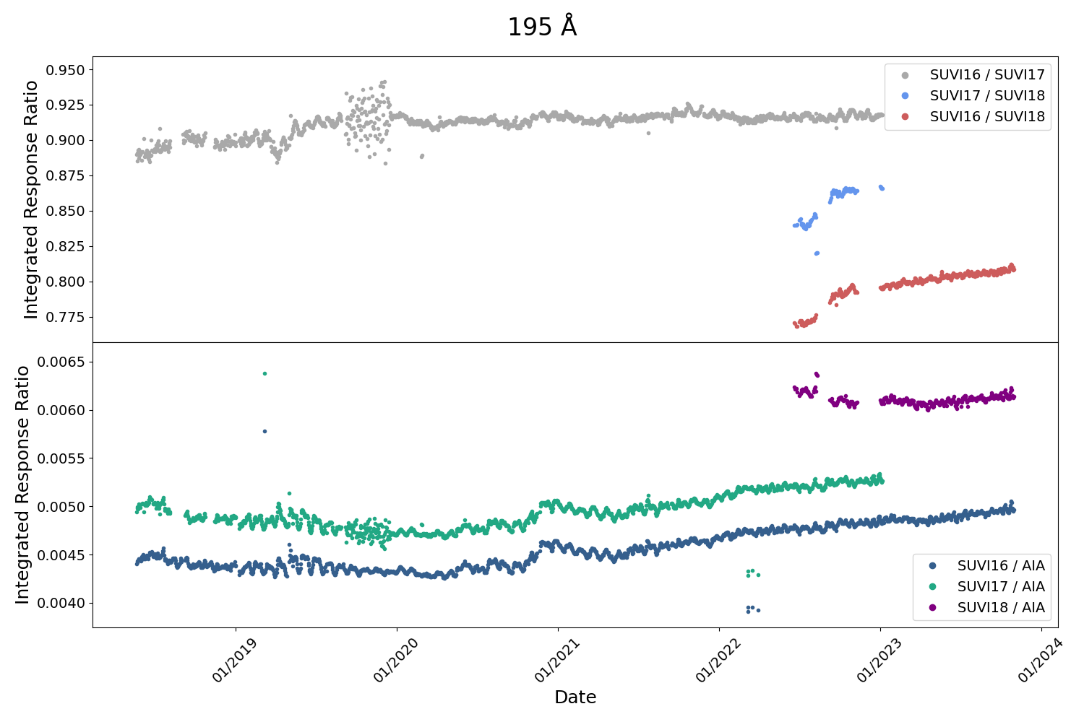
PLPT-SUVI-003: SUVI/AIA Intercalibration
GOES-18 SUVI Integrated Responses
195 Å: SUVI-16, 17, 18 and AIA bakeout / jump corrected long term trends (May 2018 - October 2023)
Note that due to differences in response functions between 193 Å AIA and 195 Å SUVI, solar activity is more visible for this wavelength
G17 ECI

Slide 46
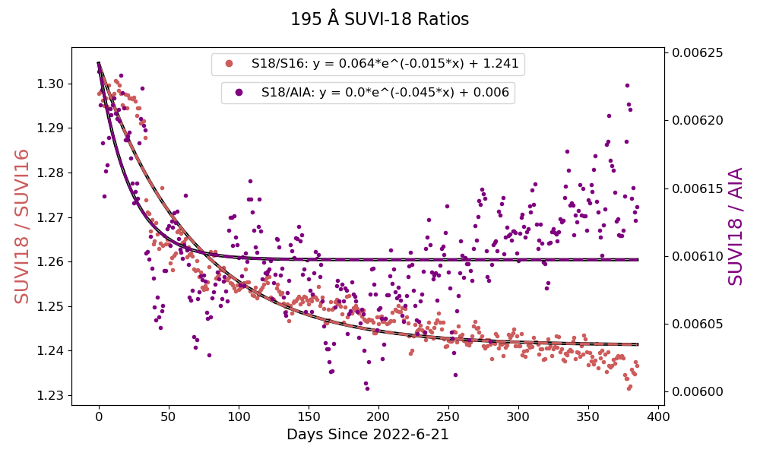
PLPT-SUVI-003: SUVI/AIA Intercalibration
GOES-18 SUVI Integrated Responses
Estimated 195 Å SUVI-18 Mission Degradation Relative to:
SUVI 16: 4.8%
AIA: 2.3%
Notes:
Likely upward trend is due to solar cycle variability, will need to monitor over a longer period to confirm

Slide 47
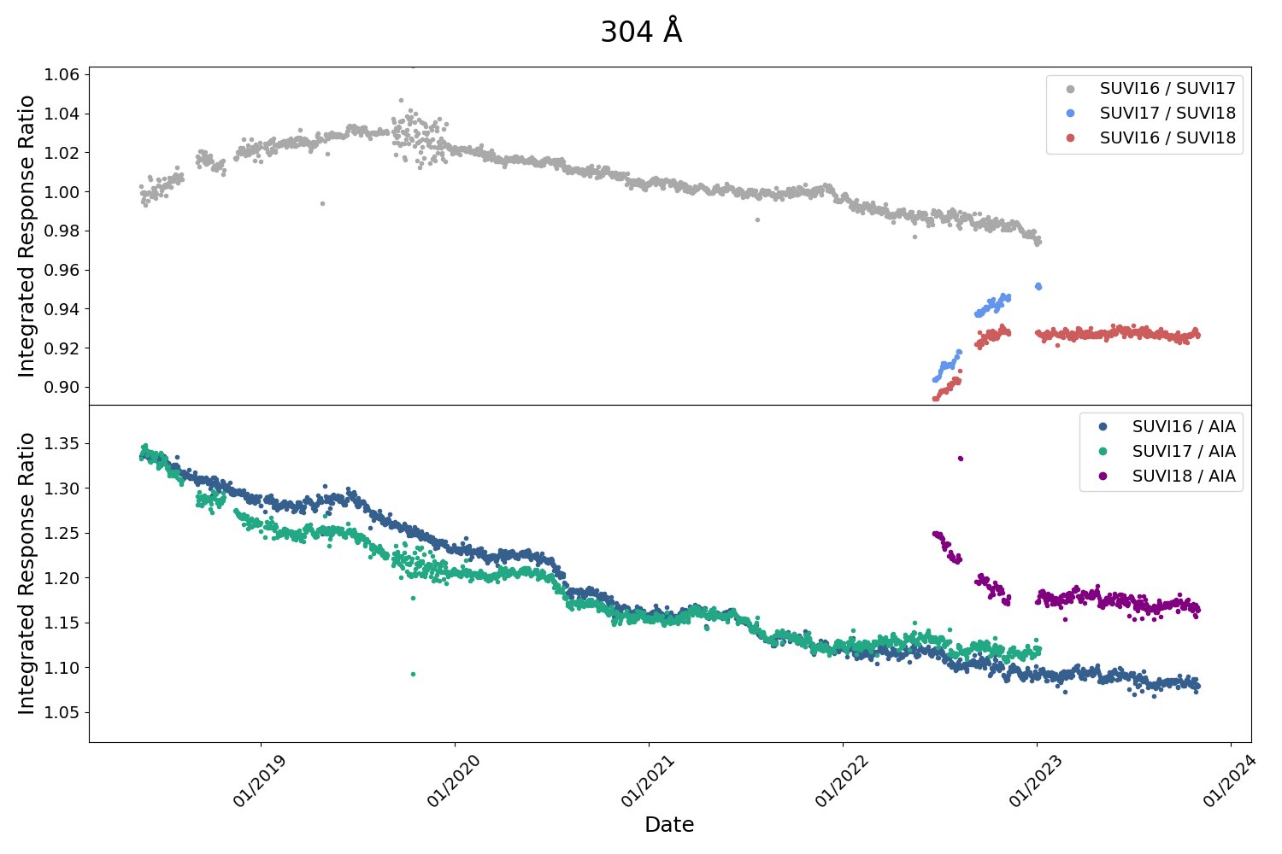
PLPT-SUVI-003: SUVI/AIA Intercalibration
GOES-18 SUVI Integrated Responses
304 Å: SUVI-16, 17, 18 and AIA bakeout / jump corrected long term trends (May 2018 - October 2023)
Steady long term degradation of SUVI-16 and SUVI-17 relative to AIA
Exponential early mission degradation of SUVI-18 as expected
G17 ECI

Slide 48
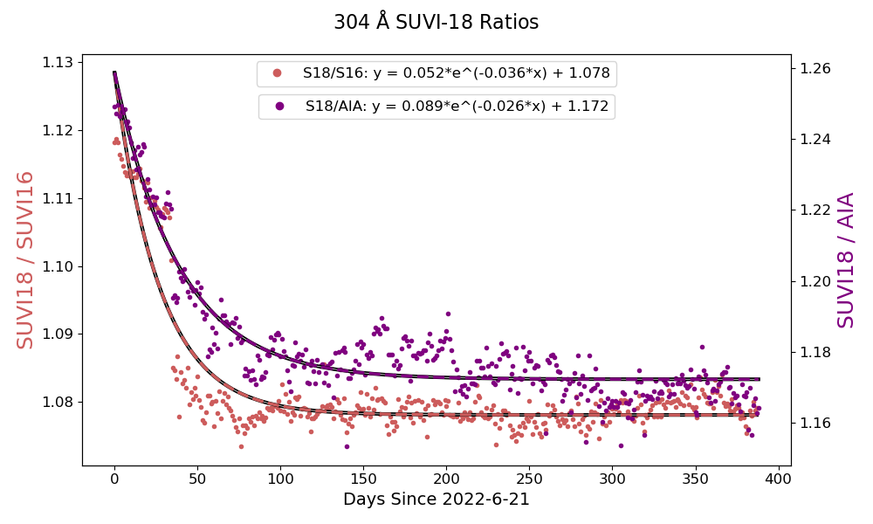
PLPT-SUVI-003: SUVI/AIA Intercalibration
GOES-18 SUVI Integrated Responses
Estimated 304 Å SUVI-18 Mission Degradation Relative to:
SUVI 16: 4.5%
AIA: 6.9%

Slide 49
PLPT-SUVI-007: SUVI/SUVI Intercalibration
Linear fits to scatter plots for SUVI/SUVI:
Take co-aligned and co-temporal SUVI images from GOES-16 and GOES-18
Make pixel-by-pixel scatter plots and linear fits to those slope reveals discrepancies in reported radiances
Ratio histograms for SUVI/SUVI:
Same approach as for SUVI/AIA taking into account differences in spectral responses
Should be more accurate than linear fits to scatter plots
Notes:
PLPT SUVI-003: Dan and Alison to update analyses for G17 SUVI.

Slide 50
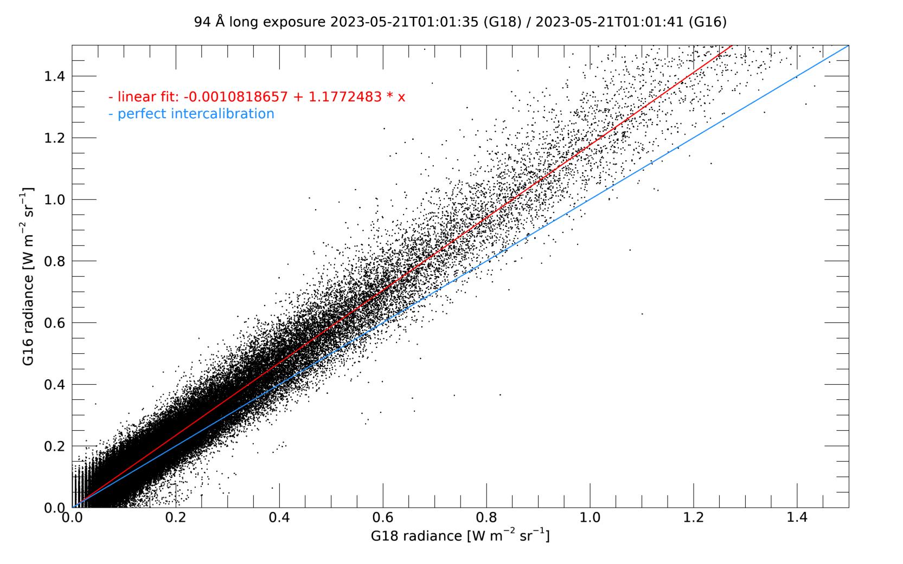
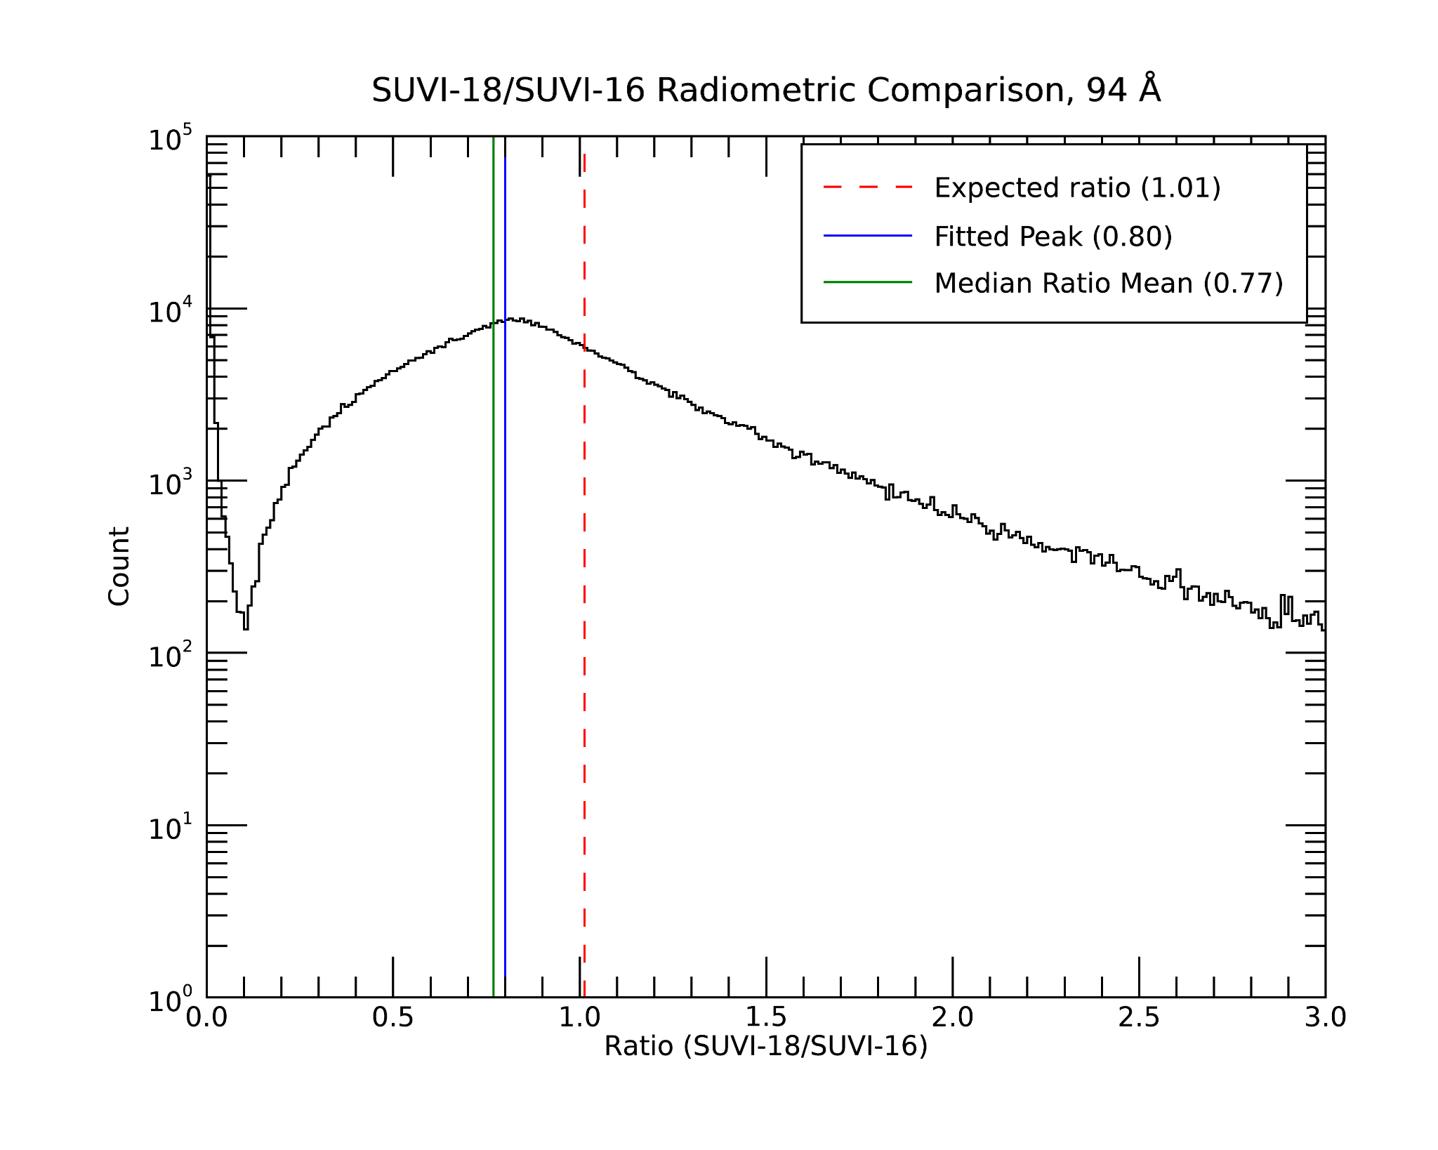
PLPT-SUVI-007: SUVI/SUVI Intercalibration
Linear fits to scatter plots and ratio histograms from co-aligned GOES-16/GOES-18 images highlight differences in the reported radiance.
94 Å (just before the light leak on GOES-16)
Reported GOES-18 radiances are ~18-21% lower than GOES-16

Slide 51
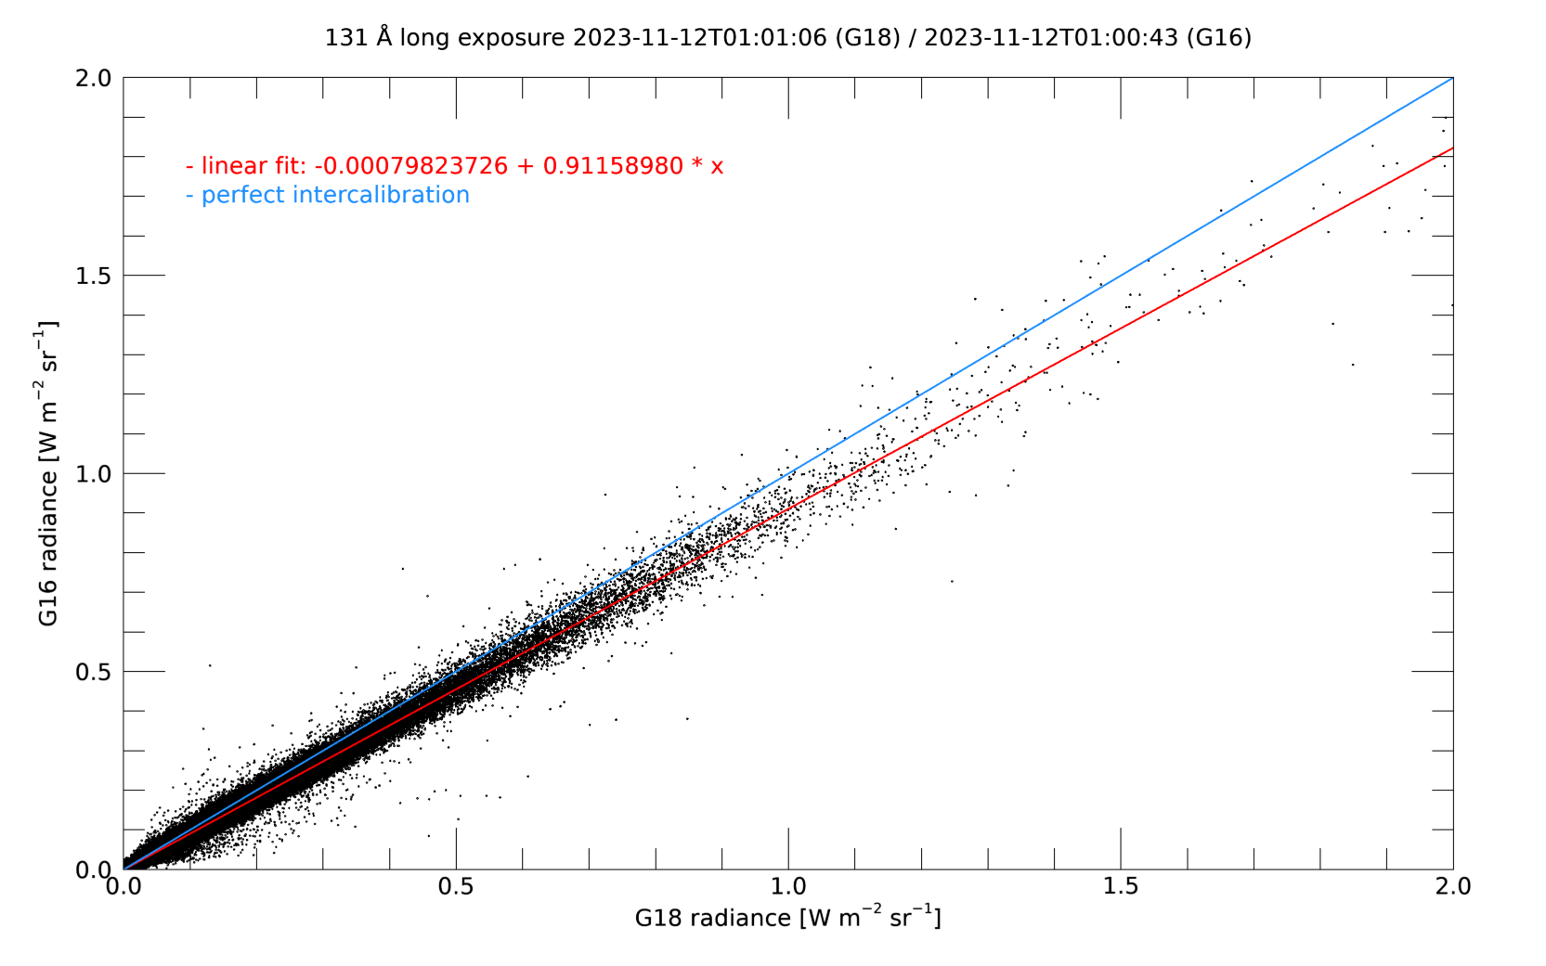
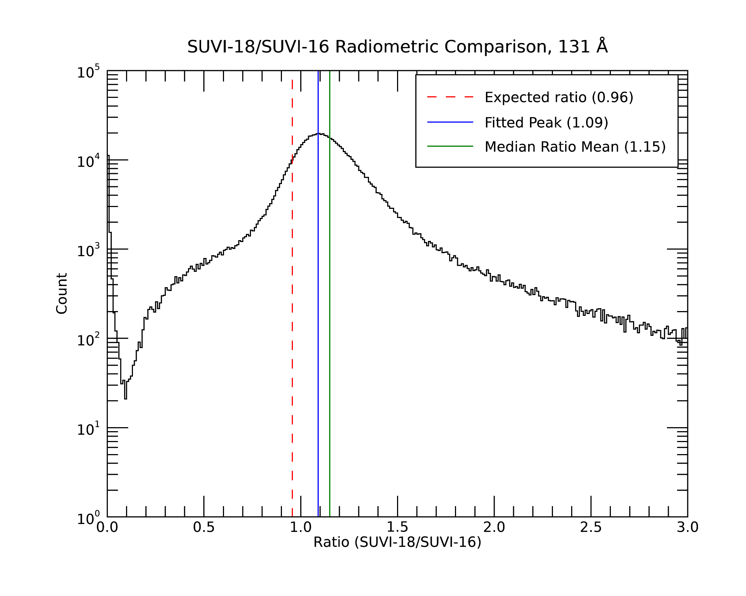
PLPT-SUVI-007: SUVI/SUVI Intercalibration
Linear fits to scatter plots and ratio histograms from co-aligned GOES-16/GOES-18 images highlight differences in the reported radiance.
131 Å
Reported GOES-18 radiances are ~7-13% higher than GOES-16

Slide 52
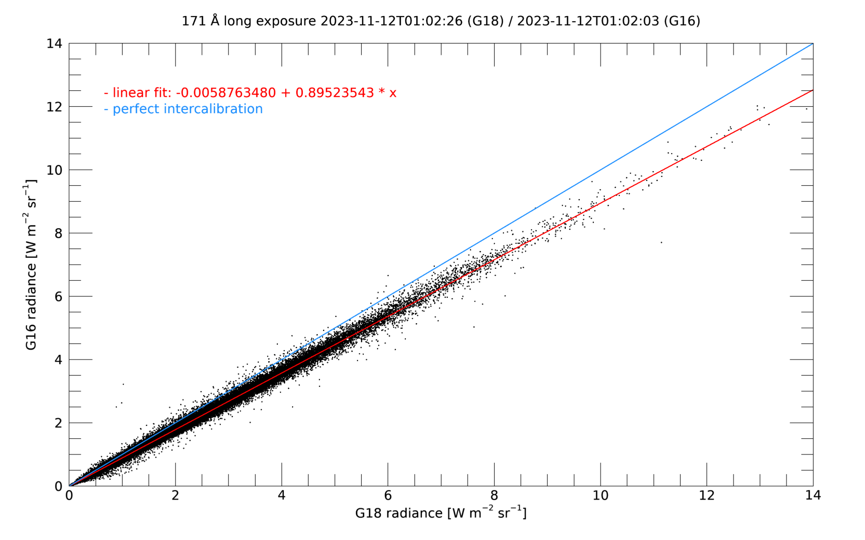
PLPT-SUVI-007: SUVI/SUVI Intercalibration
Linear fits to scatter plots and ratio histograms from co-aligned GOES-16/GOES-18 images highlight differences in the reported radiance.
171 Å
Reported GOES-18 radiances are ~10-12% higher than GOES-16

Slide 53
PLPT-SUVI-007: SUVI/SUVI Intercalibration
Linear fits to scatter plots and ratio histograms from co-aligned GOES-16/GOES-18 images highlight differences in the reported radiance.
195 Å
Reported GOES-18 radiances are ~20-25% higher than GOES-16

Slide 54
PLPT-SUVI-007: SUVI/SUVI Intercalibration
Linear fits to scatter plots and ratio histograms from co-aligned GOES-16/GOES-18 images highlight differences in the reported radiance.
284 Å
Reported GOES-18 radiances are ~21-26% higher than GOES-16

Slide 55
PLPT-SUVI-007: SUVI/SUVI Intercalibration
Linear fits to scatter plots and ratio histograms from co-aligned GOES-16/GOES-18 images highlight differences in the reported radiance.
304 Å
Reported GOES-18 radiances are ~9-12% higher than GOES-16

Slide 56
PLPT-SUVI-007: SUVI/SUVI Intercalibration
Image ratios reveal some minor flatfield artifacts (e.g. vertical stripes in 171 Å and 304 Å)
94 Å
131 Å
171 Å
195 Å
284 Å
304 Å

Slide 57
PLPT-SUVI-007: SUVI/SUVI Intercalibration
Summary:
Differences between reported GOES-16 and GOES-18 radiances are between 7 and 26 percent, depending on the channel
This is expected due to the more advanced degradation of GOES-16, but the differences are probably also caused by inaccurate spectral response function descriptions (e.g. 94 Å channel higher values for GOES-16)
MRD2048: Product Measurement Accuracy: ± 40% in radiance ✓
MRD2051: Product Measurement Precision: ± 40% in radiance ✓
Minor flatfield issues in some channels (e.g. 171 Å)

Slide 58
PLPT-SUV-006
SUVI-EXIS Intercomparison
Straight ratio comparison of EXIS-EUVSA 284 and 304Å spectral irradiance measurements to SUVI 284 and 304Å channels.
GOES-16 EXIS-EUVSA products reached Provisional Maturity September 2019, and Full Maturity May 2021.
Subsequent GS-produced Level-1b and NCEI-reprocessed data are used for SUVI trending.
GOES-18 EXIS-EUVSA Level-2 products have only recently been approved for public use.
The full record was not available at the time of this analysis.
SUVI and EXIS are very different instruments, and work is needed to achieve an apples-to-apples comparison.
Notes:
Jon to update this section

Slide 59
PLPT-SUV-006
SUVI-EXIS Intercomparison

Slide 60
PLPT-SUV-006
SUVI-EXIS Intercomparison
The GOES-16 EXIS-EUVSA daily average science product was not available for 31 May 2023 to 1 August 2023.

Slide 61
PLPT-SUV-006
SUVI-EXIS Intercomparison
SUVI/EXIS comparison of the 304 channel shows a slow, exponential degradation.

Slide 62
PLPT-SUV-006
SUVI-EXIS Intercomparison
Assuming an exponential trend, total degradation when compared against G16 EXIS-EUVSA is ~9.4%.
G18/G16 SUVI trend yields a degradation of ~3.4%

Slide 63
PLPT-SUV-006
SUVI-EXIS Intercomparison
SUVI/EXIS comparison of the 284 channel hints at degradation very early in the mission. There is also a lot of out-of-band contributions along with solar variability that makes trending in this channel quite challenging.

Slide 64
PLPT-SUV-006
SUVI-EXIS Intercomparison
Assuming an exponential trend from the start of mission, the total degradation when compared against G16 EXIS-EUVSA is ~9.3%
G18/G16 SUVI trend yields a degradation of ~5.5%

Slide 65
GOES-18 SUVI Degradation vs. Comparator Instruments
Wavelength | Comparator Instrument | Total Estimated Degradation to compared with the listed instrument | Comparator Instrument | Total Estimated Degradation to compared with the listed instrument
94 | AIA/SUVI | 12.7% | G16 SUVI/G18 SUVI | 12.6%
131 | AIA/SUVI | 12.8% | G16 SUVI/G18 SUVI | 11.9%
171 | AIA/SUVI | 4.9% | G16 SUVI/G18 SUVI | 5.2%
195 | AIA/SUVI | 2.3% | G16 SUVI/G18 SUVI | 4.8%
284 | EUVS-A | 9.3% | G16 SUVI/G18 SUVI | 5.5%
304 | AIA/SUVI EUVS-A | 6.9% 9.4% | G16 SUVI/G18 SUVI | 4.5% 3.4%
MRD 2048/2051 (±40% in radiance) is met.
Notes:
Rocket underflights for SDO delayed due to COVID-19! Rates are considered good for EUV solar instruments. (AIA 304 is > 99% degraded)

Slide 66
GOES-18 SUVI Full Maturity PS-PVR
Full Maturity Assessment

Slide 67
SUVI Performance Baseline Status
MRD ID | Description | Related PLPTs | Status
2045 | Pointing Accuracy | PLPT-SUV-003 | Validated
2046 | Product Pointing Knowledge/Mapping Uncertainty | PLPT-SUV-003 | Validated
2052 | Long-term Stability (Product Measurement Precision in Radiance) | PLPT-SUV-003, PLPT-SUV-006 | Validated
MRD2045: Pointing Accuracy
Requirements: ±3.0 arcmin (3 sigma) (N-S,E-W) of Sun Center; Stability during 60 seconds: ±2.0 arcsec (1 sigma), ±6.0 arcsec (3 sigma) (N-S, E-W)
MRD2046: Product Pointing Knowledge/Mapping Uncertainty
Requirements: ±2.5 arcsec
MRD2052: Long-term Stability (Product Measurement Precision in Radiance)
Requirements: ±30%
Absolute accuracy cannot be verified on-orbit

Slide 68
GOES-18 SUVI Performance Baseline Status
MRD ID | Description | Requirement | Results of NCEI Analysis | Status
2045 | Pointing Accuracy | 3’ | ≤ 0.5” y, ≤ 0.5” z | PASS
2046 | Product Pointing Knowledge | 2.5” | ≤ 0.45” y, ≤ 0.45” z | PASS
2052 | Long-term Stability (Product Measurement Precision in Radiance) | 30% | ≤ 13% | PASS
Pointing requirements are well met.
NCEI has demonstrated with trending that the degradation of instrument response is slow, stable, and correctible.
‹#›

Slide 69
GOES-R Full Maturity Criteria
Preparation Activity | Assessment
Validation, quality assessment, and anomaly resolution activities are ongoing. | NCEI continues to assess and diagnose issues with instrument performance and product quality. The anomaly resolution process is used as appropriate and involves NCEI’s participation in resolution and validation through the AART.
Incremental product improvements may still be occurring | Minor product issues persist, and some have the potential to impact operations. NCEI continues work to further improve the SUVI L1b product.
Users are engaged and user feedback is assessed | NCEI engages with NWS/SWPC, and has ongoing efforts to engage scientific data disseminators such as VSO, SunPy, and Helioviewer.

Slide 70
GOES-R Full Maturity Criteria
End State | Assessment
Product performance for all products is defined and documented over a wide range of representative conditions via ongoing ground truth and validation efforts. | Long-term trending activities have allowed for the assessment of the GOES-18 SUVI across a variety of solar conditions. As allowed, the SUVI instrument are compared against other well-calibrated instruments including SDO calibration rocket underflight.
Products are operationally optimized, as necessary, considering mission parameters of cost and schedule, as compared to user expectations. | Product optimization, such as LUT updates to calibration parameters, will occur as needed to maintain the SUVI L1b product.
All known product anomalies are documented, and shared with the user community. | All known product anomalies are documented within this presentation and within the L1b README documents.
Product is operational. | Yes, and is operationally leveraged through IDP and SPADES L2 product generation and at SWPC (9/1/2021).

Slide 71
GOES-18 SUVI Full Maturity PS-PVR
Summary of SUVI Product Status

Slide 72
Priorities for GOES-18 SUVI Level-1b
No impact to Operations or Full Validation Status:
Update to degradation correction coefficients
Leverage SDO Rocket Underflight data as available.
Update to INR translational/rotational offsets
Stand up NCEI SUVI Level-1b reprocessing pipeline

Slide 73
Summary of GOES-18 SUVI Readiness for Full Maturity Status
The GOES-18 SUVI is providing data to NWS/SWPC in an operational capacity.
Trending activities demonstrate that the GOES-18 SUVI instrument performance is understood and corrections to the instrument degradation can be applied.
NCEI is actively engaging with NWS/SWPC and the wider scientific community.
NCEI affirms that all known Ground System and instrumental issues prohibitive to Full Validation Maturity for the GOES-18 SUVI have been resolved or have a clearly defined path forward.
NCEI affirms that all criteria for Full Validation Maturity as defined by the GOES-R Program have been met by the GOES-18 SUVI.

Slide 74
Summary of GOES-18 SUVI Readiness for Full Maturity Status
NCEI recommends to the Review Panel that Full Validation Maturity Status be considered for the GOES-18 SUVI.

Slide 75
Reference and Back-Up Slides

Slide 76
GOES-16/GOES-18 Spectral Response Functions - 94Å
Slide 11

Slide 77
GOES-16/GOES-18 Spectral Response Functions - 131Å
Slide 11

Slide 78
GOES-16/GOES-18 Spectral Response Functions - 171Å
Slide 11

Slide 79
GOES-16/GOES-18 Spectral Response Functions - 195Å
Slide 11

Slide 80
GOES-16/GOES-18 Spectral Response Functions - 284Å
Slide 11

Slide 81
GOES-16/GOES-18 Spectral Response Functions - 304Å
Slide 11

