Slide 1
GOES-18 SUVI PS-PVR
(Full Maturity)
SWPC User Perspective
Steven Hill
NOAA/NWS Space Weather Prediction Center

Slide 2
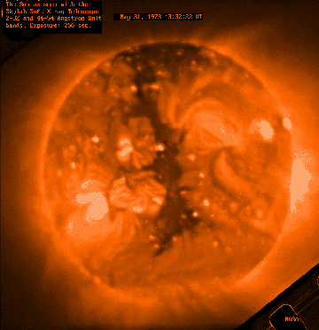
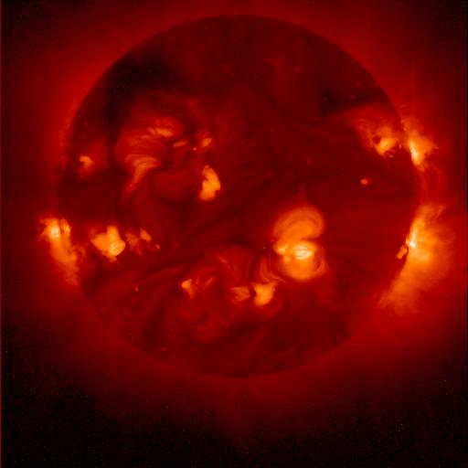
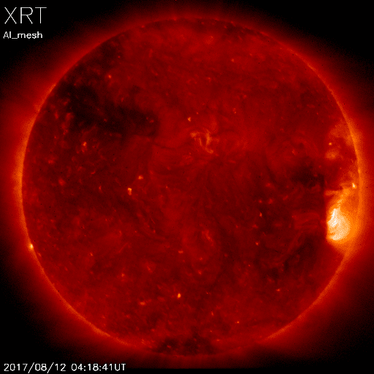
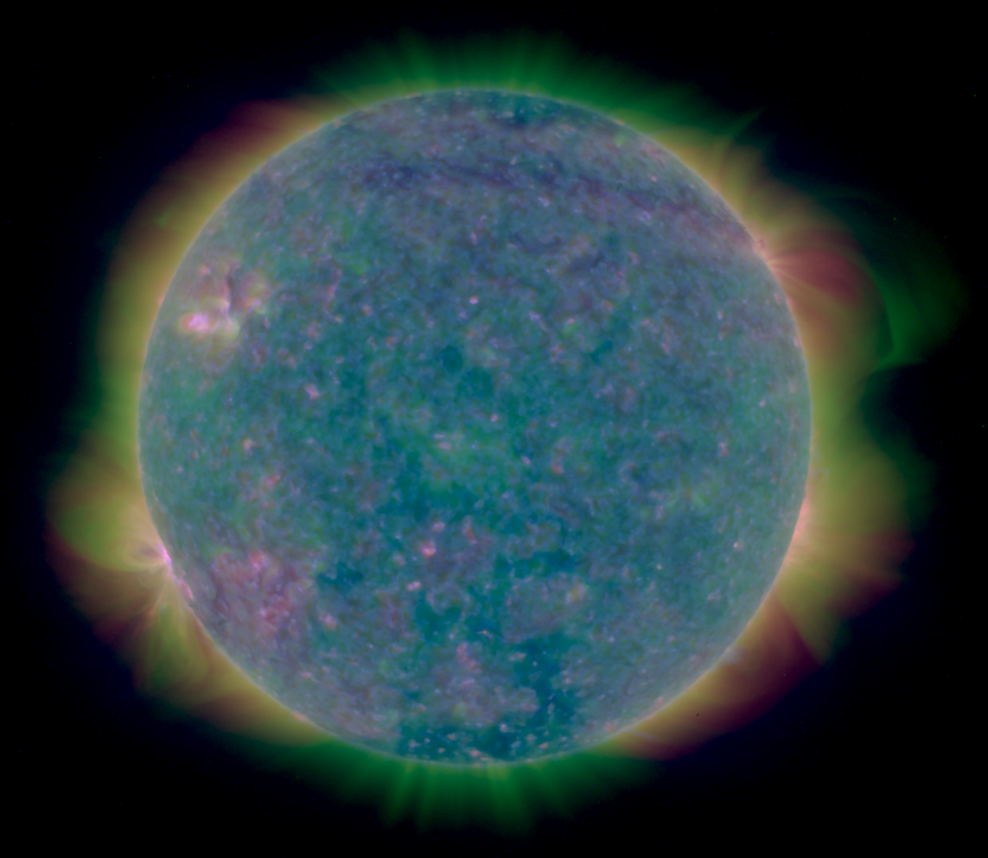
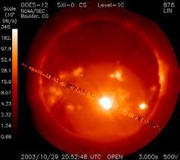
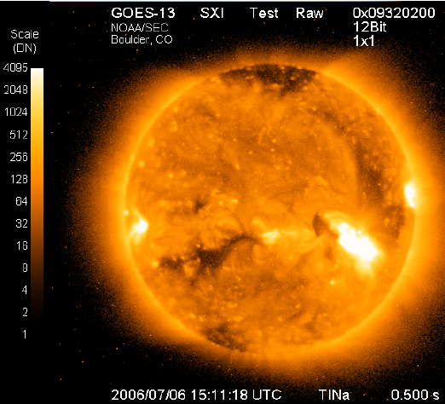
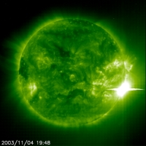
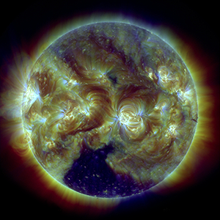
Heritage
Skylab 1973-74
Yokoh 1991-2001
Hinode 2006-
GOES 12 2001-2007
GOES 13-15 2006-20
SUVI
SOHO EIT 1996-
SDO AIA 2010-
Notes:
First proposed GOES X-ray imager in 1970s
First formal study for what became GOES-12 SXI started in 1980s

Slide 3
Forecast Applications
Provide advance warning of solar activity
  “Over the horizon” look at active regions rotating onto the Earth-facing side of the sun
Provide warning of recurring geomagnetic storms
  Tracking coronal holes as they rotate across the solar disk
Provide warning of non-recurring geomagnetic storms
  Identify, locate, and characterize eruptions (flares, coronal mass ejections)
Provide warning of solar radiation storms
  Identify, locate, and characterize eruptions (flares, coronal mass ejections)
Assess solar flaring probability
  Intensity and complexity of solar active regions

Slide 4
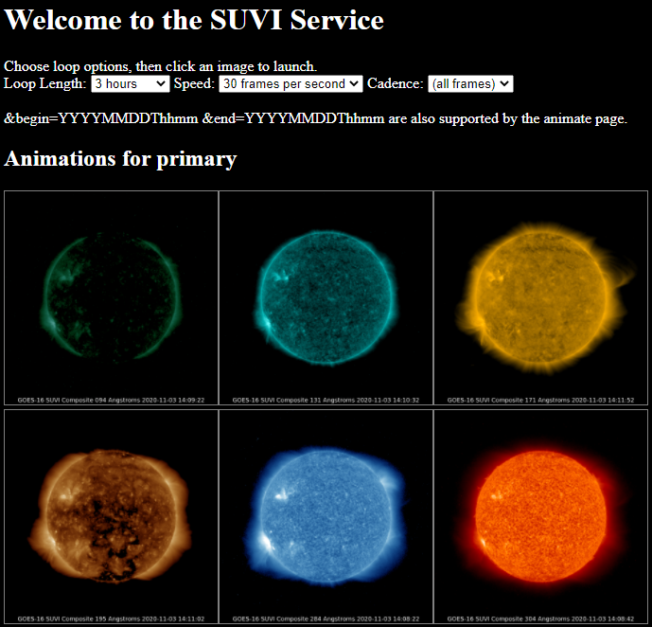
Data
Used primarily for situational awareness
Auto updating loops with selectable
  Duration: 3 hrs to 8 days
  Speed: 10 to 60 fps
  Cadence: 4 min to daily

Slide 5
Data Products
Product | Wavelength (nm) | Uses | Features and Temperature (K)
Composite Images | 9.4 | Flare location | Flares ~6x10⁶ K
 | 13.1 | Flare location | Flares ~6x10⁶ K and ‘hot’ flares ~15x10⁶ K
 | 17.1 | Active region characterization | Active regions ~6x10⁵ K
 | 19.5 | Active region characterization and flare location | Active regions ~1x10⁶ K and ‘hot’ flares ~20x10⁶ K
 | 28.4 | Coronal hole location and characterization | Coronal Holes (~2x10⁶ K)
 | 30.4 | Filament location and characterization | Filaments (~6x10⁴ K)
Thematic Map | All | Supervised pixel classifier | All
Notes:
SWPC doesn’t use the L1b products

Slide 6
Status of GOES SUVIs
GOES-18 SUVI entered full operations at SWPC on January 4, 2023, replacing GOES-17
GOES 18 SUVI is currently the preferred primary instrument due to the light leak in the 94A channel on GOES-16 SUVI
  Forecasters can switch to G16 SUVI as primary at will if G18 is unavailable due to testing, calibration, etc.
SWPC is preparing for:
  The next SPADES release and associated new products
  GOES-19 launch and SUVI checkout (and CCOR-1 checkout!)

Slide 7
SUVI & SXI Research Impact (selected)
Seaton, D. B., & Darnel, J. M. (2018). Observations of an Eruptive Solar Flare in the Extended EUV Solar Corona. The Astrophysical Journal, 852, L9. doi:10.3847/2041-8213/aaa28e | 57
Veronig, A. M., Podladchikova, T., Dissauer, K., Temmer, M., Seaton, D. B., Long, D., . . . Kliem, B. (2018). Genesis and Impulsive Evolution of the 2017 September 10 Coronal Mass Ejection. The Astrophysical Journal, 868, 107. doi:10.3847/1538-4357/aaeac5 | 68
Hill, S. M., Pizzo, V. J., Balch, C. C., Biesecker, D. A., Bornmann, P., Hildner, E., . . . Zimmermann, F. (2005). The NOAA Goes-12 Solar X-Ray Imager (SXI) 1. Instrument, Operations, and Data. Solar Physics, 226, 255-281. doi:10.1007/s11207-005-7416-x | 84
Liu, C., Lee, J., Yurchyshyn, V., Deng, N., Cho, K.-s., Karlický, M., & Wang, H. (2007). The Eruption from a Sigmoidal Solar Active Region on 2005 May 13. The Astrophysical Journal, 669, 1372-1381. doi:10.1086/521644 | 68
Temmer, M., Vršnak, B., & Veronig, A. M. (2007). Periodic Appearance of Coronal Holes and the Related Variation of Solar Wind Parameters. Solar Physics, 241, 371-383. doi:10.1007/s11207-007-0336-1 | 91
Veronig, A. M., Karlický, M., Vršnak, B., Temmer, M., Magdalenić, J., Dennis, B. R., . . . Pötzi, W. (2006). X-ray sources and magnetic reconnection in the X3.9 flare of 2003 November 3. Astronomy and Astrophysics, 446, 675-690. doi:10.1051/0004-6361:20053112 | 121
Warmuth, A., Mann, G., & Aurass, H. (2005). First Soft X-Ray Observations of Global Coronal Waves with the GOES Solar X-Ray Imager. The Astrophysical Journal, 626, L121-L124. doi:10.1086/4317 | 65
Rotter, T., Veronig, A. M., Temmer, M., & Vršnak, B. (2012). Relation Between Coronal Hole Areas on the Sun and the Solar Wind Parameters at 1 AU. Solar Physics, 281, 793-813. doi:10.1007/s11207-012-0101-y | 66

Slide 8
Summary
GOES-R SUVIs have been an overall success (16-18)
Areas of concern: NONE
Thank you to NCEI & the GOES Program!
For their persistence in overcoming issues and improving products
For pursuing improvement by engaging with the research community

Slide 9
