Slide 1



GOES-18 Solar Ultraviolet Imager (SUVI)
Provisional PS-PVR
2022 November 22
Jonathan Darnel, Christian Bethge, Alison Jarvis
GOES-R Calibration Working Group
CIRES, Univ. of Colorado & NOAA NCEI

Slide 2
AGENDA
SUVI Instrument Overview
Review of Current ADRs
Product Quality Evaluation
  General approach
  Major Issues Remaining
Provisional Maturity Assessment
Path to Full Validation Maturity
  Issues and status
  PLPT
  Risks
Summary and Recommendations

Slide 3
Commonly-Used Acronyms (CUAs)
ADR : Algorithm Discrepancy Report
AIA : Atmospheric Imaging Assembly
BSV : Below Solar Variability
CCD : Charged-Couple Device
EUV : Extreme UltraViolet
EXIS : EUV and X-ray Irradiance Sensor
FITS : Flexible Image Transport System
LUT : Look-Up Table
OMAS : Operational Metadata Aggregation Service
SDO : Solar Dynamics Observatory
SUVI : Solar UltraViolet Imager
WR : Work Request

Slide 4
SUVI Instrument & Products Overview

Slide 5
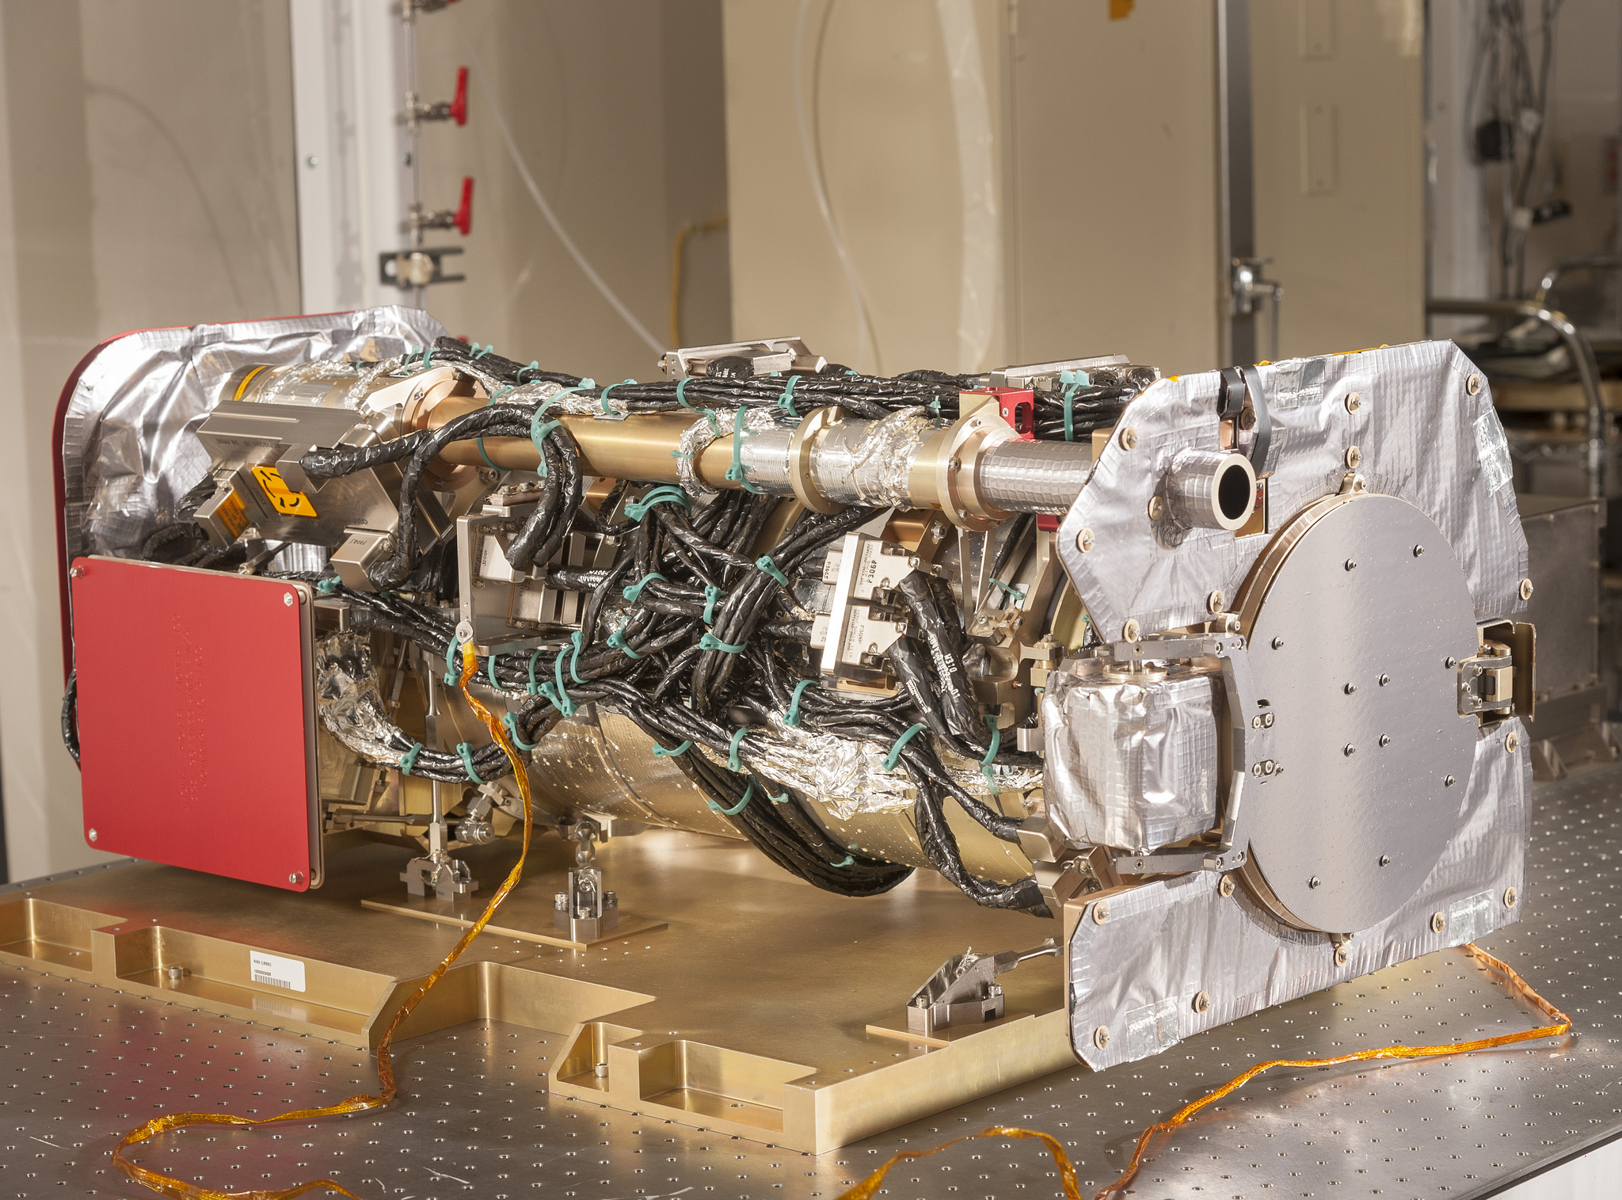
SUVI OVERVIEW

Slide 6
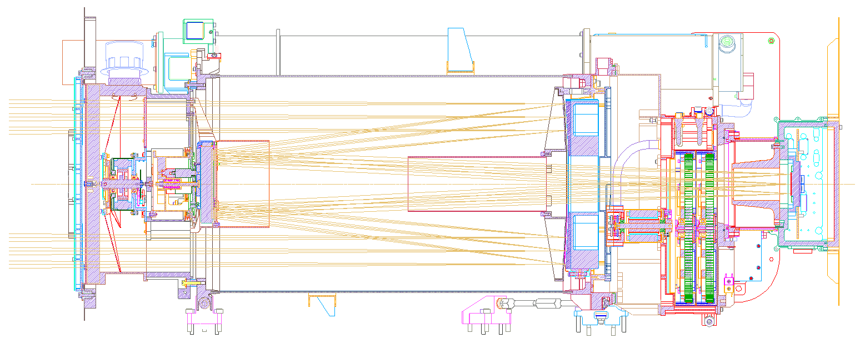
Primary Mirror
Entrance Filter
Secondary Mirror
Focal Plane Filters
CCD
Detector

Slide 7
Key SUVI Imager Requirements
Pointing knowledge: <2.5 arcsec
Pointing accuracy & stability: <0.5 arcsec
Field of view: >42×42 arcmin
Spatial resolution: <5 arcsec square pixels
Ensquared energy: >50% in 7×7 arcsec
  (43% for 94 Å bandpass)

Slide 8
Key SUVI Imager Characteristics
1280×1280 pixels
2.5 arcsec pixels, 53.5×53.3 arcmin FOV
14-bit CCD detector
Entrance aperture selector – 6 positions
2 Filter wheels:
  FW1: Open, Thin Al & Zr, Thick Al & Zr
  FW2: Glass, Open, Thin Al, Thin Zr, Thick Al
4-photodiode guide telescope for pointing

Slide 9
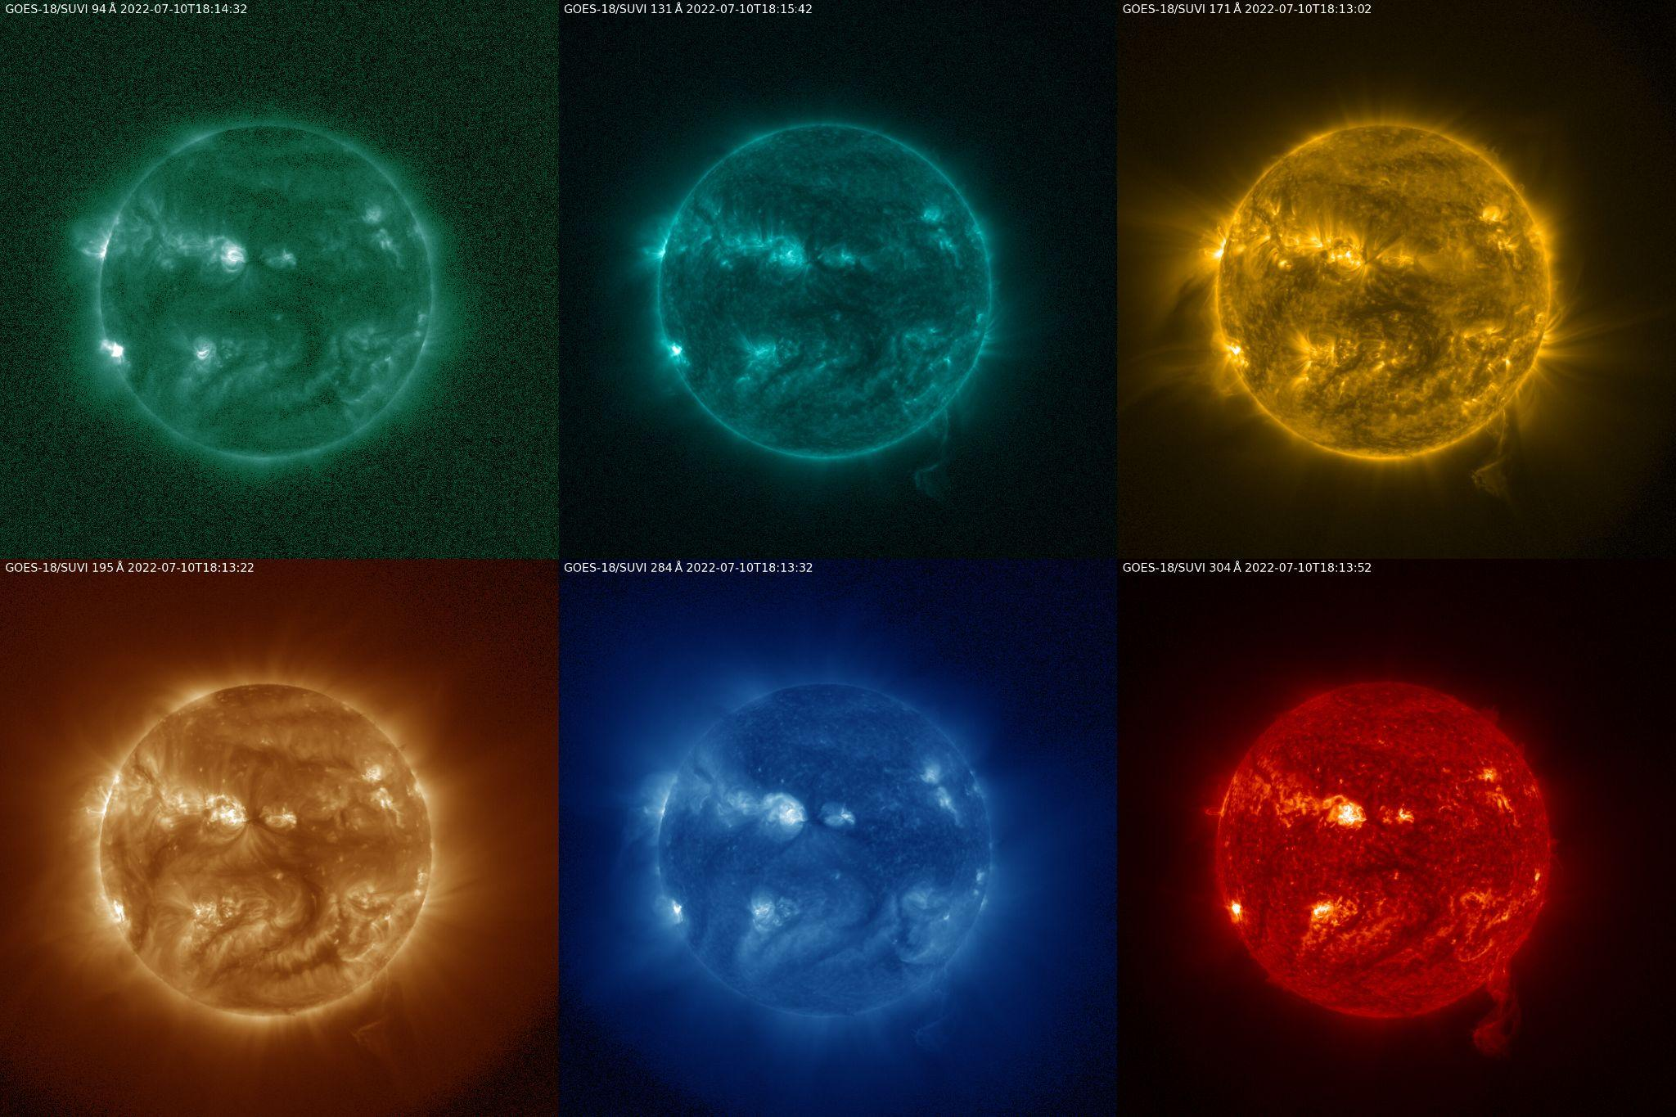
SUVI Channels
Notes:
SUVI Sun Center offset (~1arcminute Y,Z). G18 SUVI still meets pointing and FOV requirements.

Slide 10
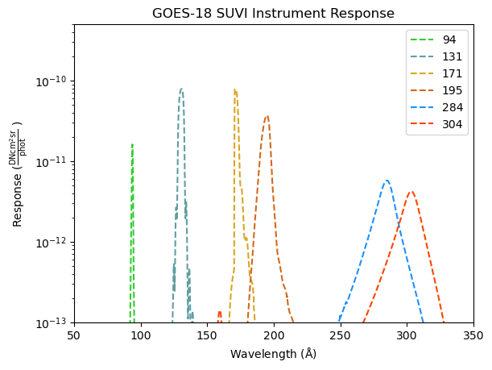
SUVI Spectral Response Functions
Computed using data from: SUVP-RP-14-5299_Rev B CDRL_079_FM3
Notes:
SUVI Response as a function of wavelength computed from the CDRL079 delivery.

Slide 11
File Formats:
netCDF vs. FITS
The SUVI L1b product is produced in both netCDF and FITS formats
The standard file format for the astrophysical community is FITS
NWS/SWPC and NCEI Level-2 algorithms expect FITS files
NCEI-CO considers the SUVI L1b FITS product as the standard, and these data are used for PLPT activities.

Slide 12
Current Look-up Table Filenames
Calibration:
(8 Aug 2022)
SUVI_CalibrationParameters(FM3A_CDRL79RevBv2_PR_09_08_33)-715939500.0.h5
INR:
(1 Nov 2022)
SUVI_NavigationParameters(FM3A_NCEI_PR_09_08_12)-710576600.0.xml

Slide 13
Task Completion: SUVI Software Tools
Task
SUVI CCSDS Level-0 Reader | Complete. Currently maintained by NCEI developers.
SUVI GT Calibration | Complete. Demonstrated by Chris Bethge during G18 PLT.
SUVI Dark Current SUVI Readout Noise SUVI Bias | Complete. Demonstrated by Jon Darnel at G17 SUVI Full Maturity.
SUVI Off-band Signal Characterization | Complete. Demonstrated by Jon Darnel during G18 PLT.
SUVI Focus Check | Complete. Demonstrated by Chris Bethge during G18 PLT.
SUVI Guide Telescope Calibration | Complete. Demonstrated by Chris Bethge during G18 PLT.
SUVI Flatfield | Complete. Demonstrated by Jon Darnel during G18 PLT.
SUVI ISP Trending | Complete. Demonstrated by Jon Darnel during G16 Provisional
Next step: Transition trending activities to NCEI cloud where appropriate.

Slide 14
Review of Pre-Provisional Maturity

Slide 15
Path to Provisional Maturity
Resolve major GPA concerns.
Verify solutions to issues raised during PLT are resolved.
Fully validate L1b after major outstanding calibration issues (darks, flats) are resolved.
Upload revised calibration tables.
PLPTs to validate instrument calibration and performance, intercalibrate with other instruments.
Daily, weekly and quarterly calibrations underway.
Provisional maturity date currently set for Nov. 22.
Notes:
Four items totally complete, two are semi-complete. We obviously missed the provisional deadlines de

Slide 16
Current ADRs at Provisional
Risk | ADR | WR | Build | Impacts | Comments
Ground System handling of Dark Frames | 260 | 6025 | - | Changes to the SUVI imaging sequences will not be properly handled | -
SUVI L1b FITS non-compliance | 1021 | 7364 | PR.10.09 | Breaks current and future software | Resolved.
SUVI DATE-OBS needs exposure time correction | 1048 | 7558 |  | Observation time metadata does not match observations. | -
SUVI GPA cannot handle additional flatfields | 1147 | 8433 |  | Mitigation for degradation/light leaks cannot be done. | -
Saturation Thresholds calculated incorrectly | 1159 | 8932 |  | All downstream L2+ products | -
Frequent fill values in SUVI l1b space location fields. | 1263 | 9321 | - | User confusion, possible impact to 1276 resolution. | -
Uncorrected Roll Angle Error | 1276 | 9406 | - | Causes INR errors due to uncorrected roll. Common to all SUVI instruments | To be Rejected
Installation of G18 SUVI INR LUT | 1290 |  |  | INR incorrect in G18 SUVI L1b | Resolved 1 Nov. 2022
‹#›

Slide 17
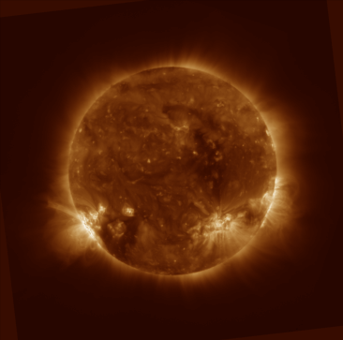
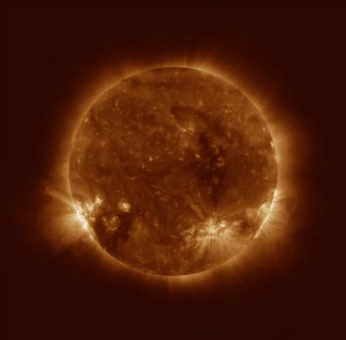
ADR 1276
Context: Key to INR is knowledge of the orientation of the SUVI instrument with respect to the Sun. The relative rotation of the SUVI instrument to solar north is captured in the CROTA and PC_{ij} keywords of the SUVI Level-1b product. Users have communicated to NCEI that there is an unknown contribution to the relative rotation that is not captured in CROTA and PC_{ij}.
NB: Every SUVI Instrument is impacted by this issue.
Level-1b
CROTA corrected
Unresolved INR errors

Slide 18
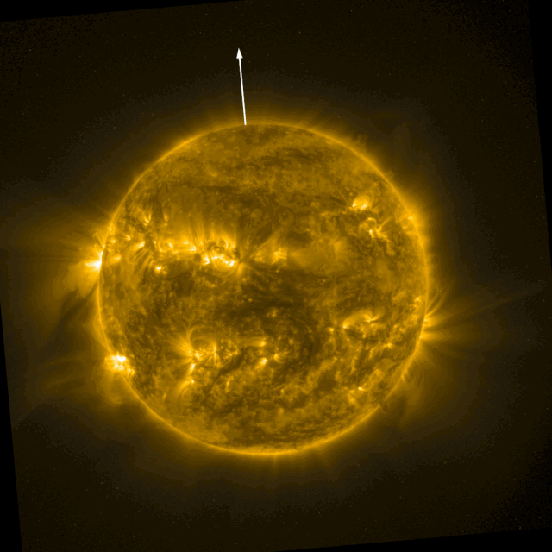
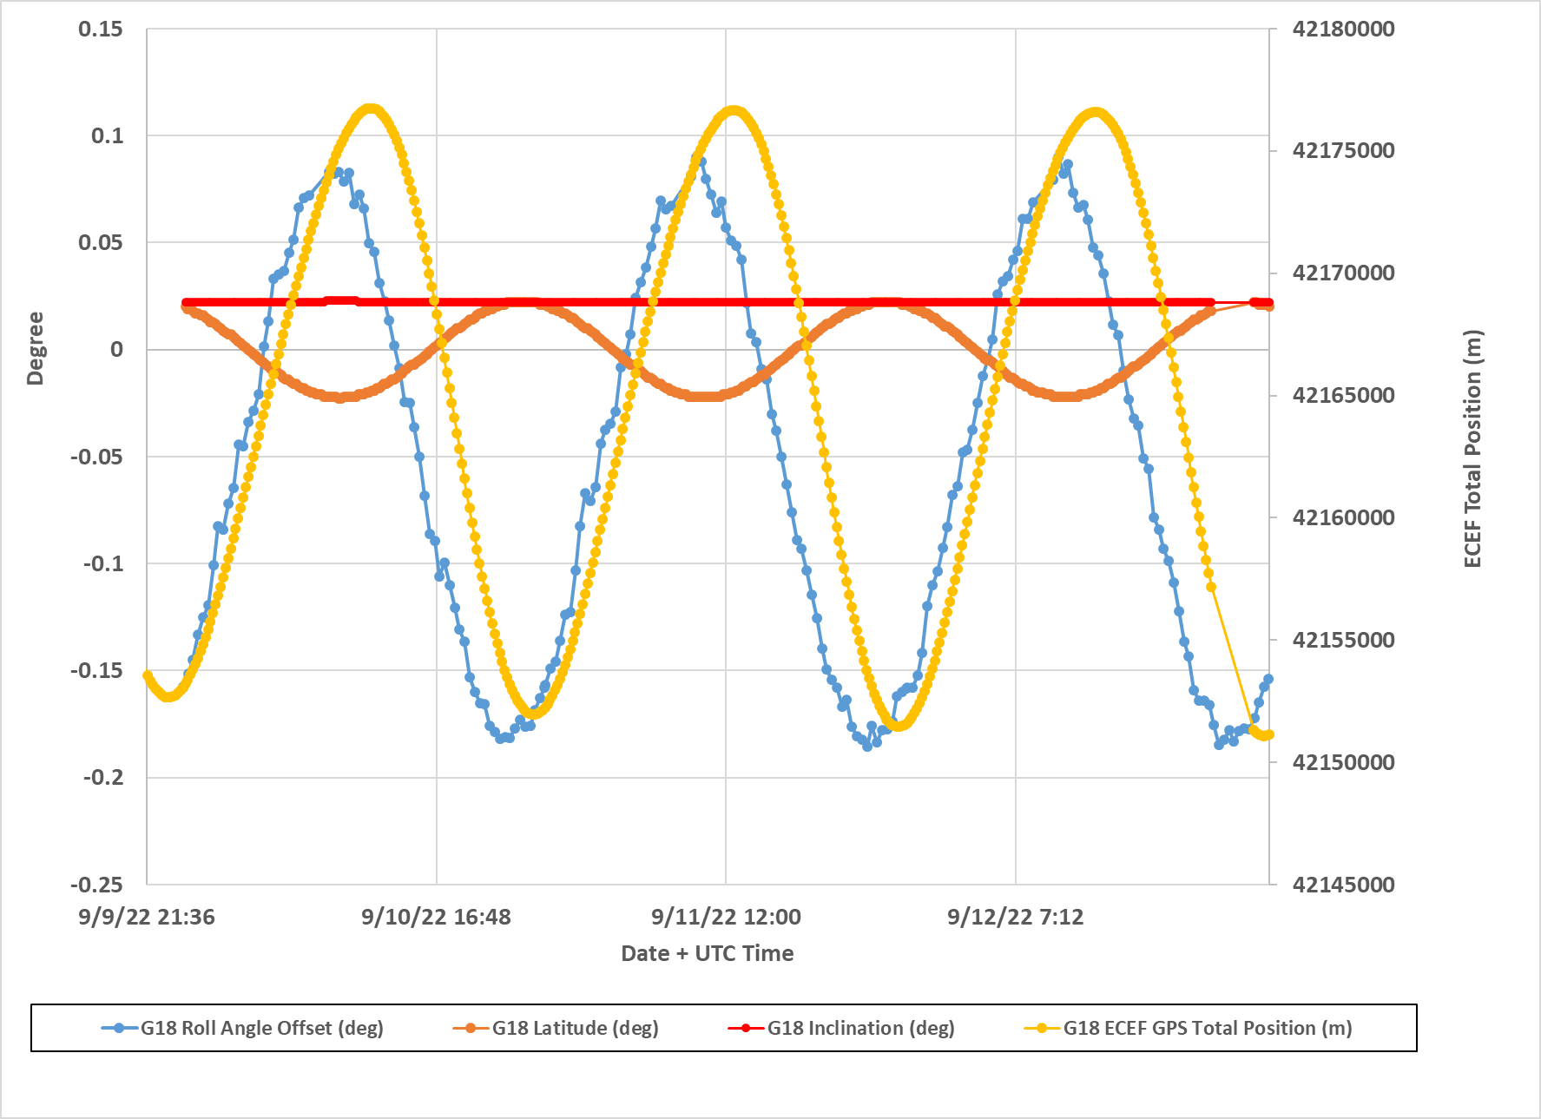
ADR 1276
<- rotation around the
SUVI-Sun line-of-sight,
animation is exaggerated
Image Credit: Ian Ross (NSOF)
The INR issue causes a”wobble” in the Level-1b product over time (animation, left). This INR error has periodic characteristics and is closely correlated with the corresponding spacecraft location (plot, right).

Slide 19
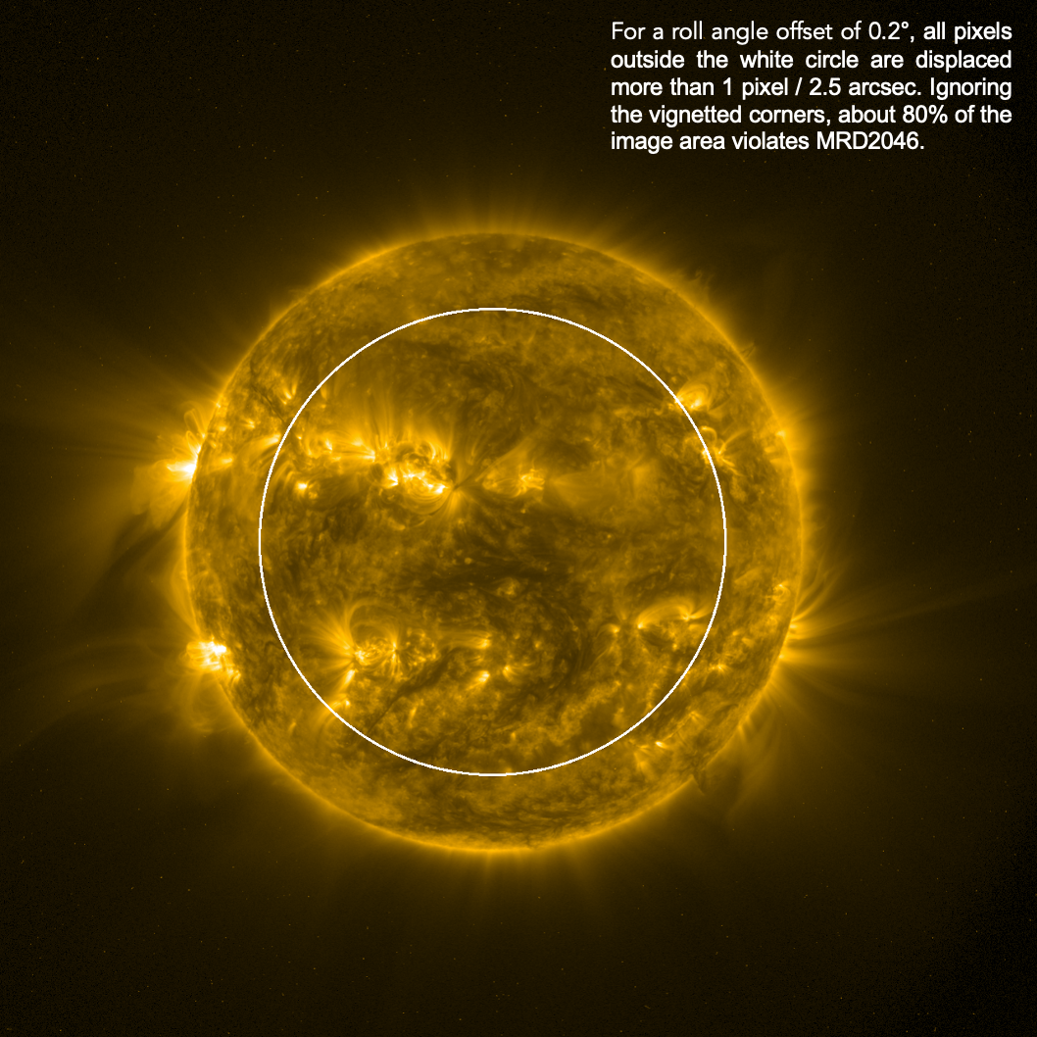
ADR 1276

Slide 20
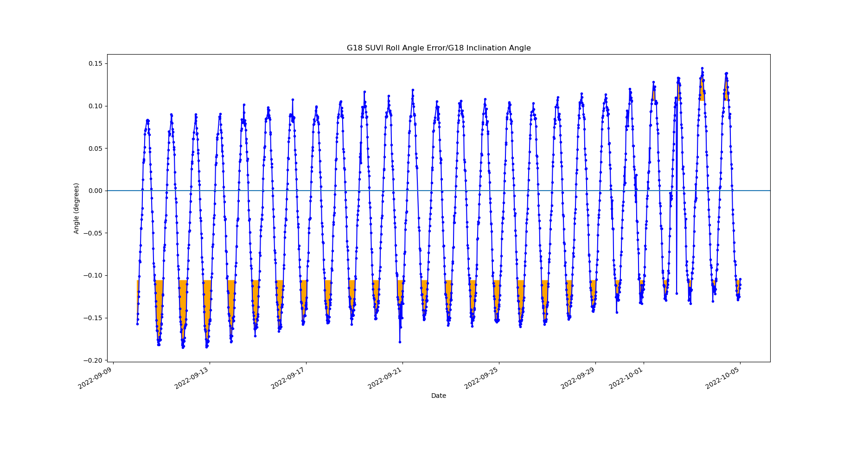
ADR 1276
For GOES-18 SUVI, the shaded regions indicate when the INR mapping within the required 45’ FOV has greater than 2.5” errors.

Slide 21
ADR 260 and 1147
ADR 260 (SUVI Dark Exposure Scaling) and ADR 1147 (SUVI LUT needs to accommodate more flatfields) both relate to the GOES-R Ground System SUVI GPA
Currently, the SUVI GPA has not demonstrated capabilities of handling new imaging sequences. Specifically, the capability of properly handling dark frames (260) and flatfields (1147).
During GOES-18 PLT, an active SUVI PLPT was performed using a novel SUVI imaging sequence to test suitability of the SUVI GPA to resolve these ADRs.
PLPT was successfully executed, and the data were recorded
  A LUT mismatch on the ground system caused the GPA to fail to process the data.
  The data can be run in a testing environment with an appropriate calibration LUT
ADR 260 and ADR 1147 remain unresolved until processing of the PLPT data produce valid Level-1b.

Slide 22
ADR 1159
Channel-specific saturation thresholds are not being calculated correctly.
  Incorrect saturation thresholds are reported in the SUVI Level-1b
Level-2 products utilize the saturation thresholds during processing

Slide 23
ADR 1263
ADR 1263 (SUVI Coordinates in Metadata) describes occasions where spacecraft location data in the SUVI Level-1b product contain default fill values (“-999”).
Cause unknown
Possible impacts to resolution of ADR1276: if the roll angle offset can be determined using the spacecraft time and coordinates, it cannot be corrected for files containing only fill values.
Occurred for 300 out of 886816 files in 195 Å for GOES-16 in 2021

Slide 24
Product Quality Assessment

Slide 25
Assessment Overview
 | Today | Required/Desired
INR | Correct Pointing and Roll offsets Applied Low-level systematic errors persist Uncorrected roll causes small INR errors | Complete INR LUT maintained
Radiometrics | LUT updated for new calibration factors Degradation Trending activities started. Working to understand differences between G16/17/18 | Strategy to disseminate degradation correction factors Degradation trending activities producing consensus results Radiometric measurements of all SUVI instruments are understood and trended Consistency between all SUVI radiometrics.
Usability | All relevant radiometric metadata is included in L1b product Scaling of L1b products is dynamic and accurately reported SUVI data is shared through Helioviewer! SUVI tools in SunPy! | Ease of use by wider scientific community

Slide 26
Post-Launch Product Tests Presented for Provisional
Test ID | Test Title | Operator | Maturity | Status
G18-O-SUVPLPT-001 | SUVI Sequence Test (Active) | GOES-R | Prov. | PASS
PLPT-SUV-001 | SUVI Trending – CCD Temperature | NCEI | Prov. | Active/PASS
PLPT-SUV-003 | SUVI-AIA Intercalibration | NCEI | Prov. | Active/PASS
PLPT-SUV-006 | SUVI-EXIS Intercalibration | NCEI | Prov. | Active/PASS
PLPT-SUV-007 | SUVI-SUVI Intercalibration | NCEI | Prov. | Active/PASS
PLPT-SUV-008 | SUVI-EVE Rocket Intercalibration | NCEI | Full | Active
All test plans and procedures are given in the SUVI Readiness, Implementation, and Management Plan (RIMP v2.0; 410-R-RIMP-0319)
Notes:
PLPTs do not provide resolution to GPA issues, are solely for long-term trending. Only 001 can be run before L1b calibration issues are stabilized.

Slide 27
PLPT-SUVI-001: SUVI CCD Temperature Trending
Demonstrate the ability to extract and trending SUVI CCD Temperatures

Slide 28
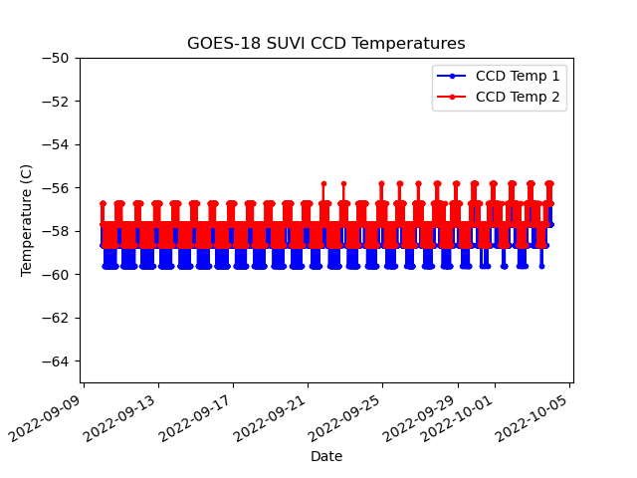
PLPT-SUVI-001: SUVI CCD Temperature Trending
Notes:
The increase from ~-65C to ~59.5C was to have the two SUVI instruments have as few operational differences as possible.

Slide 29
PLPT-SUVI-003: SUVI-AIA Intercalibration
Full field performance comparison via AIA-to-SUVI transformation and ratio (assesses flat field, focus and point-spread-function, bad pixels, and other image artifacts).
Radiometric inter-comparison via SUVI/AIA ratio versus theoretical expectations based on SUVI/AIA spectral response functions.
To ensure sufficient signal-to-noise only on-disk pixels are used for radiometric analysis.

Slide 30
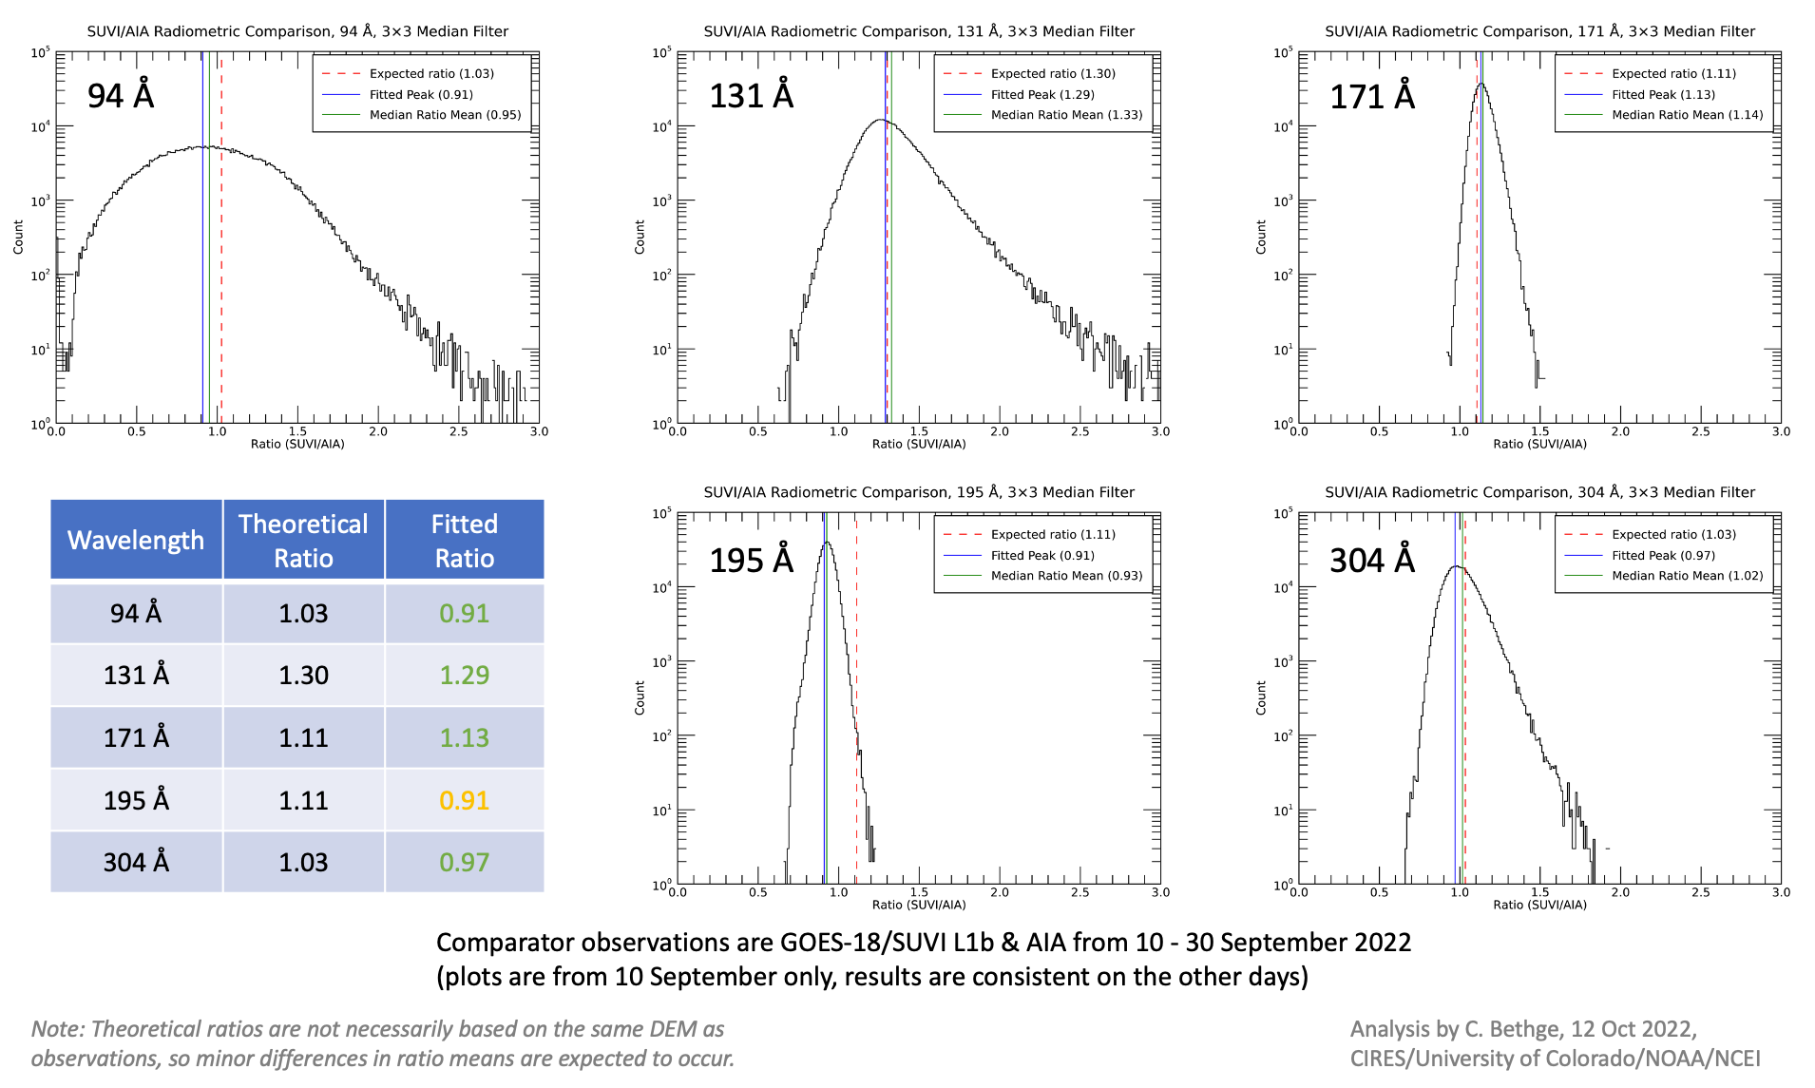
PLPT-SUVI-003: SUVI-AIA Intercalibration
Quick explanation for the plots:
- red line:
expected
- blue/green lines:
reality
Update

Slide 31
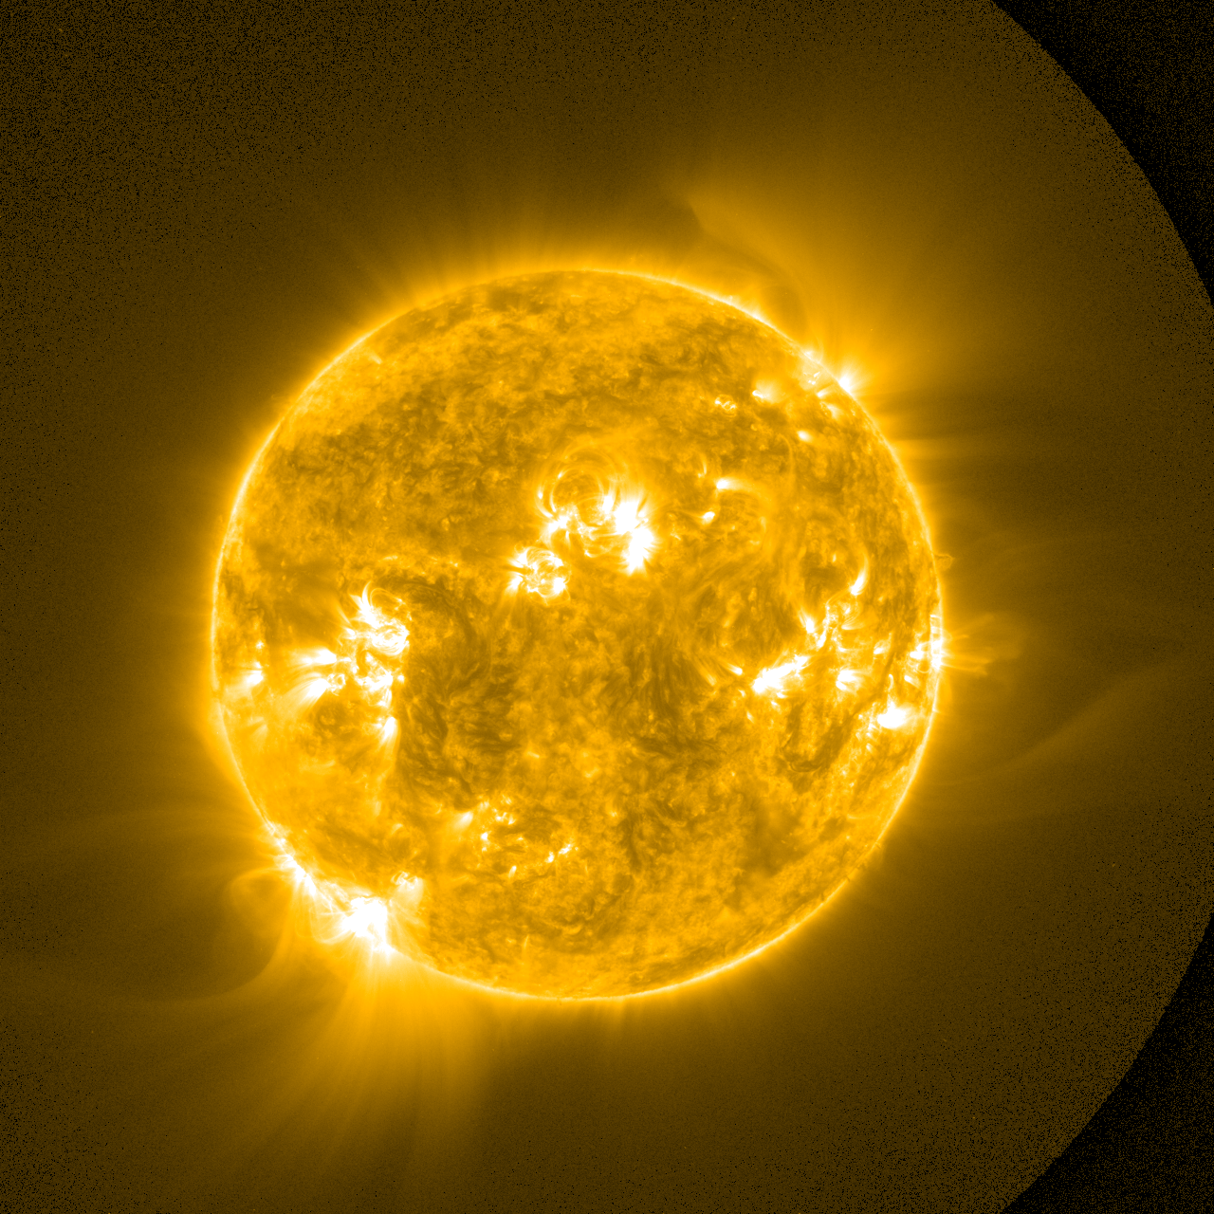
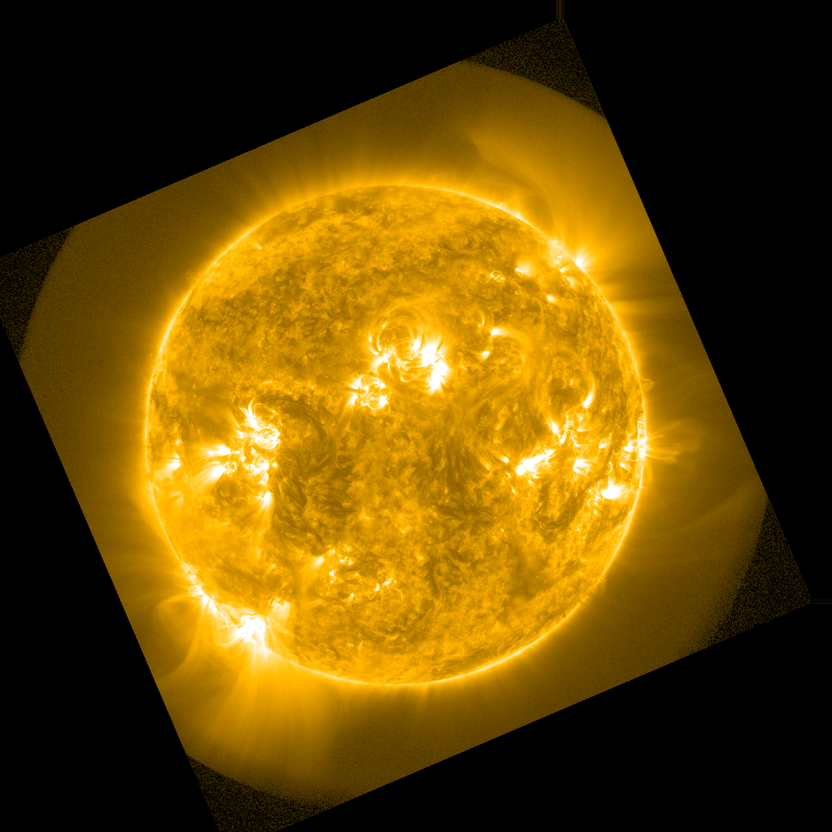
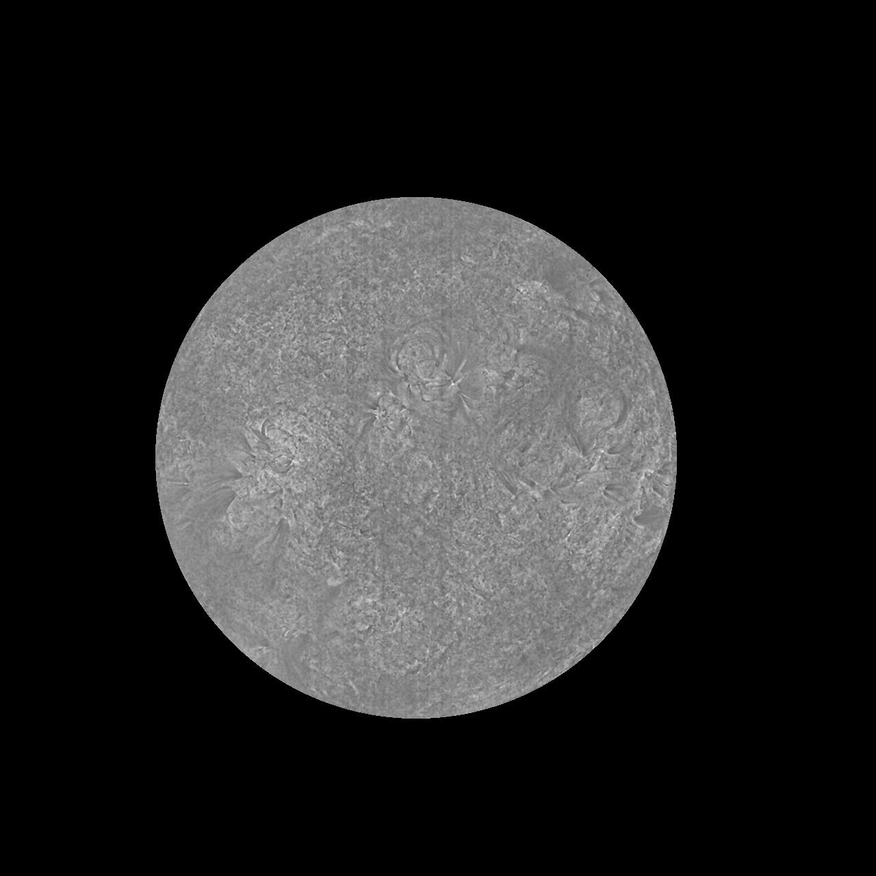
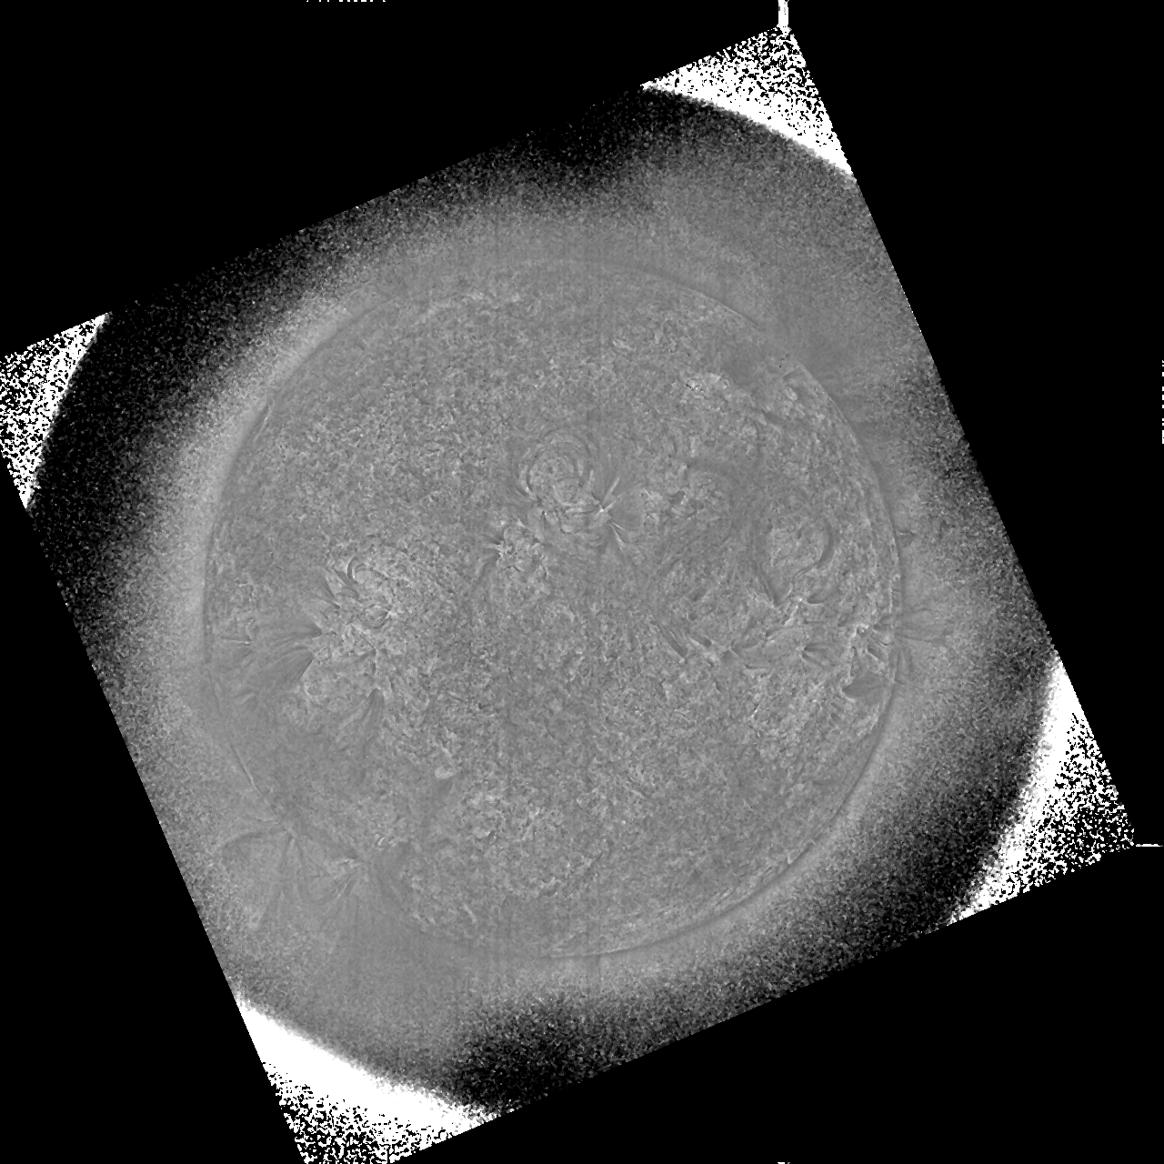
PLPT-SUVI-003: SUVI-AIA Intercalibration
SUVI 171 Å
AIA 171 Å
SUVI / AIA 171 Å

Slide 32
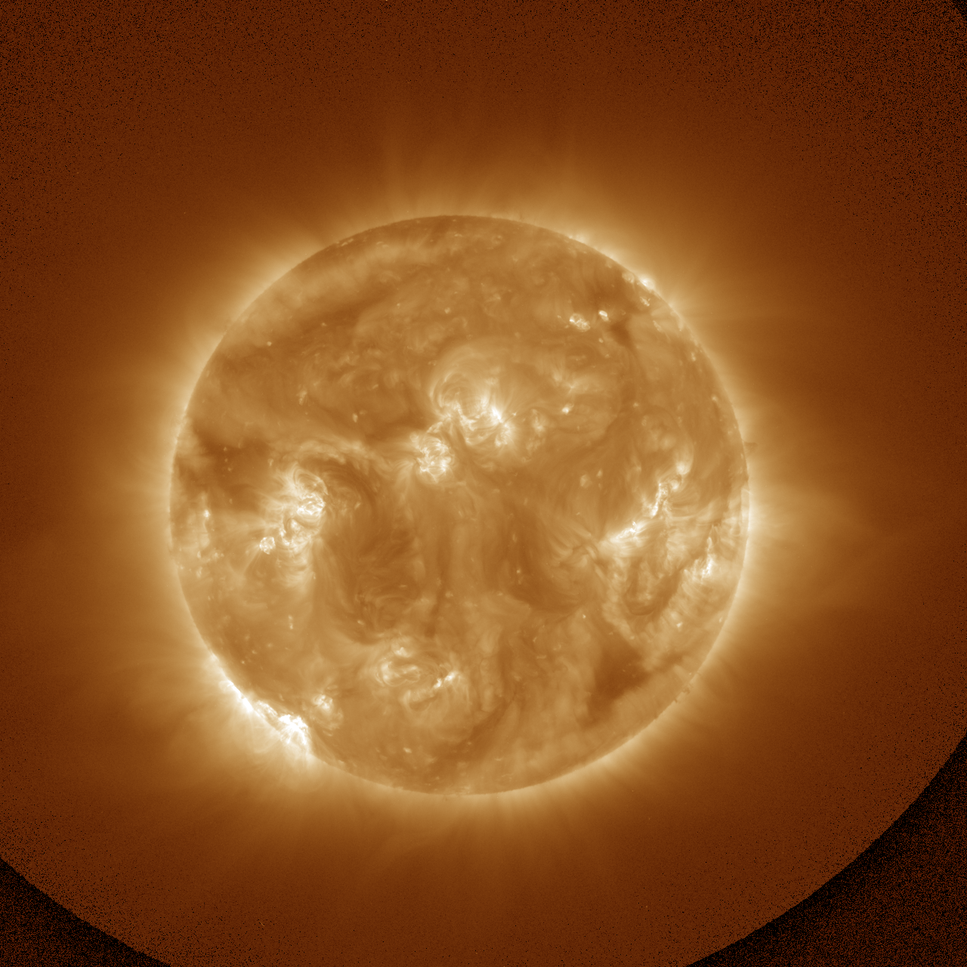
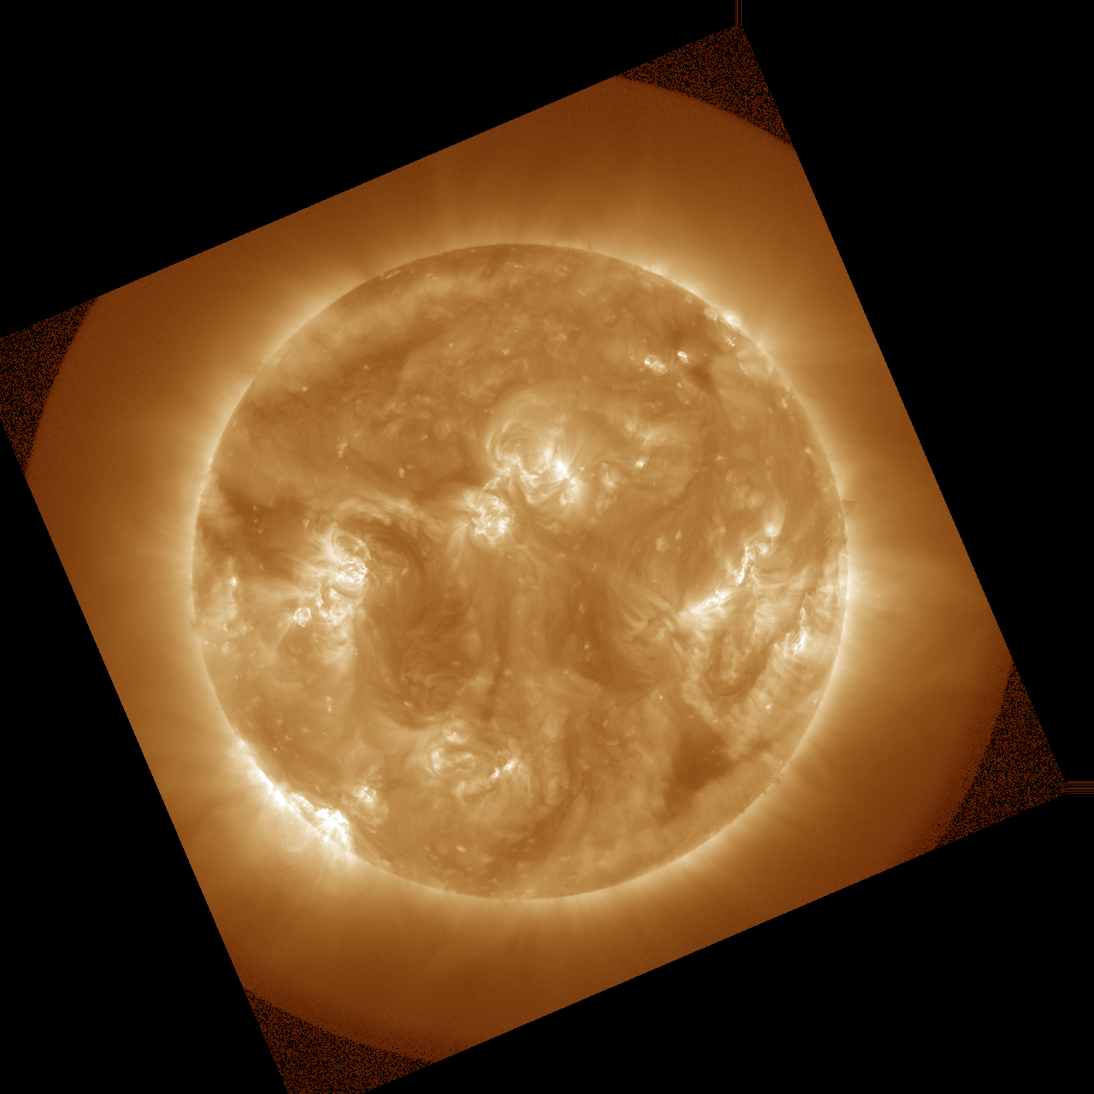
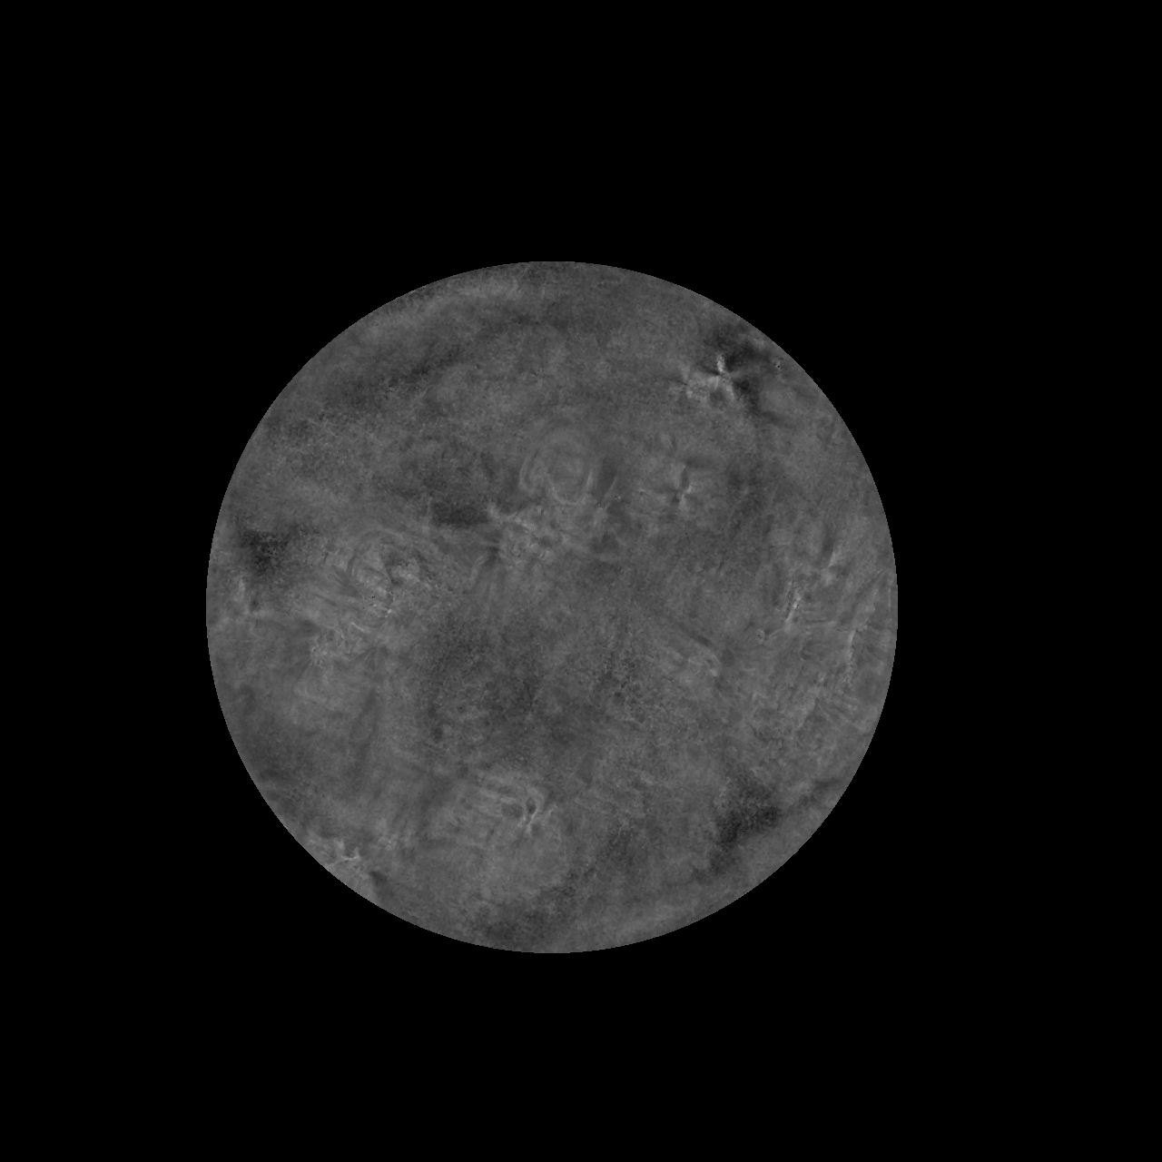
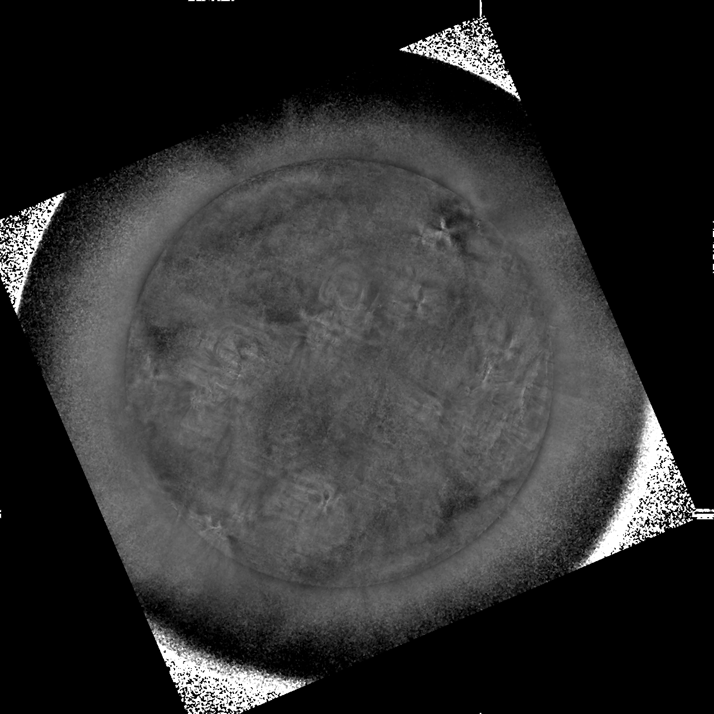
PLPT-SUVI-003: SUVI-AIA Intercalibration
SUVI 195 Å
AIA 193 Å
SUVI 195 Å / AIA 193 Å

Slide 33
PLPT-SUVI-003: SUVI-AIA Intercalibration
Summary:
GOES-18/SUVI and AIA radiometric comparison shows results within expected ranges for all comparable wavelength channels.
The largest deviations are found in 94 Å and 195 Å, which are due to noise (94 Å) and a known issue for the AIA 193 Å degradation correction.
Flatfield quality could be improved for some channels.

Slide 34
PLPT-SUVI-003: SUVI-AIA Intercalibration
There is no standard candle for EUV observations to quantify absolute degradation; comparison to AIA provides an estimate of long term degradation.
The following plots show the ratio of SUVI and AIA mean image irradiance for all comparable channels and all SUVI instruments, trended daily from June 15 - Nov 9, 2022. Note that since the units of AIA measurements differ from SUVI, the expected value of this ratio is not one.
Note that jumps due to LUT updates and bakeouts are not corrected for. No bakeouts were observed during this period, but one LUT update occurred on Aug 8, 2022. A 28 day outage is also observed for GOES-18 due to the ECI campaign.
Conclusions: SUVI-18 degradation relative to AIA during this period was not significant enough to be quantified. Generally, relative degradation for properly calibrated data was highest for SUVI-16 and least for SUVI-18, with the exception of the 94 Å channel.

Slide 35
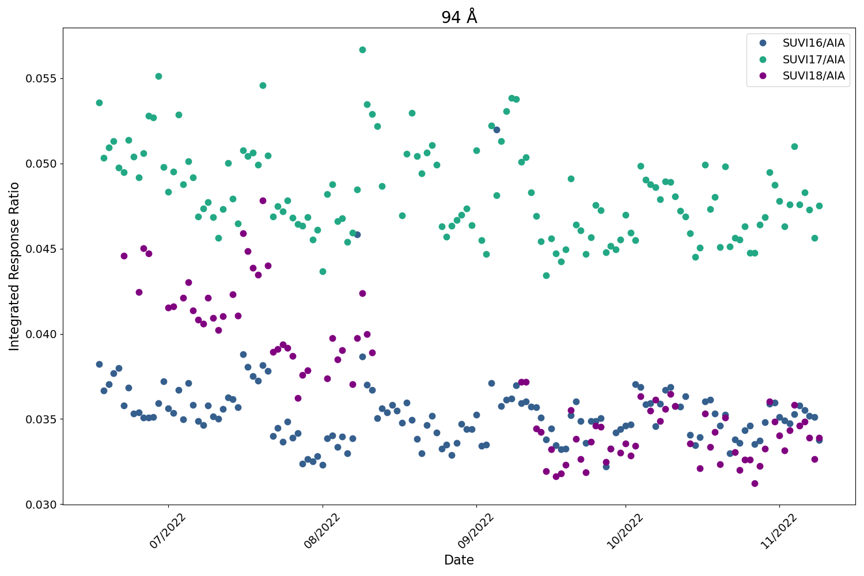
PLPT-SUVI-003: SUVI-AIA Intercalibration
SUVI 94 Å
AIA and SUVI have different saturation thresholds in 94 Å, resulting in high variance in their ratio during periods of solar activity.
Note that SUVI-17/AIA has the highest ratio value, likely due to the light leak.
G18 ECI

Slide 36
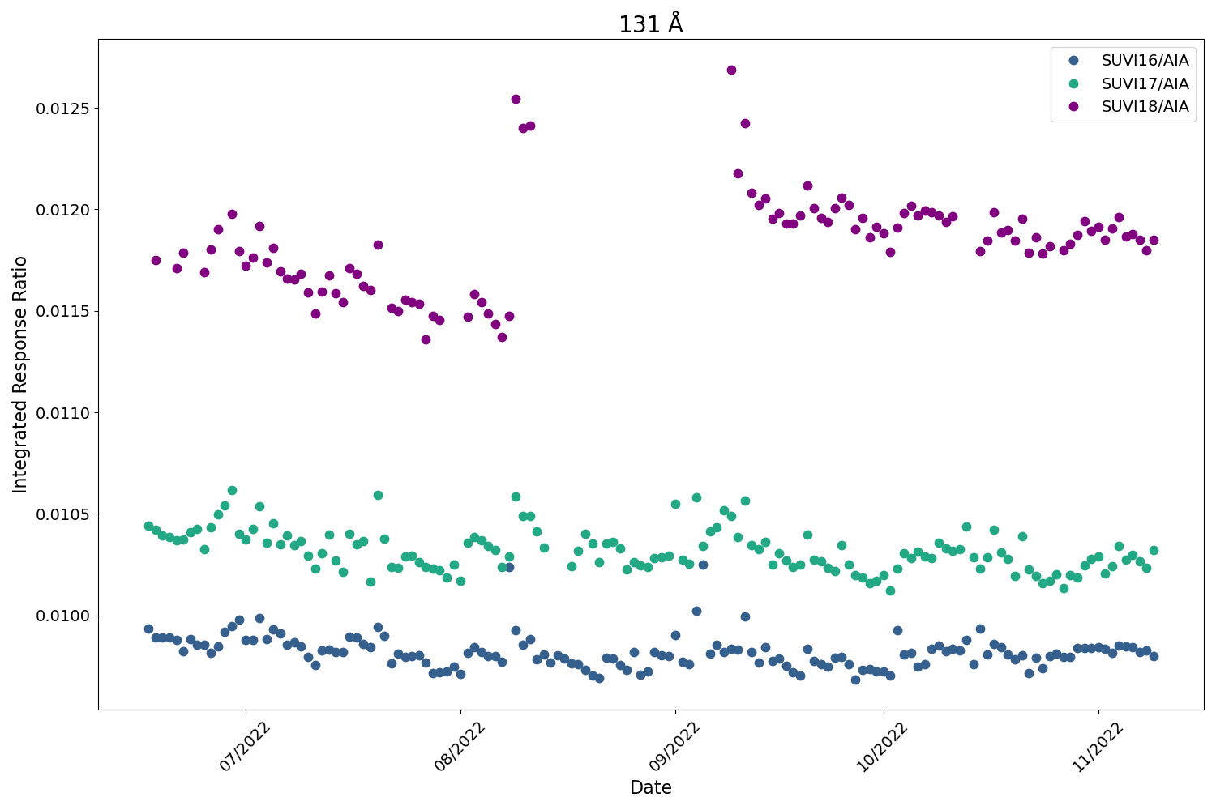
PLPT-SUVI-003: SUVI-AIA Intercalibration
SUVI 131 Å
Shift in SUVI-18 integrated response occurs following the LUT update.
As expected, the average ratio value is highest for SUVI-18 and lowest for SUVI-16.
G18 ECI
LUT Update

Slide 37
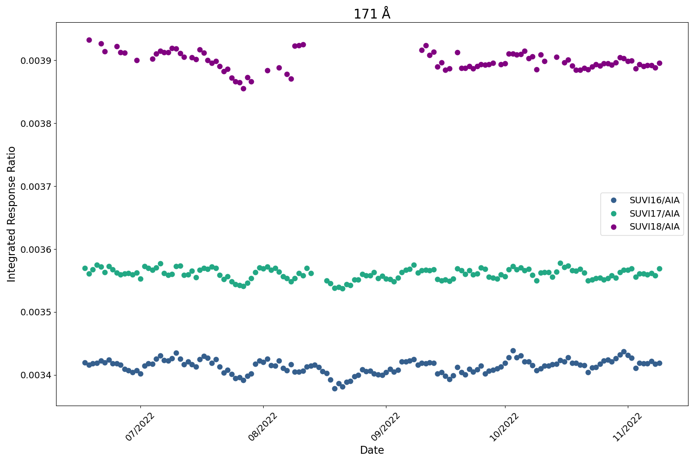
PLPT-SUVI-003: SUVI-AIA Intercalibration
SUVI 171 Å
Minimal shift in SUVI-18 integrated response following the LUT update.
Relative degradation lowest in SUVI-18.
G18 ECI
LUT Update

Slide 38
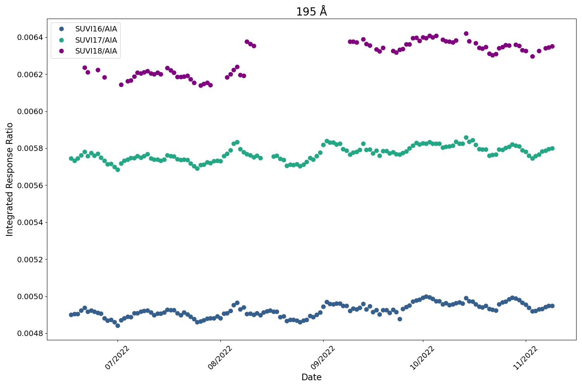
PLPT-SUVI-003: SUVI-AIA Intercalibration
SUVI 195 Å
Shift in SUVI-18 integrated response occurs following the LUT update.
Note that spectral response is slightly different in this channel for SUVI vs AIA, therefore some solar activity is preserved in the trends. These features are observed similarly between all SUVI instruments.
G18 ECI
LUT Update

Slide 39
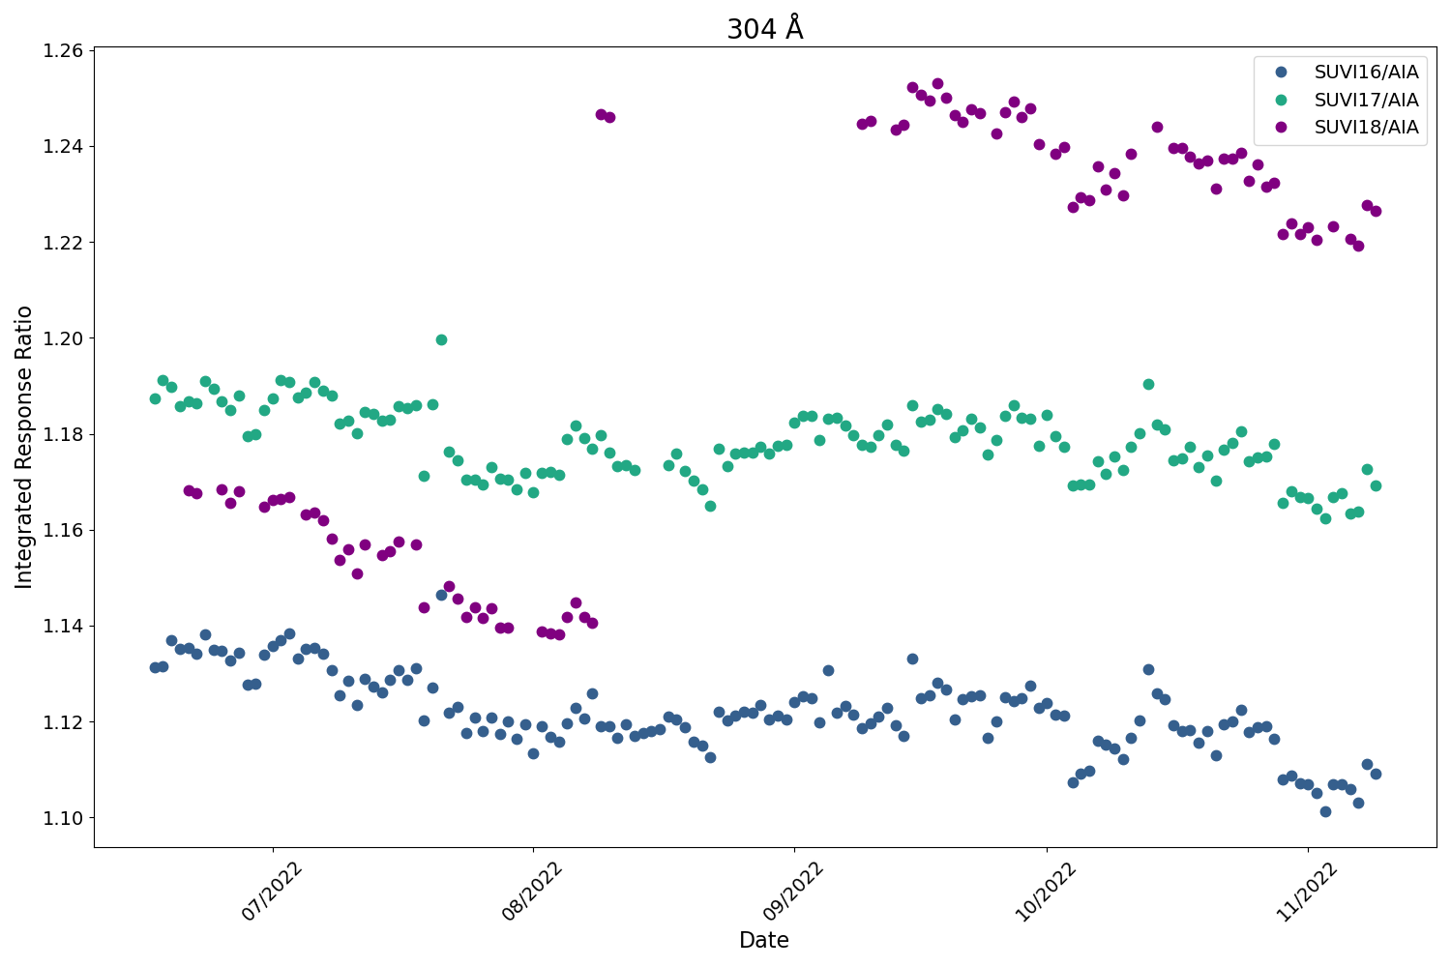
PLPT-SUVI-003: SUVI-AIA Intercalibration
SUVI 304 Å
Significant shift in SUVI-18 integrated response following the LUT update.
With properly calibrated data, relative degradation is lowest in SUVI-18.
G18 ECI
LUT Update

Slide 40
PLPT-SUVI-006: SUVI-EXIS Intercalibration
Straight ratio comparison of EXIS-EUVSA 284 and 304Å spectral irradiance measurements to SUVI 284 and 304Å channels.
GOES-16 EXIS products are used exclusively.
  GOES-17 EUVS Level-2 products are not currently produced by NCEI
  GOES-18 EXIS Level-2 products are not yet publicly available.
Value for the GOES-16 EXIS-EUVSA come from NCEI
SUVI and EXIS are very different instruments, and work is needed to achieve an apples-to-apples comparison.
The ratios between SUVI and EXIS measurements are an option in calculating the SUVI contamination correction.

Slide 41
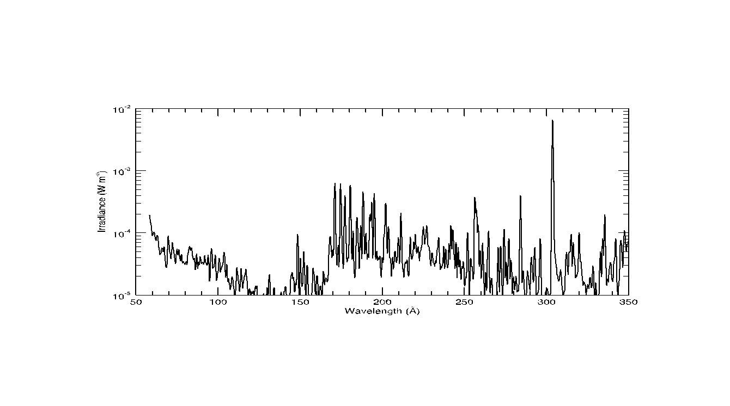
Typical Solar Spectrum
He II
(Si XI)
Fe IX
Fe X
Fe XII
(Fe XXIV)
Fe XV
Fe X
(Fe XVIII)
Fe VIII
(Fe XXI)
Notes:
A typical spectrum with observed lines highlighted. Parentheses indicate lines that might be in the passband but are not present in this spectrum. Colors indicate approximate passband regions.

Slide 42
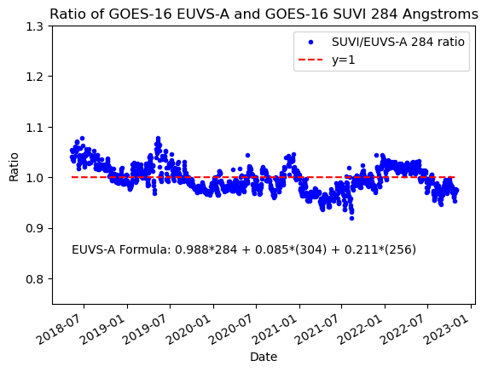
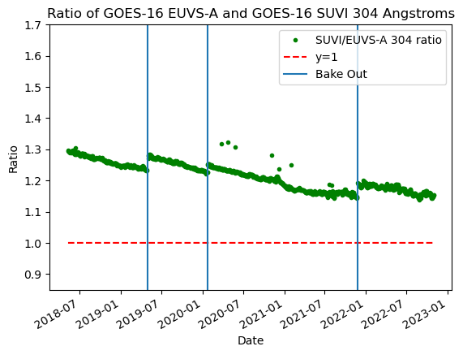
PLPT-SUVI-006: SUVI-EXIS Intercalibration
GOES-16 SUVI Retrospective
Notes:
This is an updated GOES-16 SUVI-EXIS EUVS 284/304 intercomparison.

Slide 43
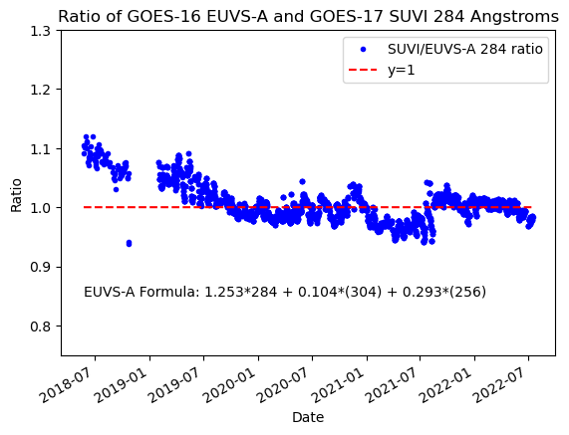
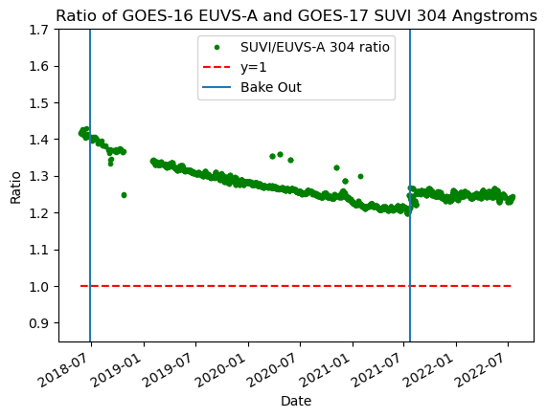
PLPT-SUVI-006: SUVI-EXIS Intercalibration
GOES-17 SUVI Retrospective
Notes:
This is an updated GOES-16 SUVI-EXIS EUVS 304 intercomparison.

Slide 44
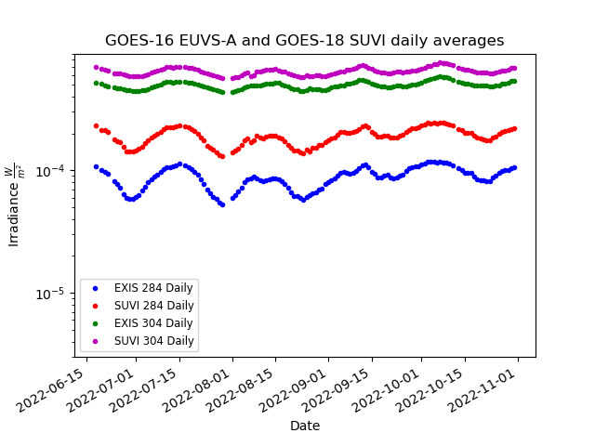
PLPT-SUVI-006: SUVI-EXIS Intercalibration
SUVI and EUVS measurements show similar trends.
Due to the broadband nature of the SUVI 284 and 304 channels, SUVI is measuring more than the discrete 284/304 lines.
Notes:
Straight-up 284measurements from GOES-17 SUVI and GOES-16 EXIS-EUVS.

Slide 45
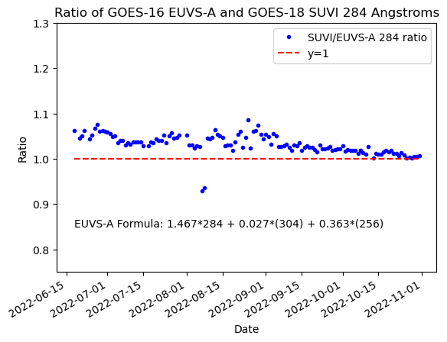
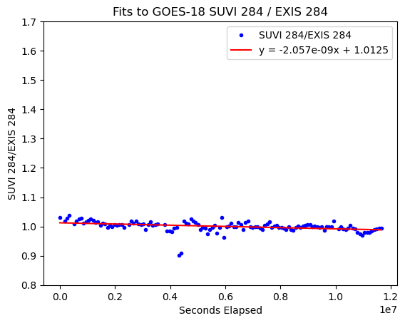
PLPT-SUVI-006: SUVI-EXIS Intercalibration
Notes:
Straight-up 304 measurements from GOES-17 SUVI and GOES-16 EXIS-EUVS.

Slide 46
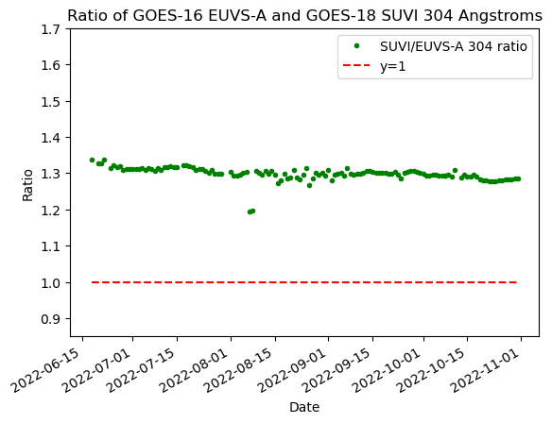
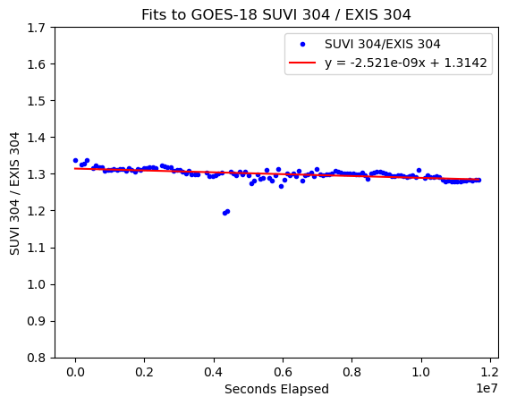
PLPT-SUVI-006: SUVI-EXIS Intercalibration
Notes:
Ratio shows a lot of variability. Early in eclipse season show some ECI measurements. LUT update is responsible for the jump after 2018-11.

Slide 47
SUVI Degradation Summary
Flight Model | 94 Å (AIA) | 131 Å (AIA) | 171 Å (AIA) | 195 Å (AIA) | 284 Å (EXIS) | 304 Å (AIA/EXIS)
FM1 | BSV | 5% | BSV | BSV | 7.8% | 11%/14%
FM2 | BSV | 13% | <1% | BSV | 10.5% | 15%/17%
FM3 | - | - | - | - | 5% | -/5%
FM1: 22 May 2018 to present
FM2: 22 May 2018 to present
FM3: 18 June 2022 to present
BSV : Below Solar Variability

Slide 48
PLPT SUVI-007: SUVI-SUVI Intercomparison
Straight comparison between respective SUVI Instruments
  Current instrument are the GOES-16/17/18 SUVI instruments
  GOES-17 SUVI has known light leaks in the 94Å channel
Comparisons between SUVI instruments illuminate the unknowns of instrument performance between the different flight models.
Plots show the ratio between SUVI measurements (blue dots), the expected ratio (red line) and a reference m=1 line (black dashed)
Expected ratio comes from the respective response functions as reported by the SUVI vendor.

Slide 49
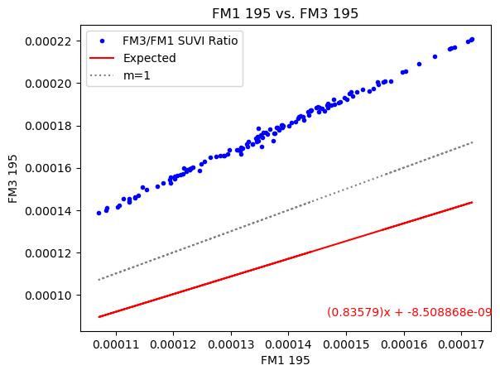
PLPT SUVI-007: SUVI-SUVI Intercomparison
FM1 and FM3
Blue Dots: SUVI Irradiance Values
Red Line: Expected Trend from respective response functions
Deviations from the expected trend line indicate an issue with the response functions. Possible explanations might include substantial degradation in one instrument.

Slide 50
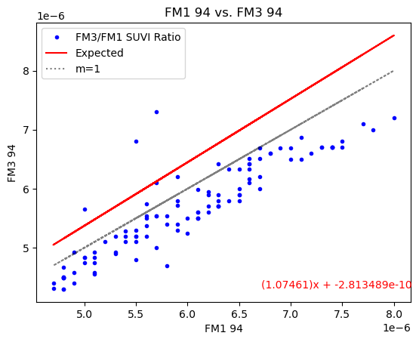
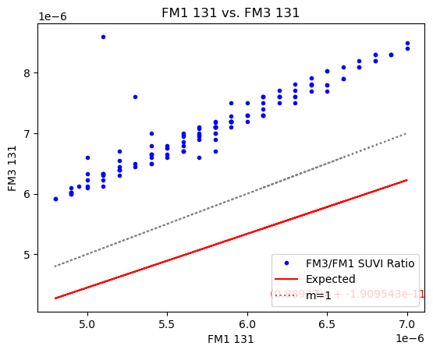
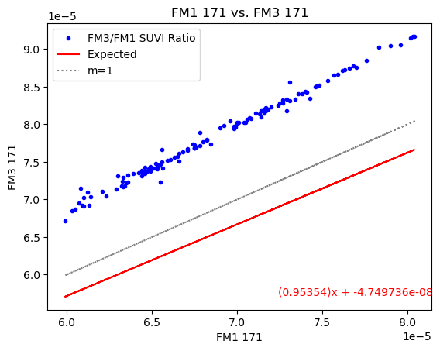
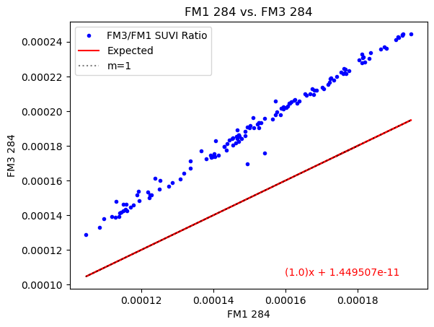
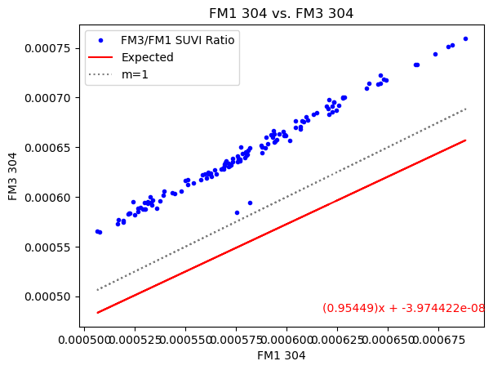
PLPT SUVI-007: SUVI-SUVI Intercomparison
FM1 and FM3

Slide 51
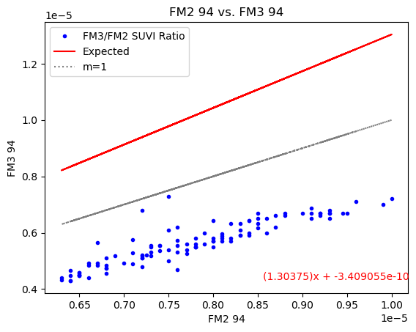
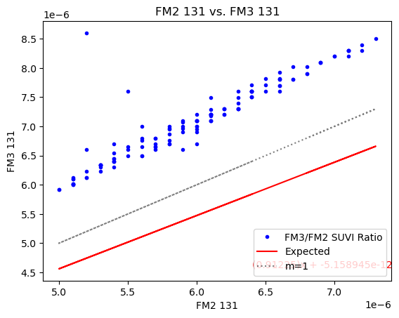
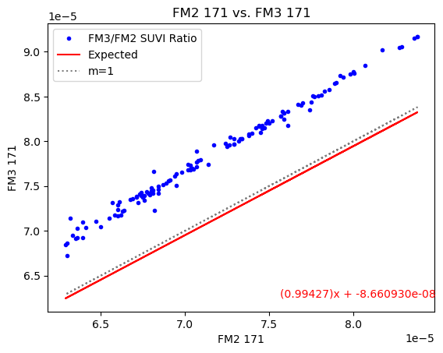
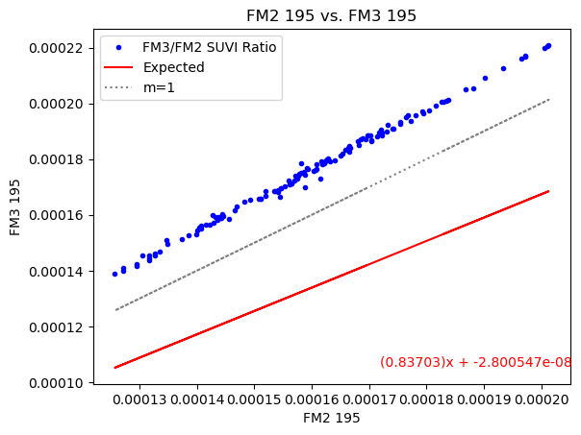
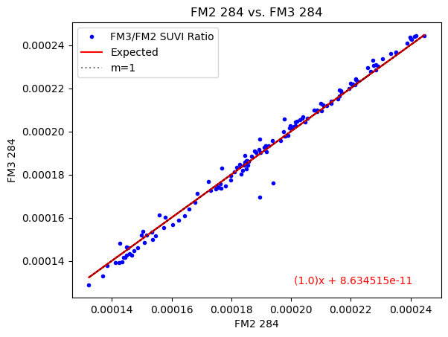
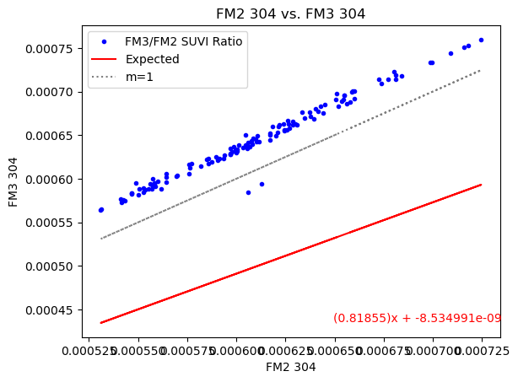
PLPT SUVI-007: SUVI-SUVI Intercomparison
FM2 and FM3
Notes:
94: blue dots below the expected trend (red line) are due to overperformance of G17 SUVI due to the white light leak.

Slide 52
PLPT SUVI-007: SUVI-SUVI Intercomparison
Summary:
The most likely culprit for the deviations from the expected trend would be degradation in the older instruments.
While the SUVI-SUVI intercomparison seems to show drastic deviations from expected trend, the actual differences in irradiance values are, in general, small.
NCEI plans to expand this exercise to include by-pixel histograms similar to PLPT-SUV-003

Slide 53
PLPT SUVI-007: SUVI-SUVI Intercomparison
Degradation of the older SUVI instruments is a suspected factor in the differences from the expected performance.
  Issues with the reported response functions cannot be ruled out
SUVI-SUVI comparisons will be expanded for the assessment of Full Maturity status.

Slide 54
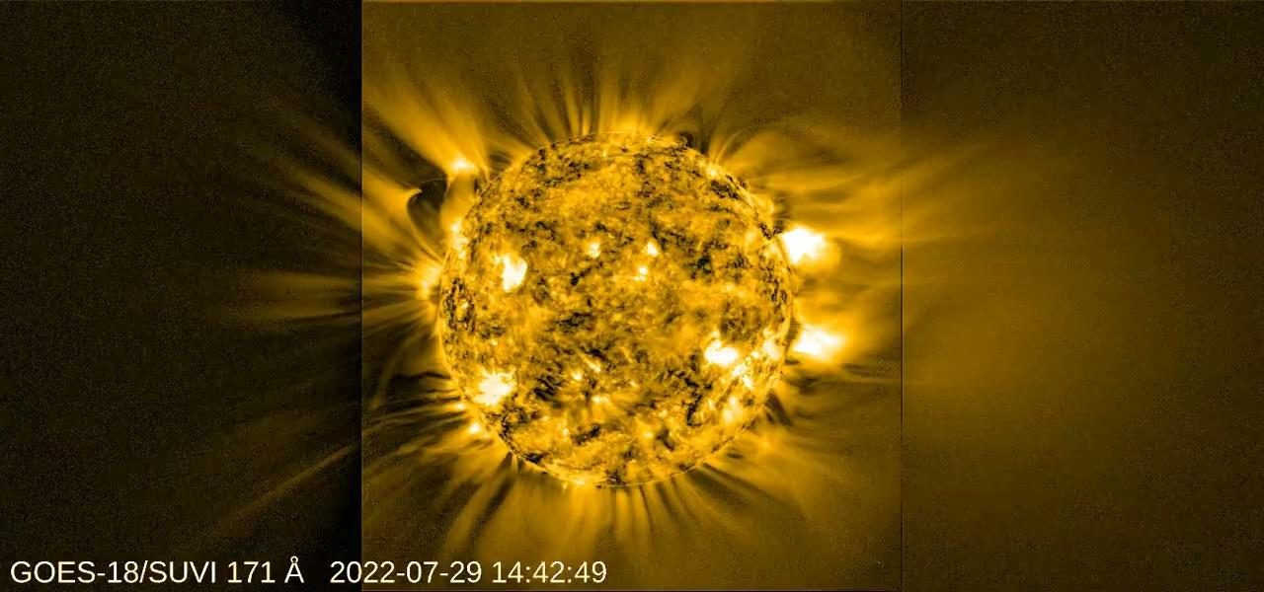
GOES-18 SUVI ECI Campaigns
Credit: Daniel Seaton (SWRI)

Slide 55
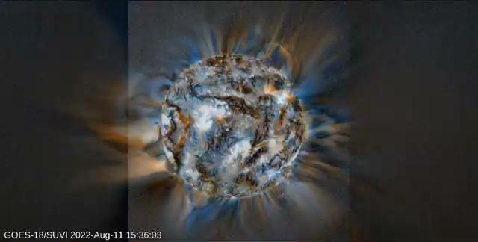
GOES-18 SUVI ECI Campaigns
Credit: Daniel Seaton (SWRI)

Slide 56
SUVI Performance Baseline Status
Assessment at Provisional
MRD ID | Description | Related PLPTs | Status
2045 | Pointing Accuracy | PLPT-SUV-003 | Validated
2046 | Product Pointing Knowledge/Mapping Uncertainty | PLPT-SUV-003 | Ongoing Investigations
2052 | Long-term Stability (Product Measurement Precision in Radiance) | PLPT-SUV-003, PLPT-SUV-006 | Preliminary results. Ongoing investigation
MRD2045: Pointing Accuracy
  Requirements: ±3.0 arcmin (3 sigma) (N-S,E-W) of Sun Center;
  Stability during 60 seconds: ±2.0 arcsec (1 sigma), ±6.0 arcsec (3 sigma) (N-S, E-W)
MRD2046: Product Pointing Knowledge/Mapping Uncertainty
  Requirements: ±2.5 arcsec
MRD2052: Long-term Stability (Product Measurement Precision in Radiance)
  Requirements: ±30%
  Absolute accuracy cannot be verified on-orbit

Slide 57
SUVI Performance Baseline Status
Assessment at Provisional
MRD ID | Description | Requirement | NCEI Analysis | Status
2045 | Pointing Accuracy | 3.0 Arcminutes | < 0.6 arcsec y, < 0.6 arcsec z | PASS
2046 | Product Pointing Knowledge/ Mapping Uncertainty | 2.5 Arcseconds | Variable | MARGINAL
2052 | Long-term Stability | 30% | ~5% 284Å ~5% 304Å | PASS
Pointing requirements are well met.
Mapping Uncertainty is a concern with requirement compliance seemingly dependent upon spacecraft position
  NCEI is currently performing an analysis and will shortly recommend a path forward.
    NCEI will submit a new ADR if a solution is viable

Slide 58
Product Maturity Assessment
Preparation Activities | Assessment
Validation activities are ongoing and the general research community is now encouraged to participate. | Validation activities are ongoing. Results have been discussed with SWPC. Release of data by NCEI will enable research community participation.
Severe algorithm anomalies and deficiencies are identified and under analysis. Solutions to anomalies are in development and testing. | The only point of concern is the resolution of the ADR 1276 root anomaly.
Incremental product improvements may still be occurring. | Incremental product improvements are expected, primarily through updated LUTs incorporating results of cross-cal.

Slide 59
Product Maturity Assessment
End State | Assessment
Product performance has been demonstrated through analysis of a small number of independent measurements obtained from select locations, periods, and associated ground truth or field campaign efforts. | PLPTs discussed here demonstrate the product performance of the GOES-18 SUVI
Product analysis is sufficient to communicate product performance to users relative to expectations (Performance Baseline). | Yes.
Documentation of product performance exists that includes recommended remediation strategies for all anomalies and weaknesses. Any algorithm changes associated with severe anomalies have been documented, implemented, tested, and shared with the user community. | Preliminary assessments show the instrument and product are in good shape. All anomalies and other concerns will be discussed within product documentation.
Testing has been fully documented. | This presentation, additional documentation to follow.
Product is ready for operational use and for use in comprehensive cal/val activities and product optimization. | NCEI: yes.

Slide 60
SUVI’s Path to Full Maturity
Critical ADRs, WRs, and risks to be resolved prior to Full Maturity.
PLPTs for Full Maturity
Comments on the status of the Performance Baseline

Slide 61
Risks and ADRs affecting Full
ADR | WR | Delivery | Description | Disposition
260 | 6025 | – | SUVI Dark Exposure Scaling | Needed to mitigate instrument degradation and light leakage.
1147 | 8433 | – | SUVI GPA Flatfield Accommodation | Needed to mitigate instrument degradation and light leakage.
1263 | 9321 | – | SUVI L1b Metadata - Spacecraft Location defaults | User confusion may result from inaccurate spacecraft locations
1276 | 9406 | – | SUVI Roll Angle unresolved error. | Rejected

Slide 62
Post-Launch Product Tests for Full
Test ID | Test Title | Operator
PLPT-SUV-001 | SUVI Trending – CCD Temperature | NCEI
PLPT-SUV-002 | SUVI Trending – Detector Performance | NCEI
PLPT-SUV-003 | SUVI-AIA Intercalibration | NCEI
PLPT-SUV-006 | SUVI-EXIS Intercalibration | NCEI
PLPT-SUV-007 | SUVI-SUVI Intercalibration | NCEI
PLPT-SUV-008 | SUVI-EVE Underflight Intercalibration | NCEI
PLPT-SUV-008: No SDO-EVE Underflight overlaps with GOES-18 SUVI to date.

Slide 63
NCEI’s Recommendation
NCEI believes that the GOES-18 SUVI L1b product has reached the Provisional Maturity as defined by the GOES-R Program

Slide 64
Disposition from NWS-SWPC
Comments and/or slides from Dr. Steven Hill of SWPC, speaking on behalf of the user community.

Slide 65
Summary and Conclusion
All ADRs/WRs critical to Provisional Maturity have been resolved, validated, or had a path of resolution defined.
We would like to thank the instrument vendor, ground system vendor, OSPO, and the GOES-R Program team for all the help to reach this milestone.
NCEI-CO and SWPC recommend the GOES-18 SUVI L1b product for Provisional Maturity
  NCEI requests the review panel to urge the GOES-R Program to facilitate and expedite a fix to ADR 1276 if one is found during the NCEI analysis.

Slide 66
Backup Slides

Slide 67
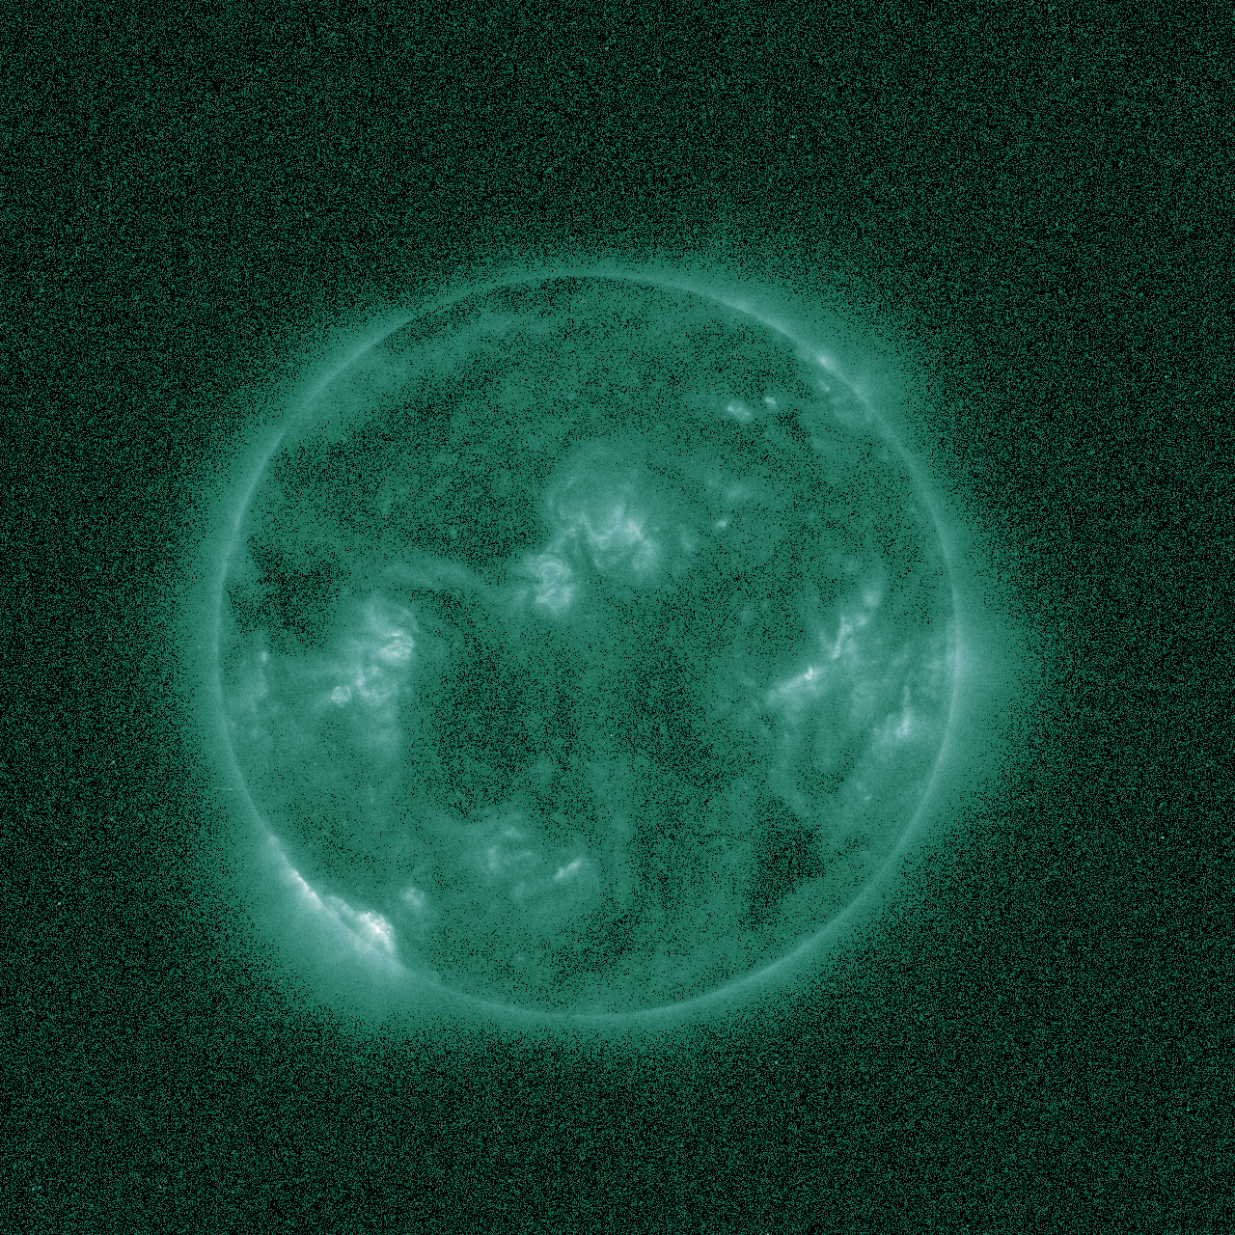



Preliminary PLPT-SUVI-003: SUVI-AIA Intercalibration
SUVI 94 Å
AIA 94 Å
SUVI/AIA 94 Å

Slide 68




Preliminary PLPT-SUVI-003: SUVI-AIA Intercalibration
SUVI 131 Å
AIA 131 Å
SUVI/AIA 131 Å

Slide 69




Preliminary PLPT-SUVI-003: SUVI-AIA Intercalibration
SUVI 304 Å
AIA 304 Å
SUVI/AIA 304 Å

Slide 70


Preliminary PLPT-SUVI-007: SUVI-SUVI Intercomparison
GOES-16 / GOES-18 ratio 171 Å
GOES-16 / GOES-18 ratio 195 Å

Slide 71

Preliminary PLPT-SUVI-003: SUVI-AIA Intercalibration
SUVI 94 Å
Degradation relative to AIA is below solar variability for both SUVI-16 and SUVI-17.
Note that 94 Å for SUVI-17 is unreliable due to the light leak.

Slide 72

Preliminary PLPT-SUVI-003: SUVI-AIA Intercalibration
SUVI 131 Å
Degradation relative to AIA is ~5% for SUVI-16 and ~13% for SUVI-17.
Since the beginning of the mission is included for SUVI-17 but not SUVI-16, it is reasonable that SUVI-17 has degraded significantly more during this period.

Slide 73

Preliminary PLPT-SUVI-003: SUVI-AIA Intercalibration
SUVI 171 Å
Degradation relative to AIA is below solar variability for SUVI-16, and <1% for SUVI-17.
Several bakeouts are observed in this channel for both SUVI-17 and SUVI-16. These are not corrected for as they contribute to degradation. AIA calibration changes and SUVI LUT updates are corrected for.
G17 ECI
G17 ECI

Slide 74

Preliminary PLPT-SUVI-003: SUVI-AIA Intercalibration
SUVI 195 Å
Degradation relative to AIA is below solar variability for both SUVI-16 and SUVI-17. Bakeouts are observed for both satellites in this channel.
Due to differences in AIA vs SUVI spectral responses, the 195 Å trend is particularly affected by solar activity. This may account for the periodic variability and upward trend.
G17 ECI
G17 ECI

Slide 75

Preliminary PLPT-SUVI-003: SUVI-AIA Intercalibration
SUVI 304 Å
Degradation relative to AIA is ~11% for SUVI-16 and ~15% for SUVI-17.
304 Å typically degrades most significantly at the beginning of the mission, so it is reasonable that SUVI-17 has degraded more during this period.
Various bakeouts are observed for both SUVI-16 and SUVI-17.
G17 ECI
G17 ECI

Slide 76

SUVI (Coronal) Temperature Response

Slide 77

Preliminary PLPT-SUVI-003: SUVI-AIA Intercalibration
AIA degradation tracked via direct and proxy measurements: EVE/MEGS-A, EVE Sounding Rocket, Flare Irradiance Spectral Model (FISM).

Slide 78


SUVI pointing knowledge: roll angle
SUVI roll angle offset from 10 Sept - 10 Oct 2022, every 20 min
SUVI pointing error at the limb

Slide 79

SUVI pointing knowledge: roll angle

Slide 80

ADR 1276

