Slide 1
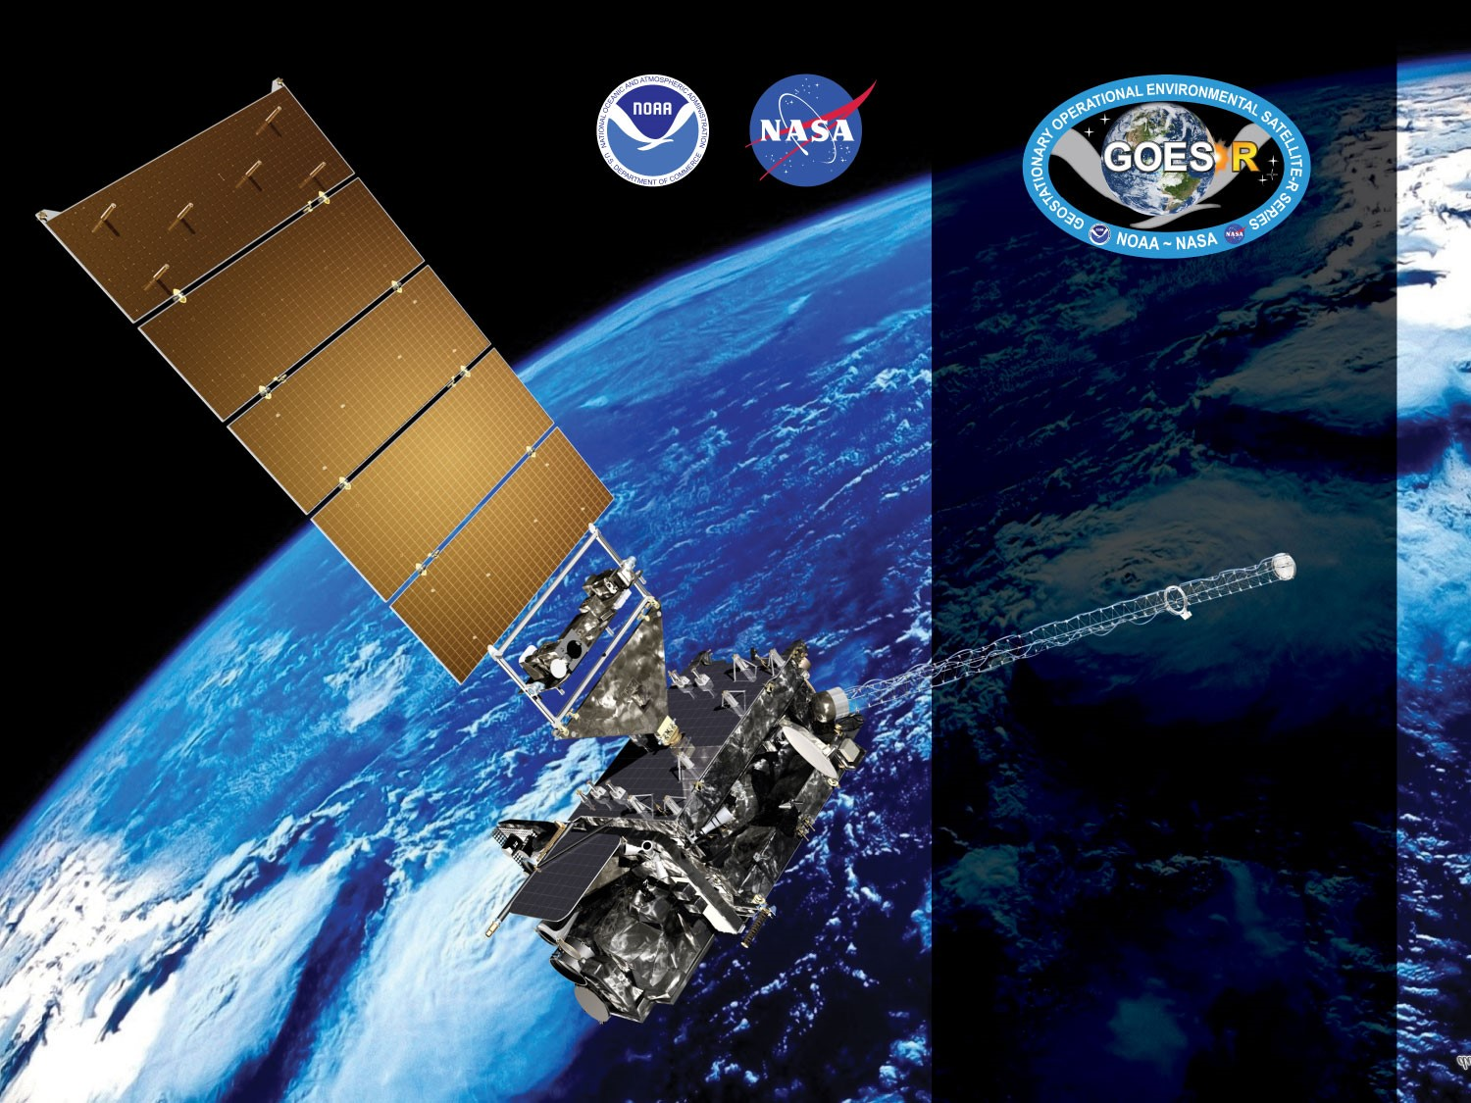
GOES-19 ABI L2+ LAP Products Provisional PS-PVR
February 5, 2025
Jaime Daniels, Mark Kulie
GOES-R AWG
NOAA/NESDIS/STAR
GOES-R AWG LAP team: Zhenglong Li, Pei Wang, Jinlong Li, Richard Dworak, Bill Bellon, UW-CIMSS

Slide 2
Agenda
Provisional Validation Product Maturity Assessment
Data since November 01, 2024
Path to Full Maturity Review
Summary and Recommendations

Slide 3
Products Overview
Same as GOES-16, GOES-17, and GOES-18 ABI L2 LAP algorithm includes regression and physical retrieval based on the infrared spectral bands as input. The algorithm is applied to 5x5 ABI pixels (~10 km) for generating LAP products over clear sky. The LAP products include LVT, LVM, TPW, and DSI.
Band Number | Wavelength (µm) | Purpose
8 | 6.19 | High-level atmospheric water vapor, winds, rainfall
9 | 6.93 | Mid-level atmospheric water vapor, winds, rainfall
10 | 7.34 | Lower-level atmospheric water vapor, winds, and SO₂
12 | 9.61* | Total ozone
13 | 10.33 | Surface and cloud
14 | 11.20 | Imagery, SST, clouds, rainfall
15 | 12.30 | Total water, ash, SST
16 | 13.30 | Air temperature, cloud heights and amounts
LAP products
Legacy Vertical Temperature profile (LVT)
Legacy Vertical Moisture profile (LVM)
Total Precipitable Water (TPW)
Derived Stability Indices (DSI)
Lifted Index (LI)
Convective Available Potential Energy (CAPE)
Showalter Index (SI)
K-Index (KI)
Total Totals (TT)
9.61* : used only in regression
Notes:
* Only used in the regression step.

Slide 4
Review: Time-Line/Context
25 June 2024 GOES-U Launch
7 July 2024 GEO orbit attained (became GOES-19)
18 July 2024 GOES-19 arrived at its checkout location of 89.5W
24 July 2024 Post Launch Product Test (PLPT) begins
1 Oct 2024 Beta maturity achieved

Slide 5
PLPTs Under Review
PLPT ID | Descriptive Title | % Complete | Results | AWG POC
ABI-FD_TPW06 | Quantitative analysis of M6 FD TPW | 100 | Complete | AWG
ABI-CONUS_TPW07 | Quantitative analysis of M6 CONUS TPW | 100 | Complete | AWG
ABI-MESO_TPW08 | Quantitative analysis of M6 Meso TPW | 100 | Complete | AWG
Notes:
PRO is responsible for 01 – 05.

Slide 6
PLPTs Under Review
PLPT ID | Descriptive Title | % Complete | Results | AWG POC
ABI-FD_LVT06 | Quantitative analysis of M6 FD LVT | 100 | Complete | AWG
ABI-CONUS_LVT07 | Quantitative analysis of M6 CONUS LVT | 100 | Complete | AWG
ABI-MESO_LVT08 | Quantitative analysis of M6 Meso LVT | 100 | Complete | AWG
Notes:
PRO is responsible for 01 – 05.

Slide 7
PLPTs Under Review
PLPT ID | Descriptive Title | % Complete | Results | AWG POC
ABI-FD_LVM06 | Quantitative analysis of M6 FD LVM | 100 | Complete | AWG
ABI-CONUS_LVM07 | Quantitative analysis of M6 CONUS LVM | 100 | Complete | AWG
ABI-MESO_LVM08 | Quantitative analysis of M6 Meso LVM | 100 | Complete | AWG
Notes:
PRO is responsible for 01 – 05.

Slide 8
PLPTs Under Review
PLPT ID | Descriptive Title | % Complete | Results | AWG POC
ABI-FD_DSI06 | Quantitative analysis of M6 FD DSI | 100 | Complete | AWG
ABI-CONUS_DSI07 | Quantitative analysis of M6 CONUS DSI | 100 | Complete | AWG
ABI-MESO_DSI08 | Quantitative analysis of M6 Meso DSI | 100 | Complete | AWG
Notes:
PRO is responsible for 01 – 05.

Slide 9
PLPT Tests for each Domain
Our 3 PLPTs dealing with analysis are comprised of the same 3 methods.
Each contains the applications of these methods on the FD, CONUS and MESO domains.
The applications of each method to each domain is summarized below.
Some methods were redundant or not possible for some domains.
Same as what was done for GOES-16/17/18 LAP
Analysis Method | FD | CONUS | MESO
Visual Inspection
Comparison to reference data (RAOB and AMSR2)
Intercomparison to GOES-16 and 18 |  | N/A | N/A

Slide 10
Provisional Validation Product Maturity Assessment
GOES-19 ABI L2+ LAP Products Provisional PS-PVR

Slide 11
GOES-19 Data Used in this Review
November 1, 2024, 1900 UTC:
-Visual images of all domains for each variable
November and December 2024
-All FD, CONUS, Meso1, and Meso2 LAP with RAOB TPW, DSI, and T/Q profile matchups within +/- 30 min, 20 km
November and December 2024
-All FD, CONUS, Meso1, and Meso2 LAP with AMSR2 TPW matchups within +/- 30 min, 20 km
November 15, 2024, 0000 UTC:
-GOES-19 and GOES-16 intercomparison
November 15, 2024, 0000 UTC:
-GOES-19 and GOES-18 intercomparison
November 15, 2024, 0120 UTC – 0310 UTC:
-Sun migration effect on product
11

Slide 12
Definitions of Metrics
Passed: No visual artifacts and/or the comparison with the reference data near or above the specification.
Failed: Cause of performance degradation is unknown.
The comparisons with the reference data are computed over all data.
12

Slide 13
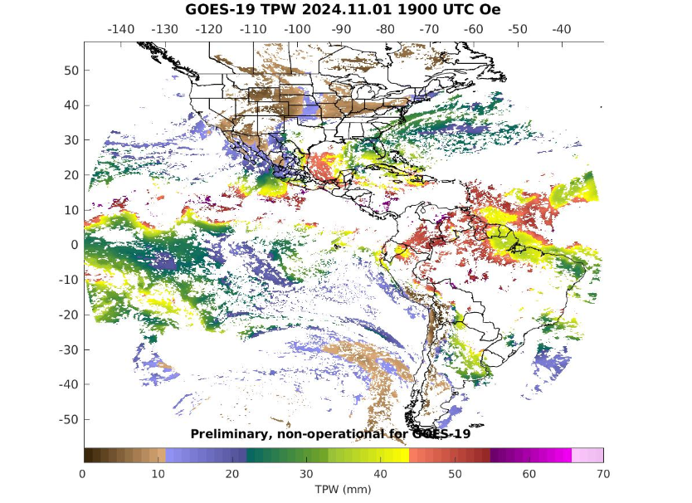
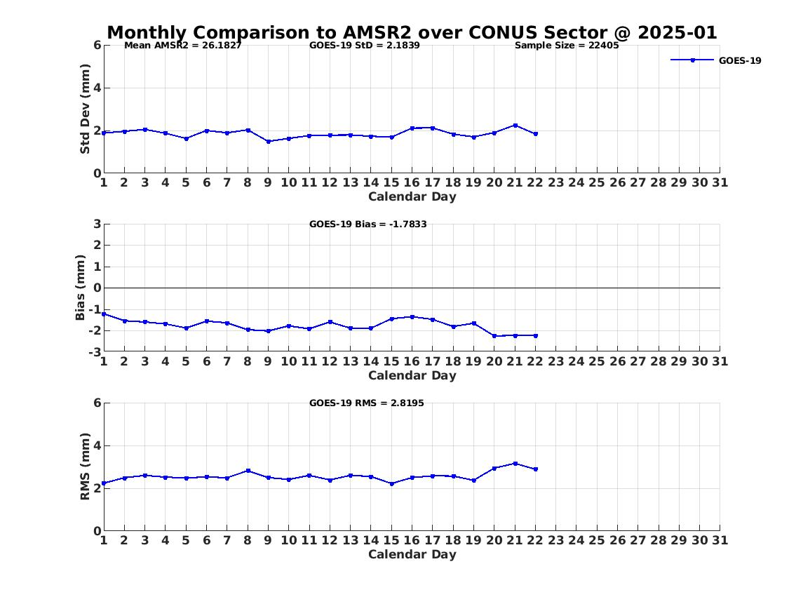
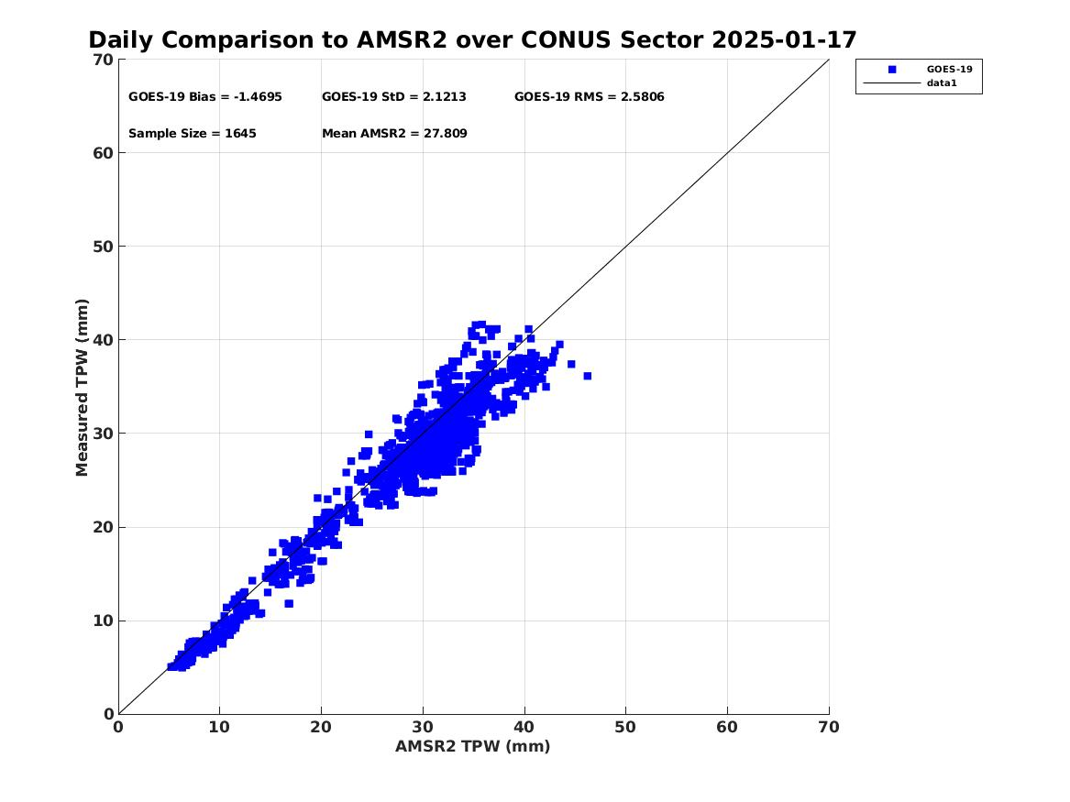
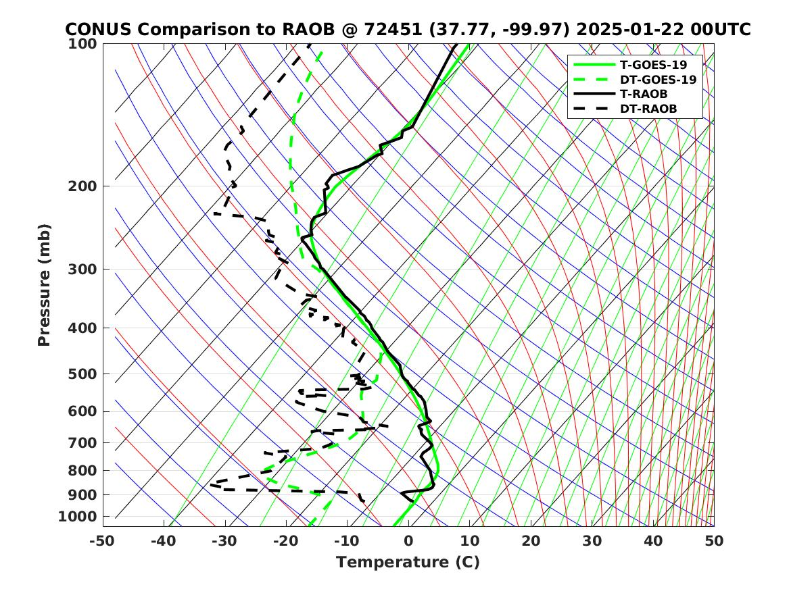
Real-time GOES-19 ABI LAP product validation webpage soundingval.ssec.wisc.edu
Imagery (Fulldisk TPW)
Regional TPW Plots with AMRS-2
Station TPW Plots

Slide 14
Examples of Visual Inspection of All Domains
14

Slide 15
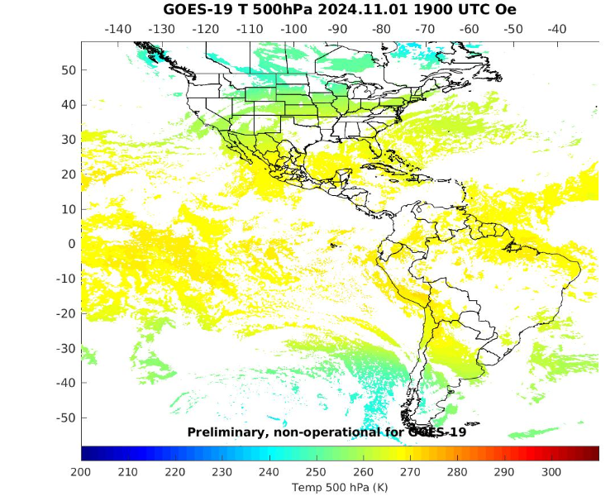
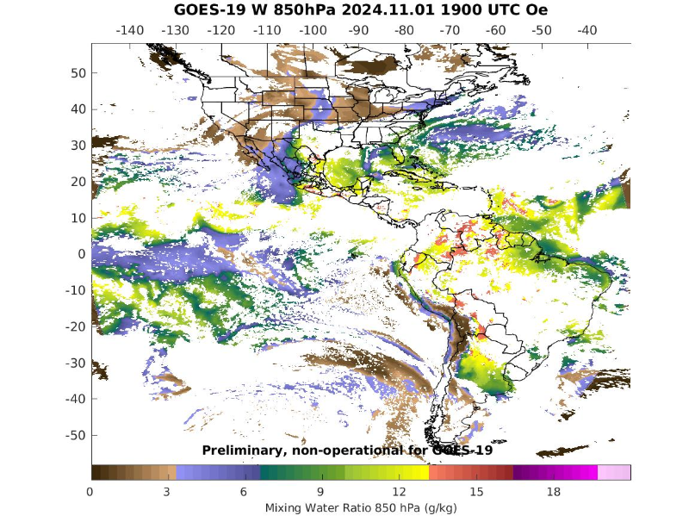
PLPT ABI-FD-TPW, LVT, LVM:
November 01 2024, 1900 UTC
TPW (mm)
Temp (K). 500 hPa
WV (g/kg) 850 hPa
TPW: Total Precipitable Water
LVT: Legacy Vertical Temperature profile
LVM: Legacy Vertical Moisture profile
15

Slide 16
PLPT ABI-FD-DSI:
November 01 2024, 1900 UTC
LI
CAPE
TT
KI
SI
LI: Lifted Index
CAPE: Convective Available Potential Energy
TT: Total Totals
KI: K-Index
SI: Showalter Index
16

Slide 17
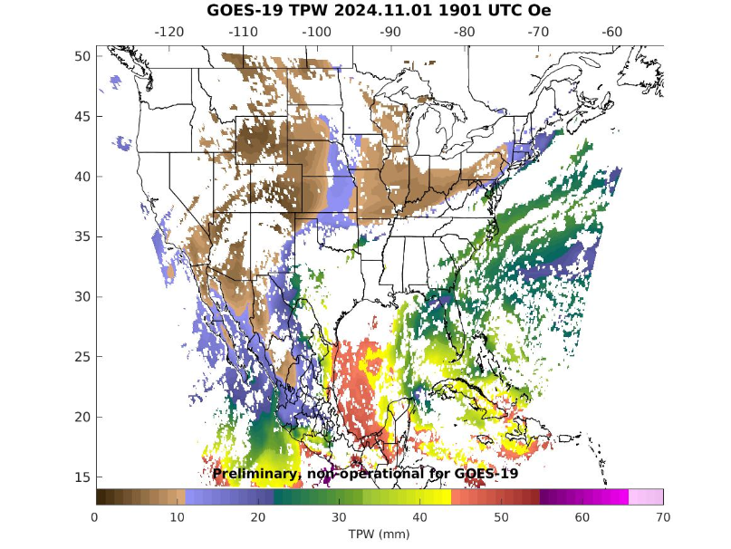
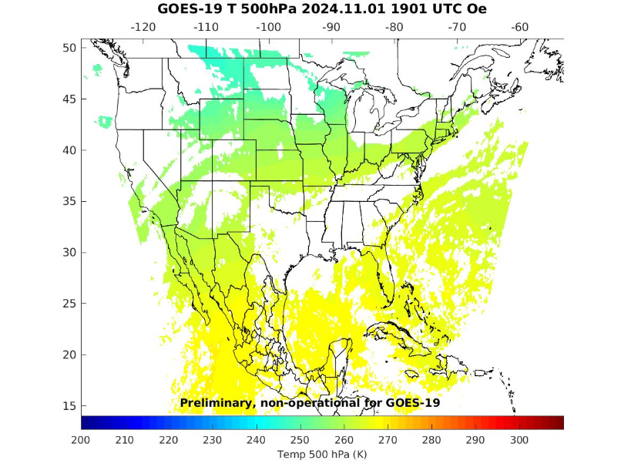
PLPT ABI-CONUS-TPW, LVT, LVM:
November 01 2024, 1901 UTC
TPW (mm)
Temp (K). 500 hPa
WV (g/kg) 850 hPa
TPW: Total Precipitable Water
LVT: Legacy Vertical Temperature profile
LVM: Legacy Vertical Moisture profile
17

Slide 18
PLPT ABI-CONUS-DSI:
November 01 2024, 1901 UTC
LI
CAPE
TT
KI
SI
LI: Lifted Index
CAPE: Convective Available Potential Energy
TT: Total Totals
KI: K-Index
SI: Showalter Index
18

Slide 19
Comparison of TPW with the RAOB, AMSR2
19

Slide 20
Requirements for ABI LAP product: TPW
Product |  | Accuracy | Precision | Range
Temperature |  | 1 K below 400 hPa and above boundary layer | 2 K below 400 hPa and above boundary layer | 180 - 320 K
Moisture |  | Sfc - 300 hPa: 18% 300 - 100 hPa: 20% | Sfc - 300 hPa: 18% 300 - 100 hPa: 20% | 0 - 100%
TPW |  | 1 mm | 3 mm | 0 - 100 mm
DSI | LI | 2.0 K | 6.5 K | -10 ~ 40 K or above
 | CAPE | 1000 J/kg | 2500 J/kg | 0 - 5000 J/kg
 | SI | 2.0 K | 6.5 K | -10 ~ 4 K or above
 | TT | 1 K | 4 K | -43 ~ 56 K
 | KI | 2 K | 6.5 K | 0 - 40 K
20

Slide 21
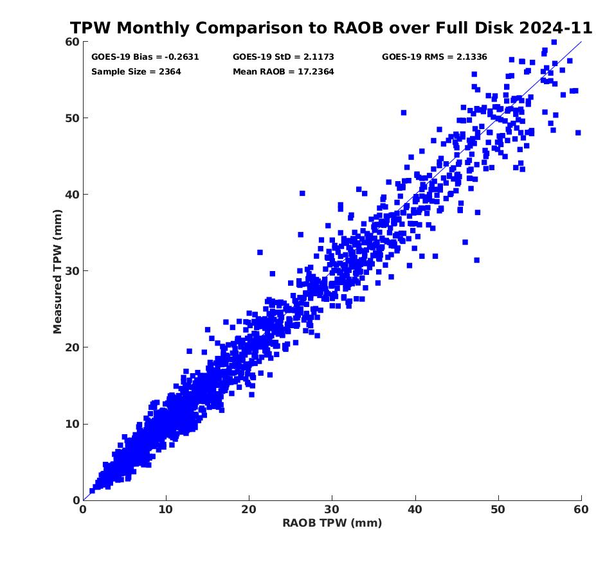
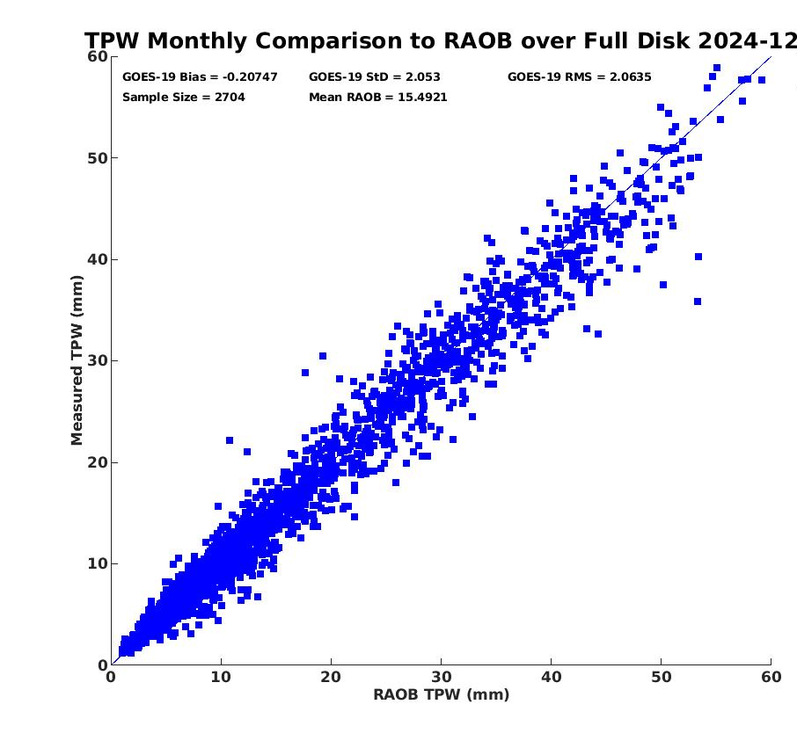
PLPT ABI-FD-TPW vs RAOB:
2024. 11 ~ 2024. 12
Accuracy spec: 1 mm
Precision spec: 3 mm
number: 2364
bias: -0.26 mm
std: 2.12 mm
number: 2704
bias: -0.21 mm
std: 2.05 mm
PASSED
21

Slide 22
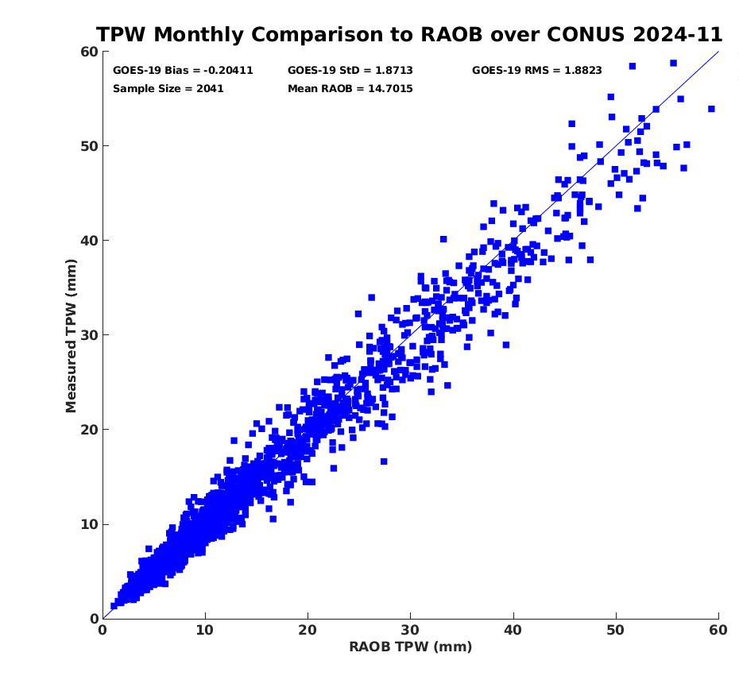
PLPT ABI-CONUS-TPW vs RAOB:
2024. 11 ~ 2024. 12
Accuracy spec: 1 mm
Precision spec: 3 mm
number: 2041
bias: -0.20 mm
std: 1.87 mm
number: 2230
bias: -0.12 mm
std: 1.75 mm
PASSED
22

Slide 23
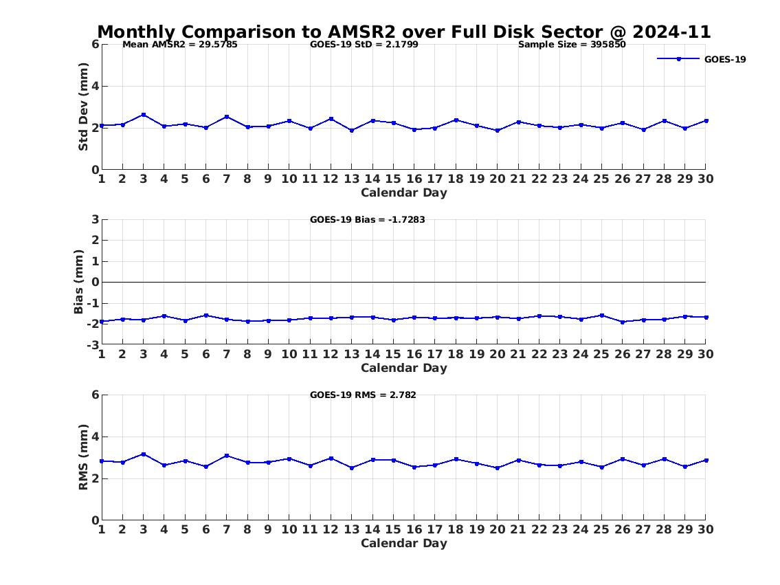
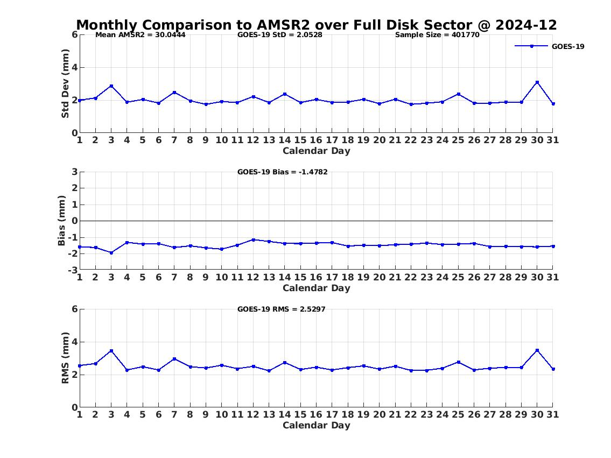
PLPT ABI-FD-TPW vs AMSR2:
2024. 11 ~ 2024. 12
Accuracy spec: 1 mm
Precision spec: 3 mm
number: 395850
bias: -1.73 mm
std: 2.12 mm
Large negative biases likely due to wet bias of AMSR2 in 202411 and 202412
Similar large negative biases from GOES-16 and 18
No such degradation from previous months from GOES-16/18
No such degradation from the comparisons with RAOB from GOES-16/18/19
number: 401770
bias: -1.49 mm
std: 2.05 mm
PASSED
23

Slide 24
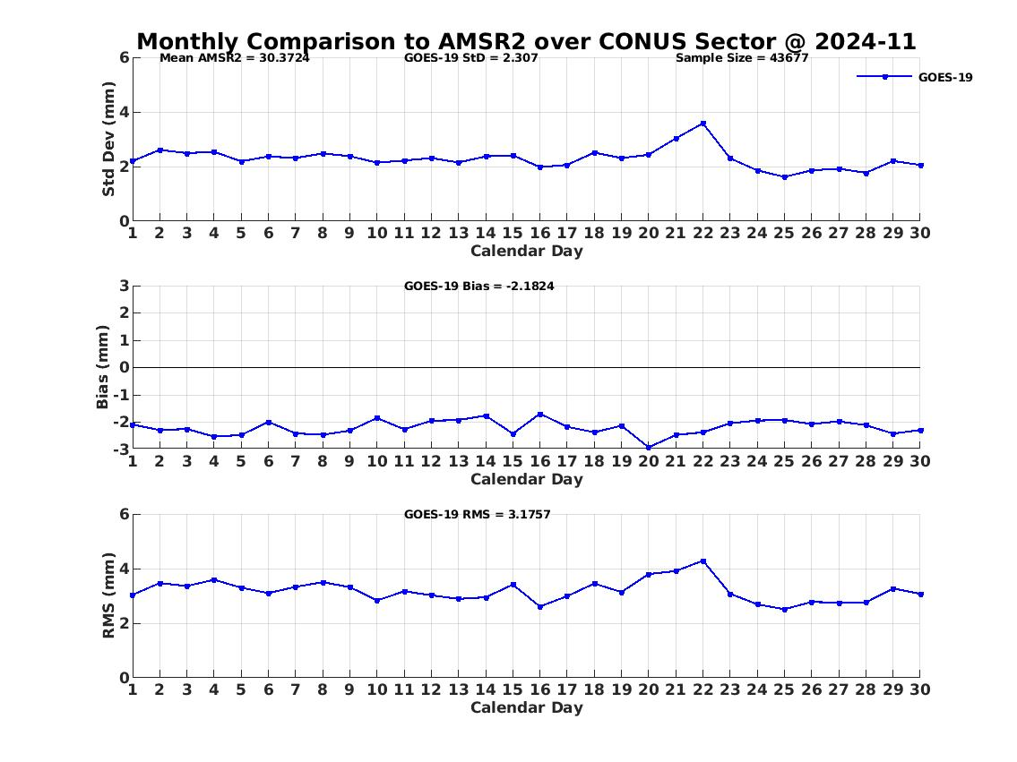
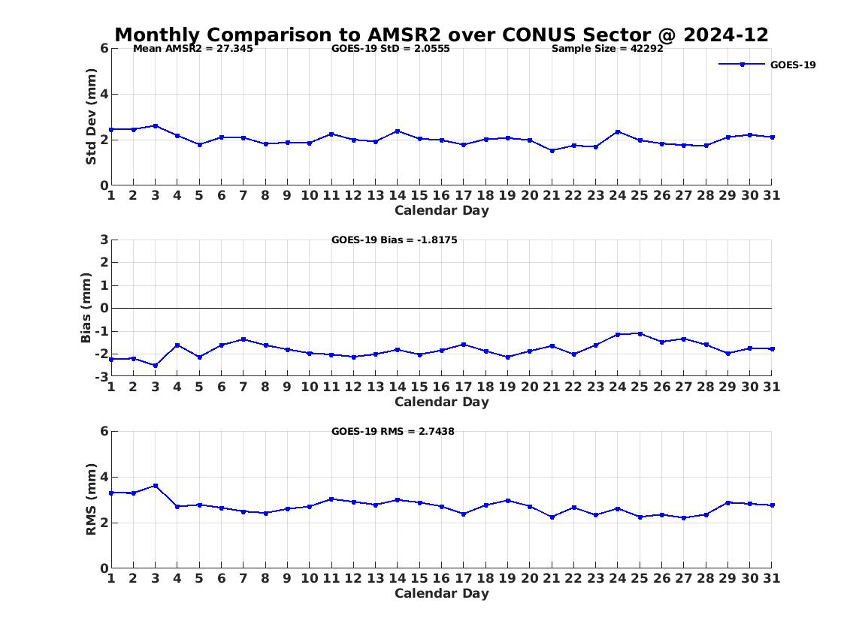
PLPT ABI-CONUS-TPW vs AMSR2:
2024. 11 ~ 2024. 12
Accuracy spec: 1 mm
Precision spec: 3 mm
number: 43677
bias: -2.18 mm
std: 2.31 mm
Large negative biases likely due to wet bias of AMSR2 in 202411 and 202412
Similar large negative biases from GOES-16 and 18
No such degradation from previous months from GOES-16/18
No such degradation from the comparisons with RAOB from GOES-16/18/19
number: 42292
bias: -1.82 mm
std: 2.06 mm
PASSED
24

Slide 25
TPW Performance Summary
TPW retrieval is working as expected on GOES-19 ABI data when combined with NWP short-range forecasts (as first guess);
With a quantitative web-based tool (http://soundingval.ssec.wisc.edu) and the comparisons with RAOB overall it does indicate performances meet spec. for all the coverages (FD, CONUS, Meso1, and Meso2),
The bias of the comparisons with AMSR-2 is a little comparatively large, likely due to wet bias from AMSR-2

Slide 26
Comparison of LVT & LVM with the RAOB
26

Slide 27
Requirements for ABI LAP products: LVT, LVM
Product |  | Accuracy | Precision | Range
Temperature (LVT) |  | 1 K below 400 hPa and above boundary layer | 2 K below 400 hPa and above boundary layer | 180 - 320 K
Moisture (LVM) |  | Sfc - 300 hPa: 18% 300 - 100 hPa: 20% | Sfc - 300 hPa: 18% 300 - 100 hPa: 20% | 0 - 100%
TPW |  | 1 mm | 3 mm | 0 - 100 mm
DSI | LI | 2.0 K | 6.5 K | -10 ~ 40 K or above
 | CAPE | 1000 J/kg | 2500 J/kg | 0 - 5000 J/kg
 | SI | 2.0 K | 6.5 K | -10 ~ 4 K or above
 | TT | 1 K | 4 K | -43 ~ 56 K
 | KI | 2 K | 6.5 K | 0 - 40 K
27

Slide 28
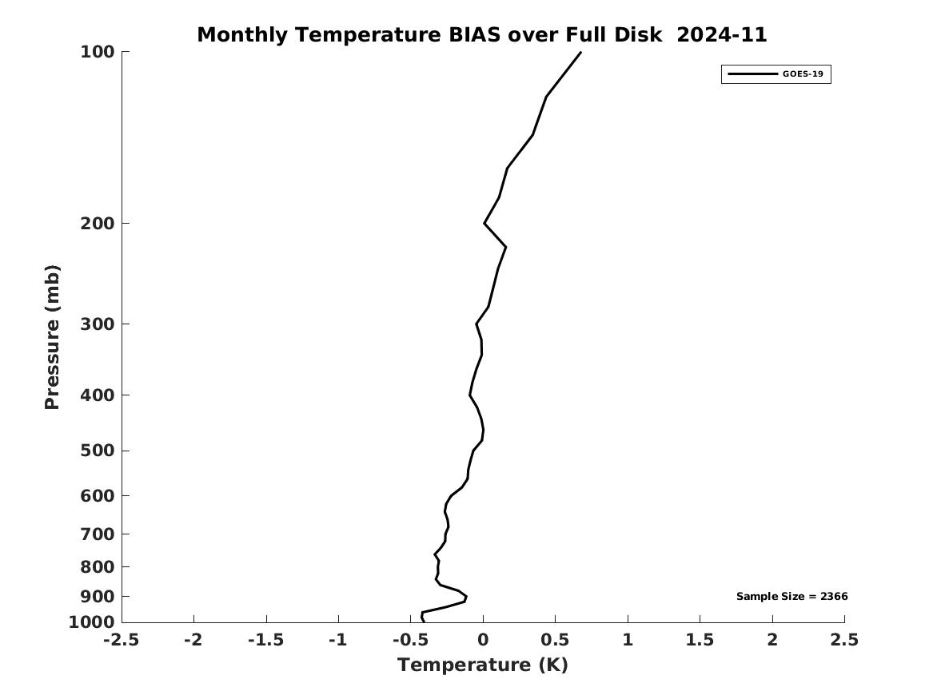
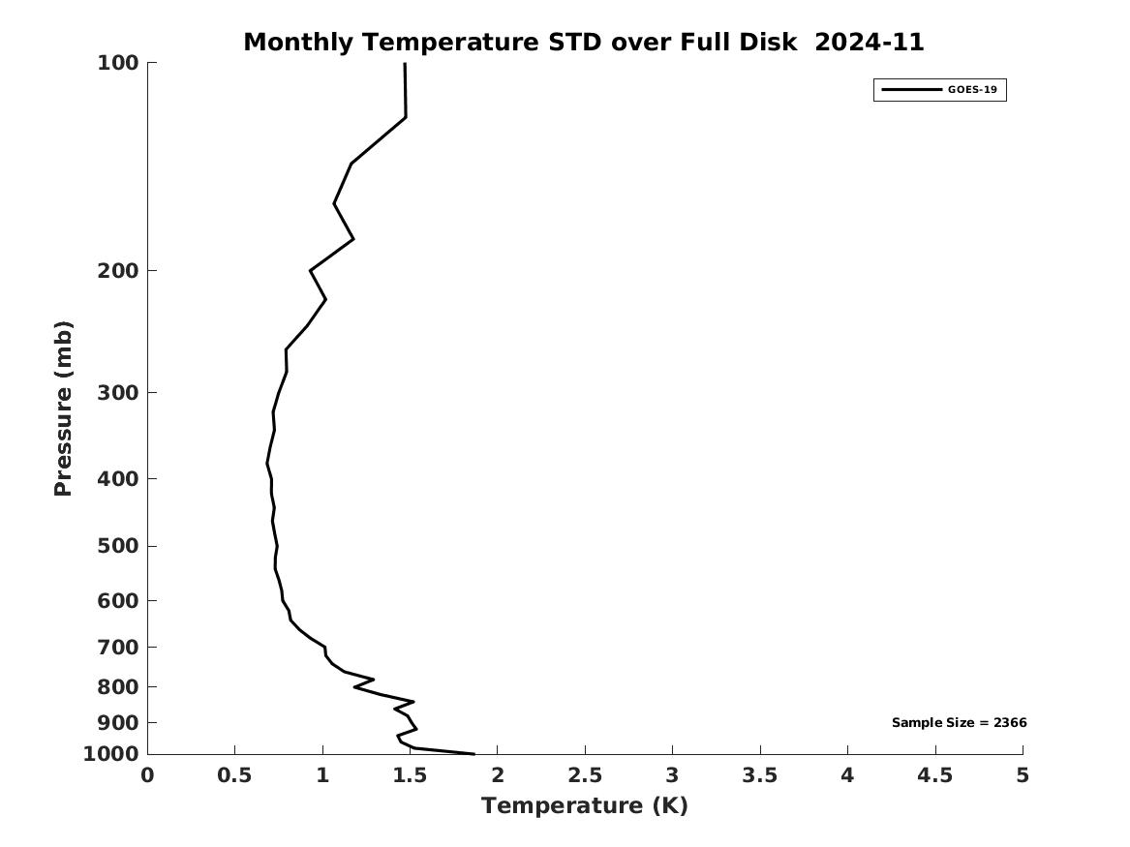
PLPT ABI-LVT, LVM (vs RAOB):
November 2024
Full Disk Temp BIAS
Full Disk Temp STD
LVT (K)
Accuracy spec:
1 K (BL-400hPa)
Precision spec:
2 K (BL-400hPa)
CONUS Temp BIAS
CONUS Temp STD
PASSED
28
Notes:
Full disk has large STD possibly due to lower RAOB quality from non-USA countries. MESO might not have enough samples for statistics.

Slide 29
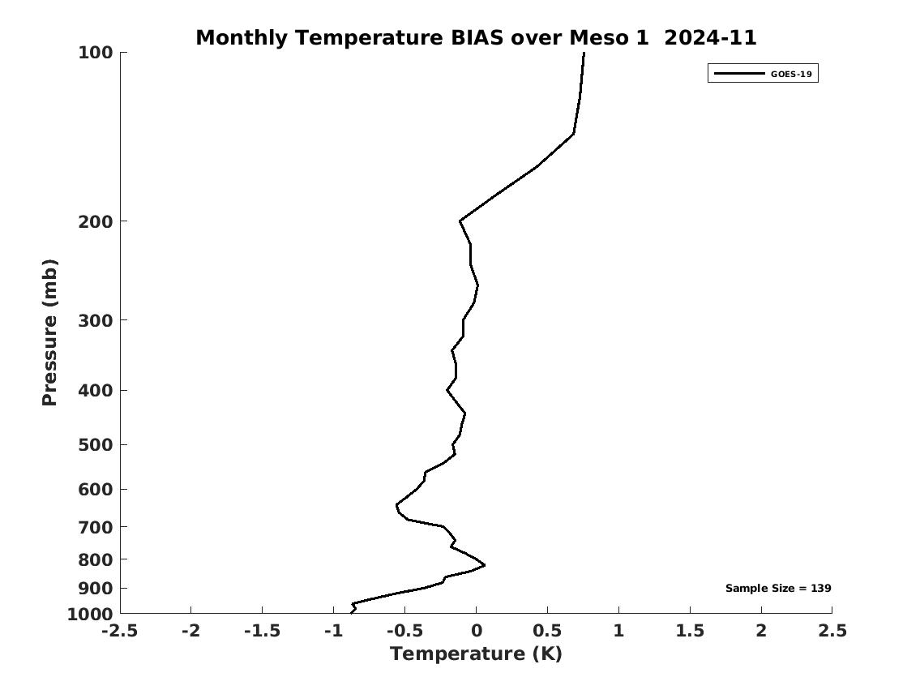
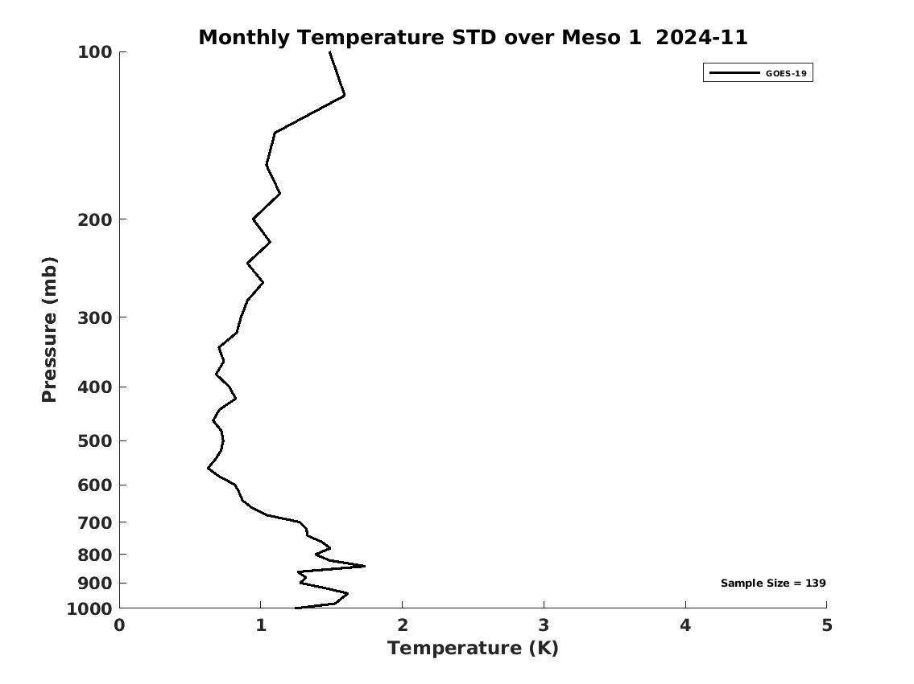
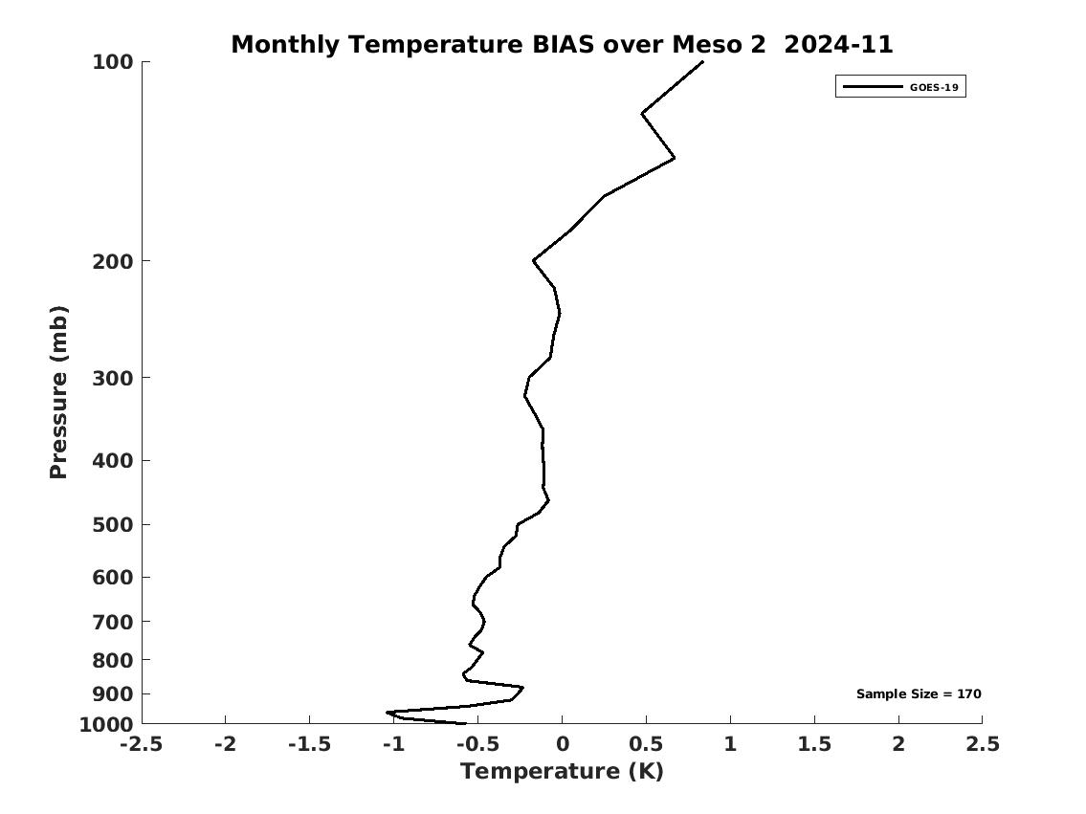
PLPT ABI-LVT, LVM (vs RAOB):
November 2024
MESO1 Temp BIAS
MESO1 Temp STD
LVT (K)
Accuracy spec:
1 K (BL-400hPa)
Precision spec:
2 K (BL-400hPa)
MESO2 Temp BIAS
MESO2 Temp STD
PASSED
29
Notes:
Full disk has large STD possibly due to lower RAOB quality from non-USA countries. MESO might not have enough samples for statistics.

Slide 30
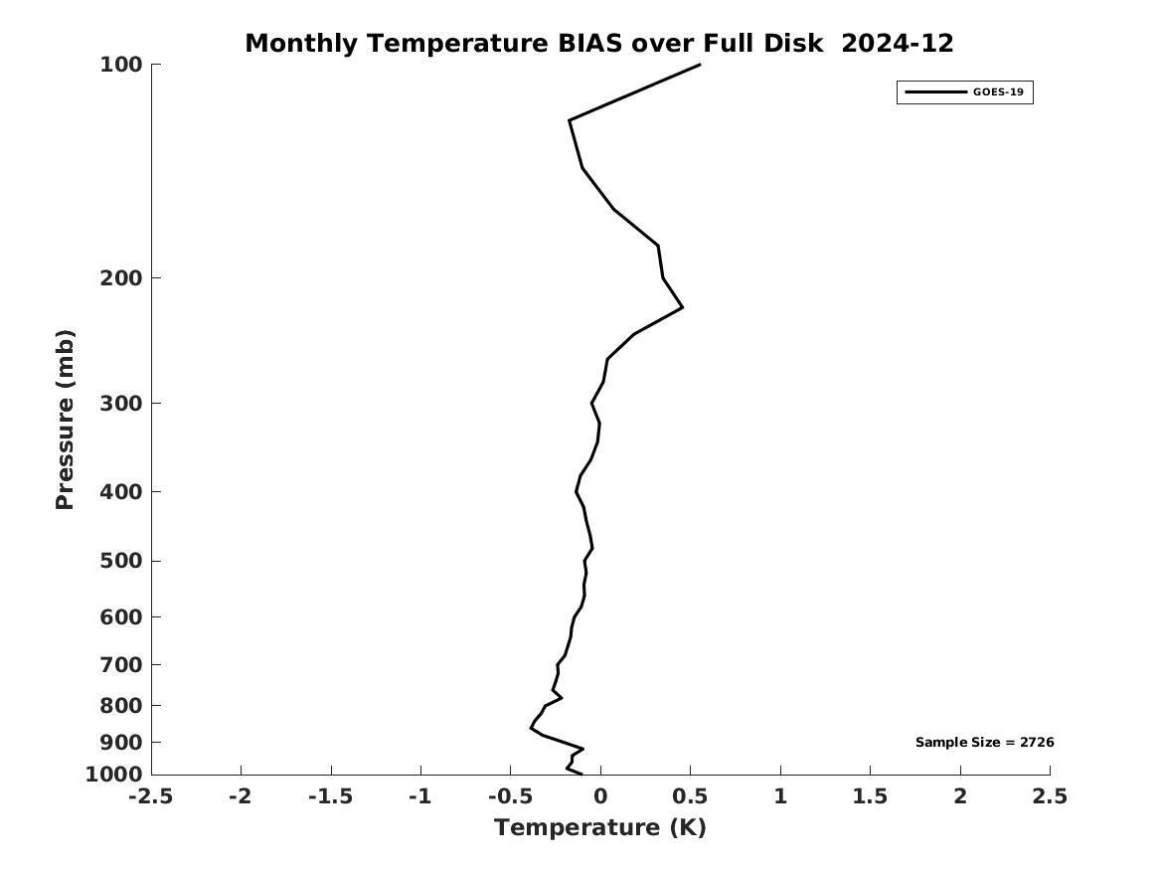
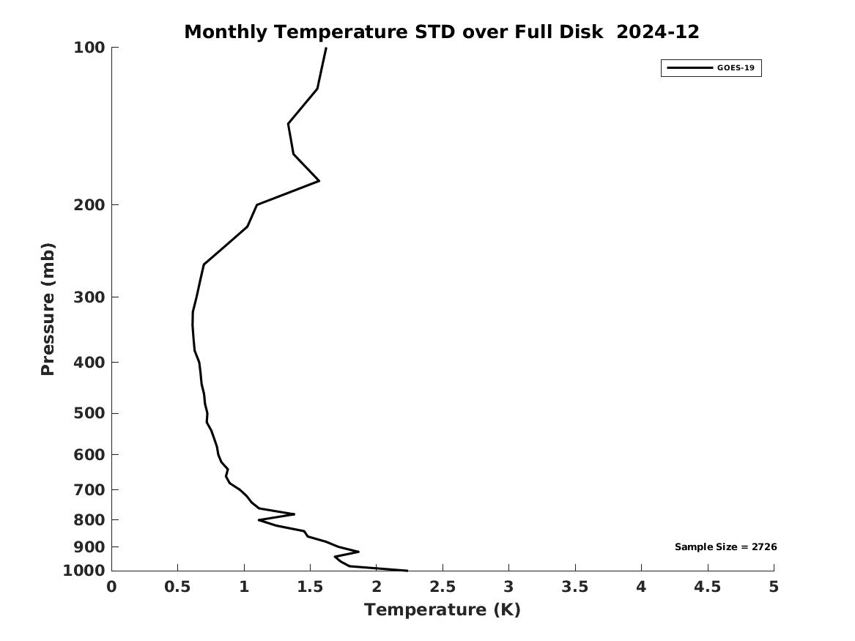
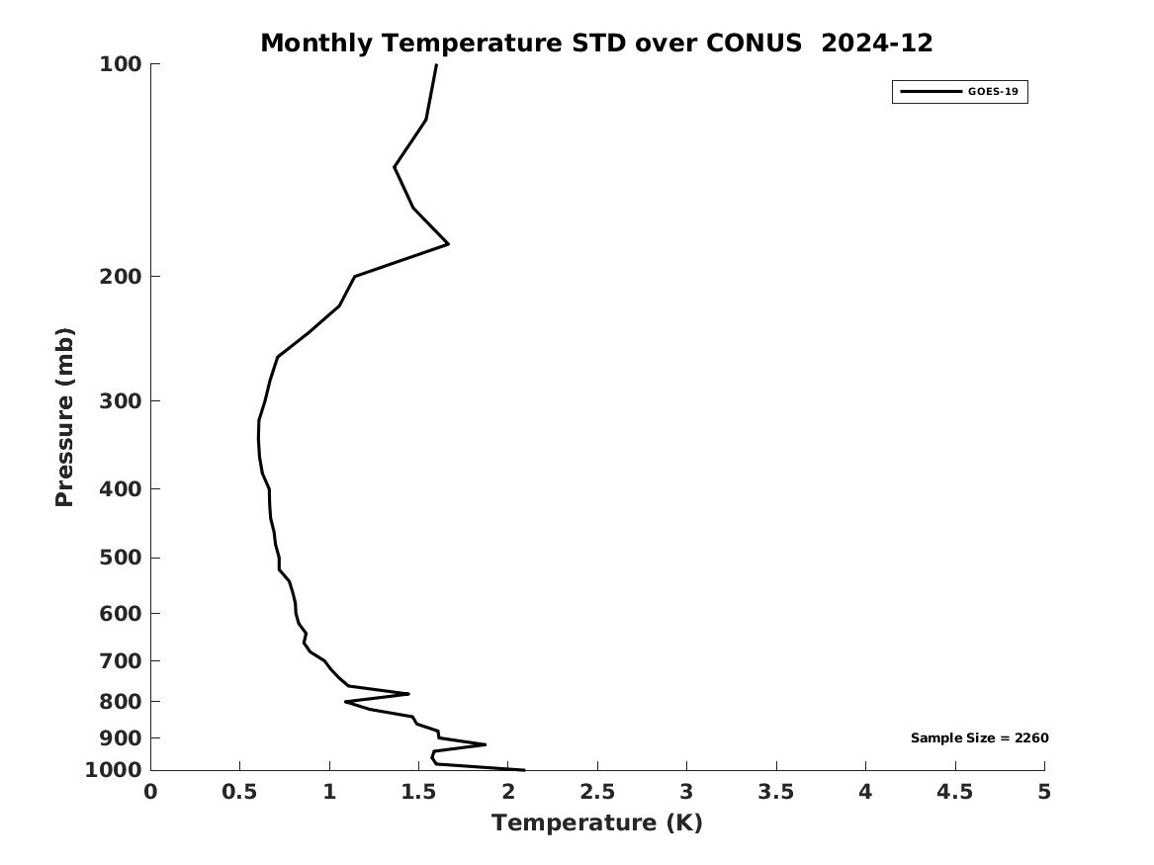
PLPT ABI-LVT, LVM (vs RAOB):
December 2024
Full Disk Temp BIAS
Full Disk Temp STD
LVT (K)
Accuracy spec:
1 K (BL-400hPa)
Precision spec:
2 K (BL-400hPa)
CONUS Temp BIAS
CONUS Temp STD
PASSED
30
Notes:
Full disk has large STD possibly due to lower RAOB quality from non-USA countries. MESO might not have enough samples for statistics.

Slide 31
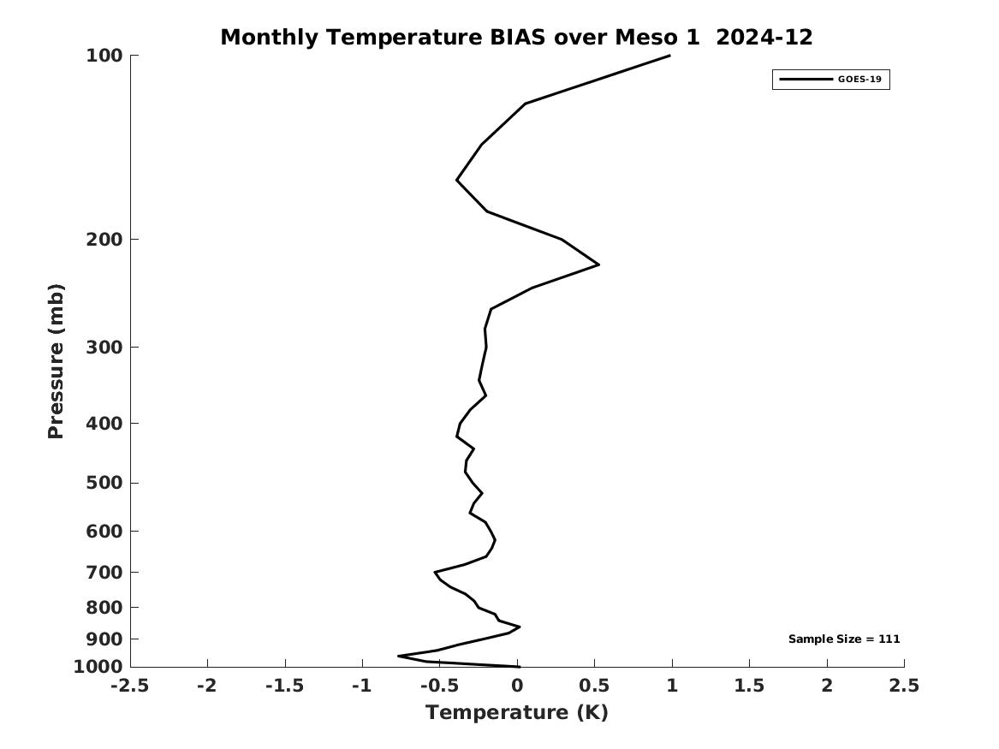
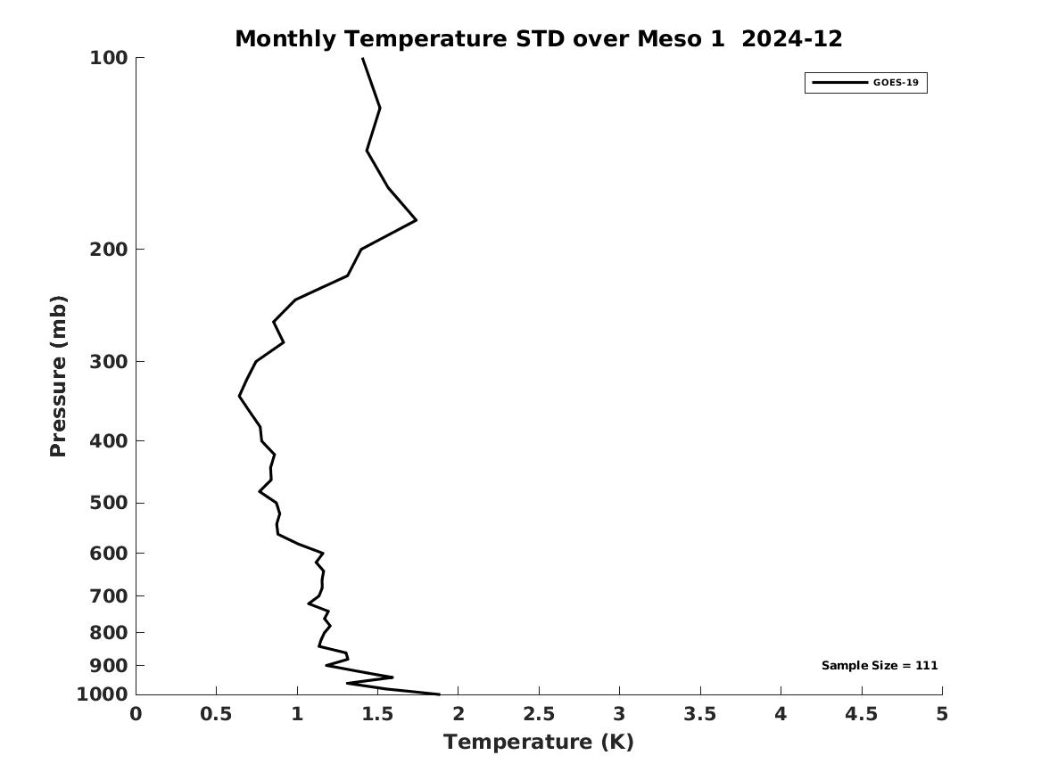
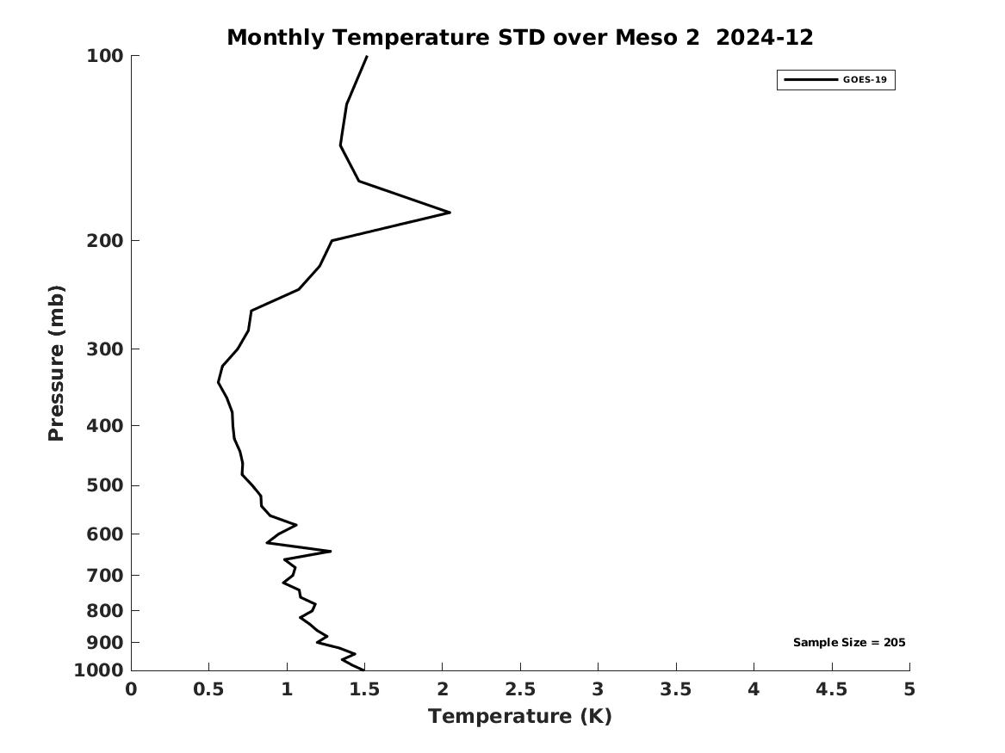
PLPT ABI-LVT, LVM (vs RAOB):
December 2024
MESO1 Temp BIAS
MESO1 Temp STD
LVT (K)
Accuracy spec:
1 K (BL-400hPa)
Precision spec:
2 K (BL-400hPa)
MESO2 Temp BIAS
MESO2 Temp STD
PASSED
31
Notes:
Full disk has large STD possibly due to lower RAOB quality from non-USA countries. MESO might not have enough samples for statistics.

Slide 32
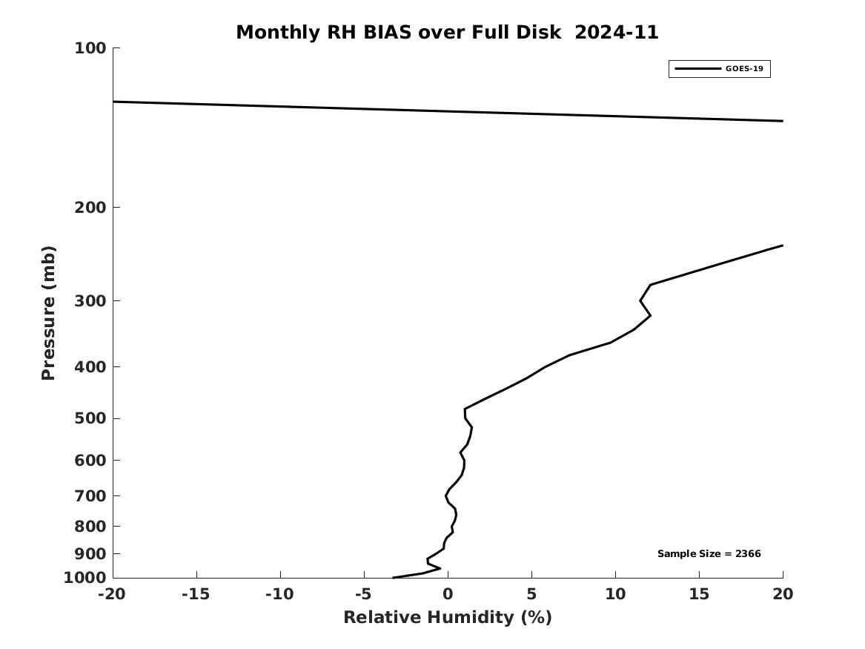
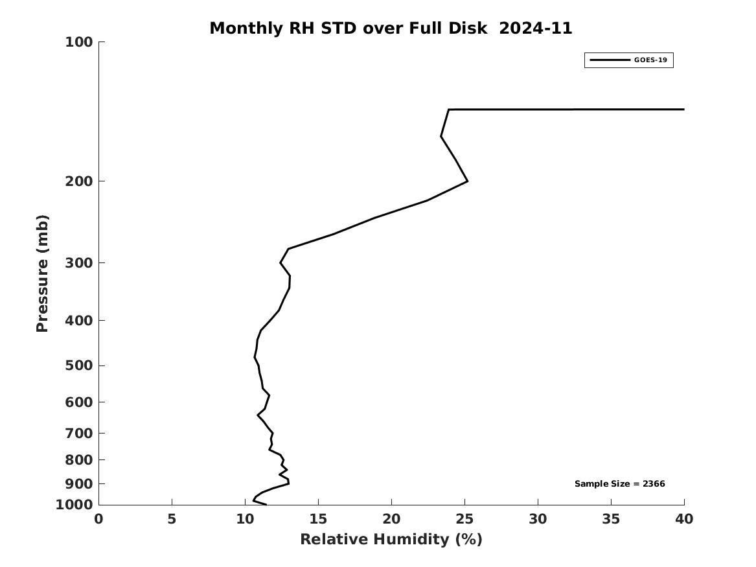
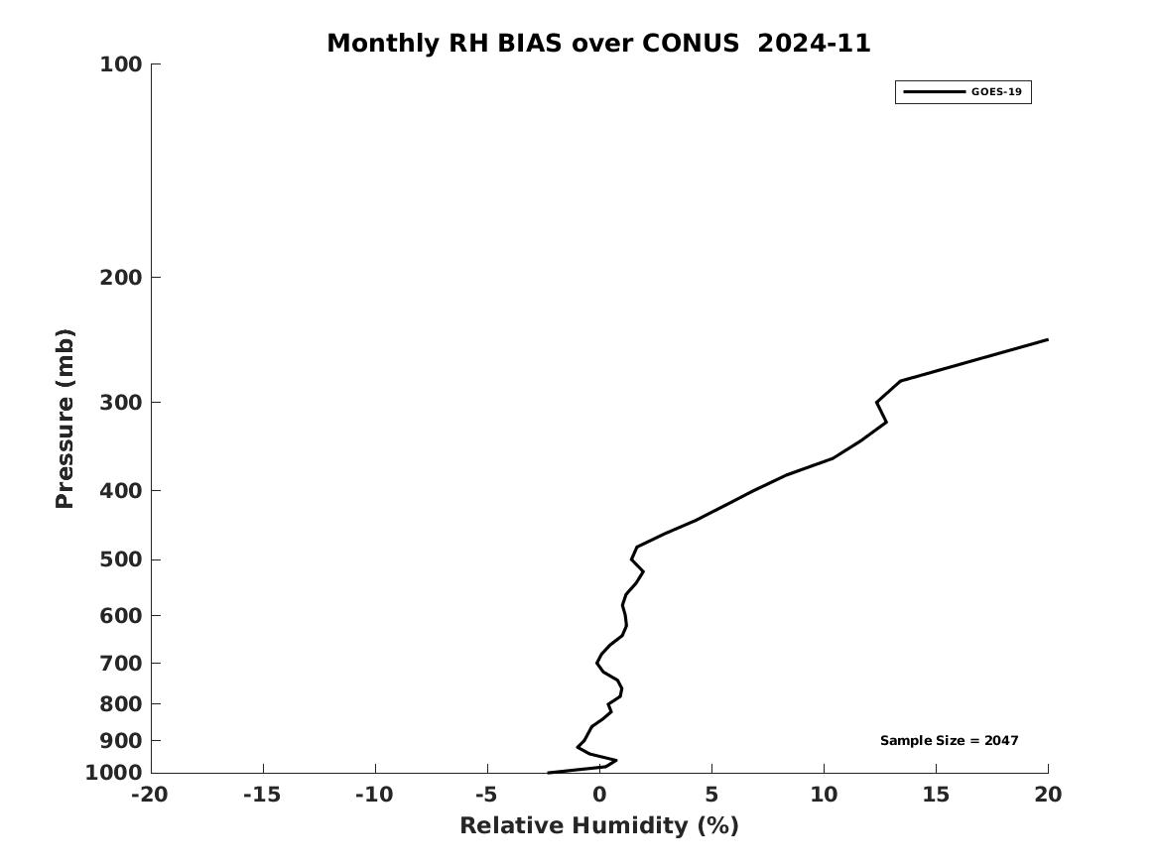
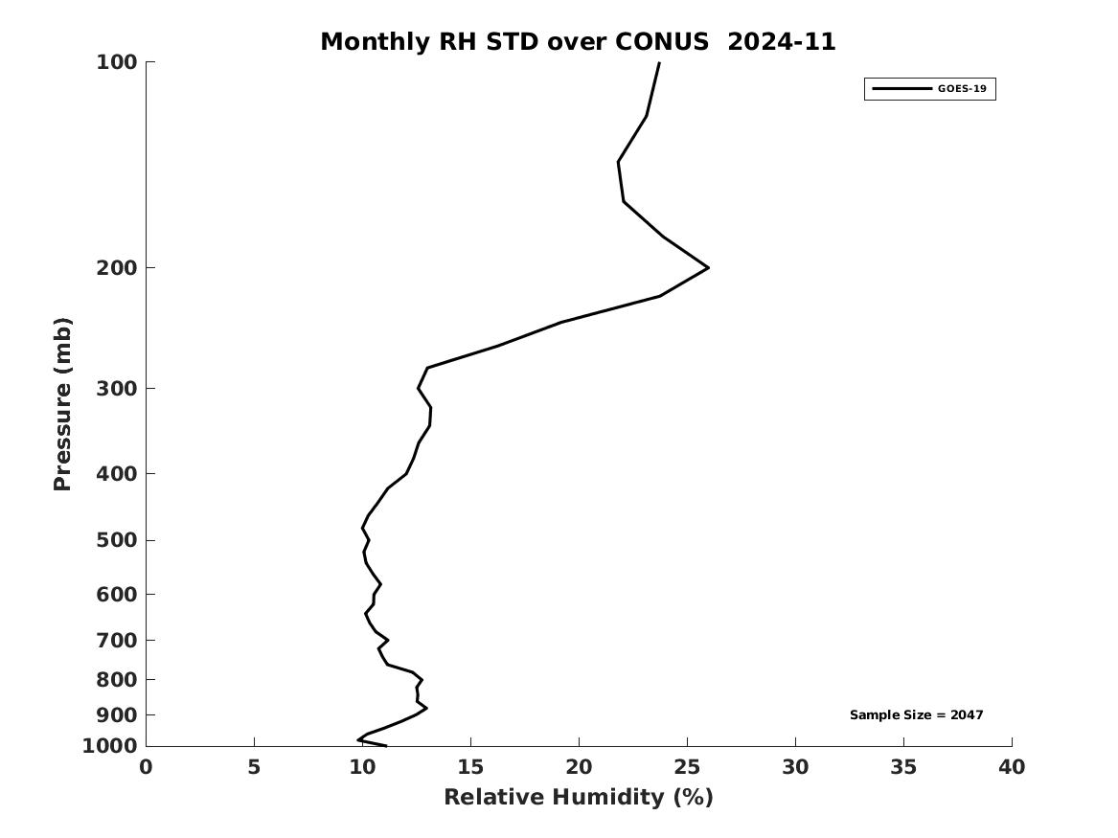
PLPT ABI-LVT, LVM (vs RAOB):
November 2024
Full Disk RH BIAS
Full Disk RH STD
LVM (%)
Accuracy & Precision spec:
18% (sfc-300hPa), 20% (300-100hPa)
CONUS RH BIAS
CONUS RH STD
Dry bias of RAOB in upper troposphere
limited moisture information in PBL and above 300hPa
PASSED
32
Notes:
Full disk has large STD possibly due to lower RAOB quality from non-USA countries. MESO might not have enough samples for statistics.

Slide 33
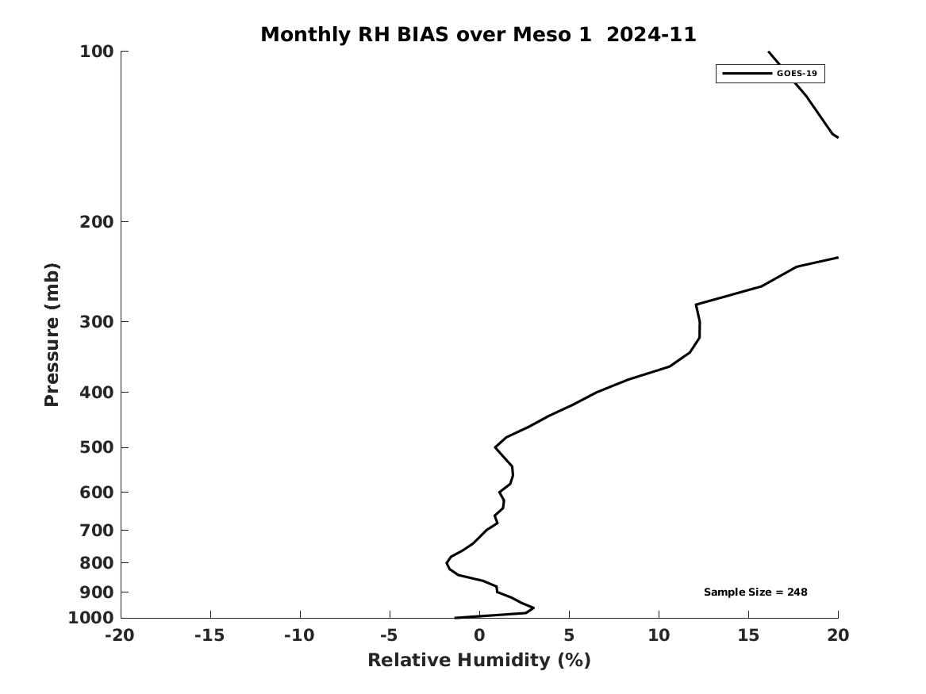
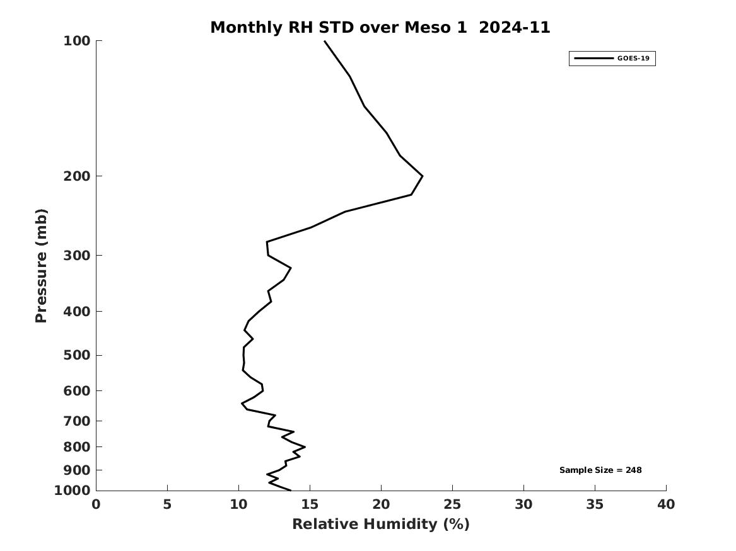
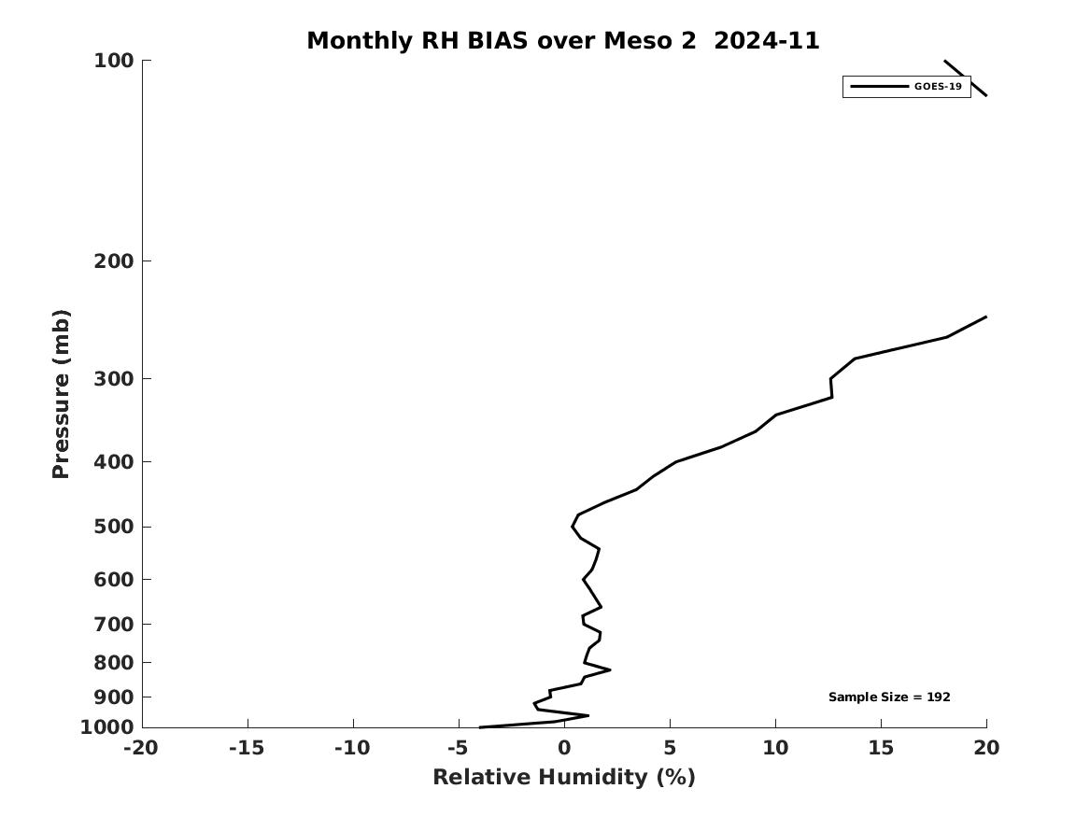
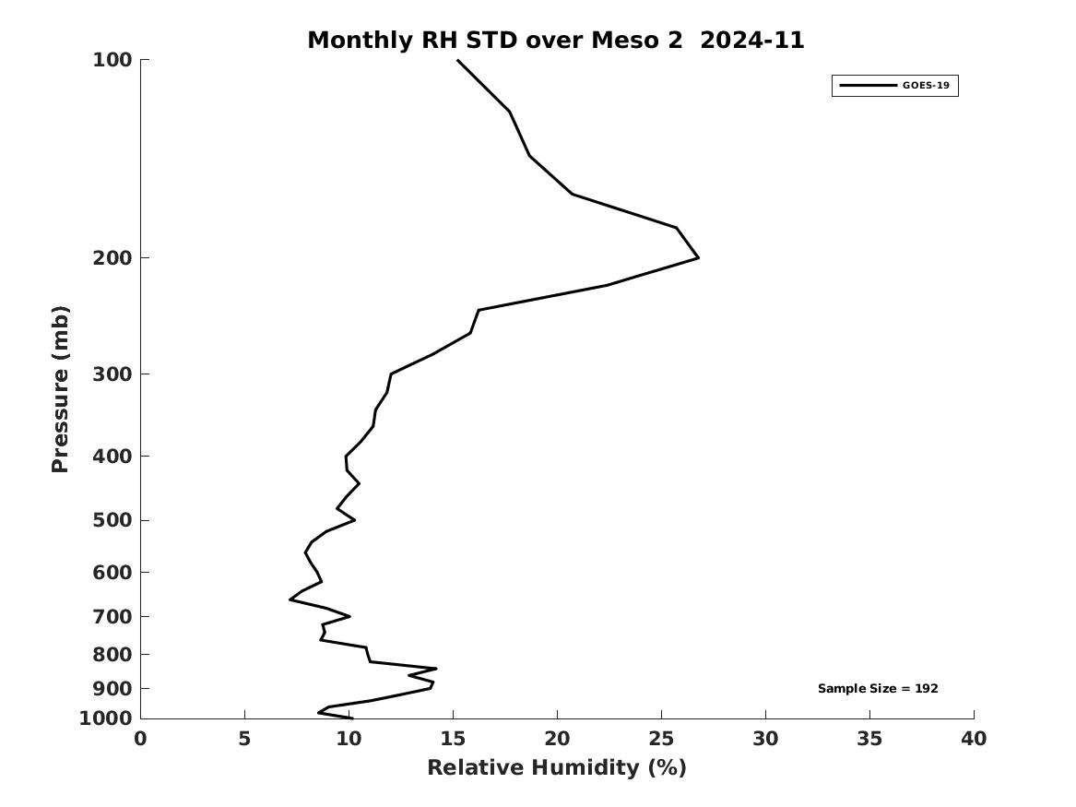
PLPT ABI-LVT, LVM (vs RAOB):
November 2024
MESO1 RH BIAS
MESO1 RH STD
LVM (%)
Accuracy & Precision spec:
18% (sfc-300hPa), 20% (300-100hPa)
MESO2 RH BIAS
MESO2 RH STD
Dry bias of RAOB in upper troposphere
limited moisture information in PBL and above 300hPa
PASSED
33
Notes:
Full disk has large STD possibly due to lower RAOB quality from non-USA countries. MESO might not have enough samples for statistics.

Slide 34
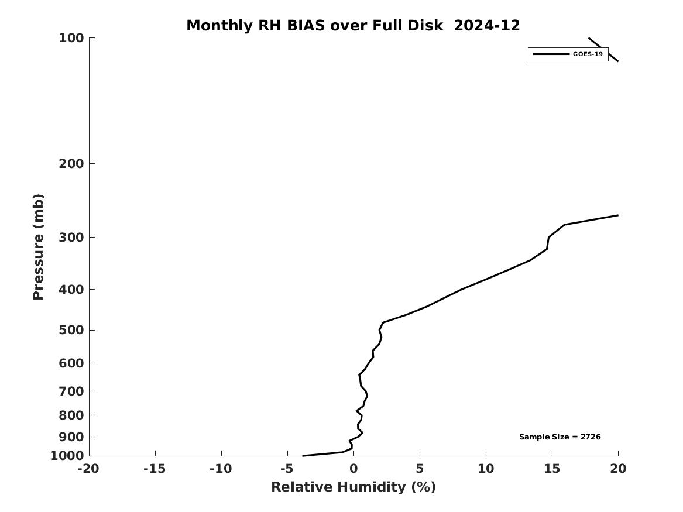
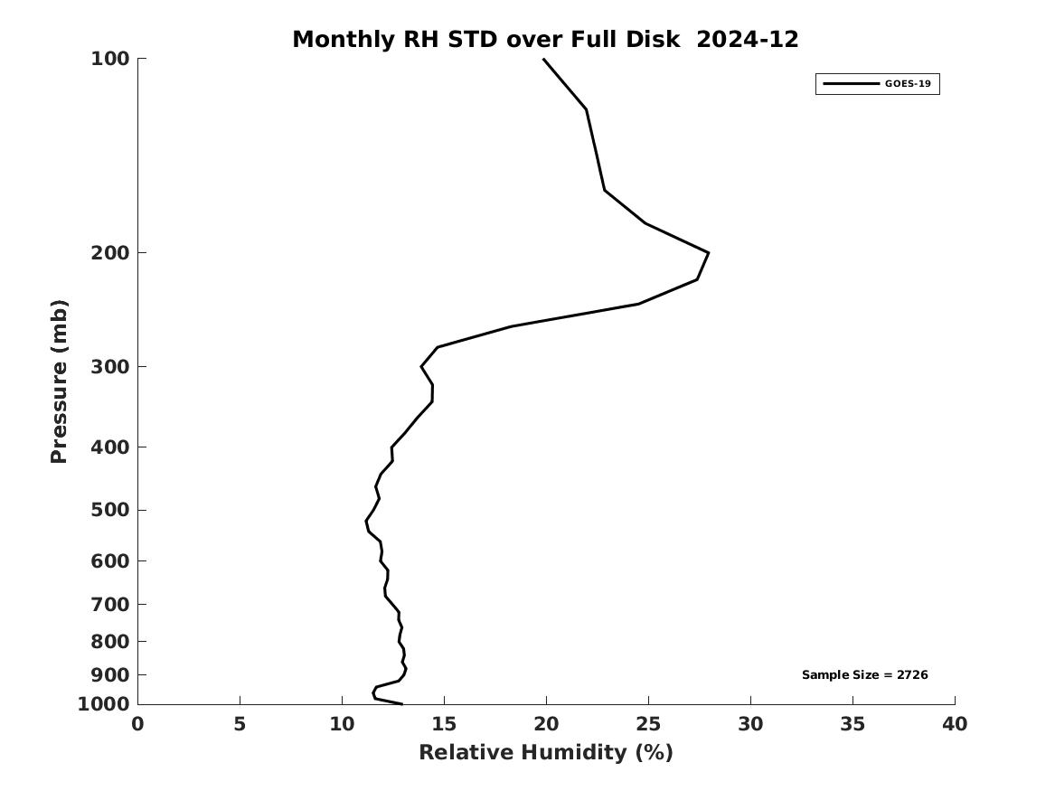
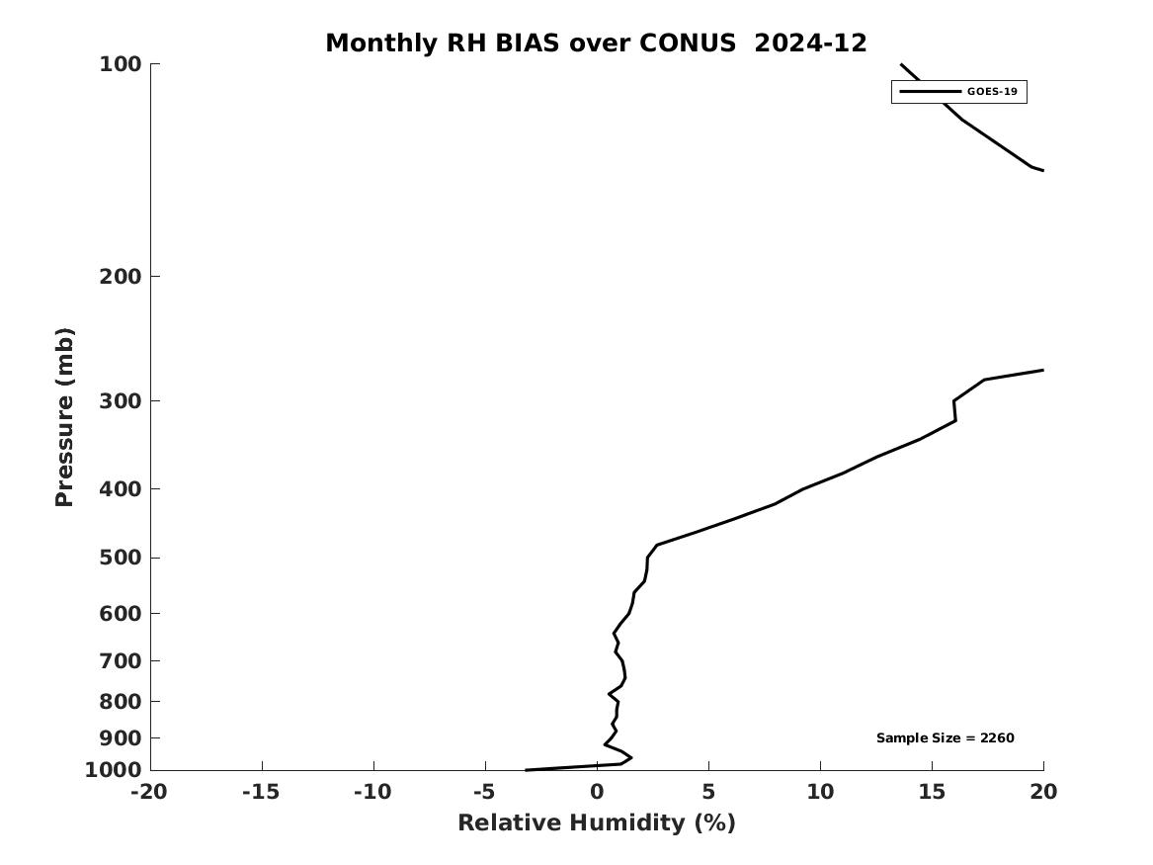
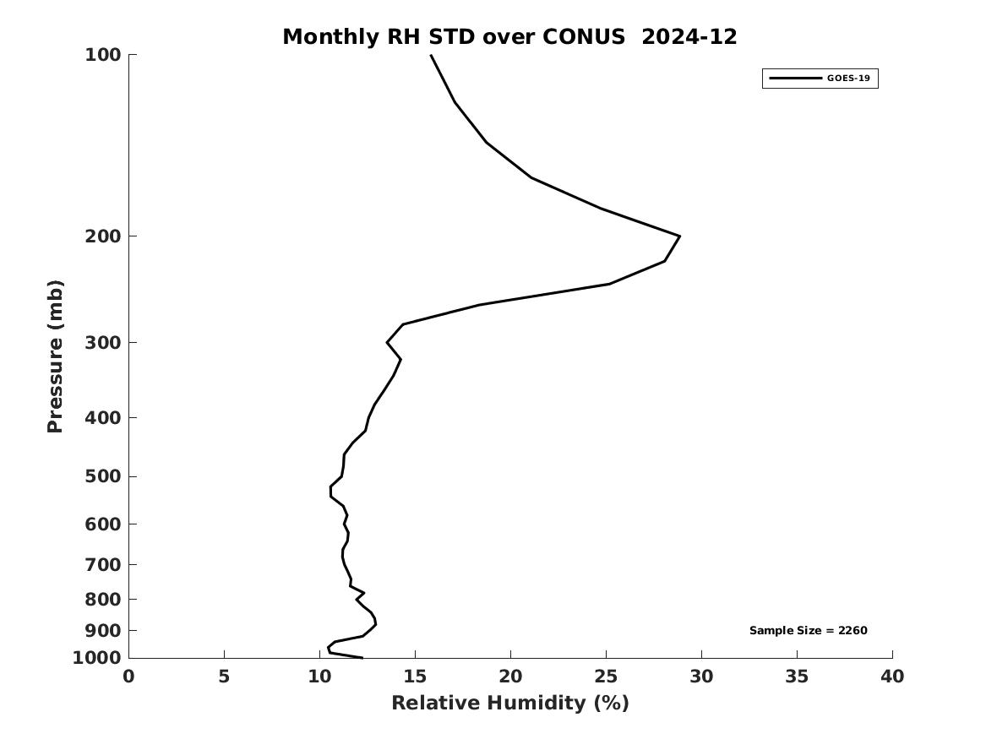
PLPT ABI-LVT, LVM (vs RAOB):
December 2024
Full Disk RH BIAS
Full Disk RH STD
LVM (%)
Accuracy & Precision spec:
18% (sfc-300hPa), 20% (300-100hPa)
CONUS RH BIAS
CONUS RH STD
Dry bias of RAOB in upper troposphere
limited moisture information in PBL and above 300hPa
PASSED
34
Notes:
Full disk has large STD possibly due to lower RAOB quality from non-USA countries. MESO might not have enough samples for statistics.

Slide 35
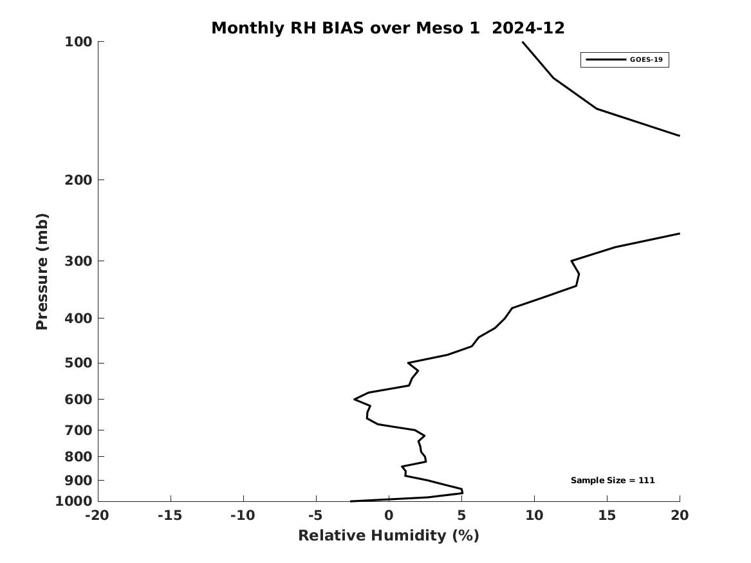
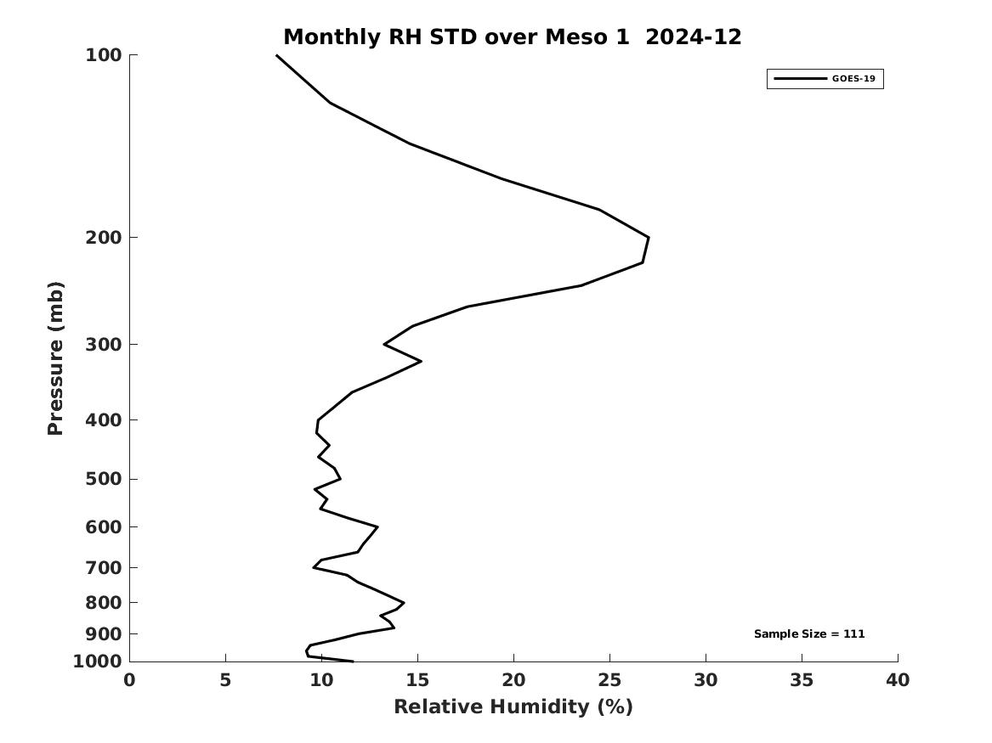
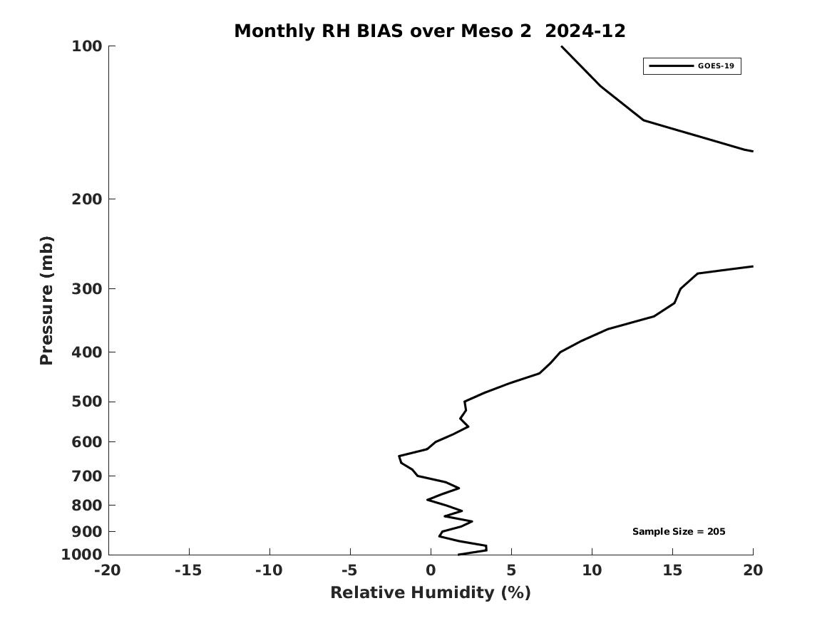
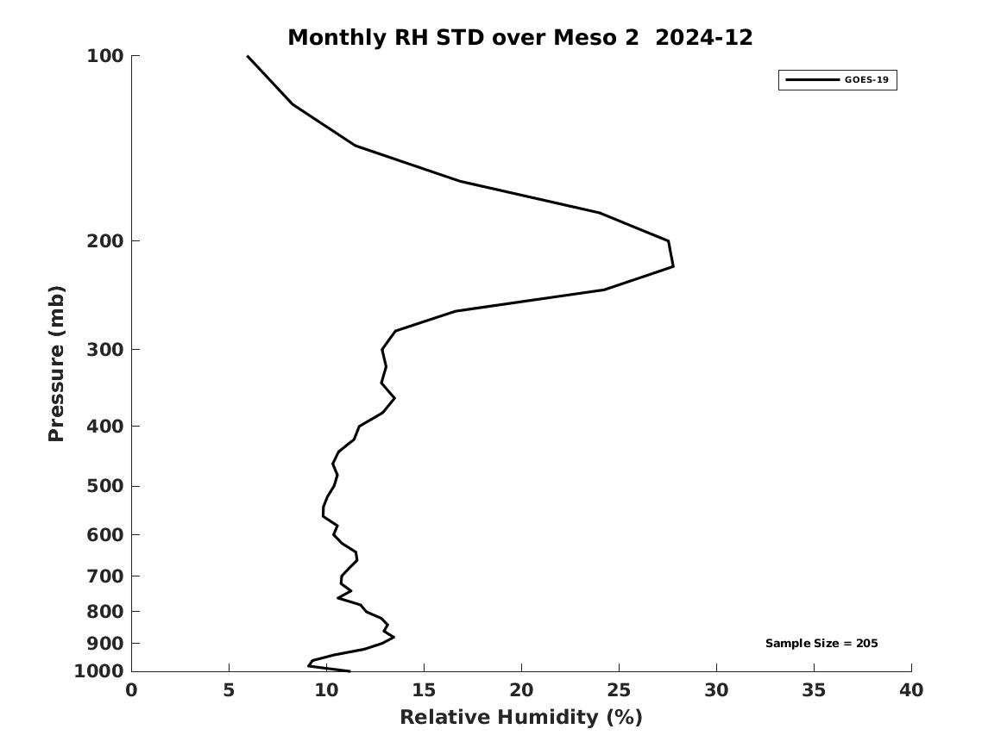
PLPT ABI-LVT, LVM (vs RAOB):
December 2024
MESO1 RH BIAS
MESO1 RH STD
LVM (%)
Accuracy & Precision spec:
18% (sfc-300hPa), 20% (300-100hPa)
MESO2 RH BIAS
MESO2 RH STD
Dry bias of RAOB in upper troposphere
limited moisture information in PBL and above 300hPa
PASSED
35
Notes:
Full disk has large STD possibly due to lower RAOB quality from non-USA countries. MESO might not have enough samples for statistics.

Slide 36
LVT and LVM Performance Summary
LVT and LVM retrievals are working as expected on GOES-19 ABI data when combined with NWP short-range forecasts (as first guess);
Retrievals are sensitive to first guess;
With a highly quantitative web-based tool (http://soundingval.ssec.wisc.edu) and the comparisons with RAOB, the performances overall meet spec. for all the coverages (FD, CONUS, Meso1, Meso2), except for the near surface temperature, and also for the Relative Humidity at upper troposphere (100 - 300 hPa) when compared with RAOB, which is likely due to the known issue of dry bias of radiosonde observations, possible lower quality from non-US RAOB, and reduced information content.
36

Slide 37
Comparison of DSI with the RAOB
37

Slide 38
Requirements for ABI LAP products: DSI
Product |  | Accuracy | Precision | Range
Temperature |  | 1 K below 400 hPa and above boundary layer | 2 K below 400 hPa and above boundary layer | 180 - 320 K
Moisture |  | Sfc - 300 hPa: 18% 300 - 100 hPa: 20% | Sfc - 300 hPa: 18% 300 - 100 hPa: 20% | 0 - 100%
TPW |  | 1 mm | 3 mm | 0 - 100 mm
DSI | LI | 2.0 K | 6.5 K | -10 ~ 40 K or above
 | CAPE | 1000 J/kg | 2500 J/kg | 0 - 5000 J/kg
 | SI | 2.0 K | 6.5 K | -10 ~ 4 K or above
 | TT | 1 K | 4 K | -43 ~ 56 K
 | KI | 2 K | 6.5 K | 0 - 40 K
38

Slide 39
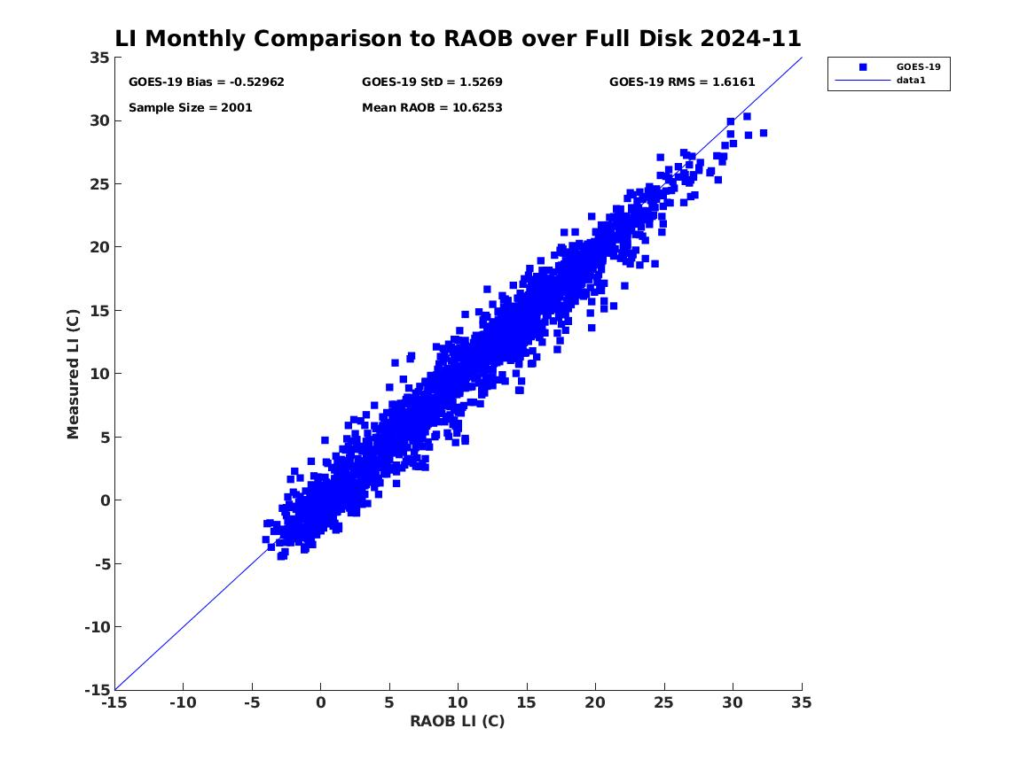
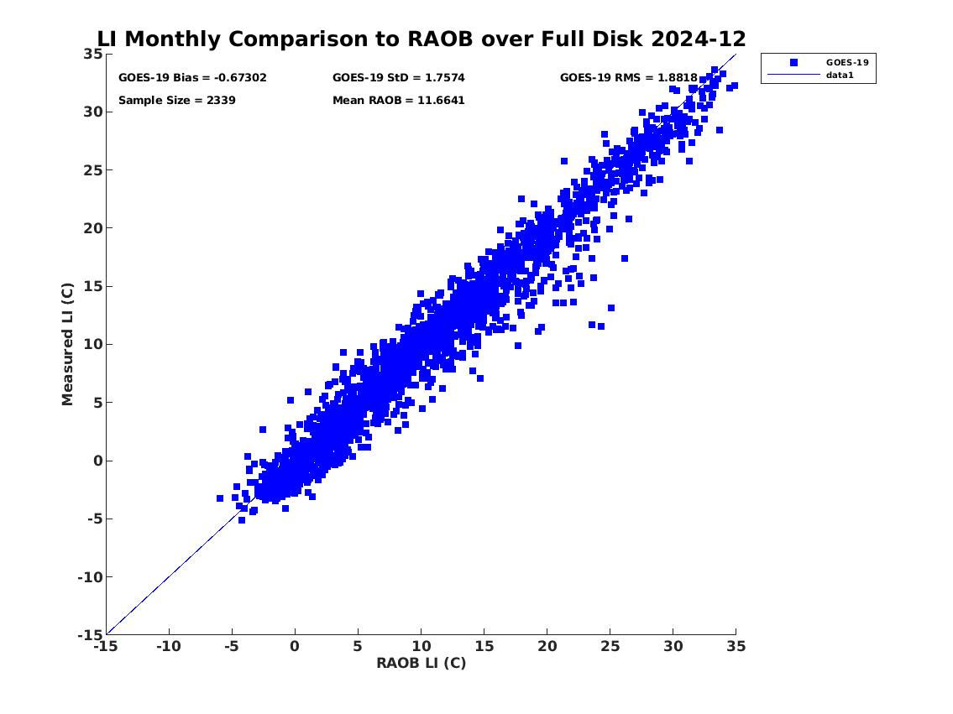
PLPT ABI-FD-DSI:
2024.11-2024.12
LI vs RAOB
Accuracy spec: 2 K
Precision spec: 6.5 K
LI
LI
number: 2001
bias: -0.53 K
std: 1.53 K
number: 2339
bias: -0.67 K
std: 1.76 K
PASSED
39

Slide 40
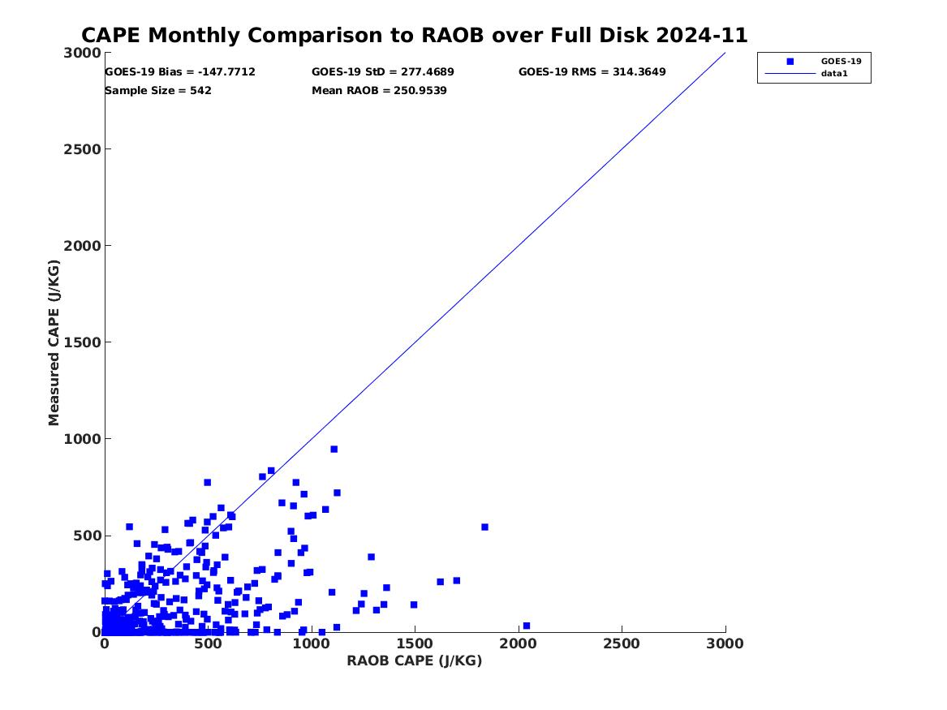
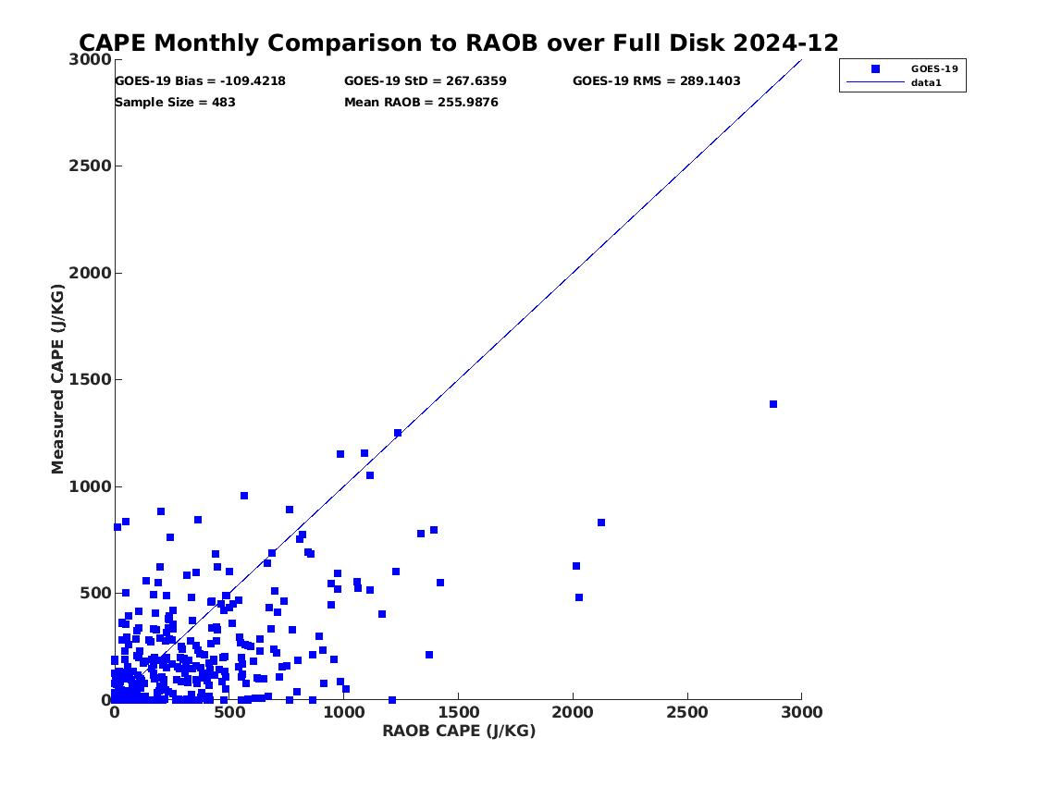
PLPT ABI-FD-DSI:
2024.11-2024.12
CAPE vs RAOB
Accuracy spec: 1000 J/kg
Precision spec: 2500 J/kg
CAPE
CAPE
number: 542
bias: -147.77 J/kg
std: 277.47 J/kg
number: 483
bias: -109.42 J/kg
std: 267.64 J/kg
PASSED
40

Slide 41
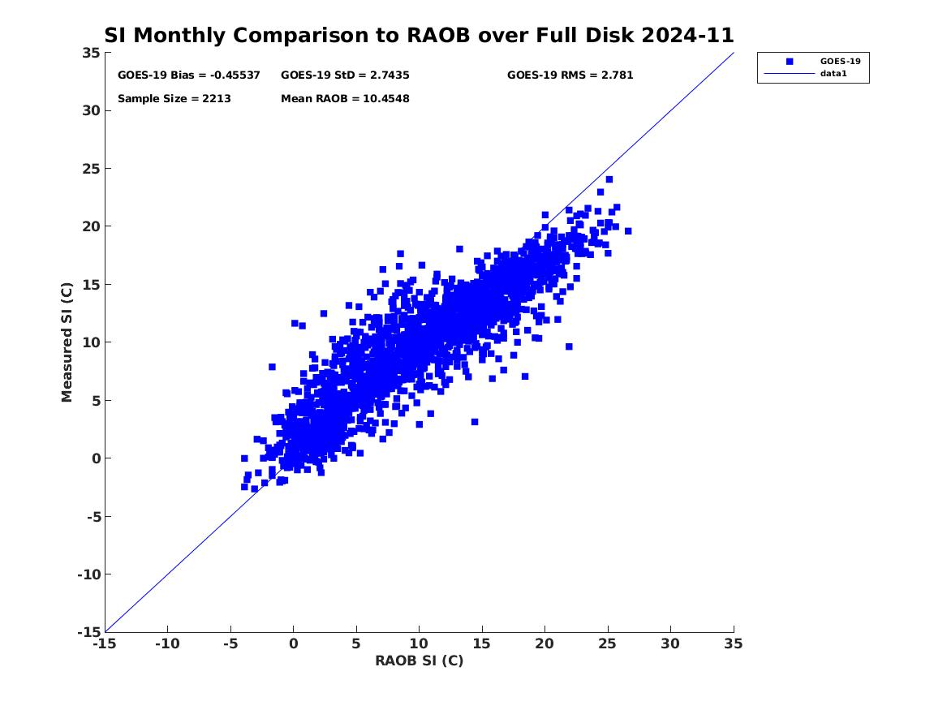
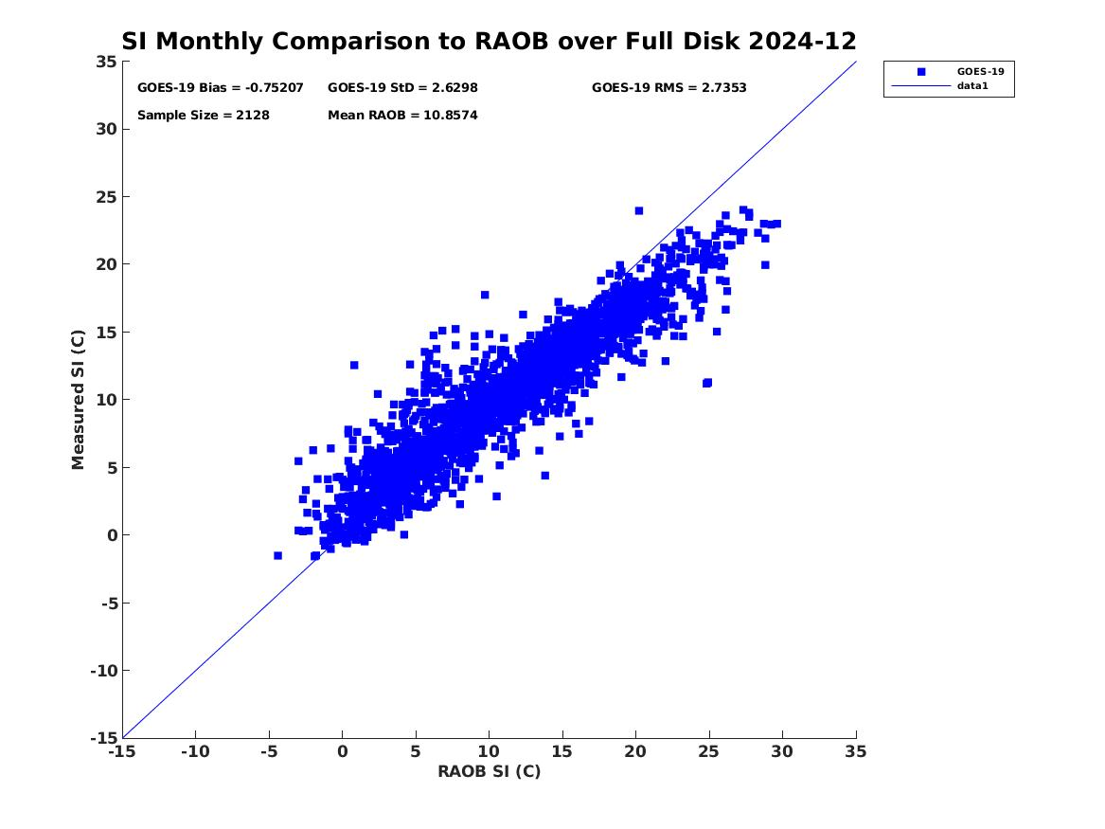
PLPT ABI-FD-DSI:
2024.11-2024.12
SI vs RAOB
Accuracy spec: 2 K
Precision spec: 6.5 K
SI
SI
number: 2213
bias: -0.46 K
std: 2.74 K
number: 2128
bias: -0.75 K
std: 2.63 K
PASSED
41

Slide 42
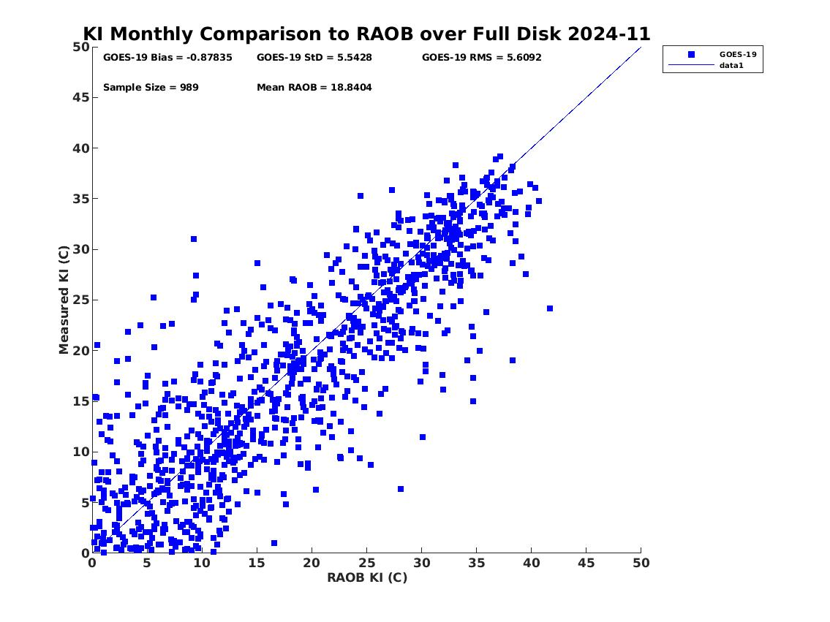
PLPT ABI-FD-DSI:
2024.11-2024.12
KI vs RAOB
Accuracy spec: 2 K
Precision spec: 6.5 K
KI
KI
number: 989
bias: -0.88 K
std: 5.54 K
number: 956
bias: 0.09 K
std: 5.62 K
PASSED
42

Slide 43
PLPT ABI-FD-DSI:
2024.11-2024.12
KI vs RAOB (KI>20)
Accuracy spec: 2 K
Precision spec: 6.5 K
K-Index | Thunderstorm Probability
Less than 20 | None
20-25 | Isolated Thunderstorms
26-30 | Widely Scattered Thunderstorms
31-35 | Scattered Thunderstorms
Above 35 | Numerous Thunderstorms
KI
number: 653
bias: -1.33 K
std: 3.82 K
PASSED
43

Slide 44
PLPT ABI-FD-DSI:
2024.11-2024.12
TT vs RAOB
Accuracy spec: 1 K
Precision spec: 4 K
TT
TT
number: 2213
bias: 0.84 K
std: 5.51 K
number: 2135
bias: 0.61 K
std: 4.94 K
44

Slide 45
PLPT ABI-FD-DSI:
2024.11-2024.12
TT vs RAOB (TT>20)
Accuracy spec: 1 K
Precision spec: 4 K
TT | Thunderstorm Probability
45-50 | Thunderstorms possible
50-55 | Thunderstorms more likely, possibly server
55-60 | Severe thunderstorms most likely
TT
number: 3505
bias: -0.41 K
std: 3.42 K
PASSED
45

Slide 46
PLPT ABI-CONUS-DSI:
2024.11-2024.12
LI vs RAOB
Accuracy spec: 2 K
Precision spec: 6.5 K
LI
LI
number: 1717
bias: -0.41 K
std: 1.52 K
number: 1921
bias: -0.44 K
std: 1.59 K
PASSED
46

Slide 47
PLPT ABI-CONUS-DSI:
2024.11-2024.12
CAPE vs RAOB
Accuracy spec: 1000 J/kg
Precision spec: 2500 J/kg
CAPE
CAPE
number: 341
bias: -161.56 J/kg
std: 310.00 J/kg
number: 282
bias: -118.73 J/kg
std: 323.00 J/kg
PASSED
47

Slide 48
PLPT ABI-CONUS-DSI:
2024.11-2024.12
SI vs RAOB
Accuracy spec: 2 K
Precision spec: 6.5 K
SI
SI
number: 1877
bias: -0.60 K
std: 2.76 K
number: 1711
bias: -1.04 K
std: 2.54 K
PASSED
48

Slide 49
PLPT ABI-CONUS-DSI:
2024.11-2024.12
KI vs RAOB
Accuracy spec: 2 K
Precision spec: 6.5 K
KI
KI
number: 706
bias: -0.68 K
std: 5.51 K
number: 666
bias: 0.04 K
std: 5.12 K
PASSED
49

Slide 50
PLPT ABI-CONUS-DSI:
2024.11-2024.12
KI vs RAOB (KI>20)
Accuracy spec: 2 K
Precision spec: 6.5 K
K-Index | Thunderstorm Probability
Less than 20 | None
20-25 | Isolated Thunderstorms
26-30 | Widely Scattered Thunderstorms
31-35 | Scattered Thunderstorms
Above 35 | Numerous Thunderstorms
KI
number: 360
bias: -1.12 K
std: 3.67 K
PASSED
50

Slide 51
PLPT ABI-CONUS-DSI:
2024.11-2024.12
TT vs RAOB
Accuracy spec: 1 K
Precision spec: 4 K
TT
TT
number: 1877
bias: 1.15 K
std: 5.49 K
number: 1718
bias: 0.83 K
std: 5.20 K
51

Slide 52
PLPT ABI-CONUS-DSI:
2024.11-2024.12
TT vs RAOB (TT>20)
Accuracy spec: 1 K
Precision spec: 4 K
TT | Thunderstorm Probability
45-50 | Thunderstorms possible
50-55 | Thunderstorms more likely, possibly server
55-60 | Severe thunderstorms most likely
TT
number: 2766
bias: -0.26 K
std: 3.48 K
PASSED
52

Slide 53
PLPT ABI-MESO1-DSI:
2024.11-2024.12
Accuracy spec: 2 K
Precision spec: 6.5 K
Accuracy spec: 1000 J/kg
Precision spec: 2500 J/kg
LI vs RAOB
CAPE vs RAOB
LI
CAPE
number: 190
bias: -0.50 K
std: 1.48 K
number: 18
bias: -19.73 J/kg
std: 174.61 J/kg
PASSED
PASSED
53

Slide 54
PLPT ABI-MESO1-DSI:
2024.11-2024.12
Accuracy spec: 2 K
Precision spec: 6.5 K
Accuracy spec: 2 K
Precision spec: 6.5 K
SI vs RAOB
KI vs RAOB
SI
KI
number: 183
bias: -1.60 K
std: 2.30 K
number: 47
bias: 0.39 K
std: 4.38 K
PASSED
PASSED
54

Slide 55
PLPT ABI-MESO1-DSI:
2024.11-2024.12
Accuracy spec: 1 K
Precision spec: 4 K
TT vs RAOB
TT vs RAOB (TT>20 K)
TT
TT
number: 183
bias: 2.23 K
std: 6.79 K
number: 112
bias: 0.06 K
std: 3.13 K
PASSED
55

Slide 56
DSI Performance Summary
DSI retrieval is working as expected on GOES-19 ABI data when combined with NWP short-range forecasts (as first guess);
With a highly quantitative web-based tool (http://soundingval.ssec.wisc.edu) and the comparisons with RAOB, it indicates the performances from LI, CAPE and SI meet spec. for all the coverages
The comparisons of TT with RAOBs show the precisions are larger than specs. However, for unstable atmosphere, the precisions meet the requirement.
56

Slide 57
GOES-16 vs. GOES-19 ABI LAP Products comparisons
Temp at 500 mb
2024.11.15 00Z
GOES 16
GOES 19
Clear-sky, Overlapped coverage
GOES 16 – GOES 19

Slide 58
GOES-19 vs. GOES-16 comparisons
LVT and LVM
2024.11.15 00Z
Statistical and STD for the overlapped area (zenith angle ≤ 65)
N = 133,237
N = 133,237

Slide 59
GOES-19 vs. GOES-16 comparisons
TPW and DSI
2024.11.15 00Z
G16 – G19 statistics (zenith angle ≤ 65)
TPW
LI
CAPE
SI
KI
TT

Slide 60
GOES-18 vs. GOES-19 ABI LAP Products comparisons
Temp at 500 mb
2024.11.15 00Z
GOES 18
GOES 19
Clear-sky, Overlapped coverage
GOES 18 – GOES 19

Slide 61
GOES-19 vs. GOES-18 comparisons
LVT and LVM
2024.11.15 00Z
Statistical and STD for the overlapped area (zenith angle ≤ 65)
N = 133,237
N = 133,237

Slide 62
GOES-19 vs. GOES-18 comparisons
TPW and DSI
2024.11.15 00Z
G18 – G19 statistics (zenith angle ≤ 65)
TPW
LI
CAPE
SI
KI
TT

Slide 63
PLPT Outcomes: Summary
All PLPT activities needed to make LAP products provisional have been completed.
Minor issues revealed by PLPTs:
-- Missing values in random areas
Slightly large discrepancies of some DSI products (precisions of TT) compared with RAOB, but meeting the requirements for unstable atmosphere
These minor issues may not prevent the declaration of Provisional Maturity

Slide 64
Path to Full Maturity Review

Slide 65
Path to Full Maturity Review
We expect to apply the same PLPTs to be conducted for Full Maturity
Extend period for testing throughout 2025.
Save L2 to enable further comparisons with the reference datasets.
Monitor the performance in warm seasons.
Currently minor issues may not prevent declaration of Full Maturity (5 issues identified through the PLPT work and will be mitigated during provisional stage)
Missing values are randomly discovered over some areas.
LAP products are affected by the migration of the sun which is likely caused by the cloud mask.
TT values have slightly larger discrepancies when compared with (“point-source”) RAOBs; when considering only unstable atmospheric conditions, the results pass the requirement.
Large wet bias when compared with RAOB around 200 hPa, likely due to the commonly known dry bias in RAOB
Large moisture std when compared with RAOB around 200 hPa, likely due to the lack of sounding information content from ABI in upper troposphere

Slide 66
Issue #1 – Missing data over random areas
Initial analysis showed missing data over random area
The missing data occur occasionally and randomly in boxed shapes
Need to revisit ADR 956 on this issue
The same issue still found for GOES-16, 18, and 19
Reported to Rico
Notes:
PRO team may clarify more about this.

Slide 67
An example of the missing data

Slide 68
Issue #2 – The effects of sun migration on products
Appears to be affecting large zenith angles more significantly
Notes:
PRO team may clarify more about this.

Slide 69
Risks to Reaching Full
Risk Name | Description | Impact | Mitigation and Schedule
Missing values over randomly distributed areas | Occasionally, there are missing values over randomly distributed boxed areas, in both the full disk and CONUS sectors. | Minor | Suggest an ADR, similar to an earlier one which we thought resolved.
The migration of the sun affecting the LAP products | The ABI LAP products are affected by sun-rise and sun-set. | Minor | Cloud mask may have influences on the ABI LAP products, as the scenes are illuminated, although appears to be a yield issue.
Wet bias of the relative humidity in upper troposphere (100 - 300 hPa) | The relative humidity in upper troposphere (100-300 hPa) shows large wet bias than the spec. | Minor | Radiosonde has dry bias in observing the relative humidity in the upper troposphere.
Moisture std of the relative humidity in upper troposphere (100 - 300 hPa) | The relative humidity in upper troposphere (100-300 hPa) shows large std than the spec. | Minor | Lack of information content in upper troposphere.
Slightly large discrepancy of several DSI | Several DSI show slightly larger discrepancy than the spec, compared to radiosondes. | Minor | If the atmospheric conditions are unstable, the statistics meet the requirements. May need a high spectrally resolution sounder in geo to fully resolve.
Small Impact
Moderate Impact
Large Impact

Slide 70
SUMMARY AND RECOMMENDATIONS
GOES-19 ABI L2 LAP Product Provisional PS-PVR

Slide 71
Summary
AWG LAP team has validated GOES-19 LAP products (TPW, LVT, LVM, DSI) from November 2024 to December 2024 with reference data from RAOB and AMSR2 in near real-time, the performance overall meet the requirements;
The intercomparisons between GOES-19 and GOES-16/18 show consistent results among LAP products from the three satellites;
AWG LAP team recommend that TPW, LVT, LVM, and DSI products be transitioned to Provisional status at this time;
AWG LAP team have found the following minor issues which should not prevent Provisional status
Missing values occur occasionally and randomly over boxed areas.
The migration of the sun affects the LAP products via cloud mask.
Comparisons of TT with RAOBs shows a little larger than spec; when considering only unstable atmospheric conditions, the results pass the requirement.
Comparisons of LVM with RAOBs shows larger wet bias than spec. in upper troposphere; likely due to the commonly know dry bias of RAOB.
Comparisons of LVM with RAOBs shows larger std than spec. in upper troposphere; likely due to the lack of sounding information content in upper troposphere.

Slide 72
Backup Material
GOES-19 ABI L2 LAP Product Provisional PS-PVR

Slide 73
PLPT ABI-FD-TPW vs AMSR2:
2024. 11 ~ 2024. 12
Accuracy spec: 1 mm
Precision spec: 3 mm
GOES-16
number: 408379
bias: -1.67 mm
std: 2.01 mm
number: 415882
bias: -1.47 mm
std: 1.88 mm
73

Slide 74
PLPT ABI-CONUS-TPW vs AMSR2:
2024. 11 ~ 2024. 12
Accuracy spec: 1 mm
Precision spec: 3 mm
GOES-16
number: 48381
bias: -2.06 mm
std: 2.33 mm
number: 46490
bias: -1.73 mm
std: 2.05 mm
74

Slide 75
PLPT ABI-FD-TPW vs AMSR2:
2024. 11 ~ 2024. 12
Accuracy spec: 1 mm
Precision spec: 3 mm
GOES-18
number: 465796
bias: -1.78 mm
std: 2.42 mm
number: 466297
bias: -1.50 mm
std: 2.19 mm
75

Slide 76
PLPT ABI-CONUS-TPW vs AMSR2:
2024. 11 ~ 2024. 12
Accuracy spec: 1 mm
Precision spec: 3 mm
GOES-18
number: 71176
bias: -1.10 mm
std: 2.05 mm
number: 67983
bias: -1.16 mm
std: 2.00 mm
76

