Slide 1
Addendum: GLM Gridded Data Products & Data Quality Product
Scott Rudlosky

Slide 2
Gridded Data & Data Quality Products
The GOES-R Ground Segment now generates gridded GLM products and distributes them to National Weather Service (NWS) forecasters via the Satellite Broadcast Network (SBN).
The science team continues work towards including a data quality product in the gridded product suite.
Archived gridded products are available via the NASA Global Hydrometeorology Resource Center (GHRC) at https://search.earthdata.nasa.gov/search/granules?p=C2278812167-GHRC_DAAC&pg[0][v]=f&pg[0][gsk]=-start_date&q=glm&tl.
Unidata presently provides access to rolling 14-day archives of the gridded GLM products that can be found at the following two links:
https://thredds.ucar.edu/thredds/catalog/satellite/goes/east/products/GLMISatSS/catalog.html
https://thredds.ucar.edu/thredds/catalog/satellite/goes/west/products/GLMISatSS/catalog.html.

Slide 3
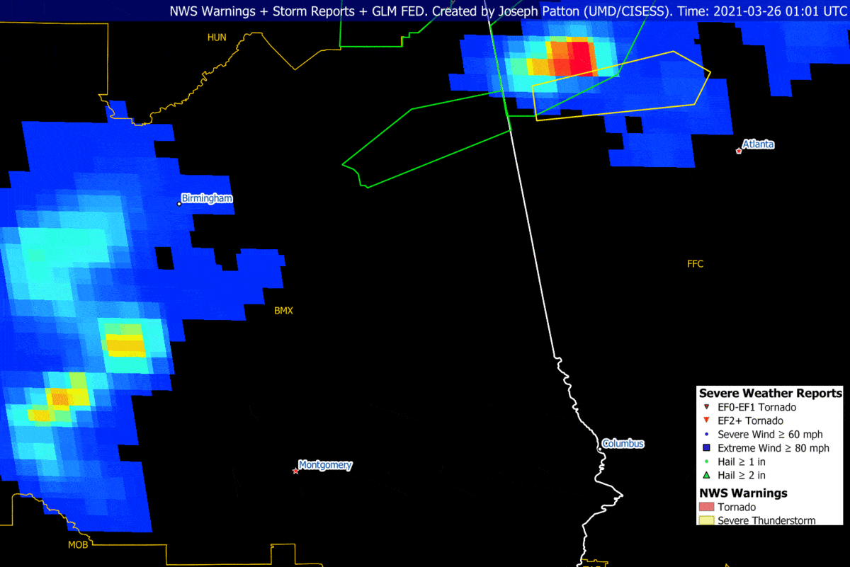
GLM Gridded Products

Slide 4
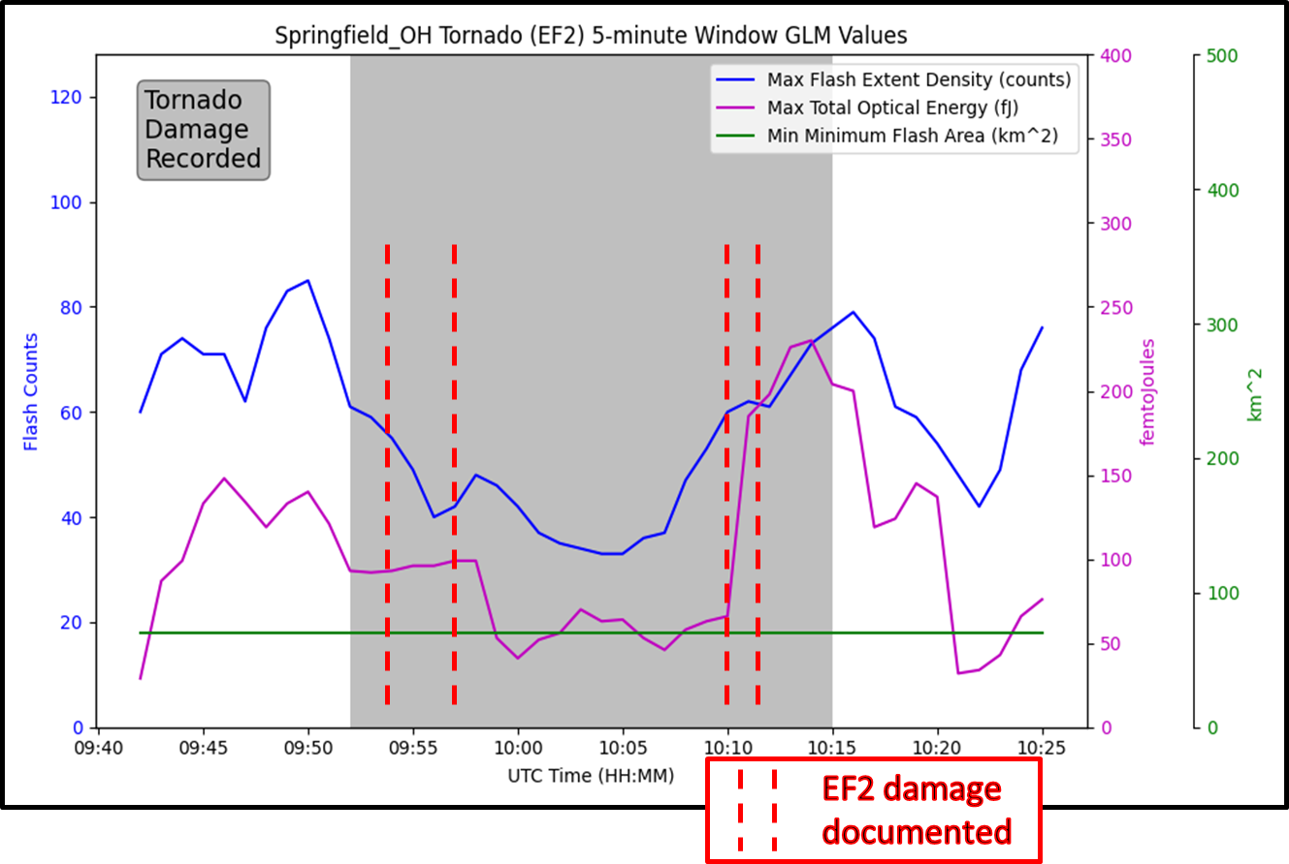
GLM Gridded Products
0
16
32
64
128
Flash counts
64
128
1000
2000
Area of the smallest flash (km²)
1
10
500
1500
Accumulated Optical Brightness (Joules x 10⁻¹⁵)

Slide 5
Background and Data Quality Products
The science team continues work towards including a data quality product in the gridded product suite.
Products:
GLM background image
GLM data quality product image
Product Overview:
GLM backgrounds are near-IR imagery at 0.777 µm, between ABI band 2 (red) and 3 (veggie). Products have about 10 km native resolution, and update every 2.5 min, and are oversampled onto the 2 km ABI fixed grid.
The GLM Data Quality Product provides a maximum flash detection efficiency and also indicates known locations with reduced data quality.
Hazardous Weather Testbed, Experimental Warning Program Demonstration:
Tested a concrete product implementation for feedback on readiness to be implemented as a routine product included in the GLM gridded imagery product stream.

Slide 6
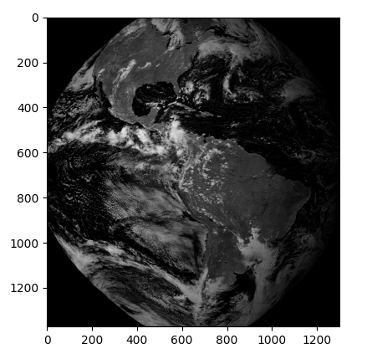
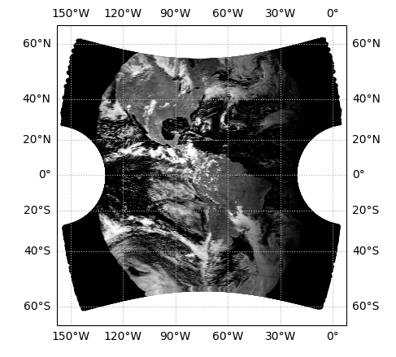
Background and Data Quality Products
Once we have the navigation parameters, we can use them to navigate the L0 data.
L0 data is received and backgrounds are extracted.
The dark current is, and the background gets navigated to lat/lon and then to fixed grid.
The 5 MSB of the background are used to look up the threshold for each pixel.
The thresholds are transformed into flash detection efficiency (via Cummins).
Other ”bad” pixels are flagged (e.g., dead pixels, near saturation pixels, etc.)
2024-09-20 18:49Z

Slide 7
Background Product
Single Day
Every Day at 18Z

Slide 8
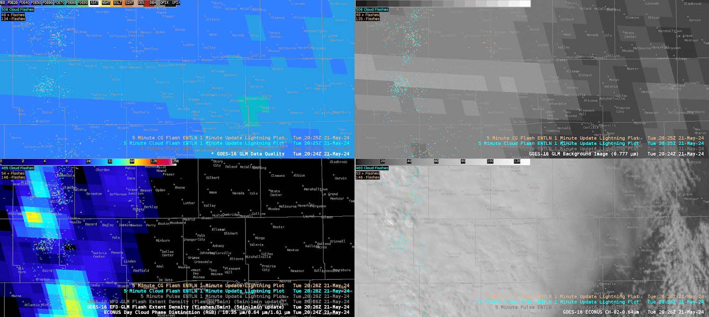
Product Use
DQP
GLM Background
GLM Flash Extent Density
ABI
Credit: Kevin Thiel

Slide 9
Background and Data Quality Products
Background and DQ products were deployed in the 2024 Hazardous Weather Testbed (HWT)
It is in a ”beta” state – it’s working, but there are refinements that need to be implemented.
Anything ideas on what we should flag?
Navigated backgrounds are (mostly) ready now.
Nav errors are usually ~100 m.
Current work is to streamline the processing to display in AWIPS.
Code will be published soon.
Level 0 events can also be navigated
Work continues towards including the background and data quality product in the formal gridded product suite

