Slide 1
GOES-19 GMAG Provisional PS-PVR
1/24/2025
CU/CIRES – NOAA/NCEI
Aspen Davis, Alison Jarvis, Sarah Auriemma,
Paul Loto’aniu, Michael Grotenhuis,
Frederick Rich, Fadil Inceoglu
Thanks also to the rest of the NCEI Space Weather Group
GOES-R Calibration Working Group Organization
Acknowledgements:
NSOF, GOES-R Flight/NASA, Lockheed Martin, GSFC, Harris/GOES-R Ground
SWPC and Howard Singer

Slide 2
Agenda
GMAG overview
Instrument status review
Review of Beta level PLT outcomes
Product quality assessment
Path to Full Validation Maturity
Summary and Recommendation

Slide 3
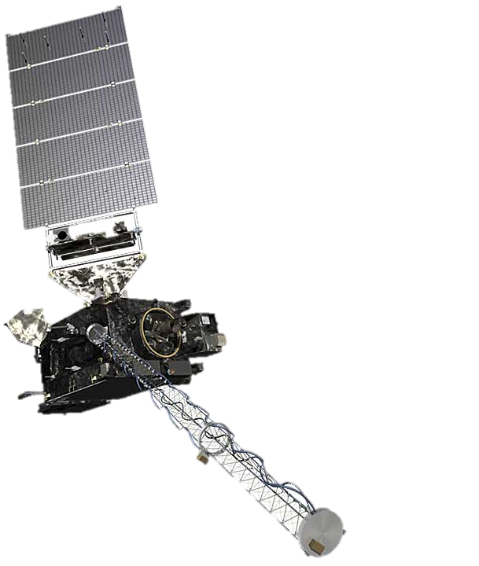
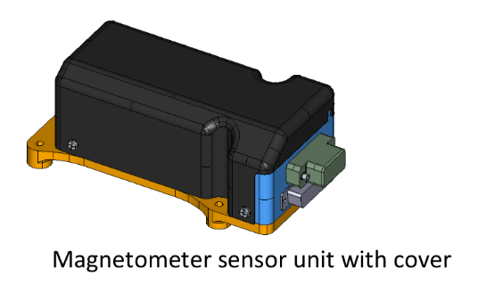
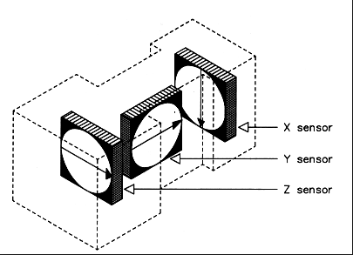
GMAG Overview
Characteristics | GOES 8-12 | GOES 13-15 | GOES-R
3-axis fluxgates | 2 | 2 | 2
Sampling Rate | 2 Hz | 2 Hz | 10 Hz
Low-Pass Filter Cutoff | 0.5 Hz | 0.5 Hz | ~2.5 Hz
Boom Length | 3 m | 8.5 m | 8.5 m
Inboard (IB) GMAG
0.3 nT noise requirement.
1 nT accuracy requirement (but performance requirements for GOES-16/GOES-17 were loosened).
Two boom-mounted fluxgate magnetometers - Inboard GMAG (IB) 6.3 m from boom base and Outboard GMAG (OB) 8.5 m from the base.
GOES-16 and GOES-17 sensor units built by Macintyre Electronic Design Associates (MEDA) Inc, in Virginia, under contract from the instrument vendor Lockheed Martin.
GOES-18 and GOES-19 sensor units, called GMAG, built by NASA-GSFC Planetary Magnetospheres Lab in Maryland, under a contract separate from the spacecraft.
Outboard (OB) GMAG

Slide 4
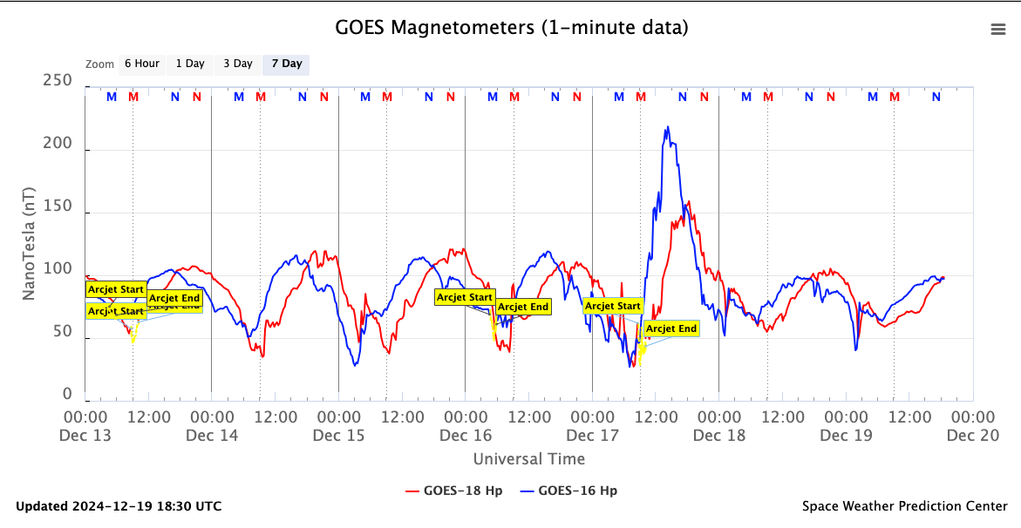
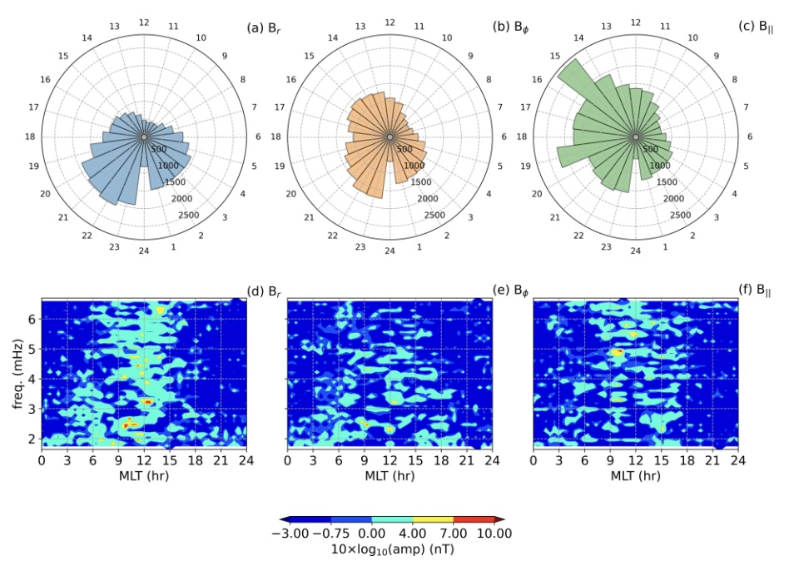
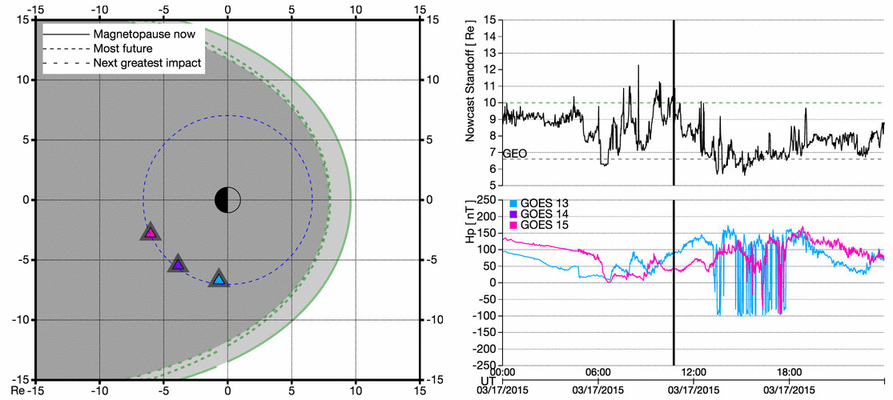
Data Usage
Operationally used by forecasters at SWPC
Real-time magnetometer dashboard on SWPC website
https://www.swpc.noaa.gov/products/goes-magnetometer
Scientific usage for research
GOES data used for historical wave event study
Loto'aniu and Inceoglu, ApJ, 2024
Continuing towards operational implementation of products such as magnetopause crossing identification

Slide 5
Instrument Status Review

Slide 6
Schedule of Previous Maturity Levels
GOES-19 GMAG turned on and boom deployed on July 22, 2024
Beta level (Vendor) PLTs successful and Beta declared on October 9, 2024
PLPTs (NCEI) supporting Provisional have been continuing
Ongoing
Machine learning algorithm to improve arcjet correction
Bias stability and accuracy monitoring as required
Continuing study into scientific usability of magnetometer data
Operationally implementing products such as magnetopause crossing and quiet field model for use by SWPC
Researching and generating new products
Analysis and resolution of ADR’s

Slide 7
Review Of Beta Level PLT Outcomes

Slide 8
Post Launch Test (PLT) and Milestones Timeline
Event | Description | Start | End | Status
1 | GMAG Boom Deployed | 7/22/24 12:20 UTC | 7/22/24 12:22 UTC | Complete
2 | GMAG Data Flow | 7/22/24 11:40 UTC | - | Ongoing
3 | (003) Sensitivity to Interference | 7/22/24 | 9/25/24
4 | (004) Sensor Difference Comparison | 7/22/24 | 1/18/25 | Complete
5 | (002) Calibration Step Test | 7/25/24 | - | Complete
6 | (005) OB Temperature Setpoint | 7/29/24 | 8/9/24 | Complete
7 | First Public Outreach | 8/13/24 | -
8 | (005) IB Temperature Setpoint | 8/12/24 | 8/24/24 | Complete
9 | Beta declared | 10/9/2024
10 | (001) 3rev maneuver 1 | 10/22/24 14:30 UTC |  | SCRUBBED
11 | (001) 3rev maneuver 2 | 10/29/24 14:30 UTC |  | SCRUBBED
12 | (001) 3rev maneuver 3 | 10/31/24 14:30 UTC | 19:04 UTC | Complete
13 | (001) 3rev maneuver 4 | 11/5/24 14:30 UTC |  | SCRUBBED
14 | RevB LUT uploaded | 11/14/24 20:55 UTC | -
15 | RevC LUT uploaded | 11/27/24 17:08 UTC | - | In OE
16 | (001) 3rev maneuver 5 | 12/3/24 15:11 UTC | 19:13 UTC | Complete

Slide 9
PLT’s Under Review
PLT ID | Descriptive Title | % Complete | Results | Delivered Vendor Report | CWG POC
G19-C-PLT-MAG-001 | Calibration Maneuver | 100 | Pass | Final report submitted 12/10/24 | Mike Grotenhuis
G19-C-PLT-MAG-002 | Health Test | 100 | Pass | Final report submitted 7/29/2024 | Mike Grotenhuis
G19-C-PLT-MAG-003 | Sensitivity to Interference | 100 | Pass | Final report submitted 11/22/2024 | Jacob Gruesbeck
G19-C-PLT-MAG-004 | Sensor difference/ratio | 100 | Pass | Final report submitted 10/7/2024 | Mike Grotenhuis
G19-C-PLT-MAG-005 | Temperature Setpoint Test | 100 | Pass | Final report submitted 9/5/2024 | Mike Grotenhuis
Required for Beta Maturity : PLT-002,-003,-004,-005

Slide 10
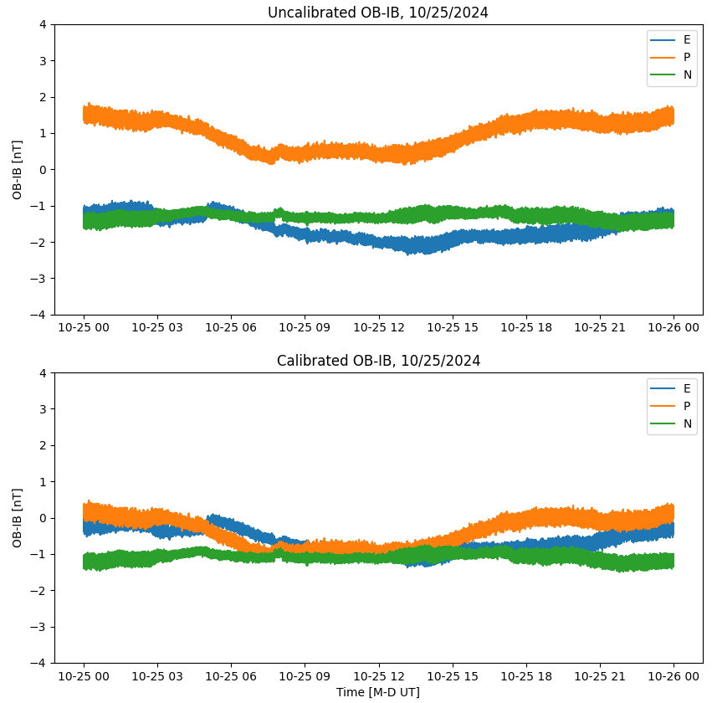
PLT G19-C-MAG-001: Calibration Maneuver
PASSED
Two, 3rev maneuvers were performed to determine the sensor zero-level bias and alignment offset
Improvements were made to the calibration determination algorithm
Determining orthogonality
Values determined from 3rev were uploaded to the LUT (RevC) and implemented on November 27, 2024
Uncalibrated OB-IB
Calibrated
OB-IB
 | OBx | OBy | OBz |  | IBx | IBy | IBz
Maneuver 1
Bias | 2.326 | 1.437 | -2.439 |  | 1.886 | -0.814 | 3.746
Alignment | 0.001 | 0.0034 | 0.0000 |  | -0.0041 | -0.0054 | 0.0157
Orthogonality* | -0.0075 | -0.0019 | -0.0036 |  | -0.002 | -0.0035 | 0.0165
Maneuver 2
Bias | 1.454 | 1.733 | -3.153 |  | 1.051 | -1.322 | 4.5
Alignment | 0.0126 | -0.0091 | 0.0073 |  | 0.0124 | 0.0086 | -0.0074
Orthogonality* | 0.0046 | -0.0033 | 0.0047 |  | 0.0045 | 0.0023 | -0.0054
*orthogonality is included as an adjustment to the factory alignment matrix

Slide 11
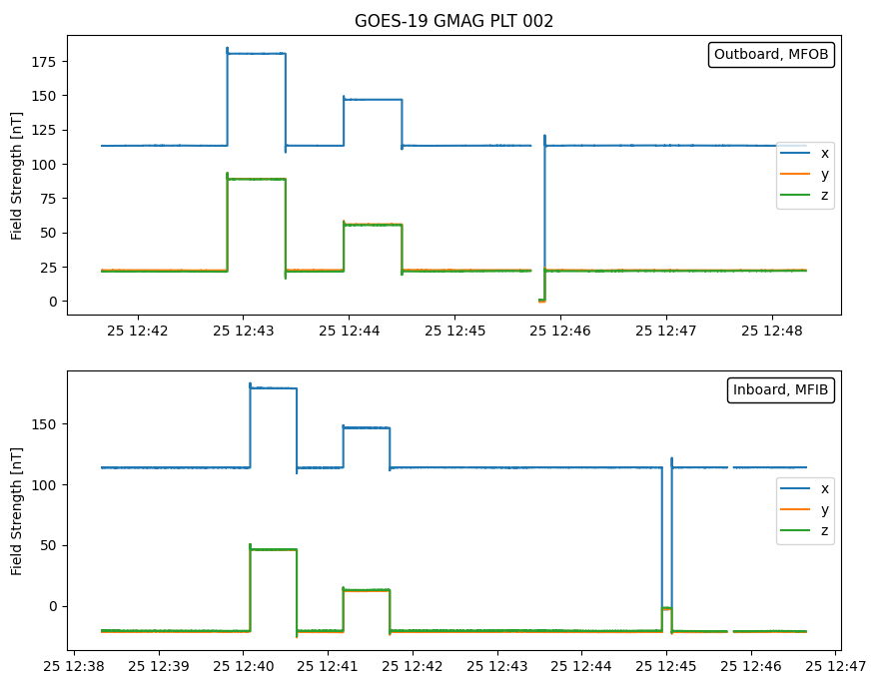
PLT G19-E-MAG-002: Health Test
PASSED
GOES-19 PLT 002
The Goddard Magnetometer provides the functionality to place a known incremental step on all axes of a specified sensor
Testing that the GMAG measures the full range of values that might be observed in space
GMAG successfully registered all pulses proportionally to the input signal as expected
Outboard
Inboard

Slide 12
PLT-G19-E-MAG-003 Sensitivity to Interference
PASSED
Subsystem | B Field Change
Momentum Adjustments | Within requirement
Aux Comm Power On | Within requirement
LTR Thruster Calibrations | Within requirement
GLM Initial Power On | Within requirement
SUVI Initial Power On | Within requirement
EXIS Power On | Within requirement
East West Station Keeping | Within requirement
IMU to Star Tracker Calibration (small and large slews) | Within requirement
SUVI-GT/FSS Alignment Calibration | Within requirement
SEGA Resolver Calibration | Within requirement
SEISS DPU On | Within requirement
SEISS Sensor Suite Power On | Within requirement
ABI Full Up Operational Config | Within requirement
GLM to Normal Mode | Within requirement
ABI Solar Calibration | Within requirement
Zero Crossings of Reaction wheels | Within requirement
SUVI Boustrophedon Test | Within requirement
Umbra Entrance and Penumbra Exit | Within requirement
Arcjet Effect – North South Station Keeping | above requirement - expected
Test subsystems to demonstrate that no stray fields are greater than magnetometer noise requirement
Outside of the Arc Jet disturbances, none of the spacecraft generated fields cause the magnetometer measurement to exceed the required noise levels.
Zero crossing of reaction wheels do cause changes in the magnetic field, but this is expected
Events involving spacecraft slewing do cause changes in magnetic field, but these are expected
Sensitivity to interference monitoring continues through full validation
From GMAG vendor team

Slide 13
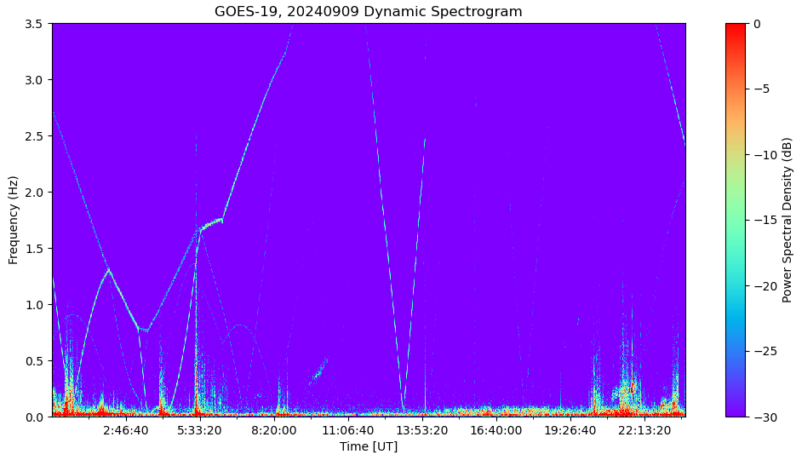
PLT-G19-E-MAG-003 : Reaction Wheel Zero Crossing
PASSED
G19 OBz Dynamic Spectrogram
FFT during RW zero crossing
IB
Noise requirement
Reaction wheel
OB
Zero crossing
FFT of reaction wheels shows that noise level is below requirement
Reaction wheel signatures clearly visible in dynamic spectrogram as expected
From GMAG vendor team

Slide 14
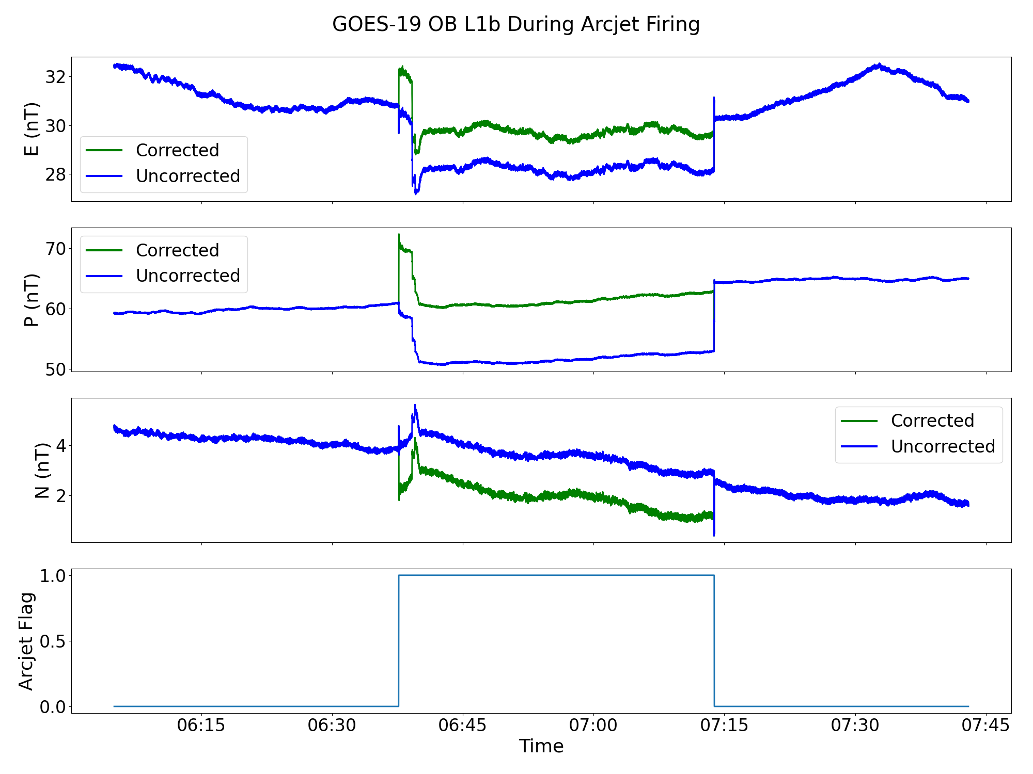
PLT-G19-E-MAG-003 Arcjet Effect
Arcjet firings have interference effects on magnetometer data, similar to GOES-16, 17 and 18
GOES – 19 firings generally occur for 90 minutes once every 4 days
Firings are flagged, however, the current correction is not valid
Further analysis is needed to generate a more accurate correction
NCEI team is working on developing a ML correction

Slide 15
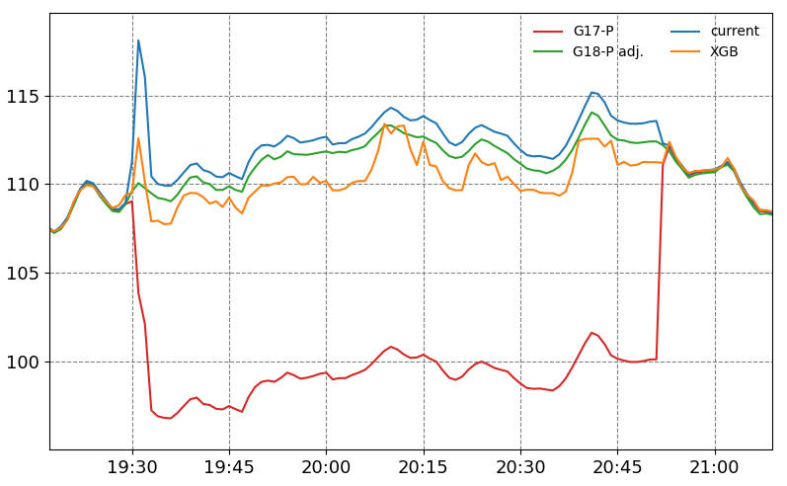
PLT-G19-E-MAG-003 New Arcjet Correction
Arcjet Correction Improvements
GOES-17 Example
B [nT]
Current correction
Improved correction
using ML method
Uncorrected data
Time [UT]
Inceoglu et al., in prep
NCEI is developing a new Machine Learning (ML) correction using the XG Boost method
New correction significantly reduces the effect of arcjets
Ongoing work is needed to continue improvements

Slide 16
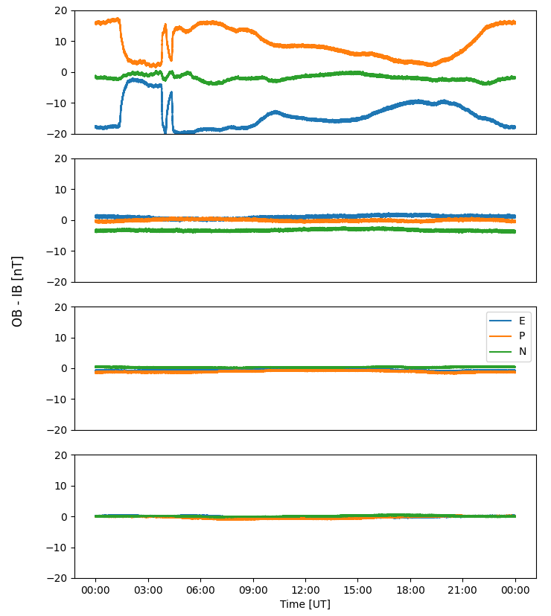
PLT-G19-E-MAG-004 Sensor Difference Comparison
PASSED
GOES-R Series
OB – IB
OB (outboard) – IB (inboard) differences for GOES-16, 17, 18, and 19 for 12/04/2024
*Due to GOES-17 storage, GOES-17 data is from 2/26/2023
GOES - 16
Ideally, the calibrated sensor difference would be 0nT and flat throughout the day
GOES – 17*
There has been significant improvement over the series
GOES - 18
Difference Mean +/- 3sigma | Obx - Ibx | Oby – IBy | Obz – IBz
GOES-16 | -13.9 +/- 14 | 9.2+/- 14.4 | -1.8 +/-2.8
GOES-17 | 1 +/- 1.4 | -0.04+/-0.9 | -3.3+/- 0.9
GOES-18 | -0.6 +/- 0.9 | -01.1+/- 0.8 | 0.3 +/- 0.3
GOES-19 | -0.1 +/- 0.8 | -0.3 +/- 1 | -0.1 +/- 0.5
GOES - 19
table values are for one, full day

Slide 17
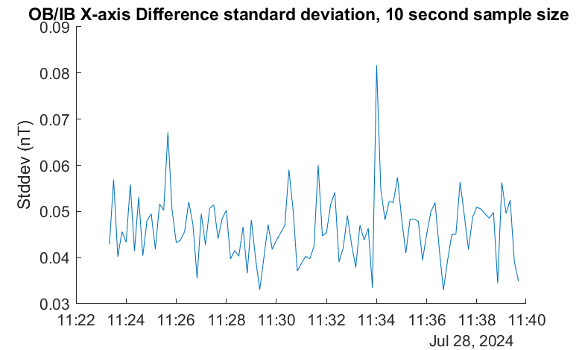
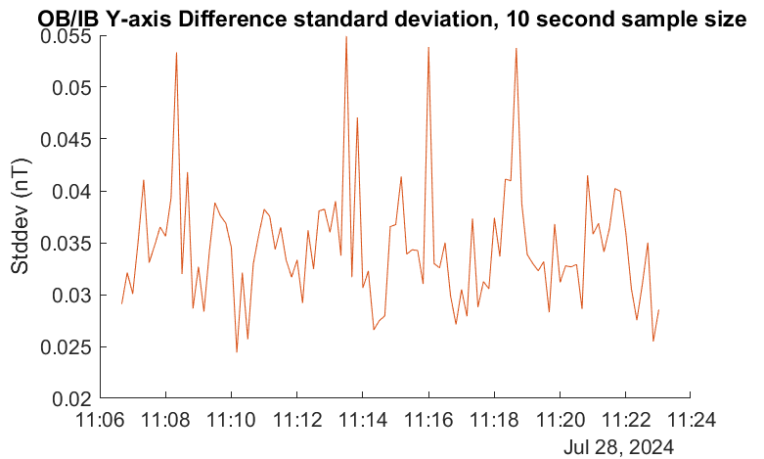
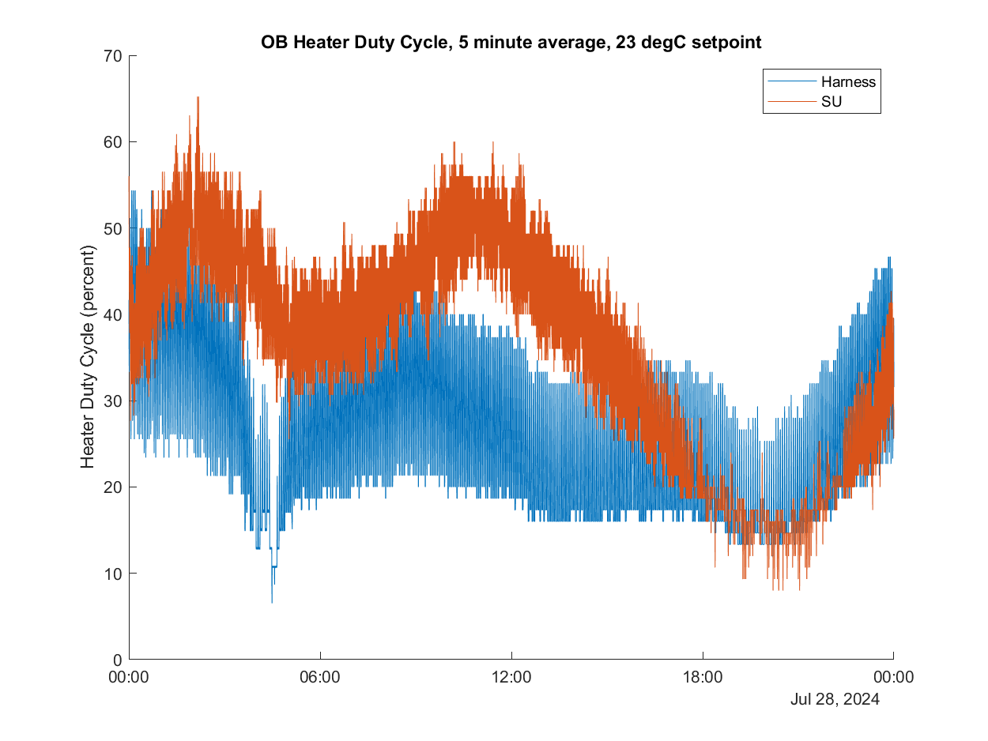
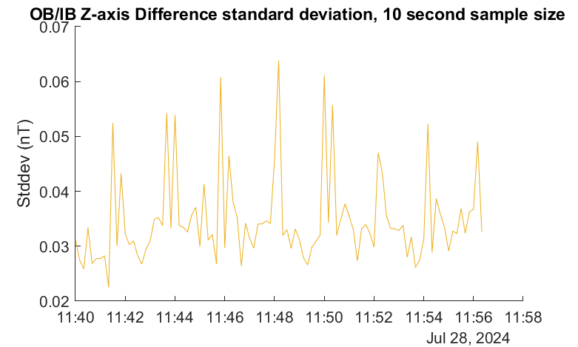
PLT-G19-E-MAG-005 Magnetometer Thermal Sensitivity
PASSED
GOES magnetometers have multiple heaters to control thermal environment of the sensors
PLT 005 Determines optimal heater setpoint for GMAG
No compelling reason to modify temperature from recommended setpoint of 23 C
Continued investigations as part of full validation
OB-IB Standard Deviation, X
Y
Heater Duty Cycle over ~24 hours
Max duty cycle 60.0 %
1 sigma average (nT)
X: 0.047nT
Y: 0.033nT
Z: 0.032nT
Z
PLT 005 report

Slide 18
Product Quality Assessment
For Provisional Level

Slide 19
Provisional Validation PLPT’s NCEI
Descriptive Title | Activity | Data needed | Success criteria | Results
PLPT-MAG-001-Comparison to quiet field models | Validate GMAG L1b product for geomagnetically quiet conditions (Kp <2) by comparing to accepted models of Earths internal plus external magnetospheric field. | 7 days (need not be contiguous) | Data demonstrate that GMAG measurements are close to magnetic field model values. | Pass
PLPT-MAG-002- Cross-satellite intercalibration (1 min data) | Validate GMAG l1b product by comparing it to operational GOES-R Series in situ magnetometer instruments. | 7 days (need not be contiguous) | Data demonstrate that GMAG measurements are close to other GOES-R series satellites. | Pass
PLPT-MAG-003- Noise Performance | Determine the noise level of the product and compare it to the MRD values of no more than 0.3 nT on each axis. | 7 days (need not be contiguous) | Noise level of the product has been determined and compared to 0.3 nT requirement. | Pass
From MAG RIMP v2.0, July 2021

Slide 20
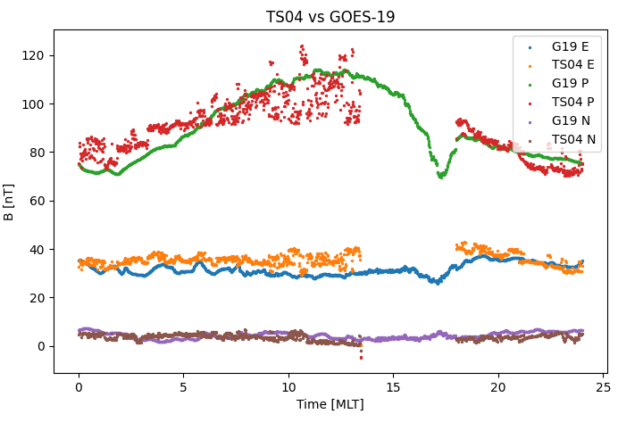
PLPT-MAG-001 Comparison to Models
PASSED
GOES-19, 1 minute average data was compared to the Tsyganenko 2004 model (TS04) for quiet time conditions
Our implementation of TS04 model successfully incorporates solar wind parameters that are propagated from DSCOVR (L1) to the Earths bow-shock
previous method required waiting 6-8 weeks for solar wind data
DSCOVR has known Faraday Cup issues that affect the quality of model comparisons
Example of quiet day (11/27/2024) with RevC LUT applied to GOES-19 data
Model profile matches GOES-19 data within +/-10nT

Slide 21
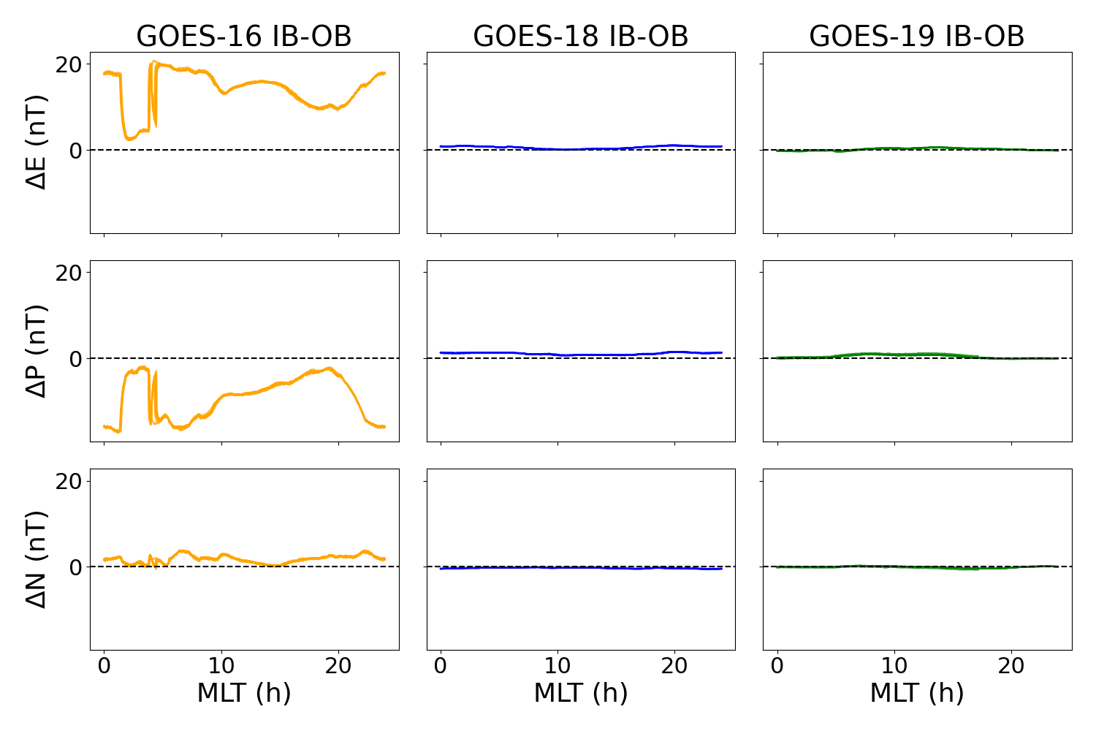
PLPT-MAG-002 Cross-Satellite Intercalibration: IB-OB differences
PASSED
Comparisons between the GOES-R satellites are subject to inaccuracies in all satellites, not just GOES-19
The plot shows IB-OB minute averages of EPN data, overlaid for 7 days
The table below shows the average and standard deviation for 7 low Kp days, with GOES-19 calibrations applied
1.5 months of data
 | E | P | N
GOES-16 | 13.867 + /- 4.429 | -9.120 +/- 4.816 | 1.740 +/- 0.908
GOES-18 | 0.575 +/- 0.308 | 1.062 +/- 0.245 | -0.333 +/- 0.106
GOES-19 | 0.123 +/- 0.268 | 0.374 +/- 0.390 | -0.1001 +/- 0.192

Slide 22
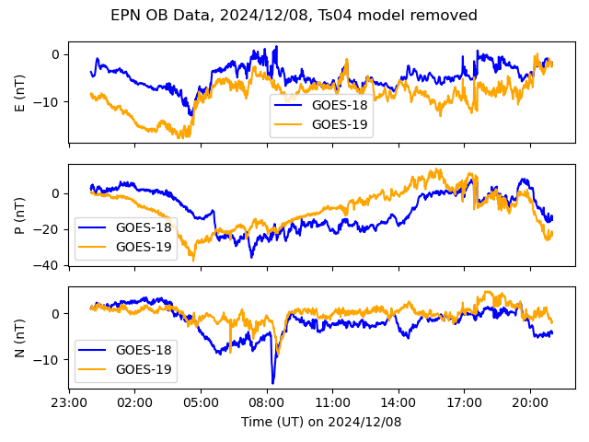
PLPT-MAG-002 Cross-Satellite Intercalibration
PASSED
When spacecraft are not co-located, cross-satellite comparisons require removing longitudinal effects by subtracting a magnetic field model
Thus, data comparisons are subject to uncertainties in the model
The plot to the right is a representative example of GOES-18 observations compared to GOES-19
GOES-18 and GOES-19 are generally within family, +/-15nT during quiet times

Slide 23
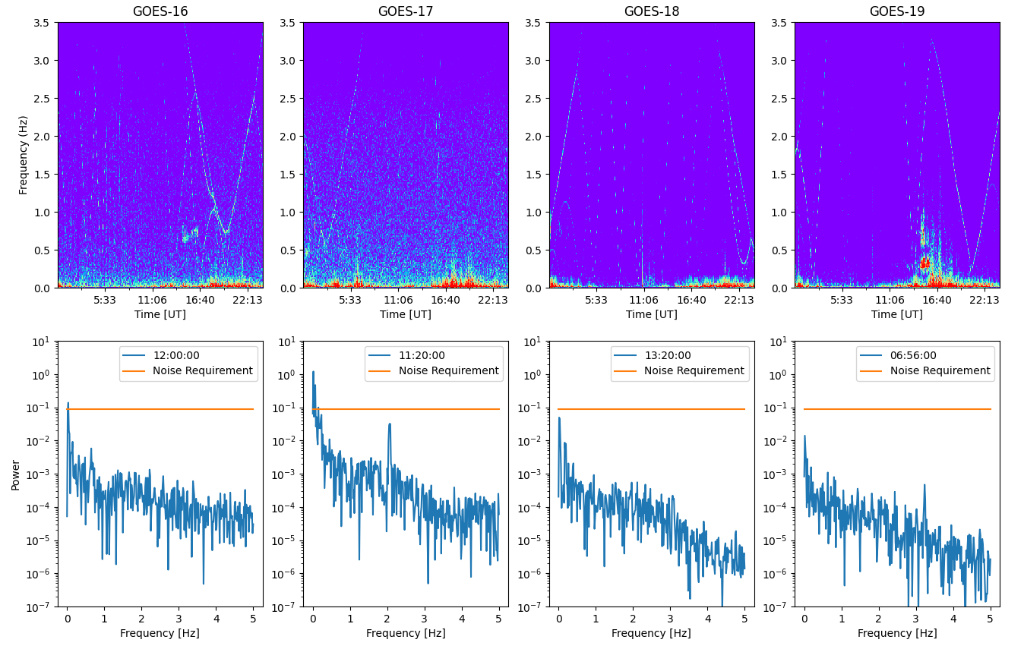
PLPT-MAG-003 Noise Performance
PASSED
Significant reduction in background noise power compared to GOES-16 and 17
Amplitude of reaction wheel noise is < 0.2nT, background is ~0.1nT
Reaction wheel effect is the same on G19 as G18
Noise is below 0.3nT requirement (excluding arcjet firing periods)

Slide 24
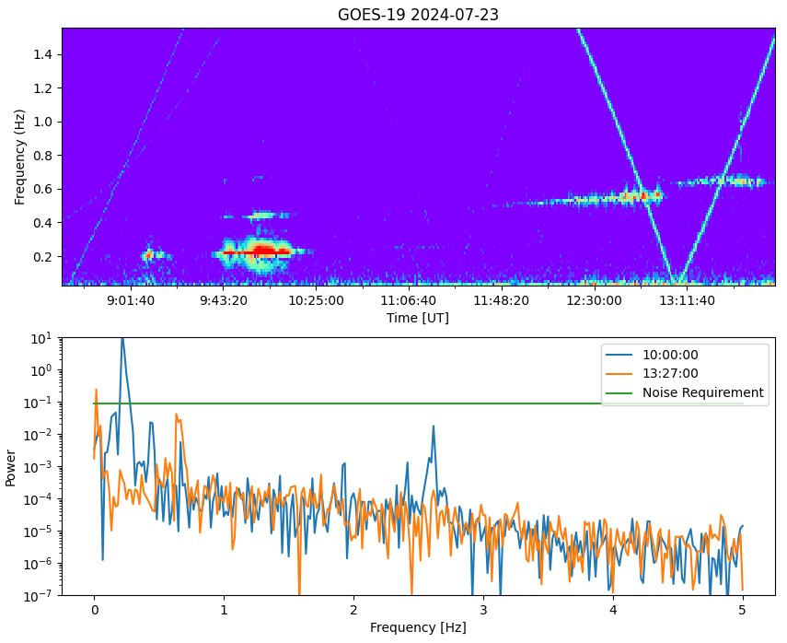
PLPT-MAG-003 Noise Performance
PASSED
Event Detection in G19
Higher-power plasma wave
Aspen update
Lower-power plasma wave or reaction wheel?
Background noise levels are low enough to identify events such as plasma waves
It is possible to identify the power signature of some plasma wave during times with reaction wheel signatures, although not as clear
-lower power waves may be missed
ULF and plasma wave event detection are part of future space weather product ideas
-Important for the enhancement and scattering of dangerous energetic particles in the magnetosphere

Slide 25
PLPT-MAG-003 Noise Performance
Noise Contributions
Sensor : < 0.1nT
Reaction Wheels : 0.1nT to 0.2nT
No significant ADC noise
Heaters : less than 0.02nT
We conclude GMAG product noise is within the 0.3nT requirement.

Slide 26
GOES 19 Provisional Validation
Preparation Activities | Assessment
Validation activities are ongoing and the general research community is now encouraged to participate. | Validation activities are ongoing. Results have been discussed with SWPC. Release of data by NCEI will enable research community participation.
Severe algorithm anomalies are identified and under analysis. Solutions to anomalies are in development and testing. | Algorithm anomalies have been recorded through ADRs. Data products continue to be monitored for algorithm anomalies.
Incremental product improvements may still be occurring. | Product improvements will result from steps to mitigate anomalies listed in “Path to Full Validation” charts.
L2+ only: Users are engaged in the Product Feedback Forums (PFF) and user feedback is assessed. | NCEI continues to be engaged with SWPC for feedback on MAG L1b data quality.

Slide 27
GOES 19 Provisional Validation
End State | Assessment
Product performance has been demonstrated through analysis of a small number of independent measurements obtained from select locations, periods, and associated ground truth or field campaign efforts. | GOES-19 MAG L1b has been compared to GOES-18, GOES-17 and GOES-16. GOES-19 MAG L1b has been compared to quiet field magnetic field model. The above were undertaken across different local times.
Product analysis is sufficient to communicate product performance to users relative to expectations (Performance Baseline). | Yes, and instrument performance continues to be studied.
Documentation of product performance exists that includes recommended remediation strategies for all anomalies and weaknesses. Any algorithm changes associated with severe anomalies have been documented, implemented, tested, and shared with the user community. | Provisional level ReadMe will be released with the data products. There is also documentation of product analysis in NASA and NCEI presentations, including this one.
Testing has been fully documented. | In this presentation and supplemental materials.
Product is ready for operational use and for use in comprehensive cal/val activities and product optimization. | Yes, products are ready for operational use, use in comprehensive cal/val activities and use in product optimization.

Slide 28
Path to Full Validation Maturity

Slide 29
Path to Full Validation
ADRs/WRs to be resolved prior to Full Validation
Analysis of transients in the OB-IB differences during GMCs
PLPTs to be conducted prior to Full Validation
Performance Baseline status
Risks to getting to Full, both from L1b product definition and user (SWPC) feedback

Slide 30
GMAG Specific ADR’s and WR’s
ADR | WR | Short Description | Status | Expected Closure
1151 |  | Arcjet correction | On hold | HOLD
1401 |  | CDRL79 RevA (prelaunch) | LUT Promoted | PR.13.07.00 on 05/30/24
1482 | 10179 | GOES-19 GMAG OB/IB difference transients correlated with field transients | Closed | 12/16/24
1507 |  | CDRL79 RevB | LUT Promoted | PR.13.10.04 on 11/15/24
1518 |  | CDRL79 RevC | LUT Promoted | PR.13.10.05 on 12/02/24
 | 8349 | update t4_status perform files to support GMAG for G18/19 | On hold | HOLD
 | 7011 | DO needs a better way to configure MAG L0 data to receive on the L band in support of yaw flips | Closed | DO.09.01.00

Slide 31
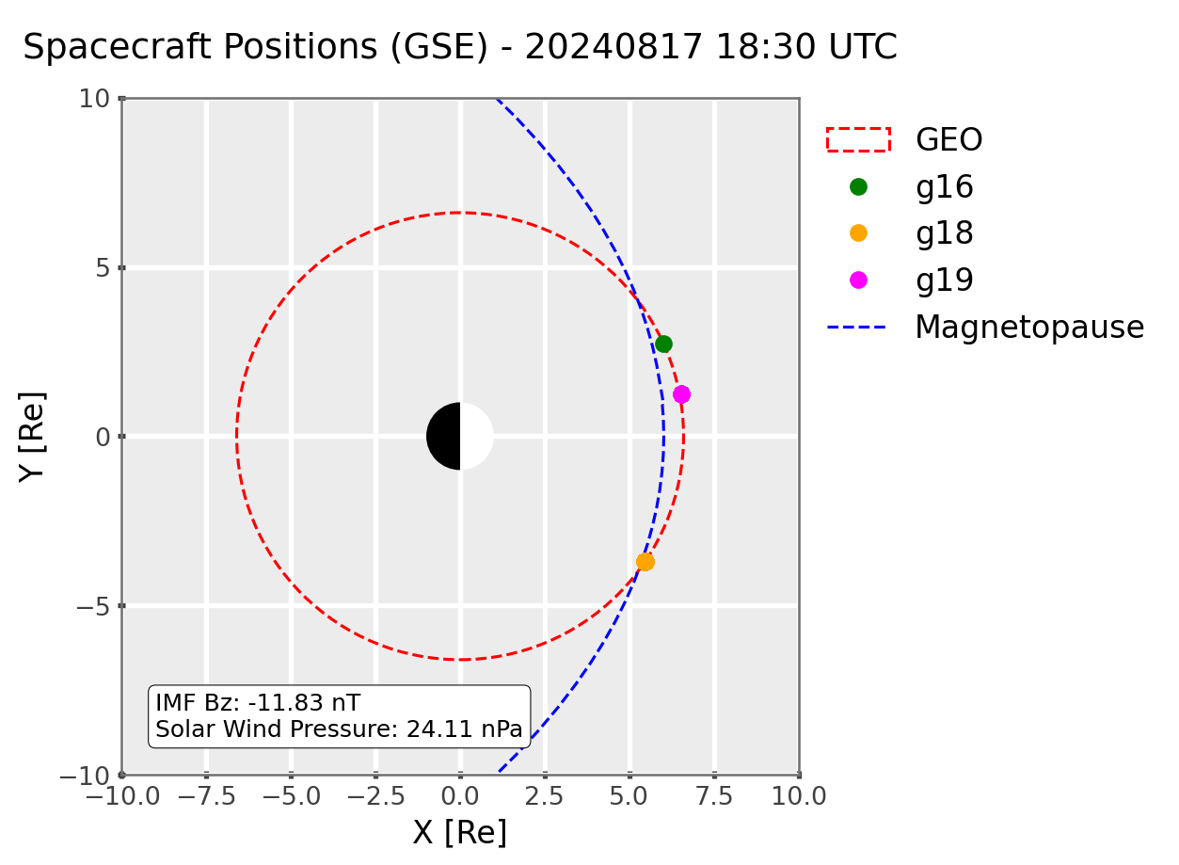
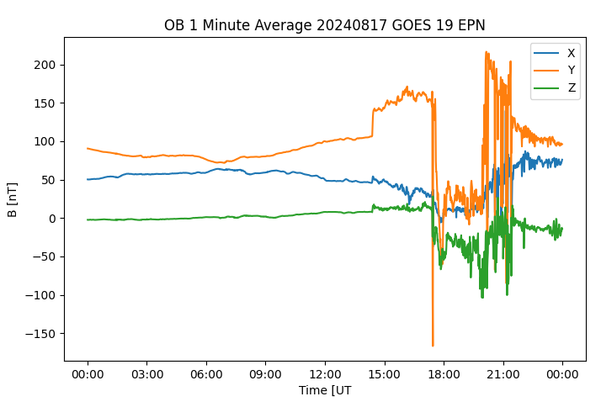
ADR 1482 GMAG Difference Transients
Magnetopause Location
18:30 UTC 8/17/24
GOES-19 OB
8/17/24 *uncalibrated data
E
P
N
GMC
Geosynchronous Magnetopause Crossings (GMC) are times when Earths magnetosphere is compressed below the GOES orbit, which exposes it to the Interplanetary Magnetic Field
GMCs are observed in the GMAG measurements as extended periods of negative field values and large changes in the measured field
The right plot is a typical example of GOES-19 OB measurements during a GMC on August 17, 2024 (prior to calibrations being applied)

Slide 32
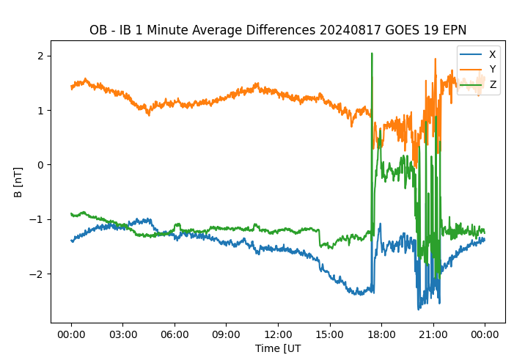
ADR 1482 GMAG Transients
During GMCs, the field values are expected to change significantly while the OB – IB differences are expected to remain consistent throughout the day
There were 4 GMC events PRIOR to GOES-19 GMAG being calibrated, which showed large variations (transients) in the range of OB - IB differences during GMCs
Transients were not seen in other GOES-R mags, however, GOES-19 was launched during a period of increased solar activity and has seen more GMCs during PLT than prior GOES-R spacecraft
Other GOES-R mags were already calibrated when they measured their first GMC
OB-IB 1 Minute Differences
8/17/24 *uncalibrated data

Slide 33
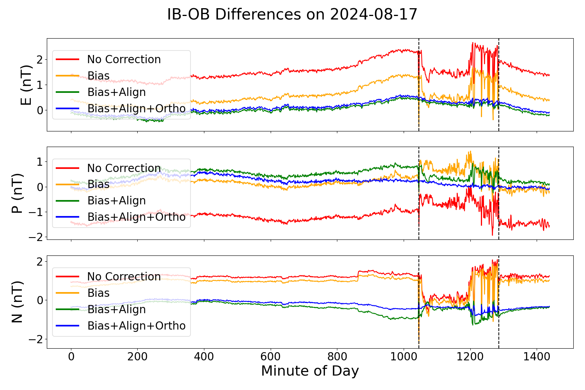
ADR 1482 GMAG Transients
IB-OB Differences 8/17/24
*data reprocessed to include new calibration values
Updates were made to the calibration algorithm to include bias, alignment and orthogonality
Applying the calibration with orthogonality greatly reduced the sensor differences during GMC events. The top figure is the previous example event with data reprocessed to include calibrations
The average sensor difference during GMC are significantly reduced after the full calibration is applied (bottom plot)
ADR/WR is closed. Continued analysis is needed to determine why the orthogonality correction improves stability during GMC, verify the calibration during future GMCs, and potentially apply improved calibrations to prior GOES-R magnetometer products

Slide 34
Path to Full Validation - PLPTs
Descriptive Title | Activity | Data needed | Success criteria
PLPT-MAG-001-Comparison to quiet field models | Validate GMAG L1b product for geomagnetically quiet conditions (Kp <2) by comparing to accepted models of Earths internal plus external magnetospheric field. | 90 days (kp < 2, need not be contiguous) | Data demonstrate that GMAG measurements are close to magnetic field model values.
PLPT-MAG-002- Cross-satellite intercalibration (full resolution data) | Validate GMAG l1b product by comparing it to operational GOES-R Series in situ magnetometer instruments. | 90 days (|Dst| ≤ 30 nT, need not be contiguous) | Data demonstrate that GMAG observations are consistent with other spacecraft observations.
PLPT-MAG-003- Noise Performance | Determine the noise level of the product and compare it to the MRD values of no more than 0.3 nT on each axis. | 90 days (kp < 2, need not be contiguous) | Noise level of the product has been determined and compared to 0.3 nT requirement.
From MAG RIMP v2.0, July 2021

Slide 35
MAG Performance Baseline Status
Assessment at Provisional
MRD ID | Description | Related PLPTs | Status
2019 | MAG Product Measurement Accuracy | -002 | PLPTs ongoing for full validation
662 | MAG Product Noise | -003 | PLPTs ongoing for full validation

Slide 36
GOES-19 Performance Baseline Validation Status
MRD2019: Product Measurement Accuracy
Quantity | MRD Requirement | Performance Baseline | Provisional PLPT Measurement
Product Measurement Accuracy: | 1 nT per axis | (3σ_{x},3σ_{y},3σ_{z}) 1 nT per axis | ± 1 nT (per axis). (not including arcjet periods)
MRD2022: Product Measurement Precision
Quantity | MRD Requirement | Performance Baseline¹ | Provisional PLPT Measurement
Product Measurement Precision: | ≤ 0.016 nT (per axis) | One bit resolution = 0.016 nT/axis. Precision ≥ sensor noise level = 0.100 nT/axis | 0.1 nT (not including arcjet periods)
¹This requirement has flowed down to the magnetometer instrument to mean that the magnetic field shall have a resolution of 0.016 nT per axis. Based on the MRD definition of precision, the product with vary by at least the noise level of the sensor.
MRD662: Noise
Quantity | MRD Requirement | Performance Baseline | Provisional PLPT Measurement
Product Noise: | Fluctuations < 0.3 nT | Low pass filter removes all transients with frequencies ≥ 2.5 Hz | 0.3nT at < 2.5 Hz (not including arcjet periods)

Slide 37
Path to Full Validation – Risks
Risk Name | Description | Impact | Mitigation and Schedule
Arcjet flag and correction | Current Arcjet correction needs to have continued analysis. Analysis of how well the arcjet flag and correction algorithm work over the next months could show flag and algorithm do not work well. Additionally, changes to arcjet firing configurations could make correction not work. | Risk GMAG L1b corrected variables being worse than uncorrected variables. | NCEI will undertake detailed analysis of the arcjet flag and correction outputs after implementation in L1b product. NCEI will also continue work towards an improved arcjet correction.
Bias stability | Bias stability should be monitored for any changes in zero level offsets. | LUT values for zero level bias and misalignment offset will not be accurate. | NCEI will perform continuing monitoring and analysis of bias stability.

Slide 38
Summary and Recommendations

Slide 39
Summary and Recommendations
We recommend that the GOES-19 magnetometer product be released at provisional maturity, considering the following recommendations
Main issues identified:
Arcjet firing contamination
Noise : e.g., reaction wheels

Slide 40
Recommendations: Arcjets
We recommend continued work to improve the arcjet correction using machine learning
This will help improve the correction for times of low power levels, different arcjet configurations and edge effects
Data from the co-location of GOES-17 and GOES-18 has been important in developing the correction, and data from any future co-locations should be taken advantage of
We also recommend further study of the effects of arcjets on the science quality of data

Slide 41
Recommendations: Other
We recommend continued work to improve the utility of data products for operations and science quality
Recommendation for ongoing bias stability monitoring
Recommend ongoing comparisons of the utility of MEDA mag and GMAG data for operational and scientific use
Recommend continued analysis of sensor differences during GMC events and retrospective application of the improved calibration algorithm to prior GOES-R magnetometer products
We emphasize our recommendation that data stewardship continue work towards improving the quality of data and reprocess archived data when necessary

Slide 42
Contact : aspen.davis@noaa.gov
paul.lotoaniu@noaa.gov
Questions?

Slide 43
Backup slides

Slide 44
GMAG Specific ADR’s and WR’s
ADR | WR | Short Description | Status | Expected Closure
1266 |  | G18 GMAG RevB LUT | closed | PR.09.08.33
1232 | 9135 | GMAG irregular timestamps | closed | PR.11.02.00
1213 |  | G18 GMAG LUT for PLT | closed | PR.09.08.13
1203 | 8970 | Mag L1b solar array current index label incorrect | closed | DO.12.00.00
1171 | 9326 | EXIS/MAG/SEISS ECEF_Z range | Closed
1056 | 7663 | DO GS updates for GMAG on GOES-T/U | closed | DO.09.03.00/DO.10.01.01
1046 | 7453 | Erroneous MAG L1b quality flag set periods | closed
1045 |  | Remove IB shadow flag from good quality flag mask | closed | DO.09.03.00/DO.10.01.01
1010 | 7368 | MAG LUTs for DO 08.01.00 | closed | PR.08.03.03
1002 | 7292 | Move leap second comments for MAG EXIS and SEISS | closed | DO.09.03.00/DO.10.01.01
890 | 6880 | Updated MAG Arc Jet Correction | closed | DO.09.03.00/DO.10.01.01
 | 7346 | Ground MM updates required for GMAG on GOES-T/U | closed | MM.10.03.00
 | 8520 | GMAG documentation incorrect in some cases | closed | MM.10.03.00
 | 10162 | Oscillations in the GOES-18 GMAG data | Submitted; Sev4

