Slide 1
Peer Stakeholder-Product Validation Review (PS-PVR) For the Provisional Maturity of GOES-19 SEISS EHIS L1b Product
February 7, 2025
Juan Rodriguez
University of Colorado CIRES and NOAA NCEI
Contributions: B. Kress, A. Boudouridis, T. Nasser (ATC)
Thanks to Ground and Flight for coordinating the installation of the revised ground LUT and flight science tables that resulted from PLT.

Slide 2
Outline
Introduction
Path to Provisional
Product Quality Evaluation (PLPTs)
Provisional Maturity Assessment
Path to Full Validation Maturity
Summary and Recommendations

Slide 3
Energetic Heavy Ion Sensor (EHIS)
inclined detectors (D2 & D3)
Credit: SEISS-D-SY079_EHIS_CALTIM_Update-1-6-14
Primary purpose: measure fluxes of solar energetic particles (SEPs) and galactic cosmic rays (GCRs) responsible for Single Event Effects (SEE) in electronics
Single solid-state telescope using angle-detecting inclined sensor (ADIS) system to discriminate heavy ions by atomic number (Z)
L1b cadence is 5 minutes
Most recent FM4 (SN102) CDRL79 release: SEISS-D-EH079-2, Rev A (30 January 2020)
EHIS FM4 (SN102) LUT:
Version at launch: FM4_EHIS_CALINR_Parameters-V1.0.h5 = "SeissEhisCalInrParameters(FM4A_CDRL88v1_1_PR_13_07_00)-770266800.h5"
Version at Provisional PS-PVR: xxx
D6
D5
D4
D1
R
Scintillator (S)
Detector | Function | Beam Calibrated
D1, D2, D3 | ADIS | p+: yes, α++: no, heavies: yes
D4 (A, B, C ganged) | Channel E1 stopping | p+: yes, α++: no, heavies: yes
D5 (A, B, C ganged) | Channel E2 stopping | p+: yes, α++: no, heavies: yes
D6 (A, B, C ganged) | Channel E3 stopping | p+: yes, α++: no, heavies: no
R (ranging) | E4 & E5 (penetrating) | p+: yes, α++: no, heavies: no
S (scintillator) | active anticoincidence | no

Slide 4
Solar Heavy Ions Are Much Less Abundant than He and H
Solar protons (hydrogen nuclei) are an order-of-magnitude more abundant than solar alpha particles (helium-4 nuclei)
Relative Abundances of Heavy Ions (12-60 MeV/n) in 22 SEP Events from Solar Cycle 23 (ACE SIS data) [Bharath et al., 2013, https://ams.confex.com/ams/93Annual/webprogram/Paper216161.html]

Slide 5
Galactic Cosmic Rays (GCRs)
Mewaldt et al.,
ApJLett, 723, 2010
Solar Cycle 23 Cosmic Ray Flux Variation
Solar Energetic Particle (SEP) events are sporadic, with durations of several days
If large enough, trigger SWPC’s real-time solar radiation storm alerts (SGPS)
Protons and alphas used in FAA-SWPC aviation dose model (SGPS)
Heavy ion fluxes and event fluences used in upset calculations (EHIS)
Some weak events observed at Earth since GOES-18 launched
Galactic Cosmic Rays (GCRs) vary slowly (solar cycle ~ 11 yrs)
Very low flux levels but nonetheless pose a Single Event Effect (SEE) hazard
Measurements could be used to improve GCR flux models that are used in statistical predictions of upset rates (EHIS)

Slide 6
PATH TO PROVISIONAL
GOES-19 EHIS L1b Product Provisional PS-PVR

Slide 7
Path to Provisional
Major milestones to date:
GOES-19 SEISS instruments turned on c. 1930 UT on 22 August 2024
GOES-19 SEISS achieved Beta status on 22 October 2024
ATC EHIS PLT status
Changes to GOES-19 EHIS flight science tables and ground LUT (ATC)
PLPT overview

Slide 8
G19 EHIS PLTs Have Successful Outcomes
SEI-001 EHIS Initial IFCs
Final report delivered 2024-10-25 (SEISS-TR-SY121-4-3)
All EHIS thresholds show small shifts or are consistent with thermal trend in pre-launch values and are in family with G16, 17 and 18
SEI-002 EHIS On-Orbit Calibration
Final report delivered 2025-01-17 (SEISS-TR-SY121-4-11)
Adjustments based on clearly-defined C, N and O histogram peaks dominated by 9-10 Oct 2024 SEP event
LUT: for first energy channel, changes to all histogram peak positions and changes to CNO peak widths
’inst_cal’: Changes to kappa values for first energy channel and to (slope, intercept) pairs
Associated table updates (CDRL 88):
Flight tables delivered 2025-01-06 (version 20250104), uploaded 2025-01-27
Ground LUT delivered 2025-01-06 (version 1.2), installed 2025-01-27

Slide 9
Validation of Revised GOES-19 LUT and Flight Tables
This is the first time it has been possible for NCEI to validate updated EHIS flight tables & LUT (from PLT-SEI-002) for Provisional PS-PVR
PHA analysis software
Sufficiently large SEP event during PLT
Reprocessed PHA data from SEP event on 09-10 Oct 2024
Prime: analysis reproduces on-orbit PHA calculations
After flight table & LUT revision by ATC, C, N, O peaks line up with LUT peak positions in E1 non-prime & prime histograms
Thanks to Trey Nasser (ATC) for help with this.
These GOES-19 data are preliminary, non-operational data and are undergoing testing. Users bear all responsibility for inspecting the data prior to use and for the manner in which the data are utilized.

Slide 10
Changes to FM4 EHIS Tables During PLT
Date Installed | Rationale | Changed | L0 | L1b
2025-01-27 | Results from PLT-002 | Ground LUT starting 17:24:36 UT, ‘inst_cal’ flight science table starting 19:09:36 UT | x | x
Notes for FM4:
Installations of updated Ground LUT and of flight tables (resulting from PLT-002) were coordinated by Flight and Ground

Slide 11
EHIS ADRs
ADR# | WR# | Short Description | Current Status | Expected Closure
1064 |  | SEISS EHIS He conversion from SGPS | Closed | PR.12.02.01
1171 | 9326 | EXIS/MAG/SEISS ECEF_Z range | Closed | DO.12.00.00
1278 | n/a | G18 SEISS EHIS LUT Update | Cancelled
1292 |  | G18 SEISS EHIS CDRL88 Rev B | Closed | PR.09.08.39 (11/18/22)
1327 |  | Make EHIS LUT Compatible with DO.12.01.00 baseline | Closed | With ADR 1064
1383 | 9955 | SEISS EHIS HE1 and HE2 energy bounds set erroneously to zero (‘0.0 MeV’ in plot legends) | In Test | Type 2, deploying as part of PR.14.00.06 under OCCR 2953, start of week of 2/9
1385 |  | Install updated G16 EHIS LUT based on ATC’s extended on-orbit analysis | Closed | PR.13.02.00 (02/07/24)
1402 | n/a | GOES-U SEISS CDRL79 Rev A for PLT | Closed | PR.13.07.00
1411 | 9956 | G17 EHIS HE1 and HE2 not produced from 105W | In Test | DO.15.00.00 (in OE tentatively in April 2025, should be in test by time of G17 reactivation in Mar)
1531 | n/a | G19 SEISS EHIS LUT Update [results of PLT SEI-002] | Closed | PR.14.00.04
ADR 1383 verified by NCEI on DE 2024-12-03 for GOES-19, 2025-01-25 for GOES-16, 2025-01-30 for GOES-18, waiting for deployment to OE next week

Slide 12
ADR 1411 Affects GOES-19
After ADR 1064, channels HE1 & HE2 are produced from SGPS fluxes.
This change introduced a sensitivity to yaw flip status that was not present previously.
Code introduced with ADR 1064 erroneously assumes that inverted yaw flip flag = 1, whereas inverted flag is actually 2.
Therefore, HE1 and HE2 are not calculated from SGPS when flag = 2.
ADR 1411 fixes this error.
The noticed absence of HE1 and HE2 data from GOES-17 during storage checkout at 105W occurred because it was inverted.
When GOES-19 undergoes yaw flip at end of March, it will be flying inverted, therefore HE1 & HE2 will not be reported until ADR 1411 is deployed to OE (DO.15, tentatively in April).

Slide 13
Path to Provisional - PLPTs
EHIS Provisional PLPTs from RIMP v 2.0 (09 July 2021)
Title | Activity | Data Needed | Success Criteria
A.2.3 SEP Channel Cross-Comparison [PLPT-SEI-004] | On-orbit cross-calibration of EHIS with SGPS above 10 MeV | One Solar Energetic Particle (SEP) event. | [Provisional] Differences quantified on data taken through validation phase.
A.2.5 Backgrounds Trending [PLPT-SEI-006] | Evaluate EHIS backgrounds in terms of expected galactic cosmic ray (GCR) fluxes. | Two months of continuous data. | [Provisional] Natural backgrounds preliminarily correlated with GCRs.
Data requirements for PLPT-SEI-004 at Provisional have been met only partially
One SEP event required - 09-10 Oct 2024 event permits validation of EHIS H1-5, HE1, and C, N, O first energy channel, and SGPS A1-A6 (7 channels)
Data requirements for PLPT-SEI-006 at Provisional maturity have been met
Four months of continuous data starting 23 Aug 2024
This solar max period is dominated by solar energetic particle (SEP) events; meaningful comparison with GCR models is not possible

Slide 14
Product quality assessment
GOES-19 EHIS L1b Product Provisional PS-PVR

Slide 15
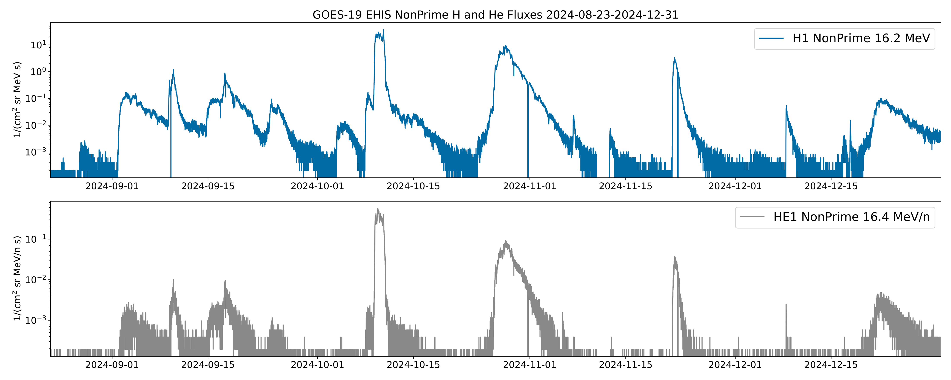
Solar Particle Events Since G19 SEISS Sensor Activation on 2024-08-22
Event analyzed for EHIS PS-PVR
Events analyzed for SGPS PS-PVR
SEP event of 9-10 October 2024 is largest event to date in Solar Cycle 25 (peak >10 MeV proton flux = 1810 pfu)
These GOES-19 data are preliminary, non-operational data and are undergoing testing. Users bear all responsibility for inspecting the data prior to use and for the manner in which the data are utilized.

Slide 16
Product Quality Assessment
PLPTs for Provisional
Top Level Evaluation
Provisional Performance Baseline Status
Note: ACE/SIS Level 2 data starting 30 Sept 2024 (BR 2606 and later) are not expected to be available until the end of January 2025. This is due to increased temperatures & noise around the December solstice as the instrument continues to age (see SIS L2 Release Notes, https://izw1.caltech.edu/ACE/ASC/DATA/level2/sis/sis_release_notes).
Therefore, in this PS-PVR, evaluation of G19 EHIS during the 9-10 Oct 2024 SEP event is limited to comparisons with G19 SGPS and G16 & G18 EHIS.
This still satisfies the RIMP criteria.

Slide 17
PLPTs for Provisional
PLPT-SEI-004: Solar Energetic Particle (SEP) Cross-Comparison
Event on 09-10 Oct 2024 (largest event since G19 launch) permits cross-calibration of H1-H5, HE1-HE2 and a few heavy ion species (C, O) in lowest energy channel
Solar wind dynamic pressure (Pdyn) was greater than 10 nPa for several hours during this event (10 Oct 2024, 16-22 UT)
When Pdyn > 10 nPa, SEP anisotropies and local time differences in the magnetosphere are greatly reduced
This permits reliable cross-calibration between different look directions and satellites (Rodriguez et al., 2014)
PLPT-SEI-006: Backgrounds
Important indicator of instrument performance
The original purpose of this PLPT was to determine whether backgrounds are consistent with model predictions of galactic cosmic ray (GCR) fluxes
Past results (GOES 16-18) have been mixed
The 4-month period following the turn-on of GOES-19 EHIS has been dominated by SEP events; meaningful comparison with GCR models is not possible
Instead, a comparison with GOES-16 and GOES-18 EHIS shows that the GOES-19 EHIS backgrounds are in-family - no anomalous noise sources

Slide 18
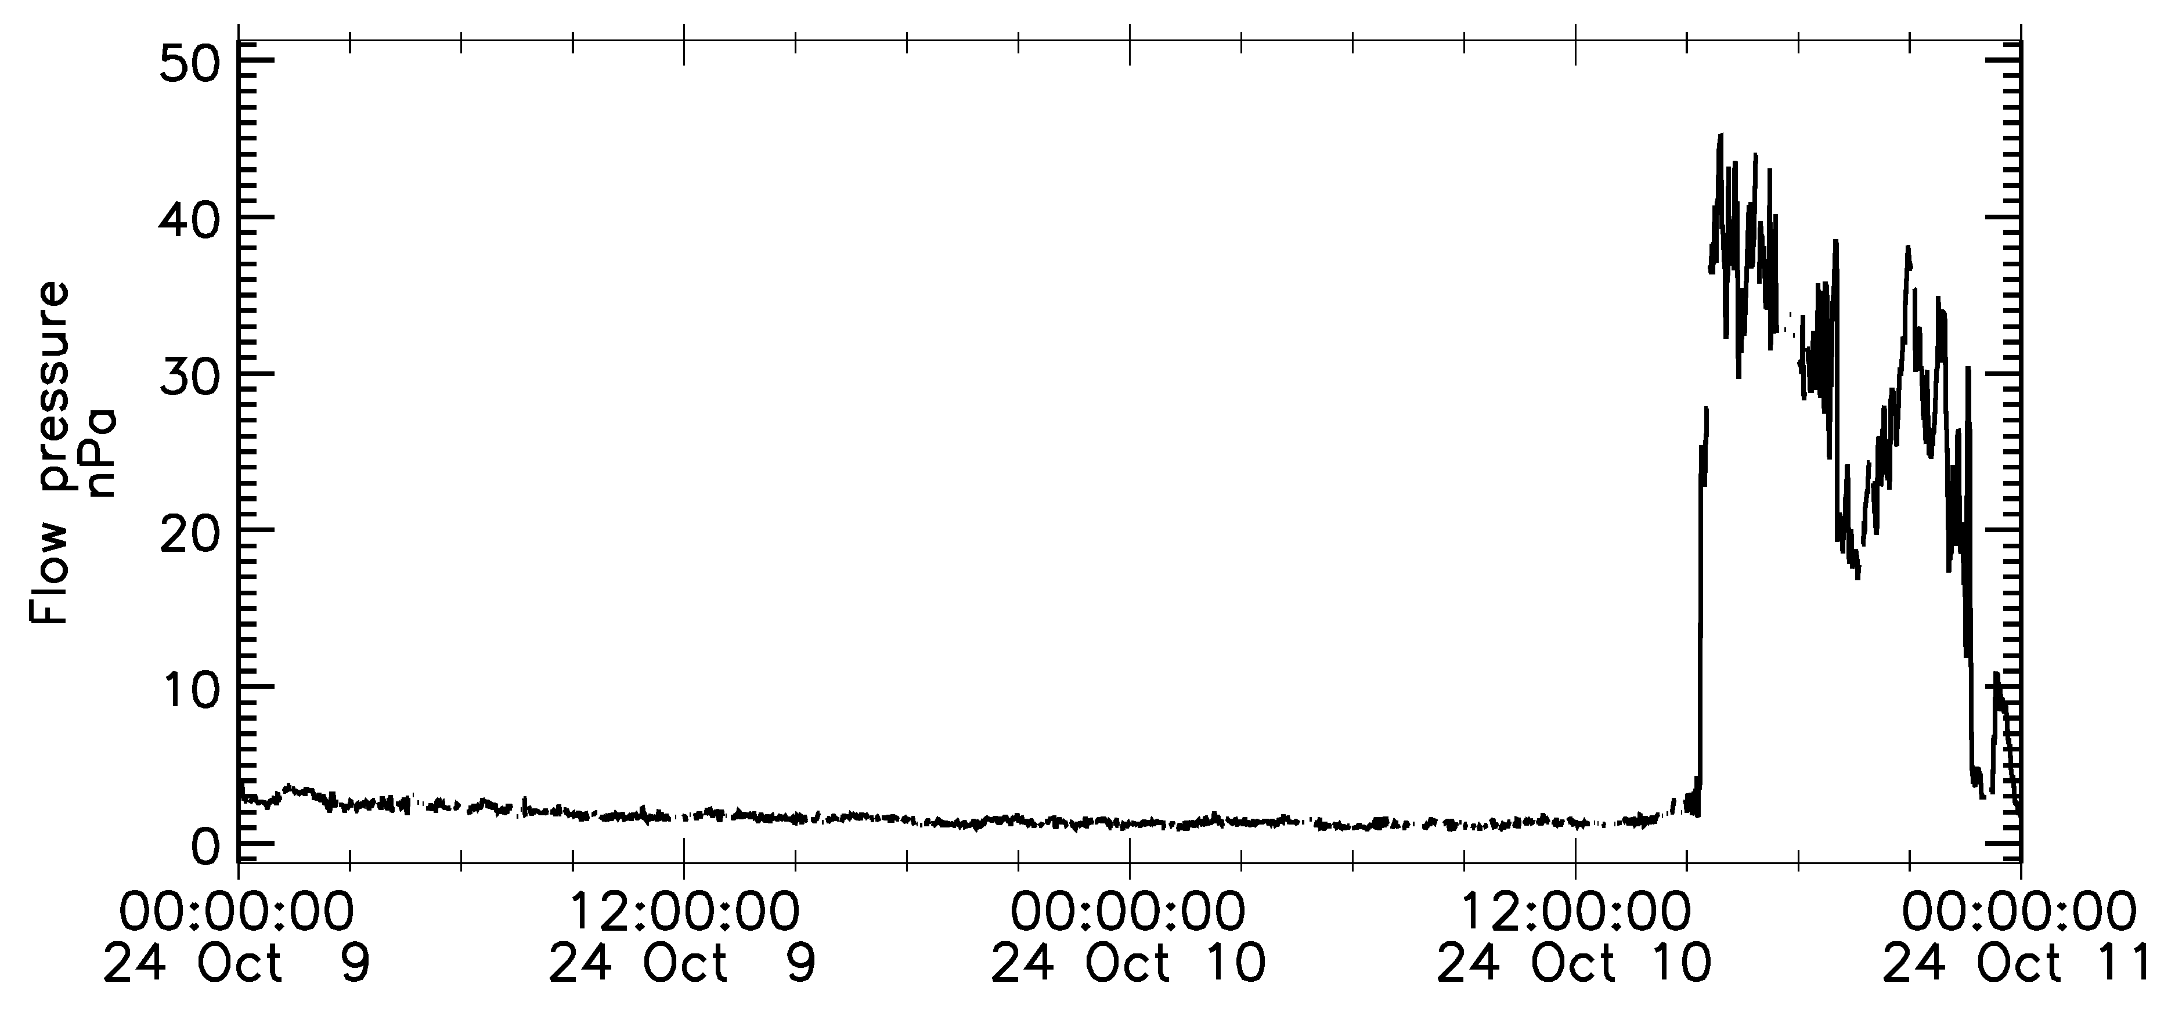
PLPT-SEI-004: SEP Cross-Comparison
H and He: G19/EHIS vs. G16 and G18/EHIS and G19/SGPS
10 Oct 2024, 16-22 UT: Pdyn > 10 nPa
Heavy ions (C, N, O): G19/EHIS vs. G16 and G18/EHIS
09 Oct 2024 06 UT - 10 Oct 2024 18 UT
NASA GSFC CDAWeb OMNI data (J. H. King and N. Papitashvili)
These GOES-19 data are preliminary, non-operational data and are undergoing testing. Users bear all responsibility for inspecting the data prior to use and for the manner in which the data are utilized.

Slide 19
PLPT-SEI-004: G19 vs. G16 EHIS Hydrogen H1
Outliers are due to natural variability
G19 EHIS H1 fluxes are 1.76x the G16 EHIS H1 fluxes (non-prime) based on ODR fit: m = 1.76 +/- 0.04
These GOES-19 data are preliminary, non-operational data and are undergoing testing. Users bear all responsibility for inspecting the data prior to use and for the manner in which the data are utilized.

Slide 20
PLPT-SEI-004: G19 vs. G16 EHIS Hydrogen H3
G19 EHIS H3 fluxes are 1.55x the G16 EHIS H3 fluxes (non-prime) based on ODR fit: m = 1.55 +/- 0.16
These GOES-19 data are preliminary, non-operational data and are undergoing testing. Users bear all responsibility for inspecting the data prior to use and for the manner in which the data are utilized.

Slide 21
PLPT-SEI-004: G19 vs. G16 EHIS Helium HE1
G19 EHIS HE1 fluxes are 1.81x the G16 EHIS HE1 fluxes (non-prime) based on ODR fit: m = 1.81 +/- 0.04
These GOES-19 data are preliminary, non-operational data and are undergoing testing. Users bear all responsibility for inspecting the data prior to use and for the manner in which the data are utilized.

Slide 22
PLPT-SEI-004: EHIS H and He cross-comparisons, L1b (prime)
 | G19 vs. G16 | G19 vs. G18 | G18 vs. G16
H1 | 1.53 ± 0.09 | 1.64 ± 0.14 | 0.92 ± 0.10
H2 | 0.71 ± 0.07 | 0.96 ± 0.08 | 0.74 ± 0.08
H3 | 1.55 ± 0.18 | 1.14 ± 0.12 | 1.37 ± 0.17
H4 | 1.47 ± 0.22 | 1.34 ± 0.19 | 1.12 ± 0.19
H5 | 1.07 ± 0.21 | 1.16 ± 0.22 | 0.92 ± 0.17
HE1 | 1.32 ± 0.06 | 1.62 ± 0.07 | 0.81 ± 0.04
Prime fluxes (side scintillator not in logic circuit)
10 Oct 2024, 16-19 UT: period of Pdyn > 10 nPa
Period shortened to avoid period of G19 repeated prime/non-prime switching
HE2-HE5 are too close to backgrounds for accurate analysis
Orthogonal Distance Regression (ODR) fit:
Accounts for uncertainty in both x and y variables
Uncertainty in fit increases as data become more noisy
HE1 is interpolated from SGPS fluxes (ADR 1064)
These GOES-19 data are preliminary, non-operational data and are undergoing testing. Users bear all responsibility for inspecting the data prior to use and for the manner in which the data are utilized.

Slide 23
PLPT-SEI-004: EHIS H and He cross-comparisons, non-prime
 | G19 vs. G16 | G19 vs. G18 | G18 vs. G16
H1 | 1.76 ± 0.04 | 1.29 ± 0.04 | 1.38 ± 0.06
H2 | 0.71 ± 0.04 | 0.91 ± 0.04 | 0.78 ± 0.05
H3 | 1.55 ± 0.16 | 1.00 ± 0.08 | 1.54 ± 0.16
H4 | 1.79 ± 0.18 | 1.52 ± 0.18 | 1.19 ± 0.14
H5 | 1.65 ± 0.27 | 1.32 ± 0.22 | 1.23 ± 0.21
HE1 | 1.81 ± 0.04 | 1.27 ± 0.03 | 1.44 ± 0.05
Non-prime fluxes (side scintillator in anti-coincidence)
10 Oct 2024, 16-22 UT: period of Pdyn > 10 nPa
HE2-HE5 are too close to backgrounds for accurate analysis
Orthogonal Distance Regression (ODR) fit:
Accounts for uncertainty in both x and y variables
Uncertainty in fit increases as data become more noisy
These GOES-19 data are preliminary, non-operational data and are undergoing testing. Users bear all responsibility for inspecting the data prior to use and for the manner in which the data are utilized.

Slide 24
PLPT-SEI-004: Same Satellite, Different Instruments
Characteristic | EHIS | SGPS
Look Directions | 1, radially outward | 2, westward and eastward
Field-of-view, full angle | 60º | T1 & T2: 60º, T3: 90º
Energy range, hydrogen (H) | 11 – 239 MeV | 1.0 – 500 MeV, >500 MeV
Number of channels, H | 5 differential | 13 differential, 1 integral
Geometric factors, H (prime) | 2.13, 1.05, 0.84, 0.56, 0.56 cm² sr | T1: 0.10-0.12, T2: 0.38-0.50, T3: 0.43-2.5 cm² sr
Energy range, helium (He) | 11 – 165 MeV/n | 1.0 – 224 MeV/n
Number of channels, He | 5 differential | 11 differential
Geometric factors, He (prime) | 2.15, 1.05, 0.72, 0.56, 0.56 cm² sr | T1: 0.05-0.11, T2: 0.29-0.31, T3: 0.72-2.5 cm² sr
EHIS H1 (11.0-24.0 MeV) and SGPS P5 (11.64-23.27 MeV) have nearly the same energy range, can be compared directly
GF (H1) = 2.13 cm² sr, GF (P5) = 0.12 cm² sr: H1 is 18x more sensitive than P5
EHIS HE1 (11-25.2 MeV/n) is bracketed by SGPS A4 (7.5-12.3 MeV/n) and A5 (14.0-24.9 MeV/n)
GF (HE1) = 2.15 cm² sr, GF (A4, A5) = 0.10 cm² sr: HE1 is >20x more sensitive than A4 and A5

Slide 25
PLPT-SEI-004: G19 EHIS and SGPS Hydrogen (1)
All EHIS and SGPS proton channels exhibit SEP fluxes above backgrounds during this event
EHIS HE1 and HE2 and SGPS A1-A6 exhibit SEP fluxes well above backgrounds during this event
EHIS
These GOES-19 data are preliminary, non-operational data and are undergoing testing. Users bear all responsibility for inspecting the data prior to use and for the manner in which the data are utilized.

Slide 26
PLPT-SEI-004: G19 EHIS and SGPS Hydrogen (2)
EHIS
EHIS
EHIS
EHIS
These GOES-19 data are preliminary, non-operational data and are undergoing testing. Users bear all responsibility for inspecting the data prior to use and for the manner in which the data are utilized.

Slide 27
PLPT-SEI-004: G19 EHIS and SGPS Helium
EHIS HE1 and HE2 and SGPS A1-A6 exhibit SEP fluxes well above backgrounds
EHIS
EHIS
EHIS
EHIS
These GOES-19 data are preliminary, non-operational data and are undergoing testing. Users bear all responsibility for inspecting the data prior to use and for the manner in which the data are utilized.

Slide 28
PLPT-SEI-004: Compare G19/EHIS H1 and G19/SGPS P5 16 MeV Proton Fluxes
Outliers are due to natural variability
Due to presence of natural outliers, Theil-Sen fit gives more reliable cross-calibration result: G19 EHIS H1 response is 50% that of G19 SGPS P5
These GOES-19 data are preliminary, non-operational data and are undergoing testing. Users bear all responsibility for inspecting the data prior to use and for the manner in which the data are utilized.

Slide 29
PLPT-SEI-004: H Fluence Spectra
EHIS np/SGPS-X = 0.60 @ H1 energy
EHIS np/SGPS-X = 0.15 @ H2 energy
EHIS np/SGPS-X = 0.37 @ H3 energy
EHIS np/SGPS-X = 1.24 @ H4 energy
EHIS np/SGPS-X = 3.47 @ H5 energy
EHIS NonPrime fluxes have OOM lower backgrounds
Backgrounds not removed
These GOES-19 data are preliminary, non-operational data and are undergoing testing. Users bear all responsibility for inspecting the data prior to use and for the manner in which the data are utilized.

Slide 30
PLPT-SEI-004: He Fluence Spectra, G19 EHIS and SGPS
SGPS A1 -X / +X = 1.03
SGPS A2A -X / +X = 1.97
SGPS A2B -X / +X = 1.17
SGPS A3 -X / +X = 1.03
SGPS A4 -X / +X = 0.65
SGPS A5 -X / +X = 0.75
SGPS A6 -X / +X = 0.75
Unreliable as measure of solar alpha particle fluence – dominated by backgrounds
EHIS np/SGPS-X = 0.48 @ HE1 energy
EHIS np/SGPS-X = 0.60 @ HE2 energy
Backgrounds not removed
These GOES-19 data are preliminary, non-operational data and are undergoing testing. Users bear all responsibility for inspecting the data prior to use and for the manner in which the data are utilized.

Slide 31
PLPT-SEI-004: He Fluence Spectra, G16, G18 and G19 SGPS
Unreliable as measure of solar alpha particle fluence – dominated by backgrounds
SEP flux ratios:
 | A1 | A2A | A2B | A3 | A4 | A5 | A6
-X G19:G16 | 0.94 | 1.13 | 1.52 | 0.87 | 0.48 | 0.61 | 0.70
-X G19:G18 | 1.07 | 1.00 | 1.26 | 1.14 | 0.80 | 0.99 | 0.73
+X G19:G16 | 0.96 | 0.49 | 0.94 | 1.05 | 1.52 | 1.46 | 0.96
+X G19:G18 | 0.95 | 0.55 | 1.03 | 0.91 | 1.27 | 1.11 | 1.09
Backgrounds not removed
These GOES-19 data are preliminary, non-operational data and are undergoing testing. Users bear all responsibility for inspecting the data prior to use and for the manner in which the data are utilized.

Slide 32
PLT-SEI-004: Comment on Inter-Calibrations
This event allowed inter-calibrations of H1-H5 and HE1-HE2 across 3 satellites (GOES 16, 18-19) and with both SGPS look directions.
This required solar wind Pdyn > 10 nPa for several hours during a SEP event.
Many of the differences (from regressions or event fluence comparisons) are >25% (the accuracy requirement).
Absolute accuracy cannot be verified on-orbit.
In such a comparison, one or both channels are not meeting the requirement.
As with SGPS, inter-calibration across all EHIS units now on-orbit (and with SGPS) is recommended.
Per COSPAR guidelines for radiation belt data, inter-calibration multiplicative scaling factors should be recorded as separate variables in the files in order to preserve traceability to the original calibrations.
This is the preferred approach for reprocessing.
In L1b, the practical approach would be to scale the geometric factors in the LUTs and to note this in the READMEs.
EHIS H and He are not used in operations, so the focus for Provisional has been ATC’s LUT and flight table updates for the heavy ion fluxes

Slide 33
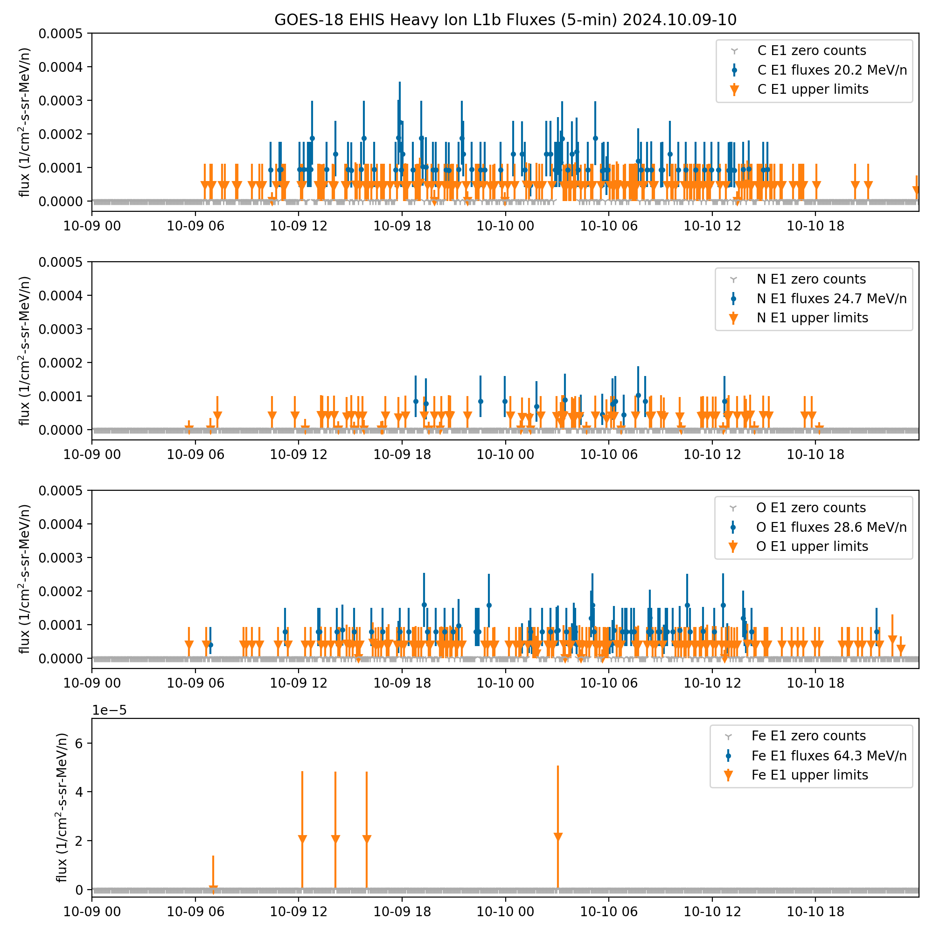
PLPT-SEI-004: G18 & G19 EHIS L1b, 9-10 Oct 2024, C, N, O and Fe
GOES-18
GOES-19
Some significant C, N and O flux readings at 5-min resolution; other elements (incl. Fe) are upper limits.
These GOES-19 data are preliminary, non-operational data and are undergoing testing. Users bear all responsibility for inspecting the data prior to use and for the manner in which the data are utilized.

Slide 34
PLPT-SEI-004: 09 Oct 2024 06 UT - 10 Oct 2024 22 UT, EHIS SCI-ELF histogram curve fits and event fluences
Apart from C, N and O in the E1 channel, histogram heavy-ion counts are very sparse during this event
GOES-16 SCI-ELF Histogram
GOES-19 SCI-ELF Histogram
N
Si
S
Fe
C
O
Ne
Mg
N
Si
S
Fe
C
O
Ne
Mg
 | Event Fluence (ions/cm²-sr-MeV/n) |  |  | Ratios
 | GOES-16 | GOES-18 | GOES-19 | 19:16 | 19:18
C (20.2 MeV/n) | 3.70 | 4.59 | 4.84 | 1.31 | 1.05
N (24.7 MeV/n) | 0.77 | 0.92 | 0.88 | 1.14 | 0.96
O (28.6 MeV/n) | 2.71 | 3.06 | 3.17 | 1.17 | 1.03
These GOES-19 data are preliminary, non-operational data and are undergoing testing. Users bear all responsibility for inspecting the data prior to use and for the manner in which the data are utilized.

Slide 35
PLPT-SEI-004 Conclusions
SEP event on 09-10 Oct 2024 was sufficiently large to permit cross-calibration of:
EHIS: H1-H5, HE1-HE2 and a few heavy ion species (C, N, O) in lowest energy channel
SGPS: 7 of 11 alpha particle channels (A1-A6)
Solar wind dynamic pressure (Pdyn) was greater than 10 nPa for several hours during this event (10 Oct 2024, 16-22 UT), permitting reliable cross-calibration between different look directions and satellites
Helium (alpha particles), ratios of event fluences:
G19 SGPS -X to G19 SGPS +X, channels A1-A6: 0.65 to 1.97 (5 of 7 channels within 25%)
G19 SGPS to G18 & G16: 0.48 to 1.52
G19 EHIS to G19 SGPS -X: 0.48 at HE1 energy, 0.6 at HE2 energy
Heavy ions (C, N, O in lowest energy channels), ratios of event fluences:
G19 EHIS to G16 EHIS: 1.14 to 1.17
G19 EHIS to G18 EHIS: 0.96 to 1.05
RIMP success criteria: On-orbit cross-calibration of EHIS with SGPS above 10 MeV, One Solar Energetic Particle (SEP) event, Differences quantified on data taken through validation phase.
RIMP success criteria met for SEP cross-comparison.
Partial calibration of heavy ions (C, N, O in lowest energy channel) due to borderline-size SEP event

Slide 36
PLPT-SEI-006: Backgrounds
The first 4 months of G19 EHIS data is characteristic of solar max: several overlapping SEP events (this was also observed in G19 SGPS data)
Using EHIS H1 (16.2 MeV) channel as criterion, it is not possible during this period to isolate a significant period of GCR-only data for comparison with GCR models
For Provisional validation, we rely on a qualitative comparison to show that G19 EHIS backgrounds are in-family with G16 and G18
These GOES-19 data are preliminary, non-operational data and are undergoing testing. Users bear all responsibility for inspecting the data prior to use and for the manner in which the data are utilized.

Slide 37
PLPT-SEI-006: G16 H, 2024-08-23 to 2024-12-31

Slide 38
PLPT-SEI-006: G18 H, 2024-08-23 to 2024-12-31

Slide 39
PLPT-SEI-006: G19 H, 2024-08-23 to 2024-12-31
These GOES-19 data are preliminary, non-operational data and are undergoing testing. Users bear all responsibility for inspecting the data prior to use and for the manner in which the data are utilized.

Slide 40
PLPT-SEI-006: G16 He, 2024-08-23 to 2024-12-31

Slide 41
PLPT-SEI-006: G18 He, 2024-08-23 to 2024-12-31

Slide 42
PLPT-SEI-006: G19 He, 2024-08-23 to 2024-12-31
These GOES-19 data are preliminary, non-operational data and are undergoing testing. Users bear all responsibility for inspecting the data prior to use and for the manner in which the data are utilized.

Slide 43
PLPT-SEI-006: Assessment
H and He:
Lowest G19 flux levels are in family with G16 and G18 fluxes
This indicates healthy instruments with no spurious noise sources
Heavy ions (C-Fe):
Not possible to extract heavy ion GCR fluxes during this 4-month solar max period
For GOES-19 Full validation, the goal is to reanalyze full bandpass functions to determine geometrical factors and effective energies appropriate for GCRs and to apply them to GCR counts isolated from a longer period of data
For this, we will need G19 bandpasses delivered by ATC under the aegis of a new SEA (as done already for G16 and G18)
RIMP success criteria: Evaluate EHIS backgrounds in terms of expected galactic cosmic ray (GCR) fluxes using two months of continuous data. Perform analysis during validation phase.
Partial success: solar max conditions prevent reliable comparison with models.
However, lowest G19 levels are in family with G16 and G18.
No risk to instrument performance is evident.

Slide 44
Top Level Evaluation
 | Status at Beta (22 Oct 2024) | Current Status (07 Feb 2025) | Future Outlook
Hydrogen (proton) flux | 09-10 Oct 2024 event was large enough for cross-calibration of all hydrogen channels | Ratios of G19 EHIS to G19 SGPS -X proton fluxes range from 0.15 at H2 energy to 3.5 at H5 energy | Looking forward to larger SEP events during solar max for Full Validation. Largest event of Solar Cycle 24 (08 Mar 2012) was 3.6x as large as 09-10 Oct 2024 event in >10 MeV proton flux.
Helium (alpha particle) flux | 09-10 Oct 2024 event was large enough for cross-calibration of some helium channels | G19 EHIS to G19 SGPS -X: 0.48 at HE1 energy, 0.6 at HE2 energy G19 SGPS -X to G19 SGPS +X, channels A1-A6: 0.65 to 1.97 G19 SGPS to G18 & G16, channels A1-A6: 0.48 to 1.52 | Looking forward to larger SEP events during solar max for Full Validation
Heavy ions (C-Cu) | 09-10 Oct 2024 event was just large enough to permit cross-calibration of a few heavy ion species in the lowest energy channel | 09-10 Oct 2024 C, N, O fluxes in lowest energy channels: G19 EHIS to G16 EHIS: 1.14 to 1.17 G19 EHIS to G18 EHIS: 0.96 to 1.05 ACE/SIS L2 fluxes not available yet for cross-calibration | Looking forward to larger SEP events during solar max for Full Validation of heavy ion species from carbon to iron

Slide 45
GOES-19 EHIS
Performance Baseline Status
Assessment at Provisional
MRD ID | Description | MRD Requirement | NCEI Assessment at Provisional | Related PLPTs | Status
1978 | EHIS Orthogonality/Coverage | 1 direction | 1 direction | -04, -06 | PASS
1982 | EHIS Measurement Range | 10-200 MeV/n 5 mass groups: H, He, (C,N,O), Ne-S, & Fe | All channels are reporting data; subset of channels could be cross-calibrated. | -04, -06 | Channels cross-calibrated: H1-H5; HE1-HE2; E1 C, N, O; SGPS A1-A6
1983 | EHIS Measurement Accuracy | 45% @min flux, 25% @10X min flux | Absolute accuracy cannot be verified on-orbit. | -04, -06 | See summary on previous chart

Slide 46
Provisional Maturity Assessment
GOES-19 EHIS L1b Product Provisional PS-PVR

Slide 47
Provisional Validation
Preparation Activities | Assessment
Validation activities are ongoing and the general research community is now encouraged to participate. | Validation activities are ongoing. GOES-19 EHIS data will be made available via NCEI’s website.
Severe algorithm anomalies are identified and under analysis. Solutions to anomalies are in development and testing. | There are currently no severe EHIS L1b algorithm anomalies. Continuing on-orbit calibration and cross-calibration are needed during large SEP events.
Incremental product improvements may still be occurring. | Product improvements will result from adjustments to flight science tables following extended-period on-orbit calibration, including a large SEP event.

Slide 48
Provisional Validation
End State | Assessment
Product performance has been demonstrated through analysis of a small number of independent measurements obtained from select locations, periods, and associated ground truth or field campaign efforts. | G19 EHIS SEP fluxes have been compared to G18 and G16 EHIS and to G19 SGPS. G19 SGPS alpha particle fluxes have been compared to G18 and G19 SGPS.
Product analysis is sufficient to communicate product performance to users relative to expectations (Performance Baseline). | All G19 EHIS hydrogen (proton) channels have been cross-calibrated. Only the two lowest-energy helium channels and 3 heavy ion elements (C, N, O) in the lowest-energy channel could be cross-calibrated.
Documentation of product performance exists that includes recommended remediation strategies for all anomalies and weaknesses. Any algorithm changes associated with severe anomalies have been documented, implemented, tested, and shared with the user community. | This presentation and README describe discrepancies and caveats at Provisional as well as peculiarities of the L1b product.
Testing has been fully documented. | This presentation.
Product is ready for operational use and for use in comprehensive cal/val activities and product optimization. | NCEI recommends real-time data distribution of GOES-19 EHIS data via the SWPC product testbed.

Slide 49
Path to full Validation Maturity
GOES-19 EHIS L1b Product Provisional PS-PVR

Slide 50
Path to Full Validation
PLPTs to be conducted prior to Full Validation
Risks to getting to Full

Slide 51
Path to Full Validation - PLPTs
Title | Activity | Data Needed | Success Criteria
A.3.4 SEP Channel Cross-Comparison [PLPT-SEI-004] | On-orbit cross-calibration of EHIS with SGPS above 10 MeV | Two Solar Energetic Particle (SEP) events. | [Full] Differences quantified on data taken through validation phase.
A.3.6 Backgrounds Trending [PLPT-SEI-006] | Evaluate EHIS backgrounds in terms of expected galactic cosmic ray (GCR) fluxes. | Four months of continuous data. | [Full] Perform analysis during validation phase.
EHIS Full PLPTs from RIMP v 2.0 (09 July 2021) – continuation of Provisional
Data requirements for Full validation:
A.3.3: 2 SEP events required
A.3.5: 4 months of data required
Full validation is not possible without at least one large SEP event with heavy ion fluxes (Carbon to Iron) above backgrounds
GOES-18 full validation had to wait for the 08 June 2024 SEP event, 19 months after the Provisional PS-PVR

Slide 52
Path to Full Validation – Risks
Risk Name | Description | Impact | Mitigation
No significant SEP Fluxes heavier than Oxygen observed for cross-calibration | IF a large SEP event does not take place | THEN G19 EHIS cannot reach Full Maturity | Need an event at least as large / iron-rich as those of 10 September 2017 or 08 June 2024 Current solar max period increases likelihood of such an event occurring
GCR fluxes cannot be analyzed due to solar activity | IF there is not an extended period of low solar activity | THEN Comparisons with GCR models will not be meaningful | At odds with current solar maximum and the need for a large SEP event! May have to wait a few years for meaningful analysis

Slide 53
Summary & Recommendations
GOES-19 EHIS L1b Product Provisional PS-PVR

Slide 54
Summary
Largest Solar Energetic Particle (SEP) event since GOES-19 launch (largest in Solar Cycle 25 to date) permitted partial evaluation of EHIS heavy ion and and helium fluxes and SGPS helium fluxes, and full evaluation of all EHIS hydrogen channels.
Risks to reaching Full Maturity have been identified.
Fixes to two ADRs remain to be deployed to OE.

Slide 55
Recommendation
NCEI believes that the GOES-19 EHIS L1b product has reached Provisional Maturity as defined by the GOES-R Program, with the closure of the following ADRs:
ADR 1383: In OE next week. Missing helium energies restored to L1b files in DE.
ADR 1411: In OE tentatively in April. No HE1 and HE2 fluxes when satellite is inverted.
ADR 1531: Closed. Updated flight science tables and LUT based on results of PLT-002 installed on 27 January 2025. Validated by NCEI through reanalysis of SCI-PHA data from 09-10 Oct 2024 SEP event.
Caveats:
The largest SEP event to date during Solar Cycle 25 and since GOES-19 launch still only permitted cross-calibration of all five EHIS hydrogen channels, the first two EHIS helium channels, the first seven SGPS helium channels, and three heavy ion species (carbon, nitrogen, and oxygen) in the lowest-energy EHIS channel
As with GOES-18, full validation should wait until a sufficiently large SEP event is observed (with significant L1b fluxes from C to Fe)
NCEI recommends that the following Special Engineering Analyses (SEAs) be performed by ATC:
Perform extended-period on-orbit calibration analysis, using at least one large SEP event or several years of GCR data: GOES-18 and -19 (already performed for G16 and G17)
Calculate energy response functions: G19 (already performed for G16 and G18)

Slide 56
Backup charts

Slide 57
Nomenclature and Flux Units
A proton is the nucleus of a hydrogen atom
Atomic number Z = 1
One nucleon: proton
An alpha particle is the nucleus of a helium-4 atom
Atomic number Z = 2
Four nucleons: two protons and two neutrons
SGPS L1b proton and alpha particle fluxes are provided in units of particles/(cm² sr s keV)
EHIS L1b hydrogen and helium nucleus fluxes are provided in units of particles/(cm² sr s MeV/nuc)
To convert SGPS units to EHIS units:
Multiply by 1000
Multiply by the number of nucleons (1 or 4)

Slide 58
EHIS Data Description
L1b He and H (Priorities 2 and 3) fluxes are calculated from coincidence rates contained in SCI-HCR packets
1-s cadence, complete set of rates in 3 s – averaged to 5 minutes
Corrected for dead time using 3-s Priority counts contained in SCI-HCR packets
L1b heavy ion (Priority 1) fluxes [Z = 6 (C) to 29 (Cu)] calculated from histograms contained in SCI-ELF packets and summed Priority 1 counts from SCI-HCR packets
1-m cadence, 5 histograms summed prior to nonlinear maximum likelihood fit
Corrected for dead time using time-averages of 3-s Priority counts contained in SCI-HCR packets
Corrected for upward fluxes using Priority counts in SCI-PEC packets (1-m cadence)
Scintillator (S) used in anti-coincidence (.NOT.S) to exclude side-penetrating particles when S is less than ‘High Flux Level’ value in ‘sci_cnfg’ flight table
.NOT.S = Non-Prime
NO S = Prime
SCI-HCR packets contain both NonPrime and Prime rates
Each minute, SCI-ELF (histograms) and SCI-PEC packets are either NonPrime or Prime, based on Scintillator state
Reported L1b fluxes (H, He, heavies) are NonPrime or Prime based on Scintillator state
1-Hz SCI-PHA packets contain highest-priority particle event every second
Designed as a valuable diagnostic; not used in real-time (L1b processing)
NonPrime is higher priority than Prime, Priority 1 is higher priority than Priority 2, etc.
SEPs analyzed using L1b H and He fluxes from EHIS and SGPS
Heavy ion GCRs analyzed using P1 histograms accumulated from PHA packets
In GEO, EHIS L1b data are almost always in Prime state due to high levels of radiation belt electron fluxes incident on the anti-coincidence Scintillator.

Slide 59
PLPT-SEI-004: Cross-calibrating Noisy Data
Linear least squares assumes that the independent variable is free of uncertainty and that the data are homoskedastic (have constant variance)
Cross-calibrating weak SEP events involves noisy independent and dependent variables that significantly violate these assumptions
Three methods used in preference to linear least squares:
Theil-Sen (Sen 1968)
Data can be heteroskedastic
Does not account for uncertainty in either variable
Python stats.mstats.theilslopes
Orthogonal Distance Regression (ODR) (Boggs+ 1992)
Accounts for uncertainty in both variables
Python scipy.odr library
Also used for G18 MAG cal/val
Numerical Recipes ‘fitexy’ (Press & Teukolsky 1992)
Accounts for uncertainty in both variables
Generalization of linear least squares
Available in IDL

Slide 60
References
Boggs, P. T., Byrd, R. H., Rogers, J. E., & Schnabel, R. B. (1992). User’s Reference Guide for ODRPACK Version 2.01, Software for Weighted Orthogonal Distance Regression, NISTIR 4834, U. S. Department of Commerce
Press, W. H., & Teukolsky, S. A. (1992) Fitting straight line data with errors in both coordinates. Computers in Physics, 6, 274.
Rodriguez, J. V., J. C. Krosschell, and J. C. Green (2014), Intercalibration of GOES 8–15 solar proton detectors, Space Weather, 12, 92–109, doi:10.1002/2013SW000996.
Sen, P. K. (1968). Estimates of the Regression Coefficient Based on Kendall’s Tau. J Am Stat Assoc 63: 1379–1389.

