Slide 1
Peer Stakeholder-Product Validation Review (PS-PVR)
For the Provisional Maturity of GOES-19 SEISS
MPS-HI L1b Product
February 14, 2025
GOES-R Calibration Working Group (CWG)
Presenter: Athanasios Boudouridis
Contributors: Juan Rodriguez, Brian Kress, Kevin Hallock, William Rowland
CIRES and NOAA NCEI
The NCEI team wish to thank the MPS-HI vendor Assurance Technology Corporation, the Space Weather Prediction Center, and the GOES-R Program

Slide 2
Outline
Introduction
Review of Beta Maturity
  Beta PLTs
  ADR/WR status
Product Quality Evaluation
  PLPTs for Provisional Maturity
  Status at Provisional Validation Review
  Review of remaining issues
Provisional Maturity Assessment
  Status
  Performance
  Risks
Path to Full Validation Maturity
Summary and Recommendations
Backup Slides

Slide 3
GOES-R Program
Satellites launched to date:
  GOES-16 (R): launched 19 November 2016
    GOES-East (75.2ºW) since 18 December 2017
  GOES-17 (S): launched 01 March 2018
    In storage (104.7ºW) since 14 March 2023
    Was GOES-West (137.2ºW) from 12 February 2019
    to 4 January 2023
  GOES-18 (T): launched 01 March 2022
    GOES-West (137ºW) since 4 January 2023
  GOES-19 (U): launched 25 June 2024
    Currently undergoing post-launch tests (89.5ºW)
    Will replace GOES-16 as GOES-East on April 4, 2025 (75.2ºW)
Each GOES-R-series observatory carries a Space Environment In-Situ Suite (SEISS)
  GOES-19 SEISS was turned on on 22 August 2024

Slide 4
Magnetospheric Particle Sensor –
High Energy (MPS-HI)
MRD 3.3.6.1.3 Magnetospheric Electrons and Protons: Medium and High Energy
Primary purpose: measure radiation belt particle fluxes in the energy range responsible for internal charging
5 electron telescopes and 5 proton telescopes
  30 deg full-width conical FOVs, centers separated by 35 deg
Each electron telescope:
  10 differential channels, 50 keV – 4 MeV
  2 integral channels, >2 MeV and >4 MeV (latter not part of L1b)
Each proton telescope:
  11 differential channels
  7 channels, 80 keV – 1 MeV (trapped)
  4 channels, 1-12 MeV (solar protons)
Two dosimeters (250 and 100 mil Al)
  Distinguish particles depositing < 1 MeV and >1 MeV
Credit: SEISS-TR-MH074-2 Rev C, Figure 3-1

Slide 5
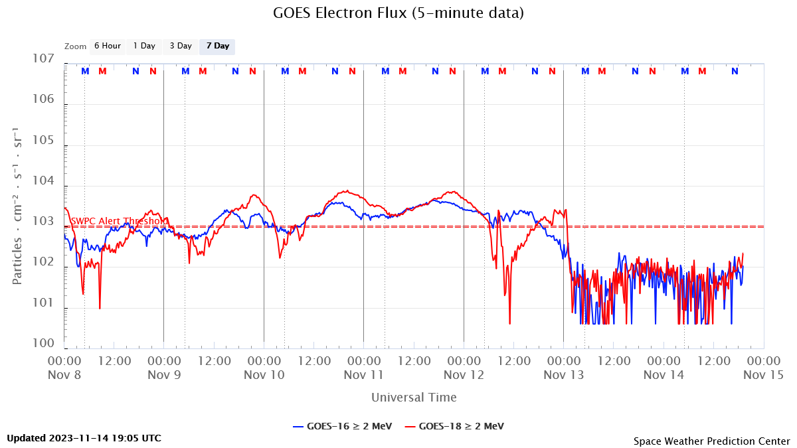
ALERT: Electron 2 MeV Integral Flux Exceeded 1000 pfu
Space Weather Message Code: ALTEF3
Serial Number: 3381
Issue Time: 2023 Nov 07 1624 UTC
ALERT: Electron 2MeV Integral Flux exceeded 1000pfu
Threshold Reached: 2023 Nov 07 1600 UTC
Station: GOES16
Potential Impacts: Satellite systems may experience significant charging resulting in increased risk to satellite systems.
Space Weather Message Code: ALTEF3
Serial Number: 3386
Issue Time: 2023 Nov 12 0500 UTC
CONTINUED ALERT: Electron 2MeV Integral Flux exceeded 1000pfu
Continuation of Serial Number: 3385
Begin Time: 2023 Nov 07 1600 UTC
Yesterday Maximum 2MeV Flux: 4373 pfu
Space Weather Prediction Center (SWPC) alert at 1000 electrons/(cm² sr s) [pfu] was developed in consultation with the satellite industry
Based always on GOES-East observations
  Fluxes systematically lower than at GOES-West by factor of 2.5 [Meredith et al., 2015]
First alert was issued on 18 May 1995
MeV electron fluxes have been very elevated starting in 2015
  Primarily owing to the action of stream interaction regions (interface between solar wind of coronal hole and quiet sun origins) on the magnetosphere

Slide 6
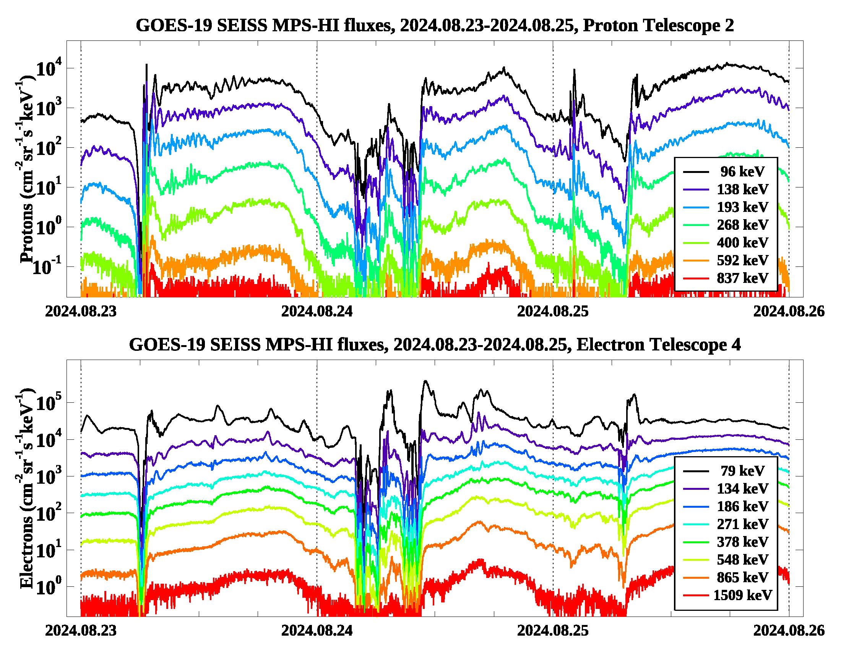
GOES-19 SEISS
First Public Image (MPS-HI)
These GOES-19 data are preliminary, non-operational data and are undergoing testing. Users bear all responsibility for inspecting the data prior to use and for the manner in which the data are utilized.

Slide 7
GOES-19 Provisional Summary
NCEI believes that the GOES-19 MPS-HI L1b product has reached the Provisional Maturity as defined by the GOES-R Program
Remaining issues
  GOES-19 MPS-HI proton telescopes 3-5 report lower fluxes than telescopes 1-2
  Low high-energy electron fluxes, channels E9-E11, hinder calibration efforts
  Background correction: the space environment is changing. Requires continued monitoring of E9-E11 background removal, and a possible revision of the background removal coefficients in the future
These GOES-19 data are preliminary, non-operational data and are undergoing testing. Users bear all responsibility for inspecting the data prior to use and for the manner in which the data are utilized.

Slide 8
Review of BETA Maturity
G19 SEISS Beta, October 22, 2024
GOES-19 MPS-HI L1b Products Provisional PS-PVR

Slide 9
G19 MPS-HI Vendor PLTs
PLT | CDRL | PLT Name | Start Date | End Date | Prelim Report Due (+2 Weeks) | Final Report Due (+2 Months)
 | SEISS-TR-Y121-4-2 | Sensor Activation | 8/22/2024 | 8/22/2024 | 9/5/2024 | 10/22/2024
SEI-003 | SEISS-TR-Y121-4-4 | MPS-HI Initial IFCs | 8/26/2024 | 8/27/2024 | 9/10/2024 | 10/25/2024
SEI-012 | SEISS-TR-Y121-4-12 | MPS-HI E11 Cross Sensor Comparison | 8/27/2024 | 9/26/2024 | 10/10/2024 | 11/26/2024
IFC – In-flight Calibration
No SEISS PLPTs supporting Beta maturity.
NCEI verified G19 MPS-HI science measurements in L1b data.
These GOES-19 data are preliminary, non-operational data and are undergoing testing. Users bear all responsibility for inspecting the data prior to use and for the manner in which the data are utilized.

Slide 10
Instrument/GPA Issues Identified and Progress Status: MPS-HI
Following is a list of ADRs that directly or indirectly affect the GOES-19 MPS-HI.
ADR# | WR# | Short Description | Current Status | Expected Closure
780 | 6845 | G16 & G17 MPS-HI and MPS-LO L1b IFC Leakage | Closed | DO.12.00.00
781 | 6477 8404 | G16 & G17 MPS-HI and SGPS L1b data gaps near IFCs | Completed | DO.09.02.00 DO.13.00.03
863 | 6736 | Graceful degradation when SGPS data not generated | In Work | DO.16.00.00
1155 | 8582 | G16 MPS-Hi P1 Channel Calibration Refinement | Closed | PR.12.06.01
1204 | 8993 | MPS-Hi Proton Flux in G-16 and G-17 | HOLD | Revisit 04/2025
1402 | --- | GOES-U SEISS CDRL79 RevA for PLT | Closed | PR.13.07.00
1517 | --- | G19 SEISS MPS-HI LUT Update | Closed | PR.13.10.05
These GOES-19 data are preliminary, non-operational data and are undergoing testing. Users bear all responsibility for inspecting the data prior to use and for the manner in which the data are utilized.

Slide 11
ADR 863: Graceful degradation when SGPS data not generated
Applies to all GOES-R spacecraft
Four electron channels from MPS-HI use SGPS-X data for a contamination correction. The SGPS P5 channel uses data from the opposite SGPS for a contamination correction. If for some reason (like a sensor failure) no data are being generated from one of the SGPS units, then the dependent products should still be produced with only graceful degradation. This is a generalization of ADR 781.
With respect to MPS-HI:
Case 1: SGPS-X data are not being generated
  MPS-HI fluxes should be calculated as if SGPS-X fluxes were zero rather than missing -- graceful degradation of 4 electron channels.
Case 2: SGPS+X data are not being generated.
  MPS-HI fluxes should be produced, no dependence on SGPS+X, no degradation.
Case 3: neither SGPS+X nor SGPS-X data being generated
  MPS-HI fluxes should be calculated as if SGPS-X fluxes were zero rather than missing -- graceful degradation of 4 electron channels.
ADR 863 is in its final stages. Test data with artificially missing SGPS data are expected from Ground for accurate verification by NCEI.
These GOES-19 data are preliminary, non-operational data and are undergoing testing. Users bear all responsibility for inspecting the data prior to use and for the manner in which the data are utilized.

Slide 12
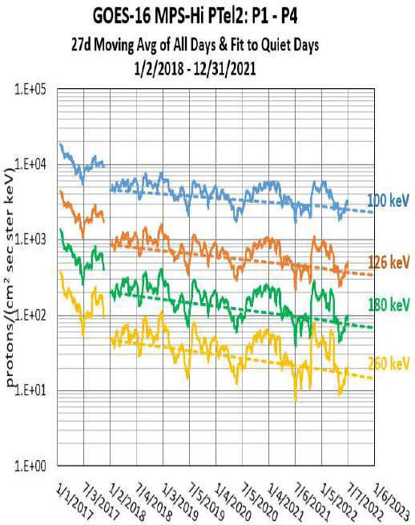
ADR 1204: MPS-HI Proton Flux in GOES-16 and GOES-17
Applies (potentially) to all GOES-R spacecraft
ADR text submitted by MIT Lincoln Labs: The daily average of measured flux of protons by the seven lowest energy channels of the five MPS-HI Proton Telescopes on both the GOES-16 and GOES-17 has been decreasing by approximately 15% to 25% per year. An examination of data, including the sunspot number, DSCOVR data and the MPS-HI electron data, has shown that the decreases are not related to the ambient particle environment or the solar cycle. These decreases cause the product requirement of 25% accuracy requirement to be violated approximately a year after the start of on-orbit operation. Recommend that the method to adjust the measured fluxes be applied to the operational product and be included in the L1b files as an additional field.
Courtesy of MIT LL
Assumes loss of gain of the proton detectors over time
Uses a 27-day moving average of all days within 01/02/2018-12/31/2021
Conducts linear fit of the quiet days
Assuming the decline continues, uses the fit parameters to lift up the declining fluxes and level the data
NCEI believes this interpretation of the decline to be erroneous
Instead of detector gain loss, NCEI believes a dead layer is forming at the surface of the detector, causing the effective energy to move upwards
These GOES-19 data are preliminary, non-operational data and are undergoing testing. Users bear all responsibility for inspecting the data prior to use and for the manner in which the data are utilized.

Slide 13
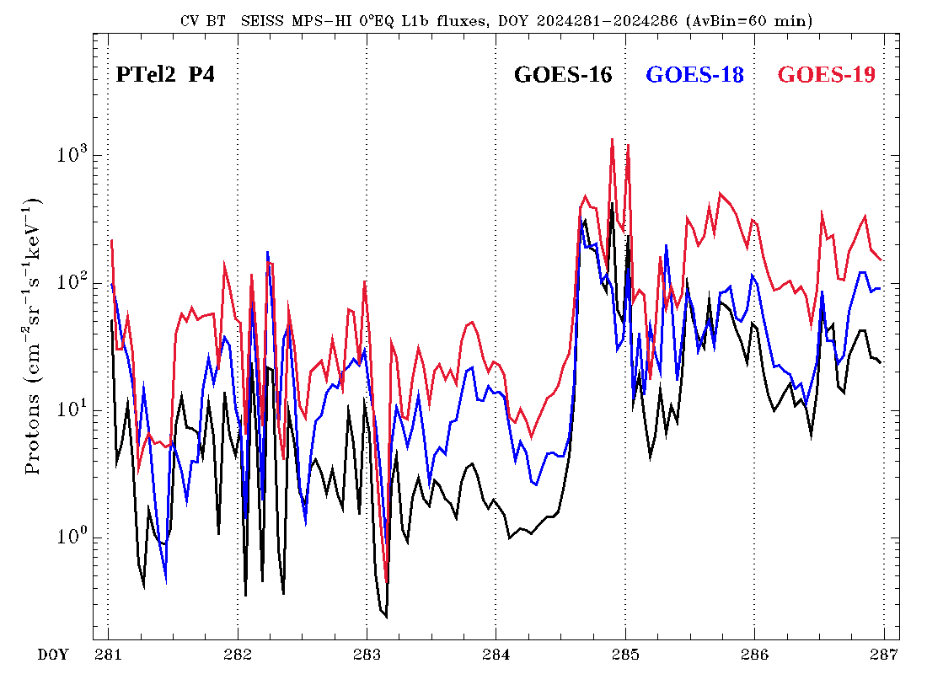
ADR 1204: New evidence from the
October 2024 Geomagnetic Storm
Three spacecraft plot, October 7-13, 2024
Compression of the magnetosphere during the October 2024 Geomagnetic Storm
Magnetopause crossing occurs on October 10, 2024
Prior to the crossing big differences among the GOES spacecraft, PTel2, P4 channel
After the crossing fluxes from all three are brought together
Not consistent with detector gain loss, as the fluxes will stay different through the crossing
But consistent with effective energy move to higher values. Typical magnetospheric proton spectra fall steeply with energy, while magnetosheath spectra are more flat.
Two types of spectra
(on following slide)
Magnetopause crossing
These GOES-19 data are preliminary, non-operational data and are undergoing testing. Users bear all responsibility for inspecting the data prior to use and for the manner in which the data are utilized.

Slide 14
ADR 1204: Flux correction, at a given energy, dependence on spectral slope
Flux
Flux
Actual spectrum
Actual spectrum
Reported
spectrum
Reported
spectrum
Energy
Energy
E_{chan.}
Reported E_{chan.}
Actual E_{chan.} (shifted)
If there is degradation in all channel gains, then we expect the same vertical distance between the degraded and actual spectra regardless of spectral slope.
If channels are shifted upward in energy, then a flatter spectrum reduces the vertical distance between reported and actual spectra.
These GOES-19 data are preliminary, non-operational data and are undergoing testing. Users bear all responsibility for inspecting the data prior to use and for the manner in which the data are utilized.

Slide 15
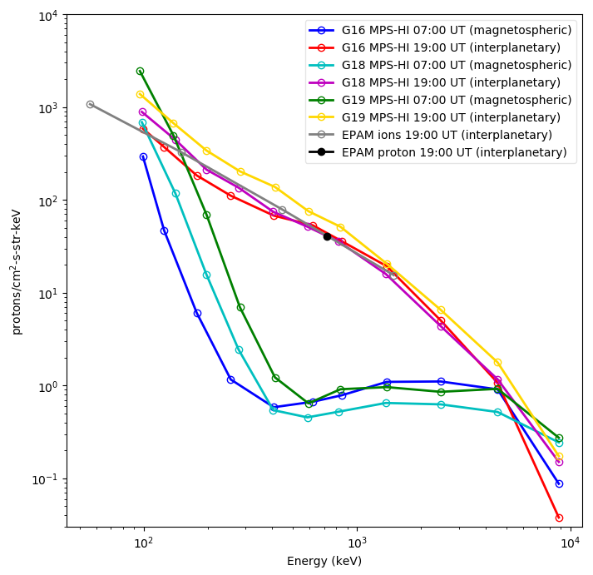
ADR 1204: Measured Proton Spectra and conclusions
Proton spectra on October 10, 2024
The apparent degradation of the MPS-HI P1-P4 (and possibly P5-P7) channels has been amply documented in previous MPS-HI reviews
It led to the submission of ADR 1204 by MIT LL in an effort to correct the affected fluxes, assumed to be the result of detector gain loss over time
New evidence from the October 2024 Geomagnetic Storm suggests that the actual cause is an upward shift of the channel effective energy
The reported proton counts are the convolution of the channel response function and the applied spectrum. Higher effective energy leads to lower counts for a steep spectrum, but not for a flat one
Interplanetary SEP spectrum
P4
Interplanetary SEP spectrum
Outer proton radiation belt
In light of this new evidence NCEI recommends the cancellation of ADR 1204, as it provides the wrong solution to the problem
NCEI will continue to investigate the issue of detector degradation in terms of energy shift
The observed storm spectra provide a way to estimate this energy shift
NCEI will provide a real time solution and/or a reprocessing one, based on their future results
P4
100s of keV to several MeV SEPs entering the magnetosphere
These GOES-19 data are preliminary, non-operational data and are undergoing testing. Users bear all responsibility for inspecting the data prior to use and for the manner in which the data are utilized.

Slide 16
ADR 1517: Modification of the
GOES-19 MPS-HI LUT
  L1b overcorrection of MPS-HI electrons, resulting in artificial dropouts and unphysical fluxes
      Affects all electron channels, differential and integral
      Result of the inverse matrix technique to determine fluxes
      Solution: diagonal matrix derived using the Bowtie technique
  L1b insufficient background correction for MPS-HI electrons, resulting in higher background levels
      Affects electron channels E9-E11
      Especially important for integral channel E11, as it affects the Space Weather Prediction Center alerts
      Result of small background removal coefficients
      Solution: calculate new background removal coefficients (PLPT-SEI-006)
These GOES-19 data are preliminary, non-operational data and are undergoing testing. Users bear all responsibility for inspecting the data prior to use and for the manner in which the data are utilized.

Slide 17
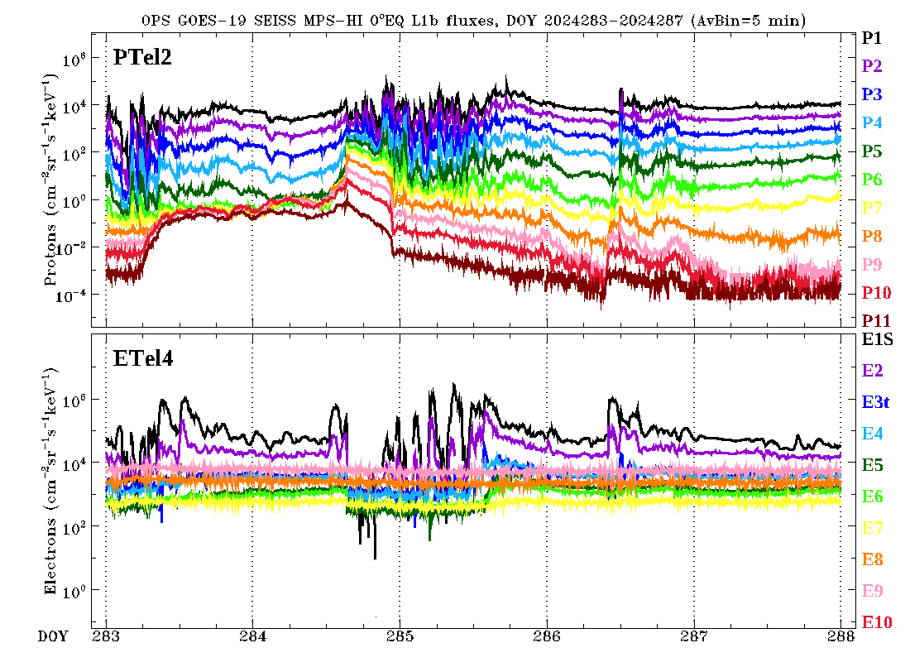
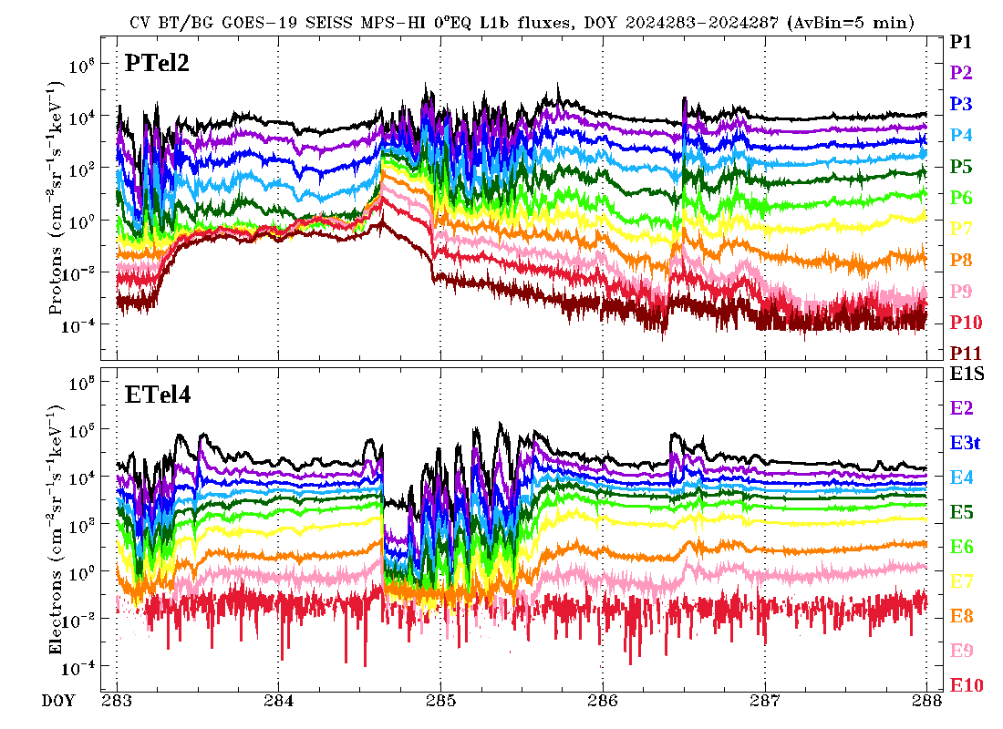
ADR 1517: Modification of the
GOES-19 MPS-HI LUT
OPS L1b, October 9-13, 2024
Bowtie technique, October 9-13, 2024
No correction for protons
Application of the bowtie analysis to produce L1b electron fluxes from L0 counts
Uses a diagonal matrix with Geometric Factors (GF) and channel Effective Energies derived from the minimalization of the variation of the GF for a variety of spectra, using a proxy dataset (CRRES)
The bowtie technique is successful in producing good quality L1b electron data from L0 counts
Boudouridis, A., Rodriguez, J. V., Kress, B. T., Dichter, B. K., & Onsager, T. G. (2020). Development of a bowtie inversion technique for real‐time processing of the GOES‐16/‐17 SEISS MPS‐HI electron channels. Space Weather, 18, e2019SW002403. https://doi.org/10.1029/2019SW002403
These GOES-19 data are preliminary, non-operational data and are undergoing testing. Users bear all responsibility for inspecting the data prior to use and for the manner in which the data are utilized.

Slide 18
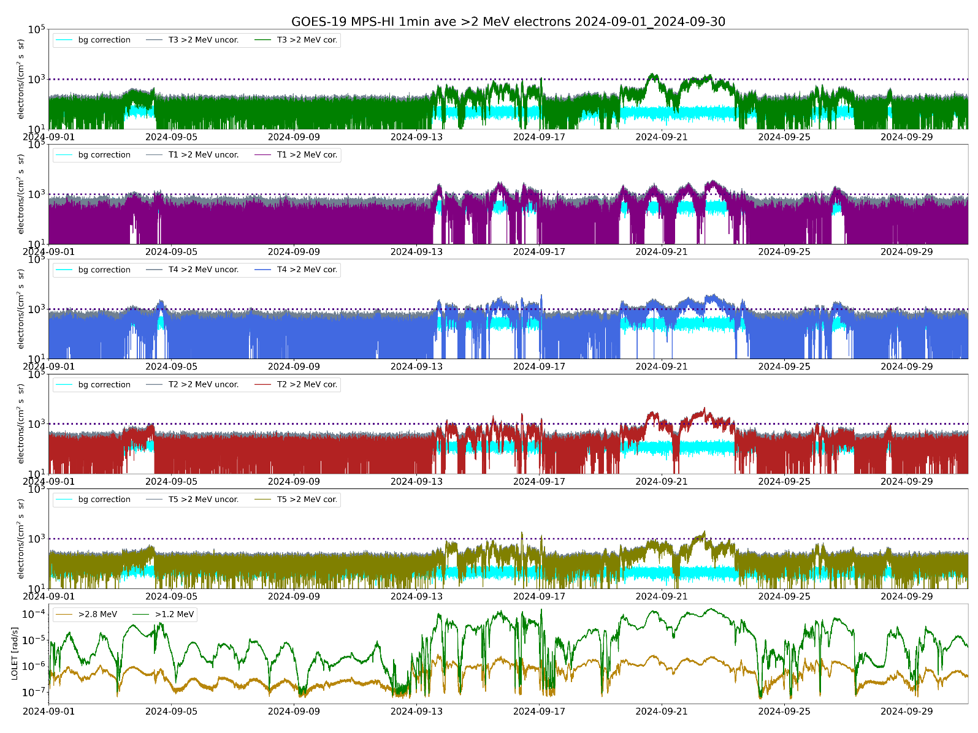
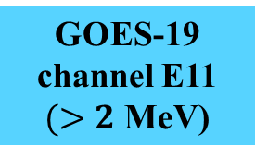
ADR 1517: Modification of the
GOES-19 MPS-HI LUT
T3
GOES-19 channel E11 $(>2$ MeV)
T1
1000 electrons per (cm² sr s)
T4
SWPC alert level very close to uncorrected backgrounds
T2
T5
Corrected backgrounds more representative of the GCR spectrum
DOS
These GOES-19 data are preliminary, non-operational data and are undergoing testing. Users bear all responsibility for inspecting the data prior to use and for the manner in which the data are utilized.

Slide 19
Product quality EVALUATION
GOES-19 MPS-HI L1b Products Provisional PS-PVR

Slide 20
Path to Provisional Validation - PLPTs
Title | Activity | Data Needed | Success Criteria
A.2.1 MPS-Hi Telescope Cross-Comparison [PLPT-SEI-002] | Determine the relative sensitivity/response among MPS-HI telescopes. | One month of continuous data. (MAG, MPS-HI) | Telescopes agree to within 25%.
A.2.3 SEP Channel Cross-Comparison [PLPT-SEI-004] | On-orbit cross-calibration of MPS-HI with SGPS 1-12 MeV protons, and all operational GOES-R Series SEISS sensors. | One Solar Energetic Particle (SEP) event. | Differences quantified on data taken through validation phase.
A.2.4 Cross Satellite Comparison of Trapped Particles [PLPT-SEI-005] | To inter-calibrate MPS-HI with the same measurements on other operational GOES-R Series satellites. The MPS-HI inter-calibration part of the test is critical for establishing the consistency of the NOAA real-time >2 MeV electron flux alerts between operational GOES-R Series satellites. | One month of continuous data. (MAG, MPS-HI) | Differences quantified on data taken through validation phase.
A.2.5 Backgrounds Trending [PLPT-SEI-006] | To evaluate MPS-HI backgrounds in terms of expected galactic cosmic ray (GCR) fluxes. | Two months of continuous data. (MPS-HI, SGPS) | Perform analysis during validation phase. Natural backgrounds preliminarily correlated with solar protons and GCRs.
MPS-HI Provisional Validation PLPTs from RIMP v 2.0 (09 July 2021).

Slide 21
Use of Reprocessed Data in Provisional Validation PLPTs
Due to the date of changes to OE (ADR 1517 for GOES-19 implemented on 11/27/2024), the Provisional Validation PLPTs used reprocessed data
We have reprocessed L0 data using software that has been demonstrated to reproduce L1b results to ‘machine precision’ (ADR 1517 verification)
This demonstrated equivalence allowed us to perform Provisional PLPTs using reprocessed MPS-HI data
These GOES-19 data are preliminary, non-operational data and are undergoing testing. Users bear all responsibility for inspecting the data prior to use and for the manner in which the data are utilized.

Slide 22
Demonstration of equivalence of reprocessed NCEI data and OE L1b (ADR 1517)
Goal: verify that ADR 1517 (GOES-19) was successfully implemented in the OE
Compared to fluxes and flux errors calculated from L0 by NCEI
  MPS-HI and SGPS L0 data aggregated into separate day files
  L0 day files processed into L1b day files based on CDRL79/CDRL80
  MPS-HI electron fluxes were derived using the bowtie diagonal matrix
For each L1b file (30 samples per channel):
  Calculate ratio of OE to NCEI products (flux and flux error, both in flux units)
  Take mean and standard deviation of ratios
  This gives a mean and a standard deviation for each L1b file
  Ideally, mean = 1.0 and standard deviation = 0.0
Results are good: ratio mean = 1.0, ratio standard deviation = 0.0 or ≲10⁻⁷ (latter observed when quantity involves special function such as square root)
These GOES-19 data are preliminary, non-operational data and are undergoing testing. Users bear all responsibility for inspecting the data prior to use and for the manner in which the data are utilized.

Slide 23
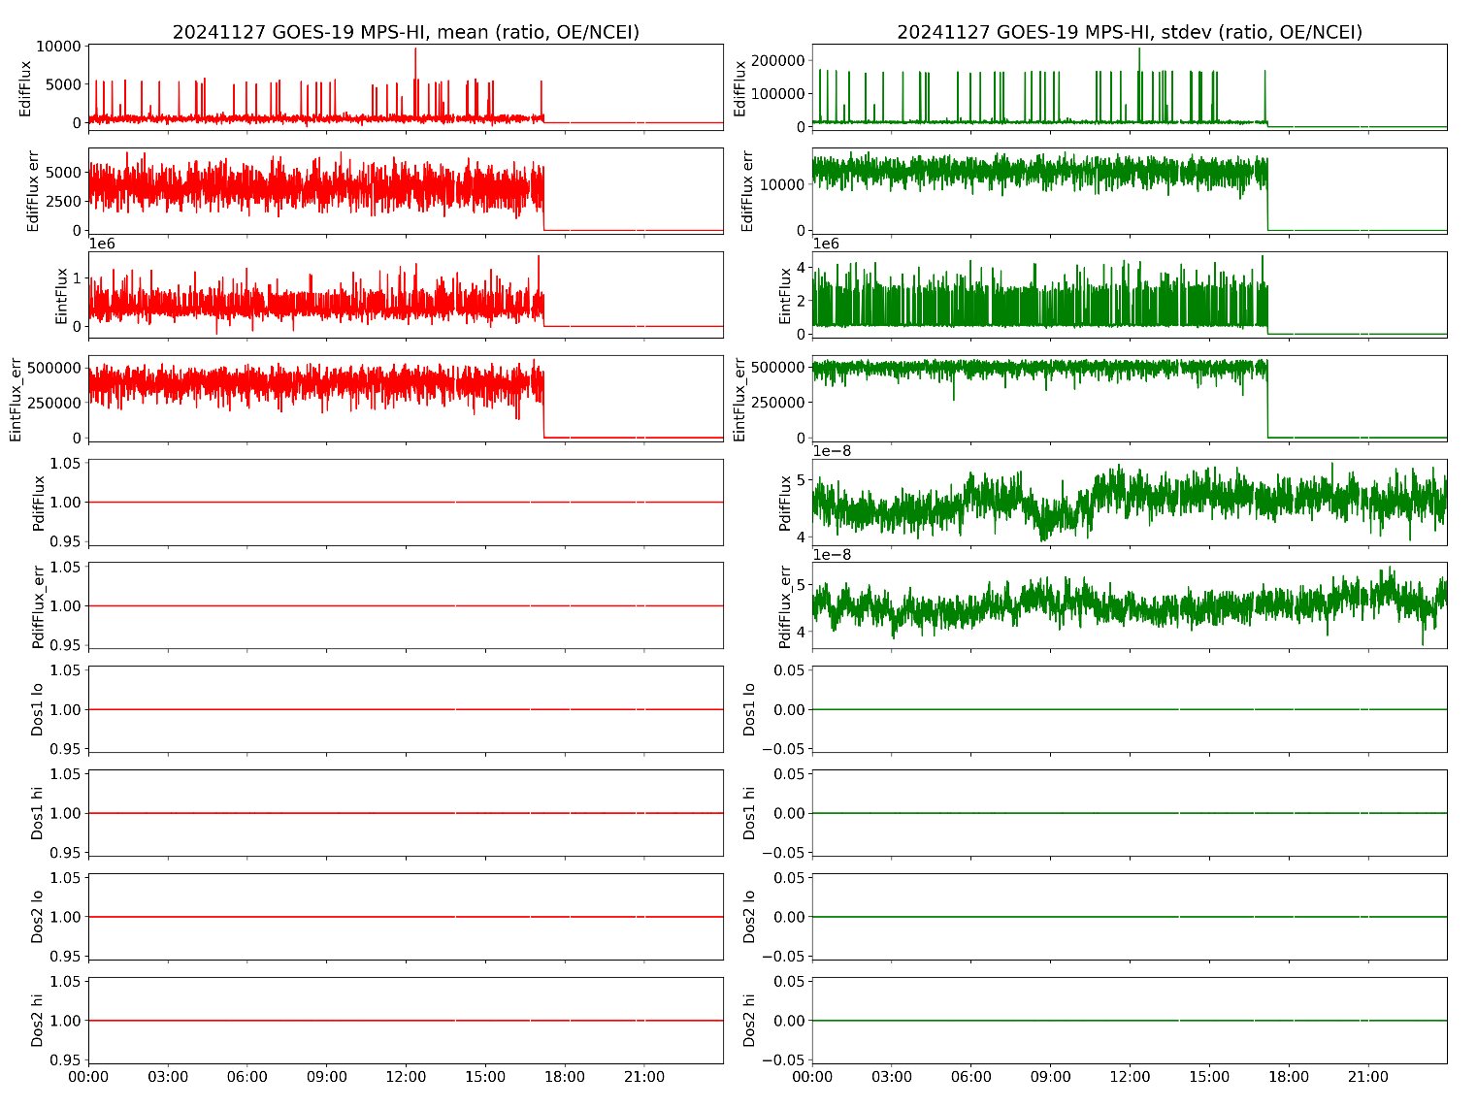
27 November 2024 (implementation day)
Demonstration of equivalence of reprocessed NCEI data and OE L1b (ADR 1517, GOES-19)
These GOES-19 data are preliminary, non-operational data and are undergoing testing. Users bear all responsibility for inspecting the data prior to use and for the manner in which the data are utilized.

Slide 24
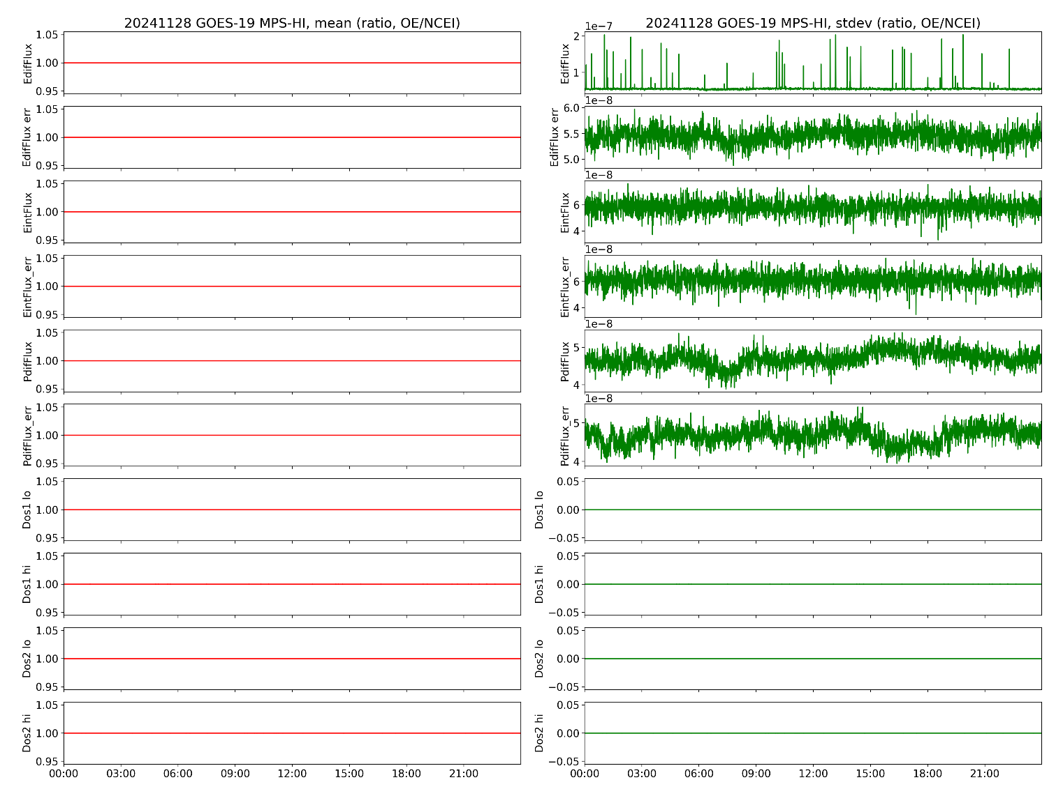
28 November 2024 (following day)
Demonstration of equivalence of reprocessed NCEI data and OE L1b (ADR 1517, GOES-19)
These GOES-19 data are preliminary, non-operational data and are undergoing testing. Users bear all responsibility for inspecting the data prior to use and for the manner in which the data are utilized.

Slide 25
PLPTs for Provisional Validation
PLPT-SEI-002: MPS-HI Telescope Cross-Comparison (Hallock)
PLPT-SEI-004: Solar Energetic Particle (SEP) Cross-Comparison (Kress)
PLPT-SEI-005: Cross-Satellite Comparison of Trapped Particles (Boudouridis, Rodriguez)
PLPT-SEI-006: Backgrounds Trending (Boudouridis, Rodriguez)
These GOES-19 data are preliminary, non-operational data and are undergoing testing. Users bear all responsibility for inspecting the data prior to use and for the manner in which the data are utilized.

Slide 26


PLPT-SEI-002: MPS-HI Telescope Cross-Comparison: Introduction
Partial Pass
Pitch Angle definition and telescope orientations
Pitch angle (PA) is angle between the particle velocity and the magnetic field (B-field).
G19 Upright
Etel.3
Expected
approx. PAs:
Etel.3: 150○
Etel.1: 115○
Etel.4: 80○
Etel.2: 45○
Etel.5: 10○
B-field
Etel.1
$≈$100○
Etel.4 particle velocity
$≈$80○
Etel.4
+z
Etel.4 look direction
Supplementary angle (SPA) = 180-PA
Particles return to the equator after bouncing near the poles with SPA
-x
Etel.2
+y
Etel.5
Body Reference Frame (BRF) coordinate system: +X East, +Y South, +Z Earthward
These GOES-19 data are preliminary, non-operational data and are undergoing testing. Users bear all responsibility for inspecting the data prior to use and for the manner in which the data are utilized.

Slide 27
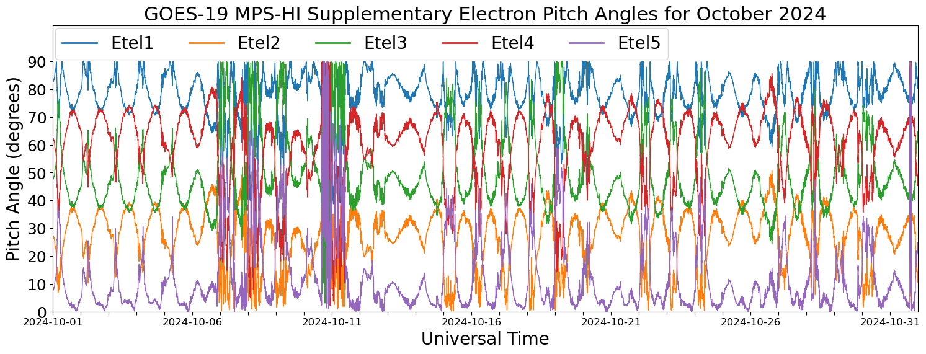
PLPT-SEI-002: MPS-HI Telescope Cross-Comparison: Method
Partial Pass
GOES-19
Electrons
October 10 storm
Comparison of responses of MPS-HI telescopes when central pitch angle is the same
Under such conditions, telescopes should be measuring the same flux for the same effective energy
The technique has been validated multiple times: 1) G17/G18/G19 MPS-LO zone intracal, 2) G13/G15 MAGED/PD cross-telescope comparisons (Rodriguez et al., [2020], JSWSC), 3) G17/G18 MPS-HI cross-telescope comparisons
Improvements over the years:
Use of supplementary angles
Thresholding to eliminate low fluxes
These GOES-19 data are preliminary, non-operational data and are undergoing testing. Users bear all responsibility for inspecting the data prior to use and for the manner in which the data are utilized.

Slide 28
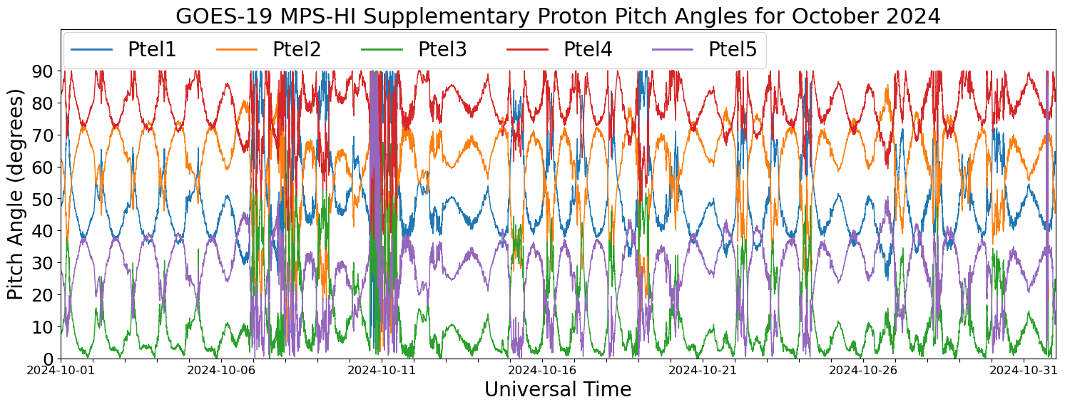
PLPT-SEI-002: MPS-HI Telescope Cross-Comparison: Method
Partial Pass
GOES-19
Protons
October 10 storm
Procedure steps:
    Input MPS-HI fluxes and pitch angles calculated from MAG L1b BRF
    Identify whenever a pair of telescopes has pitch angles within 1 degree
    Fold pitch angles > 90 degrees to get enough matches
  Report measured fluxes for each pitch angle match
  Estimate scaling factors with respect to a reference telescope
Ref: Rowland, W., and R. S. Weigel (2012), Intra-calibration of particle detectors on a three-axis stabilized geostationary platform, Space Weather, 10, S11002, doi:10.1029/2012SW000816.
These GOES-19 data are preliminary, non-operational data and are undergoing testing. Users bear all responsibility for inspecting the data prior to use and for the manner in which the data are utilized.

Slide 29
PLPT-SEI-002: MPS-HI Telescope Cross-Comparison: Results
Partial Pass
Electron Scale Factors
September 1-October 31, 2024
Proton Scale Factors
September 1-October 31, 2024
Energy band | Count threshold | T1 | T2 | T3 | T4 | T5
E1 | 1000/min | 1.104 | 0.851 | 1.037 | 1.000 | 0.969
E2 | 1000/min | 1.069 | 0.882 | 1.018 | 1.000 | 1.122
E3 | 1000/min | 0.883 | 0.773 | 0.751 | 1.000 | 0.967
E4 | 1000/min | 0.996 | 0.877 | 1.022 | 1.000 | 0.977
E5 | 1000/min | 1.026 | 0.963 | 1.037 | 1.000 | 0.940
E6 | 1000/min | 1.082 | 0.823 | 0.988 | 1.000 | 1.175
E7 | 1000/min | 1.047 | 0.989 | 0.960 | 1.000 | 0.841
E8 | 100/min | 0.968 | 1.064 | 1.011 | 1.000 | 0.955
E9 | 100/min | 1.058 | 1.043 | 1.136 | 1.000 | 0.960
E10 | 100/min
E11 | 100/min | 0.957 | 0.603 | 1.157 | 1.000
Energy band | Count threshold | T1 | T2 | T3 | T4 | T5
P1 | 1000/min | 0.784 | 1.000 | 2.962 | 1.535 | 1.336
P2 | 1000/min | 1.121 | 1.000 | 1.788 | 1.701 | 1.838
P3 | 1000/min | 1.091 | 1.000 | 1.791 | 1.611 | 1.486
P4 | 1000/min | 1.189 | 1.000 | 1.850 | 1.937 | 1.678
P5 | 100/min | 1.239 | 1.000 | 1.968 | 1.909 | 1.835
P6 | 100/min | 0.992 | 1.000 | 1.502 | 1.865 | 1.791
P7 | 100/min | 1.011 | 1.000 | 1.877 | 1.974 | 1.991
Technique not applicable to solar proton channels P8-P11
Electron scale factors are mostly within the 25% requirement. No pitch angle matches for E10 and very few for E11, due to lack of high fluxes.
Proton scale factors are within the 25% requirement for PTel1, but quite high for PTels 3-5. This is a recurring feature in the performed PLPTs.
Blue: <10%, Green: 10-25%, Red: >25%
Pink: <100 PA matches
Orange: <1000 PA matches
These GOES-19 data are preliminary, non-operational data and are undergoing testing. Users bear all responsibility for inspecting the data prior to use and for the manner in which the data are utilized.

Slide 30
PLPT-SEI-002: MPS-HI Telescope Cross-Comparison: Summary
Found Telescope Pitch Angle matches
Used the technique of Rowland and Weigel (2012) to calculate scale factors for all energies and telescopes
The electron scale factors are mostly < 25%, the telescopes agree within 25% accuracy
  No pitch angle matches for E10 and very few for E11, due to lack of high fluxes. Will revisit at Full Validation.
The proton scale factors are within the 25% requirement for PTel1. PTels 3-5 show quite high scale factors, in a different family from PTels 1-2. NCEI will continue to investigate, with the help of ATC.
PLPT-SEI-002 for GOES-19 is a
Partial Pass
These GOES-19 data are preliminary, non-operational data and are undergoing testing. Users bear all responsibility for inspecting the data prior to use and for the manner in which the data are utilized.

Slide 31
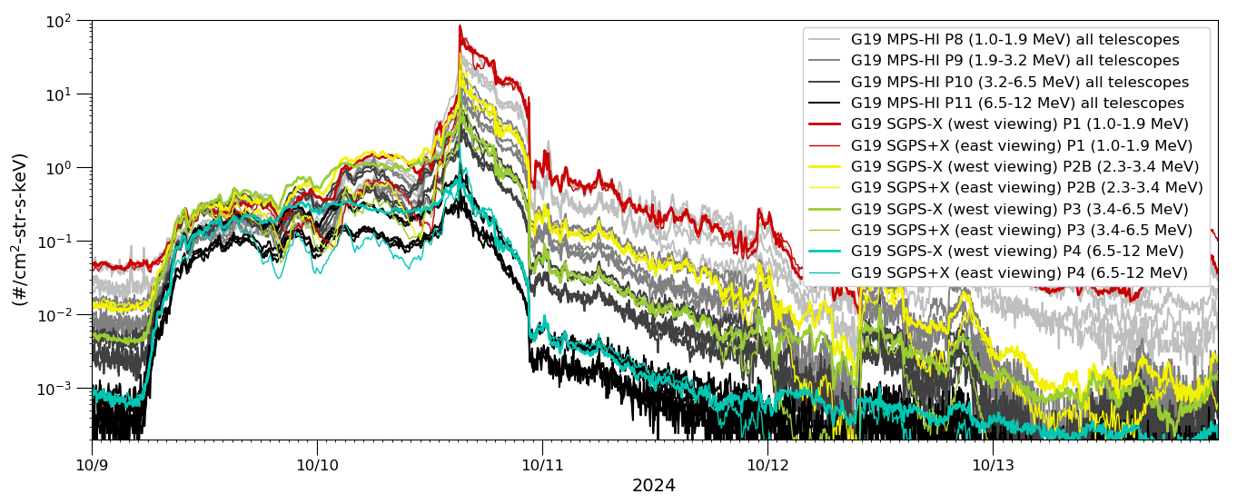
PLPT-SEI-004: SEP Channels Cross-Comparison:
G19 MPS-HI and SGPS Time series
Pass
L1b 5-minute avg. from 9-11 October 2024 Solar Particle Event and Geomagnetic storm period
Geomagnetic storm and high solar wind dynamic pressure
Fluxes from the GOES-19 MPS-HI Solar Energetic Particle (SEP) channels (P8-P11) are shown by the gray traces (all 5 proton telescopes), and SGPS P1-P4 channels with colored traces.
MPS-HI P8-P11 have energy bands similar to SGPS P1, P2B, P3 and P4.
In all four MPS-HI channels shown (P8-P11), two MPS-HI proton telescopes (PTels) are in close agreement with SGPS and three are reporting low.
The period indicated by the gray shaded region is used for the SEP channel cross comparisons.
These GOES-19 data are preliminary, non-operational data and are undergoing testing. Users bear all responsibility for inspecting the data prior to use and for the manner in which the data are utilized.

Slide 32
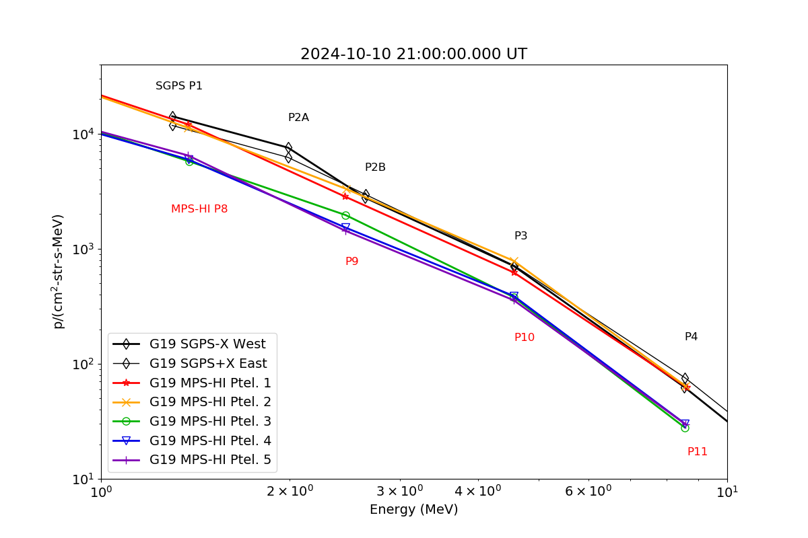
PLPT-SEI-004: SEP Channels
Cross-Comparison: Example Spectra
Pass
MPS-HI P8-P11 and SGPS P1-P4 5-minute averaged L1b spectra at 21 UT on 2024-10-10.
MPS-HI PTel-1 and -2 are in close agreement with SGPS. MPS-HI PTels 3-5 are reporting low.
The north-to-south order of MPS-HI proton telescopes is PTel-1, -4, -2, -5, -3.
These GOES-19 data are preliminary, non-operational data and are undergoing testing. Users bear all responsibility for inspecting the data prior to use and for the manner in which the data are utilized.

Slide 33
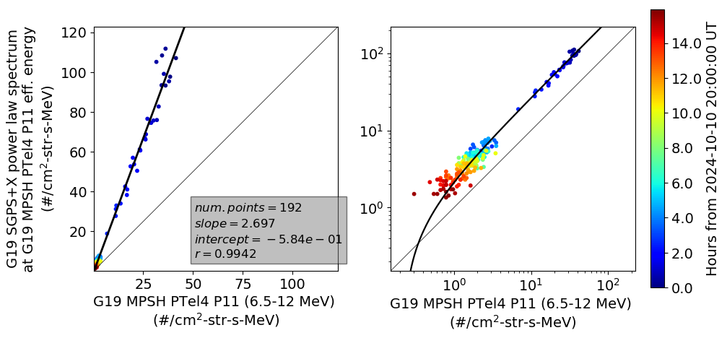
PLPT-SEI-004 SEP Channel Cross-Comparison:
G19 SGPS vs. MPS-HI Example
Pass
Scatter plot of 5 min averaged GOES-19 SGPS spectrum vs. MPS-HI PTel-4 P11 L1b fluxes, on linear scales in left panel and log scales in right panel (same data and fit is shown in both plots). The full G19 SGPS vs. MPS-HI P8-P11 comparison results are shown on the following slide.
These GOES-19 data are preliminary, non-operational data and are undergoing testing. Users bear all responsibility for inspecting the data prior to use and for the manner in which the data are utilized.

Slide 34
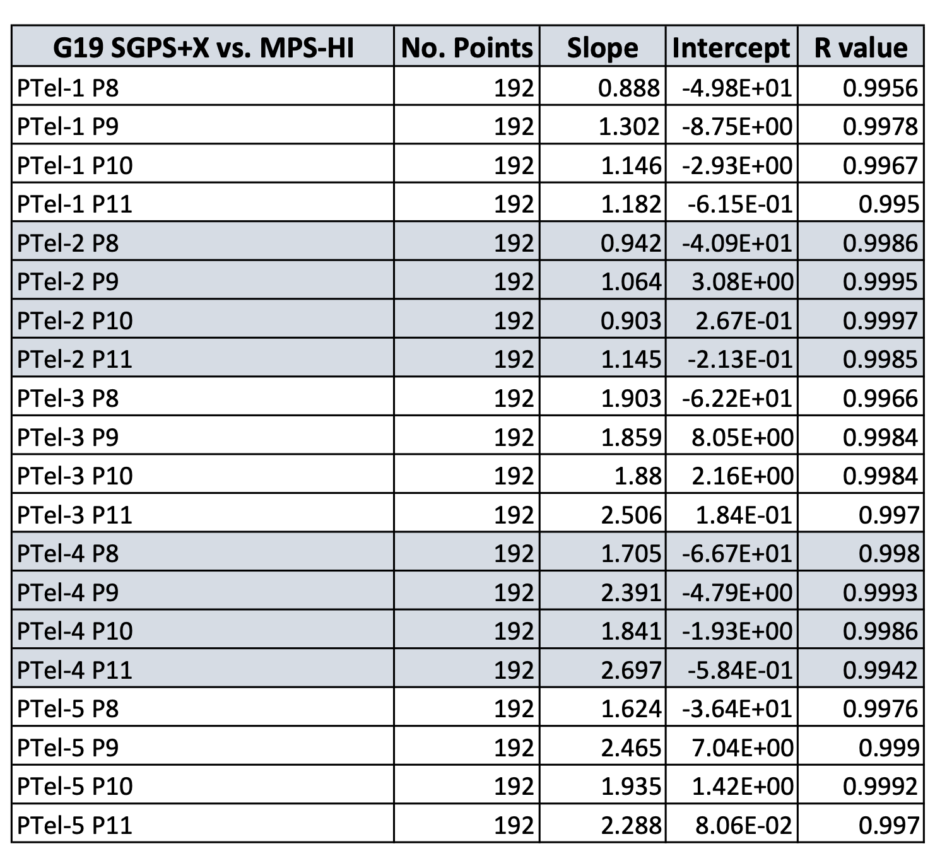
PLPT-SEI-004 SEP Channel Cross-Comparison:
G19 SGPS vs. MPS-HI Results
Pass
GOES-19 MPS-HI Ptel-1 and -2 P8-P11 agree well with SGPS, within ~10% in most cases.
GOES-19 MPS-HI PTels 3-5 are reporting approximately a factor of 2 low with respect to SGPS channels.
Worst case is a factor of ~2.7 difference between SGPS and G19 MPS-HI Ptel-4 P11, shown on previous slide.
These GOES-19 data are preliminary, non-operational data and are undergoing testing. Users bear all responsibility for inspecting the data prior to use and for the manner in which the data are utilized.

Slide 35
PLPT-SEI-004 SEP Channels
Cross-Comparison: Summary and Considerations
Pass
      Due to discrepancies between MPS-HI SEP channels and SGPS Telescope-1 (T1) channels, ground calibrations of MPS-HI SN104 P8-P11 and SGPS SN110 P1-P5 (MPS-HI and SGPS spare units) were performed at Brookhaven National Laboratory (BNL) in December 2023 under SEA41. New Particle and Heavy Ion Transport code System (PHITS) simulations of the SGPS response functions were also preformed, confirming previous SGPS T1 modeling.
      The data from the SGPS SN110 calibration at BNL was of significantly higher quality than that from earlier calibration of the SGPS SN102 unit at UC Davis and agreed well with the PHITS modeling.
      In April 2024, updated SGPS T1 geometric factors and energy bounds were provided by the SEISS instrument vendor (“Telescope-1 Addendum”), with the recommendation that the revised calibration factors be applied to all SGPS units. The new calibration factors have not been applied to operational L1b, pending full analysis of impact on integral fluxes used for Solar Particle Storm Scales and discussions with SWPC. The new calibration factors are used in the analysis shown above.
      Prior to adjustment of SGPS T1 calibration factors, the G16-G19 MPS-HI P8-P11 channels have consistently reported low with respect to similar SGPS channels (shown in previous MPS-HI PS-PVRs). With adjustment of SGPS T1 calibration factors, MPS-HI SEP channels are in general in much better agreement with SGPS T1 channels, in comparisons among all MPS-HI and SGPS flight models, shown in backup slides.
      G19 MPS-HI PTels 3-5 P8-P11 are in general reporting low with respect to G19 MPS-HI PTels 1 and 2, other MPS-HI units, and SGPS T1 channels.
These GOES-19 data are preliminary, non-operational data and are undergoing testing. Users bear all responsibility for inspecting the data prior to use and for the manner in which the data are utilized.

Slide 36
PLPT-SEI-004: SEP Channel
Cross-Comparison: Summary
In general, GOES-19 MPS-HI PTel-1 and -2 SEP channels agree well (≲10% error) with the GOES-19 SGPS units.
This recent agreement is the result of efforts by many parties:
  Terry Onsager, formerly of SWPC, advocated for an overlap in energy between the MPS-HI proton detectors and the SGPS Telescope-1 (during the instrument planning phase). Without such overlap the issue of the SEP channel discrepancy between the two instruments would have not been recognized
  Brian Kress and Juan Rodriguez of NCEI realized there was an issue after the launch of GOES-16, and asked the GOES-R program and the instrument vendor to investigate
  The GOES-R program issued SEA41 and asked the vendor to conduct new instrument calibrations at Brookhaven National Laboratory (BNL)
  The instrument vendor, Assurance Technology Corporation (ATC), planned and conducted these calibrations. Unfortunately, due to the pandemic these did not occur until December 2023, and were performed with the spare units instead of the units now onboard GOES-19
GOES-19 MPS-HI PTels 3-5 are reporting approximately a factor of 2 low with respect to SGPS channels. This needs to be investigated further.
PLPT-SEI-004 for GOES-19 is a
Pass
These GOES-19 data are preliminary, non-operational data and are undergoing testing. Users bear all responsibility for inspecting the data prior to use and for the manner in which the data are utilized.

Slide 37
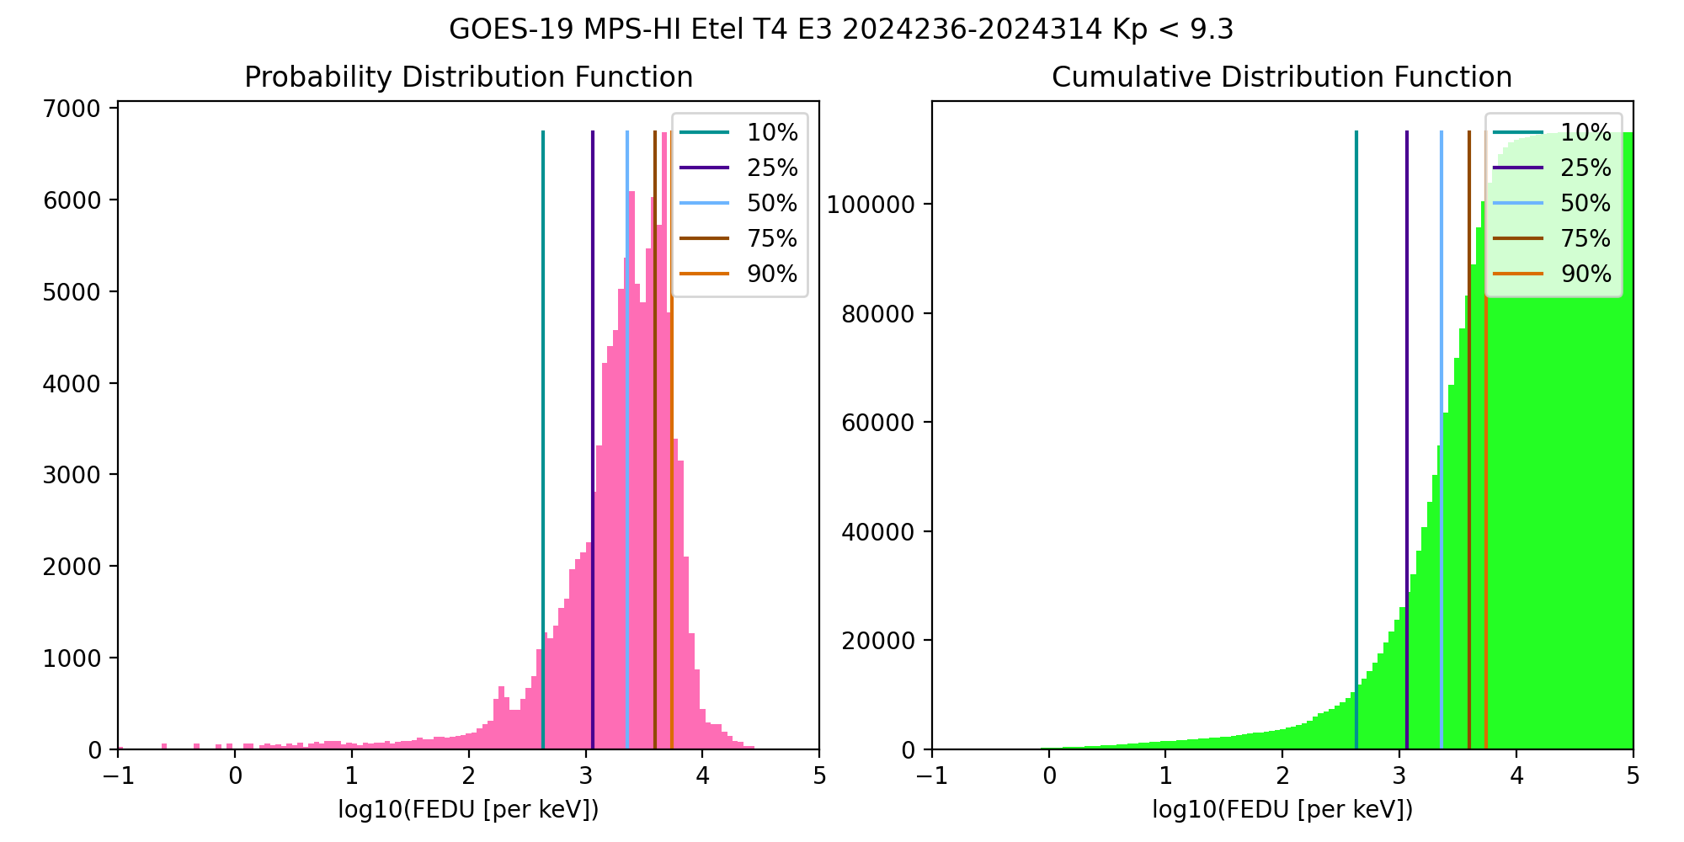
PLPT-SEI-005: Cross-Satellite
Comparison of Trapped Particles: Technique
Pass
Compare statistical differential flux spectra from GOES-16 and GOES-19, separated by ~1 hour in Magnetic Local Time (MLT):
  GOES-16 (75.2W) to GOES-19 (89.5W), 08/23/2024-11/09/2024 (~2.5 months)
  Calculate the particle distributions for all channels and telescopes
  Compare flux percentile spectra for telescopes of the same orientation
    0, ±35, ±70 deg from zenith (radially outward)
PDF: Number of fluxes in each flux bin
CDF: Number of fluxes up to a flux bin
Percentile fluxes: Flux at which number of fluxes < percentile
50% is the median of the distribution
These GOES-19 data are preliminary, non-operational data and are undergoing testing. Users bear all responsibility for inspecting the data prior to use and for the manner in which the data are utilized.

Slide 38
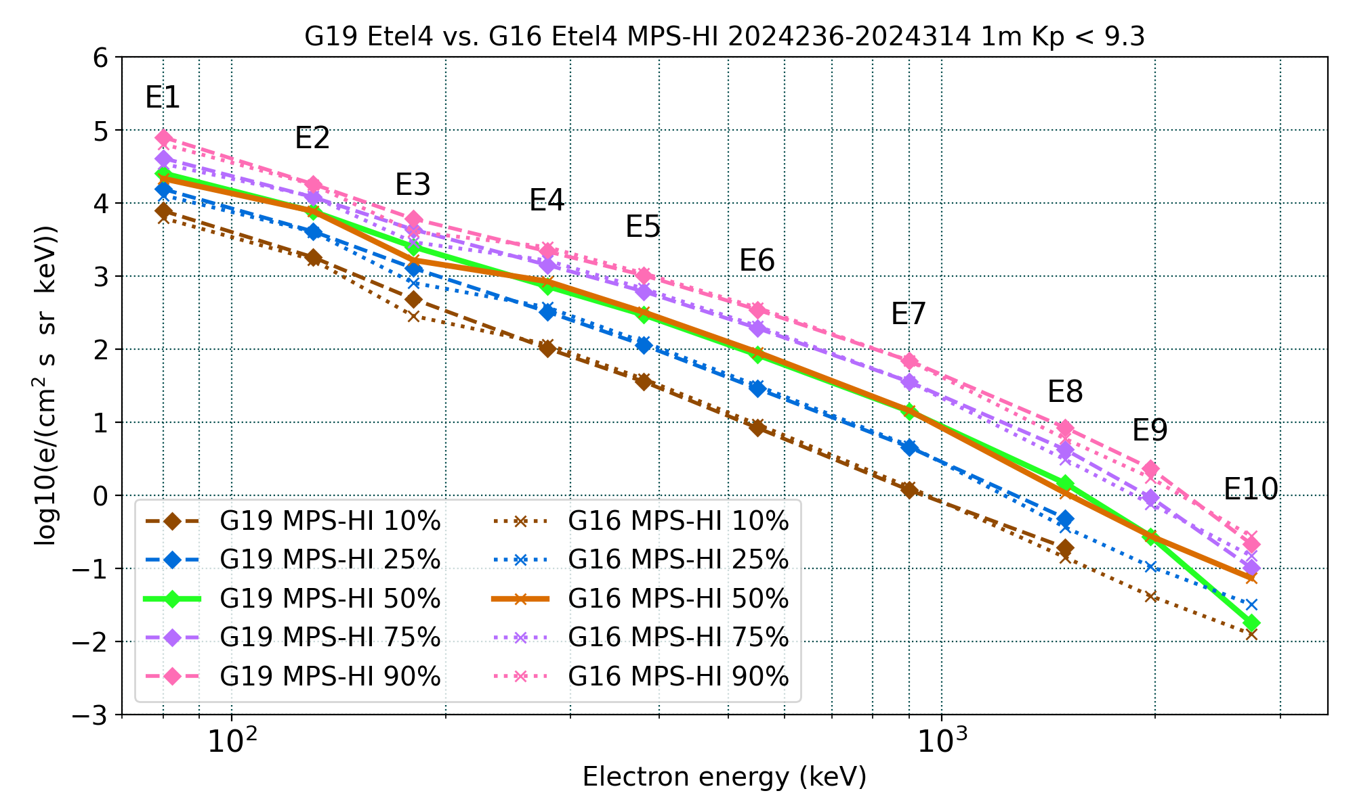
PLPT-SEI-005: Cross-Satellite
Comparison of Trapped Particles: Results
Pass
GOES-19 vs GOES-16 Electrons , 08/23/2024-11/09/2024
GOES-16 E3 fluxes are appreciably lower
E9-E10 fluxes are affected by the applied background correction (discussion is included in the backup slides)
Good agreement
in general
Missing or significantly lower fluxes are at residual background levels
Boudouridis, A., Rodriguez, J. V., Kress, B. T., Dichter, B. K., & Onsager, T. G. (2020). Development of a bowtie inversion technique for real‐time processing of the GOES‐16/‐17 SEISS MPS‐HI electron channels. Space Weather, 18, e2019SW002403. https://doi.org/10.1029/2019SW002403
These GOES-19 data are preliminary, non-operational data and are undergoing testing. Users bear all responsibility for inspecting the data prior to use and for the manner in which the data are utilized.

Slide 39
PLPT-SEI-005: Cross-Satellite
Comparison of Trapped Particles: Results
Pass
GOES-16 over GOES-19 Electrons, 08/23/2024– 11/09/2024
 |  | G16 ET3 | : | G19 ET3 |  |  | G16 ET1 | : | G19 ET1 |  |  | G16 ET4 | : | G19 ET4 |  |  | G16 ET2 | : | G19 ET2 |  |  | G16 ET5 | : | G19 ET5
 |  |  | Q |  |  |  |  | Q |  |  |  |  | Q |  |  |  |  | Q |  |  |  |  | Q
Energy (keV) | 10 | 25 | 50 | 75 | 90 | 10 | 25 | 50 | 75 | 90 | 10 | 25 | 50 | 75 | 90 | 10 | 25 | 50 | 75 | 90 | 10 | 25 | 50 | 75 | 90
80 | 0.53 | 0.58 | 0.62 | 0.63 | 0.62 | 0.97 | 0.99 | 1.04 | 1.02 | 0.98 | 0.79 | 0.82 | 0.84 | 0.84 | 0.80 | 0.71 | 0.77 | 0.79 | 0.77 | 0.76 | 0.62 | 0.67 | 0.68 | 0.69 | 0.67
130 | 0.64 | 0.68 | 0.70 | 0.71 | 0.71 | 1.10 | 1.13 | 1.14 | 1.13 | 1.14 | 0.92 | 0.98 | 1.01 | 1.02 | 0.98 | 0.72 | 0.72 | 0.71 | 0.70 | 0.74 | 0.96 | 0.98 | 1.01 | 1.01 | 1.00
180 | 0.84 | 0.82 | 0.85 | 0.85 | 0.87 | 0.92 | 0.96 | 0.98 | 0.98 | 0.98 | 0.59 | 0.63 | 0.66 | 0.67 | 0.67 | 0.95 | 0.97 | 0.91 | 0.86 | 0.89 | 1.10 | 1.11 | 1.11 | 1.13 | 1.17
278 | 1.03 | 1.10 | 1.09 | 1.08 | 1.08 | 1.14 | 1.19 | 1.17 | 1.17 | 1.16 | 1.14 | 1.15 | 1.17 | 1.15 | 1.15 | 0.89 | 0.89 | 0.90 | 0.87 | 0.86 | 0.91 | 0.95 | 0.95 | 0.95 | 0.98
380 | 0.92 | 0.95 | 0.95 | 0.96 | 0.95 | 1.08 | 1.11 | 1.07 | 1.07 | 1.06 | 1.09 | 1.10 | 1.09 | 1.09 | 1.06 | 1.20 | 1.15 | 1.16 | 1.12 | 1.11 | 0.93 | 0.92 | 0.93 | 0.92 | 0.95
550 | 0.91 | 0.87 | 0.89 | 0.88 | 0.87 | 1.27 | 1.30 | 1.26 | 1.26 | 1.26 | 1.12 | 1.10 | 1.09 | 1.07 | 1.06 | 1.01 | 0.98 | 0.99 | 0.99 | 0.99 | 1.34 | 1.33 | 1.30 | 1.27 | 1.28
900 | 1.01 | 0.96 | 0.96 | 0.96 | 0.97 | 1.10 | 1.12 | 1.13 | 1.13 | 1.13 | 1.10 | 1.05 | 1.02 | 1.00 | 1.00 | 1.25 | 1.17 | 1.13 | 1.13 | 1.14 | 0.88 | 0.81 | 0.82 | 0.82 | 0.81
1493 | 2.05 | 1.04 | 0.81 | 0.77 | 0.76 | 1.00 | 0.98 | 0.93 | 0.92 | 0.89 | 0.74 | 0.75 | 0.74 | 0.73 | 0.70 | 1.17 | 1.36 | 1.25 | 1.29 | 1.27 | 0.98 | 1.01 | 0.84 | 0.79 | 0.82
1969 |  |  | 0.95 | 0.57 | 0.52 |  |  | 1.18 | 0.97 | 0.87 |  |  | 1.01 | 0.81 | 0.75 |  |  | 1.44 | 1.12 | 1.10 |  |  | 1.19 | 0.75 | 0.74
2730 |  |  | 4.07 | 1.48 | 1.23 |  |  | 6.68 | 1.74 | 1.38 |  |  | 4.07 | 1.46 | 1.28 |  |  | 7.31 | 1.87 | 1.39 |  |  | 5.24 | 1.29 | 0.99
GOES-16 higher than GOES-19: <10% 10-25% >25%
The comparisons are made by taking the ratio of the GOES‐16 to the GOES‐19 percentile fluxes, following interpolation to 10 common energies (80, 130, 180, 278, 380, 550, 900, 1,493, 1,969, and 2,730 keV) assuming a piecewise power‐law distribution.
Boudouridis, A., Rodriguez, J. V., Kress, B. T., Dichter, B. K., & Onsager, T. G. (2020). Development of a bowtie inversion technique for real‐time processing of the GOES‐16/‐17 SEISS MPS‐HI electron channels. Space Weather, 18, e2019SW002403. https://doi.org/10.1029/2019SW002403
These GOES-19 data are preliminary, non-operational data and are undergoing testing. Users bear all responsibility for inspecting the data prior to use and for the manner in which the data are utilized.

Slide 40
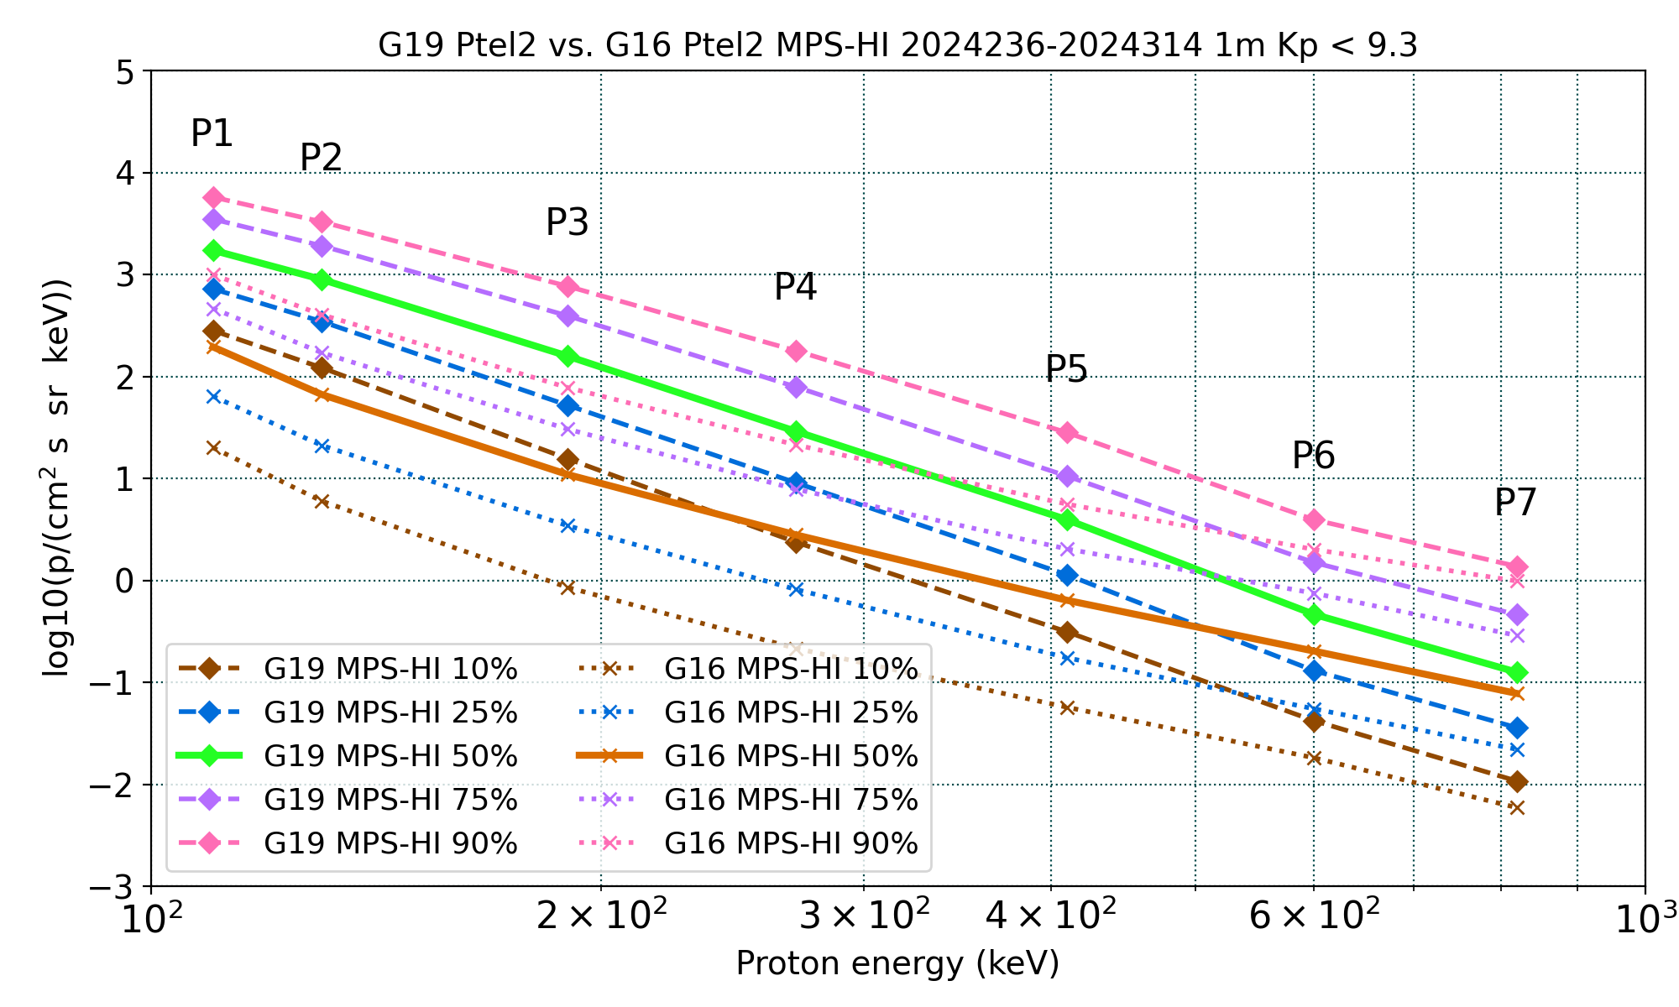
PLPT-SEI-005: Cross-Satellite
Comparison of Trapped Particles: Results
Pass
GOES-19 vs GOES-16 Protons , 08/23/2024-11/09/2024
GOES-16 fluxes are significantly lower than GOES-19 in channels P1-P5 and all telescopes)
This observation has been documented extensively (G16/G17/G18 Full PS-PVRs, and multiple NCEI and MIT studies)
A degradation of the proton detectors is actively being investigated
The proton spectrum is flattening for channels P6 and P7: effect of Solar Energetic Particle (SEP) events
Apply only to P1-P7
Boudouridis, A., Rodriguez, J. V., Kress, B. T., Dichter, B. K., & Onsager, T. G. (2020). Development of a bowtie inversion technique for real‐time processing of the GOES‐16/‐17 SEISS MPS‐HI electron channels. Space Weather, 18, e2019SW002403. https://doi.org/10.1029/2019SW002403
These GOES-19 data are preliminary, non-operational data and are undergoing testing. Users bear all responsibility for inspecting the data prior to use and for the manner in which the data are utilized.

Slide 41
PLPT-SEI-005: Cross-Satellite
Comparison of Trapped Particles: Results
Pass
GOES-19 over GOES-16 Protons, 08/23/2024-11/09/2024
 |  | G16 PT1 | : | G19 PT1 |  |  | G16 PT4 | : | G19 PT4 |  |  | G16 PT2 | : | G19 PT2 |  |  | G16 PT5 | : | G19 PT5 |  |  | G16 PT3 | : | G19 PT3
 |  |  | Q |  |  |  |  | Q |  |  |  |  | Q |  |  |  |  | Q |  |  |  |  | Q
Energy (keV) | 10 | 25 | 50 | 75 | 90 | 10 | 25 | 50 | 75 | 90 | 10 | 25 | 50 | 75 | 90 | 10 | 25 | 50 | 75 | 90 | 10 | 25 | 50 | 75 | 90
110 | 0.11 | 0.12 | 0.14 | 0.16 | 0.21 | 0.17 | 0.21 | 0.24 | 0.27 | 0.32 | 0.07 | 0.09 | 0.11 | 0.13 | 0.17 | 0.24 | 0.27 | 0.29 | 0.32 | 0.43 | 0.42 | 0.45 | 0.54 | 0.64 | 0.80
130 | 0.09 | 0.10 | 0.11 | 0.12 | 0.16 | 0.07 | 0.09 | 0.11 | 0.13 | 0.16 | 0.05 | 0.06 | 0.07 | 0.09 | 0.12 | 0.21 | 0.25 | 0.26 | 0.28 | 0.37 | 0.16 | 0.18 | 0.21 | 0.24 | 0.32
190 | 0.09 | 0.12 | 0.12 | 0.13 | 0.13 | 0.07 | 0.09 | 0.09 | 0.10 | 0.13 | 0.05 | 0.07 | 0.07 | 0.08 | 0.10 | 0.18 | 0.24 | 0.24 | 0.25 | 0.27 | 0.14 | 0.17 | 0.20 | 0.21 | 0.23
270 | 0.15 | 0.16 | 0.17 | 0.20 | 0.18 | 0.13 | 0.13 | 0.14 | 0.15 | 0.18 | 0.09 | 0.09 | 0.10 | 0.10 | 0.12 | 0.30 | 0.34 | 0.36 | 0.39 | 0.38 | 0.19 | 0.24 | 0.29 | 0.32 | 0.30
410 | 0.26 | 0.26 | 0.30 | 0.34 | 0.31 | 0.24 | 0.19 | 0.20 | 0.25 | 0.28 | 0.18 | 0.15 | 0.16 | 0.19 | 0.20 | 0.48 | 0.51 | 0.56 | 0.65 | 0.62 | 0.26 | 0.37 | 0.42 | 0.45 | 0.50
600 | 0.74 | 0.57 | 0.62 | 0.61 | 0.67 | 0.62 | 0.71 | 0.80 | 0.97 | 0.97 | 0.43 | 0.42 | 0.44 | 0.50 | 0.51 | 1.23 | 1.30 | 1.59 | 1.64 | 1.60 | 0.61 | 0.89 | 1.13 | 1.11 | 1.27
820 | 0.60 | 0.80 | 0.79 | 0.80 | 0.85 | 0.60 | 1.01 | 1.24 | 1.33 | 1.48 | 0.55 | 0.61 | 0.62 | 0.63 | 0.72 | 1.08 | 1.47 | 1.83 | 1.84 | 1.81 | 1.00 | 1.21 | 1.52 | 1.62 | 1.67
GOES-16 lower than GOES-19: <10% 10-25% 25-50% 50-75% >75%
The comparisons are made by taking the ratio of the GOES‐16 to the GOES‐19 percentile fluxes, following interpolation to 7 common energies (110, 130, 190, 270, 410, 600, and 820 keV) assuming a piecewise power‐law distribution.
Boudouridis, A., Rodriguez, J. V., Kress, B. T., Dichter, B. K., & Onsager, T. G. (2020). Development of a bowtie inversion technique for real‐time processing of the GOES‐16/‐17 SEISS MPS‐HI electron channels. Space Weather, 18, e2019SW002403. https://doi.org/10.1029/2019SW002403
These GOES-19 data are preliminary, non-operational data and are undergoing testing. Users bear all responsibility for inspecting the data prior to use and for the manner in which the data are utilized.

Slide 42
PLPT-SEI-005: Cross-Satellite
Comparison of Trapped Particles: Results
Pass
GOES-19 over GOES-16 Protons, 08/23/2024-11/09/2024
 |  | G16 PT1 | : | G19 PT1 |  |  | G16 PT4 | : | G19 PT4 |  |  | G16 PT2 | : | G19 PT2 |  |  | G16 PT5 | : | G19 PT5 |  |  | G16 PT3 | : | G19 PT3
 |  |  | Q |  |  |  |  | Q |  |  |  |  | Q |  |  |  |  | Q |  |  |  |  | Q
Energy (keV) | 10 | 25 | 50 | 75 | 90 | 10 | 25 | 50 | 75 | 90 | 10 | 25 | 50 | 75 | 90 | 10 | 25 | 50 | 75 | 90 | 10 | 25 | 50 | 75 | 90
110 | 0.11 | 0.12 | 0.14 | 0.16 | 0.21 | 0.17 | 0.21 | 0.24 | 0.27 | 0.32 | 0.07 | 0.09 | 0.11 | 0.13 | 0.17 | 0.24 | 0.27 | 0.29 | 0.32 | 0.43 | 0.42 | 0.45 | 0.54 | 0.64 | 0.80
130 | 0.09 | 0.10 | 0.11 | 0.12 | 0.16 | 0.07 | 0.09 | 0.11 | 0.13 | 0.16 | 0.05 | 0.06 | 0.07 | 0.09 | 0.12 | 0.21 | 0.25 | 0.26 | 0.28 | 0.37 | 0.16 | 0.18 | 0.21 | 0.24 | 0.32
190 | 0.09 | 0.12 | 0.12 | 0.13 | 0.13 | 0.07 | 0.09 | 0.09 | 0.10 | 0.13 | 0.05 | 0.07 | 0.07 | 0.08 | 0.10 | 0.18 | 0.24 | 0.24 | 0.25 | 0.27 | 0.14 | 0.17 | 0.20 | 0.21 | 0.23
270 | 0.15 | 0.16 | 0.17 | 0.20 | 0.18 | 0.13 | 0.13 | 0.14 | 0.15 | 0.18 | 0.09 | 0.09 | 0.10 | 0.10 | 0.12 | 0.30 | 0.34 | 0.36 | 0.39 | 0.38 | 0.19 | 0.24 | 0.29 | 0.32 | 0.30
410 | 0.26 | 0.26 | 0.30 | 0.34 | 0.31 | 0.24 | 0.19 | 0.20 | 0.25 | 0.28 | 0.18 | 0.15 | 0.16 | 0.19 | 0.20 | 0.48 | 0.51 | 0.56 | 0.65 | 0.62 | 0.26 | 0.37 | 0.42 | 0.45 | 0.50
600 | 0.74 | 0.57 | 0.62 | 0.61 | 0.67 | 0.62 | 0.71 | 0.80 | 0.97 | 0.97 | 0.43 | 0.42 | 0.44 | 0.50 | 0.51 | 1.23 | 1.30 | 1.59 | 1.64 | 1.60 | 0.61 | 0.89 | 1.13 | 1.11 | 1.27
820 | 0.60 | 0.80 | 0.79 | 0.80 | 0.85 | 0.60 | 1.01 | 1.24 | 1.33 | 1.48 | 0.55 | 0.61 | 0.62 | 0.63 | 0.72 | 1.08 | 1.47 | 1.83 | 1.84 | 1.81 | 1.00 | 1.21 | 1.52 | 1.62 | 1.67
GOES-16 lower than GOES-19: <10% 10-25% 25-50% 50-75% >75%
The comparisons are made by taking the ratio of the GOES‐16 to the GOES‐19 percentile fluxes, following interpolation to 7 common energies (110, 130, 190, 270, 410, 600, and 820 keV) assuming a piecewise power‐law distribution.
Boudouridis, A., Rodriguez, J. V., Kress, B. T., Dichter, B. K., & Onsager, T. G. (2020). Development of a bowtie inversion technique for real‐time processing of the GOES‐16/‐17 SEISS MPS‐HI electron channels. Space Weather, 18, e2019SW002403. https://doi.org/10.1029/2019SW002403
These GOES-19 data are preliminary, non-operational data and are undergoing testing. Users bear all responsibility for inspecting the data prior to use and for the manner in which the data are utilized.

Slide 43
PLPT-SEI-005: Cross-Satellite
Comparison of Trapped Particles: Results
Pass
T3
GOES-19 channel E11 $(>2$ MeV)
T1
1000 electrons per (cm² sr s)
T4
T2
T5
DOS
These GOES-19 data are preliminary, non-operational data and are undergoing testing. Users bear all responsibility for inspecting the data prior to use and for the manner in which the data are utilized.

Slide 44
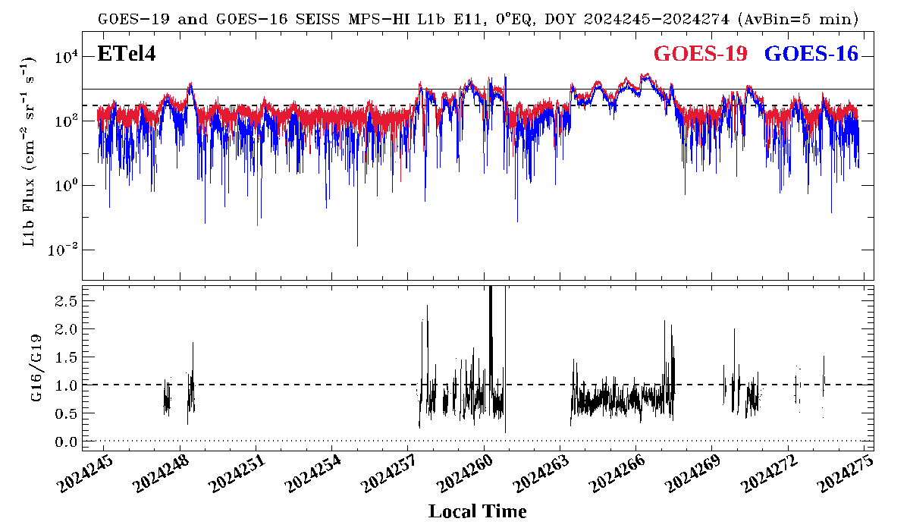
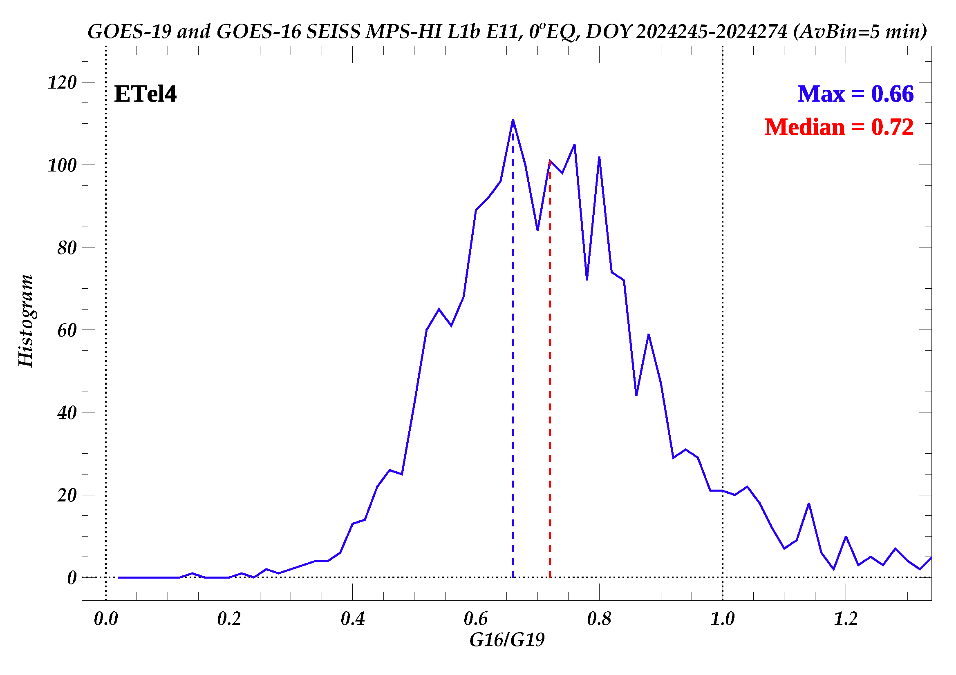
PLPT-SEI-005: Cross-Satellite
Comparison of Trapped Particles: Results
Pass
Plot GOES-19 and GOES-16 MPS-HI channel E11 (> 2 MeV) Electron Telescope 4 (ETel4 ) 5-min averaged fluxes for September 2024.
ETel4 is the central electron telescope looking along the equator.
Take the ratio GOES-16/GOES-19 of E11 ETel4 5-min average fluxes.
Make the histogram of the ratio GOES-16/-19 MPS-HI E11 ETel4 5-min average fluxes > 300 pfu.
The median of the GOES-16 to GOES-19 T4 >2 MeV flux ratio distribution is 0.72.
The G16/G19 flux ratios are in general below 1. Lack of high fluxes affects the results.
These GOES-19 data are preliminary, non-operational data and are undergoing testing. Users bear all responsibility for inspecting the data prior to use and for the manner in which the data are utilized.

Slide 45
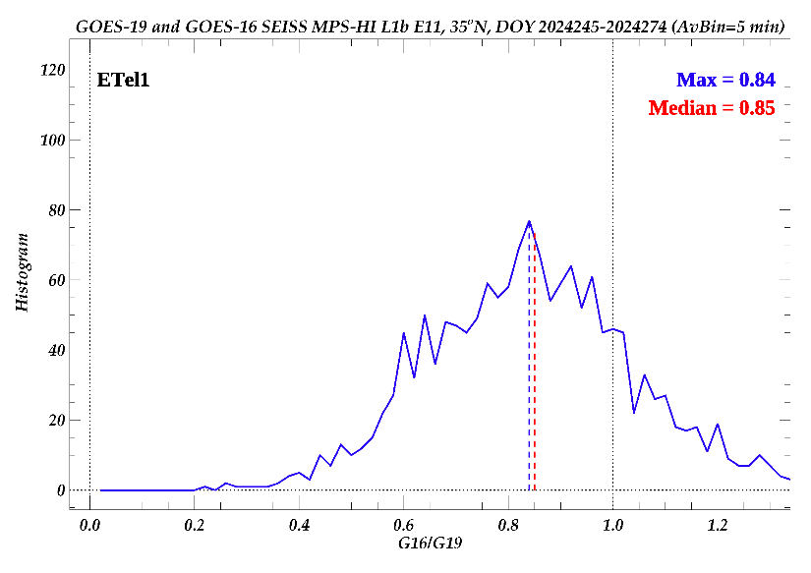
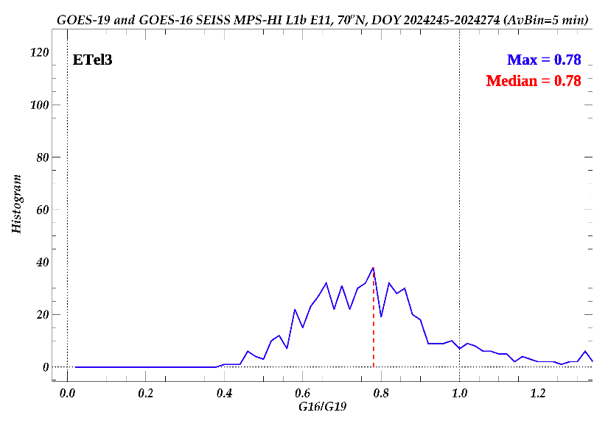
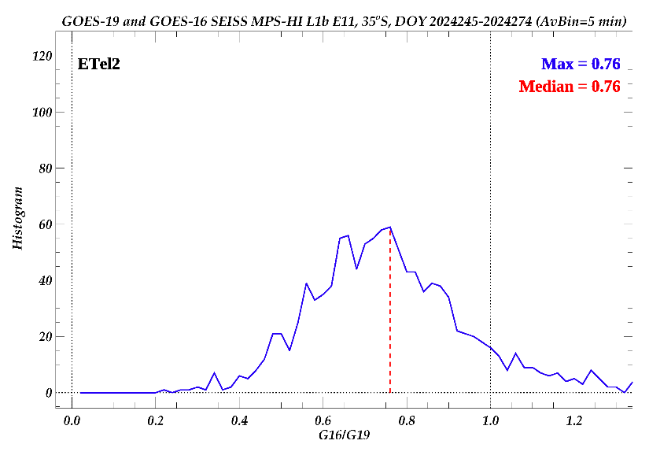
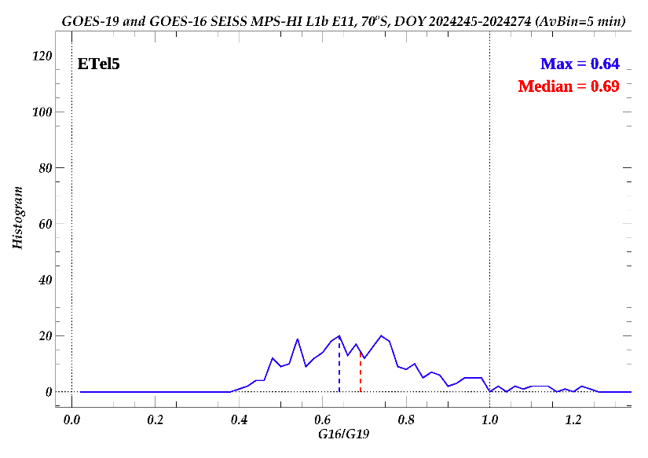
PLPT-SEI-005: Cross-Satellite
Comparison of Trapped Particles: Results
Pass
Lack of sufficient high fluxes is hampering the effort for the off-equatorial telescopes.
The older instrument (GOES-16) measures lower fluxes.
These GOES-19 data are preliminary, non-operational data and are undergoing testing. Users bear all responsibility for inspecting the data prior to use and for the manner in which the data are utilized.

Slide 46
PLPT-SEI-005: Cross-Satellite
Comparison of Trapped Particles: Summary
Differential fluxes (~2.5 months)
  The electron spectra are mostly identical
    Some lower GOES-16 fluxes as expected by the age of the GOES-16 detector
    Some GOES-19 channel/telescope pairs have somewhat lower fluxes
    The E9-E10 results are affected by the lack of high E9-E10 fluxes
  The proton spectra show significant differences
    Much lower GOES-16 fluxes are observed in channels P1-P5, and somewhat lower fluxes in P6-P7
    GOES-19 PTels 3-5 are again reporting lower fluxes than PTels 1-2, evident by the comparison with GOES-16
Integral flux, channel E11 (1 month)
  Central (equatorial) telescope T4 reveals lower fluxes at GOES-16
  T1, also close to the magnetic equator, shows better agreement
  The results are again affected by the low E11 fluxes
PLPT-SEI-005 for GOES-19 is a
Pass
These GOES-19 data are preliminary, non-operational data and are undergoing testing. Users bear all responsibility for inspecting the data prior to use and for the manner in which the data are utilized.

Slide 47

PLPT-SEI-006: Backgrounds Trending: Introduction
Pass
MPS-HI E9-E11 Background Removal
The four highest-energy electron channels from MPS-HI (E9, E10, E10A, and E11) are susceptible to contamination by 100’s of MeV protons. The baseline correction algorithm (CDRL80) uses fluxes from SGPS –X P9, P10 and P11 to estimate and remove the spurious rates due to proton contamination.
$$M_{ELE}\left(i,E11\right)=N_{ELE}^{true}\left(i,E11\right)−C_{ELE}^{obc}\left(i,E11\right)$$
$$C_{ELE}^{obc}\left(i,E11\right)=α\left(i,E11\right)F_{{SGPS−X}_{P9}}+β\left(i,E11\right)F_{{SGPS−X}_{P10}}+γ\left(i,E11\right)F_{{SGPS−X}_{P11}}$$
At launch CDRL80 sets $α=0$, $β≠0$, $γ≠0$.
Together with the values for E9, E10, and E10A, they comprise the dataset "theOutOfBandWeightingFactors" in the MPS-HI LUT.
The baseline correction derives $β$ and $γ$ for solar proton spectra from GEANT4 simulations of the proton responses of the electron channels.
The baseline algorithm is inadequate to correct for the observed slowly-varying background due presumably to Galactic Cosmic Ray (GCR) protons.
These GOES-19 data are preliminary, non-operational data and are undergoing testing. Users bear all responsibility for inspecting the data prior to use and for the manner in which the data are utilized.

Slide 48
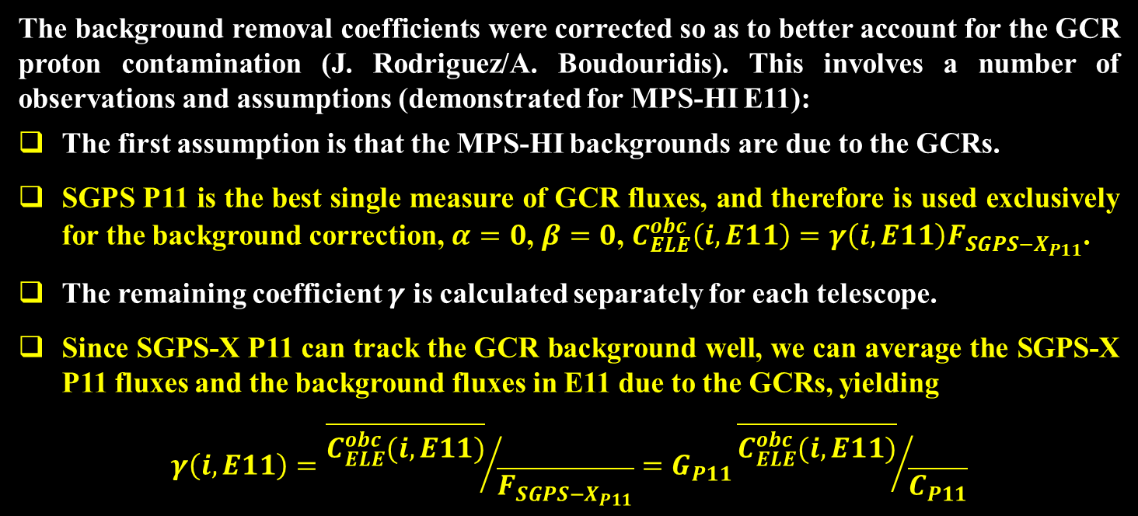
PLPT-SEI-006: Backgrounds Trending: Methodology
Pass
G19 MPS-HI E9-E11 Revised Background Removal (ADR1517)
The background removal coefficients were corrected so as to better account for the GCR proton contamination (J. Rodriguez/A. Boudouridis). This involves a number of observations and assumptions (demonstrated for MPS-HI E11):
The first assumption is that the MPS-HI backgrounds are due to the GCRs.
SGPS P11 is the best single measure of GCR fluxes, and therefore is used exclusively for the background correction, $α=0$, $β=0$, $C_{ELE}^{obc}\left(i,E11\right)=γ\left(i,E11\right)F_{{SGPS−X}_{P11}}$.
The remaining coefficient $γ$ is calculated separately for each telescope.
Since SGPS-X P11 can track the GCR background well, we can average the SGPS-X P11 fluxes and the background fluxes in E11 due to the GCRs, yielding
$$γ\left(i,E11\right)={\overline{C_{ELE}^{obc}(i,E11)}}/{\overline{F_{{SGPS−X}_{P11}}}}=G_{P11}{\overline{C_{ELE}^{obc}(i,E11)}}/{\overline{C_{P11}}}$$
These GOES-19 data are preliminary, non-operational data and are undergoing testing. Users bear all responsibility for inspecting the data prior to use and for the manner in which the data are utilized.

Slide 49
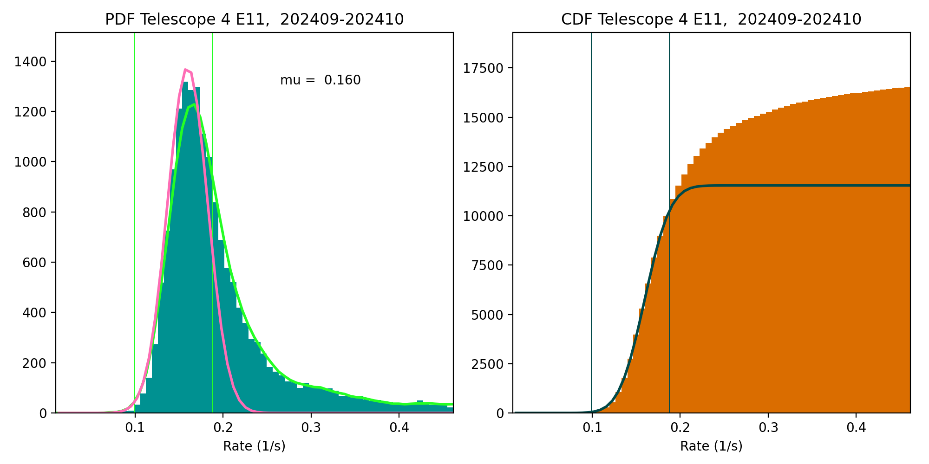
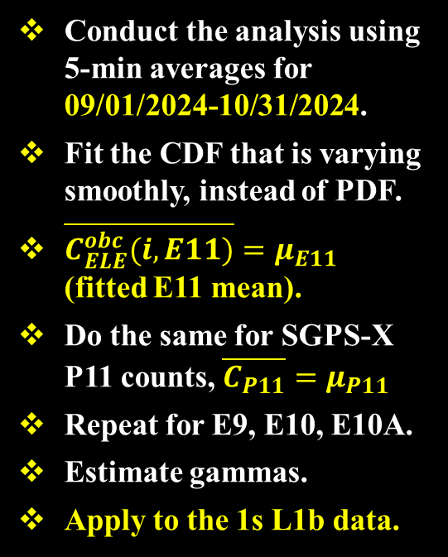

PLPT-SEI-006: Backgrounds Trending: Methodology
Pass
Modeling the GCR background
Assume that the peak and the part of the PDF below the peak are dominated by the rates due to GCRs, model as Gaussians.
Gaussian PDF: $f\left(x\right)=a exp\left[−\frac{{(x−μ)}^{2}}{2σ^{2}}\right]$
Gaussian CDF: $F\left(x\right)=aσ\sqrt{\frac{π}{2}}\left[1+erf\left(\frac{x−μ}{σ\sqrt{2}}\right)\right]$
Conduct the analysis using 5-min averages for 09/01/2024-10/31/2024.
Fit the CDF that is varying smoothly, instead of PDF.
$\overline{C_{ELE}^{obc}(i,E11)}=μ_{E11}$ (fitted E11 mean).
Do the same for SGPS-X P11 counts, $\overline{C_{P11}}=μ_{P11}$
Repeat for E9, E10, E10A.
Estimate gammas.
Apply to the 1s L1b data.
These GOES-19 data are preliminary, non-operational data and are undergoing testing. Users bear all responsibility for inspecting the data prior to use and for the manner in which the data are utilized.

Slide 50
PLPT-SEI-006: Backgrounds Trending: Results
Pass
GOES-19 LUT update
Gamma correction coefficient calculated for GOES-19 MPS-HI E9-E11,
incorporated into revised MPS-HI LUT on November 27, 2024 (ADR 1517)
 | E9 | E10 | E10A | E11
T1 | 0.4672 | 0.8409 | 0.2410 | 1.2630
T2 | 0.4523 | 0.6821 | 0.4562 | 0.7897
T3 | 0.3506 | 0.6452 | 0.4575 | 0.6023
T4 | 0.5468 | 0.7443 | 0.5253 | 1.1043
T5 | 0.4774 | 0.6841 | 0.4222 | 0.4765
These GOES-19 data are preliminary, non-operational data and are undergoing testing. Users bear all responsibility for inspecting the data prior to use and for the manner in which the data are utilized.

Slide 51
PLPT-SEI-006: Backgrounds Trending: Results
Pass
T3
GOES-19 channel E11 $(>2$ MeV)
T1
1000 electrons per (cm² sr s)
T4
SWPC alert level very close to uncorrected backgrounds
T2
T5
Corrected backgrounds more representative of the GCR spectrum
DOS
These GOES-19 data are preliminary, non-operational data and are undergoing testing. Users bear all responsibility for inspecting the data prior to use and for the manner in which the data are utilized.

Slide 52
PLPT-SEI-006: Backgrounds Trending: Summary
The baseline algorithm underestimates the backgrounds
  It is inadequate to correct for the observed slowly-varying GCRs
  After the correction, the background level is still too close to the SWPC E11 (> 2 MeV) alert level
Revision of the algorithm performed for G16/G17/G18 can be applied to GOES-19
The revised algorithm is successful in reducing the backgrounds to appropriate levels
Caveat: the space environment is changing (impacting all spacecraft!)
  The SGPS-X P11 fluxes, that the correction is based on, are decreasing
  Gamma correction factors are increasing, leading to enhanced background removal. This might be an issue with GOES-19. NCEI will keep monitoring
  NCEI is actively investigating the correlation between the MPS-HI backgrounds and the SGPS proton fluxes, and will report to the program any findings
PLPT-SEI-006 is deemed a
Pass
These GOES-19 data are preliminary, non-operational data and are undergoing testing. Users bear all responsibility for inspecting the data prior to use and for the manner in which the data are utilized.

Slide 53
GOES-19 Provisional PLPTs: Summary
Partial Pass
PLPT-SEI-002: MPS-HI Telescope Cross-Comparison
  Calculated scale factors for all energy and telescope pairs, during pitch matches with significant flux levels [Rowland and Weigel, 2012]
  Most electron energy/telescope pairs are within 25% accuracy
  PTels 1-2 are in agreement but PTels 3-5 report low. Requires further investigation
PLPT-SEI-004: Solar Energetic Particle (SEP) Cross-Comparison
  Compared G19 SGPS and MPS-HI units during a high dynamic pressure event (isotropy of fluxes has been achieved)
  G19 MPS-HI PTels 1-2 P8-P11 are in agreement with SGPS P1-P4
  MPS-HI PTels 3-5 P8-P11 report low with respect to SGPS P1-P4, and MPS-HI PTels 1-2
PLPT-SEI-005: Cross-Satellite Comparison of Trapped Particles
  Compared GOES-19 to GOES-16 by calculating flux percentile spectra
  Electron spectra agree well with a few exceptions. Low high-energy fluxes hinder the effort
  G16 proton spectra are much lower in P1-P5, lower in P6-P7. Known issue with older units
PLPT-SEI-006: Backgrounds Trending
  Calculated gamma correction factors. Correction leads to appropriate background levels
Pass
Pass
Pass
These GOES-19 data are preliminary, non-operational data and are undergoing testing. Users bear all responsibility for inspecting the data prior to use and for the manner in which the data are utilized.

Slide 54
GOES-19: Status at Provisional Review
 | Observed Issue | Current Status | Future Outlook
Electron differential flux | Dropouts due to inversion matrix Problem anticipated before the launch of the GOES-R satellites Waiver (Feb 2015) led to NCEI being funded to develop new LUT with SWPC’s concurrence | Modified MPS-HI LUT installed on 11/27/2024 is working properly in OE Comparison with GOES-16 indicates reasonable agreement | Intra-calibration results will be used (if necessary) to adjust calibration coefficients in future LUT for Full validation NCEI will keep monitoring
Backgrounds (E9-E11) | Backgrounds too high in E11 for SWPC to use this channel for >2 MeV alerts Existing contamination correction coefficients are too small | Modified MPS-HI LUT installed on 11/27/2024 is working properly in OE Modified LUT provides adequate background correction | Changing space environment will determine if modified correction continues to track E9-E11 backgrounds NCEI will keep monitoring
Proton differential flux (P1-P7) | No issues evident upon initial inspection of data | Comparisons with G16 indicates that G16 may have degraded on-orbit due to radiation damage Expect G19 to degrade as well? Source of the problem: upward shift in channel energy | NCEI will devise methodology for determining the new effective energies, and any necessary adjustment to real-time or past data
Proton differential flux (P1-P11) | MPS-HI PTels 3-5 report lower flux than PTels 1-2 and SGPS | Root cause unknown Under investigation | NCEI will investigate with the help of the instrument vendor
These GOES-19 data are preliminary, non-operational data and are undergoing testing. Users bear all responsibility for inspecting the data prior to use and for the manner in which the data are utilized.

Slide 55
GOES-19: Remaining issues
Summary
Proton channels
  GOES-19 MPS-HI proton telescopes 3-5 report lower fluxes than telescopes 1-2
  Intra-telescope scale factors high for PTels 3-5, P1-P7 channels
  SEP channels P8-P11 report lower fluxes than PTels 1-2 and SGPS
  Issue also evident in cross-satellite comparisons with GOES-16
    NCEI will investigate with the help of the instrument vendor, ATC
Electron channels
  Low high-energy electron fluxes, channels E9-E11
    Hinder calibration efforts
    NCEI will keep monitoring in anticipation of higher electron radiation belt fluxes
  Background correction: the space environment is changing
    Requires continued monitoring of E9-E11 background removal
    Possible revision of the background removal coefficients in the future
These GOES-19 data are preliminary, non-operational data and are undergoing testing. Users bear all responsibility for inspecting the data prior to use and for the manner in which the data are utilized.

Slide 56
Provisional Maturity Assessment
GOES-19 MPS-HI L1b Products Provisional PS-PVR

Slide 57
Provisional Validation
Preparation Activities | Assessment
Validation and quality assurance activities are ongoing, and the general research community is now encouraged to participate. | Validation activities are ongoing. Results have been discussed with SWPC. Release of data by NCEI will enable research community participation.
Severe algorithm anomalies are identified and under analysis. Solutions to anomalies are in development and testing. | Major anomalies fixed through LUT modification (ADR 1517). Correct performance of LUT verified in OE.
Incremental product improvements may still be occurring. | Incremental product improvements are expected, primarily through updated LUTs incorporating results of cross-cal.
Users are engaged in the Customer Forums, and user feedback is assessed. | Engagement with the operational and scientific community is on an ongoing basis. User concerns and questions are routinely addressed.
From 410-R-RIMP-0318 Version 2.0 07/09/2021,
Responsible Organization: GOES-R Program/Code 410

Slide 58
Provisional Validation
End State | Assessment
Product performance has been demonstrated through analysis of a small number of independent measurements obtained from selected locations, periods, and associated ground-truth/field program efforts. | PLPTs performed on reprocessed MPS-HI fluxes from post-launch to present.
Product analysis is sufficient to communicate product performance to users relative to expectations. | Yes, to the limited extent of available resources and time, prioritized based on customer needs.
Documentation of product performance exists that includes recommended remediation strategies for all anomalies and weaknesses. Any algorithm changes associated with severe anomalies have been documented, implemented, tested, and shared with the user community. | This presentation, the L1b Readme files, the memos on background correction, and article by Boudouridis et al. [2020] in Space Weather.
Testing has been fully documented. | This presentation; memo on background correction.
Product is ready for operational use and for use in comprehensive cal/val activities and product optimization. | NCEI: yes.
From 410-R-RIMP-0318 Version 2.0 07/09/2021,
Responsible Organization: GOES-R Program/Code 410

Slide 59
Performance Baseline Status
Assessment at Provisional Validation
MRD ID | Description | Related PLPTs | Status
1996 | MPS-HI Orthogonality/Coverage | -02, -04 | PLPTs underway
2000 | MPS-HI Measurement Range | -02, -04 | PLPTs underway
2001 | MPS-HI Measurement Accuracy | -02, -04, -05, -06 | PLPTs underway
MRD1996: Data in 5 directions
  Currently being met for electrons and protons
MRD2000: Measurement Range
  Requirements: Electrons 50 keV to 4 MeV plus >2 MeV;
  Protons 80 keV to 10 MeV
  Currently, all channels are functional and exhibit characteristic variation in behavior w/ energy
  Ground cal & cross-cal activities indicate that energy measurement range is covered
MRD2001: Measurement Accuracy
  Requirements: @min flux <45%, @10X min flux < 25%
  Absolute accuracy cannot be verified on-orbit
  Results of PLPT-002 indicate that the inter-telescope electron differences are rarely greater than 25%, but PTels 3-5 P1-P7 channels report low compared to PTels 1-2
  Results of PLPT-004 show that GOES-19 MPS-HI PTels 3-5 P8-P11 report lower fluxes than Ptels 1-2 and SGPS
  Results of PLPT-005 indicate that GOES-19 P1-P4 proton fluxes are systematically higher than GOES-16 fluxes
  Results of PLPT-006 show that backgrounds are representative of GCRs, but the space environment is changing, background needs to be monitored

Slide 60
Remaining Risks
Risk Name | Description | Impact | Mitigation and Schedule
MPS-HI Proton Telescopes 3-5 | IF the cause of the lower fluxes is not determined | THEN agreement with Telescopes 1-2 and SGPS will not be achieved | NCEI will investigate with the help of ATC
MPS-HI low high-energy electron fluxes | IF MPS-HI E9-E11 fluxes remain low | THEN proper evaluation of these channels will be incomplete | NCEI will monitor anticipating higher fluxes Re-evaluate and report at the Full Validation
MPS-HI E9-E11 Background removal variation | IF the variation of the space environment is not adequately assessed | THEN proper tracking of the backgrounds will be insufficient | NCEI will monitor the changes in the space environment Will revisit background removal and modify the LUT accordingly

Slide 61
Path to full Validation Maturity
GOES-19 MPS-HI L1b Products Provisional PS-PVR

Slide 62
Path to Full Validation
ADRs/WRs put through previous GOES-R units, that might indirectly affect GOES-19, need to be resolved prior to Full Validation.
PLPTs to be conducted prior to Full Validation.
Performance Baseline status to be re-assessed.
Risks to getting to Full, both from L1b product definition and user (SWPC) feedback, need to be assessed and addressed.

Slide 63
Path to Full Validation - PLPTs
Title | Activity | Data Needed | Success Criteria
A.3.2 MPS-Hi Telescope Cross-Comparison [PLPT-SEI-002] | Determine the relative sensitivity/response among MPS-HI telescopes. | Three months of continuous data. (MAG, MPS-HI) | [Full] Telescopes agree to within 25%.
A.3.4 SEP Channel Cross-Comparison [PLPT-SEI-004] | On-orbit cross-calibration of MPS-HI with SGPS 1-12 MeV protons, and all operational GOES-R Series SEISS sensors. | Two Solar Energetic Particle (SEP) events. | [Full] Differences quantified on data taken through validation phase.
A.3.5 Cross Satellite Comparison of Trapped Particles [PLPT-SEI-005] | To inter-calibrate MPS-HI with the same measurements on other operational GOES-R Series satellites. The MPS-HI inter-calibration part of the test is critical for establishing the consistency of the NOAA real-time >2 MeV electron flux alerts between operational GOES-R Series satellites. | Three months of continuous data. (MAG, MPS-HI) | [Full] Differences quantified on data taken through validation phase.
A.3.6 Backgrounds Trending [PLPT-SEI-006] | To evaluate MPS-HI backgrounds in terms of expected galactic cosmic ray (GCR) fluxes. | Four months of continuous data. (MPS-HI, SGPS) | [Full] Perform analysis during validation phase.
MPS-HI Full Validation PLPTs from RIMP v 2.0 (09 July 2021).

Slide 64
Summary & Recommendations
GOES-19 MPS-HI L1b Products Provisional PS-PVR

Slide 65
Summary
ADR/WR status: all ADRs identified for GOES-19 or indirectly affect it have been closed or have clear path forward
  ADR 863: NCEI needs test data. Deployed preemptively on 02/13/2025
    Can become critical in case of catastrophic SGPS failure, as SWPC alert channel E11 will be lost
  ADR 1204: NCEI recommends cancellation and closure
    The suggested correction was determined to be wrong
    The cause of the issue is the shift of the channel effective energy to higher values
Planned Provisional PLPTs have been completed
Remaining risks that have been identified
  MPS-HI proton Telescopes 3-5 report lower fluxes than Telescopes 1-2 and SGPS
  Low high-energy electron fluxes (E9-E11) hinder calibration efforts
  Space environment is changing: E9-E11 background removal might need revision
Remaining ADRs that directly or indirectly affect the GOES-19 MPS-HI
863 | 6736 | Graceful degradation when SGPS data not generated | In Work | DO.16.00.00
1204 | 8993 | MPS-Hi Proton Flux in G-16 and G-17 | HOLD | Revisit 04/2025

Slide 66
Recommendations
NCEI believes that the GOES-19 MPS-HI L1b product has reached the Provisional Maturity as defined by the GOES-R Program

Slide 67
Backup slides
GOES-19 MPS-HI L1b Products Provisional PS-PVR

Slide 68
PLPT-SEI-005: Cross-Satellite
Comparison of Trapped Particles: Results
Pass
GOES-19 vs GOES-16 Electrons , 08/23/2024-11/09/2024
GOES-16 E3 fluxes are appreciably lower
E9-E10 fluxes are affected by the applied background correction
Good agreement
in general
Missing or significantly lower fluxes are at residual background levels
Boudouridis, A., Rodriguez, J. V., Kress, B. T., Dichter, B. K., & Onsager, T. G. (2020). Development of a bowtie inversion technique for real‐time processing of the GOES‐16/‐17 SEISS MPS‐HI electron channels. Space Weather, 18, e2019SW002403. https://doi.org/10.1029/2019SW002403
These GOES-19 data are preliminary, non-operational data and are undergoing testing. Users bear all responsibility for inspecting the data prior to use and for the manner in which the data are utilized.

Slide 69
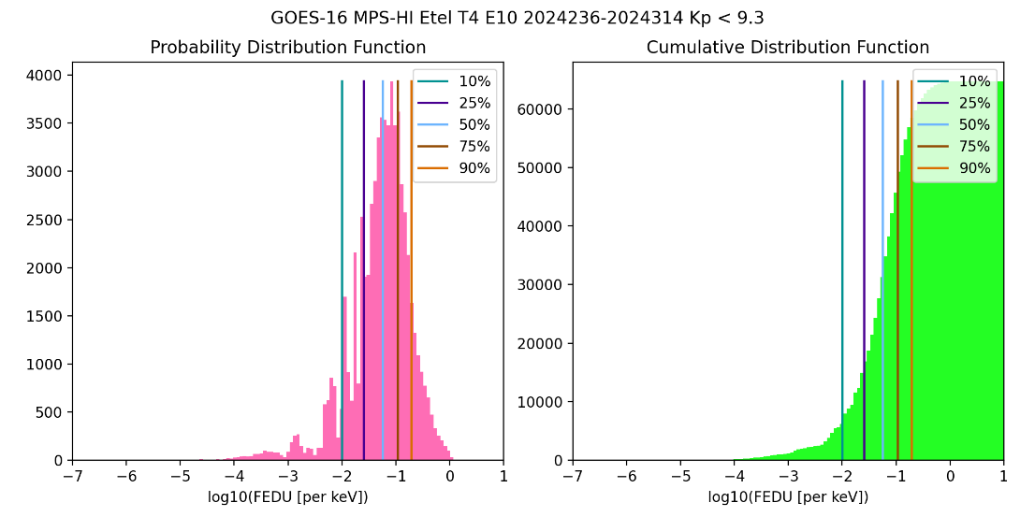
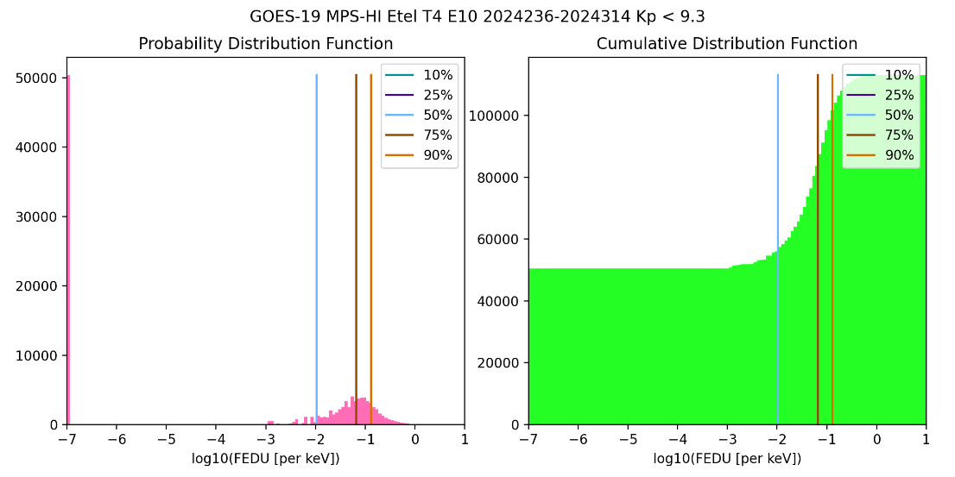
PLPT-SEI-005: Cross-Satellite
Comparison of Trapped Particles: Results
Pass
GOES-19 vs GOES-16 Electrons , 08/23/2024-11/09/2024
GOES-19 E10 exhibits numerous small values
Result of background correction: negative values are substituted with a small value
Percentile fluxes do not ignore those points in order for the higher percentiles to have meaning
Shifts median to lower values
The important question is why there are more background values for GOES-19 than GOES-16?
Backgrounds
Median
These GOES-19 data are preliminary, non-operational data and are undergoing testing. Users bear all responsibility for inspecting the data prior to use and for the manner in which the data are utilized.

Slide 70
PLPT-SEI-006: Backgrounds Trending: Correction comparison
GOES-16 (ADR 407, November 14, 2017)
 | E9 | E10 | E10A | E11
T1 | 0.3782 | 0.6490 | 0.5446 | 1.472
T2 | 0.4758 | 0.5929 | 0.2715 | 1.252
T3 | 0.4155 | 0.6052 | 0.3842 | 1.325
T4 | 0.2721 | 0.5213 | 0.5278 | 1.281
T5 | 0.4513 | 0.5538 | 0.3977 | 1.303
GOES-19 (ADR 1517, November 27, 2024)
 | E9 | E10 | E10A | E11
T1 | 0.4672 | 0.8409 | 0.2410 | 1.2630
T2 | 0.4523 | 0.6821 | 0.4562 | 0.7897
T3 | 0.3506 | 0.6452 | 0.4575 | 0.6023
T4 | 0.5468 | 0.7443 | 0.5253 | 1.1043
T5 | 0.4774 | 0.6841 | 0.4222 | 0.4765
GOES-19 gammas for E10 are larger than GOES-16
These GOES-19 data are preliminary, non-operational data and are undergoing testing. Users bear all responsibility for inspecting the data prior to use and for the manner in which the data are utilized.

Slide 71
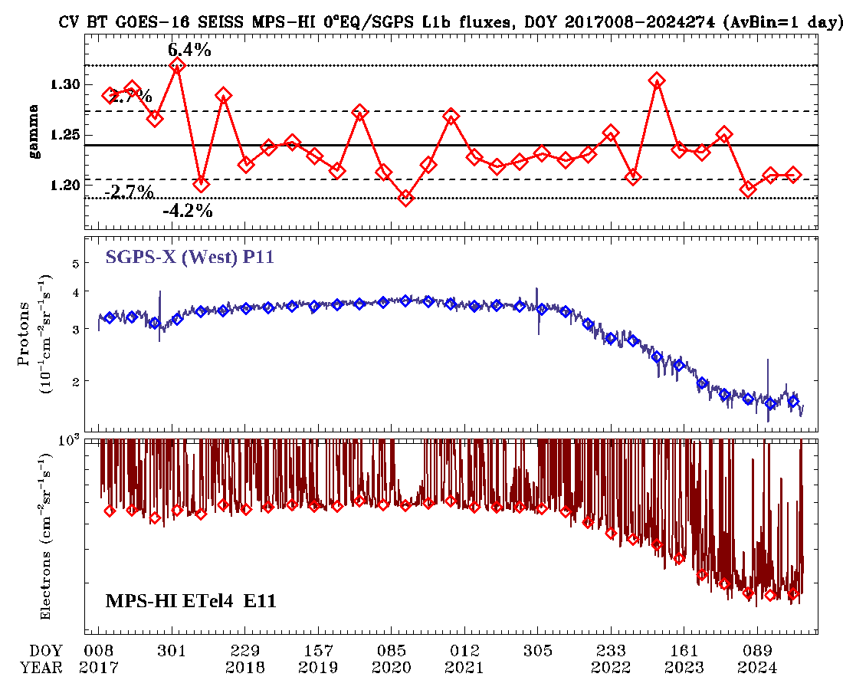
PLPT-SEI-006: Backgrounds Trending: Long Term Investigation
GOES-16, Equatorial Telescope 4, 01/2017-09/2024
Plot MPS-HI E11 fluxes without the background removal along with SGPS-X P11 fluxes
Overplot the backgrounds estimates and P11 averages
Plot the estimated gammas
Gammas stay more or less the same despite P11 flux decline
These GOES-19 data are preliminary, non-operational data and are undergoing testing. Users bear all responsibility for inspecting the data prior to use and for the manner in which the data are utilized.

Slide 72
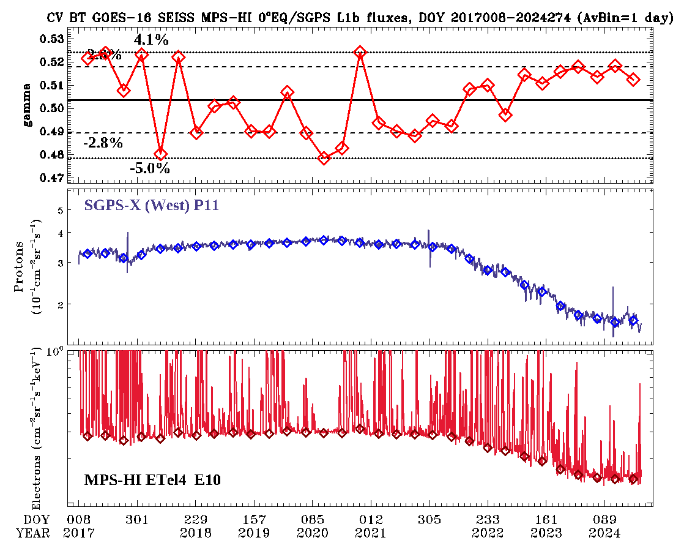
PLPT-SEI-006: Backgrounds Trending: Long Term Investigation
GOES-16, Equatorial Telescope 4, 01/2017-09/2024
Plot MPS-HI E10 fluxes without the background removal along with SGPS-X P11 fluxes
Overplot the backgrounds estimates and P11 averages
Plot the estimated gammas
Gammas stay more or less the same despite P11 flux decline
These GOES-19 data are preliminary, non-operational data and are undergoing testing. Users bear all responsibility for inspecting the data prior to use and for the manner in which the data are utilized.

Slide 73
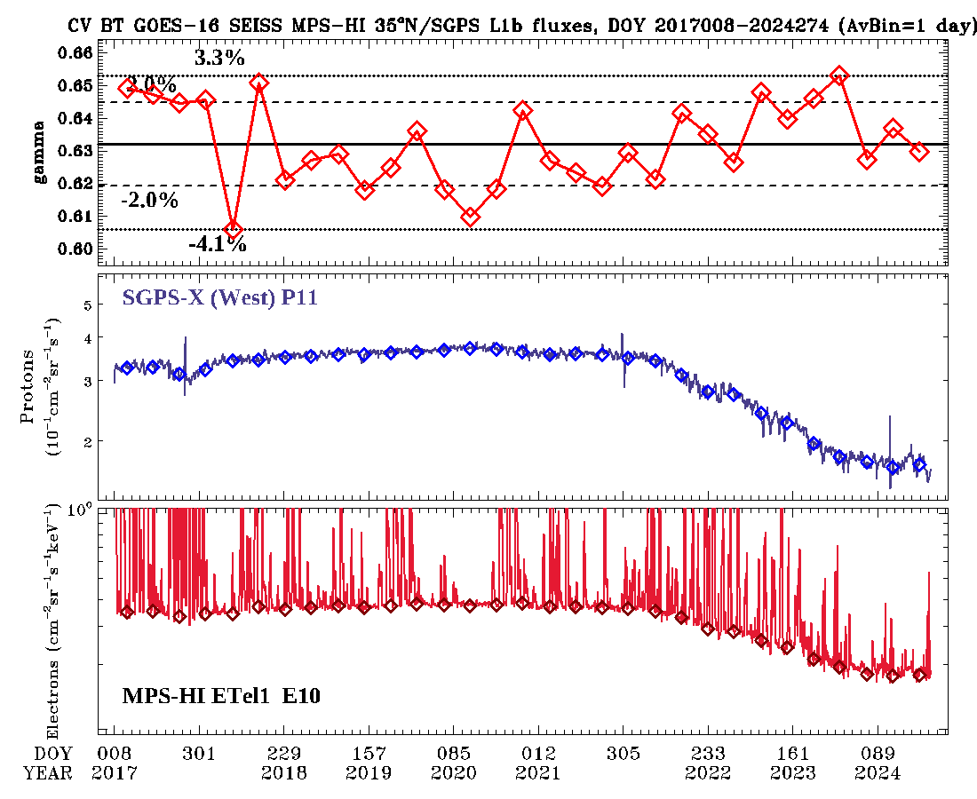
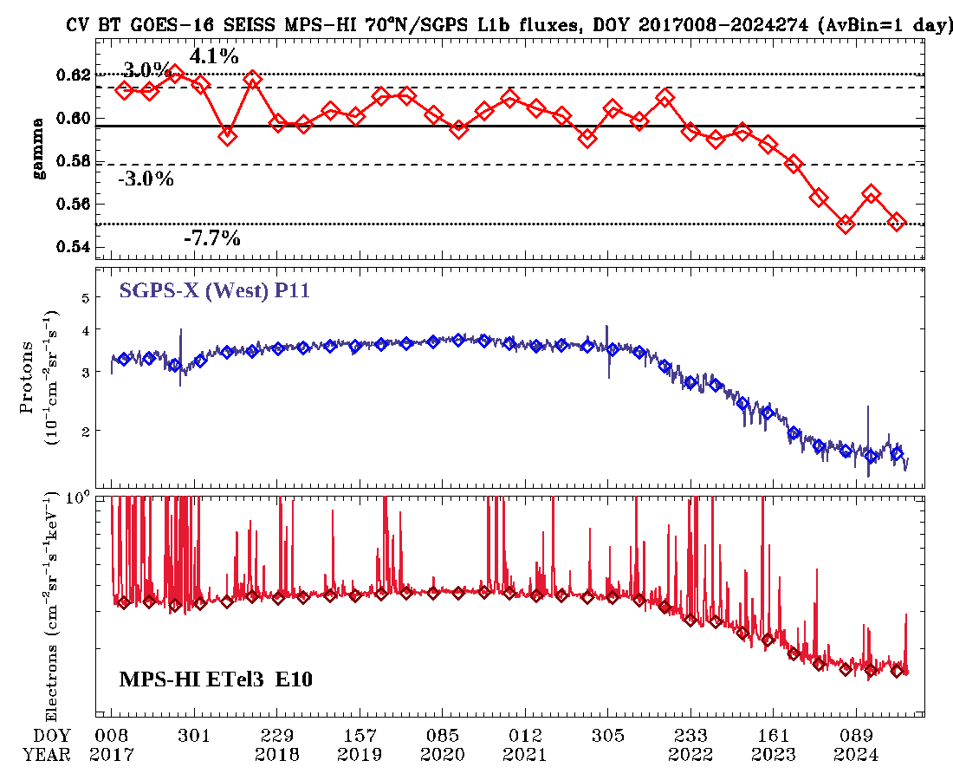
Backgrounds Trending:
Long Term Investigation
GOES-16, 35º North Tel. 1, 01/2017-09/2024
GOES-16, 70º North Tel. 3, 01/2017-09/2024
Gammas stay steady but variable at 35N Tel. 1, decline slightly at 70N Tel. 3
These GOES-19 data are preliminary, non-operational data and are undergoing testing. Users bear all responsibility for inspecting the data prior to use and for the manner in which the data are utilized.

Slide 74
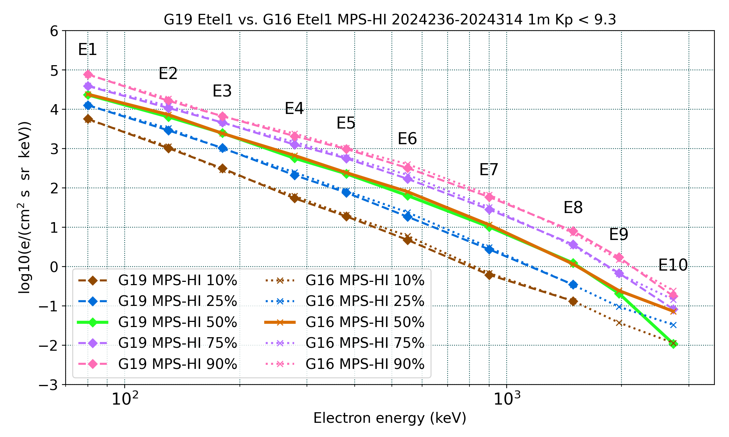
PLPT-SEI-005: Cross-Satellite
Comparison of Trapped Particles: Results
Pass
GOES-19 vs GOES-16 Electrons , 08/23/2024-11/09/2024
Missing or significantly lower fluxes are at residual background levels
Boudouridis, A., Rodriguez, J. V., Kress, B. T., Dichter, B. K., & Onsager, T. G. (2020). Development of a bowtie inversion technique for real‐time processing of the GOES‐16/‐17 SEISS MPS‐HI electron channels. Space Weather, 18, e2019SW002403. https://doi.org/10.1029/2019SW002403
These GOES-19 data are preliminary, non-operational data and are undergoing testing. Users bear all responsibility for inspecting the data prior to use and for the manner in which the data are utilized.

Slide 75
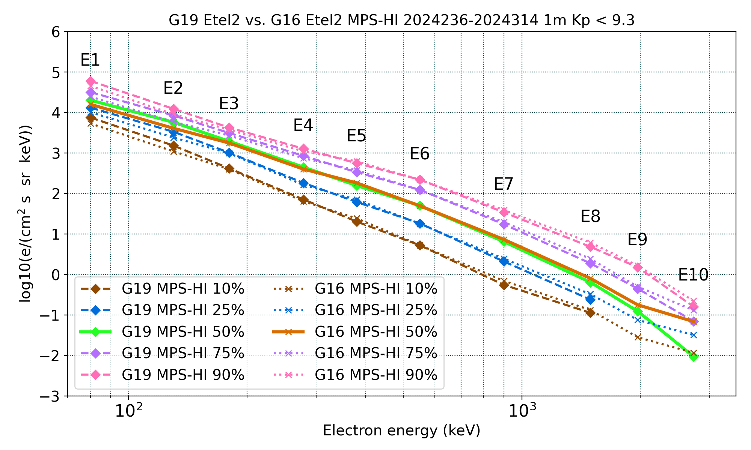
PLPT-SEI-005: Cross-Satellite
Comparison of Trapped Particles: Results
Pass
GOES-19 vs GOES-16 Electrons , 08/23/2024-11/09/2024
Missing or significantly lower fluxes are at residual background levels
Boudouridis, A., Rodriguez, J. V., Kress, B. T., Dichter, B. K., & Onsager, T. G. (2020). Development of a bowtie inversion technique for real‐time processing of the GOES‐16/‐17 SEISS MPS‐HI electron channels. Space Weather, 18, e2019SW002403. https://doi.org/10.1029/2019SW002403
These GOES-19 data are preliminary, non-operational data and are undergoing testing. Users bear all responsibility for inspecting the data prior to use and for the manner in which the data are utilized.

Slide 76
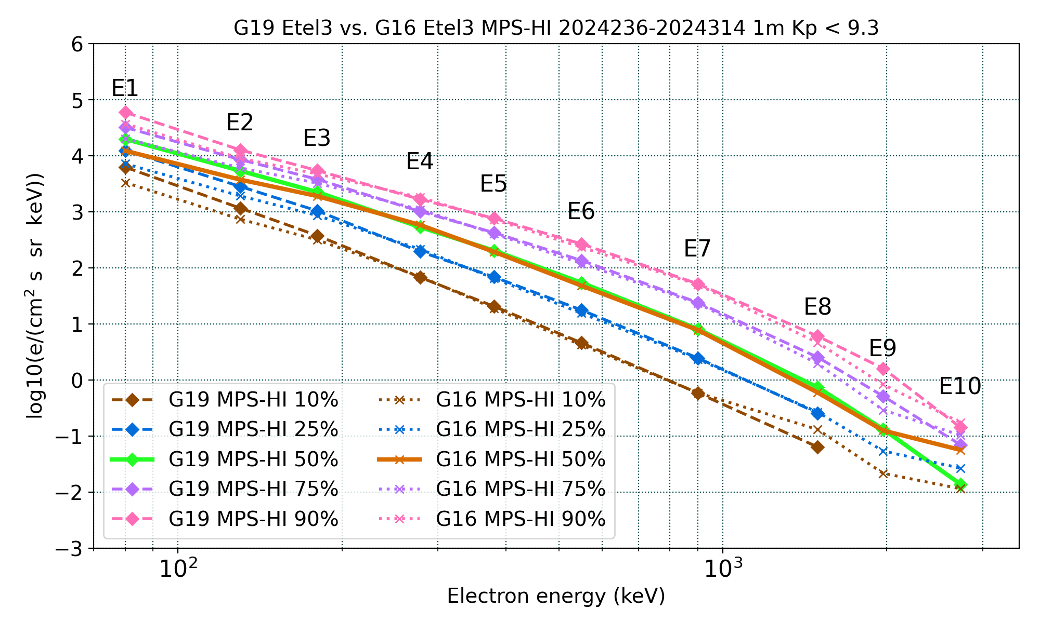
PLPT-SEI-005: Cross-Satellite
Comparison of Trapped Particles: Results
Pass
GOES-19 vs GOES-16 Electrons , 08/23/2024-11/09/2024
Missing or significantly lower fluxes are at residual background levels
Boudouridis, A., Rodriguez, J. V., Kress, B. T., Dichter, B. K., & Onsager, T. G. (2020). Development of a bowtie inversion technique for real‐time processing of the GOES‐16/‐17 SEISS MPS‐HI electron channels. Space Weather, 18, e2019SW002403. https://doi.org/10.1029/2019SW002403
These GOES-19 data are preliminary, non-operational data and are undergoing testing. Users bear all responsibility for inspecting the data prior to use and for the manner in which the data are utilized.

Slide 77
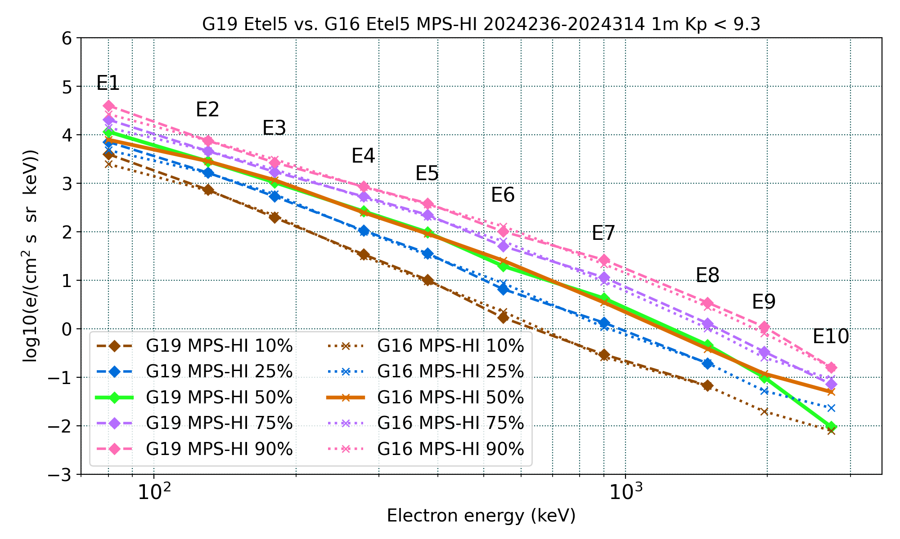
PLPT-SEI-005: Cross-Satellite
Comparison of Trapped Particles: Results
Pass
GOES-19 vs GOES-16 Electrons , 08/23/2024-11/09/2024
Missing or significantly lower fluxes are at residual background levels
Boudouridis, A., Rodriguez, J. V., Kress, B. T., Dichter, B. K., & Onsager, T. G. (2020). Development of a bowtie inversion technique for real‐time processing of the GOES‐16/‐17 SEISS MPS‐HI electron channels. Space Weather, 18, e2019SW002403. https://doi.org/10.1029/2019SW002403
These GOES-19 data are preliminary, non-operational data and are undergoing testing. Users bear all responsibility for inspecting the data prior to use and for the manner in which the data are utilized.

Slide 78
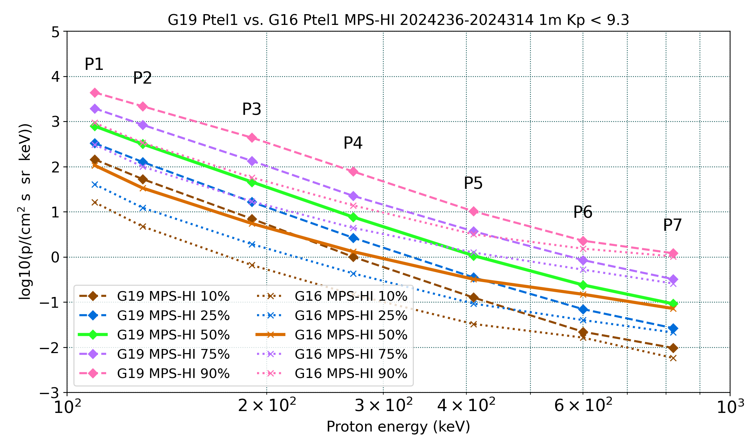
PLPT-SEI-005: Cross-Satellite
Comparison of Trapped Particles: Results
Pass
GOES-19 vs GOES-16 Protons , 08/23/2024-11/09/2024
Apply only to P1-P7
Boudouridis, A., Rodriguez, J. V., Kress, B. T., Dichter, B. K., & Onsager, T. G. (2020). Development of a bowtie inversion technique for real‐time processing of the GOES‐16/‐17 SEISS MPS‐HI electron channels. Space Weather, 18, e2019SW002403. https://doi.org/10.1029/2019SW002403
These GOES-19 data are preliminary, non-operational data and are undergoing testing. Users bear all responsibility for inspecting the data prior to use and for the manner in which the data are utilized.

Slide 79
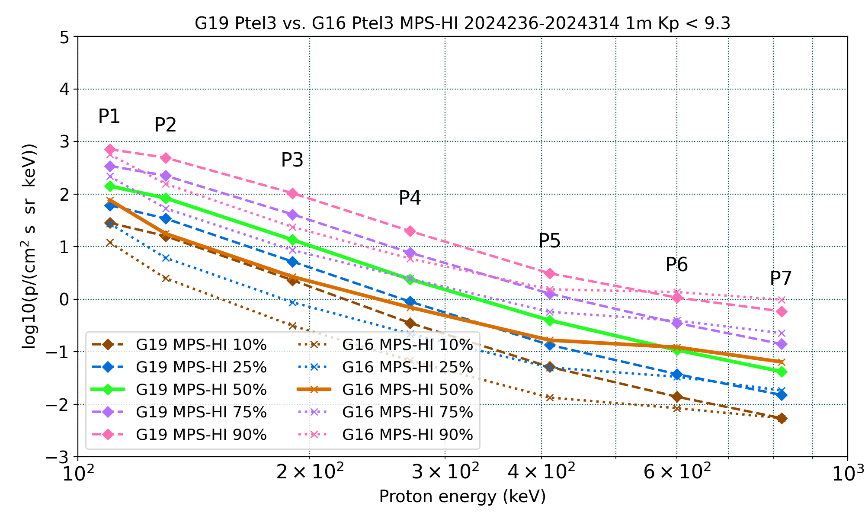
PLPT-SEI-005: Cross-Satellite
Comparison of Trapped Particles: Results
Pass
GOES-19 vs GOES-16 Protons , 08/23/2024-11/09/2024
Apply only to P1-P7
Boudouridis, A., Rodriguez, J. V., Kress, B. T., Dichter, B. K., & Onsager, T. G. (2020). Development of a bowtie inversion technique for real‐time processing of the GOES‐16/‐17 SEISS MPS‐HI electron channels. Space Weather, 18, e2019SW002403. https://doi.org/10.1029/2019SW002403
These GOES-19 data are preliminary, non-operational data and are undergoing testing. Users bear all responsibility for inspecting the data prior to use and for the manner in which the data are utilized.

Slide 80
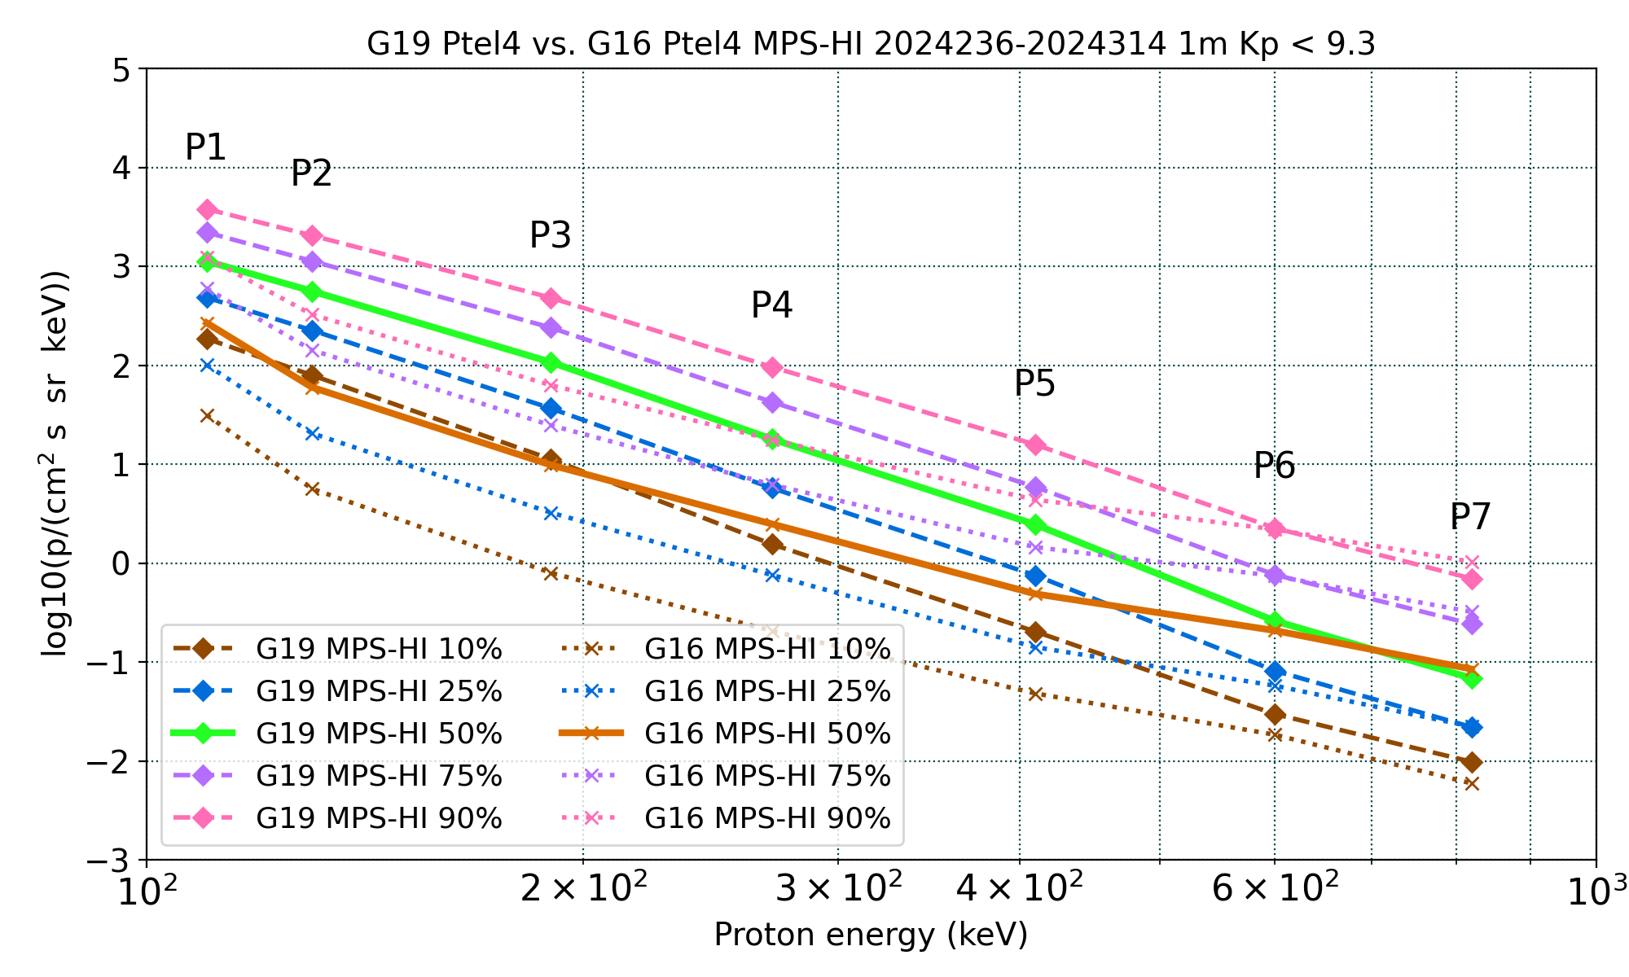
PLPT-SEI-005: Cross-Satellite
Comparison of Trapped Particles: Results
Pass
GOES-19 vs GOES-16 Protons , 08/23/2024-11/09/2024
Apply only to P1-P7
Boudouridis, A., Rodriguez, J. V., Kress, B. T., Dichter, B. K., & Onsager, T. G. (2020). Development of a bowtie inversion technique for real‐time processing of the GOES‐16/‐17 SEISS MPS‐HI electron channels. Space Weather, 18, e2019SW002403. https://doi.org/10.1029/2019SW002403
These GOES-19 data are preliminary, non-operational data and are undergoing testing. Users bear all responsibility for inspecting the data prior to use and for the manner in which the data are utilized.

Slide 81
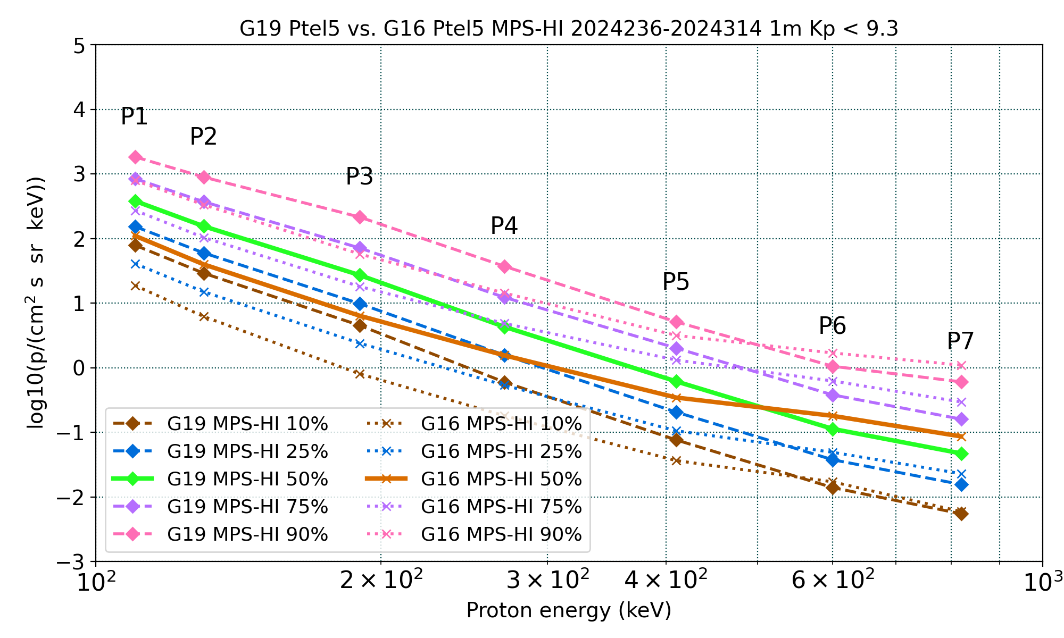
PLPT-SEI-005: Cross-Satellite
Comparison of Trapped Particles: Results
Pass
GOES-19 vs GOES-16 Protons , 08/23/2024-11/09/2024
Apply only to P1-P7
Boudouridis, A., Rodriguez, J. V., Kress, B. T., Dichter, B. K., & Onsager, T. G. (2020). Development of a bowtie inversion technique for real‐time processing of the GOES‐16/‐17 SEISS MPS‐HI electron channels. Space Weather, 18, e2019SW002403. https://doi.org/10.1029/2019SW002403
These GOES-19 data are preliminary, non-operational data and are undergoing testing. Users bear all responsibility for inspecting the data prior to use and for the manner in which the data are utilized.

