Slide 1
Peer Stakeholder-Product Validation Review (PS-PVR)
G19 MPS-Lo Provisional Validation
SWPC Overview
February 11, 2025
Presenter: Steve Hill
These GOES-19 data are preliminary, non-operational data and are undergoing testing. Users bear all responsibility for inspecting the data prior to use and for the manner in which the data are utilized.

Slide 2
G19 MPS-Lo Provisional Validation
SWPC Overview
Instrument
  NOAA’s first plasma instrument on GOES
  Measures thermal population (~1keV at geosynchronous)
Primary Uses
  Satellite industry: Surface Charging
  Human Spaceflight: Anticipated for avionics
Requirements
  Derived from 2002 user-requirements workshop
Supported by
  Space Environment Engineering and Science Applications Workshop Roadmaps
  National Space Weather Strategy and Action Plan
  2023 Satellite Environment Testbed Exercise

Slide 3
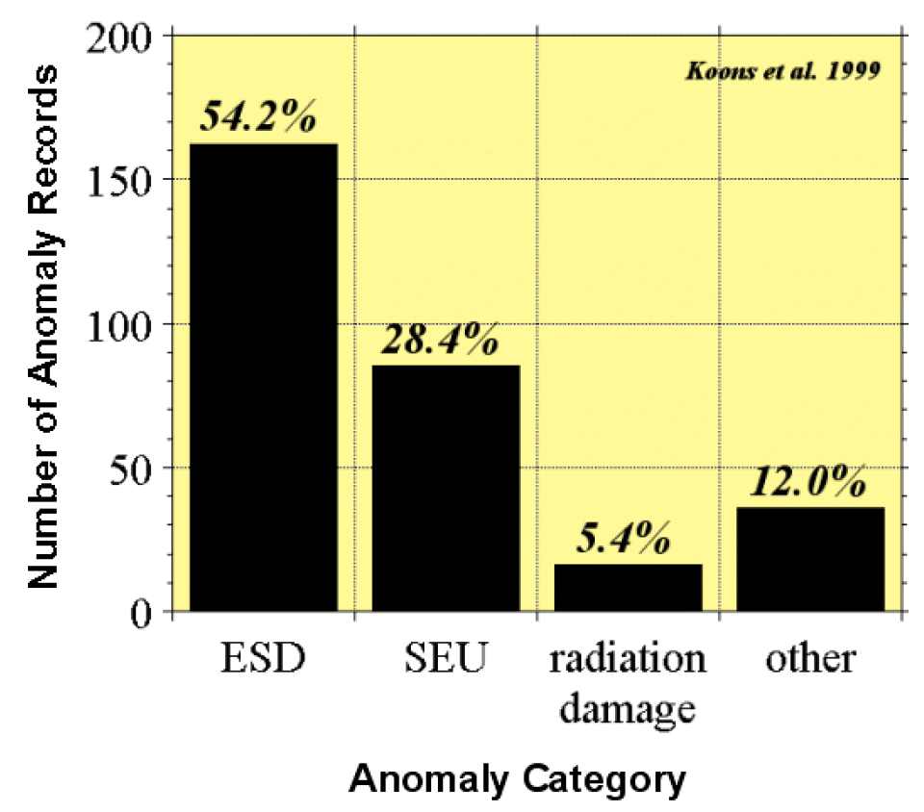
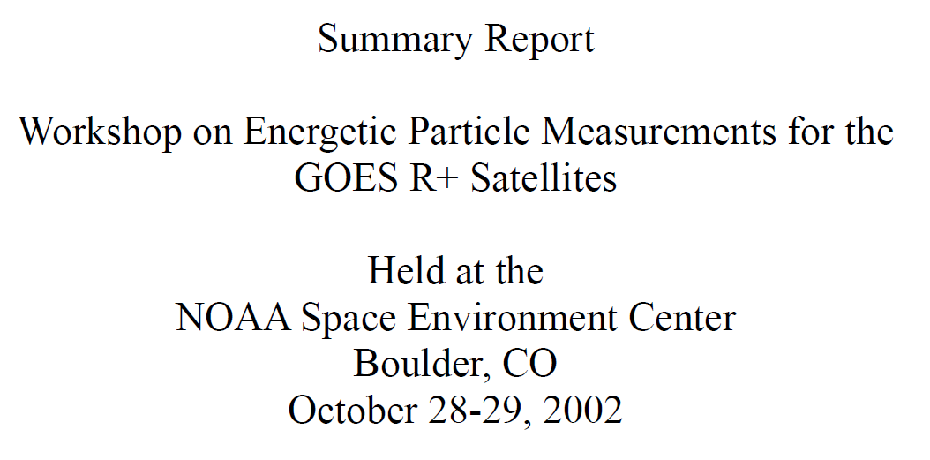
GOES User Requirements Workshop
Compilation of databases of spacecraft anomalies attributed to the space environment
Study sponsored by the National Security Space Architect
Workshop recommended low energy electron and proton measurements to support spacecraft anomaly resolution related to surface charging (electrostatic discharge (ESD)) and to monitor radiation dose to surfaces and surface damage.

Slide 4
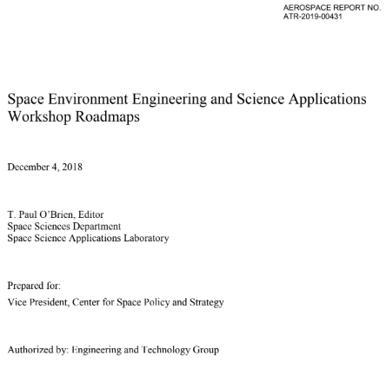
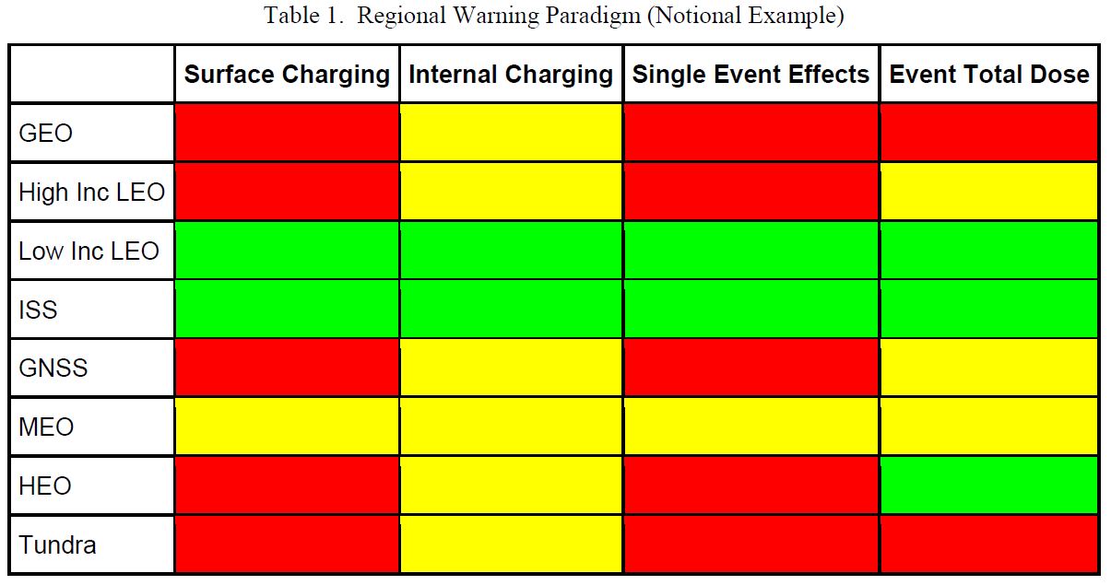
Space Environment Engineering and Science Applications Workshop
Aerospace Report No. ATR-2019-00431, 2019
“The highest priority hazard is solar energetic particles and their access to the magnetosphere, followed closely by the electron plasma of the ring current, which causes surface charging.”

Slide 5
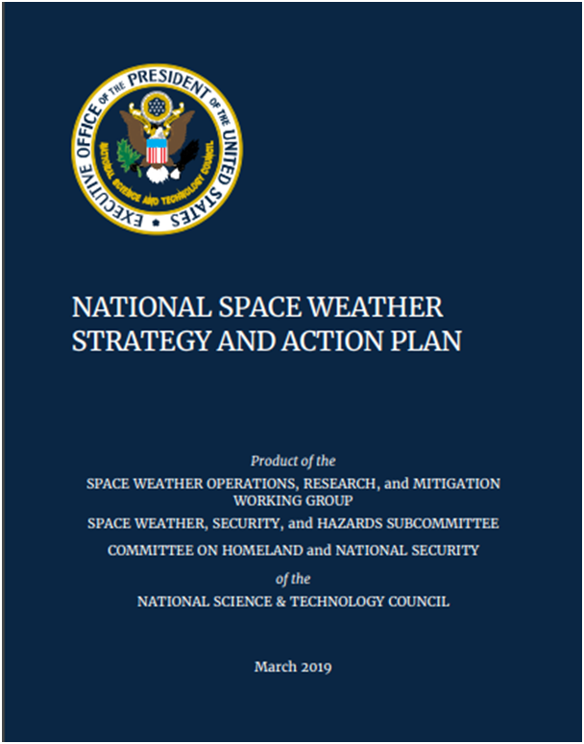
National Space Weather Strategy and Action Plan
Action 2.11.6: DOC, in coordination with NASA and DoD, develop a plan for a robust real-time assimilative environmental specification model such that it supports 1) Nowcasting of the space environment, and 2) Analysis and attribution of spacecraft anomalies due to routine and extreme space weather
MPS-Lo will be an important data source for this data assimilative environmental model

Slide 6
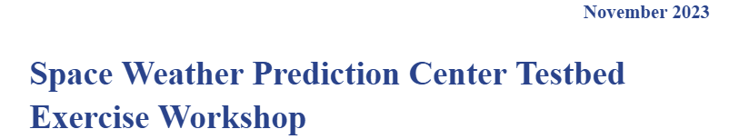
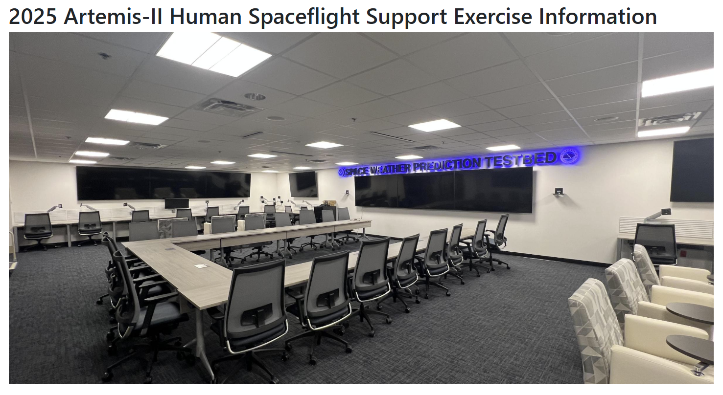

2023 Satellite Environment
Testbed Exercise
Supported provision of corrected MPS-Lo data both in real-tie and retrospectively

Slide 7
G19 MPS-LO Provisional Validation PS-PVR SWPC Summary
MPS-Lo brings an important new capability that characterizes the surface-charging environment and addresses an important satellite industry need
SWPC concurs with NCEI’s recommendation for MPS-Lo to transition to Provisional Validation status
  Issues remain, such High Backgrounds / Negative Fluxes, Interzonal Crosstalk, and error in absolute values of reported fluxes
  Software corrections have been identified that can address most issues and will enable useful flux measurements
SWPC is highly appreciative of the excellent work and diligence provided by NCEI, as well as the support provided by ATC and the entire GOES project

