Slide 1
Peer Stakeholder-Product Validation Review (PS-PVR) G19 SGPS Provisional Validation SWPC Overview
December 6, 2024
Presenter: Steve Hill
These GOES-19 data are preliminary, non-operational data and are undergoing testing. Users bear all responsibility for inspecting the data prior to use and for the manner in which the data are utilized.

Slide 2
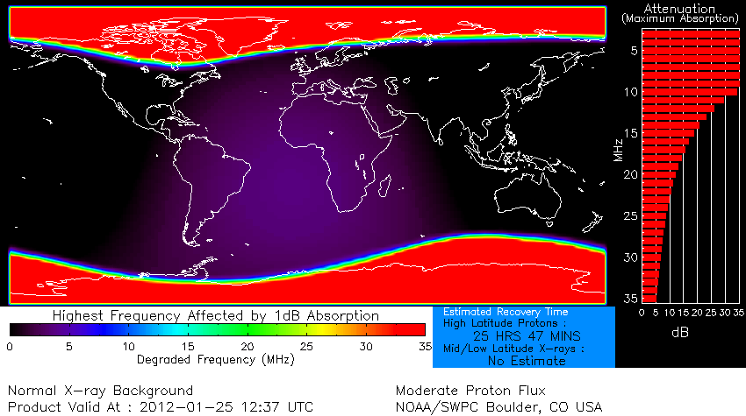
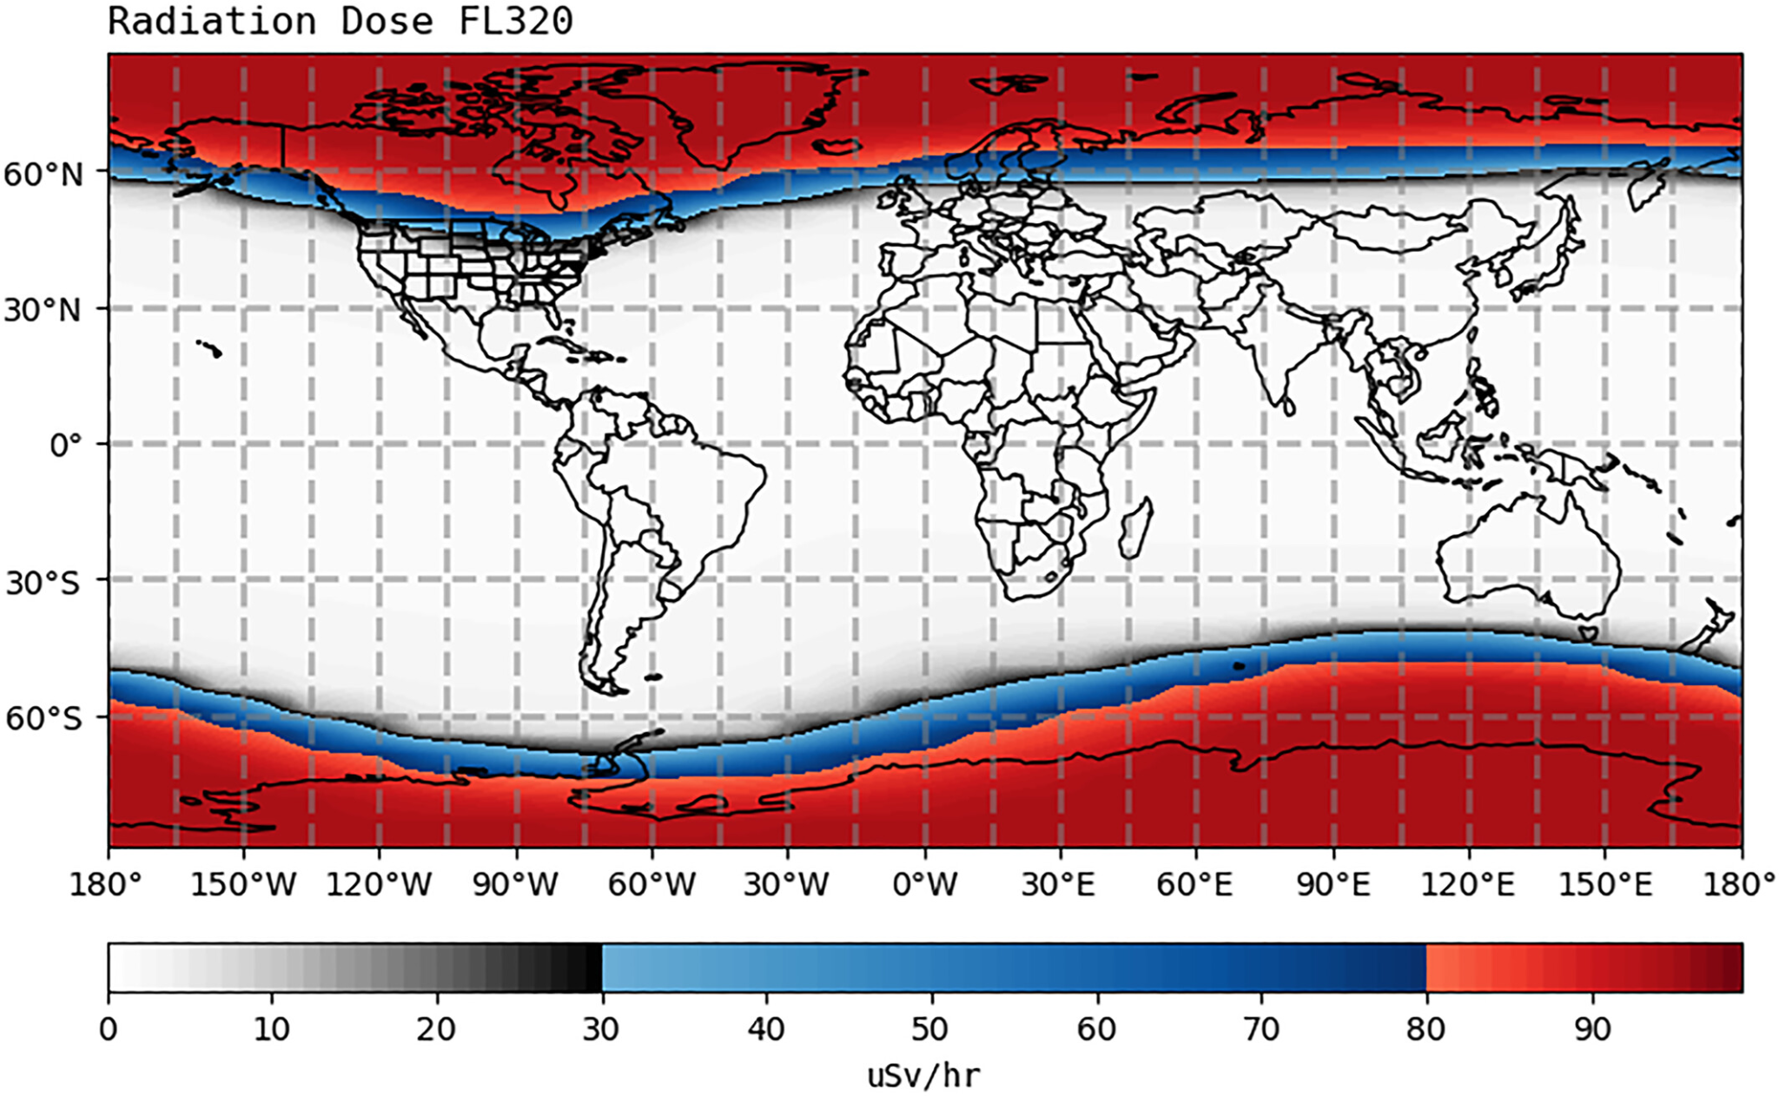
Primary Uses of SGPS Data
Solar Radiation Storm Scale
One of three NOAA space weather scales.
Aviation industry:
HF radio blackout product
Radiation advisories
Satellite industry:
Satellite launch support
Satellite anomaly resolution and design guidelines
Human space exploration
Apollo era through International Space Station
Artemis Program

Slide 3
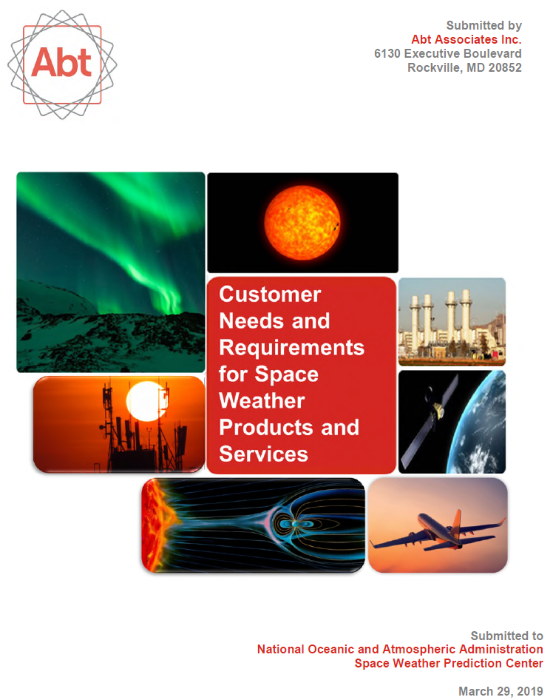
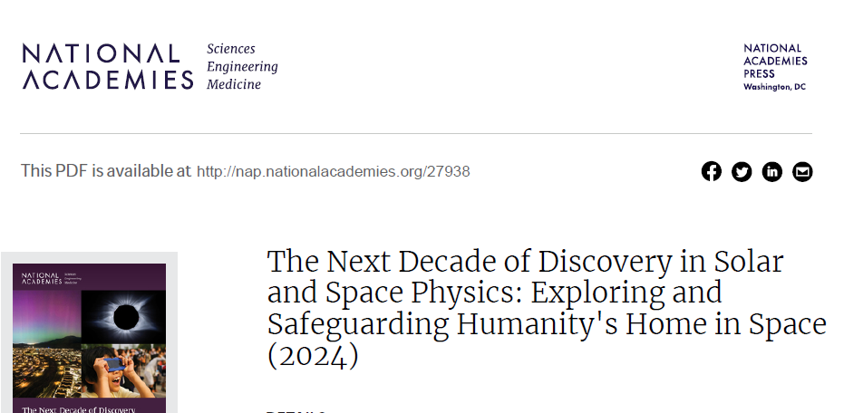
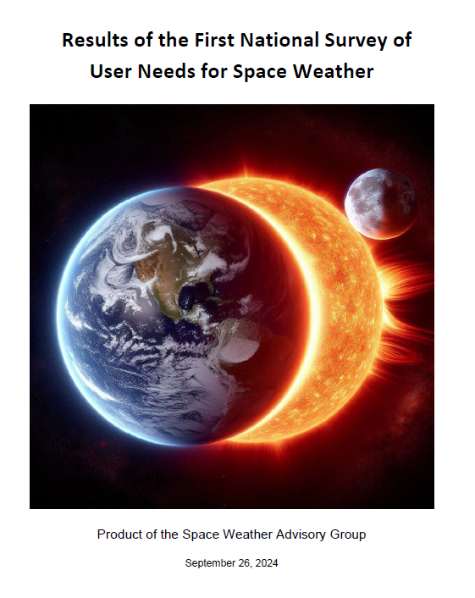
Requirements
2022 Testbed Exercise
for Aviation
2023 Satellite Environment
Testbed Exercise

Slide 4
G19 SGPS Provisional Validation PS-PVR: SWPC Summary
SGPS data are essential to support satellite launch and on-orbit operations, human and robotic exploration, aviation operations, and radio communication.
GOES 19 SGPS overall appears to be performing well.
SWPC concurs with NCEI’s recommendation for SGPS L1b to transition to provisional validation status.
Path for P8C correction
ADRs to be addressed
SWPC is highly appreciative of the dedication and excellent work of ATC, NCEI, and the GOES program for reaching this level of maturity of the SGPS data.
We look forward to the continuing work bringing the instrument to full validation.

